Slide 1
Class 20 Secured Transactions Spring 2021 Default
Randal C. Picker
James Parker Hall Distinguished Service Professor of Law
The Law School
The University of Chicago
Copyright © 2001-21 Randal C. Picker. All Rights Reserved.

Slide 2
The Key Attributes of Security
Property Rights
The secured creditor has the right to repossess the collateral after default (9-609)
Also has the right to sell the property (9-610) or kept it in satisfaction of the debt (9-620)
Priority Rights
The secured creditor has priority over unsecured creditors (9-201)

Slide 3
Basic Structure of Default
9-601(a)
[Rights of secured party after default.]
After default, a secured party has the rights provided in this part and, except as otherwise provided in Section 9‑602, those provided by agreement of the parties.
9-602
Extensive set of nonwaivable obligations

Slide 4
9-603 on Standards
(a) [Agreed standards.]
The parties may determine by agreement the standards measuring the fulfillment of the rights of a debtor or obligor and the duties of a secured party under a rule stated in Section 9-602 if the standards are not manifestly unreasonable.

Slide 5
9-603 on Standards
(b) [Agreed standards inapplicable to breach of peace.]
Subsection (a) does not apply to the duty under Section 9‑609 to refrain from breaching the peace.

Slide 6
Turning Collateral Into Cash
Need to focus on practical issues posed by realizing value from collateral
Inventory? Equipment? The debtor holds it and won’t be eager to give it up.
General Intangibles? How would you grab a trademark? Could you sell it?

Slide 7
Turning Collateral Into Cash
Accounts? Not “held” by debtor, so maybe worthwhile
Deposit Accounts? Same

Slide 8
Overview
Two Key Mechanisms
9-610. Disposition After Default
9-620 to 9-622. Retention of Collateral in Full or Partial Satisfaction of Debt
One Noteworthy Right
9-623. Right to Redeem Collateral

Slide 9
Understanding Default Incentives
TTYN (1 of 2)
Hypo
SP owed $200
Five unsecured creditors each owed $100
Collateral has a fair market value (FMV) of $250 but it would cost $15 in legal fees etc to establish that

Slide 10
Understanding Default Incentives
TTYN (2 of 2)
Scenario 1
SP moves to sell collateral for $200
What happens?
Scenario 2
SP proposes to keep collateral to satisfy debt
What happens?

Slide 11
Secured Creditor Opportunism
Opportunism I
Debtor is entitled to surplus left over after disposition; SP won’t care about size of surplus
Opportunism II
SP tells debtor will keep collateral in satisfaction of debt when collateral is worth much more

Slide 12
Debtor Indifference and Ignorance
Debtor Indifference
Debtor may not get to keep surplus anyhow
Just goes to other creditors, so why care
Need to get those with a stake in the disposition of collateral involved

Slide 13
Debtor Indifference and Ignorance
Debtor Ignorance
In consumer settings, debtors may not fully understand consequences of decisions

Slide 14
Household Debt
New York Fed (Feb 2021)

Slide 15
CARES Act Forebearance
New York Fed (Feb 2021)

Slide 16
Total Household Debt
New York Fed (Feb 2021)

Slide 17
Loan Delinquency
New York Fed (Feb 2021)

Slide 18
9-609 on Breach of the Peace
(a) [Possession; rendering equipment unusable; disposition on debtor’s premises.]
After default, a secured party:
(1) may take possession of the collateral; and
(2) without removal, may render equipment unusable and dispose of collateral on a debtor’s premises under Section 9‑610.

Slide 19
9-609 on Breach of the Peace
(b) [Judicial and nonjudicial process.]
A secured party may proceed under subsection (a):
(1) pursuant to judicial process; or
(2) without judicial process, if it proceeds without breach of the peace.

Slide 20
Understanding the Breach of the Peace Standard
Williams (8th Cir. 1982)
Shared private property driveway; early in the morning; “polite” verbal exchange between Williams and repo men
Result: Over dissent, JNOV, reversing $5000 in damages against Ford

Slide 21
Understanding the Breach of the Peace Standard
Salisbury Livestock (Wyo. 1990)
Related third party private property; rural setting; early in the morning; no exchange or other confrontation
Result: Jury question posed

Slide 22
BOP Standards: Wyoming
Wyoming Criminal Breach of the Peace Statute
“A person commits breach of the peace if he disturbs the peace of a community or its inhabitants by using threatening, abusive or obscene language or violent actions with knowledge or probable cause to believe he will disturb the peace.”

Slide 23
BOP Standards: Restatement 116
Restatement (Second) of Torts § 116 on Civil Breaches
“A breach of the peace is a public offense done by violence, or one causing or likely to cause an immediate disturbance of public order.”

Slide 24
Trespass: Baseline
Restatement of Torts (Second) 158 (1965)
One is subject to liability to another for trespass, irrespective of whether he thereby causes harm to any legally protected interest of the other, if he intentionally
(a) enters land in the possession of the other, or causes a thing or a third person to do so, or

Slide 25
Trespass: Baseline
(b) remains on the land, or
(c) fails to remove from the land a thing which he is under a duty to remove.

Slide 26
Trespass: Privilege to Enter Land
Restatement of Torts (Second) 198 (1965)
(1) One is privileged to enter land in the possession of another, at a reasonable time and in a reasonable manner, for the purpose of removing a chattel to the immediate possession of which the actor is entitled, and which has come upon the land otherwise than with the actor's consent or by his tortious conduct or contributory negligence.

Slide 27
Trespass: Privilege to Enter Land
Restatement of Torts (Second) 198 (1965)
(2) The actor is subject to liability for any harm done in the exercise of the privilege stated in Subsection (1) to any legally protected interest of the possessor in the land or connected with it, except where the chattel is on the land through the tortious conduct or contributory negligence of the possessor.

Slide 28
9-610. Disposition After Default
(a) [Disposition after default.]
After default, a secured party may sell, lease, license, or otherwise dispose of any or all of the collateral in its present condition or following any commercially reasonable preparation or processing.

Slide 29
9-610 Cont.
(b) [Commercially reasonable disposition.]
Every aspect of a disposition of collateral, including the method, manner, time, place, and other terms, must be commercially reasonable. If commercially reasonable, a secured party may dispose of collateral by public or private proceedings, by one or more contracts, as a unit or in parcels, and at any time and place and on any terms.

Slide 30
9-610 Cont.
(c) [Purchase by secured party.]
A secured party may purchase collateral:
(1) at a public disposition; or
(2) at a private disposition only if the collateral is of a kind that is customarily sold on a recognized market or the subject of widely distributed standard price quotations.

Slide 31
Priority and Default Rights
Key Questions
How does the existence of a senior security interest effect the rights of a junior secured creditor to repossess collateral under 9-609?
To sell the collateral under 9-610?
Can a senior secured creditor insist that the property be turned over by a junior?

Slide 32
Priority and Default Rights
Key Questions
What rights do different creditors have to the proceeds of the sale?

Slide 33
9-617. Rights of Transferees
(a) [Effects of disposition.]
A secured party’s disposition of collateral after default:
(1) transfers to a transferee for value all of the debtor’s rights in the collateral;
(2) discharges the security interest under which the disposition is made; and

Slide 34
9-617(a) Cont.
(3) discharges any subordinate security interest or other subordinate lien [other than liens created under [cite acts or statutes providing for liens, if any, that are not to be discharged]].

Slide 35
9-617 Cont.
(b) [Rights of good-faith transferee.]
A transferee that acts in good faith takes free of the rights and interests described in subsection (a), even if the secured party fails to comply with this article or the requirements of any judicial proceeding.

Slide 36
9-615. Application of Proceeds of Disposition
Tracks Our Discussion of 9-608 on Collections
9-615(a): Expenses of disposition, then secured debt being pursued, then junior secured debts
9-615(c): Noncash proceeds rules
9-615(d): Surplus and deficiency structure

Slide 37
Junior Disposition Example
Hypo
Assume that collateral has a fair market value of $500K
Three secured creditors: senior owed $300K, second owed $100K and third owed $200K
Assume costs $25K to dispose of collateral

Slide 38
Junior Disposition Example
Sale
Assume second secured creditor is able to sell at price that fully reflects FMV of the collateral
What will the collateral sell at? How should the proceeds be divided?

Slide 39
Answer
Sales Price: $200K
Under 9-617(a), second and third security interests are discharged (purchaser takes free of those), but takes subject to senior interest owed $300K
Means net value to purchaser is only $200K

Slide 40
Answer
Division of $200K proceeds
$25K to cover costs of sale under 9-615(a)(1)
$100K to second under 9-615(a)(2)
$75K to third under 9-615(a)(3) assuming conditions are met
First secured creditor has no claim on proceeds as fully protected from continuing security interest

Slide 41
Status of Proceeds of Disposition by Junior Secured Party
This is 9-615(g)

Slide 42
9-615(g): Proceeds and Junior Secured Parties
(g)
A secured party that receives cash proceeds of a disposition in good faith and without knowledge that the receipt violates the rights of the holder of a security interest or other lien that is not subordinate to the security interest or agricultural lien under which the disposition is made:

Slide 43
9-615(g): Proceeds and Junior Secured Parties
(1) takes the cash proceeds free of the security interest or other lien;
(2) is not obligated to apply the proceeds of the disposition to the satisfaction of obligations secured by the security interest or other lien; and

Slide 44
9-615(g): Proceeds and Junior Secured Parties
(3) is not obligated to account to or pay the holder of the security interest or other lien for any surplus.

Slide 45
Harley-Davidson (CA1 2015)
Core Facts
Security interest in financed Cessna 421C
Plane repossessed; guarantor on hook for debt
Key Issues
Commercial reasonableness of this particular sale

Slide 46
9-311
Perfection of security interests in property subject to certain statutes, regulations, and treaties.
(a) Security interest subject to other law. Except as otherwise provided in subsection (d), the filing of a financing statement is not necessary or effective to perfect a security interest in property subject to:

Slide 47
9-311
(1) a statute, regulation, or treaty of the United States whose requirements for a security interest’s obtaining priority over the rights of a lien creditor with respect to the property preempt Section 9-310(a);

Slide 48
9-311
Official Comment 2
“An example of the type of federal statute referred to in subsection (a)(1) is 49 U.S.C. sections 44107-11, for civil aircraft of the United States.”

Slide 49
FAA Recordation System
49 USC 44107

Slide 50
Int’l Treaties
49 USC 44107

Slide 51
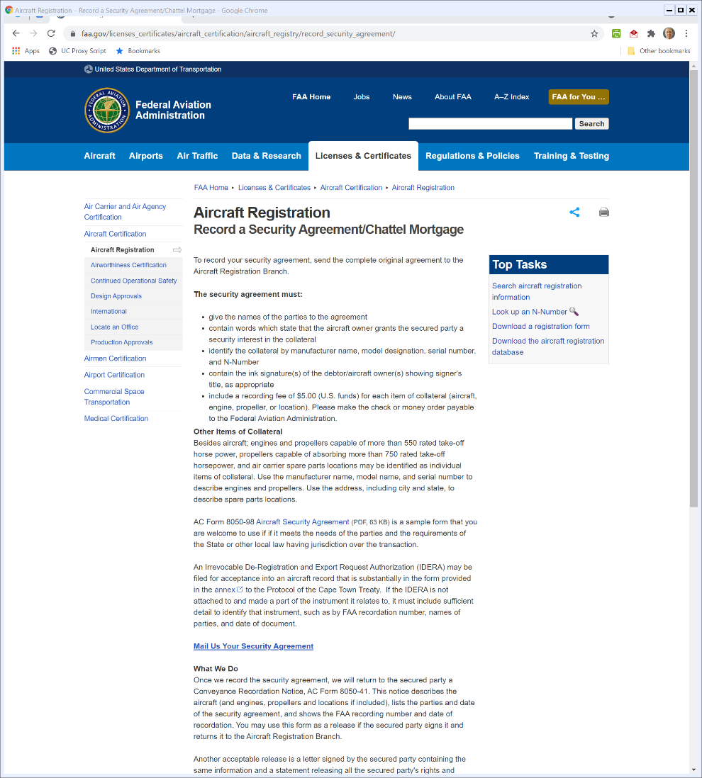

FAA Registration Process
FAA Website
Notes:
https://www.faa.gov/licenses_certificates/aircraft_certification/aircraft_registry/record_security_agreement/

Slide 52


The Airplane Market
Controller.com

Slide 53


What Garmin Sells
garmin.com

Slide 54


Pricy Avionics
garmin.com

Slide 55
Harley-Davidson (CA1 2015)
TTYN (1 of 2)
Evaluating This Sale
Missing logbook?
Missing avionics?
Use of dealer?
Vandalism and needed repairs?
As-is warranty?

Slide 56
Harley-Davidson (CA1 2015)
TTYN (2 of 2)
How do these impact commercial reasonableness?

Slide 57
9-620. Retention of Collateral
Old Statute
Keep collateral, discharge debt
New Statute
Allows for partial satisfaction of debt
Means that debtor may owe deficiency judgment

Slide 58
9-623. Redemption
(a) [Persons that may redeem.]
A debtor, any secondary obligor, or any other secured party or lienholder may redeem collateral.

Slide 59
9-623 Cont.
(b) [Requirements for redemption.]
To redeem collateral, a person shall tender:
(1) fulfillment of all obligations secured by the collateral; and
(2) the reasonable expenses and attorney’s fees described in Section 9‑615(a)(1).

Slide 60
9-623 Cont.
(c) [When redemption may occur.]
A redemption may occur at any time before a secured party:
(1) has collected collateral under Section 9‑607;
(2) has disposed of collateral or entered into a contract for its disposition under Section 9‑610; or

Slide 61
9-623 Cont.
(3) has accepted collateral in full or partial satisfaction of the obligation it secures under Section 9‑622.

Slide 62
Secured Party Mistakes in Implementing Part 6
9-625: Damages
9-626: Rebuttable Presumption Rule
9-627: Commercial Reasonableness Standards
9-628: Limitations on Liability

Slide 63
9-625
(b) [Damages for noncompliance.]
Subject to subsections (c), (d), and (f), a person is liable for damages in the amount of any loss caused by a failure to comply with this article. Loss caused by a failure to comply may include loss resulting from the debtor’s inability to obtain, or increased costs of, alternative financing.

Slide 64
Deficiency Judgments
Hypo
SP is owed $200K
Conducts 9-610 disposition of the collateral
Costs: $25K
Sale Price: $100K
Creates $125K deficiency judgment (owed to SP as unsecured debt)

Slide 65
Deficiency Judgments: Old Article 9 Caselaw
Absolute Bar Rule
Failure to comply with default sales rule forfeits deficiency judgment
Rebuttable Presumption Rule
Failure to comply creates rebuttable presumption that complying sale would have resulted in zero deficiency judgment

Slide 66
Old Article 9 Caselaw
Setoff Rule
No consequence for deficiency judgment
Assess instead damage to debtor: extent to which defect lowered proceeds from sale

Slide 67
9-626: Rebuttable Presumption Rule
(a) [Applicable rules if amount of deficiency or surplus in issue.]
In an action arising from a transaction, other than a consumer transaction, in which the amount of a deficiency or surplus is in issue, the following rules apply:

Slide 68
9-626(a) Cont.
(1) A secured party need not prove compliance with the provisions of this part relating to collection, enforcement, disposition, or acceptance unless the debtor or a secondary obligor places the secured party’s compliance in issue.

Slide 69
9-626(a) Cont.
(2) If the secured party’s compliance is placed in issue, the secured party has the burden of establishing that the collection, enforcement, disposition, or acceptance was conducted in accordance with this part.

Slide 70
9-626(a) Cont.
(3) [pretty messy but (4) is key];
(4) For purposes of paragraph (3)(B), the amount of proceeds that would have been realized is equal to the sum of the secured obligation, expenses, and attorney’s fees unless the secured party proves that the amount is less than that sum.

Slide 71
9-626(a) Cont.
Meaning
Once debtor or other person challenges whether disposition complied with Article 9, SP has burden to prove that it did
Assumption is that complying sale would have covered debt and fees
Presumed zero deficiency unless SP proves otherwise

Slide 72
9-626 Cont.: Not Necessarily in Consumer Transactions
(b) [Non-consumer transactions; no inference.]
The limitation of the rules in subsection (a) to transactions other than consumer transactions is intended to leave to the court the determination of the proper rules in consumer transactions. The court may not infer from that limitation the nature of the proper rule in consumer transactions and may continue to apply established approaches.

