Slide 1
Class 1
Secured Transactions Spring 2021
What is a Security Interest?
Randal C. Picker
James Parker Hall Distinguished Service Professor of Law
The Law School
The University of Chicago
Copyright © 2001-21 Randal C. Picker. All Rights Reserved.

Slide 2
Mechanics
Lunches: Google Doc Sign Up
  https://docs.google.com/document/d/1Jhd5hvEnQAfPpgxZjApcHja8dcnKDgpz9f3S7pfsDCE/edit?usp=sharing
Office Hours
  Week by Week: this week: Thursday, 4:15-5:15; I will send the zoom link

Slide 3
Mechanics
Warm cold calling
  Emails morning of
  Determined by excel spreadsheet random numbers

Slide 4
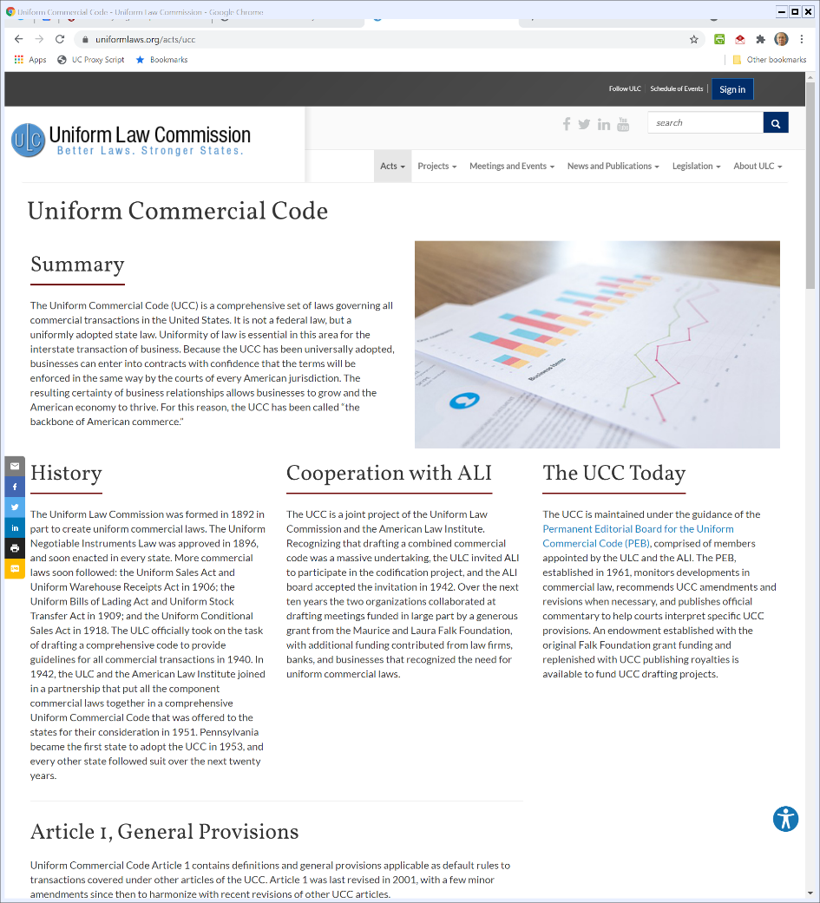
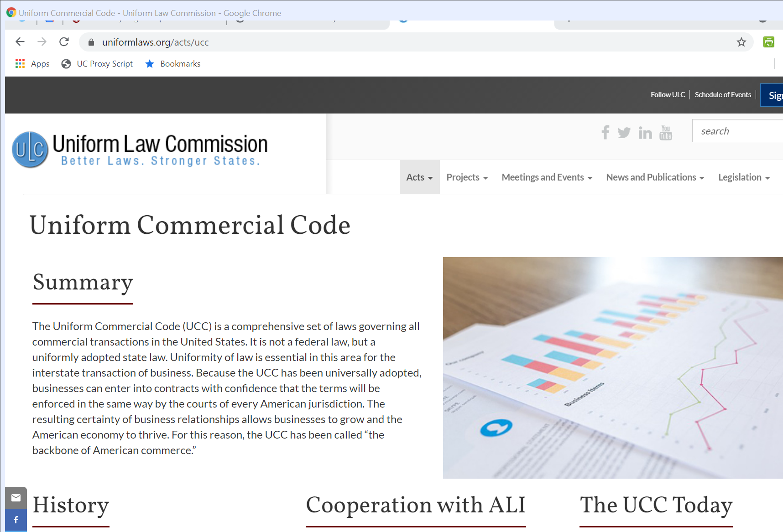
Uniformity By Choice
Uniform Law Commission
Notes:
https://www.uniformlaws.org/acts/ucc

Slide 5
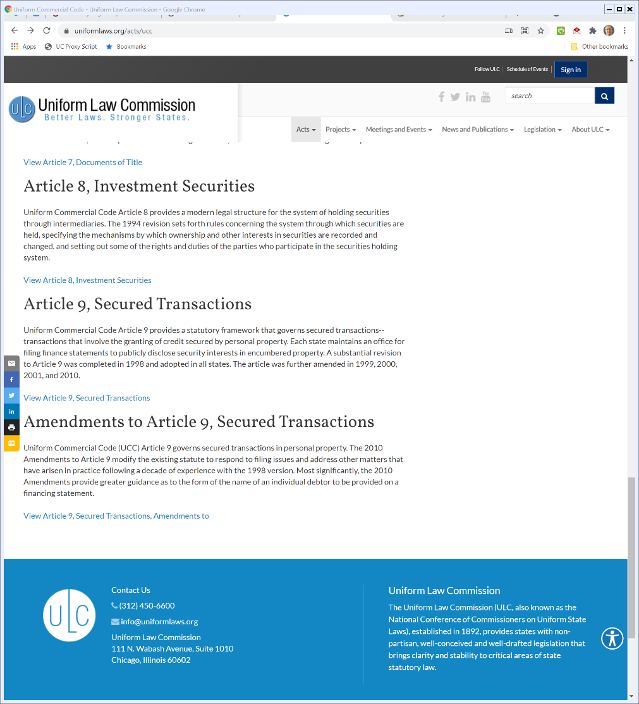

Article 9 Overview
Uniform Law Commission

Slide 6
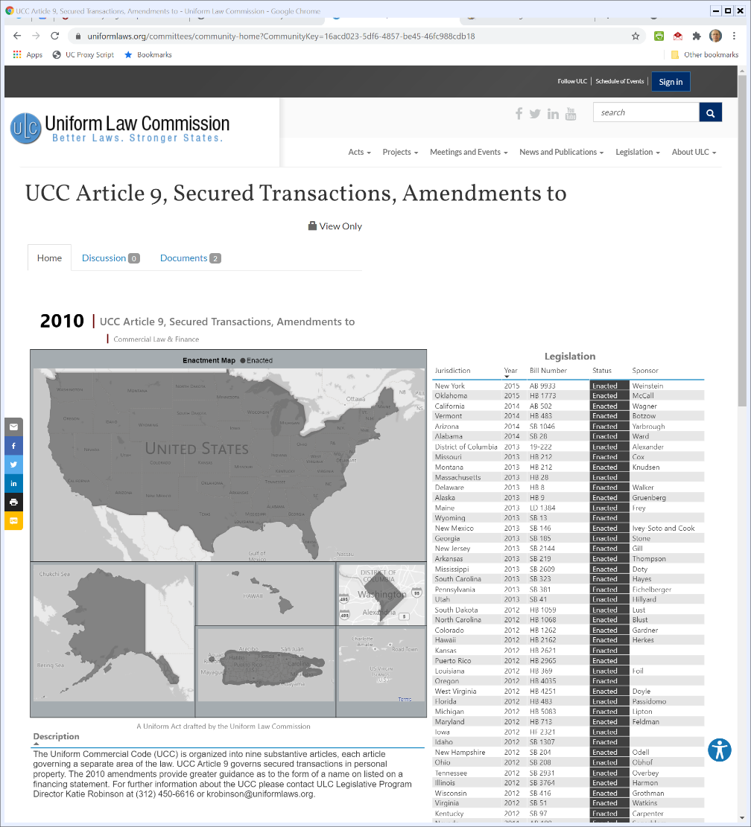
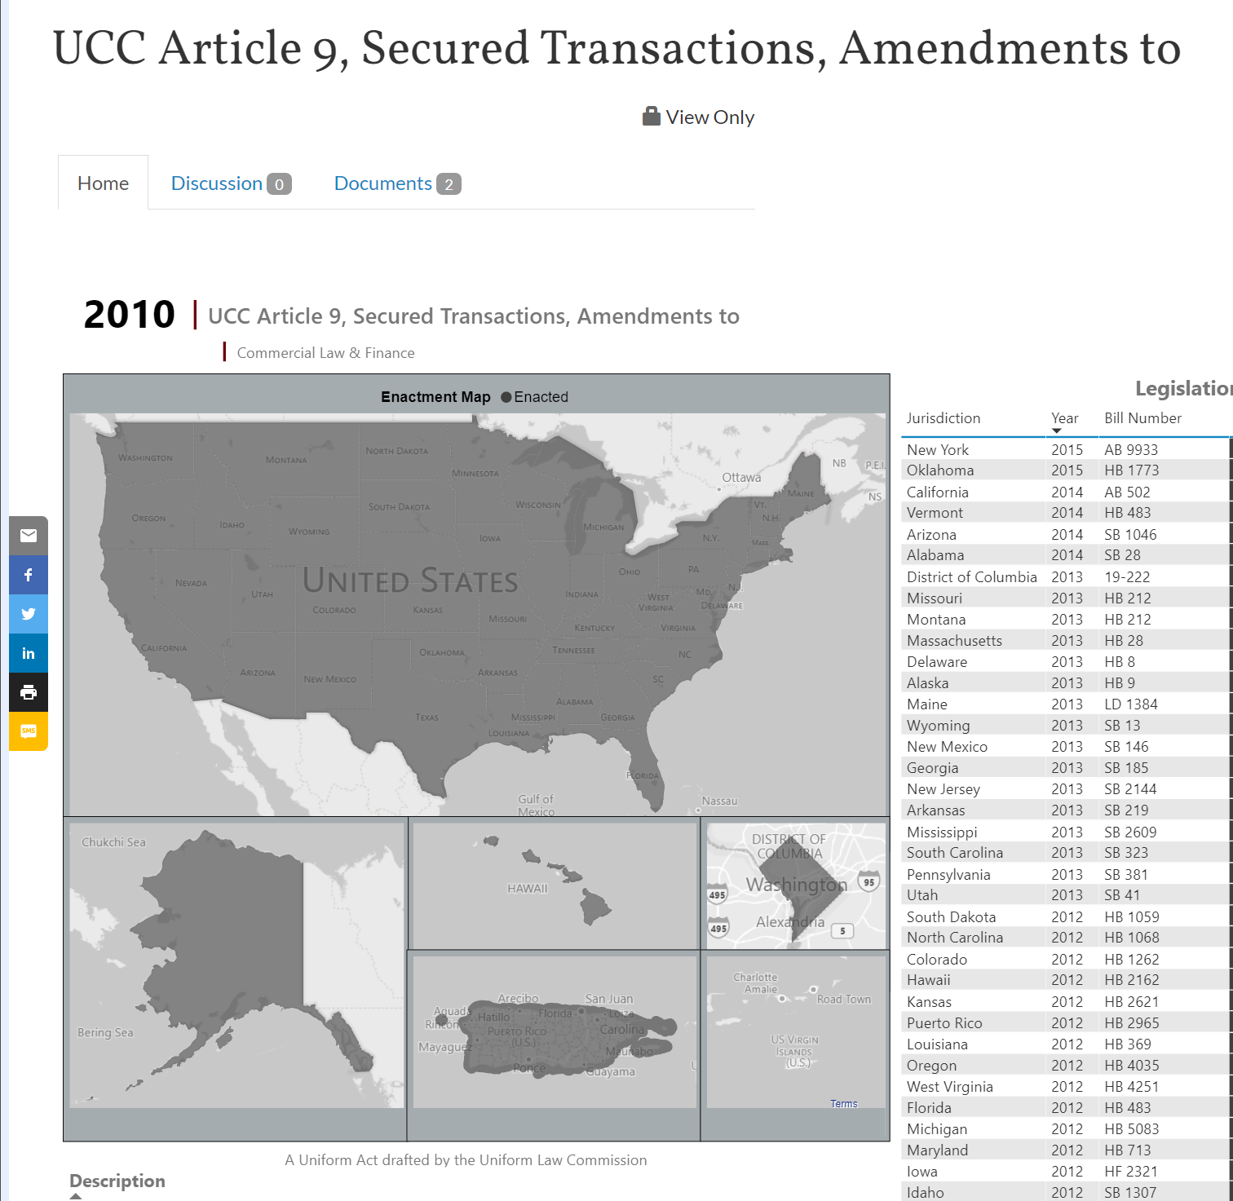
Article 9 Adoption
Uniform Law Commission
Notes:
https://www.uniformlaws.org/committees/community-home?CommunityKey=16acd023-5df6-4857-be45-46fc988cdb18

Slide 7
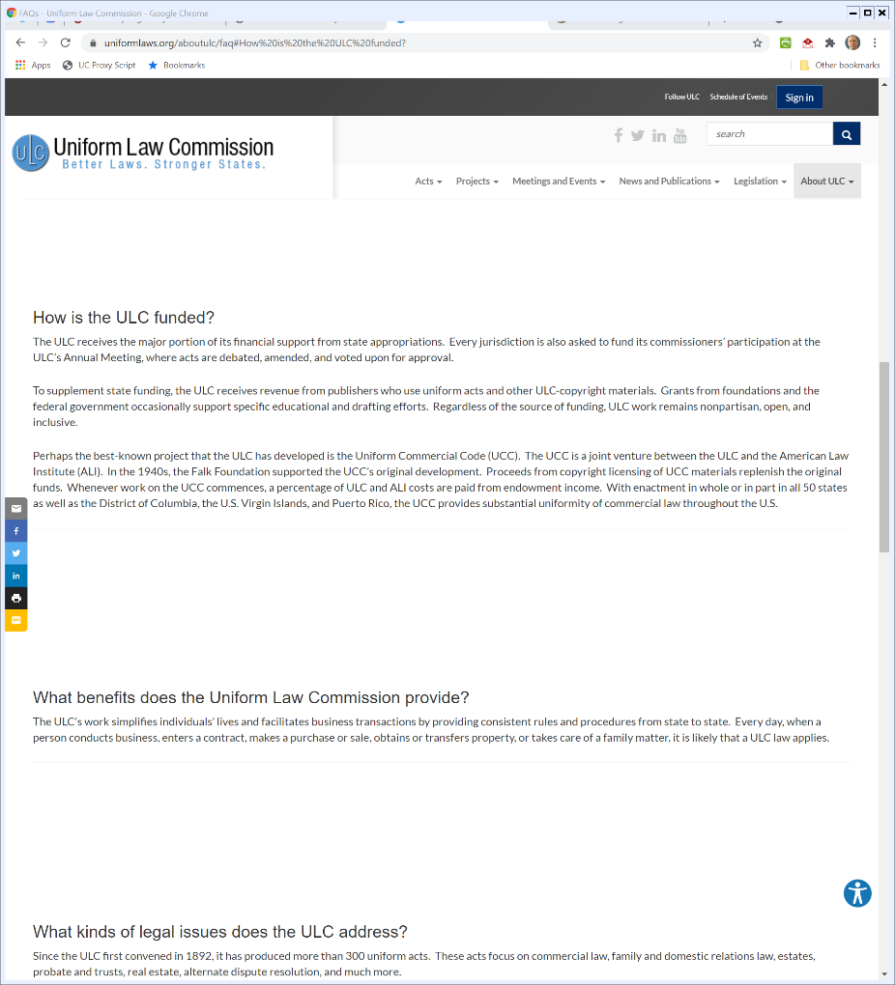
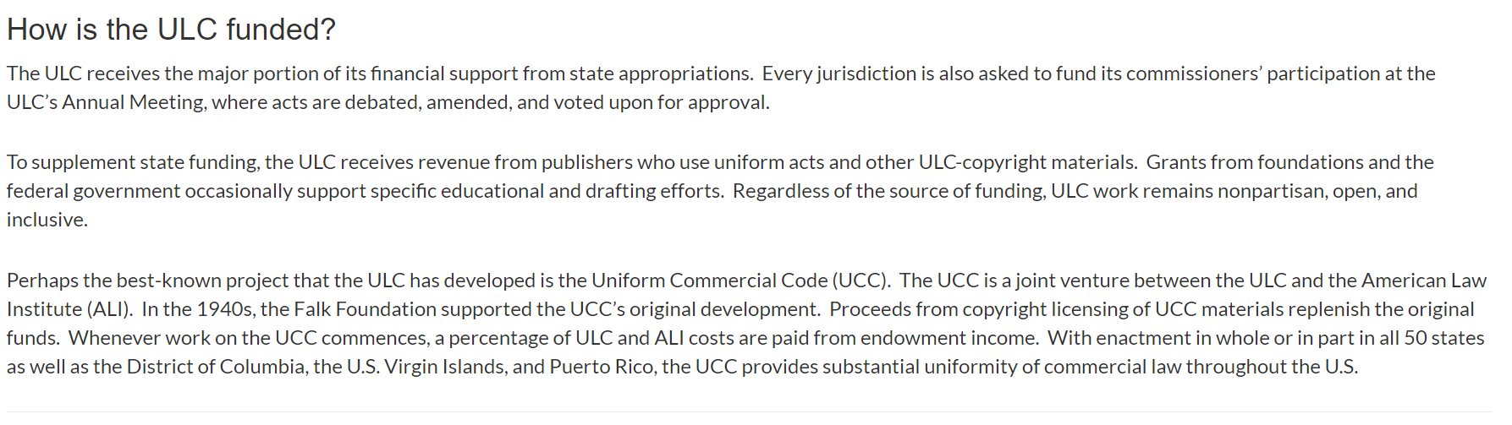
UCC Copyright
Uniform Law Commission

Slide 8
Statutes
Syllabus
  http://picker.uchicago.edu/sectrans/STSyllOnline.htm
Illinois
  http://picker.uchicago.edu/sectrans/PickerSecTransStatuteF18.pdf

Slide 9
Statutes: Text
Nebraska
  https://nebraskalegislature.gov/laws/browse-ucc.php
  But comments seem to be gone
But DC has?:
  https://code.dccouncil.us/dc/council/code/titles/28/subtitles/I/articles/9/

Slide 10
Statutes: Text
Maybe Get
  Baird et al: Statutes book: https://www.amazon.com/Commercial-Debtor-Creditor-Selected-Statutes-2020/dp/1684679745/ref=sr_1_1?dchild=1&keywords=baird+commercial+law&qid=1617036724&sr=8-1

Slide 11
Attachment and Perfection of the Security Interest
2: Promises to repay loan
Debtor
1: Lends $
Bank
3: Grants a security interest
in a particular asset
Public
4: Gives notice of
security interest

Slide 12
UCC 1 Financing Statement (9-502(a))

Slide 13
The Key Attributes of Security
Property Rights
  The secured creditor has the right to repossess the collateral after default (9-609)
  Also has the right to sell the property (9-610) or kept it in satisfaction of the debt (9-620)
Priority Rights
  The secured creditor has priority over unsecured creditors (9-201)

Slide 14
The Reified Priority System
TTYN
Debtor
Finco
1/1
SA: EQ
FS: EQ
$10K
3/1: $10K Unsecured
2/1
SA: INV
FS: INV
$10K
Creditco
3/15
INV = $5000
EQ = $15000
Bank
3/15: Who has priority?

Slide 15
Applying this Here
Security Interests
  Finco: SI in EQ worth $15K, owed $10K
  Bank: SI in INV worth $5K, owed $10K
  Finco gets $10K, Bank $5K
What should we do with the other $5K in EQ?
Corp
Finco
1/1
SA: EQ
FS: EQ
$10K
2/1
SA: INV
FS: INV
$10K
3/1: $10K Unsecured
Creditco
Bank
3/15
INV = $5000
EQ = $15000

Slide 16
Applying this Here
Corp
Finco
Unsecured Debts
  Finco: $0
  Bank: $5K
  Creditco: $10K
Assets: $5K in EQ
1/1
SA: EQ
FS: EQ
$10K
2/1
SA: INV
FS: INV
$10K
3/1: $10K Unsecured
Creditco
3/15
INV = $5000
EQ = $15000
Bank

Slide 17
Applying this Here
Fair Division Among Unsecured Creditors
  Bankruptcy Code implements pro rata rule in BC 726(b)
Corp
Finco
1/1
SA: EQ
FS: EQ
$10K
2/1
SA: INV
FS: INV
$10K
3/1: $10K Unsecured
Creditco
3/15
INV = $5000
EQ = $15000
Bank

Slide 18
The Pro Rata Rule
Three Steps
  1: Total the unsecured claims against the assets
  2: Total the assets
  3: For each creditor, give that creditor the fraction of the assets that that creditor holds of the claims

Slide 19
The Pro Rata Rule
Doing That Here
  1: Total Debts: 0 + 5 + 10 = 15
  2: Total Assets: 5
  3
    Bank gets (5/15) x 5 = $1,667
    Creditco get (10/15) x 5 = $3,333

Slide 20
Final Distribution
Finco gets $10K
Bank gets $5K + $1,667 = $6,667
Creditco gets $3,333
Corp
Finco
1/1
SA: EQ
FS: EQ
$10K
2/1
SA: INV
FS: INV
$10K
3/1: $10K Unsecured
Creditco
3/15
INV = $5000
EQ = $15000
Bank

Slide 21
9-322(a)(1)
Ranking Rule for Conflicting Security Interests
  Conflicting perfected security interests and agricultural liens rank according to priority in time of filing or perfection

Slide 22
9-322(a)(1)
Priority dates from the earlier of the time
  a filing covering the collateral is first made or
  the security interest or agricultural lien is first perfected
if there is no period thereafter when there is neither filing nor perfection

Slide 23
The First-to-File Rule I
TTYN (1 of 3)
Debtor
Finco
1/1
SA: EQ
FS: EQ
$10K
2/1
SA: EQ
FS: EQ
$10K
2/1 Who has priority?
Bank

Slide 24
The First-to-File Rule II
TTYN (2 of 3)
2/2
FS: EQ
Finco
Debtor
1/1
SA: EQ
$10K
2/1
SA: EQ
FS: EQ
$10K
2/2 Who has priority?
Bank

Slide 25
The First to File Rule III
TTYN (3 of 3)
1/1
FS: EQ
Debtor
Finco
2/1
SA: EQ
FS: EQ
$10K
3/1
SA: EQ
$10K
Bank
3/1 Who has priority?

Slide 26
FTF I Answer
Finco filed first, so Finco has priority

Slide 27
FTF II Answer
Bank filed first, so Bank has priority

Slide 28
FTF III Answer
Finco filed first, so Finco wins

Slide 29
1-201(b)(35)
Definition of a Security Interest
  “Security interest” means an interest in personal property or fixtures which secures payment or performance of an obligation.

Slide 30
1-201(b)(35)
Definition of a Security Interest
  “Security interest” means an interest in personal property or fixtures which secures payment or performance of an obligation.

Slide 31
9-203
(a) [Attachment.]
  A security interest attaches to collateral when it becomes enforceable against the debtor with respect to the collateral, unless an agreement expressly postpones the time of attachment.

Slide 32
9-203
(b) [Enforceability.]
  Except as otherwise provided …, a security interest is enforceable against the debtor and third parties with respect to the collateral only if:
    (1) value has been given;
    (2) the debtor has rights in the collateral or the power to transfer rights in the collateral to a secured party; and

Slide 33
9-203
    (3) one of the following conditions is met:
      (A) the debtor has authenticated a security agreement that provides a description of the collateral …

Slide 34
Clark: Starting Questions
Documents
  What documents were done as part of the original deal?
  Why were those documents created?
Events
  What is the rough timeline of events?

Slide 35
Clark
Chrysler lends $85,000
Clark
Chrysler
7/86
Mortgage: Inn
Ack re Liquor License
FS (UCC-1): License
Westmoreland County
Commonwealth of PA
4-468. Licenses not assignable; transfers .… The license shall constitute a privilege between the Board and the licensee. As between the licensee and third parties, the license shall constitute property.
6/29/87
Passes
4-468
PA

Slide 36
Acknowledgement
We, the undersigned, do hereby acknowledge, consent and agree that liquor license TR-1793 issued by the Pennsylvania Liquor Control Board for use at premises situate(d) at R.D. # 1, Box 19, Ligonier, Pennsylvania 15650, will not be removed from said premises, nor transferred without the prior written consent of Finance America Consumer Discount Company, until mortgage loan from Finance America Consumer Discount Company to Diane C. Clark and Dick J. Clark a/k/a Richard J. Clark is paid in full.

Slide 37
What Does Chrysler Have?
The Law of the Chicken
  “We liken Chrysler’s rights to the rights of a party to maintain a debtor’s chicken within an enclosed, fenced-off area, under an agreement that the creditor might maintain the fence in place, preventing the chicken from being removed or used in any other place, or sold”

Slide 38
What Does Chrysler Have?
The Law of the Chicken
  “or transferred to any other person by the debtor, yet the secured creditor has no right in himself, on default or otherwise, to remove the chicken for his own benefit.”

Slide 39
Sec Trans Exercise 1: Rewriting Clark
TTYN
Google Docs link
  https://docs.google.com/document/d/1nr5TBT-D7lcB77jkR0vFVRjlngjuhk7p3HAYntFjMy8/edit?usp=sharing

Slide 40
The Right Way to Do It: After-Acquired Property
9-204(a) and After-Acquired Property
  Chrysler could have avoided its problems by including an after-acquired property clause in the contract with Clark
  Usually, the AAP clause covers property that the debtor later acquires, but it could also cover rights that the debtor has that later become property

Slide 41
Top Down v. Bottom Up Approaches
How Should We Set Incomplete Interests?
  If it is intended that the secured creditor have less than the full set of rights, it is probably safer to create a security interest and remove rights than to try to create the desired rights individually

