Slide 1
Class 26: Wed 3 Dec 2025
Antitrust Fall 2025
Meta Platforms
Randal C. Picker
James Parker Hall Distinguished Service Professor of Law
The Law School
The University of Chicago
Copyright © 2025 Randal C. Picker. All Rights Reserved.

Slide 2
Northern Securities Merger to Be Dissolved
New York Times (15 Mar 1904)

Slide 3
FTC Gets Power to Enforce CA7
Clayton Act (15 Oct 1914)

Slide 4
Power to Order Stock Divestiture
Clayton Act (15 Oct 1914)

Slide 5
FTC and CA7
272 U.S. 554 (1926)

Slide 6
Not Section 5 Here
272 U.S. 554 (1926)

Slide 7
1950: Closing the Clayton Act Asset Loophole
Pub. L. 81-899 (29 Dec 1950)

Slide 8
1957 du Pont Decision: Based on 40-Year Old Acquistion
New York Times (4 June 1957)

Slide 9
1917-19 Stock Purchase
353 U.S. 586 (1957)

Slide 10
Can Proceed After Stock Was Acquired
“‘Incipiency’ in this context denotes not the time the stock was acquired, but any time when the acquisition threatens to ripen into a prohibited effect. … To accomplish the congressional aim, the Government may proceed at any time that an acquisition may be said with reasonable probability to contain a threat that it may lead to a restraint of commerce or tend to create a monopoly of a line of commerce.”
du Pont (U.S. 1957)

Slide 11
Gov’t Can Bring CA7 Action at Any Time
du Pont (U.S. 1957)

Slide 12
1966: Dean Foods (5-4)
384 U.S. 597 (1966)

Slide 13
The All Writs Act
Dean Foods (U.S. 1966)

Slide 14
All Writs Power Intact
Dean Foods (U.S. 1966)

Slide 15
FTC Can Seek Preliminary Injunction under All Writs Act
Dean Foods (U.S. 1966)

Slide 16
Other 4: Nope
Dean Foods (U.S. 1966)

Slide 17
Other 4: Nope
Dean Foods (U.S. 1966)

Slide 18
1973 Amendments
Pub. L. 93-153 (16 Nov 1973)

Slide 19
Additional FTC Powers
Pub. L. 93-153 (16 Nov 1973)

Slide 20
New Injunction Powers
Pub. L. 93-153 (16 Nov 1973)

Slide 21
Early Case Law
529 F.2d 196 (3rd Cir. 1976)

Slide 22
Hart Scott Rodino
Pub. L. 94-435 (30 Sept 1976)

Slide 23
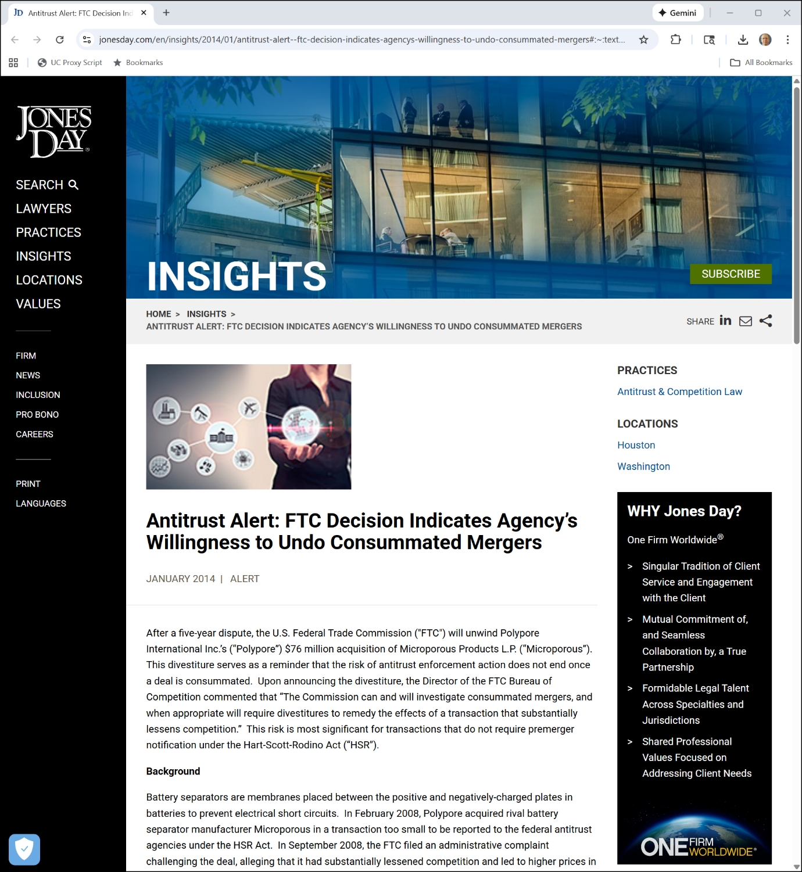
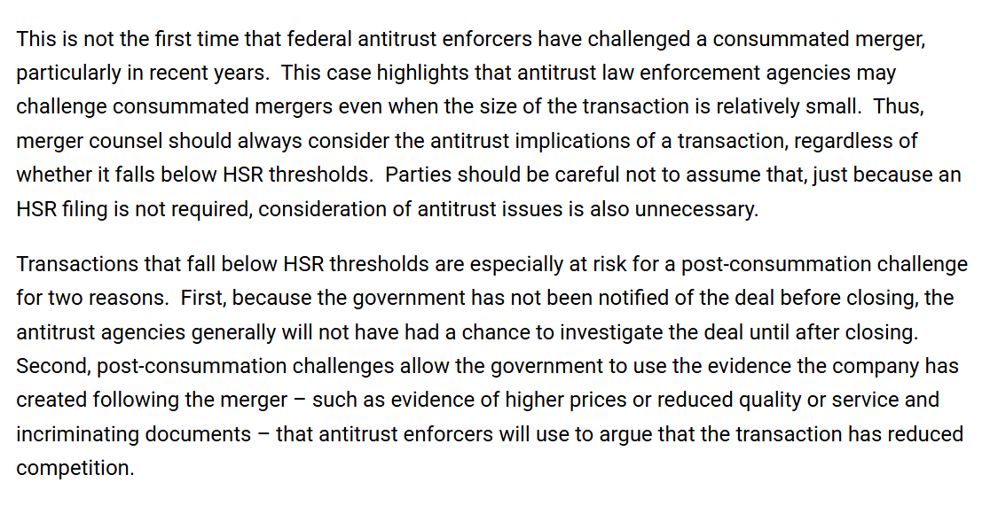
Challenges to Below-HSR Threshold Mergers
Jones Day (Jan 2014)
Notes:
https://www.jonesday.com/en/insights/2014/01/antitrust-alert--ftc-decision-indicates-agencys-willingness-to-undo-consummated-mergers#:~:text=After%20a%20five%2Dyear%20dispute,agencies%20under%20the%20HSR%20Act.

Slide 24
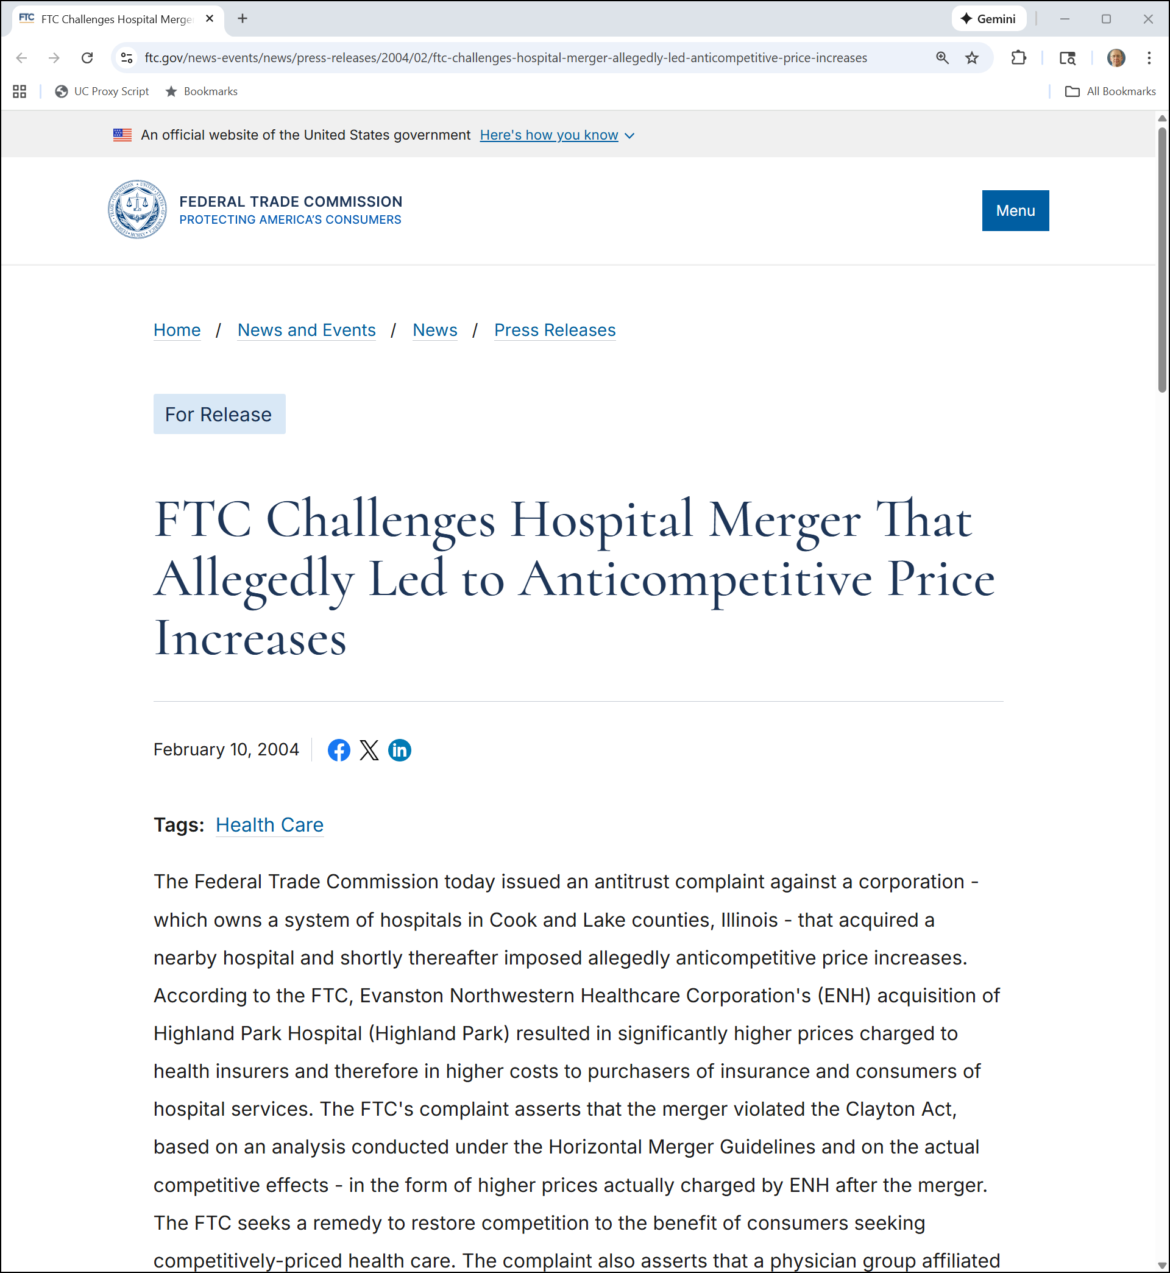
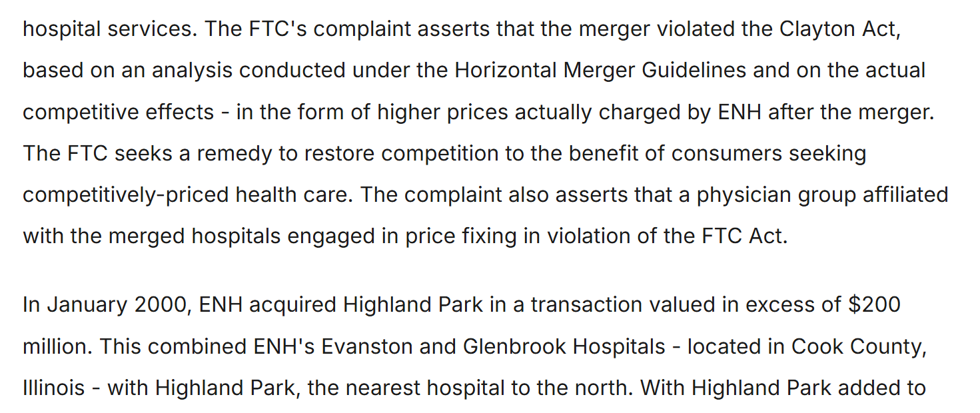
Challenge of Notified Consummated Merger Under CA7
FTC (10 Feb 2004)

Slide 25
AMG on 13(b)
593 U.S. 67 (U.S. 2021)

Slide 26
FTC Enforcement Via Internal Proceedings
AMG (U.S. 2021)

Slide 27
Additional FTC Authority
AMG (U.S. 2021)

Slide 28
Equitable Monetary Relief
AMG (U.S. 2021)

Slide 29
FTC Can’t Get Monetary Relief Via 13(b)
AMG (U.S. 2021)

Slide 30
Scope of Permanent Injunction Power
“Taken as a whole, the provision focuses upon relief that is prospective, not retrospective. Consider the words ‘is violating’ and ‘is about to violate’ (not ‘has violated’) setting forth when the Commission may request injunctive relief.”
AMG (U.S. 2021)

Slide 31
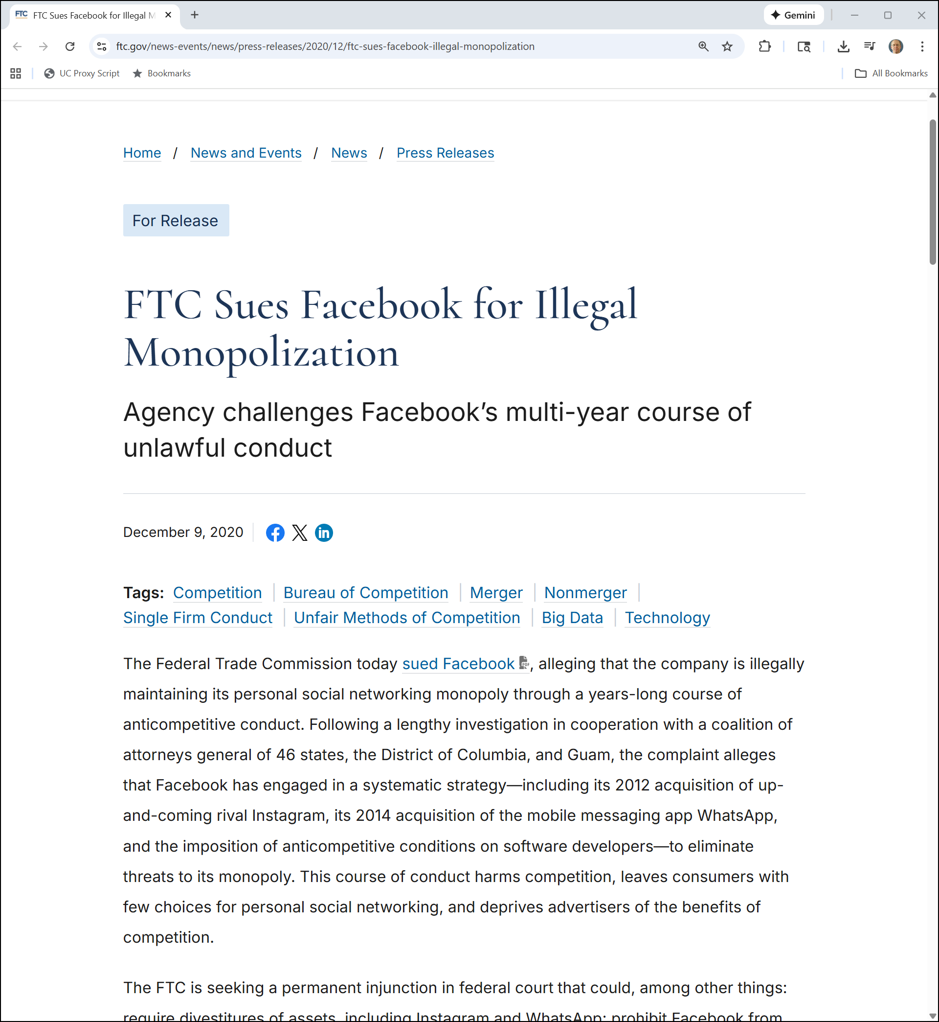
PSN Monopoly
FTC (9 Dec 2020)
Notes:
https://www.ftc.gov/news-events/news/press-releases/2020/12/ftc-sues-facebook-illegal-monopolization

Slide 32
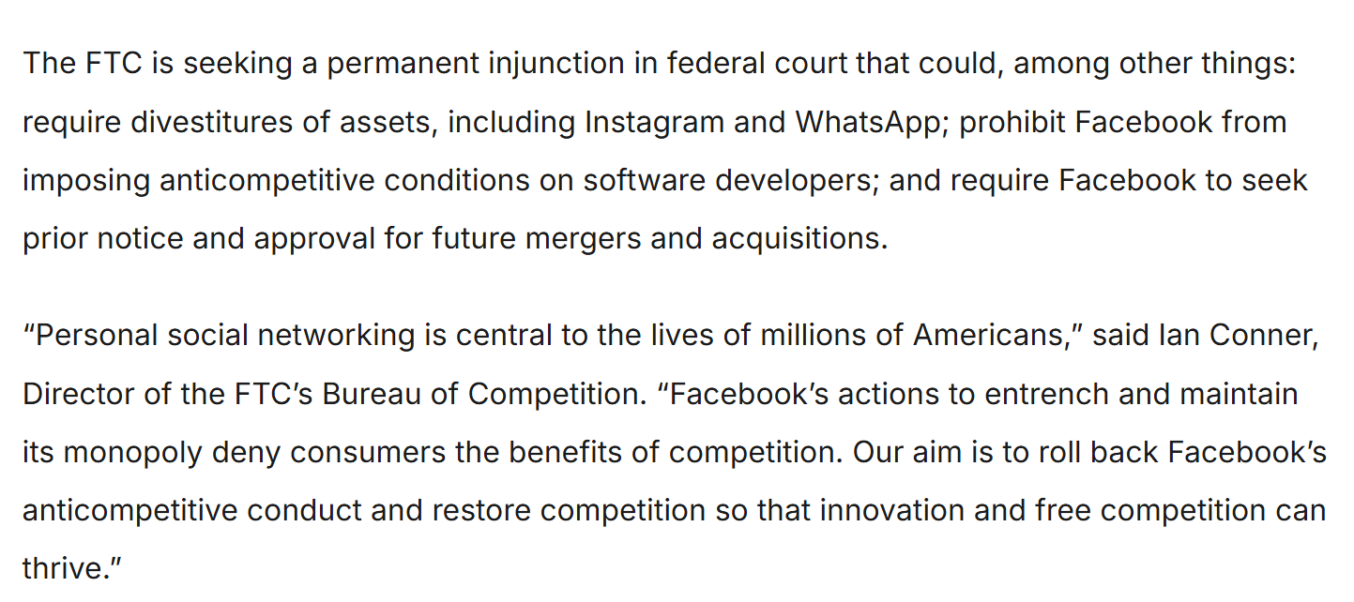
Permanent Injunction
FTC (9 Dec 2020)
Notes:
https://www.ftc.gov/news-events/news/press-releases/2020/12/ftc-sues-facebook-illegal-monopolization

Slide 33
Injunctive Relief Under 13(b) for FTC 5(a) Violation
FTC Redacted Complaint (13 Jan 2021)

Slide 34
Market: Personal Social Networking
FTC Redacted Complaint (13 Jan 2021)

Slide 35
“Staggering Profits”
FTC Redacted Complaint (13 Jan 2021)

Slide 36
Zuck’s Emails
FTC Redacted Complaint (13 Jan 2021)

Slide 37
Market Definition
FTC Redacted Complaint (13 Jan 2021)

Slide 38
Monopoly Power: Dominant Share (of What?)
FTC Redacted Complaint (13 Jan 2021)

Slide 39
More Zuck Emails
FTC Redacted Complaint (13 Jan 2021)

Slide 40
And More
FTC Redacted Complaint (13 Jan 2021)

Slide 41
Anticompetitive Interoperability Rules
FTC Redacted Complaint (13 Jan 2021)

Slide 42
Single Count: SA2 Violation
FTC Redacted Complaint (13 Jan 2021)

Slide 43
SA2 Violation; 53(b) Relief
FTC Redacted Complaint (13 Jan 2021)

Slide 44
Divest IG/WA and More
FTC Redacted Complaint (13 Jan 2021)

Slide 45
Still More
FTC Redacted Complaint (13 Jan 2021)

Slide 46
MTD Opinion
D.Ct. Opinion (26 June 2021)

Slide 47
Insufficient Pleading by FTC
D.Ct. Opinion (26 June 2021)

Slide 48
Need Metrics
D.Ct. Opinion (26 June 2021)

Slide 49
Interoperability Claim Can’t Go Forward
D.Ct. Opinion (26 June 2021)

Slide 50
Revised Complaint
FTC Amended Complaint(19 Aug 2021)

Slide 51
2nd MTD Rejected
D.Ct. Opinion (11 Jan 2022)

Slide 52
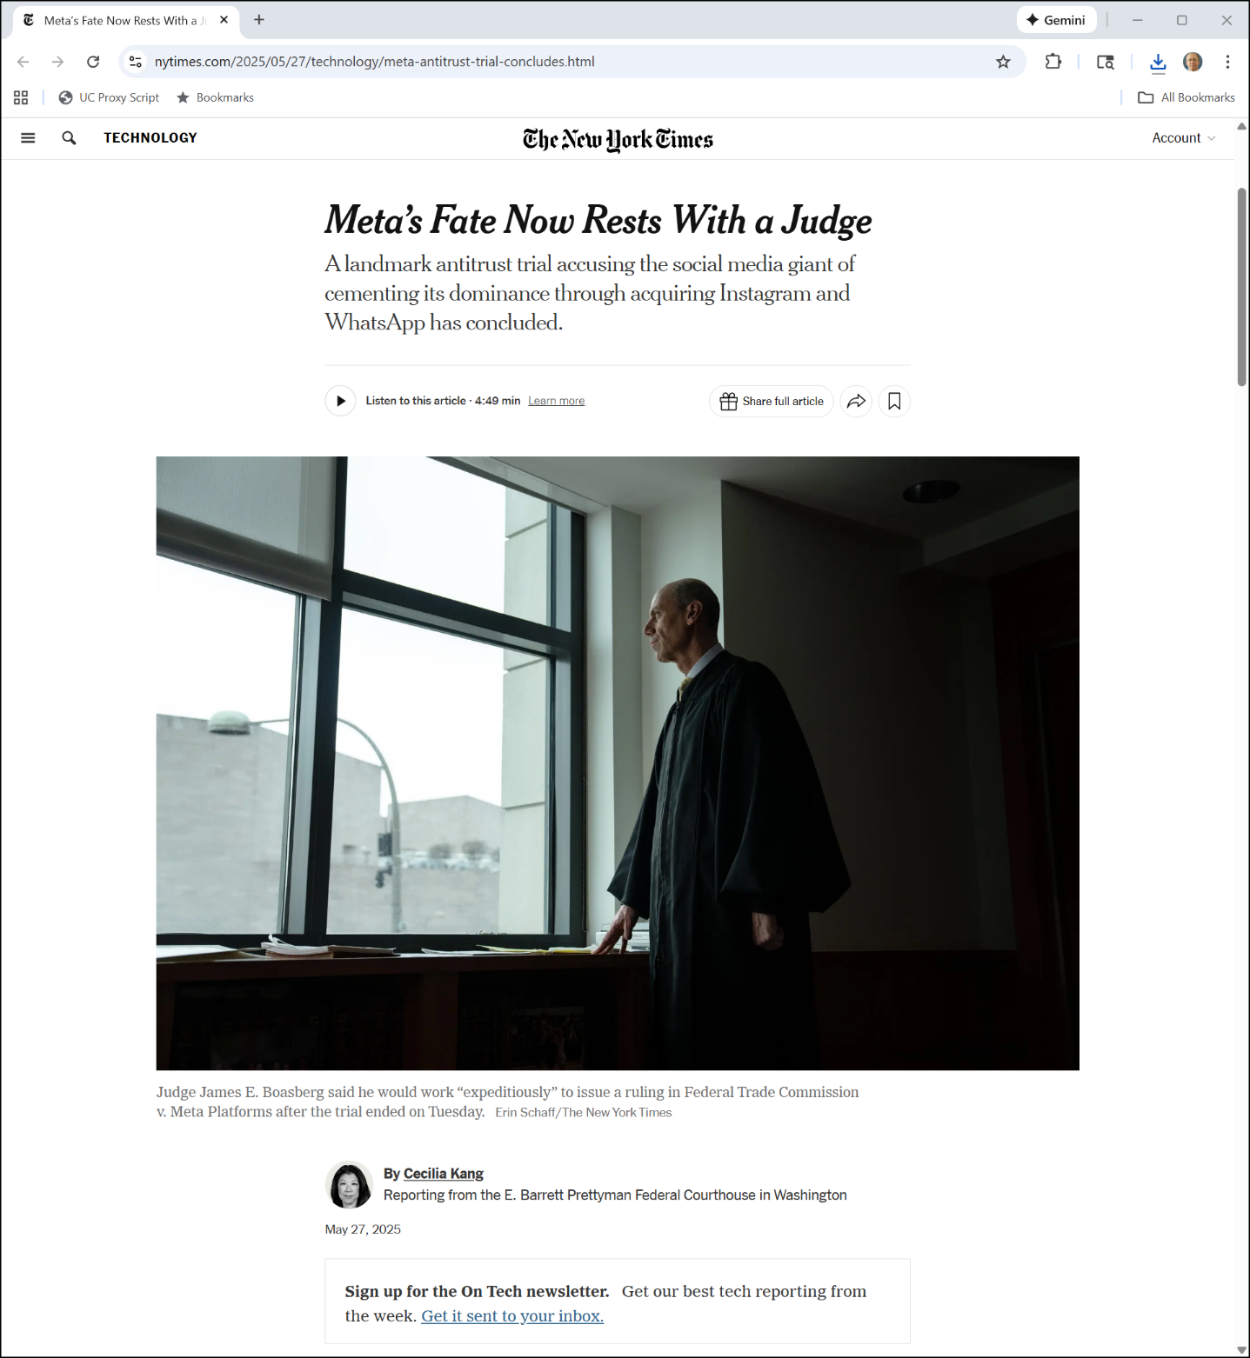
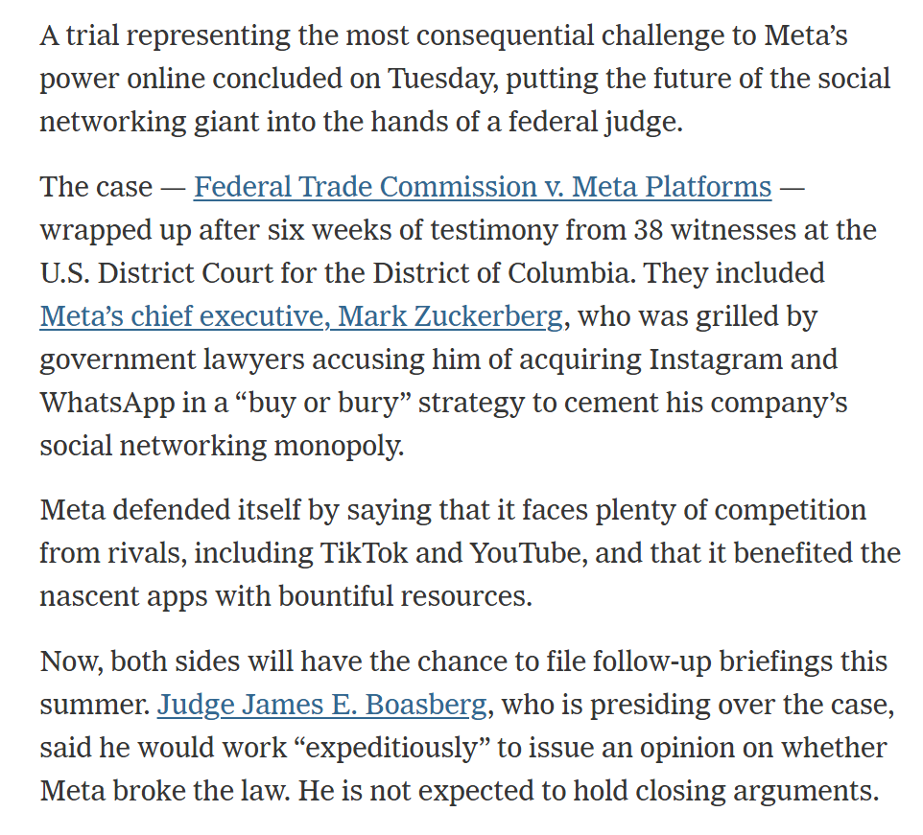
Six-Week Trial Done
New York Times (27 May 2025)
Notes:
https://www.nytimes.com/2025/05/27/technology/meta-antitrust-trial-concludes.html

Slide 53
Case Dismissed
FTC v Meta Opinion (18 Nov 2025)

Slide 54
FB Isn’t Old FB
“Americans now spend only 17% of their time on Facebook viewing content from their friends. See DX 1152 (Jan. 2025 Facebook Surface Breakdown). On Instagram, that number is 7%. See DX 1153 (Jan. 2025 Instagram Surface Breakdown). What has replaced content from friends? For the most part, short videos posted by strangers and recommended by AI.”
FTC v Meta Opinion (18 Nov 2025)

Slide 55
We Watch Video on FB/IG
“A majority of Americans’ time on Facebook is now spent watching videos. See DX 1147 (U.S. Share of Facebook Time Spent on Video). Same for their time on Instagram. See DX 1153 (Jan. 2025 Instagram Surface Breakdown). In particular, both apps have shifted to primarily showing Reels.”
FTC v Meta Opinion (18 Nov 2025)

Slide 56
DX 1152: 17% of FB Time is from Friends
FTC v. Meta Exhibits

Slide 57
DX 1153: 7% on IG
FTC v. Meta Exhibits

Slide 58
DX-1147: Video on FB
FTC v. Meta Exhibits

Slide 59
Friends Less Important (15%)
FTC v Meta Opinion (18 Nov 2025/2 Dec 2025)

Slide 60
Do Posts from Friends Matter?
FTC v Meta Opinion (18 Nov 2025/2 Dec 2025)

Slide 61
People Don’t Post
FTC v Meta Opinion (18 Nov 2025/2 Dec 2025)

Slide 62
Stale Friends Network
FTC v Meta Opinion (18 Nov 2025)

Slide 63
Posting by Friends Has Gone Private
FTC v Meta Opinion (18 Nov 2025)

Slide 64
DX 585: Private Sharing
FTC v. Meta Exhibits

Slide 65
Why Did This Happen?
“First, smartphone usage exploded. … Second, cellphone data got better. It got faster, so people could watch videos on their phones without bushwhacking through constant freezing and buffering. … Third, the steady progress of cellular data was followed by a massive leap in AI. Advanced AI algorithms can now analyze your preferences, search through billions of pieces of content, and find engaging videos about the things you care most about in the world.”
FTC v Meta Opinion (18 Nov 2025)

Slide 66
The Rise of TikTok
FTC v Meta Opinion (18 Nov 2025/2 Dec 2025)

Slide 67
More TikTok
FTC v Meta Opinion (18 Nov 2025/2 Dec 2025)

Slide 68
Summarizing TikTok
FTC v Meta Opinion (18 Nov 2025/2 Dec 2025)

Slide 69
Time Spent Is the Right Metric
“In the Court’s view, the best single measure of market share is total time spent. For one, that statistic makes the most analytic sense. … Time spent … captures the intensity of use: if someone spends two minutes on Instagram and two hours on TikTok, she should not count as an equal user of each. Plus, time spent is the best proxy for what drives these apps’ revenue: ads. The more time someone spends on an app, the more ads it can show him, and the more money it will make..”
FTC v Meta Opinion (18 Nov 2025)

Slide 70
No Monopoly Power Here (30%)
FTC v Meta Opinion (18 Nov 2025/2 Dec 2025)

Slide 71
No Monopoly Power Here
FTC v Meta Opinion (18 Nov 2025/2 Dec 2025)

Slide 72
Timing
“Before turning to the methods of proof, one more preliminary remains: when must the FTC show that Meta had monopoly power? Throughout this case, the Court has held that the agency must prove that Meta is violating the law now. … The FTC’s authority to seek injunctions comes from Section 13(b) of the FTC Act … . …The FTC can therefore seek to enjoin only conduct that currently violates the law or imminently will.”
FTC v Meta Opinion (18 Nov 2025)

Slide 73
Profits?
“The FTC first argues that Meta must hold a monopoly because it has long earned profits that exceed its cost of capital. Persistent profits above the cost of capital may indeed suggest monopoly power. But they can also imply any of the other reasons why one firm is more profitable than its rivals: shrewd management, exceptional efficiency, booming demand, or risky investments that hit big. … The record here … reveals several other factors that could be driving Meta’s handsome profits, none of which the FTC has foreclosed.”
FTC v Meta Opinion (18 Nov 2025)

