Slide 1
Class 25: Mon 1 Dec 2025 Antitrust Fall 2025 Google Search
Randal C. Picker
James Parker Hall Distinguished Service Professor of Law
The Law School
The University of Chicago
Copyright © 2012-25 Randal C. Picker. All Rights Reserved.

Slide 2
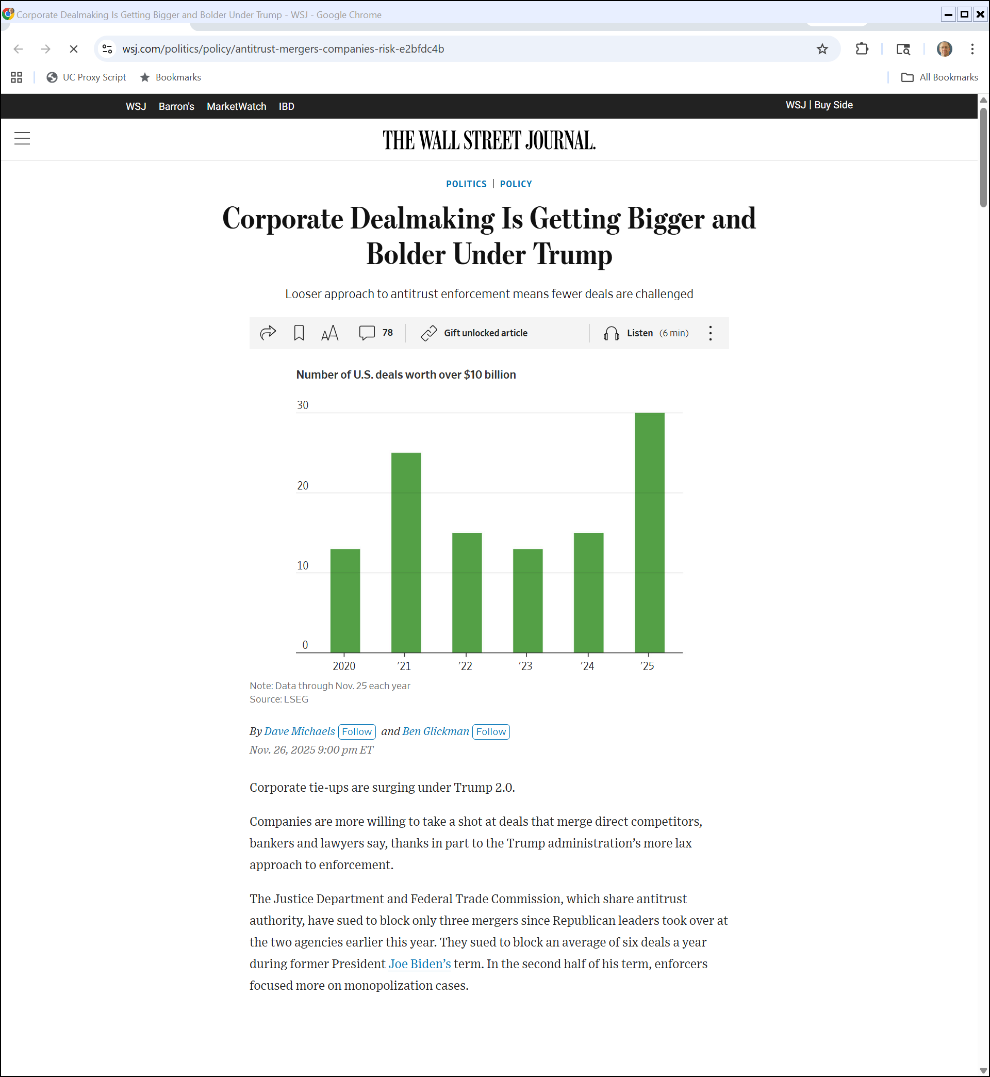
Merger Surge
WSJ (26 Nov 2025)
Notes:
https://www.wsj.com/politics/policy/antitrust-mergers-companies-risk-e2bfdc4b

Slide 3
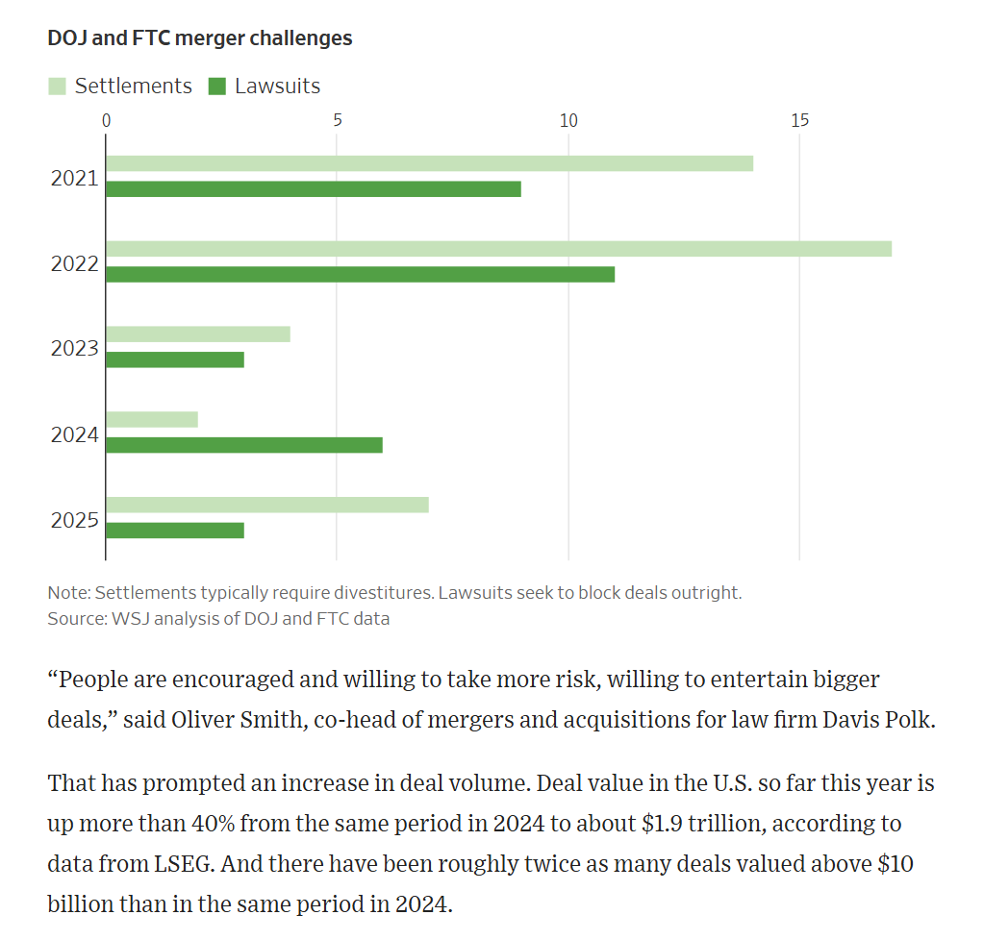
Merger Surge
WSJ (26 Nov 2025)
Notes:
https://www.wsj.com/politics/policy/antitrust-mergers-companies-risk-e2bfdc4b

Slide 4
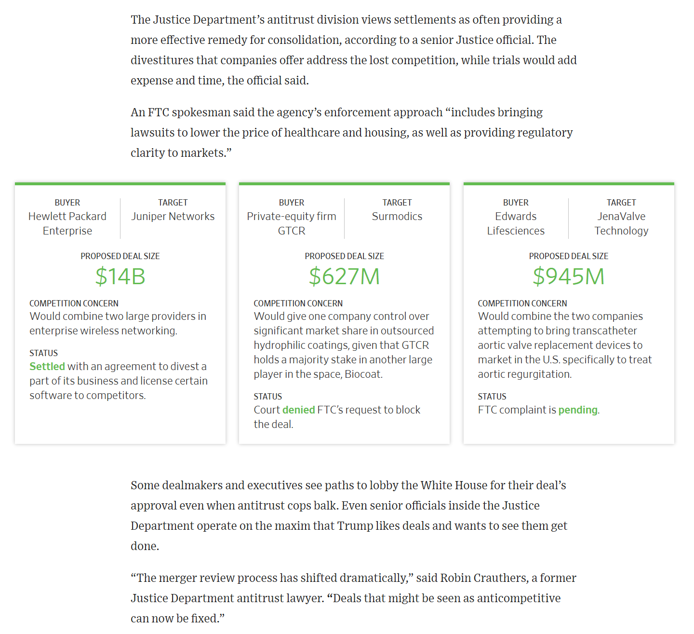
Merger Surge
WSJ (26 Nov 2025)
Notes:
https://www.wsj.com/politics/policy/antitrust-mergers-companies-risk-e2bfdc4b

Slide 5
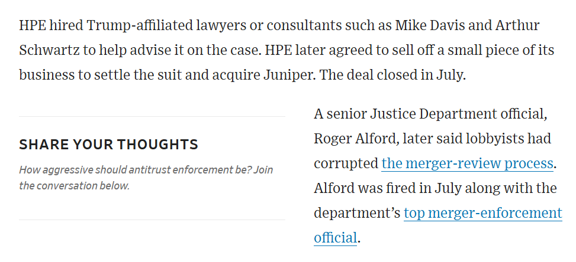
Merger Surge
WSJ (26 Nov 2025)
Notes:
https://www.wsj.com/politics/policy/antitrust-mergers-companies-risk-e2bfdc4b

Slide 6
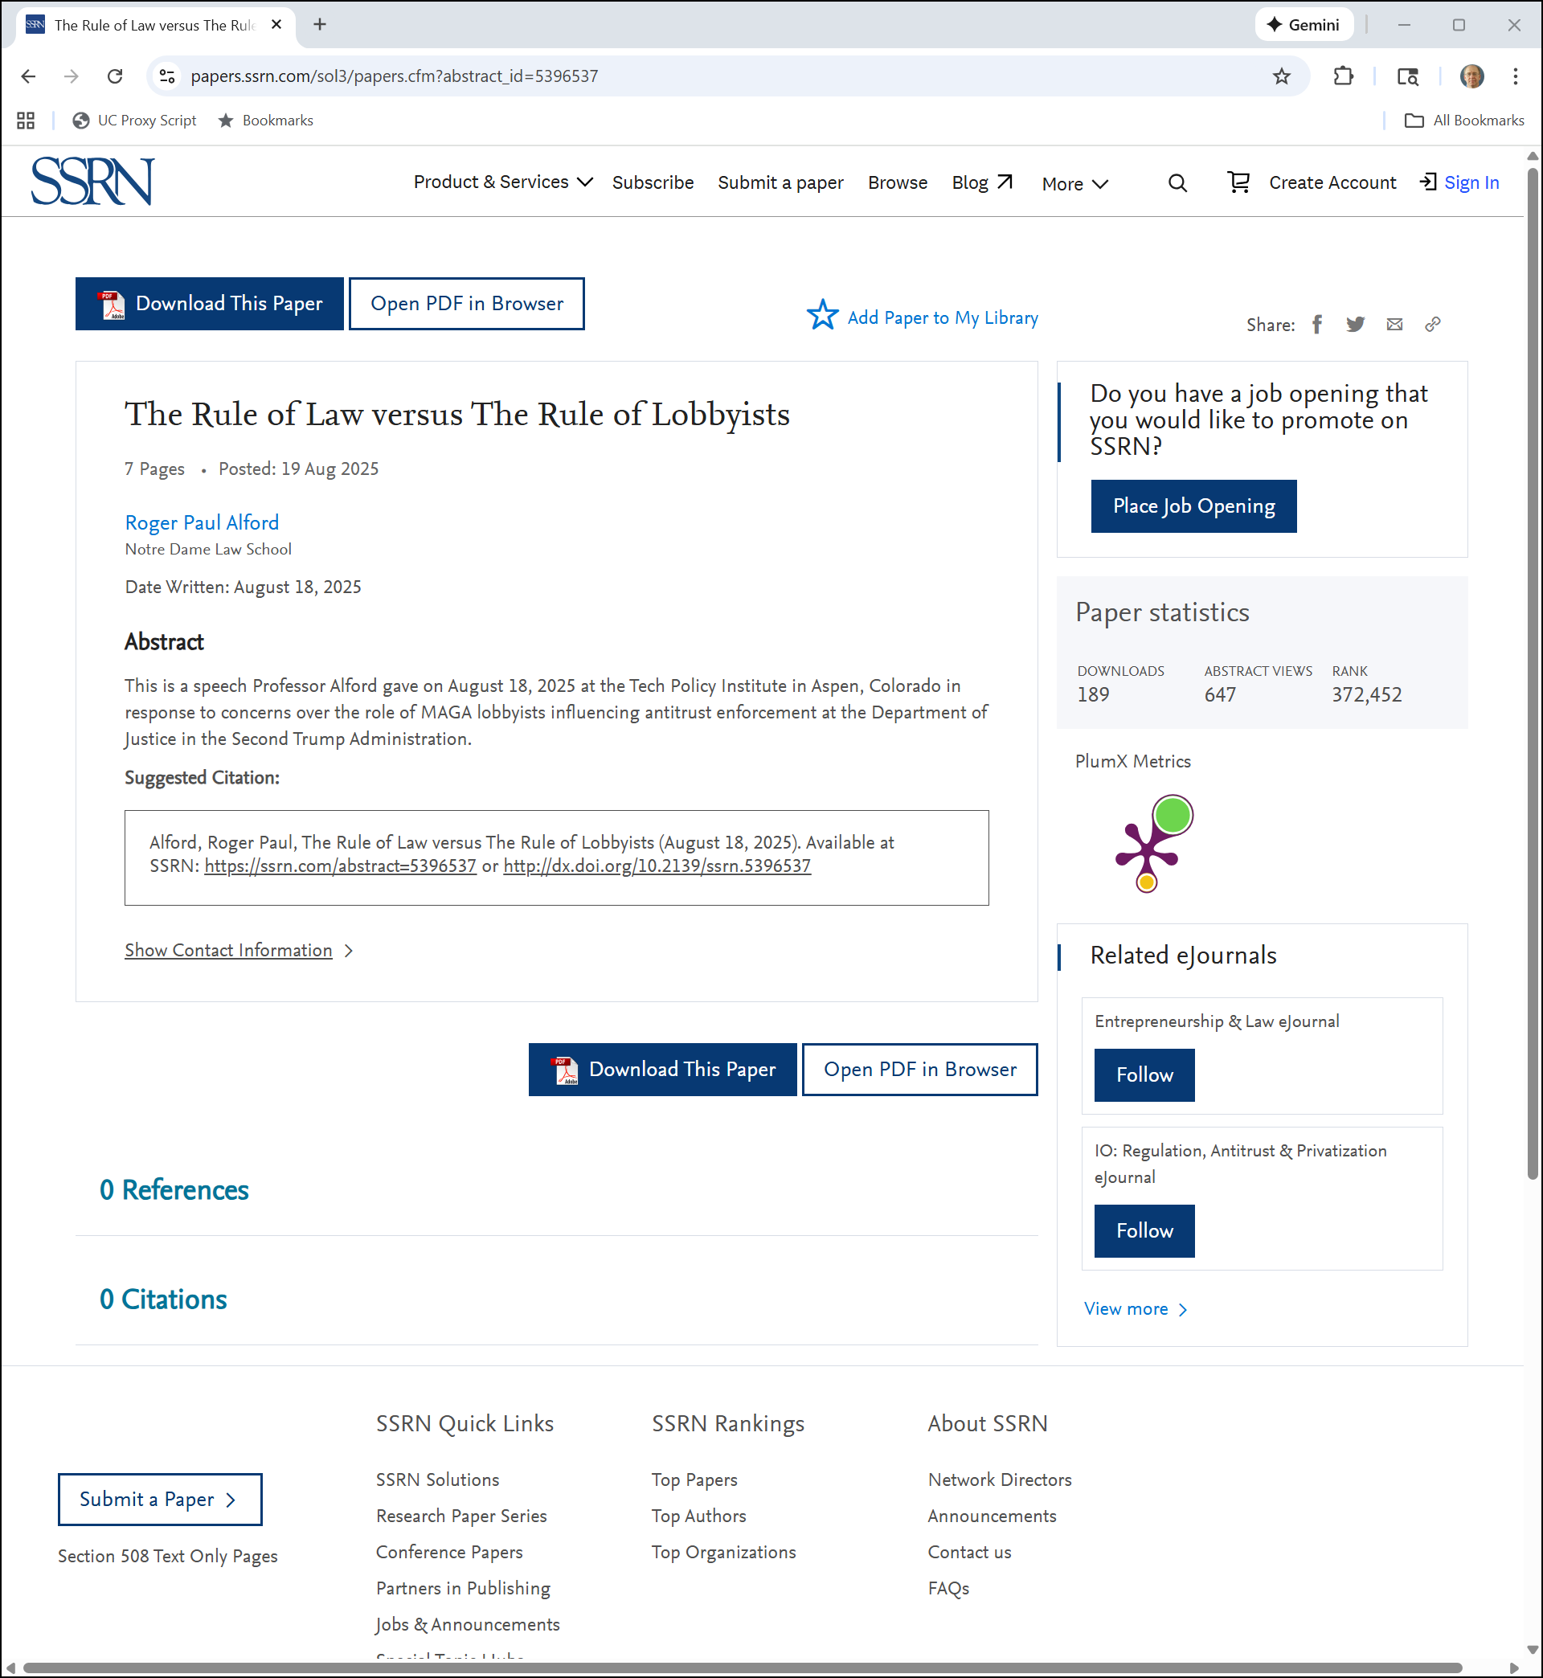
Alford Paper
SSRN (30 Nov 2025)
Notes:
https://papers.ssrn.com/sol3/papers.cfm?abstract_id=5396537

Slide 7
Looking to the Future
TTYN (1 of 4)
Hypo
From this baseline position, two events will occur
(1) Chrome will displace IE as the leading browser seemingly by building a better product
(2) Microsoft will achieve no meaningful position in smartphone operating systems while Apple and Google will rise to form a duopoly

Slide 8
Looking to the Future
TTYN (2 of 4)
Hypo
Google, via Chrome and Android, and Apple with its control of iOS and Safari, will have the same power over defaults that Microsoft had with Windows and IE when the personal computer was dominant

Slide 9
Looking to the Future
TTYN (3 of 4)
Questions
Does Google need to somehow not set Google as the default search engine in Chrome? What would it do in the alternative?
Google’s business model for Android is to give the software away for free but to charge in-kind by requiring the distribution of Chrome (and more) and by having rules regarding search defaults

Slide 10
Looking to the Future
TTYN (4 of 4)
Questions
Is Google allowed to do that?
What would legitimate competition look like between Bing and Google Search for distribution contracts with Apple, Verizon etc?
Given these two facts, what is your forecast as to Google’s market share in search in 2024 given the starting position in 2009? Lower? Higher?

Slide 11
Dominant Market Share for Search (Since 2009?)
U.S. v. Google (D.D.C. Aug 5, 2024)

Slide 12
Monopoly Power in General Search Text Ads
U.S. v. Google (D.D.C. Aug 5, 2024)

Slide 13
Monopolist’s Contracts Are Exclusionary?
U.S. v. Google (D.D.C. Aug 5, 2024)

Slide 14
Competition for the Contract?
U.S. v. Google (D.D.C. Aug 5, 2024)

Slide 15
Competition for the Contract?
U.S. v. Google (D.D.C. Aug 5, 2024)

Slide 16
Microsoft Failed in Mobile With Permanent Effects
U.S. v. Google (D.D.C. Aug 5, 2024)

Slide 17
“Google Has No True Competitor”
U.S. v. Google (D.D.C. Aug 5, 2024)

Slide 18
“No Price” Means No Competition
U.S. v. Google (D.D.C. Aug 5, 2024)

Slide 19
Microsoft III and Exclusivity
“Microsoft compels application of the exclusive dealing framework. See 253 F.3d at 69–70. That framework requires the court to consider, at the threshold, the degree to which the agreements foreclose the relevant markets. Id..”
U.S. v. Google (D.D.C. Aug 5, 2024)

Slide 20
Sorting Exclusivity
“Exclusivity need be neither express nor complete to render an agreement ‘exclusive’ for Section 2 purposes: De facto and partial exclusivity may suffice depending on the circumstances.”
U.S. v. Google (D.D.C. Aug 5, 2024)

Slide 21
Sorting Exclusivity
“Google’s browser agreements are exclusive insofar as they establish Google as the out-of-the-box default search engine. The Apple ISA requires that Google be preloaded as the exclusive default search engine on all Safari search access points in exchange for [redacted]% revenue share.”
U.S. v. Google (D.D.C. Aug 5, 2024)

Slide 22
What About Apple’s Deal for Bing?
“… Apple’s agreement with Microsoft provides that Apple will provide a readily discoverable means of switching the default and will install Bing as a default bookmark. … The fact that Google’s browser partners can contract with its rivals for distribution through less efficient channels does not, however, immunize the challenged agreements from being deemed exclusive. That is the clear lesson of Microsoft.”
U.S. v. Google (D.D.C. Aug 5, 2024)

Slide 23
G Paid A $20B in 2022
U.S. v. Google (D.D.C. Aug 5, 2024)

Slide 24
What Would Happen if Apple Switched Defaults?
U.S. v. Google (D.D.C. Aug 5, 2024)

Slide 25
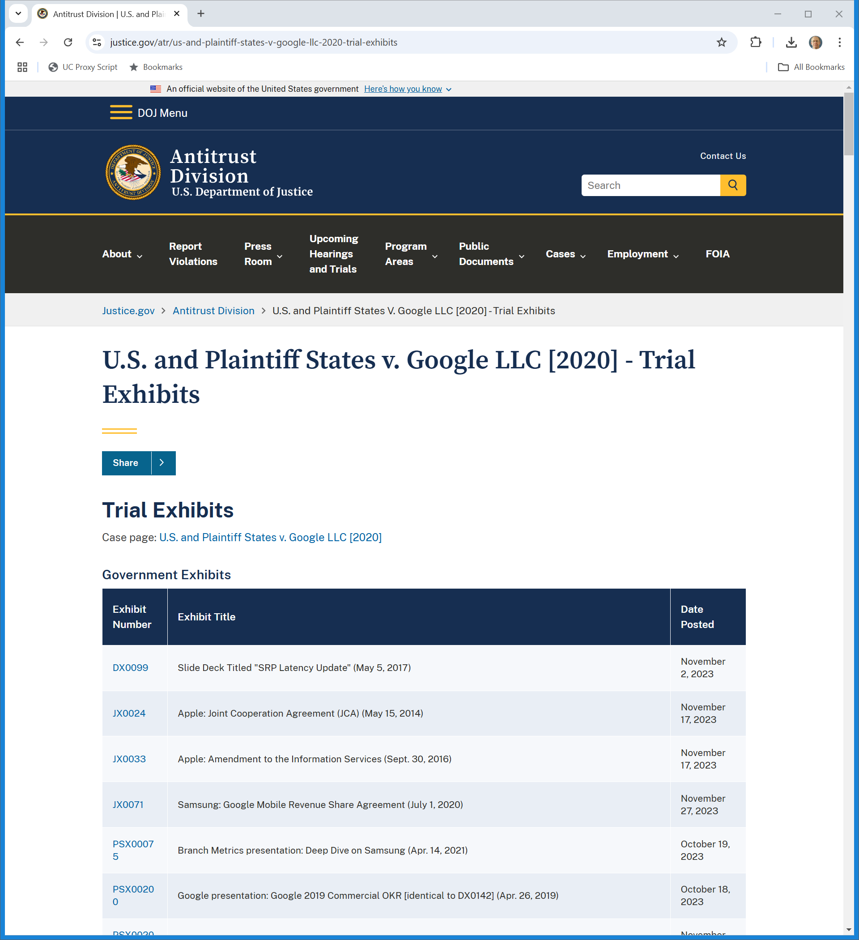
Trial Exhibits
Trial Exhibits (Visited 26 Nov 2024)
Notes:
https://www.justice.gov/atr/us-and-plaintiff-states-v-google-llc-2020-trial-exhibits

Slide 26
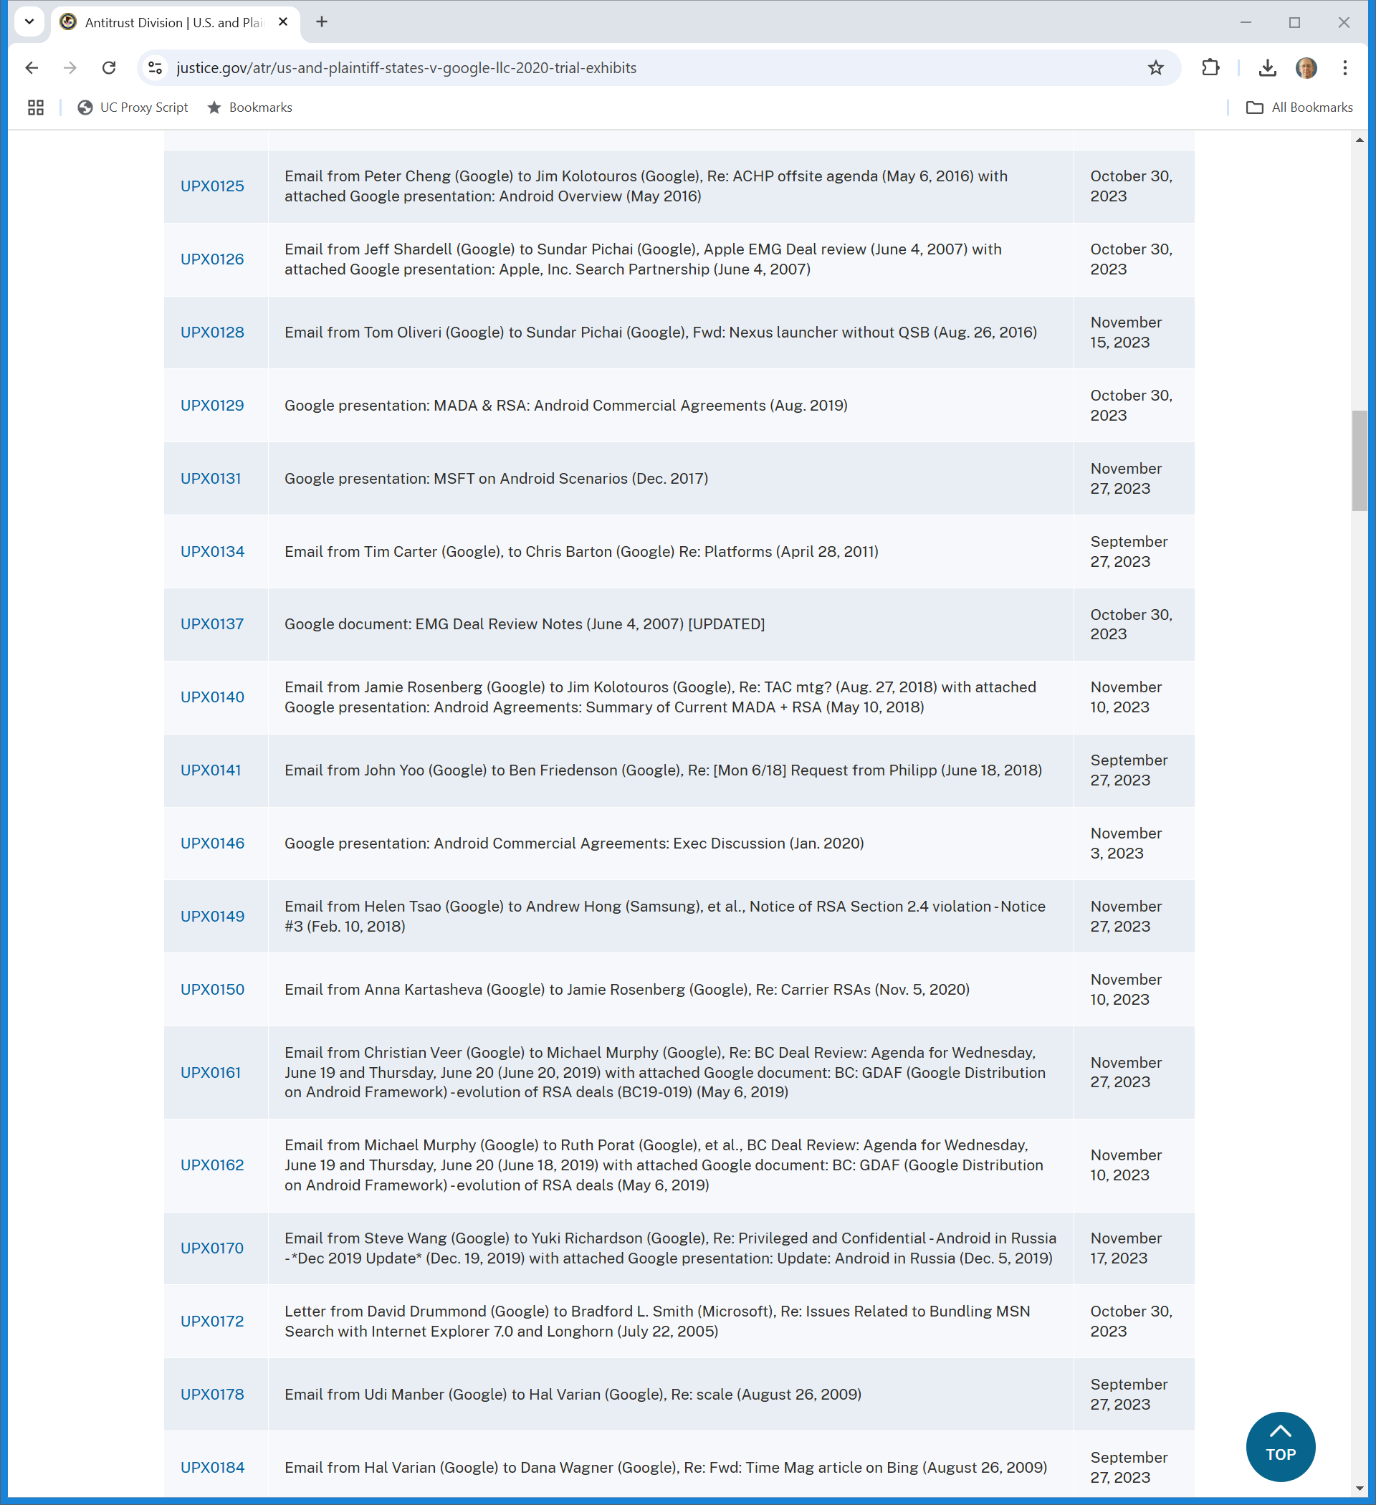
UPX142? UPX148?
Trial Exhibits (Visited 26 Nov 2024)
Notes:
https://www.justice.gov/atr/us-and-plaintiff-states-v-google-llc-2020-trial-exhibits

Slide 27
How Much Money Is at Stake for Google?
U.S. v. Google (D.D.C. Aug 5, 2024)

Slide 28
UPX1050
U.S. v. Google (D.D.C. Aug 5, 2024)

Slide 29
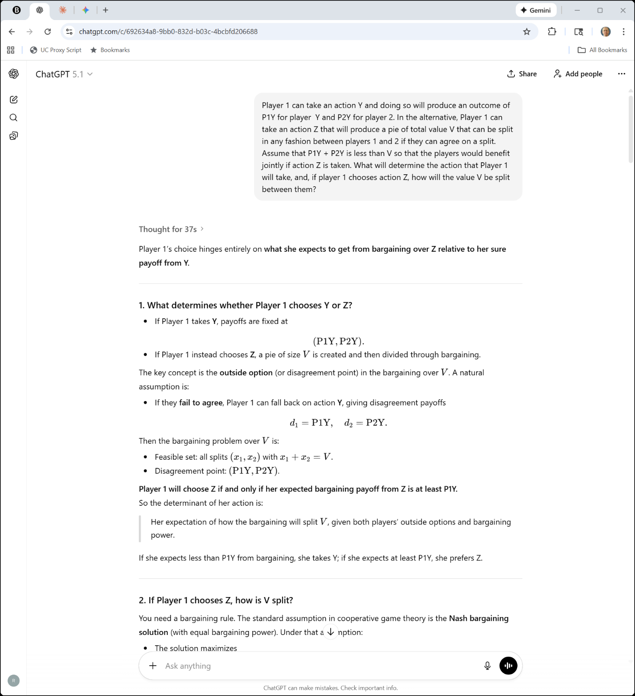

Understanding Bargaining
ChatGPT (25 Nov 2025)

Slide 30
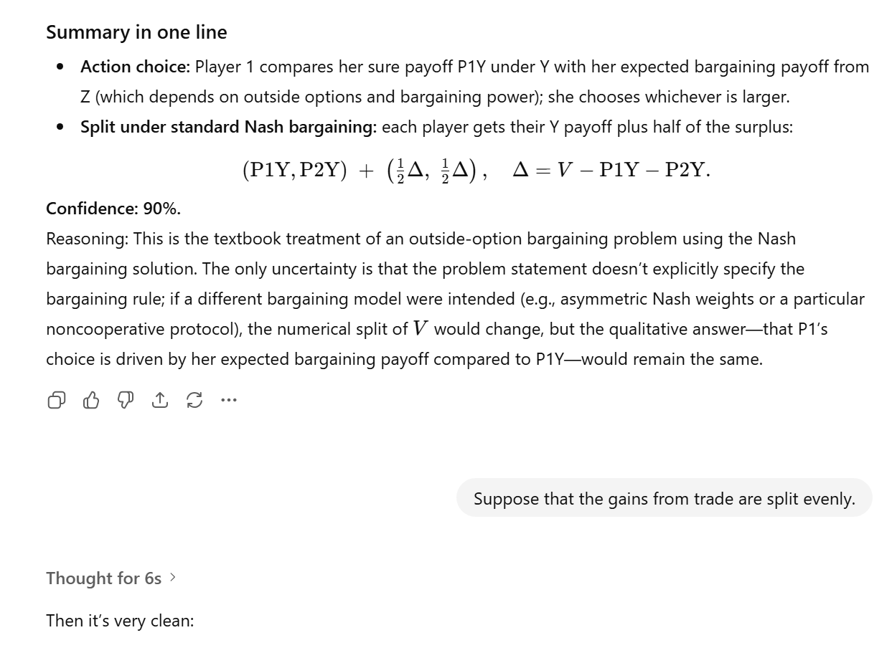
Nash Bargaining With Outside Options
ChatGPT (25 Nov 2025)

Slide 31
Nash: The Bargaining Problem
Econometrica (Apr 1950)

Slide 32
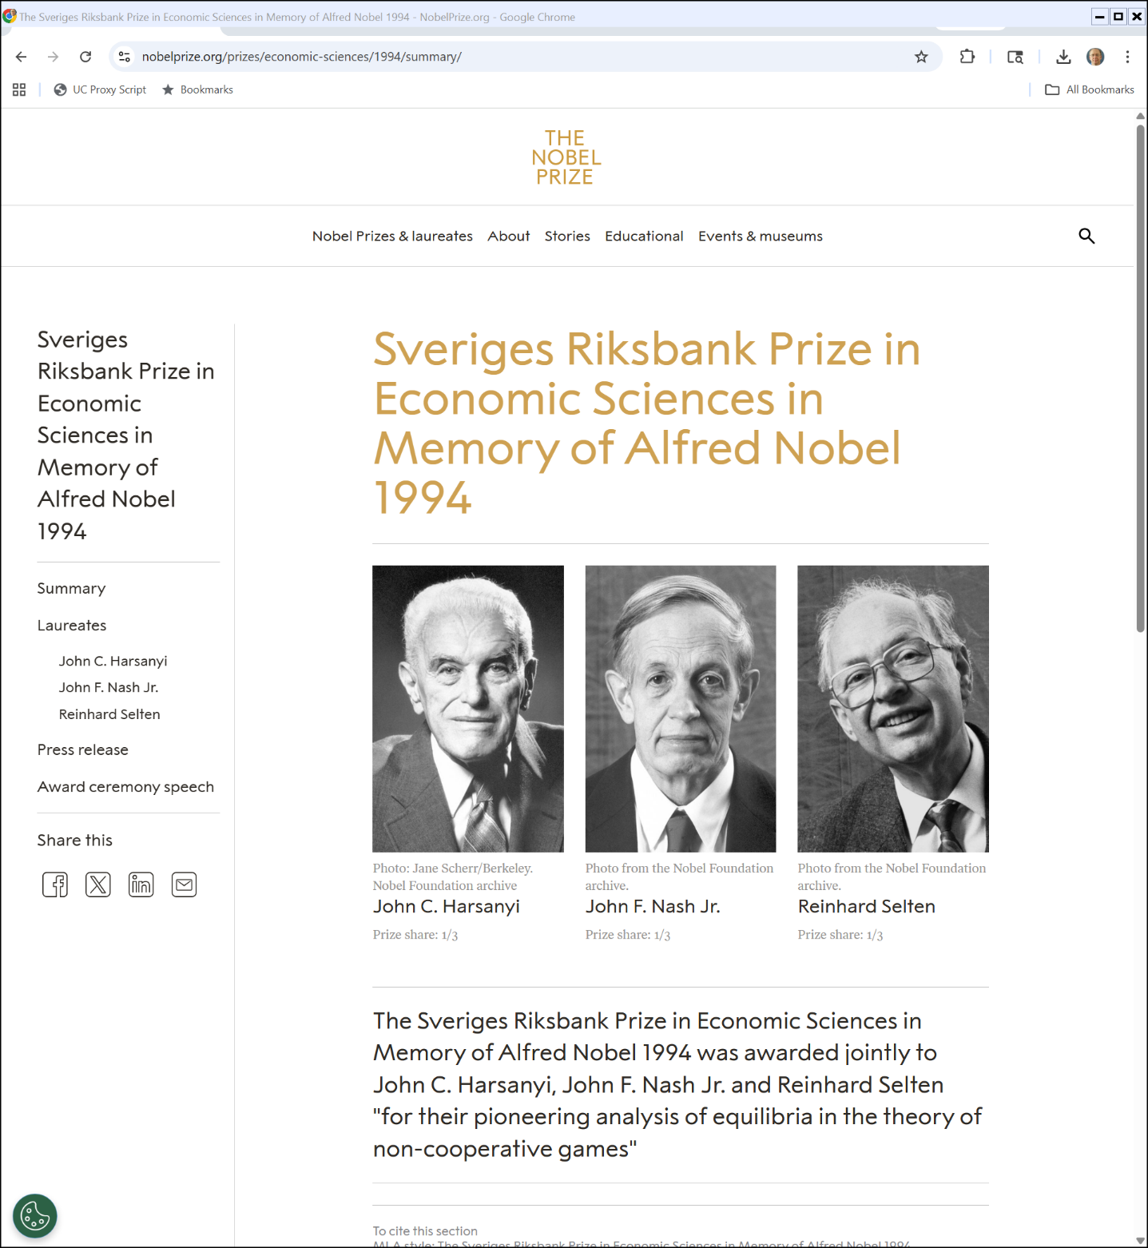

1994 Econ Nobel
Nobelprize.org (25 Nov 2025)

Slide 33
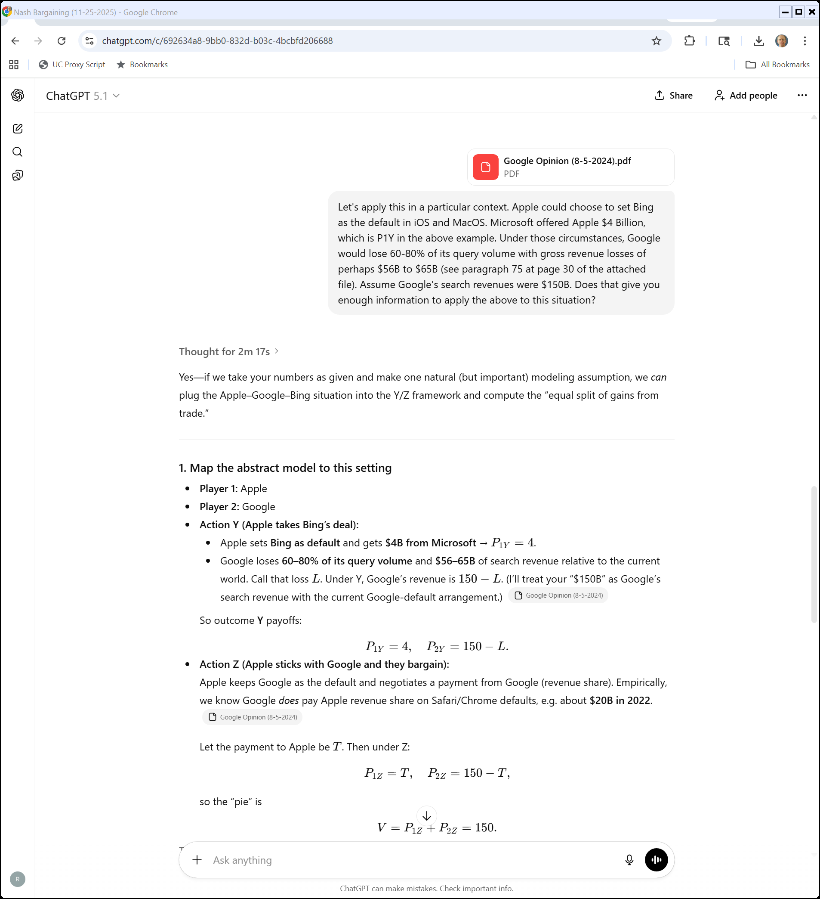
Applying This Here
ChatGPT (25 Nov 2025)

Slide 34
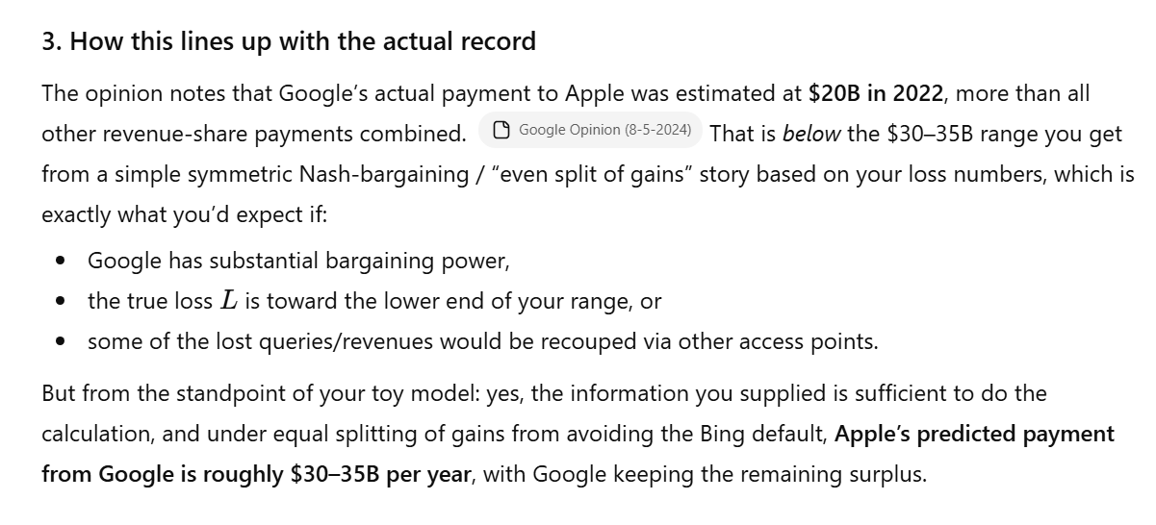
Fancy Back of the Envelope
ChatGPT (25 Nov 2025)

Slide 35
Verizon Deal: Google Pays More for More
U.S. v. Google (D.D.C. Aug 5, 2024)

Slide 36
Are the RSAs Exclusive?
U.S. v. Google (D.D.C. Aug 5, 2024)

Slide 37
G Offered a Menu
U.S. v. Google (D.D.C. Aug 5, 2024)

Slide 38
Verizon Wanted the Money
U.S. v. Google (D.D.C. Aug 5, 2024)

Slide 39
Prima Facie Case Made (and No Procomp Justifications)
U.S. v. Google (D.D.C. Aug 5, 2024)

Slide 40
Illegal Monopoly Maintenance
U.S. v. Google (D.D.C. Aug 5, 2024)

Slide 41
Illegal Monop Maintenance in General Search Text Ads
U.S. v. Google (D.D.C. Aug 5, 2024)

Slide 42
Liability Phase: Two SA2 Violations
U.S. v. Google (D.D.C. Aug 5, 2024)

Slide 43
Remedies Opinion
U.S. v. Google (D.D.C. Sept 2, 2025)

Slide 44
Remedy Goal: Restore Competition
“It is the duty of the district court, upon finding a violation of the antitrust laws, to redress the violation and restore competition. See United States v. U.S. Gypsum Co., 340 U.S. 76, 88 (1950); Ford Motor Co. v. United States, 405 U.S. 562, 573 (1972).”
U.S. v. Google (D.D.C. Sept 2, 2025)

Slide 45
What Is a Remedy Supposed to Do?
“The remedy in a Section 2 enforcement action ‘must seek’ to ‘unfetter a market from anticompetitive conduct,’ ‘deny to the defendant the fruits of its statutory violation, and ensure that there remain no practices likely to result in monopolization in the future.’ United States v. Microsoft Corp., 253 F.3d 34, 103 (D.C. Cir. 2001) … .”
U.S. v. Google (D.D.C. Sept 2, 2025)

Slide 46
How Big is the Fruit? Under 9.2%
U.S. v. Google (D.D.C. Aug 5, 2024)

Slide 47
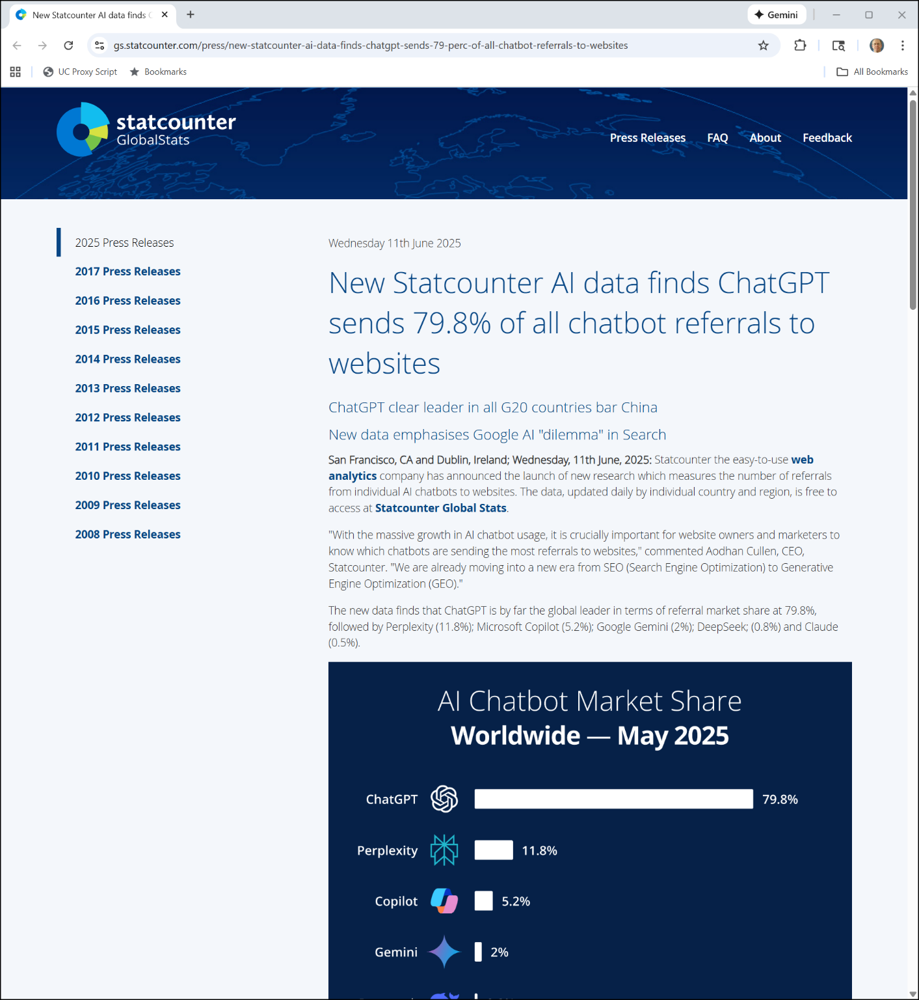

New Statcounter Metrics
Statcounter (11 June 2025)
Notes:
https://gs.statcounter.com/press/new-statcounter-ai-data-finds-chatgpt-sends-79-perc-of-all-chatbot-referrals-to-websites

Slide 48
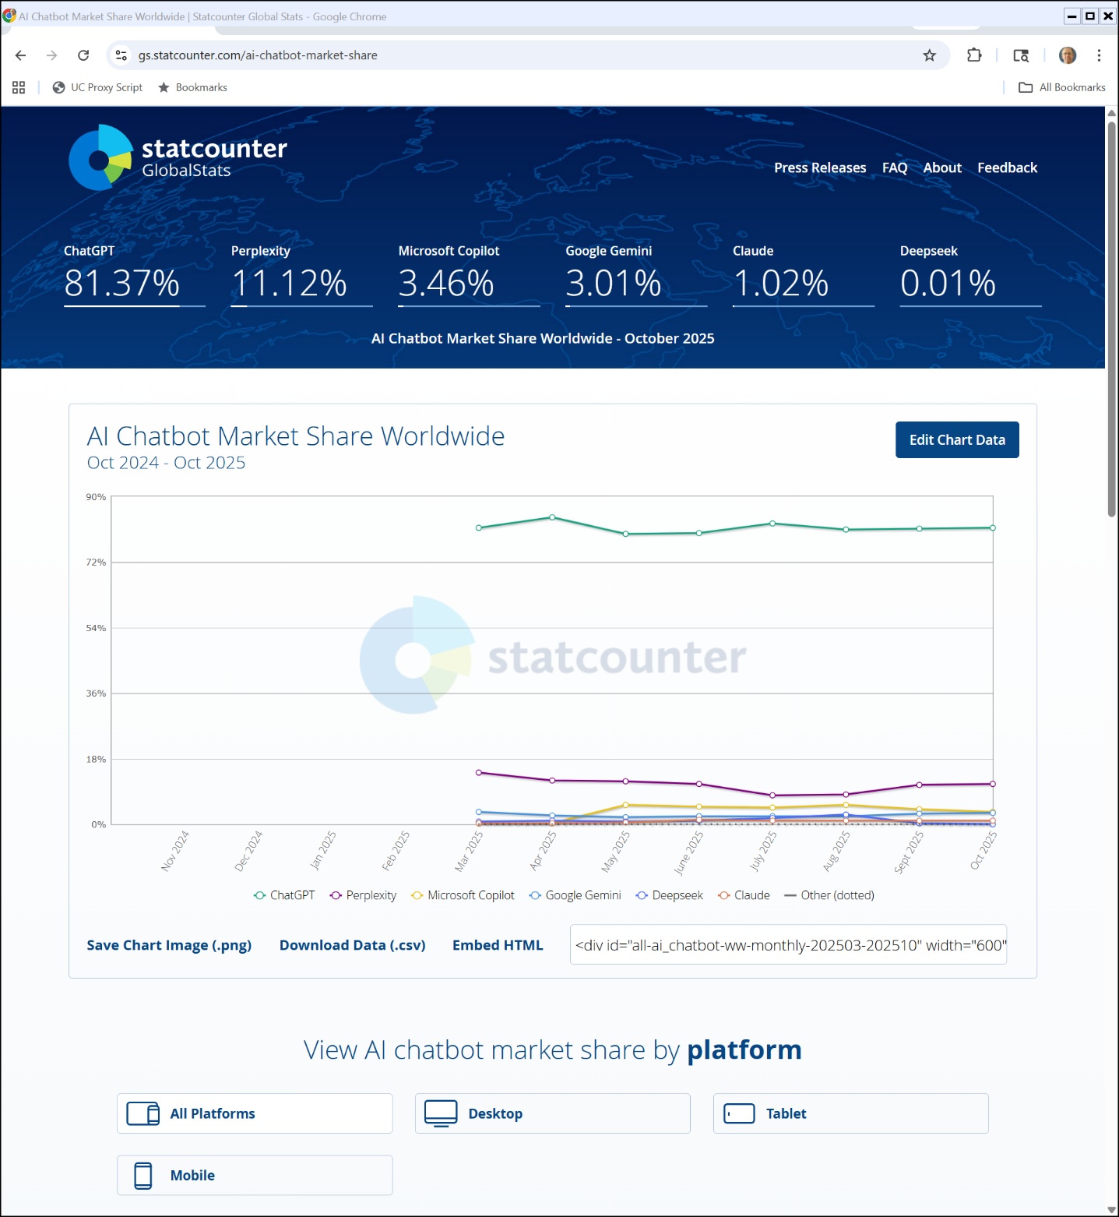
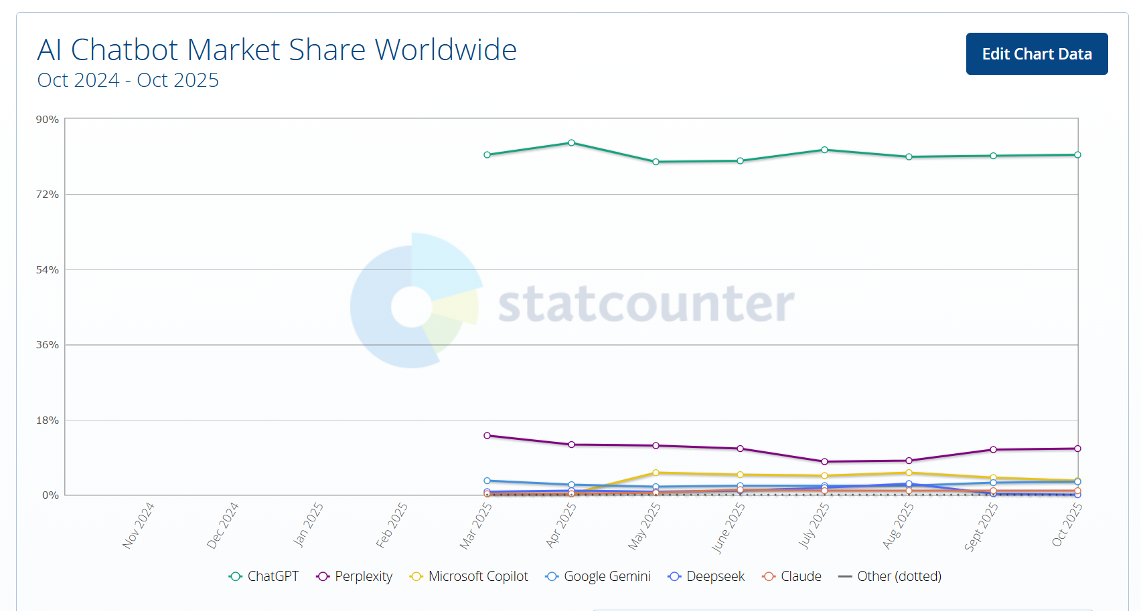
Chatbot Market Share
Statcounter (30 Nov 2025)

Slide 49
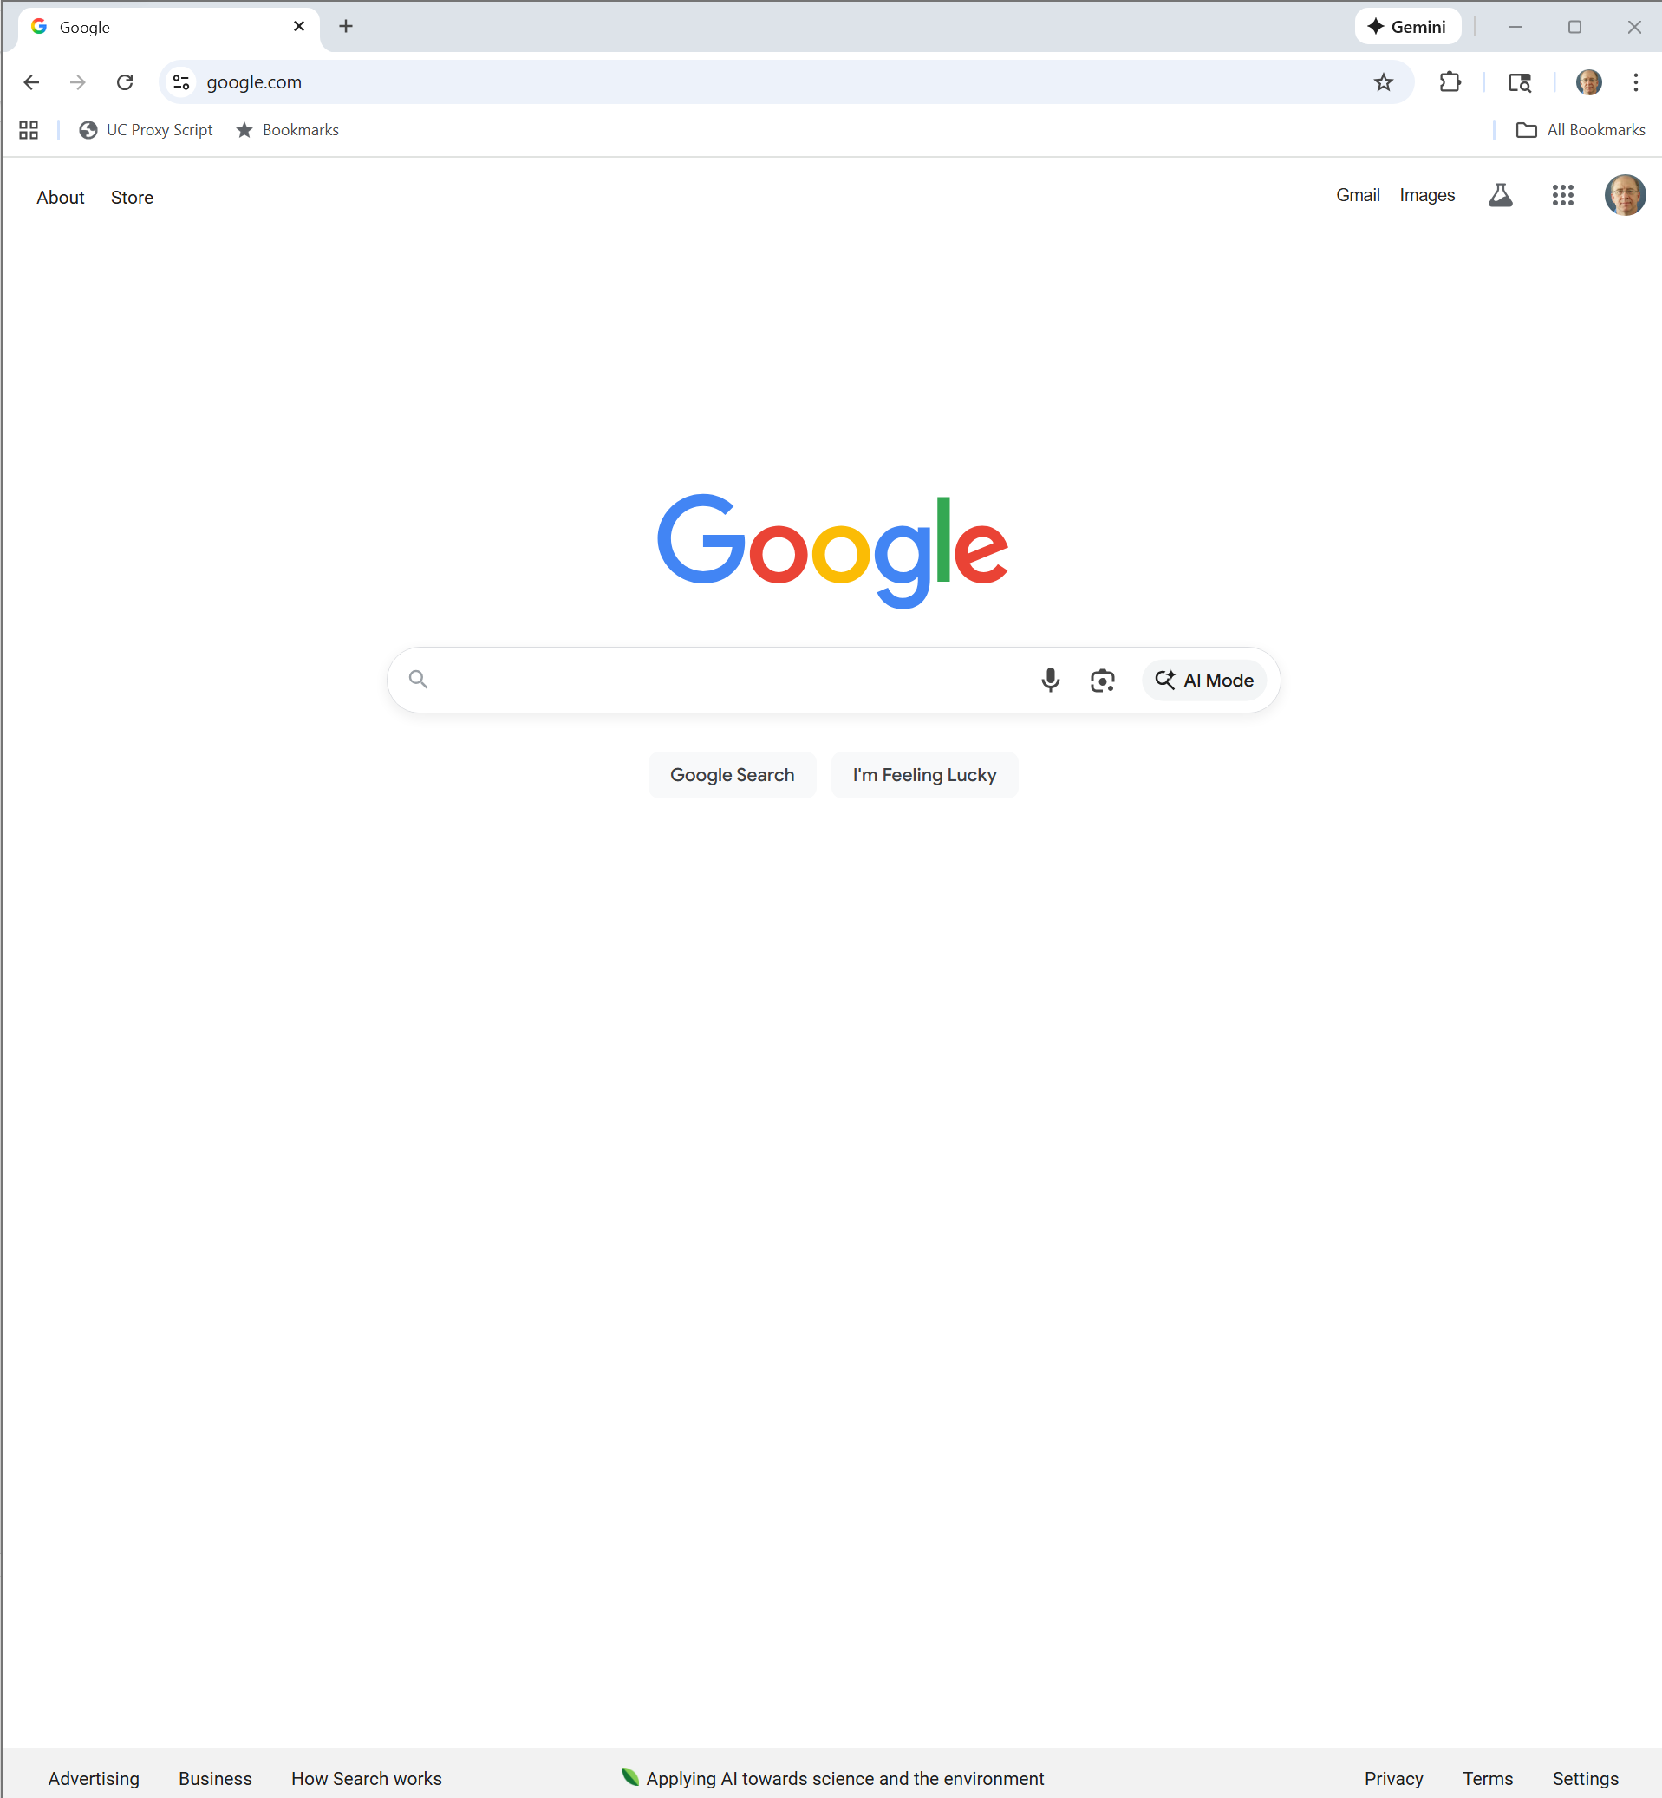
Google.com Now in Chrome
Google (25 Nov 2025)
Notes:
Google.com

Slide 50
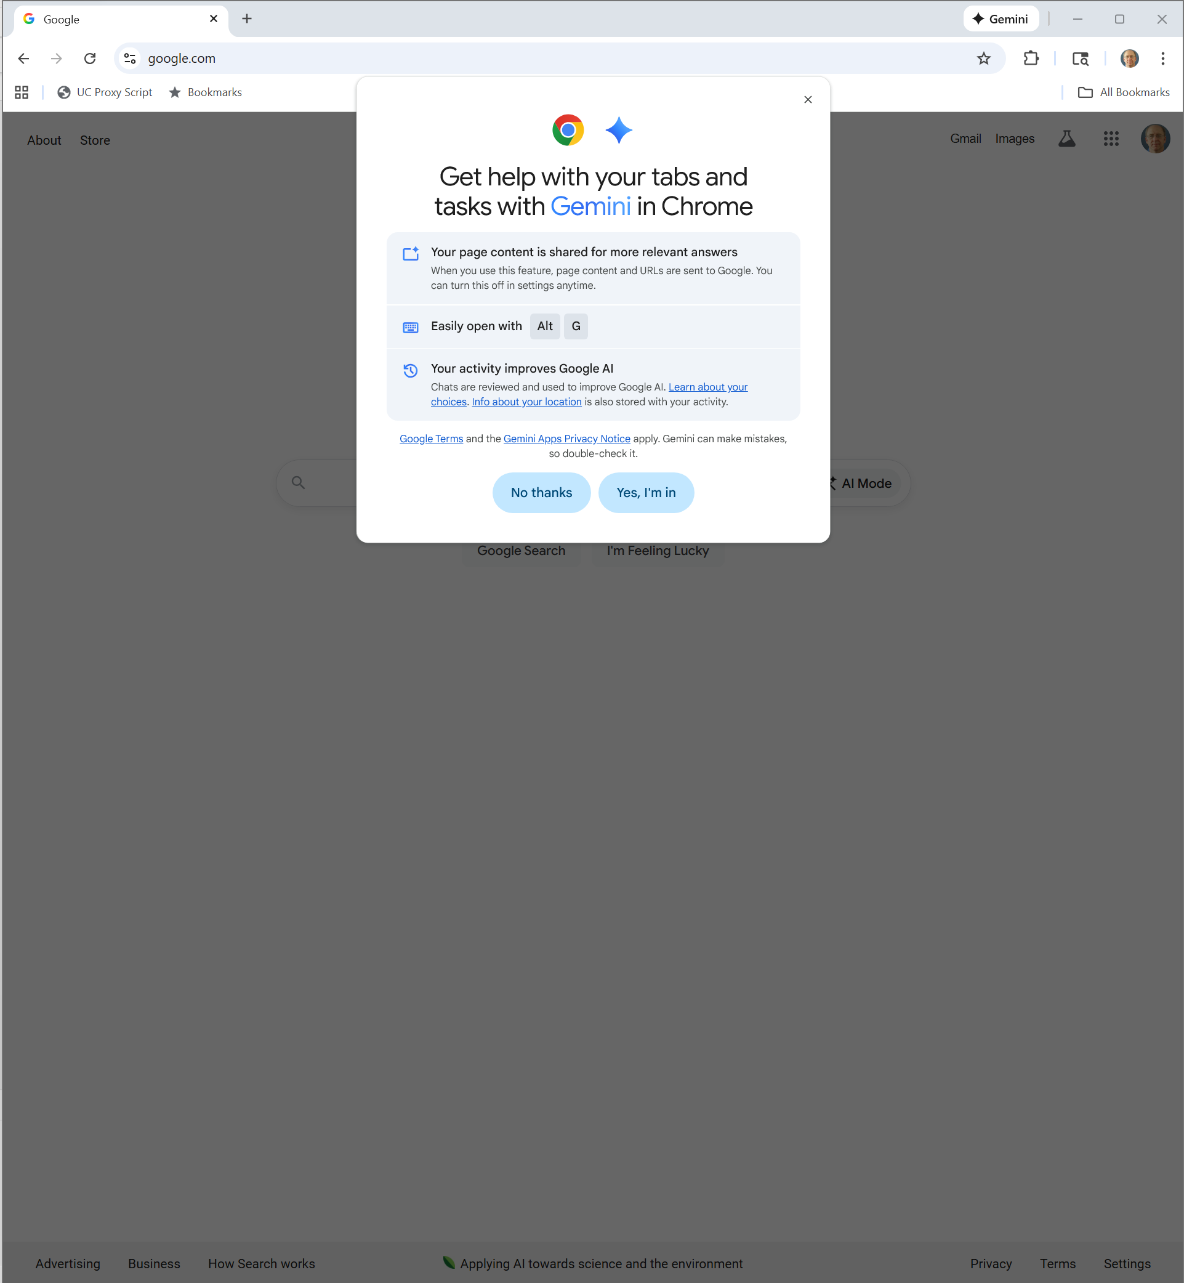
Clicking on Gemini
Google (25 Nov 2025)

Slide 51
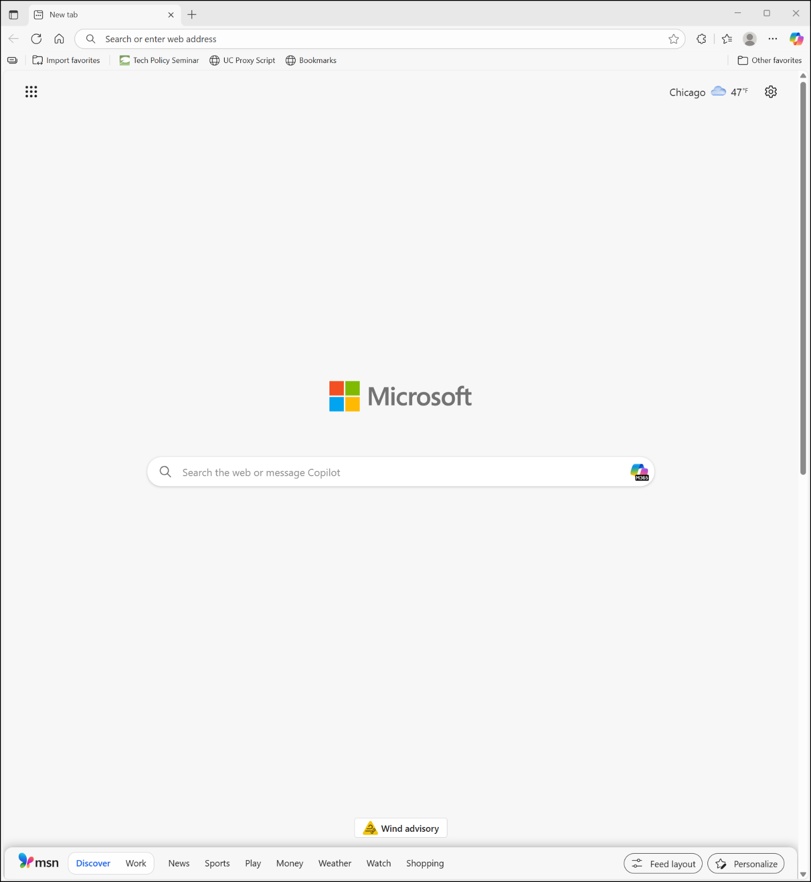
Edge
MS Edge (25 Nov 2025)

Slide 52
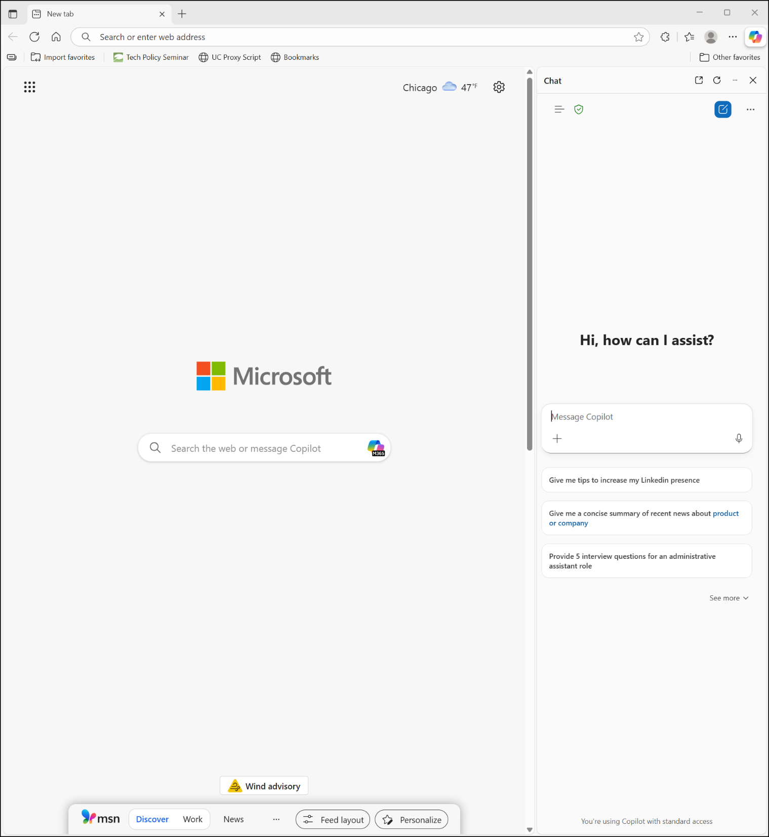
Clicking
MS Edge (25 Nov 2025)

Slide 53
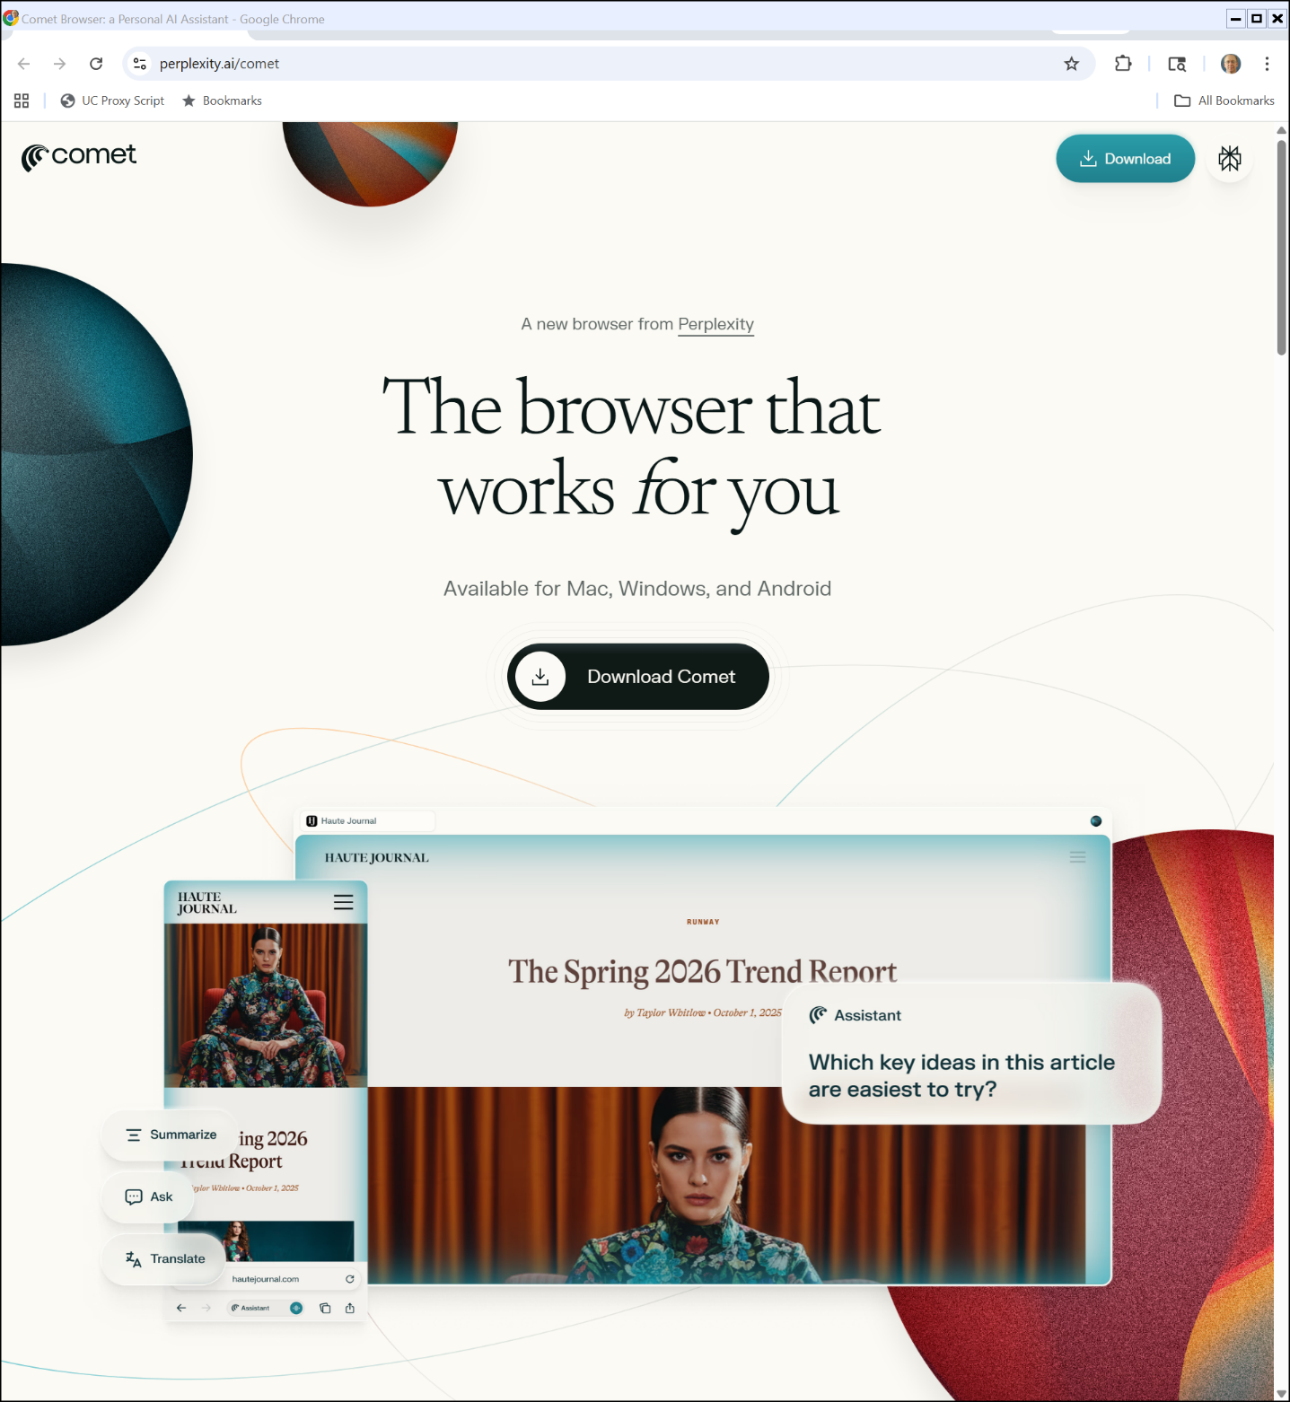
New Browsers
Perplexity (25 Nov 2025)
Notes:
https://www.perplexity.ai/comet

Slide 54
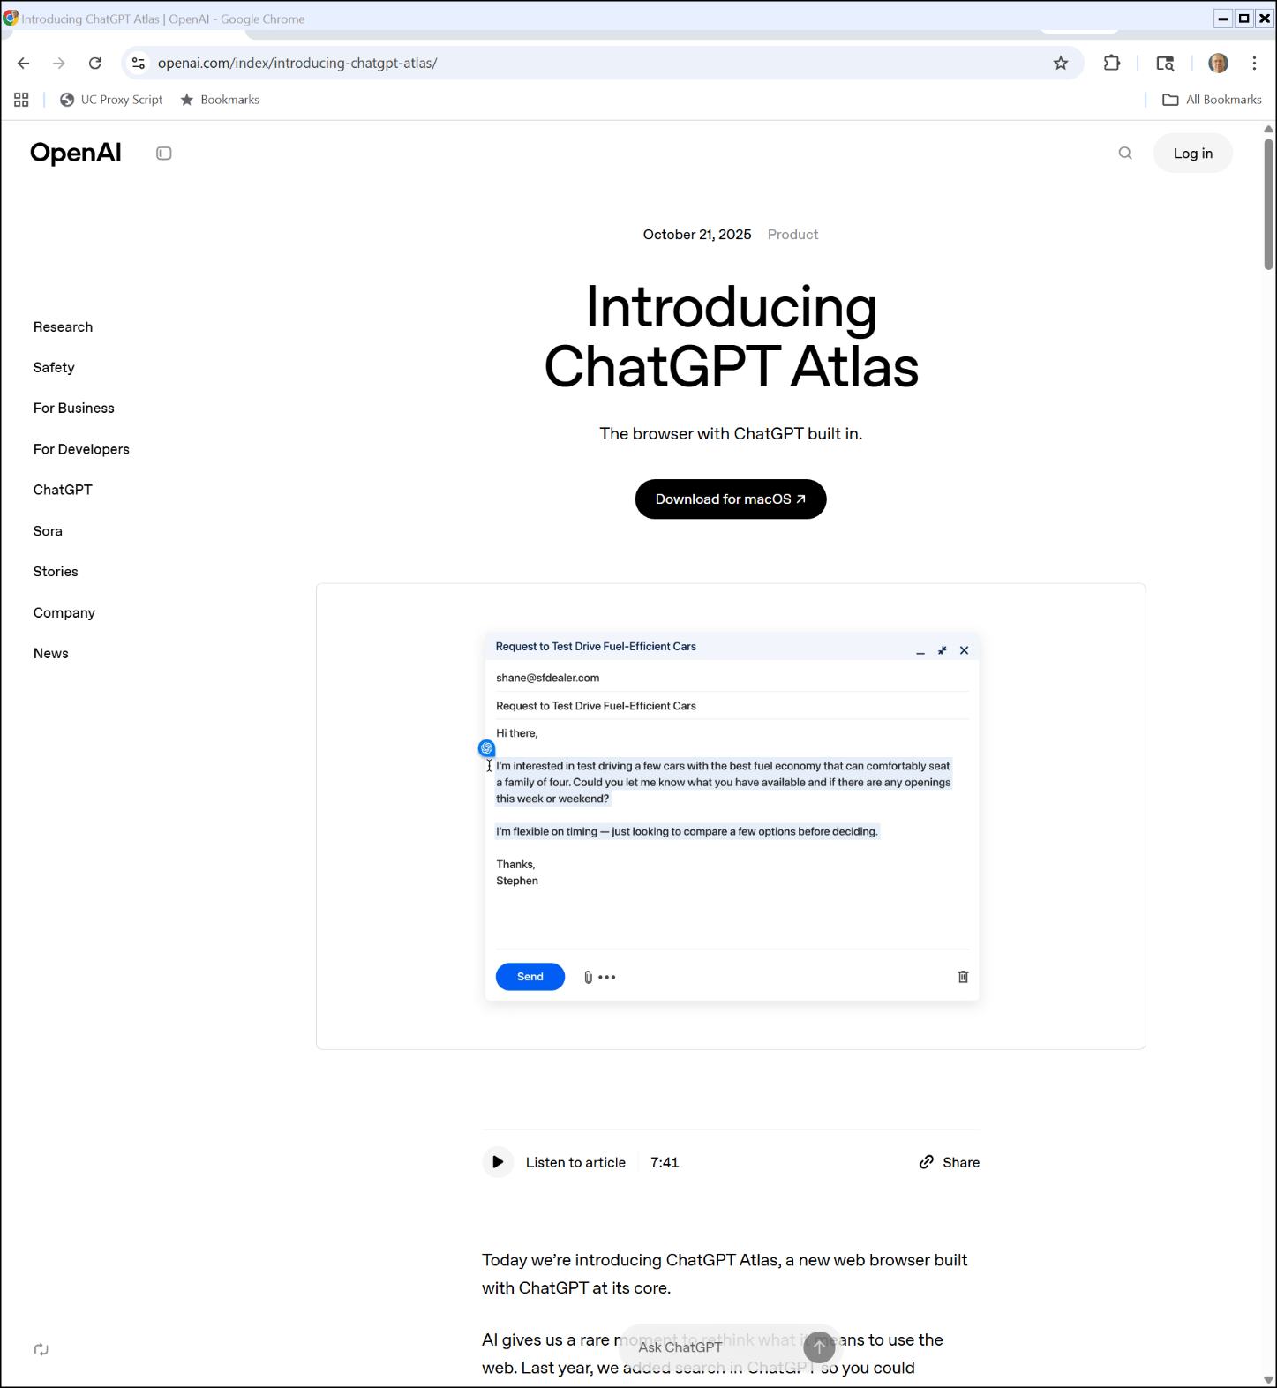
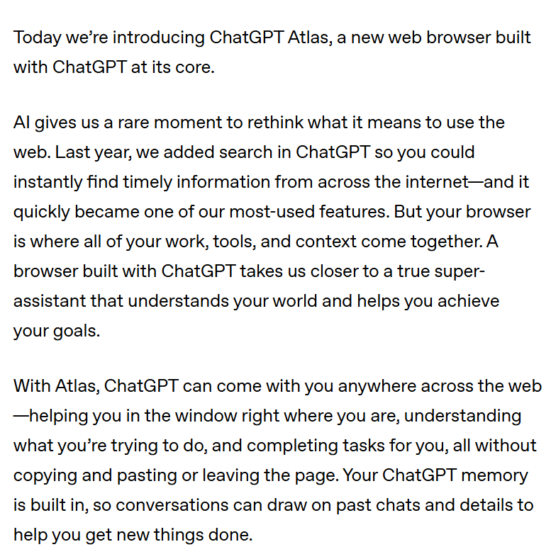
And More
OpenAI (25 Nov 2025)
Notes:
https://openai.com/index/introducing-chatgpt-atlas/

Slide 55
Seeking Remedies
TTYN (1 of 2)
Possible Remedies
Chrome divestiture
Change search defaults in Chrome
Android divestiture
Block Google from doing deals for search defaults with third parties

Slide 56
Seeking Remedies
TTYN (2 of 2)
Possible Remedies
Data sharing/mandatory wholesaling
Force Google to share data, search results, ads and more to help jump start new competitors
Choice Screen
Other ideas? AI: How does the emergence of AI matter?

Slide 57
No Exclusive Contracts
“Google will be barred from entering or maintaining any exclusive contract relating to the distribution of Google Search, Chrome, Google Assistant, and the Gemini app.”
U.S. v. Google (D.D.C. Sept 2, 2025)

Slide 58
No Divestitures
“Google will not be required to divest Chrome; nor will the court include a contingent divestiture of the Android operating system in the final judgment.”
U.S. v. Google (D.D.C. Sept 2, 2025)

Slide 59
Payments Allowed
“Google will not be barred from making payments or offering other consideration to distribution partners for preloading or placement of Google Search, Chrome, or its GenAI products.”
U.S. v. Google (D.D.C. Sept 2, 2025)

Slide 60
Downstream Harms
“Cutting off payments from Google almost certainly will impose substantial—in some cases, crippling—downstream harms to distribution partners, related markets, and consumers, which counsels against a broad payment ban.e, Google Assistant, and the Gemini app.”
U.S. v. Google (D.D.C. Sept 2, 2025)

Slide 61
Mandatory Data Sharing
“Google will have to make available to Qualified Competitors certain search index and user-interaction data, though not ads data, as such sharing will deny Google the fruits of its exclusionary acts and promote competition.”
U.S. v. Google (D.D.C. Sept 2, 2025)

Slide 62
Ad Syndication
“Google shall offer Qualified Competitors search and search text ads syndication services to enable those firms to deliver high-quality search results and ads to compete with Google while they develop their own search technologies and capacity.”
U.S. v. Google (D.D.C. Sept 2, 2025)

Slide 63
New Defaults?
“Even with newfound flexibility, distributors still are likely to select Google as its primary, if not only, default GSE. See, e.g., Rem. Tr. at 3830:6-10 (Cue) (‘So we have to pick what’s best for our customers, and today, that is still Google.’).”
U.S. v. Google (D.D.C. Sept 2, 2025)

Slide 64
Google Can Pay for Defaults
“So, for now, Google will be permitted to pay distributors for default placement. There are strong reasons not to jolt the system and to allow market forces to do the work.”
U.S. v. Google (D.D.C. Sept 2, 2025)

Slide 65
FN 14: Another Approach
“One possibility is allowing Google to make payments for distribution but not for default distribution, also referred to as ‘unconditional revenue share.’ See, e.g., Rem. Tr. at 4367:21–4368:5 (Murphy). Plaintiffs have not proposed that remedy as an alternative to a payment ban … . Without a more substantial record on such a remedy, the court is presently ill-equipped to consider it.”
U.S. v. Google (D.D.C. Sept 2, 2025)

Slide 66
Choice Screens?
“In simple terms, these provisions would enable users to choose a GSE at various search access points and to select a default GSE on a search access point, where there is one. … The purpose behind offering users a choice screen is to blunt the ‘power of defaults.’ See Google, 747 F. Supp. 3d at 45 ¶ 65, 159–161. … In theory, a choice screen could dampen the default effect. It would give the user the option to select Google or a different GSE with minimal choice friction. A remedy that promotes user choice is unquestionably consistent with the goals of antitrust law.”
U.S. v. Google (D.D.C. Sept 2, 2025)

Slide 67
Courts Shouldn’t Redesign Products
“First, ‘[t]he case law is unwavering in the admonition that it is not a proper task for the Court to undertake to redesign products.’ New York I, 224 F.Supp.2d at 158. … [A] compelled product design is not an appropriate use of the court’s equitable powers.”
U.S. v. Google (D.D.C. Sept 2, 2025)

Slide 68
Wouldn’t Matter Anyhow
“Third, choice screens are not likely to change the competitive landscape under current or even near-term market conditions. Plaintiffs’ economic experts have acknowledged as much. … And the real world offers proof. The European Commission has mandated the display of choice screens on Android devices since 2020, yet there has been little shift in market share away from Google. … The court declines to impose a remedy whose prospect of promoting competition is dim.”
U.S. v. Google (D.D.C. Sept 2, 2025)

Slide 69
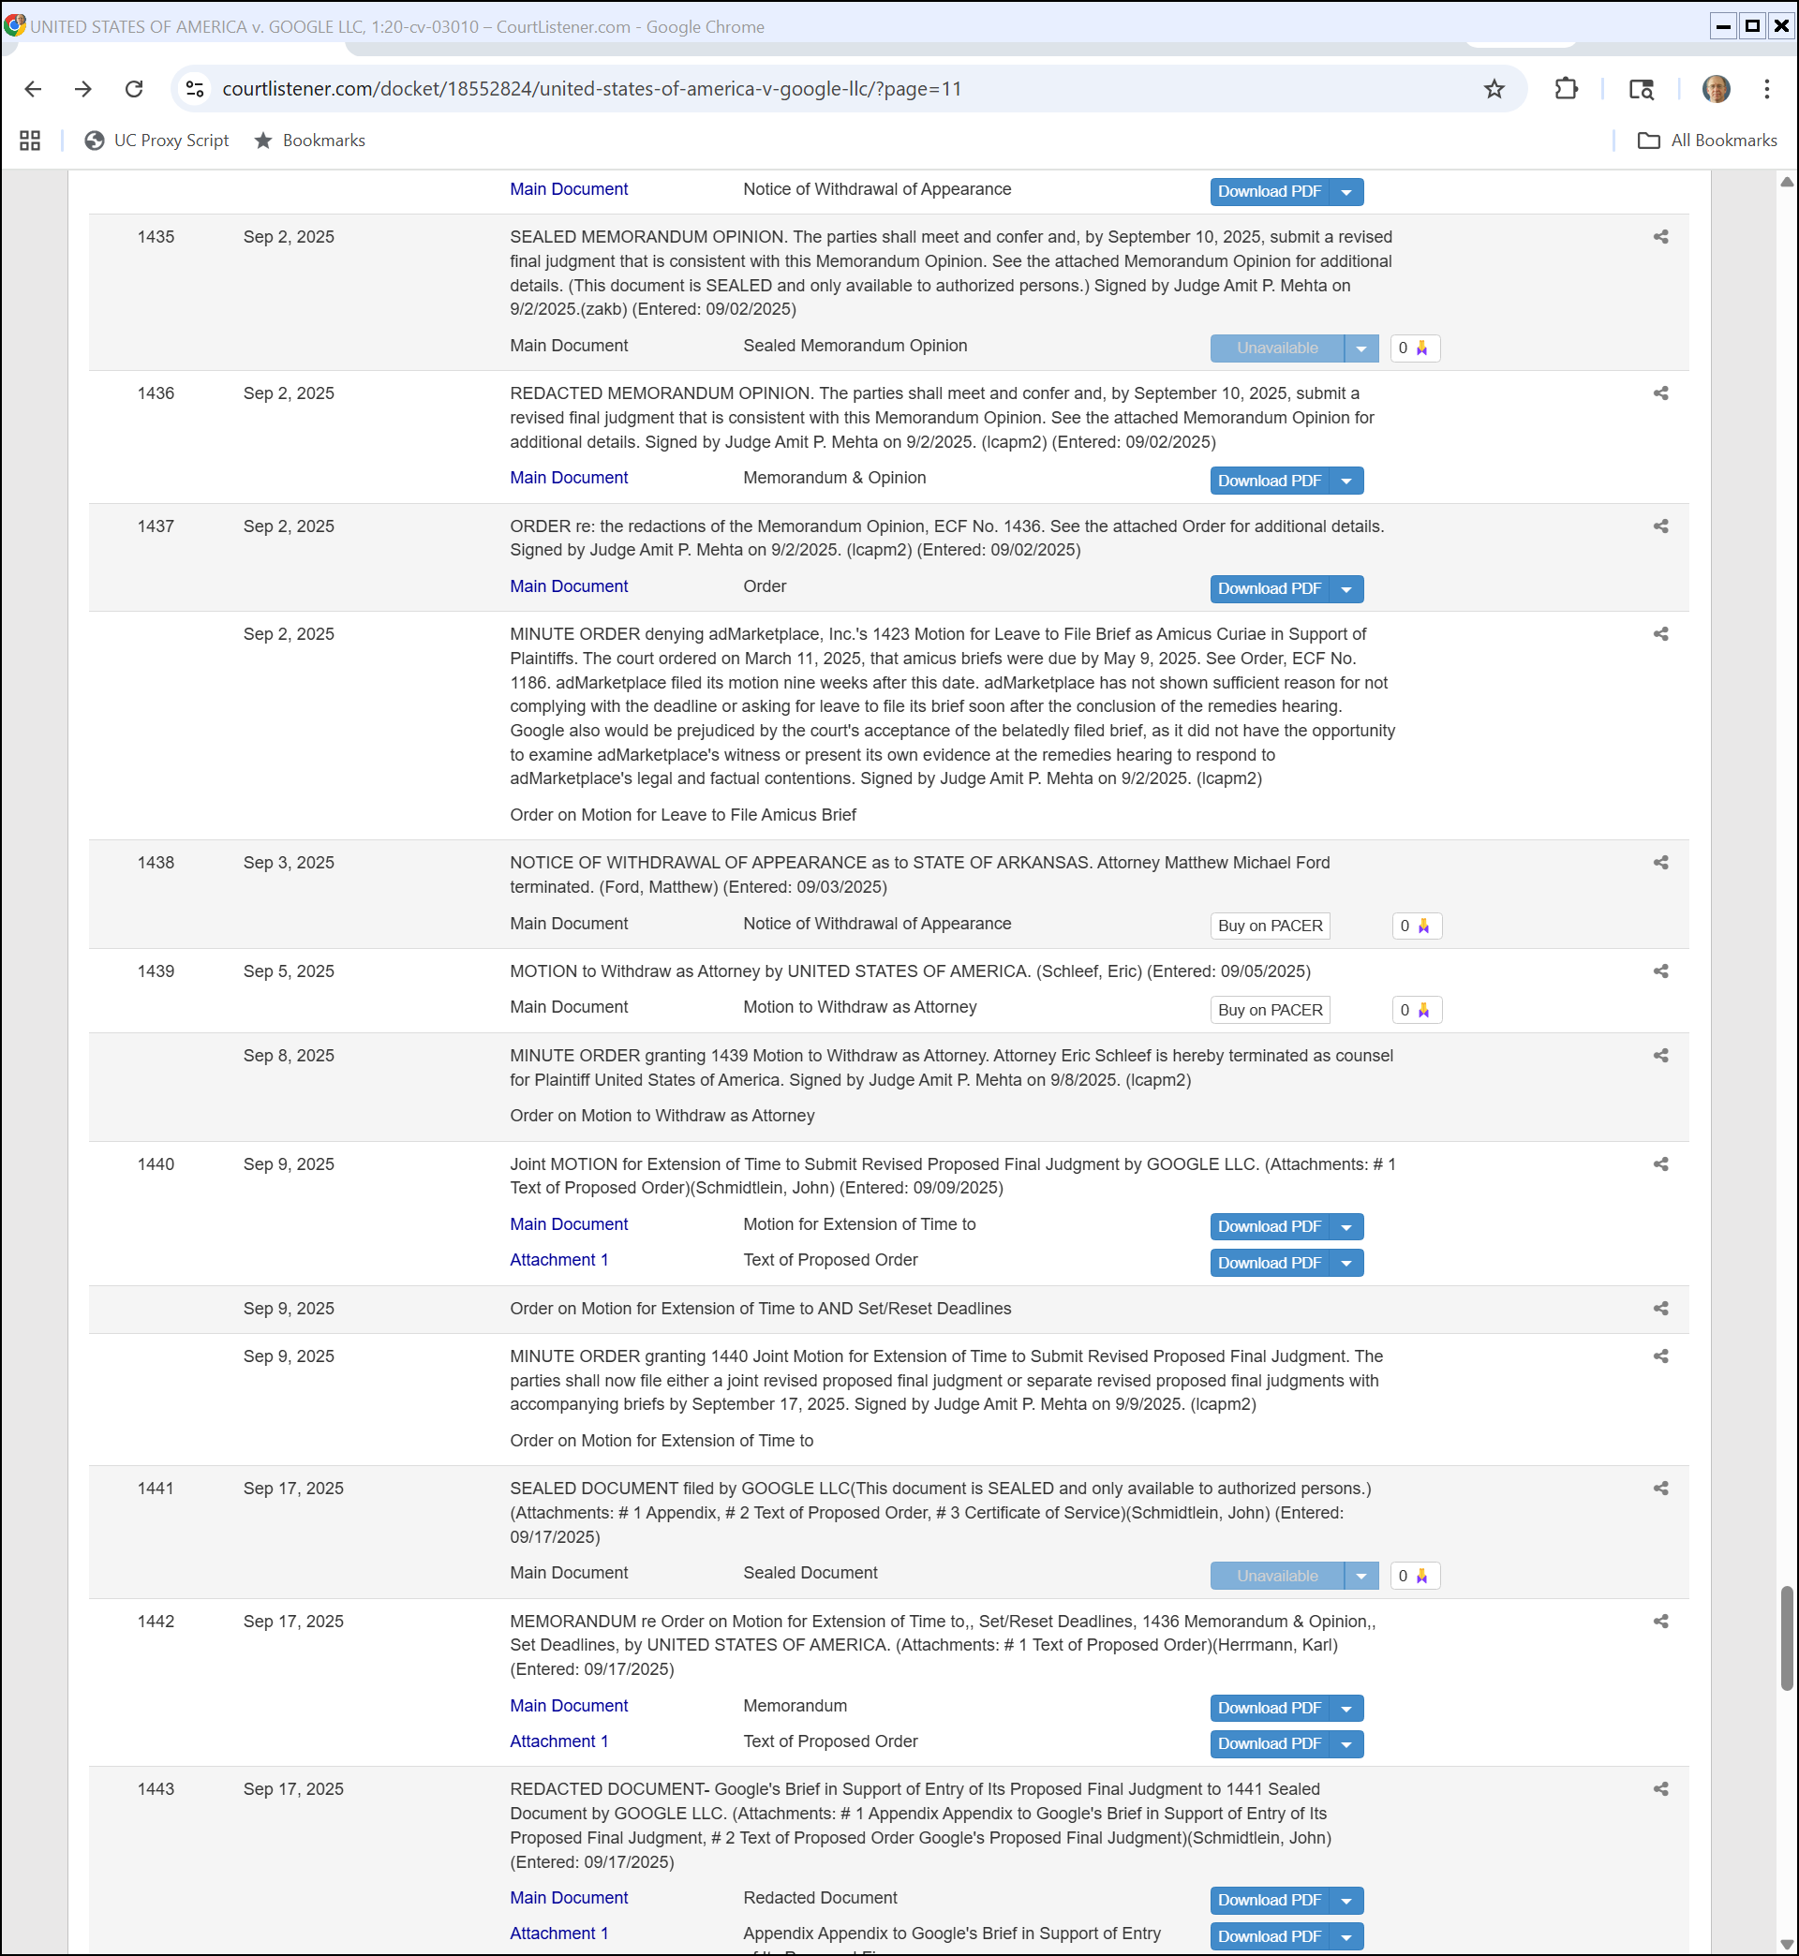
Where Are We?
U.S. v. Google Docket

Slide 70
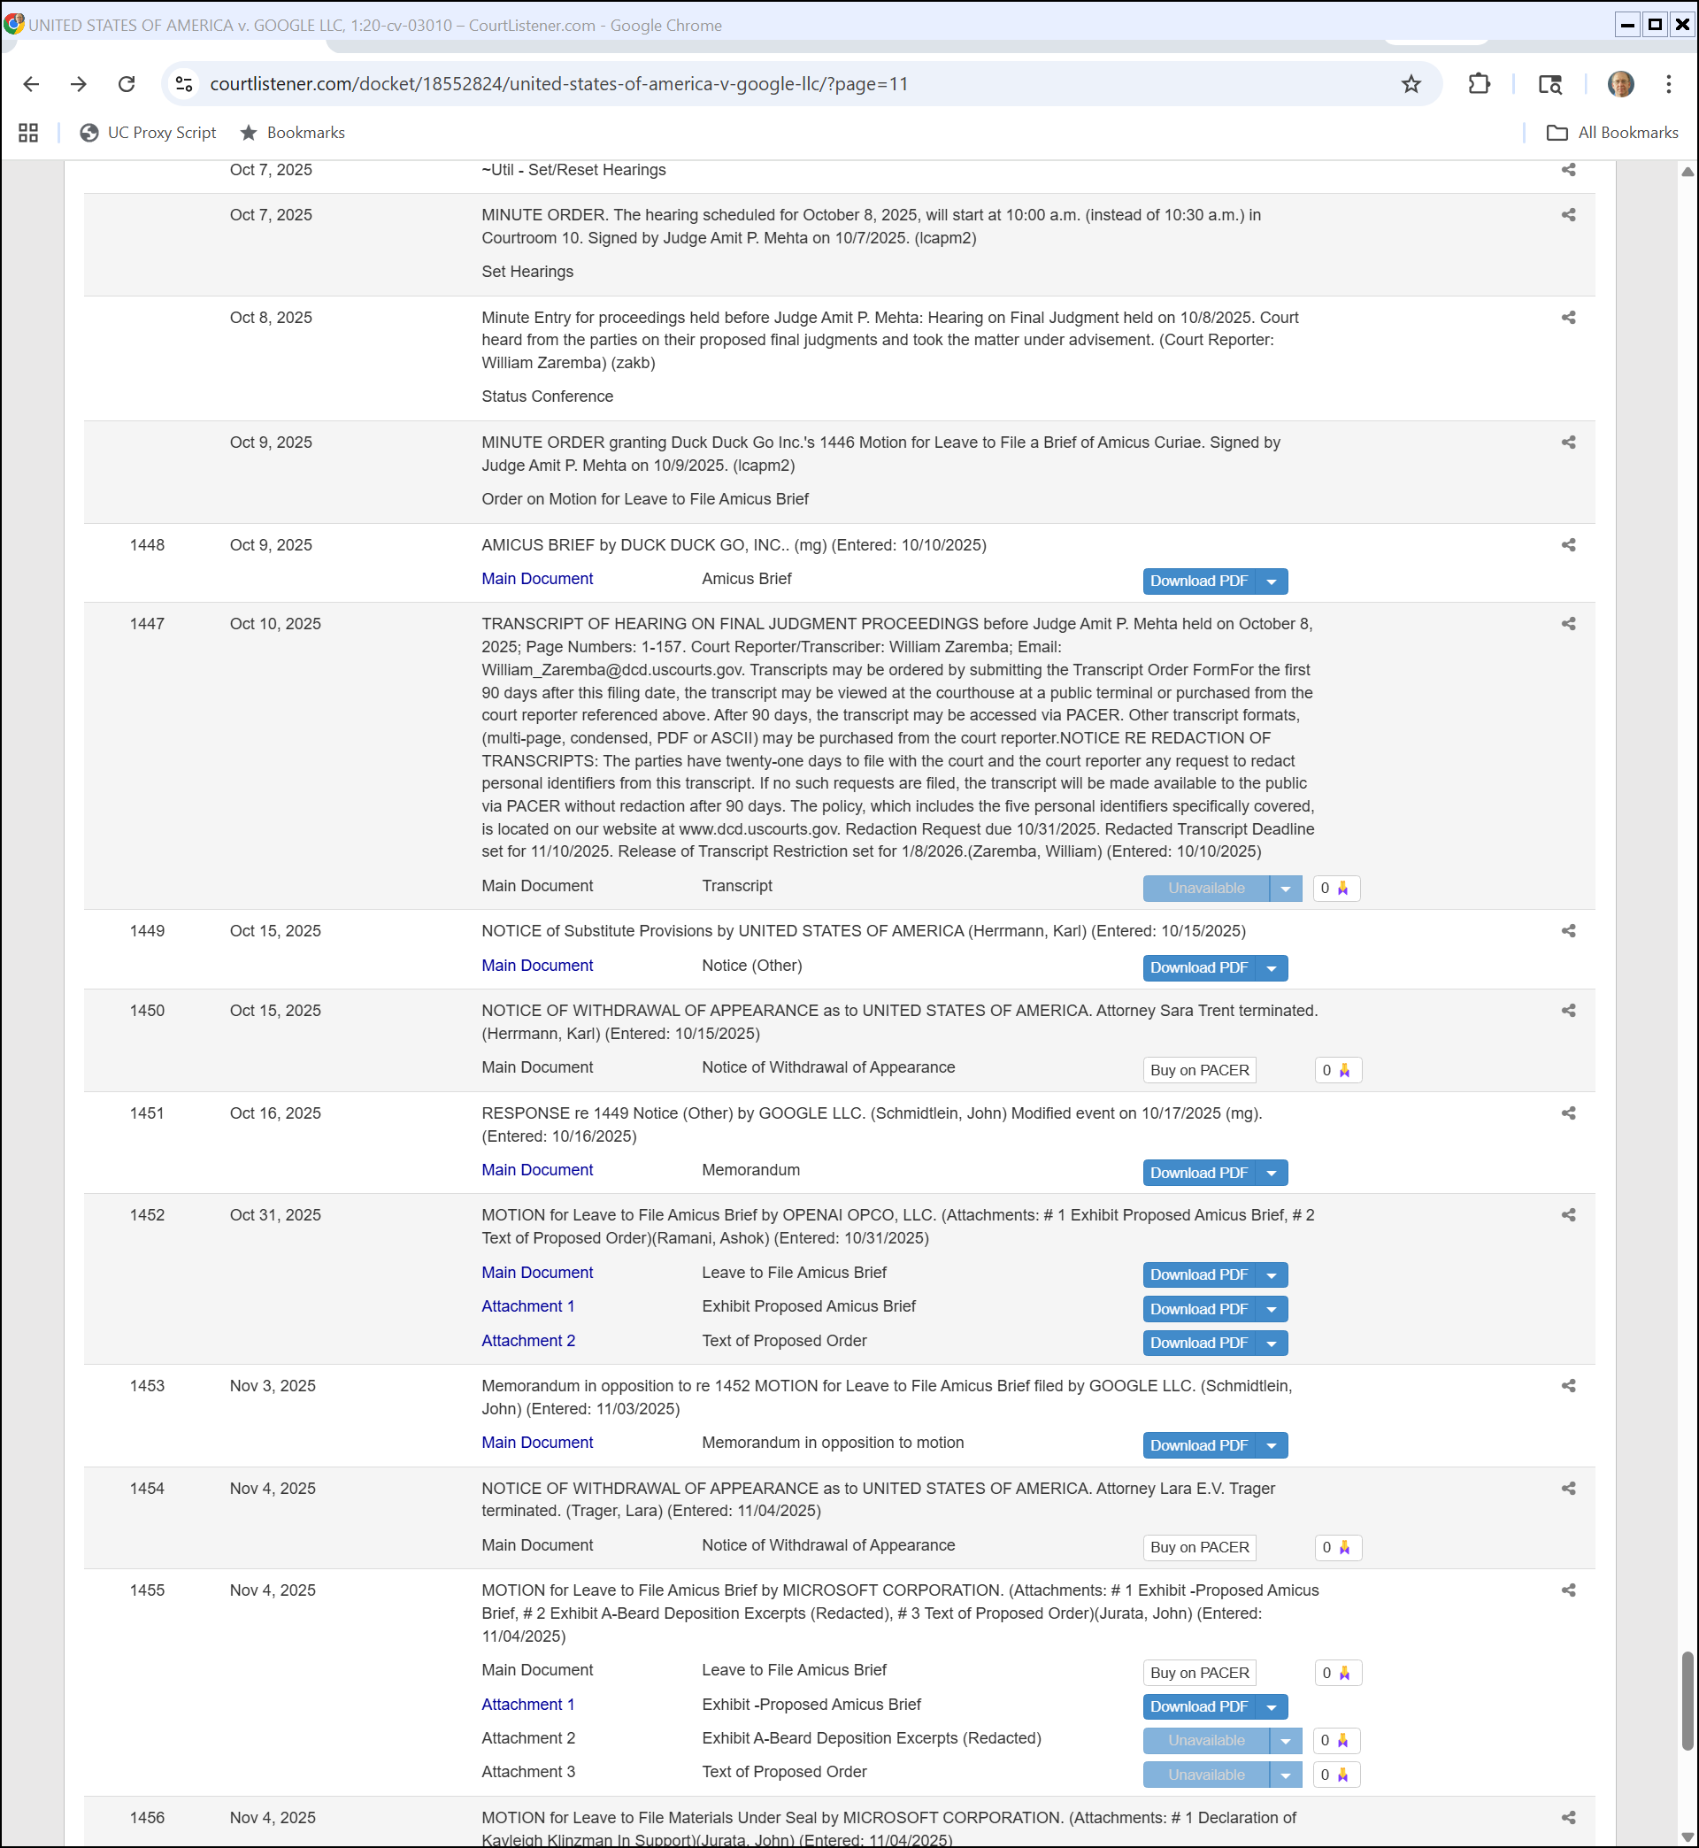
Oct 8: Final Judgment Hearing
U.S. v. Google Docket

Slide 71
More Views
U.S. v. Google Docket

Slide 72
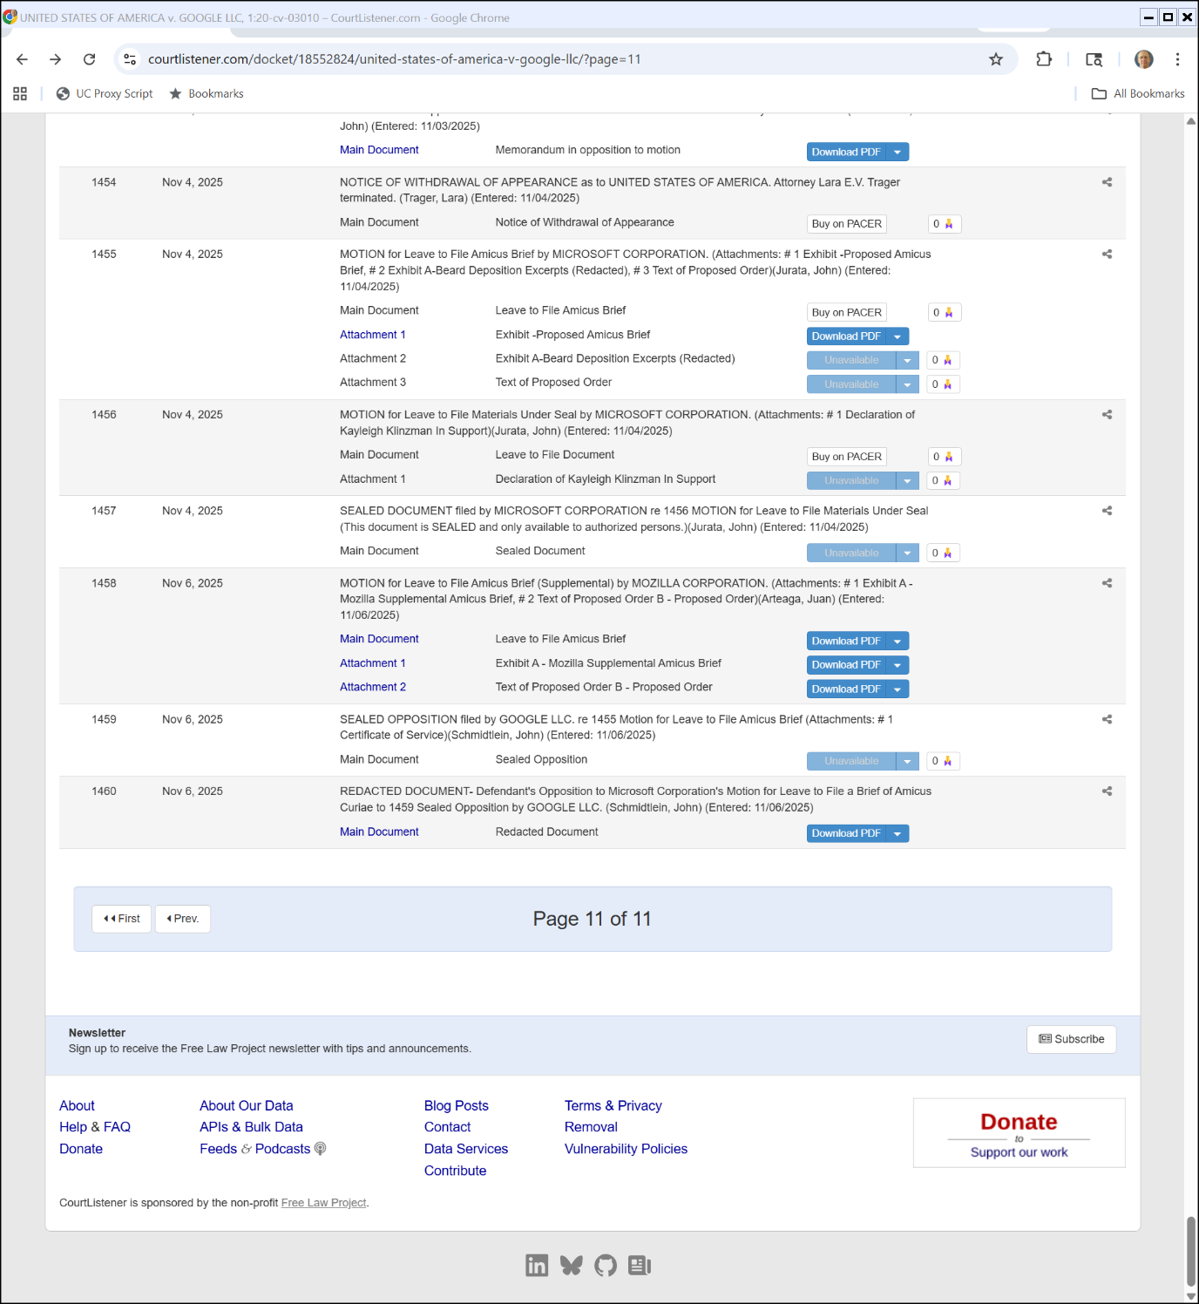
Three Months In: Waiting for Final Judgment
U.S. v. Google Docket

