Slide 1
Class 24: Thurs 20 Nov 2025 Antitrust Fall 2025 Google Search
Randal C. Picker
James Parker Hall Distinguished Service Professor of Law
The Law School
The University of Chicago
Copyright © 2012-25 Randal C. Picker. All Rights Reserved.

Slide 2
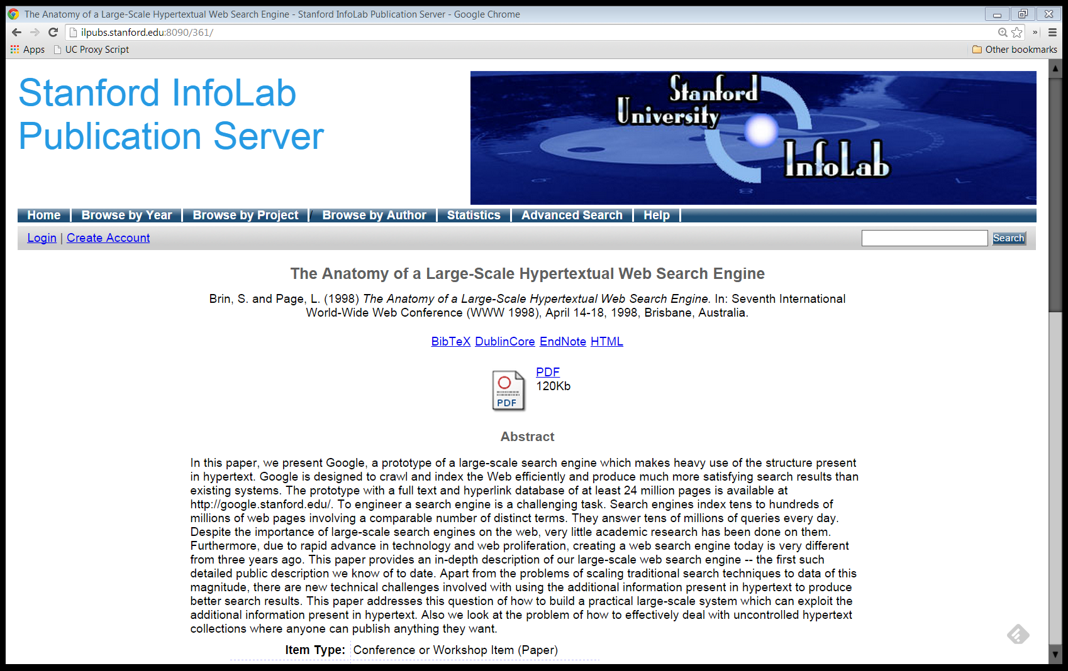
1998 Google Paper
Brin & Page (1998)

Slide 3
A Prototype Search Engine
“In this paper, we present Google, a prototype of a large-scale search engine which makes heavy use of the structure present in hypertext.”
Brin & Page (1998)

Slide 4
Advertising and Mixed Motives
“Currently, the predominant business model for commercial search engines is advertising. The goals of the advertising business model do not always correspond to providing quality search to users. … For this type of reason …, we expect that advertising funded search engines will be inherently biased towards the advertisers and away from the needs of the consumers.”
Brin & Page (1998)

Slide 5
Bias is Difficult to Evaluate
“Since it is very difficult even for experts to evaluate search engines, search engine bias is particularly insidious. A good example was OpenText, which was reported to be selling companies the right to be listed at the top of the search results for particular queries … .”
Brin & Page (1998)

Slide 6
Bias is Difficult to Evaluate
“… This type of bias is much more insidious than advertising, because it is not clear who ‘deserves’ to be there, and who is willing to pay money to be listed.”
Brin & Page (1998)

Slide 7
Easy to Favor, Hard to Detect
“But less blatant bias are likely to be tolerated by the market. For example, a search engine could add a small factor to search results from ‘friendly’ companies, and subtract a factor from results from competitors. This type of bias is very difficult to detect but could still have a significant effect on the market. Furthermore, advertising income often provides an incentive to provide poor quality search results. … ”
Brin & Page (1998)

Slide 8
Good, but Not Too Good
“In general, it could be argued from the consumer point of view that the better the search engine is, the fewer advertisements will be needed for the consumer to find what they want. This of course erodes the advertising supported business model of the existing search engines”
Brin & Page (1998)

Slide 9
Conclusion?
“But we believe the issue of advertising causes enough mixed incentives that it is crucial to have a competitive search engine that is transparent and in the academic realm.”
Brin & Page (1998)

Slide 10
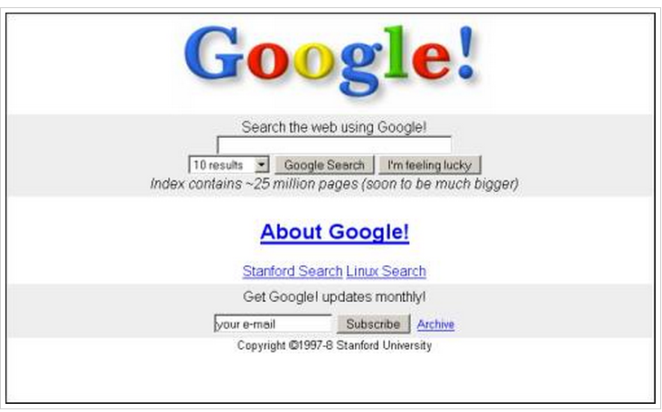
Original Google Homepage
11 Nov 1998

Slide 11
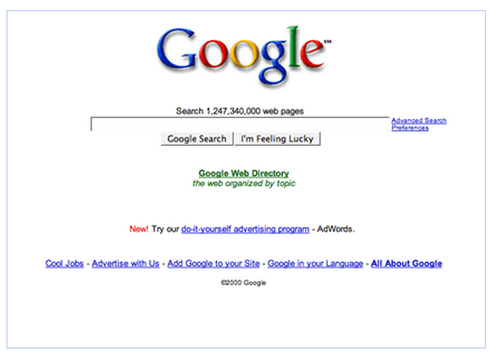
Adwords
27 Oct 2000

Slide 12
Understanding Market Power in Adv Markets
Media markets such as radio and TV
Competition always a click away and (historically) zero cash price to viewers
Exercise market power against consumers (raise prices to consumers) through advertising volume and intensity

Slide 13
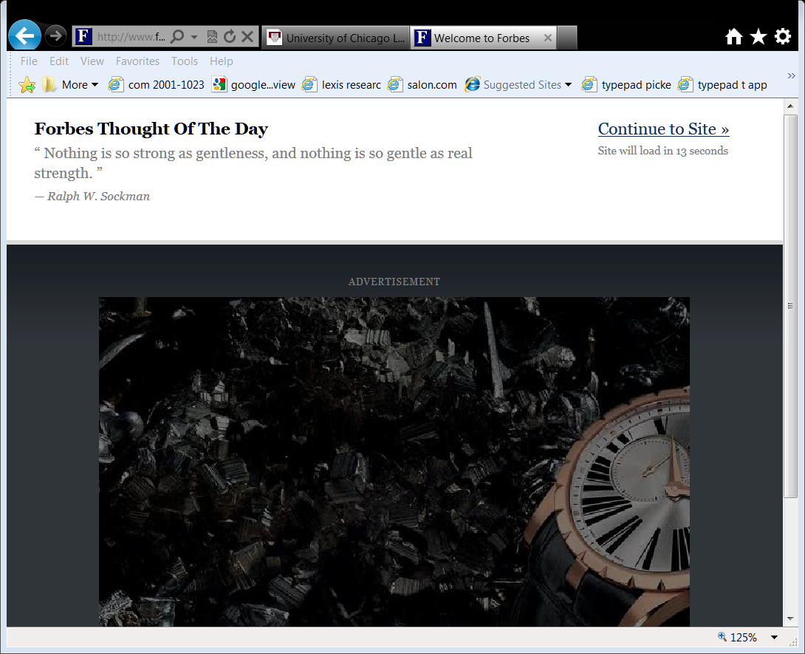
Forbes Magazine Website
Ad-supported media companies degrade content
For a media company with market power: have lots of ads as a legitimate exercise of market power
Antitrust will bar media company with market power from using that power to maintain power or increase it

Slide 14
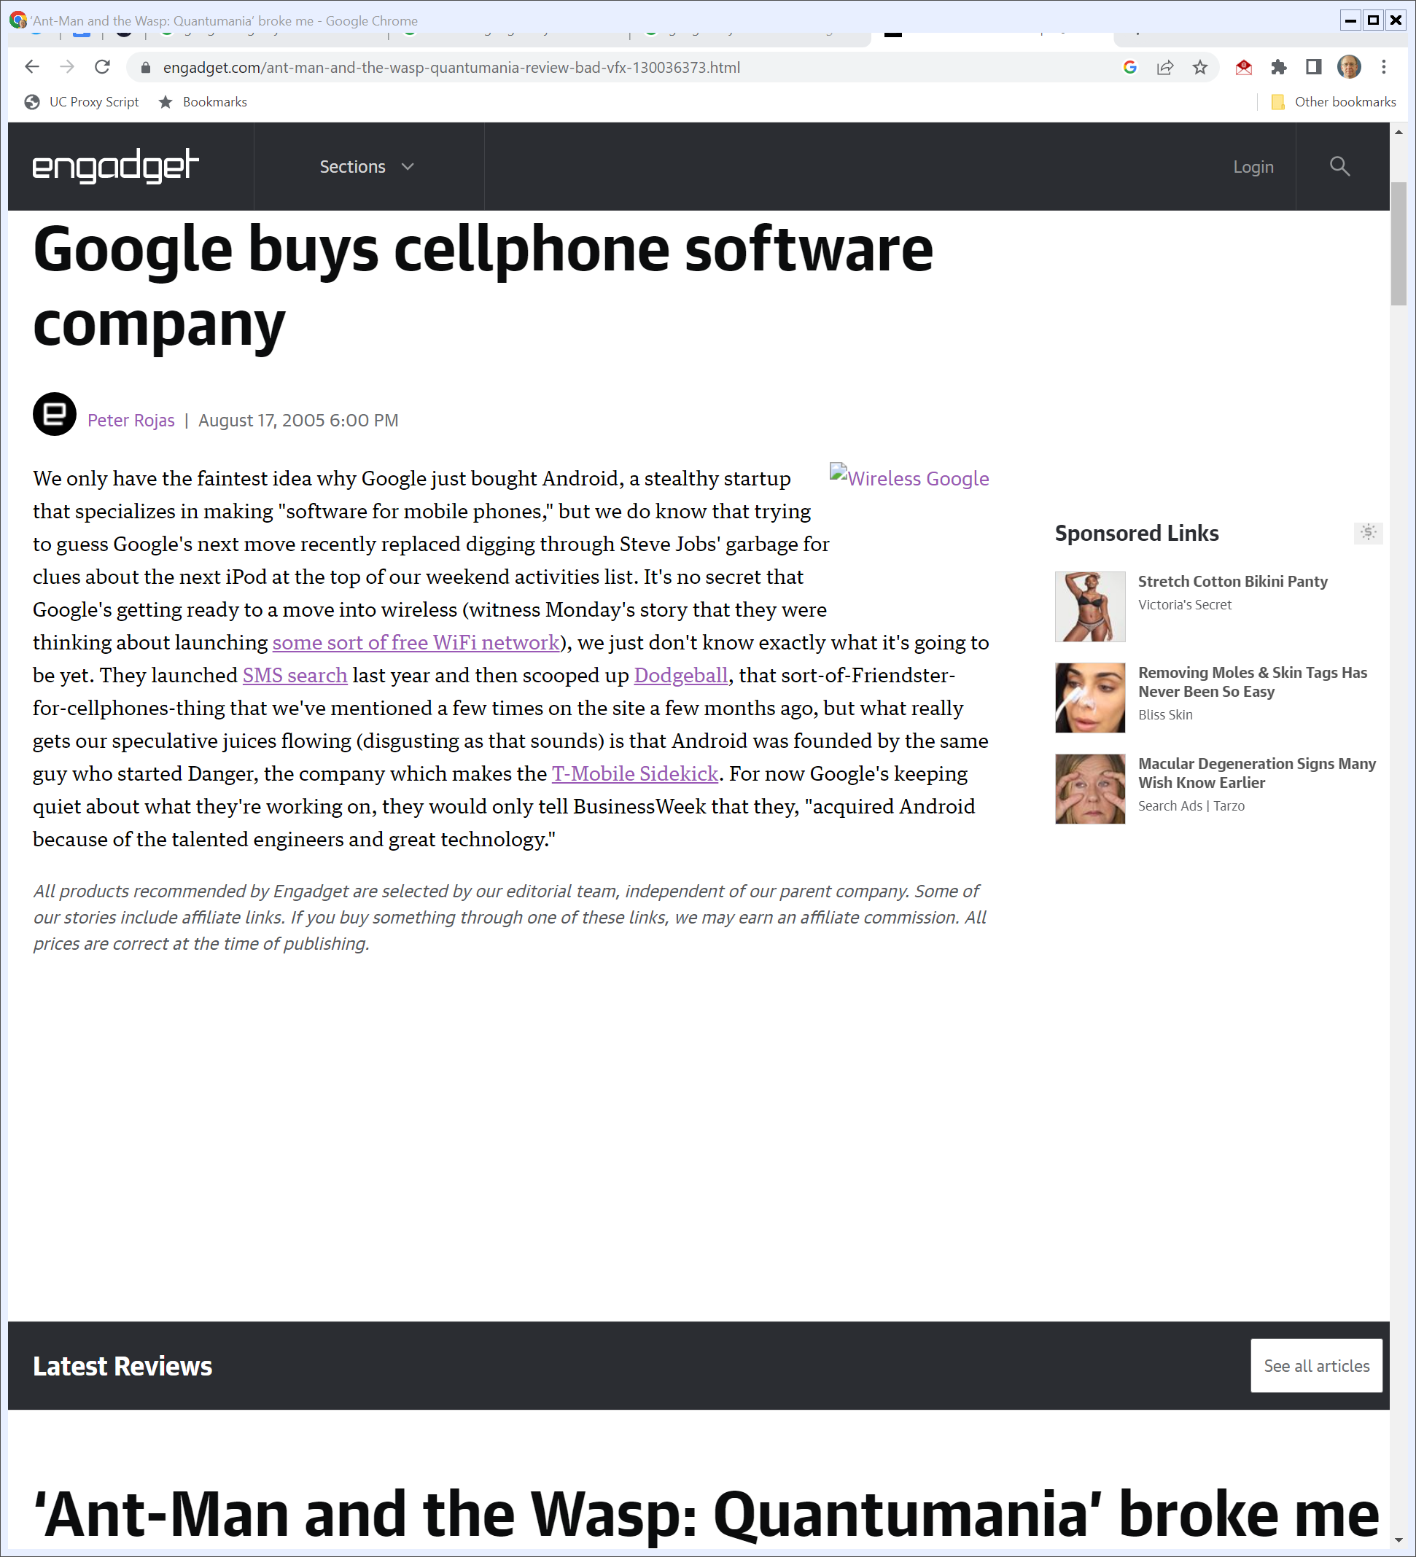
Aug 2005: G Buys Android
Engadget (17 Aug 2005)
Notes:
https://www.engadget.com/ant-man-and-the-wasp-quantumania-review-bad-vfx-130036373.html

Slide 15
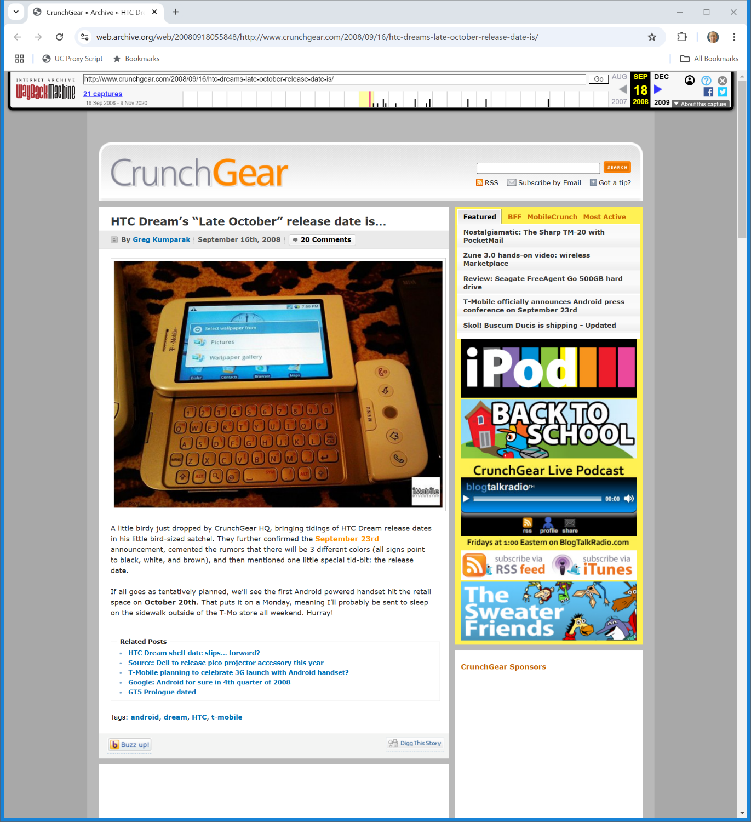
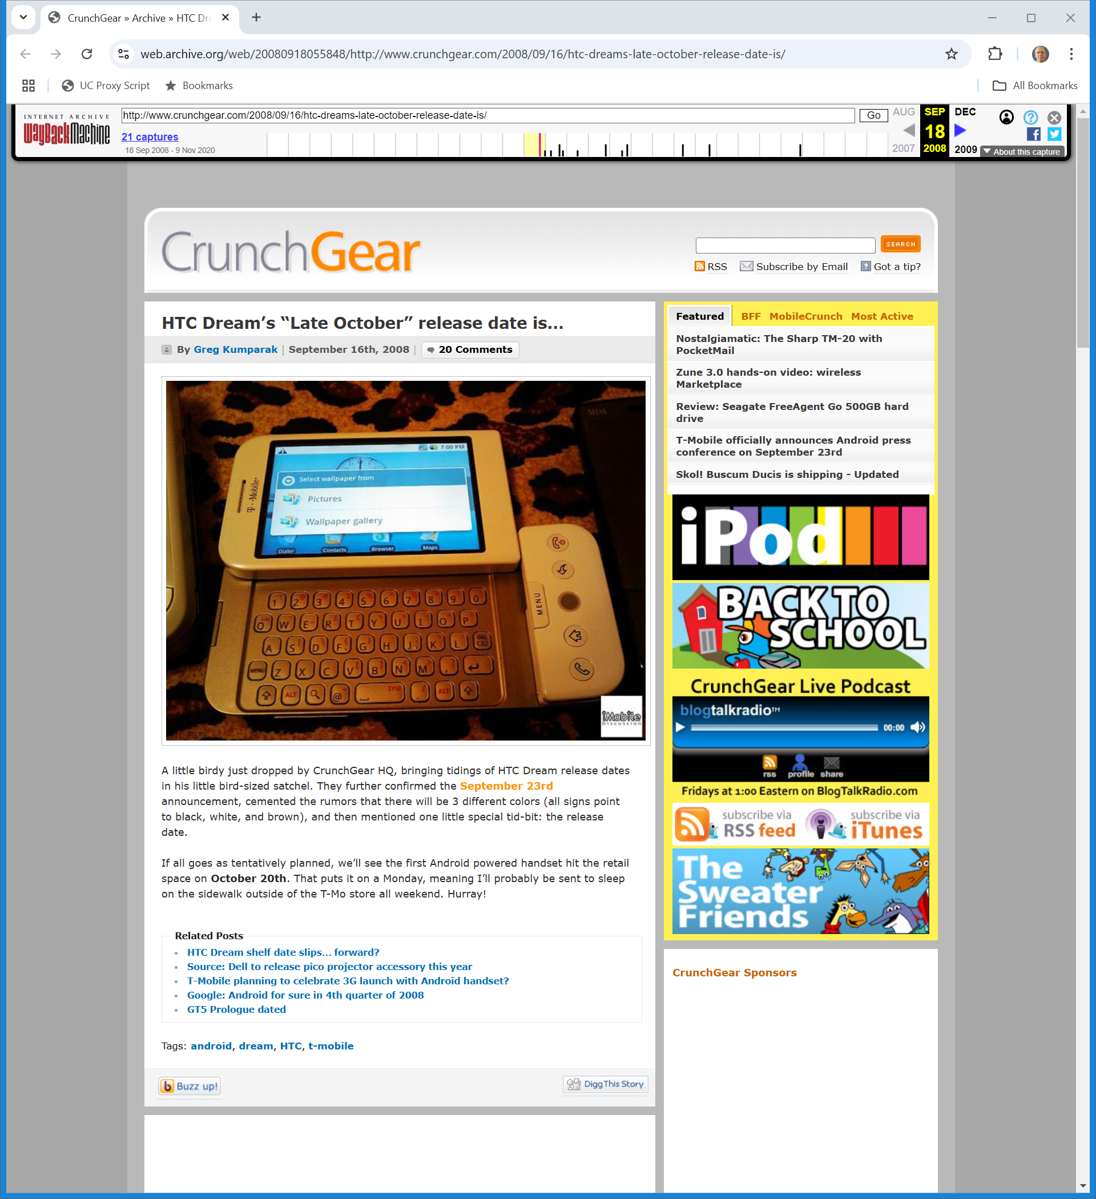
Oct 2008: HTC Dream: 1st Android Phone
CrunchGear (16 Sept 2008)
Notes:
https://web.archive.org/web/20080918055848/http://www.crunchgear.com/2008/09/16/htc-dreams-late-october-release-date-is/

Slide 16
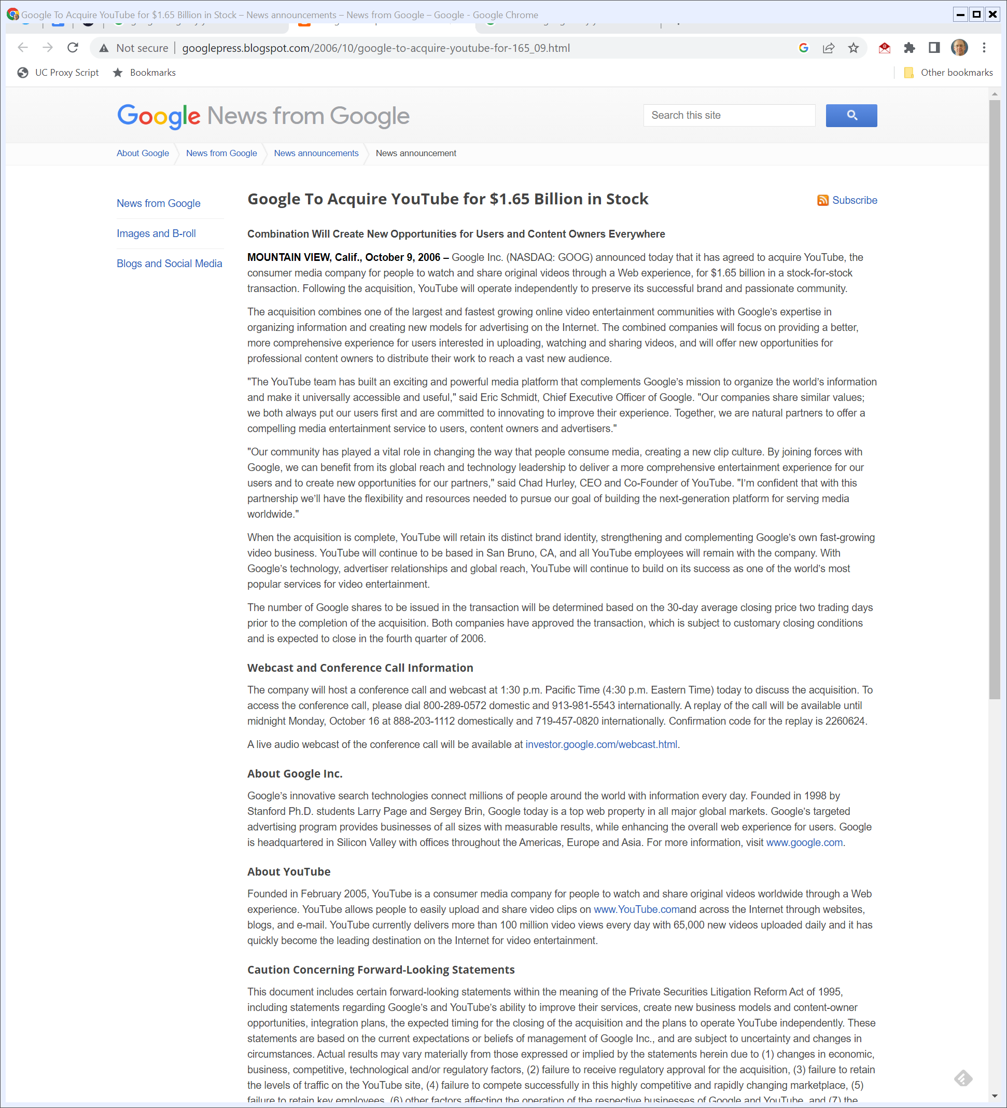
Oct 2006: G Buys YouTube
Google (9 Oct 2006)
Notes:
http://googlepress.blogspot.com/2006/10/google-to-acquire-youtube-for-165_09.html

Slide 17
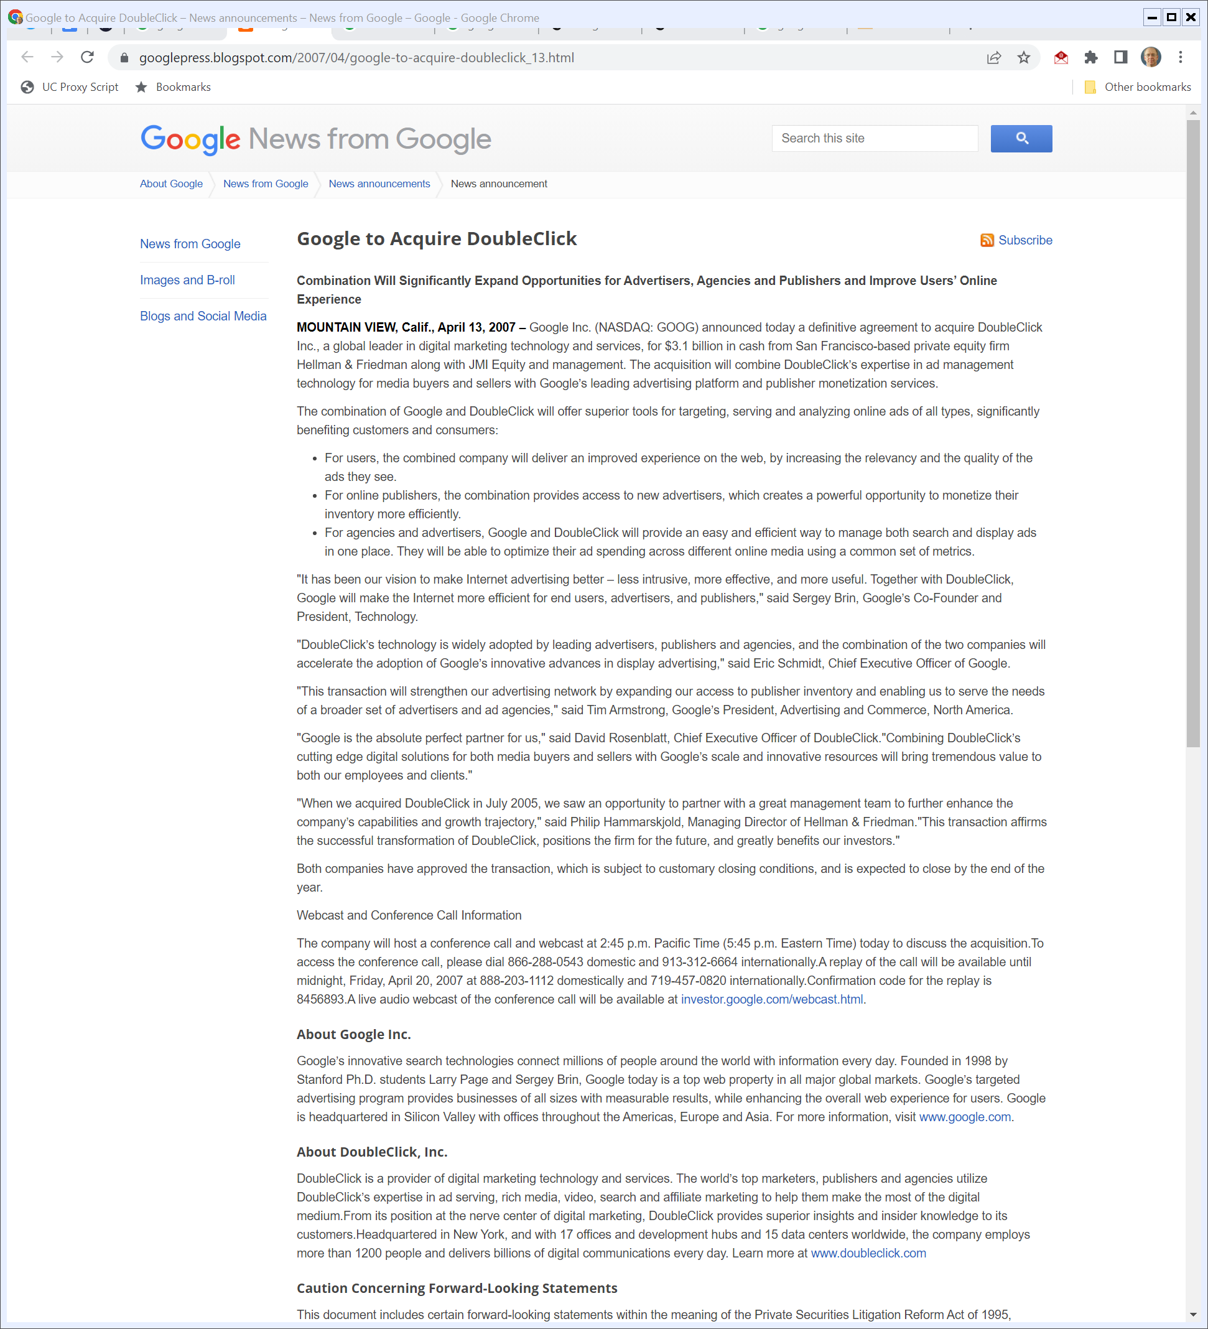
April 2007: G Buys DC
Google (13 Apr 2007)
Notes:
https://googlepress.blogspot.com/2007/04/google-to-acquire-doubleclick_13.html

Slide 18
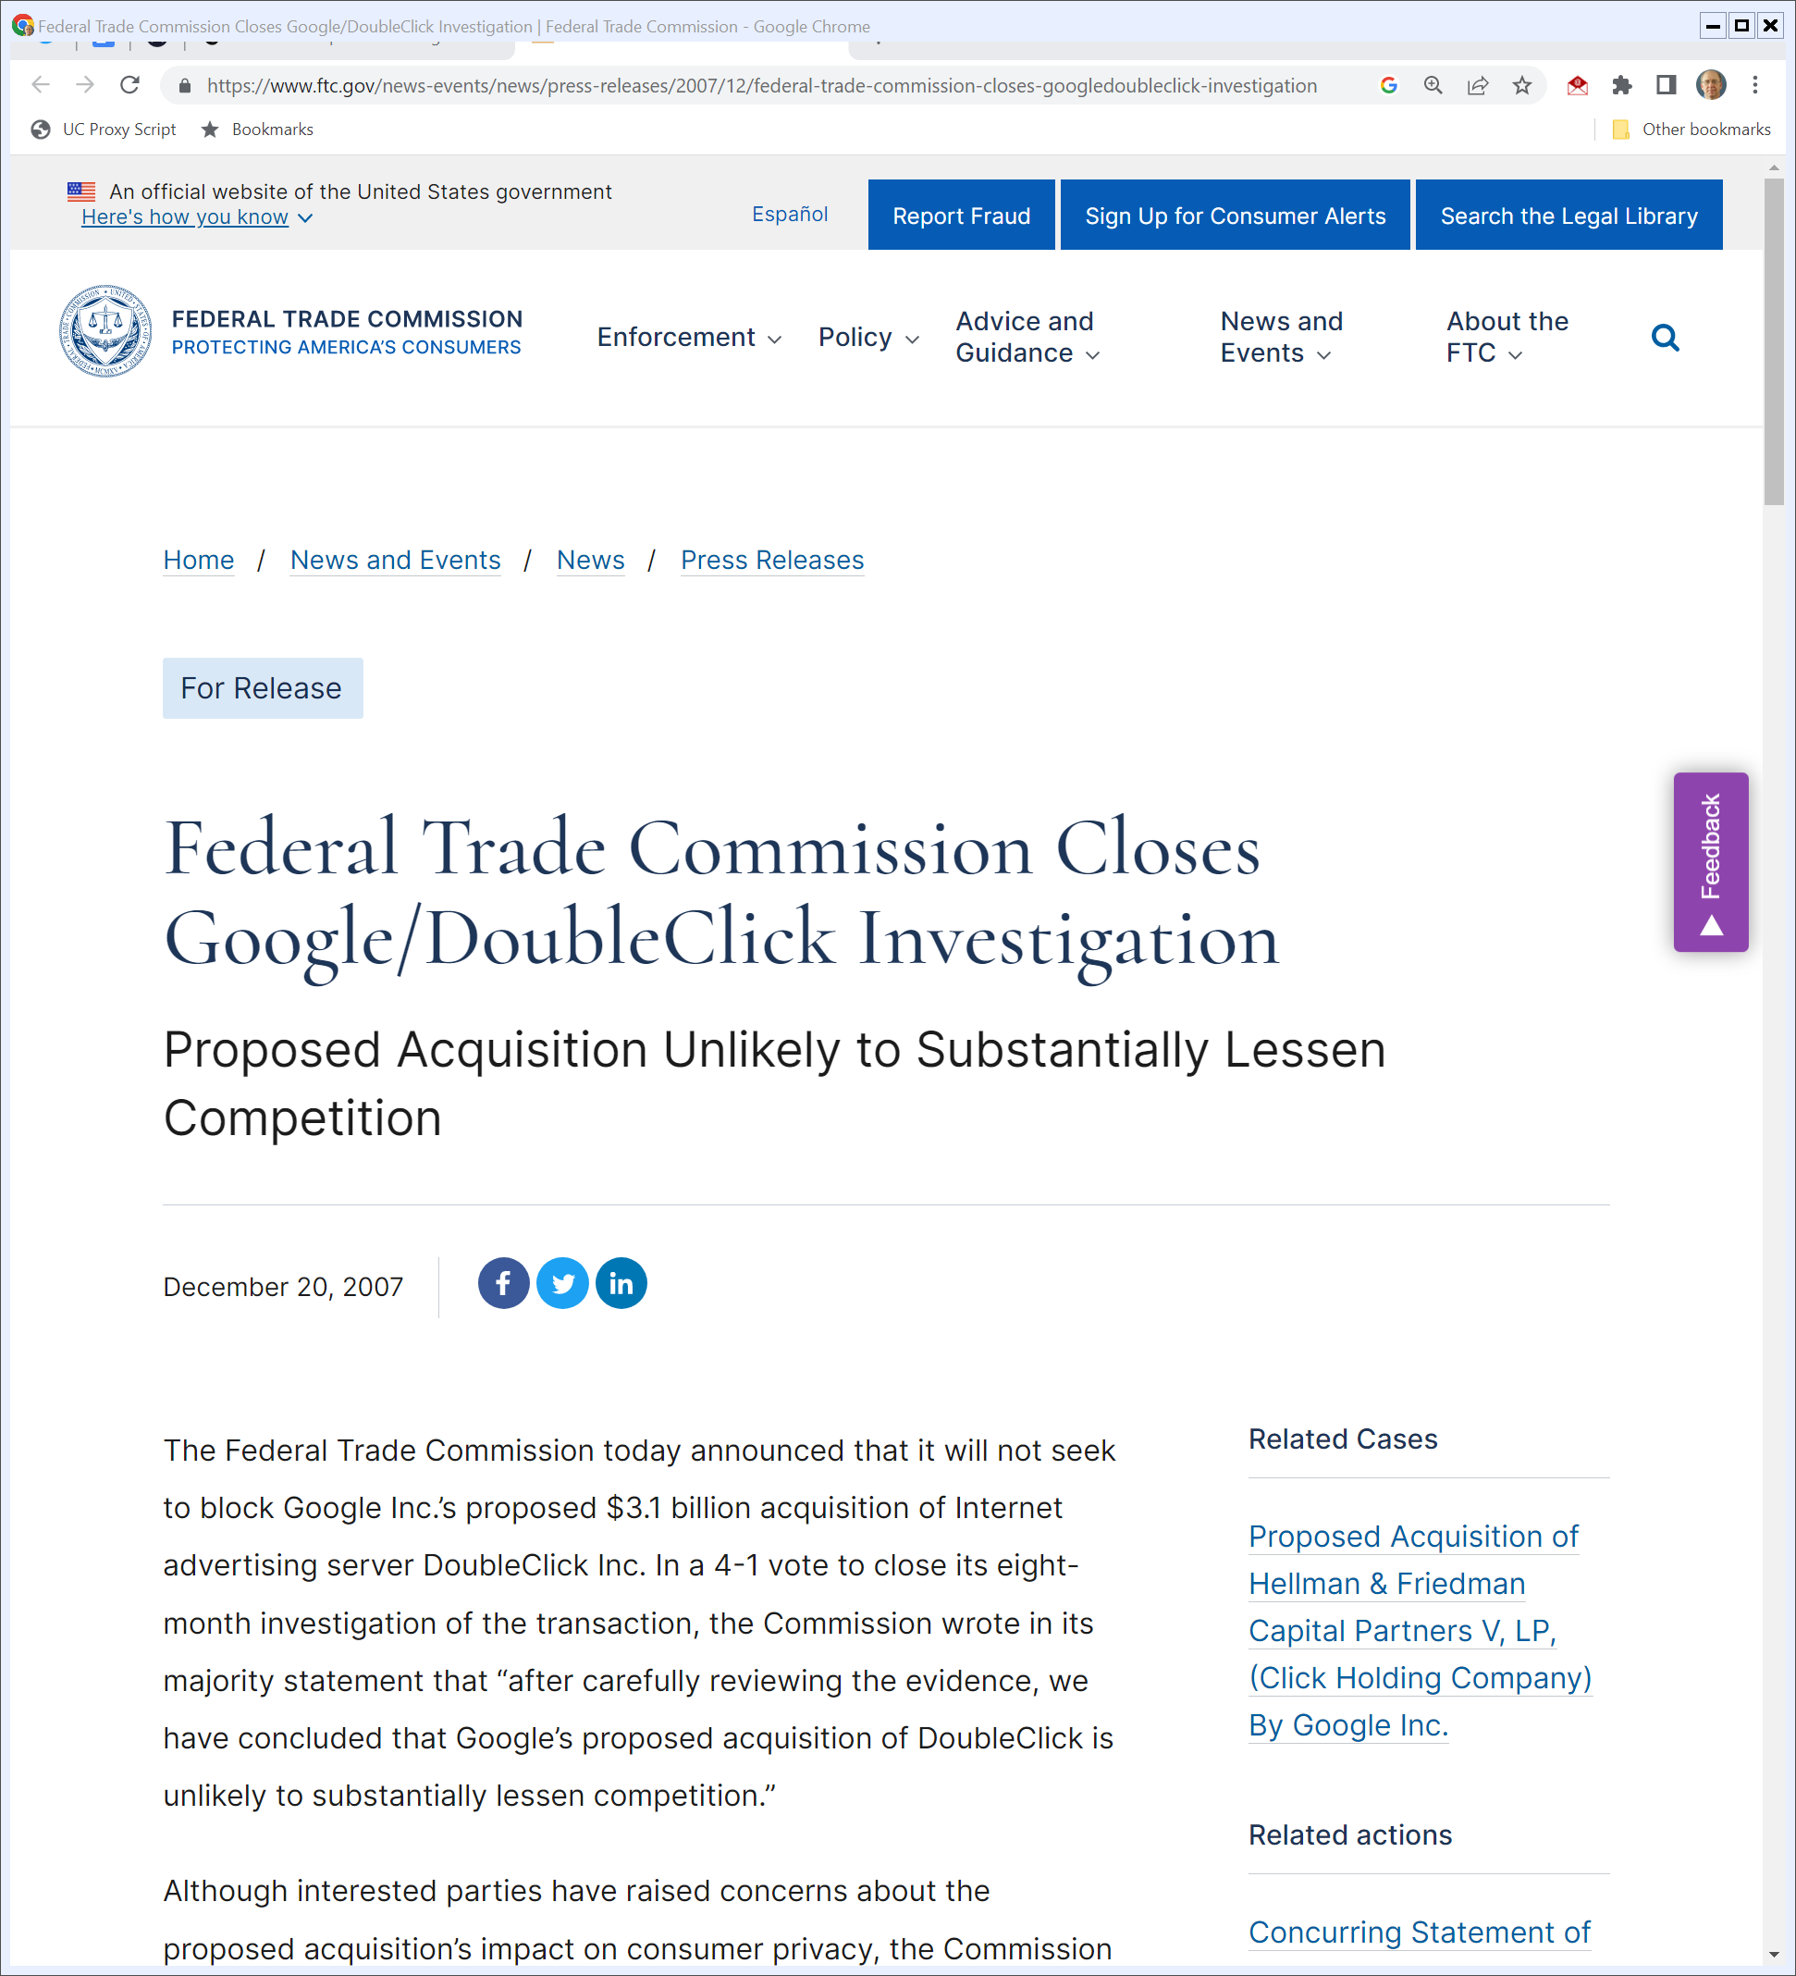
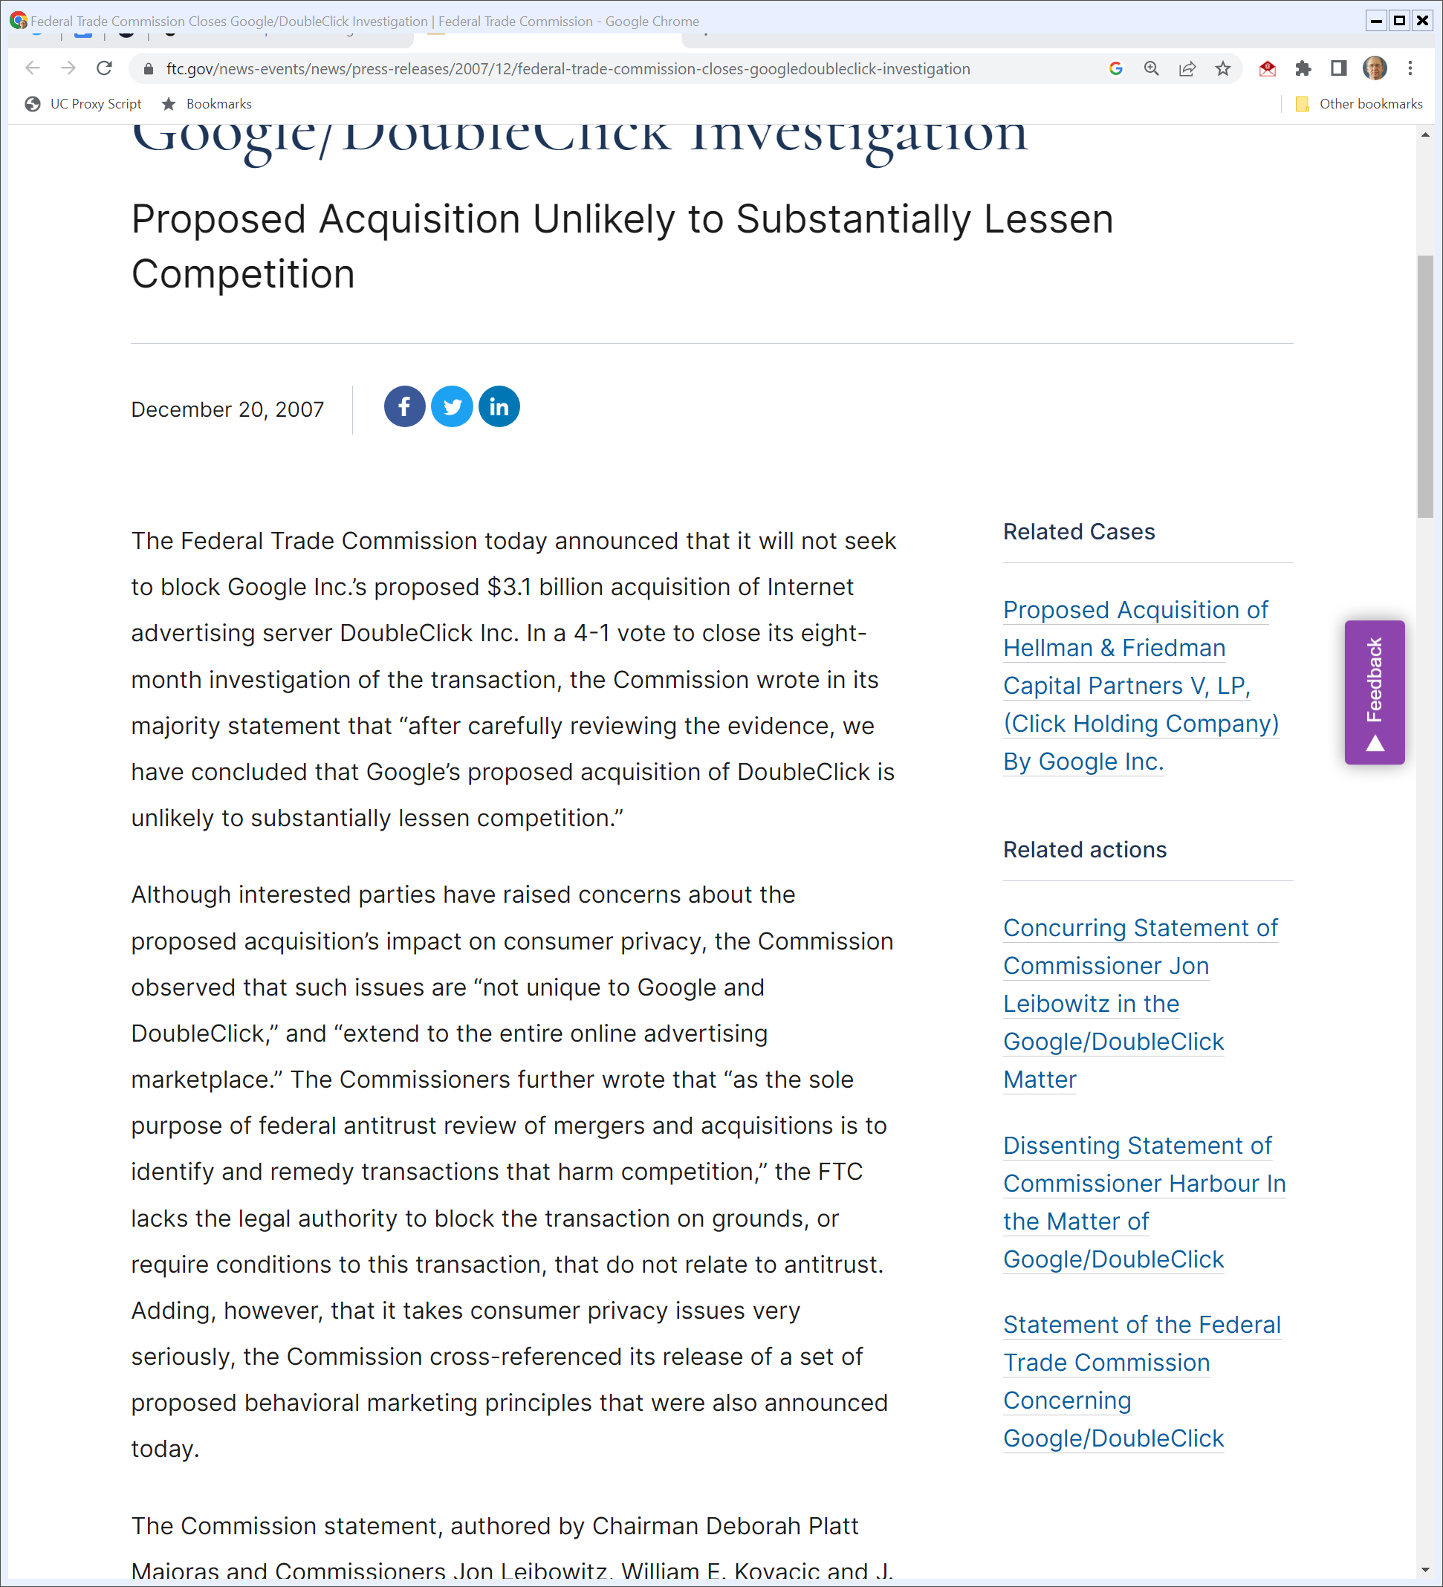
Dec 2007: FTC Declines to Challenge Deal
FTC (20 Dec 2007)
Notes:
https://www.ftc.gov/news-events/news/press-releases/2007/12/federal-trade-commission-closes-googledoubleclick-investigation

Slide 19
And in Europe?
European Commission (11 Mar 2008)

Slide 20
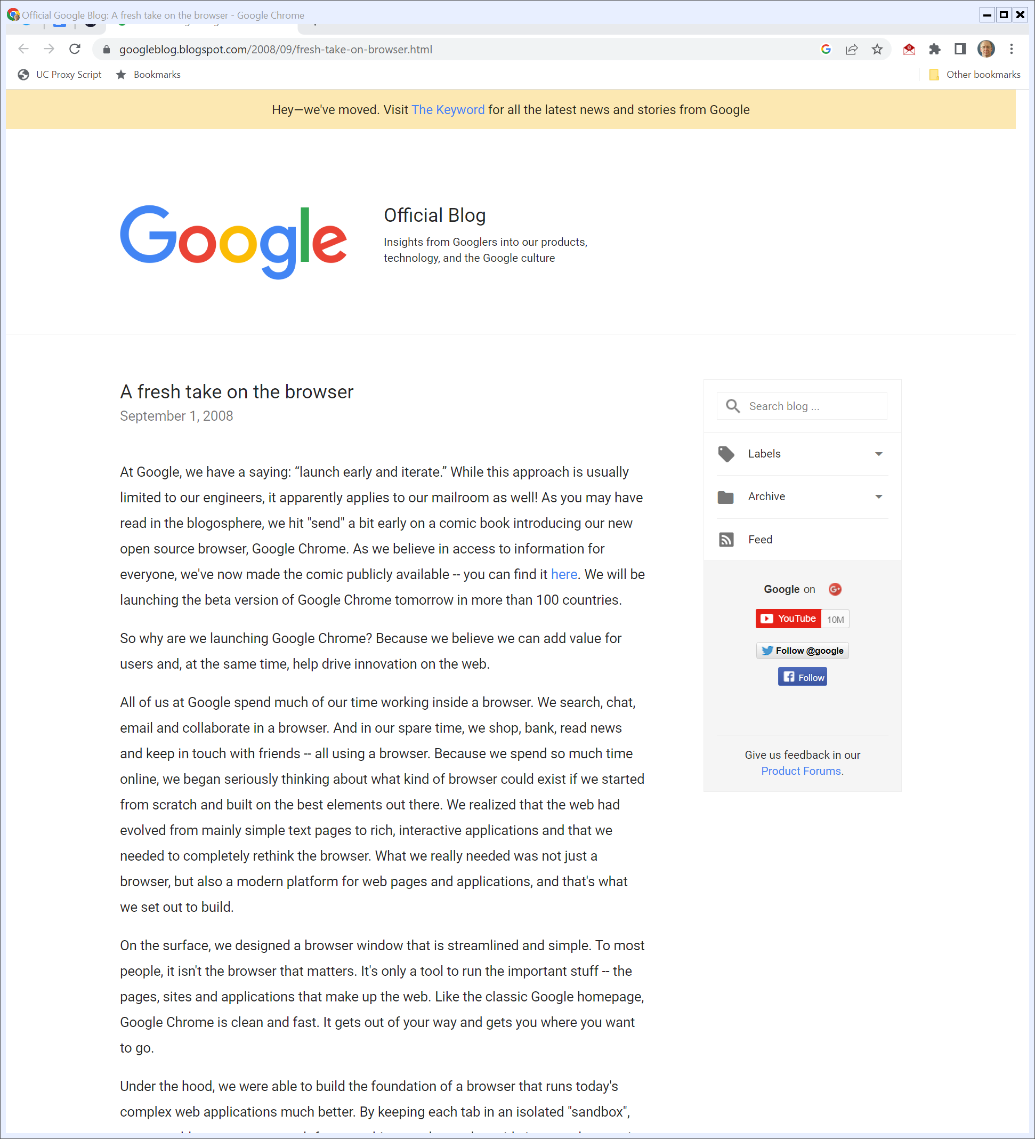
1 Sept 2008: Google Releases Chrome
Google (1 Sept 2008)
Notes:
https://googleblog.blogspot.com/2008/09/fresh-take-on-browser.html

Slide 21
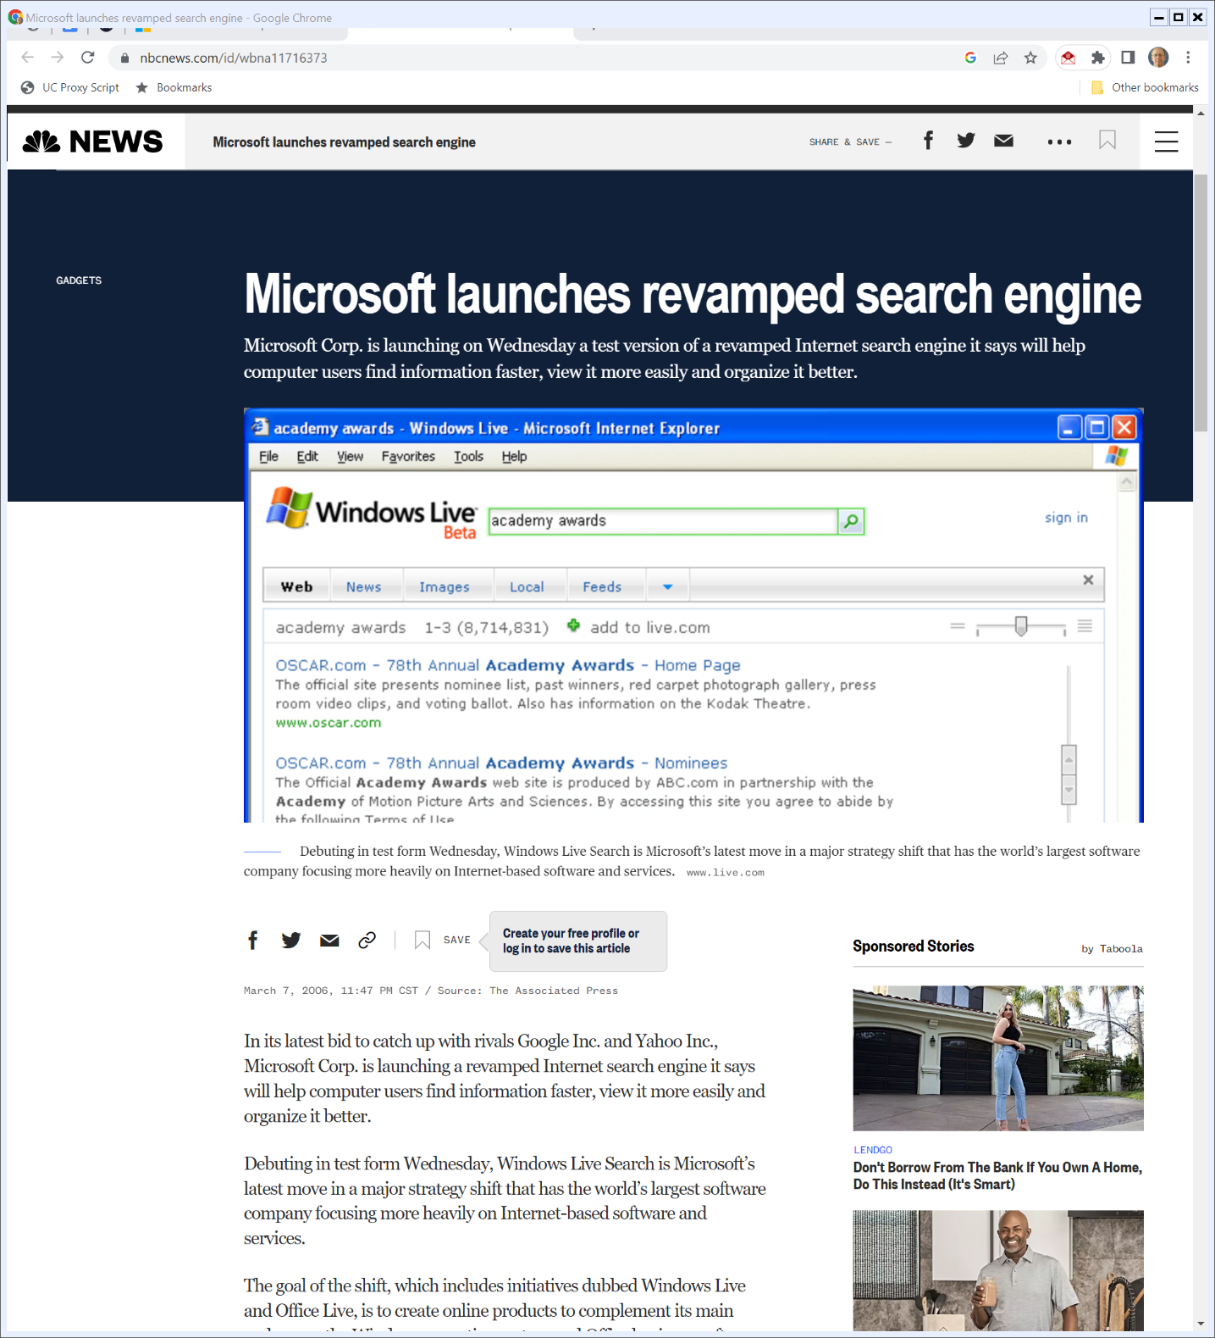
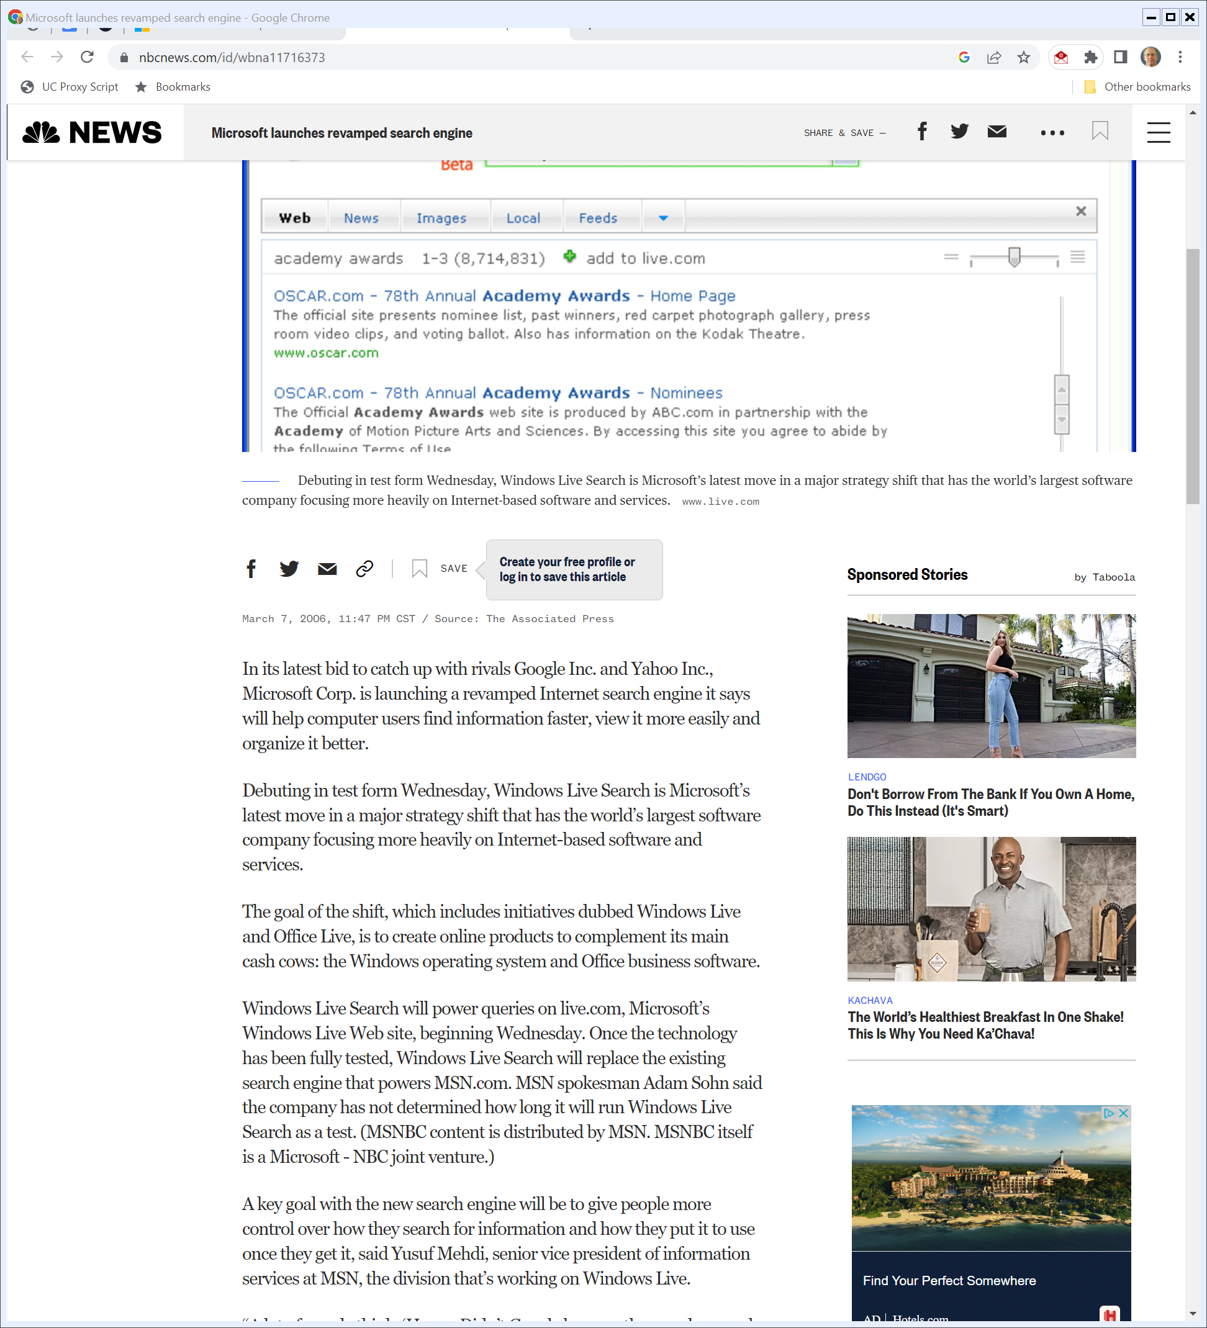
Updated Windows Live Search
NBC News (7 Mar 2006)
Notes:
https://www.nbcnews.com/id/wbna11716373

Slide 22
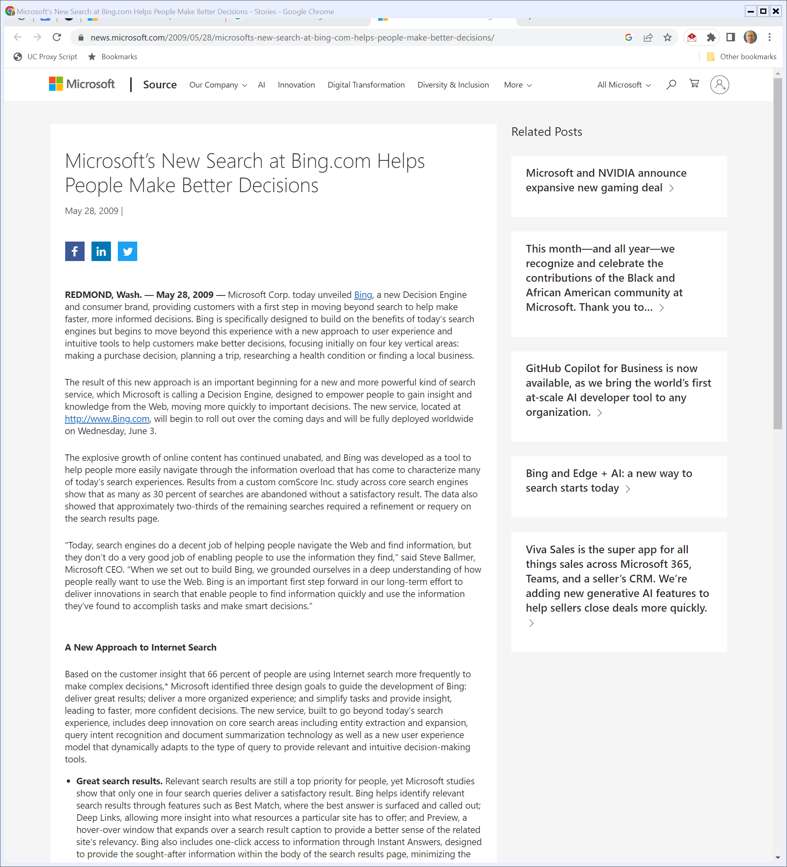
28 May 2009: Beyond Search with Bing
Microsoft (28 May 2009)
Notes:
https://news.microsoft.com/2009/05/28/microsofts-new-search-at-bing-com-helps-people-make-better-decisions/

Slide 23
28 May 2009: Beyond Search with Bing
Microsoft (28 May 2009)
Notes:
https://news.microsoft.com/2009/05/28/microsofts-new-search-at-bing-com-helps-people-make-better-decisions/

Slide 24
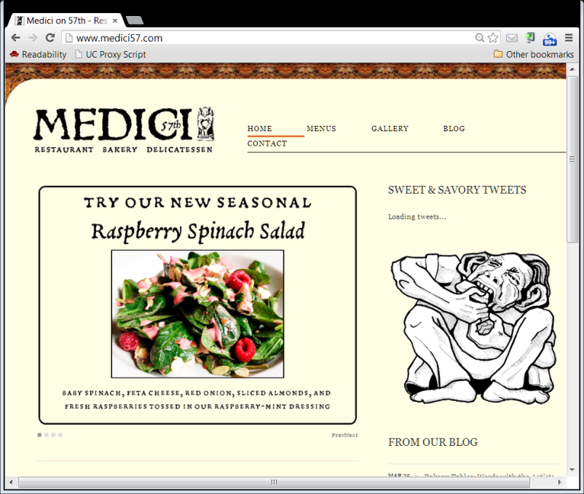
Google Content: 1st Party Websites
What the restaurant says about itself
Advertisers
Google
Consumers

Slide 25
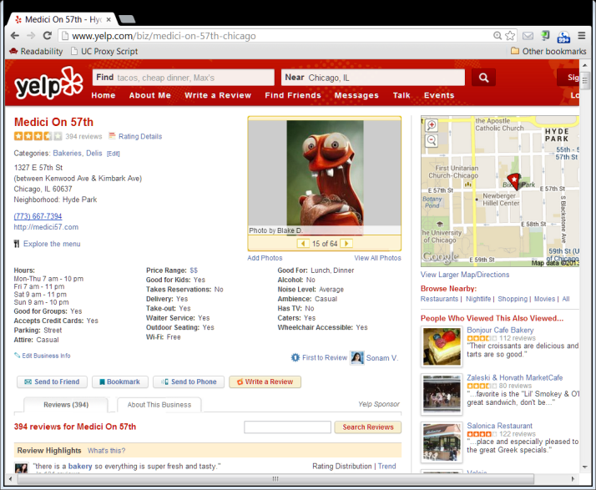
Google Content: 1st Party Websites
Consumers as Producers
What consumers say about the restaurant
Yelp
How should we let an incumbent with a large market share (a dominant firm?) respond to entry?
Consumers as Users

Slide 26
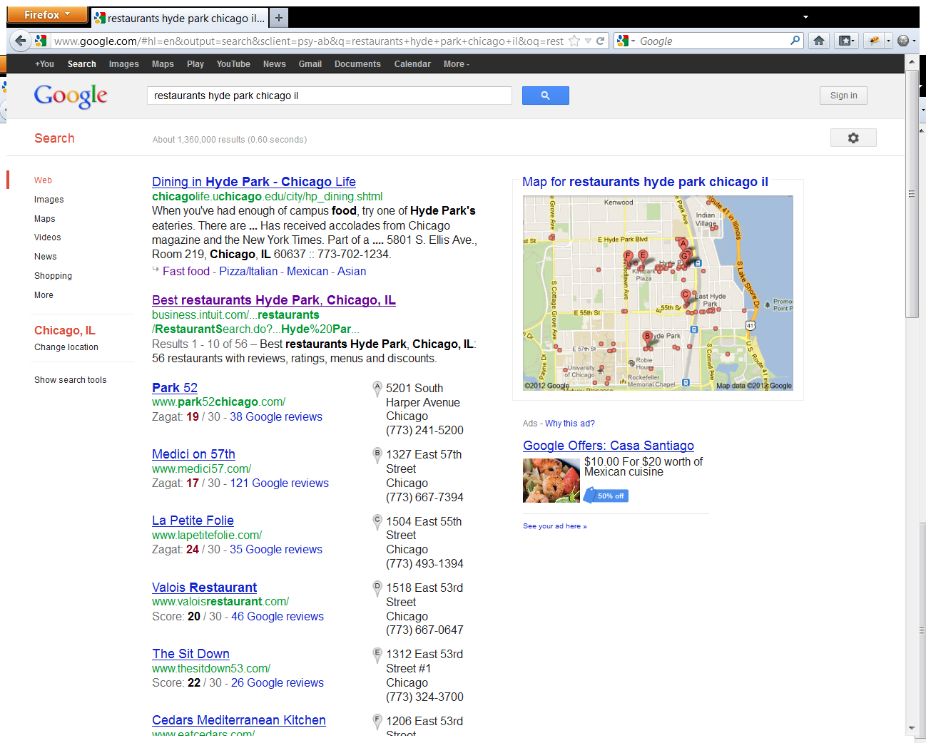
Google Content: 1st Party Websites
3. No Competition: Hardwired in favor of Google
1. Organic Search Competition (no $)
4. Onebox result: hardwired Google reviews; organic competition?
2. Auctions (all $)
Google HP Restaurants Search (25 June 2012)

Slide 27
Switch from Ten Blue Links to Universal Search
“Some vertical websites alleged that Google unfairly promoted its own vertical properties through changes in its search results page, such as the introduction of the “Universal Search” box, which prominently displayed Google vertical search results in response to certain types of queries, including shopping and local.”
U.S. FTC (3 Jan 2013)

Slide 28
Better Answers Aren’t a Violation of Sec 5
“While Google’s prominent display of its own vertical search results on its search results page had the effect in some cases of pushing other results ‘below the fold,’ the evidence suggests that Google’s primary goal in introducing this content was to quickly answer, and better satisfy, its users’ search queries by providing directly relevant information.”
U.S. FTC (3 Jan 2013)

Slide 29
No Sec 5 Violation
“Based on this evidence, we do not find Google’s business practices with respect to the claimed search bias to be, on balance, demonstrably anticompetitive, and do not at this time have reason to believe that these practices violate Section 5.”
U.S. FTC (3 Jan 2013)

Slide 30
Understanding the Onebox
The issue here wasn’t universal search or the onebox.
The issue was the hard-wired linking of the Google review sites.
Google Hyde Park Restaurants Search (25 June 2012)

Slide 31
EC Launches Google Shopping Investigation
European Commission (30 Nov 2010)
Notes:
https://ec.europa.eu/commission/presscorner/detail/en/IP_10_1624

Slide 32
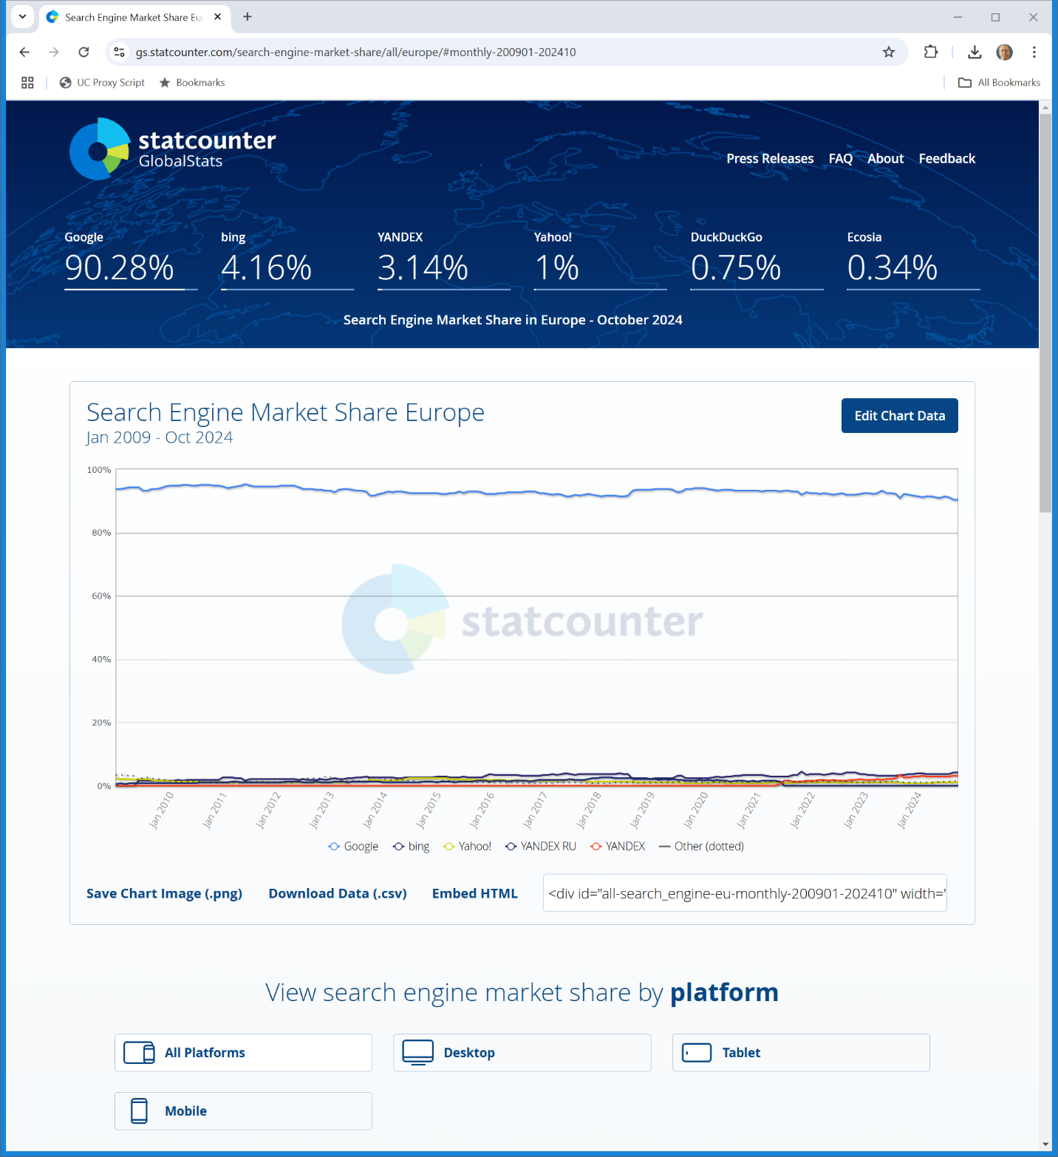
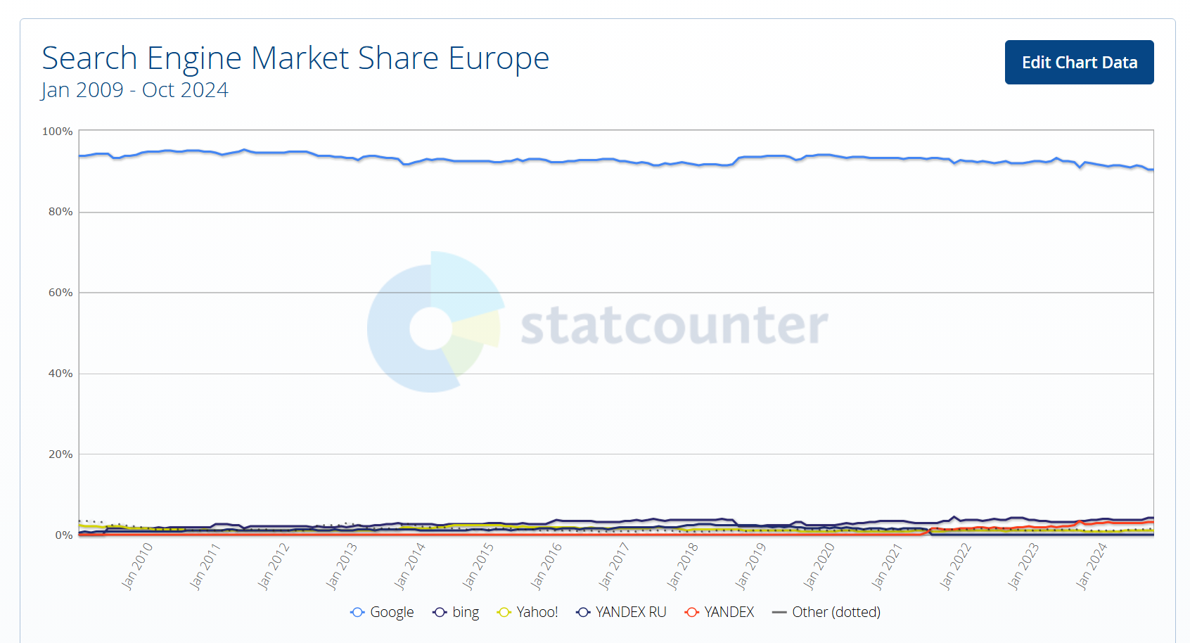
European Search Market Share
statcounter (27 Nov 2024)
Notes:
https://gs.statcounter.com/search-engine-market-share/all/europe/#monthly-200901-202410

Slide 33
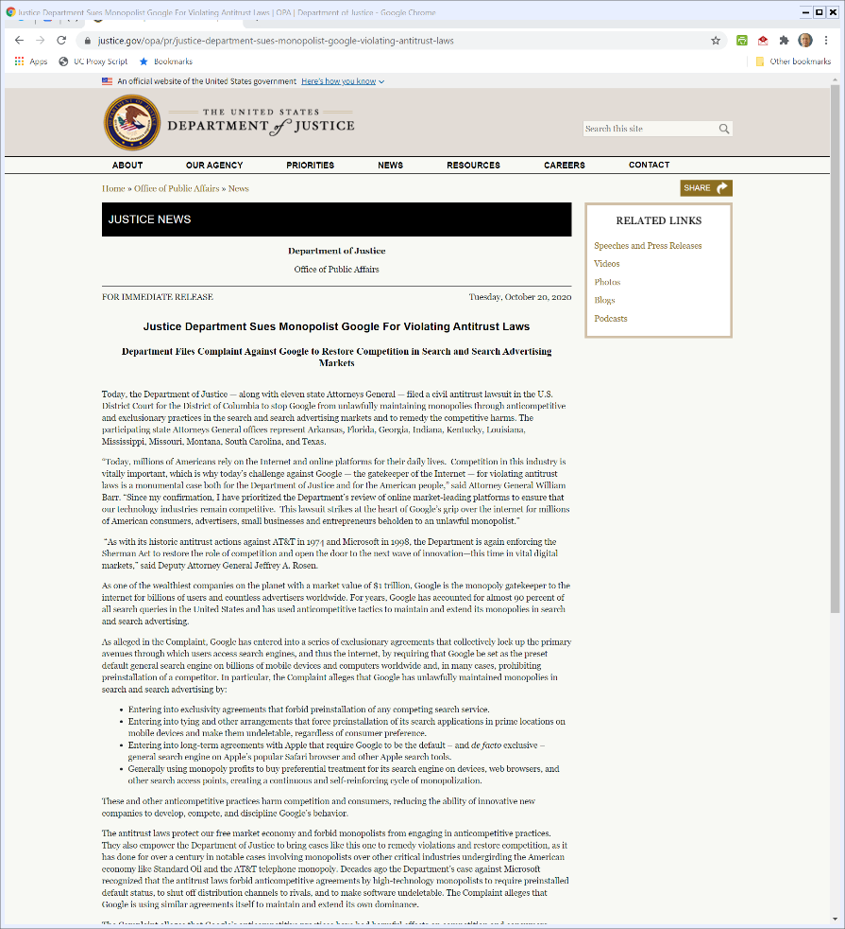
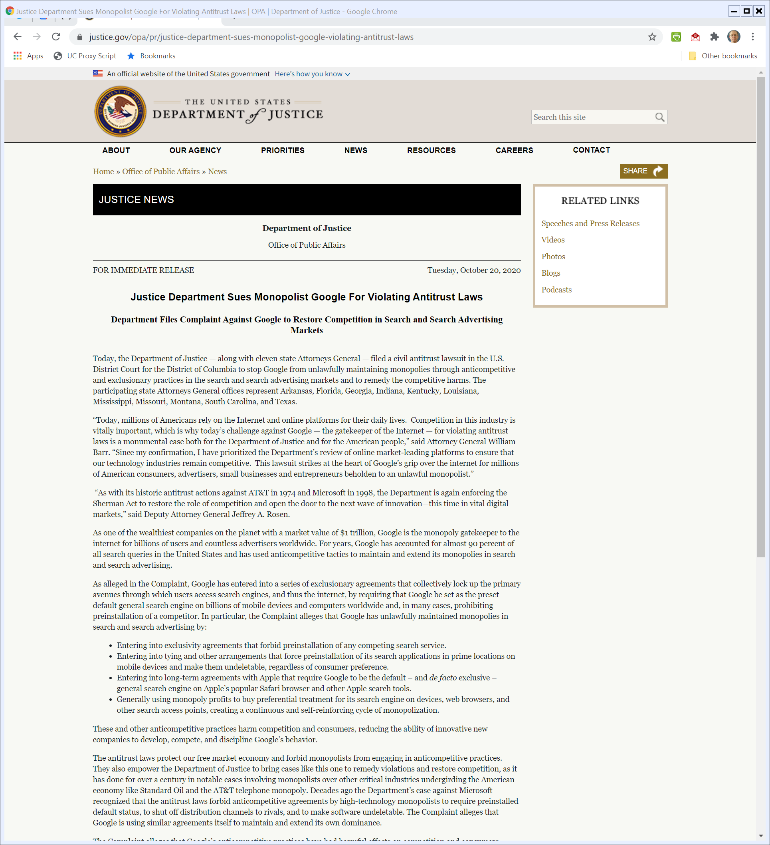
The Monopolist Google
U.S. DOJ Press Release (20 Oct 2020)
Notes:
https://www.justice.gov/opa/pr/justice-department-sues-monopolist-google-violating-antitrust-laws

Slide 34
The Monopolist Google
U.S. DOJ Press Release (20 Oct 2020)
Notes:
https://www.justice.gov/opa/pr/justice-department-sues-monopolist-google-violating-antitrust-laws

Slide 35
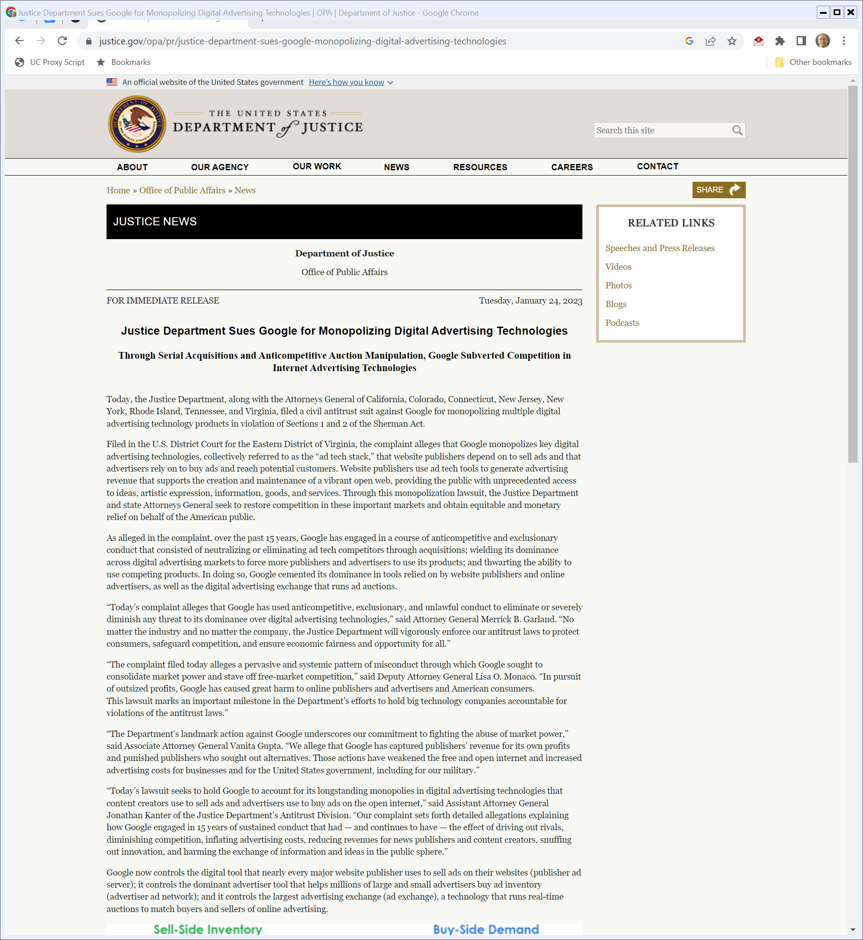
Second DOJ Case: Ad Tech Stack
DOJ (24 Jan 2023)
Notes:
https://www.justice.gov/opa/pr/justice-department-sues-google-monopolizing-digital-advertising-technologies

Slide 36
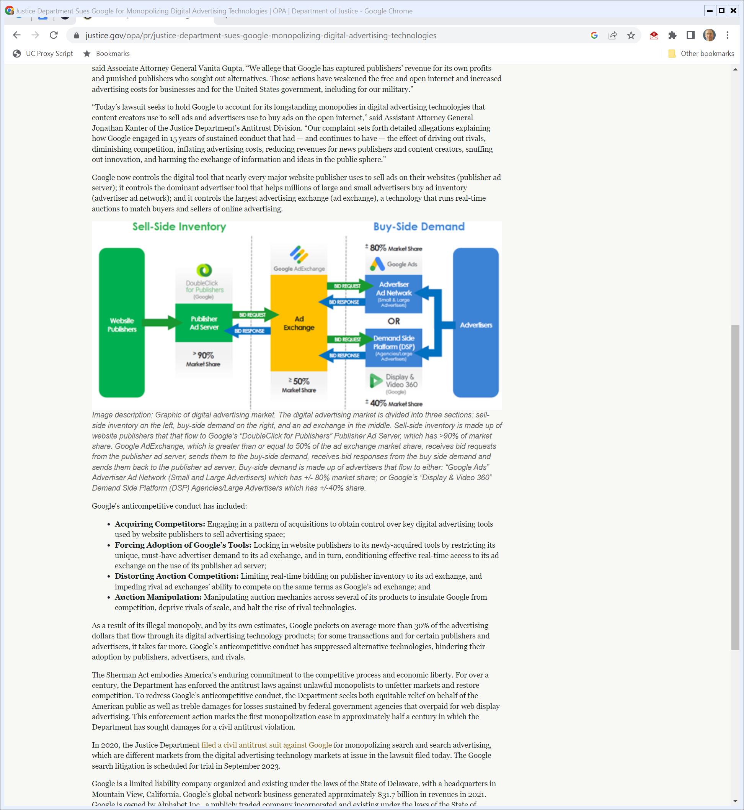
G Position in Ad Tech Stack
DOJ (24 Jan 2023)
Notes:
https://www.justice.gov/opa/pr/justice-department-sues-google-monopolizing-digital-advertising-technologies

Slide 37
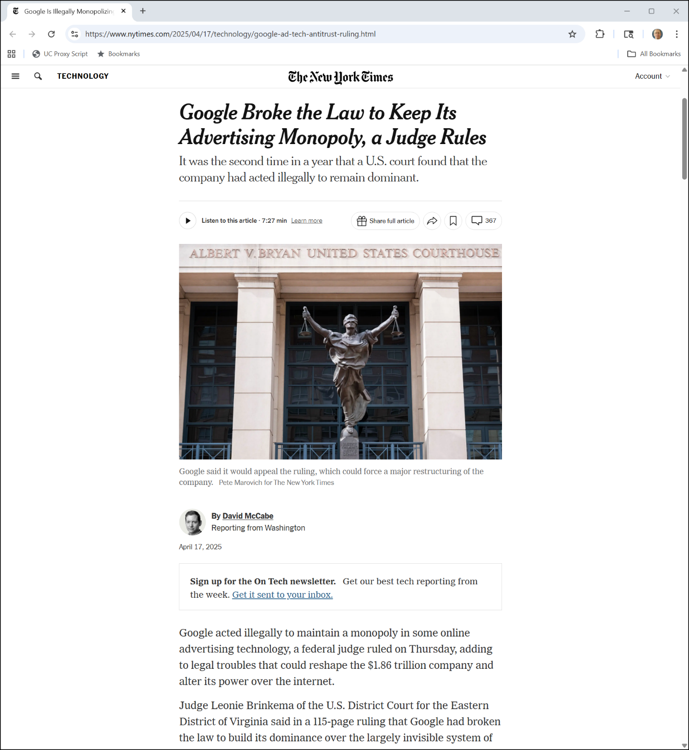
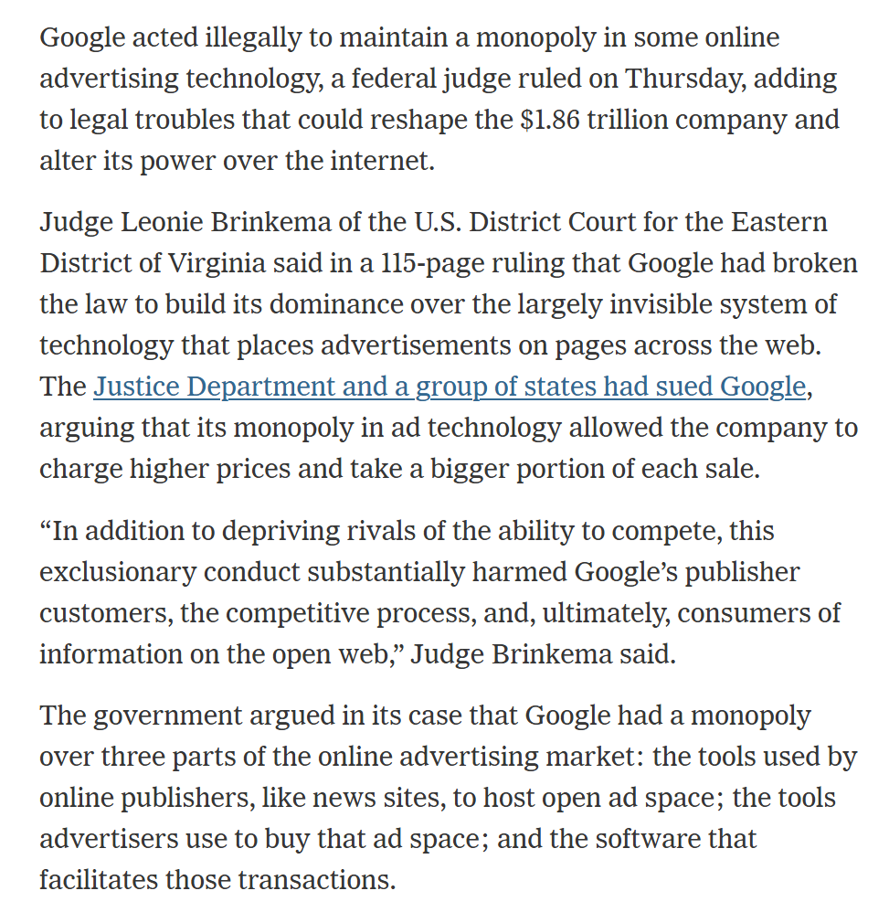
April 2025 Liability Finding
NYT (17 Apr 2025)
Notes:
https://www.nytimes.com/2025/04/17/technology/google-ad-tech-antitrust-ruling.html

Slide 38
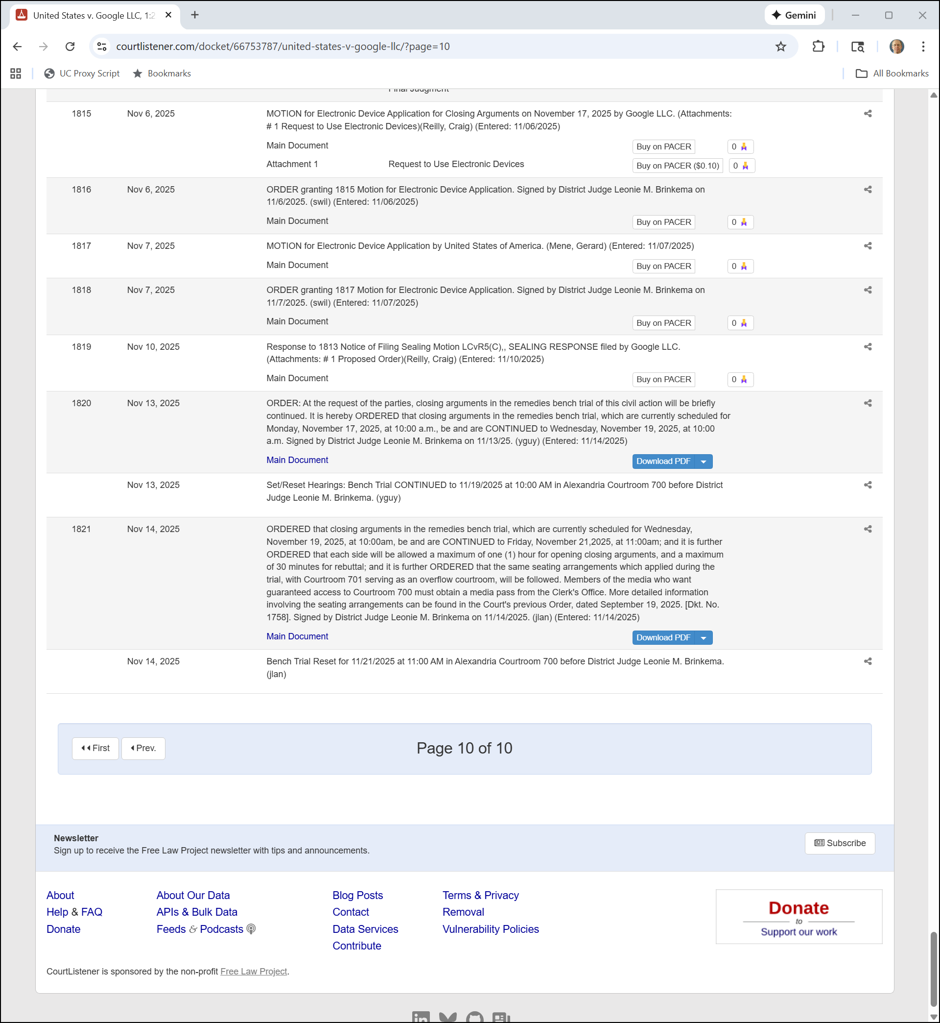
Remedy Phase
Docket (20 Nov 2025)

Slide 39
20 Oct 2020: U.S. v. Google

Slide 40
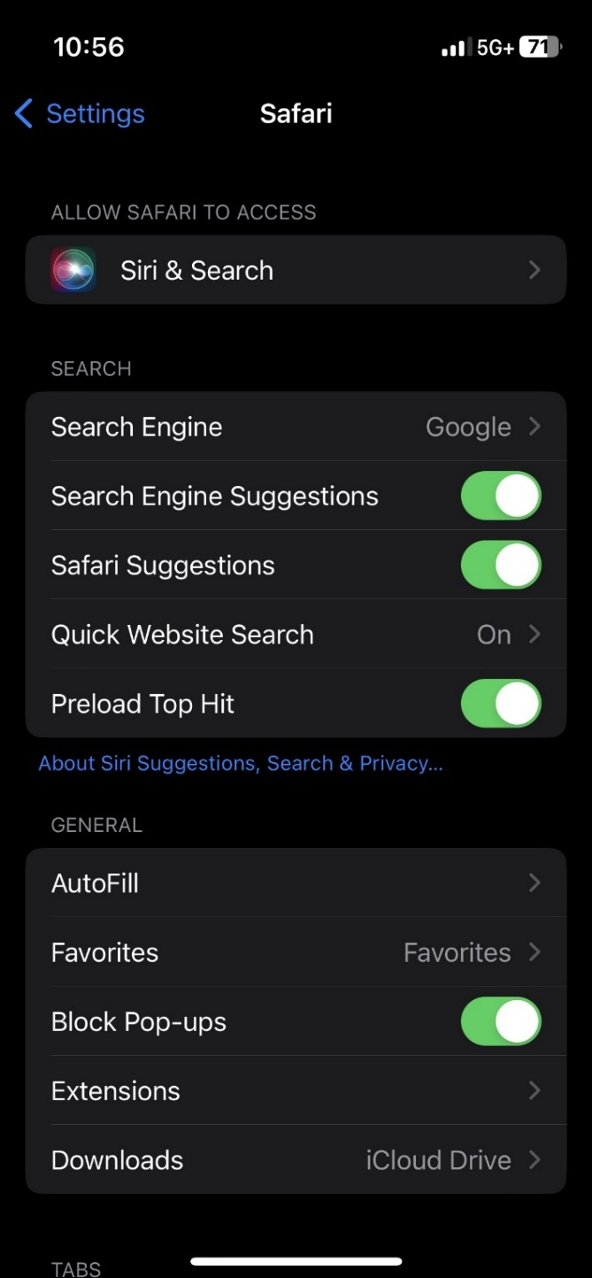
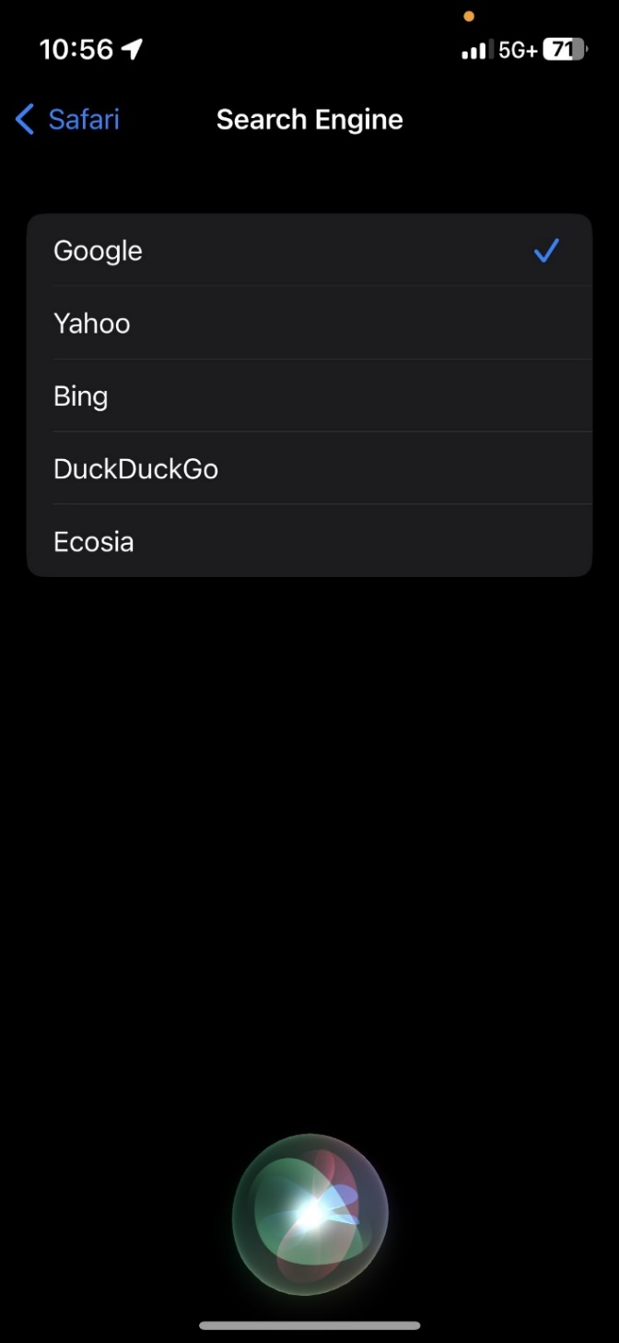
What is the Case About? (Changed Slightly in iOS18)
Picker iPhone (11 Oct 2023)

Slide 41
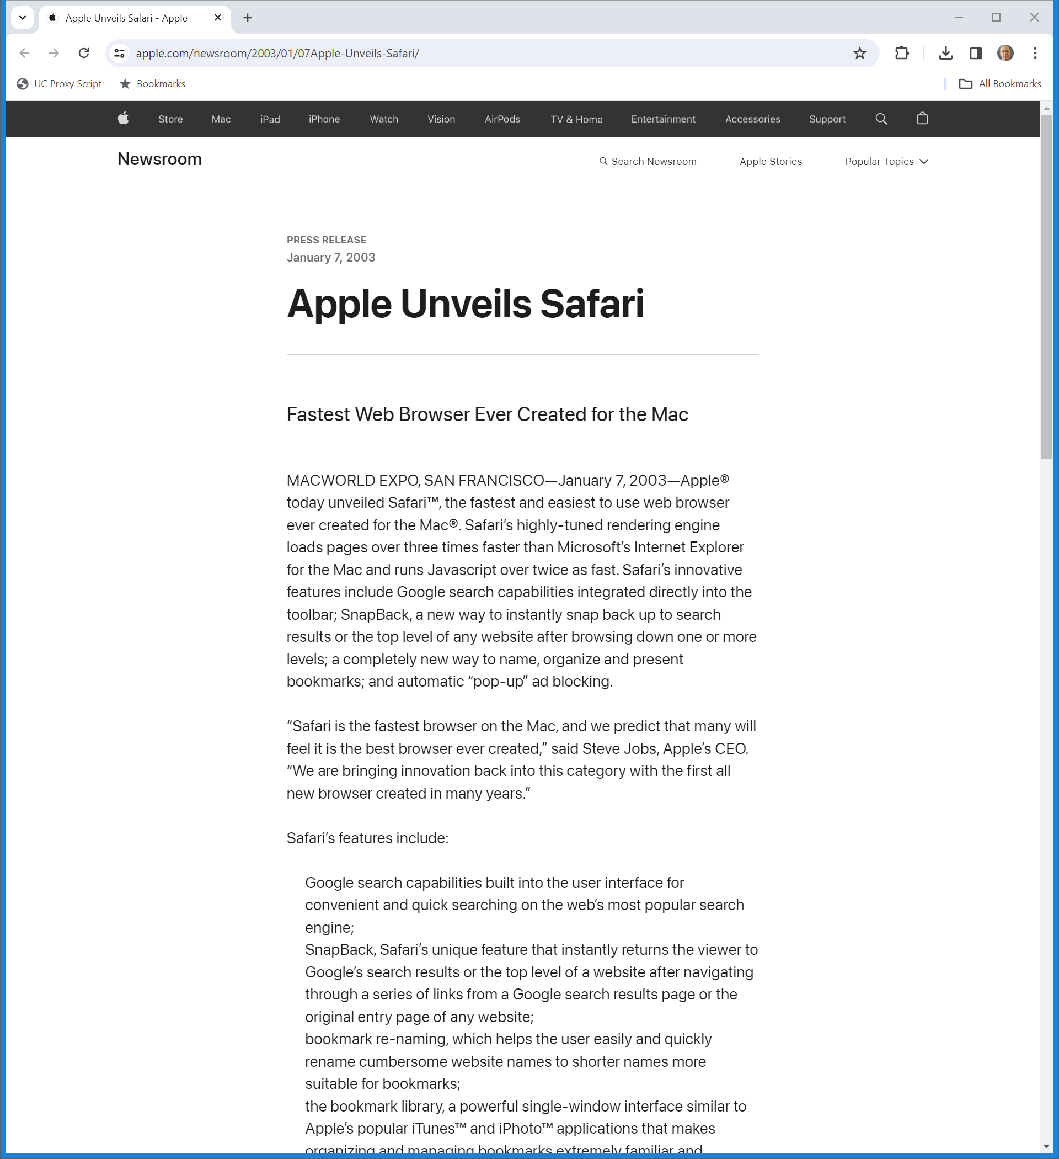
Jan 2003: Apple Announces Mac Safari
Apple (7 Jan 2003)
Notes:
https://www.apple.com/newsroom/2003/01/07Apple-Unveils-Safari/

Slide 42
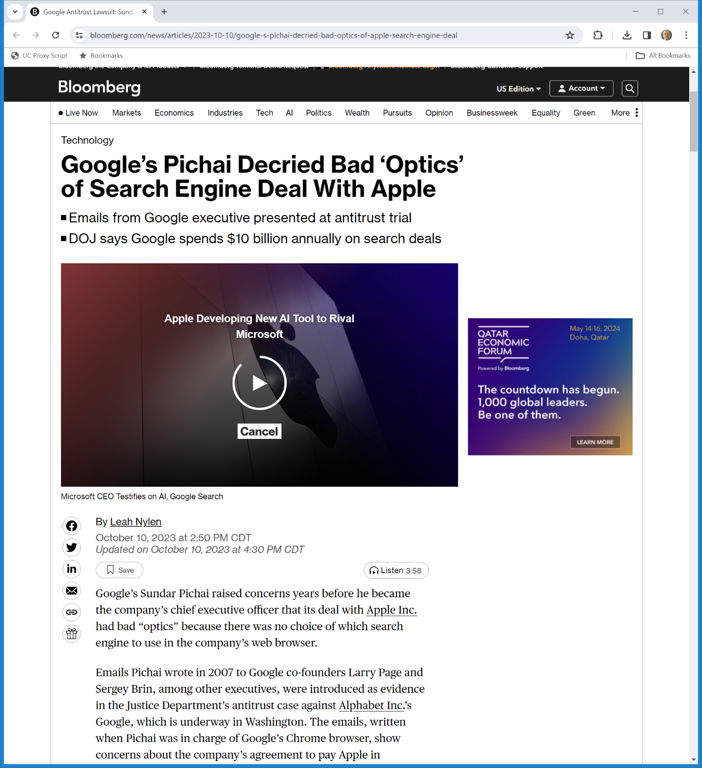
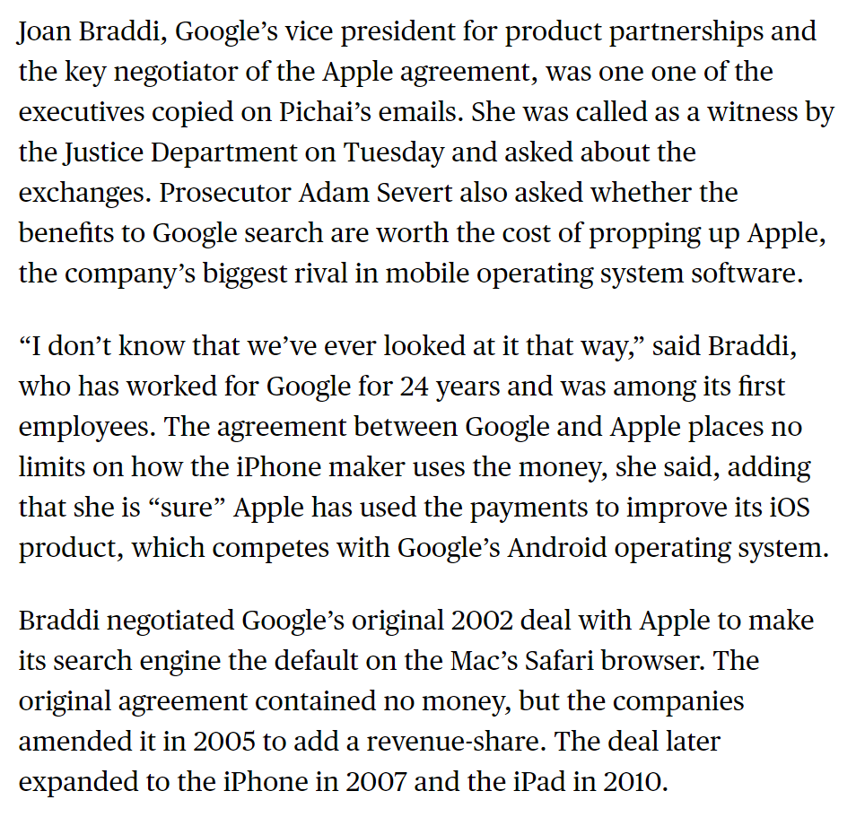
No $ Initially But Changed in 2005
Bloomberg (10 Oct 2023)
Notes:
https://www.bloomberg.com/news/articles/2023-10-10/google-s-pichai-decried-bad-optics-of-apple-search-engine-deal

Slide 43
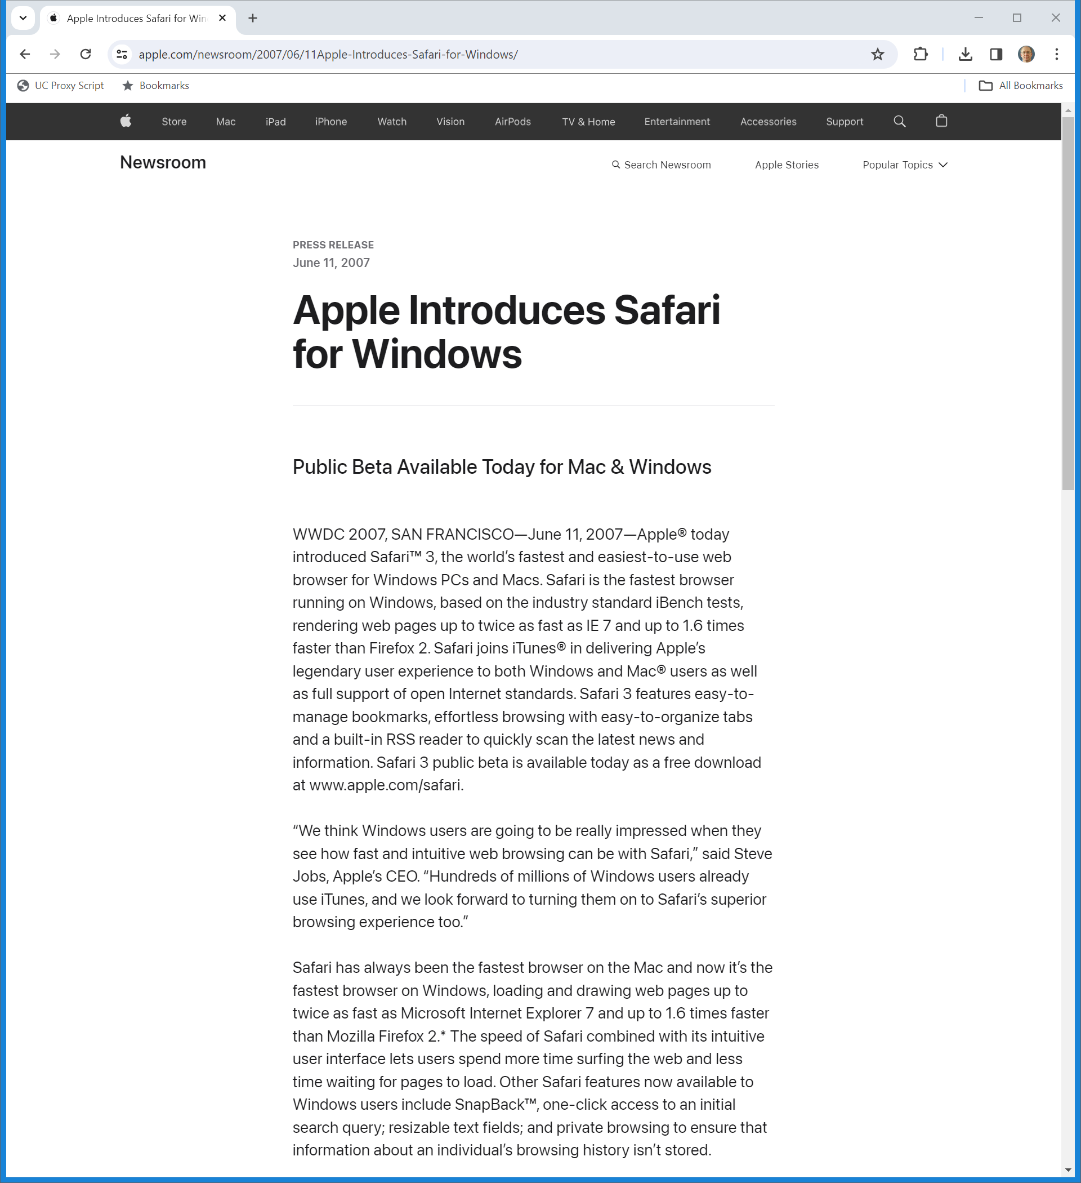
11 June 2007: Safari for Windows
Apple (11 June 2007)

Slide 44
1 June 2007: Apple Email: Choose Search Default
U.S. v. Google: UPX0677

Slide 45
4 June 2007: G Review of Possible Apple Deal
U.S. v. Google: UPX0126

Slide 46
The State of Apple Before the iPhone
U.S. v. Google: UPX0126

Slide 47
Payments to Apple
U.S. v. Google: UPX0126

Slide 48
What Apple Gets Now/What Apple Wants
U.S. v. Google: UPX0126

Slide 49
What Google Should Offer
U.S. v. Google: UPX0126

Slide 50
4 June 2007: Deal Offered to Apple
U.S. v. Google: UPX0072

Slide 51
Sent using Blackberry
U.S. v. Google: UPX0072

Slide 52
6 June 2007: Possible Deal Terms
U.S. v. Google: UPX0552

Slide 53
6 June 2007: Possible Deal Terms
U.S. v. Google: UPX0552

Slide 54
Users; Optics
U.S. v. Google: UPX0552

Slide 55
Aug 2024: Liability Phase Ruling
U.S. v. Google (D.D.C. Aug 5, 2024)

Slide 56
Whinston: Gov’t Expert
Whinston Direct Testimony (UPXD102) (5 Oct 2023)

Slide 57
Google’s Dominance Since 2009
Whinston Direct Testimony (UPXD 102) (5 Oct 2023)

Slide 58
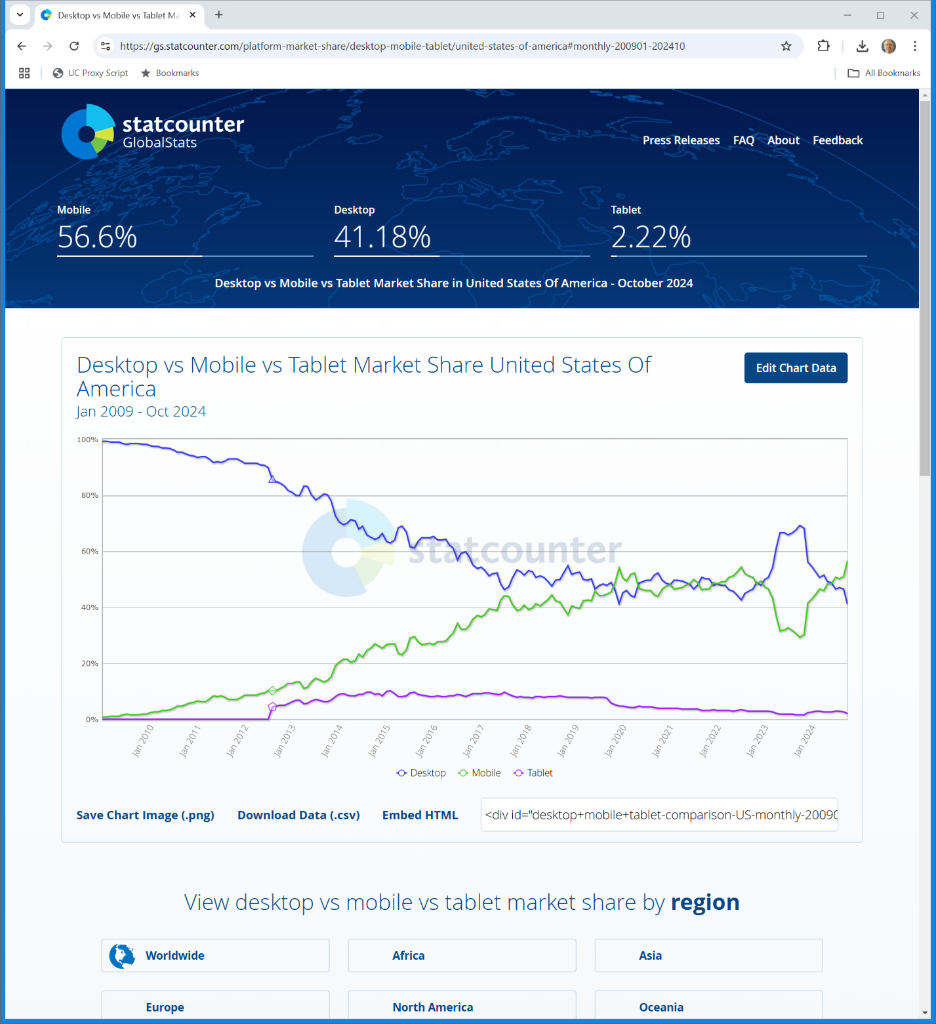
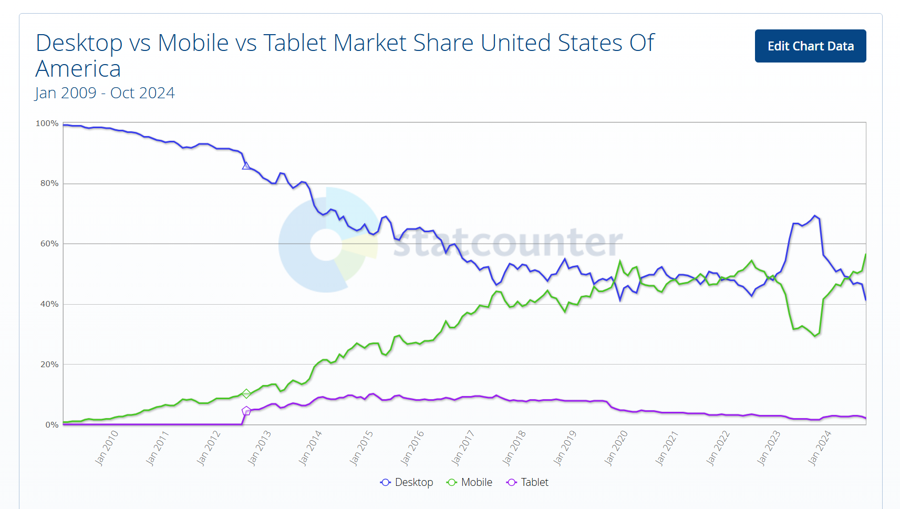
U.S. Device Share
Jan 2009: Desktop: 99.26
statcounter (27 Nov 2024)
Notes:
https://gs.statcounter.com/platform-market-share/desktop-mobile-tablet/united-states-of-america#monthly-200901-202410

Slide 59
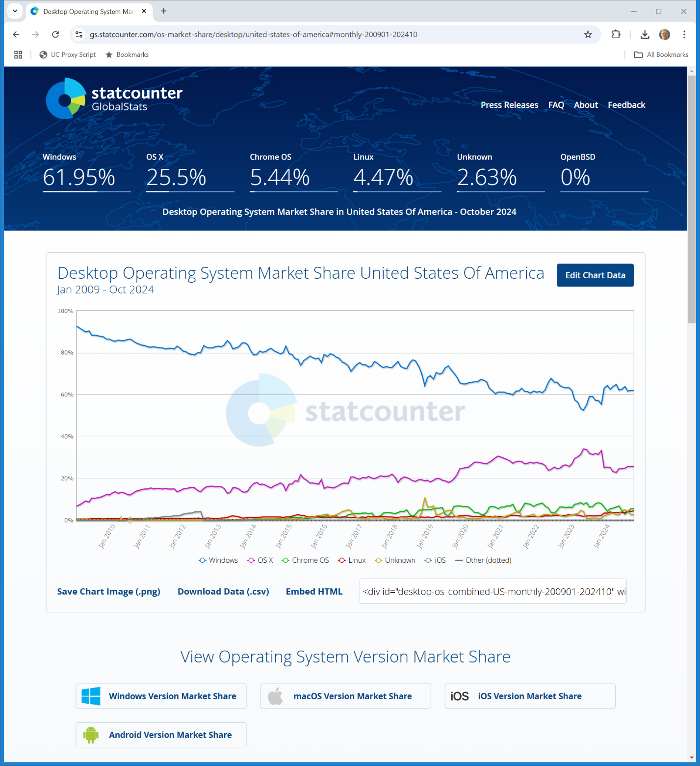

U.S. Desktop OS Market Shares
Jan 2009: W92.37/M6.73
statcounter (27 Nov 2024)
Notes:
https://gs.statcounter.com/os-market-share/desktop/united-states-of-america#monthly-200901-202410

Slide 60
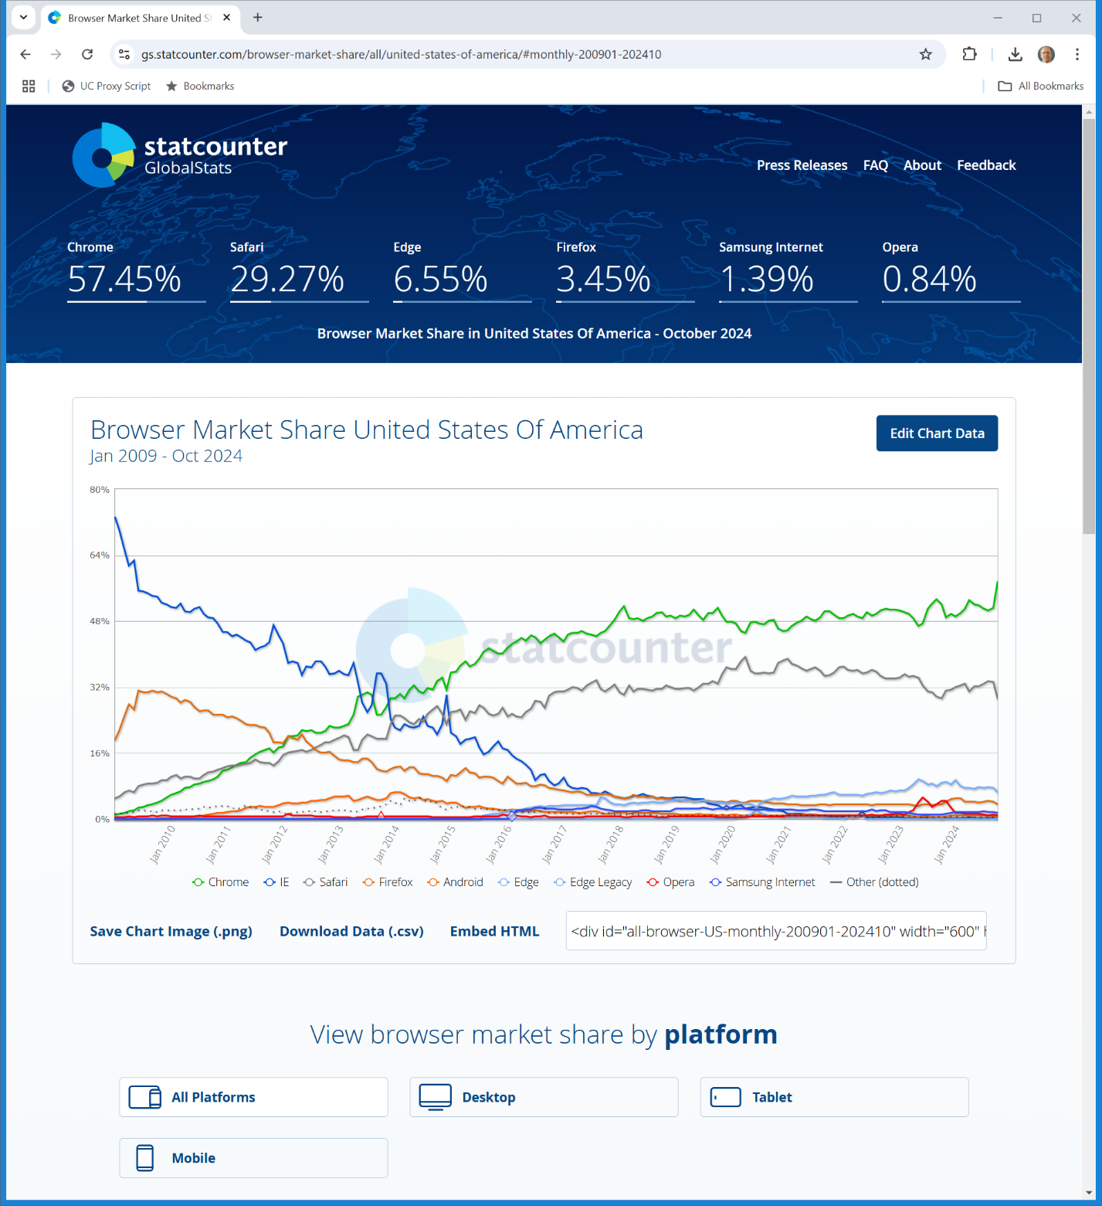
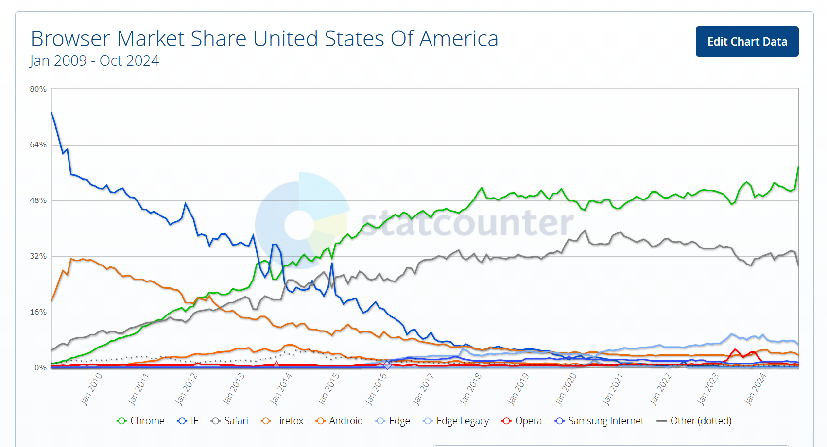
U.S. Browser Market Shares
Jan 2009: IE73.01/F19.25/S5.02
statcounter (27 Nov 2024)
Notes:
https://gs.statcounter.com/browser-market-share/all/united-states-of-america/#monthly-200901-202410

Slide 61
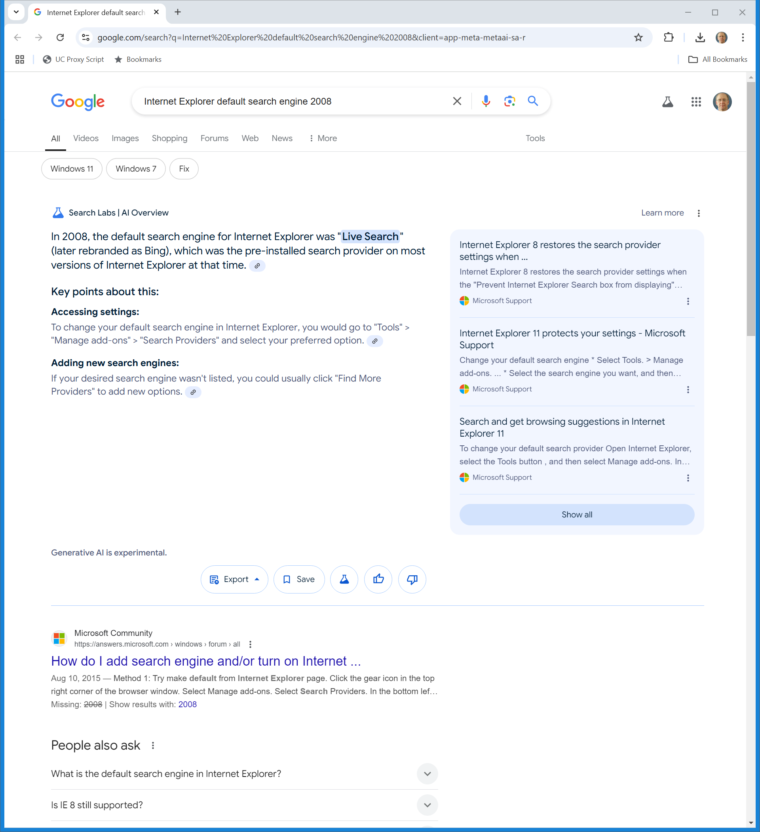
IE Default Search Engine in 2008?
Jan 2009: MS controls 92% of defaults? 73%?
Google (27 Nov 2024)
Notes:
https://www.google.com/search?q=Internet%20Explorer%20default%20search%20engine%202008&client=app-meta-metaai-sa-r

Slide 62
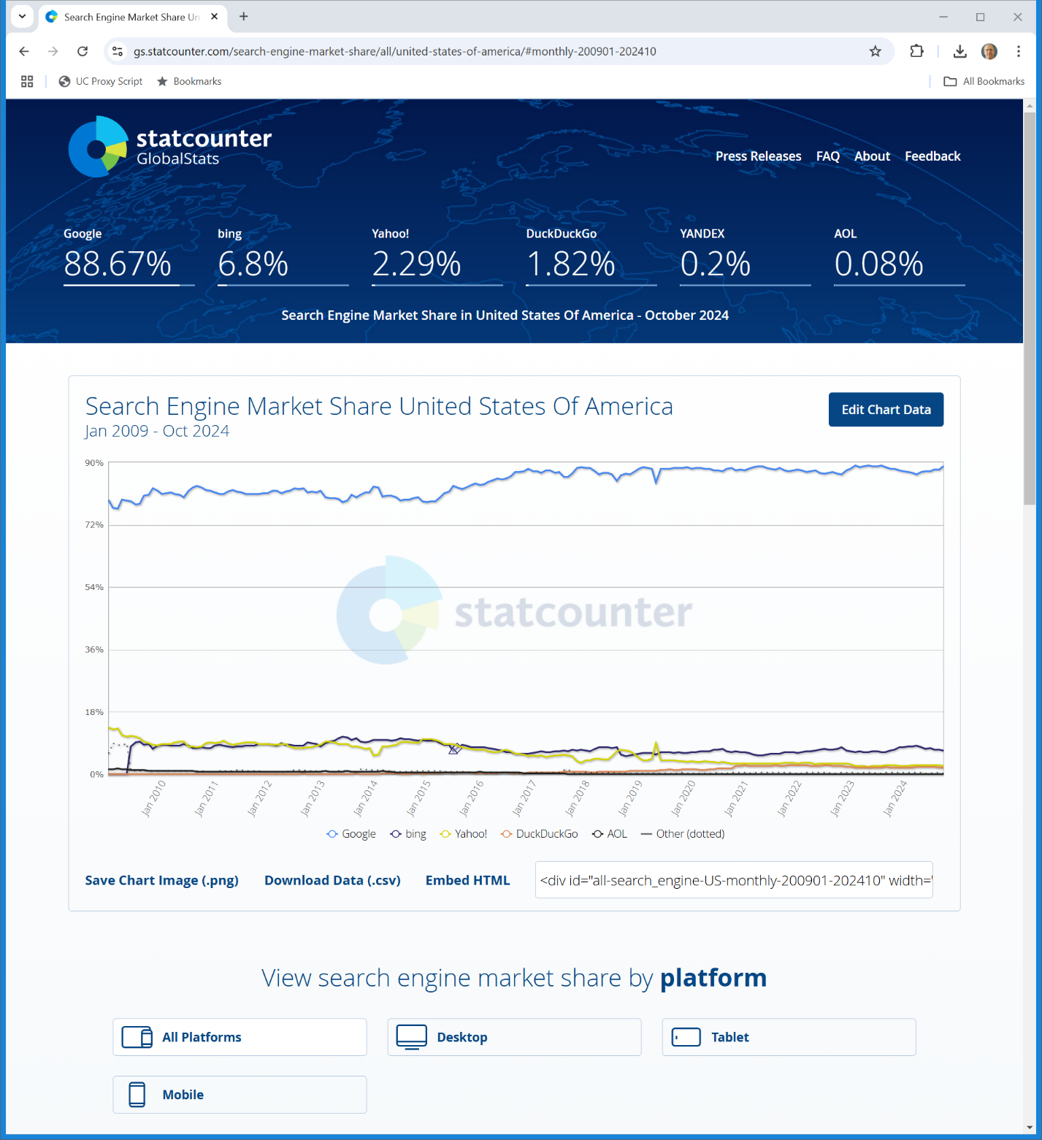
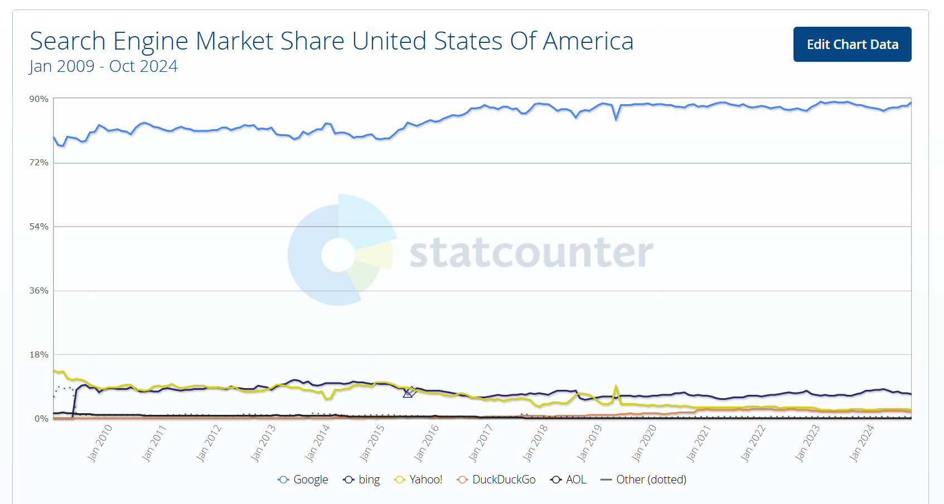
U.S. Search Engine Market Shares
Jun 2009: G78.67/Y10.98/B8.08
statcounter (27 Nov 2024)
Notes:
https://gs.statcounter.com/search-engine-market-share/all/united-states-of-america/#monthly-200901-202410

Slide 63
Looking to the Future
TTYN (1 of 4)
Hypo
From this baseline position, two events will occur
(1) Chrome will displace IE as the leading browser seemingly by building a better product
(2) Microsoft will achieve no meaningful position in smartphone operating systems while Apple and Google will rise to form a duopoly

Slide 64
Looking to the Future
TTYN (2 of 4)
Hypo
Google, via Chrome and Android, and Apple with its control of iOS and Safari, will have the same power over defaults that Microsoft had with Windows and IE when the personal computer was dominant

Slide 65
Looking to the Future
TTYN (3 of 4)
Questions
Does Google need to somehow not set Google as the default search engine in Chrome? What would it do in the alternative?
Google’s business model for Android is to give the software away for free but to charge in-kind by requiring the distribution of Chrome (and more) and by having rules regarding search defaults

Slide 66
Looking to the Future
TTYN (4 of 4)
Questions
Is Google allowed to do that?
What would legitimate competition look like between Bing and Google Search for distribution contracts with Apple, Verizon etc?
Given these two facts, what is your forecast as to Google’s market share in search in 2024 given the starting position in 2009? Lower? Higher?

