Slide 1
Class 22: Mon 17 Nov 2025 Antitrust Fall 2025 Big Tech: App Stores
Randal C. Picker
James Parker Hall Distinguished Service Professor of Law
The Law School
The University of Chicago
Copyright © 2022-25 Randal C. Picker. All Rights Reserved.

Slide 2
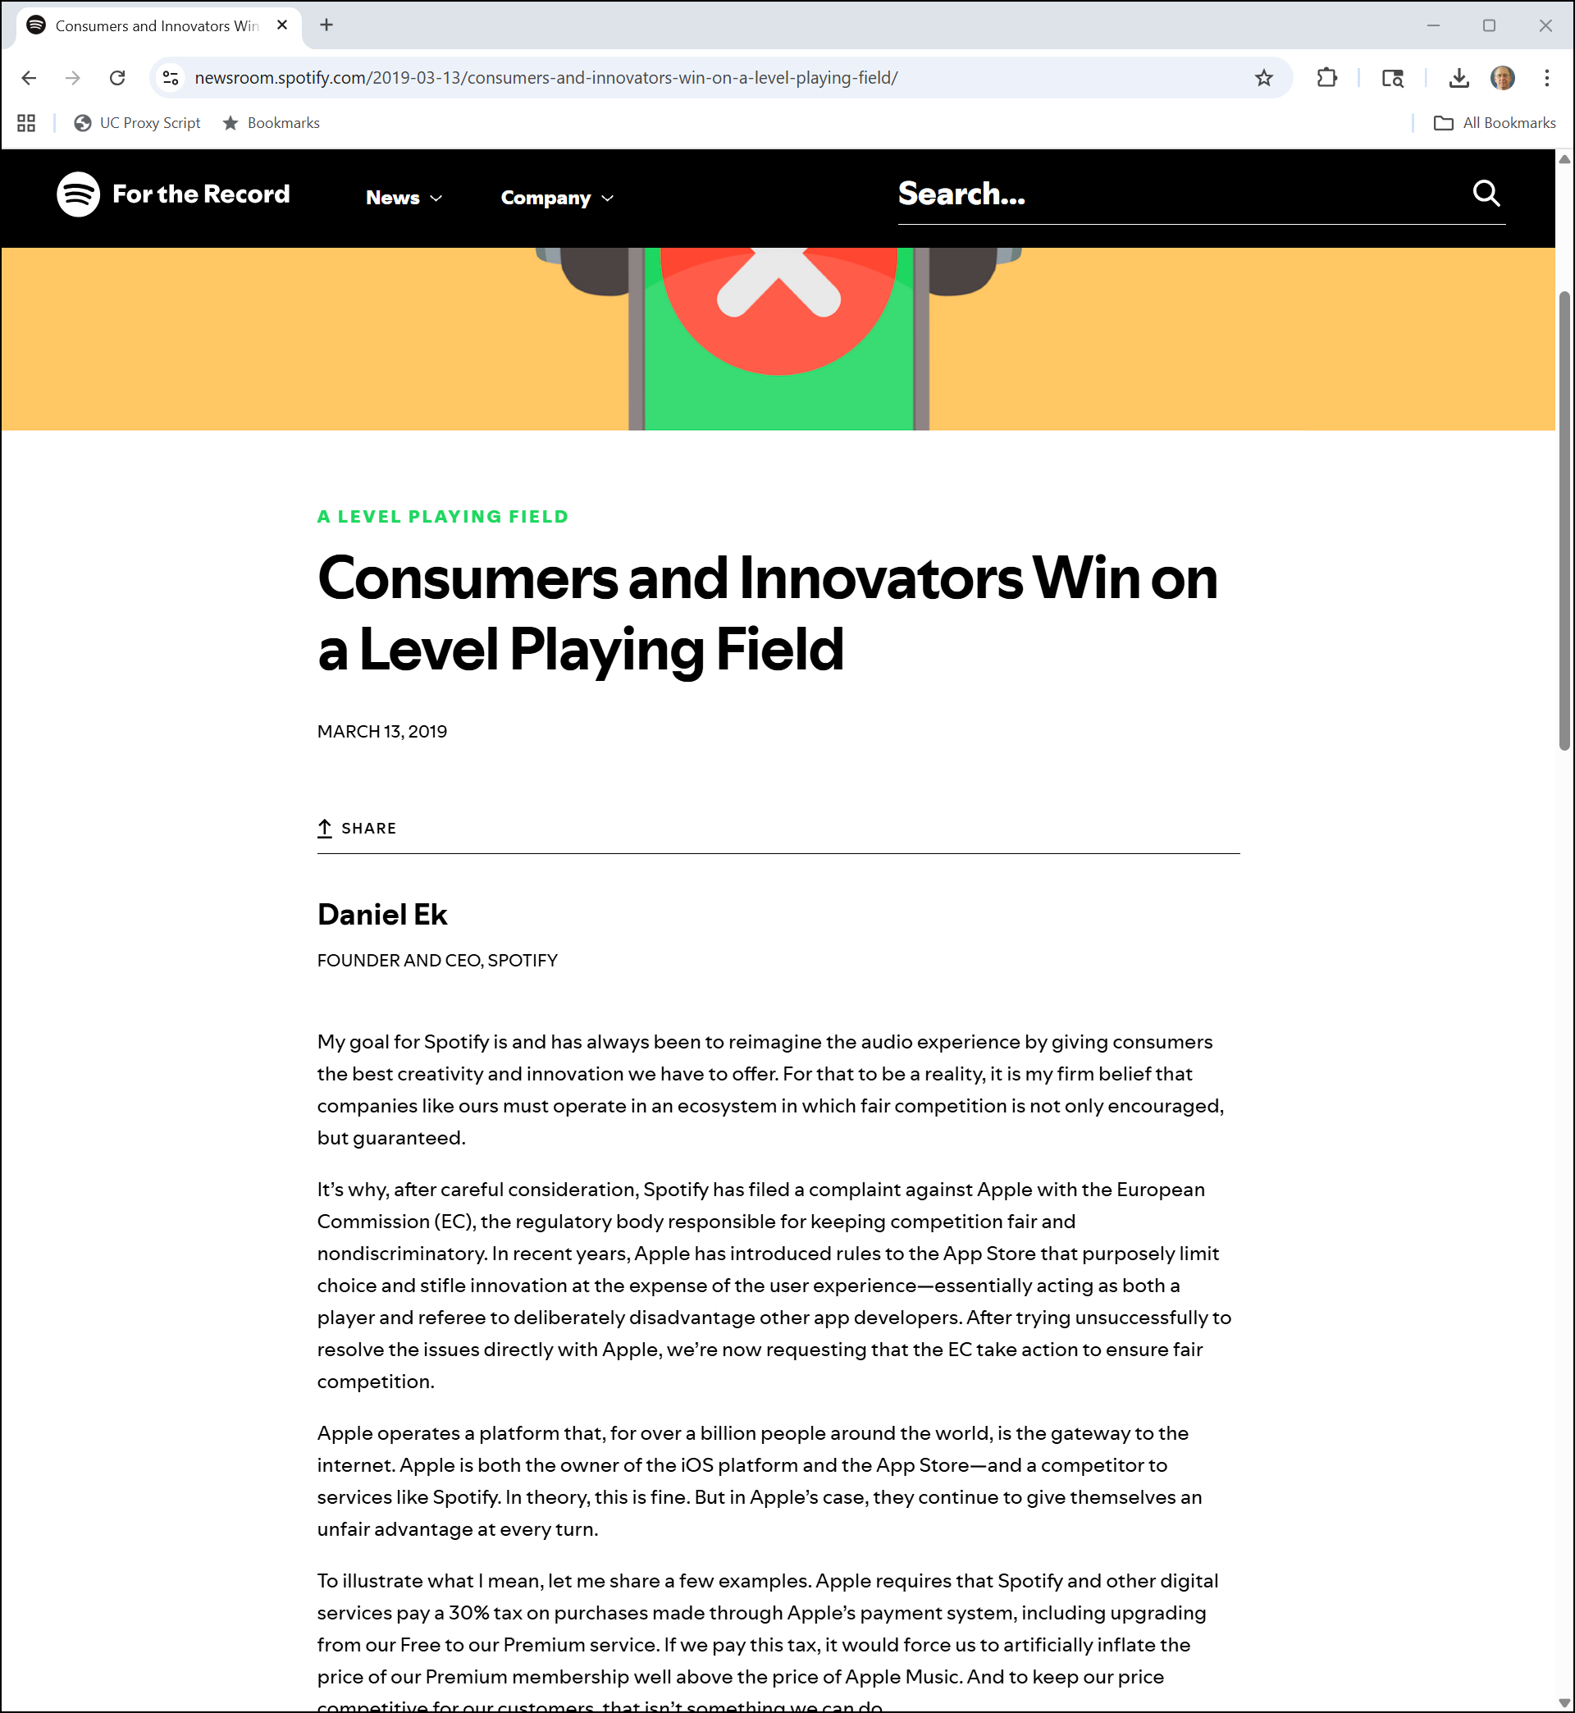
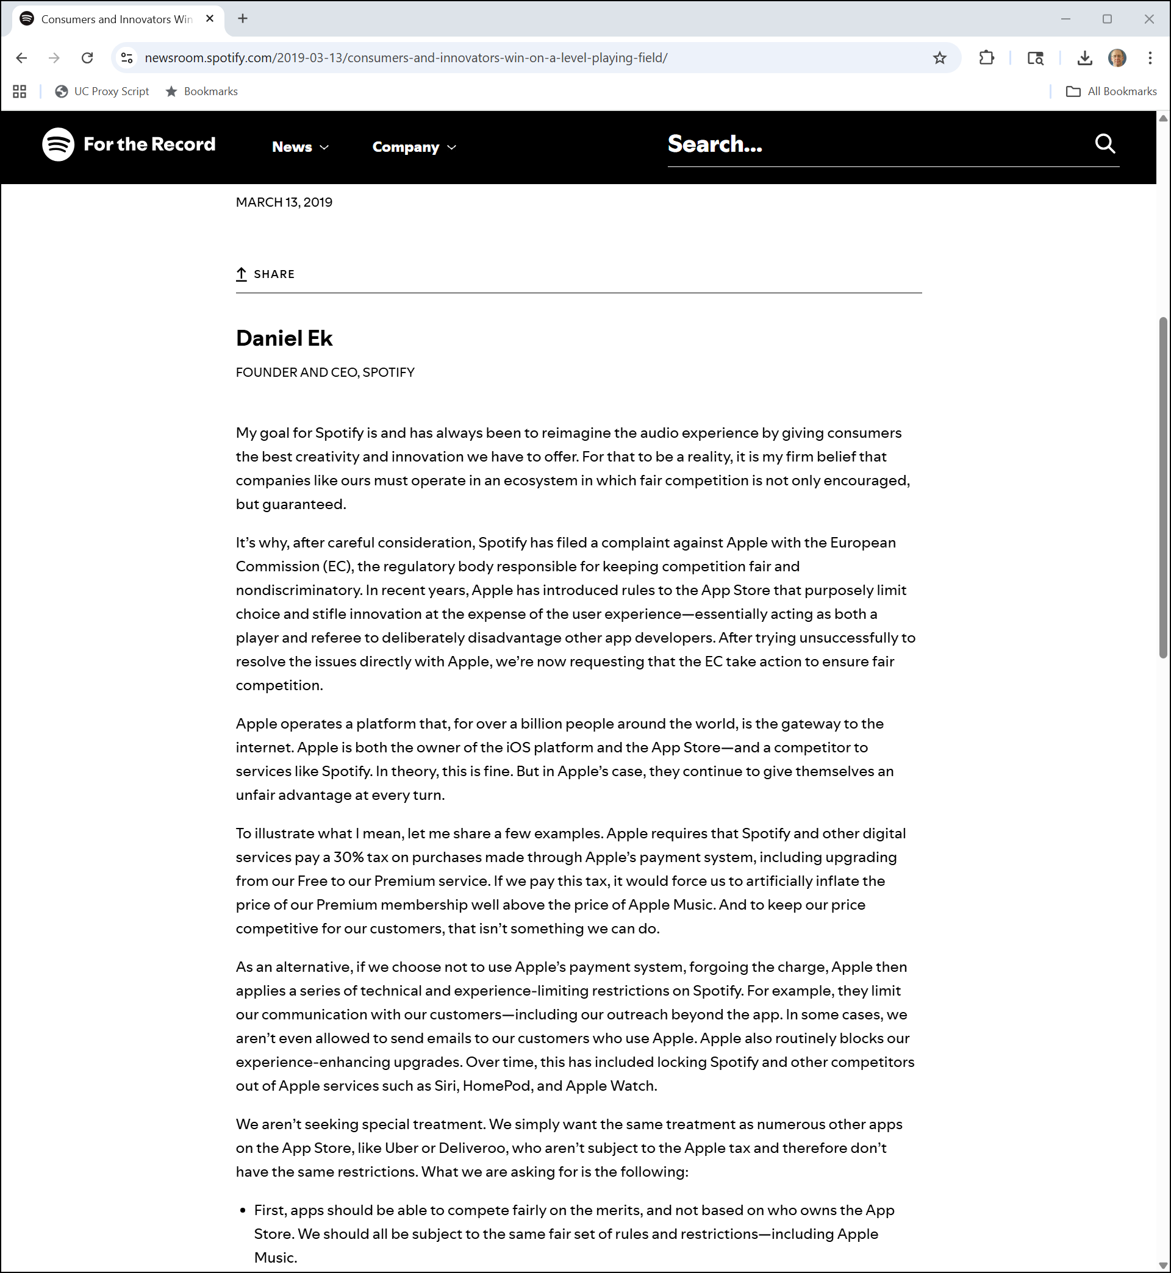
Spotify EC Complaint
Spotify (13 Mar 2019)
Notes:
https://newsroom.spotify.com/2019-03-13/consumers-and-innovators-win-on-a-level-playing-field/

Slide 3
Why Is Spotify Unhappy?
Spotify (13 Mar 2019)
Notes:
https://newsroom.spotify.com/2019-03-13/consumers-and-innovators-win-on-a-level-playing-field/

Slide 4
The Digital Markets Act: Contestable and Fair Markets
DMA (14 Sept 2022)

Slide 5
Going Beyond Competition Law
DMA (14 Sept 2022)

Slide 6
Contestability and Fairness
DMA (14 Sept 2022)

Slide 7
Understanding Contestability
DMA (14 Sept 2022)

Slide 8
Understanding Unfairness
DMA (14 Sept 2022)

Slide 9
Redesigning the App Store
TTYN (1 of 2)
Questions
You are Apple. Spotify is unhappy and talking to the EC, plus the DMA has been passed
Do you want to reset the pricing structure of the app store? Reduce the 30% royalty? Put Spotify and Uber on a level playing field? Charge a fee for every app that is downloaded? Charge a fee for companies with lots of apps?

Slide 10
Redesigning the App Store
TTYN (2 of 2)
Questions
How do you want to take into account the possibility that the EC may force you other App Stores?

Slide 11
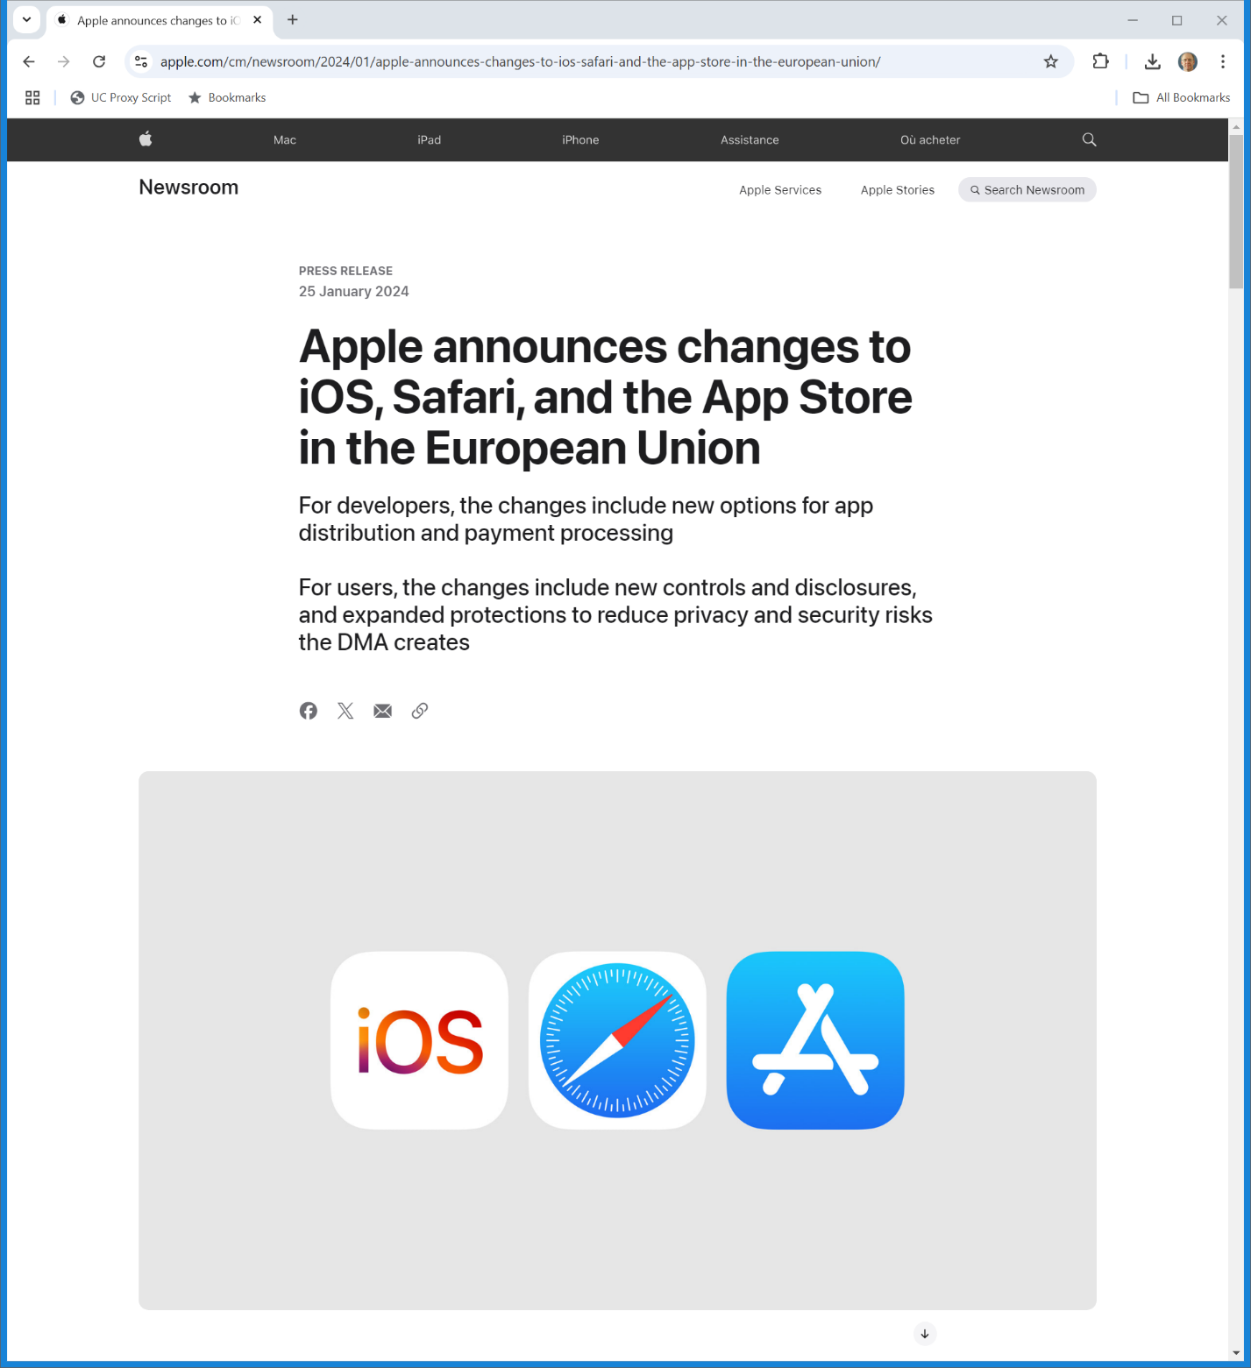
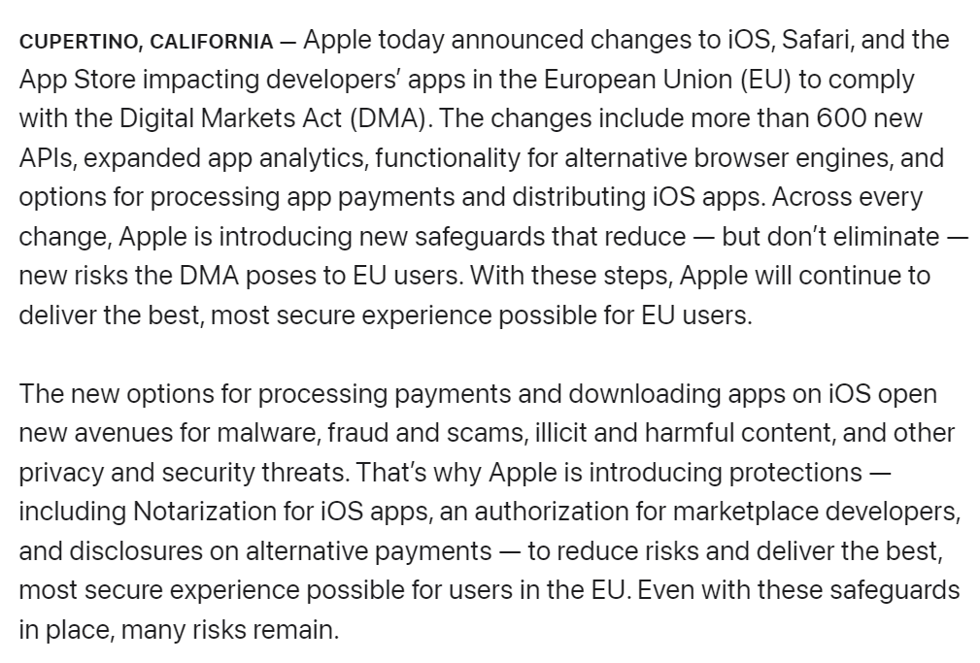
Apple DMA Revamp
Apple (25 Jan 2024)
Notes:
https://www.apple.com/cm/newsroom/2024/01/apple-announces-changes-to-ios-safari-and-the-app-store-in-the-european-union/

Slide 12
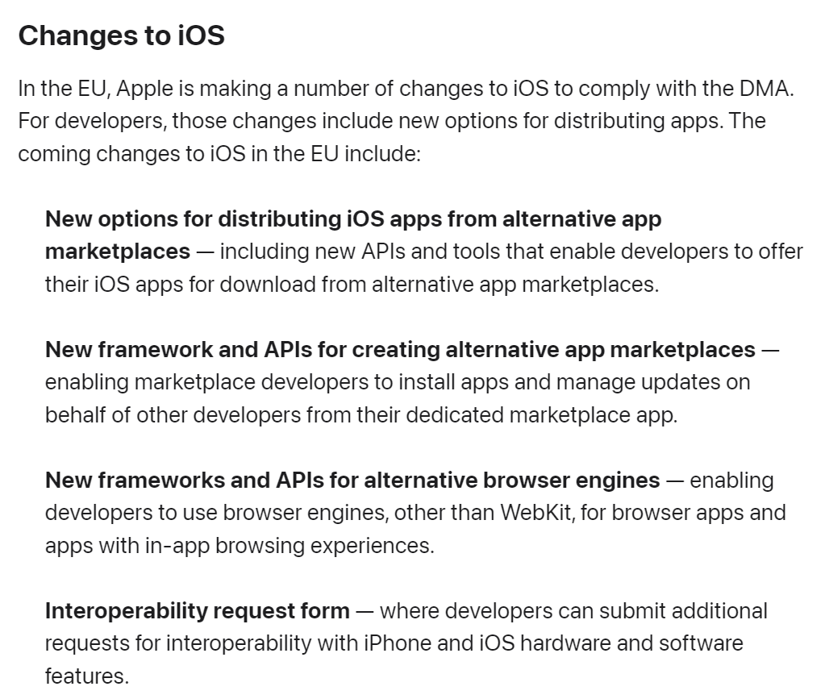
Alternative App Stores
Apple (25 Jan 2024)
Notes:
https://www.apple.com/cm/newsroom/2024/01/apple-announces-changes-to-ios-safari-and-the-app-store-in-the-european-union/

Slide 13
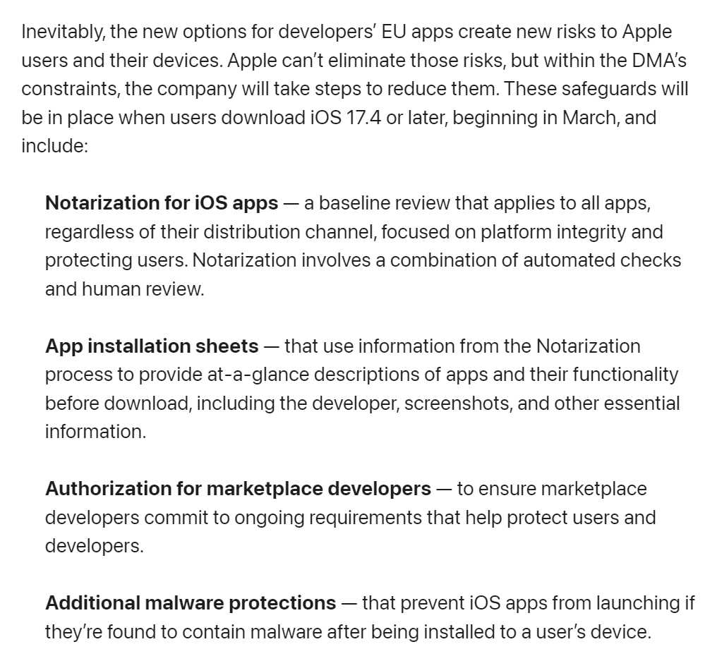
New Security Approaches
Apple (25 Jan 2024)
Notes:
https://www.apple.com/cm/newsroom/2024/01/apple-announces-changes-to-ios-safari-and-the-app-store-in-the-european-union/

Slide 14
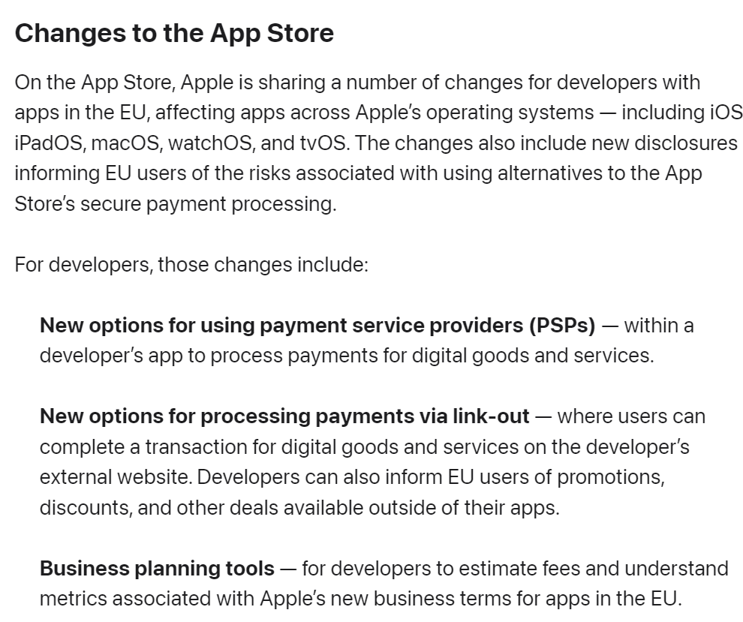
Alternative Payment Systems
Apple (25 Jan 2024)
Notes:
https://www.apple.com/cm/newsroom/2024/01/apple-announces-changes-to-ios-safari-and-the-app-store-in-the-european-union/

Slide 15
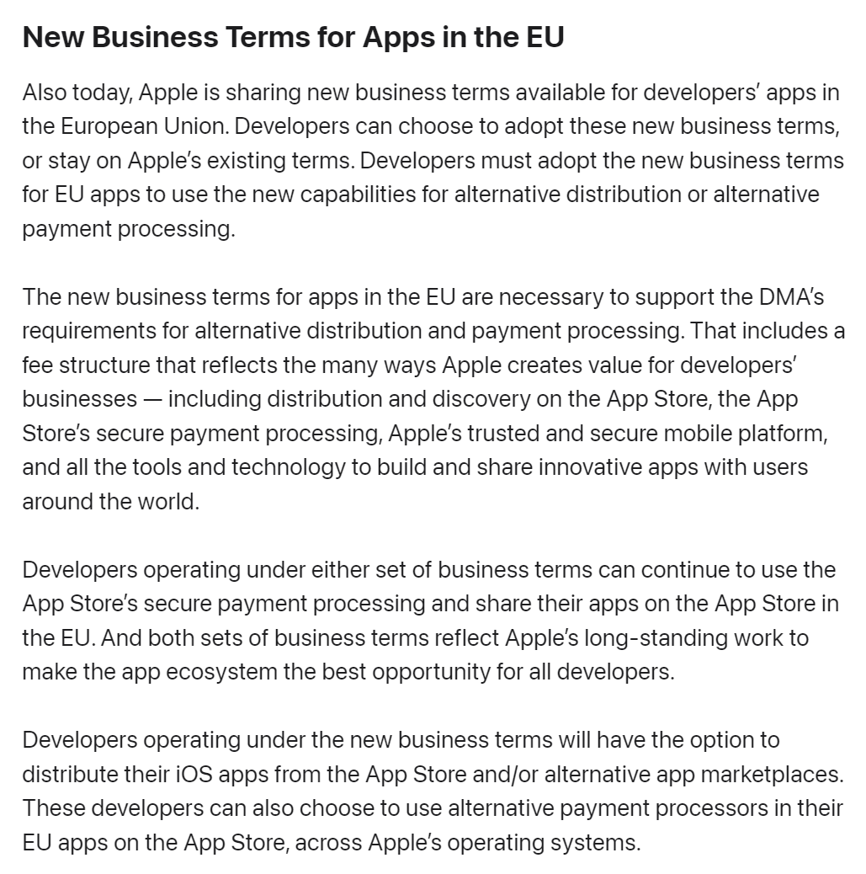
New Business Terms
Apple (25 Jan 2024)
Notes:
https://www.apple.com/cm/newsroom/2024/01/apple-announces-changes-to-ios-safari-and-the-app-store-in-the-european-union/

Slide 16
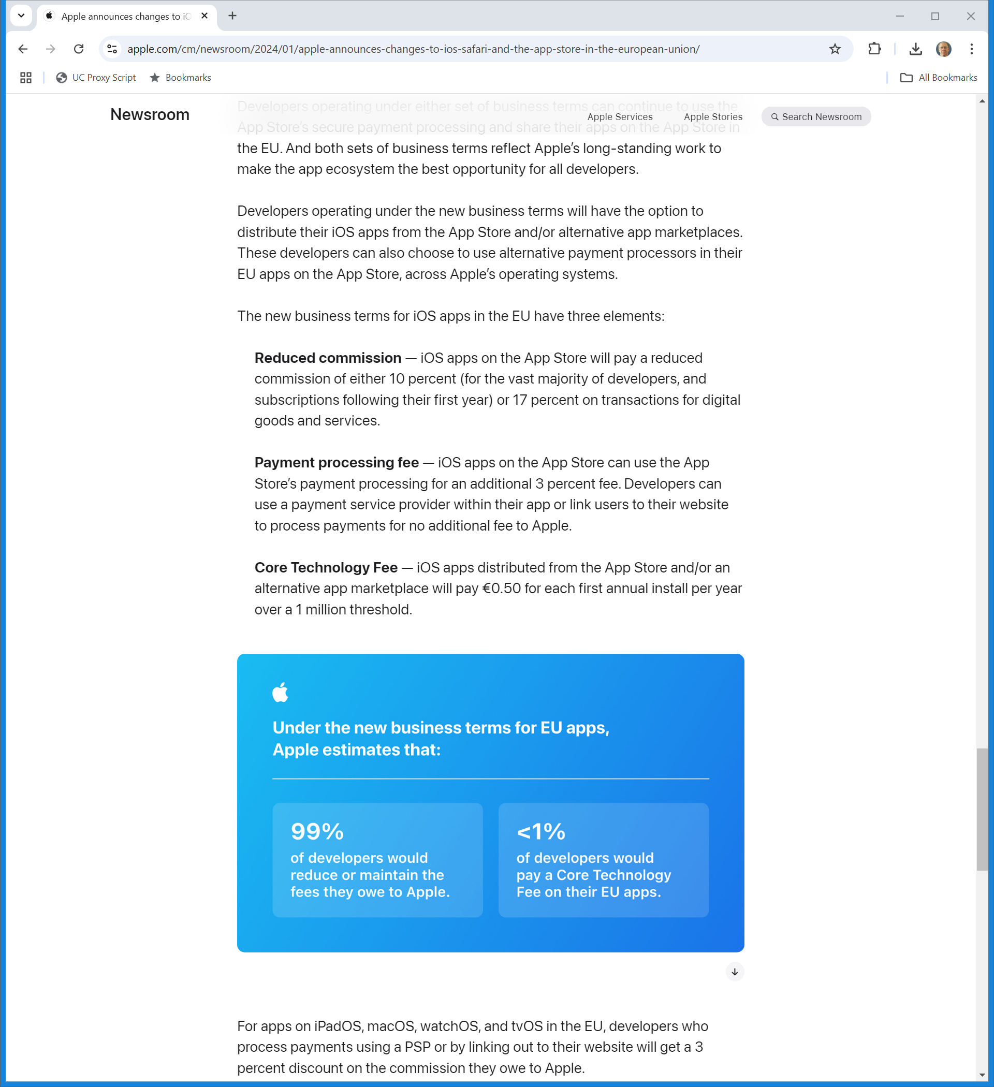
New Fee Structure
Apple (25 Jan 2024)
Notes:
https://www.apple.com/cm/newsroom/2024/01/apple-announces-changes-to-ios-safari-and-the-app-store-in-the-european-union/

Slide 17
Consequences
Apple (25 Jan 2024)
Notes:
https://www.apple.com/cm/newsroom/2024/01/apple-announces-changes-to-ios-safari-and-the-app-store-in-the-european-union/

Slide 18
Apple Fined €1.8B
European Commission (4 Mar 2024)

Slide 19
Anti-Steering as Unfair Trading Condition
European Commission (4 Mar 2024)

Slide 20
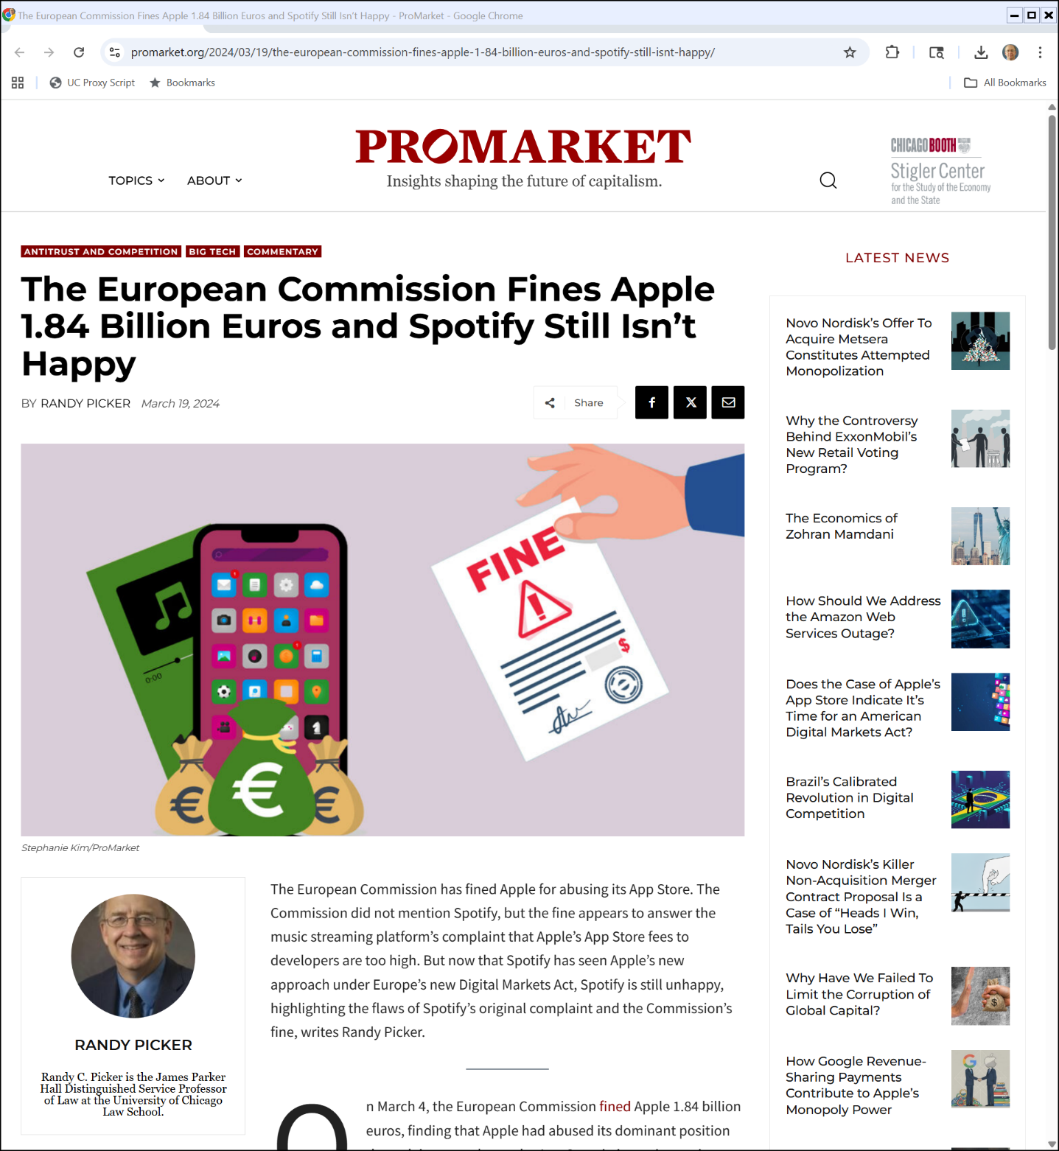

Me on This
ProMarket (19 Mar 2024)

Slide 21
Apple and DMA: Steering and Fees
European Commission (24 June 2024)
Notes:
https://ec.europa.eu/commission/presscorner/detail/en/ip_24_3433

Slide 22
Steering/New Fees
European Commission (24 June 2024)
Notes:
https://ec.europa.eu/commission/presscorner/detail/en/ip_24_3433

Slide 23
More Concerns
European Commission (24 June 2024)
Notes:
https://ec.europa.eu/commission/presscorner/detail/en/ip_24_3433

Slide 24
Apple’s Noncompliance?
European Commission (24 June 2024)
Notes:
https://ec.europa.eu/commission/presscorner/detail/en/ip_24_3433

Slide 25
Apple EU Commitments
European Commission (11 July 2024)
Notes:
https://ec.europa.eu/commission/presscorner/detail/en/ip_24_3706

Slide 26
NFC Access
European Commission (11 July 2024)
Notes:
https://ec.europa.eu/commission/presscorner/detail/en/ip_24_3706

Slide 27
Apple DMA Fine
European Commission (23 Apr 2025)

Slide 28
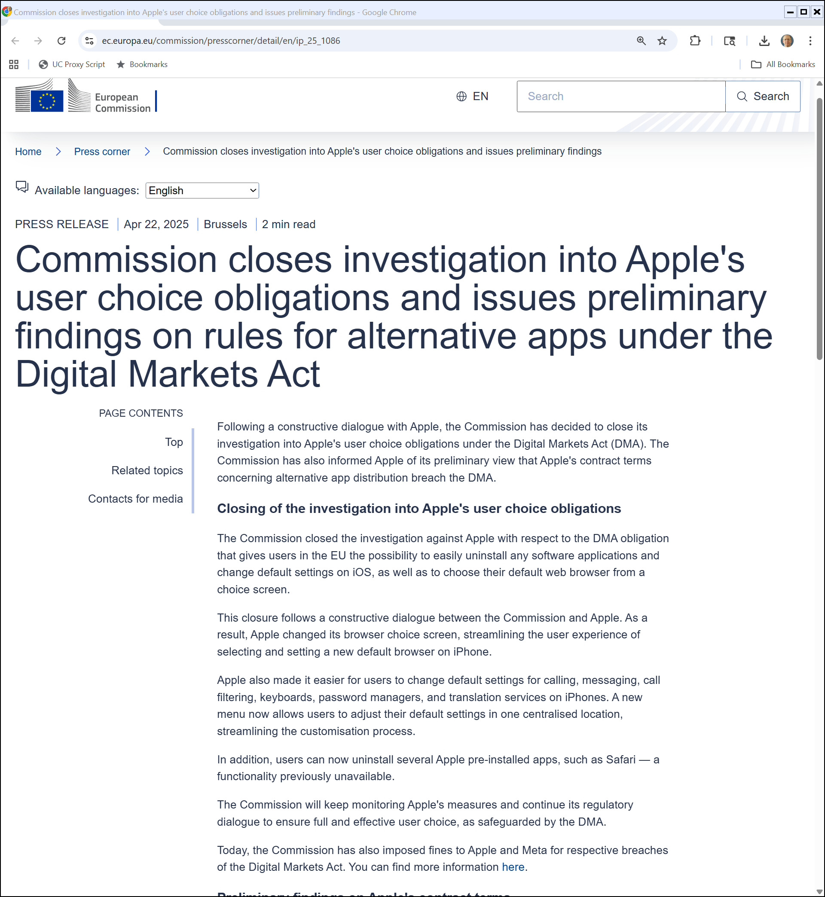
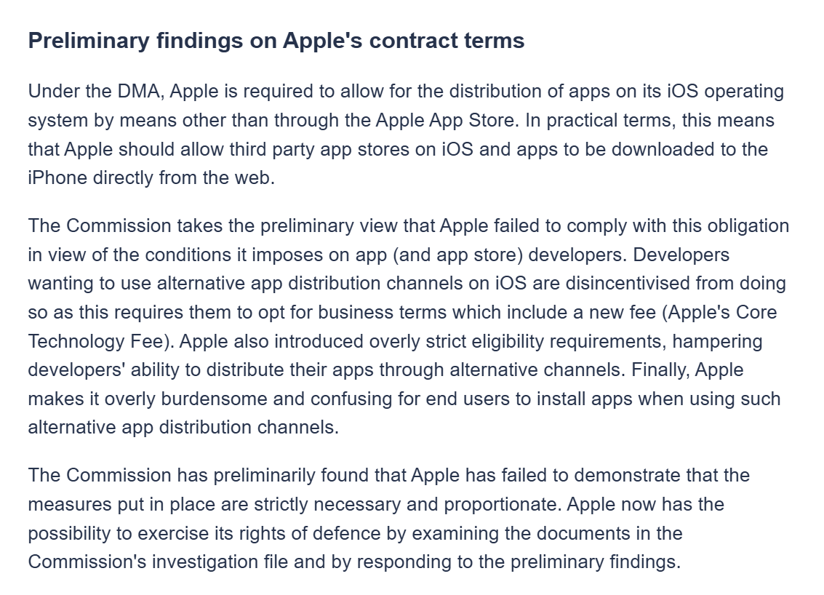
Continuing Concerns re New Fees
European Commission (22 Apr 2025)
Notes:
https://ec.europa.eu/commission/presscorner/detail/en/ip_25_1086

Slide 29
396 Pages from the UK
Kent v. Apple (UK Comp Appeal Tribunal 23 Oct 2025)

Slide 30
TOC
Kent v. Apple (UK Comp Appeal Tribunal 23 Oct 2025)

Slide 31
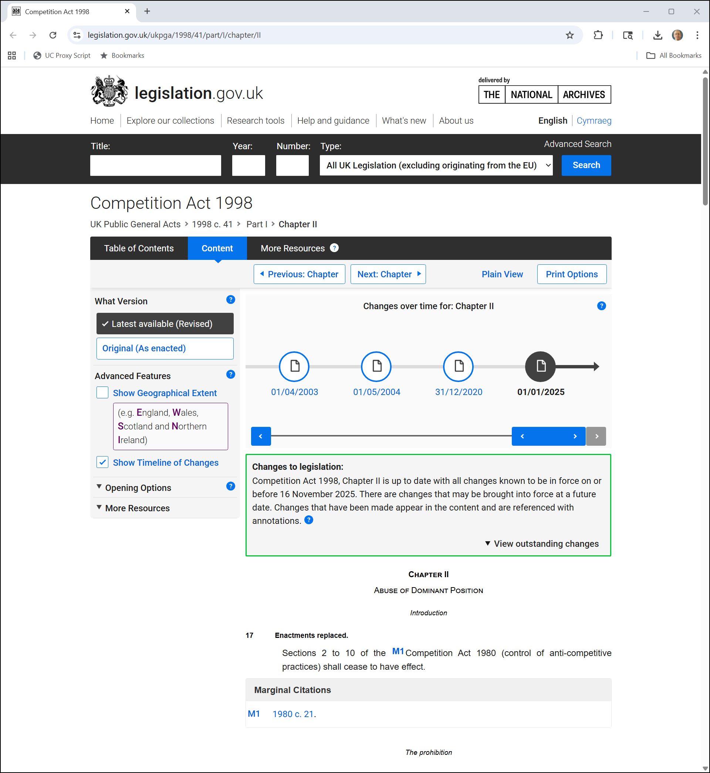
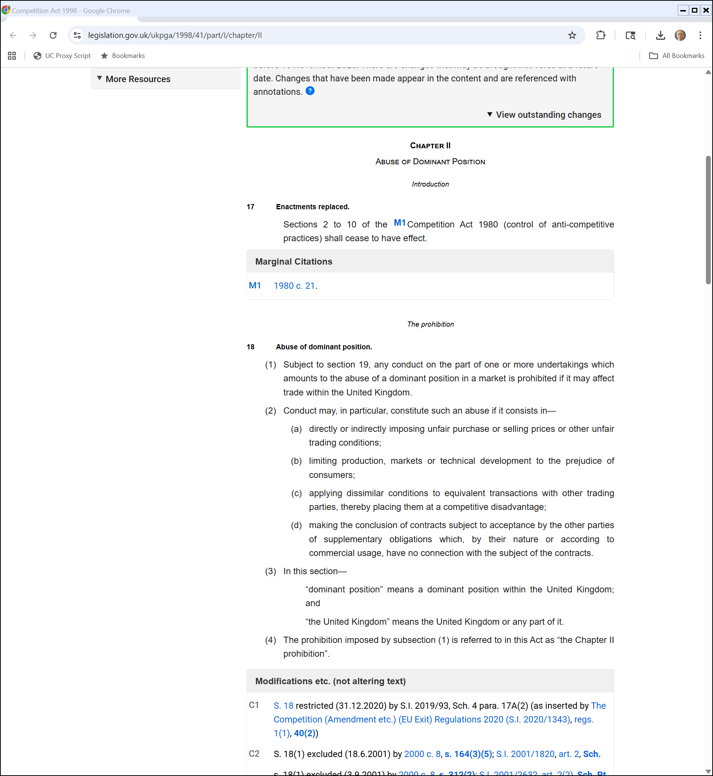
UK: Abuse of Dominant Position
UK Competition Act 1998
Notes:
https://www.legislation.gov.uk/ukpga/1998/41/part/I/chapter/II

Slide 32
Tying In App Payment Services to App Store
Kent v. Apple (UK Comp Appeal Tribunal 23 Oct 2025)

Slide 33
Excessive and Unfair Pricing
Kent v. Apple (UK Comp Appeal Tribunal 23 Oct 2025)

Slide 34
Excessive and Unfair Pricing
Kent v. Apple (UK Comp Appeal Tribunal 23 Oct 2025)

Slide 35
PC App Distribution: 12% to 20%
Kent v. Apple (UK Comp Appeal Tribunal 23 Oct 2025)

Slide 36
Excessive and Unfair
Kent v. Apple (UK Comp Appeal Tribunal 23 Oct 2025)

Slide 37
The 30% Bundle
Kent v. Apple (UK Comp Appeal Tribunal 23 Oct 2025)

Slide 38
17.5% Distribution/10% Payments
Kent v. Apple (UK Comp Appeal Tribunal 23 Oct 2025)

Slide 39
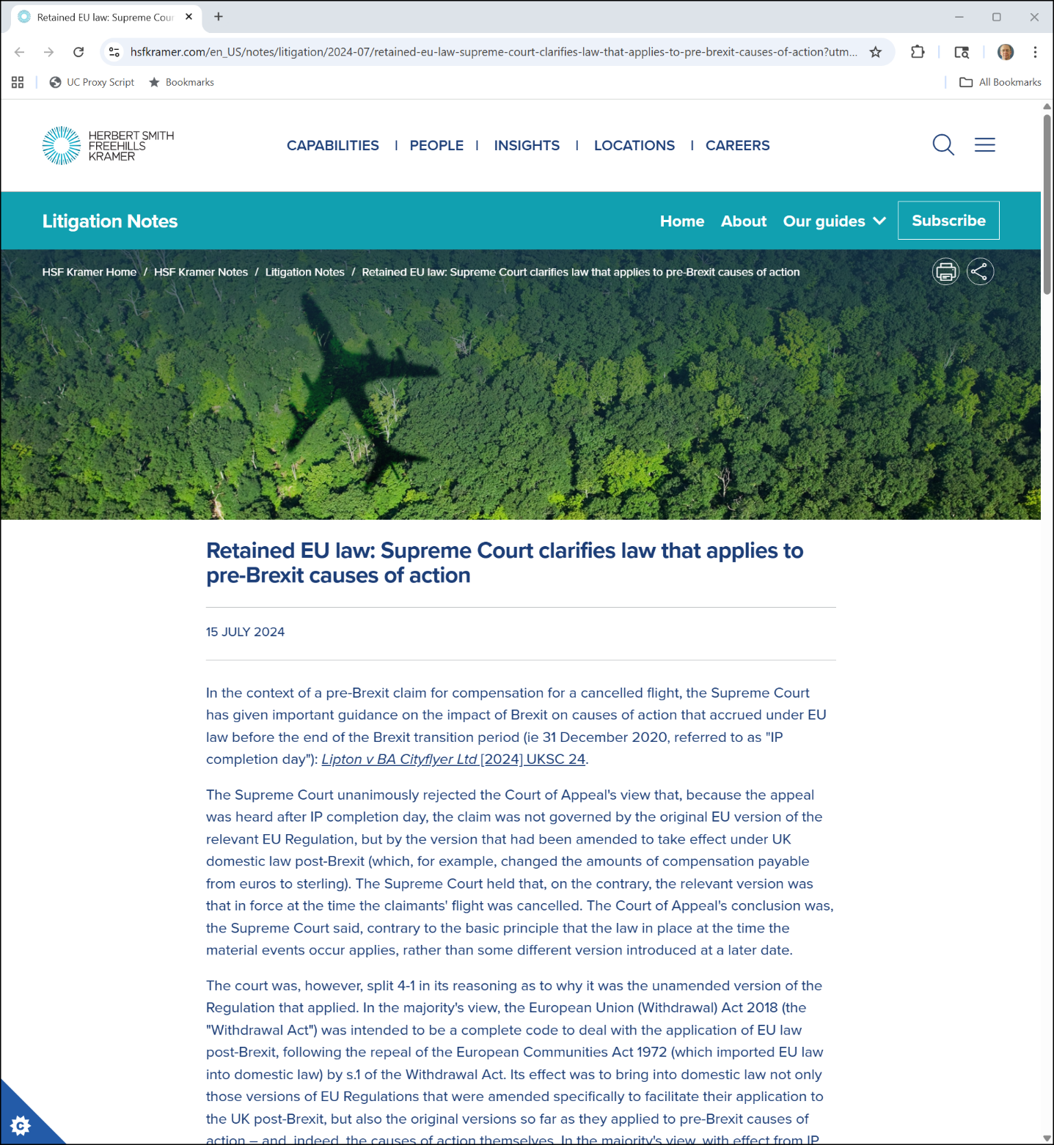

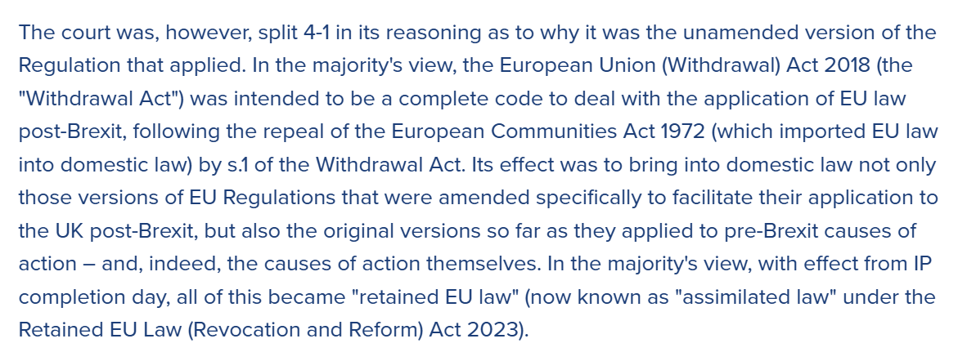
UK Law Post-Brexit
Herbert Smith (15 July 2024)

Slide 40
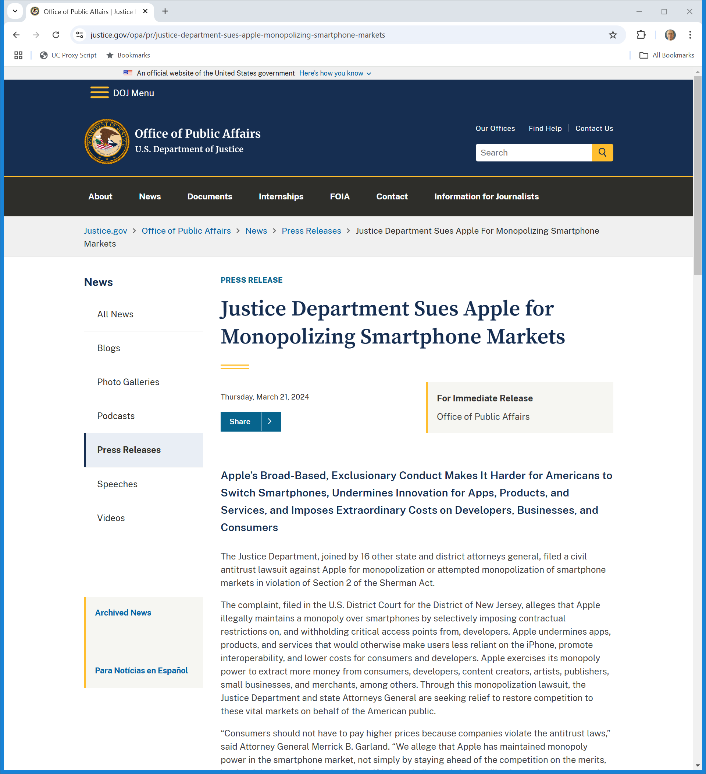
Mar 2024: DOJ Suit Against Apple
U.S. DOJ (21 Mar 2024)
Notes:
https://www.justice.gov/opa/pr/justice-department-sues-apple-monopolizing-smartphone-markets

Slide 41
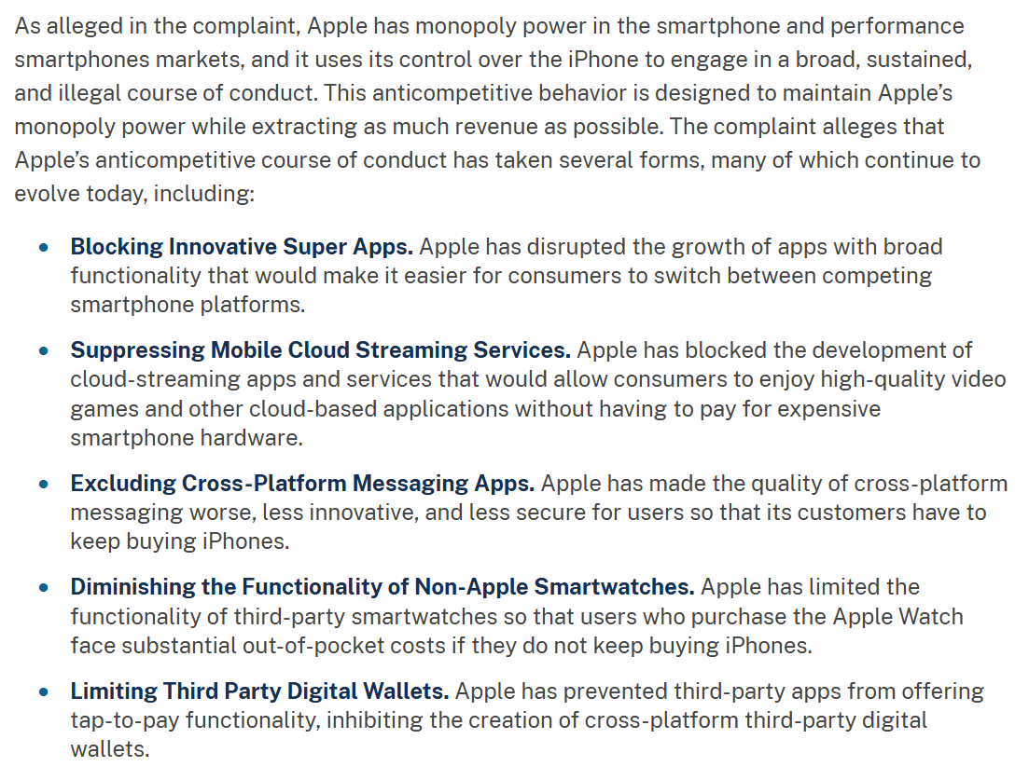
Mar 2024: DOJ Suit Against Apple
U.S. DOJ (21 Mar 2024)
Notes:
https://www.justice.gov/opa/pr/justice-department-sues-apple-monopolizing-smartphone-markets

Slide 42
Apple MTD Denied
U.S. v. Apple (30 June 2025)

Slide 43
Aug 2020: Epic Sues Google
Epic v. Google Complaint (13 Aug 2020)

Slide 44
Theory of the Case
Epic v. Google Complaint (13 Aug 2020)

Slide 45
Is There A Relevant Antitrust Market?
Epic v. Google Jury Verdict Form (11 Dec 2023)

Slide 46
Two Markets: App Distribution/In-App Billing
Epic v. Google Jury Verdict Form (11 Dec 2023)

Slide 47
Monopolization?: Yes
Epic v. Google Jury Verdict Form (11 Dec 2023)

Slide 48
Epic/Google Remedy
Google Play Store Injunction (N.D. Calif. 7 Oct 2024)

Slide 49
Preserving App Store Competition
Google Play Store Injunction (N.D. Calif. 7 Oct 2024)

Slide 50
More App Store Competition
Google Play Store Injunction (N.D. Calif. 7 Oct 2024)

Slide 51
Alt Payments/Outside App Info
Google Play Store Injunction (N.D. Calif. 7 Oct 2024)

Slide 52
Third-Party App Distribution
Google Play Store Injunction (N.D. Calif. 7 Oct 2024)

Slide 53
Distribute App Stores in Google Play
Google Play Store Injunction (N.D. Calif. 7 Oct 2024)

Slide 54
CA9 Appeal
Epic Games v. Google (CA9 31 July 2025)

Slide 55
Google Play Store and Two-Sided Markets
Epic Games (CA9 31 July 2025)

Slide 56
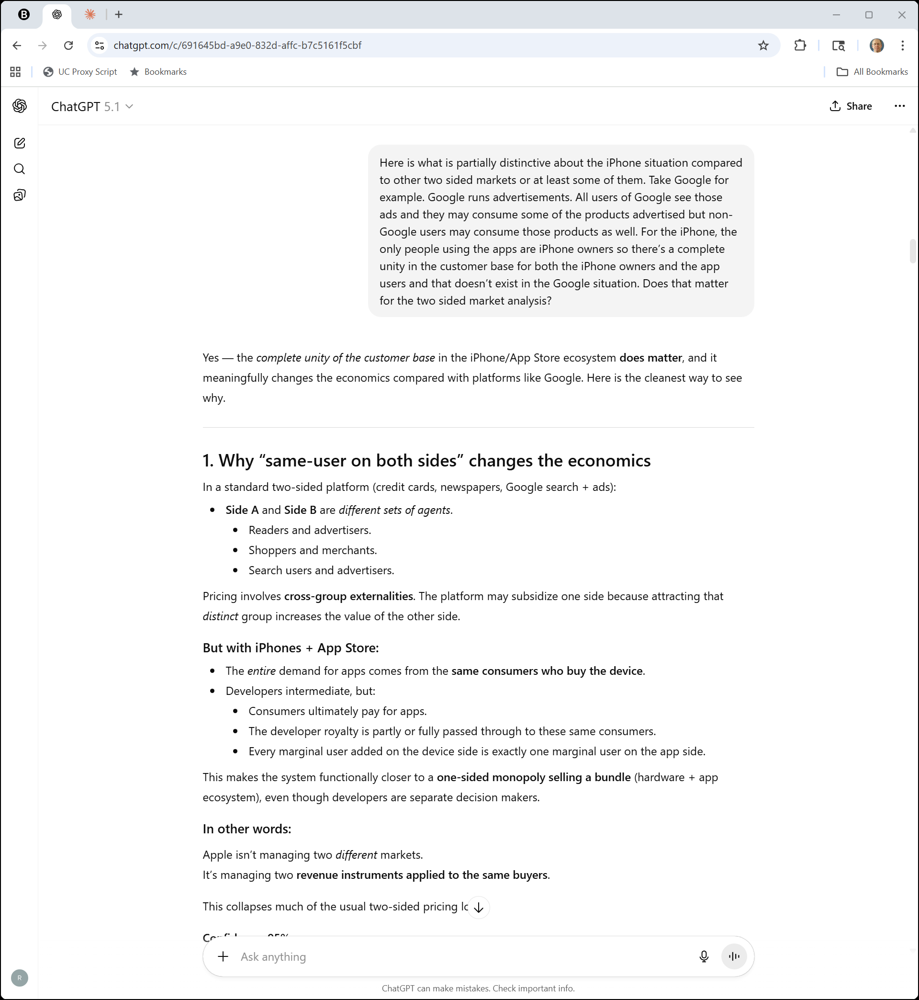
iPhone Ecosystem Is Different
ChatGPT

Slide 57
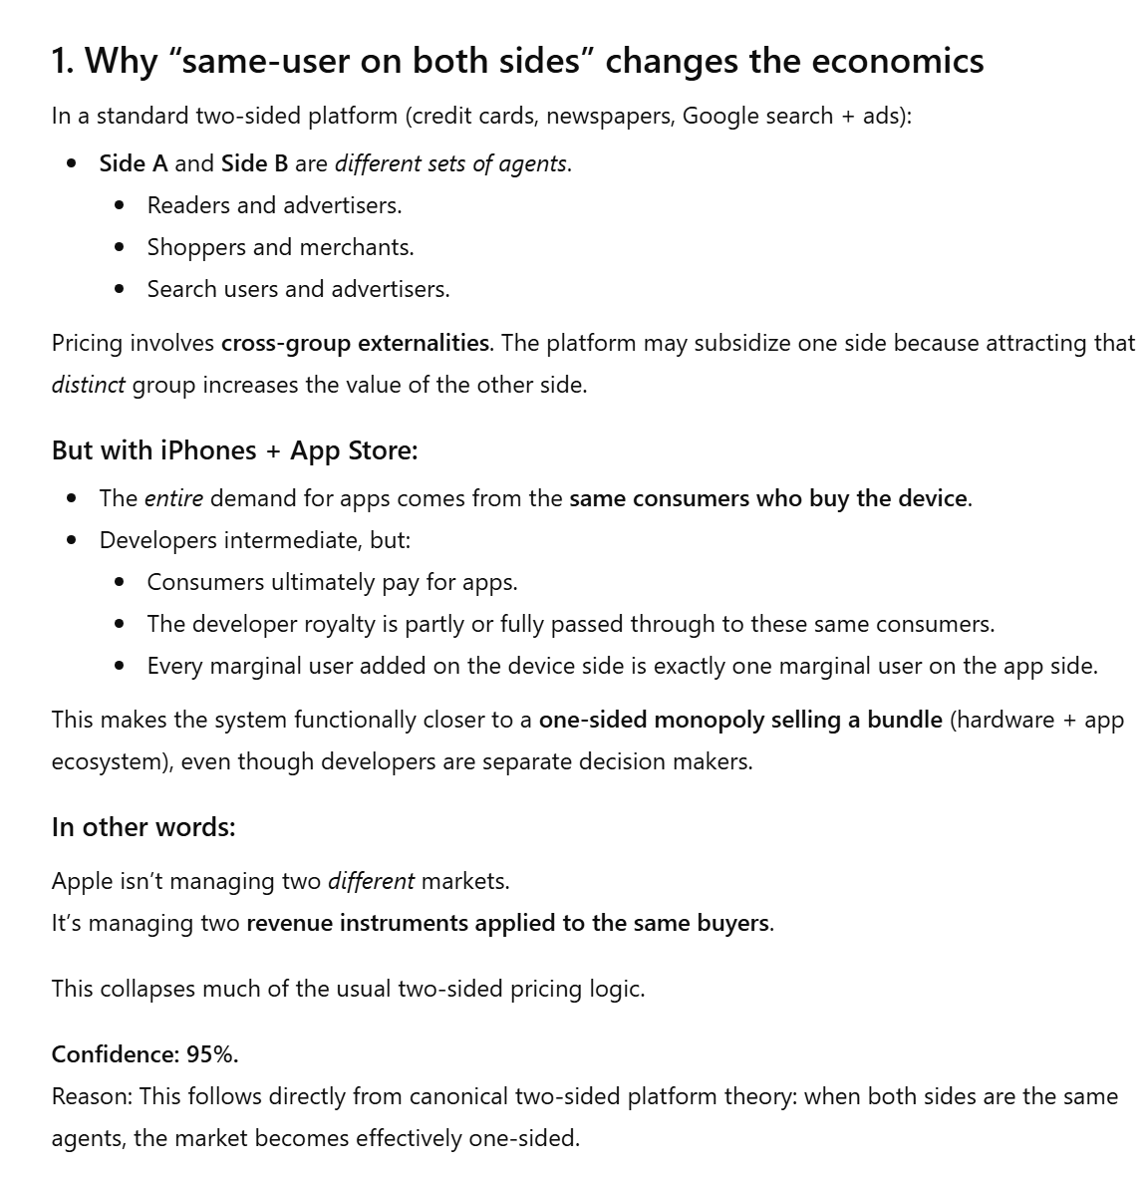
iPhone Ecosystem Is Different
ChatGPT

Slide 58
Google OEM Anticompetitive Behavior
Epic Games (CA9 31 July 2025)

Slide 59
Google Anticompetitive Deal with App Devs
Epic Games (CA9 31 July 2025)

Slide 60
Now What?: Redesigning Google Play
TTYN
Questions
Epic has won its appeal in the Ninth Circuit
What happens next? Live with the original injunction? Negotiate a revision of it? What would Epic want? What would Google want?

Slide 61
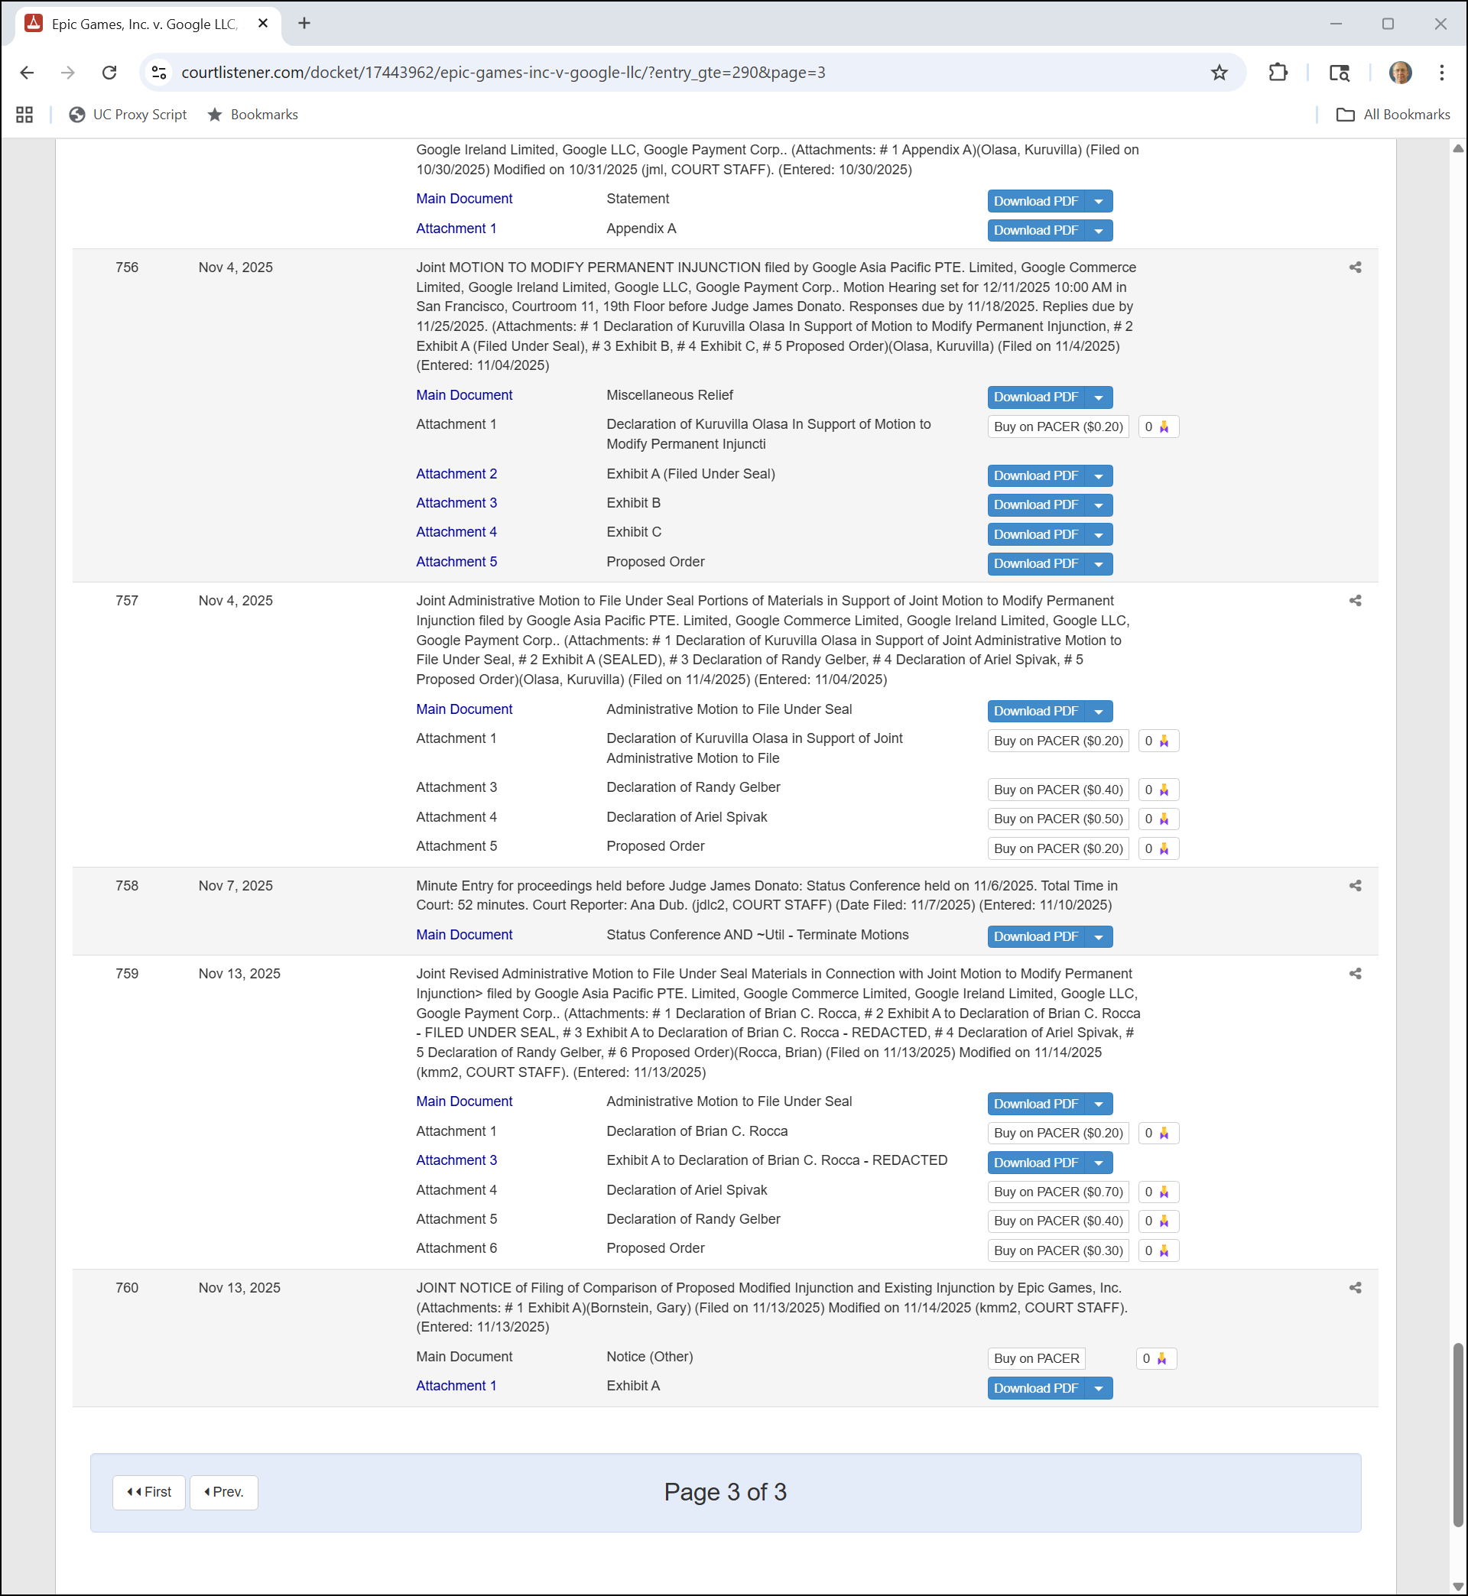
Joint Motion for Settlement
Epic v. Google Docket (17 Nov 2025)

Slide 62
Other Cases
Epic Games Joint Motion (4 Nov 2025)

Slide 63
Controlling Google’s Fees
Epic Games Joint Motion (4 Nov 2025)

Slide 64
Redline Changes
Redline (13 Nov 2025)

Slide 65
Redline Changes
Redline (13 Nov 2025)

