Slide 1
Class 21: Wed 12 Nov 2025 Antitrust Fall 2025 App Stores
Randal C. Picker
James Parker Hall Distinguished Service Professor of Law
The Law School
The University of Chicago
Copyright © 2000-25 Randal C. Picker. All Rights Reserved.

Slide 2
Kodak: Understanding Aftermarkets
504 U.S. 451 (1992)

Slide 3
Competition in Foremarkets and Aftermarkets
“The principal issue here is whether a defendant’s lack of market power in the primary equipment market precludes—as a matter of law—the possibility of market power in derivative aftermarkets.”
Kodak (U.S. 1992)

Slide 4
Switching and Information Costs
“Respondents offer a forceful reason why Kodak’s theory, although perhaps intuitively appealing, may not accurately explain the behavior of the primary and derivative markets for complex durable goods: the existence of significant information and switching costs. These costs could create a less responsive connection between service and parts prices and equipment sales.”
Kodak (U.S. 1992)

Slide 5
Can’t Do SJ Here Given Market Questions
“In sum, there is a question of fact whether information costs and switching costs foil the simple assumption that the equipment and service markets act as pure complements to one another. We conclude, then, that Kodak has failed to demonstrate that respondents’ inference of market power in the service and parts markets is unreasonable, and that, consequently, Kodak is entitled to summary judgment.”
Kodak (U.S. 1992)

Slide 6
And Kodak Seems to Exercise Market Power
“It is clearly reasonable to infer that Kodak has market power to raise prices and drive out competition in the aftermarkets, since respondents offer direct evidence that Kodak did so.”
Kodak (U.S. 1992)

Slide 7
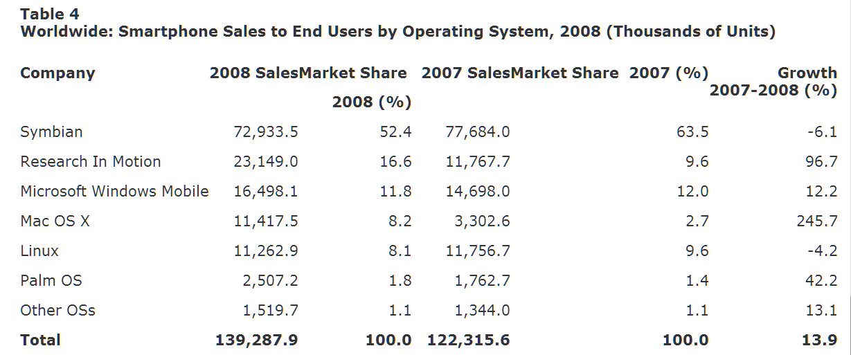
Smartphone OS Market Shares, 2007 & 2008
Gartner (11 Mar 2009)

Slide 8
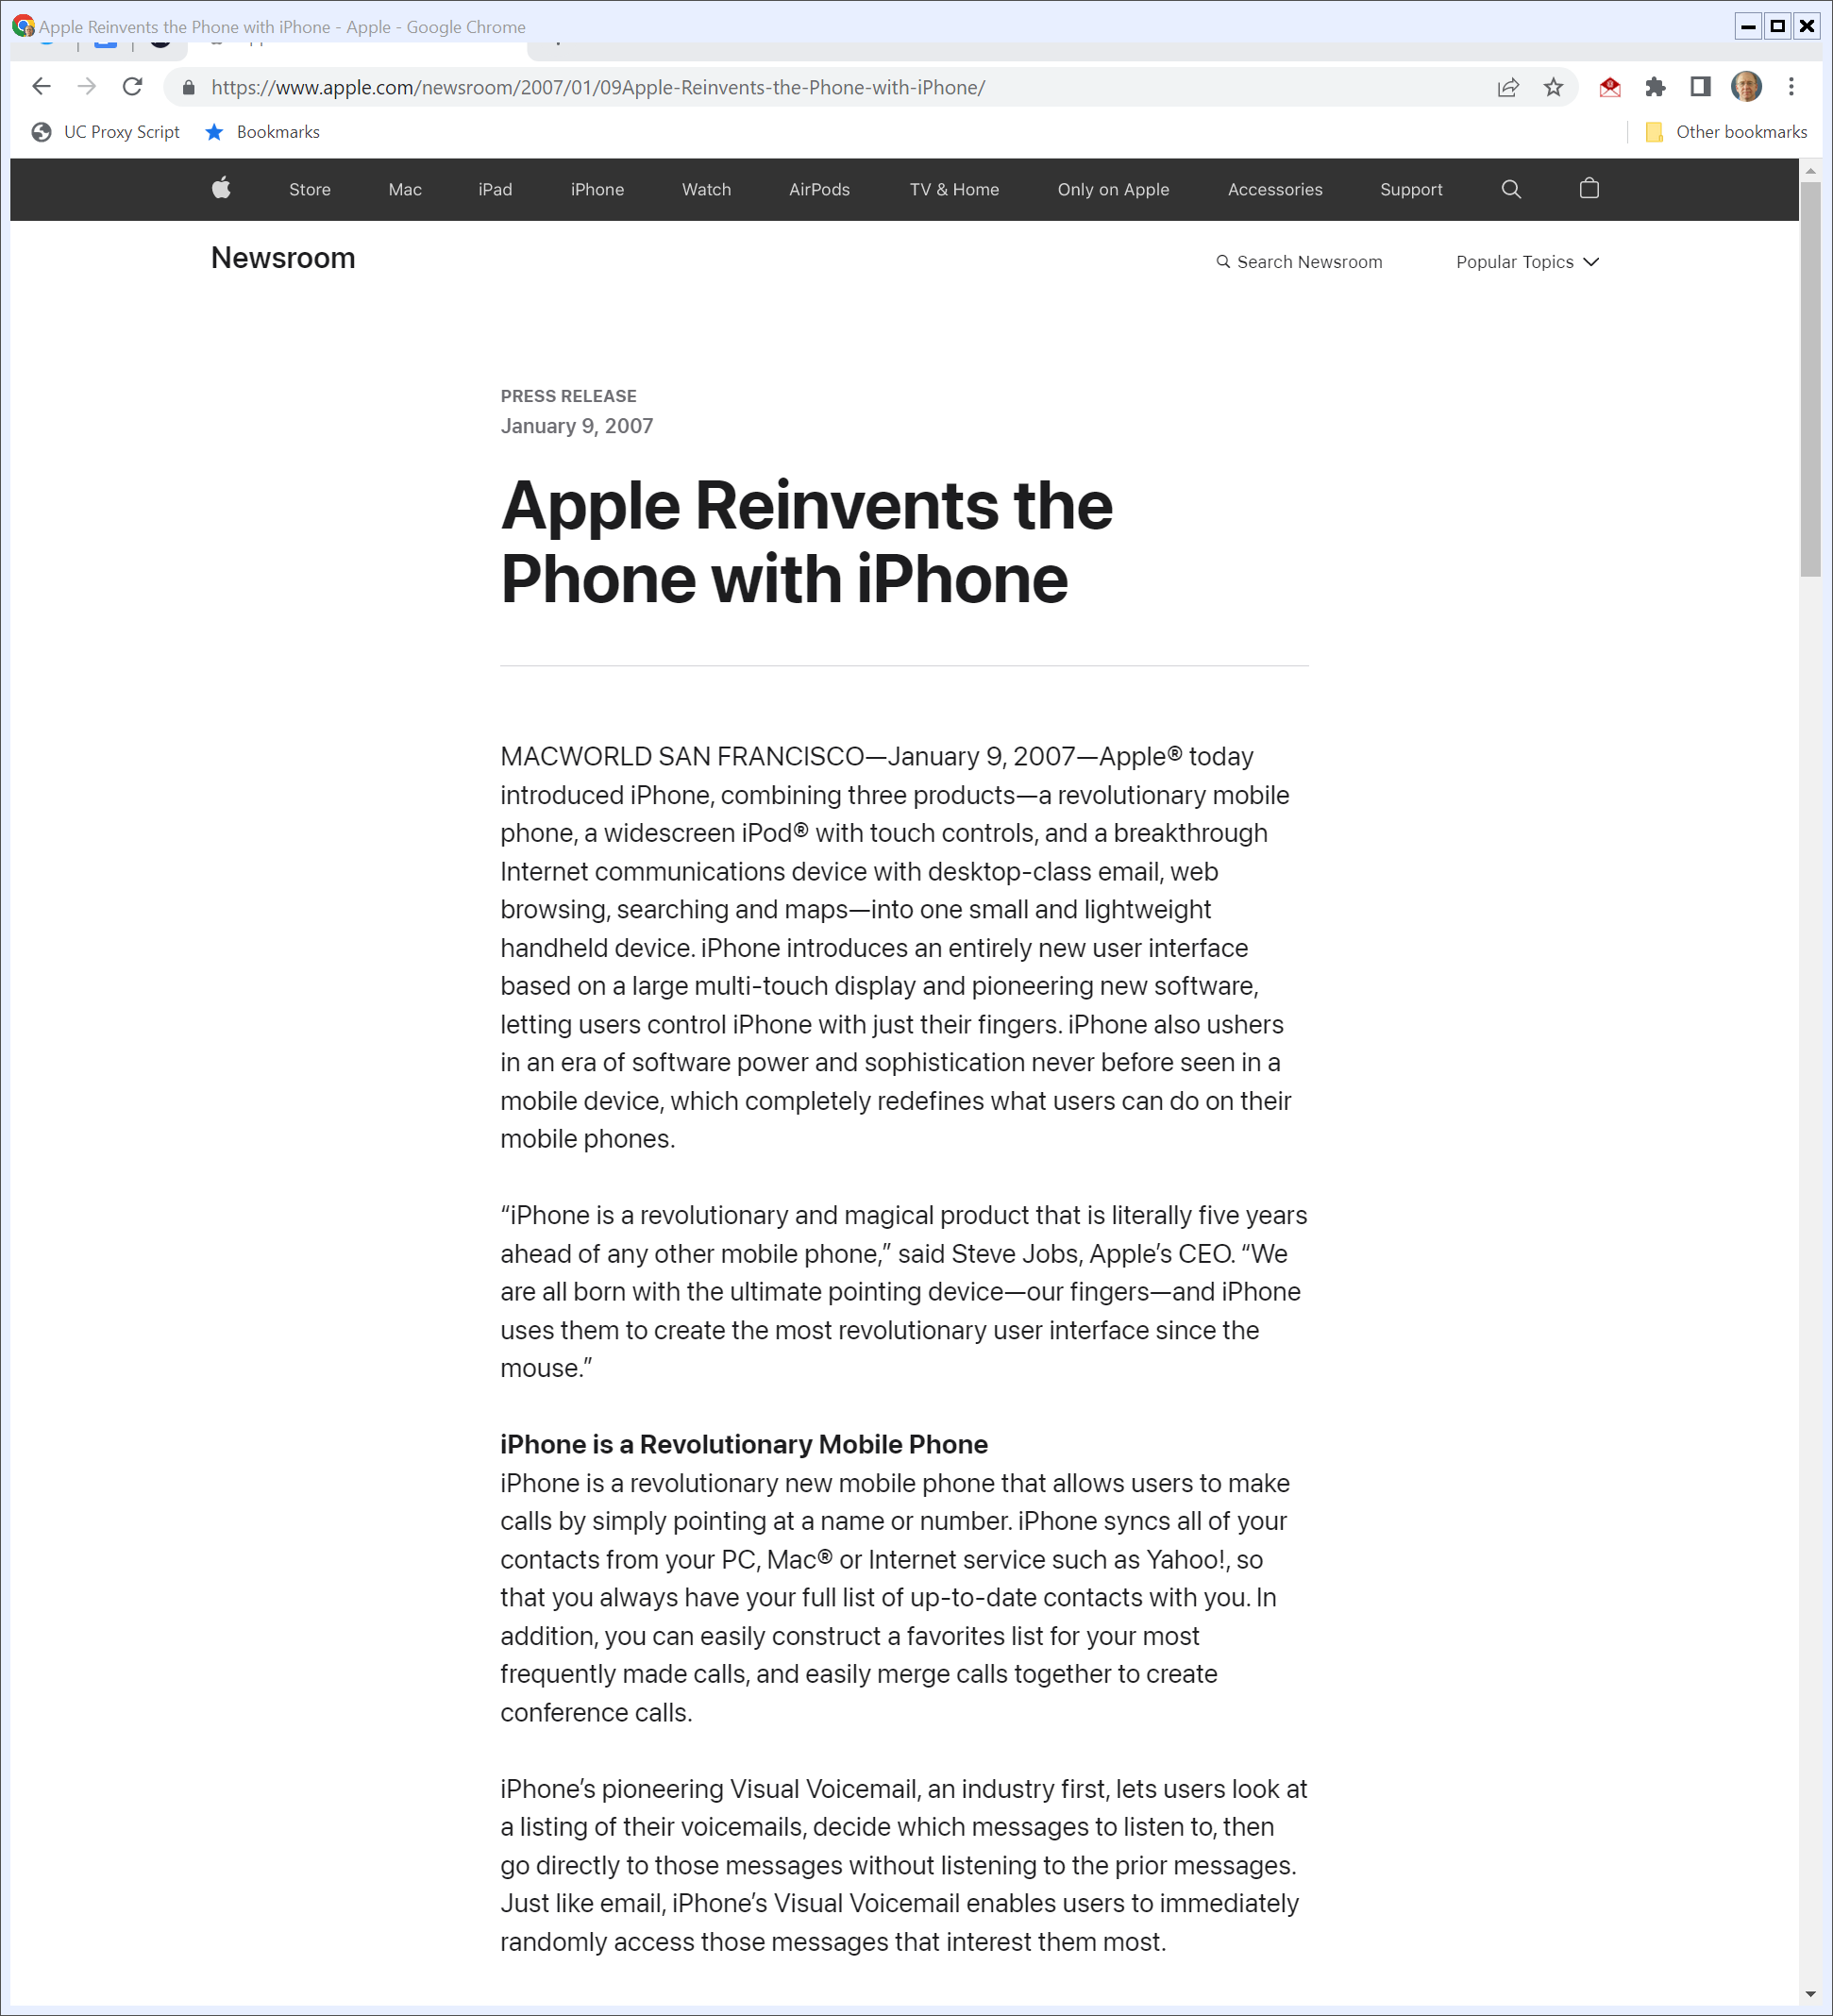
2007 SF Macworld iPhone Launch
“Apple® today introduced iPhone, combining three products—a revolutionary mobile phone, a widescreen iPod® with touch controls, and a breakthrough Internet communications device with desktop-class email, web browsing, searching and maps—into one small and lightweight handheld device.”
Apple (9 Jan 2007)
Notes:
https://www.apple.com/newsroom/2007/01/09Apple-Reinvents-the-Phone-with-iPhone/

Slide 9
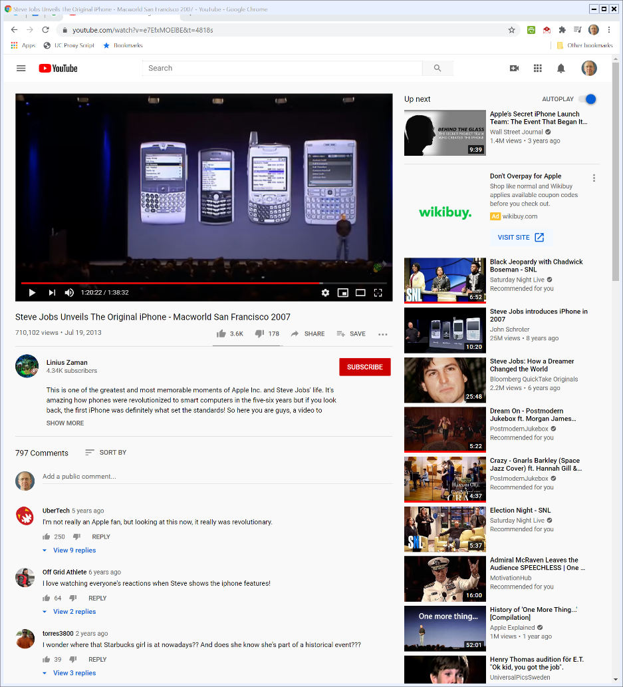

The Future and the Past
2007 SF Macworld
Notes:
https://www.youtube.com/watch?v=e7EfxMOElBE&t=4818s

Slide 10
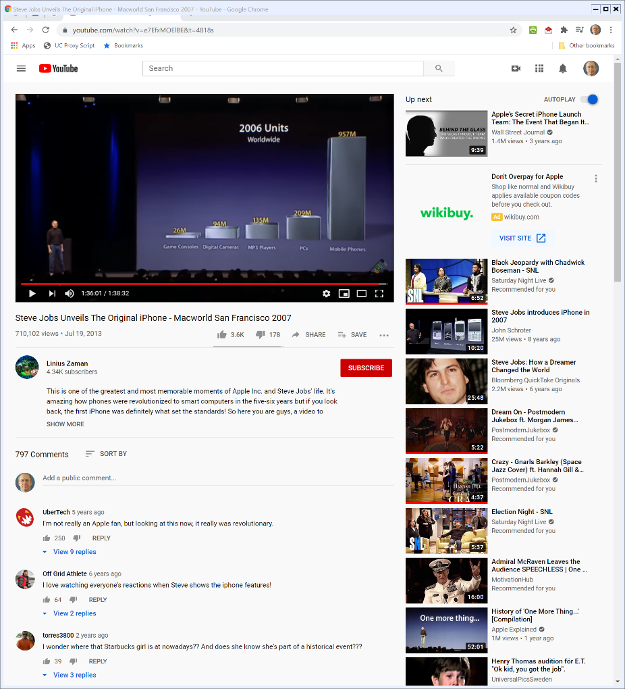

The Size of the Opportunity
2007 SF Macworld
Notes:
https://www.youtube.com/watch?v=e7EfxMOElBE&t=4818s

Slide 11
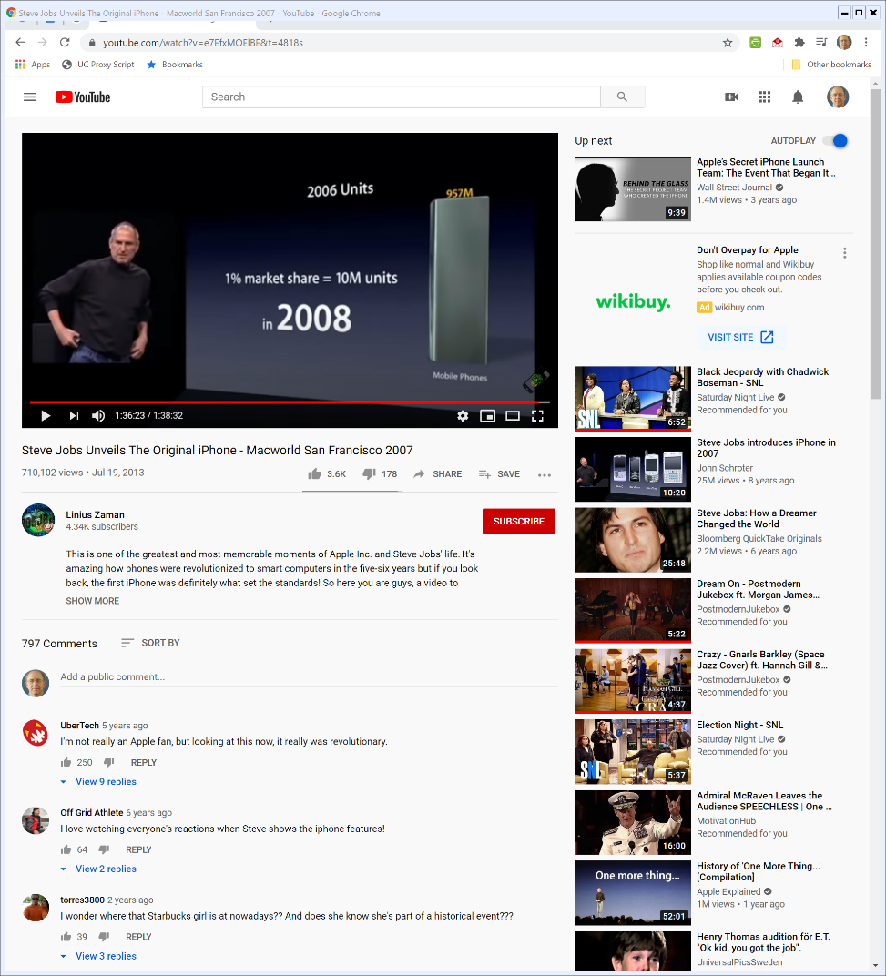

Apple’s Goal in 2008? 1%
2007 SF Macworld
Notes:
https://www.youtube.com/watch?v=e7EfxMOElBE&t=4818s

Slide 12
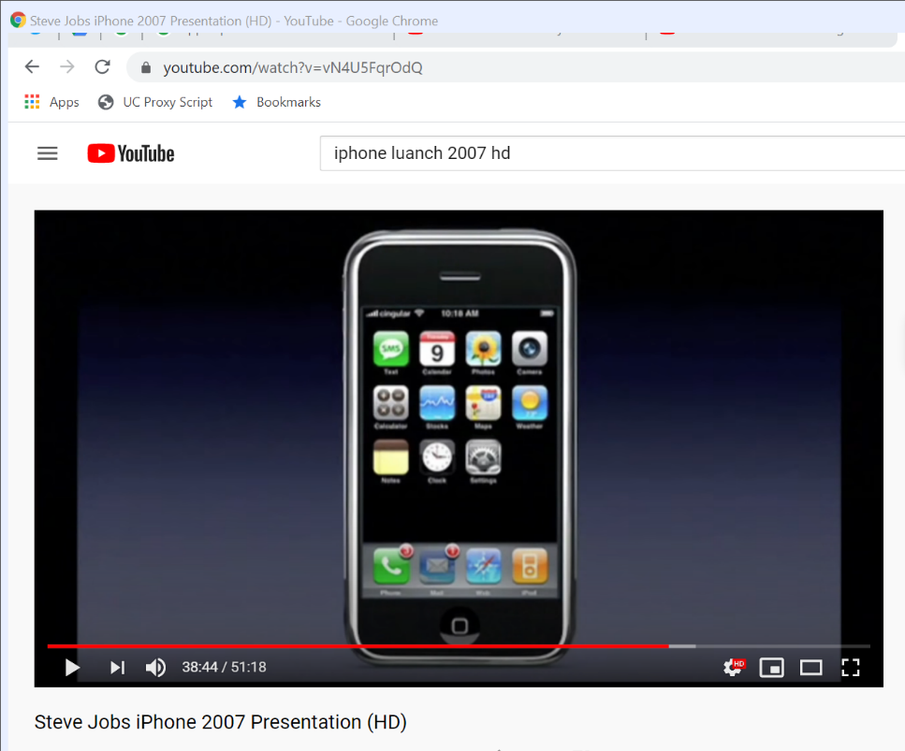
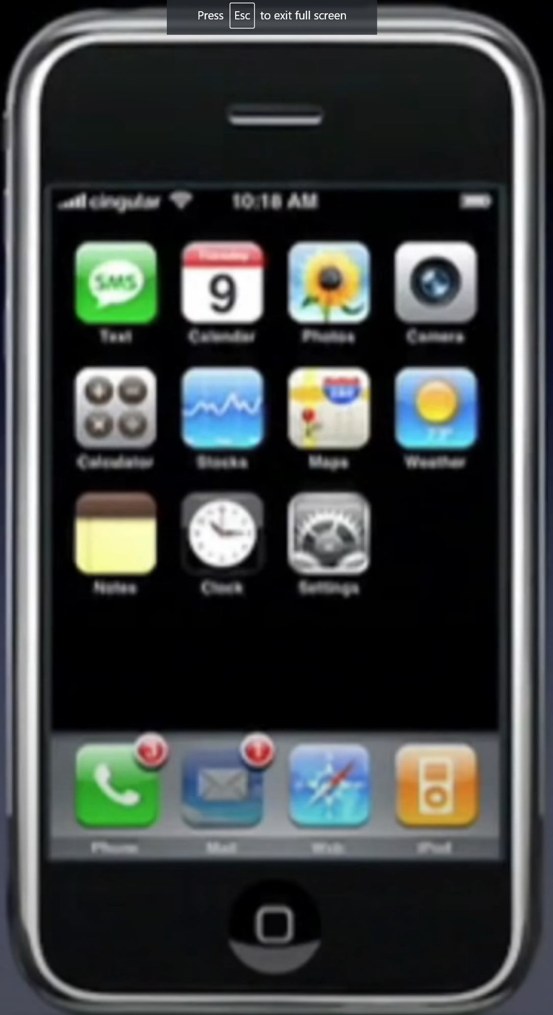
The App Usage and Distribution Model in 2007
1. Apple chooses the apps
2. You use the web (with Google Search and Yahoo Search built-in)
2007 SF Macworld
Notes:
At 38:44 of https://www.youtube.com/watch?v=vN4U5FqrOdQ

Slide 13
Assessing the Jan 2007 iPhone
TTYN
Questions
How should we evaluate the design of the iPhone in 2007?
Is Apple engaging in a unilateral refusal to deal by not having an app store?
How should we think about aftermarkets in this context?

Slide 14
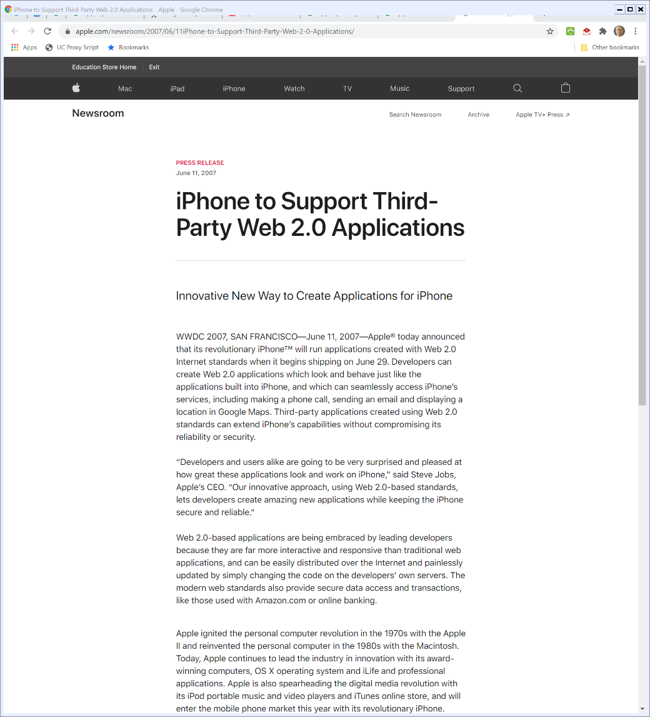
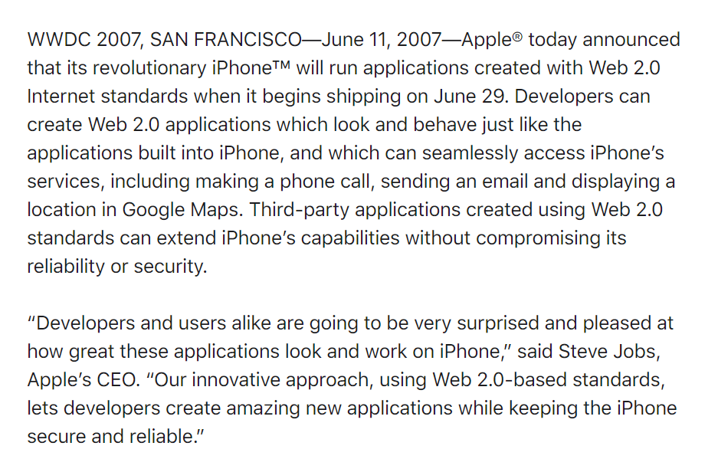
11 June 2007: iPhone Web 2.0 Applications
Apple (11 June 2007)
Notes:
https://www.apple.com/newsroom/2007/06/11iPhone-to-Support-Third-Party-Web-2-0-Applications/

Slide 15
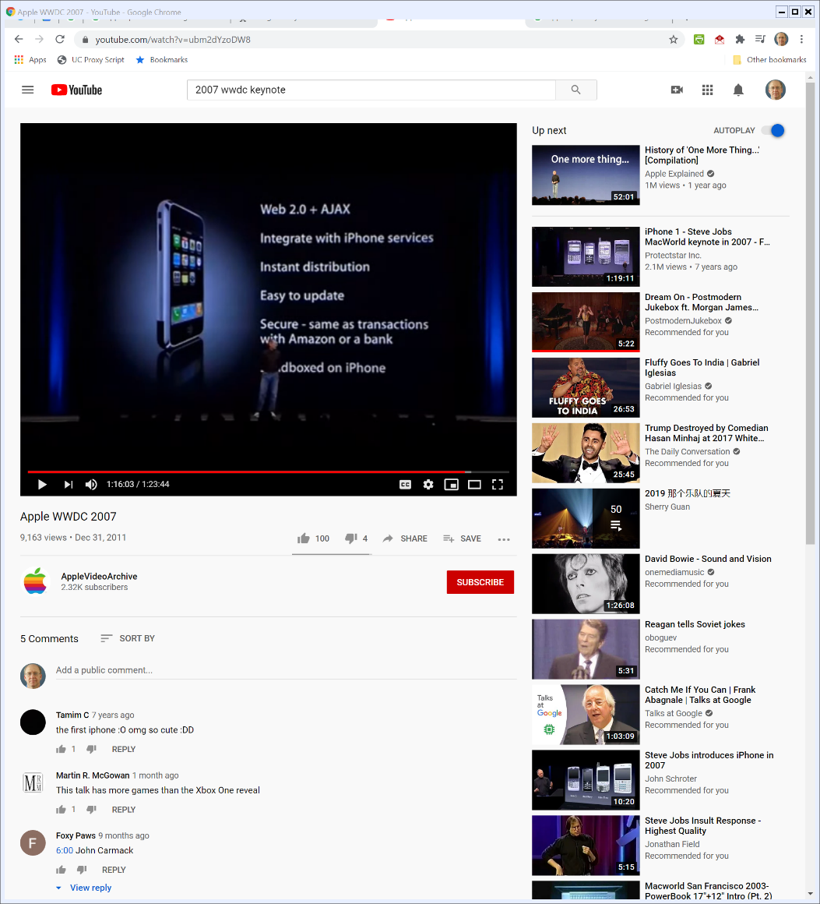

Distribution Model: Web-Based, Controlled by Developers, No Apple Curation
Apple WWDC 2007 (11 June 2007)
Notes:
https://www.youtube.com/watch?v=ubm2dYzoDW8

Slide 16
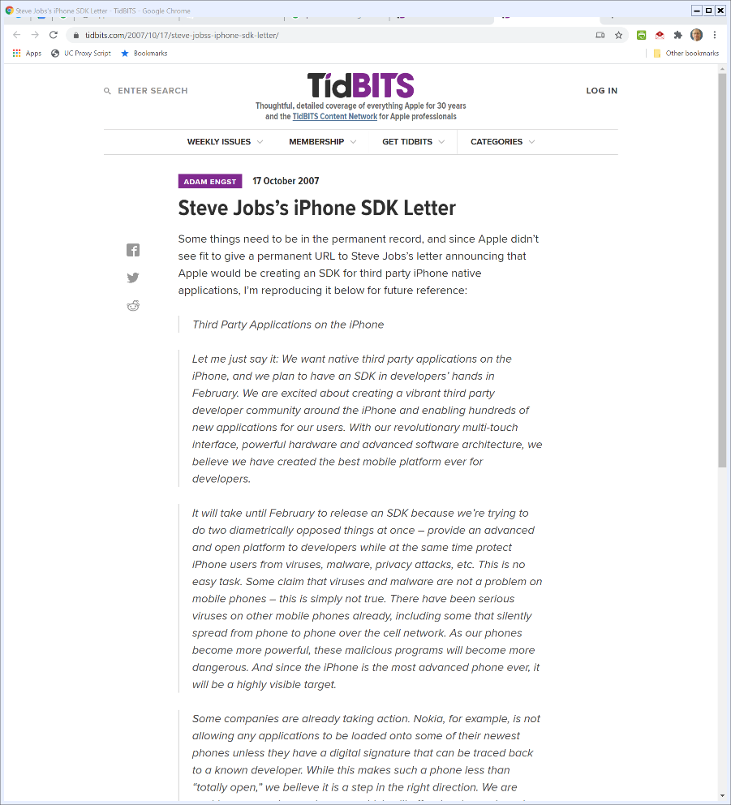
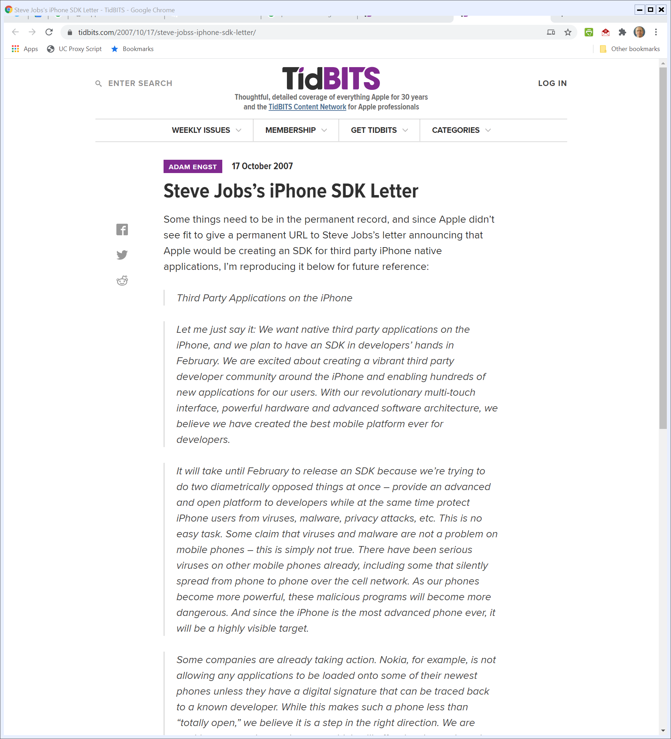
17 Oct 2007: Jobs on Native iPhone Apps
Tidbits.com (17 Oct 2007)
Notes:
https://tidbits.com/2007/10/17/steve-jobss-iphone-sdk-letter/

Slide 17
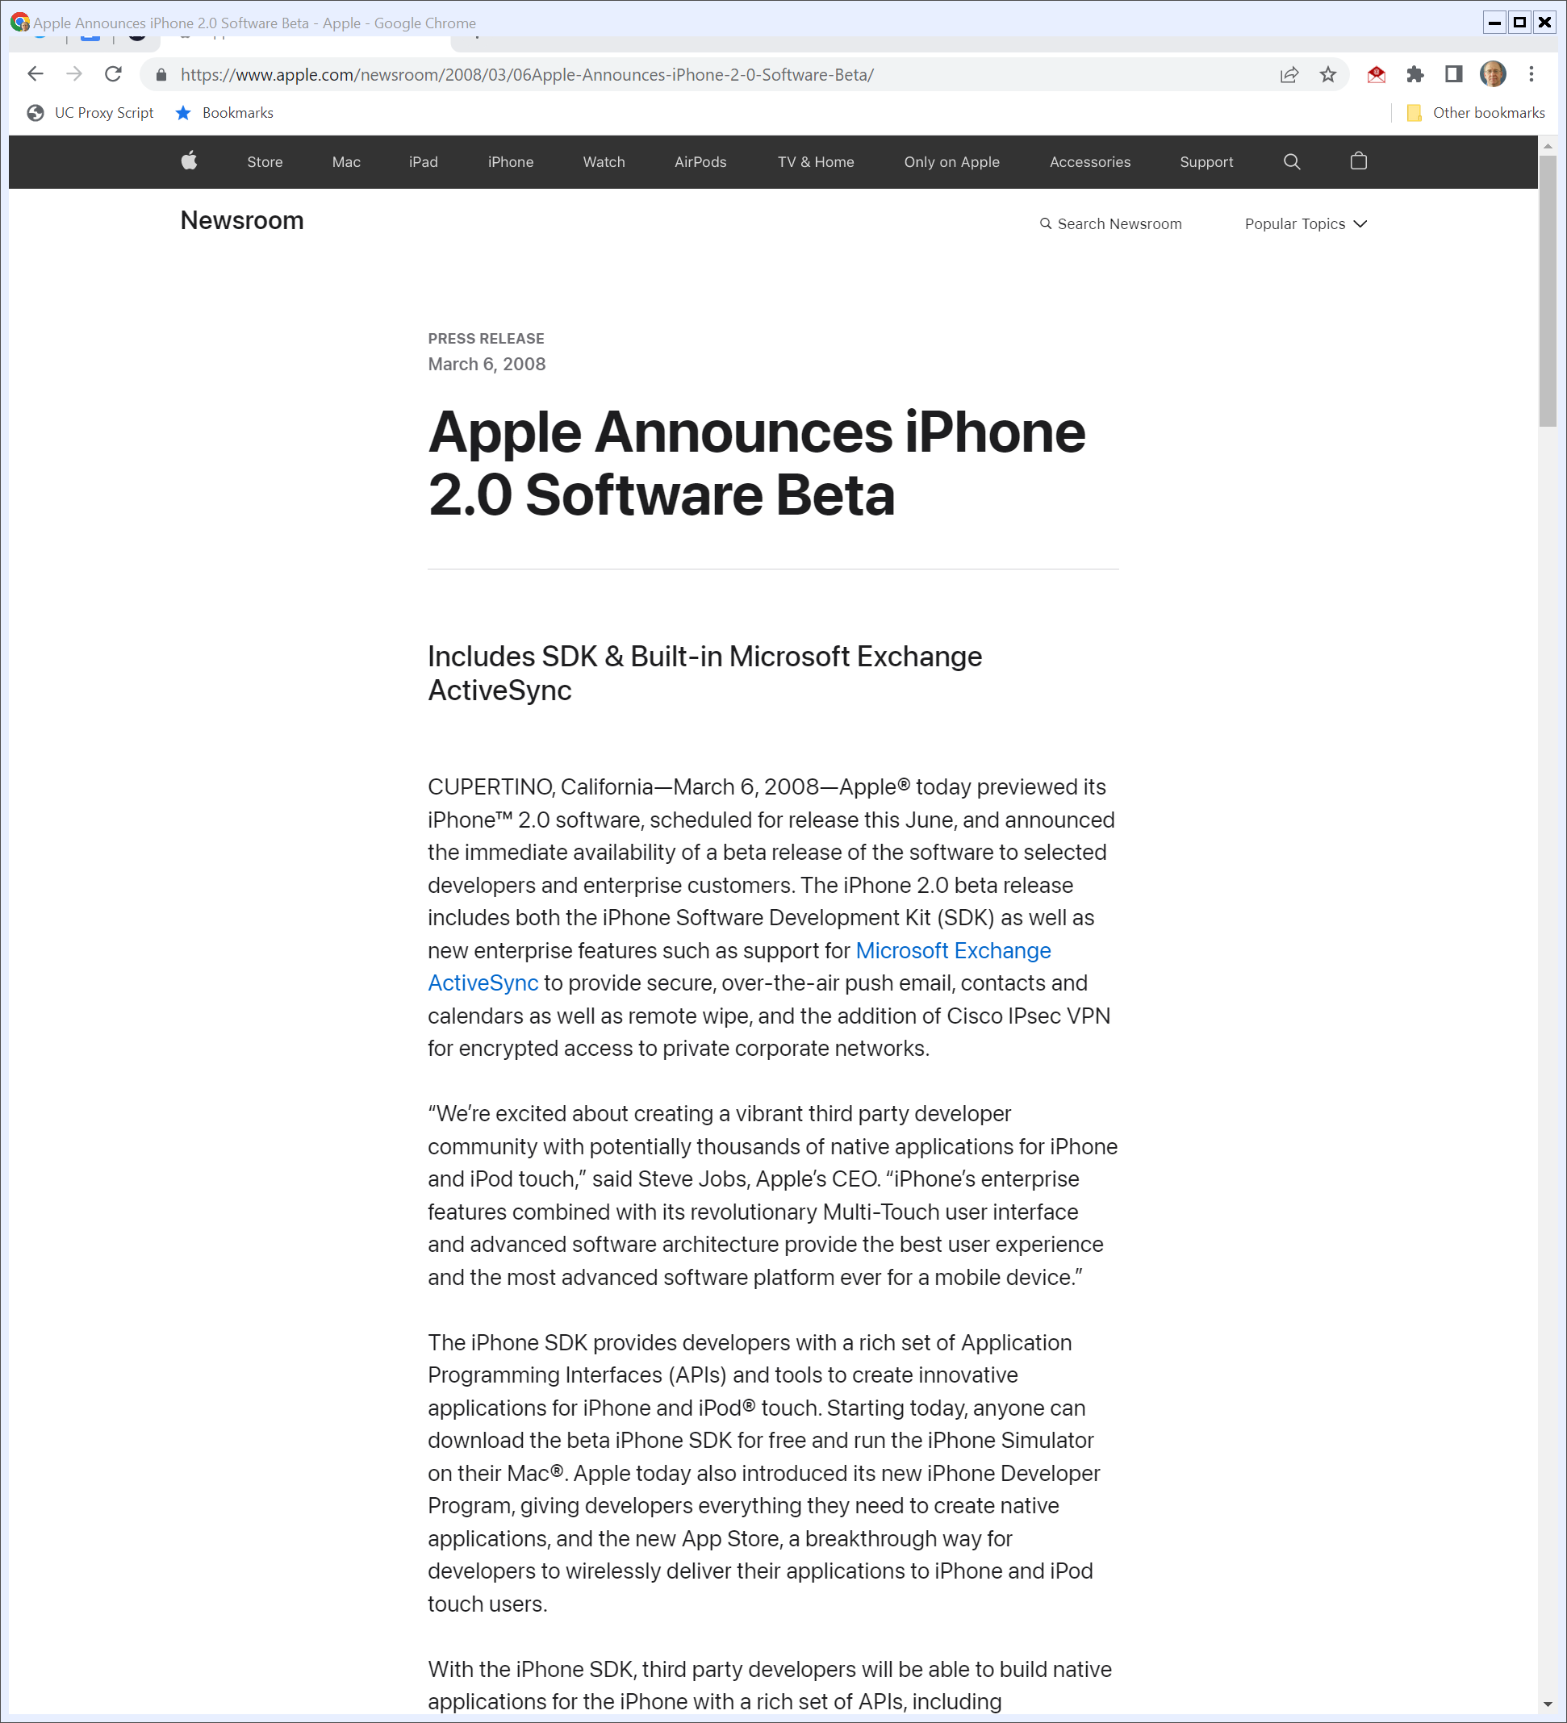
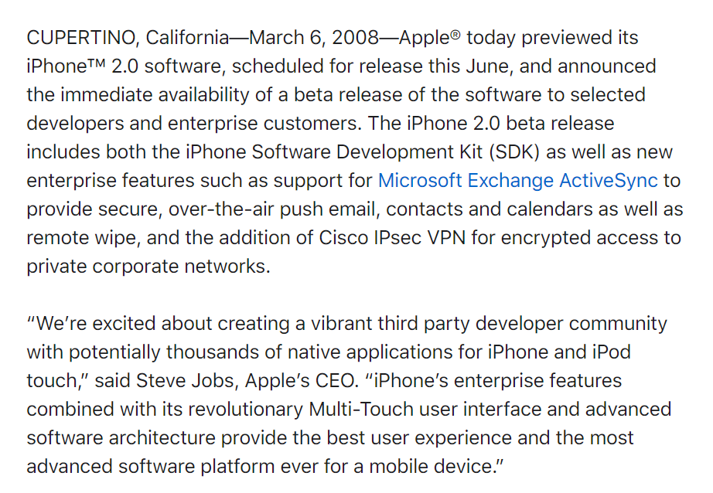
6 Mar 2008: iPhone 2.0 Software Beta and SDK
Apple.com (6 Mar 2008)
Notes:
https://www.apple.com/newsroom/2008/03/06Apple-Announces-iPhone-2-0-Software-Beta/

Slide 18
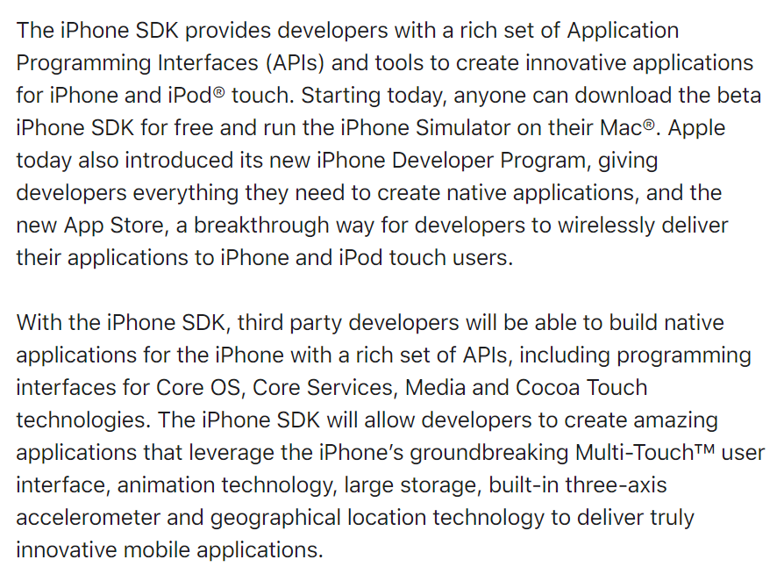
iPhone APIs
Apple.com (6 Mar 2008)
Notes:
https://www.apple.com/newsroom/2008/03/06Apple-Announces-iPhone-2-0-Software-Beta/

Slide 19
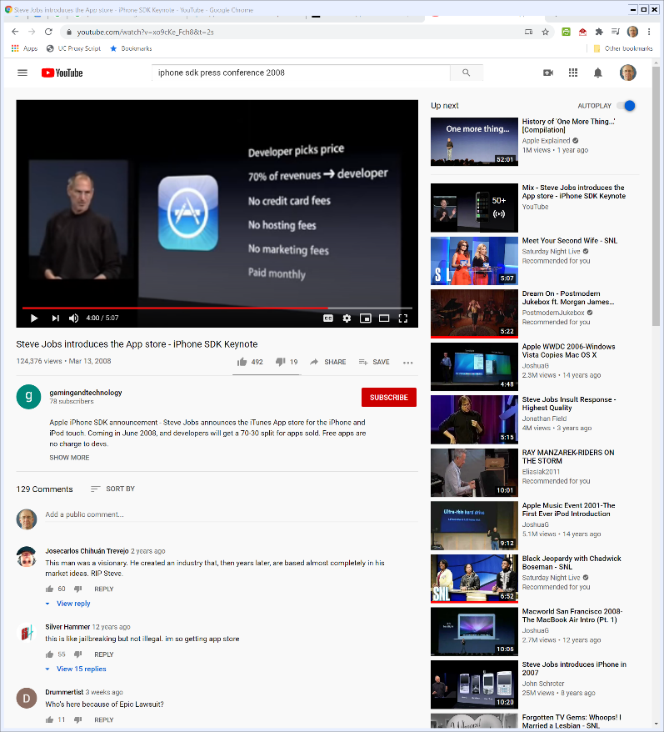

6 Mar 2008: App Store Introduction
“[B]est deal going to distribute applications”
Steve Jobs (6 Mar 2008)
Notes:
https://www.youtube.com/watch?v=xo9cKe_Fch8&t=2s

Slide 20


A Curated App Store
Steve Jobs (6 Mar 2008)
Notes:
https://www.youtube.com/watch?v=xo9cKe_Fch8&t=2s

Slide 21
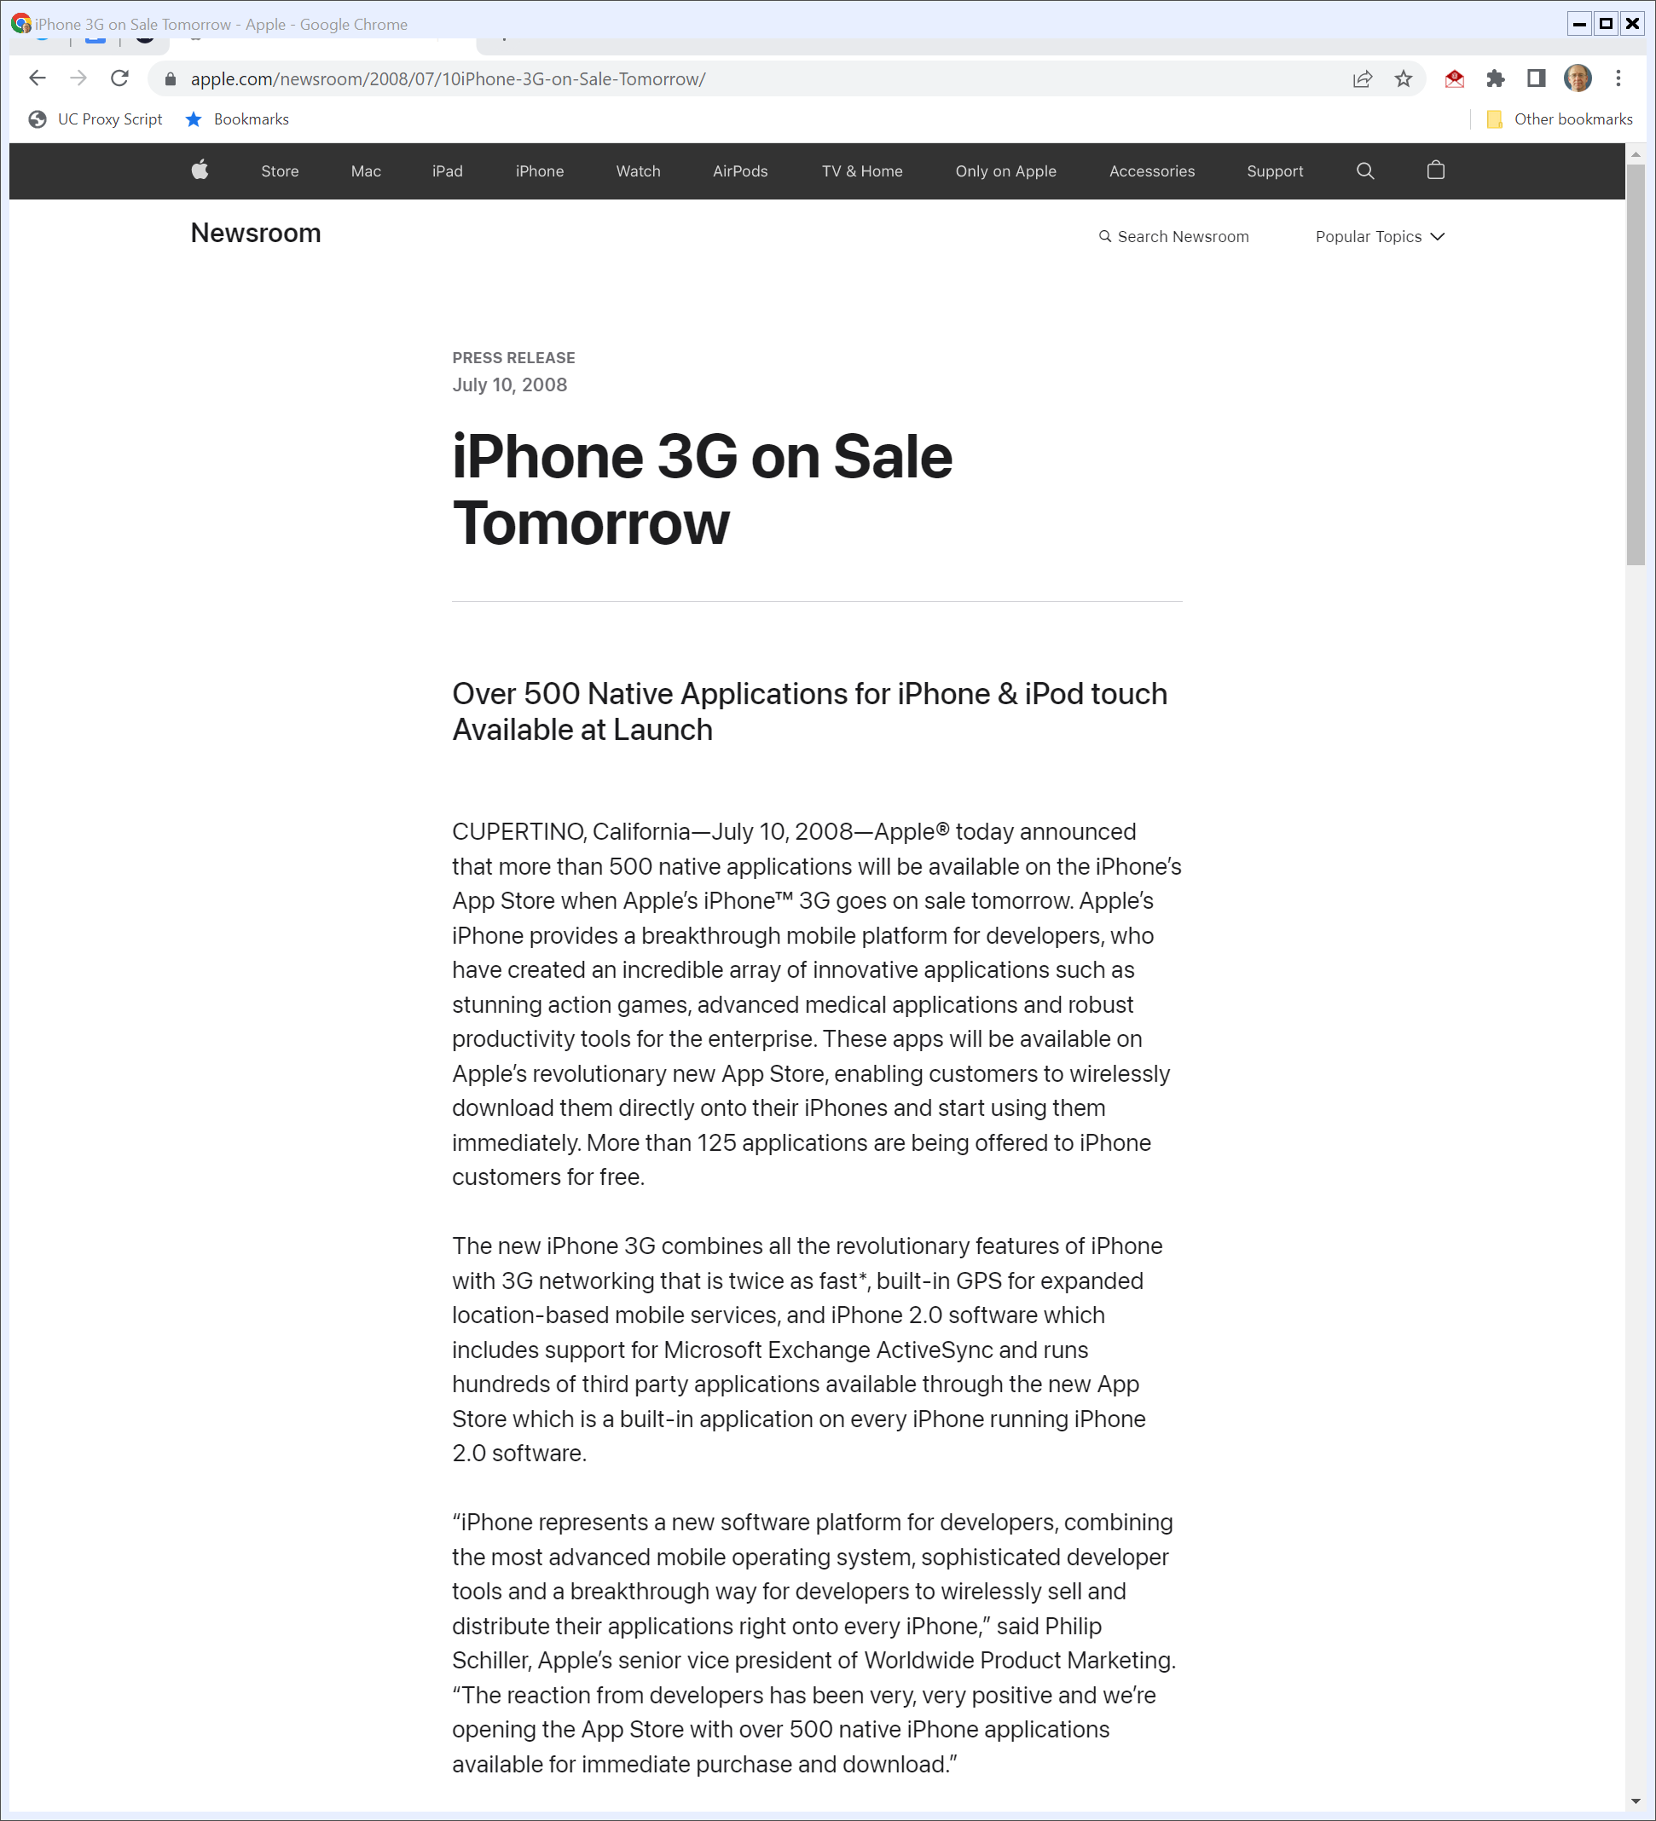
App Store Launch
“Apple® today announced that more than 500 native applications will be available on the iPhone’s App Store when Apple’s iPhone™ 3G goes on sale tomorrow. … .”
Apple (10 July 2008)
Notes:
https://www.apple.com/newsroom/2008/07/10iPhone-3G-on-Sale-Tomorrow/

Slide 22
App Store Launch
“These apps will be available on Apple’s revolutionary new App Store, enabling customers to wirelessly download them directly onto their iPhones and start using them immediately.”
Apple (10 July 2008)

Slide 23
Assessing the 3G iPhone and App Store
TTYN
Questions
How should we evaluate the design of the iPhone and App Store in mid-2008?
Are there obvious antitrust concerns in the design decisions that Apple is making here?

Slide 24
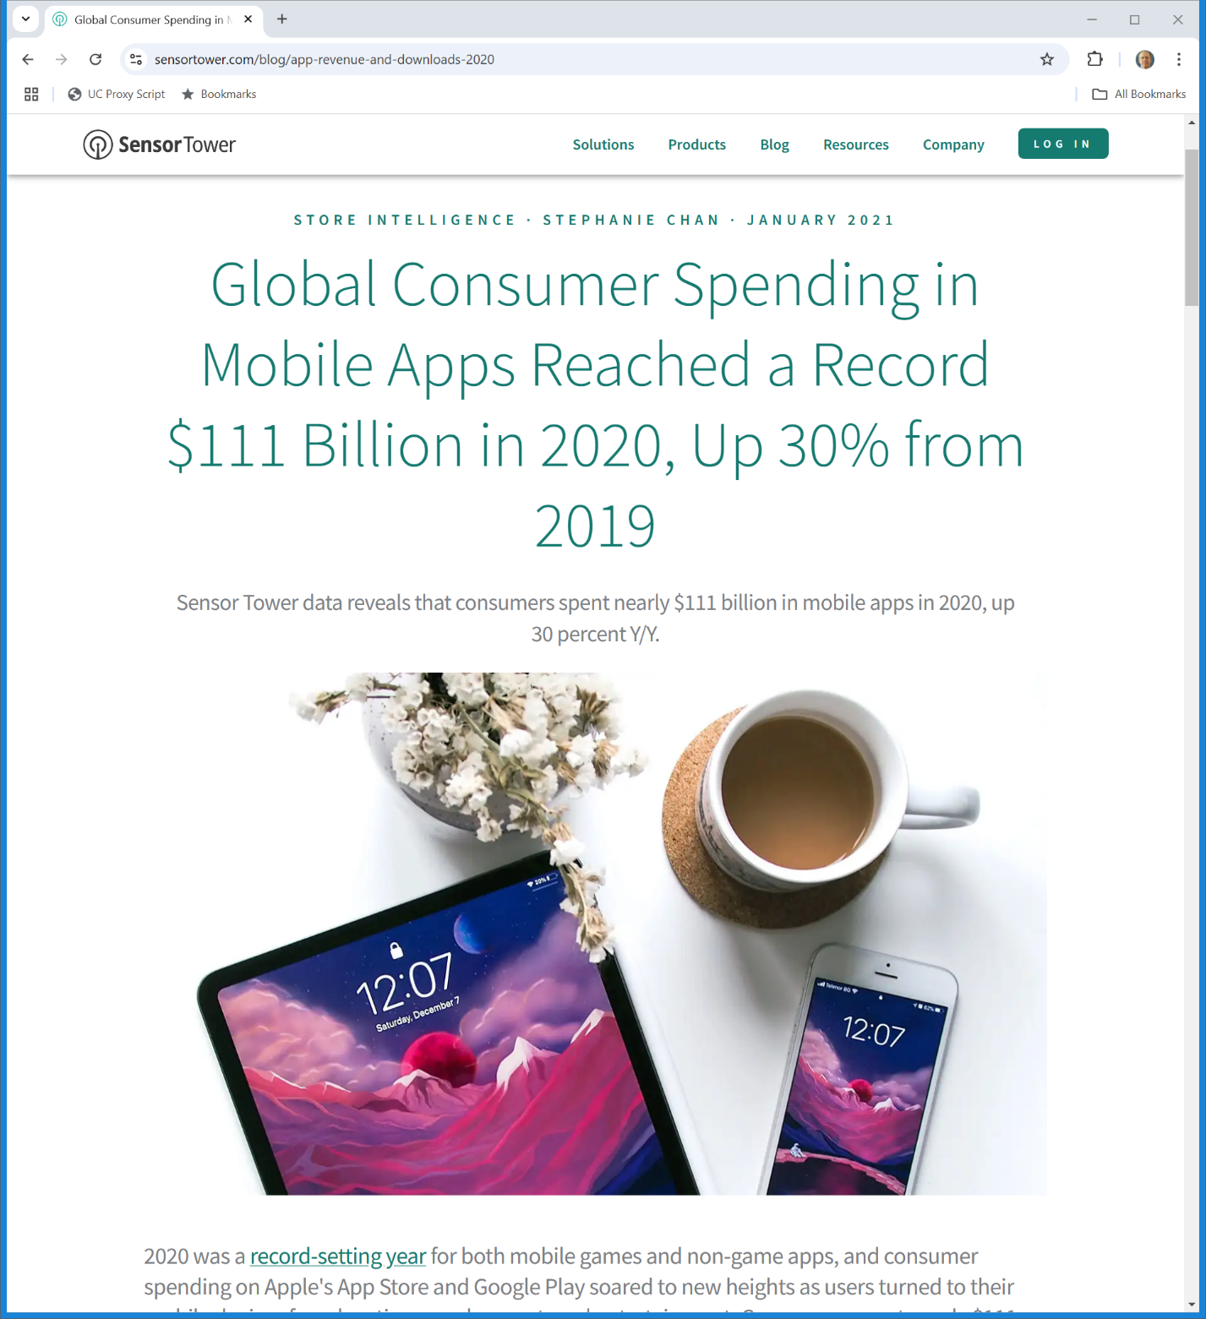
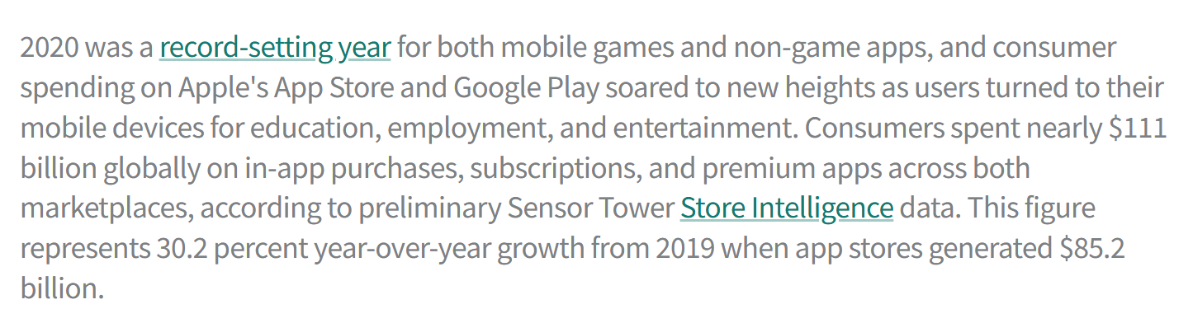
Mobile App Revenues
SensorTower (Jan 2021)
Notes:
https://sensortower.com/blog/app-revenue-and-downloads-2020

Slide 25
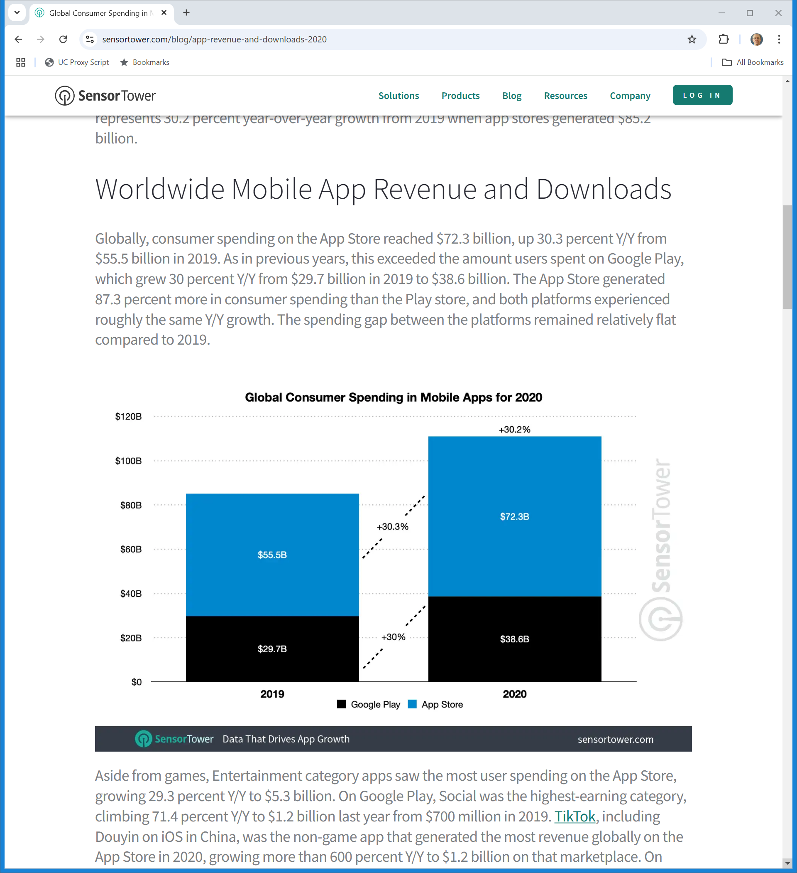
Mobile App Revenues
SensorTower (Jan 2021)
Notes:
https://sensortower.com/blog/app-revenue-and-downloads-2020

Slide 26
30 June 2020: Let Epic Compete
Apple TRO Response Ex. D (21 Aug 2020)

Slide 27
30 June 2020: Sweeney Email to Cook et al
Apple TRO Response Ex. D (21 Aug 2020)

Slide 28
30 June 2020: Sweeney Email to Cook et al
Apple TRO Response Ex. D (21 Aug 2020)

Slide 29
10 July 2020: Apple Responds with Six-Page Letter
Apple TRO Response Ex. E: Apple Letter (10 July 2020)

Slide 30
Apple’s Rules Protect the Platform
Apple TRO Response Ex. E: Apple Letter (10 July 2020)

Slide 31
App Store is Not a Public Utility
Apple TRO Response Ex. E: Apple Letter (10 July 2020)

Slide 32
Epic Charges $$$ but Doesn’t Want Apple to Do So
Apple TRO Response Ex. E: Apple Letter (10 July 2020)

Slide 33
Epic Charges $$$ but Doesn’t Want Apple to Do So
Apple TRO Response Ex. E: Apple Letter (10 July 2020)

Slide 34
Epic Launches
Apple TRO Response Ex. G: Sweeney Email (13 Aug 2020)

Slide 35
“Repugnant to the principles of a free society”
Apple TRO Response Ex. G: Sweeney Email (13 Aug 2020)

Slide 36
Epic Launches
Apple TRO Response Ex. G: Sweeney Email (13 Aug 2020)

Slide 37
13 Aug 2020: Epic Turns on Direct Payment Option
Epic Apple Complaint (13 Aug 2020)

Slide 38
Apple Boots Out Fortnite
Epic Apple Complaint (13 Aug 2020)

Slide 39
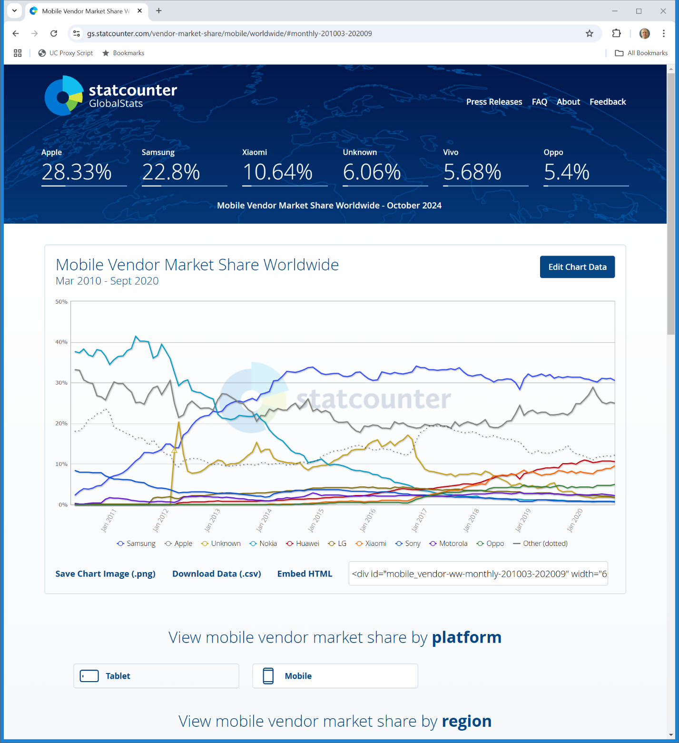
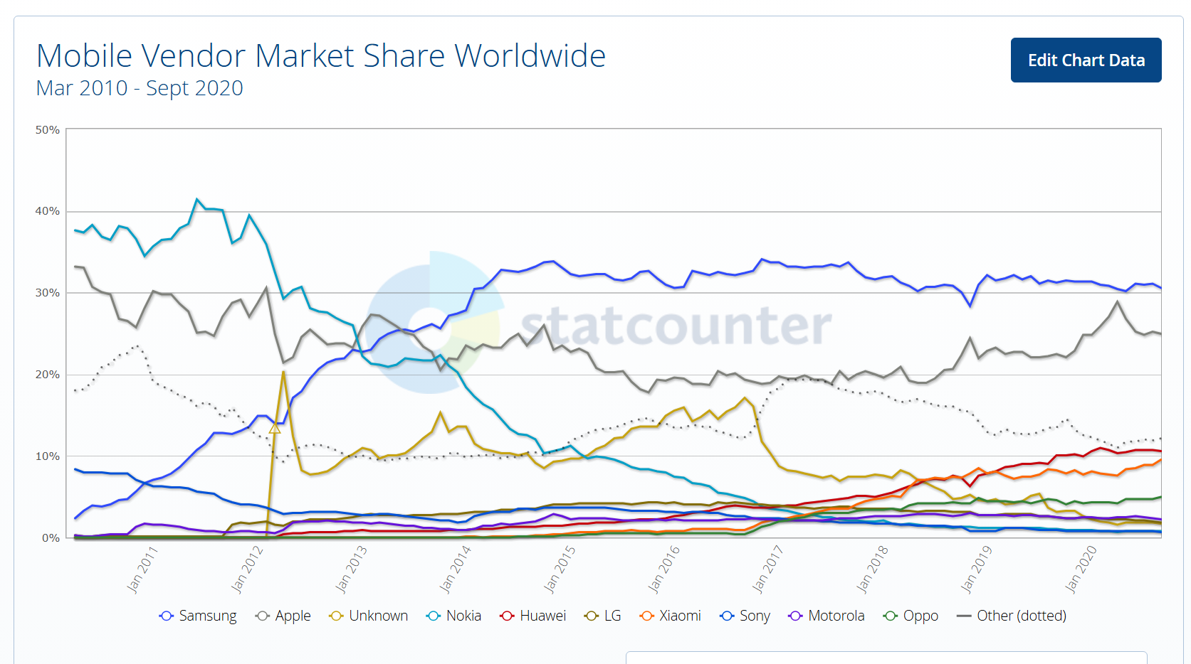
WW Mobile Vendor Market Shares
Statcounter (Visited 18 Nov 2024)
Notes:
https://gs.statcounter.com/vendor-market-share/mobile/worldwide/#monthly-201003-202009

Slide 40
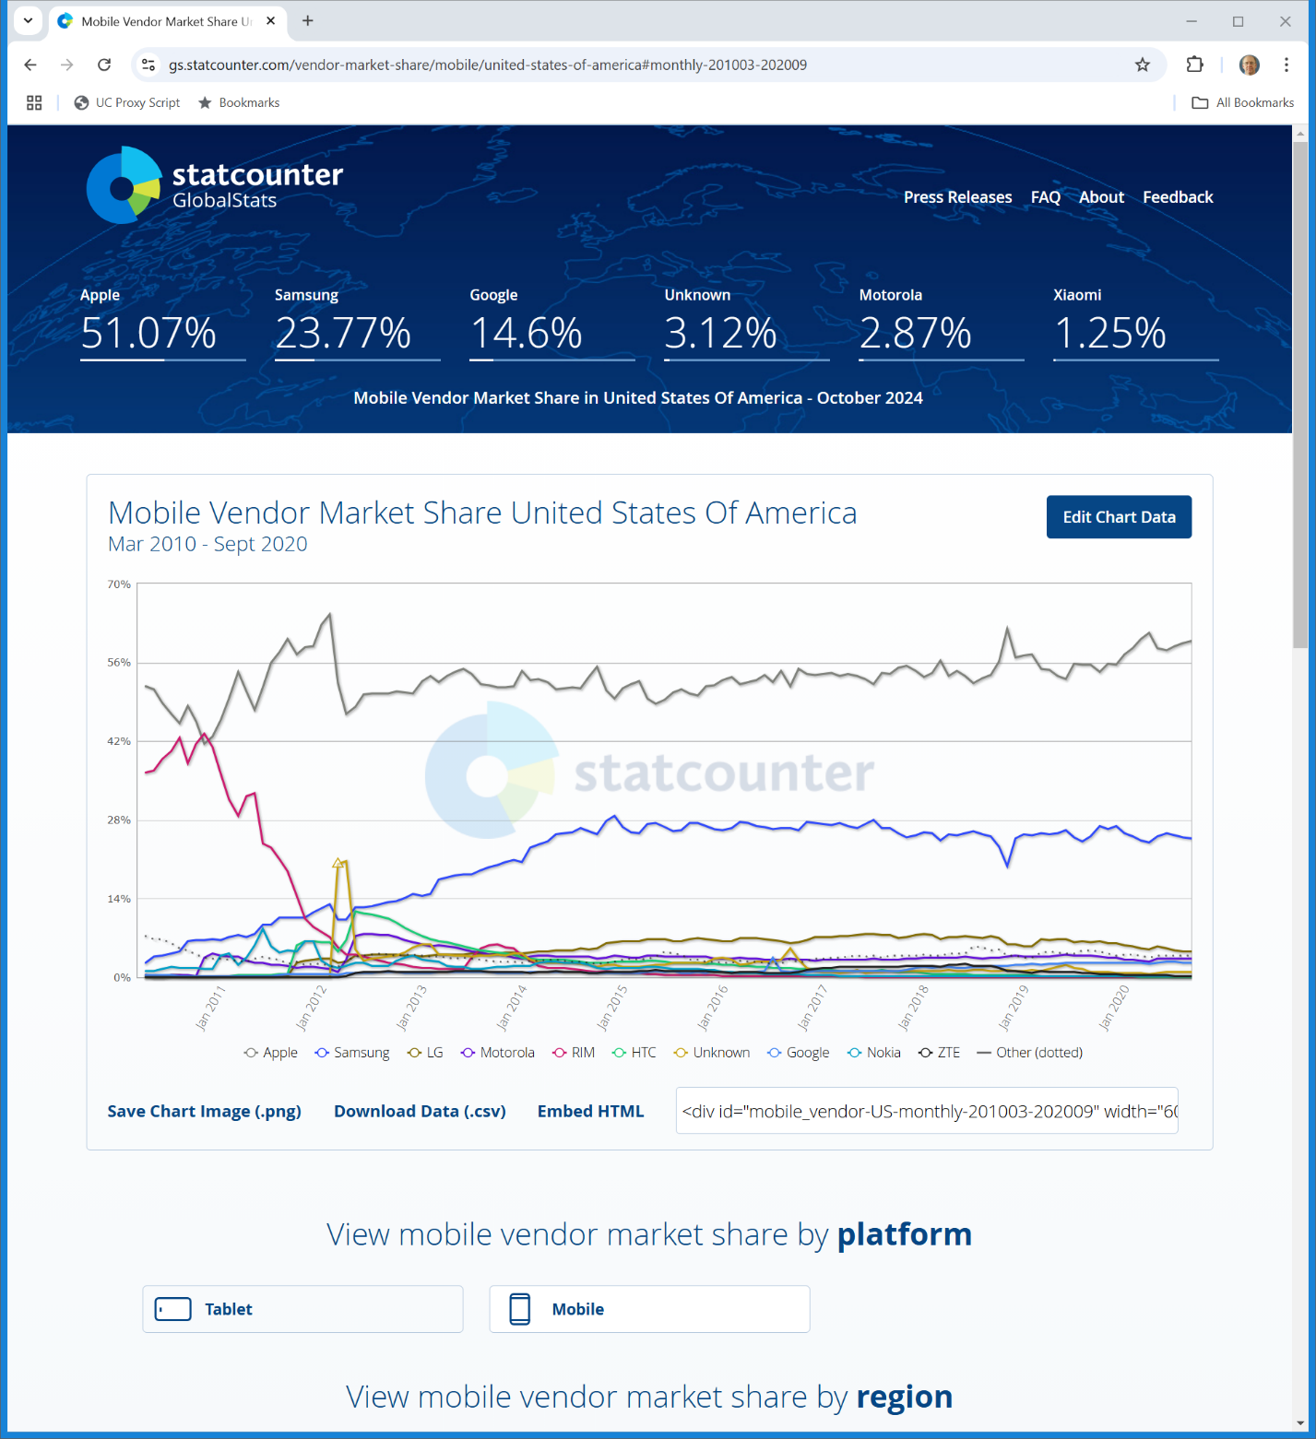
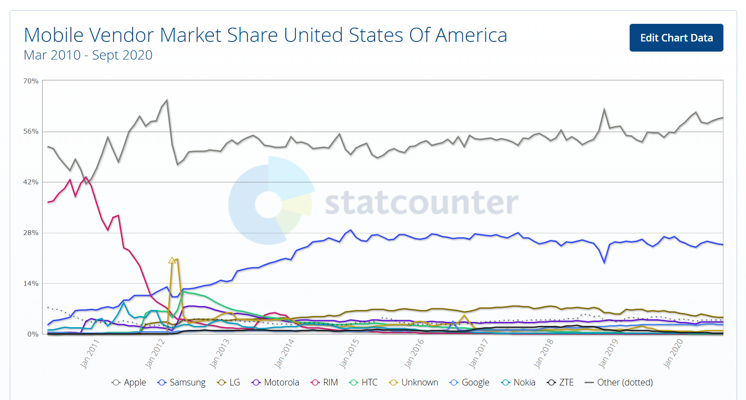
U.S. Mobile Vendor Market Shares
Statcounter (Visited 18 Nov 2024)
Notes:
https://gs.statcounter.com/vendor-market-share/mobile/united-states-of-america#monthly-201003-202009

Slide 41
13 Aug 2020: Epic Sues Apple (and Google)
Epic Apple Complaint (13 Aug 2020)

Slide 42
Drafting the Complaint
TTYN
Questions
How should markets be defined in a possible complaint by Epic against Apple? Product? Geographic?
What are the theories of liability that should be alleged?

Slide 43
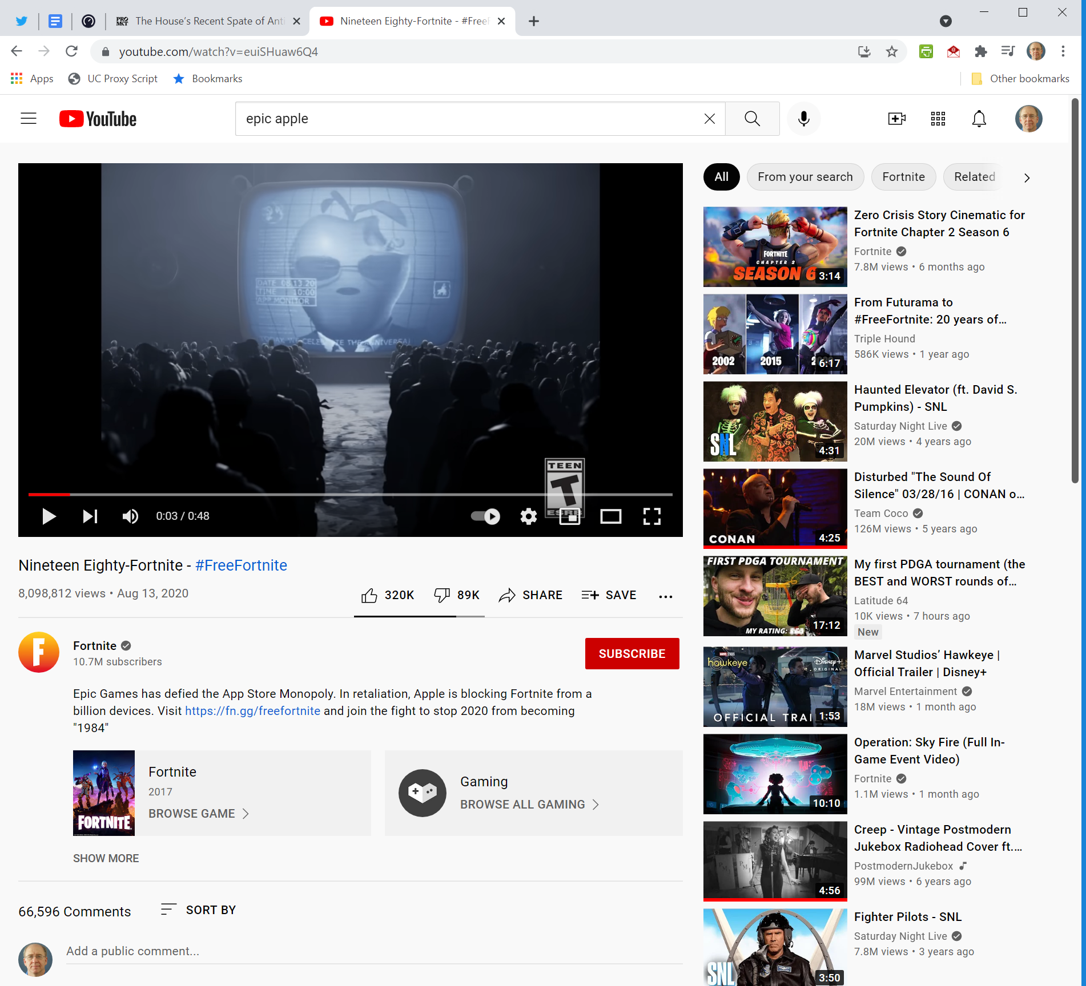
Epic PR Campaign: euiSHuaw6Q4
Epic Games (13 Aug 2020)
Notes:
https://www.youtube.com/watch?v=euiSHuaw6Q4

Slide 44
Theories of Liability
Epic Apple Complaint (13 Aug 2020)

Slide 45
Ten Counts
Epic Apple Complaint (13 Aug 2020)

Slide 46
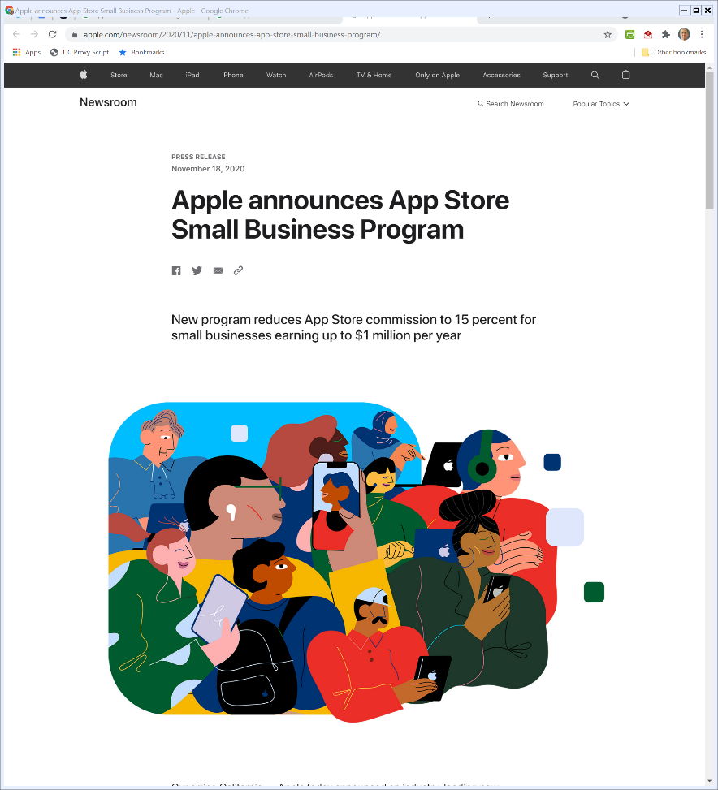
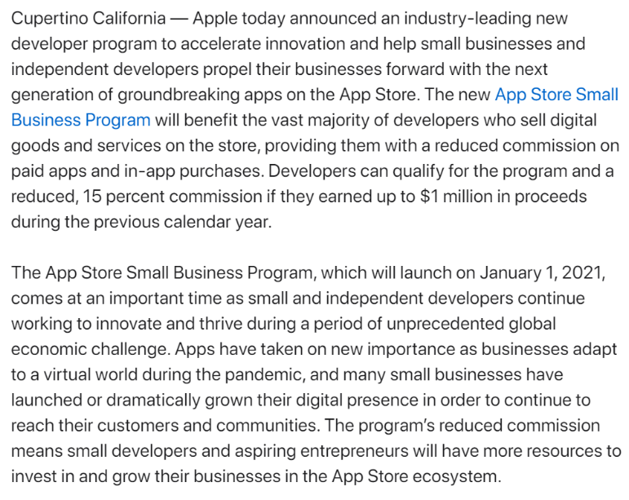
18 Nov 2020: Apple Commission Change
Apple.com (18 Nov 2020)
Notes:
https://www.apple.com/newsroom/2020/11/apple-announces-app-store-small-business-program/

Slide 47
10 Sept 2021: District Court Decision
Dist Ct Order (10 Sept 2021)

Slide 48
Protecting Competition
Dist Ct Order (10 Sept 2021)

Slide 49
Market Definition
Dist Ct Order (10 Sept 2021)

Slide 50
Apple Isn’t a Monopolist on this Evidence
Dist Ct Order (10 Sept 2021)

Slide 51
But Apple Limits on Steering Violate California Law
Dist Ct Order (10 Sept 2021)

Slide 52
Permanent Injunction
Dist Ct (10 Sept 2021)

Slide 53
24 Apr 2023: Ninth Circuit Ruling
Epic v. Apple (9th Cir. 2023)

Slide 54
The Success of the App Store
Epic v. Apple (9th Cir. 2023)

Slide 55
IP Monetization
“By agreeing to the DPLA, developers unlock access to Apple’s vast consumer base—the over 1 billion users that make up about 15% of global smartphone users. They also receive tools that facilitate the development of iOS aps, including advanced application-programming interfaces, beta software, and an app-testing software. In essence, Apple uses the DPLA to license its IP to developers in exchange for a $99 fee and an ongoing 30% commission on developers’ iOS revenue.”
Epic v. Apple (9th Cir. 2023)

Slide 56
An Open Platform
“Epic’s requested relief, though somewhat vague, would essentially convert iOS into an entirely open platform: Developers would be free to distribute apps through any means they wish and use any in-app payment processor they choose.”
Epic v. Apple (9th Cir. 2023)

Slide 57
Epic Doesn’t Want to Pay for It
“Taken together, this relief would create a pathway for developers to bypass Apple’s 30% commission altogether, though Epic made open-ended assurances at trial that its relief would allow Apple to collect a commission—just not in the manner that the DPLA establishes.”
Epic v. Apple (9th Cir. 2023)

Slide 58
How Does Apple Get Paid for its IP?
“… [T]here was little in the record showing how Epic envisioned Apple accomplishing its IP-compensation goal through the proposed LRA. Because the court upheld the app-distribution restriction, Apple would still be entitled to its 30% commission on in-app purchases within apps downloaded from the App Store.”
Epic v. Apple (9th Cir. 2023)

Slide 59
How Does Apple Get Paid for its IP?
“On its own initiative, the district court floated the idea of Apple permitting multiple in-app payment processors while reserving a right to audit developers to ensure compliance with the 30% commission. But it quickly rejected that as an alternative because it ‘would seemingly impose both increased monetary and time costs.’”
Epic v. Apple (9th Cir. 2023)

Slide 60
Apple’s Procompetitive Rationales: Security
“Here, the district court accepted two sets of rationales as non-pretextual and legally cognizable. First, it found that Apple implemented the restrictions to improve device security and user privacy—thereby enhancing consumer appeal and differentiating iOS devices and the App Store from those products’ respective competitors.”
Epic v. Apple (9th Cir. 2023)

Slide 61
Apple’s Procompetitive Rationales: IP Payment
“Second, the court partially accepted Apple’s argument that it implemented the restrictions to be compensated for its IP investment. While the court credited the IP-compensation rationale generally, it rejected the rationale ‘with respect to the 30% commission rate specifically.’”
Epic v. Apple (9th Cir. 2023)

Slide 62
Business Model Competition
“With Apple’s restrictions in place, users are free to decide which kind of app-transaction platform to use. Users who value security and privacy can select (by purchasing an iPhone) Apple’s closed platform and pay a marginally higher price for apps. Users who place a premium on low prices can (by purchasing an Android device) select one of the several open app-transaction platforms, which provide marginally less security and privacy.”
Epic v. Apple (9th Cir. 2023)

Slide 63
Business Model Competition
“Apple’s restrictions create a heterogenous market for app-transaction platforms which, as a result, increases interbrand competition—the primary goal of antitrust law. See, e.g., Leegin Creative Leather Prod., Inc. v. PSKS, Inc., 551 U.S. 877, 895 (2007) … .”
Epic v. Apple (9th Cir. 2023)

Slide 64
Non-Price Features as Key Part of Competition
“Antitrust law assumes that competition best allocates resources by allowing firms to compete on ‘all elements of a bargain—quality, service, safety, and durability—and not just the immediate cost.’ Nat’l Soc’y of Pro. Eng’rs v. United States, 435 U.S. 679, 695 (1978). If we were to accept Epic and its amici’s argument, then no defendant could cite competing on non-price features as a procompetitive rationale.”
Epic v. Apple (9th Cir. 2023)

Slide 65
Inadequate Proof on IP Payment Alternatives
“As the district court noted, in a world where Apple maintains its distribution restriction but payment processing is opened up, Apple would still be contractually entitled to its 30% commission on in-app purchasers. Apart from any argument by Epic, the district court ‘presume[d]’ that Apple could ‘utilize[e] a contractual right to audit developers . . . to ensure compliance with its commissions.’ But the court then rejected such audits as an LRA because they ‘would seemingly impose both increased monetary and time costs.’”
Epic v. Apple (9th Cir. 2023)

Slide 66
California Unfair Competition Law
“We now turn to Apple’s cross-appeal, beginning with its arguments concerning the UCL. The district court found that Epic suffered an injury sufficient to confer Article III standing, concluded that Apple’s anti-steering provision violates the UCL’s unfair prong, and entered an injunction prohibiting Apple from enforcing the anti-steering provision against any developer. Apple challenges each aspect on appeal. We affirm.”
Epic v. Apple (9th Cir. 2023)

Slide 67
Willful Violation
“For the reasons set forth herein, the Court FINDS Apple in willful violation of this Court’s 2021 Injunction which issued to restrain and prohibit Apple’s anticompetitive conduct and anticompetitive pricing. Apple’s continued attempts to interfere with competition will not be tolerated.”
Dist Ct Op (30 Apr 2025)

Slide 68
Supracompetitive = Anticompetitive (No!)
“To summarize: One, after trial, the Court found that Apple’s 30 percent commission “allowed it to reap supracompetitive operating margins” and was not tied to the value of its intellectual property, and thus, was anticompetitive. Apple’s response: charge a 27 percent commission (again tied to nothing) on off-app purchases, where it had previously charged nothing, and extend the commission for a period of seven days after the consumer linked-out of the app. Apple’s goal: maintain its anticompetitive revenue stream.”
Dist Ct Op (30 Apr 2025)

Slide 69
Scare Screens
“Two, the Court had prohibited Apple from denying developers the ability to communicate with, and direct consumers to, other purchasing mechanisms. Apple’s response: impose new barriers and new requirements to increase friction and increase breakage rates with full page “scare” screens, static URLs, and generic statements. Apple’s goal: to dissuade customer usage of alternative purchase opportunities and maintain its anticompetitive revenue stream. In the end, Apple sought to maintain a revenue stream worth billions in direct defiance of this Court’s Injunction.”
Dist Ct Op (30 Apr 2025)

Slide 70
Scare Screens
Dist Ct Op (30 Apr 2025)

Slide 71
Scare Screens
Dist Ct Op (30 Apr 2025)

Slide 72
Civil Contempt
“The Court HOLDS Apple in civil contempt. Sanctions and relief with respect to Apple’s noncompliance are set forth infra Section IV.”
Dist Ct Op (30 Apr 2025)

Slide 73
New Injunction: No Outside App Commissions
Dist Ct Op (30 Apr 2025)

Slide 74
New Injunction
Dist Ct Op (30 Apr 2025)

Slide 75
Criminal Referral
“Accordingly, under Rule 42(a)(2) of the Federal Rules of Criminal Procedure, the Court refers the issue to the United States Attorney for the Northern District of California, Patrick D. Robbins, or his designee(s), for investigation against Apple and Alex Roman, Apple’s Vice President of Finance specifically. The Court takes no position on whether a criminal prosecution is or is not warranted.”
Dist Ct Op (30 Apr 2025)

Slide 76
Penalties?
“It will be for the executive branch to decide whether Apple should be deprived of the fruits of its violation, in addition to any penalty geared to deter future misconduct.”
Dist Ct Op (30 Apr 2025)

Slide 77
Insubordination?
“Apple willfully chose not to comply with this Court’s Injunction. It did so with the express intent to create new anticompetitive barriers which would, by design and in effect, maintain a valued revenue stream; a revenue stream previously found to be anticompetitive. That it thought this Court would tolerate such insubordination was a gross miscalculation. As always, the coverup made it worse. For this Court, there is no second bite at the apple.”
Dist Ct Op (30 Apr 2025)

Slide 78
CA9 Stay Denial
Ninth Circuit (4 June 2025)

Slide 79
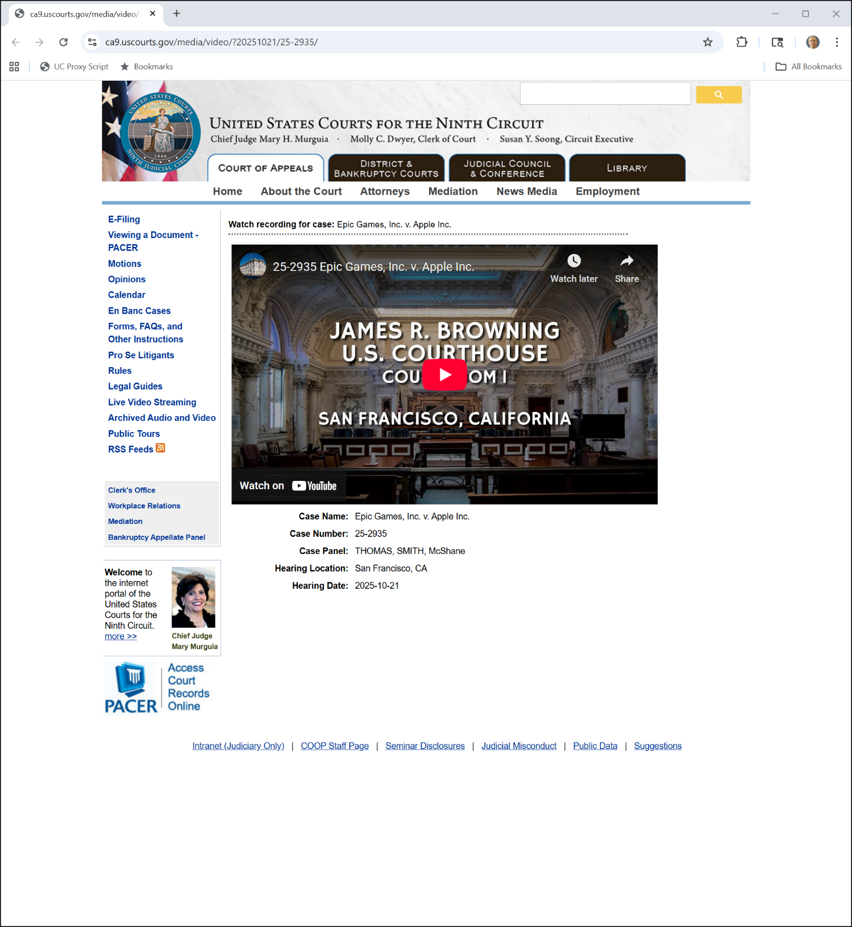

21 Oct 2025 Oral Arg
Ninth Circuit (8 Nov 2025)
Notes:
https://www.ca9.uscourts.gov/media/video/?20251021/25-2935/

Slide 80
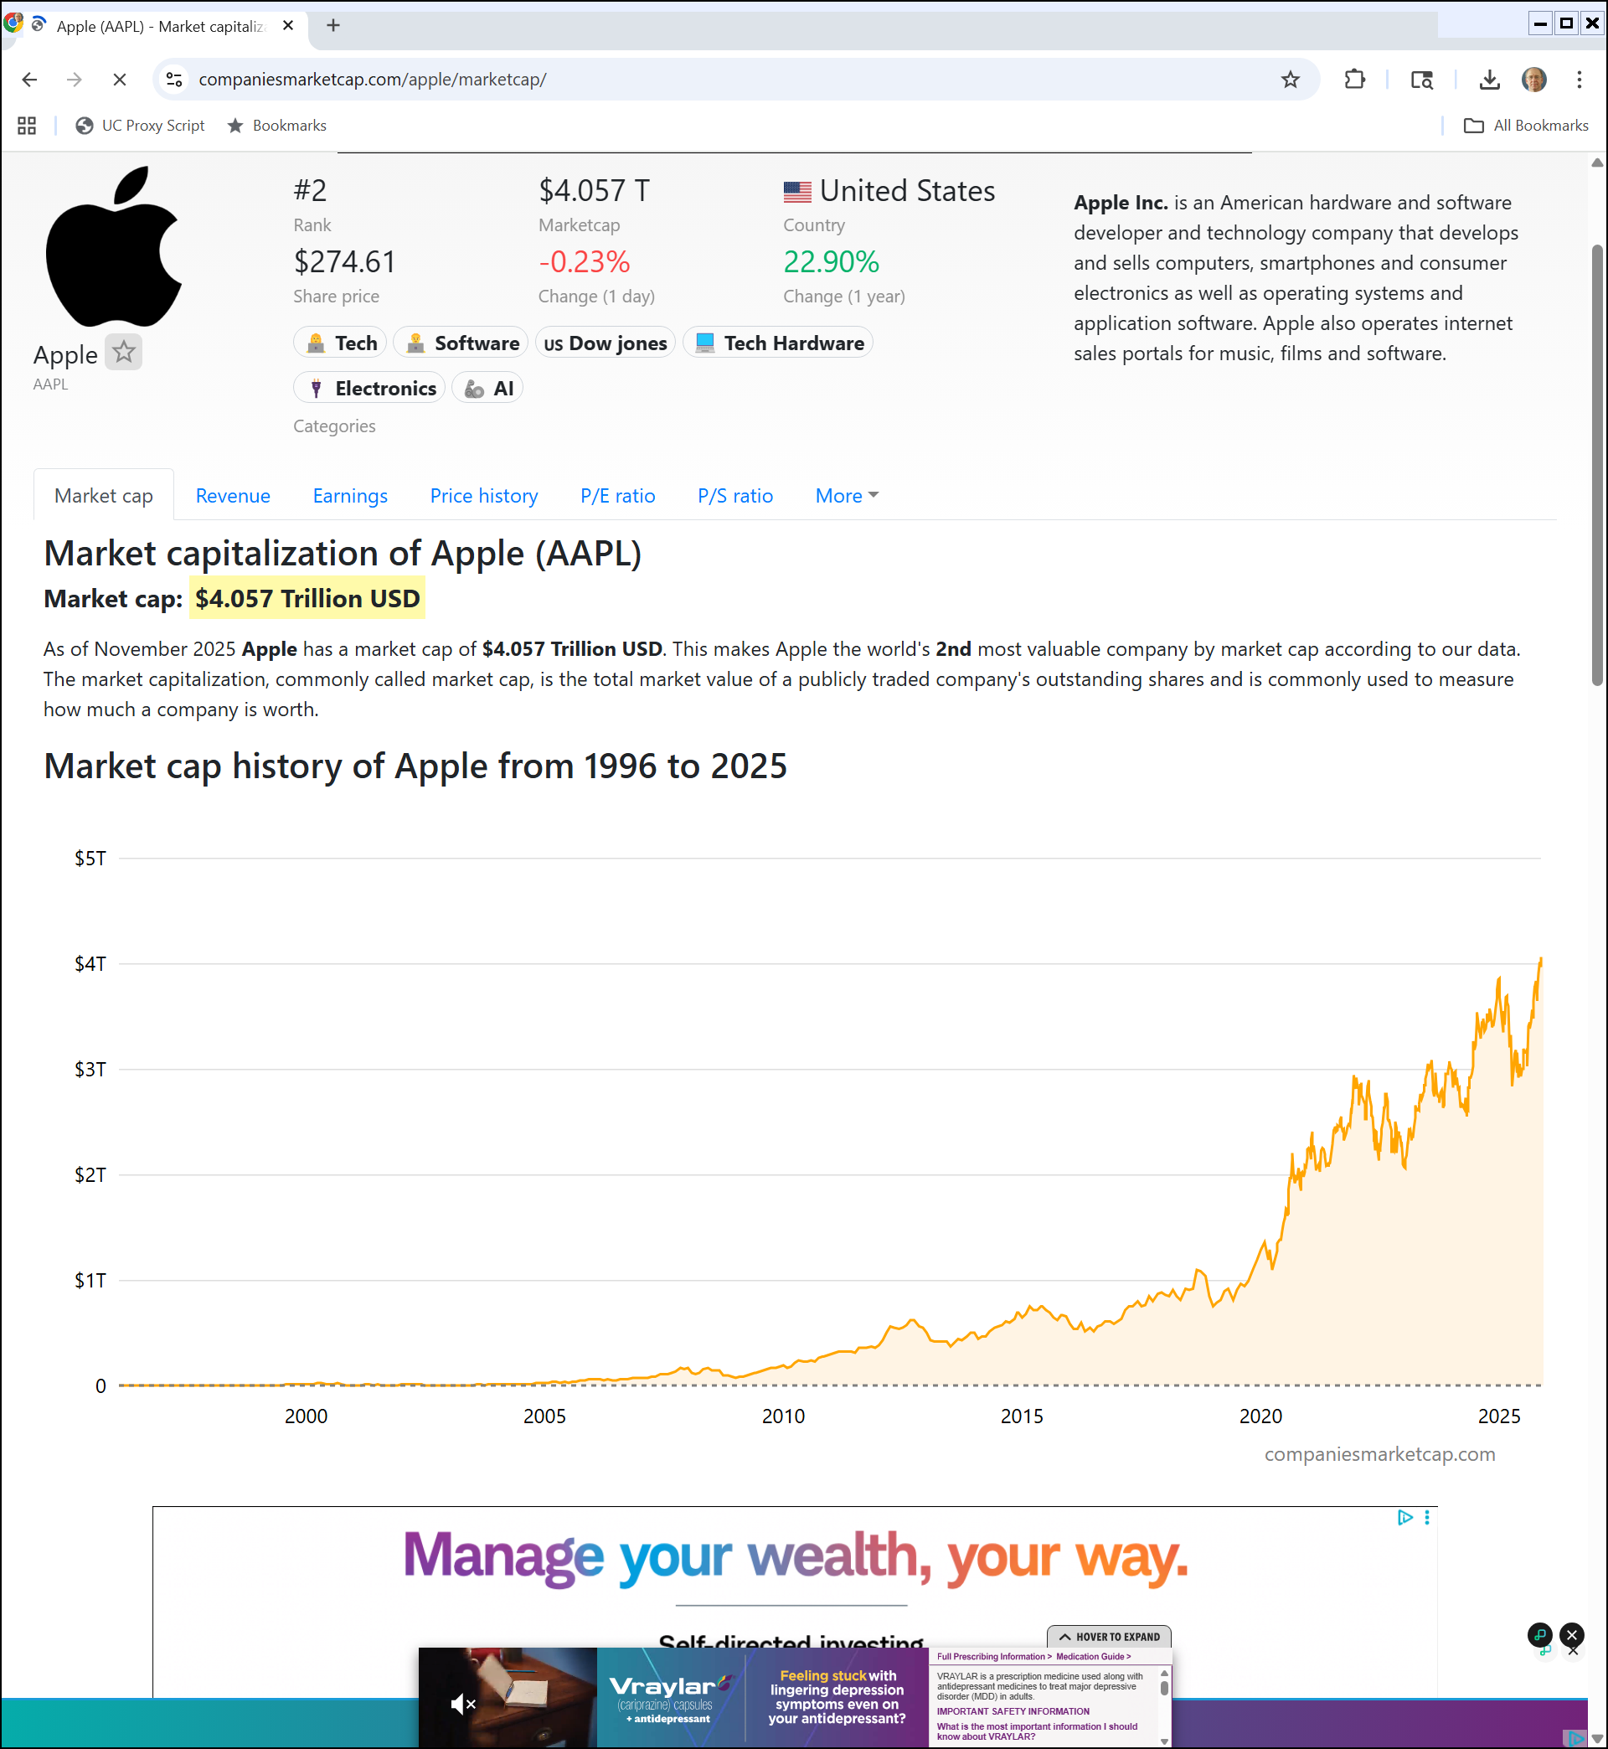
$4T
companiesmarketcap.com (12 Nov 2025)
Notes:
https://companiesmarketcap.com/apple/marketcap/

