Slide 1
Class 19: Fri 7 Nov 2025
Antitrust Fall 2025
Big Tech: Microsoft
Randal C. Picker
James Parker Hall Distinguished Service Professor of Law
The Law School
The University of Chicago
Copyright © 2000-25 Randal C. Picker. All Rights Reserved.

Slide 2
The Trillion Dollar Magazine Cover
Popular Electronics (Jan 1975)

Slide 3
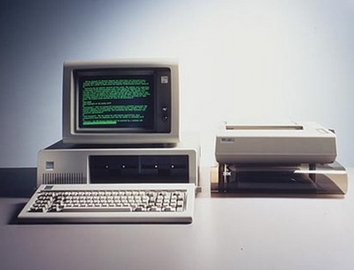
12 Aug 1981: IBM Personal Computer
Intel 8088 processor
16K to 256K RAM
28 pounds with two disk drives (no hard drive)

Slide 4
Three Operating Systems!
Three operating systems available (DOS, CP/M-86 and UCSD p-System)
Two languages: Pascal and BASIC Interpreter (based on Microsoft Basic)
IBM PC (12 Aug 1981)

Slide 5
1994: US v. IBM (MS-DOS Licensing)
MS-DOS Complaint (15 July 1994)

Slide 6
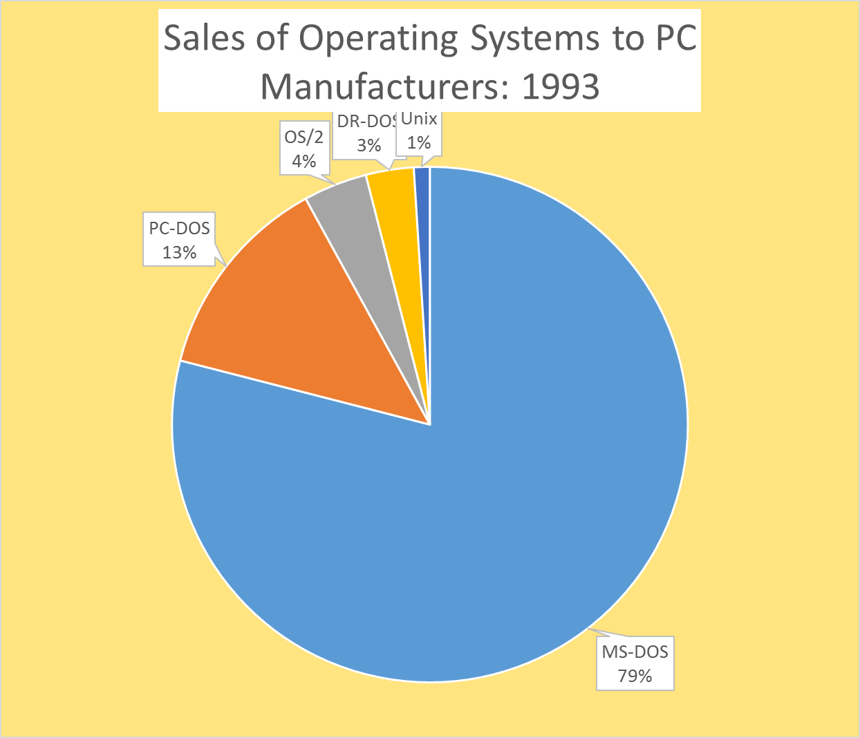
Microsoft’s Position
MS-DOS Competitive Impact Statement (15 July 1994)

Slide 7
1995: Microsoft’s Vision
“Our vision for the last 20 years can be summarized in a succinct way. We saw that exponential improvements in computer capabilities would make great software quite valuable. Our response was to build an organization to deliver great software products.”
Bill Gates, Internet Tidal Wave Memo (26 May 1995)

Slide 8
Network Improvements
“In the next 20 years the improvement in computer power will be outpaced by the exponential improvements in communications networks. The combination of these elements will have a fundamental impact on work, learning and play.”
Bill Gates, Internet Tidal Wave Memo (26 May 1995)

Slide 9
The Coming Role of the Internet
“The Internet is at the forefront of all of this and developments on the Internet over the next several years will set the course of our industry for a long time to come. … Now I assign the Internet the highest level of importance.”
Bill Gates, Internet Tidal Wave Memo (26 May 1995)

Slide 10
Internet More Important than GUI
“The Internet is the most important single development to come along since the IBM PC was introduced in 1981. It is even more important than the arrival of the graphical user interface (GUI).”
Bill Gates, Internet Tidal Wave Memo (26 May 1995)

Slide 11
Emergence of Netscape
“A new competitor ‘born’ on the Internet is Netscape. Their browser is dominant, with 70% usage share … . They are pursuing a multi-platform strategy where they move the key API into the client to commoditize the underlying operating system.”
Bill Gates, Internet Tidal Wave Memo (26 May 1995)

Slide 12
Netscape’s API Platform Strategy (Middleware)
Developers
Developers
Navigator and Java
W OS
M OS
Consumers
Consumers

Slide 13
A Scary New Device?
“One scary possibility being discussed by Internet fans is whether they should get together and create something far less expensive than a PC which is powerful enough for Web browsing.”
Bill Gates, Internet Tidal Wave Memo (26 May 1995)

Slide 14
Building a Browser
TTYN (1 of 4)
You are Microsoft in 1994/95
  1. Can you build a browser?
  2. What can you use it for?
  3. How are you allowed to distribute it?
  4. Can you discuss this with Netscape?
  5. What other issues should you think through?

Slide 15
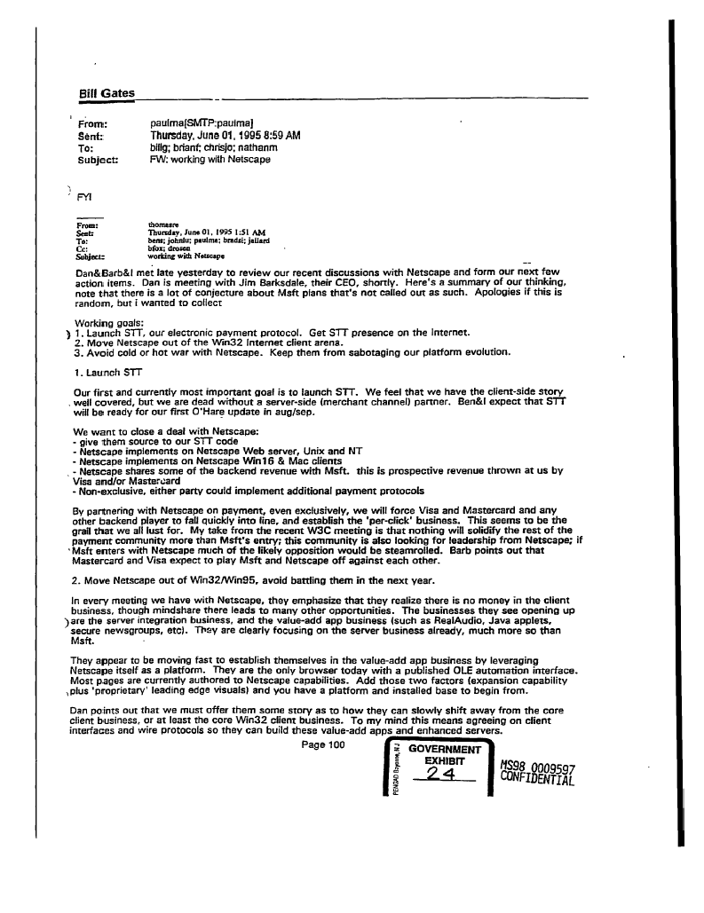
TTYN (2 of 4)
Email “Working with Netscape” (1 June 1995) (Gov’t Ex 24)

Slide 16
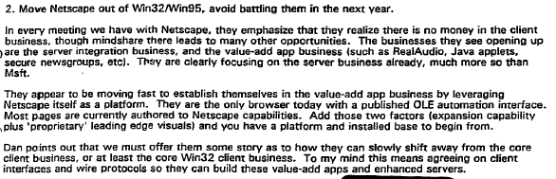
TTYN (3 of 4)
Email “Working with Netscape” (1 June 1995) (Gov’t Ex 24)

Slide 17
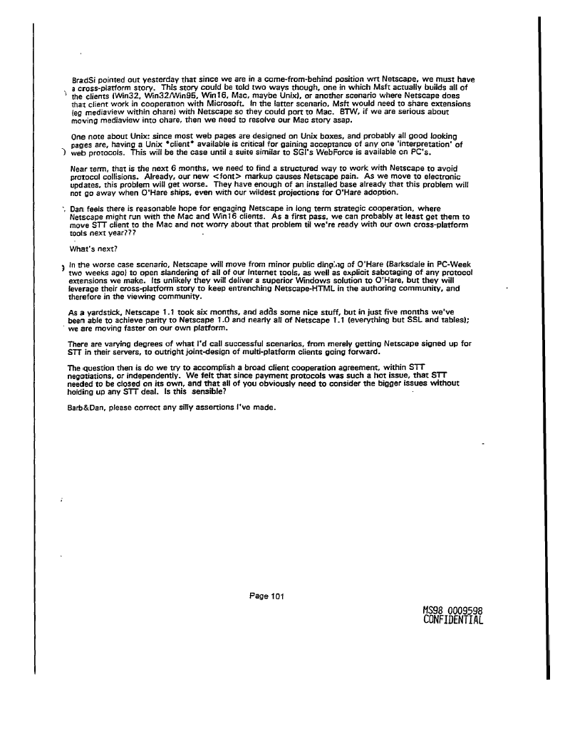
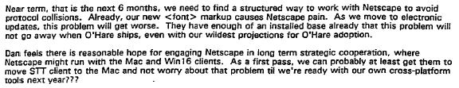
TTYN (4 of 4)
Email “Working with Netscape” (1 June 1995) (Gov’t Ex 24)

Slide 18
1998: U.S. v Microsoft
US v Microsoft Complaint (18 May 1998)

Slide 19
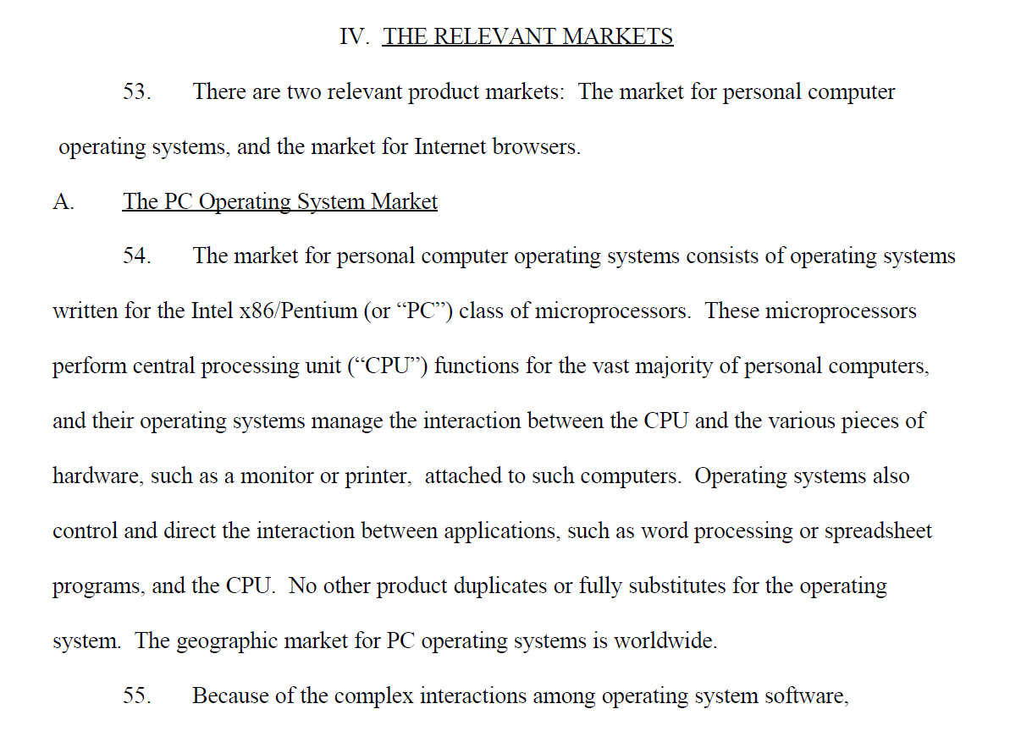
Definition of Relevant Market
US v Microsoft (18 May 1998)

Slide 20
Definition of Relevant Market
US v Microsoft (18 May 1998)

Slide 21
1st Claim: Illegal Exclusive Dealing
US v Microsoft (18 May 1998)

Slide 22
2nd Claim: Tying of IE to Windows
US v Microsoft (18 May 1998)

Slide 23
3rd Claim: Illegal Monopoly Maintenance
US v Microsoft (18 May 1998)

Slide 24
4th Claim: Attempted Monopolization
US v Microsoft (18 May 1998)

Slide 25
Microsoft Corp.
“Not later than four months after entry of this Final Judgment, Microsoft shall submit to the Court and the Plaintiffs a proposed plan of divestiture.”
97 F.Supp.2d 59 (D.D.C. 2000)

Slide 26
Original Divestiture Remedy
New MS 1: OfficeCo (and copy of IE and can modify it)
Microsoft
New MS 2: WindowsCo (and copy of IE (but can’t modify it))
US v. Microsoft, DDC (June 7, 2000)

Slide 27
Microsoft III
253 F.3d 34 (D.C. Cir. 2001)

Slide 28
D.C. Circuit Opinion
Liability
  Affirms in large part monopoly maintenance
  Reverses on attempted monopolization of browser market, as plaintiffs failed to adequately define the market
  Reverses tying: per se analysis was not appropriate, rule of reason analysis required

Slide 29
SA2 Step 1: Harm to Competitive Process and to Consumers
“First, to be condemned as exclusionary, a monopolist’s act must have an ‘anticompetitive effect.’ That is, it must harm the competitive process and thereby harm consumers. In contrast, harm to one or more competitors will not suffice.”
Microsoft III (CADC 2001)

Slide 30
SA2 Step 2: Showing of Harm to Competition
“Second, the plaintiff, on whom the burden of proof of course rests, must demonstrate that the monopolist’s conduct indeed has the requisite anticompetitive effect. … [N]o less in a case brought by the Government, it must demonstrate that the monopolist’s conduct harmed competition, not just a competitor.”
Microsoft III (CADC 2001)

Slide 31
SA2 Step 3: Procompetitive Justification
“Third, if a plaintiff successfully establishes a prima facie case under § 2 by demonstrating anticompetitive effect, then the monopolist may proffer a ‘procompetitive justification’ for its conduct. … If the monopolist asserts a procompetitive justification—a nonpretextual claim that its conduct is indeed a form of competition on the merits because it involves, for example, greater efficiency or enhanced consumer appeal—then the burden shifts back to the plaintiff to rebut that claim.”
Microsoft III (CADC 2001)

Slide 32
SA2 Step 4: Do Harms Outweigh Benefits?
“Fourth, if the monopolist’s procompetitive justification stands unrebutted, then the plaintiff must demonstrate that the anticompetitive harm of the conduct outweighs the procompetitive benefit. In cases arising under § 1 of the Sherman Act, the courts routinely apply a similar balancing approach under the rubric of the ‘rule of reason’.”
Microsoft III (CADC 2001)

Slide 33
SA2 Monopolization: Effect, Not Intent
“Finally, in considering whether the monopolist’s conduct on balance harms competition and is therefore condemned as exclusionary for purposes of § 2, our focus is upon the effect of that conduct, not upon the intent behind it. Evidence of the intent behind the conduct of a monopolist is relevant only to the extent it helps us understand the likely effect of the monopolist's conduct.”
Microsoft III (CADC 2001)

Slide 34
Structure of Monopolization Inquiry
Court suggests four steps but hard to separate 1 and 2
Three Steps
  1. Is the conduct anti-competitive? If so, makes out prima facie case under Sec. 2 if mkt power already shown?
  2. Can the monopolist offer a procompetitive justification for the conduct?

Slide 35
Structure of Monopolization Inquiry
  3. If so, plaintiff must show harm outweighs benefits
Intent
  As such, unimportant
Overall
  Parallels approach under Sec. 1 rule of reason inquiry

Slide 36
Two Markets in Play
“Therefore, Microsoft’s efforts to gain market share in one market (browsers) served to meet the threat to Microsoft’s monopoly in another market (operating systems) by keeping rival browsers from gaining the critical mass of users necessary to attract developer attention away from Windows as the platform for software development.”
Microsoft III (CADC 2001)

Slide 37
Internet Access Provider (IAP) Deals
“Microsoft has exclusive deals with ‘fourteen of the top fifteen access providers in North America[, which] account for a large majority of all Internet access subscriptions in this part of the world.’ Id. ¶ 308. By ensuring that the ‘majority’ of all IAP subscribers are offered IE either as the default browser or as the only browser, Microsoft’s deals with the IAPs clearly have a significant effect in preserving its monopoly; they help keep usage of Navigator below the critical level necessary for Navigator or any other rival to pose a real threat to Microsoft’s monopoly.”
Microsoft III (CADC 2001)

Slide 38
Monop Maintenance: OEMs
TTYN (1 of 3)
Original Equipment Makers (OEMs)
  These are companies that make PCs
  Could not remove IE icon from desktop
  Could not insert Internet access provider offers (AOL, Prodigy, others) in initial boot sequence
  More general limits on changing desktop
How should we assess these?

Slide 39
Monop Maintenance: Integration
TTYN (2 of 3)
Three Specific Acts of Integrating IE and Windows
  Exclusion of IE from Add/Remove utility
  Limited override of consumer default browser choice in some cases
  Commingling of code: deletion of IE would “cripple” Windows itself
How should we assess these?

Slide 40
Monop Maintenance: IAP Deals
TTYN (3 of 3)
Inducements
  Free IE to internet access providers (IAPs) and bounty to IAPs for signing up IE users
  IE Access Kit: Easy access for IAP to IE and free
  Desktop placement swapped for agreement not to distribute Navigator above fixed percentage
How should we assess these?

Slide 41
MM: OEMs and Integration
Raising Rivals’ Costs
  MS restrictions made it more expensive for OEMs to install Navigator
  That in turn protected Microsoft’s OS monopoly by reducing potential middleware competition
  Integration of IE and Windows--commingling of IE code and Windows code--did this as well

Slide 42
MM: Distribution
Limiting Distribution Opportunities for Netscape and Java
  MS entered into contracts with OEMs, IAPs, ICPs and others that put numerical limits on Navigator distribution
  Standard Fashions?

Slide 43
Exclusive IAP Deals as SA2 Violation
“Plaintiffs having demonstrated a harm to competition, the burden falls upon Microsoft to defend its exclusive dealing contracts with IAPs by providing a procompetitive justification for them. Significantly, Microsoft’s only explanation for its exclusive dealing is that it wants to keep developers focused upon its APIs—which is to say, it wants to preserve its power in the operating system market.”
Microsoft III (CADC 2001)

Slide 44
Exclusive IAP Deals as SA2 Violation
“That is not an unlawful end, but neither is it a procompetitive justification for the specific means here in question, namely exclusive dealing contracts with IAPs. Accordingly, we affirm the District Court’s decision holding that Microsoft’s exclusive contracts with IAPs are exclusionary devices, in violation of § 2 of the Sherman Act.”
Microsoft III (CADC 2001)

Slide 45
Java Competition
“As explained above, however, a monopolist does not violate the antitrust laws simply by developing a product that is incompatible with those of its rivals. … In order to violate the antitrust laws, the incompatible product must have an anticompetitive effect that outweighs any procompetitive justification for the design.”
Microsoft III (CADC 2001)

Slide 46
Threatening Intel
“The District Court held that Microsoft also acted unlawfully with respect to Java by using its ‘monopoly power to prevent firms such as Intel from aiding in the creation of cross-platform interfaces.’ Conclusions of Law, at 43. … Microsoft does not deny the facts found by the District Court, nor does it offer any procompetitive justification for pressuring Intel not to support cross-platform Java. Microsoft lamely characterizes its threat to Intel as ‘advice.’ ... Therefore we affirm the conclusion that Microsoft’s threats to Intel were exclusionary, in violation of § 2 of the Sherman Act.”
Microsoft III (CADC 2001)

Slide 47
Controlling Monopolist’s Response to Nascent Threats
“… [S]uffice it to say that it would be inimical to the purpose of the Sherman Act to allow monopolists free reign to squash nascent, albeit unproven, competitors at will—particularly in industries marked by rapid technological advance and frequent paradigm shifts.”
Microsoft III (CADC 2001)

Slide 48
Attempted Monopolization of the Browser Market?
“To establish a dangerous probability of success, plaintiffs must as a threshold matter show that the browser market can be monopolized, i.e., that a hypothetical monopolist in that market could enjoy market power. This, in turn, requires plaintiffs (1) to define the relevant market and (2) to demonstrate that substantial barriers to entry protect that market. Because plaintiffs have not carried their burden on either prong, we reverse without remand.”
Microsoft III (CADC 2001)

Slide 49
Rule of Reason for Tying Here
“We hold that the rule of reason, rather than per se analysis, should govern the legality of tying arrangements involving platform software products. … There being no close parallel in prior antitrust cases, simplistic application of per se tying rules carries a serious risk of harm. Accordingly, we vacate the District Court’s finding of a per se tying violation and remand the case.”
Microsoft III (CADC 2001)

Slide 50
Applying Jefferson Parish Here
“The per se rule’s direct consumer demand and indirect industry custom inquiries are, as a general matter, backward-looking and therefore systematically poor proxies for overall efficiency in the presence of new and innovative integration.”
Microsoft III (CADC 2001)

Slide 51
D.C. Circuit Opinion
Remedy
  Needed to be reversed given liability reversals
  Independently reversed for failure to conduct a remedies hearing
  Also reversed for Judge Jackson’s extrajudicial statements

Slide 52
Microsoft Remedy: Big Picture
Included
  Bar past anti-competitive contractual practices
  Free OEMs, ISPs and others to facilitate competition
  Some disclosure obligations of API and communications protocols and corresponding licenses of IP

Slide 53
Microsoft Remedy: Big Picture
Omitted
  Mandatory distribution (must carry) of Netscape Navigator or Java?
  Open source IE?
  Much broader disclosure obligations?
  Direct limitations on scope of bundling and integration?
  Mandatory porting of Office?

Slide 54
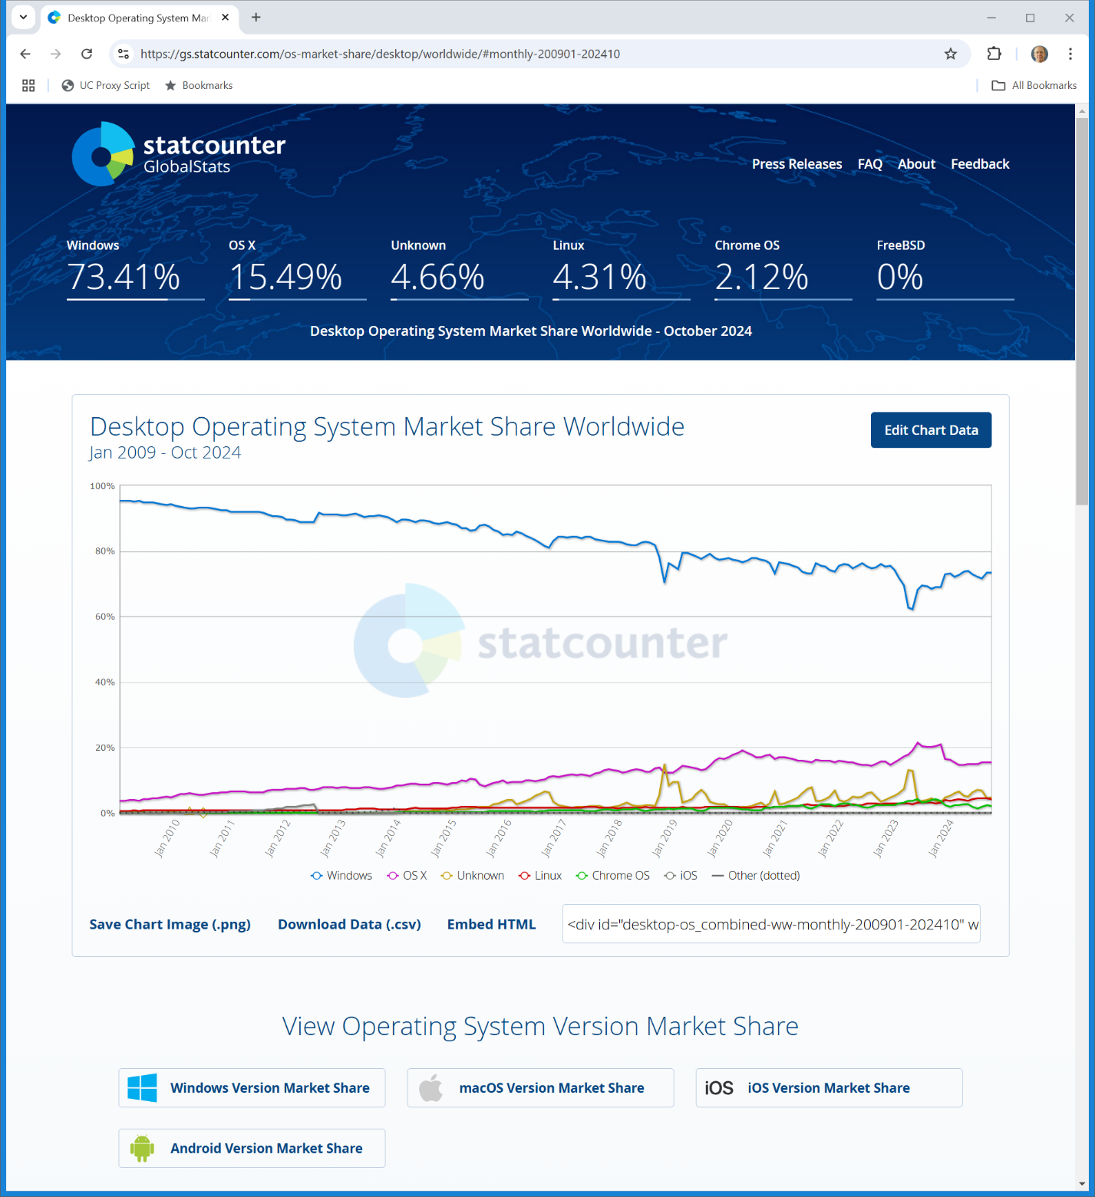
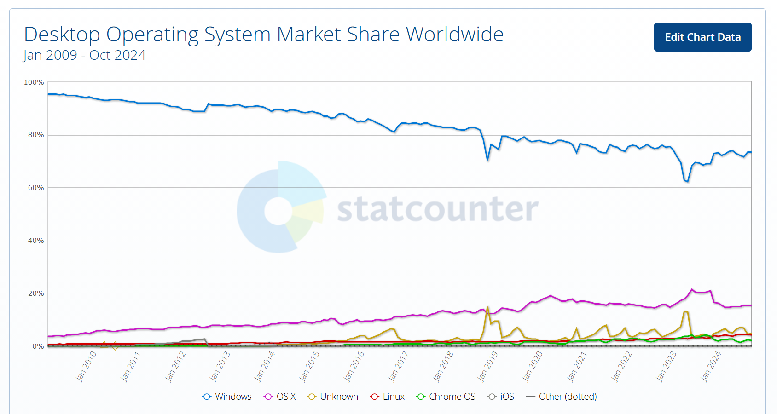
Worldwide Desktop OS Market Shares
Statcounter (12 Nov 2024)
Notes:
https://gs.statcounter.com/os-market-share/desktop/worldwide/#monthly-200901-202410

Slide 55
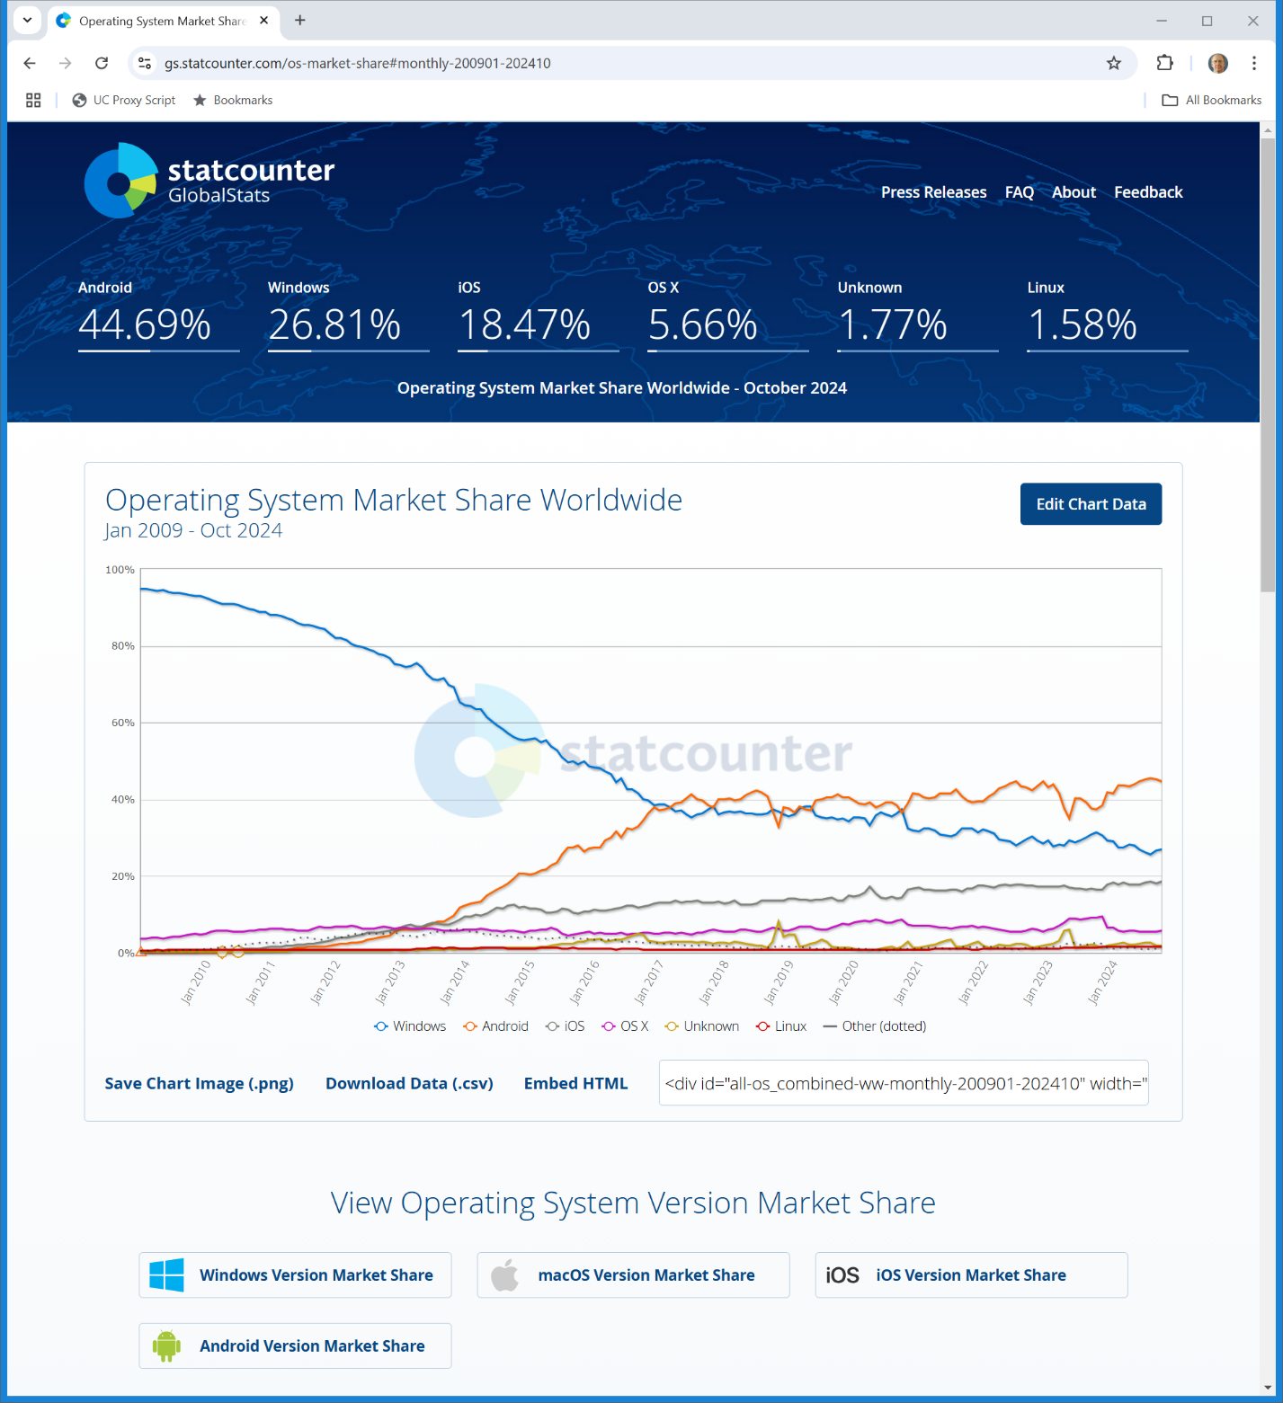
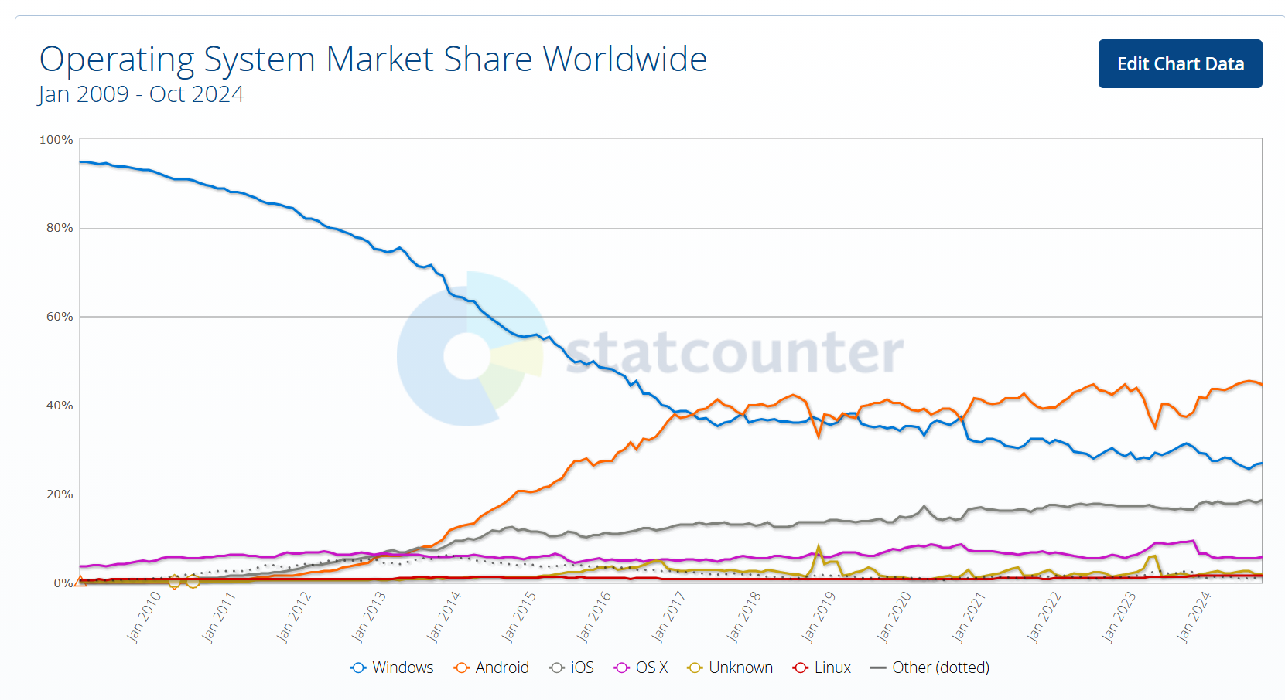
Worldwide OS Market Shares
Statcounter (12 Nov 2024)
Notes:
https://gs.statcounter.com/os-market-share#monthly-200901-202410

Slide 56
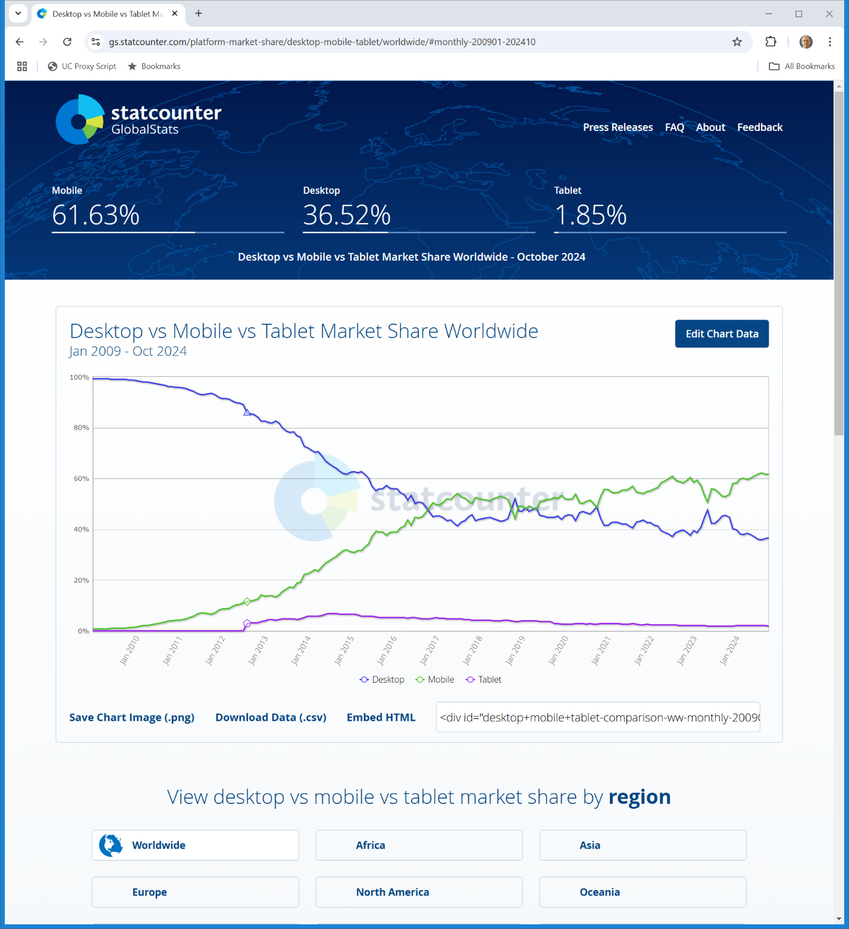

Device Competition
Statcounter (12 Nov 2024)
Notes:
https://gs.statcounter.com/platform-market-share/desktop-mobile-tablet/worldwide/#monthly-200901-202410

Slide 57
Worldwide PC Sales
Statista (2023)

Slide 58
Building a Media Player
TTYN
You are at Microsoft in the 1990s
  1. Can you build a media player?
  2. What can you use it for?
  3. How are you allowed to distribute it?
  4. What other issues should you think through?

Slide 59
OS Extension, New Market Entry & Tying in Two-Sided Markets
Publishers & Advertisers
Developers
In a two-sided market, tying can be closer to pure leveraging of the platform as to a different customer base on one side of the market
W OS
Browser
Consumers

Slide 60
OS Extension, New Market Entry & Tying in Two-Sided Markets
Music Cos
Publishers & Advertisers
Developers
Media Player
W OS
Browser
Platform tying as one-sided leveraging
Consumers

Slide 61
EC Statement of Objections WMP
“Finally, the Commission also believes that Microsoft may have acted illegally by incorporating its new Media Player product into its Windows PC operating system. … Microsoft ties its Media Player to its ubiquitous Windows operating system, a channel of distribution which is not available to competing vendors of media players.”
European Commission (30 Aug 2001)
Notes:
https://ec.europa.eu/commission/presscorner/detail/en/IP_01_1232

Slide 62
EC Statement of Objections WMP
“Microsoft may thereby deprive PC manufacturers and final users of a free choice over which products they want to have on their PCs, especially as there are no ready technical means to remove or uninstall the Media Player product. Competing products may therefore be a priori set at a disadvantage which is not related to their price or quality. The result is a weakening of effective competition in the market, a reduction of consumer choice, and less innovation”
European Commission (30 Aug 2001)

Slide 63
EC WMP Violation
“The European Commission has concluded, after a five-year investigation, that Microsoft Corporation broke European Union competition law by leveraging its near monopoly in the market for PC operating systems (OS) onto the markets for work group server operating systems and for media players. …”
European Commission (24 Mar 2004)

Slide 64
EC WMP Violation
“Microsoft is also required, within 90 days, to offer a version of its Windows OS without Windows Media Player to PC manufacturers (or when selling directly to end users). In addition, Microsoft is fined €497 million for abusing its market power in the EU.”
European Commission (24 Mar 2004)

Slide 65
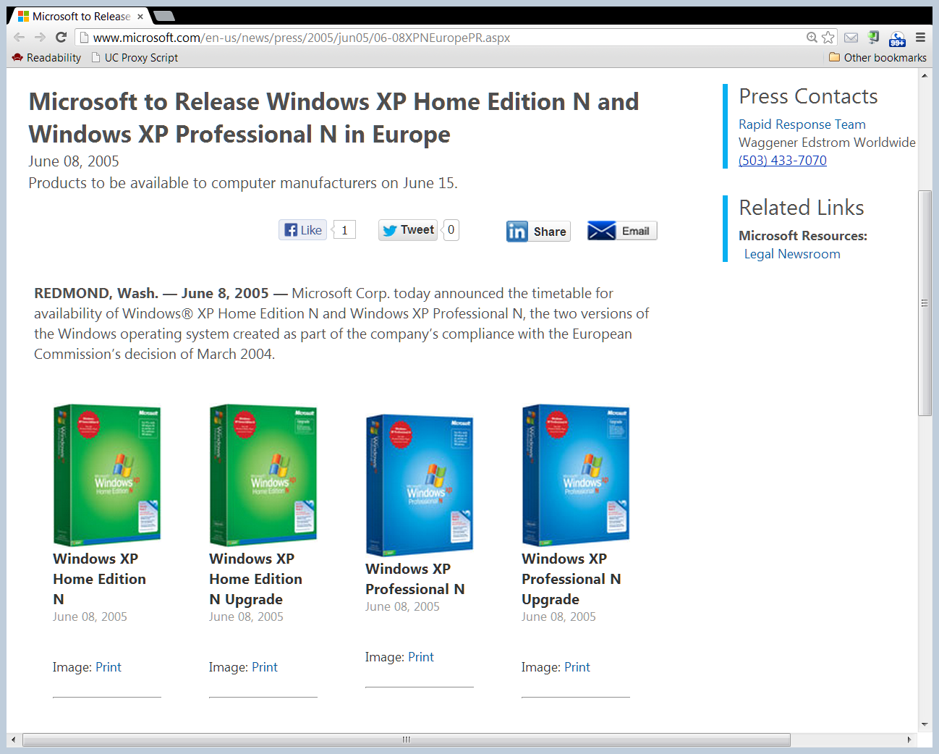
Understanding the EC WMP Remedy
Versioning with a Subtraction Remedy
  Simple to create multiple versions of Windows
  Create version with Windows Media Player, 2nd version without WMP and let the market decide
Microsoft Press Release (8 June 2005)

Slide 66
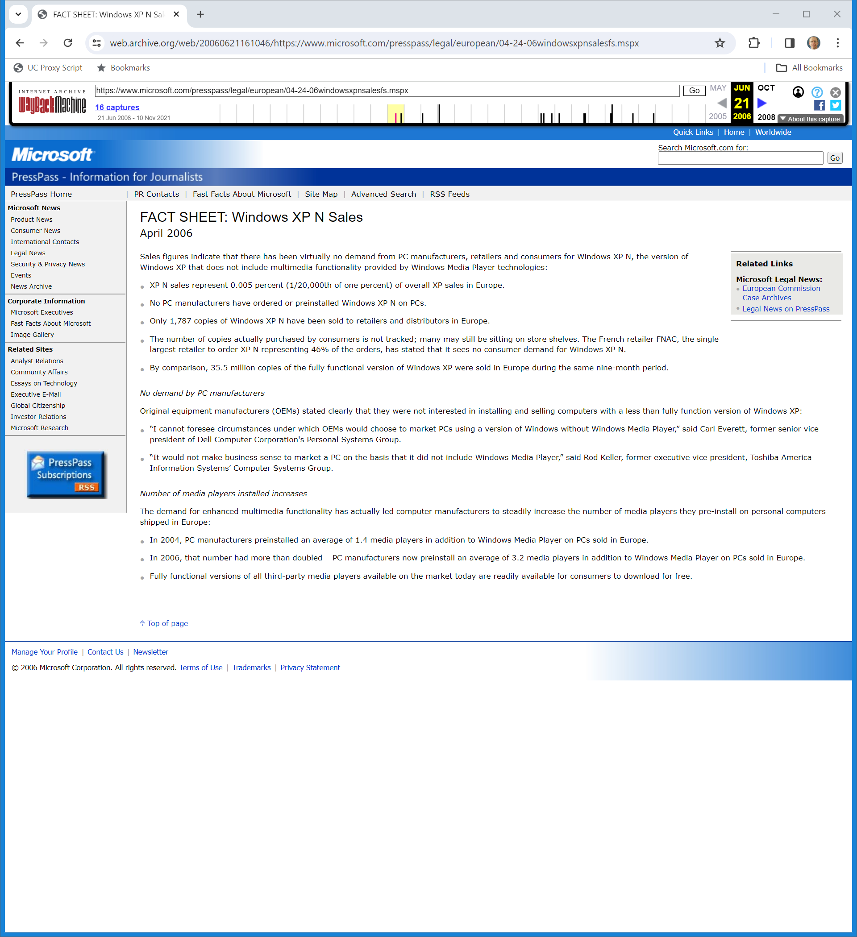
Comparison Sales of Two Versions of Windows XP
Microsoft Fact Sheet (April 2006)
Notes:
https://web.archive.org/web/20060621161046/https://www.microsoft.com/presspass/legal/european/04-24-06windowsxpnsalesfs.mspx

Slide 67
Media Player Installation Increasing
Microsoft Fact Sheet (April 2006)
Notes:
https://web.archive.org/web/20060621161046/https://www.microsoft.com/presspass/legal/european/04-24-06windowsxpnsalesfs.mspx

Slide 68
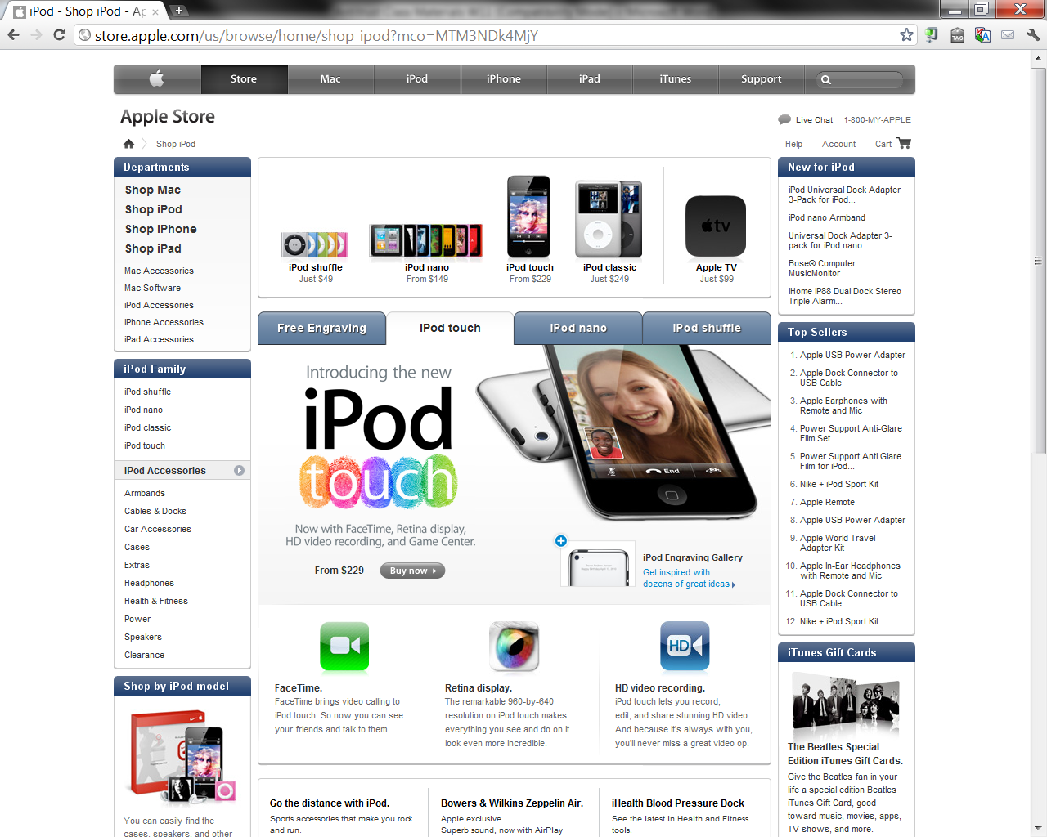
What Mattered: The iPod

Slide 69
2009: EC SO re IE Tying
“In the SO, the Commission sets out evidence and outlines its preliminary conclusion that Microsoft’s tying of Internet Explorer to the Windows operating system harms competition between web browsers, undermines product innovation and ultimately reduces consumer choice.”
European Commission (17 Jan 2009)
Notes:
https://ec.europa.eu/commission/presscorner/detail/en/MEMO_09_15

Slide 70
Browser Ballot Settlement
“Under the commitments approved by the Commission, Microsoft will make available for five years in the European Economic Area (through the Windows Update mechanism) a ‘Choice Screen’ enabling users of Windows XP, Windows Vista and Windows 7 to choose which web browser(s) they want to install in addition to, or instead of, Microsoft’s browser Internet Explorer.”
European Commission (16 Dec 2009)
Notes:
https://ec.europa.eu/commission/presscorner/detail/en/IP_09_1941

Slide 71
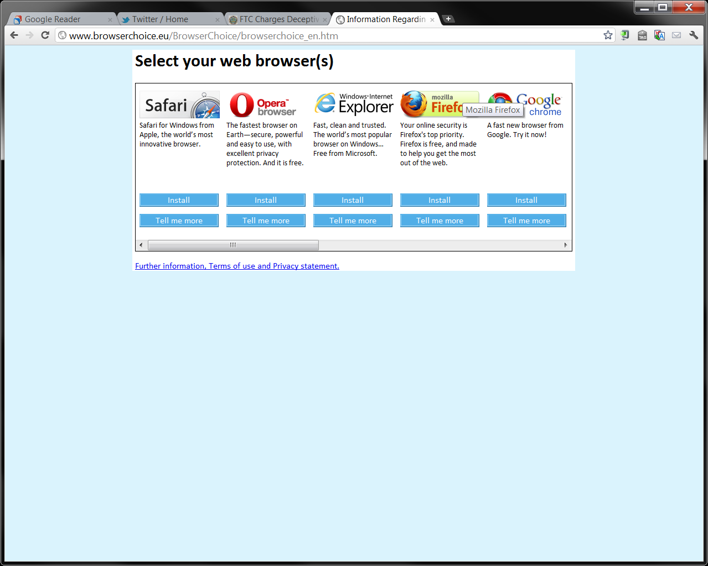
Browser Choice
www.browserchoice.eu

Slide 72
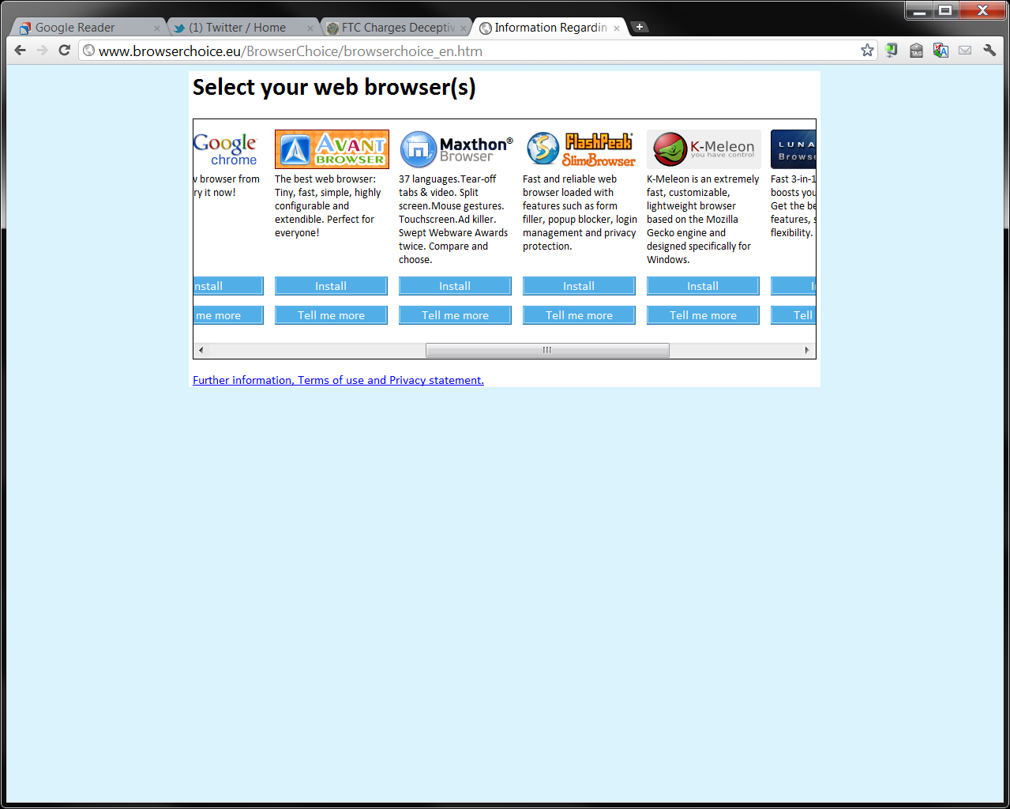
More
www.browserchoice.eu

Slide 73
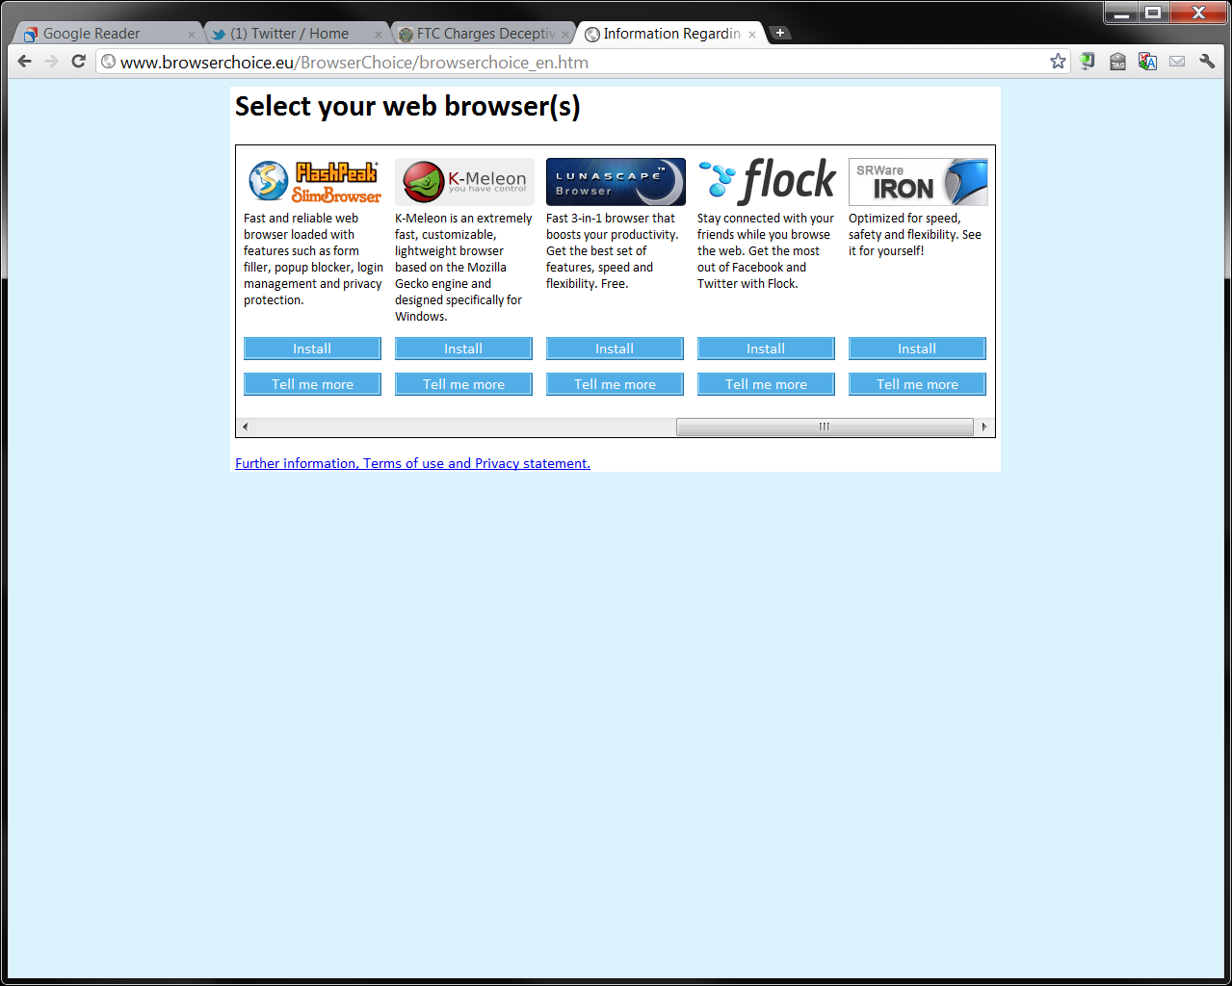
And Still More
www.browserchoice.eu

Slide 74
2012: New EC Investigation re Windows 7
“On the basis of information it has received, the Commission believes that Microsoft may have failed to roll out the choice screen with Windows 7 Service Pack 1, which was released in February 2011. ”
European Commission (17 July 2012)
Notes:
https://ec.europa.eu/commission/presscorner/detail/en/IP_12_800

Slide 75
No Choice Screen for 17 Months?
“This is despite the fact that, in December 2011, Microsoft indicated in its annual compliance report to the Commission that it was in compliance with its commitments. From February 2011 until today, millions of Windows users in the EU may have not seen the choice screen.”
European Commission (17 July 2012)
Notes:
https://ec.europa.eu/commission/presscorner/detail/en/IP_12_800

Slide 76
2012: EC SO on Brower Choice Failure
“In its statement of objections, the Commission takes the preliminary view that Microsoft has failed to roll out the browser choice screen with its Windows 7 Service Pack 1, which was released in February 2011. From February 2011 until July 2012, millions of Windows users in the EU may not have seen the choice screen. Microsoft has acknowledged that the choice screen was not displayed during that period.”
European Commission (24 Oct 2012)
Notes:
https://ec.europa.eu/commission/presscorner/detail/en/IP_12_1149

Slide 77
2013: New Fine
“The European Commission has imposed a €561 million fine on Microsoft for failing to comply with its commitments to offer users a browser choice screen enabling them to easily choose their preferred web browser.”
European Commission (6 Mar 2013)
Notes:
https://ec.europa.eu/commission/presscorner/detail/en/IP_13_196

Slide 78
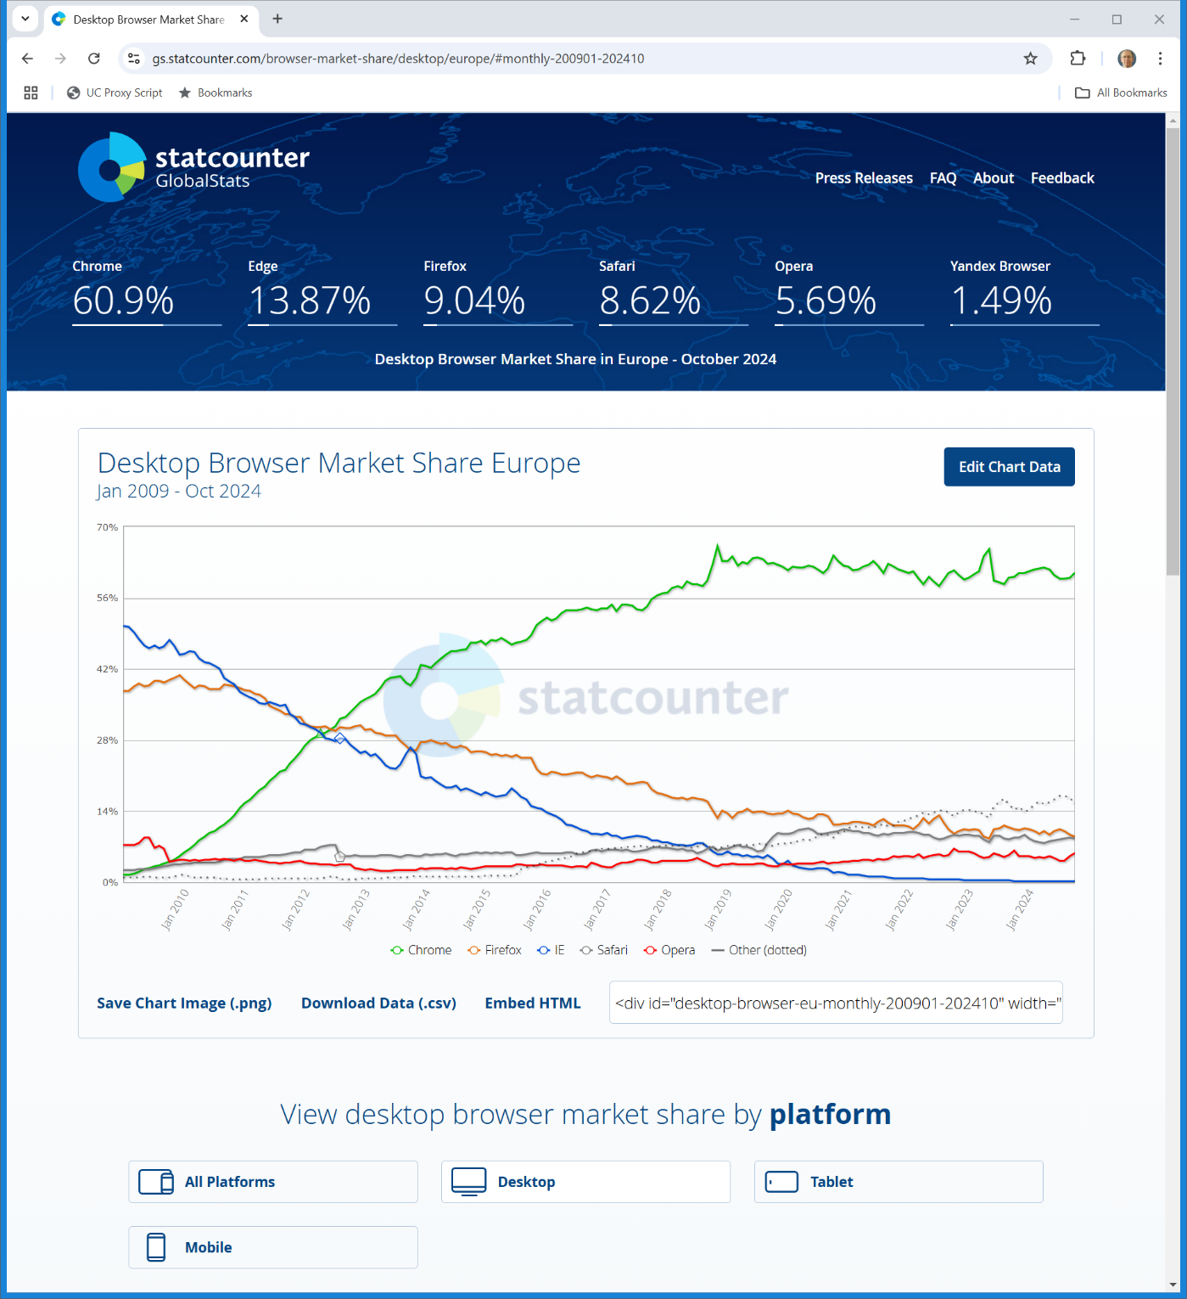

Desktop Browser Market Share in Europe
StatCounter (Visited 12 Nov 2024)
Notes:
https://gs.statcounter.com/browser-market-share/desktop/europe/#monthly-200901-202410

Slide 79
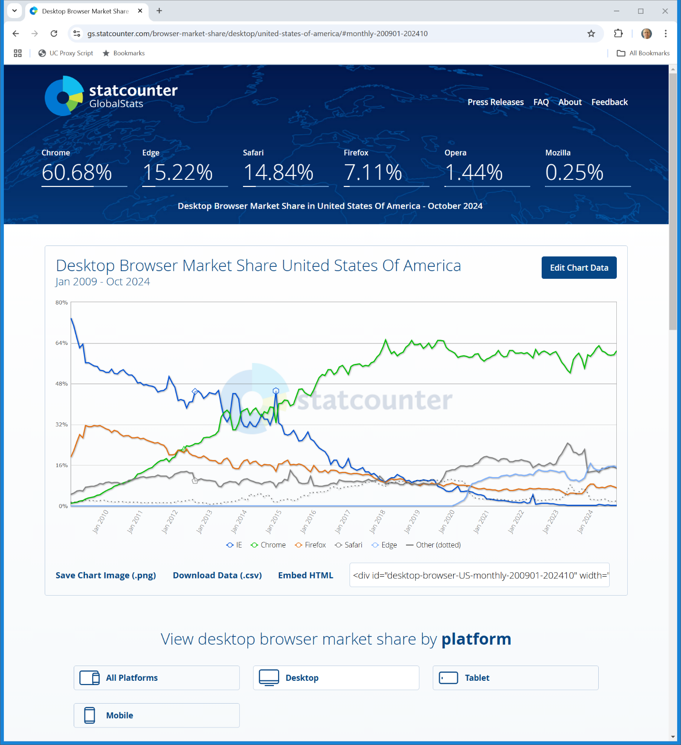

Desktop Browser Market Share in U.S.
StatCounter (Visited 12 Nov 2024)
Notes:
https://gs.statcounter.com/browser-market-share/desktop/united-states-of-america/#monthly-200901-202410

Slide 80
Microsoft Teams
European Commission (12 Sept 2025)

Slide 81
Tying and Distribution Advantage
European Commission (12 Sept 2025)

