Slide 1
Class 18: Thurs 6 Nov 2025 Antitrust Fall 2025 Extraterritorial Application of the Sherman Act
Randal C. Picker
James Parker Hall Distinguished Service Professor of Law
The Law School
The University of Chicago
Copyright © 2000-25 Randal C. Picker. All Rights Reserved.

Slide 2
Simple Version of Today
Every country is on its own

Slide 3
FTAIA Legislative History
S. Rep. 97-27 (18 Mar 1981)

Slide 4
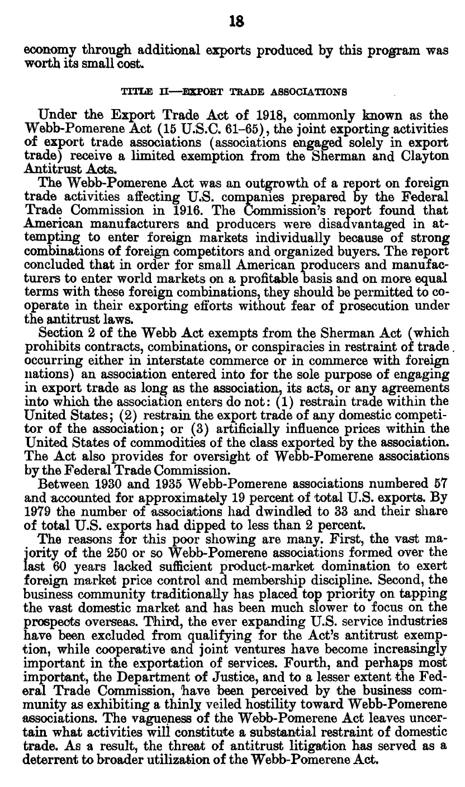
1918: Webb-Pomerene Act: Help Export Cartels
S. Rep. 97-27 (18 Mar 1981)

Slide 5
Antitrust Exemption for Exports
S. Rep. 97-27 (18 Mar 1981)

Slide 6
Reasons for Failure
S. Rep. 97-27 (18 Mar 1981)

Slide 7
Expand Antitrust Immunity for Exports
S. Rep. 97-27 (18 Mar 1981)

Slide 8
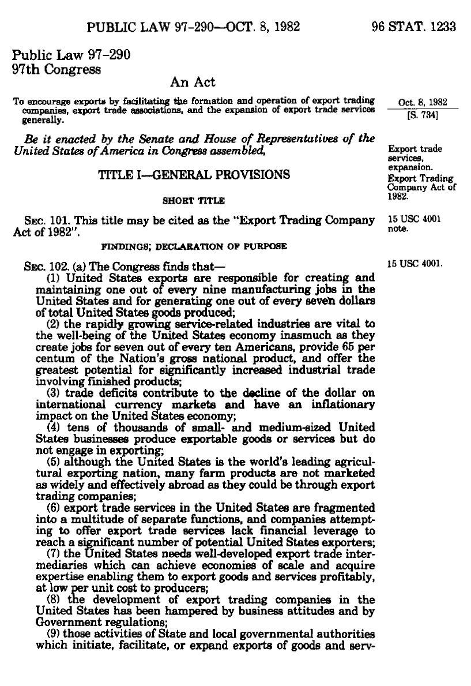
Export Trading Company Act of 1982
Pub. L. 92-290 (8 Oct 1982)

Slide 9
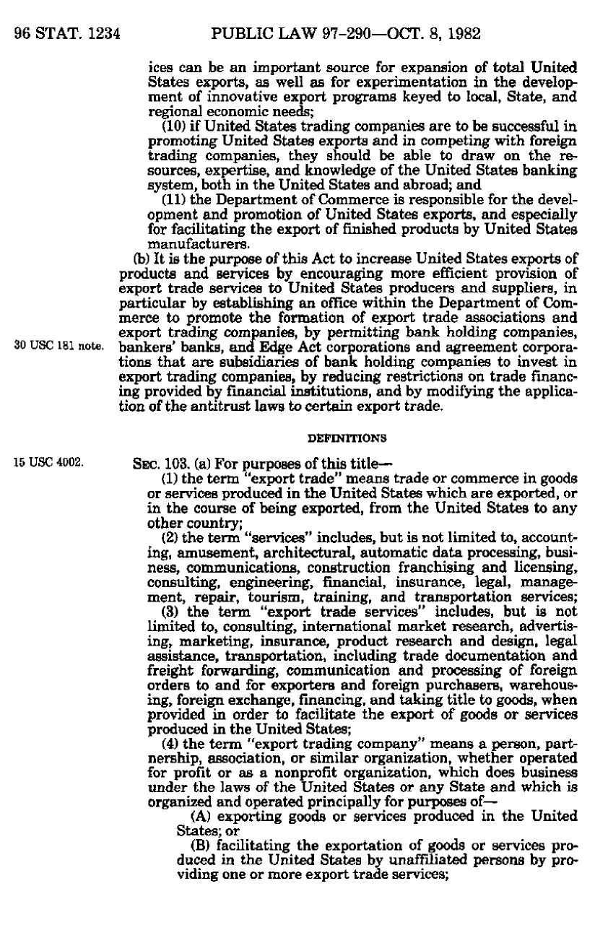
Modify Application of Antitrust Law
Pub. L. 92-290 (8 Oct 1982)

Slide 10
Foreign Trade Antitrust Improvements Act of 1982
Pub. L. 92-290 (8 Oct 1982)

Slide 11
Foreign Trade Antitrust Improvements Act of 1982
Pub. L. 92-290 (8 Oct 1982)

Slide 12
Hartford Fire
509 U.S. 764 (1993)

Slide 13
Hartford Fire (US 1993)
Question Presented
Did the court of appeals properly assess the extraterritorial reach of the U.S. antitrust laws in light of this Court’s teachings and contemporary understanding of international law when it held that a U.S. district court may apply U.S. law to the conduct of a foreign insurance market regulated abroad?

Slide 14
Domestic Commercial General Liability (CGL) Insurance
Retrocessional Reinsurance
UK
Reinsurance
UK
Primary Insurers
Hartford Fire
Allstate
CIGNA
Aetna
US
ISO
Shared Inputs
California Customer
Illinois Customer
New York Customer

Slide 15
Hypo 1: UK Price Fixing
TTYN (1 of 5)
Facts
UK reinsurers price fix in UK
Insurance is sold in US and then resold in reinsurance market in UK
Law
Assume price fixing here is illegal under SA 1
Assume also illegal under UK equivalent

Slide 16
Hypo 1: Questions
TTYN (2 of 5)
Consider the permutations
US law v. UK law
US court v. UK court
So
Can a US citizen harmed by the price fixing bring an SA1/UK law claim in a US court/UK court?

Slide 17
Hypo 2: OK under UK Law
TTYN (3 of 5)
The Switch
Suppose UK behavior is not illegal under UK law
This tracks Hartford Fire facts, as UK regulators blessed conduct there
How should this alter whether SA violation can be asserted? International comity?

Slide 18
Hypo 2: OK under UK Law
TTYN (4 of 5)
Do we have a “conflict” between US law and UK law?
Are there reasons to believe that UK law will not take US consequences into account sufficiently?

Slide 19
Hypo 3: Direct Conflict
TTYN (5 of 5)
The Switch
UK law requires the conduct in question
US law forbids it
How should this alter whether SA violation can be asserted?

Slide 20
Extraterritorial Application of Sherman Act
“[I]t is well established by now that the Sherman Act applies to foreign conduct that was meant to produce and did in fact produce some substantial effect in the United States.”
Hartford Fire (US 1993)

Slide 21
Key Points
Domestic Effects v. Foreign Harms and Benefits
Home country will have strongest interest in protecting its citizens against internal harms
Outside country may not internalize those harms

Slide 22
Key Points
Domestic Effects v. Foreign Harms and Benefits
Outside country may get most of the benefits of antitrust violation and few of the harms and may have weak incentive to regulate the conduct

Slide 23
FTAIA: We Don’t Care about You
Antitrust Harms to Outsiders are Just Fine
Fake: “The Sherman Act shall not apply if the harms associated with a restraint of trade are borne by non-U.S. citizens.”
Real: “Sections 1 to 7 of this title shall not apply to conduct involving trade or commerce (other than import trade or import commerce) with foreign nations unless …”

Slide 24
Empagran
542 U.S. 155 (2004)

Slide 25
Why Should U.S. Law Apply?
“Why should American law supplant, for example, Canada’s or Great Britain’s or Japan’s own determination about how best to protect Canadian or British or Japanese customers from anticompetitive conduct engaged in significant part by Canadian or British or Japanese or other foreign companies?”
Empagran (US 2004)

Slide 26
Selling Potash 1
TTYN (1 of 3)
SP Hypo 1
US companies get together and fix price on potash
US consumers buy in the US at inflated prices
Section 1 violation?

Slide 27
Selling Potash 2
TTYN (2 of 3)
SP Hypo 2
As before, US companies get together, but they announce: “We will continue to compete in domestic sales, but we are going to fix prices for potash we sell overseas.”
Canadian consumers buy in Canada at inflated prices
Section 1 violation?

Slide 28
Selling Potash 3
TTYN (3 of 3)
SP Hypo 3
Canadian companies get together and fix price on potash
Canadian consumers buy in Canada at inflated potash
Section 1 violation?

Slide 29
SP Hypo 1 Answer
Sure

Slide 30
SP Hypo 2 Answer
No Violation under FTAIA
“shall not apply to conduct involving trade or commerce (other than import trade or import commerce) with foreign nations”
So far so good

Slide 31
SP Hypo 2 Answer
Under sub(1)(A), should be no effect on domestic trade or imports
Under sub(1)(B), might think effect on export trade—indeed that is the purpose of the export cartel—but next part of FTAIA focuses on “conduct only for injury to export business” and this shouldn’t qualify, as the exporters themselves want to do it.

Slide 32
SP Hypo 2 Answer
Canadian consumers should ask Canadian law for help
What sub (1)(B) cover?
Might think that the section might cover, for example, a group boycott by a group of exporters against another exporter
Would need to meet normal liability rules regarding group boycotts

Slide 33
SP3 Hypo Answer
Hard to understand US interest
Canadian consumers should proceed under Canadian law

Slide 34
Selling Potash 4
TTYN (1 of 3)
SP Hypo 4
Canadian companies get together and fix price on potash
US consumers buy in the US at inflated prices
Section 1 violation? Does a federal court have subject matter jurisdiction over such a claim?

Slide 35
Selling Potash 5
TTYN (2 of 3)
SP Hypo 5: Combining 1 & 2
Canadian corps get together & fix price on potash
Prices are fixed in both domestic & overseas mkts
US consumers buy in US at inflated prices, Canadian consumers buy in Canada at inflated prices
Who has a Section 1 Action?

Slide 36
Selling Potash 6
TTYN (3 of 3)
SP Hypo 6
Canadian firm participates in cartel but doesn’t sell in US (Canpotex)
Plaintiffs want to tag that firm with conspiracy antitrust liability under US law
US consumers buy in US at inflated prices from other sellers
Who has a Section 1 Action?

Slide 37
SP Hypo 4 Answer
This replays Hartford Fire and raises the jurisdiction question there and in Minn-Chem.
Should be Section 1 Violation
How do you enforce the judgment?
This covers potash imported into US in Minn-Chem

Slide 38
SP Hypo 5 Answer
Shouldn’t the answer just be the combined answers for 1 and 2?
US customers have a good SA1 action, Canadian customers should look to Canadian law?

Slide 39
But What of the Actual Language of the FTAIA
(2) such effect gives rise to a claim under the provisions of sections 1 to 7 of this title, other than this section.
Cover One, Cover All?
Once one claim is covered thereby bring the conduct within Section 1, aren’t all claims arising out of that conduct covered?
Rejected by Sup Ct in Empagran (US 2004)

Slide 40
SP Hypo 6 Answer
Raised in Minn-Chem
Court seems to say that there isn’t a territorial problem in that situation given the direct, substantial and reasonably foreseeable effect in the U.S.
May have issues on actual antitrust theory of liability based on alleged benchmark pricing strategy

Slide 41
Minn-Chem
683 F.3d 845 (7th Cir. 2012) (en banc)

Slide 42
Understanding Import Commerce
“There can be no question that the import commerce exclusion puts some of the conduct alleged in the Complaint outside the special rules created in the FTAIA for Sherman Act claims. The plaintiffs are U.S. entities that have purchased potash directly from members of the alleged cartel. The defendant members of the cartel are all located outside the United States. Those transactions that are directly between the plaintiff purchasers and the defendant cartel members are the import commerce of the United States in this sector.”
Minn-Chem (7th Cir. 2012)

Slide 43
Apply Hartford Fire
“The FTAIA does not require any special showing in order to bring these transactions back into the Sherman Act, as Empagran put it, because they were never removed from the statute. That does not mean, however, that plaintiffs are home free. Rather, we must still apply the rules governing import commerce for purposes of the antitrust laws. … In Hartford Fire, the Supreme Court confirmed this rule, stating that ‘‘the Sherman Act covers foreign conduct producing a substantial intended effect in the United States.’’ 509 U.S. at 797.”
Minn-Chem (7th Cir. 2012)

Slide 44
Extending Liability to Canpotex
“Presumably, in order to avoid Illinois Brick’s prohibition on ‘pass on’ antitrust damages, 431 U.S. at 728, the plaintiffs are seeking to hold firms like Canpotex jointly and severally liable for any damages the direct sellers might be ordered to pay, perhaps under a conspiracy theory.”
Minn-Chem (7th Cir. 2012)

Slide 45
Coming Within the Sherman Act
“In particular, we must decide whether the plaintiffs have plausibly alleged that the defendants’ conduct took place either in import commerce and are thus subject to the more general rules of Hartford Fire for effects on commerce, or if they have in whole or in part described conduct subject to the FTAIA, and if so, whether the allegations describe direct, substantial, and foreseeable effects on domestic or import commerce.”
Minn-Chem (7th Cir. 2012)

Slide 46
Plain Vanilla Import Commerce and Hartford Fire
“In our view, much of the Complaint alleges straightforward import transactions. Under Hartford Fire the plaintiffs thus must allege that the conduct of the foreign cartel members was (1) meant to produce and (2) did in fact produce some substantial effect in the United States. … The Complaint contains ample material supporting both of those points.”
Minn-Chem (7th Cir. 2012)

Slide 47
Host Country Incentives
“Foreign cartels, especially those over natural resources that are scarce in the United States and that are traded in a unified international market, have often been the target of either governmental or private litigation. The host country for the cartel will often have no incentive to prosecute it.”
Minn-Chem (7th Cir. 2012)

Slide 48
U.S. Is the Right Enforcer
“It is the U.S. authorities or private plaintiffs who have the incentive—and the right—to complain about overcharges paid as a result of the potash cartel, and whose interests will be sacrificed if the law is interpreted not to permit this kind of case.”
Minn-Chem (7th Cir. 2012)

Slide 49
And Here?
“The payment of overcharges by those customers was objectively foreseeable, and the amount of commerce is plainly substantial.”
Minn-Chem (7th Cir. 2012)

Slide 50
Criminal Price Fixing
Superseding Indictment (19 June 2010)

Slide 51
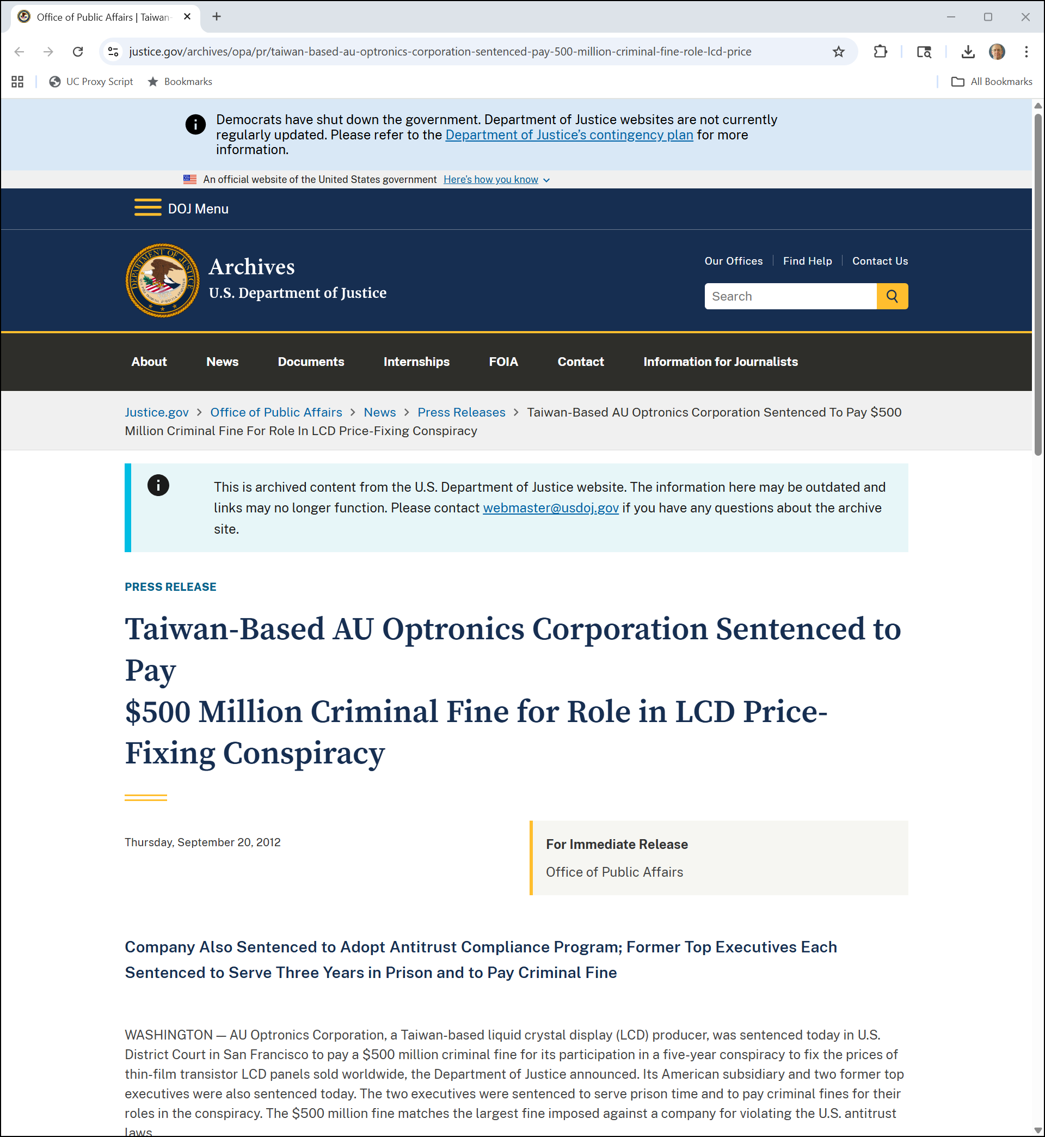
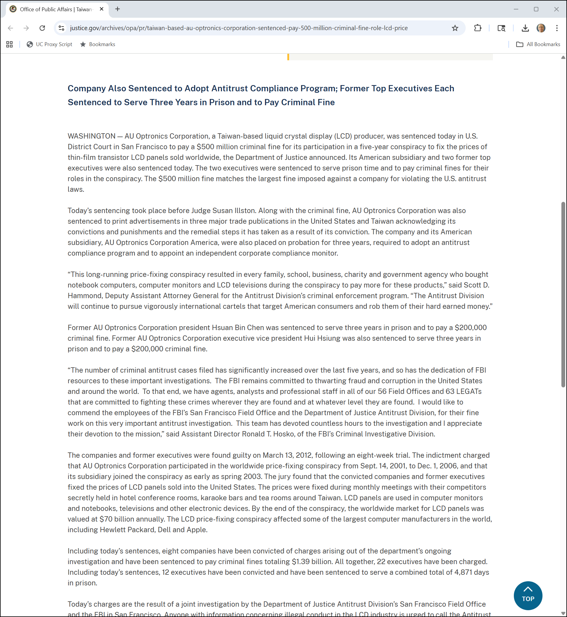
Criminal Fines/Sentences
DOJ (20 Sept 2012)
Notes:
https://www.justice.gov/archives/opa/pr/taiwan-based-au-optronics-corporation-sentenced-pay-500-million-criminal-fine-role-lcd-price

Slide 52
Criminal Fines/Sentences
DOJ (20 Sept 2012)
Notes:
https://www.justice.gov/archives/opa/pr/taiwan-based-au-optronics-corporation-sentenced-pay-500-million-criminal-fine-role-lcd-price

Slide 53
Motorola Mobility (CA7 2015)
Key Questions
How should Motorola’s organization choices matter for antitrust enforcement?
Should that operate differently for gov’t actions and private actions?

Slide 54
Selling LCD Screens 1
TTYN (1 of 4)
LCD Hypo 1
US LCD screen manufacturers form cartel
Sell to Motorola Mobility (US firm) for sales of phones in U.S. markets
Section 1 Violation?

Slide 55
Selling LCD Screens 2
TTYN (2 of 4)
LCD Hypo 2
UK LCD screen manufacturers form cartel
Sell to Motorola Mobility (US firm) for sales of phones in U.S. markets
Section 1 Violation?

Slide 56
Selling LCD Screens 3
TTYN (3 of 4)
LCD Hypo 3
UK LCD screen manufacturers form cartel
Sell to Motorola Mobility sub (UK firm)
That firm resells to MM parent (US firm) for sales of phones in U.S. markets
Section 1 Violation?

Slide 57
TTYN (4 of 4)
LCD 1
LCD 2
LCD 3
LCD 4
Non-US
Non-US
Non-US
Non-US
1%
99%
Motorola
US
42%
Motorola
Motorola
China
Singapore
57%
Customer
Customer
Non-US
US

Slide 58
LCD Hypo 1 Answer
Sure
Plain vanilla cartel
Per se illegal Section 1 violation

Slide 59
LCD Hypo 2 Answer
Hartford Fire Replay
Straightforward application of extraterritoriality rules set out in Hartford Fire
MM should be able to assert a SA 1 claim

Slide 60
LCD Hypo 3 Answer
Copperweld?
Illinois Brick?
Under Illinois Brick, an indirect purchaser can’t sue for the manufacturing level cartel; only the direct purchaser can

