Slide 1
Class 17: Wed 5 Nov 2025
Antitrust Fall 2025
Labor and the Gig Economy
Randal C. Picker
James Parker Hall Distinguished Service Professor of Law
The Law School
The University of Chicago
Copyright © 2019-25 Randal C. Picker. All Rights Reserved.

Slide 2
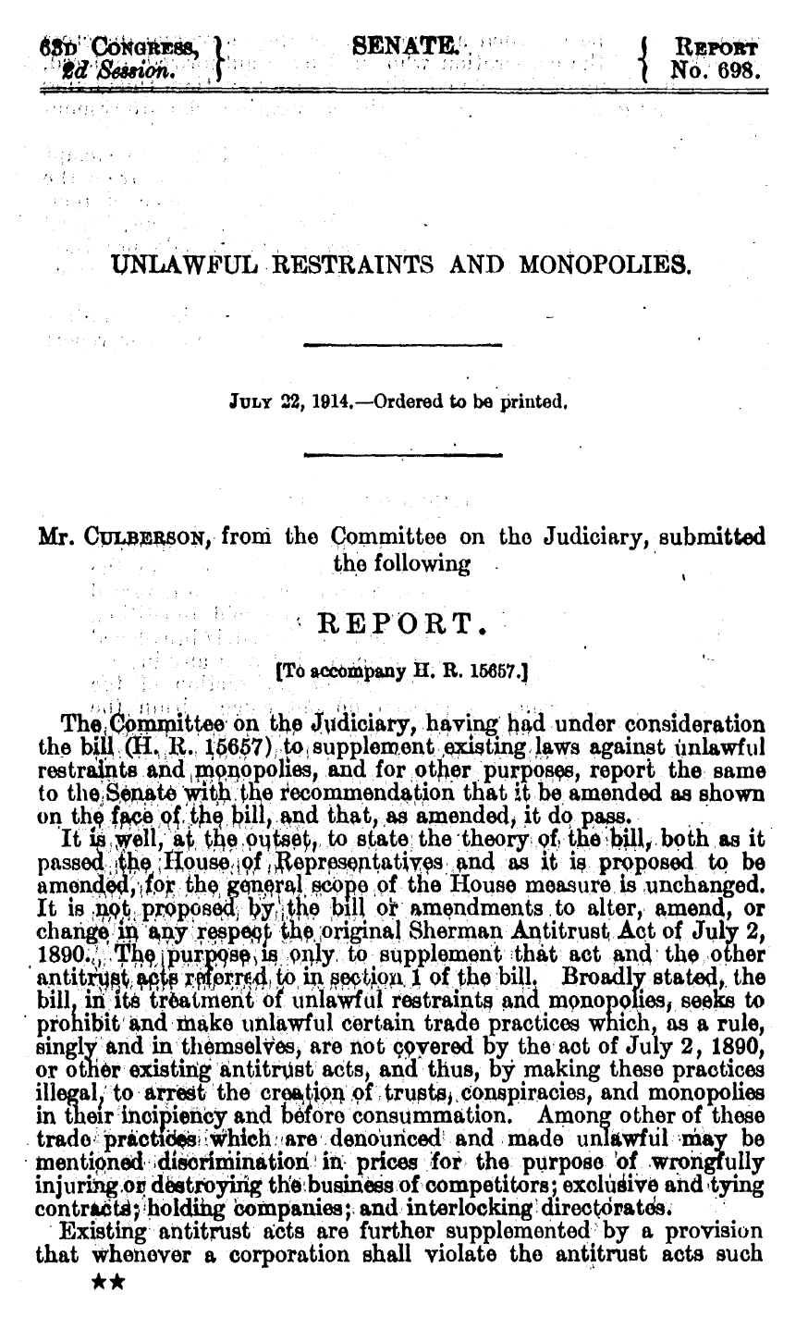
Clayton Act Legis History re Labor Orgs
S. Rep. 63-698 (22 July 1914)

Slide 3
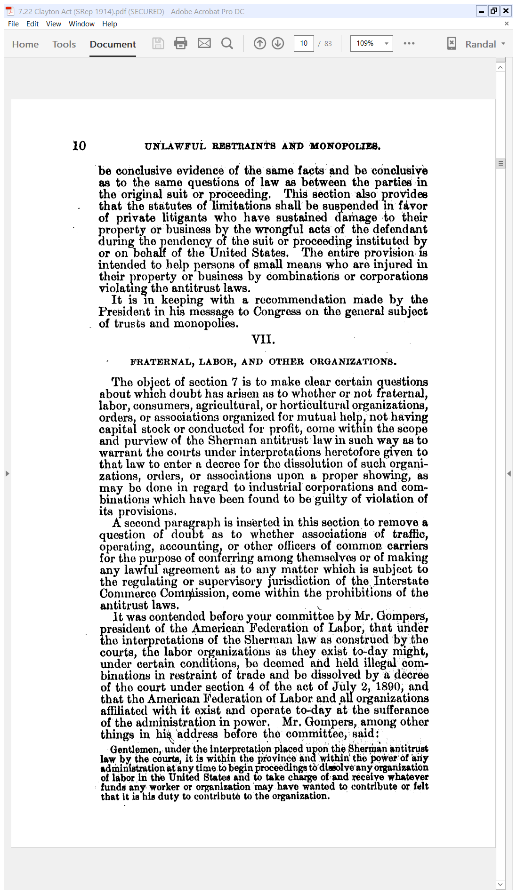
Exempt Labor Orgs from Sherman Act
S. Rep. 63-698 (22 July 1914)

Slide 4
Exempt Labor Orgs from Sherman Act
S. Rep. 63-698 (22 July 1914)

Slide 5
The Clayton Act
Clayton Act (15 Oct 2014)

Slide 6
Labor Exemption
Clayton Act (15 Oct 2014)

Slide 7
Limits on Injunctions in Labor Disputes
Clayton Act (15 Oct 2014)

Slide 8
Robust Labor Disputes
Clayton Act (15 Oct 2014)

Slide 9
Norris-LaGuardia Act Legislative History
House Report (2 Mar 1932)

Slide 10
Federal Courts Failed to Implement Clayton Act
House Report (2 Mar 1932)

Slide 11
Duplex Printing as Part of the Problem
House Report (2 Mar 1932)

Slide 12
Restrictions on Injunctions re Labor Disputes
Norris-LaGuardia Act (23 Mar 1932)

Slide 13
Balancing Organizational Rights
Norris-LaGuardia Act (23 Mar 1932)

Slide 14
Making Unenforceable Contracts That Block Unions
Norris-LaGuardia Act (23 Mar 1932)

Slide 15
Enactment of the Wagner Act
NYT (6 July 1935)

Slide 16
NLRA Findings and Policy
National Labor Relations Act (5 July 1935)

Slide 17
Bargaining Power and Organization
National Labor Relations Act (5 July 1935)

Slide 18
The Right to Form Unions to Bargain
National Labor Relations Act (5 July 1935)

Slide 19
McDonald’s No-Poach Clause
Deslandes v. McDonald’s, 81 F.4th 699 (7th Cir. 2023)

Slide 20
So You Want to Open a McDonald’s
McDonald’s Franchise Agreement

Slide 21
The McDonald’s System (30 Pages)
McDonald’s Franchise Agreement

Slide 22
The No-Poach Clause
McDonald’s Franchise Agreement

Slide 23
Competing Firms
TTYN (1 of 3)
Restaurants Hypo 1
  All of the restaurants, separately owned, in a particular town agree that they will not try to hire employees from each other
Antitrust issues?

Slide 24
One Firm, Many Locations I
TTYN (2 of 3)
Restaurants Hypo 2
  A restaurant corporation, call it Lettuce Entertain You, operates multiple restaurants within a single corporate entity
  The company has a policy that one LEY restaurant will not try to hire employees from another LEY restaurant
Antitrust issues?

Slide 25
One Firm, Many Locations II
TTYN (3 of 3)
Restaurants Hypo 3
  A restaurant corporation, call it McDonalds, operates multiple restaurants but does so through separate entities known as franchises
  The franchise contracts state that one McDonalds will not try to hire employees from another McDs
Antitrust issues?

Slide 26
Market Conditions
“The district judge found it undisputed that within three miles of Deslandes’s home there are between 42 and 50 quickservice restaurants as well as two McDonald’s franchises, and that within ten miles of her home there are 517 quick-service restaurants. … So the Rule of Reason is out of this suit, and, as quick-look analysis is part of the Rule of Reason, it is out too. But the district judge jettisoned the per se rule too early.”
McDonald’s (7th Cir. 2023)

Slide 27
Ancillary Agreements
“An agreement among competitors is not naked if it is ancillary to the success of a cooperative venture. See, e.g., Polk Bros., Inc. v. Forest City Enterprises, Inc., 776 F.2d 185 (7th Cir. 1985); Rothery Storage & Van Co. v. Atlas Van Lines, Inc., 792 F.2d 210, 229 (D.C. Cir. 1986). Consider a partnership to practice law. The partners devote their time to the law firm and pool their revenues; that’s a horizontal agreement. The partners also promise not to compete with the law firm by taking their own clients.”
McDonald’s (7th Cir. 2023)

Slide 28
Ancillary Agreements
“That agreement is lawful because the promise to devote all legal time to the firm’s business helps each law firm compete against its rivals; in antitrust jargon, the no-compete pledge is ancillary to the venture in the sense that it makes the partnership more effective when competing in the market for legal services. See Broadcast Music, Inc. v. Columbia Broadcasting System, Inc., 441 U.S. 1, 9 (1979).”
McDonald’s (7th Cir. 2023)

Slide 29
Training Costs and No-Poach Clauses
“Common training and job classifications could in principle justify restraints on poaching.”
McDonald’s (7th Cir. 2023)

Slide 30
Per Se?
“So what was the no-poach clause doing? Was it protecting franchises’ investments in training, or was it allowing them to appropriate the value of workers’ own investments? … These are all potentially complex questions, which cannot be answered by looking at the language of the complaint. They require careful economic analysis.”
McDonald’s (7th Cir. 2023)

Slide 31
Ripple: Clarifying?
“Our opinion sends the ancillary restraint defense back to the district court for further analysis. It makes clear that, in further proceedings before the district court, the defendants bear the burden of establishing that the no-poaching clause in the franchise agreement qualifies as an ancillary restraint.”
McDonald’s (7th Cir. 2023)

Slide 32
No Poaching Clauses in Franchises
Krueger & Ashenfelter (2018)

Slide 33
No Poaching Clauses in Franchises
Krueger & Ashenfelter (2018)

Slide 34
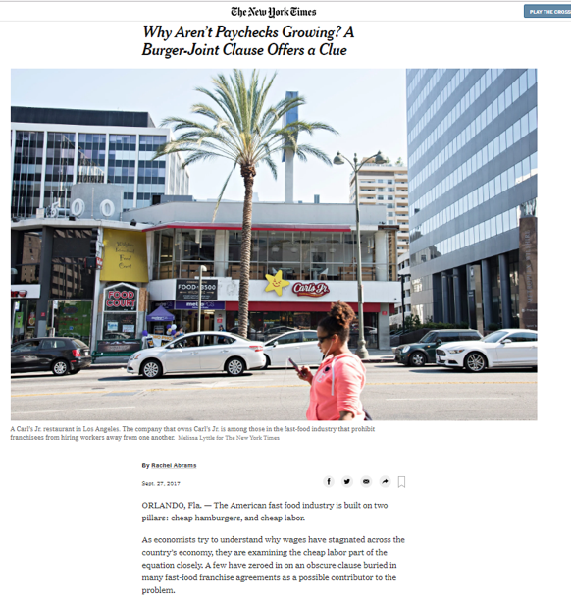
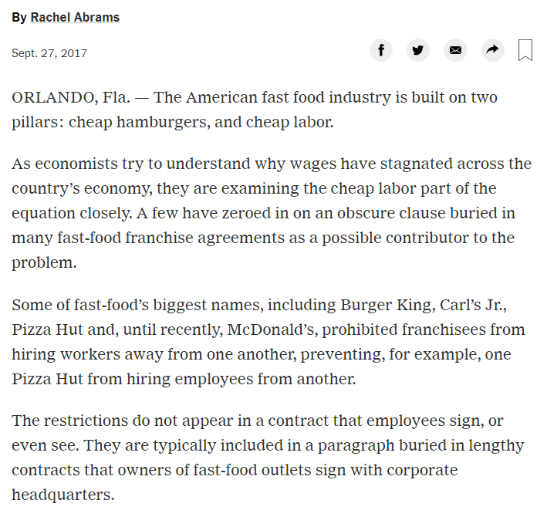
No Poaching Clauses in Franchises
NYT (27 Sept 2017)
Notes:
https://www.nytimes.com/2017/09/27/business/pay-growth-fast-food-hiring.html

Slide 35
No Poaching Clauses in Franchises
NYT (27 Sept 2017)

Slide 36
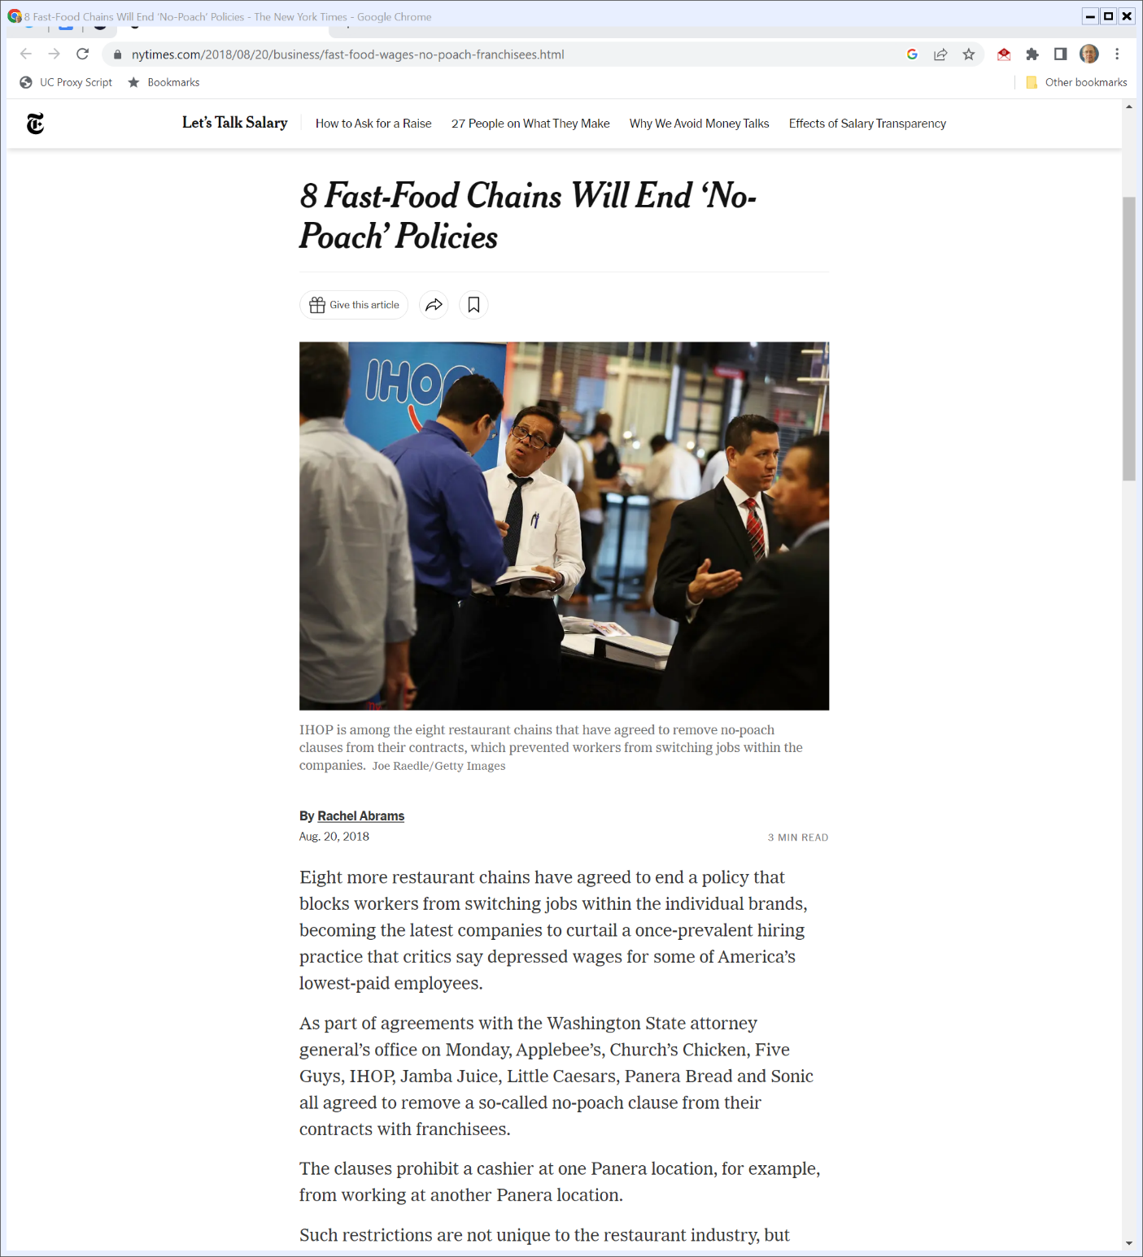
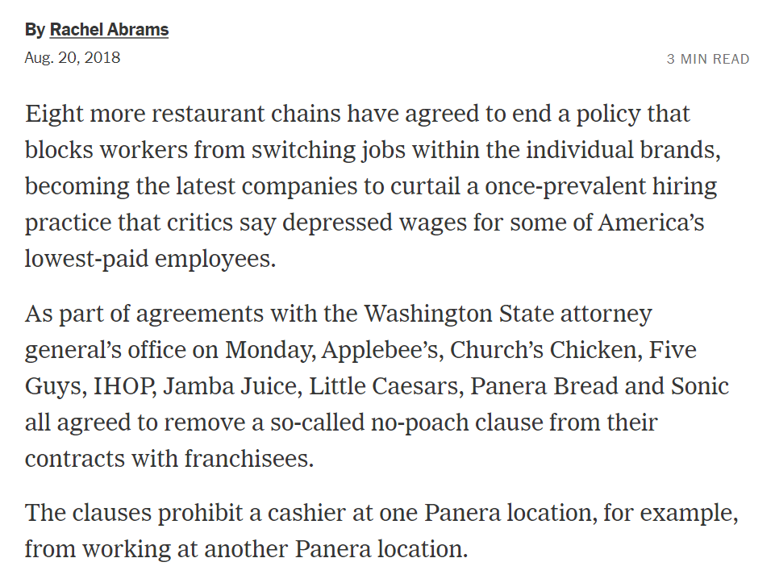
Wash AG Pushes Changes
New York Times (20 Aug 2018)
Notes:
https://www.nytimes.com/2018/08/20/business/fast-food-wages-no-poach-franchisees.html

Slide 37
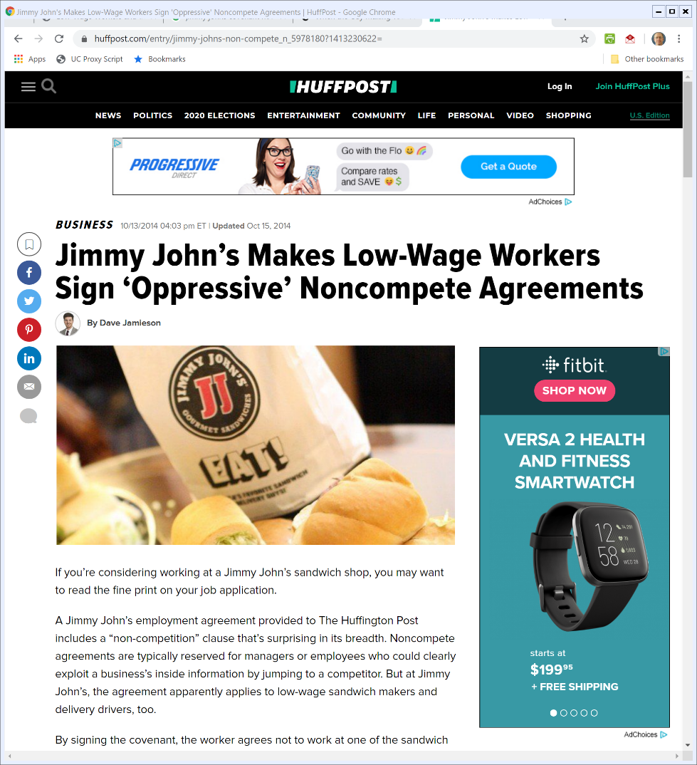
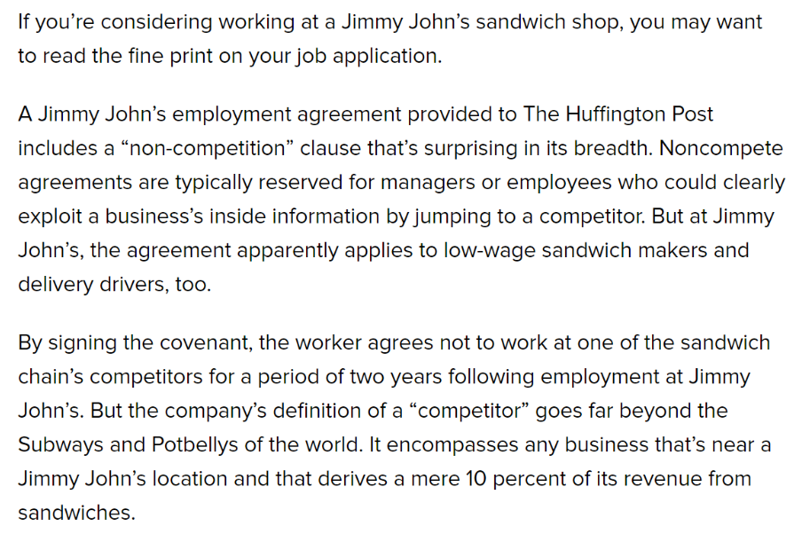
The Jimmy John’s CNTC
HuffPo (13 Oct 2014)
Notes:
https://www.huffpost.com/entry/jimmy-johns-non-compete_n_5978180?1413230622=

Slide 38
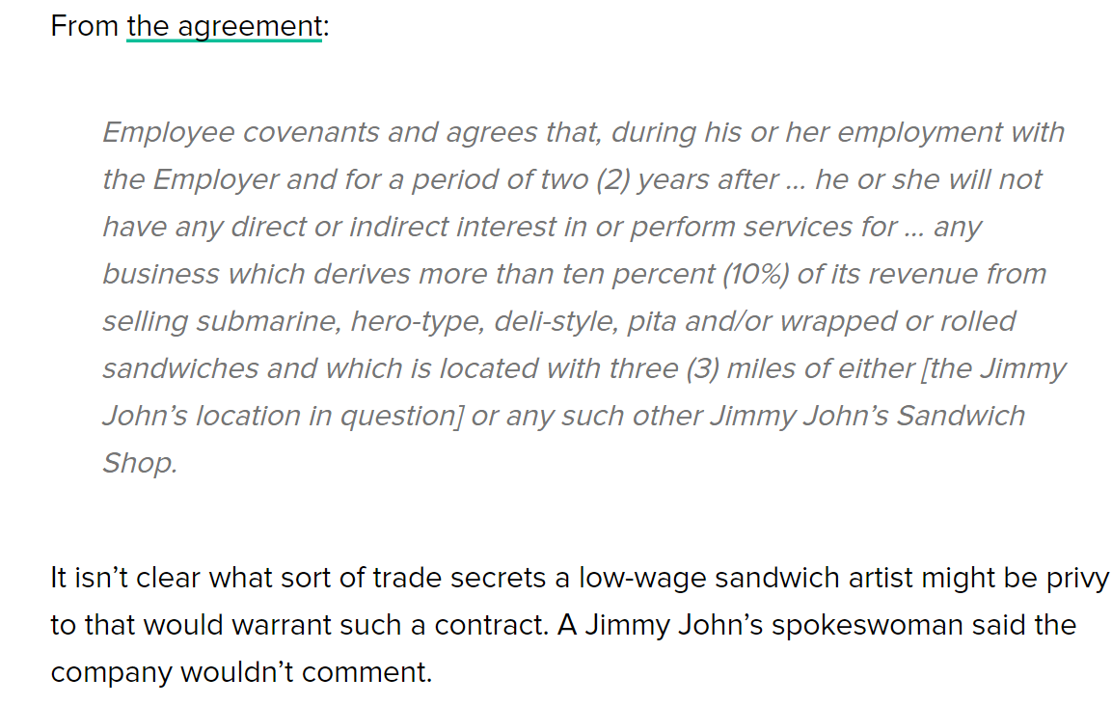
The Jimmy John’s CNTC
HuffPo (13 Oct 2014)

Slide 39
Effects of Non-Competes on Wages
Lipsitz & Starr (Dec 2019)

Slide 40
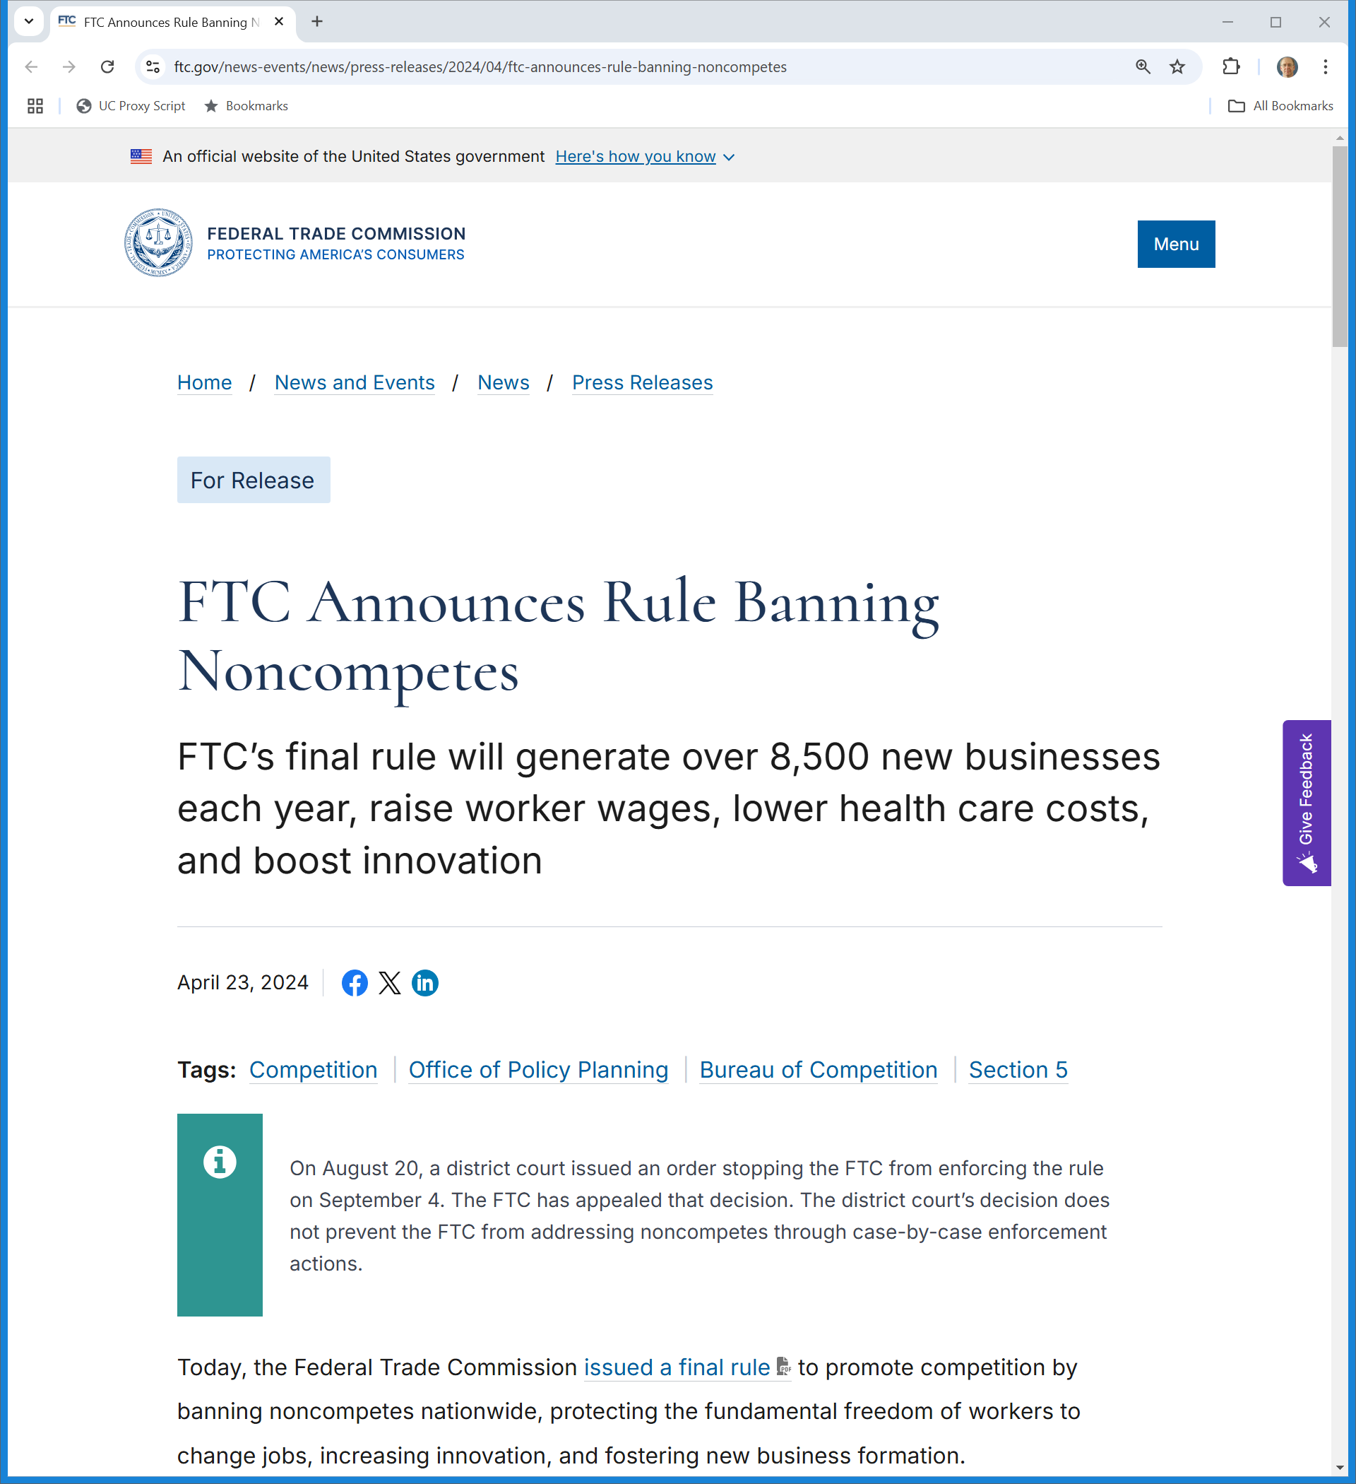
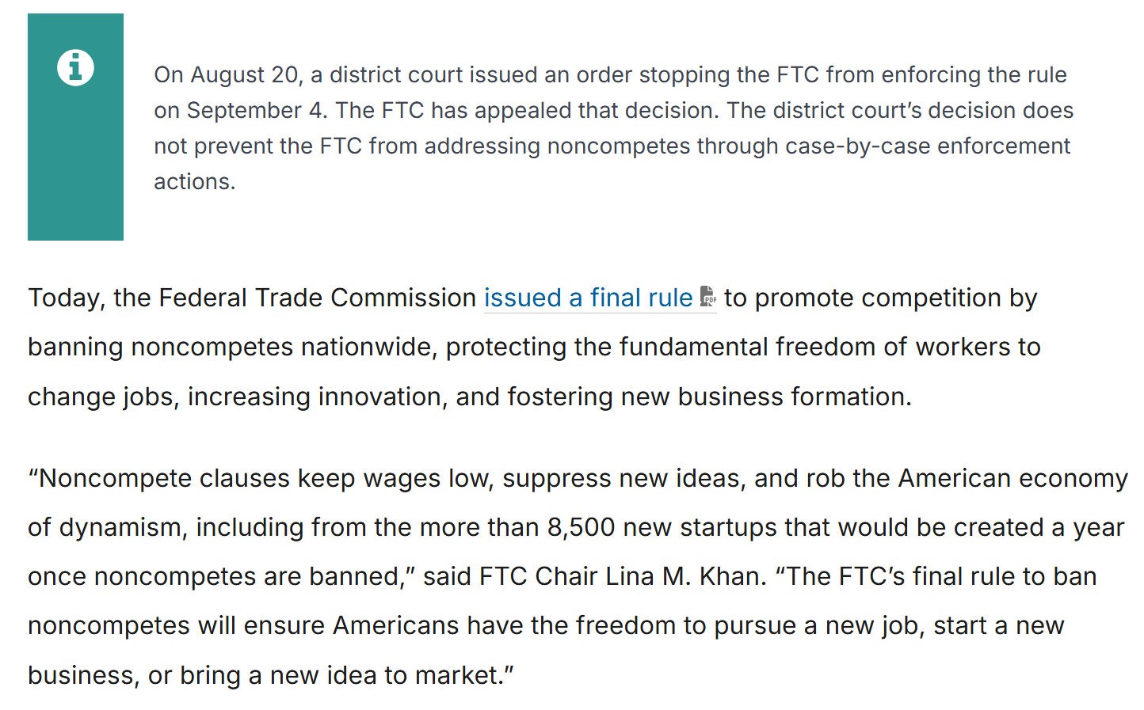
FTC Noncompetes Rulemaking
FTC (23 Apr 2024)
Notes:
https://www.ftc.gov/news-events/news/press-releases/2024/04/ftc-announces-rule-banning-noncompetes

Slide 41
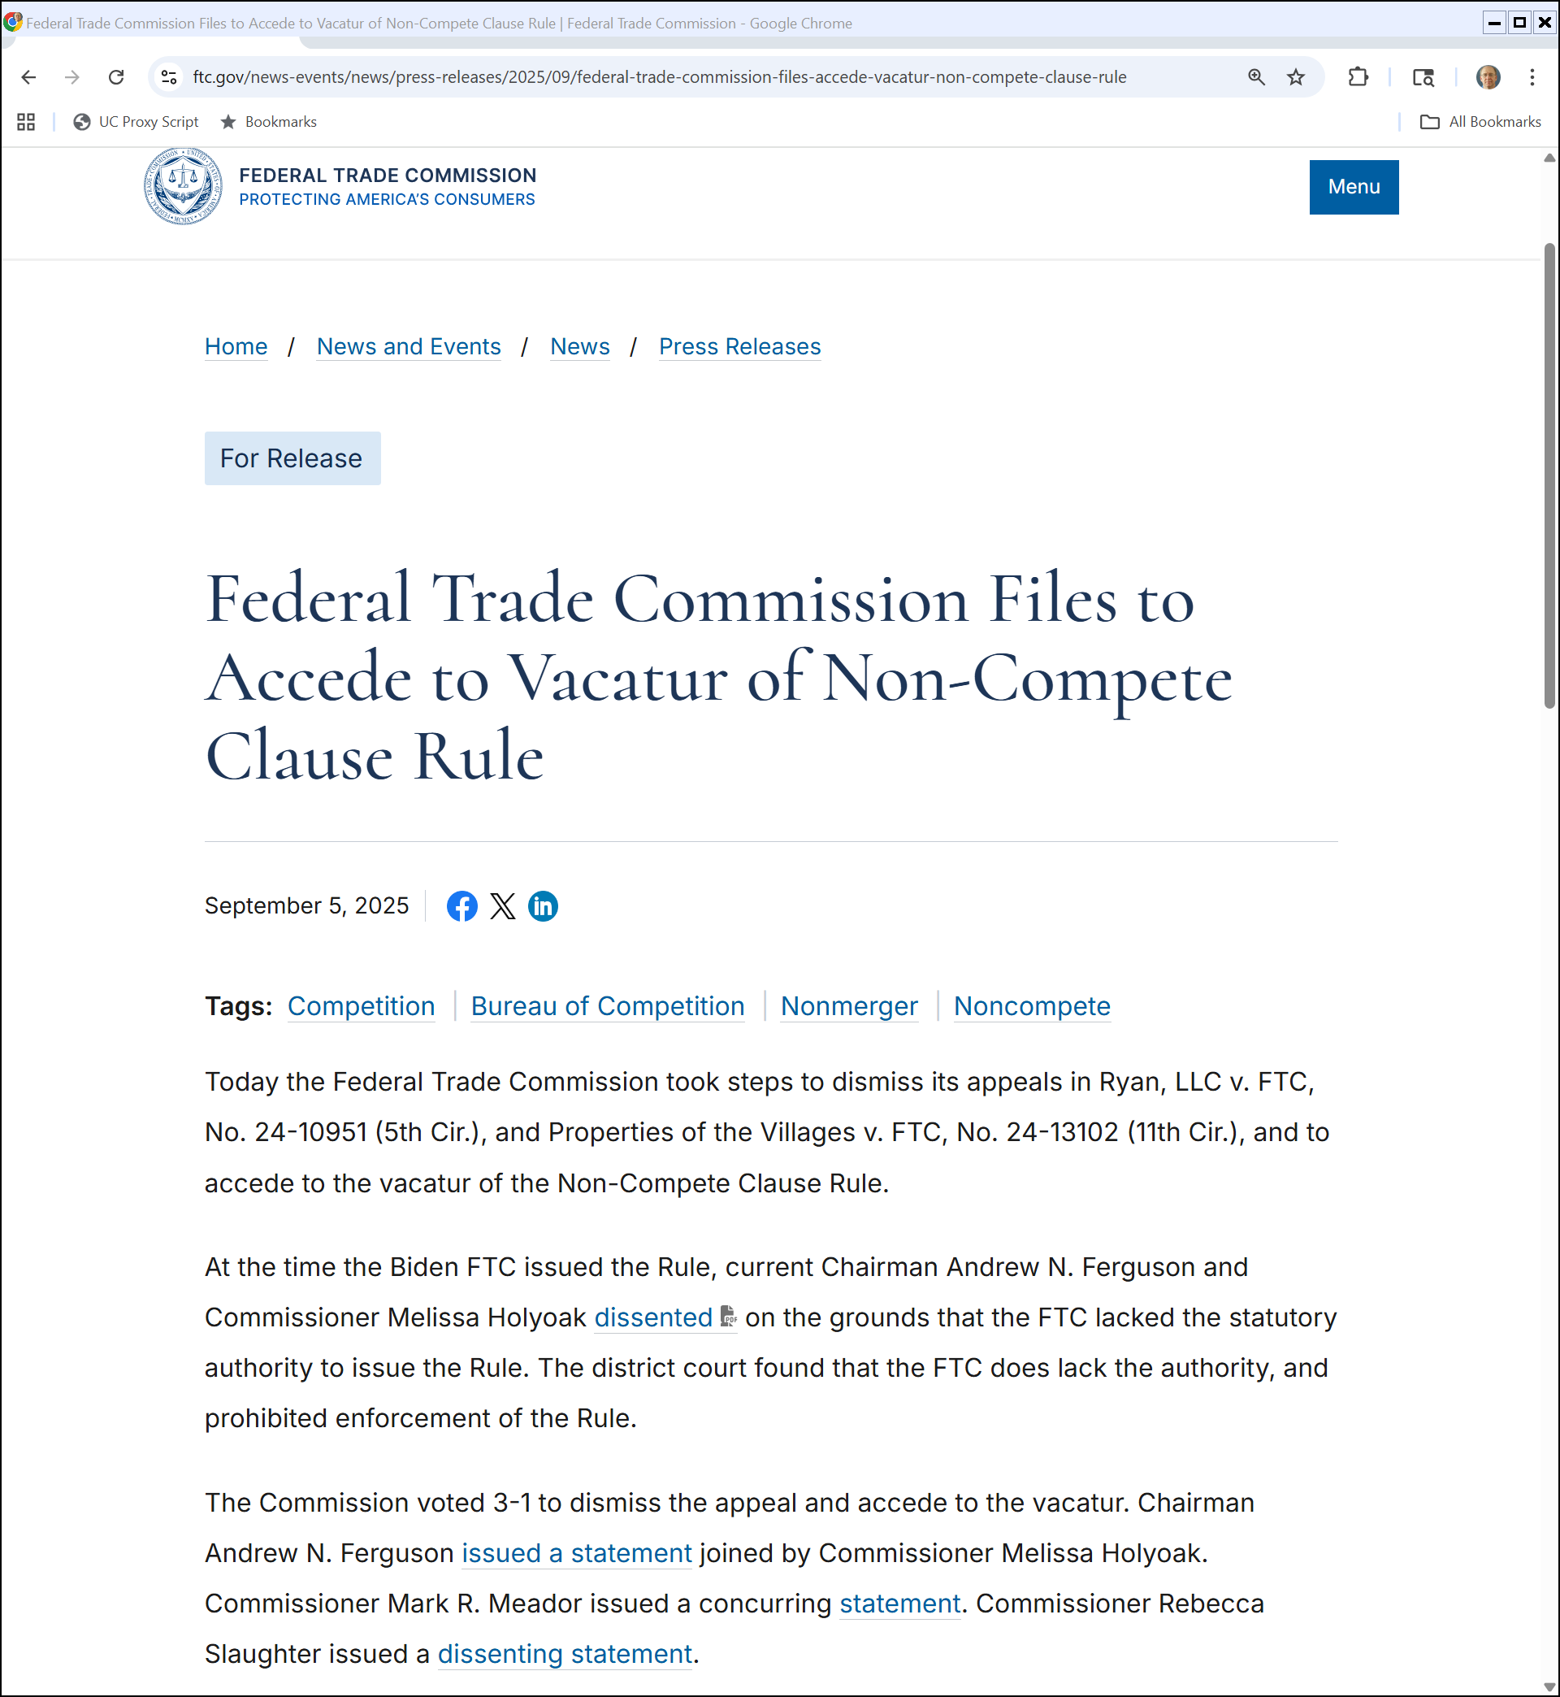
Non-Compete Rule Dies
FTC (5 Sept 2025)
Notes:
https://www.ftc.gov/news-events/news/press-releases/2025/09/federal-trade-commission-files-accede-vacatur-non-compete-clause-rule

Slide 42
Sorting Experts in 2017 Case
Deslandes Status Report (24 Sept 2025)
Notes:
Case filed on 6-28-2017

Slide 43
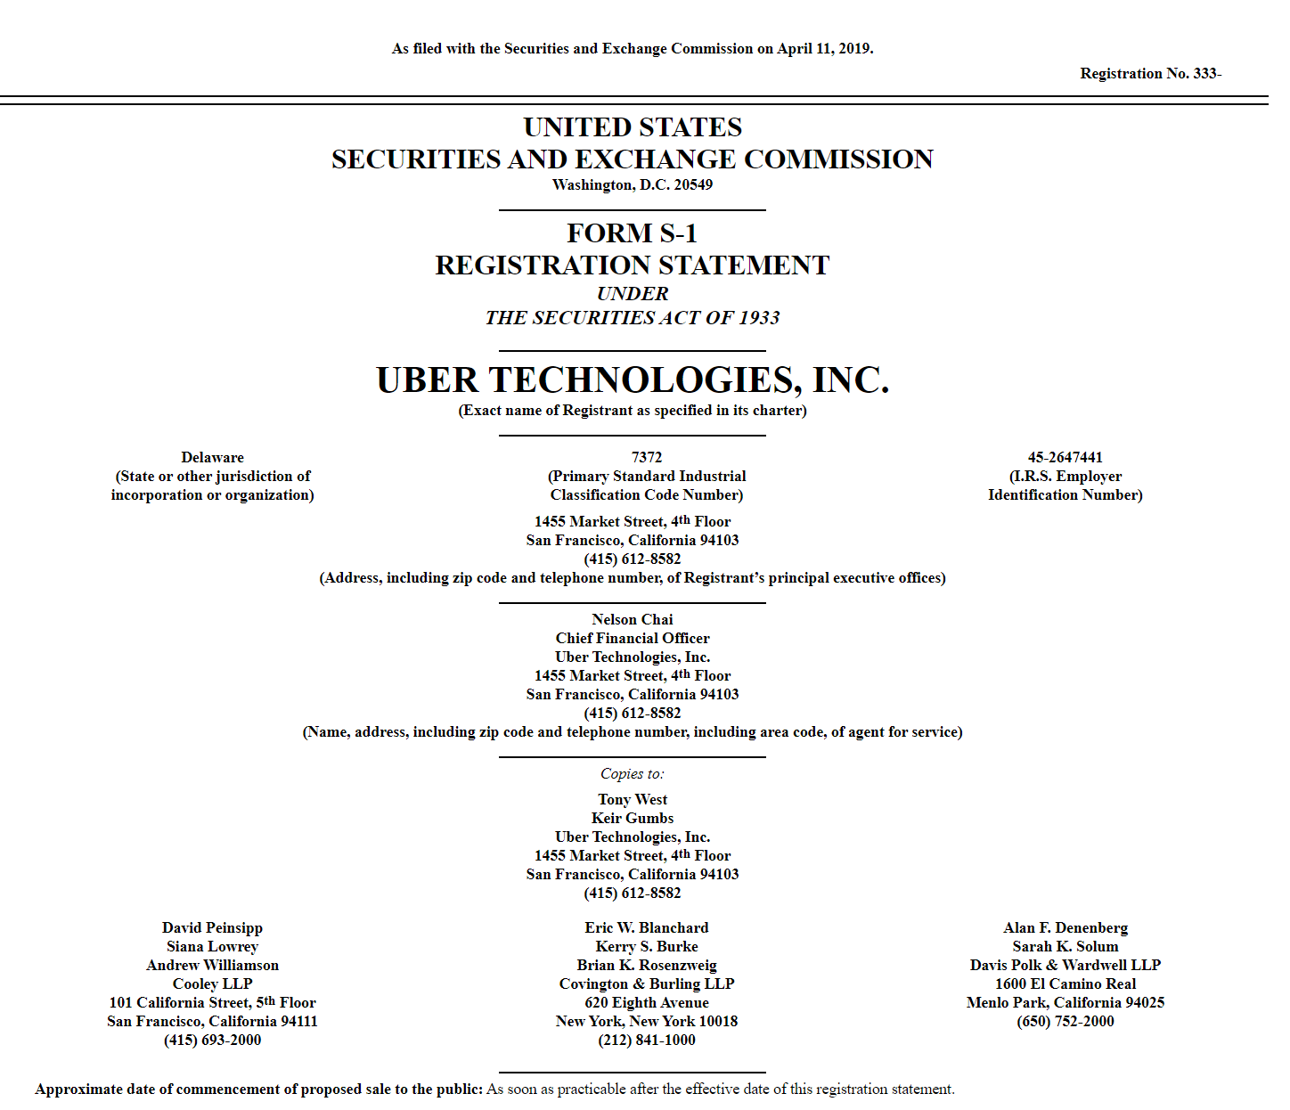
Uber IPO
Uber S-1 (11 Apr 2019)

Slide 44
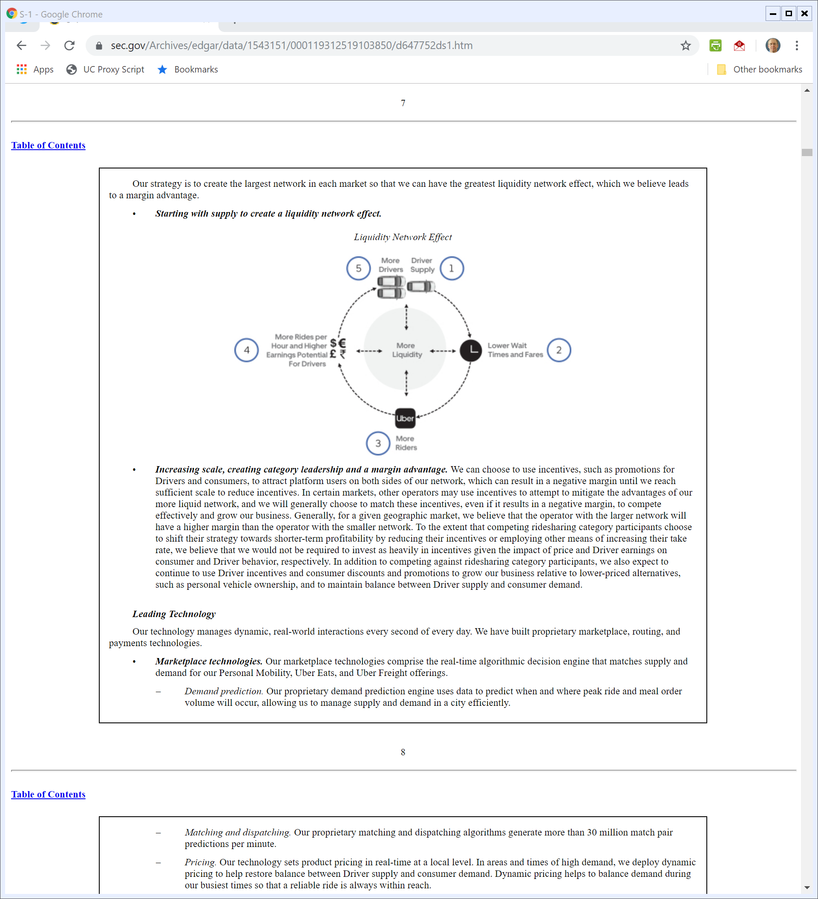
Uber Runs a Platform to Create Liquidity
Uber S-1 (11 Apr 2019)

Slide 45
Uber Surge Pricing Patent
US 9,305,310 B2 (5 Apr 2016)

Slide 46
Uber Surge Pricing Patent
US 9,305,310 B2 (5 Apr 2016)

Slide 47
Issues for Today
Questions
  1. Does the operation of Uber raise SA1 price-fixing issues? (Meyer (SDNY 2016))

Slide 48
Driver Deal
TTYN (1 of 4)
Driving Hypo 1
  All of the drivers in a particular geographic market get together and establish prices for trips around town
Antitrust issues? Does it matter if they use an app to match passengers and drivers?

Slide 49
Driving Matchmaker
TTYN (2 of 4)
Driving Hypo 2
  A firm sets up an app to match potential drivers and passengers in a geographic market
  It uses an algorithm to make particular matches and then matched Ds and Ps negotiate rates. The firm gets a cut of the fee if a deal is done.
Antitrust issues?

Slide 50
Driving Entrant
TTYN (3 of 4)
Driving Hypo 3
  A firm hires drivers as employees in a geographic market
  It sets up an app to match passengers and its drivers and it sets the rate for each trip.
Antitrust issues? Does it matter if the drivers are new to the driving market?

Slide 51
Pricing Mechanisms
TTYN (4 of 4)
Driving Hypo 4
  Uber runs a platform with drivers and passengers. Uber is able to observe the conditions of supply and demand in each location.
  Uber matches Ds/Ps and using its algorithm sets a price of $10 for a ride. D and P can both decline.
Antitrust issues?

Slide 52
Takeaways
Cartelization
  Uber could organize price-fixing among drivers ala Interstate Circuit or Apple and could use an algorithm to do that
  And perhaps there is sufficient uncertainty about what the actual Uber algorithm does to survive a motion to dismiss

Slide 53
Takeaways
Organizing Competition
  That said, Uber certainly doesn’t have an antitrust obligation to maximize driver competition within its platform
  Uber creates a customer base and can allocate that to drivers as Uber sees fit

Slide 54
Takeaways
Organizing Competition
  When Uber matches Ds/Ps, my guess is they are setting prices for each ride based on observations about local demand and supply
  They don’t need a driver cartel or agreement among the drivers to do that

Slide 55
Takeaways
Organizing Competition
  And the fact that Ds and Ps can multihome means that Uber is just an additional option—perhaps a new product ala Broadcast Music–and it doesn’t reduce any other opportunities for competition by Ds for Ps

Slide 56
Motion to Vacate Arbitral Award
Meyer v. Kalanick (22 May 2020)

Slide 57
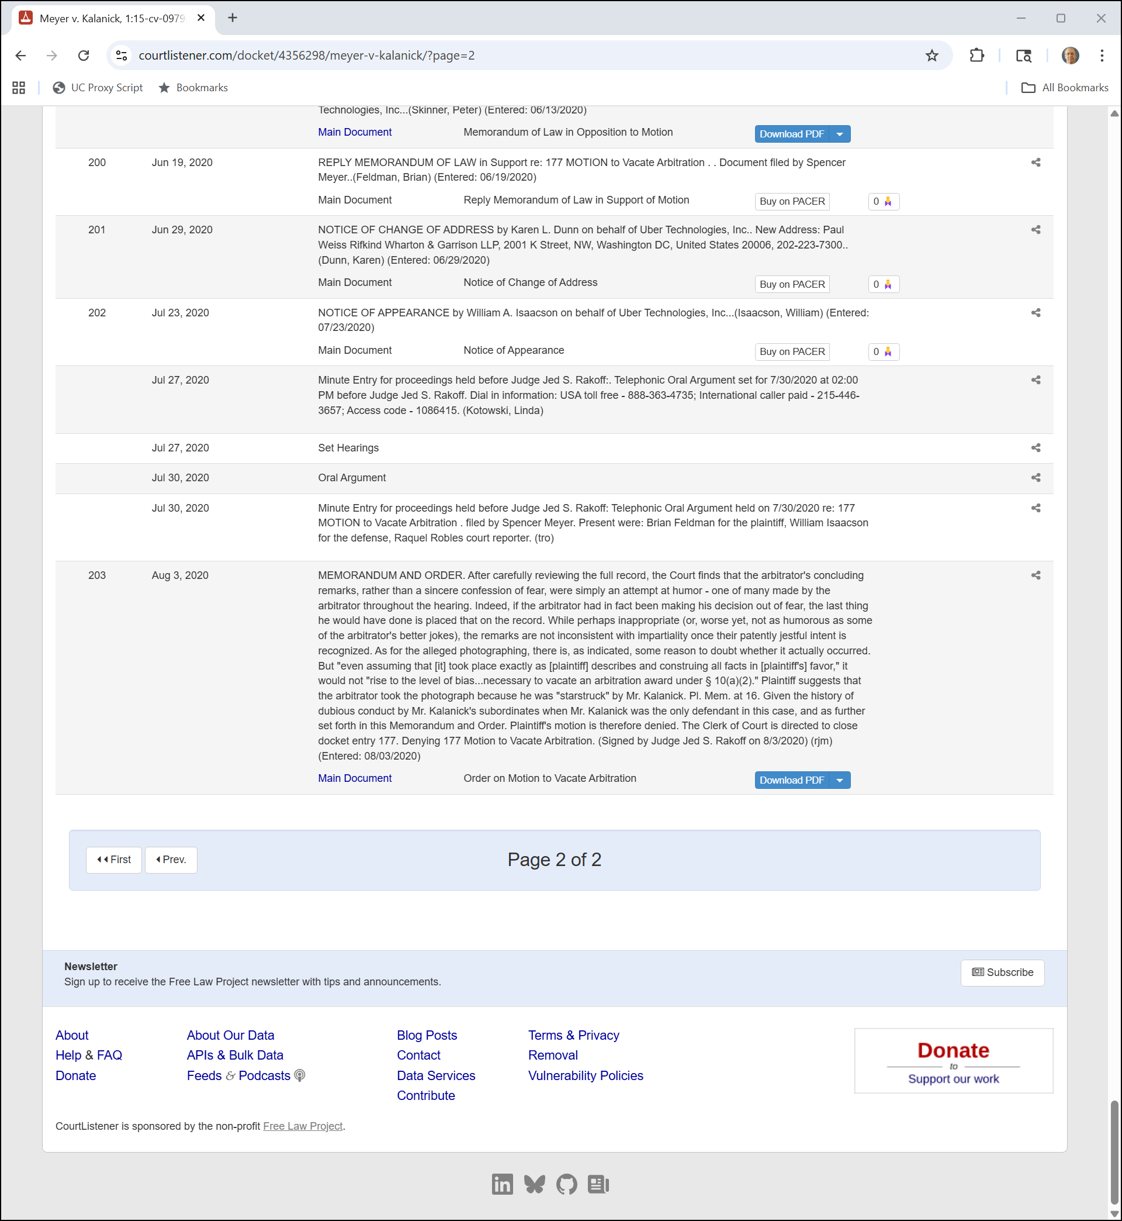
3 Aug 2020: ???
Meyer v. Kalanick Docket (5 Nov 2022)

Slide 58
Issues for Today
Questions
  2. Was Uber’s entry into Philadelphia attempted monopolization in violation of SA2? (Philadelphia Taxi Ass’n (CA3 2018))
    Answer: No, clearly no and so says CA3
Window into Noerr-Pennington doctrine

Slide 59
Doctrinal Background: Noerr Motor Freight
365 U.S. 127 (1961)

Slide 60
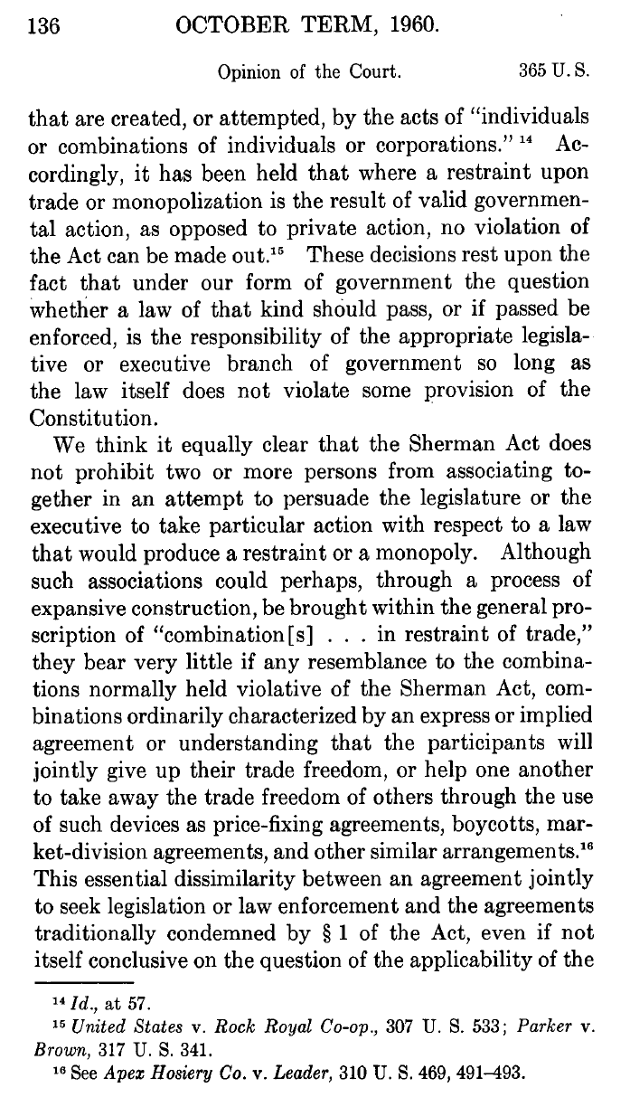
Sherman Act Not Violated by Valid Gov’t Action
“Accordingly, it has been held that where a restraint upon trade or monopolization is the result of valid governmental action, as opposed to private action, no violation of the Act can be made out. These decisions rest upon the fact that under our form of government the question whether a law of that kind should pass, or if passed be enforced, is the responsibility of the appropriate legislative or executive branch of government so long as the law itself does not violate some provision of the Constitution.”
Noerr Motor Freight (US 1961)

Slide 61
Sherman Act Doesn’t Control Efforts to Get Monopoly through Law
“We think it equally clear that the Sherman Act does not prohibit two or more persons from associating together in an attempt to persuade the legislature or the executive to take particular action with respect to a law that would produce a restraint or a monopoly.”
Noerr Motor Freight (US 1961)

Slide 62
Doctrinal Background: Pennington
381 U.S. 657 (1965)

Slide 63
Noerr-Pennington Doctrine
“Neither finding, however, is permitted by Noerr for the reasons stated in that case. Joint efforts to influence public officials do not violate the antitrust laws even though intended to eliminate competition. Such conduct is not illegal, either standing alone or as part of a broader scheme itself violative of the Sherman Act. The jury should have been so instructed and, given the obviously telling nature of this evidence, we cannot hold this lapse to be mere harmless error.”
Pennington (US 1965)

Slide 64
Philadelphia Taxi
836 F.3d 332 (3rd Cir. 2018)

Slide 65
Efficiency Is Good
“Second, Uber’s ability to operate at a lower cost is not anticompetitive. Running a business with greater economic efficiency is to be encouraged, because that often translates to enhanced competition among market players, better products, and lower prices for consumers.”
Philadelphia Taxi Ass’n (3rd Cir. 2018)

Slide 66
Illegal Conduct and Antitrust
“Even if Uber were able to cut costs by allegedly violating PPA regulations, Appellants cannot use the antitrust laws to hold Uber liable for these violations absent proof of anticompetitive conduct. Even unlawful conduct is ‘of no concern to the antitrust laws’ unless it produces an anticompetitive effect. Brunswick Corp. v. Pueblo Bowl-O-Mat, Inc., 429 U.S. 477, 487 (1977).”
Philadelphia Taxi Ass’n (3rd Cir. 2018)

Slide 67
Issues for Today
Questions
  3. Does the Sherman Act (or other law) bar Seattle from setting up local collective bargaining laws for ride-share drivers? (City of Seattle (CA9 2018))
    Yes, per CA9

Slide 68
Parker v. Brown
317 U.S. 341 (1943)

Slide 69
Sherman Act Targets Individuals, Not States
“Here the state command to the Commission and to the program committee of the California Prorate Act is not rendered unlawful by the Sherman Act since, in view of the latter’s words and history, it must be taken to be a prohibition of individual and not state action. … The state itself exercises its legislative authority in making the regulation and in prescribing the conditions of its application.”
Parker (US 1943)

Slide 70
State Acted as Sovereign
“The state in adopting and enforcing the prorate program made no contract or agreement and entered into no conspiracy in restraint of trade or to establish monopoly but, as sovereign, imposed the restraint as an act of government which the Sherman Act did not undertake to prohibit.”
Parker (US 1943)

Slide 71
Midcal
445 U.S. 97 (1980)

Slide 72
The Midcal Test
“First, the challenged restraint must be ‘one clearly articulated and affirmatively expressed as state policy’; second, the policy must be ‘actively supervised’ by the State itself.”
Midcal (US 1980)

Slide 73
Town of Hallie
471 U.S. 34 (1985)

Slide 74
State Supervision Not Required for Municipality
“We conclude that the actions of the City of Eau Claire in this case are exempt from the Sherman Act. They were taken pursuant to a clearly articulated state policy to replace competition in the provision of sewage services with regulation. We further hold that active state supervision is not a prerequisite to exemption from the antitrust laws where the actor is a municipality rather than a private party.”
Town of Hallie (US 1985)

Slide 75
North Carolina Dental
574 U.S. 494 (2015)

Slide 76
Another Application of Parker
“This case arises from an antitrust challenge to the actions of a state regulatory board. A majority of the board’s members are engaged in the active practice of the profession it regulates. The question is whether the board’s actions are protected from Sherman Act regulation under the doctrine of state-action antitrust immunity, as defined and applied in this Court's decisions beginning with Parker v. Brown, 317 U.S. 341 (1943).”
North Carolina Dental (US 2015)

Slide 77
No Immunity Here
“The Sherman Act protects competition while also respecting federalism. It does not authorize the States to abandon markets to the unsupervised control of active market participants, whether trade associations or hybrid agencies. If a State wants to rely on active market participants as regulators, it must provide active supervision if state-action immunity under Parker is to be invoked.”
North Carolina Dental (US 2015)

Slide 78
City of Seattle
890 F.3d 769 (9th Cir. 2018)

Slide 79
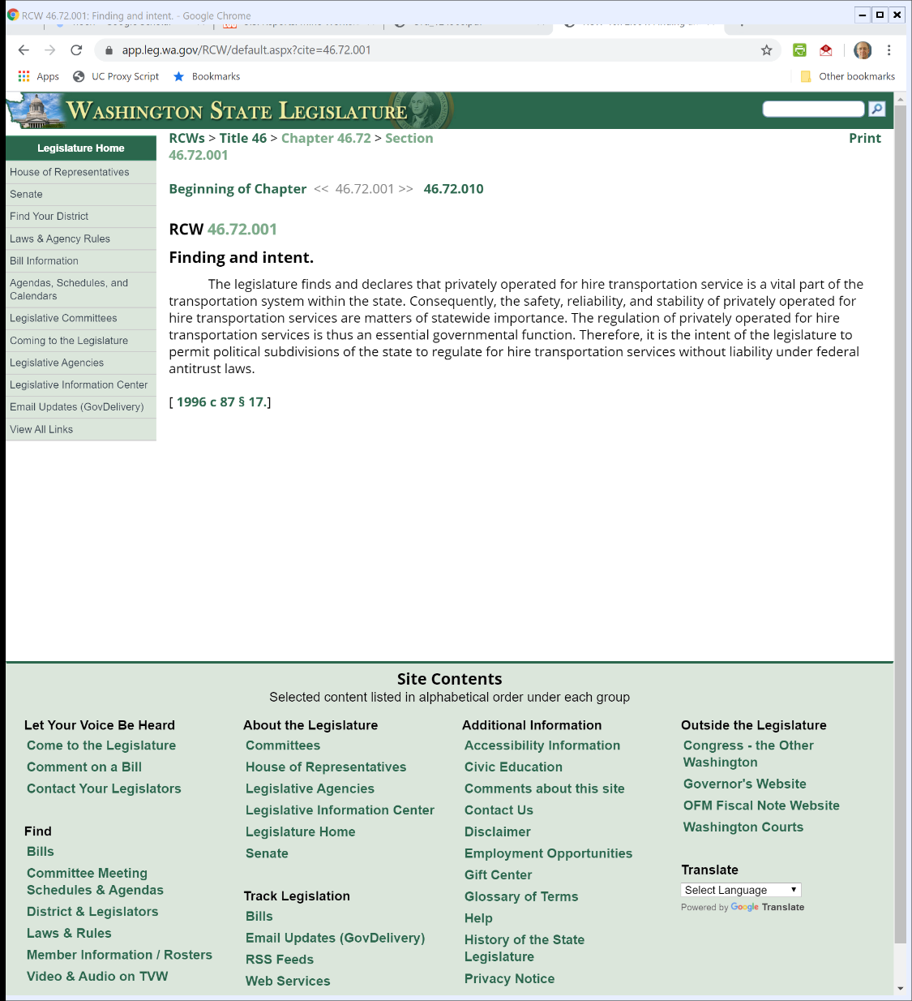

RCW 46.72.001: AT Exemption for For Hire Transportation Local Reg
Rev. Code WA (Visited: 24 Feb 2016)
Notes:
https://app.leg.wa.gov/RCW/default.aspx?cite=46.72.001

Slide 80
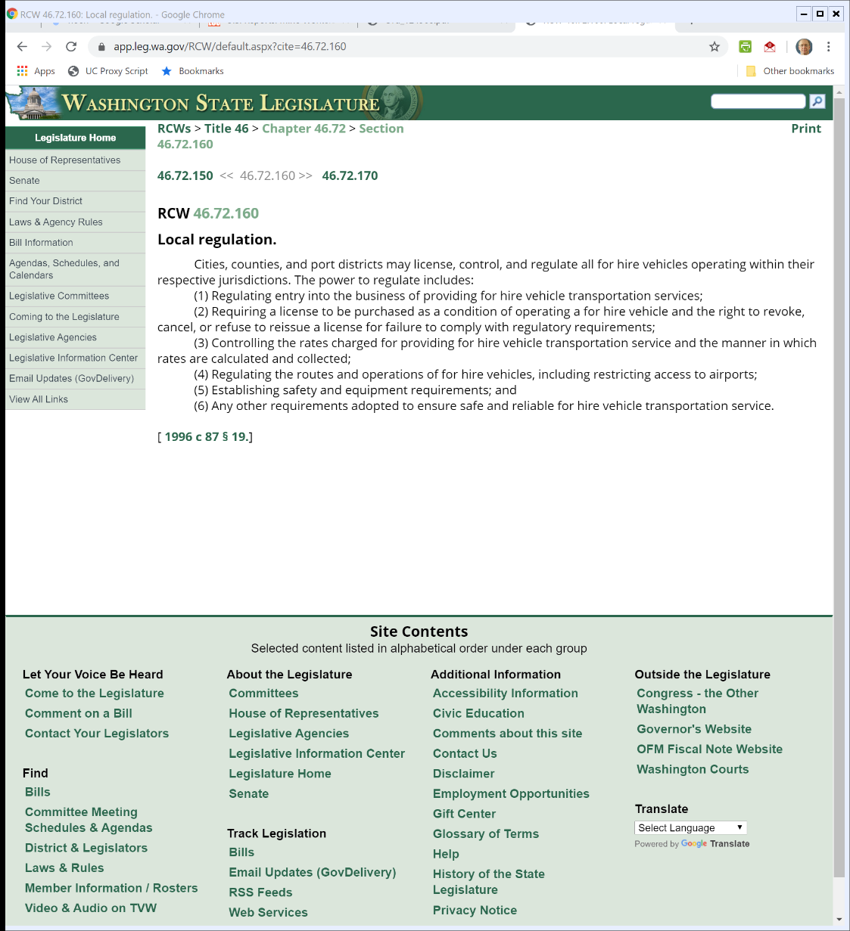
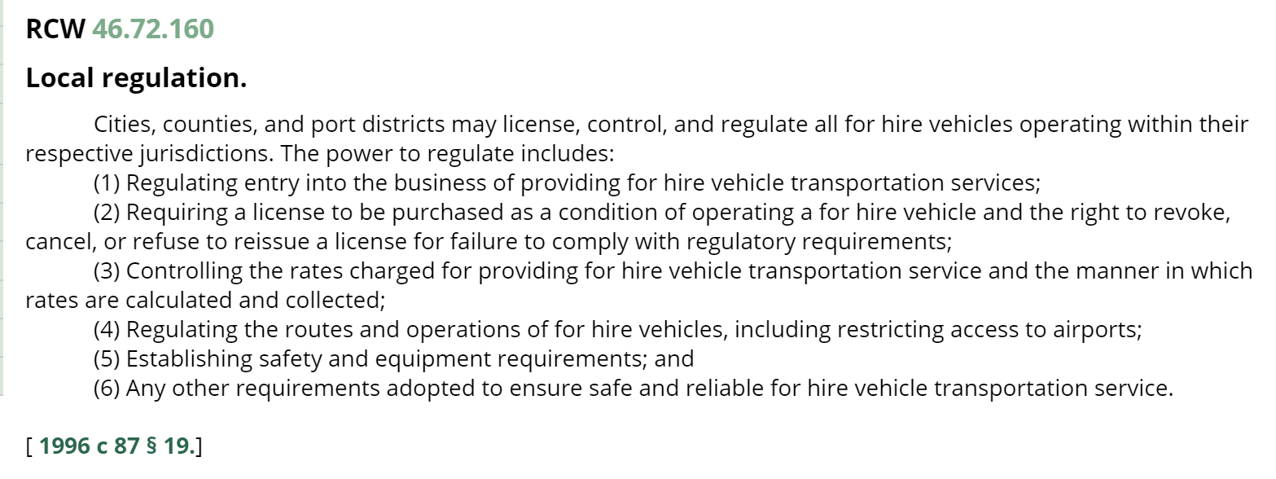
Local Regulatory Powers
Rev. Code WA (Visited: 24 Feb 2016)

Slide 81
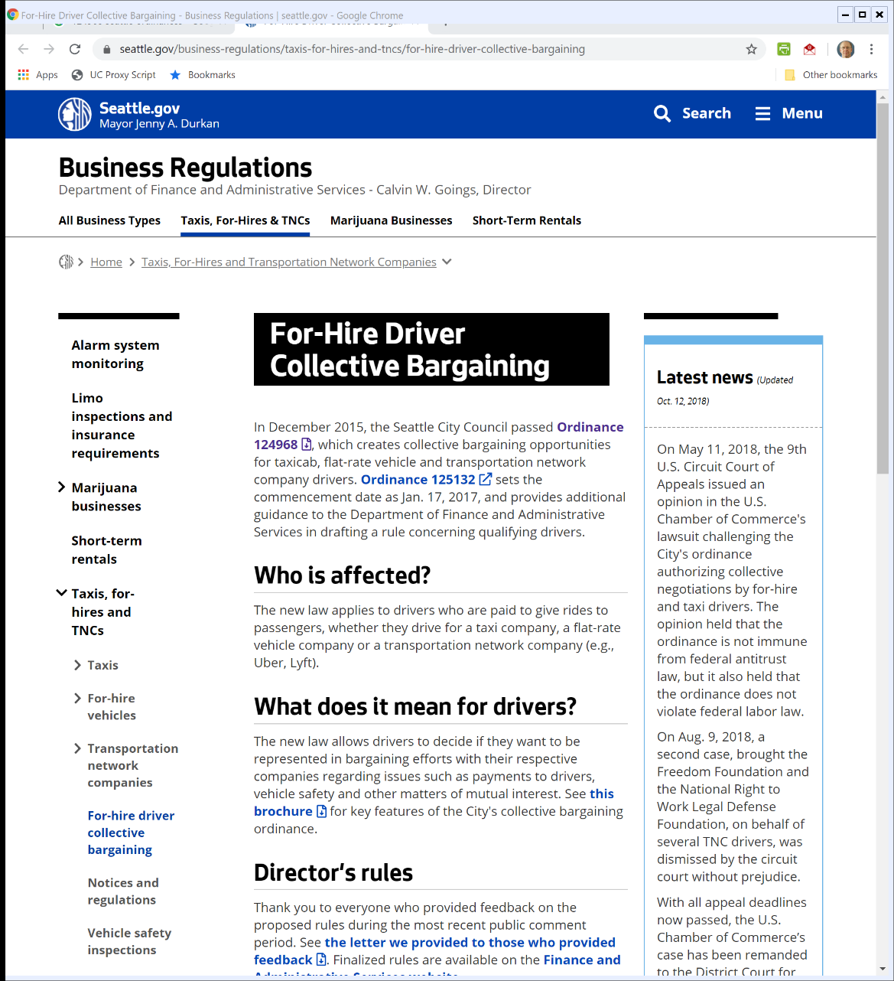

Seattle Ordinances
Seattle.gov (Visited: 24 Feb 2020)

Slide 82
And in City of Seattle?
Two Issues
  Are Uber/Lyft sufficiently picked up under the underlying WA statutes to satisfy the “clearly articulated” state policy prong?
    Uber/Lyft want to say that they are just platforms and perhaps input providers to transportation industries but not for hire operators

Slide 83
And in City of Seattle?
Two Issues
    CA9 says no; companies didn’t exist when statute was passed (1996)
    CA9 reads Midcal to require active supervision here

Slide 84
Two-Sided Market But State Reg Only Addresses One Side
“The regulation of rates in one area—i.e., the regulation of rates charged to passengers for transportation services—does not confer the shield of state-action immunity onto anticompetitive conduct in a related market—i.e., price-fixing the fees for-hire drivers pay to Uber and Lyft in order to use their digital platforms.”
City of Seattle (9th Cir. 2018)

Slide 85
No Active Supervision Here
“In contrast, this case presents a scenario in which the City authorizes collective price-fixing by private parties, which the Director evaluates and ratifies. The amount of discretion the Ordinance confers upon private actors is far from trivial. Having decided that the active-supervision requirement applies to this case, we turn to examine whether it is met. Clearly, it is not.”
City of Seattle (9th Cir. 2018)

