Slide 1
Class 15: Thurs 30 Oct 2025
Antitrust Fall 2025
Antitrust Injury and Remedies
Randal C. Picker
James Parker Hall Distinguished Service Professor of Law
The Law School
The University of Chicago
Copyright © 2000-25 Randal C. Picker. All Rights Reserved.

Slide 2
What Today is About
Two Takes on “Antitrust Injury”
  What does it mean to have an antitrust injury?
  What does that mean for who has standing to bring an antitrust claim?

Slide 3
Brunswick
Questions
  What was bowling like in the early 1960s?
  What sort of market power does Brunswick have, if any, and what is the source of that power? Does that matter?

Slide 4
Brunswick Financial Position
Brunswick Annual Report 1964

Slide 5
Pin-Setting Innovation
U.S. Patent No. 2,967,708

Slide 6
Brunswick Patent (Paramas NJ)
U.S. Patent No. 2,967,708

Slide 7
Brunswick
429 U.S. 477 (1977)

Slide 8
Liability in Brunswick?
TTYN (1 of 3)
Hypo
  Brunswick sells bowling equipment, but buyers fail and it then vertically integrates into bowling centers
What are the theories of antitrust liability here? Predatory pricing? CA7 violation?

Slide 9
Liability in Brunswick?
TTYN (2 of 3)
Building Out the Hypo
  Step 1
    Assume five towns each with an independently-owned (IO) bowling center
    Assume entry in each town by a new IO bowling center
  Assess the change in competition

Slide 10
Liability in Brunswick?
TTYN (3 of 3)
Building Out the Hypo
  Step 2
    Assume the new entrants fail and Brunswick, who had not operated bowling centers, takes over all five of them
  Assess the change in competition
Is this Brunswick?

Slide 11
Brunswick: Understanding Antitrust Injury
Key Facts
  Brunswick sold automatic pinsetters on secured credit.
  When purchasers could not pay, it took over many bowling centers.
  In so doing, it came to control 2% of bowling centers in the United States.

Slide 12
Brunswick
Suit and Result
  Competitors in three markets brought suit alleging a violation of Sec. 7 of the Clayton Act.
  Verdict of $2.4 million, before trebling, was awarded.
  Damages measured additional income of plaintiffs had the failing bowling centers closed.

Slide 13
Brunswick
But For Causation and Antitrust Violations
  Assume the Sec. 7 violation.
  Damages should reflect alternative world without violation?

Slide 14
Defining Antitrust Injury
Understanding Antitrust Injury
  Damages resulted from inability to have market power and exercise it.
  Market power is bad, not good, and denial of it is not antitrust injury.

Slide 15
What Happened to Competition?
“At base, respondents complain that by acquiring the failing centers petitioner preserved competition, thereby depriving respondents of the benefits of increased concentration. The damages respondents obtained are designed to provide them with the profits they would have realized had competition been reduced.”
Brunswick (US 1977)

Slide 16
What Happened to Competition?
“The antitrust laws, however, were enacted for ‘the protection of competition, not competitors,’ Brown Shoe Co. v. United States, 370 U.S., at 320. It is inimical to the purposes of these laws to award damages for the type of injury claimed here.”
Brunswick (US 1977)

Slide 17
Brunswick: Antitrust Injury Required
“We therefore hold that the plaintiffs to recover treble damages on account of Sec. 7 violations, they must prove more than injury causally linked to an illegal presence in the market. Plaintiffs must prove antitrust injury, which is to say injury of the type the antitrust laws were intended to prevent and that flows from that which makes the defendants’ acts unlawful.”
Brunswick (US 1977)

Slide 18
Nature of the Injury
“The injury should reflect the anticompetitive effect either of the violation or of anticompetitive acts made possible by the violation.”
Brunswick (US 1977)

Slide 19
Standing
Hypo
  Manufacturers (M) sell to Retailers (R) who sell to ultimate Consumers.
  Ms engage in price-fixing raising input cost to Rs.
Who has standing to sue for the violation?
  Retailers (direct purchasers)?
  Consumers (indirect purchasers)?

Slide 20
Standing
Question
  What should determine how we allocate standing as between direct purchasers and indirect purchasers?
Answer
  Hanover Shoe/Illinois Brick doctrine says direct purchasers can sue and indirect purchasers cannot

Slide 21
Standing
Answer
  Note that in this standard situation, we have two sets of direct purchasers (R from M) and (C from R) and one set of indirect purchasers (C from M)

Slide 22
Hanover Shoe
392 U.S. 481 (1968)

Slide 23
Rejection of Passing-On Defense
Issue
  The defendant manufacturer argued that its purchaser had “passed on” the illegal overcharges to its customers, hence the purchaser had suffered no injury.
  The Supreme Court rejected this passing on defense, making it possible for the retailer/purchaser to sue.

Slide 24
Antitrust Defendant Can’t Assert Passing On Defense
“Our conclusion is that Hanover proved injury and the amount of its damages for the purposes of its treble-damage suit when it proved that United had overcharged it during the damage period and showed the amount of the overcharge; United was not entitled to assert a passing-on defense.”
Hanover (US 1968)

Slide 25
Illinois Brick
431 U.S. 720 (1977)

Slide 26
Ban on Indirect Purchaser Suits
Issue
  Indirect purchasers attempted to sue under Sec. 4 of the Clayton Act.
  To avoid the possibility of multiple recovery by both direct purchasers and indirect purchasers and to avoid allocation issues, consistent with Hanover Shoe, the Court found that indirect purchasers lacked standing.

Slide 27
Ban on Indirect Purchaser Suits
The Rule of Illinois Brick
  Only direct purchasers have standing to sue under CA 4.

Slide 28
Block Indirect Purchasers from Bringing CA4 Claims
“We are left, then, with two alternatives: either we must overrule Hanover Shoe (or at least narrowly confine it to its facts), or we must preclude respondents from seeking to recover on their pass-on theory. We choose the latter course.”
Illinois Brick (US 1977)

Slide 29
Understanding Damages
Hypo
  Retailers face our standard demand curve: P = 10 – Q
  Retailers incur a marginal cost of 2 per unit, plus the wholesale price paid to M
  Manufacturing has a marginal cost of 2 as well

Slide 30
Version 1: Competitive R, Competitive M
P = MC at both levels, so wholesale price is 2, retail price is 4
Quantity is 6

Slide 31
Version 2: Competitive R, Monop M
Assume cartel forms in M
Demand Curve faced by M
  P = MC is the key condition at R
    10 – Q = 2 + Pw
    So, Pw = 8 – Q is the demand curve faced by M

Slide 32
Ver 2: Comp R, Monop M
Monop maxes by setting MC = MR
  The demand curve gives rise to a function for marginal revenue of 8 – 2Q
  Max implies 8 – 2Q = 2 or Q = 3, Pw = 5, and P = 7

Slide 33
Version 2
Results
Deadweight loss of 4.5

Slide 34
Calculating Damages: The Overcharge
TTYN (1 of 2)
Calculating the Overcharge
  Pw is 5 with M power, before Pw was 2
  Overcharge is 3 per unit
  3 units sold under monop, so damages of 9?
Overcharge as Disgorgement of Profits
    This is just the monop’s profits, so this damages measure is to require that profits be disgorged.

Slide 35
Alternative: Deadweight Loss as Measure of Damages
TTYN (2 of 2)
Social harm here is deadweight loss of 4.5, not profits of 9, which is just a transfer
Questions
  Should we assess DWL as damages? Overcharge? Something else?
  What does this say regarding standing?

Slide 36
Treble Damages
Penalty may reflect under-enforcement risk
What consequences for standing?
Try this: Pw = 5, Oh Goody!
  Retailers recognize M power exercise, know they will get treble damages
  Actual price is Pw list minus anticipated damages

Slide 37
Treble Damages
  They compete this away so consumers benefit, even if no indirect action allowed
  Less “unfairness” to Cs in barring indirect actions
  Plausible?

Slide 38
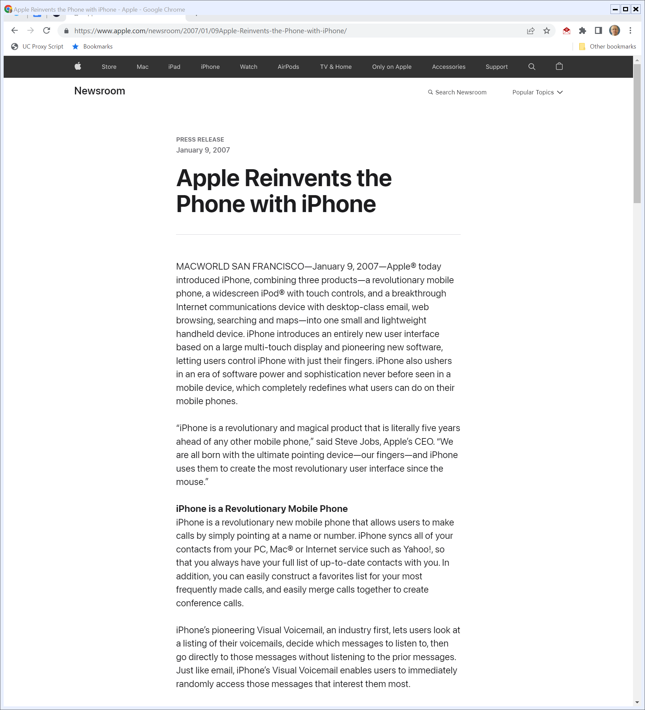
2007 SF Macworld iPhone Launch
“Apple® today introduced iPhone, combining three products—a revolutionary mobile phone, a widescreen iPod® with touch controls, and a breakthrough Internet communications device with desktop-class email, web browsing, searching and maps—into one small and lightweight handheld device.”
Apple (9 Jan 2007)
Notes:
https://www.apple.com/newsroom/2007/01/09Apple-Reinvents-the-Phone-with-iPhone/

Slide 39
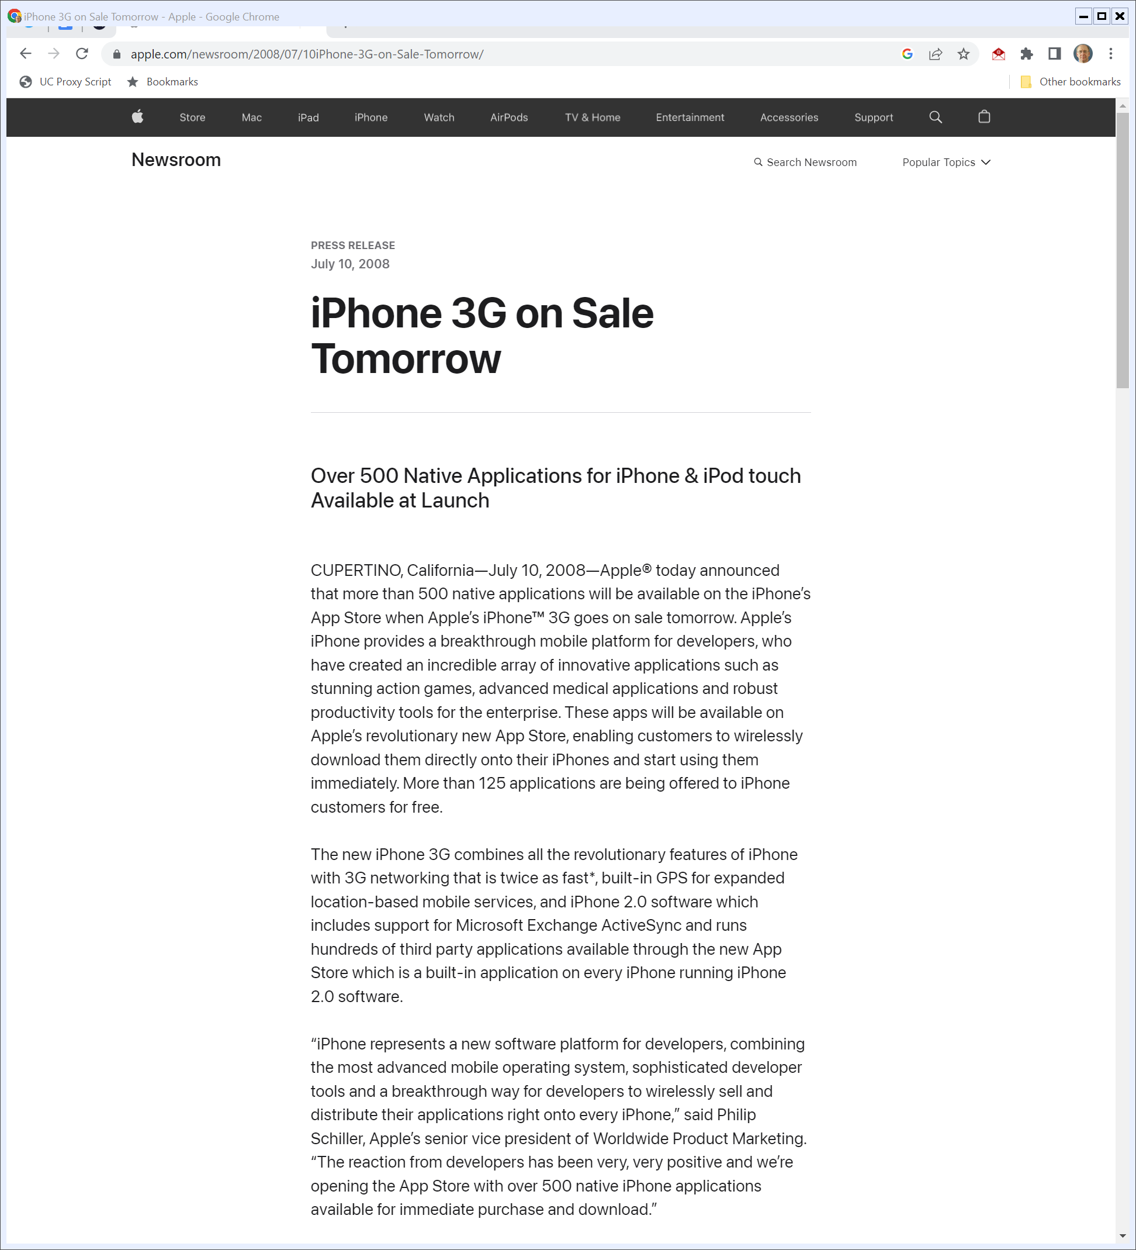
App Store Launch
“Apple® today announced that more than 500 native applications will be available on the iPhone’s App Store when Apple’s iPhone™ 3G goes on sale tomorrow. … These apps will be available on Apple’s revolutionary new App Store, enabling customers to wirelessly download them directly onto their iPhones and start using them immediately.”
Apple (10 July 2008)
Notes:
https://www.apple.com/newsroom/2008/07/10iPhone-3G-on-Sale-Tomorrow/

Slide 40
The iOS App Cartel
TTYN (1 of 3)
AvP Hypo 1
  All iOS app developers form a cartel and fix prices
  Apple buys apps from developers and resells those to consumers. Apple adds a fee for providing retail services that it folds into the price of the apps it sells to users.
Who has standing to assert a claim re the cartel?

Slide 41
The iOS App Cartel Again
TTYN (2 of 3)
AvP Hypo 2
  All iOS app producers form a cartel and fix prices
  Apple does not buy apps from developers. Apple is just an agent and title to apps passes directly from developers to consumers. Apple sells apps at the price specified by the developers.

Slide 42
The iOS App Cartel Again
TTYN (3 of 3)
AvP Hypo 2
  Apple charges a fee to developers for distributing the apps.
Who has standing to assert a claim re the cartel?

Slide 43

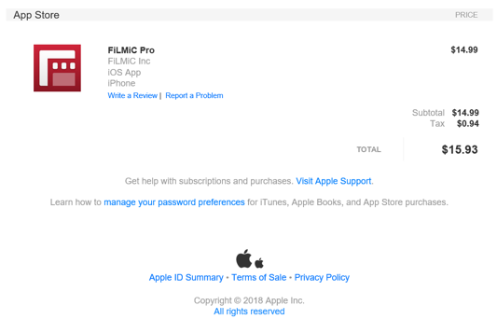
Buying iOS Apps
Receipt from Apple

Slide 44
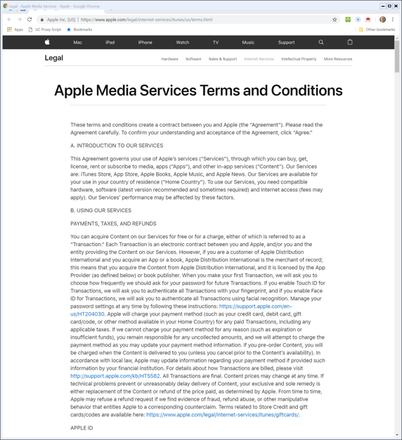
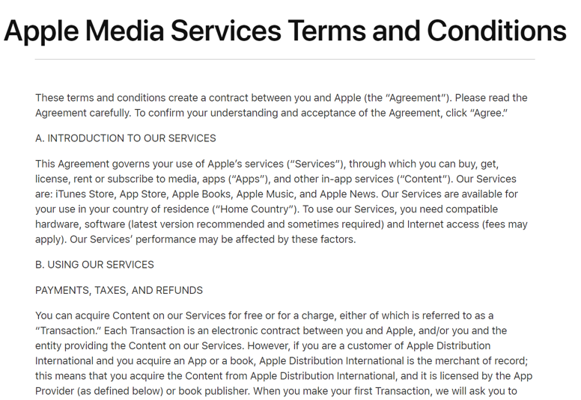
Apple’s Contract with iOS Users
Apple Terms of Service (17 Sept 2018)

Slide 45
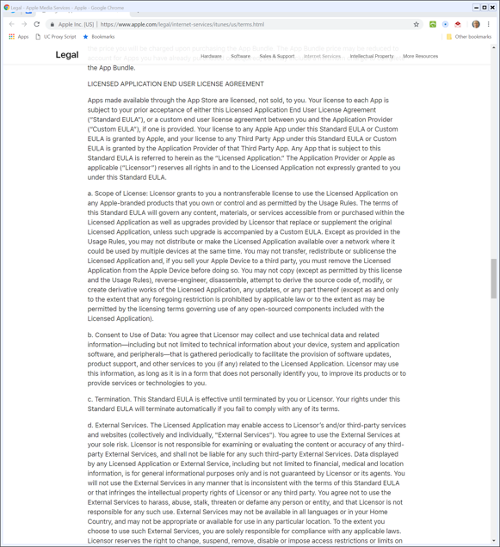
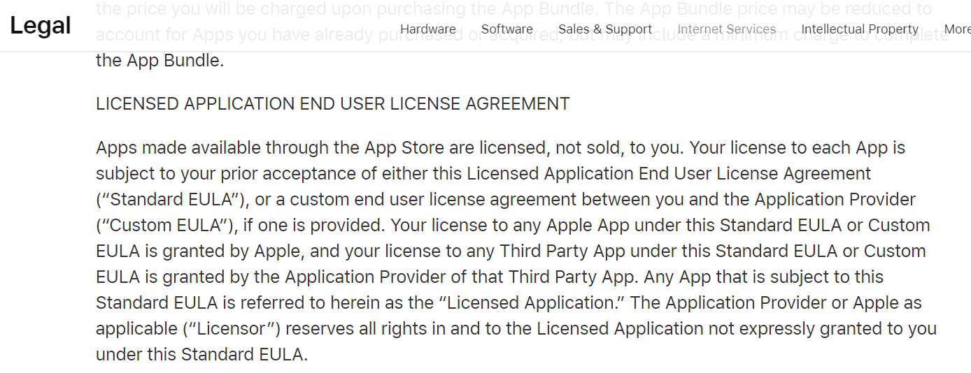
Apps are Licensed, Not Sold
Apple Terms of Service (17 Sept 2018)

Slide 46
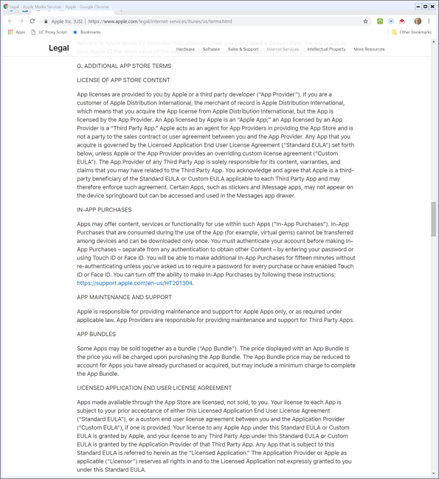
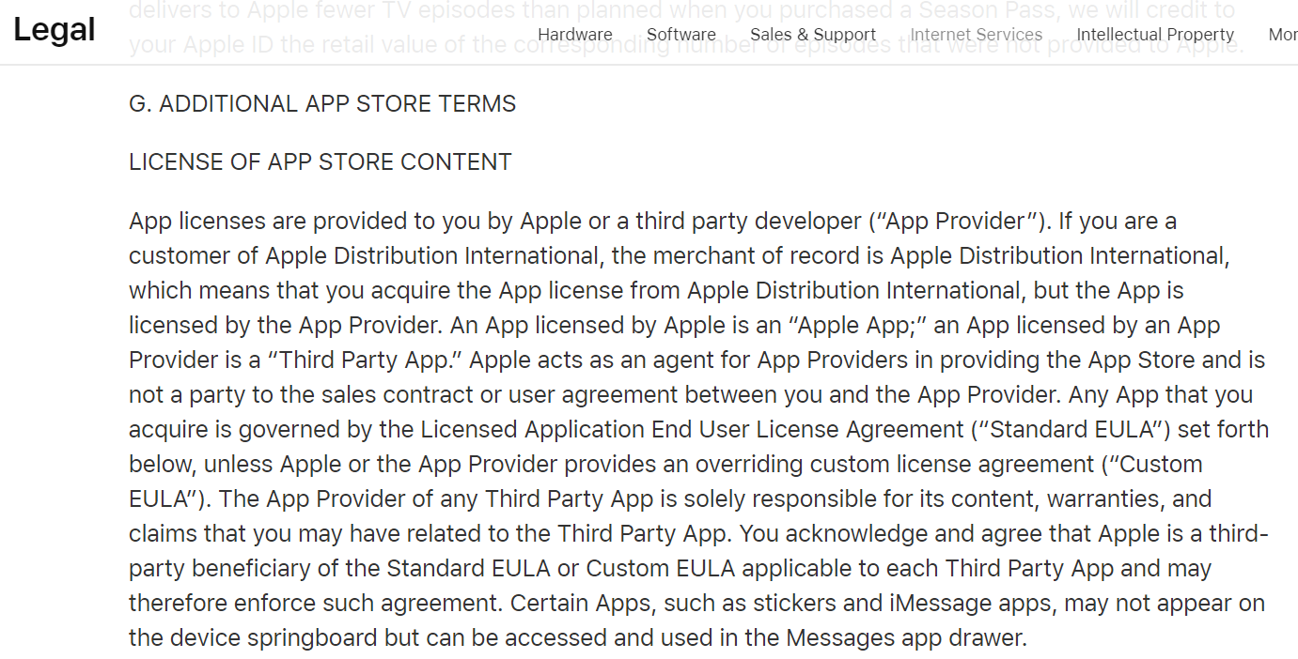
Apple as Agent for Third Party Apps
Apple Terms of Service (17 Sept 2018)

Slide 47
Pepper v Apple Complaint
Original Complaint (29 Dec 2011)

Slide 48
Buying and Selling iOS Apps
TTYN (1 of 2)
AvP Hypo 3
  I transfer $15 to Apple. At the end of the process, Apple gets $4.50 and FilmicPro gets $10.50.
  Does it matter how the money flows?
    User → A $15 → F $10.50?
    User → F $15 → A $4.50?
    User → F $10.50, User → A $4.50?

Slide 49
Buying and Selling iOS Apps
TTYN (2 of 2)
Questions
  Does the flow of funds matter for antitrust?
  Does the fact that Apple is running a platform matter? That this is a two-sided market?
  What does Sup Ct say about that?

Slide 50
Majority: Apple As Seller
“In 2007, Apple started selling iPhones. The next year, Apple launched the retail App Store, an electronic store where iPhone owners can purchase iPhone applications from Apple.”
Apple v. Pepper (U.S 2019)

Slide 51
Dissent: Apple Not The Seller from Its Internet App Store
“The lawsuit before us depends on just the sort of pass-on theory that Illinois Brick forbids. The plaintiffs bought apps from third-party app developers (or manufacturers) in Apple’s retail Internet App Store, at prices set by the developers.”
Apple v. Pepper (U.S 2019)

Slide 52
Majority: Users as Direct Purchasers from Apple
“The plaintiffs purchased apps directly from Apple and therefore are direct purchasers under Illinois Brick. At this early pleadings stage of the litigation, we do not assess the merits of the plaintiffs’ antitrust claims against Apple, nor do we consider any other defenses Apple might have. We merely hold that the Illinois Brick direct-purchaser rule does not bar these plaintiffs from suing Apple under the antitrust laws.”
Apple v. Pepper (US 2019)

Slide 53
Majority: And Again
“The sole question presented at this early stage of the case is whether these consumers are proper plaintiffs for this kind of antitrust suit—in particular, our precedents ask, whether the consumers were ‘direct purchasers’ from Apple. Illinois Brick, 431 U.S. at 745-746. It is undisputed that the iPhone owners bought the apps directly from Apple. Therefore, under Illinois Brick, the iPhone owners were direct purchasers who may sue Apple for alleged monopolization.”
Apple v. Pepper (US 2019)

Slide 54
Monopolist and Monopsonist!
“A retailer who is both a monopolist and a monopsonist may be liable to different classes of plaintiffs—both to downstream consumers and to upstream suppliers—when the retailer’s unlawful conduct affects both the downstream and upstream markets.”
Apple v. Pepper (U.S 2019)

Slide 55
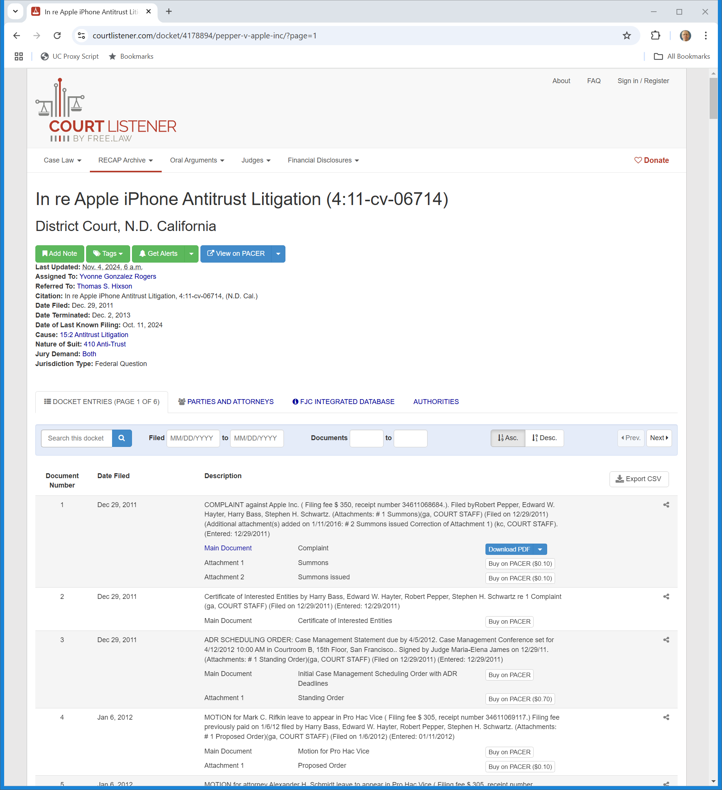
Pepper v. Apple Update
N.D. Calif. Docket (Visited 30 Oct 2025)
Notes:
https://www.courtlistener.com/docket/4178894/pepper-v-apple-inc/?page=1

Slide 56
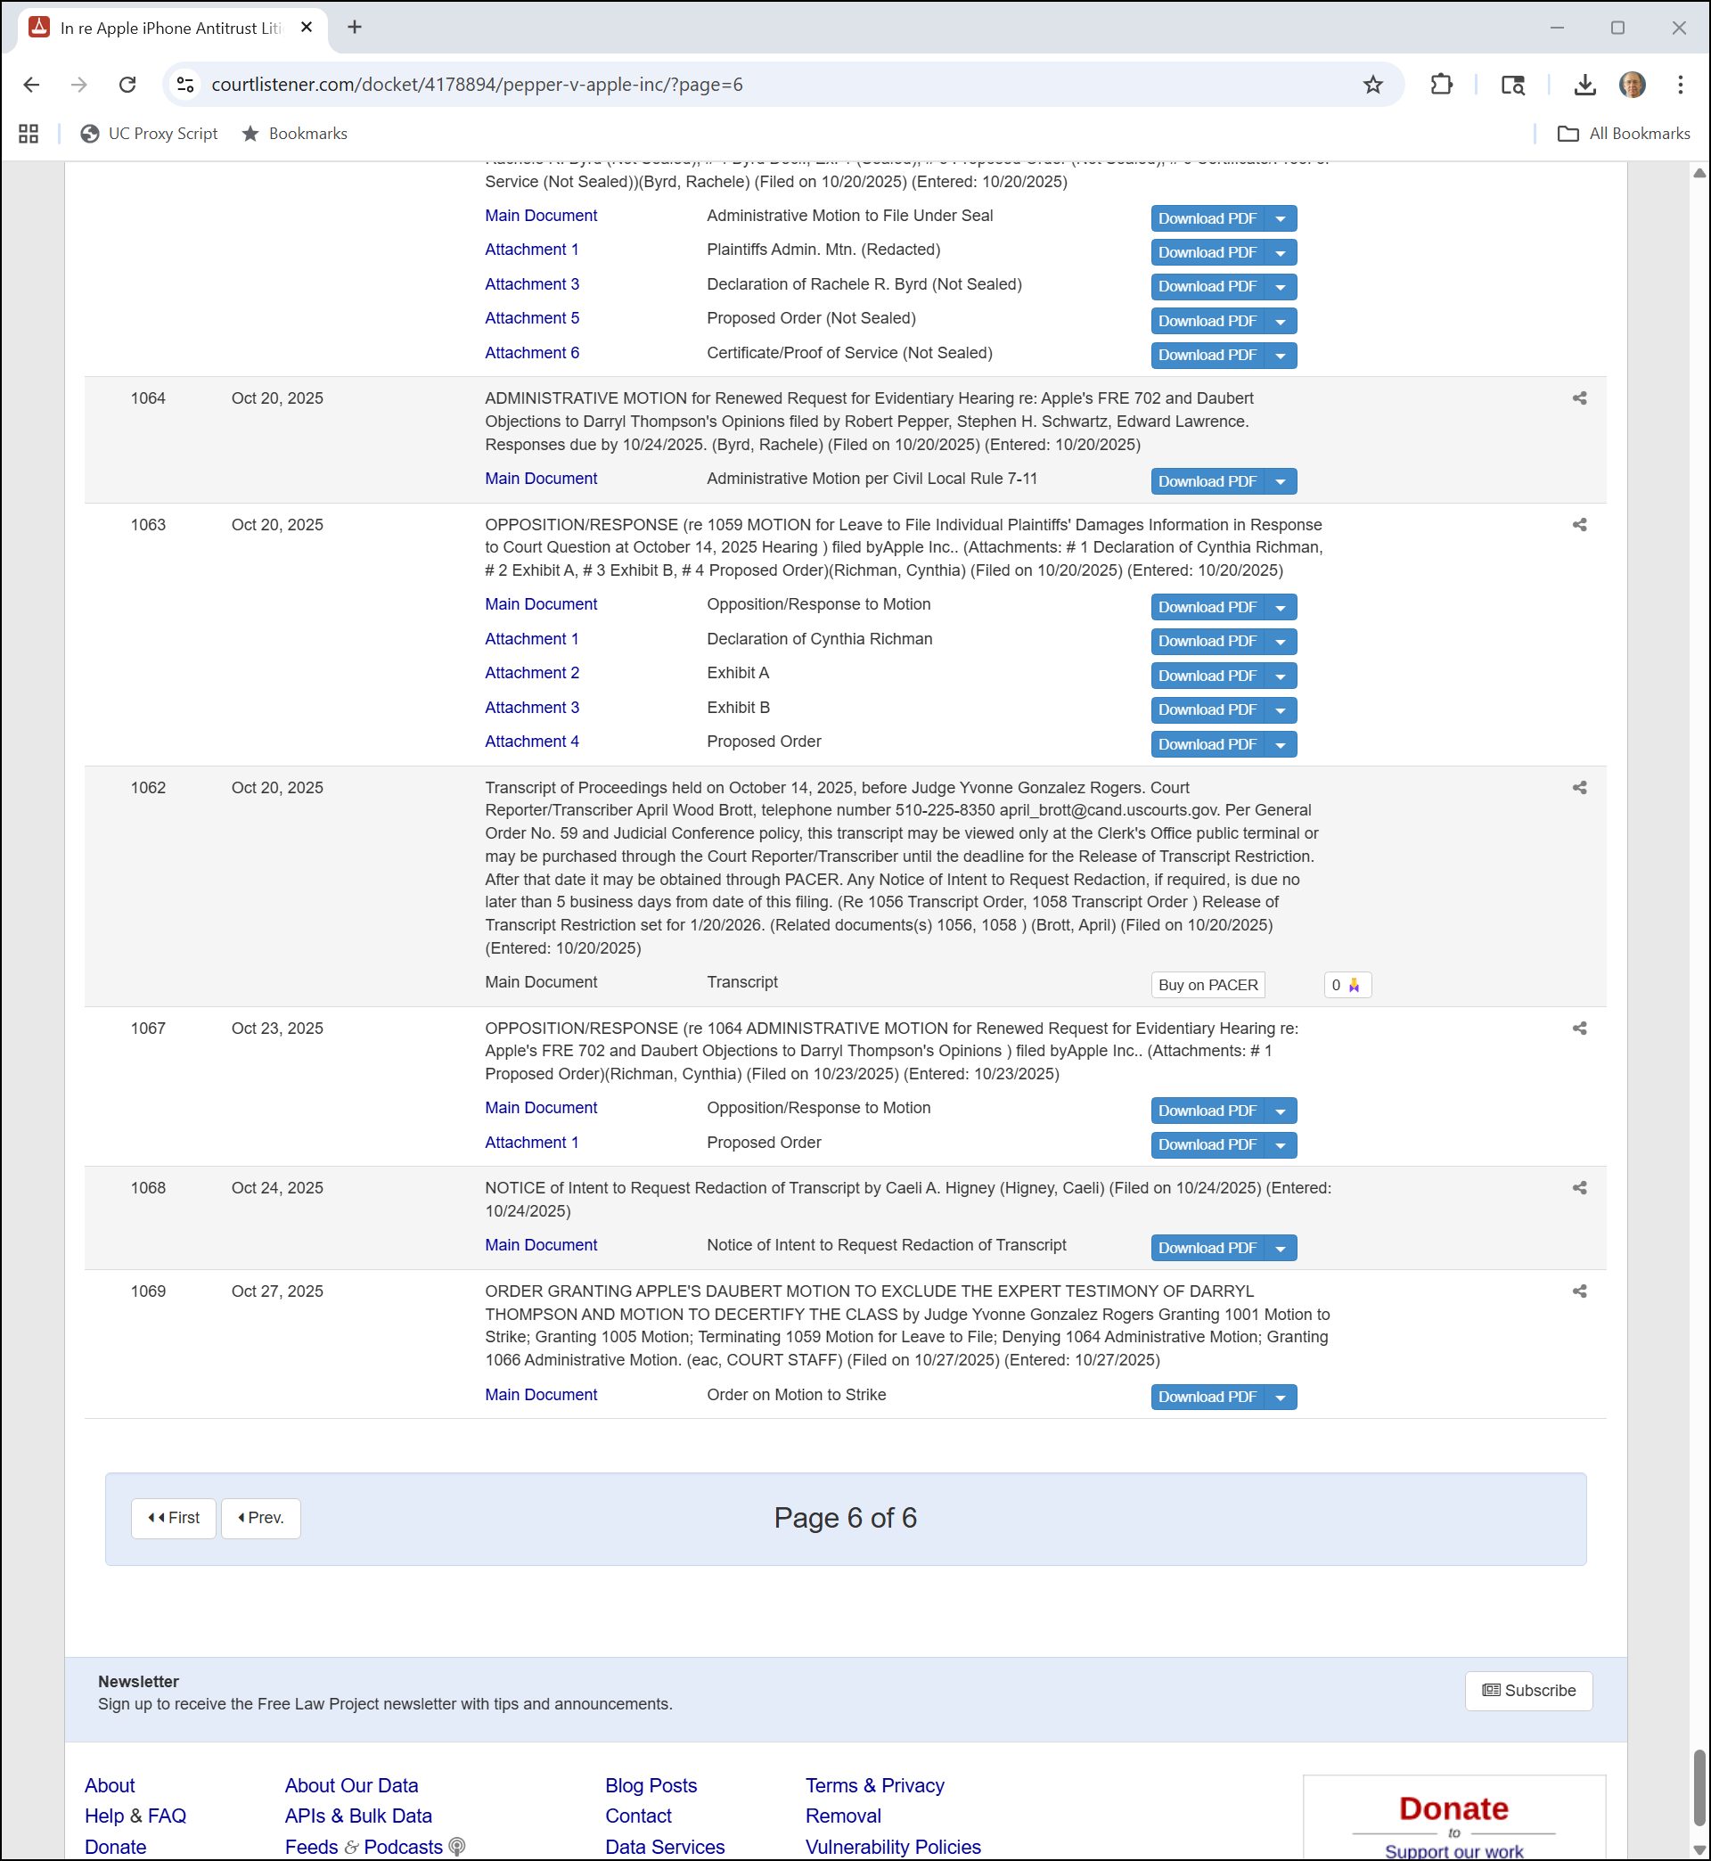
Most Recent Filings
N.D. Calif. Docket (Visited 30 Oct 2025)
Notes:
https://www.courtlistener.com/docket/4178894/pepper-v-apple-inc/?page=6

Slide 57
Daubert Motion Granted; Class Decertified
N.D. Calif. (27 Oct 2025)

Slide 58
AvP Hypo 1 Answer
Answer
  This is just Illinois Brick.
  Indirect purchasers—the actual users of the apps—lack standing to assert the cartel claim against the developers.
  Apple has to assert the claim.

Slide 59
AvP Hypo 2 Answer
Answer
  We only have one purchaser here, not two
  The app users purchaser directly from the developers and should be able to assert the price fixing claim against them.

Slide 60
AvP Hypo 3 Answer
Answer
  Flow of funds shouldn’t matter, though flow of title may but Court rejects this

