Slide 1
Class 14: Wed 29 Oct 2025
Antitrust Fall 2025
Mergers: The 2023 Guidelines
Randal C. Picker
James Parker Hall Distinguished Service Professor of Law
The Law School
The University of Chicago
Copyright © 2000-25 Randal C. Picker. All Rights Reserved.

Slide 2
Clayton Act Section 7
Key Text
  No person engaged in commerce or in any activity affecting commerce shall acquire, directly or indirectly, the whole or any part of the stock or other share capital and no person subject to the jurisdiction of the Federal Trade Commission shall acquire the whole or any part of the assets of

Slide 3
Clayton Act Section 7
  another person engaged also in commerce or in any activity affecting commerce, where in any line of commerce or in any activity affecting commerce in any section of the country, the effect of such acquisition may be substantially to lessen competition, or to tend to create a monopoly.

Slide 4
Questions
What is there? What is missing?
  Does Section 7 say anything about consumer welfare? Worker welfare? Others?
  Does it say anything about preserving small businesses?

Slide 5
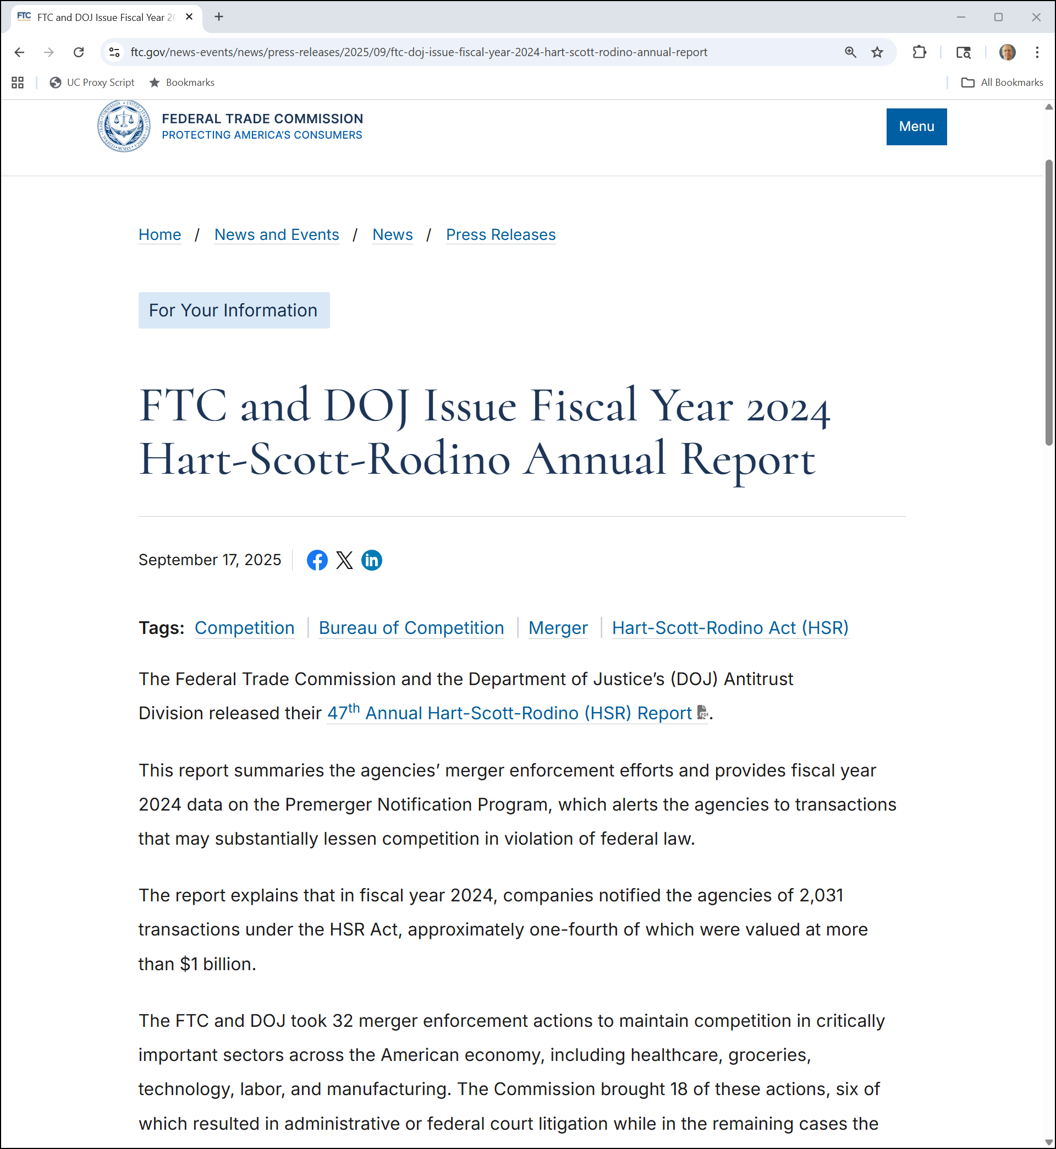
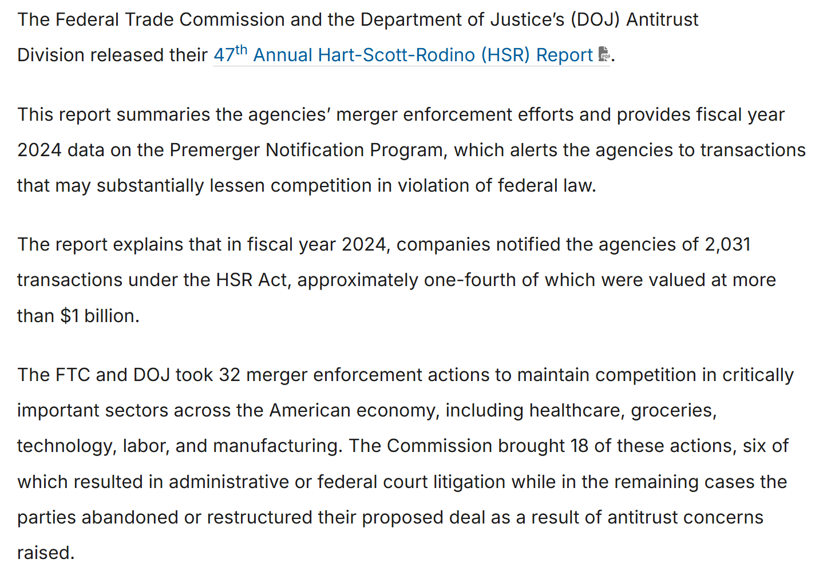
2024 HSR Results
FTC (17 Sept 2025)
Notes:
https://www.ftc.gov/news-events/news/press-releases/2025/09/ftc-doj-issue-fiscal-year-2024-hart-scott-rodino-annual-report

Slide 6
Mergers for Ten Years
HSR FY 2024

Slide 7
Billion $ Deals
HSR FY 2024

Slide 8
Actions Taken
HSR FY 2024

Slide 9
Second Requests
HSR FY 2024

Slide 10
More on the Process
HSR FY 2024

Slide 11
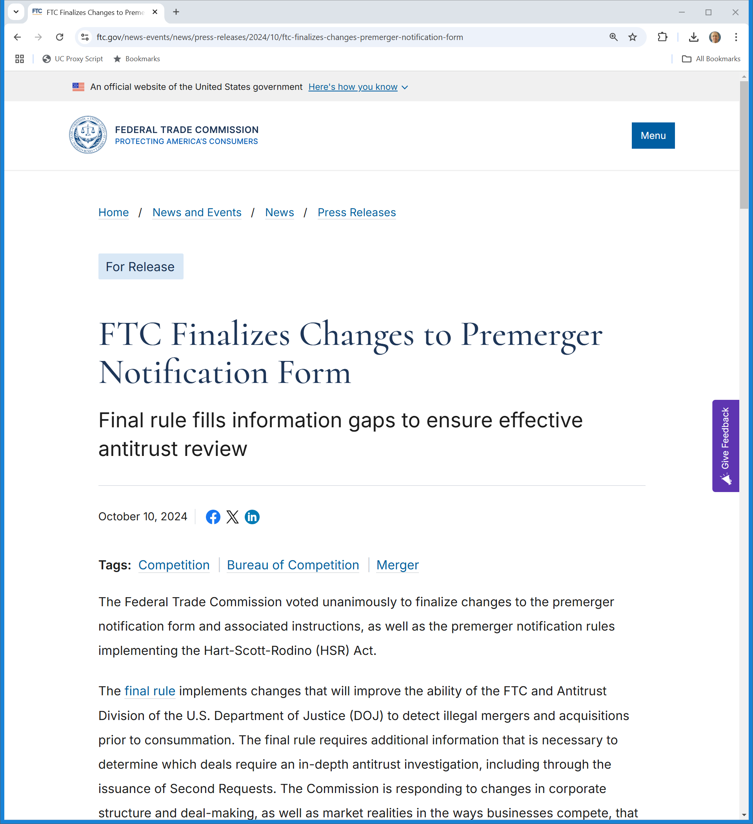
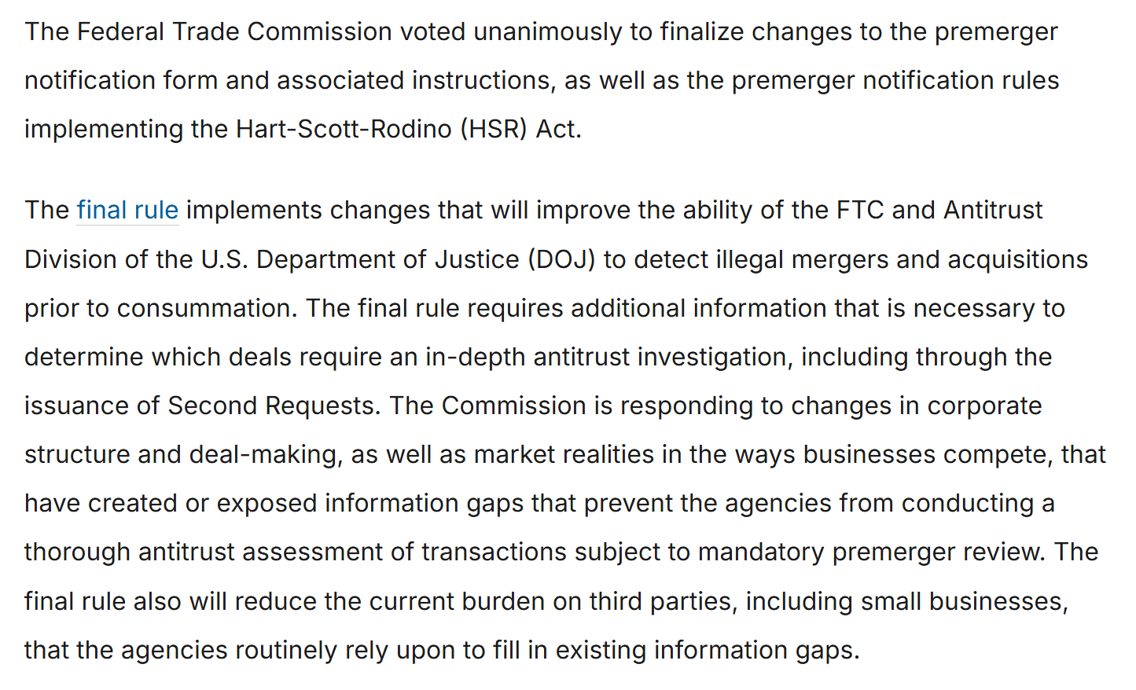
New HSR Filing Rules
FTC (10 Oct 2024)
Notes:
https://www.ftc.gov/news-events/news/press-releases/2024/10/ftc-finalizes-changes-premerger-notification-form

Slide 12
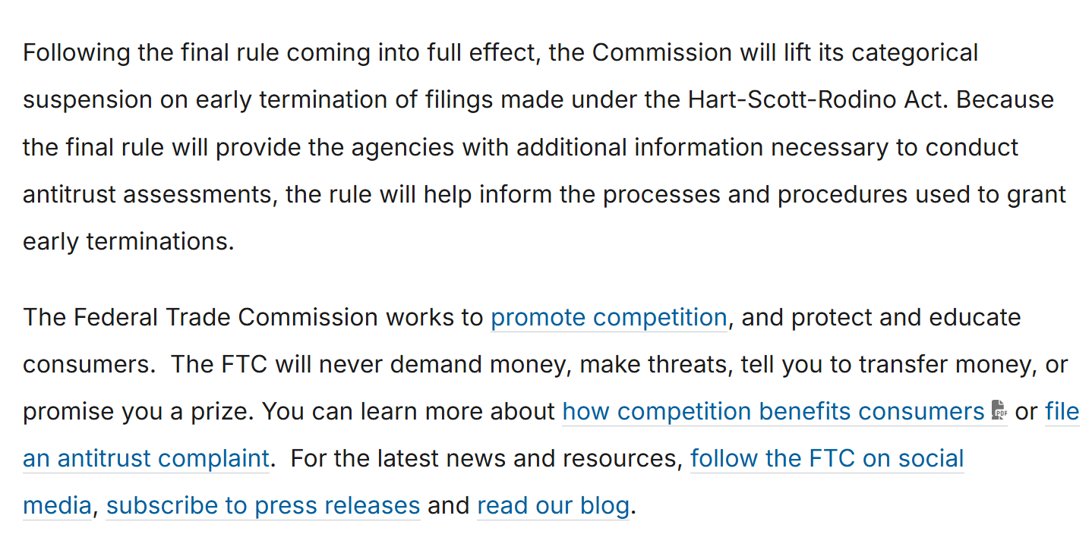
Lift Early Termination Ban
FTC (10 Oct 2024)
Notes:
https://www.ftc.gov/news-events/news/press-releases/2024/10/ftc-finalizes-changes-premerger-notification-form

Slide 13
Judging Concentration
Concentration Ratios
  Just add the market shares for a given number of firms
  So speak of four-firm concentration ratio or 8-firm concentration ratio

Slide 14
Judging Concentration
Examples
  A: (25,25,25,25): 4-firm ratio is 100%
  B: (100,0,0,0): 4-firm ratio is 100%
  C: (40,20,10,10,5,5,5,2,2,1): 4 firm ratio is 80%

Slide 15
The Herfindahl-Hirschman Index
Comparing A and B
  In the prior example, Industries A and B had the same four-firm ratio, but competition is almost certainly quite different.
  Try an alternative measure: square the market shares and add

Slide 16
Calculating HHIs
Examples
  A: 25*25 + 25*25 + 25*25 + 25*25 = 2,500
  B: 100 * 100 + 0*0 + 0*0 + 0*0 = 10,000
  C: 40*40 + 20*20 + 10*10 + 10*10 + 5*5 + 5*5 + 5*5 + 2*2 + 2*2 + 1*1 = 2,284

Slide 17
Mergers and HHIs
A merger of two firms increases the HHI by 2 * S₁ * S₂
  When the firms merge, their combined market share will be S₁ + S₂.
  (S₁ + S₂) * (S₁ + S₂) = S₁*S₁ + 2*S₁*S₂ + S₂*S₂

Slide 18
Mergers and HHIs
Prior Examples
  When the top two firms in Industry C merge, the HHI goes up by 2 * 40 * 20, or 1600, from 2284 to 3884.
  When the first firm merges with the fifth firm, the HHI rises by 2 * 40 * 5, or 400, from 2284 to 2684.
  This is a 1200 difference.

Slide 19
Brown Shoe
370 U.S. 294 (1962)

Slide 20
Early Post-1950 Amendments Case
Brown Shoe (US 1962)

Slide 21
Shoe Manufacturing Market Shares
Brown Shoe (US 1962)

Slide 22
Brown: 4th Largest M at 4%
Brown Shoe (US 1962)

Slide 23
Kinney: 1-2% of retail, 0.5% of M (12th largest)
Brown Shoe (US 1962)

Slide 24
“Protection of Viable, Small Locally Owned Businesses”
Brown Shoe (US 1962)

Slide 25
Given Trends: Stop Now
Brown Shoe (US 1962)

Slide 26
Philadelphia National Bank
374 U.S. 321 (1963)

Slide 27
Don’t Always Need Detailed Info
Philadelphia National Bank (US 1963)

Slide 28
Presumption to Block Mergers If …
Philadelphia National Bank (US 1963)

Slide 29
30% Enough to Block Here
Philadelphia National Bank (US 1963)

Slide 30
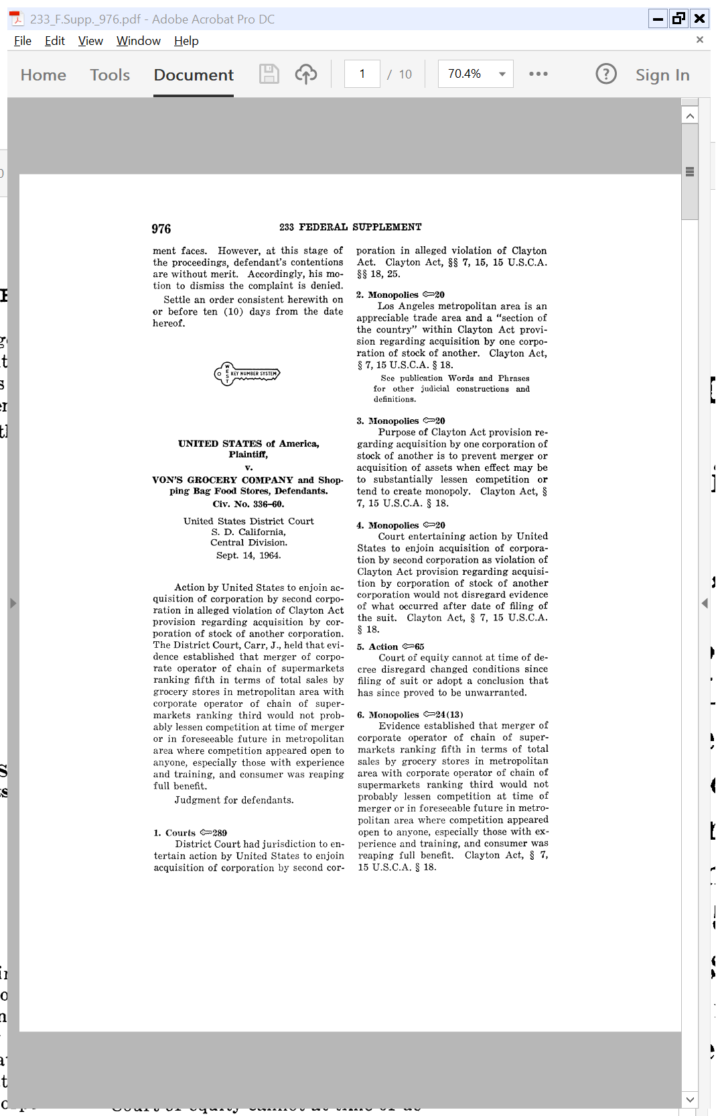
Merger of Von’s and Shopping Bag
Von’s, 233 F.Supp. 976 (S.D. Calif. 1964)

Slide 31
Grocery Stores in Los Angeles
Von’s, 233 F.Supp. 976 (S.D. Calif. 1964)

Slide 32
Von’s
384 U.S. 270 (1966)

Slide 33
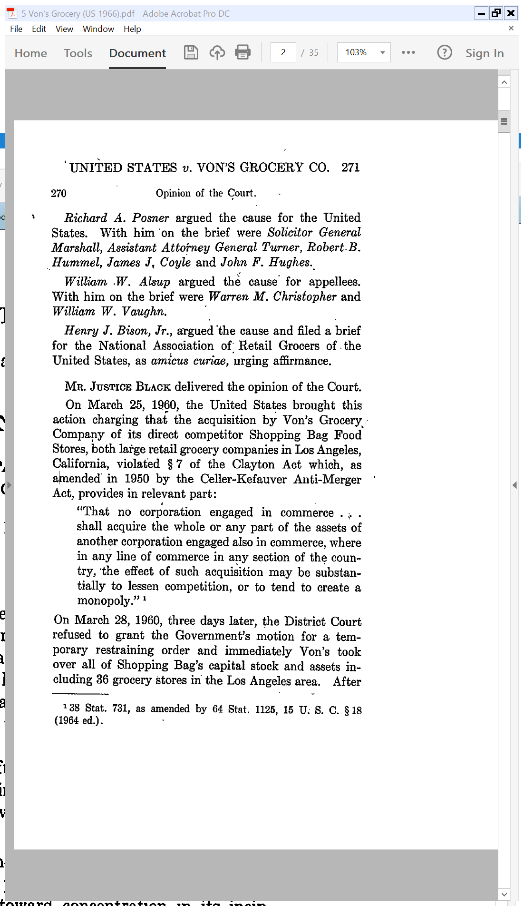
Von’s Buys Shopping Bag
Von’s (US 1966)

Slide 34
Market Shares Here
Von’s (US 1966)

Slide 35
Many Acquisitions
Von’s (US 1966)

Slide 36
Enough to Block Merger
Von’s (US 1966)

Slide 37
1968 Merger Guidelines
USDOJ (1968)

Slide 38
Horizontal Mergers
USDOJ (1968)

Slide 39
>75%: Highly Concentrated Markets
USDOJ (1968)

Slide 40
Less Highly Concentrated Markets
USDOJ (1968)

Slide 41
Concentration Trend
USDOJ (1968)

Slide 42
1982 Merger Guidelines
USDOJ (1982)

Slide 43
Switch to HHIs from Concentration Ratios
USDOJ (1982)

Slide 44
HHI Zones and the Merger Grid
USDOJ (1982)

Slide 45
Pre-2010 DOJ-FTC Grid
Increase in Post-Merger Concentration
< 50
50 to 100
> 100
Unconcentrated:
< 1000
No challenge
No challenge
No challenge
Post-Merger HHI
Moderately Conc:
1000 to 1800
No challenge
No challenge
High scrutiny
Highly Conc.:
> 1800
Presumed unlawful
No challenge
High scrutiny

Slide 46
Real Numbers: Brown Shoe
TTYN (1 of 2)
Sketch of Facts from Case
  Top 24 Ms have 35% of market
    Top 4 (I, EJ, GS, B(w/K)): 23% of market
      Brown: 4% (and 4th largest)
      Kinney pre merger: 0.5% (and 12th largest at that)
    5-24 must have 12% of the market
    Rest have remaining 65%

Slide 47
Real Numbers: Brown Shoe
TTYN (2 of 2)
Applying the Grid
  Make a few intelligent assumptions and calculate ballpark numbers for
    Industry pre-merger HHI
    Increase from merger
    Post-merger HHI
What does the grid say about Brown Shoe?

Slide 48
Von’s and the Pre-2010 Grid (TTYN (1 of 2))
Von’s

Slide 49
Von’s and the Pre-2010 Grid
TTYN (2 of 2)
What did the pre-2010 grid say about Von’s?

Slide 50
2010 DOJ/FTC Horizontal Merger Guidelines
19 Aug 2010

Slide 51
Relevant Statutes
DOJ/FTC Horizontal Merger Guidelines (19 Aug 2010)

Slide 52
2010 DOJ-FTC Grid
Increase in Post-Merger Concentration
< 100
100 to 200
> 200
Unconcentrated:
< 1500
No challenge
No challenge
No challenge
Post-Merger HHI
Moderately Conc:
1500 to 2500
No challenge
Scrutiny
Scrutiny
Highly Conc.:
> 2500
Presumed unlawful
No challenge
Scrutiny

Slide 53
Implementing the 2010 Grid
Increase in Post-Merger Concentration
  Remember that the increase in the HHI is 2*S₁*S₂.
  50 points is two 5% market share firms or a 10% firm and a 2.5% firm
  100 points is roughly two 7% firms or a 10% firm and a 5% firm.

Slide 54
New Merger Guidelines
FTC/DOJ (18 Dec 2023)

Slide 55
Overview of Structure
“Section 2 describes how the Agencies apply these Guidelines. Specifically, Guidelines 1-6 describe distinct frameworks the Agencies use to identify that a merger raises prima facie concerns, and Guidelines 7-11 explain how to apply those frameworks in several specific settings.”
2023 Merger Guidelines

Slide 56
1: Presumed Illegal
“Guideline 1: Mergers Raise a Presumption of Illegality When They Significantly Increase Concentration in a Highly Concentrated Market. Market concentration is often a useful indicator of a merger’s likely effects on competition. The Agencies therefore presume, unless sufficiently disproved or rebutted, that a merger between competitors that significantly increases concentration and creates or further consolidates a highly concentrated market may substantially lessen competition.”
2023 Merger Guidelines

Slide 57
2: Eliminate Substantial Competition
“Guideline 2: Mergers Can Violate the Law When They Eliminate Substantial Competition Between Firms. The Agencies examine whether competition between the merging parties is substantial since their merger will necessarily eliminate any competition between them.”
2023 Merger Guidelines

Slide 58
3: Increase Risk of Coordination
“Guideline 3: Mergers Can Violate the Law When They Increase the Risk of Coordination. The Agencies examine whether a merger increases the risk of anticompetitive coordination. A market that is highly concentrated or has seen prior anticompetitive coordination is inherently vulnerable and the Agencies will infer, subject to rebuttal evidence, that the merger may substantially lessen competition. In a market that is not highly concentrated, the Agencies investigate whether facts suggest a greater risk of coordination than market structure alone would suggest.”
2023 Merger Guidelines

Slide 59
4: Potential Competition
“Guideline 4: Mergers Can Violate the Law When They Eliminate a Potential Entrant in a Concentrated Market. The Agencies examine whether, in a concentrated market, a merger would (a) eliminate a potential entrant or (b) eliminate current competitive pressure from a perceived potential entrant.”
2023 Merger Guidelines

Slide 60
5: Foreclosure
“Guideline 5: Mergers Can Violate the Law When They Create a Firm That May Limit Access to Products or Services That Its Rivals Use to Compete. When a merger creates a firm that can limit access to products or services that its rivals use to compete, the Agencies examine the extent to which the merger creates a risk that the merged firm will limit rivals’ access, gain or increase access to competitively sensitive information, or deter rivals from investing in the market.”
2023 Merger Guidelines

Slide 61
6: Dominant Positions
“Guideline 6: Mergers Can Violate the Law When They Entrench or Extend a Dominant Position. The Agencies examine whether one of the merging firms already has a dominant position that the merger may reinforce, thereby tending to create a monopoly. They also examine whether the merger may extend that dominant position to substantially lessen competition or tend to create a monopoly in another market.”
2023 Merger Guidelines

Slide 62
7: Consolidation Trend
“Guideline 7: When an Industry Undergoes a Trend Toward Consolidation, the Agencies Consider Whether It Increases the Risk a Merger May Substantially Lessen Competition or Tend to Create a Monopoly. A trend toward consolidation can be an important factor in understanding the risks to competition presented by a merger. The Agencies consider this evidence carefully when applying the frameworks in Guidelines 1-6.”
2023 Merger Guidelines

Slide 63
8: Series of Acquisitions
“Guideline 8: When a Merger is Part of a Series of Multiple Acquisitions, the Agencies May Examine the Whole Series. If an individual transaction is part of a firm’s pattern or strategy of multiple acquisitions, the Agencies consider the cumulative effect of the pattern or strategy when applying the frameworks in Guidelines 1-6.”
2023 Merger Guidelines

Slide 64
9: Platforms
“Guideline 9: When a Merger Involves a Multi-Sided Platform, the Agencies Examine Competition Between Platforms, on a Platform, or to Displace a Platform. Multi-sided platforms have characteristics that can exacerbate or accelerate competition problems. The Agencies consider the distinctive characteristics of multi-sided platforms when applying the frameworks in Guidelines 1-6.”
2023 Merger Guidelines

Slide 65
10: Competing Buyers (Workers)
“Guideline 10: When a Merger Involves Competing Buyers, the Agencies Examine Whether It May Substantially Lessen Competition for Workers, Creators, Suppliers, or Other Providers. The Agencies apply the frameworks in Guidelines 1-6 to assess whether a merger between buyers, including employers, may substantially lessen competition or tend to create a monopoly.”
2023 Merger Guidelines

Slide 66
11: Partial Ownership
“Guideline 11: When an Acquisition Involves Partial Ownership or Minority Interests, the Agencies Examine Its Impact on Competition. The Agencies apply the frameworks in Guidelines 1-6 to assess if an acquisition of partial control or common ownership may substantially lessen competition.”
2023 Merger Guidelines

Slide 67
HHIs: Return to < 2010
“The Agencies generally measure concentration levels using the Herfindahl-Hirschman Index (‘HHI’). The HHI is defined as the sum of the squares of the market shares; it is small when there are many small firms and grows larger as the market becomes more concentrated, reaching 10,000 in a market with a single firm. Markets with an HHI greater than 1,800 are highly concentrated, and a change of more than 100 points is a significant increase.”
2023 Merger Guidelines

Slide 68
The New Grid: Words
“A merger that creates or further consolidates a highly concentrated market that involves an increase in the HHI of more than 100 points is presumed to substantially lessen competition or tend to create a monopoly. The Agencies also may examine the market share of the merged firm: a merger that creates a firm with a share over thirty percent is also presumed to substantially lessen competition or tend to create a monopoly if it also involves an increase in HHI of more than 100 points.”
2023 Merger Guidelines

Slide 69
The New Grid
2023 Merger Guidelines

Slide 70
4.3: Market Definition
“The Agencies identify the ‘area of effective competition’ in which competition may be lessened ‘with reference to a product market (the ‘line of commerce’) and a geographic market (the ‘section of the country.’).’ The Agencies refer to the process of identifying market(s) protected by the Clayton Act as a ‘market definition’ exercise and the markets so defined as ‘relevant antitrust markets,’ or simply ‘relevant markets.’ Market definition can also allow the Agencies to identify market participants and measure market shares and market concentration.”
2023 Merger Guidelines

Slide 71
Defining A Market: Direct Competition
“The Agencies rely on several tools to demonstrate that a market is a relevant antitrust market. For example, the Agencies may rely on any one or more of the following to identify a relevant antitrust market. A. Direct evidence of substantial competition between the merging parties can demonstrate that a relevant market exists … .”
2023 Merger Guidelines

Slide 72
Defining A Market
“B. Direct evidence of the exercise of market power can demonstrate the existence of a relevant market in which that power exists. … C. A relevant market can be identified from evidence on observed market characteristics (‘practical indicia’) … . D. Another common method employed by courts and the Agencies is the hypothetical monopolist test.”
2023 Merger Guidelines

Slide 73
Hypothetical Monopolist Test
“The Hypothetical Monopolist/Monopsonist Test (‘HMT’) evaluates whether a group of products is sufficiently broad to constitute a relevant antitrust market. To do so, the HMT asks whether eliminating the competition among the group of products by combining them under the control of a hypothetical monopolist likely would lead to a worsening of terms for customers.”
2023 Merger Guidelines

Slide 74
The SSNIP Test
“When evaluating a merger of sellers, the HMT asks whether a hypothetical profit-maximizing firm, not prevented by regulation from worsening terms, that was the only present and future seller of a group of products (‘hypothetical monopolist’) likely would undertake at least a small but significant and non-transitory increase in price (‘SSNIP’) or other worsening of terms (‘SSNIPT’) for at least one product in the group.”
2023 Merger Guidelines

Slide 75
5% Increase Usually
“When considering price, the Agencies will often use a SSNIP of five percent of the price charged by firms for the products or services to which the merging firms contribute value.”
2023 Merger Guidelines

Slide 76
Calculating Market Shares
“How market shares are calculated may further depend on the characteristics of a particular market, and on the availability of data. Moreover, multiple metrics may be informative in any particular case. For example:
  Revenues in a relevant market often provide a readily available basis on which to compute shared and are often a good measure of attractiveness to customers.
  Unit sales may provide a useful measure of competitive significance in cases where one unit of a low-priced product can serve as a close substitute for one unit of a higher-priced product.”
2023 Merger Guidelines

Slide 77
New Case under 2023 Guidelines
FTC v. Tapestry (SDNY 24 Oct 2024)

Slide 78
Market Definition: “Accessible Luxury Handbags”
FTC v. Tapestry (SDNY 24 Oct 2024)

Slide 79
FTC: Mass Market v. Accessible Luxury v. True Luxury
FTC v. Tapestry (SDNY 24 Oct 2024)

Slide 80
Defendants: One Handbag Market
FTC v. Tapestry (SDNY 24 Oct 2024)

Slide 81
Court: FTC Right
FTC v. Tapestry (SDNY 24 Oct 2024)

Slide 82
Accessible Luxury as Market
FTC v. Tapestry (SDNY 24 Oct 2024)

Slide 83
HHIs
FTC v. Tapestry (SDNY 24 Oct 2024)

Slide 84
2023 Guideline Thresholds
FTC v. Tapestry (SDNY 24 Oct 2024)

Slide 85
Strong Presumption of Anticompetitive Effects
FTC v. Tapestry (SDNY 24 Oct 2024)

Slide 86
4: Potential Competition
“Mergers can substantially lessen competition by eliminating a potential entrant. For instance, a merger can eliminate the possibility that entry or expansion by one or both firms would have resulted in new or increased competition in the market in the future. A merger can also eliminate current competitive pressure exerted on other market participants by the mere perception that one of the firms might enter. Both of these risks can be present simultaneously.”
2023 Merger Guidelines

Slide 87
6: Entrench or Extend a Dominant Position
“The Agencies consider whether a merger may entrench or extend an already dominant position. … The Agencies also evaluate whether the merger may extend that dominant position into new markets. Mergers that entrench or extend a dominant position can also violate Section 2 of the Sherman Act. At the same time, the Agencies distinguish anticompetitive entrenchment from growth or development as a consequence of increased competitive capabilities or incentives.”
2023 Merger Guidelines

Slide 88
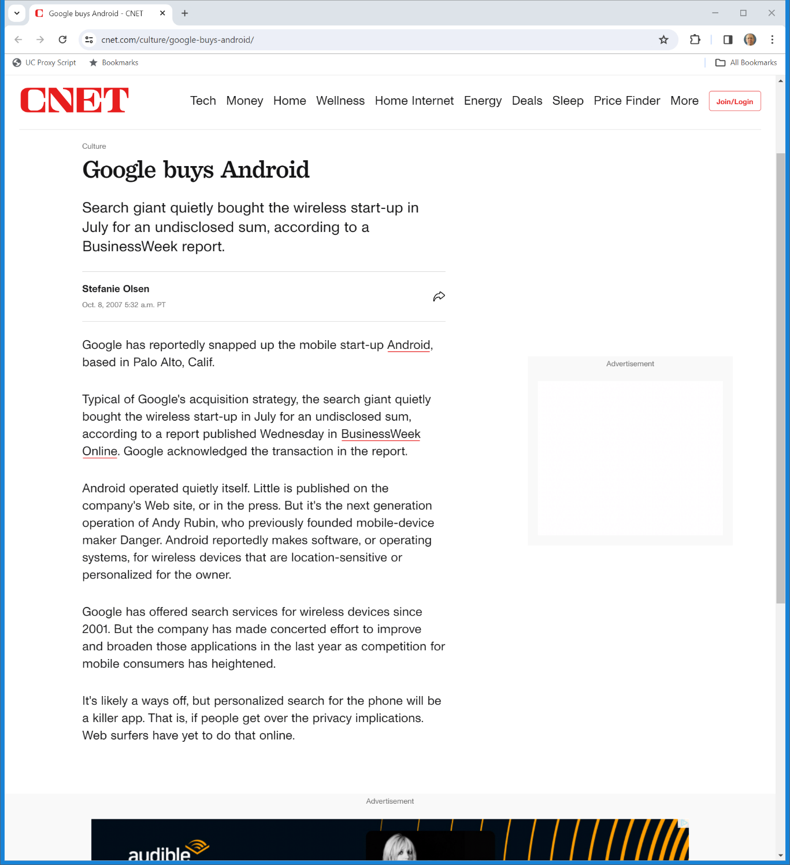

July 2007: Google Buys Android (TTYN (1 of 7))
Cnet (8 Oct 2007)
Notes:
https://www.cnet.com/culture/google-buys-android/

Slide 89
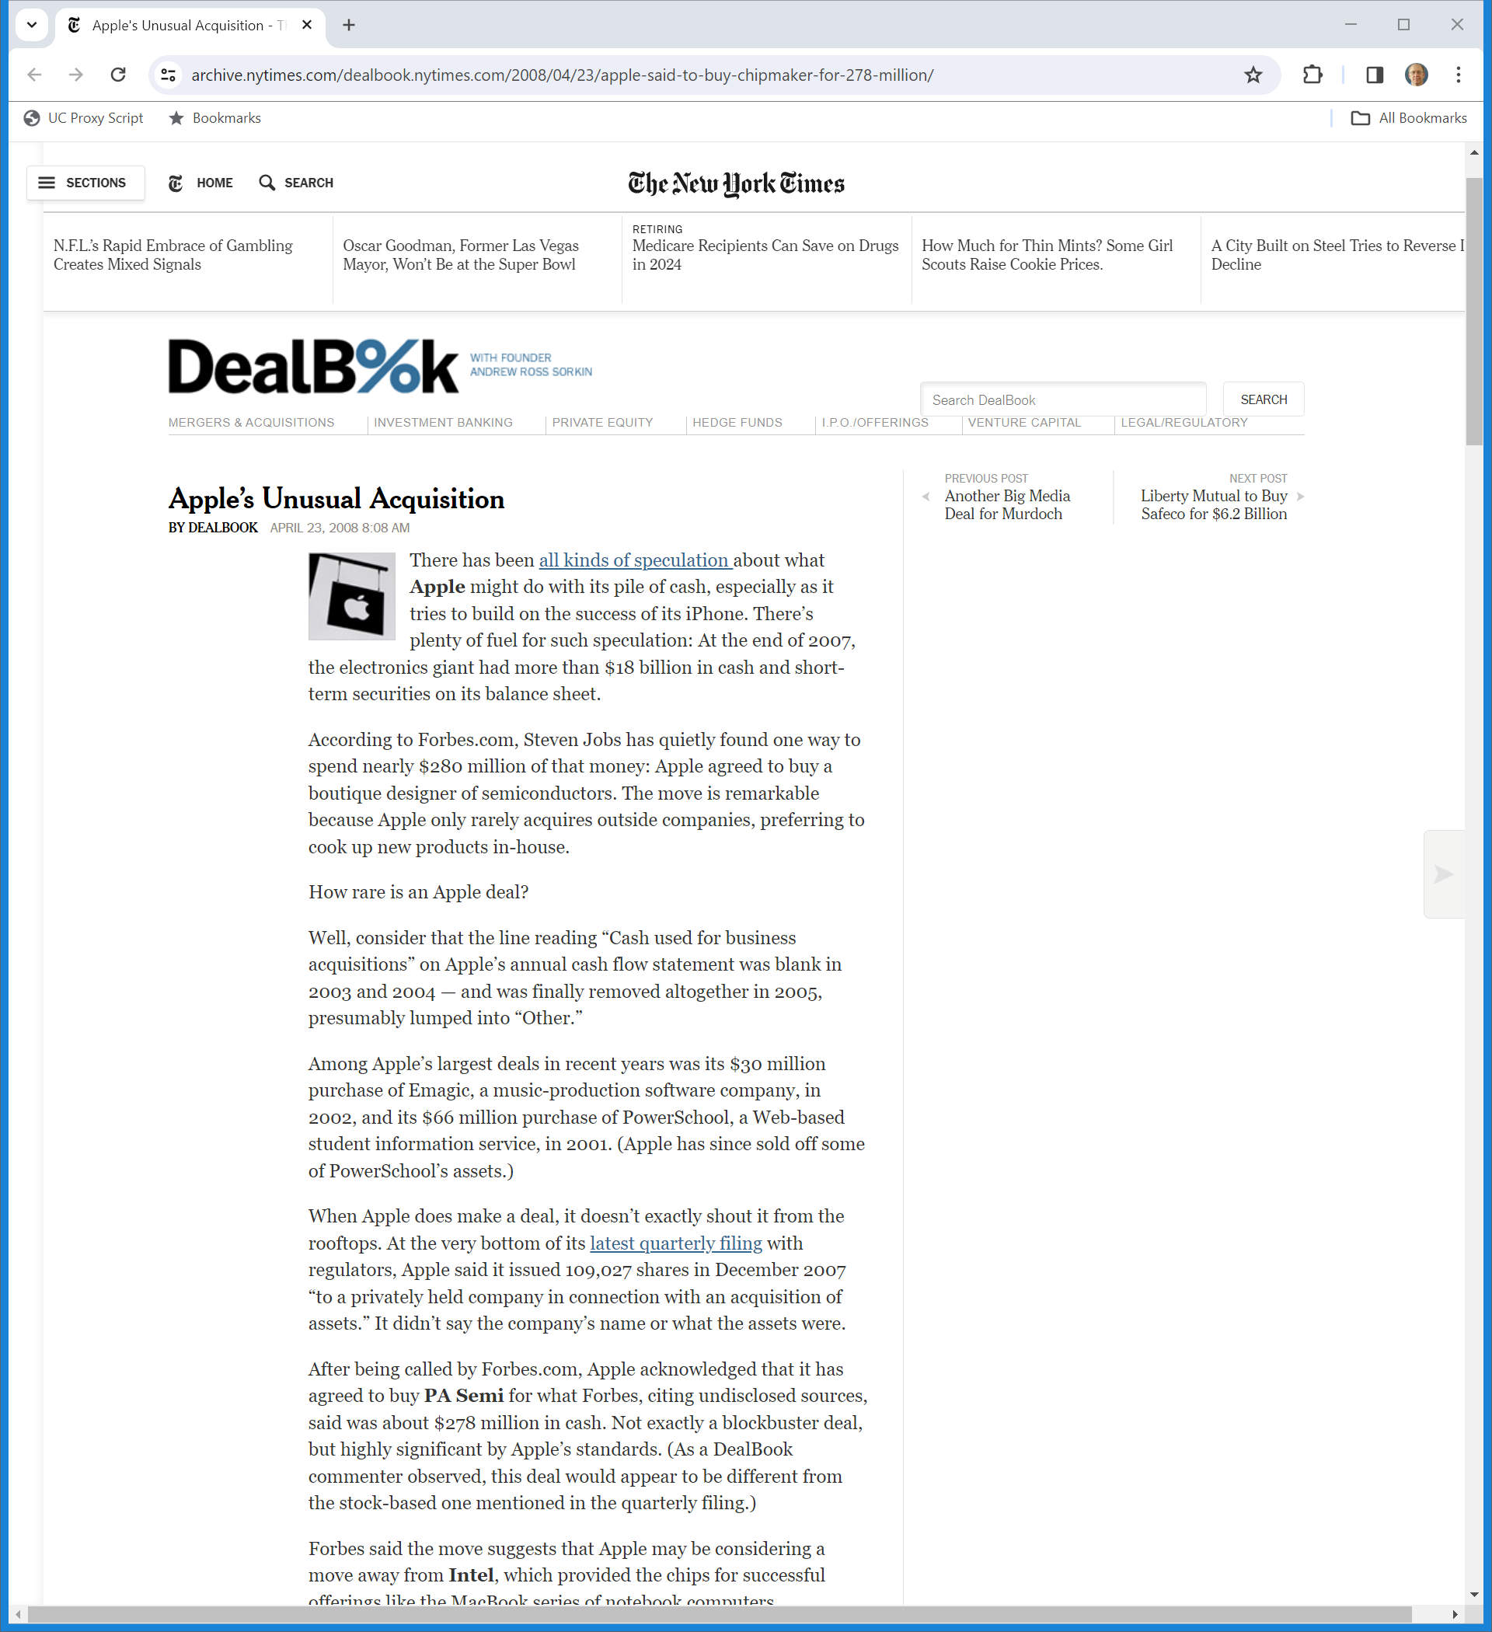
2008: Apple Buys A Chip Design Firm (TTYN (2 of 7))
New York Times (23 Apr 2008)
Notes:
https://archive.nytimes.com/dealbook.nytimes.com/2008/04/23/apple-said-to-buy-chipmaker-for-278-million/

Slide 90
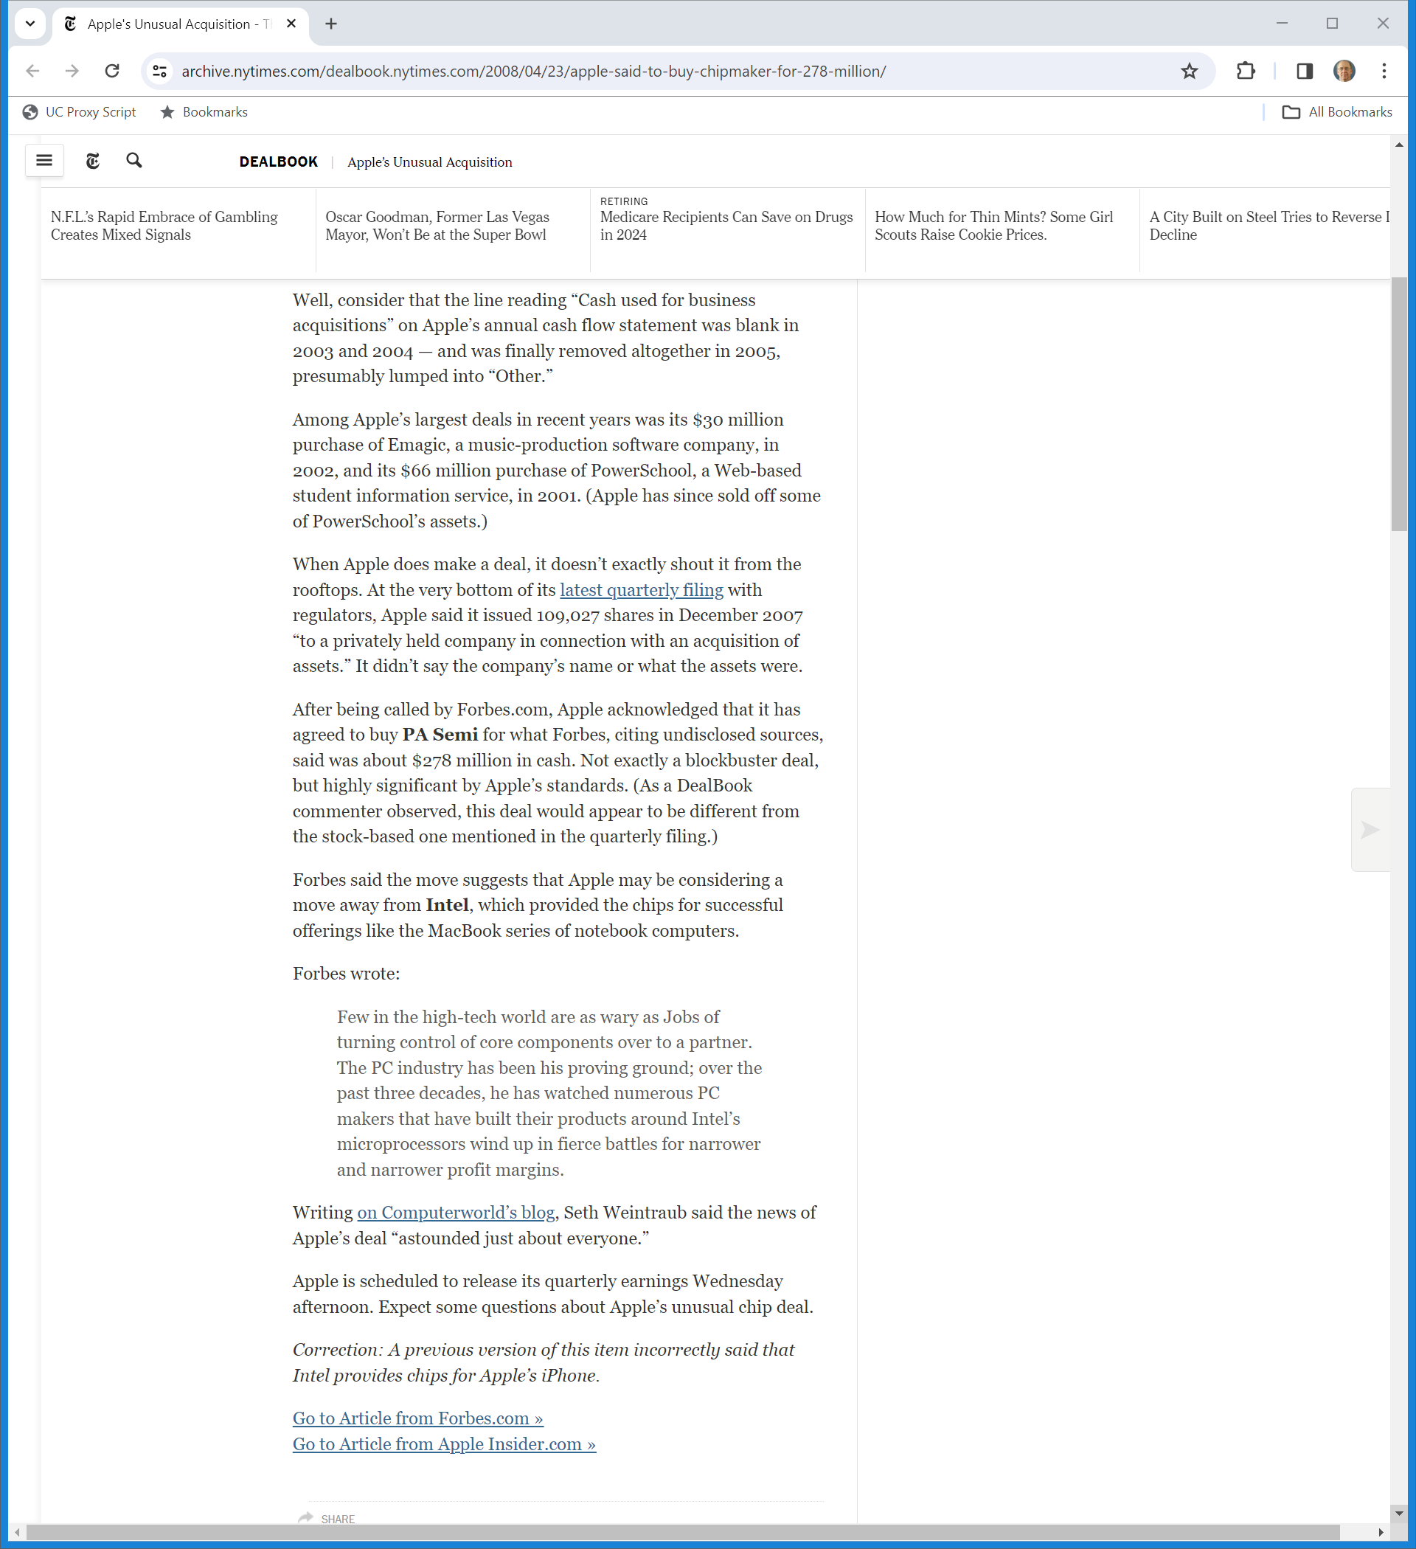
PA Semi for $278M (TTYN (3 of 7))
New York Times (23 Apr 2008)
Notes:
https://archive.nytimes.com/dealbook.nytimes.com/2008/04/23/apple-said-to-buy-chipmaker-for-278-million/

Slide 91
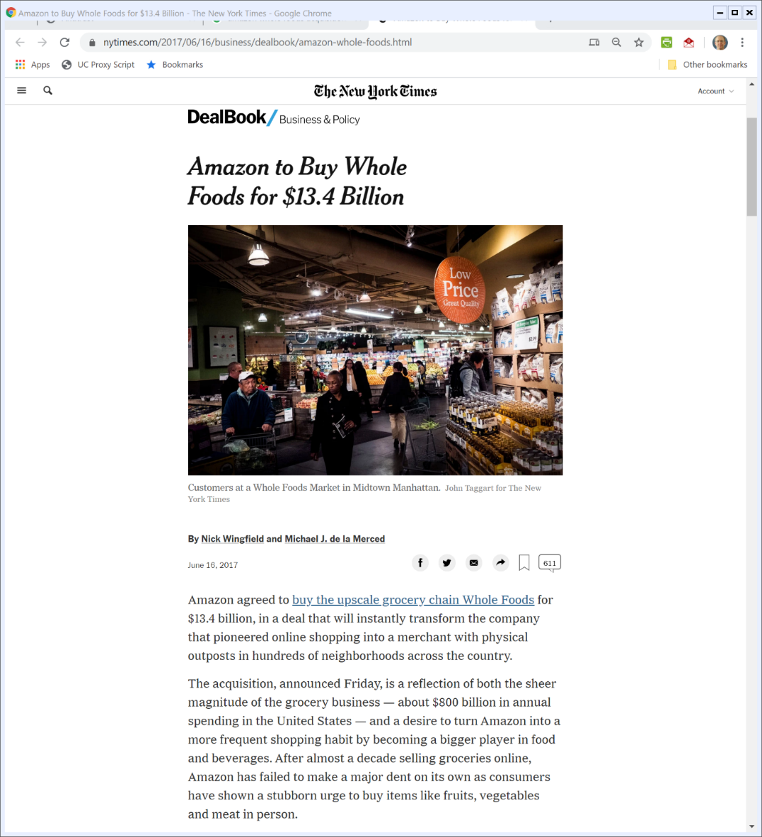
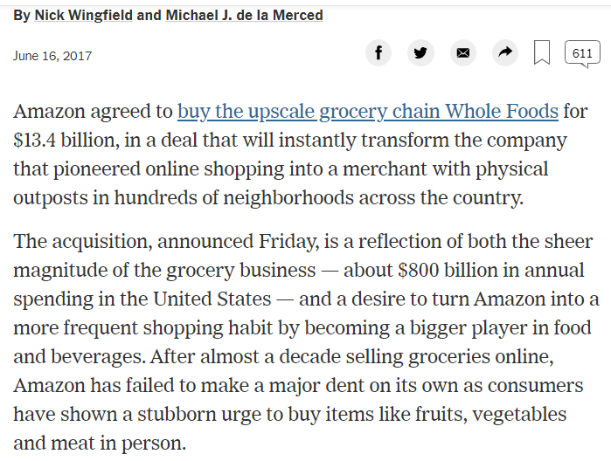
16 June 2017: Amazon to Buy Whole Foods (TTYN (4 of 7))
New York Times (16 July 2017)
Notes:
https://www.nytimes.com/2017/06/16/business/dealbook/amazon-whole-foods.html

Slide 92
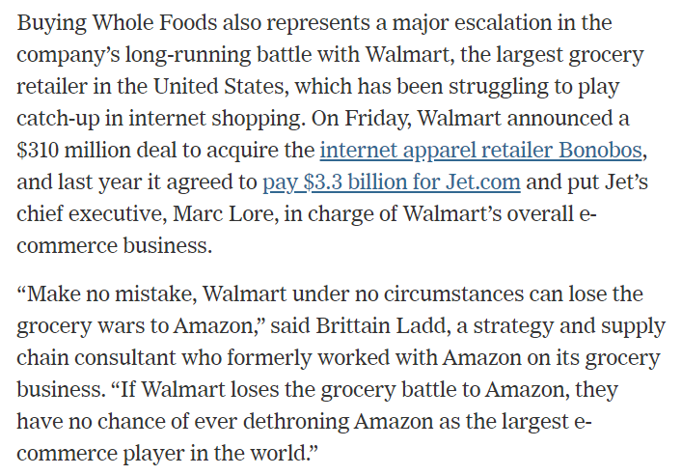
16 June 2017: Amazon to Buy Whole Foods (TTYN (5 of 7))
New York Times (16 July 2017)
Notes:
https://www.nytimes.com/2017/06/16/business/dealbook/amazon-whole-foods.html

Slide 93
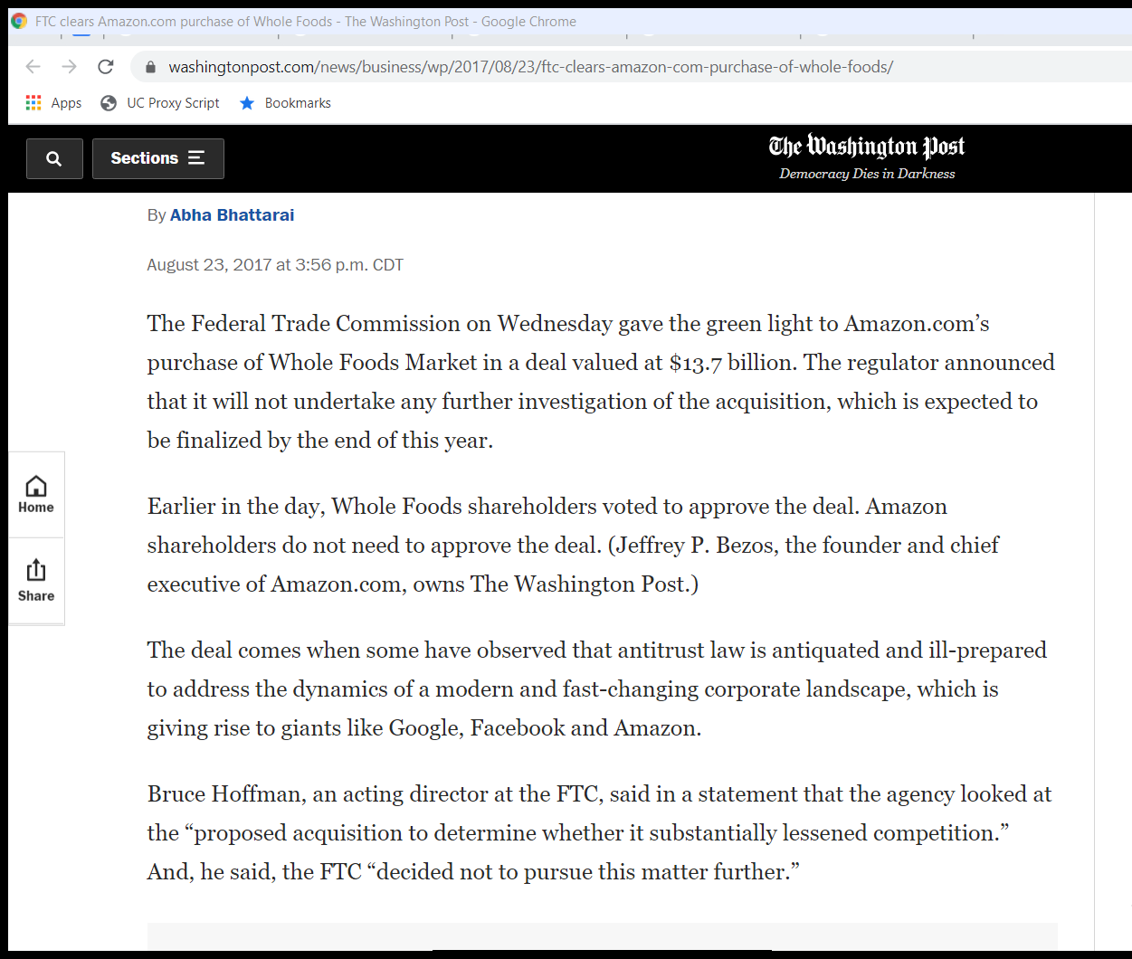
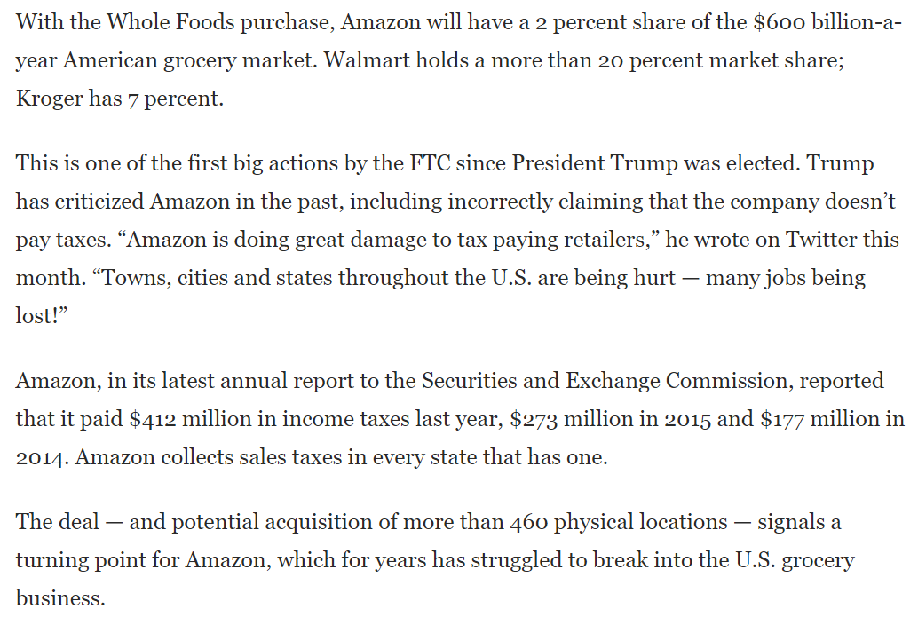
Additional Info on Deal (TTYN (6 of 7))
Wash Post (23 Aug 2017)
Notes:
https://www.washingtonpost.com/news/business/wp/2017/08/23/ftc-clears-amazon-com-purchase-of-whole-foods/

Slide 94
Buy or Build
TTYN (7 of 7)
Questions
  How would the 2023 Guidelines have applied to these deals?

Slide 95
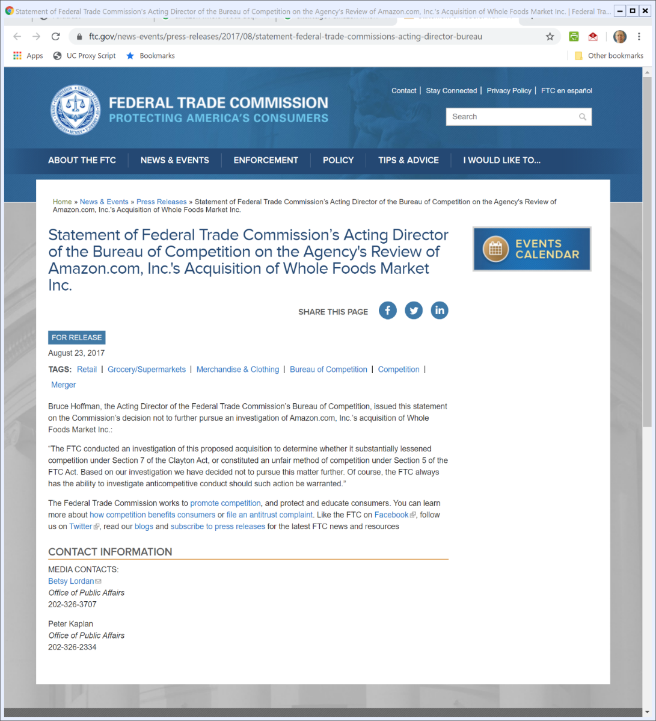
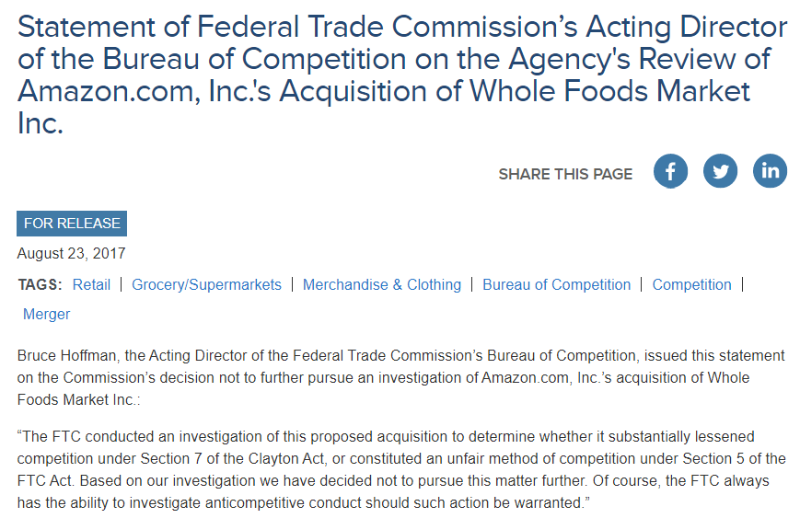
FTC Greenlights Deal
FTC (23 Aug 2017)
Notes:
https://www.ftc.gov/news-events/press-releases/2017/08/statement-federal-trade-commissions-acting-director-bureau

Slide 96
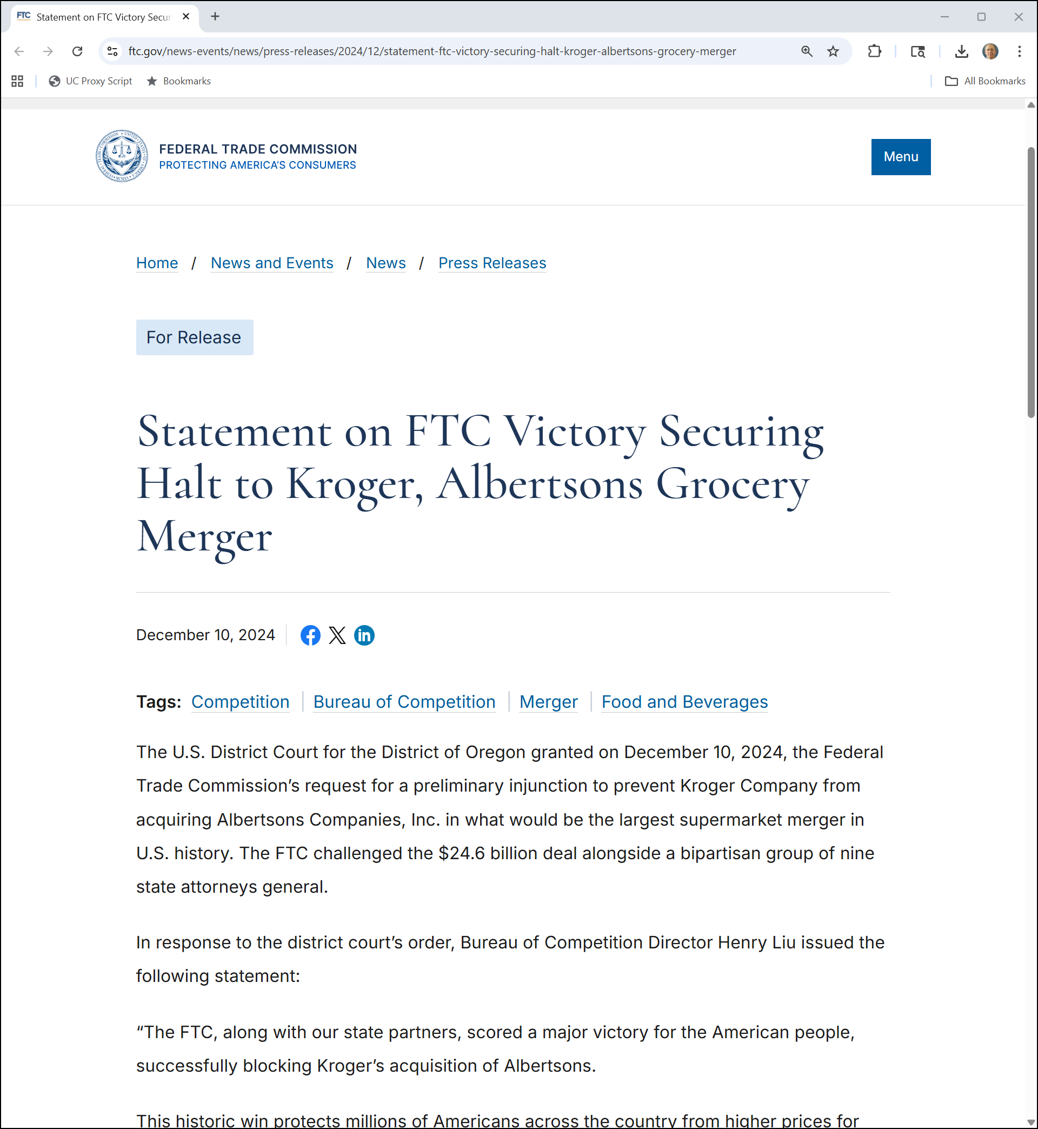
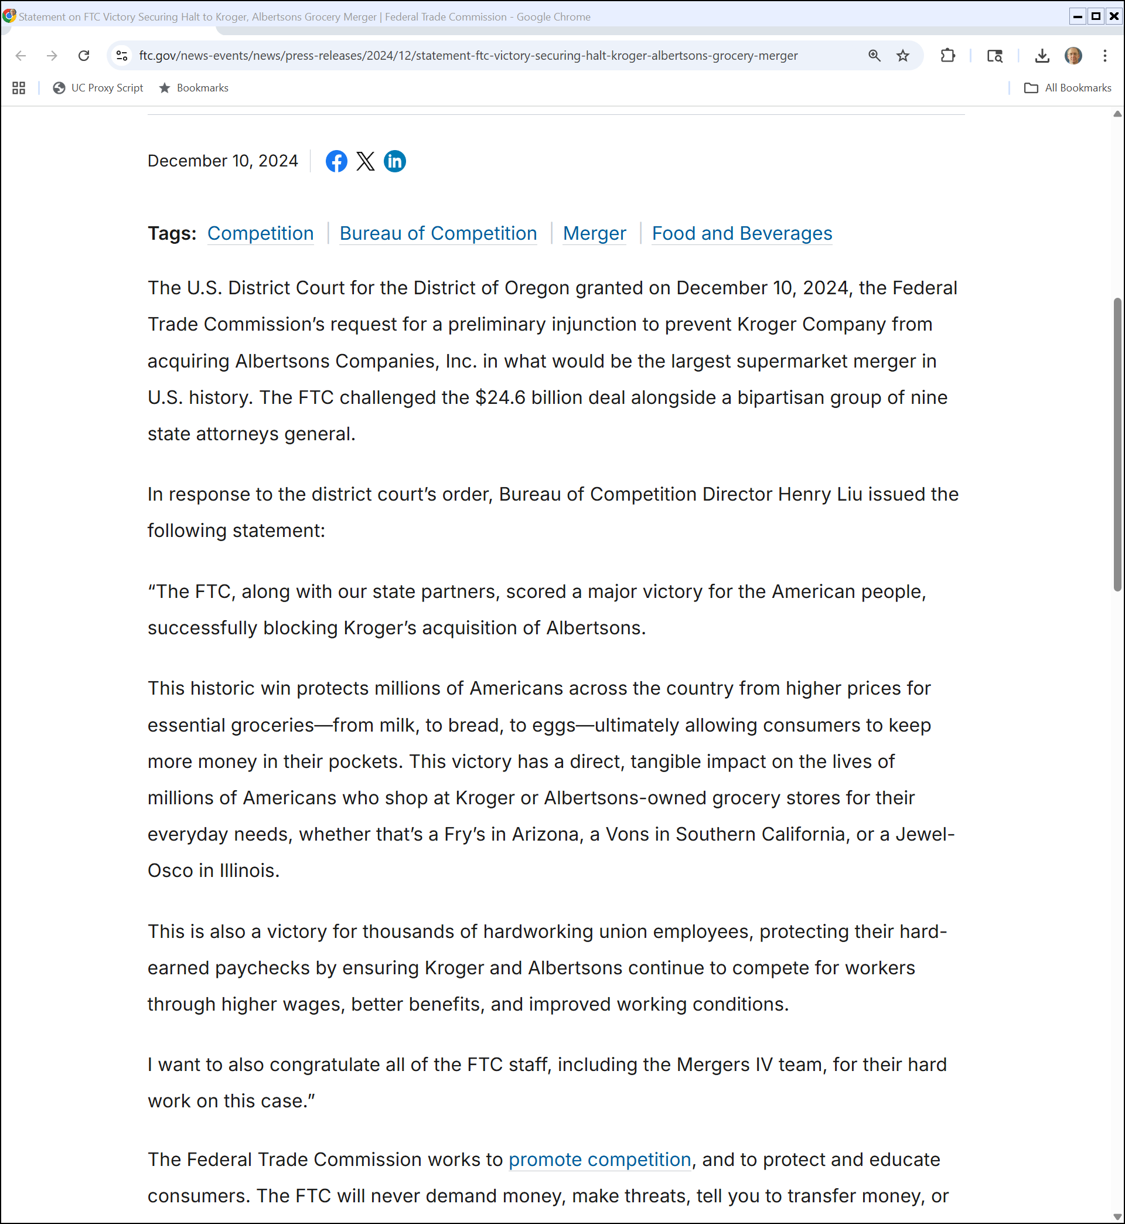
Kroger, Albertsons
FTC (10 Dec 2024)

Slide 97
Kroger, Albertsons
FTC (10 Dec 2024)

