Slide 1
Class 13: Mon 27 Oct 2025
Antitrust Fall 2025
Vertical Mergers
Randal C. Picker
James Parker Hall Distinguished Service Professor of Law
The Law School
The University of Chicago
Copyright © 2000-25 Randal C. Picker. All Rights Reserved.

Slide 2
Vertical Foreclosure
Key Question
  Will the purchaser have an incentive to deny a new competitor access to an essential input now that it operating in two businesses at once, meaning, the input supply business and the business in which the input is used?
This is foreclosure

Slide 3
Litigating the Fix
Key Question
  Firm X wants to buy Firm Y. X understands some of the antitrust concerns that might be raised. X puts in place contracts and more to try to address those concerns.
How should these arrangements be evaluated? And at what stage of the process?

Slide 4
Demand and Costs
Production
  Produced by Manufacturer and sold by Retailer.
Demand Curve
  P = 10 - Q
Marginal Costs
  MC of production (incurred by M) = 2
  MC of distribution (incurred by R) = 2

Slide 5
Vertically Integrated Monopoly Result
P
10
CS
P = 10 – Q
P_{M}
Demand Curve
MC = 4
Profits
DWL
MR = 10 – 2Q
P_{C}
TC
Marginal Cost
Q_{M}
Q_{C}
10
Q
Marginal Revenue

Slide 6
Stacked Monopolies
Suppose that we separate manufacturing and retail.
Retailer Demand and Costs
  The retailer faces the same demand curve as before.
  As to costs, the retailer buys the good at wholesale from M at a price of Pw.

Slide 7
Stacked Monopolies
  This means that the retailer faces total per unit costs of Pw + marginal cost of distribution, which is 2.
Retailer Decisionmaking
  Our monopolist retailer will maximize by equating its costs with marginal revenues, so
  Pw + 2 = 10 - 2Q

Slide 8
Deriving Demand Curves
Derived Demand Curve for Manufacturer
  Rearranging Pw = 8 - 2Q.
  This looks like a relationship between wholesale prices and the quantity that will be demanded, meaning that we have created the demand curve faced by the manufacturer.

Slide 9
Stacked Monopoly Result
P
10
Derived DC
CS
Derived Demand Pw = 8 – 2Q
P_{M}
Demand Curve
Profits
DWL
MC = 2
P_{C}
TC
Marginal Cost
MR = 8 – 4Q
M MC
Q₂
Q_{M}
Q_{C}
10
Q
M MR
Marginal Revenue
9
9

Slide 10
Double Marginalization
Two Monopolies Are Worse Than One
  This is the harm of stacked monopolies, or of double marginalization.
  What drives this is that the retailer makes its decisions based on the costs it faces—the wholesale price plus its marginal retail costs—rather than the actual cost of producing a unit of the good.

Slide 11
Double Marginalization
  It ignores the profits that that difference creates for the monopolist manufacturer when it makes its purchasing decisions

Slide 12
2016-2019: AT&T/Time Warner
AT&T, 916 F.3d 1029 (D.C. Cir. 2019)

Slide 13
Appeal From D.Ct. Limited to Leverage Theory
AT&T (D.C. Cir. 2019)

Slide 14
Failure of Gov’t Theory and Evidence
AT&T (D.C. Cir. 2019)

Slide 15
Failure to Rebut Defendant’s Data; Didn’t Account for Arbitration Offer or Emerging Competition
AT&T (D.C. Cir. 2019)

Slide 16
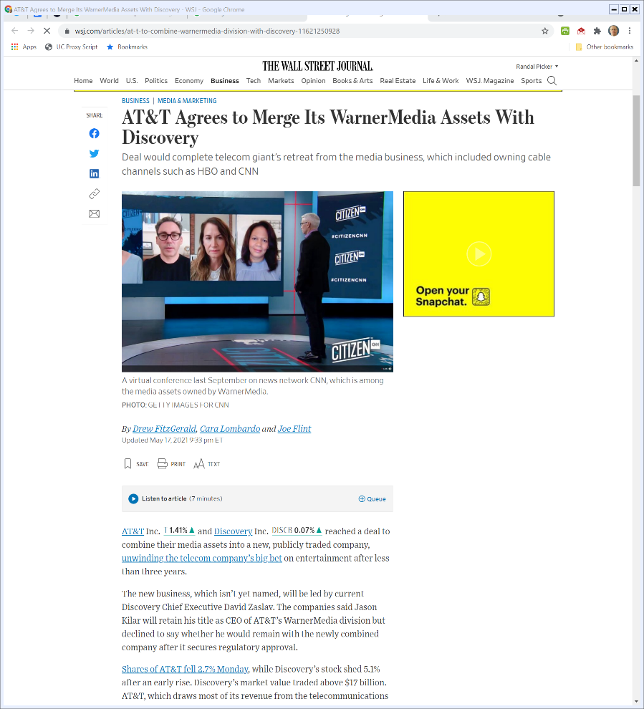
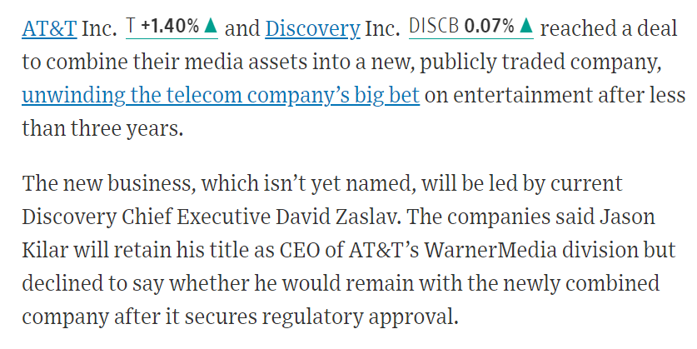
AT&T Spinoff
The Wall Street Journal (17 May 2021)
Notes:
https://www.wsj.com/articles/at-t-to-combine-warnermedia-division-with-discovery-11621250928

Slide 17
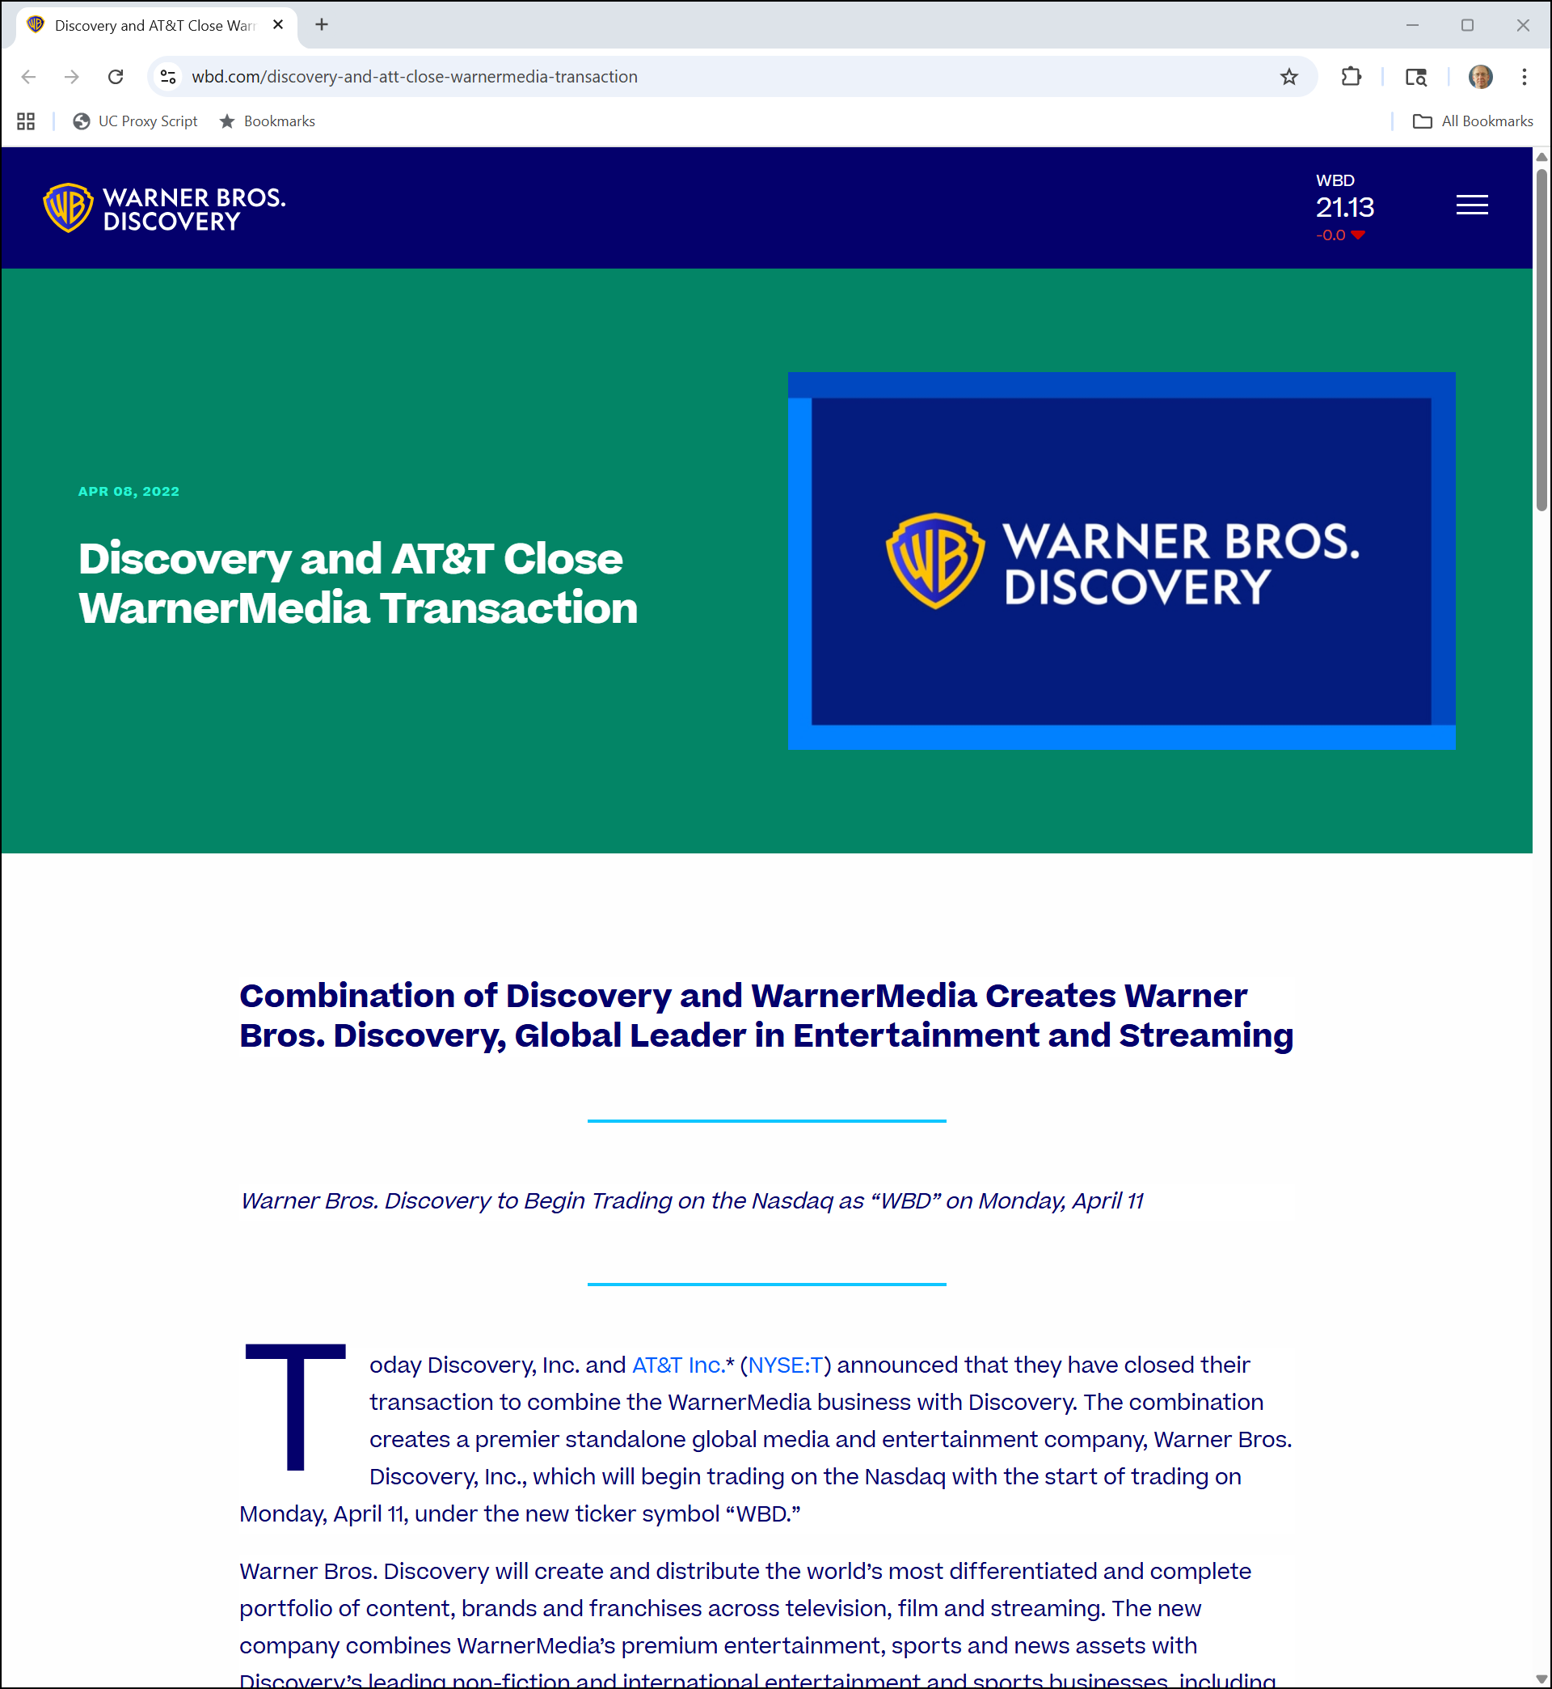
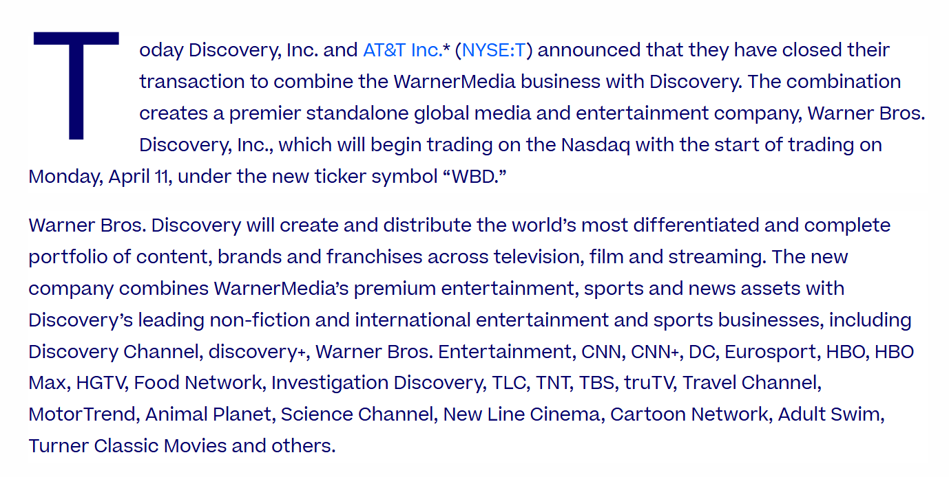
Warner Bros. Discovery
WBD (8 Apr 2022)
Notes:
https://www.wbd.com/discovery-and-att-close-warnermedia-transaction

Slide 18
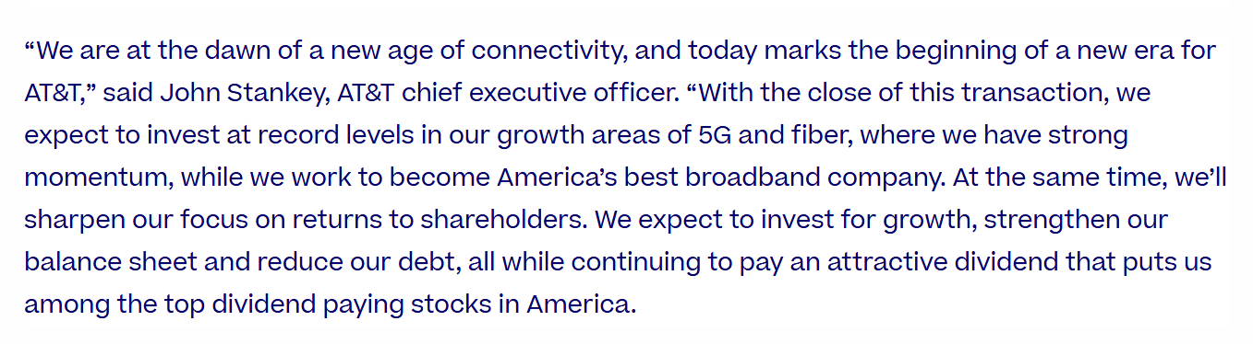
And AT&T?
WBD (8 Apr 2022)
Notes:
https://www.wbd.com/discovery-and-att-close-warnermedia-transaction

Slide 19
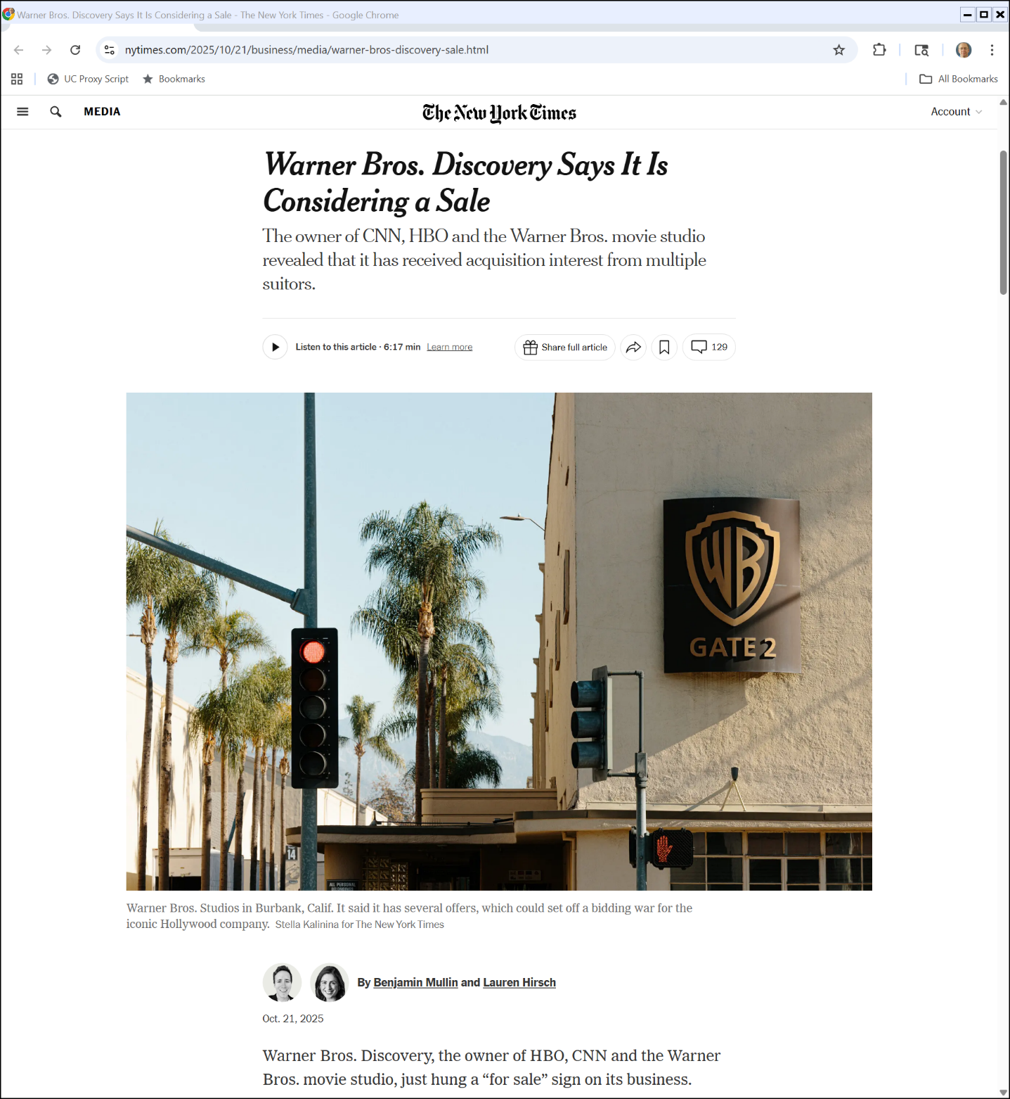
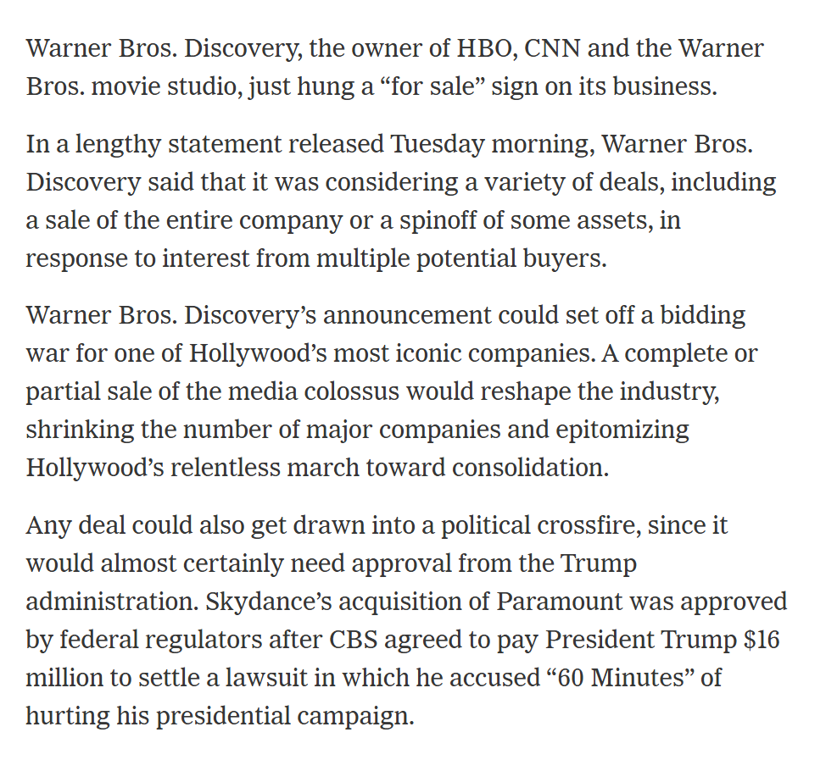
Warner Bros. Is For Sale
New York Times (21 Oct 2025)
Notes:
https://www.nytimes.com/2025/10/21/business/media/warner-bros-discovery-sale.html

Slide 20
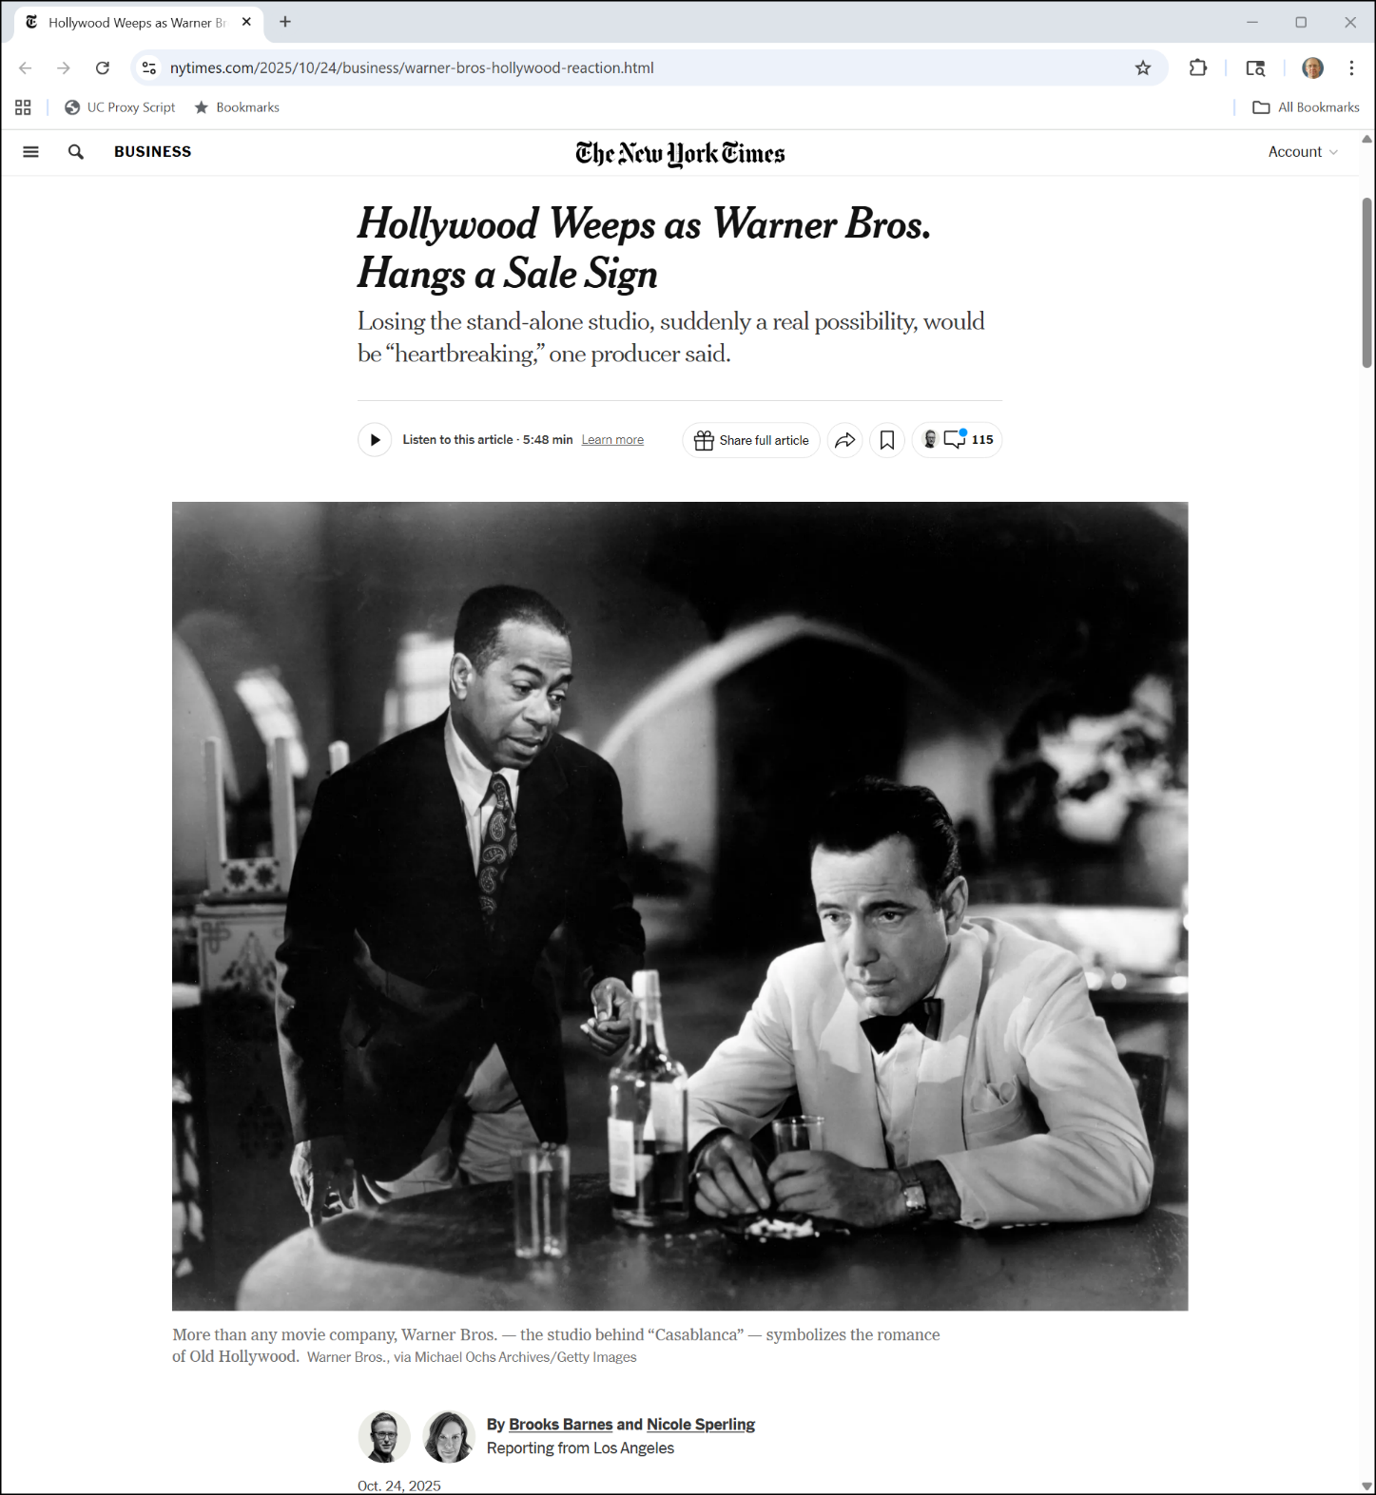
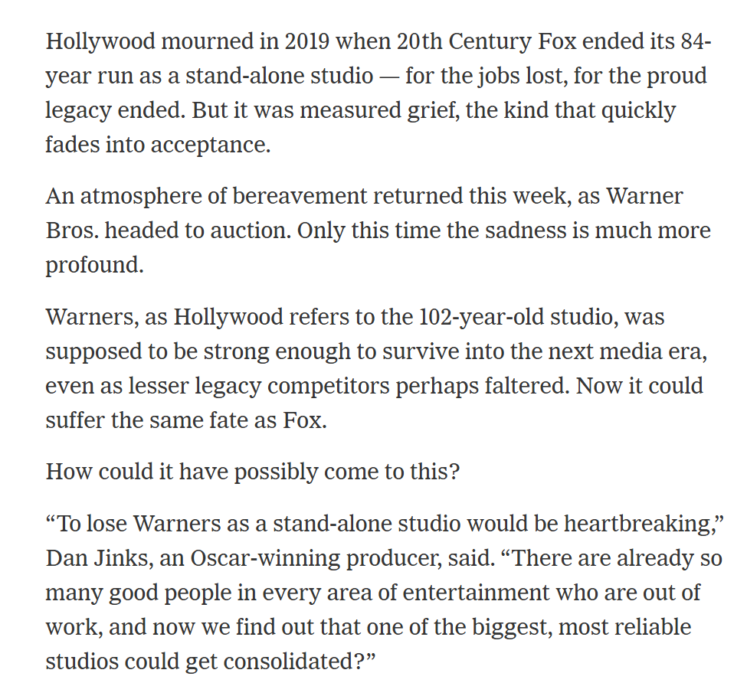
And Hollywood Is Sad
New York Times (24 Oct 2025)
Notes:
https://www.nytimes.com/2025/10/24/business/warner-bros-hollywood-reaction.html

Slide 21
Jan 2000: AOL/TW
New York Times (11 Jan 2000)

Slide 22
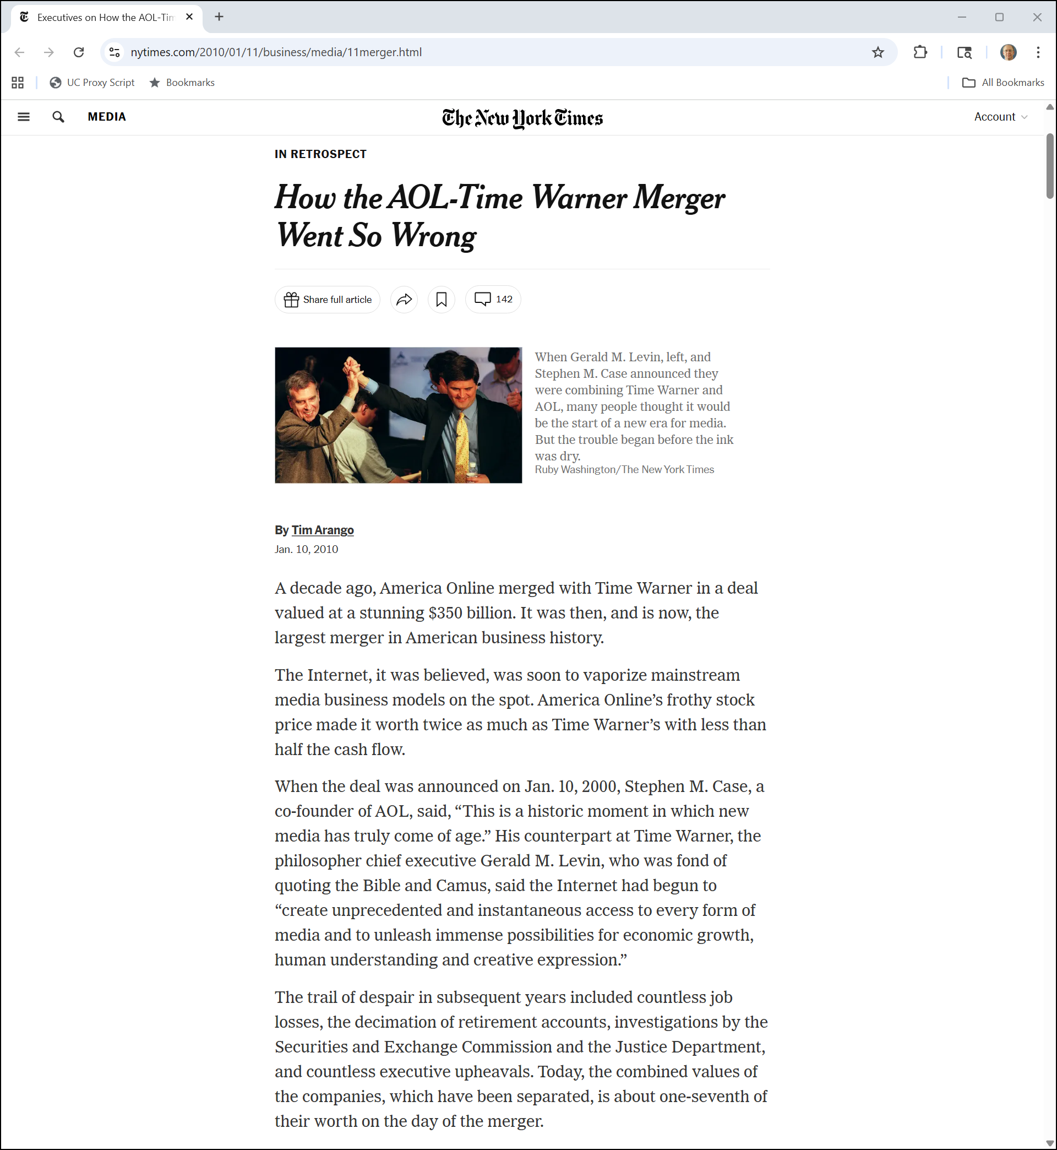
Complete Bust
New York Times (10 Jan 2010)
Notes:
https://www.nytimes.com/2010/01/11/business/media/11merger.html

Slide 23
Complete Bust
New York Times (10 Jan 2010)
Notes:
https://www.nytimes.com/2010/01/11/business/media/11merger.html

Slide 24
2020 Vertical Merger Guidelines

Slide 25
Table of Contents
Vertical Merger Guidelines (30 June 2020)

Slide 26
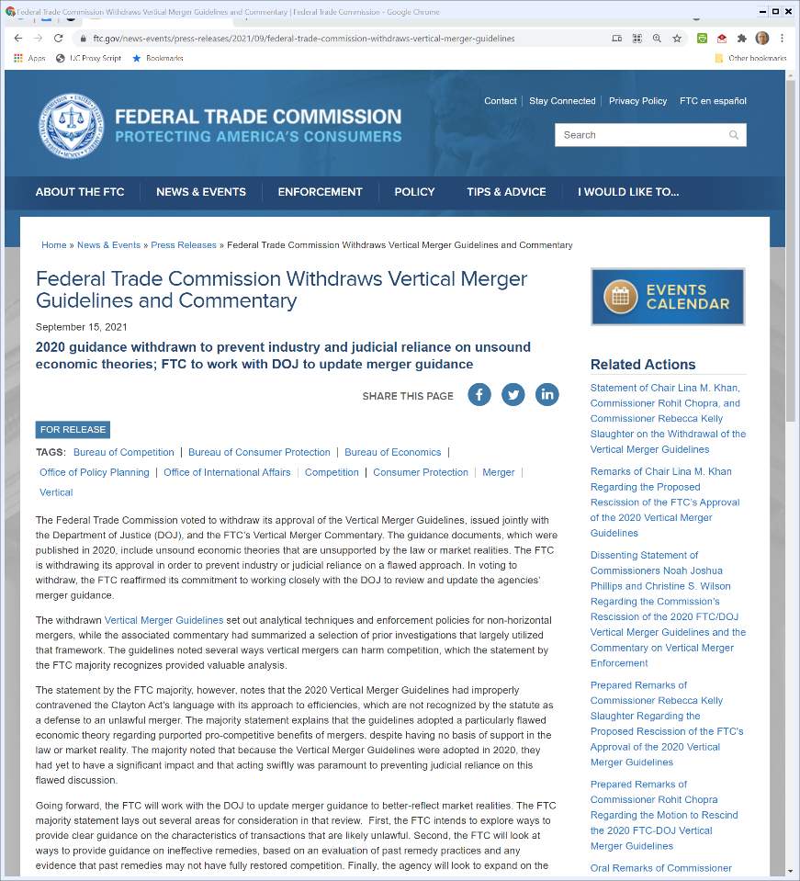
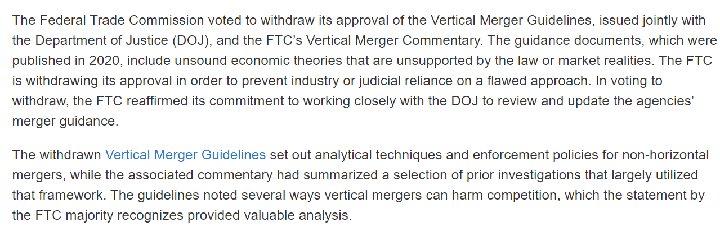
FTC Withdraws Vertical Merger Guidelines
FTC (15 Sept 2021)
Notes:
https://www.ftc.gov/news-events/press-releases/2021/09/federal-trade-commission-withdraws-vertical-merger-guidelines

Slide 27
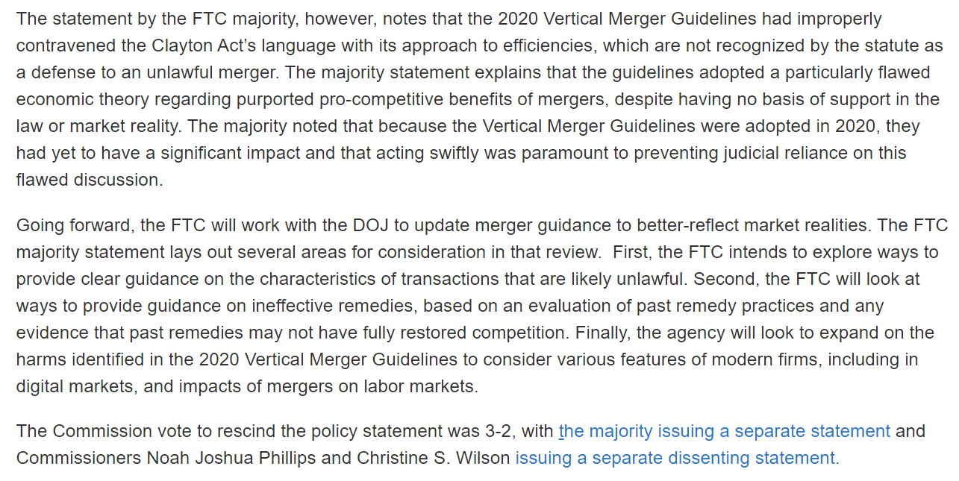
FTC Withdraws Vertical Merger Guidelines
FTC (15 Sept 2021)
Notes:
https://www.ftc.gov/news-events/press-releases/2021/09/federal-trade-commission-withdraws-vertical-merger-guidelines

Slide 28
New Merger Guidelines
FTC/DOJ (18 Dec 2023)

Slide 29
Illumina/Grail
Illumina v. FTC (5th Cir. 15 Dec 2023)

Slide 30
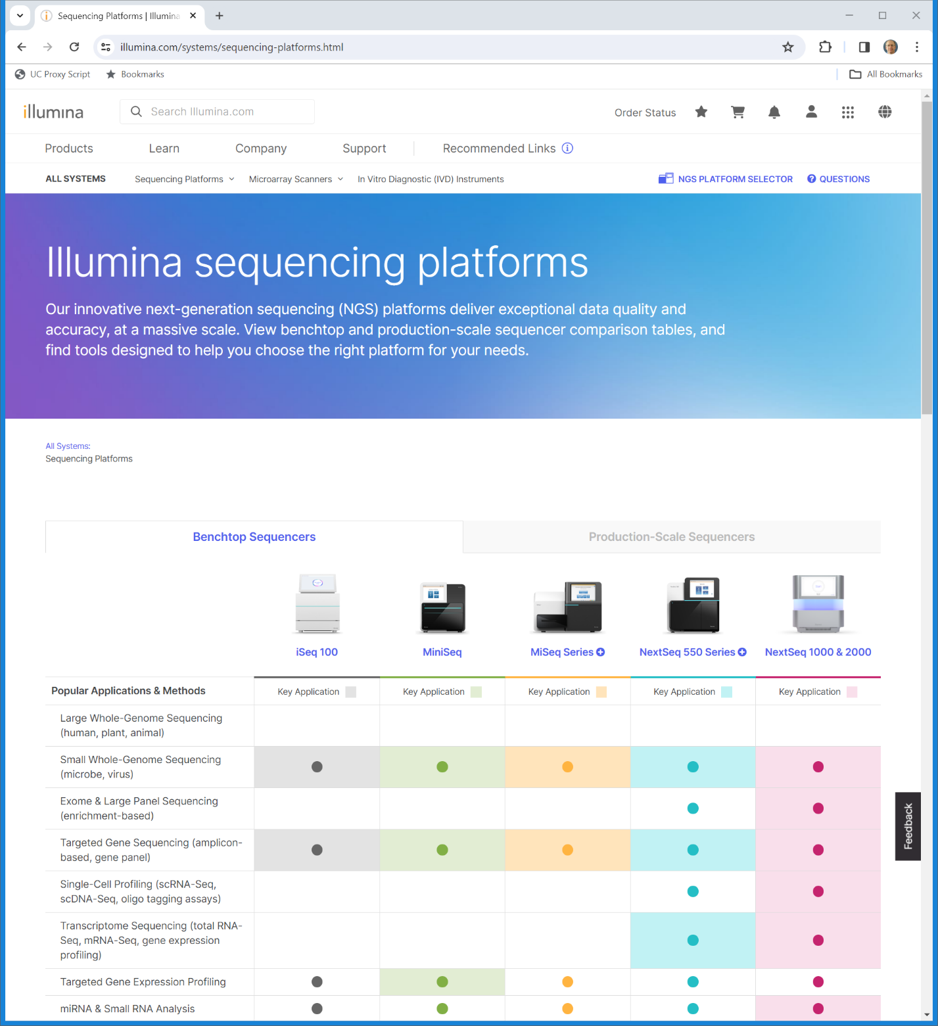
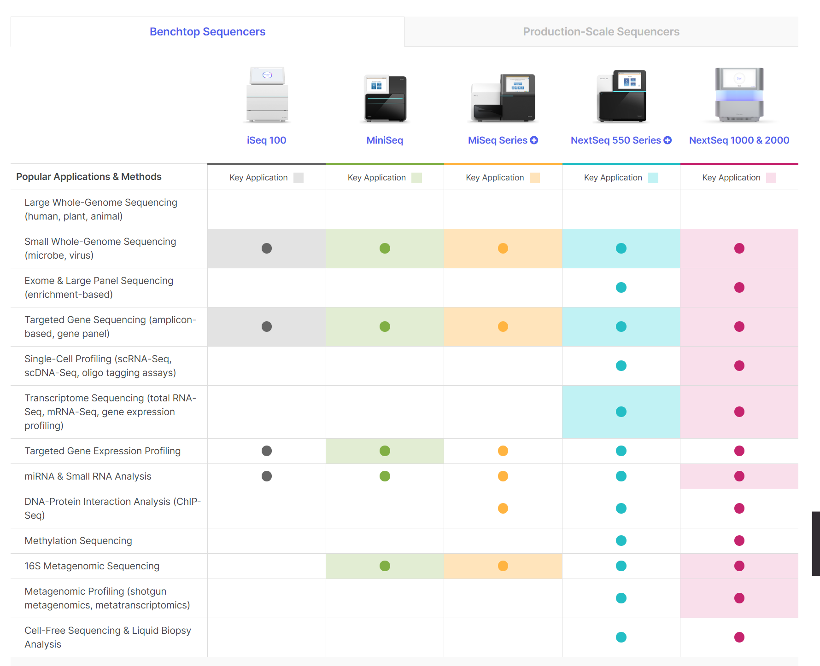
Next-Gen Sequencing Platforms
Illumina (Visited 10 Jan 2024)
Notes:
https://www.illumina.com/company/about-us.html

Slide 31
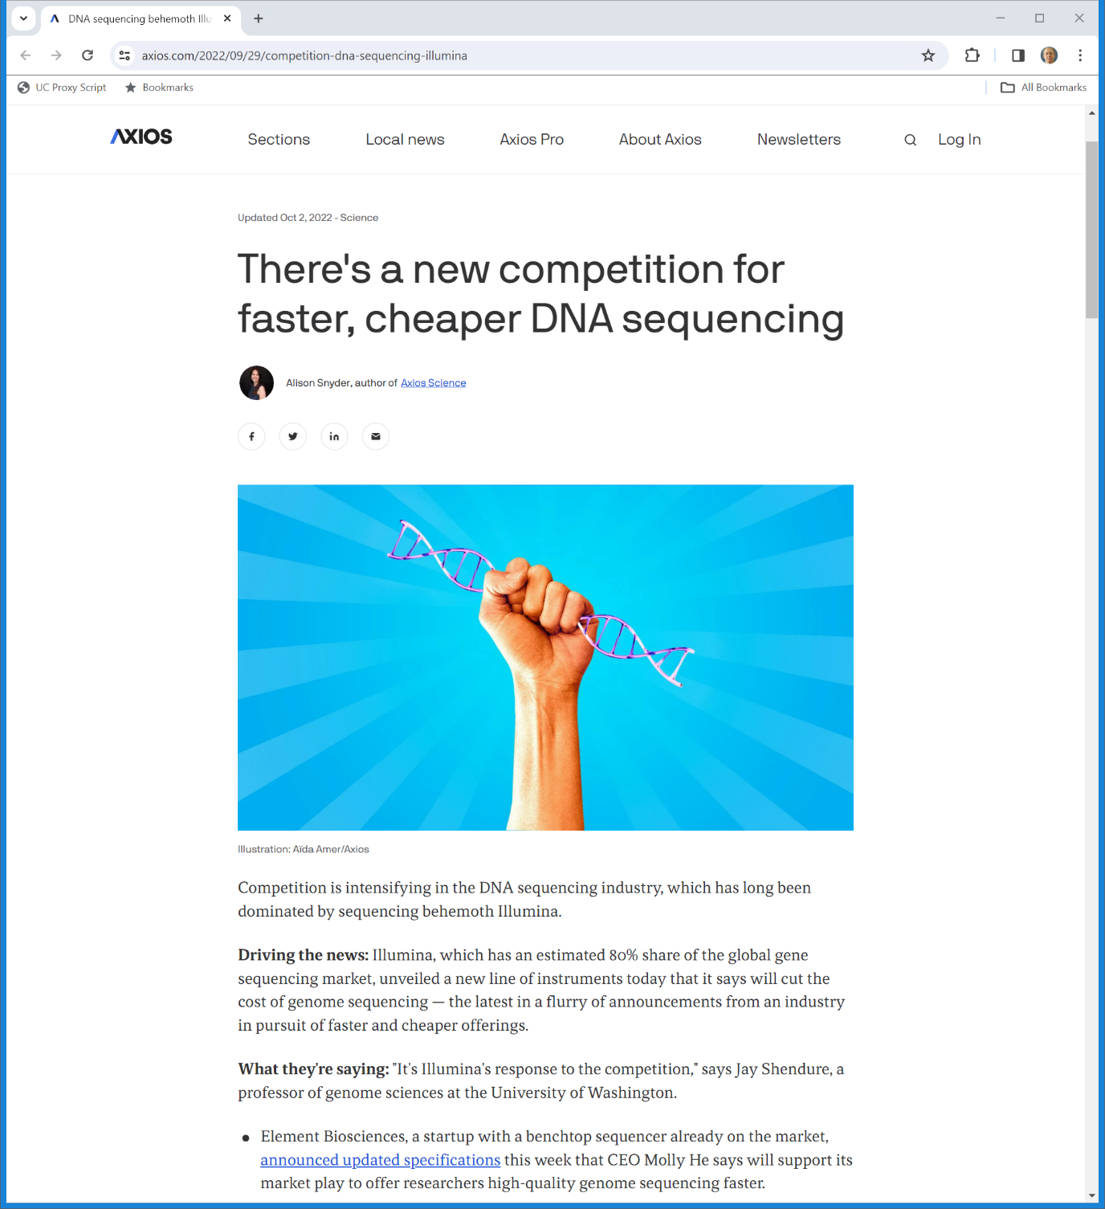
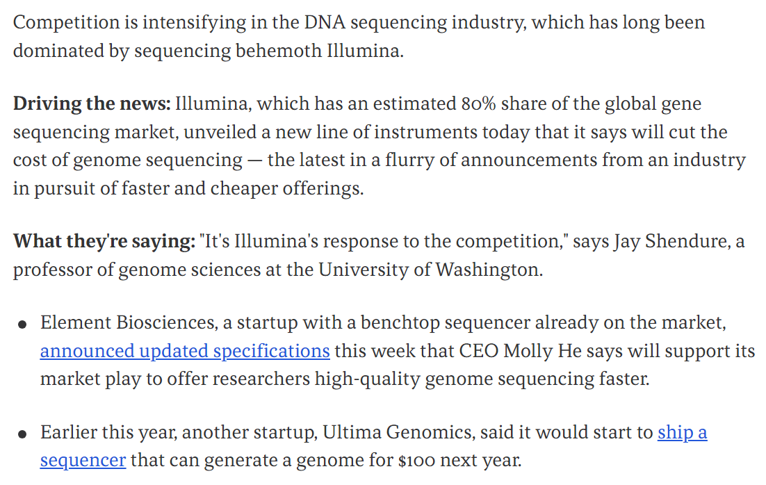
Illumina: 80% Market Share?
Axios (2 Oct 2022)

Slide 32
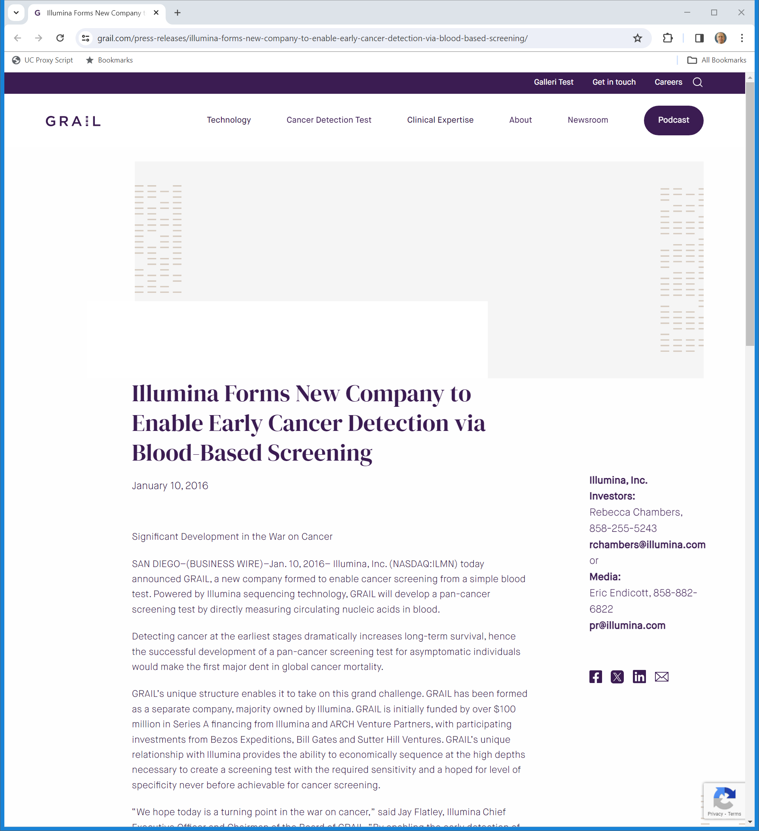
Jan 2016: Illumina Forms Grail As Majority Owner
Grail (10 Jan 2016)

Slide 33
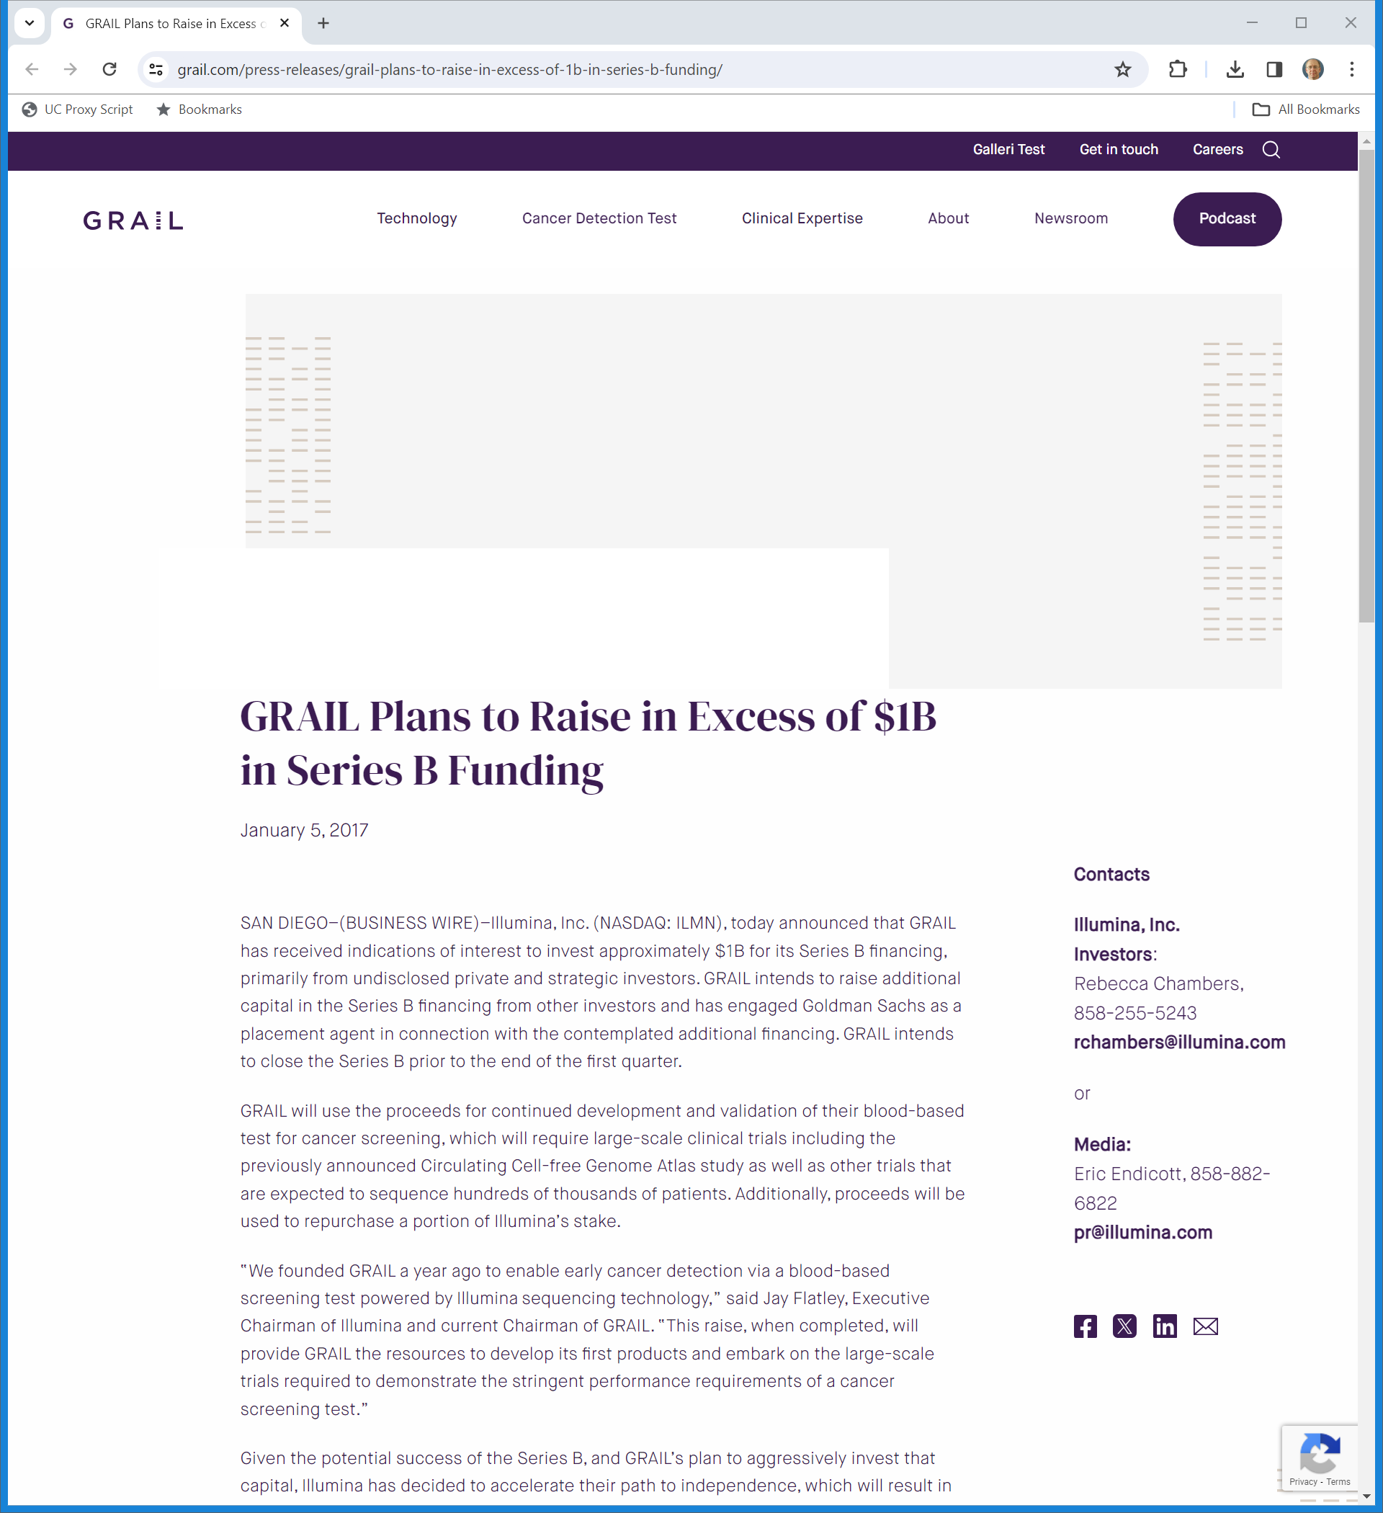
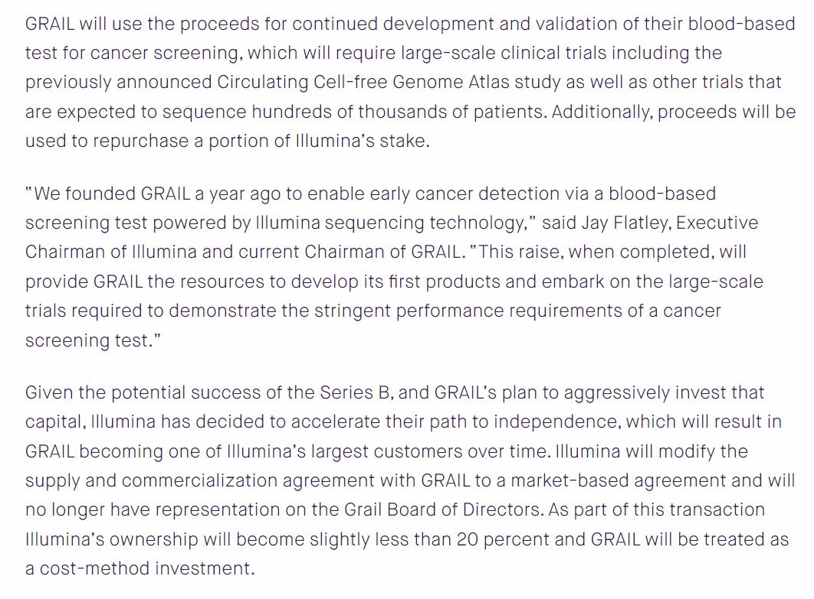
Raising Money/Separating from Illumina
Grail (5 Jan 2017)
Notes:
https://grail.com/press-releases/grail-plans-to-raise-in-excess-of-1b-in-series-b-funding/

Slide 34
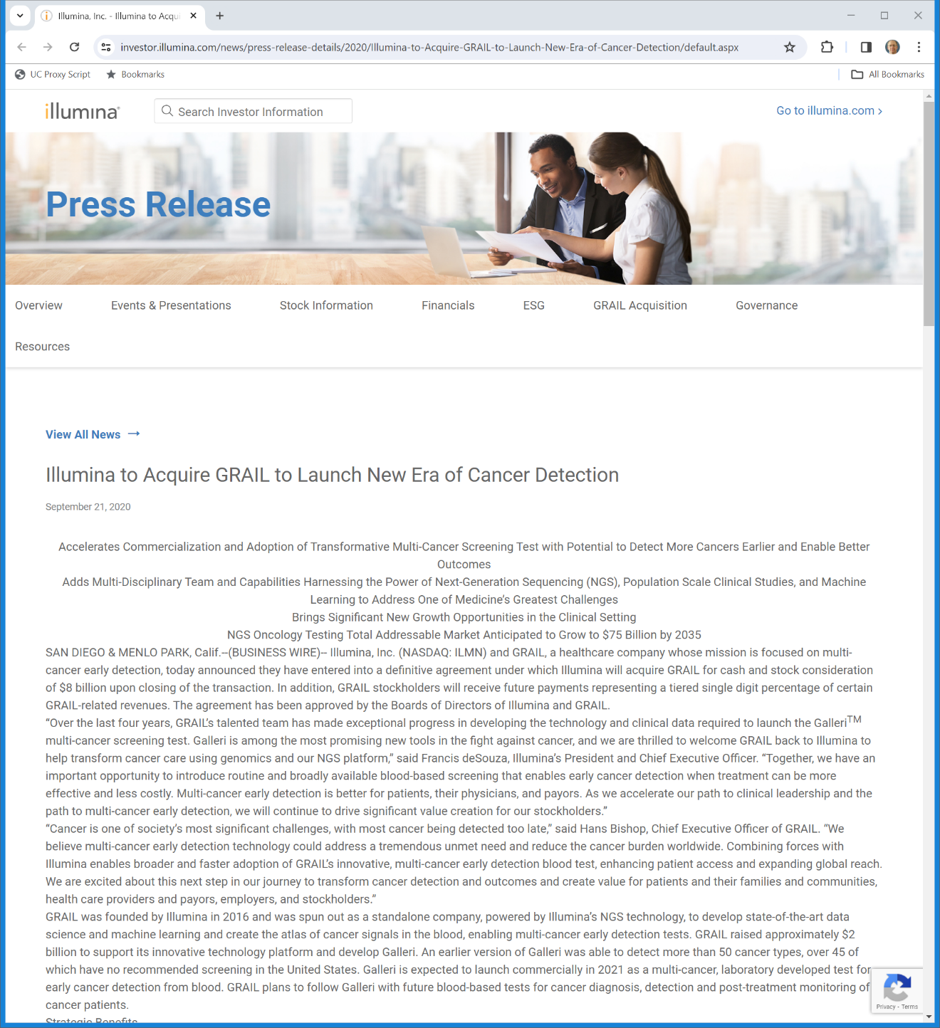
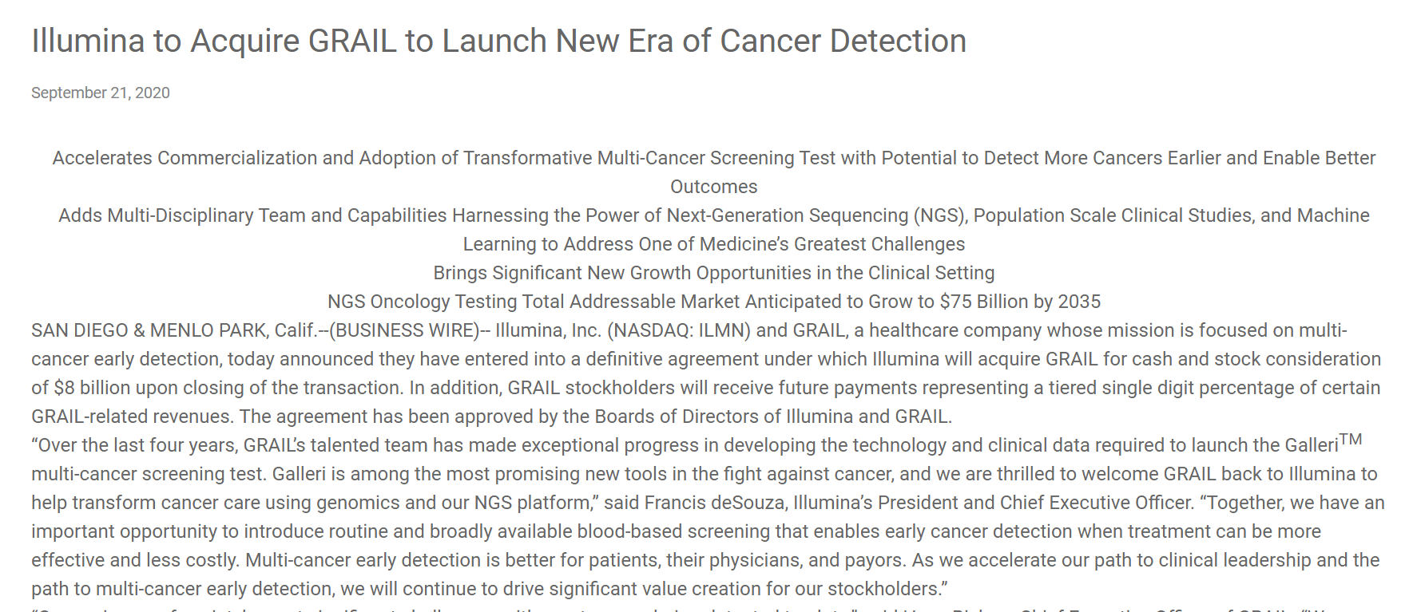
Sept 2020: Illumina Moves to Buy Grail for $8B
Illumina (21 Sept 2020)

Slide 35
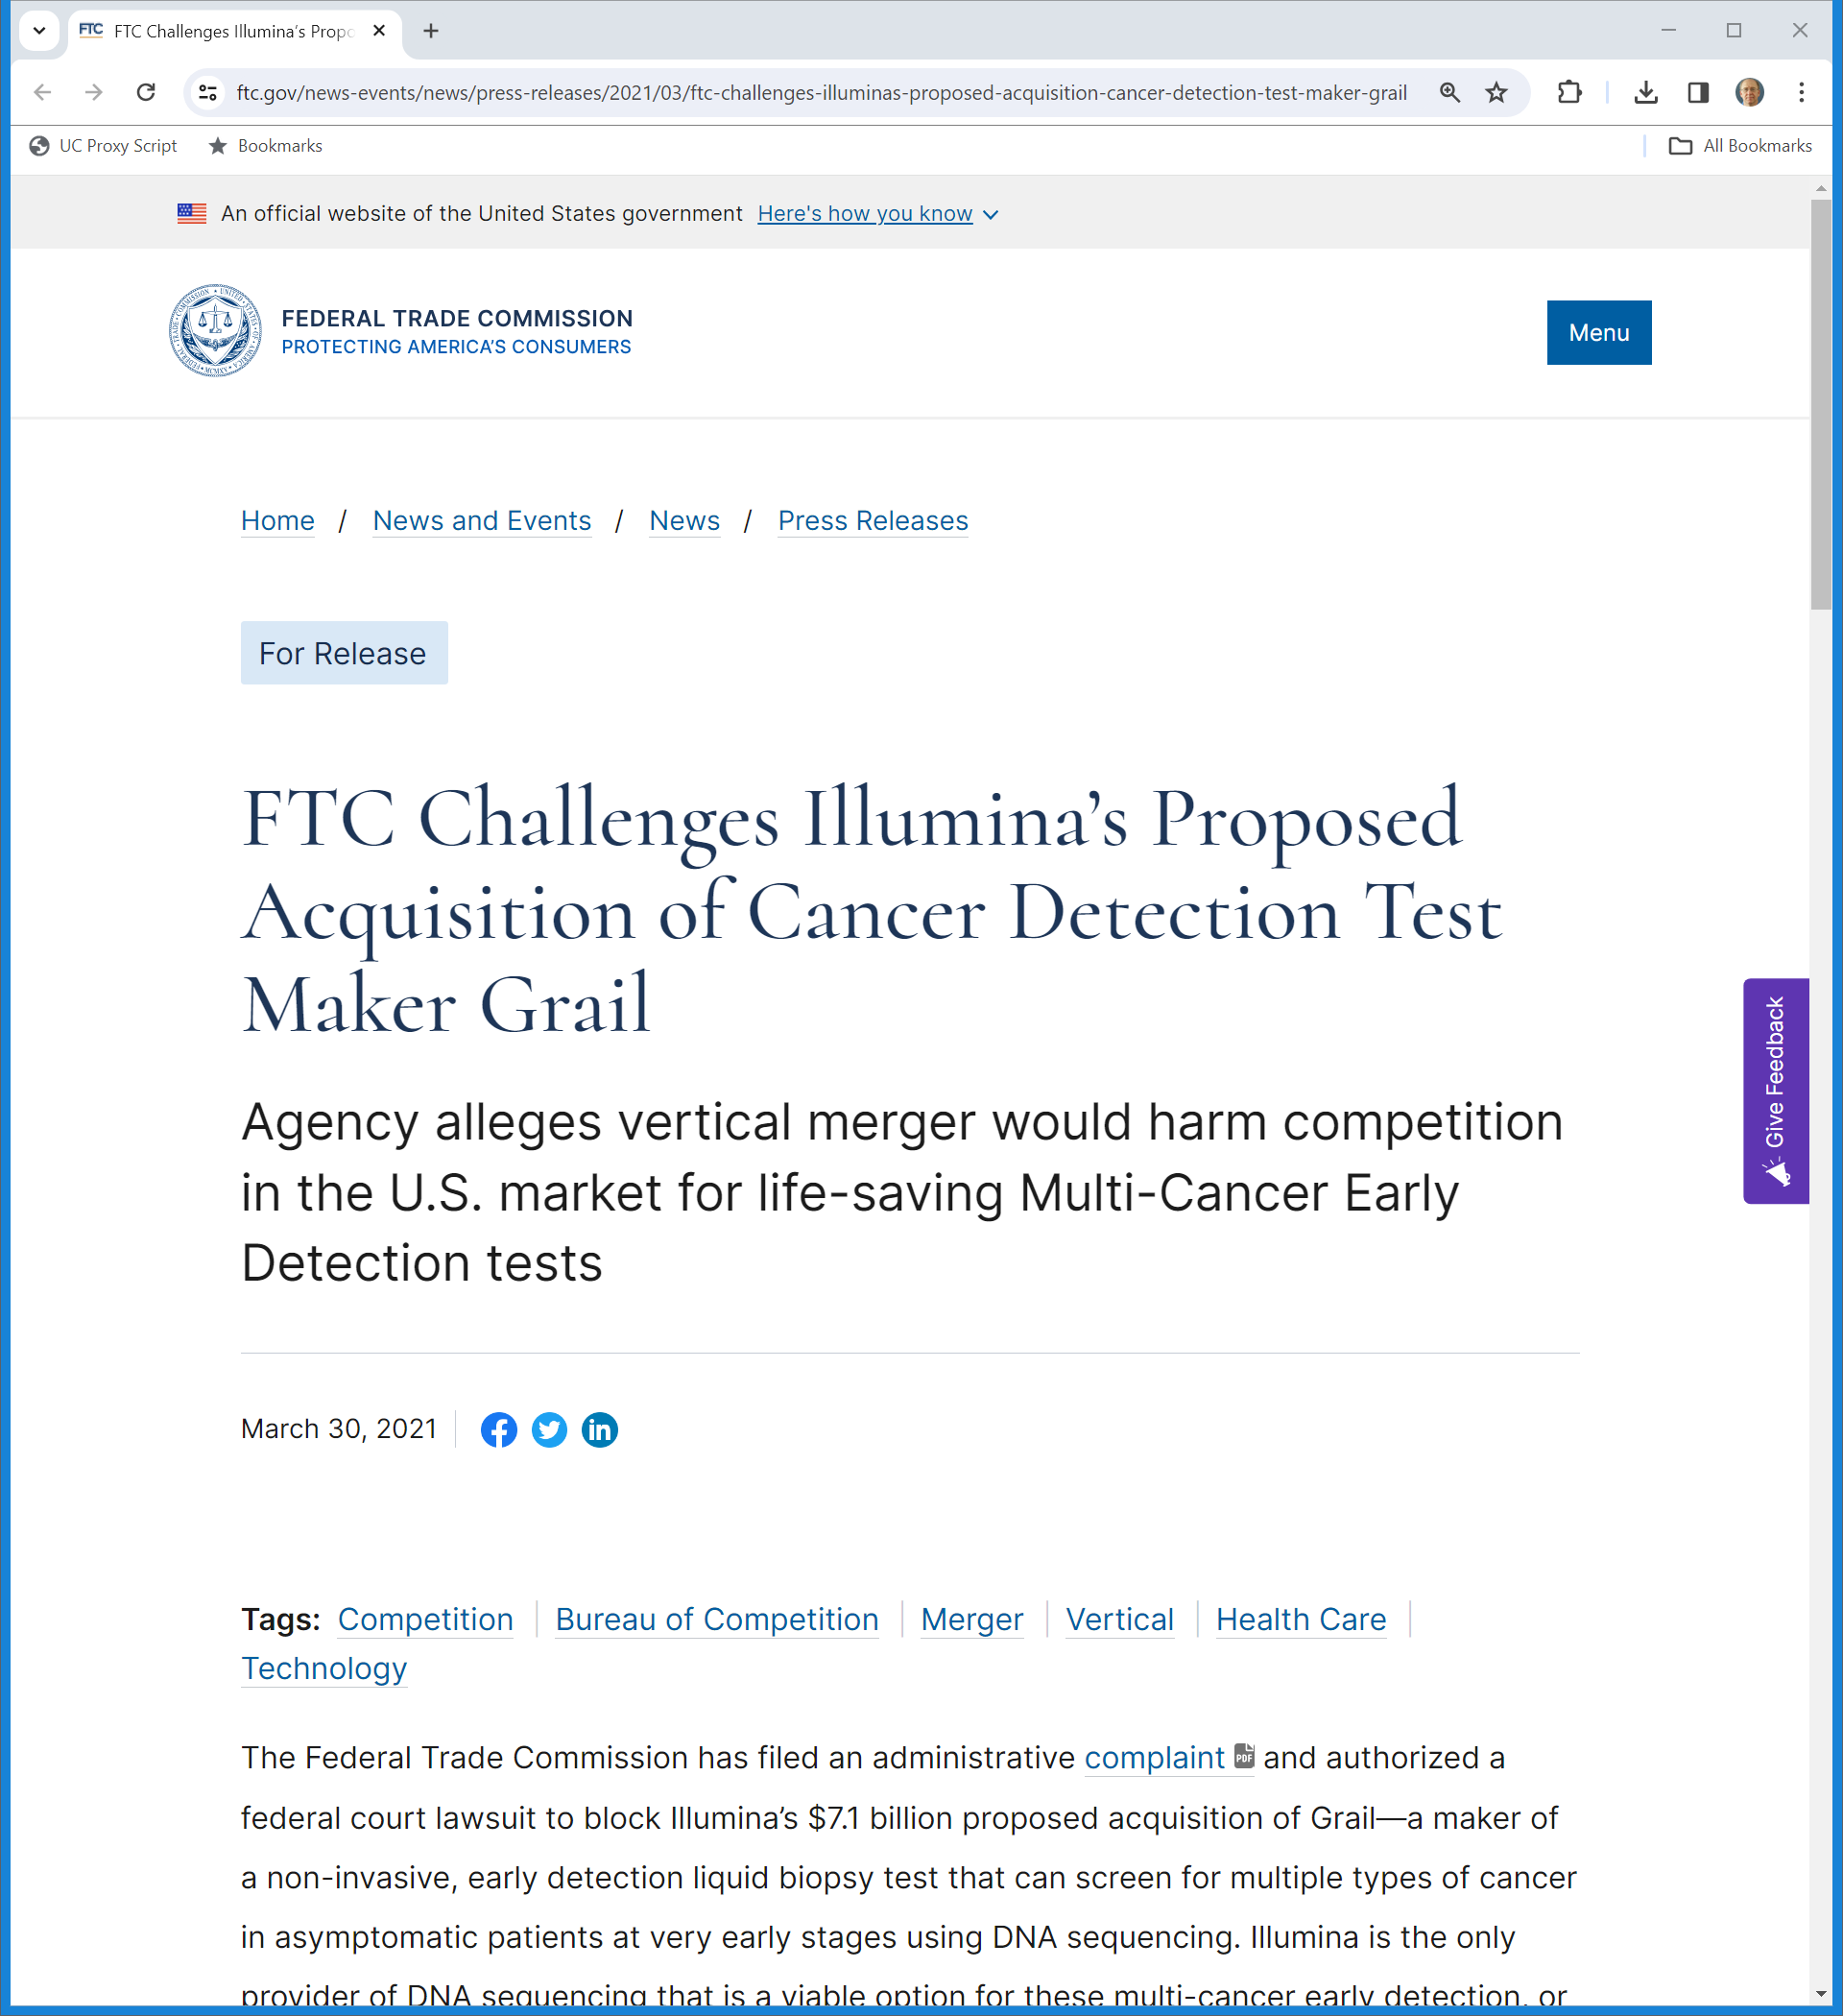
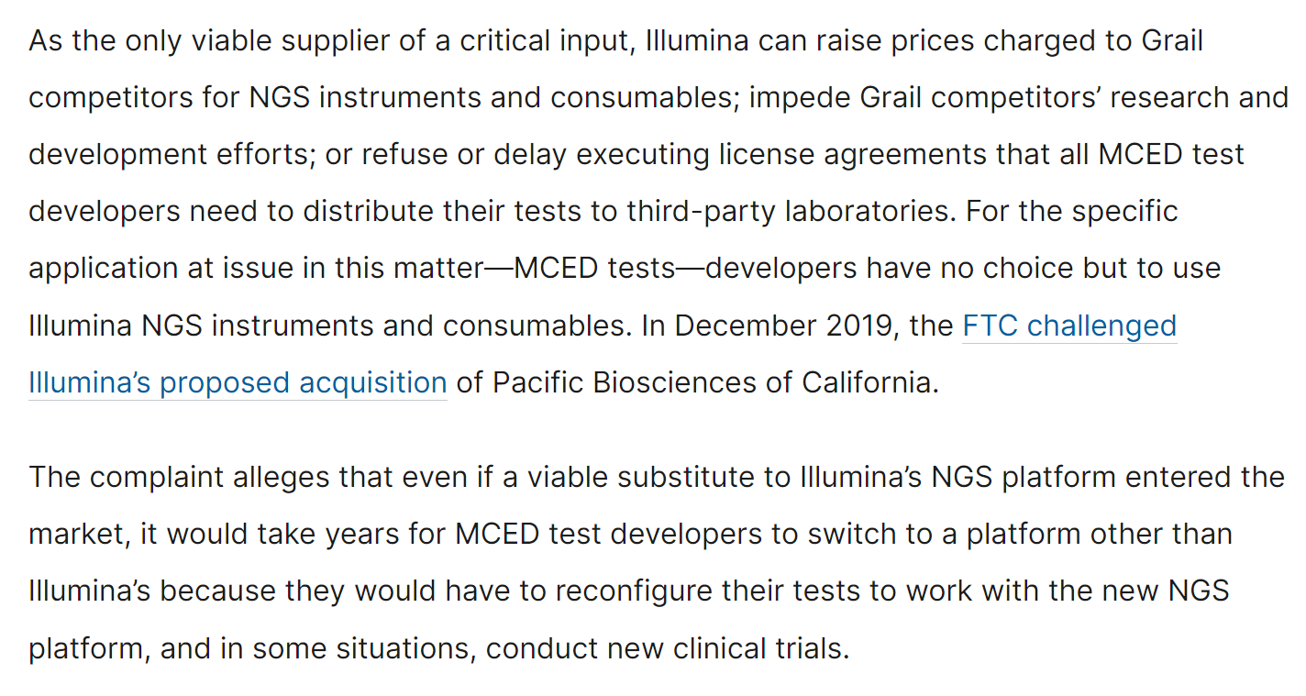
FTC Challenge
FTC (30 Mar 2021)

Slide 36
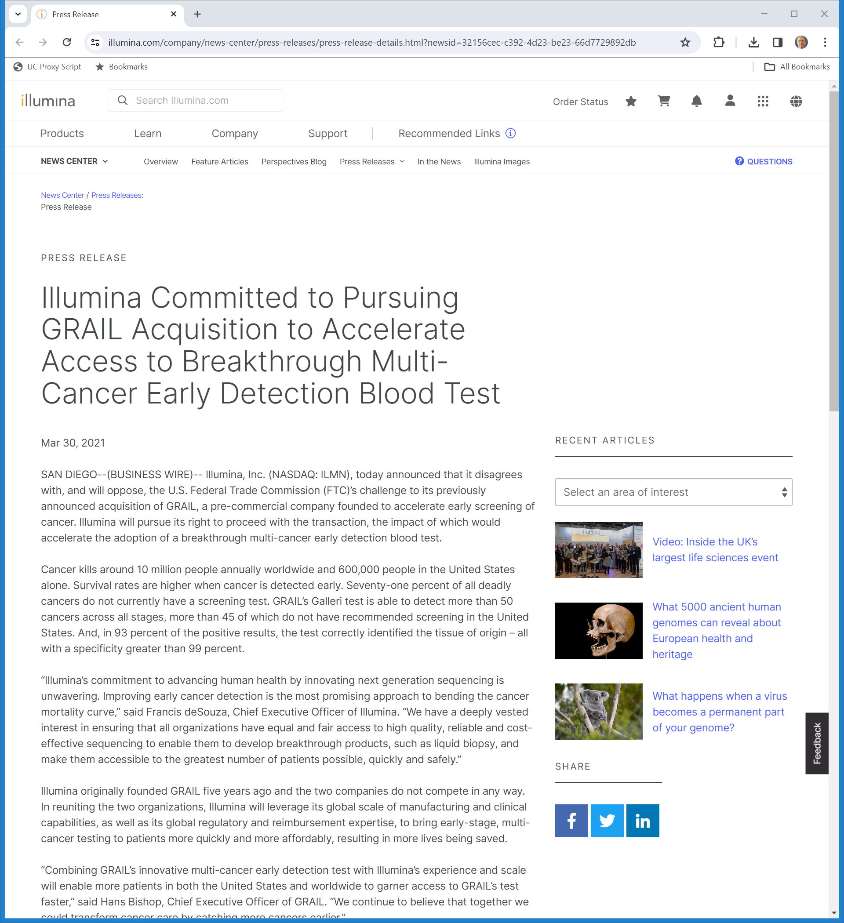
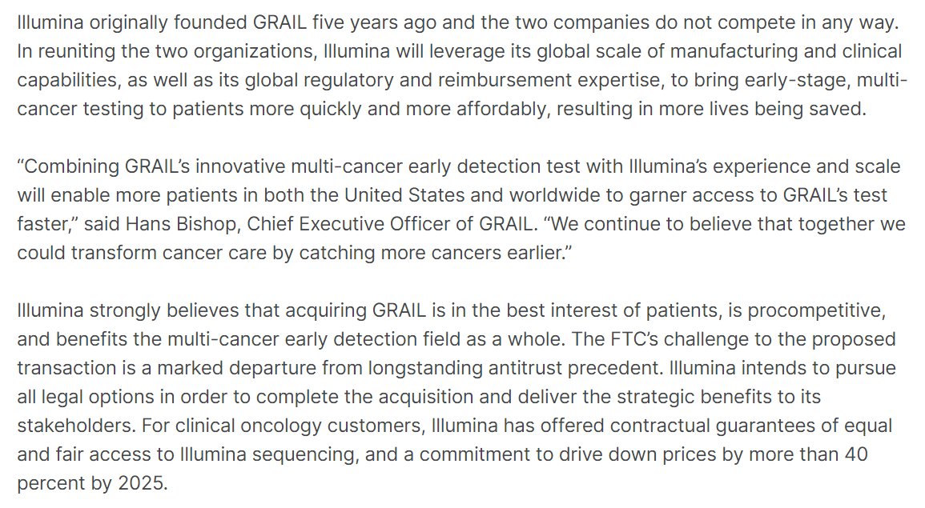
“Equal and Fair Access”
Illumina (30 Mar 2021)
Notes:
https://www.illumina.com/company/news-center/press-releases/press-release-details.html?newsid=32156cec-c392-4d23-be23-66d7729892db

Slide 37
Illumina Open Offer: 40 Pages
Illumina (29 Mar 2021)

Slide 38
EC to Investigate
European Commission (20 Apr 2021)
Notes:
https://ec.europa.eu/commission/presscorner/detail/en/MEX_21_1846

Slide 39
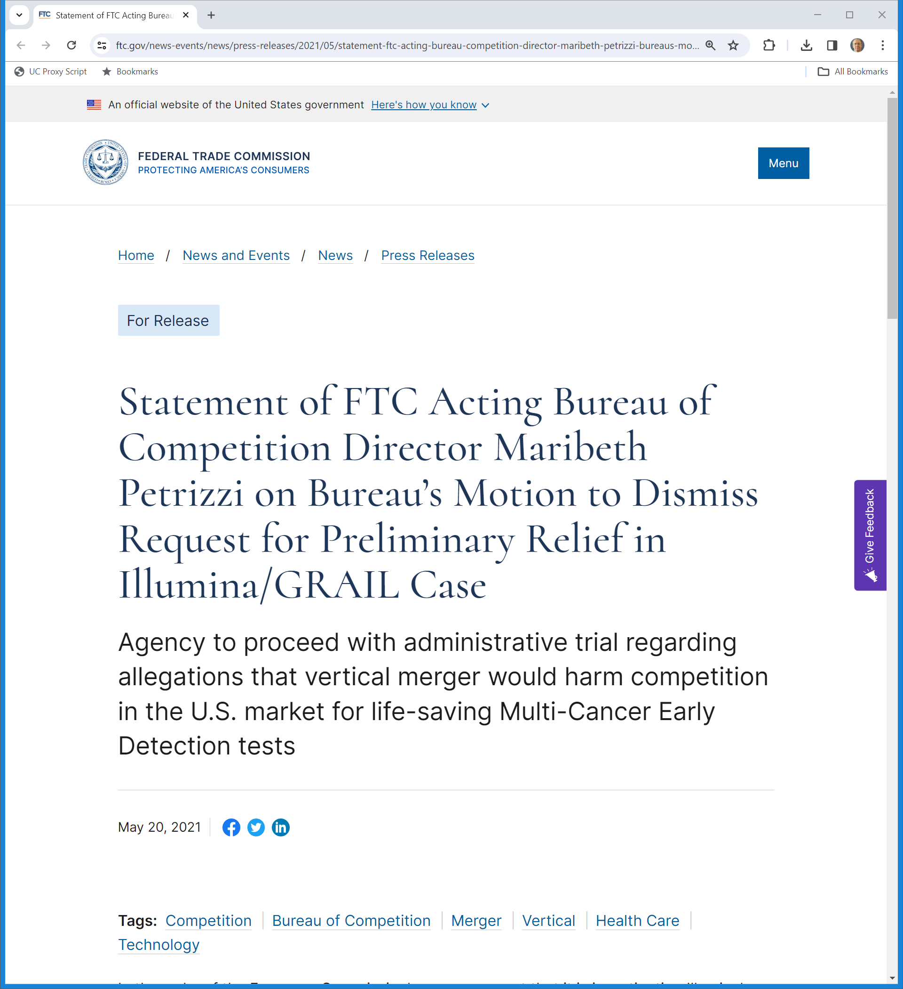
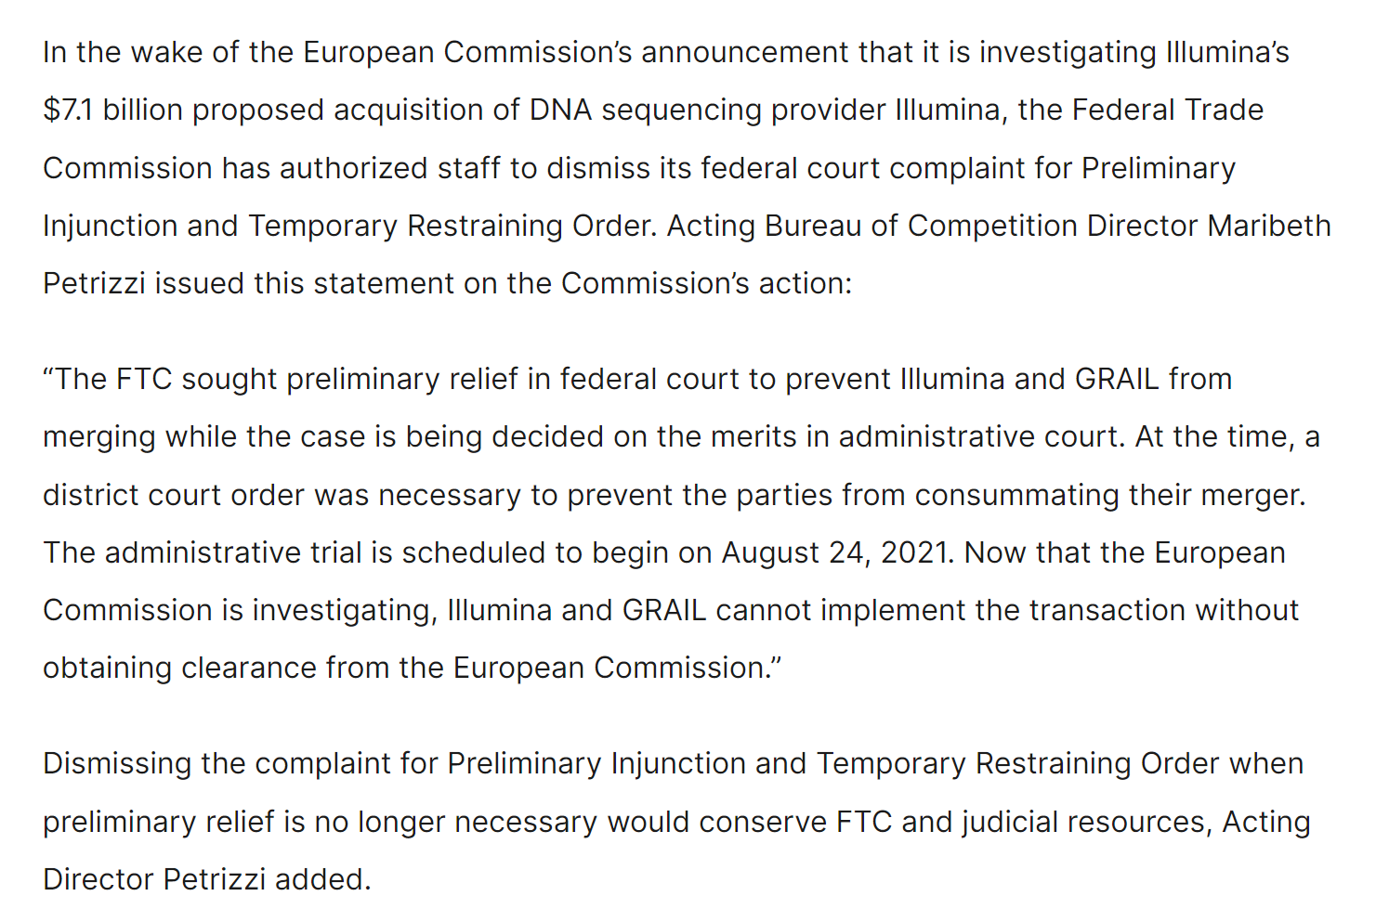
May 2021: FTC Drops PI Given EC Move
FTC (20 May 2021)
Notes:
https://www.ftc.gov/news-events/news/press-releases/2021/05/statement-ftc-acting-bureau-competition-director-maribeth-petrizzi-bureaus-motion-dismiss-request

Slide 40
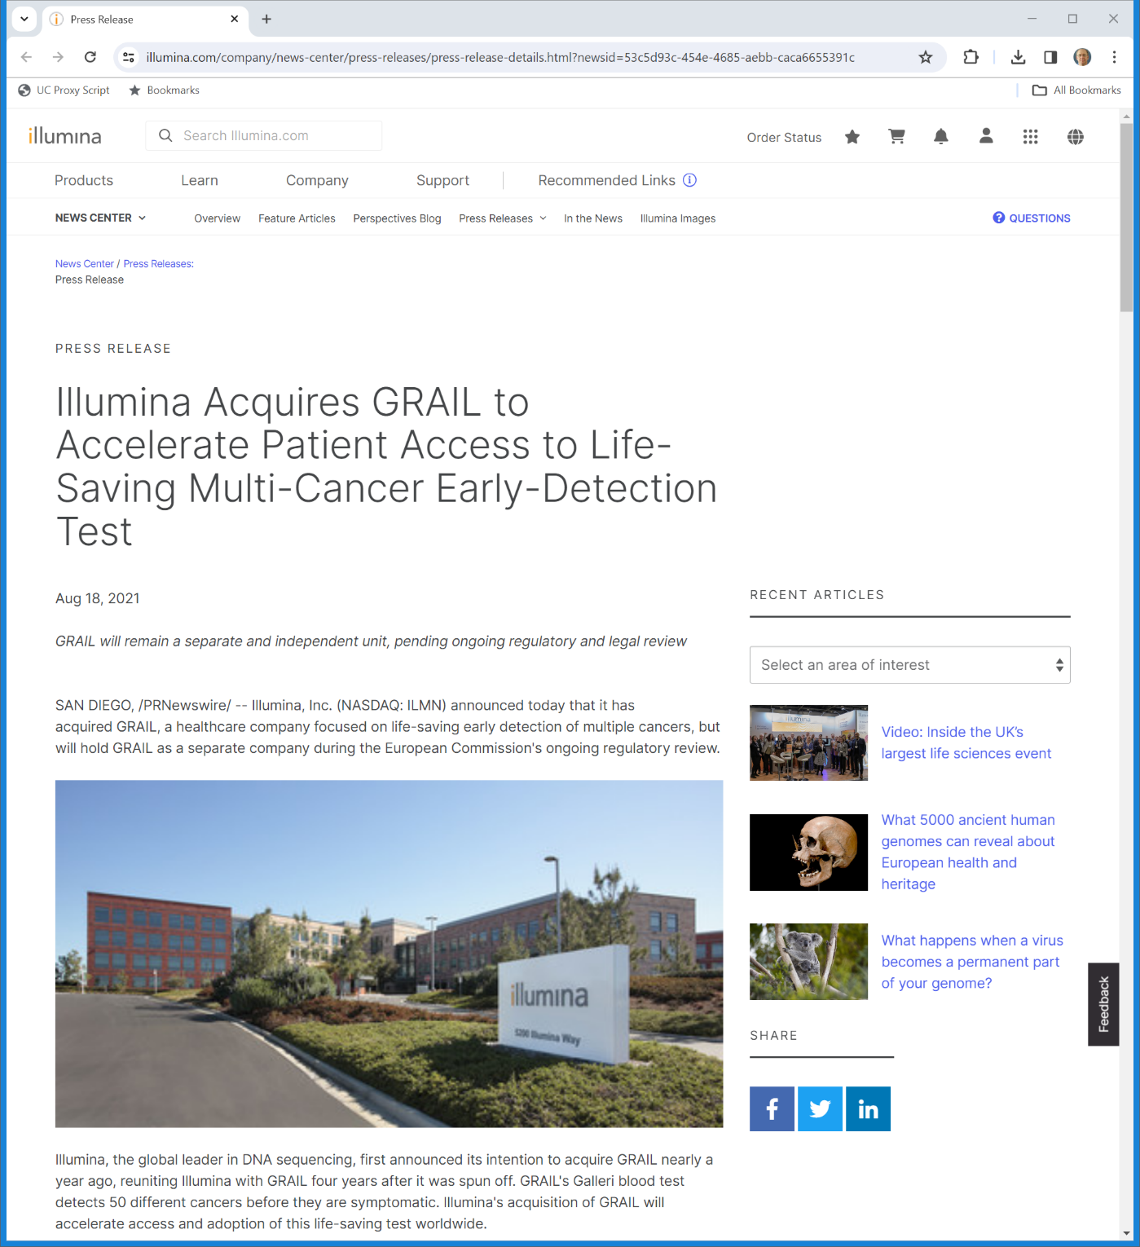
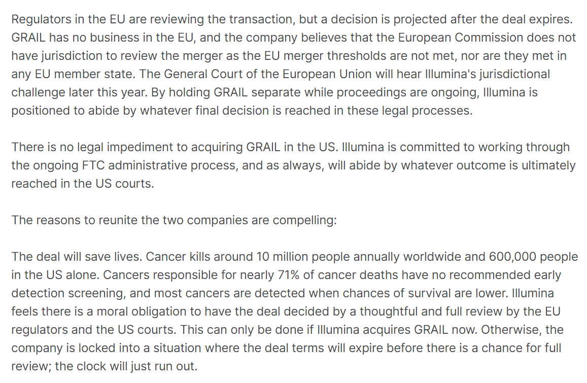
18 Aug 2021: Illumina Closes Grail Deal
Illumina (18 Aug 2021)
Notes:
https://www.illumina.com/company/news-center/press-releases/press-release-details.html?newsid=53c5d93c-454e-4685-aebb-caca6655391c

Slide 41
EC: Breach of Standstill Obligation?
European Commission (20 Aug 2021)
Notes:
https://ec.europa.eu/commission/presscorner/detail/en/ip_21_4322

Slide 42
EC Referral Upheld
CJEU (13 July 2022)

Slide 43
Sept 2022: EC Bars Purchase
European Commission (6 Sept 2022)
Notes:
https://ec.europa.eu/commission/presscorner/detail/en/ip_22_5364

Slide 44
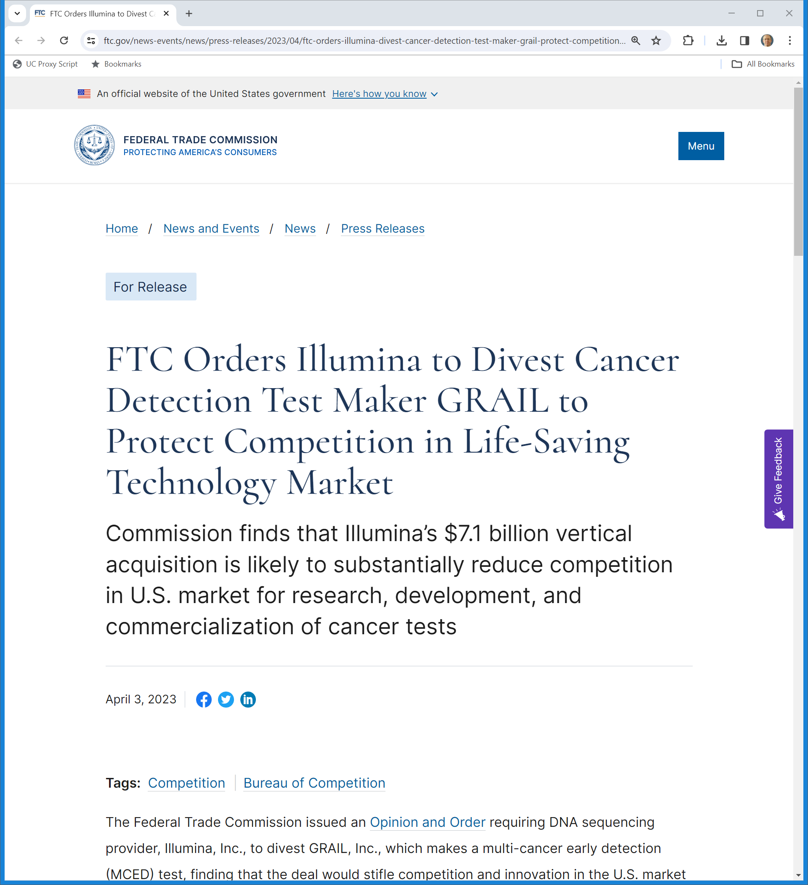
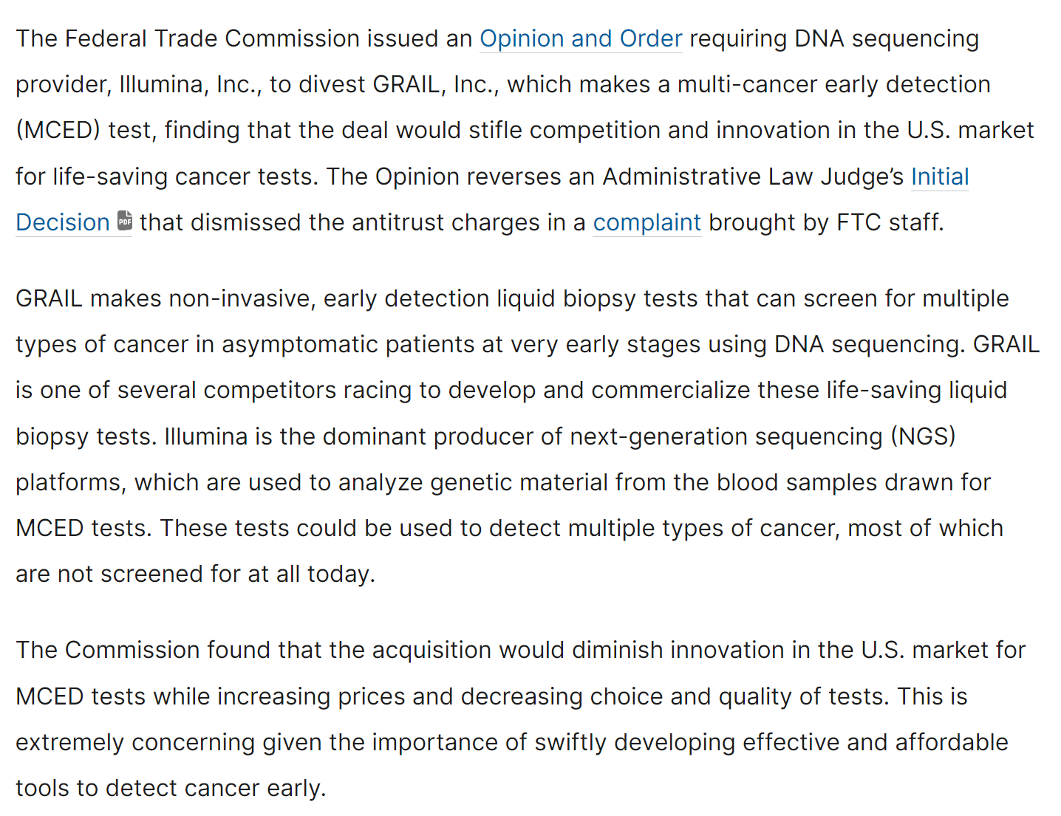
Apr 2023: FTC Orders Divestiture (Reversing ALJ)
FTC (3 Apr 2023)
Notes:
https://www.ftc.gov/news-events/news/press-releases/2023/04/ftc-orders-illumina-divest-cancer-detection-test-maker-grail-protect-competition-life-saving

Slide 45
July 2023: Gun-Jumping Fine of €432M
European Commission (12 July 2023)
Notes:
https://ec.europa.eu/commission/presscorner/detail/en/ip_23_3773

Slide 46
July 2023: Gun-Jumping Fine
European Commission (12 July 2023)
Notes:
https://ec.europa.eu/commission/presscorner/detail/en/ip_23_3773

Slide 47
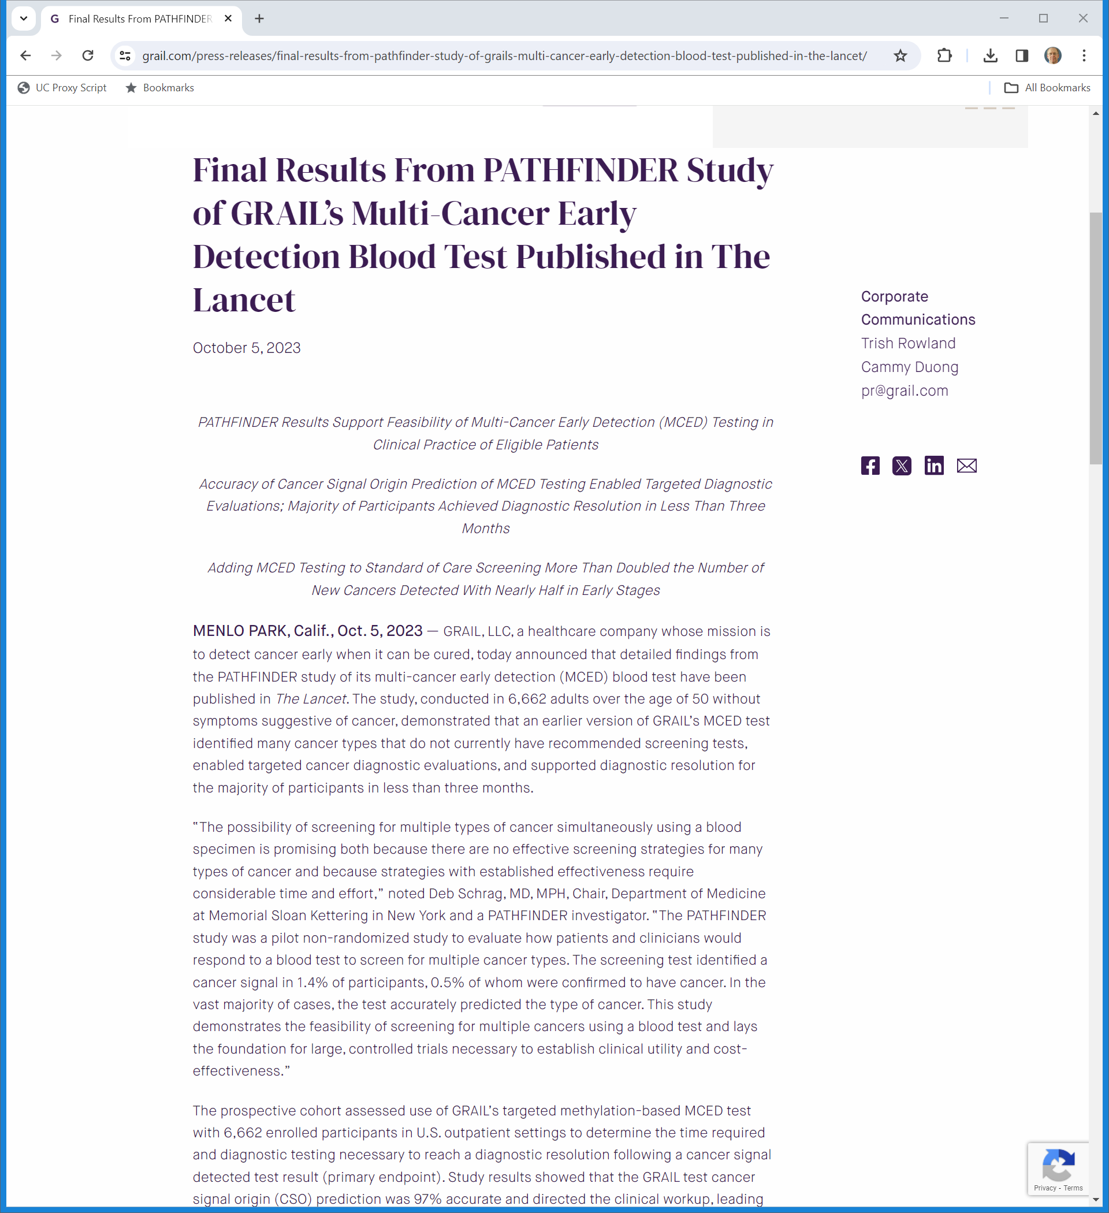
Cancer Test Progress
Grail (5 Oct 2023)
Notes:
https://grail.com/press-releases/final-results-from-pathfinder-study-of-grails-multi-cancer-early-detection-blood-test-published-in-the-lancet/

Slide 48
Oct 2023: EC Orders Divestiture
European Commission (12 Oct 2023)
Notes:
https://ec.europa.eu/commission/presscorner/detail/en/ip_23_4872

Slide 49
Oct 2023: EC Orders Divestiture
European Commission (12 Oct 2023)
Notes:
https://ec.europa.eu/commission/presscorner/detail/en/ip_23_4872

Slide 50
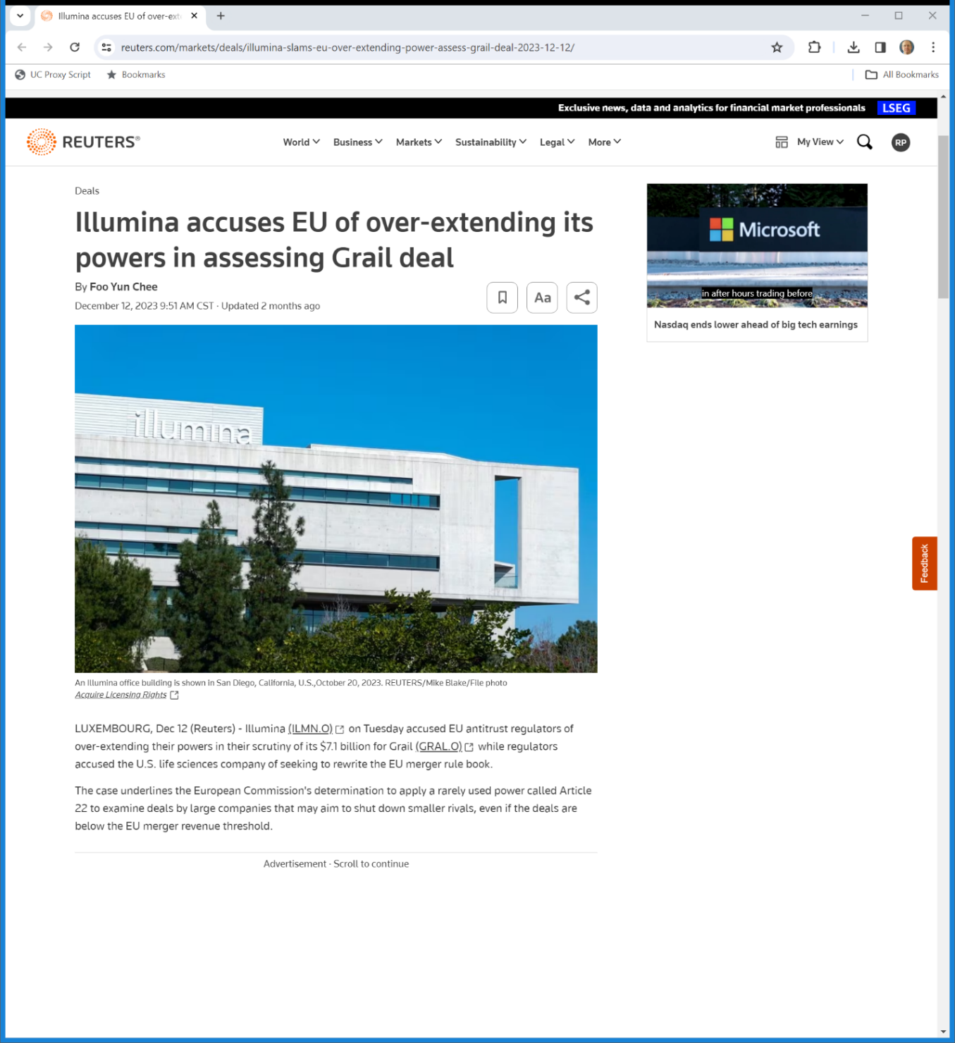
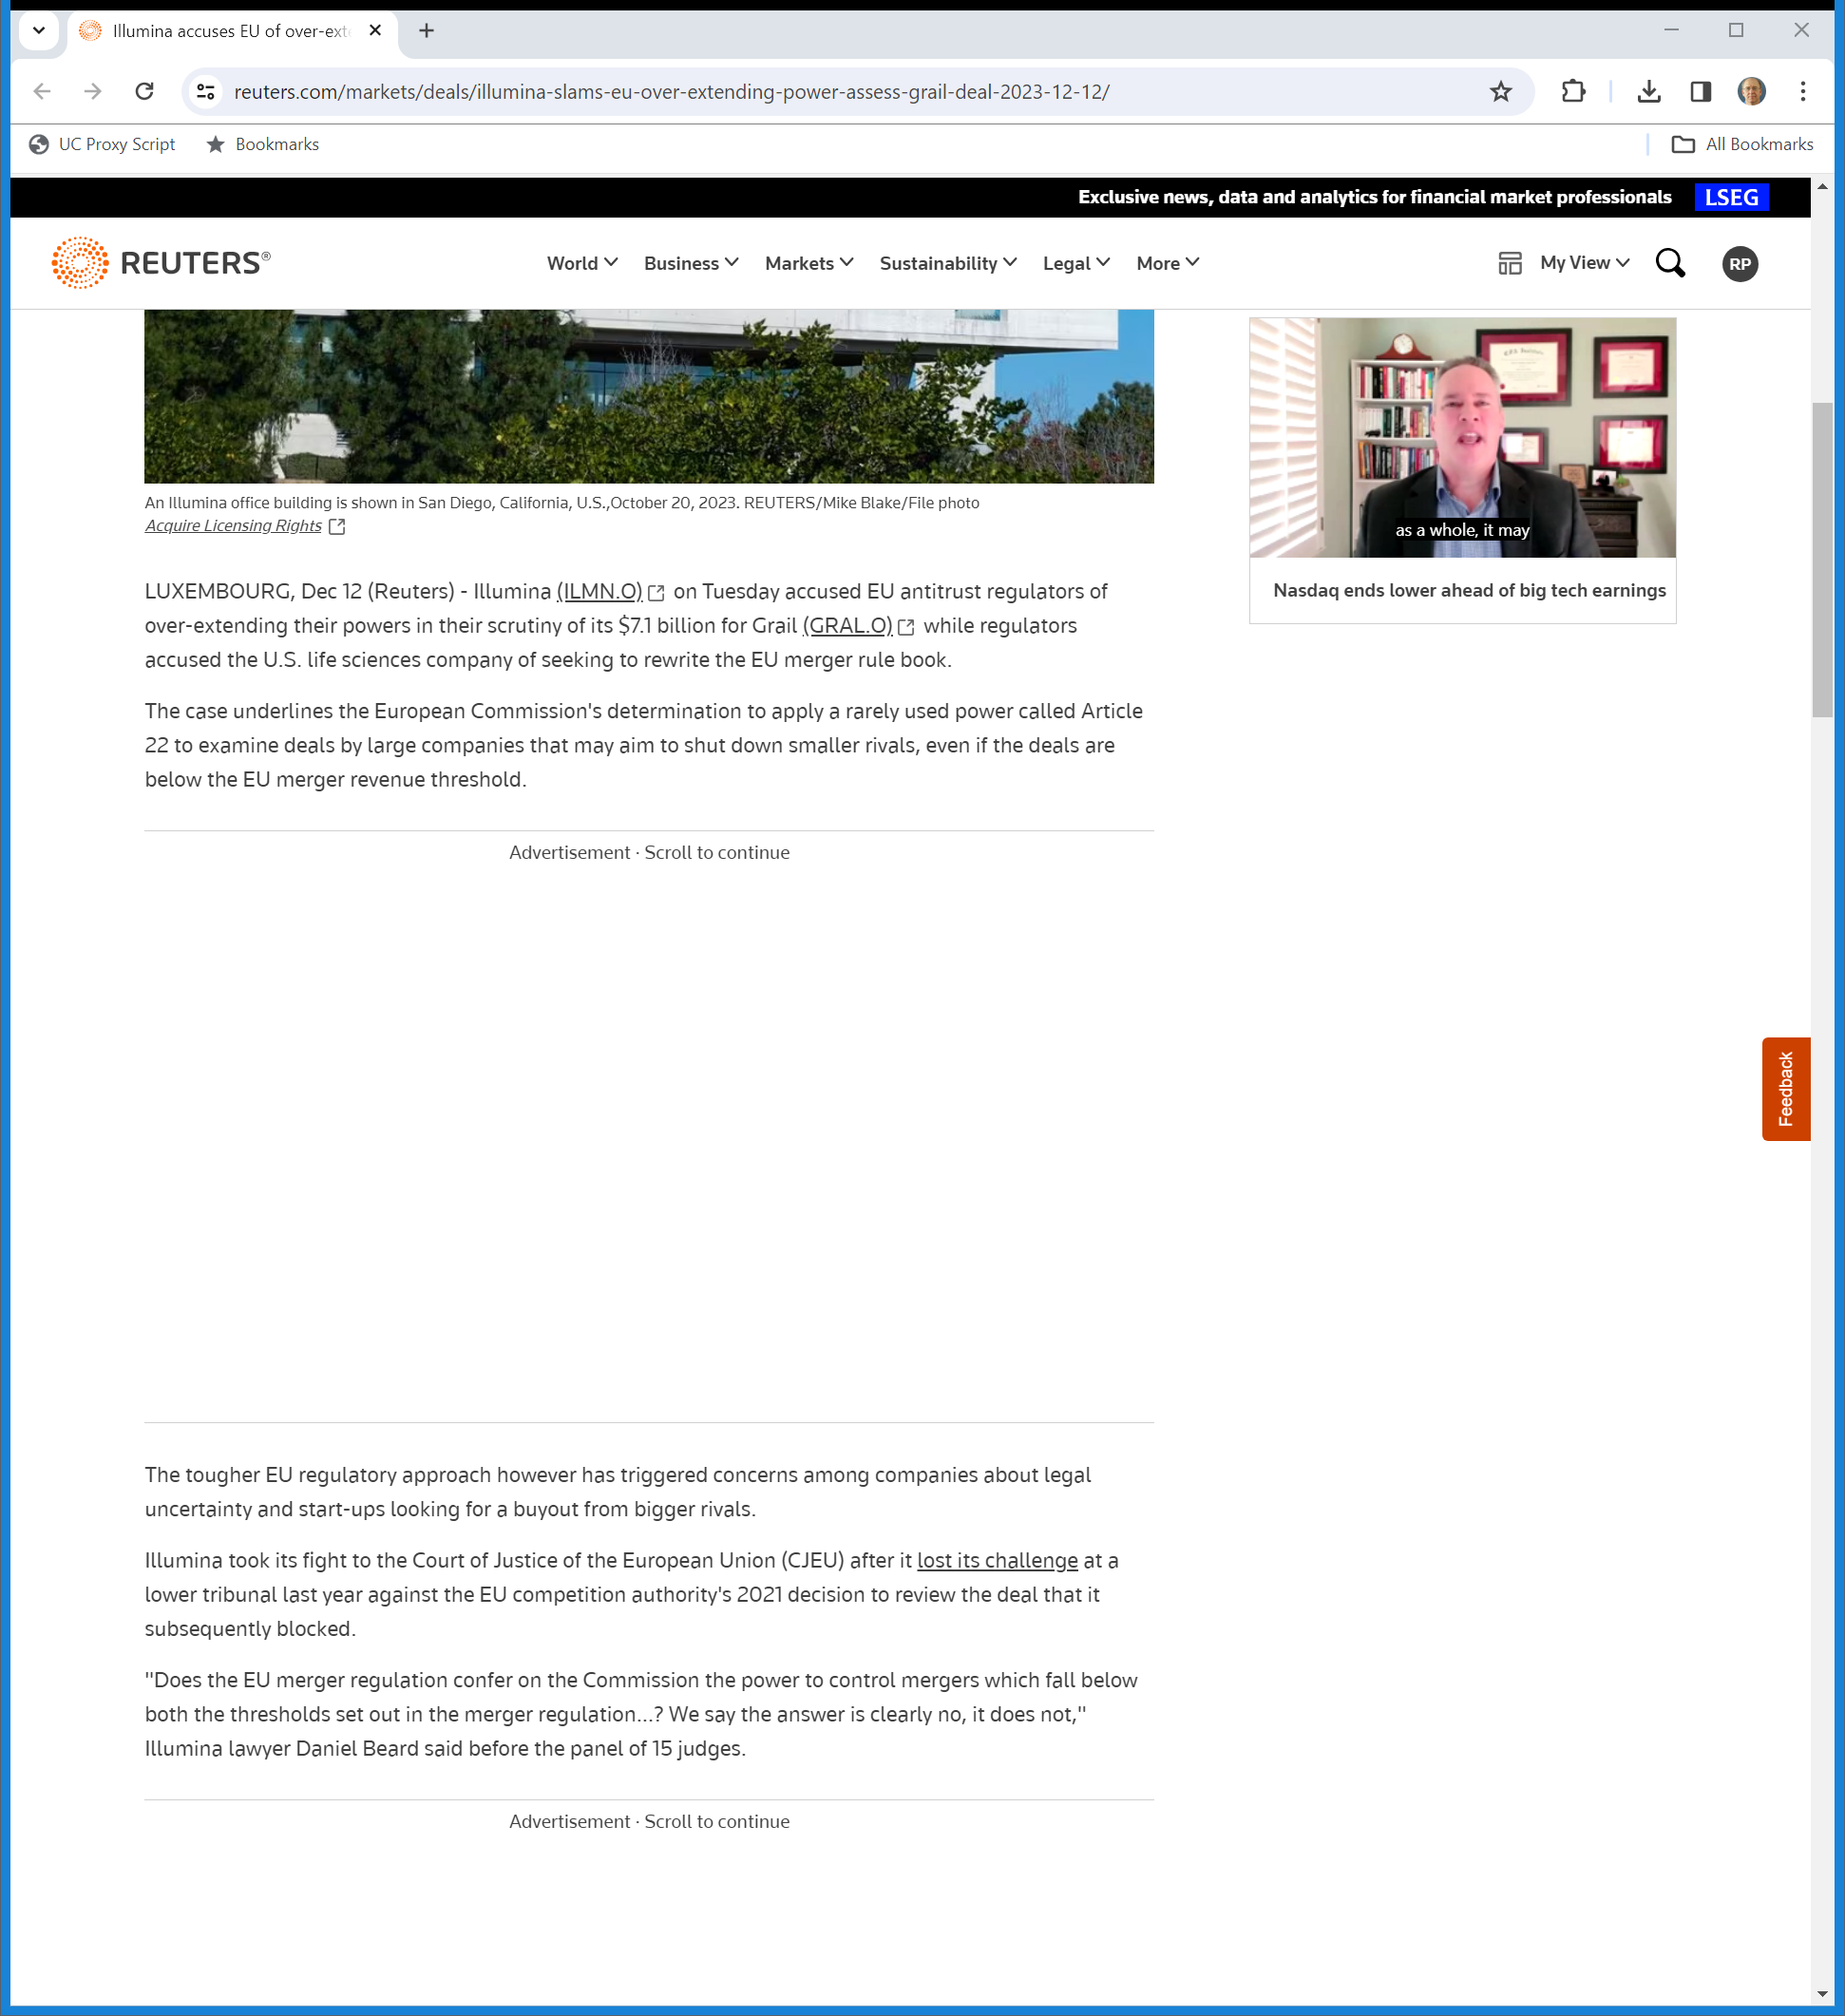
12 Dec 2023: Illumina Appeal Before CJEU
Reuters (12 Dec 2023)
Notes:
https://www.reuters.com/markets/deals/illumina-slams-eu-over-extending-power-assess-grail-deal-2023-12-12/

Slide 51
Licensing the NGS Platform
TTYN (1 of 4)
Hypo 1
  Single firm owns NGS platform and also builds blood-based cancer detection tests that require the use of the platform
  Firm refuses to license NGS platform to potential test competitors (and has never done so)
Antitrust issues?

Slide 52
Licensing the NGS Platform
TTYN (2 of 4)
Hypo 2
  Single firm owns NGS platform
  Creates wholly own sub that builds blood-based cancer detection tests that require the use of the platform
  Firm refuses to license NGS platform to potential test competitors (and has never done so)
Antitrust issues?

Slide 53
Licensing the NGS Platform
TTYN (3 of 4)
Hypo 3
  Single firm owns NGS platform
  Firm announces that it will license the platform exclusively to one company in the tests market and holds auction for that license
Antitrust issues?

Slide 54
Licensing the NGS Platform
TTYN (4 of 4)
Hypo 4
  Single firm owns NGS platform
  Firm licenses NGS platform to all comers
  Firm looks to buy one firm in the tests market
Antitrust issues?

Slide 55
Illumina/Grail
Illumina v. FTC (5th Cir. 15 Dec 2023)

Slide 56
A Little Con Law (But Not for Us)
Illumina v. FTC (5th Cir. 2023)

Slide 57
DOJ/FTC Overlaps
GAO (Jan 2023)

Slide 58
DOJ/FTC Overlaps
GAO (Jan 2023)

Slide 59
Foreclosure: The Ability-and-Incentive Test
“We begin by addressing the test upon which all Commissioners agreed—the ability-and-incentive test. Under this framework, courts consider whether the merged firm will have the ability and incentive to foreclose rivals from sources of supply or distribution to determine whether the merger is likely to substantially lessen competition in the relevant market.”
Illumina v. FTC (5th Cir. 2023)

Slide 60
Foreclosure Tradeoffs
“As the Commission explained, the degree to which Illumina has an incentive to foreclose Grail’s rivals depends upon the balance of two competing interests: Illumina’s interest in maximizing its profits in the downstream market for MCED tests vis-à-vis its ownership interest in Grail versus Illumina’s interest in maximizing its profits in the upstream market for NGS platforms vis-à-vis its sales to all MCED-test developers.”
Illumina v. FTC (5th Cir. 2023)

Slide 61
Foreclosure Tradeoffs
“Foreclosing Grail’s rivals would increase the former (by diverting MCED-test sales from competitors to Grail) but decrease the latter (by reducing the total number of MCED tests in the marketplace). So, the Commission reasoned, the greater Illumina’s ownership stake in Grail, the more its interest in maximizing downstream profits will outweigh its interest in preserving upstream profits, and thus the more incentive it will have to foreclose.”
Illumina v. FTC (5th Cir. 2023)

Slide 62
FTC Views on Possible Foreclosure Were Reasonable
“Given Illumina’s monopoly power and shifting business priorities, it was reasonable for the Commission to conclude that Illumina would likely foreclose against Grail’s competitors—even at the expense of some short-term profits—to pursue its long-term goal of establishing itself (via Grail) as the market leader in clinical testing.”
Illumina v. FTC (5th Cir. 2023)

Slide 63
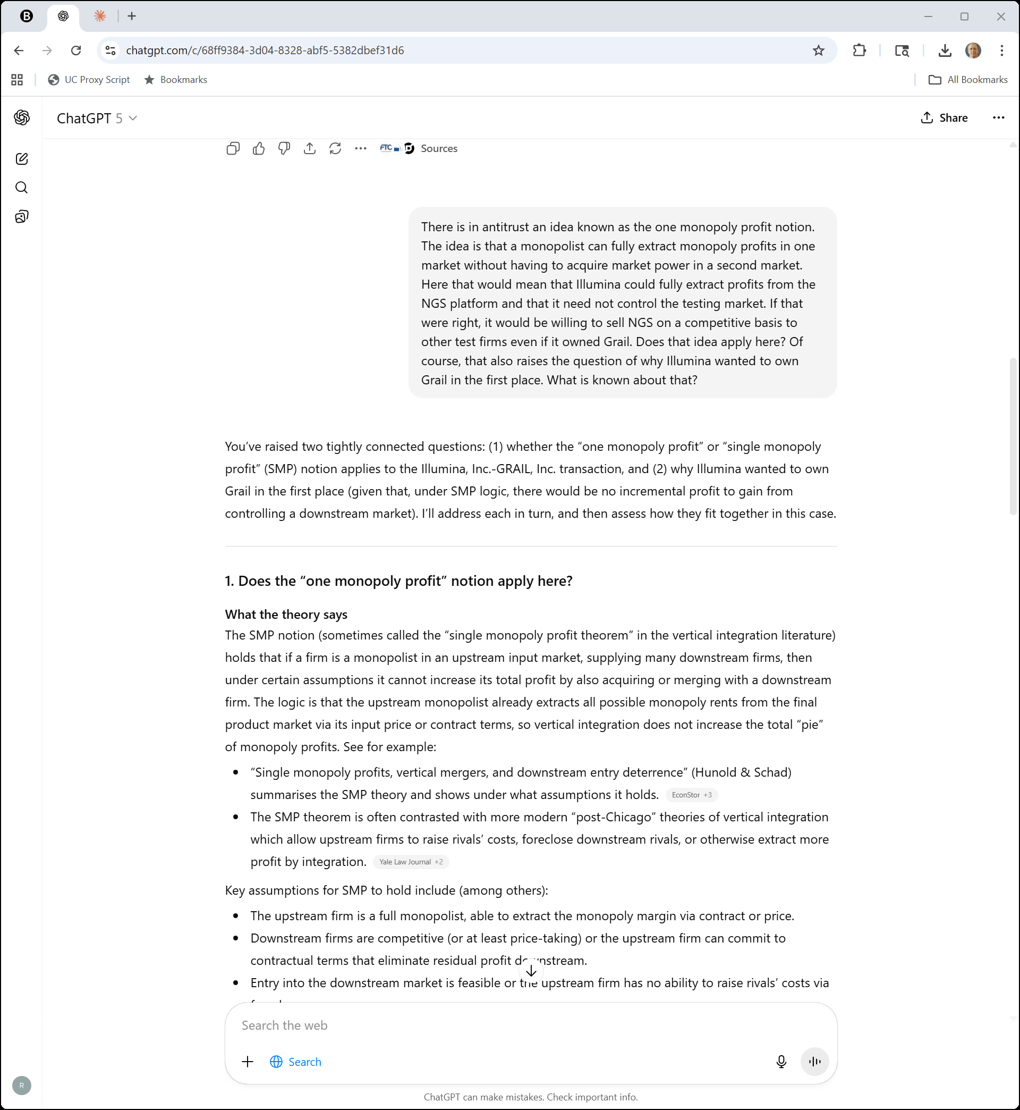
Left Shoe Monopolist?
ChatGPT (27 Oct 2025)

Slide 64
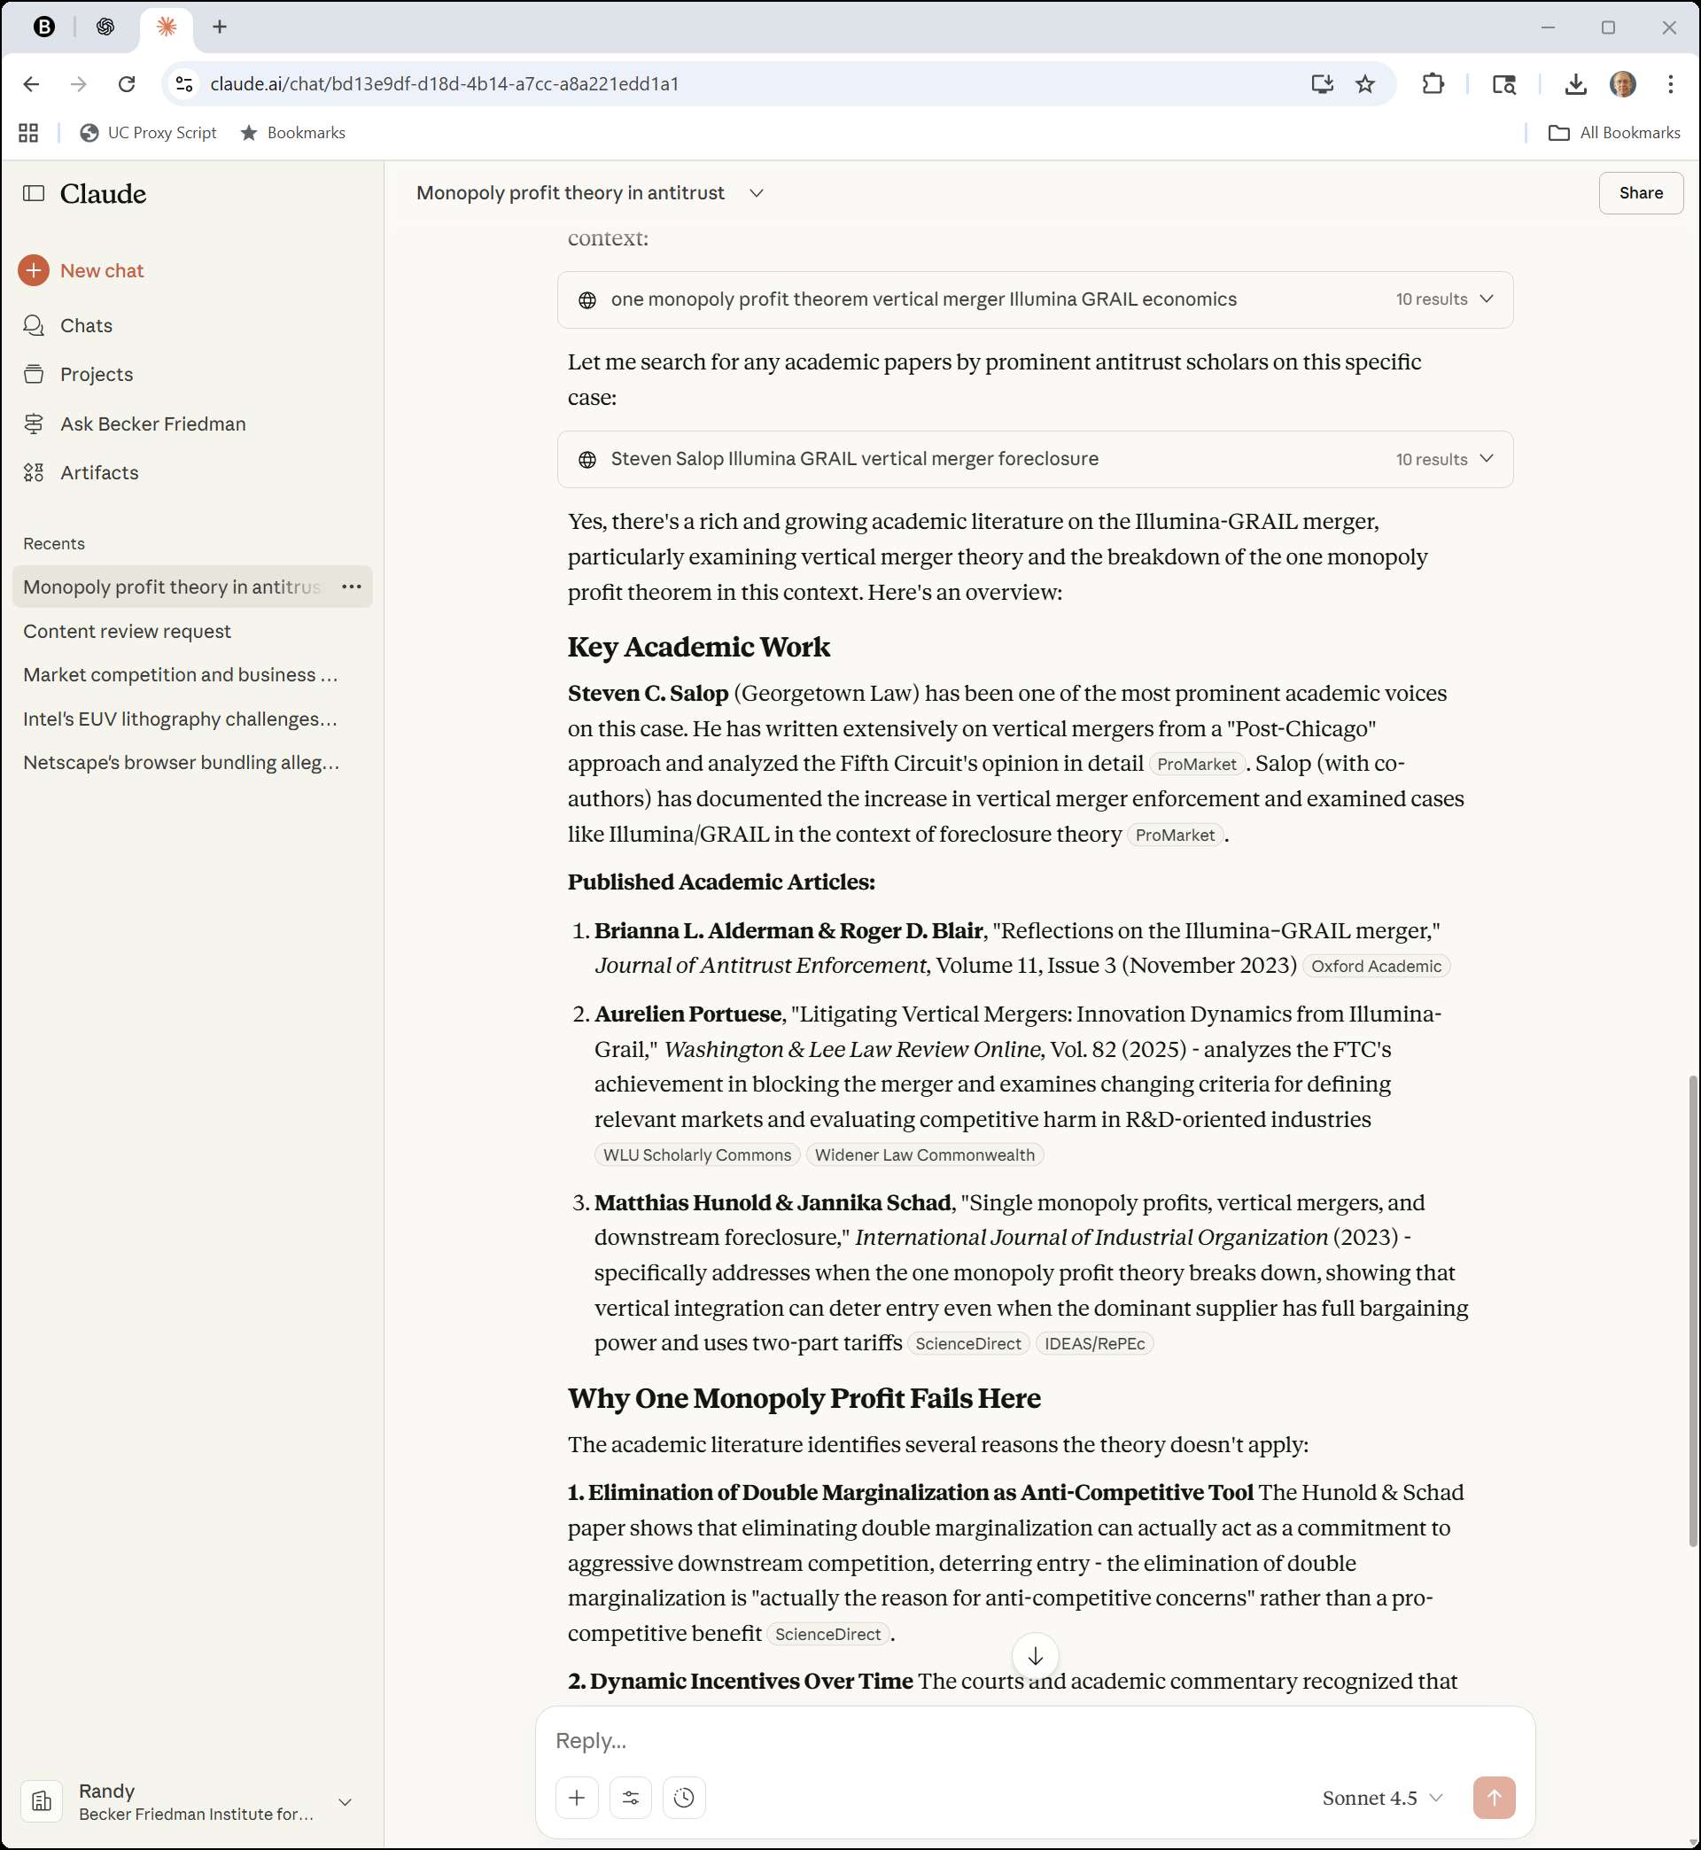
Literature?
Claude (27 Oct 2025)

Slide 65
Situating the Open Offer
“Based on the record, the parties’ arguments, and applicable case law, we see three different options for the point in the Section 7 analysis at which the Open Offer could come into play. The first option—pressed by Illumina—is to require Complaint Counsel to account for the Open Offer as part of its prima facie case.”
Illumina v. FTC (5th Cir. 2023)

Slide 66
Situating the Open Offer
“The second option—adhered to by the Commission’s majority opinion—is to only consider the Open Offer at the remedy stage following a finding of liability. The third option—suggested by Commissioner Wilson in her concurring opinion—is to place the burden of showing the Open Offer’s competitive effects on Illumina as part of its rebuttal to the prima facie case. As explained below, we agree with Commissioner Wilson.”
Illumina v. FTC (5th Cir. 2023)

Slide 67
But Doesn’t Matter As Much as You Might Think
“As we and our sister circuits have recognized, the burden-shifting framework is ‘somewhat artificial.’ FTC v. Butterworth Health Corp., No. 96-2440, 1997 WL 420543, at *1 (6th Cir. July 8, 1997); accord Chicago Bridge, 534 F.3d at 424–25. …”
Illumina v. FTC (5th Cir. 2023)

Slide 68
But Doesn’t Matter As Much as You Might Think
“‘In practice, however, the government usually introduces all of its evidence at one time, and the defendant responds in kind.’ [FTC v. Univ. Health, Inc., 938 F.2d 1206, 1219 n.25 (11th Cir. 1991)]. Thus, the ‘evidence is often considered all at once and the burdens are often analyzed together.’ Chicago Bridge, 534 F.3d at 425. This is particularly true in vertical merger cases.”
Illumina v. FTC (5th Cir. 2023)

Slide 69
FTC Ignored Sec 7 Standard
“This is where the Commission erred. The Commission held Illumina to a rebuttal standard that was incompatible with the plain language of Section 7 of the Clayton Act … . In effect, Illumina could only rebut Complaint Counsel’s showing of a likelihood of a substantial reduction in competition with a showing that, due to the Open Offer, the merger would not lessen competition at all. This was legal error. The Commission’s standard stems from its mistaken belief that the Open Offer is a remedy.”
Illumina v. FTC (5th Cir. 2023)

Slide 70
Bottom Line on Open Offer
“To rebut Complaint Counsel’s prima facie case, Illumina was only required to show that the Open Offer sufficiently mitigated the merger’s effect such that it was no longer likely to substantially lessen competition. Illumina was not required to show that the Open Offer would negate the anticompetitive effects of the merger entirely.”
Illumina v. FTC (5th Cir. 2023)

Slide 71
Merger Would Eliminate Grail Royalties
“First, Illumina claimed that the merger would reduce (if not eliminate entirely) Grail’s obligation to pay Illumina a royalty, which would have generated a significant consumer surplus. The Commission found that this claimed efficiency was neither merger specific nor likely to be passed through to consumers. We find that the former determination was not supported by substantial evidence, but the latter was.”
Illumina v. FTC (5th Cir. 2023)

Slide 72
Eliminate Double Marginalization?
“Second, Illumina argued that the merger would eliminate double marginalization—i.e., Illumina would no longer charge Grail a margin, as it did before the merger—leading to additional consumer surplus. But Illumina never put forward a proposed model for calculating this benefit, only an ‘illustrative’ one.”
Illumina v. FTC (5th Cir. 2023)

Slide 73
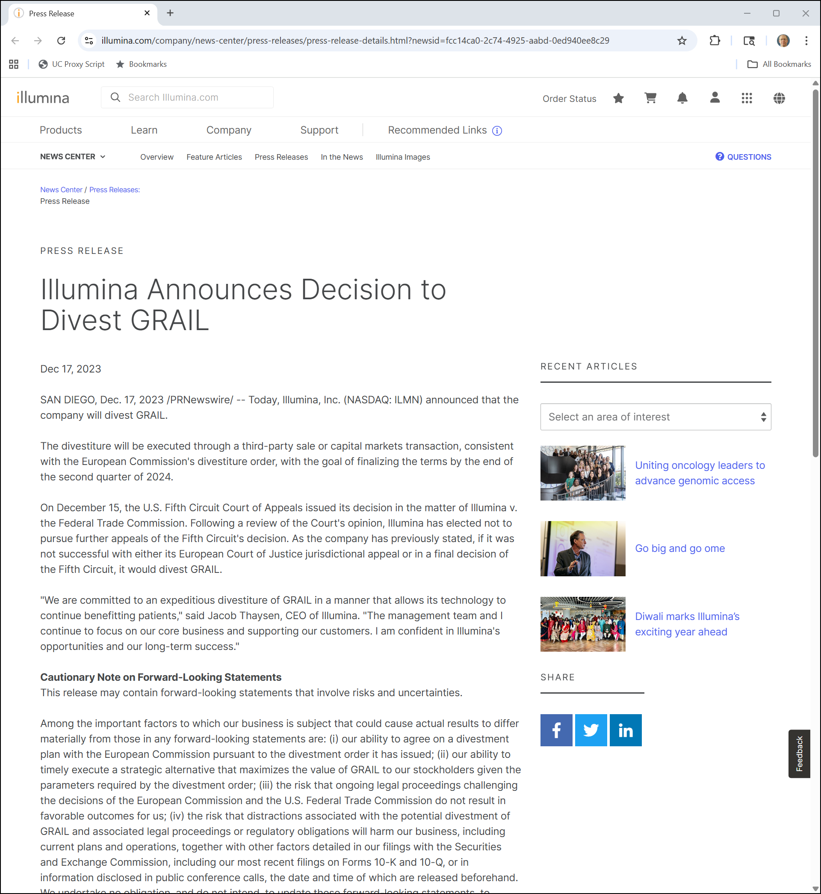
Illumina Announces It Will Divest Grail
Illumina PR (17 Dec 2023)
Notes:
https://www.illumina.com/company/news-center/press-releases/press-release-details.html?newsid=fcc14ca0-2c74-4925-aabd-0ed940ee8c29

Slide 74
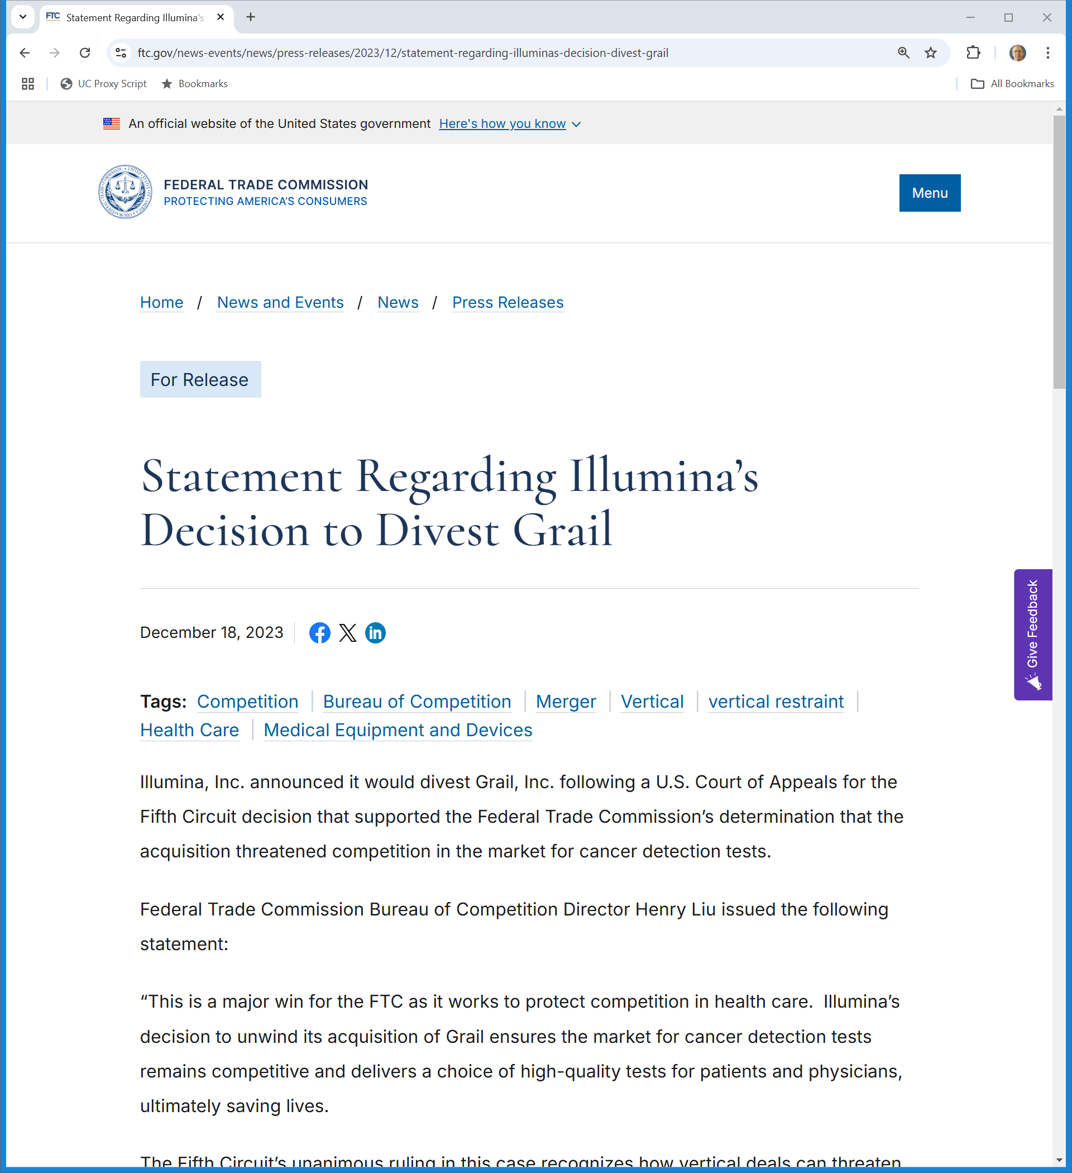
FTC Statement
FTC (18 Dec 2023)
Notes:
https://www.ftc.gov/news-events/news/press-releases/2023/12/statement-regarding-illuminas-decision-divest-grail

Slide 75
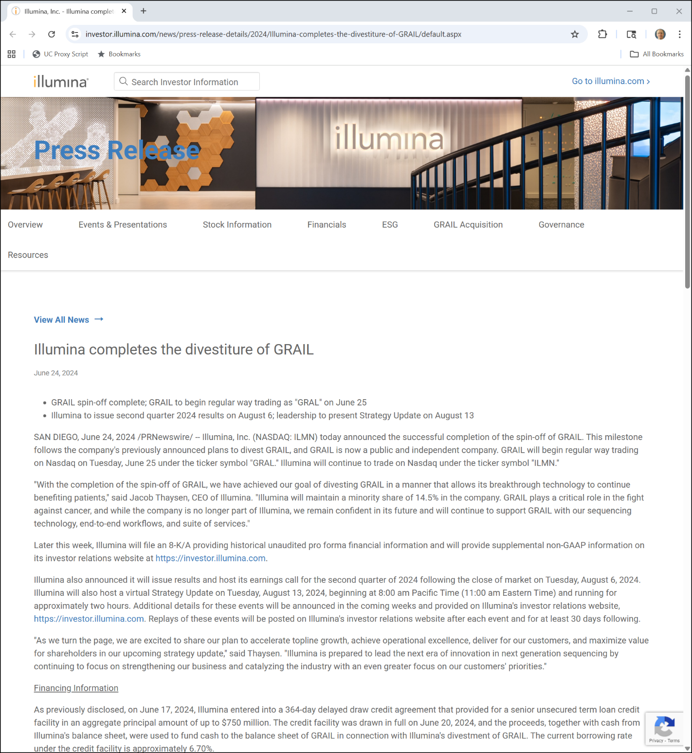

Grail Out
Illumina PR (24 June 2024)

Slide 76
Sept 2024: Prior EU Illumina Decision Overturned
Court of Justice of the European Union (3 Sept 2024)

Slide 77
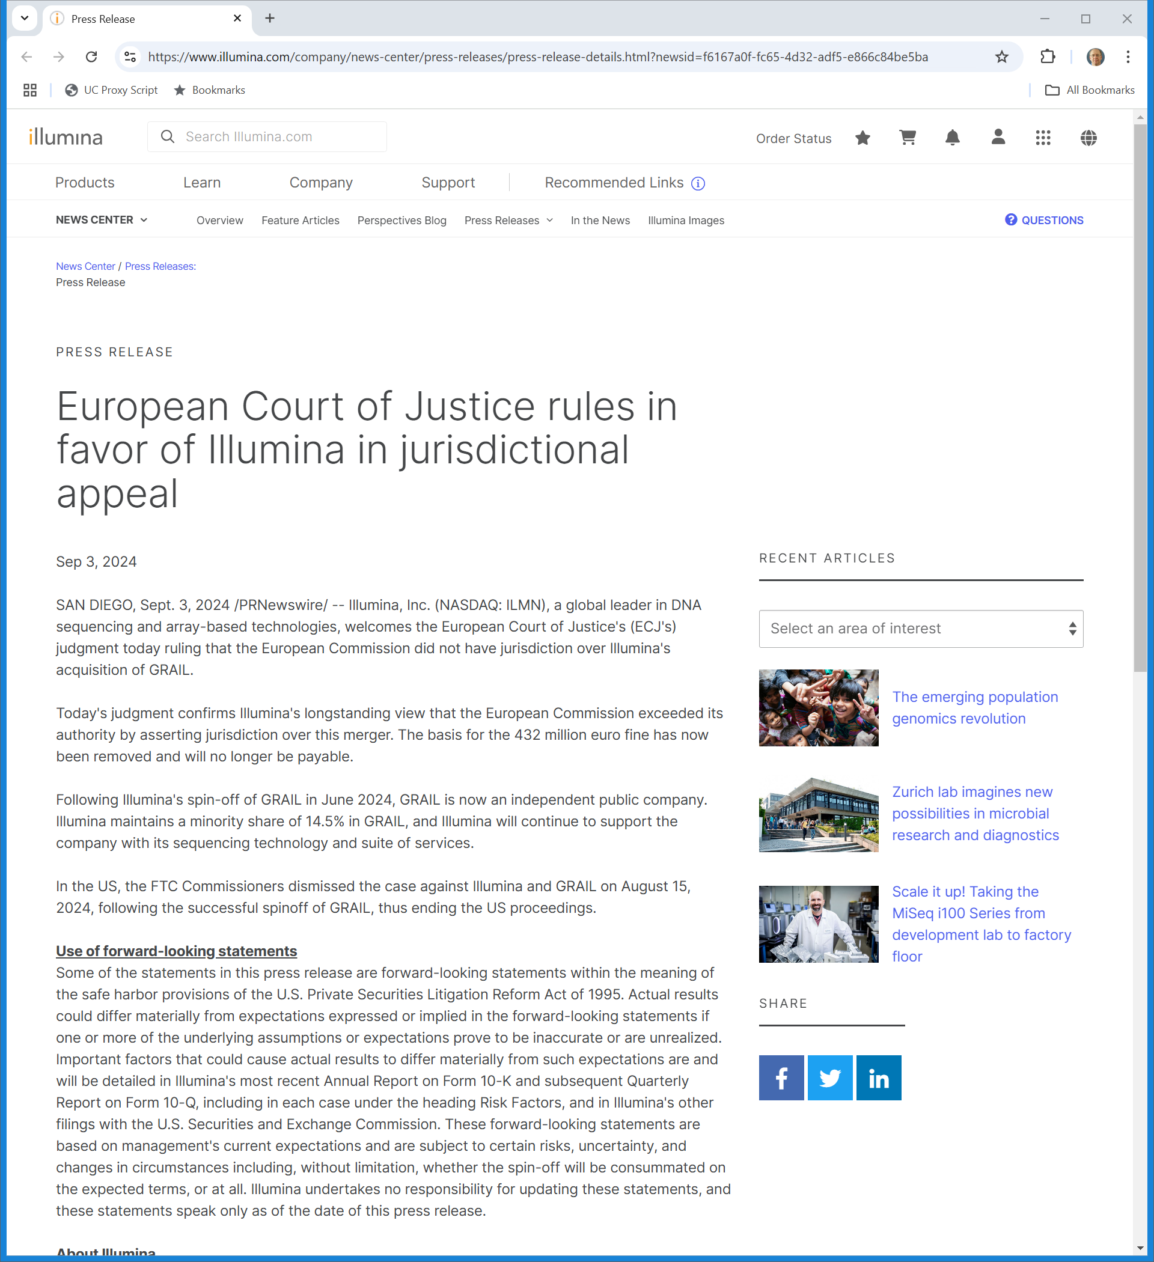
Illumina Statement
Illumina (3 Sept 2024)
Notes:
https://www.illumina.com/company/news-center/press-releases/press-release-details.html?newsid=f6167a0f-fc65-4d32-adf5-e866c84be5ba

Slide 78
Licensing the NGS Platform Answers
Hypo 1
  Individual firm has no general duty to deal
Hypo 2
  Presence of wholly-owned sub shouldn’t change this (Copperweld)

Slide 79
Licensing the NGS Platform Answers
Hypo 3
  Need to not get confused about exclusivity here
  Firm is offering exclusive license to tech, meaning licensee knows that it won’t face competitors
  Firm isn’t insisting that licensee not use tech that competes with firm’s tech
  That might raise CA3 issues but as licensor firm doesn’t face competition for its tech, it doesn’t need to negotiate for that type of exclusivity

Slide 80
Licensing the NGS Platform Answers
Hypo 4
  That is actually the case itself and raises the foreclosure issues that are present there

