Slide 1
Class 12: Thurs 23 Oct 2025
Antitrust Fall 2025
M&A: Potential/Nascent Comp
Randal C. Picker
James Parker Hall Distinguished Service Professor of Law
The Law School
The University of Chicago
Copyright © 2000-25 Randal C. Picker. All Rights Reserved.

Slide 2
Today’s Issues
Nascent Competition
  What is it?
  Does it matter?

Slide 3
Today’s Issues
Actual Potential Competition
  Firm X wants to buy firm Y: Is firm X [likely] to enter the market if it doesn’t buy firm Y?
  If so, if we allow the deal, we lose the chance to have firm X enter the market on its own

Slide 4
Today’s Issues
Perceived Potential Competition
  Firm X wants to buy firm Y: Is firm X seen by others in the market as [likely] to enter the market if it doesn’t buy firm Y and does that change the behavior of those other firms today?
  If so, if we allow the deal, we lose the competitive pressure that firm X’s presence is currently exerting on the market

Slide 5
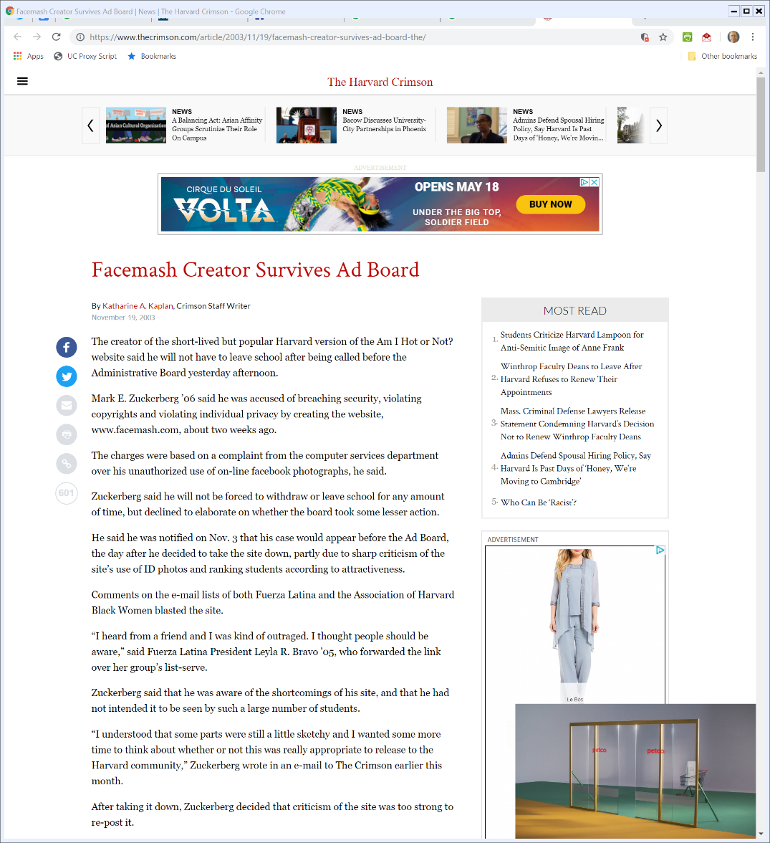
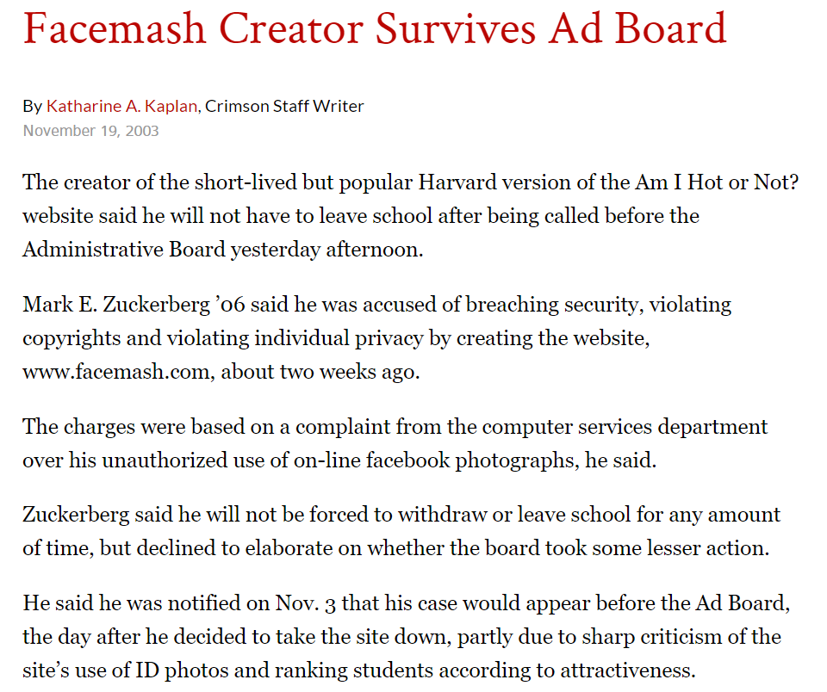
Facemash
Harvard Crimson (19 Nov 2003)
Notes:
https://www.thecrimson.com/article/2003/11/19/facemash-creator-survives-ad-board-the/

Slide 6
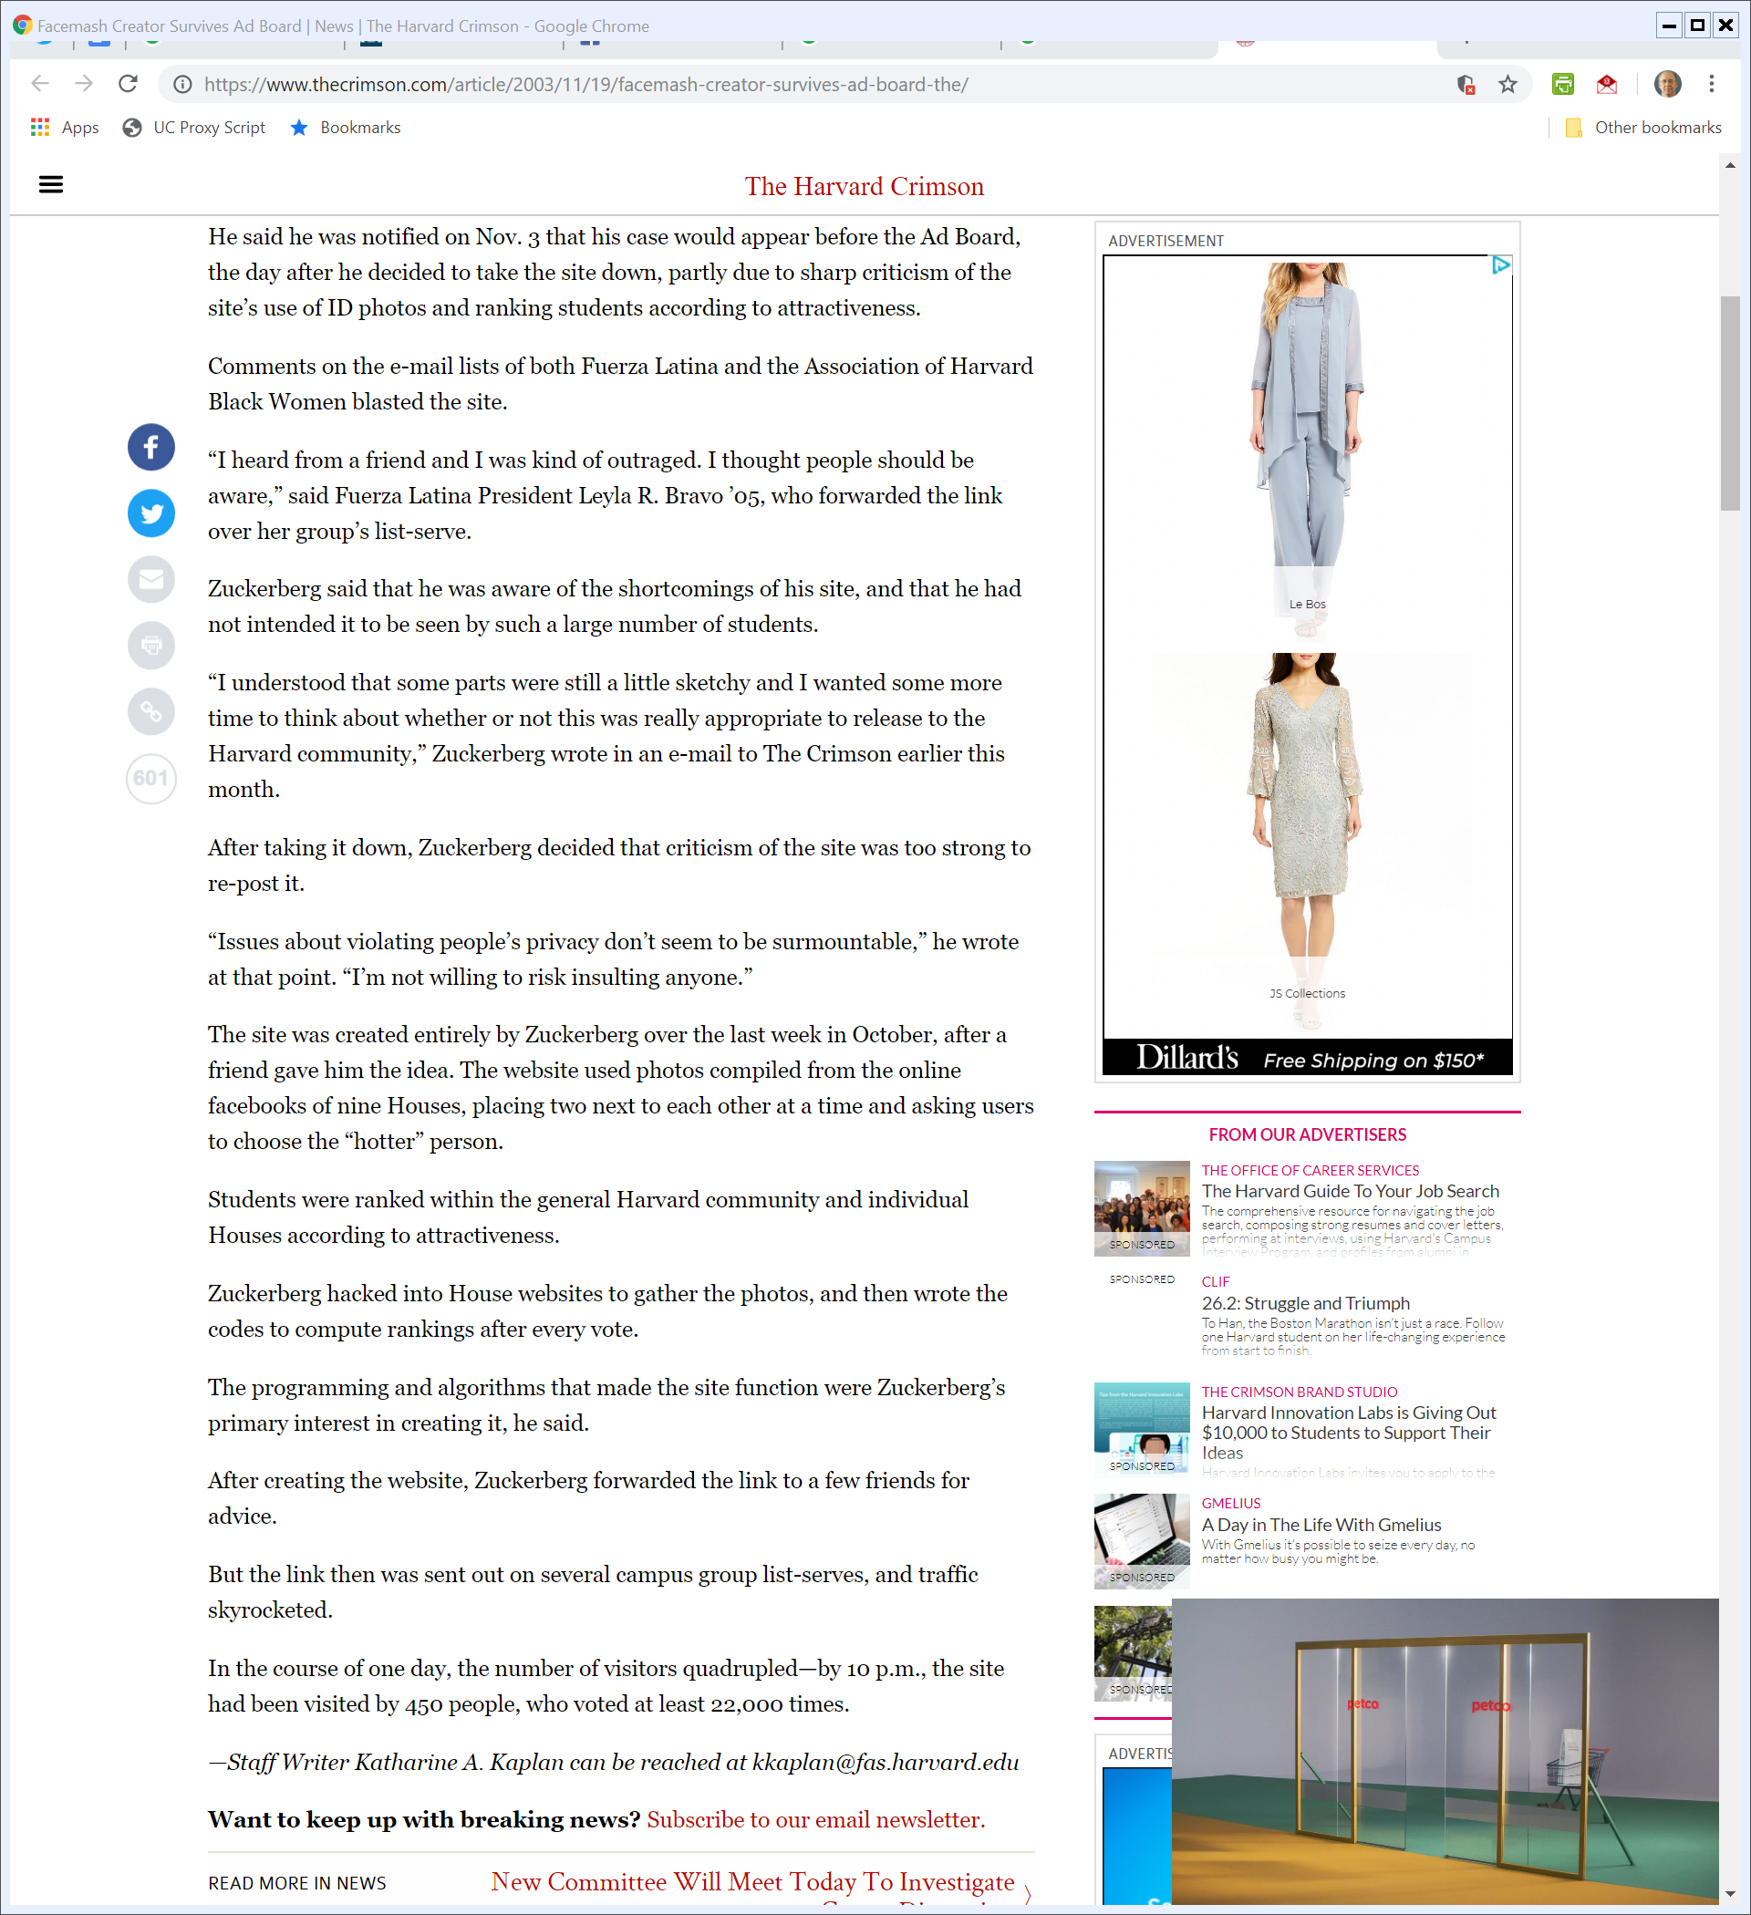
No Insults
Harvard Crimson (19 Nov 2003)

Slide 7
Virality
Harvard Crimson (19 Nov 2003)

Slide 8
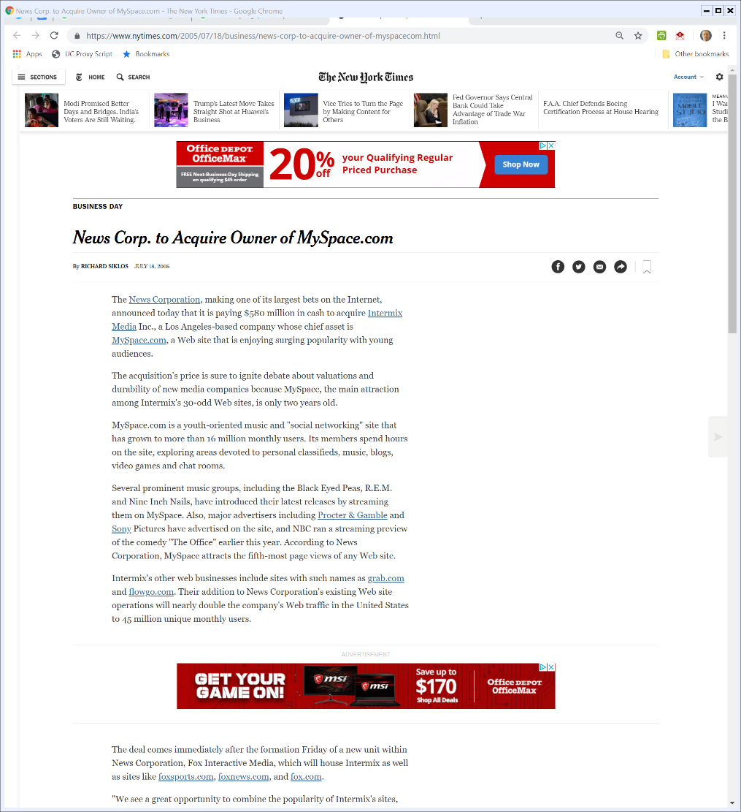

2005: News Corp MySpace Buy
NYT (18 July 2005)
Notes:
https://www.nytimes.com/2005/07/18/business/news-corp-to-acquire-owner-of-myspacecom.html

Slide 9
16 Million Monthly Users
NYT (18 July 2005)
Notes:
https://www.nytimes.com/2005/07/18/business/news-corp-to-acquire-owner-of-myspacecom.html

Slide 10
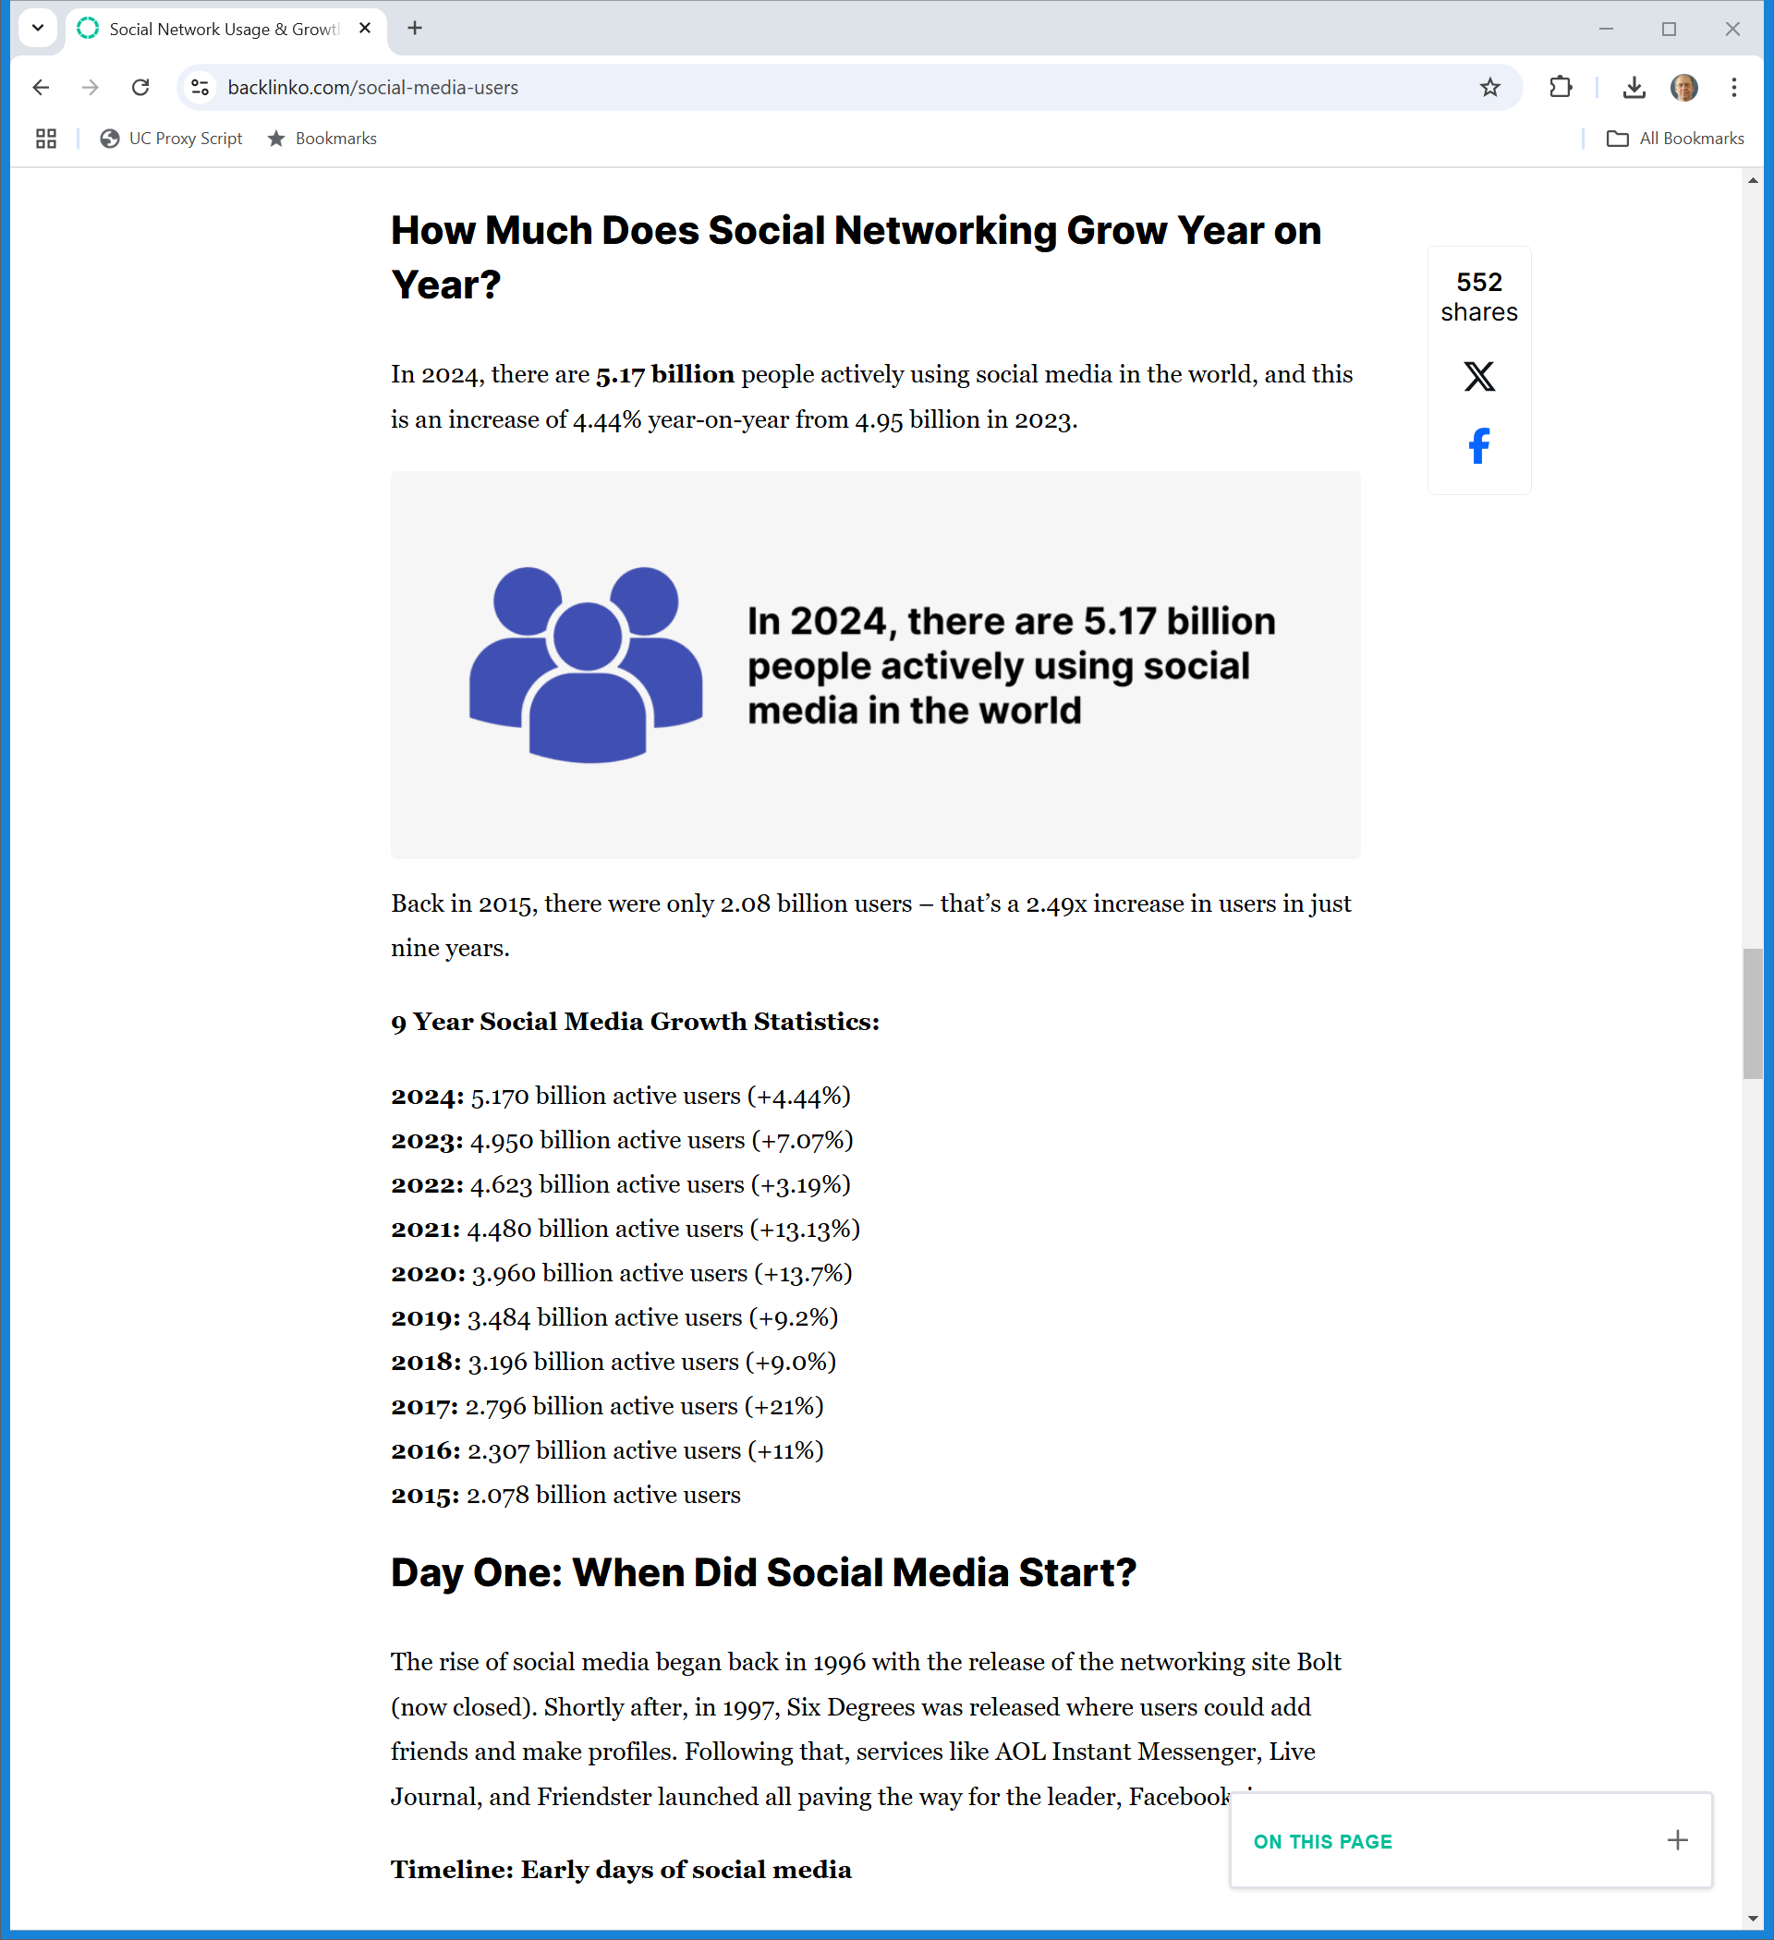
Jump Ahead: Understanding Nascency
Backlinko.com (Visited 28 Oct 2024)
Notes:
https://backlinko.com/social-media-users

Slide 11
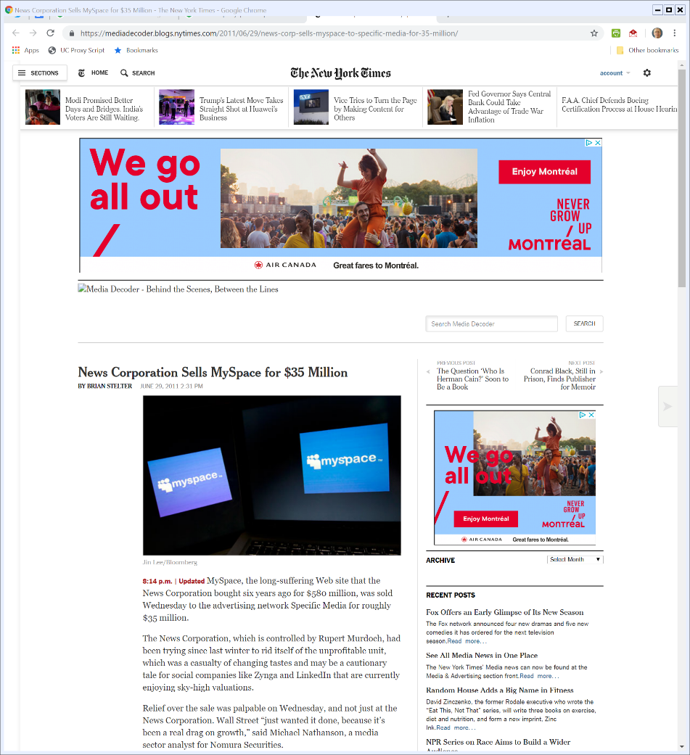

2011: Sale of MySpace
NYT (29 June 2011)
Notes:
https://mediadecoder.blogs.nytimes.com/2011/06/29/news-corp-sells-myspace-to-specific-media-for-35-million/

Slide 12
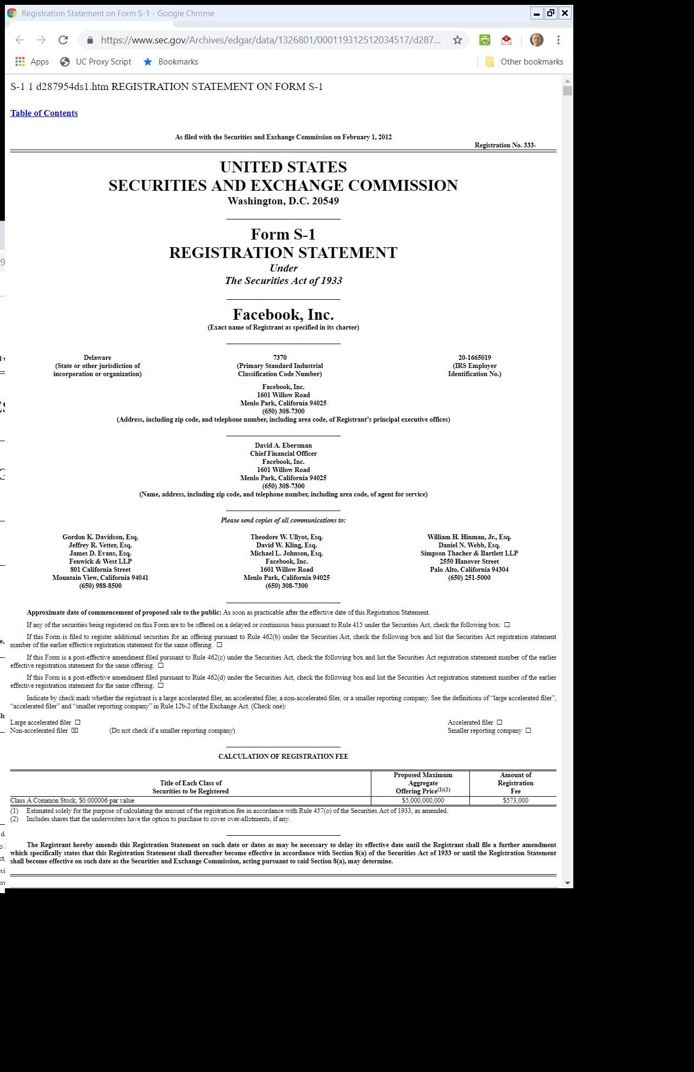
Facebook IPO
Facebook S1 (1 Feb 2012)

Slide 13
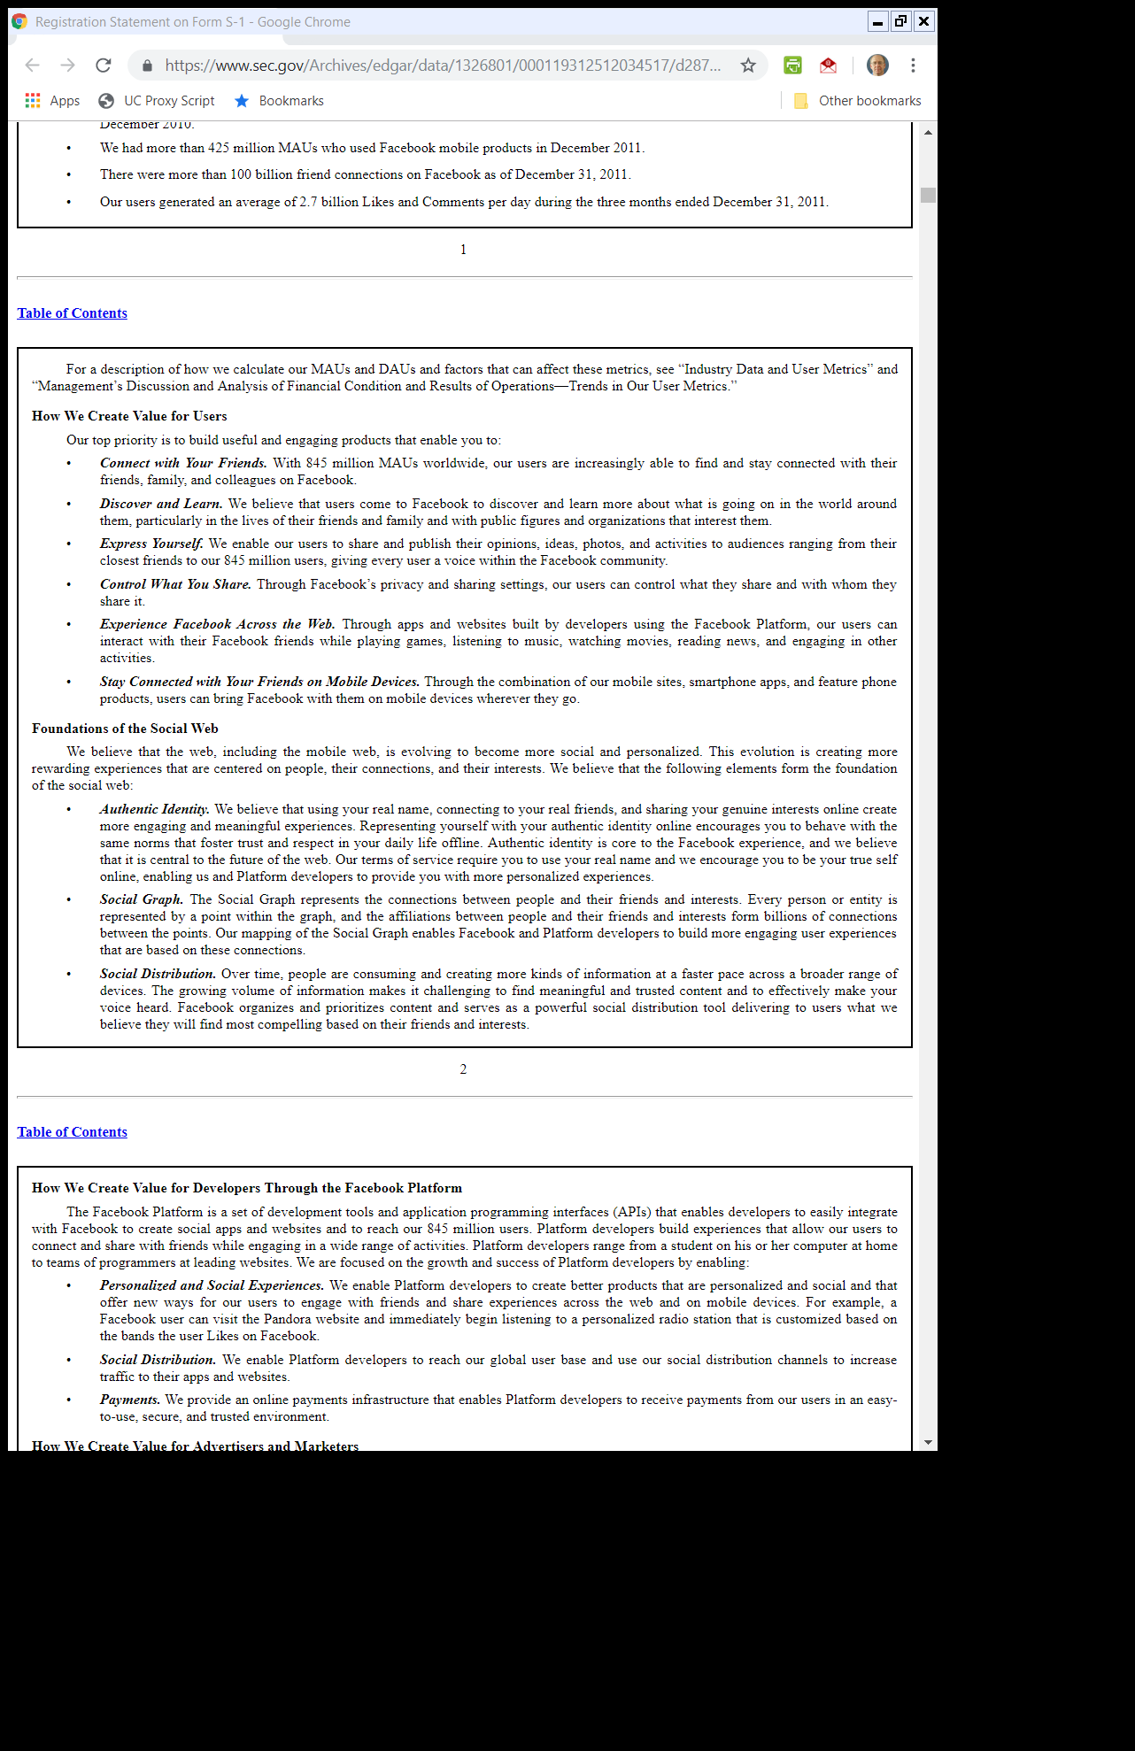
Facebook IPO: Core Mechanism
Facebook S1 (1 Feb 2012)

Slide 14
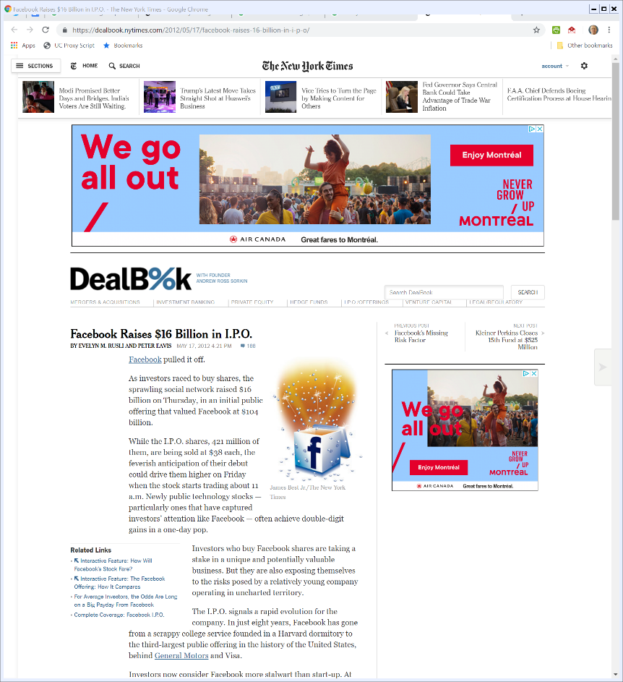

17 May 2012: Facebook IPO
NYT(17 May 2012)
Notes:
https://dealbook.nytimes.com/2012/05/17/facebook-raises-16-billion-in-i-p-o/

Slide 15
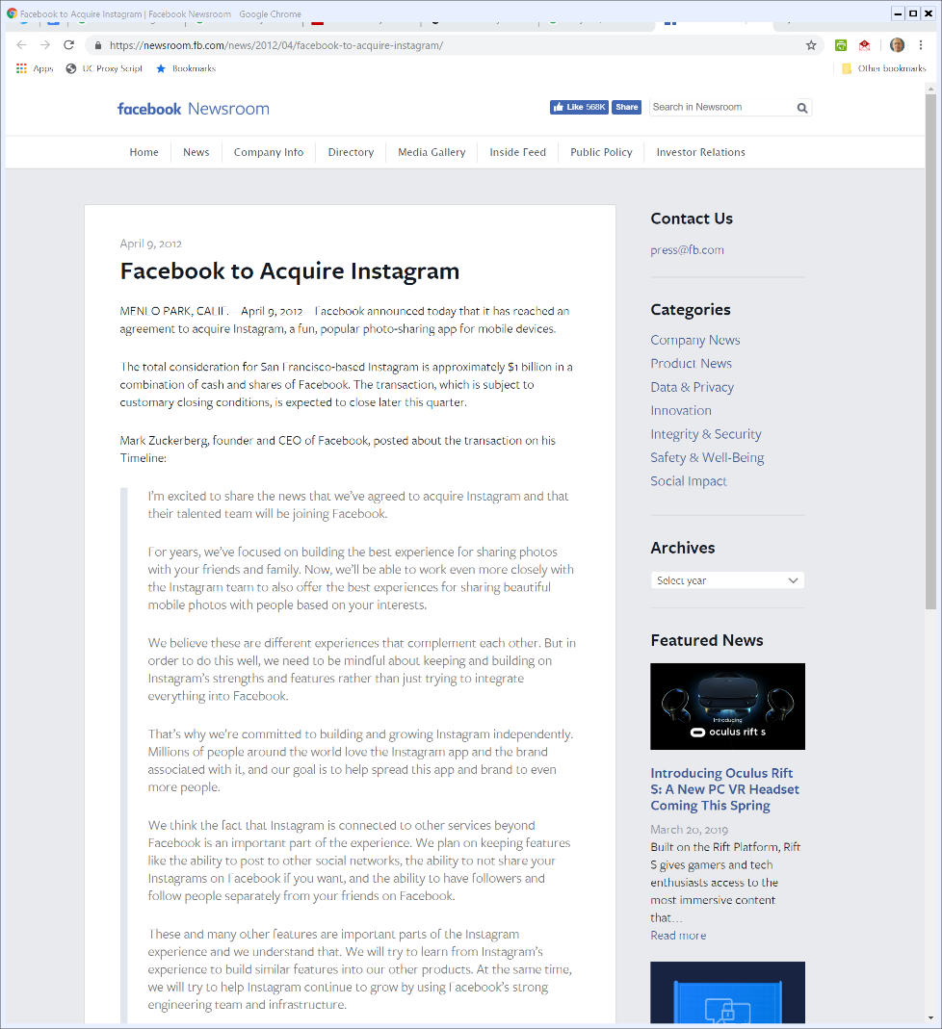

9 Apr 2012: FB Buys Instagram
Facebook PR (9 Apr 2012)
Notes:
https://newsroom.fb.com/news/2012/04/facebook-to-acquire-instagram/

Slide 16
Network Links?
Facebook PR (9 Apr 2012)
Notes:
https://newsroom.fb.com/news/2012/04/facebook-to-acquire-instagram/

Slide 17
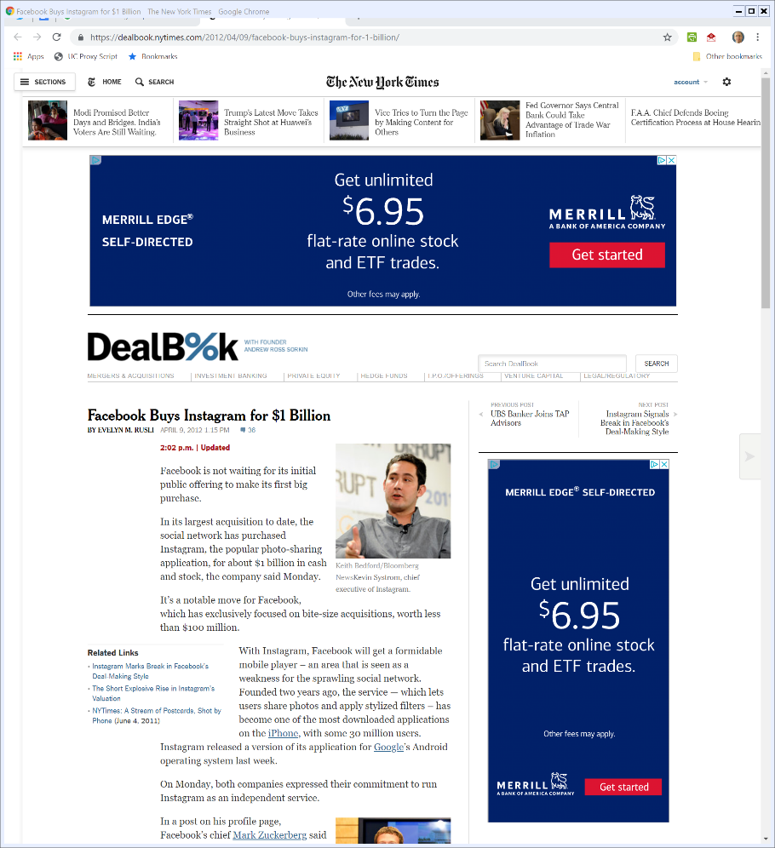

$1 Billion
NYT (9 Apr 2012)
Notes:
https://dealbook.nytimes.com/2012/04/09/facebook-buys-instagram-for-1-billion/

Slide 18
Mark Z: Thinking about Buying IG (TTYN (1 of 5))
Internal FB Emails (Feb 2012)

Slide 19
David E (FB CFO): Why? (TTYN (2 of 5))
Internal FB Emails (Feb 2012)

Slide 20
Limited Number of Social Dynamics (TTYN (3 of 5))
Internal FB Emails (Feb 2012)

Slide 21
Didn’t Mean to Say We Would be Eliminating Competitors (TTYN (4 of 5))
Internal FB Emails (Feb 2012)

Slide 22
Reading the Emails
TTYN (5 of 5)
Questions
  What do these emails say regarding why FB wanted to buy IG?
  Had the FTC had them, how should that have mattered for how they saw the deal?

Slide 23
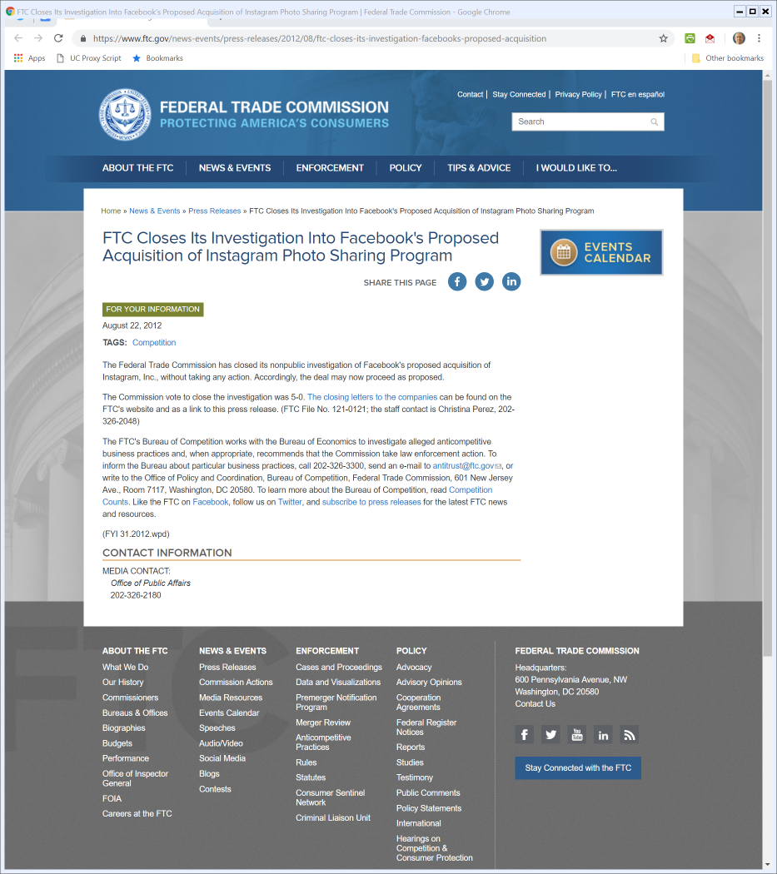

FTC Instagram Review
22 Aug 2012
Notes:
https://www.ftc.gov/news-events/press-releases/2012/08/ftc-closes-its-investigation-facebooks-proposed-acquisition

Slide 24
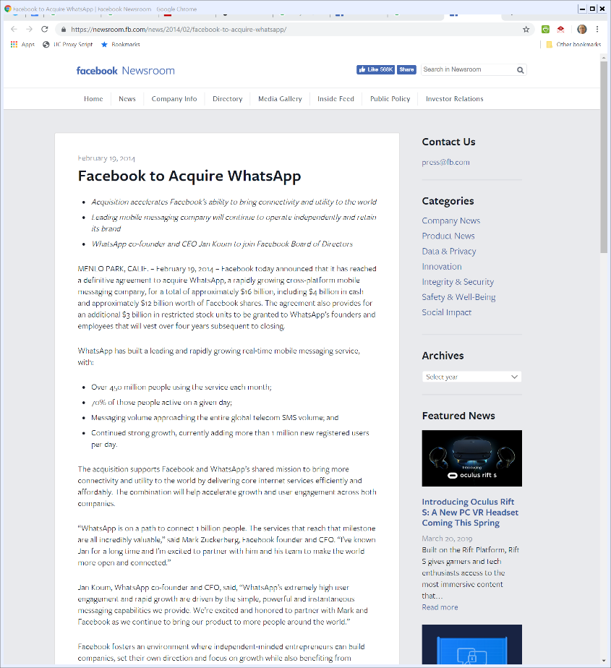

Feb 2014: FB Buys WhatsApp for $16B
Facebook PR (19 Feb 2014)
Notes:
https://newsroom.fb.com/news/2014/02/facebook-to-acquire-whatsapp/

Slide 25
Feb 2014: FB Buys WhatsApp for $16B
Facebook PR (19 Feb 2014)
Notes:
https://newsroom.fb.com/news/2014/02/facebook-to-acquire-whatsapp/

Slide 26
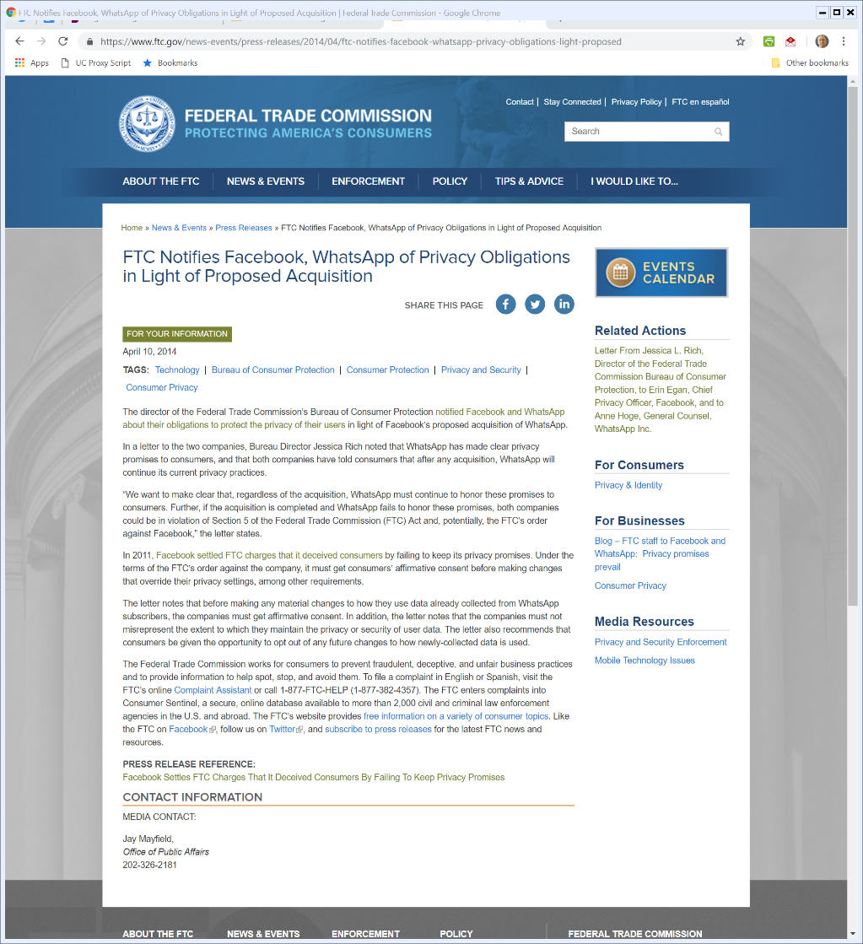

FTC WhatsApp Review
10 Apr 2014
Notes:
https://www.ftc.gov/news-events/press-releases/2014/04/ftc-notifies-facebook-whatsapp-privacy-obligations-light-proposed

Slide 27
EU on FB/WhatsApp: Not Close Competitors
EU Press Release (3 Oct 2014)
Notes:
https://ec.europa.eu/commission/presscorner/detail/en/MEX_14_1003

Slide 28
FB and WhatsApp Not Social Network Competitors
EU Press Release (3 Oct 2014)

Slide 29
Data Concentration Not a Problem
EU Press Release (3 Oct 2014)

Slide 30
Privacy Outside of EU Competition Law
EU Press Release (3 Oct 2014)

Slide 31
How Much Should You Pay?
TTYN (1 of 3)
Hypo
  Company Y is worth $100 million based on the cash flows that it can generate over time
  Company X believes that it could turn Y into something worth $2 billion if it owned X
  Company F believes that it could turn Y into something worth at least $5 billion if it owned F

Slide 32
How Much Should You Pay?
TTYN (2 of 3)
Questions
  Should the owners of Y sell the company?
  How much should X being willing to pay for Y? F?
  Who will end up owning Y and at what price?
  Would it matter if Y could only produce on its own a value of $10 million? 0?

Slide 33
Facebook Deals
TTYN (3 of 3)
Replay Them
  How should the antitrust/competition authorities have seen these deals?
  Which of the deals should been blocked and on what basis?

Slide 34
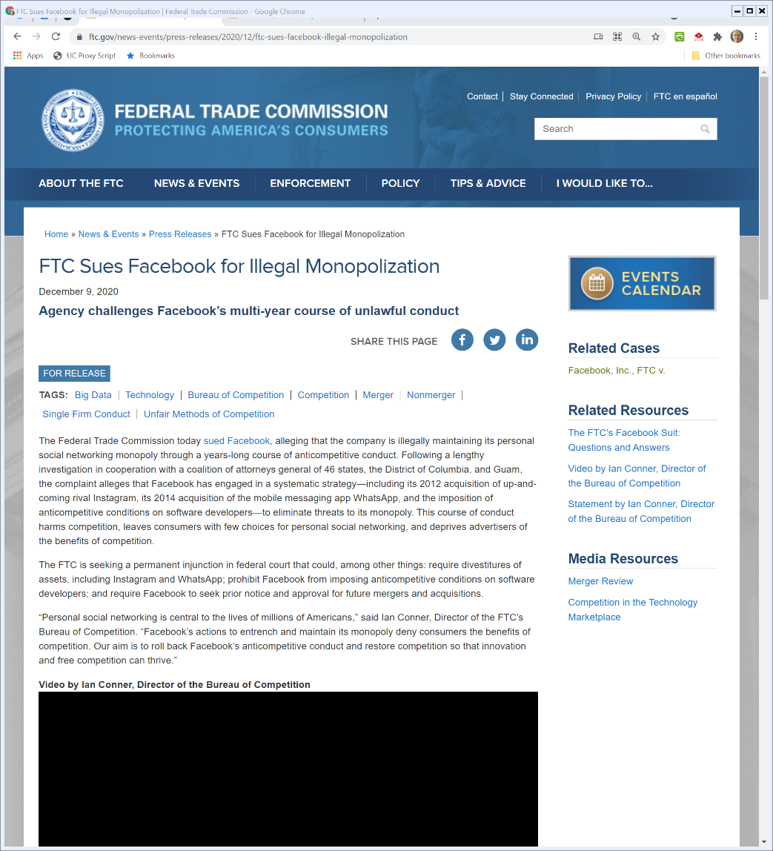

9 Dec 2020: FTC Monopolization Case v FB
FTC.gov (9 Dec 2020)
Notes:
https://www.ftc.gov/news-events/press-releases/2020/12/ftc-sues-facebook-illegal-monopolization

Slide 35
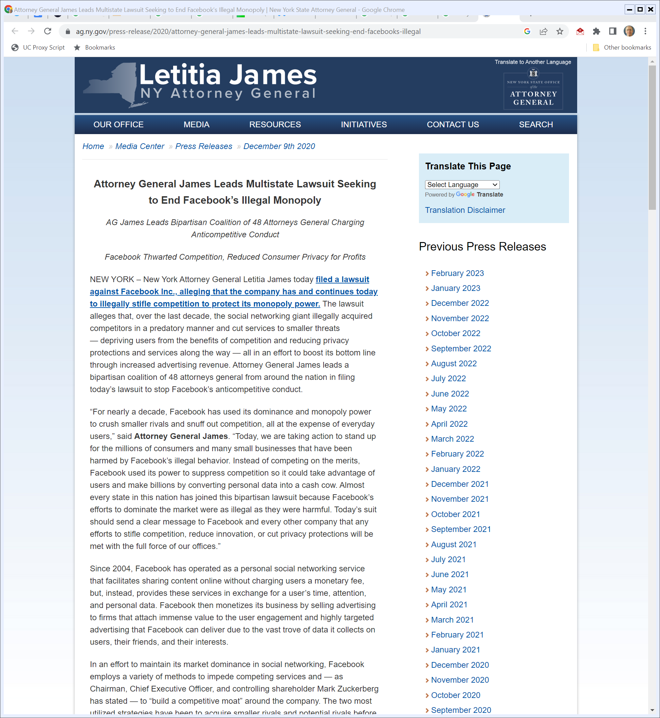
State FB Complaint
New York AG (9 Dec 2020)
Notes:
https://ag.ny.gov/press-release/2020/attorney-general-james-leads-multistate-lawsuit-seeking-end-facebooks-illegal

Slide 36
State FB Case Dismissed
State FB Case (28 June 2021)

Slide 37
Apr 2023: Affirmed
66 F.4th 288 (D.C. Cir. 2023)

Slide 38
FTC Complaint Dismissal
FTC FB Opinion (28 June 2021)

Slide 39
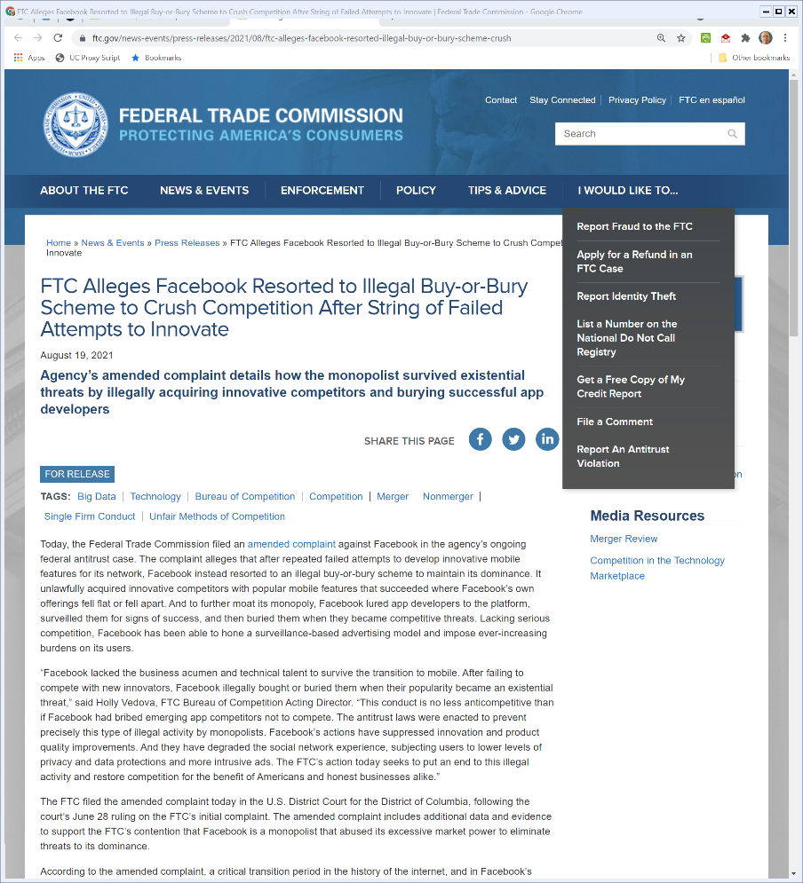
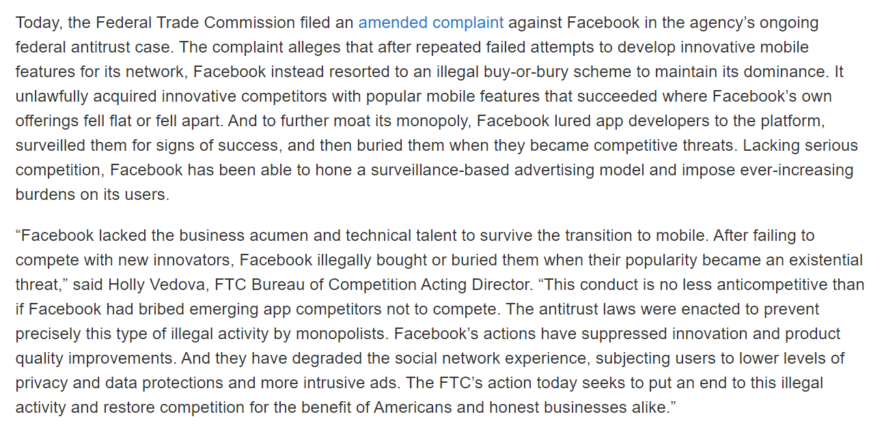
19 Aug 2021: Amended Complaint
FTC Amended Complaint (19 Aug 2021)
Notes:
https://www.ftc.gov/news-events/press-releases/2021/08/ftc-alleges-facebook-resorted-illegal-buy-or-bury-scheme-crush

Slide 40
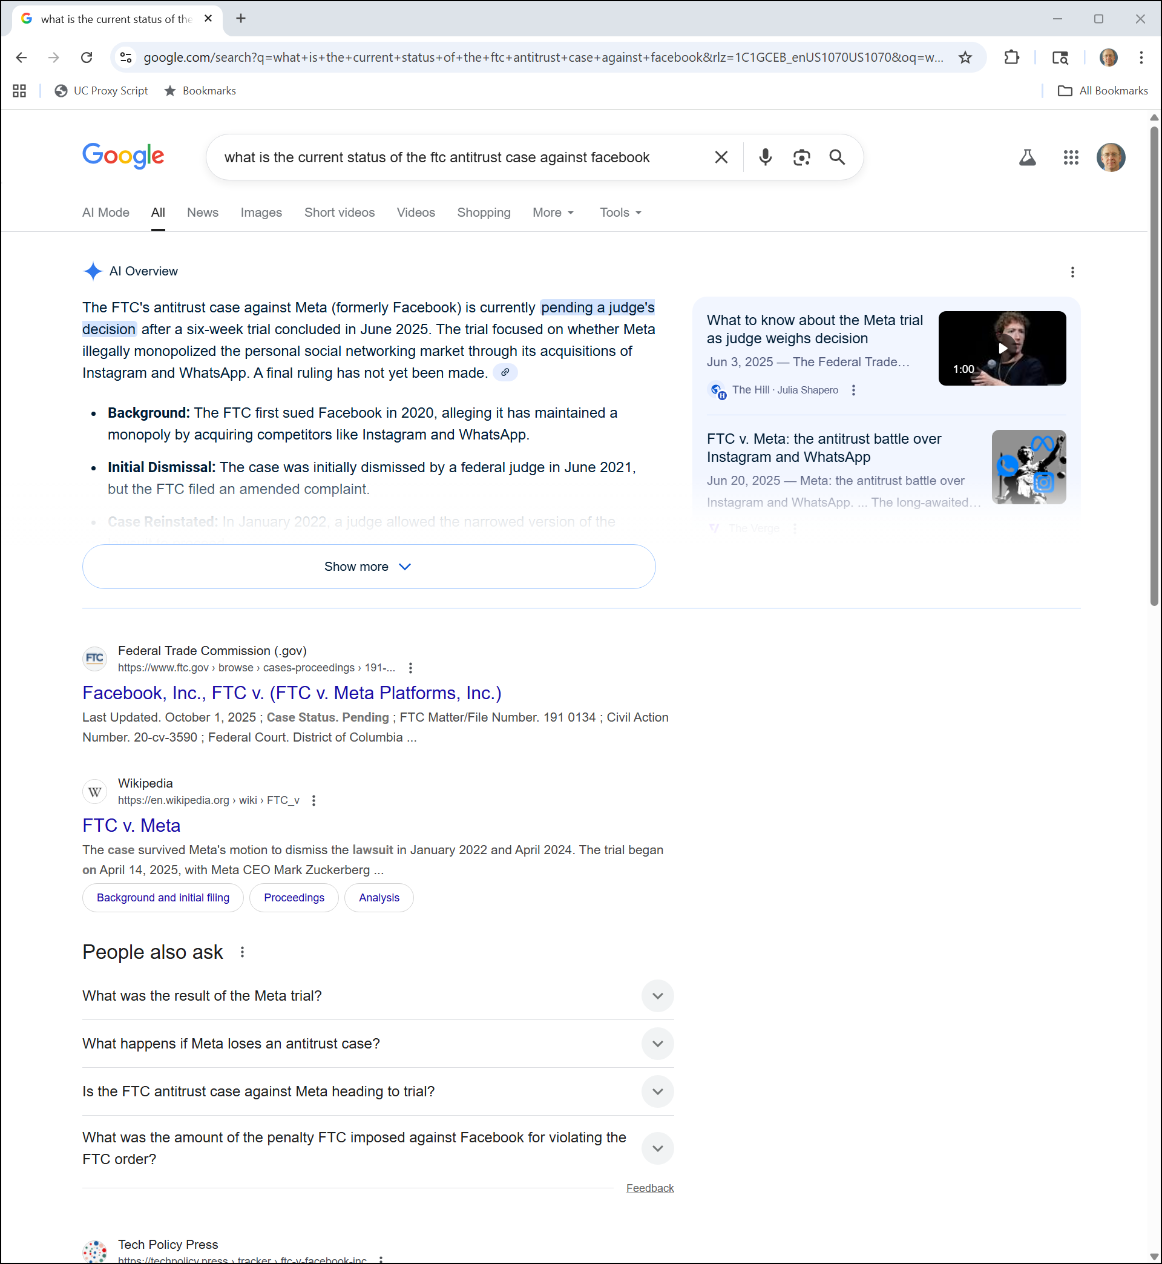
Current Status?
Google (23 Oct 2025)
Notes:
https://www.google.com/search?q=what+is+the+current+status+of+the+ftc+antitrust+case+against+facebook&rlz=1C1GCEB_enUS1070US1070&oq=what+is+the+current+status+of+the+ftc+antitrust+case+against+facebook&gs_lcrp=EgZjaHJvbWUyBggAEEUYOdIBCTE0OTUwajBqN6gCALACAA&sourceid=chrome&ie=UTF-8

Slide 41
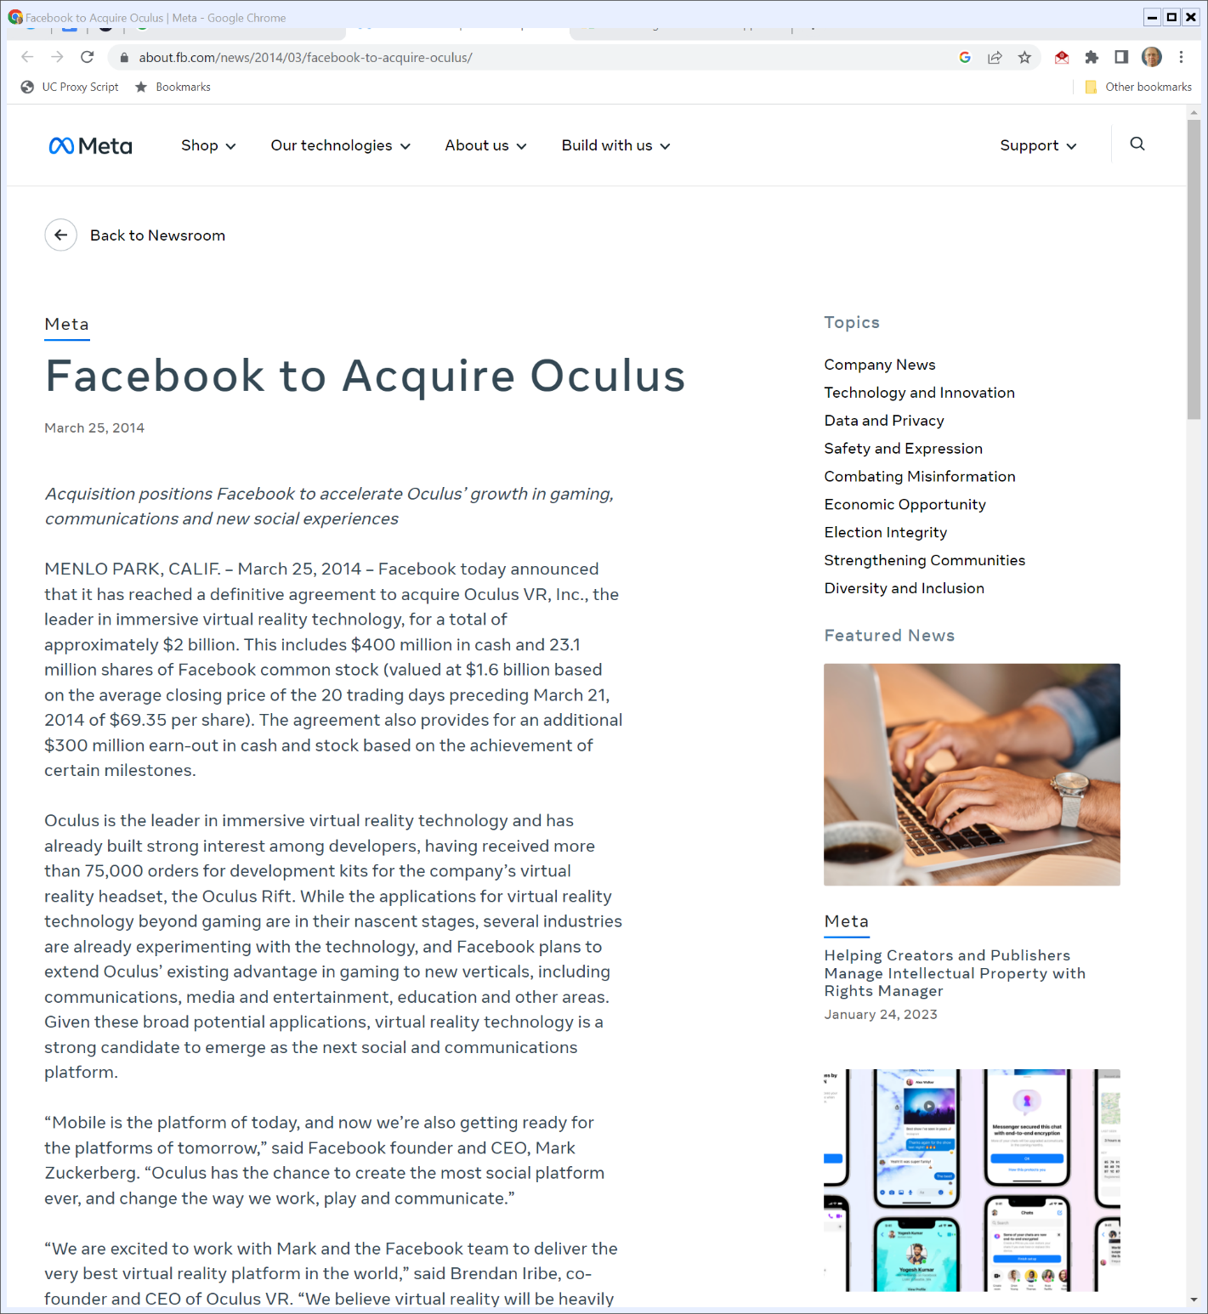

25 Mar 2014: FB Buys Oculus
Facebook PR (25 Mar 2014)
Notes:
https://about.fb.com/news/2014/03/facebook-to-acquire-oculus/

Slide 42
Tomorrow’s Platform
Facebook PR (25 Mar 2014)
Notes:
https://about.fb.com/news/2014/03/facebook-to-acquire-oculus/

Slide 43
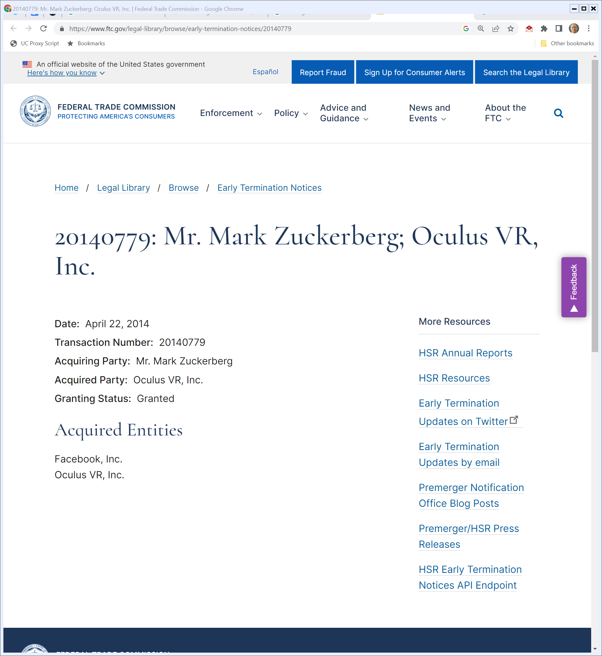
FTC: Nothing Here
FTC.gov (22 Apr 2014)
Notes:
https://www.ftc.gov/legal-library/browse/early-termination-notices/20140779

Slide 44
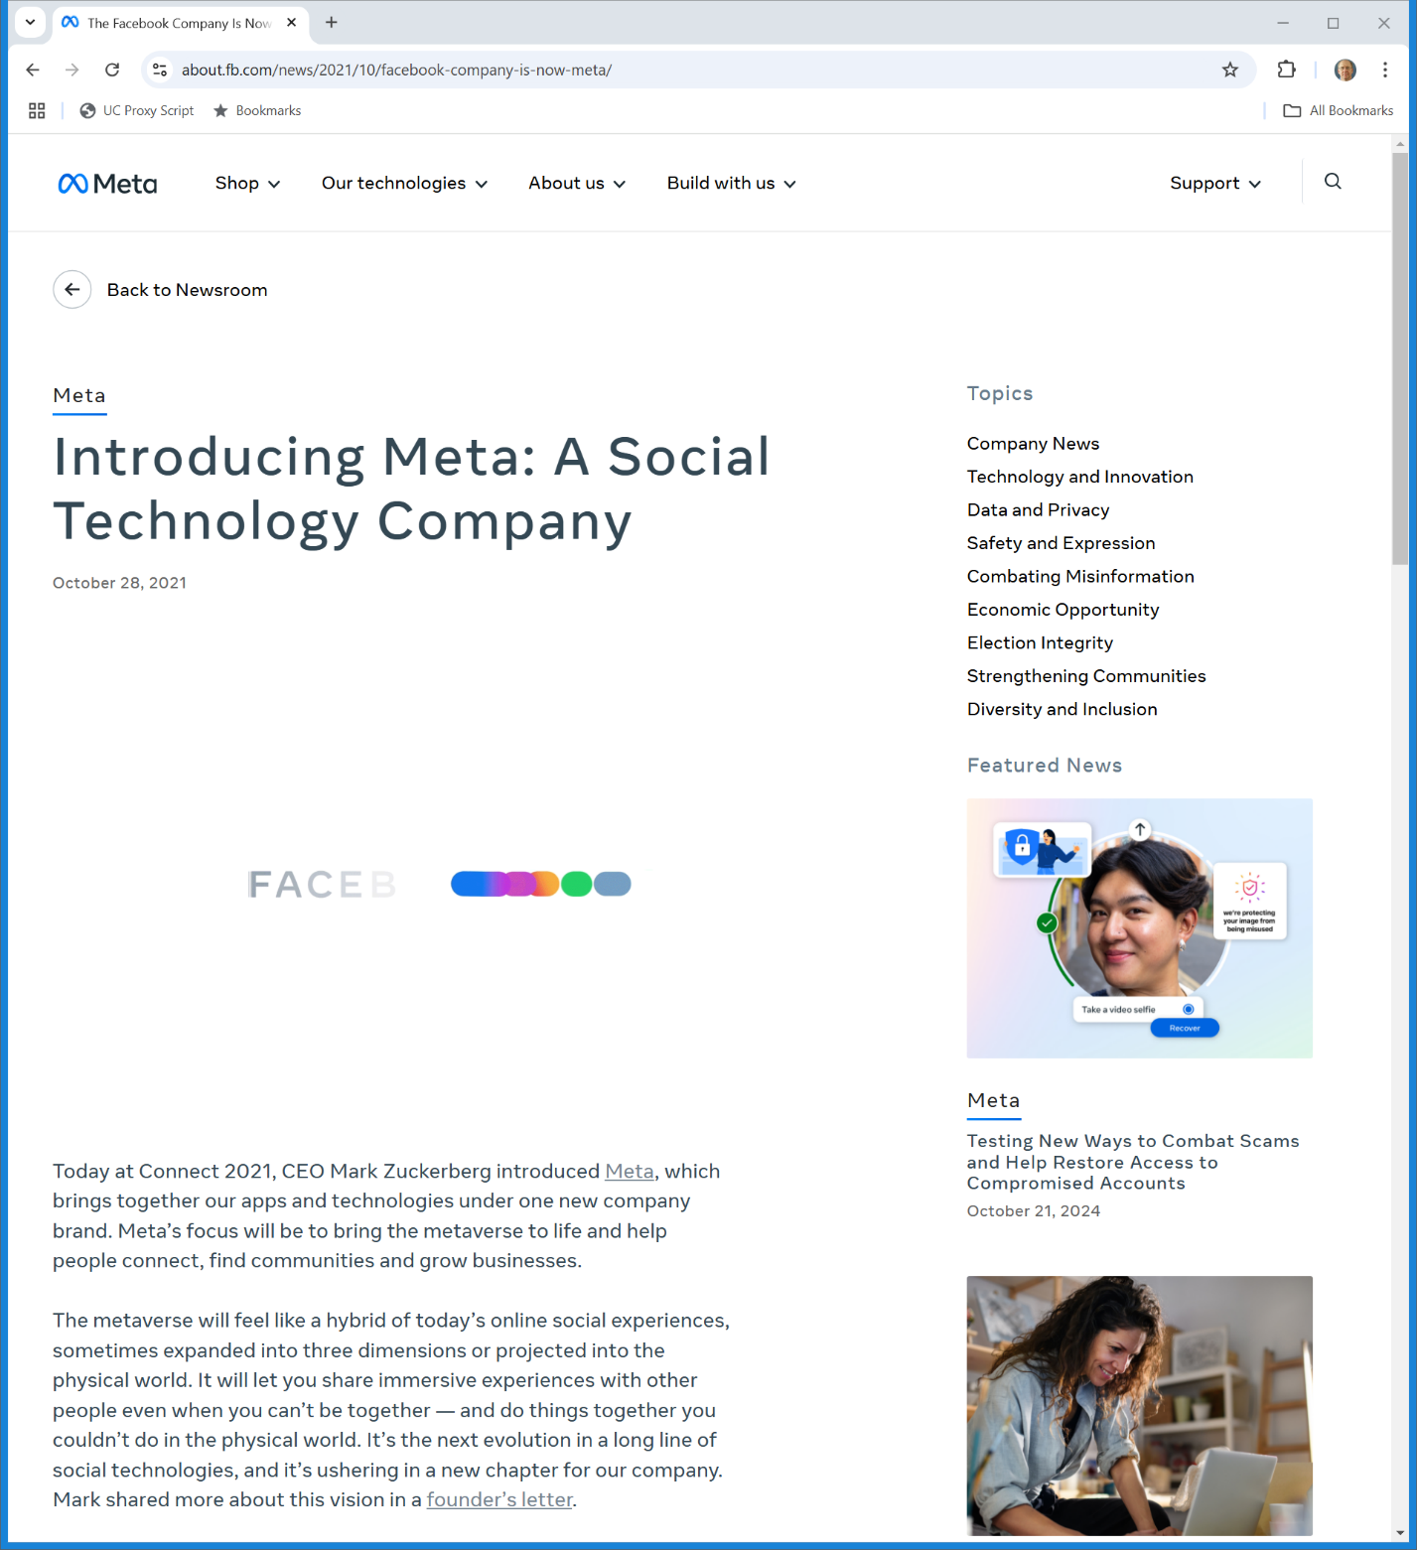

Four Years Ago: Meta
Fb.com (28 Oct 2021)
Notes:
https://about.fb.com/news/2021/10/facebook-company-is-now-meta/

Slide 45
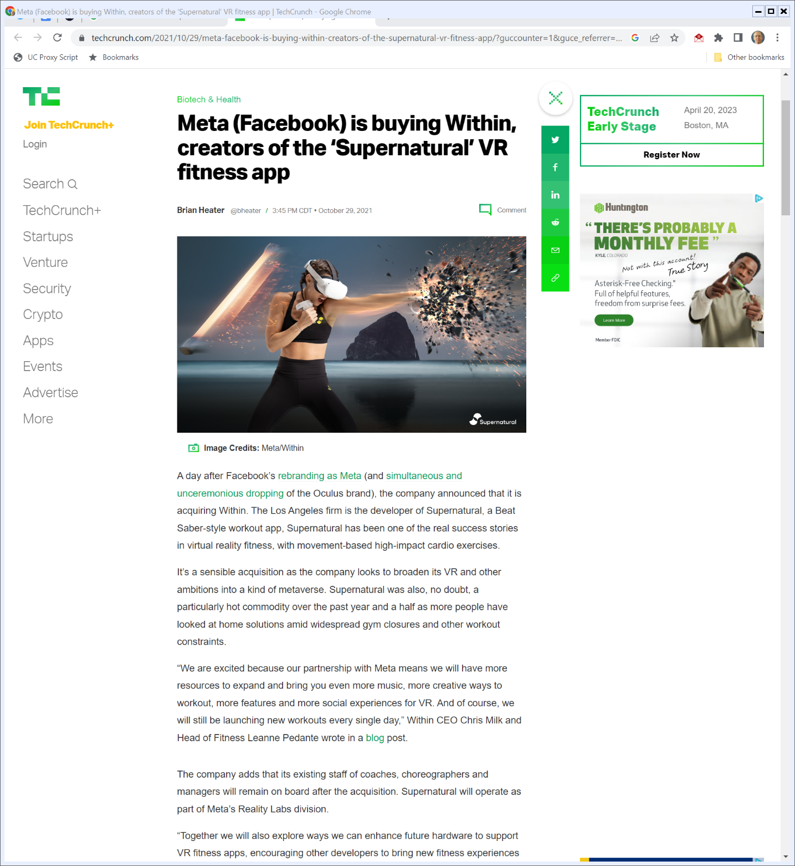
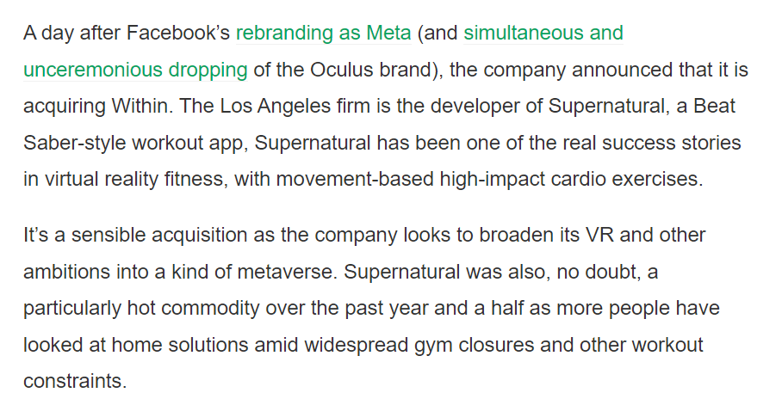
Meta Announces Within Deal
TechCrunch (29 Oct 2021)
Notes:
https://techcrunch.com/2021/10/29/meta-facebook-is-buying-within-creators-of-the-supernatural-vr-fitness-app/

Slide 46
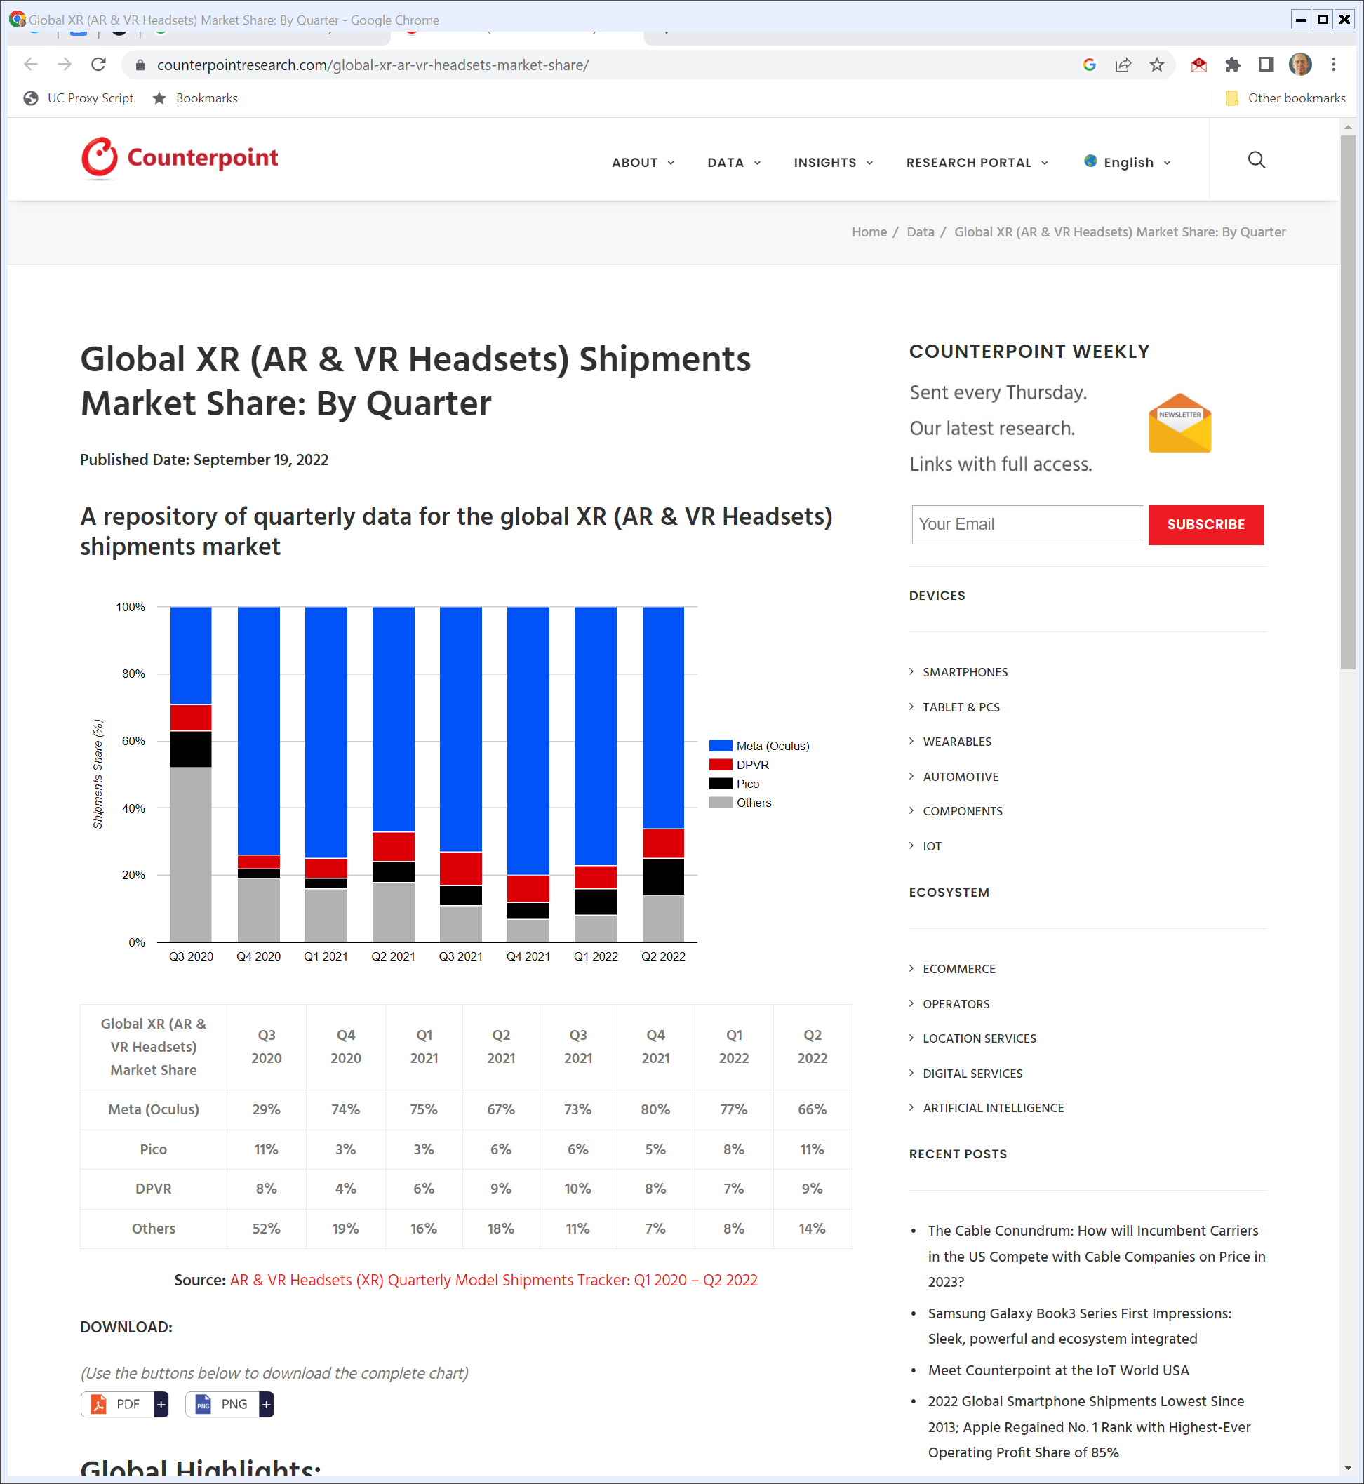
XR Market Shares
Counterpoint (19 Sept 2022)

Slide 47
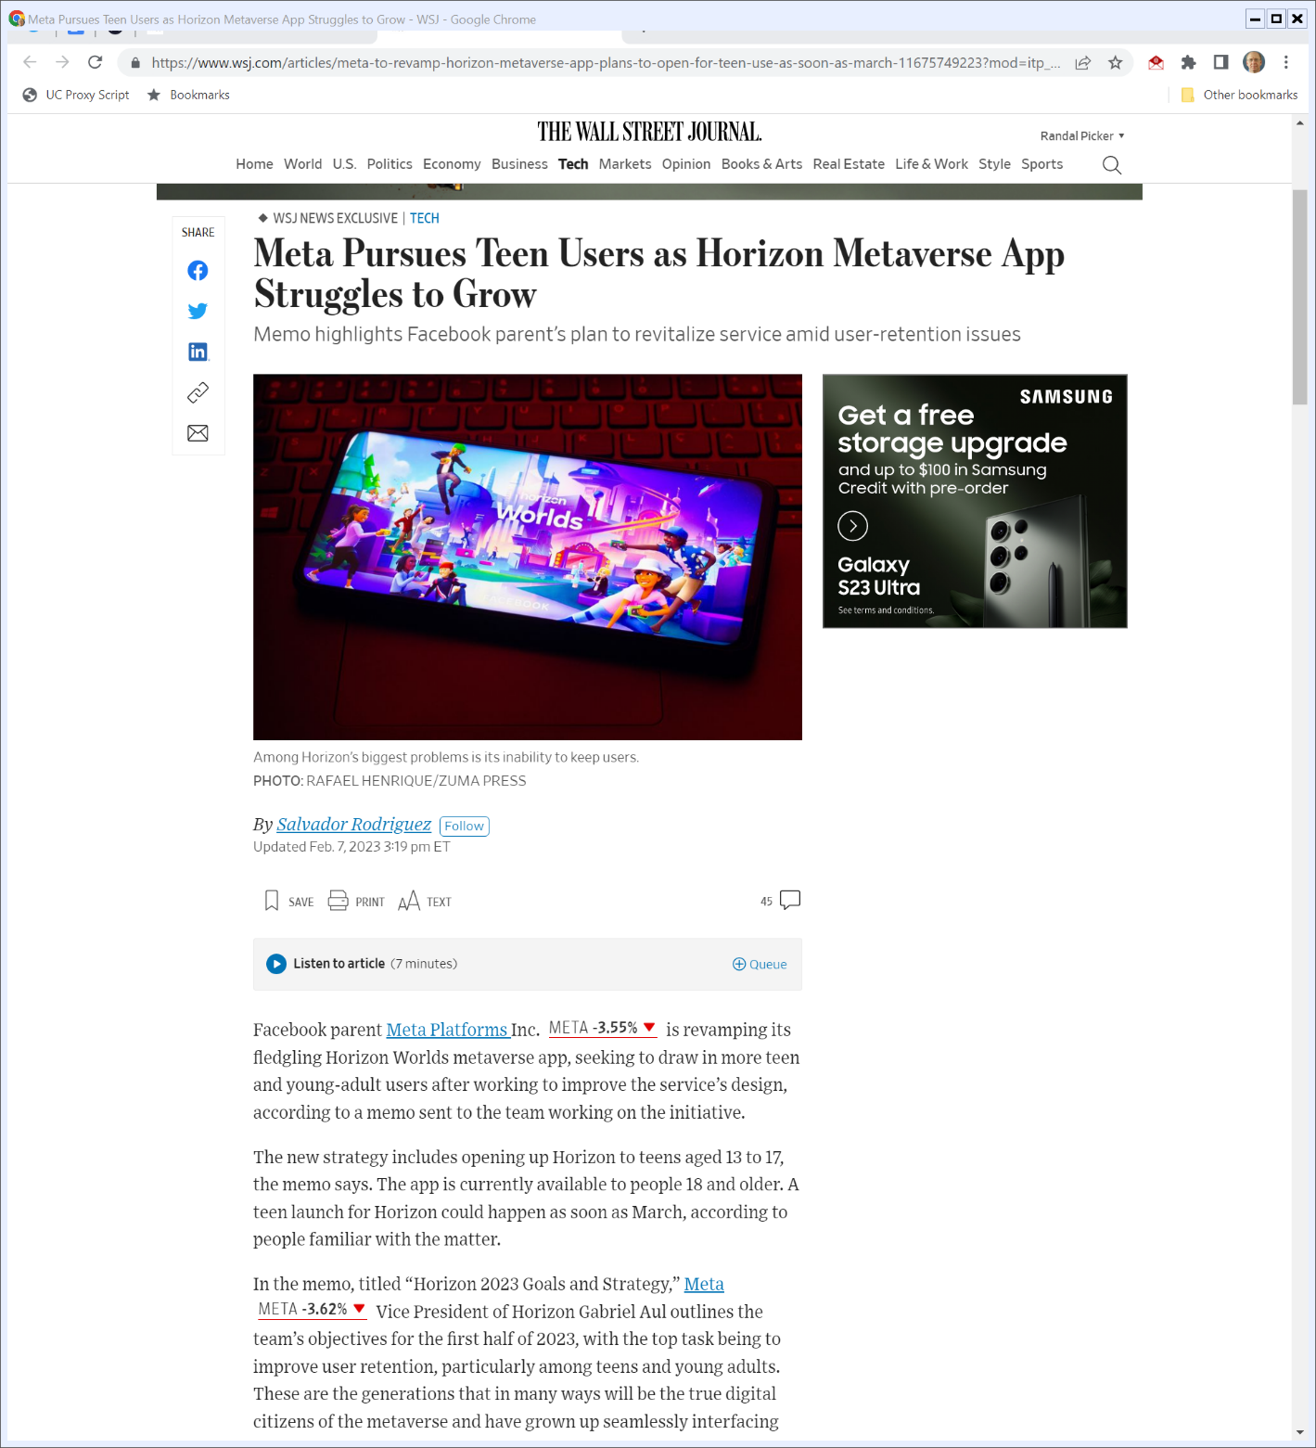
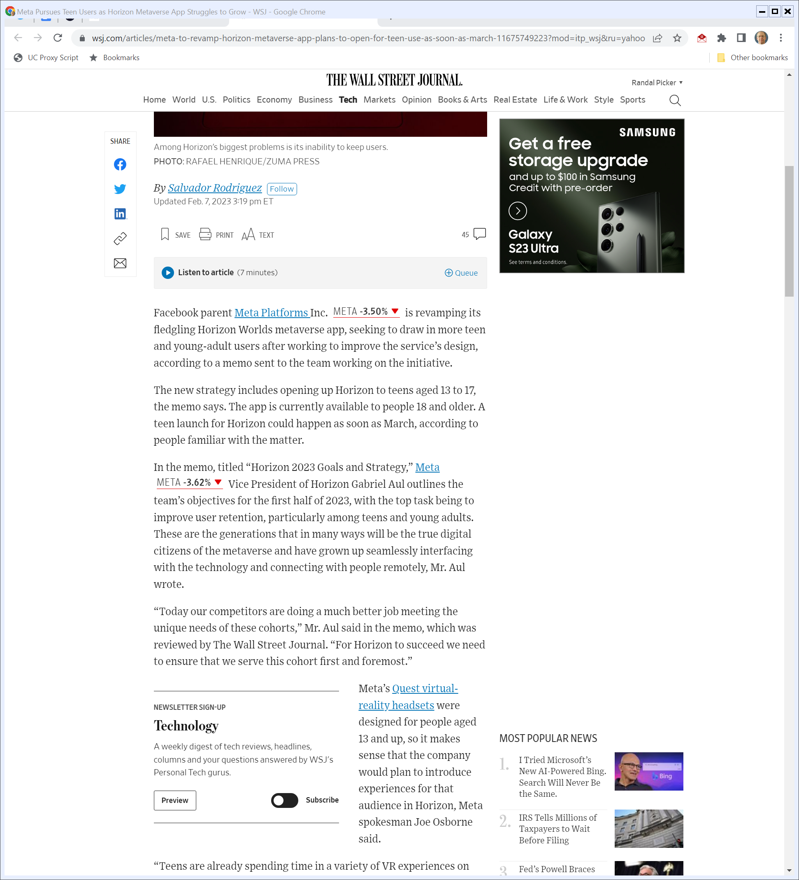
And How Is It Going for Meta?
The Wall Street Journal (7 Feb 2023)
Notes:
https://www.wsj.com/articles/meta-to-revamp-horizon-metaverse-app-plans-to-open-for-teen-use-as-soon-as-march-11675749223?mod=itp_wsj&ru=yahoo

Slide 48
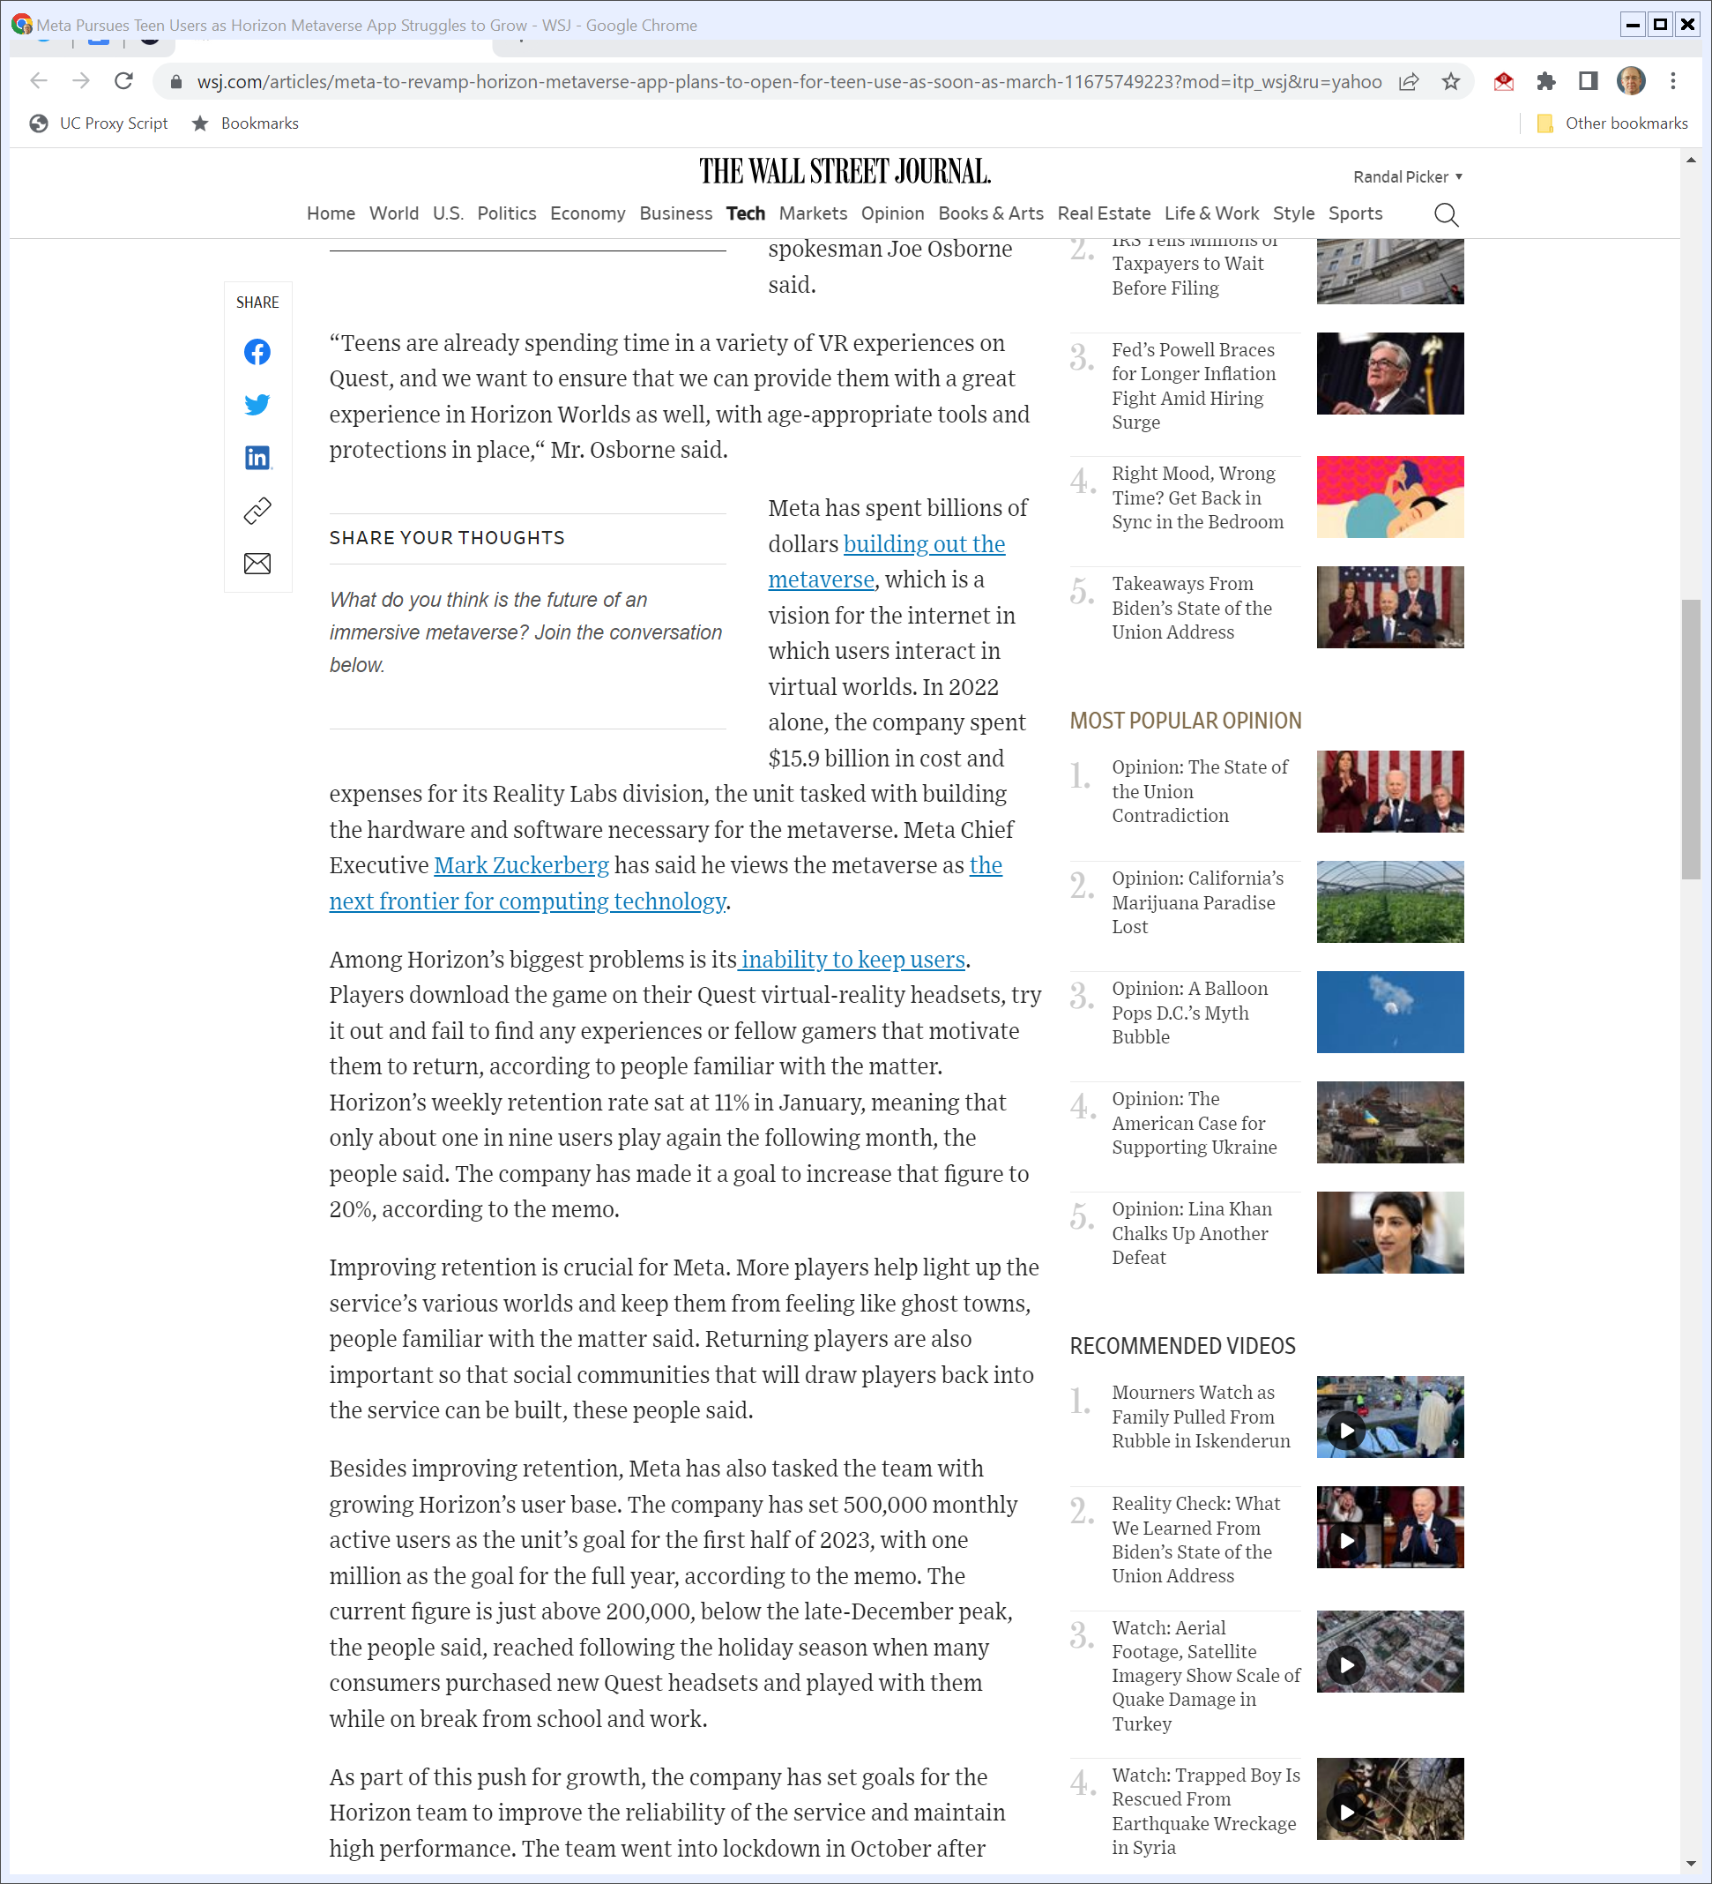
Spending Billions …
The Wall Street Journal (7 Feb 2023)
Notes:
https://www.wsj.com/articles/meta-to-revamp-horizon-metaverse-app-plans-to-open-for-teen-use-as-soon-as-march-11675749223?mod=itp_wsj&ru=yahoo

Slide 49

Getting Ghost Towns
The Wall Street Journal (7 Feb 2023)
Notes:
https://www.wsj.com/articles/meta-to-revamp-horizon-metaverse-app-plans-to-open-for-teen-use-as-soon-as-march-11675749223?mod=itp_wsj&ru=yahoo

Slide 50
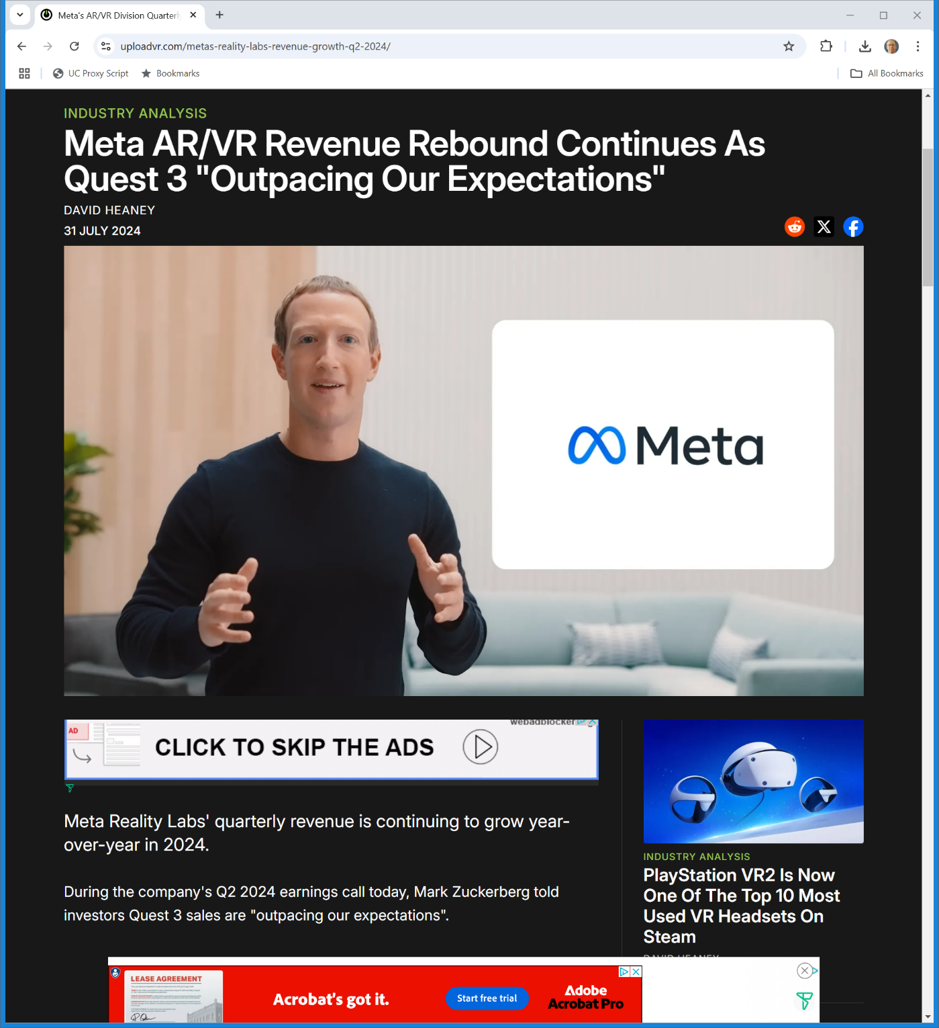
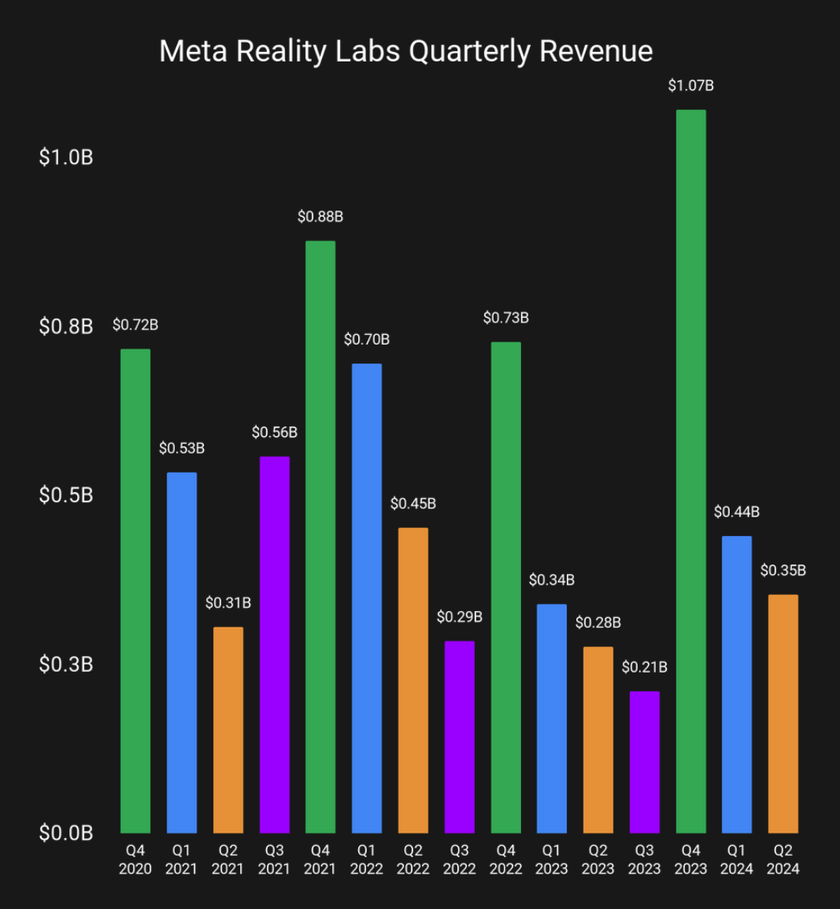
Meta VR Revenues
Uploadvr.com (31 July 2024)
Notes:
https://www.uploadvr.com/metas-reality-labs-revenue-growth-q2-2024/

Slide 51
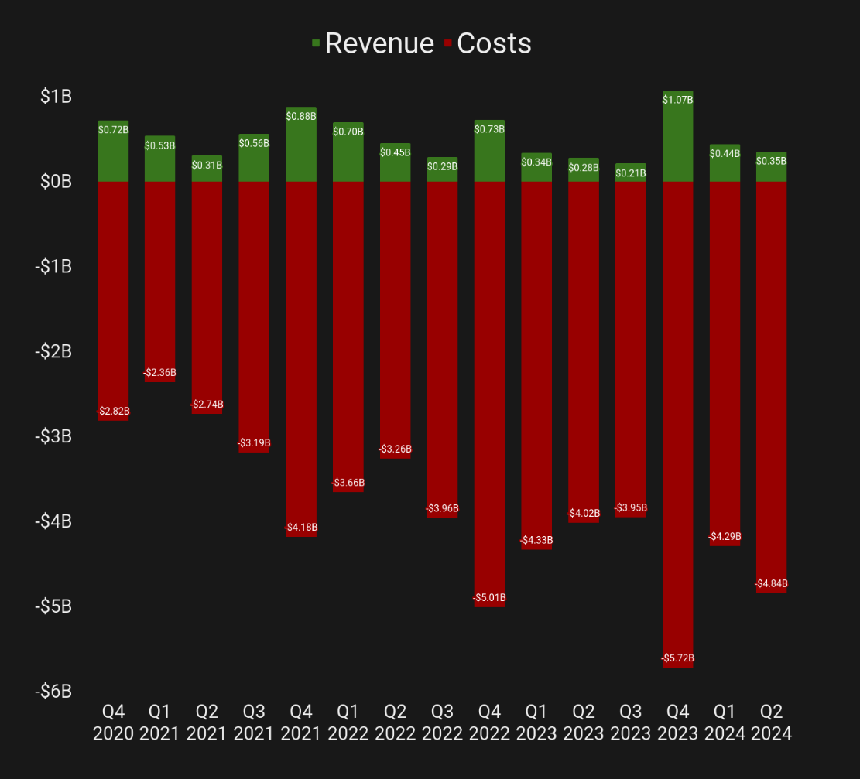
Meta VR Revenues and Costs
Uploadvr.com (31 July 2024)
Notes:
https://www.uploadvr.com/metas-reality-labs-revenue-growth-q2-2024/

Slide 52
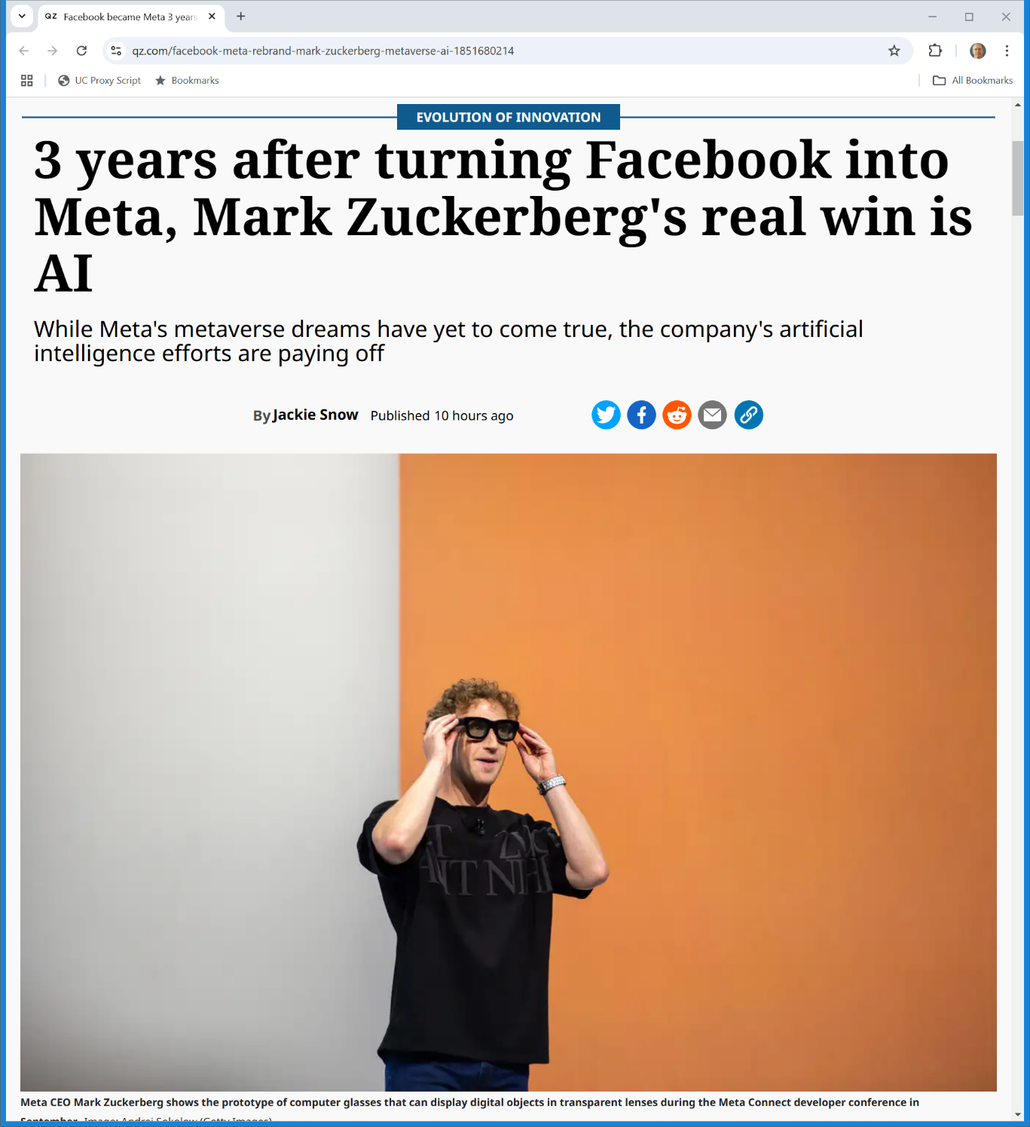
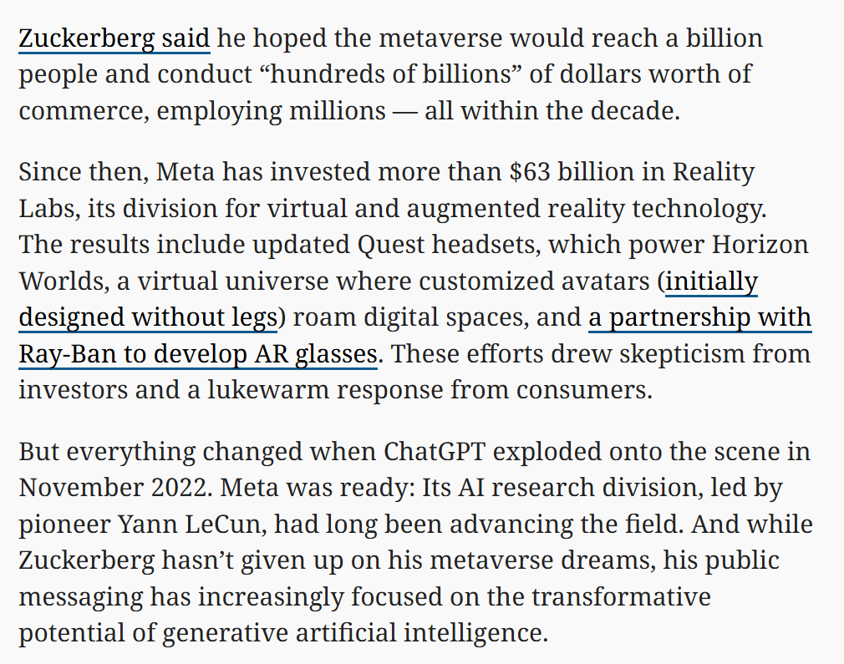
$63 Billion
Quartz (28 Oct 2024)
Notes:
https://qz.com/facebook-meta-rebrand-mark-zuckerberg-metaverse-ai-1851680214

Slide 53
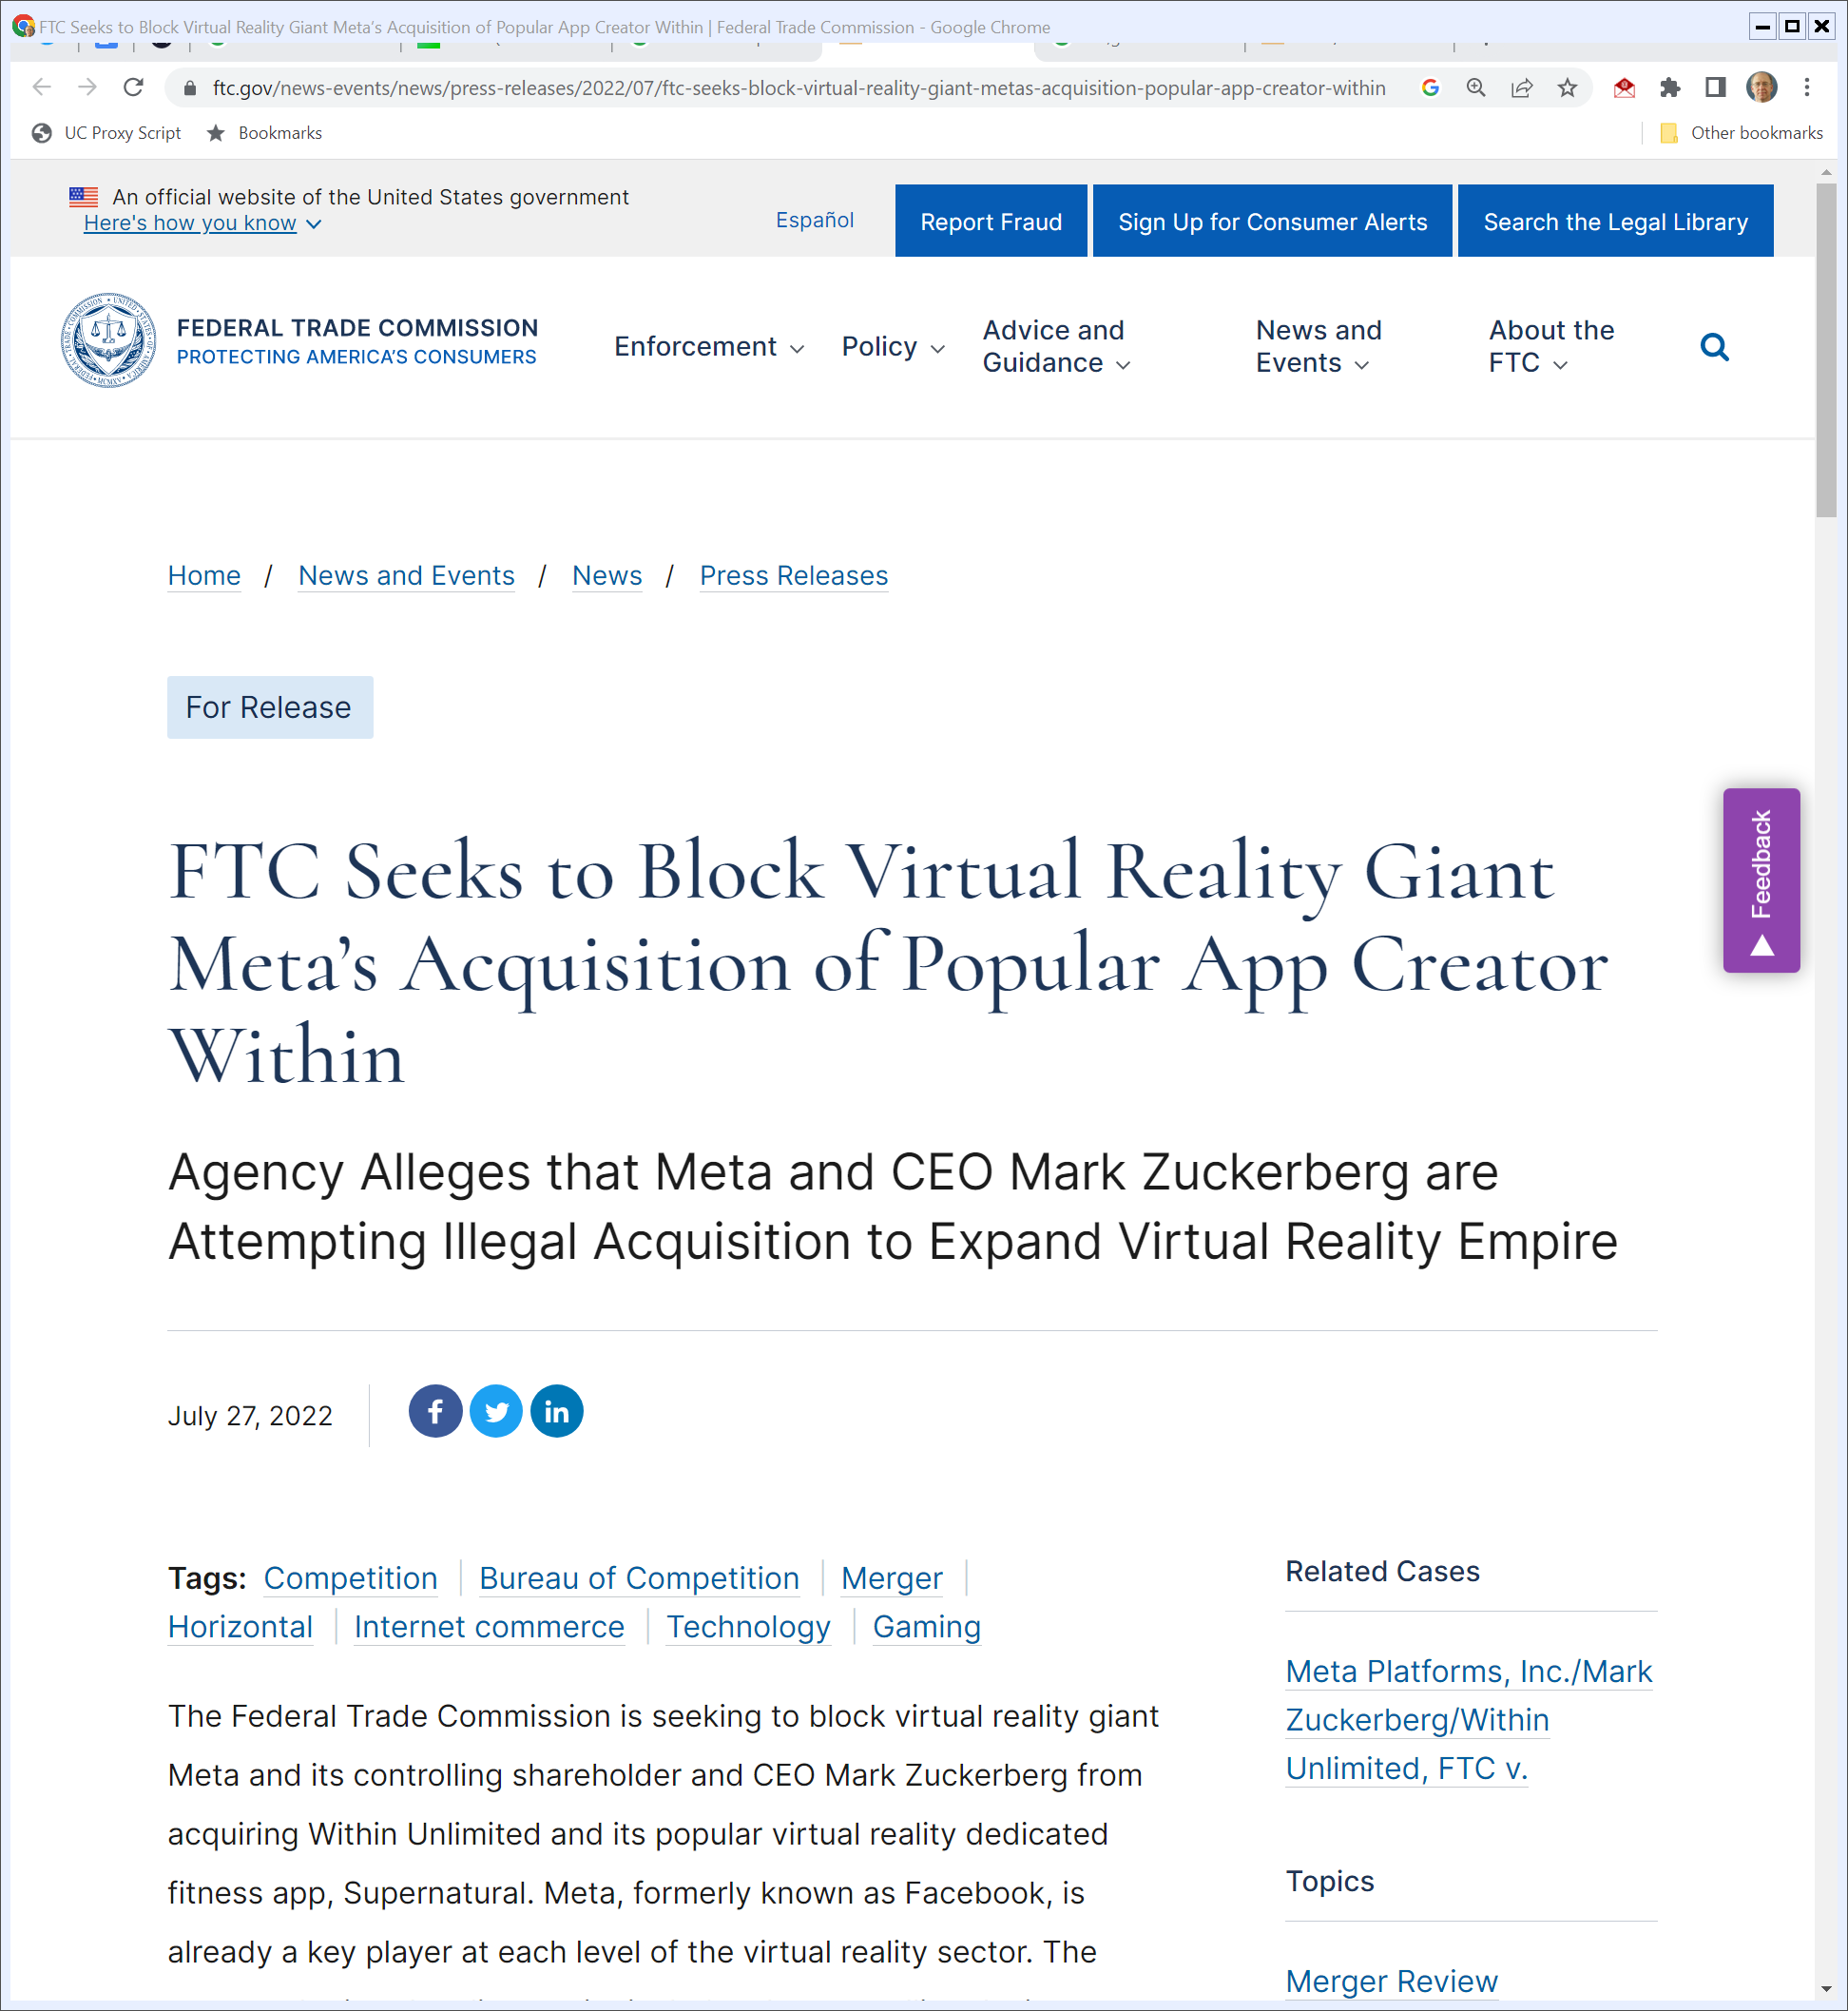
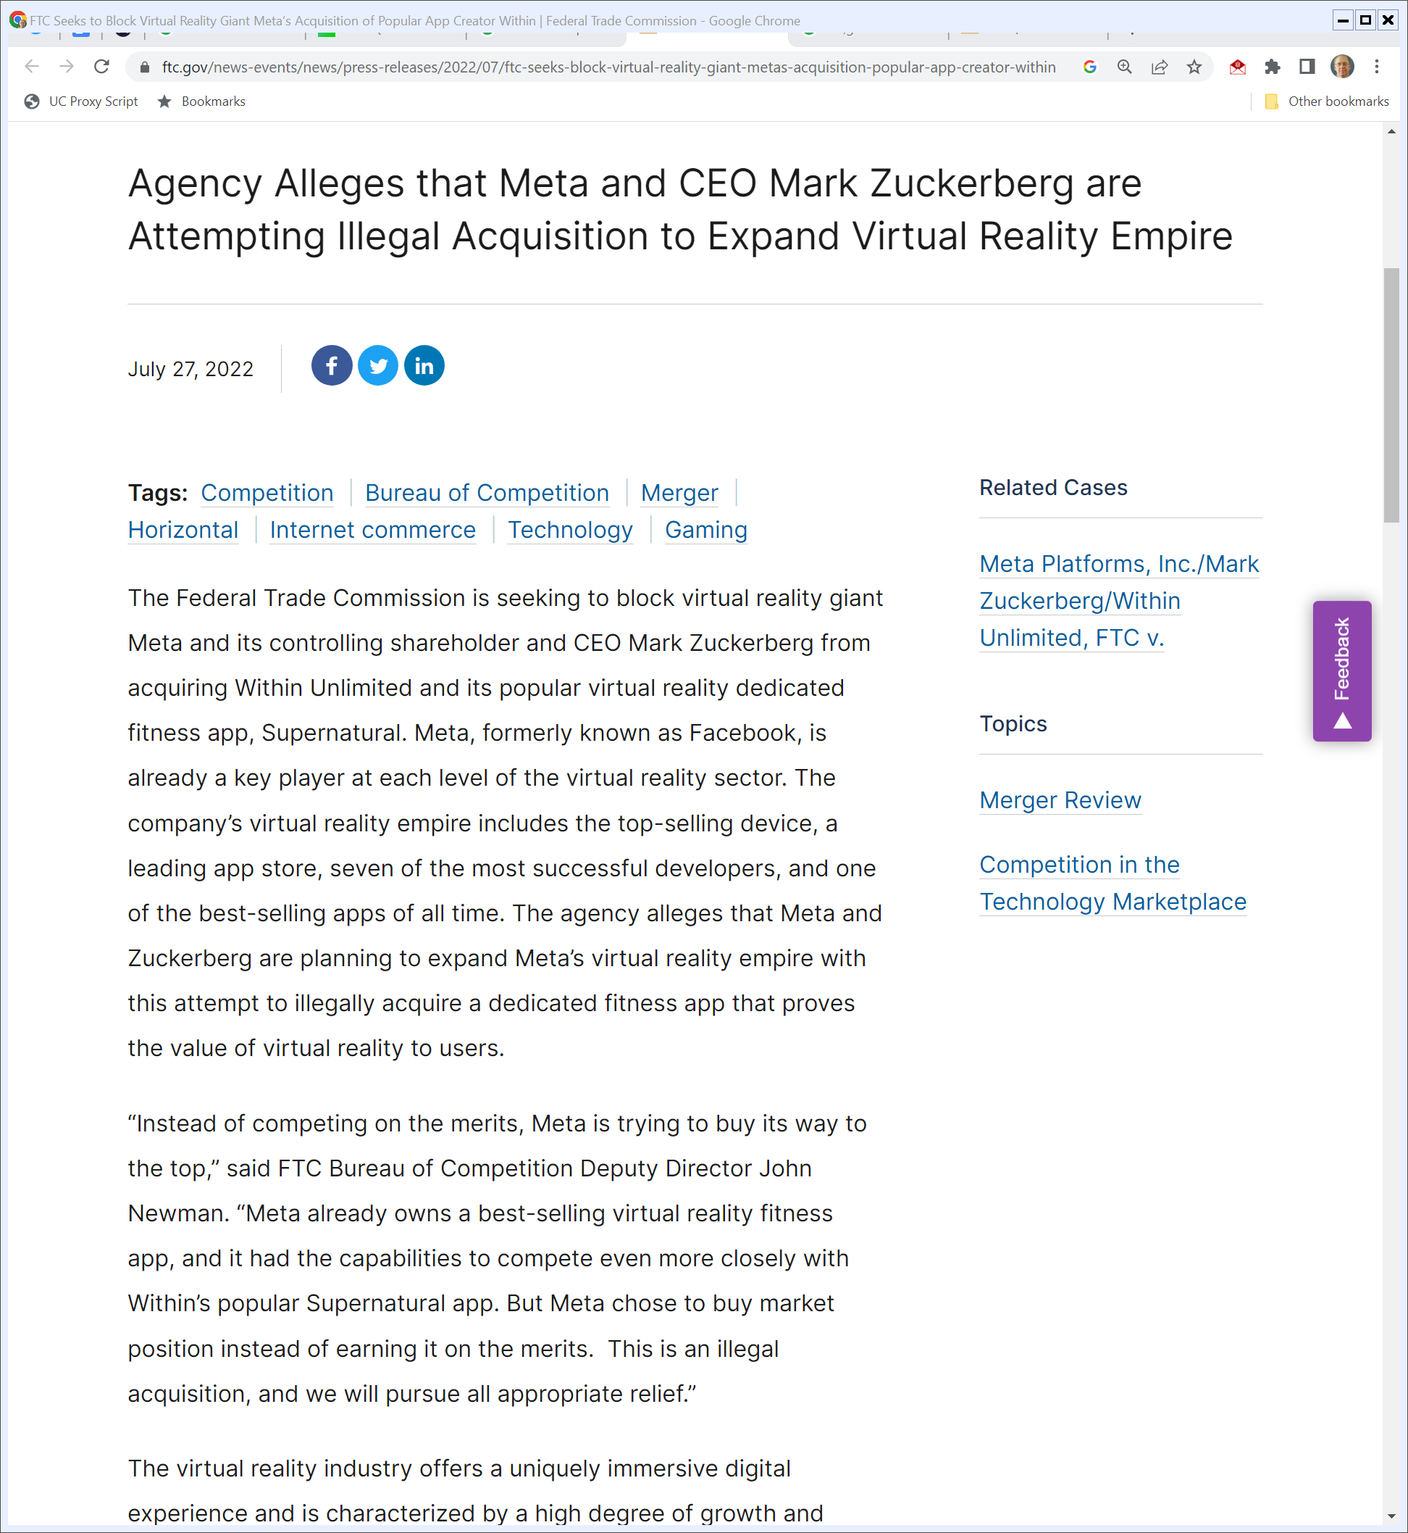
Blocking the VR Giant
FTC (27 July 2022)
Notes:
https://www.ftc.gov/news-events/news/press-releases/2022/07/ftc-seeks-block-virtual-reality-giant-metas-acquisition-popular-app-creator-within

Slide 54
Marine Bancorporation
418 U.S. 602 (U.S. 1974)

Slide 55
Focus on the Firm at the Fringe of the Market
“In developing and applying the doctrine, the Court has recognized that a market extension merger may be unlawful if the target market is substantially concentrated, if the acquiring firm has the characteristics, capabilities, and economic incentive to render it a perceived potential de novo entrant, and if the acquiring firm’s premerger presence on the fringe of the target market in fact tempered oligopolistic behavior on the part of existing participants in that market.”
Marine Bancorporation (U.S. 1974)

Slide 56
Wings Effect = Matters for Competition Now
“In other words, the Court has interpreted § 7 as encompassing what is commonly known as the ‘wings effect’—the probability that the acquiring firm prompted premerger procompetitive effects within the target market by being perceived by the existing firms in that market as likely to enter de novo. Falstaff, supra, at 531-537. The elimination of such present procompetitive effects may render a merger unlawful under § 7.”
Marine Bancorporation (U.S. 1974)

Slide 57
A Second Conception (Not Yet Adopted)
“Although the concept of perceived potential entry has been accepted in the Court’s prior § 7 cases, the potential-competition theory upon which the Government places principal reliance in the instant case has not.”
Marine Bancorporation (U.S. 1974)

Slide 58
A Second Conception: Force De Novo/Toehold Entry?
“The Court has not previously resolved whether the potential-competition doctrine proscribes a market extension merger solely on the ground that such a merger eliminates the prospect for long-term deconcentration of an oligopolistic market that in theory might result if the acquiring firm were forbidden to enter except through a de novo undertaking or through the acquisition of a small existing entrant (a so-called foothold or toehold acquisition). Falstaff expressly reserved this issue.”
Marine Bancorporation (U.S. 1974)

Slide 59
Not Decided Before and Not Here
“Accordingly, we cannot hold for the Government on its principal potential-competition theory. Indeed, since the preconditions for that theory are not present, we do not reach it, and therefore we express no view on the appropriate resolution of the question reserved in Falstaff. We reiterate that this case concerns an industry in which new entry is extensively regulated by the State and Federal Governments.”
Marine Bancorporation (U.S. 1974)

Slide 60
Framing Meta/Within
Key Questions
  Why should we let Big Tech firms buy anything?
  Is that something about the size of these firms?
  Something about the nature of the industry?

Slide 61
Meta/Within Order
Meta/Within (NDCA 31 Jan 2023/13 Dec 2023)

Slide 62
Why Does Meta Want to Buy Within?
Meta/Within (NDCA 13 Dec 2023)

Slide 63
Why Does Meta Want to Buy Within?
Meta/Within (NDCA 13 Dec 2023)

Slide 64
Competing With Apple?
Meta/Within (NDCA 13 Dec 2023)

Slide 65
Serious Exercisers v. Fitness Strugglers
Meta/Within (NDCA 13 Dec 2023)

Slide 66
Market Shares
Meta/Within (NDCA 13 Dec 2023)

Slide 67
VR Dedicated Fitness Apps as Submarket
Meta/Within (NDCA 13 Dec 2023)

Slide 68
Meta and Actual Potential Competition
“The FTC first argues that the Acquisition would substantially lessen competition because it deprives the VR dedicated fitness app market of the competition that would have arisen from Meta’s independent entry into the market, a theory known as the ‘actual potential competition’ or ‘actual potential entrant’ doctrine. See, e.g., United States v. Marine Bancorporation, Inc., 418 U.S. 602, 633 (1974).”
Meta/Within (NDCA 13 Dec 2023)

Slide 69
Meta and Actual Potential Competition
“Although the Supreme Court has twice declined to resolve the doctrine’s validity when presented, it has nonetheless identified two essential preconditions before the theory can be applied: (1) the alleged potential entrant must have ‘available feasible means for entering the [relevant] market other than by acquiring [the target company]’; and (2) those ‘means offer a substantial likelihood of ultimately producing deconcentration of that market or other significant procompetitive effects.’ Id.”
Meta/Within (NDCA 13 Dec 2023)

Slide 70
Apply It Here
“Given the actual potential competition doctrine’s consistent, albeit distant, history of judicial recognition, the Court declines to reject the theory outright and will apply the doctrine as developed.”
Meta/Within (NDCA 13 Dec 2023)

Slide 71
“Noticeably Greater than Fifty Percent”
“Furthermore, the harm to competition the doctrine aims to prevent is not the loss of present competition but rather the potential loss of a future competitor (the acquiring company). Given the many a priori inferences required by the doctrine, the Court is wary of any inquiry that strays too close to the specters of ephemeral possibilities, yet it must nonetheless ensure the standard does not require the FTC to operate on certainties.”
Meta/Within (NDCA 13 Dec 2023)

Slide 72
“Noticeably Greater than Fifty Percent”
“The Court accordingly holds that the ‘reasonable probability’ standard—as clarified by the Fifth Circuit to suggest a likelihood noticeably greater than fifty percent—is the standard of proof that the FTC must present.”
Meta/Within (NDCA 13 Dec 2023)

Slide 73
Understanding Potential Competition
Questions
  Is this the right framework for this?
  How many possible entrants are there?
    Does it matter if the number of potential entrants drops from 11 to 10 rather than from 3 to 2?
  Is there something distinctive about Meta as a possible entrant?

Slide 74
Not Reasonably Probable That Meta Would Enter
Meta/Within (NDCA 13 Dec 2023)

Slide 75
Meta Skeptical Internally
Meta/Within (NDCA 13 Dec 2023)

Slide 76
FTC Loses on Actual Potential Competition
Meta/Within (NDCA 13 Dec 2023)

Slide 77
Perceived Potential Competition (Wing Effects)
Meta/Within (NDCA 13 Dec 2023)

Slide 78
Not Here
Meta/Within (NDCA 13 Dec 2023)

