Slide 1
Class 11: Wed 22 Oct 2025 Antitrust Fall 2025 Mergers: An Industry Arc
Randal C. Picker
James Parker Hall Distinguished Service Professor of Law
The Law School
The University of Chicago
Copyright © 2000-25 Randal C. Picker. All Rights Reserved.

Slide 2
Merger Policy
What are we trying to accomplish?
We don’t want mergers to reduce competition
But we also want to get assets into the most valuable hands
Mergers can facilitate more rapid entry by firms that are able to scale projects quickly
How do we square these?

Slide 3
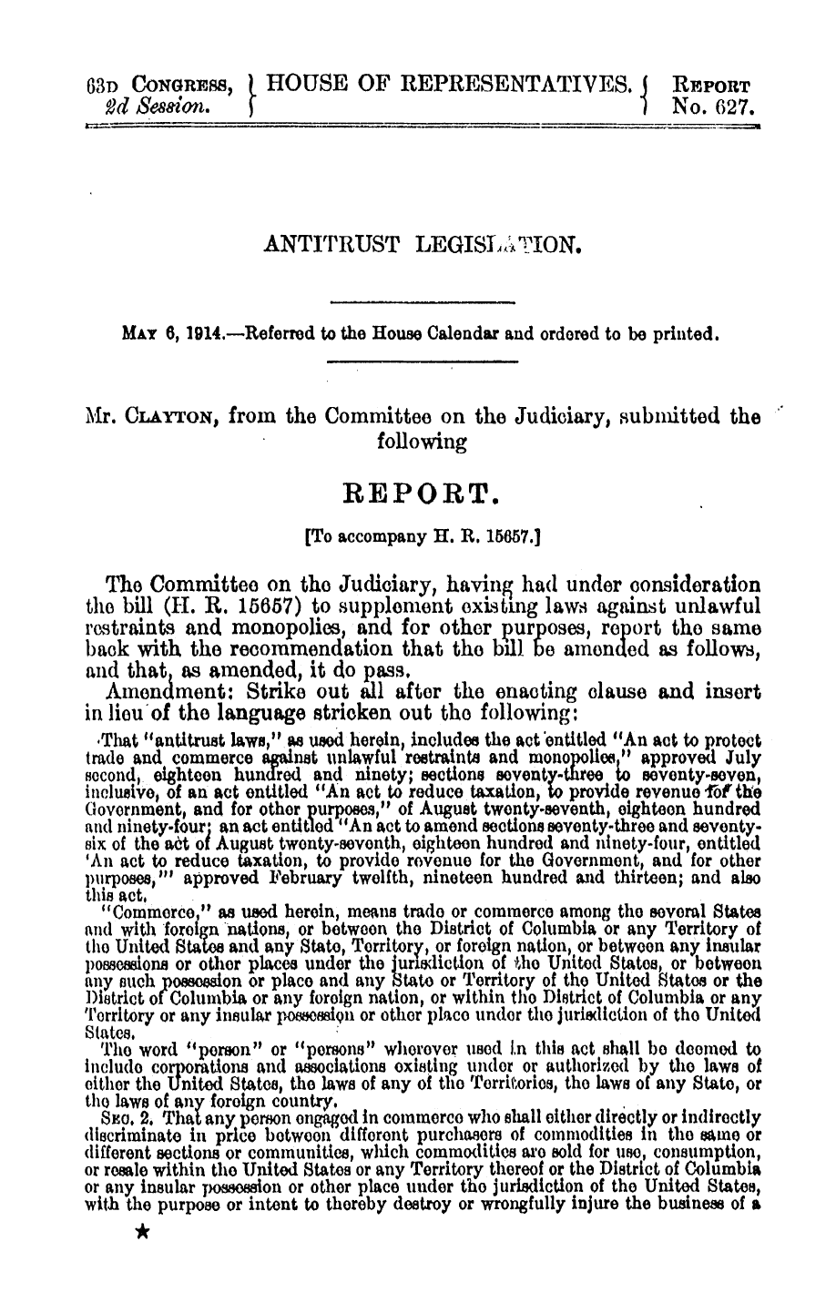
Clayton Act Legis History
H. Rep. 63-627 (6 May 1914)

Slide 4
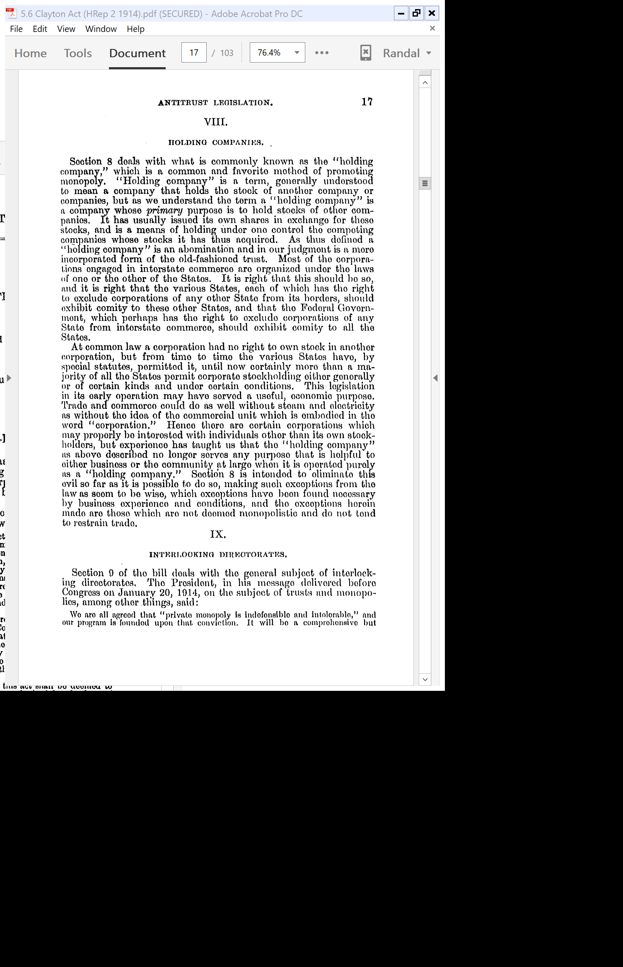
Holding Companies Owning Competitors
H. Rep. 63-627 (6 May 1914)

Slide 5
A Little Corporate Law History
H. Rep. 63-627 (6 May 1914)

Slide 6
1914 Clayton Act
38 Stat. 730 (15 Oct 1914)

Slide 7
Sec. 7: Targeted Stock Acquisitions (15 USC 18)
38 Stat. 730 (15 Oct 1914)

Slide 8
1950 Act
64 Stat. 1125 (29 Dec 1950)

Slide 9
1950 Act Legislative History
H. Rep. 81-1191 (4 Aug 1949)

Slide 10
High and Increasing Levels of Concentration
H. Rep. 81-1191 (4 Aug 1949)

Slide 11
M&A as a Source of Concentration
H. Rep. 81-1191 (4 Aug 1949)

Slide 12
Why Isn’t CA7 Enough?: Doesn’t Deal with Asset Purchases
H. Rep. 81-1191 (4 Aug 1949)

Slide 13
The Asset Loophole
H. Rep. 81-1191 (4 Aug 1949)

Slide 14
The Text Changes
H. Rep. 81-1191 (4 Aug 1949)

Slide 15
Less Restrictive Language?
H. Rep. 81-1191 (4 Aug 1949)

Slide 16
How Does this Differ from the Sherman Act?
H. Rep. 81-1191 (4 Aug 1949)

Slide 17
Types of Mergers
H. Rep. 81-1191 (4 Aug 1949)

Slide 18
Does it Apply to Vertical Mergers?
H. Rep. 81-1191 (4 Aug 1949)

Slide 19
Current Section 7
“No person engaged in commerce or in any activity affecting commerce shall acquire, directly or indirectly, the whole or any part of the stock or other share capital and no person subject to the jurisdiction of the Federal Trade Commission shall acquire the whole or any part of the assets of another person engaged also in commerce or in any activity affecting commerce, where in any line of commerce or in any activity affecting commerce in any section of the country, the effect of such acquisition may be substantially to lessen competition, or to tend to create a monopoly.”
15 USC 18

Slide 20
1974 Expediting Act Amendments
Pub. L. 93-528 (21 Dec 1974)

Slide 21
See The Path
Timeline from 1950 to 1974
New amendments to Section 7 in 1950 bring more acquisitions into Section 7 framework
Sup Ct has mandatory jurisdiction over antitrust appeals from trial court decisions in that window; that ended with 1974 amendments
Brown (1962), PNB (1963) and Von’s (1966) all done that way

Slide 22
1976: Hart-Scott-Rodino
Pub. L. 94-435 (30 Sept 1976)

Slide 23
Legislative History
S. Rep. 94-803 (6 May 1976)

Slide 24
Expanded Pre-Case Investigation Tools
S. Rep. 94-803 (6 May 1976)

Slide 25
Parens Patriae Powers to AGs
S. Rep. 94-803 (6 May 1976)

Slide 26
Premerger Notification
S. Rep. 94-803 (6 May 1976)

Slide 27
1976 as a Dividing Line
Post-1950/Pre-1976
Many cases are litigated under Sec. 7 of the Clayton Act
Over an extended period, the Supreme Court averages almost one case per year (but Sup Ct role driven by the Expediting Act)

Slide 28
1976 as a Dividing Line
After-1976
Cases vanish (esp in Sup Ct (but. again, the Expediting Act))
Passage of Hart-Scott-Rodino in 1976 changes antitrust practice from court-driven to agency driven

Slide 29
Merger Policy as Regulatory Policy
From Courts to Regulation
Mergers are controlled through regulation.
Mergers of any real size will trigger HSR notification duties.
This results in a negotiation with the FTC or DOJ over how the transaction might be structured to eliminate competitive concerns.

Slide 30
Merger Policy as Regulatory Policy
Litigation?
Absent a consent decree, most parties abandon proposed mergers.
Litigation over the statute has been relatively rare (but this has been changing as the agencies have become less willing to negotiate)

Slide 31
Brown Shoe
370 U.S. 294 (1962)

Slide 32
Product Market Definition: Cross-Elasticity of Demand/Submarkets
“The outer boundaries of a product market are determined by the reasonable interchangeability of use or the cross-elasticity of demand between the product itself and substitutes for it. However, within this broad market, well-defined submarkets may exist which, in themselves, constitute product markets for antitrust purposes. United States v. E.I. du Pont de Nemours & Co., 353 U.S. 586, 593-595.”
Brown Shoe (U.S. 1962)

Slide 33
Product Market Definition: Relevant Factors
“The boundaries of such a submarket may be determined by examining such practical indicia as industry or public recognition of the submarket as a separate economic entity, the product’s peculiar characteristics and uses, unique production facilities, distinct customers, distinct prices, sensitivity to price changes, and specialized vendors.”
Brown Shoe (U.S. 1962)

Slide 34
Examine Every Line of Commerce
“Because § 7 of the Clayton Act prohibits any merger which may substantially lessen competition ‘in any line of commerce’ (emphasis supplied), it is necessary to examine the effects of a merger in each such economically significant submarket to determine if there is a reasonable probability that the merger will substantially lessen competition. If such a probability is found to exist, the merger is proscribed.”
Brown Shoe (U.S. 1962)

Slide 35
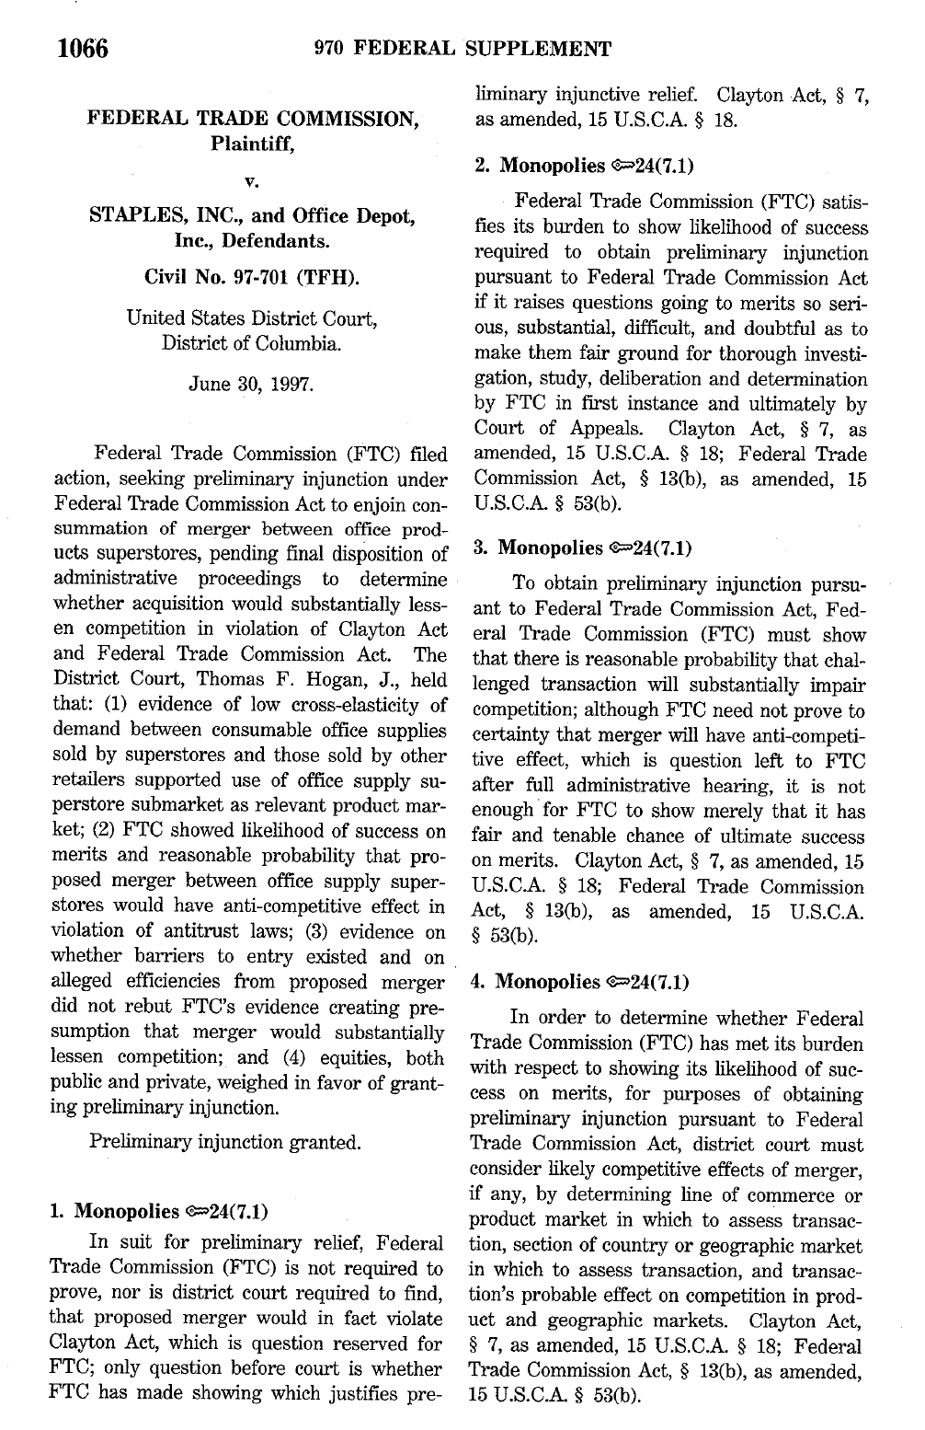
Staples I
970 F. Supp. 1066 (D.D.C. 1997)

Slide 36
4 Sept 1996: Staples wants to buy Office Depot
3 Major Players in Office Superstores
Office Depot: > 500 stores, 38 states and DC, with emphasis in South and Midwest
Staples: > 550 stores, 28 states and DC, mainly Northeast and California
OfficeMax: 575 stores, 48 states
Staples wants to buy Office Depot

Slide 37
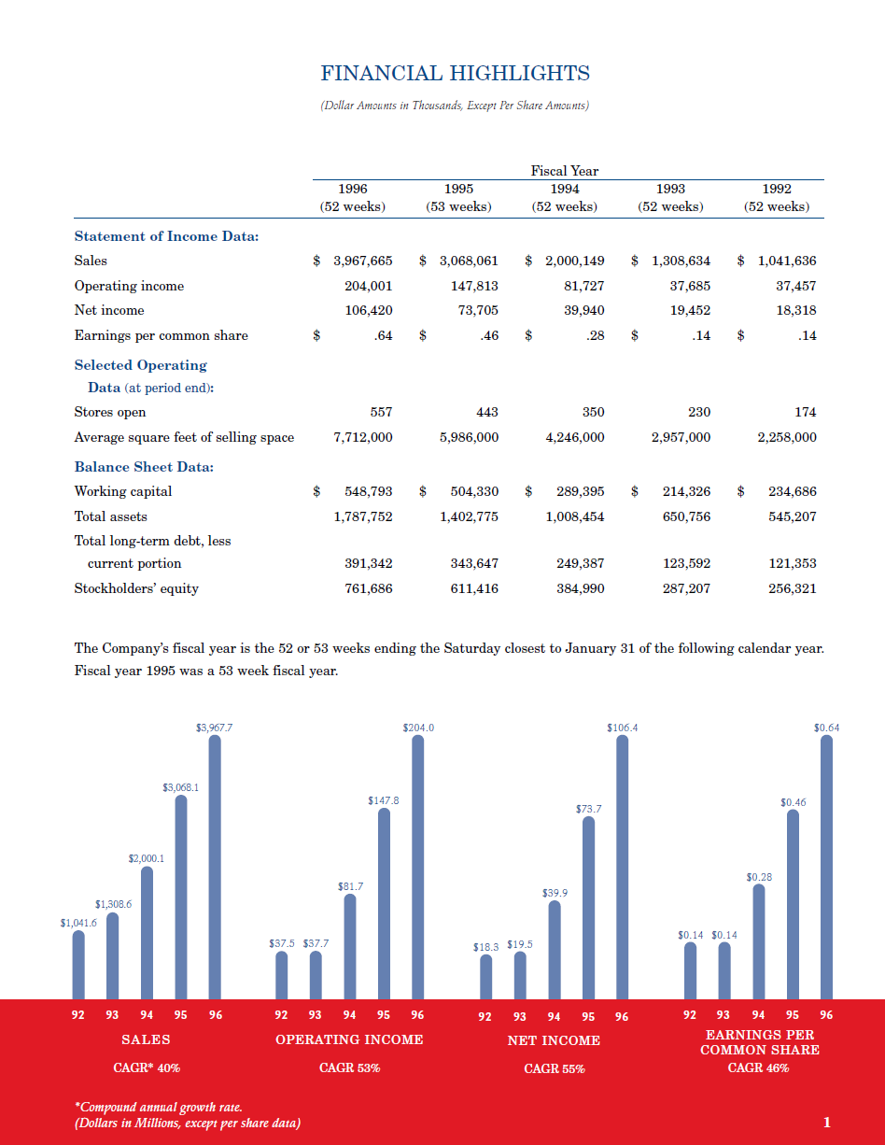
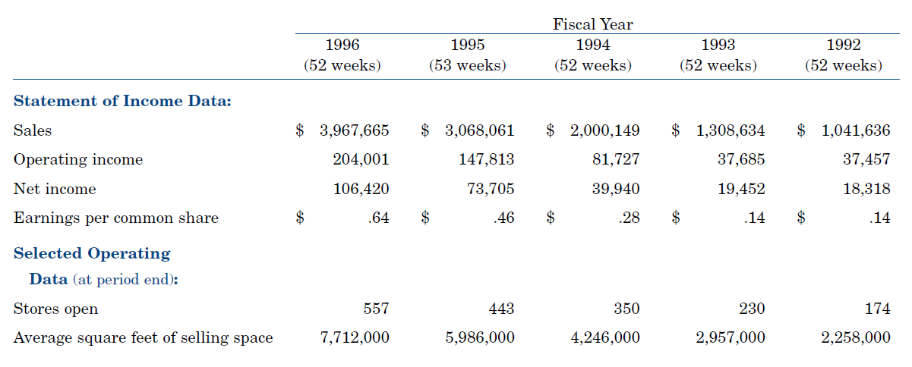
Rapid Growth of Staples
Staples Annual Report 1996

Slide 38
And for Office Depot: Stores
Office Depot 10-K 1997

Slide 39
Office Depot Revenues
Office Depot 10-K 1997

Slide 40
The Path to the Complaint
Staples I (DDC 1997)

Slide 41
The Preliminary Injunction Standard
Staples I (DDC 1997)

Slide 42
Amended Complaint
FTC, Staples/Office Depot (10 Apr 1997)

Slide 43
Product Market Definition (Cluster Market)
“12.a. One relevant product market or submarket in which the competitive effects of the proposed merger may be assessed is the retail sale of office supplies (sometimes called ‘consumable’ office supplies) through office supply superstores.”
FTC, Staples/Office Depot (10 Apr 1997)

Slide 44
Product Market Definition (Cluster Market and Target Market)
“12.b. Another relevant product market in which the competitive effects of the proposed merger may be assessed is the broader market consisting of the sale of office supplies (sometimes called ‘consumable’ office supplies) through retail stores to small businesses and individuals with home offices.”
FTC, Staples/Office Depot (10 Apr 1997)

Slide 45
Geographic Market Definition
“Staples and Office Depot are the only two office supply superstore firms in the following fifteen relevant geographic markets: San Diego, California; Salinas, California; Visalia-Tulare-Porterville, California; Lakeland-Winter Haven, Florida; Ocala, Florida; Tampa-St. Petersburg-Clearwater, Florida; Fort Pierce-Port St. Lucie, Florida; Champaign-Urbana, Illinois; Louisville, Kentucky; Baltimore, Maryland; Greenville, North Carolina; Florence, South Carolina; Charlottesville, Virginia; Washington, D.C.; and Spokane, Washington.”
FTC, Staples/Office Depot (10 Apr 1997)

Slide 46
Geographic Market Definition
“OfficeMax, Inc., the only other office supply superstore firm in the United States, operates office supply superstores in all the remaining relevant geographic markets.”
FTC, Staples/Office Depot (10 Apr 1997)

Slide 47
Potential Competition: Where They Would Compete in the Future
“In addition, the effect of the proposed merger, if consummated, may be substantially to lessen competition by eliminating actual potential competition between Staples and Office Depot in other metropolitan areas where they would compete in the future, including, but not limited to: (1) Bergen County, New Jersey; (2) Fayetteville, North Carolina; (3) Albany-Schenectady-Troy, New York; and (4) Fredericksburg, Virginia.”
FTC, Staples/Office Depot (10 Apr 1997)

Slide 48
Relief Sought
FTC, Staples/Office Depot (10 Apr 1997)

Slide 49
Possible Market Definitions
FTC 2
“Sale of consumable office supplies through retail stores to small businesses and individuals with home offices”
Defendant Market Definitions
Office products (and would give combined market share for OD/S of 5.5%)

Slide 50
Eight OSS Market Types
O Max | O Depot | Staples | Post-Merger
N | N | N | 0 to 0: No change
Y | N | N | 1 to 1: No change
N | Y | N | 1 to 1: OD -> S, no change in effective competition
N | N | Y | 1 to 1: No change
Y | Y | N | 2 to 2: OD -> S, no change in effective competition
Y | N | Y | 2 to 2: No change
N | Y | Y | 2 to 2 w/fix: Sell OD to OM, then no change in effective competition
Y | Y | Y | 3 to 2: This is the box that matters

Slide 51
Staples Competition Forecast
Overlap: 1995 Actual and 2000 Projected
Year | Staples Only | S & OD | S & OM | All 3 | Total
1995 | 17% | 29% | 37% | 17% | 100%
2000 | 12% | 7% | 12% | 69% | 100%

Slide 52
Understanding Market Config 8: What Happens to Prices?
I
II
Paper Store
OSS1
P/P/P
OSS2
P/P/P
OSS1
P/P/P
OSS2
P/P/P
Pen Store
Post-Its Store
OSS1
P/P/P
OSS2
P/P/P
Paper Store
OSS1
P/P/P
OSS2
P/P/P
Pen Store
Post-Its Store
OSS3
P/P/P
OSS3
P/P/P
III
IV

Slide 53
How Should We Assess the Evidence Here?
TTYN (1 of 5)
Functional characteristics of stores
OSS: 20K to 30K sq. ft. w/anywhere from 5000 to 7500 SKUs devoted to consumables
Warehouse clubs: 100 to 289 SKUs consumables
K-Mart, Target: < 570 SKUs consumables
Wal-Mart: 1067 to 2400 SKUs consumables

Slide 54
How Should We Assess the Evidence Here?
TTYN (2 of 5)
Direct economic evidence
Jan 1997 Data
Staples prices are 13% higher in one OSS markets than in 3-firm OSS markets
ODs prices are 5% higher in one OSS markets than in 3-firm OSS markets
How should we think about comparisons between 1 OSS markets and 3 OSS markets?

Slide 55
How Should We Assess the Evidence Here?
TTYN (3 of 5)
Direct economic evidence
Staples prices 1-2% higher in one OSS market w/o warehouse club vs. those w/warehouse club
This is the OSS v. non-OSS data

Slide 56
How should we assess the market?
TTYN (4 of 5)
Market Definition: Through the eyes of producers?
Documents refer to office superstore industry, define market shares based on that as the denominator
Defendants establish price zones calibrated to competition present; price differently when competing office superstore is present

Slide 57
How should we assess the market?
TTYN (5 of 5)
Market Definition: Through the eyes of customers?
Surveys of customer behavior?
As shopper exits office super store, ask “Do you shop at Wal-Mart? Do you go there to buy pencils?”
As shopper exits Wal-Mart, do the same?

Slide 58
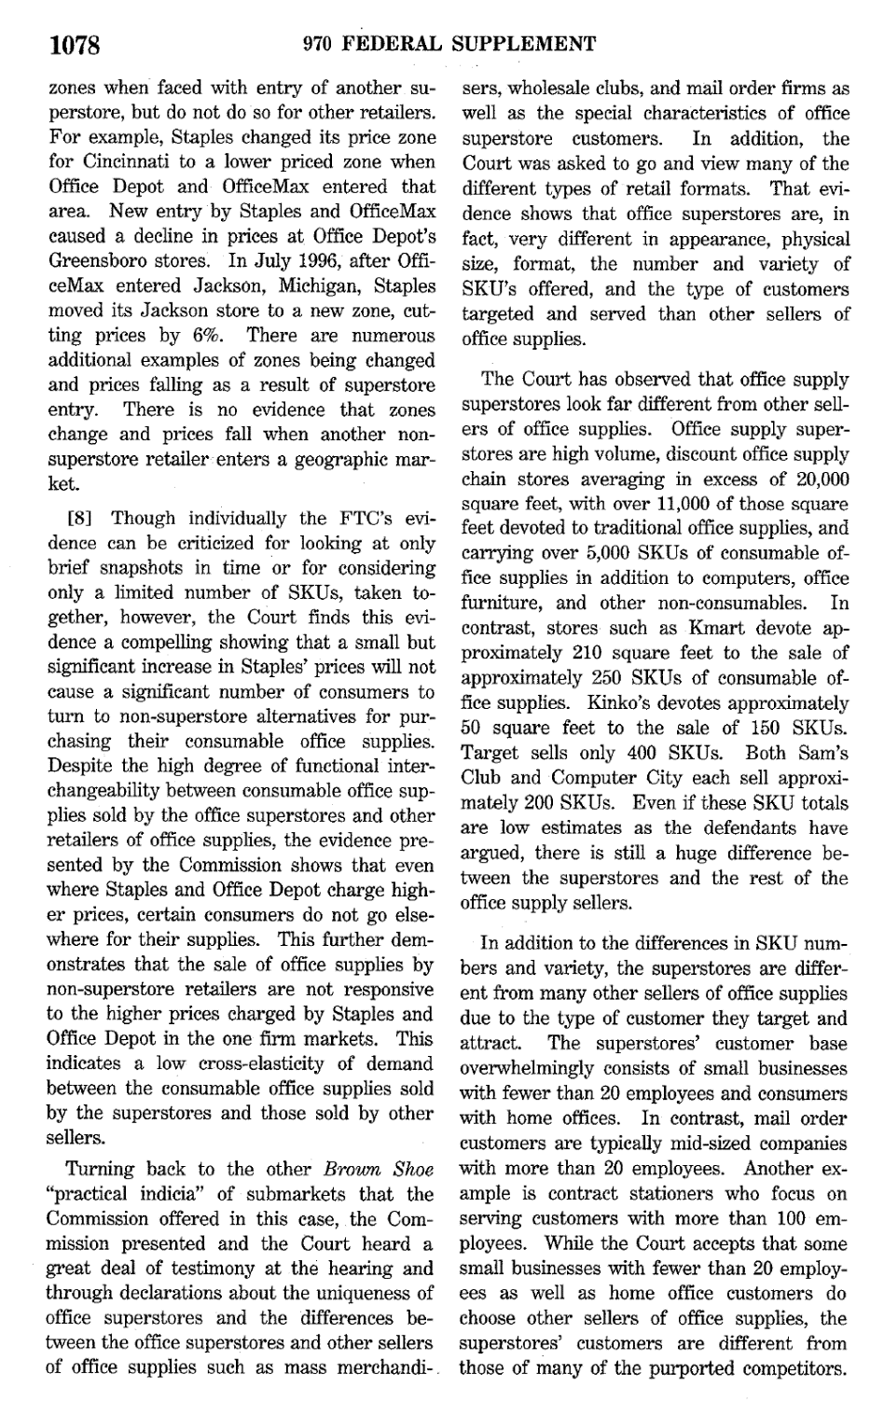
Bottom Line: Consumer Behavior Defines the Market
“Despite the high degree of functional interchangeability between consumable office supplies sold by the office superstores and other retailers of office supplies, the evidence presented by the Commission shows that even where Staples and Office Depot charge higher prices, certain consumers do not go elsewhere for their supplies.”
FTC v. Staples (D.D.C. 1997)

Slide 59
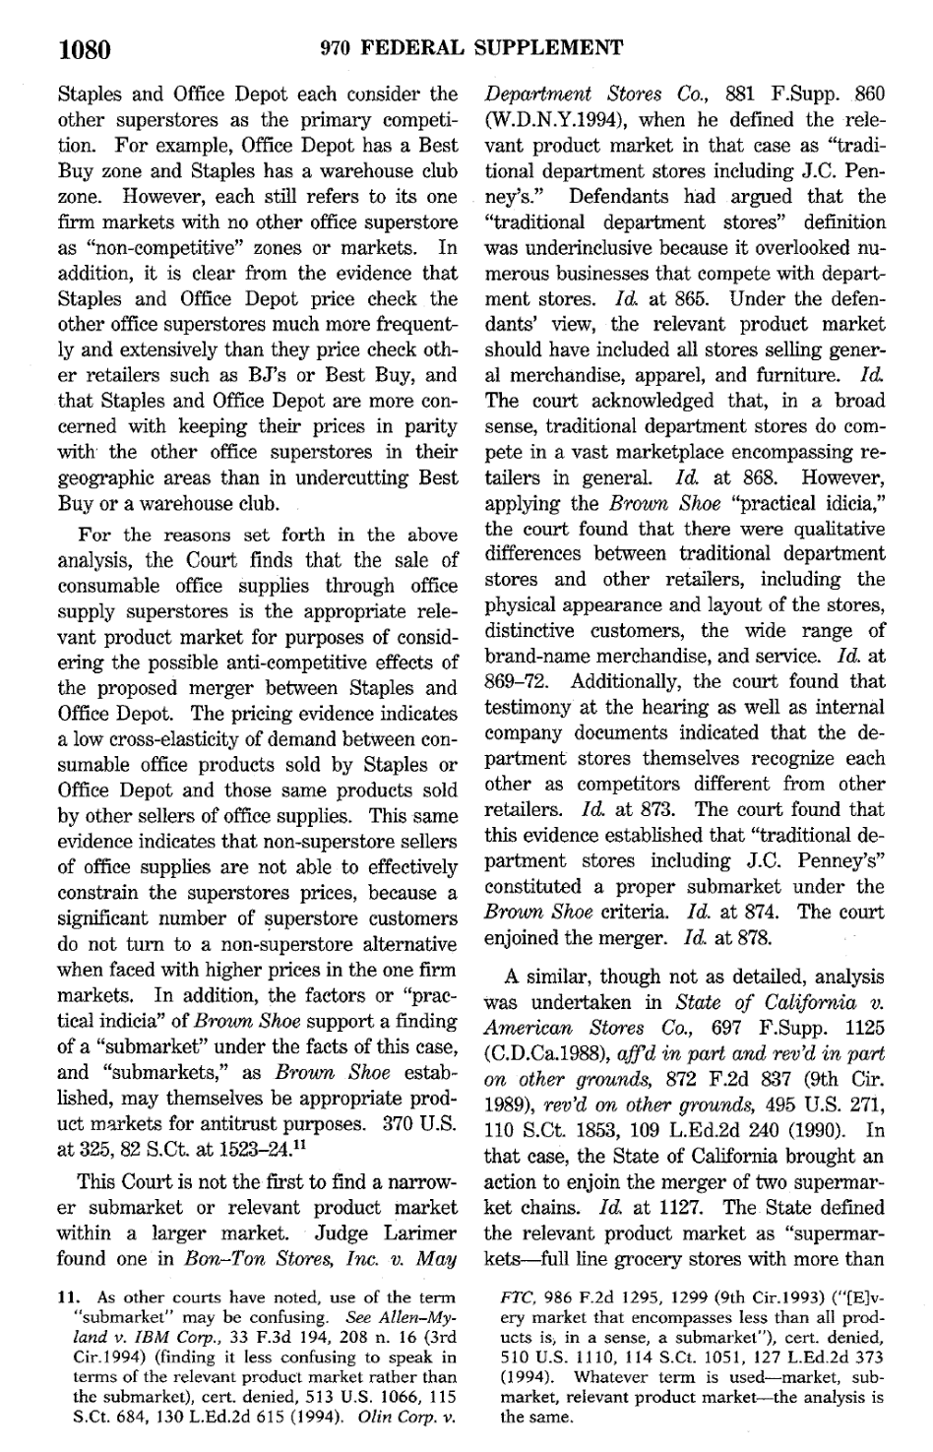
Bottom Line: Pricing Evidence
“The pricing evidence indicates a low cross-elasticity of demand between consumable office products sold by Staples or Office Depot and those same products sold by other sellers of office supplies.”
FTC v. Staples (D.D.C. 1997)

Slide 60
Bottom Line: Pricing Evidence
“This same evidence indicates that non-superstore sellers of office supplies are not able to effectively constrain the superstores prices, because a significant number of superstore customers do not turn to a non-superstore alternative when faced with higher prices in the one firm markets.”
FTC v. Staples (D.D.C. 1997)

Slide 61
du Pont
351 U.S. 377 (1956)

Slide 62
Du Pont (US 1956)
Key Facts
Cellophane “market” is 75% du Pont and 25% Sylvania with the latter’s position limited by patent licenses
Cellophane is 20% of flexible packaging materials “market”
Does du Pont have market power?

Slide 63
Possible Substitutes for Consumers Define Market
“Determination of the competitive market for commodities depends on how different from one another are the offered commodities in character or use, how far buyers will go to substitute one commodity for another.”
du Pont (US 1956)

Slide 64
Cross-Elasticity of Demand
“What is called for is an appraisal of the ‘cross-elasticity’ of demand in the trade. See Note, 54 Col. L. Rev. 580. The varying circumstances of each case determine the result.”
du Pont (US 1956)

Slide 65
Interchangeability
“In considering what is the relevant market for determining the control of price and competition, no more definite rule can be declared than that commodities reasonably interchangeable by consumers for the same purposes make up that ‘part of the trade or commerce,’ monopolization of which may be illegal.”
du Pont (US 1956)

Slide 66
Elasticities and Cross-Elasticities
Elasticity
The price of Diet Coke rises: what happens to Diet Coke sales?
They consume less, but how much less?
An elasticity is one way of describing that

Slide 67
Elasticities and Cross-Elasticities
Next Question: Cross-Elasticity
The price of Diet Coke rises: what happens to sales of Diet Pepsi?
If DC and DP are in the same market, DP sales would rise
Cross-elasticity of demand is a way of quantifying that

Slide 68
Elasticities and Cross-Elasticities
Cross-Elasticity Key Idea
How much does a rise in the price of one good change the quantity consumed of a second good?

Slide 69
Defining Cross Elasticity
The percentage change in quantity of good 1 divided by the percentage change in price of good 2.
Formally:

Slide 70
Examples
Increase of price of McDonald’s hamburger:
How many more hamburgers are sold by Burger King?
How much more chicken is sold by KFC?
How many more meals are sold by Alinea?

Slide 71
And Back to the Case
Increase of price office consumables at Staples?
Are more office consumables sold at
Office Depot?: Evidence says yes
Walmart? : Evidence says no
Costco? : Evidence says no

Slide 72
How should we evaluate the possibility of entry?
New Pure Entrants into OSS Market?
Decline from 23 OSS chains to 3 in 11 years
Failure of Office 1
Failure of chains associated with existing retailers
Expansion of others? Wal-Mart? Best Buy?
Tried and backed away

Slide 73
How should we evaluate the claims of efficiency?
Assessing the numbers
Internal inconsistencies: 500% difference between FTC numbers and those presented to boards of directors
Projected vendor cost savings: limited base, casual extrapolation (omission of HP), and questions of merger-specificity

Slide 74
How should we evaluate the claims of efficiency?
Pass through rates
Projected pass through of benefits to consumers of 2/3s vs. historic rates of 15-17%
How Do Efficiencies Matter?
Statute, guidelines and prior Sup Ct cases don’t seem to contemplate efficiencies as directly relevant; matter only to extent ensures price drops for consumers

Slide 75
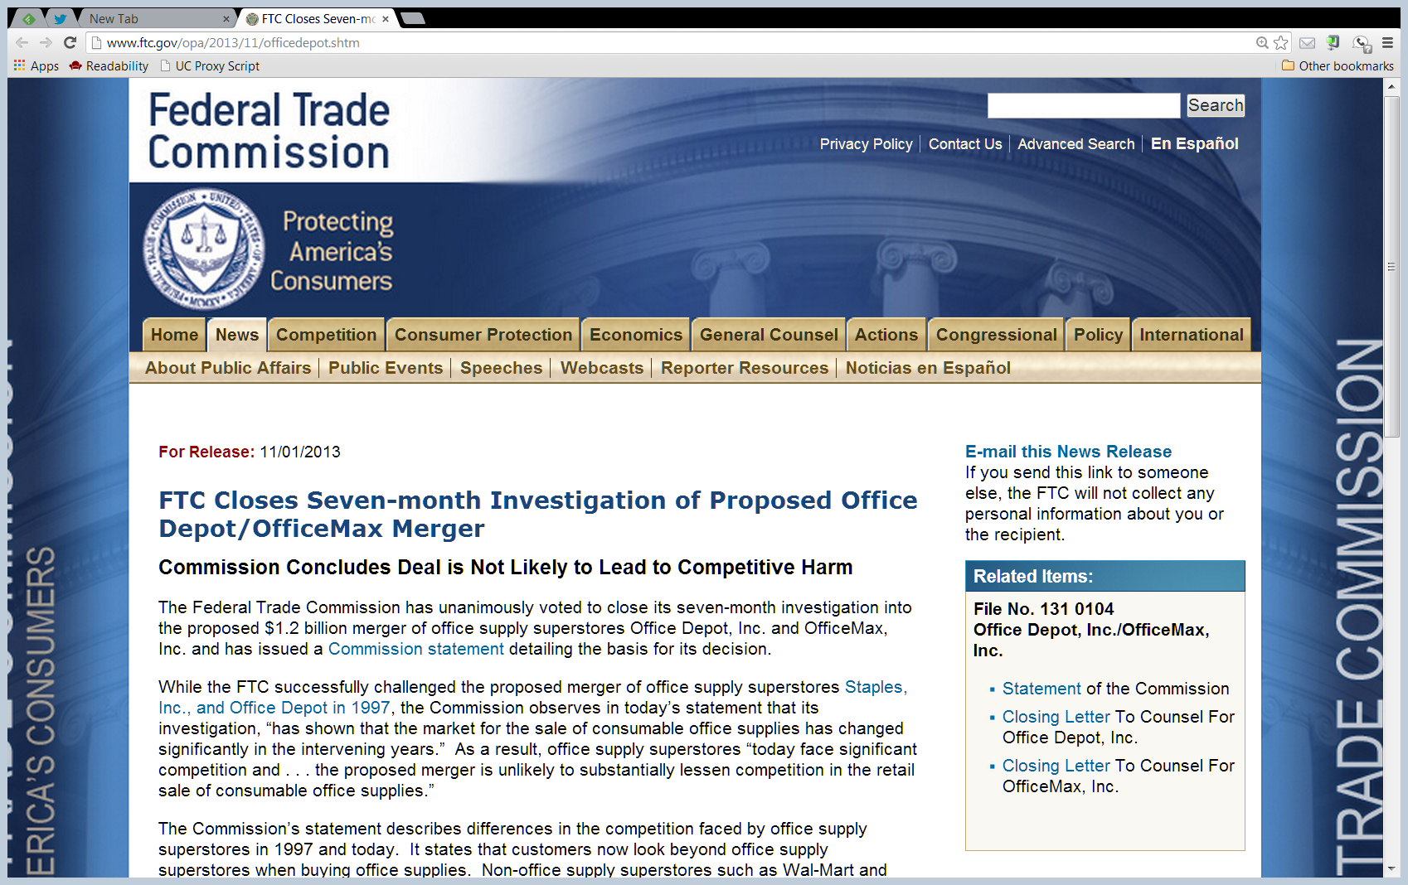
2013: Deal 2: No Challenge
FTC, Office Depot/OfficeMax (1 Nov 2013)

Slide 76
No Challenge
“The Commission has unanimously decided to close its seven-month investigation of Office Depot, Inc.’s proposed merger with OfficeMax, Inc., a transaction that aims to combine the country’s second and third largest chains of office supply superstores (OSS).”
FTC, Office Depot/OfficeMax (1 Nov 2013)

Slide 77
Market Has Changed
“Although sixteen years ago the Commission blocked a proposed merger between Staples, Inc. and Office Depot, the nation’s two largest OSS, our current investigation has shown that the market for the sale of consumable office supplies has changed significantly in the intervening years.”
FTC, Office Depot/OfficeMax (1 Nov 2013)

Slide 78
Market Has Changed
“One is that customers now look beyond OSS for office supply products and rely more heavily on non-OSS brick-and-mortar retailers. Mass merchants like Wal-Mart and Target and club stores like Costco and Sam’s Club have proliferated and expanded their product offerings and sales of office supplies.”
FTC, Office Depot/OfficeMax (1 Nov 2013)

Slide 79
Online Commerce
“The other is the explosive growth of online commerce, which has had a major impact on this market. Online retailers stock a vast array of office supply products and can deliver them quickly anywhere in the country at nominal cost.”
FTC, Office Depot/OfficeMax (1 Nov 2013)

Slide 80
2015: Deal 3
“Staples, Inc. (Nasdaq: SPLS) and Office Depot, Inc. (Nasdaq: ODP) today announced that the companies have entered into a definitive agreement under which Staples will acquire all of the outstanding shares of Office Depot.”
Staples PR (4 Feb 2015)

Slide 81
Staples Again
190 F.Supp.3d 100 (D.D.C. 2016)

Slide 82
Complaint before the FTC
FTC Admin Complaint (7 Dec 2015)

Slide 83
Market Definition (Cluster and Target)
“25. The relevant market is the sale and distribution of consumable office supplies to large B-to-B customers in the United States. Large B-to-B customers are particularly vulnerable to the proposed Merger because many have nationwide or multi-regional operations and require an office supplies vendor that can provide low pricing, high levels of service, and delivery across all of their operations. For such customers, Staples and Office Depot are the two best options”
FTC Admin Complaint (7 Dec 2015)

Slide 84
Market Definition: Consumable Office Supplies
“26. Consumable office supplies consist of an assortment of office supplies, such as pens, paper clips, notepads, and copy paper, that are used and replenished frequently.”
FTC Admin Complaint (7 Dec 2015)

Slide 85
Market Definition: And Not …
“28. Consumable office supplies do not include ink and toner for printers and copiers. Many B-to-B customers, particularly large B-to-B customers, buy ink and toner directly from ink and toner manufacturers, or as part of a package of ‘managed print services,’”
FTC Admin Complaint (7 Dec 2015)

Slide 86
Market Definition: And Not …
“in which vendors bundle ink and toner sales with leases of copier and printers, repair services, and/or copy or printer maintenance services. As a result, large B-to-B customers often purchase ink and toner from different vendors, under different contracts, that those from which they purchase consumable office supplies.”
FTC Admin Complaint (7 Dec 2015)

Slide 87
Market Definition: And Not …
“29. Consumable office supplies do not include other office-related products, such as janitorial or break-room products. Janitorial or break-room products are sold under substantially different competitive conditions than consumable offices supplies.”
FTC Admin Complaint (7 Dec 2015)

Slide 88
Applying the Grid from the Guidelines
“43. … Post-Merger, the market would be substantially more highly concentrated than it is today. Post-Merger, Staples would control more than 70% of this relevant market. The next largest competitor would possess less than 5% of the relevant market.”
FTC Admin Complaint (7 Dec 2015)

Slide 89
Applying the Grid from the Guidelines
“43. … The Merger would result in a post-Merger HHI of well over 2500, and an increase in concentration of well over 200 points. Post-Merger market concentration would be more than 4900, and would increase HHIs in an already concentrated market by well over 200 points.”
FTC Admin Complaint (7 Dec 2015)

Slide 90
Applying the Grid from the Guidelines
“44. The Merger is presumptively unlawful under relevant case law and the Merger Guidelines.”
FTC Admin Complaint (7 Dec 2015)

Slide 91
FTC v. Staples (DDC 2016)
Baker Hughes (D.C. Cir. 1990) Structure re Success on the Merits
(1) Gov’t must show undue concentration (often per the Merger Guidelines)
(2) Defendant must rebut
(3) Gov’t then bears burden of proof (and continues to have burden of persuasion)

Slide 92
FTC v. Staples (DDC 2016)
Market Definition Questions
Cluster markets
Focuses on complementary goods together, not substitutes
Targeted Markets
Not all consumers are the same; merger may matter more or less for different consumers

Slide 93
Amazon Not Ready to Compete in B-to-B Market
FTC v. Staples (D.D.C. 2016)

Slide 94
And Again from the Original
FTC v. Staples (D.D.C. 2016)

Slide 95
Amazon Not Ready to Compete in B-to-B Market
FTC v. Staples (D.D.C. 2016)

Slide 96
And Again from the Original
FTC v. Staples (D.D.C. 2016)

Slide 97
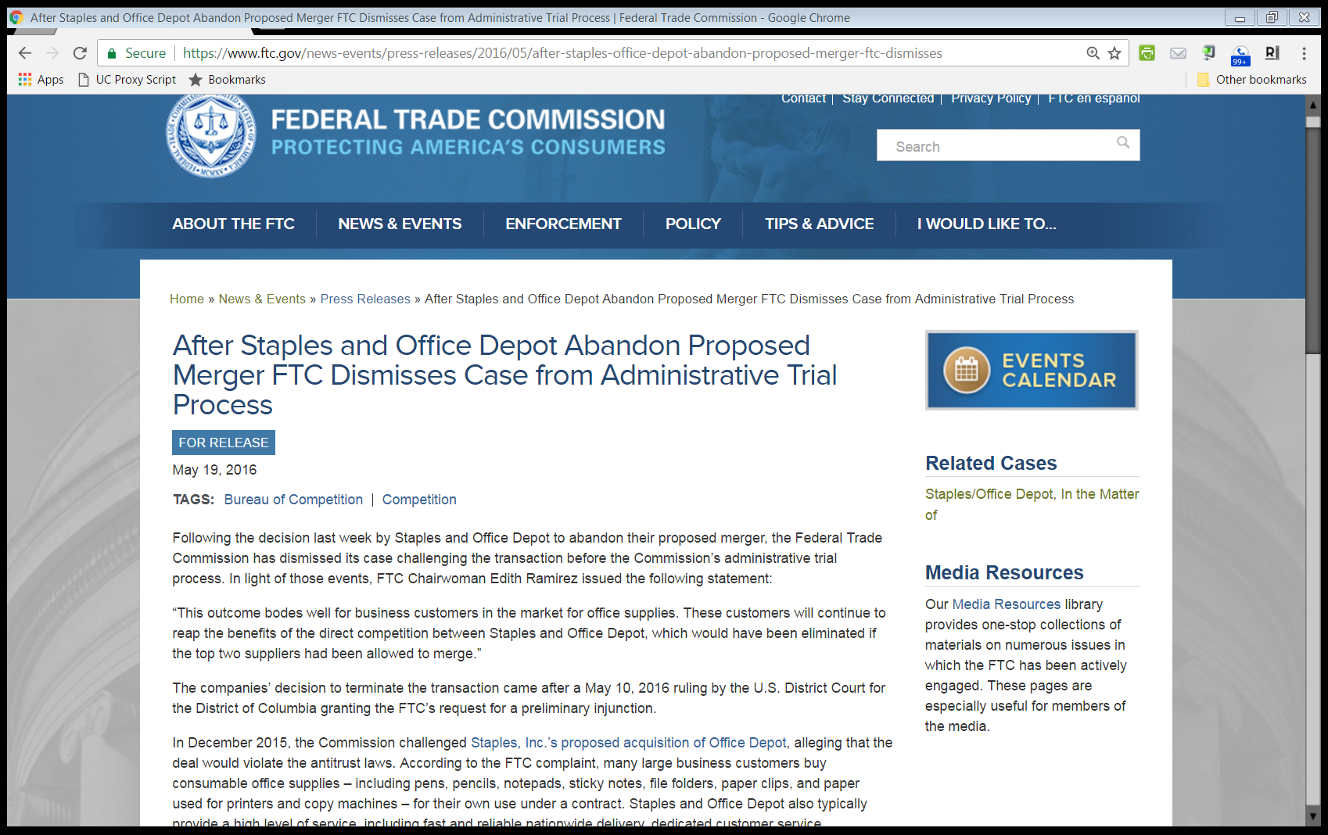
Merger Abandoned
FTC PR (19 May 2016)

Slide 98
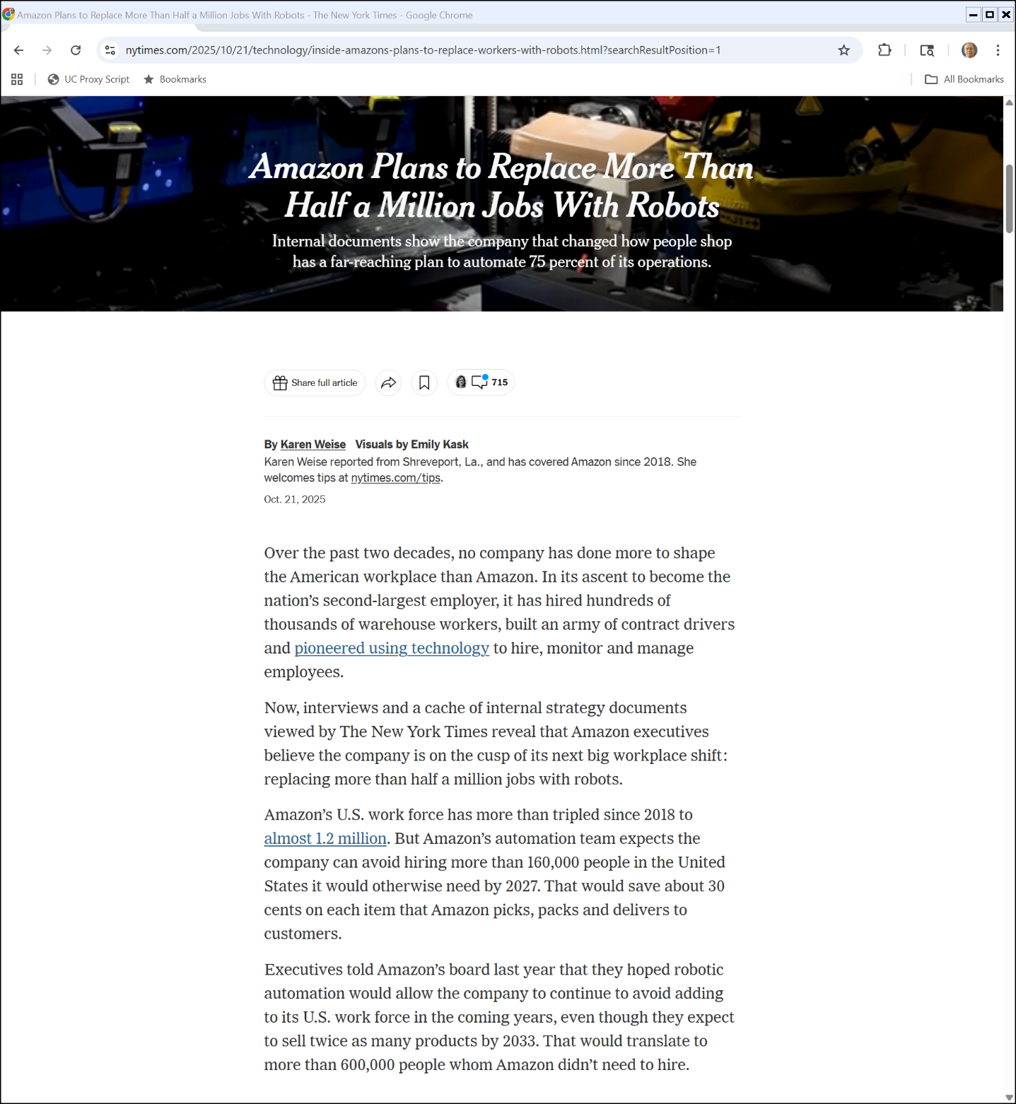

Amazon Robots
New York Times (21 Oct 2025)
Notes:
https://www.nytimes.com/2025/10/21/technology/inside-amazons-plans-to-replace-workers-with-robots.html?searchResultPosition=1

