Slide 1
Class 10: Mon 20 Oct 2025
Antitrust Fall 2025
Bundled Discounts
Randal C. Picker
James Parker Hall Distinguished Service Professor of Law
The Law School
The University of Chicago
Copyright © 2000-25 Randal C. Picker. All Rights Reserved.

Slide 2
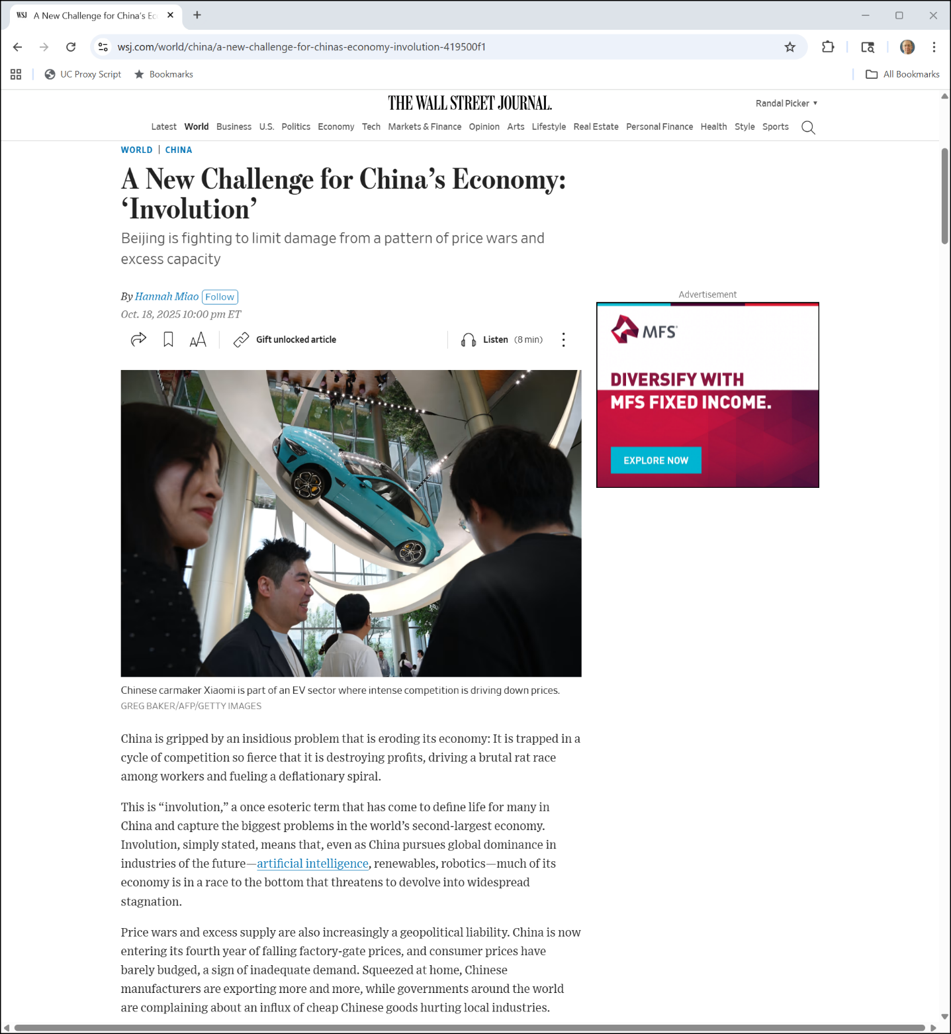
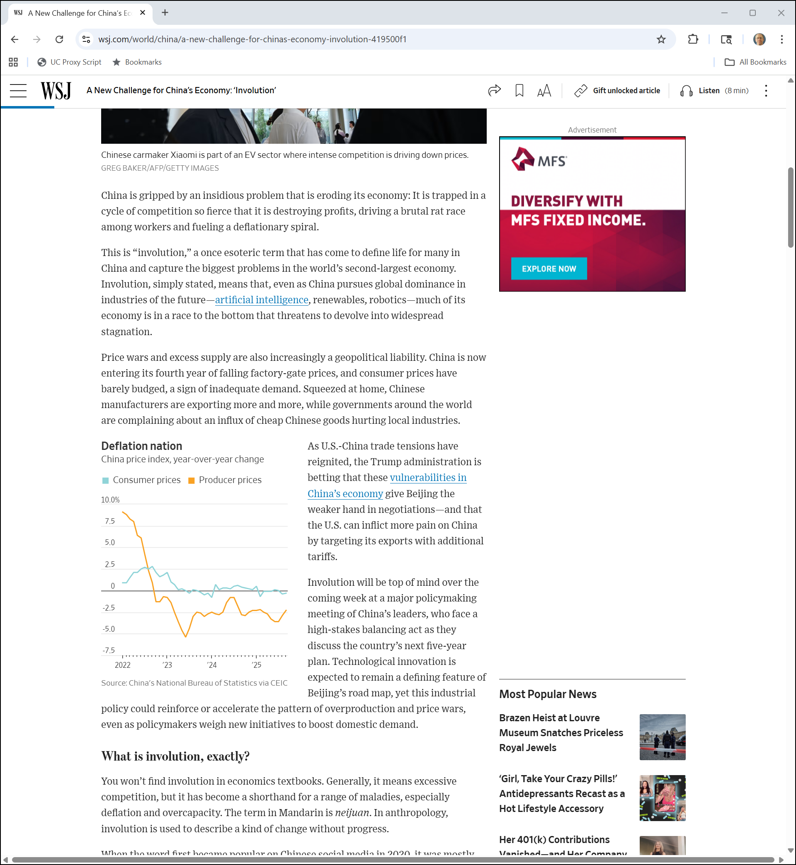
Involution?
WSJ (20 Oct 2025)
Notes:
https://www.wsj.com/world/china/a-new-challenge-for-chinas-economy-involution-419500f1

Slide 3
Too Much Competition?
WSJ (20 Oct 2025)
Notes:
https://www.wsj.com/world/china/a-new-challenge-for-chinas-economy-involution-419500f1

Slide 4
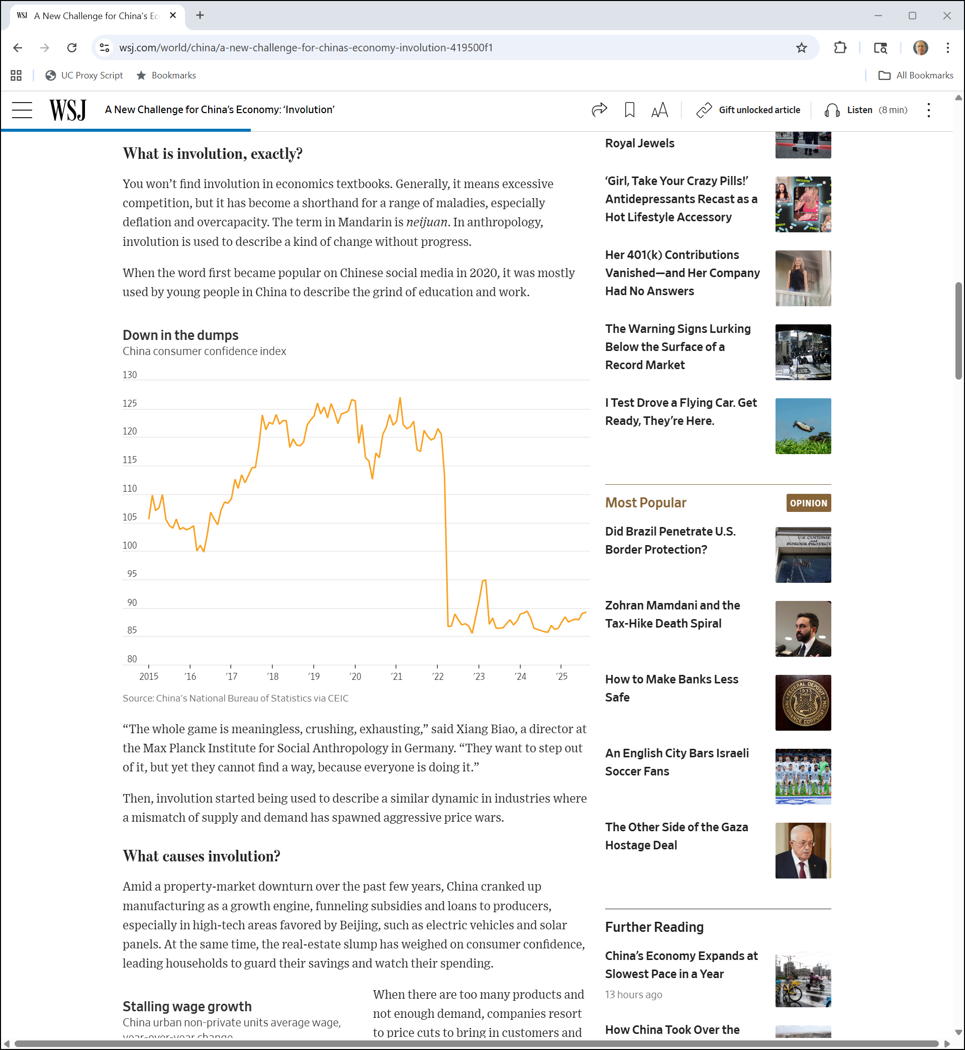
Life on The Treadmill
WSJ (20 Oct 2025)
Notes:
https://www.wsj.com/world/china/a-new-challenge-for-chinas-economy-involution-419500f1

Slide 5
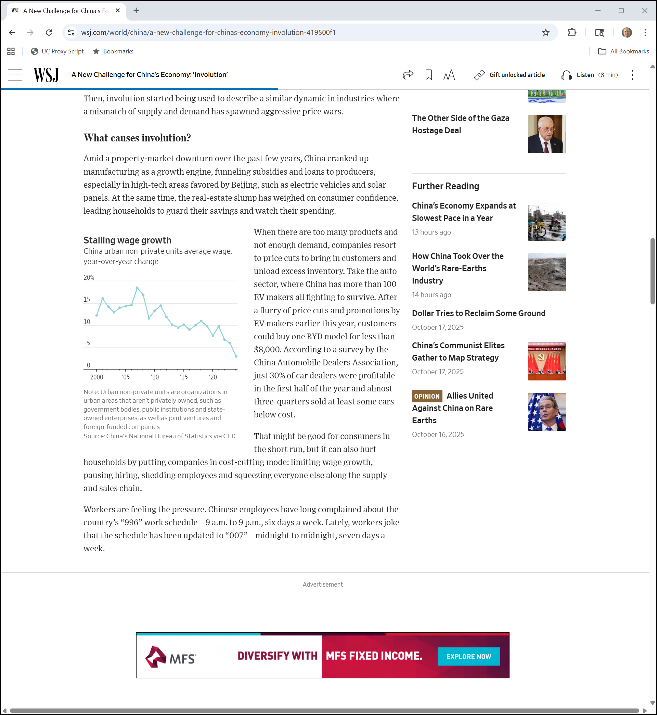
Gov’t subsidies?
WSJ (20 Oct 2025)
Notes:
https://www.wsj.com/world/china/a-new-challenge-for-chinas-economy-involution-419500f1

Slide 6
007
WSJ (20 Oct 2025)
Notes:
https://www.wsj.com/world/china/a-new-challenge-for-chinas-economy-involution-419500f1

Slide 7
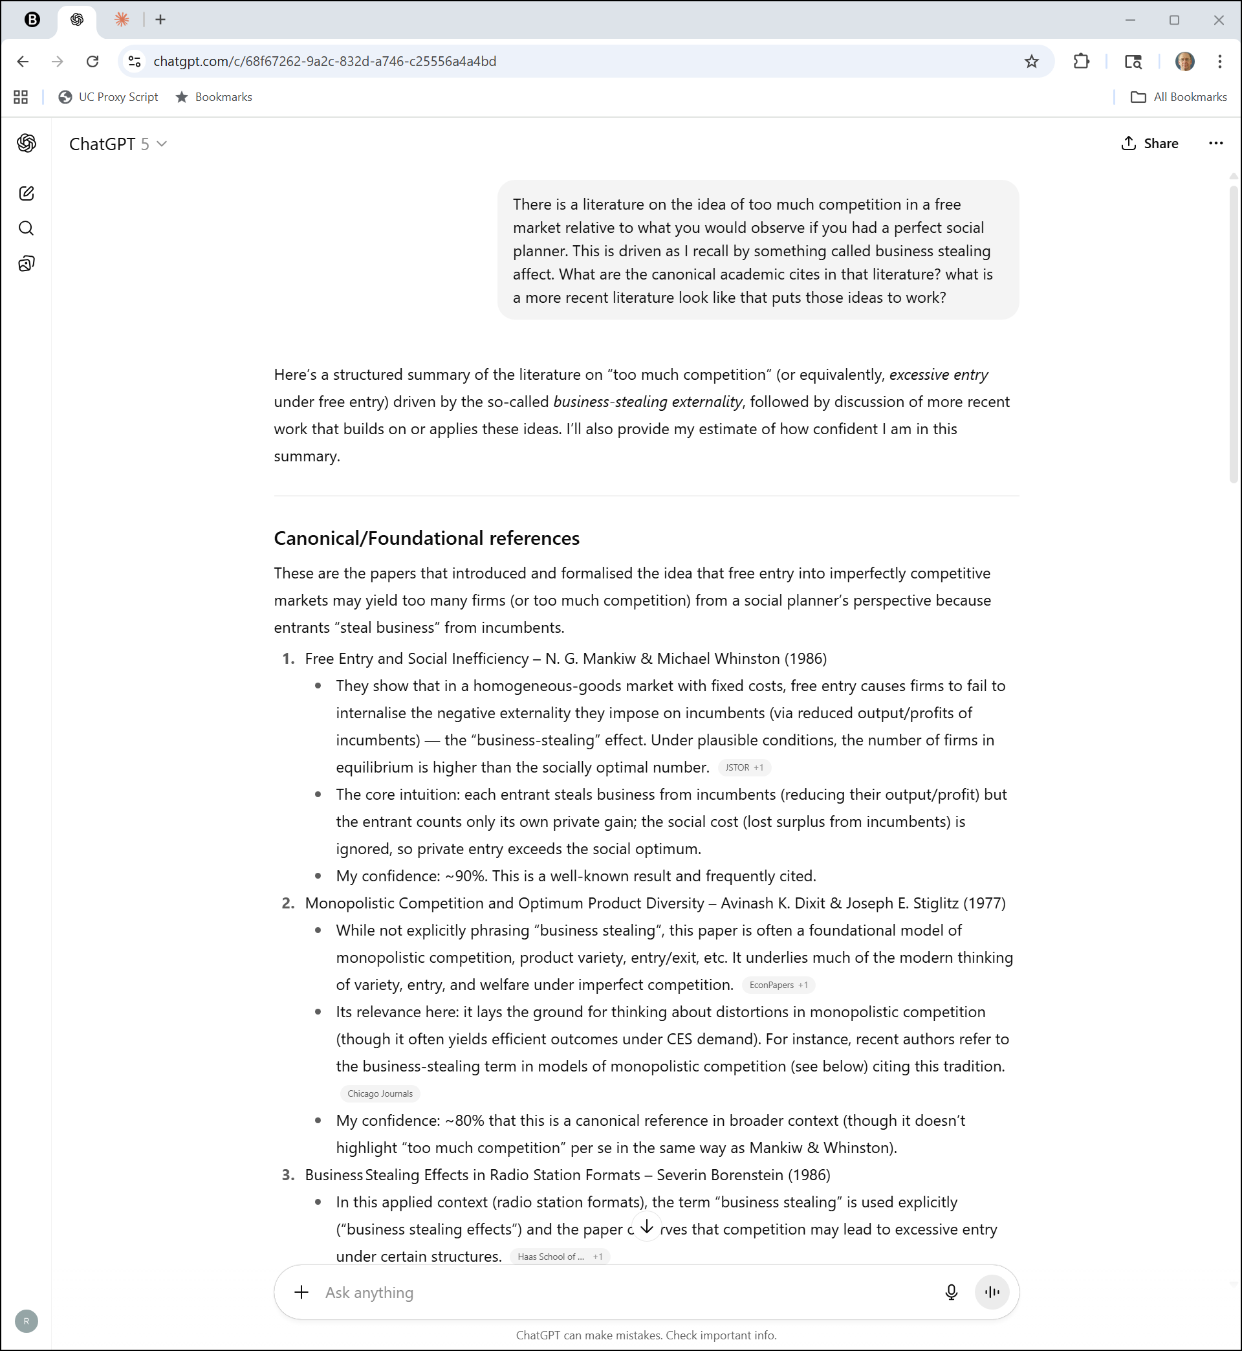
Over-Competition Literature
ChatGPT (20 Oct 2025)

Slide 8
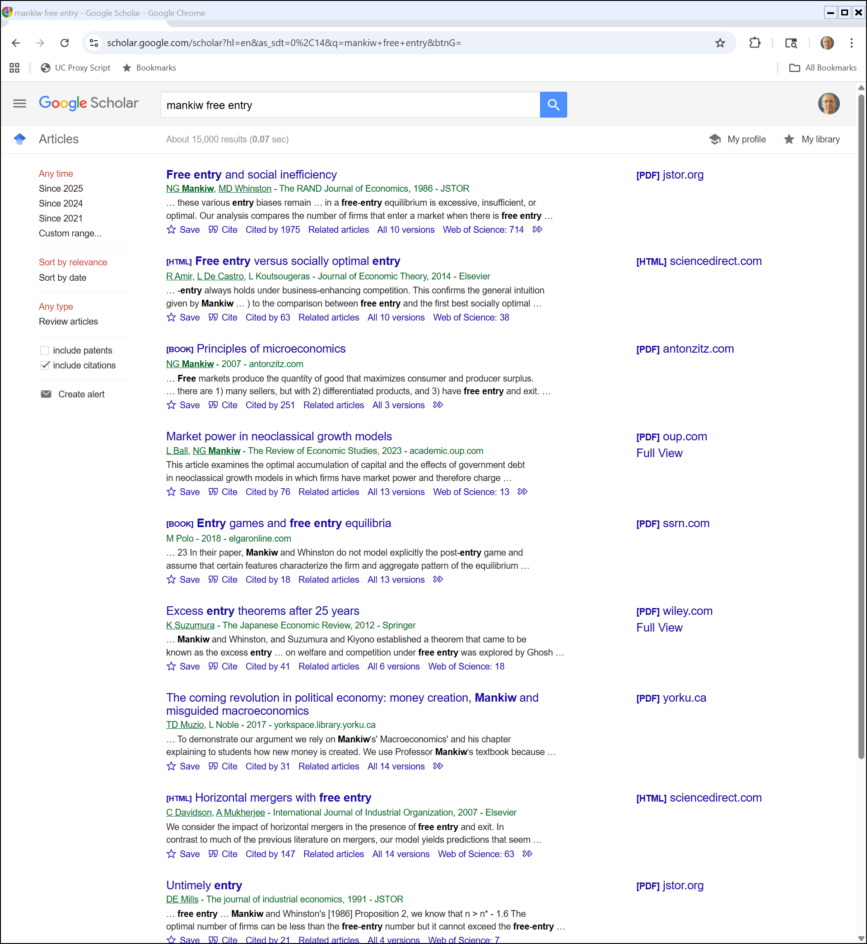
Excess Entry
Google Scholar (20 Oct 2025)

Slide 9
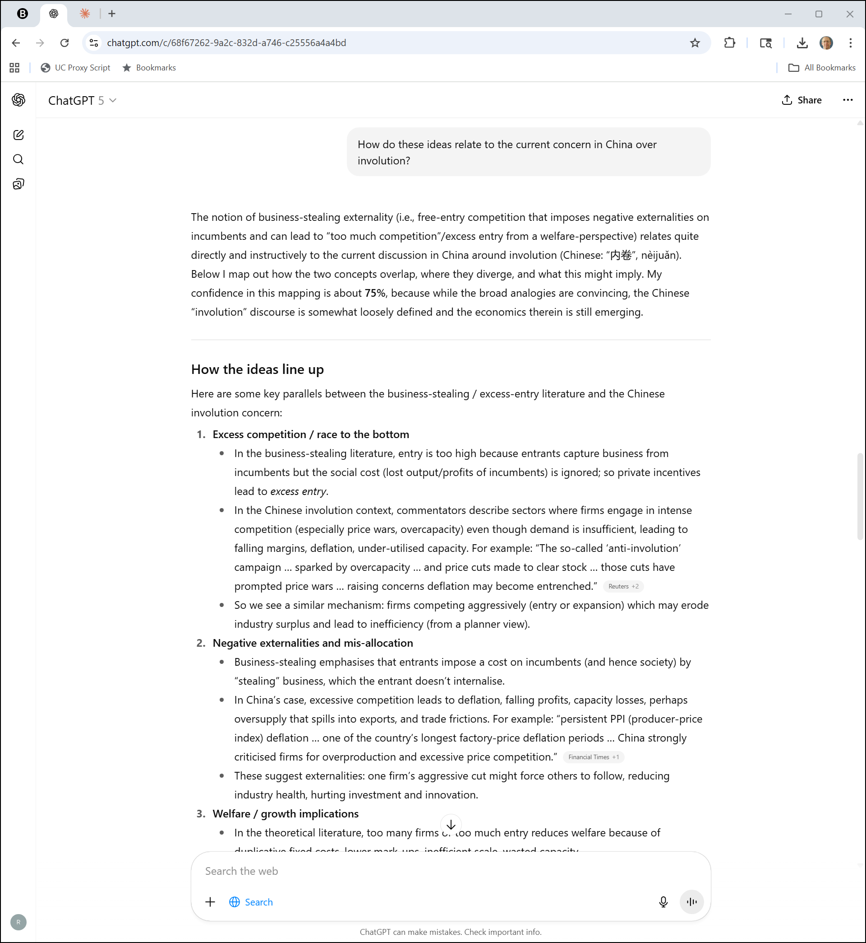
And China?
ChatGPT (20 Oct 2025)

Slide 10
And China?
ChatGPT (20 Oct 2025)

Slide 11
Listening to the Radio
TTYN (1 of 2)
Hypo 1
  100 music radio listeners: 80 like country, 20 like classical. Advertisers value listeners equally.
  Two possible free over-the-air radio stations
  Suppose owned separately: what will happen?
  Suppose owned by a single firm: what will happen?

Slide 12
Listening to the Radio
TTYN (2 of 2)
Hypo 2
  Same set up, but now a third station can enter the market; assume a fixed cost F to start each station
  Will the third station want to enter the market in either of the two station scenarios? And do what?
  Is that socially valuable?

Slide 13
Back to the Beginning
Steiner (QJE 1952)

Slide 14
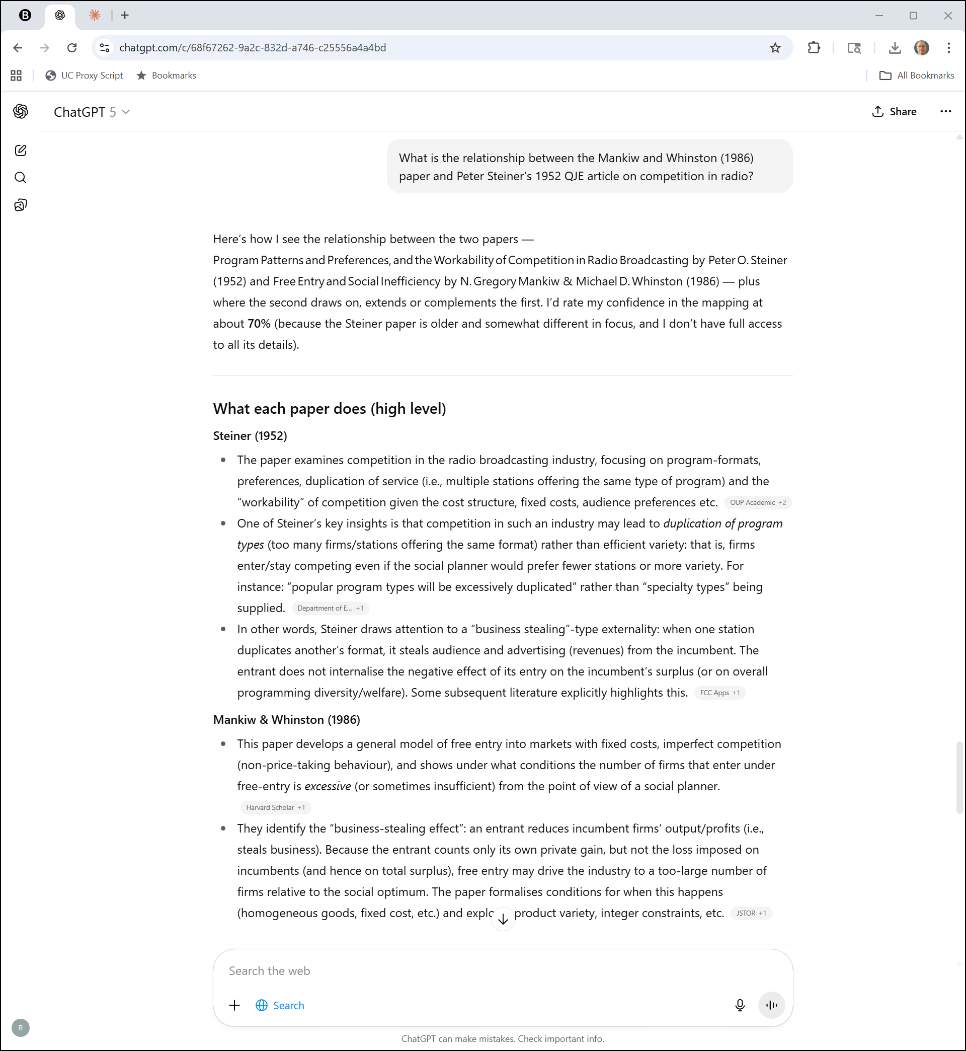
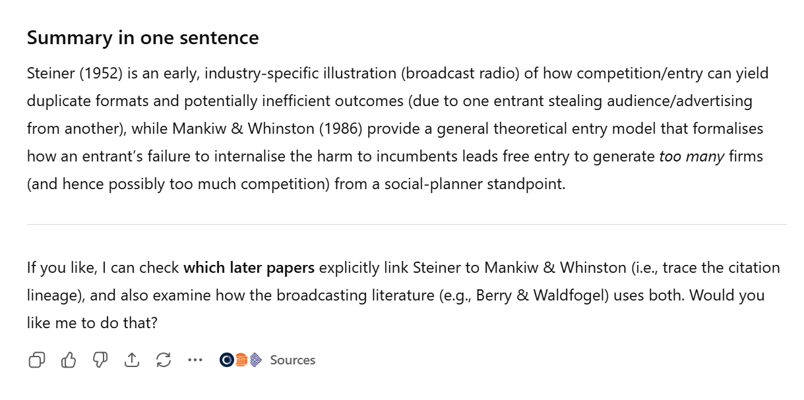
M&W and Steiner?
ChatGPT (20 Oct 2025)

Slide 15
Key Question for Today
Question
  How do we ensure that an entrant who is at least as efficient as the incumbent can compete?

Slide 16
Spectrum Sports, Inc.
506 U.S. 447 (1993)

Slide 17
Three-part test for attempted monopolization
“… [T]o demonstrate attempted monopolization a plaintiff must prove (1) that the defendant has engaged in predatory or anticompetitive conduct with (2) a specific intent to monopolize and (3) a dangerous probability of achieving monopoly power.”
Spectrum Sports (US 1993)

Slide 18
PeaceHealth (CA9 2007/8)

Slide 19
Why Bundling?
“Bundled discounts are pervasive, and examples abound. Season tickets, fast food value meals, all-in-one home theater systems—all are bundled discounts. Like individual consumers, institutional purchasers seek and obtain bundled discounts, too. See, e.g., LePage’s Inc. v. 3M, 324 F.3d 141, 154 (3d Cir. 2003) (en banc).”
PeaceHealth (CA9 2007)

Slide 20
Starting Point re Bundling
“That bundled discounts are a common feature of our current economic system is relevant to our analysis of allegedly anticompetitive conduct under § 2 of the Sherman Act. … The frequency with which we see bundled discounts in varied contexts does not insulate such discounts from antitrust review, but it heightens the need to ensure that the rule adopted does not expose inventive and legitimate forms of price competition to an overbroad liability standard.”
PeaceHealth (CA9 2007)

Slide 21
Benefits of Bundling
“Bundled discounts generally benefit buyers because the discounts allow the buyer to get more for less. … Bundling can also result in savings to the seller because it usually costs a firm less to sell multiple products to one customer at the same time than it does to sell the products individually.”
PeaceHealth (CA9 2007)

Slide 22
Selling Fast Food: New McD’s Value Combos
New York Times (4 Apr 1997)

Slide 23
Extra Value Meals
New York Times (4 Apr 1997)

Slide 24
Understanding Value Meal Pricing
New York Times (4 Apr 1997)

Slide 25
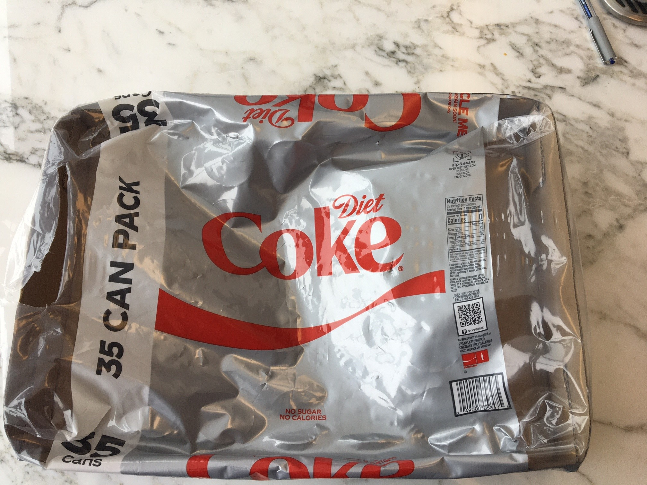
Costco Diet Coke (TTYN (1 of 5))
Picker Photo (30 Jan 2023)

Slide 26
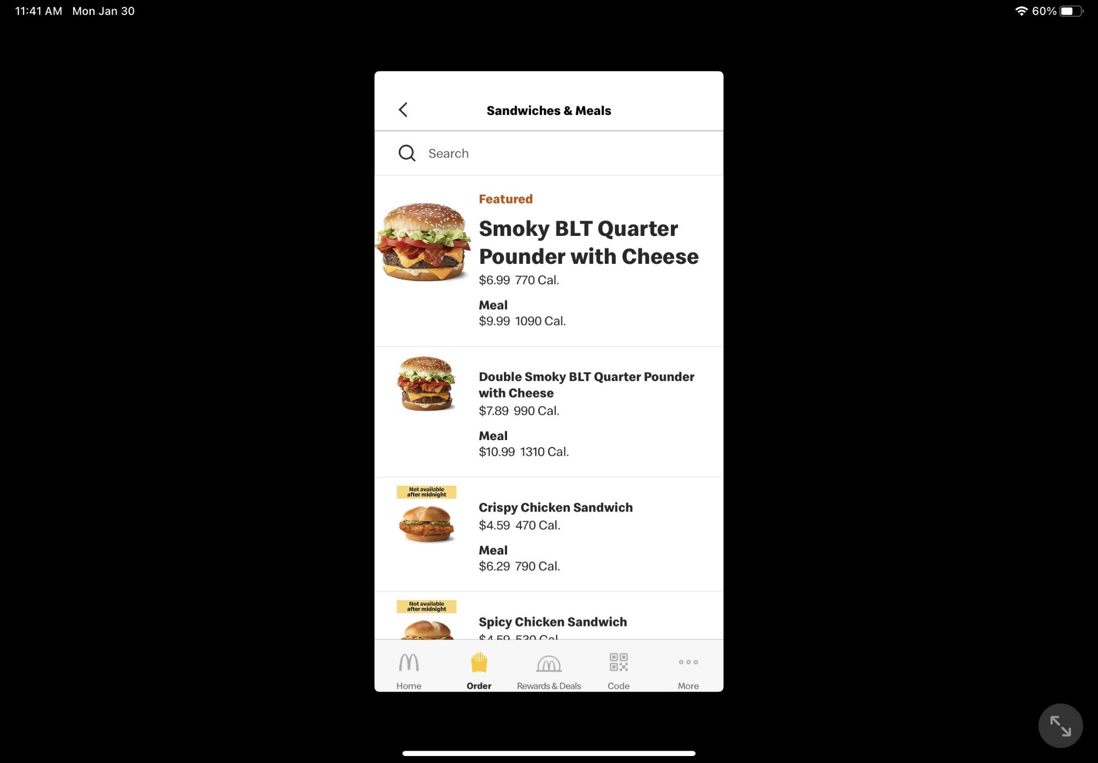
Ordering at McD’s (TTYN (2 of 5))
McD’s App (30 Jan 2023)

Slide 27
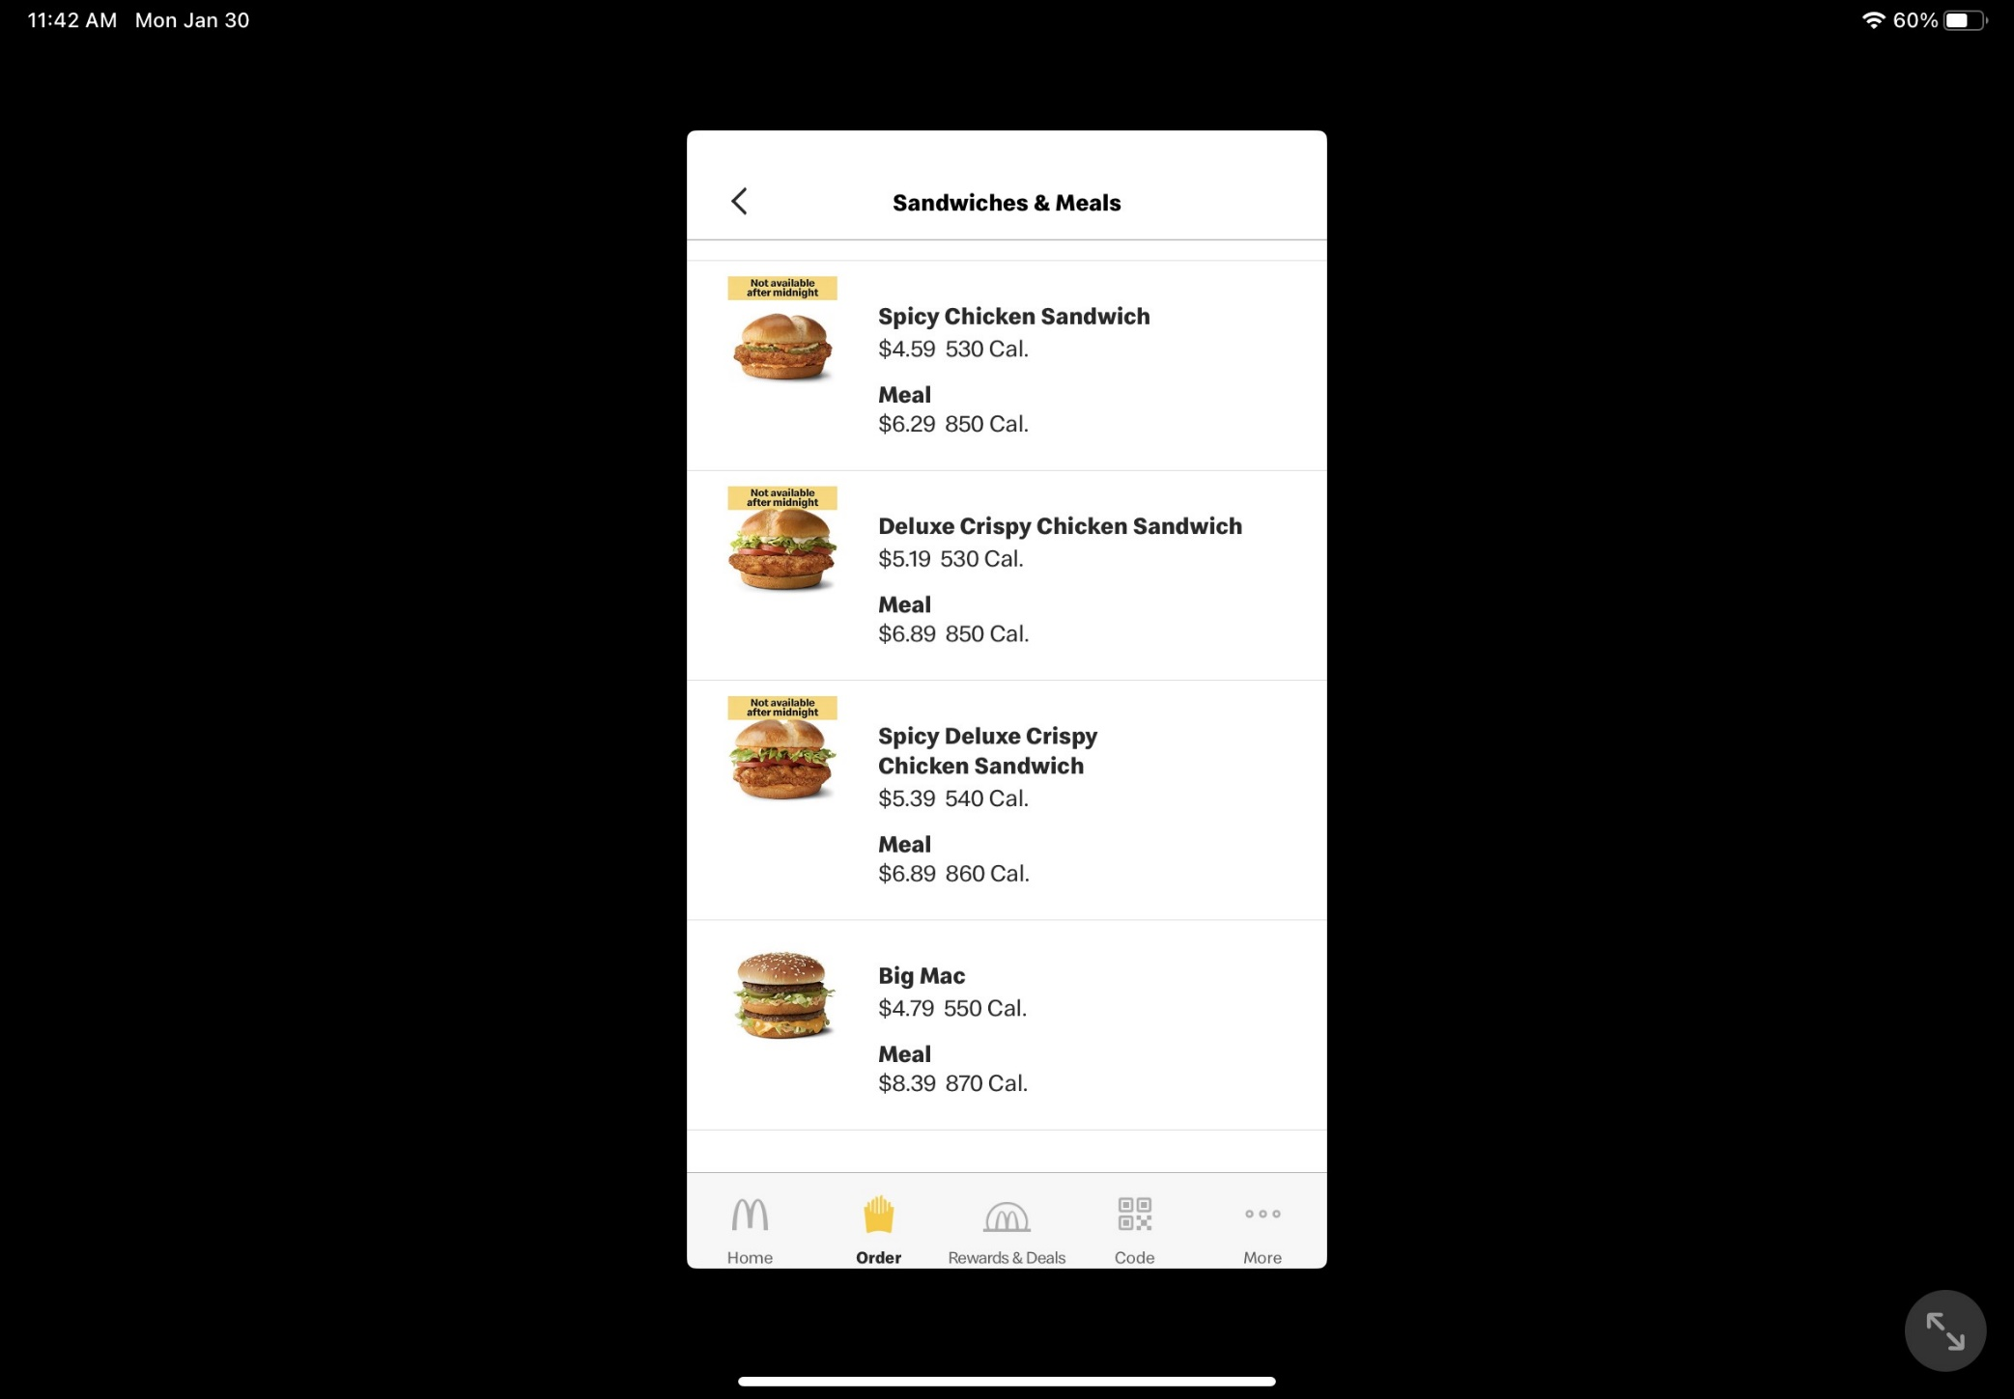
Ordering at McD’s (TTYN (3 of 5))
McD’s App (30 Jan 2023)

Slide 28
Buying at McD’s (TTYN (4 of 5))
McD’s App (30 Jan 2023)

Slide 29
Questions
TTYN (5 of 5)
Questions
  What is going on in these situations? Are we seeing the same effects in Costco and McDonald’s?
  And are these the same mechanisms as we see in LePage’s and PeaceHealth?
  Would something change if Costco offered me the deal only if I stopped buying DC at Target?

Slide 30
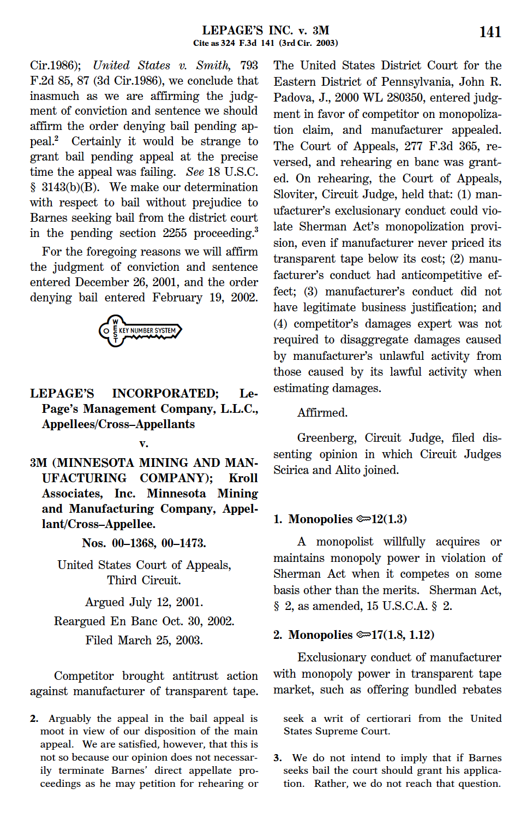
LePage’s Inc. v. 3M
324 F.3d 141 (3d Cir. 2003) (en banc)

Slide 31
LePage’s
Quick Facts
  3M has monopoly in transparent tape market
  LePage’s enters and targets private label tape sales
  3M enters private label sales and introduces bundled pricing
  LePage’s faces financial trouble and sues

Slide 32
LePage’s
District Court Result
  Jury trial
  3M wins on alleged violations of SA 1 and Clayton Act 3
  Loses on monopolization and attempted monopolization under SA 2
  Roughly $23mm in damages, trebled to $69mm

Slide 33
Framing the Antitrust Issues
Questions
  If 3M is monopolizing, in what market?
  Attempting to monopolize, in what market?
  CA 3 tying: what to what?

Slide 34
Sup Ct Test for SA2 Violation
“Thus, nothing that the Supreme Court has written since Brooke Group dilutes the Court’s consistent holdings that a monopolist will be found to violate § 2 of the Sherman Act if it engages in exclusionary or predatory conduct without a valid business justification.”
LePage’s Inc (3rd Cir. 2003)

Slide 35
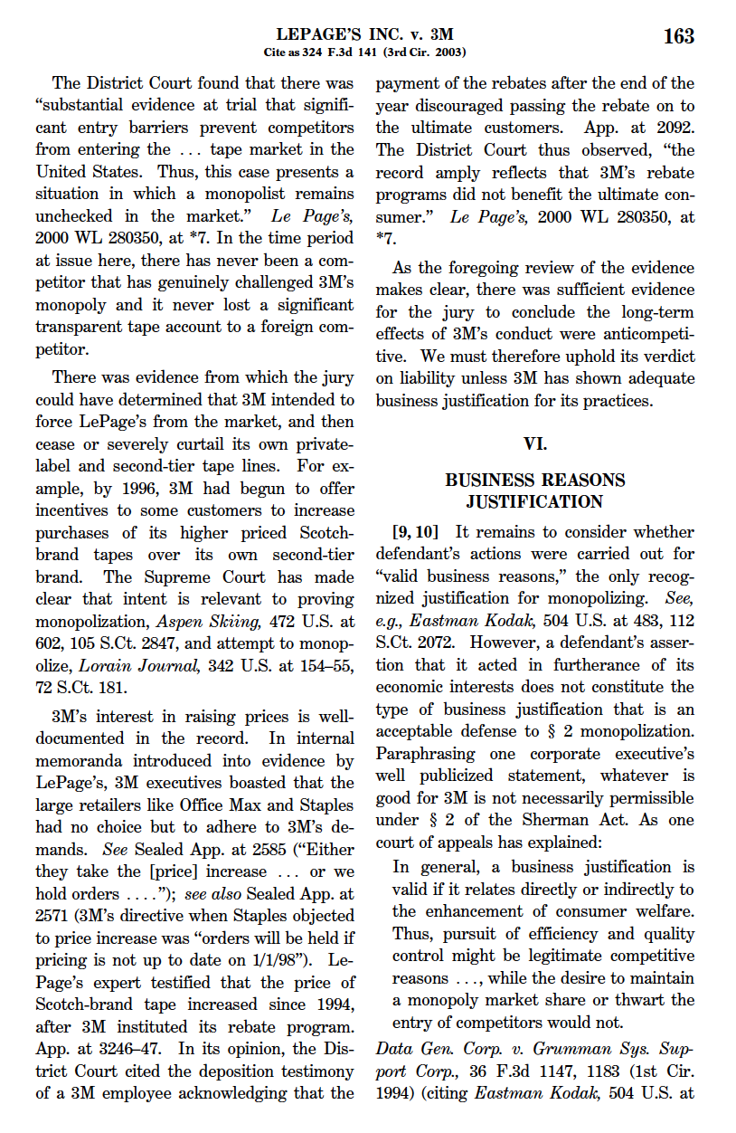
The Business Justification Defense
“In general, a business justification is valid if it relates directly or indirectly to the enhancement of consumer welfare. Thus, pursuit of efficiency and quality control might be legitimate competitive reasons ..., while the desire to maintain a monopoly market share or thwart the entry of competitors would not.”
LePage’s Inc (3rd Cir. 2003)

Slide 36
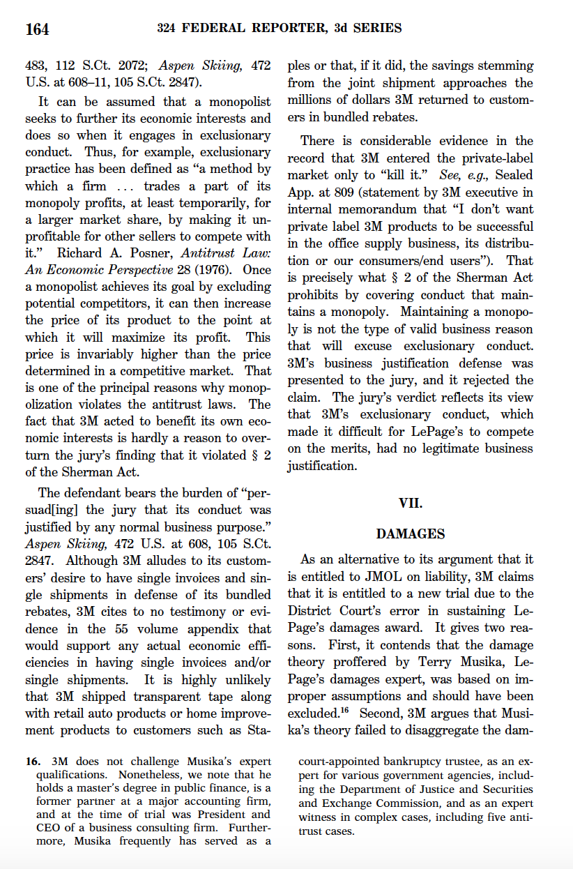
Exclusionary Practice
“Thus, for example, exclusionary practice has been defined as ‘a method by which a firm ... trades a part of its monopoly profits, at least temporarily, for a larger market share, by making it unprofitable for other sellers to compete with it.’ Richard A. Posner, Antitrust Law: An Economic Perspective 28 (1976).”
LePage’s Inc (3rd Cir. 2003)

Slide 37
Defendant Has Burden of Persuasion
“The defendant bears the burden of ‘‘persuad[ ing] the jury that its conduct was justified by any normal business purpose.’’ Aspen Skiing, 472 U.S. at 608.”
LePage’s Inc (3rd Cir. 2003)

Slide 38
Predatory Pricing?
TTYN (1 of 2)
Hypo
  Incumbent is efficient producer; its relevant marginal cost is $50
  When no threat of entry, charges monopoly price of $100
  Entrant appears with marginal cost of $70
  Incumbent sets price of $69
Predatory?

Slide 39
Predatory Pricing?
TTYN (2 of 2)
Hypo
  Continuing; after entrant exits, Incumbent raises price to $100 again
Does that change the analysis?
  And would anything change in the analysis if the Incumbent charged some customers $100 and others say $80? If the Incumbent exercised its market power in a discriminatory fashion?

Slide 40
Rules for Entry Again
Critical Issue
  What is a permissible response by an incumbent to entry?

Slide 41
Being a Monopolist
TTYN (1 of 3)
Hypo 1
  Only producing product A (Scotch brand transparent tape)
  MC per unit for 3M: $40
  Sets monopoly price of $100
Any antitrust issues?

Slide 42
Second Market Entry
TTYN (2 of 3)
Hypo 2
  LePage’s enters Product B (private-label transparent tape) and 3M responds by entering product B market
  MC per unit
    for 3M, $50; for L, $40
  3M sets price of $60, L of $55
Any antitrust issues?

Slide 43
Enter to Kill?
TTYN (3 of 3)
Hypo 3
  Replay prior hypo with cost different numbers
  MC per unit
    for 3M, $40; for L, $41
  3M sets price of $40.50, L of ??
Any antitrust issues?

Slide 44
Bundling Hypo
TTYN (1 of 2)
Hypo 4
  3M bundles together A&B and sells at price of $139
  Continues to sell A alone at $100, B alone at $60, while L sells B for $55
  Assume MCs of:
    3M: for A, $40, for B, $50; L: for B, $40

Slide 45
Bundling Hypo
TTYN (2 of 2)
Questions
  Is 3M selling the bundle below cost?
    This is what the aggregate discount rule asks
  Is 3M selling product B below cost when it sells the bundle?
    This is the question the discount attribution rule asks
  Antitrust issues?

Slide 46
Hypo 4 Answer
Answering the Questions
  Aggregate Discount Rule
    Bundle price is $139
    Total bundle cost is 40 + 50 = 90
  Price exceeds costs, so no SA2 violation

Slide 47
Hypo 4 Answer
Answering the Questions
  Discount Attribution Rule
    3M bundle price is $139
    3M total price of bundled products sold separately is $160
    Discount is $21

Slide 48
Hypo 4 Answer
Answering the Questions
  Discount Attribution Rule
    Allocate the $21 discount to the separate price of the competitive product
      3M price for B is $60 so 60 – 21 = 39
    Is implicit B price of $39 below 3M’s cost for B?
      Yes, with MC = 50
  Yes, so possible violation here

Slide 49
Hypo 4 Answer
Why Does this Matter?
  This is bad, probably for two reasons
    We now have the inefficient producer making B (3M’s costs are $50 for B, L’s $40)
    If the private-label market competes with branded-market, this may weaken private-label competitor in the long-run

Slide 50
Hypo 4 Answer
Bundling and Scale of Entry
  Bundling alters scale of entry
    Might need to enter branded-tape market and private-label tape market simultaneously
    Seems low probability of successful entry in branded-tape market

Slide 51
Dissent: 3M’s Output Increased: What Does that Mean Here?
“Unlike the situation of the defendant in Aspen, 3M’s pricing structure and bundled rebates were not contrary to its economic interests, as they likely increased its sales. In fact, that is exactly what LePage’s is complaining about.”
LePage’s Inc (3rd Cir. 2003)

Slide 52
Bundling as Below Cost Pricing
“Accordingly, we hold that the exclusionary conduct element of a claim arising under § 2 of the Sherman Act cannot be satisfied by reference to bundled discounts unless the discounts result in prices that are below an appropriate measure of the defendant’s costs.”
PeaceHealth (CA9 2007)

Slide 53
Aggregate Discount Rule
“PeaceHealth and some amici urge us to adopt a rule they term the ‘aggregate discount’’ rule. This rule condemns bundled discounts as anticompetitive only in the narrow cases in which the discounted price of the entire bundle does not exceed the bundling firm’s incremental cost to produce the entire bundle.”
PeaceHealth (CA9 2007)

Slide 54
Discount Attribution Standard
“Instead, as our cost-based rule, we adopt what amici refer to as a ‘discount attribution’ standard. Under this standard, the full amount of the discounts given by the defendant on the bundle are allocated to the competitive product or products. If the resulting price of the competitive product or products is below the defendant’s incremental cost to produce them, the trier of fact may find that the bundled discount is exclusionary for the purpose of § 2.”
PeaceHealth (CA9 2007)

Slide 55
PeaceHealth
TTYN (1 of 3)
The Hypo in PeaceHealth
  Need both shampoo (S) and conditioner (C) to wash your hair properly
  A has monop of C market, A and B both compete in S market
  A: MC for C is $2.5, for S is $1.5
  B: MC for S is $1.25

Slide 56
PeaceHealth
TTYN (2 of 3)
The Hypo in PeaceHealth
  A sells C alone for $5 and S alone for $3
  A sells bundle for $5.25

Slide 57
PeaceHealth
TTYN (3 of 3)
Questions as Before
  Is A selling the bundle below cost?
    This is what the aggregate discount rule asks
  Is A selling the competitive product, S, below cost when it sells the bundle?
    This is the question the discount attribution rule asks
  Antitrust issues?

Slide 58
PeaceHealth Hypo Answer
Answering the Questions
  Aggregate Discount Rule
    Bundled price for A for C+S is $5.25
    Total bundle cost is $2.5 + $1.5 = $4
  Price exceeds costs, so no SA2 violation

Slide 59
PeaceHealth Hypo Answer
Answering the Questions
  Discount Attribution Rule
    A bundle price is $5.25
    A total price of bundled products sold separately is $8
    Discount is $2.75

Slide 60
PeaceHealth Hypo Answer
Answering the Questions
  Discount Attribution Rule
    Allocate the $2.75 discount to the separate price of the competitive product
      A price for S is $3 so 3 – 2.75 = 0.25
    Is implicit price of $0.25 below A’s cost for S?
      Yes, with MC = $1.50
  Yes, so possible violation here

Slide 61
PeaceHealth Hypo Answer
Answering the Questions
  Discount Attribution Rule
    Easier Path: Sells A alone for $5, bundle of A+B for $5.25, means effective “marginal” price for B is 25 cents
    Is that below cost? Yes

Slide 62
Making Sense of the Hypo
TTYN (1 of 2)
New Version of PH Hypo
  A is only firm in market and sells C+S together for $8
  Need both to wash hair
  Has costs as before (cost of C is $2.5, S $1.5)
  Making profits of $4 on each bundle sold

Slide 63
Making Sense of the Hypo
TTYN (2 of 2)
New Version of PH Hypo
  A zillion entrants appear in the shampoo market, each with costs of $1.25, so they would be willing to sell S for $1.25
How should A react to this? Continue to sell bundle? Unbundle and sell C at what price?

Slide 64
Understanding the New Hypo
Analysis
  The hypo sets up a fixed proportions case where one S goes with one C
  The left-shoe monopolist hypo tell us that the monopolist can fully extract profits just selling the monopolized goods

Slide 65
Understanding the New Hypo
Analysis
  When the lower-cost entrants appear so that shampoo will be sold at $1.25, the conditioner monopolist should exit shampoo and just sell conditioner
  Was selling bundle for $8 before, now sell conditioner for 8 – 1.25 = 6.75 for profits of 6.75 – 2.50 = 4.25

Slide 66
Understanding the New Hypo
Takeaway?
  Hypo in the case doesn’t really work given fixed proportions structure
  Monopolist should welcome lower cost entry in shampoo market

