Slide 1
Class 9: Thurs 16 Oct 2025
Antitrust Fall 2025
Tying
Randal C. Picker
James Parker Hall Distinguished Service Professor of Law
The Law School
The University of Chicago
Copyright © 2000-25 Randal C. Picker. All Rights Reserved.

Slide 2
CA Section 3 (now 15 USC 14)
  “It shall be unlawful … to … make a sale or contract for sale of goods … on the condition, agreement, or understanding that the … purchaser thereof shall not use or deal in the goods … of a competitor … where the effect of … such condition … may be to substantially lessen competition or tend to create a monopoly in any line of commerce.”
38 Stat. 730 (15 Oct 1914)

Slide 3
Jefferson Parish
466 U.S. 2 (1984)

Slide 4
An Exclusivity Case?
“At issue in this case is the validity of an exclusive contract between a hospital and a firm of anesthesiologists. We must decide whether the contract gives rise to a per se violation of § 1 of the Sherman Act … .”
Jefferson Parish (US 1984)

Slide 5
Tying Case: Focus on Patients, Not Roux Contract
“In sum, any inquiry into the validity of a tying arrangement must focus on the market or markets in which the two products are sold, for that is where the anticompetitive forcing has its impact. Thus, in this case our analysis of the tying issue must focus on the hospital’s sale of services to its patients, rather than its contractual arrangements with the providers of anesthesiological services.”
Jefferson Parish (US 1984)

Slide 6
Fn 28: Not the Roux Contract
“It is essential to differentiate between the Roux contract and the legality of the contract between the hospital and its patients. The Roux contract is nothing more than an arrangement whereby Roux supplies all of the hospital’s needs for anesthesiological services. That contract raises only an exclusive-dealing question, see n. 51, infra. The issue here is whether the hospital’s insistence that its patients purchase anesthesiological services from Roux creates a tying arrangement.”
Jefferson Parish (US 1984)

Slide 7
And the Contract Changed
“The 1971 contract provided for a 1-year term automatically renewable for successive 1-year periods unless either party elected to terminate. In 1976, a second written contract was executed containing most of the provisions of the 1971 agreement. Its term was five years and the clause excluding other anesthesiologists from the hospital was deleted; the hospital nevertheless continued to regard itself as committed to a closed anesthesiology department. Only Roux was permitted to practice anesthesiology at the hospital.”
Jefferson Parish (US 1984)

Slide 8
Hyde Standing?
“Respondent has standing to enforce § 1 by virtue of § 4 of the Clayton Act, 38 Stat. 731, as amended, 15 U. S. C. § 15.”
Jefferson Parish (US 1984)

Slide 9
Tying as Per Se Illegal?
“Certain types of contractual arrangements are deemed unreasonable as a matter of law. … A price-fixing agreement between competitors is the classic example of such an arrangement. … It is far too late in the history of our antitrust jurisprudence to question the proposition that certain tying arrangements pose an unacceptable risk of stifling competition and therefore are unreasonable ‘per se.’ The rule was first enunciated in International Salt Co. v. United States, 332 U.S. 392, 396 (1947) … .”
Jefferson Parish (US 1984)

Slide 10
Tying and CA3
“The rule also reflects congressional policies underlying the antitrust laws. In enacting §3 of the Clayton Act, 15 U.S.C. § 14, Congress expressed great concern about the anticompetitive character of tying arrangements. … While this case does not arise under the Clayton Act, the congressional finding made therein concerning the competitive consequences of tying is illuminating, and must be respected.”
Jefferson Parish (US 1984)

Slide 11
O’Connor: But …
“The Court has never been willing to say of tying arrangements, as it has of price fixing, division of markets, and other agreements subject to per se analysis, that they are always illegal, without proof of market power or anticompetitive effect.”
Jefferson Parish (US 1984)

Slide 12
International Salt
332 U.S. 392 (1947)

Slide 13
IBM
298 U.S. 131 (1936)

Slide 14
The Left Shoe Monopolist
TTYN (1 of 2)
Situation
  M has a monopoly in the production of left shoes.
  Marginal cost of making a left shoe is $1.
  Anyone can produce right shoes at a marginal cost of $1.
  Customers value pairs of shoes at $102.

Slide 15
The Left Shoe Monopolist
TTYN (2 of 2)
What should our monopolist do?
  Sell left shoes alone?
  Offer both and let consumers choose?
  Require consumers to buy both?

Slide 16
Fixed Proportions and Tying
Don’t Need To Tie Shoes
  M can extract the full monopoly profit by setting a price for left shoes of $101.
  Absent a more sophisticated story, tying will not increase the profits of M in the fixed proportions case.

Slide 17
Fixed v. Variable Proportions
Variable Proportions Case
  We cannot make a general statement about social welfare and tying in the variable proportions case.
  Price discrimination through tying can either increase welfare or reduce it.
Fixed Proportions Case
  Tying should not increase profits, so we should expect other motives to be at work.

Slide 18
Metering and Tying
Monopoly over Machine
  How do I exploit my monopoly power over the machine?
More than One Price
  I would like to charge different customers different prices for the machine
  How do I do that? Use the consumable to gauge value for the machine

Slide 19
Metering and Tying
TTYN (1 of 4)
Hypo 1
  IBM wants to count cards to effectively create multiple prices for monopolized machine
  Suppose they just count cards and bill machine users based on card use; IBM doesn’t care where cards come from
Competition issues?

Slide 20
Metering and Tying
TTYN (2 of 4)
Hypo 2
  As before, want to count cards
  Suppose IBM says they can’t monitor card use effectively when machine customers buy cards from multiple vendors
  So insist on card purchases from IBM
Competition issues?

Slide 21
Metering and Tying
TTYN (3 of 4)
Hypo 3
  As before, card counting and monitoring problems
  IBM exits card business but continues to insist customers buy cards only from IBM
  IBM will buy cards from card makers for resale
Competition issues?

Slide 22
Metering and Tying
TTYN (4 of 4)
Hypo 4
  IBM invents tech that lets it accurately counts cards that flow through machine
  IBM exits card business fully: doesn’t make cards, doesn’t buy or sell cards
  IBM charges device fee + fee based on card use
Competition issues?

Slide 23
Tying Foreclosure From Substantial Market Per Se Illegal
“Not only is price-fixing unreasonable, per se, United States v. Socony-Vacuum Oil Co., 310 U.S. 150; United States v. Trenton Potteries Co., 273 U.S. 392, but also it is unreasonable, per se, to foreclose competitors from any substantial market. Fashion Originators Guild v. Federal Trade Commission, 114 F.2d 80, affirmed, 312 U.S. 457.”
Int’l Salt (U.S. 1947)

Slide 24
Building a Hospital
TTYN (1 of 3)
Hypo 1
  Hospital, a corporation, has OR, supplies, doctors, nurses
  Some of those doctors are anesthesiologists
  No one provides medical services at the hospital who isn’t employed by the hospital
SA 1 issues? SA2 issues?

Slide 25
Building a Hospital
TTYN (2 of 3)
Hypo 2
  Hospital, a corporation, has OR, supplies, doctors, nurses, but no anesthesiologists
  Hospital enters into doubly-exclusive contract—exclusive both ways—with Roux Corp
  All services at hospital provided by hospital employees or by people who work for Roux

Slide 26
Building a Hospital
TTYN (3 of 3)
Questions
  What are the non-antitrust consequences of how the two hospitals are organized?
  What are the competition consequences of the two different forms of organization?
  Are there SA1 or SA2 issues in either case?

Slide 27
Exclusive Dealing: Tampa Electric
365 U.S. 320 (1961)

Slide 28
20-Year Exclusive Coal Contract
Tampa Electric (U.S. 1961)

Slide 29
Exclusive Contracts and CA3
“In practical application, even though a contract is found to be an exclusive-dealing arrangement, it does not violate the section unless the court believes it probable that performance of the contract will foreclose competition in a substantial share of the line of commerce affected.”
Tampa Electric (U.S. 1961)

Slide 30
1: Define the Line of Commerce
“First, the line of commerce, i.e., the type of goods, wares, or merchandise, etc., involved must be determined, where it is in controversy, on the basis of the facts peculiar to the case.”
Tampa Electric (U.S. 1961)

Slide 31
2: Determine the Area of Effective Competition
“Second, the area of effective competition in the known line of commerce must be charted by careful selection of the market area in which the seller operates, and to which the purchaser can practicably turn for supplies. In short, the threatened foreclosure of competition must be in relation to the market affected.”
Tampa Electric (U.S. 1961)

Slide 32
3: Foreclose a Substantial Share
“Third, and last, the competition foreclosed by the contract must be found to constitute a substantial share of the relevant market. That is to say, the opportunities for other traders to enter into or remain in that market must be significantly limited … .”
Tampa Electric (U.S. 1961)

Slide 33
Small Amount Here in Content and No CA3 Violation
Tampa Electric (U.S. 1961)

Slide 34
If No CA3 Violation, then No SA1 or SA2 Violation
“We need not discuss the respondents’ further contention that the contract also violates § 1 and § 2 of the Sherman Act, for if it does not fall within the broader proscription of § 3 of the Clayton Act it follows that it is not forbidden by those of the former.”
Tampa Electric (U.S. 1961)

Slide 35
Fn 51: Exclusive Contract Not In Issue Here
“The effect of the contract, of course, has been to remove the East Jefferson Hospital from the market open to Roux’s competitors. Like any exclusive-requirements contract, this contract could be unlawful if it foreclosed so much of the market from penetration by Roux’s competitors as to unreasonably restrain competition in the affected market, the market for anesthesiological services. See generally Tampa Electric Co. v. Nashville Coal Co., 365 U.S. 320 (1961); Standard Oil Co. of California v. United States, 337 U.S. 293 (1949). However, respondent has not attempted to make this showing.”
Jefferson Parish (US 1984)

Slide 36
O’Connor: Roux Contract as Exclusive Dealing
“Whether or not the hospital-Roux contract is characterized as a tie between distinct products, the contract unquestionably does constitute exclusive dealing. Exclusive-dealing arrangements are independently subject to scrutiny under § 1 of the Sherman Act, and are also analyzed under the rule of reason. Tampa Electric Co. v. Nashville Coal Co., 365 U.S. 320, 333-335 (1961).”
Jefferson Parish (US 1984)

Slide 37
O’Connor: No Violation Here
“Even without engaging in a detailed analysis of the size of the relevant markets we may readily conclude that there is no likelihood that the exclusive-dealing arrangement challenged here will either unreasonably enhance the hospital’s market position relative to other hospitals, or unreasonably permit Roux to acquire power relative to other anesthesiologists. Accordingly, this exclusive-dealing arrangement must be sustained under the rule of reason.”
Jefferson Parish (US 1984)

Slide 38
Two Products or One Product?
“In making that analysis, we must consider whether petitioners are selling two separate products that may be tied together, and, if so, whether they have used their market power to force their patients to accept the tying arrangement.”
Jefferson Parish (US 1984)

Slide 39
Separateness
Tying requires two distinct products
What makes for separate products?
  Functional relation?
    Do we ever see anesthesiological services purchased without a hospital operating room?
  Character of demand?
    Even if simultaneous use is inevitable, do consumers want to self-bundle?

Slide 40
Separate Consumer Demand
“Thus, in this case no tying arrangement can exist unless there is a sufficient demand for the purchase of anesthesiological services separate from hospital services to identify a distinct product market in which it is efficient to offer anesthesiological services separately from hospital services.”
Jefferson Parish (US 1984)

Slide 41
Tying Tests: Power and Forcing
“Our cases have concluded that the essential characteristic of an invalid tying arrangement lies in the seller’s exploitation of its control over the tying product to force the buyer into the purchase of a tied product that the buyer either did not want at all, or might have preferred to purchase elsewhere on different terms.”
Jefferson Parish (US 1984)

Slide 42
Per Se Sort Of?
“Without a showing of actual adverse effect on competition, respondent cannot make out a case under the antitrust laws, and no such showing has been made.”
Jefferson Parish (US 1984)

Slide 43
Cert Petition
SAP v. Teradata (2 June 2025)

Slide 44
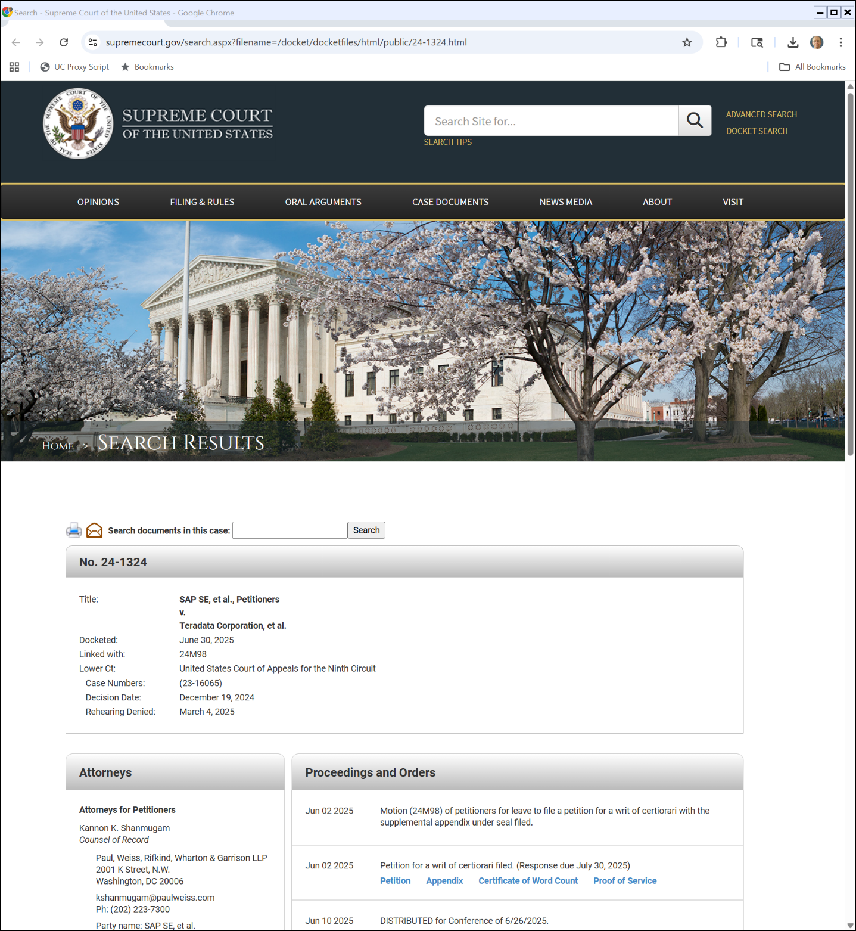
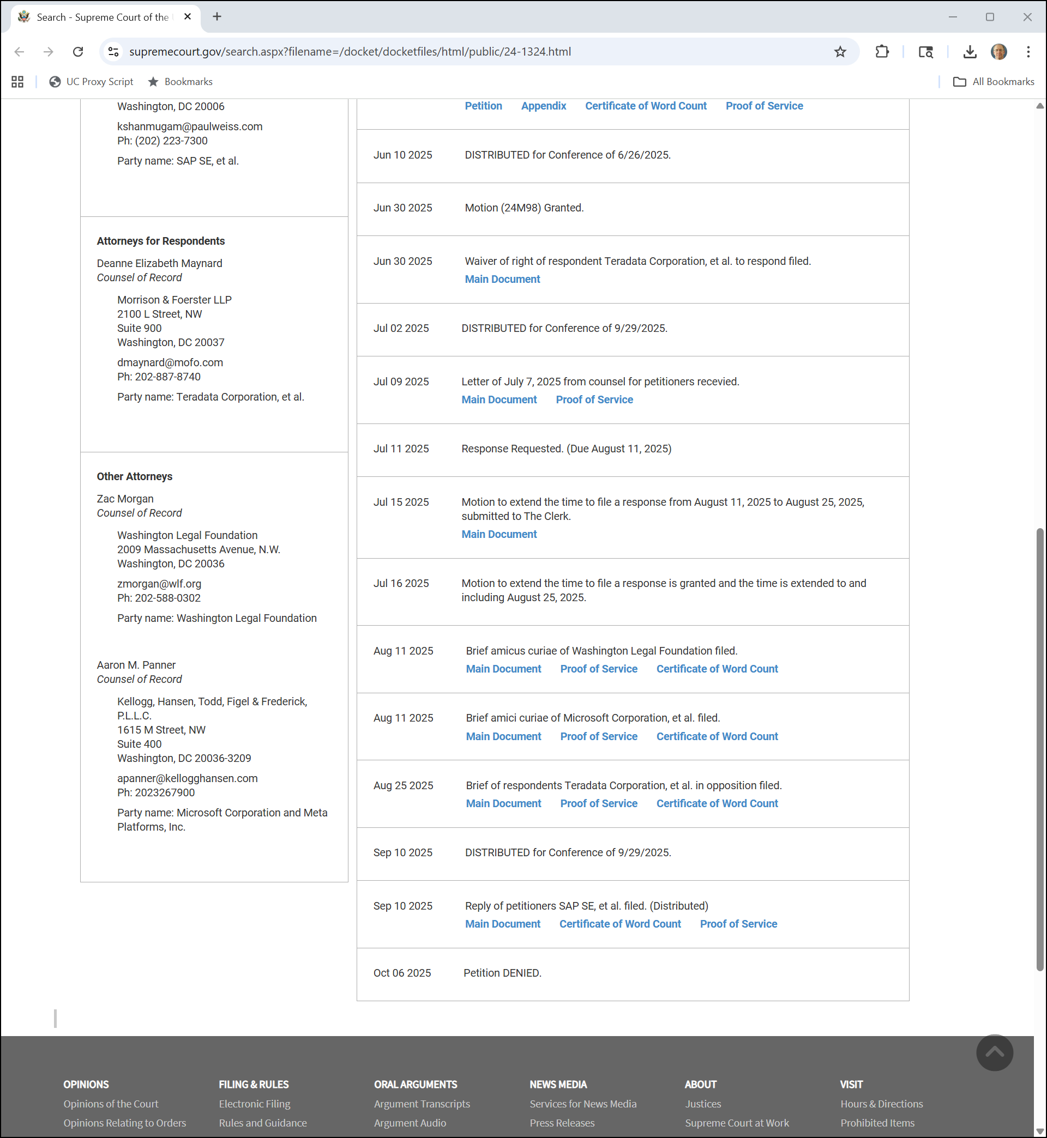
6 Oct 2025: Motion Denied
SAP v. Teradata Docket
Notes:
https://www.supremecourt.gov/search.aspx?filename=/docket/docketfiles/html/public/24-1324.html

Slide 45

And What Does It Mean?
Twitter (6 Oct 2025)

