Slide 1
Class 8: Wed 15 Oct 2025 Antitrust Fall 2025 Individual Refusals to Deal & Predation
Randal C. Picker
James Parker Hall Distinguished Service Professor of Law
The Law School
The University of Chicago
Copyright © 2000-25 Randal C. Picker. All Rights Reserved.

Slide 2
Grinnell
384 U.S. 563 (1966)

Slide 3
SA2 Monopolization
“The offense of monopoly under § 2 of the Sherman Act has two elements: (1) the possession of monopoly power in the relevant market and (2) the willful acquisition or maintenance of that power as distinguished from growth or development as a consequence of a superior product, business acumen, or historic accident.”
Grinnell (US 1966)

Slide 4
Market Shares and Market Power
Grinnell (US 1966)

Slide 5
Market Shares and Market Power
Grinnell (US 1966)

Slide 6
Linkline
555 U.S. 438 (2009)

Slide 7
What Can a Monopolist Do?
“Simply possessing monopoly power and charging monopoly prices does not violate §2; rather, the statute targets ‘the willful acquisition or maintenance of that power as distinguished from growth or development as a consequence of a superior product, business acumen, or historic accident. United States v. Grinnell Corp., 384 U.S. 563, 570-571 (1966).”
Linkline (US 2009)

Slide 8
Aspen Skiing Co.
472 U.S. 585 (1985)

Slide 9
Aspen Skiing (US 1985)
Key Facts
1945-60: 3 mountains developed--Ajax, Highlands, Buttermilk—and operated separately
1962: 6-day, all-Aspen ticket introduced
Six coupons
Revenues divided based on number of coupons collected

Slide 10
Aspen Skiing (US 1985)
1964: Aspen Skiing buys Buttermilk, uniting it with Ajax
Introduces two-area ticket, which outsells all-Aspen ticket
1967: Aspen Skiing opens Snowmass
All-Aspen ticket outsells own three-area ticket
1971 Forward: Changes in ticket technology

Slide 11
Aspen Skiing (US 1985)
1977: AS offers AH fixed share of 13.2% of revenues, deal done at 15%
1978: AS offers AH 12.5% of revs, killing the all-Aspen ticket
AS refuses to sell daily lift tickets at any price to AH

Slide 12
Aspen Skiing (US 1985)
1981 Pricing by AS
Daily $22
3-area, 6-day $114

Slide 13
Aspen Skiing (US 1985)
Highlands Market Share
76-77: 20.5%
77-78: 15.7%
78-79: 13.1%
79-80: 12.5%
80-81: 11%

Slide 14
Complaint and the Lower Courts
District Court
AH alleges monopolization by AS
AH wins actual damages of $2.5 million
Injunction requiring 4-area ticket

Slide 15
Complaint and the Lower Courts
Court of Appeals
Affirmed
All-Aspen ticket was “essential facility” under Terminal Railroad
Also violated Sec. 2, efforts were to create or maintain a monopoly
No valid business reason to refuse to accept coupons from AH’s Adventure Pack

Slide 16
Situations to Look For in Aspen
TTYN (1 of 3)
Markets
What are the relevant markets here? How does the Sup Ct see that here? How did the Colorado AG see that?

Slide 17
Situations to Look For in Aspen
TTYN (2 of 3)
Three Types of Market Participants
What does competition look like?
What does a good monopolist look like?
By good monopolist, I mean a firm that has obtained monopoly power in an allowed way and is exercising it in a fashion consistent with the Sherman Act

Slide 18
Situations to Look For in Aspen
TTYN (3 of 3)
Three Types of Market Participants
What does a bad monopolist look like?
By bad monopolist I mean one that is seeking to, per Grinnell, acquire more monopoly power or to maintain the monopoly power that it has
What do consumers want?

Slide 19
The Colorado AG: Price-Fixing Cartel?
Aspen Skiing (US 1985)

Slide 20
No General Obligation to Deal with Competitors
“Ski Co., therefore, is surely correct in submitting that even a firm with monopoly power has no general duty to engage in a joint marketing program with a competitor.”
Aspen Skiing (US 1985)

Slide 21
Jury Instructions: Scale Economies
“For example, a firm that has lawfully acquired a monopoly position is not barred from taking advantage of scale economies by constructing a large and efficient factory. These benefits are a consequence of size and not an exercise of monopoly power.”
Aspen Skiing (US 1985)

Slide 22
Jury Instructions: Cooperation Obligations
“Nor is a corporation which possesses monopoly power under a duty to cooperate with its business rivals. Also a company which possesses monopoly power and which refuses to enter into a joint operating agreement with a competitor or otherwise refuses to deal with a competitor in some manner does not violate Section 2 if valid business reasons exist for that refusal.”
Aspen Skiing (US 1985)

Slide 23
Jury Instructions: Cooperation Obligations
“In other words, if there were legitimate business reasons for the refusal, then the defendant, even if he is found to possess monopoly power in a relevant market, has not violated the law. We are concerned with conduct which unnecessarily excludes or handicaps competitors. This is conduct which does not benefit consumers by making a better product or service available—or in other ways—and instead has the effect of impairing competition.”
Aspen Skiing (US 1985)

Slide 24
Skiing Competition?
TTYN (1 of 5)
Hypo
100 music radio listeners: 80 like country, 20 like classical. Advertisers value listeners equally.
Two possible free over-the-air radio stations
Suppose owned separately: what will happen?
Suppose owned by a single firm: what will happen?

Slide 25
Skiing Competition?
TTYN (2 of 5)
Hypo
100 skiers: 80 like basic hills, 20 like expert hills
Two possible mountains in Aspen, each has to choose to have one type of mountain, either basic or expert

Slide 26
Skiing Competition?
TTYN (3 of 5)
Hypo
Suppose owned separately: what will happen?
Suppose owned by a single firm: what will happen?
How does the radio example compare here?

Slide 27
Skiing Competition?
TTYN (4 of 5)
Aspen and Utah compete for 100 skiers. Demand set by the number of mountains in Aspen

Slide 28
Skiing Competition?
TTYN (5 of 5)
Results
Once at a destination, absent bundling tickets, skiers split evenly among the mountains.
So this gives a result for Aspen of 5; 15 and 15; 17, 17 and 17; and 13, 13, 13 and 13.
How should we divide revenues in Aspen?

Slide 29
Trinko
540 U.S. 398 (2004)

Slide 30
Aspen Skiing as the Limit
“Aspen Skiing is at or near the outer boundary of § 2 liability. … The unilateral termination of a voluntary (and thus presumably profitable) course of dealing suggested a willingness to forsake short-term profits to achieve an anticompetitive end. Ibid. Similarly, the defendant’s unwillingness to renew the ticket even if compensated at retail price revealed a distinctly anticompetitive bent.”
Trinko (US 2004)

Slide 31
No Voluntary Prior Course of Dealing
“The refusal to deal alleged in the present case does not fit within the limited exception recognized in Aspen Skiing. The complaint does not allege that Verizon voluntarily engaged in a course of dealing with its rivals, or would ever have done so absent statutory compulsion.”
Trinko (US 2004)

Slide 32
Brooke Group
509 U.S. 209 (1993)

Slide 33
Predatory Pricing: Pricing Below Costs And …
Brooke Group (US 1993)

Slide 34
Predatory Pricing: And Recoupment
Brooke Group (US 1993)

Slide 35
Price Drops Usually Benefit Consumers
Brooke Group (US 1993)

Slide 36
Hypo
TTYN (1 of 5)
Railroad between Chicago; Zion, IL; and Milwaukee
Milwaukee
Zion, IL
100
Chicago

Slide 37
Hypo
TTYN (2 of 5)
Three possible businesses: C/Z, Z/M, C/M
Do Stand Alone Valuations for Each
C/Z
Z/M
C/M
Milwaukee
Zion, IL
Chicago
100

Slide 38
Hypo
TTYN (3 of 4)
Questions
Would you invest in any of these businesses on a standalone basis?
Which would you invest in overall?

Slide 39
Pricing Hypo
TTYN (4 of 5)
Different Versions: Three Prices
1: C/Z: $5; Z/M: $5; C/M: $150
2: C/Z: $1; Z/M: $1; C/M: $158
3: C/Z: $13.33; Z/M: $13.33; C/M: $133.33

Slide 40
Pricing Hypo
TTYN (5 of 5)
Questions
Are any of these prices below cost and therefore possibly predatory?

Slide 41
RR as Business Proposition
Three possible businesses: C/Z, Z/M, C/M
Standalone Evaluation: C/Z
Value to public of 20, operating costs of 5 and fixed costs of 50
Loss of 35
Lousy business

Slide 42
RR as Business Proposition
Standalone Evaluation: Z/M
Repeat C/Z analysis
Standalone Evaluation: C/M
Value to public of 200, operating costs of 50, fixed costs of 100
Profits of 50
Jump right in

Slide 43
RR as Business Proposition
Combination of Services
With C/M as main service, C/Z and Z/M make sense as add-on services
Fixed costs already incurred
Each has value of 20 and operating costs of 5 for additional profits of 15
Overall 240 in revenues possible, 160 in costs, 80 in profits

Slide 44
Cost Assessment
Difficulties of assigning common costs
True of common fixed costs and of common variable costs

Slide 45
Pricing and Entry
Competitor Perspective
Suppose C/Z entrant with same (better?) cost structure
How will the entrant see the cost question?

Slide 46
Pricing and Entry
Three Situations
Incumbent sets prices so that entrant could not recover all costs
Incumbent lowers prices after entry
Incumbent matches prices set by entrant

Slide 47
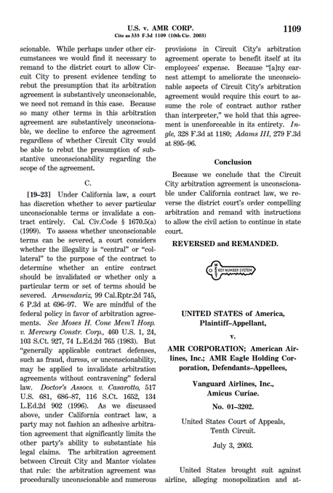
AMR Corp.
335 F.3d 1109 (10th Cir. 2003)

Slide 48
Capacity Changes
TTYN (1 of 4)
Hypo
Costs $10 to rent plane to fly one of two routes
Econ of the Routes
A: Other Variable Cost $100; Revenues: $108
B: Other Variable Cost $100; Revenues: $102
Should you rent a plane? If you rent the plane, are you predating?

Slide 49
Capacity Changes
TTYN (2 of 4)
Change the Hypo
Instead, you already own the plane
An accountant tells you that she would allocate $10 in past costs to flying the plane on route A or B, but no actual current expenditures
Should you fly the plane? Which route? If you fly the plane, are you predating?

Slide 50
Understanding Predation Measures
TTYN (3 of 4)
Hypo
You have a crew and a plane. Treat both as short-run fixed costs.
Route A round trip: Make 100 = Revenues 200 – Variable Cost 100 (fuel, peanuts)
Route B round trip: Make 20 = Revenues 120 – Variable Cost 100 (f & p)

Slide 51
Understanding Predation Measures
TTYN (4 of 4)
Hypo
If you allocate to B, is this predatory? Aren’t you sacrificing short-run profits?

Slide 52
The Mechanisms of Competition
Costs and Prices
Suppose that entrant has lower costs than American (see fn. 3)
Suppose that American just matches prices (see fn. 15)
How does American match prices and drive the competitor out of business?

Slide 53
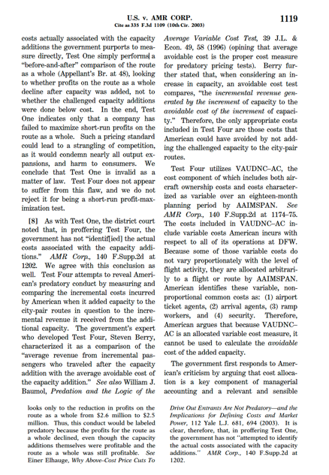
Evaluating Profit Sacrifice
“Test One simply performs a “before-and-after” comparison of the route as a whole, looking to whether profits on the route as a whole decline after capacity was added, not to whether the challenged capacity additions were done below cost. In the end, Test One indicates only that a company has failed to maximize short-run profits on the route as a whole.”
AMR Corp (10th Cir. 2003)

Slide 54
Evaluating Profit Sacrifice
“Such a pricing standard could lead to a strangling of competition, as it would condemn nearly all output expansions, and harm to consumers. We conclude that Test One is invalid as a matter of law.”
AMR Corp (10th Cir. 2003)

Slide 55
Wrong Costs Included in Test Four
“Because the cost component of Test Four includes arbitrarily allocated variable costs, it does not compare incremental revenue to average avoidable cost. Instead, it compares incremental revenue to a measure of both average variable cost and average avoidable cost.”
AMR Corp (10th Cir. 2003)

Slide 56
Wrong Costs Included in Test Four
“Therefore, Test Four does not measure only the avoidable or incremental cost of the capacity additions and cannot be used to satisfy the government’s burden in this case.”
AMR Corp (10th Cir. 2003)

Slide 57
Gov’t Fails Under Brooke Group Test
“We conclude that all four proxies are invalid as a matter of law, fatally flawed in their application, and fundamentally unreliable. Because it is uncontested that American did not price below AVC for any route as a whole, we agree with the district court’s conclusion that the government has not succeeded in establishing the first element of Brooke Group, pricing below an appropriate measure of cost.”
AMR Corp (10th Cir. 2003)

