Slide 1
Class 5: Wed 8 Oct 2025 Antitrust Fall 2025 Horizontal? Vertical?
Randal C. Picker
James Parker Hall Distinguished Service Professor of Law
The Law School
The University of Chicago
Copyright © 2012-25 Randal C. Picker. All Rights Reserved.

Slide 2
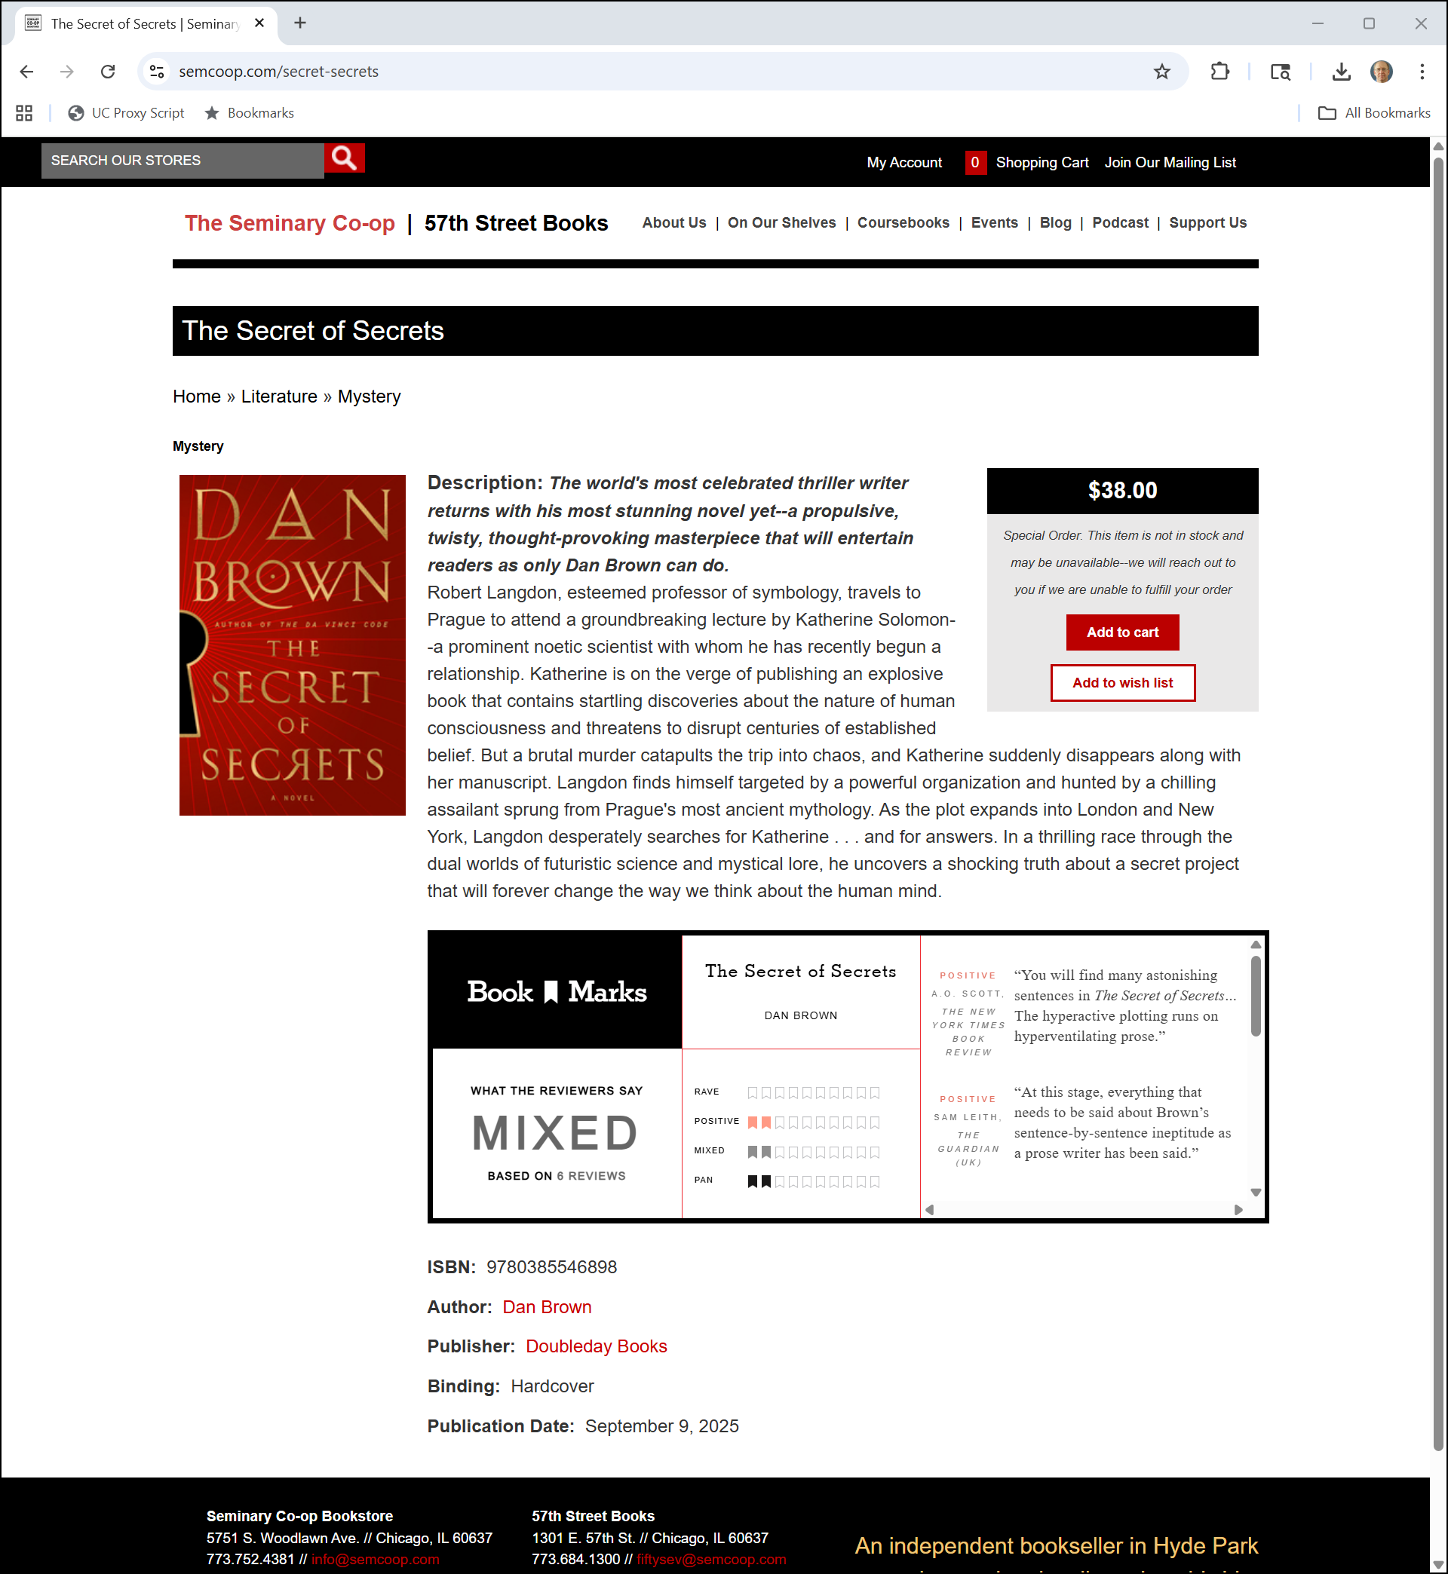
Searching for Secrets
Sem Coop (7 Oct 2025)
Notes:
https://www.semcoop.com/secret-secrets

Slide 3
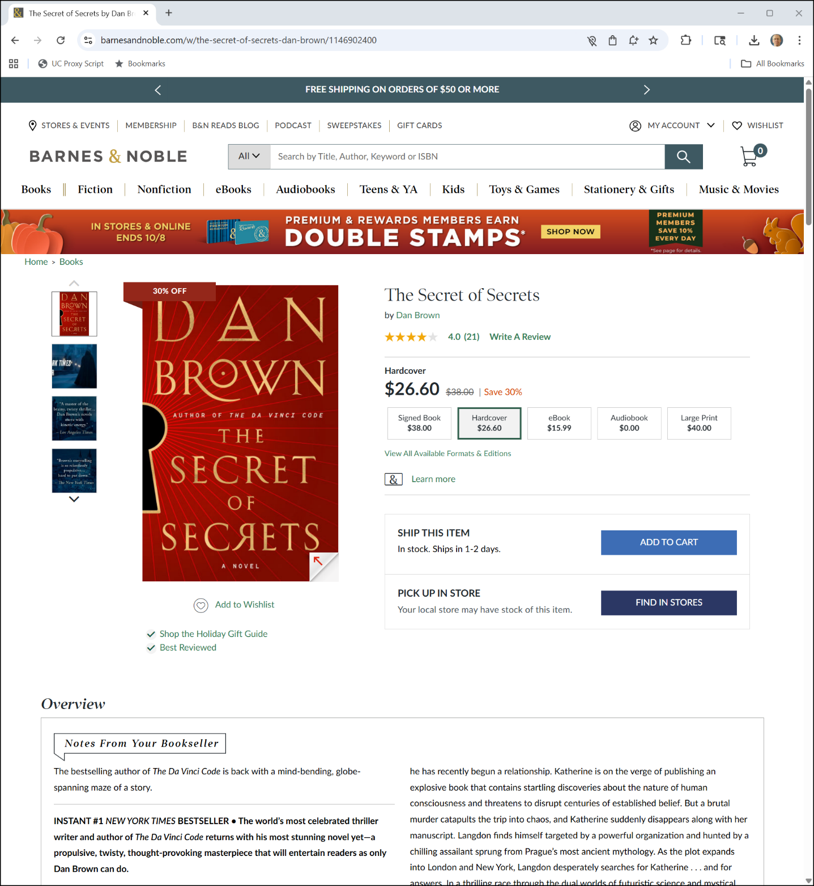

Searching for Secrets
B&N (7 Oct 2025)
Notes:
https://www.barnesandnoble.com/w/the-secret-of-secrets-dan-brown/1146902400

Slide 4
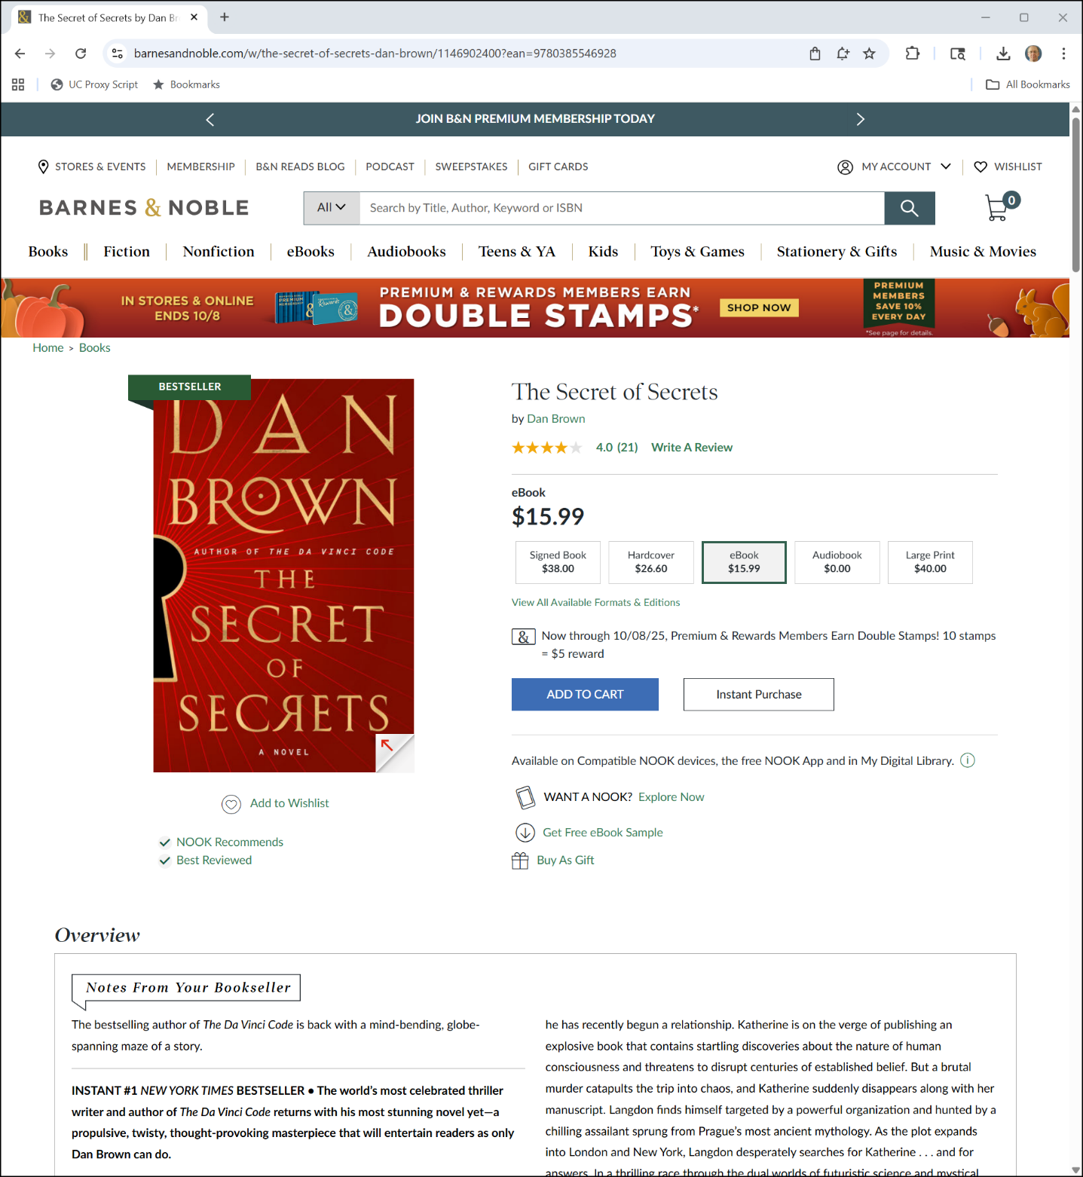

ebook for the Nook
B&N (7 Oct 2025)
Notes:
https://www.barnesandnoble.com/w/the-secret-of-secrets-dan-brown/1146902400?ean=9780385546928

Slide 5
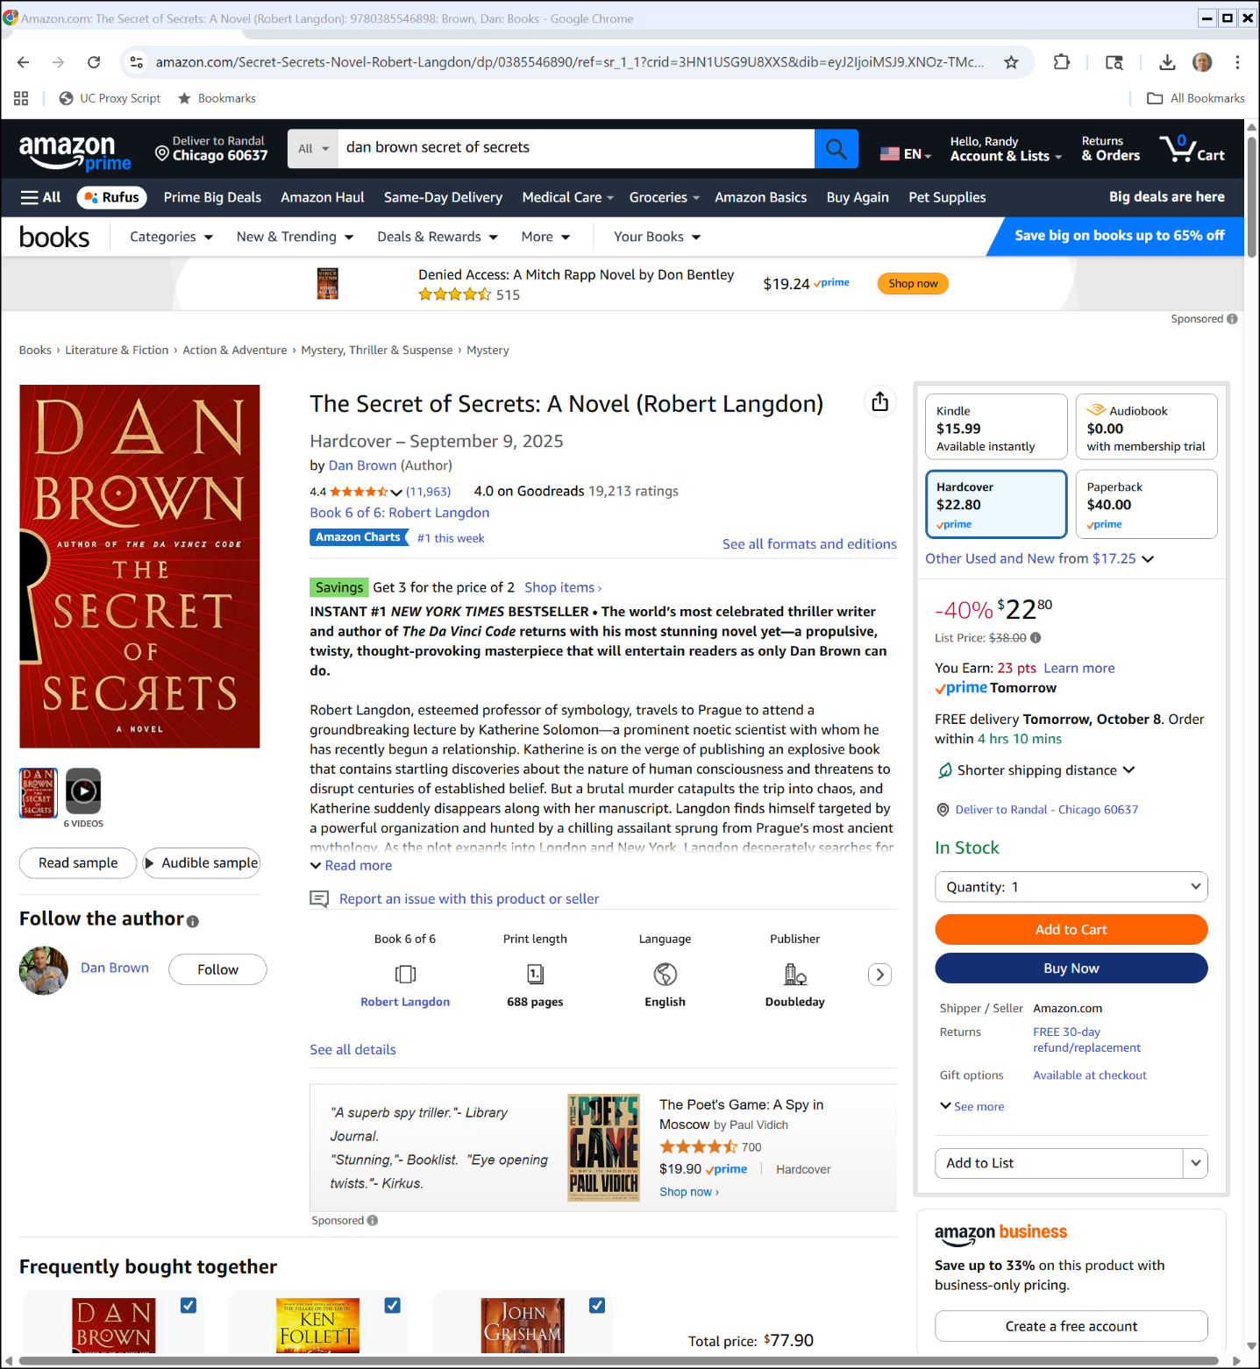

Searching for Secrets
Amazon (7 Oct 2025)

Slide 6
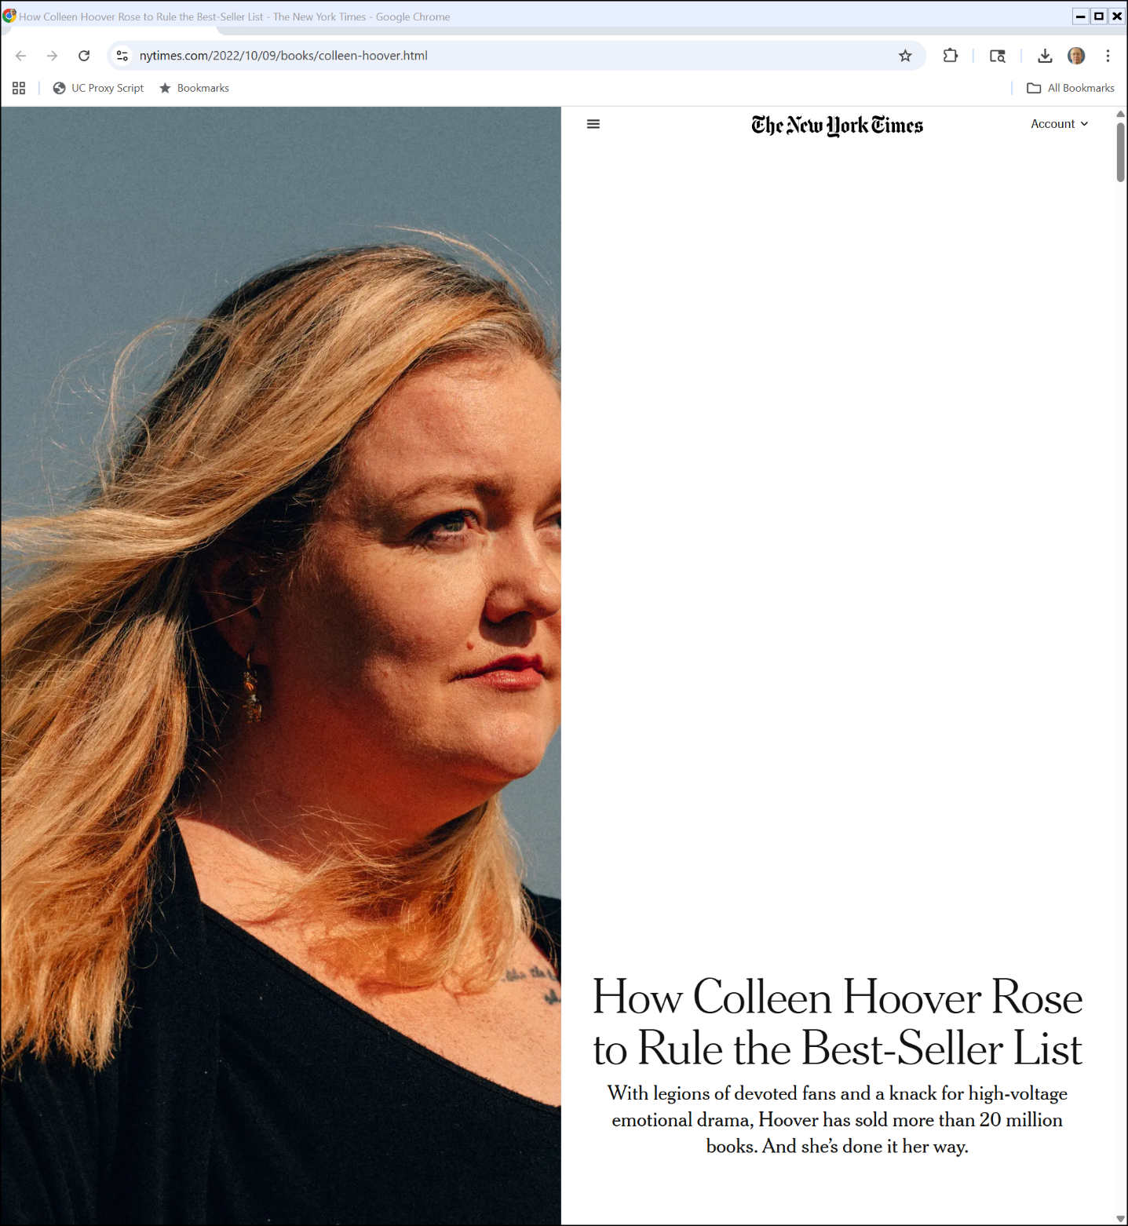
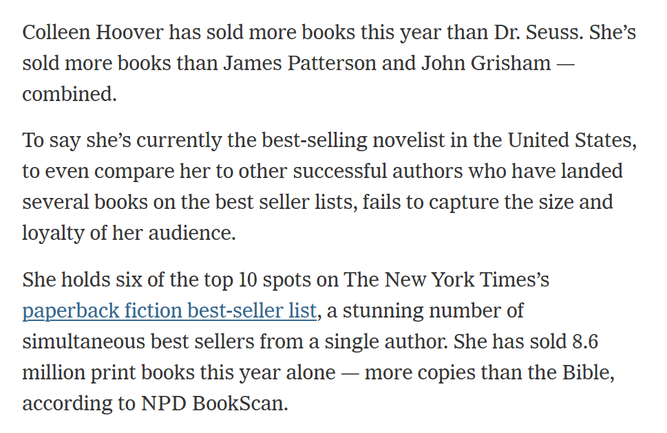
Colleen Hoover
New York Times (9 Oct 2022)
Notes:
https://www.nytimes.com/2022/10/09/books/colleen-hoover.html

Slide 7
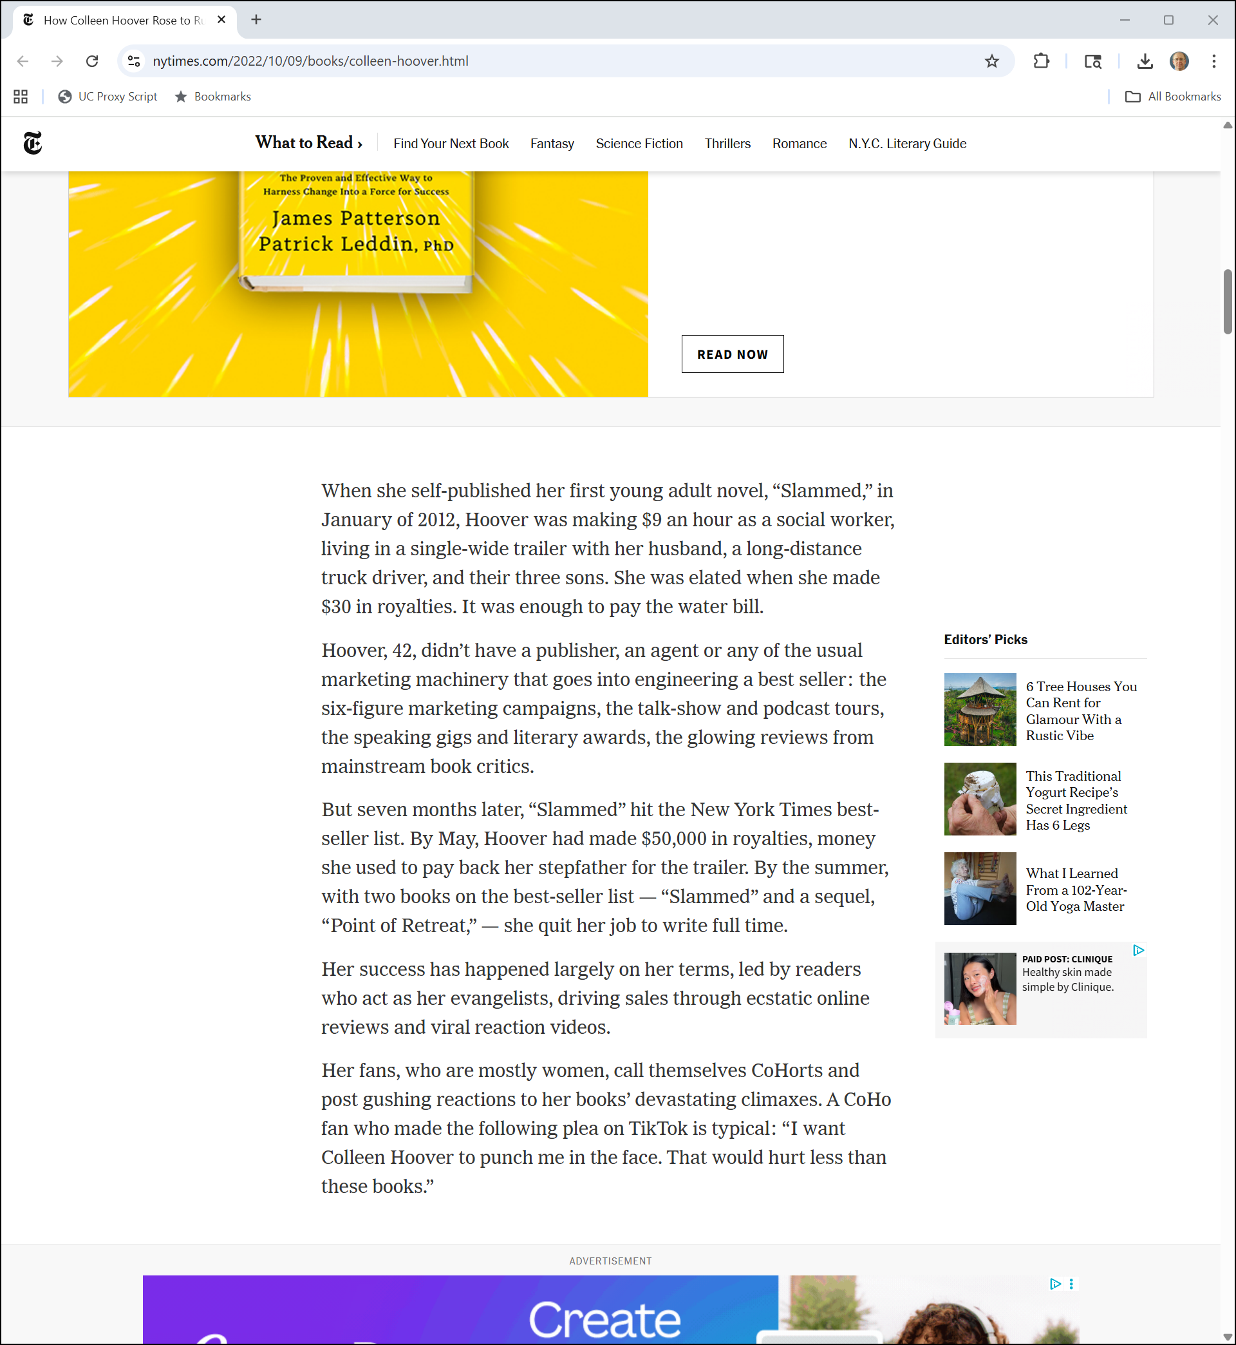
Colleen Hoover
New York Times (9 Oct 2022)
Notes:
https://www.nytimes.com/2022/10/09/books/colleen-hoover.html

Slide 8
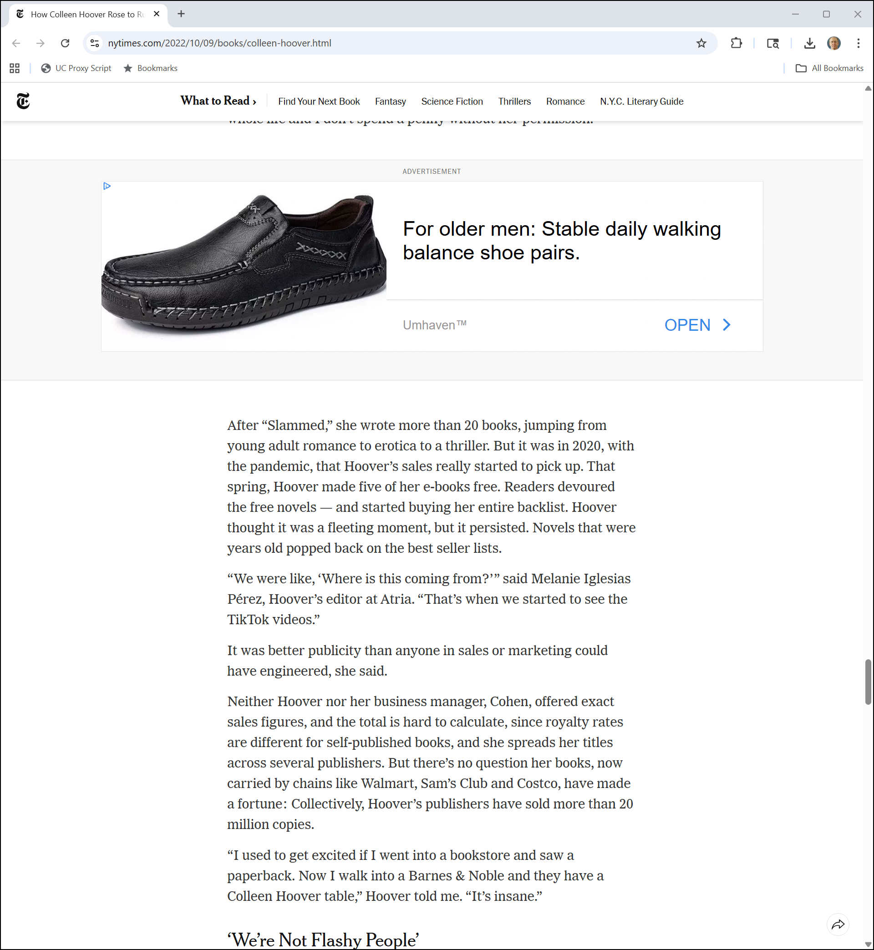
Colleen Hoover
New York Times (9 Oct 2022)
Notes:
https://www.nytimes.com/2022/10/09/books/colleen-hoover.html

Slide 9
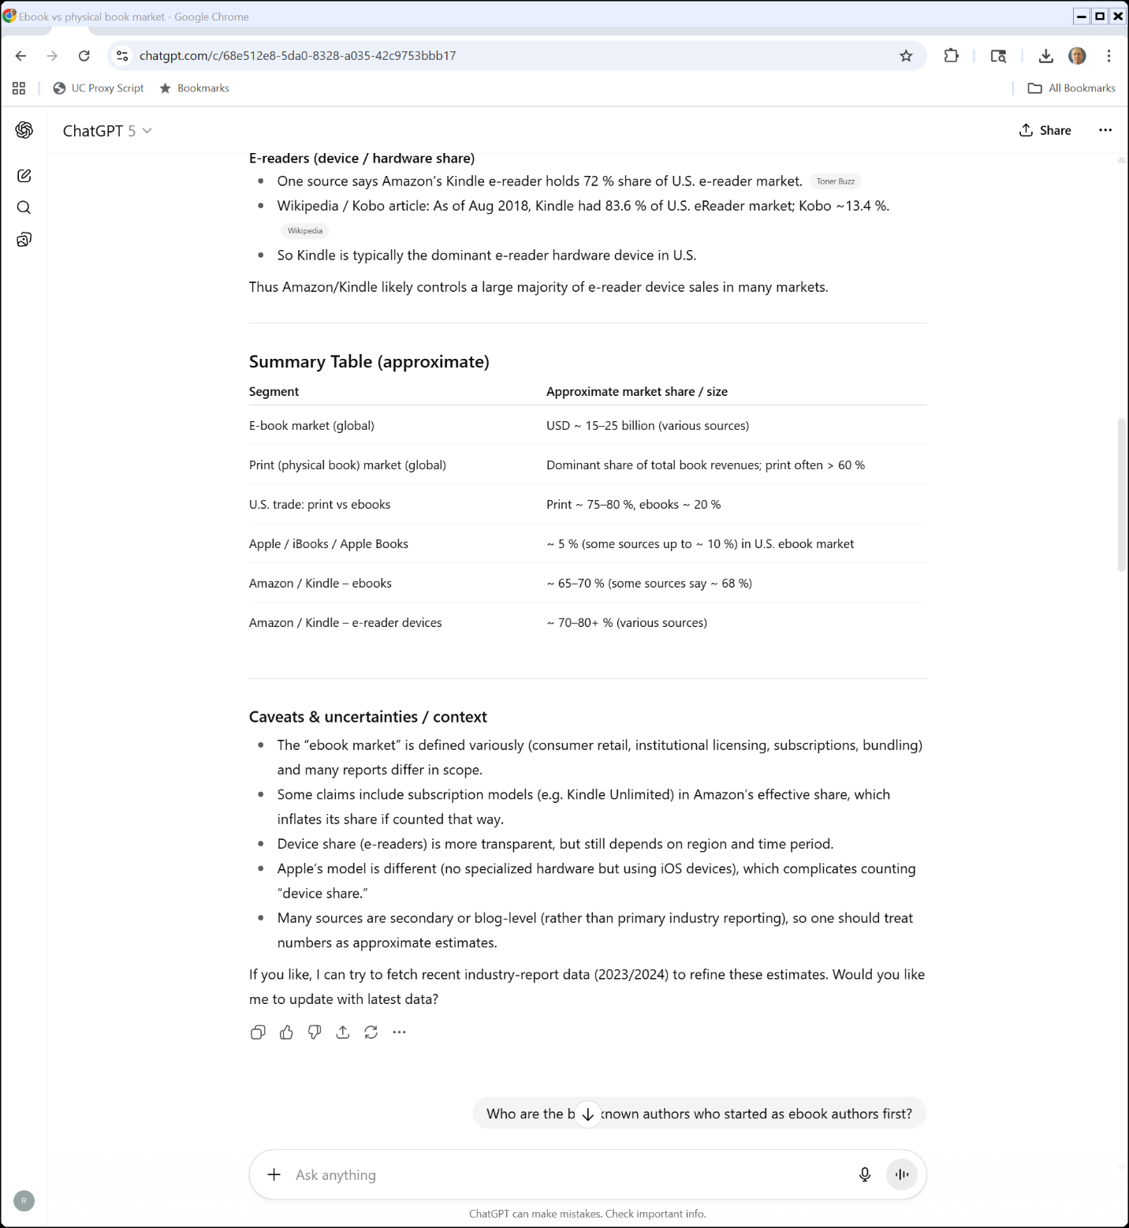
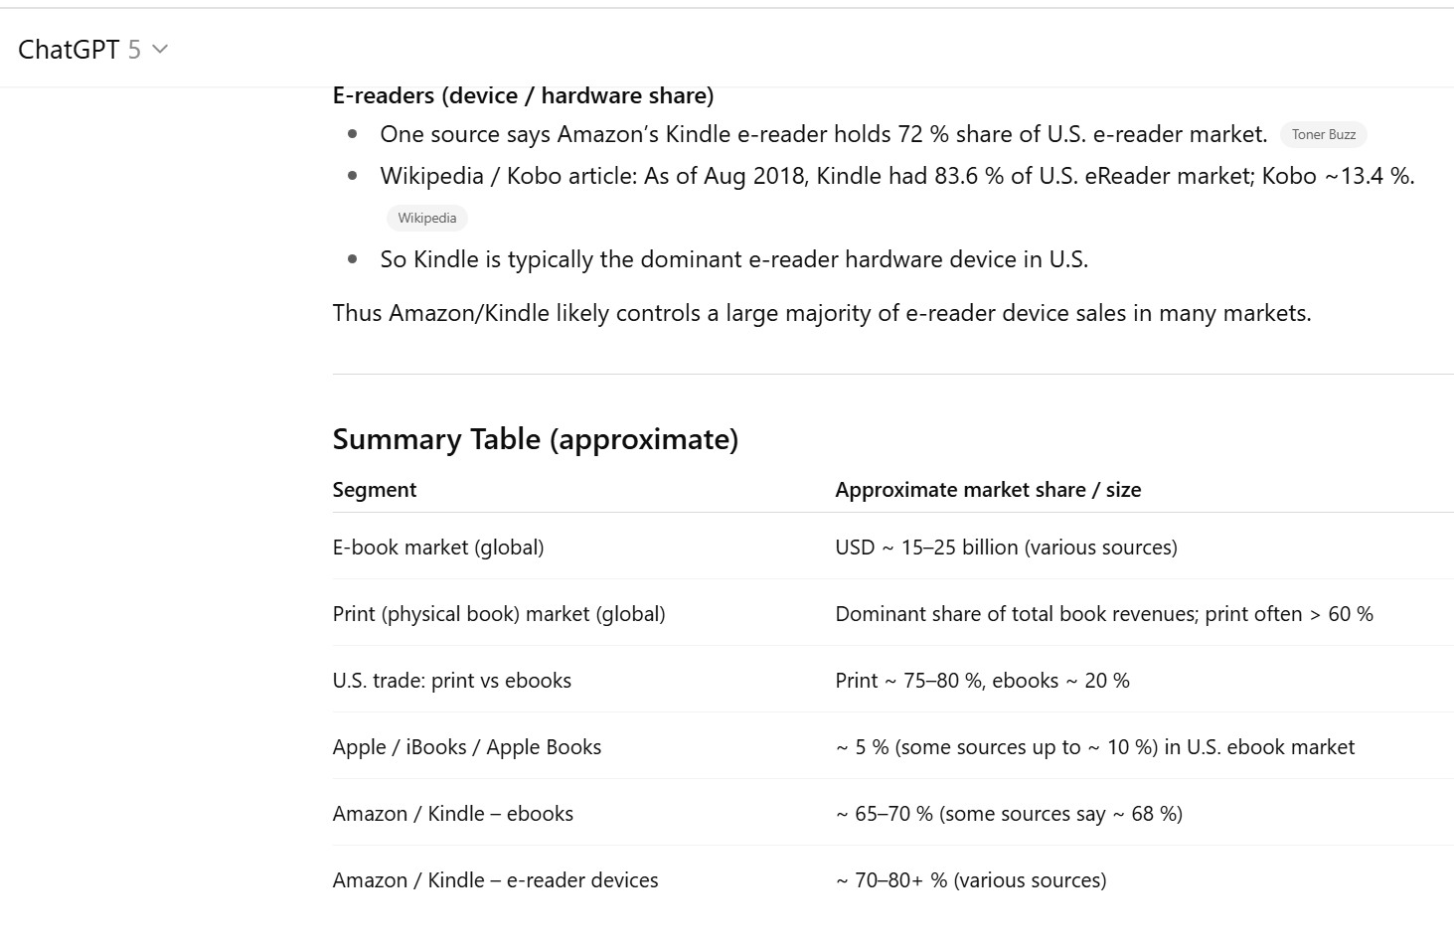
Current State of ebook Market?
ChatGPT (7 Oct 2025)

Slide 10
Framing Digital Entry
TTYN (1 of 4)
Hypo 1: Acrobat
Adobe plans to build an authoring and reading platform called Acrobat with two components: writing software and reading software
Stylized facts
Initially charged $25 for reading software, now gives it away

Slide 11
Framing Digital Entry
TTYN (2 of 4)
Hypo 1: Acrobat
Always has charged for the authoring software
How should we think about the competition/antitrust choices posed by that business design?

Slide 12
Framing Digital Entry
TTYN (3 of 4)
Hypo 2: Xbox
Microsoft is ready to launch a new game console
Stylized facts
The plan was to sell the console below cost such that Microsoft would lose $100 to $150 on each sale

Slide 13
Framing Digital Entry
TTYN (4 of 4)
Hypo 2: Xbox
But Microsoft would use a lock-and-key mechanism, perhaps blessed by the DMCA, to control access to the Xbox
It would then sell licenses to game developers (either lump sum, per game or something else)
Competitions/antitrust issues?

Slide 14
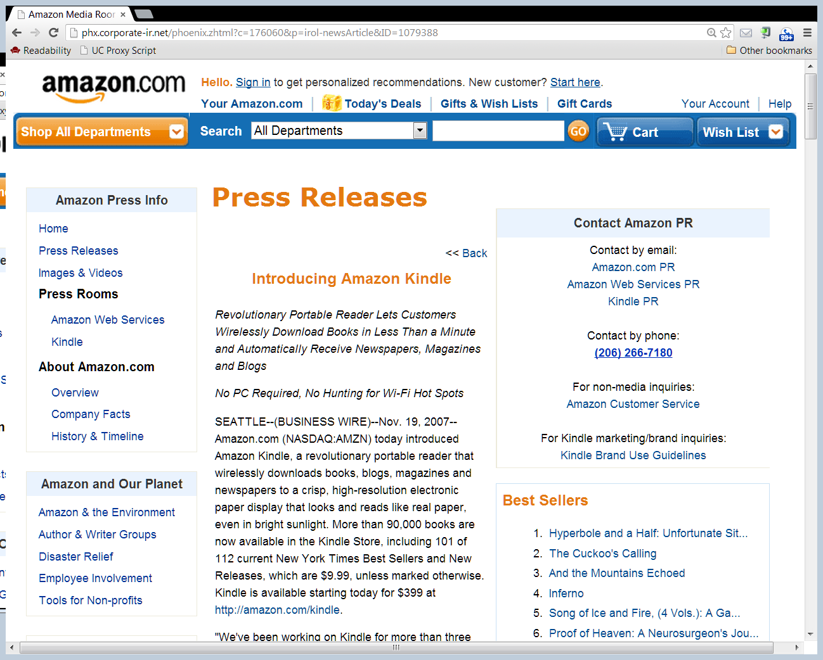
Kindle Launch
Amazon PR (19 Nov 2007)

Slide 15
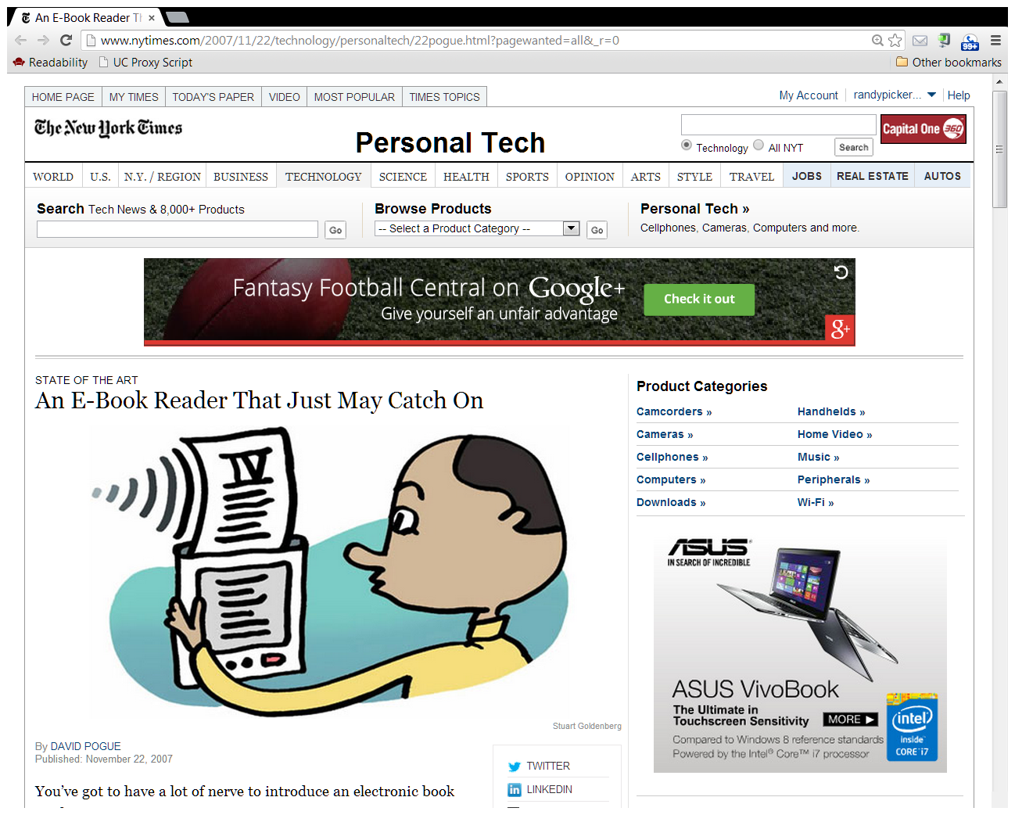
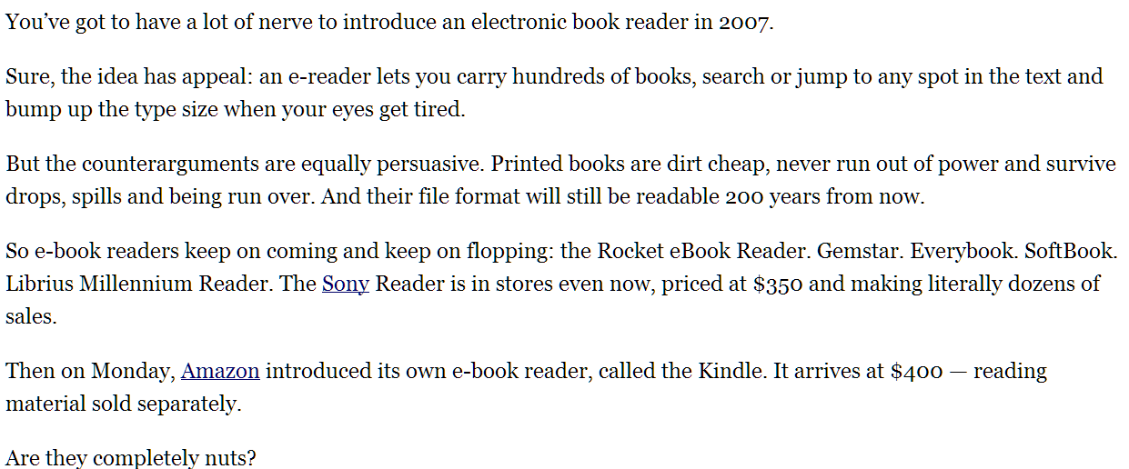
NYT Review
New York Times (22 Nov 2007)

Slide 16
Book Reading on the Kindle in 2007

Slide 17
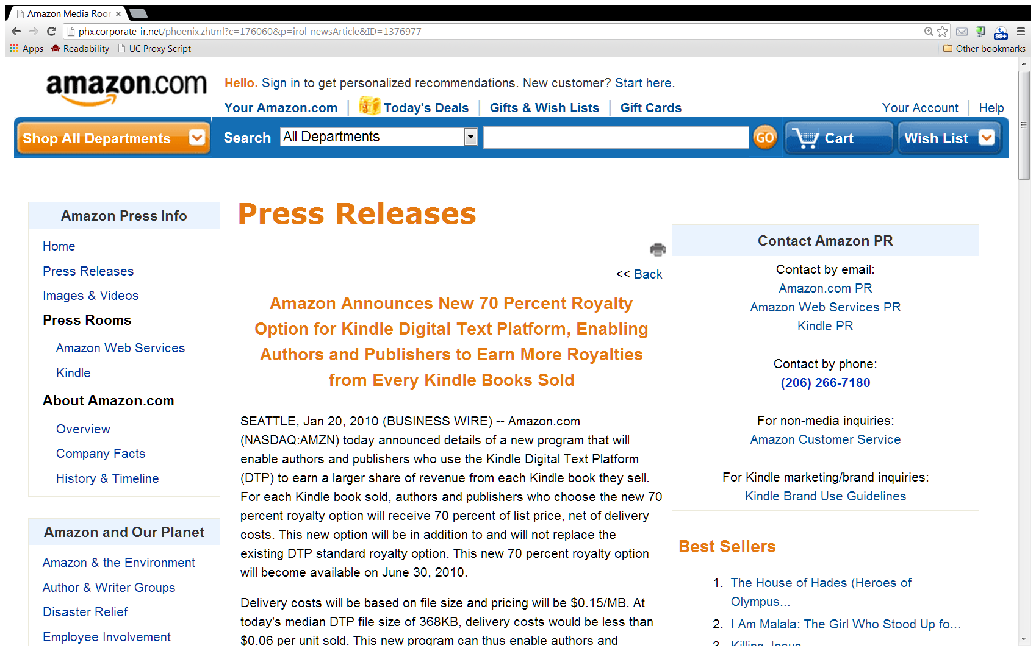
Disintermediation
Amazon PR (20 Jan 2010)

Slide 18
Framing Digital Entry
TTYN (1 of 3)
Hypo 3: Amazon Kindle
Amazon launches Kindle in 2007 with a price for the reader of $400 and a per ebook price for best sellers of $10

Slide 19
Framing Digital Entry
TTYN (2 of 3)
Hypo 3: Amazon Kindle
Try four sets of stylized facts
Competitions/antitrust issues?
Ereader | Ebook bestsellers
Loses $ | Loses $
Loses $ | Makes $
Makes $ | Loses $
Makes $ | Makes $

Slide 20
Framing Digital Entry
TTYN (3 of 3)
Have I framed this correctly?
Are ebook readers and ebook bestsellers the things that we should be paying attention to or are there more relevant market considerations?

Slide 21
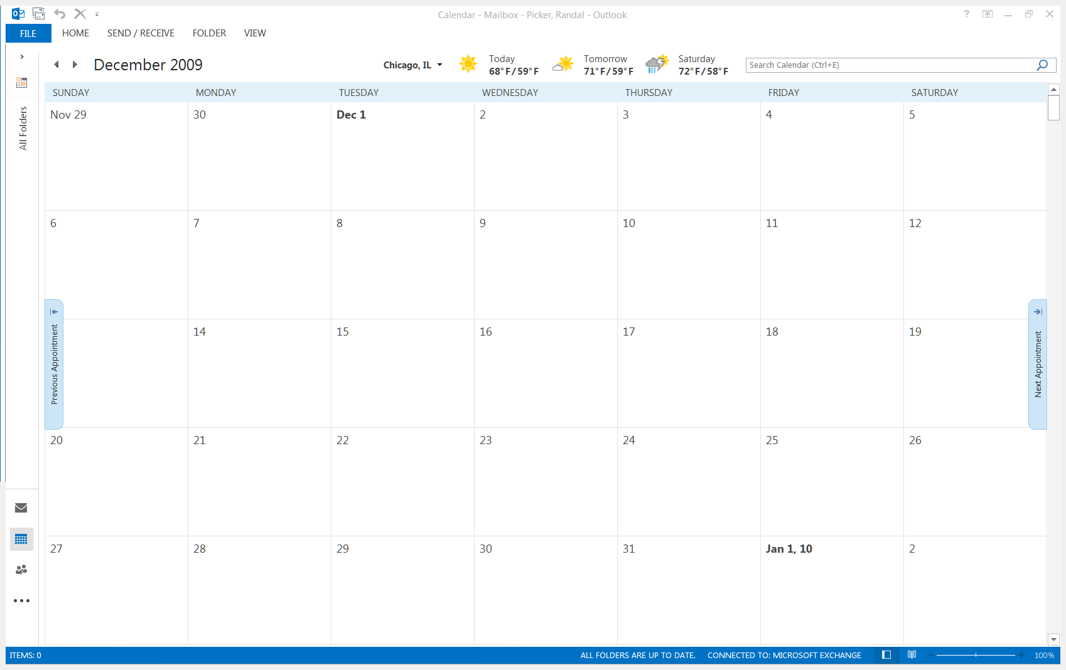
Initial Apple Phone Calls
Apple Phone Calls to Book Publishers
Apple’s Eddie Cue makes phone calls to Big Six publishers to set up in-person meetings in NY
Makes clear to each that he is meeting with each of the Big Six
Tuesday, 8 Dec 2009

Slide 22
Initial Meetings with Publishers
Cue, Moerer and Apple in-house attorney Saul meet with each of the Big Six
Apple discloses iPad and wants bookstore on iPad with Big Six
Apple won’t sell books at a loss but doesn’t want to be at a price disadvantage with Amazon
Apple suggests eBook prices at $11.99 to $14.99
Tues/Wed, 15-16 Dec 2009

Slide 23
Selling Models
Agency Model vs. Wholesale Model
Hachette and HarperCollins propose that Apple use agency model rather than wholesale model
Cue rejects that
Tues/Wed, 15-16 Dec 2009

Slide 24
Two Books Sales Models
The Wholesale Model
Book publishers set wholesale prices and sell books to retailers
Retailers, as owners of books, set retail prices to consumers

Slide 25
Two Books Sales Models
The Agency Model
Wholesalers do not sell books to retailers
Retailers instead act as agent of wholesalers in selling books directly to consumers
Wholesalers set prices at which books are sold to consumers
Retailers are paid fee for agent services

Slide 26
Second Round of Meetings
Second Round of Apple Meetings with S&S, Macmillan and Random House
Described prior meetings with Big Six
Stated that industry needed to move to agency model
Apple wanted 30% fee
Proposed general eBook pricing at the iBookstore of $12.99
Publishers needed to adopt agency model with other ebook retailers
Mon/Tues, 20-21 Dec 2009

Slide 27
Cue to Jobs re Pricing
Cue Email to Jobs, Mon, 21 Dec 2009, PX-0043

Slide 28
Cue to Reidy
Cue Email to Reidy, Mon, 4 Jan 2010, PX-0021

Slide 29
Cue to Reidy
Cue Email to Reidy, Mon, 4 Jan 2010, PX-0021

Slide 30
Cue to Reidy
Cue Email to Reidy, Mon, 4 Jan 2010, PX-0021

Slide 31
Framing the ebook Case
TTYN (1 of 4)
Hypo 4
Five of the leading six book publishers meet for lunch and agree on a table of prices for ebooks.
They also agree that they will not do business with any ebook platform that doesn’t adhere to those prices.
Antitrust issues? Horizontal? Vertical?

Slide 32
Framing the ebook Case
TTYN (2 of 4)
Hypo 5
One book publisher approaches Apple to negotiate to sells its ebooks on Apple’s new platform.
Apple and the publisher agree on terms.
Antitrust issues? Horizontal? Vertical?

Slide 33
Framing the ebook Case
TTYN (3 of 4)
Hypo 6
Apple announces that it will open a digital store.
App providers sign a contract with Apple and each sets price to consumers
Apple charges a 30% fee on each sale.
Antitrust issues?

Slide 34
Framing the ebook Case
TTYN (4 of 4)
Hypo 7
Apple adds ebooks to its online store. As is the case for apps, Apple charges a 30% fee on each sale.
The contract that each publisher signs with Apple for the store contains an MFN
Antitrust issues?

Slide 35
10-11 Jan 2010: The Draft MFN Clause
The Clause:
“If, for any particular New Release in hardcover format, the then-current Customer Price at any time is or becomes higher than a customer price offered by any other reseller (“Other Customer Price”), then Publisher shall designate a new, lower Customer Price to meet such lower Other Customer Price.”

Slide 36
Cue to Moerer
Cue/Moerer Emails, 9-10 Jan 2010, PX-0487

Slide 37
Cue to Moerer
Cue/Moerer Emails, 9-10 Jan 2010, PX-0487

Slide 38
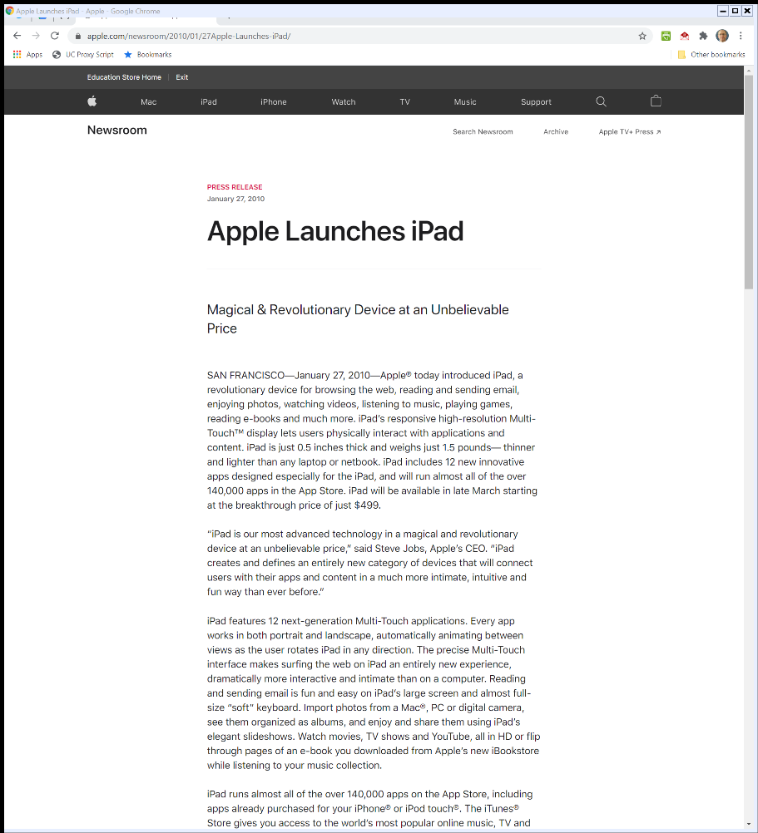
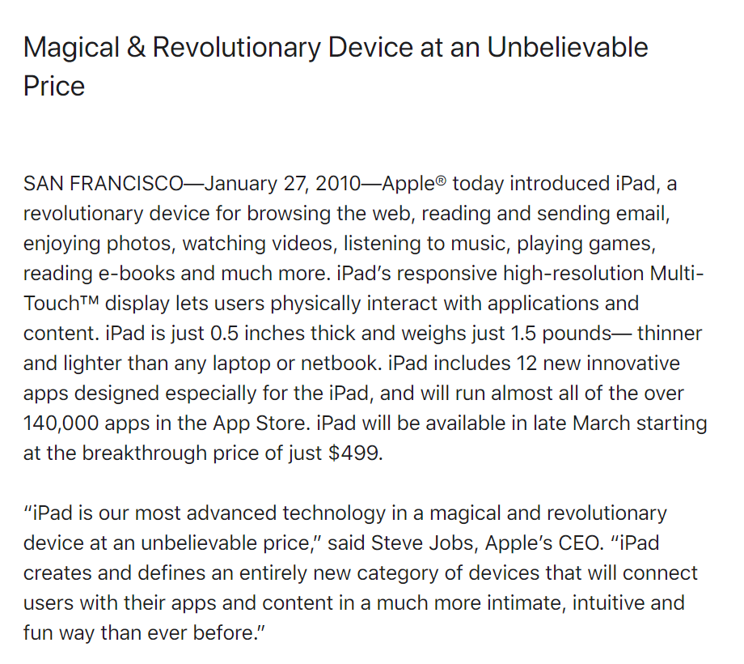
27 Jan 2010: iPad Launch
Apple PR (27 Jan 2020)
Notes:
https://www.apple.com/newsroom/2010/01/27Apple-Launches-iPad/

Slide 39
Post-Launch Evidence
Sargent Email to Cue (31 Jan 2010) PX-0053

Slide 40
eBook Price Increases at Amazon
From the SDNY Opinion, 952 F.Supp.2d 638 (2013)

Slide 41
What is at Stake in Apple?
Key Questions
What exactly is the contract, combination or conspiracy in restraint of trade?
Is this a horizontal or a vertical case? Why does that matter?
What should we make of Amazon?

Slide 42
U.S. v. Apple
791 F.3d 290 (2nd Cir. 2015)

Slide 43
Understanding Apple’s Contracts
“… Apple’s benign portrayal of its Contracts with the Publisher Defendants is not persuasive—not because those Contracts themselves were independently unlawful, but because, in context, they provide strong evidence that Apple consciously orchestrated a conspiracy among the Publisher Defendants.”
Apple (CA2 2015)

Slide 44
MFN as Signal/Commitment
“By the very act of signing a Contract with Apple containing an MFN Clause, then, each of the Publisher Defendants signaled a clear commitment to move against Amazon, thereby facilitating their collective action.”
Apple (CA2 2015)

Slide 45
Price-Fixing Conspiracy
“In short, the relevant ‘agreement in restraint of trade’ in this case is the price‐fixing conspiracy identified by the district court, not Apple’s vertical contracts with the Publisher Defendants.”
Apple (CA2 2015)

Slide 46
Dissent: Suppose Apple Blocked the Kindle App
“And if Apple had attempted to pursue this hardware-based competition by programming its iPad to run the iBookstore but to reject Amazon’s Kindle application, Apple might have been exposed to an entirely different antitrust peril. See United States v. Microsoft Corp., 253 F.3d 34, 50-80 (D.C. Cir. 2001) (en banc) … ”
Apple (CA2 2015)

Slide 47
Dissent: Where Is DOJ on Amazon?
“True, Apple could not have known that the Antitrust Division would have adopted the position that below-cost pricing is not a concern of antitrust policy: who could have guessed that the government would adopt a policy that is primitive as a matter of antitrust doctrine and illiterate as a matter of economics?”
Apple (CA2 2015)

