Slide 1
Class 4: Mon 6 Oct 2025
Antitrust Fall 2025
Competitive Practices
Randal C. Picker
James Parker Hall Distinguished Service Professor of Law
The Law School
The University of Chicago
Copyright © 2000-25 Randal C. Picker. All Rights Reserved.

Slide 2
Demand Curve: Consumers will buy more at lower prices
P
10
Demand Curve
P = 10 – Q
10
Q

Slide 3
What Does a Competitive Outcome Look Like?
P
10
Price = Average Cost (here Marginal Cost)
Demand Curve
P = 10 – Q
Consumer Surplus
MC = 4
P_{C}
Total Revs (TR)/Total Costs (TC)
Q_{C}
10
Q

Slide 4
What Happens with a Monopoly?: Output Declines
P
Marginal Revenue = Marginal Cost
10
CS
P = 10 – Q
P_{M}
Demand Curve
MC = 4
Profits
DWL
MR = 10 – 2Q
P_{C}
TC
Marginal Cost
DWL = Deadweight Loss
Q_{M}
Q_{C}
10
Q
Marginal Revenue

Slide 5
Wilson’s Five Trust Bills
New York Times (21 Jan 1914)

Slide 6
Wilson’s Five Brothers
New York Times (21 Jan 1914)

Slide 7
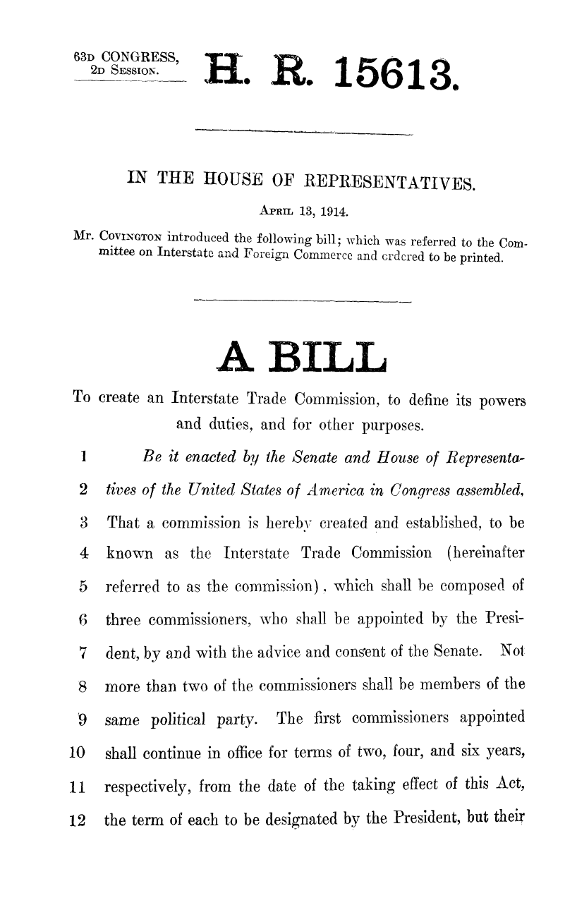
The Interstate Trade Commission
H.R. 15613 (13 Apr 1914)

Slide 8
Just Reports to the President
H.R. 15613 (13 Apr 1914)

Slide 9
Minority Views: No Real New Powers
H. Rep. 533 (14 Apr 1914)

Slide 10
Minority Views: What is the Key Problem?
H. Rep. 533 (14 Apr 1914)

Slide 11
Minority Views: Condemn Unfair and Oppressive Competition (But Not Defined)
H. Rep. 533 (14 Apr 1914)

Slide 12
Section 10
H.R. 15660 (14 Apr 1914)

Slide 13
Creation of Federal Trade Commission
38 Stat. 717 (26 Sept 1914)

Slide 14
Unfair Methods of Competition Declared Unlawful
38 Stat. 717 (26 Sept 1914)

Slide 15
FTCA Sec. 5
Sec. 45. Unfair methods of competition unlawful; prevention by Commission
  (a) Declaration of unlawfulness; power to prohibit unfair practices; inapplicability to foreign trade
    (1) Unfair methods of competition in or affecting commerce, and unfair or deceptive acts or practices in or affecting commerce, are hereby declared unlawful.

Slide 16
The Road to the Clayton Act
H.R. 15657 (14 Apr 1914)

Slide 17
The Clayton Act
38 Stat. 730 (15 Oct 1914)

Slide 18
Clayton Act Roadmap
26 Sections. Key provisions for us:
  Sec 2: Price discrimination (amended in 1936 by Robinson-Patman Act)
  Sec 3: Limits on exclusive dealing
  Secs 6, 20: Labor
  Sec 7: Stock purchases (later amendments)
  Sec 8: Interlocking directorates

Slide 19
Section 3
  “It shall be unlawful … to … make a sale or contract for sale of goods … on the condition, agreement, or understanding that the … purchaser thereof shall not use or deal in the goods … of a competitor … where the effect of … such condition … may be to substantially lessen competition or tend to create a monopoly in any line of commerce.”
38 Stat. 730 (15 Oct 1914)

Slide 20
Dr. Miles
220 U.S. 373 (1911)

Slide 21
Is Vertical Price Fixing OK?
“If there be an advantage to a manufacturer in the maintenance of fixed retail prices, the question remains whether it is one which he is entitled to secure by agreements restricting the freedom of trade on the part of dealers who own what they sell.”
Dr. Miles (US 1911)

Slide 22
Vertical Price Fixing = Horizontal Price Fixing
“As to this, the complainant can fare no better with its plan of identical contracts than could the dealers themselves if they formed a combination and endeavored to establish the same restrictions, and thus to achieve the same result, by agreement with each other. If the immediate advantage they would thus obtain would not be sufficient to sustain such a direct agreement, the asserted ulterior benefit to the complainant cannot be regarded as sufficient to support its system.”
Dr. Miles (US 1911)

Slide 23
Horizontal Price Fixing Per Se Illegal
“But agreements or combinations between dealers, having for their sole purpose the destruction of competition and the fixing of prices, are injurious to the public interest and void. They are not saved by the advantages which the participants expect to derive from the enhanced price to the consumer.”
Dr. Miles (US 1911)

Slide 24
U.S. v. Colgate
250 U.S. 300 (1919)

Slide 25
Retailer Could Do Anything
“Considering all said in the opinion (notwithstanding some serious doubts) we are unable to accept the construction placed upon it by the Government. We cannot, e.g., wholly disregard the statement that ‘The retailer, after buying, could, if he chose, give away his purchase, or sell it at any price he saw fit, or not sell it at all; his course in these respects being affected only by the fact that he might by his action incur the displeasure of the manufacturer, who could refuse to make further sales to him, as he had the undoubted right to do.’”
250 U.S. 300 (1919)

Slide 26
So No Vertical Agreement
“And we must conclude that, as interpreted below, the indictment does not charge Colgate & Company with selling its products to dealers under agreements which obligated the latter not to resell except at prices fixed by the company.”
250 U.S. 300 (1919)

Slide 27
If No Purpose to Create Monopoly, Free to Set Terms of Dealing
“In the absence of any purpose to create or maintain a monopoly, the act does not restrict the long recognized right of trader or manufacturer engaged in an entirely private business, freely to exercise his own independent discretion as to parties with whom he will deal. And, of course, he may announce in advance the circumstances under which he will refuse to sell. ‘The trader or manufacturer, on the other hand, carries on an entirely private business, and can sell to whom he pleases.’ United States v. Trans-Missouri Freight Association, 166 U.S. 290, 320.”
250 U.S. 300 (1919)

Slide 28
Colgate
End Result
  Implementation of retail (resale) price maintenance (RPM) depends on whether done under agreement, in which case per se violation under Dr. Miles, or unilaterally, in which case OK under Colgate

Slide 29
Clayton Act Sec. 3
It shall be unlawful for any person engaged in commerce, in the course of such commerce,
  to lease or make a sale or contract for sale of goods, wares, merchandise, machinery, supplies, or other commodities, whether patented or unpatented, for use, consumption, or resale within the United States or any Territory thereof or the District of Columbia or any insular possession or other place under the jurisdiction of the United States, or fix a price charged therefor, or discount from, or rebate upon, such price,

Slide 30
Clayton Act Sec. 3
on the condition, agreement, or understanding that
  the lessee or purchaser thereof shall not use or deal in the goods, wares, merchandise, machinery, supplies, or other commodities of a competitor or competitors of the lessor or seller

Slide 31
Clayton Act Sec. 3
where the effect of
  such lease, sale, or contract for sale or such condition, agreement, or understanding may be to substantially lessen competition or tend to create a monopoly in any line of commerce.

Slide 32
M-R Hypo
TTYN (1 of 3)
Facts
  A retail store has a certain amount of shelf space available to sell products of manufacturers.
  It can divide that finite amount of space however it would like, meaning that it could carry goods from only one manufacturer or two or more.

Slide 33
M-R Hypo
TTYN (2 of 3)
Facts
  Suppose the store decides to auction off that space to a single manufacturer.
Does that raise antitrust issues? Are there benefits to exclusivity? Harms? Does it matter whether there are other retail stores that compete with the first store?

Slide 34
M-R Hypo
TTYN (3 of 3)
Small Town: One Store
Big City: Many Stores

Slide 35
Standard Fashion Co.
258 U.S. 346 (1922)

Slide 36


Boston, MA: Washington and Temple
Notes:
https://www.thefreedomtrail.org/freedom-trail/boston-common.shtml

Slide 37
Standard Fashion (US 1922)
Key Facts
  Standard Fashions and Boston retailer entered into two-year exclusive agency contract
  Retailer would sell only Standard Fashion garment patterns, and therefore could not sell McCall patterns
  Retailer was alleged to have breached contract and SF sued to enforce

Slide 38
Standard Fashion
Market Info
  SF controls 40% of pattern agencies
Lower Courts
  District court dismissed, affirmed by Court of Appeals

Slide 39
What Does “May” Mean in CA3?
“Section 3 condemns sales or agreements where the effect of such sale or contract of sale ‘may’ be to substantially lessen competition or tend to create monopoly. It thus deals with consequences to follow the making of the restrictive covenant limiting the right of the purchaser to deal in the goods of the seller only. But we do not think that the purpose in using the word ‘may’ was to prohibit the mere possibility of the consequences described.”
Standard Fashion (US 1922)

Slide 40
“Probably” Lessen Competition; Substantial
“It was intended to prevent such agreements as would under the circumstances disclosed probably lessen competition, or create an actual tendency to monopoly. That it was not intended to reach every remote lessening of competition is shown in the requirement that such lessening must be substantial.”
Standard Fashion (US 1922)

Slide 41
Says Agency Contract But Isn’t Really
“It is insisted by the petitioner that the contract is not one of sale, but is one of agency or joint venture, but an analysis of the contract shows that a sale was in fact intended and made. … Full title and dominion passed to the buyer. While this contract is denominated one of agency, it is perfectly apparent that it is one of sale.”
Standard Fashion (US 1922)

Slide 42
Barred Dealing in Goods of Competitor
“The contract contains an agreement that the respondent shall not sell or permit to be sold on its premises during the term of the contract any other make of patterns. It is shown that on or about July 1, 1917, the respondent discontinued the sale of the petitioner’s patterns and placed on sale in its store patterns of a rival company known as the McCall Company.”
Standard Fashion (US 1922)

Slide 43
CA3: Incipiency
“The Clayton Act sought to reach the agreements embraced within its sphere in their incipiency, and in the section under consideration to determine their legality by specific tests of its own which declared illegal contracts of sale made upon the agreement or understanding that the purchaser shall not deal in the goods of a competitor or competitors of the seller, which may ‘substantially lessen competition or tend to create a monopoly.’”
Standard Fashion (US 1922)

Slide 44
Incipient Monopoly?
“Both courts below found that the contract interpreted in the light of the circumstances surrounding the making of it was within the provisions of the Clayton Act as one which substantially lessened competition and tended to create monopoly. These courts put special stress upon the fact found that, of 52,000 so-called pattern agencies in the entire country, the petitioner, or a holding company controlling it and two other pattern companies, approximately controlled two-fifths of such agencies.”
Standard Fashion (US 1922)

Slide 45
Incipient Monopoly?
“As the Circuit Court of Appeals summarizing the matter pertinently observed: ‘The restriction of each merchant to one pattern manufacturer must in hundreds, perhaps in thousands, of small communities amount to giving such single pattern manufacturer a monopoly of the business in such community.’”
Standard Fashion (US 1922)

Slide 46
Incipient Monopoly?
“‘Even in the larger cities, to limit to a single pattern maker the pattern business of dealers most resorted to by customers whose purchases tend to give fashions their vogue, may tend to facilitate further combinations; so that the plaintiff, or some other aggressive concern, instead of controlling two-fifths, will shortly have almost, if not quite, all the pattern business.’”
Standard Fashion (US 1922)

Slide 47
Analysis
Sup Ct finds violation of CA Sec. 3
Evaluating Exclusive Agencies
  What are the advantages (disadvantages of exclusive agency)?
Evaluating Incipiency
  What is the optimal time to address antitrust issues?

Slide 48
Analysis
  Take a snapshot and play the movie forward
Evaluating Competition
  How and when should we evaluate the nature of competition?
  Suppose competition for exclusive agencies?
  What of local monopolies?

Slide 49
Northwest Wholesale Stationers
472 U.S. 284 (1985)

Slide 50
Northwest Wholesale Stationers (1985)
Setup
  The end of per se analysis of group boycotts
Key Facts
  100 office supply retailers create wholesale purchasing cooperative
  Anyone can buy through the coop, but only members get purchase rebates

Slide 51
Northwest Wholesale Stationers
  Pacific Stationery operated at retail and wholesale; eventually excluded from the coop
  Note relative sizes: Northwest: $5.8 million in wholesale sales; Pacific: $7.6 million in wholesale and retail sales

Slide 52
Northwest Wholesale Stationers
Lower Courts
  District Court: Not per se, do rule of reason; no anticompetitive effect, so SJ for Northwest
  9th Cir: Reverses, group boycott, so per se liability

Slide 53
Analysis
Economic benefits of purchasing cooperatives?
Legitimacy of membership rules?

Slide 54
The Virtues of Shared Wholesale Cooperatives
“Wholesale purchasing cooperatives such as Northwest are not a form of concerted activity characteristically likely to result in predominantly anticompetitive effects. Rather, such cooperative arrangements would seem to be ‘designed to increase economic efficiency and render markets more, rather than less, competitive.’ Broadcast Music, Inc. v. Columbia Broadcasting System, Inc., supra, at 20.”
Northwest Wholesale Stationers (US 1985)

Slide 55
Holding
“Unless the cooperative possesses market power or exclusive access to an element essential to effective competition, the conclusion that expulsion is virtually always likely to have an anticompetitive effect is not warranted. … Absent such a showing with respect to a cooperative buying arrangement, courts should apply a rule-of-reason analysis.”
Northwest Wholesale Stationers (US 1985)

Slide 56
Miller-Tydings: Validated Min RPM Allowed under State Law
Pub. L. 75-314 (17 Aug 1937)

Slide 57
Second Proviso: Only Vertical, Not Horizontal
Pub. L. 75-314 (17 Aug 1937)

Slide 58
State Laws on Manufacturer Required Retail Prices
S. Rep. 75-879 (7 July 1937)

Slide 59
Why?: Protect Small Retailers
S. Rep. 75-879 (7 July 1937)

Slide 60
1952 Amendments
H.R. Rep. 82-1437 (27 Feb 1952)

Slide 61
Undercut 45 States
H.R. Rep. 82-1437 (27 Feb 1952)

Slide 62
1952 Amendments: Restore Miller-Tydings
66 Stat. 631 (14 July 1952)

Slide 63
1975 Amendments
Pub. L. 94-145 (12 Dec 1975)

Slide 64
Repeal Miller-Tydings
S. Rep. 94-466 (20 Nov 1975)

Slide 65
Why?
S. Rep. 94-466 (20 Nov 1975)

Slide 66
Hypo 1
TTYN (1 of 4)
Facts
  BEC and Hartwell, two retail competitors, get together and agree on minimum prices for calculators manufactured by Sharp.
Business Outcome
  Depends on success in policing each other.
SA1 violation?

Slide 67
Hypo 2
TTYN (2 of 4)
Facts
  BEC and Hartwell agree that education is required to sell the new-fangled calculators, and that the only way to solve the free-riding problem is through agreed-on minimum prices.
Business Outcome
  Depends on success in policing each other.
SA1 violation?

Slide 68
Hypo 3
TTYN (3 of 4)
Facts
  Sharp announces suggested retail prices and terminates BEC when it does not maintain those prices; no prior complaints from Hartwell.
Business Outcome
  Fixed minimum price for Sharp calculators.
SA1 violation?

Slide 69
Hypo 4
TTYN (4 of 4)
Facts
  Sharp asks both BEC and Hartwell to adhere to minimum retail prices and they agree to do so.
Business Outcome
  Fixed minimum price for Sharp calculators in Houston.
SA1 violation? How do these four cases differ?

Slide 70
Leegin Creative v . PSKS
551 U.S. 877 (2007)

Slide 71
Leegin: Starting with the Business
Jerry Kohl: Leegin President
  “[W]e want the consumers to get a different experience than they get in Sam’s Club or in Wal-Mart. And you can’t get that kind of experience or support or customer service from a store like Wal-Mart.”

Slide 72
What does RPM Do?
Core Notion
  Focus on combinations of product and associated services
    Higher price: product with high-level of services
    Lower price: product with low-level of services
When can we sustain both combinations in the market? Do we want to do so?

Slide 73
What does RPM Do?
Free-Riding and Sustaining Both Combinations
  When can the low-end service provider free-ride on the high-end provider?
  If free-riding occurs, all provide low-end services
  With RPM, all provide high-end services

Slide 74
Substitutes for RPM
Consider substitutes for RPM
  Don’t do agreements, do Colgate
  Don’t contract on price, contract directly regarding the desired level of services and terminate retailers that fail to provide those services
Costs? Benefits? Which way does this cut?

Slide 75
What are the Harms of RPM?
Try
  Raises prices?
  Facilitates illegal Section 1 horizontal cartels, either among manufacturers or retailers?
  Allows manufacturer with market power to exclude other manufacturers at retail level?

Slide 76
Understanding a Set of Cases
“If we were to decide the procompetitive effects of resale price maintenance were insufficient to overrule Dr. Miles, then cases such as Colgate and GTE Sylvania themselves would be called into question.”
Leegin (US 2007)

Slide 77
“Traps for the Unwary”
“In sum, it is a flawed antitrust doctrine that serves the interests of lawyers—by creating legal distinctions that operate as traps for the unwary—more than the interests of consumers—by requiring manufacturers to choose second-best options to achieve sound business objectives.”
Leegin (US 2007)

Slide 78
Stare Decisis and Reliance Interests
Questions
  Dr. Miles was decided in 1911; under what circumstances should the Supreme Court overturn it?
  How does the situation in Leegin compare with other cases that have overturned per se rules?

Slide 79
Hypo 1 Answer
Legal Outcome
  Horizontal price fixing is a per se violation of Sec. 1 under Socony-Vacuum.

Slide 80
Hypo 2 Answer
Legal Outcome
  This is just price-fixing with a good motive, but good motives are irrelevant.
  Still a per se violation of SA 1

Slide 81
Hypo 3 Answer
Legal Outcome
  Unilateral action, so no violation per Colgate.

Slide 82
Hypo 4 Answer
Legal Outcome
  This is minimum RPM, a per se violation of Sec. 1 under Dr. Miles and now a rule of reason case under Leegin

