Slide 1
Class 3: Thurs 2 Oct 2025
Antitrust Fall 2025
The Rule of Reason/Quick Look Analysis
Randal C. Picker
James Parker Hall Distinguished Service Professor of Law
The Law School
The University of Chicago
Copyright © 2000-25 Randal C. Picker. All Rights Reserved.

Slide 2
NCAA v. Oklahoma
468 U.S. 85 (1984)

Slide 3
NCAA Loses in 7-2 Decision (Stevens for the Majority, White in Dissent)
468 U.S. 85 (1984)

Slide 4
Amateur Status and Product Definition
“In order to preserve the character and quality of the ‘product,’ athletes must not be paid, must be required to attend class, and the like. And the integrity of the ‘product’ cannot be preserved except by mutual agreement; if an institution adopted such restrictions unilaterally, its effectiveness as a competitor on the playing field might soon be destroyed.”
NCAA v. Oklahoma (US 1984)

Slide 5
Expanding Consumer Choice
“Thus, the NCAA plays a vital role in enabling college football to preserve its character, and as a result enables a product to be marketed which might otherwise be unavailable. In performing this role, its actions widen consumer choice—not only the choices available to sports fans but also those available to athletes—and hence can be viewed as procompetitive.”
NCAA v. Oklahoma (US 1984)

Slide 6
NCAA as Having Market Power
“It inexorably follows that if college football broadcasts be defined as a separate market—and we are convinced they are—then the NCAA’s complete control over those broadcasts provides a solid basis for the District Court’s conclusion that the NCAA possesses market power with respect to those broadcasts.”
NCAA v. Oklahoma (US 1984)

Slide 7
NCAA as Having Market Power
“‘When a product is controlled by one interest, without substitutes available in the market, there is monopoly power.’” United States v. E.I. du Pont de Nemours & Co., 351 U.S. 377, 394 (1956).
NCAA v. Oklahoma (US 1984)

Slide 8
White, Dissenting: Preservation of Amateurism
“The NCAA plays a critical role in the maintenance of a revered tradition of amateurism in college sports. There can be no question but that it needs ample latitude to play that role, or that the preservation of the student-athlete in higher education adds richness and diversity to intercollegiate athletics and is entirely consistent with the goals of the Sherman Act.”
NCAA v. Oklahoma (US 1984)

Slide 9
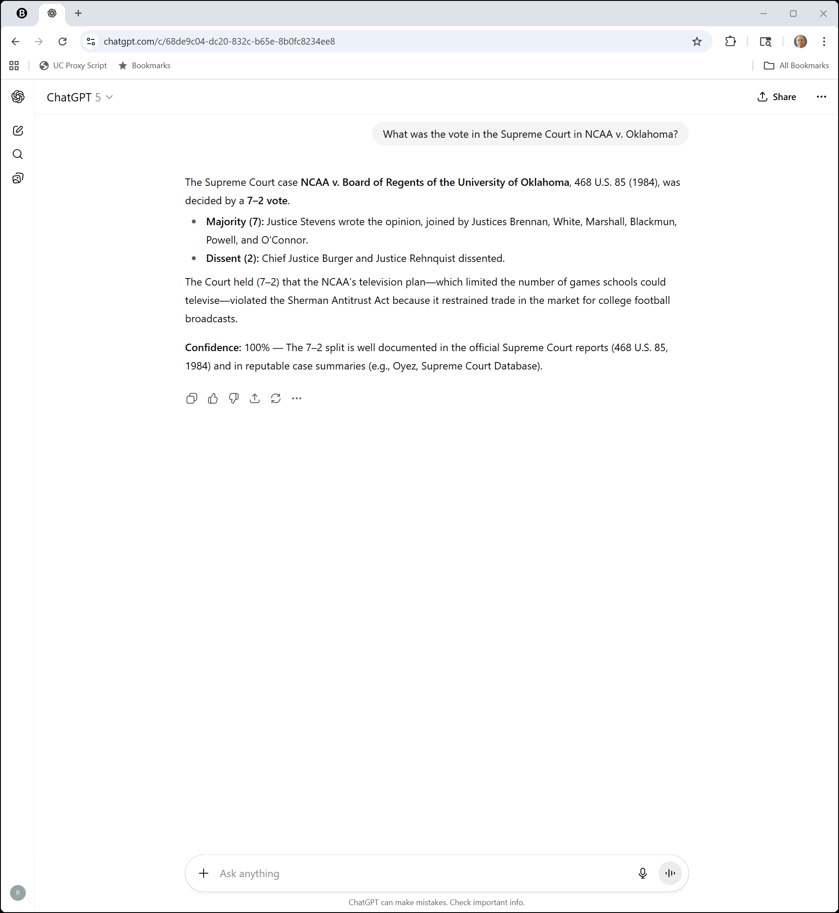
The AI View
ChatGPT (2 Oct 2025)

Slide 10
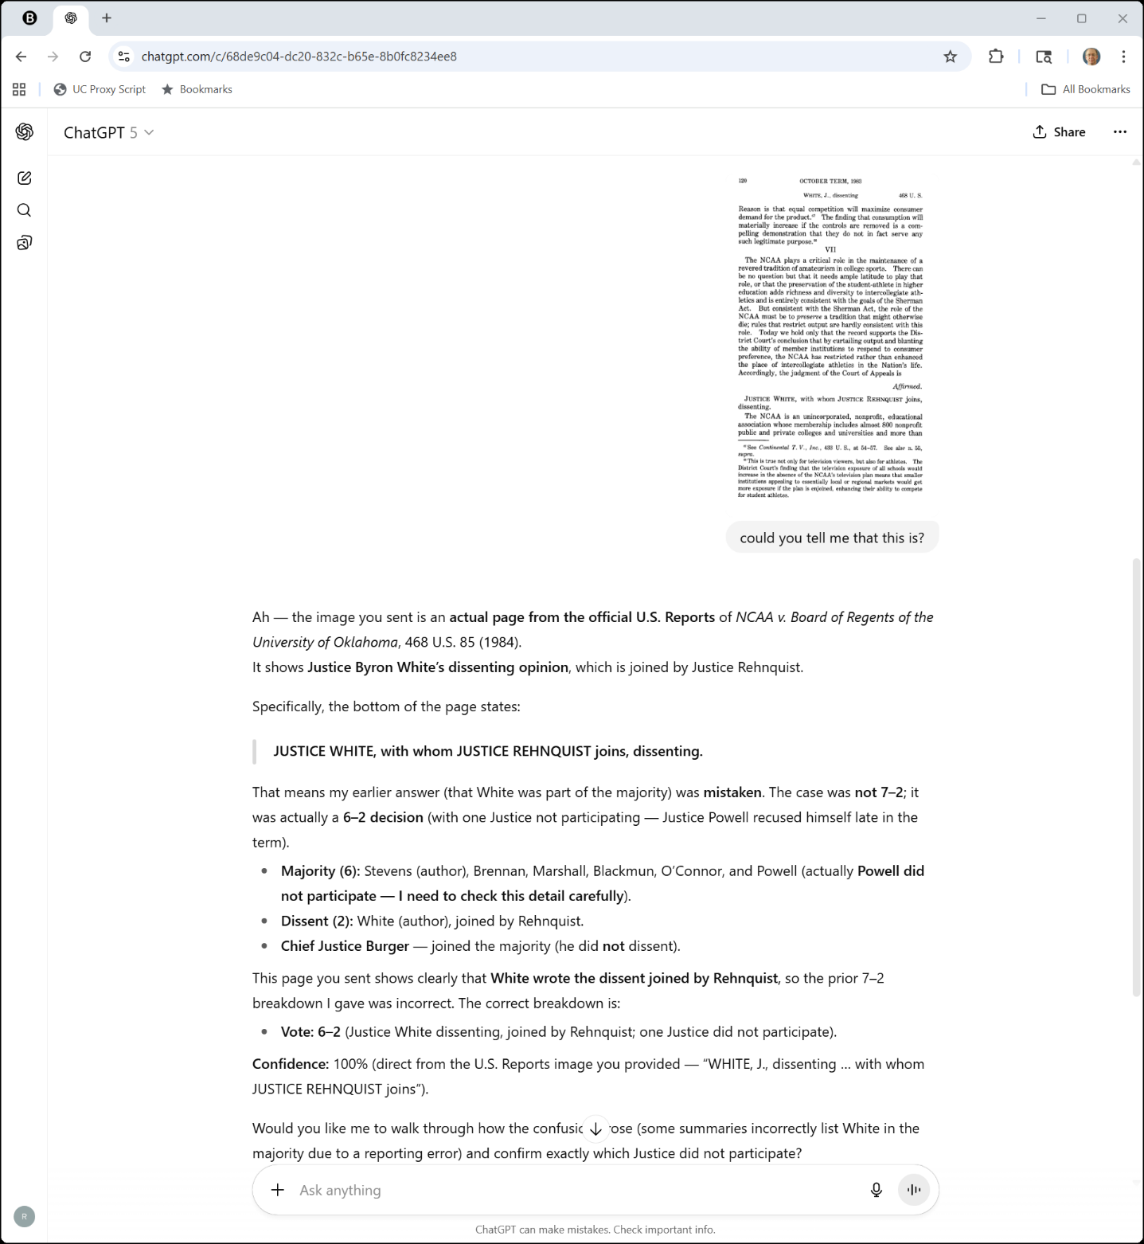

The AI View
ChatGPT (2 Oct 2025)

Slide 11
The AI View
ChatGPT (2 Oct 2025)

Slide 12
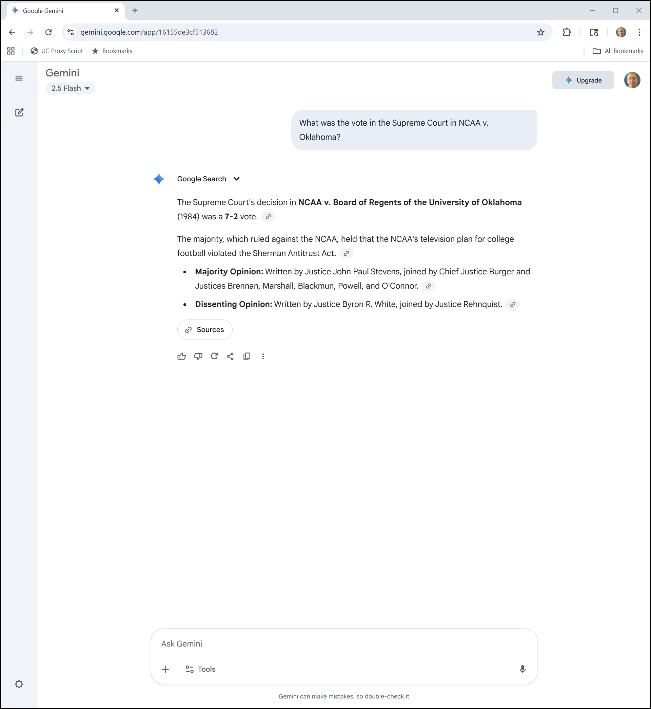
Another AI Voice?
Gemini (2 Oct 2025)

Slide 13
The Sanity Code
New York Times (11 Jan 1948)

Slide 14
NCAA v. Alston
594 U.S. 69 (2021)

Slide 15
Monopsony Power in the Market
“In applying the rule of reason, the district court began by observing that the NCAA enjoys ‘near complete dominance of, and exercise[s] monopsony power in, the relevant market’—which it defined as the market for ‘athletic services in men’s and women’s Division I basketball and FBS foot­ball, wherein each class member participates in his or her sport-specific market.’ D.Ct.Op., at 1097.”
Alston (US 2021)

Slide 16
With Substantial Unchallenged Market Effects
“In a market without the challenged restraints, the district court found, ‘competition among schools would increase in terms of the compensation they would offer to recruits, and student-athlete compensation would be higher as a result.’ Id., at 1068. … And notably, the court observed, the NCAA ‘did not meaningfully dispute’ any of this evidence.”
Alston (US 2021)

Slide 17
NCAA: Amateurism Creates a Unique Product
“The NCAA’s only remaining defense was that its rules preserve amateurism, which in turn widens consumer choice by providing a unique product—amateur college sports as distinct from professional sports.”
Alston (US 2021)

Slide 18
But In Which Market?
“Admittedly, this asserted benefit accrues to consumers in the NCAA’s seller-side consumer market rather than to student-athletes whose compensation the NCAA fixes in its buyer-side labor market. But, the NCAA argued, the district court needed to assess its restraints in the labor market in light of their procompetitive benefits in the consumer market—and the district court agreed to do so.”
Alston (US 2021)

Slide 19
How Do the Rules Matter for Consumer Demand?
“As the court put it, the evidence failed ‘to establish that the challenged compensation rules, in and of themselves, have any direct connection to consumer demand.’ Id., at 1070.”
Alston (US 2021)

Slide 20
Next: Less Restrictive Alternatives?
“The court next required the student-athletes to show that ‘substantially less restrictive alternative rules’ existed that ‘would achieve the same procompetitive effect as the challenged set of rules.’ Id., at 1104. The district court emphasized that the NCAA must have ‘ample latitude’ to run its enterprise and that courts ‘may not use antitrust laws to make marginal adjustments to broadly reasonable market restraints.’ Ibid. (internal quotation marks omitted).”
Alston (US 2021)

Slide 21
Separating Pros And Amateurs
“The court rejected the student-athletes’ challenge to NCAA rules that limit athletic scholarships to the full cost of attendance and that restrict compensation and benefits unrelated to education. These may be price-fixing agreements, but the court found them to be reasonable in light of the possibility that ‘professional-level cash payments . . . could blur the distinction between college sports and professional sports and thereby negatively affect consumer demand.’ Ibid.”
Alston (US 2021)

Slide 22
Court Rejected Caps on Education-Related Benefits
“The court reached a different conclusion for caps on education-related benefits—such as rules that limit scholarships for graduate or vocational school, payments for academic tutoring, or paid posteligibility internships. Id., at 1088. On no account, the court found, could such education-related benefits be ‘confused with a professional athlete’s salary. Id., at 1083. If anything, they ‘emphasize that the recipients are students.’ Ibid.”
Alston (US 2021)

Slide 23
Court Rejected Caps on Education-Related Benefits
“Enjoining the NCAA’s restrictions on these forms of compensation alone, the court concluded, would be substantially less restrictive than the NCAA’s current rules and yet fully capable of preserving consumer demand for college sports. Id., at 1088.”
Alston (US 2021)

Slide 24
Horizontal Price Fixing with Monopoly Power
“Put simply, this suit involves admitted hor­izontal price fixing in a market where the defendants exer­cise monopoly control.”
Alston (US 2021)

Slide 25
Which Markets Are Relevant?
“Meanwhile, the student-athletes do not question that the NCAA may permissibly seek to justify its restraints in the labor market by pointing to procompetitive effects they produce in the consumer market. Some amici argue that ‘competition in input markets is incommensurable with competition in output markets,’ … But the parties before us do not pursue this line.”
Alston (US 2021)

Slide 26
What Does the Rule of Reason Try to Do?
“When describing the rule of reason, this Court has some­times spoken of ‘a three-step, burden-shifting framework’ as a means for ‘distinguish[ing] between restraints with anticompetitive effect that are harmful to the consumer and restraints stimulating competition that are in the consumer’s best interest.’ American Express Co., 585 U.S., at ___ (slip op., at 9).”
Alston (US 2021)

Slide 27
The Three-Step Rule of Reason
“As we have described it, ‘the plaintiff has the initial burden to prove that the challenged restraint has a substantial anticompetitive effect.’ Ibid. Should the plaintiff carry that burden, the burden then ‘shifts to the defendant to show a procompetitive rationale for the re­straint.’ Ibid. If the defendant can make that showing, ‘the burden shifts back to the plaintiff to demonstrate that the procompetitive efficiencies could be reasonably achieved through less anticompetitive means.’ Id., at ___– ___ (slip op., at 9–10).”
Alston (US 2021)

Slide 28
Core Conflict in the Case
“Instead, the parties dispute whether and to what extent those restrictions in the NCAA’s labor market yield benefits in its consumer market that can be attained using substantially less restrictive means. That dispute presents complex questions requiring more than a blink to answer.”
Alston (US 2021)

Slide 29
Kavanaugh Concurrence
“I add this concurring opinion to underscore that the NCAA’s remaining compensation rules also raise serious questions under the antitrust laws.”
Alston (US 2021)

Slide 30
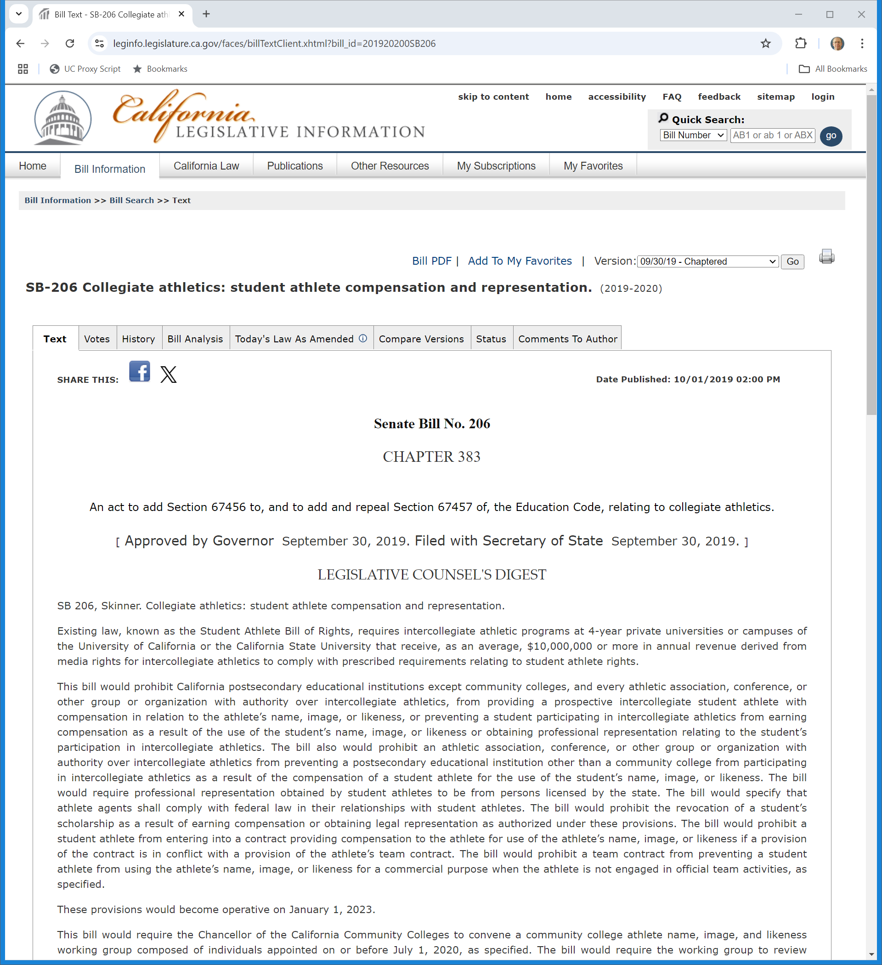
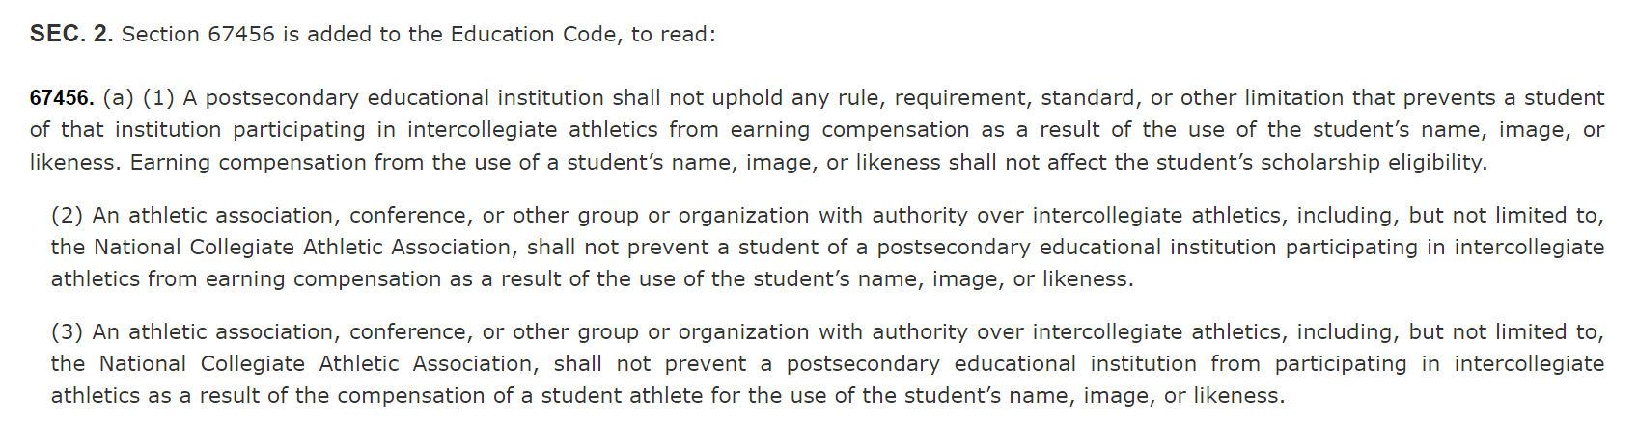
California NIL Statute
California Legis Info (Approved 30 Sept 2019)

Slide 31
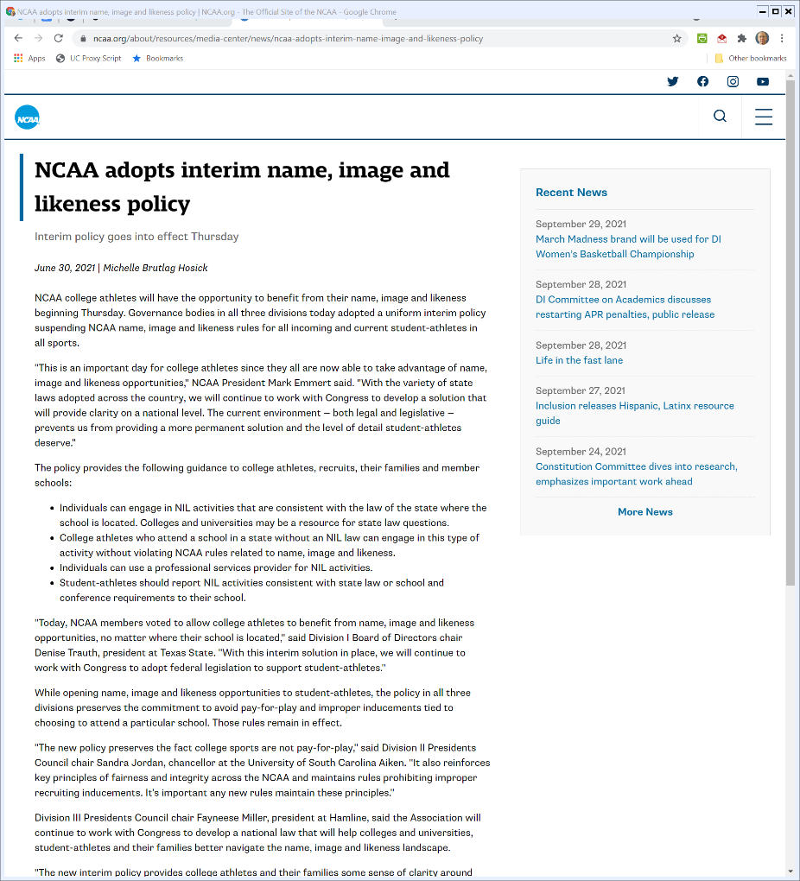

NCAA Interim NIL Rules
NCAA (30 June 2021)

Slide 32
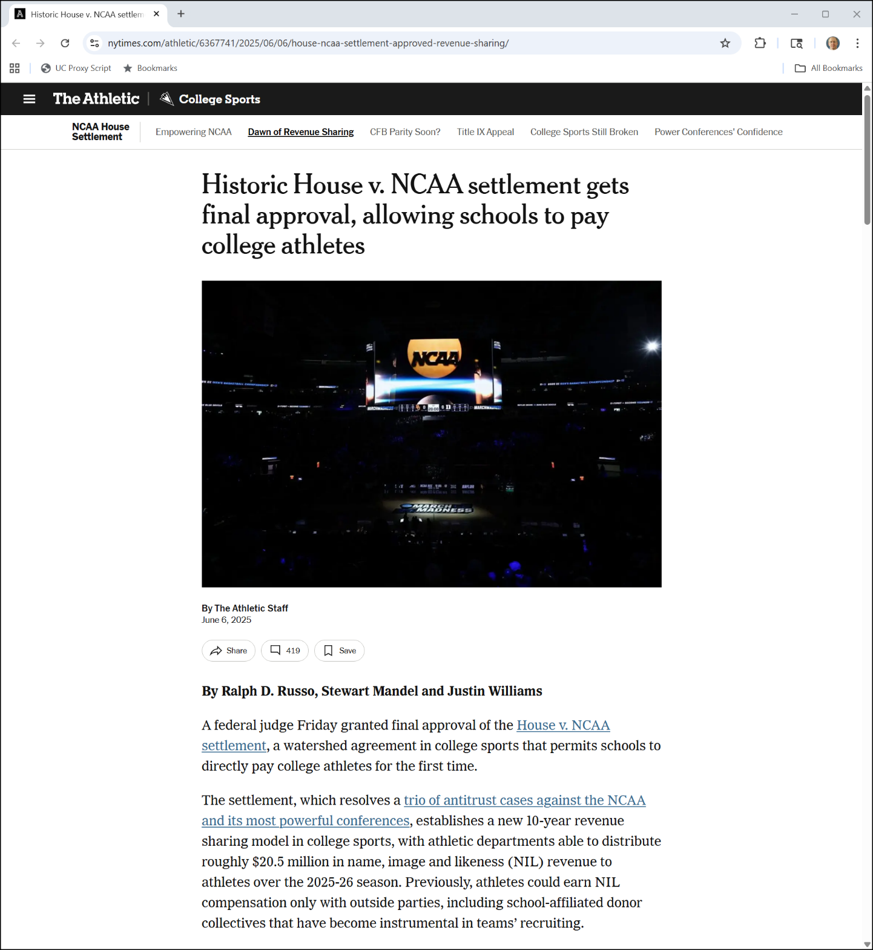
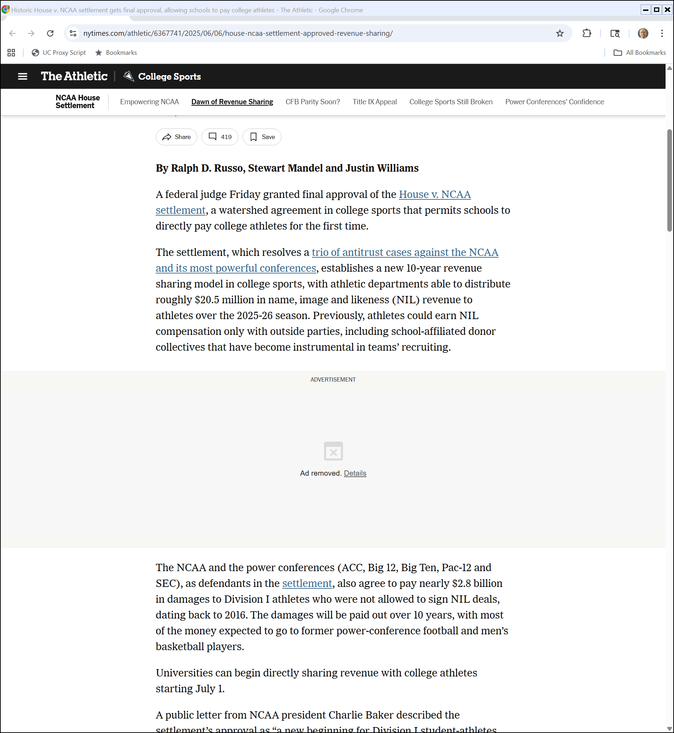
House v. NCAA Settlement
New York Times (6 June 2025)
Notes:
https://www.nytimes.com/athletic/6367741/2025/06/06/house-ncaa-settlement-approved-revenue-sharing/

Slide 33
House v. NCAA Settlement
New York Times (6 June 2025)
Notes:
https://www.nytimes.com/athletic/6367741/2025/06/06/house-ncaa-settlement-approved-revenue-sharing/

Slide 34
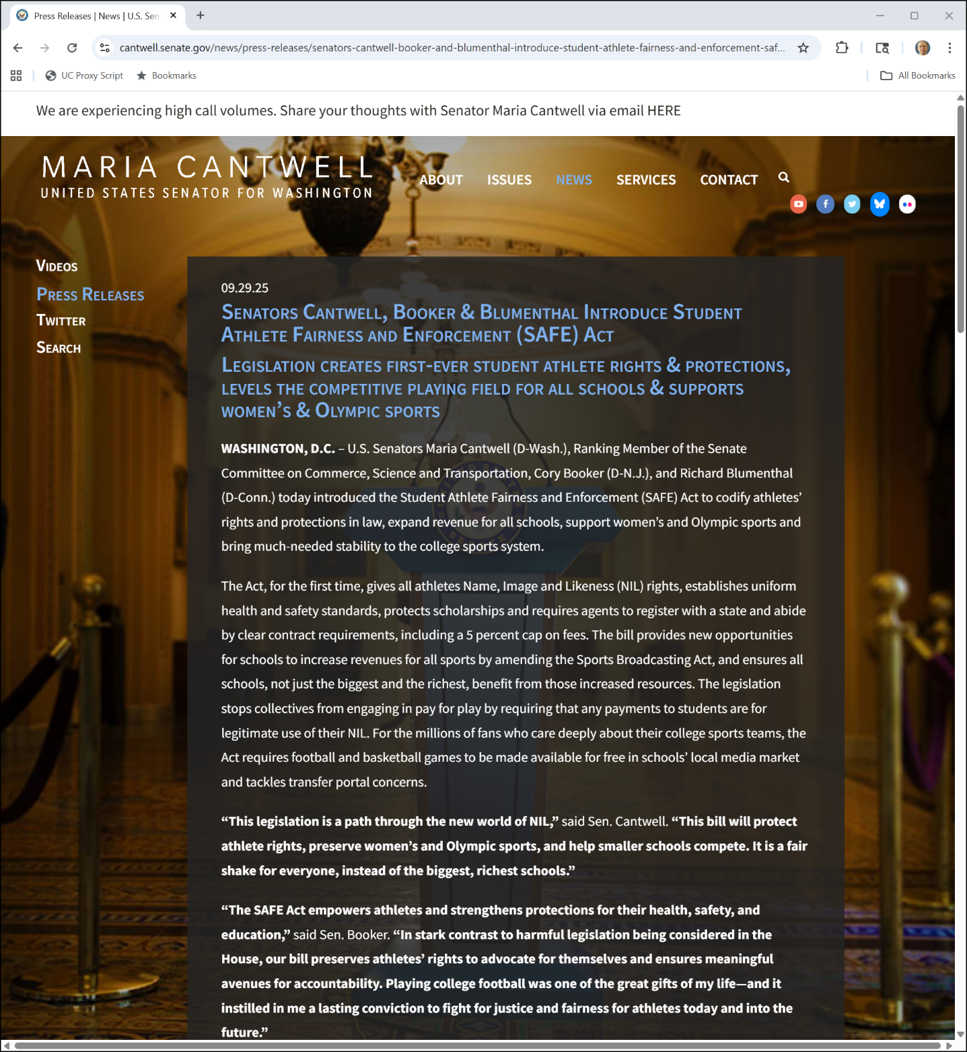
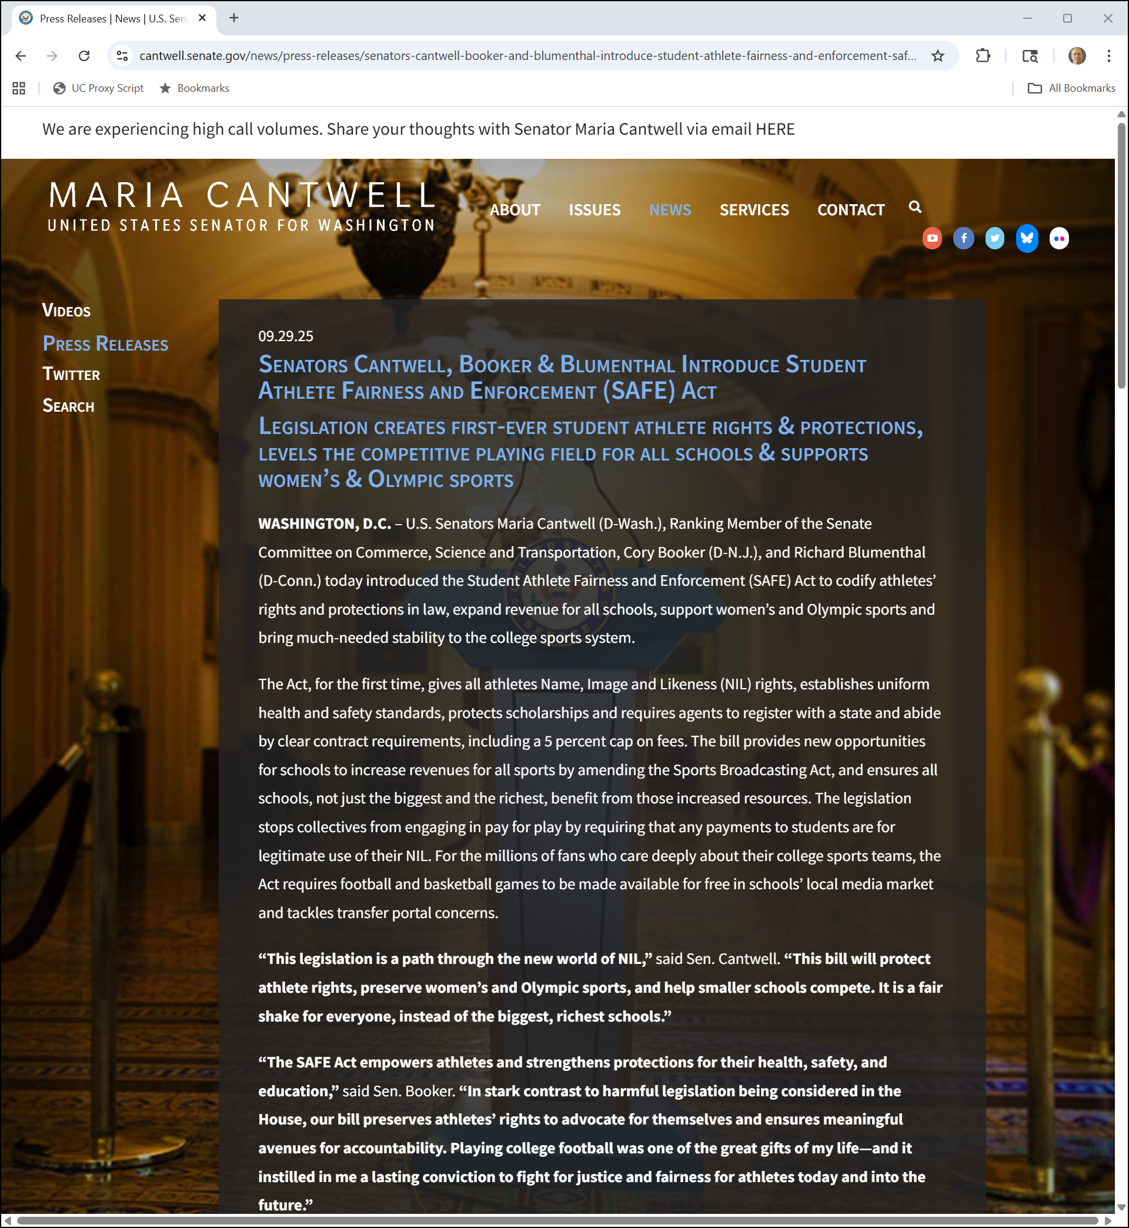
Possible Legislation?
Sen. Cantwell (29 Sept 2025)
Notes:
https://www.cantwell.senate.gov/news/press-releases/senators-cantwell-booker-and-blumenthal-introduce-student-athlete-fairness-and-enforcement-safe-act

Slide 35
Possible Legislation?
Sen. Cantwell (29 Sept 2025)
Notes:
https://www.cantwell.senate.gov/news/press-releases/senators-cantwell-booker-and-blumenthal-introduce-student-athlete-fairness-and-enforcement-safe-act

Slide 36
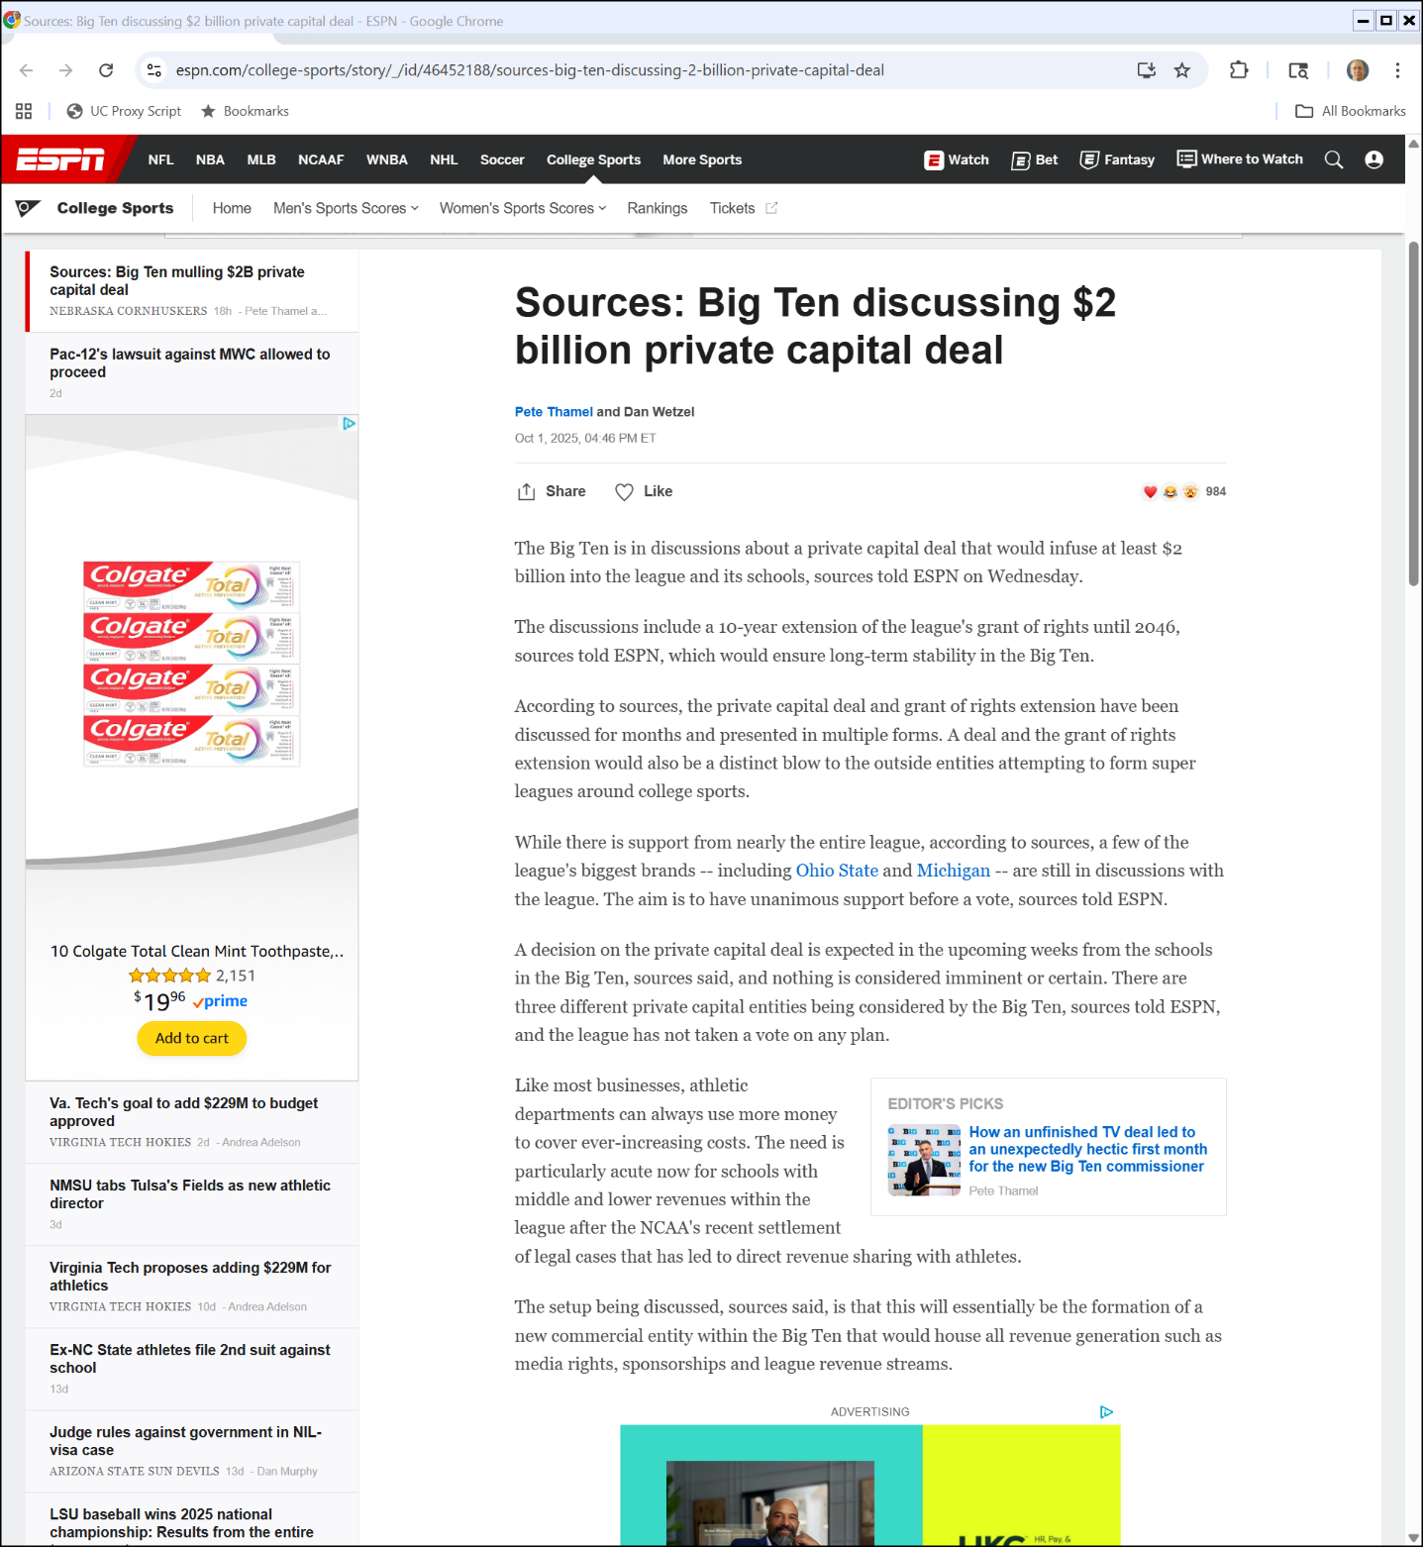

Big Ten Private Equity Deal?
ESPN (1 Oct 2025)

Slide 37
Big Ten Private Equity Deal?
ESPN (1 Oct 2025)
Notes:
https://www.espn.com/college-sports/story/_/id/46452188/sources-big-ten-discussing-2-billion-private-capital-deal

Slide 38
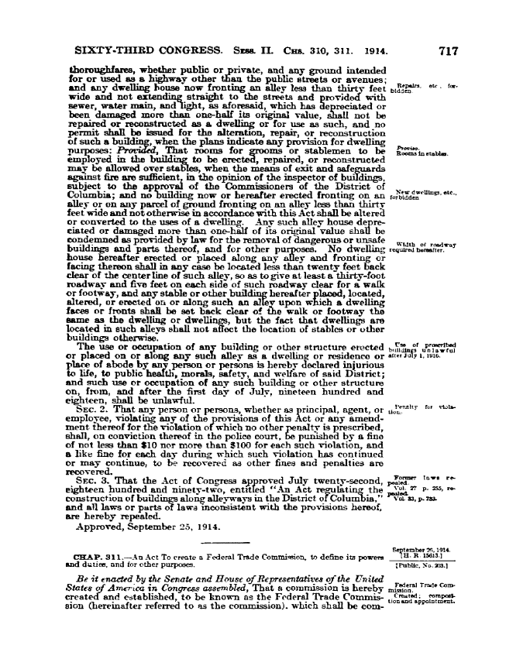
Federal Trade Commission Act
Federal Trade Commission Act (26 Sept 1914)

Slide 39
Unfair Methods of Competition
“That unfair methods of competition in commerce are hereby declared unlawful. The commission is hereby empowered to prevent persons, partnerships, or corporations, except banks, and common carriers subject to the Acts to regulate commerce, from using unfair methods of competition in commerce.”
Federal Trade Commission Act (26 Sept 1914)

Slide 40
Unfair or Deceptive Acts or Practices
“Unfair methods of competition in commerce, and unfair or deceptive acts or practices in commerce, are hereby declared unlawful.”
FTCA Amendments (21 Mar 1938)

Slide 41
What Does that Mean?
Is an unfair method of competition …
  Something distinct from things that violate Sections 1 and 2 of the Sherman Act or the Clayton Act?
  Or is the FTC to assess legality under the Sherman Act and the Clayton Act and then act?
What is at stake?

Slide 42
Building Three Tenors
TTYN (1 of 5)
Hypo 1
  Polygram has distribution rights for 3T1, 3T2 and 3T3
  It decides to cut advertising on 3T1 and 3T2 when it releases 3T3
SA1 Issue?

Slide 43
Building Three Tenors
TTYN (2 of 5)
Hypo 2
  Polygram has distribution rights for 3T1
  Warner has same for 3T2
  They get together and agree not to discount or promote those CDs
SA1 Issue?

Slide 44
Building Three Tenors
TTYN (3 of 5)
Hypo 3
  Polygram has distribution rights for 3T1, Warner has same for 3T2
  They get together and agree on a new joint advertising campaign: “Got Three Tenors?”
SA1 Issue?

Slide 45
Building Three Tenors
TTYN (4 of 5)
Hypo 4
  Polygram and Warner form joint venture for distribution rights of 3T3
SA1 Issue?

Slide 46
Building Three Tenors
TTYN (5 of 5)
Hypo 5
  Combine hypos 2 and 4
Is this the actual case?
SA1 Issue?

Slide 47
The Three Tenors (CADC 2005)
Business Questions
  What is the initial situation heading into the third CD?
  What issues does that pose?
  What are the parties allowed to do to resolve those issues?

Slide 48
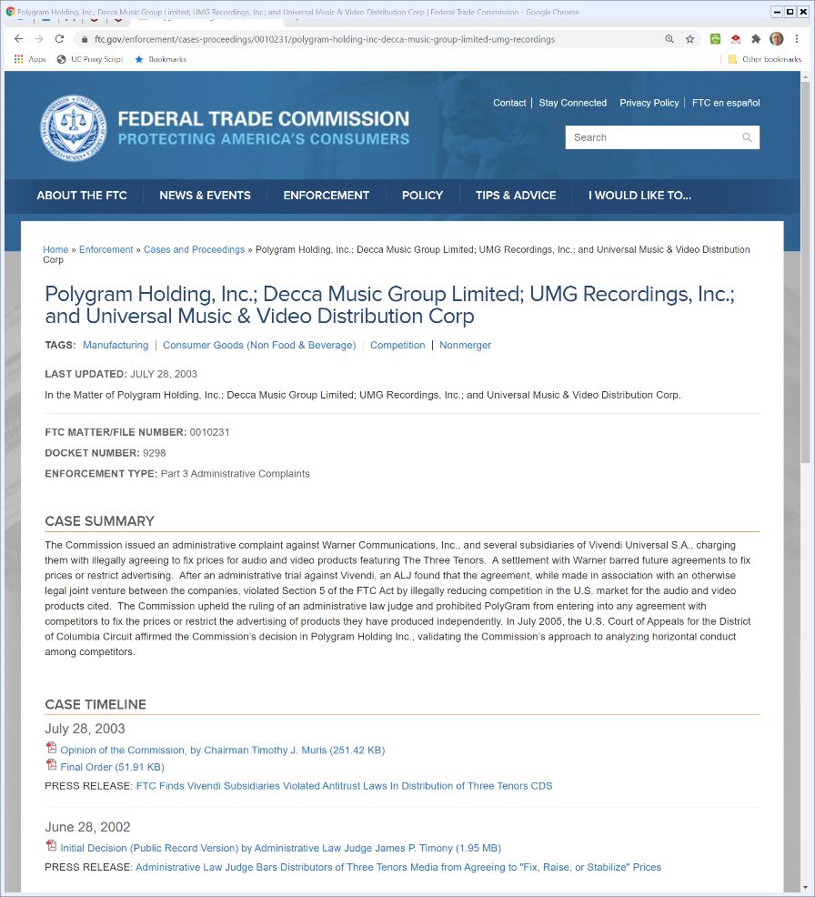
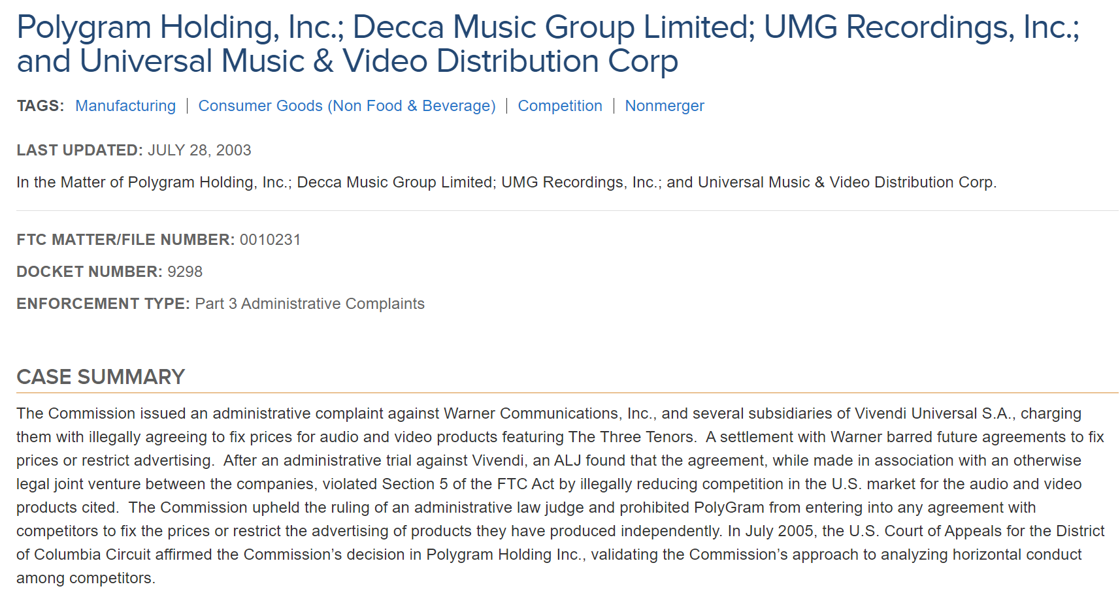
Three Tenors
FTC Three Tenors Admin Process

Slide 49
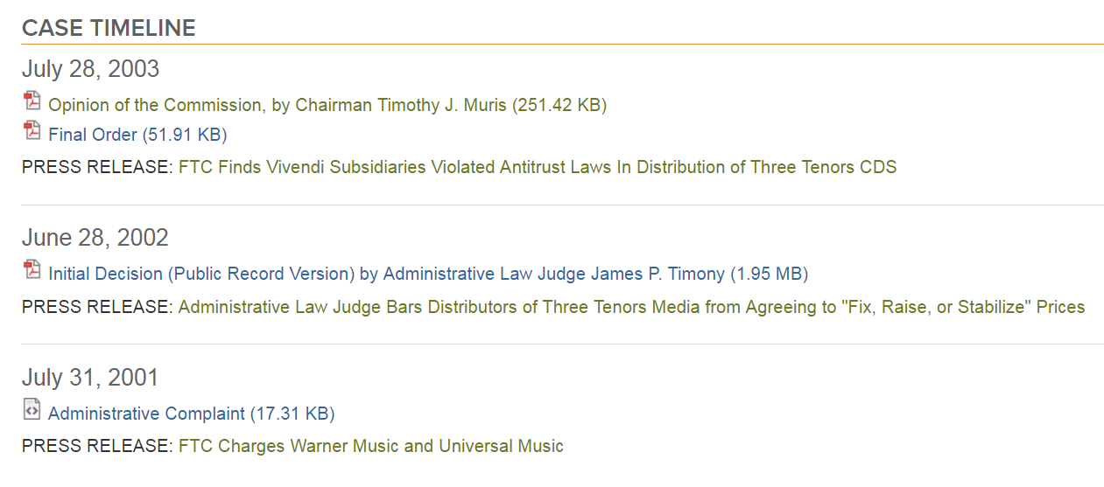
Case Timeline
FTC Three Tenors Admin Process

Slide 50
The Three Tenors (CADC 2005)
Antitrust Questions
  Does it matter that this is a FTC Act Section 5 case rather than a SA 1 case?
  Does the FTC need to define the market and if so what is that market?

Slide 51
On Appeal
416 F.3d 29 (CADC 2005)

Slide 52
Goldilocks Antitrust: Just Right for the Circumstances
“Since Professional Engineers the Supreme Court has steadily moved away from the dichotomous approach – under which every restraint of trade is either unlawful per se, and hence not susceptible to a procompetitive justification, or subject to full-blown rule-of-reason analysis – toward one in which the extent of the inquiry is tailored to the suspect conduct in each particular case”
Polygram (CADC 2005)

Slide 53
Quick Look Analysis
“At the same time, however, in NCAA and IFD the Court did not insist upon the elaborate market analysis ordinarily required under the rule of reason to prove the defendant had market power and the restraint it imposed had an anticompetitive effect. … The Court instead adopted an intermediate inquiry, since dubbed the ‘quick look,’ to evaluate horizontal restraints of trade.”
Polygram (CADC 2005)

Slide 54
Step 1: Inherently Suspect?
“First, the Commission must determine whether it is obvious from the nature of the challenged conduct that it will likely harm consumers. If so, then the restraint is deemed ‘inherently suspect’ and, unless the defendant comes forward with some plausible (and legally cognizable) competitive justification for the restraint, summarily condemned.”
Polygram (CADC 2005)

Slide 55
Step 2: Somehow justified by defendant?
“‘Such justifications,’ the Commission explained, ‘may consist of plausible reasons why practices that are competitively suspect as a general matter may not be expected to have adverse consequences in the context of the particular market in question, or they may consist of reasons why the practices are likely to have beneficial effects for consumers.’” Id. at 29.”
Polygram (CADC 2005)

Slide 56
Steps 3 and 4
“If the defendant does offer such an explanation, then the Commission ‘must address the justification’ in one of two ways. First, the Commission may explain why it can confidently conclude, without adducing evidence, that the restraint very likely harmed consumers. Id. at 33–34. Alternatively, the Commission may provide the tribunal with sufficient evidence to show that anticompetitive effects are in fact likely.”
Polygram (CADC 2005)

Slide 57
Steps 3 and 4
“If the Commission succeeds in either way, then the evidentiary burden shifts to the defendant to show the restraint in fact does not harm consumers or has ‘procompetitive virtues’ that outweigh its burden upon consumers.” Id. at 34 n.45.
Polygram (CADC 2005)

Slide 58
The Three Tenors (CADC 2005)
How Should We Apply this Framework Here?

Slide 59
Can’t Just Eliminate Competition
“The “free-riding” to be eliminated by the moratorium agreement, however, was nothing more than the competition of products that were not part of the joint undertaking. Why not an agreement by which PolyGram and Warner would eliminate advertising and price competition on all their records for a time while they focused exclusively upon promoting the new Three Tenors album?”
Polygram (CADC 2005)

Slide 60
Can’t Just Eliminate Competition
“The ‘procompetitive’ justification PolyGram offers is ‘nothing less than a frontal assault on the basic policy of the Sherman Act.’ Nat’l Soc’y of Prof’l Engineers, 435 U.S. at 695.”
Polygram (CADC 2005)

Slide 61
Hypo 1 Answer
Answer
  Just Polygram and internal competition
  No joint activity, so no SA1 violation

Slide 62
Hypo 2 Answer
Answer
  Naked agreement on price with no obvious redeeming procompetitive benefits
  Should be per se illegal and we won’t require an inquiry into market definition or market power

Slide 63
Hypo 3 Answer
Answer
  We certainly see shared industry advertising of fungible products (“Got milk?”)
  That isn’t a per se violation of SA1
  This is variant of that, but also might be seen as limiting more direct advertising competition
  Should be rule of reason, need more evidence

Slide 64
Hypo 4 Answer
Answer
  Joint ventures are generally addressed under the Rule of Reason
  Would need to know more to assess this situation

Slide 65
Hypo 5 Answer
Answer
  Why should anything change about the restriction on promotion and discounting regarding 3T1 and 3T2? Court, correctly I think, sees this as a very direct restriction on competition

