Slide 1
Class 2: Wed 1 Oct 2025 Antitrust Fall 2025 Finding the Agreement
Randal C. Picker
James Parker Hall Distinguished Service Professor of Law
The Law School
The University of Chicago
Copyright © 2000-25 Randal C. Picker. All Rights Reserved.

Slide 2
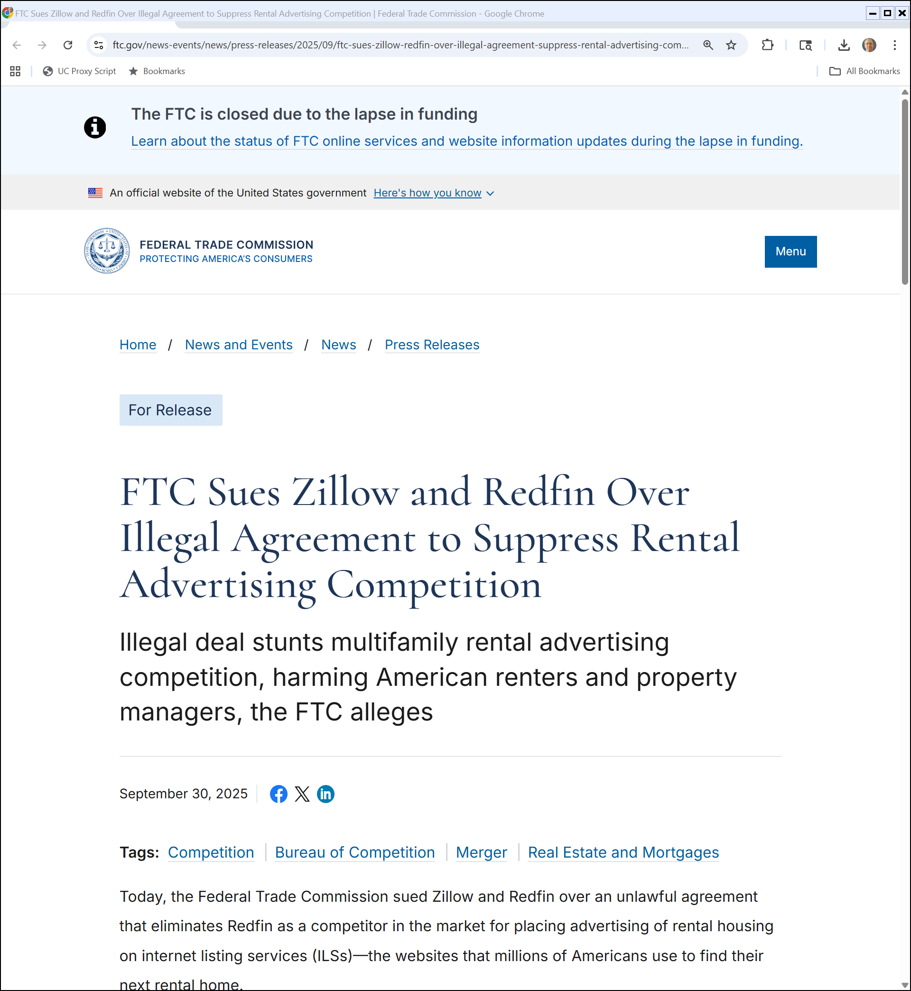
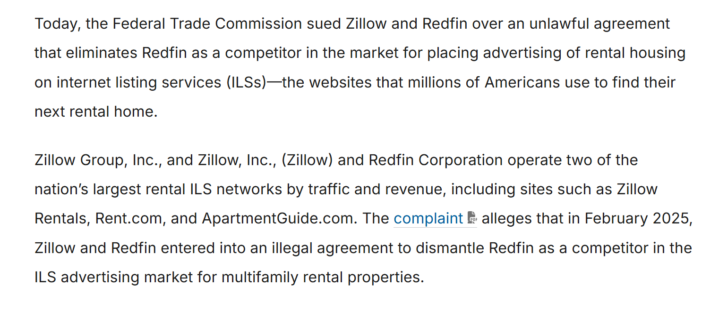
FTC Closed
FTC (30 Sept 2025)
Notes:
https://www.ftc.gov/news-events/news/press-releases/2025/09/ftc-sues-zillow-redfin-over-illegal-agreement-suppress-rental-advertising-competition

Slide 3
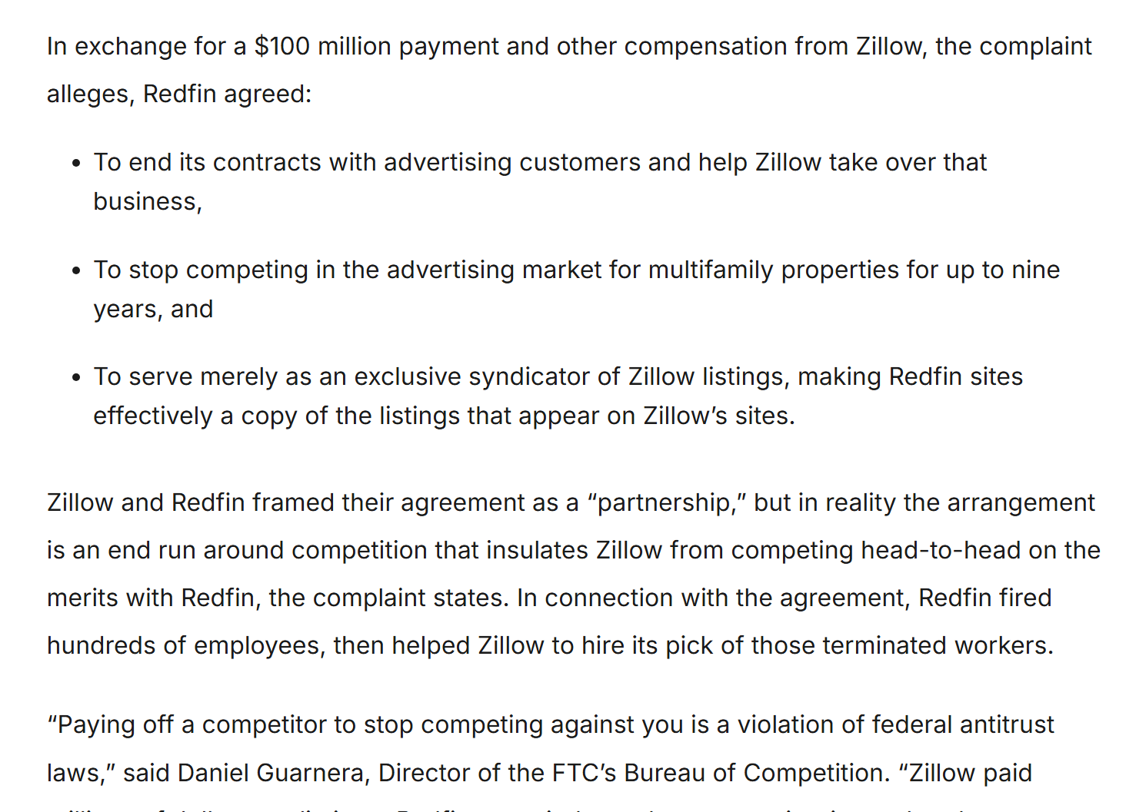
Zillow Lawsuit
FTC (30 Sept 2025)
Notes:
https://www.ftc.gov/news-events/news/press-releases/2025/09/ftc-sues-zillow-redfin-over-illegal-agreement-suppress-rental-advertising-competition

Slide 4
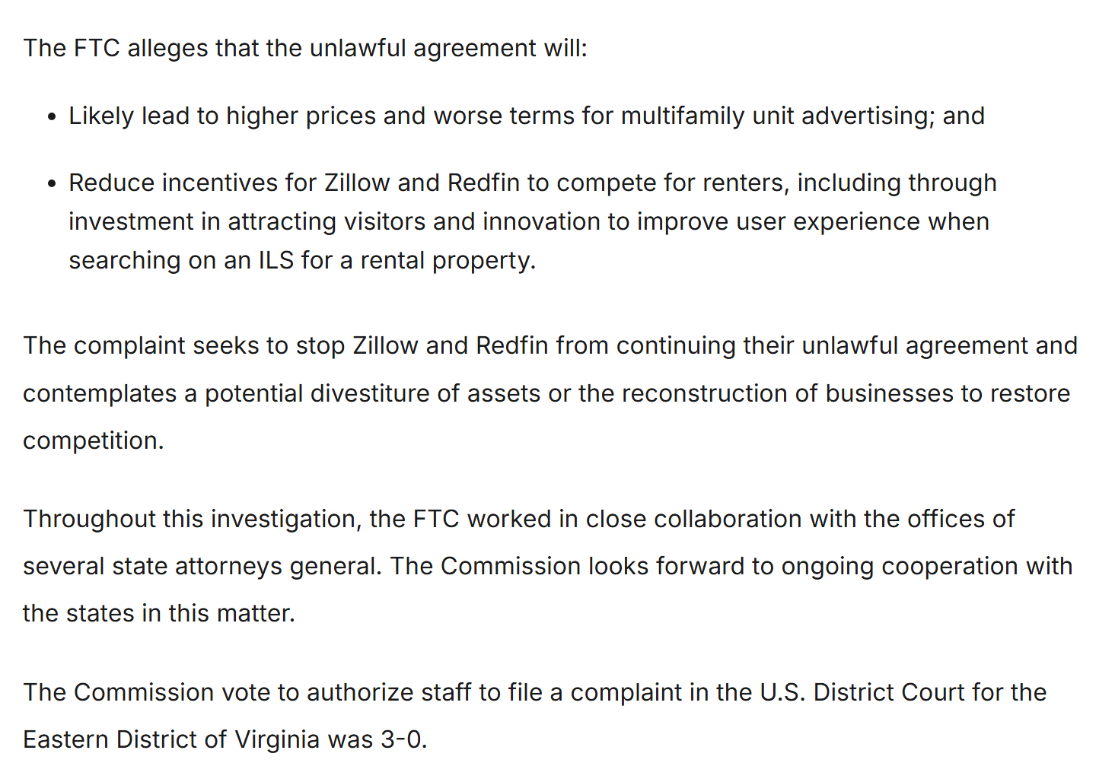
3-0 Vote
FTC (30 Sept 2025)
Notes:
https://www.ftc.gov/news-events/news/press-releases/2025/09/ftc-sues-zillow-redfin-over-illegal-agreement-suppress-rental-advertising-competition

Slide 5
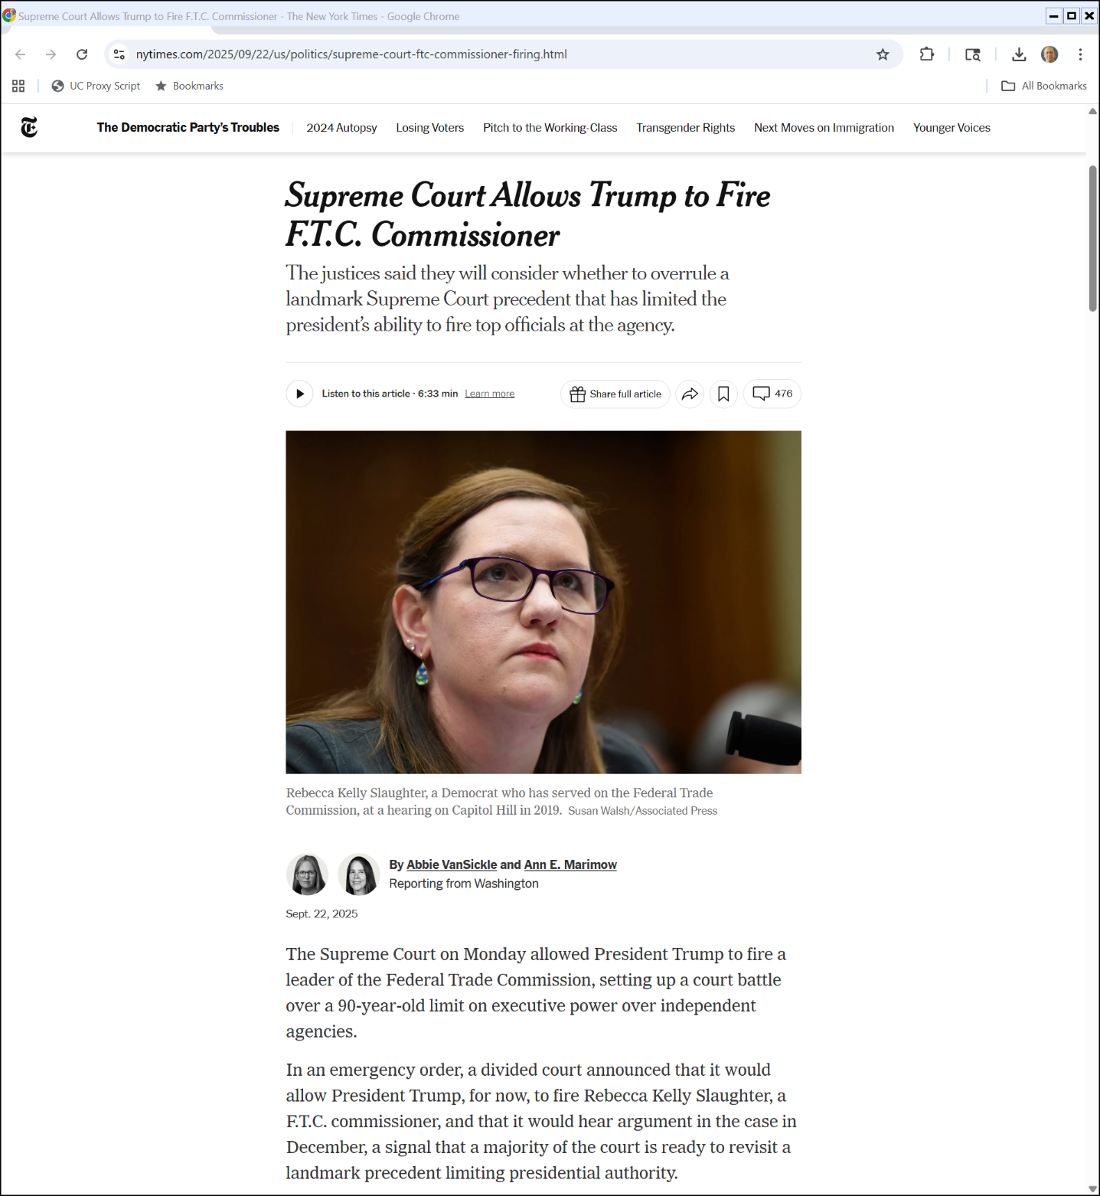
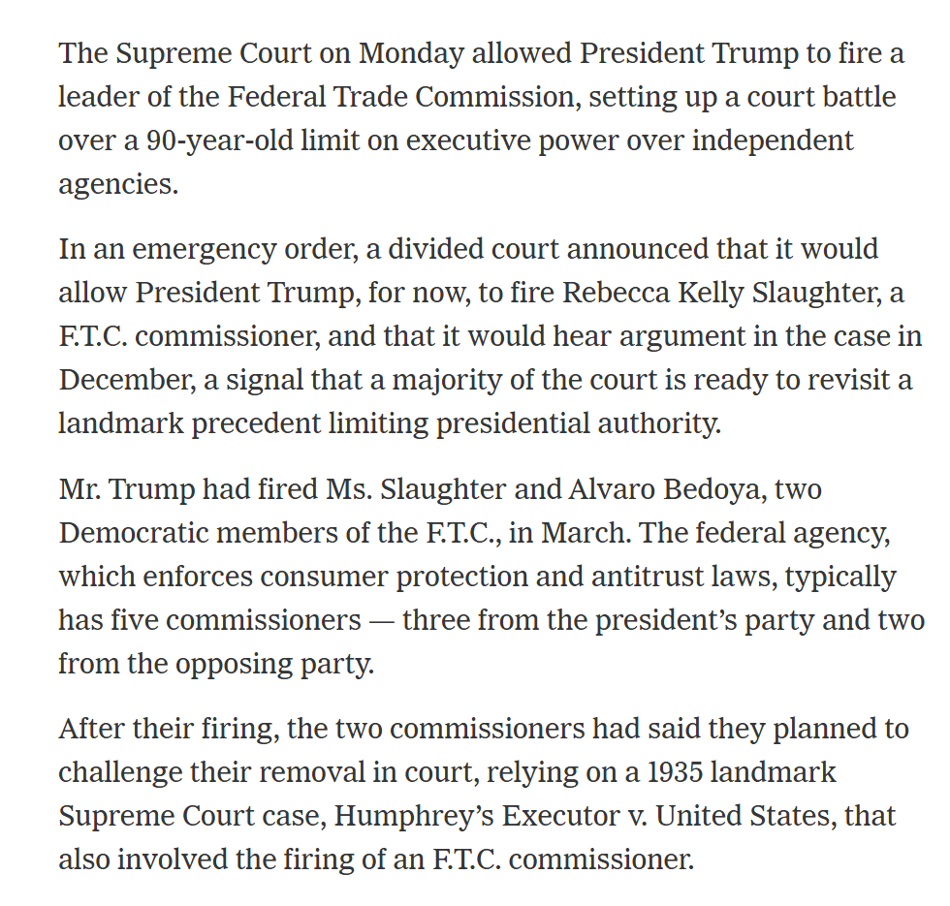
The Missing FTC Commissioners
New York Times (22 Sept 2025)

Slide 6
Independent Agencies
Trump v. Slaughter (U.S. Sept 22, 2025)

Slide 7
Independent Agencies
Trump v. Slaughter (U.S. Sept 22, 2025)

Slide 8
Removal Of Humphrey
New York Times (8 Oct 1933)

Slide 9
Removal Of Humphrey
New York Times (8 Oct 1933)

Slide 10
The New Deal and The Supreme Court
New York Times (28 May 1935)

Slide 11
The New Deal and The Supreme Court
New York Times (28 May 1935)

Slide 12
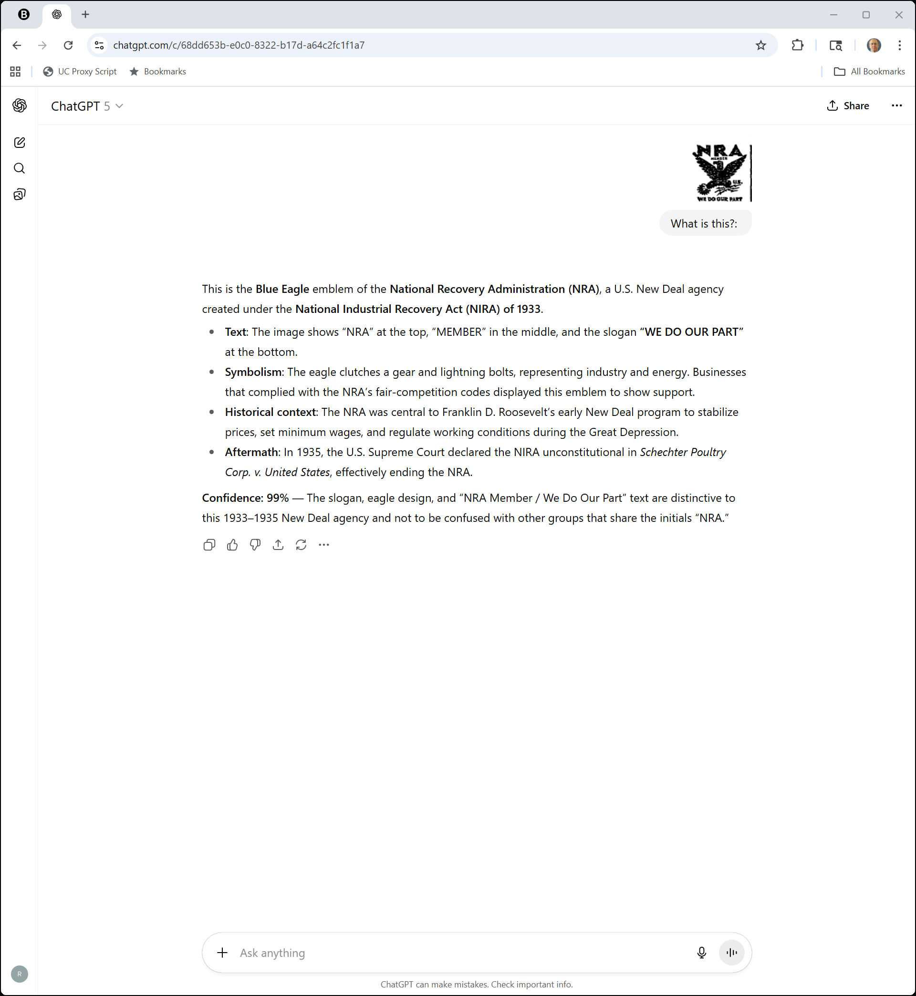
And The Symbol in the Upper Left Corner?
ChatGPT 5 (1 Oct 2025)

Slide 13
Humphrey’s Executor
295 U.S. 602 (1935)

Slide 14
Statutory Basis for Removal
295 U.S. 602 (1935)

Slide 15
Constitutional?
295 U.S. 602 (1935)

Slide 16
Removal Would Threaten Agency Independence
295 U.S. 602 (1935)

Slide 17
Back to the Kagan Dissent
Trump v. Slaughter (U.S. Sept 22, 2025)

Slide 18
Back to the Kagan Dissent
Trump v. Slaughter (U.S. Sept 22, 2025)

Slide 19
Production of Property: The Great American Novel
TTYN (1 of 3)
Supply
Novelist-wannabe contemplates writing book. It will cost her $12 to do so
Once written, each copy of the book can be produced for $1
Demand
Two consumers: One would value the book at 10, the second at 5

Slide 20
Questions
TTYN (2 of 3)
What would we like to happen?
What will happen?

Slide 21

Pricing Movies in 1934 (TTYN (3 of 3))
Chicago Tribune (12 July 1934)

Slide 22
Filling the Movie Theater (TTYN (1 of 3))
Movie Theater
(100 seats)
Assume:
Fixed Costs = 500, Marginal costs = 0
Two types of consumers
Type Y: 80 consumers, V_{Y} = 10
Type S: 20 consumers, V_{S} = 4
Different types are readily identifiable

Slide 23
Filling the Movie Theater
TTYN (2 of 3)
Three Sets of Prices
Hypo 1: Tickets cost $4
Hypo 2: Tickets cost $5
Hypo 3: Tickets cost $6.25
Assess these alternatives

Slide 24
Filling the Movie Theater
TTYN (3 of 3)
Fourth Set of Prices
Hypo 1: Tickets cost $4
Hypo 2: Tickets cost $5
Hypo 3: Tickets cost $6.25
Hypo 4: Price to Y is $6, Price to S is $1
Assess this alternative. What are the mechanics of implementing this approach?

Slide 25
Results when P = $4
Movie Theater
(100 seats)
80 Ys, V_{Y} = 10
20 Ss, V_{S} = 4
F = 500
First try: Set ticket price at $4
What happens?
All 100 consumers attend the movie
Total revenues = 100*4 = 400
The firm doesn’t cover costs, so we shouldn’t think of that as a sustainable competitive outcome
Social Welfare (SWF) = 80*10 + 20*4 -500 = 380

Slide 26
Results when P = $5
Movie Theater
(100 seats)
80 Ys, V_{Y} = 10
20 Ss, V_{S} = 4
F = 500
Second try: Set ticket price at $5
What happens?
80 Type Y consumers attend the movie
Total revenues = 80*5 = 400
The firm doesn’t cover costs, so we shouldn’t think of that as a sustainable competitive outcome
S types who we want to attend the movie don’t
SWF = 80*10 – 500 = 300

Slide 27
Results when P = $6.25
Movie Theater
(100 seats)
80 Ys, V_{Y} = 10
20 Ss, V_{S} = 4
F = 500
Third try: Set ticket price at $6.25
What happens?
80 Type Y consumers attend the movie
Total revenues = 80*6.25 = 500
The firm just cover costs but makes no “profit”, and these are the features of a competitive outcome
S types who we want to attend the movie still don’t
SWF = 80*10 – 500 = 300 = 3.75*80

Slide 28
Fourth Attempt Results
Movie Theater
(100 seats)
80 Ys, V_{Y} = 10
20 Ss, V_{S} = 4
F = 500
Fourth try: Set different prices for different groups:
Drop price on Y Types to $6.
Set price on S Type at $1
How do the Y Types experience this?
What happens?

Slide 29
Fourth Attempt Results
Movie Theater
(100 seats)
80 Ys, V_{Y} = 10
20 Ss, V_{S} = 4
F = 500
Fourth try: P_{Y} = 6, P_{S} = 1
What happens?
All 100 consumers attend the movie
Total revenues = 80*6 + 20*1 = 500
The firm just covers costs
SWF = 10*80 + 4*20 – 500 = 380
We have maximized SWF while covering costs of operation

Slide 30
Fourth Attempt Results
Movie Theater
(100 seats)
Fourth try: P_{Y} = 6, P_{S} = 1
But we have done this by charging different prices to different consumers (price discrimination).
Each Y type effectively pays $6 of the fixed costs, while each S type pays $1 of the fixed costs

Slide 31
Key Feature of Example
Movie Theater
(100 seats)
Assume:
Fixed Costs = 500, Marginal costs = 0
Two types of consumers
Type Y: 80 consumers, V_{Y} = 10
Type S: 20 consumers, V_{S} = 4
Different types are readily identifiable
How should the theater segment consumers if the types aren’t identifiable?

Slide 32
Implementing This
Movie Theater
(100 seats)
Things that Won’t Work:
Sell two types of tickets, Y-tickets for $6 and S-tickets for $1 and ask customers to select the tickets that match their type
Have two theaters right next to each other, one selling $6 tickets and the second $1 tickets

Slide 33
A Different Mechanism
Movie Theater
New Movie
Movie Theater
6-month old movie
Could this work?
Have two theaters next to each other: the first plays a new movie (the first-run theater) while the second plays a six-month old movie (the second run theater)

Slide 34
Is This Interstate Circuit?
Movie Theater
New Movie
Movie Theater
6-month old movie
Note the investments that need to be made in market segmentation:
We are making some viewers wait to see the movie when we could have them seeing it now (have two 1st run theaters instead of one 1st run and one 2nd run), but we need the delay (the window) to separate the customers

Slide 35
Movie Antitrust Case Filed
New York Times (21 July 1938)

Slide 36
Interstate Circuit
306 U.S. 208 (1939)

Slide 37
Interstate Circuit
Motion
Picture
Distributors
Paramount
2
8
O’Donnell GM
Hoblitzelle Pres
Interstate
Circuit
Texas
Consolidated
Theatres
Exhibitors
Texas
43 Theatres
1st and 2nd Run
66 Theatres
1st and 2nd Run

Slide 38
The Letter
Interstate Circuit (US 1909)

Slide 39
The Letter
Interstate Circuit (US 1909)

Slide 40
Evaluating the Evidence
What does the evidentiary record look like to an outsider?
If you were a second-run theatre, what would you think?
What evidence would be available to you?
If you were going to bring a private antitrust action, how would you frame the complaint?

Slide 41
Finding the Conspiracy
Paramount
8
2
Interstate
Circuit
7
3
6
4
5

Slide 42
Holding: Agreement v. Conspiracy
“While the District Court’s finding of an agreement of the distributors among themselves is supported by the evidence, we think that in the circumstances of this case such agreement for the imposition of the restrictions upon subsequent-run exhibitors was not a prerequisite to an unlawful conspiracy.”
Interstate Circuit (US 1909)

Slide 43
Holding: “Contemplated and Invited”
“It was enough that, knowing that concerted action was contemplated and invited, the distributors gave their adherence to the scheme and participated in it. Each distributor was advised that the others were asked to participate; each knew the cooperation was essential to successful operation of the plan.”
Interstate Circuit (US 1909)

Slide 44
Holding: Invitation and Action
“Acceptance by competitors, without previous agreement, of an invitation to participate in a plan, the necessary consequence of which, if carried out, is restraint of interstate commerce, is sufficient to establish an unlawful conspiracy under the Sherman Act.”
Interstate Circuit (US 1909)

Slide 45
Paramount
334 U.S. 131 (1948)

Slide 46
Paramount Divestiture
New York Times (26 Feb 1949)

Slide 47
Theatre Enterprises
346 U.S. 537 (1954)

Slide 48
Independent Decisions or Via Agreement
“The crucial question is whether respondents’ conduct toward petitioner stemmed from independent decision or from an agreement, tacit or express. To be sure, business behavior is admissible circumstantial evidence from which the fact finder may infer agreement. Interstate Circuit, Inc. v. United States, 1939, 306 U.S. 208.”
Theatre Enterprises (US 1954)

Slide 49
Conscious Parallelism Isn’t Enough
“But this Court has never held that proof of parallel business behavior conclusively establishes agreement or, phrased differently, that such behavior itself constitutes a Sherman Act offense.”
Theatre Enterprises (US 1954)

Slide 50
Conscious Parallelism Isn’t Enough
“Circumstantial evidence of consciously parallel behavior may have made heavy inroads into the traditional judicial attitude toward conspiracy; but ‘conscious parallelism’ has not yet read conspiracy out of the Sherman Act entirely.”
Theatre Enterprises (US 1954)

Slide 51
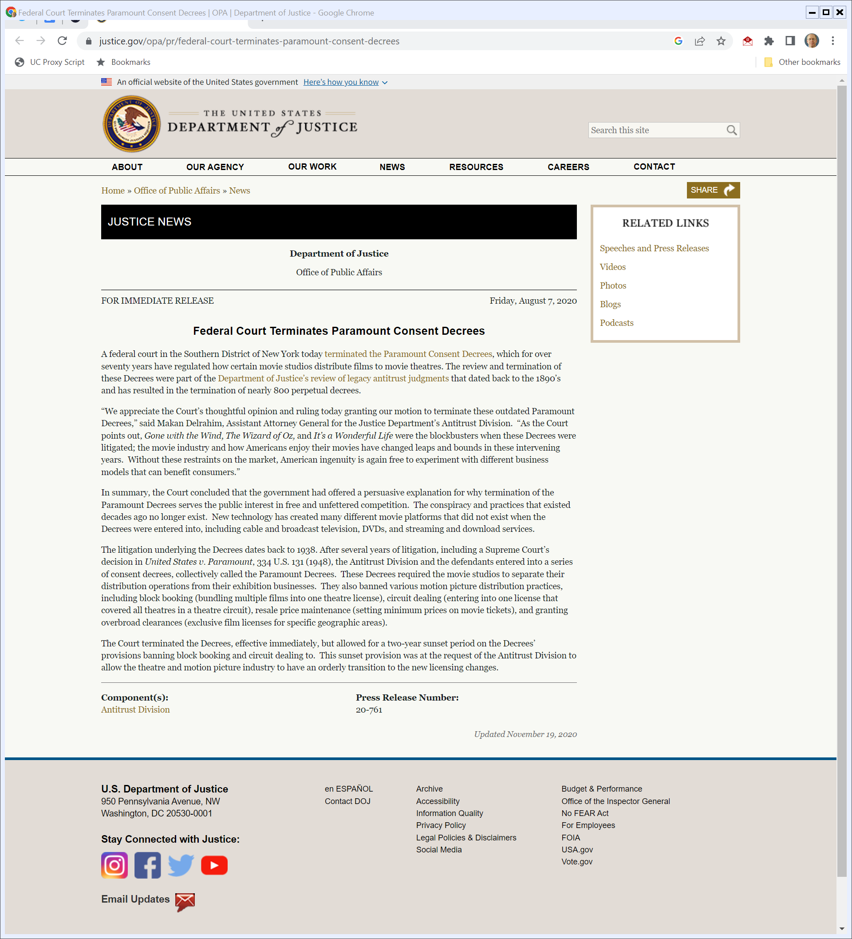
End of Paramount Decrees
DOJ (7 Aug 2020)
Notes:
https://www.justice.gov/opa/pr/federal-court-terminates-paramount-consent-decrees

Slide 52
Twombly
550 U.S. 544 (2007)

Slide 53
Independent or Not?
“… ‘[t]he crucial question’ is whether the challenged anticompetitive conduct ‘stem[s] from independent decision or from an agreement, tacit or express,’ Theatre Enterprises, 346 U.S., at 540. While a showing of parallel ‘business behavior is admissible circumstantial evidence from which the fact finder may infer agreement,’ it falls short of ‘conclusively establish[ing] agreement or ... itself constitut[ing] a Sherman Act offense.’ Id., at 540-541.”
Twombly (US 2007)

Slide 54
Independent or Not?
“Even ‘conscious parallelism,’ a common reaction of ‘firms in a concentrated market [that] recogniz[e] their shared economic interests and their interdependence with respect to price and output decisions’ is ‘not in itself unlawful.’ Brooke Group Ltd. v. Brown & Williamson Tobacco Corp., 509 U.S. 209, 227 (1993) … .”
Twombly (US 2007)

Slide 55
Independent or Not?
“ … [P]roof of a § 1 conspiracy must include evidence tending to exclude the possibility of independent action, see Monsanto Co. v. Spray-Rite Service Corp., 465 U.S. 752 (1984); and at the summary judgment stage a § 1 plaintiffs offer of conspiracy evidence must tend to rule out the possibility that the defendants were acting independently, see Matsushita Elec. Industrial Co. v. Zenith Radio Corp., 475 U.S. 574 (1986).”
Twombly (US 2007)

Slide 56
Pleading Requirements: Facts Suggesting Conspiracy Is Plausible
“In applying these general standards to a § 1 claim, we hold that stating such a claim requires a complaint with enough factual matter (taken as true) to suggest that an agreement was made. Asking for plausible grounds to infer an agreement does not impose a probability requirement at the pleading stage; it simply calls for enough fact to raise a reasonable expectation that discovery will reveal evidence of illegal agreement.”
Twombly (US 2007)

Slide 57
Must Have Facts to Get Beyond Mere Parallel Conduct
“It makes sense to say, therefore, that an allegation of parallel conduct and a bare assertion of conspiracy will not suffice. Without more, parallel conduct does not suggest conspiracy, and a conclusory allegation of agreement at some unidentified point does not supply facts adequate to show illegality. Hence, when allegations of parallel conduct are set out in order to make a § 1 claim, they must be placed in a context that raises a suggestion of a preceding agreement, not merely parallel conduct that could just as well be independent action.”
Twombly (US 2007)

Slide 58
Price Increases
TTYN (1 of 3)
Hypos
V1: Firm raises its prices; competitors learn of that and match the price increase
V2: Firm announces in trade publication that it will raise prices in a week; it does so and competitors match

Slide 59
Price Increases
TTYN (2 of 3)
Hypos
V3: Firm announces in email to its competitors that it will raise prices in a week; it does so and competitors match

Slide 60
Price Increases
TTYN (3 of 3)
Questions
In which of these cases could you draft an SA1 complaint that would satisfy Twombly’s plausible facts standard?
Are any of these hypos Kleen Products?

Slide 61
Public Communication and Collusion
Duso et al (25 July 2025)

Slide 62
Kleen Products
Consol & Amended Complaint (10 Nov. 2010)

Slide 63
Structure of the Industry
Complaint (10 Nov 2010)

Slide 64
Changed Market Shares
Complaint (10 Nov 2010)

Slide 65
Prior Antitrust Violations
Complaint (10 Nov 2010)

Slide 66
Capacity Reductions and Price Increases
Complaint (10 Nov 2010)

Slide 67
Capacity Reductions and Price Increases
Complaint (10 Nov 2010)

Slide 68
SA1 Violation
Complaint (10 Nov 2010)

Slide 69
SA1 Violation
Complaint (10 Nov 2010)

Slide 70
Kleen Products
910 F.3d 927 (7th Cir. 2018)

Slide 71
More Likely Than Not
“It is the substantive law, however, that establishes what the plaintiff must address. The Purchasers needed evidence that would allow a trier of fact to nudge the ball over the 50‐yard line and rationally to say that the existence of an agreement is more likely than not.”
Kleen Products (7th Cir. 2018)

Slide 72
More Likely Than Not
“Put more directly, they must put on the table ‘some evidence which, if believed, would support a finding of concerted behavior.’ Toys ‘R’ Us Inc. v. FTC, 221 F.3d 928, 935 (7th Cir. 2000).”
Kleen Products (7th Cir. 2018)

Slide 73
What Mistakes Should Antitrust Make?
“The outcome of this case flows directly from both the limitation in section 1 of the Sherman Act to anticompetitive agreements and the Supreme Court’s cautions against interfering with individual firm behavior in ways that could inadvertently distort incentives to compete.”
Kleen Products (7th Cir. 2018)

Slide 74
Antitrust Policy Tradeoffs
“Scholars, lawmakers, and courts have yet to agree on a regulatory regime that can address oligopolistic behavior that leads to higher prices and reduced consumer choice, without stifling normal business activity. For now, we follow established law to the effect that ‘‘conscious parallelism’ has not yet read conspiracy out of the Sherman Act entirely.’ Twombly, 550 U.S. at 552 (citation omitted).”
Kleen Products (7th Cir. 2018)

Slide 75
At Best, Only Tacit Collusion (And Not Enough)
“Because the evidence proffered by the Purchasers does not tend to exclude the possibility that Georgia-Pacific and WestRock engaged only in tacit collusion, we AFFIRM the judgment of the district court.”
Kleen Products (7th Cir. 2018)

Slide 76
More Tacit: Text Messaging II
782 F.3d 867 (7th Cir. 2015)

Slide 77
Tacit Collusion Doesn’t Violate SA1
“The point that [the plaintiffs] have particular difficulty accepting is that the Sherman Act imposes no duty on firms to compete vigorously, or for that matter at all, in price. This troubles some antitrust experts, such as Harvard Law School Professor Louis Kaplow, whose book Competition Policy and Price Fixing (2013) argues that tacit collusion should be deemed a violation of the Sherman Act. That of course is not the law, and probably shouldn’t be.”
Text Messaging II (7th Cir. 2015)

