Slide 1
Class 1: Mon 29 Sept 2025 Antitrust Fall 2025 Characterizing Horizontal Agreements
Randal C. Picker
James Parker Hall Distinguished Service Professor of Law
The Law School
The University of Chicago
Copyright © 2000-25 Randal C. Picker. All Rights Reserved.

Slide 2
1888 NY Trust Investigation
NY Trust Investigation (1888)

Slide 3
Standard Oil as Original Trust
NY Trust Investigation (1888)

Slide 4
Samuel Dodd: A Defence of Trusts
New York Tribune (2 Feb 1890)

Slide 5
2 Jan 1882: The Standard Oil Trust Agreement
Ohio v. Standard Oil Co. (Oh. 1892)

Slide 6
Full and Free Competition, Raise Cost to Consumer
S. 3445 (14 Aug 1888)

Slide 7
Remedies: Double Damages; Corporate Franchise Forfeiture
S. 3445 (14 Aug 1888)

Slide 8
An Amendment
S.1 (2 Apr 1890)

Slide 9
An Amendment
S.1 (2 Apr 1890)

Slide 10
The Sherman Act
26 Stat 209 (2 July 1890)

Slide 11
Sherman Act Sec. 1
Sherman Act: July 2, 1890
Every
contract, combination in the form of trust or otherwise, or conspiracy,
in restraint of trade or commerce
among the several States, or with foreign nations,
is declared to be illegal.

Slide 12
Sherman Act Sec. 1
Every person who shall make any contract or engage in any combination or conspiracy hereby declared to be illegal shall be deemed guilty of a [felony], and, on conviction thereof, shall be punished by fine not exceeding $[100,000,000] if a corporation, or, if any other person, $[1,000,000], or by imprisonment not exceeding [10] years, or by both said punishments, in the discretion of the court.

Slide 13
Trans-Missouri
166 U.S. 290 (1897)

Slide 14
SA1 Covers All Restraints
“When, therefore, the body of an act pronounces as illegal every contract or combination in restraint of trade or commerce among the several States, etc., the plain and ordinary meaning of such language is not limited to that kind of contract alone which is in unreasonable restraint of trade, but all contracts are included in such language, and no exception or limitation can be added without placing in the act that which has been omitted by Congress.”
Trans-Missouri (U.S. 1897)

Slide 15
15 May 1911: Standard Oil Decision
New York Times (16 May 1911)

Slide 16
15 May 1911: Standard Oil Decision
New York Times (16 May 1911)

Slide 17
President Taft on Moving to Unreasonable Restraints of Trade
New York Times (16 May 1911)

Slide 18
Socony-Vacuum
310 U.S. 150 (1940)

Slide 19
Price Fixing Per Se Illegal
“As we have indicated, the machinery employed by a combination for price-fixing is immaterial. Under the Sherman Act a combination formed for the purpose and with the effect of raising, depressing, fixing, pegging, or stabilizing the price of a commodity in interstate or foreign commerce is illegal per se.”
Socony-Vacuum Oil Co. (U.S. 1940)

Slide 20
Chicago Board of Trade
246 U.S. 231 (1918)

Slide 21
Rule of Reason Framework
“Every agreement concerning trade, every regulation of trade, restrains. To bind, to restrain, is of their very essence. The true test of legality is whether the restraint imposed is such as merely regulates and perhaps thereby promotes competition or whether it is such as may suppress or even destroy competition.”
Chicago Board of Trade (US 1918)

Slide 22
Rule of Reason Framework
“To determine that question the court must ordinarily consider the facts peculiar to the business to which the restraint is applied; its condition before and after the restraint was imposed; the nature of the restraint and its effect, actual or probable. The history of the restraint, the evil believed to exist, the reason for adopting the particular remedy, the purpose or end sought to be attained, are all relevant facts.”
Chicago Board of Trade (US 1918)

Slide 23
US v. ASCAP
New York Times (18 Feb 1941)

Slide 24
106. Exclusive rights in copyrighted works
Subject to sections 107 through 121
the owner of copyright under this title has the exclusive rights to do and to authorize any of the following:
(1) to reproduce the copyrighted work in copies or phonorecords;
(2) to prepare derivative works based upon the copyrighted work;

Slide 25
106 (Cont.)
(3) to distribute copies or phonorecords of the copyrighted work to the public by sale or other transfer of ownership, or by rental, lease, or lending;
(4) in the case of literary, musical, dramatic, and choreographic works, pantomimes, and motion pictures and other audiovisual works, to perform the copyrighted work publicly;

Slide 26
Broadcast Music
441 U.S. 1 (1979)

Slide 27
Price Setting or Price Fixing?
TTYN (1 of 3)
Hypo 1
There is a Jewel grocery store near the Law School
It buys lots of products from many companies (Kellogg, General Mills and others) and sells them for various prices. Some boxes of cereals of different brands have the same price.
Section 1 violation? Is this different from BMI?

Slide 28
The Music Grocery Store
TTYN (2 of 3)
Hypo 2
A company approaches composers one-by-one and seeks a nonexclusive right to license nondramatic public performances
It then licenses the songs, one by one, and each song is offered for exactly the same price
Section 1 Violation? BMI?

Slide 29
Selling the Public Performance Right
TTYN (3 of 3)
Hypo 3
All the composers get together and agree that they will license the right to engage in nondramatic public performances; only way rights will be licensed
One-by-one licenses and each song offered for exactly the same price
Section 1 Violation? BMI?

Slide 30
Hypo 2 Answer
Does anything in the case create “a contract … in restraint of trade?”
Suppose contract between ASCAP and composer says something like
“You C authorize us A to authorize users of your music. You C continue to have the right to also authorize music users, and you C can authorize other rights vendors to be able to authorize as well.”

Slide 31
Hypo 3 Answer
Horizontal price-fixing cartel

Slide 32
ASCAP License Structure
Emerged from prior antitrust litigation
The Blanket License
The key feature is that the license fee is tied to the radio station’s/TV station’s gross revenue.
This means that the license fee is independent of actual use of ASCAP songs.

Slide 33
ASCAP License Structure
The Per Program License
License based on revenues for the program in which the music is played
Licensee can sue to have federal court set “reasonable fee”

Slide 34
District Court: Not Per Se Illegal Price Fixing, Not an Undue Restraint
“After an 8-week trial, limited to the issue of liability, the court dismissed the complaint, rejecting again the claim that the blanket license was price fixing and a per se violation of § 1 of the Sherman Act, and holding that since direct negotiation with individual copyright owners is available and feasible there is no undue restraint of trade, illegal tying, misuse of copyrights, or monopolization.”
Broadcast Music (US 1979)

Slide 35
CA2: Per Se Illegal Price Fixing
“Though agreeing with the District Court’s factfinding and not disturbing its legal conclusions on the other antitrust theories of liability, the Court of Appeals held that the blanket license issued to television networks was a form of price fixing illegal per se under the Sherman Act. 562 F. 2d 130, 140 (CA2 1977). This conclusion, without more, settled the issue of liability under the Sherman Act … .”
Broadcast Music (US 1979)

Slide 36
What Does CBS Want?: No Blanket License, Rates Based on Use
“CBS would prefer that ASCAP be authorized, indeed directed, to make all its compositions available at standard per-use rates within negotiated categories of use. … But if this in itself or in conjunction with blanket licensing constitutes illegal price fixing by copyright owners, CBS urges that an injunction issue forbidding ASCAP to issue any blanket license or to negotiate any fee except on behalf of an individual member for the use of his own copyrighted work or works.”
Broadcast Music (US 1979)

Slide 37
What Does the Blanket License Accomplish?
TTYN (1 of 3)
Public Goods v. Private Goods
Songs are public goods with zero marginal cost of use
My consumption of the song doesn’t diminish your ability to consume the song
Diet Coke is a private good
If I drink the Diet Coke, you can’t

Slide 38
What Does the Blanket License Accomplish?
TTYN (2 of 3)
Use Incentives
Who do we want to use a public good?
Pricing?
What price would we like for the use of individual songs? Why?

Slide 39
What Does the Blanket License Accomplish?
TTYN (3 of 3)
Enforcing Copyright
What does the blanket license accomplish that a per use scheme would not?

Slide 40
Is the Practice a Threat to the Free-Market?
“More generally, in characterizing this conduct under the per se rule, our inquiry must focus on whether the effect and, here because it tends to show effect, see United States v. United States Gypsum Co., 438 U.S. 422, 436 n. 13 (1978), the purpose of the practice are to threaten the proper operation of our predominantly free-market economy”
Broadcast Music (US 1979)

Slide 41
Ask: Does the Practice Reduce Output?
“—that is, whether the practice facially appears to be one that would always or almost always tend to restrict competition and decrease output, and in what portion of the market, or instead one designed to ‘increase economic efficiency and render markets more, rather than less, competitive.’ Id., at 441 n. 16.”
Broadcast Music (US 1979)

Slide 42
Blanket License as Different Product
“This substantial lowering of costs, which is of course potentially beneficial to both sellers and buyers, differentiates the blanket license from individual use licenses. The blanket license is composed of the individual compositions plus the aggregating service. Here, the whole is truly greater than the sum of its parts; it is, to some extent, a different product.”
Broadcast Music (US 1979)

Slide 43
Apply Rule of Reason on Remand
“With this background in mind, which plainly enough indicates that over the years, and in the face of available alternatives, the blanket license has provided an acceptable mechanism for at least a large part of the market for the performing rights to copyrighted musical compositions, we cannot agree that it should automatically be declared illegal in all of its many manifestations. Rather, when attacked, it should be subjected to a more discriminating examination under the rule of reason.”
Broadcast Music (US 1979)

Slide 44
FN 40: How Does ASCAP Hand Out the Money?
“Moreover, because of the nature of the product--a composition can be simultaneously ‘consumed’ by many users--composers have numerous markets and numerous incentives to produce, so the blanket license is unlikely to cause decreased output, one of the normal undesirable effects of a cartel. And since popular songs get an increased share of ASCAP’s revenue distributions, composers compete even within the blanket license in terms of productivity and consumer satisfaction.”
Broadcast Music (US 1979)

Slide 45
2021 Consent Decrees Review
15 Jan 2021
Notes:
https://www.justice.gov/atr/antitrust-consent-decree-review-ascap-and-bmi-2019

Slide 46
Review Every Five Years
15 Jan 2021
Notes:
https://www.justice.gov/atr/antitrust-consent-decree-review-ascap-and-bmi-2019

Slide 47
American Needle Complaint

Slide 48
Key Parties
American Needle Complaint

Slide 49
Copperweld
467 U.S. 752 (1984)

Slide 50
Section 1 Doesn’t Apply Inside a Firm
“The officers of a single firm are not separate economic actors pursuing separate economic interests, so agreements among them do not suddenly bring together economic power that was previously pursuing divergent goals. Coordination within a firm is as likely to result from an effort to compete as from an effort to stifle competition.”
Copperweld (U.S. 1984)

Slide 51
Section 1 Doesn’t Apply Inside a Firm
“In the marketplace, such coordination may be necessary if a business enterprise is to compete effectively. For these reasons, officers or employees of the same firm do not provide the plurality of actors imperative for a § 1 conspiracy.”
Copperweld (U.S. 1984)

Slide 52
SA1 Doesn’t Apply to Parent and Wholly-Owned Sub
“For similar reasons, the coordinated activity of a parent and its wholly owned subsidiary must be viewed as that of a single enterprise for purposes of § 1 of the Sherman Act. A parent and its wholly owned subsidiary have a complete unity of interest. Their objectives are common, not disparate; their general corporate actions are guided or determined not by two separate corporate consciousnesses, but one.”
Copperweld (U.S. 1984)

Slide 53
SA Section 8
“That the word ‘person,’ or ‘persons,’ wherever used in this act shall be deemed to include corporations and associations existing under or authorized by the laws of either the United States, the laws of any of the Territories, the laws of any State, or the laws of any foreign country.”
26 Stat 209 (2 July 1890)

Slide 54
American Needle
538 F.3d 736 (7th Cir. 2008)

Slide 55
NFL as Part of Broader Entertainment Market
“Simply put, nothing in § 1 prohibits the NFL teams from cooperating so the league can compete against other entertainment providers. Indeed, antitrust law encourages cooperation inside a business organization—such as, in this case, a professional sports league—to foster competition between that organization and its competitors.”
American Needle (7th Cir. 2008)

Slide 56
Treat NFL Teams as Single Entity
“Viewed in this light, the NFL teams are best described as a single source of economic power when promoting NFL football through licensing the teams’ intellectual property, and we thus cannot say that the district court was wrong to so conclude.”
American Needle (7th Cir. 2008)

Slide 57
Organizing Competition
TTYN (1 of 3)
Licensing the Logos/Trademarks
There are logos/trademarks associated with the Indianapolis Colts, the Chicago Bears and the NFL
Consider different entities: Colts, Inc; Bears, Inc; NFLP, Inc.

Slide 58
Organizing Competition
TTYN (2 of 3)
How should we think about organizing competition here? Four alternatives:
1. Should there be a single entity that exclusively licenses all of the logos?
2. Should each entity license all of the logos (Bears, Inc. could license Colts logos, Bears logos and NFL logos)

Slide 59
Organizing Competition
TTYN (3 of 3)
How should we think about organizing competition here? Four alternatives:
3. Should each team be able to license its own logos and those of the NFL?
4. Should each team be able to license only its own logos and should NFLP be able to license only NFL logos?

Slide 60
American Needle
560 U.S. 183 (2010)

Slide 61
Elimination of Independent Decisionmakers; Loss of Actual or Potential Competition
“The key is whether the alleged “contract, combination . . ., or conspiracy” is concerted action—that is, whether it joins together separate decisionmakers. The relevant inquiry, therefore, is whether there is a “contract, combination . . ., or conspiracy” amongst “separate economic actors pursuing separate economic interests,” Copperweld Corp. v. Independence Tube Corp., 467 U.S. 752, 769 (1984), … .”
American Needle (US 2010)

Slide 62
Elimination of Independent Decisionmakers; Loss of Actual or Potential Competition
“such that the agreement “deprives the marketplace of independent centers of decisionmaking,” ibid., and therefore of “diversity of entrepreneurial interests,” Fraser v. Major League Soccer, L.L.C., 284 F.3d 47, 57 (C.A.1 2002) (Boudin, C.J.), and thus of actual or potential competition.”
American Needle (US 2010)

Slide 63
Function Not Form
“Because the inquiry is one of competitive reality, it is not determinative that two parties to an alleged § 1 violation are legally distinct entities. Nor, however, is it determinative that two legally distinct entities have organized themselves under a single umbrella or into a structured joint venture.”
American Needle (US 2010)

Slide 64
Have Independent Decisonmakers Joined Together?
“The question is whether the agreement joins together “independent centers of decisionmaking.” Id., at 769. If it does, the entities are capable of conspiring under § 1, and the court must decide whether the restraint of trade is an unreasonable and therefore illegal one.”
American Needle (US 2010)

Slide 65
Situating the NFLP
“Nevertheless we think it clear that for the same reasons the 32 teams’ conduct is covered by § 1, NFLP’s actions also are subject to § 1, at least with regards to its marketing of property owned by the separate teams. NFLP’s licensing decisions are made by the 32 potential competitors, and each of them actually owns its share of the jointly managed assets.”
American Needle (US 2010)

Slide 66
Apply Rule of Reason Here (And Usually No Violation)
“When ‘restraints on competition are essential if the product is to be available at all,’ per se rules of illegality are inapplicable, and instead the restraint must be judged according to the flexible Rule of Reason. … In such instances, the agreement is likely to survive the Rule of Reason. See Broadcast Music, Inc. v. Columbia Broadcasting System, Inc., 441 U.S. 1, 23 (1979) (‘Joint ventures and other cooperative arrangements are also not usually unlawful . . . where the agreement . . . is necessary to market the product at all’).”
American Needle (US 2010)

Slide 67
Detailed Analysis May Not Be Required
“And depending upon the concerted activity in question, the Rule of Reason may not require a detailed analysis; it ‘can sometimes be applied in the twinkling of an eye.’ NCAA, 468 U.S., at 110, n. 39.”
American Needle (US 2010)

Slide 68
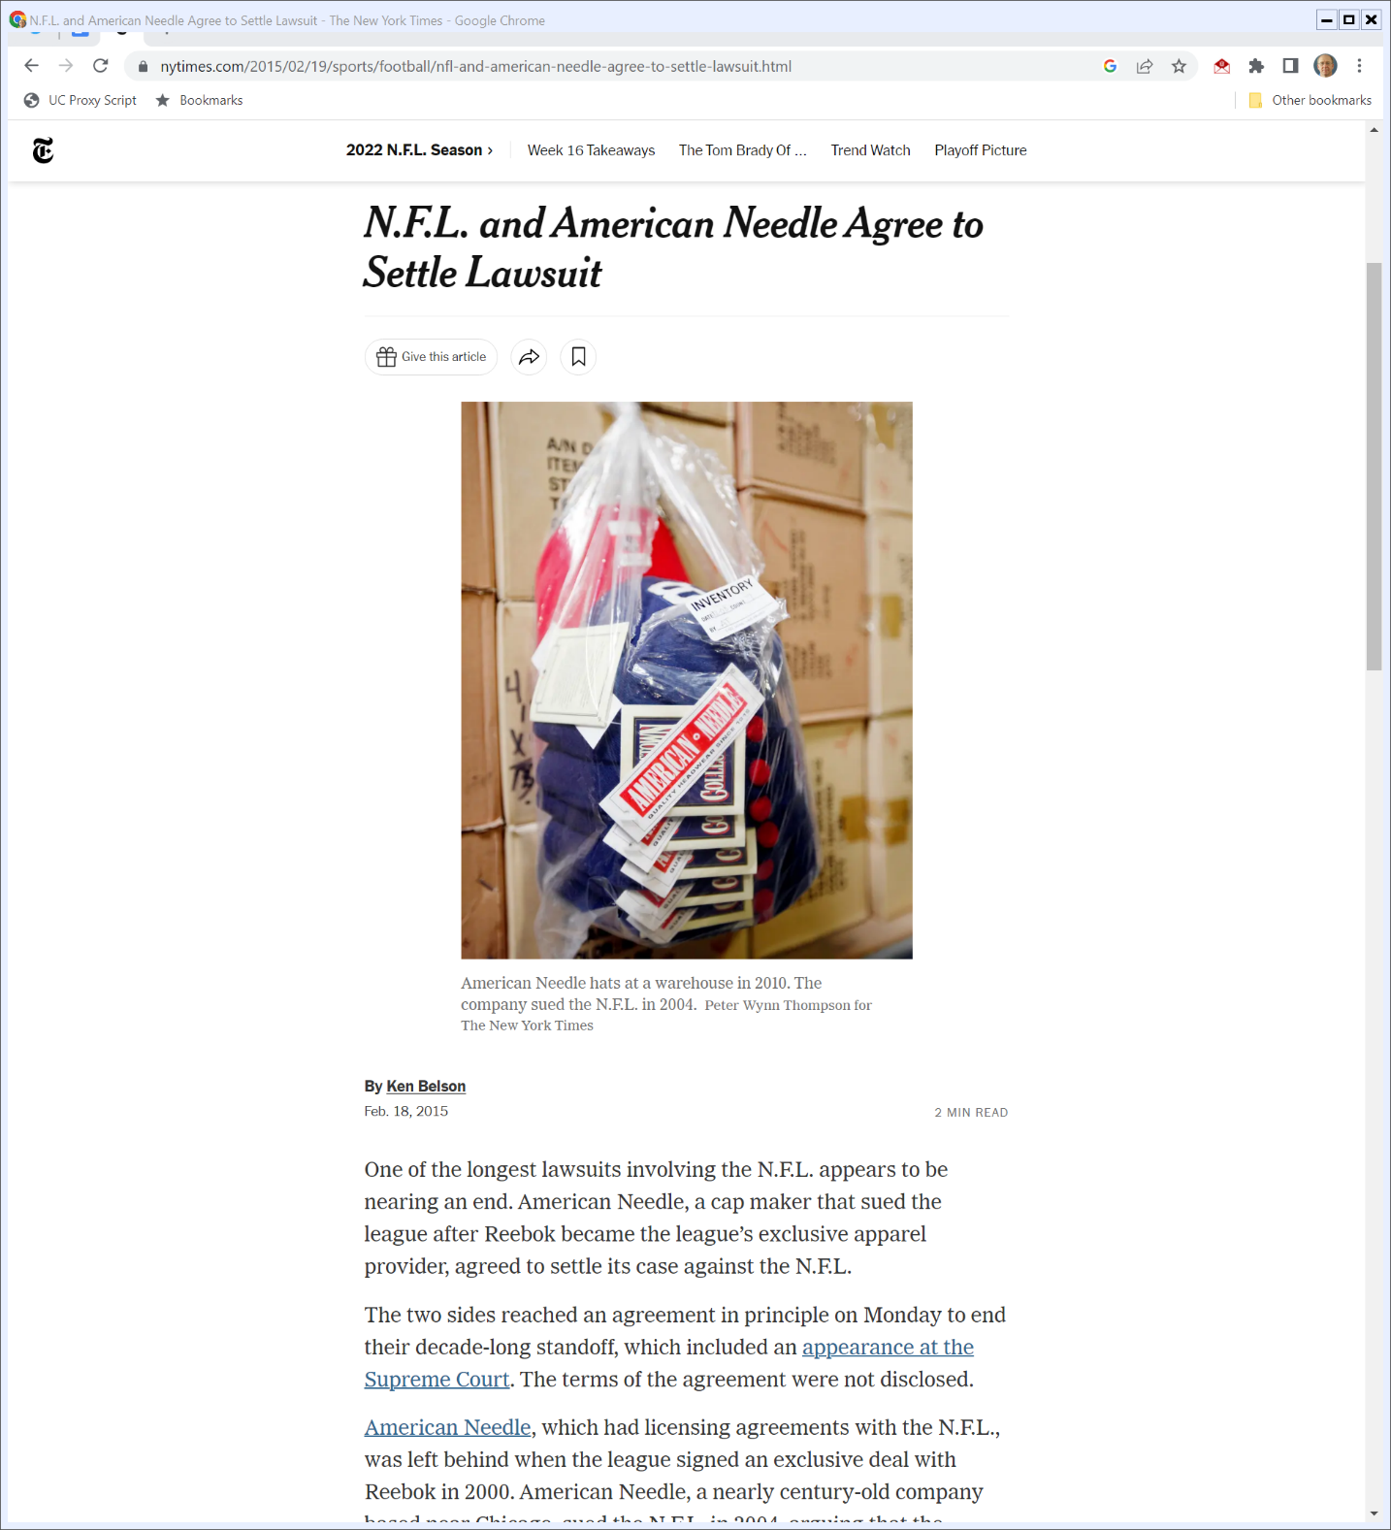

2015: American Needle Settlement
New York Times (18 Feb 2015)
Notes:
https://www.nytimes.com/2015/02/19/sports/football/nfl-and-american-needle-agree-to-settle-lawsuit.html

