Slide 1
Class 21 Platforms and Networks Spring 2022 Regulating Big Tech: Devices and Platforms
Randal C. Picker
James Parker Hall Distinguished Service Professor of Law
The Law School
The University of Chicago
Copyright © 2022 Randal C. Picker. All Rights Reserved.

Slide 2
What Should We Do About Big Tech?
Today’s Questions
What, if anything, should we do about these firms?
What are the right competition policy/regulations to apply to them?
Is that through antitrust or new laws of the sort that we read for today?

Slide 3
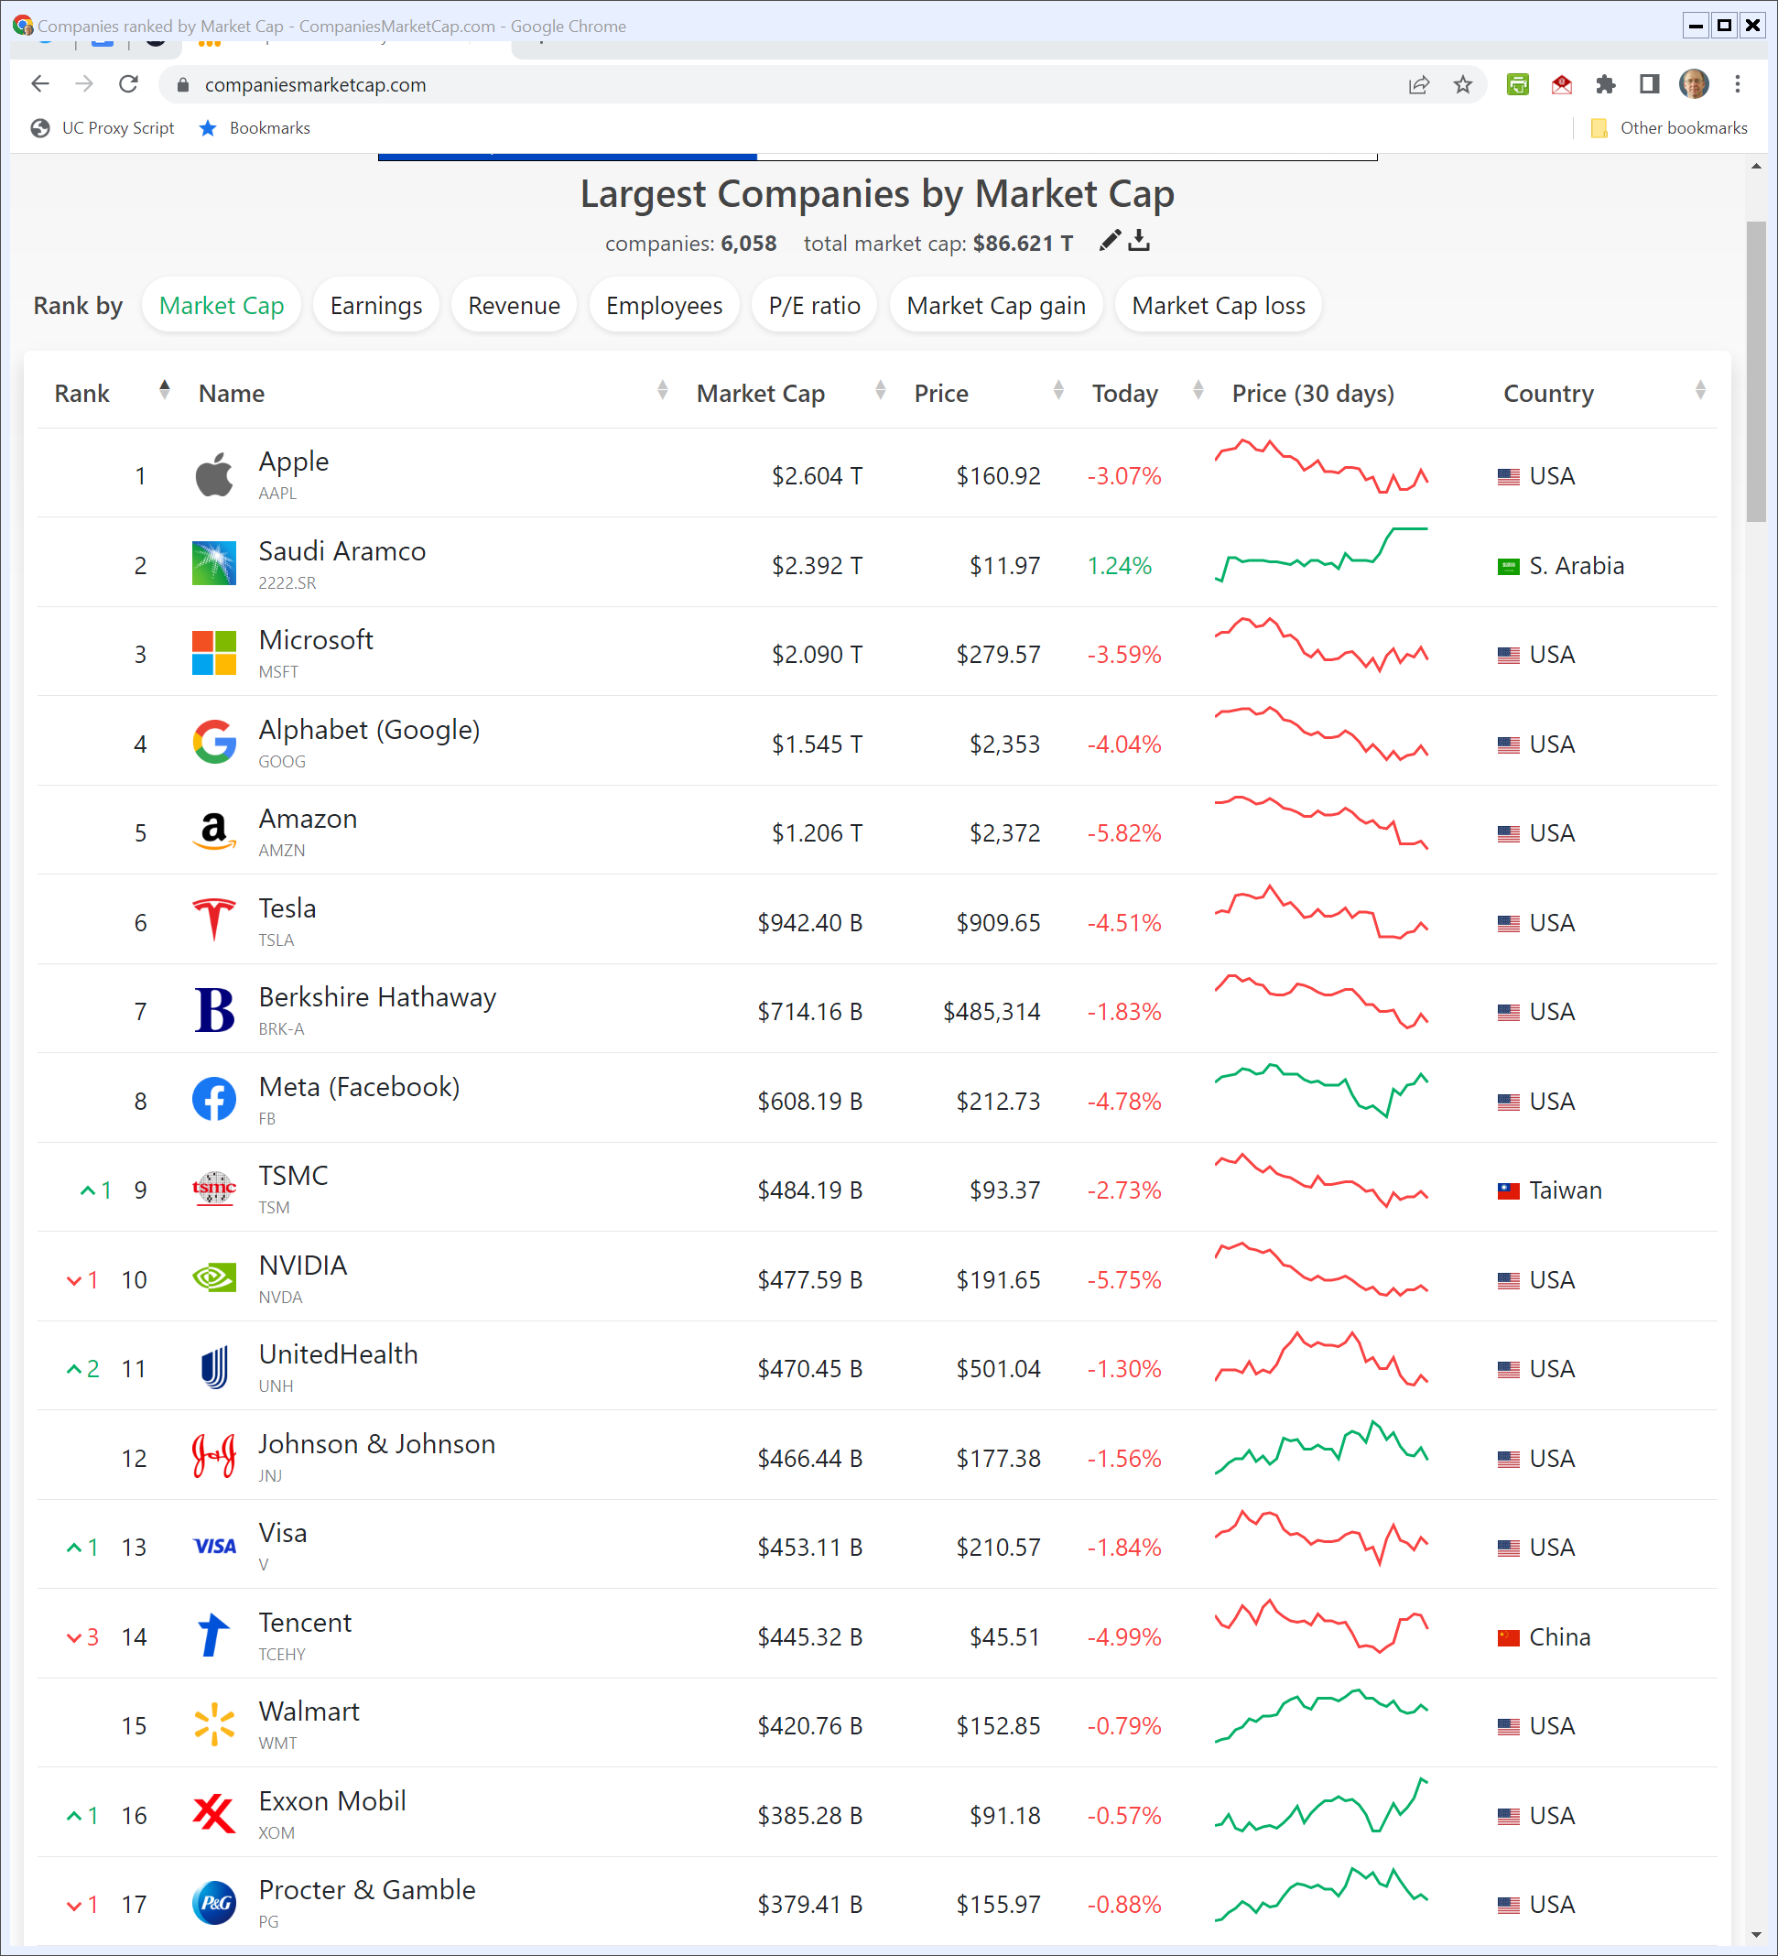
Companies Ranked by Market Cap
Companiesmarketcap.com (5 May 2022)
Notes:
https://companiesmarketcap.com/

Slide 4
Mobile OS Competition
TTYN (1 of 4)
Hypo
Consider three approaches to smartphones:
Apple: Vertically-integrated stack: our hardware, our OS
Microsoft: We license software to handset makers, just like we licensed MS-DOS/Windows to PC makers

Slide 5
Mobile OS Competition
TTYN (2 of 4)
Google: We give away (for free) Android, our smartphone OS, (and really we mean the open source Android plus key proprietary software such as Google Play) to handset makers but we insist that you also bring with it the Google Search app and Chrome
We will make money through advertising and via the fees we charge in the Google Play app store

Slide 6
Mobile OS Competition
TTYN (3 of 4)
Questions
What are the differences in the three business models?
How should we think about competition issues here, both at the beginning and then as the market evolves?

Slide 7
Mobile OS Competition
TTYN (4 of 4)
Questions
What does all of this mean for how funds should flow within the Android ecosystem?
And how does that impact the EC’s tying claims?

Slide 8
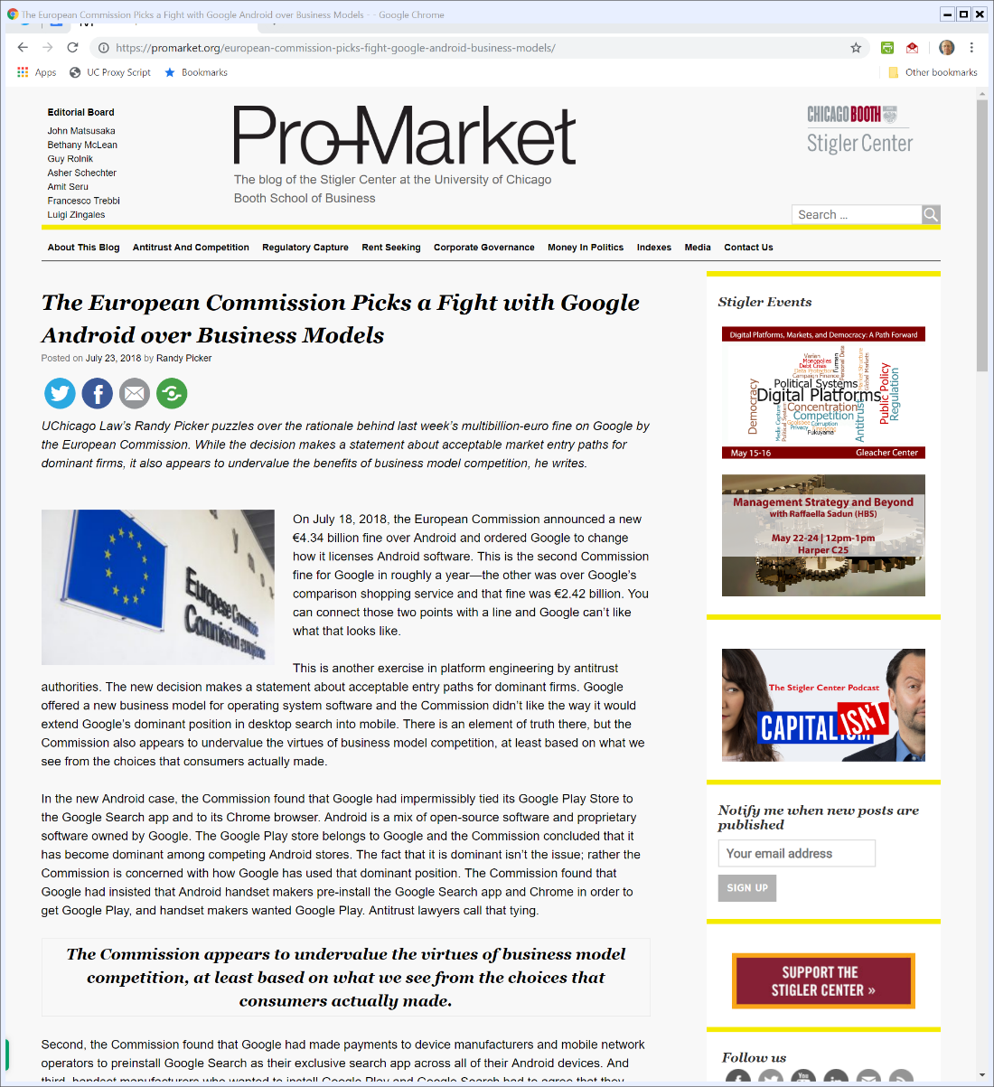
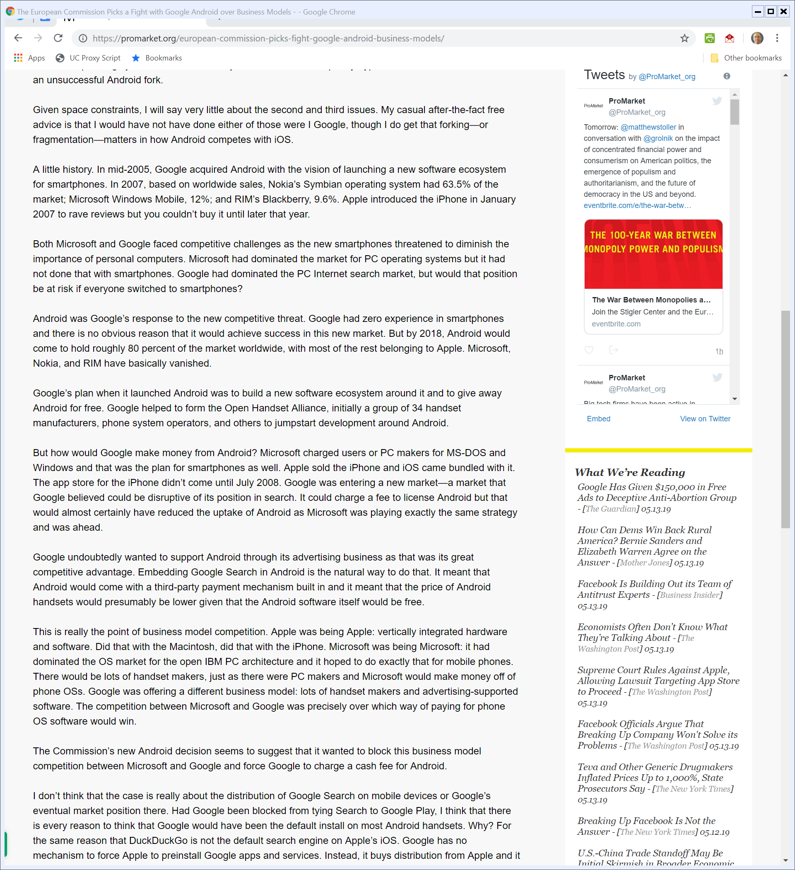
Smartphone OS Competition
Picker, ProMarket blog (23 July 2018)

Slide 9

Smartphone OS Competition
Picker, ProMarket blog (23 July 2018)

Slide 10
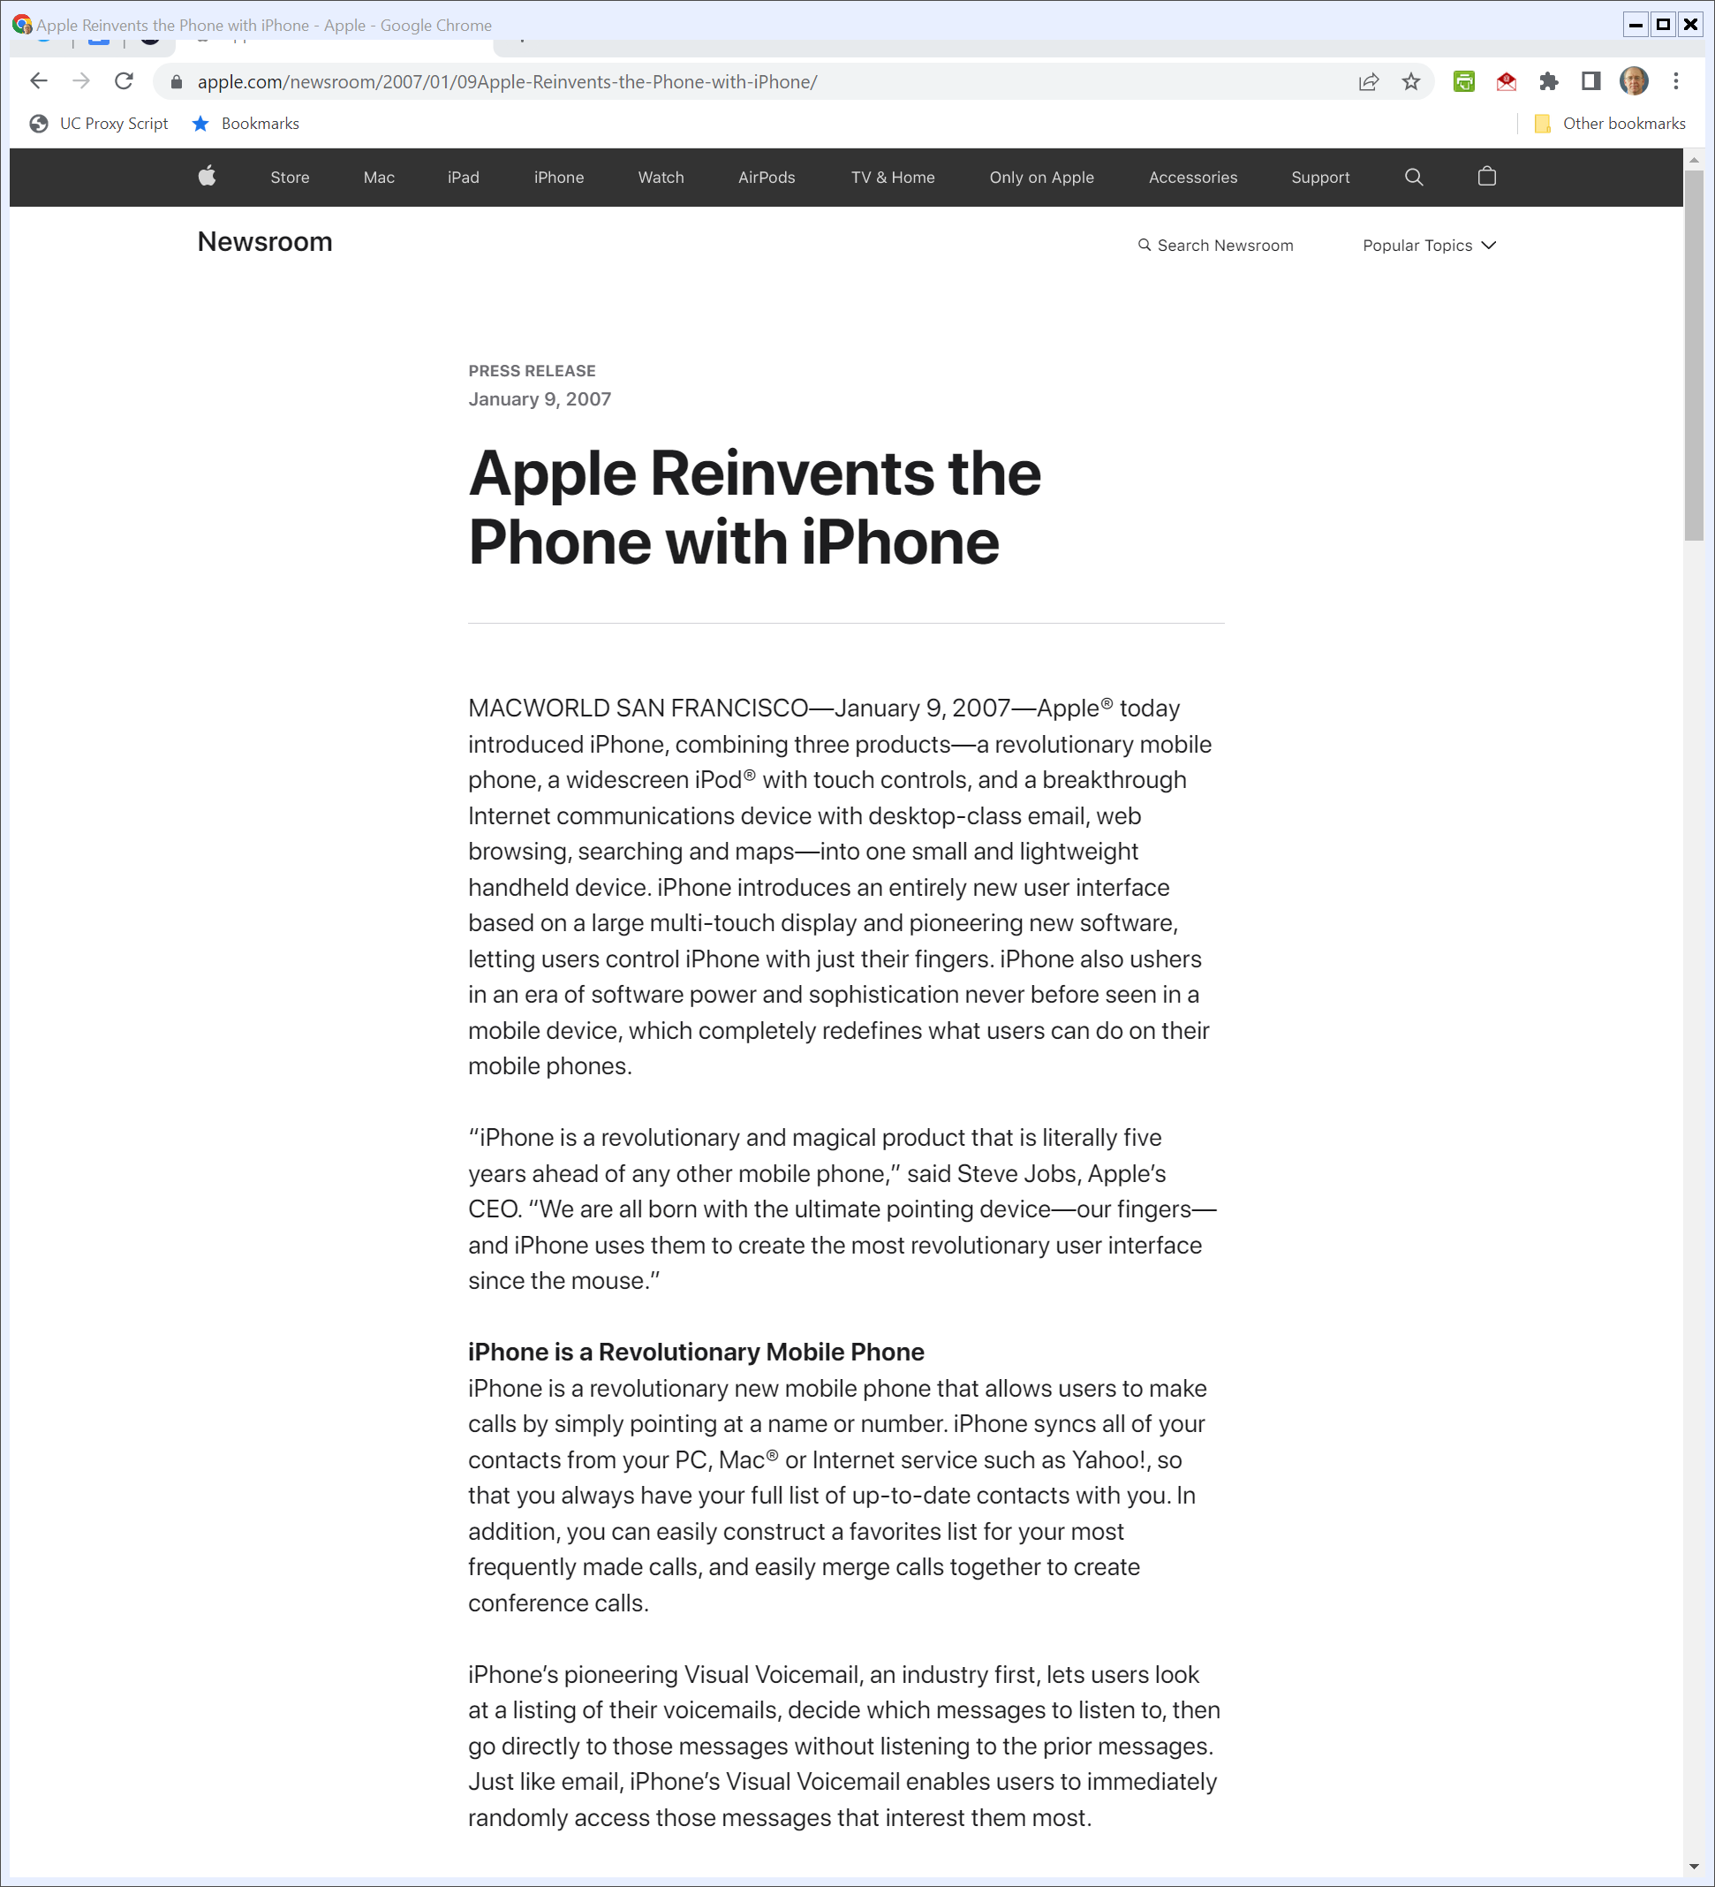
2007 SF Macworld iPhone Launch
“Apple® today introduced iPhone, combining three products—a revolutionary mobile phone, a widescreen iPod® with touch controls, and a breakthrough Internet communications device with desktop-class email, web browsing, searching and maps—into one small and lightweight handheld device.”
Apple (9 Jan 2007)
Notes:
https://www.apple.com/newsroom/2007/01/09Apple-Reinvents-the-Phone-with-iPhone/

Slide 11
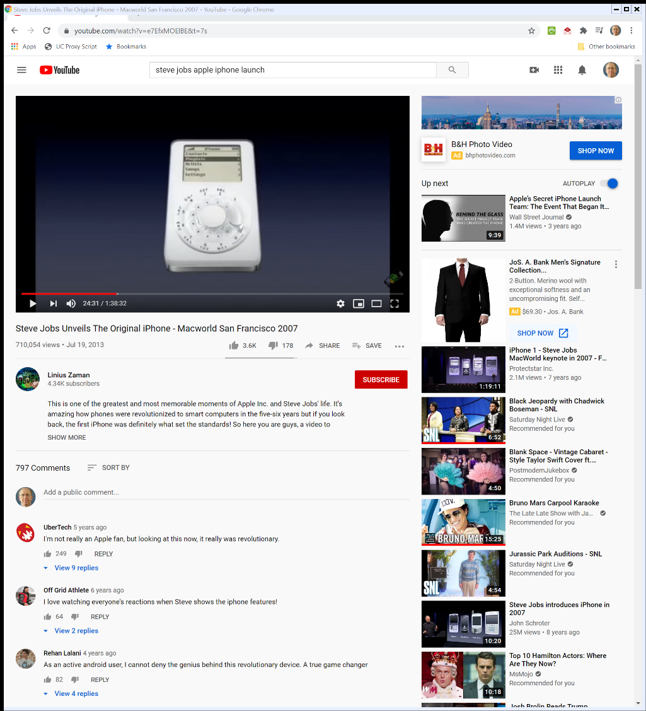

2007 SF Macworld iPhone Launch
Apple (9 Jan 2007)

Slide 12
iPhone Launch
“iPhone introduces an entirely new user interface based on a large multi-touch display and pioneering new software, letting users control iPhone with just their fingers.”
Apple (9 Jan 2007)

Slide 13
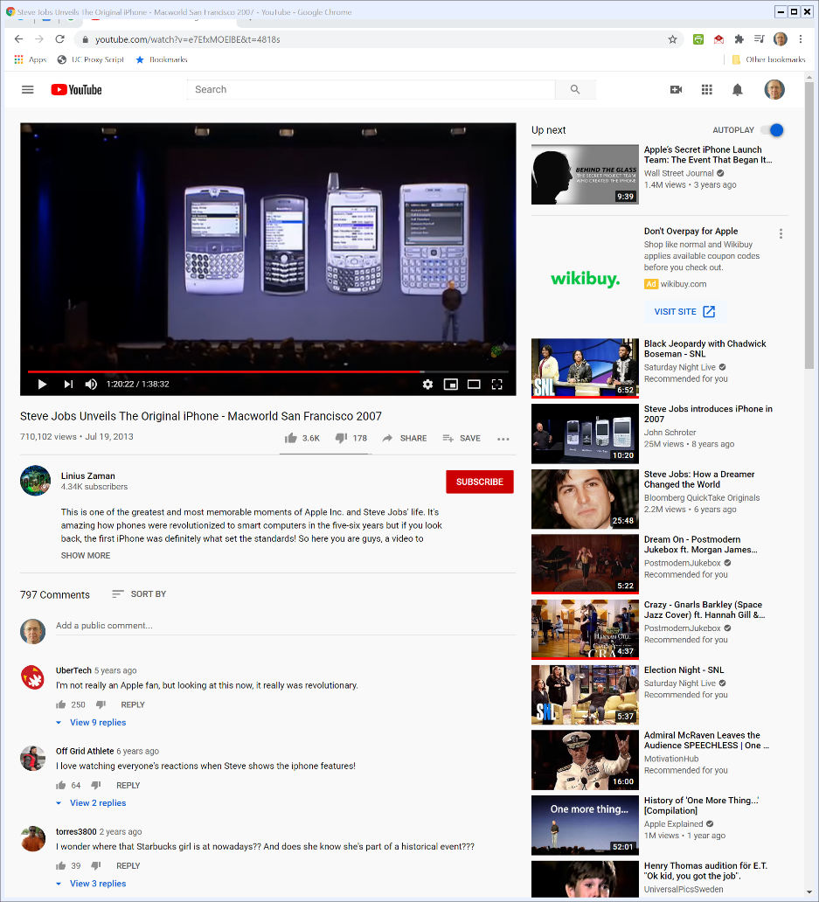

The Future and the Past
2007 SF Macworld
Notes:
https://www.youtube.com/watch?v=e7EfxMOElBE&t=4818s

Slide 14
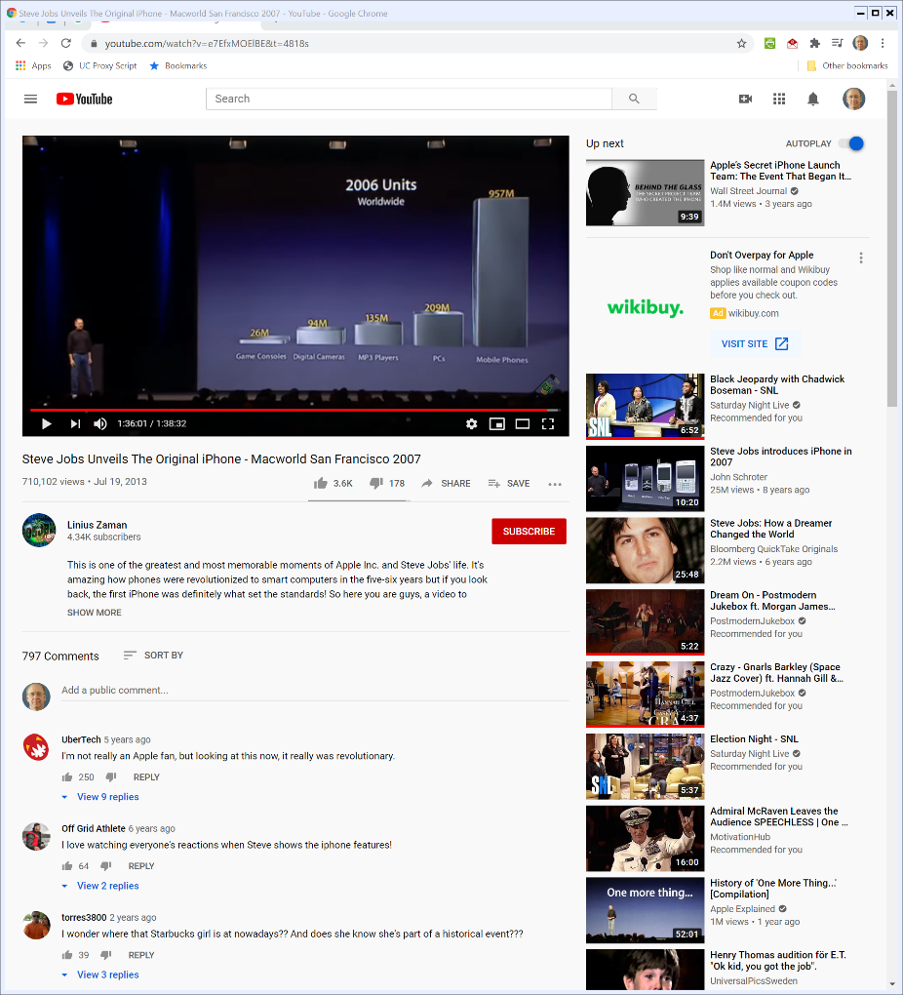

The Size of the Opportunity
2007 SF Macworld
Notes:
https://www.youtube.com/watch?v=e7EfxMOElBE&t=4818s

Slide 15
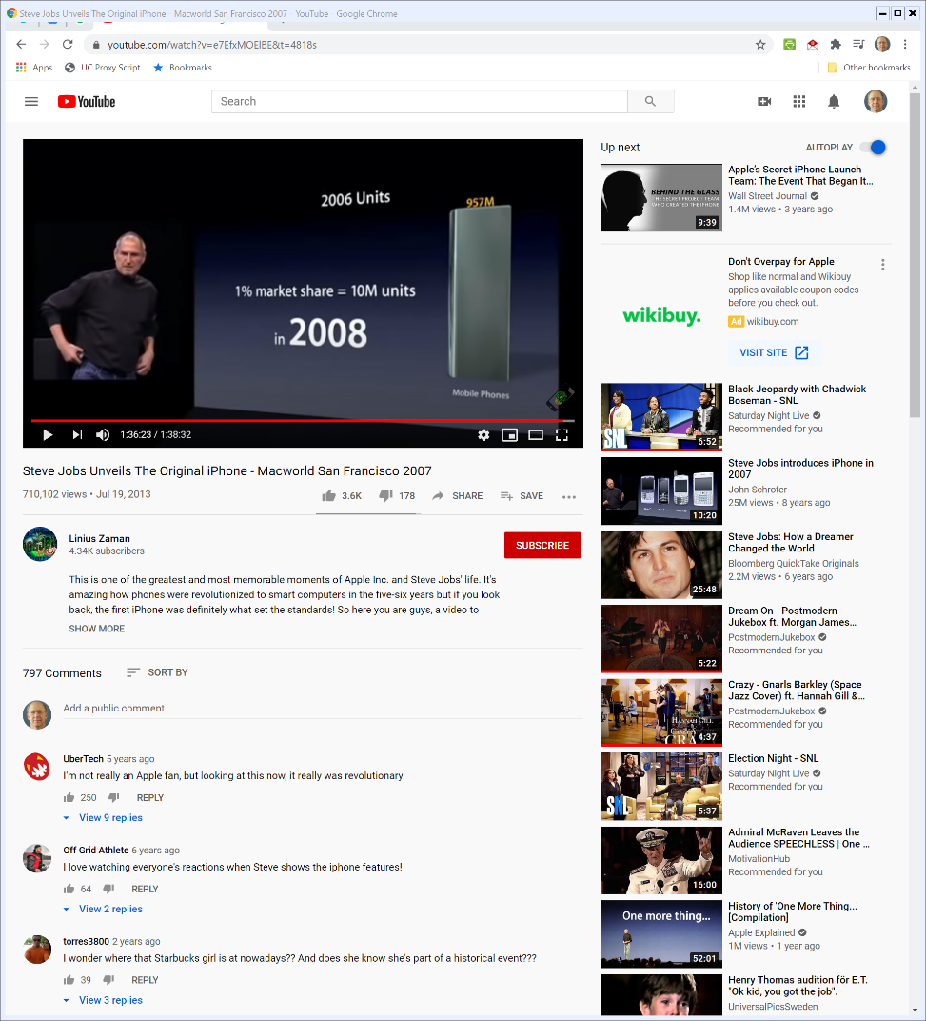

Apple’s Goal in 2008? 1%
2007 SF Macworld
Notes:
https://www.youtube.com/watch?v=e7EfxMOElBE&t=4818s

Slide 16
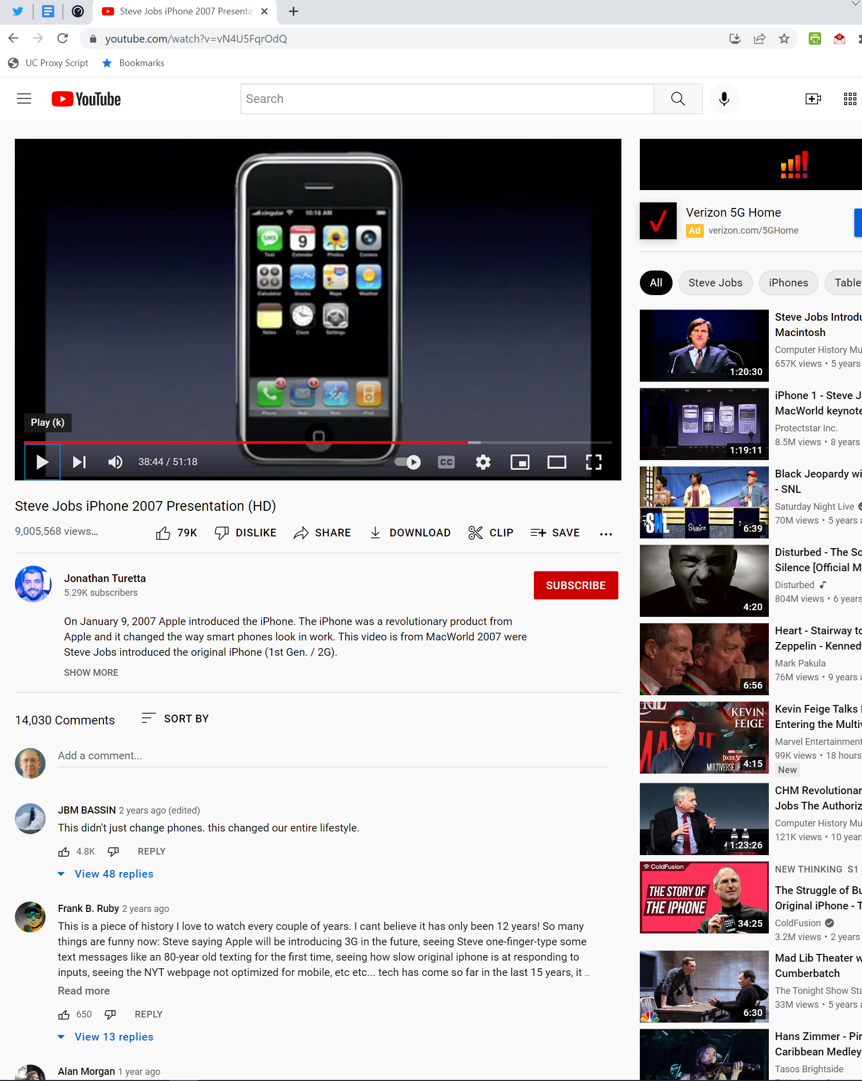
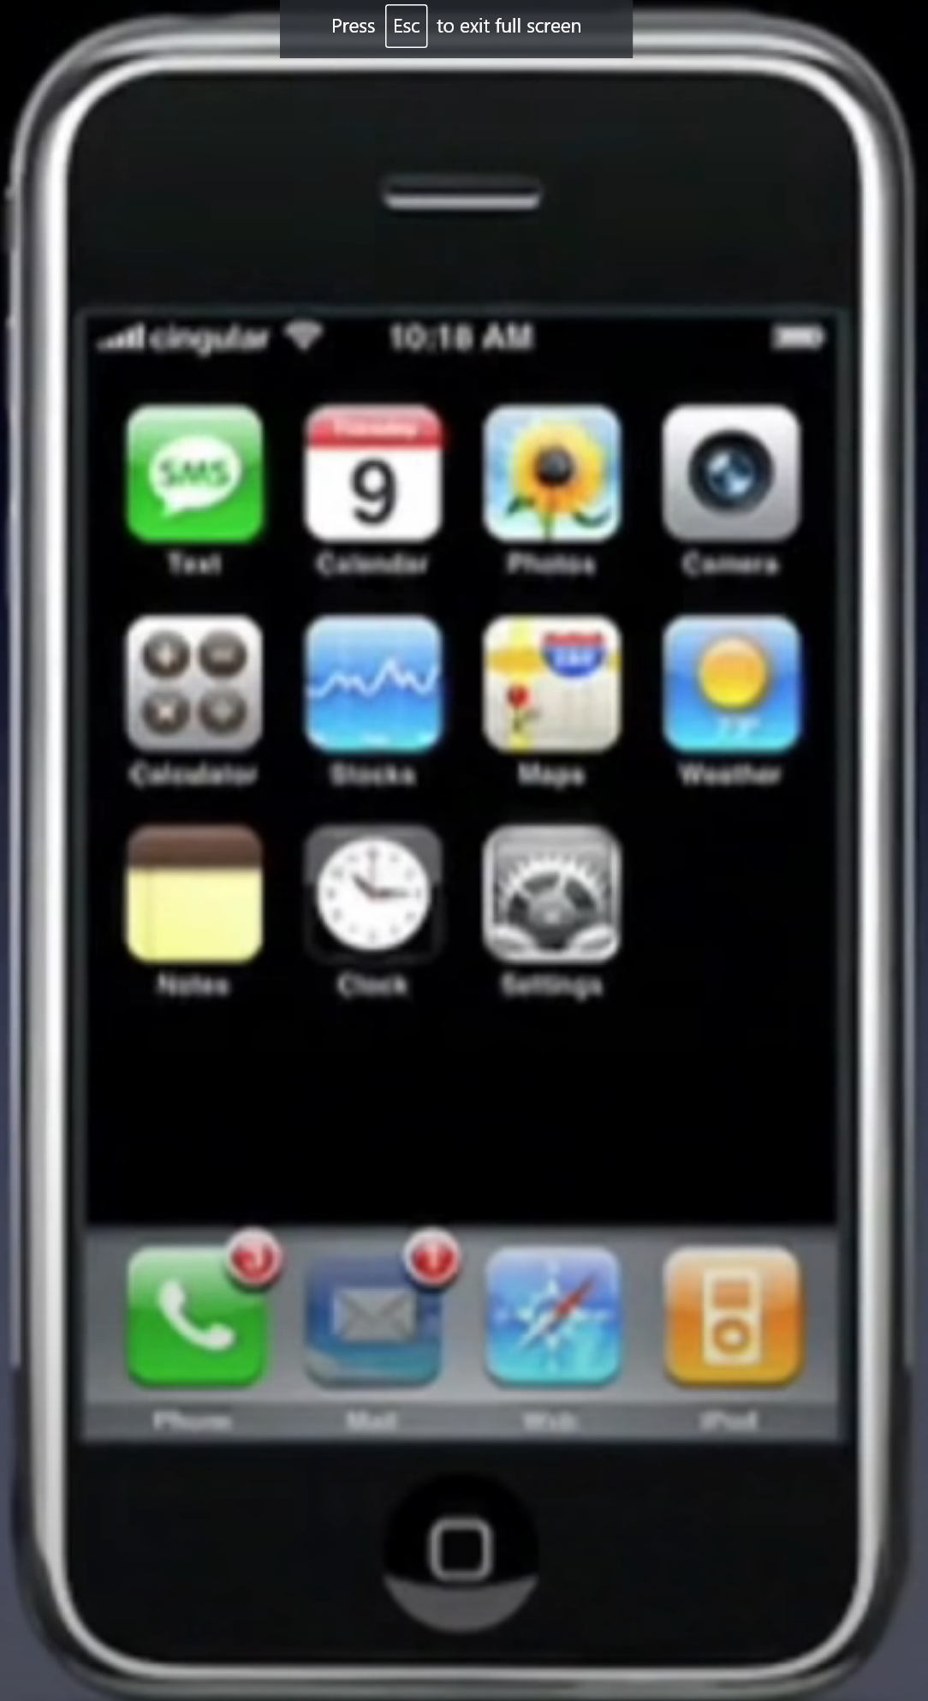
The App Usage and Distribution Model in 2007
1. Apple chooses the apps
2. You use the web (with Google Search and Yahoo Search built-in)
2007 SF Macworld
Notes:
At 38:44 of https://www.youtube.com/watch?v=vN4U5FqrOdQ

Slide 17
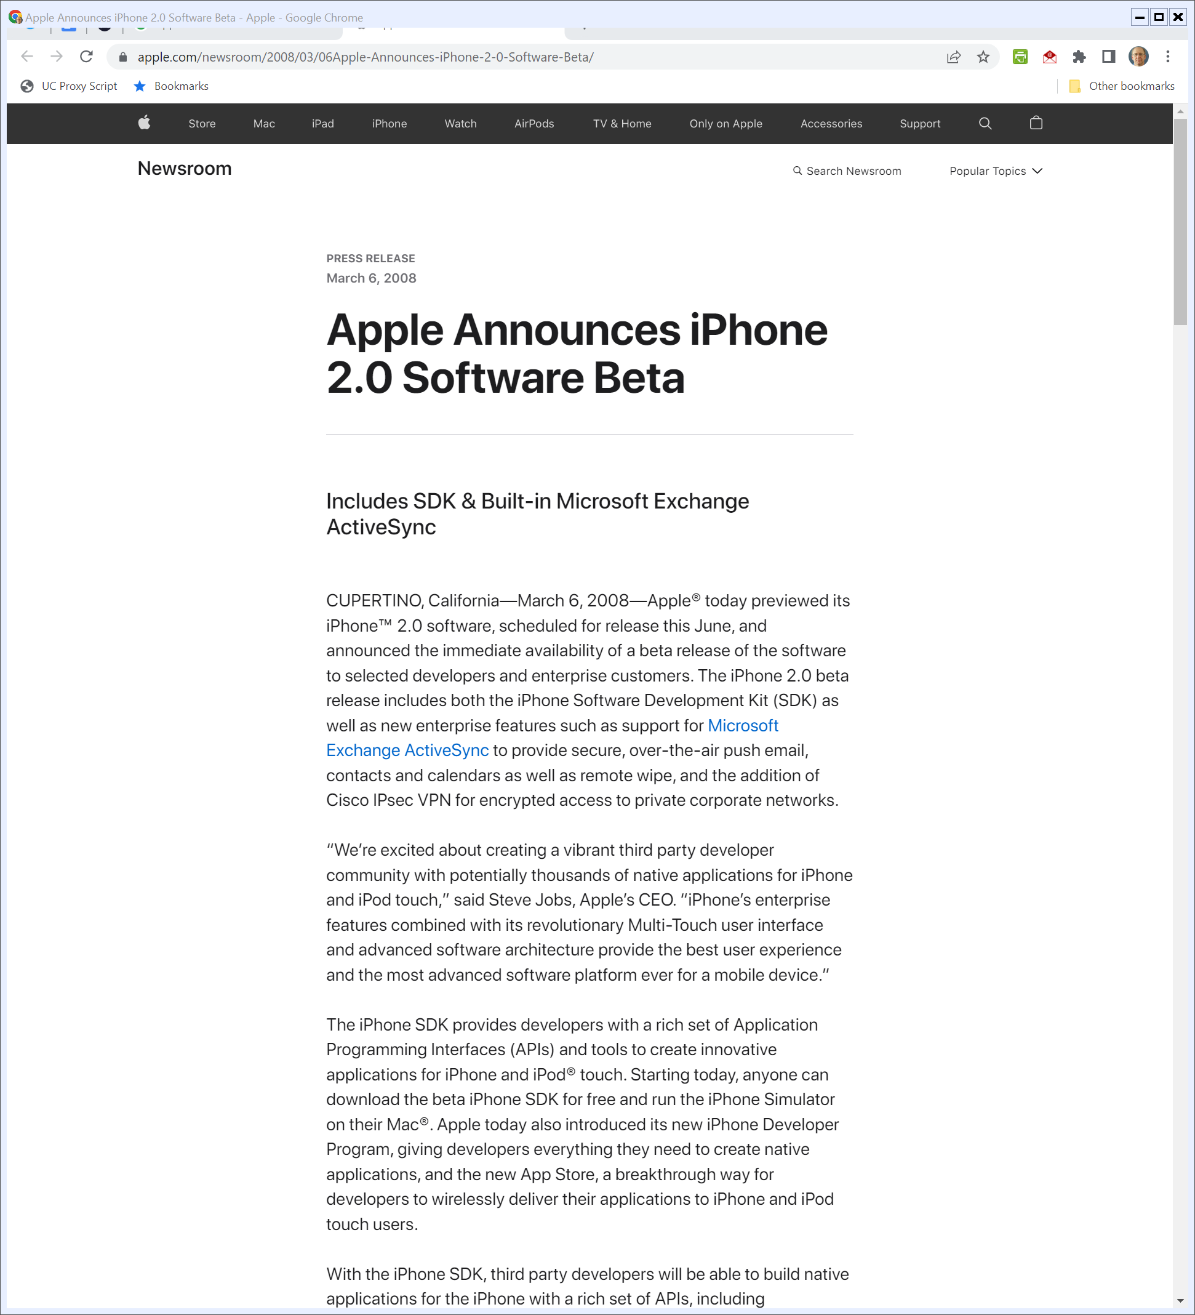
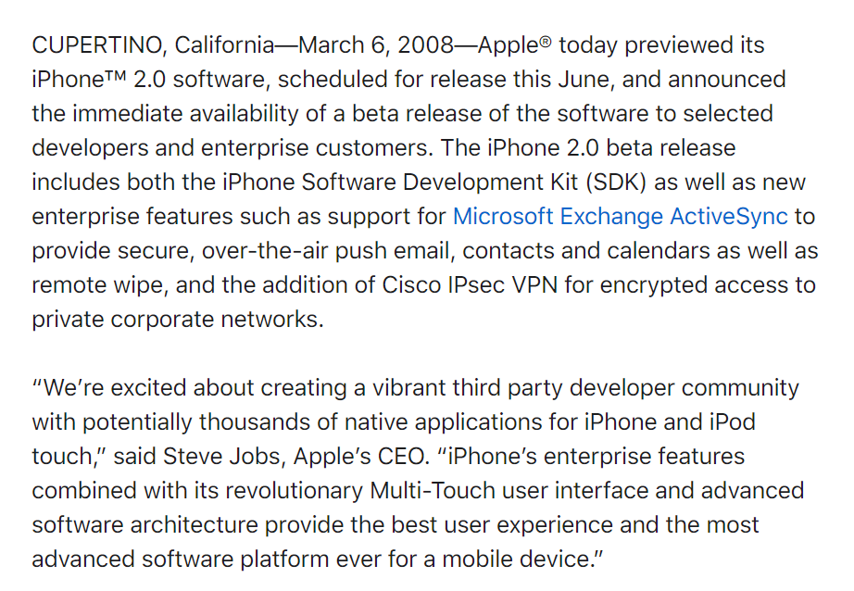
6 Mar 2008: iPhone 2.0 Software Beta and SDK
Apple.com (6 Mar 2008)
Notes:
https://www.apple.com/newsroom/2008/03/06Apple-Announces-iPhone-2-0-Software-Beta/

Slide 18
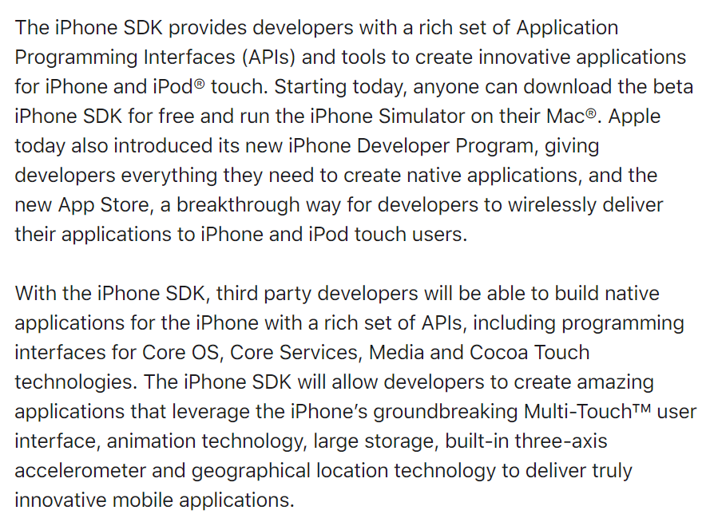
6 Mar 2008: iPhone 2.0 Software Beta and SDK
Apple.com (6 Mar 2008)
Notes:
https://www.apple.com/newsroom/2008/03/06Apple-Announces-iPhone-2-0-Software-Beta/

Slide 19
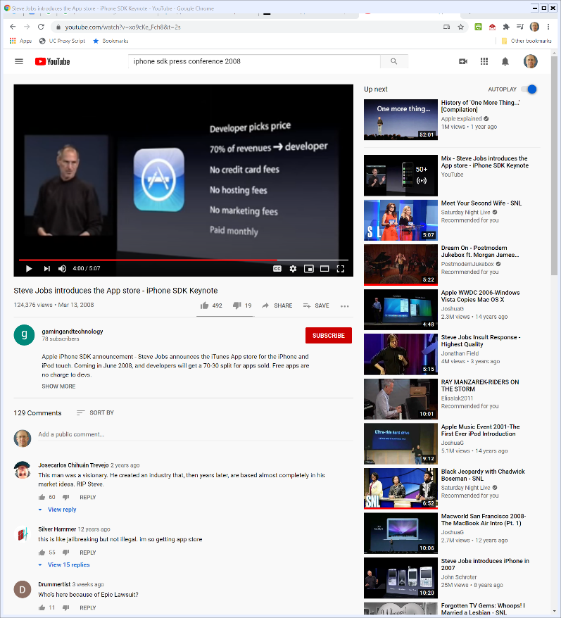

6 Mar 2008: App Store Introduction
“[B]est deal going to distribute applications”
Steve Jobs (6 Mar 2008)
Notes:
https://www.youtube.com/watch?v=xo9cKe_Fch8&t=2s

Slide 20


A Curated App Store
Steve Jobs (6 Mar 2008)
Notes:
https://www.youtube.com/watch?v=xo9cKe_Fch8&t=2s

Slide 21
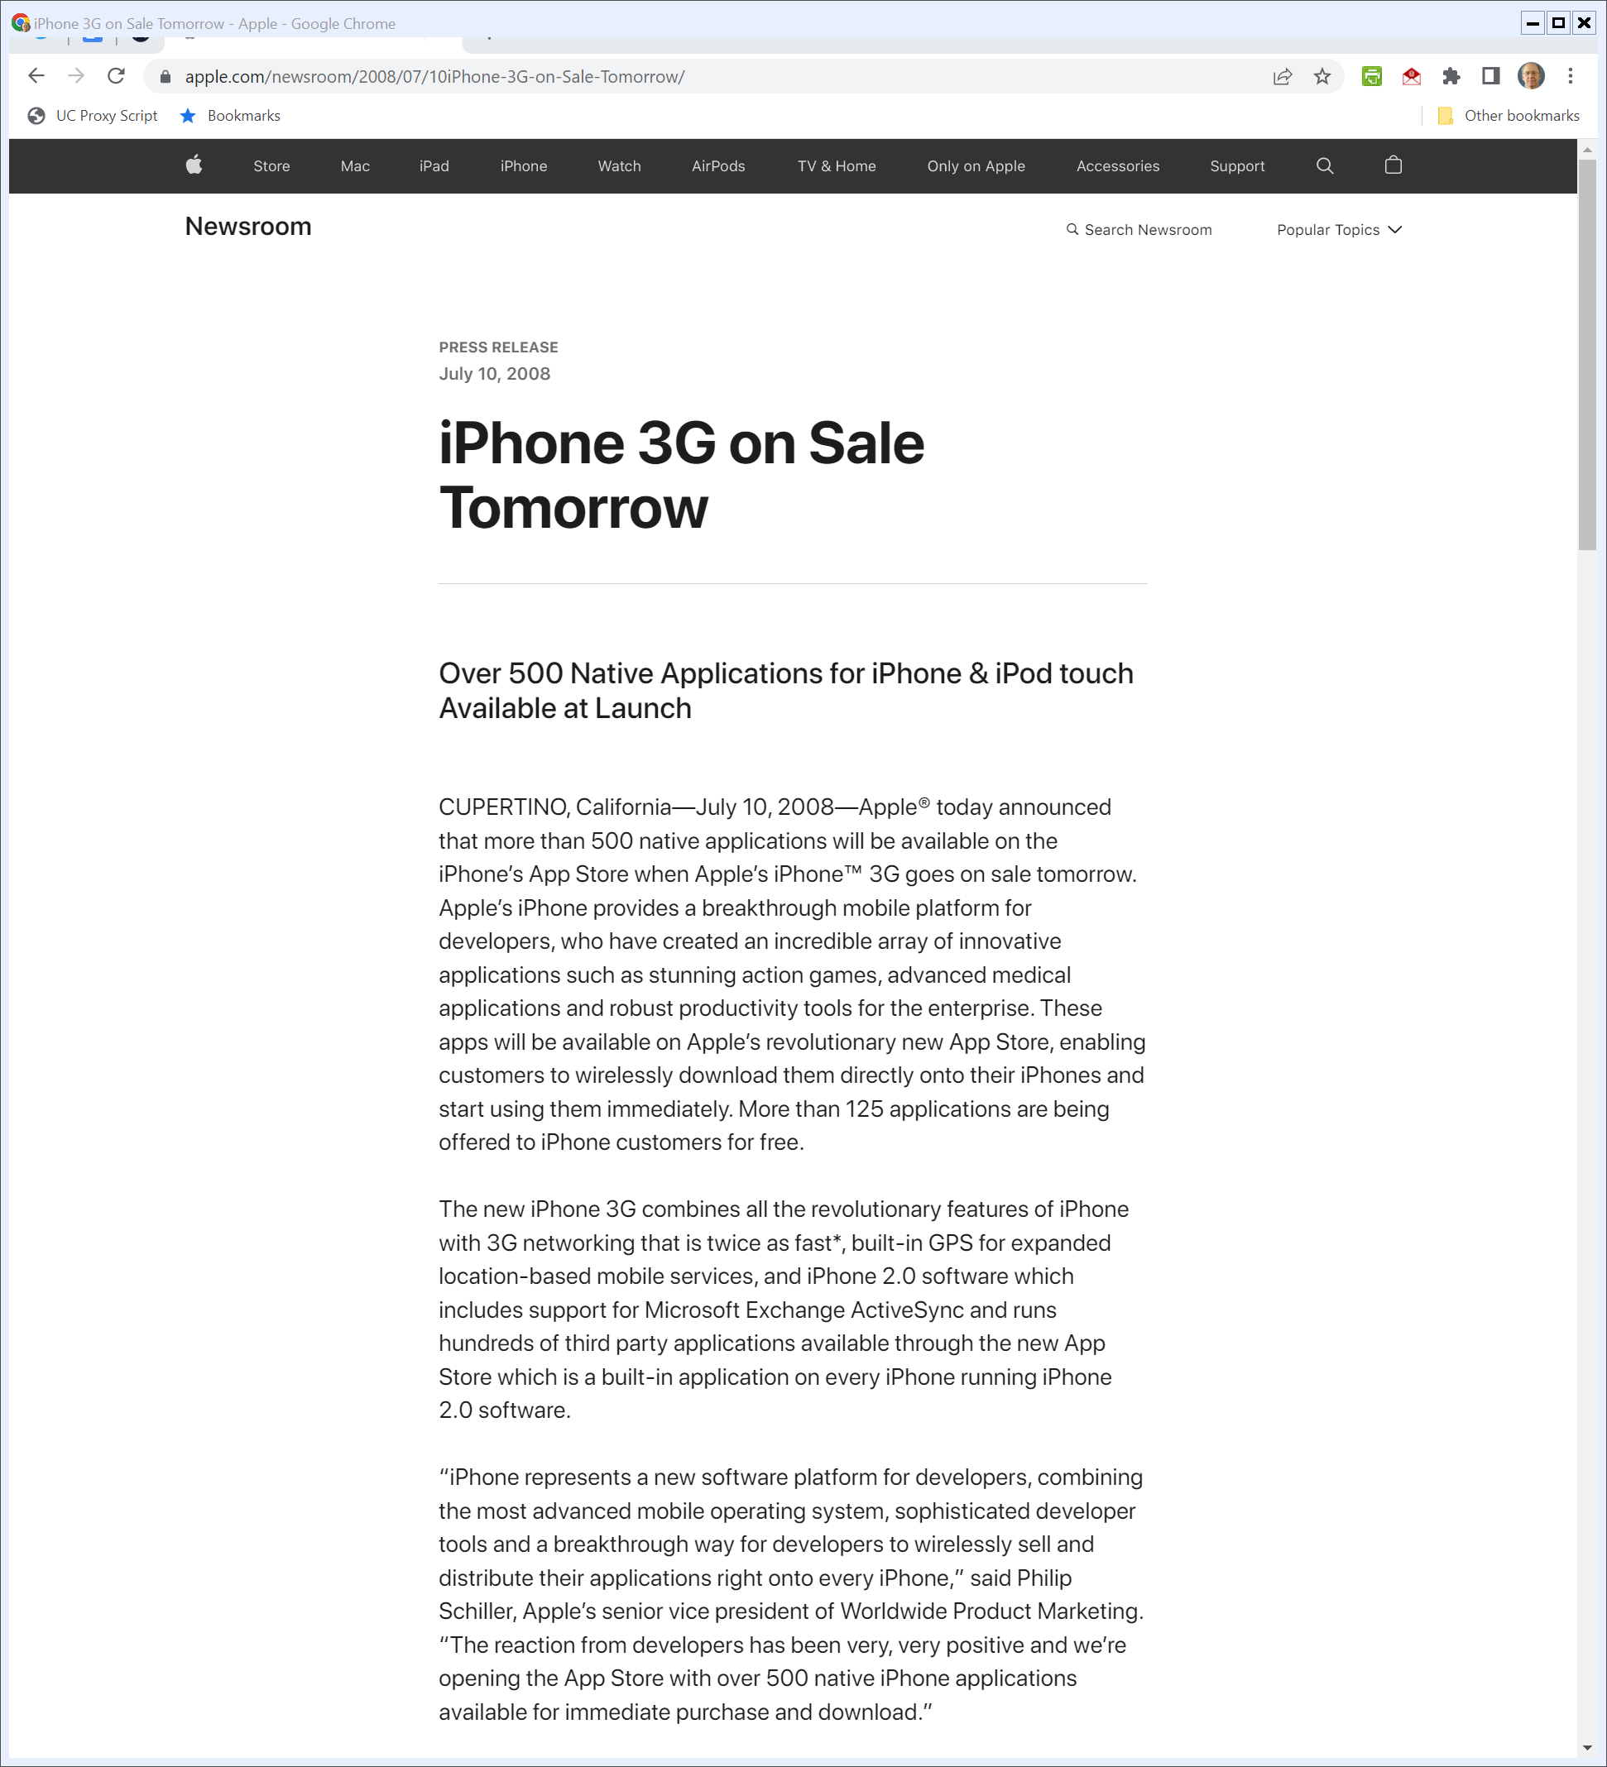
App Store Launch
“Apple® today announced that more than 500 native applications will be available on the iPhone’s App Store when Apple’s iPhone™ 3G goes on sale tomorrow. … .”
Apple (10 July 2008)
Notes:
https://www.apple.com/newsroom/2008/07/10iPhone-3G-on-Sale-Tomorrow/

Slide 22
App Store Launch (Monopolization?)
“These apps will be available on Apple’s revolutionary new App Store, enabling customers to wirelessly download them directly onto their iPhones and start using them immediately.”
Apple (10 July 2008)
Notes:
https://www.apple.com/newsroom/2008/07/10iPhone-3G-on-Sale-Tomorrow/

Slide 23
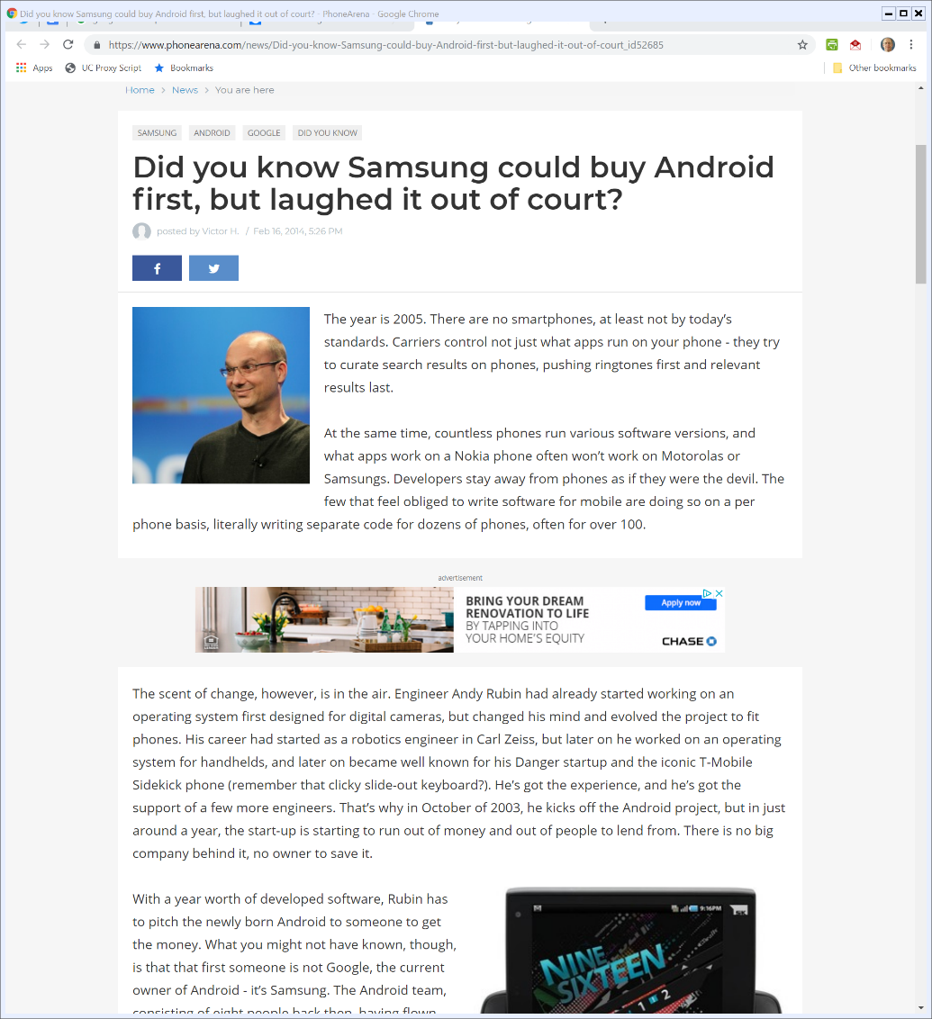
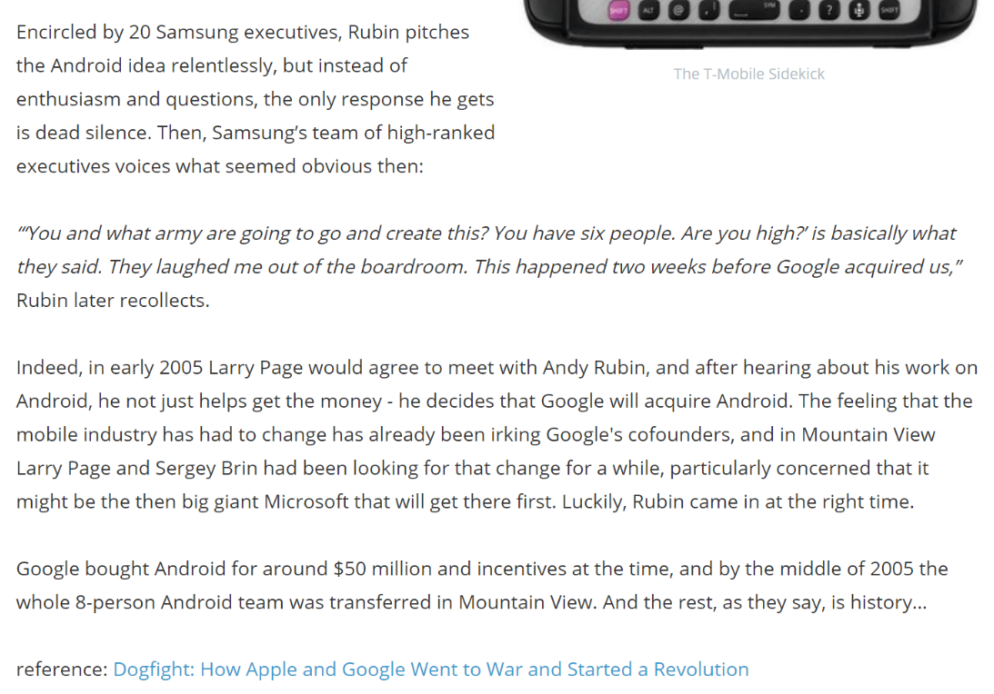
2005: Google Buys Android for $50MM (and Samsung Doesn’t)
Phonearena.com (16 Feb 2014)
Notes:
https://www.phonearena.com/news/Did-you-know-Samsung-could-buy-Android-first-but-laughed-it-out-of-court_id52685

Slide 24
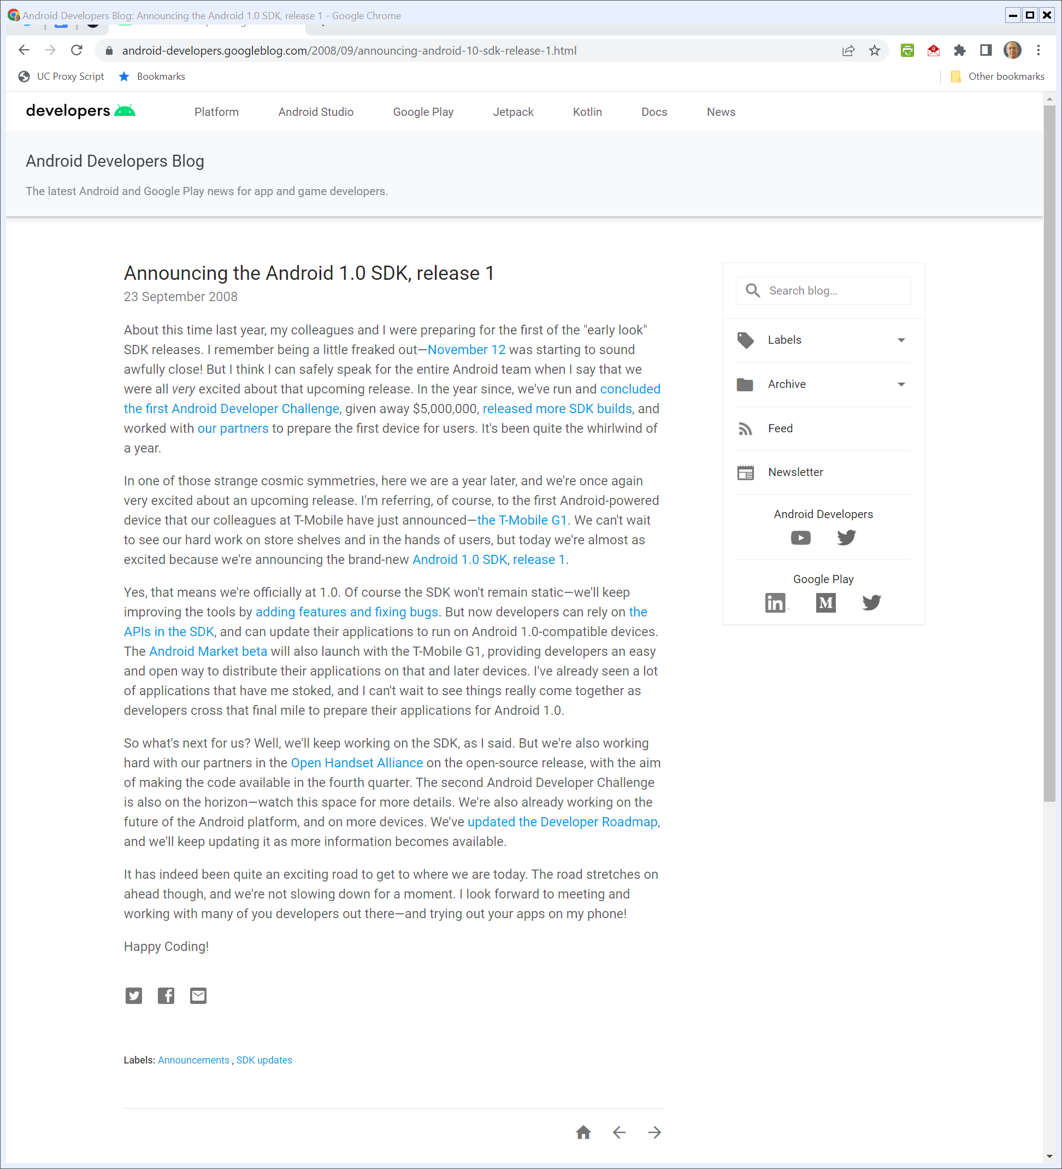
Android Launch
“In one of those strange cosmic symmetries, here we are a year later, and we’re once again very excited about an upcoming release. I’m referring, of course, to the first Android-powered device that our colleagues at T-Mobile have just announced—the T-Mobile G1.”
Android Developers Blog (23 Sept 2008)
Notes:
Aug 16, 2005: Google buys Android: http://www.bloomberg.com/bw/stories/2005-08-16/google-buys-android-for-its-mobile-arsenal
https://android-developers.googleblog.com/2008/09/announcing-android-10-sdk-release-1.html

Slide 25
Android Launch
“We can’t wait to see our hard work on store shelves and in the hands of users, but today we’re almost as excited because we’re announcing the brand-new Android 1.0 SDK, release 1.”
Android Developers Blog (23 Sept 2008)
Notes:
Aug 16, 2005: Google buys Android: http://www.bloomberg.com/bw/stories/2005-08-16/google-buys-android-for-its-mobile-arsenal

Slide 26
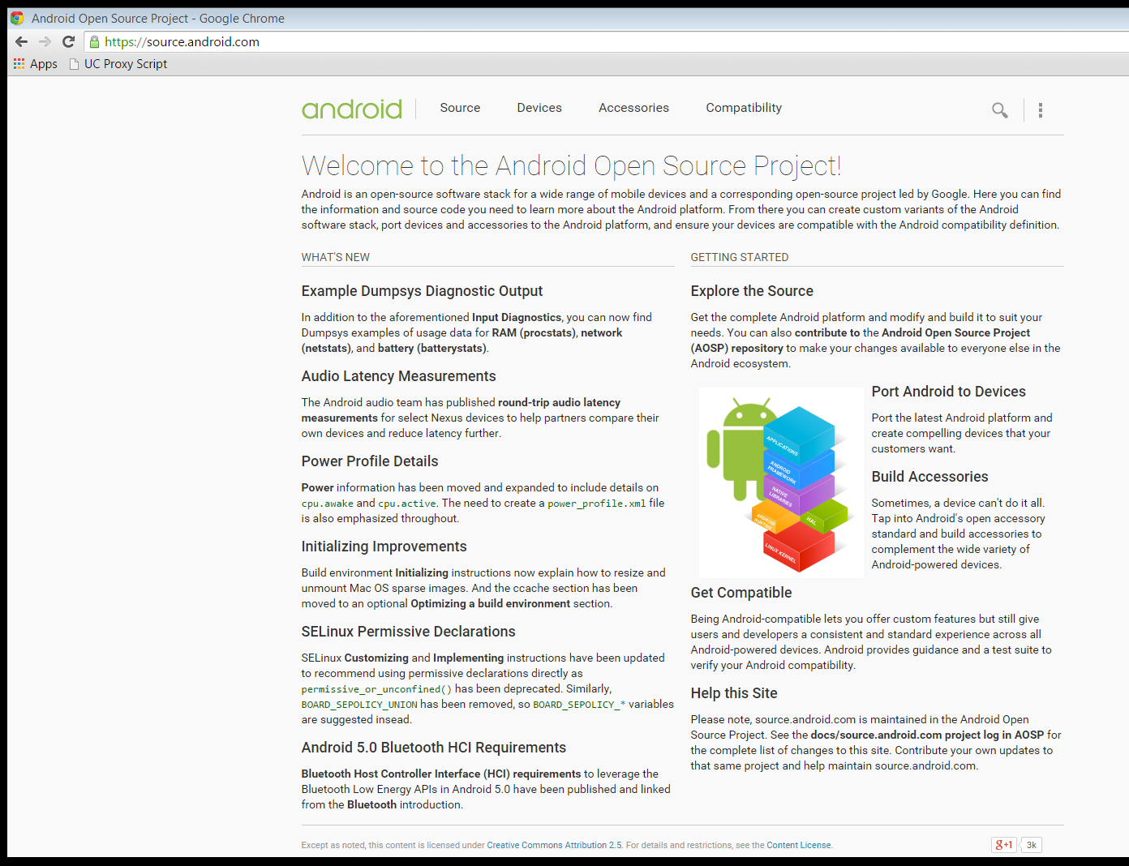
Open Source Led By Google
“Android is an open-source software stack for a wide range of mobile devices and a corresponding open-source project led by Google. Here you can find the information and source code you need to learn more about the Android platform.”
Android.com

Slide 27
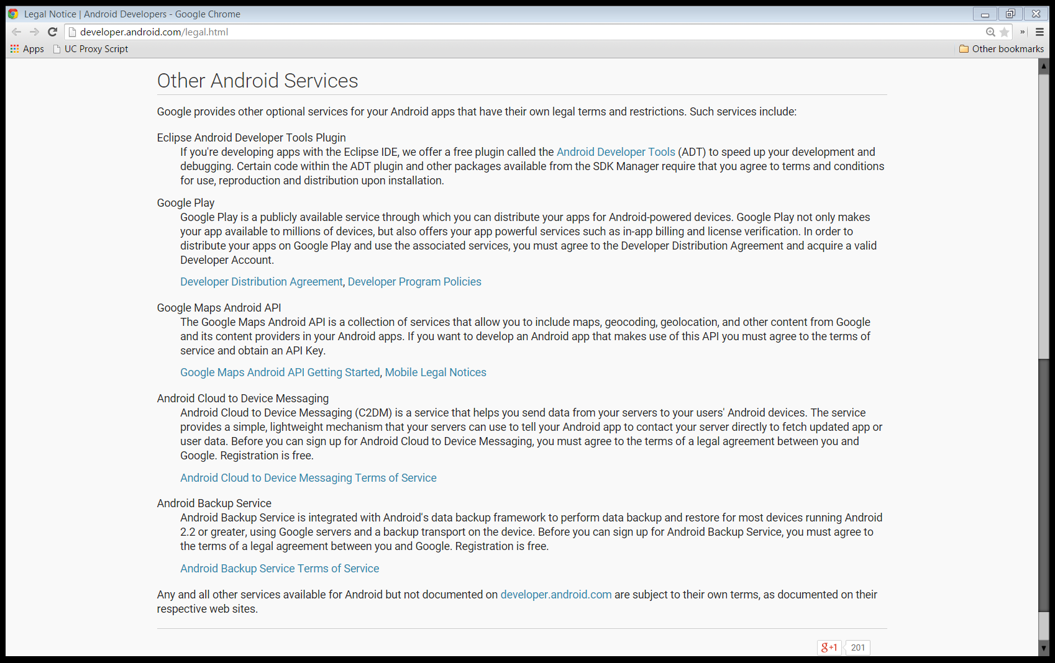
Piecemeal Platform and Contracts
Google Play: “Google Play is a publicly available service through which you can distribute your apps for Android-powered devices. Google Play not only makes your app available to millions of devices, but also offers your app powerful services such as in-app billing and license verification.”
Android Legal Notice

Slide 28
Piecemeal Platform and Contracts
Google Play: “In order to distribute your apps on Google Play and use the associated services, you must agree to the Developer Distribution Agreement and acquire a valid Developer Account.”
Android Legal Notice

Slide 29
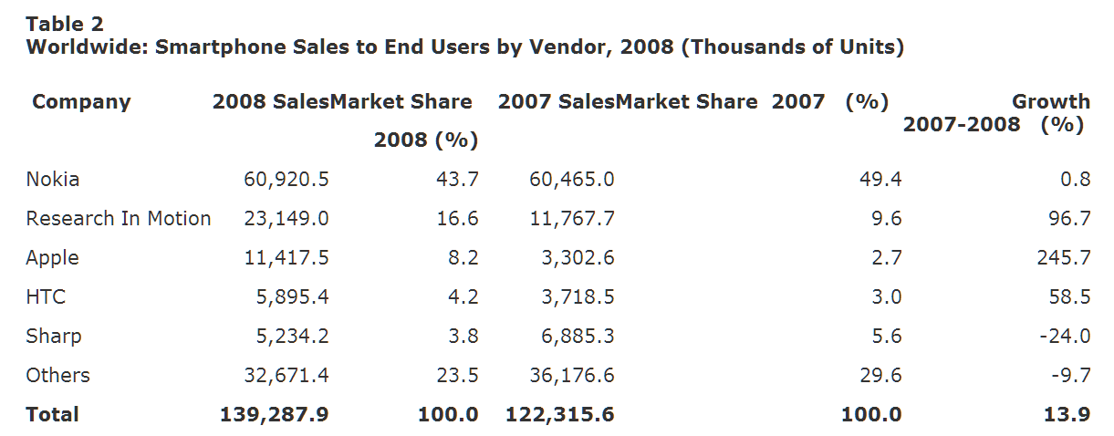
Smartphone Handset Market Shares, 2007 & 2008
Gartner (11 Mar 2009)

Slide 30
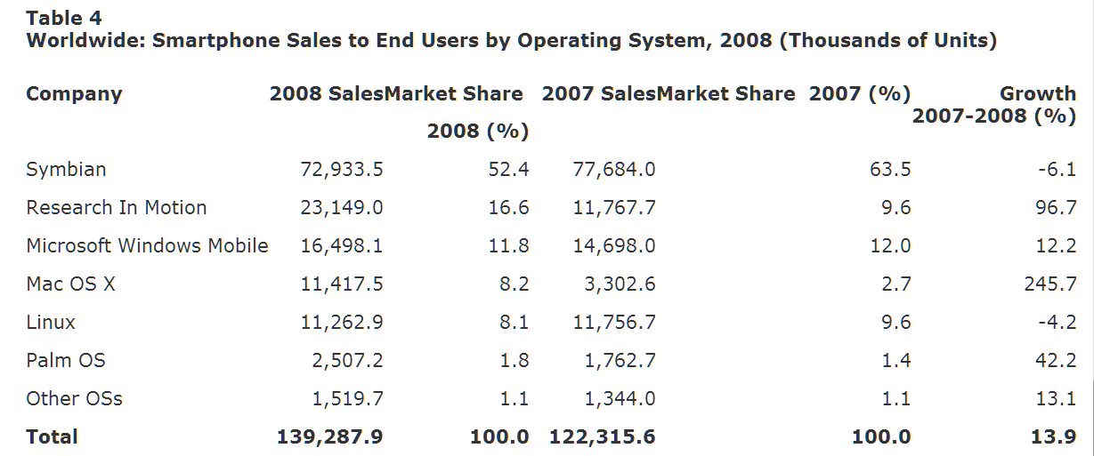
Smartphone OS Market Shares, 2007 & 2008
Gartner (11 Mar 2009)

Slide 31
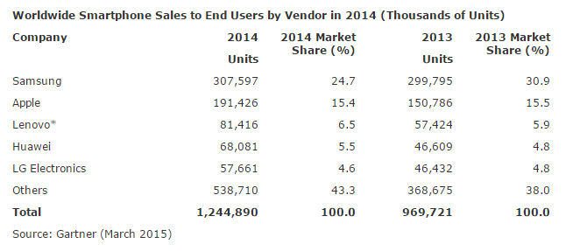
Smartphone Handset Market Shares, 2013 & 2014
Gartner (3 Mar 2015)

Slide 32
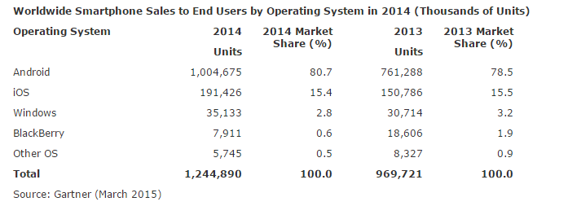
Smartphone OS Market Shares, 2013 & 2014
Gartner (3 Mar 2015)

Slide 33
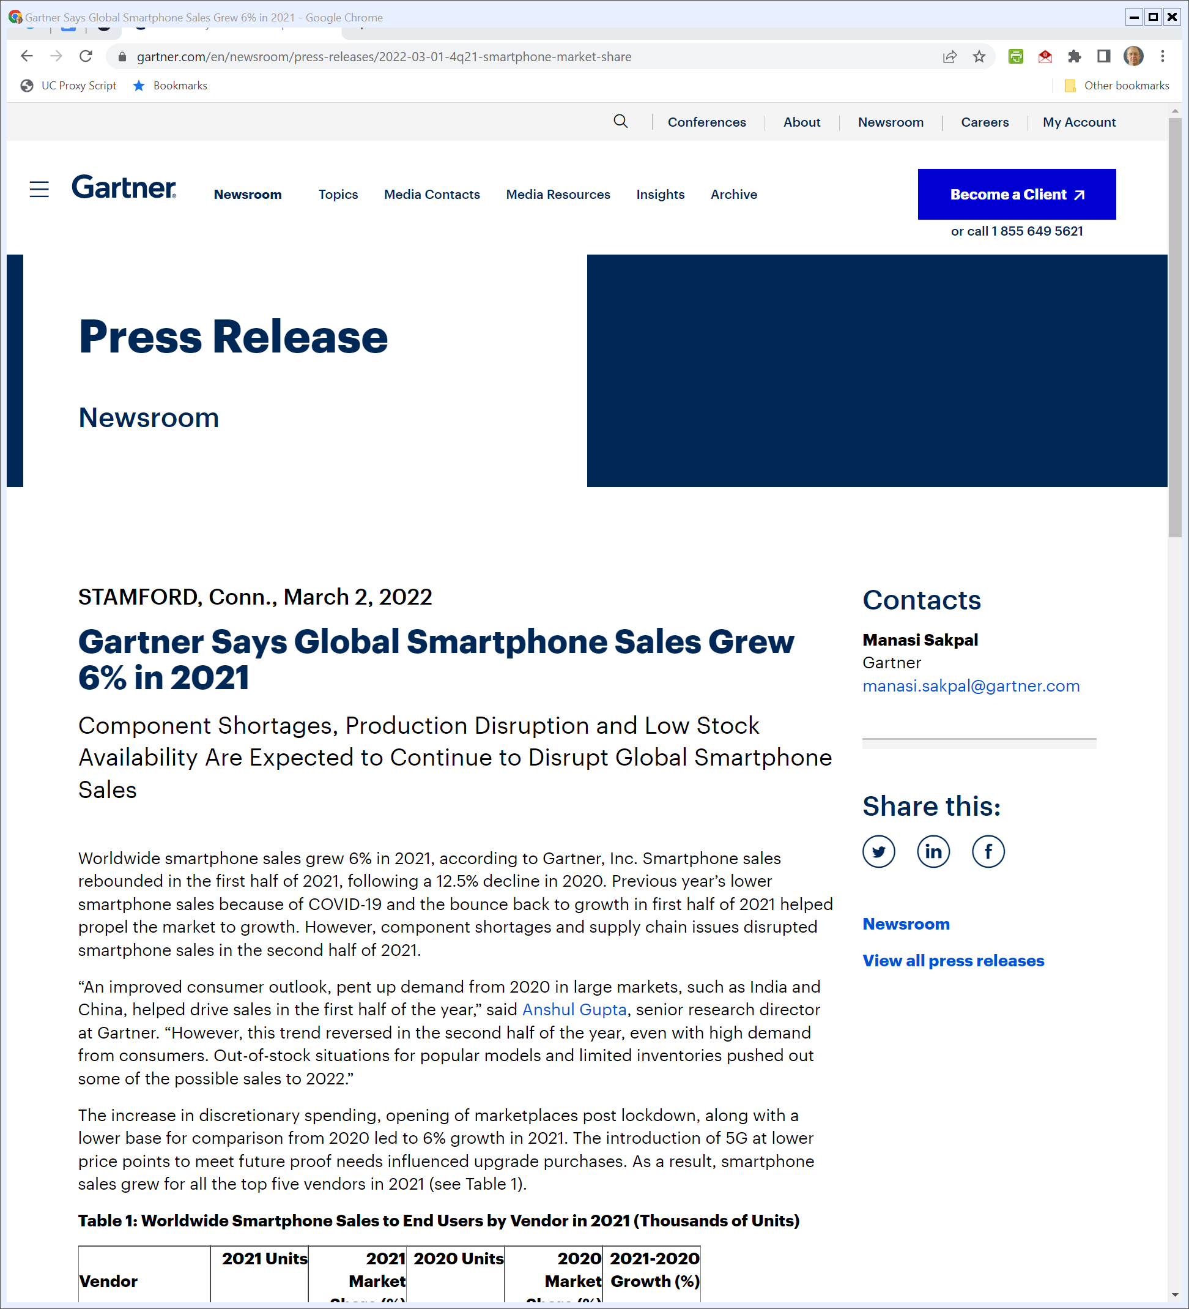
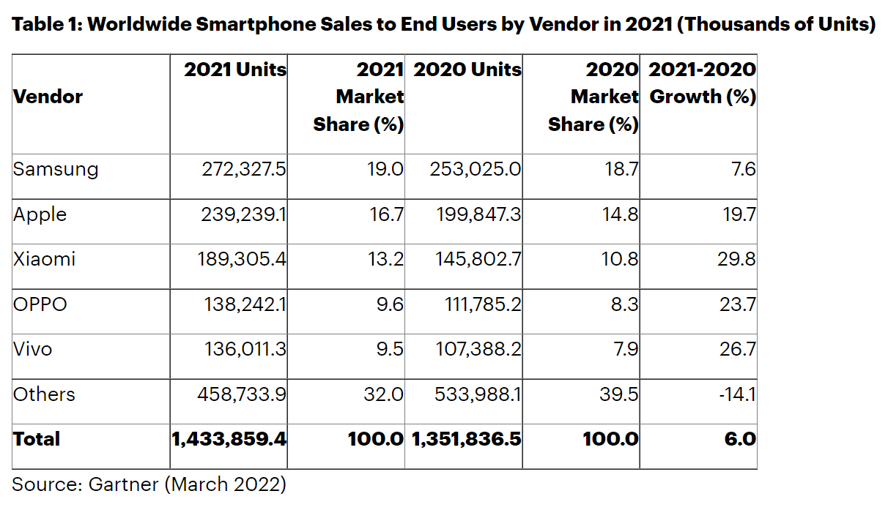
2021 Smartphone Sales
Gartner (2 Mar 2002)
Notes:
https://www.gartner.com/en/newsroom/press-releases/2022-03-01-4q21-smartphone-market-share

Slide 34
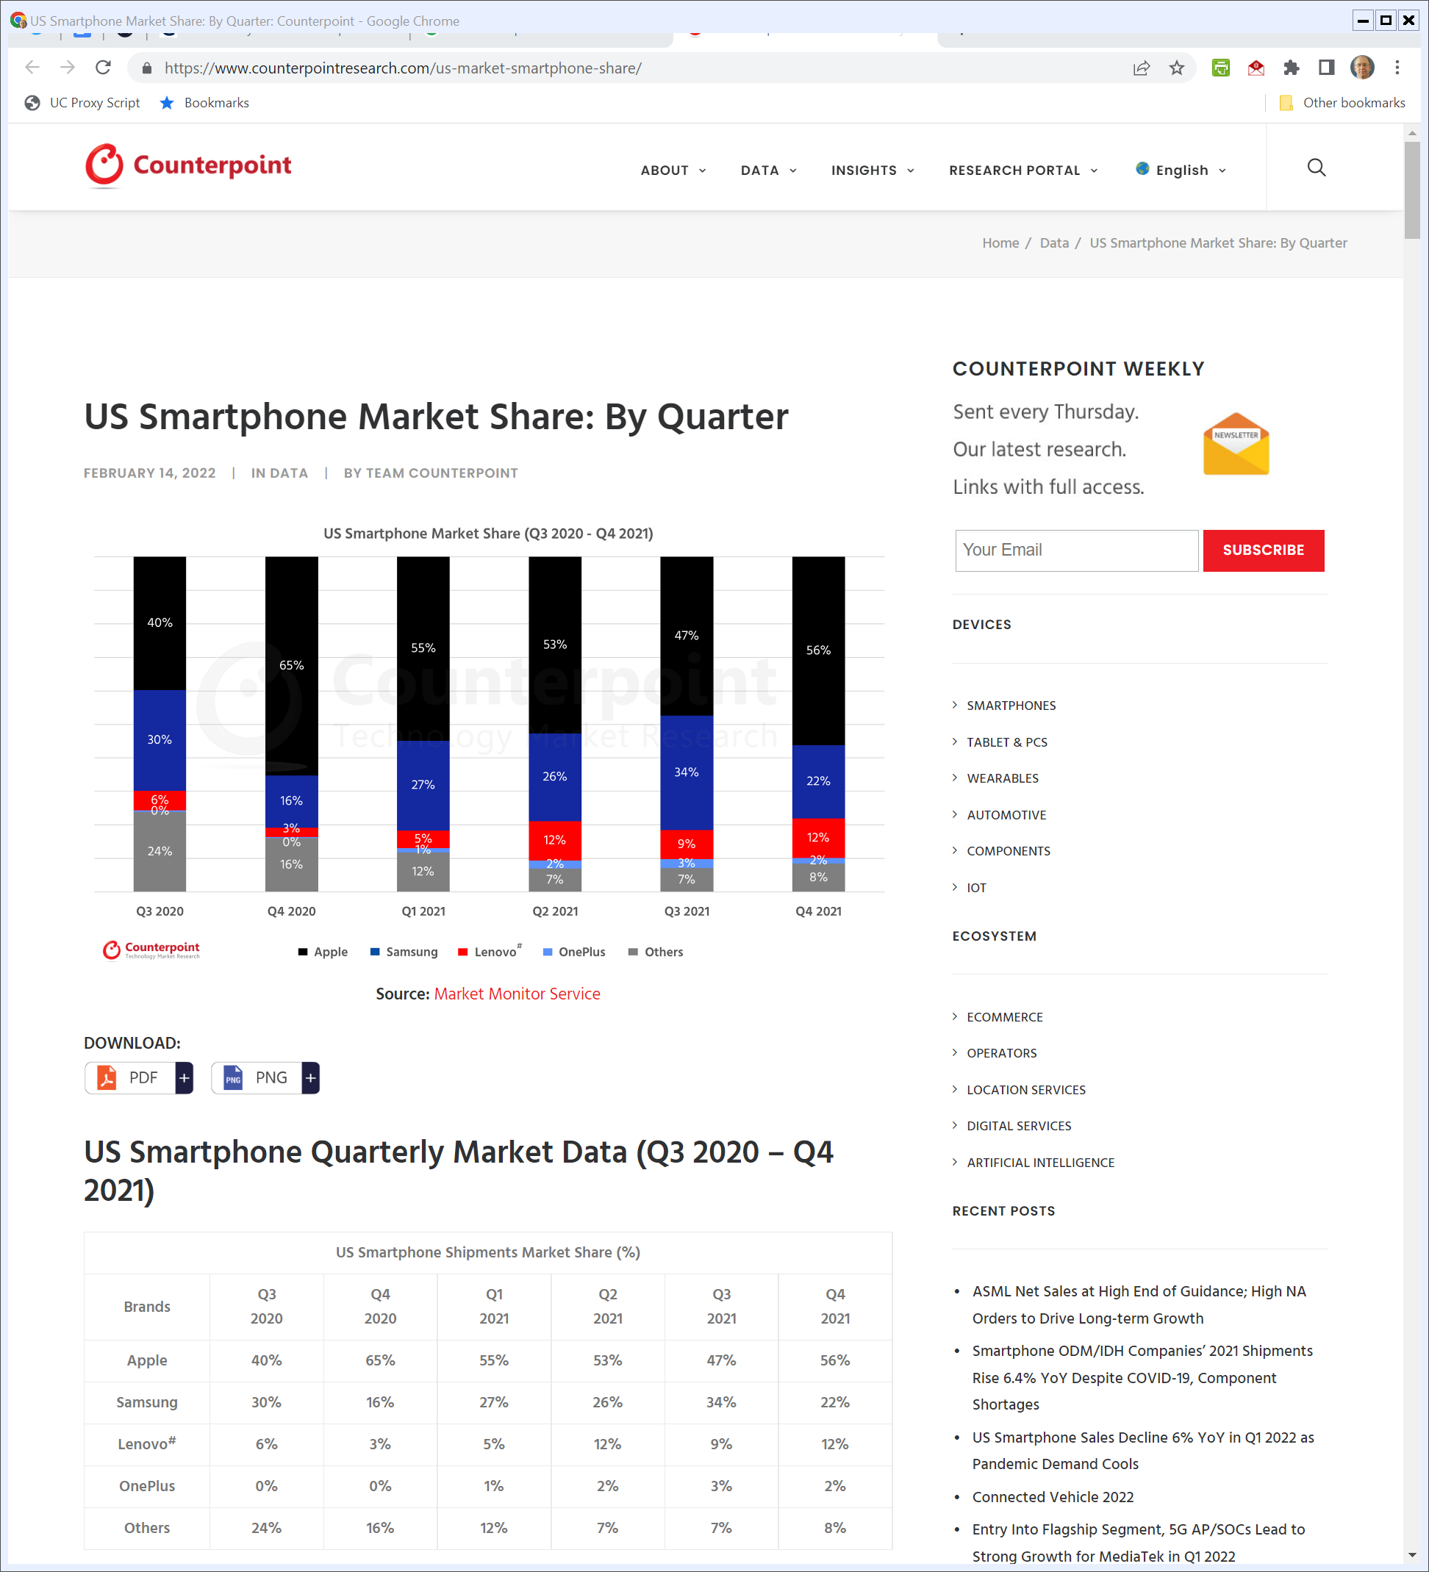
U.S. Smartphone Sales
Counterpoint (14 Feb 2022)
Notes:
https://www.counterpointresearch.com/us-market-smartphone-share/

Slide 35
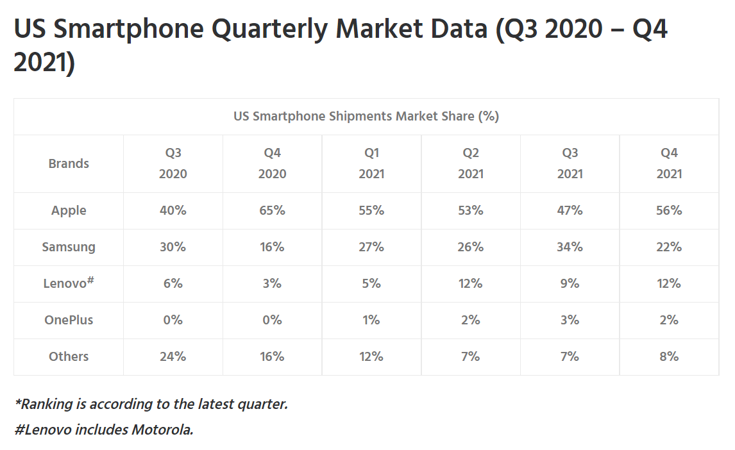
U.S. Smartphone Sales
Counterpoint (14 Feb 2022)
Notes:
https://www.counterpointresearch.com/us-market-smartphone-share/

Slide 36
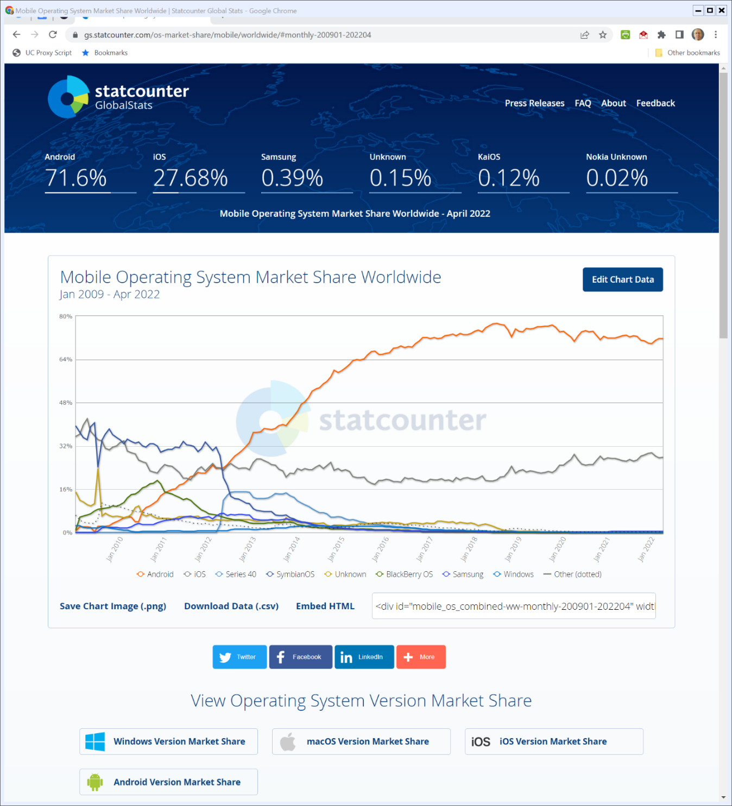

World Mobile OS Market Share
Statcounter (Visited 4 May 2022)
Notes:
https://gs.statcounter.com/os-market-share/mobile/worldwide/#monthly-200901-202204

Slide 37
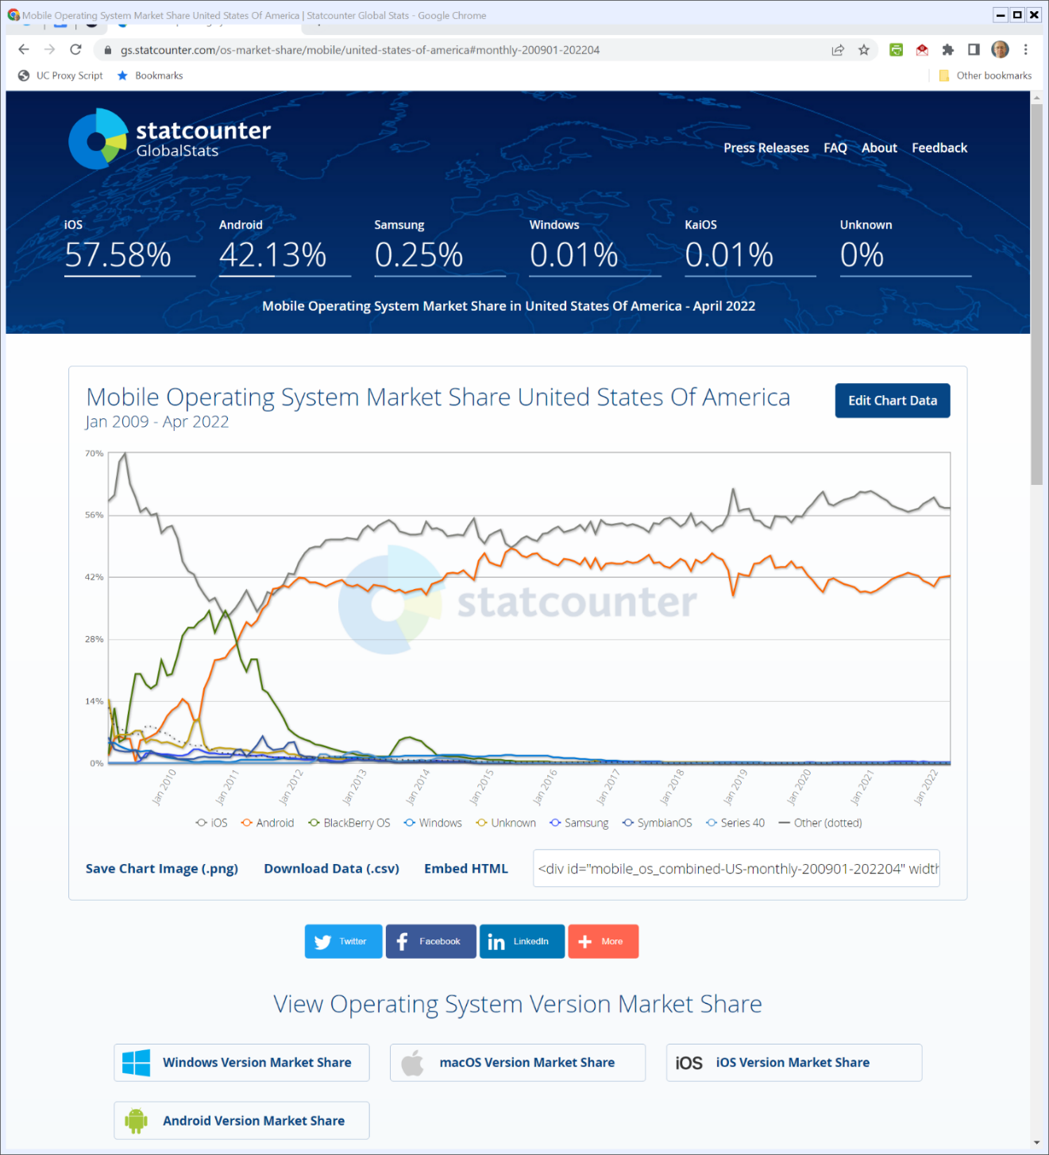

U.S. Mobile OS Market Share
Statcounter (Visited 4 May 2022)
Notes:
https://gs.statcounter.com/os-market-share/mobile/united-states-of-america#monthly-200901-202204

Slide 38
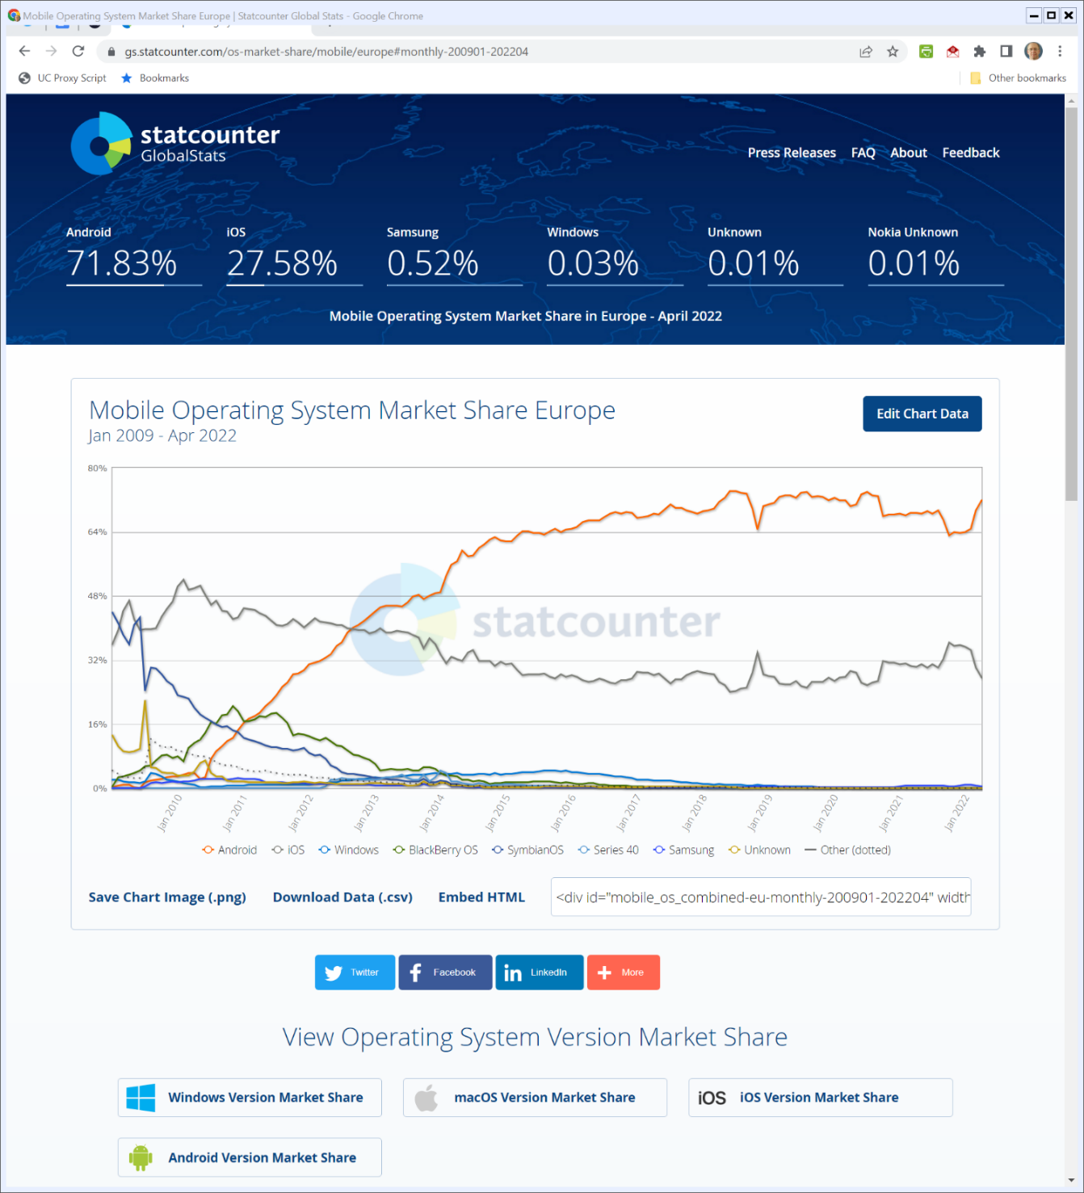

Europe Mobile OS Market Share
Statcounter (Visited 4 May 2022)
Notes:
https://gs.statcounter.com/os-market-share/mobile/europe#monthly-200901-202204

Slide 39
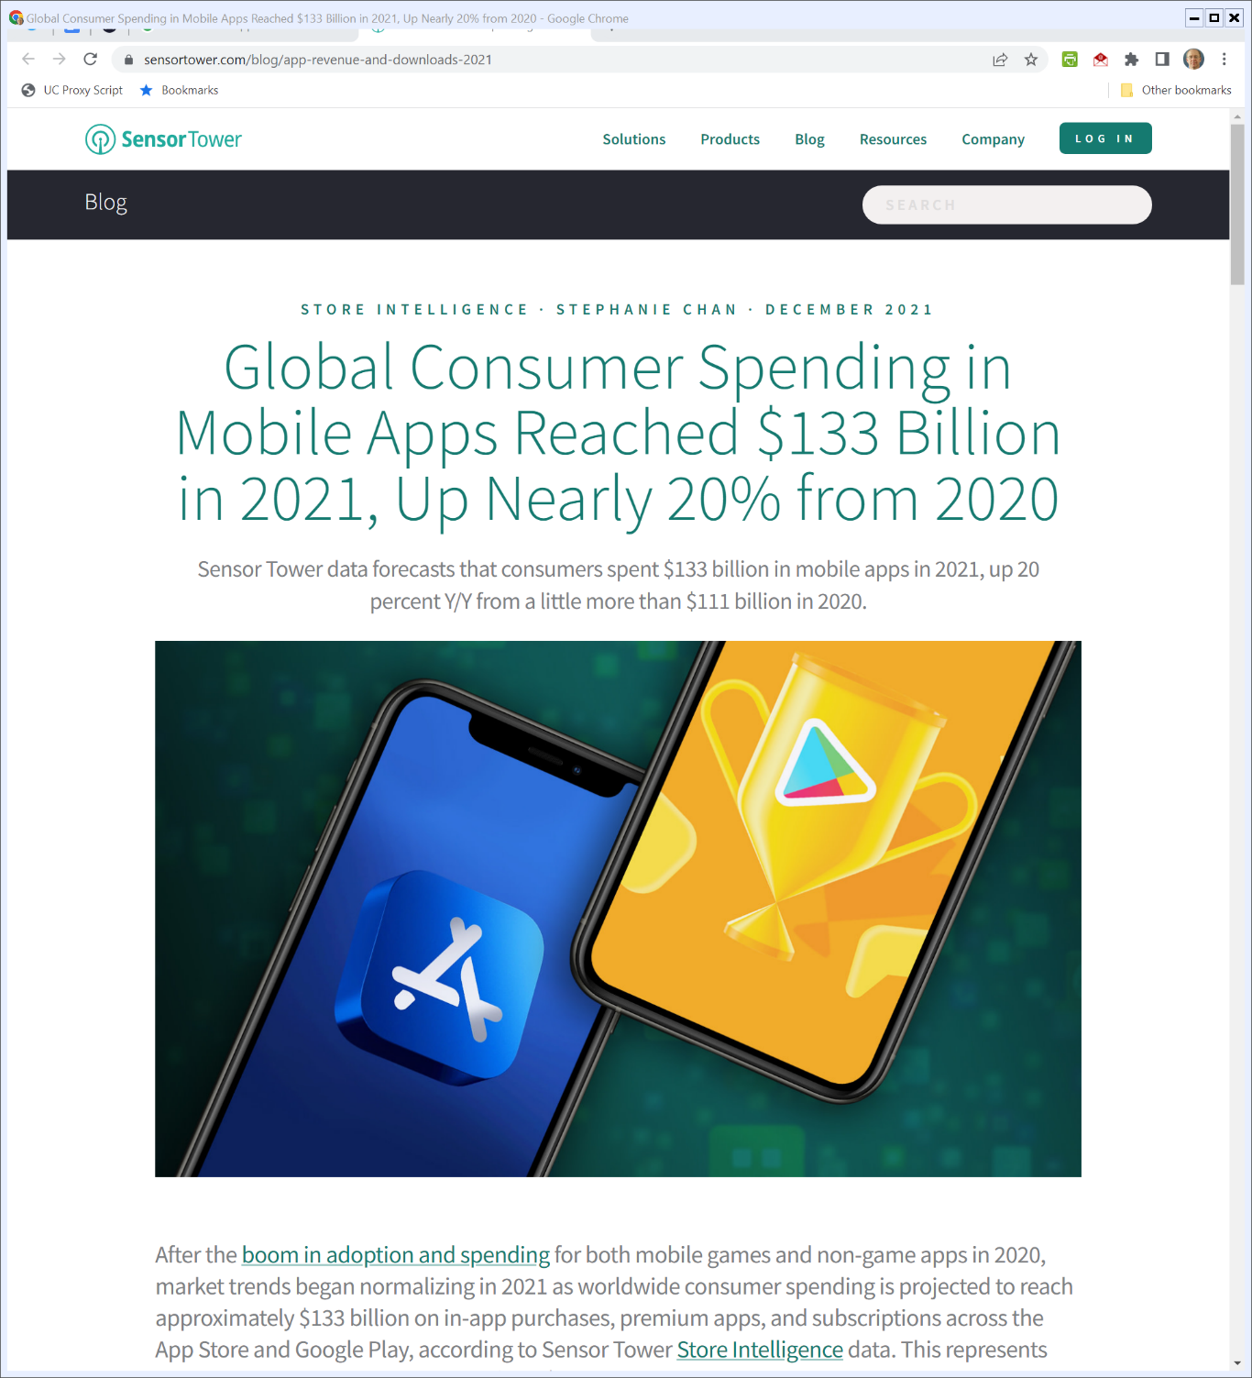
2021 Mobile App Spending
SensorTower (Dec 2021)
Notes:
https://sensortower.com/blog/app-revenue-and-downloads-2021

Slide 40
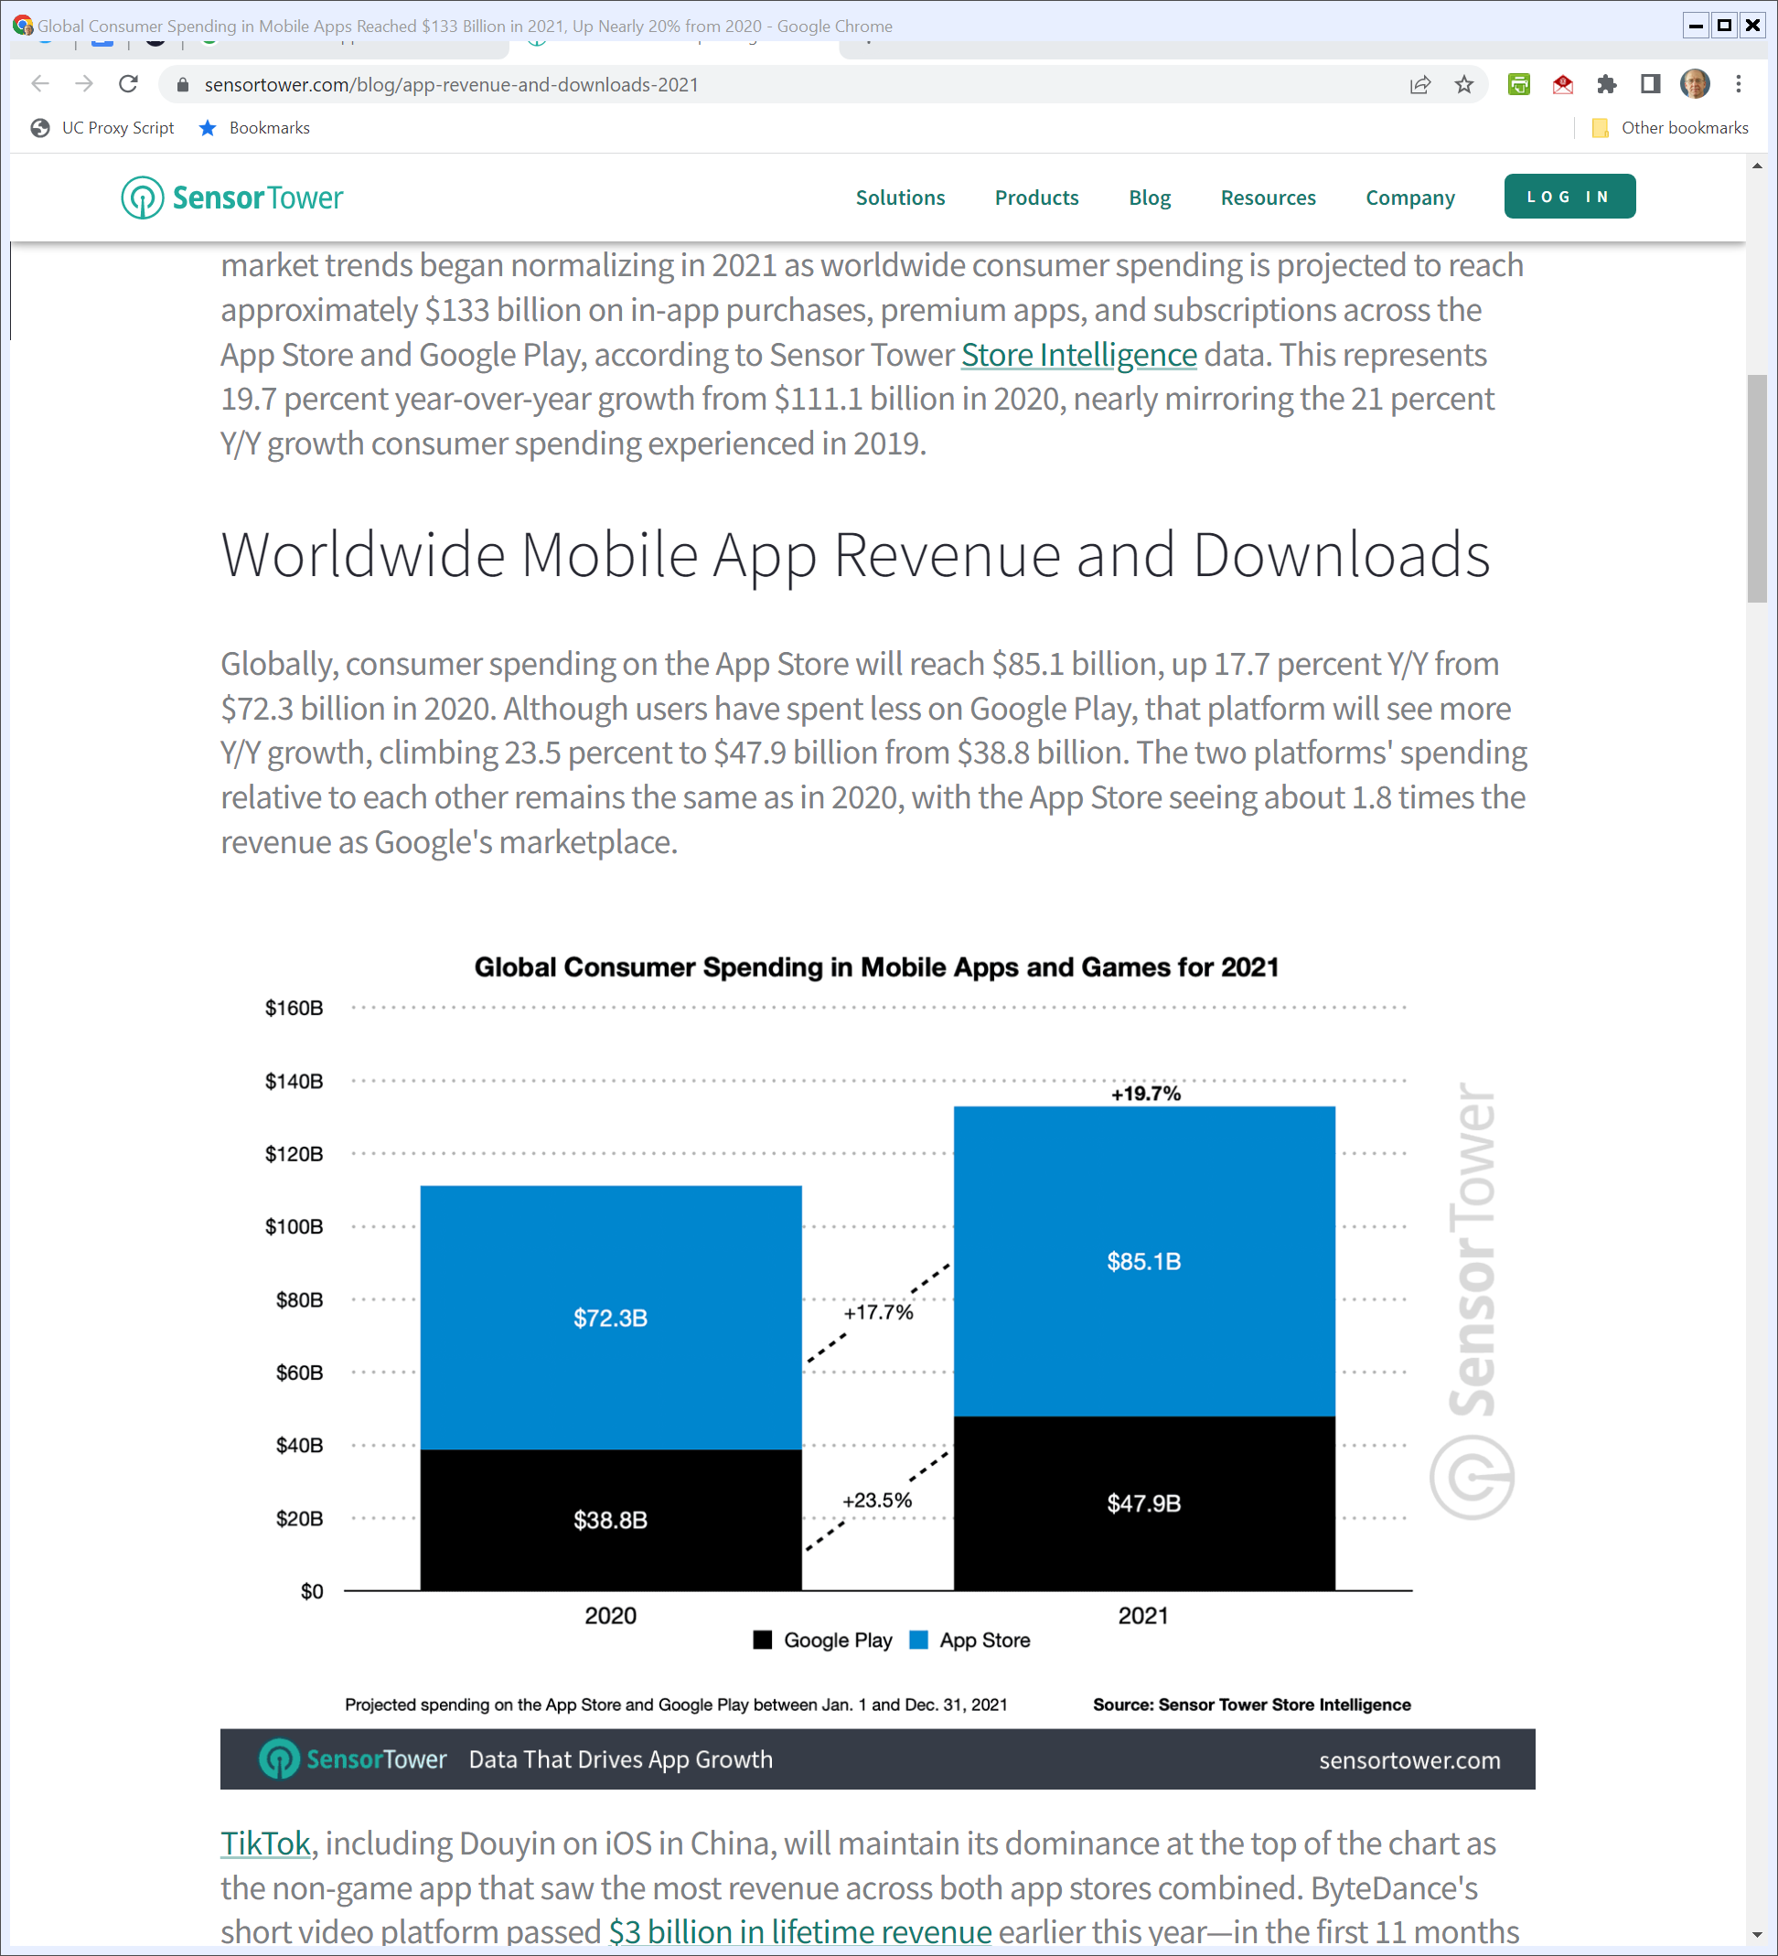
$$$: Google Play v. App Store
SensorTower (Dec 2021)
Notes:
https://sensortower.com/blog/app-revenue-and-downloads-2021

Slide 41
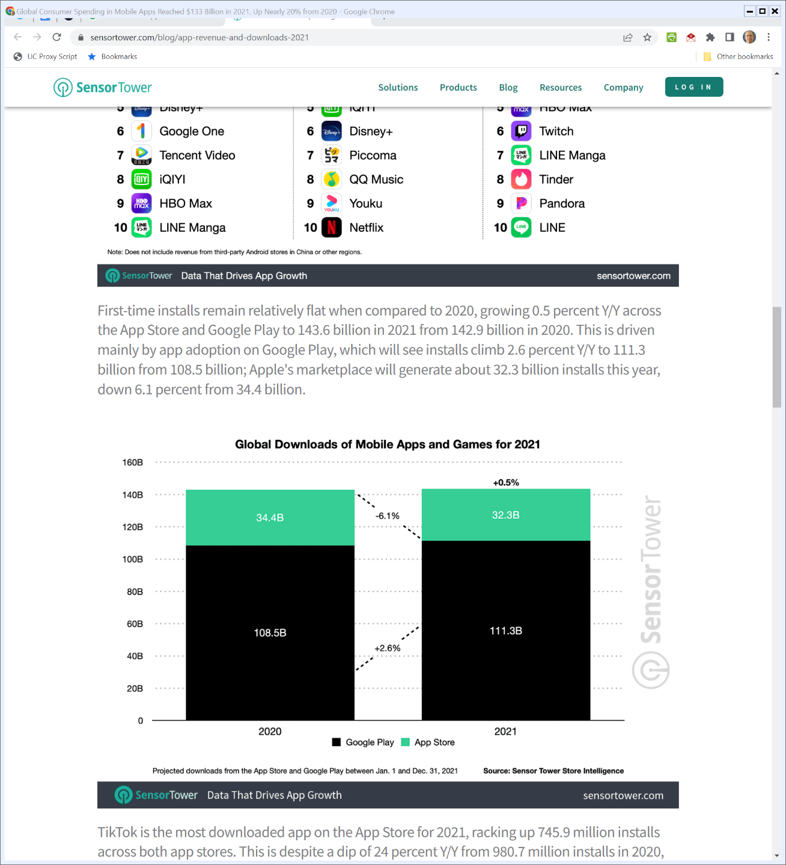
Downloads
SensorTower (Dec 2021)
Notes:
https://sensortower.com/blog/app-revenue-and-downloads-2021

Slide 42
Starting with the App Store
TTYN (1 of 5)
Hypo
You are a member of Congress considering possible legislation to deal with platforms
Four possible regulatory tools are on the table: (1) common carrier status; (2) nondiscrimination; (3) rate regulation; and (4) required open competition

Slide 43
Starting with the App Store
TTYN (2 of 5)
1. Common Carrier
The app store should be treated like a common carrier, meaning that Apple cannot refuse to carry any applications and must have uniform pricing
Can’t block apps with malware, can’t block porn, can’t block misinformation and more

Slide 44
Starting with the App Store
TTYN (3 of 5)
2. Nondiscrimination
A nondiscrimination obligations as to all apps:
Apple would be allowed to filter (blocking certain types of apps) but it would need to do this without regard to ownership
No preinstallation of Apple apps or paid preinstallation from others
No app ranking

Slide 45
Starting with the App Store
TTYN (4 of 5)
3. Price Regulation
Apple currently charges a 30% commission on fee-based apps
Apple instead should be required to have “just and reasonable” rates and a federal agency should regulate those rates

Slide 46
Starting with the App Store
TTYN (5 of 5)
4. Competing App Stores
Apple should be barred from limiting iOS devices from operating with competing app stores
App store competition would push agency fees to competitive levels and the market could sort the right balance of curation and openness for apps

Slide 47
Open Apps Market Act
S. 2710 (17 Feb 2022)

Slide 48
Definitions
S. 2710 (17 Feb 2022)

Slide 49
Definitions
S. 2710 (17 Feb 2022)

Slide 50
Definitions
S. 2710 (17 Feb 2022)

Slide 51
Exclusivity and Tying: In-App Payments
S. 2710 (17 Feb 2022)

Slide 52
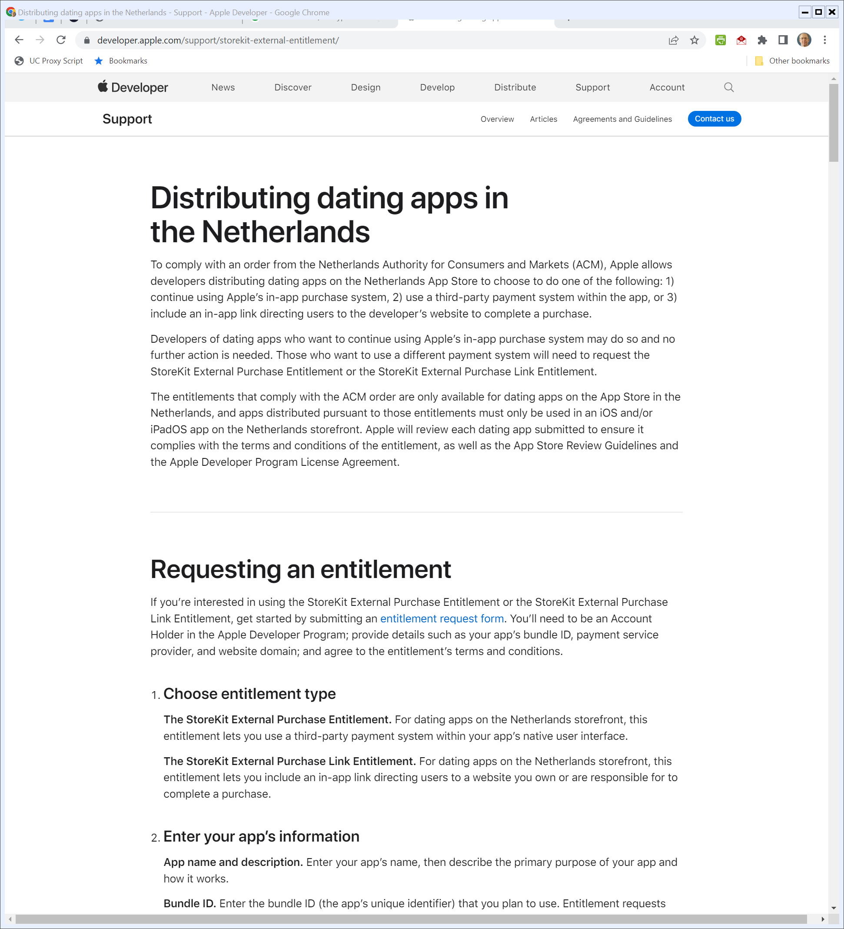
Dating Apps in the Netherlands
Apple (roughly 4 Feb 2022)
Notes:
https://developer.apple.com/support/storekit-external-entitlement/

Slide 53
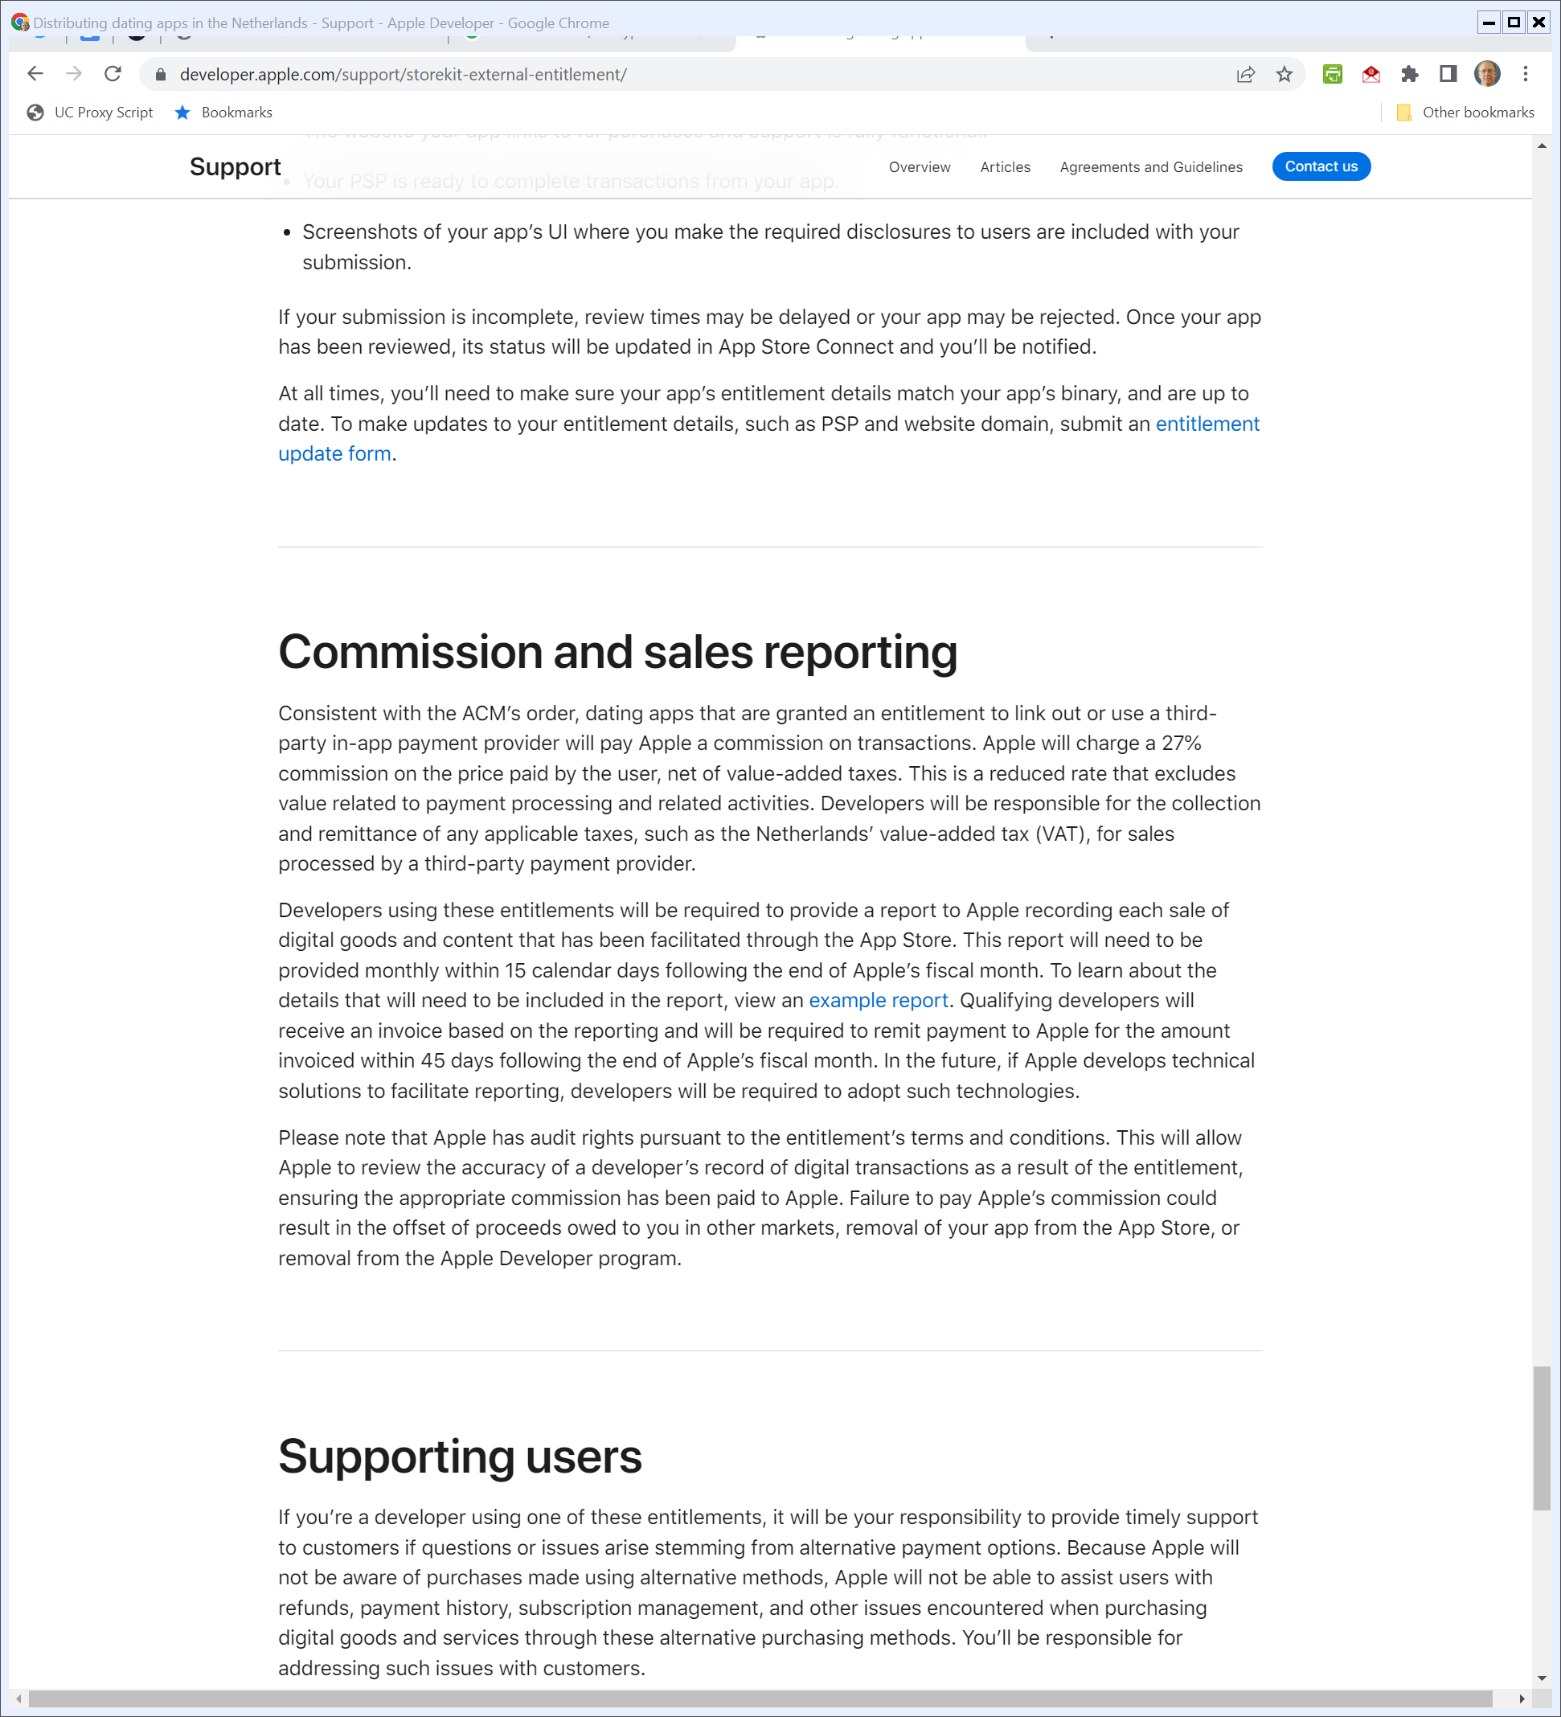
27% Fee Instead
Apple (roughly 4 Feb 2022, visited 5 May 2022)
Notes:
https://developer.apple.com/support/storekit-external-entitlement/

Slide 54
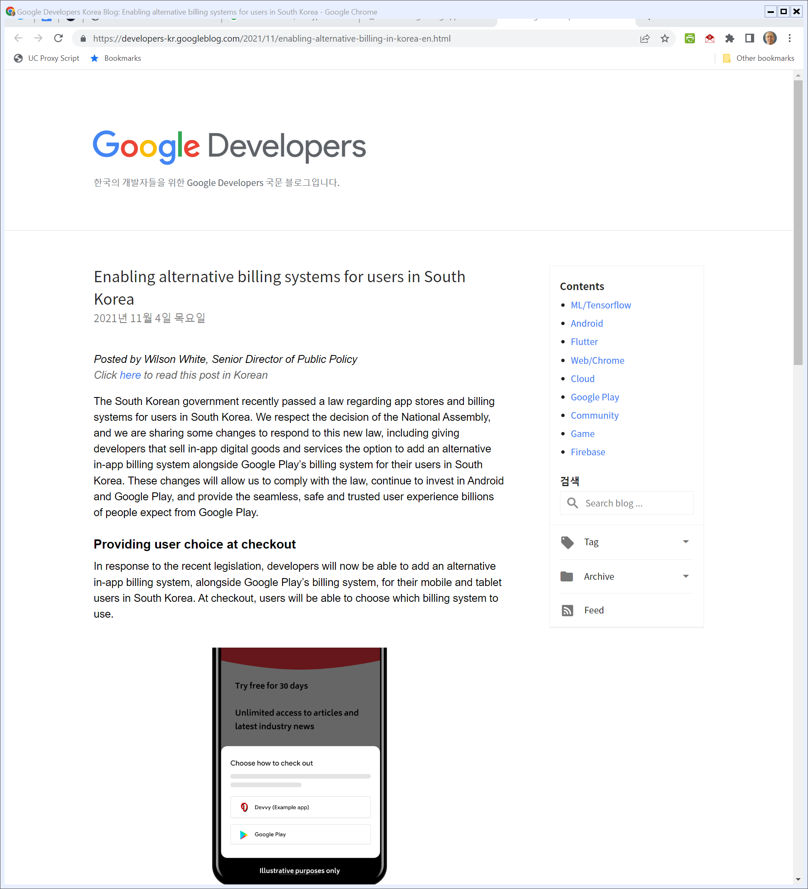
South Korea and Google
Google Korean Developer Site (2021-11-4)
Notes:
https://developers-kr.googleblog.com/2021/11/enabling-alternative-billing-in-korea-en.html

Slide 55
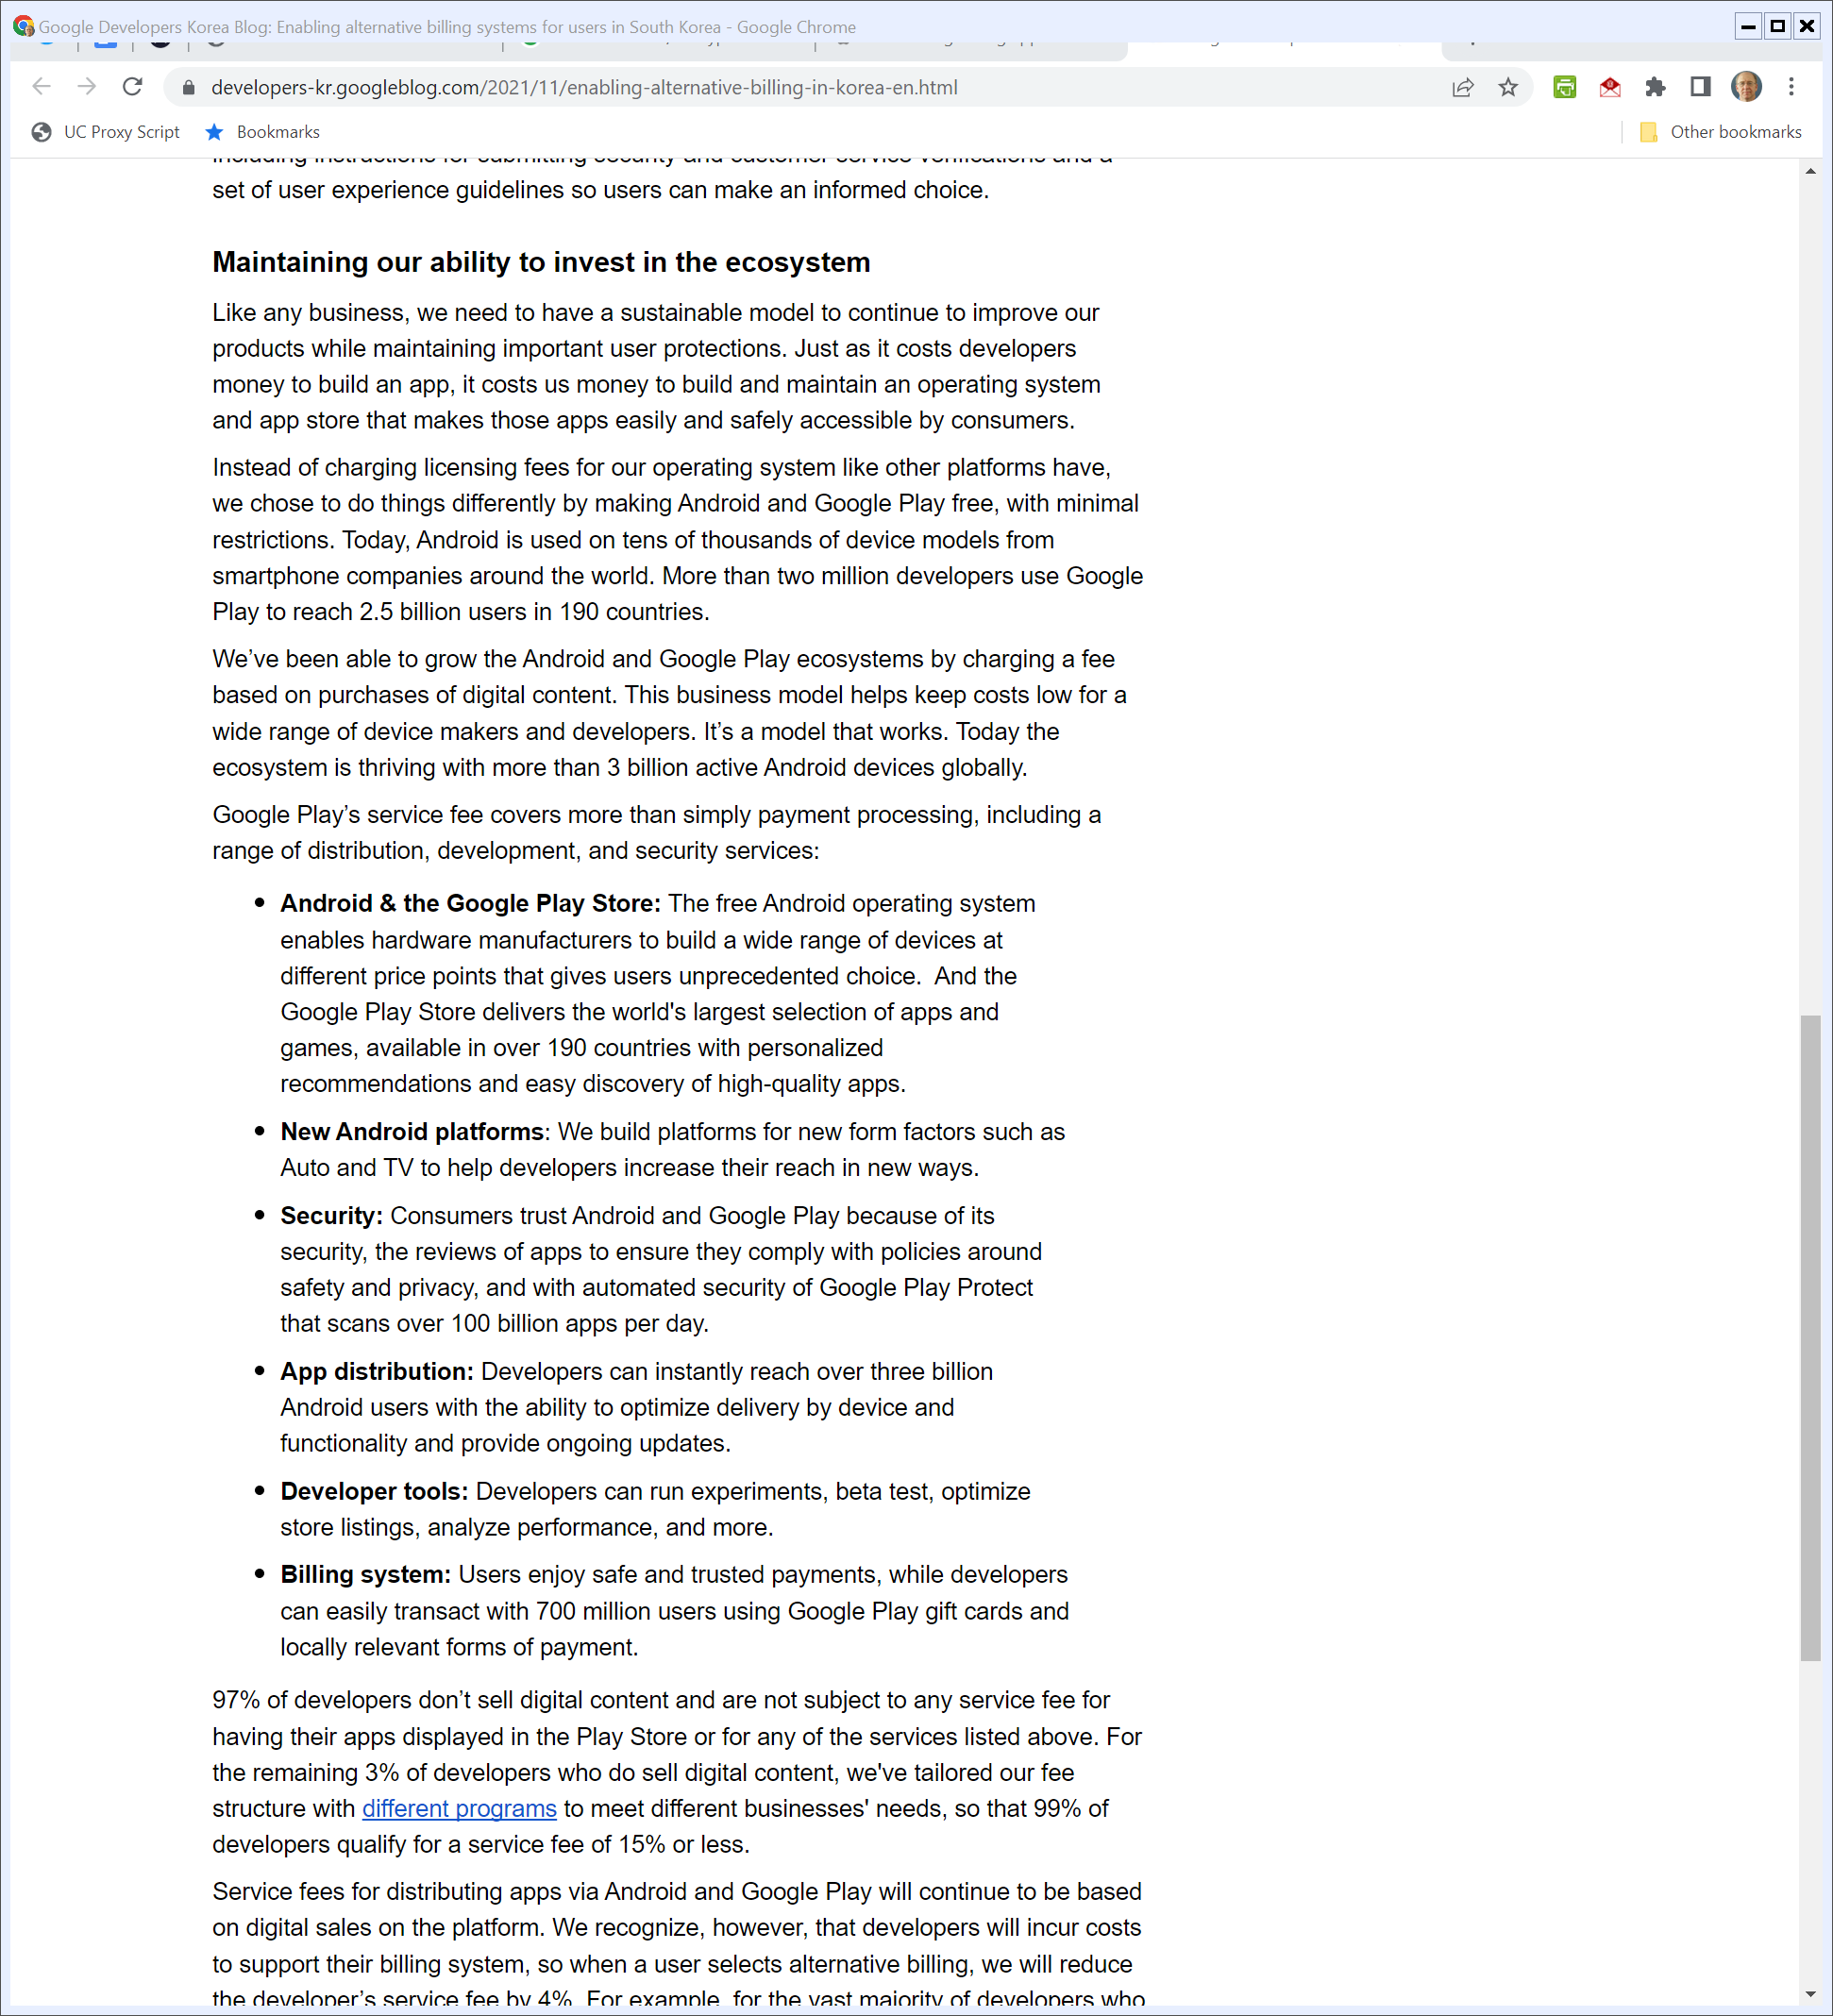
Funding Android
Google Korean Developer Site (2021-11-4)
Notes:
https://developers-kr.googleblog.com/2021/11/enabling-alternative-billing-in-korea-en.html

Slide 56
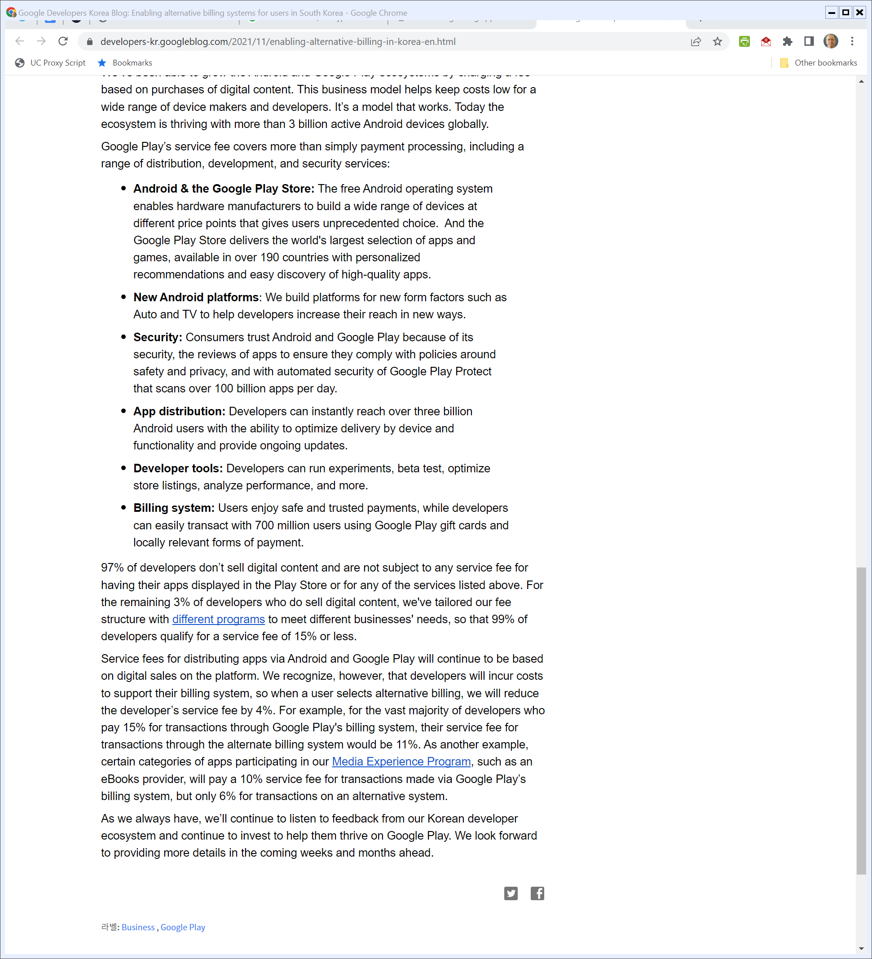
Normal Fees – 4%
Google Korean Developer Site (2021-11-4)
Notes:
https://developers-kr.googleblog.com/2021/11/enabling-alternative-billing-in-korea-en.html

Slide 57
Exclusivity and Tying: MFNs; Retribution
S. 2710 (17 Feb 2022)

Slide 58
No Blocking of Communications
S. 2710 (17 Feb 2022)

Slide 59
Interoperability (App Store Choice)
S. 2710 (17 Feb 2022)

Slide 60
Search Self-Preferencing
S. 2710 (17 Feb 2022)

Slide 61
Search Self-Preferencing
S. 2710 (17 Feb 2022)

Slide 62
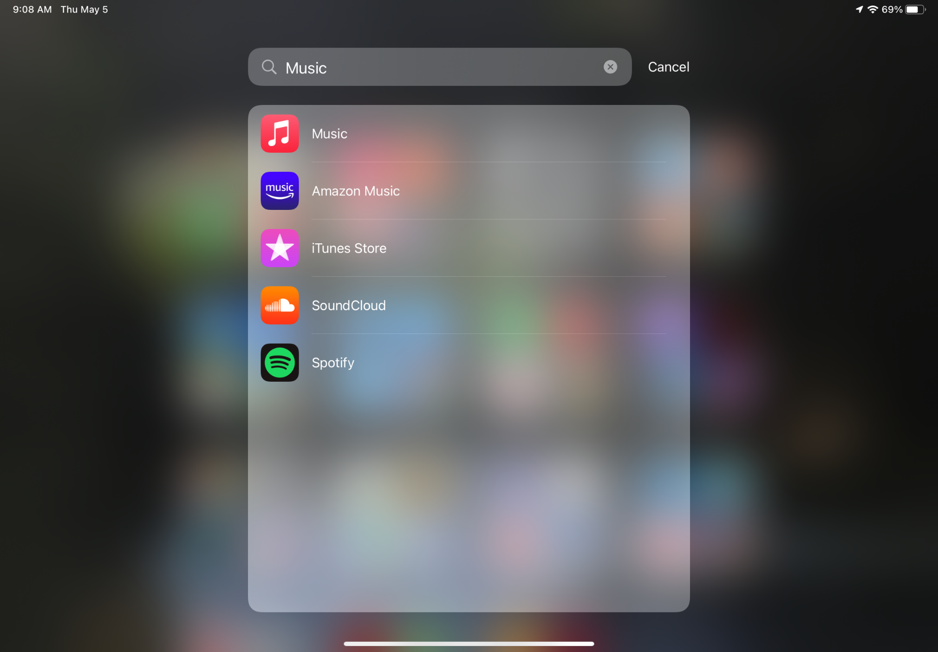
“Music” Search on iPad
Picker iPad (5 May 2022)

Slide 63
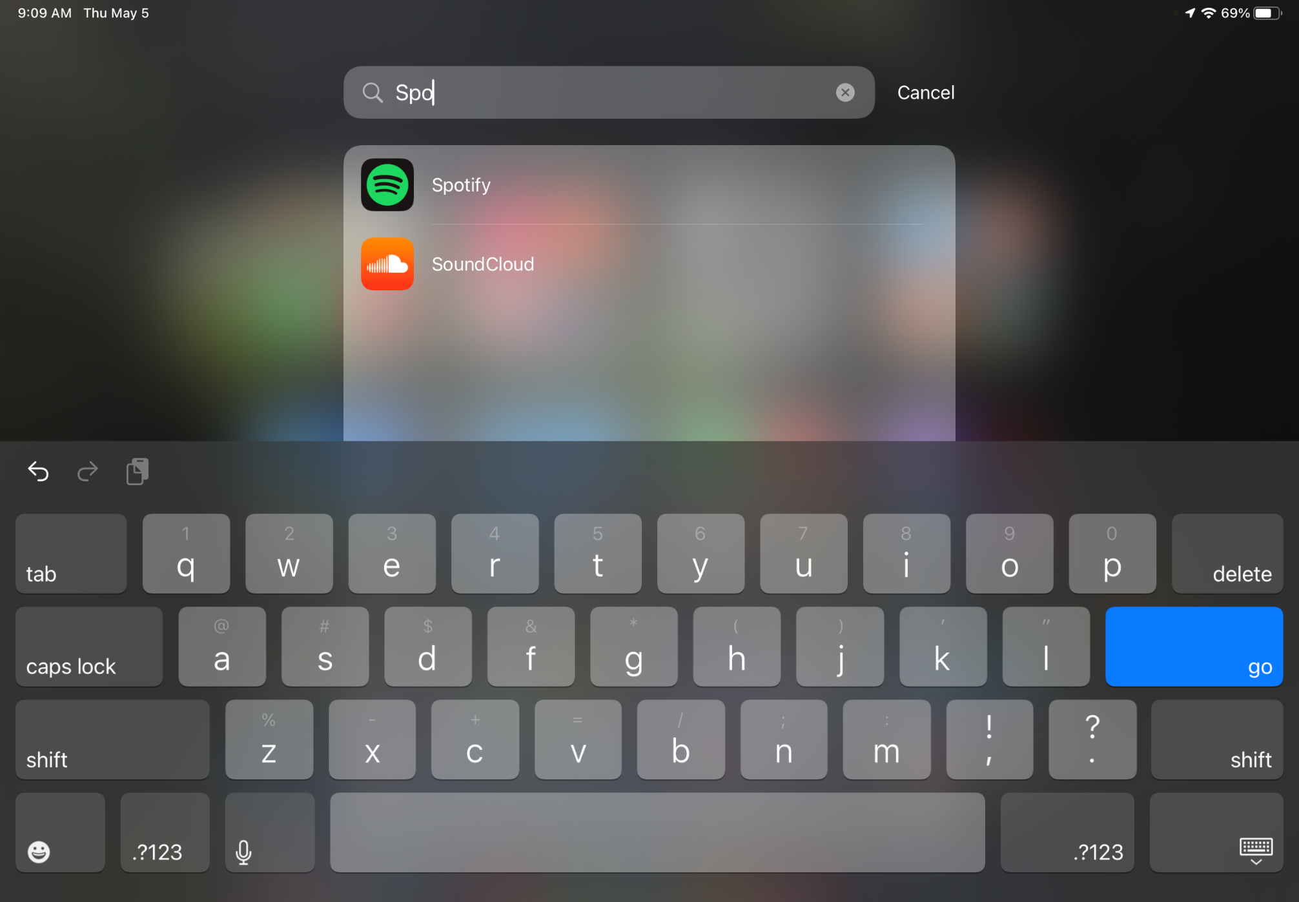
“Spo” Search on iPad
Picker iPad (5 May 2022)

Slide 64
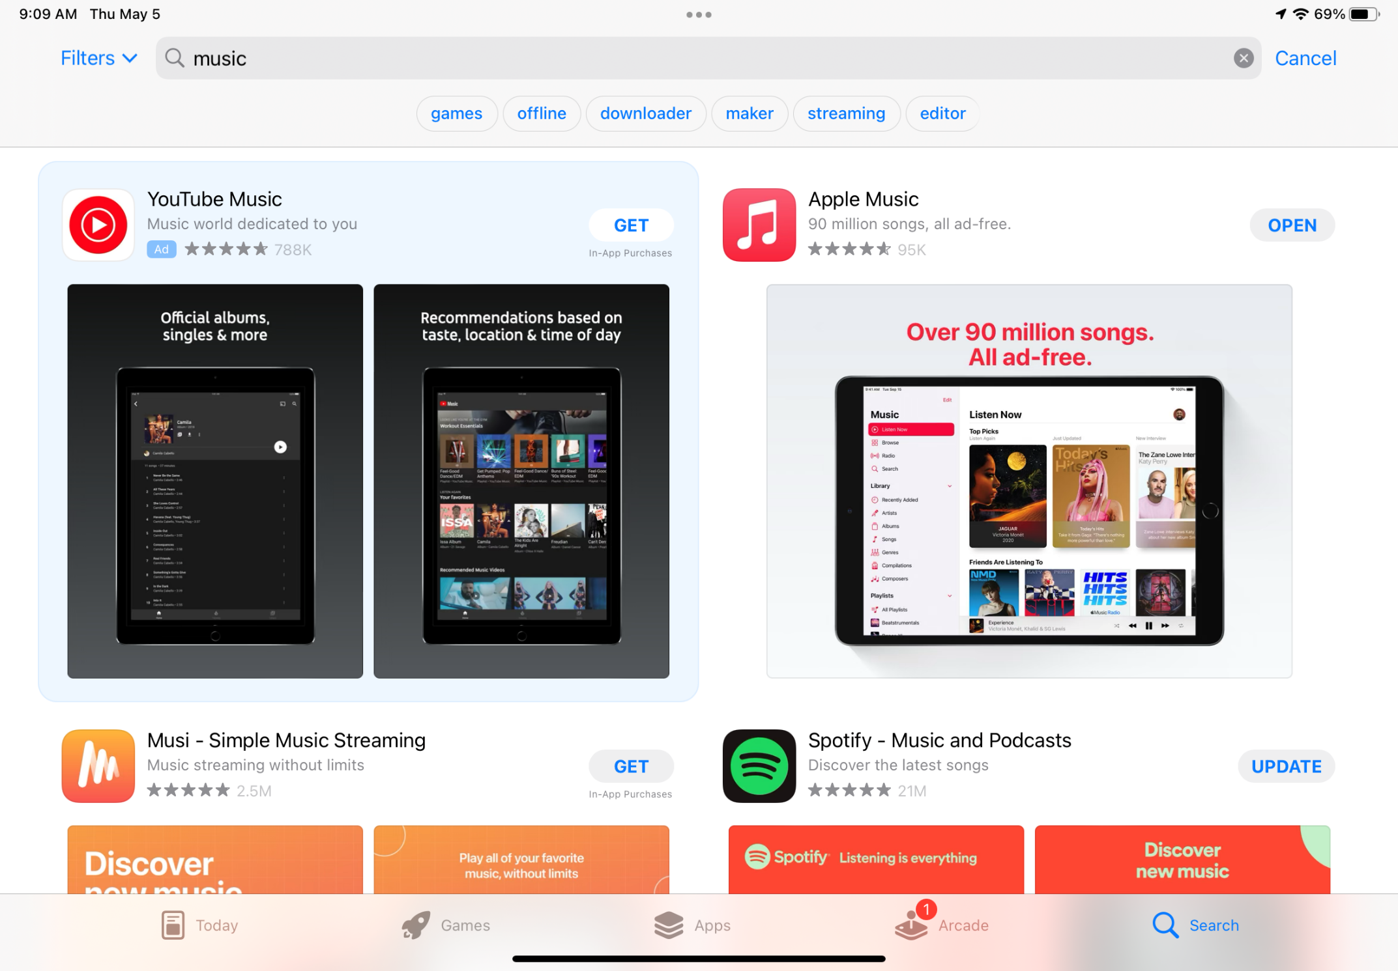
“Music” Search on App Store
5 May 2022

Slide 65
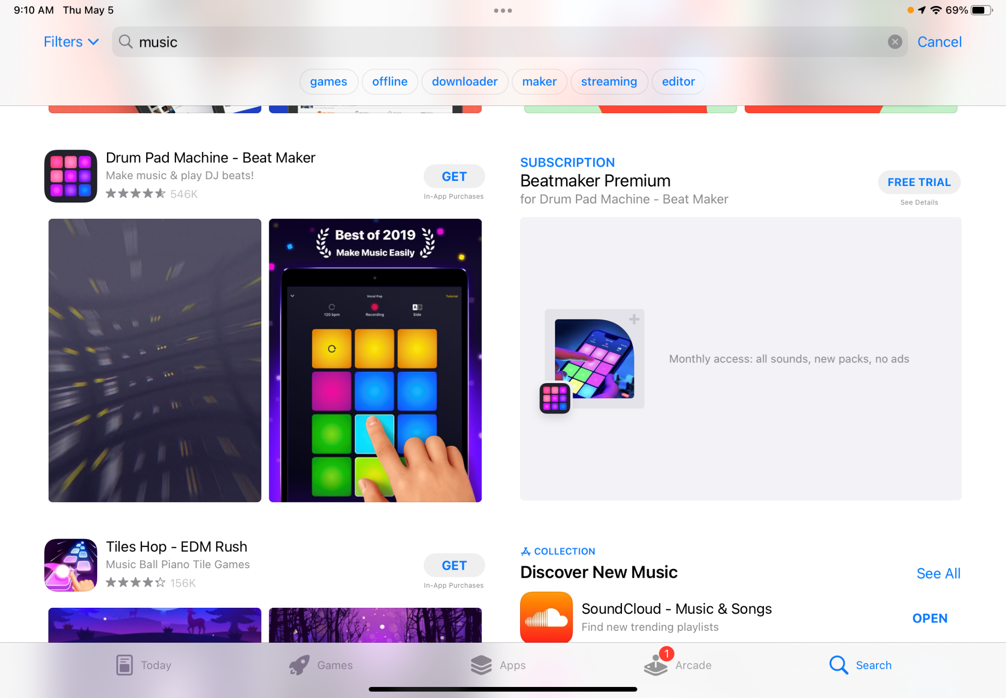
“Music” Search on App Store
5 May 2022

Slide 66
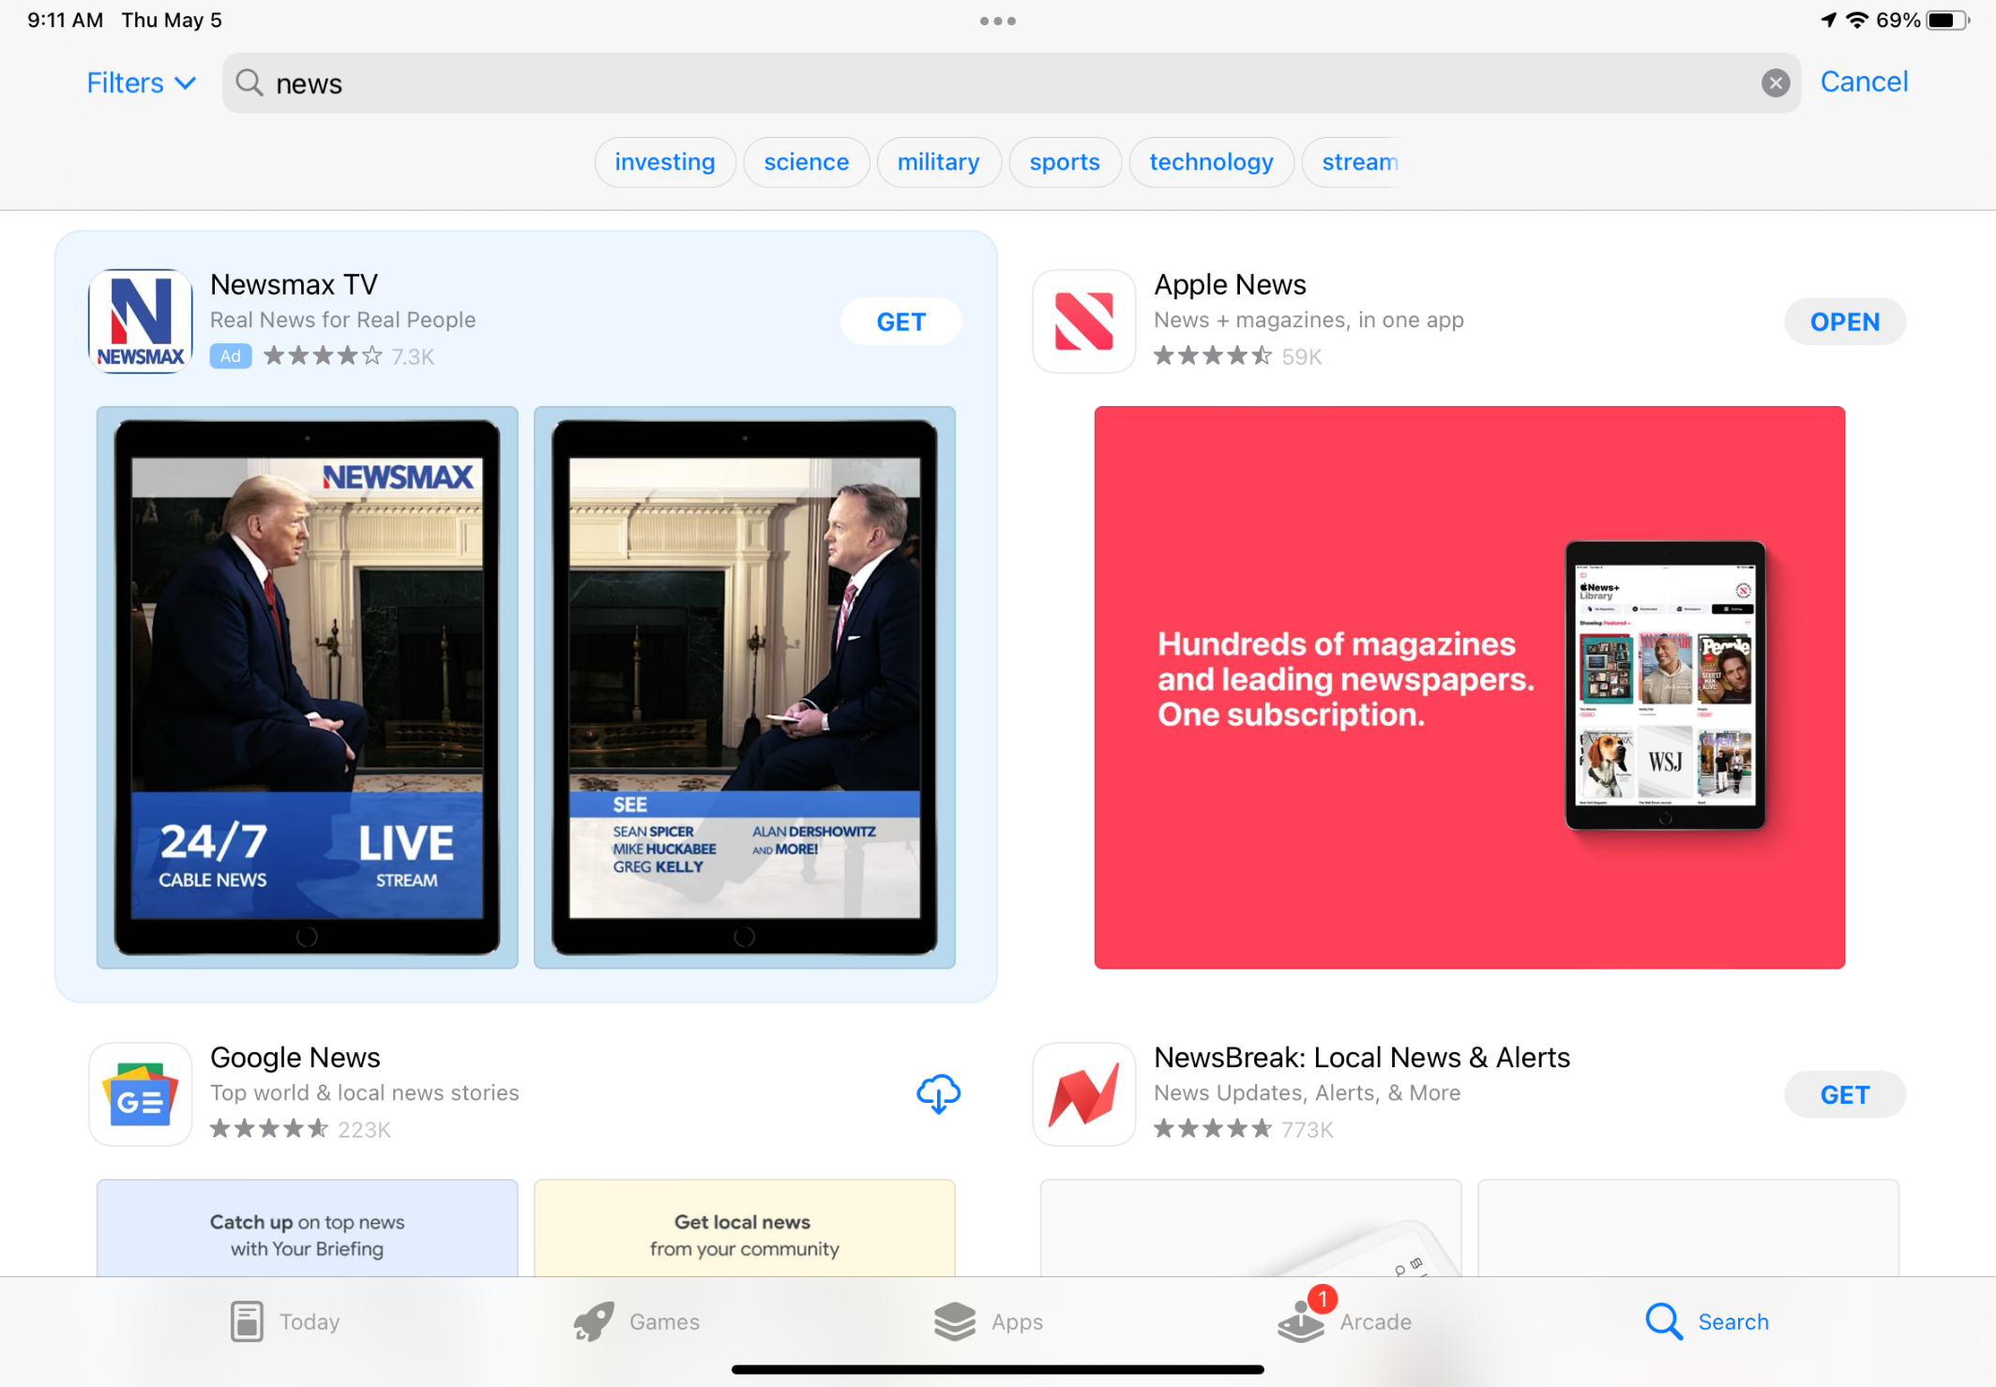
“News” Search on App Store
5 May 2022

Slide 67
Open App Development
S. 2710 (17 Feb 2022)

Slide 68
EC SO on Apple and NFC
European Commission (2 May 2022)

Slide 69
EC SO on Apple and NFC
European Commission (2 May 2022)

Slide 70
Security and Privacy Defense
S. 2710 (17 Feb 2022)

Slide 71
Safe Harbors
S. 2710 (17 Feb 2022)

Slide 72
Burden of Proof on Covered Company
S. 2710 (17 Feb 2022)

Slide 73
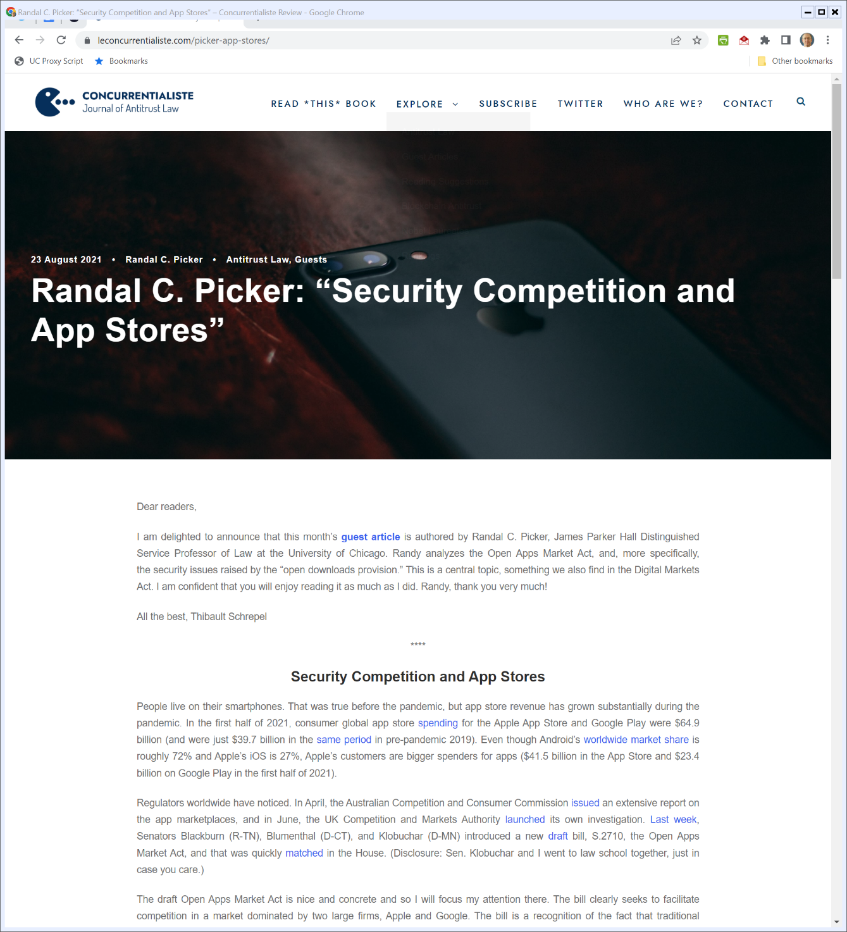
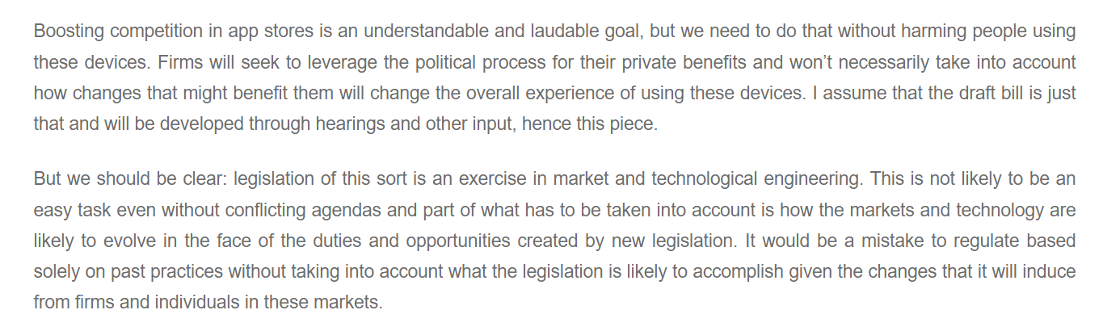
Security and App Store Competition
Picker (23 Aug 2021)

Slide 74
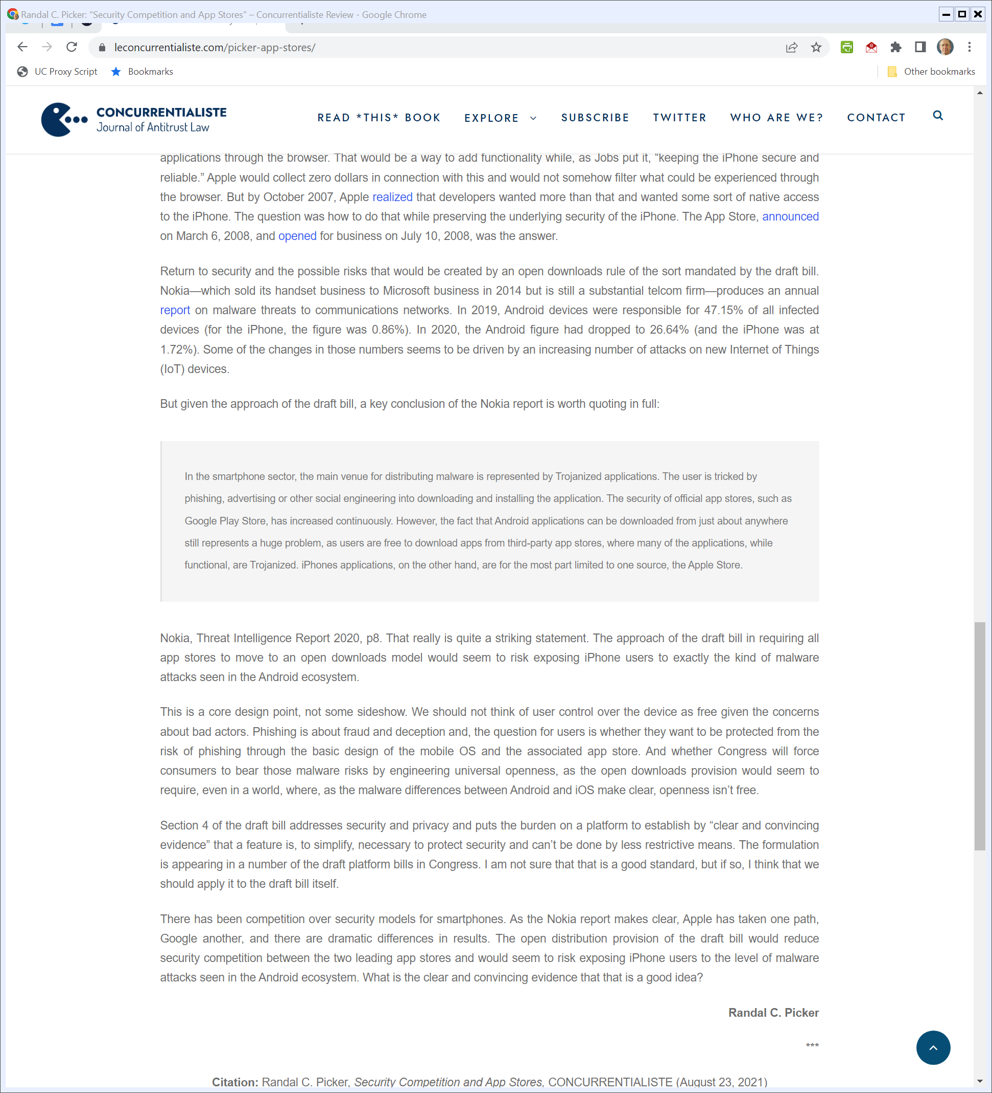
Security and App Store Competition
Picker (23 Aug 2021)

Slide 75
American Innovation and Choice Online Act
S. 2992 (2 Mar 2022)

Slide 76
Definitions
S. 2992 (2 Mar 2022)

Slide 77
Definitions: “Covered Platform”
An online platform that meets any of the following conditions (and others):
50M monthly active users (MAUs) in the U.S.
100K monthly active business users in the U.S.
net annual sales of $550B (?)
market cap of $550B
1B worldwide MAUs
S. 2992 (2 Mar 2022)

Slide 78
Definitions: “Online Platform”
S. 2992 (2 Mar 2022)

Slide 79
Unlawful Conduct: Self-Pref
S. 2992 (2 Mar 2022)

Slide 80
Unlawful Conduct: Self-Pref
S. 2992 (2 Mar 2022)

Slide 81
Unlawful Conduct: Self-Pref
S. 2992 (2 Mar 2022)

Slide 82
Unlawful Conduct: Discrimination
S. 2992 (2 Mar 2022)

Slide 83
Affirmative Defenses
S. 2992 (2 Mar 2022)

Slide 84
Preinstallation
TTYN (1 of 3)
Hypo 1
Apple builds the iPhone. It adds software:
The operating system: iOS
The App Store
Various apps (Safari, a calculator, email, calendar, messaging software, FaceTime, Maps, Wallet and more)

Slide 85
Preinstallation
TTYN (2 of 3)
Questions
Does this raise antitrust issues? Does it matter whether the apps can or cannot be deleted?
Do we think that these activities should be regulated?
How would S. 2992 apply to this situation?

Slide 86
Preinstallation
TTYN (3 of 3)
Questions
Could Apple auction off the right to be the default App Store, browser, search engine etc.?
Would Apple be required to offer an EU-style MS browser ballot or search engine choice screen for each of the apps that it currently preinstalls? For an alternative OS?

Slide 87
ABA Views
ABA S. 2992 Letter (27 Apr 2022)

Slide 88
Executive Summary: More Direct Ties to Antitrust
ABA S. 2992 Letter (27 Apr 2022)

Slide 89
Require Market Power
ABA S. 2992 Letter (27 Apr 2022)

Slide 90
Focus On Harm to the Competitive Process
ABA S. 2992 Letter (27 Apr 2022)

Slide 91
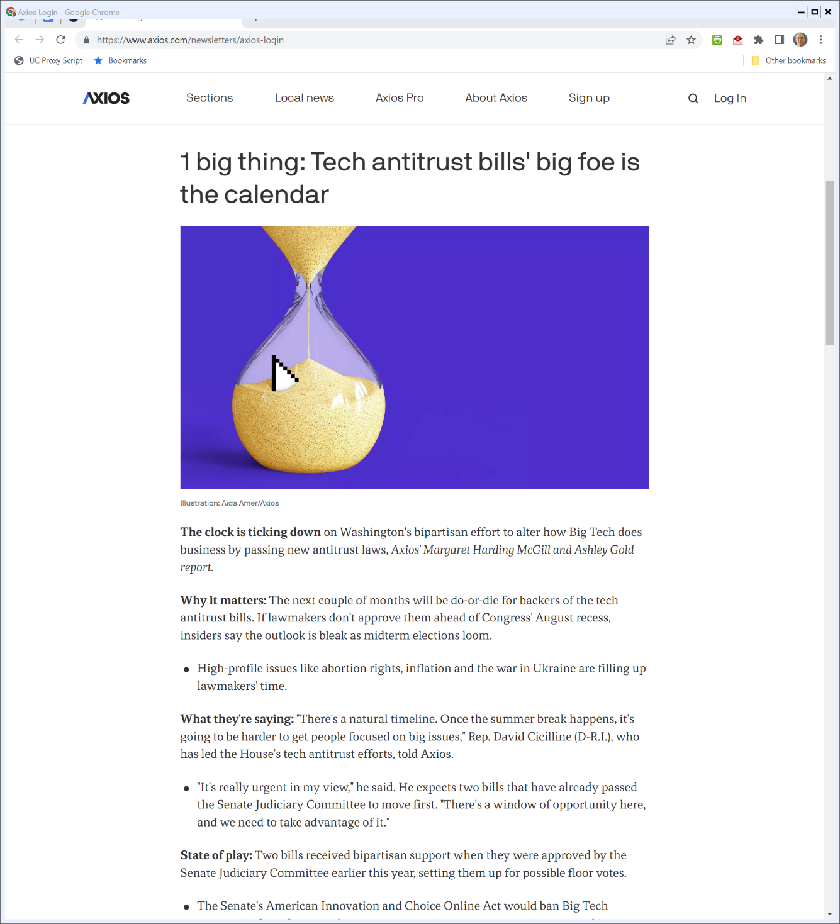

And in Congress?
Axios (5 May 2022)
Notes:
https://www.axios.com/newsletters/axios-login

Slide 92
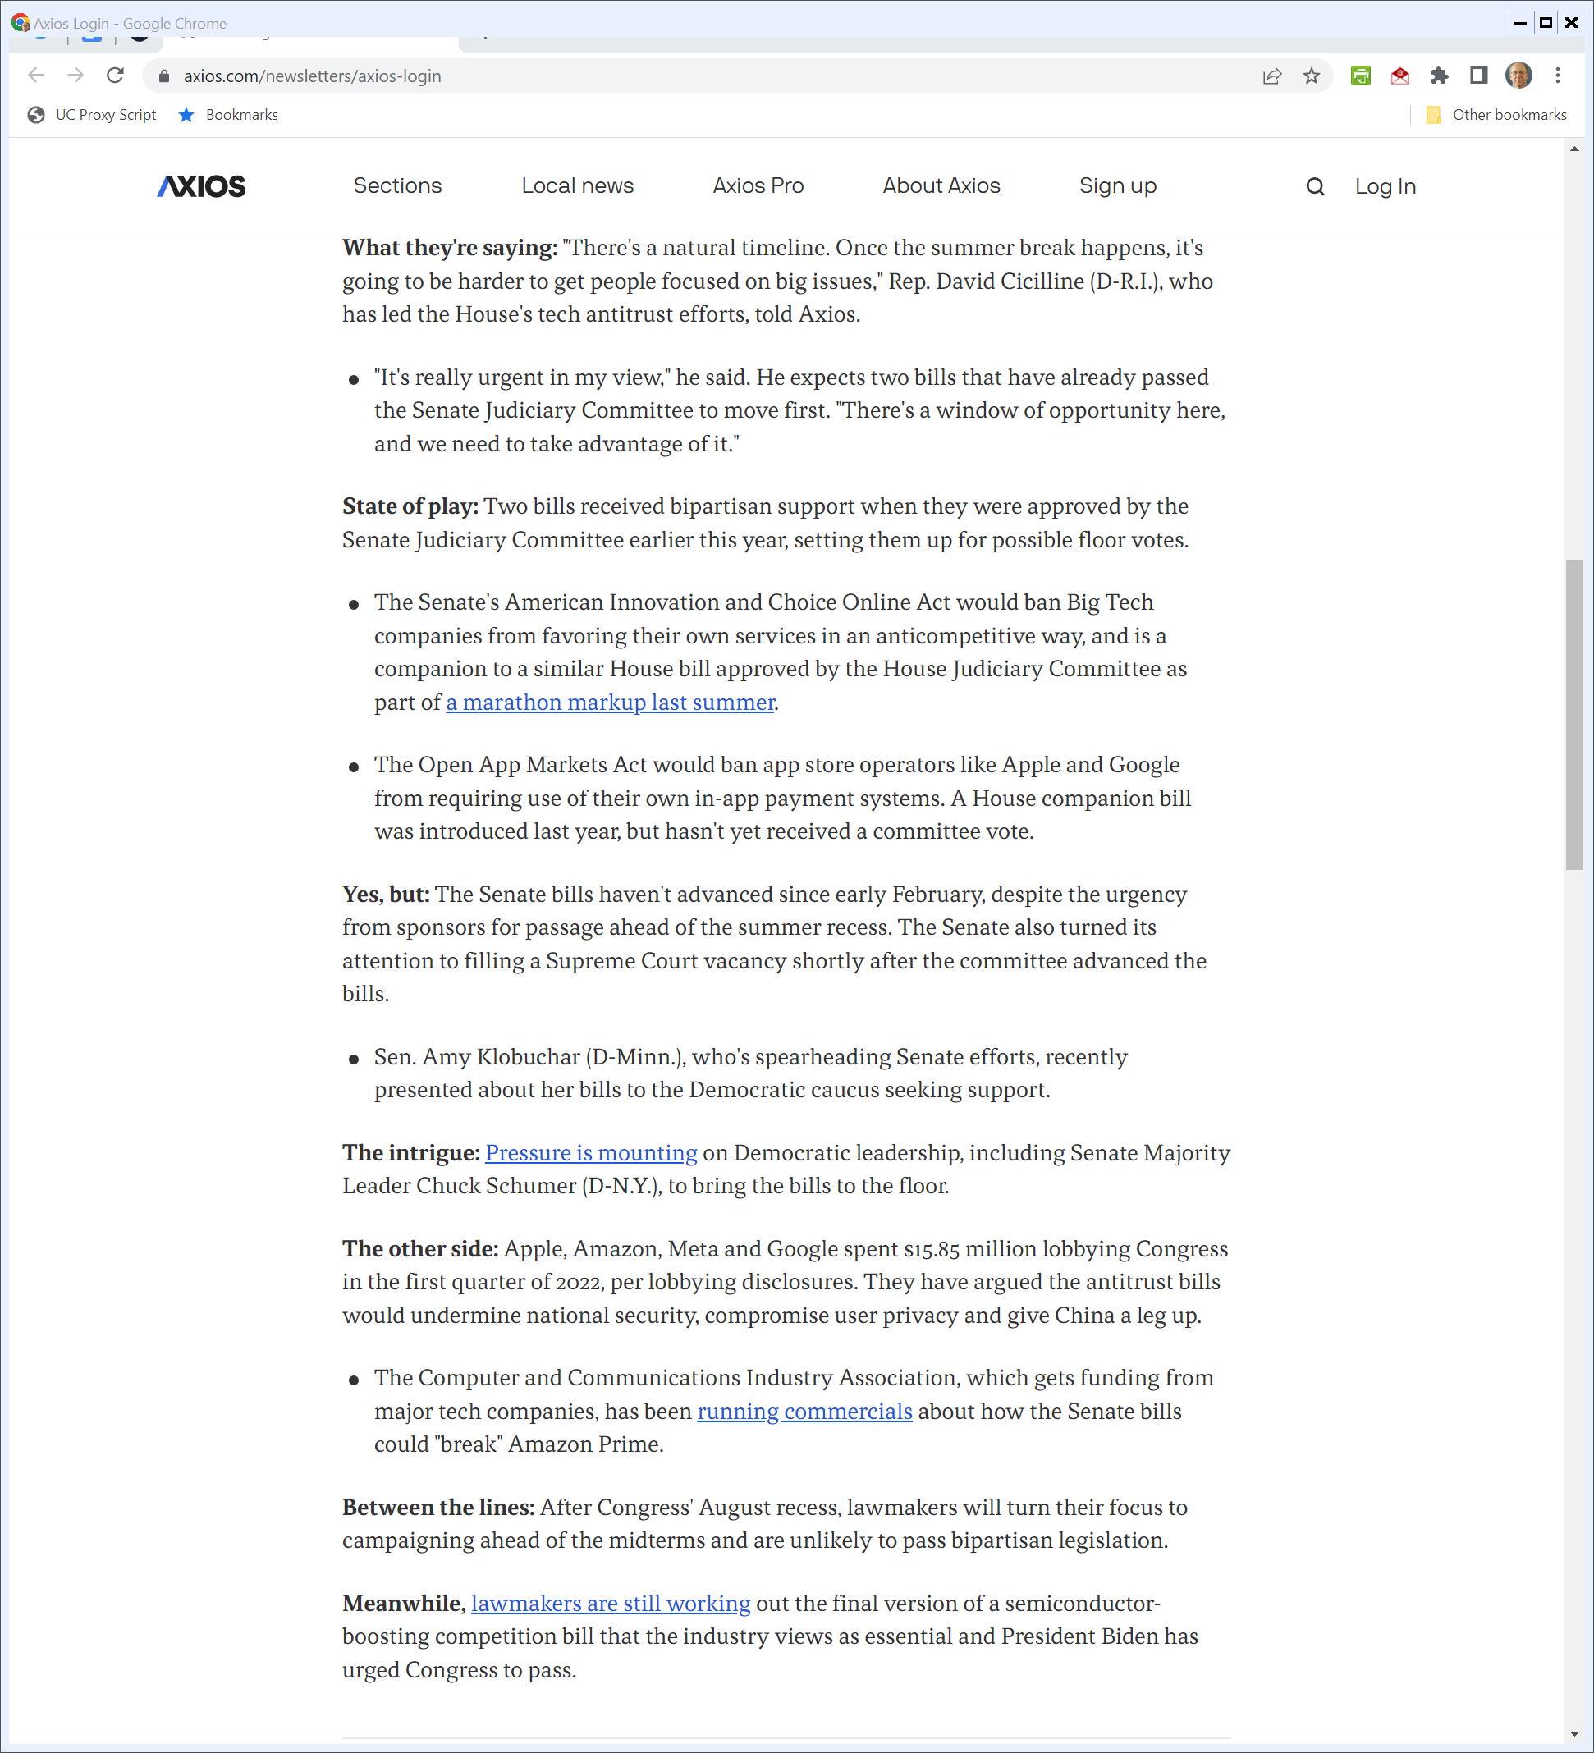
And in Congress?
Axios (5 May 2022)
Notes:
https://www.axios.com/newsletters/axios-login

Slide 93
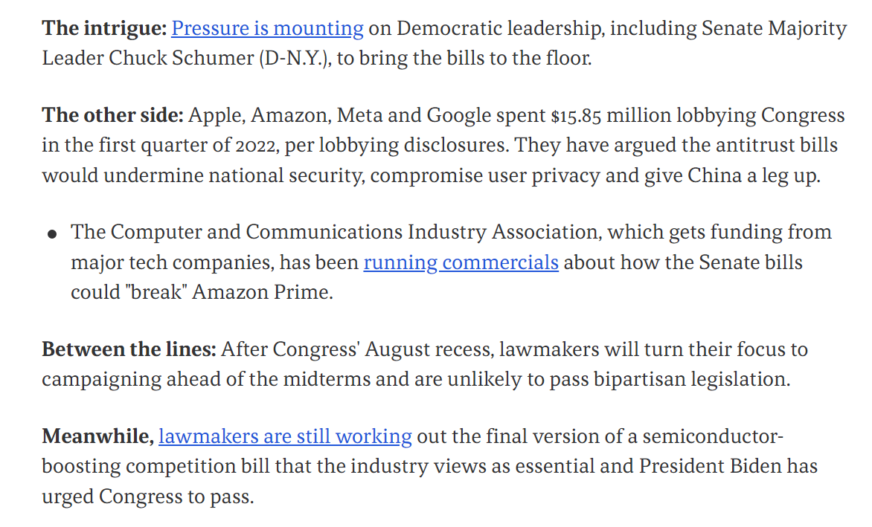
And in Congress?
Axios (5 May 2022)
Notes:
https://www.axios.com/newsletters/axios-login

Slide 94
And in Congress?
Axios (5 May 2022)
Notes:
https://www.axios.com/newsletters/axios-login

