Slide 1
Class 20 Platforms and Networks Spring 2022 Regulating Big Tech: Microsoft Remedies
Randal C. Picker
James Parker Hall Distinguished Service Professor of Law
The Law School
The University of Chicago
Copyright © 2019-22 Randal C. Picker. All Rights Reserved.

Slide 2
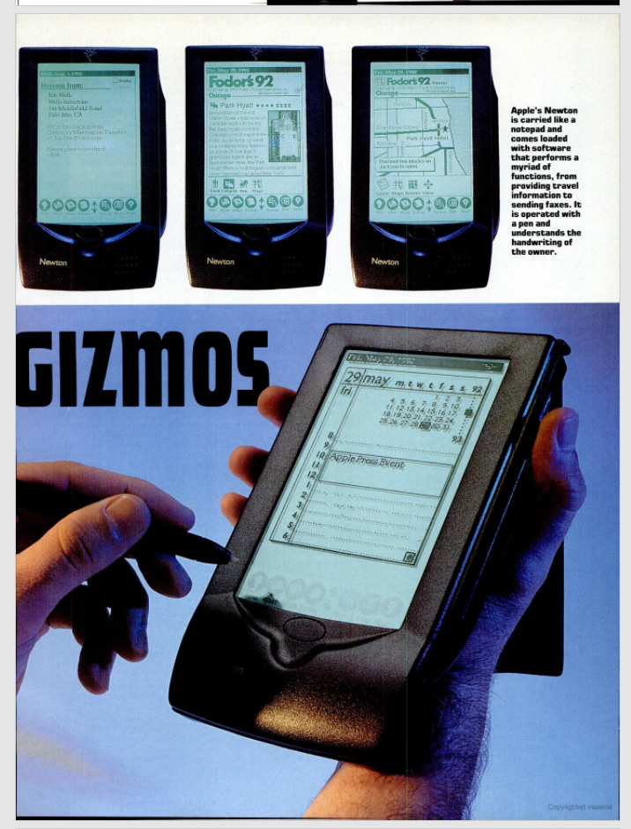
The Apple Newton
NY Magazine (17 Aug 1992)

Slide 3
Jan 95: MS Moves Online
New York Times (13 Jan 1995)

Slide 4
Moore’s Law and Software
“Our vision for the last 20 years can be summarized in a succinct way. We saw that exponential improvements in computer capabilities would make great software quite valuable. Our response was to build an organization to deliver great software products.”
Bill Gates, Internet Tidal Wave Memo (26 May 1995)

Slide 5
The Network is Next
“In the next 20 years the improvement in computer power will be outpaced by the exponential improvements in communications networks. The combination of these elements will have a fundamental impact on work, learning and play.”
Bill Gates, Internet Tidal Wave Memo (26 May 1995)

Slide 6
The Internet: Highest Importance
“The Internet is at the forefront of all of this and developments on the Internet over the next several years will set the course of our industry for a long time to come. … Now I assign the Internet the highest level of importance.”
Bill Gates, Internet Tidal Wave Memo (26 May 1995)

Slide 7
(Internet = IBM PC) > GUI
“The Internet is the most important single development to come along since the IBM PC was introduced in 1981. It is even more important than the arrival of the graphical user interface (GUI).”
Bill Gates, Internet Tidal Wave Memo (26 May 1995)

Slide 8
The Netscape Threat
“A new competitor ‘born’ on the Internet is Netscape. Their browser is dominant, with 70% usage share … . They are pursuing a multi-platform strategy where they move the key API into the client to commoditize the underlying operating system.”
Bill Gates, Internet Tidal Wave Memo (26 May 1995)

Slide 9
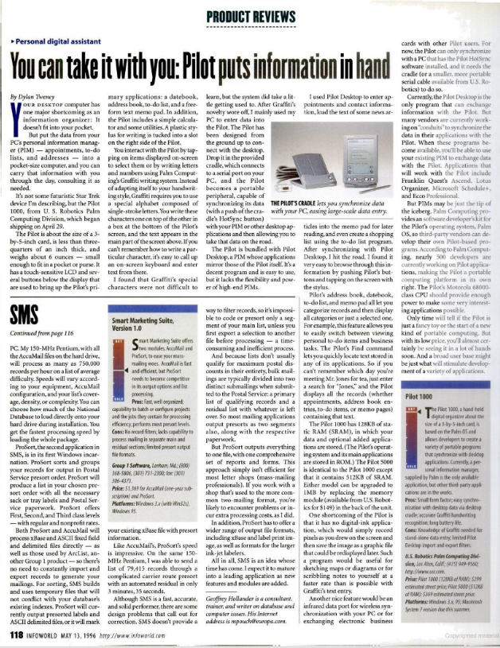
May 1996: Palm Pilot
InfoWorld (13 May 1996)

Slide 10
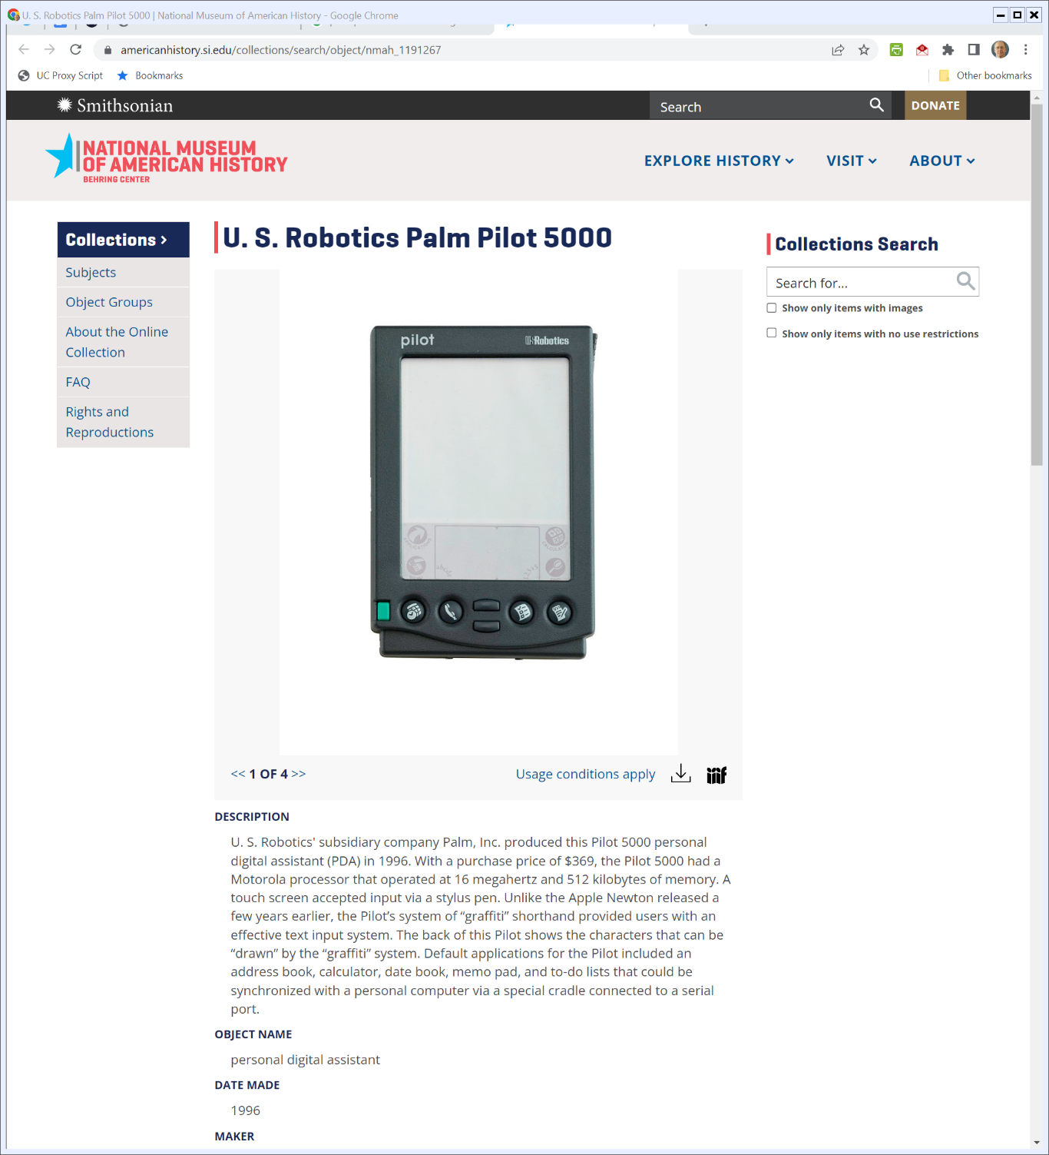

PDA: Personal Digital Assistant
Smithsonian (Visited 4 May 2022)
Notes:
https://americanhistory.si.edu/collections/search/object/nmah_1191267

Slide 11
1998 Complaint
US v Microsoft (18 May 1998)

Slide 12
Netscape’s API Platform Strategy (Middleware)
Developers
Developers
Navigator and Java
W OS
M OS
Consumers
Consumers

Slide 13
July 1999: The State of the Browser Market
Bill Gate Email (11 July 1999)

Slide 14
July 1999: Handhelds and Voice
Bill Gate Email (11 July 1999)

Slide 15
July 1999: Using Office to Alter PDA Competition
Bill Gate Email (11 July 1999)

Slide 16
June 2020: Breakup Ordered
New York Times (8 June 2000)

Slide 17
Original Breakup Remedy (TTYN (1 of 3))
“Not later than four months after entry of this Final Judgment, Microsoft shall submit to the Court and the Plaintiffs a proposed plan of divestiture.”
US v. Microsoft (DDC 7 June 2000)

Slide 18
Original Breakup Remedy (TTYN (2 of 3))
New MS 1: OfficeCo (and copy of IE and can modify it)
Microsoft
New MS 2: WindowsCo (and copy of IE (but can’t modify it))
US v. Microsoft (DDC 7 June 2000)

Slide 19
The MS Break Up
TTYN (3 of 3)
MS loses at trial on 3 Apr 2000
Key Questions
What was the point of the planned break up?
How would that have altered competition?
How does the break up compare to the AT&T break up?

Slide 20
Separate OS and Apps
Microsoft Break Up Order (7 June 2000)

Slide 21
Treatment of IE: Entry Path Limits
Microsoft Break Up Order (7 June 2000)

Slide 22
API Parity
Microsoft Break Up Order (7 June 2000)

Slide 23
Mandatory API Disclosure (and Note Handhelds)
Microsoft Break Up Order (7 June 2000)

Slide 24
With and Without Versions with Pro Rata Discount
Microsoft Break Up Order (7 June 2000)

Slide 25
Nov 2001: U.S./MS Settlement
New York Times (3 Nov 2001)

Slide 26
Baby Bills: A Break Up Alternative
TTYN (1 of 4)
Idea
IP is public good with zero marginal cost; can create copies for free
Split MS vertically giving each new firm a copy of Windows, Office and IE
Competition for free?

Slide 27
Open Source IE
TTYN (2 of 4)
As Proposed by the States
“Microsoft ... disclose and license all source code for all Browser software [and that the license] grant a royalty-free, non-exclusive perpetual right on a non-discriminatory basis to make, use, modify and distribute without limitation products implementing or derived from Microsoft’s source code....”

Slide 28
Java/Navigator Must Carry
TTYN (3 of 4)
As Proposed by the States
“For a period of 10 years from the date of entry of the Final Judgment, Microsoft shall distribute free of charge, in binary form, with all copies of its Windows Operating System Product and Browser ... a competitively performing Windows-compatible version of the Java runtime environment

Slide 29
Java/Navigator Must Carry
TTYN (4 of 4)
As Proposed by the States
“... compliant with the latest Sun Microsystems Technology Compatibility Kit.”
What would this accomplish? Does this raise the same issues as the open-source IE remedy?

Slide 30
Thinking About Remedies
Try this
Absent the illegal conduct, what would the industry look like today?
Suppose that I could prove that the market shares of Netscape and IE would have been 90/10 in 2000 but were instead 50/50 because of the illegal conduct

Slide 31
Thinking About Remedies
Try this
Are there remedies available that would create that position?
Does that mean blocking the distribution of IE for some period? Mandating the distribution by MS of NN for some period?

Slide 32
Thinking About Remedies
Try this
Is that protecting competition or “market engineering aimed at protecting a specific competitor?”

Slide 33
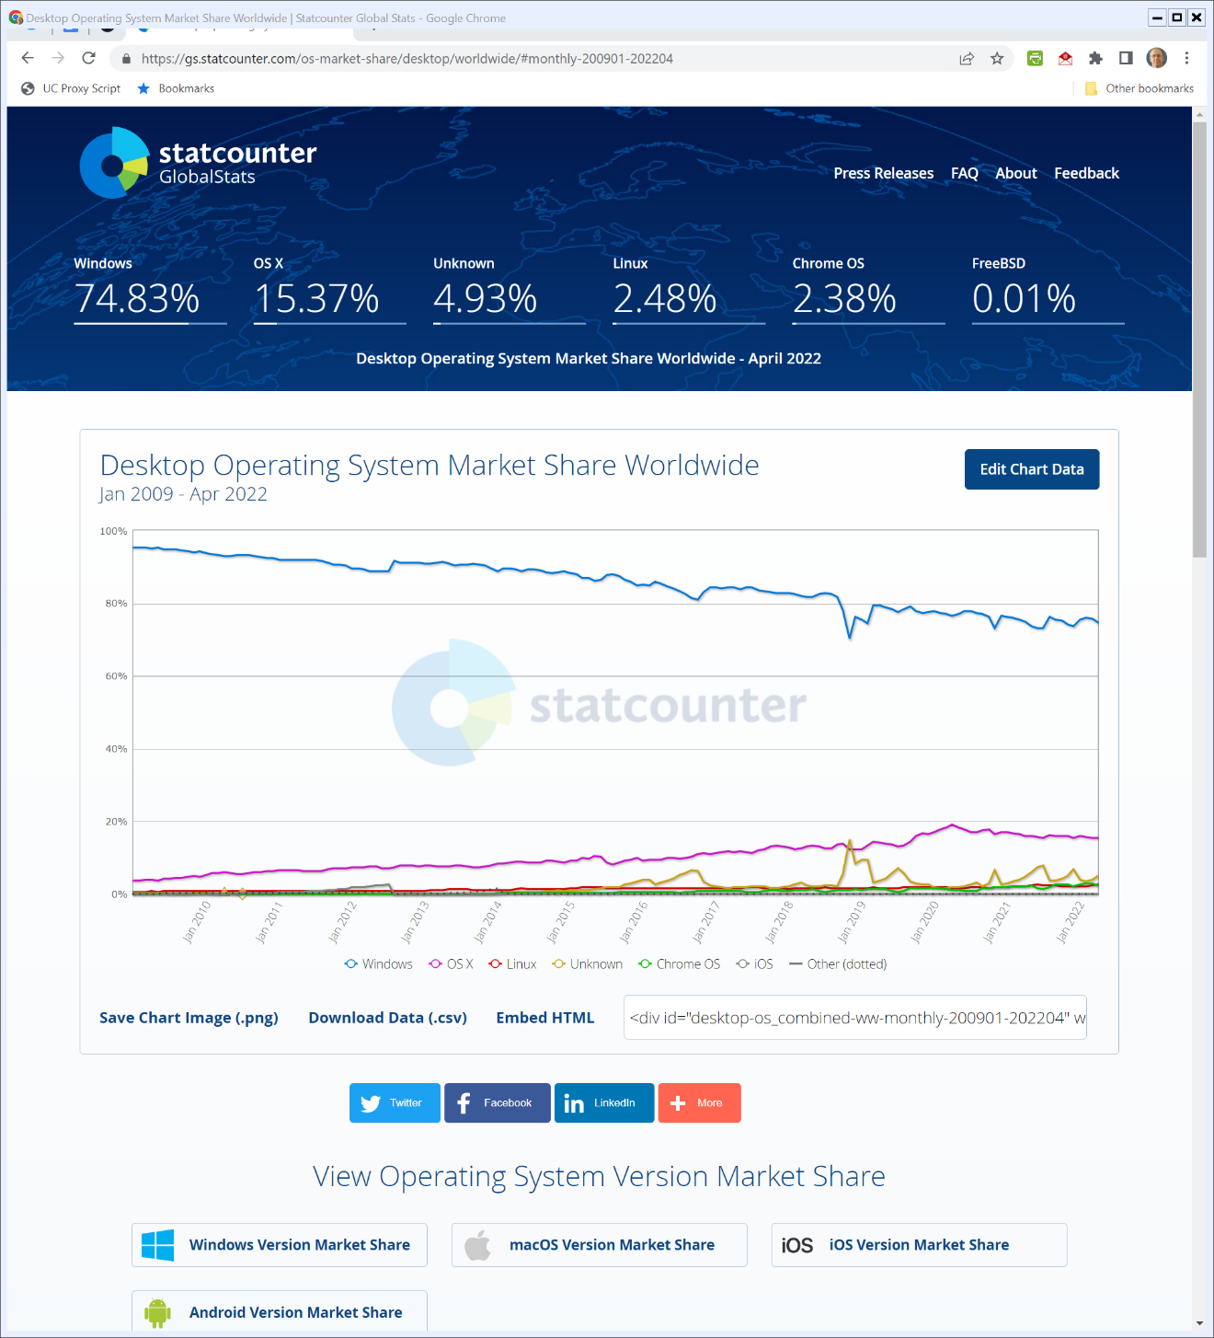

Desktop OS Market Share (TTYN (1 of 3))
Statcounter.com (3 May 2022)
Notes:
https://gs.statcounter.com/os-market-share/desktop/worldwide/#monthly-200901-202204

Slide 34
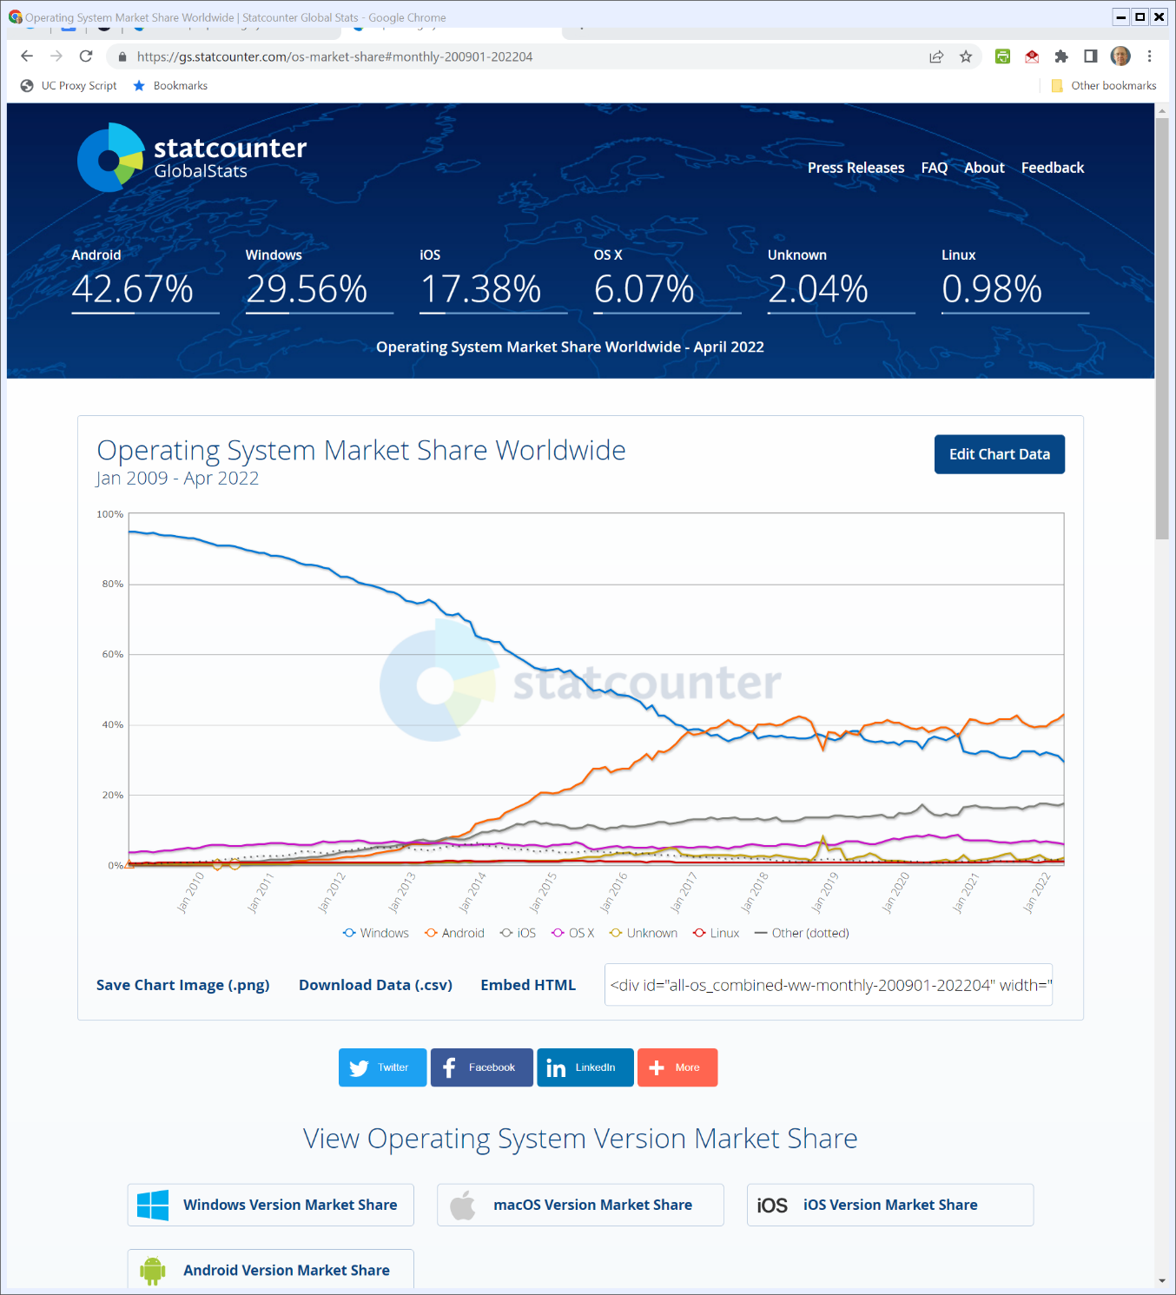

OS Market Shares (TTYN (2 of 3))
Statcounter.com (3 May 2022)
Notes:
https://gs.statcounter.com/os-market-share#monthly-200901-202204

Slide 35
Understanding the Charts
TTYN (3 of 3)
Questions
What do these two charts say about competition?
About antitrust remedies?

Slide 36
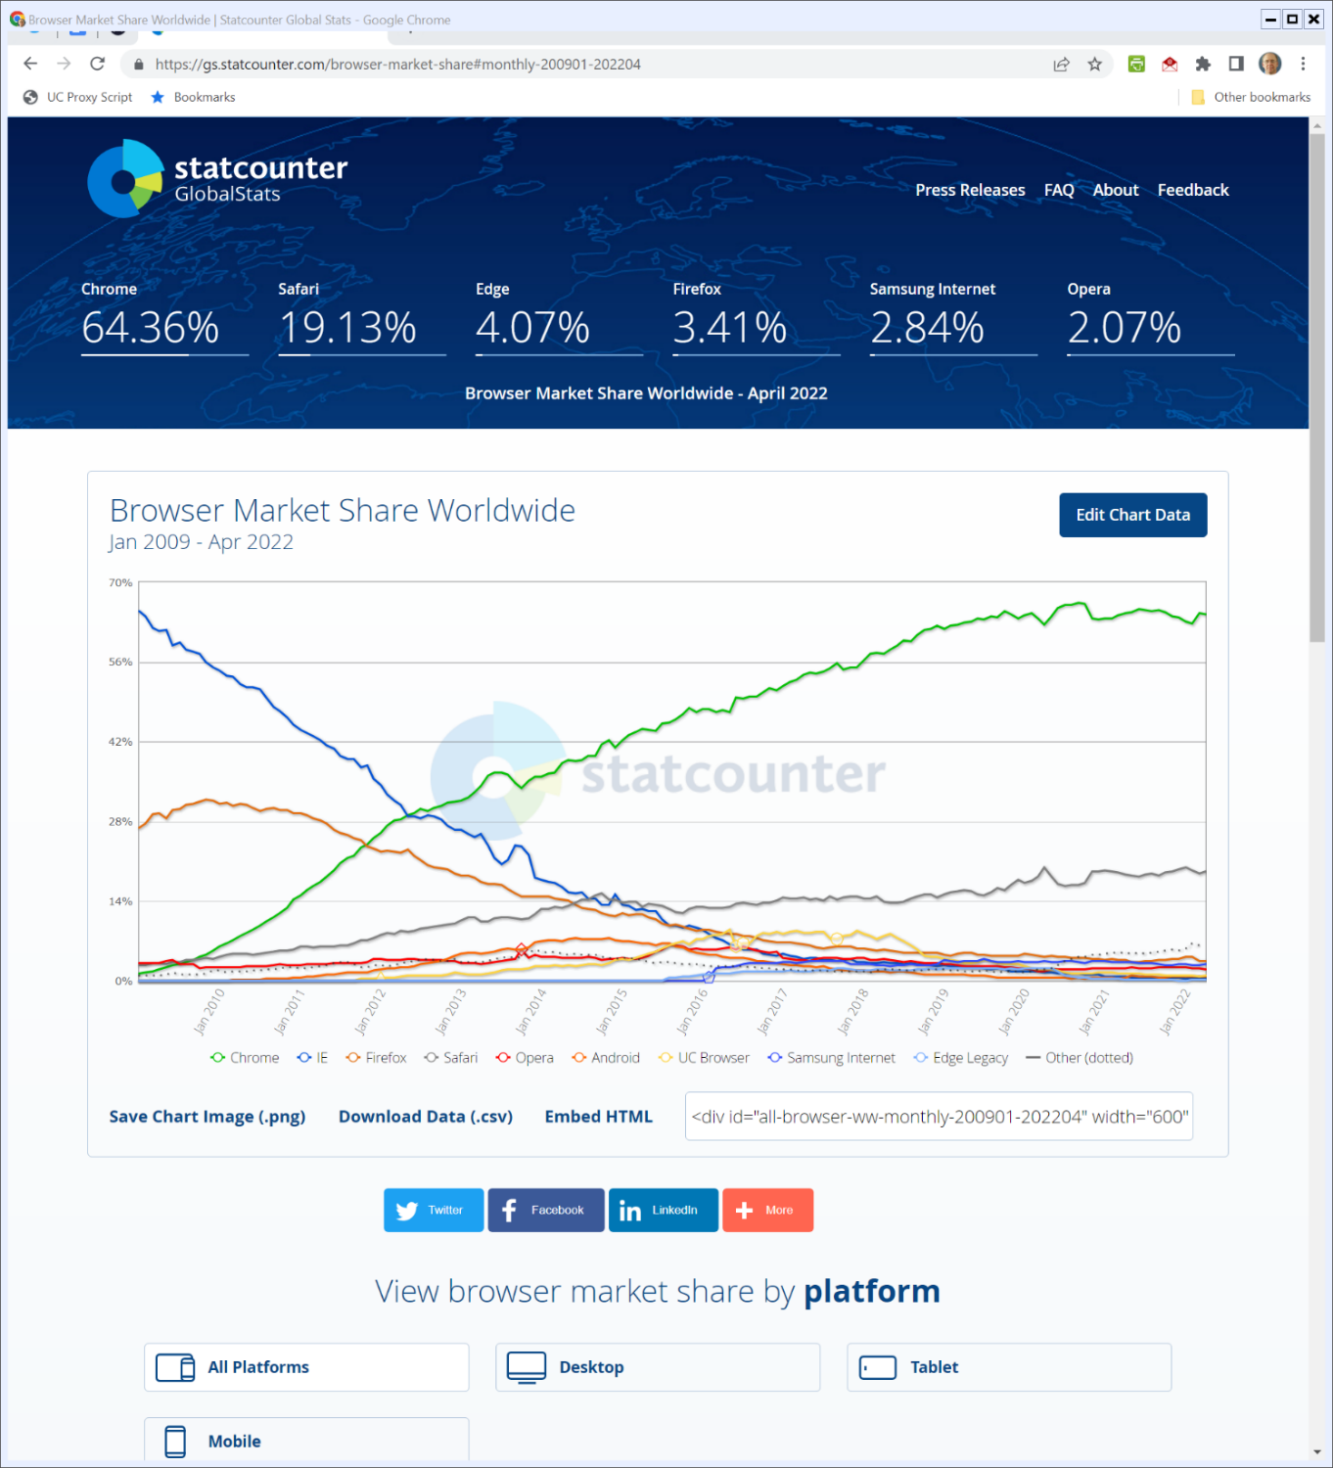

Browser Market Share (all Platforms) (TTYN (1 of 6))
Statcounter.com (3 May 2022)
Notes:
https://gs.statcounter.com/browser-market-share#monthly-200901-202204

Slide 37
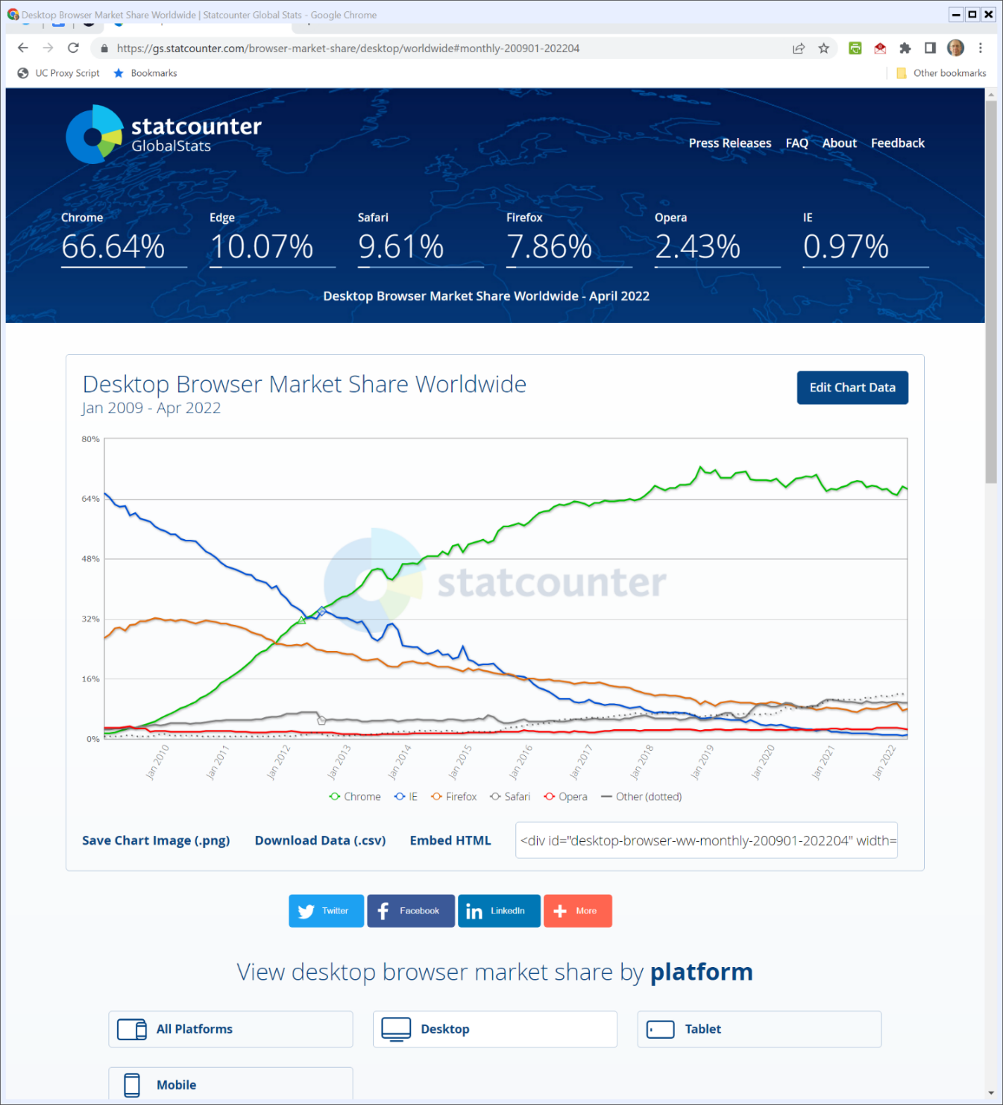

Browser Market Share (Desktop) (TTYN (2 of 6))
Statcounter.com (3 May 2022)
Notes:
https://gs.statcounter.com/browser-market-share/desktop/worldwide#monthly-200901-202204

Slide 38
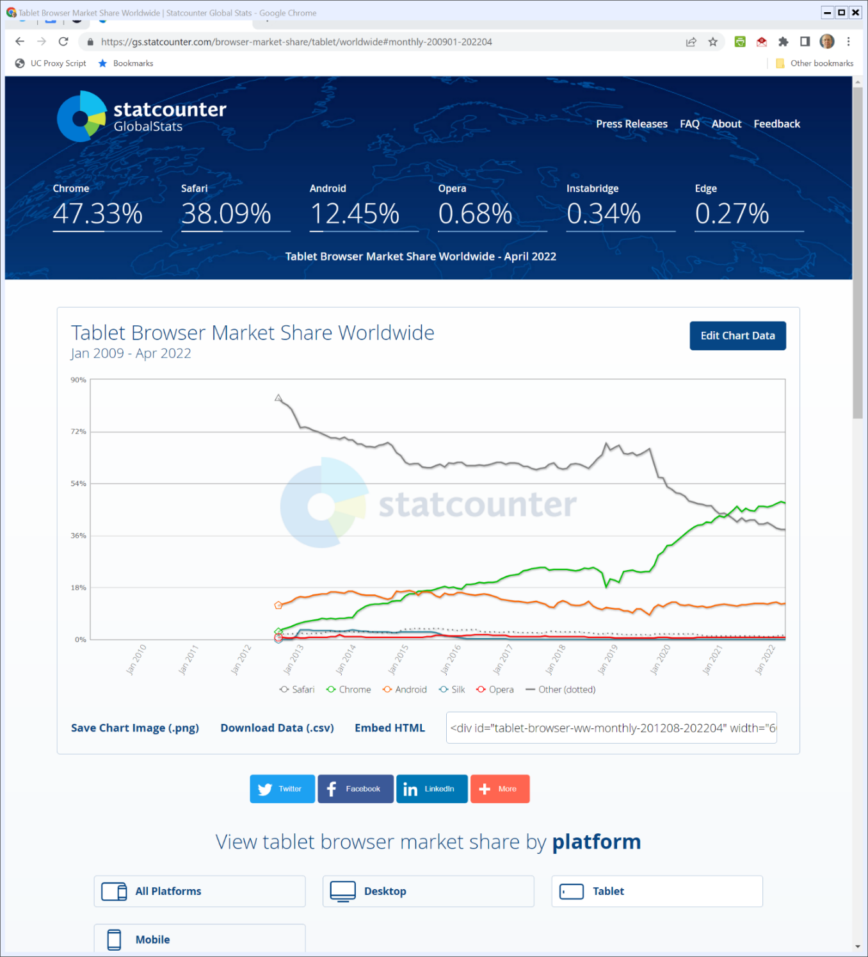

Browser Market Share (Tablet) (TTYN (3 of 6))
Statcounter.com (3 May 2022)
Notes:
https://gs.statcounter.com/browser-market-share/tablet/worldwide#monthly-200901-202204

Slide 39
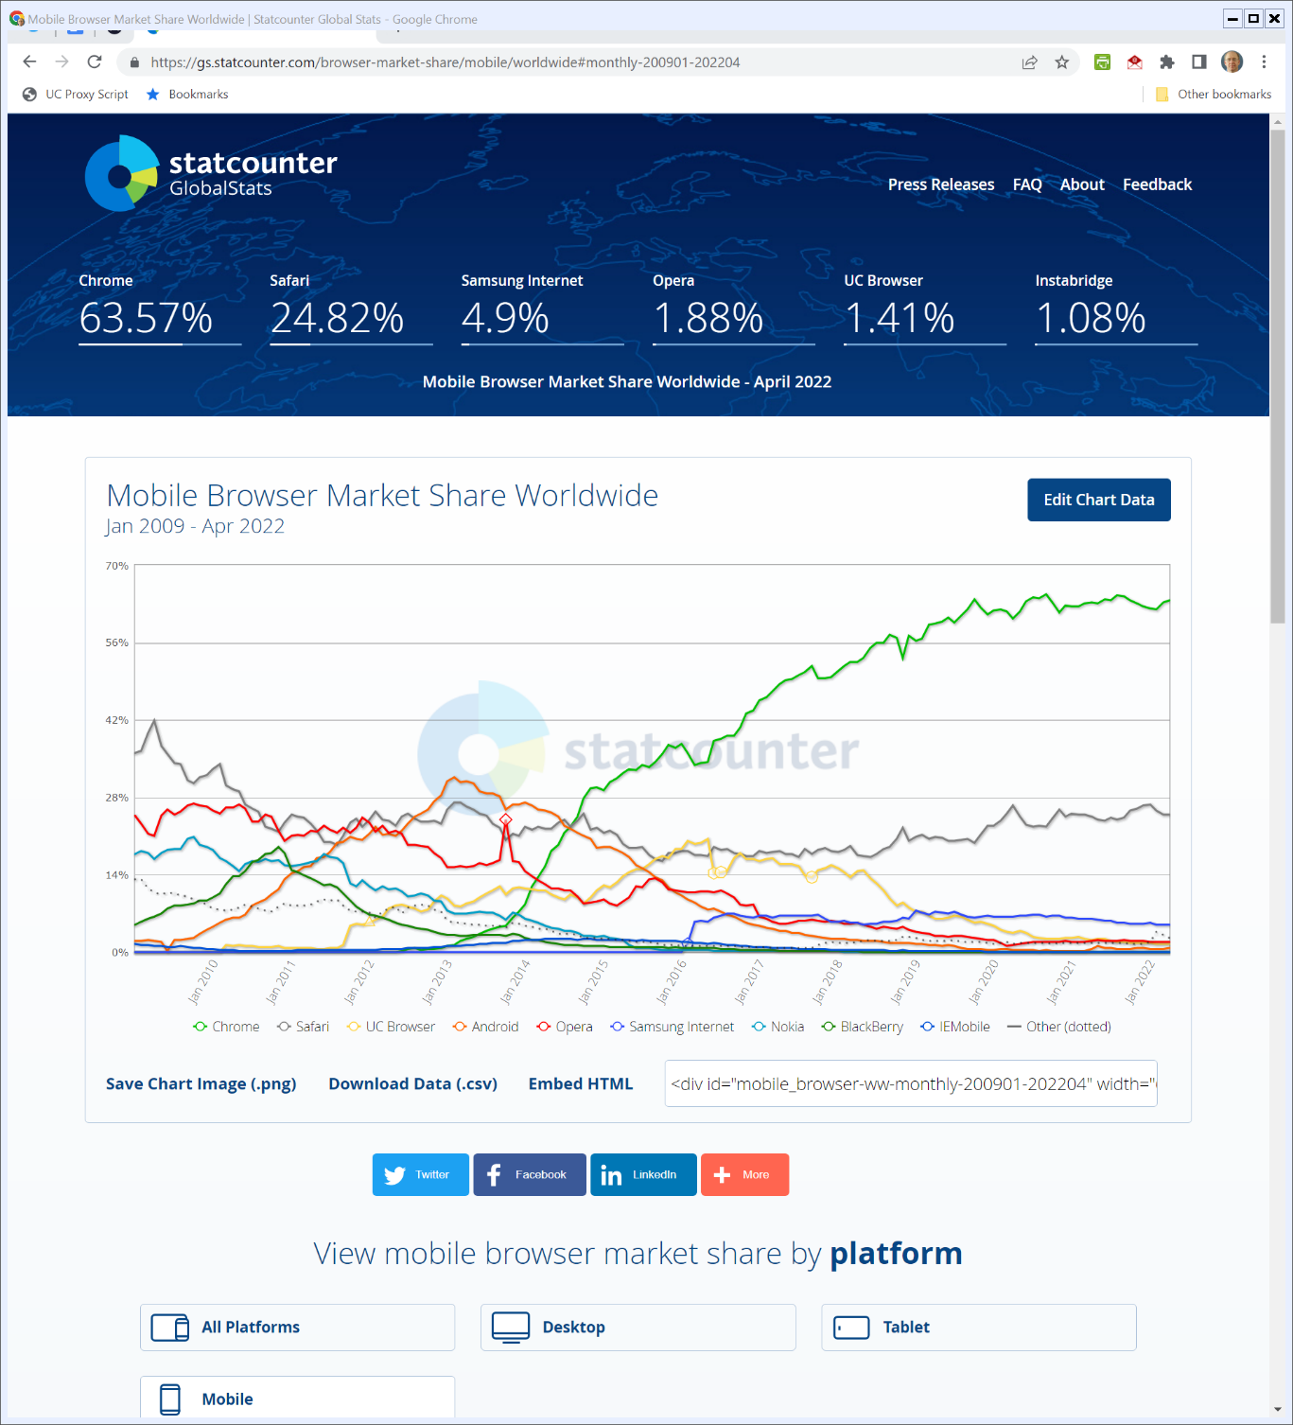

Browser Market Share (Mobile) (TTYN (4 of 6))
Statcounter.com (3 May 2022)
Notes:
https://gs.statcounter.com/browser-market-share/mobile/worldwide#monthly-200901-202204

Slide 40
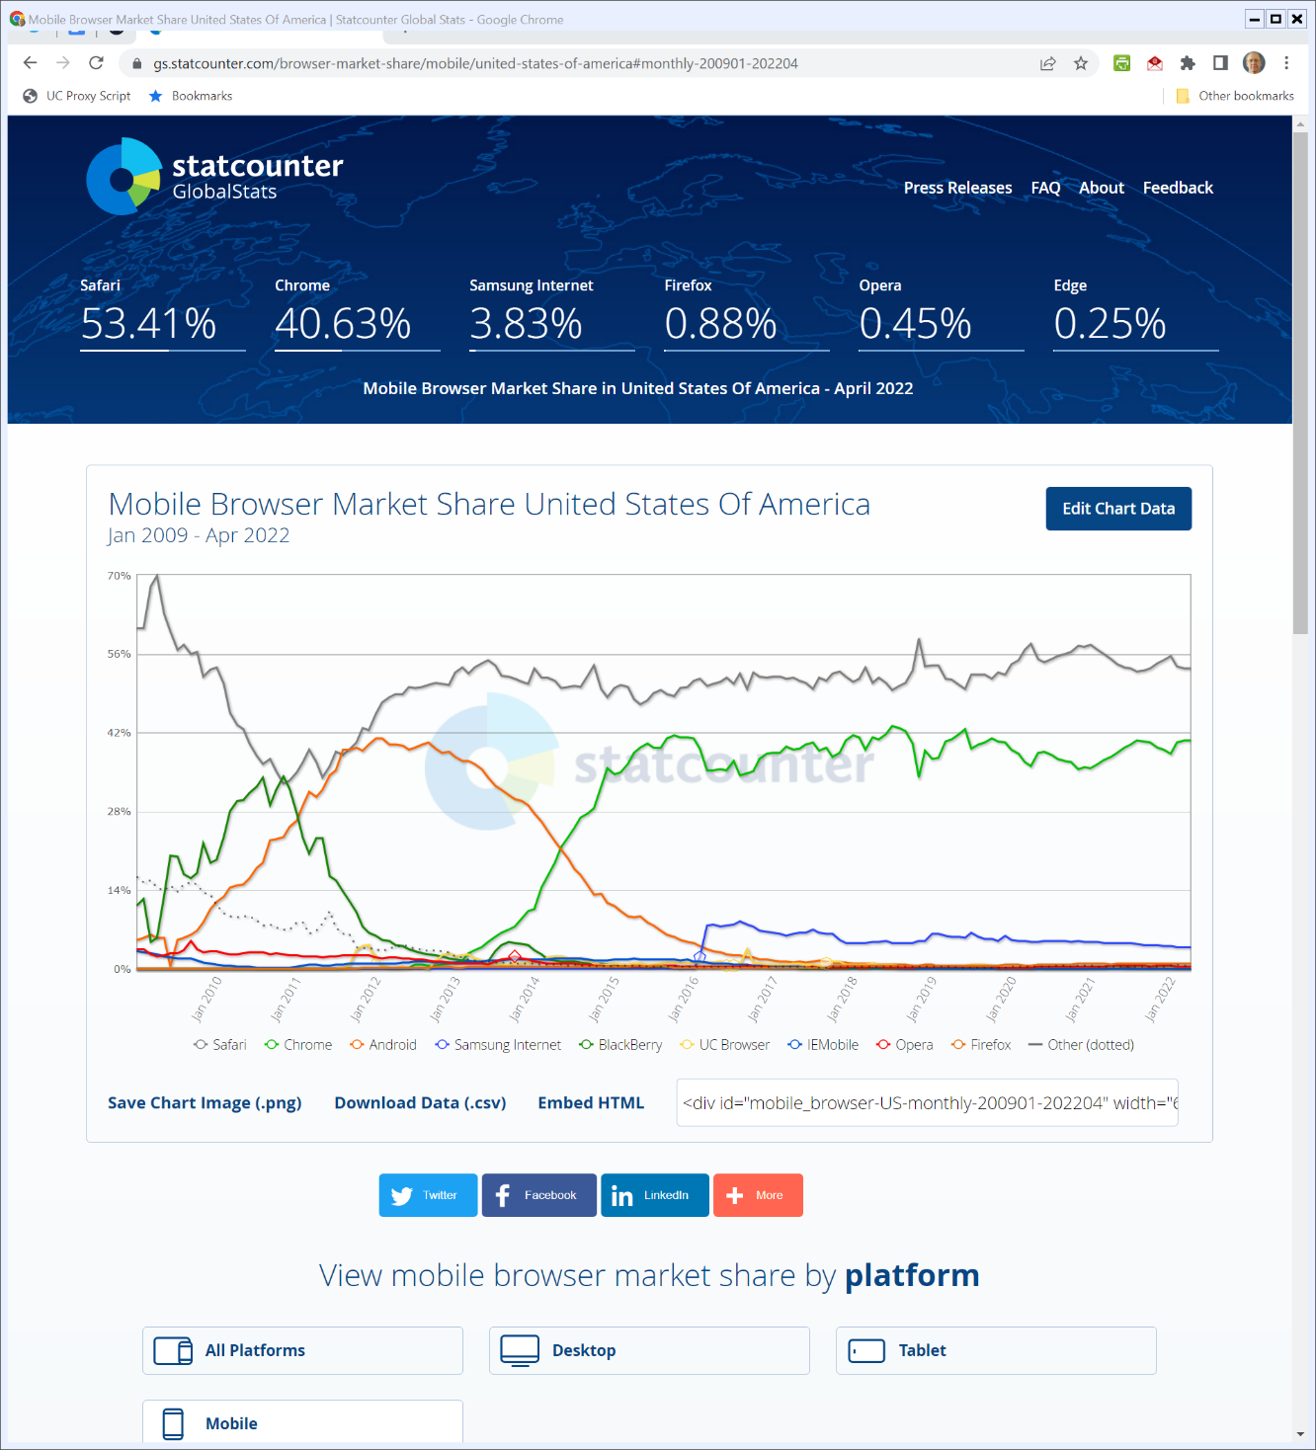

Browser Market Share (Mobile) (U.S.) (TTYN (5 of 6))
Statcounter.com (3 May 2022)
Notes:
https://gs.statcounter.com/browser-market-share/mobile/united-states-of-america#monthly-200901-202204

Slide 41
Understanding the Charts
TTYN (6 of 6)
Questions
What do these charts say about competition?
About antitrust remedies?

