Slide 1
Class 19
Platforms and Networks
Spring 2022
Market Engineering: EV Transition
Randal C. Picker
James Parker Hall Distinguished Service Professor of Law
The Law School
The University of Chicago
Copyright © 2022 Randal C. Picker. All Rights Reserved.

Slide 2
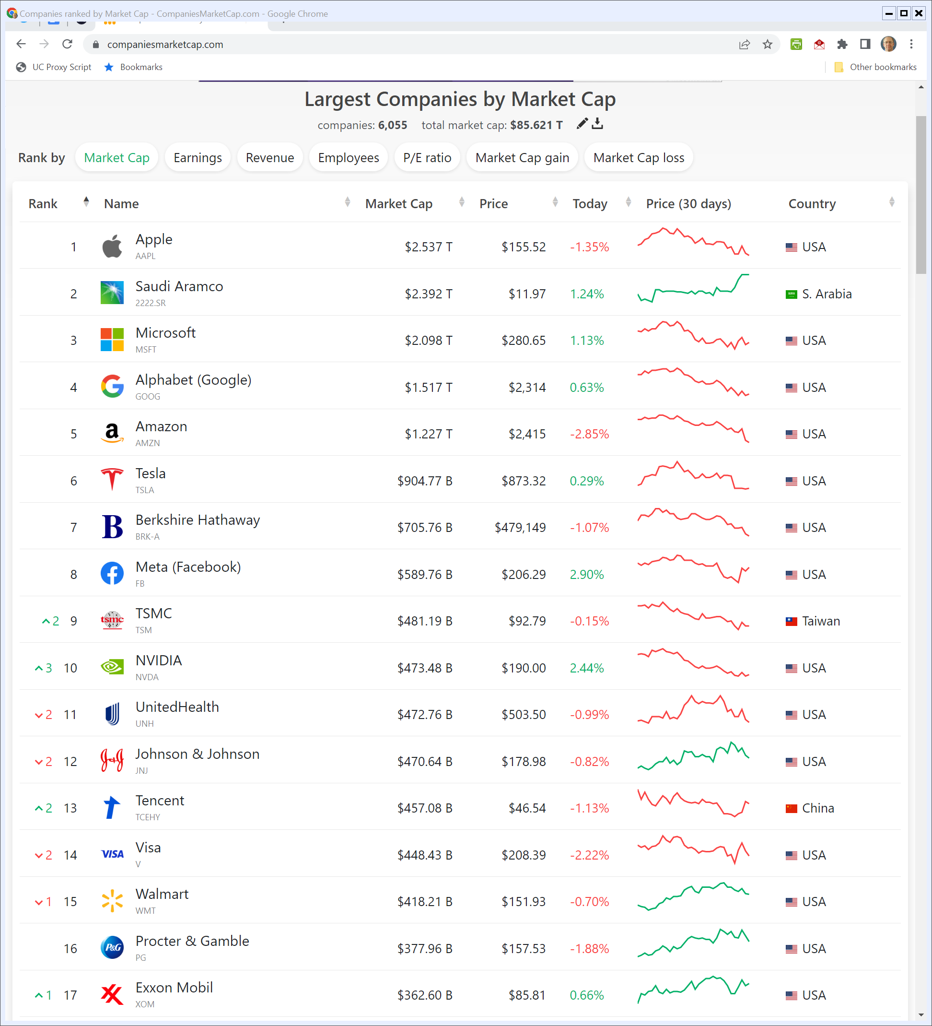
Firms by Market Cap
Companiesmarketcap.com (Visited 2 May 2022)
Notes:
https://companiesmarketcap.com/

Slide 3
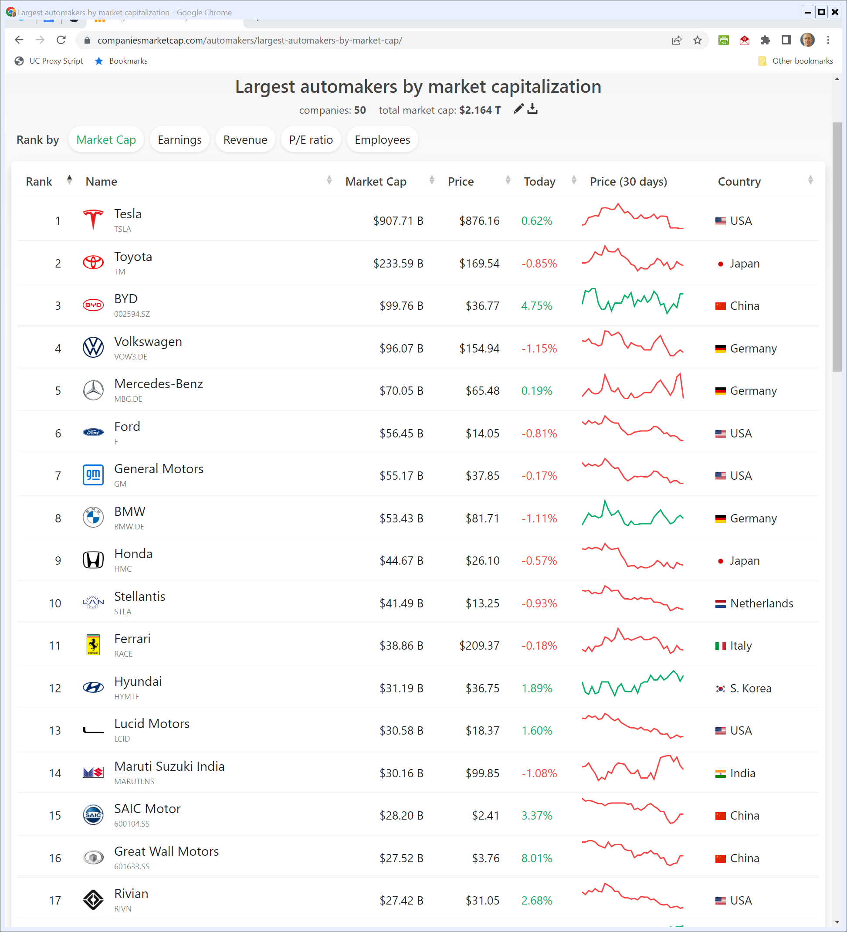
Car Firms by Market Cap
Companiesmarketcap.com (Visited 2 May 2022)
Notes:
https://companiesmarketcap.com/automakers/largest-automakers-by-market-cap/

Slide 4
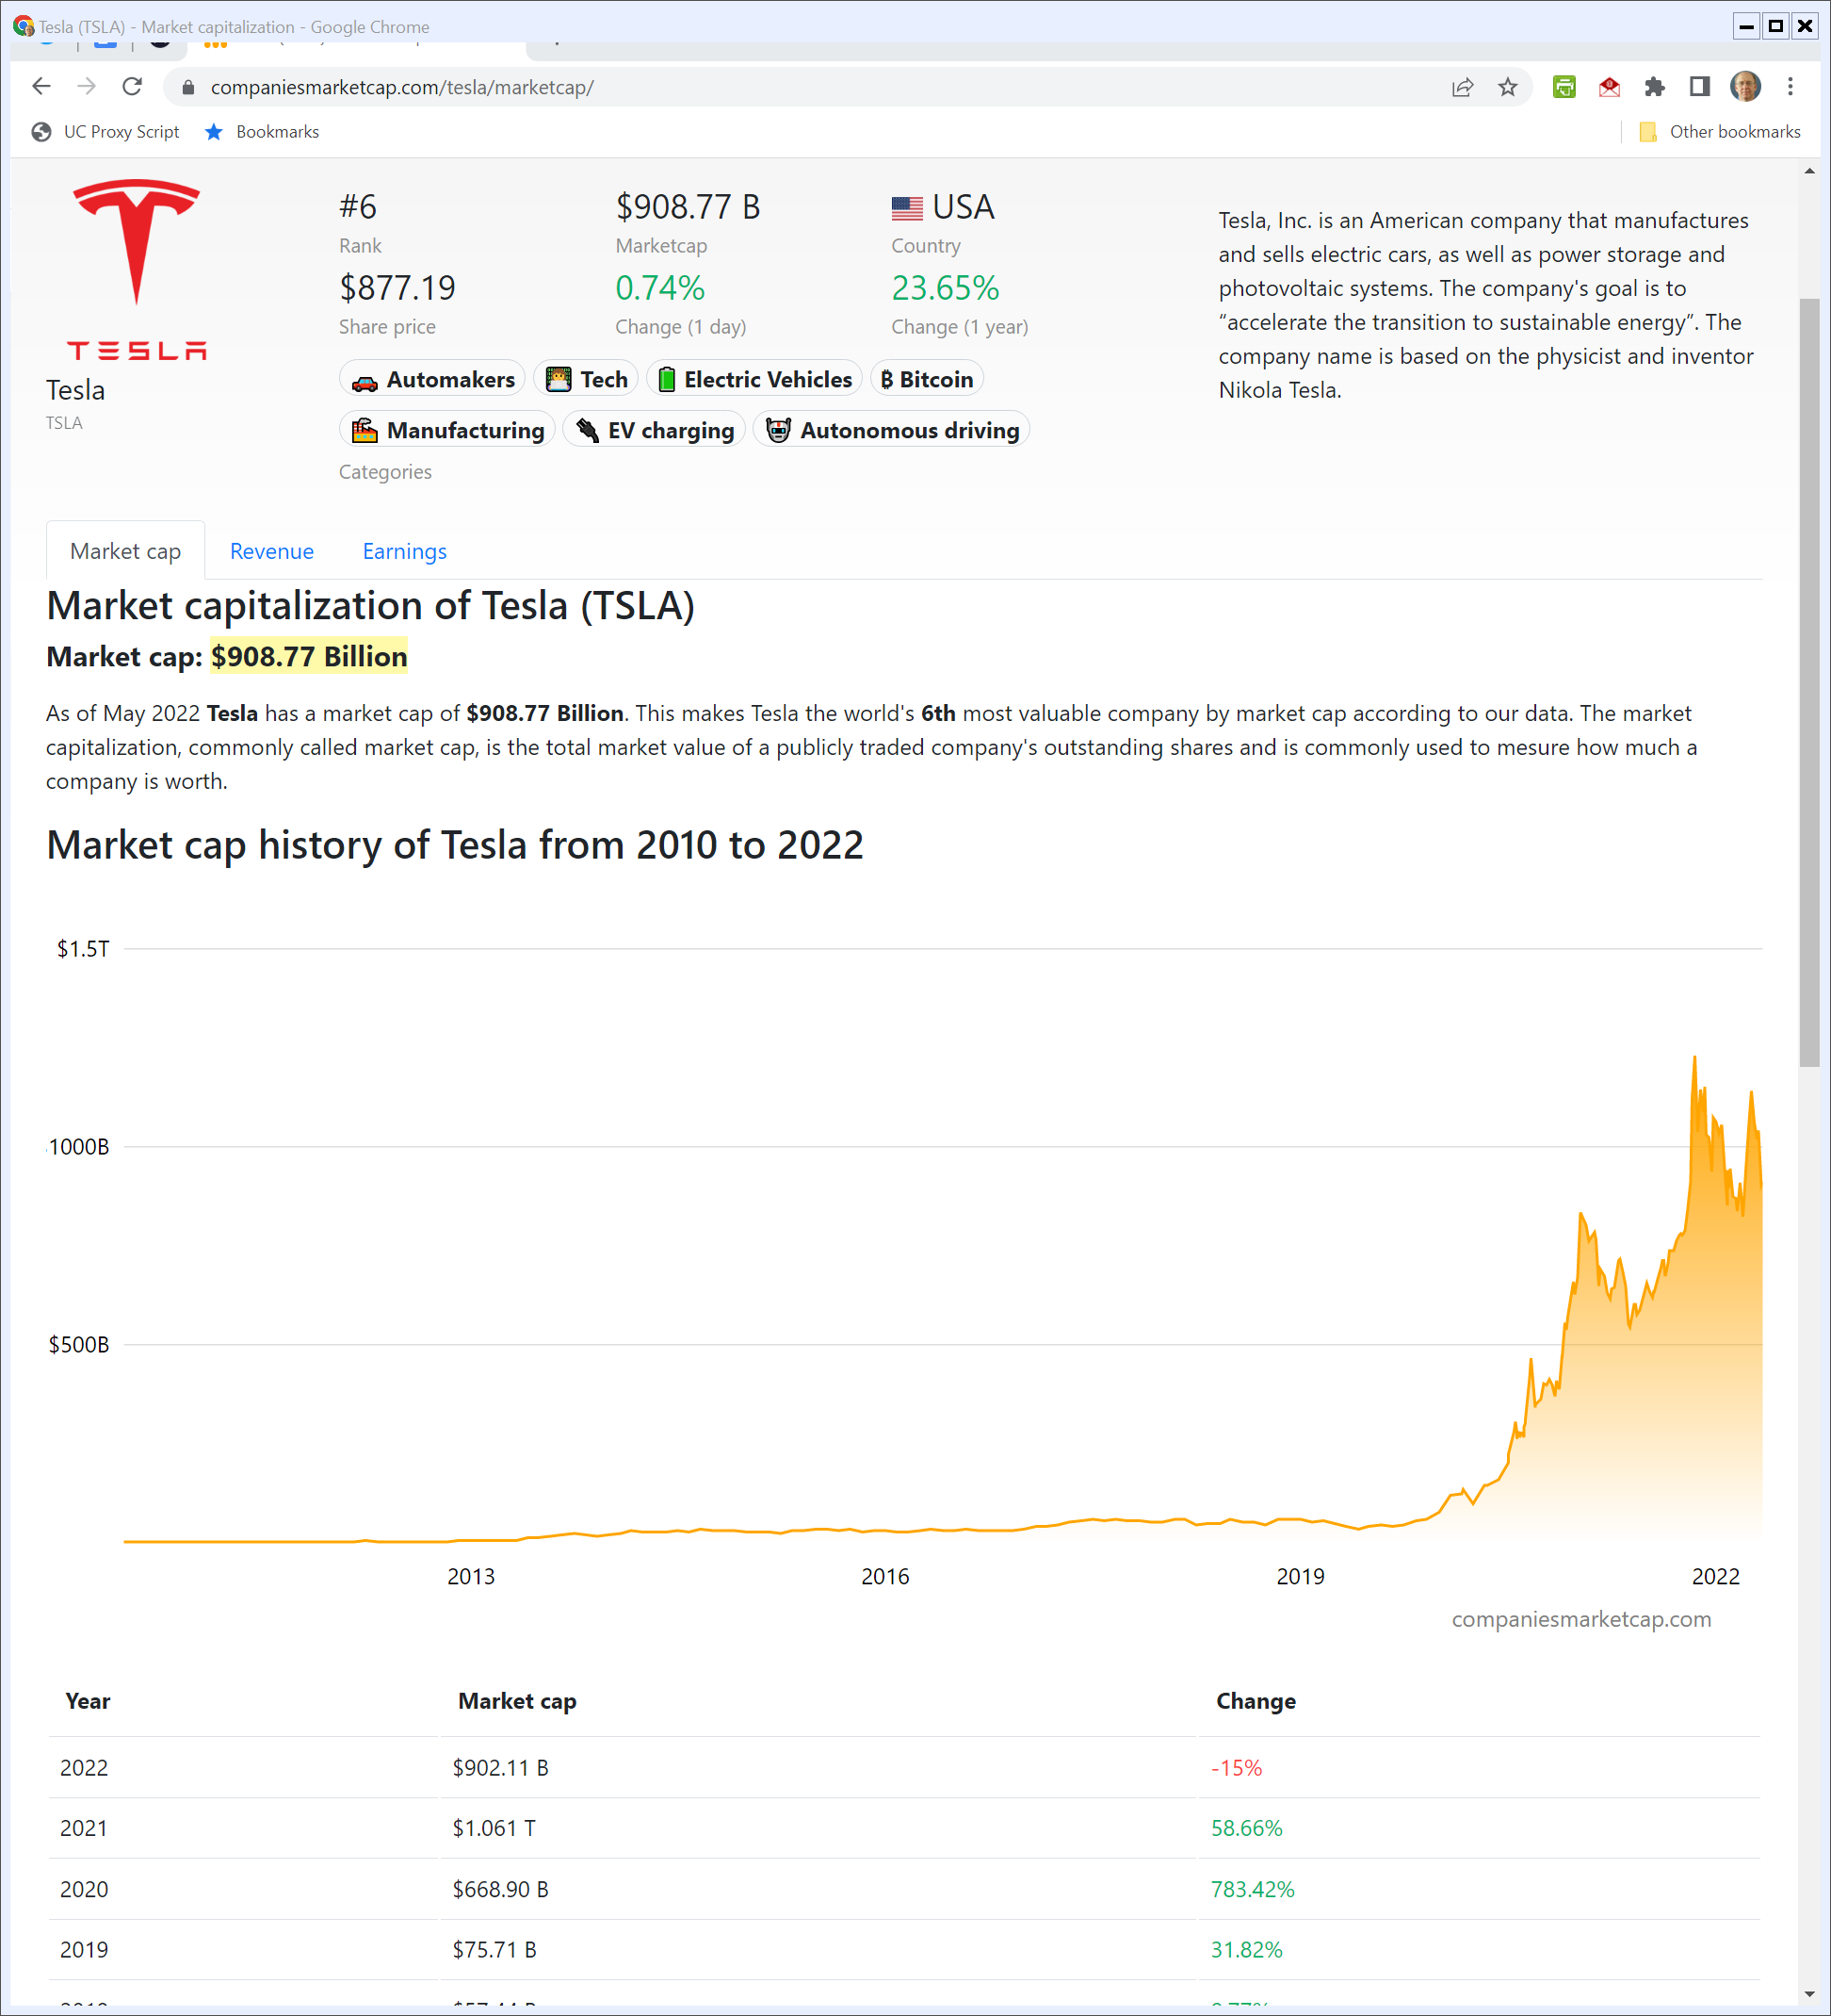
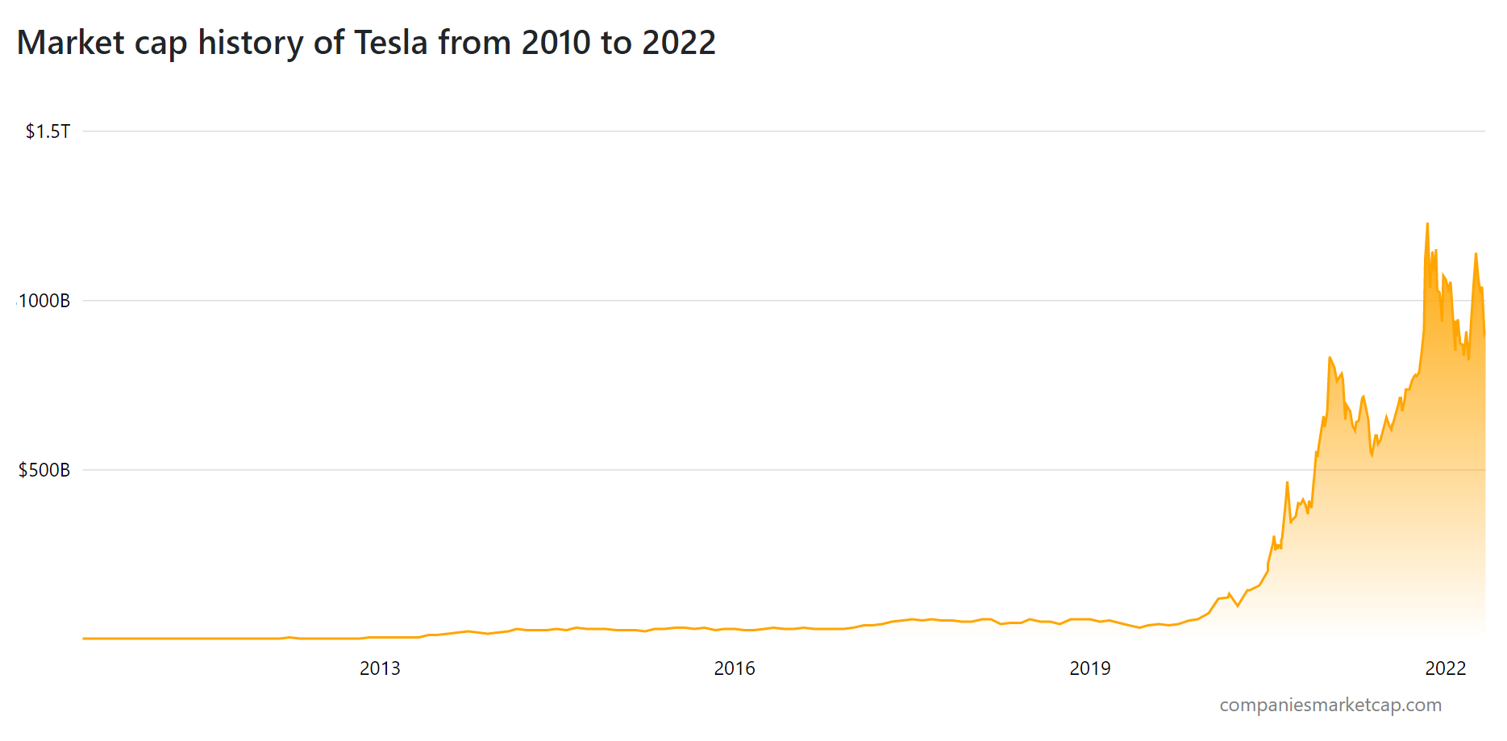
Tesla Market Cap History
Companiesmarketcap.com (Visited 2 May 2022)
Notes:
https://companiesmarketcap.com/tesla/marketcap/

Slide 5
Energy Policy Act of 2005
Pub. L. 109-58 (8 Aug 2005)

Slide 6
Title XVII Incentives
Pub. L. 109-58 (8 Aug 2005)

Slide 7
Sec. 1703 Projects
Pub. L. 109-58 (8 Aug 2005)

Slide 8
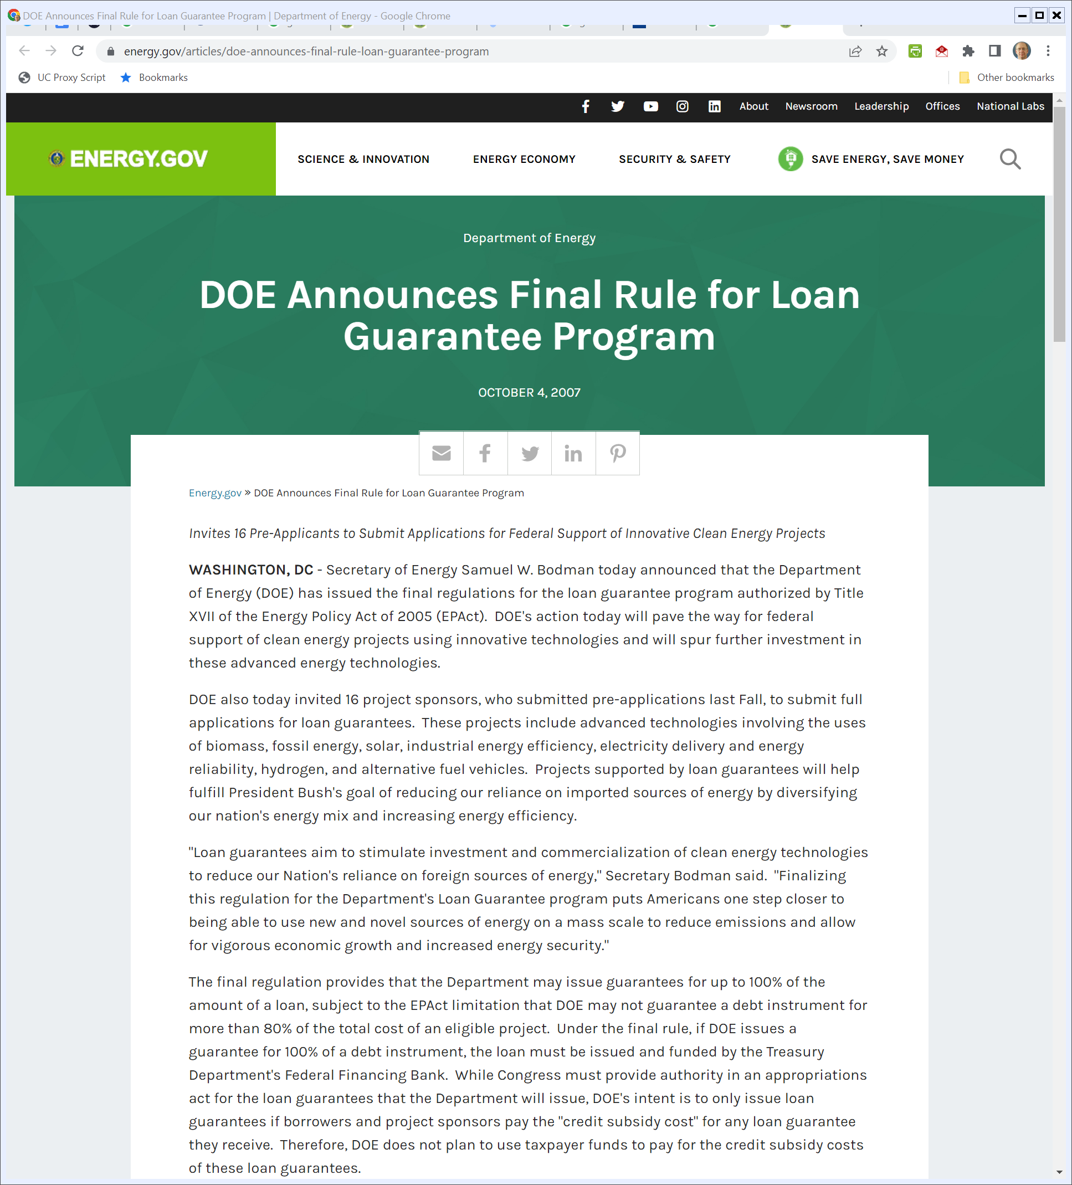
Oct 2007: DOE Loan Guarantee Regs
DOE (4 Oct 2007)
Notes:
https://www.energy.gov/articles/doe-announces-final-rule-loan-guarantee-program

Slide 9
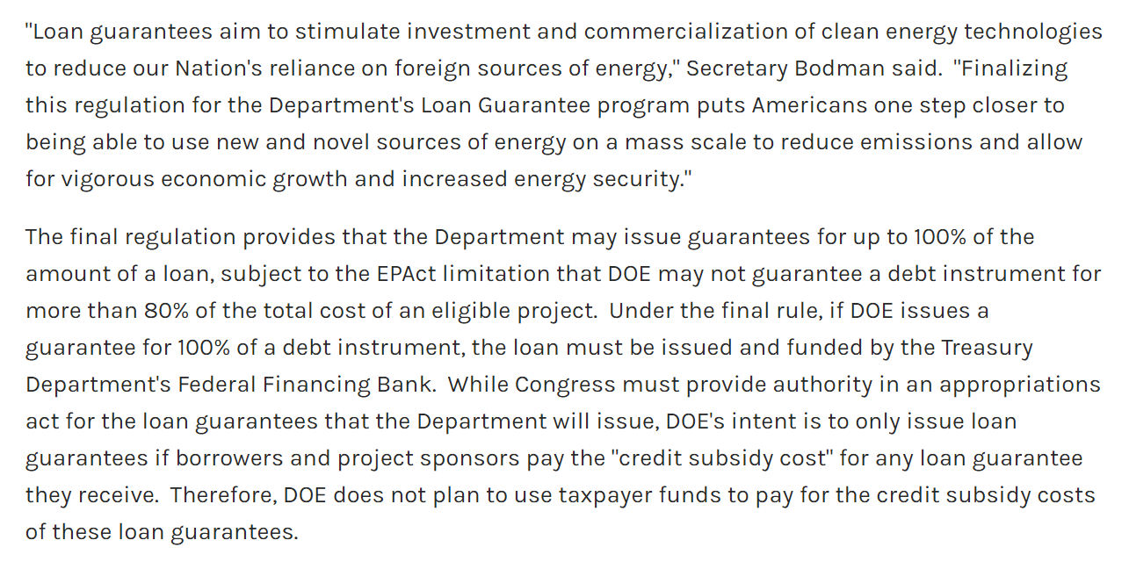
Financing Structure
DOE (4 Oct 2007)
Notes:
https://www.energy.gov/articles/doe-announces-final-rule-loan-guarantee-program

Slide 10
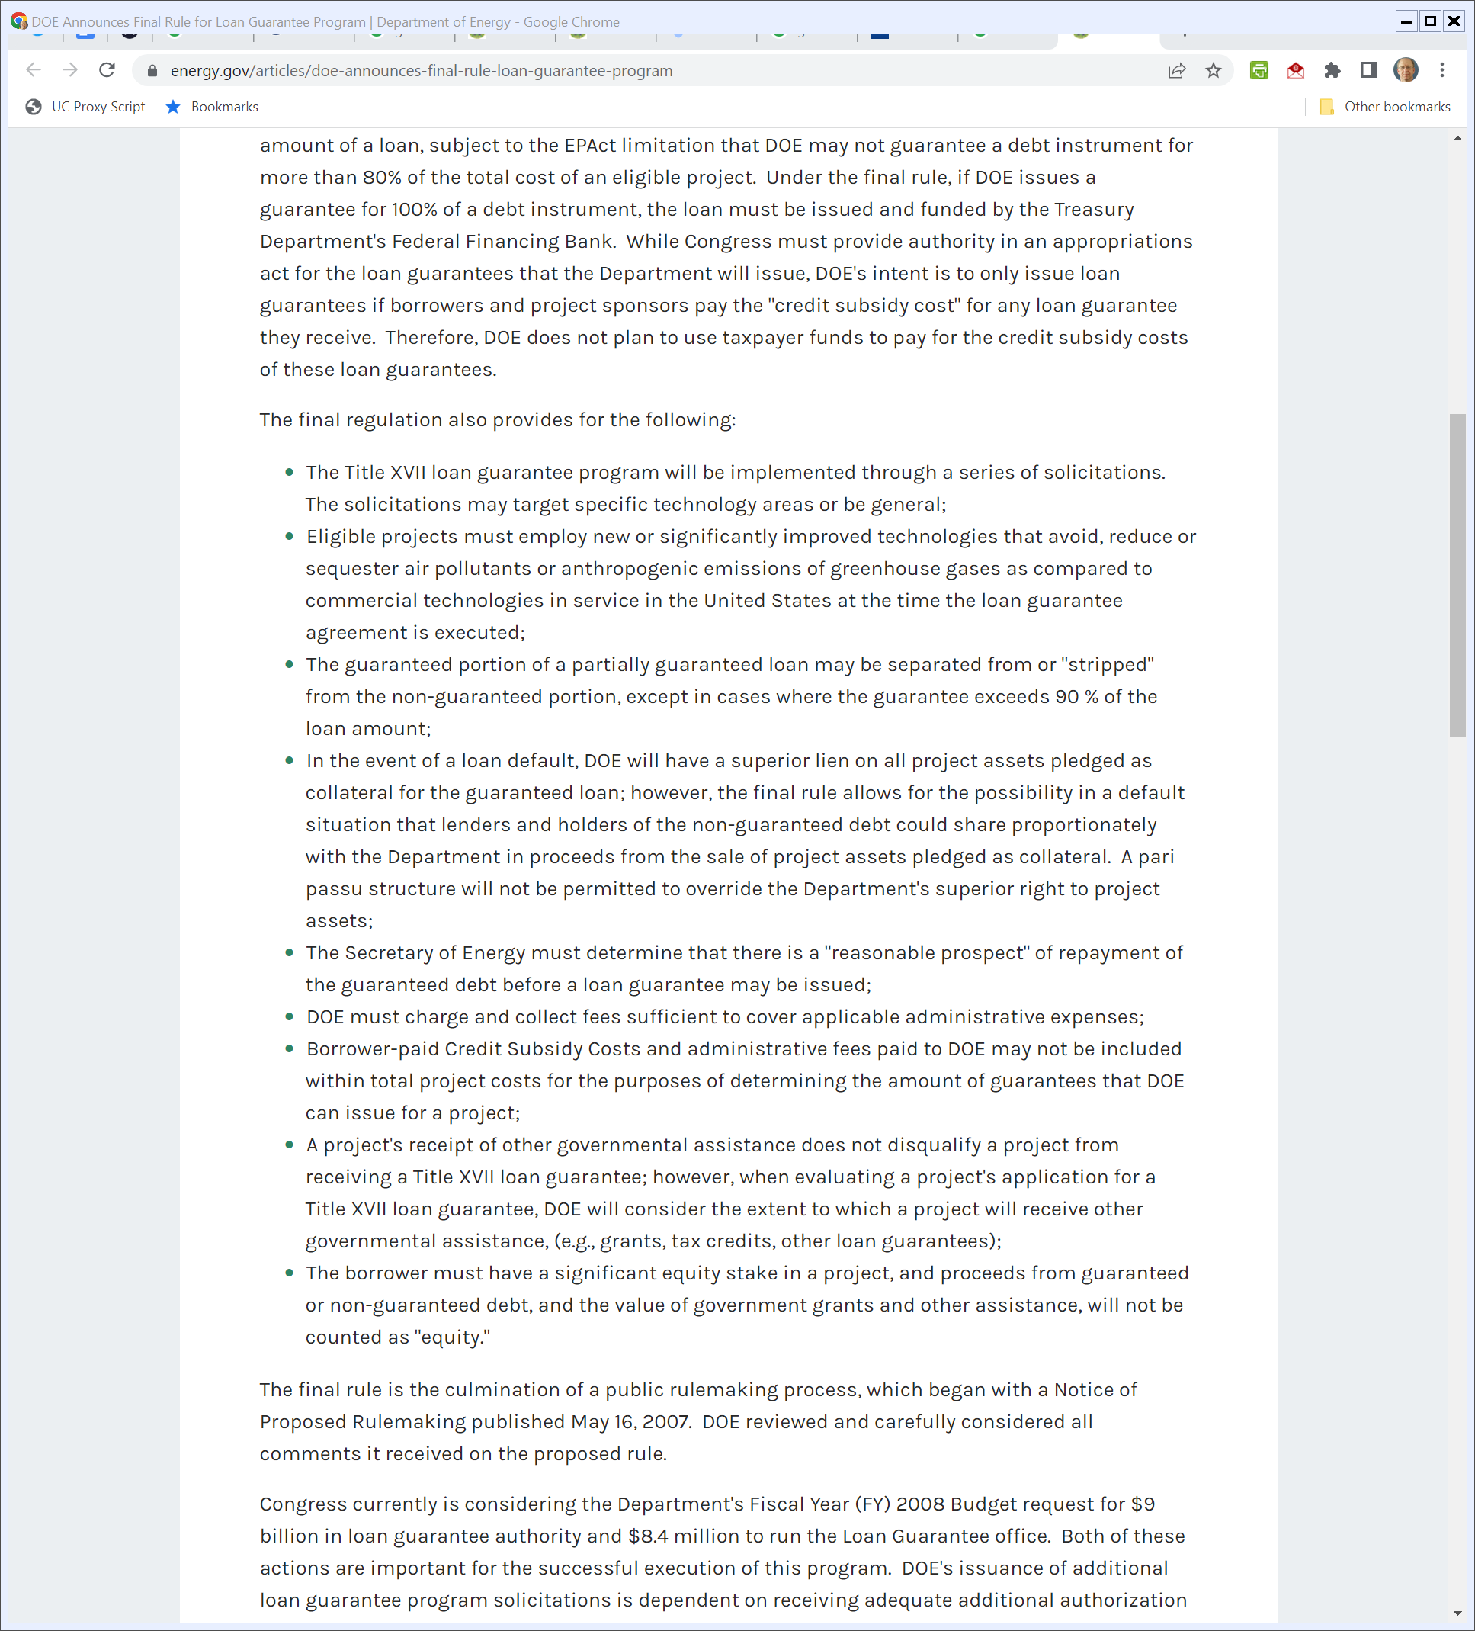
Structure of Loans
DOE (4 Oct 2007)
Notes:
https://www.energy.gov/articles/doe-announces-final-rule-loan-guarantee-program

Slide 11
Structure of Loans
DOE (4 Oct 2007)
Notes:
https://www.energy.gov/articles/doe-announces-final-rule-loan-guarantee-program

Slide 12
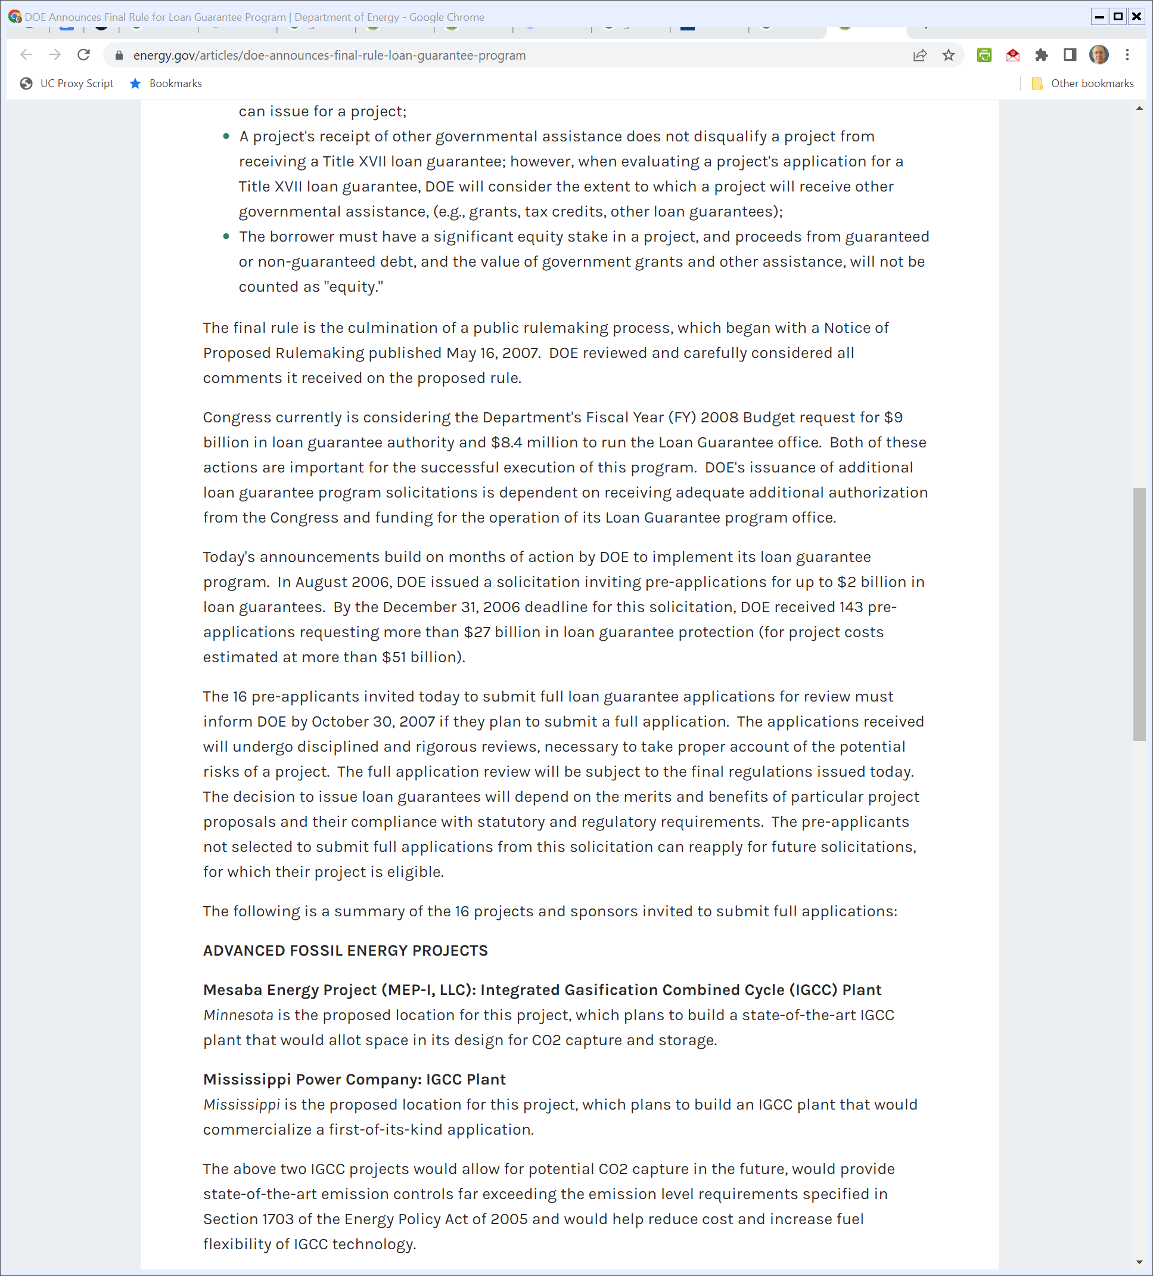
How Much Money?
DOE (4 Oct 2007)
Notes:
https://www.energy.gov/articles/doe-announces-final-rule-loan-guarantee-program

Slide 13
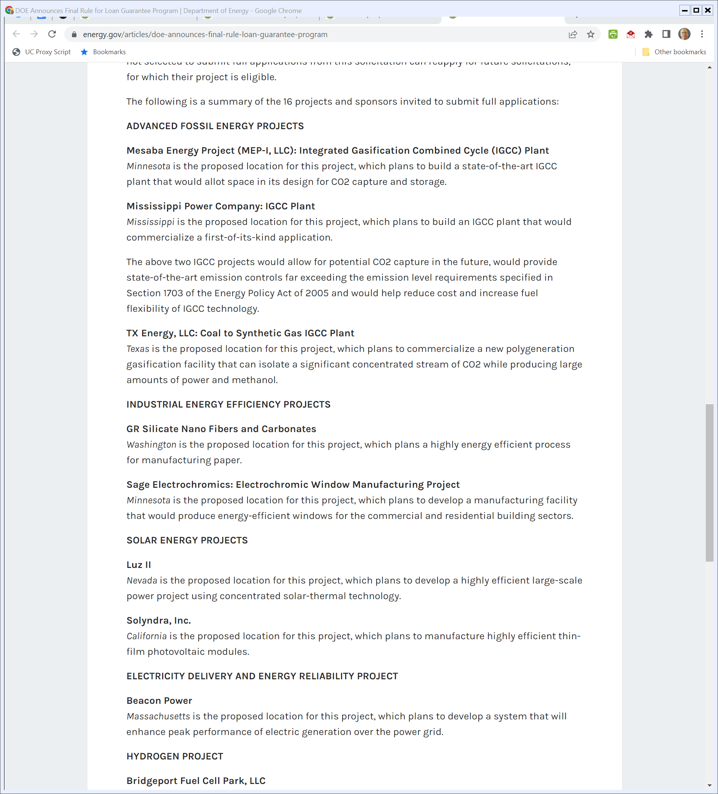
16 Projects
DOE (4 Oct 2007)
Notes:
https://www.energy.gov/articles/doe-announces-final-rule-loan-guarantee-program

Slide 14
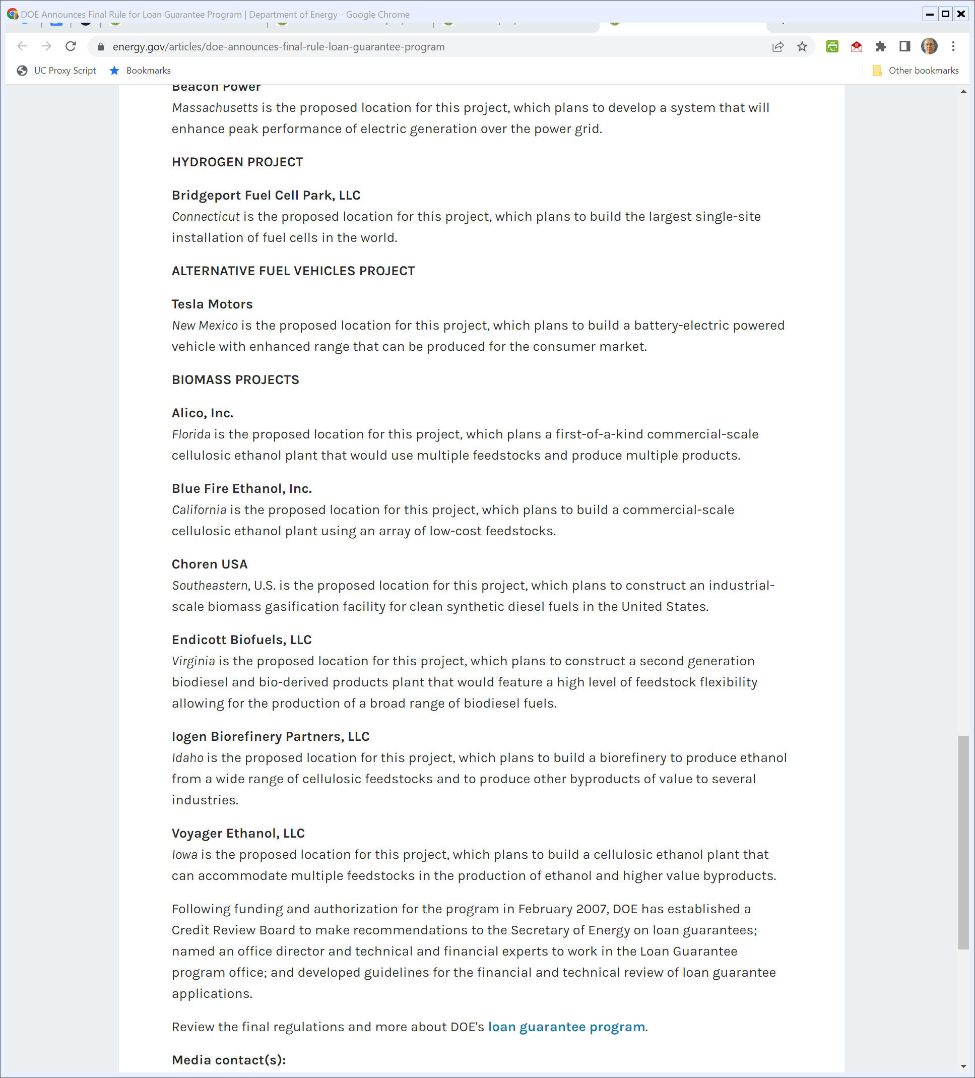
More Projects
DOE (4 Oct 2007)
Notes:
https://www.energy.gov/articles/doe-announces-final-rule-loan-guarantee-program

Slide 15
Energy Independence and Security Act of 2007
Pub. L. 110-140 (19 Dec 2007)

Slide 16
Battery Loan Guarantee Program
Pub. L. 110-140 (19 Dec 2007)

Slide 17
Advanced Tech Vehicles Manufacturing
Pub. L. 110-140 (19 Dec 2007)

Slide 18
ATVM Program: U.S. Facilities
Pub. L. 110-140 (19 Dec 2007)

Slide 19
ATVM Program: Direct Loans
Pub. L. 110-140 (19 Dec 2007)

Slide 20
ATVM Program: Project Choice
Pub. L. 110-140 (19 Dec 2007)

Slide 21
ATVM Program: Rates
Pub. L. 110-140 (19 Dec 2007)

Slide 22
Assessing the ATVM Program
CRS (15 Jan 2015)

Slide 23
Detroit Declining
CRS (15 Jan 2015)

Slide 24
And Then the Great Recession Hit
CRS (15 Jan 2015)

Slide 25
GM/Chrysler Ch 11s and Gov’t Financing
CRS (15 Jan 2015)

Slide 26
GM/Chrysler Ch 11s and Gov’t Financing
CRS (15 Jan 2015)

Slide 27
Funding the ATVM Program
CRS (15 Jan 2015)

Slide 28
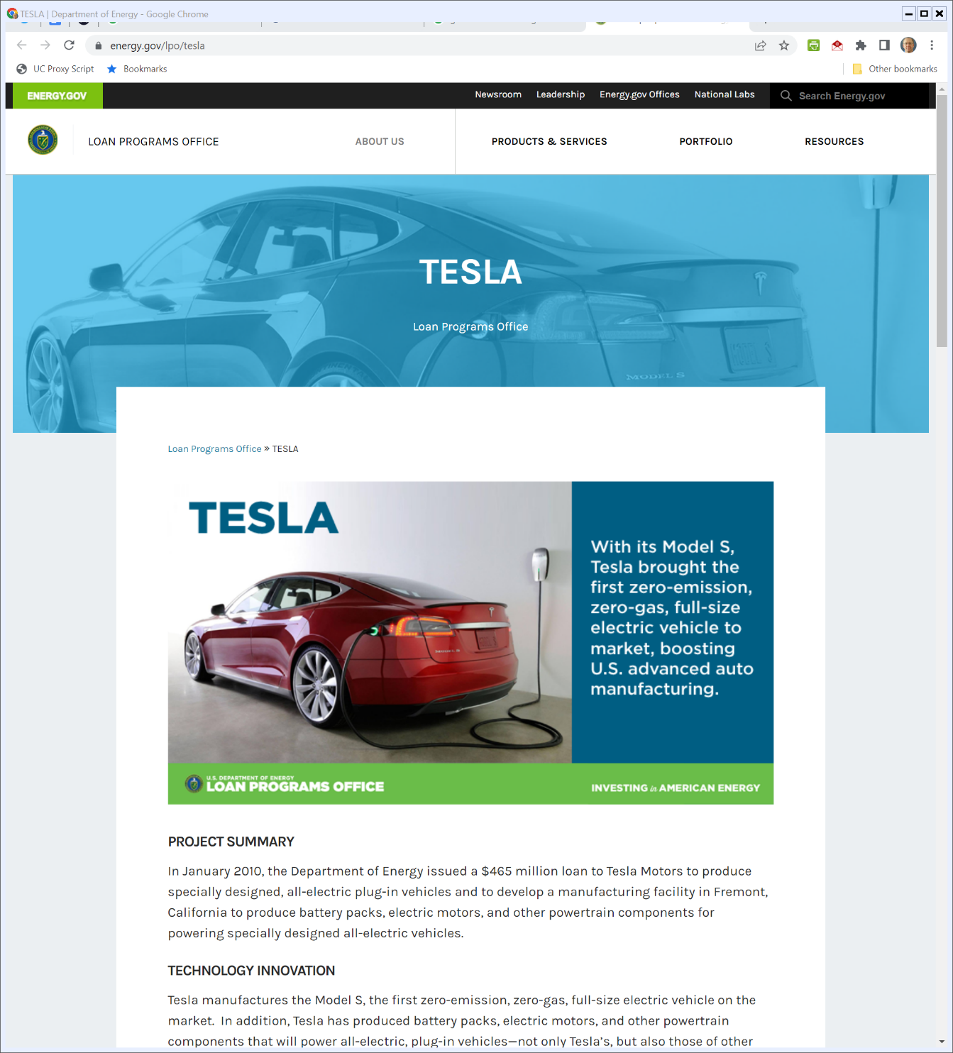

Jan 2010: Gov’t Loan to Tesla
Energy.gov (Visited 25 Apr 2022)
Notes:
https://www.energy.gov/lpo/tesla

Slide 29
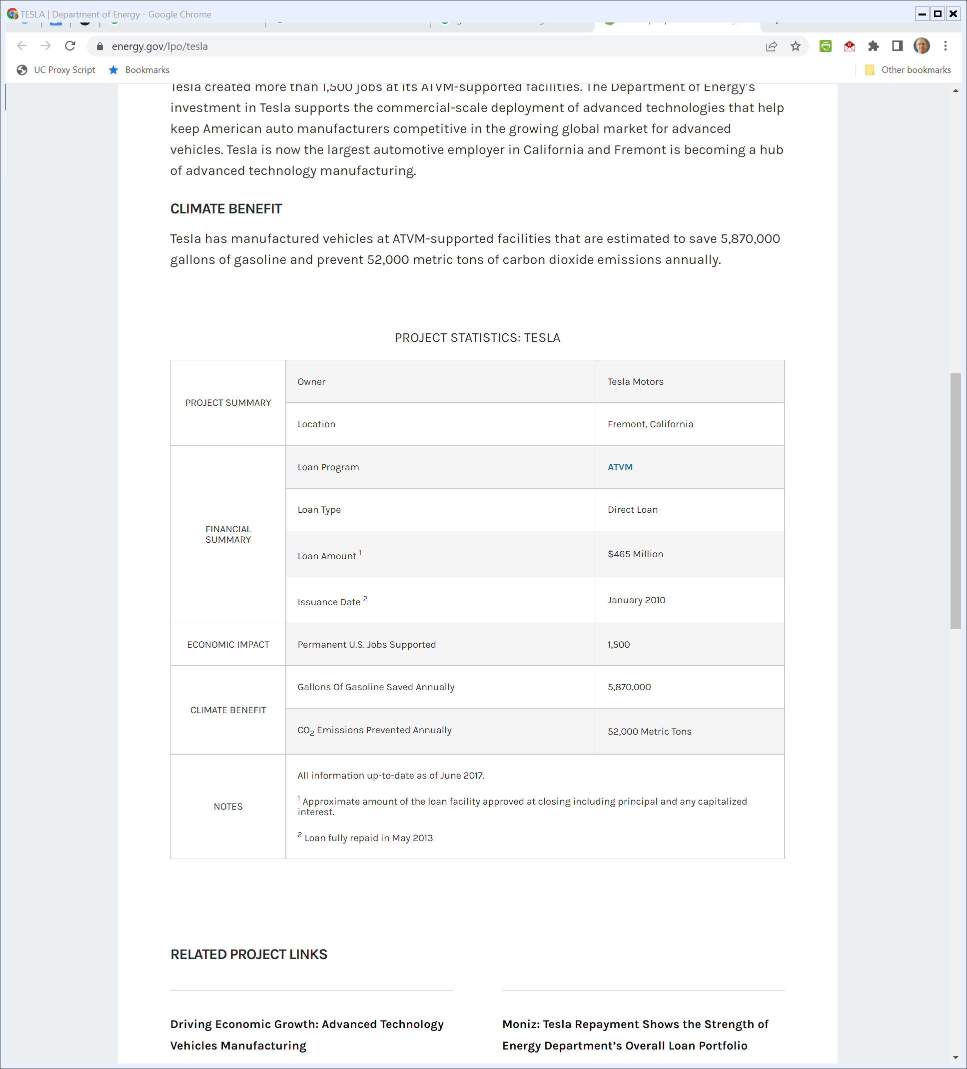
Jan 2010: Gov’t Loan to Tesla
Energy.gov (Visited 25 Apr 2022)
Notes:
https://www.energy.gov/lpo/tesla

Slide 30
29 Jan 2010: Tesla Moves to Go Public
Tesla Prelim Prospectus (29 Jan 2010)

Slide 31
End of 2009: 937 Cars Sold (GM Sold About 2.1M in 2009)
Tesla Prelim Prospectus (29 Jan 2010)

Slide 32
State of Finances
Tesla Prelim Prospectus (29 Jan 2010)

Slide 33
Size of Loan vs. Tesla
Tesla Prelim Prospectus (29 Jan 2010)

Slide 34
Size of Loan vs. Tesla
Tesla Prelim Prospectus (29 Jan 2010)

Slide 35
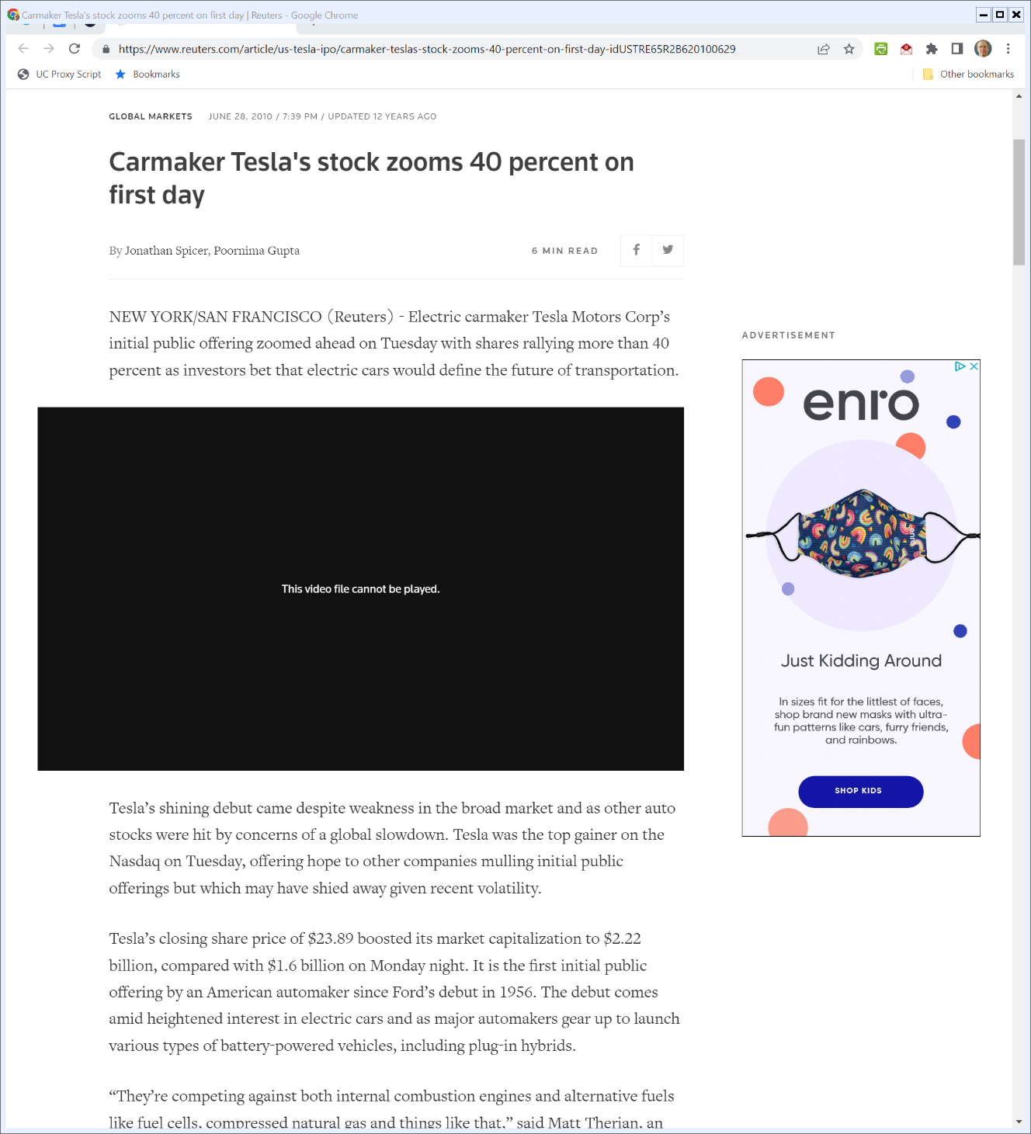
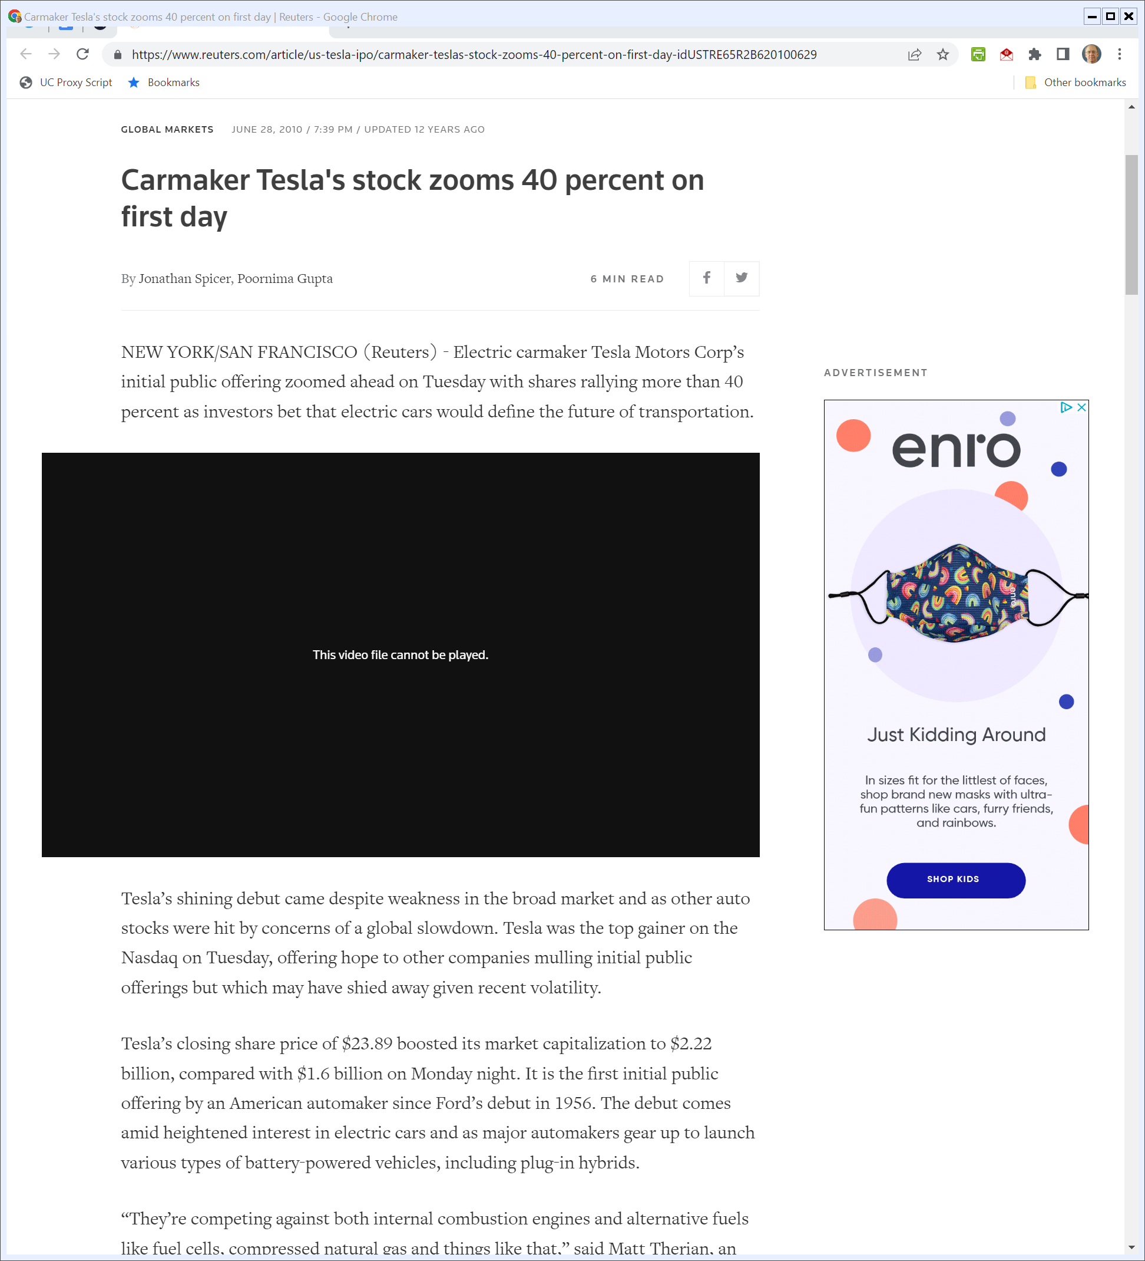
The IPO
Reuters (28 June 2010)
Notes:
https://www.reuters.com/article/us-tesla-ipo/carmaker-teslas-stock-zooms-40-percent-on-first-day-idUSTRE65R2B620100629

Slide 36
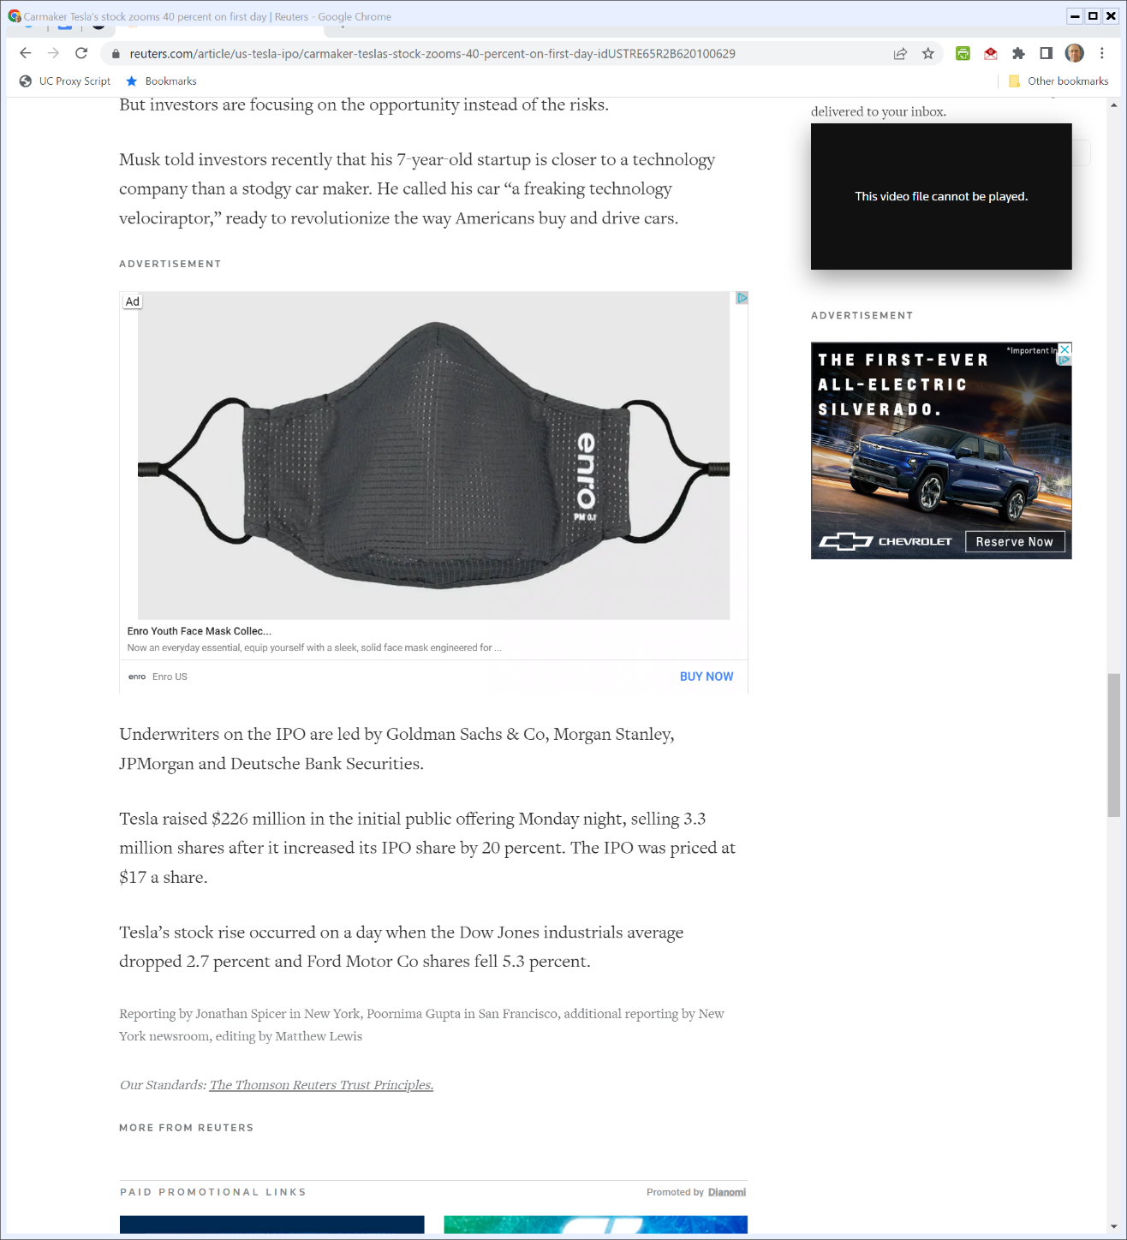

Raised $226M
Reuters (28 June 2010)
Notes:
https://www.reuters.com/article/us-tesla-ipo/carmaker-teslas-stock-zooms-40-percent-on-first-day-idUSTRE65R2B620100629

Slide 37
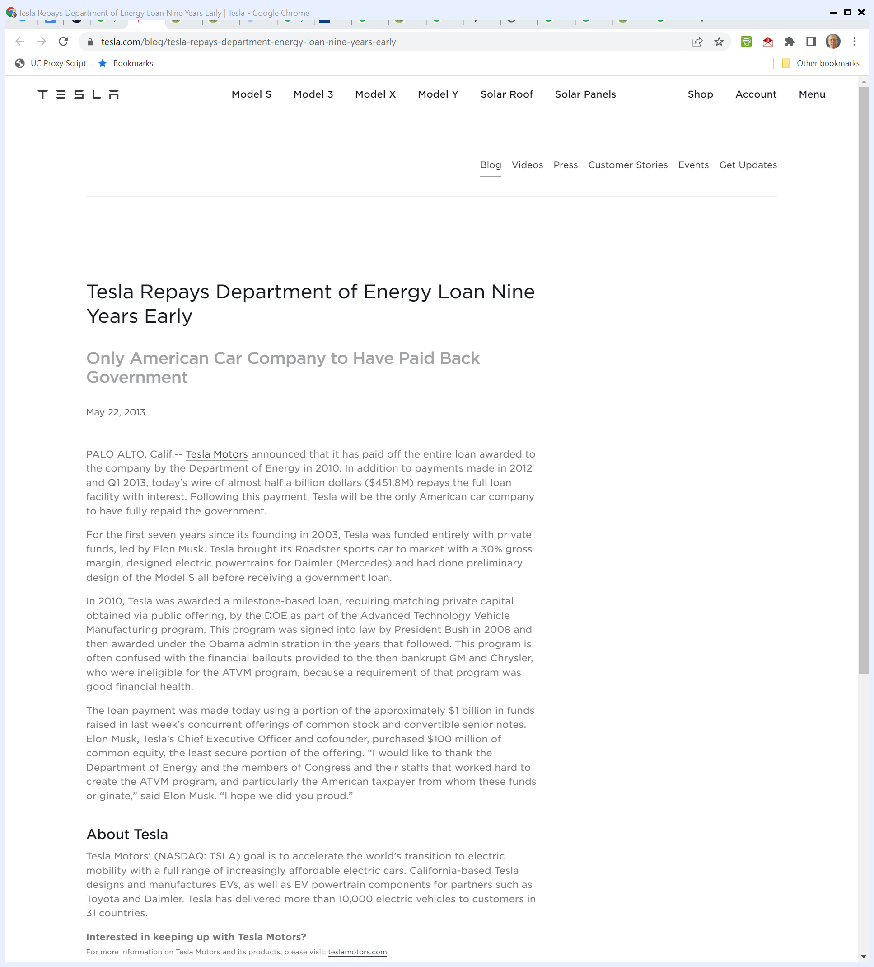
May 2013: Tesla Repays Loan
Tesla (22 May 2013)

Slide 38
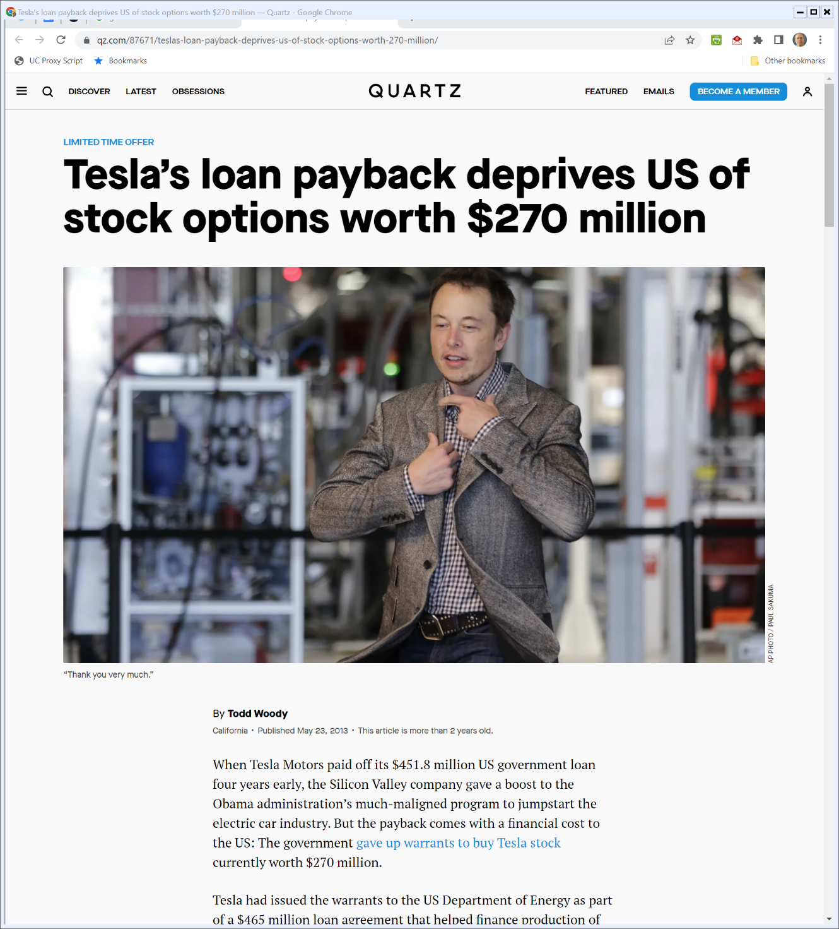
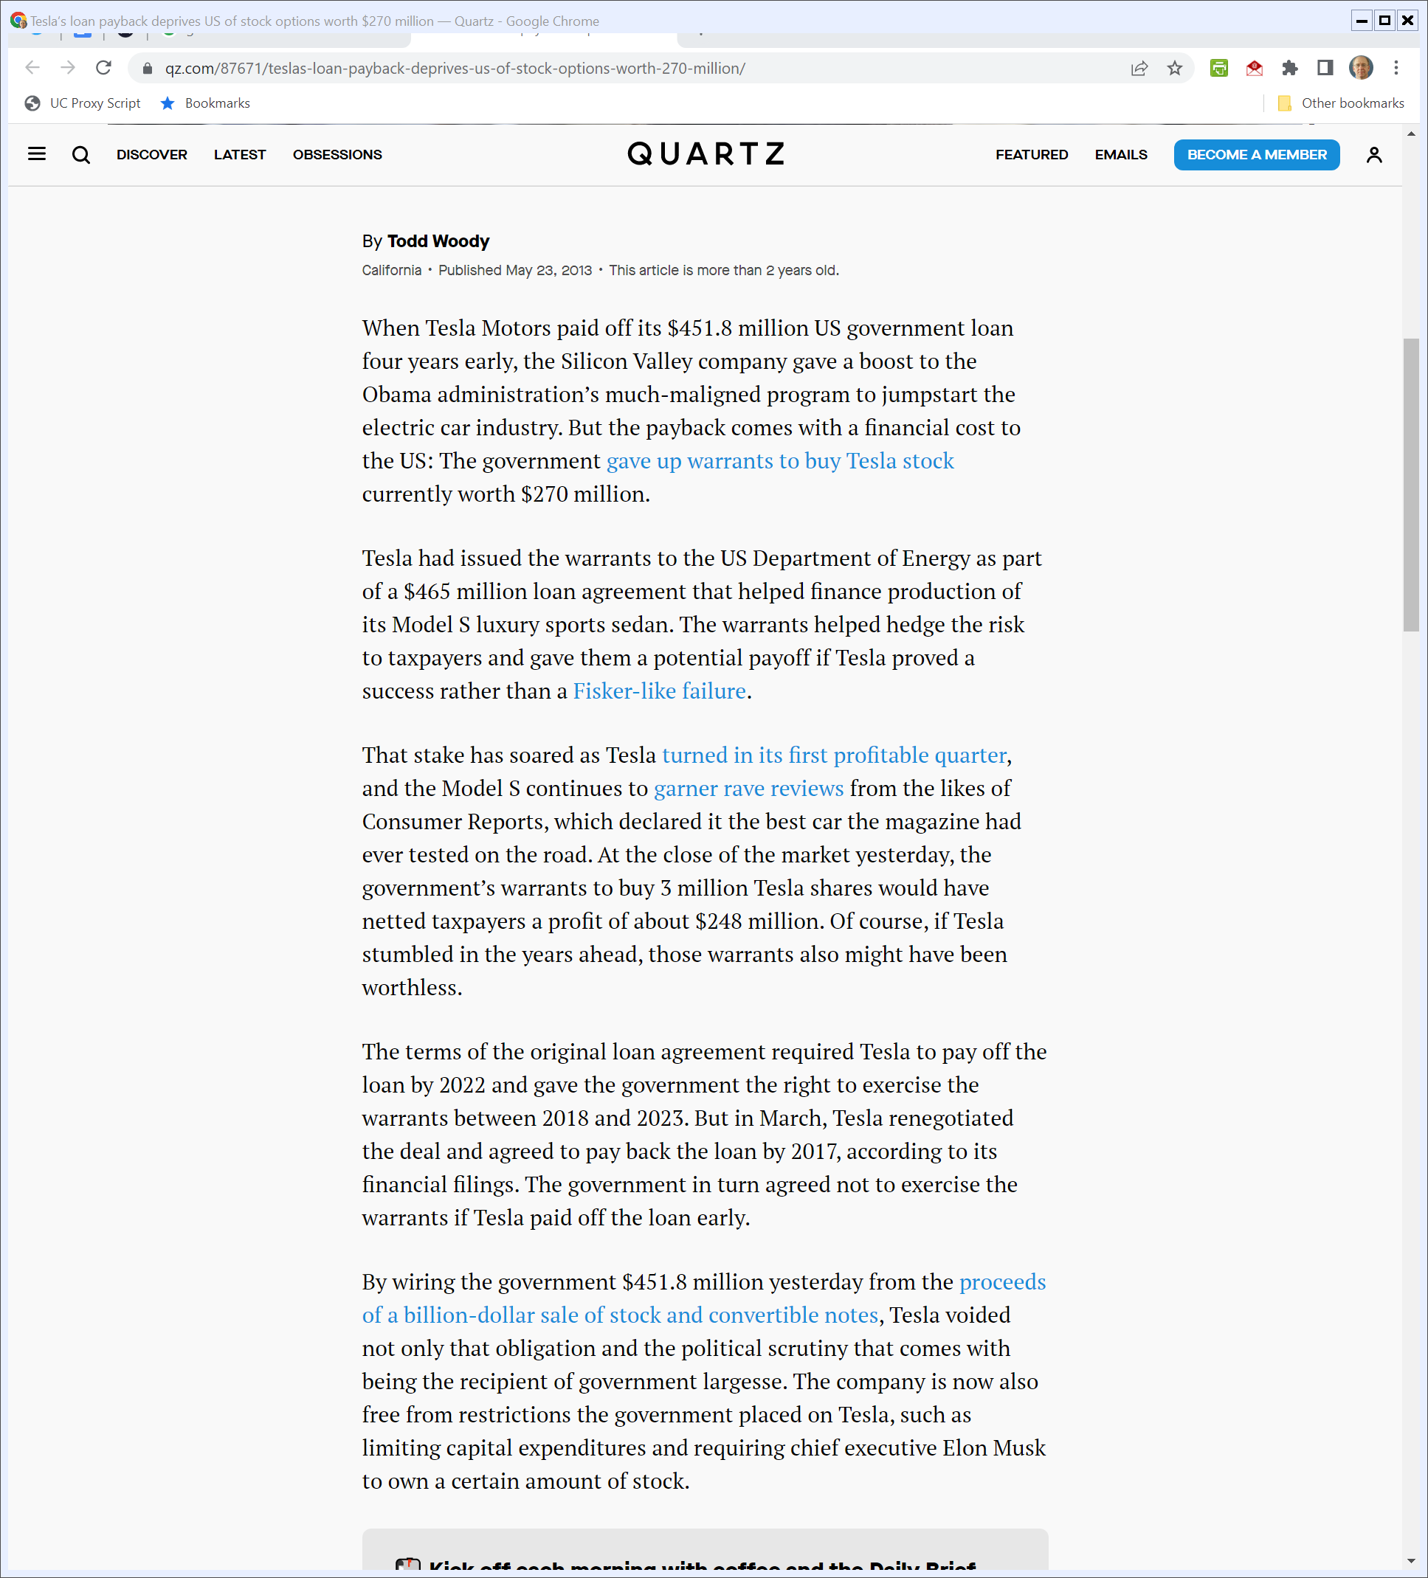
Repayment Killed Warrants
Quartz (23 May 2013)
Notes:
https://qz.com/87671/teslas-loan-payback-deprives-us-of-stock-options-worth-270-million/

Slide 39
Repayment Killed Warrants
Quartz (23 May 2013)
Notes:
https://qz.com/87671/teslas-loan-payback-deprives-us-of-stock-options-worth-270-million/

Slide 40
ATVM Loans Through 2014
CRS (15 Jan 2015)

Slide 41
Program Results Through 2014
CRS (15 Jan 2015)

Slide 42
Jobs Implications
CRS (15 Jan 2015)

Slide 43
Taking Stock?
TTYN
Assessing all of this
  How should we think about gov’t loan programs of this sort? Is this similar to what we saw with the rural electrification program?
  When should the gov’t do below market loans? Why shouldn’t the government take equity?
  When do we think gov’t capital markets are superior/inferior to private capital markets?

Slide 44
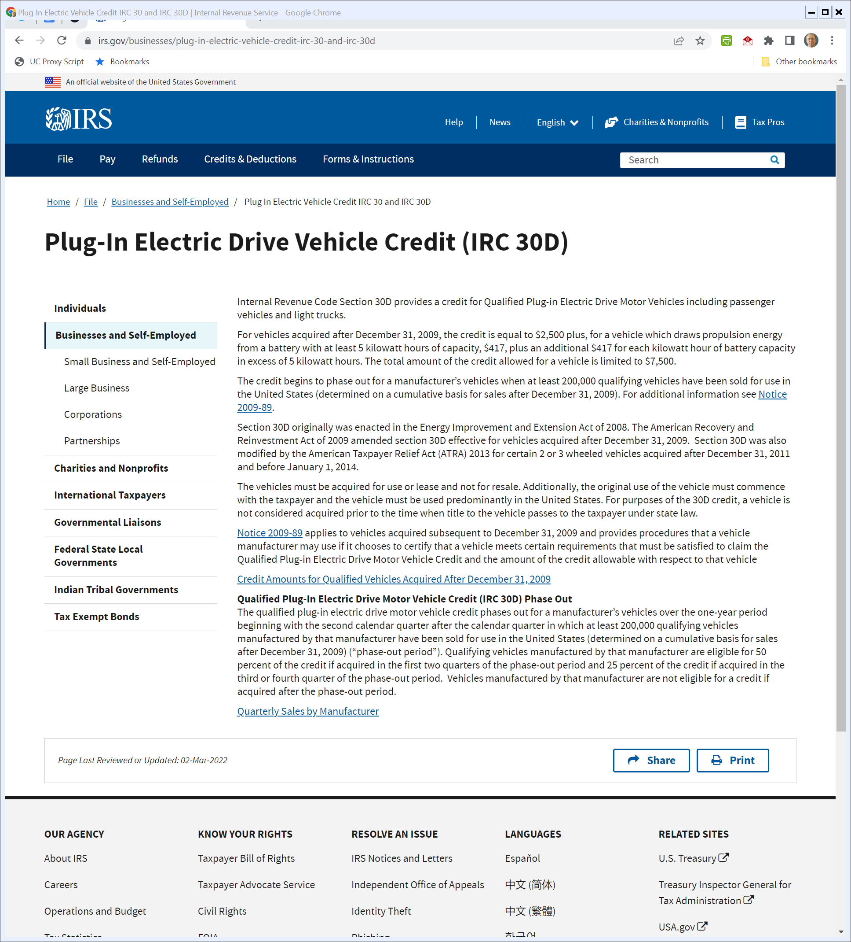
EV Tax Credits
IRS.gov (Visited 25 Apr 2022)
Notes:
https://www.irs.gov/businesses/plug-in-electric-vehicle-credit-irc-30-and-irc-30d

Slide 45
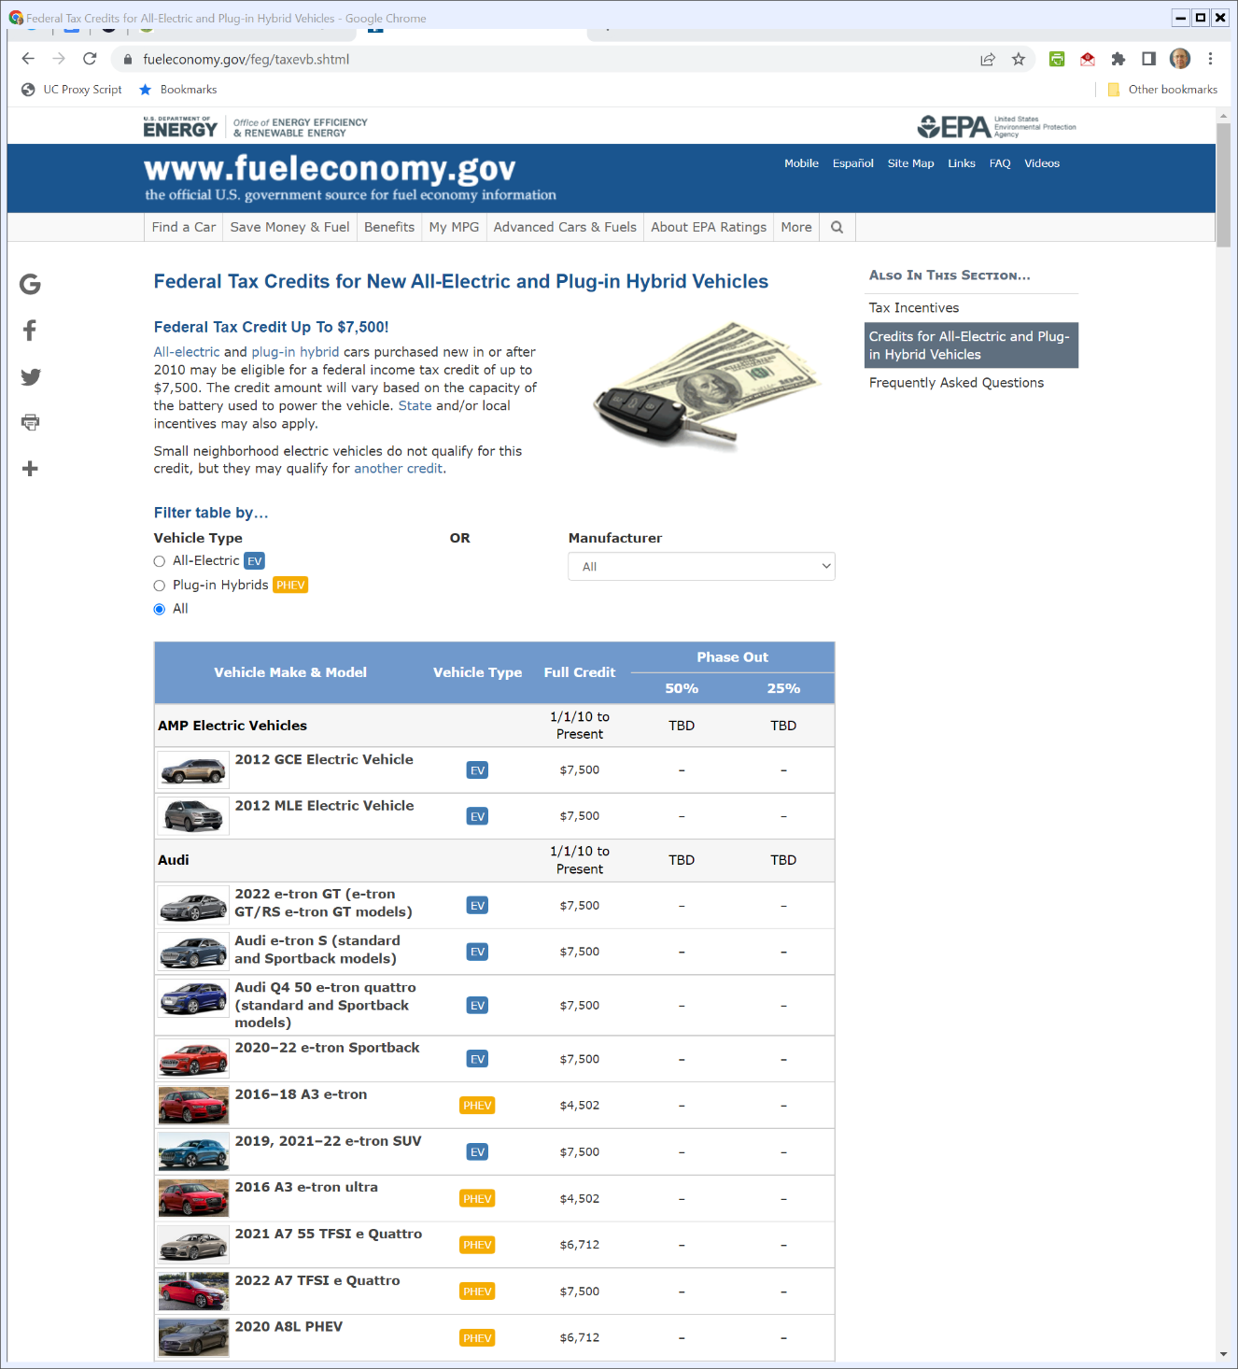

EV Tax Credits
Fueleconomy.gov (visited 25 Apr 2022)
Notes:
https://www.fueleconomy.gov/feg/taxevb.shtml

Slide 46
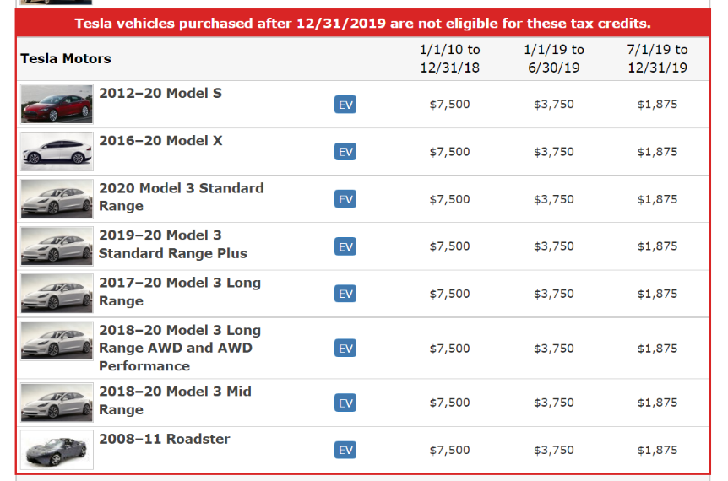
EV Tax Credits
Fueleconomy.gov (visited 25 Apr 2022)
Notes:
https://www.fueleconomy.gov/feg/taxevb.shtml

Slide 47
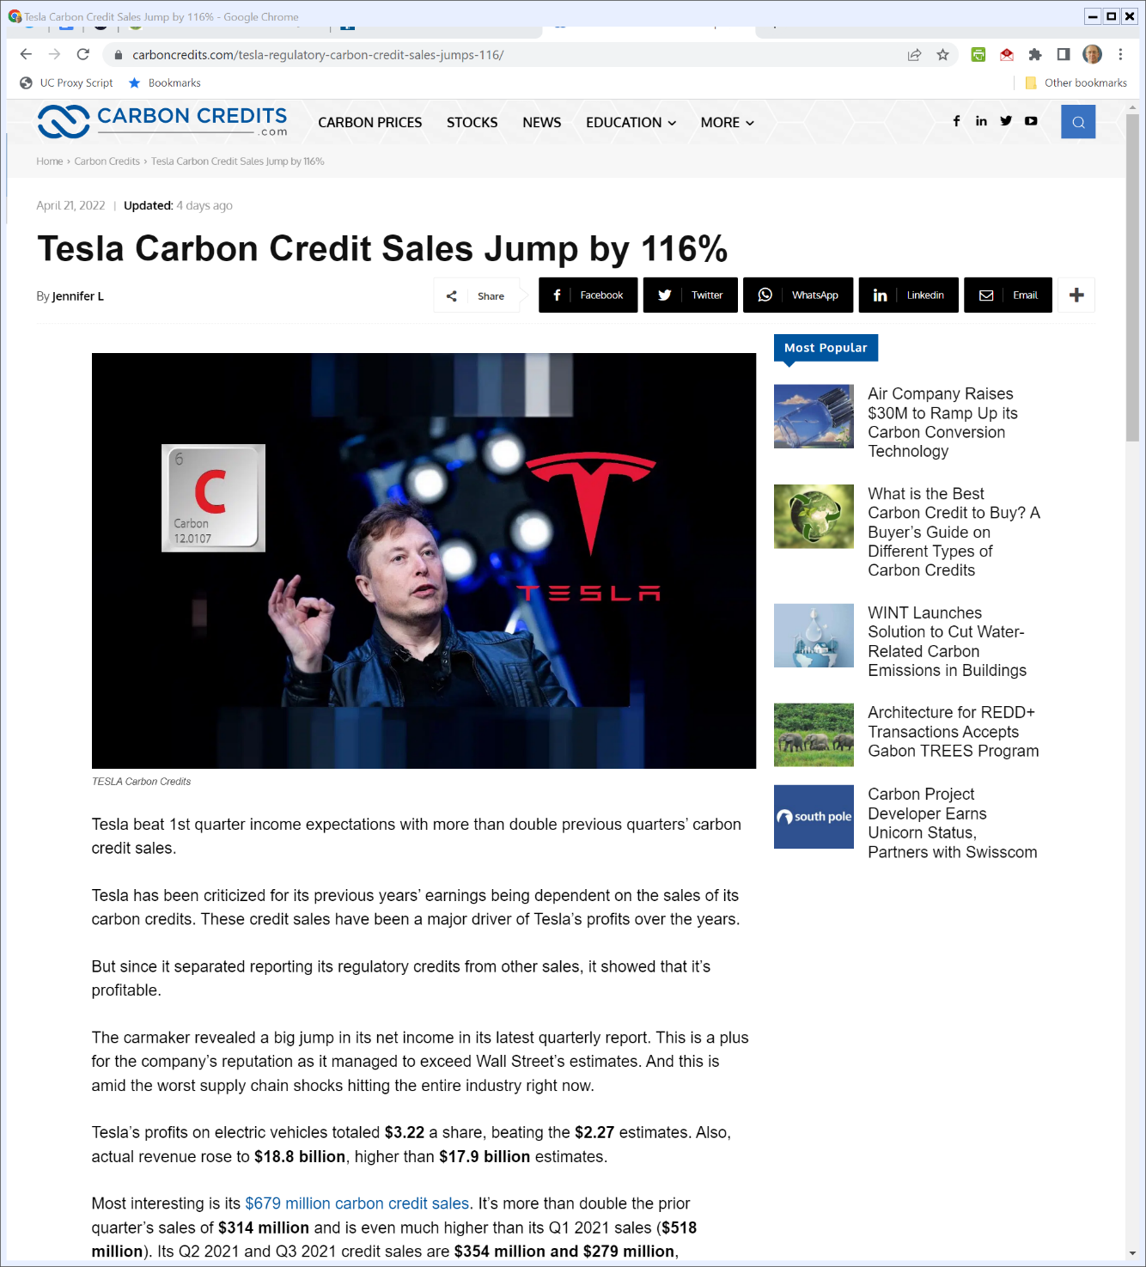
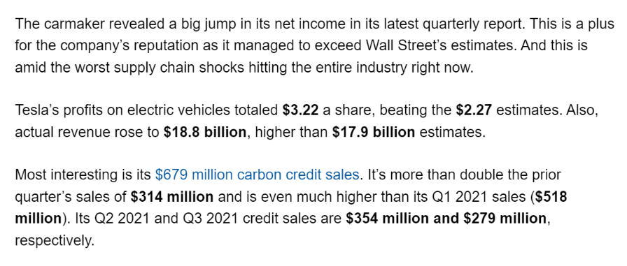
Tesla’s Carbon Credit Sales
CarbonCredits.com (21 Apr 2022)

Slide 48
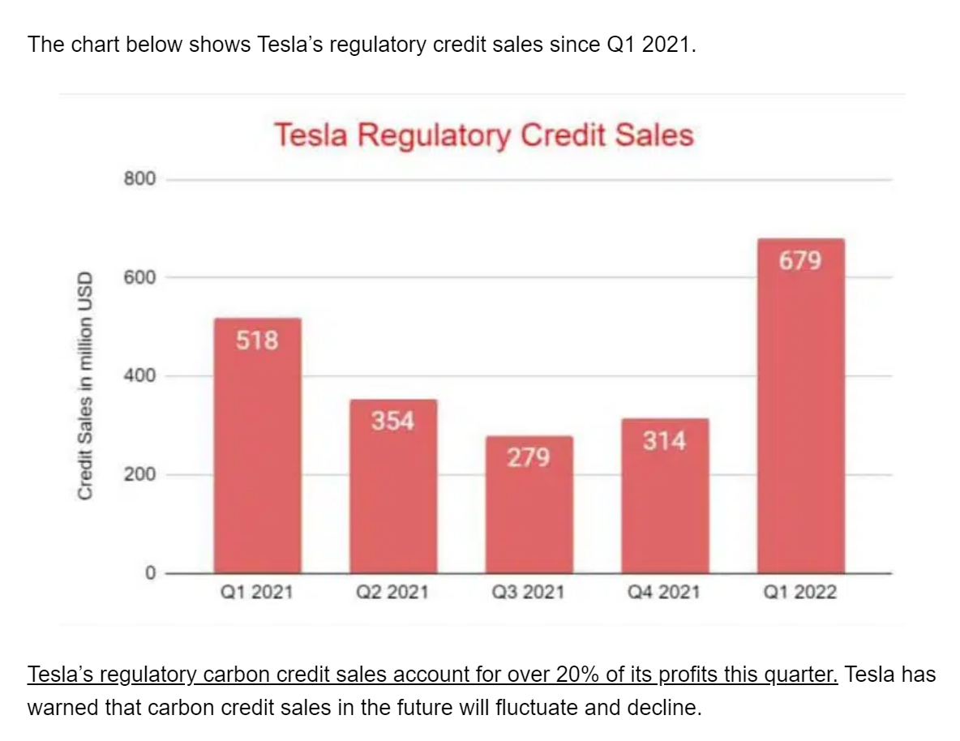
Tesla’s Carbon Credit Sales
CarbonCredits.com (21 Apr 2022)

Slide 49
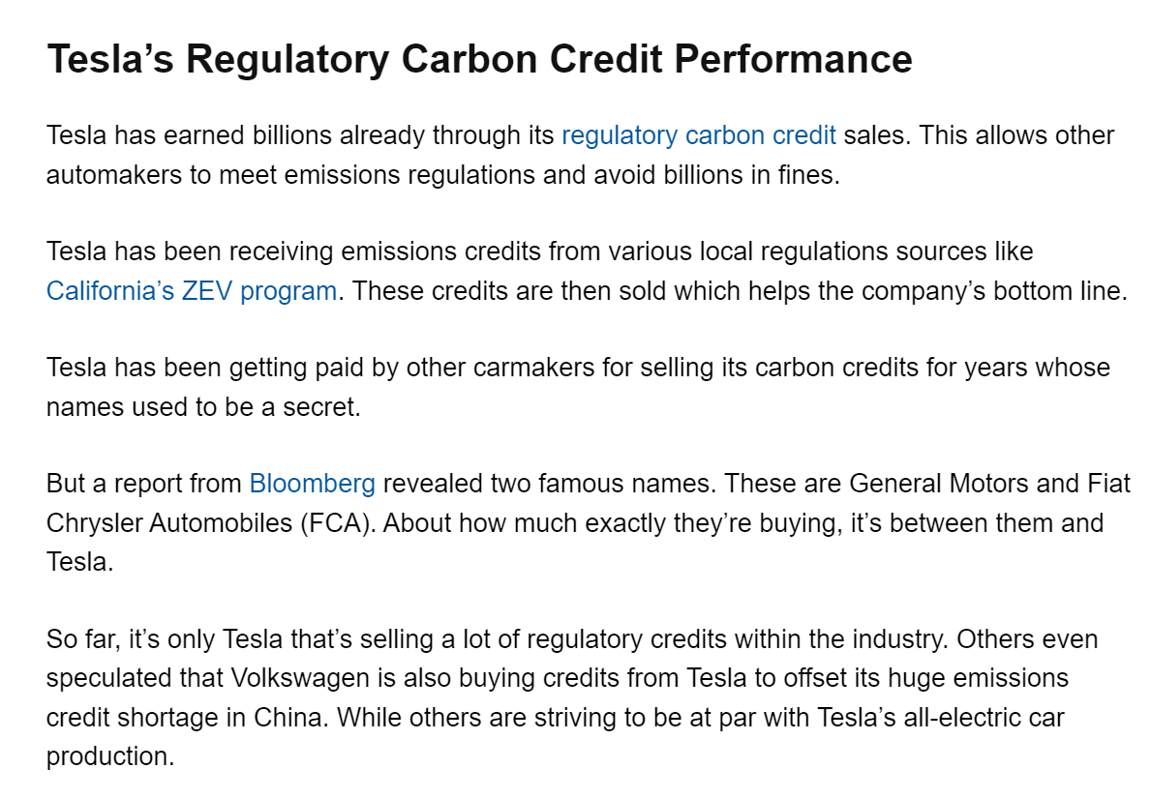
Tesla’s Carbon Credit Sales
CarbonCredits.com (21 Apr 2022)

Slide 50
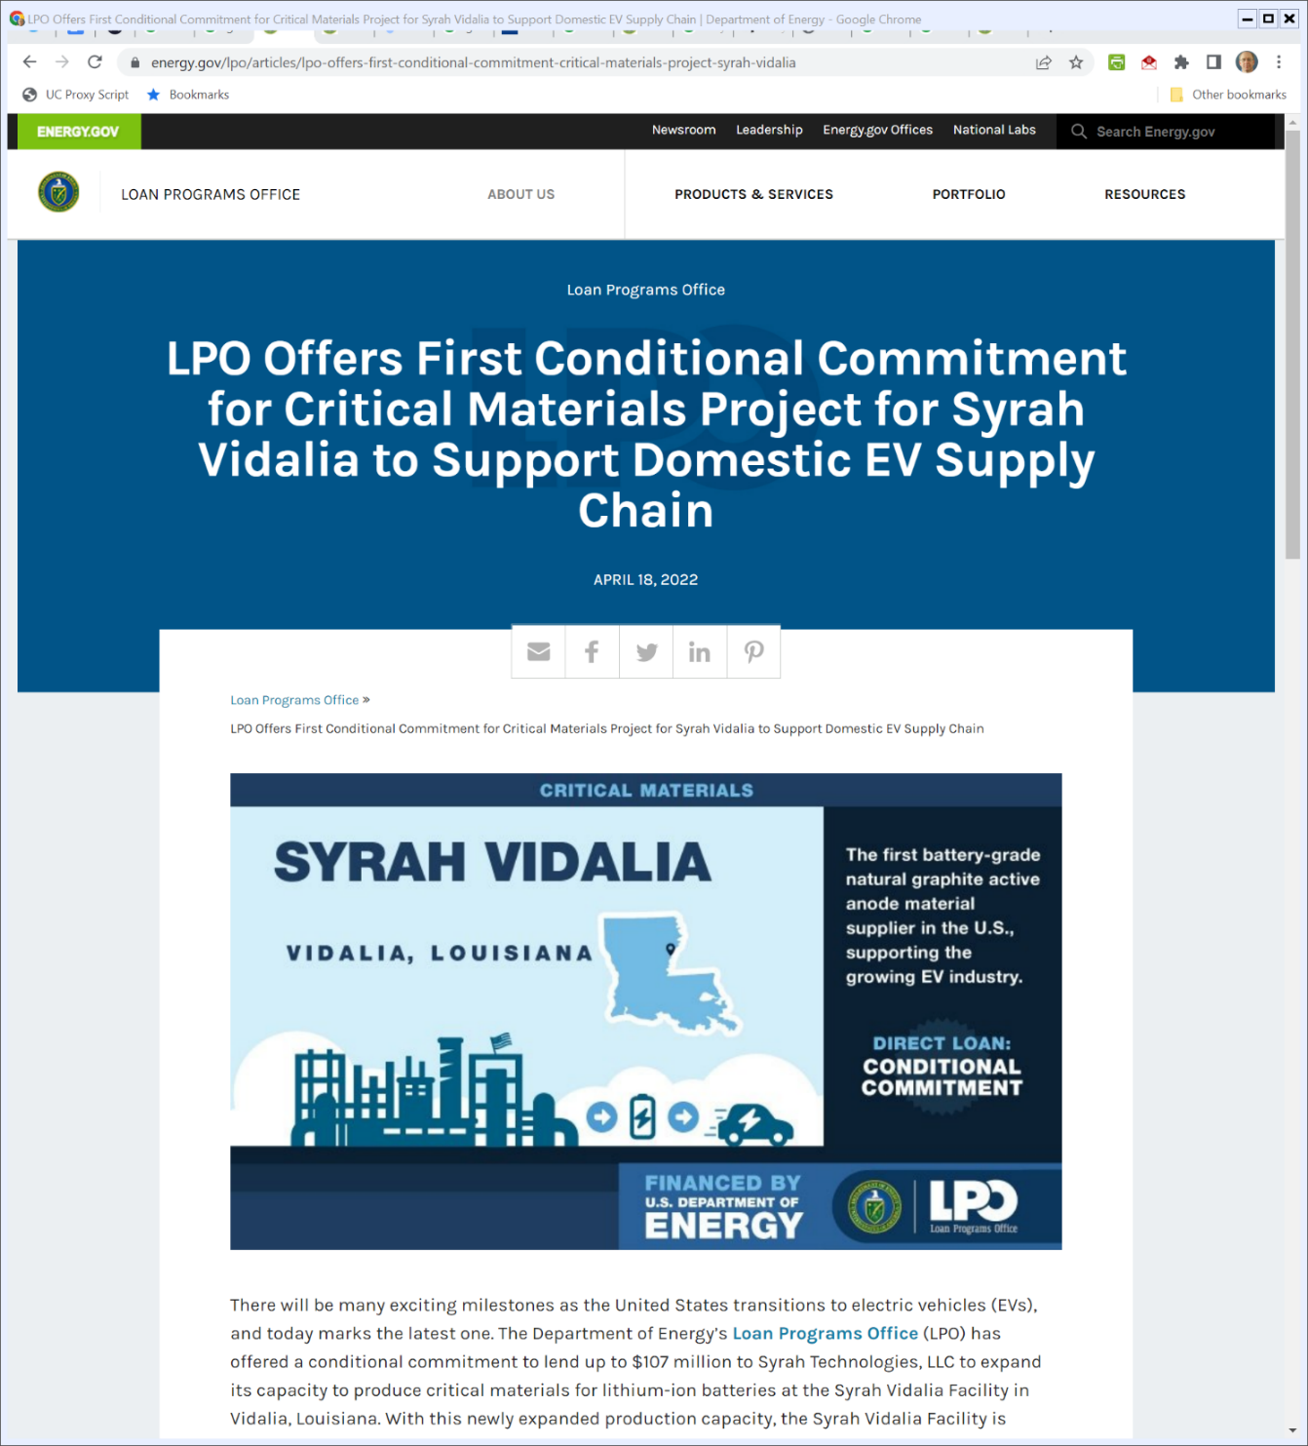
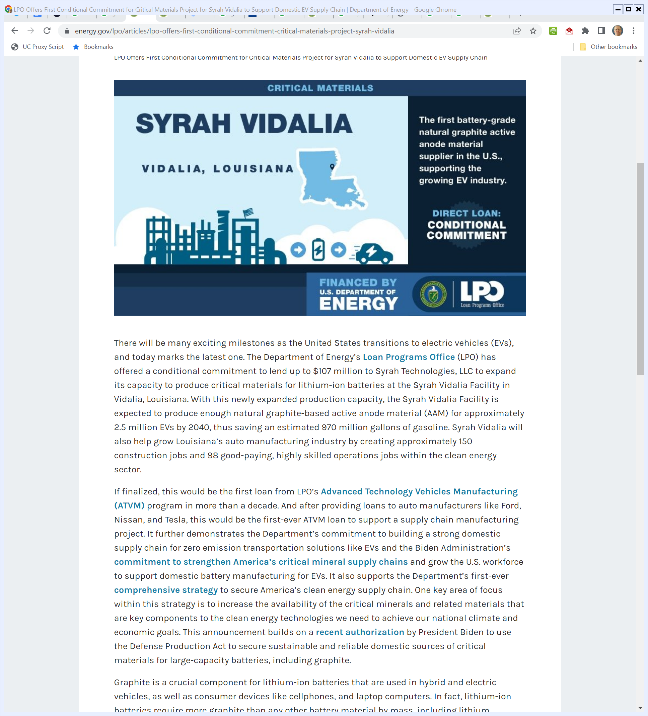
Recent Loan Activity
Energy.gov (18 Apr 2022)
Notes:
https://www.energy.gov/lpo/loan-programs-office

Slide 51
1st ATVM Loan in a Decade
Energy.gov (18 Apr 2022)
Notes:
https://www.energy.gov/lpo/loan-programs-office

Slide 52
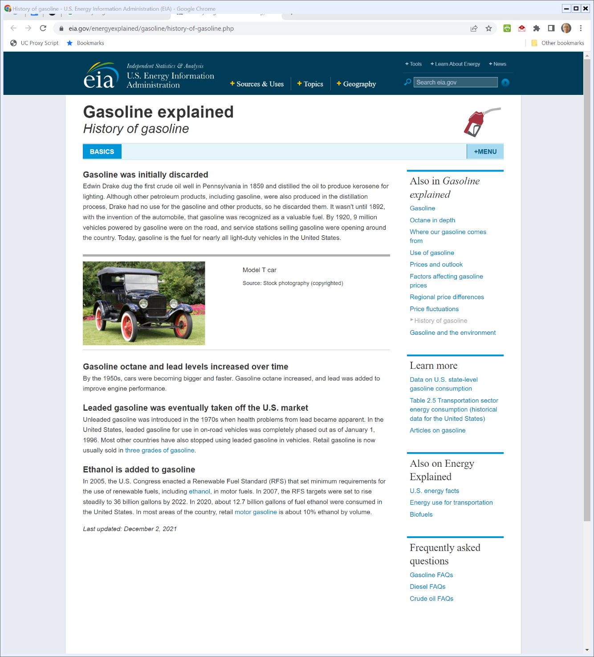

History of Gasoline
U.S. EIA (Visited 25 Apr 2022)
Notes:
https://www.eia.gov/energyexplained/gasoline/history-of-gasoline.php

Slide 53
Gas Station History
Beckman (1956/2011)

Slide 54
1929-1954
Beckman (1956/2011)

Slide 55
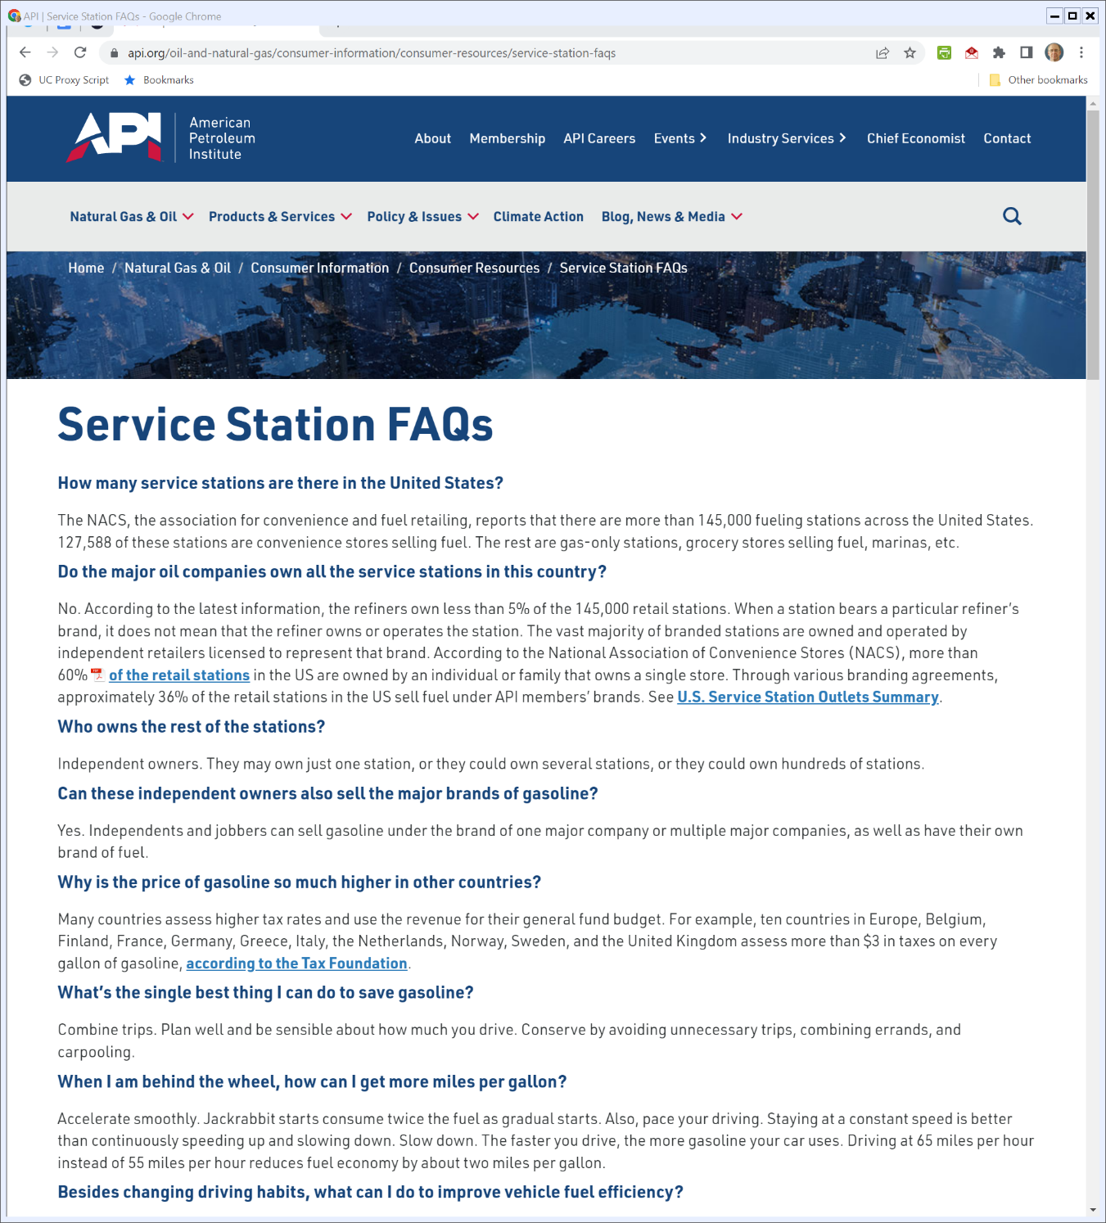

And Today
API (Visited 25 Apr 2022)
Notes:
https://www.api.org/oil-and-natural-gas/consumer-information/consumer-resources/service-station-faqs

Slide 56
2015 FAST Act
Pub. L. 114-94 (4 Dec 2015)

Slide 57
Alternative Fuel Corridors
Pub. L. 114-94 (4 Dec 2015)

Slide 58
Alternative Fuel Corridors
Pub. L. 114-94 (4 Dec 2015)

Slide 59
Alternative Fuel Corridors
Pub. L. 114-94 (4 Dec 2015)

Slide 60

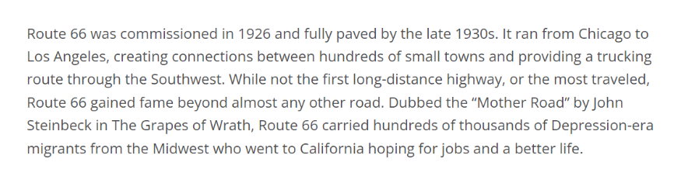
Route 66
Smithsonian (Visited 26 Apr 2022)
Notes:
https://americanhistory.si.edu/america-on-the-move/route-66

Slide 61
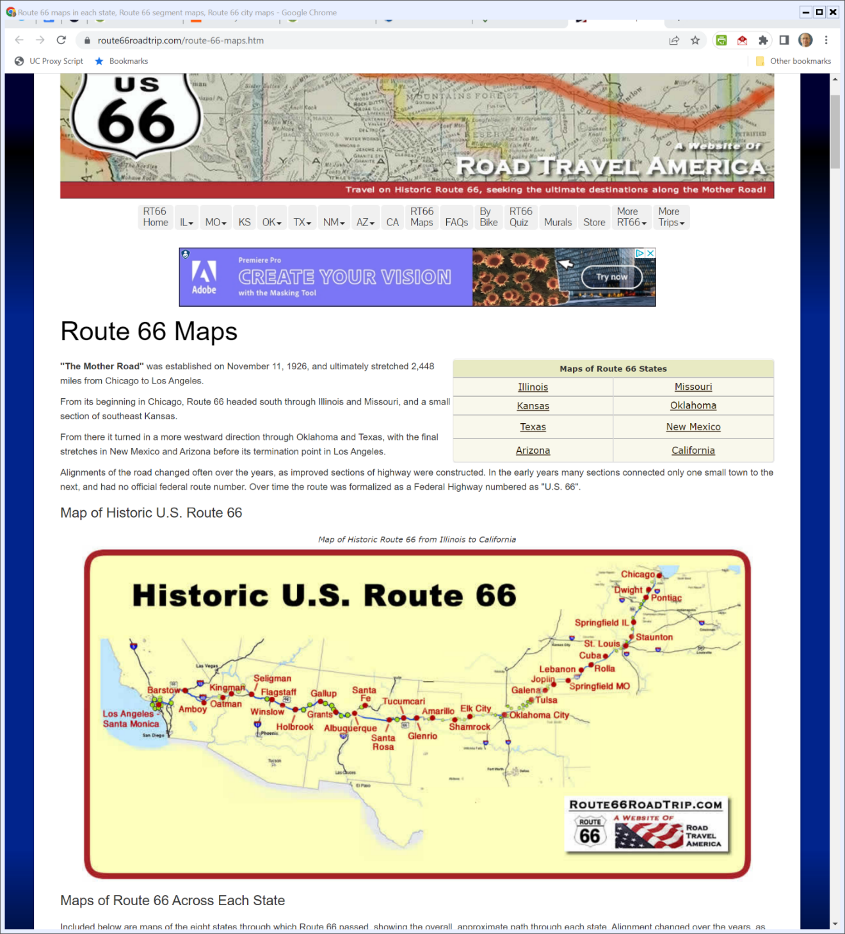

The Path of Route 66
Route66roadtrip.com (Visited 26 Apr 2022)
Notes:
https://www.route66roadtrip.com/route-66-maps.htm

Slide 62
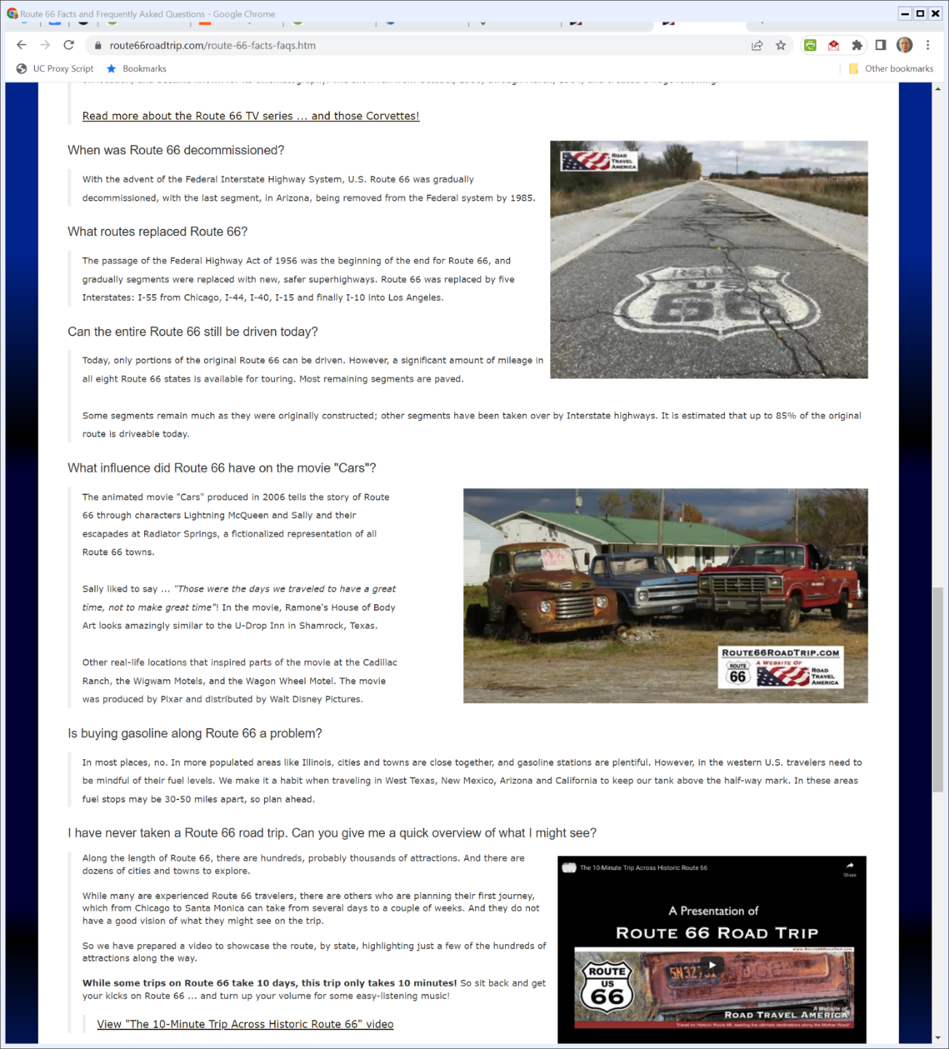

Interstate Replacements
Route66roadtrip.com (Visited 26 Apr 2022)
Notes:
https://www.route66roadtrip.com/route-66-facts-faqs.htm

Slide 63
And Gasoline?
Route66roadtrip.com (Visited 26 Apr 2022)
Notes:
https://www.route66roadtrip.com/route-66-facts-faqs.htm

Slide 64
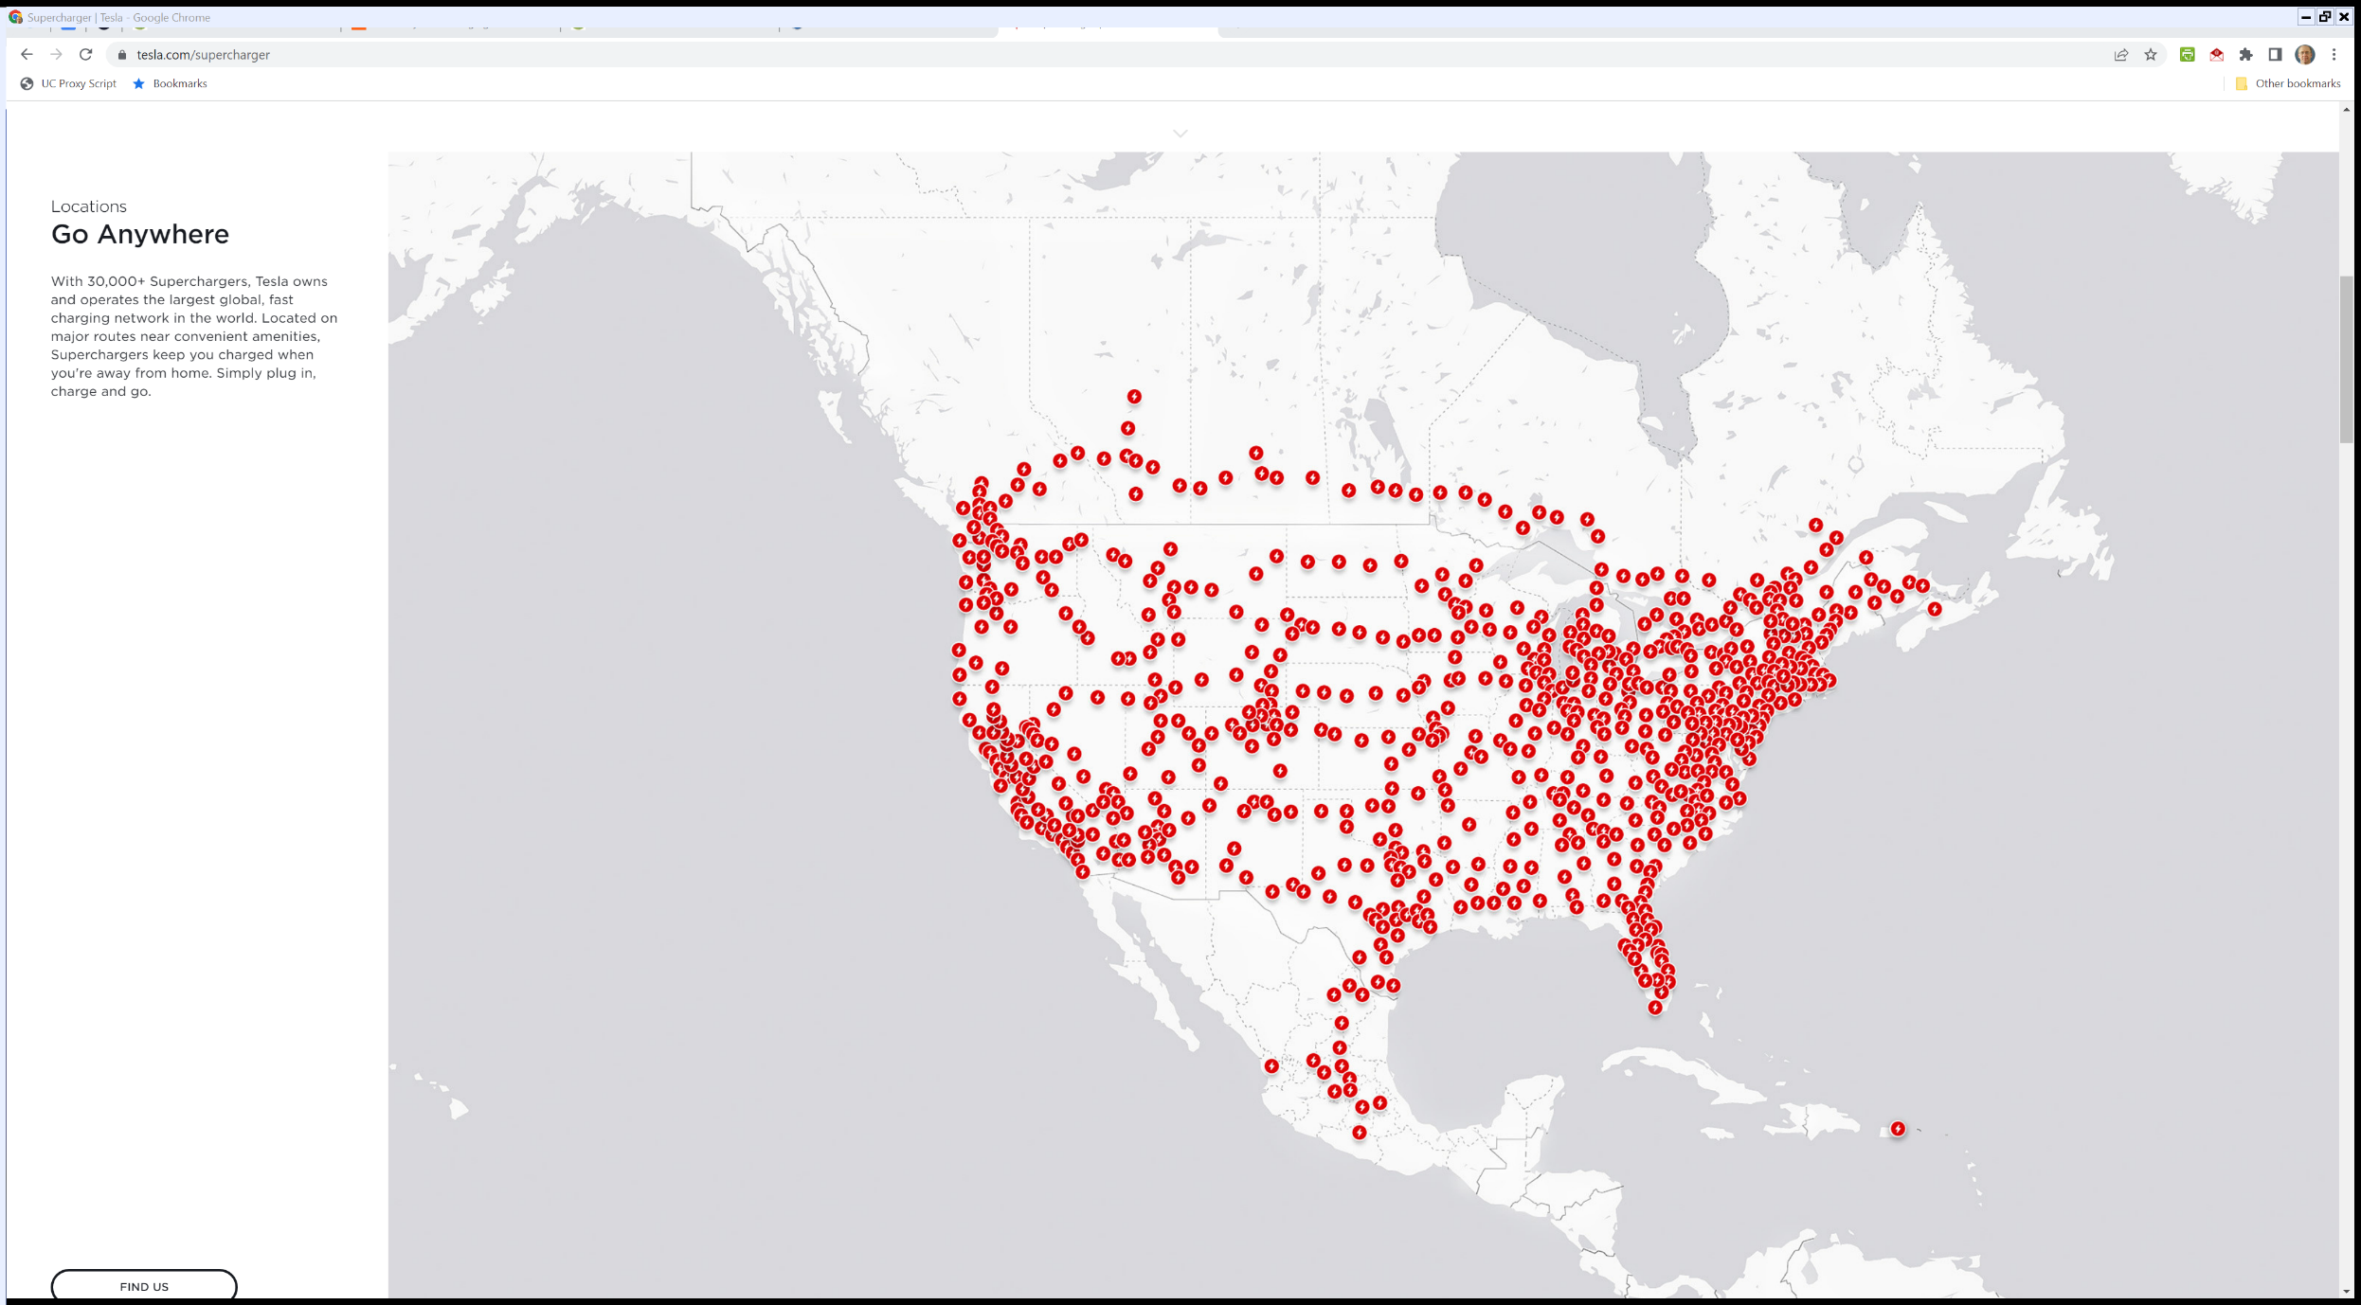
Tesla’s 30,000+ Supercharger Network
Tesla (Visited 26 Apr 2022)
Notes:
https://www.tesla.com/supercharger

Slide 65
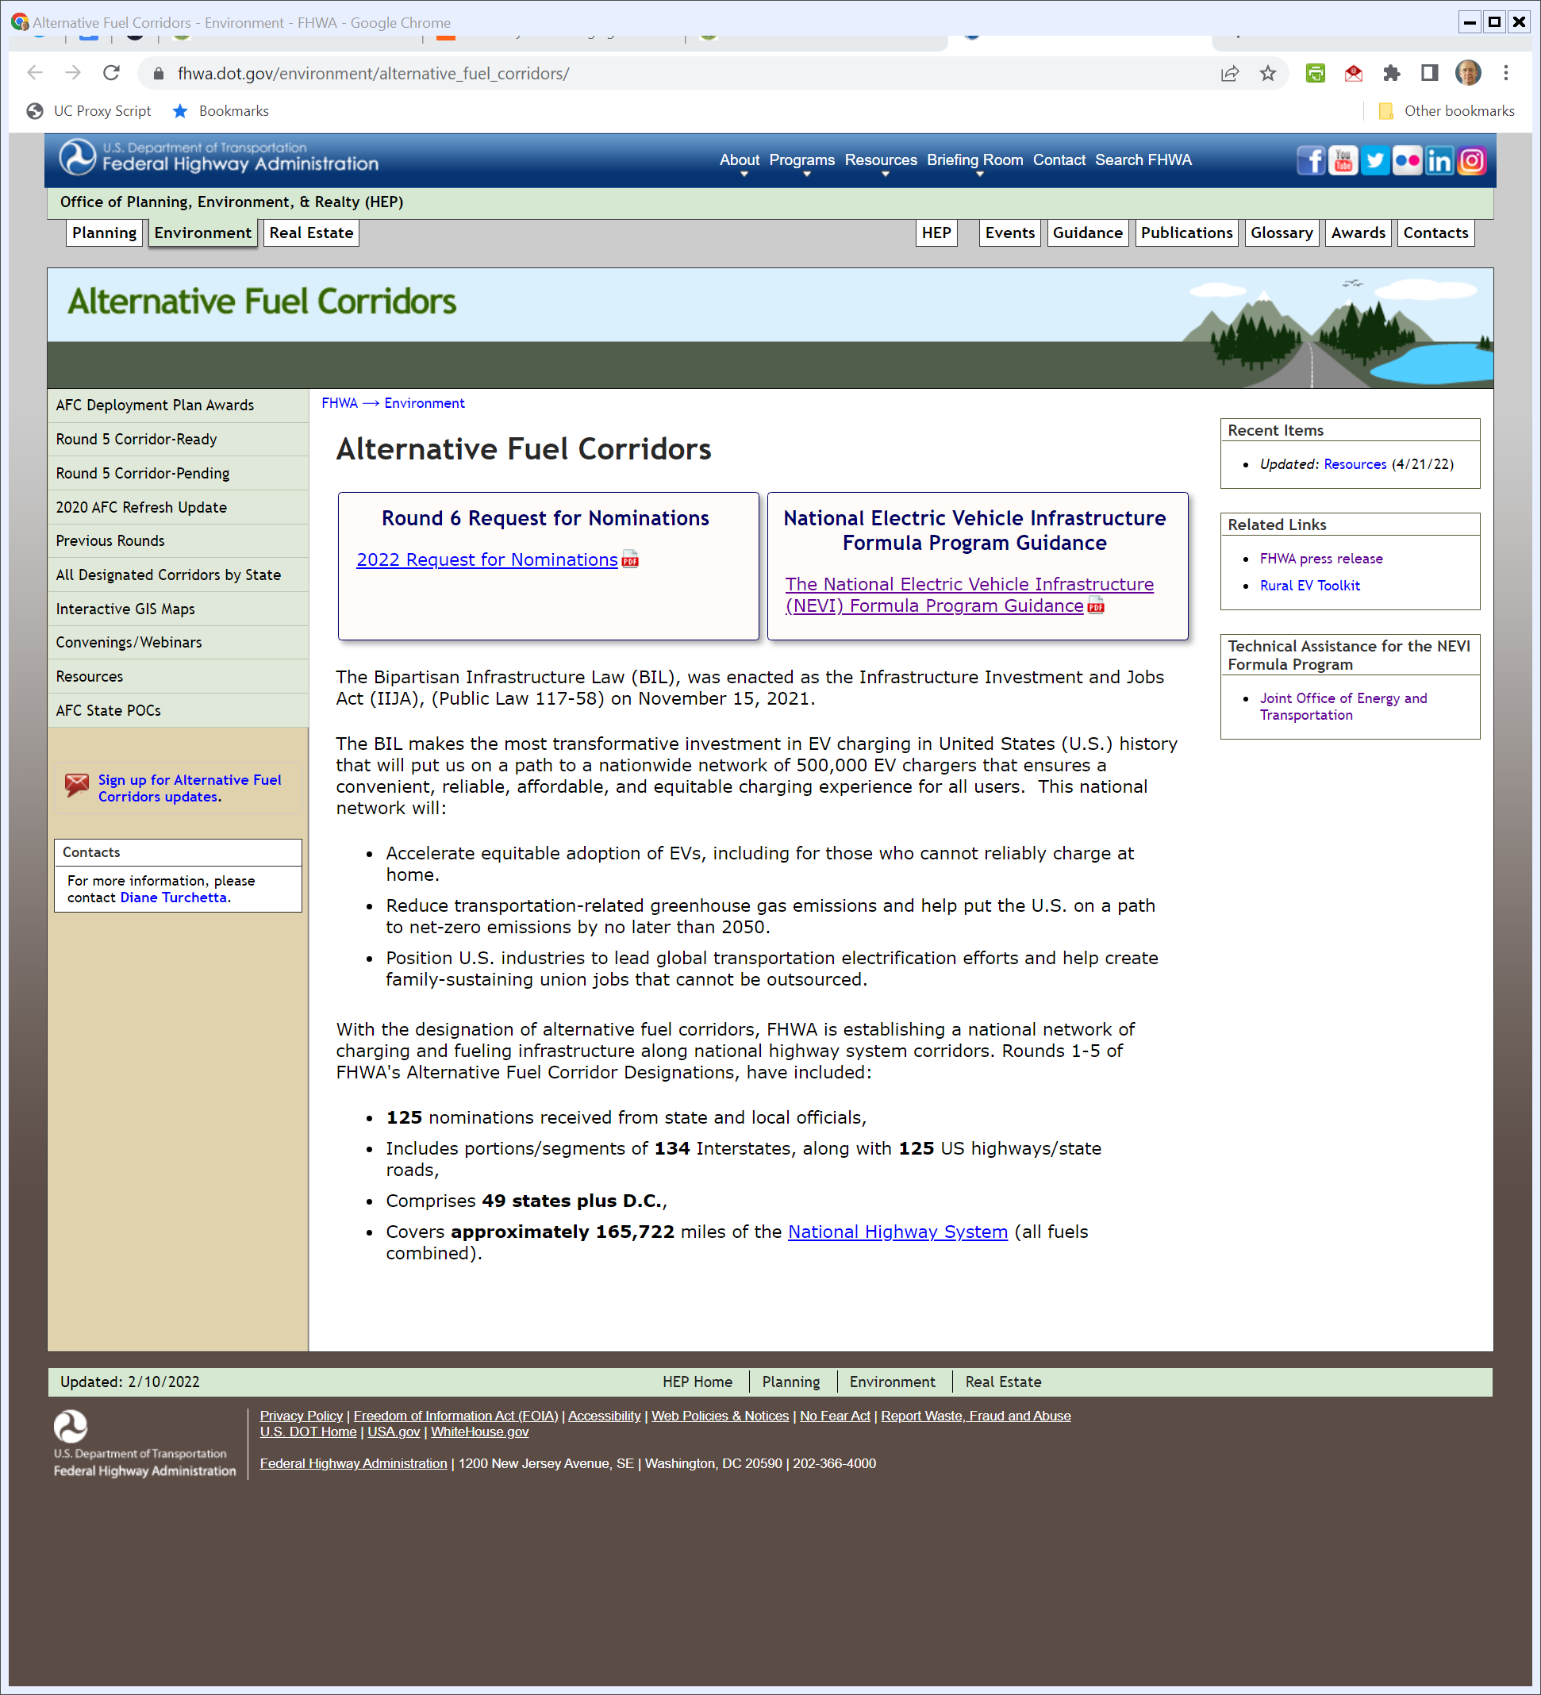
Infrastructure Act
fhwa.dot.gov (Visited 26 Apr 2022)
Notes:
https://www.fhwa.dot.gov/environment/alternative_fuel_corridors/

Slide 66
Fuel Corridor Designation
fhwa.dot.gov (Visited 26 Apr 2022)
Notes:
https://www.fhwa.dot.gov/environment/alternative_fuel_corridors/

Slide 67
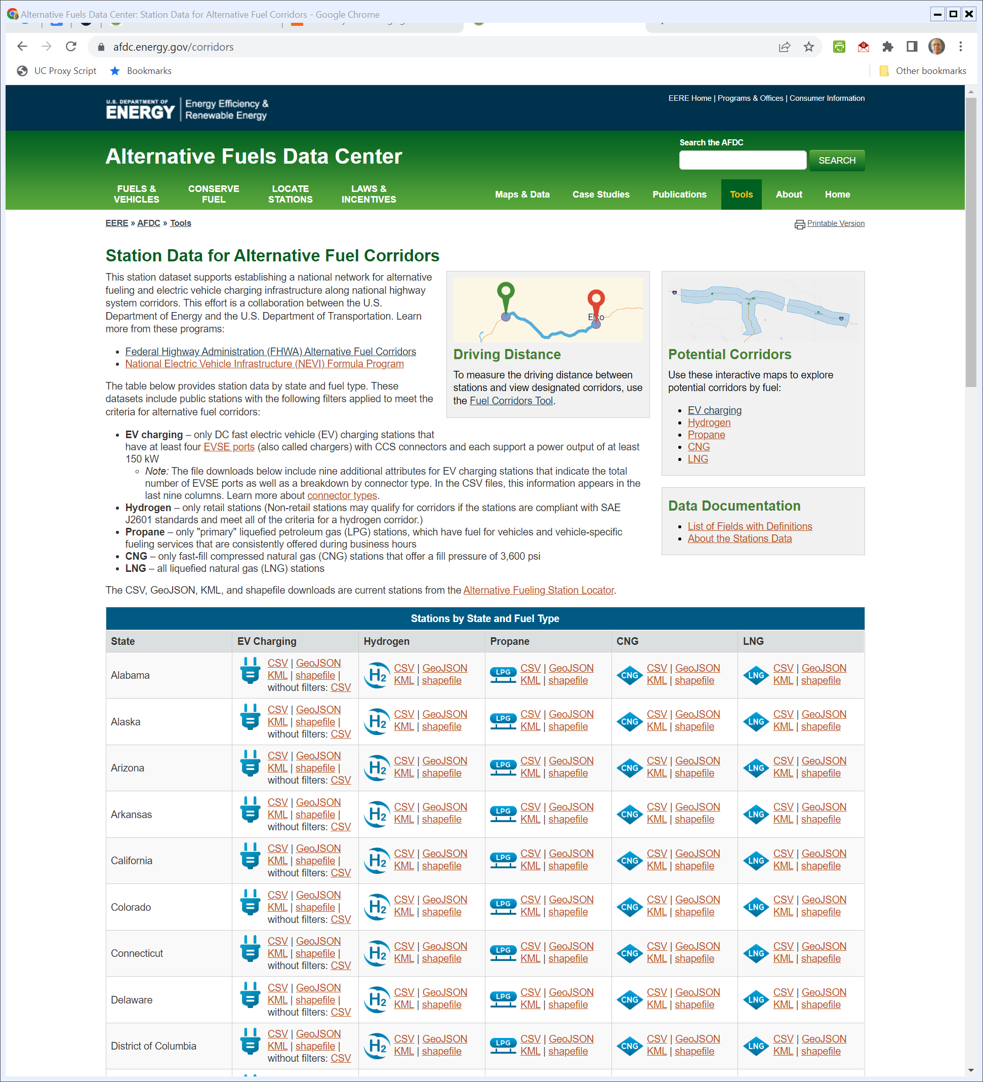
Where Can You Get Fuel?
DOE Fuel Data (Visited 26 Apr 2022)
Notes:
https://afdc.energy.gov/corridors

Slide 68
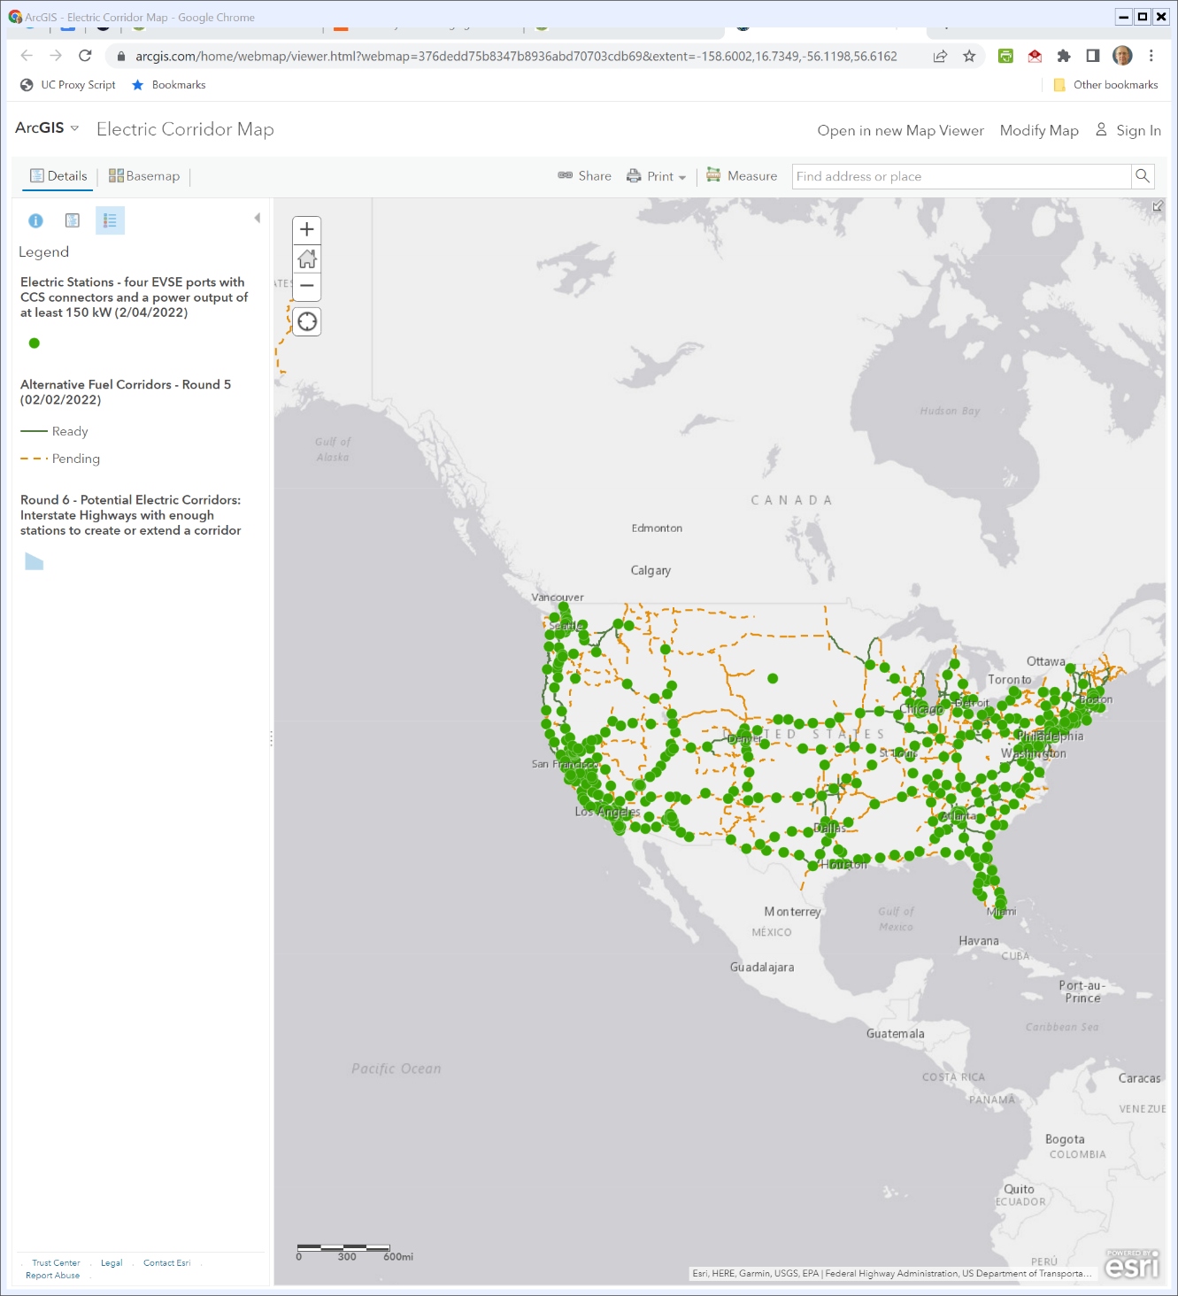
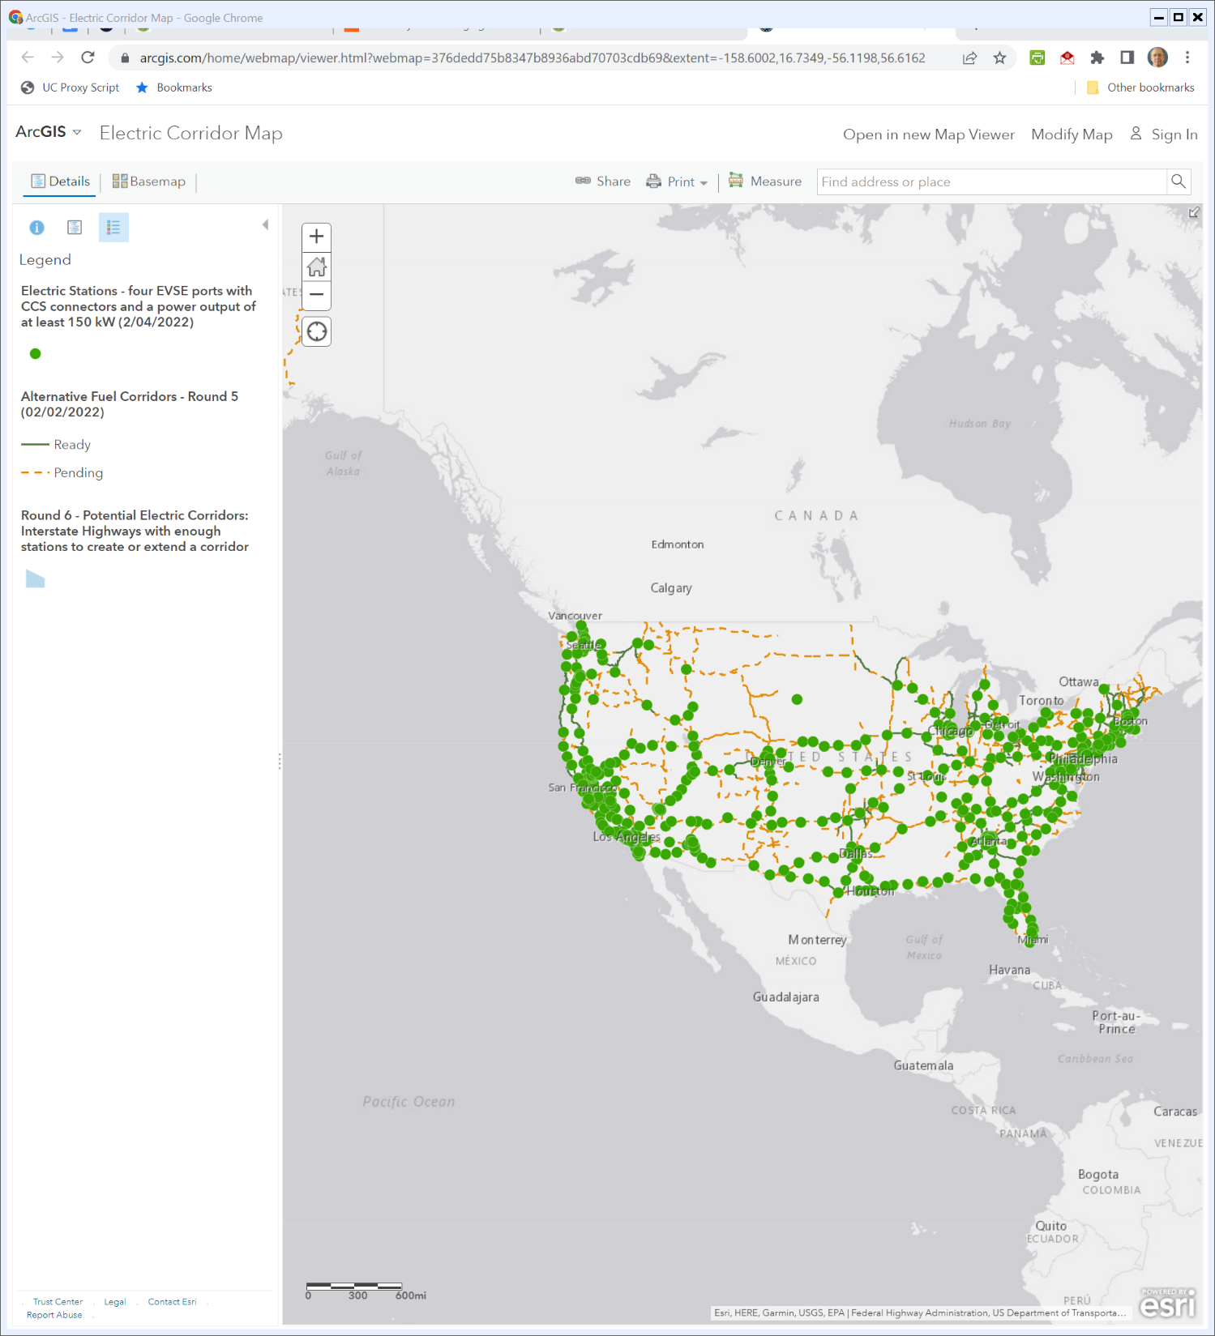
A Trip Across the Country?
DOE Electric Corridor Map (Visited 26 Apr 2022)
Notes:
https://www.arcgis.com/home/webmap/viewer.html?webmap=376dedd75b8347b8936abd70703cdb69&extent=-158.6002,16.7349,-56.1198,56.6162

Slide 69
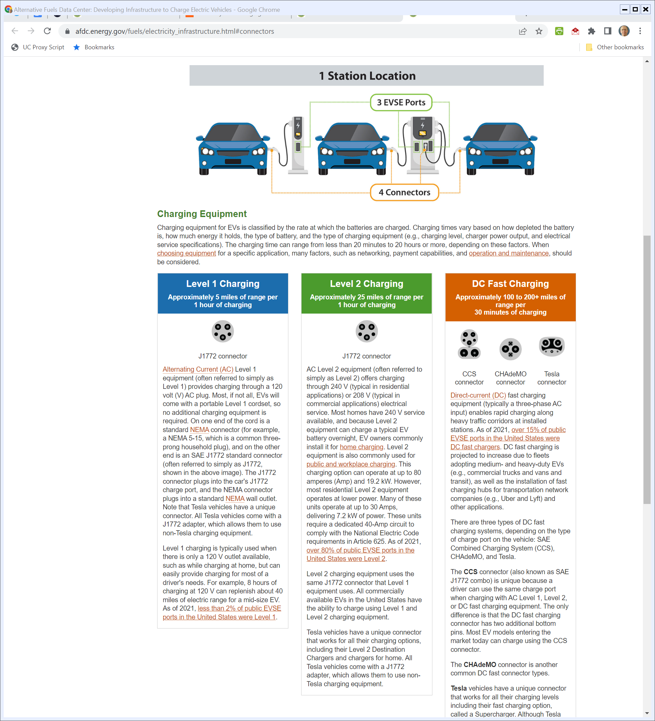
Connector Types
DOE (Visited 26 Apr 2022)
Notes:
https://afdc.energy.gov/fuels/electricity_infrastructure.html#connectors

Slide 70
EV Chargers and the Gov’t
TTYN
Assessing all of this
  Does the gov’t need to play a role in the roll out of the EV charging infrastructure?
  Is this about coordination (meaning the corridors)? About funding charging stations? Standardization of plugs?
  Are there post office/rural broadband/rural electrification types issues?

