Slide 1
Class 18 Platforms and Networks Spring 2022 Market Engineering: Vaccines
Randal C. Picker
James Parker Hall Distinguished Service Professor of Law
The Law School
The University of Chicago
Copyright © 2020-22 Randal C. Picker. All Rights Reserved.

Slide 2
The Focus Today
Questions
1. What role should the gov’t play in organizing supply chain networks?
2. The two toaster problem: how much should the gov’t invest in preparedness (such as stockpiles of PPE and ventilators)?
3. What role should the gov’t play in developing new products (semiconductors, vaccines)?

Slide 3
Truman Response to Korea Invasion
New York Times (20 July 1950)

Slide 4
Planned Defense Bill
New York Times (20 July 1950)

Slide 5
Planned Defense Bill
New York Times (20 July 1950)

Slide 6
Defense Production Act of 1950
Pub. L. 81-774 (8 Sept 1950)

Slide 7
Truman DPA Order
New York Times (10 Sept 1950)

Slide 8
Truman Acts under DPA
New York Times (17 Dec 1950)

Slide 9
How is the DPA Used?
GAO Report (June 2008)

Slide 10
Inconsistent Use of DPA Contractual Priority Rules
GAO Report (June 2008)

Slide 11
DOD Also Uses Capacity Expansion Rules
GAO Report (June 2008)

Slide 12
DPA Reauthorization Act of 2009
Pub. L. 11-67 (30 Sept 2009)

Slide 13
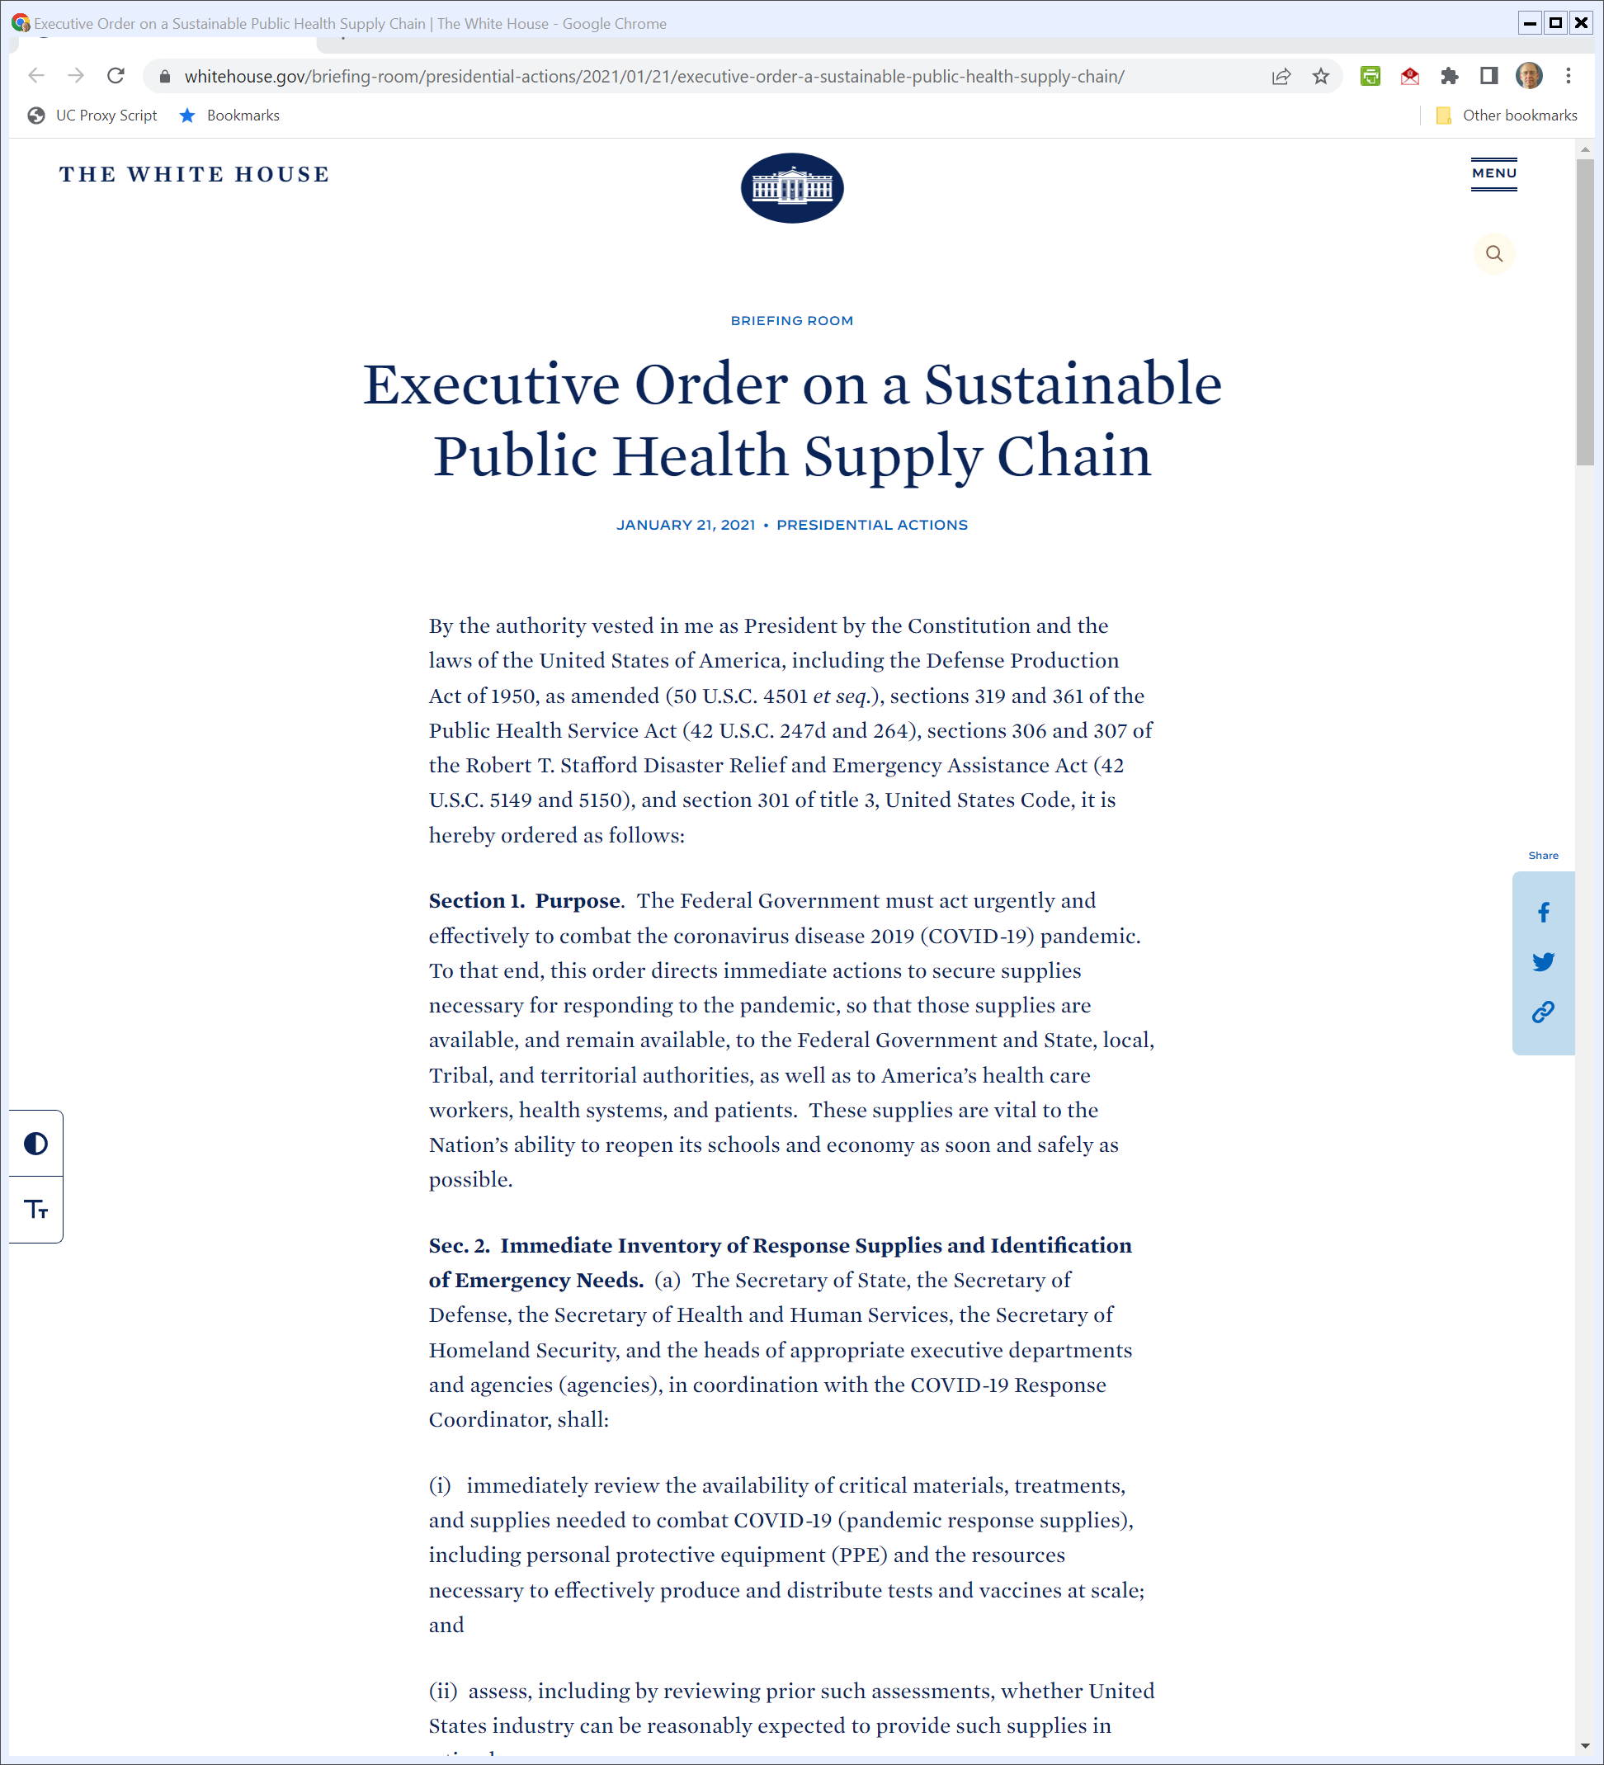
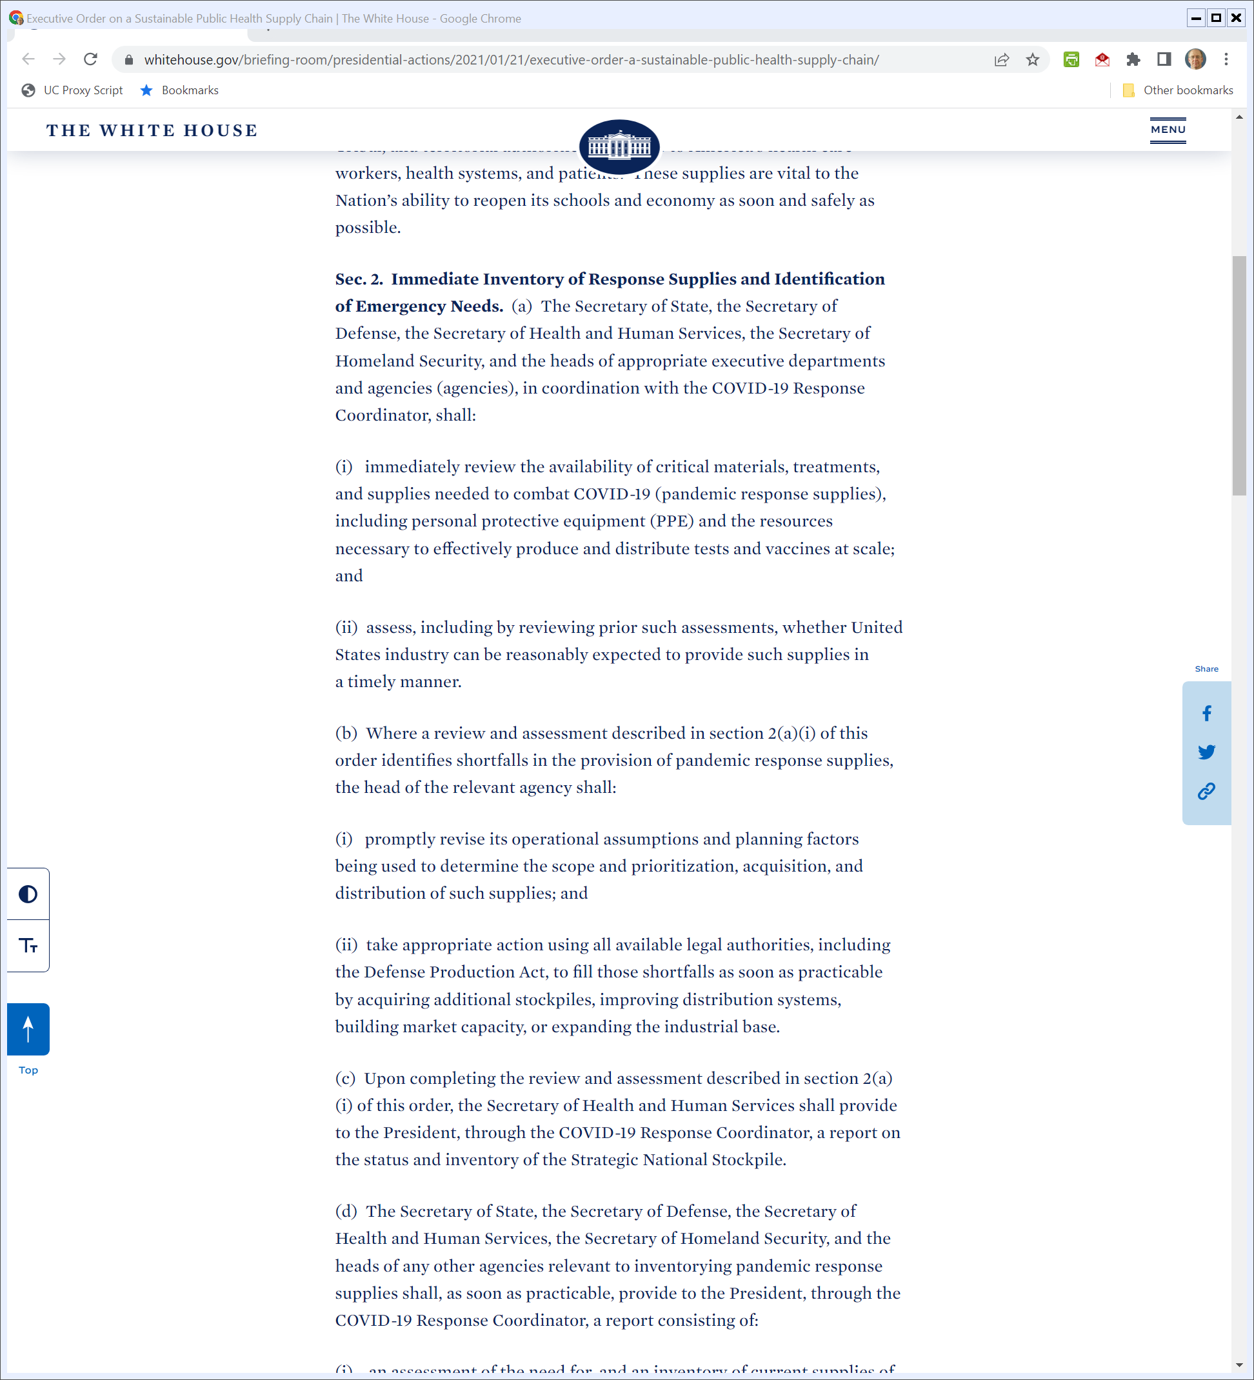
Biden Use of DPA
Biden (21 Jan 2021)
Notes:
https://www.whitehouse.gov/briefing-room/presidential-actions/2021/01/21/executive-order-a-sustainable-public-health-supply-chain/

Slide 14
Biden Use of DPA
Biden (21 Jan 2021)
Notes:
https://www.whitehouse.gov/briefing-room/presidential-actions/2021/01/21/executive-order-a-sustainable-public-health-supply-chain/

Slide 15
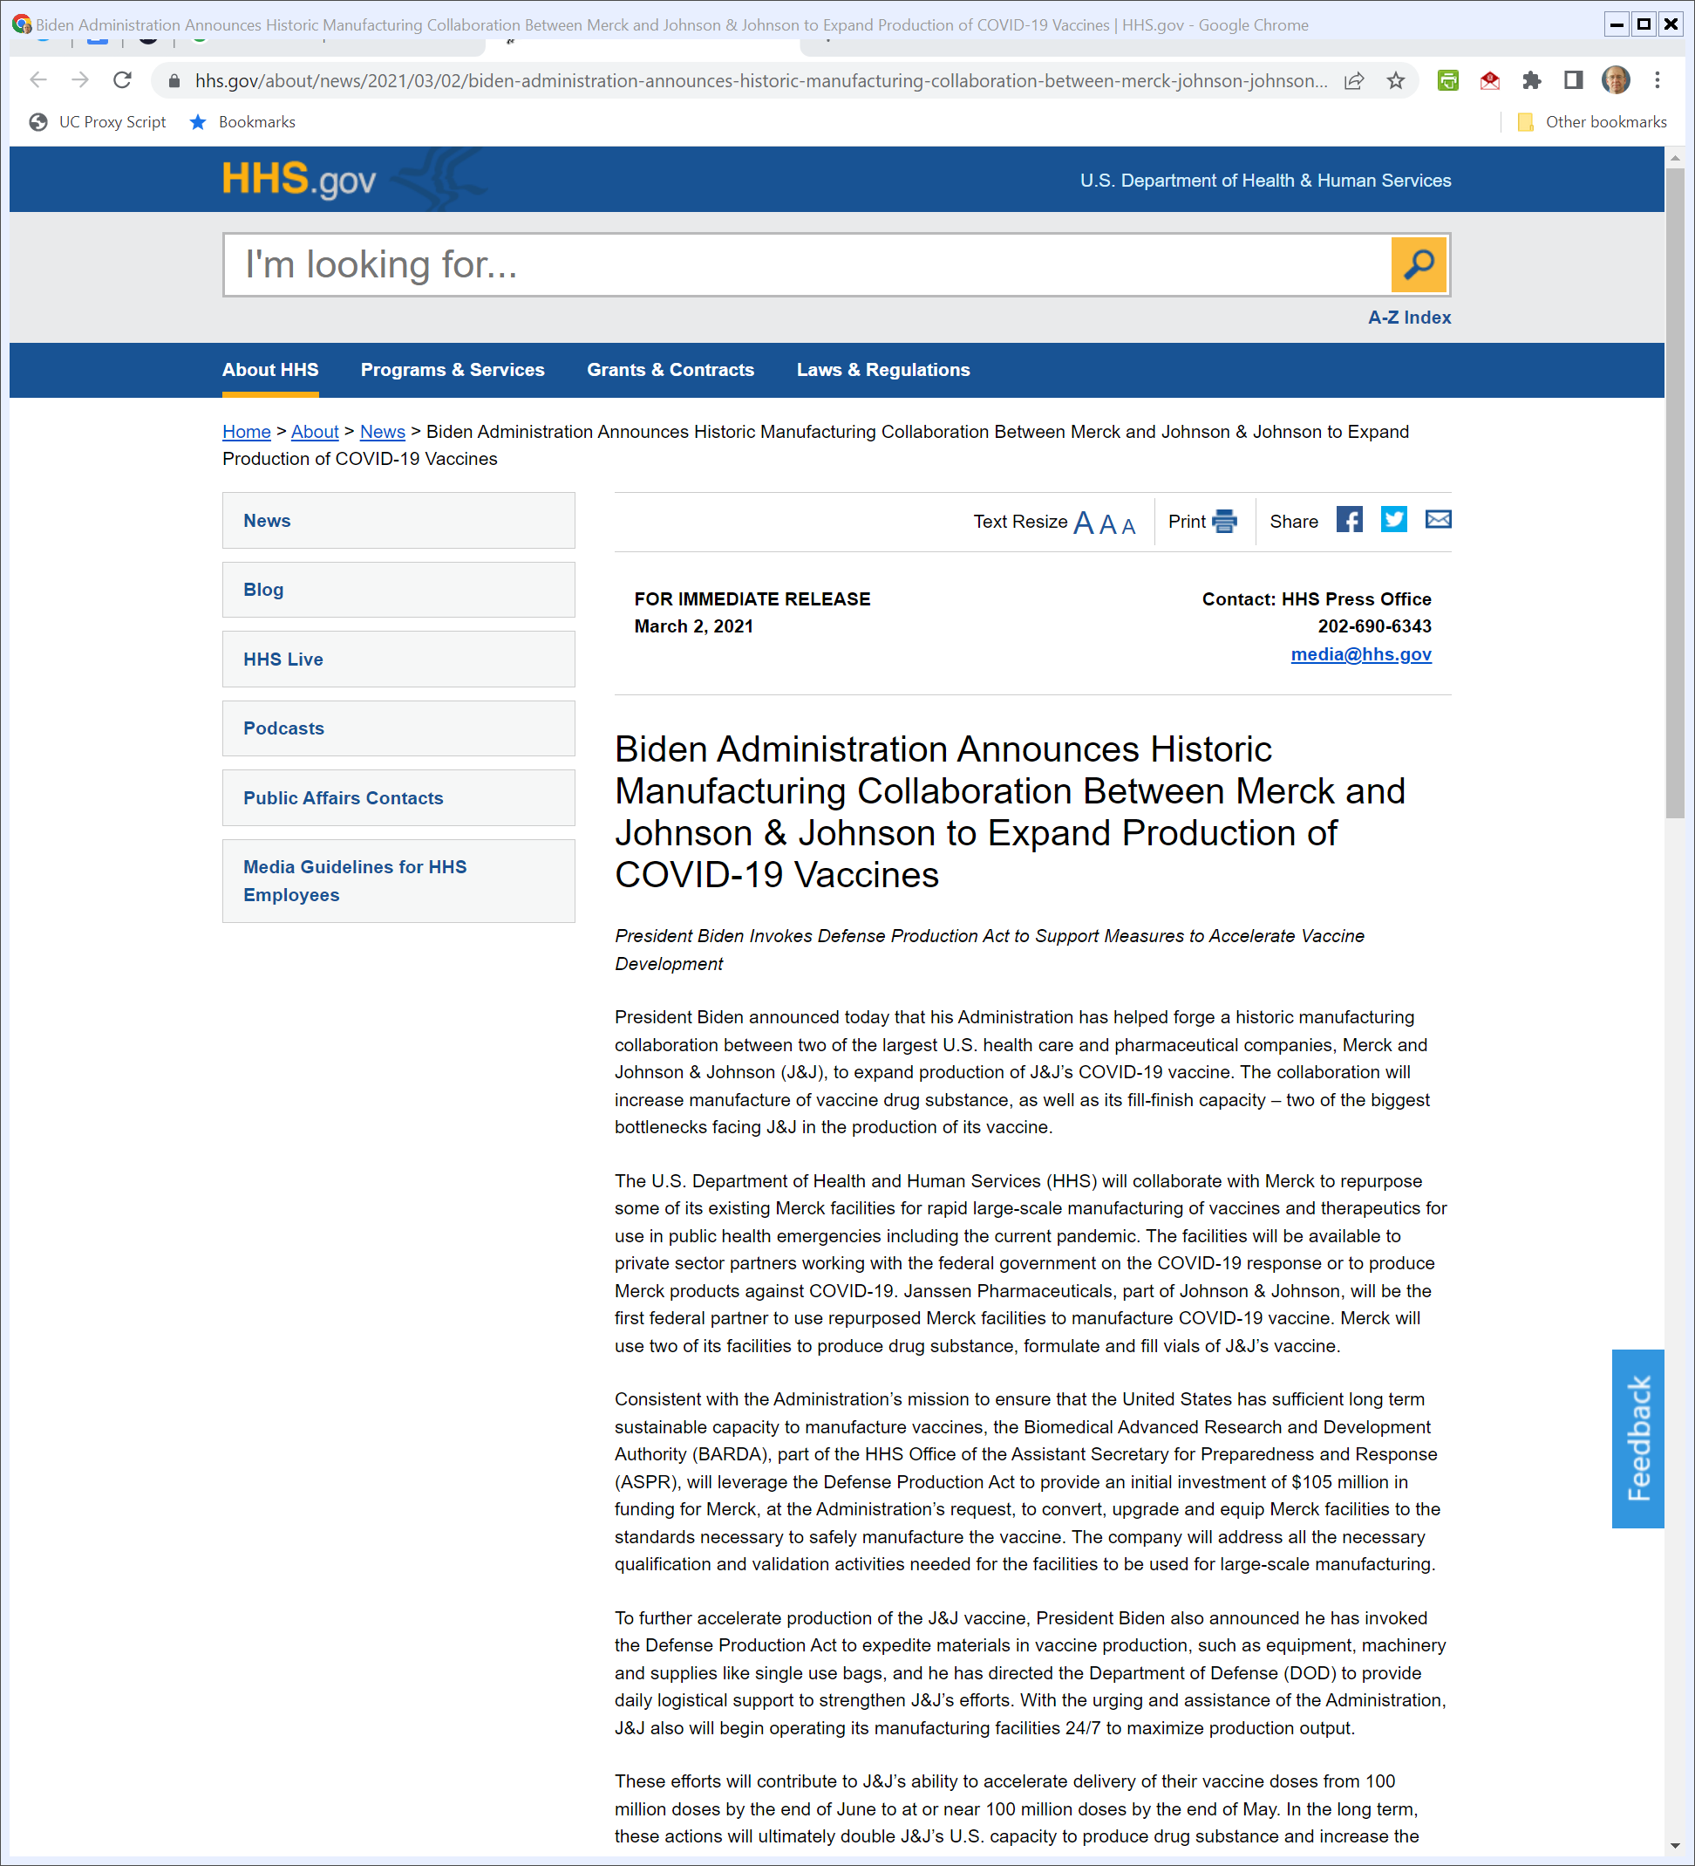
More Biden DPA
HHS.gov (2 Mar 2021)
Notes:
https://www.hhs.gov/about/news/2021/03/02/biden-administration-announces-historic-manufacturing-collaboration-between-merck-johnson-johnson-expand-production-covid-19-vaccines.html

Slide 16
More Biden DPA
HHS.gov (2 Mar 2021)
Notes:
https://www.hhs.gov/about/news/2021/03/02/biden-administration-announces-historic-manufacturing-collaboration-between-merck-johnson-johnson-expand-production-covid-19-vaccines.html

Slide 17
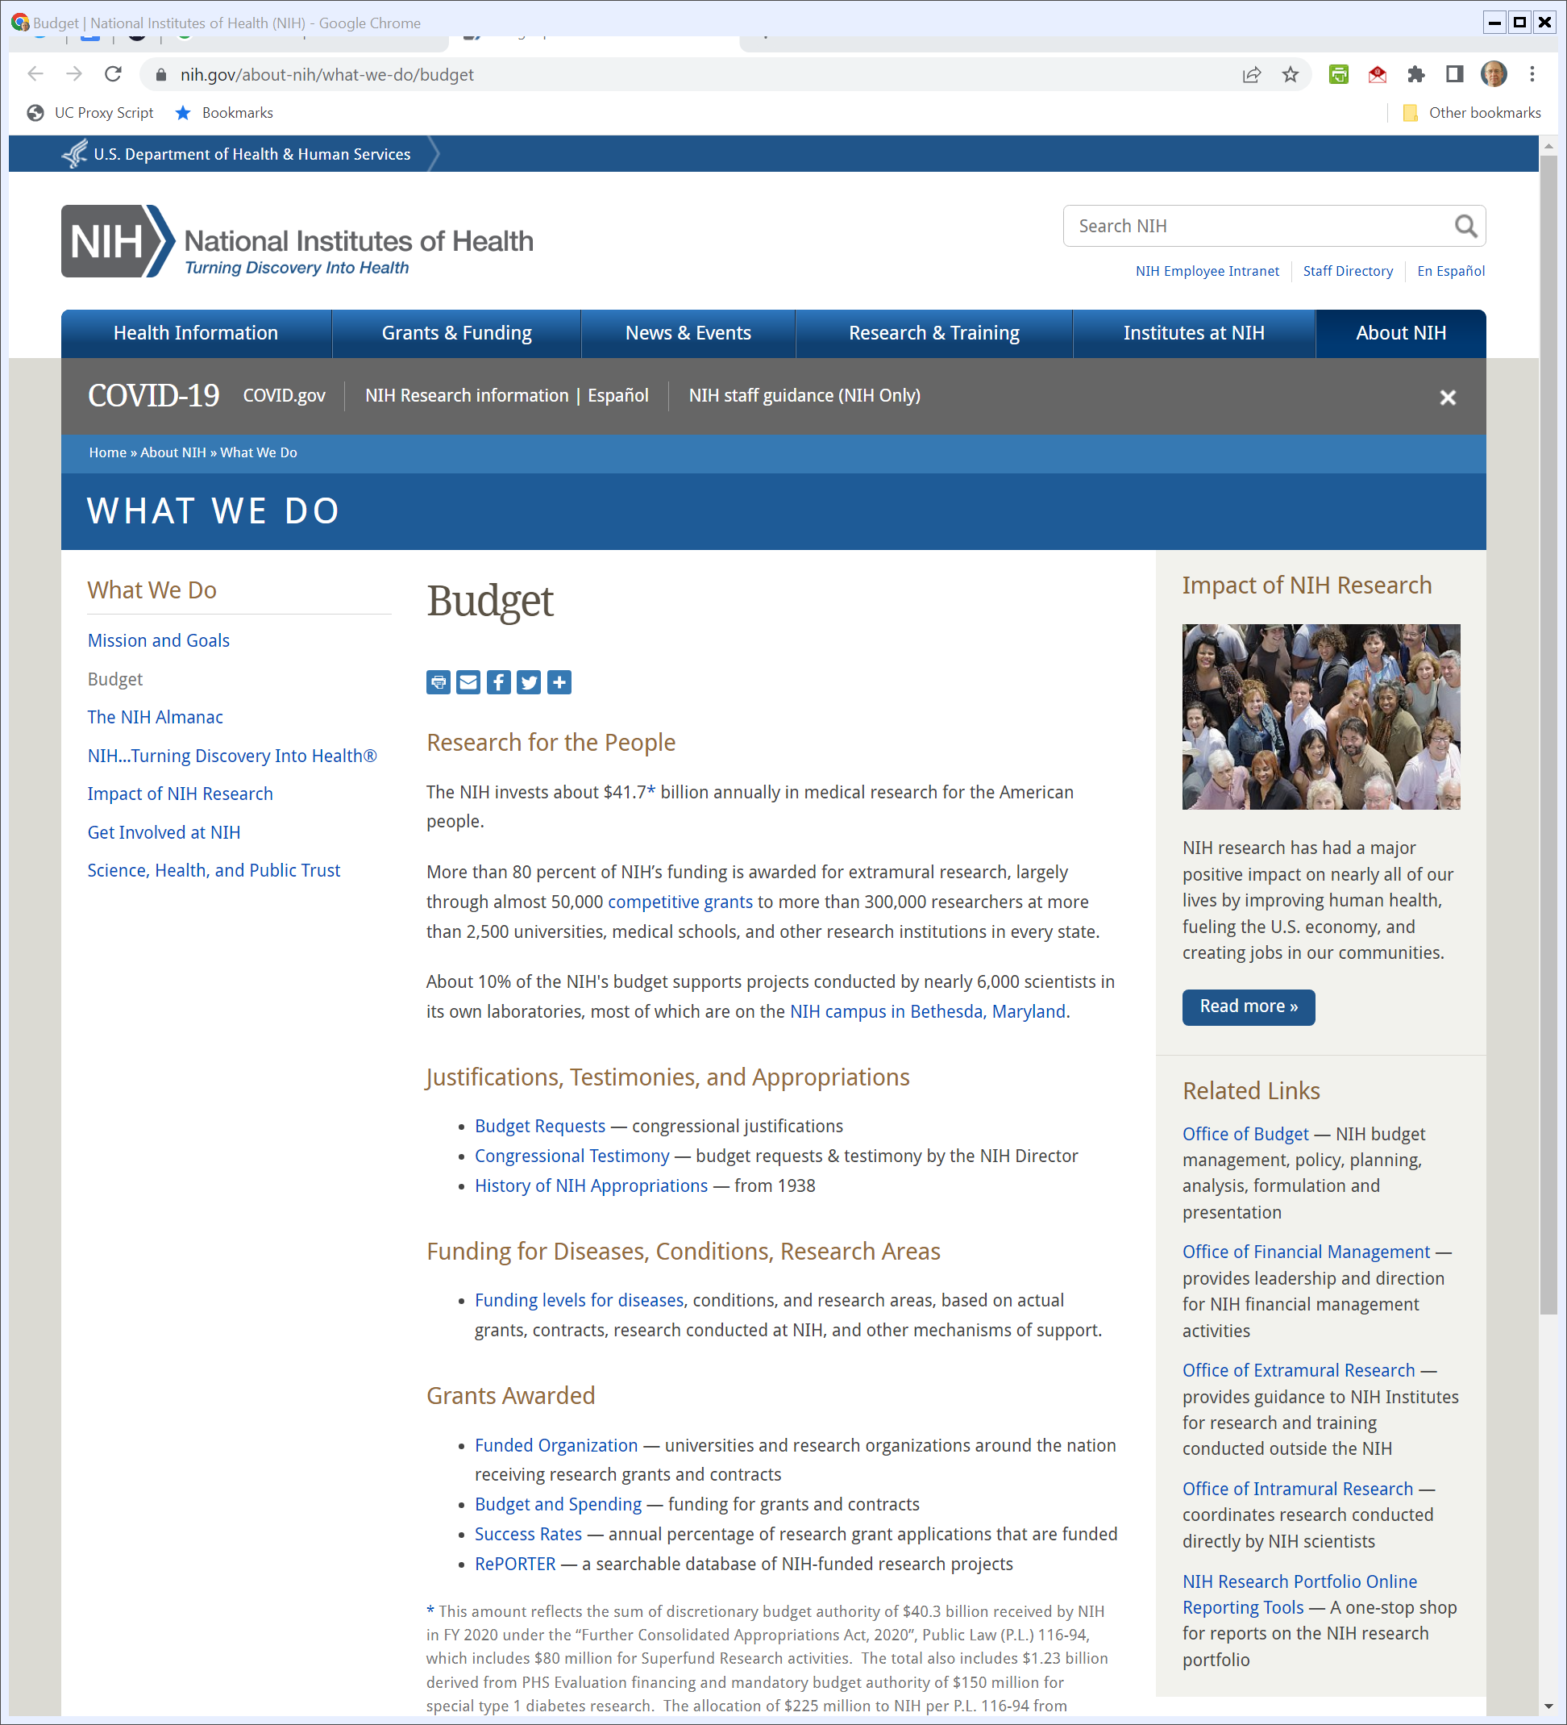
NIH
NIH.gov (Visited 28 Apr 2022)

Slide 18
R&D Context
CRS (4 Oct 2021)

Slide 19
2002: Public Health Security Act (104 pages of get ready)
Pub. L. 107-188 (12 June 2002)

Slide 20
New Ass’t Sec: Pub Health Emergency Preparedness
Pub. L. 107-188 (12 June 2002)

Slide 21
Revitalizing CDC
Pub. L. 107-188 (12 June 2002)

Slide 22
Strategic National Stockpile
Pub. L. 107-188 (12 June 2002)

Slide 23
Strategic National Stockpile
Pub. L. 107-188 (12 June 2002)

Slide 24
Quarantine Provisions
Pub. L. 107-188 (12 June 2002)

Slide 25
Background to 2004 Bioshield Act
H.Rep. 108-147 (10 June 2003)

Slide 26
Private Market R&D Incentives
H.Rep. 108-147 (10 June 2003)

Slide 27
FDA Lacks Appropriate Emergency Powers
H.Rep. 108-147 (10 June 2003)

Slide 28
We Are Going to Fix All of That
H.Rep. 108-147 (10 June 2003)

Slide 29
2004: Project Bioshield Act (30 Pages)
Pub. L. 108-276 (21 July 2004)

Slide 30
Development of New Countermeasures; Possible Market Commitments
Pub. L. 108-276 (21 July 2004)

Slide 31
Funding: $5.6 Billion
Pub. L. 108-276 (21 July 2004)

Slide 32
New FDA Emergency Authority
Pub. L. 108-276 (21 July 2004)

Slide 33
New FDA Emergency Authority
Pub. L. 108-276 (21 July 2004)

Slide 34
Heading into the 2006 Act
H.Rep. 109-686 (26 Sept 2006)

Slide 35
Updating 2004 Bioshield Law
H.Rep. 109-686 (26 Sept 2006)

Slide 36
Single Point of Authority for R&D, Procurement
H.Rep. 109-686 (26 Sept 2006)

Slide 37
BARDA
H.Rep. 109-686 (26 Sept 2006)

Slide 38
2006 Pandemic Act (51 pages)
Pub. L. 109-417 (19 Dec 2006)

Slide 39
Vaccine Tracking in Influenza Pandemic
Pub. L. 109-417 (19 Dec 2006)

Slide 40
Medical Surge Capacity
Pub. L. 109-417 (19 Dec 2006)

Slide 41
Creation of BARDA
Pub. L. 109-417 (19 Dec 2006)

Slide 42
BARDA Duties
Pub. L. 109-417 (19 Dec 2006)

Slide 43
Supporting Innovation
Pub. L. 109-417 (19 Dec 2006)

Slide 44
Funding
Pub. L. 109-417 (19 Dec 2006)

Slide 45
Antitrust Immunity
Pub. L. 109-417 (19 Dec 2006)

Slide 46
Procurement
Pub. L. 109-417 (19 Dec 2006)

Slide 47
Sales Exclusivity
Pub. L. 109-417 (19 Dec 2006)

Slide 48
Surge Capacity
Pub. L. 109-417 (19 Dec 2006)

Slide 49
Pandemic Act of 2019 (61 pages)
Pub. L. 116-22 (24 June 2019)

Slide 50
Pandemic Act of 2019 (61 pages)
Pub. L. 116-22 (24 June 2019)

Slide 51
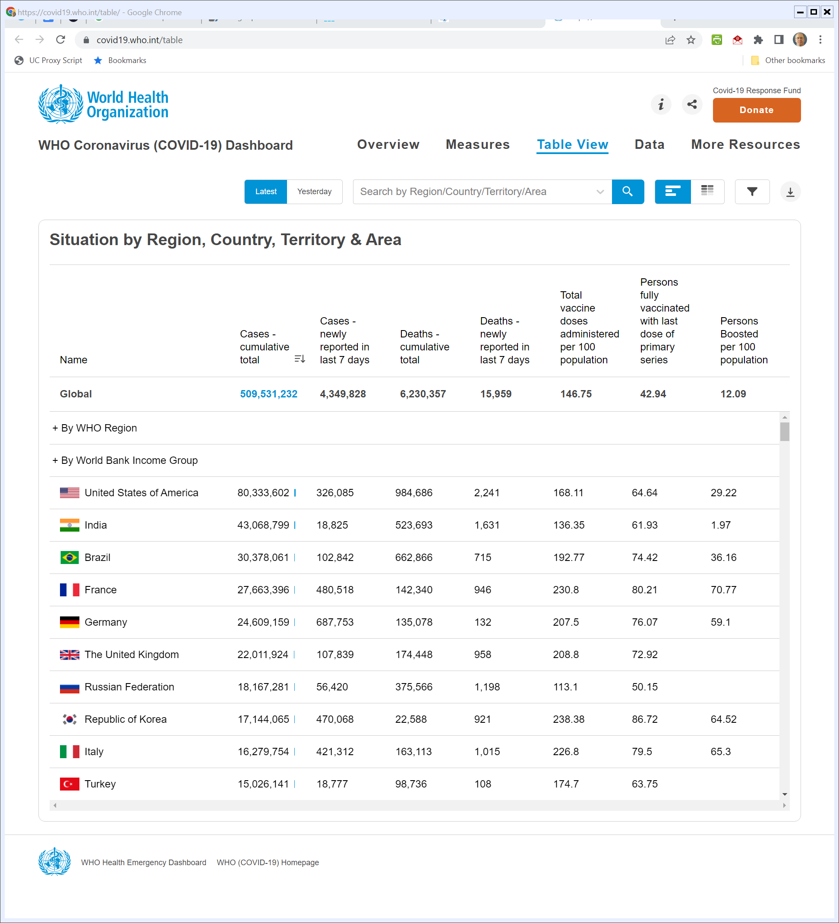
Where Are We Now?
WHO (Visited 28 Apr 2022)
Notes:
https://covid19.who.int/table

Slide 52
Another Run
Financial Times (29 Nov 2021)

Slide 53
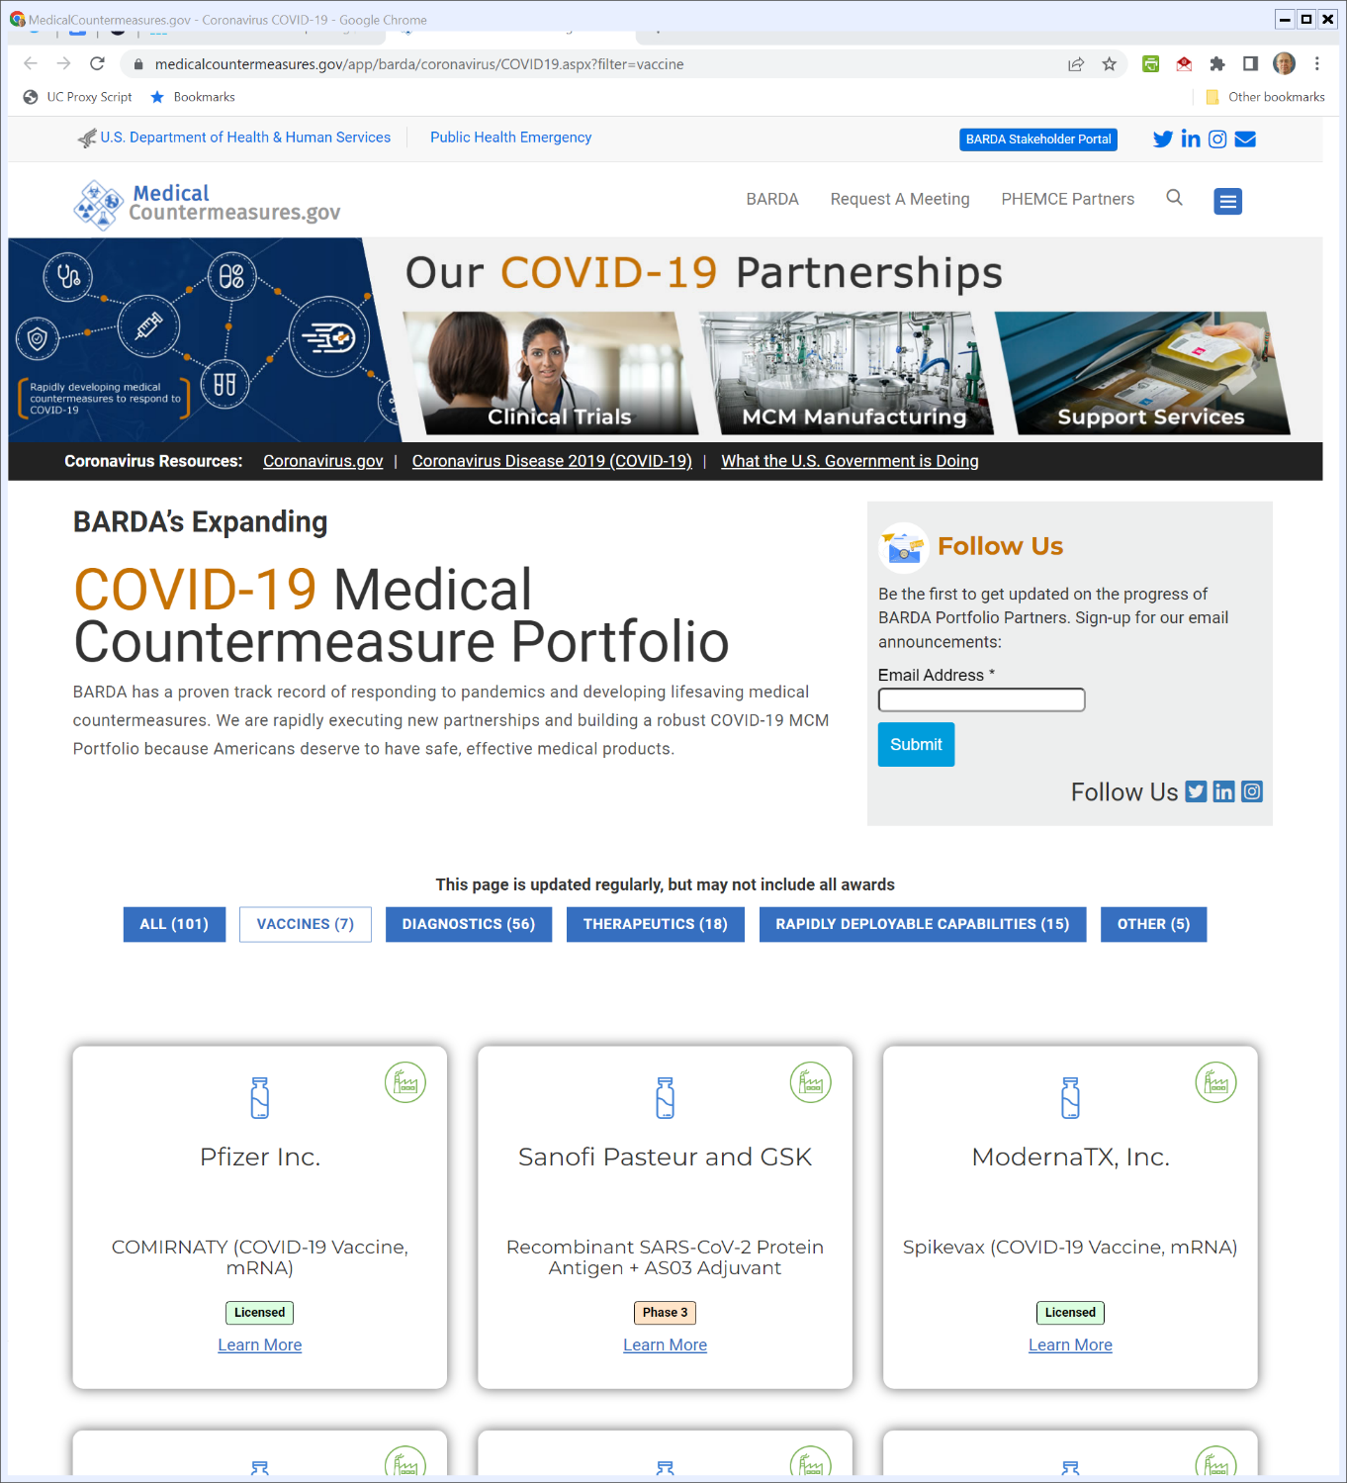

BARDA’s Vaccine Projects
Medicalcountermeasures.gov (Visited 28 Apr 2022)
Notes:
https://www.medicalcountermeasures.gov/app/barda/coronavirus/COVID19.aspx?filter=vaccine

Slide 54
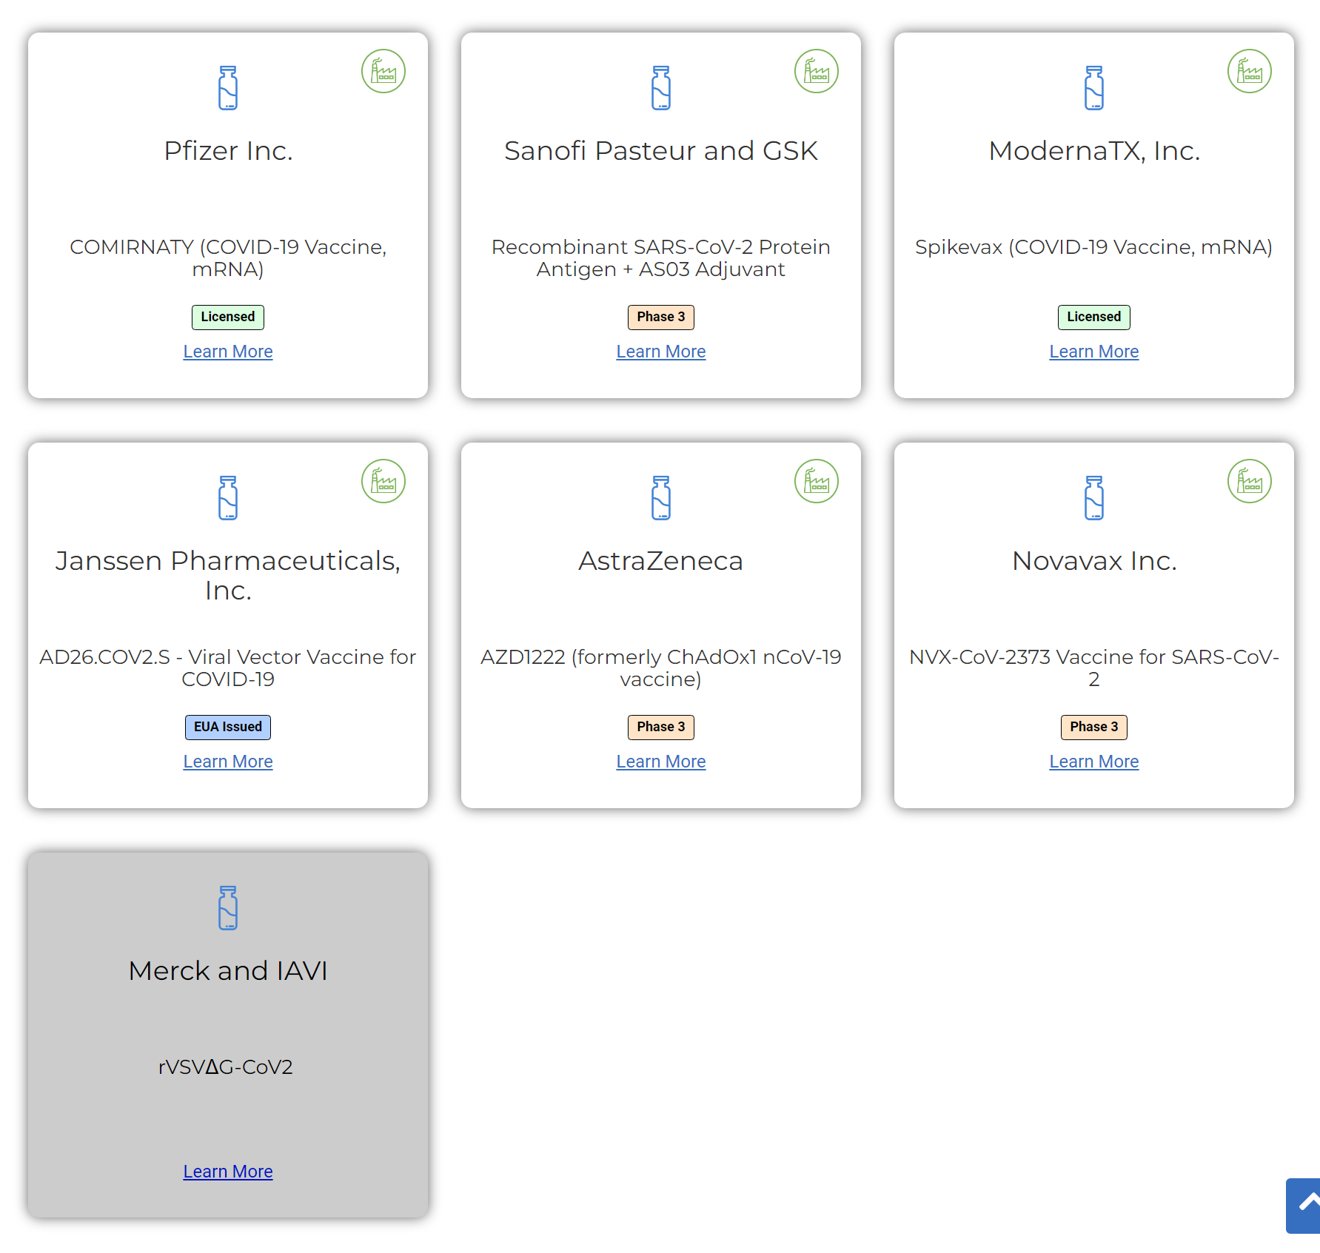
BARDA’s Vaccine Projects
Medicalcountermeasures.gov (Visited 28 Apr 2022)
Notes:
https://www.medicalcountermeasures.gov/app/barda/coronavirus/COVID19.aspx?filter=vaccine

Slide 55
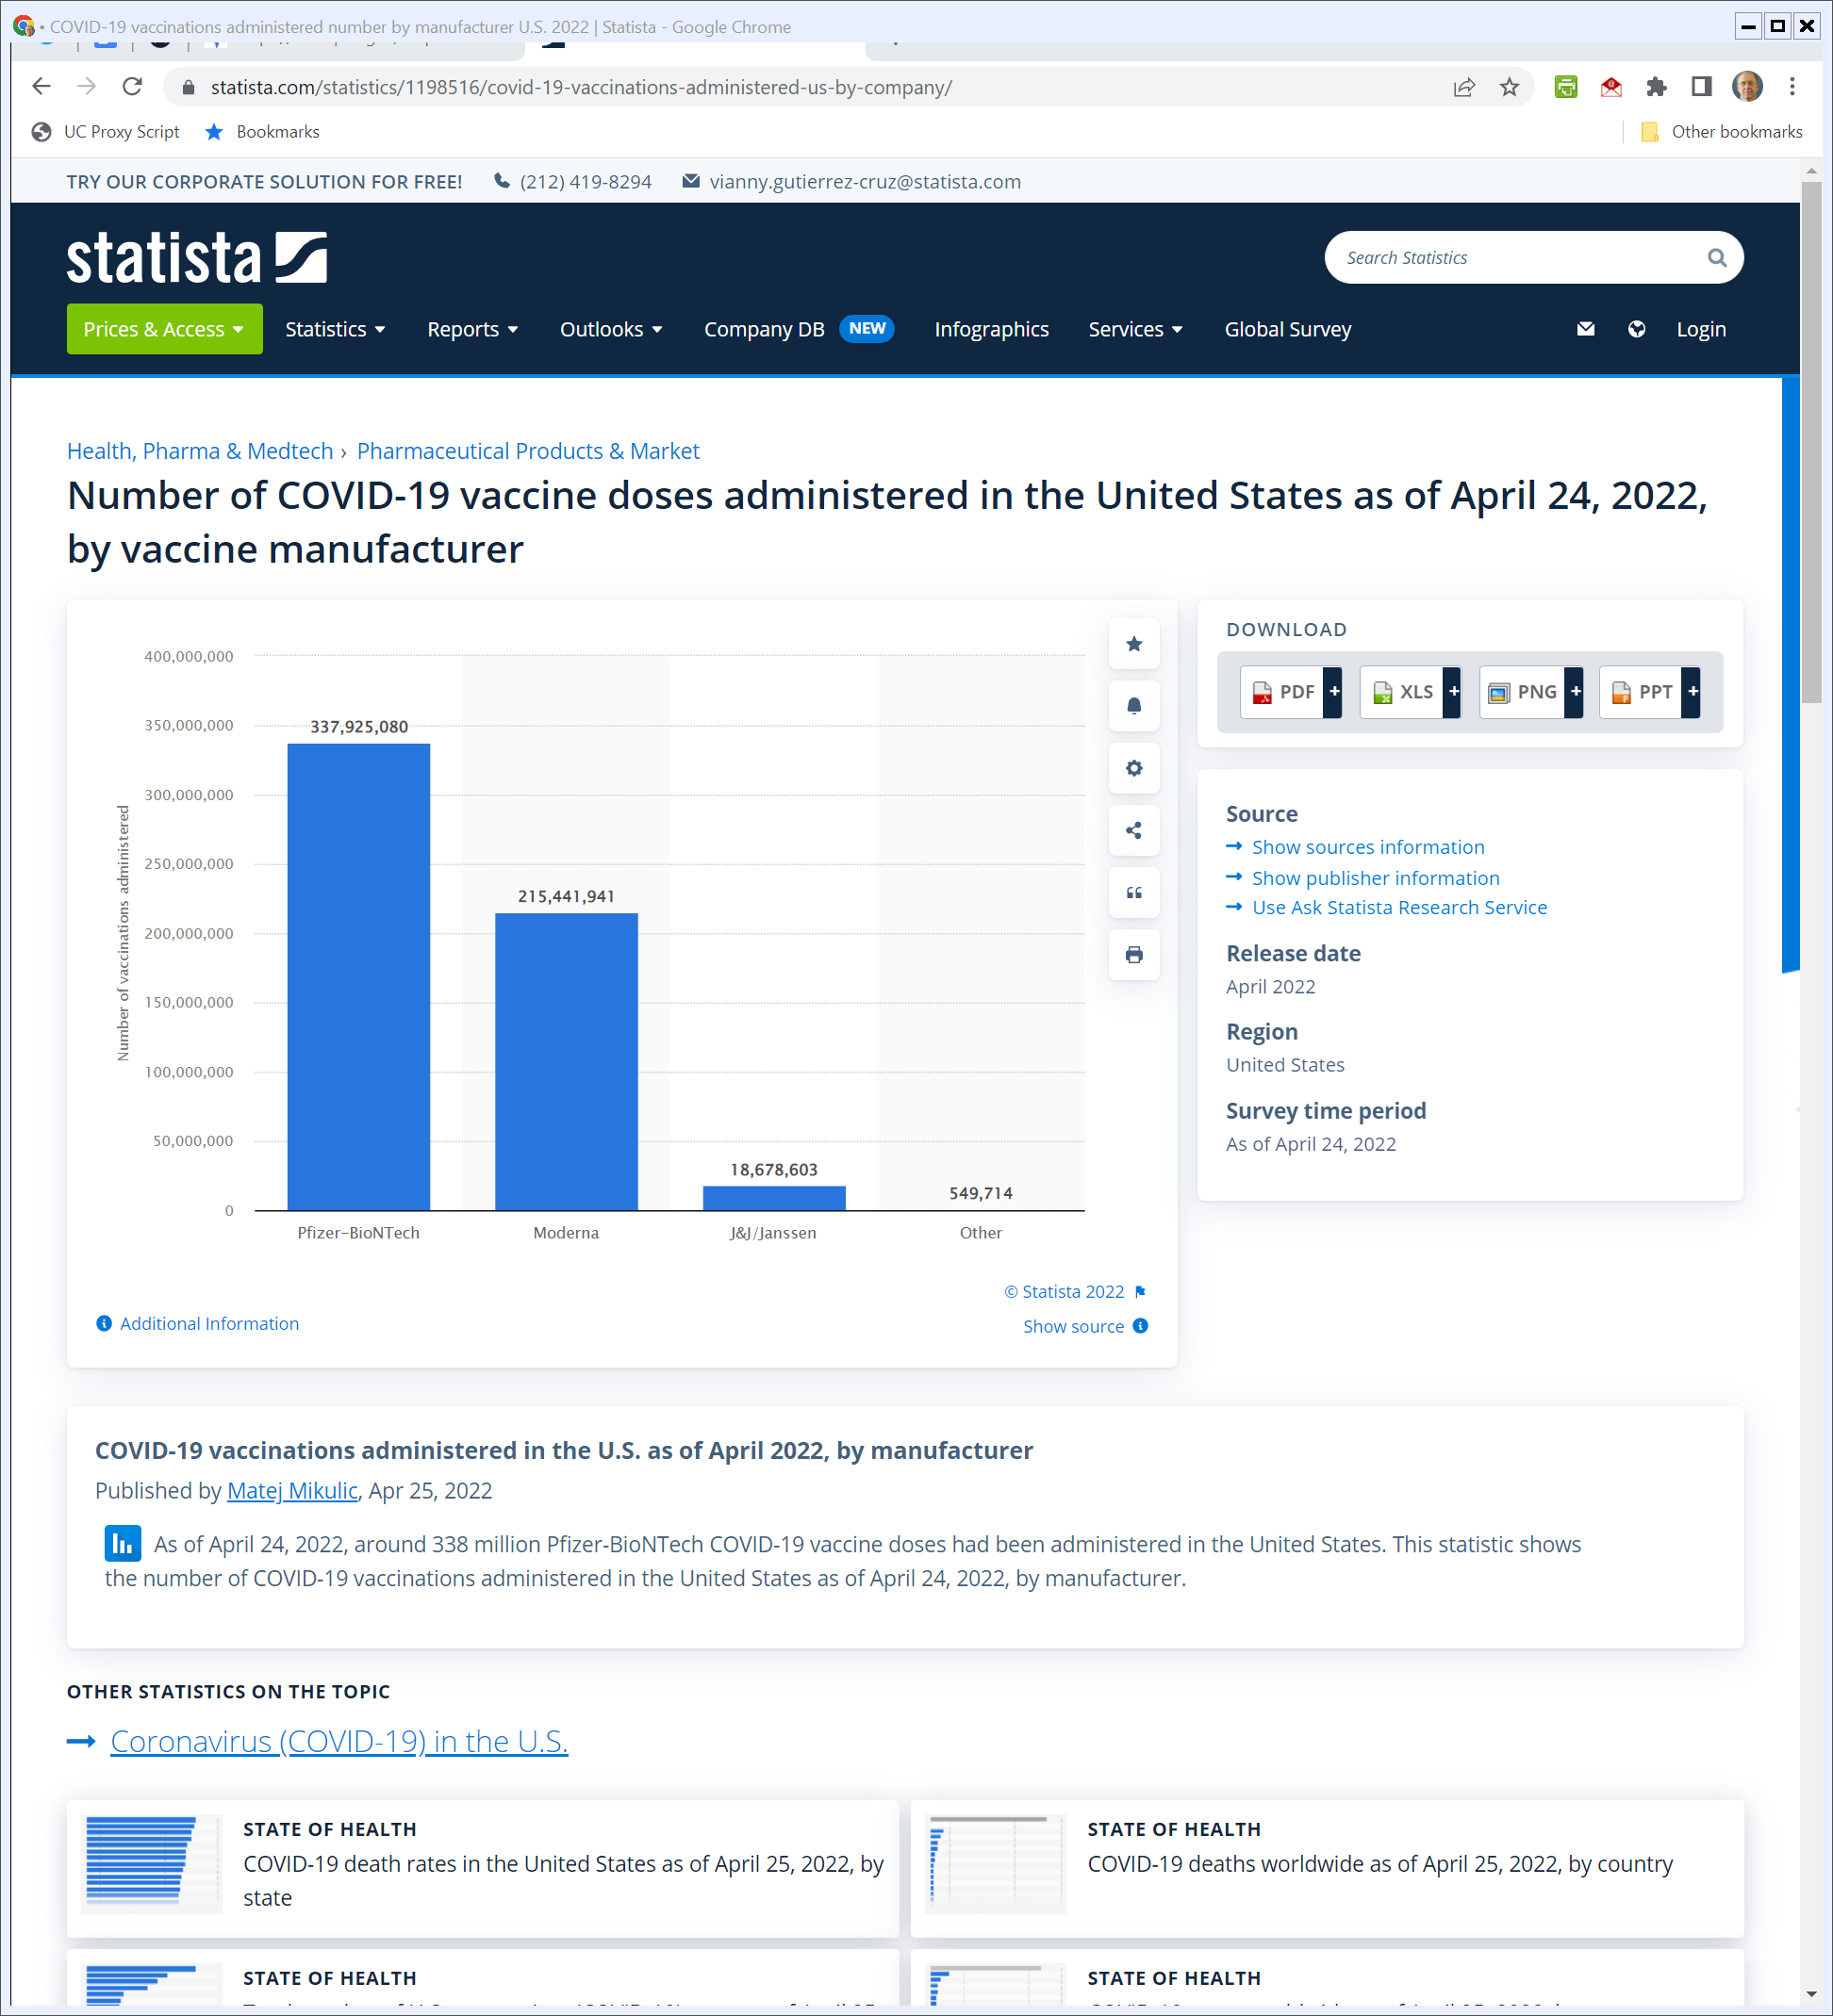
U.S. Covid Vaccines
Statista (24 Apr 2022)
Notes:
https://www.statista.com/statistics/1198516/covid-19-vaccinations-administered-us-by-company/

Slide 56
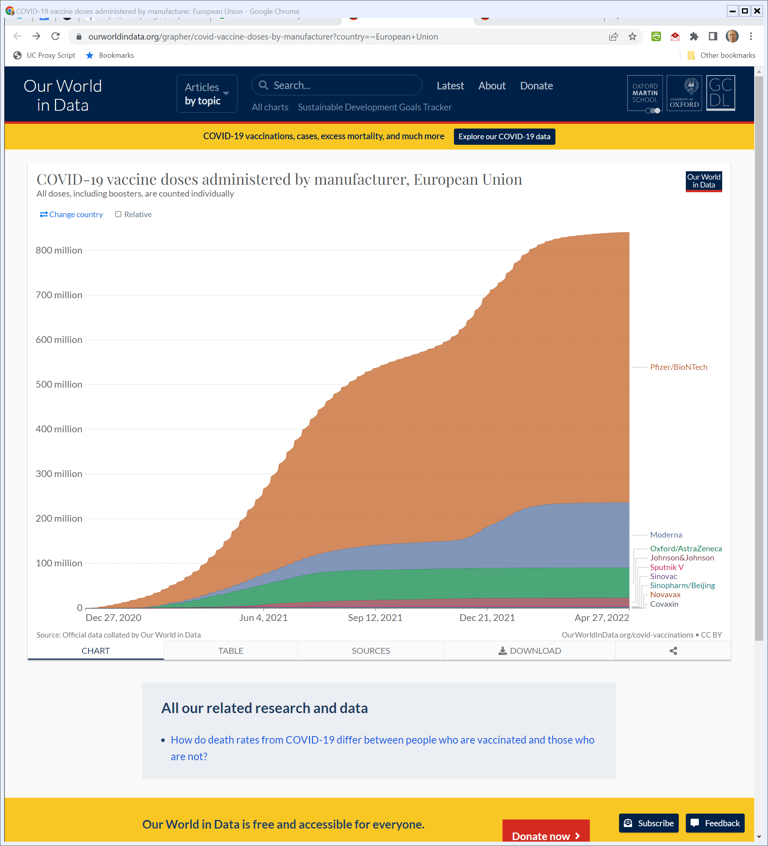
European Union
Ourworldindata.org (Visited 28 Apr 2022)
Notes:
https://ourworldindata.org/grapher/covid-vaccine-doses-by-manufacturer?country=~European+Union

Slide 57
OWS Development Plan
HHS (undated)

Slide 58
2020 Timeline
HHS (undated)

Slide 59
Nov 2018: Moderna Red Herring
Moderna S-1 (9 Nov 2018)

Slide 60
The Tech
Moderna S-1 (9 Nov 2018)

Slide 61
21 Development Candidates
Moderna S-1 (9 Nov 2018)

Slide 62
Financials
Moderna S-1 (9 Nov 2018)

Slide 63
24 Dev Candidates
Moderna Annual Report (2019)

Slide 64
Patents
Moderna Annual Report (2019)

Slide 65
And Financially?
Moderna Annual Report (2019)

Slide 66
16 Apr 2020: BARDA Award to Moderna
Moderna Press Release (16 Apr 2020)

Slide 67
16 Apr 2020: BARDA Award to Moderna
Moderna Press Release (16 Apr 2020)

Slide 68
Old Yesterday’s NYT Front Page
New York Times (19 May 2020)

Slide 69
The Contract
Moderna/U.S. Contract (16 Apr 2020)
Notes:
https://www.hhs.gov/sites/default/files/vaccine-contract-with-moderna-modifications-p00001-p00002-p00003.pdf

Slide 70
TOC
Moderna/U.S. Contract (16 Apr 2020)

Slide 71
100 Million Doses by 2021
Moderna/U.S. Contract (16 Apr 2020)

Slide 72
$483M Cap
Moderna/U.S. Contract (16 Apr 2020)

Slide 73
Statement of Work
Moderna/U.S. Contract (16 Apr 2020)

Slide 74
????
Moderna/U.S. Contract (16 Apr 2020)

Slide 75
Standard Federal Contracting
Moderna/U.S. Contract (16 Apr 2020)

Slide 76
Patents
Moderna/U.S. Contract (16 Apr 2020)

Slide 77
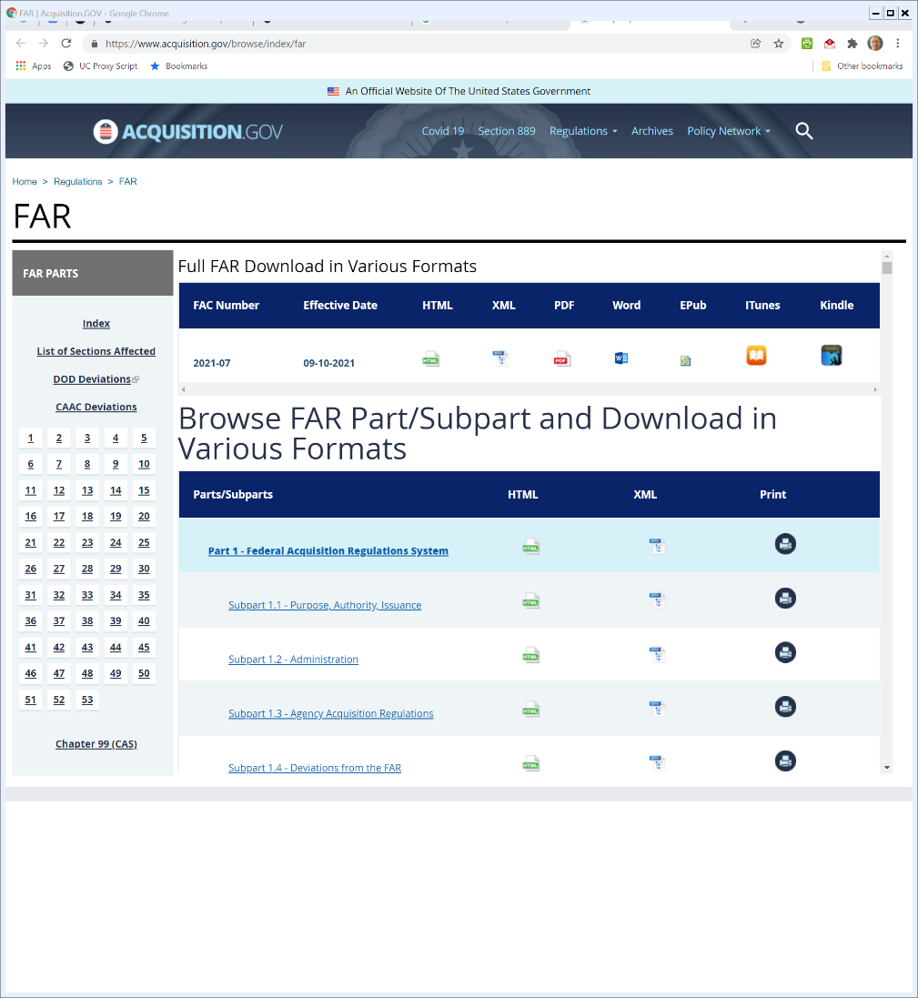

U.S. Fed Contracting
Acquisition.gov (Visited on 1 Dec 2021)
Notes:
https://www.acquisition.gov/browse/index/far

Slide 78
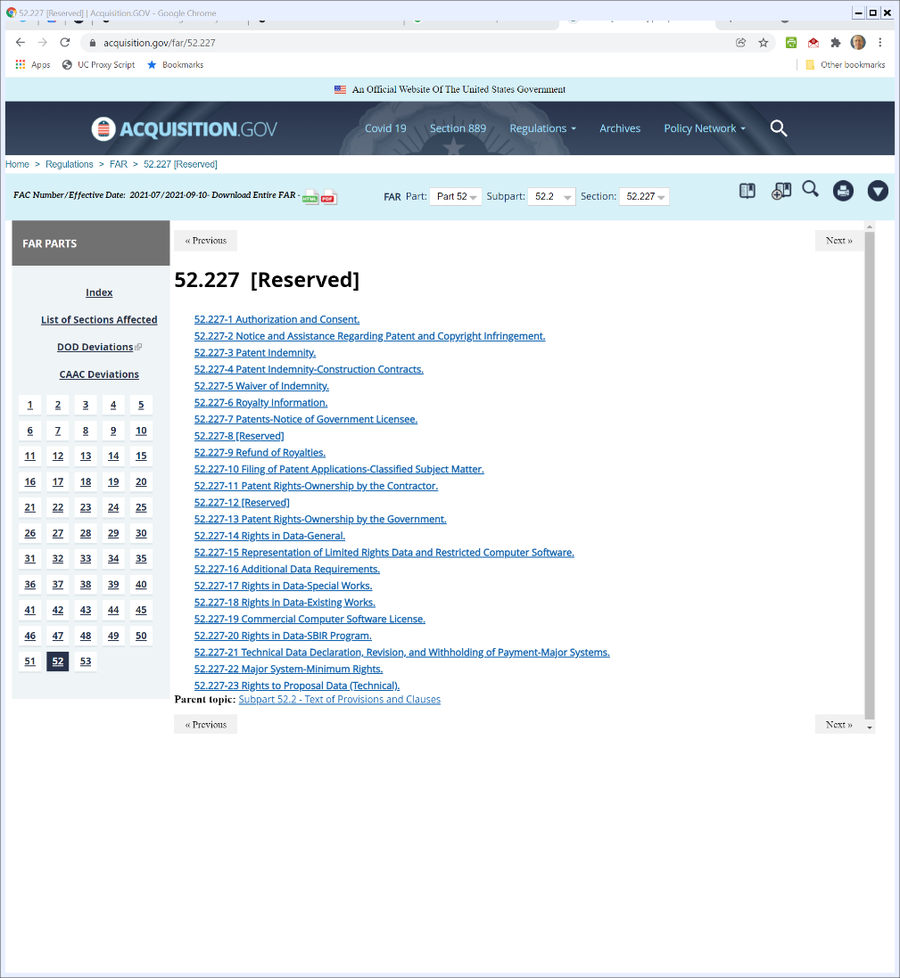

52.227: Sub 11 (Contractor Owns), Sub 13 (Gov’t Owns)
Acquisition.gov (Visited on 1 Dec 2021)
Notes:
https://www.acquisition.gov/browse/index/far

Slide 79
1992 Pages
Fed Acquisition Reg (FY2019)

Slide 80
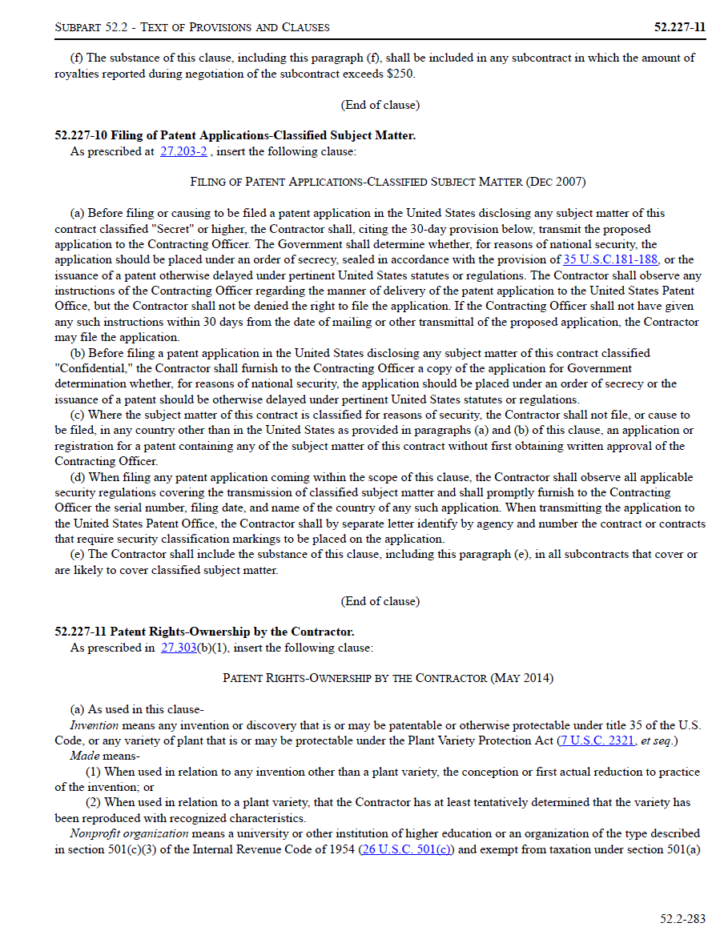
52.227-11
Fed Acquisition Reg (FY2019)

Slide 81
Contractor’s Patent Rights
52.227-11 (FY2019)

Slide 82
Gov’t License?
52.227-11 (FY2019)

Slide 83
Aug/Sept 2020: Second Contract: 500M Doses
Moderna/U.S. Contract (8 Sept 2020)

Slide 84
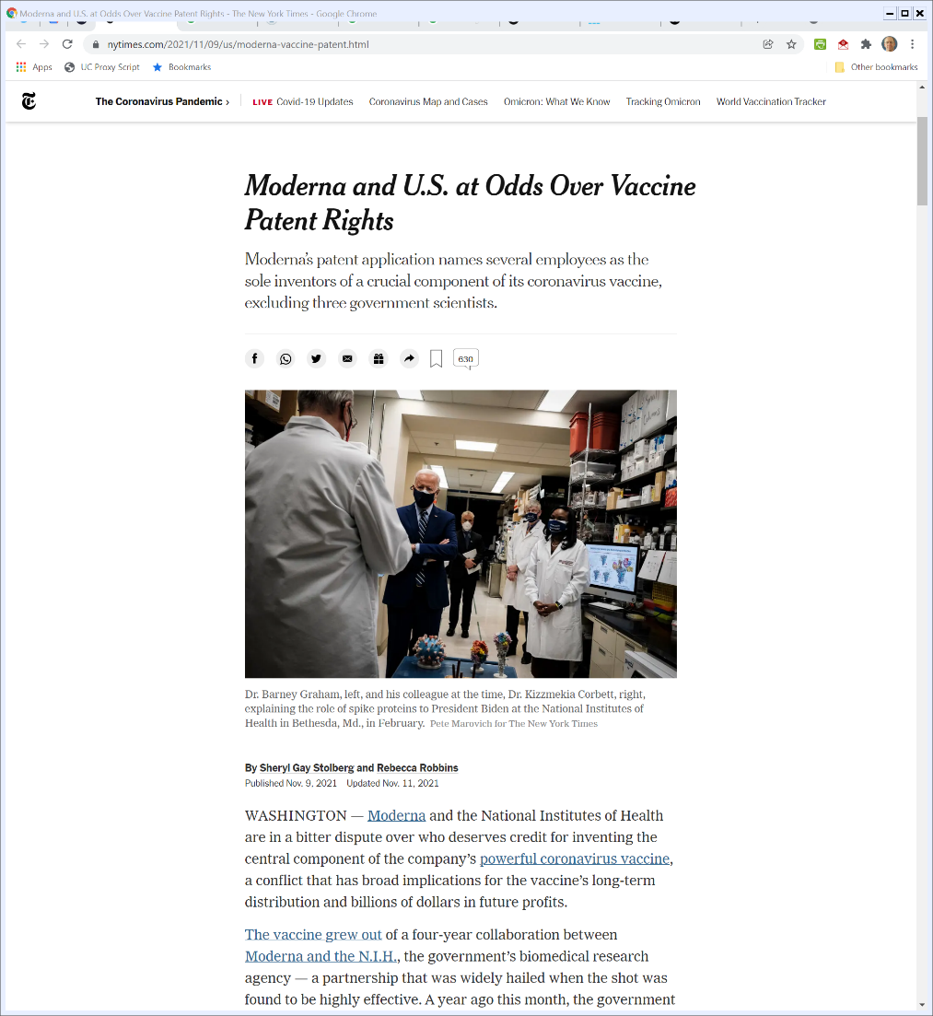
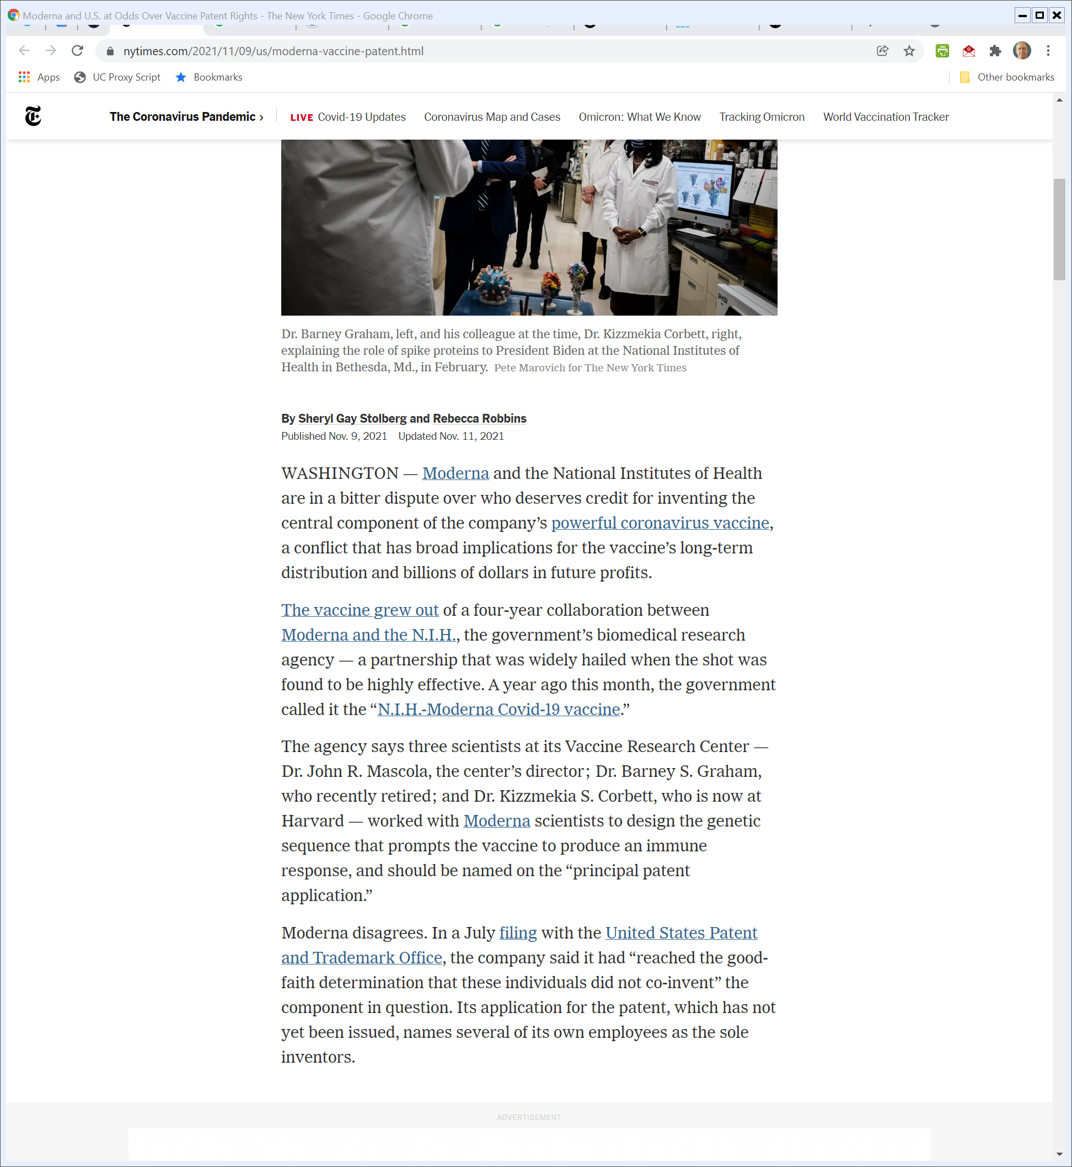
Moderna/NIH Fight Over Inventor Status
New York Times (9 Nov 2021)
Notes:
https://www.nytimes.com/2021/11/09/us/moderna-vaccine-patent.html

Slide 85
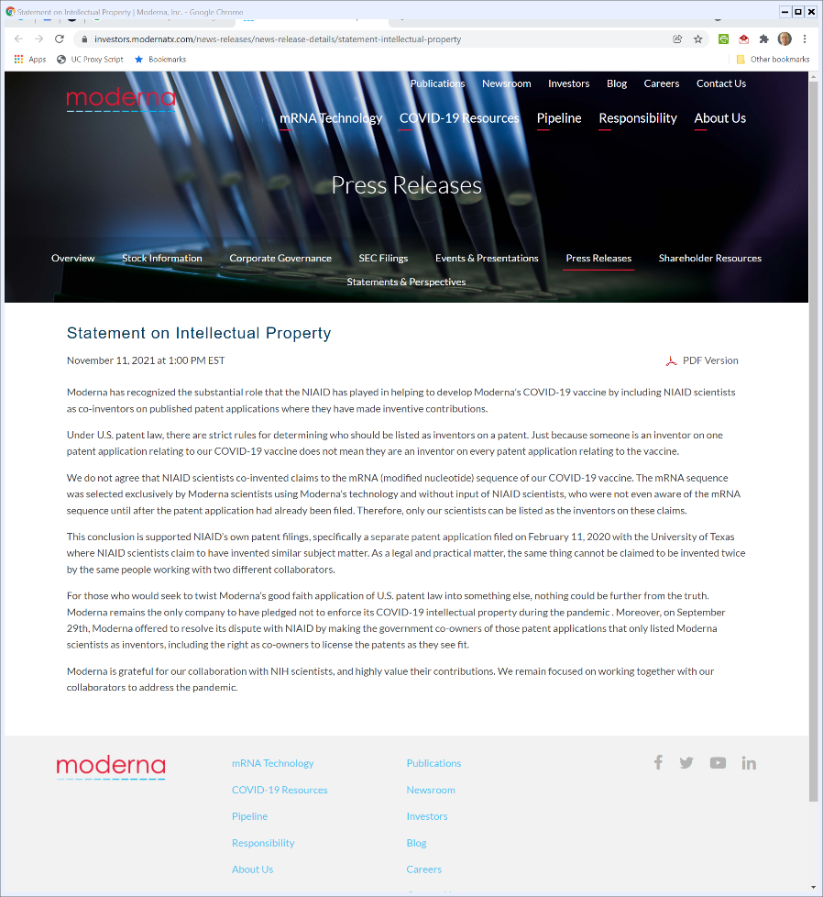

“Co-Owners to License the Patents as They See Fit”
Moderna (11 Nov 2021)
Notes:
https://investors.modernatx.com/news-releases/news-release-details/statement-intellectual-property

Slide 86
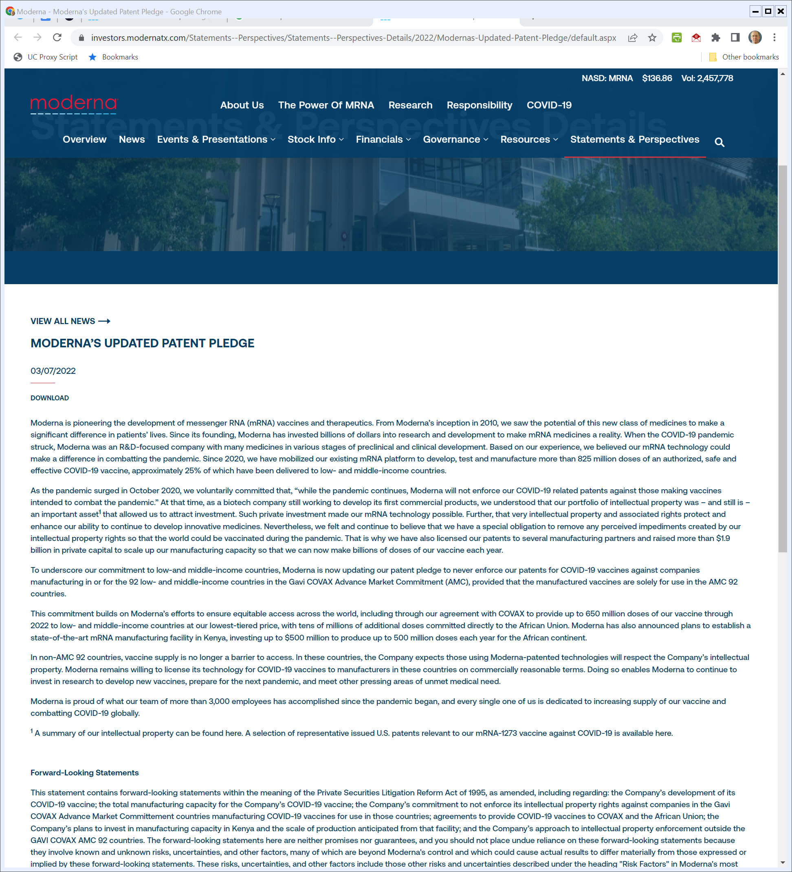
Enforcement of Patents?
Moderna (7 Mar 2022)
Notes:
https://investors.modernatx.com/Statements--Perspectives/Statements--Perspectives-Details/2022/Modernas-Updated-Patent-Pledge/default.aspx

Slide 87
Not for 92 Countries
Moderna (7 Mar 2022)
Notes:
https://investors.modernatx.com/Statements--Perspectives/Statements--Perspectives-Details/2022/Modernas-Updated-Patent-Pledge/default.aspx

Slide 88
2020 Timeline: July
HHS (undated)

Slide 89
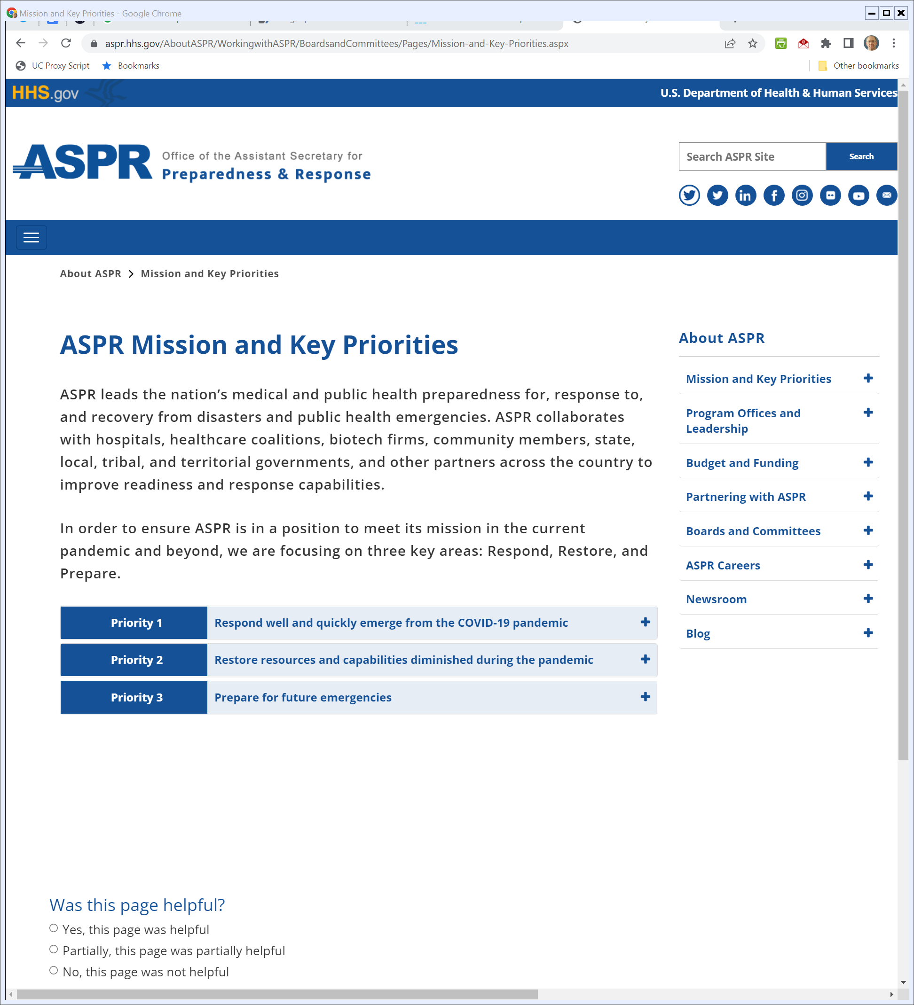
Post-OWS
Aspr.hhs.gov (Visited 28 Apr 2022)
Notes:
https://aspr.hhs.gov/AboutASPR/WorkingwithASPR/BoardsandCommittees/Pages/Mission-and-Key-Priorities.aspx

Slide 90
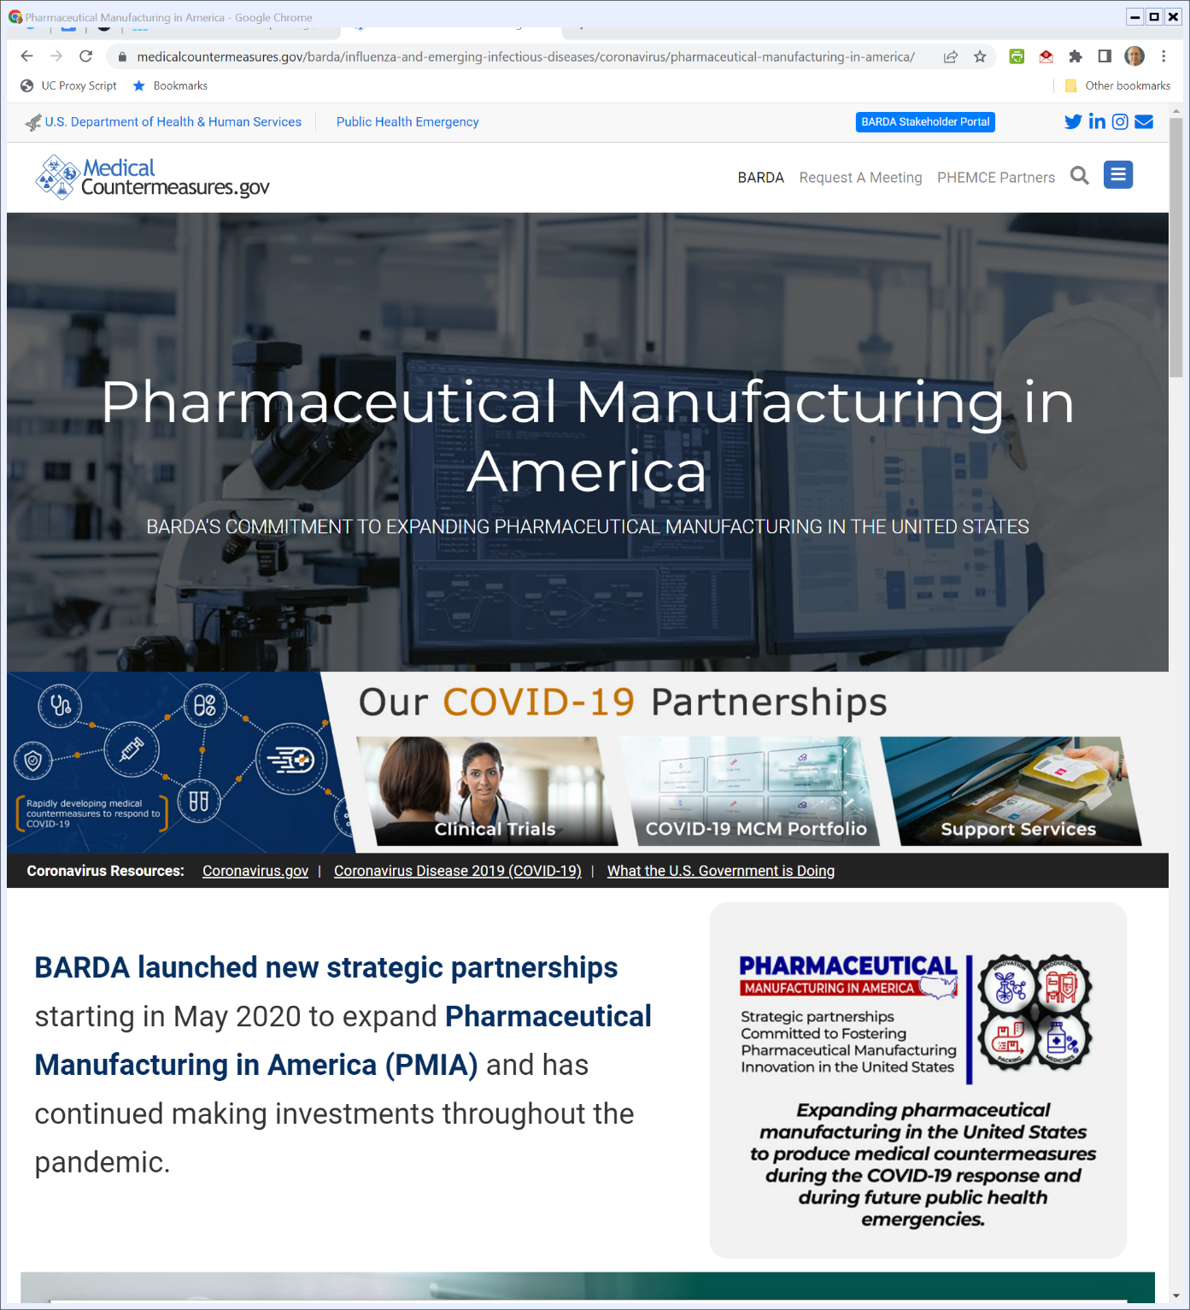
BARDA’s Role in Manufacturing
Medicalcountermeasures.gov (Visited 28 Apr 2022)
Notes:
https://www.medicalcountermeasures.gov/barda/influenza-and-emerging-infectious-diseases/coronavirus/pharmaceutical-manufacturing-in-america/

Slide 91
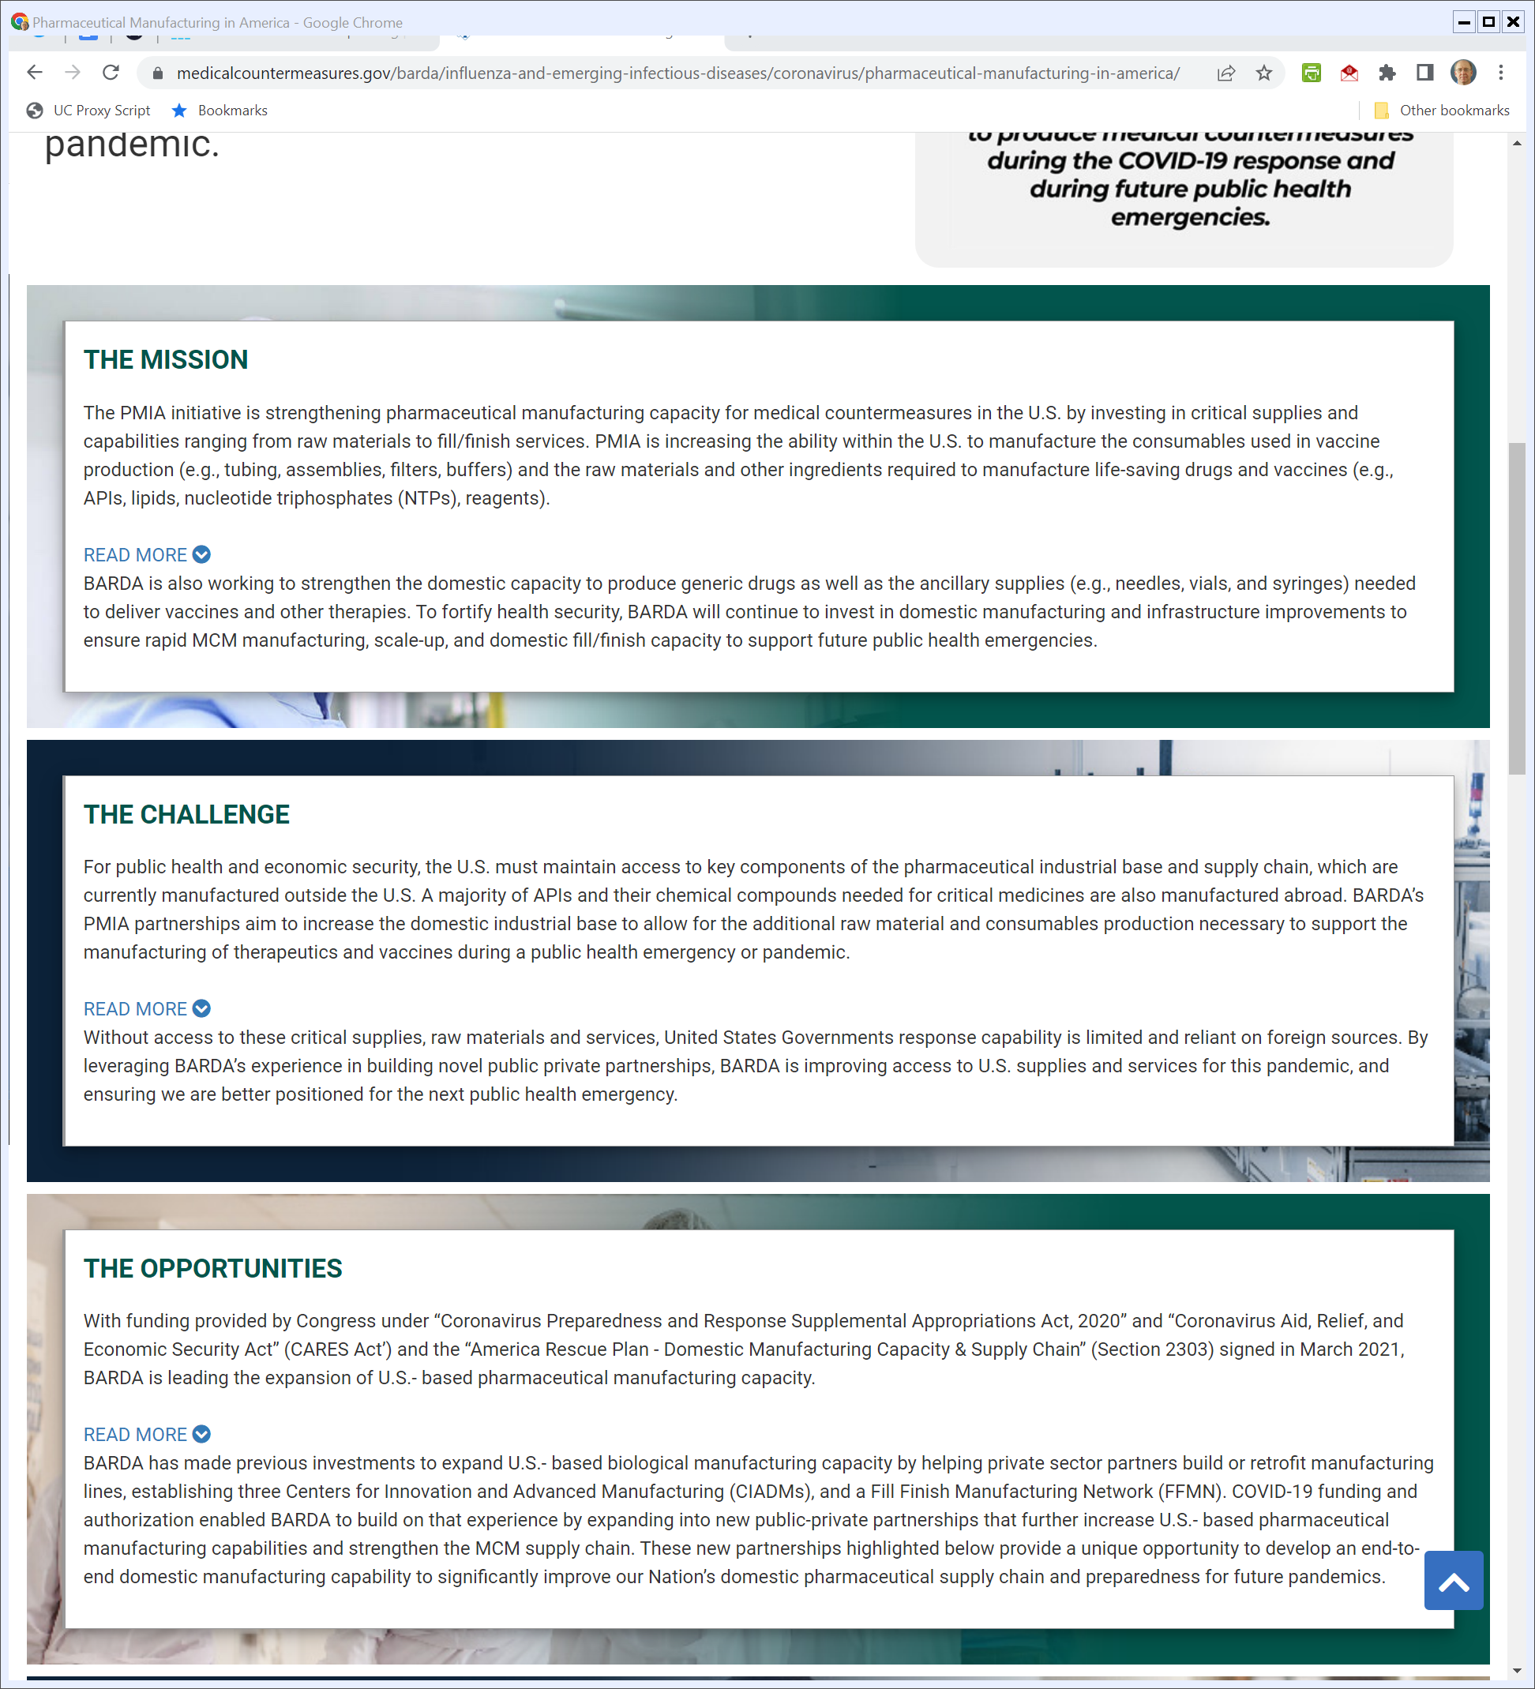
BARDA’s Role in Manufacturing
Medicalcountermeasures.gov (Visited 28 Apr 2022)
Notes:
https://www.medicalcountermeasures.gov/barda/influenza-and-emerging-infectious-diseases/coronavirus/pharmaceutical-manufacturing-in-america/

Slide 92
BARDA’s Role in Manufacturing
Medicalcountermeasures.gov (Visited 28 Apr 2022)
Notes:
https://www.medicalcountermeasures.gov/barda/influenza-and-emerging-infectious-diseases/coronavirus/pharmaceutical-manufacturing-in-america/

Slide 93
BARDA’s Role in Manufacturing
Medicalcountermeasures.gov (Visited 28 Apr 2022)
Notes:
https://www.medicalcountermeasures.gov/barda/influenza-and-emerging-infectious-diseases/coronavirus/pharmaceutical-manufacturing-in-america/

Slide 94
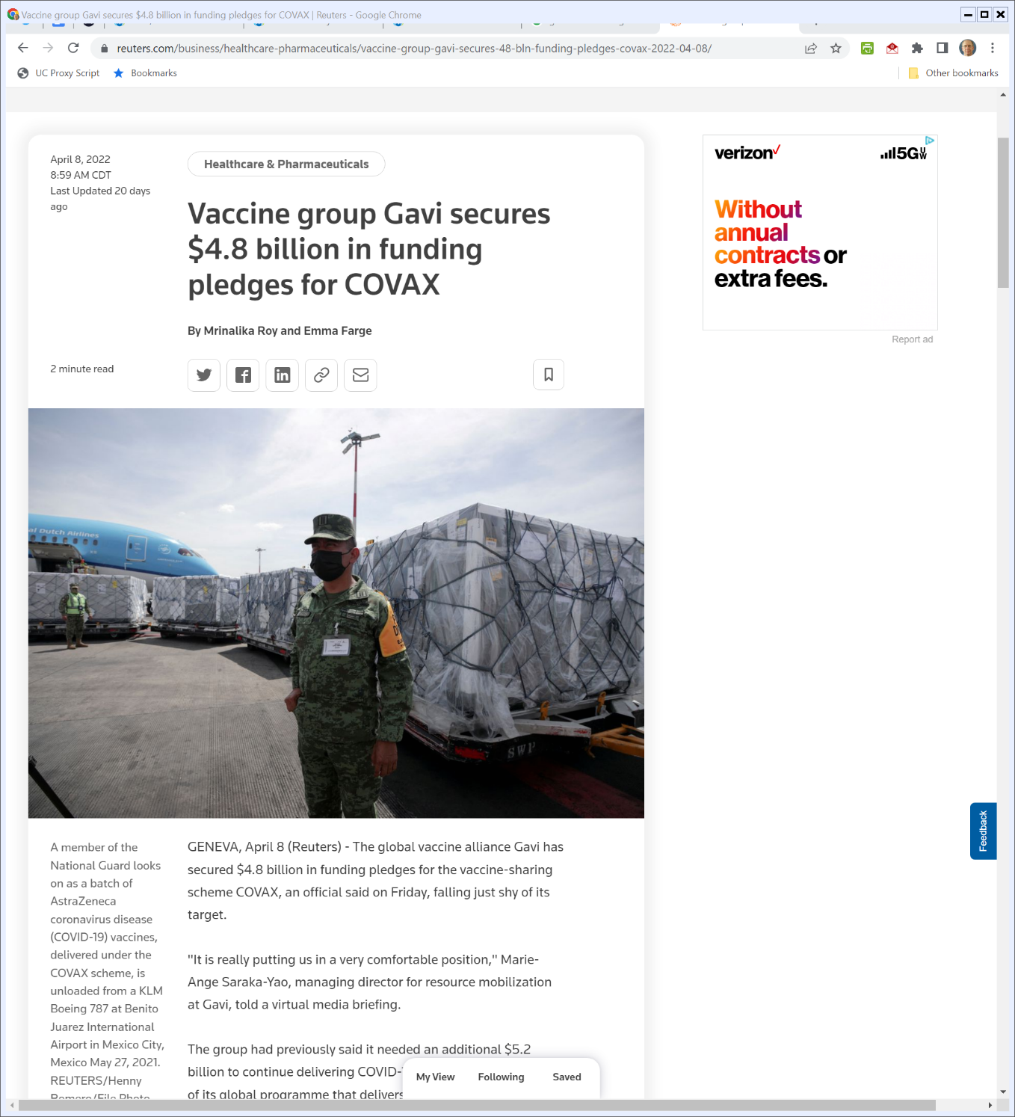
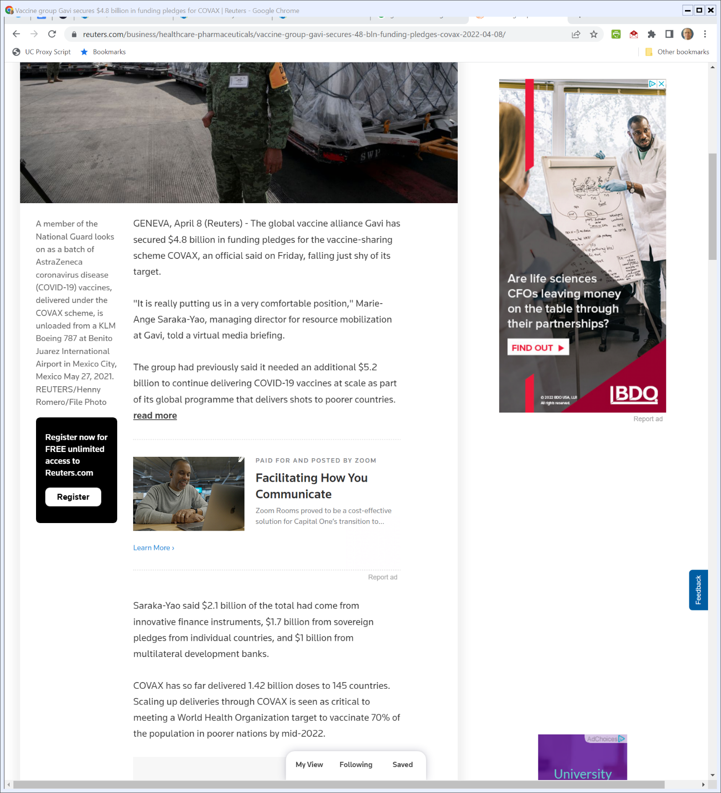
Vaccinating the World
Reuters (8 Apr 2022)
Notes:
https://www.reuters.com/business/healthcare-pharmaceuticals/vaccine-group-gavi-secures-48-bln-funding-pledges-covax-2022-04-08/

Slide 95
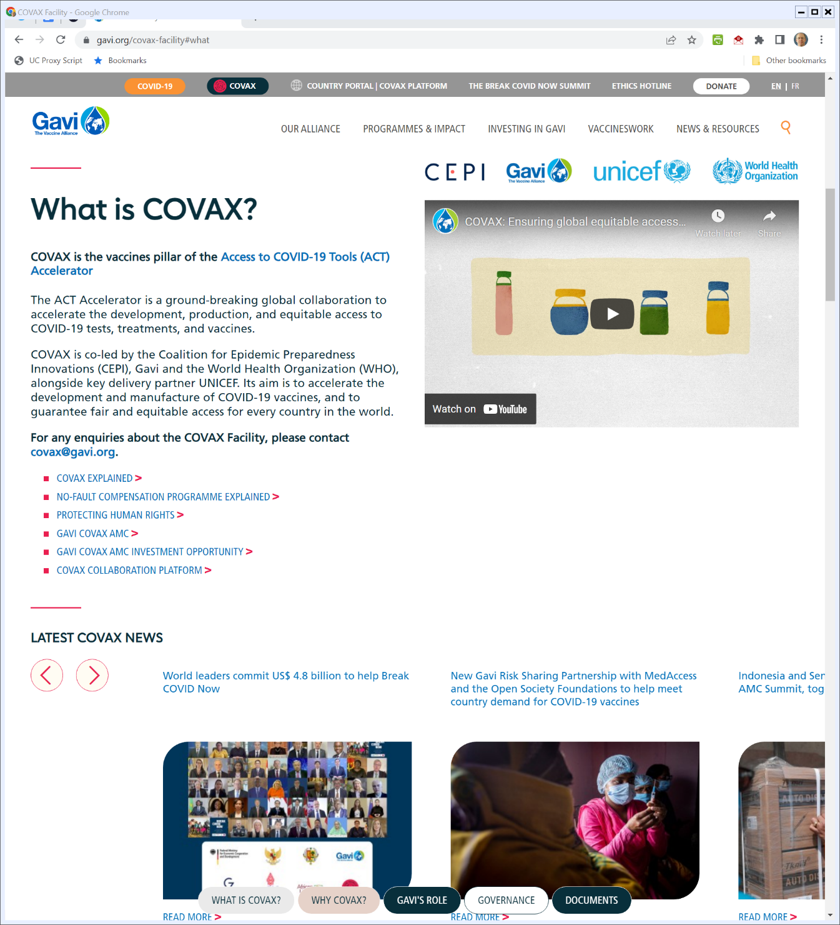

Gavi COVAX
Gavi.org (Visited 28 Apr 2022)
Notes:
https://www.gavi.org/covax-facility#what

