Slide 1
Class 17
Platforms and Networks
Spring 2022
Market Engineering: Chips
Randal C. Picker
James Parker Hall Distinguished Service Professor of Law
The Law School
The University of Chicago
Copyright © 2022 Randal C. Picker. All Rights Reserved.

Slide 2
Today
Questions/Issues
  When should we care about whether goods/services are produced domestically?
  If we want to do that, is there a role for the government?
  If so, what is the best mechanism for government intervention?

Slide 3
Ford Willow Run Bomber Plant
New York Times (22 May 1942)

Slide 4
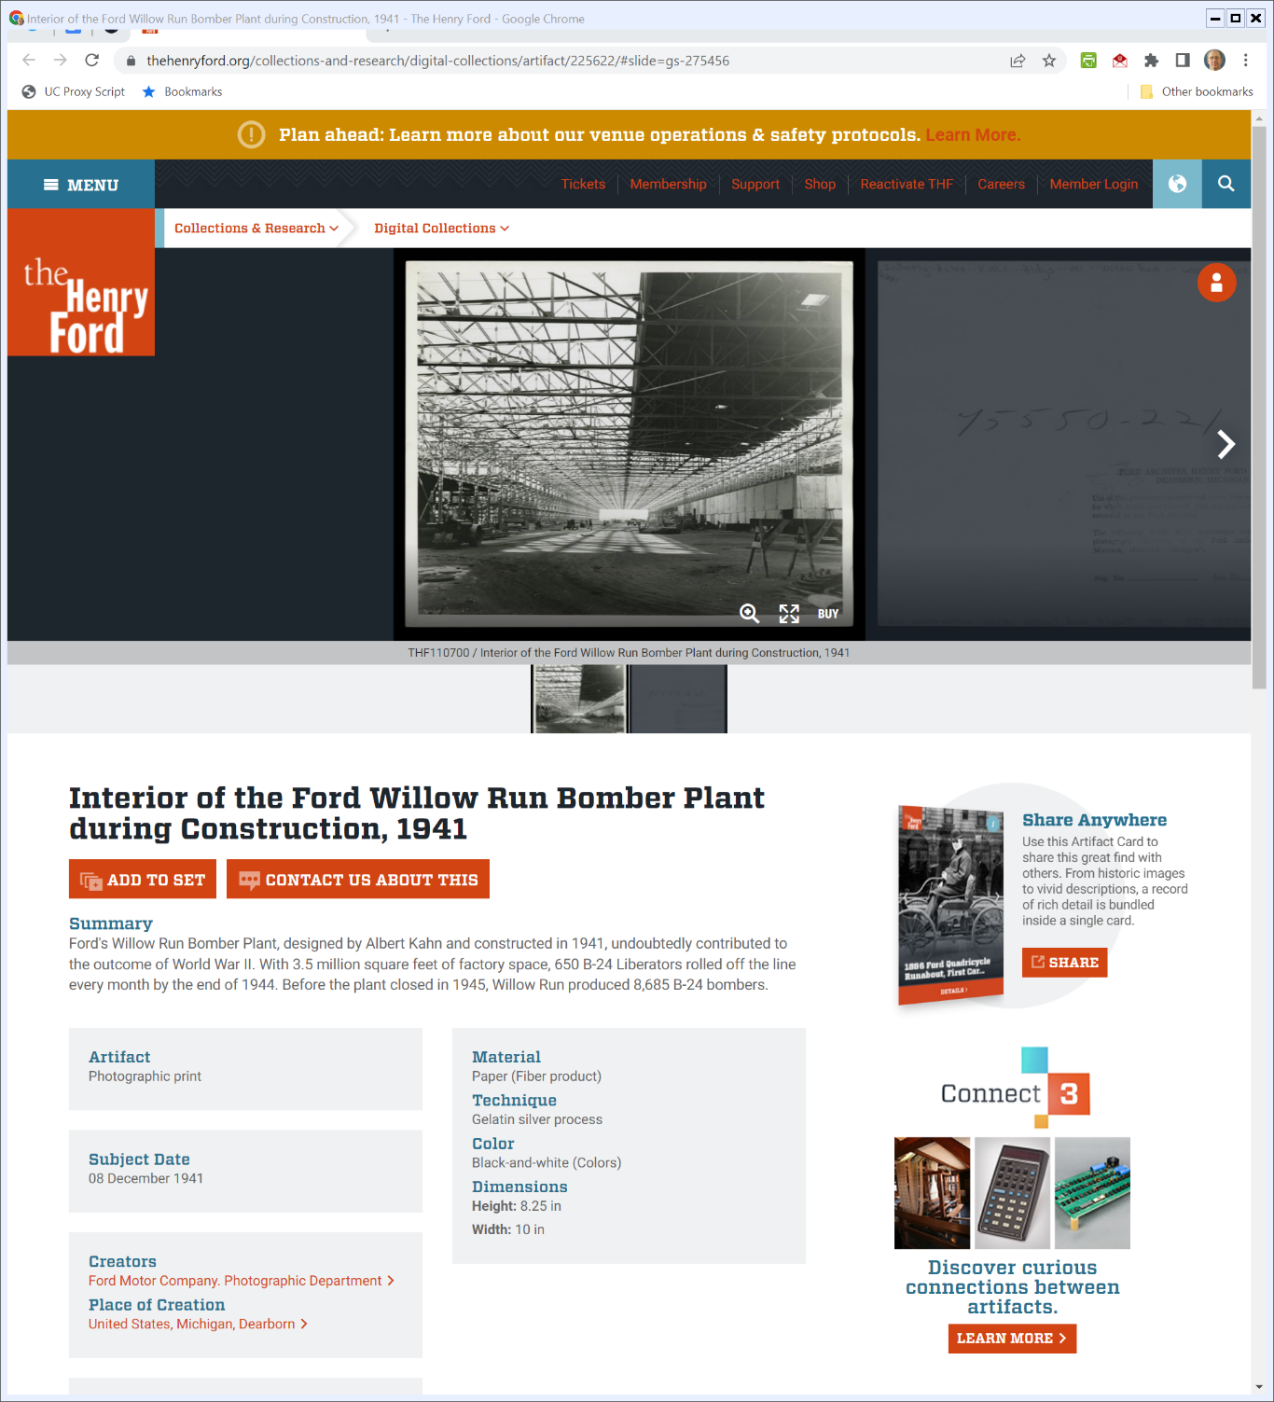

More on Willow Run
Henry Ford Museum (Visited 15 Apr 2022)
Notes:
https://www.thehenryford.org/collections-and-research/digital-collections/artifact/225622/#slide=gs-275456

Slide 5
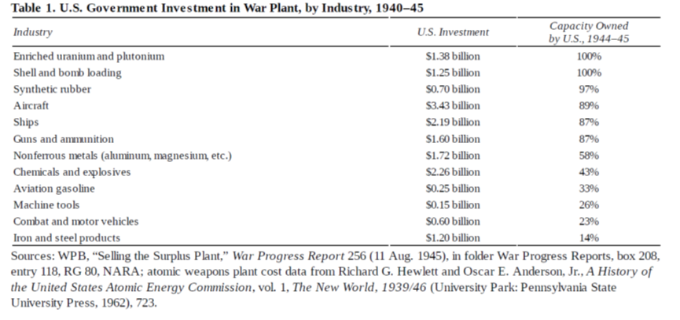
U.S. Gov’t WWII War Plant Investment
Wilson, Creative Destruction (2016)

Slide 6
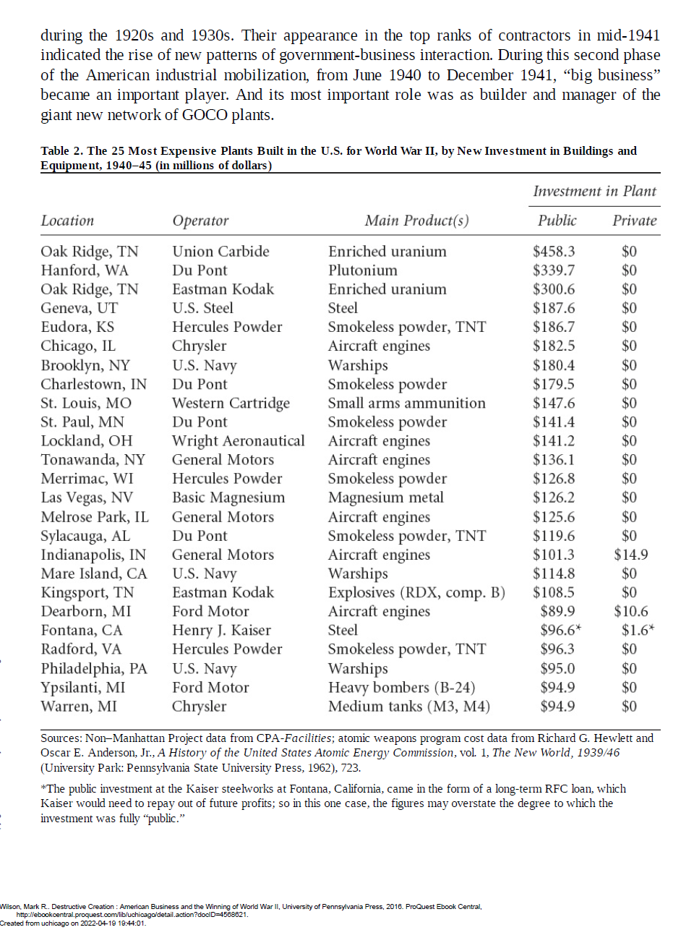
GOCO: Gov’t Owned, Contractor Operated
Wilson, Creative Destruction (2016)

Slide 7
Largest U.S. Gov’t Contracts
Wilson, Creative Destruction (2016)

Slide 8
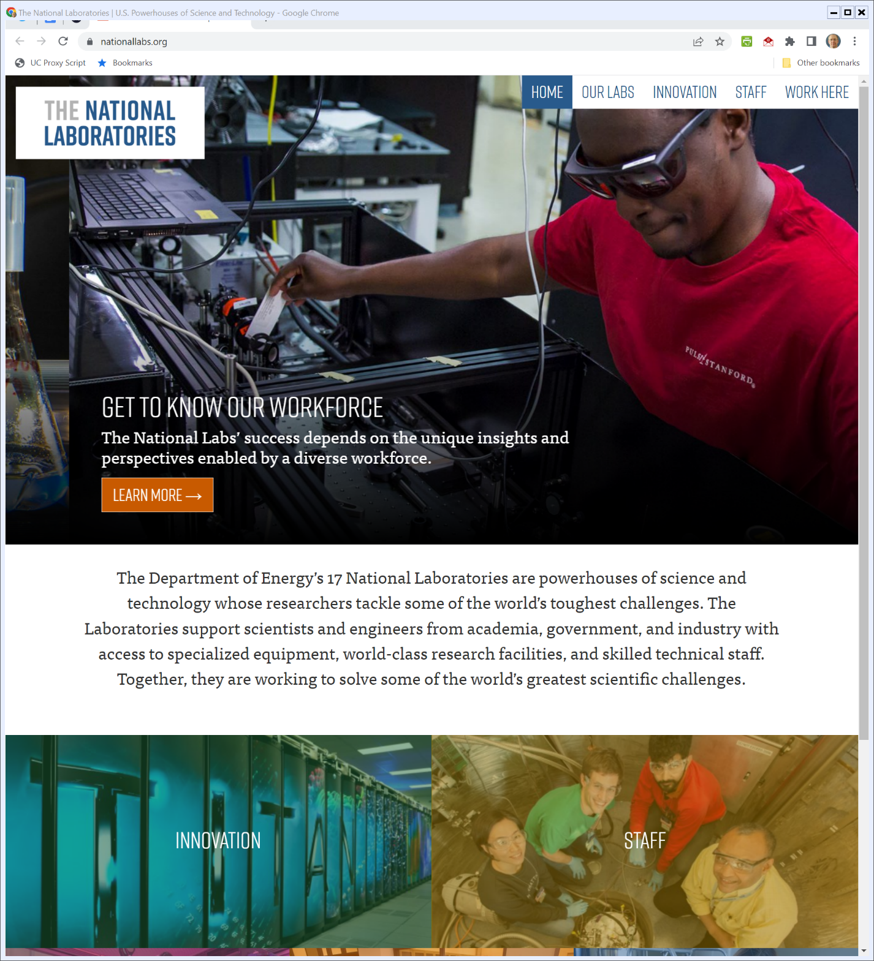
GOCO Today: National Labs
Nationallabs.org (Visited 27 Apr 2022)
Notes:
https://nationallabs.org/

Slide 9
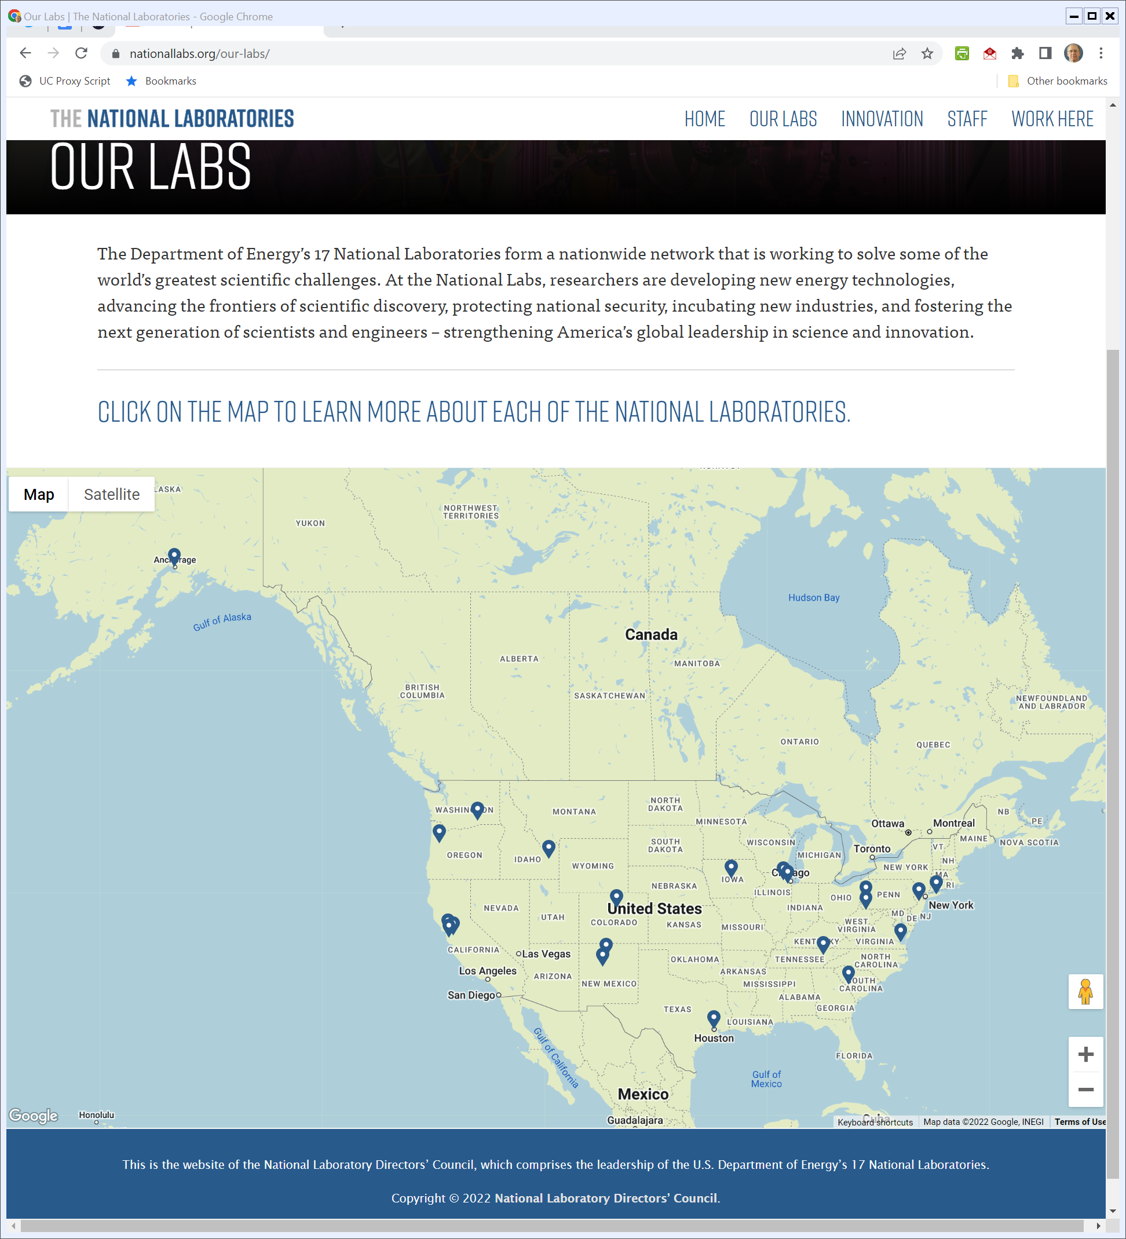
GOCO Today: National Labs
Nationallabs.org (Visited 27 Apr 2022)
Notes:
https://nationallabs.org/our-labs/

Slide 10
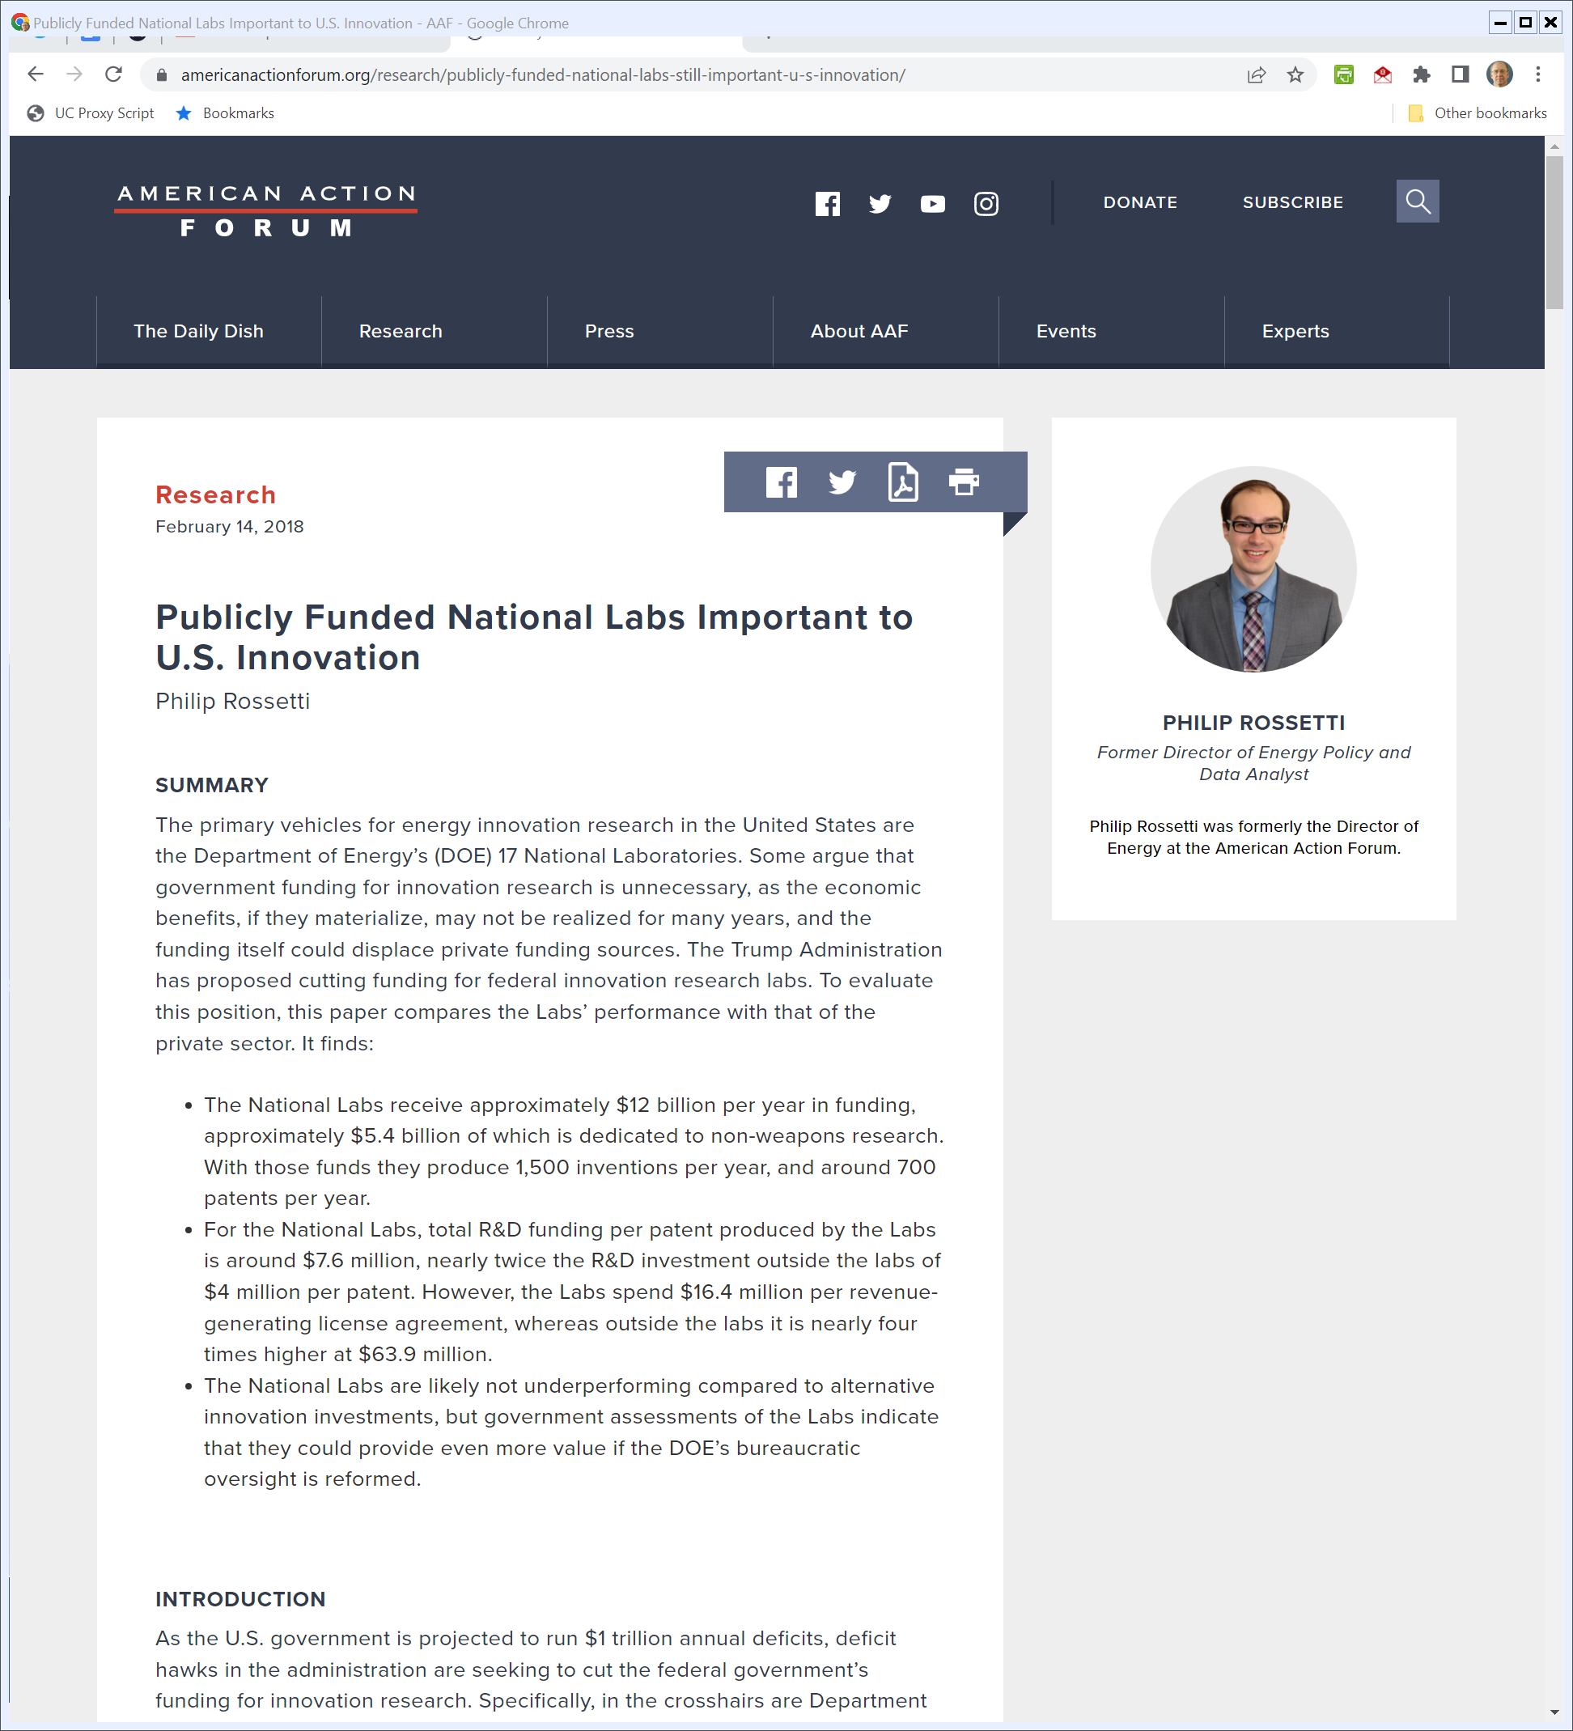
2018: $12B for National Labs
Rossetti (14 Feb 2018)
Notes:
https://www.americanactionforum.org/research/publicly-funded-national-labs-still-important-u-s-innovation/

Slide 11
Trade Expansion Act of 1962
Pub. L. 87-794 (11 Oct 1962)

Slide 12
Purposes
Pub. L. 87-794 (11 Oct 1962)

Slide 13
Presidential Powers re Tariffs
Pub. L. 87-794 (11 Oct 1962)

Slide 14
National Security
Pub. L. 87-794 (11 Oct 1962)

Slide 15
Adjust Imports to Protect National Security
Pub. L. 87-794 (11 Oct 1962)

Slide 16
Domestic Production Needs
Pub. L. 87-794 (11 Oct 1962)

Slide 17
Oct 1962: Cuban Missile Crisis
NYT (23 Oct 1962)

Slide 18
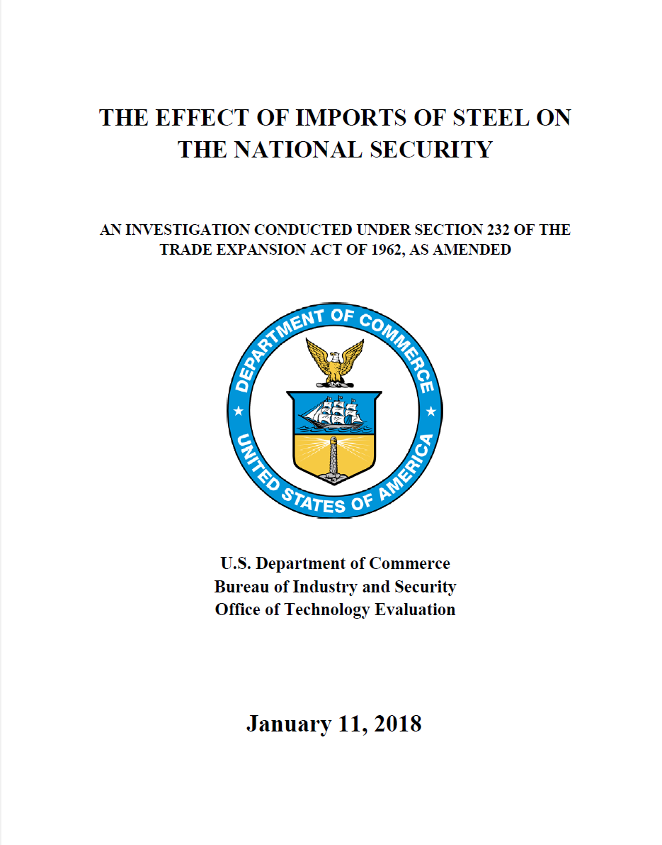
Sec 232 Steel Investigation
U.S. Dept of Commerce (11 Jan 2018)

Slide 19
Rising Demand for Steel
U.S. Dept of Commerce (11 Jan 2018)

Slide 20
U.S. Steel Imports Increasing
U.S. Dept of Commerce (11 Jan 2018)

Slide 21
Why?: Imports Have Lower Prices, So U.S. Steel Mills are Closing
U.S. Dept of Commerce (11 Jan 2018)

Slide 22
Substantial Decrease in U.S. Steel Employment
U.S. Dept of Commerce (11 Jan 2018)

Slide 23
Excess Chinese Steel Production
U.S. Dept of Commerce (11 Jan 2018)

Slide 24
Foreign Production Overhang
U.S. Dept of Commerce (11 Jan 2018)

Slide 25
Need for Tariff
U.S. Dept of Commerce (11 Jan 2018)

Slide 26
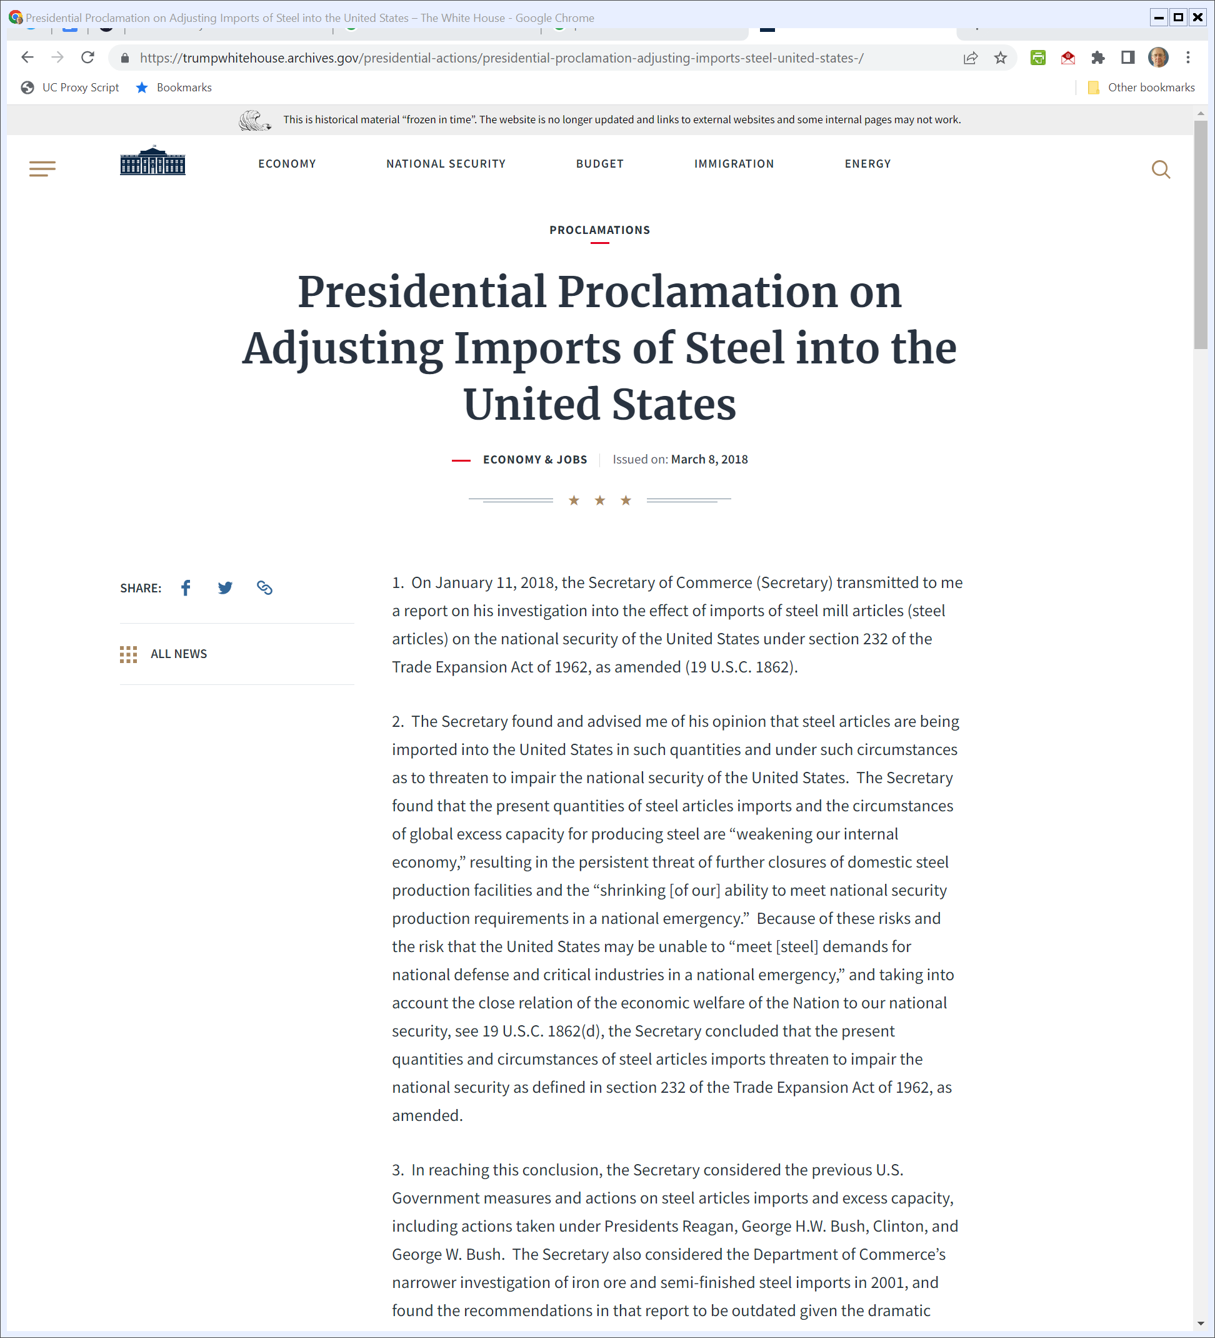
Trump Steel Proclamation
8 Mar 2018
Notes:
https://trumpwhitehouse.archives.gov/presidential-actions/presidential-proclamation-adjusting-imports-steel-united-states-/

Slide 27
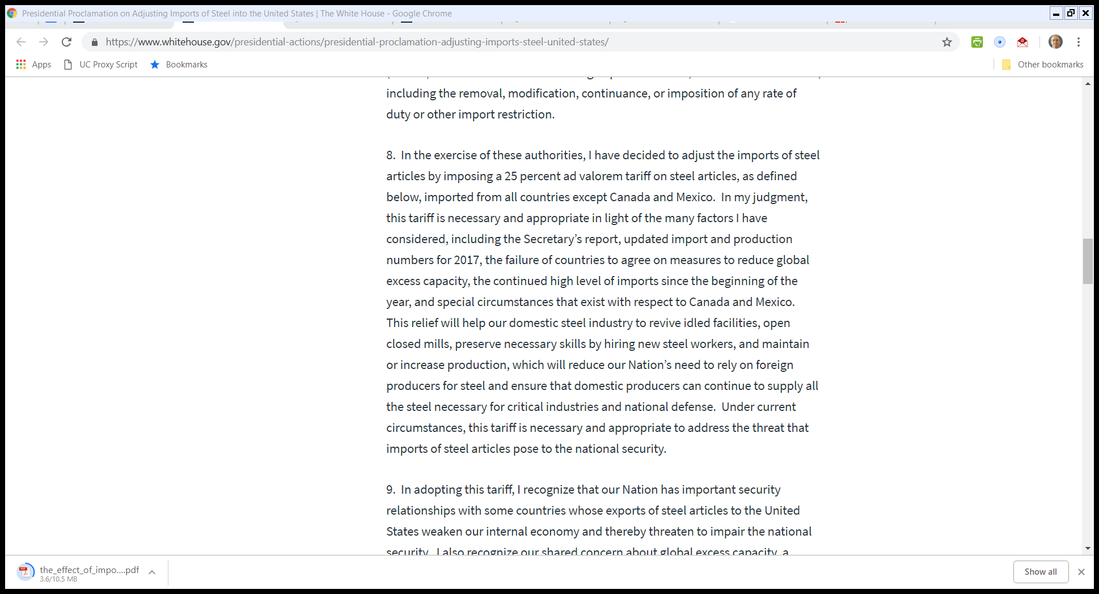
Trump Steel Proclamation
8 Mar 2018
Notes:
https://trumpwhitehouse.archives.gov/presidential-actions/presidential-proclamation-adjusting-imports-steel-united-states-/

Slide 28
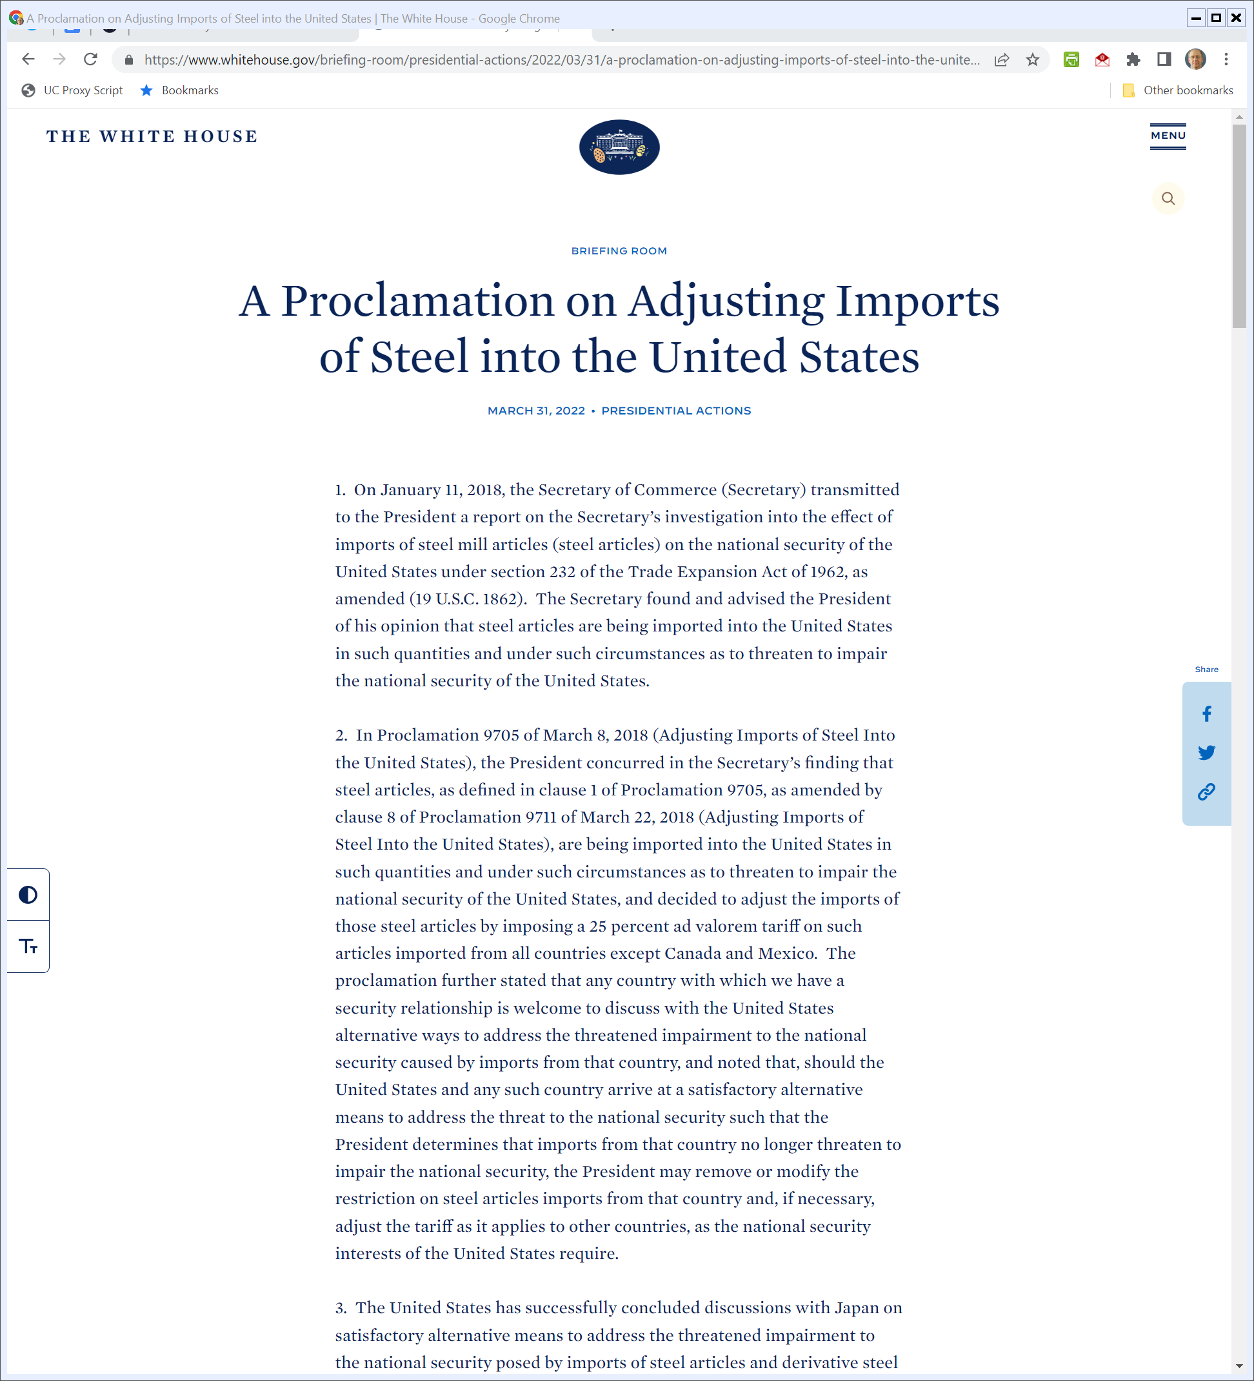
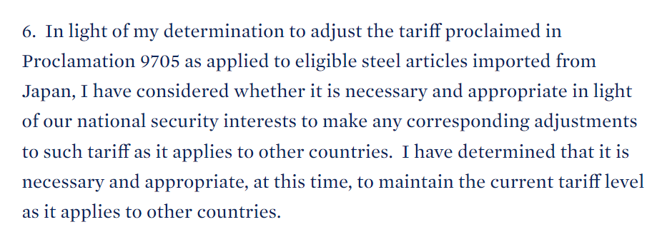
Biden Update
The White House (31 Mar 2022)
Notes:
https://www.whitehouse.gov/briefing-room/presidential-actions/2022/03/31/a-proclamation-on-adjusting-imports-of-steel-into-the-united-states-2/

Slide 29
1933 Statute
Pub. L. 72-428 (3 Mar 1933)

Slide 30
Buy American
Pub. L. 72-428 (3 Mar 1933)

Slide 31
Understanding Buy American
CRS (13 Mar 2009)

Slide 32
“Protect Domestic Labor”
CRS (13 Mar 2009)

Slide 33
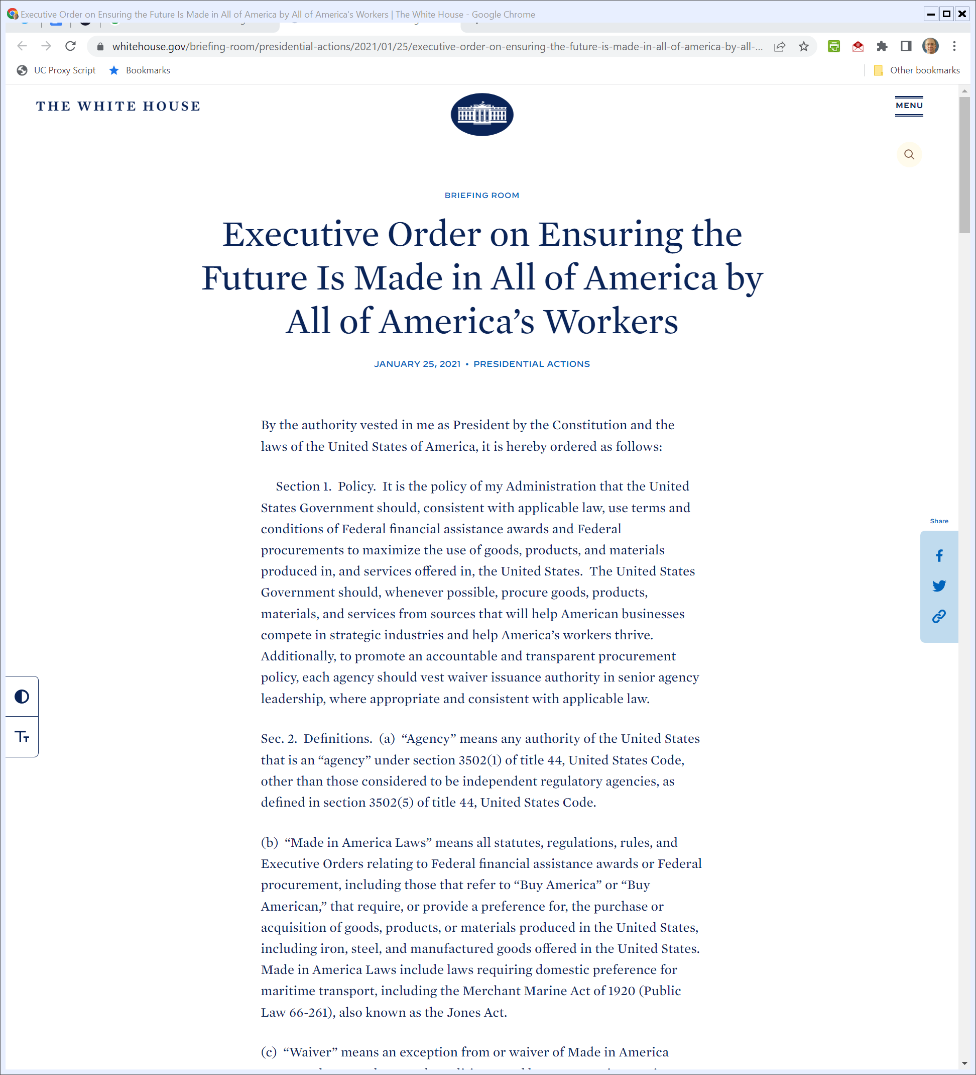
Buy American
Biden Executive Order 14005 (25 Jan 2021)

Slide 34
2021 Infrastructure Act
Pub. L. 117-58 (15 Nov 2021)

Slide 35
Build America, Buy America Act
Pub. L. 117-58 (15 Nov 2021)

Slide 36
2021 Infrastructure Act
Pub. L. 117-58 (15 Nov 2021)

Slide 37
Rolling Out Buy American
OMB (18 Apr 2022)

Slide 38
Bardeen & Brattain: The Transistor, A Semi-Conductor Triode
Physical Review (25 June 1948)

Slide 39
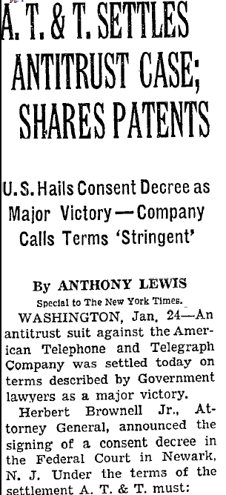
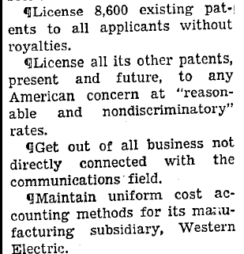
1956 AT&T Settlement
New York Times (25 Jan 1956)

Slide 40
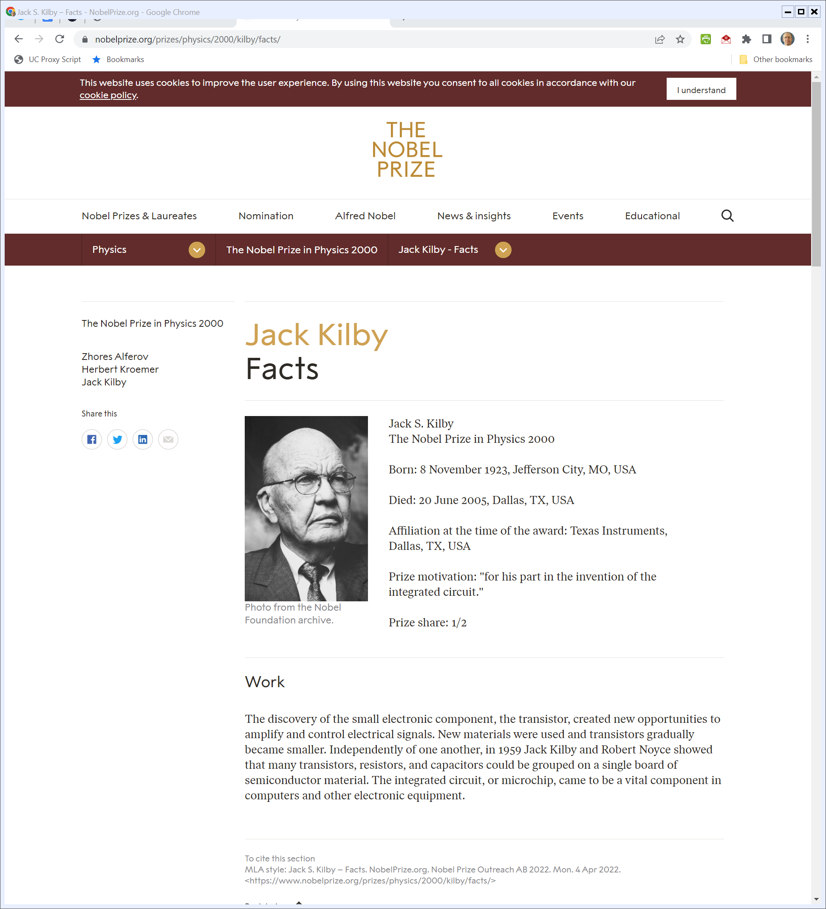
2000 Nobel Prize in Physics
Nobelprize.org (Visited 4 Apr 2022)
Notes:
https://www.nobelprize.org/prizes/physics/2000/kilby/facts/

Slide 41
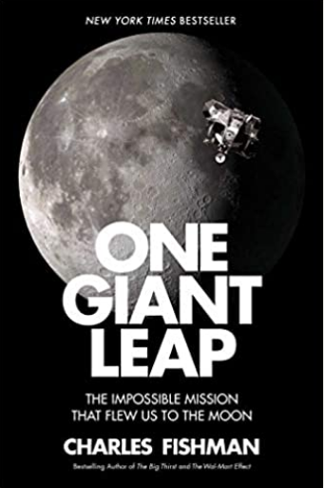
U.S. Gov’t Integrated Circuit Purchases
1962: 100% (of total IC market)
1963: 94%
1964: 85%
1965: 72% (with volume up a factor of 20)
Fishman (2020, p303)

Slide 42
Moore’s Law
Electronics (19 Apr 1965)

Slide 43
The Future
Electronics (19 Apr 1965)

Slide 44
Linear in Log2
Electronics (19 Apr 1965)

Slide 45
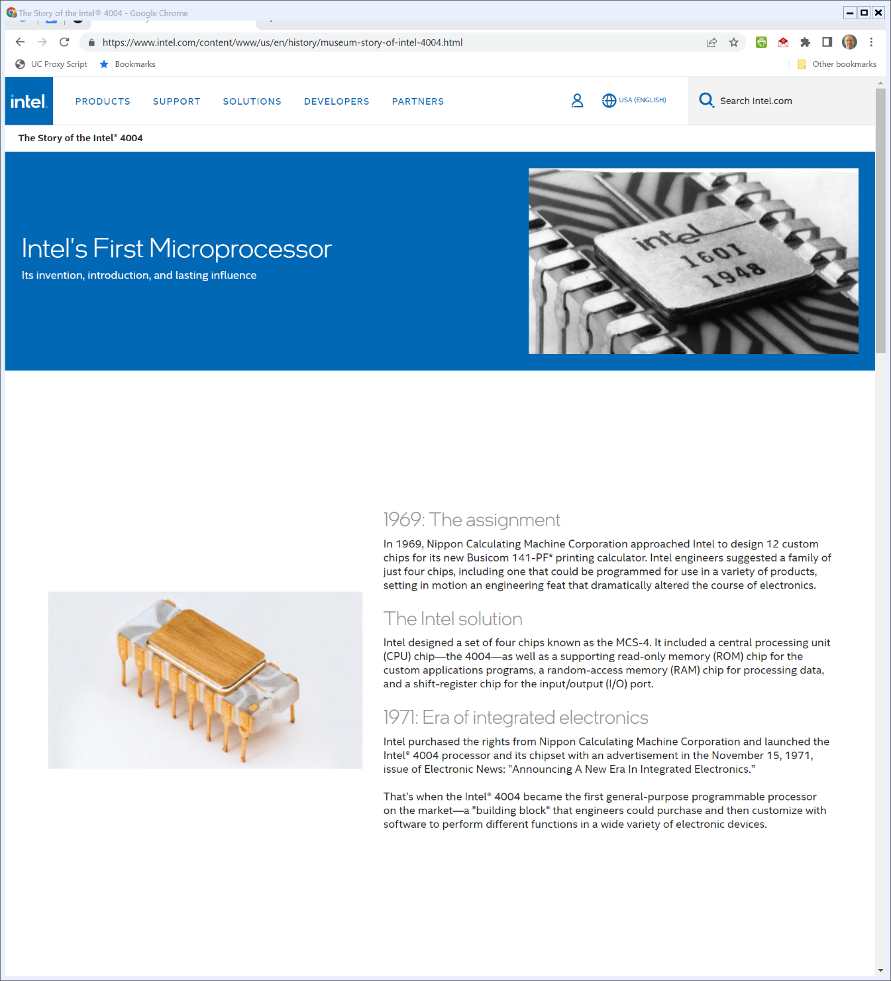

15 Nov 1971: Intel Releases 4004
Intel (Visited 15 Apr 2022)
Notes:
https://www.intel.com/content/www/us/en/history/museum-story-of-intel-4004.html

Slide 46
The DRAM Transformation
New York Times (16 June 1985)

Slide 47
Intel Exits Memory Market
New York Times (11 Oct 1985)

Slide 48
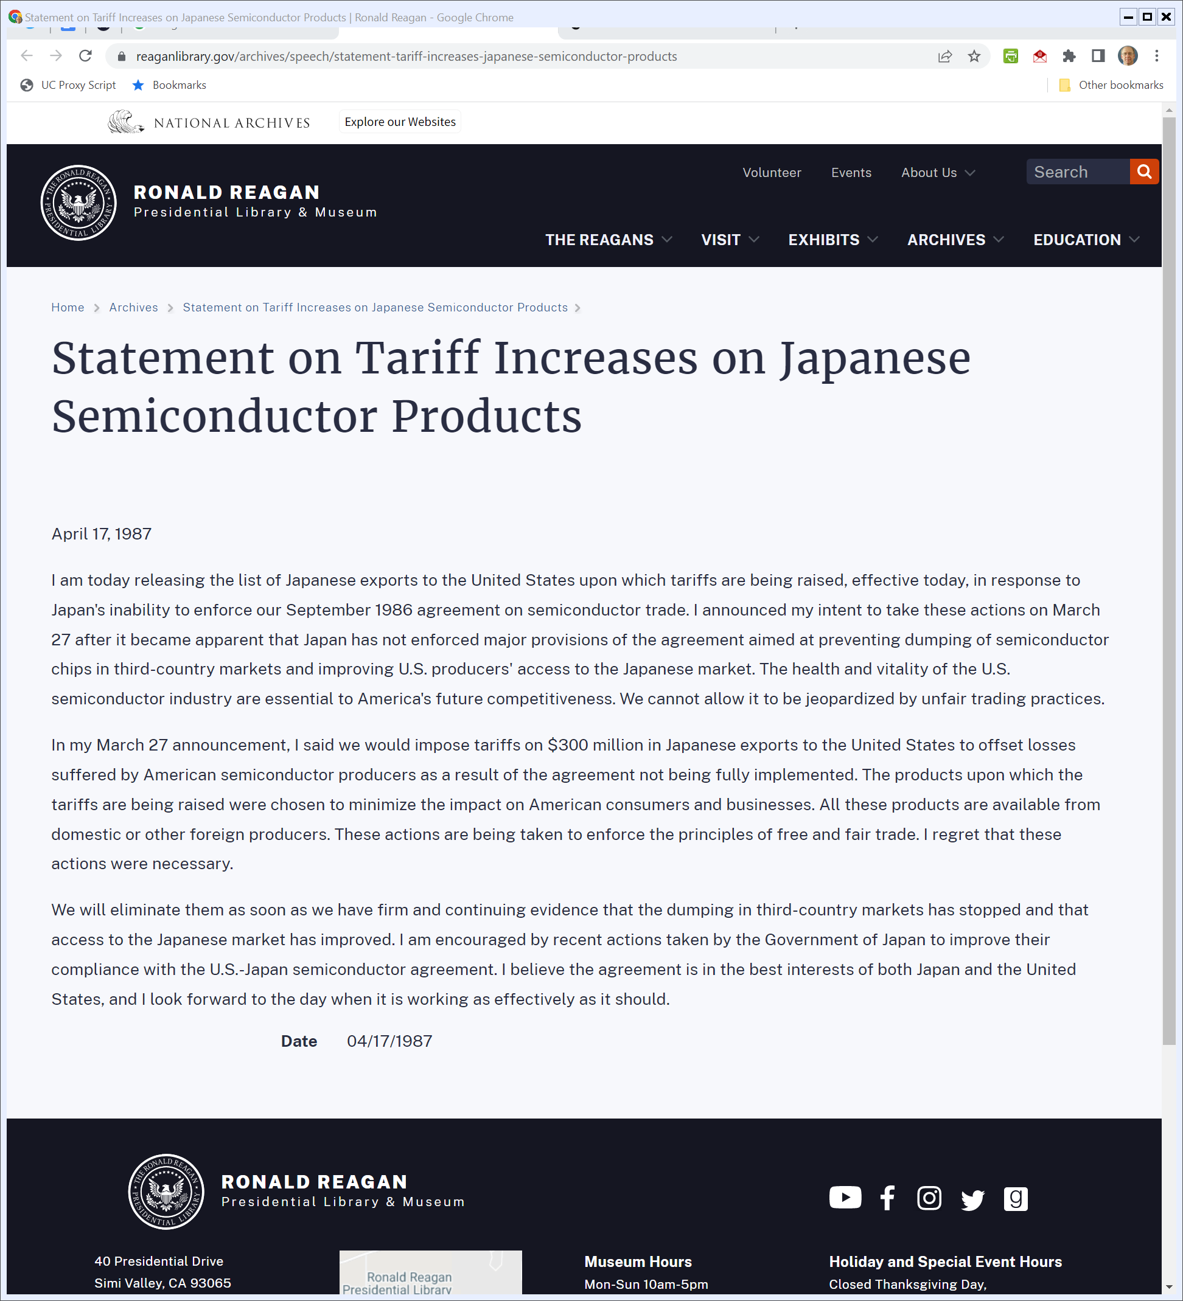
Apr 1987: Reagan Semiconductor Tariffs
Reagan (17 Apr 1987)
Notes:
https://www.reaganlibrary.gov/archives/speech/statement-tariff-increases-japanese-semiconductor-products

Slide 49
Japan Tariffs
New York Times (18 Apr 1987)

Slide 50
Gov’t Blocks Sale of Fairchild
New York Times (17 Mar 1987)

Slide 51
1987 Defense Appropriations Act
Pub. L. 100-180 (4 Dec 1987)

Slide 52
Chip Research
Pub. L. 100-180 (4 Dec 1987)

Slide 53
Sematech
Pub. L. 100-180 (4 Dec 1987)

Slide 54
What Did Sematech Accomplish?
Irwin & Klenow (1996)

Slide 55
MIPS
Hennessy et al (1982)

Slide 56
Heading Inside a Start-Up
MIPS Oral History Panel (18 Feb 2011)

Slide 57
Fabless Chip Production: Vertical Distintegration
MIPS Oral History Panel (18 Feb 2011)

Slide 58
The Role of UNIX (and the 1956 Final Judgment)
MIPS Oral History Panel (18 Feb 2011)

Slide 59
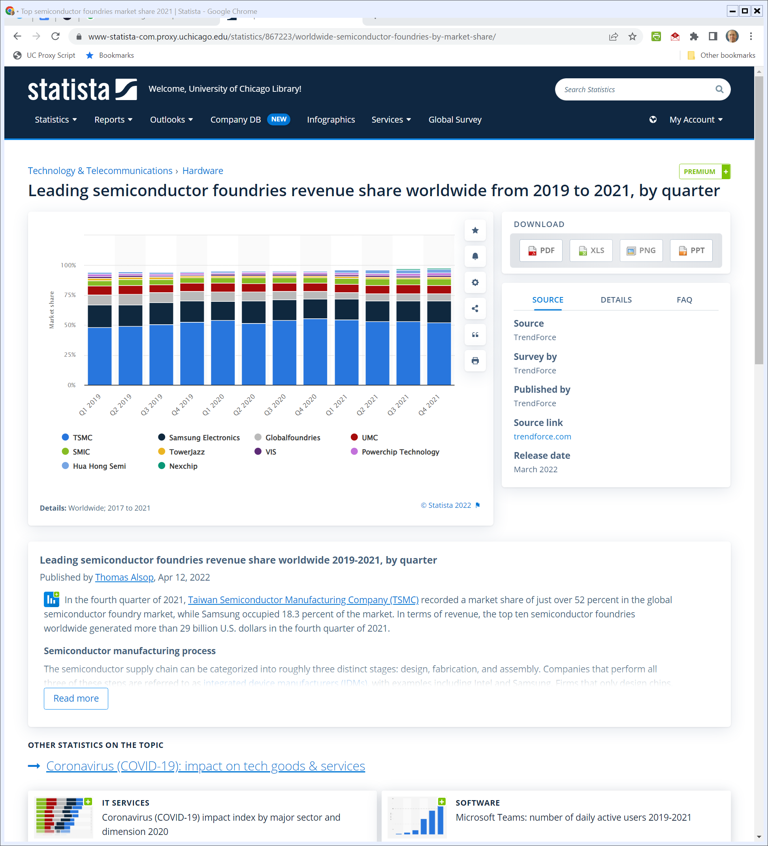
Fabless Chip Production
Statista (Visited 27 Apr 2022)
Notes:
https://www-statista-com.proxy.uchicago.edu/statistics/867223/worldwide-semiconductor-foundries-by-market-share/

Slide 60
Another Approach
SIA (2021 Report)

Slide 61
U.S. Manufacturing Share
SIA (2021 Report)

Slide 62
What Does This Mean?
SIA (2021 Report)

Slide 63
Manufacturing Tech by Node
SIA (2021 Report)

Slide 64
Defense Appropriations Bill: 1482 Pages
Pub. L. 11-283 (1 Jan 2021)

Slide 65
Title XCIX: CHIPS for America
Pub. L. 11-283 (1 Jan 2021)

Slide 66
Semiconductor Incentives
Pub. L. 11-283 (1 Jan 2021)

Slide 67
Investment Amounts
Pub. L. 11-283 (1 Jan 2021)

Slide 68
What Can You Use the Money For?
Pub. L. 11-283 (1 Jan 2021)

Slide 69
DoD Needs
Pub. L. 11-283 (1 Jan 2021)

Slide 70
How Do You Know Whether You Can Trust a Chip?
Pub. L. 11-283 (1 Jan 2021)

Slide 71
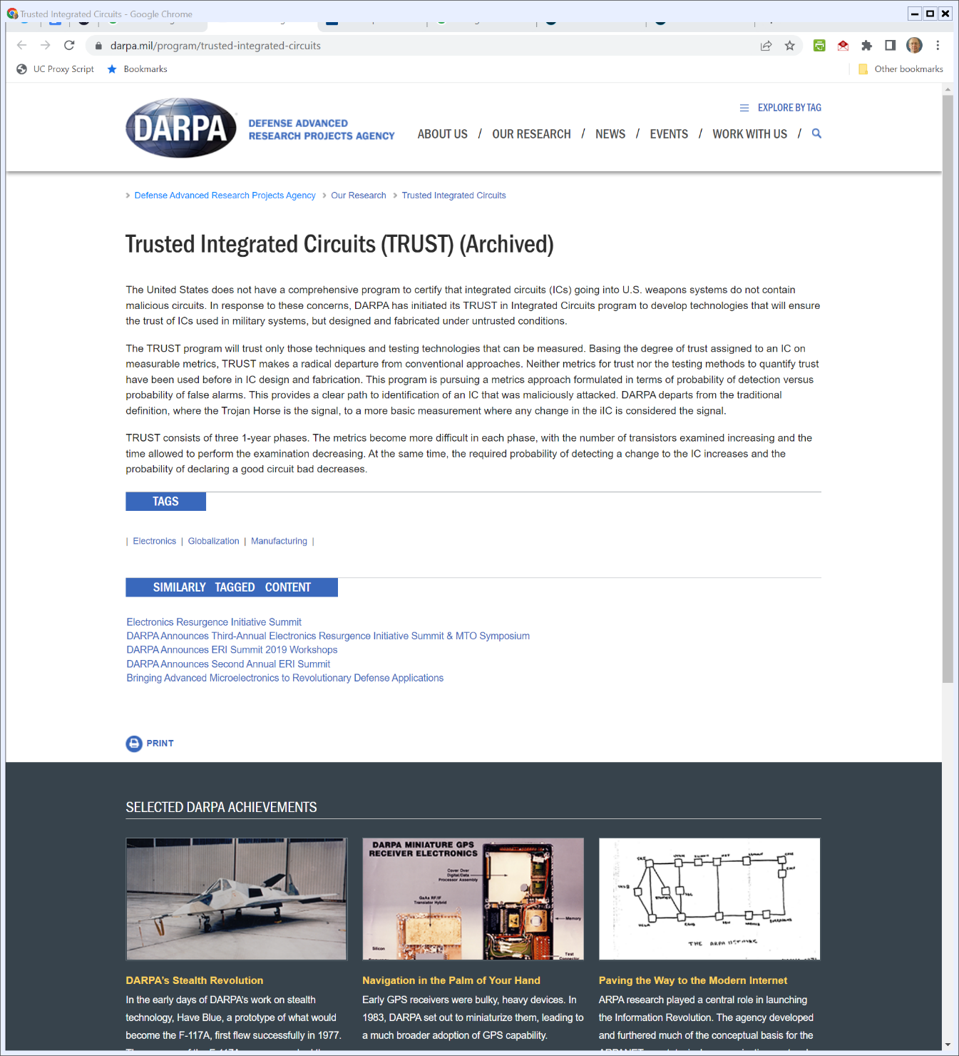

ARPA Program
DARPA (Visited 27 Apr 2022)
Notes:
https://www.darpa.mil/program/trusted-integrated-circuits

Slide 72
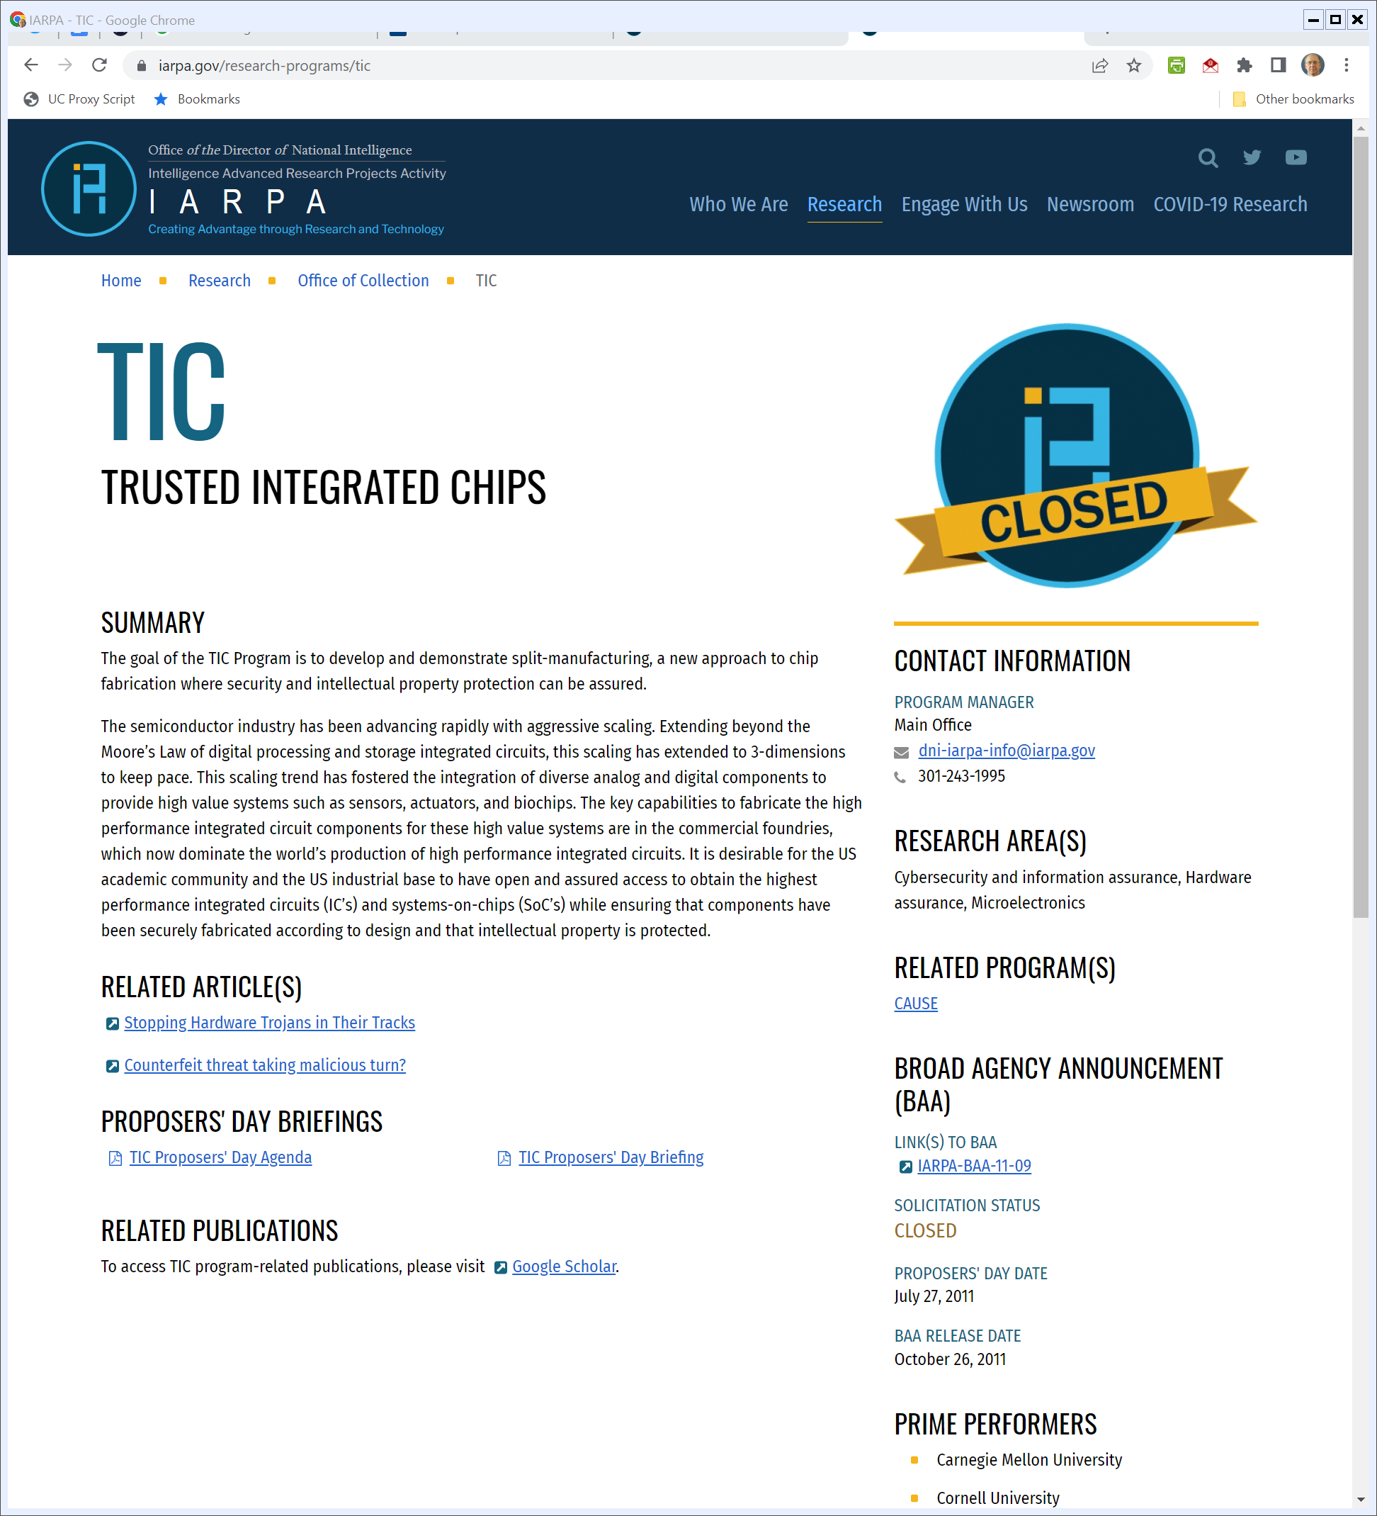
IARPA and Trusted Chips
IARPA (Visited 27 Apr 2022)
Notes:
https://www.iarpa.gov/research-programs/tic

Slide 73
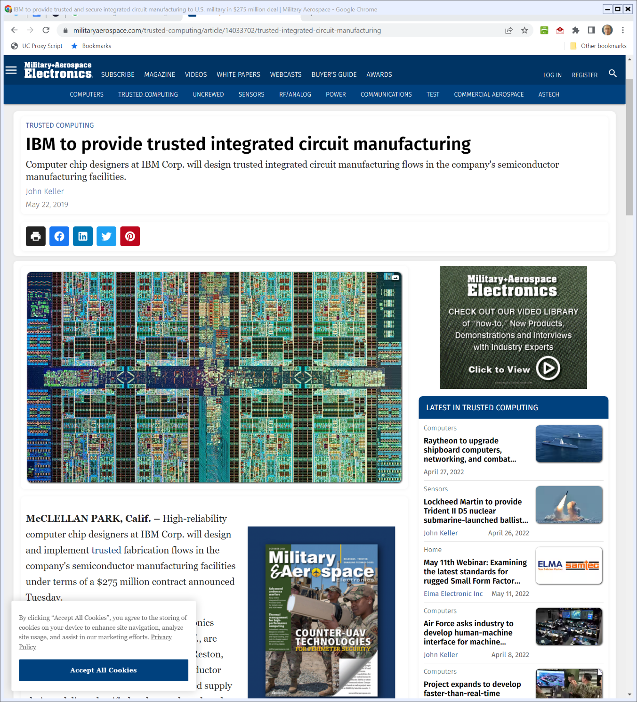
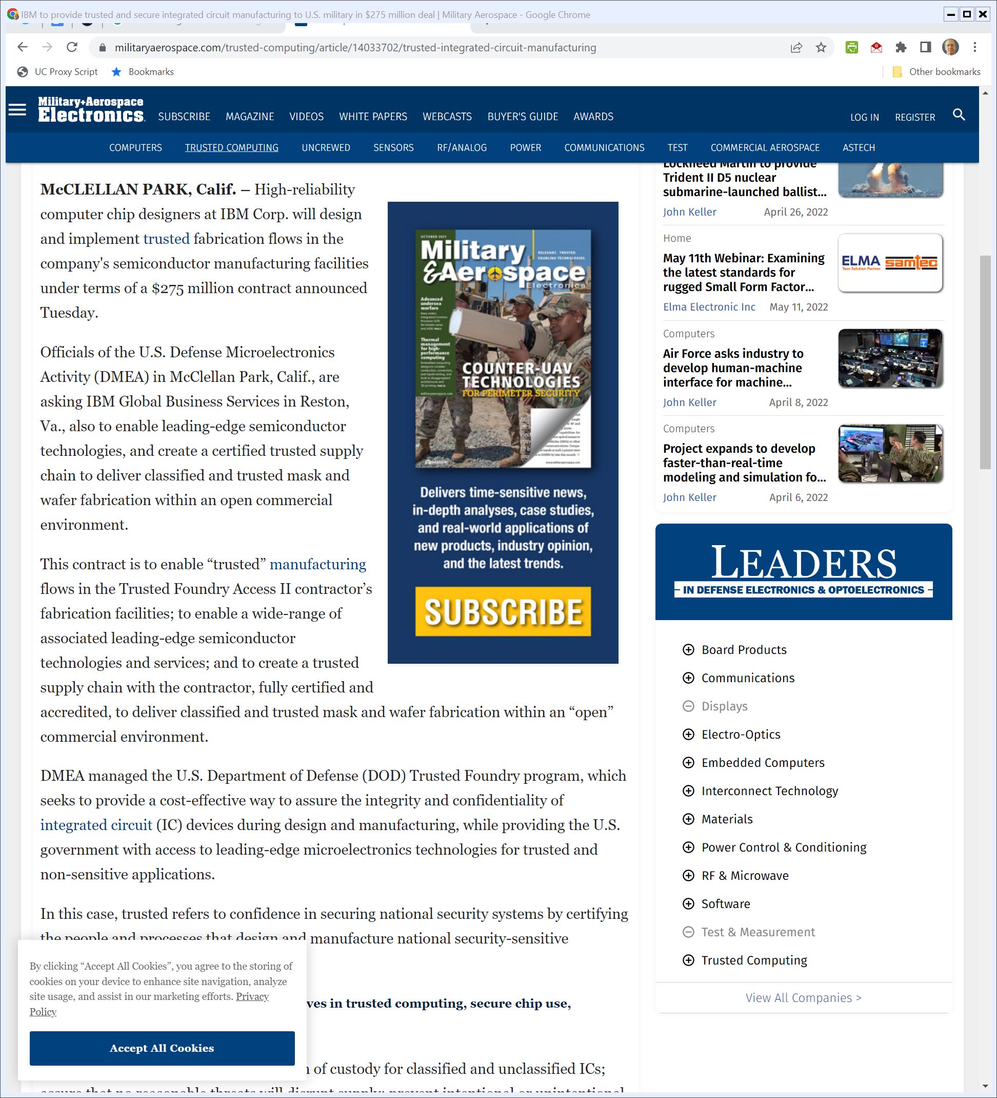
IBM Building Trusted Chips
Militaryaerospace.com (22 May 2019)
Notes:
https://www.militaryaerospace.com/trusted-computing/article/14033702/trusted-integrated-circuit-manufacturing

Slide 74
DoD Trusted Foundry Program
Militaryaerospace.com (22 May 2019)
Notes:
https://www.militaryaerospace.com/trusted-computing/article/14033702/trusted-integrated-circuit-manufacturing

Slide 75
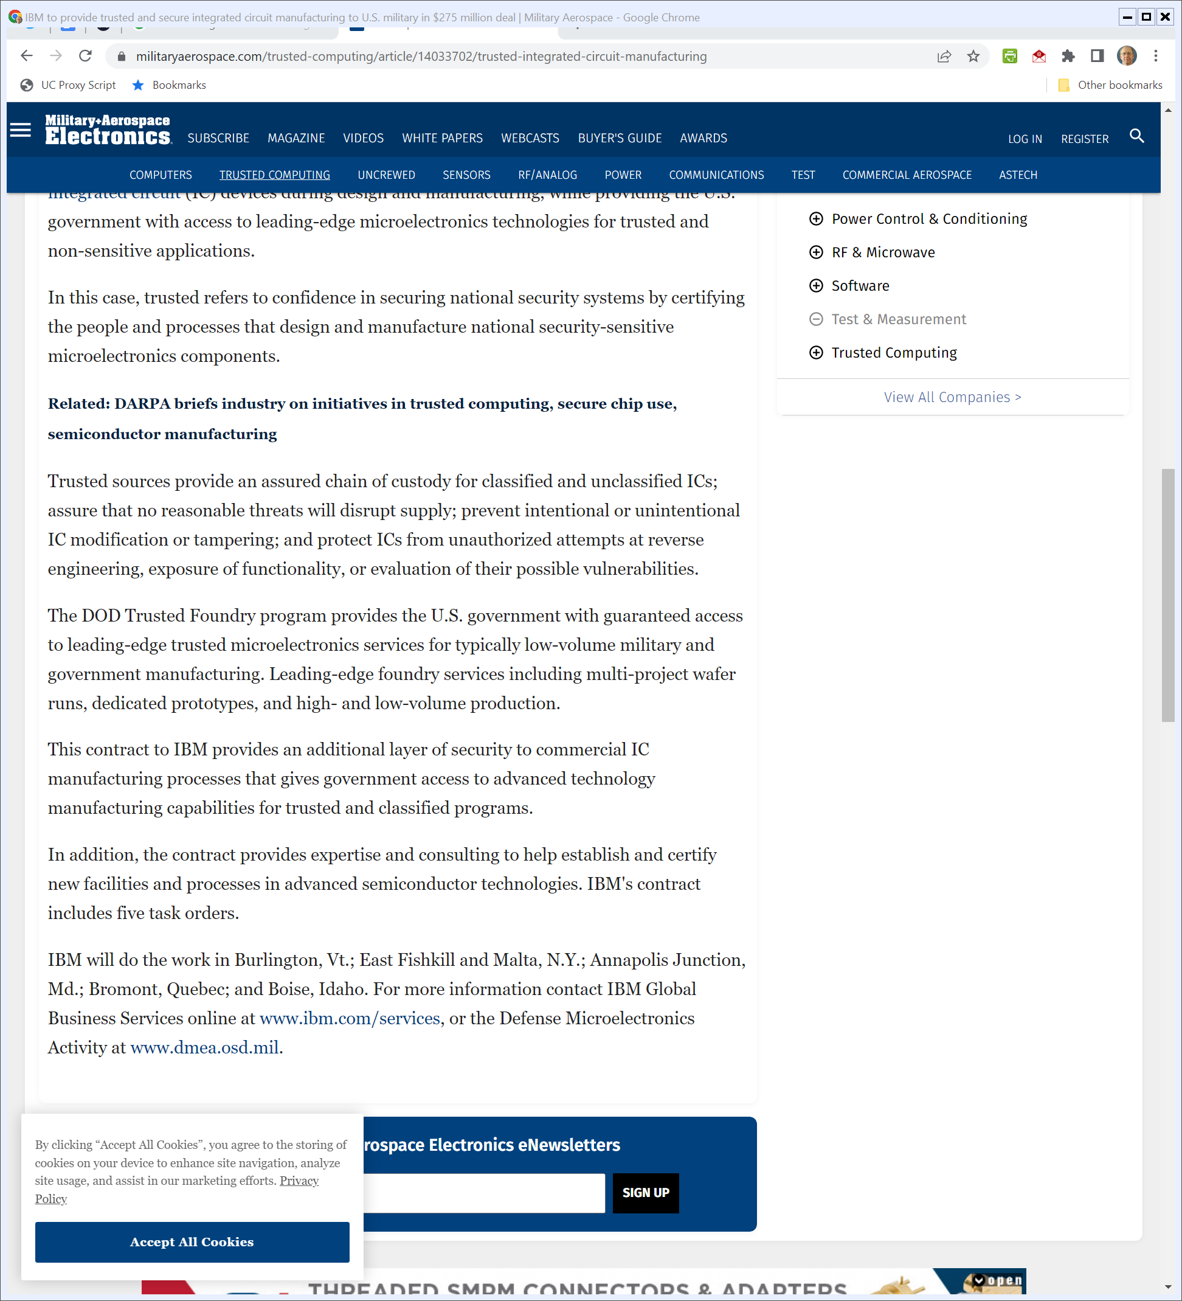
The Problem of Low-Volume Chips
Militaryaerospace.com (22 May 2019)
Notes:
https://www.militaryaerospace.com/trusted-computing/article/14033702/trusted-integrated-circuit-manufacturing

Slide 76
Where Does IBM Do This?
Militaryaerospace.com (22 May 2022)
Notes:
https://www.militaryaerospace.com/trusted-computing/article/14033702/trusted-integrated-circuit-manufacturing

Slide 77
Secure Chip Supply Chains
Pub. L. 11-283 (1 Jan 2021)

Slide 78
Secure Chip Supply Chains
Pub. L. 11-283 (1 Jan 2021)

Slide 79
Chip R&D
Pub. L. 11-283 (1 Jan 2021)

Slide 80
Chip R&D Strategy
Pub. L. 11-283 (1 Jan 2021)

Slide 81
New National Lab?
Pub. L. 11-283 (1 Jan 2021)

Slide 82
Nat’l Chip Tech Center
Pub. L. 11-283 (1 Jan 2021)

Slide 83
Nat’l Chip Tech Center
Pub. L. 11-283 (1 Jan 2021)

Slide 84
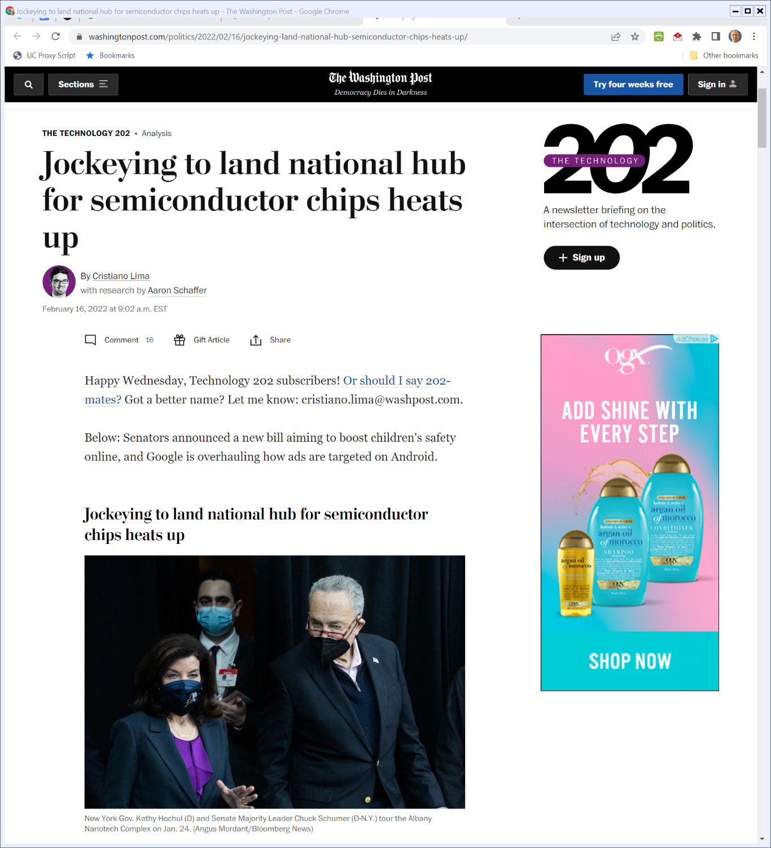
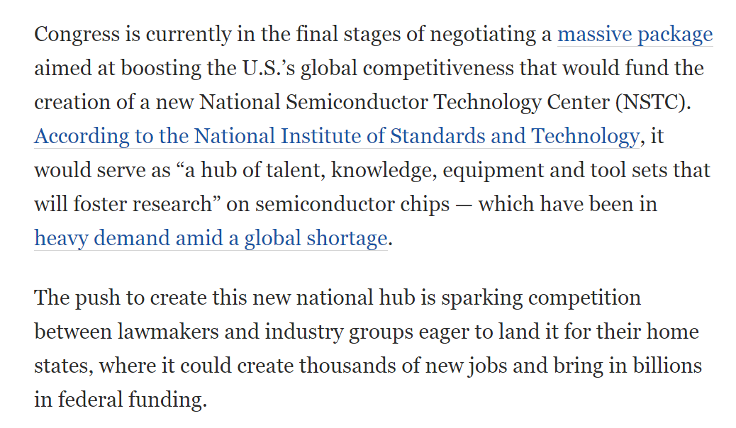
Political Fight Over Center
The Washington Post (16 Feb 2022)
Notes:
https://www.washingtonpost.com/politics/2022/02/16/jockeying-land-national-hub-semiconductor-chips-heats-up/

Slide 85
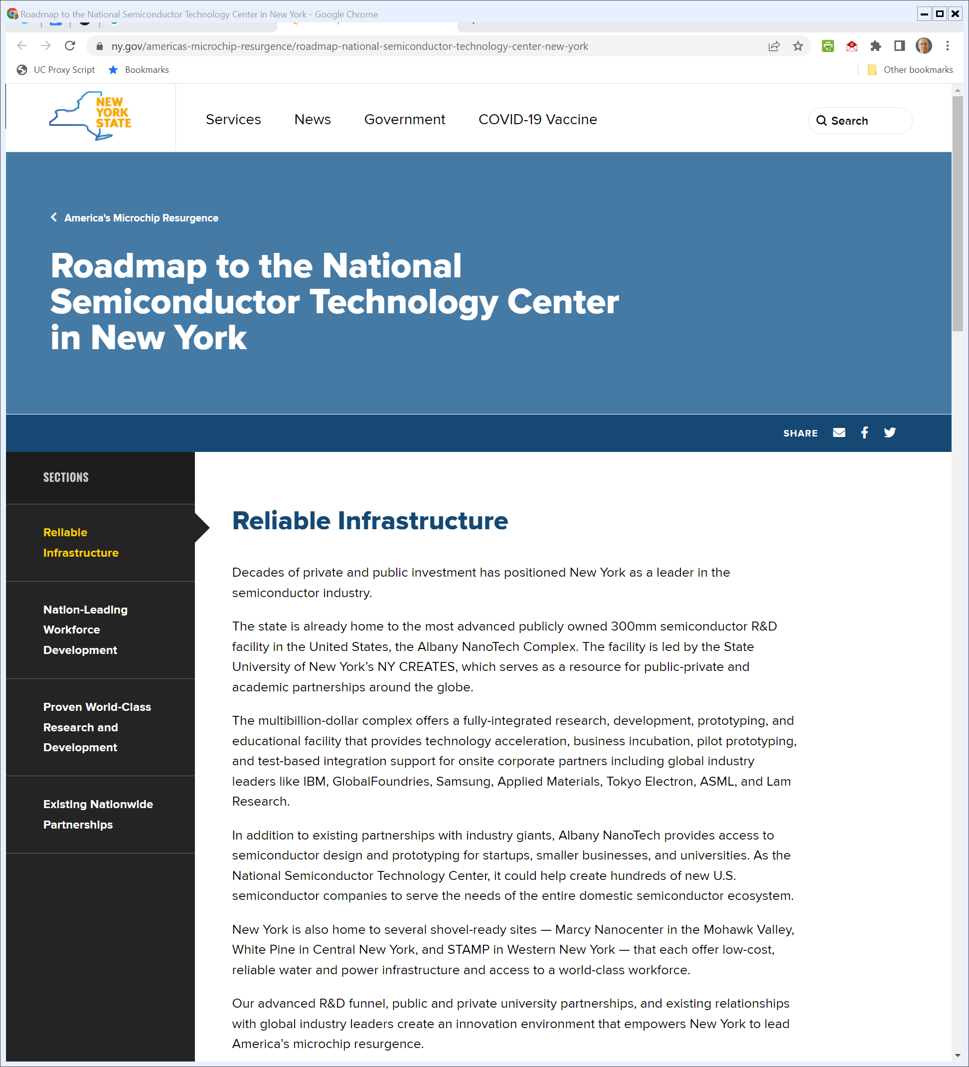
New York’s Play
NY.gov (Visited 27 Apr 2022)
Notes:
https://www.ny.gov/americas-microchip-resurgence/roadmap-national-semiconductor-technology-center-new-york

Slide 86
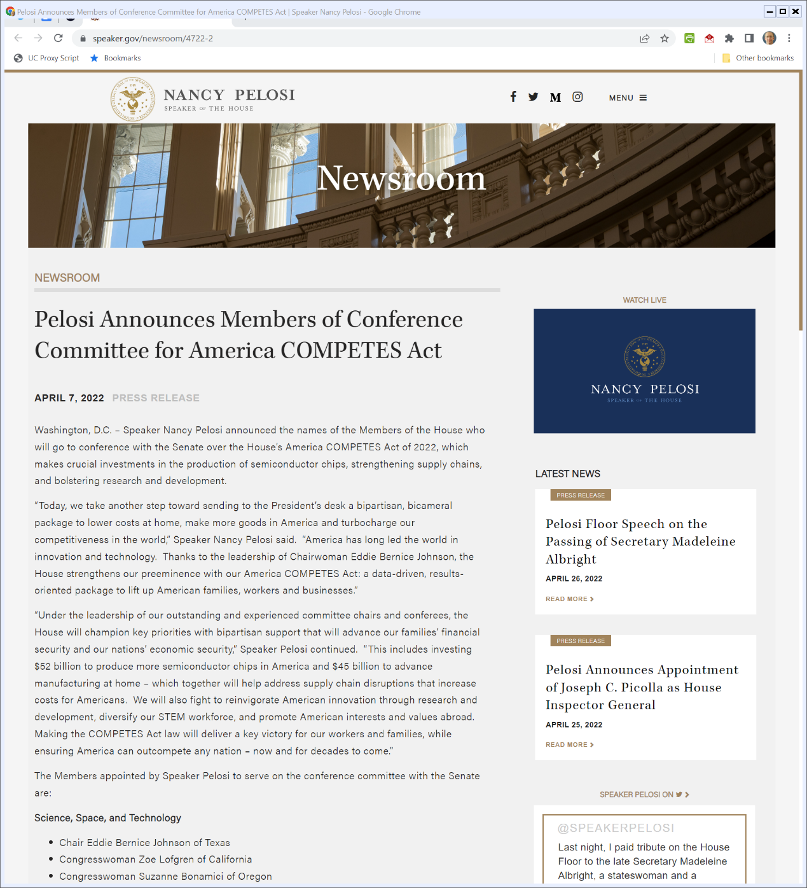

Funding CHIPS for America (and Much More)
Speaker.gov (7 Apr 2022)
Notes:
https://www.speaker.gov/newsroom/4722-2

Slide 87
Competing Versions
Akin Gump (14 Feb 2022)

