Slide 1
Class 16 Platforms and Networks Spring 2022 Content Platforms: Content and Carriage Conflicts
Randal C. Picker
James Parker Hall Distinguished Service Professor of Law
The Law School
The University of Chicago
Copyright © 2000-22 Randal C. Picker. All Rights Reserved.

Slide 2
The Focus Today
Key Questions
Cable TV emerged as an intermediary between traditional over-the-air broadcasters and the viewing public, plus it allowed for the distribution of non-OTA channels such as ESPN
What restricts what an intermediary like cable can do? Can it discriminate in favor/against content?

Slide 3
1962: UHF Tuners
Pub. L. 87-529 (10 July 1962)

Slide 4
1962: UHF Tuners (Chickens and Eggs)
Pub. L. 87-529 (10 July 1962)

Slide 5
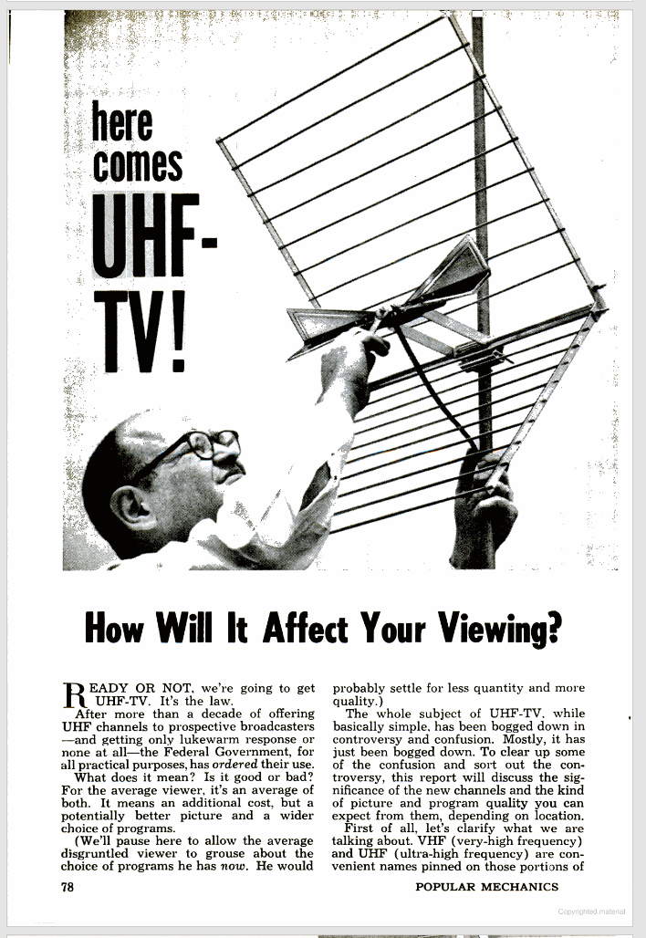
UHF Channels
Popular Mechanics (Dec 1962)

Slide 6
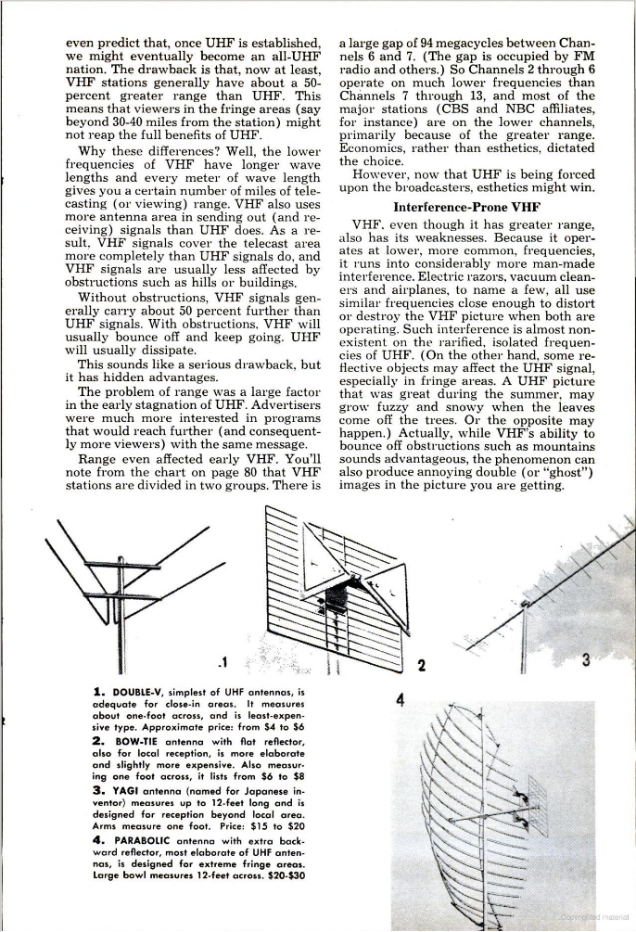
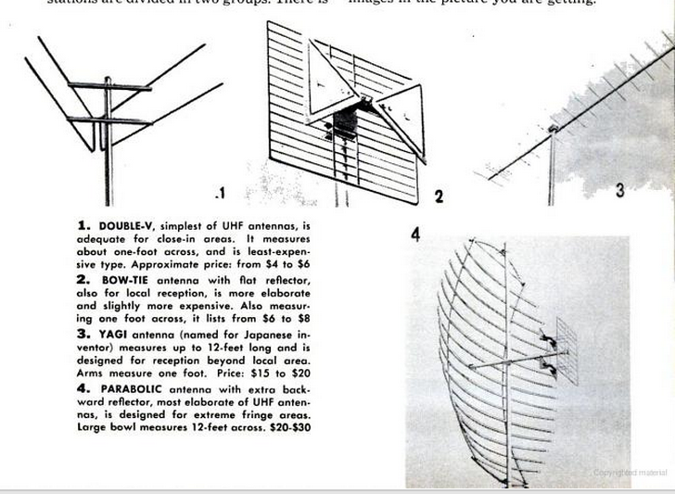
Requires A New Antenna
Popular Mechanics (Dec 1962)

Slide 7
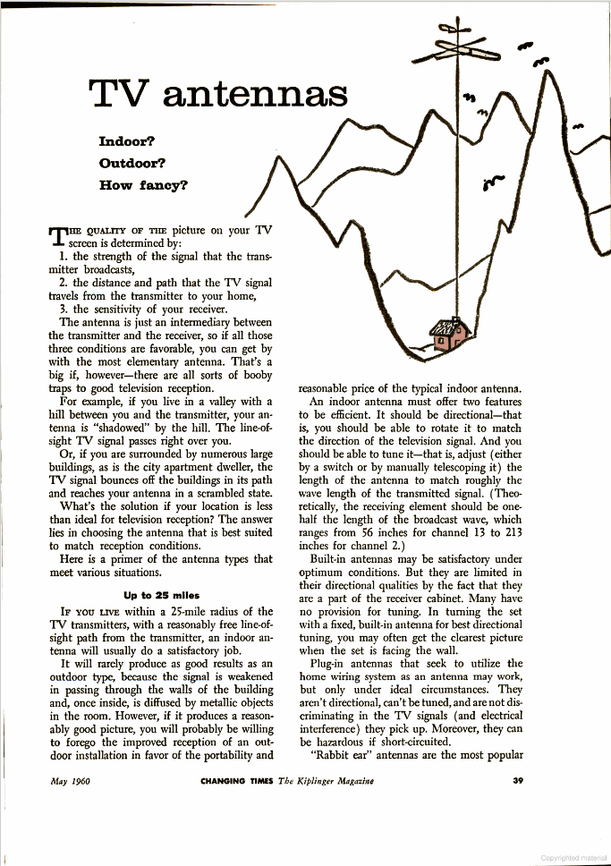
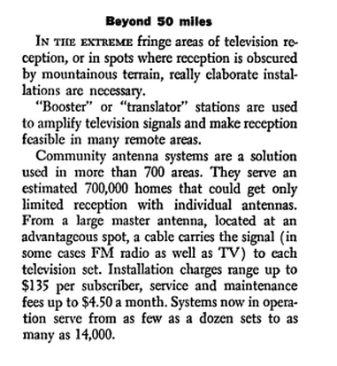
Shared Antennae (Community Antenna TV) (CATV) (Cable)
Kiplinger’s Personal Finance (May 1960)

Slide 8
CATV Systems Don’t Violate Copyright
Fortnightly (U.S. 1968)

Slide 9
CATV Systems Don’t Violate Copyright
“Broadcasters perform. Viewers do not perform. Thus, while both broadcaster and viewer play crucial roles in the total television process, a line is drawn between them. One is treated as active performer; the other, as passive beneficiary. When CATV is considered in this framework, we conclude that it falls on the viewer’s side of the line.”
Fortnightly (U.S. 1968)

Slide 10
Grabbing Extra Signals OK
Teleprompter (U.S. 1974)

Slide 11
Grabbing Extra Signals OK
“By importing signals that could not normally be received with current technology in the community it serves, a CATV system does not, for copyright purposes, alter the function it performs for its subscribers.”
Teleprompter (U.S. 1974)

Slide 12
1976 Copyright Act
Changed public performance right to bring cable into the statute
Created statutory license regime for secondary transmissions to ensure cable access
Pub. L. 94-553 (19 Oct 1976)

Slide 13
1992 Cable Act Legis History
S. Rep. 102-92 (28 June 1991)

Slide 14
The Basis for the 1984 Act
S. Rep. 102-92 (28 June 1991)

Slide 15
Core Rules of the 1984 Act
S. Rep. 102-92 (28 June 1991)

Slide 16
Growth of Cable
S. Rep. 102-92 (28 June 1991)

Slide 17
Problems
S. Rep. 102-92 (28 June 1991)

Slide 18
Prices Rising, Weak Competition
Pub. L. 102-385 (5 Oct 1992)

Slide 19
Dominant Concentrated Medium
Pub. L. 102-385 (5 Oct 1992)

Slide 20
Carriage Conflicts Tied to Ownership
Pub. L. 102-385 (5 Oct 1992)

Slide 21
Important Role of Free Local TV
Pub. L. 102-385 (5 Oct 1992)

Slide 22
Cable Puts Broadcast TV at Risk
Pub. L. 102-385 (5 Oct 1992)

Slide 23
No More Antennas; Cable Best Distribution Tool
Pub. L. 102-385 (5 Oct 1992)

Slide 24
Broadcast Externalities
Pub. L. 102-385 (5 Oct 1992)

Slide 25
Cable Rate Reg and Effective Competition Standard
Pub. L. 102-385 (5 Oct 1992)

Slide 26
Must Carry Obligations
Pub. L. 102-385 (5 Oct 1992)

Slide 27
Must Carry for Noncommercial Stations
Pub. L. 102-385 (5 Oct 1992)

Slide 28
Retransmission Consent
Pub. L. 102-385 (5 Oct 1992)

Slide 29
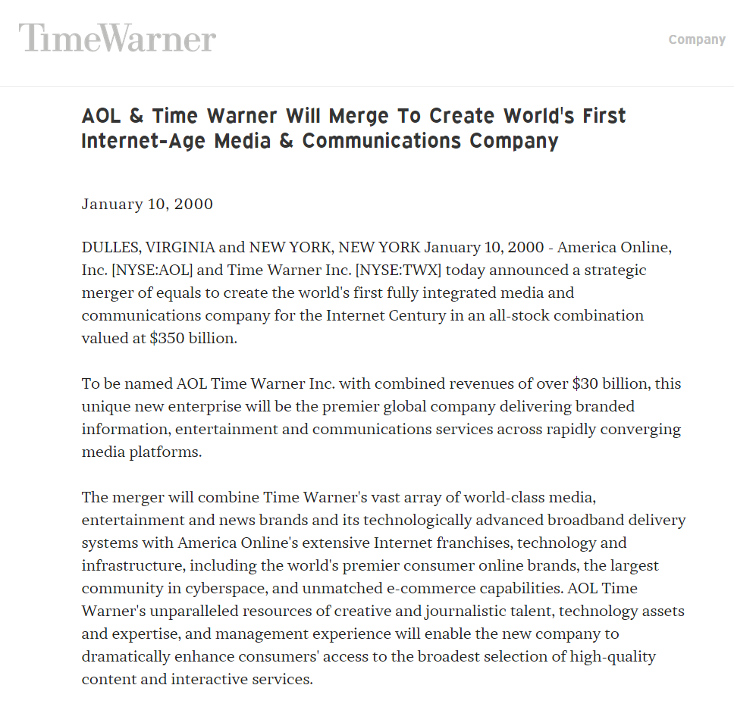
AOL/Time Warner Merger
“America Online, Inc. [NYSE:AOL] and Time Warner Inc. [NYSE:TWX] today announced a strategic merger of equals to create the world’s first fully integrated media and communications company for the Internet Century in an all-stock combination valued at $350 billion.”
Time Warner Press Release (10 Jan 2000)

Slide 30
Magazines (TTYN (1 of 6))
New York Times (13 Nov 2000)

Slide 31
Movies (TTYN (2 of 6))
New York Times (13 Nov 2000)

Slide 32
Music (TTYN (3 of 6))
New York Times (13 Nov 2000)

Slide 33
Cable Channels (TTYN (4 of 6))
New York Times (13 Nov 2000)

Slide 34
Websites (TTYN (5 of 6))
New York Times (13 Nov 2000)

Slide 35
Cable Systems (TTYN (6 of 6))
New York Times (13 Nov 2000)

Slide 36
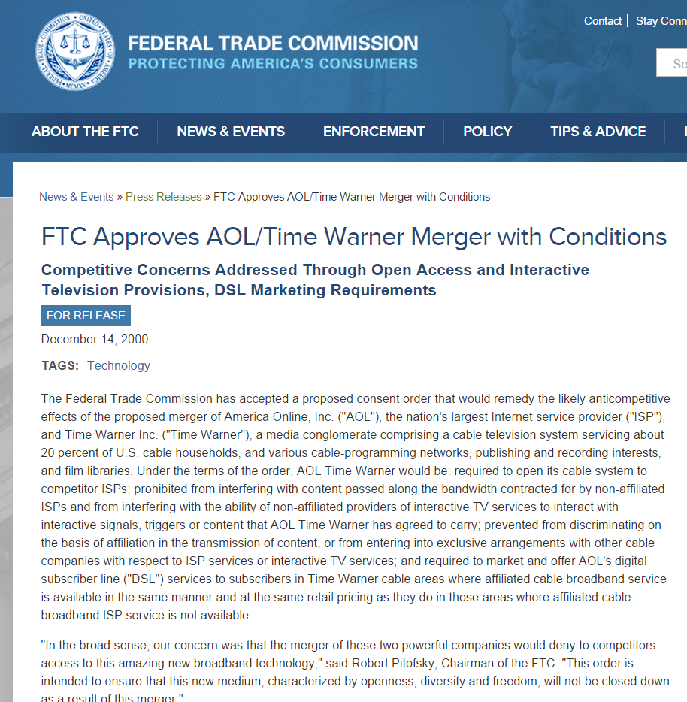
FTC Approval: “Yes, but …”
“Under the terms of the order, AOL Time Warner would be: required to open its cable system to competitor ISPs; prohibited from interfering with content passed along the bandwidth contracted for by non-affiliated ISPs and from interfering with the ability of non-affiliated providers of interactive TV”
FTC Press Release (14 Dec 2000)

Slide 37
FTC Approval: “Yes, but …”
“services to interact with interactive signals, triggers or content that AOL Time Warner has agreed to carry; prevented from discriminating on the basis of affiliation in the transmission of content or from entering into exclusive arrangements with other cable companies with respect to ISP services or interactive TV services;”
FTC Press Release (14 Dec 2000)

Slide 38
FTC Approval: “Yes, but …”
“and required to market and offer AOL’s digital subscriber line (“DSL”) services to subscribers in Time Warner cable areas where affiliated cable broadband service is available in the same manner and at the same retail pricing as they do in those areas where affiliated cable broadband ISP service is not available.”
FTC Press Release (14 Dec 2000)

Slide 39
AOL/Time Warner Split
Time Warner Press Release (10 Dec 2009)

Slide 40
Three Tier Video Distribution Market
Content Producers
Networks, Independent Companies, Larry David, Tina Fey, Dick Wolf
Content Aggregators
Broadcast Networks
Cable Networks
Online Video Distributors (OVDs) (Amazon, Apple, Hulu, Netflix)

Slide 41
Three Tier Video Distribution Market
Content Aggregators
Broadcast Networks
Cable Networks
Online Video Distributors (OVDs) (Amazon, Apple, Hulu, Netflix)
Content Distribution
OTA Broadcast
MVPDs: Cable, DBS, Telcos
OVDs

Slide 42
Access to Content and Discrimination
Core Issue
Comcast will now control more content than it currently does (critically, NBC, but other networks as well, plus Universal)
How will the change in ownership of the content alter incentives to distribute it?
How would that alter competition?

Slide 43
Access to Content and Discrimination
Benefits to New Ownership?
Eliminate double marginalization?

Slide 44
NBCU
GE
Vivendi
88%
12%
NBCU
Broadcast Licenses & such for NBC and Telemundo
Cable Channels (Bravo, MSNBC, etc.)
Universal Studios
Comcast-NBCU Deal

Slide 45
Comcast
Comcast
Cable Distribution & Broadband
Cable Channels (RSNs, E!, etc.)
Fancast (online distribution)
Comcast-NBCU Deal

Slide 46
Hulu
NBCU
News
Disney
Private
32%
XX%
XX%
XX%
Hulu
Comcast-NBCU Deal

Slide 47
New Joint Venture Structure
Comcast
Cable Distribution & Broadband
Fancast (online distribution)
GE
51%
49%
New Joint Venture
Cable Channels (RSNs, E!, etc.)
Broadcast Licenses & such for NBC and Telemundo
Cable Channels (Bravo, MSNBC, etc.)
Universal Studios
Hulu Shares
April 24, 2022
47
Comcast-NBCU Deal

Slide 48
Deal Structure
TTYN (1 of 5)
Now Deal
GE buys out Vivendi
Joint venture between Comcast and GE with ownership interests and asset contributions mapped out above
Future buy/sell rights as well

Slide 49
Deal Structure
TTYN (2 of 5)
Future Buy/Sell Rights
GE can’t sell position for 3.5 years, Comcast can’t sell for four years
Comcast has right to buy at fair market value any interest that GE wants to sell

Slide 50
Deal Structure
TTYN (3 of 5)
Future Buy/Sell Rights
GE can put (force Comcast to buy) 50% of its interest after 3.5 years and the rest of its interest after 7 years
If GE puts after 3.5, Comcast can call (force GE to sell) the rest of GE’s interest at that time

Slide 51
Deal Structure
TTYN (4 of 5)
Future Buy/Sell Rights
If GE doesn’t put after 3.5 years, Comcast can call 50% of GE’s interest 5 years out from original deal date and all of GE’s remaining interest after 8 years
What does this structure accomplish? Does it change the competition analysis?

Slide 52
Deal Structure
TTYN (5 of 5)
Starting Questions
What do we think explains the joint venture? Why not an outright purchase by Comcast?
What are the horizontal antitrust issues raised by this structure?

Slide 53
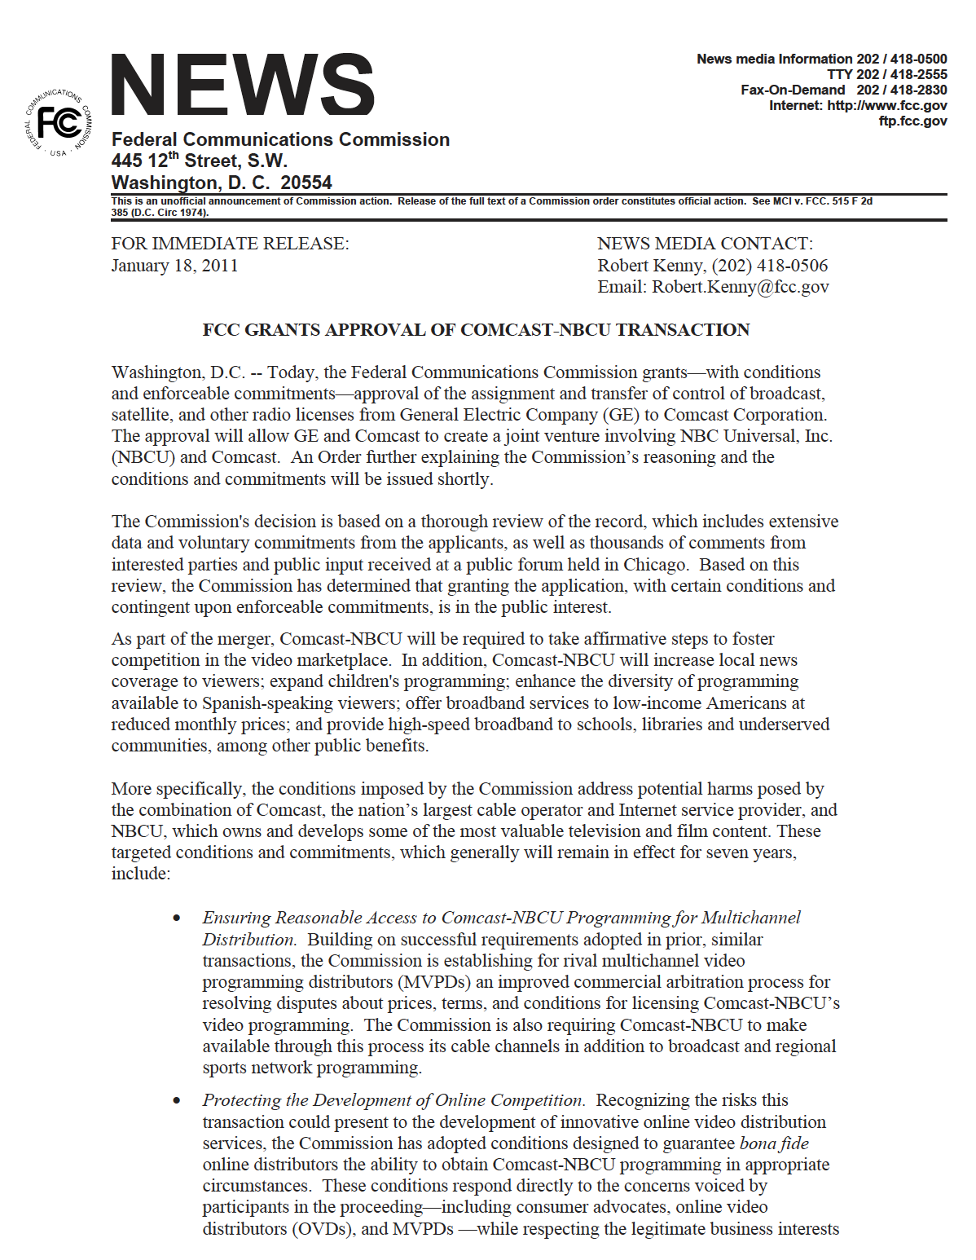
Approval: Comcast/NBCU transaction
FCC Press Release (18 Jan 2011)

Slide 54
Access to JV Content
FCC Press Release (18 Jan 2011)

Slide 55
Access to JV Content
FCC Press Release (18 Jan 2011)

Slide 56
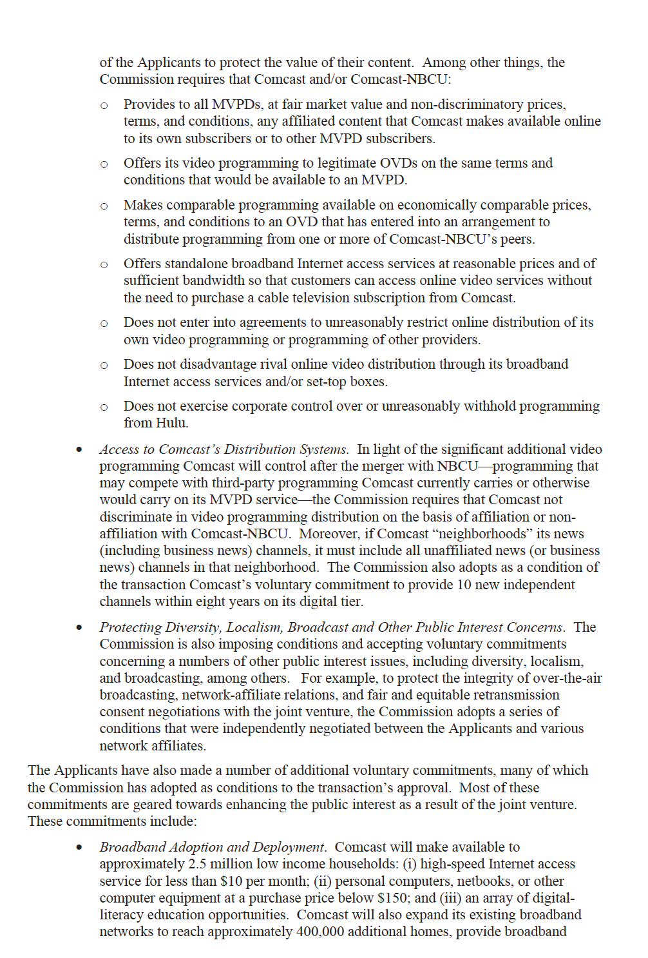
Digital Divide
FCC Press Release (18 Jan 2011)

Slide 57
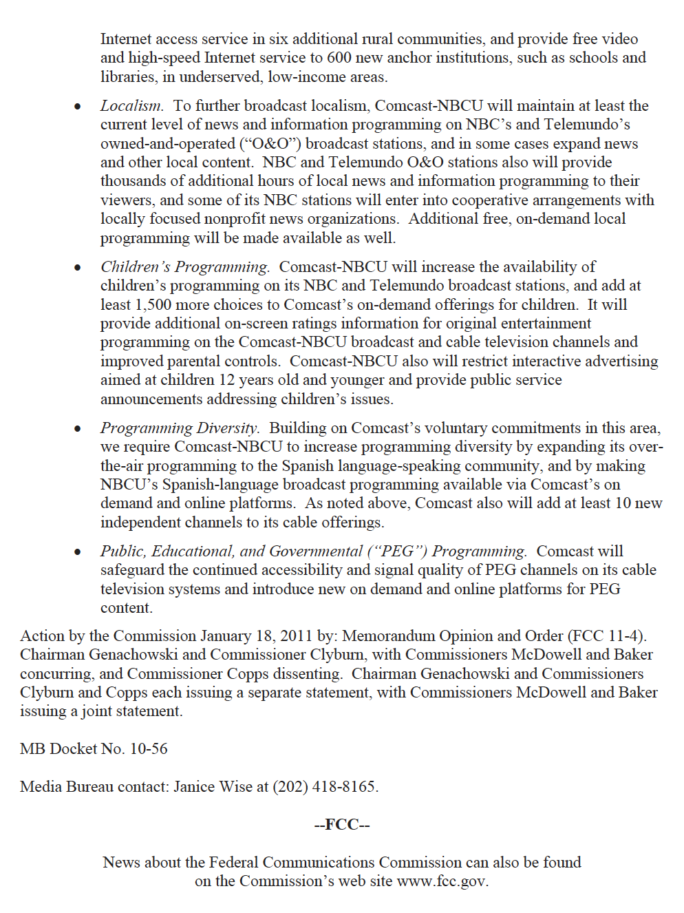
Localism
FCC Press Release (18 Jan 2011)

Slide 58
Protecting Kids
FCC Press Release (18 Jan 2011)

Slide 59
Diversity and PEG Channels
FCC Press Release (18 Jan 2011)

Slide 60
Comcast/NBC Universal
Competitive Impact Statement (18 Jan 2011)

Slide 61
OVD Access to Content
Competitive Impact Statement (18 Jan 2011)

Slide 62
OVDs Get CBS Deal for NBC Content
Competitive Impact Statement (18 Jan 2011)

Slide 63
No Broadband Discrimination
Competitive Impact Statement (18 Jan 2011)

Slide 64
Fear is Comcast will Prioritize Its Own Traffic
Competitive Impact Statement (18 Jan 2011)

Slide 65
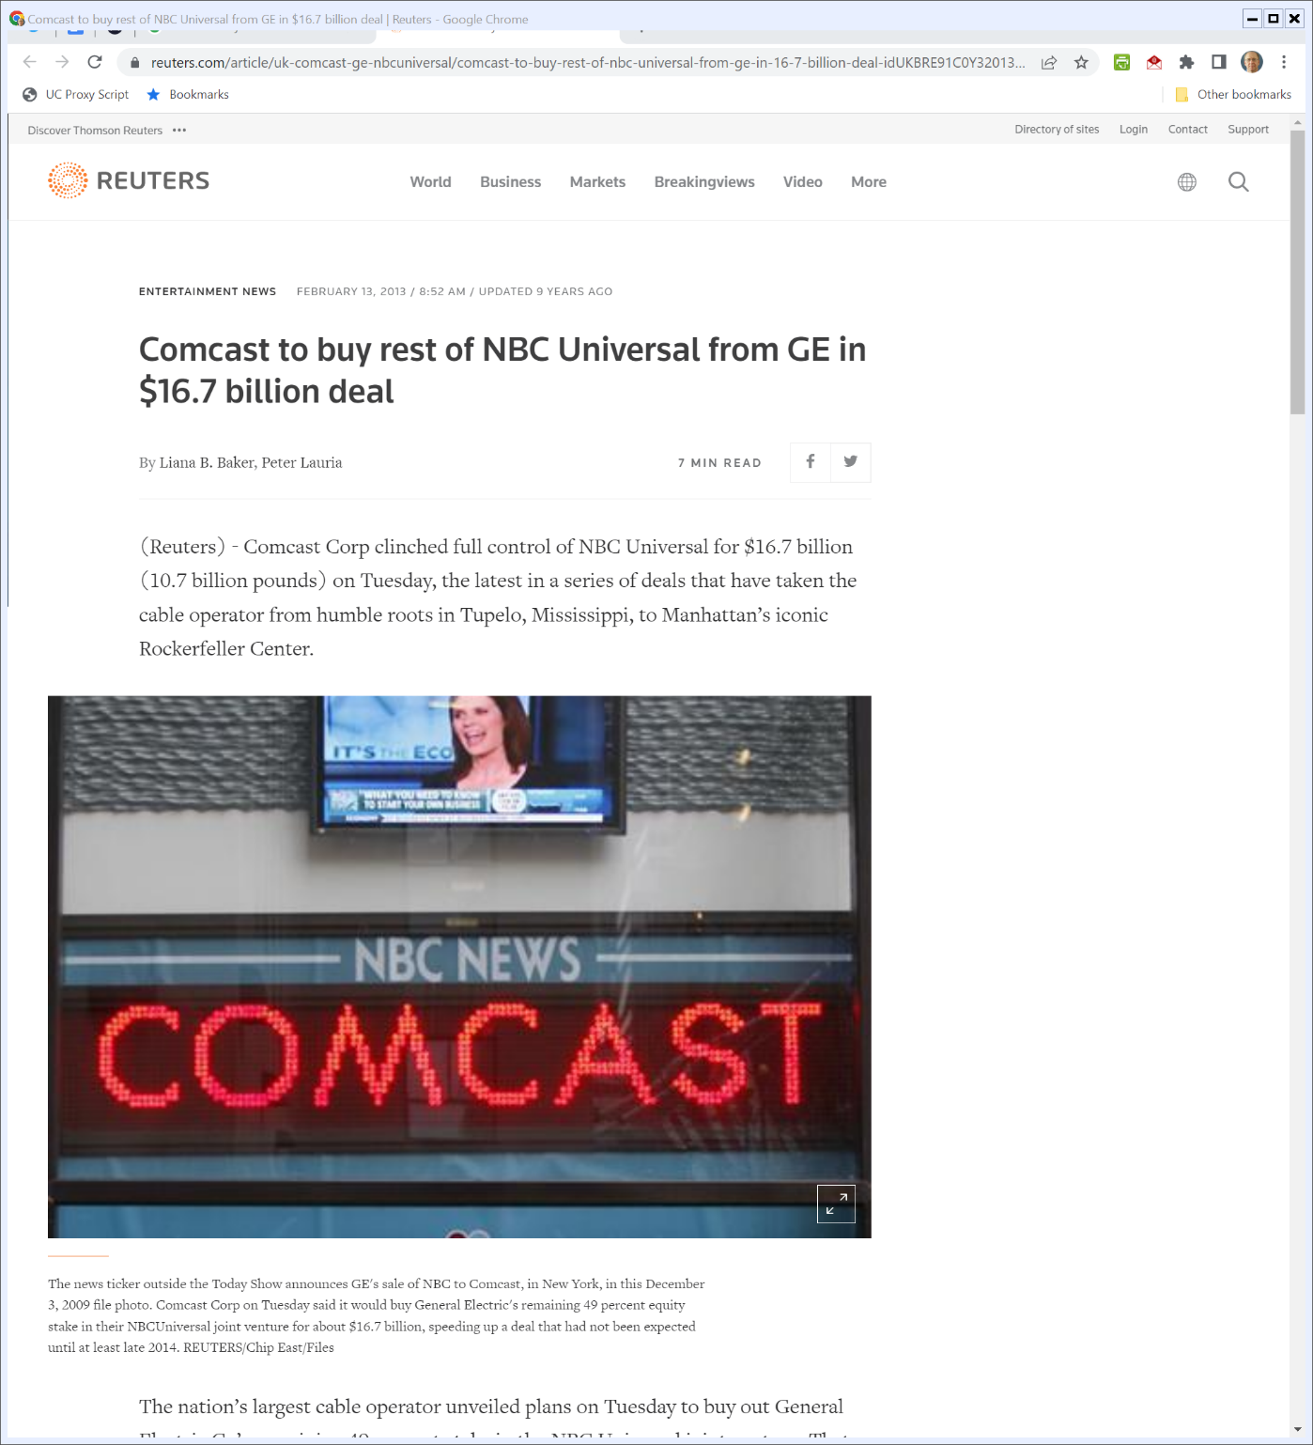
Feb 2013: Comcast Buys Rest of NBCU
Reuters (13 Feb 2013)
Notes:
https://www.reuters.com/article/uk-comcast-ge-nbcuniversal/comcast-to-buy-rest-of-nbc-universal-from-ge-in-16-7-billion-deal-idUKBRE91C0Y320130213

Slide 66
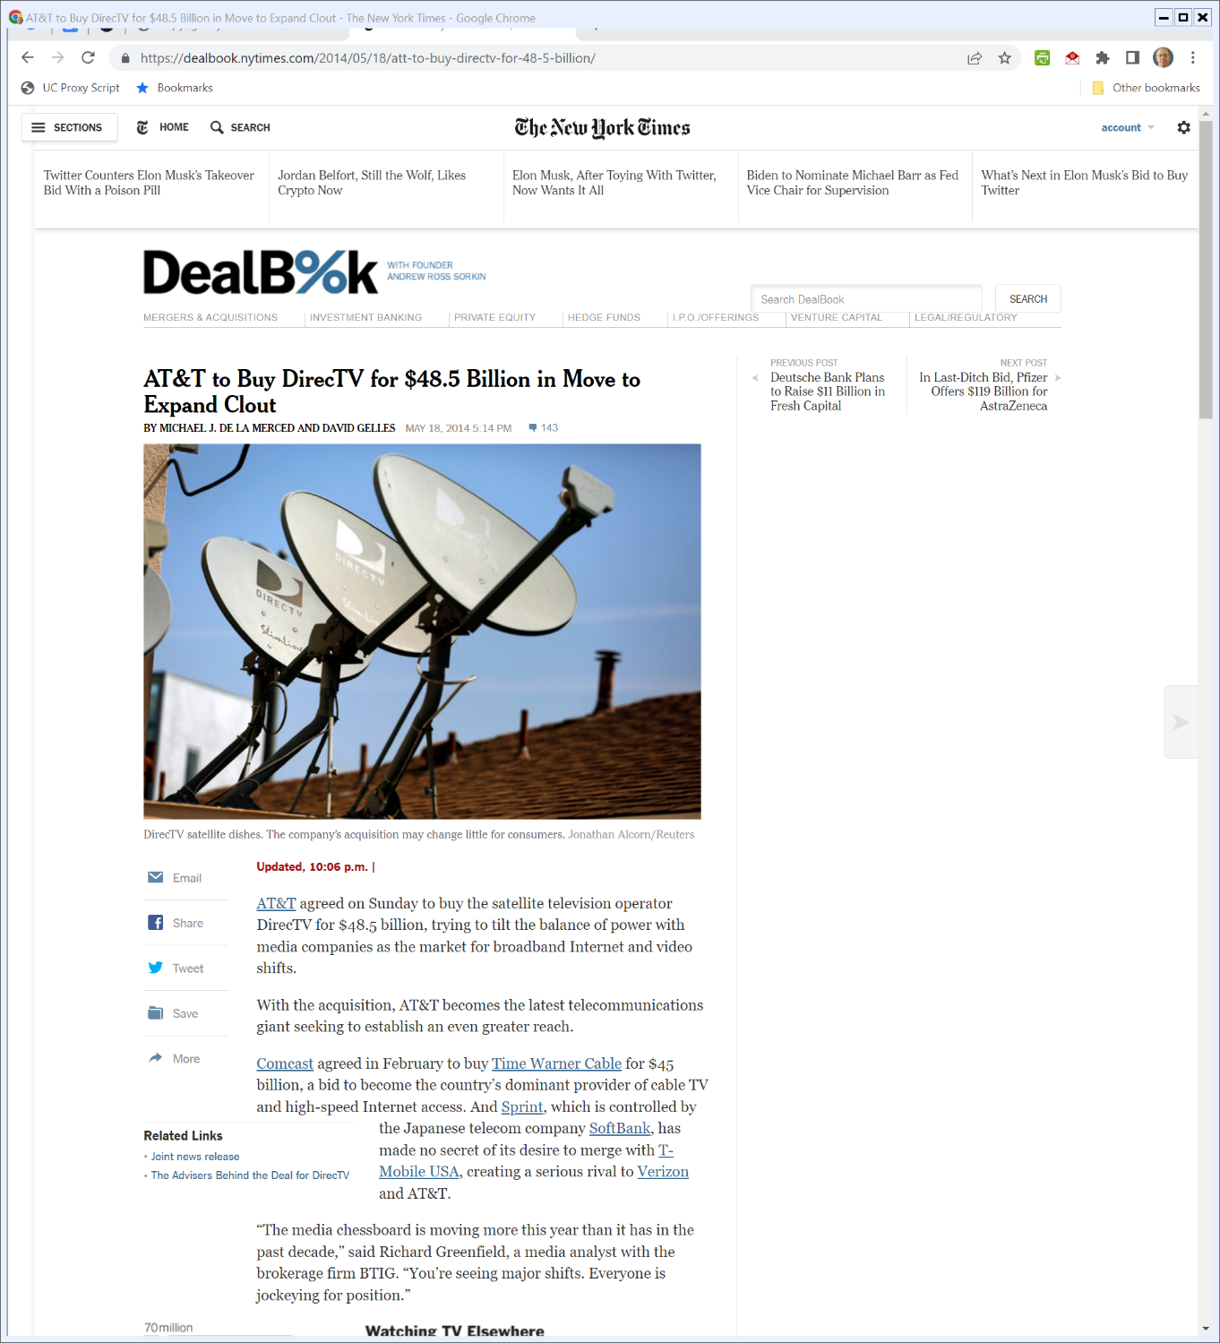
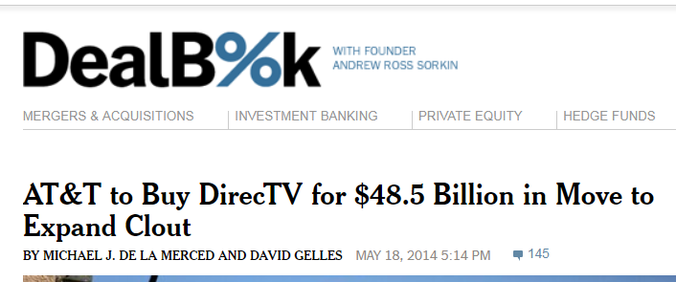
AT&T DirecTV Deal
New York Times (18 May 2014)
Notes:
https://dealbook.nytimes.com/2014/05/18/att-to-buy-directv-for-48-5-billion/

Slide 67
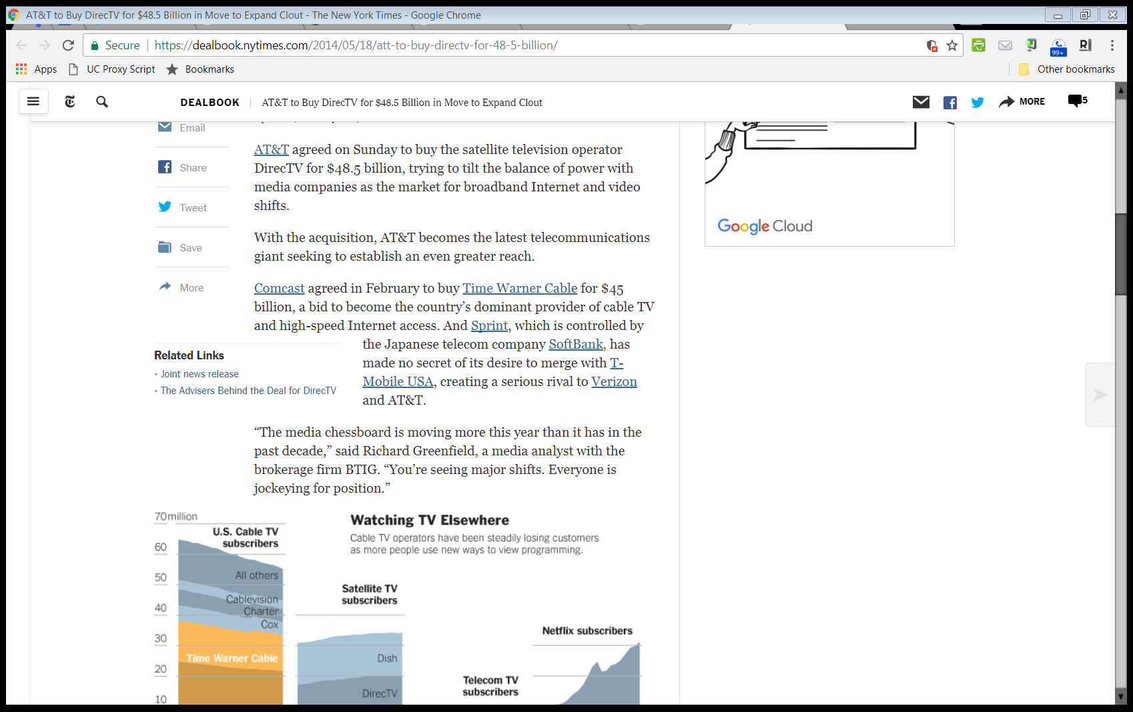
AT&T DirecTV Deal
New York Times (18 May 2014)

Slide 68
Other Possible Deals
New York Times (18 May 2014)

Slide 69
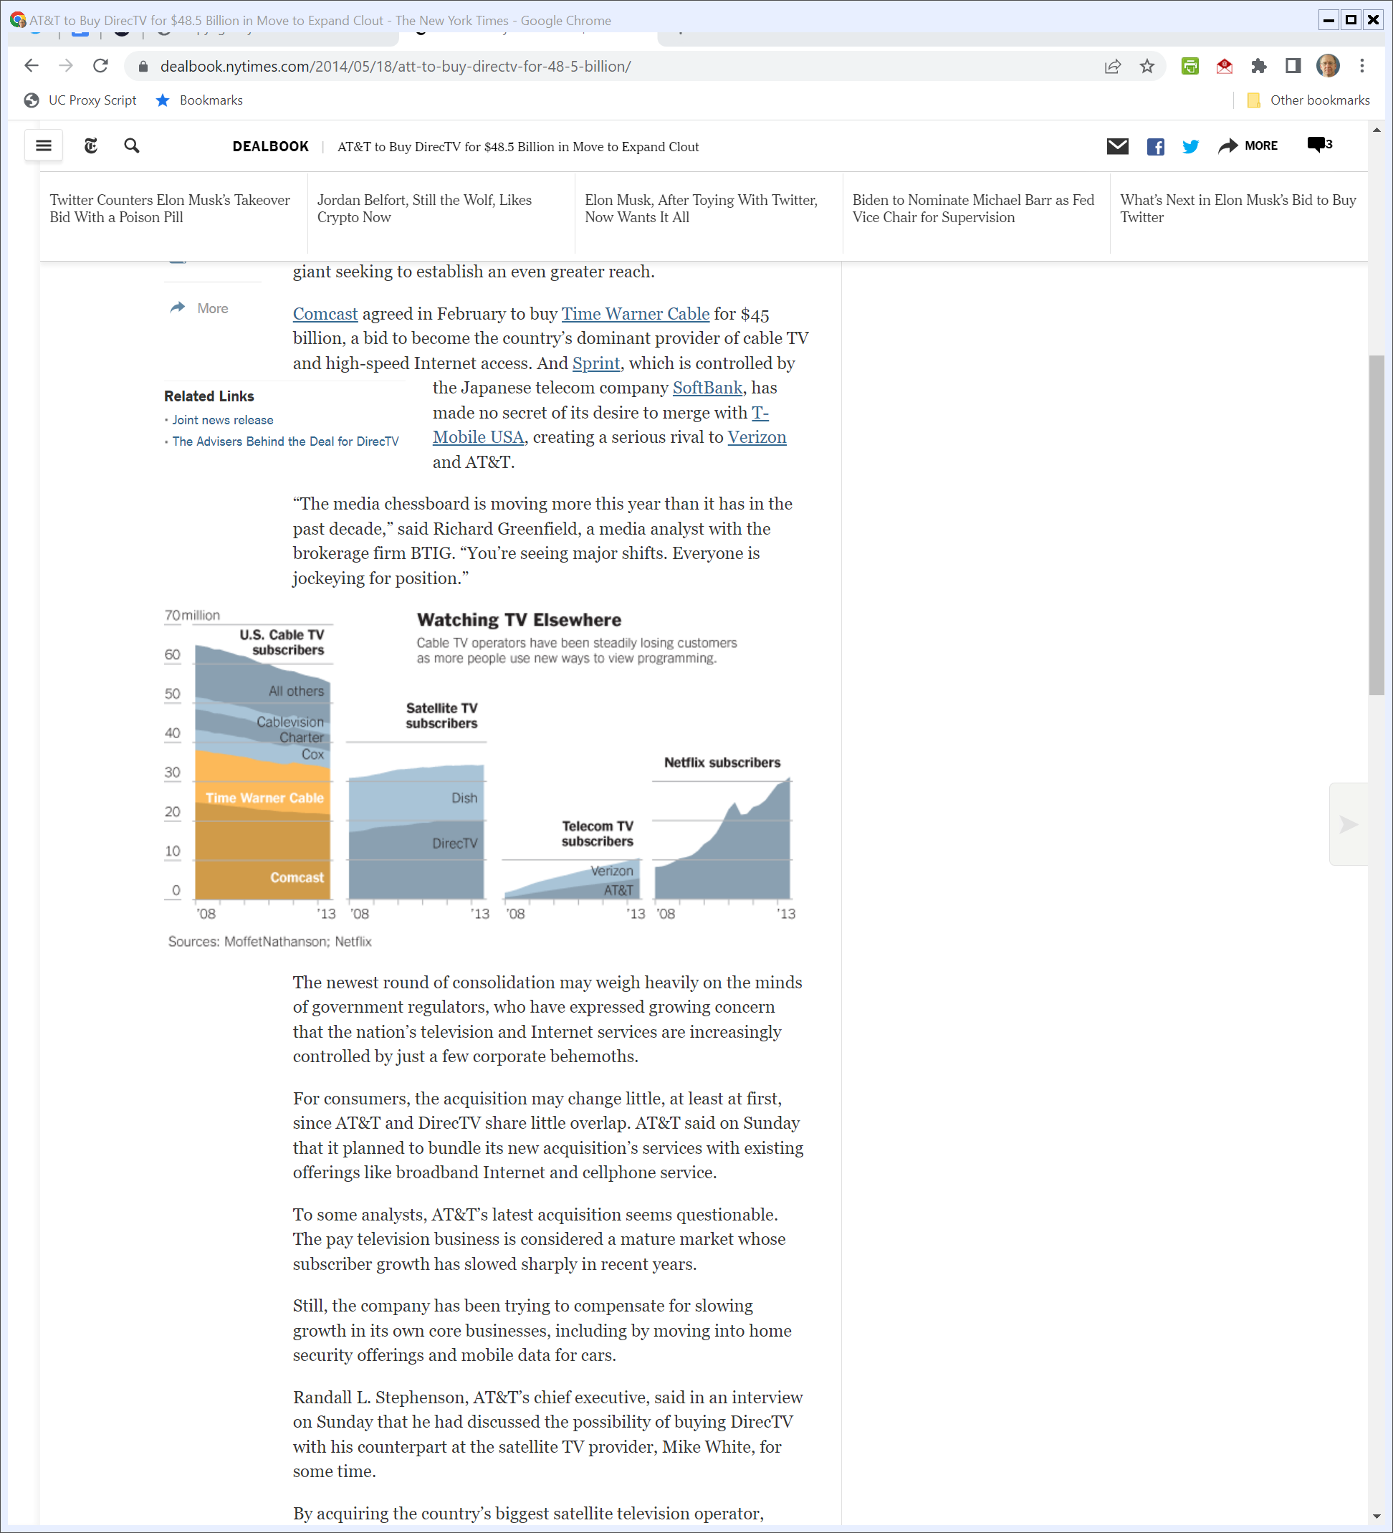
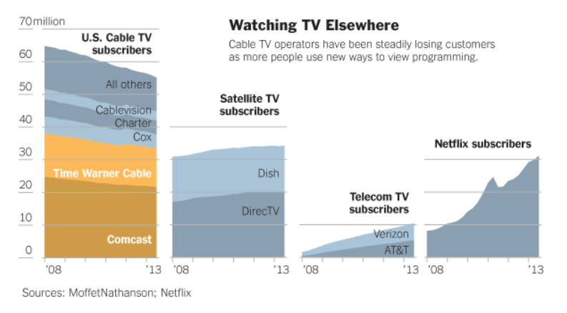
Current State of TV
New York Times (18 May 2014)

Slide 70
Comcast Time Warner Cable Deal Dead
FCC Press Release (24 Apr 2015)

Slide 71
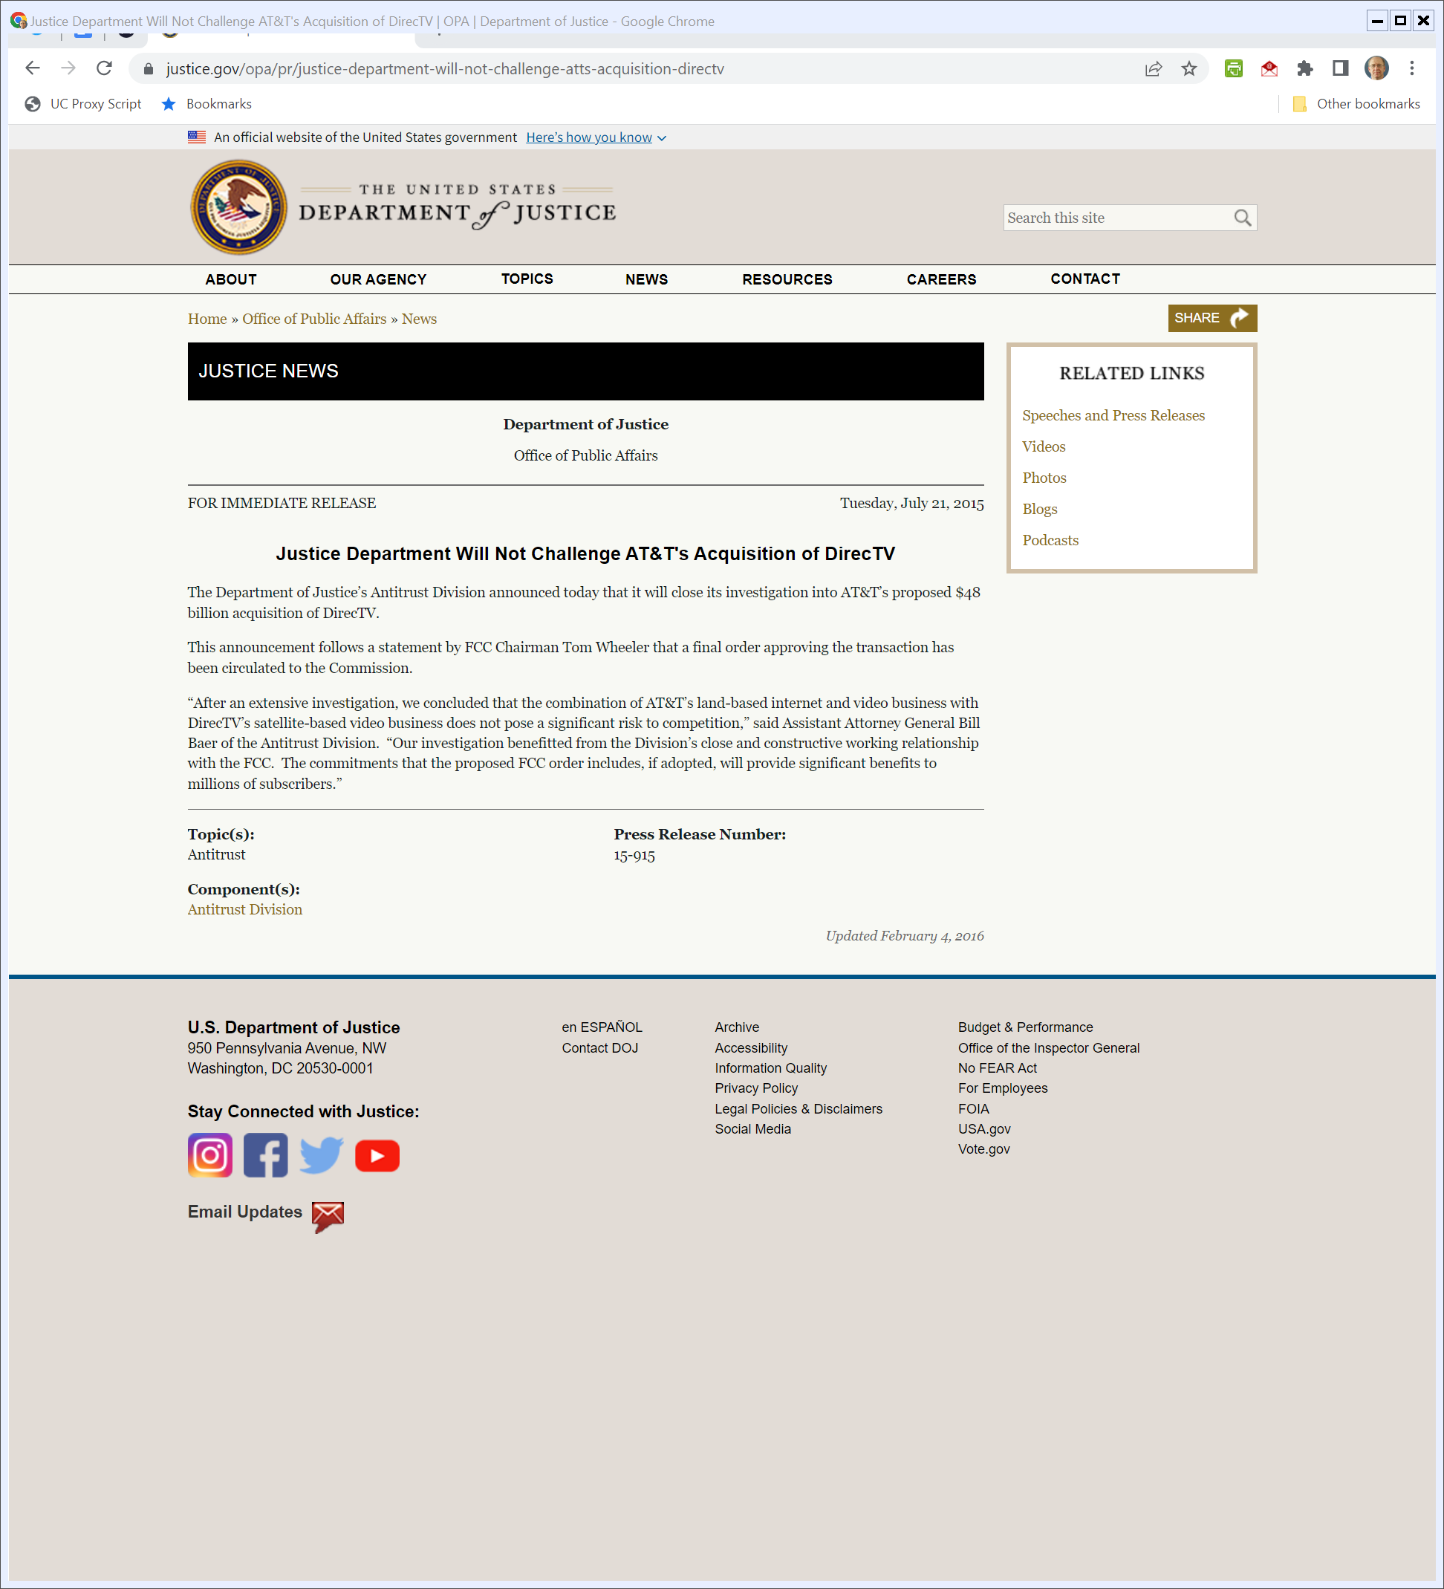
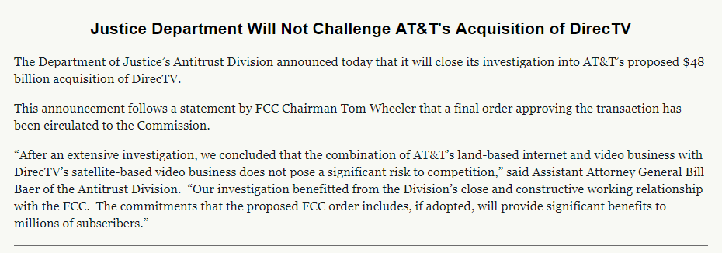
No Challenge to AT&T DirecTV Deal
DOJ Press Release (21 July 2015)

Slide 72
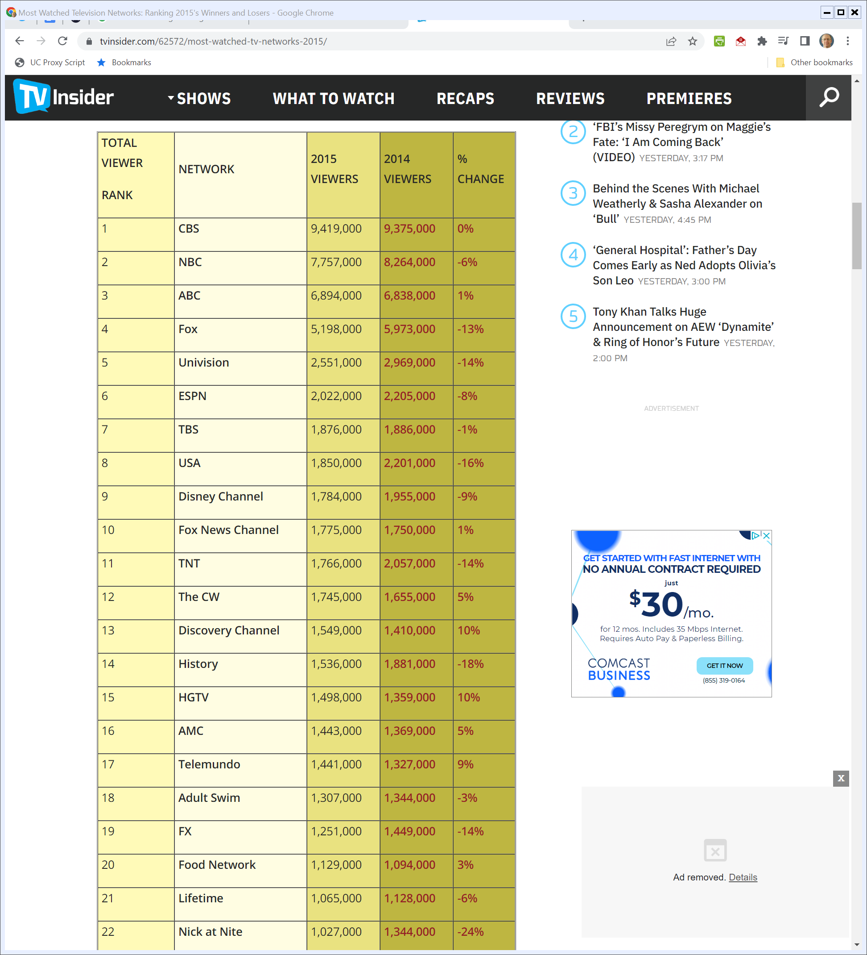
2015 Most Watched Networks
TVInsider.com (28 Dec 2015)
Notes:
https://www.tvinsider.com/62572/most-watched-tv-networks-2015/

Slide 73
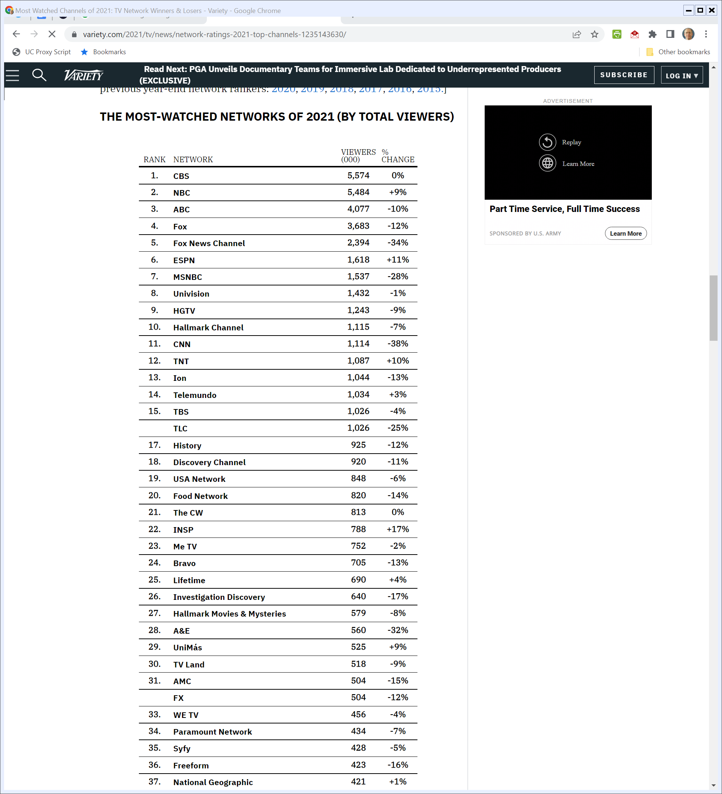
2021 Most-Watched Networks
Variety (30 Dec 2021)
Notes:
https://variety.com/2021/tv/news/network-ratings-2021-top-channels-1235143630/

Slide 74
AT&T/Time Warner
TTYN
Hypo
AT&T and Time-Warner have proposed to merge
You are at DOJ and the parties approach you and offer to settle the case in a way that parallels the deal cut for Comcast/NBCU
What do you do?

Slide 75
Gov’t Expert Report
AT&T/Time Warner

Slide 76
Nash Bargaining Theory
AT&T/Time Warner

Slide 77
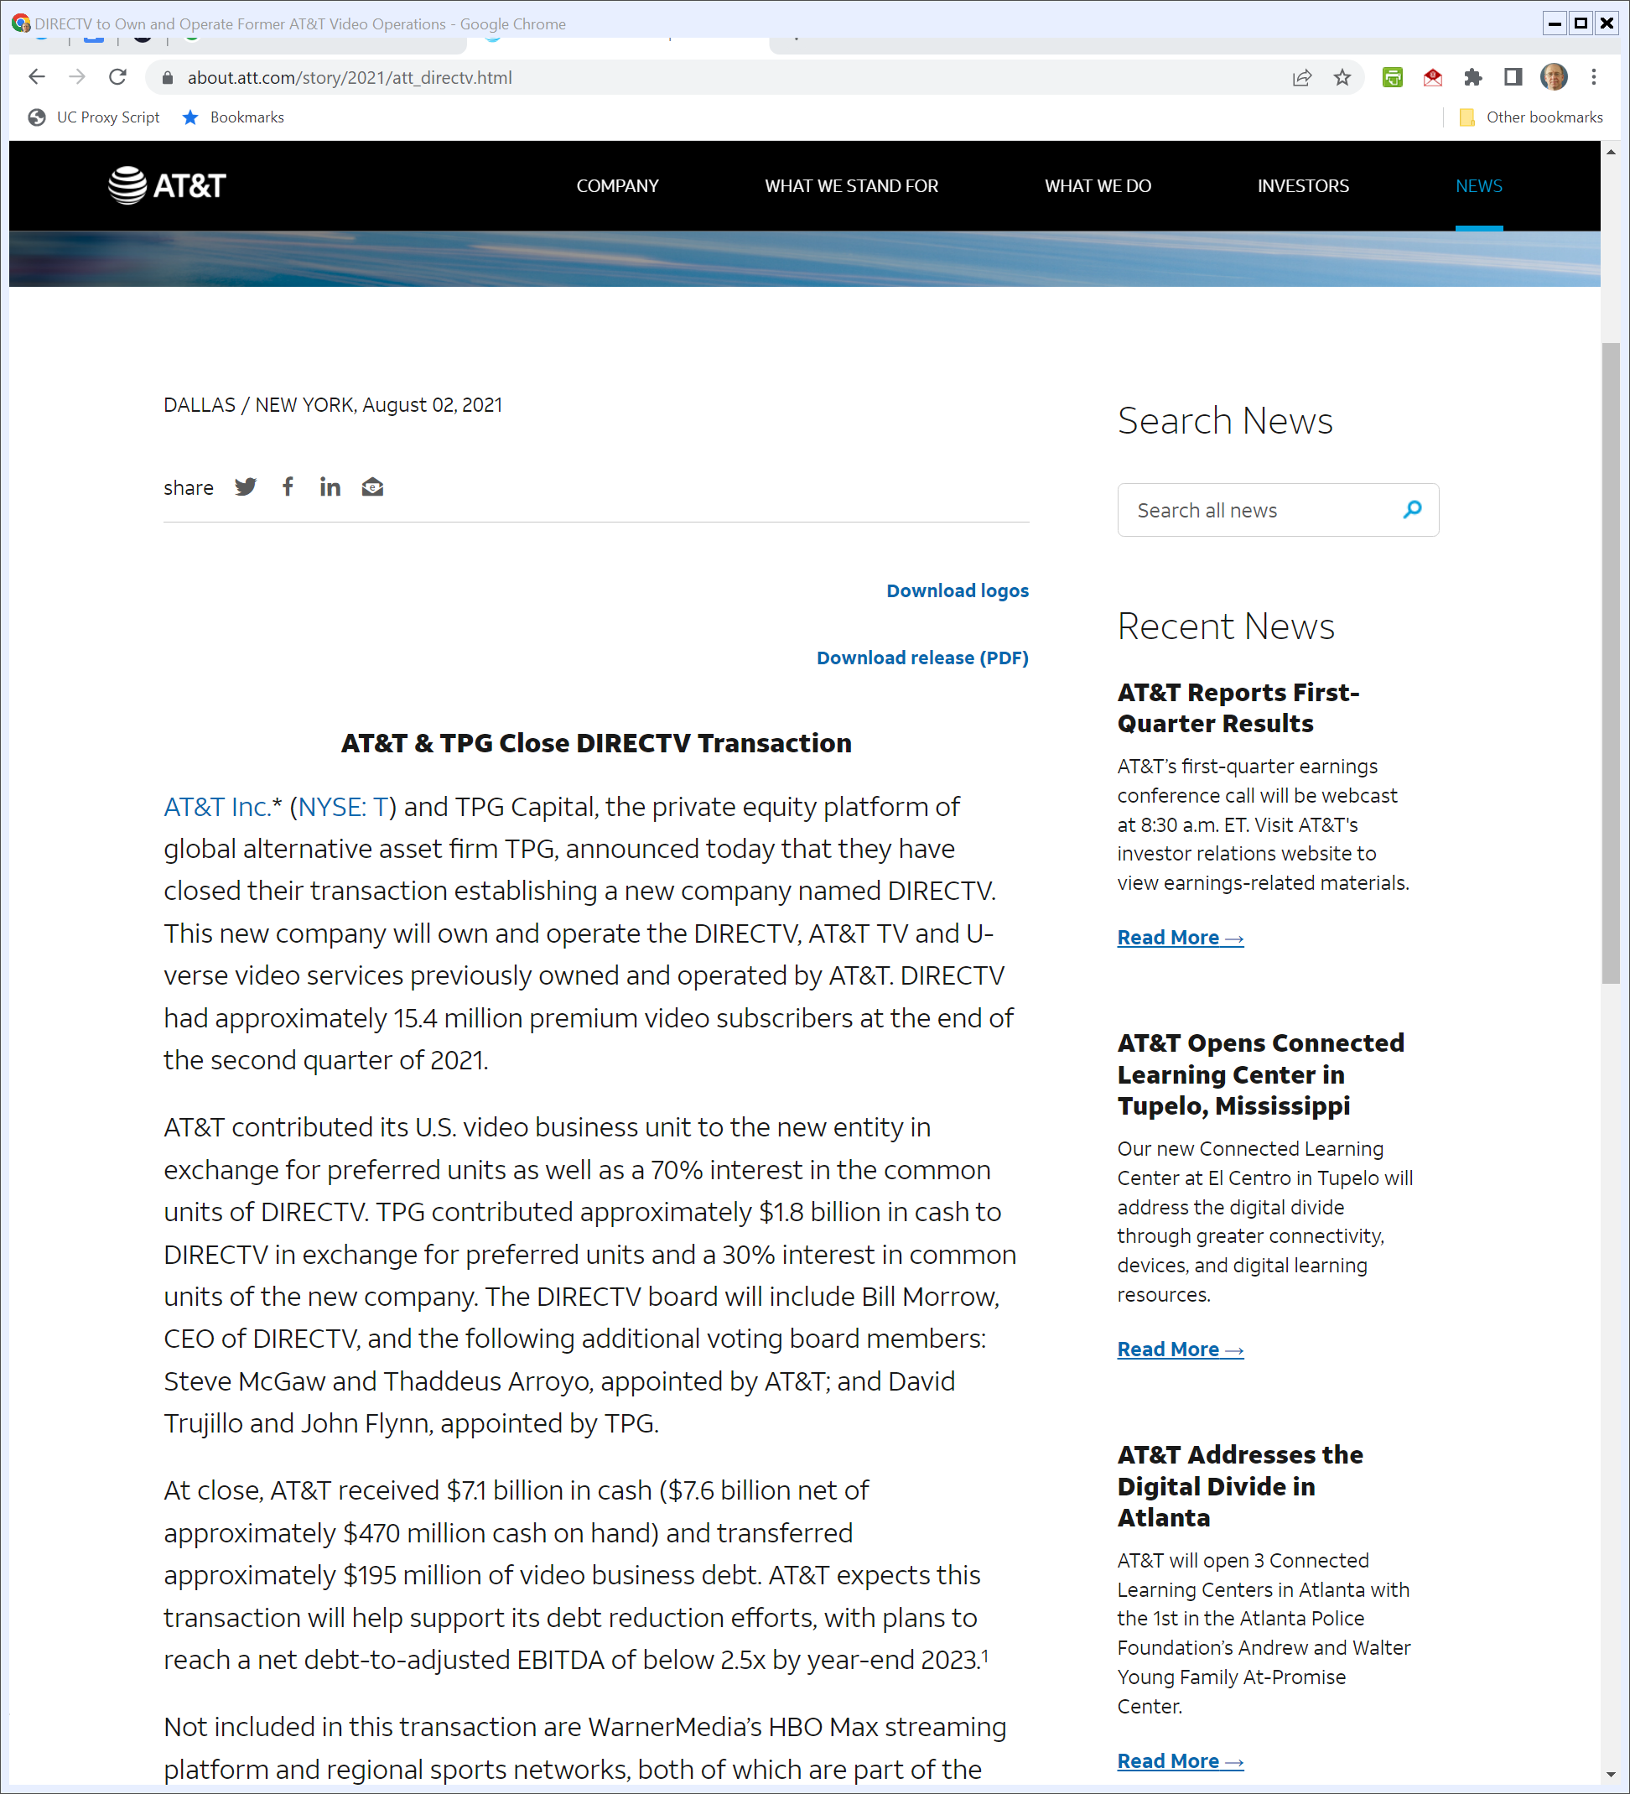
Aug 2021: ATT Spins Off DIRECTV and U-Verse
AT&T (2 Aug 2021)

Slide 78
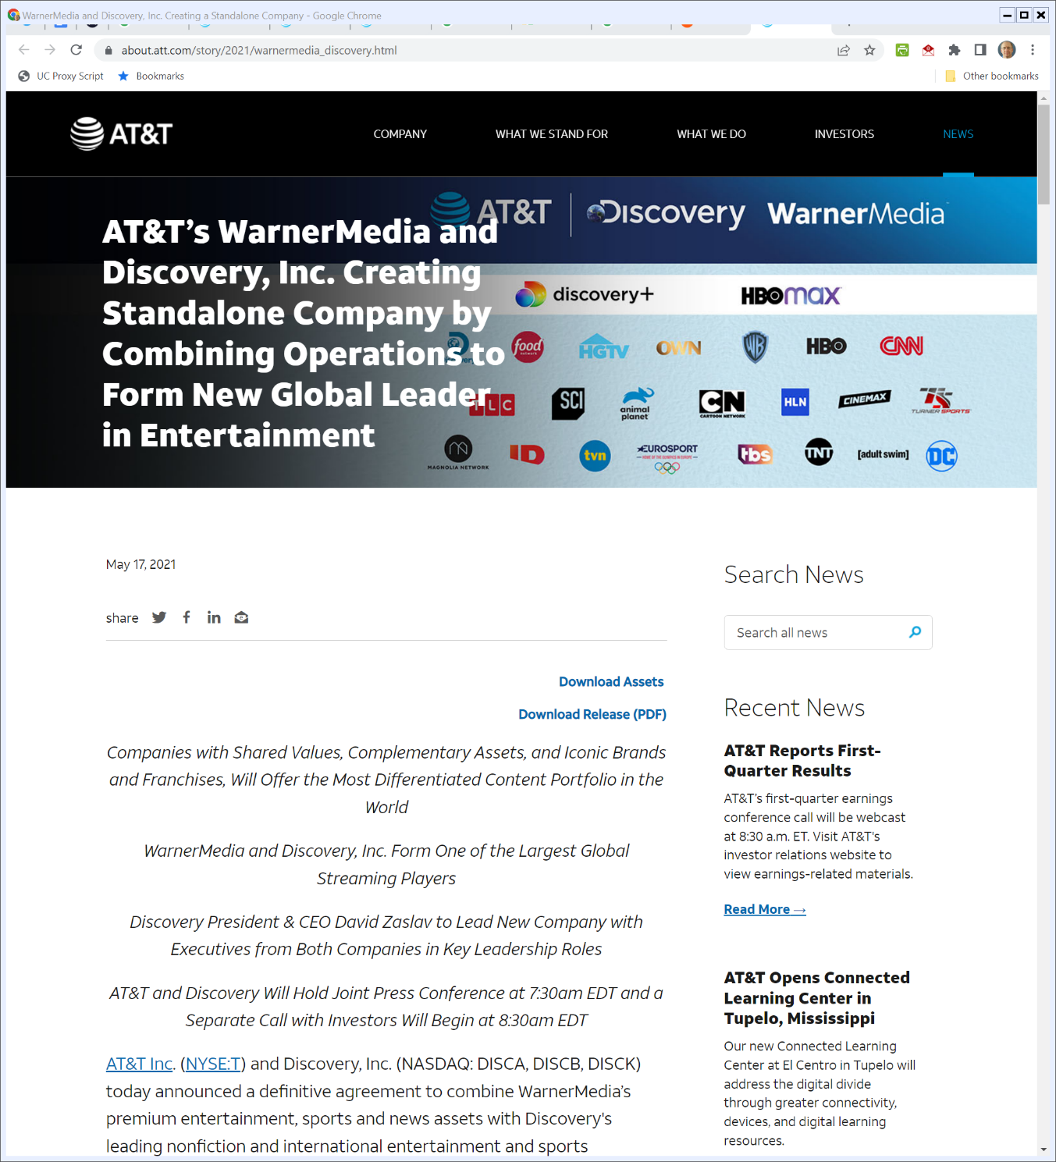
Mar 2021: AT&T/Time Warner Break Up
AT&T (17 May 2021)
Notes:
https://about.att.com/story/2021/warnermedia_discovery.html

Slide 79
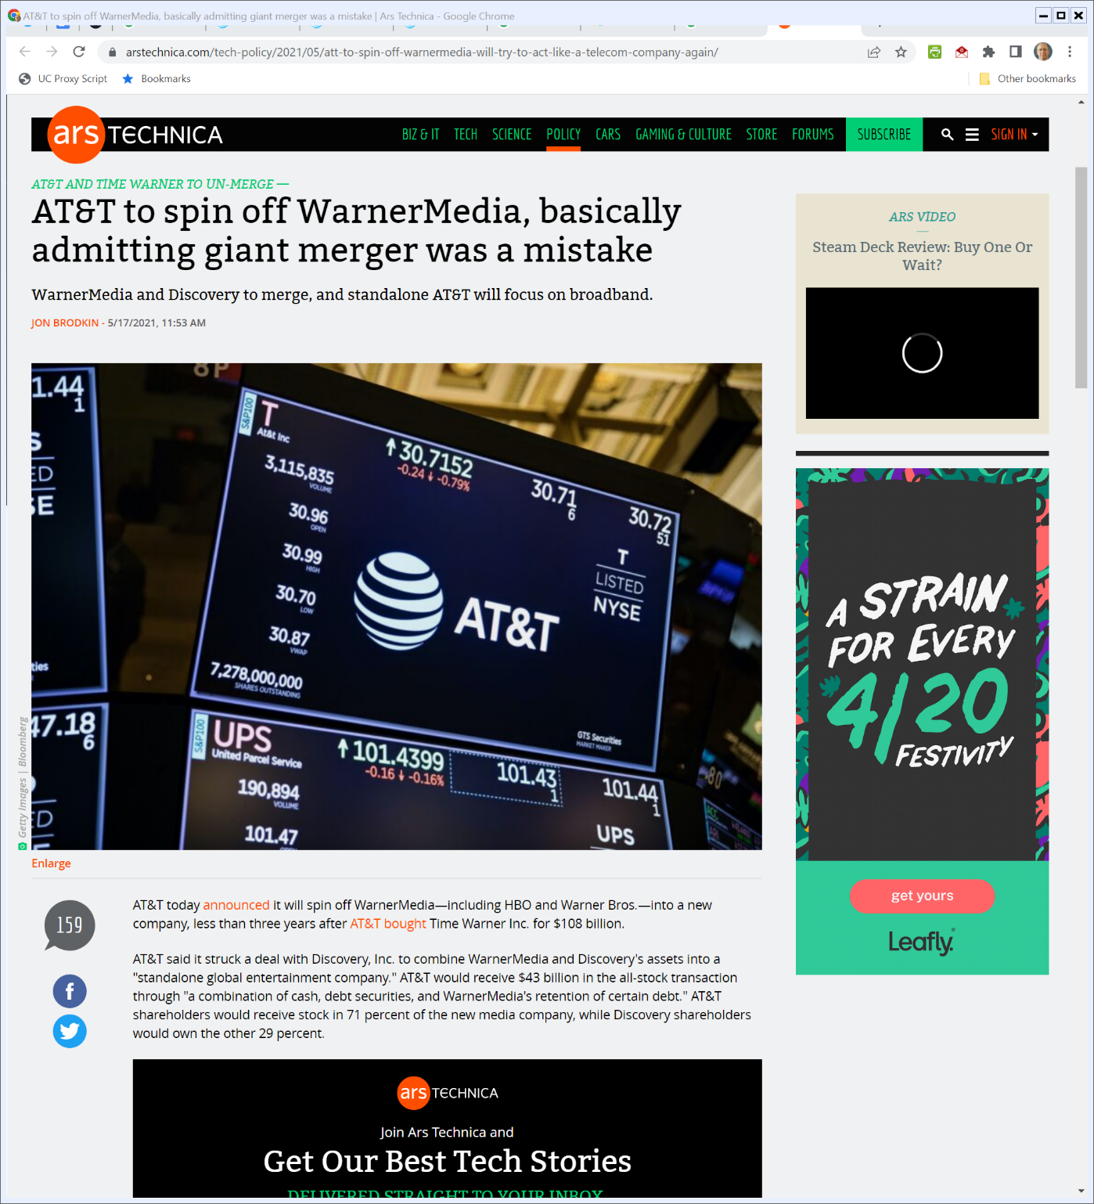
Alternatively …
ArsTechnica (17 May 2021)
Notes:
https://arstechnica.com/tech-policy/2021/05/att-to-spin-off-warnermedia-will-try-to-act-like-a-telecom-company-again/

Slide 80
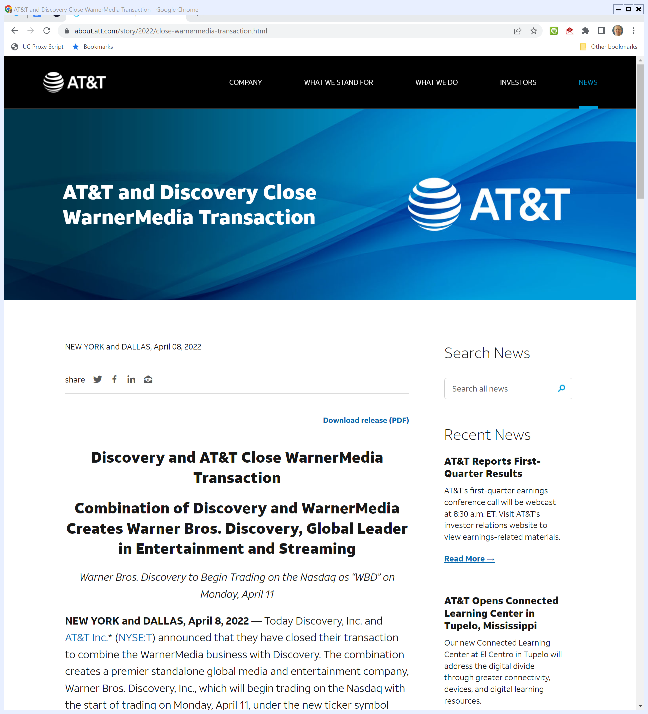
Apr 2022: ATT Closes WarnerMedia Deal
AT&T (8 Apr 2022)
Notes:
https://about.att.com/story/2022/close-warnermedia-transaction.html

Slide 81
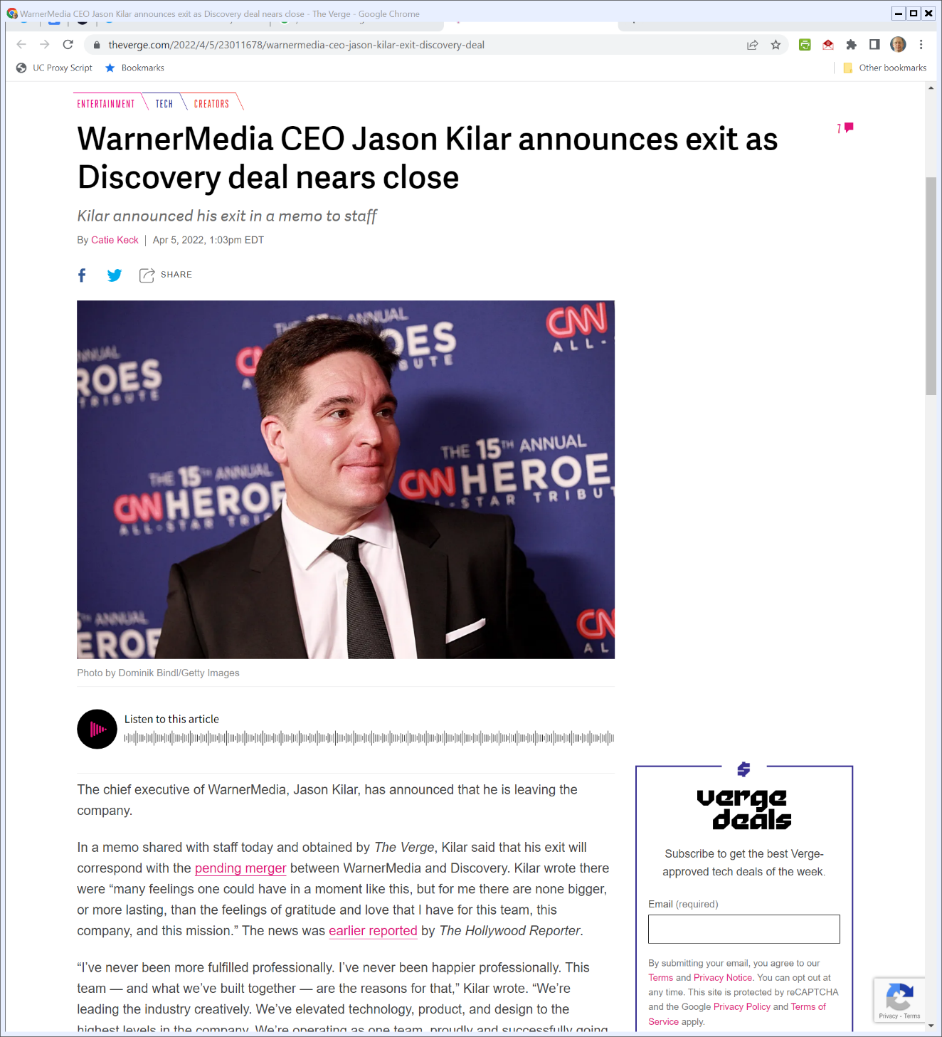
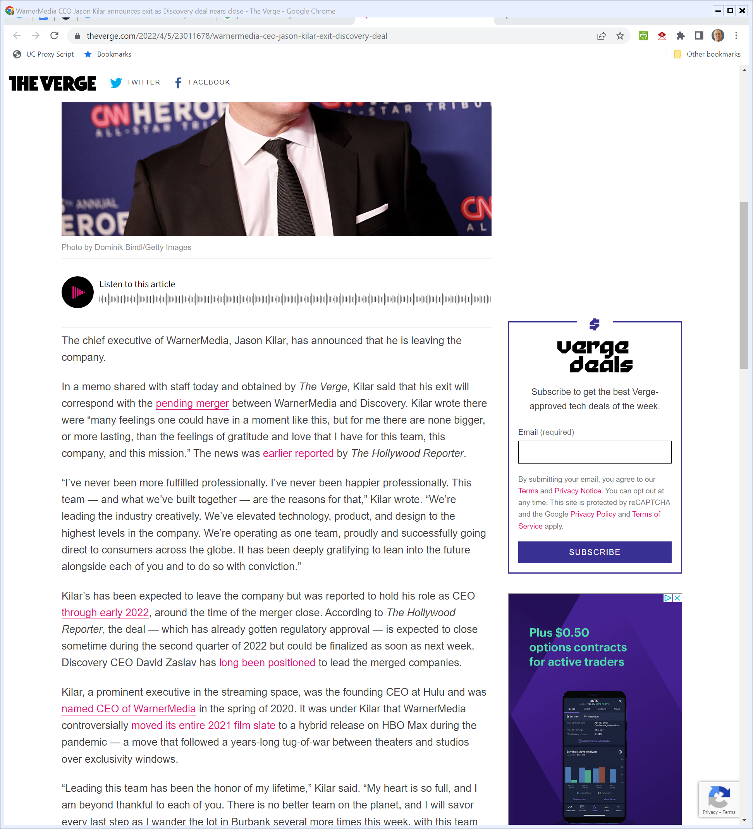
WM CEO Exit
The Verge (5 Apr 2022)
Notes:
https://www.theverge.com/2022/4/5/23011678/warnermedia-ceo-jason-kilar-exit-discovery-deal

Slide 82
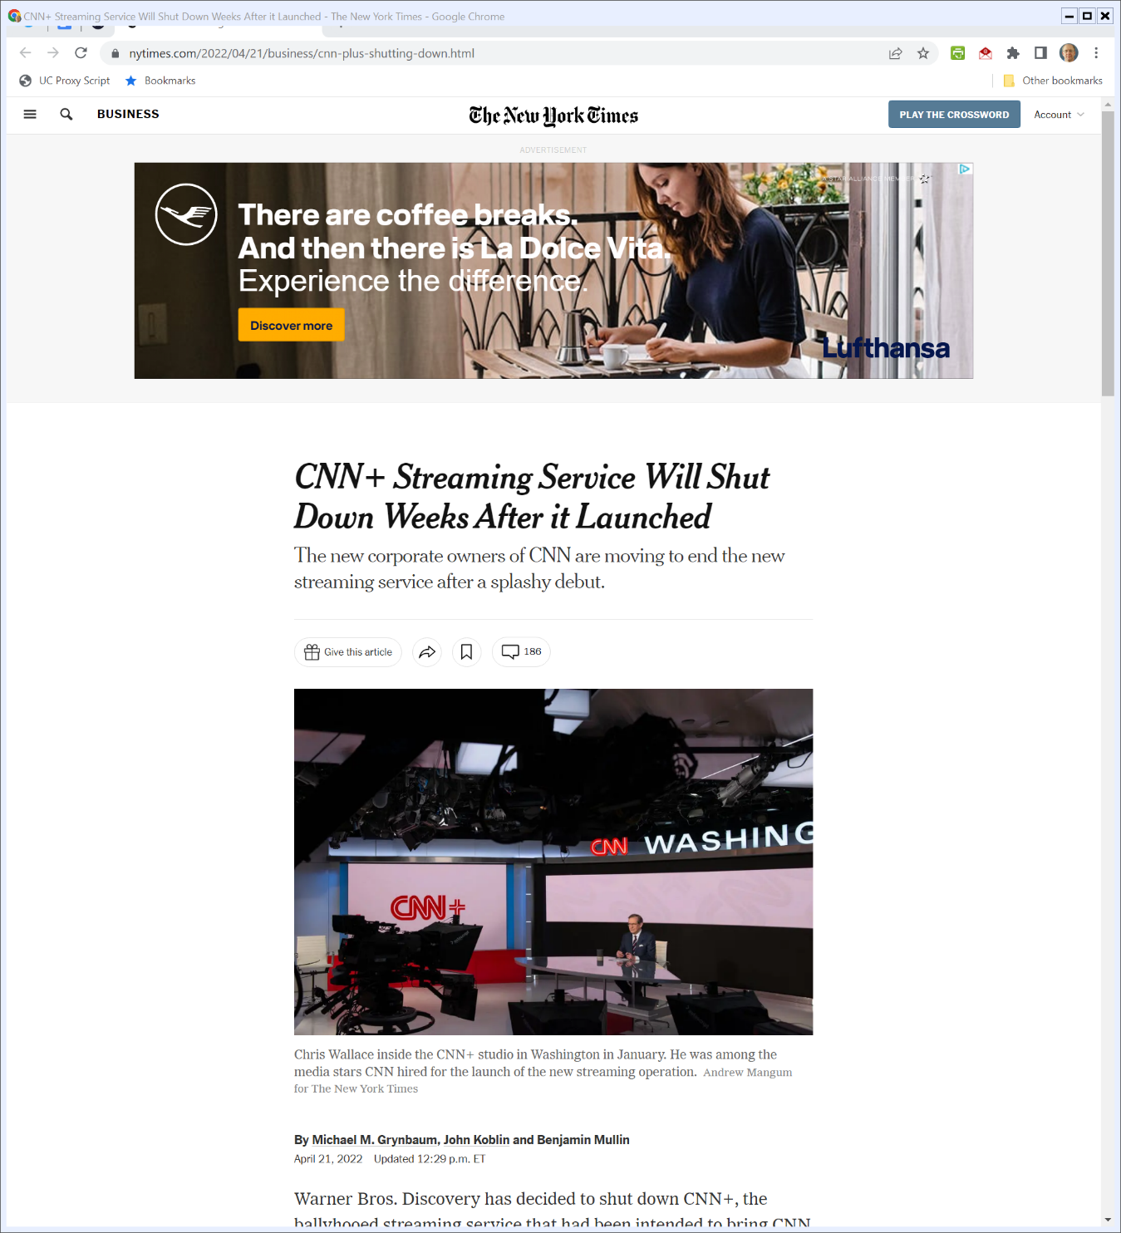
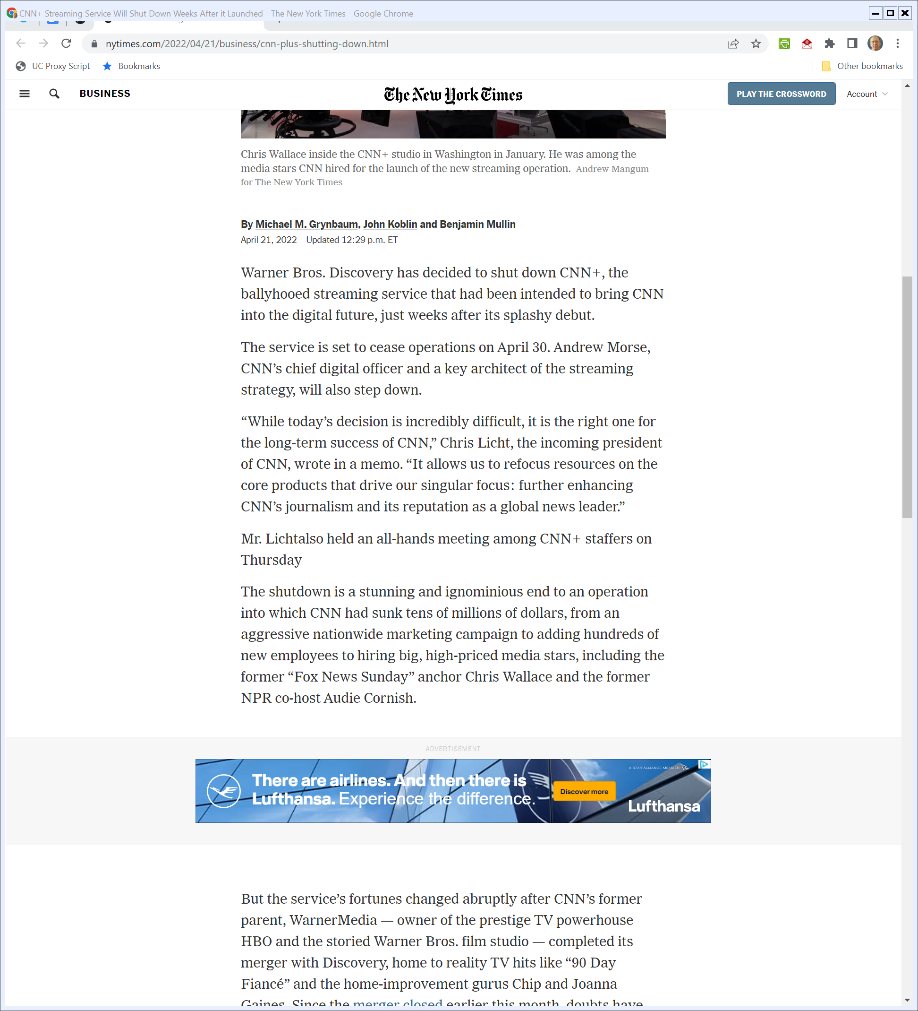
CNN+ Dies
New York Times (21 Apr 2022)
Notes:
https://www.nytimes.com/2022/04/21/business/cnn-plus-shutting-down.html

Slide 83
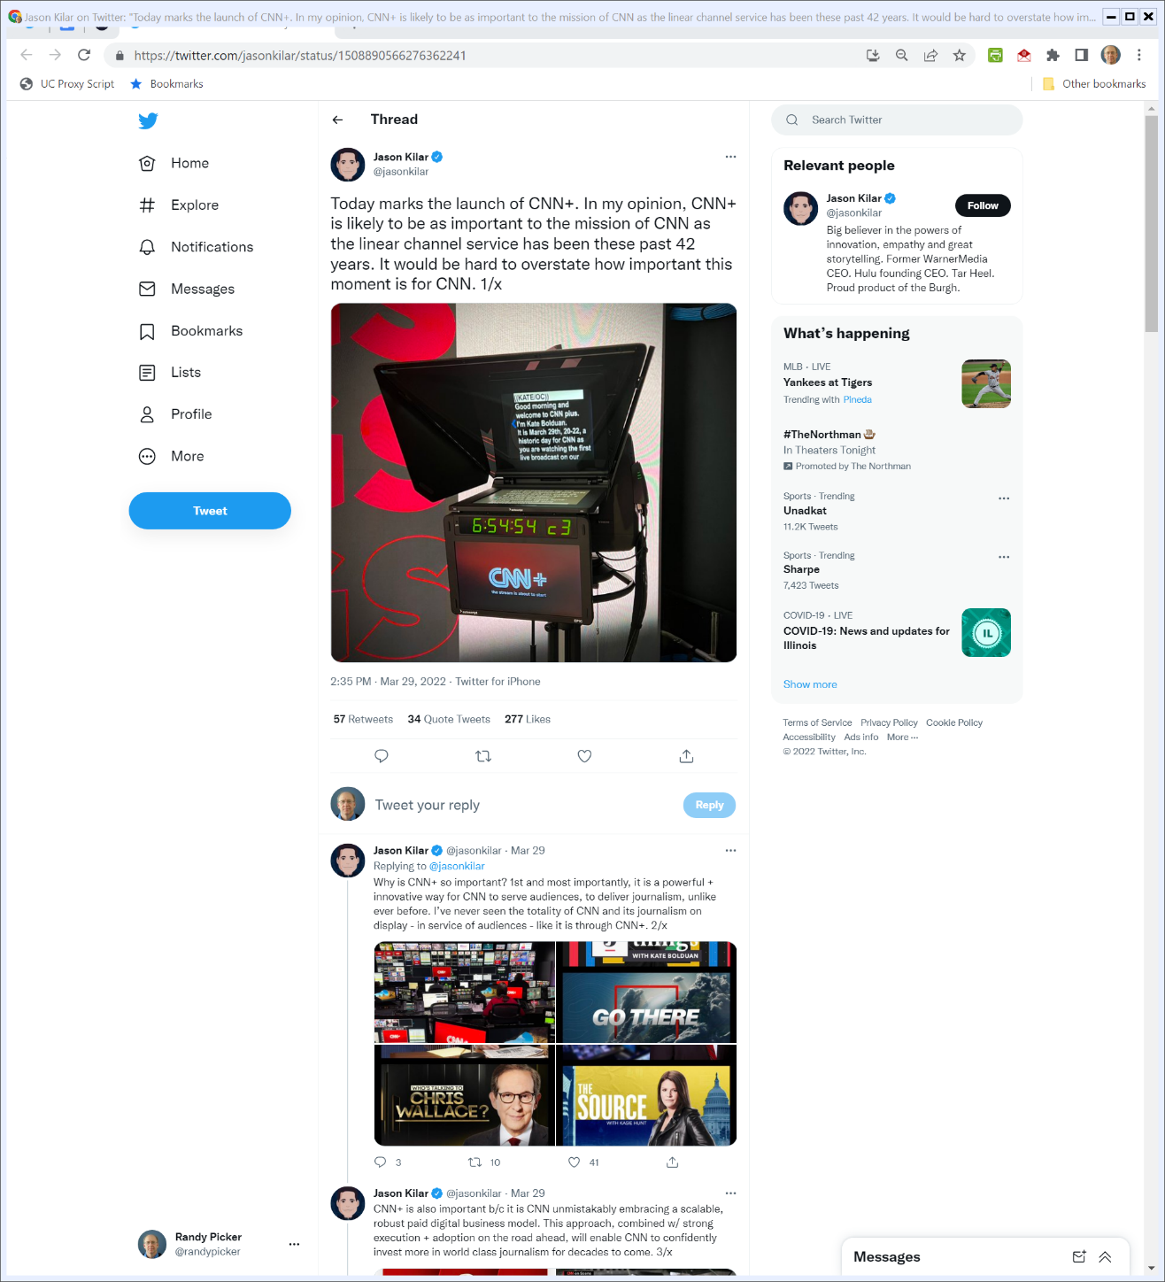

CNN+ Strategy
https://twitter.com/jasonkilar/status/1508890566276362241 (29 Mar 2022)
Notes:
https://twitter.com/jasonkilar/status/1508890566276362241

Slide 84
CNN+ Strategy
https://twitter.com/jasonkilar/status/1508890566276362241 (29 Mar 2022)
Notes:
https://twitter.com/jasonkilar/status/1508890566276362241

Slide 85
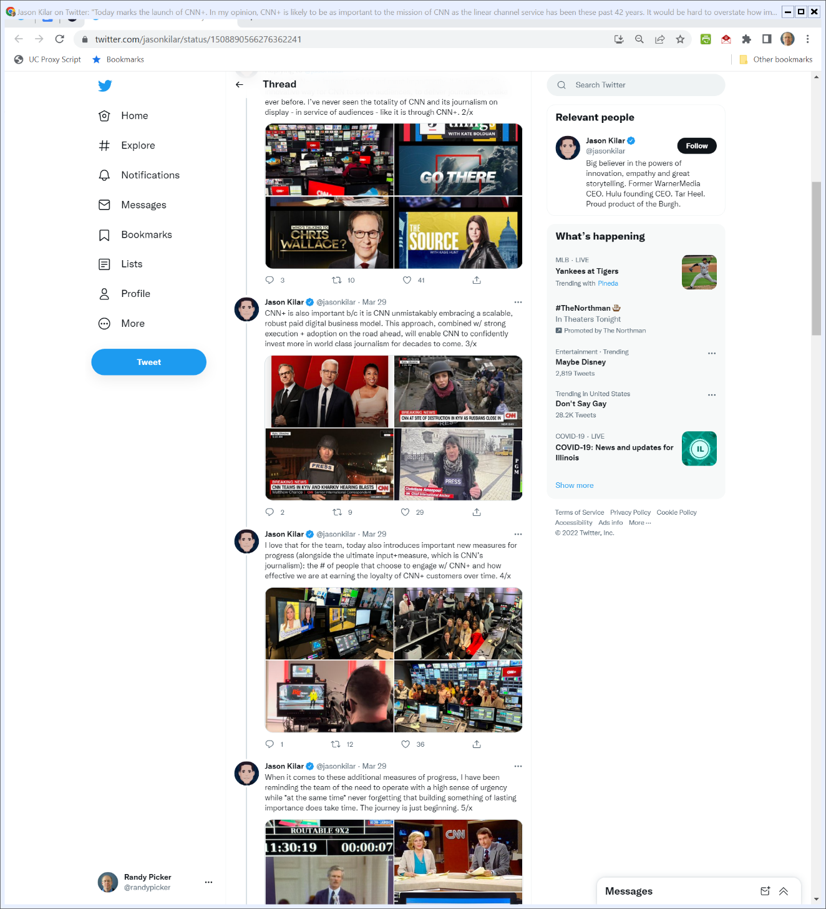

CNN+ Strategy
https://twitter.com/jasonkilar/status/1508890566276362241 (29 Mar 2022)
Notes:
https://twitter.com/jasonkilar/status/1508890566276362241

Slide 86
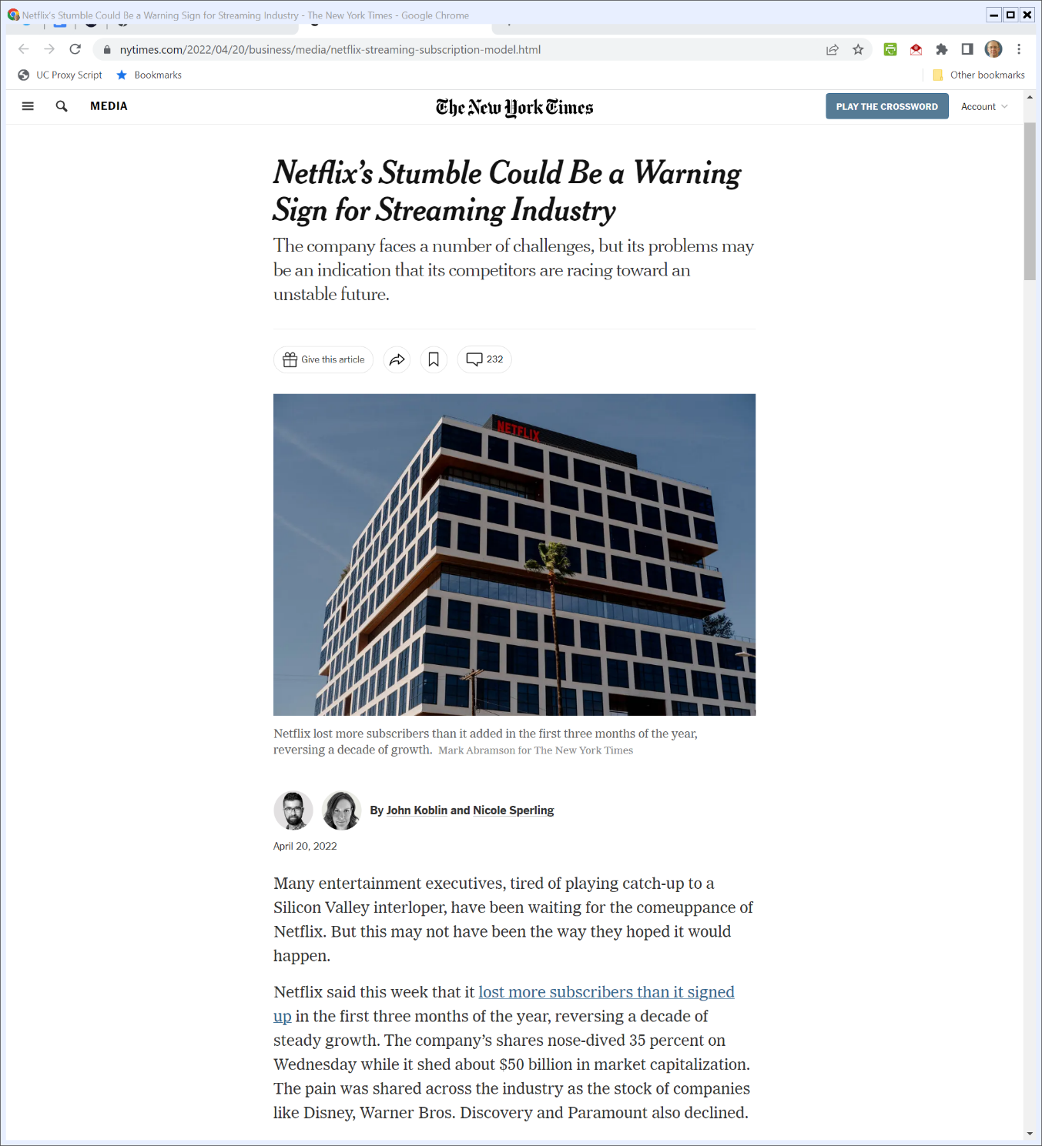
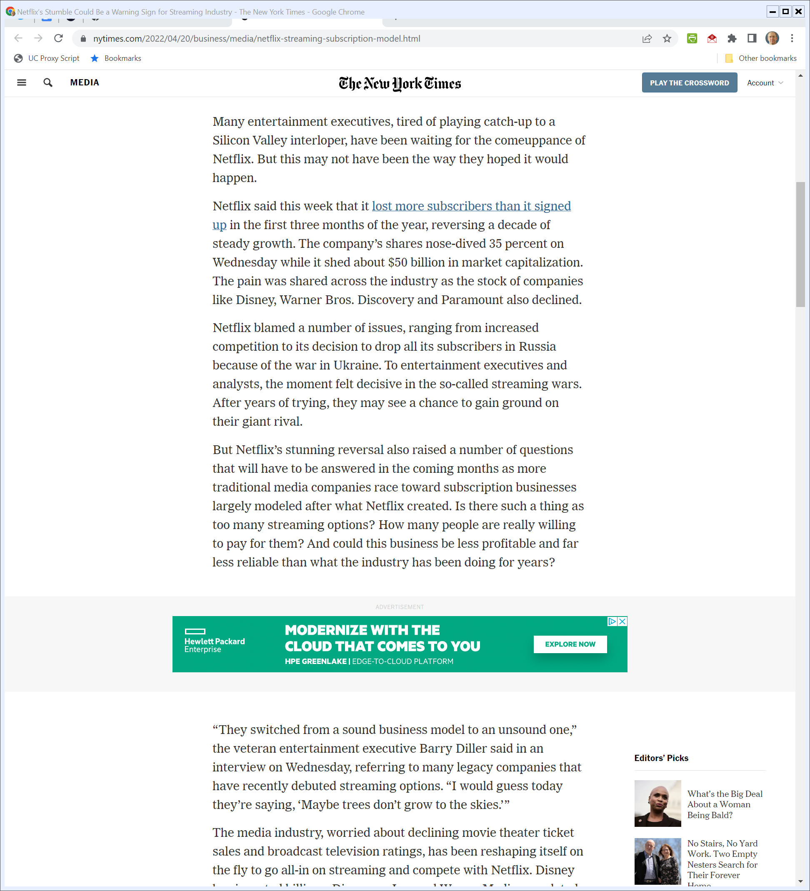
Streaming Competition
New York Times (20 Apr 2022)
Notes:
https://www.nytimes.com/2022/04/20/business/media/netflix-streaming-subscription-model.html

