Slide 1
Class 14 Platforms and Networks Spring 2022 Wireless Infrastructure
Randal C. Picker
James Parker Hall Distinguished Service Professor of Law
The Law School
The University of Chicago
Copyright © 2014-22 Randal C. Picker. All Rights Reserved.

Slide 2
The Focus Today
Key Questions
What are the right ways to control the use of spectrum?
As needs change, how should spectrum be repurposed?

Slide 3
Starting Points
Three
Your Day so Far
Classroom Seats
Watching TV

Slide 4
1: Tell Me About Your Day
TTM

Slide 5
2: Classroom Seats

Slide 6
3 Watching TV

Slide 7
State of Video Competition
FCC 16th Video Report (2 Apr 2015)

Slide 8
Broadcast-Only Households: 9.84% 2013-14
FCC 16th Video Report (2 Apr 2015)

Slide 9
Starting Points: Three Ideas
1. Controlling Interference
Need to figure out how to manage interference and coordinate talking when everyone could talk at the same time

Slide 10
Starting Points: Three Ideas
2. Reallocating Spectrum
Once we have made an initial allocation of the spectrum, what is the process for changing allocations as technology and market demand evolves?

Slide 11
Starting Points: Three Ideas
3. Over-the-Air TV
We invest tons of spectrum in broadcast TV and yet relatively few people capture those signals directly
Most people get the signals through an intermediary
How should we think about the use of that spectrum?

Slide 12
Licensing by Federal Government
“That a person, company, or corporation within the jurisdiction of the United States shall not use or operate any apparatus for radio communication as a means of commercial intercourse among the several States … the effect of which extends beyond the jurisdiction of the State or Territory in which the same are made,”
The Radio Act of 1912

Slide 13
Licensing by Federal Government
“or where interference would be caused thereby with the receipt of messages or signals from beyond the jurisdiction of the said State or Territory, except under and in accordance with a license, revocable for cause, in that behalf granted by the Secretary of Commerce and Labor upon application therefor; … .”
The Radio Act of 1912

Slide 14
Control Radio and Radio Channels
“That this Act is intended to regulate all forms of interstate and foreign radio transmissions and communications within the United States, its Territories and possessions; to maintain the control of the United States over all the channels of interstate and foreign radio transmission;”
Radio Act of 1927

Slide 15
Federally-Defined Licenses
“and to provide for the use of such channels, but not the ownership thereof, by individuals, firms, or corporations, for limited periods of time, under licenses granted by Federal authority, and no such license shall be construed to create any right, beyond the terms, conditions, and periods of the license.”
Radio Act of 1927

Slide 16
Federal Radio Commission
“That a commission is hereby created and established to be known as the Federal Radio Commission, hereinafter referred to as the commission, which shall be composed of five commissioners Appointed by the President … .”
Radio Act of 1927

Slide 17
1934: Creation of FCC
Pub. L. 73-416 (19 June 1934)

Slide 18
Herzel Comment
Leo Herzel, 18 U Chi L Rev 802 (1951)

Slide 19
How To Transition from B&W to Color
Leo Herzel, 18 U Chi L Rev 802 (1951)

Slide 20
How to Allocate Spectrum: Gov’t Fiat?
Leo Herzel, 18 U Chi L Rev 802 (1951)

Slide 21
Or Markets?: Lease to Highest Bidder
Leo Herzel, 18 U Chi L Rev 802 (1951)

Slide 22
What Role Should the FCC Play? (And a Rough Draft of The Problem of Social Cost?)
Coase, 2 J Law & Econ 1 (Oct 1959)

Slide 23
A More Limited FCC Is Possible
Coase, 2 J Law & Econ 1 (Oct 1959)

Slide 24
Prices and Spectrum
Coase, 2 J Law & Econ 1 (Oct 1959)

Slide 25
Prices and Spectrum
Coase, 2 J Law & Econ 1 (Oct 1959)

Slide 26
New Tech Doesn’t Necessarily Require New Regulatory Tools
Coase, 2 J Law & Econ 1 (Oct 1959)

Slide 27
1968: Land Mobile Service Order
FCC (17 July 1968)

Slide 28
AT&T Pushing to Swap UHF for Mobile
FCC (17 July 1968)

Slide 29
3 Apr 1973: First Portable Phone Call
Chicago Tribune (4 Apr 1973)

Slide 30
Motorola Portable Phone
Motorola PR (3 Apr 1973)

Slide 31
Complex System
Motorola PR (3 Apr 1973)

Slide 32
1974 Land Mobile Service Order
FCC (2 May 1974)

Slide 33
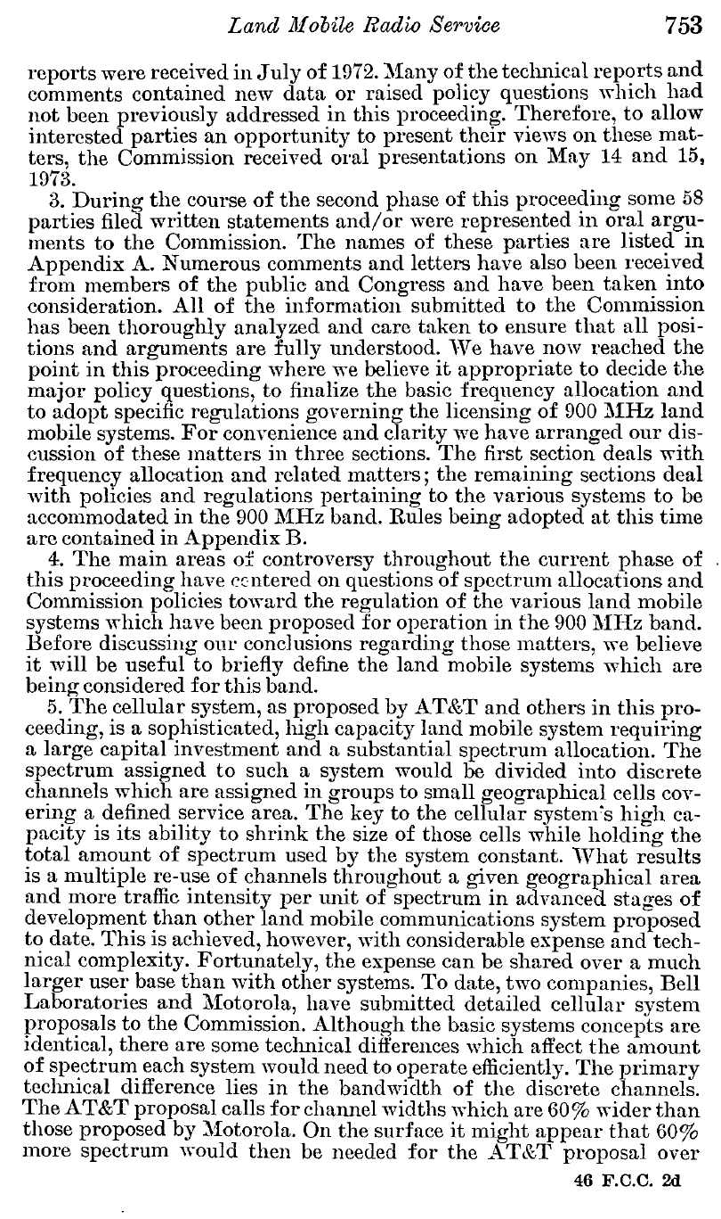
Possible Cellular System
FCC (2 May 1974)

Slide 34
1980 Cellular Order
FCC (8 Jan 1980)

Slide 35
Tech Change Drives Legal Change
FCC (8 Jan 1980)

Slide 36
1981 Cell License Order
FCC (4 May 1981)

Slide 37
Create Competition
FCC (4 May 1981)

Slide 38
But Give One License to Wireline Carrier
FCC (4 May 1981)

Slide 39
1981 Omnibus Budget Act
Pub. L. 97-35 (13 Aug 1981)

Slide 40
Random Allocation of Licenses Among Qualified
Pub. L. 97-35 (13 Aug 1981)

Slide 41
1984 Cell License Allocation
FCC (24 May 1984)

Slide 42
Lotteries
FCC (24 May 1984)

Slide 43
1985: Still Sorting Lotteries
FCC (3 May 1985)

Slide 44
Considering Auctions
FCC (3 May 1985)

Slide 45
No Auctions
FCC (3 May 1985)

Slide 46
1992 PCS: 1970s UHF Path
FCC NOPR (7 Feb 1992)

Slide 47
Auction No. 4 Results
NYT (14 Mar 1995)

Slide 48
Jan 1997: FCC Unlicensed Spectrum Order: 5 GHz
FCC (9 Jan 1997)

Slide 49
Wireless Local Area Networks (Wi-Fi)
FCC (9 Jan 1997)

Slide 50
National Broadband Plan
FCC National Broadband Plan (16 Mar 2010)

Slide 51
Allocate More Spectrum for Broadband
“Recommendation 5.8: The FCC should make 500 megahertz newly available for broadband use within the next 10 years, of which 300 megahertz between 225 MHz and 3.7 GHz should be made newly available for mobile use within five years.”
FCC National Broadband Plan (16 Mar 2010)

Slide 52
Tax Relief! Job Creation!
P.L. 112-96 (22 Feb 2012)

Slide 53
Reverse Auctions of Broadcast TV Spectrum
P.L. 112-96 (22 Feb 2012)

Slide 54
What is Being Sold?
P.L. 112-96 (22 Feb 2012)

Slide 55
2016 NTIA (zoom)

Slide 56
Network Industries
FCC Incentive Auction Staff Summary (16 Jan 2013)

Slide 57
TV Spectrum Starting Points
FCC Incentive Auction Staff Summary (16 Jan 2013)

Slide 58
TV Spectrum Starting Points
FCC Incentive Auction Staff Summary (16 Jan 2013)

Slide 59
Shuffling Spectrum Use
FCC Incentive Auction Staff Summary (16 Jan 2013)

Slide 60
Running Two Auctions at Once
FCC Incentive Auction Staff Summary (16 Jan 2013)

Slide 61
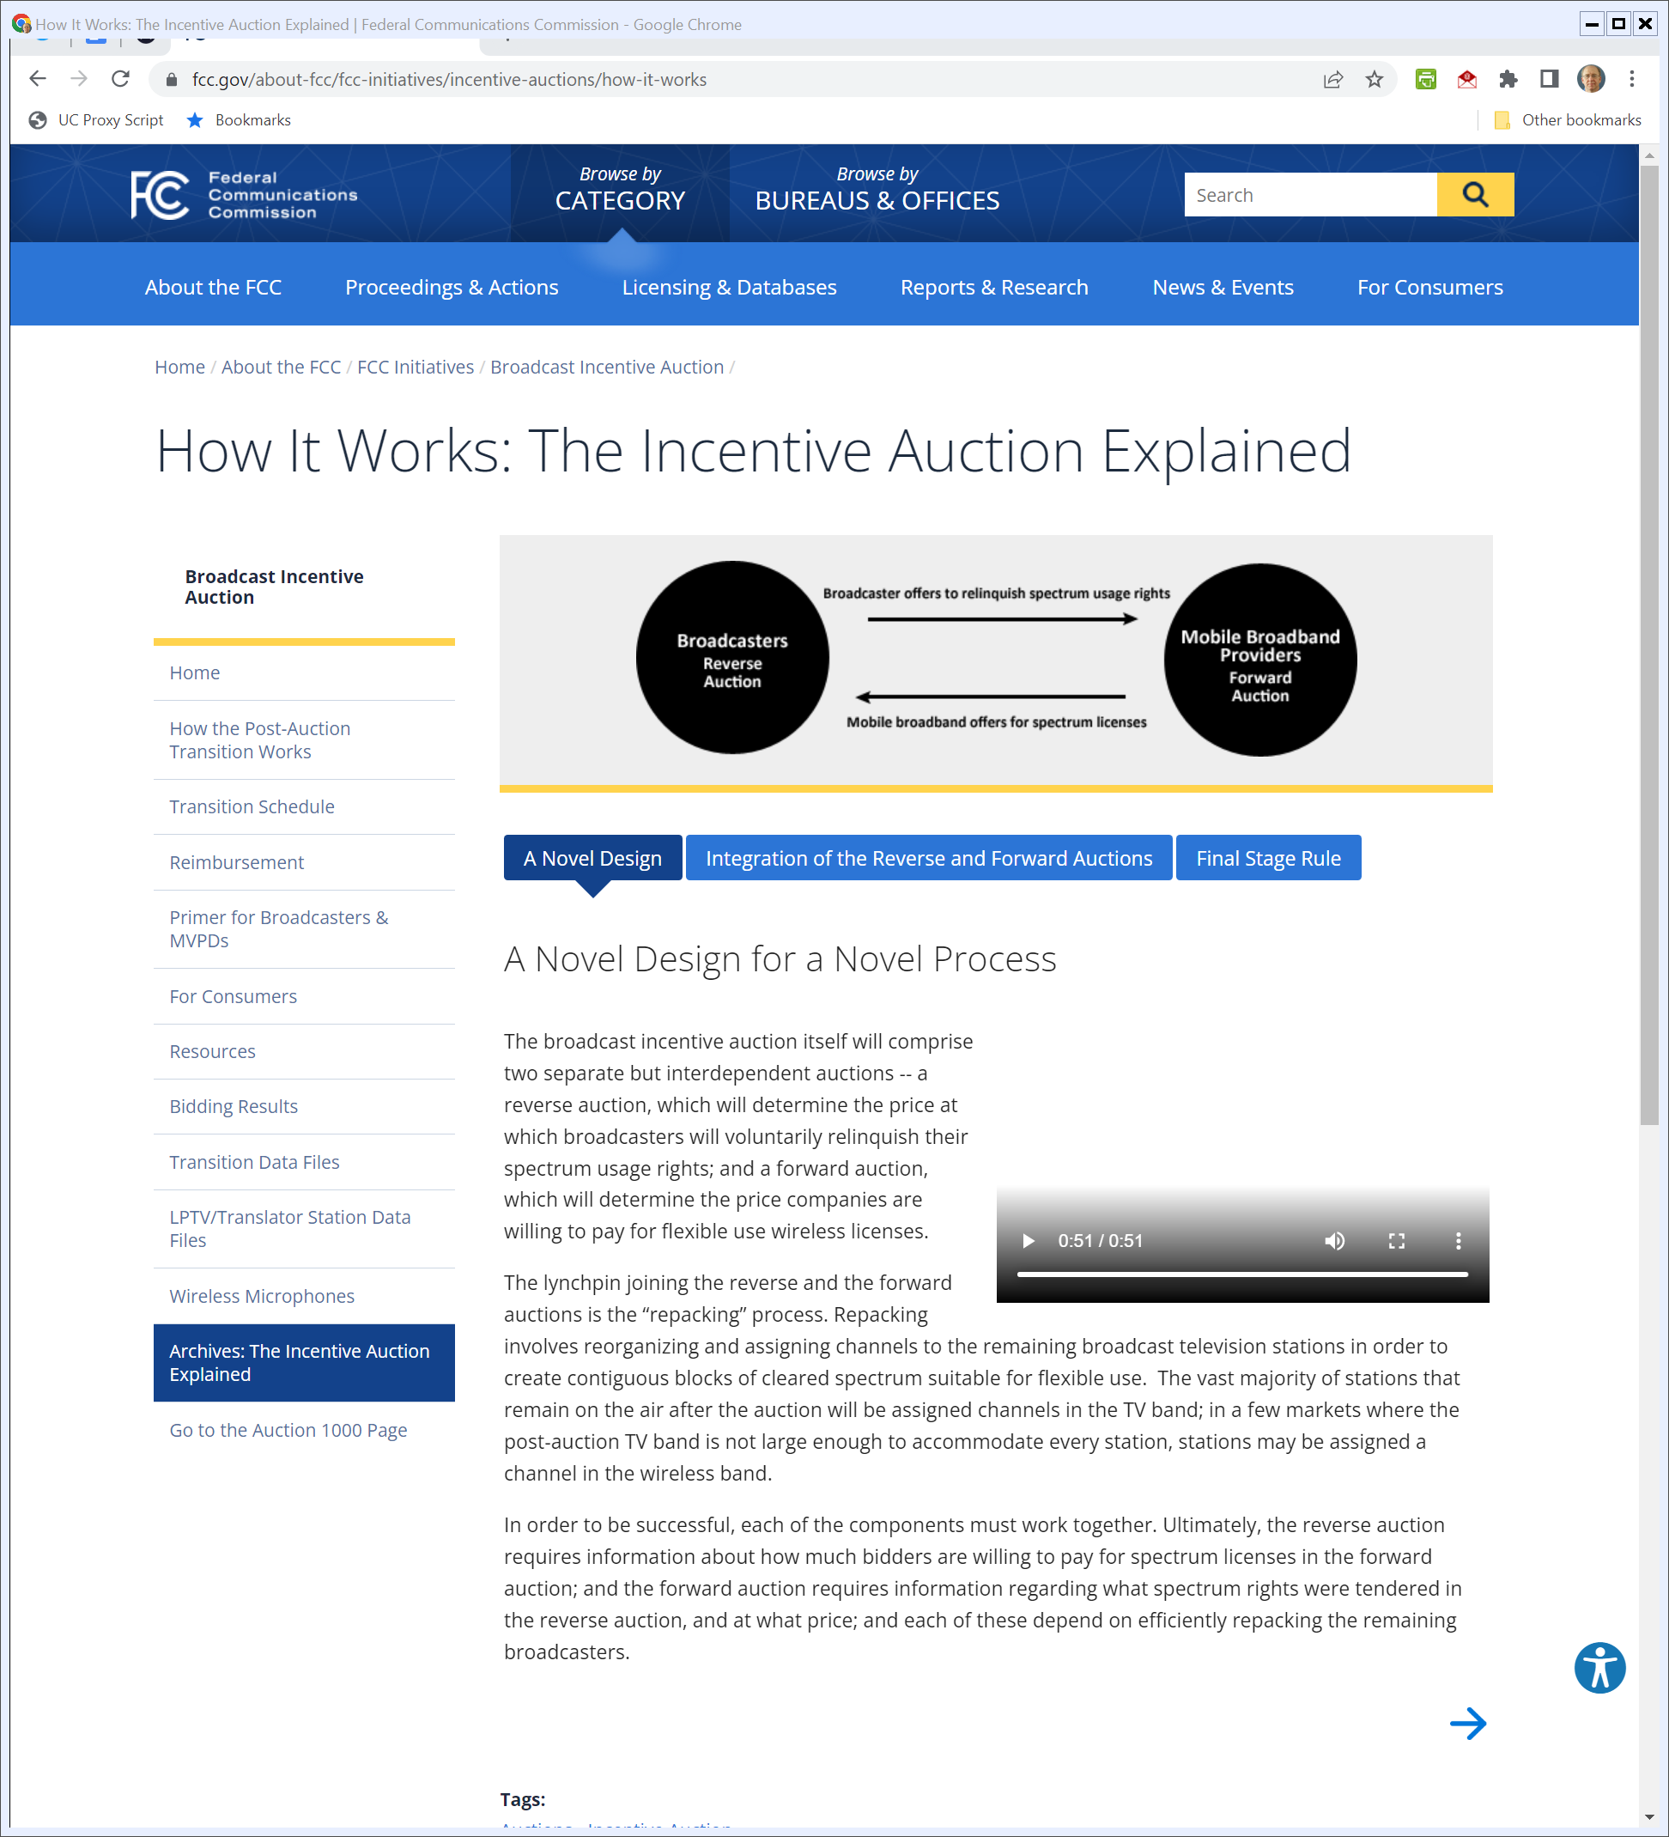
Running the Auctions
https://www.fcc.gov/about-fcc/fcc-initiatives/incentive-auctions/how-it-works

Slide 62
More?
Milgrom & Segal (JPE 2020)

Slide 63
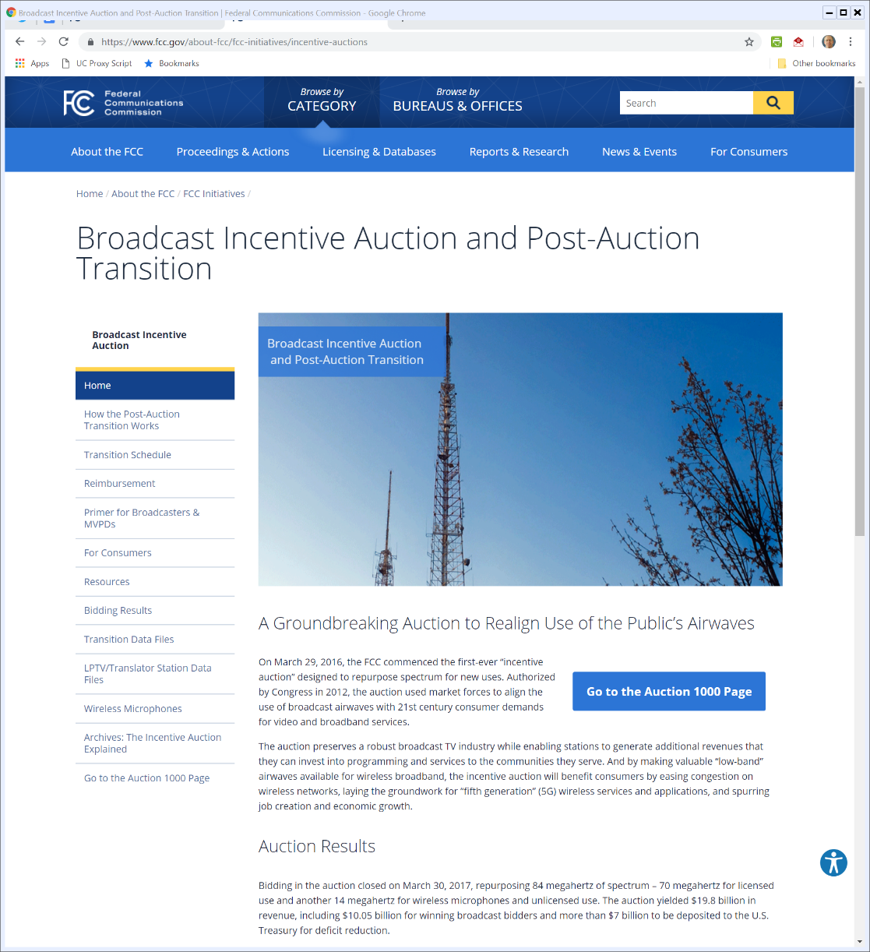
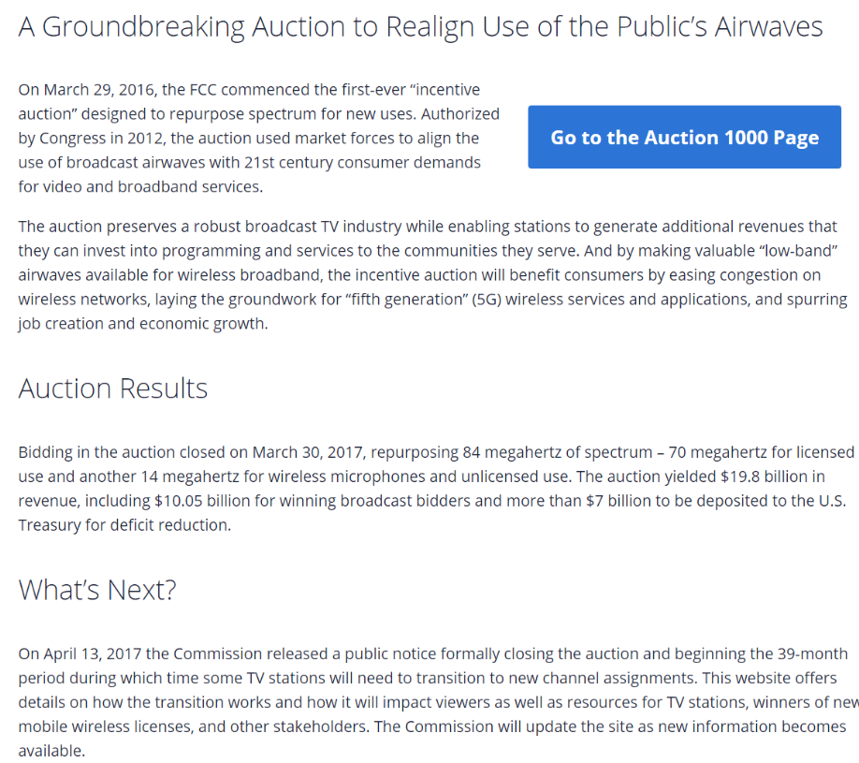
FCC Incentive Auction Results
Notes:
https://www.fcc.gov/about-fcc/fcc-initiatives/incentive-auctions

Slide 64
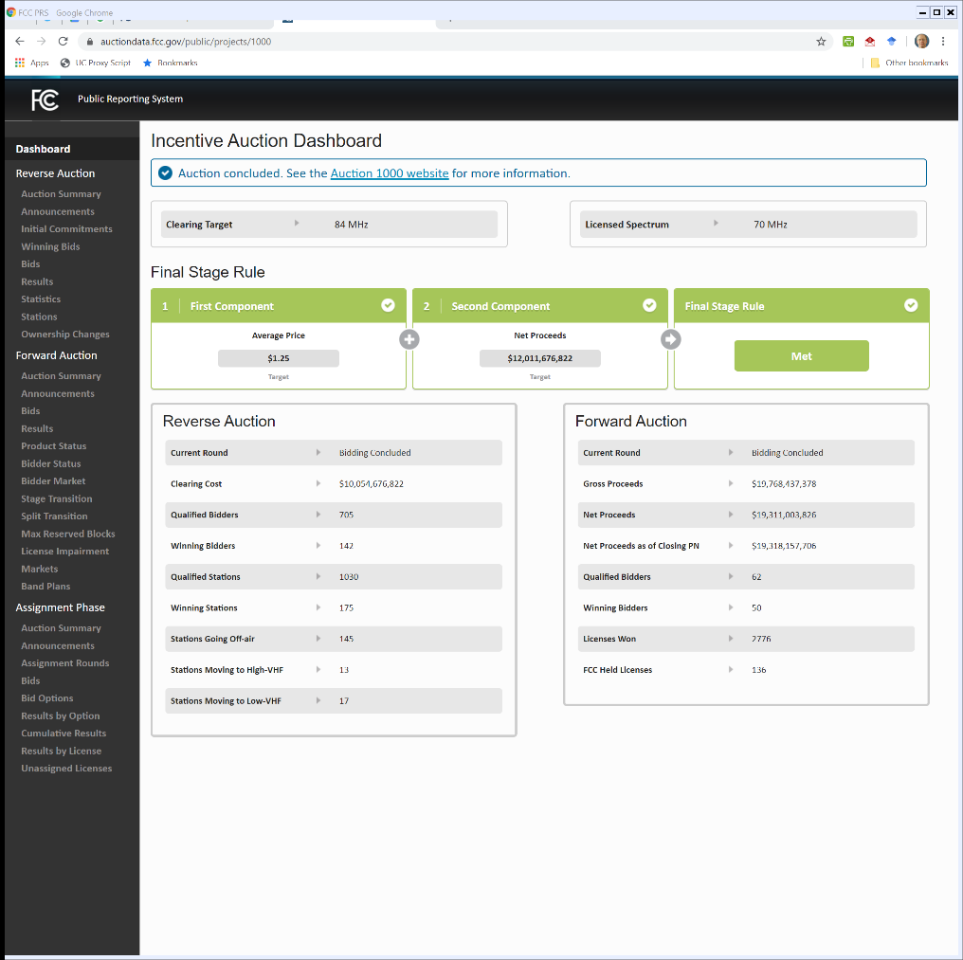
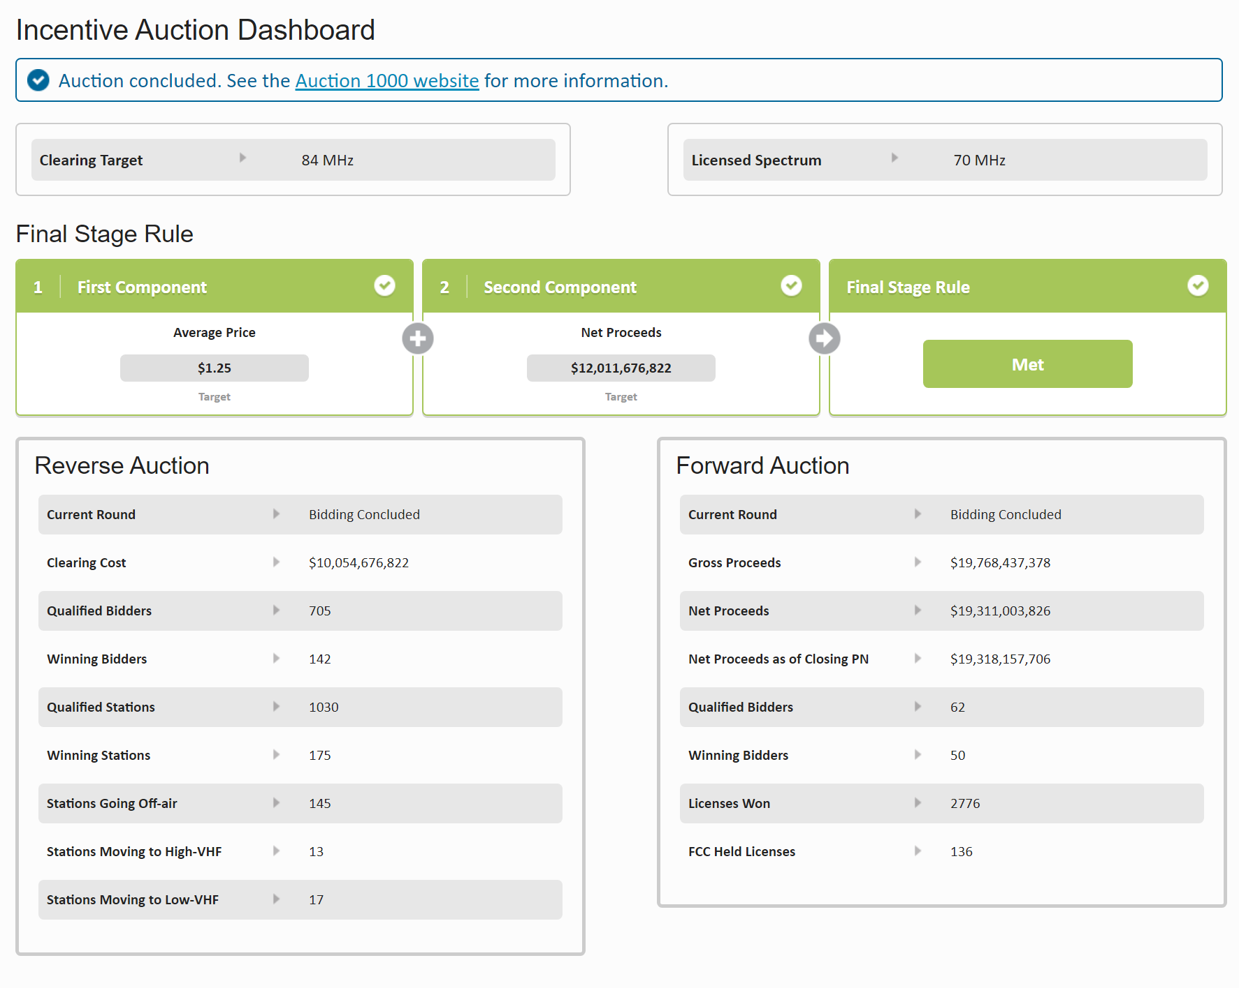
Incentive Auction Results
Notes:
https://auctiondata.fcc.gov/public/projects/1000

Slide 65
Who Got It?
CRS (11 Oct 2017)

Slide 66
39 Month Transition
FCC (13 July 2020)
Notes:
https://www.fcc.gov/document/post-incentive-auction-transition-successfully-meets-39-month-deadline

Slide 67
987 TV Stations Moved
FCC (13 July 2020)
Notes:
https://www.fcc.gov/document/post-incentive-auction-transition-successfully-meets-39-month-deadline

Slide 68
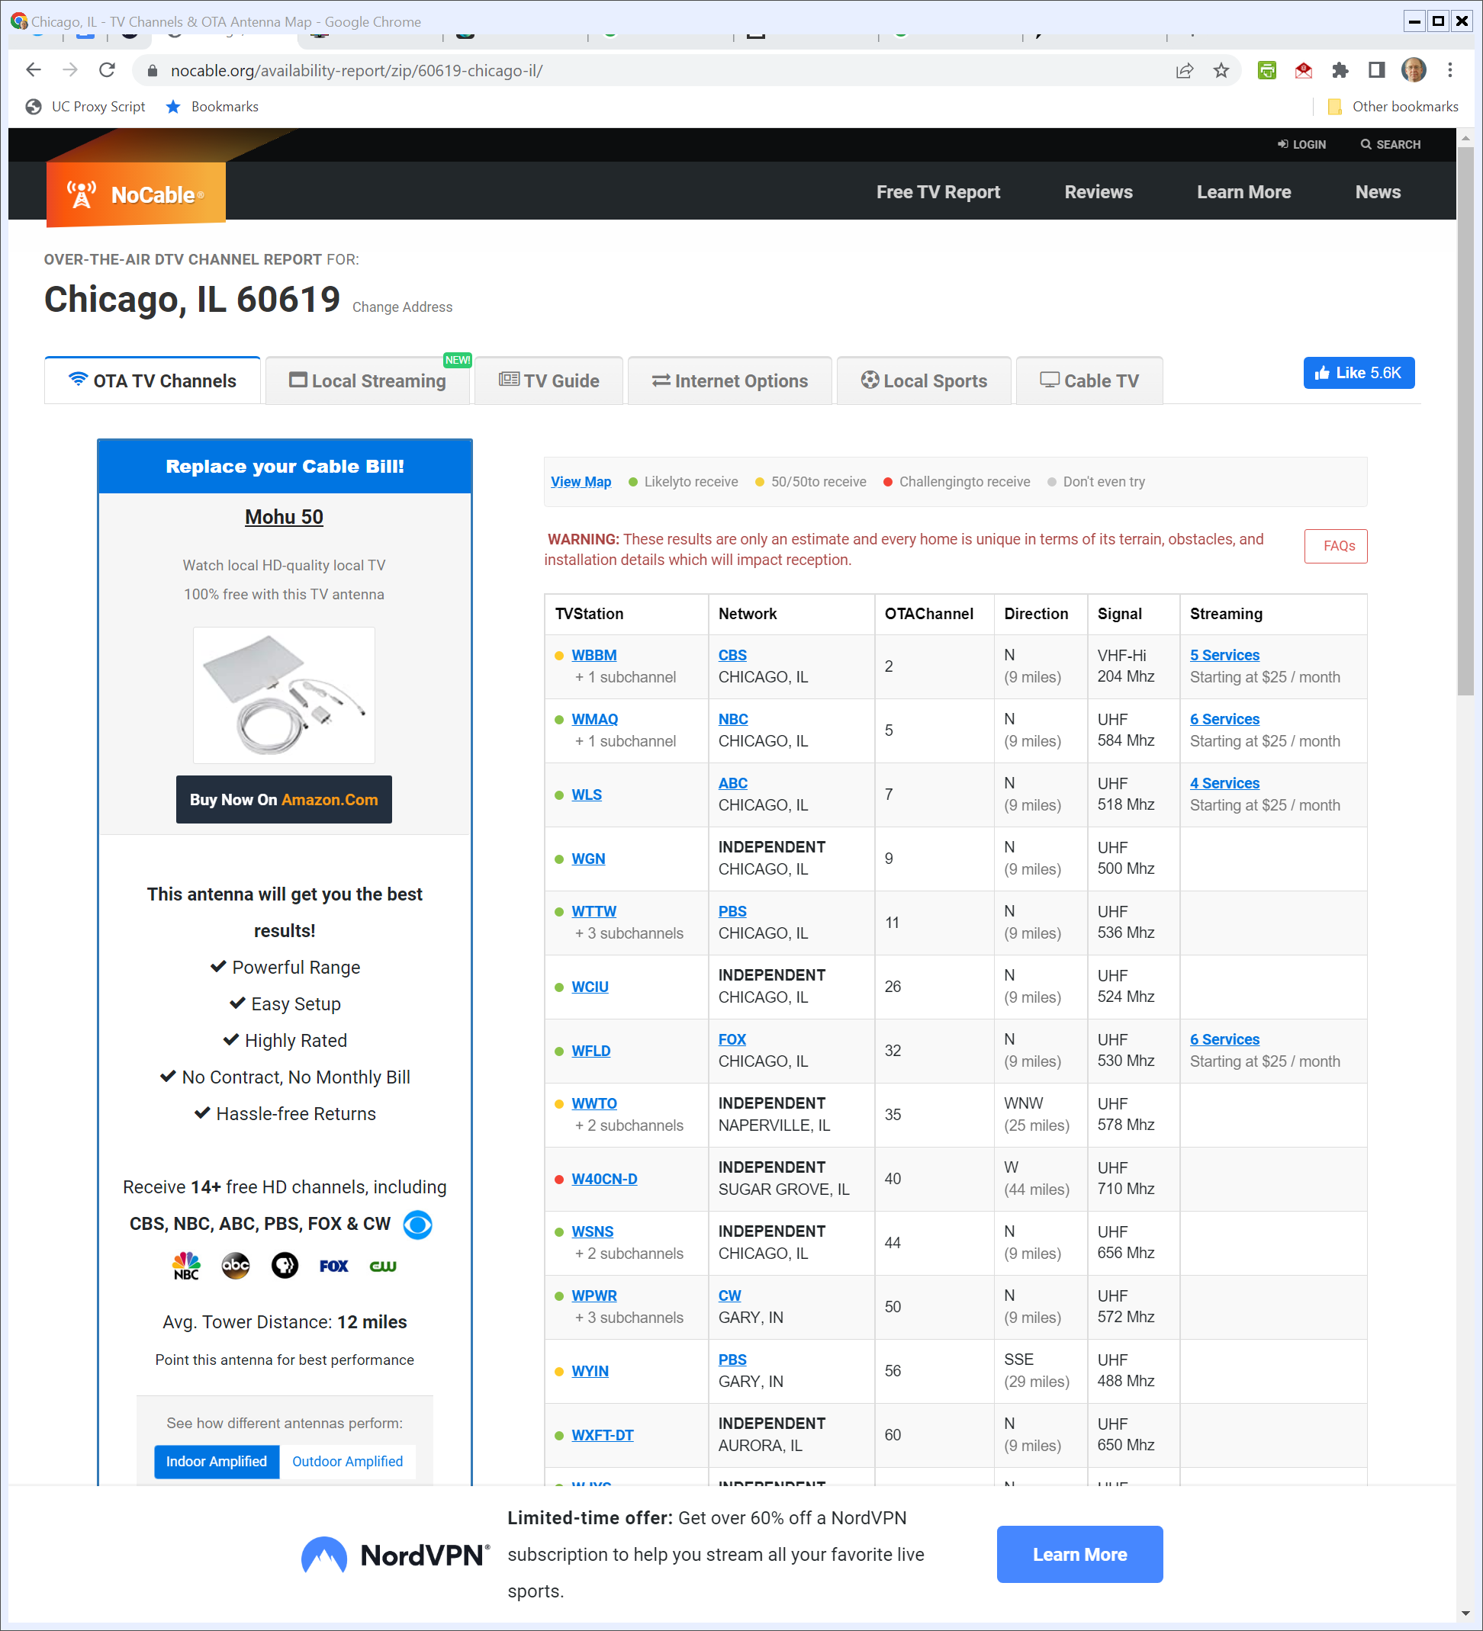
OTA TV in Chicago
NoCable.org (Visited 20 Apr 2022)
Notes:
https://nocable.org/availability-report/zip/60619-chicago-il/

Slide 69
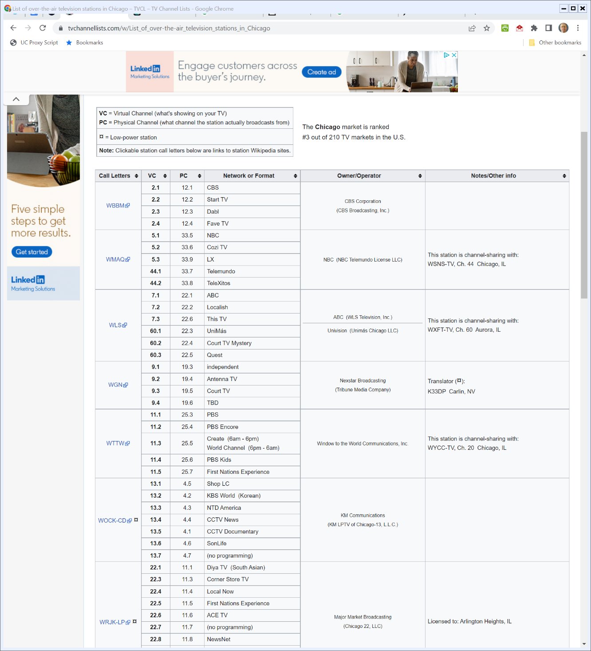
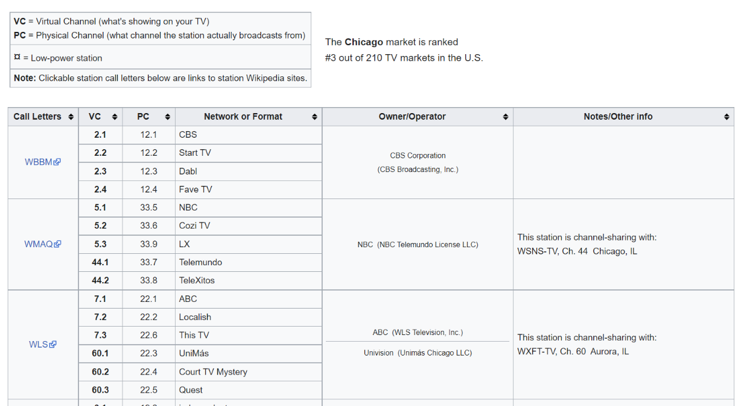
Better List?
TVChannellists.com (Visited 20 Apr 2022)
Notes:
https://www.tvchannellists.com/w/List_of_over-the-air_television_stations_in_Chicago

Slide 70
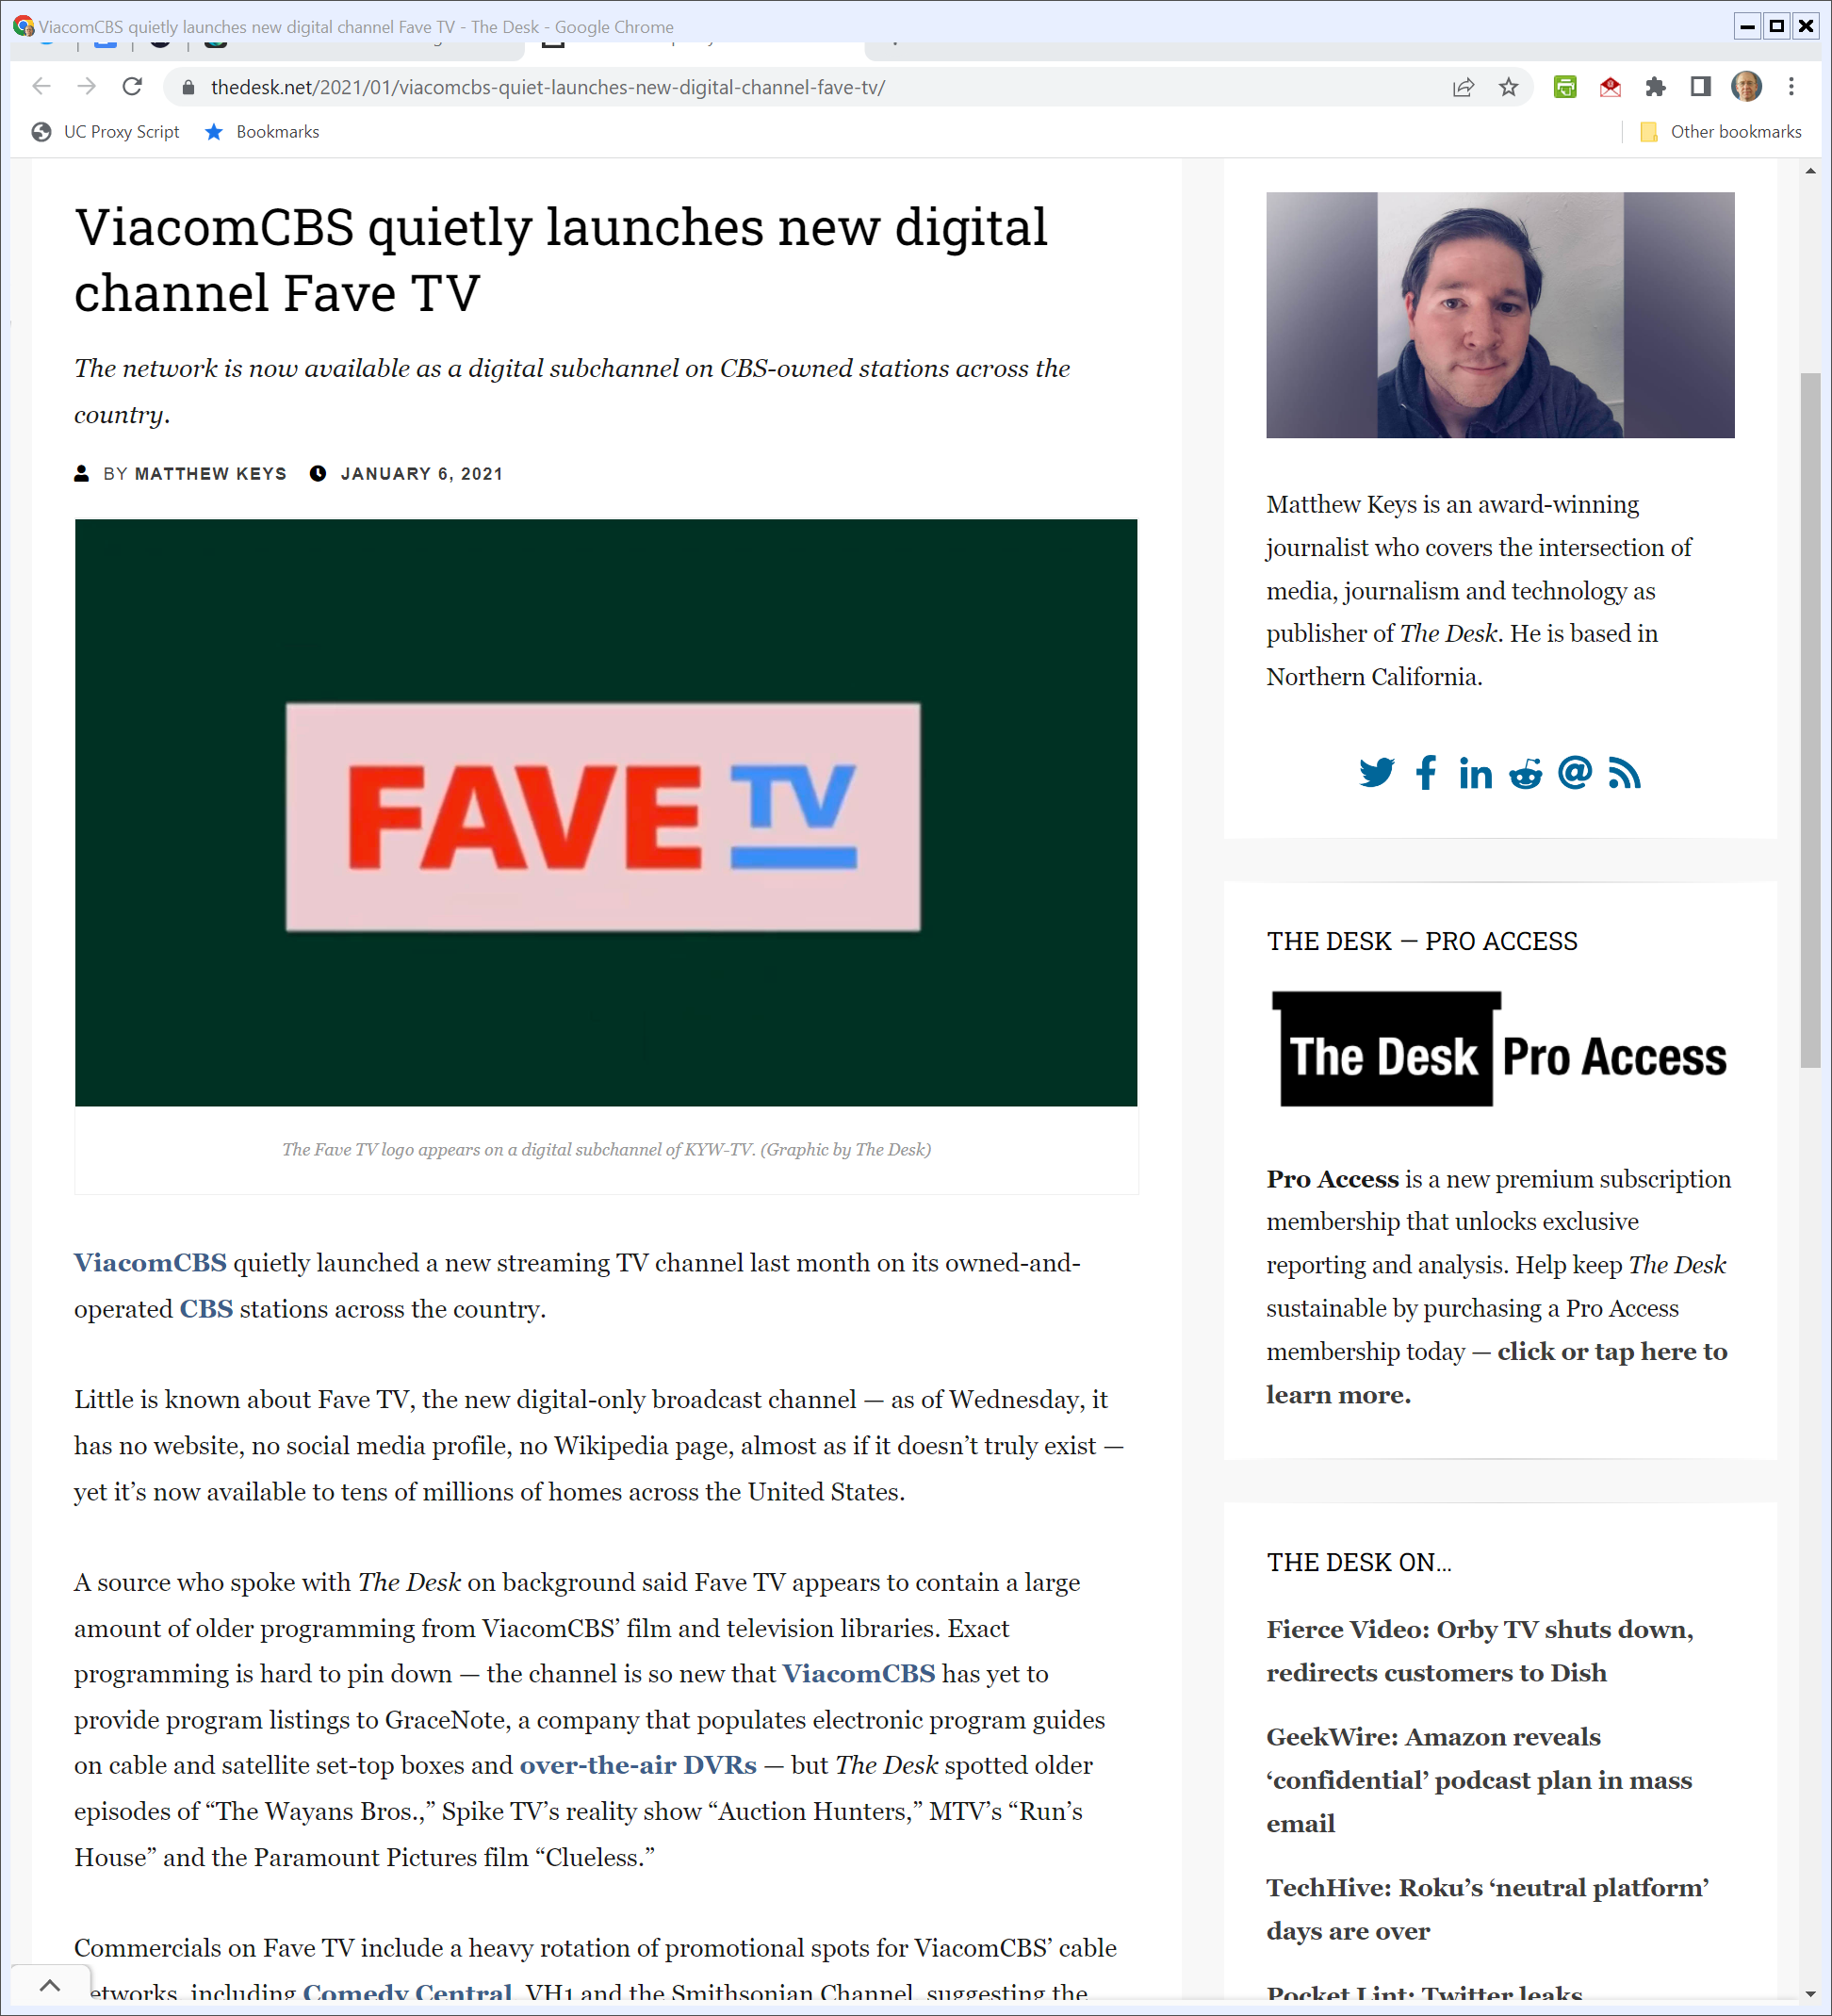
Fave TV Launch
TheDesk.net (6 Jan 2021)

Slide 71
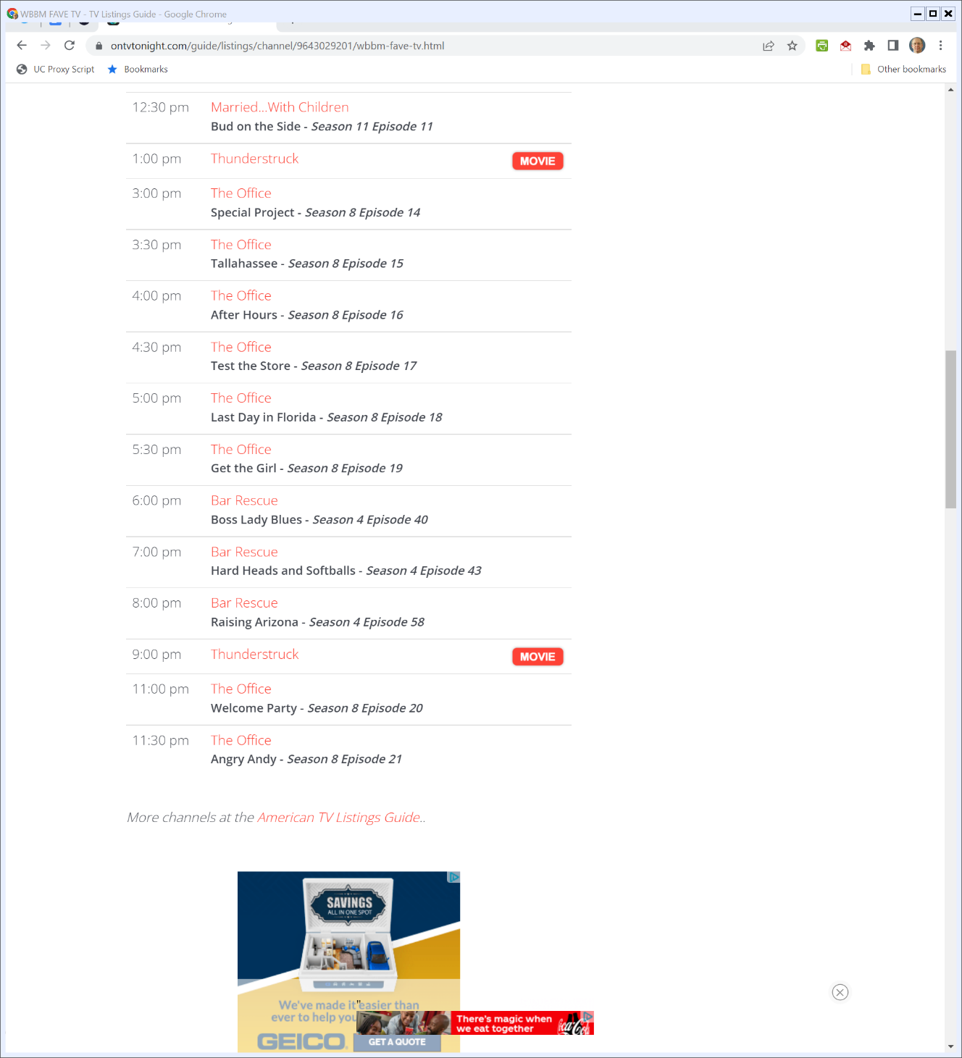

The Problem of Broadcasting
OnTvTonight.com (Visited 20 Apr 2022)

Slide 72
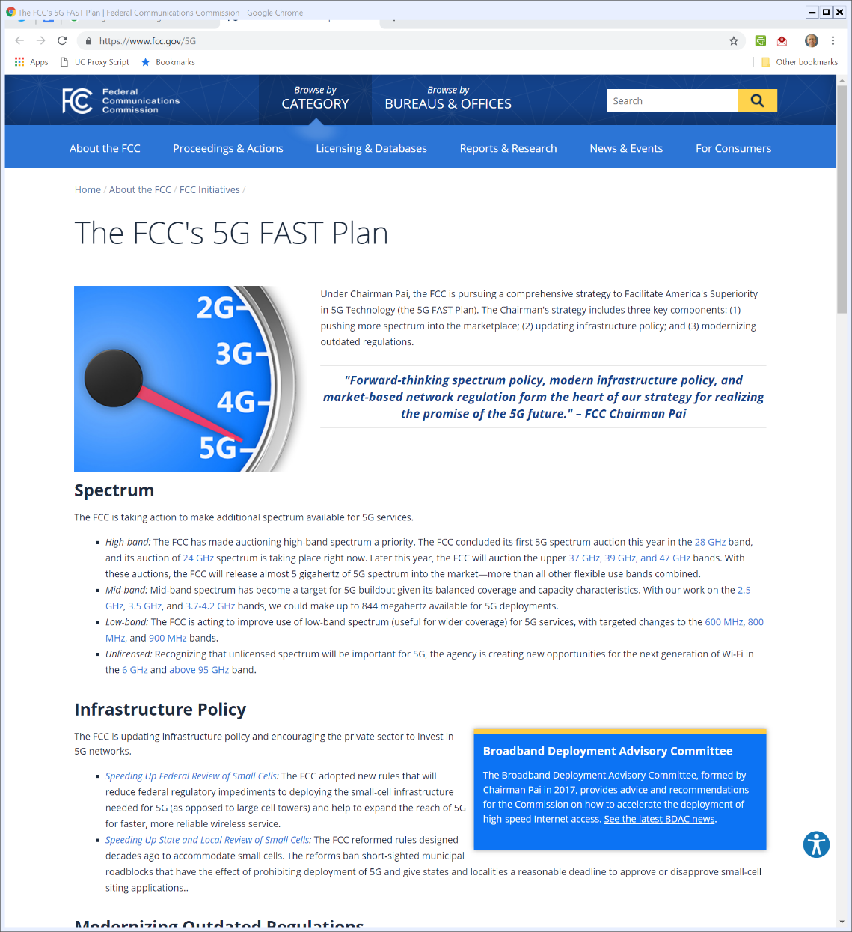

5G Roll Out
Notes:
https://www.fcc.gov/5G

Slide 73
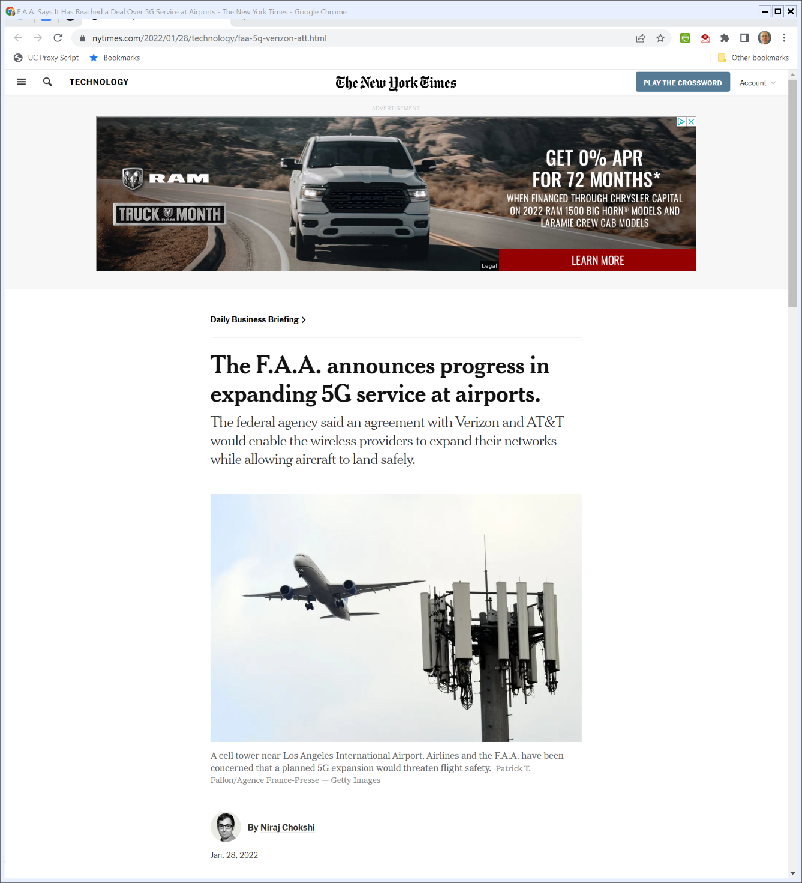
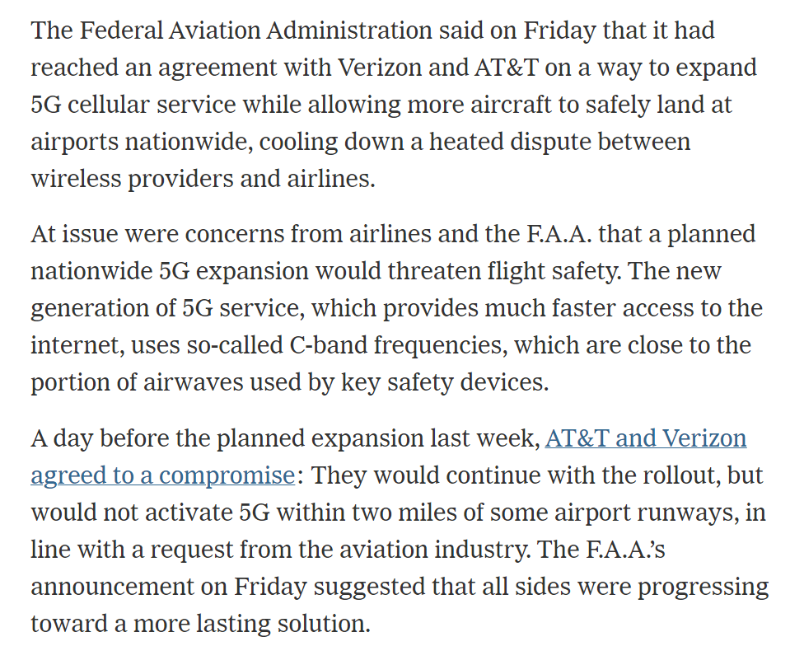
5G Interference
New York Times (28 Jan 2022)
Notes:
https://www.nytimes.com/2022/01/28/technology/faa-5g-verizon-att.html

Slide 74
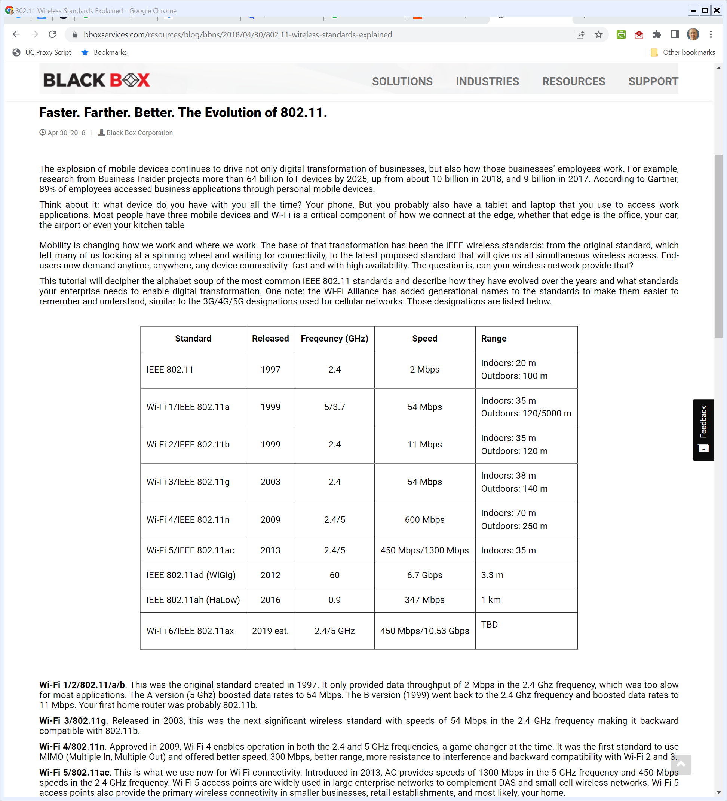
Evolution of Wi-Fi
Black Box (30 Apr 2018)
Notes:
https://www.bboxservices.com/resources/blog/bbns/2018/04/30/802.11-wireless-standards-explained

Slide 75
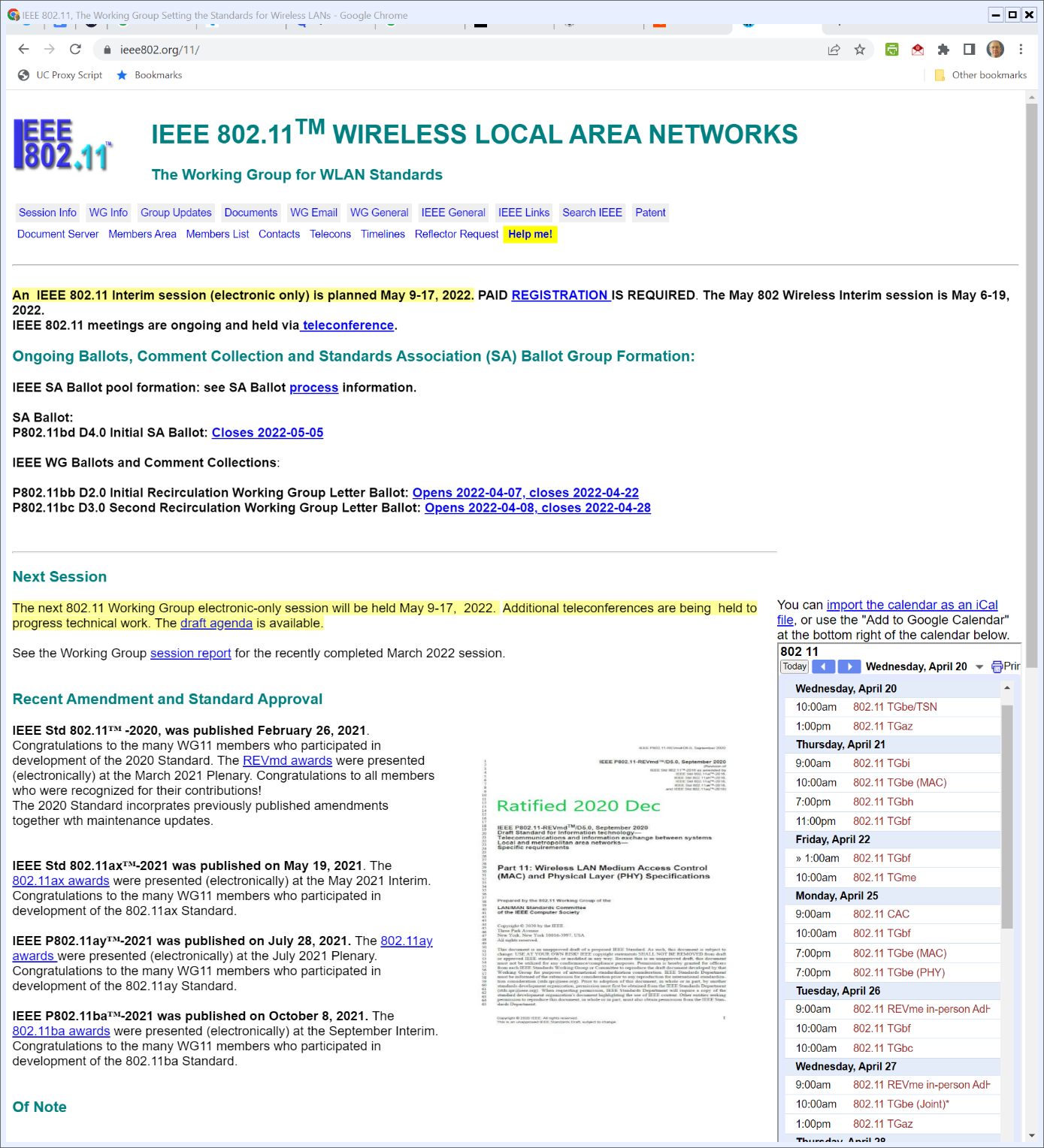
IEEE 802.11
IEEE802.org (Visited 20 Apr 2022)
Notes:
https://www.ieee802.org/11/

Slide 76
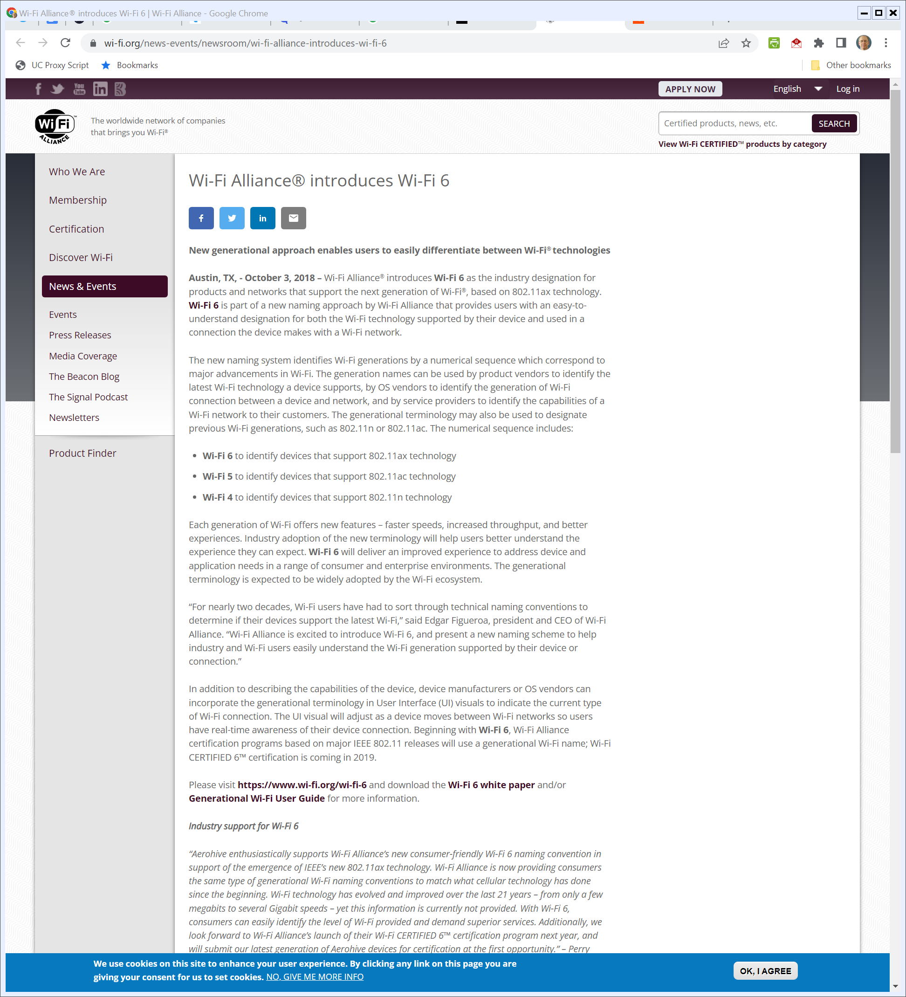
And Wi-Fi?
Wi-Fi Alliance (3 Oct 2018)
Notes:
https://www.wi-fi.org/news-events/newsroom/wi-fi-alliance-introduces-wi-fi-6

Slide 77
New Unlicensed Spectrum
Monisha Ghosh (10 Apr 2020)

Slide 78
Growing Use of Wi-Fi
Monisha Ghosh (10 Apr 2020)

Slide 79
New Unlicensed Spectrum
FCC (23 Apr 2020)

Slide 80
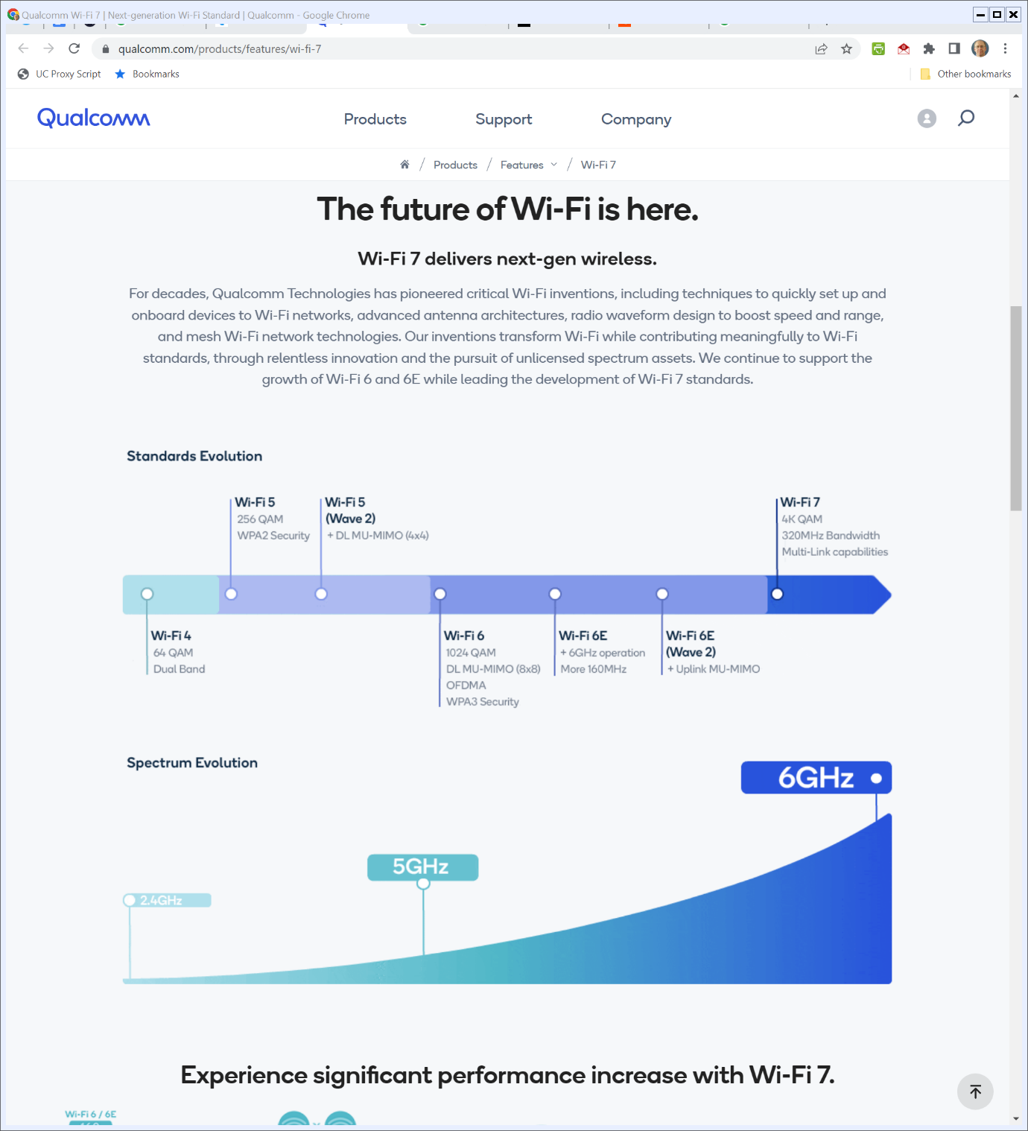
Wi-Fi 7?
Qualcomm (Visited 20 Apr 2022)
Notes:
https://www.qualcomm.com/products/features/wi-fi-7

