Slide 1
Class 13 Platforms and Networks Spring 2022 Content Platforms: HDTV and DVDs
Randal C. Picker
James Parker Hall Distinguished Service Professor of Law
The Law School
The University of Chicago
Copyright © 2014-22 Randal C. Picker. All Rights Reserved.

Slide 2
The Focus Today
Key Questions
Two standards get created today at roughly the same time (circa 1996): DTV and DVD
What explains the different role that the federal gov’t played in the creation of these two standards?
Should the gov’t have been more/less active in these two situations?

Slide 3
What Defines a Platform/Network/Standard?
TTYN (1 of 3)
Graphs?
Consider three configurations for a five member network:
A
B
C
D
E
B
B
A
C
A
C
D
E
D
E

Slide 4
What Defines a Platform/Network/Standard?
TTYN (2 of 3)
Coordinated Demand?
Is there a Ford network?
Complimentary Goods Bundles?
Cars with gas engines and gasoline stations?
Old IBM tabulating equipment and punch cards?
Intel chips and Windows-based software?
DVD disks and players?

Slide 5
What Defines a Platform/Network/Standard?
TTYN (3 of 3)
Credit card systems: Visa, Mastercard, Amex?
Other Cases
Suppose McDonald’s introduced a frequent eater program: would this create a network?

Slide 6
What issues are posed by standard setting?
Can there be too much competition?
Can there be too little competition?
Are there pathologies in standard setting?

Slide 7
Winner Take All Markets: Simple Version
TTYN
Two Sector Economy
500 individuals
One sector: everyone earns $10
Second sector: one person will earn $1000, everyone else will earn nothing, probability of winning is just 1/N
What outcome do we want?

Slide 8
Winner Take All Markets: Simple Version
Answer
499 in sector 1, 1 in sector 2
GNP is 499 * 10 + 100* 1 = 5990

Slide 9
Winner Take All Markets: Simple Version
What outcome will we get?
Answer
Individuals enter sector 2 until expected return is $10.
100 individuals in sector 2, 400 in sector 1
GNP is 400 * 10 + 1000*1 + 99*0 = 5000
Same GNP as if we did not have WTA sector: the value of that sector is fully dissipated

Slide 10
WTA Markets: Version II
Empirical Claim
Creators do not capture all of the social benefits of their discoveries
Spillover from the WTA Sector to the Sure-Thing Sector
The winner in the WTA sector only gets 1000g, where g is [0,1]
The balance, (1-g)1000, spills over into the other sector

Slide 11
WTA Markets: Version II
What outcome do we want?
Answer
Again, allocate 499 to ST, 1 to WTA, for social welfare of 5990

Slide 12
WTA Markets: Version II
What outcome will we get?
Equilibrium condition given by:
Solution:

Slide 13
WTA Markets: Version II
Numbers
g =1 gives N = 100, as before
g = 0.10645 gives N = 9
g = 0.012 gives N = 1, the social optimum
Note this version assumes WTA losers do not share in spillover; could do version in which they did

Slide 14
WTA Markets: Version II
Bottom Line
Spillovers can mitigate concern over tragedy of the commons style over-competition
Indeed, if spillovers are too high, we could have too few pursuing the WTA sector
Essentially empirical question on conflicting incentives

Slide 15
Too much competition?
What are the harms of too much competition? What does that mean?
Winner Take All example suggests that too many firms may seek to set standards

Slide 16
Consequences/Implications
Match to Standards Setting
Think of standard setting problem as one in which only a few standards (K =1, 2 or 3?) will survive?
Does this suggest that too many firms will try to be standards setters, given the returns, than is optimal?

Slide 17
Consequences/Implications
Solutions?
Weaken property rights to solve the problem?
Allow collectivization ala DVD standard setting and patent pool to minimize competition?

Slide 18
Too little competition?
Collusion
If we permit firms to establish standards collectively, won’t they collude?
Won’t this result in lower output and higher prices, the classic harms of monopoly?
How should we evaluate whether a particular deal is collusive?

Slide 19
Pathologies in standard setting?
Basic Idea of Network Externalities
The more individuals using the product, the more valuable it is to each user.
The telephone is the classic example; a single-phone network is of no use.

Slide 20
Pathologies in standard setting?
Collective Adoption Defects
At least in theory, adoption of products with network externalities can be frustrated through collective action problems.
Excess inertia: an old standard should be displaced, but isn’t.
Excess momentum: an old standard should be maintained, but is not.

Slide 21
1940: FCC Annual Report

Slide 22
TV: Experimental So Far
“It was felt by the [Television Committee of the Commission] that although the television industry had not advanced beyond the experimental stage, it had arrived at the point where more rapid progress could be expected by the licensing of a class of station to render sponsored programs to the public on a limited basis.”
FCC, 6th Annual Report (1940)

Slide 23
TV Broadcast Standards Undetermined
“Upon the evidence given at the April 8 hearing, the Commission decided that in order to insure to the public a television system which is the product of comprehensive research, the standards of transmission should not be determined at that time.”
FCC, 6th Annual Report (1940)

Slide 24
New National Television System Committee (NTSC) Standards
“At the [March 20, 1941] hearing the Commission found the industry had reached agreement that television broadcasting was ready for standardization. The standards as finally proposed by the NTSC at the hearing represent … the undivided engineering opinion of the industry.”
FCC, 7th Annual Report (1941)

Slide 25
1 July 1941: TV Launches
“July 1, 1941, marked the beginning of television broadcast service to the public on a commercial basis. … [E]ach broadcast station was required to render a minimum of 15 hours program service per week.”
FCC, 8th Annual Report (1942)

Slide 26
Four Stations
“Two television broadcast stations, both in New York City … . Philadelphia … . Schenectady, New York … .”
FCC, 8th Annual Report (1942)

Slide 27
June 1942: Five TV Stations
“During June, 1942, the Commission authorized the completion with materials on hand of a fifth commercial station, located in Chicago, Illinois.”
FCC, 8th Annual Report (1942)

Slide 28
Blowing on the Embers of TV
“The broadcast service that will be rendered by these five stations in various locations of the United States, augmented by the several experimental stations that continue to make limited broadcasts, should keep alive this new art during the war.”
FCC, 8th Annual Report (1942)

Slide 29
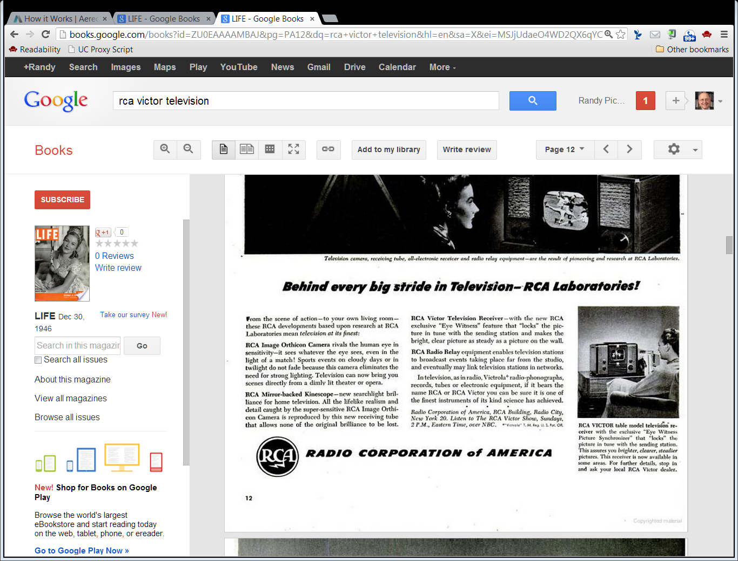
TV!
Life Magazine (30 Dec 1946)

Slide 30
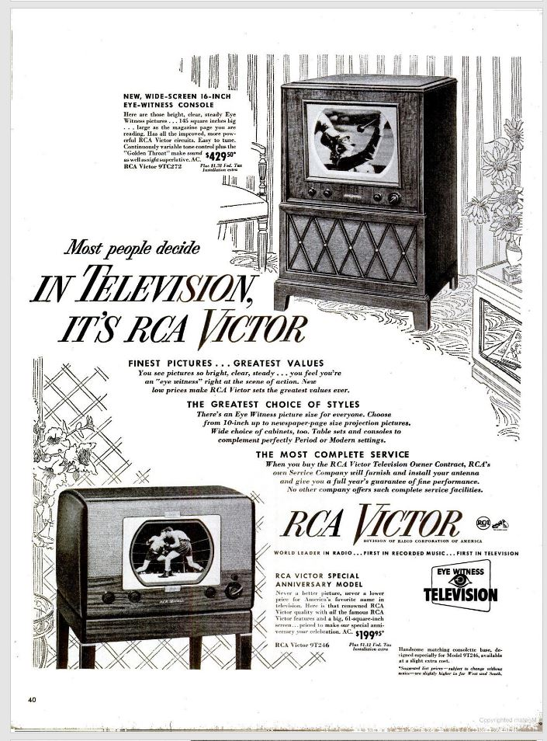
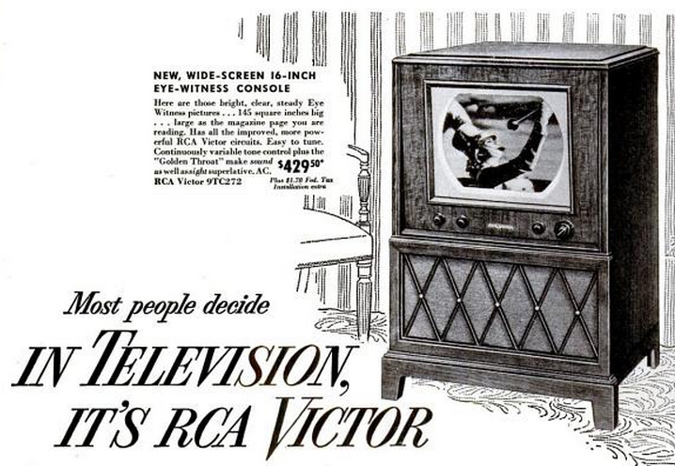
16-Inch Wide-Screen
Life Magazine (12 Sept 1949)
Notes:
https://books.google.com/books?id=yUkEAAAAMBAJ&pg=PA40&dq=life+magazine+september+12+1949+rca+victor&hl=en&sa=X&ved=2ahUKEwiA4IeTn-z1AhVVkokEHcTMDE8QuwV6BAgIEAY#v=onepage&q&f=false

Slide 31
The 1948 Freeze
“On September 30, 1948, the Commission issued a report and order, commonly referred to as the ‘freeze order.’ … The Commission noted that it could not continue to make assignments under the existing table since the evidence presented at the hearing raised serious questions concerning the validity of the bases upon which the table was constructed.”
FCC, 18th Annual Report (1952)

Slide 32
Lifting the Freeze
“The Sixth Report and Order lifted the ‘freeze’ on the authorization and construction of new TV stations, assigned 70 UHF channels (between 470-890 megacycles) in addition to the 12 VHF channels (between 54-216 megacycles) which were in use,”
FCC, 18th Annual Report (1952)

Slide 33
Lifting the Freeze
“promulgated a new nation-wide table of TV frequency assignments making available 2,053 assignments in 1,291 communities throughout the United States, its Territories and possessions, and provided for a change of frequency for 30 of the then existing 108 VHF stations.”
FCC, 18th Annual Report (1952)

Slide 34
Lifting the Freeze
FCC, 18th Annual Report (1952)

Slide 35
TV Channels: The Checkerboard in the Sky
Green Bay
2, 6
Milwaukee
4, 10, 12
Managing Interference
Co-Channel Interference
Adjacent Channel Interference
Chicago
2, 5, 7, 9, 11

Slide 36
1953: FCC Color TV Order

Slide 37
Adopting a Broadcast Standard for Color TV
“Upon a careful consideration of the complete record in this proceeding, we are of the view that the signal specifications proposed by petitioners provide a reasonable basis for the development of a color television service in the public interest.”
FCC, Color TV Order (17 Dec 1953)

Slide 38
Adopting a Broadcast Standard for Color TV
“We have therefore concluded that the present rules and standards for the broadcast of color television based on the field sequential signal specifications should be deleted and that the signal specifications in this proceeding should be adopted in lieu thereof at this time.”
FCC, Color TV Order (17 Dec 1953)

Slide 39
DTV Technology
Switch from Analog to Digital
From waves to 1s and 0s
Think of as language switch: broadcast equipment and receivers (TVs) speak French to each other, switching to English
Allows for Compression
Digital format uses spectrum more efficiently

Slide 40
Extra Spectrum I
Old Analog
New Digital
6 MHz Channel
Space between Channels to Reduce Interference
6 MHz Channel
6 MHz Channel
6 MHz Channel

Slide 41
Extra Spectrum II
Try This With DTV Spectrum Savings
6 MHz Channel Delivering one Analog SDTV Signal
xx MHz Channel Delivering one DTV SDTV Signal
6 - xx MHz Channel Leftover

Slide 42
1996 Telco Act Sec. 201: Broadcast Spectrum Flexibility
Adds New 47 USC 336
Key Features
Limits new licenses for advanced TV to current FCC license holders
FCC authorized to adopt regs re quality of ATV signal and minimum number of hours ATV must be transmitted per day
Original license must be returned some day

Slide 43
1996 FCC DTV
FCC, 4th Report and Order on Advanced TV (1996)

Slide 44
Transition from Old TV to Digital TV
“This proceeding began in 1987, when we issued our first inquiry into the potential for advanced television (“ATV”) services. … Early in the process we decided that no additional spectrum would be allocated for television broadcasting, but that existing broadcasters should be permitted to upgrade their transmission technology so long as the public remains served throughout any transition period.”
FCC, 4th Report and Order on Advanced TV (1996)

Slide 45
Designing the Switch: Term Sheet?
TTYN (1 of 4)
Key Questions
What should the FCC have been seeking to do in the DTV switch?
What should the goals have been?
What should the tools have been?

Slide 46
What Is Distinctive About this Standard Setting?
TTYN (2 of 4)
Questions
Is this different from other standard setting situations?
Is there a greater role for the gov’t than in the creation of the DVD?

Slide 47
What Is Distinctive About this Standard Setting?
TTYN (3 of 4)
Questions
Would you have selected a single DTV broadcast standard?
Mandated other technical specifications (720p v. 1080i)?
Required a minimum number of DTV broadcast hours per day?

Slide 48
Using Extra Spectrum
TTYN (4 of 4)
How to Use “Extra” Spectrum?
More channels in standard broadcast format?
Higher broadcast format (HDTV)?
Other uses?

Slide 49
New Broadcast Opportunities
“In addition to being able to broadcast one, and under some circumstances two, high definition television (‘HDTV’) programs, the Standard allows for multiple streams, or ‘multicasting,’ of Standard Definition Television (‘SDTV’) programming at a visual quality better than the current analog signal.”
FCC, 4th Report and Order on Advanced TV (1996)

Slide 50
Lots of Video, Audio and Newspapers
“Utilizing this Standard, broadcasters can transmit three, four, five, or more such program streams simultaneously. The Standard allows for the broadcast of literally dozens of CD-quality audio signals. It permits the rapid delivery of large amounts of data; an entire edition of the local daily newspaper could be sent, for example, in less than two seconds.”
FCC, 4th Report and Order on Advanced TV (1996)

Slide 51
Telephone Directories. Any Info.
“Other material, whether it be telephone directories, sports information, stock market updates, information requested concerning certain products featured in commercials, computer software distribution, interactive education materials, or virtually any other type of information access can also be provided.”
FCC, 4th Report and Order on Advanced TV (1996)

Slide 52
Use Broadcast Spectrum to Distribute Software?
“While we would anticipate that licensees would, at the very least, continue to provide tomorrow what consumers have come to expect today -- that is, at least one free program per 6 MHz channel -- we also expect to authorize its use to transmit, for example, newspapers, stock market or sports data and, perhaps of greatest significance, software applications directly to computing devices.”
FCC, 4th Report and Order on Advanced TV (1996)

Slide 53
DTV Standard
FCC, 4th Report and Order on Advanced TV (1996)

Slide 54
The Digital Tuner Mandate
Aug. 2002 FCC Order
Required
By July 1, 2004: 50 percent of televisions with screens sized 36 inches or larger
By July 1, 2005
100 percent of televisions 36 inches or larger
50 percent of televisions with screens between 25 inches and 36 inches

Slide 55
The Digital Tuner Mandate
By July 1, 2006
100 percent of televisions with screens between 25 inches and 36 inches
By July 1, 2007
100 percent of televisions with screens between 13 inches and 24 inches, and 100 percent of other devices (DVD players, VCRs, etc.) that receive broadcast television signals.

Slide 56
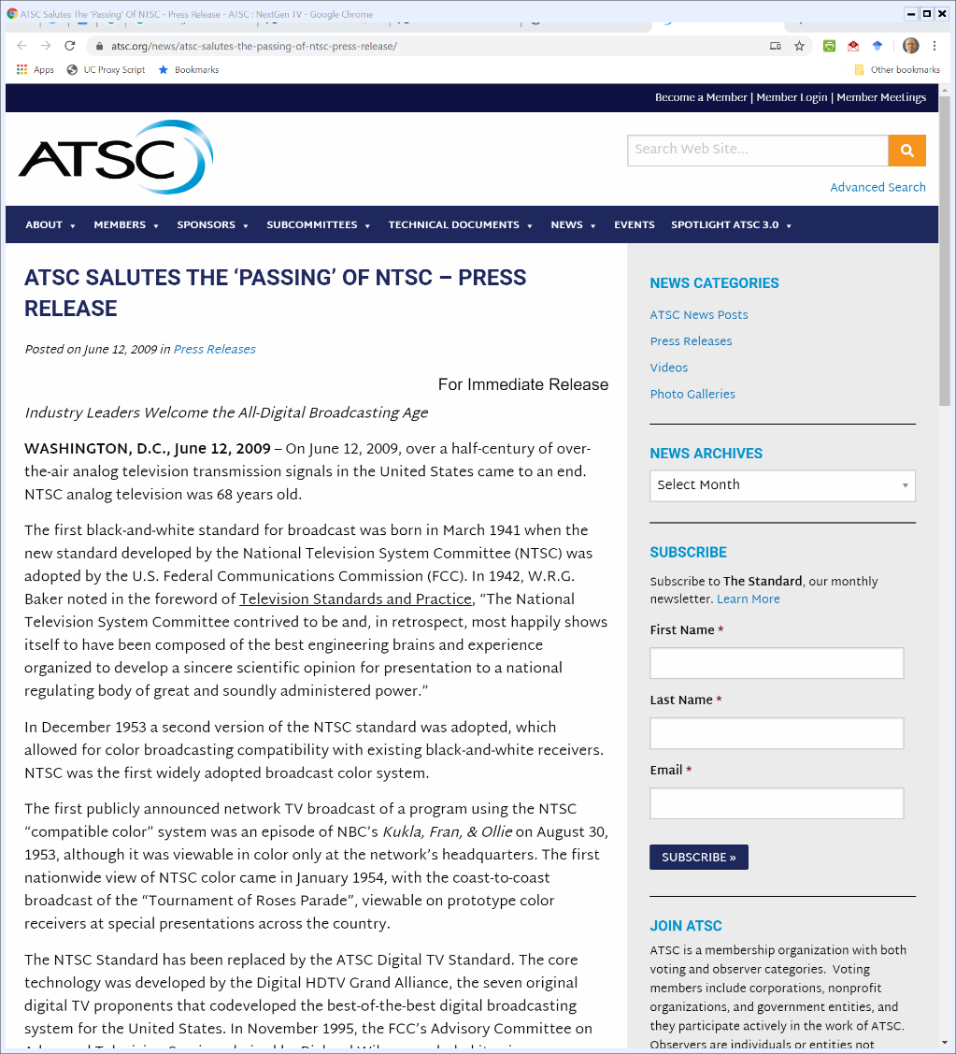
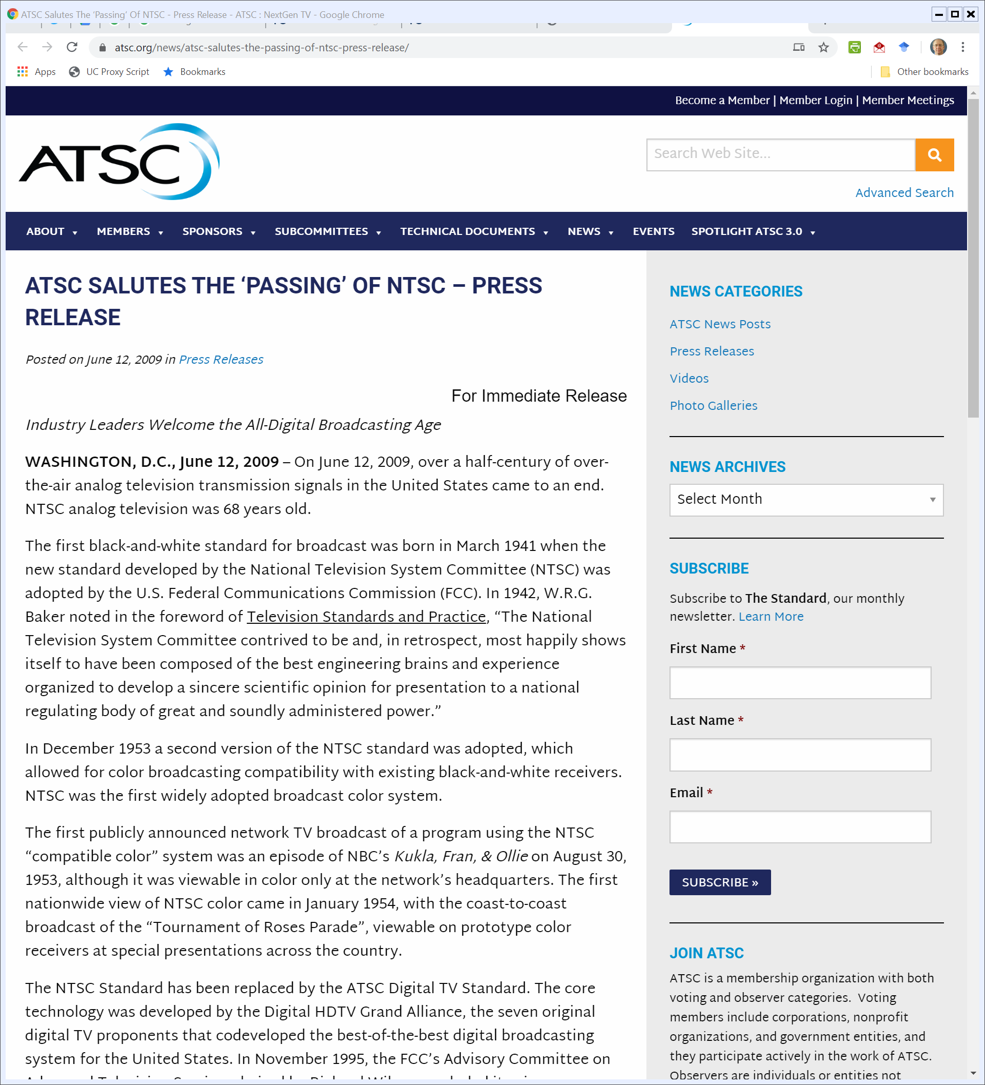
June 2009: End of NTSC Broadcasting
ATSC (12 June 2009)
Notes:
https://www.atsc.org/news/atsc-salutes-the-passing-of-ntsc-press-release/

Slide 57

June 2009: End of NTSC Broadcasting
ATSC (12 June 2009)
Notes:
https://www.atsc.org/news/atsc-salutes-the-passing-of-ntsc-press-release/

Slide 58
Nov. 2017: FCC on Next Gen TV
FCC (16 Nov 2017)
Notes:
https://www.fcc.gov/fcc-authorizes-permissive-use-next-generation-tv-broadcast-transmission-standard

Slide 59
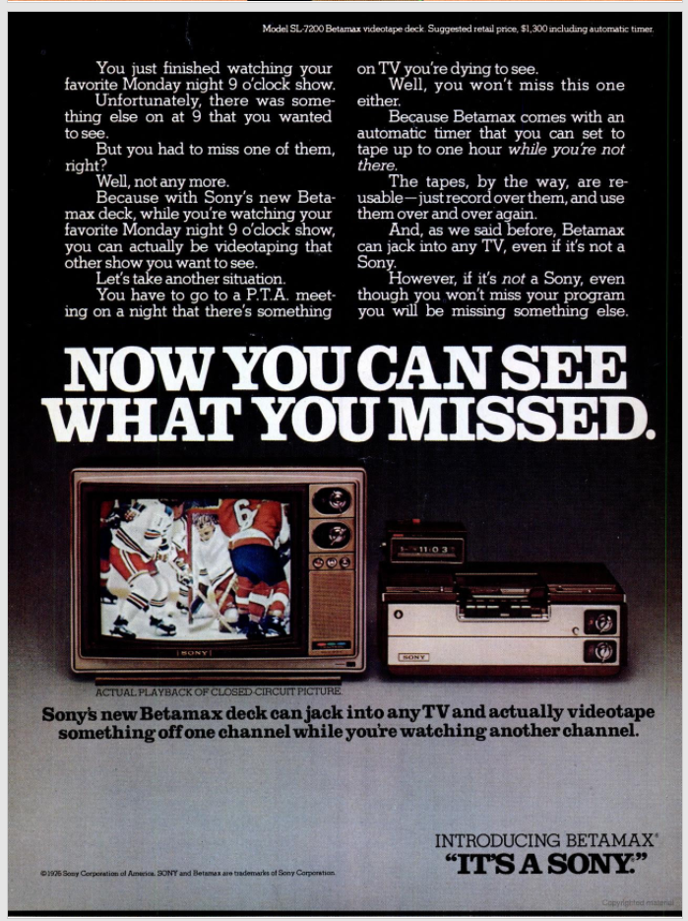
Sony Betamax Ad
New York Magazine (14 June 1976)

Slide 60
Sony Betamax Ad
New York Magazine (14 June 1976)

Slide 61
Sony Betamax Ad
New York Magazine (14 June 1976)

Slide 62
Sony Betamax Ad
New York Magazine (14 June 1976)

Slide 63
1984 Sony Case
Sony v. Universal, 464 U.S. 417 (1984)

Slide 64
1984 Sony Case
Sony v. Universal, 464 U.S. 417 (1984)

Slide 65
1984 Sony Case
Sony v. Universal, 464 U.S. 417 (1984)

Slide 66
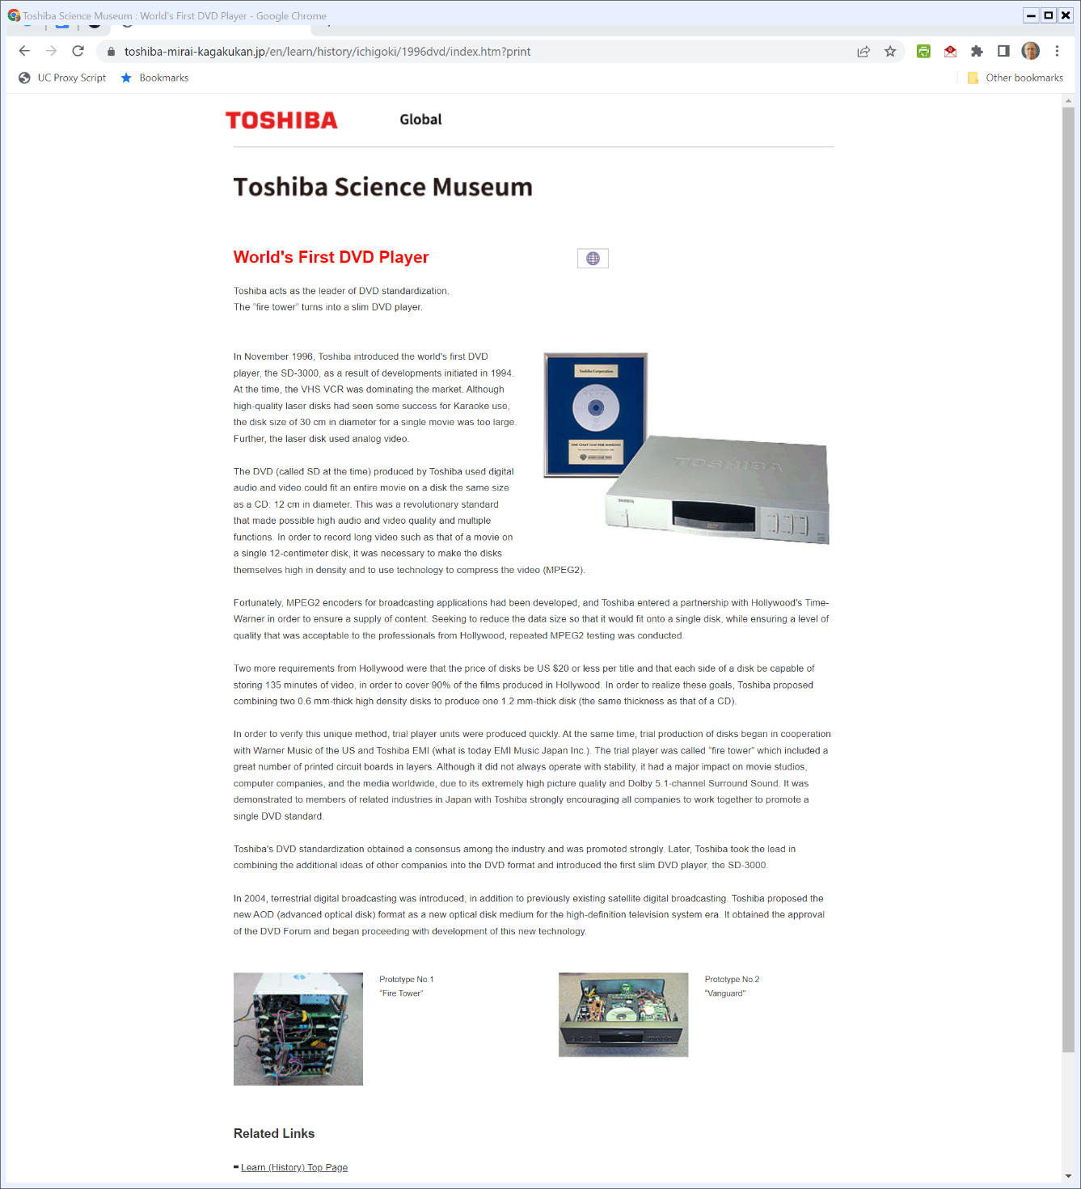

1996: Toshiba Releases First DVD Player
Toshiba Science Museum
Notes:
http://toshiba-mirai-kagakukan.jp/en/learn/history/ichigoki/1996dvd/index.htm?print

Slide 67
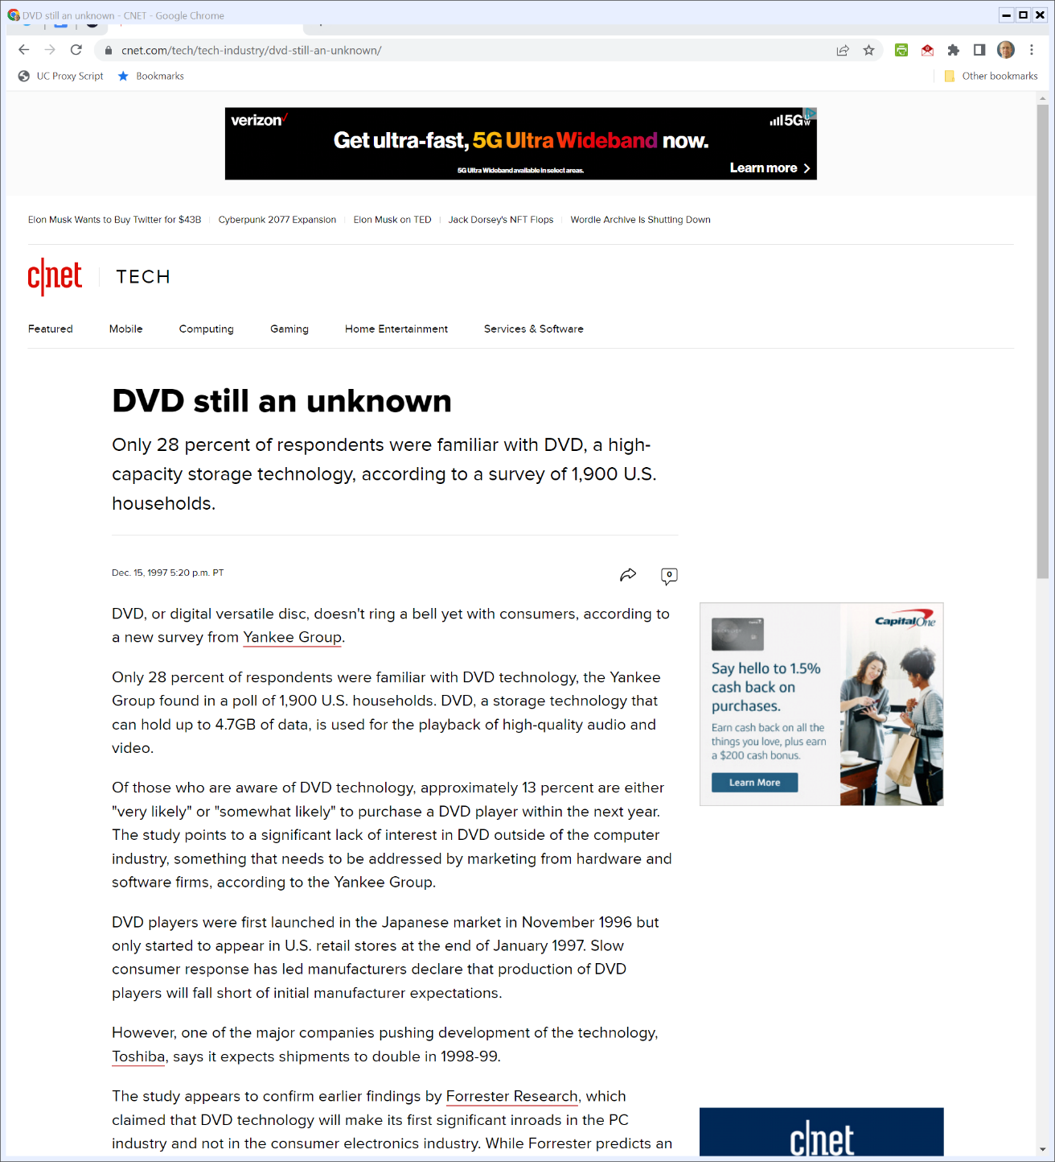

1997: Emergence of DVD
c|net (15 Dec 1997)
Notes:
https://www.cnet.com/tech/tech-industry/dvd-still-an-unknown/

Slide 68
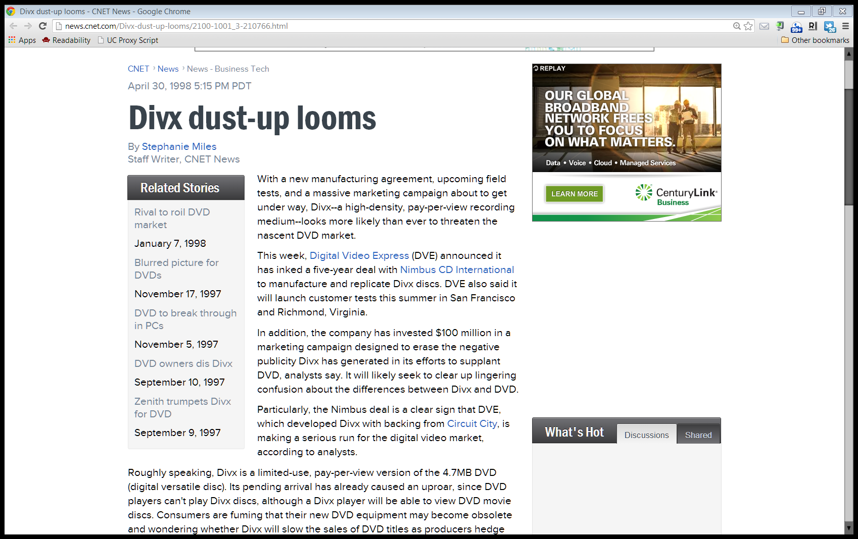
1998 Divx Fight
c|net (30 Apr 1998)

Slide 69
1998 Divx Fight
c|net (30 Apr 1998)

Slide 70
Creating the DVD
TTYN (1 of 2)
Hypo
It is say 1996. The basic technology is available for a successor to the VCR
Questions
What steps do you want to take to build this new platform for the distribution of content?

Slide 71
Creating the DVD
TTYN (2 of 2)
Questions
How do you want to use tools related to IP to help?
Should you ask DOJ its view through the business review process?
What steps can you take to structure this market?
What role, if any, for the government here?

