Slide 1
Class 11
Platforms and Networks
Spring 2022
Internet: Net Neutrality
Randal C. Picker
James Parker Hall Distinguished Service Professor of Law
The Law School
The University of Chicago
Copyright © 2014-22 Randal C. Picker. All Rights Reserved.

Slide 2
The Focus Today
Key Questions/Issues
  On net neutrality, there is the policy and then there is the law/process
  We see lots of examples of non-neutralities (think the Post Office in 1845). Under what circumstances, if any, is non-neutrality acceptable?

Slide 3
The Focus Today
Key Questions/Issues
  Should we think of the 2015 open internet rules as a modern version of common carriage?
  We are going to see a 15-year plus fight over net neutrality and it is still ongoing. What does the length/shape of that fight tell us about using regulation to control discrimination in platform markets?

Slide 4
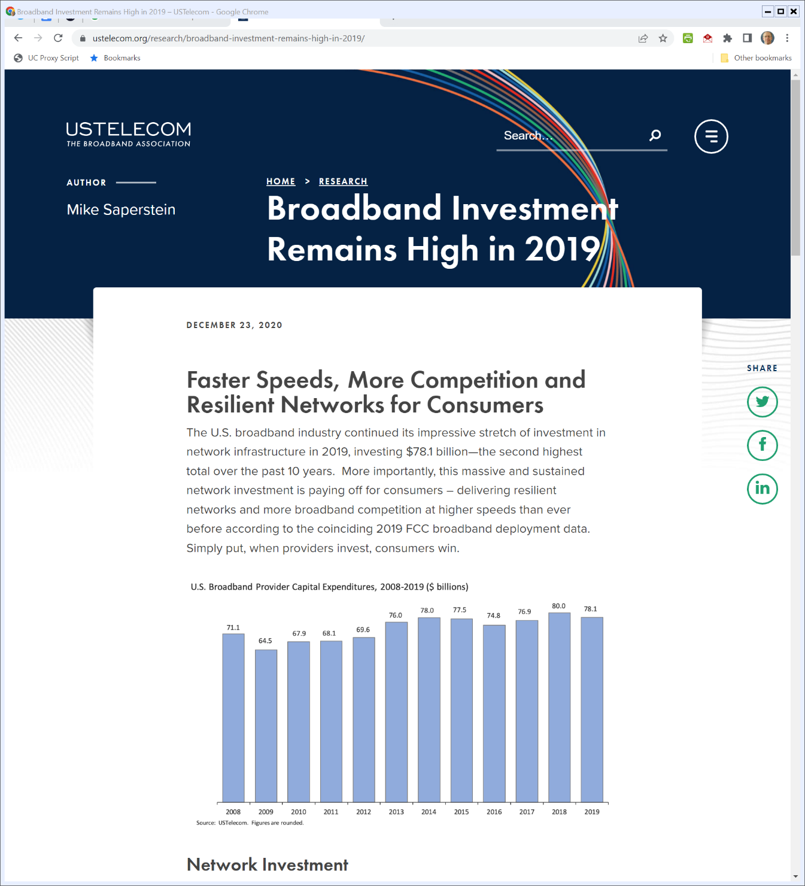
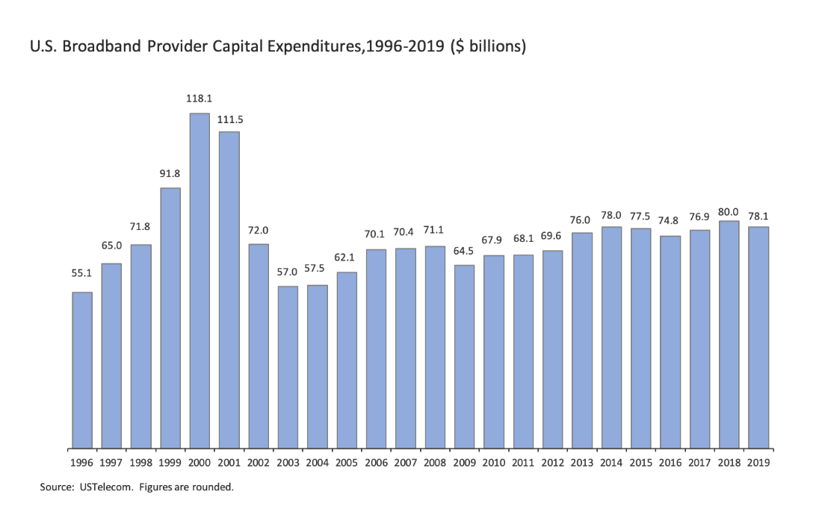
Infrastructure Spending
USTELECOM (23 Dec 2020)
Notes:
https://www.ustelecom.org/research/broadband-investment-remains-high-in-2019/

Slide 5
A Simple Delivery Service (TTYN (1 of 3))
Chicago
New York
Two Possible Services: Medium or Slow/Fast
 | Slow | Medium | Fast
C1 | $0 | $10 | $15
C2 | $9 | $10 | $11
Fixed Costs = $8
 | Slow | Medium | Fast
Marg Cost | $2 | $4 | $6
5

Slide 6
SWF under Medium System
TTYN (2 of 3)
Questions
  Suppose we build the medium delivery system
  Does building that system make sense compared to having no system?
  Is there a price that could be set to implement that system?

Slide 7
SWF under Slow/Fast System
TTYN (3 of 3)
Consider Three Possible Outcomes
  1. Both use slow
  2. Both use fast
  3. C1 uses fast, C2 uses slow
Fixed Costs = $8
 | Slow | Medium | Fast
C1 | $0 | $10 | $15
C2 | $9 | $10 | $11
 | Slow | Medium | Fast
Marg Cost | $2 | $4 | $6

Slide 8
SWF under Medium System
Assessing Viability of Business
  Would consumers value it for more than it costs to create it?
Outcome
  Total costs of delivering both packages = 8 + 4 + 4 = 16

Slide 9
SWF under Medium System
Consumer Values
  Each consumer values package at $10 so total value is $20 against costs of $16
Potential Boost to SWF = $4.
  Business creates value
  Are there prices that implement that?

Slide 10
SWF under Medium System
Key Assumptions
  Again competition pushes prices to just cover costs
Prices?
  Set delivery price = 8

Slide 11
SWF under Medium System
Outcome
  Both buy, so revenues are $16 against costs of $16
  Each receives consumer surplus of $2, so SWF boosted by $4.
Successfully implement desired outcome via prices

Slide 12
SWF under Slow/Fast System
Case 1. Both Use Slow
  Total costs = 8 + 2 + 2 = 12
  C1 values at $0, C2 at $9, so max revenues are $9 against costs of $12
  Failure!

Slide 13
SWF under Slow/Fast System
Case 2. Both Use Fast
  Total costs = 8 + 6 + 6 = 20
  C1 values at $15, C2 at $11, so max revenues are $26 against costs of $20
  Might be able to sustain this business
  SWF increase would be plus 6 (26 - 20)

Slide 14
SWF under Slow/Fast System
Case 3. C1 Uses Fast, C2 Uses Slow
  Total costs = 8 + 6 + 2 = 16
  C1 values at $15, C2 at $9, so max revenues are $24 against costs of $16
  Might be able to sustain this business
  SWF increase would be plus 8 (24 - 16)

Slide 15
SWF under Slow/Fast System
Can we implement this through prices?
Key Assumptions
  Again competition pushes prices to just cover costs

Slide 16
SWF under Slow/Fast System
Case 2: Both Use Fast
  Total costs = 8 + 6 + 6 = 20
  Set P_{Fast} = 10, P_{Slow} > 8 (?)
  Both C1 and C2 buy fast, costs are covered, so business is sustainable and net boost to SWF = 6
But …
 | Slow | Medium | Fast
C1 | $0 | $10 | $15
C2 | $9 | $10 | $11

Slide 17
SWF under Slow/Fast System
Case 2: No Internalization of Marginal Costs by C2
  C2 only values fast at $2 more than slow, but it costs $4 more to produce fast service than slow service
  That means we don’t want C2 buying fast service and we need a pricing mechanism that does that

Slide 18
SWF under Slow/Fast System
Case 3: C1 Uses Fast, C2 Uses Slow
  Total costs = 8 + 6 + 2 = 16
  Set P_{Fast} = 10, P_{Slow} = 6
  C1 buys fast and C2 buys slow; costs are covered, so business is sustainable and net boost to SWF = 8
Best outcome achieved!
 | Slow | Medium | Fast
C1 | $0 | $10 | $15
C2 | $9 | $10 | $11

Slide 19
Takeaways on A Simple Delivery System
SWF Improved with Different Tiers of Service
  In medium-only example, overall SWF increase is $4 and that is $2 for each of C1 and C2
  In slow/fast example, overall SWF increase is $8: C1 gets $5 and C2 get $3
  The two tier system improves overall SWF and gives each consumer more surplus

Slide 20
Bars VOIP Blocking
“According to the terms of the consent decree, Madison River commits that it will refrain from blocking VOIP traffic and ensure that such blocking will not recur. The company will pay a contribution of $15,000 to the United States Treasury to settle this matter.”
FCC (3 Mar 2005)

Slide 21
Four Internet Principles
“The Federal Communications Commission today adopted a policy statement that outlines four principles to encourage broadband deployment and preserve and promote the open and interconnected nature of public Internet: (1) consumers are entitled to access the lawful Internet content of their choice;”
FCC (5 Aug 2005)

Slide 22
Four Internet Principles
“(2) consumers are entitled to run applications and services of their choice, subject to the needs of law enforcement; (3) consumers are entitled to connect their choice of legal devices that do not harm the network; and (4) consumers are entitled to competition among network providers, application and service providers, and content providers.”
FCC (5 Aug 2005)

Slide 23
Why a Policy?
“Comcast’s goal is to provide its customers with the best residential cable Internet service possible. In order to help accomplish this, Comcast has adopted this Acceptable Use Policy (the ‘Policy’).”
Comcast Acceptable Use Policy

Slide 24
Policy Limits
“In general, the Policy prohibits uses and activities involving the Service that are illegal, infringe the rights of others, or interfere with or diminish the use and enjoyment of the Service by others.”
Comcast Acceptable Use Policy

Slide 25
No Copyright Infringement
“… upload, post, publish, transmit, reproduce, create derivative works of, or distribute in any way information, software or other material obtained through the Service or otherwise that is protected by copyright or other proprietary right, without obtaining any required permission of the owner … .”
Comcast Acceptable Use Policy

Slide 26
Assessing the Comcast Policy
TTYN
Questions and Issues
  This was, of course, drafted, in whole or in part, by lawyers
  What do you like about the acceptable use policy?
  What do you find problematic?
  What is your forecast as to how it would be used?

Slide 27
Comcast Content Blocking
“Ruling on a complaint by Free Press and Public Knowledge as well as a petition for declaratory ruling, the Commission concluded that Comcast has unduly interfered with Internet users’ right to access the lawful Internet content and to use the applications of their choice.”
FCC (1 Aug 2008)

Slide 28
Comcast Content Blocking
“Specifically, the Commission found that Comcast had deployed equipment throughout its network to monitor the content of its customers’ Internet connections and selectively block specific types of connections known as peer-to-peer connections.”
FCC (1 Aug 2008)

Slide 29
Blocking BitTorrent
“The Commission’s action today is the result of an exhaustive examination of conduct that was first brought to light by Comcast subscribers who noticed that they had problems using peer-to-peer applications, such as BitTorrent, over their Comcast broadband connections.”
FCC (1 Aug 2008)

Slide 30
Comcast: Not Us
“When first confronted with press reports about these difficulties, Comcast disclaimed any responsibility for its customers’ problems. … Comcast changed its story and admitted that it did target its subscribers’ peer-to-peer traffic for interference.”
FCC (1 Aug 2008)

Slide 31
Only at Peak Congestion
“The company initially claimed that it did so only during periods of peak network congestion and of heavy network traffic.”
FCC (1 Aug 2008)

Slide 32
Actually Not ….
“Later, confronted with yet more evidence suggesting that interference was not limited in this manner, Comcast recast its position yet again and admitted that it interferes with peer-to-peer traffic regardless of the level of overall network congestion at the time and regardless of the time of day.”
FCC (1 Aug 2008)

Slide 33
Anticompetitive Motive
“Indeed, the Commission noted that Comcast has an anticompetitive motive to interfere with customers’ use of peer-to-peer applications.”
FCC (1 Aug 2008)

Slide 34
Anticompetitive Motive
“Such applications, including those relying on BitTorrent, provide Internet users with the opportunity to view high-quality video that they might otherwise watch (and pay for) on cable television.”
FCC (1 Aug 2008)

Slide 35
Anticompetitive Motive
“Such video distribution poses a potential competitive threat to Comcast’s video-on-demand (‘VOD’) service.”
FCC (1 Aug 2008)

Slide 36
Did the FCC have the Power to Regulate Comcast?
“In this case we must decide whether the Federal Communications Commission has authority to regulate an Internet service provider’s network management practices.”
Comcast v FCC (D.C. Cir. 2010)

Slide 37
Not on the Basis the FCC Relied Upon
“The Commission also relies on various provisions of the Communications Act that do create such responsibilities, but for a variety of substantive and procedural reasons those provisions cannot support its exercise of ancillary authority over Comcast’s network management practices.”
Comcast v FCC (D.C. Cir. 2010)

Slide 38
Dec 2010: FCC Open Internet Order
FCC (23 Dec 2010)

Slide 39
Core Rules
FCC (23 Dec 2010)

Slide 40
Jan 2014: Verizon Ruling
Verizon v. FCC, 740 F.3d 623 (D.C. Cir. 2014)

Slide 41
Déjà Vu All Over Again
“For the second time in four years, we are confronted with a Federal Communications Commission effort to compel broadband providers to treat all Internet traffic the same regardless of source—or to require, as it is popularly known, ‘net neutrality.’”
Verizon v. FCC (D.C. Cir. 2014)

Slide 42
General Broadband Authority
“As we explain in this opinion, the Commission has established that section 706 of the Telecommunications Act of 1996 vests it with affirmative authority to enact measures encouraging the deployment of broadband infrastructure.”
Verizon v. FCC (D.C. Cir. 2014)

Slide 43
FCC Read of 706 is Reasonable
“The Commission, we further hold, has reasonably interpreted section 706 to empower it to promulgate rules governing broadband providers’ treatment of Internet traffic”
Verizon v. FCC (D.C. Cir. 2014)

Slide 44
The Virtuous Circle of Innovation
“and its justification for the specific rules at issue here—that they will preserve and facilitate the ‘virtuous circle’ of innovation that has driven the explosive growth of the Internet—is reasonable and supported by substantial evidence.”
Verizon v. FCC (D.C. Cir. 2014)

Slide 45
But There are Limits on What FCC Can Do
“That said, even though the Commission has general authority to regulate in this arena, it may not impose requirements that contravene express statutory mandates.”
Verizon v. FCC (D.C. Cir. 2014)

Slide 46
Can’t Implement Common Carrier Rules if Not Classified as Such
“Given that the Commission has chosen to classify broadband providers in a manner that exempts them from treatment as common carriers, the Communications Act expressly prohibits the Commission from nonetheless regulating them as such.”
Verizon v. FCC (D.C. Cir. 2014)

Slide 47
Meaning?: Only Transparency Survives
“Because the Commission has failed to establish that the anti-discrimination and anti-blocking rules do not impose per se common carrier obligations, we vacate those portions of the Open Internet Order.”
Verizon v. FCC (D.C. Cir. 2014)

Slide 48
400 Page Download
FCC Open Internet Order (12 Mar 2015)

Slide 49
The Virtuous Innovation Cycle
“Four years ago, the Commission adopted open Internet rules to protect and promote the ‘virtuous cycle’ that drives innovation and investment on the Internet—both at the ‘edges’ of the network, as well as in the network itself.”
FCC Open Internet Order (12 Mar 2015)

Slide 50
Does Market Power Matter?
“Consistent with the Verizon courts analysis, this Order need not conclude that any specific market power exists in the hands of one or more broadband providers in order to create and enforce these rules. Thus, these rules do not address, and are not designed to deal with, the acquisition or maintenance of market power or its abuse, real or potential.”
FCC Open Internet Order (12 Mar 2015)

Slide 51
Three Problems (and Same Rules for Fixed and Mobile)
“Because the record overwhelmingly supports adopting rules and demonstrates that three specific practices invariably harm the open Internet—Blocking, Throttling, and Paid Prioritization—this Order bans each of them, applying the same rules to both fixed and mobile broadband Internet access service.”
FCC Open Internet Order (12 Mar 2015)

Slide 52
No Throttling
“A person engaged in the provision of broadband Internet access service, insofar as such person is so engaged, shall not impair or degrade lawful Internet traffic on the basis of Internet content, application, or service, or use of a non-harmful device, subject to reasonable network management.”
FCC Open Internet Order (12 Mar 2015)

Slide 53
No Blocking
“A person engaged in the provision of broadband Internet access service, insofar as such person is so engaged, shall not block lawful content, applications, services, or nonharmful devices, subject to reasonable network management.”
FCC Open Internet Order (12 Mar 2015)

Slide 54
No Paid Prioritization
“A person engaged in the provision of broadband Internet access service, insofar as such person is so engaged, shall not engage in paid prioritization.”
FCC Open Internet Order (12 Mar 2015)

Slide 55
Defining Paid Prioritization
“‘Paid prioritization’ refers to the management of a broadband provider’s network to directly or indirectly favor some traffic over other traffic, including through use of techniques such as traffic shaping, prioritization, resource reservation, or other forms of preferential traffic management, either (a) in exchange for consideration (monetary or otherwise) from a third party, or (b) to benefit an affiliated entity.”
FCC Open Internet Order (12 Mar 2015)

Slide 56
No Unreasonable Interference/Disadvantage
“Any person engaged in the provision of broadband Internet access service, insofar as such person is so engaged, shall not unreasonably interfere with or unreasonably disadvantage (i) end users’ ability to select, access, and use broadband Internet access service or the lawful Internet content, applications, services, or devices of their choice, or (ii) edge providers’ ability to make lawful content, applications, services, or devices available to end users. Reasonable network management shall not be considered a violation of this rule.”
FCC Open Internet Order (12 Mar 2015)

Slide 57
Transparency Rule Continues
“A person engaged in the provision of broadband Internet access service shall publicly disclose accurate information regarding the network management practices, performance, and commercial terms of its broadband Internet access services sufficient for consumers to make informed choices regarding use of such services and for content, application, service, and device providers to develop, market, and maintain Internet offerings.”
FCC Open Internet Order (12 Mar 2015)

Slide 58
Broad Classification Authority Under Brand X
“Exercising our delegated authority to interpret ambiguous terms in the Communications Act, as confirmed by the Supreme Court in Brand X, today’s Order concludes that the facts in the market today are very different from the facts that supported the Commission’s 2002 decision to treat cable broadband as an information service and its subsequent application to fixed and mobile broadband services.”
FCC Open Internet Order (12 Mar 2015)

Slide 59
Reclassify Broadband Under Title II
“By classifying broadband Internet access service under Title II of the Act, in our view the Commission addresses any limitations that past classification decisions placed on the ability to adopt strong open Internet rules, as interpreted by the D.C. Circuit in the Verizon case.”
FCC Open Internet Order (12 Mar 2015)

Slide 60
Appeal of 2015 FCC Open Internet Order
USTA v. FCC, 825 F.3d 674 (D.C. Cir. 2016)

Slide 61
Third Time in Seven Years
“For the third time in seven years, we confront an effort by the Federal Communications Commission to compel internet openness—commonly known as net neutrality—the principle that broadband providers must treat all internet traffic the same regardless of source.”
USTA v. FCC (D.C. Cir. 2016)

Slide 62
Title II Reclassification
“The Commission then promulgated the order at issue in this case — the 2015 Open Internet Order — in which it reclassified broadband service as a telecommunications service, subject to common carrier regulation under Title II of the Communications Act.”
USTA v. FCC (D.C. Cir. 2016)

Slide 63
Relied on Forbearance Powers to Promulgate New Rules
“The Commission also exercised its statutory authority to forbear from applying many of Title II’s provisions to broadband service and promulgated five rules to promote internet openness.”
USTA v. FCC (D.C. Cir. 2016)

Slide 64
Affirms Power to Reclassify
“Three separate groups of petitioners … challenge the Order, arguing that the Commission lacks statutory authority to reclassify broadband as a telecommunications service … . For the reasons set forth in this opinion, we deny the petitions for review.”
USTA v. FCC (D.C. Cir. 2016)

Slide 65
Do You Like the 2015 Open Internet Order?
And if so, where would you apply it?
  Do you care about filtering by endpoints/edges?
    Apple curates the app store: should we have app store neutrality?
    Netflix curates video: should we have streaming neutrality?
    Google and Facebook filter content; should we bar that type of filtering?

Slide 66
2017: Restoring Internet Freedom
FCC (14 Dec 2017)

Slide 67
2017: Restoring Internet Freedom
FCC (14 Dec 2017)

Slide 68
Rely on Antitrust and Consumer Protection
FCC (14 Dec 2017)

Slide 69
Appeal of 2017 FCC Order
Mozilla (D.C. Cir. 2019)

Slide 70
Order Upheld (Mainly)
Mozilla (D.C. Cir. 2019)

Slide 71
Rejects Efforts to Preempt States Plus More
Mozilla (D.C. Cir. 2019)

Slide 72
Calif Net Neutrality Law
Calif SB 822 (30 Sept 2018)

Slide 73
Calif Law Challenge
ACA Connects (9th Cir. 2022)

Slide 74
Calif Law Challenge
ACA Connects (9th Cir. 2022)

Slide 75
No Preemption
ACA Connects (9th Cir. 2022)

Slide 76
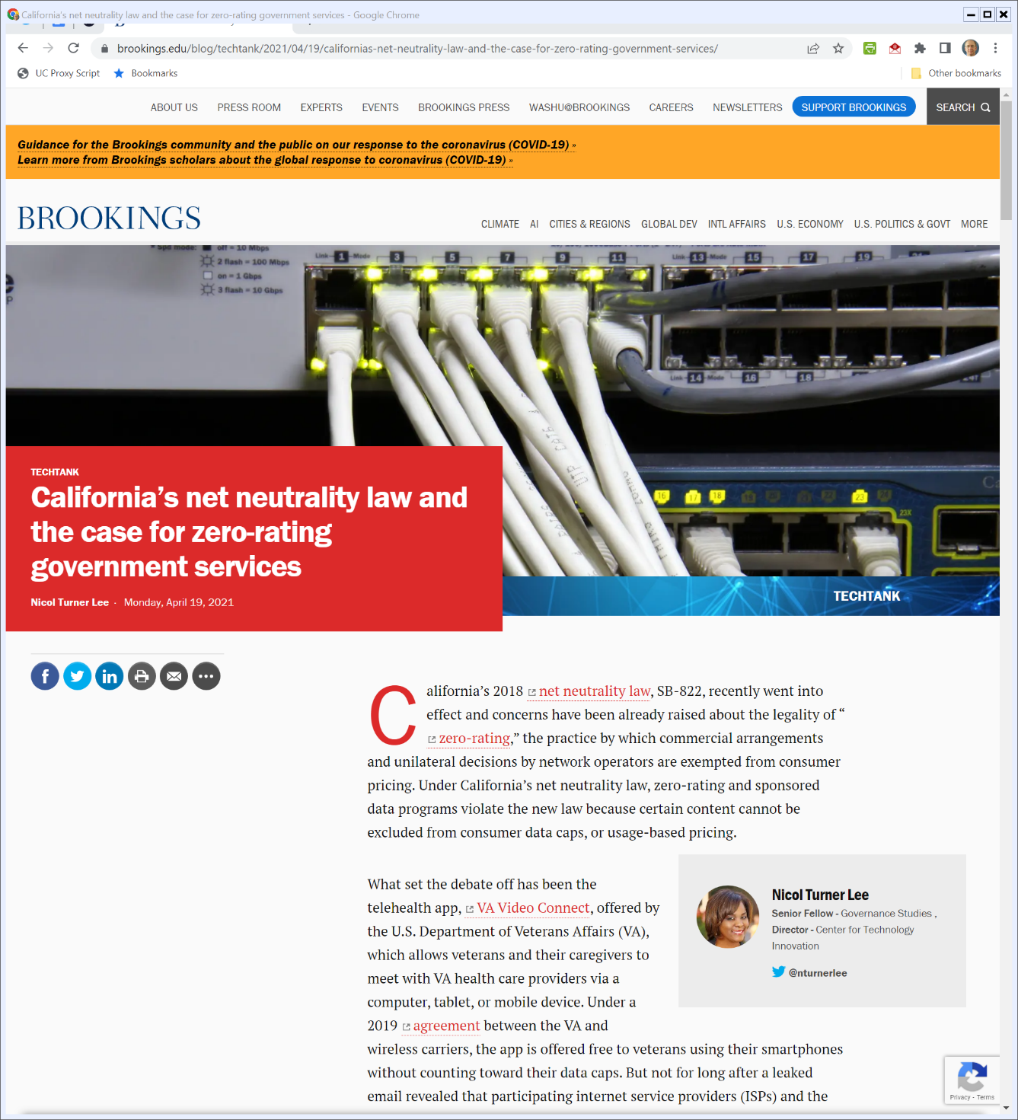

Zero Rating
Brookings (19 Apr 2021)

