Slide 1
Class 10
Platforms and Networks
Spring 2022
Internet: Creation and Construction
Randal C. Picker
James Parker Hall Distinguished Service Professor of Law
The Law School
The University of Chicago
Copyright © 2014-22 Randal C. Picker. All Rights Reserved.

Slide 2
The Focus Today
Key Questions/Issues
  Given the framework provided by the 1996 Telecommunications Act, how should the FCC classify broadband service?
  What turns on that classification choice?

Slide 3
Communications Act of 1934
Pub. L. 73-416 (19 June 1934)

Slide 4
Definition of Common Carrier
Pub. L. 73-416 (19 June 1934)

Slide 5
Title II: Common Carrier Duties
Pub. L. 73-416 (19 June 1934)

Slide 6
Title II: Common Carrier Duties
Pub. L. 73-416 (19 June 1934)

Slide 7
Title II: Common Carrier Duties
Pub. L. 73-416 (19 June 1934)

Slide 8
4 Oct 1957: Sputnik Launch
New York Herald Tribune (6 Oct 1957)

Slide 9
4 Oct 1957: Sputnik Launch
New York Herald Tribune (6 Oct 1957)

Slide 10
“A Grave Defeat for America”
New York Herald Tribune (6 Oct 1957)

Slide 11
Communist Triumph
New York Herald Tribune (6 Oct 1957)

Slide 12
Trailing in ICBMs
New York Herald Tribune (6 Oct 1957)

Slide 13
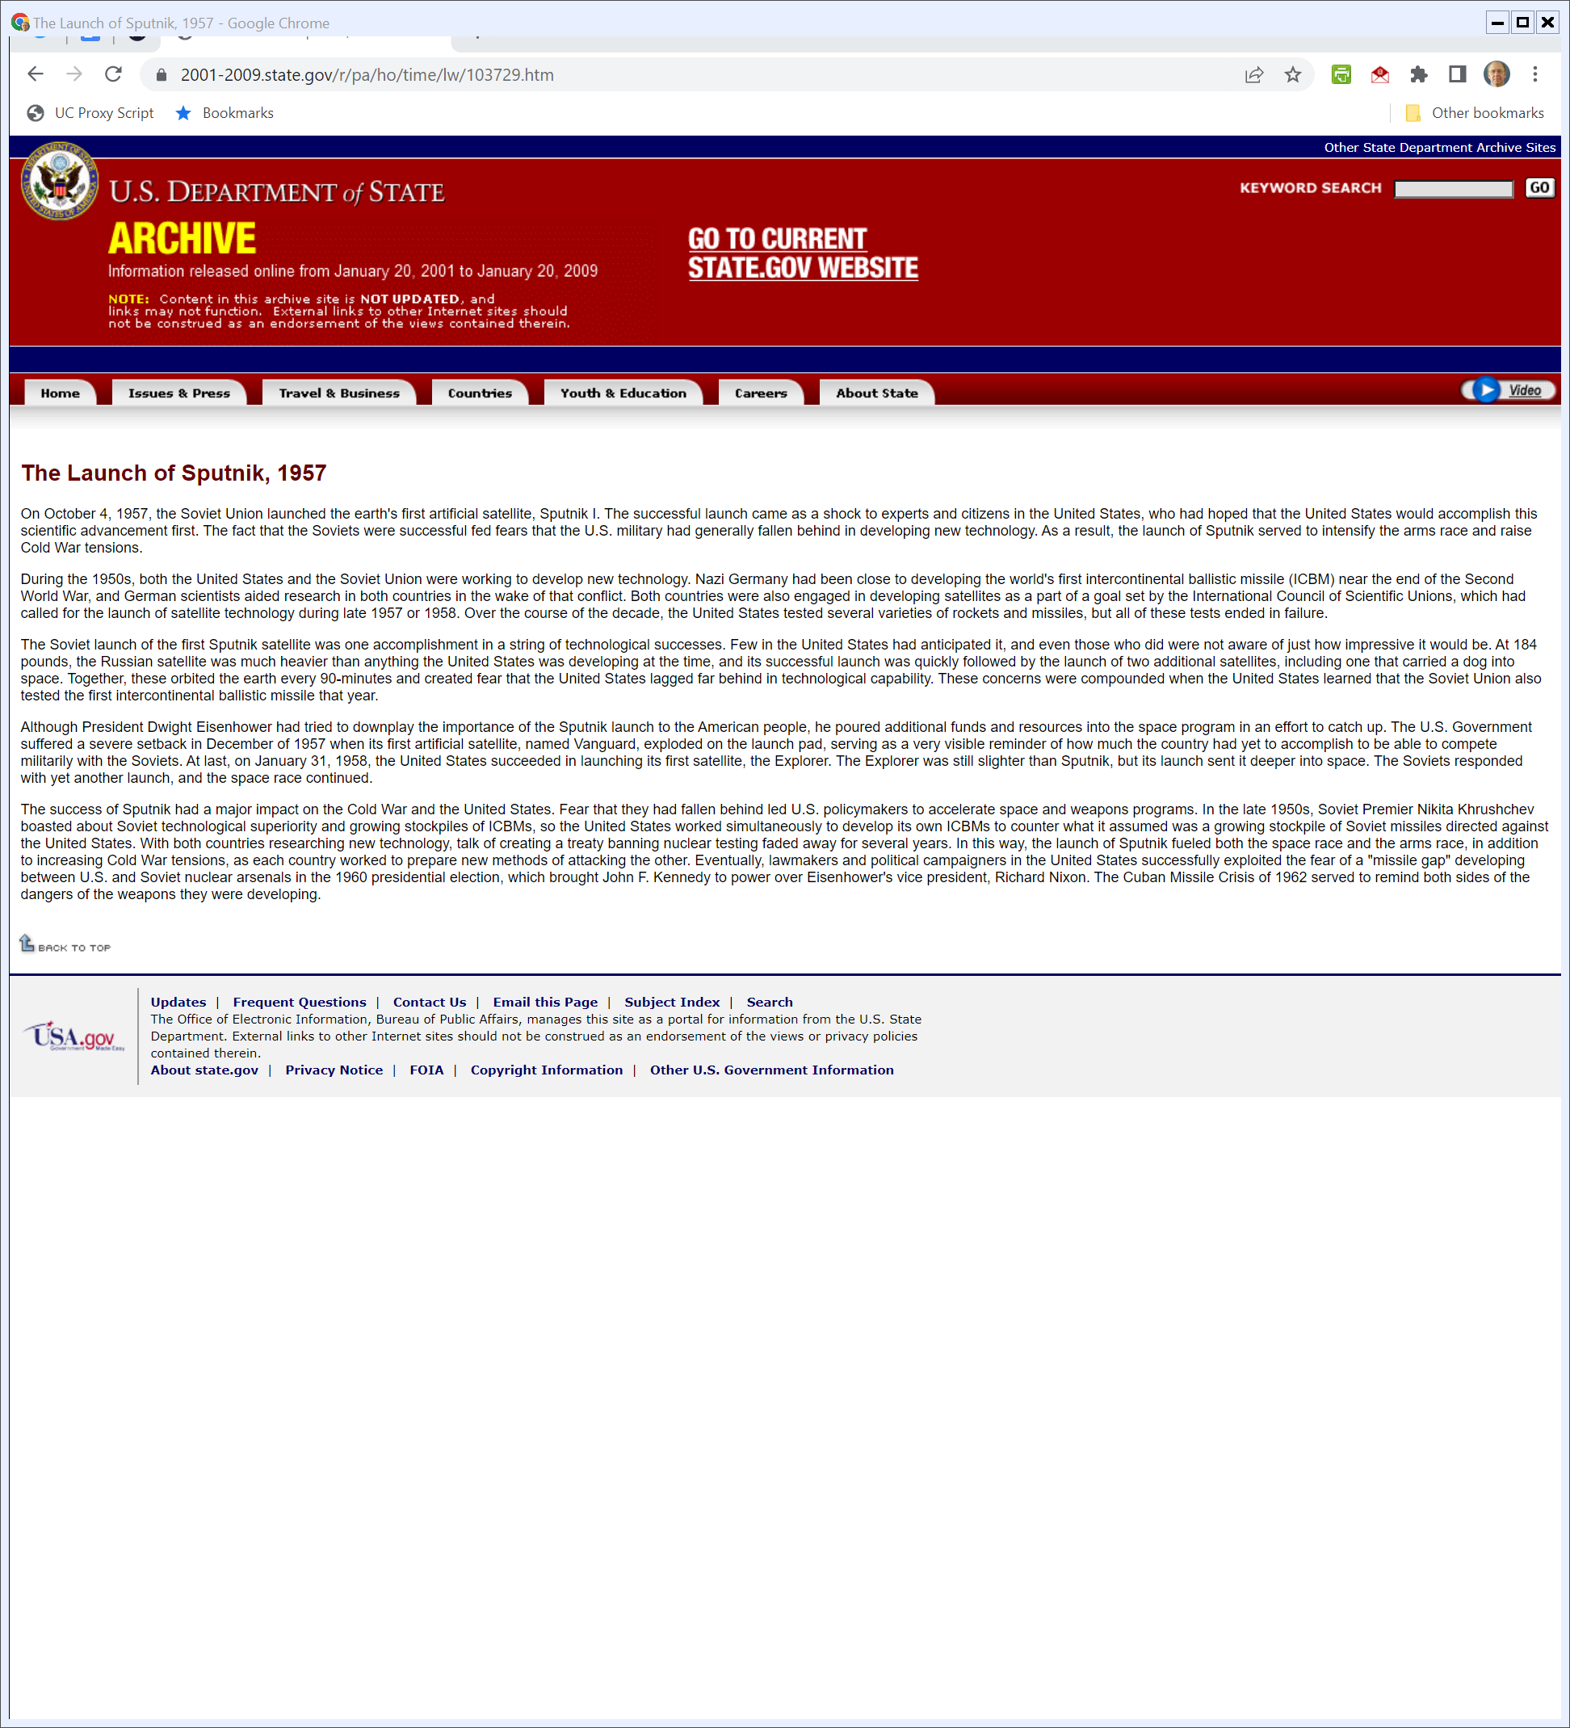
U.S. State Dept Assessment of Sputnik
State.gov (Visited 11 Apr 2022)
Notes:
https://2001-2009.state.gov/r/pa/ho/time/lw/103729.htm

Slide 14
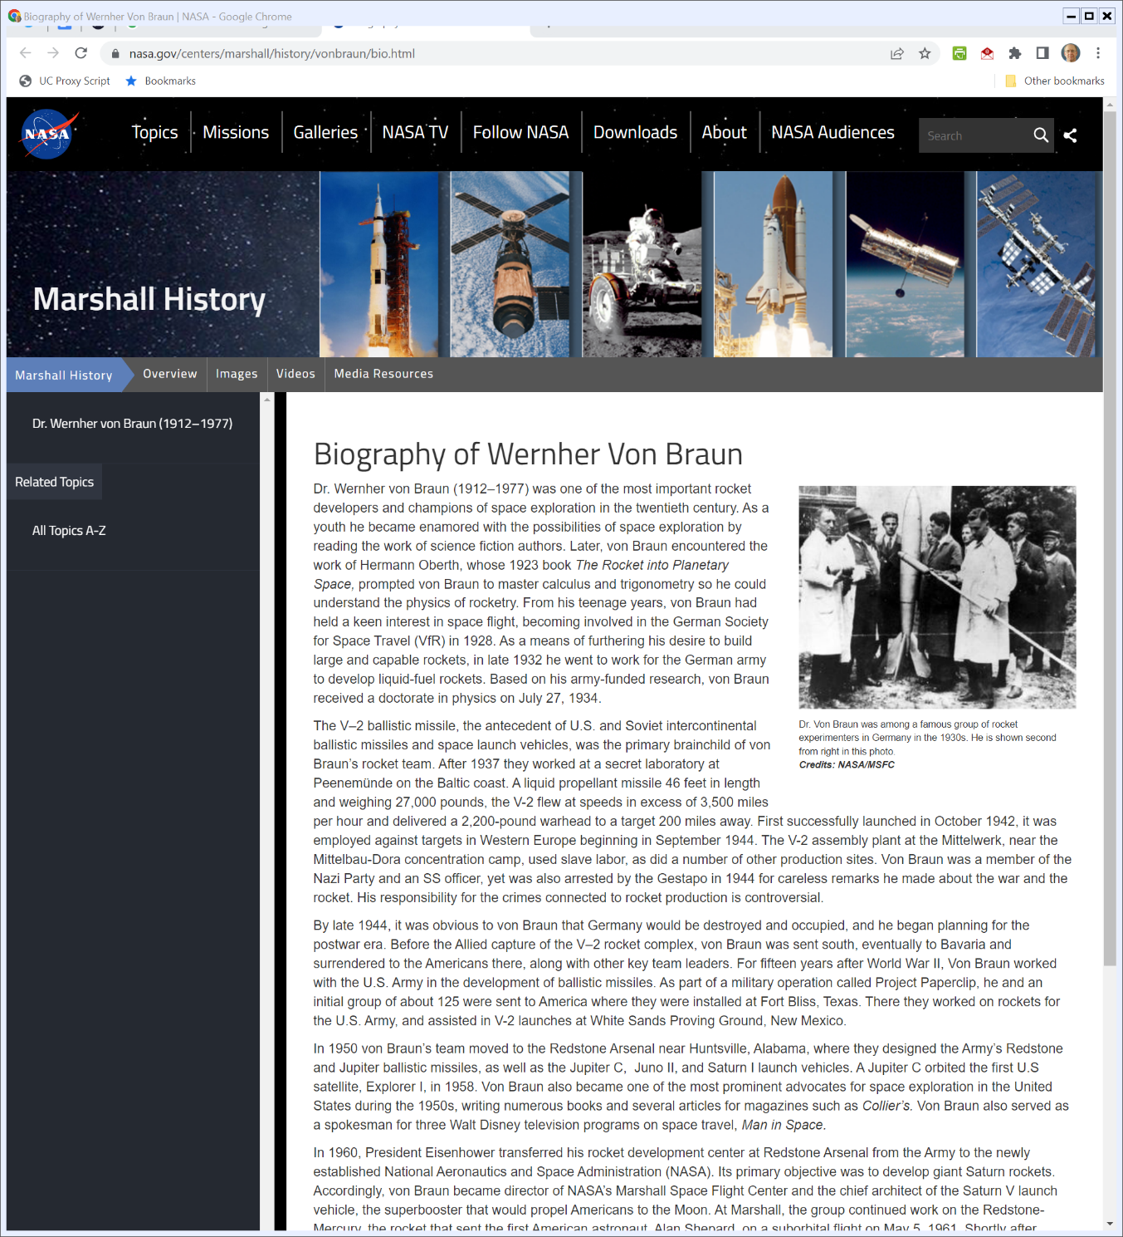

Werner von Braun
Nasa.gov (Visited 11 Apr 2022)
Notes:
https://www.nasa.gov/centers/marshall/history/vonbraun/bio.html

Slide 15
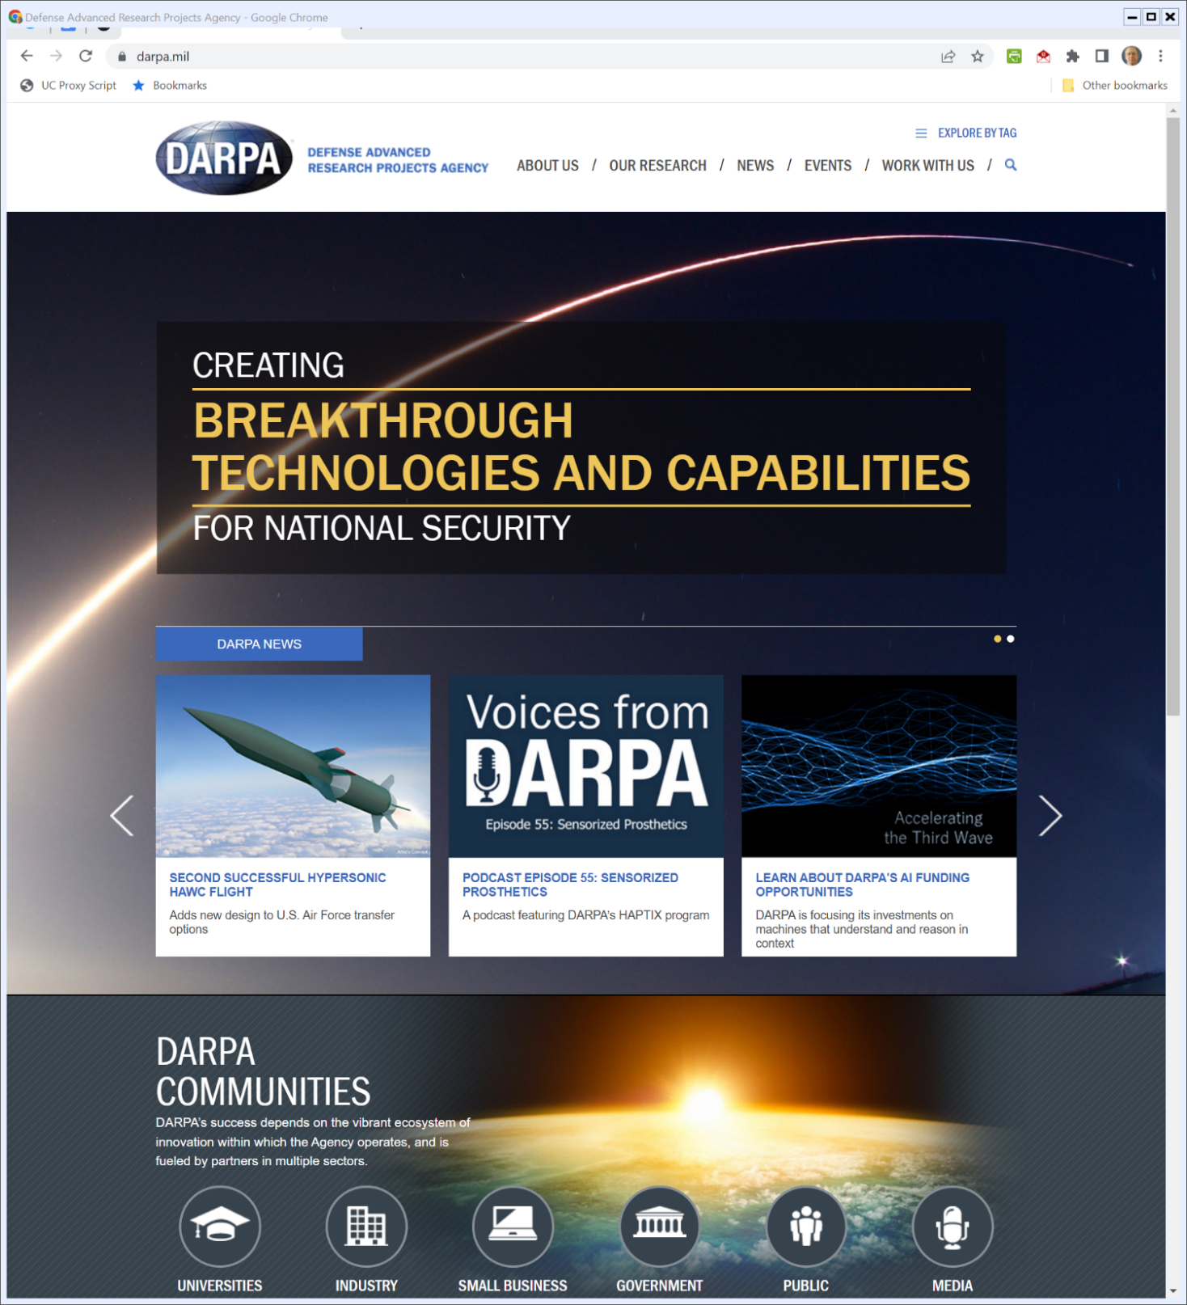
DARPA

Slide 16
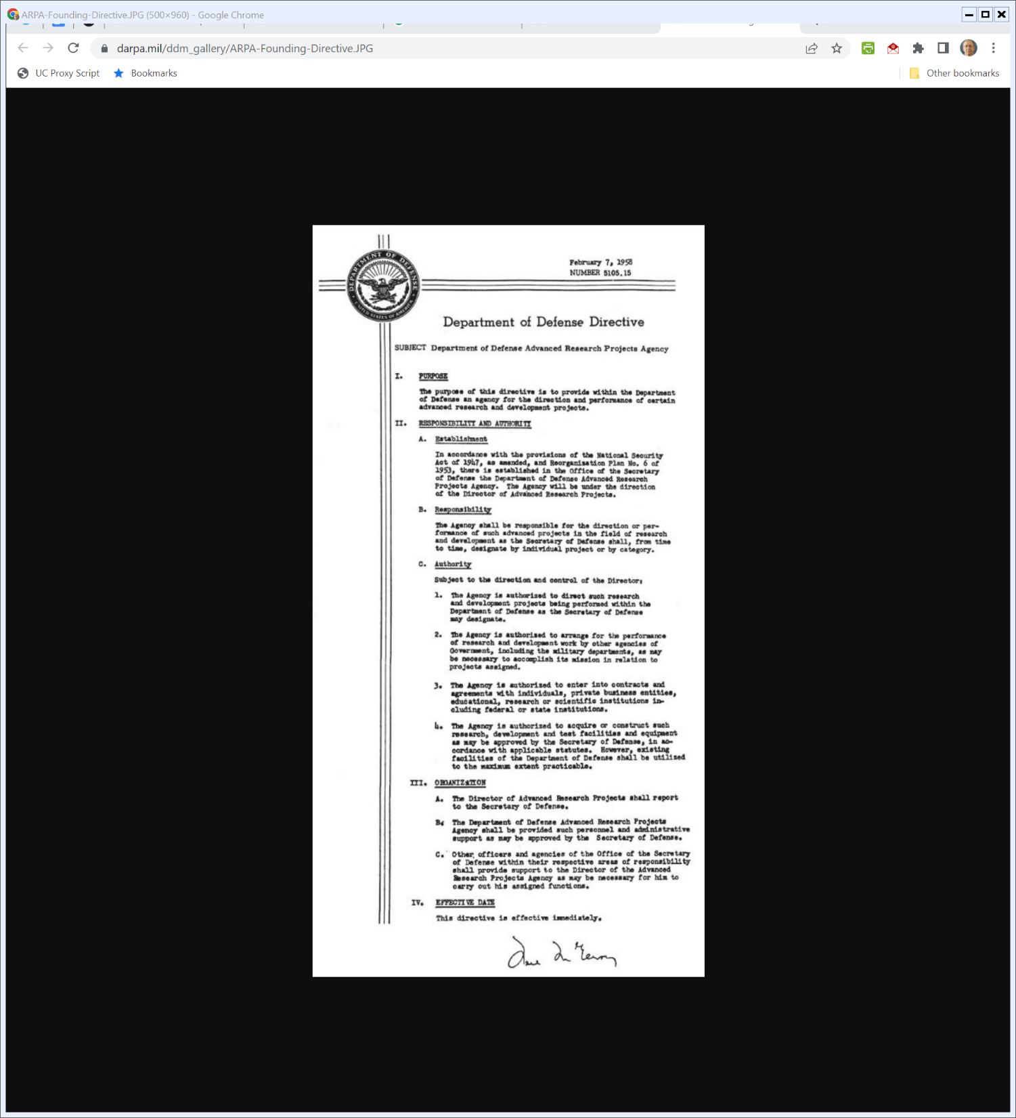
DOD Directive 5105.15
U.S. DOD (7 Feb 1958)
Notes:
https://www.darpa.mil/ddm_gallery/ARPA-Founding-Directive.JPG

Slide 17
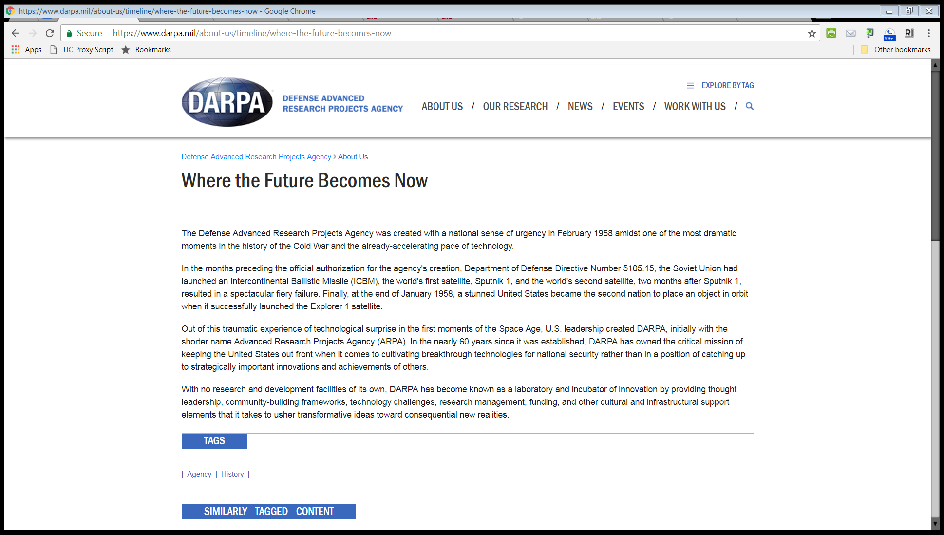
DARPA History
“The Defense Advanced Research Projects Agency was created with a national sense of urgency in February 1958 amidst one of the most dramatic moments in the history of the Cold War and the already-accelerating pace of technology.”

Slide 18
DARPA History
“Out of this traumatic experience of technological surprise in the first moments of the Space Age, U.S. leadership created DARPA, initially with the shorter name Advanced Research Projects Agency (ARPA).”

Slide 19
Licklider Memo
ARPA (23 Apr 1963)

Slide 20
“Netted Together”
ARPA (23 Apr 1963)

Slide 21
Baran On Distributed Communications Networks
IEEE (Mar 1964)

Slide 22
Baran On Distributed Communications Networks
IEEE (Mar 1964)

Slide 23
Dec 1969: APRANET
BBN Report No. 4799 (Apr 1981)

Slide 24
Cerf & Kahn (1974)
IEEE (May 1974)

Slide 25
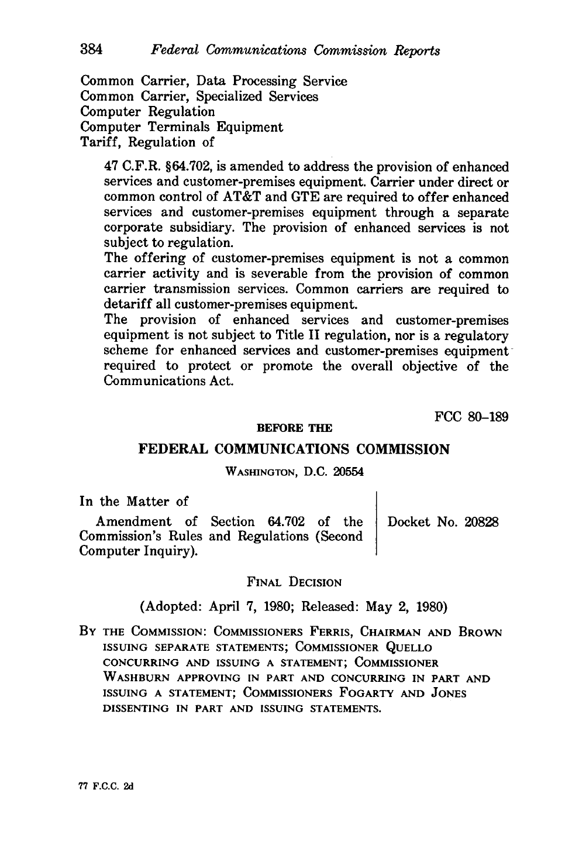
FCC Computer II Ruling
FCC (2 May 1980)

Slide 26
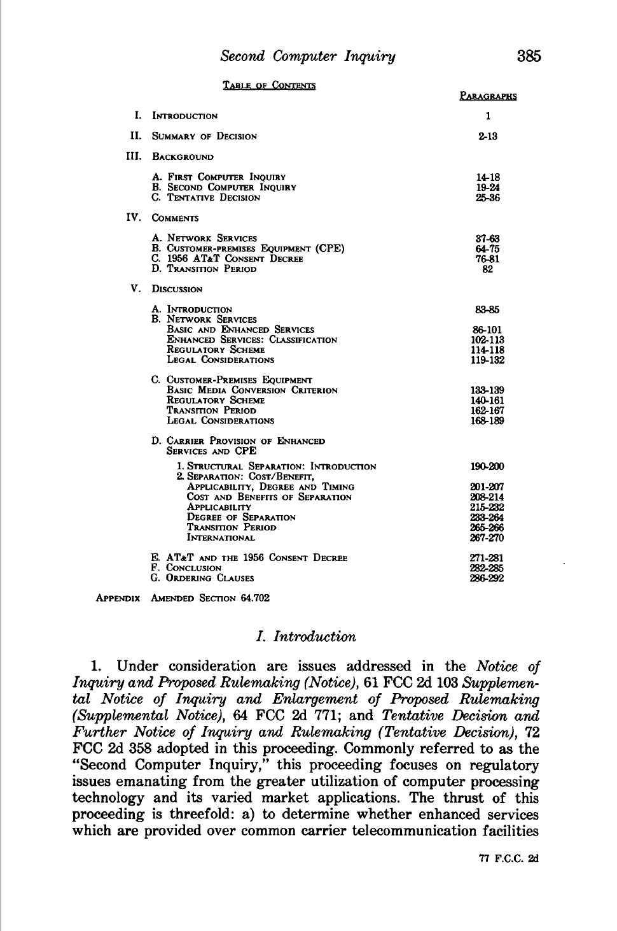
FCC Computer II Ruling
FCC (2 May 1980)

Slide 27
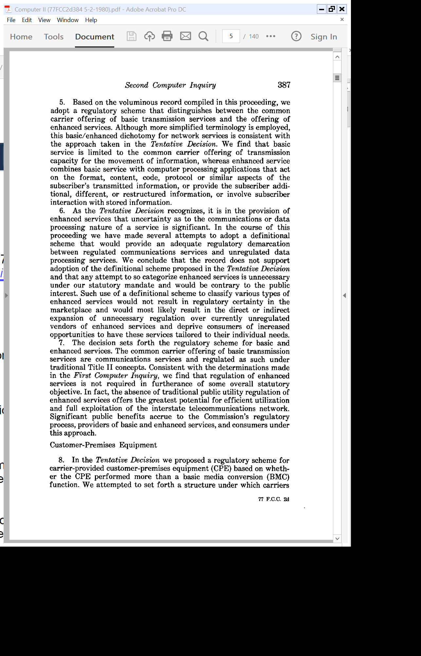
Separate Basic Services (Common Carrier) from Enhanced Services
FCC (2 May 1980)

Slide 28
Don’t Regulate Enhanced Offerings
FCC (2 May 1980)

Slide 29
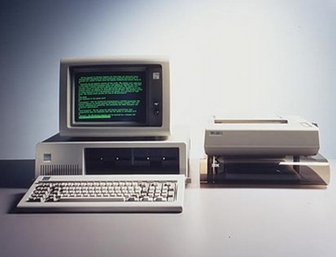
12 Aug 1981: IBM PC

Slide 30
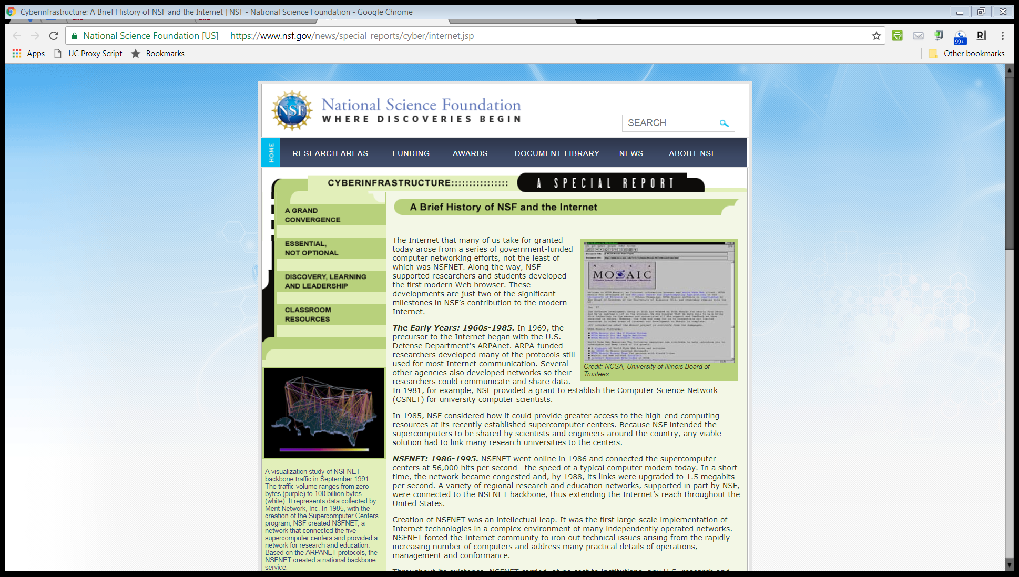
Transition from APRA
NSF.gov
Notes:
https://www.nsf.gov/news/news_summ.jsp?cntn_id=103050

Slide 31
NSFNET
NSF.gov

Slide 32
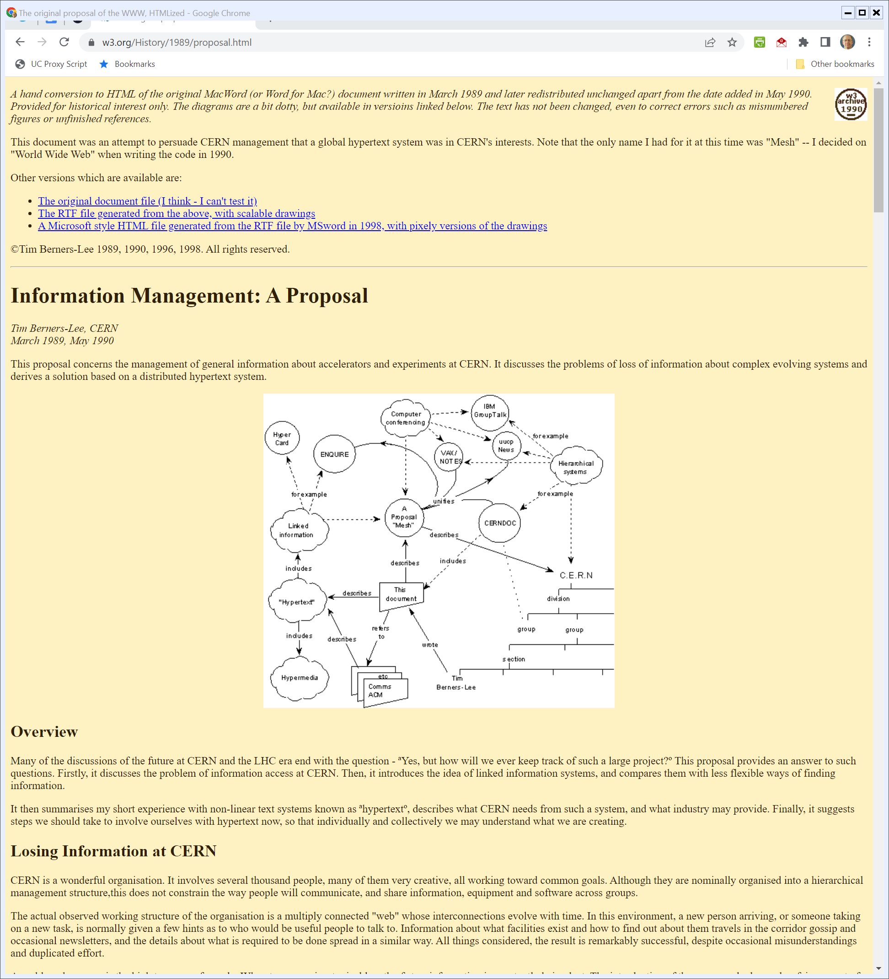
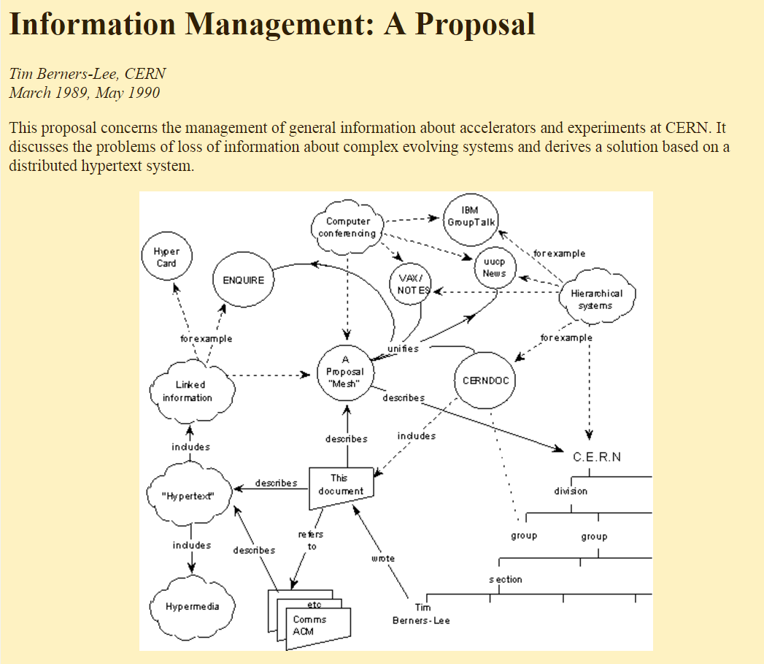
Mar 1989: Berners-Lee Mesh Proposal
www.w3.org
Notes:
https://www.w3.org/History/1989/proposal.html

Slide 33
1991 Computing Act
Pub. L. 102-194 (9 Dec 1991)

Slide 34
Legislative History
S. Rep. 102-64 (23 May 1991)

Slide 35
From the APRANET …
S. Rep. 102-64 (23 May 1991)

Slide 36
To the Internet
S. Rep. 102-64 (23 May 1991)

Slide 37
NCSA Mosaic
New York Times (8 Dec 1993)

Slide 38
NCSA Mosaic
New York Times (8 Dec 1993)

Slide 39
1996 Act: 107 Pages
Pub. L. 104-104 (Feb 8 1996)

Slide 40
Definition of Information Service
Pub. L. 104-104 (8 Feb 1996)

Slide 41
Telcom Definitions
Pub. L. 104-104 (8 Feb 1996)

Slide 42
Regulation of Telcom Services
Pub. L. 104-104 (8 Feb 1996)

Slide 43
47 USC 254: Universal Service
Pub. L. 104-104 (8 Feb 1996)

Slide 44
Definition of Universal Service
Pub. L. 104-104 (8 Feb 1996)

Slide 45
Scope; Payment Obligations
Pub. L. 104-104 (8 Feb 1996)

Slide 46
More Payment Differences
Pub. L. 104-104 (8 Feb 1996)

Slide 47
New Forbearance Rules
Pub. L. 104-104 (8 Feb 1996)

Slide 48
Advanced Telecommunications
Pub. L. 104-104 (8 Feb 1996)

Slide 49
Definition (and Only Use of “Broadband” in 1996 Act)
Pub. L. 104-104 (8 Feb 1996)

Slide 50
Cable Modem Ruling
“The FCC determined that cable modem service is not a ‘cable service’ as defined by the Communications Act. The FCC also said that cable modem service does not contain a separate ‘telecommunications service’ offering and therefore is not subject to common carrier regulation.”
FCC (14 Mar 2002)
Notes:
https://www.fcc.gov/document/fcc-classifies-cable-modem-service-information-service

Slide 51
Cable Modem Ruling
FCC (15 Mar 2002)

Slide 52
Sept 2001: State of U.S. Broadband
“As of September 2001, 50.5% of U.S. households had Internet connections. The vast majority of them subscribe to “narrowband” service provided over local telephone facilities. … We use the term ‘narrowband’ here to refer to Internet access service that is designed to operate at speeds of less than 200 kilobits-per-second (‘Kbps’) in both directions.”
FCC (15 Mar 2002)

Slide 53
Sept 2001: State of U.S. Broadband
“Industry analysts estimate that high-speed Internet access service is now available to approximately 75-80% of all the homes in the United States via DSL or cable modem service, and approximately 11% of all households subscribe to these services today.”
FCC (15 Mar 2002)

Slide 54
Sept 2004: FCC 4th Broadband Report
FCC (9 Sept 2004)

Slide 55
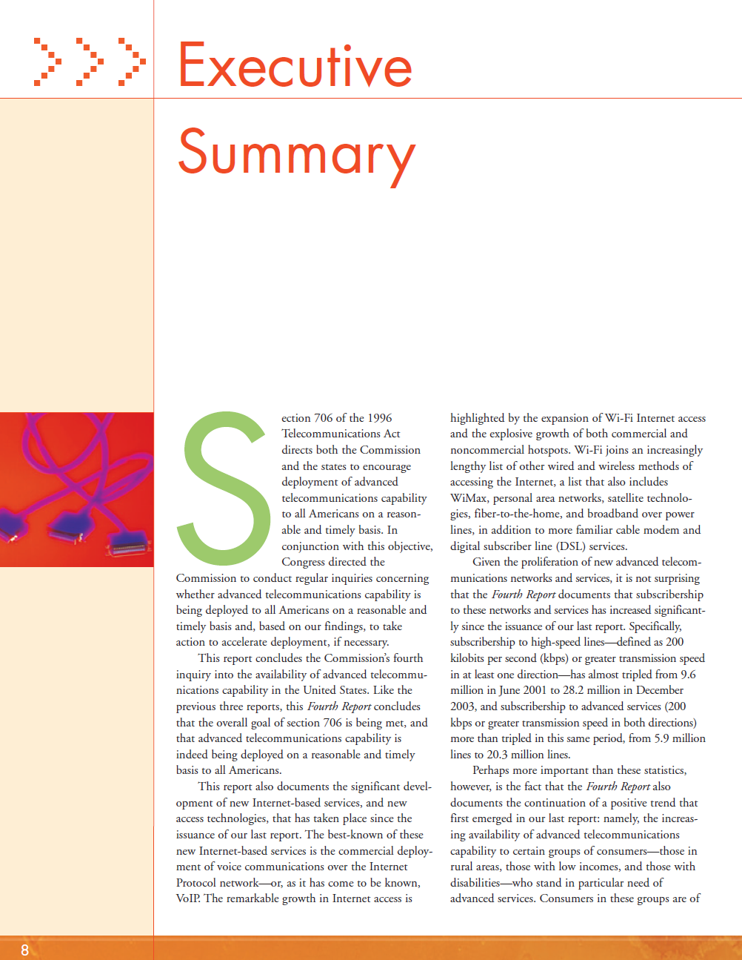
FCC’s Sec. 706 Obligations
FCC (9 Sept 2004)

Slide 56
Broadband Growth
FCC (9 Sept 2004)

Slide 57
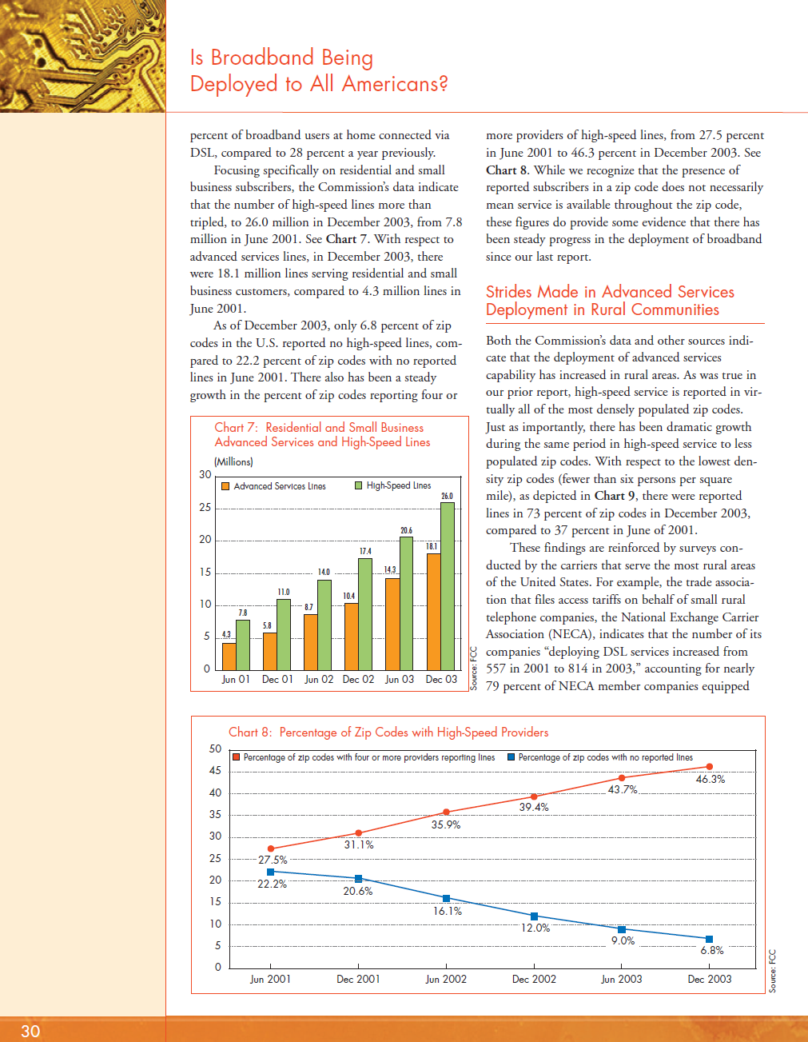
How Much Competition is There?
FCC (9 Sept 2004)

Slide 58
U.S. v. The World
FCC (9 Sept 2004)

Slide 59
New Tech Developments: Wi-Fi!
FCC (9 Sept 2004)

Slide 60
Brand X
545 U.S. 967 (2005)

Slide 61
Key Questions
Questions
  1. What turned on how the FCC classified cable modem service?
  2. How did the language of the 1996 Act limit the choices available to the FCC?
  3. Does the FCC’s choice survive the Chevron standard?
  4. How do you get your pizza?

Slide 62
Aug 2005: New DSL Order
FCC (5 Aug 2005)

Slide 63
Aug 2005: New DSL Order
FCC (5 Aug 2005)

Slide 64
Aug 2005: Open Internet Statement
FCC (5 Aug 2005)

