Slide 1
Class 9 Platforms and Networks Spring 2022 Telcom: Unbundling under the 1996 Act
Randal C. Picker
James Parker Hall Distinguished Service Professor of Law
The Law School
The University of Chicago
Copyright © 2014-22 Randal C. Picker. All Rights Reserved.

Slide 2
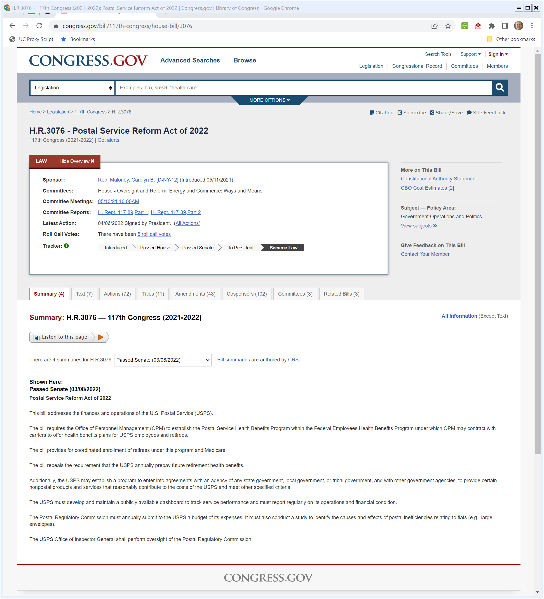
Postal Reform Act Signed Yesterday
Congress.gov

Slide 3
The Focus Today
Key Questions/Issues
The 1982 AT&T breakup was based on the idea of unbundling long-distance and local telephone service, where the former was seen as competitive and the latter as a natural monopoly
How should we extend that framework to the unbundling of the local telephone network?

Slide 4
The Focus Today
Key Questions/Issues
Are all aspects of local telephone networks natural monopolies? Are there pieces where competition might occur?
How do we facilitate that competition through access to the NM components? At what prices?

Slide 5
Natural Monopoly: Two Key Pricing Issues
Above MC Pricing Loses Welfare
Pricing above marginal costs entails a loss of welfare. There are consumers who would be happy to pay more than what it costs to generate the next unit who will be denied access to the good.

Slide 6
Natural Monopoly: Two Key Pricing Issues
MC Pricing Causes Insolvency
At the same time, if price is set at marginal cost, the firm loses money. It recovers only the marginal costs of production and does not recover its fixed costs.

Slide 7
Ramsey Pricing: Max Welfare Subject to Solvency
Goal
Set prices so as to maximize consumer welfare while ensuring that the firm is just solvent.
Question
How do we price in the best way while recovering the fixed costs?

Slide 8
Ramsey Pricing: Max Welfare Subject to Solvency
Intuition
Lose less social welfare by trying to recover the fixed costs from the relatively inelastic market

Slide 9
Expected Savings from Price Caps
FCC Chair Statement (16 Mar 1989)

Slide 10
Problems with Rate-of-Return Regs
FCC Chair Statement (16 Mar 1989)

Slide 11
Dynamic Reg Structure
FCC Chair Statement (16 Mar 1989)

Slide 12
Dynamic Reg Structure
FCC Chair Statement (16 Mar 1989)

Slide 13
Price Caps v. Rate of Return Regulation
Perverse or Missing Incentives under Rate of Return Regulation
Utilities just pass through costs (subject to prudence); no incentive to reduce costs or innovate
If utility has regulated and unregulated components, will dump costs from unreg to reg

Slide 14
1996 Act: 107 Pages
Pub. L. 104-104 (Feb 8 1996)

Slide 15
Spurring Local Competition
Telecommunications Act of 1996

Slide 16
Special RBOC Regs
Telecommunications Act of 1996

Slide 17
Broadcast
Telecommunications Act of 1996

Slide 18
Cable/Regulatory Reform
Telecommunications Act of 1996

Slide 19
Obscenity and Violence
Telecommunications Act of 1996

Slide 20
Miscellaneous
Telecommunications Act of 1996

Slide 21
BOC Entry Into Non-Local Calling
Telecommunications Act of 1996

Slide 22
Facilities-Based Competition
Telecommunications Act of 1996

Slide 23
BOCs and Electronic Publishing
Telecommunications Act of 1996

Slide 24
Relationship between 1996 Act and Consent Decrees
Telecommunications Act of 1996

Slide 25
Unbundling Local and Long Distance
Long Distance Success Story
Separate local calling from long distance
Microwave entry—facilities-based entry—as starting point
Creates lots of competition in long distance
Mental model for 1996 Act approach

Slide 26
Telco Act Structure
1996 Act
Passed February 8, 1996
Kills off the Modified Final Judgment
Basic Idea
Instant competition by reducing state law entry barriers
Limited, targeted entry while offering full-slate of services

Slide 27
1996 Act’s Local Competition Framework
Three Key Changes
Kills State Entry Barriers
Feds preempt state entry barriers (47 USC 253(a))
Quarantine BOCs
Can’t enter long distance unless facilities-based local competitor exists (47 USC 271)

Slide 28
1996 Act’s Local Competition Framework
Incumbent Local Exchange Carrier Access Rules (47 USC 251(c))
Interconnection
Exchange and completion of telephone calls
Unbundling
More on this
Resale
Offer telecommunications services for resale at wholesale rates

Slide 29
251(c)(2): ILEC Interconnection Obligation
Telecommunications Act of 1996

Slide 30
251(c)(3): UNEs: Unbundled Network Elements
Telecommunications Act of 1996

Slide 31
Definition of Network Element
Telecommunications Act of 1996

Slide 32
251(c)(4): Resale
Telecommunications Act of 1996

Slide 33
251(d): Reg Timeline/Access Standards (necessary/impair)
Telecommunications Act of 1996

Slide 34
252(a): Access at What Price?: Contracts Sent to PUCs
Telecommunications Act of 1996

Slide 35
252(b): Arbitration before State PUC
Telecommunications Act of 1996

Slide 36
252(d): Pricing Standards
Telecommunications Act of 1996

Slide 37
252(d)(3): Wholesale Prices
Telecommunications Act of 1996

Slide 38
Access and Necessary: Three Approaches
TTYN (1 of 4)
Essential Facilities as Physical Necessity
Impossible physically to build new element
Economic Necessity
Yes, a new facility could be built, but it could not be sustained economically

Slide 39
Access and Necessary: Three Approaches
TTYN (2 of 4)
Policy Necessity
Yes, it could be sustained economically, but it would take many years, and that would delay local competition substantially

Slide 40
Implementing the 1996 Act
TTYN (3 of 4)
Hypo
It is 1996 and you are a the FCC and have six months to issue new rules to implement the new act
You have been tasked to offer an understanding of “necessary” and “impair” in implementing the sharing obligations of the 1996

Slide 41
Implementing the 1996 Act
TTYN (4 of 4)
Hypo
You have also been asked to offer an interpretation of the pricing provisions of 252(d)(1)(A)
What goal do you have in establishing the rules? What choices can you make to reach that goal?

Slide 42
758 Pages
FCC 1st Report and Order (8 Aug 1996)

Slide 43
Understanding “Necessary”
FCC 1st Report and Order

Slide 44
Understanding “Impair”
FCC 1st Report and Order

Slide 45
Pricing: Forward Looking Costs
FCC 1st Report and Order

Slide 46
Iowa Utilities: The Access Rules
525 U.S. 366 (25 Jan 1999)

Slide 47
Iowa Utilities
Question
Does the FCC’s interpretation of “necessary” and “impair” under Section 251(d)(2) survive Chevron deference?

Slide 48
Iowa Utilities Result
Key Results
FCC ignored the possibility of self-provisioning or buying from other third parties in assessing whether access was necessary
FCC counted even a minimal impairment as an impairment justifying access

Slide 49
262 Pages
FCC Third Report and Order (1999)

Slide 50
UNE by UNE
FCC Third Report and Order (1999)

Slide 51
Toughening Up “Necessary”: Preclude
FCC Third Report and Order (1999)

Slide 52
And “Impair”: Materially Diminishes
FCC Third Report and Order (1999)

Slide 53
USTA I: Overturns 2nd Set of FCC Rules
290 F.3d 415 (D.C. Cir. 24 May 2002)

Slide 54
Rules Aren’t Market Specific
“As to almost every element, the Commission chose to adopt a uniform national rule, mandating the element’s unbundling in every geographic market and customer class, without regard to the state of competitive impairment in any particular market. As a result, UNEs will be available to CLECs in many markets where there is no reasonable basis for thinking that competition is suffering from any impairment of a sort that might have the object of Congress’s concern.”
USTA I (D.C. Cir. 2002)

Slide 55
Verizon: Understanding TELRIC
535 U.S. 467 (13 May 2002)

Slide 56
Verizon
Question
Does the FCC’s interpretation of “cost” under Section 252(d)(1) survive Chevron deference?

Slide 57
UNE Pricing: 47 USC 252(d)(1)
Determinations by a State commission of the just and reasonable rate for the interconnection of facilities and equipment for purposes of subsection (c)(2) of section 251 of this title, and the just and reasonable rate for network elements for purposes of subsection (c)(3) of such section--

Slide 58
UNE Pricing: 47 USC 252(d)(1)
(A) shall be--
(i) based on the cost (determined without reference to a rate-of-return or other ratebased proceeding) of providing the interconnection or network element (whichever is applicable), and
(ii) nondiscriminatory, and
(B) may include a reasonable profit.

Slide 59
Sec. 252(d)(1) Rewrite I
TTYN (1 of 3)
(A) shall be--
(i) based on the historical cost of providing the interconnection or network element (whichever is applicable), and
(ii) nondiscriminatory

Slide 60
Sec. 252(d)(1) Rewrite II
TTYN (2 of 3)
(A) shall be--
(i) based on the replacement cost of providing the interconnection or network element (whichever is applicable), and
(ii) nondiscriminatory

Slide 61
Buy v. Build Hypo
TTYN (3 of 3)
Facts
Cost $1000 to build facility yesterday
Costs $500 to build same facility today
Will cost $100 to build same facility tomorrow, if we build the facility today.
Question
What price should an entrant face to use the existing facility?

Slide 62
Buy v. Build Hypo
Framework
This is learning by doing in the possible presence of spillovers. (See Tirole, The Theory of Industrial Organization, 329-330 (1988).)

Slide 63
576 Pages
FCC Report and Order (2003)

Slide 64
Expanded Role for States
FCC Report and Order (2003)

Slide 65
USTA II: Overturns Third Set of Rules
359 F.3d 554 (D.C. Cir. 2004)

Slide 66
Can’t Just Delegate to States
“We therefore vacate, as an unlawful subdelegation of the Commission’s § 251(d)(2) responsibilities, those portions of the Order that delegate to state commissions the authority to determine whether CLECs are impaired without access to network elements, and in particular we vacate the Commission’s scheme for subdelegating mass market switching determinations.”
USTA II (D.C. Cir. 2004)

Slide 67
185 Pages
FCC Order on Remand (4 Feb 2005)

Slide 68
UNE Revisions
FCC Order on Remand (4 Feb 2005)

Slide 69
Covad: 4th Set OK
450 F.3d 528 (D.C. 2006)

Slide 70
1996 to 2006: A Decade to Get to Final Rules
“The Federal Communications Commission has thrice attempted—unsuccessfully—to implement the “unbundling” provisions of the Telecommunications Act of 1996. This case involves a series of petitions for review of the FCC’s fourth attempt. Because we conclude the Commission’s fourth try is a charm, we deny all of the petitions for review.”
Covad (D.C. Cir. 2006)

Slide 71
So What Happened?: Landlines by Carrier Type
FCC, Local Telephone Competition Report (as of 31 Dec 2009)

Slide 72
Landlines by Carrier Type
FCC, Local Telephone Competition Report (as of 31 Dec 2013)

Slide 73
Cell Phone Growth
FCC Wireless Report (18 Aug 1995)

Slide 74
Wireless Growth
FCC 10th Ann Wireless Report (30 Sept 2005)

Slide 75
Wireless Growth
FCC 15th Ann Wireless Report (27 June 2011)

Slide 76
U.S. Wireless Connections
FCC, 20th Annual Wireless Report (27 Sept 2017)

