Slide 1
Class 8 Platforms and Networks Spring 2022 Traditional Telcom: Breaking Up AT&T
Randal C. Picker
James Parker Hall Distinguished Service Professor of Law
The Law School
The University of Chicago
Copyright © 2019-22 Randal C. Picker. All Rights Reserved.

Slide 2
The Focus Today
Key Questions/Issues
1. What is the right way to organize telephone competition? Has that changed over time? If so, what caused the changes?
2. How should we use business-line restrictions (quarantines) to shape that competition?
3. How do we ensure nondiscriminatory provision of services by dominant firms?

Slide 3
The Focus Today
Key Questions/Issues
4. How should we think about cross-subsidization here?
5. And, relatedly, you are a legit monopolist. You make a bunch of money. What are you allowed to do with that money?
6. New Class Name: Market Engineering and Competition Design?

Slide 4
1840 Morse Telegraph Patent
U.S. Patent No. 1647 (20 June 1840)

Slide 5
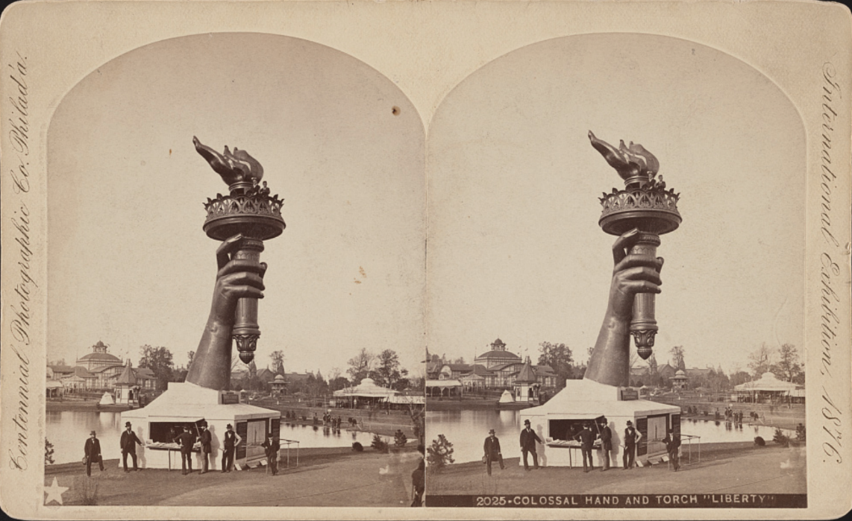
1876 Centennial Exhibition
Library of Congress (Visited 6 Apr 2022)
Notes:
https://www.loc.gov/item/97502738/
https://tile.loc.gov/storage-services/service/pnp/ppmsca/02900/02957v.jpg

Slide 6
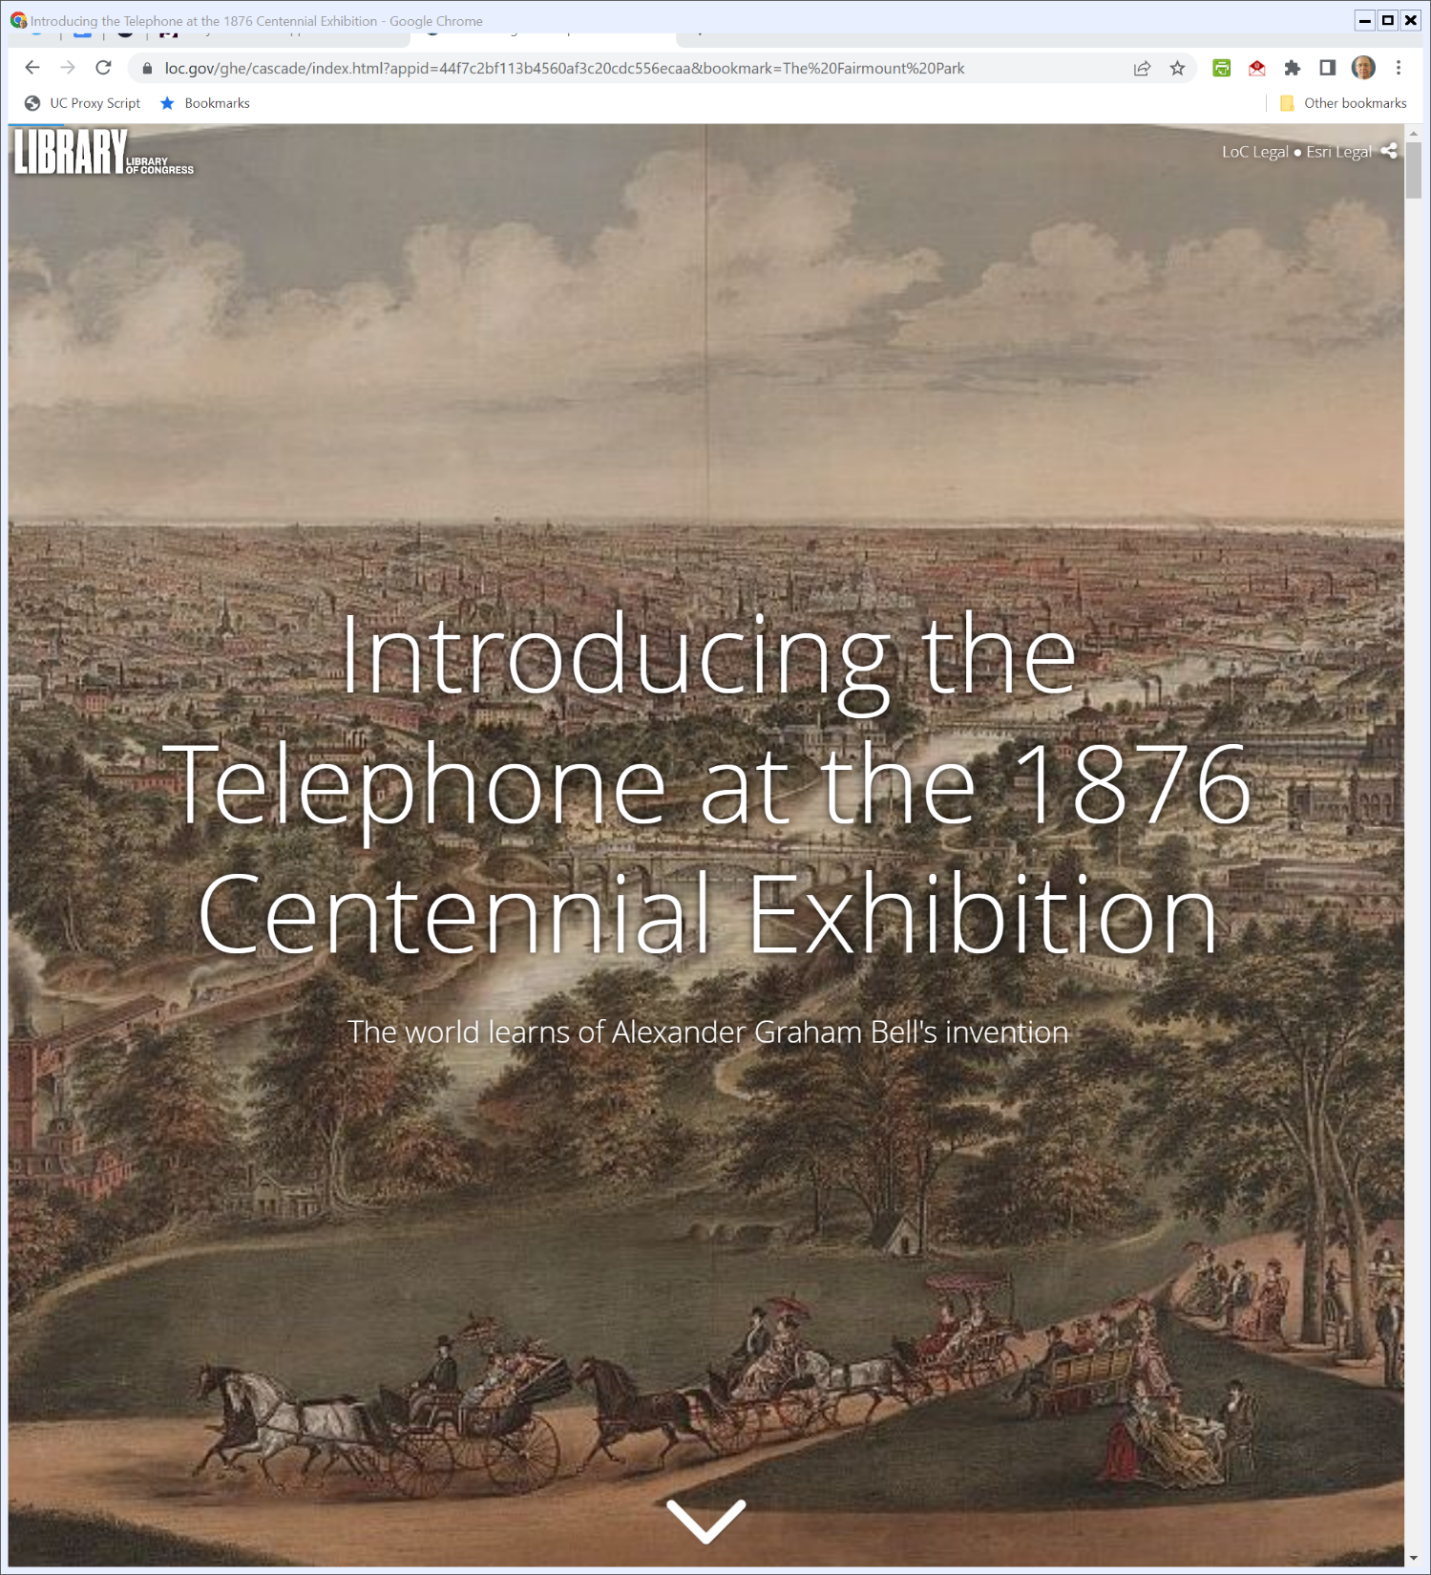
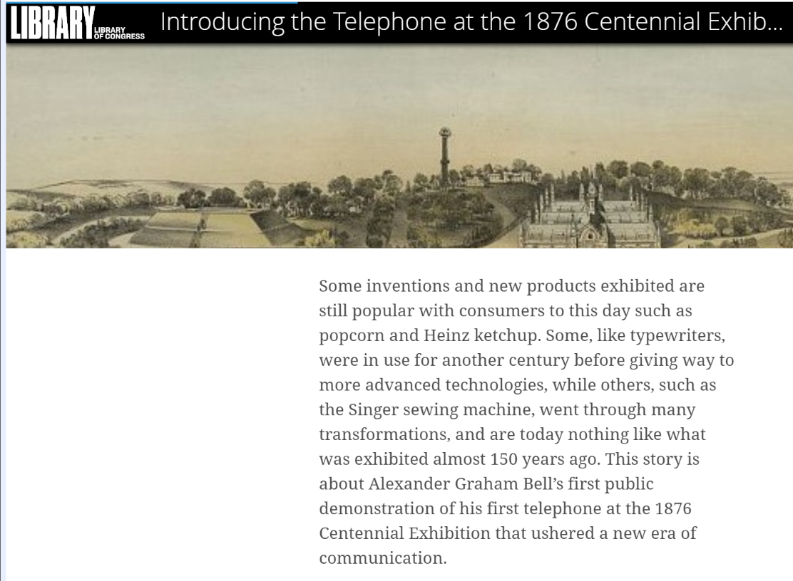
Bell Demonstrates His Invention
Library of Congress (Visited 6 Apr 2022)
Notes:
https://www.loc.gov/ghe/cascade/index.html?appid=44f7c2bf113b4560af3c20cdc556ecaa&bookmark=The%20Fairmount%20Park

Slide 7
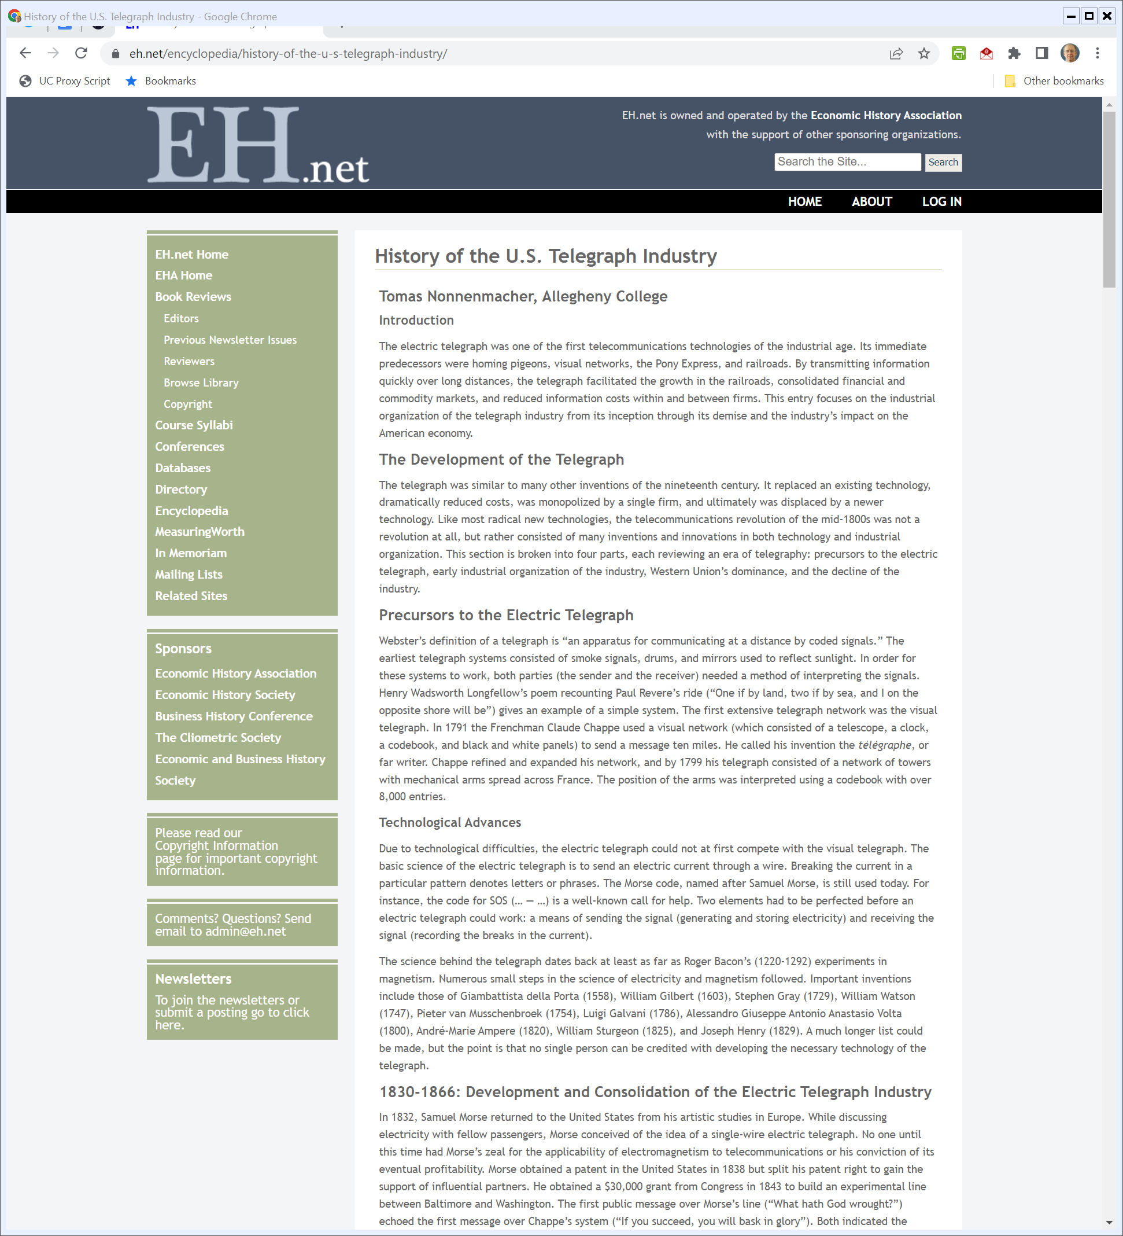
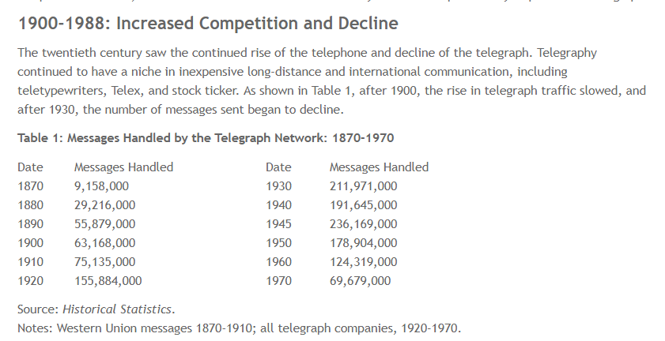
Telegraph Statistics
Nonnenmacher, History of the U.S. Telegraph Industry
Notes:
https://eh.net/encyclopedia/history-of-the-u-s-telegraph-industry/

Slide 8
Telephone Penetration
FCC, Trends in Telephone Service (Sept 2010)

Slide 9
Merger of AT&T and WU
WSJ (18 Nov 1909)

Slide 10
Kingsbury Commitment
NYT (20 Dec 1913)

Slide 11
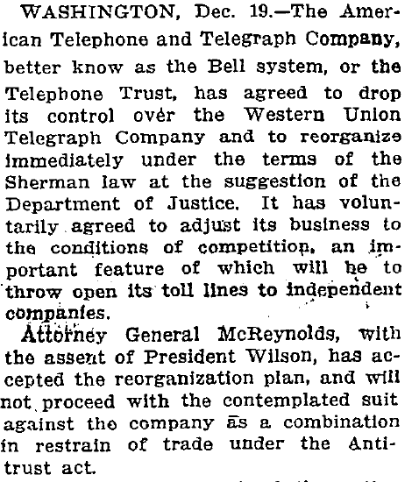
The First Break Up of AT&T: Sell WU and Toll Line Interconnection
NYT (20 Dec 1913)

Slide 12
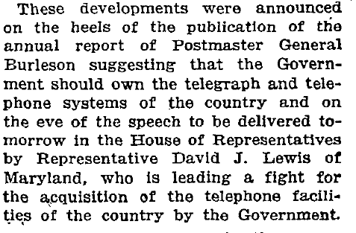
Gov’t Control Over Wires?
NYT (20 Dec 1913)

Slide 13
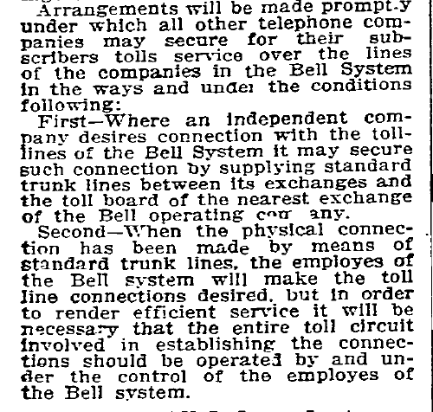
Interconnection
NYT (20 Dec 1913)

Slide 14
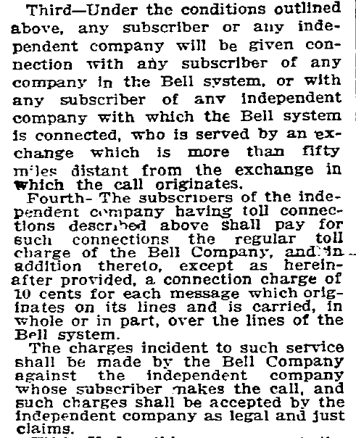
Interconnection
NYT (20 Dec 1913)

Slide 15
ENIAC: Electronic Numerical Integrator and Computer
Chicago Daily Tribune (15 Feb 1946)

Slide 16
ENIAC
Chicago Daily Tribune (15 Feb 1946)

Slide 17
ENIAC Info
Chicago Daily Tribune (15 Feb 1946)

Slide 18
Bardeen & Brattain: The Transistor, A Semi-Conductor Triode
Physical Review (25 June 1948)

Slide 19
NYT on Transistor
New York Times (1 July 1948)

Slide 20
Jan 1949: U.S. Gov’t Brings Antitrust Suit Against AT&T
New York Times (15 Jan 1949)

Slide 21
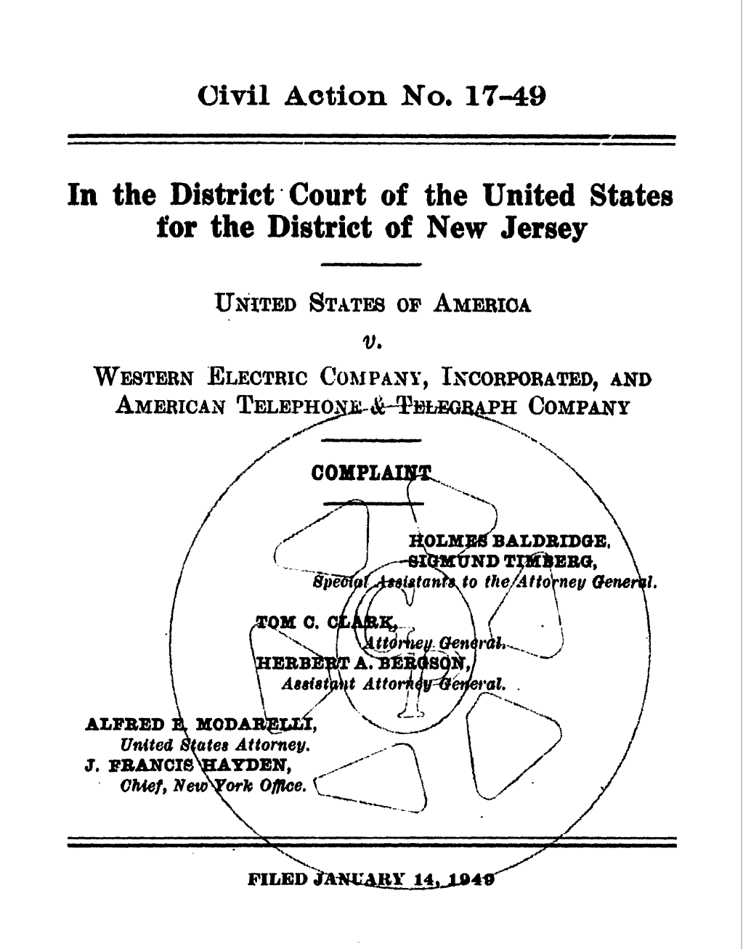
1949 AT&T Antitrust Suit
U.S. v. Western Electric and AT&T (14 Jan 1949)

Slide 22
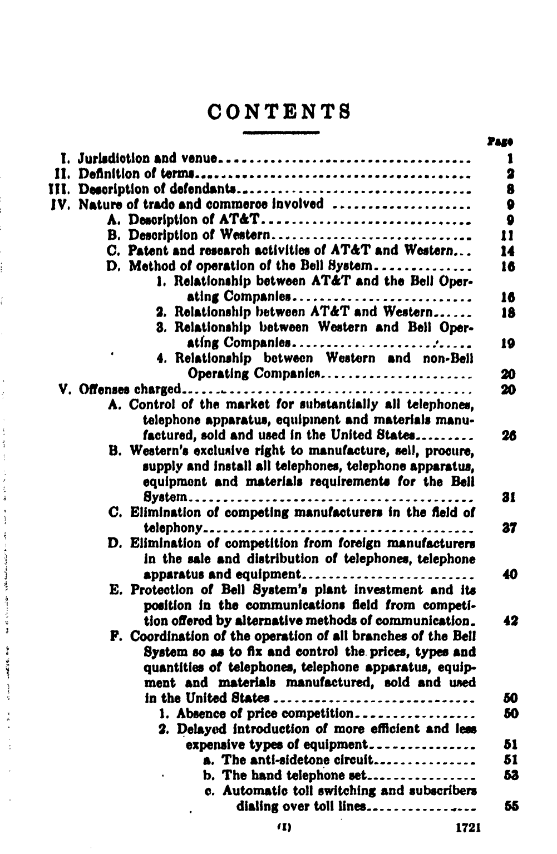
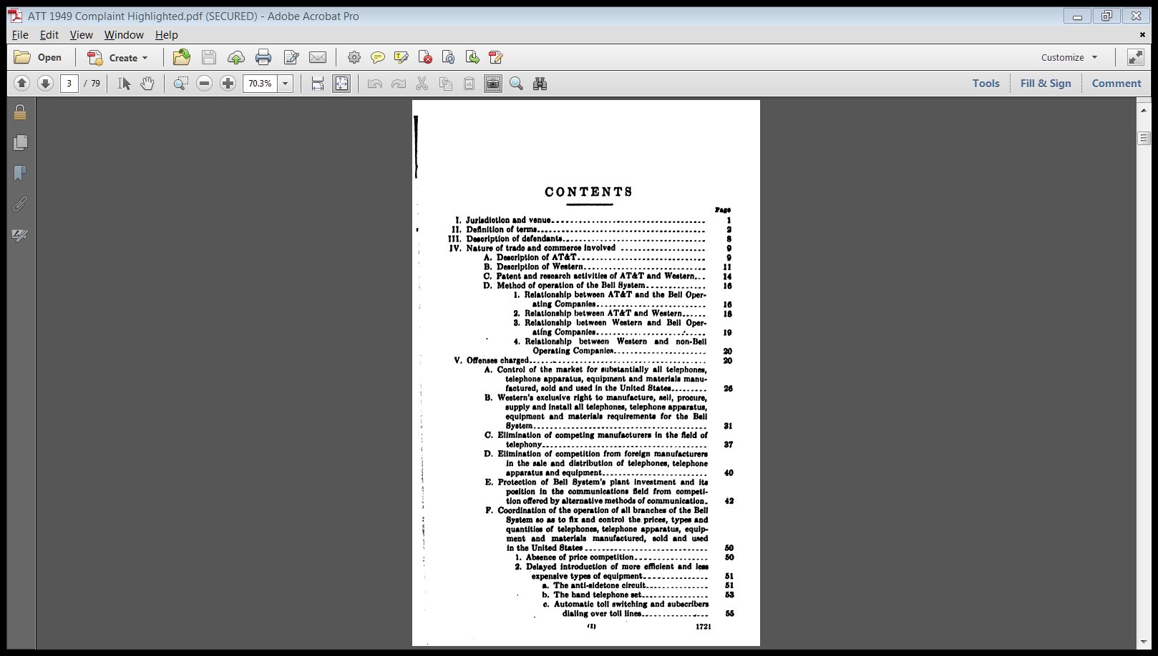
1949 Suit Offenses
U.S. v. Western Electric and AT&T (14 Jan 1949)

Slide 23
1949 Suit Offenses
U.S. v. Western Electric and AT&T (14 Jan 1949)

Slide 24
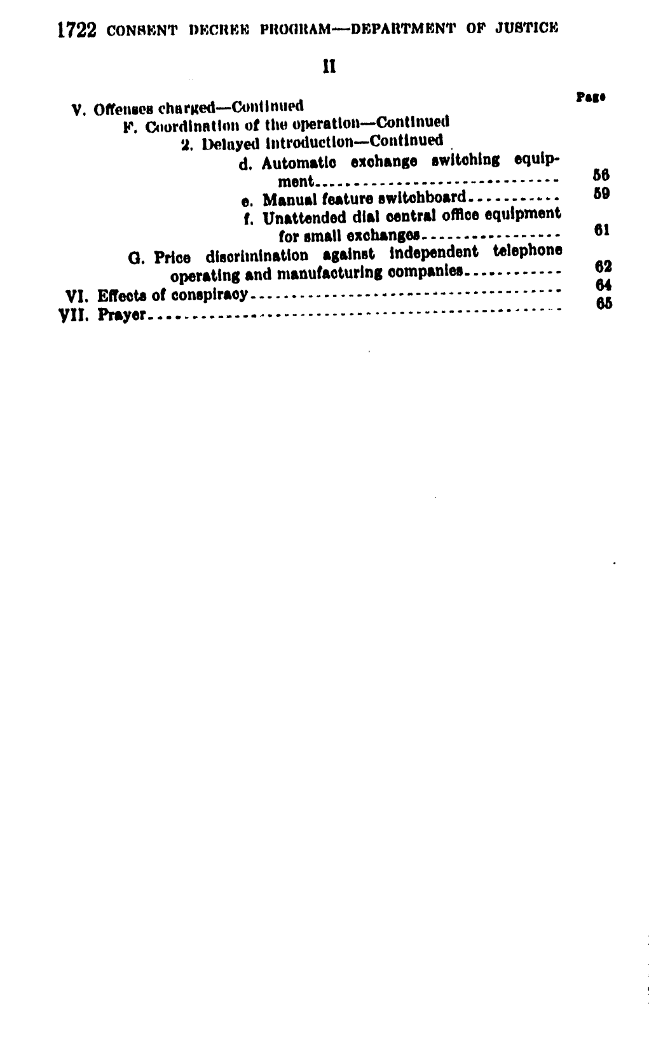
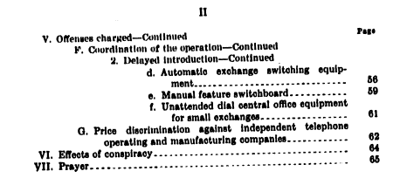
1949 Suit Offenses
U.S. v. Western Electric and AT&T (14 Jan 1949)

Slide 25
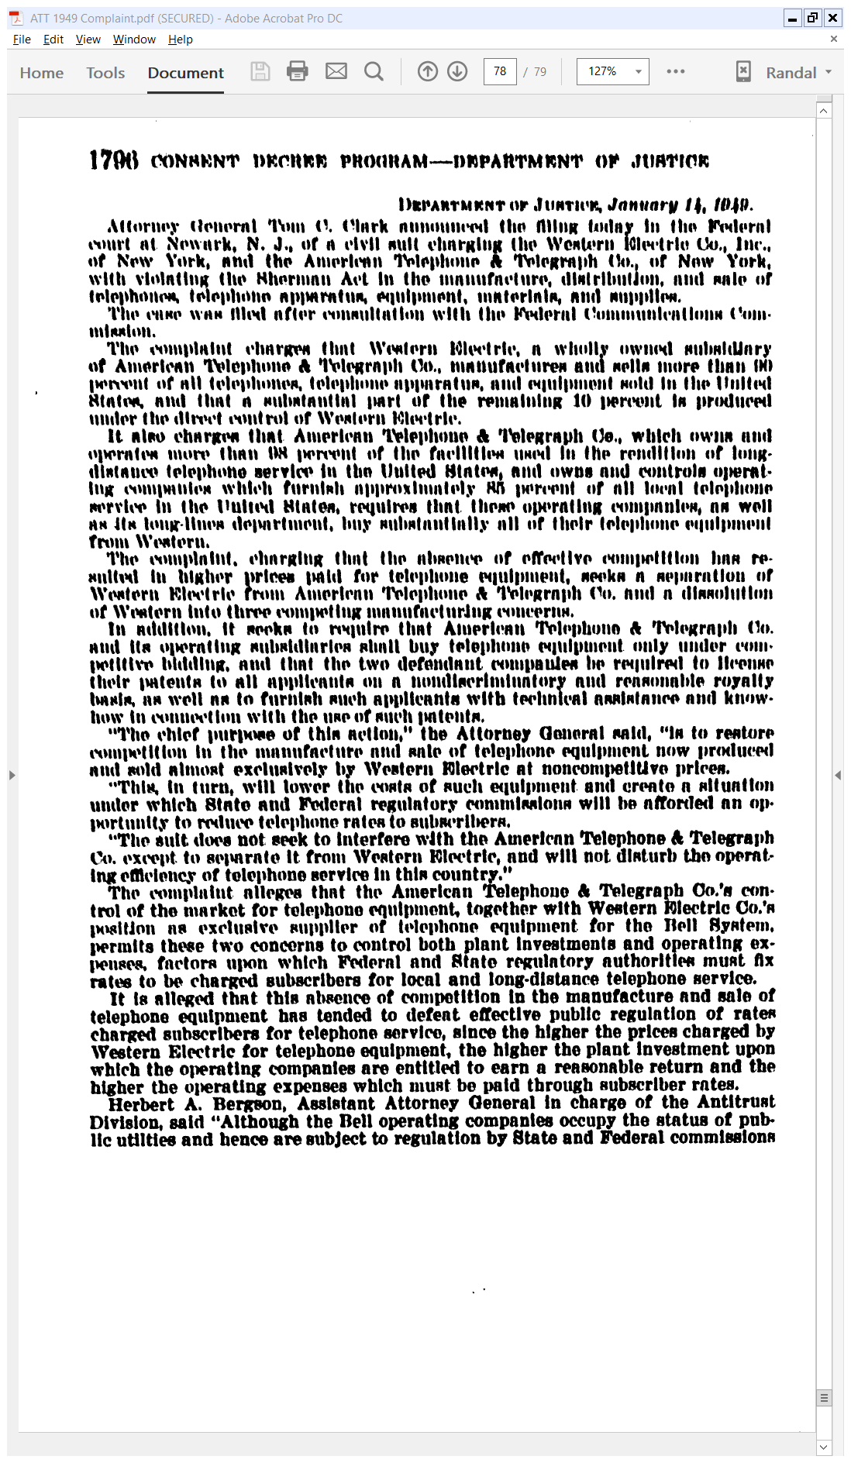
Joint Ownership Defeats Reg
U.S. AG Clark Statement (14 Jan 1949)

Slide 26
Joint Ownership Defeats Reg
U.S. AG Clark Statement (14 Jan 1949)

Slide 27
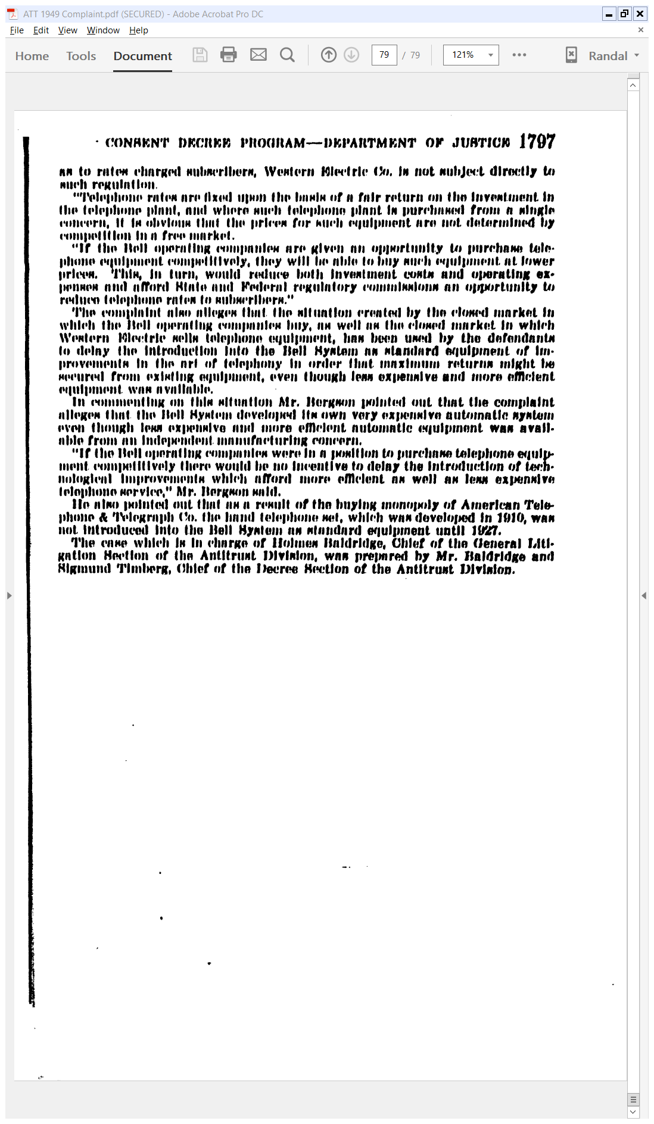
Can’t Calculate Fair Return with Distorted Prices
U.S. AG Clark Statement (14 Jan 1949)

Slide 28
Bell Labs Transistor Symposium
Bell Labs (15 Nov 1951)

Slide 29
“Aid the Military Effort”
Bell Labs (15 Nov 1951)

Slide 30
The Path to Settlement
H.Rep. Report (30 Jan 1959)

Slide 31
DOD Intervention with U.S. Attorney General
H.Rep. Report (30 Jan 1959)

Slide 32
1956 AT&T Settlement
New York Times (25 Jan 1956)

Slide 33
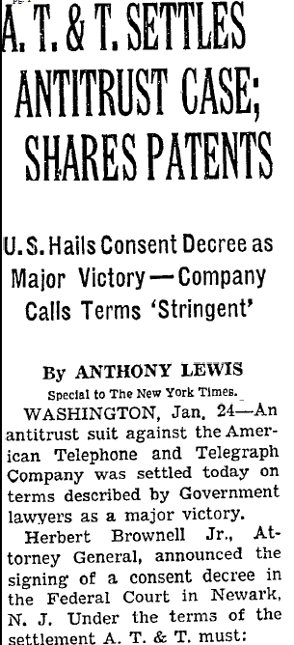
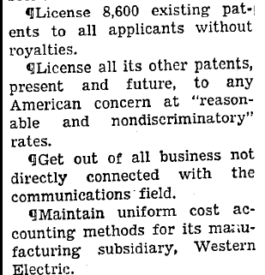
1956 AT&T Settlement
New York Times (25 Jan 1956)

Slide 34
Apr 1964: IBM 360 Intro
Wall Street Journal (8 Apr 1964)

Slide 35
1968: FCC Land Mobile Service Order
FCC Inquiry and NOPR (17 July 1968)

Slide 36
1969: FCC MCI Order
FCC MCI Order (13 Aug 1969)

Slide 37
Local Interconnection in Public Interest
FCC MCI Order (13 Aug 1969)

Slide 38
Hyde Dissent: Competition Not Always Good
FCC MCI Order (13 Aug 1969)

Slide 39
Lee Dissent: MCI Is Just Creamskimming
FCC MCI Order (13 Aug 1969)

Slide 40
Lee Dissent: MCI Is Just Creamskimming
FCC MCI Order (13 Aug 1969)

Slide 41
Apr 1973: The Portable Phone
New York Times (4 Apr 1973)

Slide 42
Nov 1974: U.S. Antitrust Suit v. AT&T
NYT (21 Nov 1974)

Slide 43
1980: Cellular Service
FCC Inquiry and NOPR (8 Jan 1980)

Slide 44
1983: Cell Phone Service Starts
The Wall Street Journal (27 Dec 1983)

Slide 45
AT&T Break Up
New York Times (9 Jan 1982)

Slide 46
AT&T Breakup
NYT (4 Aug 1983)

Slide 47
Settling the Case?
TTYN (1 of 4)
Hypo
It is late 1981 and you are Bill Baxter, head of the antitrust division and former Stanford law professor
You are open to settling the AT&T case with the core of the settlement being the separation of long distance service and local service

Slide 48
Settling the Case?
TTYN (2 of 4)
Questions
What limitations would you seek in such a settlement?
Would you bar the local phone companies from entering the long-distance market? Yellow pages? Other markets?
How would you regulate the obligations of locals regarding long-distance interconnection?

Slide 49
Settling the Case?
TTYN (3 of 4)
Questions
Assuming that AT&T is going to keep long-distance, what would you require regarding long-distance competitor access to AT&Ts long-distance network?
What other businesses would you allow AT&T to enter or bar it from entering?

Slide 50
Settling the Case?
TTYN (4 of 4)
Questions
What does AT&T want here? The new RBOCs?
And their competitors?

Slide 51
Key Regulatory Tools
Key Tools
Isolation of natural monopoly businesses from other businesses
Names for this: Structural separation; quarantine; line-of-business restrictions
Non-discriminatory access to NM components

Slide 52
Key Regulatory Tools
Isolation of natural monopoly businesses from other businesses
Limits the ability to cross-subsidize non-NM businesses (competitive businesses) from NM business
Limits the ability of NM to give itself favorable access to NM components

Slide 53
Key Regulatory Tools
Understanding Cross-Subsidization Here
The core idea seems to be about limiting the ability of the monopolist to use profits in the NM business to fund the second competitive business
Is this specific to regulated industries? More general?
And is this a statement about the role of internal and external capital markets?

Slide 54
Applications
Isolation of Natural Monopolies
Saw versions of this in the electricity industry
FERC Order 888 only insisted on functional separation of generation and transmission
1982 AT&T break up went much further in insisting on divestiture of RBOCs from new AT&T
Nondiscriminatory Access

Slide 55
Applications
Nondiscriminatory Access
Saw a version of this in Terminal Railroad
Sup Ct wanted opportunity for equal rights (ownership and governance)
FERC Order 888 created nondiscriminatory access regime for electricity distribution grid

Slide 56
Applications
Nondiscriminatory Access
A couple of versions of that in today’s materials
RBOCs required to create access equivalent to that received by new AT&T on completion of long distance calls
Long-distance entrants given access to AT&T long-distance network; enter piecemeal rather than at the scale of AT&T’s network

Slide 57
What Do Quarantines Do?
F₁
F₂
F₃
F₄
…
F_{N}

Slide 58
What Do Quarantines Do?
If the market is competitive …
Probably don’t matter
We remove one firm from the competition, but the fact that the market is competitive means that other, roughly equivalent firms should be able to jump in instead
No harm to removing one firm

Slide 59
What Do Quarantines Do?
If the market isn’t competitive …
Now we may have removed an important competitor from the market
This firm could both exert competitive pressure on other firms, reducing the likelihood of the emergence of market power
And the firm could produce important innovations

Slide 60
What Do Quarantines Do?
How should we assess the quarantines here?
Blocking AT&T from computers in 1956?
Blocking the new AT&T from electronic publishing in 1984?
Blocking the RBOCs from long distance (interexchange) and electronic publishing?

Slide 61
What Do Quarantines Do?
Trade Offs
Take the 1956 computer quarantine
Prevented AT&T from cross-subsidizing computer development from phone monopoly profits
Blocked AT&T from computers (gov’t sues IBM for mainframe monopoly in 1969)
Prevents possible faster natural integration (innovation in) computers and communications

Slide 62
1999: Long Distance Competition
FCC, Long Distance Report (31 Mar 1999)

Slide 63
2003: Last Long Distance Report
FCC, Long Distance Report (14 May 2003)

Slide 64
2003: Last Long Distance Report
FCC, Long Distance Report (14 May 2003)
Notes:
Cross subsidization point

Slide 65
Seeing the Future?
Topics
Bypass?
Electronic Publishing?
Advertising?

Slide 66
Another AT&T Break Up
New York Times (21 Sept 1995)

