Slide 1
Class 7 Platforms and Networks Spring 2022 Cybersecurity
Randal C. Picker
James Parker Hall Distinguished Service Professor of Law
The Law School
The University of Chicago
Copyright © 2022 Randal C. Picker. All Rights Reserved.

Slide 2
The Focus Today
Key Questions/Issues
1. As you will see, the Biden 2021 executive order is hardly the first one on cybersecurity. Why do we need yet another order?
2. Have the prior orders failed to achieve their goals? If so, why?
3. And what precisely was the state of U.S. cybersecurity in May 2021?

Slide 3
A Computer Virus
New York Times (4 Nov 1988)

Slide 4
A Computer Virus
New York Times (4 Nov 1988)

Slide 5
And The Next Day
New York Times (5 Nov 1988)

Slide 6
The Morris Worm
New York Times (5 Nov 1988)

Slide 7
What Did It Do?
New York Times (5 Nov 1988)

Slide 8
Should We Talk About Security In Public?
New York Times (11 Nov 1988)

Slide 9
Morris CFAA Sentence
New York Times (5 May 1990)

Slide 10
Computer Fraud and Abuse Act of 1986
Pub. L. 99-474 (16 Oct 1986)

Slide 11
1984 Computer Law
Pub. L. 98-473 (12 Oct 1984)

Slide 12
1986 CFAA Legis History
S. Rep. 99-432 (3 Sept 1986)

Slide 13
“A Technological Explosion”
S. Rep. 99-432 (3 Sept 1986)

Slide 14
Extensive Computer Crime
S. Rep. 99-432 (3 Sept 1986)

Slide 15
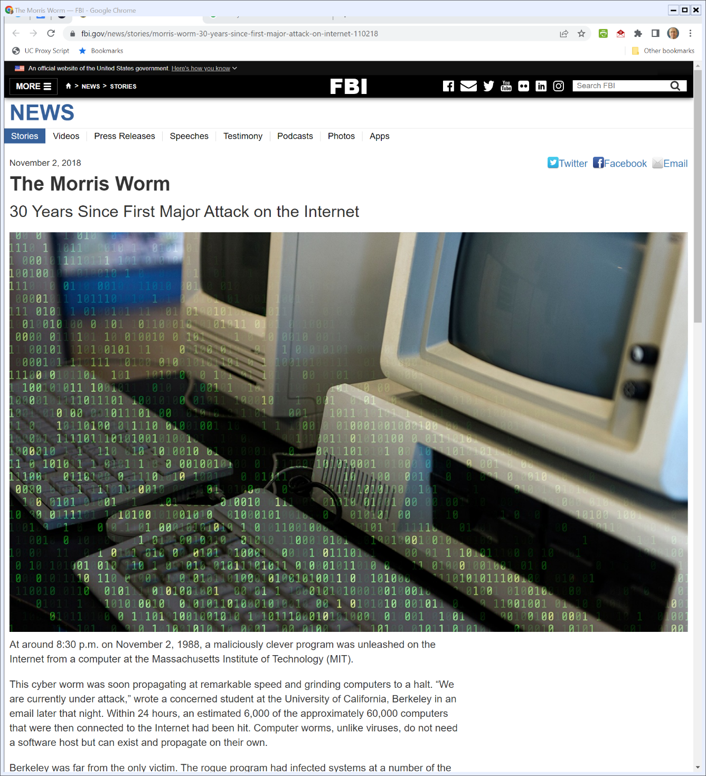
FBI Retrospective
FBI (21 Nov 2018)
Notes:
https://www.fbi.gov/news/stories/morris-worm-30-years-since-first-major-attack-on-internet-110218

Slide 16
Van Buren
593 U.S. ___ (3 June 2021)

Slide 17
July 1996: Clinton Exec Order
Wall Street Journal (17 July 1996)

Slide 18
The Threat
Exec. Order 13010 (15 July 1996)

Slide 19
Critical Infrastructure Commission
Exec. Order 13010 (15 July 1996)

Slide 20
And The Report
PCCIP Report (13 Oct 1997)

Slide 21
Growing Risk; Shared Responsibility
PCCIP Report (13 Oct 1997)

Slide 22
A Changed Threat
PCCIP Report (13 Oct 1997)

Slide 23
Better Gov’t/Private Sector Cooperation
PCCIP Report (13 Oct 1997)

Slide 24
Clearing Houses
PCCIP Report (13 Oct 1997)

Slide 25
May 1998: Clinton Update
New York Times (23 May 1998)

Slide 26
New Clinton Directive
Clinton PDD/NSC-63 (22 May 1998)

Slide 27
National Goal
Clinton PDD/NSC-63 (22 May 1998)

Slide 28
Public-Private Partnership
Clinton PDD/NSC-63 (22 May 1998)

Slide 29
Post 9-11 Critical Infrastructure Order
Bush Exec Order 13231 (16 Oct 2001)

Slide 30
New Board
Bush Exec Order 13231 (16 Oct 2001)

Slide 31
Board Responsibilities
Bush Exec Order 13231 (16 Oct 2001)

Slide 32
Info Sharing/Coordination
Bush Exec Order 13231 (16 Oct 2001)

Slide 33
Read the Title
GAO Report (July 2002)

Slide 34
Background
GAO Report (July 2002)

Slide 35
“Nevertheless”
GAO Report (July 2002)

Slide 36
Still Lots to Do
GAO Report (July 2002)

Slide 37
Bush Board Report
National Strategy (Feb 2003)

Slide 38
Threats Increasing
National Strategy (Feb 2003)

Slide 39
Public-Private Partnership
National Strategy (Feb 2003)

Slide 40
Dept of Homeland Security Role
National Strategy (Feb 2003)

Slide 41
Five Priorities
National Strategy (Feb 2003)

Slide 42
Partnerships
Obama Exec Order 13636 (12 Feb 2013)

Slide 43
Coordination and Info Sharing
Obama Exec Order 13636 (12 Feb 2013)

Slide 44
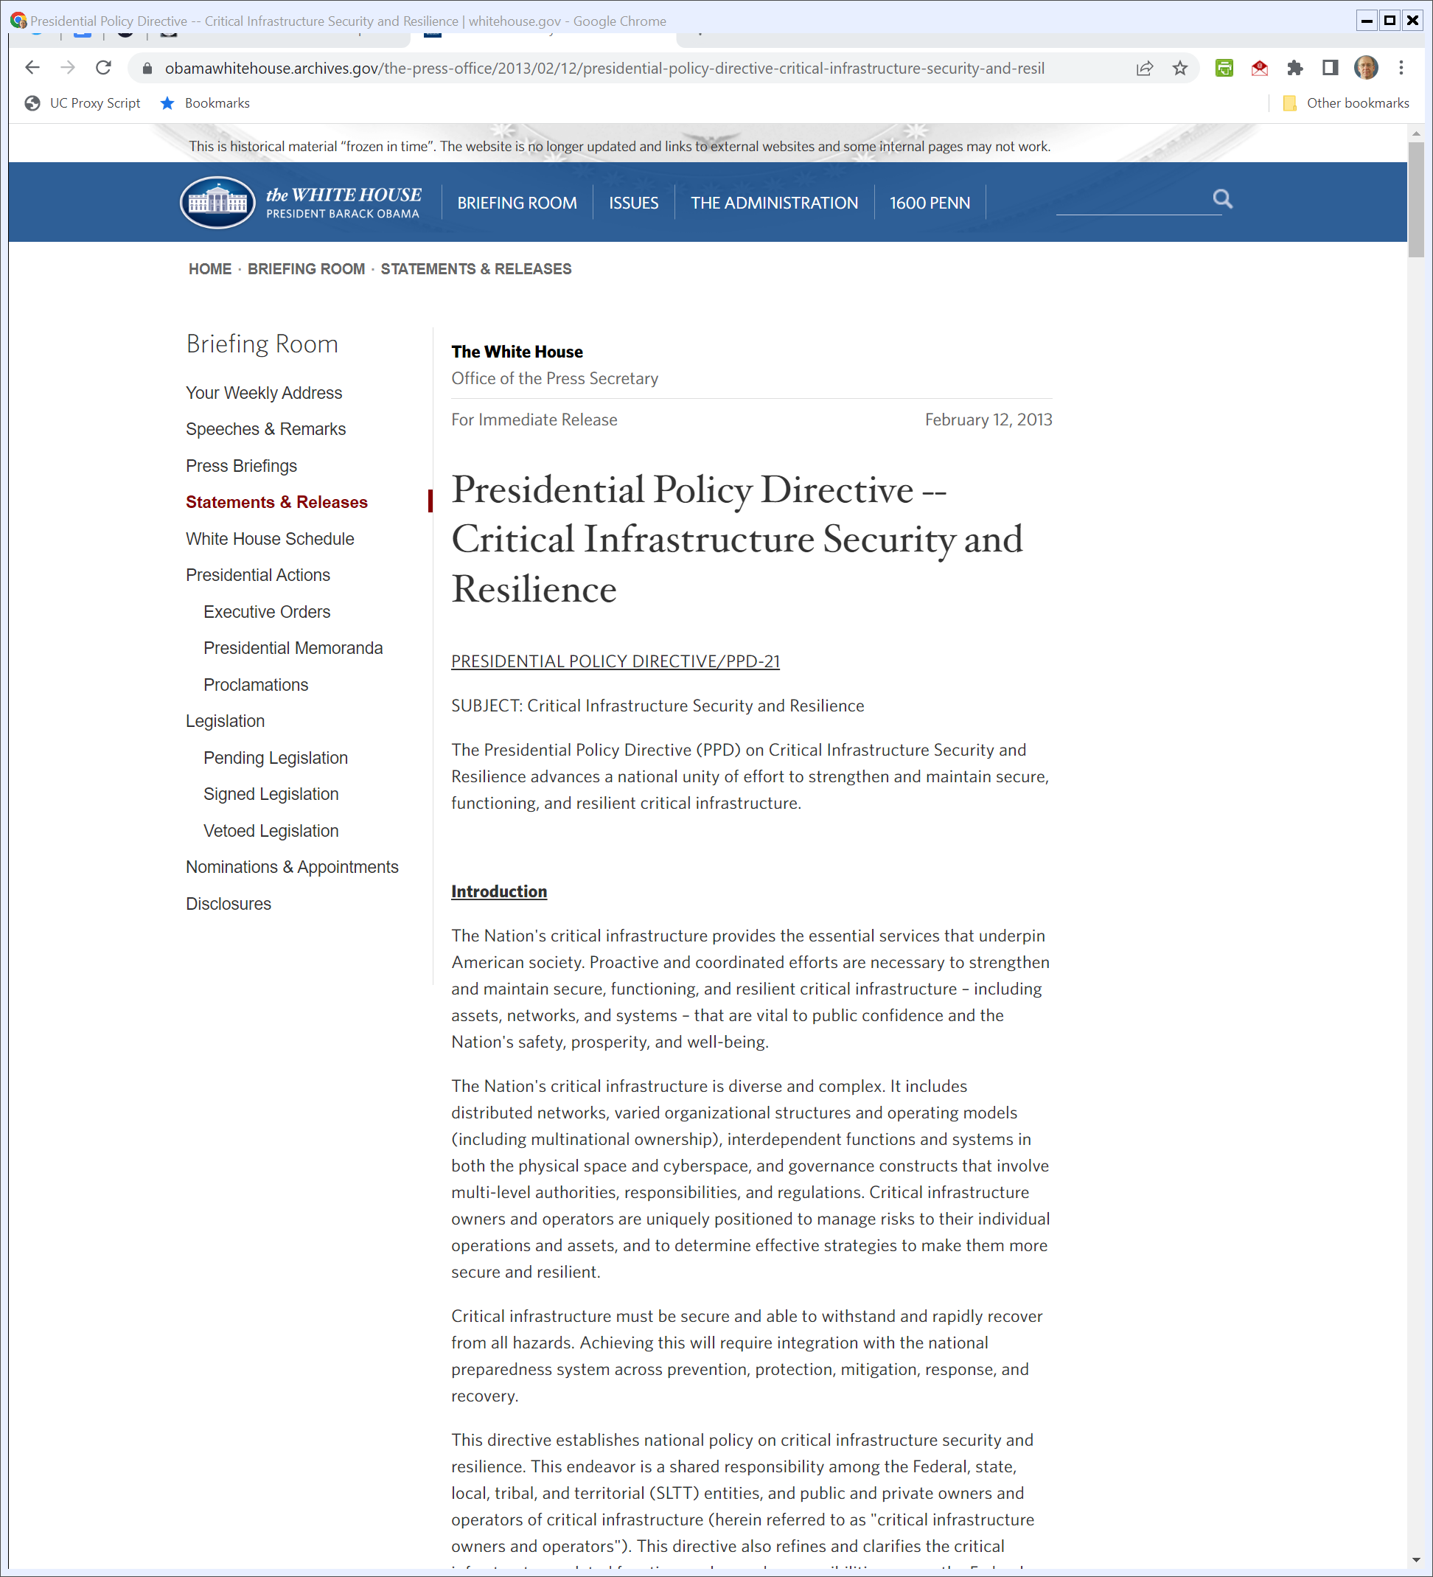
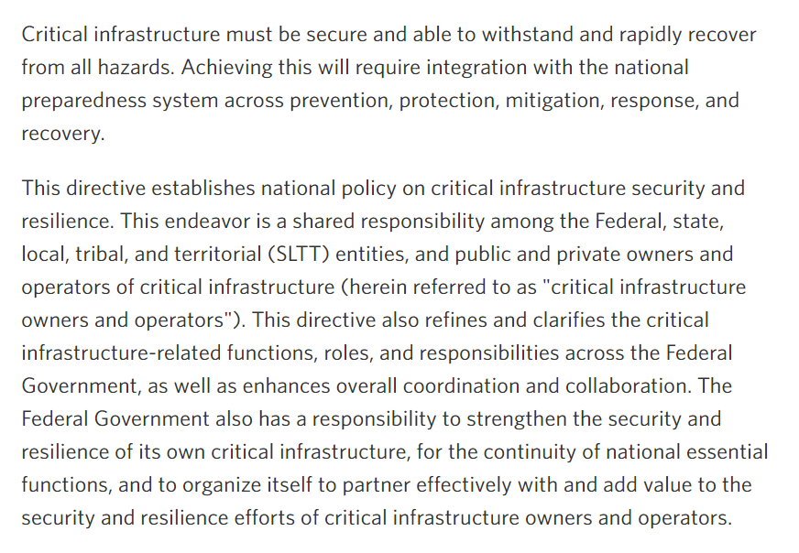
Policy Directive
Obama PPD-21 (12 Feb 2013)
Notes:
https://obamawhitehouse.archives.gov/the-press-office/2013/02/12/presidential-policy-directive-critical-infrastructure-security-and-resil

Slide 45
Cybersecurity Enhancement Act of 2014
Pub. L. 113-274 (18 Dec 2014)

Slide 46
Cybersecurity Enhancement Act of 2014
Pub. L. 113-274 (18 Dec 2014)

Slide 47
Legislative History
S. Rep. 113-270 (12 Nov 2014)

Slide 48
Rising Problems
S. Rep. 113-270 (12 Nov 2014)

Slide 49
Rising Problems
S. Rep. 113-270 (12 Nov 2014)

Slide 50
Attacks on Physical Infrastructure
S. Rep. 113-270 (12 Nov 2014)

Slide 51
Promote Info Sharing
Obama Exec Order 13691 (13 Feb 2015)

Slide 52
Another Commission
Obama Exec Order 13718 (9 Feb 2016)

Slide 53
Commission Task
Obama Exec Order 13718 (9 Feb 2016)

Slide 54
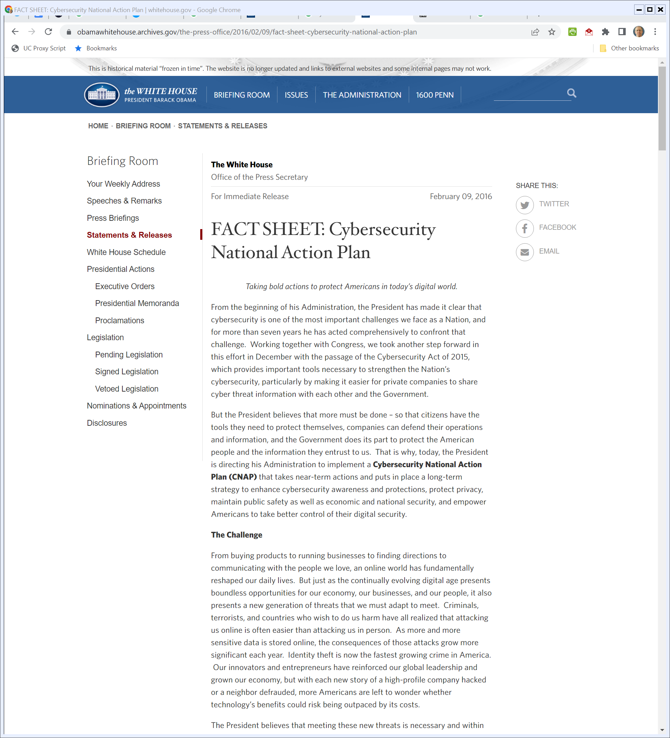
Cybersecurity National Action Plan
Obama White House Archive (9 Feb 2016)

Slide 55
Obama Commission Report
Obama Commission Report (1 Dec 2016)

Slide 56
Public and Private Cooperation
Obama Commission Report (1 Dec 2016)

Slide 57
Six Imperatives
Obama Commission Report (1 Dec 2016)

Slide 58
Cybersecurity Protection
Trump Exec Order 13800 (11 May 2017)

Slide 59
Protecting Key Infrastructure
Trump Exec Order 13800 (11 May 2017)

Slide 60
Botnets
Trump Exec Order 13800 (11 May 2017)

Slide 61
Electricity
Trump Exec Order 13800 (11 May 2017)

Slide 62
2018 Statute: 19 Pages
Pub. L. 115-278 (16 Nov 2018)

Slide 63
Legis History
Pub. L. 115-278 (16 Nov 2018)

Slide 64
New Cybersecurity Agency
Pub. L. 115-278 (16 Nov 2018)

Slide 65
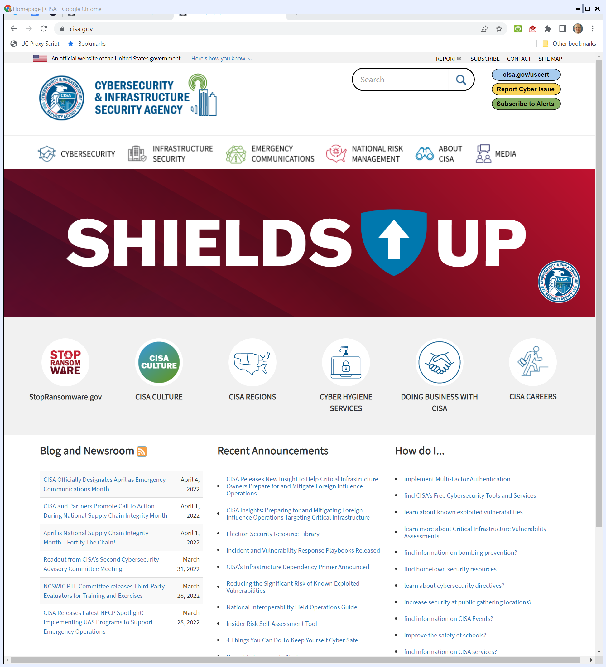
CISA
Cisa.gov (Visited 4 Apr 2022)
Notes:
https://www.cisa.gov/

Slide 66
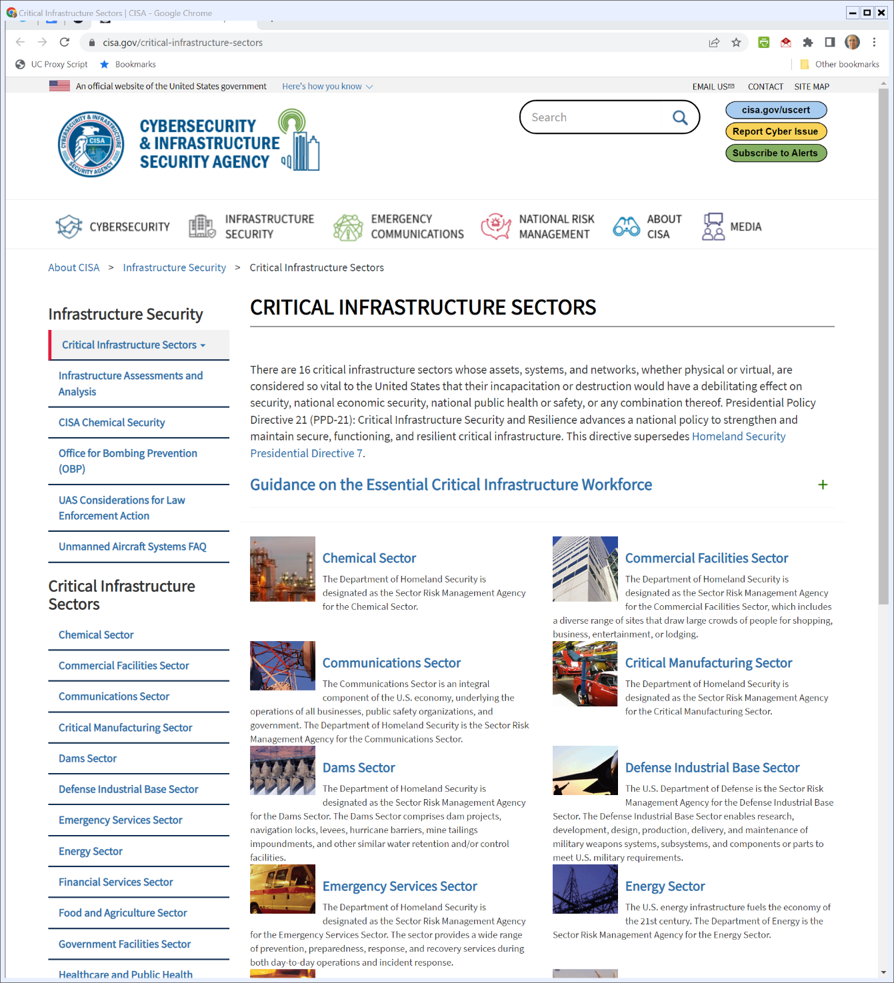
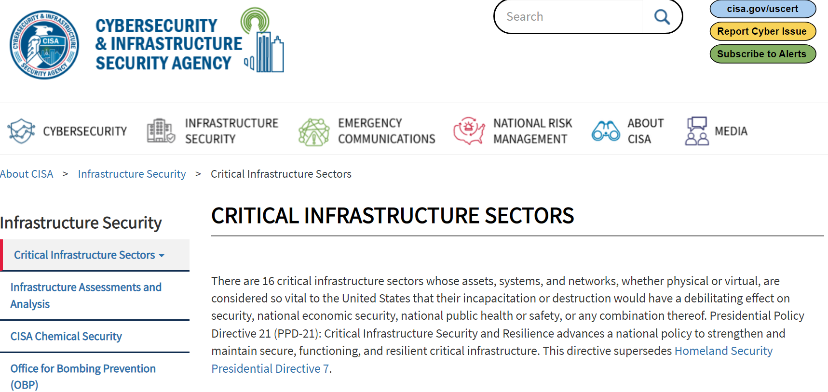
CISA
Cisa.gov (Visited 4 Apr 2022)
Notes:
https://www.cisa.gov/critical-infrastructure-sectors

Slide 67
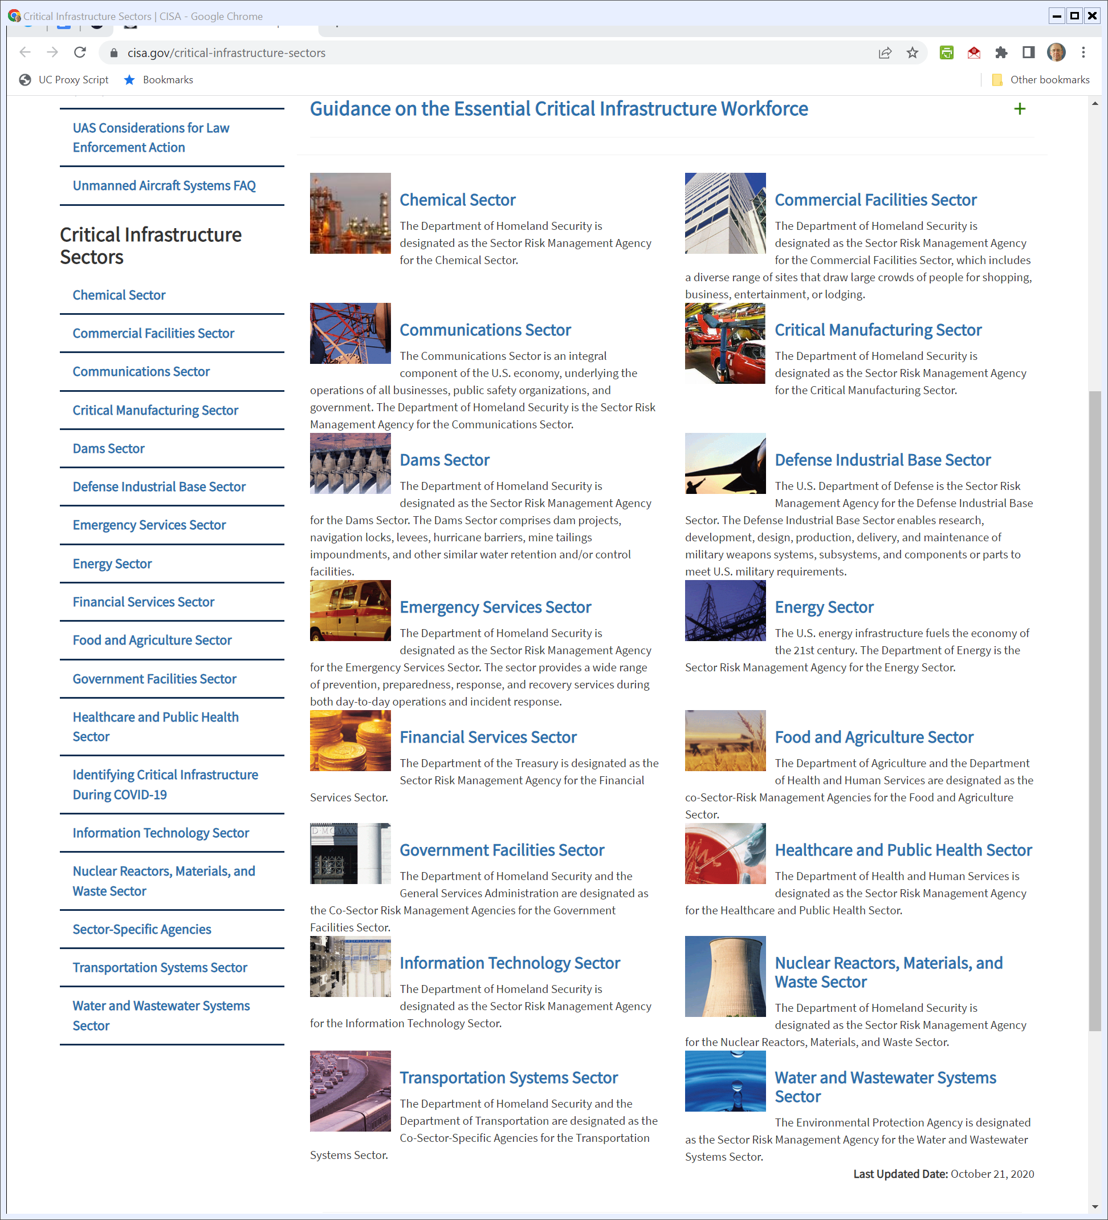
CISA
Cisa.gov (Visited 4 Apr 2022)
Notes:
https://www.cisa.gov/critical-infrastructure-sectors

Slide 68
How Are We Doing?
GAO (16 Apr 2021)

Slide 69
“Yet”
GAO (16 Apr 2021)

Slide 70
GAO Update
GAO (2 Dec 2021)

Slide 71
Cyber Vulnerabilities
IBM X-Force (2022)

Slide 72
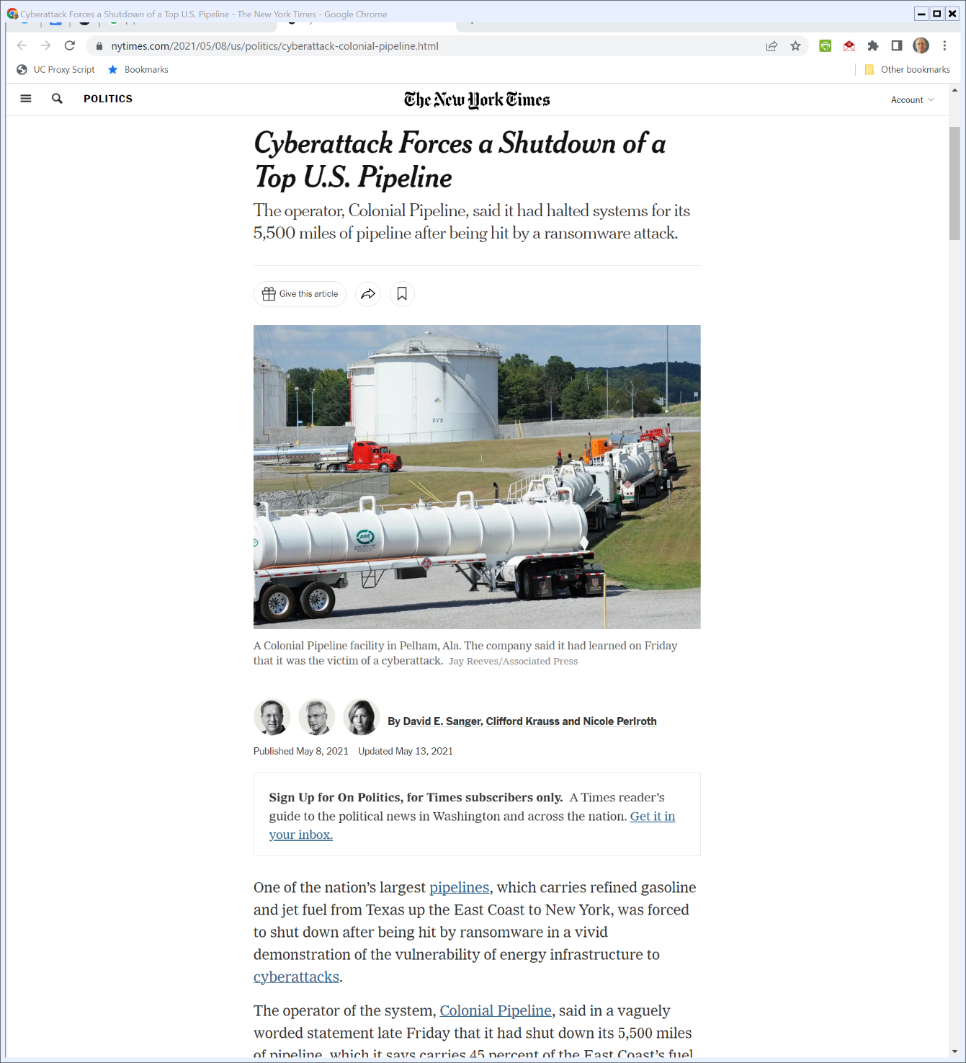
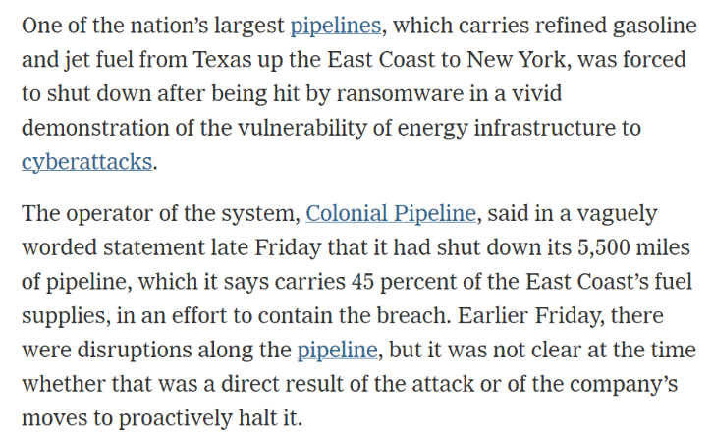
Colonial Pipeline
New York Times (8 May 2021)
Notes:
https://www.nytimes.com/2021/05/08/us/politics/cyberattack-colonial-pipeline.html

Slide 73
Bold Action: Public Private Partnerships
Biden Exec Order (12 May 2021)

Slide 74
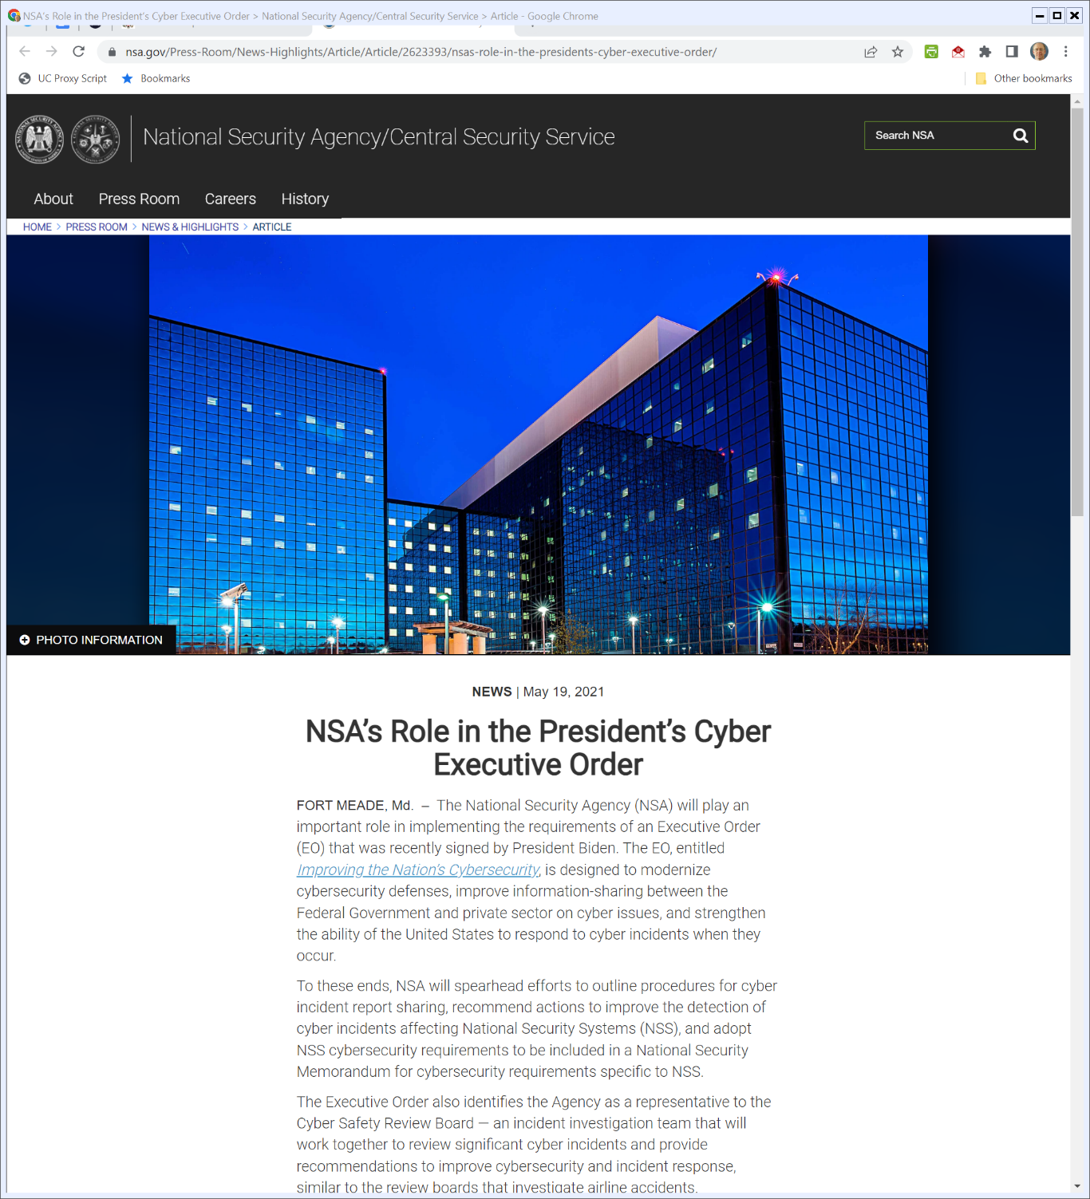
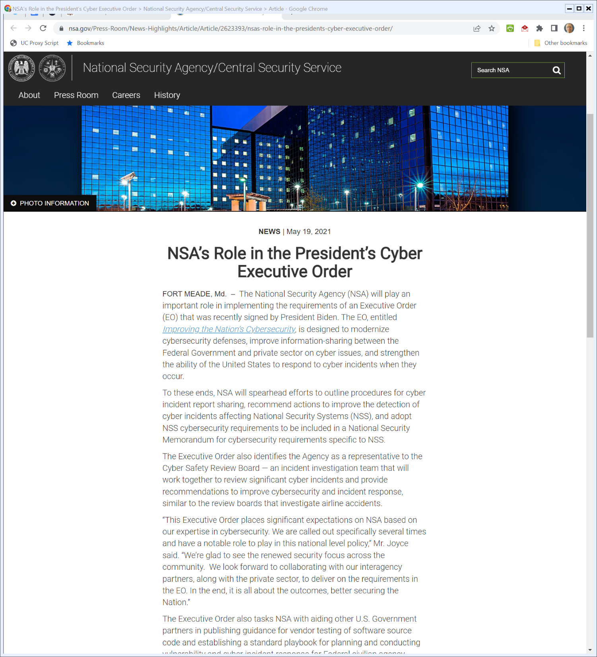
NSA Role
NSA.gov (Visited 4 Apr 2022)
Notes:
https://www.nsa.gov/Press-Room/News-Highlights/Article/Article/2623393/nsas-role-in-the-presidents-cyber-executive-order/

Slide 75
NSA Role
NSA.gov (Visited 4 Apr 2022)
Notes:
https://www.nsa.gov/Press-Room/News-Highlights/Article/Article/2623393/nsas-role-in-the-presidents-cyber-executive-order/

