Slide 1
Class 6
Platforms and Networks
Spring 2022
Managing Grids and Networks: Electricity
Randal C. Picker
James Parker Hall Distinguished Service Professor of Law
The Law School
The University of Chicago
Copyright © 2014-22 Randal C. Picker. All Rights Reserved.

Slide 2
The Focus Today
Key Questions/Issues
  1. What is the right mix of regulatory tools (antitrust v. sector-specific regulation) for building an interconnection regime?
  2. To what extent should coordination be voluntary or forced?
  3. How should we allocate costs for shared projects to add capacity to the grid?

Slide 3
Why Electricity is Hard
Can’t Store It (But changing?)
  Needs to be created when it is used
  Travels over system at speed of light
Flows Can’t Be Controlled
  “The flow of alternating current (AC) electricity cannot be controlled like a liquid or gas by opening or closing a valve in a pipe, or switched like calls over a long-distance telephone network.”

Slide 4
Why Electricity is Hard
    “Electricity flows freely along all available paths from the generators to the loads in accordance with the laws of physics—dividing among all connected flow paths in the network, in inverse proportion to the impedance (resistance plus reactance) on each path”
  See Final Report on the August 14, 2003 Blackout in the United States and Canada p.6
Notes:
http://www.hks.harvard.edu/hepg/Papers/BlackoutFinal-Web.pdf

Slide 5
Changes in Sources
WSJ (30 Nov 2017)

Slide 6
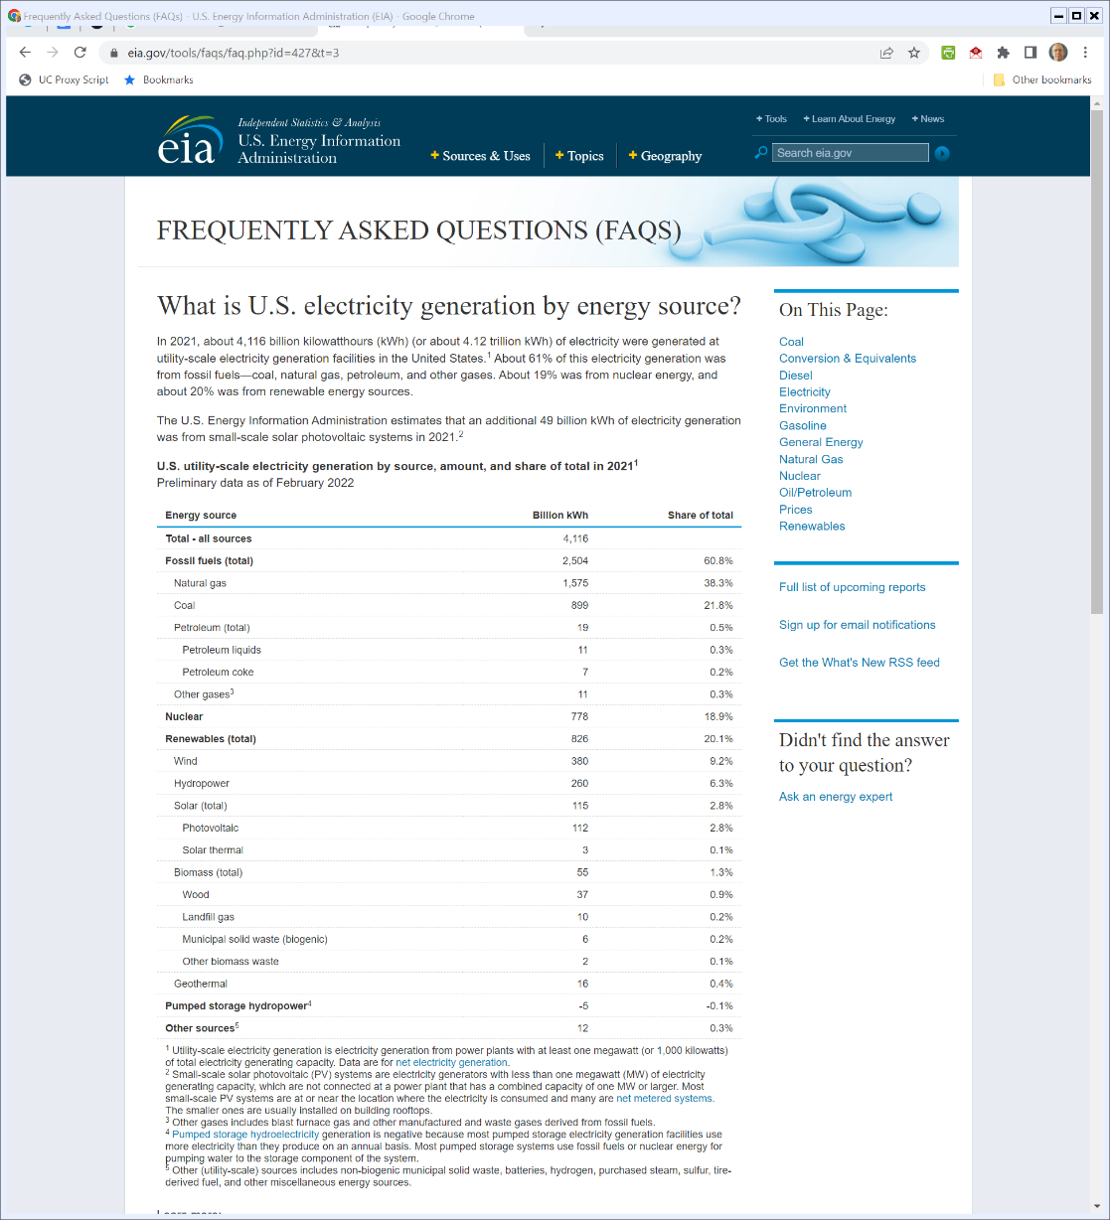

U.S. Electricity by Source
U.S. Energy Info Admin (Visited: 31 Mar 2022)
Notes:
https://www.eia.gov/tools/faqs/faq.php?id=427&t=3

Slide 7
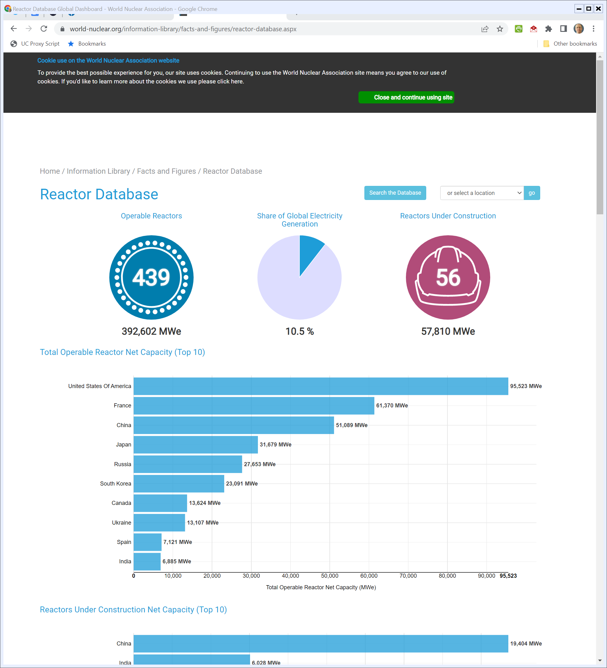
Countries by Nuclear Power
World Nuclear Ass’n (Visited 31 Mar 2022)
Notes:
http://www.world-nuclear.org/information-library/facts-and-figures/reactor-database.aspx

Slide 8
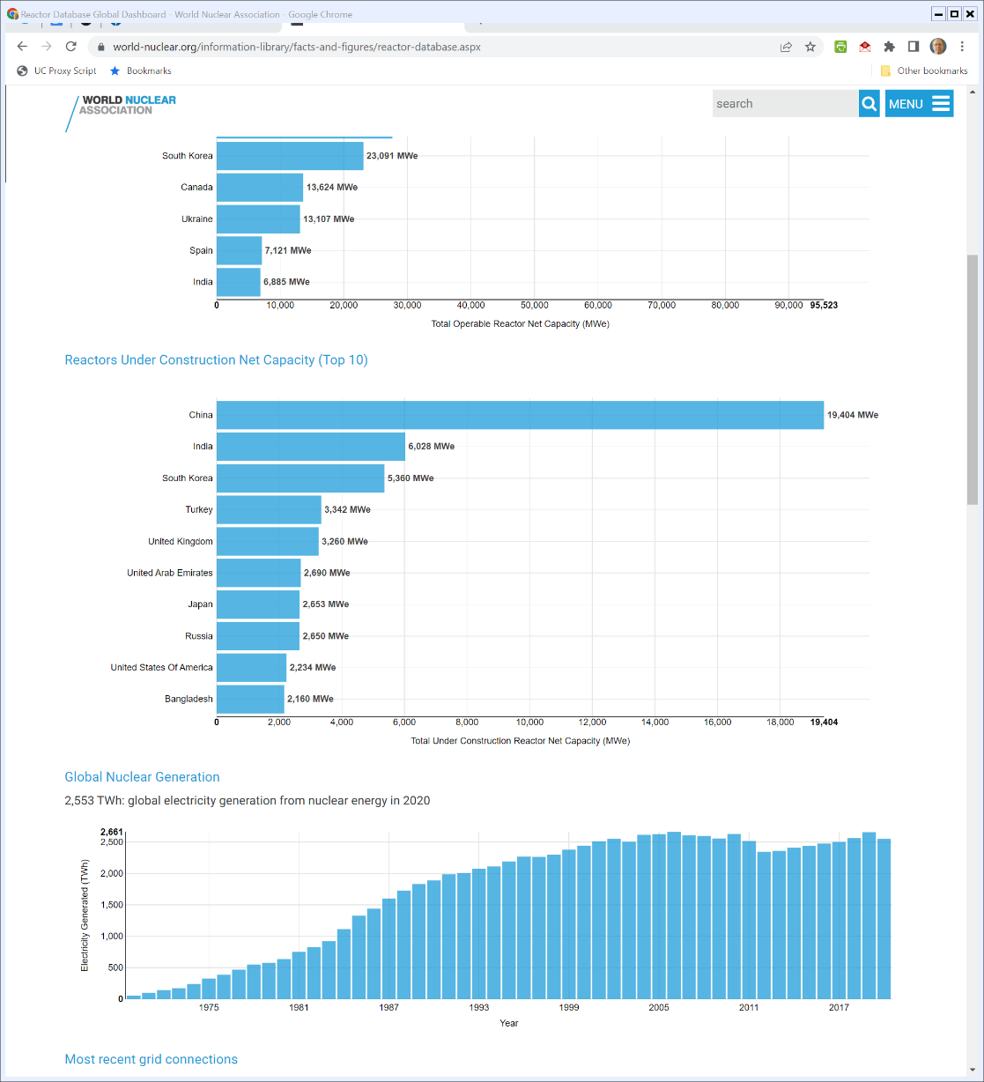

Countries by Construction
World Nuclear Ass’n (Visited 31 Mar 2022)

Slide 9
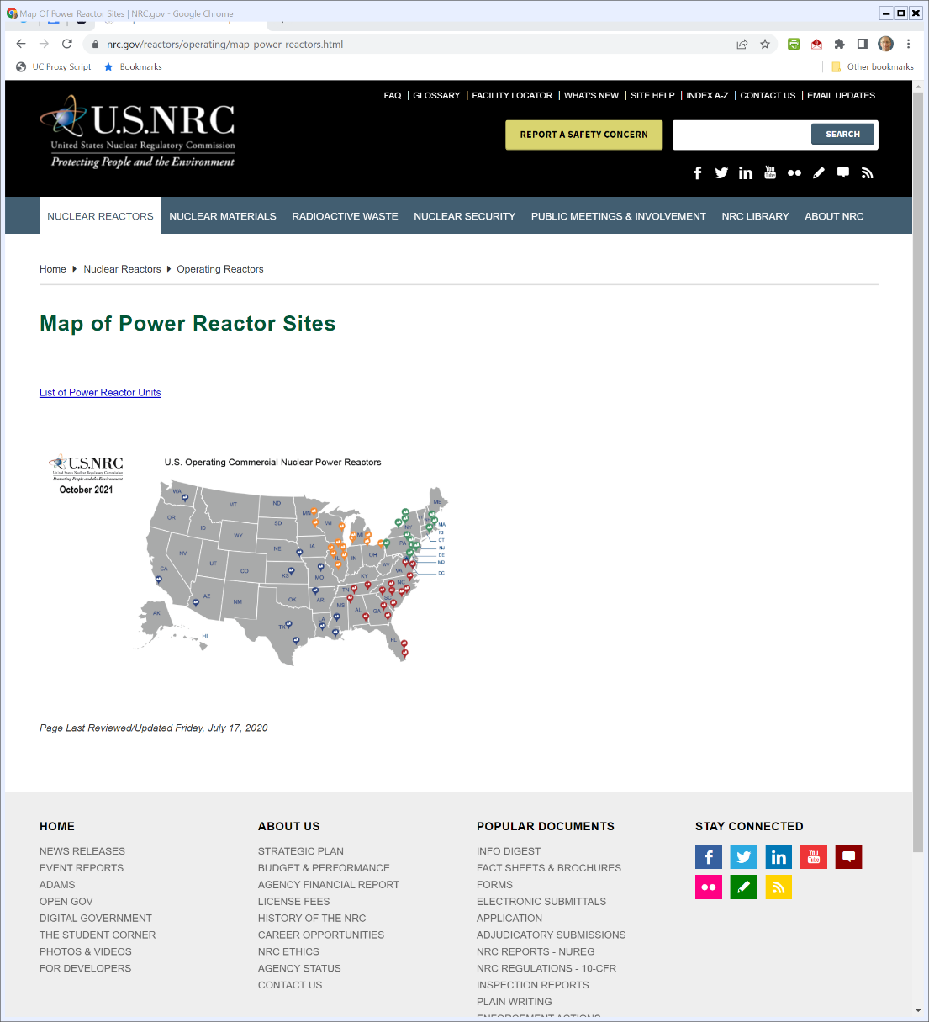

U.S. NRC Nuclear Power Plant Map
Notes:
https://www.nrc.gov/reactors/operating/map-power-reactors.html

Slide 10
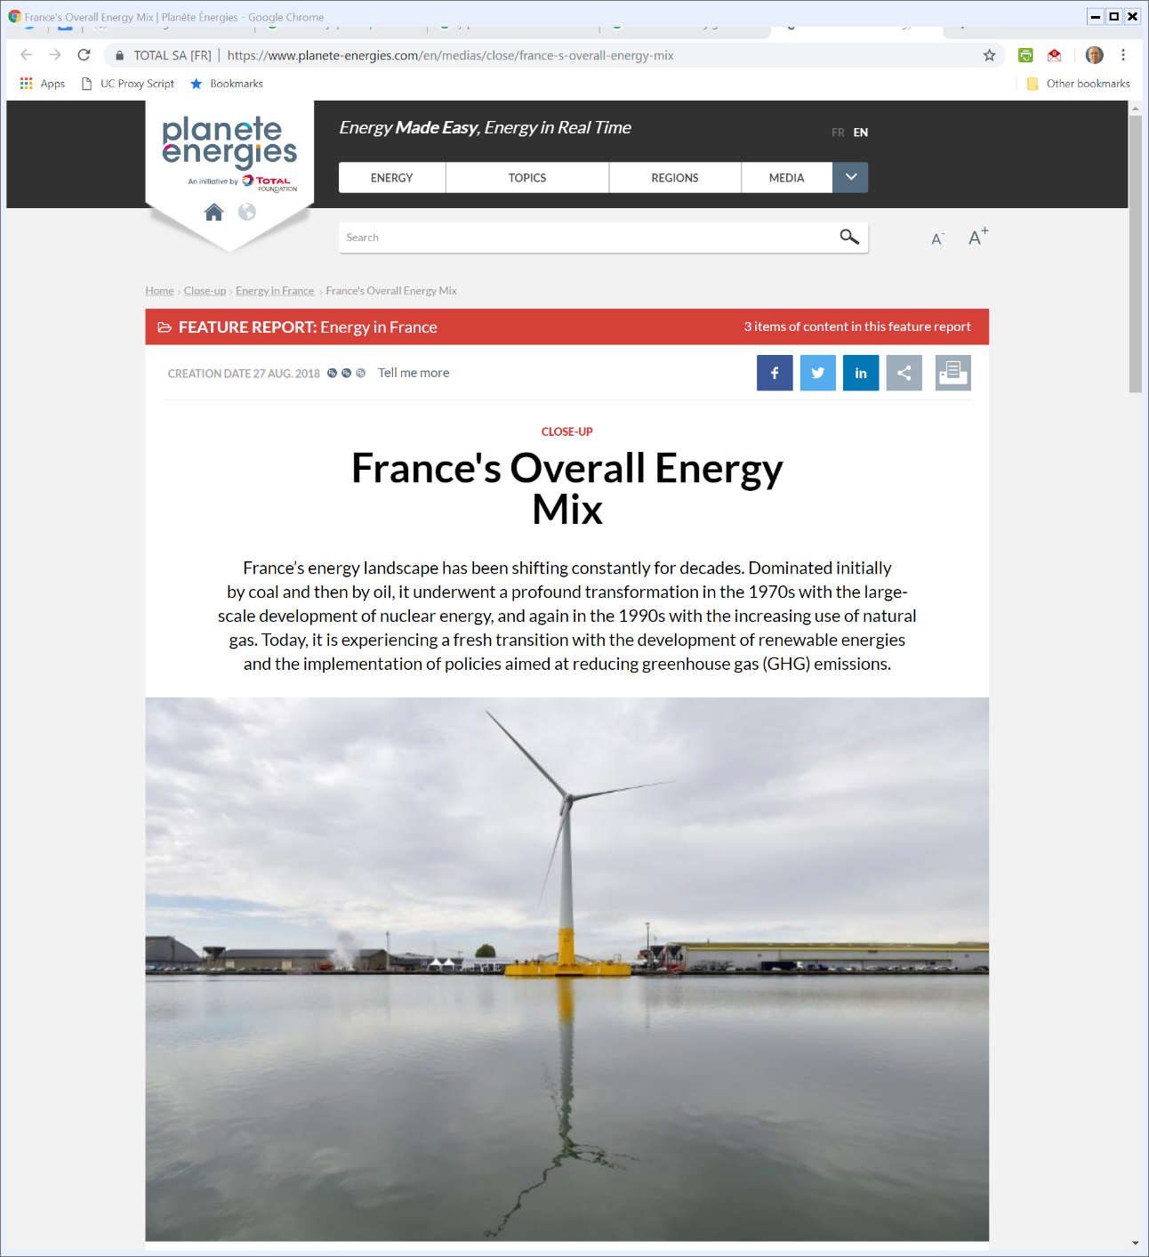
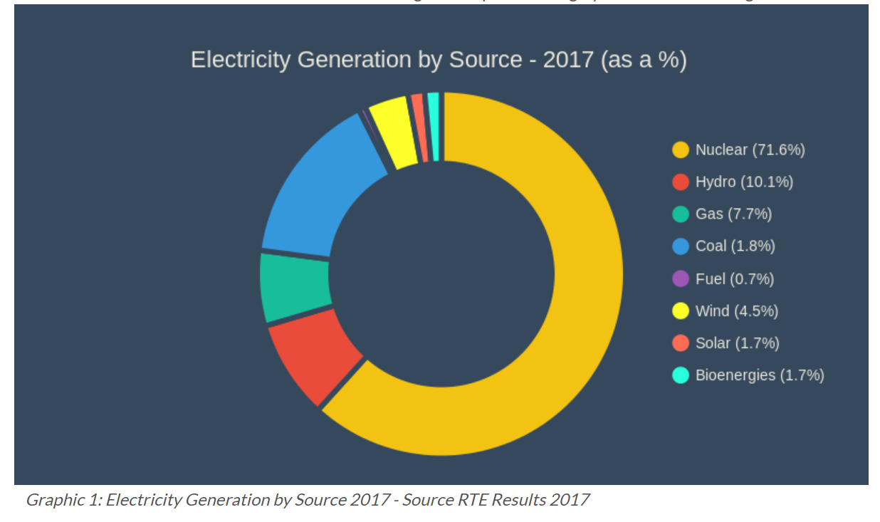
France Electricity Generation by Source
Planete energies (27 Aug 2018)
Notes:
https://www.planete-energies.com/en/medias/close/france-s-overall-energy-mix

Slide 11
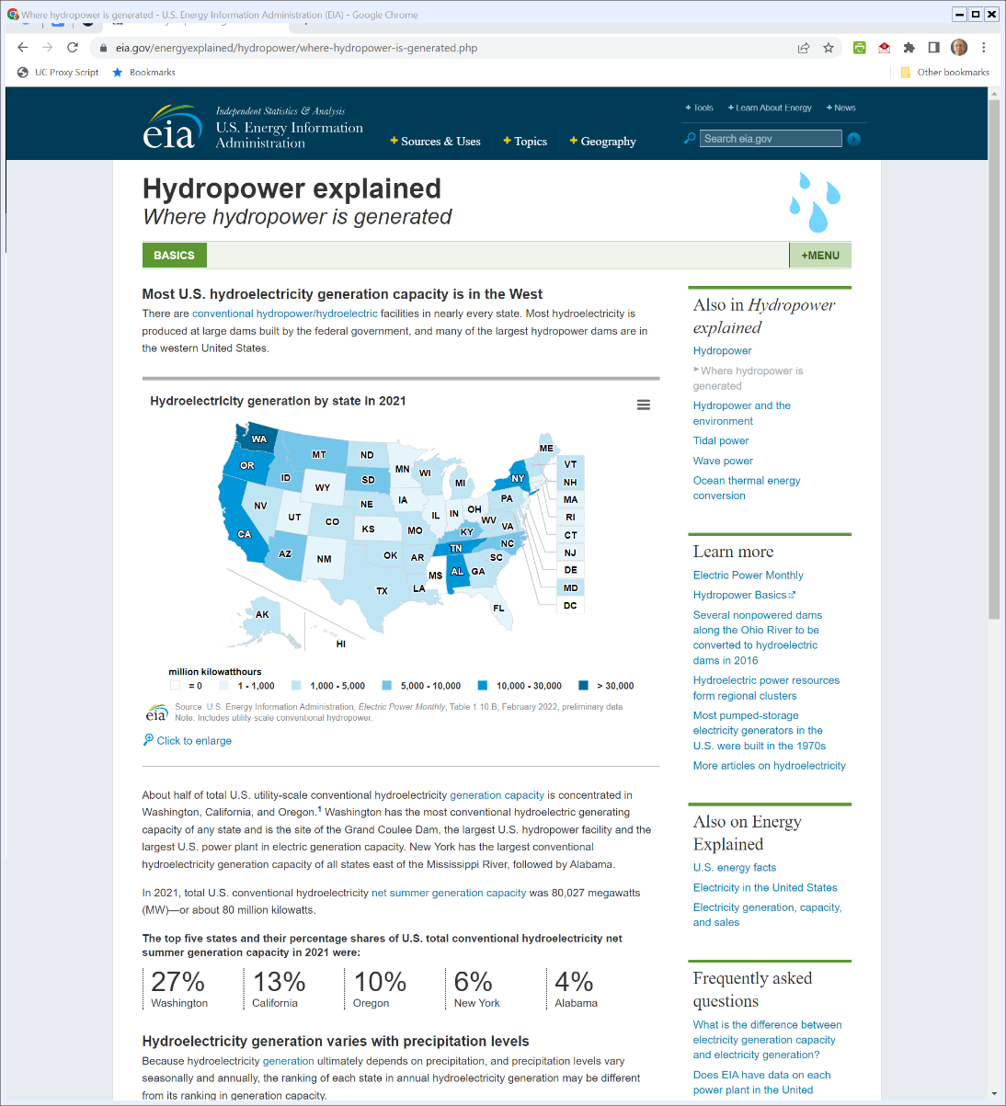

U.S. Hydropower Clustered in a Few States
U.S. Energy Info Admin (Visited: 31 Mar 2022)
Notes:
https://www.eia.gov/energyexplained/hydropower/where-hydropower-is-generated.php

Slide 12
U.S. Wind Generation
AWEA (4th Q 2018)

Slide 13
Wind Generation by State
AWEA (4th Q 2018)

Slide 14
Wind Share by State
AWEA Ann Mkt Report (2018)

Slide 15
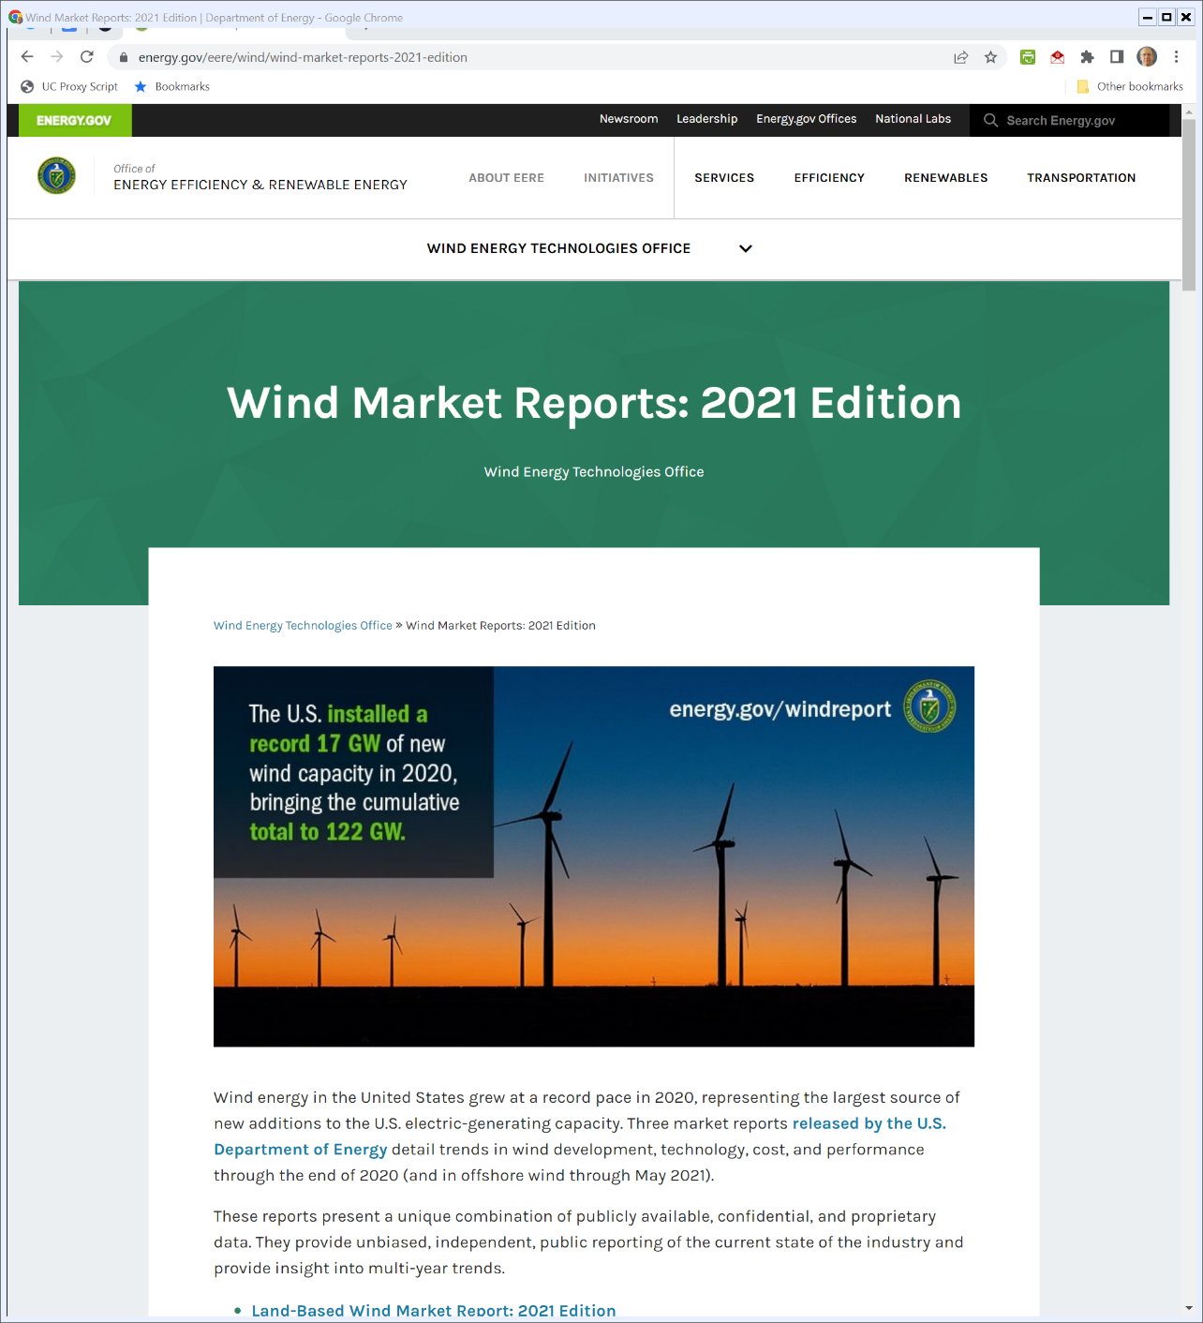

Wind Capacity Growing
Energy.gov (Visited 31 Mar 2022)
Notes:
https://www.energy.gov/eere/wind/wind-market-reports-2021-edition

Slide 16
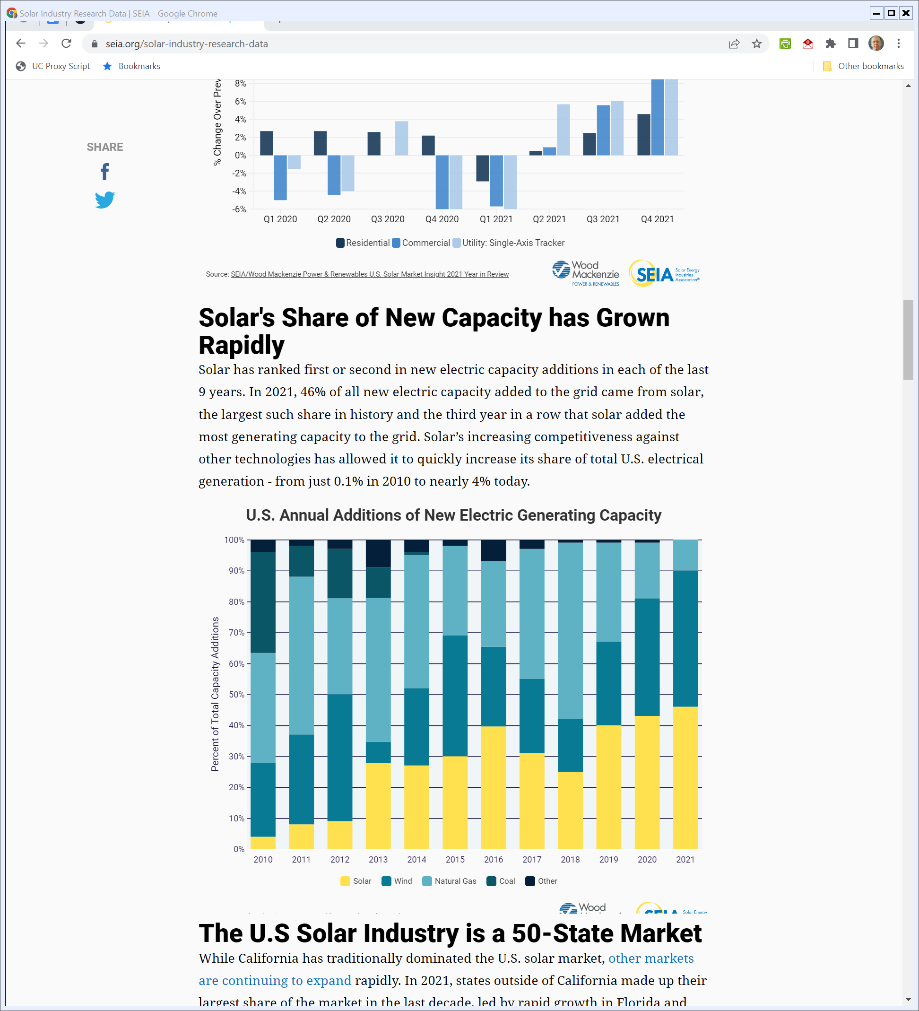
New Generation in the U.S.
SEIA (Mar 2022)
Notes:
https://seia.org/solar-industry-research-data

Slide 17
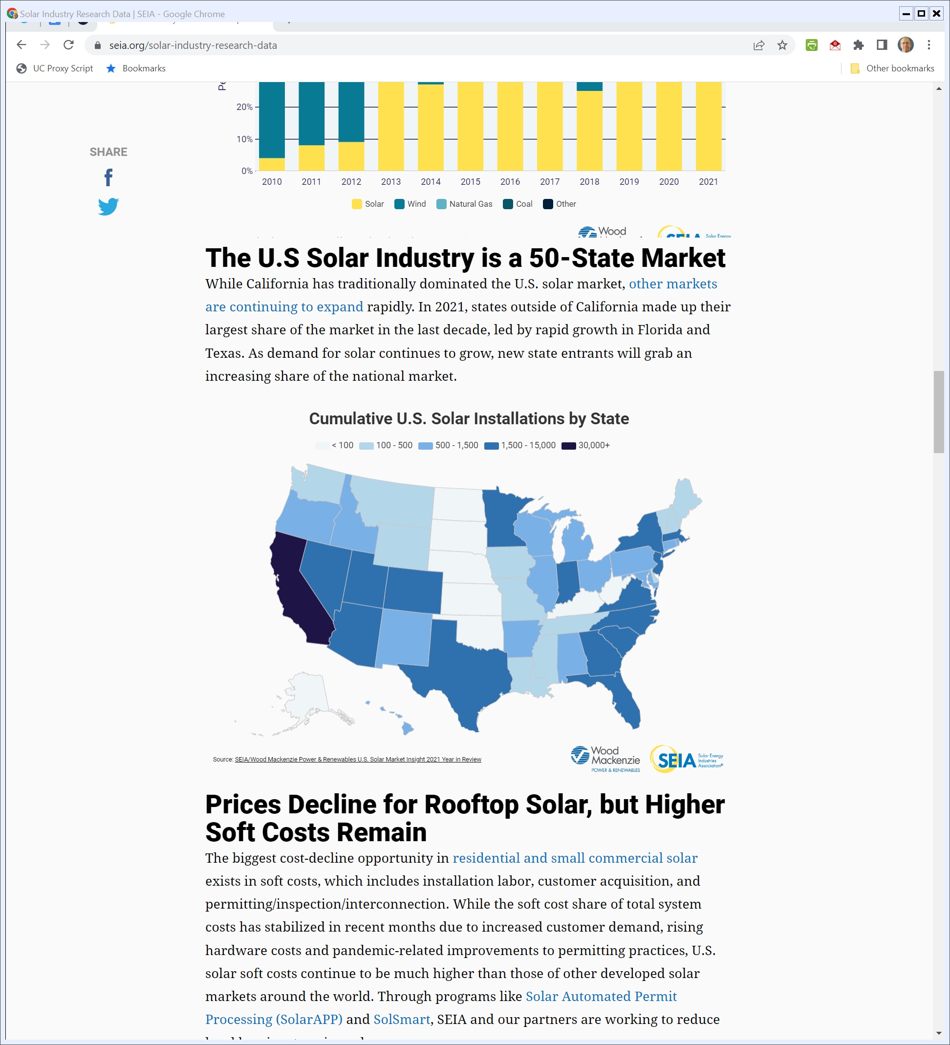
Where is Solar?
SEIA (Mar 2022)
Notes:
https://seia.org/solar-industry-research-data

Slide 18
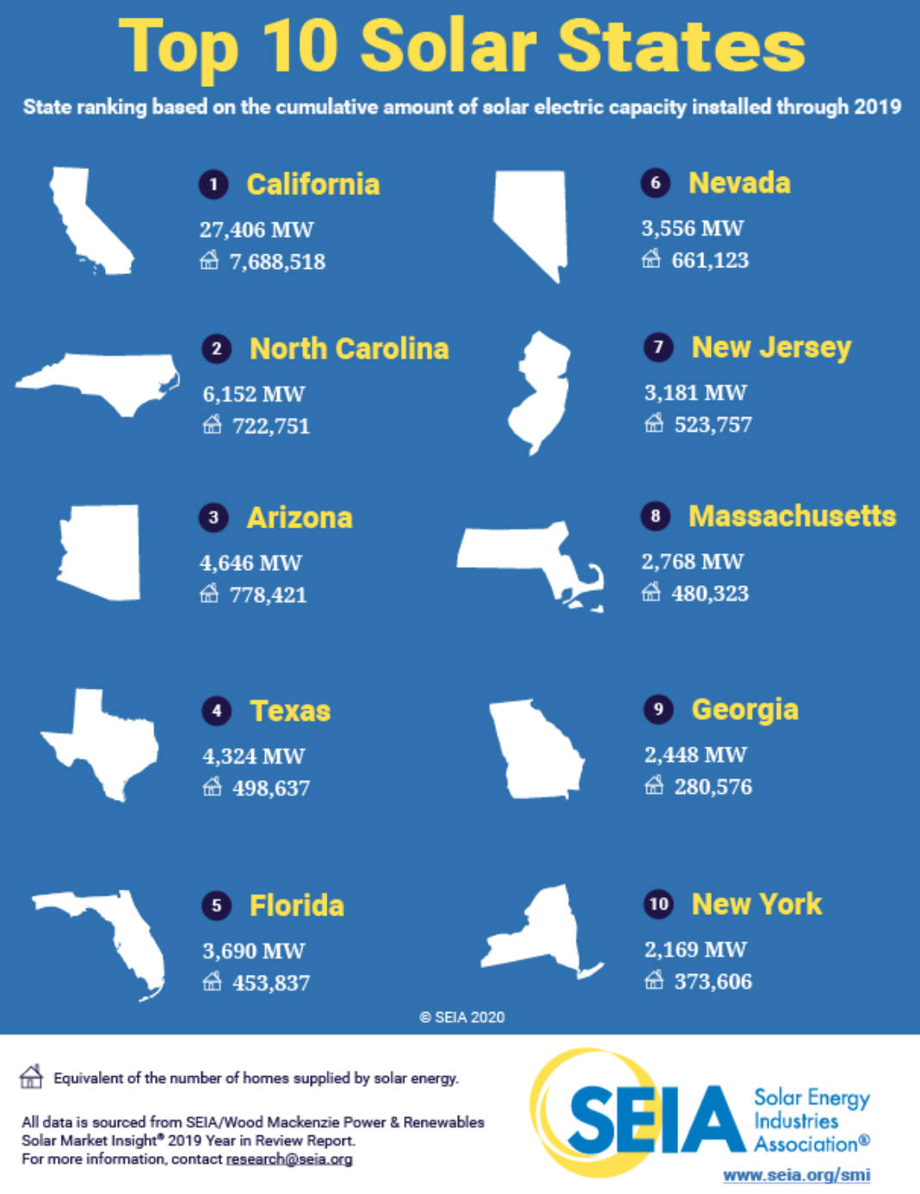
Solar Location
SEIA (Visited: 12 Apr 2020)

Slide 19
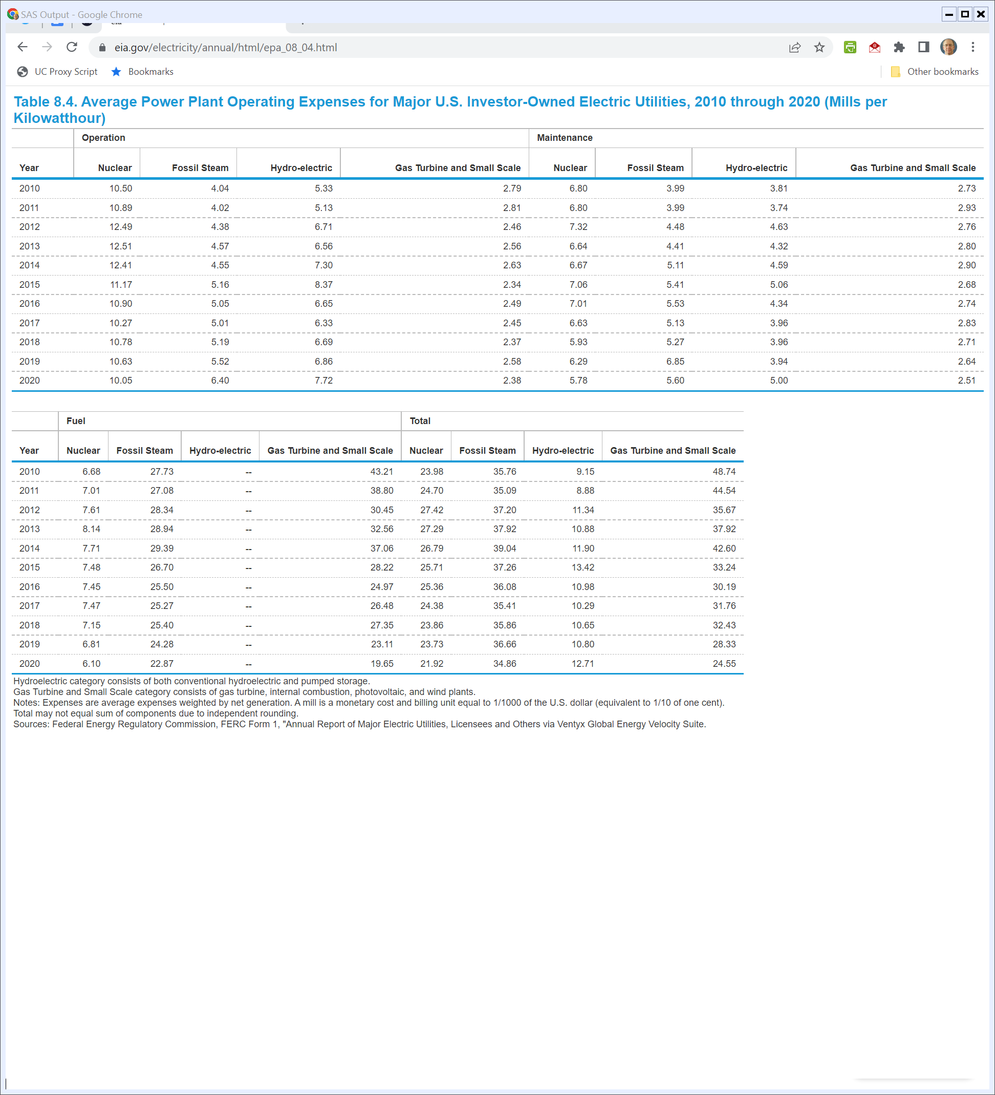
U.S. Energy Cost of Production
U.S. Energy Info Admin (Visited 31 Mar 2022)
Notes:
https://www.eia.gov/electricity/annual/html/epa_08_04.html

Slide 20
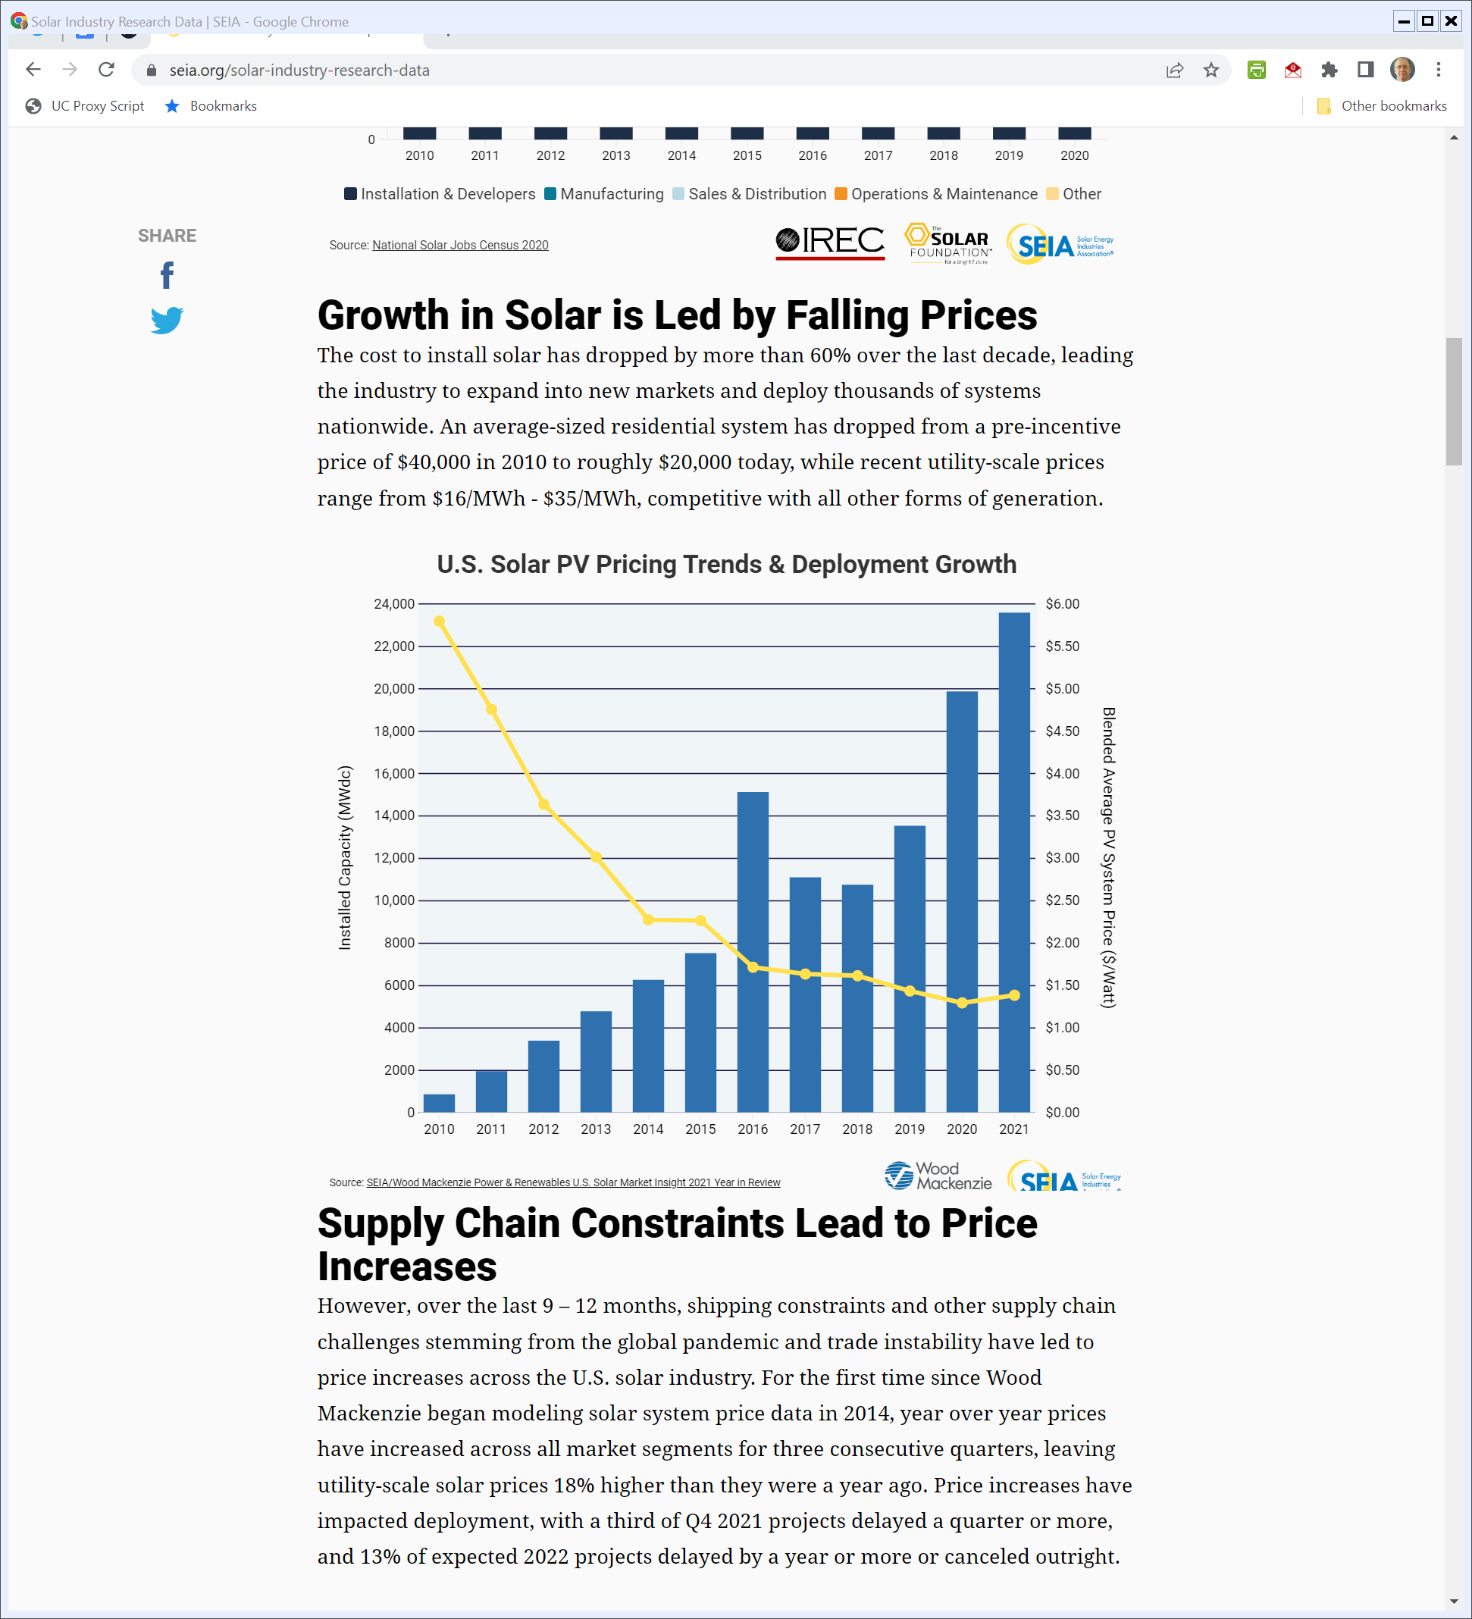
Solar Costs Dropping
SEIA (Mar 2022)
Notes:
https://seia.org/solar-industry-research-data

Slide 21
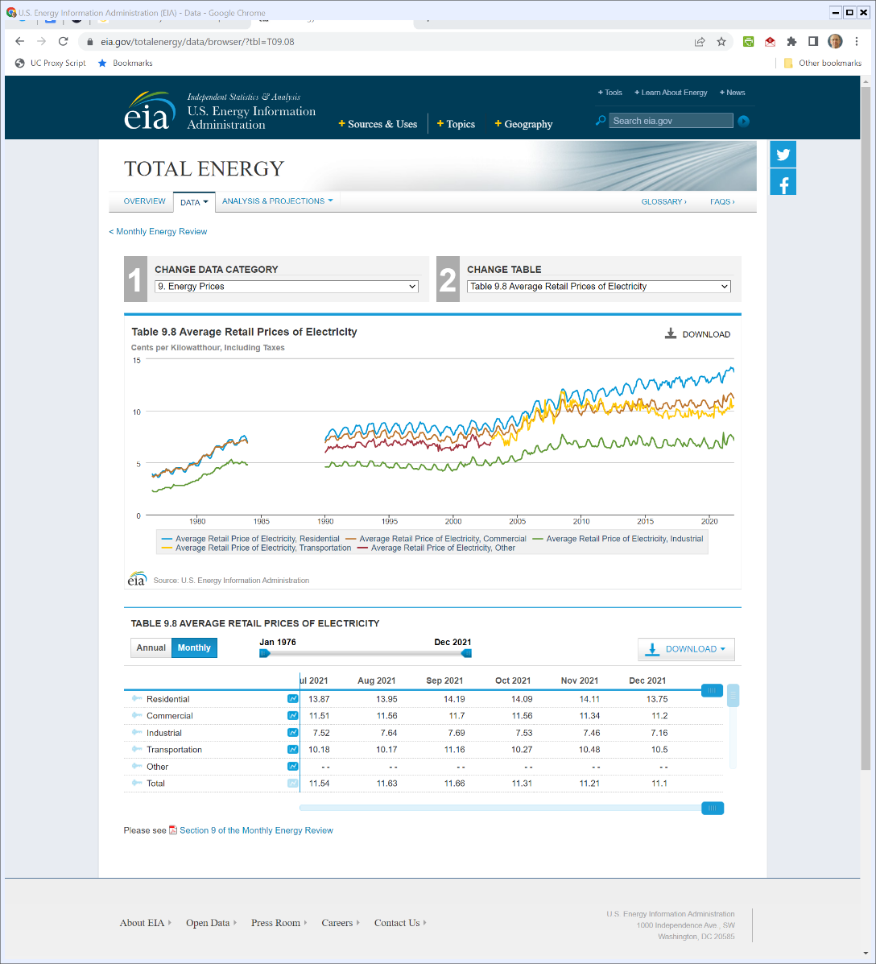

U.S. Electricity Prices by Year
U.S. Energy Info Admin (Visited 31 Mar 2022)
Notes:
https://www.eia.gov/totalenergy/data/browser/?tbl=T09.08

Slide 22
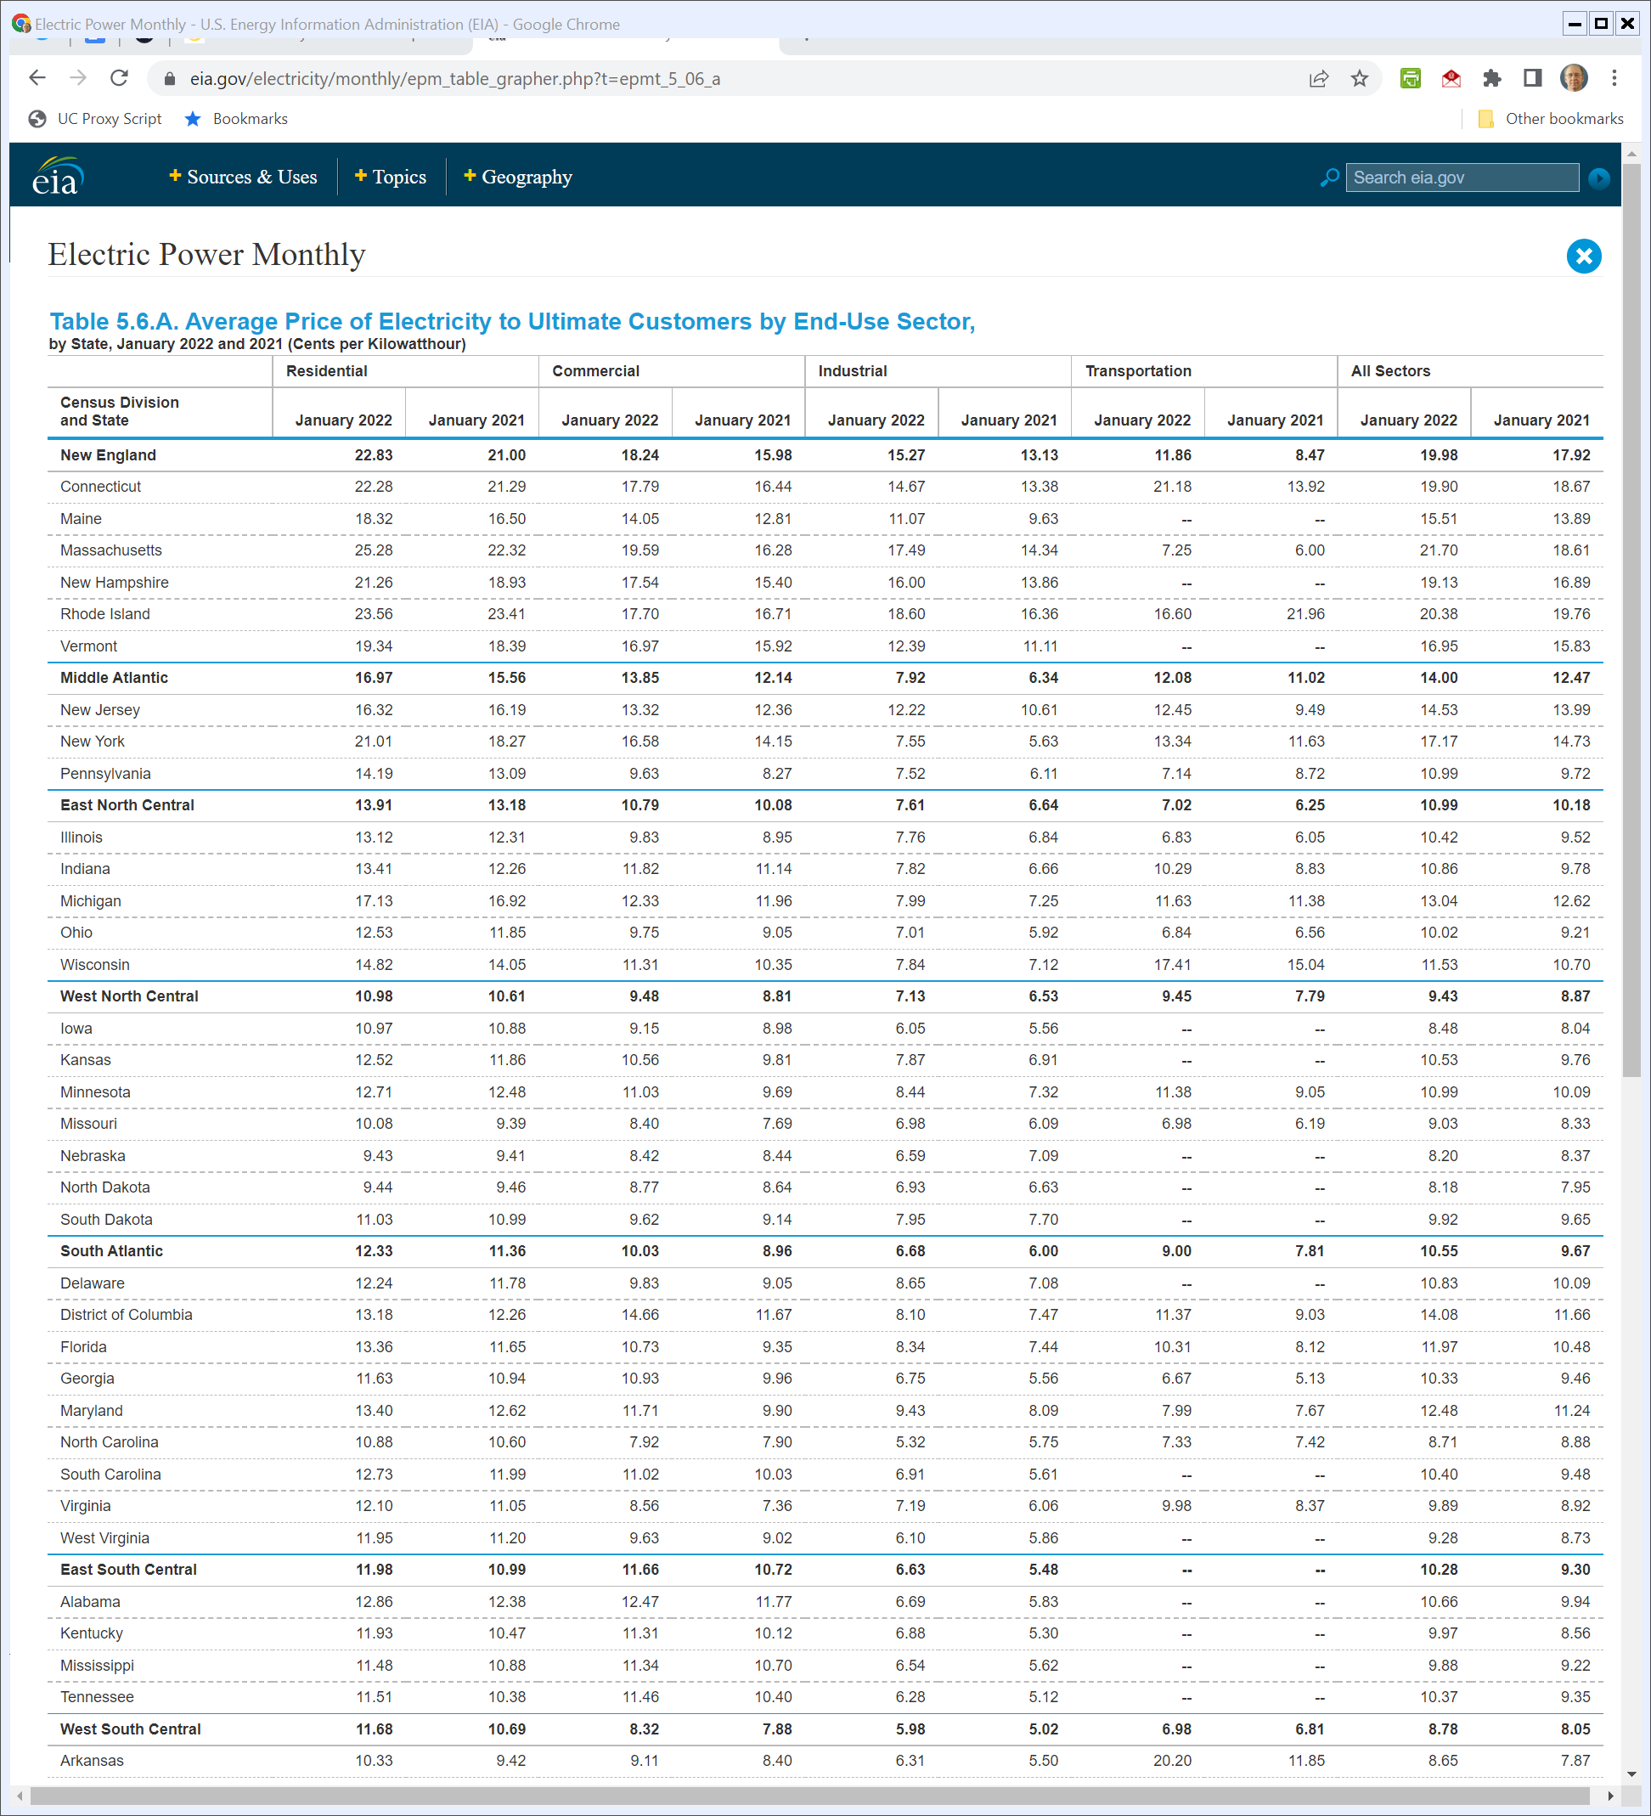
State Variation in Electricity Prices
U.S. Energy Info Admin (Visited 31 Mar 2022)
Notes:
https://www.eia.gov/electricity/monthly/epm_table_grapher.php?t=epmt_5_06_a

Slide 23
The Creation of Federal Authority over Electricity
The Run Up to the Federal Power Act of 1935
  States regulate utilities intrastate
  With vertically-integrated local monopolies, approach works except for sales near state lines
Attleboro (US 1927)
  States lack authority to regulate interstate power sales (the Attleboro Gap)

Slide 24
Attleboro
273 U.S. 83 (1927)

Slide 25
States Lack Power Over Interstate Electricity
Attleboro (US 1927)

Slide 26
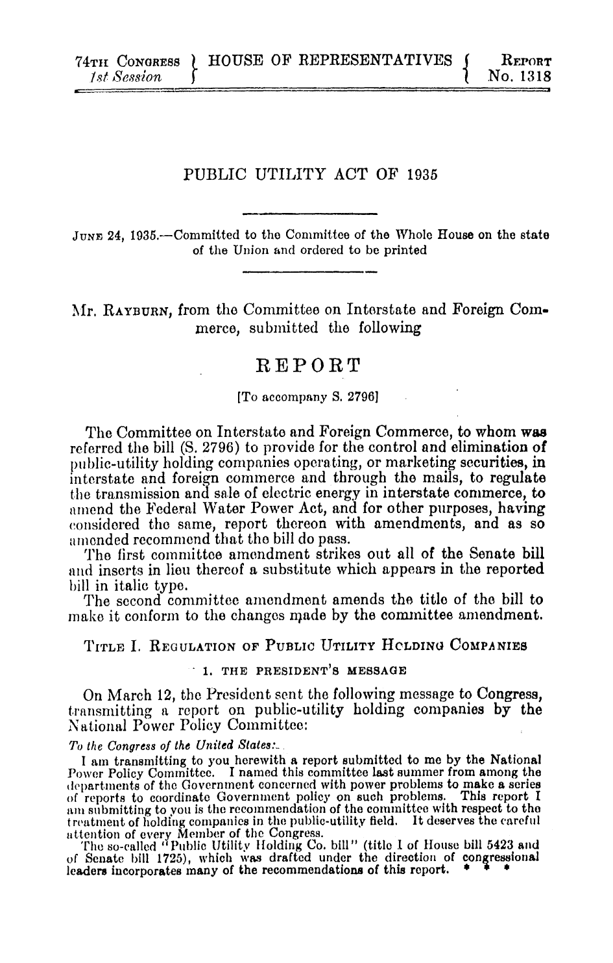
Creating Federal Electricity Reg
H. Rep 74-1318 (24 June 1935)

Slide 27
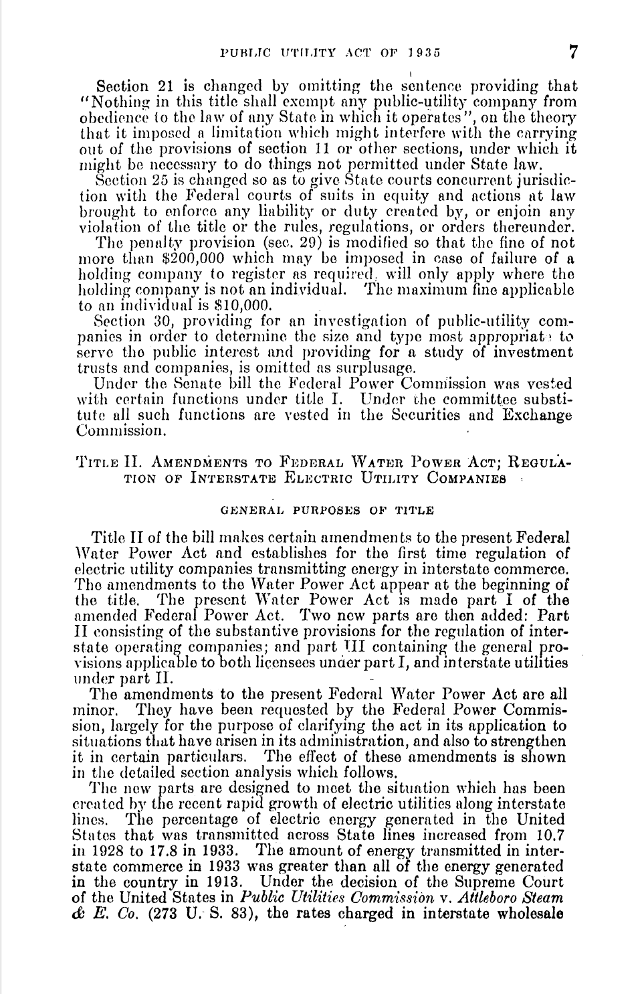
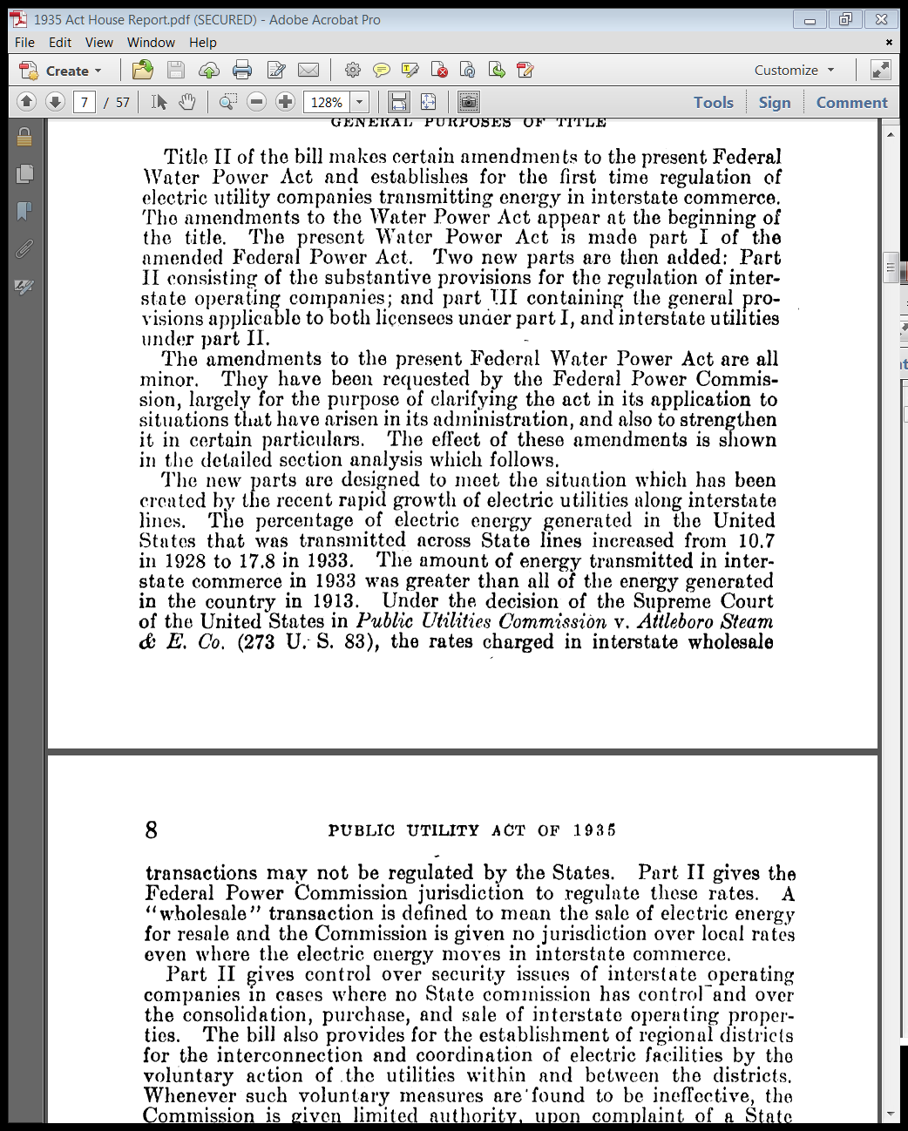
Change in Interstate Distribution of Electricity
H. Rep 74-1318 (24 June 1935)

Slide 28
New Fed Electricity Statute
Public Utility Act of 1935

Slide 29
Federal and State Zones of Control
Public Utility Act of 1935

Slide 30
Regional Operations and Voluntary Interconnection
Public Utility Act of 1935

Slide 31
FPC Interconnection Authority
Public Utility Act of 1935

Slide 32
Just and Reasonable Rates
Public Utility Act of 1935

Slide 33
FPC (now FERC) Power to Fix Rates
Public Utility Act of 1935

Slide 34
Mapping to Current Law
1935 Federal Power Act
  16 USC 824. Declaration of policy; application of subchapter (§ 201)
  16 USC 824d. Rates and charges; schedules; suspension of new rates; automatic adjustment clauses (§ 205)
  16 USC 824e. Power of Commission to fix rates and charges; determination of cost of production or transmission (§ 206)

Slide 35
Otter Tail
410 U.S. 366 (1973)

Slide 36
What the FPA Didn’t Do
S.1725, 74th Cong. 1st Sess. (6 Feb 1935)

Slide 37
Draft Bill Had a Common Carrier Provision
S.1725, 74th Cong. 1st Sess. (6 Feb 1935)

Slide 38
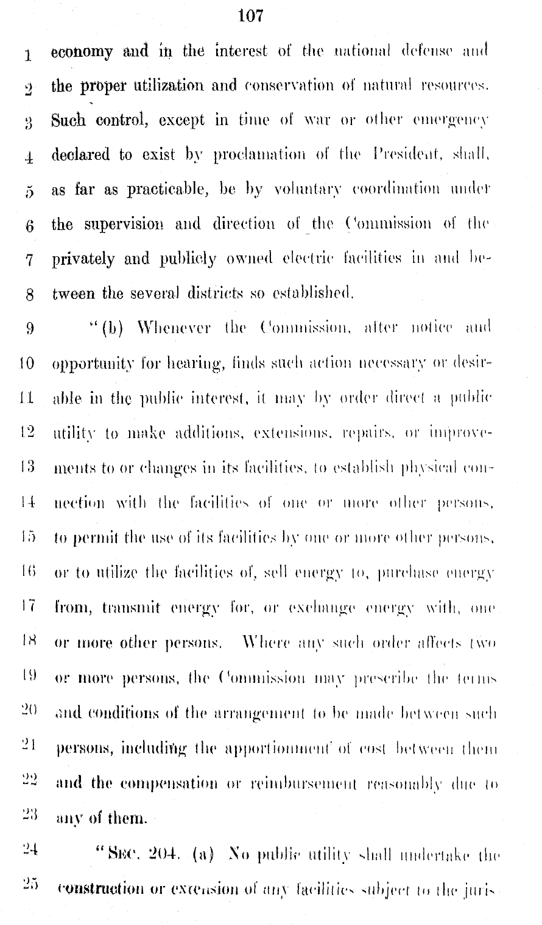
Draft Bill Gave FPA More Powers re Interconnection and Expansions
S.1725, 74th Cong. 1st Sess. (6 Feb 1935)

Slide 39
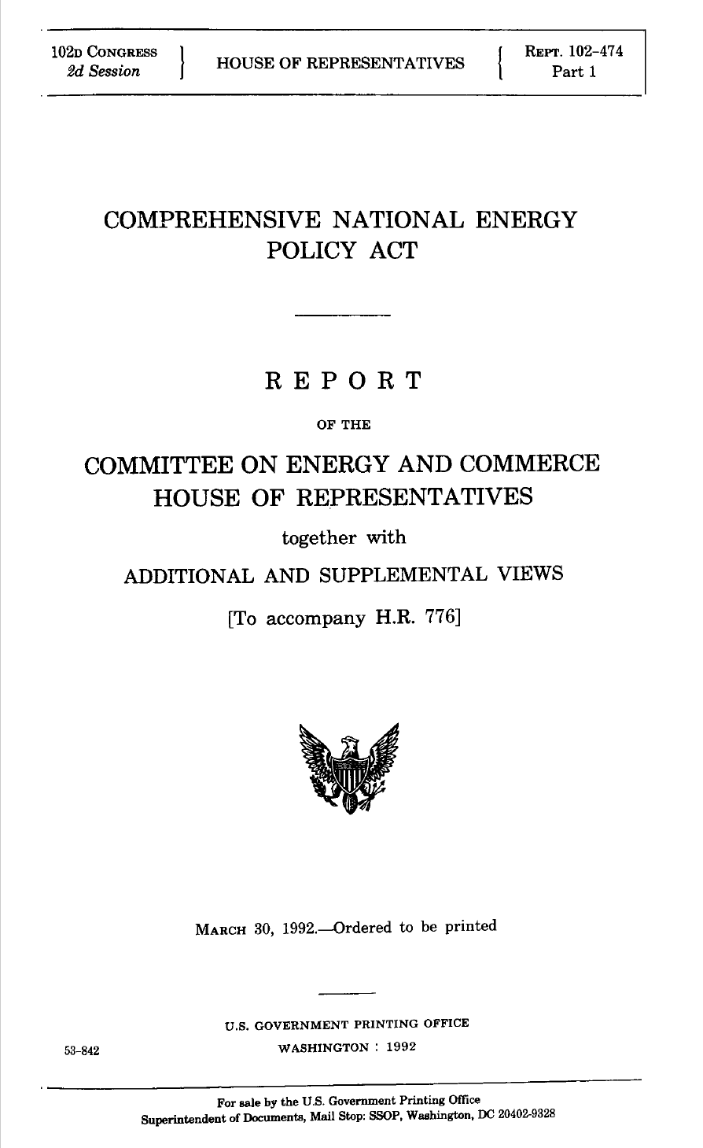
Run Up to 1992 Act
H. Rept. 102-474 (30 Mar 1992)

Slide 40
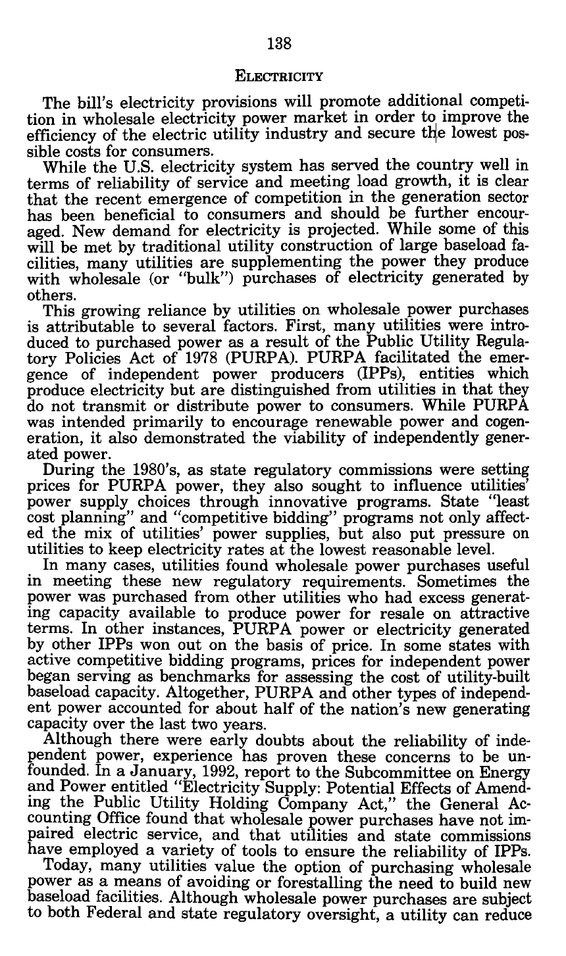
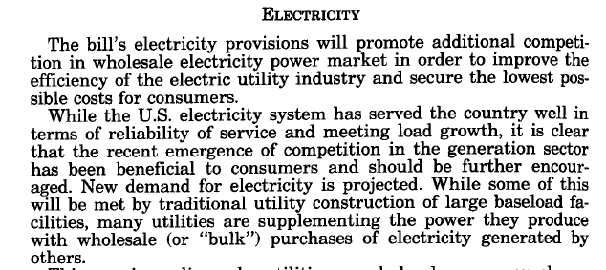
Boost Competition in Wholesale Markets
H. Rept. 102-474 (30 Mar 1992)

Slide 41
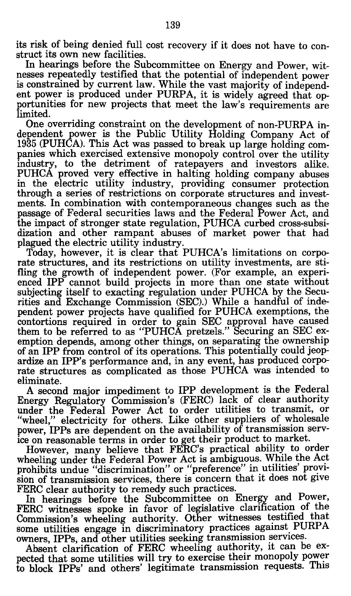
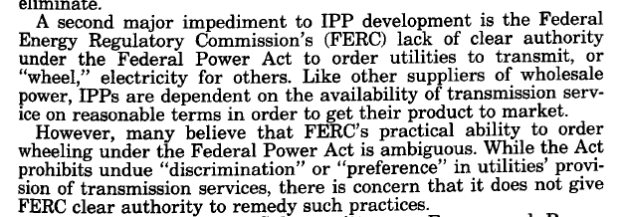
Questions re FERC Authority over Wheeling
H. Rept. 102-474 (30 Mar 1992)

Slide 42
1992 Statute: 358 Pages
Energy Policy Act of 1992

Slide 43
FERC Power over Transmission Services
Energy Policy Act of 1992

Slide 44
Allocation of Transmission Costs
Energy Policy Act of 1992

Slide 45
FERC Order 888
61 FR 21540 (10 May 1996)

Slide 46
Unbundling: Open Access Transmission Regime
61 FR 21540 (10 May 1996)

Slide 47
Changes in Economics of Generation
61 FR 21540 (10 May 1996)

Slide 48
Orders 888/889: Creating a Nondiscriminatory Market
Major Steps
  Separate rates for generation, transmission and ancillary services
  Common information system, for both the owner of the grid and outsiders (the OASIS—Open Access Same-Time Information System)
  Owner of transmission grid must “buy” as outsider would

Slide 49
Network Mergers (and Rate Pancaking)
Mergers of Substitutes
  Anticompetitive
Mergers of Complements
  Network segments
  Eliminate double marginalization
  Could be beneficial

Slide 50
Regional Transmission Organizations
FERC Order 2000 (20 Dec 1999)

Slide 51
Benefits of RTOS
FERC Order 2000 (20 Dec 1999)

Slide 52
Voluntary Approach
FERC Order 2000 (20 Dec 1999)

Slide 53
RTO Map
FERC RTO Map (Nov 2015)
Notes:
Source: FERC: http://www.ferc.gov/industries/electric/indus-act/rto.asp

Slide 54
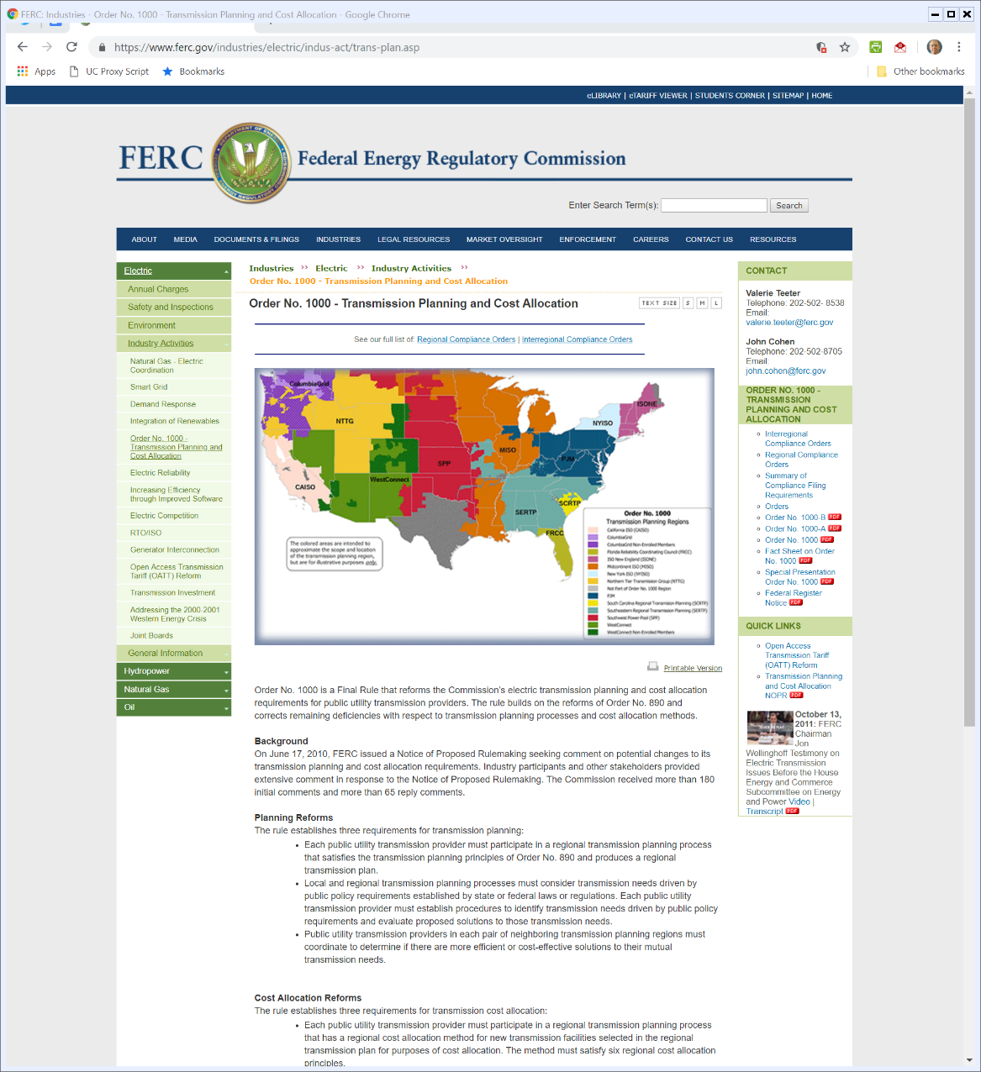

2011 FERC Order 1000
FERC Order 1000 (21 July 2011)
Notes:
https://www.ferc.gov/industries/electric/indus-act/trans-plan.asp

Slide 55
Transmission Planning Regions
FERC Order 1000 (21 July 2011)
Notes:
https://www.ferc.gov/industries/electric/indus-act/trans-plan.asp

Slide 56
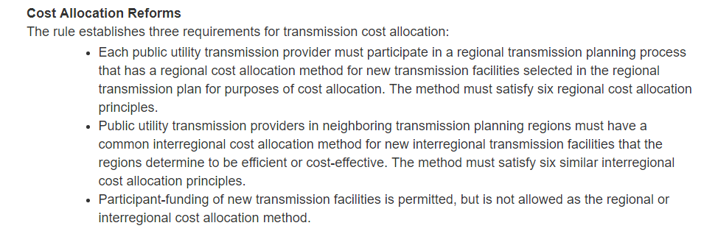
New Cost Allocation Rules
FERC Order 1000 (21 July 2011)
Notes:
https://www.ferc.gov/industries/electric/indus-act/trans-plan.asp

Slide 57
New Rules: 134 FR Pages
FERC Order 1000 (11 Aug 2011)

Slide 58
Cost/Benefit Correpondence
FERC Order 1000 (11 Aug 2011)

Slide 59
Same for Interregional
FERC Order 1000 (11 Aug 2011)

Slide 60
MISO Analysis
MISO MVP Analysis (10 Jan 2012)

Slide 61
MVP Map
MISO MVP Analysis (10 Jan 2012)

Slide 62
MISO Multi-Value Projects
MISO MVP Benefits

Slide 63
Illinois Commerce Comm, 721 F3d 764 (7th Cir. 2013)
Three Key Issues to Discuss
  1. Allocation of Costs of Grid Expansion
  2. Rate Pancaking with Multiple RTOs
  3. RTO Voluntariness and Entrance and Exit Fees

Slide 64
Cost Allocation: Nearest v. All
ICC v FERC (7th Cir 2013)

Slide 65
Cost Allocation: Peak v. Non-Peak
ICC v FERC (7th Cir 2013)

Slide 66
Cost Allocation: Buyers (Loads) v Generators
ICC v FERC (7th Cir 2013)

Slide 67
Cost Allocation: Location Incentives
ICC v FERC (7th Cir 2013)

Slide 68
Rate Pancaking (Double Marginalization)
ICC v FERC (7th Cir 2013)

Slide 69
Voluntary RTOs and Entrance and Exit Fees
ICC v FERC (7th Cir 2013)

