Slide 1
Class 5
Platforms and Networks
Spring 2022
Managing Grids and Networks: Natural Gas Pipelines
Randal C. Picker
James Parker Hall Distinguished Service Professor of Law
The Law School
The University of Chicago
Copyright © 2014-22 Randal C. Picker. All Rights Reserved.

Slide 2
The Focus Today
Key Questions/Issues
  1. How do we organize competition between competing networks (pipelines here)?
  2. How does the scale of the network matter for that competition?
  3. How do the mechanics of rolled-in pricing vs. incremental pricing matter for that?

Slide 3
The Focus Today
Key Questions/Issues
  4. When is cross-subsidization good (Post Office)? When is it bad (natural gas pipelines)?

Slide 4
Natural Monopoly: Production and Cost Function
Available to anyone
Given by: cq + K
  q is quantity of good produced
  c is the cost of producing one unit of each good (marginal cost)
  K is fixed cost of production
  A producer must pay K regardless of how much of the good is produced
  Idea: An entry fee to get into the business

Slide 5
Natural Monopoly: Production and Cost Function
  A producer must pay K regardless of how much of the good is produced
  Idea: An entry fee to get into the business
How many firms would an all-powerful social planner have?

Slide 6
Understanding Natural Monopoly
Production Cost Focus: One Firm
  Any quantity of the good can be produced at the lowest cost by having a single firm
  The costs of producing each unit of the good is the same regardless of the number of firms (fixed marginal cost of production)

Slide 7
Understanding Natural Monopoly
  Two firms = two entry fees (2K) and the second entry fee is wasted
  We might see that this cost function creates a natural monopoly

Slide 8
Understanding Natural Monopoly
Competition Focus: More than One Firm?
  But we also know that a monopolist will reduce output (and that creates a deadweight loss)
  All-powerful social planner needs to control exercise of monopoly power
  Does this through regulation

Slide 9
Understanding Natural Monopoly
Natural Monopoly and Regulation
  This production function provides natural basis for single-firm situations with regulations controlling exercise of market power.

Slide 10
Natural Monopoly and Entry
Situation
  Suppose that we have one firm producing with this cost function and no regulation.
  Will other firms enter?
  Put differently, does this production function give rise to monopoly at all?

Slide 11
Natural Monopoly and Entry
Answer
  It depends on what the entrant believes will happen
  Three Scenarios
    The Tough Incumbent
    Price Competition
    Quantity Competition

Slide 12
No. 1: The Tough Incumbent
TTYN (1 of 3)
Hypo
  Entrant believes that Incumbent monopolist will slash prices to c, marginal cost, in response to entry
Will E enter?

Slide 13
No. 2: Price Competitors
TTYN (2 of 3)
Hypo
  E believes and E and I will compete on price
  More precisely, an outcome of their interaction will be a situation in which E is happy with her price, given I’s price, and vice versa.
Will E enter?

Slide 14
No. 3: Quantity Competitors
TTYN (3 of 3)
Hypo
  Switch from prices to quantities
  Look for an outcome in which E is happy with her quantity, given I’s quantity, and vice versa.
Will E enter?

Slide 15
Two Canonical Oligopoly Models: Cournot (1838)
Cournot (1838)

Slide 16
Two Canonical Oligopoly Models: Bertrand (1883)
Bertrand (1883)

Slide 17
One Solution Concept: The Nash Equilibrium
Nash (1950)

Slide 18
No. 1: The Tough Incumbent
Answer
  No, just covers marginal costs, and loses fixed cost of K

Slide 19
No. 2: Price Competitors
Answer
  Probably not.
  One possible outcome of this process, called Bertrand competition, is P = c.
  Lowering prices slightly diverts the entire market to the seller and increases profits.
  This repeats scenario 1 outcome and no reason to enter

Slide 20
No. 3: Quantity Competitors
Answer
  Specify demand curve: P = a – bQ
  End point: Firms will enter until all profits are gone (zero profits condition)

Slide 21
How many firms will enter?
With cost function and demand curve, solution has form

Slide 22
Bottom Line
Duh: Answer depends on precise values
But
  Depending on competition assumptions, Bertrand v. Cournot, good chance that we will have more than one firm competing
  Remember, this is in a case where the lowest cost way to produce every quantity of output is by having a single firm

Slide 23
Bottom Line
  So, key point, natural monopoly costs will not necessarily give rise to a monopoly at all

Slide 24
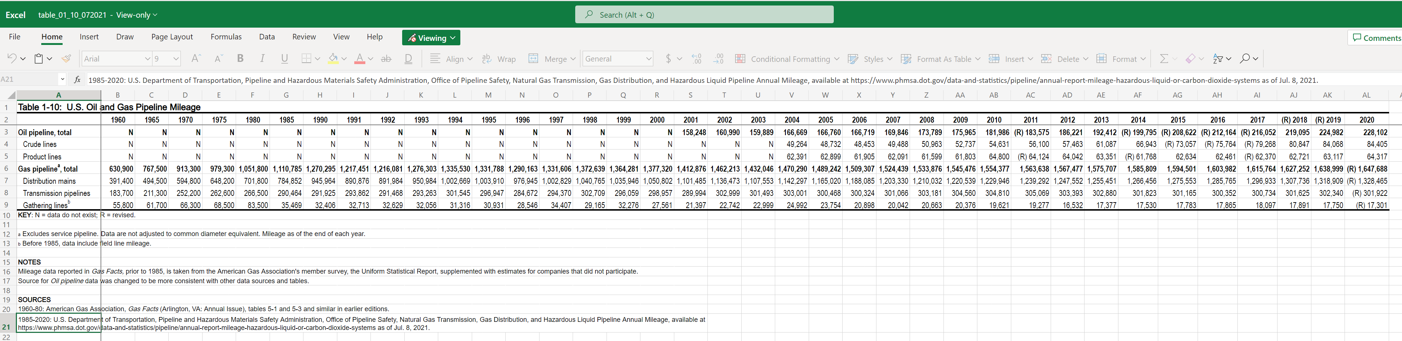
U.S. Gas Pipeline Mileage
U.S. Bureau of Transportation Statistics
Notes:
https://www.bts.gov/content/us-oil-and-gas-pipeline-mileage

Slide 25
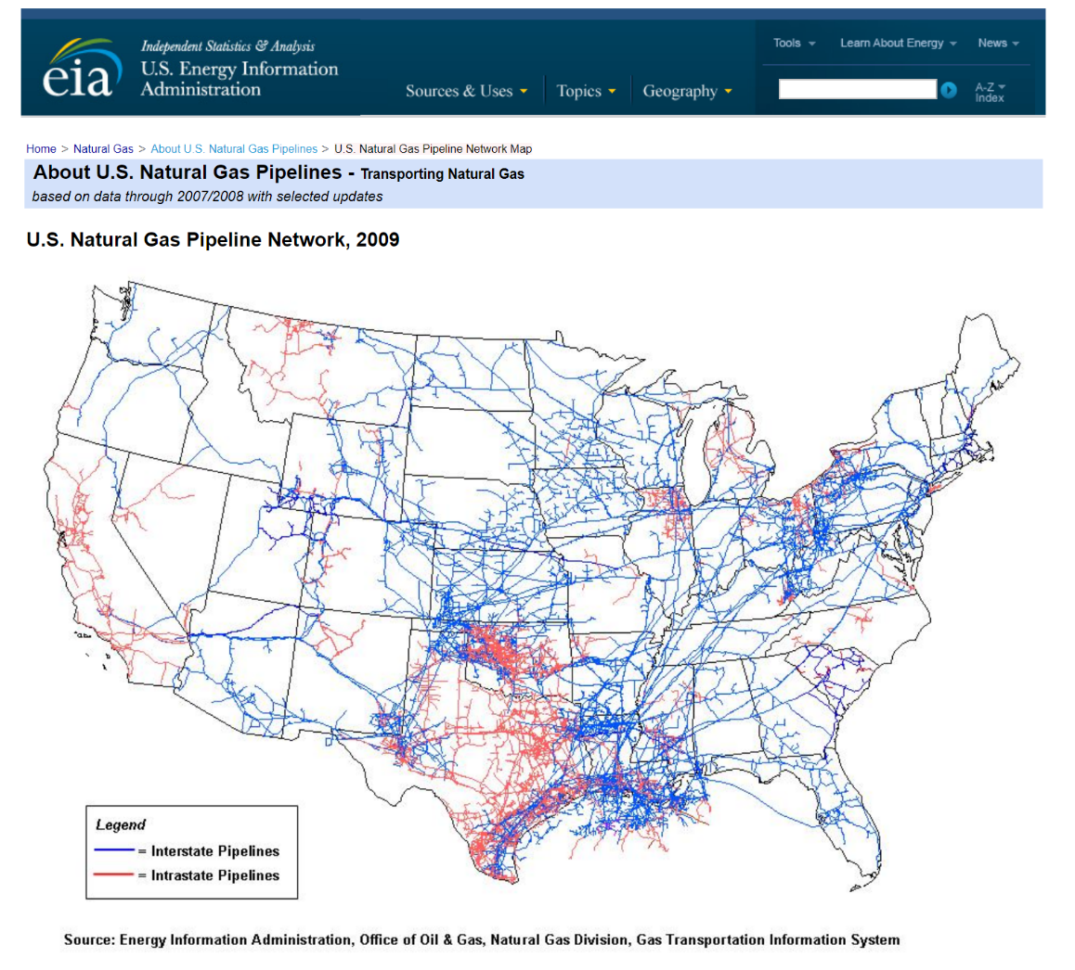
2009 U.S. Natural Gas Pipeline Network
U.S. Energy Info Admin (2009)
Notes:
https://www.eia.gov/naturalgas/archive/analysis_publications/ngpipeline/ngpipelines_map.html

Slide 26
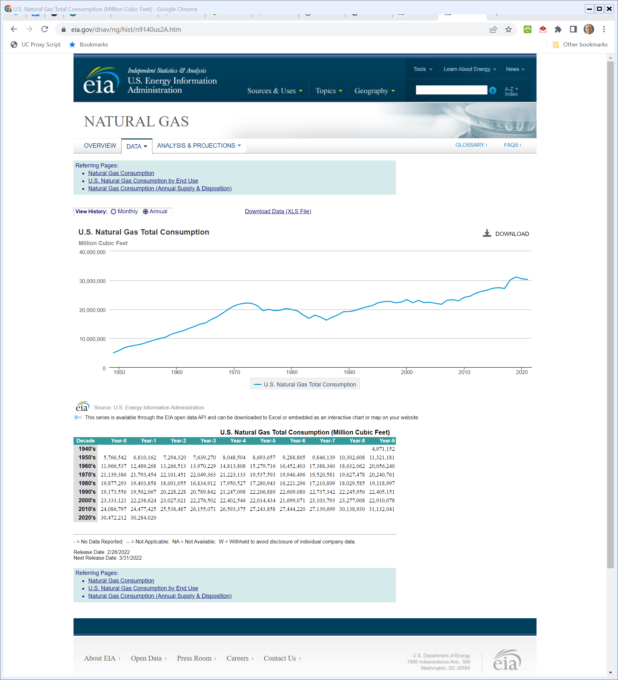
U.S. Natural Gas Total Consumption
U.S. Energy Info Admin
Notes:
https://www.eia.gov/dnav/ng/hist/n9140us2A.htm

Slide 27
1938 Natural Gas Act
Pub. L. 75-688 (21 June 1938)

Slide 28
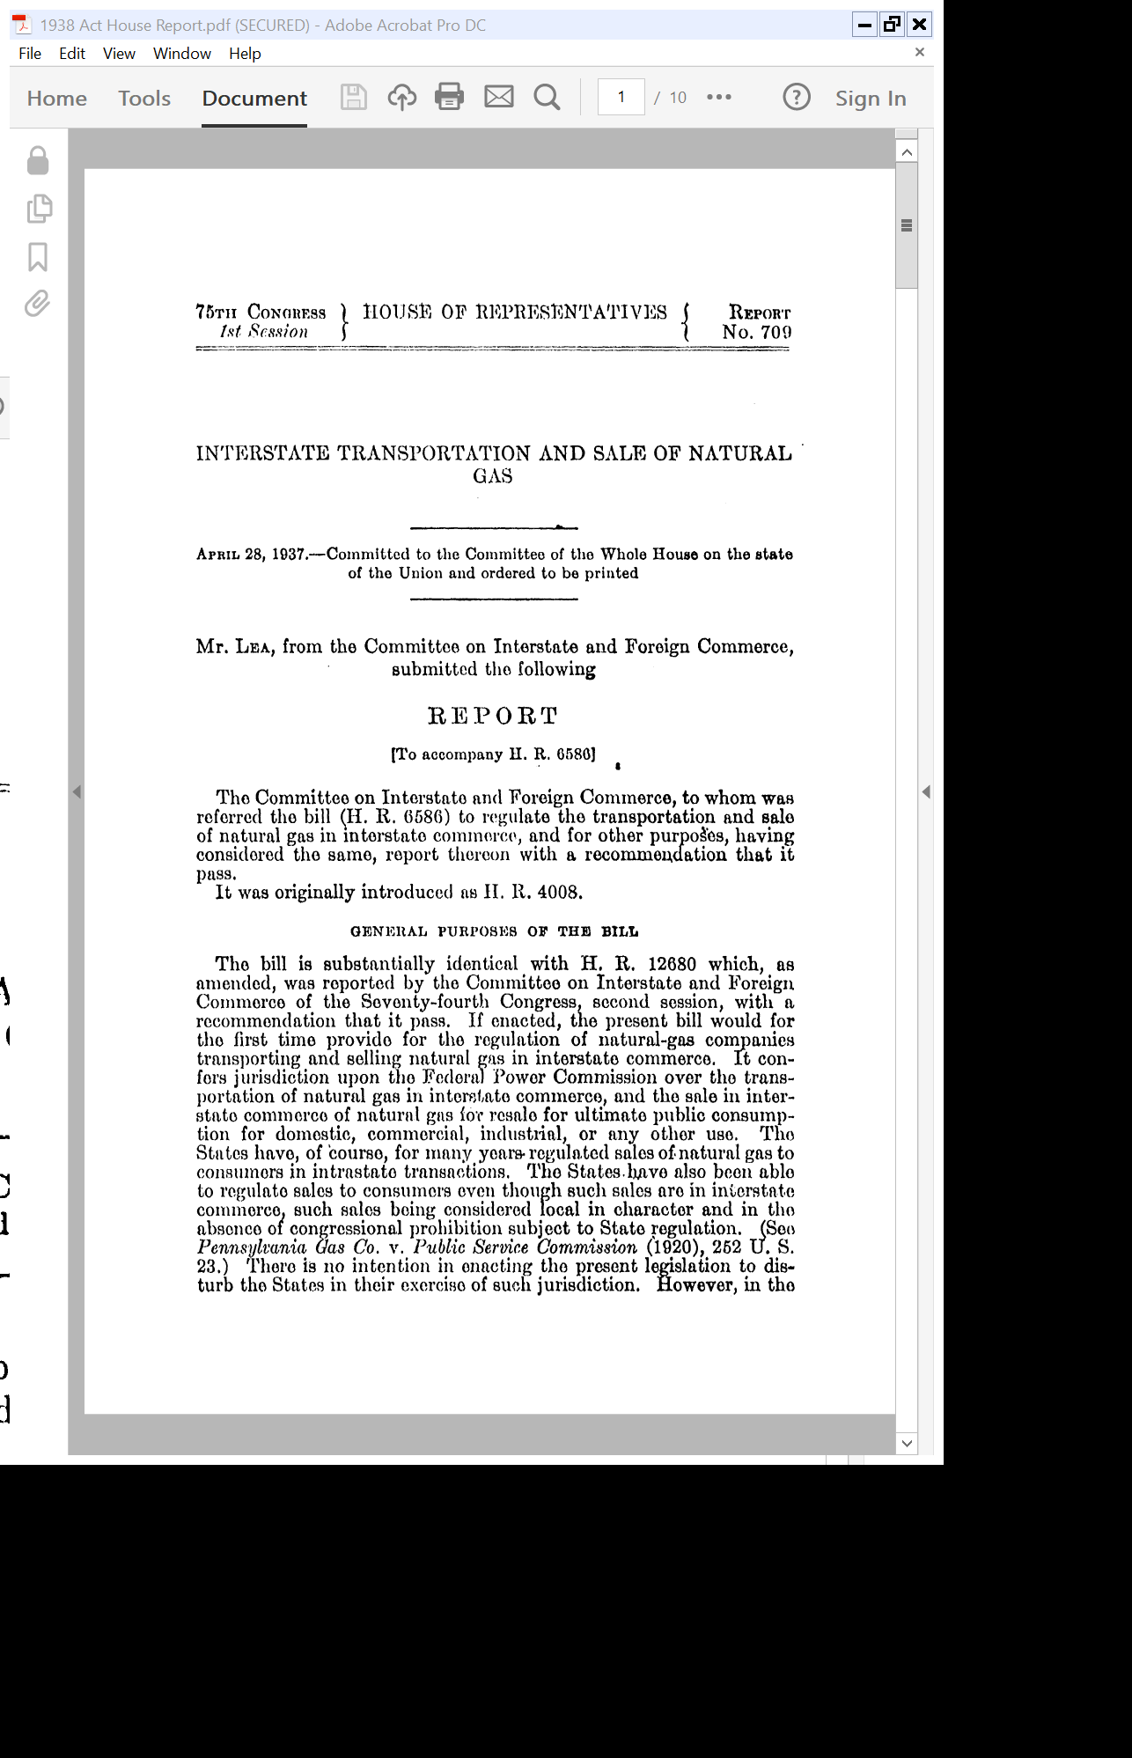
Add Interstate Reg; Leave Intrastate in Place
H.Rep. 75-709 (28 Apr 1937)

Slide 29
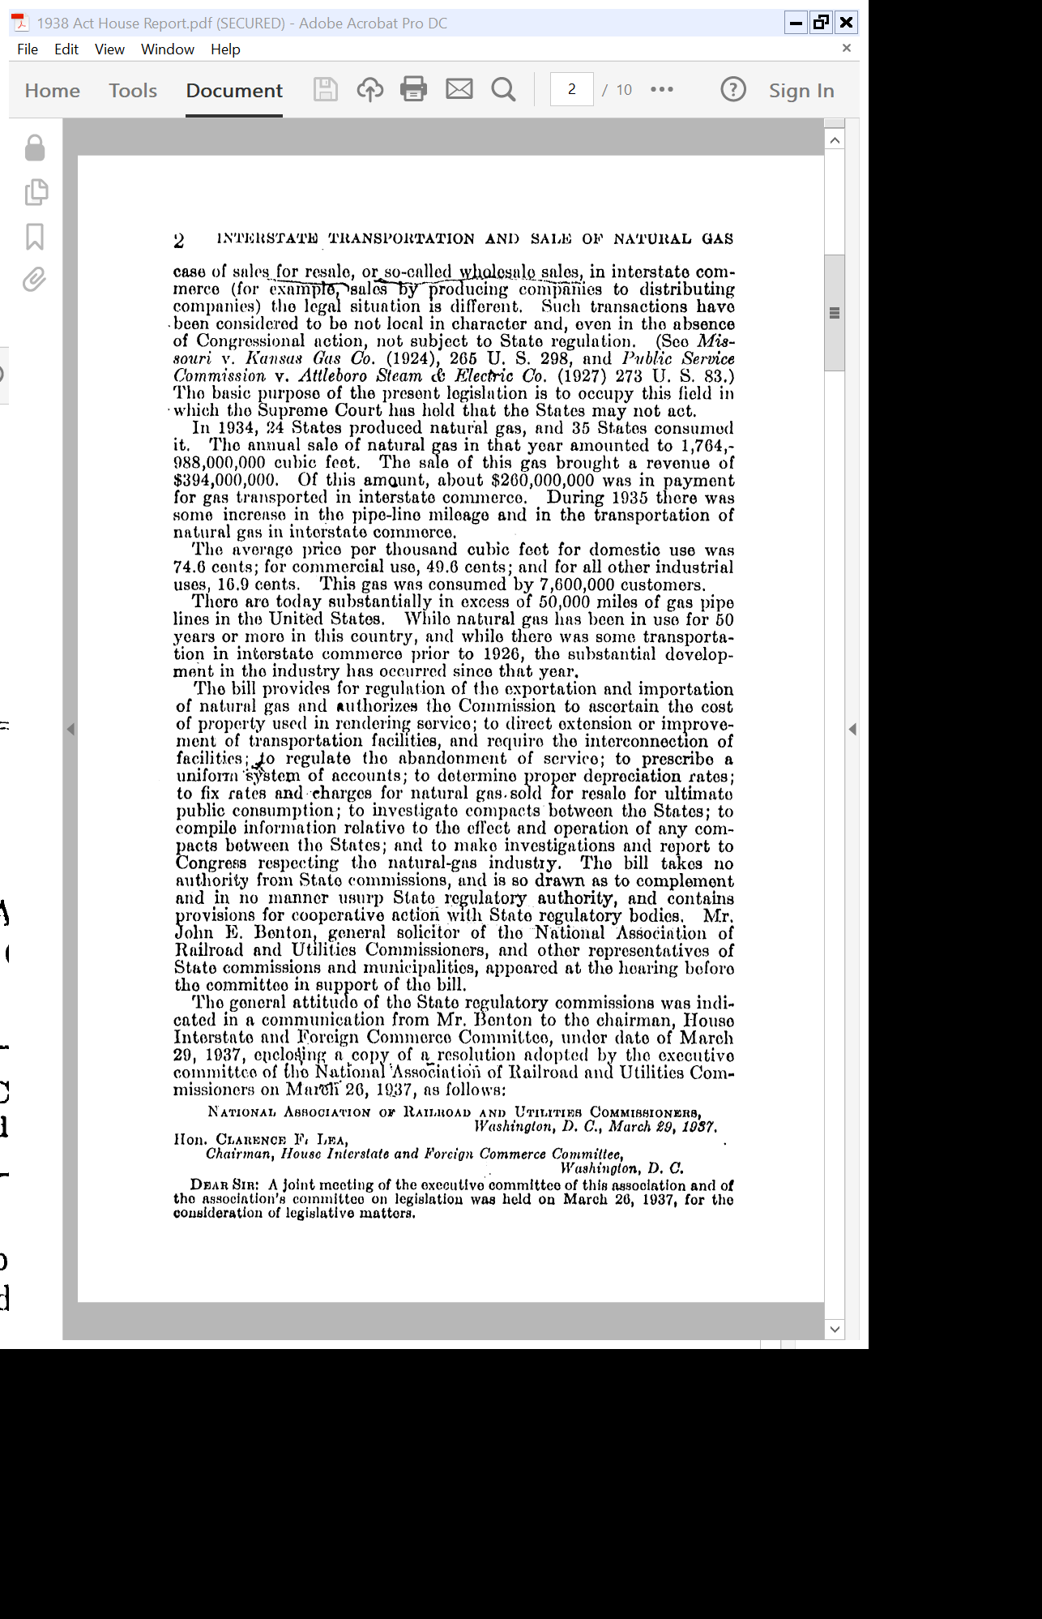
States Can’t Act
H.Rep. 75-709 (28 Apr 1937)

Slide 30
Growing Rapidly
H.Rep. 75-709 (28 Apr 1937)

Slide 31
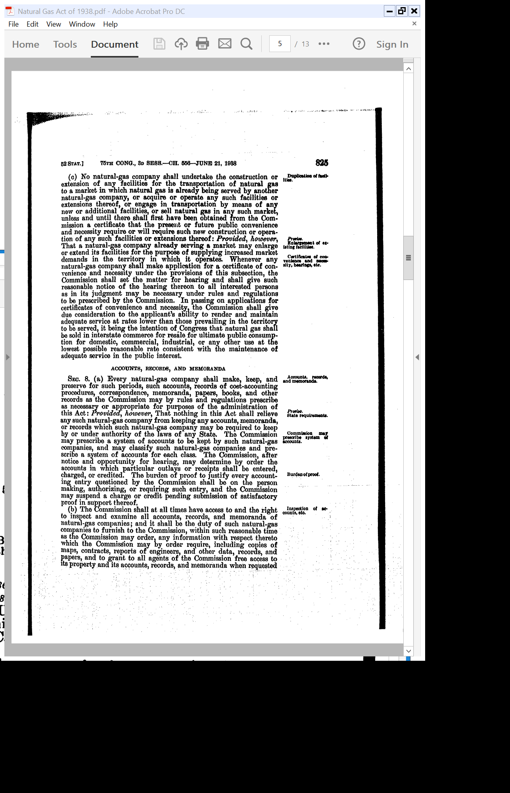
Regulated Entry
Pub. L. 75-688 (21 June 1938)

Slide 32
1942 Amendments
Pub. L. 77-444 (7 Feb 1942)

Slide 33
Expansion of Certificate of Entry Regime
H.Rep. 77-1290 (21 Oct 1941)

Slide 34
Title 15, Chap. 15B.: Natural Gas
United States Code (30 Mar 2022)

Slide 35
15 USC 717 and forward
United States Code (30 Mar 2022)

Slide 36
Current Statute
“…[A] certificate shall be issued to any qualified applicant therefor, authorizing the whole or any part of the operation, sale, service, construction, extension, or acquisition covered by the application, if it is found that the applicant is able and willing properly to do the acts and to perform the service proposed and to conform to the provisions of this chapter and the requirements, rules, and regulations of the Commission thereunder,”
15 USC 717f(e)

Slide 37
Current Statute
“and that the proposed service, sale, operation, construction, extension, or acquisition, to the extent authorized by the certificate, is or will be required by the present or future public convenience and necessity; otherwise such application shall be denied. The Commission shall have the power to attach to the issuance of the certificate and to the exercise of the rights granted thereunder such reasonable terms and conditions as the public convenience and necessity may require.”
15 USC 717f(e)

Slide 38


About Jets
Jetspizza.com (30 Mar 2022)

Slide 39
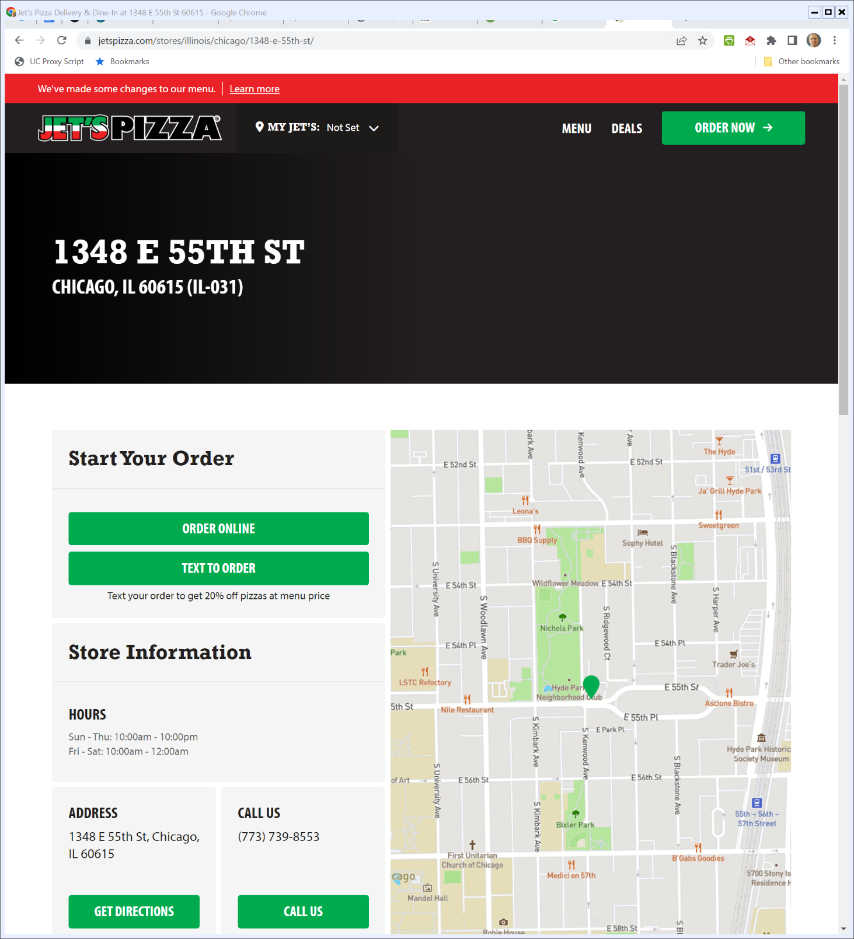
New Jet Pizza
Visited 30 Mar 2022

Slide 40


The Lost City
The Numbers (Visited 30 Mar 2022)
Notes:
https://www.the-numbers.com/movie/Lost-City-The-(2022)#tab=summary

Slide 41
Hypo
TTYN (1 of 4)
Five potential customers would like access to a pipeline
B
A
C
D
E
System Access Point

Slide 42
Questions
TTYN (2 of 4)
How should we design the network?
How should we allocate the costs?
Additional Facts
  $10 a unit for pipe
  Ignore distribution costs

Slide 43
Grid 1
TTYN (3 of 4)
Try this:
B
2
1
3
A
C
D
4
5
E
System Access Point

Slide 44
Suggested Payment Scheme
TTYN (4 of 4)
Equal share to any company using pipe
B
2
A
1
3
C
D
5
System Access Point
E

Slide 45
Issues
TTYN (1 of 2)
D is paying 14.50, but could get to the access point on its own for 10.
D will defect.
B
2
1
A
C
D
4
3
5
E
System Access Point

Slide 46
New Allocations
TTYN (2 of 2)
B
2
A
1
C
D
4
3
5
System Access Point
E

Slide 47
Problems
D and E Symmetry Violated
  D paying $10 while E pays 2.5
  Occupy same position vis-à-vis access point and third parties.

Slide 48
Problems
A, B and C Coalition Defection
  Paying 37.49
  Suppose C built directly to the access point.
    Cost of that line would be 14.14, cost of A and B straight-line chunks would be 20, for total of 34.14.

Slide 49
Try Again
TTYN (1 of 2)
B
2
1
A
C
D
3
4
5
6
E
System Access Point

Slide 50
Allocations
TTYN (2 of 2)
B
A
1
C
D
3
4
5
6
System Access Point
Cost of short length is 7.07
Total cost of system is 20 + 28.28 = 48.28
E

Slide 51
Problems?
How should we evaluate this one?

Slide 52
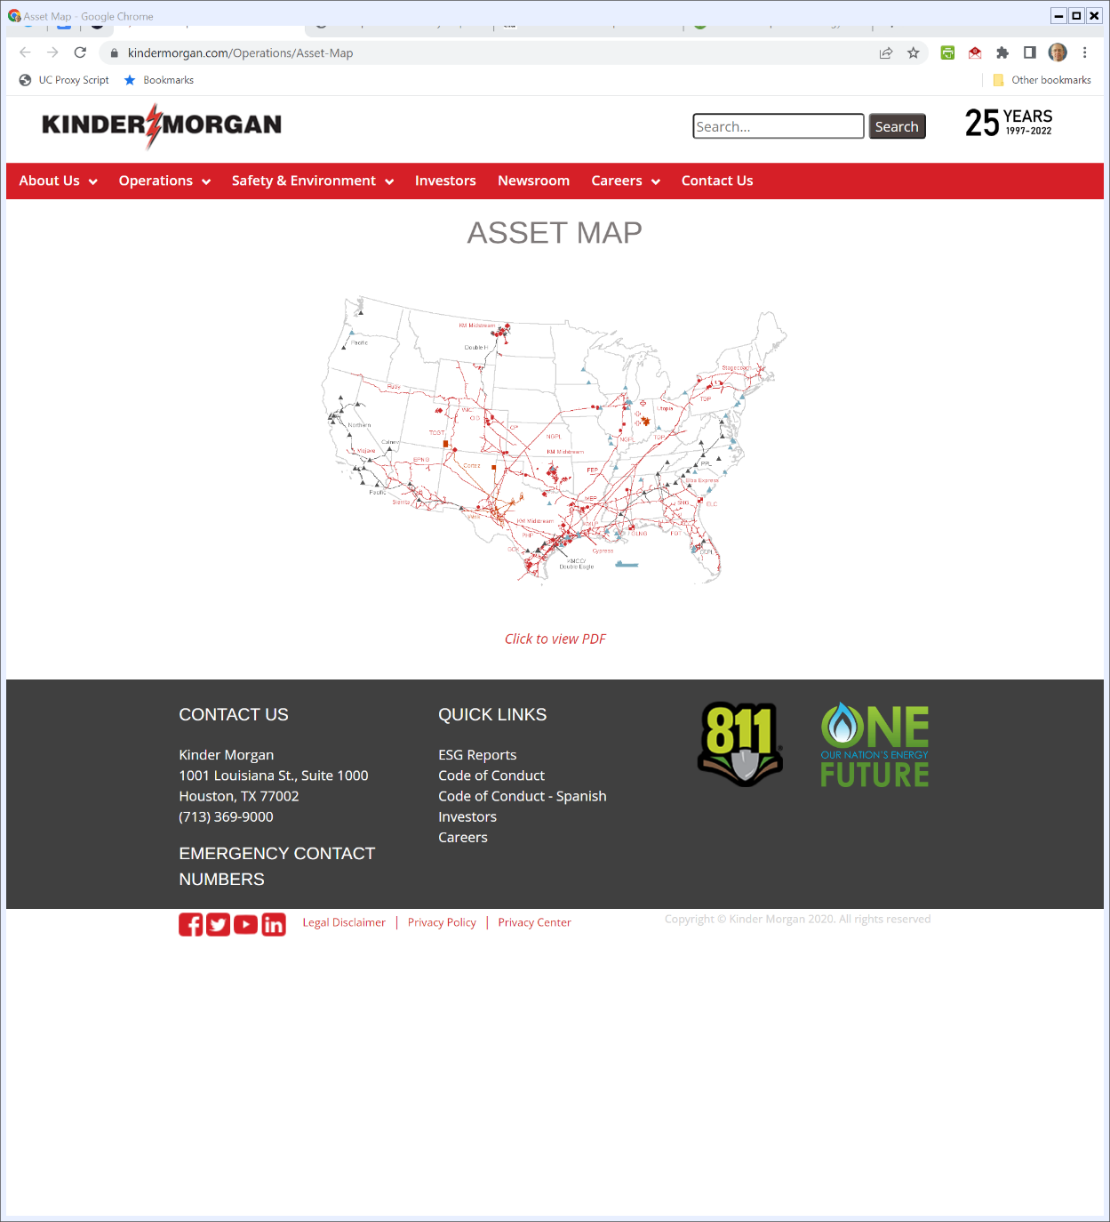
Pipeline Map
Kinder Morgan (Visited 30 Mar 2022)
Notes:
https://www.kindermorgan.com/Operations/Asset-Map

Slide 53
Older Sonat Map

Slide 54
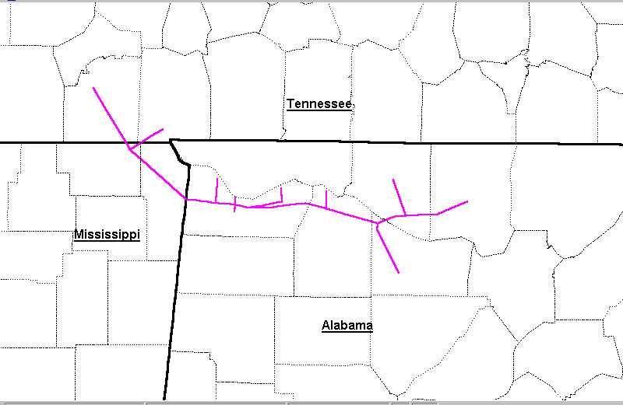
Alabama-Tennessee Natural Gas Pipeline Co.

Slide 55
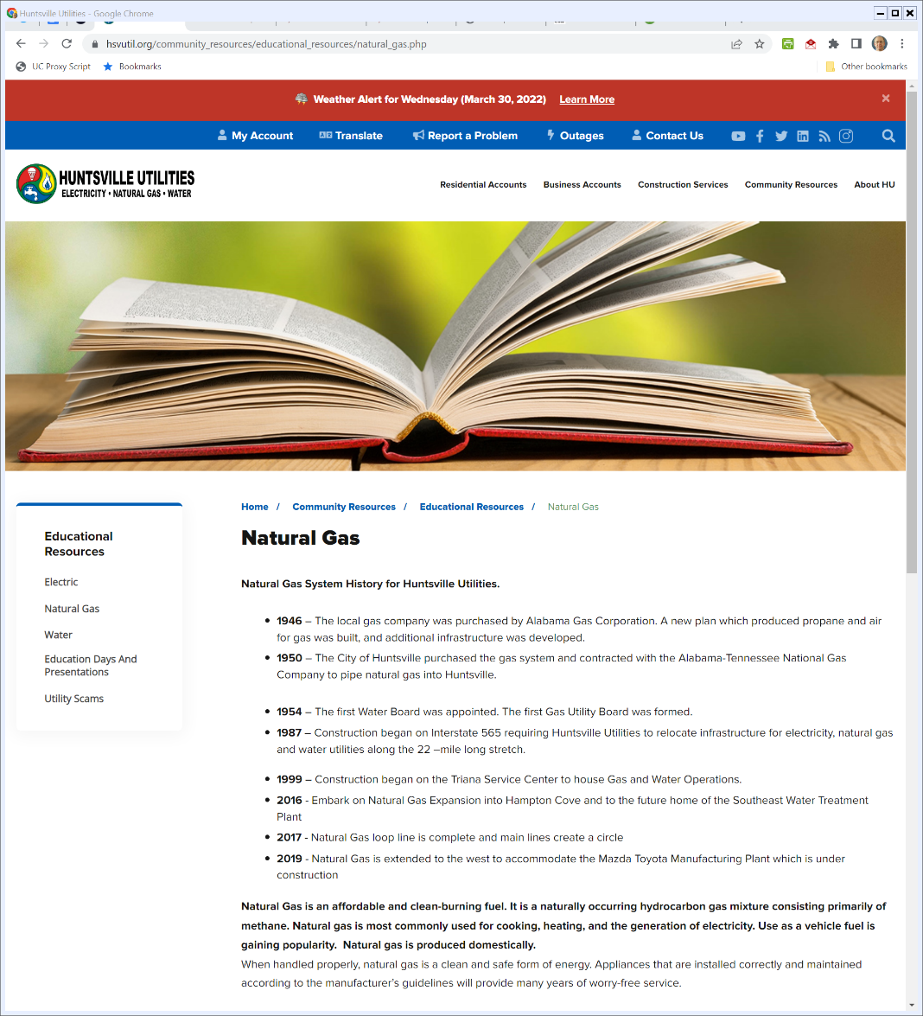

Huntsville Utilities
Hsvutil.org (Visited 30 Mar 2022)
Notes:
https://www.hsvutil.org/community_resources/educational_resources/natural_gas.php

Slide 56
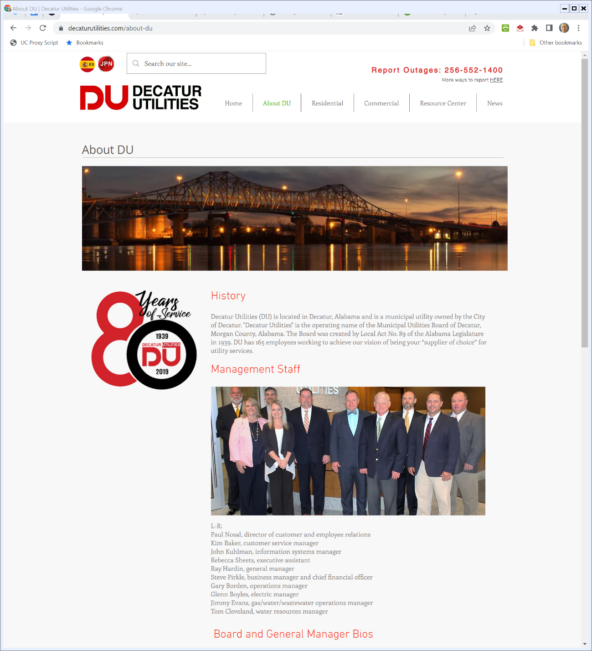

Decatur Utilities
Decaturutilities.com (Visited 30 Mar 2022)
Notes:
https://www.decaturutilities.com/about-du

Slide 57
Southern Natural Gas: Economics of Pipelines
Now Project
  109.53 miles of 16-inch pipeline
  8.47 miles of 12-inch pipeline
  Two turbine compressor units, 4700 hp and 1600 hp
  Three meter stations
  Capacity: 76,350 Mcf per day
  Cost: $52.8 million

Slide 58
Southern Natural Gas: Economics of Pipelines
Future Project
  More compression at cost of $10 million
  Extra capacity: 70,000 Mcf per day
Clear economies of scale over this range

Slide 59
SNG: Key Institutional Features
Open Season
  Device to assess potential demand for project pre-investment
Long-Term Contracts
  Long-lived investment -> Long-lived commitments
  Means locus of competition is changed from day by day to commitments made during open seasons

Slide 60
SNG: Key Institutional Features
Pricing Mechanisms: Incremental Rates v. Rolled-In Rates
  Incremental Rates: New users must bear all of the costs
  Rolled-In Rates: Pre-existing users bear some of the costs

Slide 61
Sonat: Just a Coalition Defection?
What is happening here?
  Preexisting configuration leads to one split of value
  Potential Sonat entry makes it possible for five shippers to defect
Does this match the framework we just considered?

Slide 62
Pricing and Incentives I
TTYN (1 of 2)
Current Phone System
New User
How should we allocate the cost of this connection?

Slide 63
Pricing and Incentives II
TTYN (2 of 2)
Entrant’s Pipeline
Incumbent’s Extension
Incumbent Pipeline System
How will pricing rules alter extension competition?

Slide 64
Pricing and Incentives I
Make new user fully internalize cost, so incremental pricing?
Analysis
  Network externalities idea makes clear that preexisting users benefit from addition of new user
  Full internalization will push too many costs of new users

Slide 65
Pricing and Incentives I
  Some sort of sharing, i.e., rolling in is preferable
Is this the situation in Southern Natural Gas?
  So FERC finds

Slide 66
Pricing and Incentives II
Analysis
  Incremental pricing preserves level-playing field for extension between incumbent and entrant
  Rolled-in pricing gives incumbent decided advantage
  This will create a push to larger integrated networks
How should we evaluate this?

Slide 67
Facts Here
Cost Estimates
  Initial: $52.8 million
    “Four” would pay only 40% of this in 20 years
  Then $66.6m, then $103.5
Long-Term System Benefits
  Southern: $39 million
  FERC: $25 million

Slide 68
FERC’s Revised Policy
Revised Pricing Policy: Certification of New Interstate Natural Gas Pipeline Facilities, 88 FERC 61,227 (1999)
  Arguably requires incremental pricing for Southern proposal
  Does not apply retroactively

Slide 69
Incremental Pricing, Not Rolled In
No Cross-Subsidization
  “The threshold requirement in establishing the public convenience and necessity for existing pipelines proposing an expansion project is that the pipeline must be prepared to financially support the project without relying on subsidization from its existing customers.”

Slide 70
Incremental Pricing, Not Rolled In
  “The requirement that the project be able to stand on its own financially without subsidies changes the current pricing policy which has a presumption in favor of rolled-in pricing. Eliminating the subsidization usually inherent in rolled-in rates recognizes that a policy of incrementally pricing facilities sends the proper price signals to the market.”

Slide 71
Incremental Pricing, Not Rolled In
  “With a policy of incremental pricing, the market will then decide whether a project is financially viable.”

Slide 72
Consequences for Existing Pipelines
FERC Says:
  “A number of commenters were concerned that the Commission might give too much weight to the impact on the existing pipeline and its captive customers and undervalue the benefits that can arise from competitive alternatives. The Commission’s focus is not to protect incumbent pipelines from the risk of loss of market share to a new entrant, but rather to take the impact into account in balancing the interests.”

Slide 73
FERC NOI re Pipeline Policy Statement
FERC (19 Apr 2018)

Slide 74
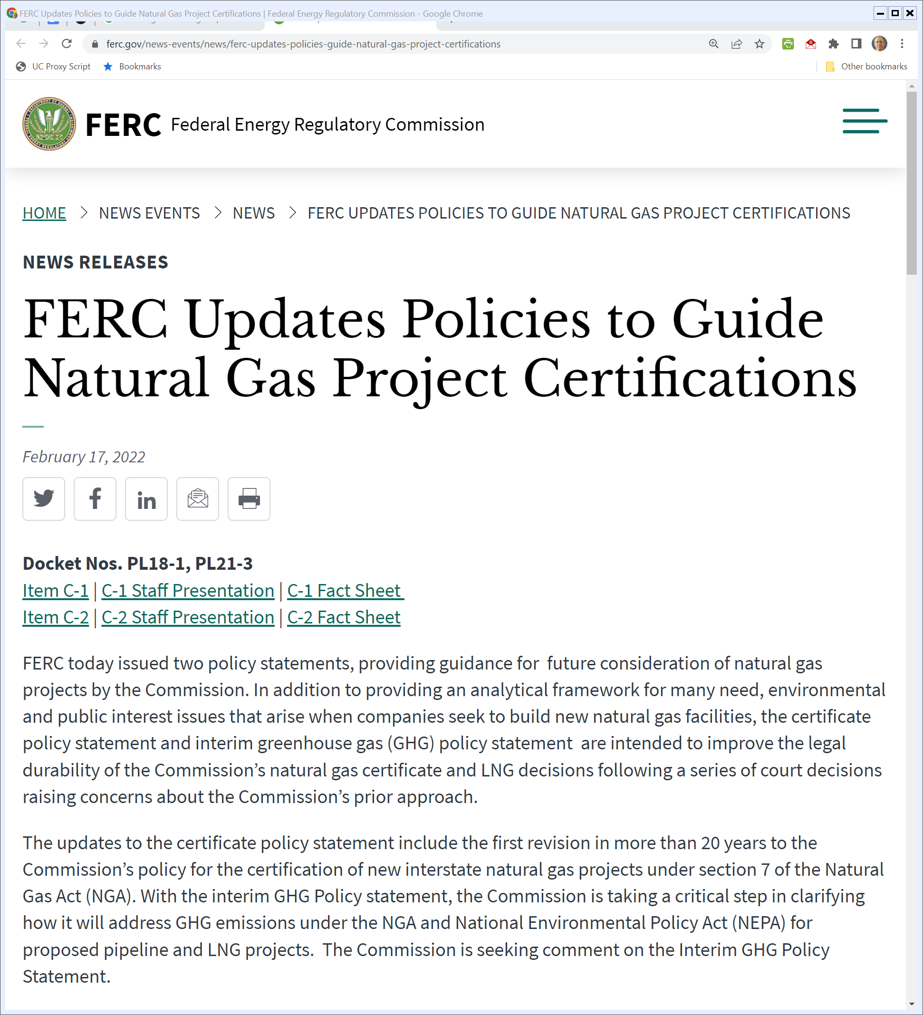
Updated Guidelines?
FERC (17 Feb 2022)
Notes:
https://www.ferc.gov/news-events/news/ferc-updates-policies-guide-natural-gas-project-certifications

Slide 75
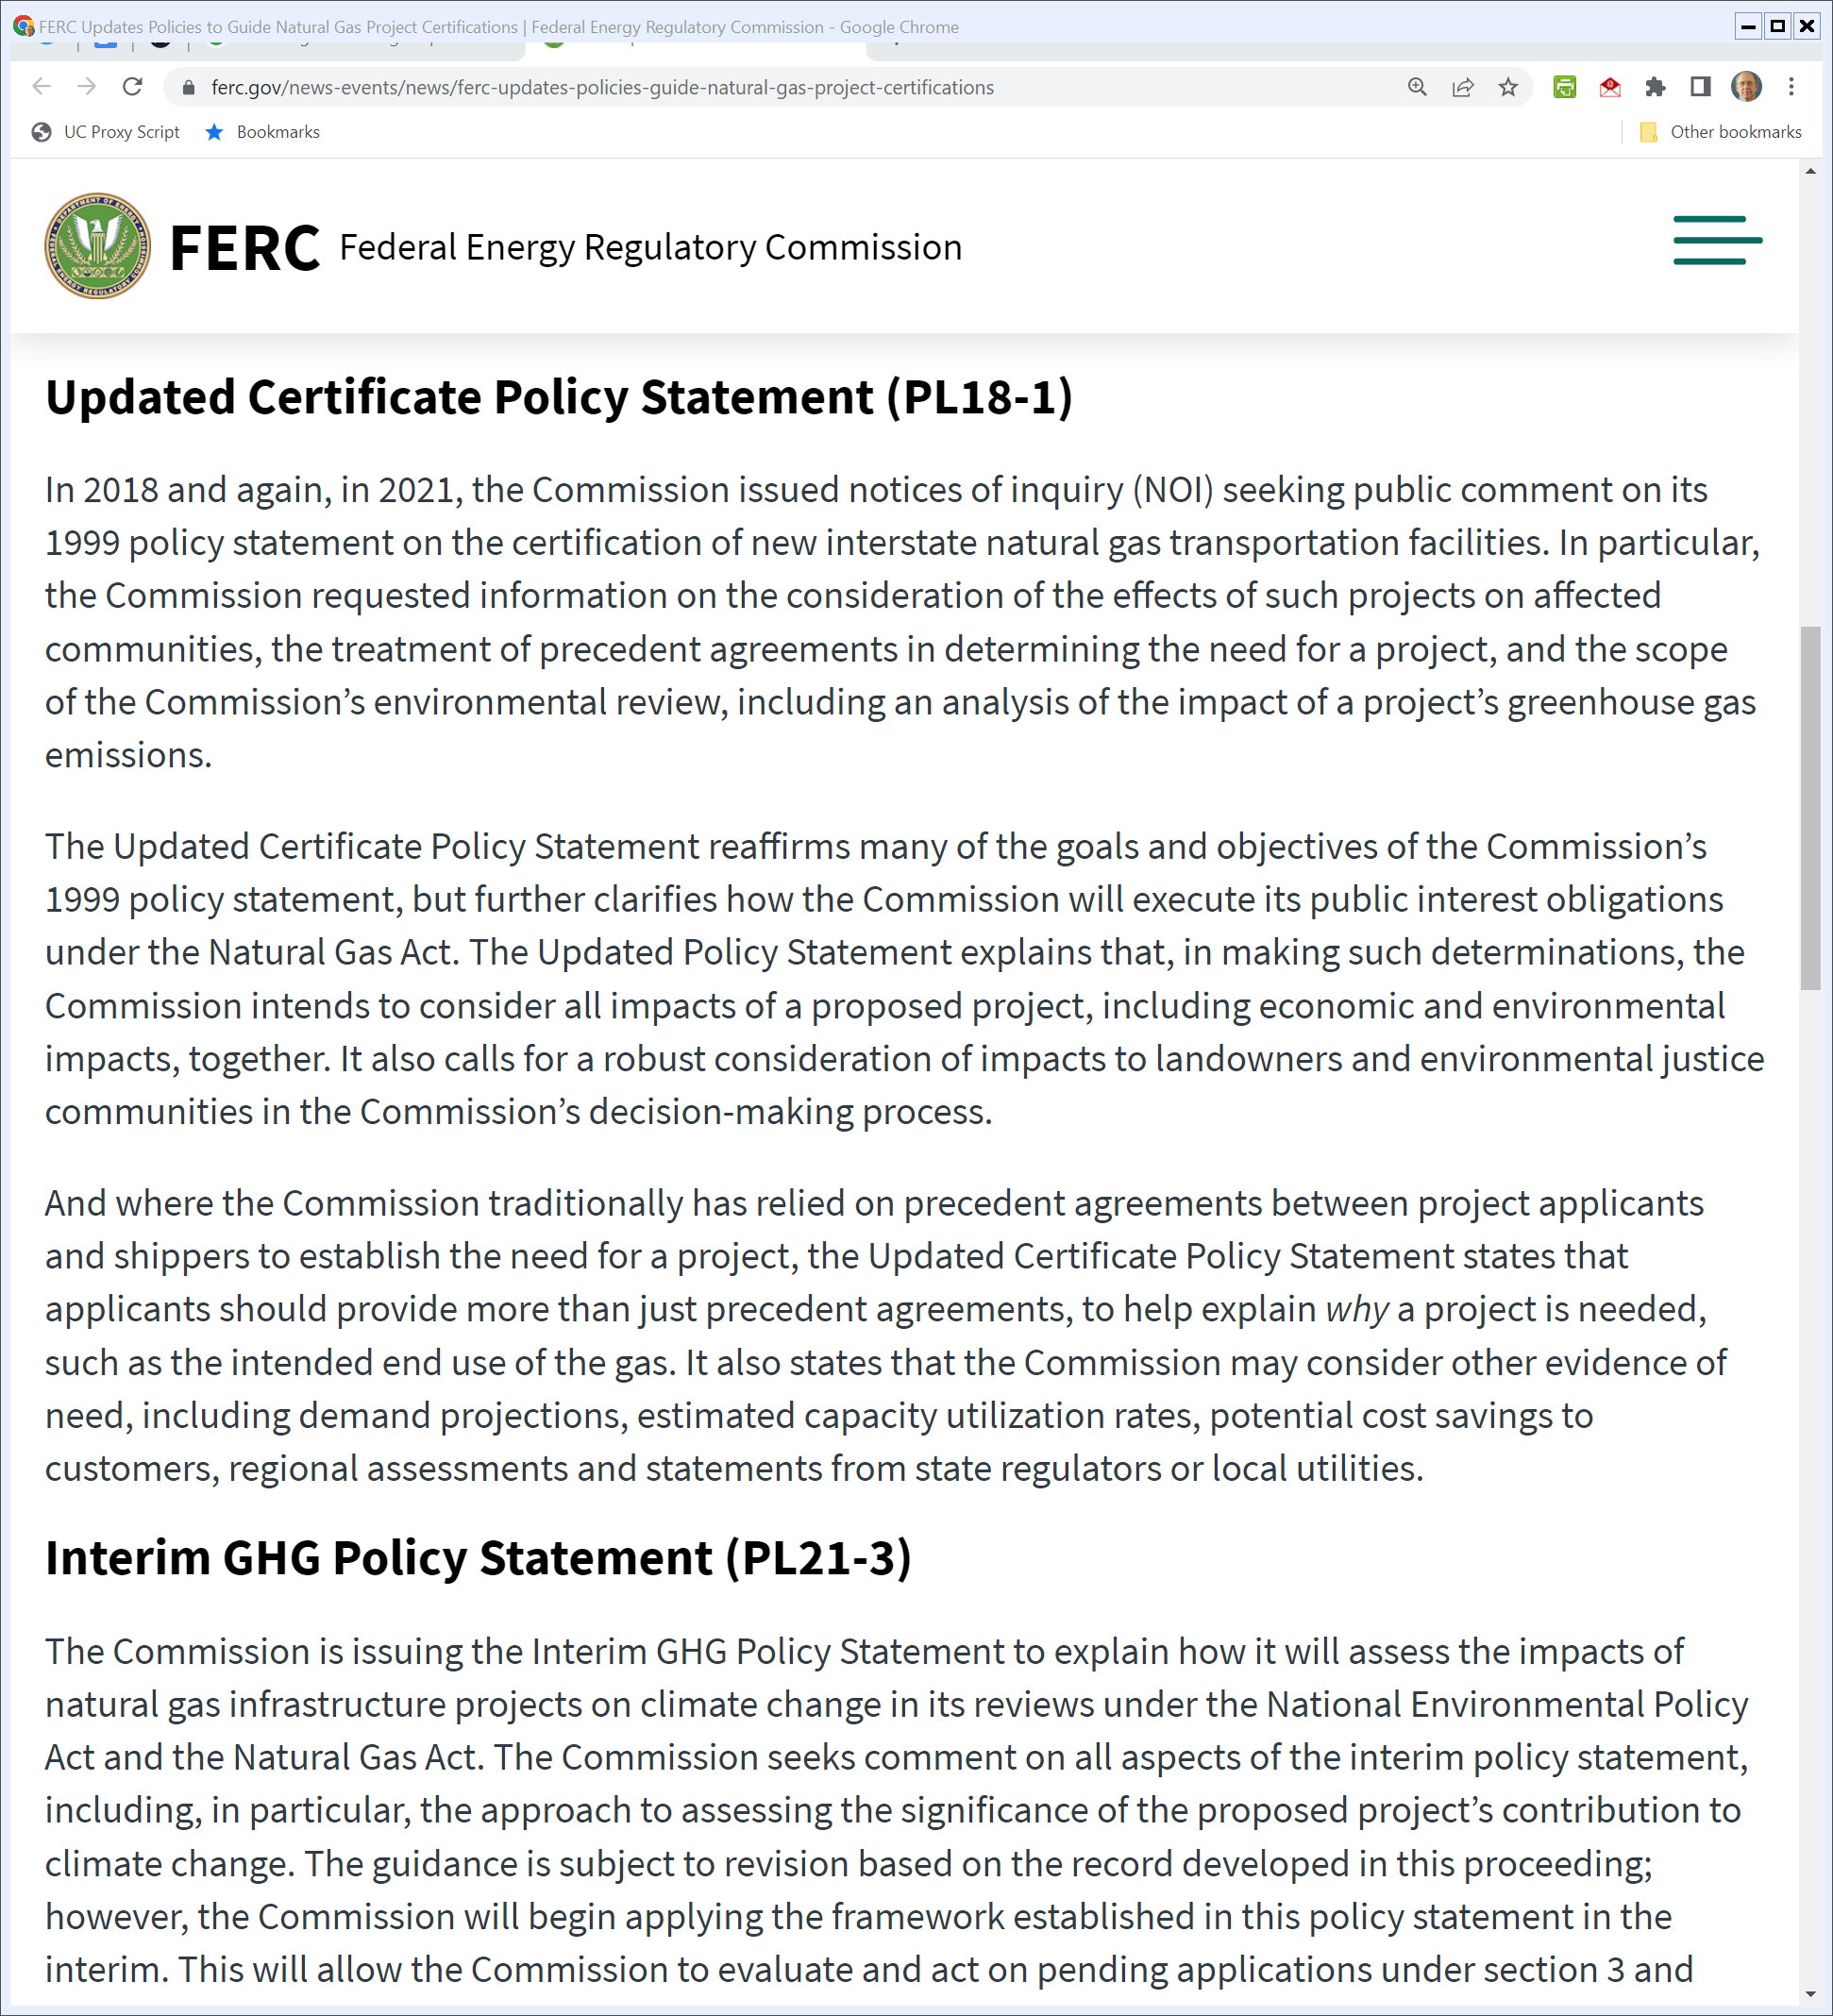
Evolving the Public Interest
FERC (17 Feb 2022)
Notes:
https://www.ferc.gov/news-events/news/ferc-updates-policies-guide-natural-gas-project-certifications

Slide 76
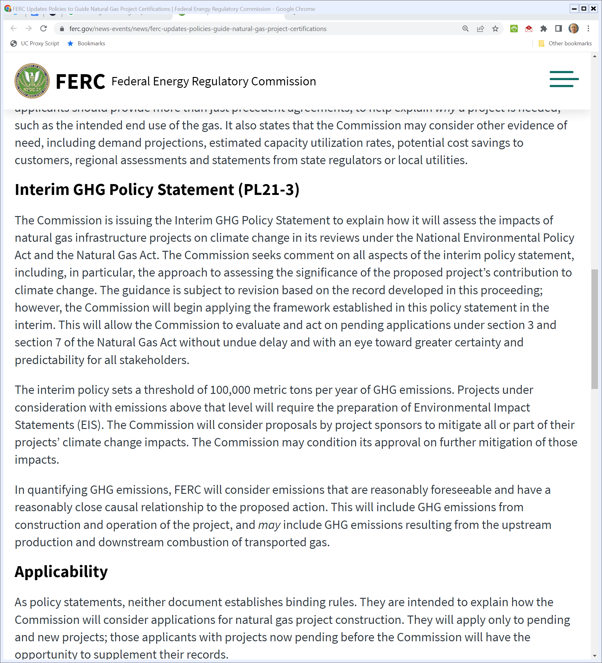
Climate Change Considerations
FERC (17 Feb 2022)
Notes:
https://www.ferc.gov/news-events/news/ferc-updates-policies-guide-natural-gas-project-certifications

Slide 77
NEPA and Pipelines
D.C. Circuit (11 Mar 2022)

Slide 78
Need to Account for GHG Emissions
D.C. Circuit (11 Mar 2022)

Slide 79
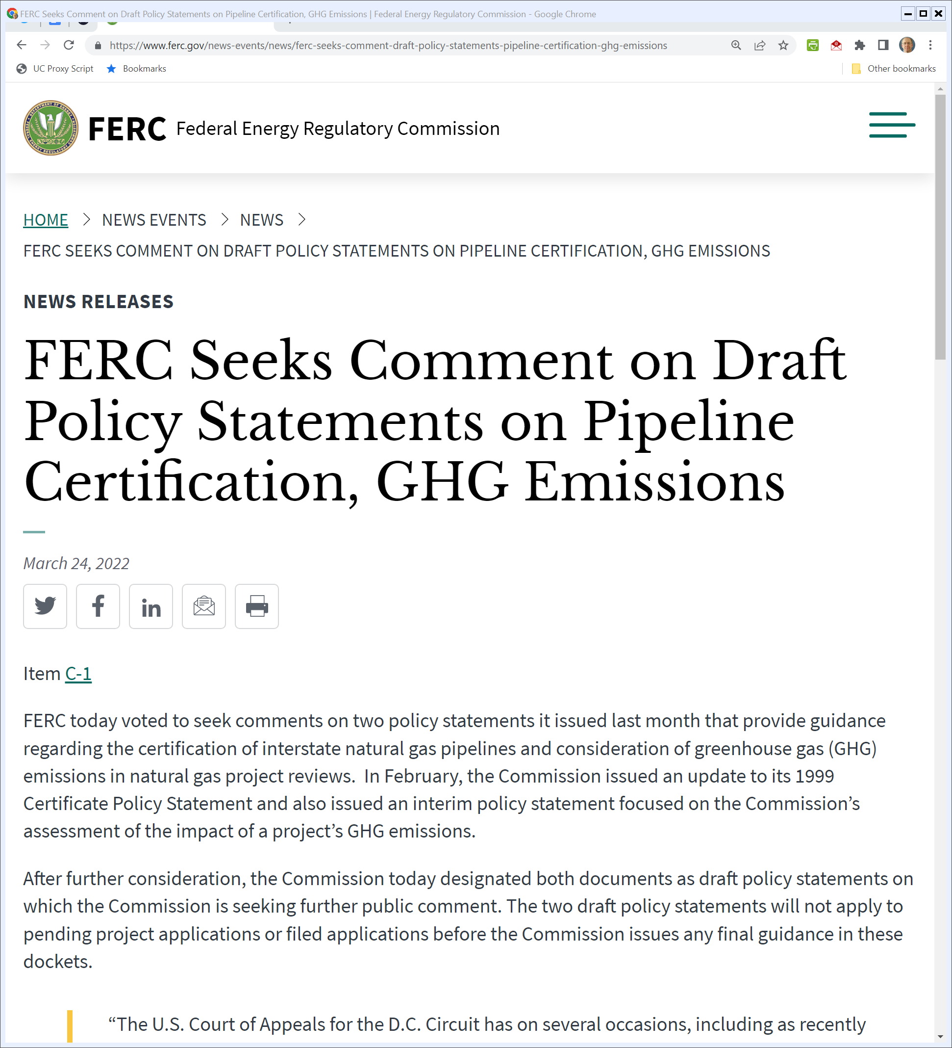
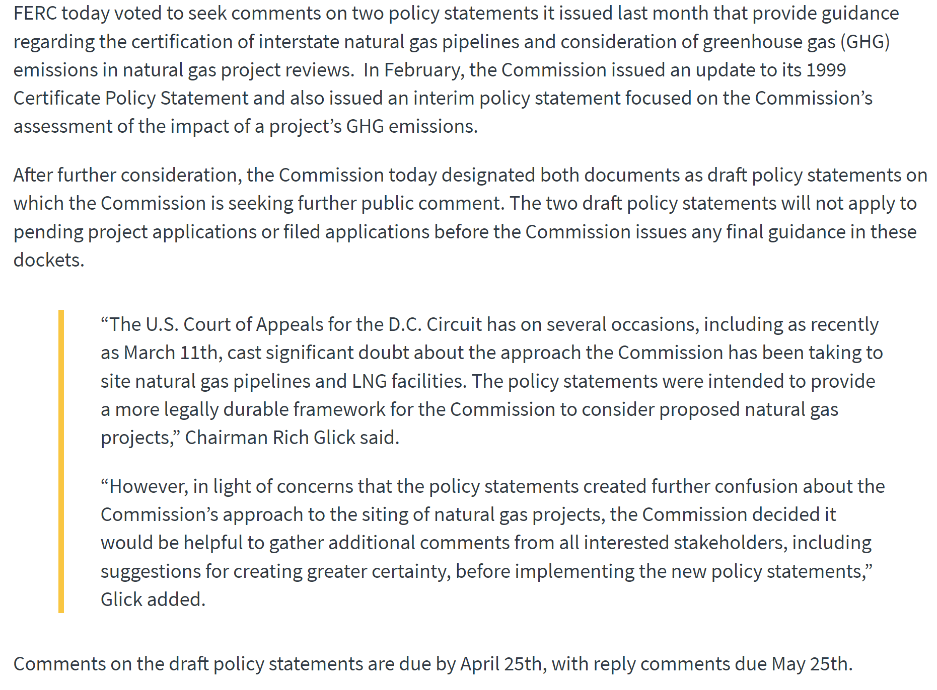
Never Mind?
FERC (24 Mar 2022)
Notes:
https://www.ferc.gov/news-events/news/ferc-seeks-comment-draft-policy-statements-pipeline-certification-ghg-emissions

Slide 80
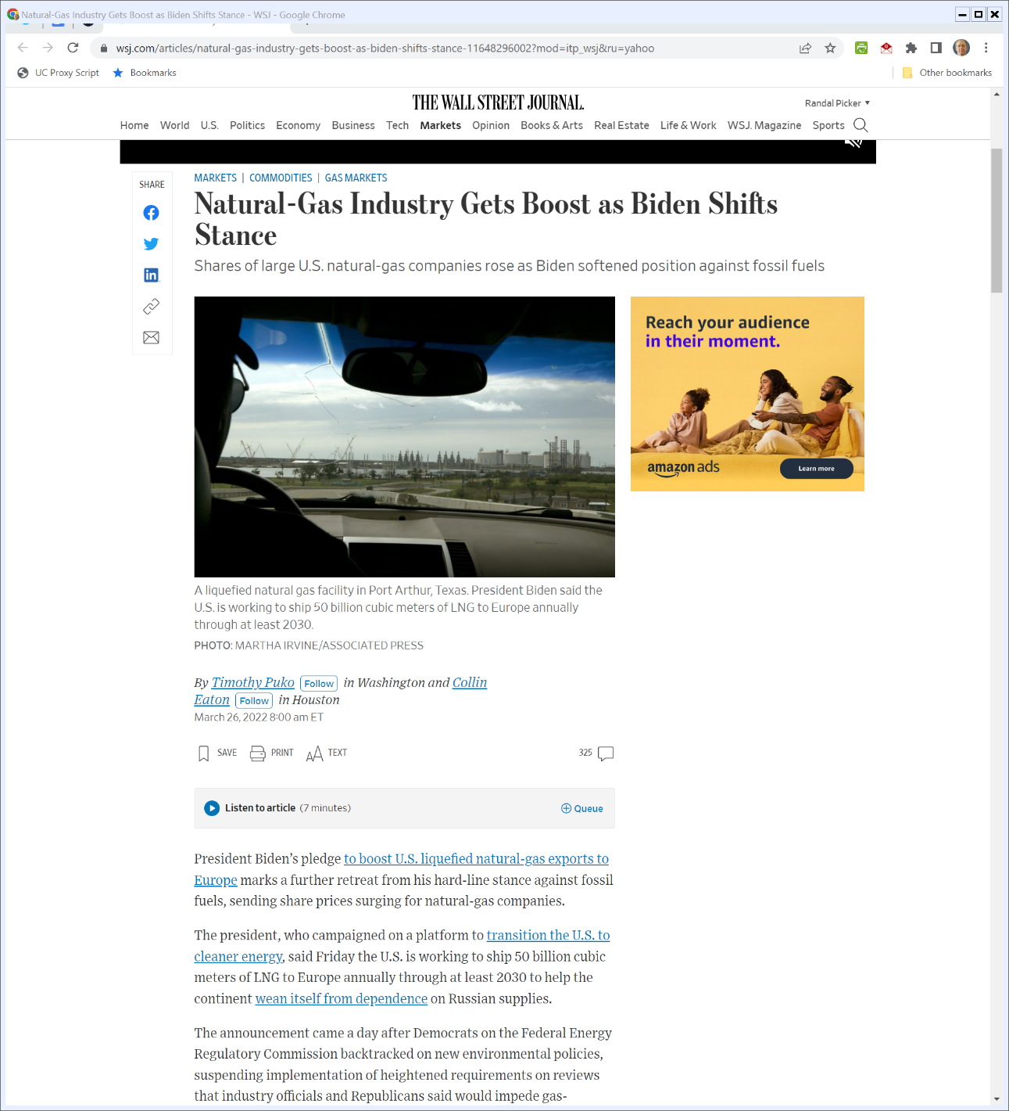
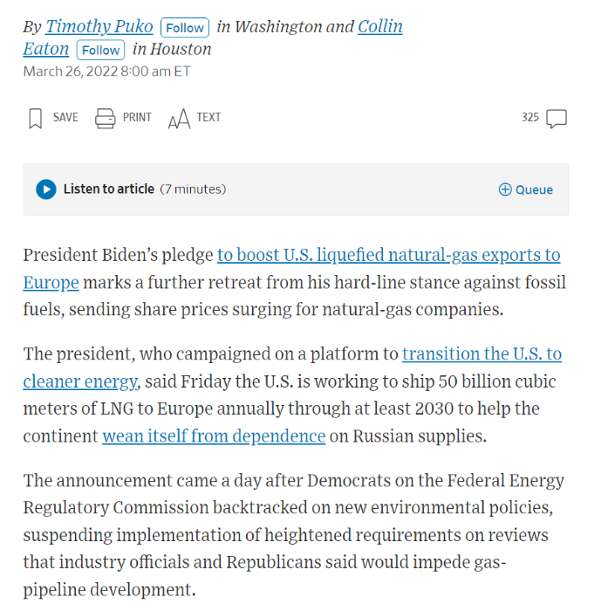
Ukraine Invasion
WSJ (26 Mar 2022)
Notes:
https://www.wsj.com/articles/natural-gas-industry-gets-boost-as-biden-shifts-stance-11648296002?mod=itp_wsj&ru=yahoo

Slide 81
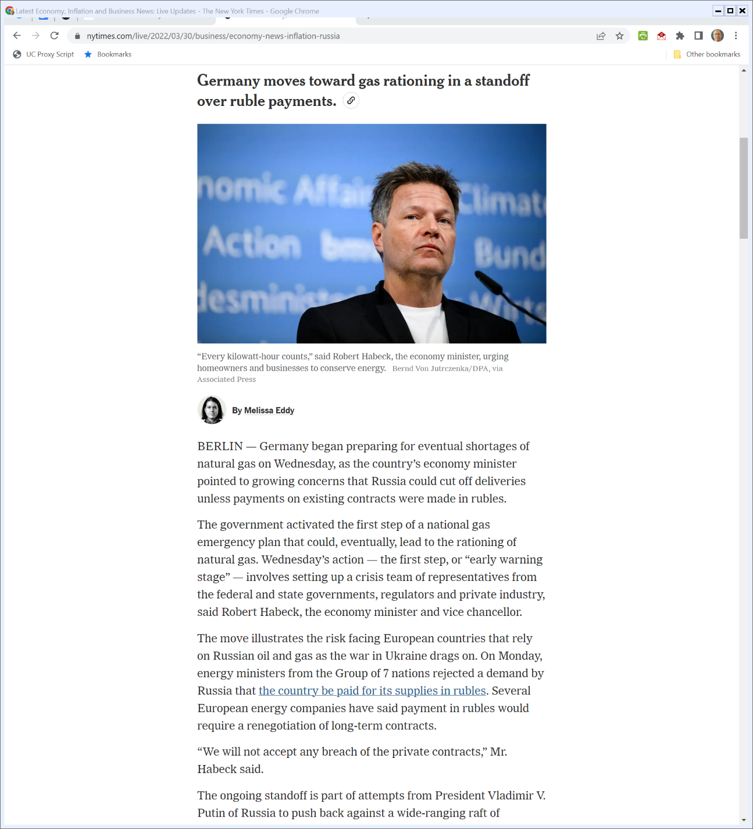

German Natural Gas Rationing
New York Times (30 Mar 2022)

Slide 82
The Draft Rules
Federal Register (1 Mar 2022)

Slide 83
Moving From: “Are There Customers?” to “Why Natural Gas?”
Federal Register (1 Mar 2022)

Slide 84
Environmental Justice
Federal Register (1 Mar 2022)

