Slide 1
Class 4 Platforms and Networks Spring 2022 The Constitutional Framework for Price Regulation
Randal C. Picker
James Parker Hall Distinguished Service Professor of Law
The Law School
The University of Chicago
Copyright © 2014-22 Randal C. Picker. All Rights Reserved.

Slide 2
The Fifth Amendment
5th
No person shall … be deprived of life, liberty, or property, without due process of law; nor shall private property be taken for public use, without just compensation.

Slide 3
The Fourteenth Amendment
Section 1
… No State shall make or enforce any law which shall abridge the privileges or immunities of citizens of the United States; nor shall any State deprive any person of life, liberty, or property, without due process of law; nor deny any person within its jurisdiction the equal protection of the laws.

Slide 4
Rate of Return Regulation: The Dilemma
Investors face two risks:
Single use assets—railroad tracks and the like—that cannot be moved or put into alternative uses.
Investors cannot respond to threats of expropriation by moving the assets elsewhere.
These are natural monopolies, so rate regulation will be common.

Slide 5
Rate of Return Regulation: The Dilemma
The Political Dilemma
How does the gov’t commit to investors that it will not expropriate after the fact through rate setting?

Slide 6
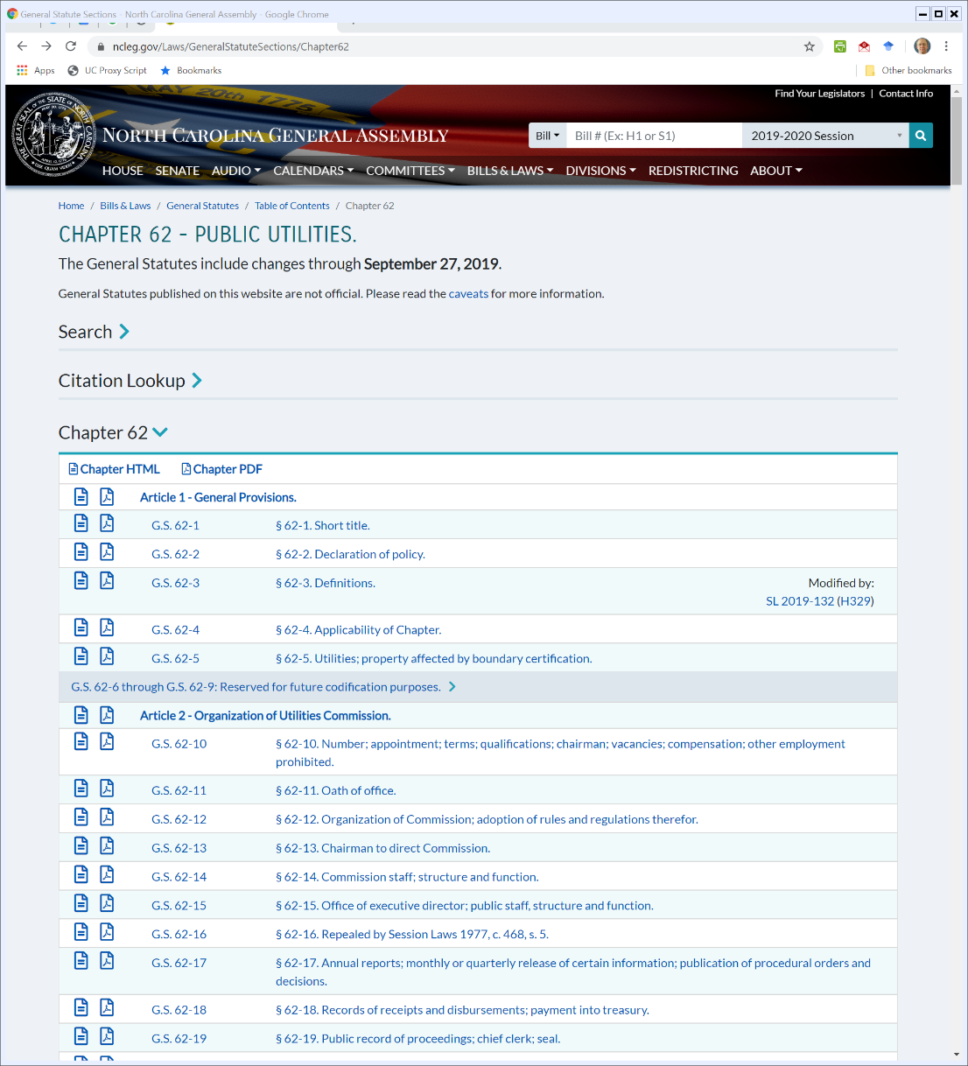
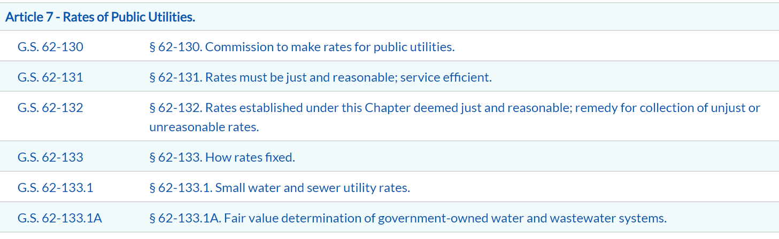
North Carolina Public Utilities Statutes
NC General Assembly (Visited 6 Apr 2020)
Notes:
https://www.ncleg.gov/Laws/GeneralStatuteSections/Chapter62

Slide 7
62-133(b)(3): “Ascertain such public utility’s reasonable operating expenses, including actual investment currently consumed through reasonable actual depreciation”
62-133(a): “the Commission shall fix such rates as shall be fair both to the public utilities and to the consumer”
(
)
Operating Expenses
Rate of Return
Rate Base
Revenue Requirements
+
x
=
62-133(b)(1): “Ascertain the reasonable original cost of the public utility’s property used and useful, or to be used and useful within a reasonable time after the test period, in providing the service rendered to the public within the State, less that portion of the cost which has been consumed by previous use recovered by depreciation expense”

Slide 8
62-133(b)(4): A Fair Return
“Fix such rate of return on the cost of the property ascertained pursuant to subdivision (1) of this subsection as will enable the public utility by sound management to produce a fair return for its shareholders, considering changing economic conditions and other factors, …”
N.C. Gen. Stat 62-133

Slide 9
62-133(c): Compete in Capital Markets
“to maintain its facilities and services in accordance with the reasonable requirements of its customers in the territory covered by its franchise, and to compete in the market for capital funds on terms that are reasonable and that are fair to its customers and to its existing investors.”
N.C. Gen. Stat 62-133

Slide 10
62-133(c): Determining Original Cost
“The original cost of the public utility’s property, including its construction work in progress, shall be determined as of the end of the test period used in the hearing and the probable future revenues and expenses shall be based on the plant and equipment in operation at that time.”
N.C. Gen. Stat 62-133

Slide 11
62-133(c): Used and Useful Property
“… [T]he Commission shall consider such relevant, material and competent evidence as may be offered by any party to the proceeding tending to show actual changes in costs, revenues or the cost of the public utility’s property used and useful, or to be used and useful within a reasonable time after the test period, in providing the service rendered to the public within this State … .”
N.C. Gen. Stat 62-133

Slide 12
62-133(d, e): Reasonable and Just Rates from Time to Time
“(d) The Commission shall consider all other material facts of record that will enable it to determine what are reasonable and just rates.
(e) The fixing of a rate of return shall not bar the fixing of a different rate of return in a subsequent proceeding.”
N.C. Gen. Stat 62-133

Slide 13
What If?
Possible Changes
Prices change?
Plans change as in Duquesne Light?
Made sense to start, made sense to stop
Costs are unexpectedly high?

Slide 14
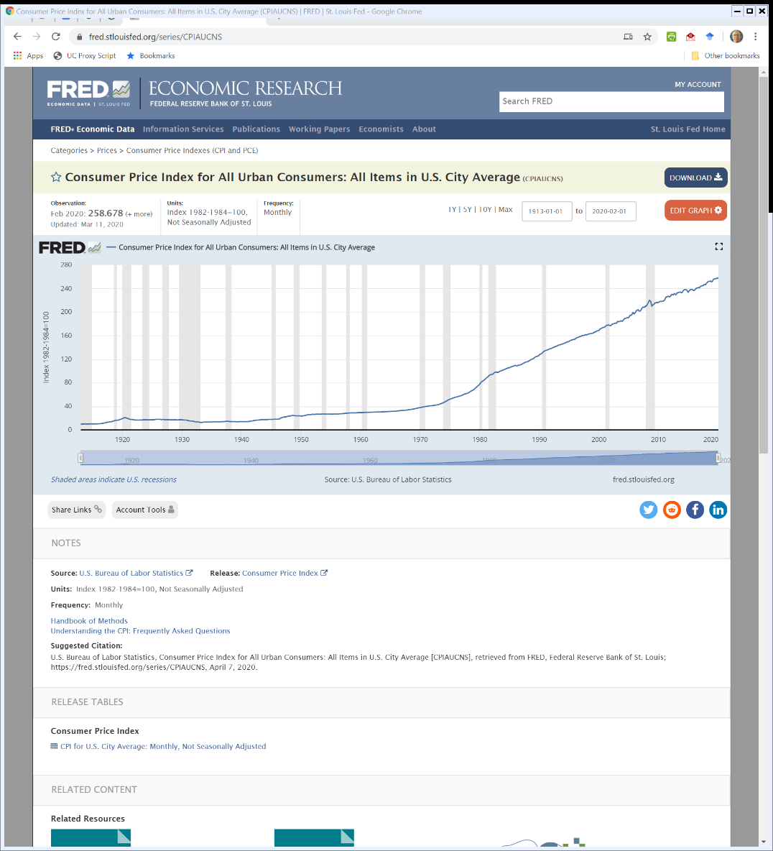

How Should We Deal with Changes in Prices over Time?: 1913-2020 CPI
FRED at St. Louis Fed (Visited: 8 Apr 2020)
Notes:
https://fred.stlouisfed.org/series/CPIAUCNS

Slide 15
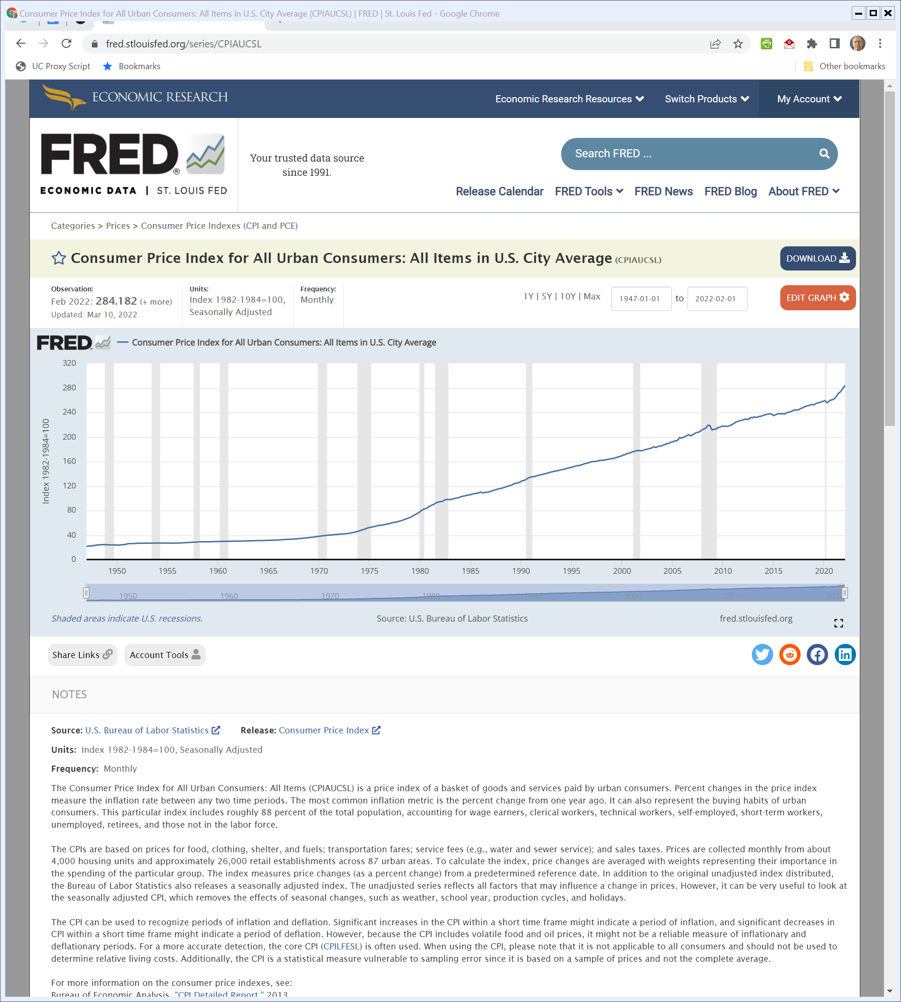
How Should We Deal with Changes in Prices over Time?: 1913-2022 CPI
FRED at St. Louis Fed (Visited: 28 Mar 2022)
Notes:
https://fred.stlouisfed.org/series/CPIAUCNS

Slide 16
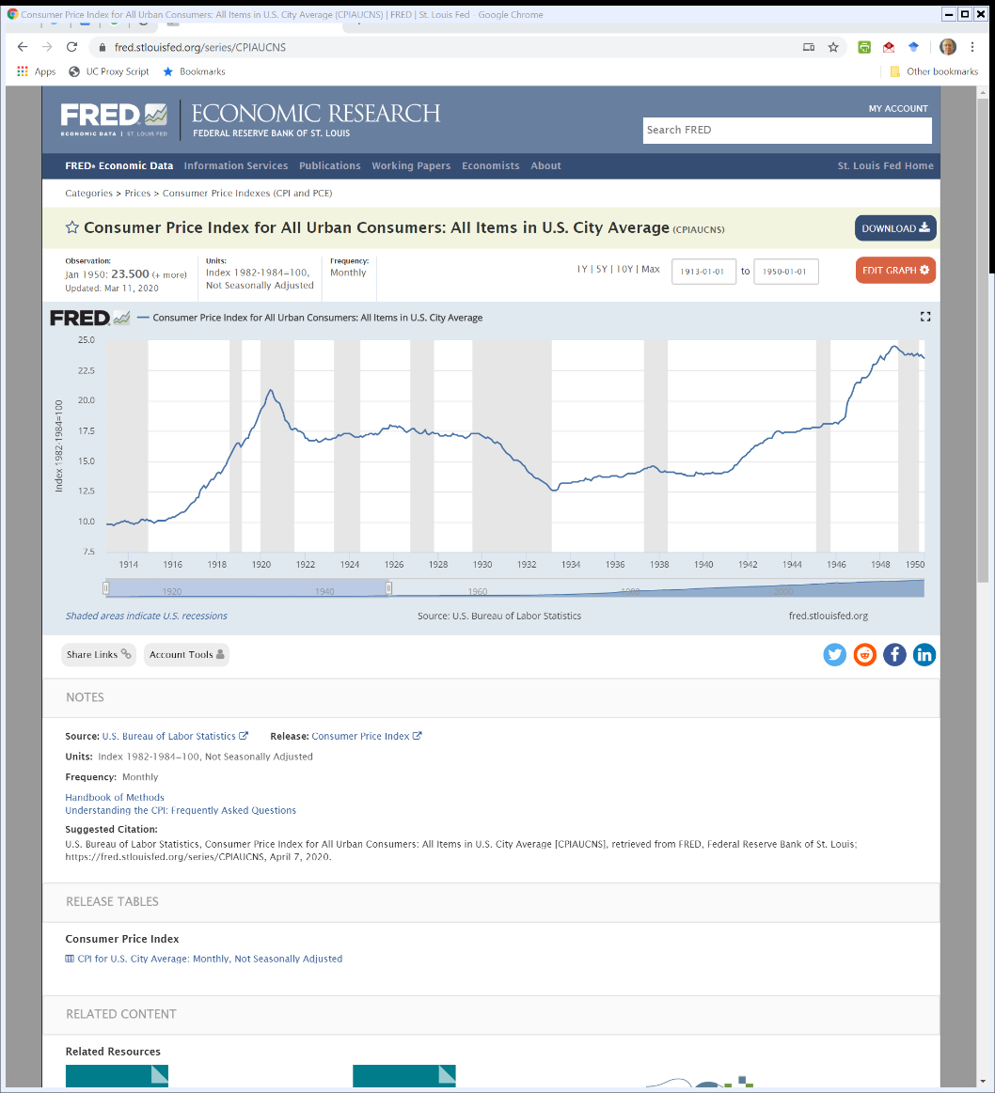
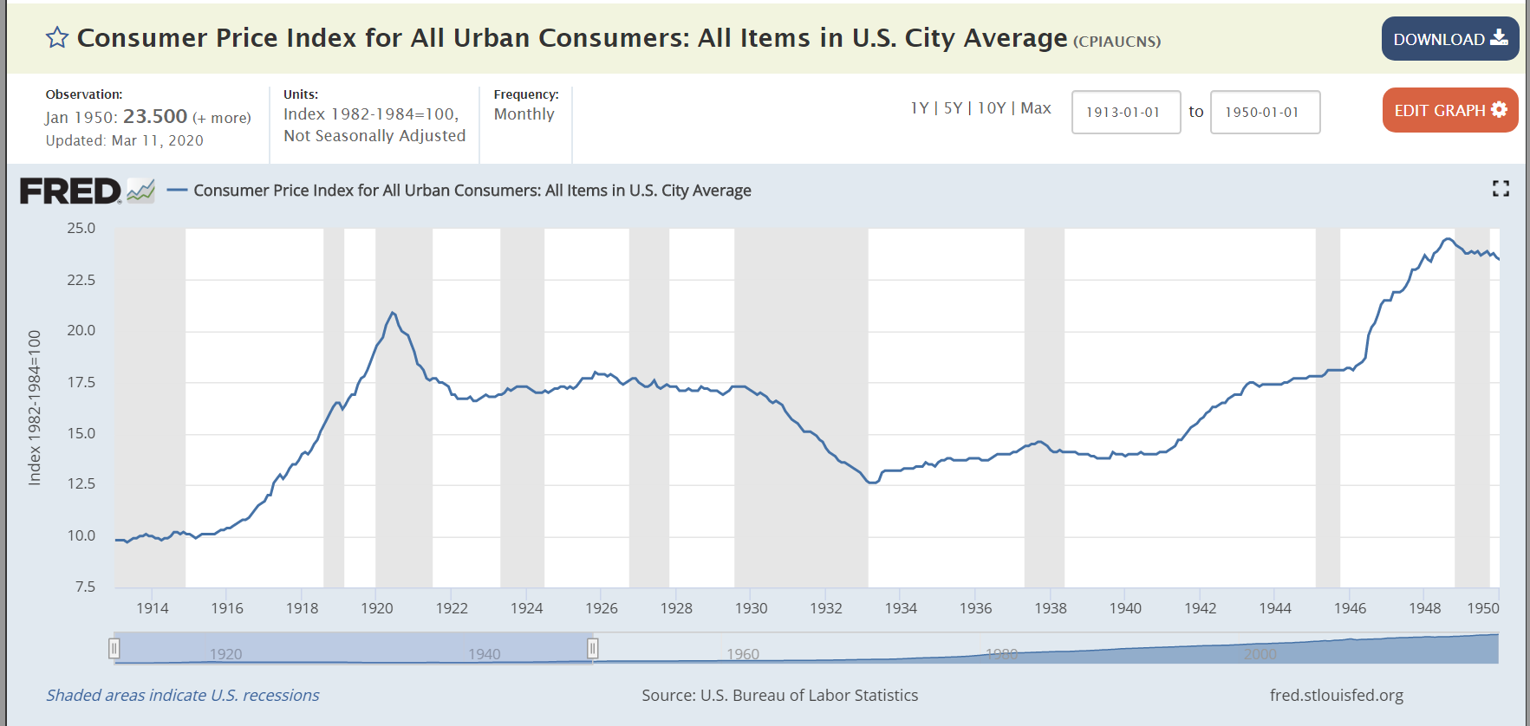
How Should We Deal with Changes in Prices over Time?: 1913-1950 CPI
FRED at St. Louis Fed (Visited: 8 Apr 2020)
Notes:
https://fred.stlouisfed.org/series/CPIAUCNS

Slide 17
What Happens When Costs are Unexpectedly High?
Three Possibilities
(1) Recovery of all of the costs from ratepayers, by allowing amortization of the investment plus a return on the unamortized balance
(2) Recovery of all costs from shareholders through a total disallowance of recovery in rates, instead requiring the utility to write off the entire amount in a single year

Slide 18
What Happens When Costs are Unexpectedly High?
(3) Recovery from ratepayers and shareholders through amortization of costs in rates over a period of years, with no return on the unamortized balance.

Slide 19
Regulating RRs in Nebraska
TTYN (1 of 6)
Hypo
It is 1893 and you are member of the Nebraska state legislature
The topic is regulations of railroads
Questions
What laws do you want to pass? What are issues that you care about?

Slide 20
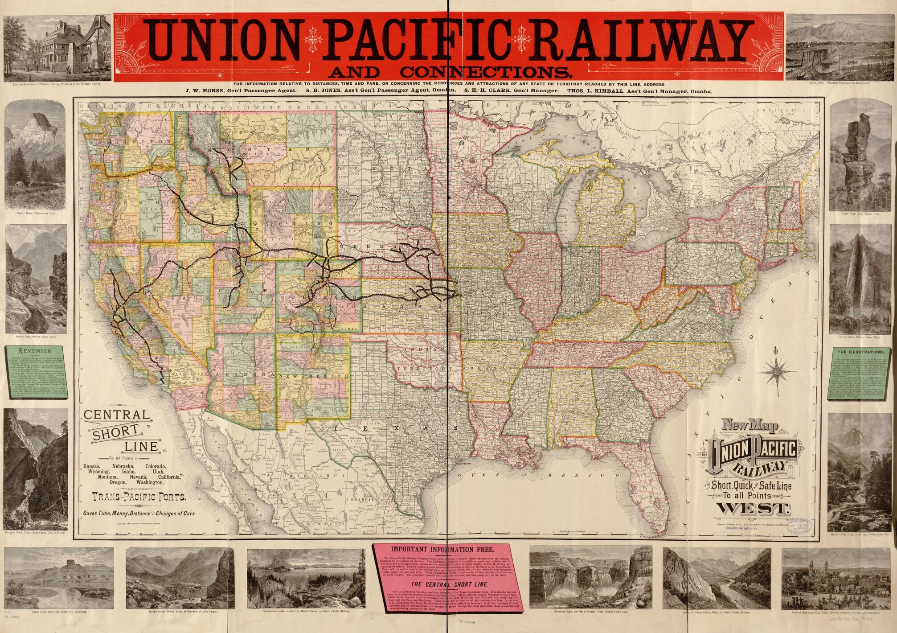
Union Pacific Map (TTYN (2 of 6))
LOC: Rand McNally (1883)
Notes:
https://www.loc.gov/item/98688838/
UP finished May 10, 1869 with golden spike at Promontory, Utah

Slide 21
Basis for Reg: Nebraska Constitution (1875)
TTYN (3 of 6)
Railways heretofore constructed, or that may hereafter be constructed in this state, are hereby declared public highways, and shall be free to all persons for the transportation of their persons and property thereon, under such regulations as may be prescribed by law.

Slide 22
Basis for Reg: Nebraska Constitution (1875)
TTYN (4 of 6)
And the legislature may from time to time pass laws establishing reasonable maximum rates of charges for the transportation of passengers and freight on the different railroads in this state. The liability of railroad corporations as common carriers shall never be limited.

Slide 23
RR as Corporation for Public Purposes (TTYN (5 of 6))
Smyth v. Ames (US 1898)

Slide 24
Scope of Law (TTYN (6 of 6))
Interstate Commerce Act (4 Feb 1887)

Slide 25
Reasonable and Just Charges
Interstate Commerce Act (4 Feb 1887)

Slide 26
Unjust Discrimination
Interstate Commerce Act (4 Feb 1887)

Slide 27
No Long Haul/Short Haul Discrimination
Interstate Commerce Act (4 Feb 1887)

Slide 28
Published Rates
Interstate Commerce Act (4 Feb 1887)

Slide 29
Creation of ICC
Interstate Commerce Act (4 Feb 1887)

Slide 30
What Can the ICC Do?
Interstate Commerce Act (4 Feb 1887)

Slide 31
Pipelines; Express Companies
ICA Amendments (29 June 1906)

Slide 32
ICC Given Power to Determine Rates
ICA Amendments (29 June 1906)

Slide 33
Hypo
TTYN (1 of 4)
Railroad between Chicago; Zion, IL; and Milwaukee
Milwaukee
Zion, IL
Chicago

Slide 34
RR as Business Proposition
TTYN (2 of 4)
Three possible businesses: C/Z, Z/M, C/M
Standalone Evaluation: C/Z
Standalone Evaluation: Z/M
Standalone Evaluation: C/M

Slide 35
Rate of Return Regulation
TTYN (3 of 4)
Illinois Rate Setting
Illinois sets rate of 5 for C/Z service
Rationale
RR would be built from M to Z to C even without separate C/Z service, hence no cost causation for fixed costs for C/Z service
Just cover operating costs of 5

Slide 36
Constitutional?
TTYN (4 of 4)
14th Amendment
No State shall … deprive any person of life, liberty, or property, without due process of law …
How does the Illinois rate stack up?

Slide 37
RR as Business Proposition
Standalone Evaluation: C/Z
Value to public of 20, operating costs of 5 and fixed costs of 50
Loss of 35
Lousy business

Slide 38
RR as Business Proposition
Standalone Evaluation: Z/M
Repeat C/Z analysis
Value to public of 20, operating costs of 5 and fixed costs of 50
Loss of 35
Lousy business

Slide 39
RR as Business Proposition
Standalone Evaluation: C/M
Value to public of 200, operating costs of 50, fixed costs of 100
Profits of 50
Jump right in

Slide 40
RR as Business Proposition
Combination of Services?
Analysis
With C/M as main service, C/Z and Z/M make sense as add-on services
Fixed costs already incurred

Slide 41
RR as Business Proposition
Combination of Services?
Analysis
Each has value of 20 and operating costs of 5 for additional profits of 15
Overall
240 in revenues
160 in costs, 80 in profits

Slide 42
Smyth v. Ames
169 U.S. 466 (1898)

Slide 43
Local or Interstate Assessment?
Smyth v. Ames (U.S. 1898)

Slide 44
Rejects Idea State Can Force Local Losses
Smyth v. Ames (U.S. 1898)

Slide 45
No Intrastate/Interstate Cross-Subsidization
Smyth v. Ames (U.S. 1898)

Slide 46
Actual $$$: OE + Interest + Dividends?
Smyth v. Ames (U.S. 1898)

Slide 47
A Private Corp Performing a Public Function
Smyth v. Ames (U.S. 1898)

Slide 48
Fair Return on a Fair Value
Smyth v. Ames (U.S. 1898)

Slide 49
Smyth v. Ames
Internal Logic
Market mimicking: The market doesn’t care what it cost, it cares what it is worth.
Bad investments won’t add to value, so no return on them
Good investments create value, and high returns to utility shareholders

Slide 50
Smyth v. Ames
Problems
How assess value of unique assets with thin markets?
Capitalization of cash flows is circular as cash flows determined by rates set.

Slide 51
Issues on Risk Allocation
Mimicking Markets
Should we seek to mimic a market result?
What would that mean?
Risk Control
Who is better situated to eliminate the risk of bad projects? Shareholders or consumers?

Slide 52
Issues on Risk Allocation
Risk Diversification
Who is better able to diversify the risk of failed projects? Shareholders or consumers?

Slide 53
Analysis
Mimicking Markets
Smart decision-making irrelevant: question is whether value is created
No ability to extract dollars from customers merely because project made sense upfront

Slide 54
Analysis
Risk Control
Both groups, shareholders and ratepayer/consumers, are quite diffuse
Consumers have no direct say, only through public official perhaps

Slide 55
Analysis
Risk Diversification
Consumers as consumers can’t diversify by using multiple electricity companies
Trend is entry, and shareholders will be stuck
Shareholders can hold portfolio of stocks

Slide 56
Cost Allocation
Cost Allocation Based on Causation
Operating Costs
Arise only through operating, so allocate those costs to those operations

Slide 57
Cost Allocation
Fixed Costs
Allocate only to those operations that use them
C/M and C/Z use line to Zion, Z/M doesn’t
C/M and Z/M use line to Milwaukee, C/Z doesn’t
Basis for Allocation
Fair share based on use or value?

Slide 58
Fixed Cost Allocation
Calculate Use Figures
Allocate Pro Rata Based on Share of Use?

Slide 59
Fixed Cost Allocation
Allocate Costs to Minimize Distortions while Covering Costs
Must cover operating costs on segment to send correct price signals for usage
B
C
F
A
D
E

Slide 60
Fixed Cost Allocation
Allocate Costs to Minimize Distortions while Covering Costs
Allocate fixed costs based on sensitivity of demand for use: the less-price sensitive, the greater the share of fixed costs borne (Ramsey pricing)

Slide 61
Fixed Cost Allocation
Results in short-haul/long-haul discrimination, banned by Sec. 4 of the Interstate Commerce Act of 1887.

Slide 62
Southwestern Bell
262 U.S. 276 (1923)

Slide 63
After 25 Years, How Does Smyth Look?
Southwestern Bell (U.S. 1923)

Slide 64
Exchange Value? Capitalize Earnings?
Southwestern Bell (U.S. 1923)

Slide 65
Some Version of Cost
Southwestern Bell (U.S. 1923)

Slide 66
Rate Base: $$$ Prudently Invested, Amount of Capital Charge
Southwestern Bell (U.S. 1923)

Slide 67
Possible Measures of Value
Try Three:
Sales Prices of Assets?
Present Value of Earnings?
Common Stock Prices?

Slide 68
Possible Measures of Value
Issues
Sales Prices: Very thin markets
PV: Circular, as dependent on rates
CS: Same problem

Slide 69
Hope Natural Gas
320 U.S. 591 (1944)

Slide 70
Not Theory, But Results
Hope Natural Gas (U.S. 1944)

Slide 71
Sufficient Returns to Capital to Attract It
Hope Natural Gas (U.S. 1944)

Slide 72
Duquesne Facts
Decisions
In 1967, in anticipation of demand run-up, started to build more nuclear plants
Spent $35 million on preliminary costs
Events led to cancellation of plants
Three Mile Island
Arab oil embargo: reduced anticipated econ growth and hence demand for electricity

Slide 73
Duquesne Facts
Requests of the Commission
Duquesne sought right to recoup expenditures from PUC in 1980 and 1981
Comm agreed all decisions made were reasonable and prudent
1983: Commission allowed $3.5 million in rev, for 10 years to cover costs

Slide 74
Duquesne Facts
Legal Challenge by Penn Office of the Consumer Advocate
Penn Supreme Court concluded Comm overstepped authority

Slide 75
Duquesne Facts
Why? New statute enacted in 1982:
Pennsylvania enacted a law which barred including investments in the rate base or otherwise in the rates charged by a utility before the time at which the facility “is used and useful in service to the public.”

Slide 76
Duquesne Facts
This meant that expenditures on cancelled plants would never be recovered.
Note that the statute was subsequently amended in October 1985 to allow recover of prudent cancellation costs

Slide 77
Duquesne Facts
The utilities challenged the rule as a taking in violation of the 5th Amend., applicable to the states through the 14th Amend.
Justification/Implications
Implements the idea that failed investments are borne by shareholders

Slide 78
Duquesne Facts
Note Perverse Incentives
Complete and put into service just to get into rate base

Slide 79
Duquesne Light
488 U.S. 299

Slide 80
Like Hope: Focus on Impact
Duquesne (U.S. 1989)

Slide 81
Fear Flipflopping by Regulators
Duquesne (U.S. 1989)

