Slide 1
Class 3 Platforms and Network Industries Spring 2022 Building Infrastructure
Randal C. Picker
James Parker Hall Distinguished Service Professor of Law
The Law School
The University of Chicago
Copyright © 2014-22 Randal C. Picker. All Rights Reserved.

Slide 2
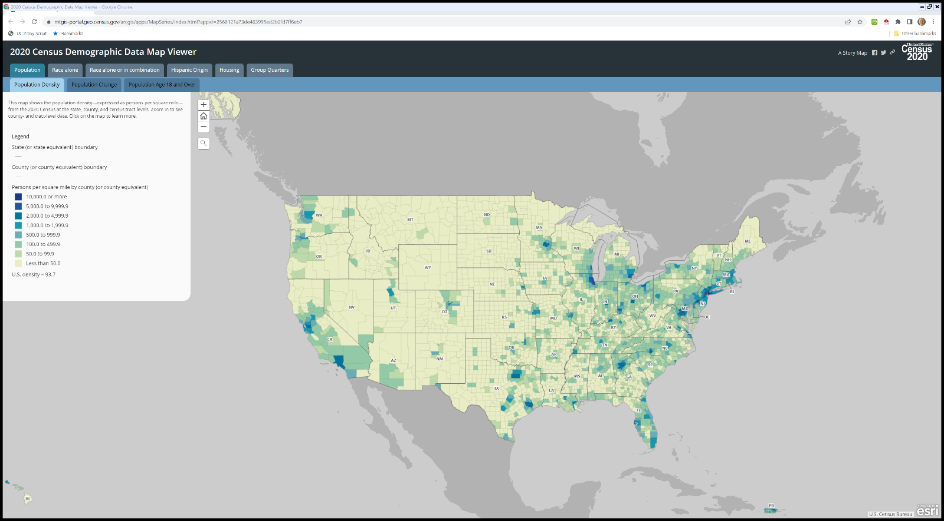

Population Density
2020 U.S. Census

Slide 3
2008 EPA Septic
EPA Septic Systems Fact Sheet (Oct 2008)

Slide 4
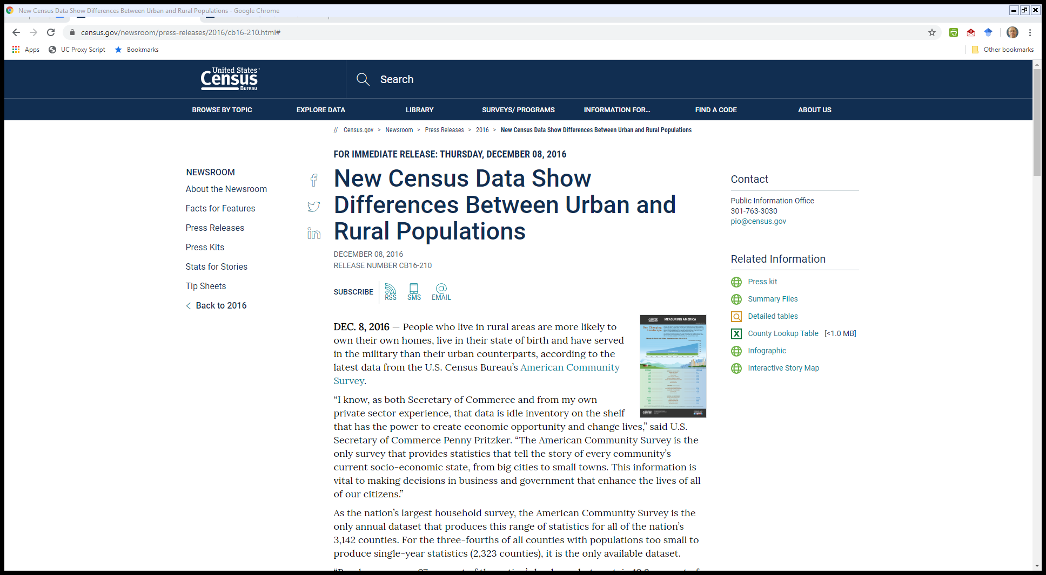
Urban and Rural Differences
U.S. Census (8 Dec 2016)
Notes:
https://www.census.gov/newsroom/press-releases/2016/cb16-210.html#
https://www.census.gov/newsroom/press-kits/2016/20161208_acs5yr2015.html

Slide 5
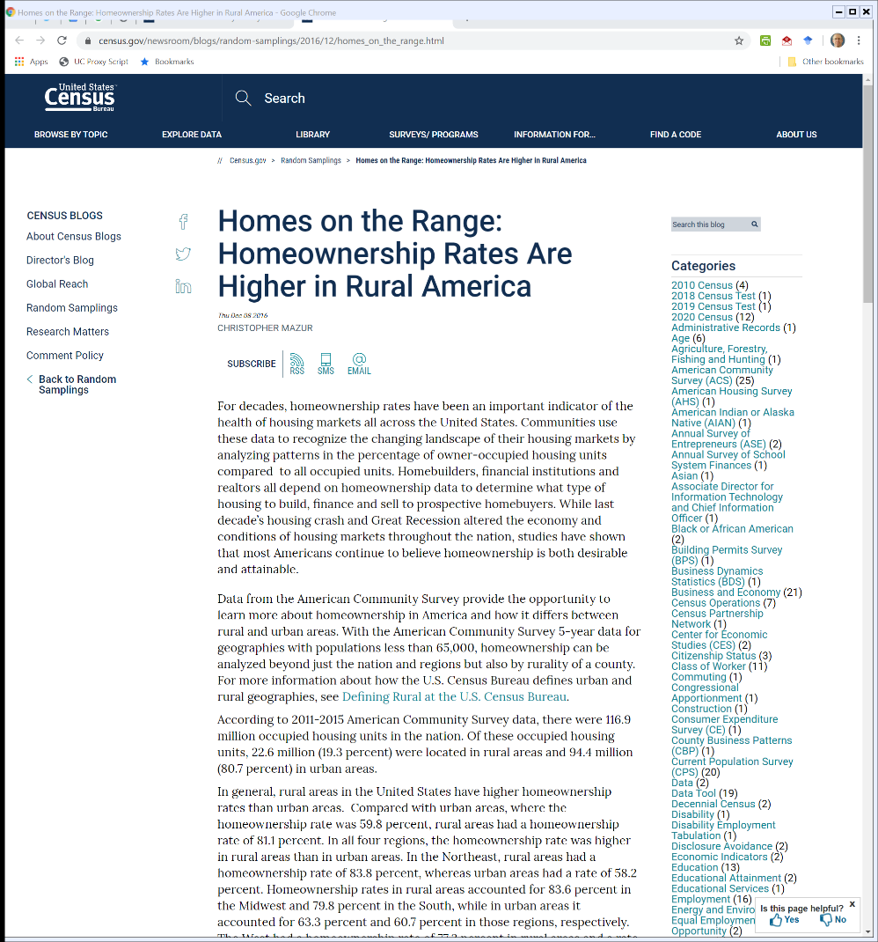
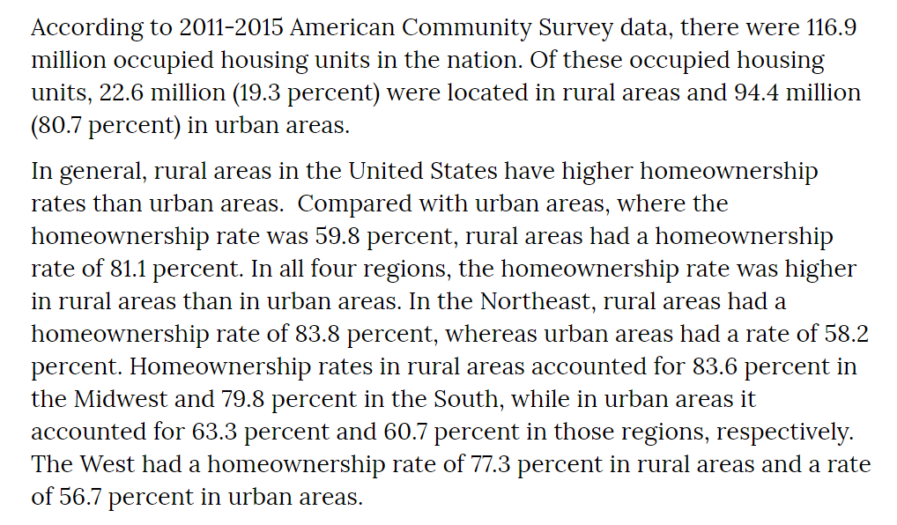
Rural Home Ownership Exceeds Urban
U.S. Census (8 Dec 2016)
Notes:
https://www.census.gov/newsroom/blogs/random-samplings/2016/12/homes_on_the_range.html

Slide 6
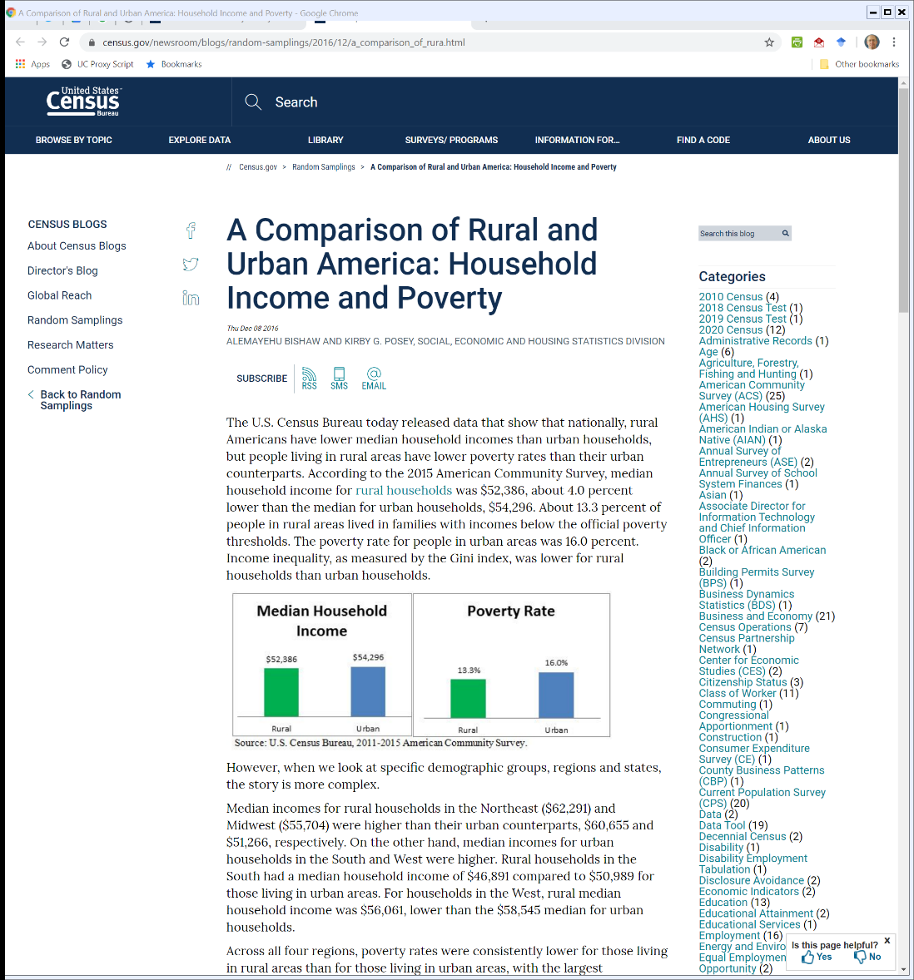
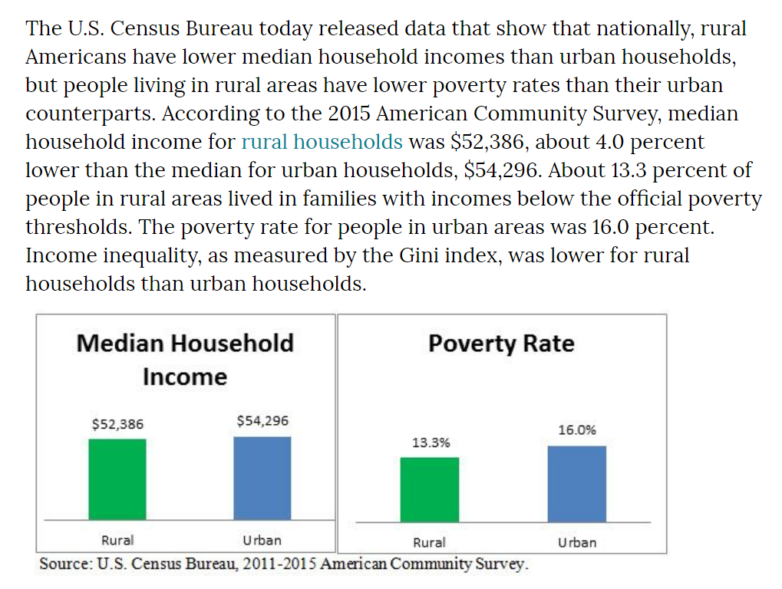
Income and Poverty
U.S. Census (8 Dec 2016)
Notes:
https://www.census.gov/newsroom/blogs/random-samplings/2016/12/a_comparison_of_rura.html

Slide 7
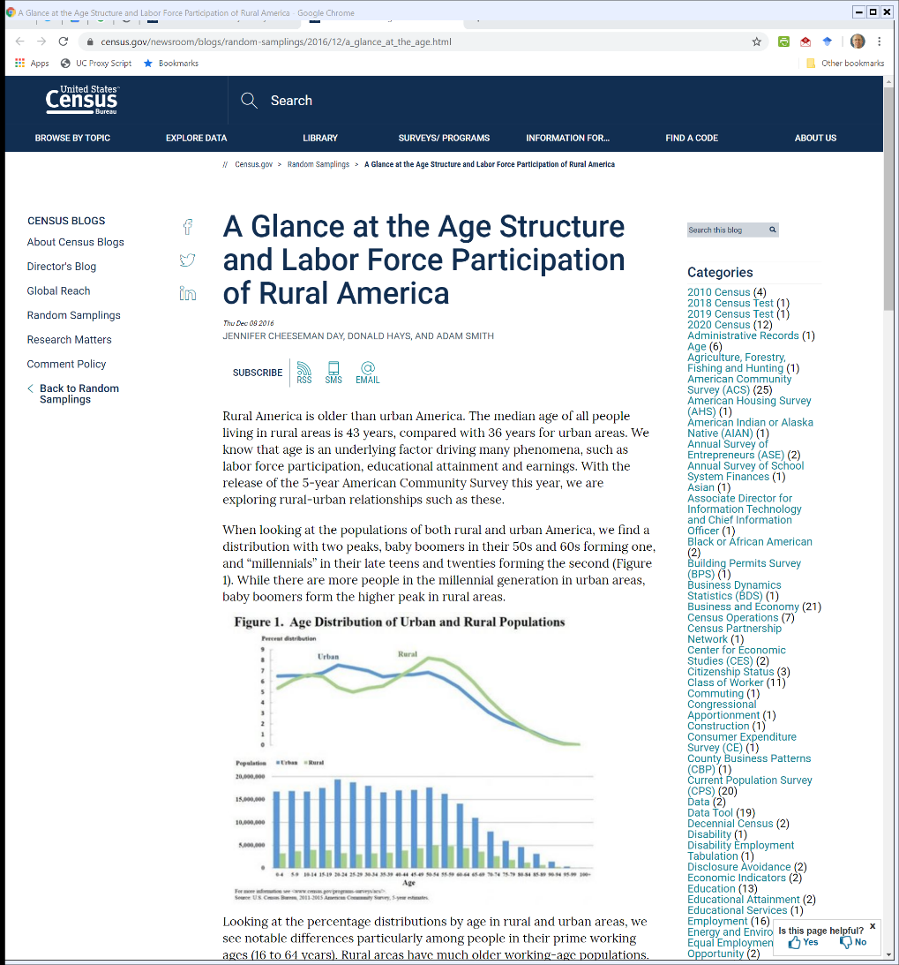
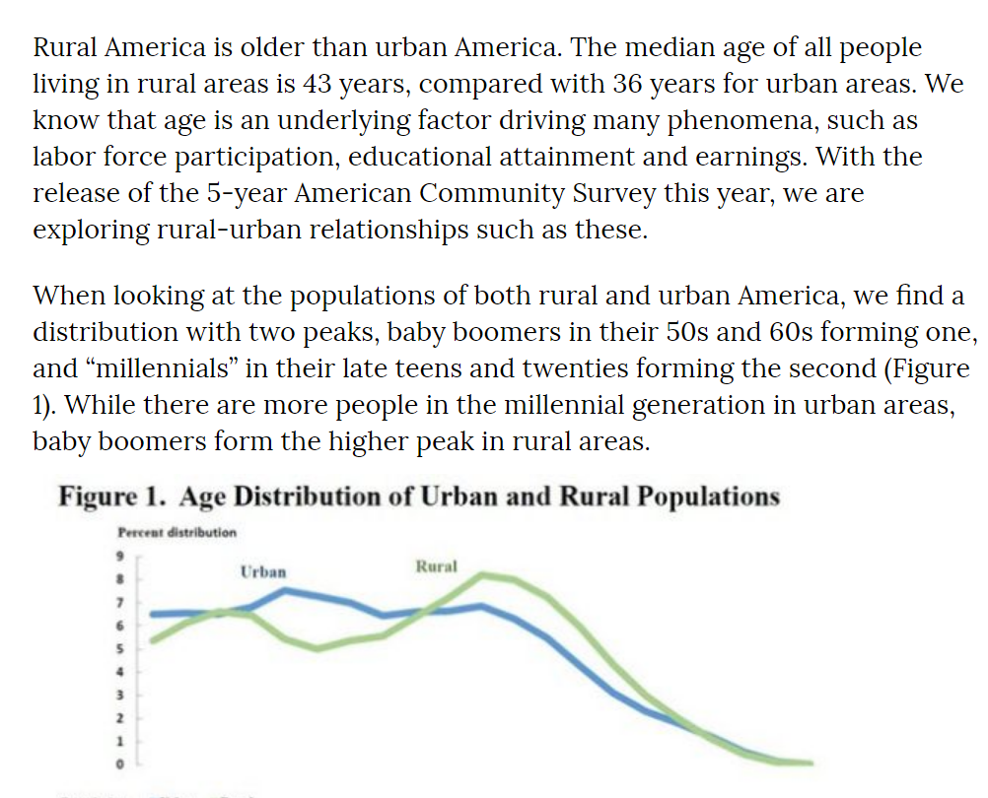
Rural Areas Are Older
U.S. Census (8 Dec 2016)
Notes:
https://www.census.gov/newsroom/blogs/random-samplings/2016/12/a_glance_at_the_age.html

Slide 8
Urban v. Rural
TTYN (1 of 3)
Key Questions
Is this a relevant dichotomy? Why?
How should we think about this?
Are there types of services where the distribution of those services are irrelevant?
Starbucks? (Utah vacation: 35 miles!)

Slide 9
Urban v. Rural
TTYN (2 of 3)
Key Questions
Other services where there should be at least a floor everywhere?
Water? Sewer?
Hospitals? Schools? Grocery Stores?
Air and water quality?

Slide 10
Urban v. Rural
TTYN (3 of 3)
Key Questions
Which services should have identical levels?
Telephone? Electricity? Broadband?
And should we measure by access or actual adoption?
At what level of government should these questions be assessed?

Slide 11
Federal-Aid Road Act of 1916
U.S. Constitution: Art. I, Sec 8:
The Congress shall have Power … To establish Post Offices and post Roads
1916 Act seen as first major federal move into roads

Slide 12
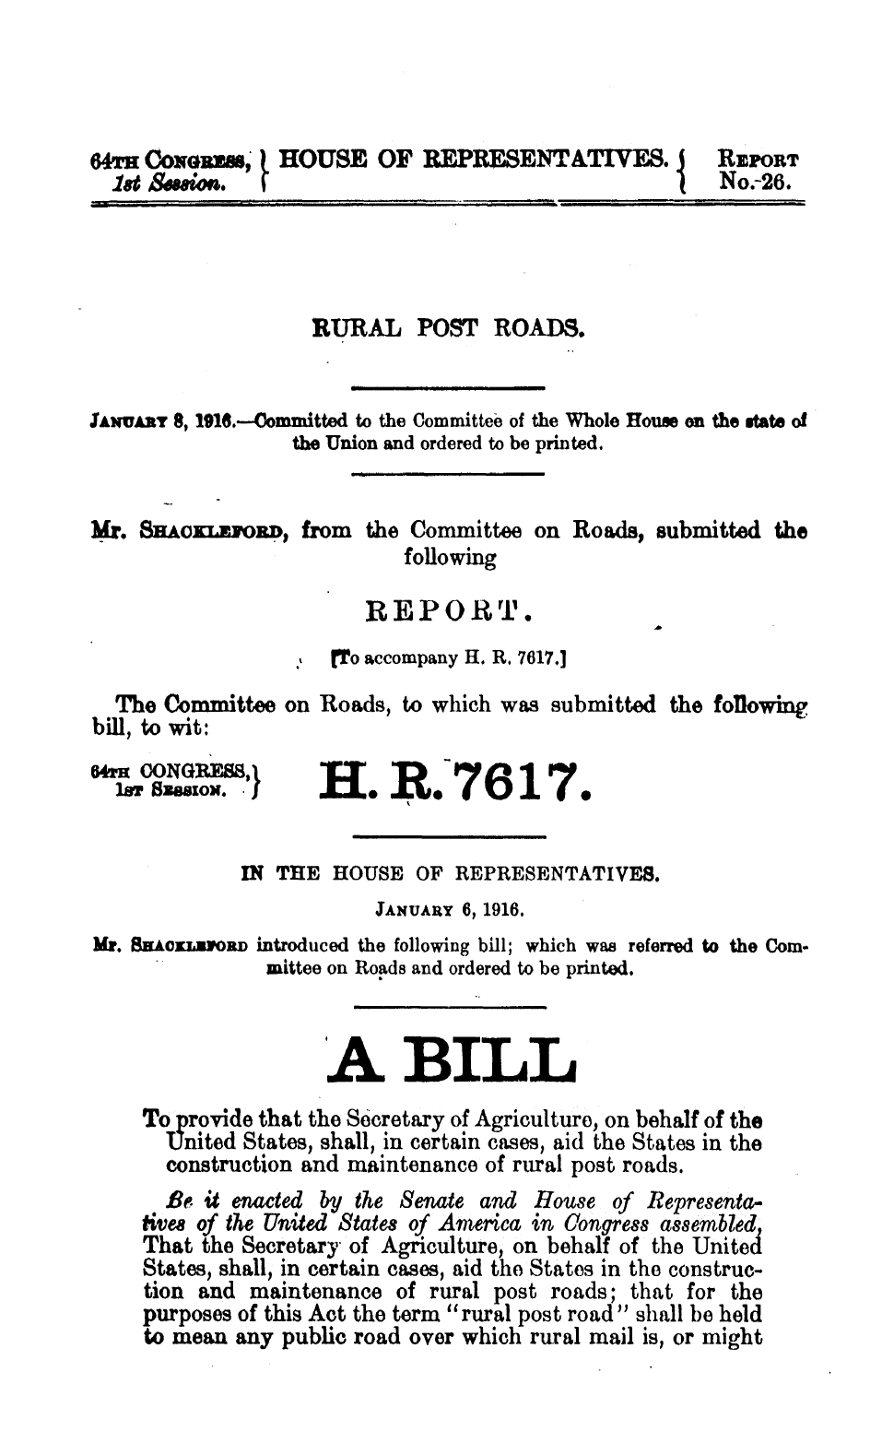
Legislative History of 1916 Roads Act
H.Rep. 64-26 (6 Jan 1916)

Slide 13
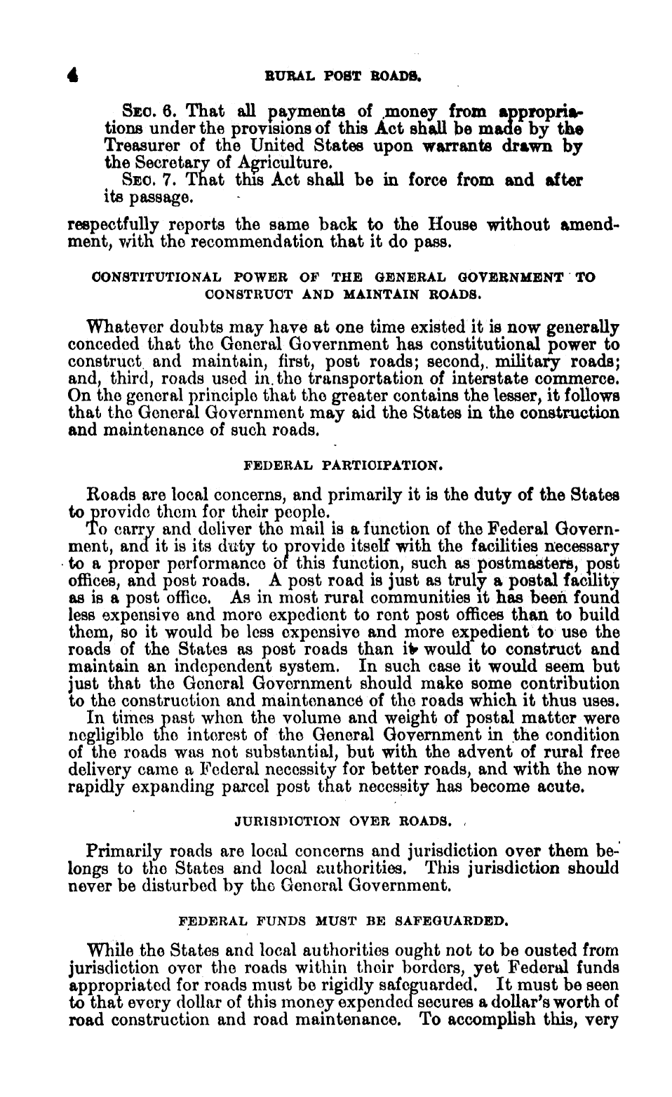
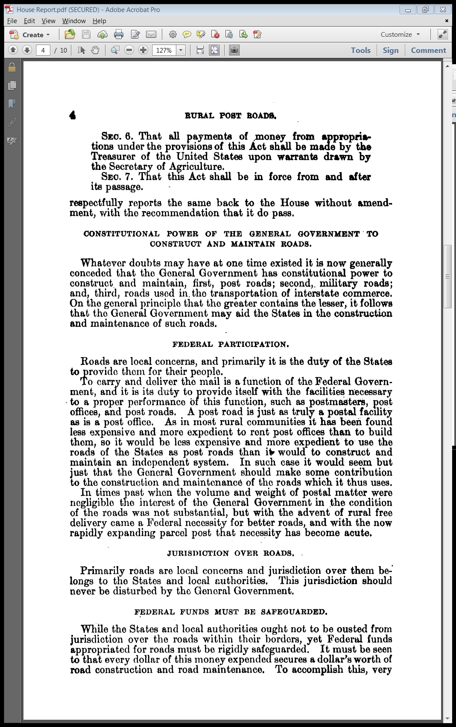
Federal Constitutional Authority
H.Rep. 64-26 (6 Jan 1916)

Slide 14
Change in Post Office Services
H.Rep. 64-26: Rural Post Roads (6 Jan 1916)

Slide 15
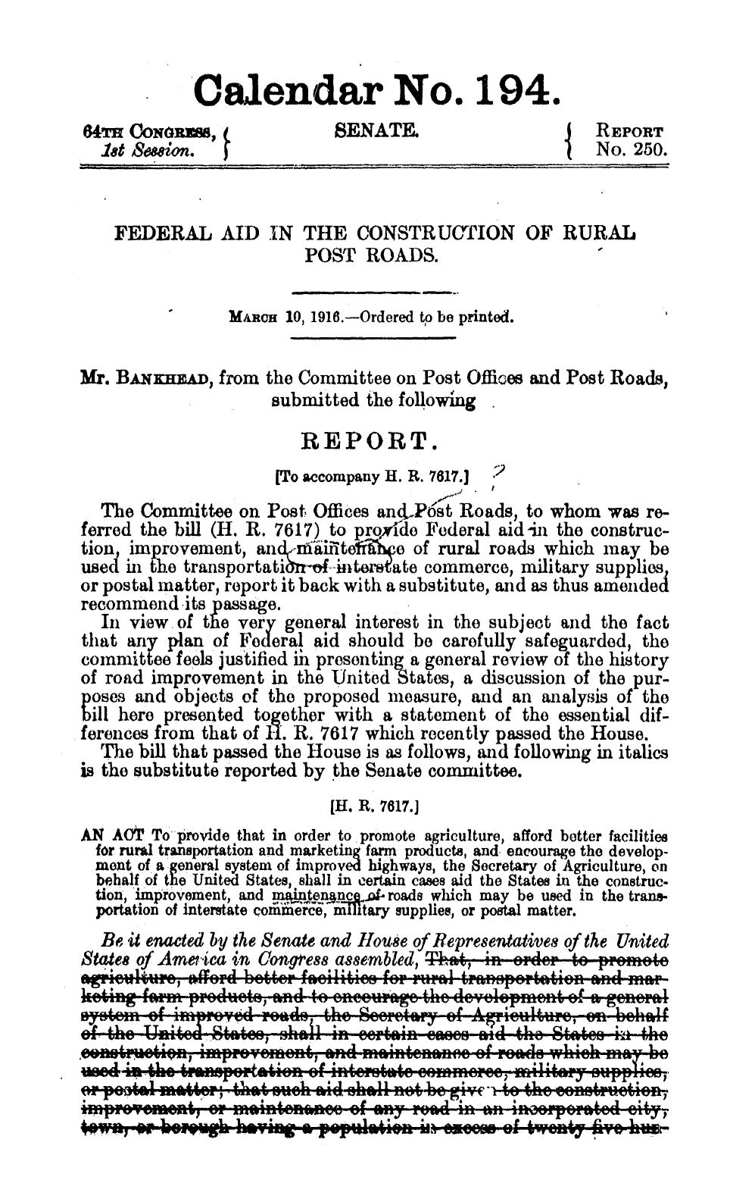
Heading into the 1916 Act
S.Rep. 64-250 (10 Mar 1916)

Slide 16
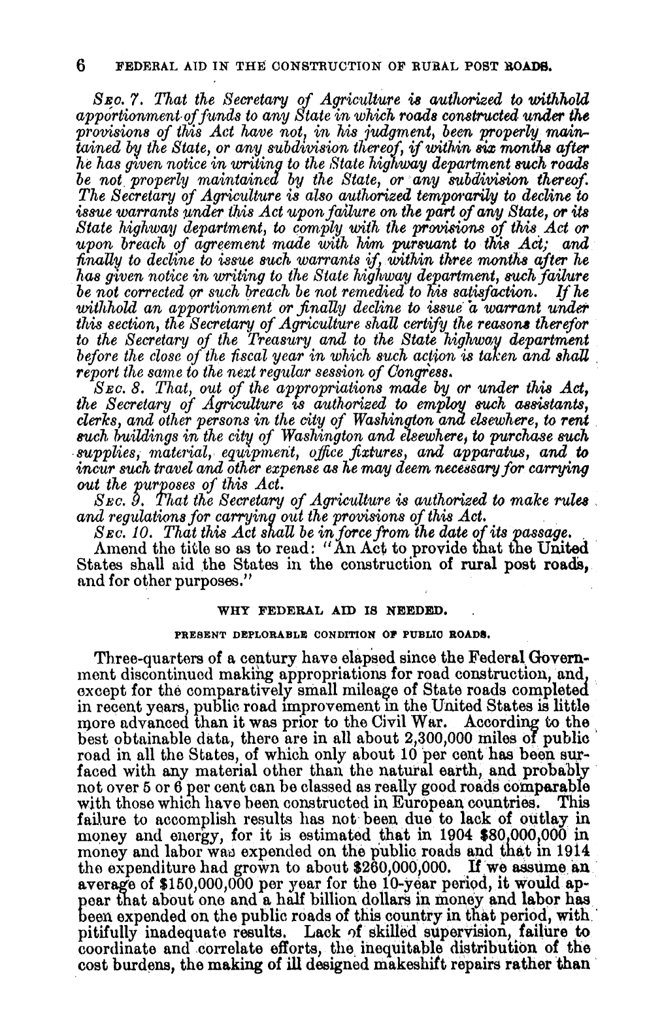
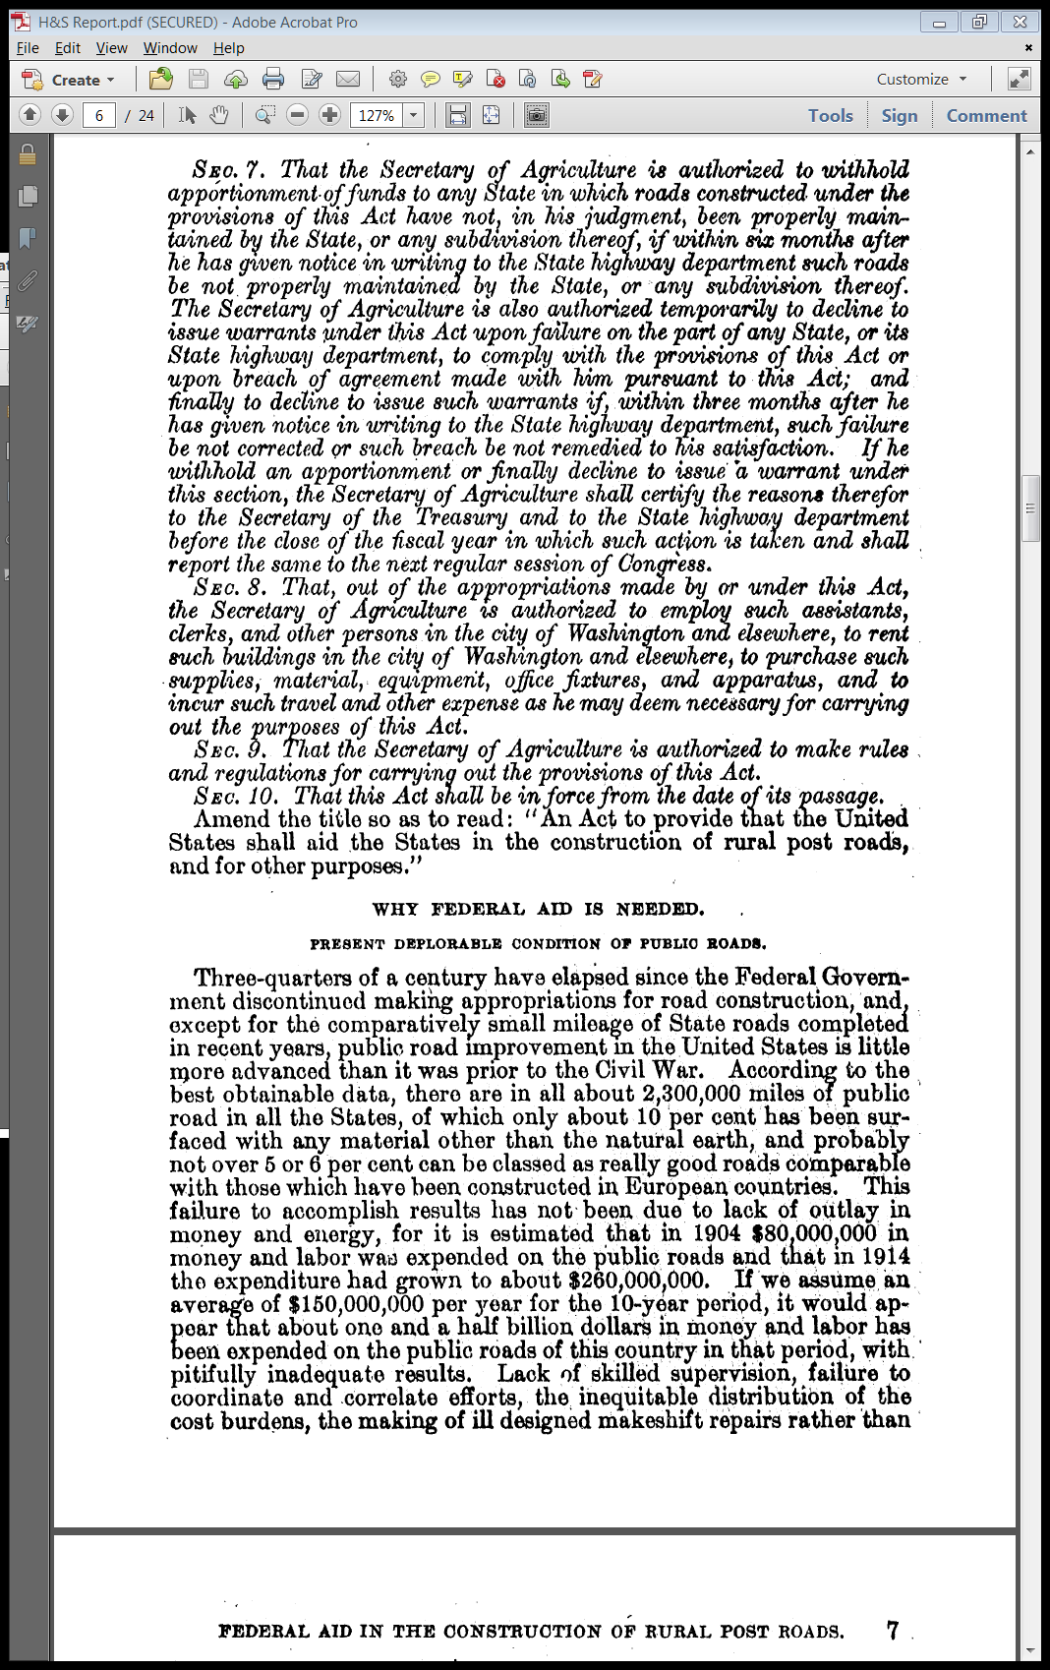
Current Roads in U.S. Are Lousy
S.Rep. 64-250 (10 Mar 1916)

Slide 17
Lots of $$$ and Poor Results
S.Rep. 64-250 (10 Mar 1916)

Slide 18
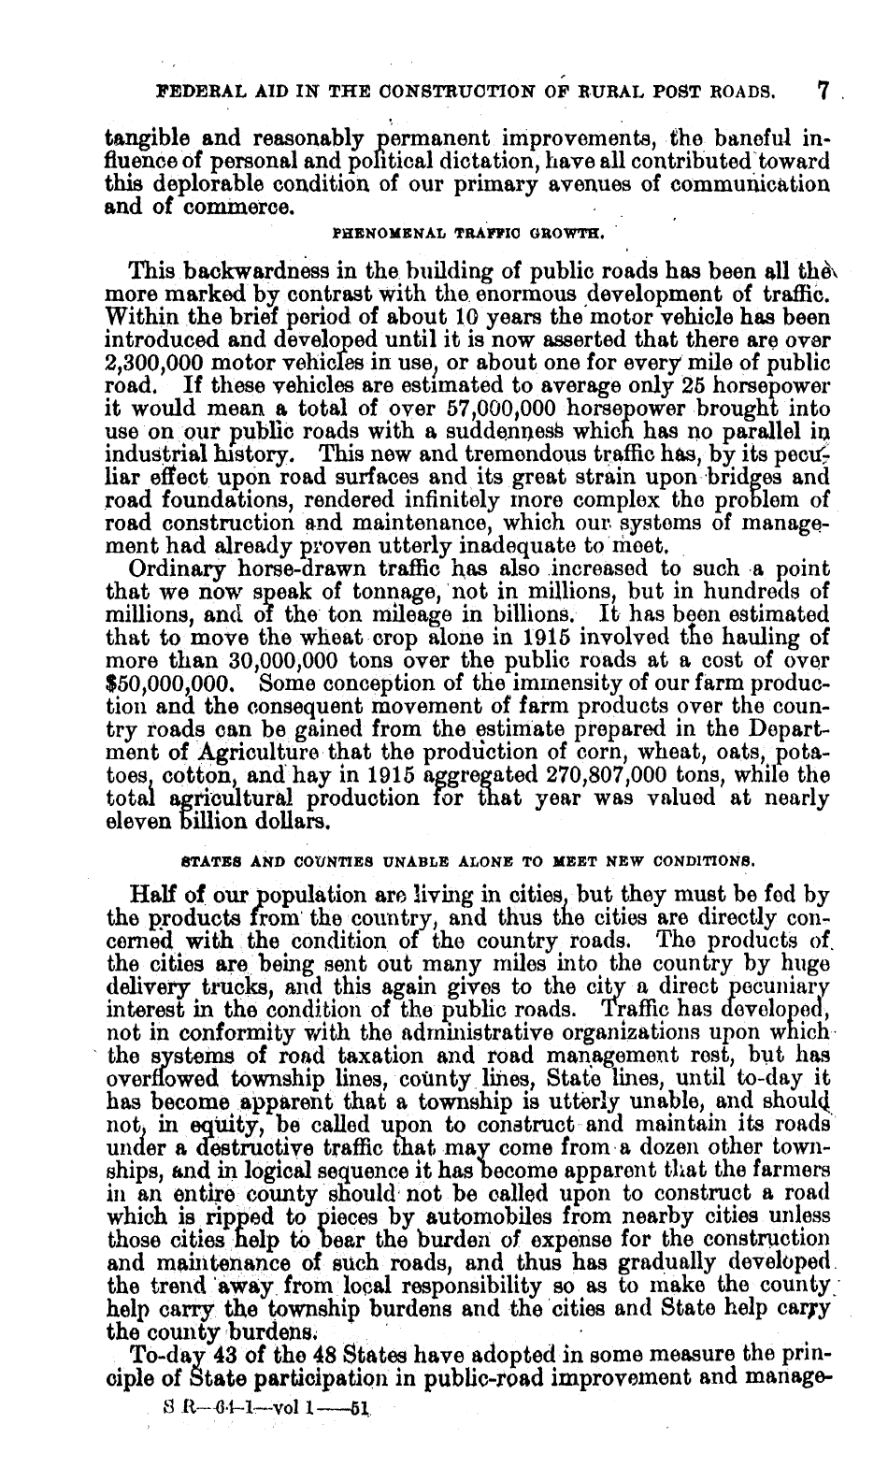
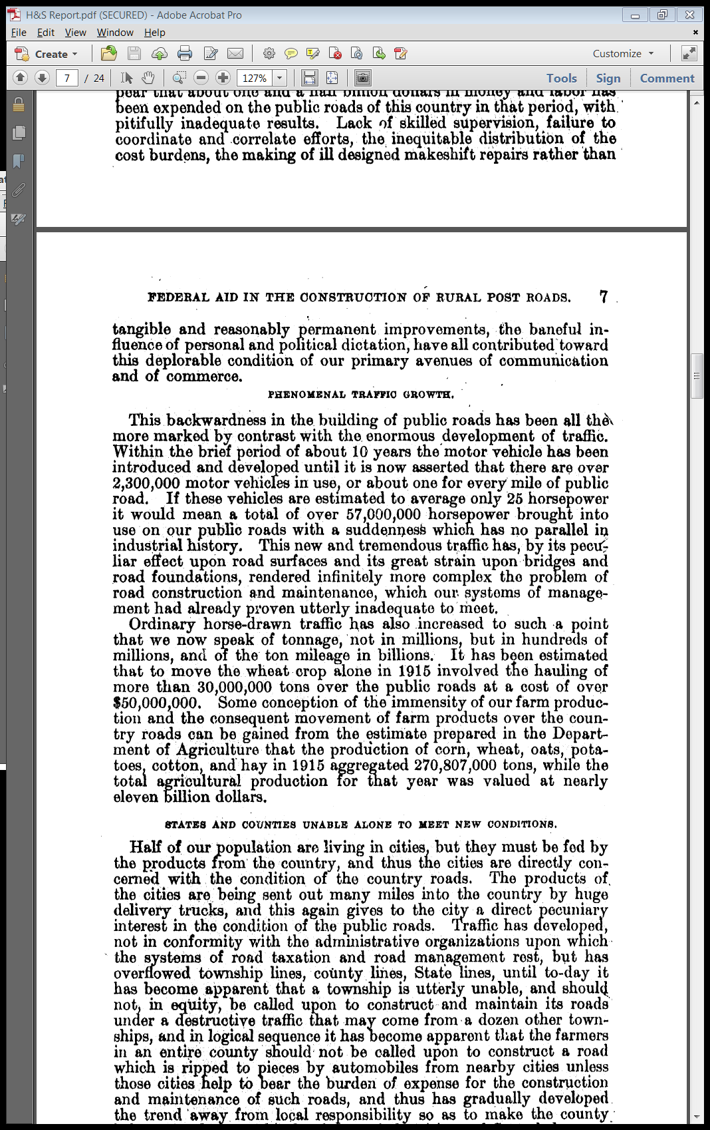
Traffic Growth: Cars
S.Rep. 64-250 (10 Mar 1916)

Slide 19
And Actual Horses
S.Rep. 64-250 (10 Mar 1916)

Slide 20
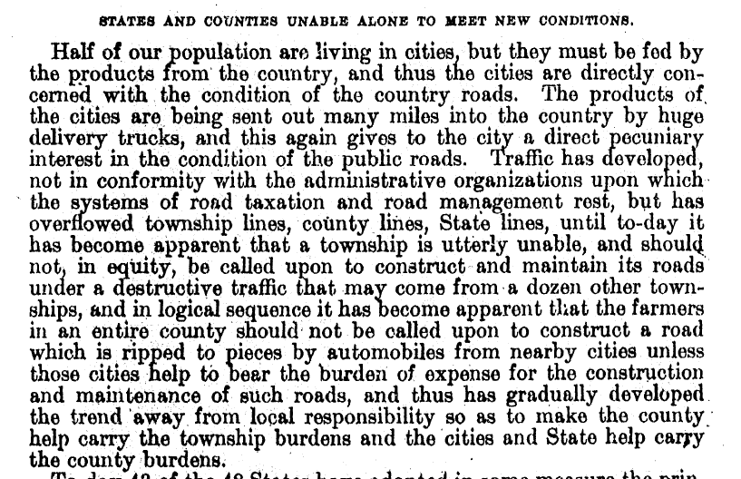
Rural and Urban Areas Linked/Spillovers
S.Rep. 64-250 (10 Mar 1916)

Slide 21
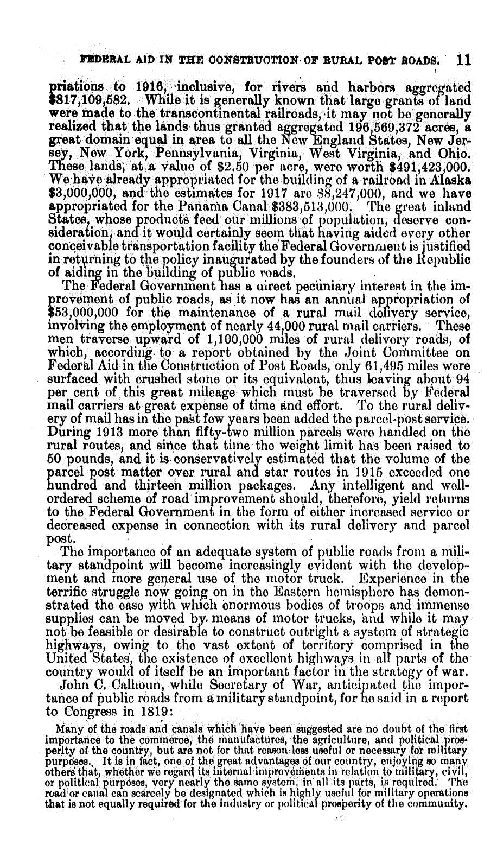
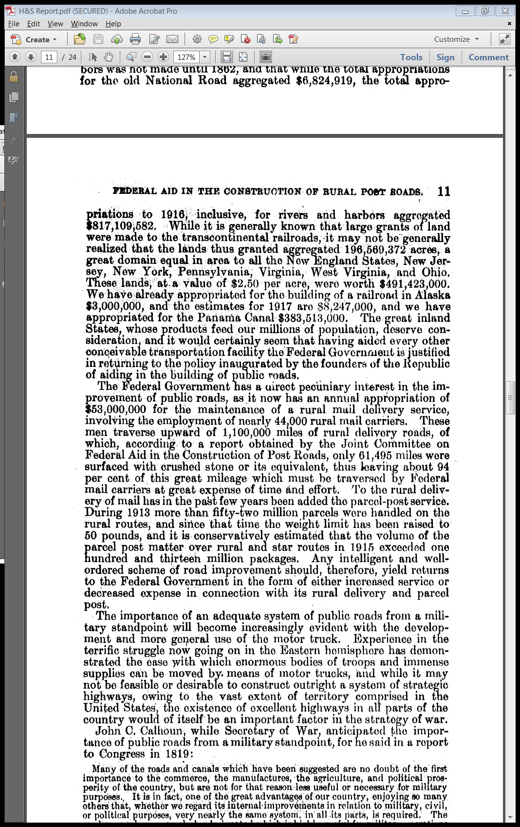
Role of Roads in Mail Delivery
S.Rep. 64-250 (10 Mar 1916)

Slide 22
Role of Roads for Military
S.Rep. 64-250 (10 Mar 1916)

Slide 23
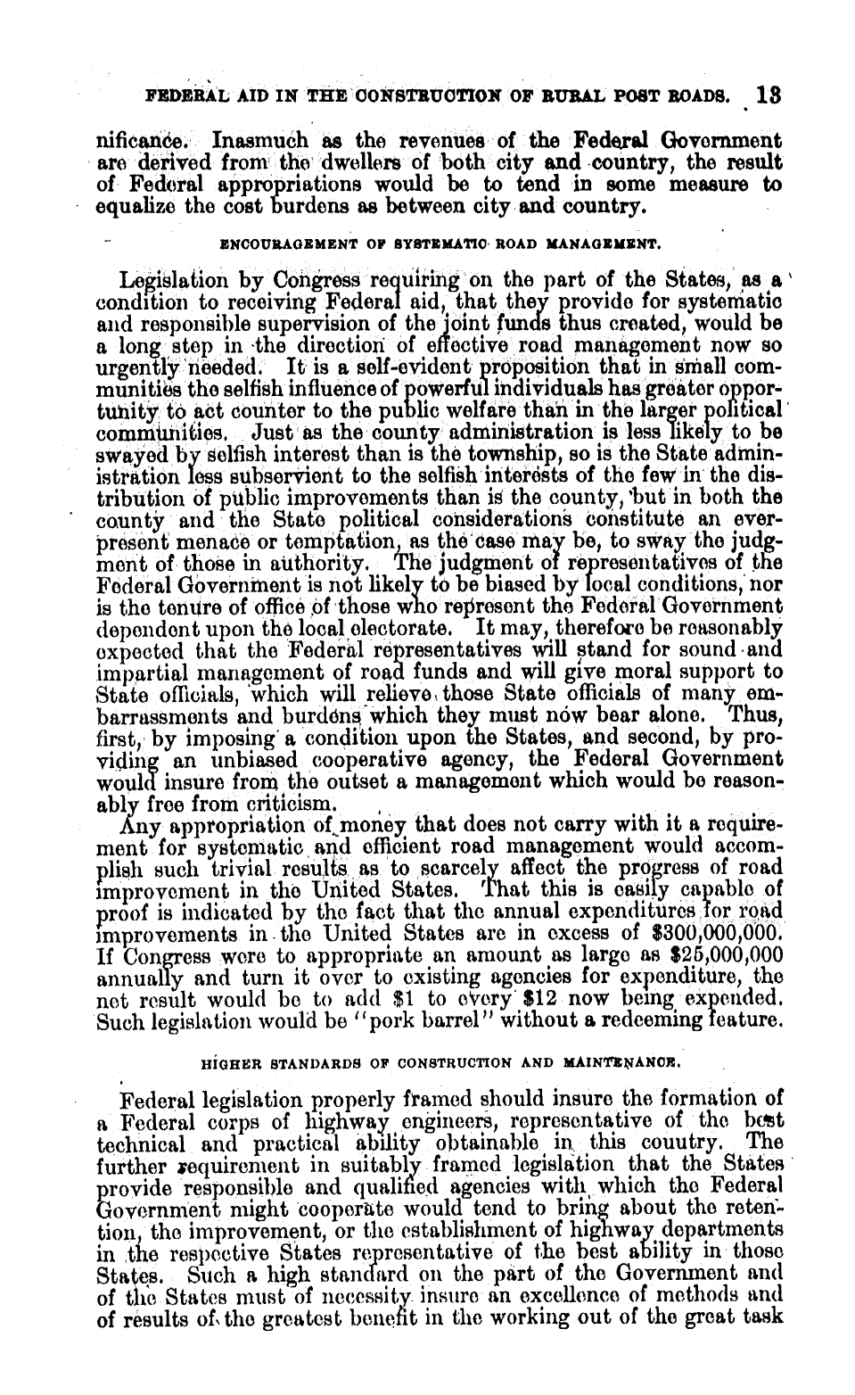
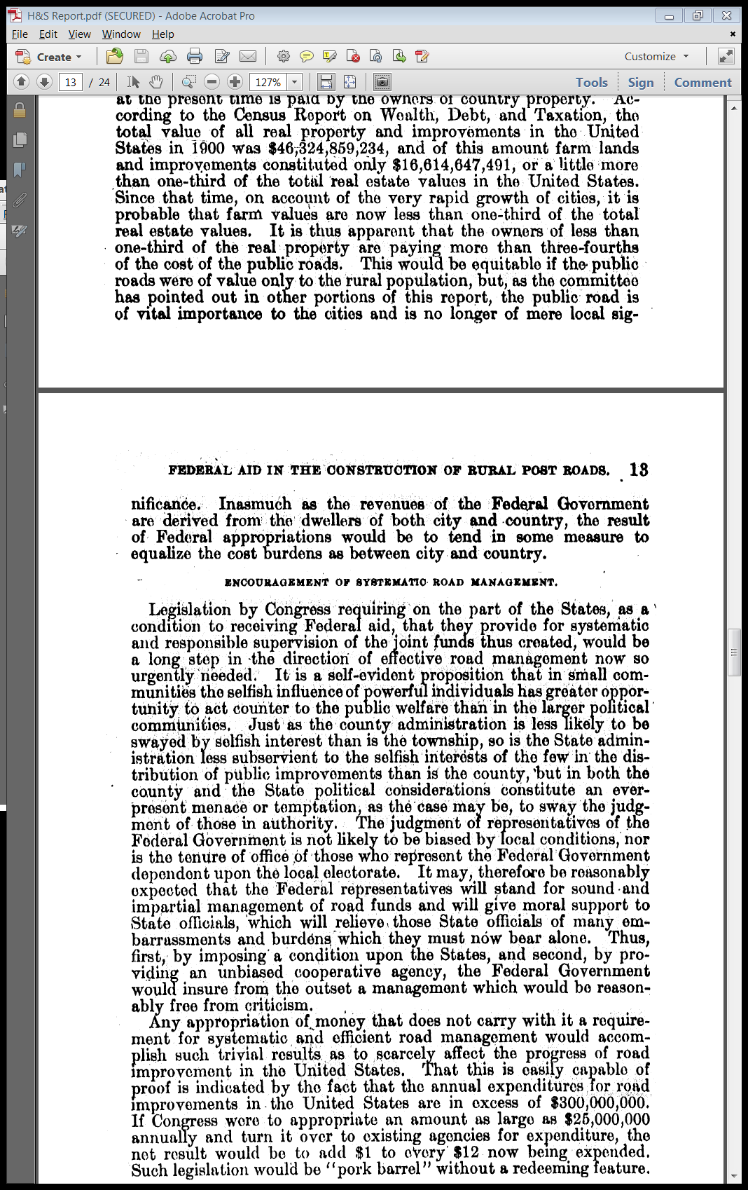
Local Gov’t Distortions
S.Rep. 64-250 (10 Mar 1916)

Slide 24
Local Gov’t Distortions
S.Rep. 64-250 (10 Mar 1916)

Slide 25

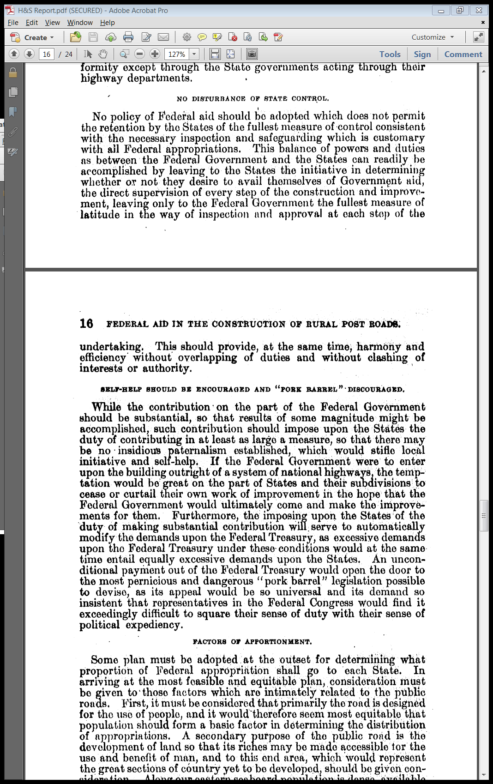
Importance of State Stake
S.Rep. 64-250 (10 Mar 1916)

Slide 26
Importance of State Stake: Limit Pork Barrel Projects
S.Rep. 64-250 (10 Mar 1916)

Slide 27
Rural Post Roads
Federal-Aid Road Act of 1916

Slide 28
Sec. 2: Definition of Rural Post Roads (Pop < 2500)
Federal-Aid Road Act of 1916

Slide 29
Sec. 4: Apportionment of Funds: Three Thirds: Area, Population, Mail Routes
Federal-Aid Road Act of 1916

Slide 30
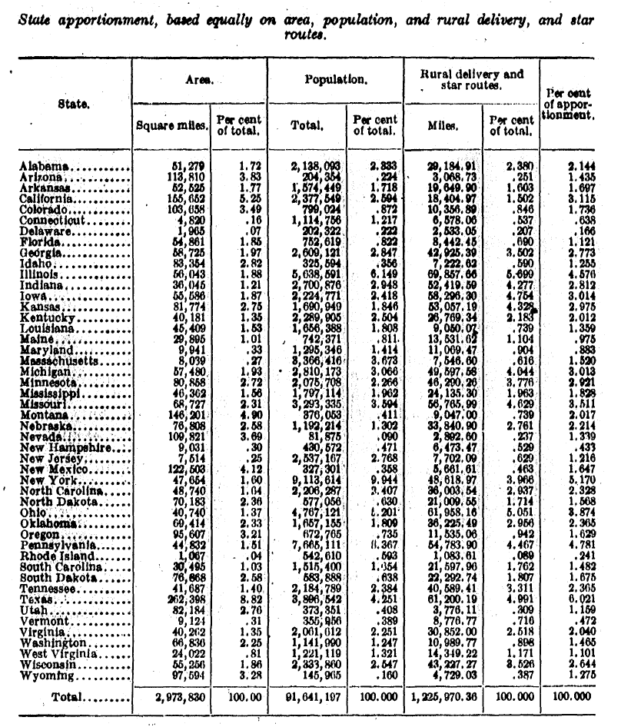
Apportionment Factors (in 48 states)
S. Rep. 64-250 (10 Mar 1916)

Slide 31
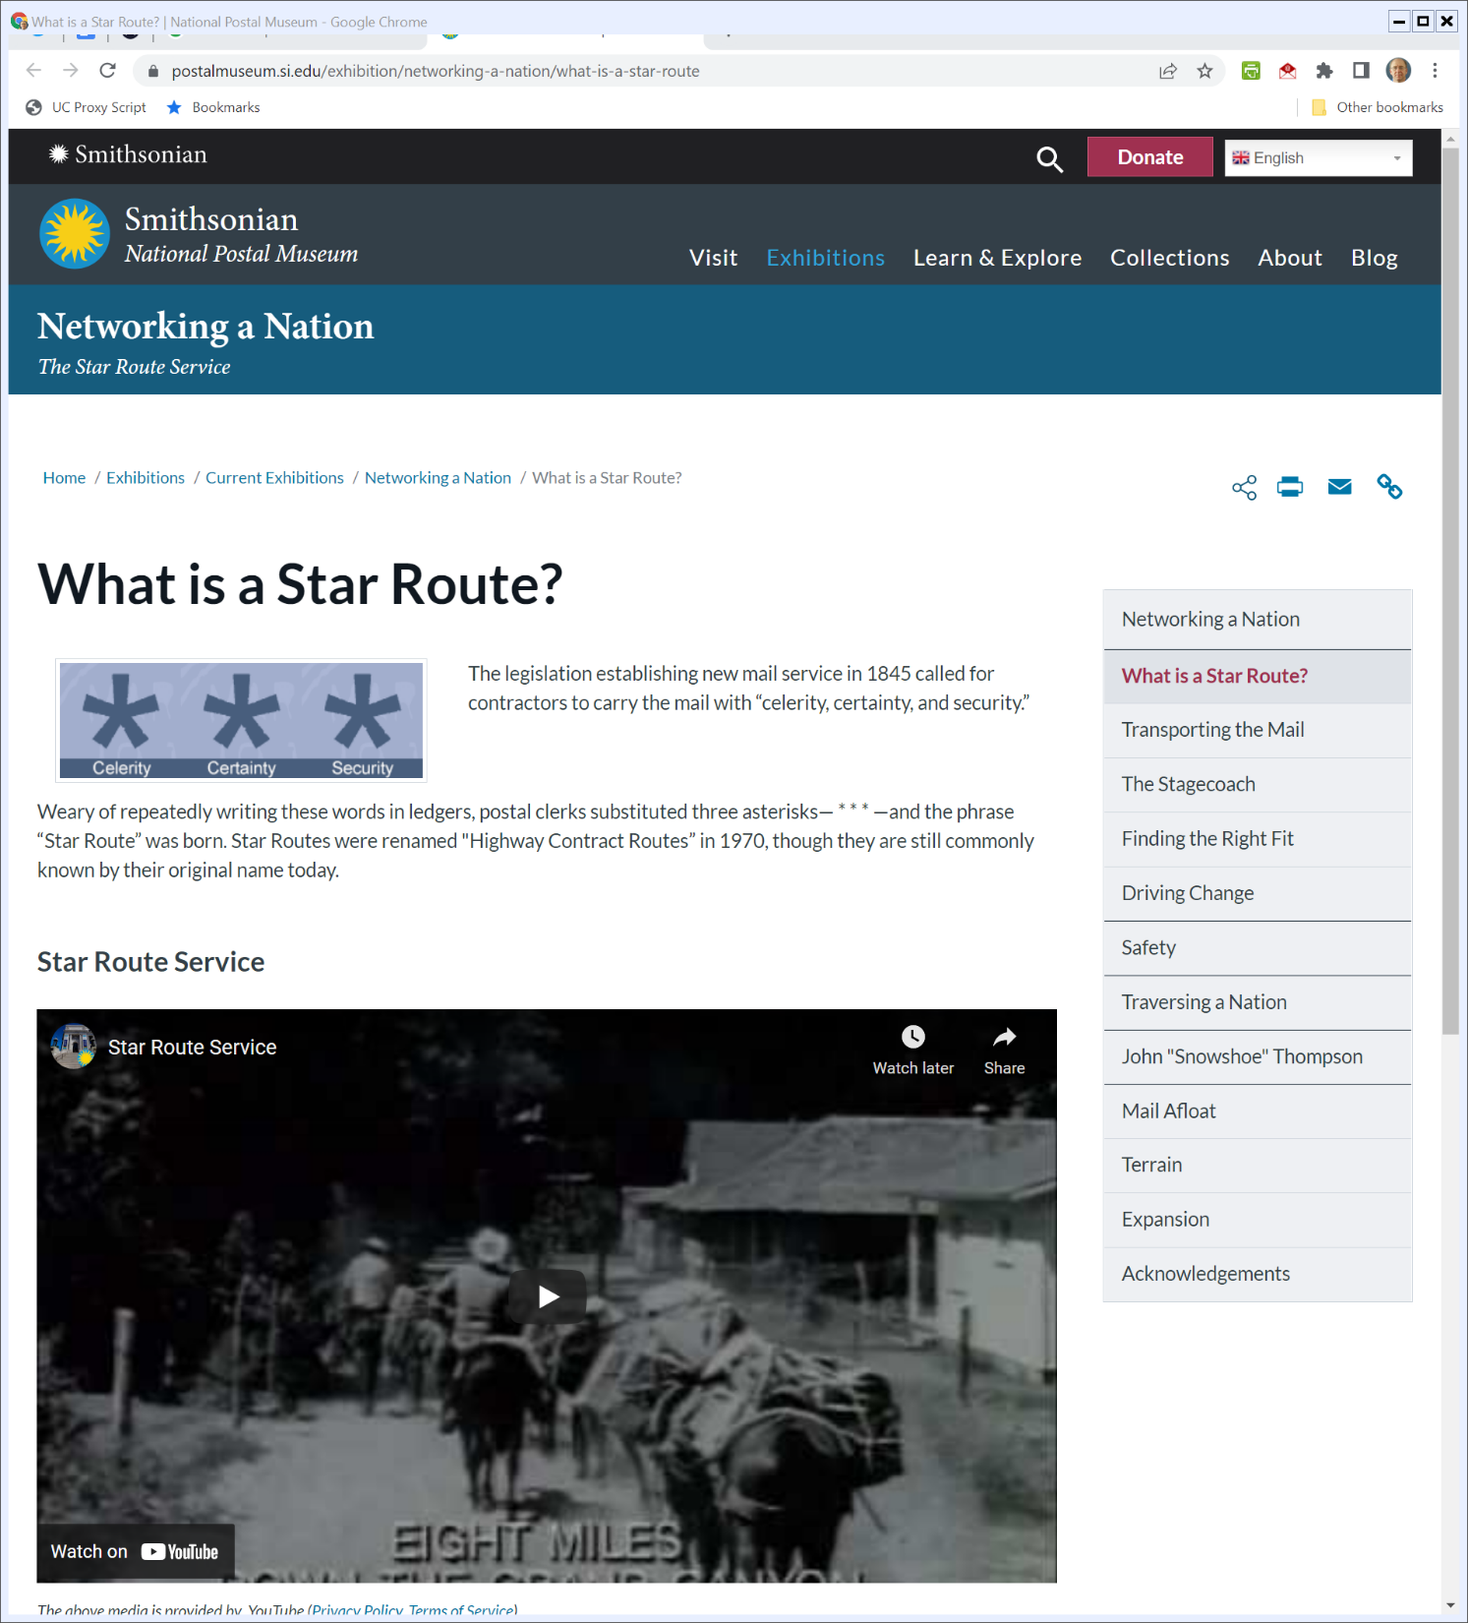
Definition of Star Route
Smithsonian (Visited 24 Mar 2022)
Notes:
https://postalmuseum.si.edu/exhibition/networking-a-nation/what-is-a-star-route

Slide 32
Sec. 6: 50/50 Federal, State Funding
Federal-Aid Road Act of 1916

Slide 33
1921 Highway Act
Federal Highway Act of 1921

Slide 34
Sec. 6: Designation of Interstate Highways
Federal Highway Act of 1921

Slide 35
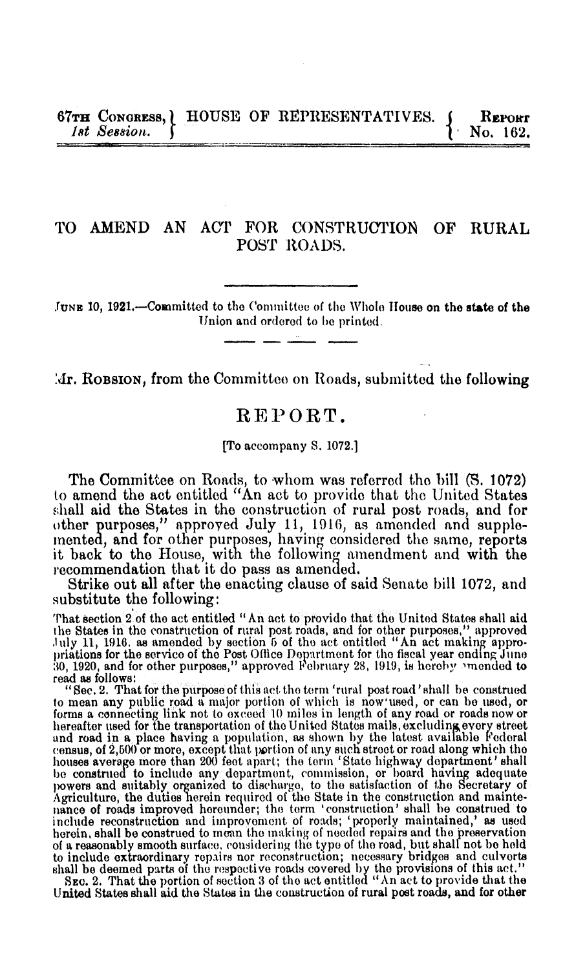
1921 Act Legis History
H.Rep. 67-162 (10 June 1921)

Slide 36
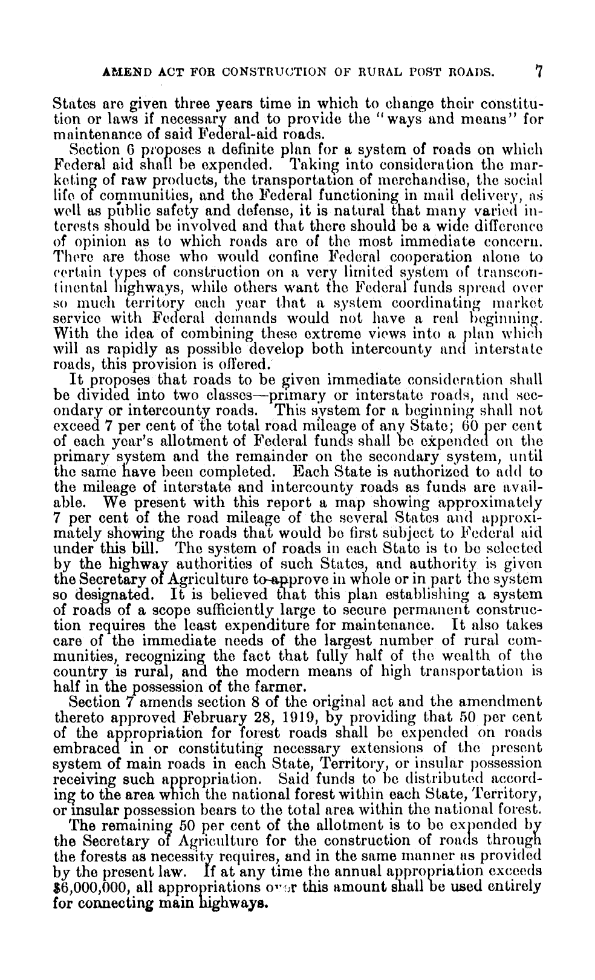
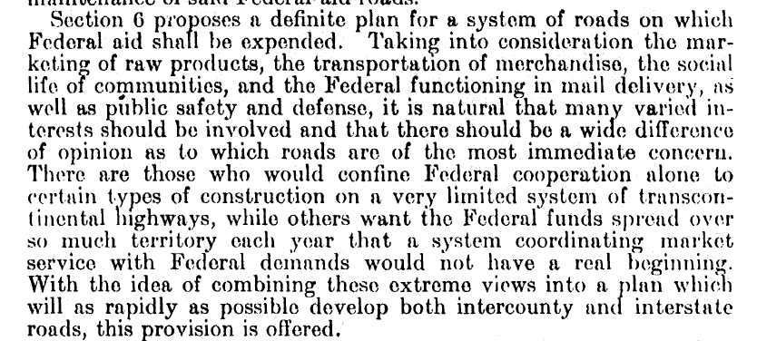
Post WWI Priority and Vision Conflicts
H.Rep. 67-162 (10 June 1921)

Slide 37
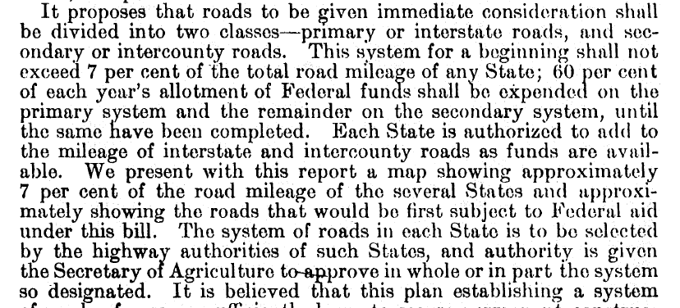
Designation of Interstate System
H.Rep. 67-162 (10 June 1921)

Slide 38
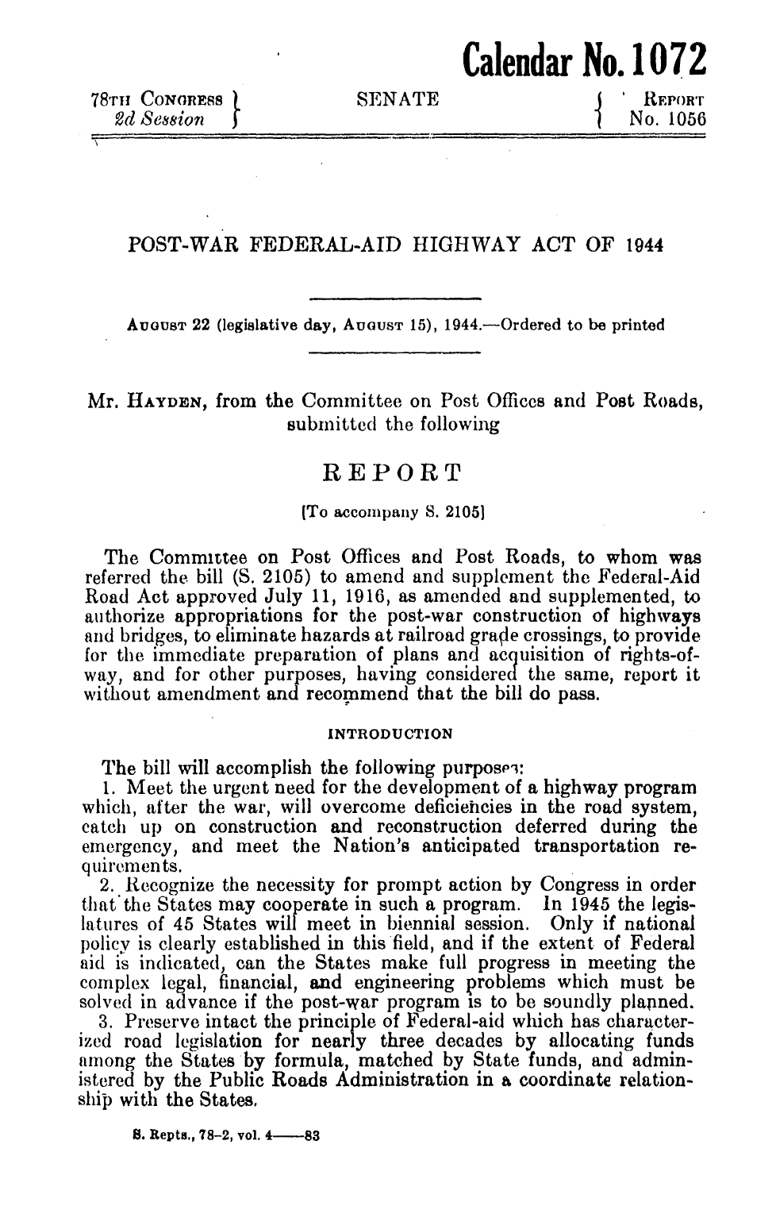
1944 Highway Act Legislative History
S. Rep. 78-1056 (22 Aug 1944)

Slide 39
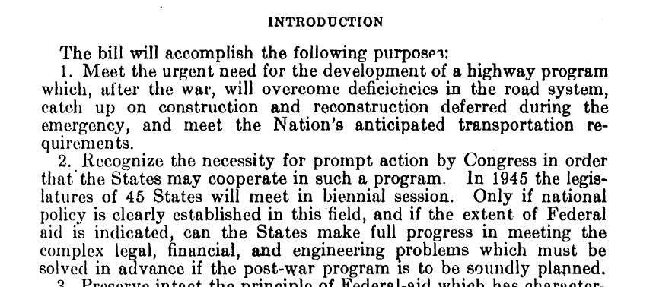
Post WWII Plan
S. Rep. 78-1056 (22 Aug 1944)

Slide 40
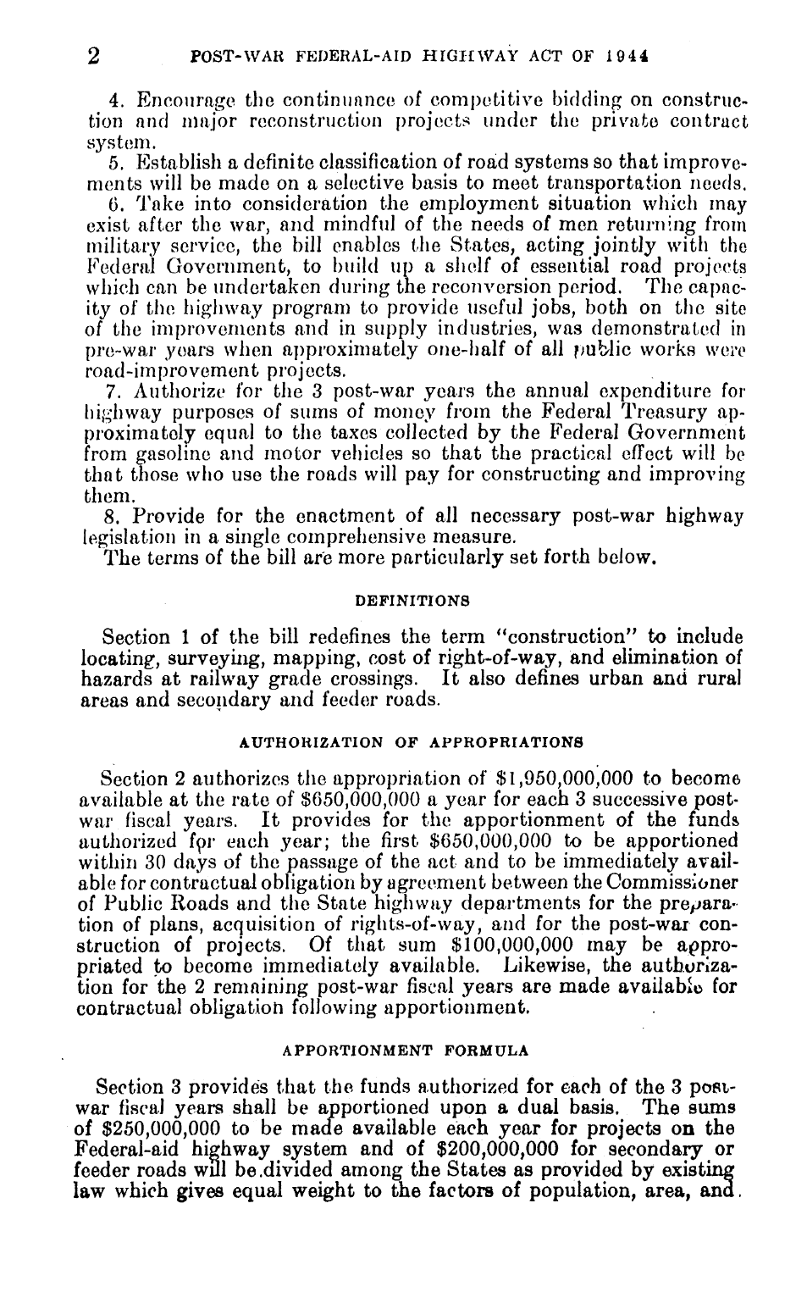
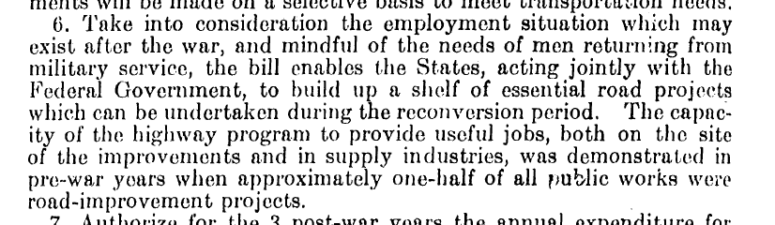
Highways as Jobs Program
S. Rep. 78-1056 (22 Aug 1944)

Slide 41
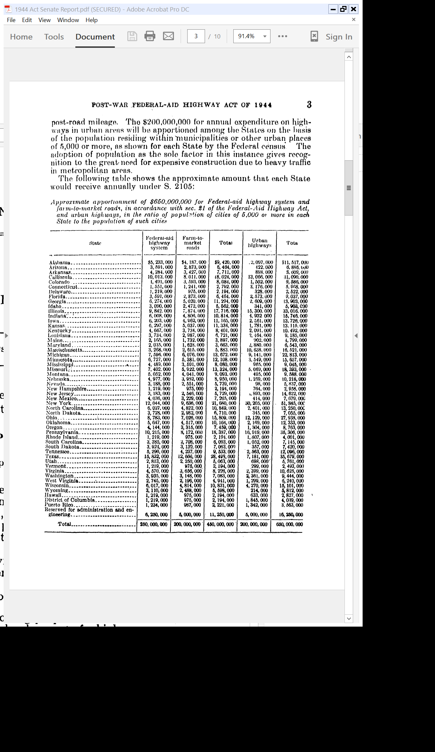
Expected Allocation of $$$
S. Rep. 78-1056 (22 Aug 1944)

Slide 42
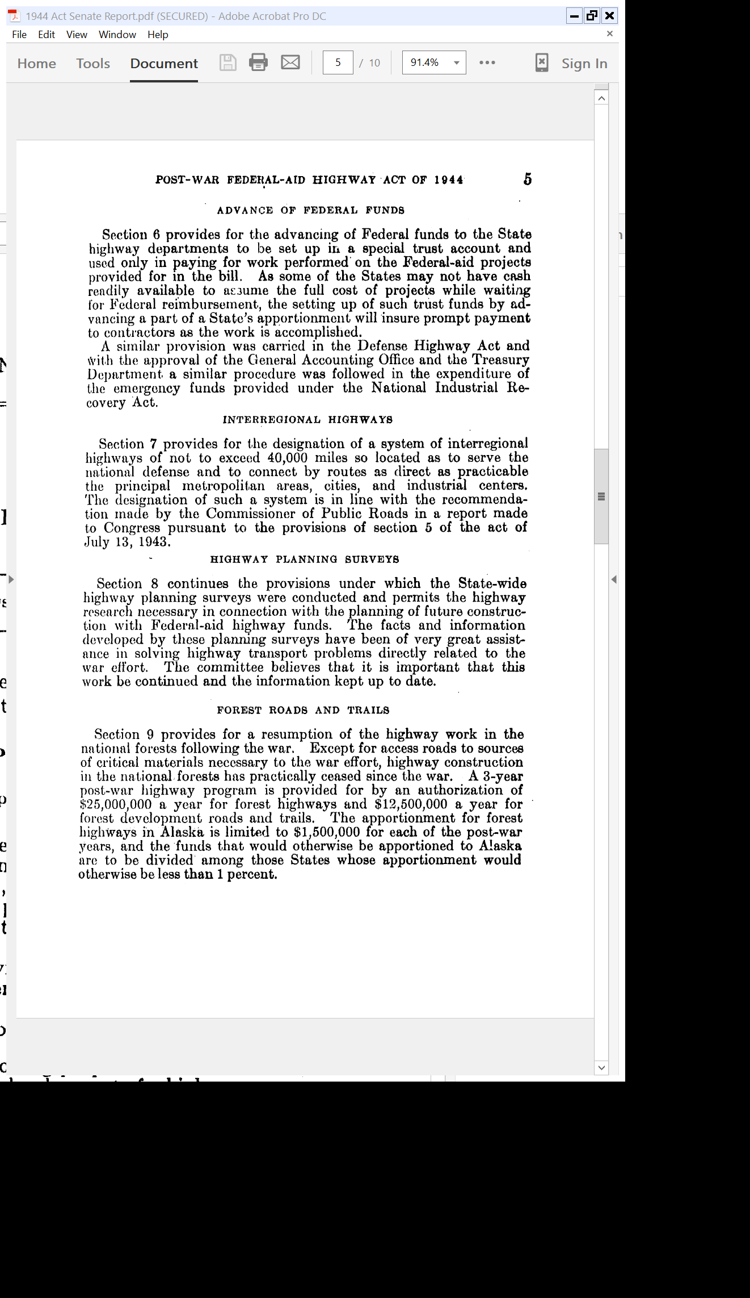
Sec. 7: Interstate Highway System for National Defense
S. Rep. 78-1056 (22 Aug 1944)

Slide 43
1944 Highway Act
Pub. L. 78-521 (20 Dec 1944)

Slide 44
Designation of Interstate System
Pub. L. 78-521 (20 Dec 1944)

Slide 45
12 July 1954: Eisenhower Roads Speech
New York Times (13 July 1954)

Slide 46
12 July 1954: Eisenhower Roads Speech
New York Times (13 July 1954)

Slide 47
And the Opposition
New York Times (14 July 1954)

Slide 48
And the Opposition
New York Times (14 July 1954)

Slide 49
Ike Signs 1956 Roads Bill
New York Times (30 June 1956)

Slide 50
41K Miles to Link Big Cities
New York Times (30 June 1956)

Slide 51
1956 Highway Act
Pub. L. 84-627 (29 June 1956)

Slide 52
Continuing Funding Allocation
Pub. L. 84-627 (29 June 1956)

Slide 53
Interstate System
Pub. L. 84-627 (29 June 1956)

Slide 54
1957-59: Apportionment System: One Half Pop, One Half Prior System (with Floor)
Pub. L. 84-627 (29 June 1956)

Slide 55
Federal Cost Share: 90 to 95%
Pub. L. 84-627 (29 June 1956)

Slide 56
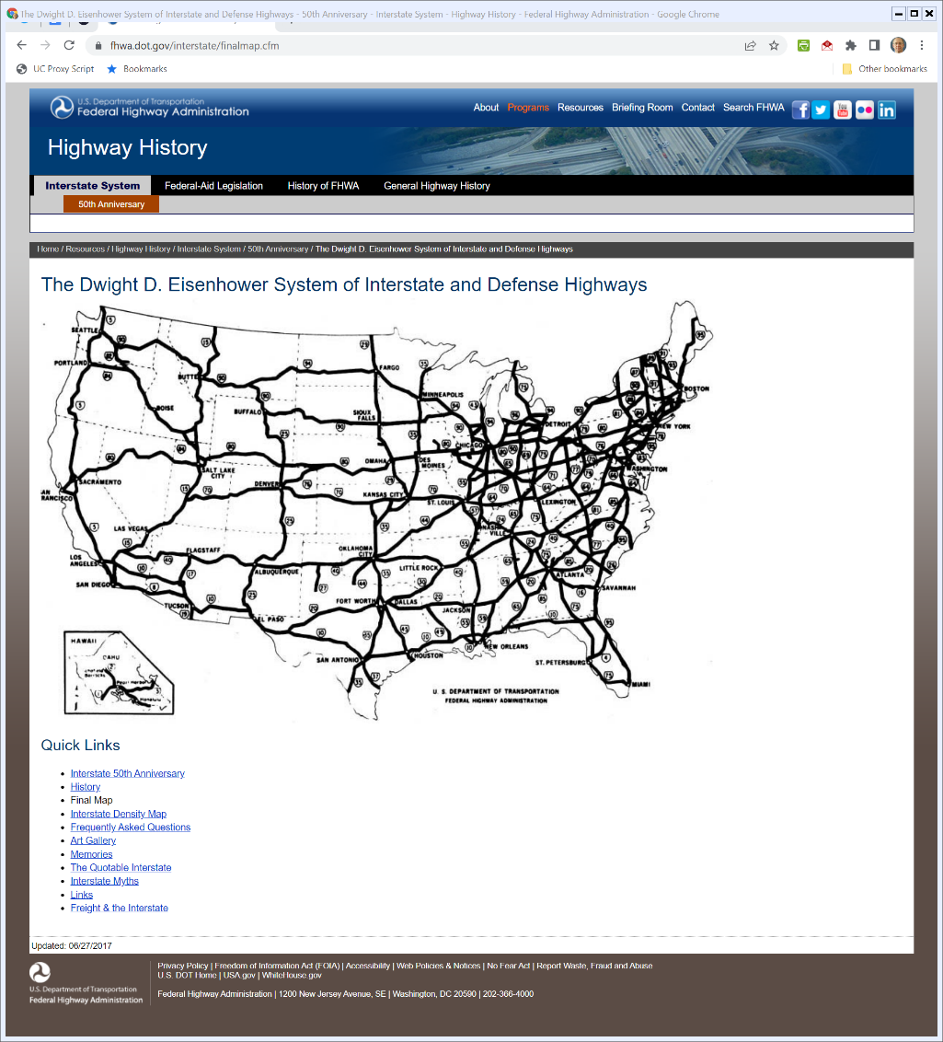

Final System
USDOT Federal Highway Admin (27 June 2017)
Notes:
https://www.fhwa.dot.gov/interstate/finalmap.cfm

Slide 57
What Did the Interstate System Do?
Cucu (10 Mar 2022)

Slide 58
Simple Approach to Government and Public Finance
A Few States, One National Government
What projects should we finance at what levels and why?
When will we see projects switch levels and why?

Slide 59
Mechanisms
Key Questions
Is this about allocating resources and decisions between federal govt and state govt?
Should the federal govt bypass state govt and rely on private actors?
If private, should it matter whether they are for-profit or non-profit? Investor-owned vs. community owned?

Slide 60
Types of Projects: National
National Projects
Benefits flow to everyone though not necessarily in equal amounts
Not located in one particular jurisdiction
Projects: National defense? Currency? Post office? Highways?

Slide 61
How Should We Finance Projects?
Possible Choices
Territorial area
Population
Number of jurisdictions
Pro rata based on value

Slide 62
N1: Shared Benefits and Identical
TTYN (1 of 4)
Project Costs and Outcomes
VPurple = 15, VPink = 15
Cost of Project: 20
Taxes: TPurple = 10, TPink = 10
How should we evaluate this project?
Would a national legislature adopt it?

Slide 63
N2: Shared Benefits and Identical
TTYN (2 of 4)
Project Costs and Outcomes
VPurple = 5, VPink = 5
Cost of Project: 20
Taxes: TPurple = 10, TPink = 10
How should we evaluate this project?
Would a national legislature adopt it?

Slide 64
N3: Shared Benefits and Different
TTYN (3 of 4)
Project Costs and Outcomes
VPurple = 2, VPink = VRed = 8
Cost of Project: 21
Taxes
TPurple = TPink = TRed = 7
How should we evaluate this project?
Would a national legislature adopt it?

Slide 65
N4: Shared and Very Asymmetric Benefits
TTYN (4 of 4)
Project Costs and Outcomes
VPurple = 5, VPink = 22
Cost of Project: 20
Taxes: TPurple = ?, TPink = ?
How should we evaluate this project?
Would a national legislature adopt it?

Slide 66
N1: Good National Project
Evaluation
Budget balanced
Overall benefits exceed costs
“Fair” allocation of costs and benefits

Slide 67
N2: A Dead Bad Project
Evaluation
Budget balanced
Overall costs exceed benefits
Shouldn’t expect project to go forward

Slide 68
N3: A Live Bad Project?
Evaluation
Budget balanced
Overall costs exceed benefits
Pink and Red gain, Purple loses: Can Pink and Red impose will on Purple?
Could that happen in a national legislature?

Slide 69
N4: The Risk of Free Riding
Evaluation
Overall benefits exceed costs
Pink would move forward w/o Purple: Can Purple free ride? Does level matter?

Slide 70
1924 Washing Machine
New York Herald Tribune (7 Sept 1924)

Slide 71
1936 Act on Rural Electricity
Pub. L. 74-605 (20 May 1936)

Slide 72
Use of Funds
Pub. L. 74-605 (20 May 1936)

Slide 73
Lend at Rate U.S. Borrows At
Pub. L. 74-605 (20 May 1936)

Slide 74
Rural Means <= 1500
Pub. L. 74-605 (20 May 1936)

Slide 75
History of the REA
REA History (19 Apr 1982)

Slide 76
Funding and Interest Rates
REA History (19 Apr 1982)

Slide 77
Rural Telephones
REA History (19 Apr 1982)

Slide 78
% of Farms with Electric and Telephone Service
REA History (19 Apr 1982)

Slide 79
Grades of Telephone Service
REA History (19 Apr 1982)

Slide 80
Interest Rates
REA History (19 Apr 1982)

Slide 81
Types of Projects: Local
Local Only Projects
Benefits flow only locally
Often located in one particular jurisdiction
Examples: Local parks, local libraries, fire and police stations
Electricity? Broadband?

Slide 82
L1: Identical Local Benefits
TTYN (1 of 3)
Project Costs and Outcomes
VPurple = 15, VPink = 15
Cost of Project: 10 each
Taxes: TPurple = 10, TPink = 10
How should we evaluate these projects?
Would state legislatures adopt them?

Slide 83
L2: Identical Local Benefits
TTYN (2 of 3)
Project Costs and Outcomes
VPurple = 5, VPink = 5
Cost of Project: 10 each
Taxes: TPurple = 10, TPink = 10
How should we evaluate these projects?
Would state legislatures adopt them?

Slide 84
L3: Different Local Benefits
TTYN (3 of 3)
Project Costs and Outcomes
VPurple = 5, VPink = 12
Cost of Project: 10 each
Taxes: TPurple = ?, TPink = ?
How should we evaluate these projects?
Would state legislatures adopt them?

Slide 85
L1: Good Local Project
Evaluation
Budget balanced
Benefits in each jurisdiction exceed costs
All benefits and costs internalized

Slide 86
L2: Bad Local Project
Evaluation
Budget balanced
Costs in each jurisdiction exceed benefits
Neither project will go forward

Slide 87
L3: Local Tailoring
Evaluation
Purple should reject project, Pink should adopt
Full internalization
Will Pink try to go national (claim N3)? (Spending other people’s money)

Slide 88
Matching Real Life with the Hypos
Try These Situations
Federal-Aid Road Act of 1916?
Federal-Aid Road Act of 1956?
Rural electrification in 1936?
New public broadband network? Rural or urban or both?

Slide 89
Types of Projects: Local with Spillover
Local with Spillover
Benefits flow locally with some spillovers across jurisdiction
Often located in one particular jurisdiction
Examples:
Local highways?
Interstate highways?

Slide 90
LwS: Good Project
TTYN (1 of 2)
Project Costs and Outcomes
V1Purple = 8, V1Pink = 4
V2Purple = 4, V2Pink = 8
Cost of Project: 10 each
Taxes: TPurple = ?, TPink = ?

Slide 91
LwS: Good Project
TTYN (2 of 2)
Questions
Can we do these as purely local projects? Do we need to coordinate? Do we need to go national?

Slide 92
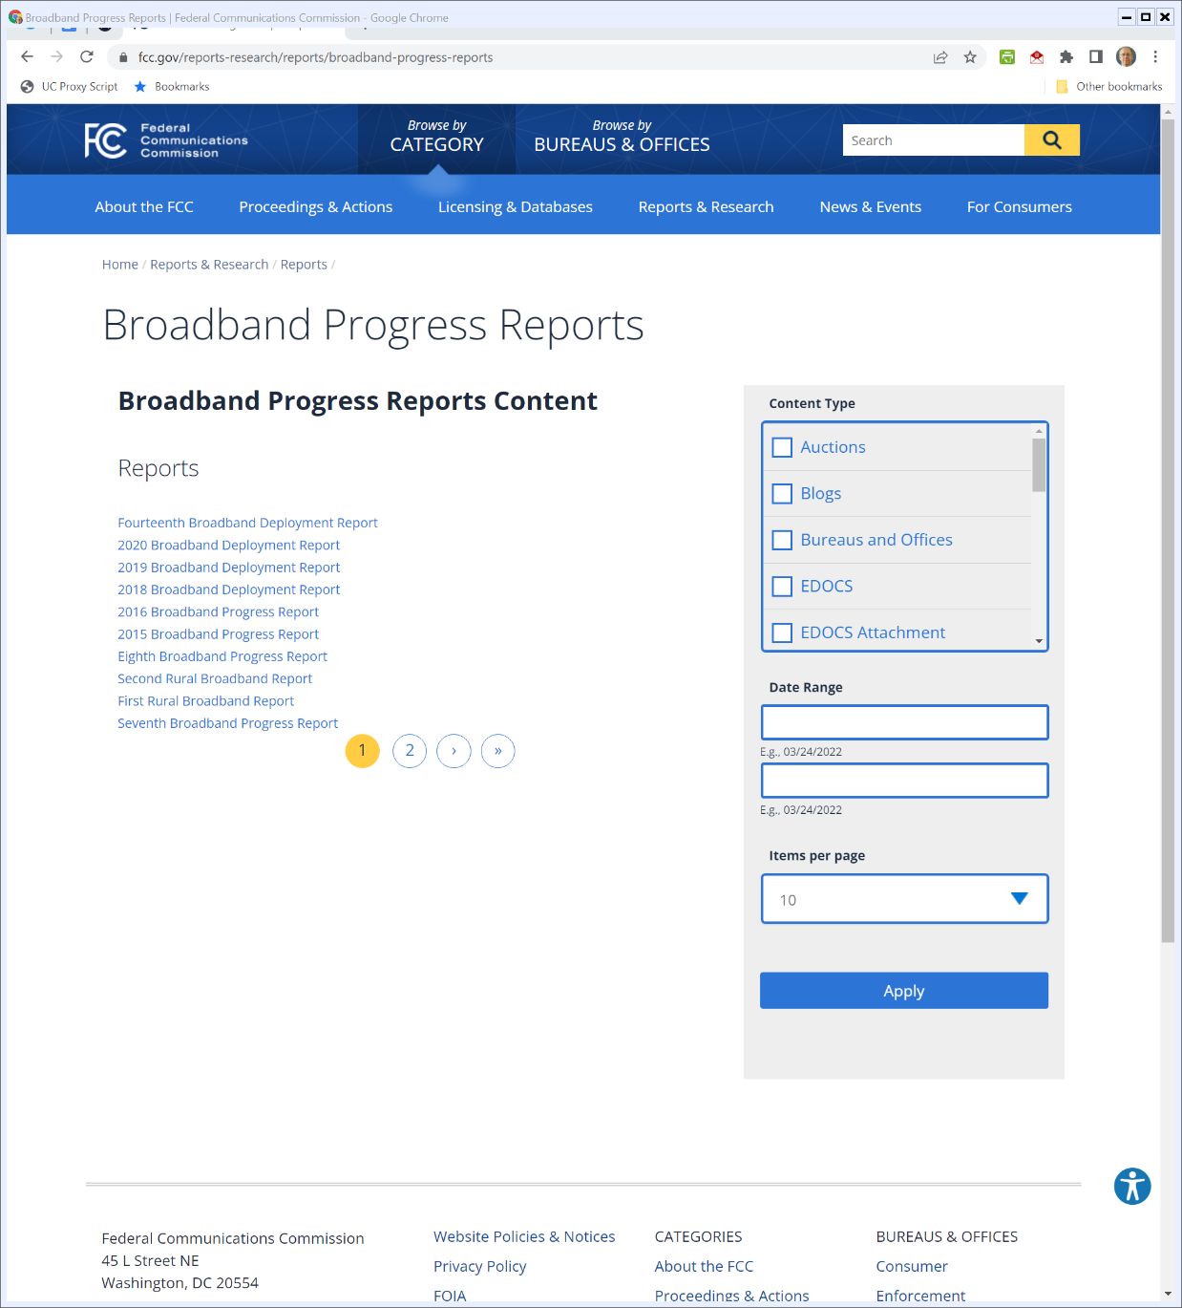

FCC Broadband Reports
FCC (Visited 24 Mar 2022)
Notes:
https://www.fcc.gov/reports-research/reports/broadband-progress-reports

Slide 93
2011: U.S. Rural Broadband
FCC Second Rural Broadband Report (17 June 2011)

Slide 94
June 2010: Urban v. Rural (19M Rural Without)
FCC Second Rural Broadband Report (17 June 2011)

Slide 95
2011 Rural Broadband Order (752 pages!)
FCC 11-161 (18 Nov 2011)

Slide 96
Extending the Universal Service Idea
FCC 11-161 (18 Nov 2011)

Slide 97
2014 Update Order: New Speed Standard, Urban-Rural Comparability
FCC Chair Tom Wheeler (18 Dec 2014)

Slide 98
2018: Universal Service Auctions
FCC Press Release (28 Aug 2018)

Slide 99
Rural Wireless Broadband
FCC Press Release (1 Apr 2020)

Slide 100
Rural Digital Opportunity Fund
FCC (30 Jan 2020)

Slide 101
And the Actual Order
FCC (7 Feb 2020)

Slide 102
Tons of Granularity
FCC (7 Feb 2020)

Slide 103
RDOF Roll Out
FCC (16 Dec 2021)

Slide 104
And Again
FCC (28 Jan 2022)

Slide 105
Back to the Beginning
Key Questions Again
What are the principles at work here for assessing services in rural v. urban areas?
How should we classify broadband with regard to urban v. rural?
How should we think about mechanisms for implementing whatever goals we settle upon?

