Slide 1
Class 2 Platforms and Network Industries Spring 2022 Access, Common Carriage and Interconnection
Randal C. Picker
James Parker Hall Distinguished Service Professor of Law
The Law School
The University of Chicago
Copyright © 2007-22 Randal C. Picker. All Rights Reserved.

Slide 2
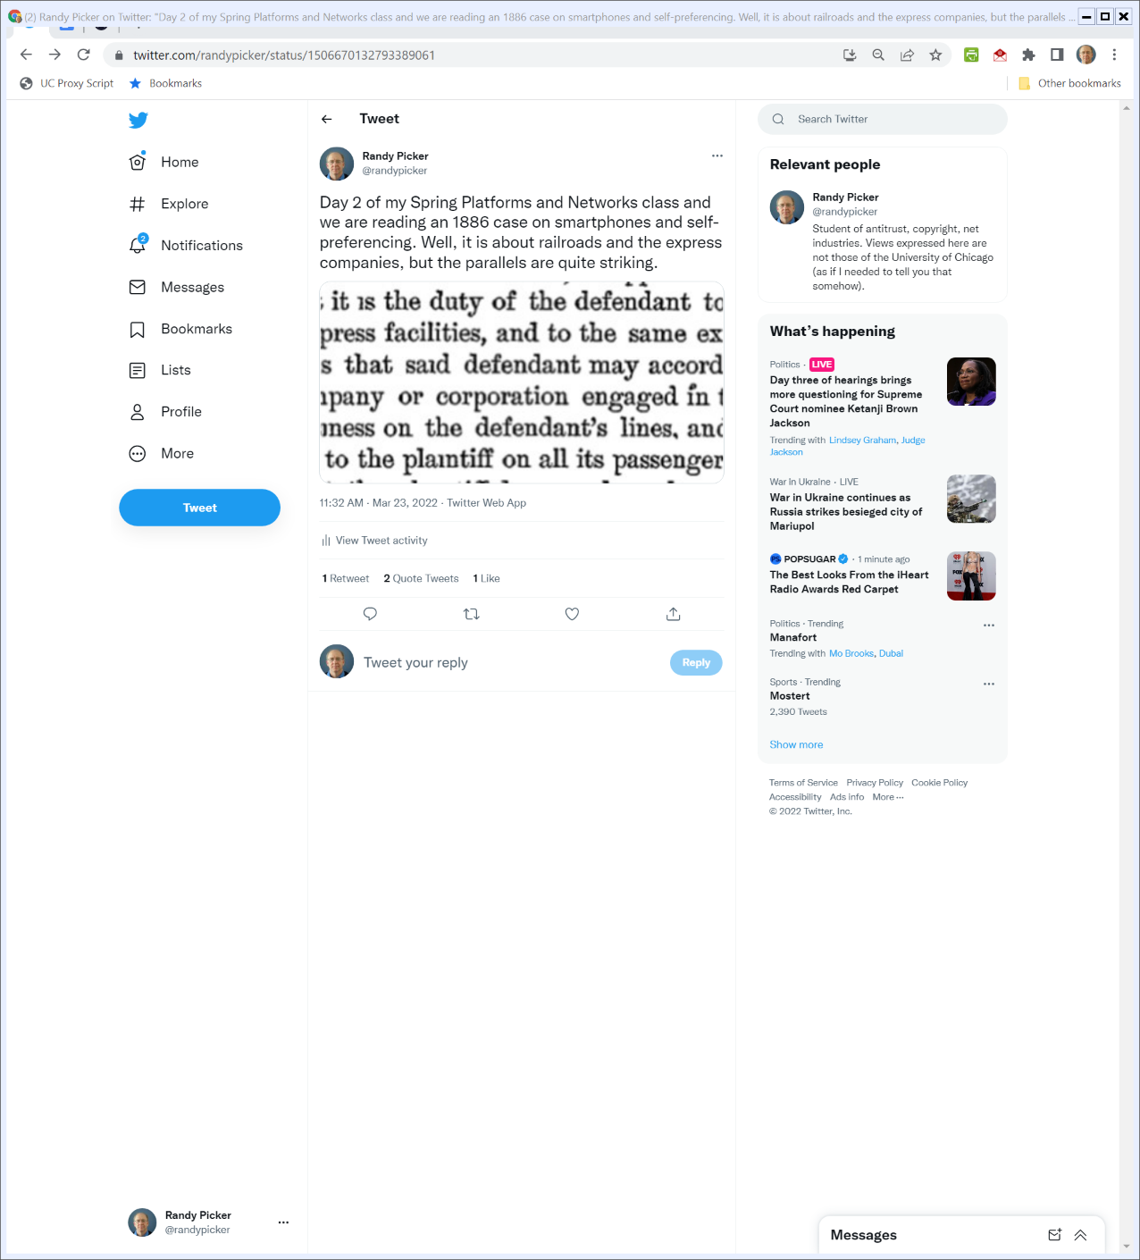

1886 and Today
@randypicker (23 Mar 2022)

Slide 3
The Focus Today
Key Questions/Issues
1. What is a common carrier? What consequences attach to that status?
2. How does a firm become a common carrier?
3. To what extent can a common carrier (platform?) discriminate against third parties?
4. How should shared facilities like those in Terminal Railroad be owned and operated?

Slide 4
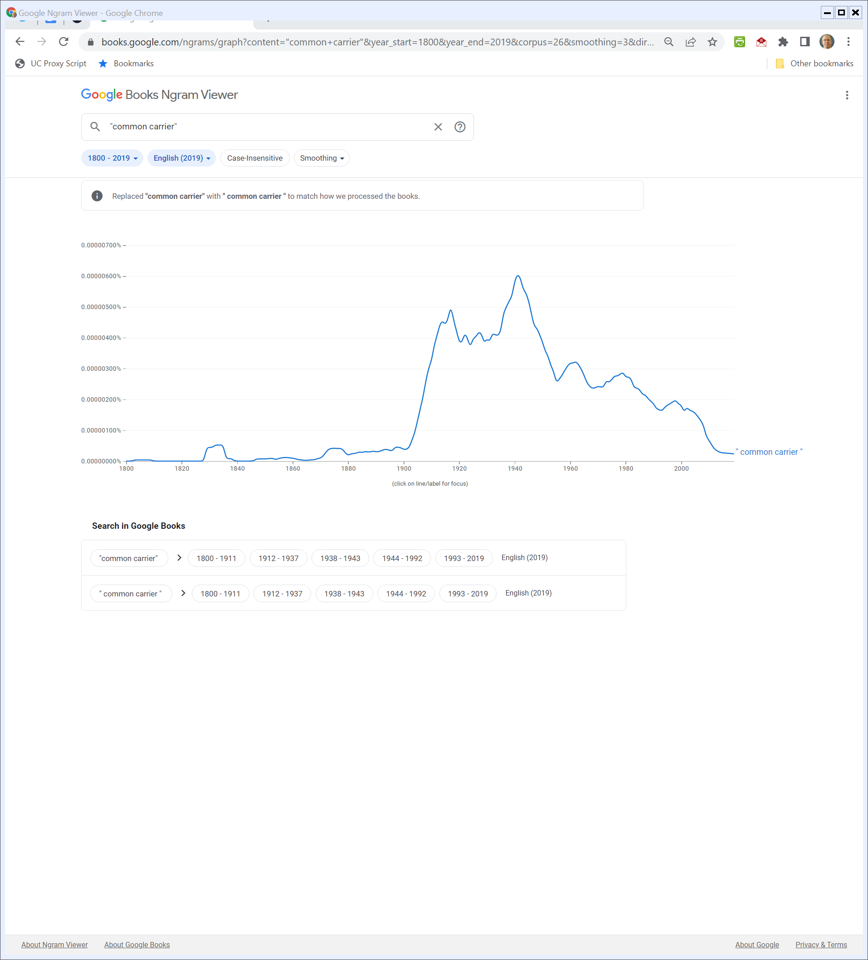
“Common Carrier”
Google Ngram (23 Mar 2023)

Slide 5
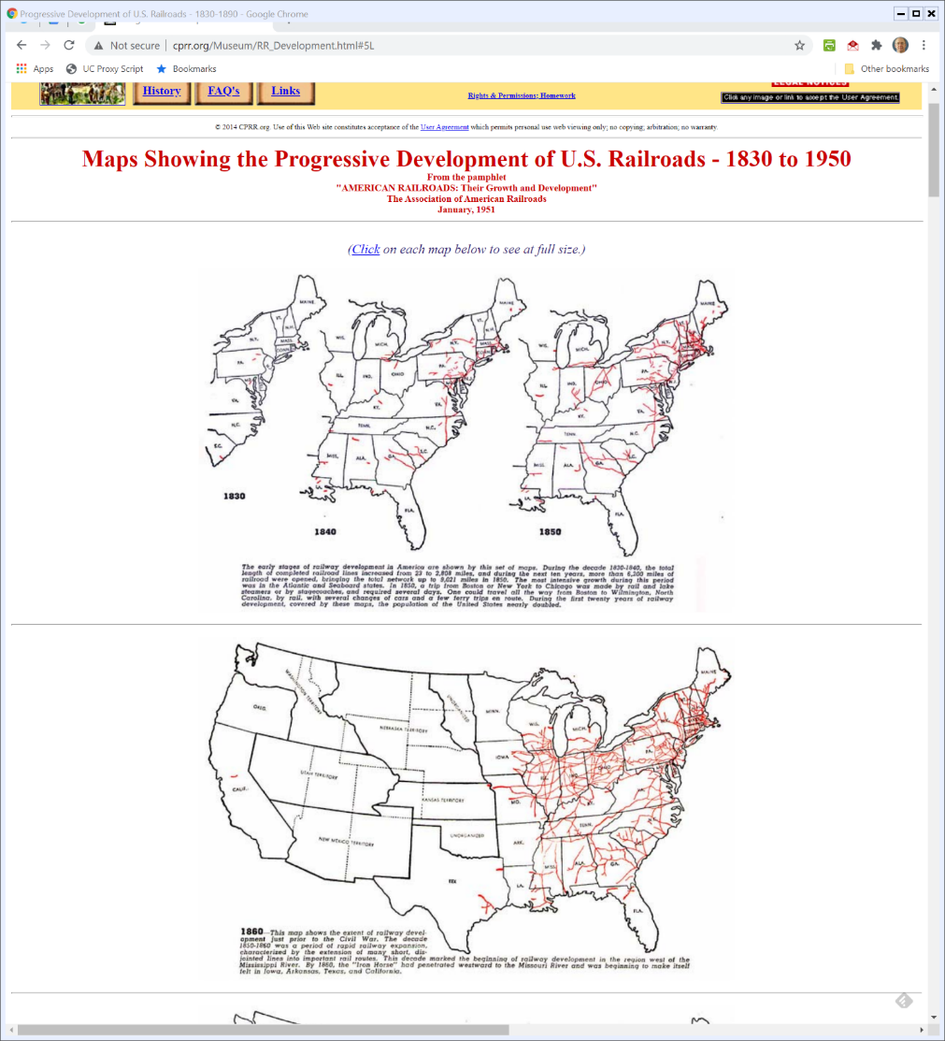
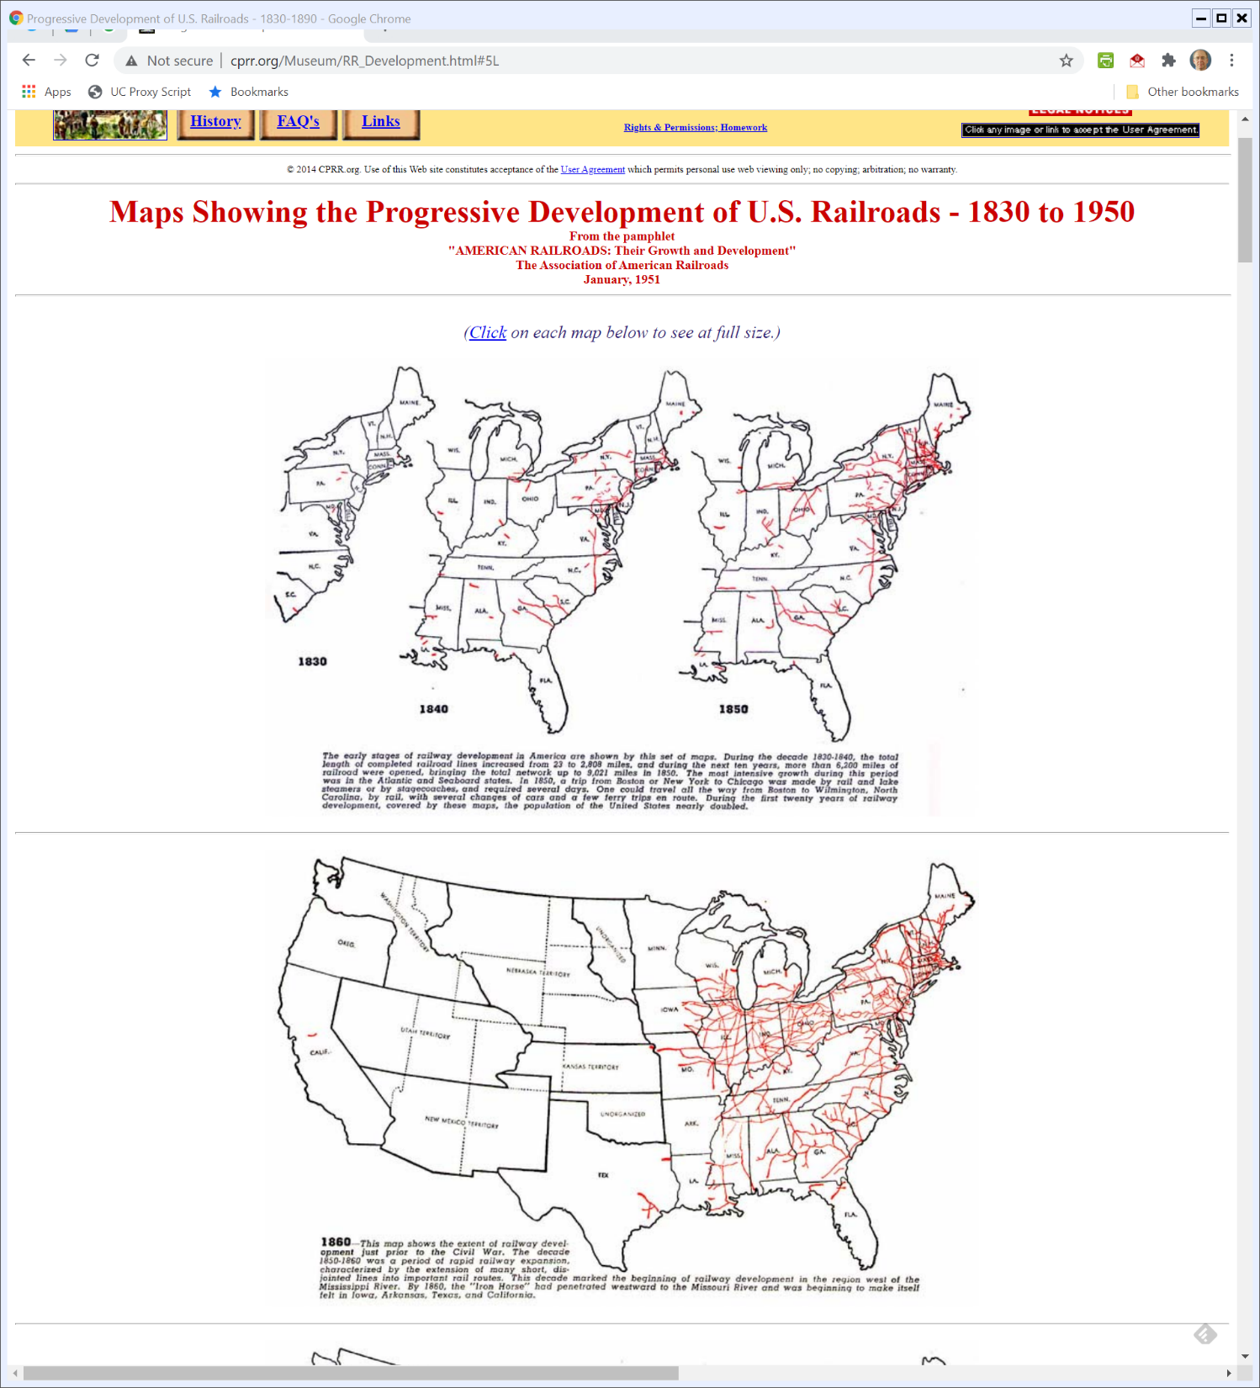
1830-1850: U.S. Railroads
Central Pacific RR Museum
Notes:
http://cprr.org/Museum/RR_Development.html#5L

Slide 6
1860: U.S. Railroads
Central Pacific RR Museum
Notes:
http://cprr.org/Museum/RR_Development.html#5L

Slide 7
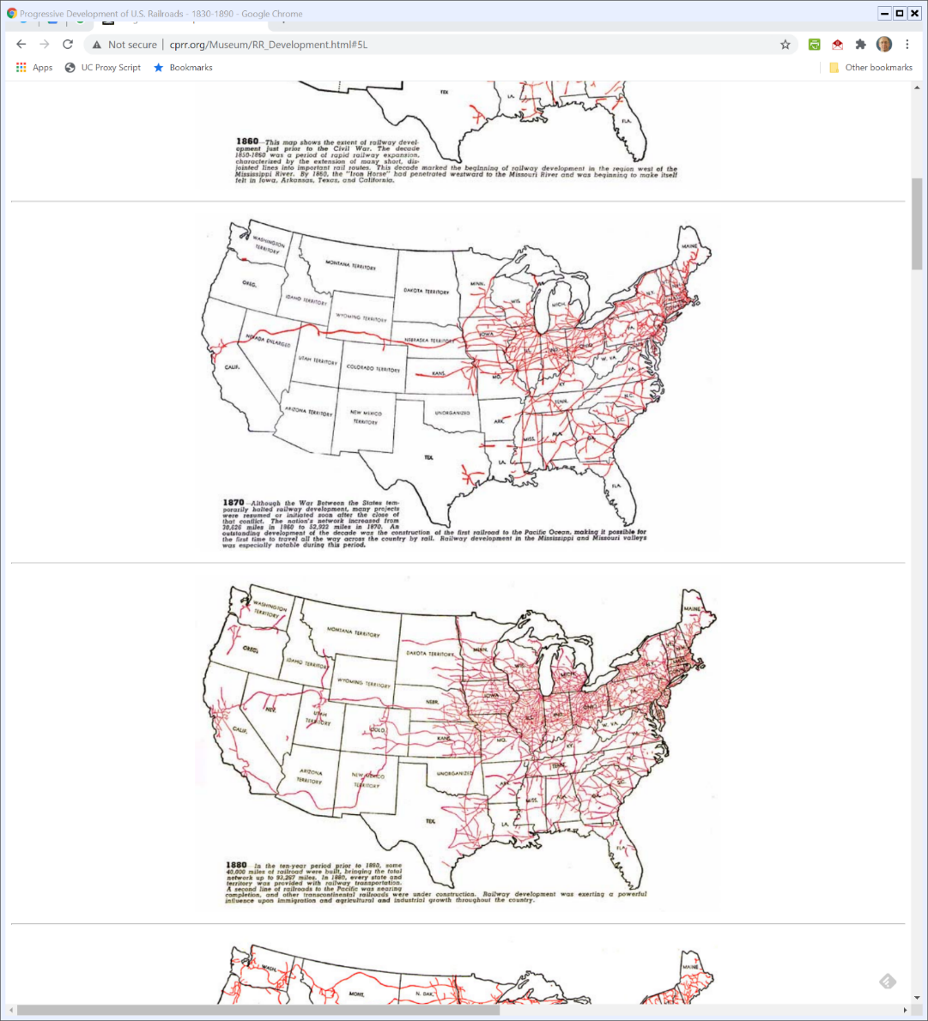

1870: The West Opens
Central Pacific RR Museum
Notes:
http://cprr.org/Museum/RR_Development.html#5L

Slide 8

1880: U.S. Railroads
Central Pacific RR Museum
Notes:
http://cprr.org/Museum/RR_Development.html#5L

Slide 9
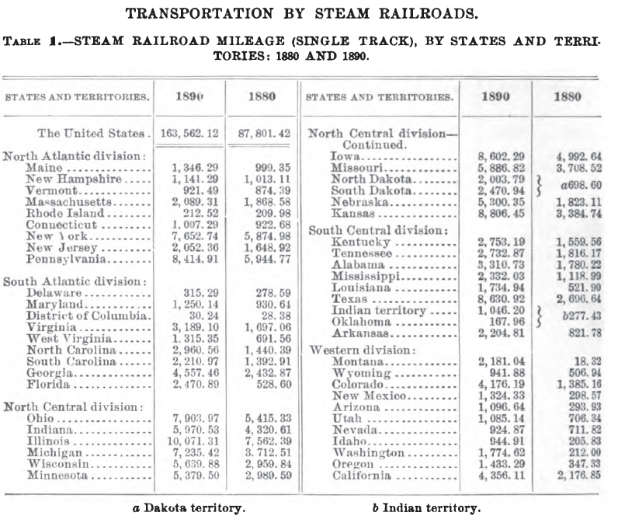
Railroad Mileage
11th U.S. Census (1890)

Slide 10
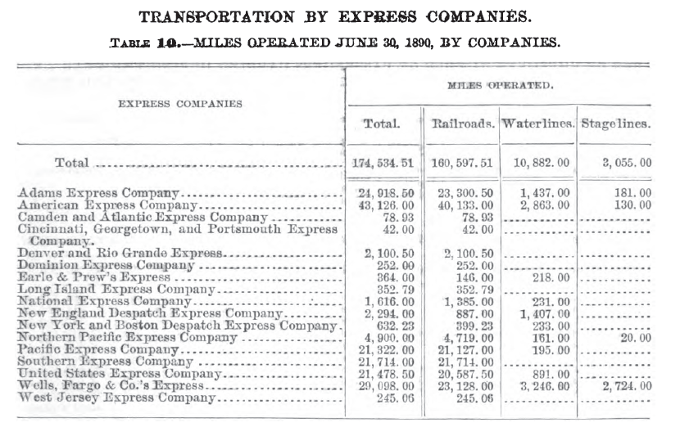
Express Companies: Miles Operated
11th U.S. Census (1890)

Slide 11
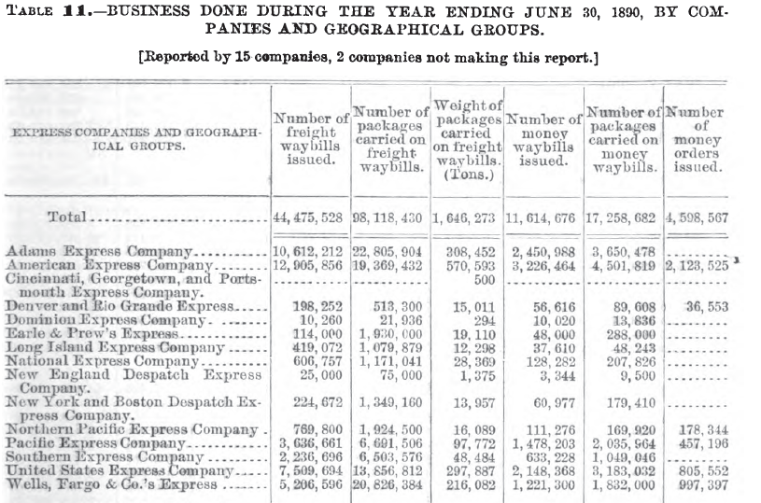
Volume of Deliveries
11th U.S. Census (1890)

Slide 12
Historical Background
Creation of Express Service
Started in 1839
Provide a superior class of service for items of sufficient value to justify a higher level of care
Express company would contract with a railroad to attach a car or to arrange for space in a car

Slide 13
Historical Background
Express company would take full responsibility
Service offered on a daily basis
Interconnected Network Created
Key companies—the Adams, the American, the United States and the Southern—divide market between them and arrange connection handoffs.

Slide 14
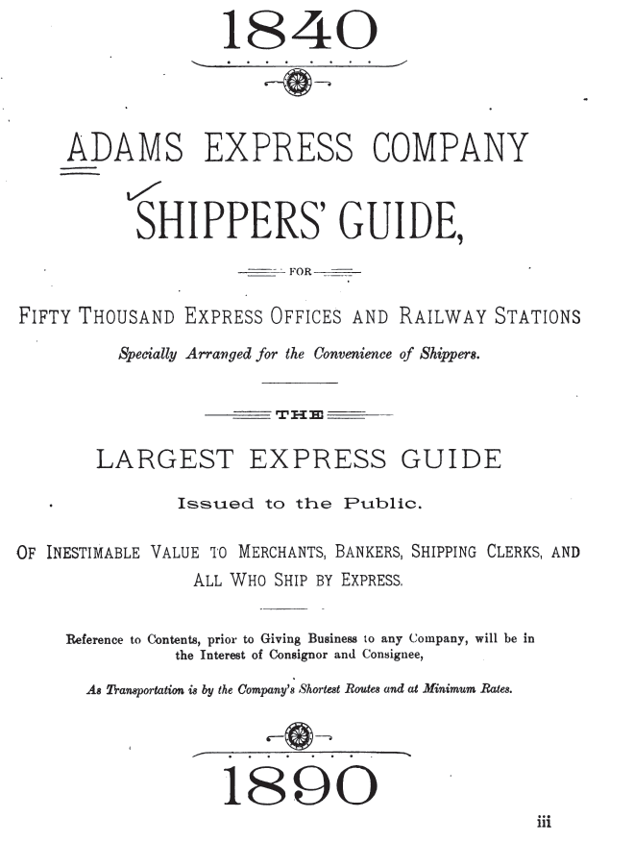
“Overnight” Shipping in 1840
Adams Express Co. Shippers’ Guide (1890)

Slide 15
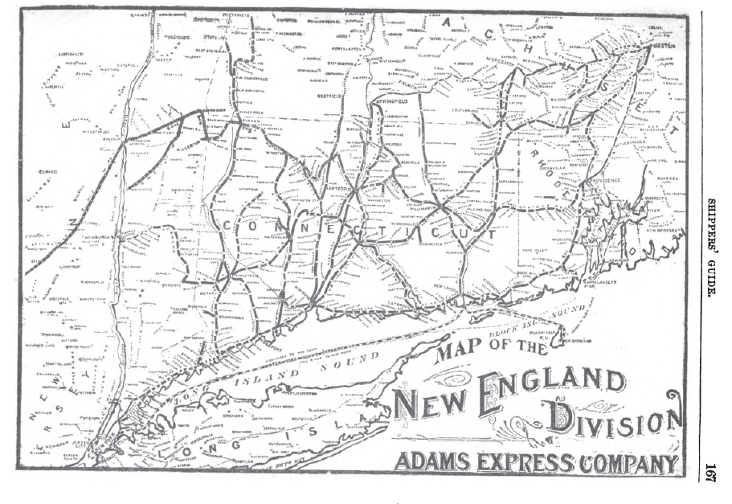
New England Division Map
Adams Express Co. Shippers’ Guide (1890)

Slide 16
1881 Express Business History
Stimson, History of the Express Business (1881)

Slide 17
Harnden
Stimson, History of the Express Business (1881)

Slide 18
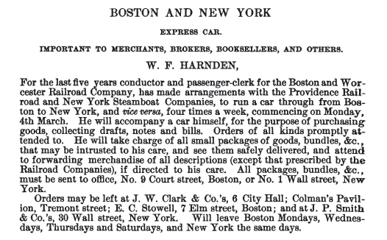
23 Feb 1839: Boston Newspaper Ad
Stimson, History of the Express Business (1881)

Slide 19
Contractual Arrangements with Railroads
William Harnden and the Boston & New York Transportation Company
Assigned 150 cubic feet on daily basis to Harnden for a payment of $250 per month
Terminable upon the giving of one month’s notice

Slide 20
The Express Cases
117 US 1 (1886)

Slide 21
23 Nov 1871 Contract
The Express Cases (US 1886)

Slide 22
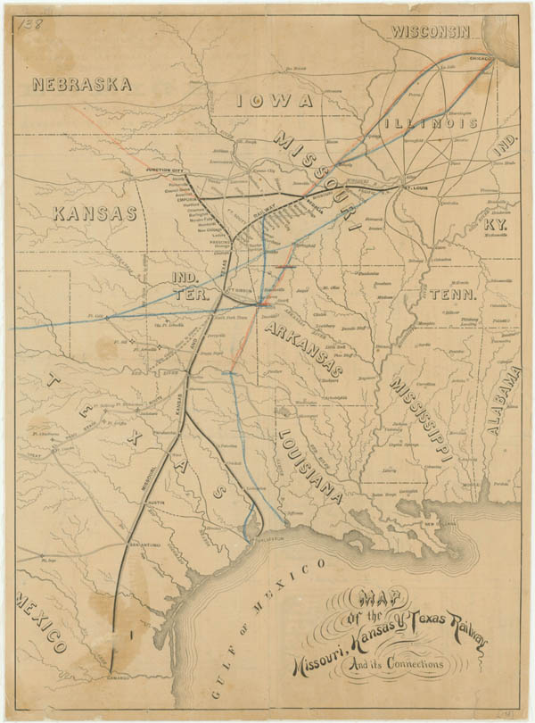
1875: The Katy Railroad
Source: Texas State Library

Slide 23
Sec. 1: Structure of Express Service
The Express Cases (US 1886)

Slide 24
Sec. 1: Structure of Express Service
The Express Cases (US 1886)

Slide 25
Sec. 3: Fee Paid by Express Co.
The Express Cases (US 1886)

Slide 26
Sec. 4: RR Use of Express Service
The Express Cases (US 1886)

Slide 27
Sec. 5: Market Separation between Express and Freight; MFN
The Express Cases (US 1886)

Slide 28
Sec. 6: Future Expansions
The Express Cases (US 1886)

Slide 29
Sec. 7: Duration and Termination
The Express Cases (1886)

Slide 30
Decrees Entered Below
The Express Cases (US 1886)

Slide 31
No Self-Preferencing
The Express Cases (US 1886)

Slide 32
Can the RRs Exclude Particular Firms?
The Express Cases (US 1886)

Slide 33
Past Practice on Multiple Express Carriers
The Express Cases (US 1886)

Slide 34
Fighting Over Common Carrier Status
TTYN (1 of 2)
Hypo
It is 1885 and you are a lawyer for an express company/a railroad
Questions
What do the arguments look like regarding whether the railroads have common carrier status as to the express companies?

Slide 35
Fighting Over Common Carrier Status
TTYN (2 of 2)
What do the express companies/railroads want here?
What is your prediction as to what would happen should the express companies/railroads win the cases?

Slide 36
Conflict with Railroads
After nine years, railroads announce intention to terminate the contract and enter the express business.
Express company filed suit and received preliminary injunction continuing access right.
Duty to carry at “just and reasonable rate of compensation”

Slide 37
Sources of Interconnection Obligations
Constitutions
Statutes
Common law status
Contract

Slide 38
Missouri Constitution: Public Highways; Common Carriers
“In Missouri, by the Constitution, railways are ‘declared public highways, and railroad companies common carriers.’ The general assembly is also required ‘to pass laws to correct abuses and prevent unjust discrimination and extortion in rates of freight and passenger tariffs on the different railroads in this State,’ and ‘to pass laws establishing reasonable maximum rates of charges for the transportation of passengers and freight on said railroads, and enforce all such laws by adequate penalties.’ Art. XII., sec. 14.”
The Express Cases (1886)

Slide 39
Missouri Constitution: No Discrimination or Preference
“And by section 23 it is provided that ‘no discrimination in charges or facilities in transportation shall be made between transportation companies and individuals, or in favor of either, by abatement, drawback, or otherwise, and no railroad company, or any lessee, manager, or employe thereof shall make any preference in furnishing cars or motive power.’.”
The Express Cases (1886)

Slide 40
Kansas Statute: Need to Ensure Express Service Is Accomodated
“Every railway corporation in this state which now is, or may hereafter be, engaged in the transportation of persons or property, shall give public notice of the regular time of starting and running its cars, and shall furnish sufficient accommodations for the transportation of all such passengers, baggage, mails, and express freight as shall”
The Express Cases (1886)

Slide 41
Kansas Statute
“within a reasonable time previous thereto, be offered for transportation at the place of starting, at the junction of other roads, and at the several stopping places; and they are hereby required to stop all trains carrying passengers at the junction or intersection of other railways a sufficient length of time to allow the transfer of”
The Express Cases (1886)

Slide 42
Kansas Statute: Interconnection Obligation
“passengers, personal baggage, mails, and express freight from the trains or railways so connecting or intersecting, or they may mutually arrange for the transportation of such persons and property over both roads without change of cars; and they shall be compelled to receive all passengers and freight from such connecting and intersecting roads whenever the same shall be delivered to them.”
The Express Cases (1886)

Slide 43
Sources of Interconnection Obligations: Contract and Status
Contract
The starting and ending point here
Common law status (“Common Carrier”)
Non-discrimination duties with passengers and freight
Why not with express companies as well?

Slide 44
Express Companies Need to Establish Right to Carriage
“Such being the case, the right of the express companies to a decree depends upon their showing the existence of a usage, having the force of law in the express business, which requires railroad companies to carry all express companies on their passenger trains as express carriers are usually carried.”
The Express Cases (1886)

Slide 45
All Prior Usage Keyed Off of Contracts
“The question is not whether these railroad companies must furnish the general public with reasonable express facilities, but whether they must carry these particular express carriers for the purpose of enabling them to do an express business over the lines. In all these voluminous records there is not a syllable of evidence to show a usage for the carriage of express companies on the passenger trains of railroads unless specially contracted for.”
The Express Cases (1886)

Slide 46
The General Public is Differently Situated
“If the general public were complaining because the railroad companies refused to carry express matter themselves on their passenger trains, or to allow it to be carried by others, different questions would be presented. As it is, we have only to decide whether these particular express companies must be carried notwithstanding the termination of their special contract rights.”
The Express Cases (1886)

Slide 47
1907: State of the Express Business
U.S. Bureau of the Census (1907)

Slide 48
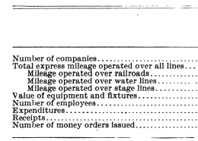
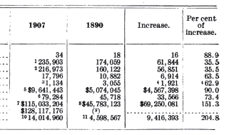
1890 v. 1907
U.S. Bureau of the Census (1907)

Slide 49
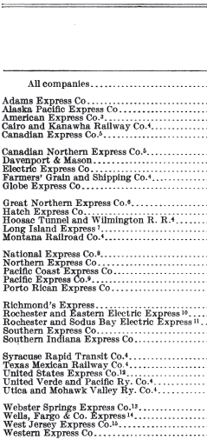
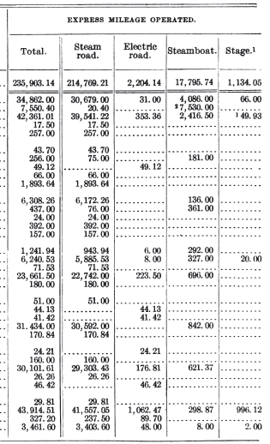
1907 Mileage Figures
U.S. Bureau of the Census (1907)

Slide 50
1912: Post Office Entry into Express Business
New York Times (29 Dec 1912)

Slide 51
100 Year Retrospective on Parcel Post
USPS (20 Dec 2013)

Slide 52
What Parcel Post Did
USPS (20 Dec 2013)

Slide 53
Old-School Amazon
USPS (20 Dec 2013)

Slide 54
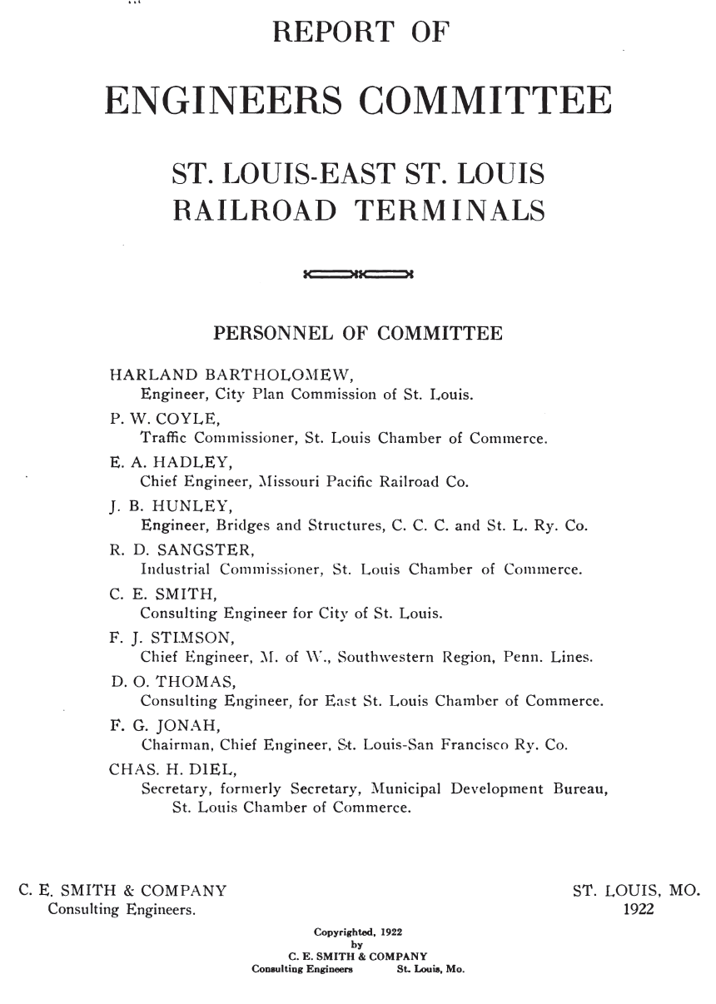
St. Louis Terminals Report
St. Louis Chamber of Commerce (1922)

Slide 55
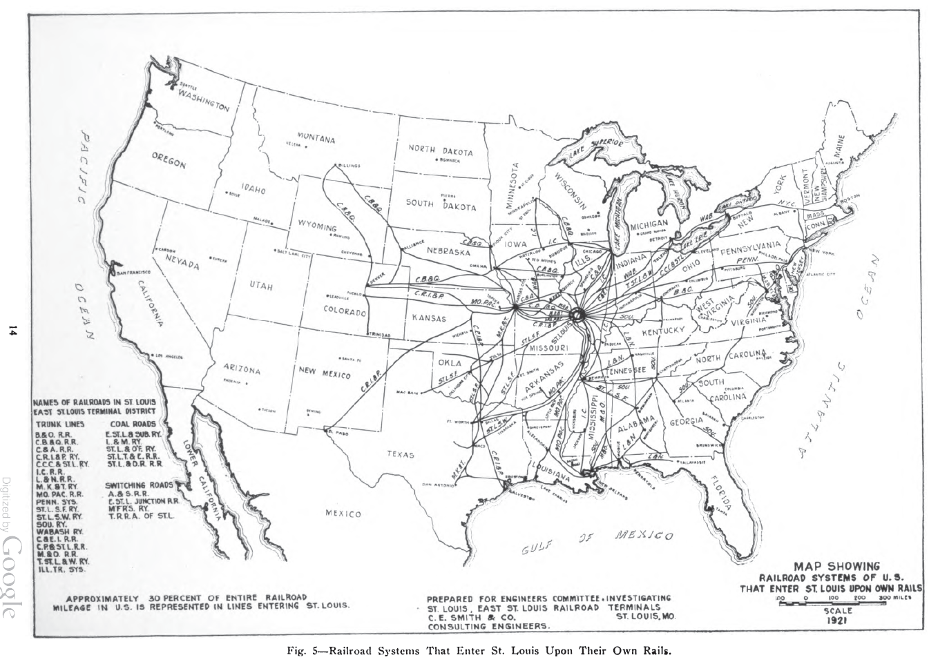
RR Entry into St. Louis
St. Louis Chamber of Commerce (1922)

Slide 56
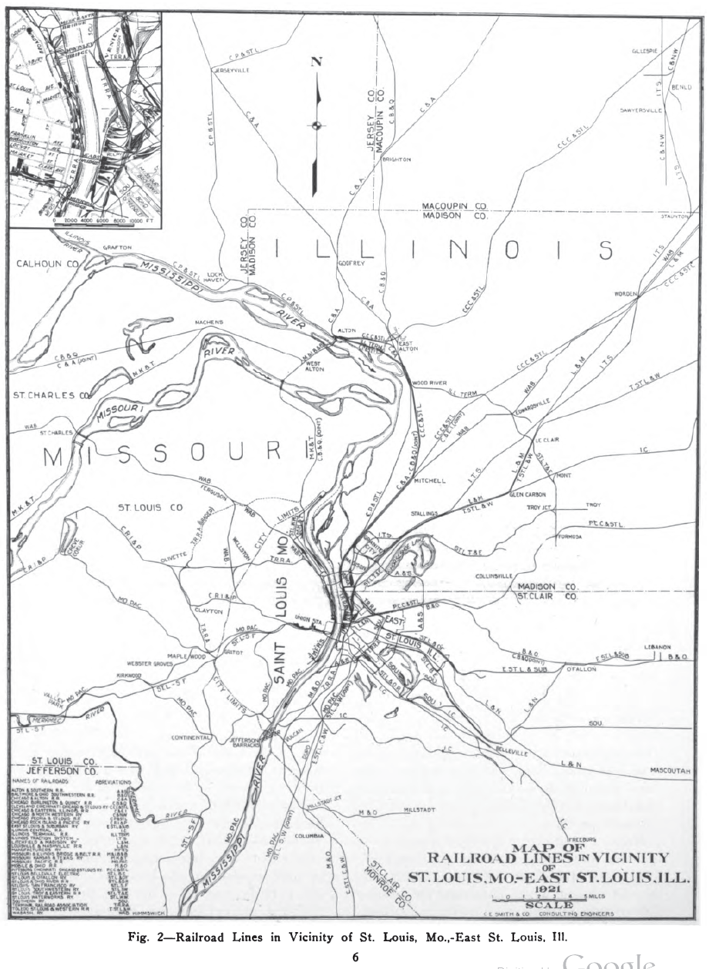
Just St. Louis
St. Louis Chamber of Commerce (1922)

Slide 57
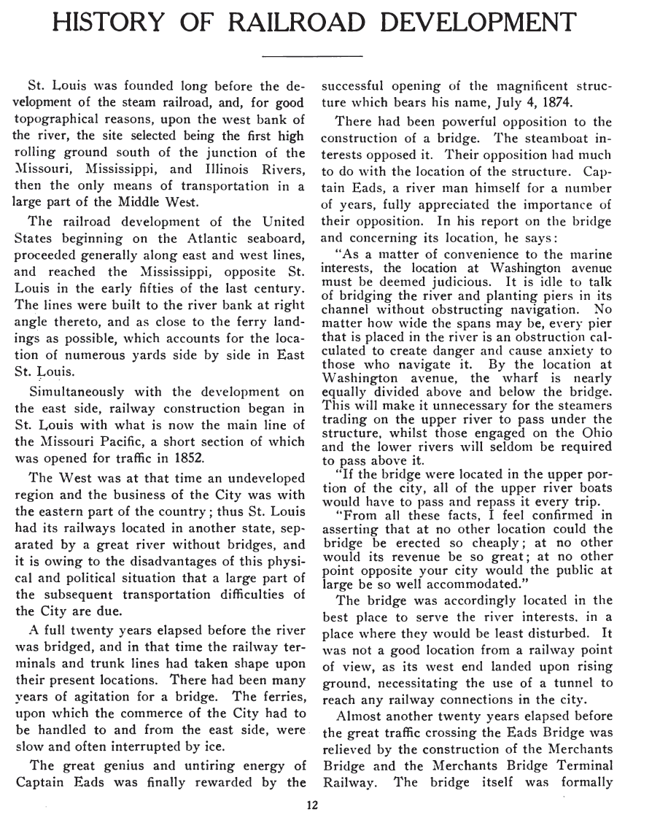
Without the West, No Need to Cross The River
St. Louis Chamber of Commerce (1922)

Slide 58
Building Bridges and Use of River
St. Louis Chamber of Commerce (1922)

Slide 59
Building Bridges and Use of River
St. Louis Chamber of Commerce (1922)

Slide 60
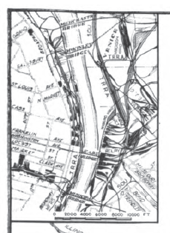
And Then the Close Up
St. Louis Chamber of Commerce (1922)

Slide 61
Theory of Terminal RR Ass’n: Cooperation Not Competition
St. Louis Chamber of Commerce (1922)

Slide 62
That Said
St. Louis Chamber of Commerce (1922)

Slide 63
Terminal Railroad
224 US 383 (1912)

Slide 64
What is the Best Way to Organize Terminals?
Terminal Railroad (US 1912)

Slide 65
Joint Agency and No Discrimination
Terminal Railroad (US 1912)

Slide 66
Facility Isn’t Jointly Owned
“That the instrumentalities so combined are not jointly owned or managed by all of the companies compelled to use them is a significant fact which must be taken into account for the purpose of determining whether there has been a violation of the anti-trust act.”
Terminal Railroad (US 1912)

Slide 67
Facility Isn’t Jointly Owned
“The control and ownership is that of the fourteen roads which are defendants. The railroad systems and the coal roads converging at St. Louis, which are not associated with the proprietary companies, are under compulsion to use the terminal system, and yet have no voice in its control.”
Terminal Railroad (US 1912)

Slide 68
Running the Association
TTYN (1 of 2)
Hypo
You are one of the 14 railroads already in the association and there are ten railroads outside the association
Questions
Would you have different rules (rates being charged, other things) for members/nonmembers?

Slide 69
Running the Association
TTYN (2 of 2)
Questions
How would you approach adding new members to the association (and do recall that the membership had grown from 6 to 14)?
How do you think the operation of the ass’n would change if the ten outsiders were given the chance to join the ass’n?

Slide 70
Operation of the Bridges: Rates and Access
Non-Profit
Rates were set so to just cover fixed charges, operating and maintenance expenses
No dividends were paid to owners
Access
All railroad paid the same rates and had the same right of access

Slide 71
Operation of the Bridges: Rates and Access
Questions
What are the benefits of non-profit organization?
Costs?
Isn’t non-discriminatory access enough?

Slide 72
Operation of the Bridges: Control and Decision-Making
Membership
Start with six railroads as co-venturers
Expanded to 14 through additional admits
Pre-existing members had veto power over new members

Slide 73
Operation of the Bridges: Control and Decision-Making
Internal Decisions
Not told how decisions were made internally within the group
Majority voting?
Questions
Again, why isn’t this sufficient?

Slide 74
Devices for Managing Market Power
Competition
In most settings, we control market power by ensuring that there is competition
Could we do that here? With what consequences?

Slide 75
Devices for Managing Market Power
Structural Approaches
Should we think of non-profit status as a commitment device to not use market power?
Does joint ownership and equal access suffice?
Gov’t Regulation
Rate setting in all of its forms

