Slide 1
Class 1
Platforms and Networks
Spring 2022
The Post Office
Randal C. Picker
James Parker Hall Distinguished Service Professor of Law
The Law School
The University of Chicago
Copyright © 2014-22 Randal C. Picker. All Rights Reserved.

Slide 2
The Focus Today
Key Questions/Issues
  1. What role did the U.S. post office play in the formation of the country? What did that mean for the design of the postal network?
  2. What should limit the extent of federal ownership and operations of businesses?

Slide 3
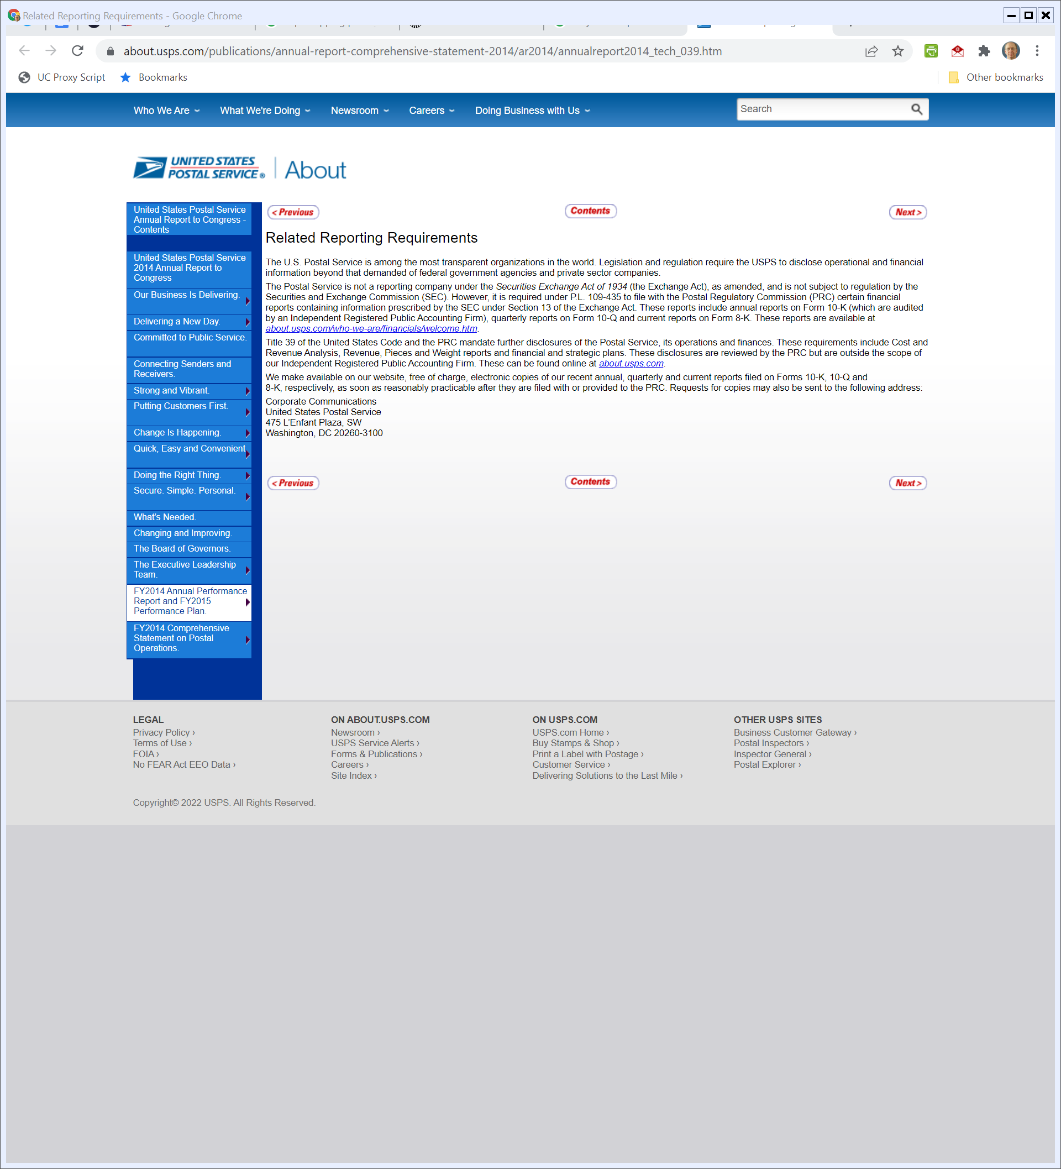
Getting USPS Info
USPS (Visited 20 Mar 2022)
Notes:
https://about.usps.com/publications/annual-report-comprehensive-statement-2014/ar2014/annualreport2014_tech_039.htm

Slide 4
The Business of the USPS
USPS Form 10-K (30 Sept 2021)

Slide 5
Universal Service; PRC; Types of Products
USPS Form 10-K (30 Sept 2021)

Slide 6
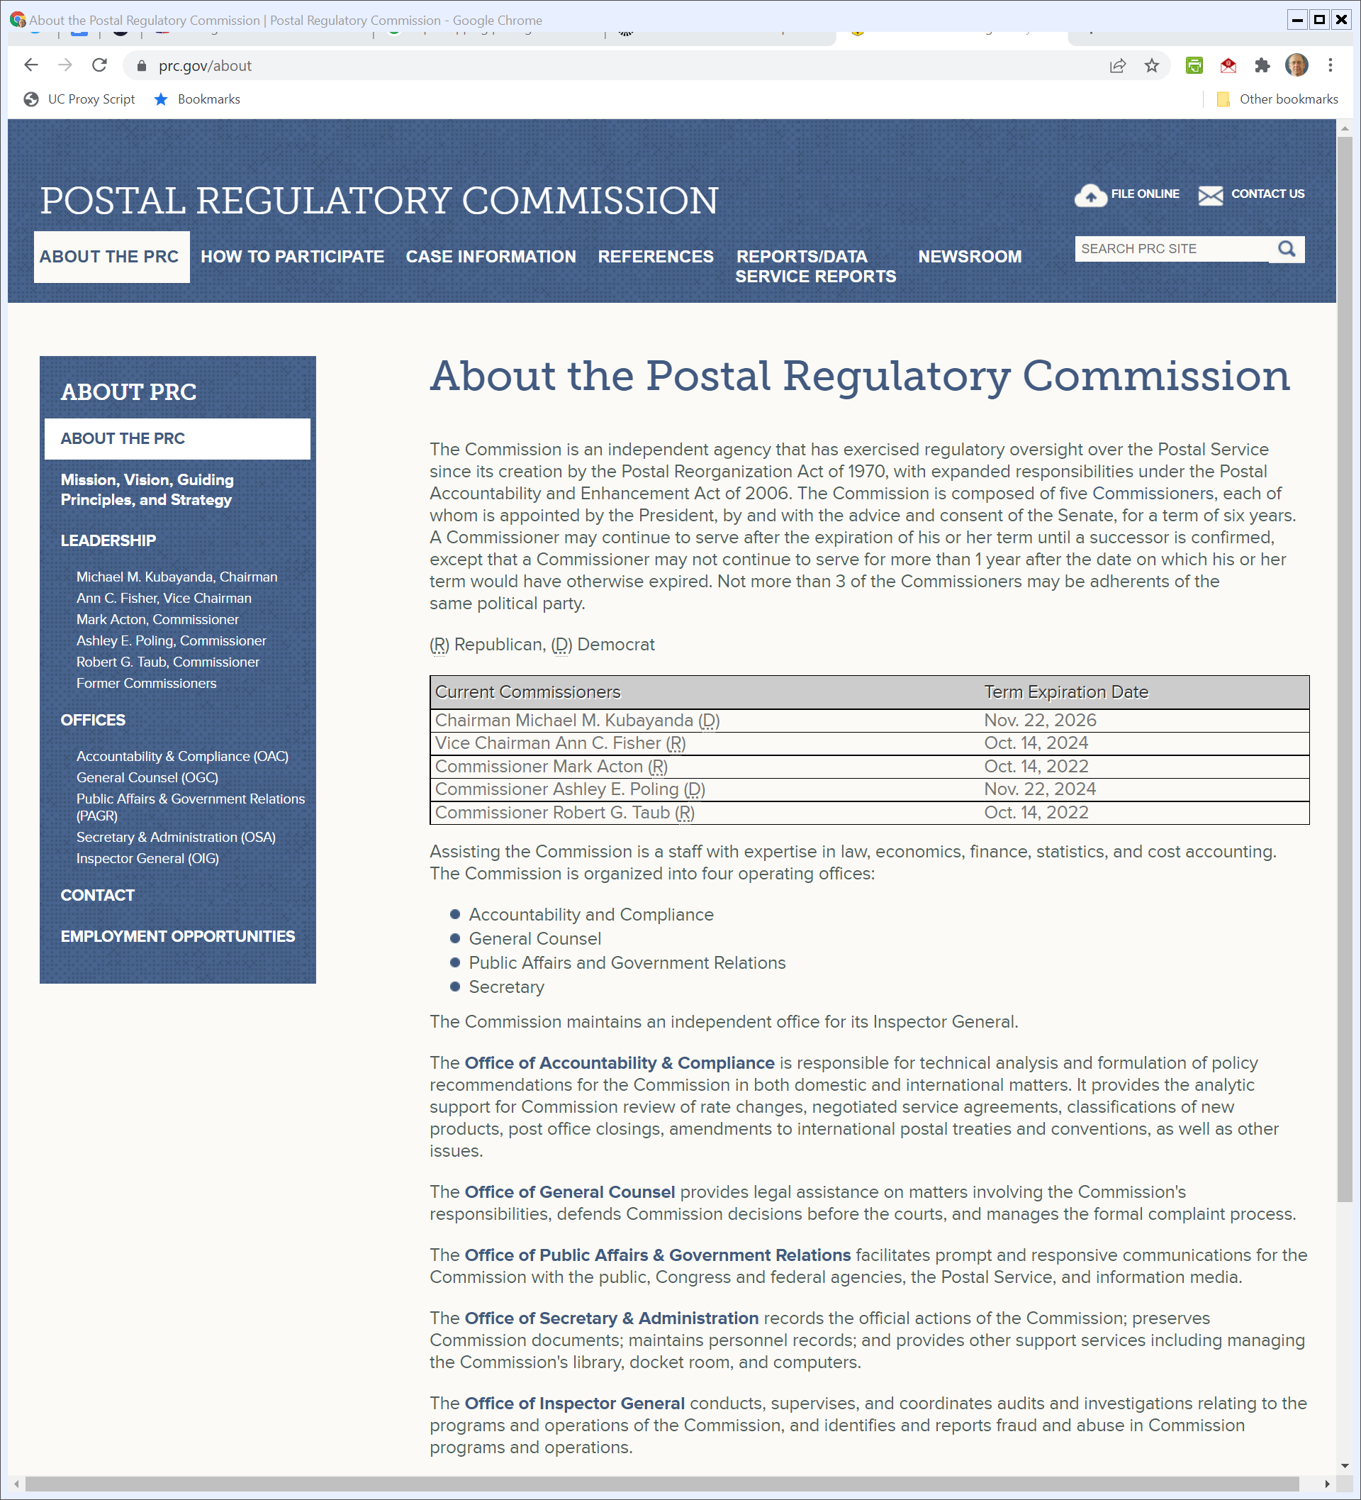
Postal Regulatory Commission
PRC.gov (Visited 20 Mar 2022)
Notes:
https://www.prc.gov/about

Slide 7
Key USPS Stats 2012-21
2022 USPS Postal Facts Companion

Slide 8
Key USPS Stats 2012-21
2022 USPS Postal Facts Companion

Slide 9
U.S. First-Class Mail Volume
Historian USPS (Feb 2021)
Notes:
Source: http://about.usps.com/who-we-are/postal-history/first-class-mail-since-1926.pdf

Slide 10
Market Dominant Services
USPS Form 10-K (30 Sept 2021)

Slide 11
Market Dominant Services
USPS Form 10-K (30 Sept 2021)

Slide 12
Cross-Subsidization and Competitive Services
USPS Form 10-K (30 Sept 2021)

Slide 13
Who Does USPS Compete With?
USPS Form 10-K (30 Sept 2021)

Slide 14
Financial Results
USPS Form 10-K (30 Sept 2021)

Slide 15
Recasting That
USPS Form 10-K (30 Sept 2021)

Slide 16
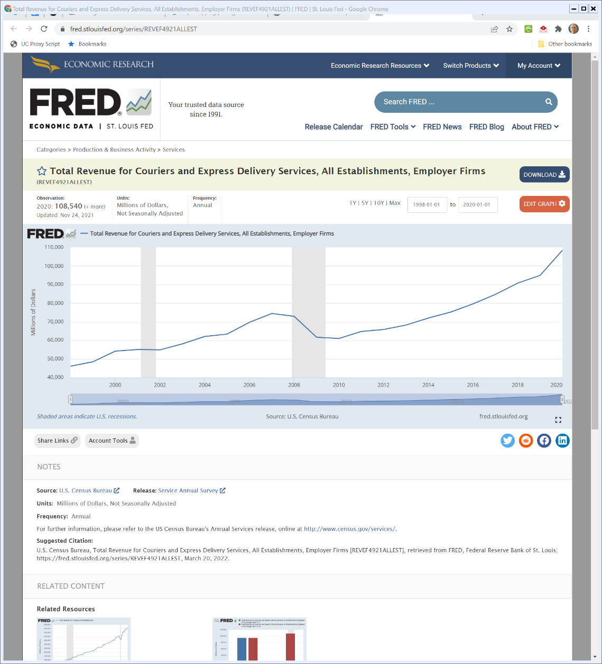
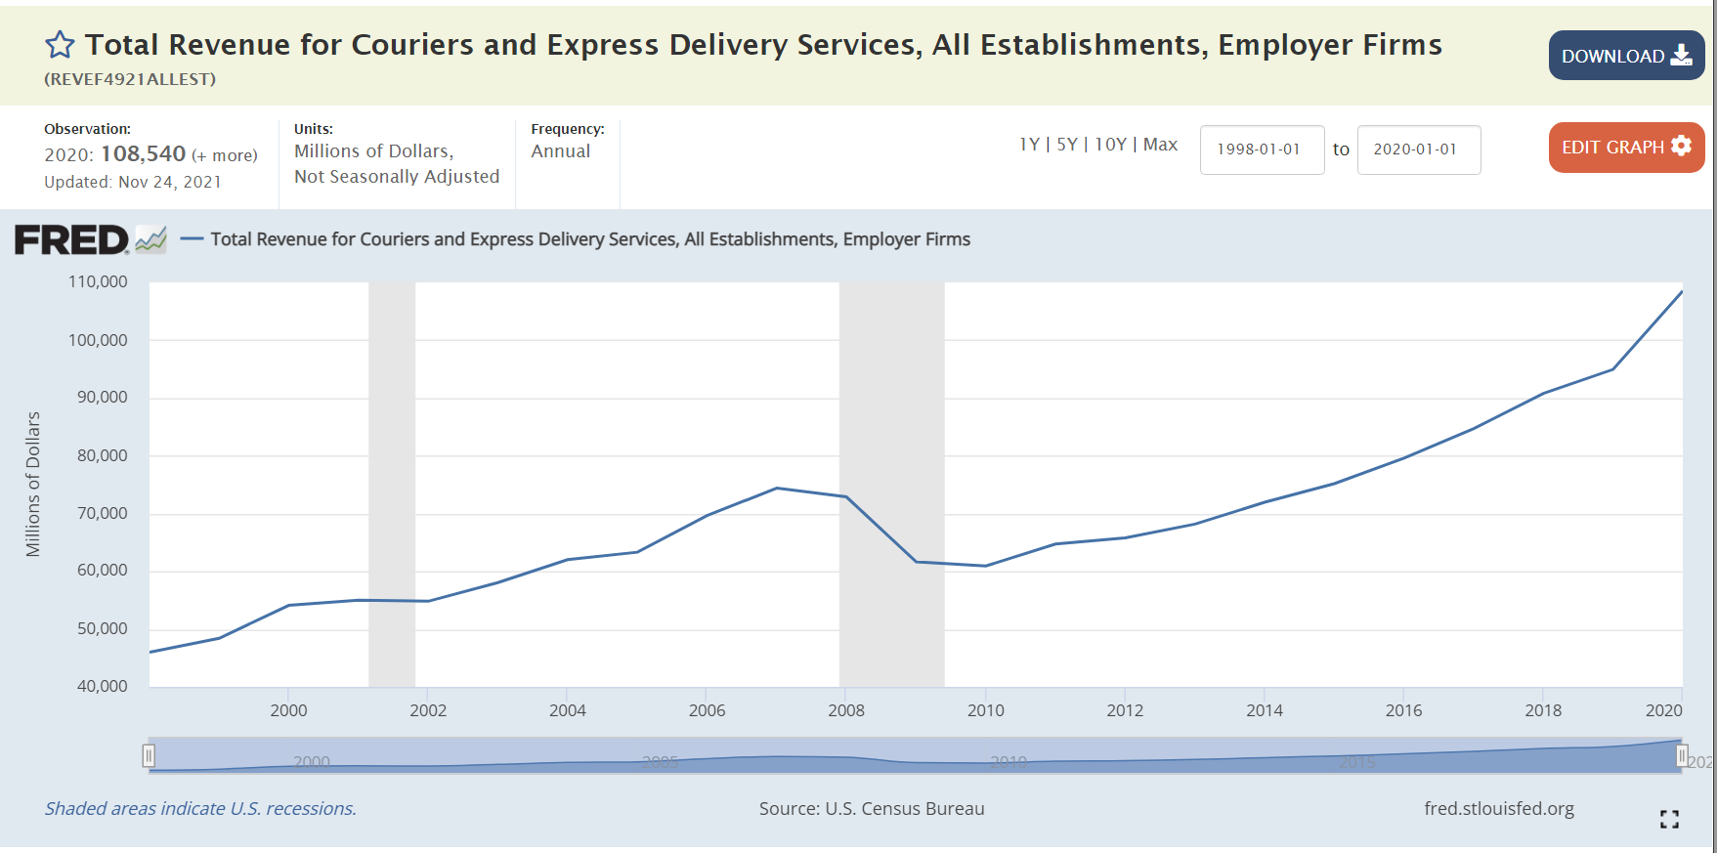
Courier and Express Delivery Revenues
FRED (Visited 20 Mar 2022)
Notes:
https://fred.stlouisfed.org/series/REVEF4921ALLEST

Slide 17
Communications Economics
TTYN
Hypo
  A wants to send B a message
  A values having B receive the message at $2; B values receiving the message at an additional $2
  Social cost to transmit message is $3
Who should pay? A? B? Both?

Slide 18
Key Point
Communications Externalities
  Both A and B may benefit from the message
  If A or B bears the full cost of the message, may have too few messages sent

Slide 19
Key Point
Simple Example
  If we charge sender or recipient full-cost of message, if they can’t compensate each other, message won’t be sent even though doing so increases welfare

Slide 20
Moving this to the Real World
Counting Costs
  How much more expensive is it to charge both senders and receivers as compared to just charging one or the other?

Slide 21
U.S. Constitution
TTYN (1 of 4)
Art. I, Sec 8:
  The Congress shall have Power … To establish Post Offices and post Roads
How would you implement this given the broad goals of U.S. postal policy?

Slide 22
1789: First Postal Act (TTYN (2 of 4))
Post Office Act of 1789 (22 Sept 1789)

Slide 23
Constructing the U.S. Postal System
TTYN (3 of 4)
Your Situation
  I want you to construct the post office
  Would you have the gov’t do this? Exclusively, meaning would you allow firms to compete with the gov’t if the gov’t is a provider?
  Where would you put post offices? Urban areas? Rural areas? What would be the principle that you would use for that?

Slide 24
Constructing the U.S. Postal System
TTYN (4 of 4)
Your Situation
  Would you let other firms share home mail boxes/slots?
  How would you do pricing? What role would distance play? Weight? Type of content (e.g. newspapers v. letters)?
  Would you allow priorities so that some materials could be transported faster than others?

Slide 25
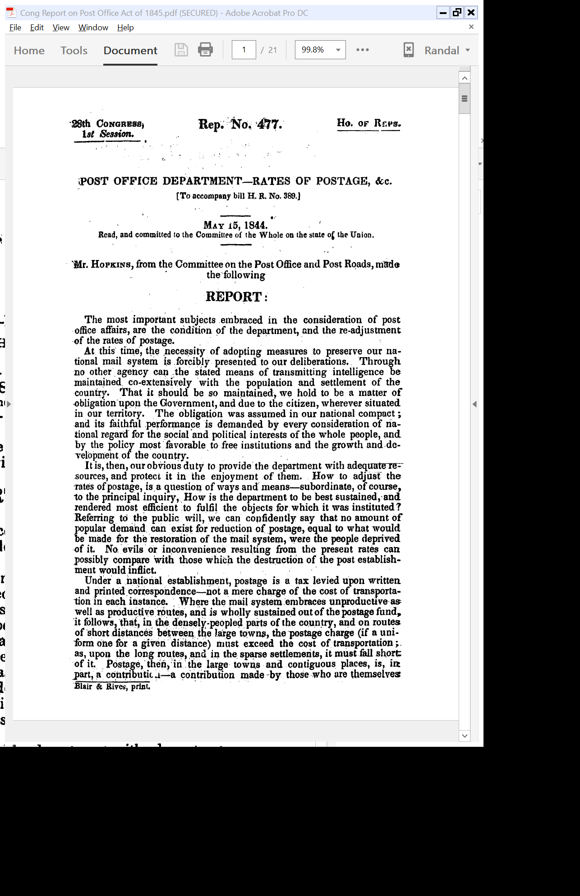
Post Office as Obligation of the Gov’t; Universal Service Obligation
House Report (15 May 1844)

Slide 26
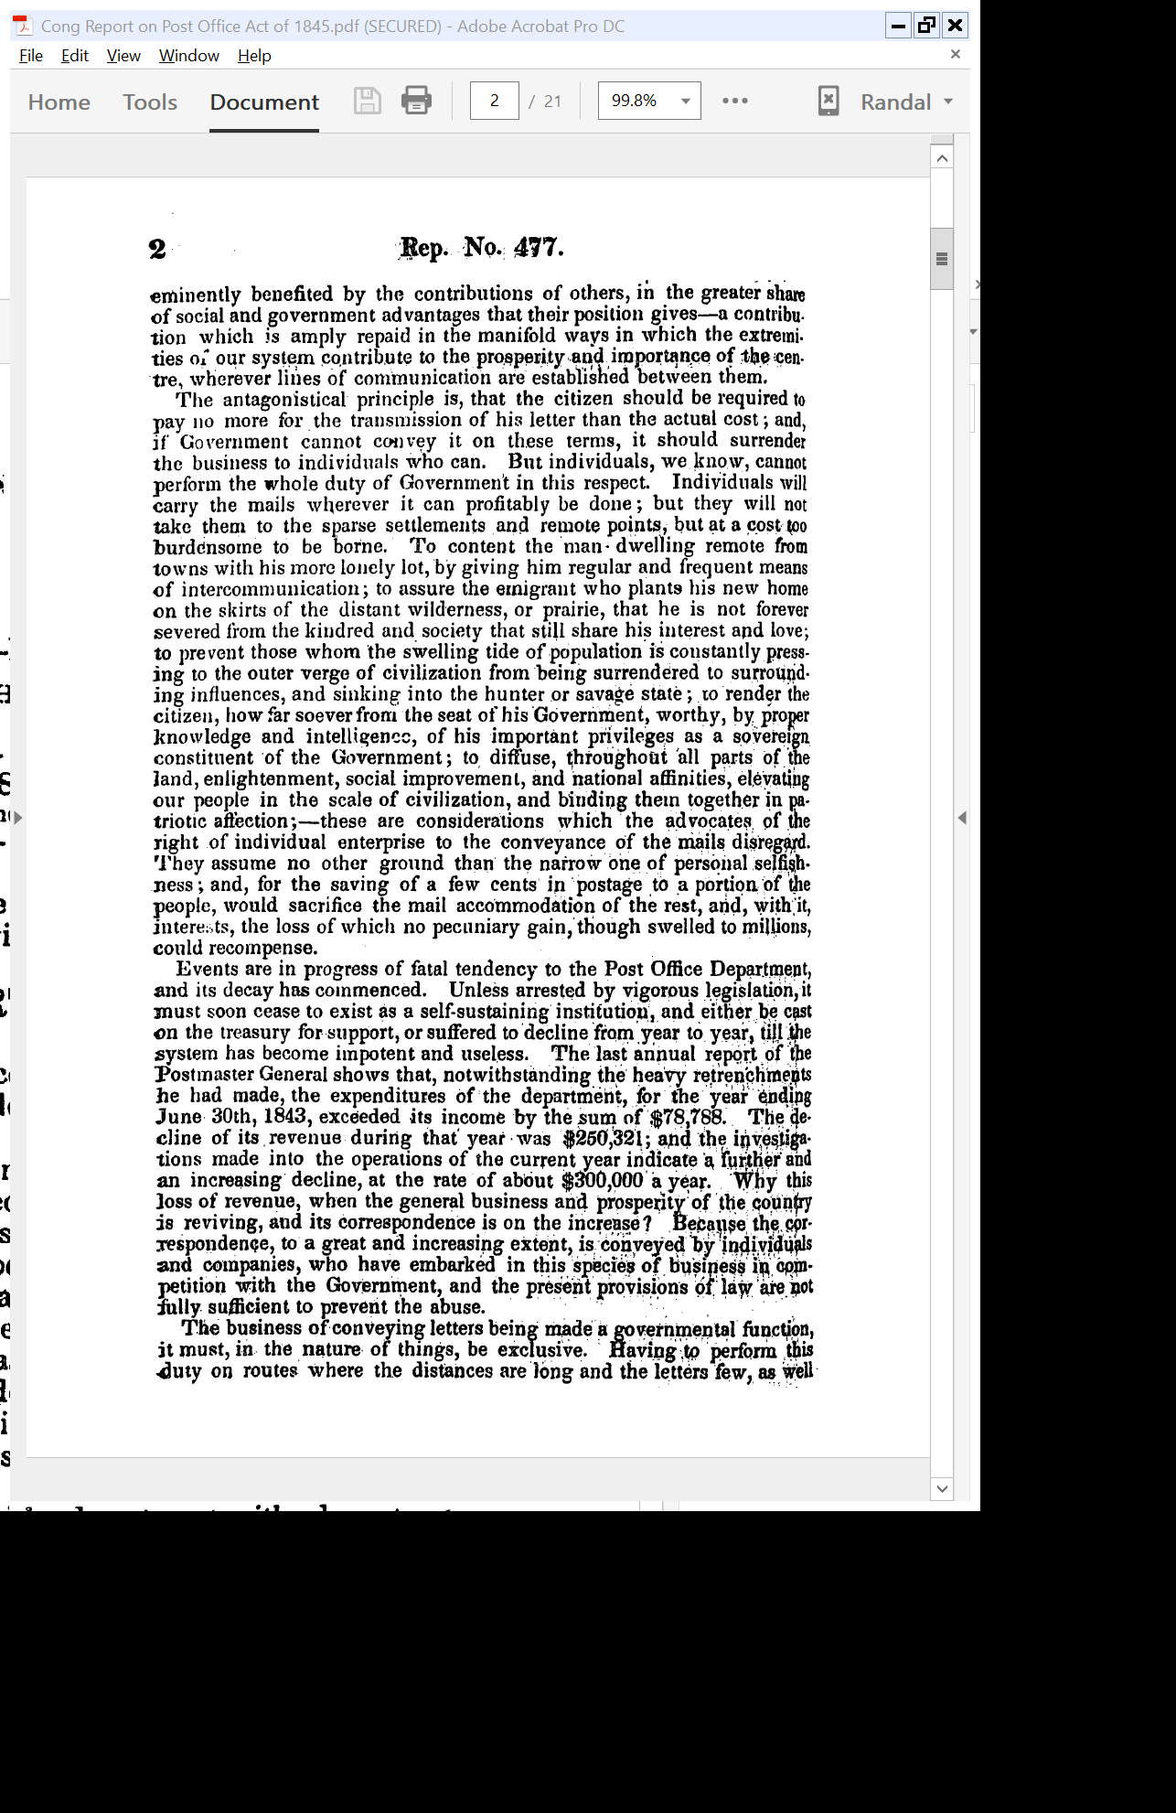
Cross-Subsidization of Rural by Urban
House Report (15 May 1844)

Slide 27
Private Firms Will Seek to Deliver on Profitable Routes
House Report (15 May 1844)

Slide 28
Things Ignored by Private Actors
House Report (15 May 1844)

Slide 29
“Its Decay Has Commenced”
House Report (15 May 1844)

Slide 30
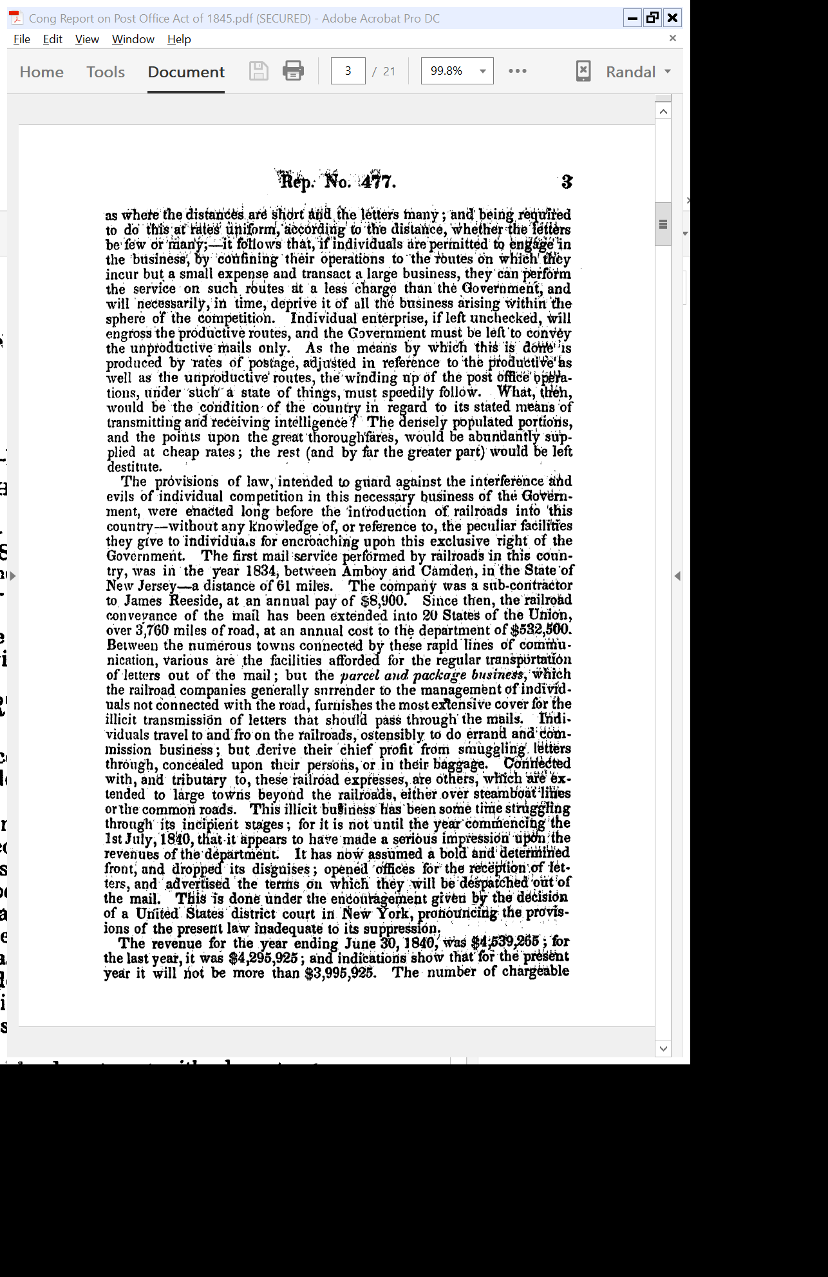
Gov’t Monopoly Required
House Report (15 May 1844)

Slide 31
Role of Railroads in Illegal Mail
House Report (15 May 1844)

Slide 32
Understanding the Pricing and Quality Rules of 1845 Act
Neutral Pricing
  Key to distance and weight
  Not type of content
But
  Newspapers completely free if within size and distance limit

Slide 33
Understanding the Pricing and Quality Rules of 1845 Act
  Magazines have lower rates compared to letters for same weights; rates independent of distance
And Discrimination in Quality of Service
  Sec 4 contemplates different levels of quality of service of newspapers and magazines relative to regular letter service

Slide 34
1912: Post Office Entry into Express Business
New York Times (29 Dec 1912)

Slide 35
1912: Post Office Entry into Express Business
New York Times (29 Dec 1912)

Slide 36
1914 USPS Ann Report
U.S. Postmaster General Annual Report (1914)

Slide 37
Create Gov’t Monop on Telegraph and Telephone
U.S. Postmaster General Annual Report (1914)

Slide 38
Create Gov’t Monop on Telegraph and Telephone
U.S. Postmaster General Annual Report (1914)

Slide 39
Telegraph and Telephone are Natural Monopolies
U.S. Postmaster General Annual Report (1914)

Slide 40
Constitution Favors Gov’t Ownership of Telegraph and Telephone
U.S. Postmaster General Annual Report (1914)

Slide 41
One Post Office to Rule Them All
TTYN
Hypo
  It is 1914 and you are a member of Congress
  The post office has recently entered a new business but believes that it should operate a non-profit telegraph and telephone business, perhaps exclusively
How would you evaluate that?

Slide 42
1970 Postal Act: “A Basic and Fundamental Service”
Pub. L. 91-375 (12 Aug 1970)

Slide 43
Urban/Rural; Employees; Costs
Pub. L. 91-375 (12 Aug 1970)

Slide 44
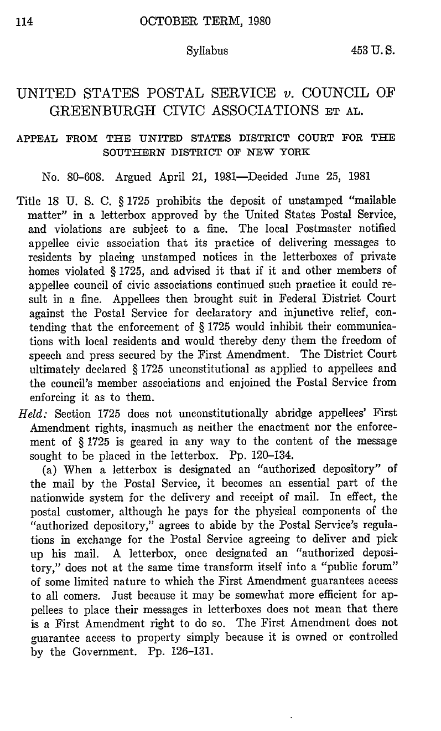
Council of Greenburgh (US 1981)
453 U.S. 114 (1981)

Slide 45
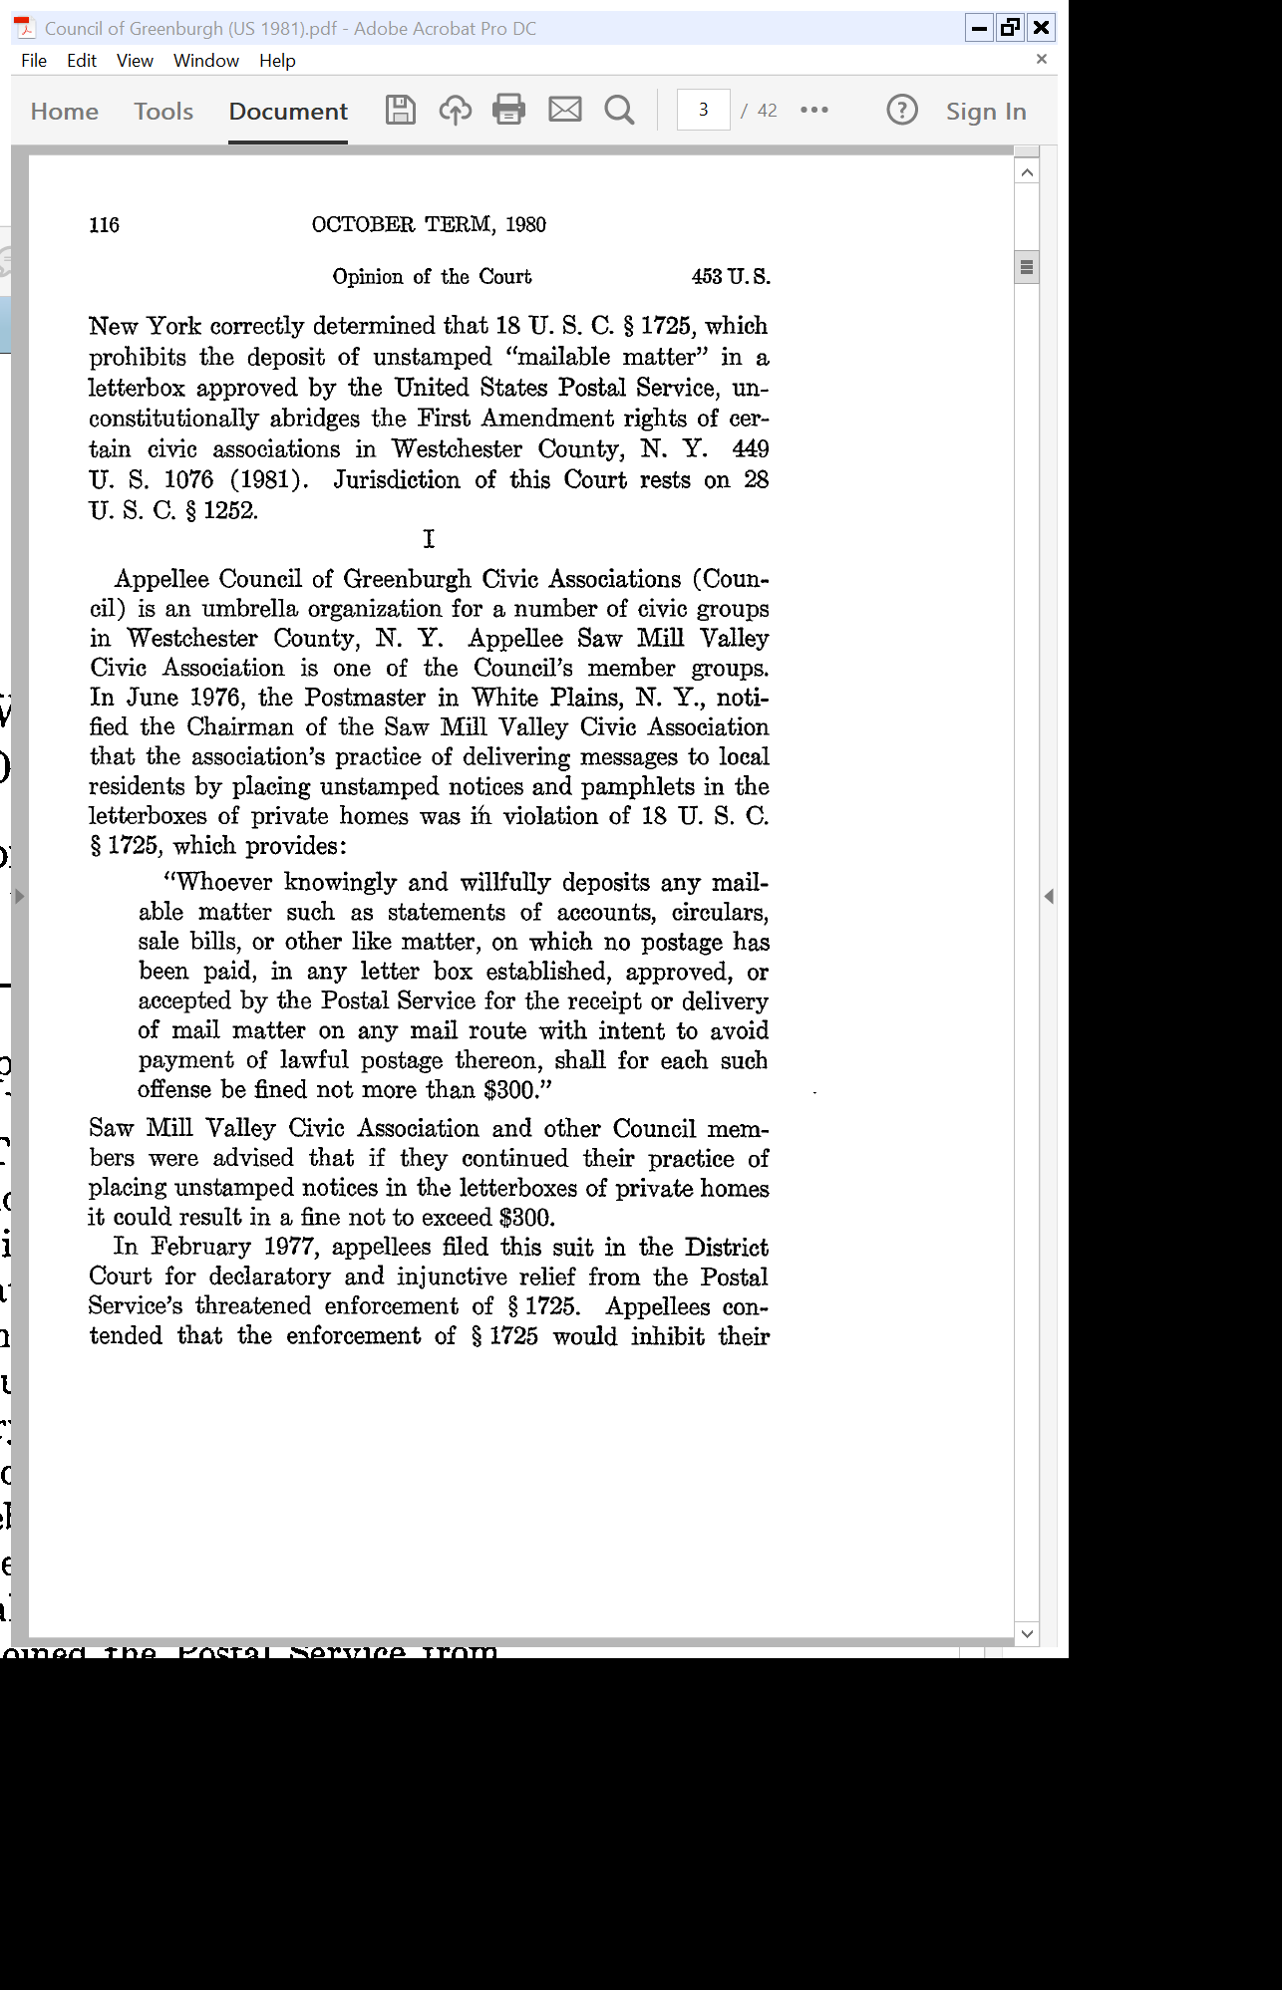
18 USC 1725
Council of Greenburgh (US 1981)

Slide 46
2006 Postal Act
Pub. L. 109-435 (20 Dec 2006)

Slide 47
Policing Cross-Subsidization
S. Rep. 108-318 (25 Aug 2004)

Slide 48
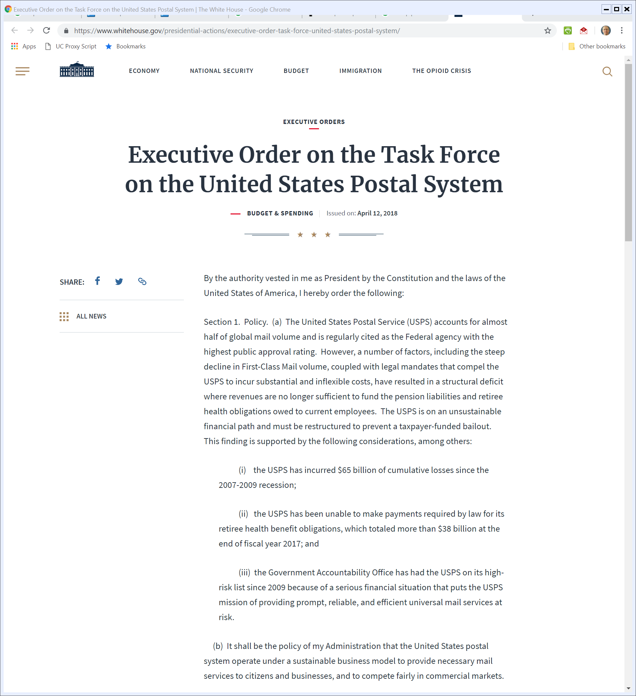
2018: What Next for USPS?
Executive Order (12 Apr 2018)

Slide 49
The Future of the Post Office?
Task Force Report (Dec 2018)

Slide 50
Dos: Sell Mailbox Access
Task Force Report (Dec 2018)

Slide 51
Don’ts: No Banking
Task Force Report (Dec 2018)

Slide 52
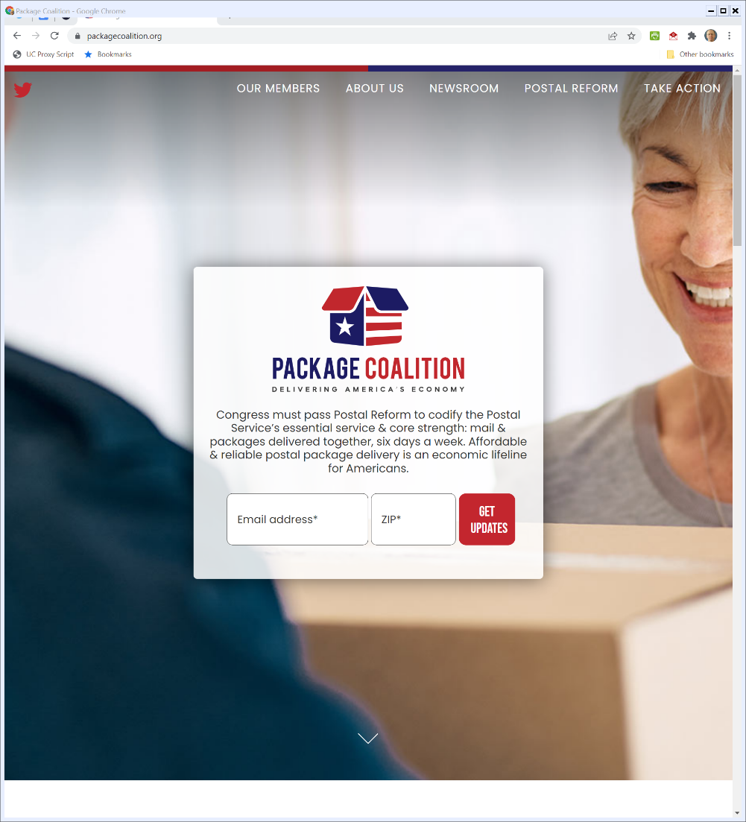

Backers of Reform
Package Coalition (Visited 20 Mar 2022)
Notes:
https://www.packagecoalition.org/

Slide 53
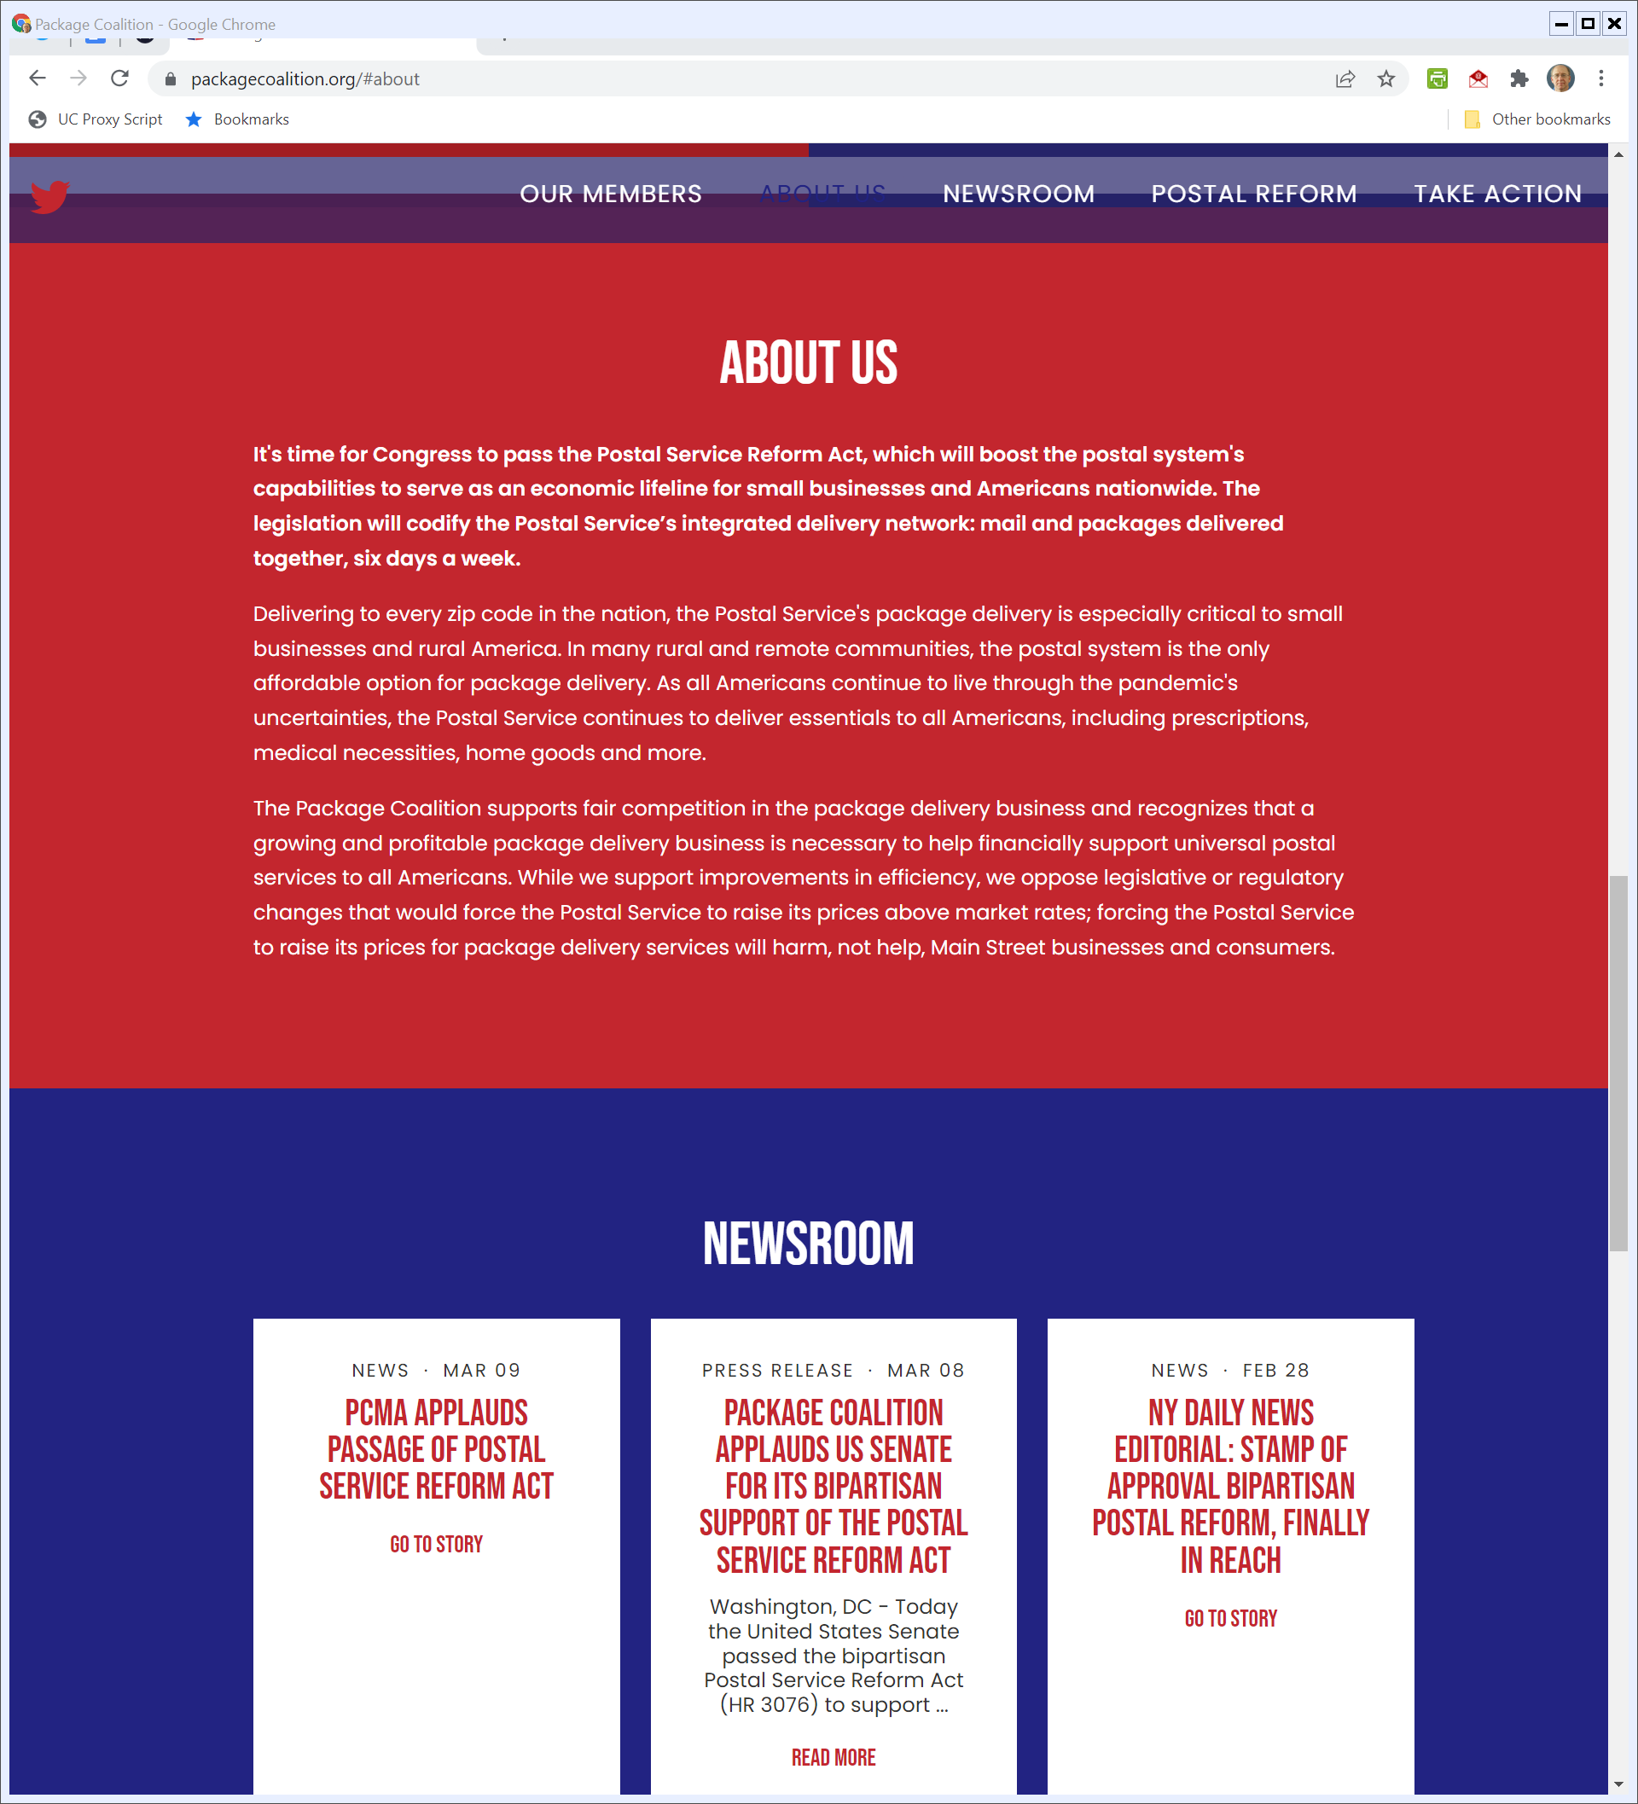
Small Business Lifeline
Package Coalition (Visited 20 Mar 2022)

Slide 54
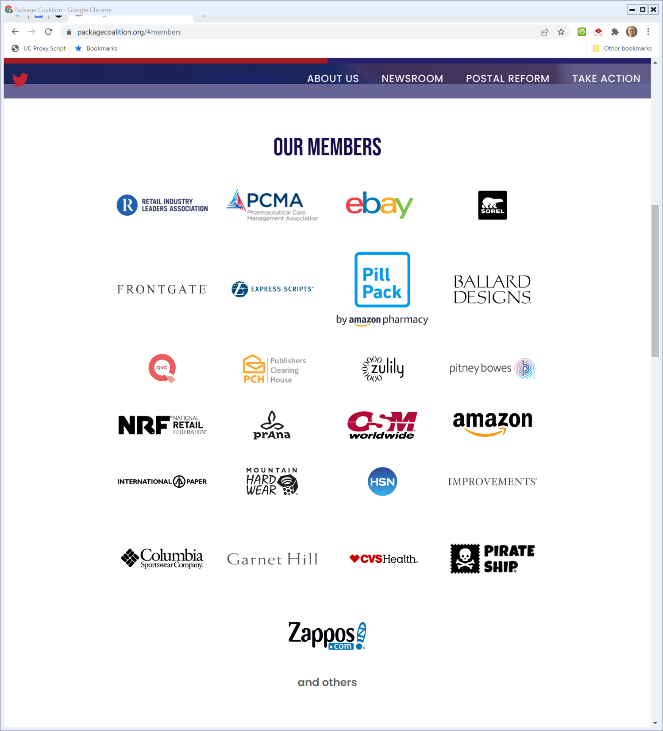
Members of the Coalition
Package Coalition (Visited 20 Mar 2022)

Slide 55
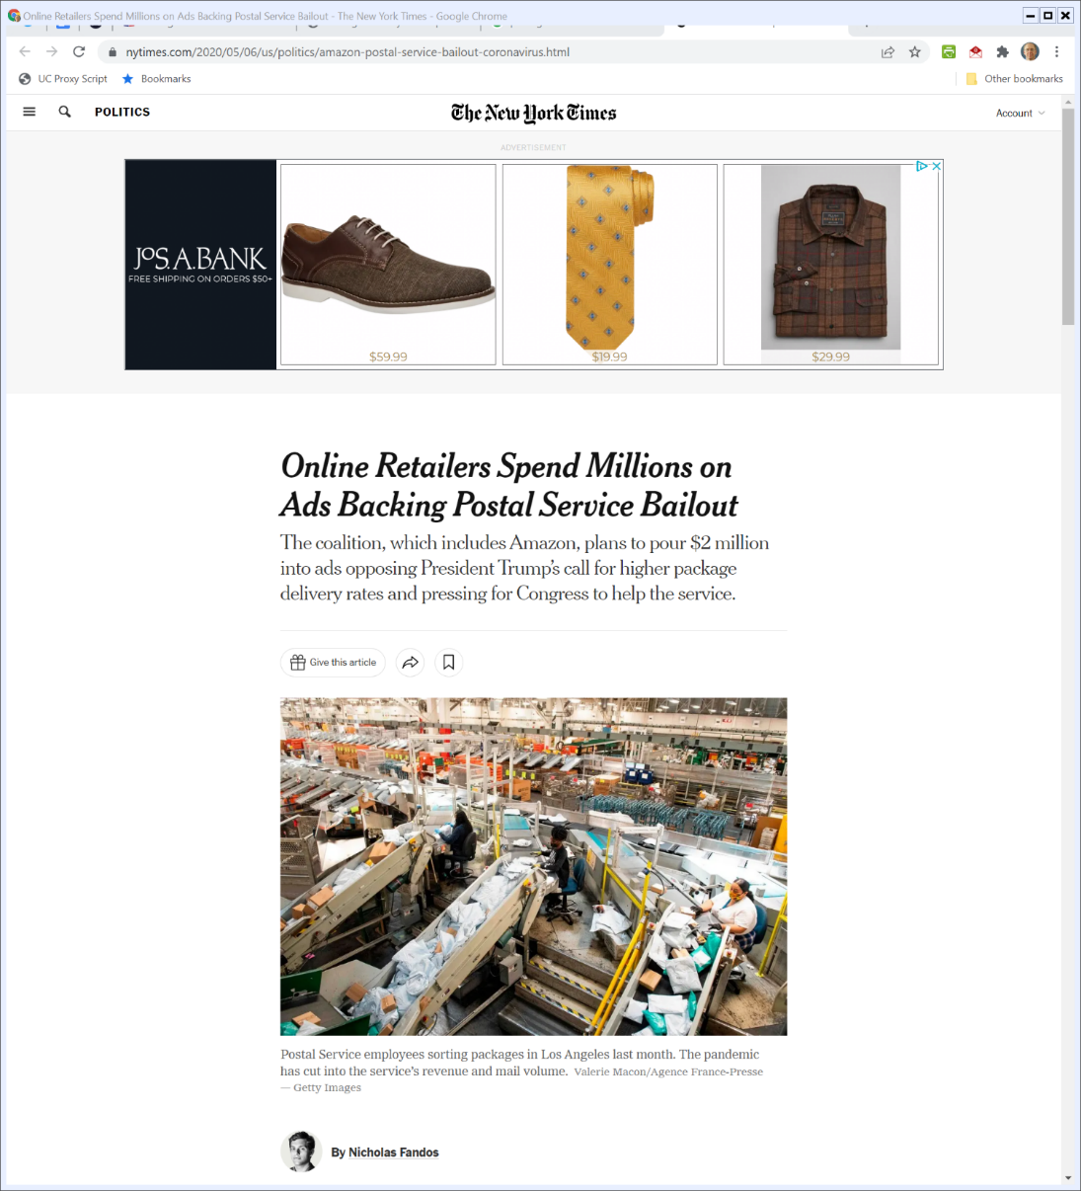
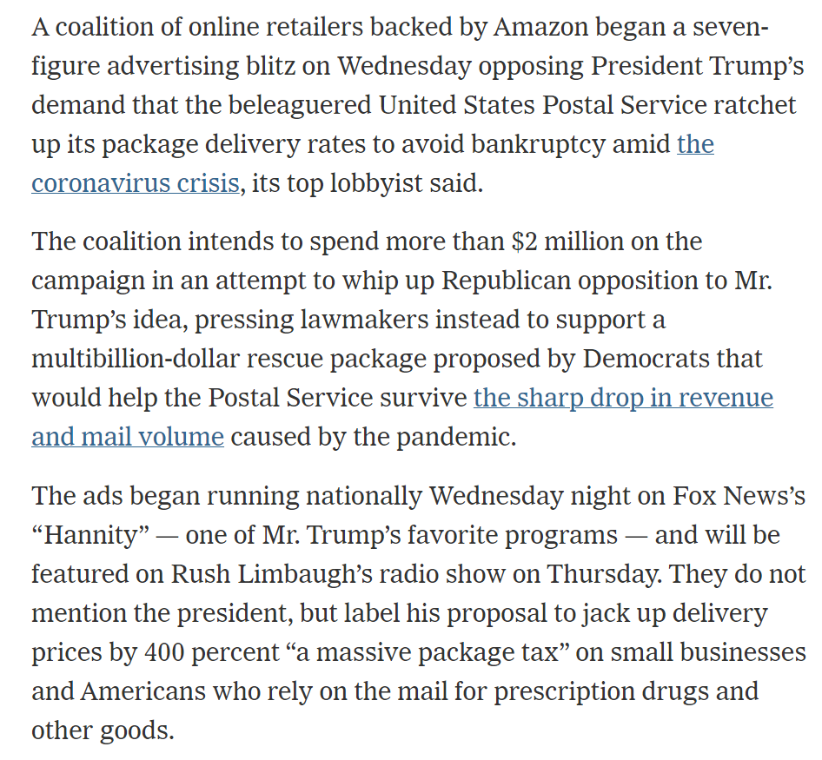
Postal Reform Spending
New York Times (6 May 2020)
Notes:
https://www.nytimes.com/2020/05/06/us/politics/amazon-postal-service-bailout-coronavirus.html

Slide 56
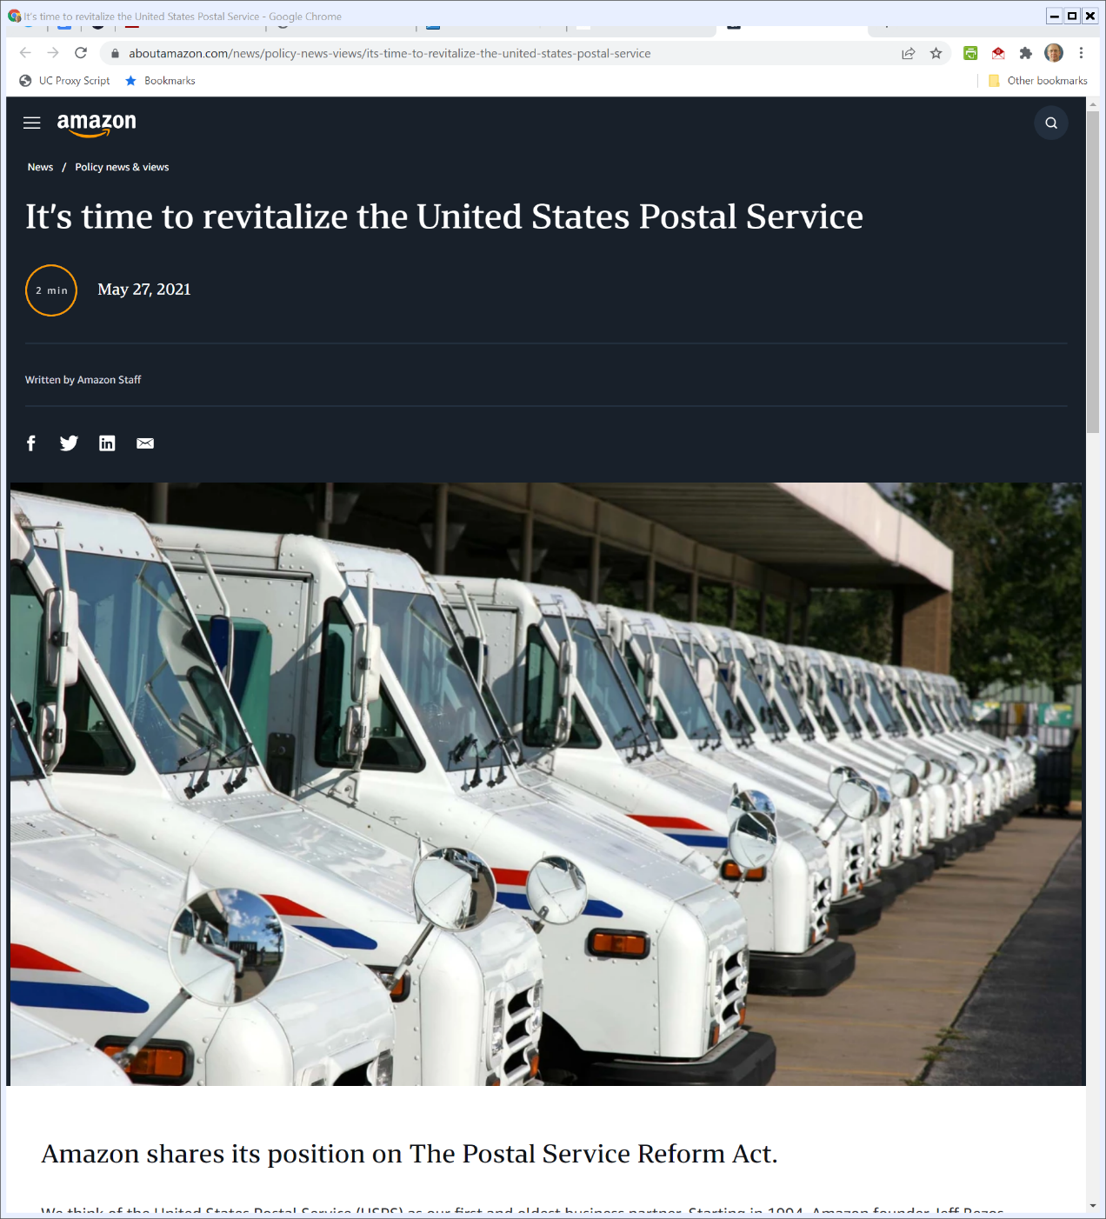
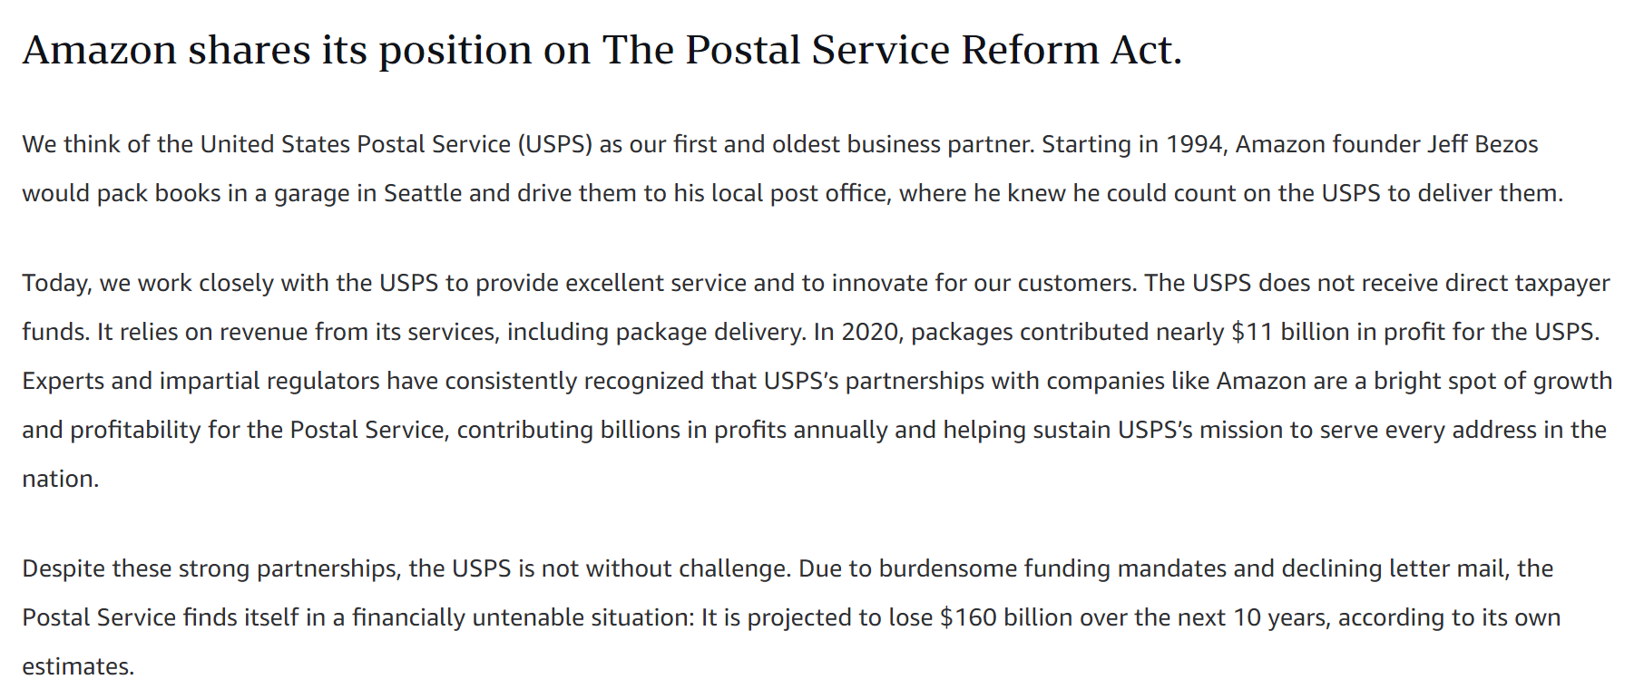
Amazon’s Oldest Partner
Amazon (27 May 2021)

Slide 57
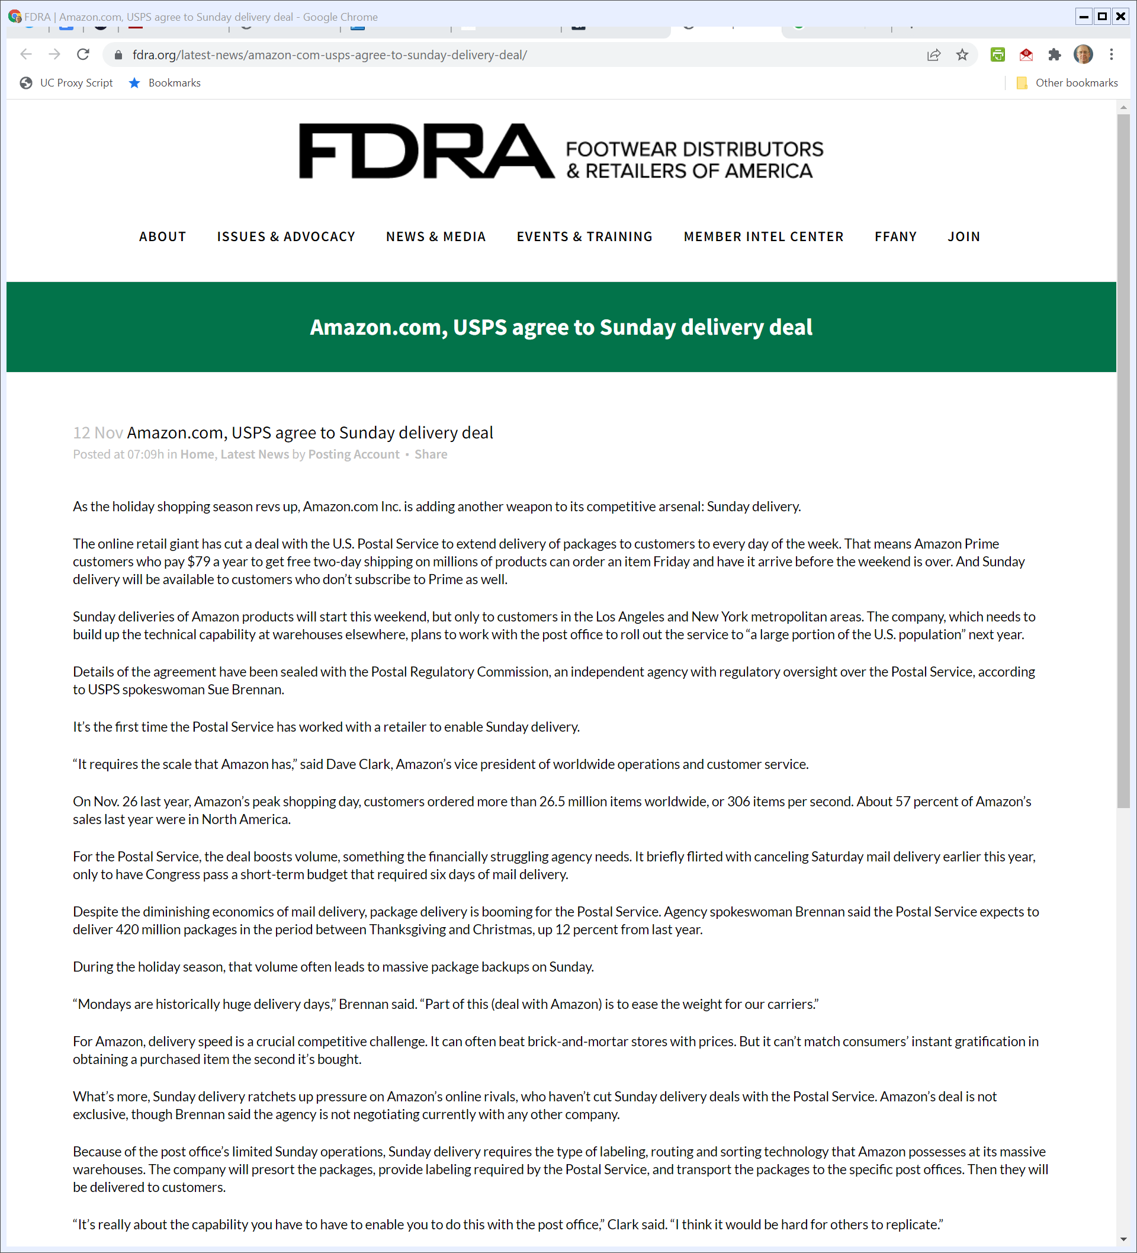
Amazon, USPS Sunday Delivery Deal
FDRA (12 Nov 2021)

Slide 58
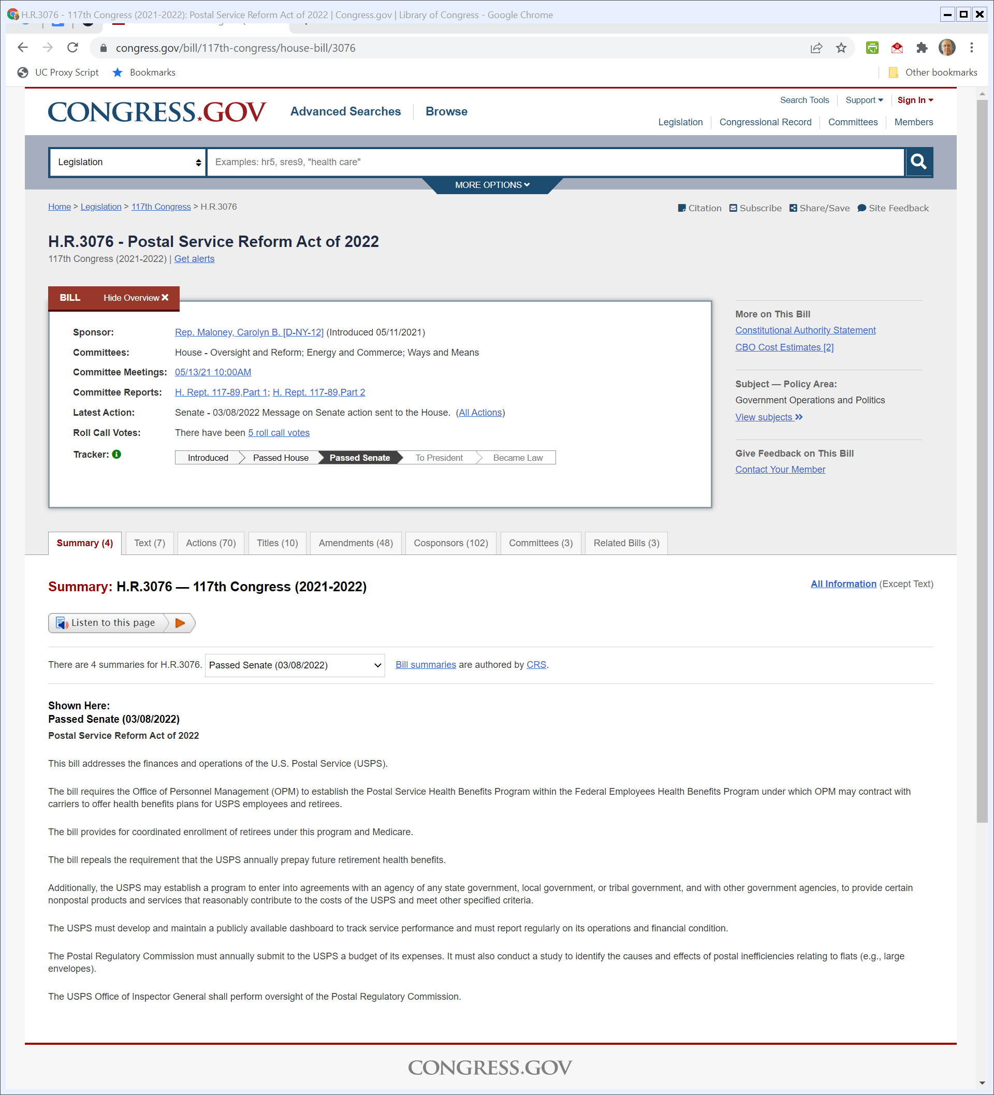
Postal Service Reform Act of 2022
H.R. 3076 (Visited 21 Mar 2022)
Notes:
https://www.congress.gov/bill/117th-congress/house-bill/3076

Slide 59
Bill Overview: Health Benefits
House Committee (Visited 21 Mar 2022)

Slide 60
Bill Overview
House Committee (Visited 21 Mar 2022)

Slide 61
Provisions
H.R. 3076 (Visited 21 Mar 2022)

Slide 62
Sec. 103: Nonpostal Services
H.R. 3076 (Visited 21 Mar 2022)

Slide 63
Services for State and Local Gov’ts
H.R. 3076 (Visited 21 Mar 2022)

Slide 64
Sec. 202: Integrated Delivery Network
H.R. 3076 (Visited 21 Mar 2022)

Slide 65
What Does that Mean?
CRS (2 June 2021)

Slide 66
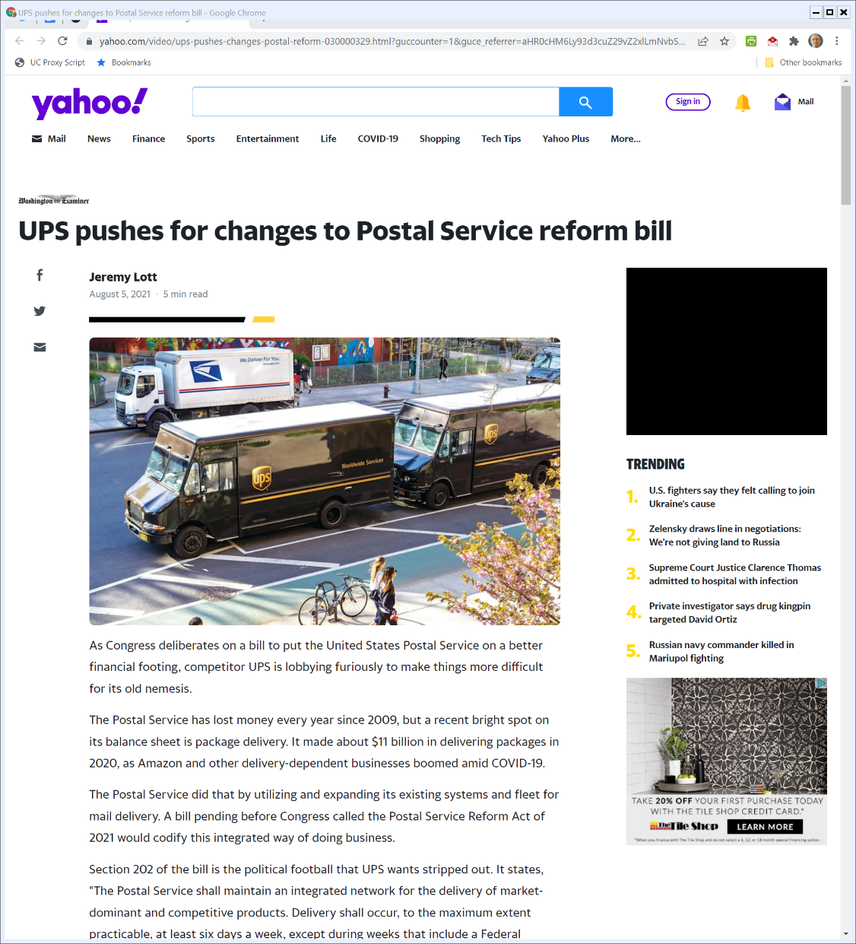
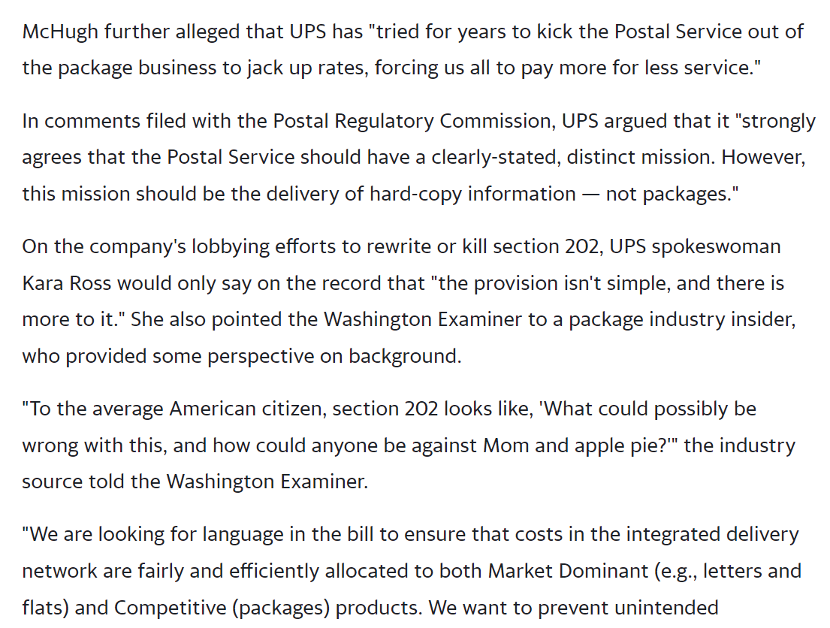
UPS on Sec. 202
Wash Examiner (5 Aug 2021)
Notes:
https://www.yahoo.com/video/ups-pushes-changes-postal-reform-030000329.html?guccounter=1&guce_referrer=aHR0cHM6Ly93d3cuZ29vZ2xlLmNvbS8&guce_referrer_sig=AQAAAMDueFiSjT2DEDrTeMmno7tUuLhvMNW65P7l7pTQTqxQnZ7PLSu2BndmgTRapPF_CEhzXyrIN3pBL_fRpTovIRvbOagSJ3EknP4ETqqEY6eN3CL2V3W13FEM5isBNwPjQFBVEw39tW5BoBbnN5JV2481Kf_YaiBgPBbFTRBzxA3x

Slide 67
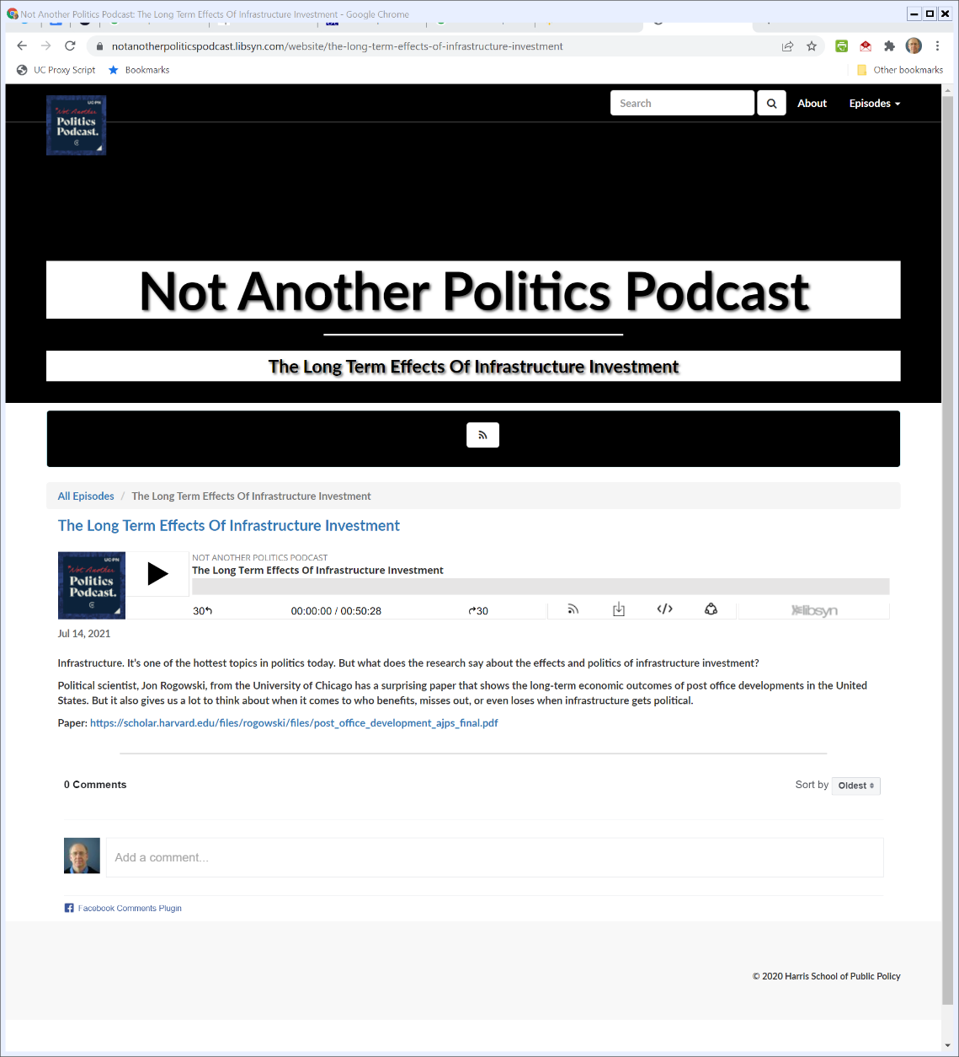

Not Another Politics Podcast
14 July 2021

Slide 68
Saw This Morning
Aneja & Xu (Mar 2022)

