Slide 1
Class 8: W11/19/2025; S11/22/2025 Booth 42201: The Legal Infrastructure of Business International Issues
Randal C. Picker
James Parker Hall Distinguished Service Professor of Law
The Law School
The University of Chicago
Copyright © 2002-25 Randal C. Picker. All Rights Reserved.

Slide 2
Tariffs
A Quick History of Tariff Acts

Slide 3
Harding Speech on Tariffs
New York Times (7 Dec 1921)

Slide 4
“A Scientific and Wholly Just Administration of the Law”
New York Times (7 Dec 1921)

Slide 5
“The Outbreak of the War was the Salvation of the American Industries”
S. Rep. (10 Apr 1922)

Slide 6
Dealing with Foreign Subsidies
S. Rep. (10 Apr 1922)

Slide 7
Protecting American Workers and Key Industries
S. Rep. (10 Apr 1922)

Slide 8
Tariff Act of 1922
Pub. L. 77-318 (21 Sept 1922)

Slide 9
Unfair Methods of Competition and Acts
Pub. L. 77-318 (21 Sept 1922)

Slide 10
President Power to Impose Tariffs
Pub. L. 77-318 (21 Sept 1922)

Slide 11
Lead Up to 1930 Act
S. Rep. 37 (4 Sept 1929)

Slide 12
Revised Section 337
S. Rep. 37 (4 Sept 1929)

Slide 13
Bill Passes
New York Times (15 June 1930)

Slide 14
Tariff Act of 1930 (Smoot-Hawley)
Pub. L. 71-361 (17 June 1930)

Slide 15
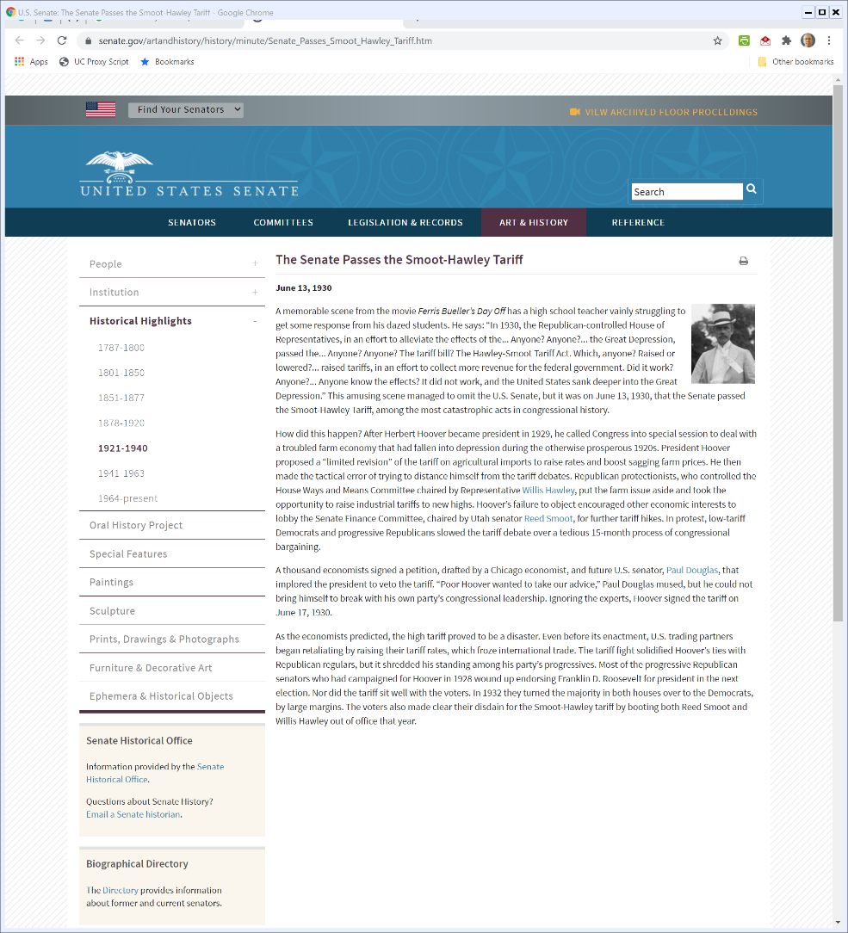

“Among the Most Catastrophic Acts in Congressional History”
Senate.gov
Notes:
https://www.senate.gov/artandhistory/history/minute/Senate_Passes_Smoot_Hawley_Tariff.htm

Slide 16
Trade Expansion Act of 1962
Pub. L. 87-794 (11 Oct 1962)

Slide 17
Purposes
Pub. L. 87-794 (11 Oct 1962)

Slide 18
Presidential Powers re Tariffs
Pub. L. 87-794 (11 Oct 1962)

Slide 19
National Security
Pub. L. 87-794 (11 Oct 1962)

Slide 20
Adjust Imports to Protect National Security
Pub. L. 87-794 (11 Oct 1962)

Slide 21
Domestic Production Needs
Pub. L. 87-794 (11 Oct 1962)

Slide 22
Steel Tariffs
Steel Tariffs

Slide 23
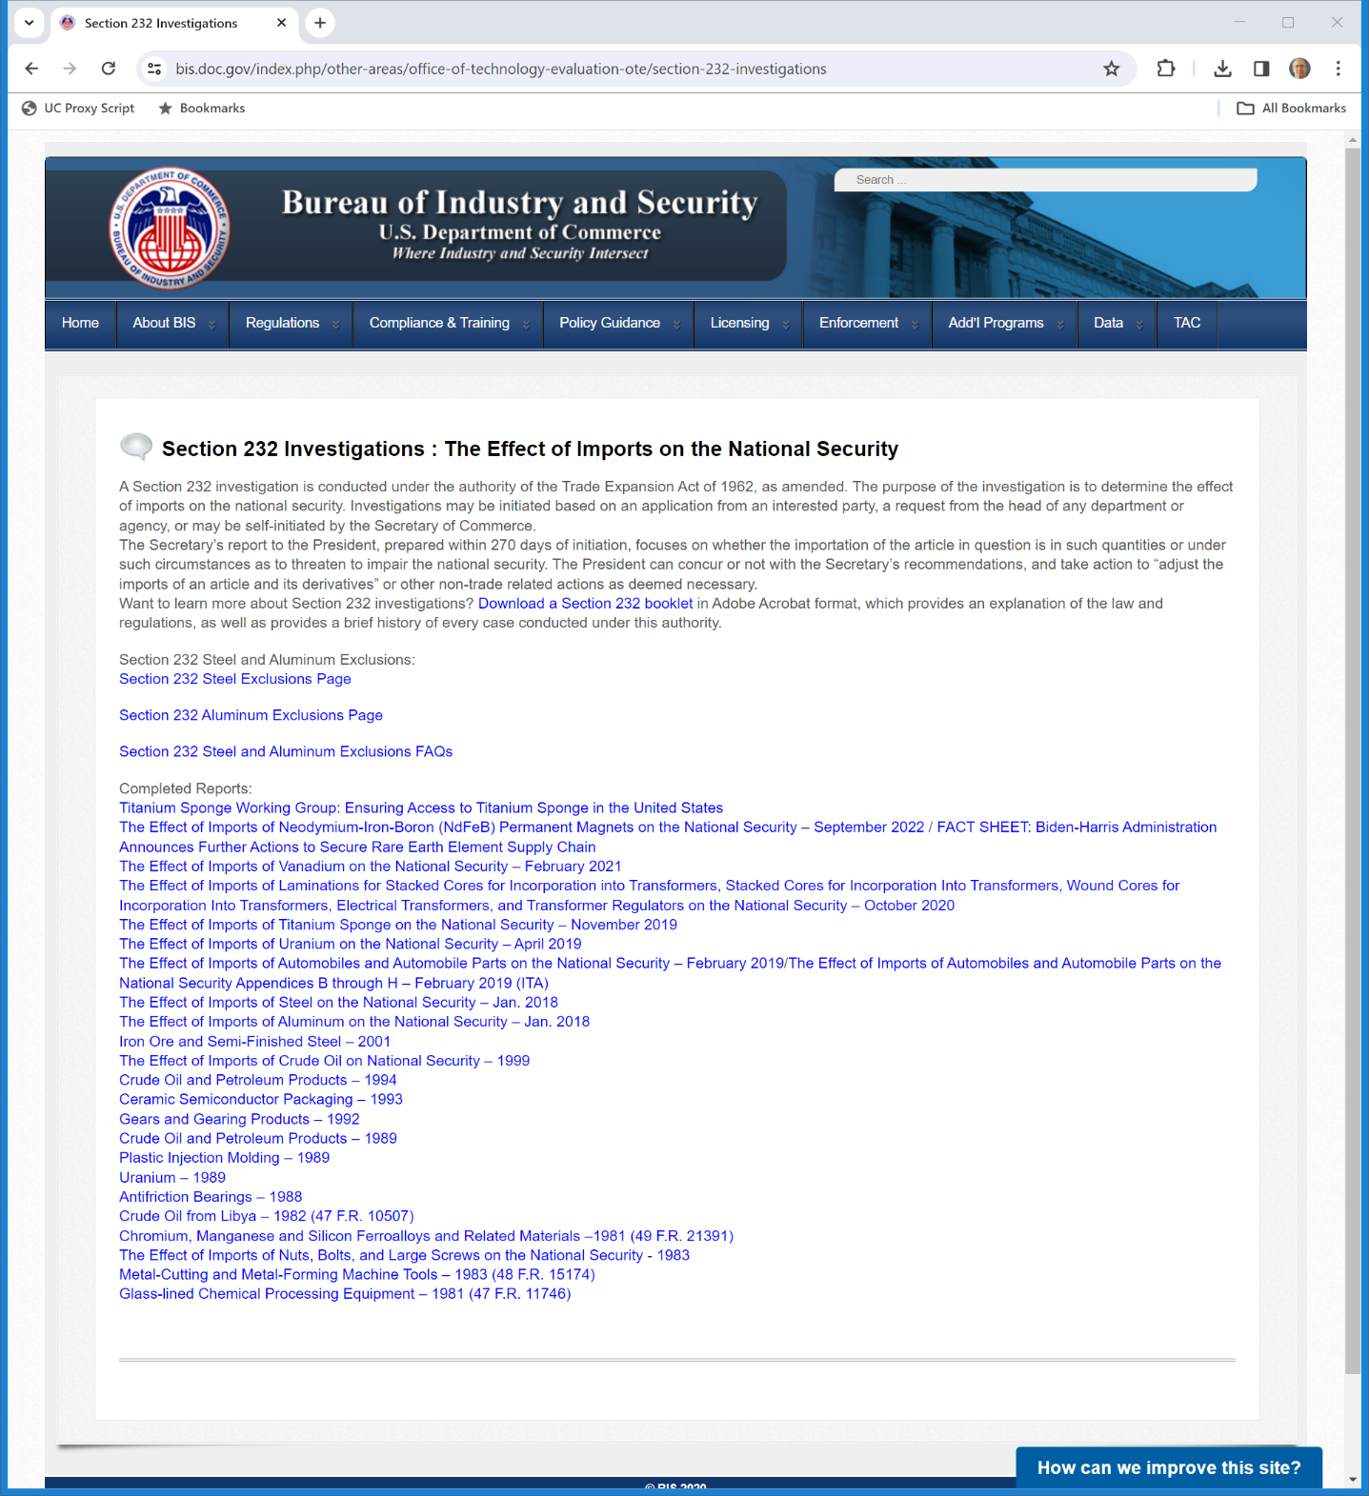
Sec 232 Investigation
“A Section 232 investigation is conducted under the authority of the Trade Expansion Act of 1962, as amended. The purpose of the investigation is to determine the effect of imports on the national security. Investigations may be initiated based on an application from an interested party, a request from the head of any department or agency, or may be self-initiated by the Secretary of Commerce.”
U.S. Dept of Commerce
Notes:
https://www.bis.doc.gov/index.php/other-areas/office-of-technology-evaluation-ote/section-232-investigations

Slide 24

Sec 232 Investigation
“The Secretary’s report to the President, prepared within 270 days of initiation, focuses on whether the importation of the article in question is in such quantities or under such circumstances as to threaten to impair the national security. The President can concur or not with the Secretary’s recommendations, and take action to ‘adjust the imports of an article and its derivatives’ or other non-trade related actions as deemed necessary.”
U.S. Dept of Commerce
Notes:
https://www.bis.doc.gov/index.php/other-areas/office-of-technology-evaluation-ote/section-232-investigations

Slide 25
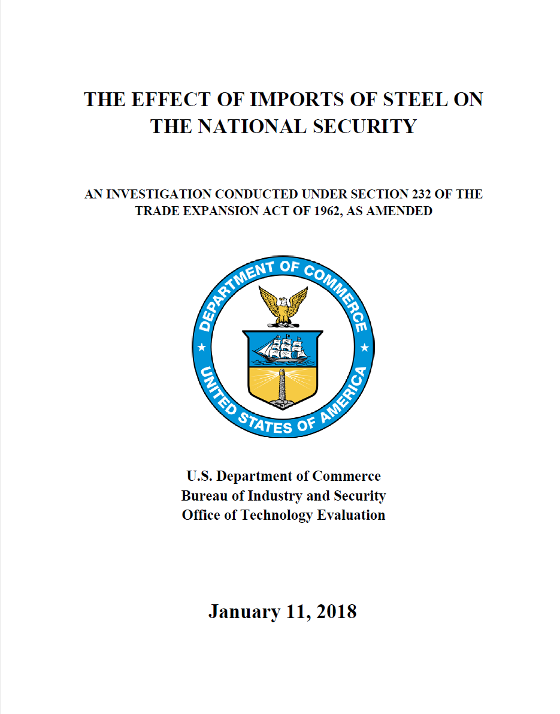
Sec 232 Steel Investigation
U.S. Dept of Commerce (11 Jan 2018)

Slide 26
Rising Demand for Steel
U.S. Dept of Commerce (11 Jan 2018)

Slide 27
U.S. Steel Imports Increasing
U.S. Dept of Commerce (11 Jan 2018)

Slide 28
Why?: Imports Have Lower Prices, So U.S. Steel Mills are Closing
U.S. Dept of Commerce (11 Jan 2018)

Slide 29
Substantial Decrease in U.S. Steel Employment
U.S. Dept of Commerce (11 Jan 2018)

Slide 30
Excess Chinese Steel Production
U.S. Dept of Commerce (11 Jan 2018)

Slide 31
Foreign Production Overhang
U.S. Dept of Commerce (11 Jan 2018)

Slide 32
Need for Tariff
U.S. Dept of Commerce (11 Jan 2018)

Slide 33
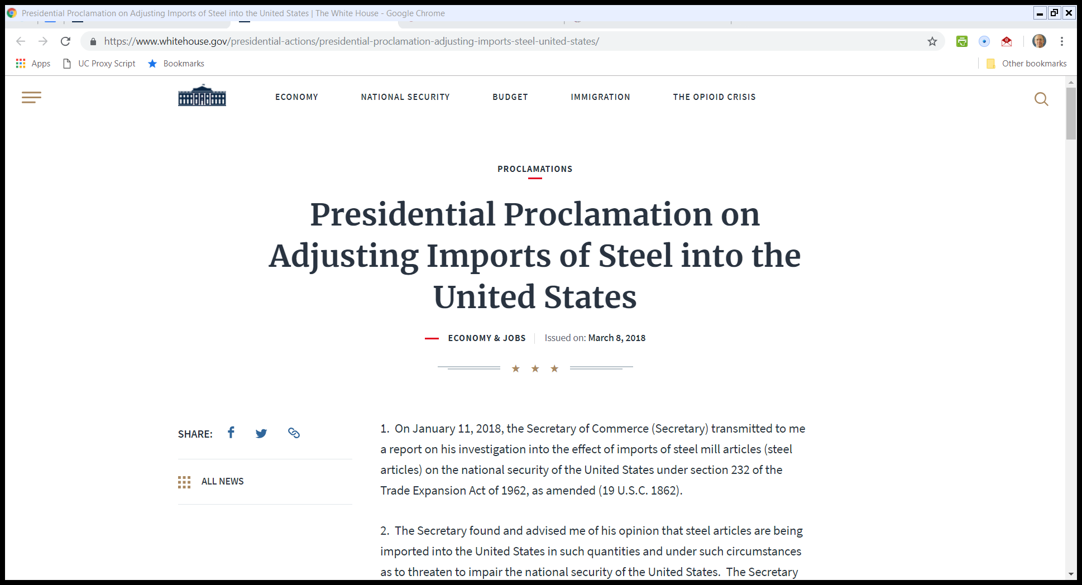
Pres. Trump Steel Proclamation
8 Mar 2018

Slide 34
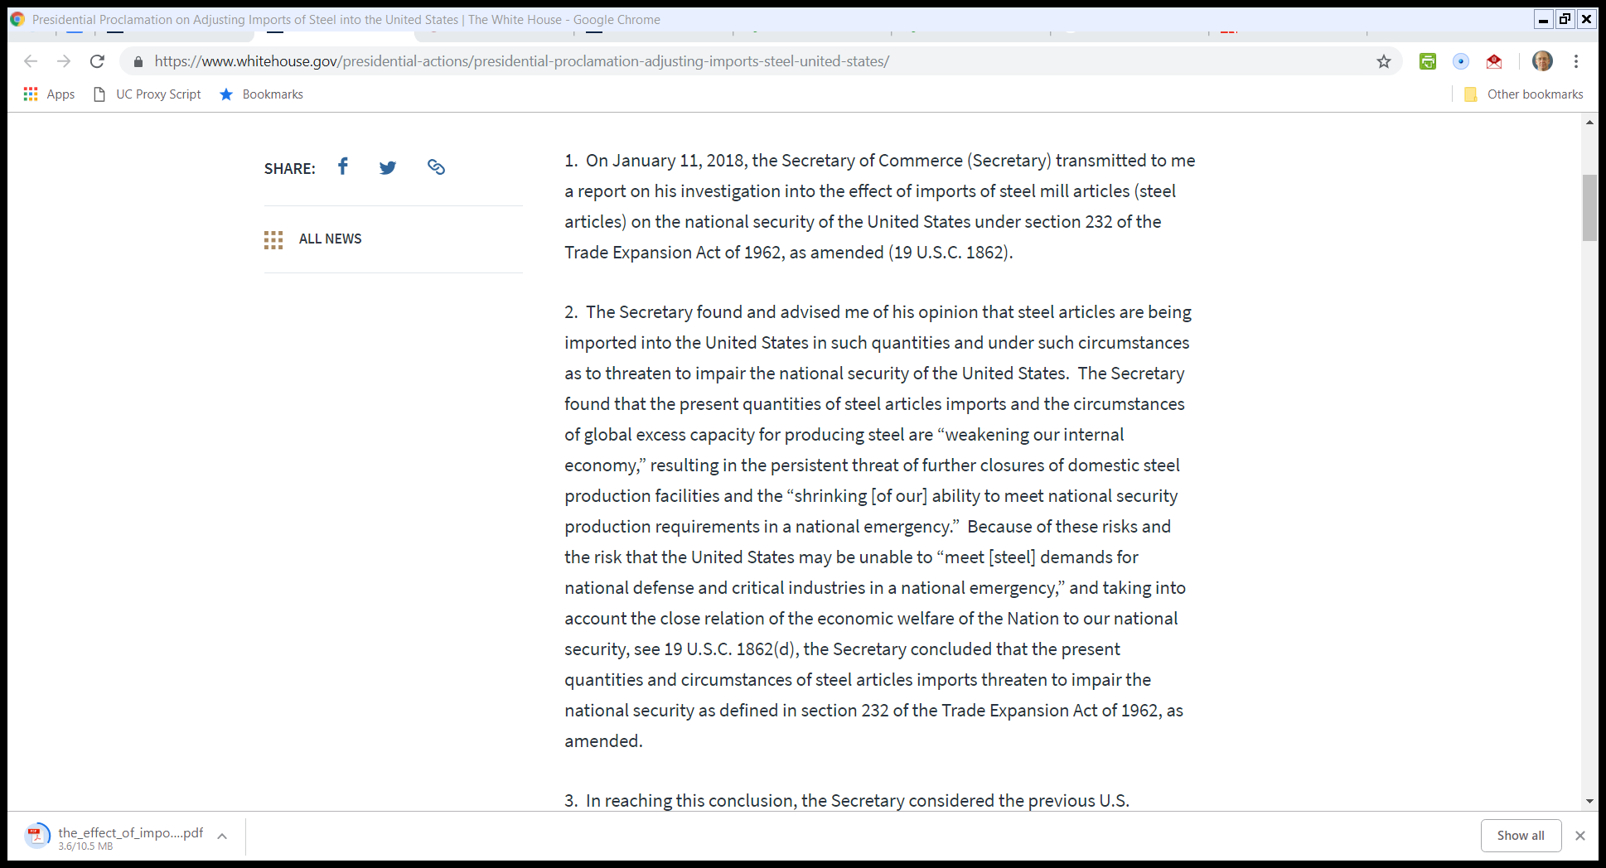
Pres. Trump Steel Proclamation
8 Mar 2018

Slide 35
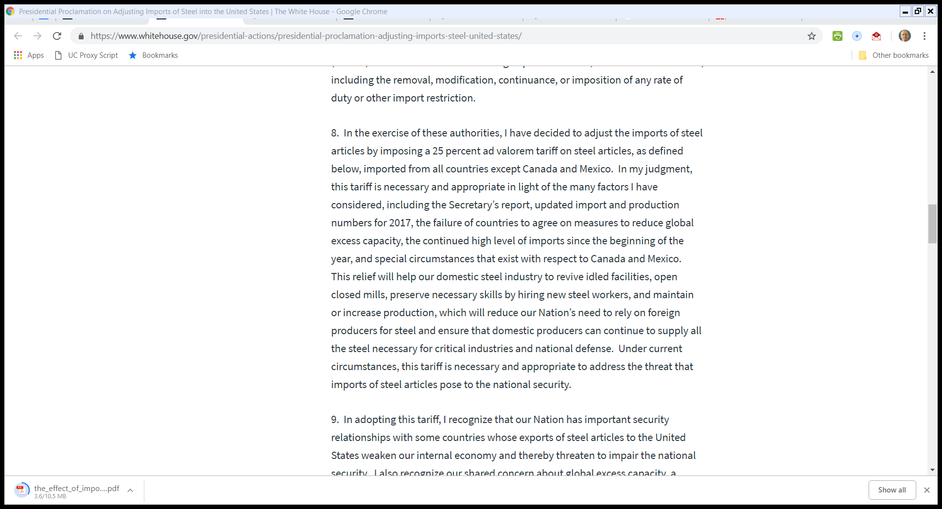
Pres. Trump Steel Proclamation
8 Mar 2018

Slide 36
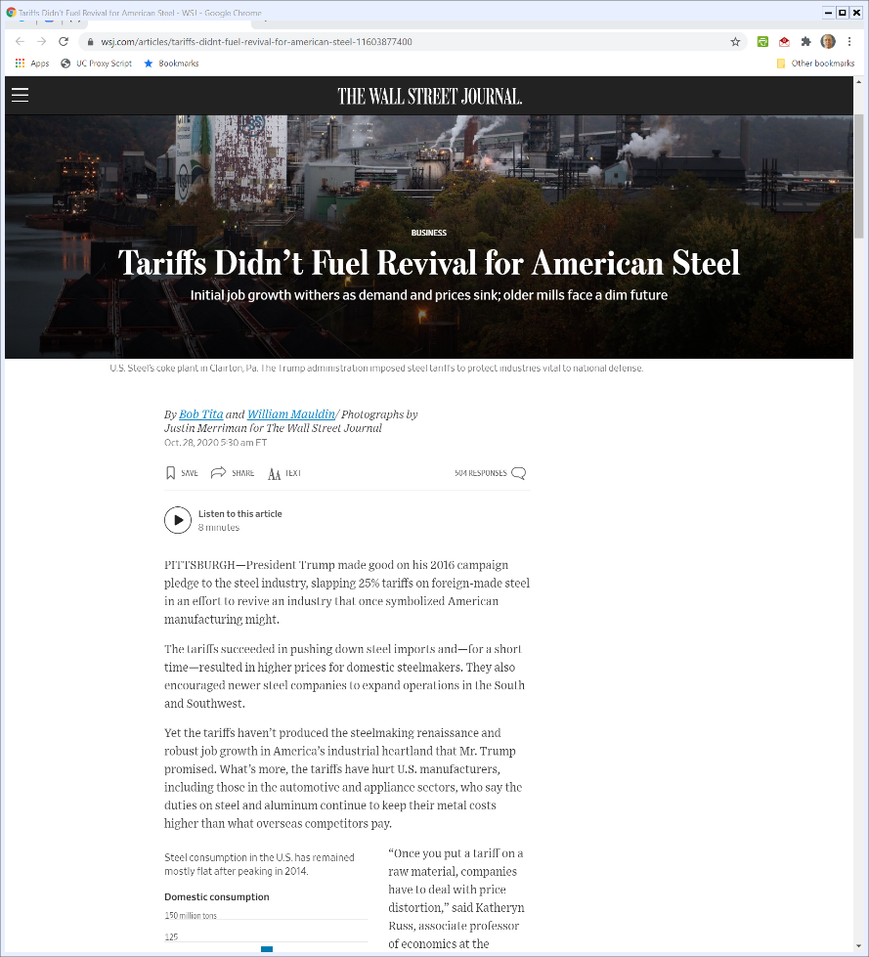

What Did the Steel Tariffs Do?
WSJ (28 Oct 2020)
Notes:
https://www.wsj.com/articles/tariffs-didnt-fuel-revival-for-american-steel-11603877400

Slide 37
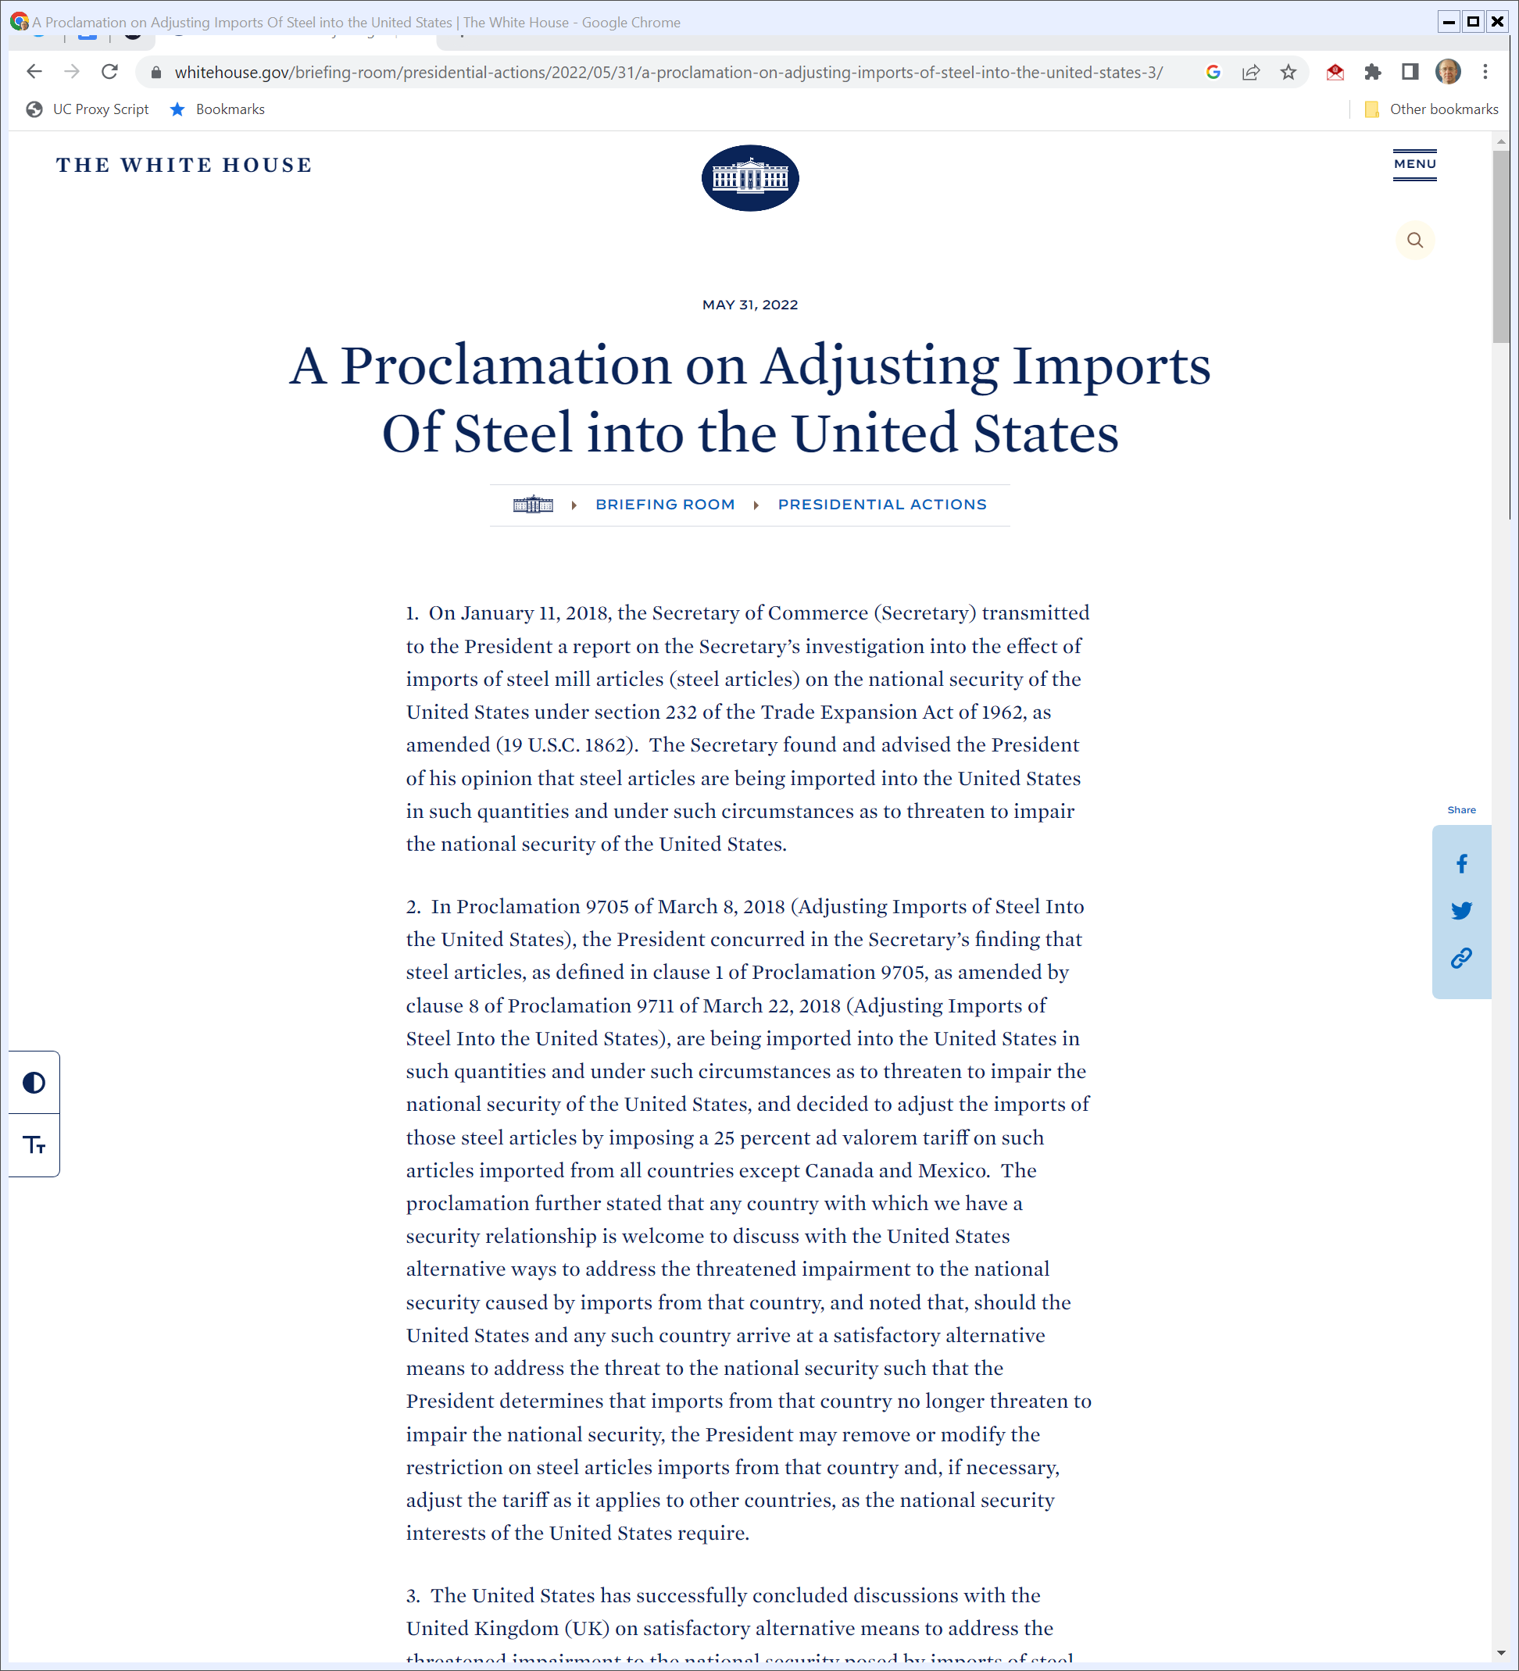
And the Biden Administration?
Biden White House (31 May 2022)
Notes:
https://www.whitehouse.gov/briefing-room/presidential-actions/2022/05/31/a-proclamation-on-adjusting-imports-of-steel-into-the-united-states-3/

Slide 38
Trump II Tariffs
Trump II Tariffs

Slide 39
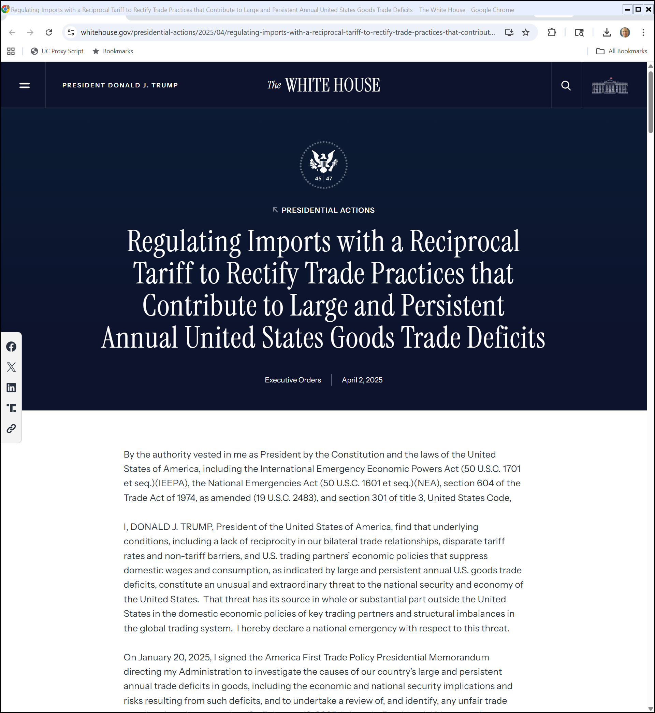
Liberation Day
The White House (2 Apr 2025)
Notes:
https://www.whitehouse.gov/presidential-actions/2025/04/regulating-imports-with-a-reciprocal-tariff-to-rectify-trade-practices-that-contribute-to-large-and-persistent-annual-united-states-goods-trade-deficits/

Slide 40
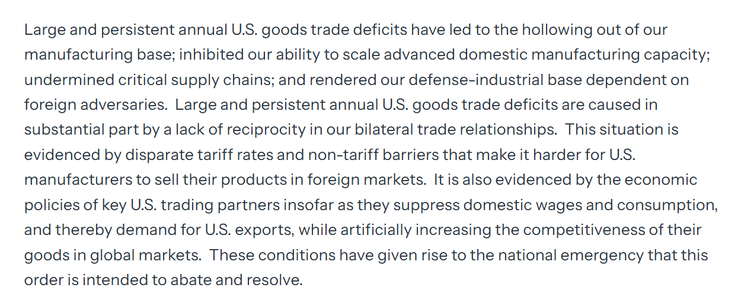
The Nature of the Emergency
The White House (2 Apr 2025)
Notes:
https://www.whitehouse.gov/presidential-actions/2025/04/regulating-imports-with-a-reciprocal-tariff-to-rectify-trade-practices-that-contribute-to-large-and-persistent-annual-united-states-goods-trade-deficits/

Slide 41
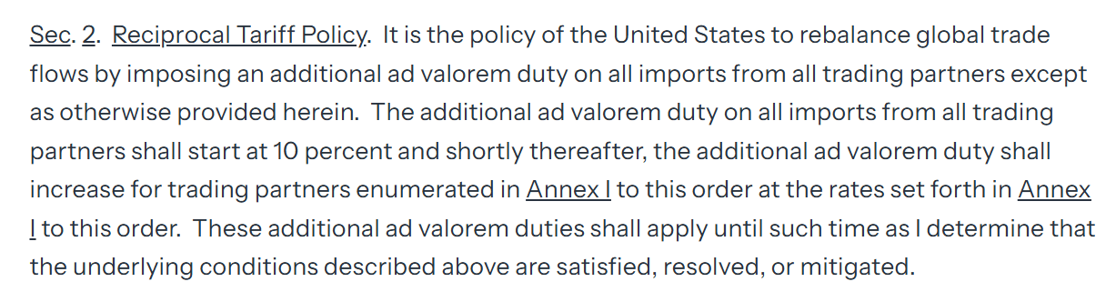
Tariff Rates
The White House (2 Apr 2025)
Notes:
https://www.whitehouse.gov/presidential-actions/2025/04/regulating-imports-with-a-reciprocal-tariff-to-rectify-trade-practices-that-contribute-to-large-and-persistent-annual-united-states-goods-trade-deficits/

Slide 42
Annex I Rates
The White House (2 Apr 2025)
Notes:
https://www.whitehouse.gov/presidential-actions/2025/04/regulating-imports-with-a-reciprocal-tariff-to-rectify-trade-practices-that-contribute-to-large-and-persistent-annual-united-states-goods-trade-deficits/

Slide 43
IEEPA
Pub. L. 95-223 (28 Dec 1977)

Slide 44
IEEPA
Pub. L. 95-223 (28 Dec 1977)

Slide 45
1971
NYT (16 Aug 1971)

Slide 46
Trading With the Enemy Act
Pub. L. 65-91 (6 Oct 1917)

Slide 47
Yoshida: Surcharge Valid
“We conclude, therefore, that Congress, in enacting § 5(b) of the TWEA, authorized the President, during an emergency, to exercise the delegated substantive power, i.e., to ‘regulate importation,’ by imposing an import duty surcharge or by other means appropriately and reasonably related, as discussed below, to the particular nature of the emergency declared.”
526 F.2d 560 (Customs and Patent Appeals 1975)

Slide 48
Tariffs Case
Cert Petition (17 June 2025)

Slide 49
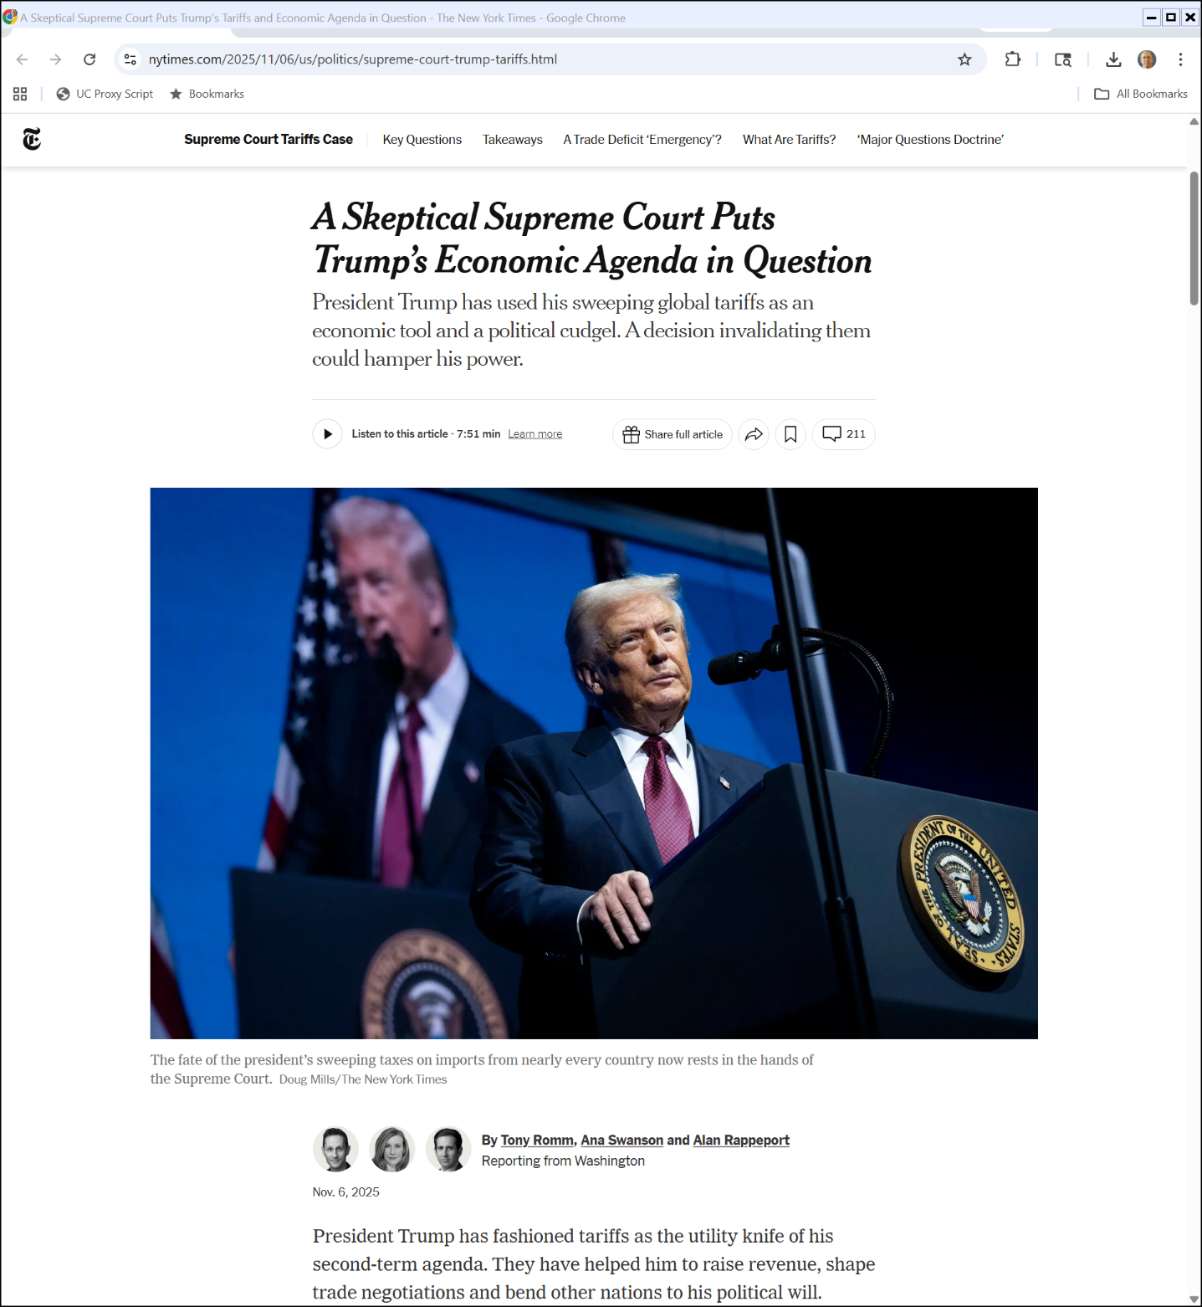
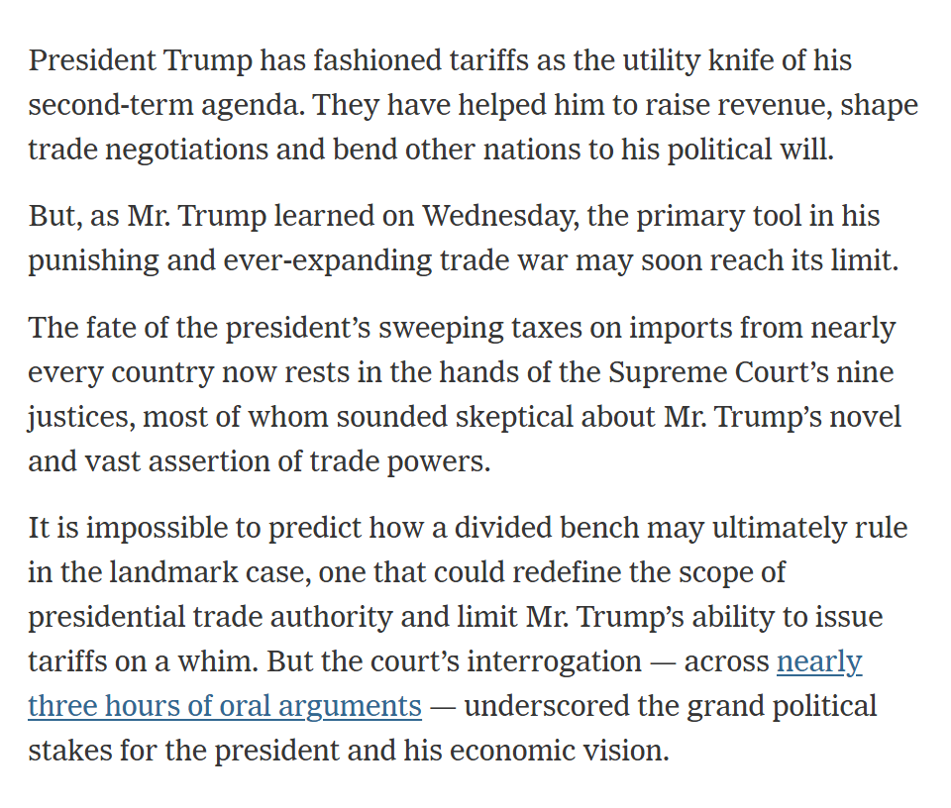
A Skeptical Supreme Court?
NYT (6 Nov 2025)

Slide 50
Chips
Chips

Slide 51
Situating Chips
SIA (2021 Report)

Slide 52
U.S. Manufacturing Share
SIA (2021 Report)

Slide 53
Manufacturing Tech by Node
SIA (2021 Report)

Slide 54
Defense Appropriations Bill: 1482 Pages
Pub. L. 11-283 (1 Jan 2021)

Slide 55
CHIPS for America
Pub. L. 11-283 (1 Jan 2021)

Slide 56
Semiconductor Incentives
Pub. L. 11-283 (1 Jan 2021)

Slide 57
DoD Needs
Pub. L. 11-283 (1 Jan 2021)

Slide 58
How Do You Know Whether You Can Trust a Chip?
Pub. L. 11-283 (1 Jan 2021)

Slide 59
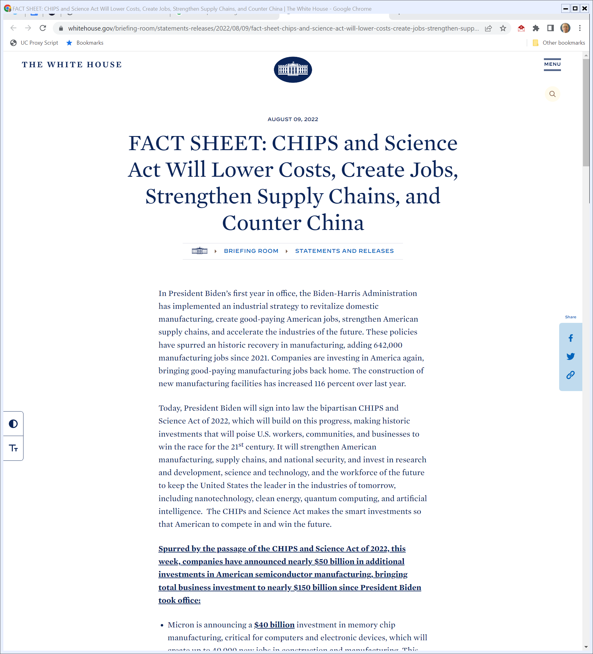
2022 Chips and Science Act
Biden White House (9 Aug 2022)
Notes:
https://www.whitehouse.gov/briefing-room/statements-releases/2022/08/09/fact-sheet-chips-and-science-act-will-lower-costs-create-jobs-strengthen-supply-chains-and-counter-china/

Slide 60
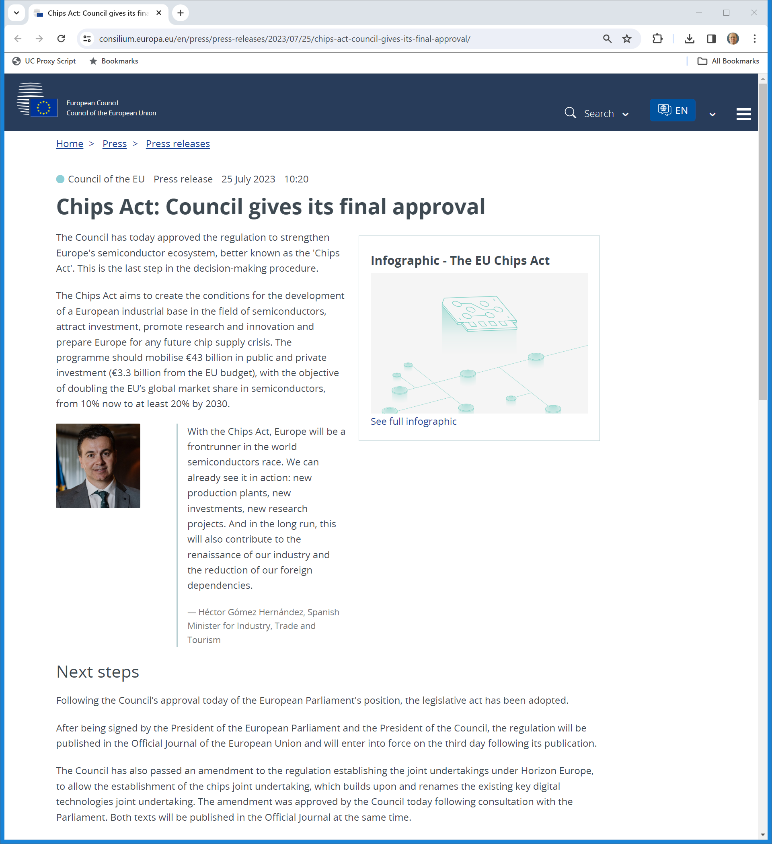
European Chips Act
Council of the EU (25 July 2023)
Notes:
https://www.consilium.europa.eu/en/press/press-releases/2023/07/25/chips-act-council-gives-its-final-approval/

Slide 61
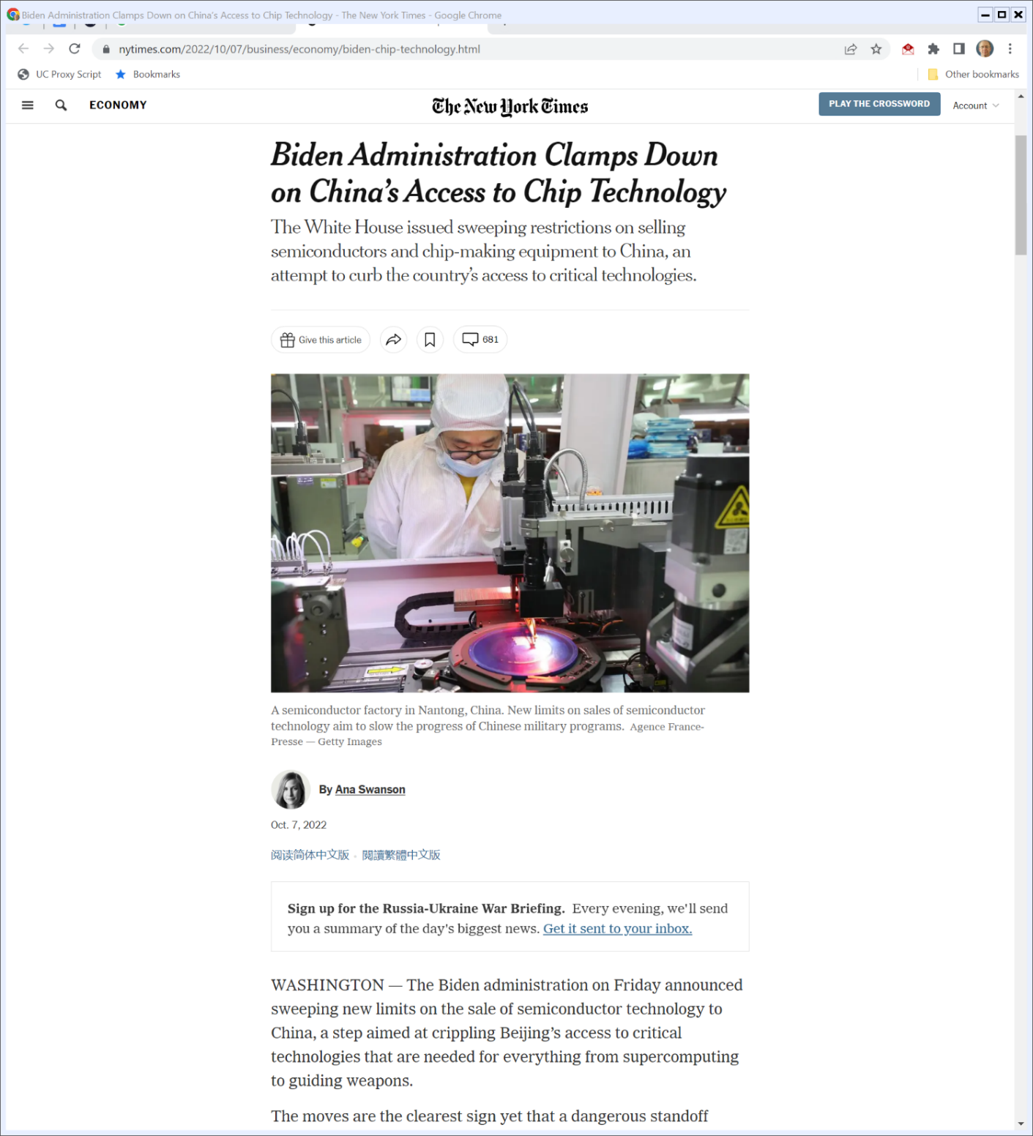
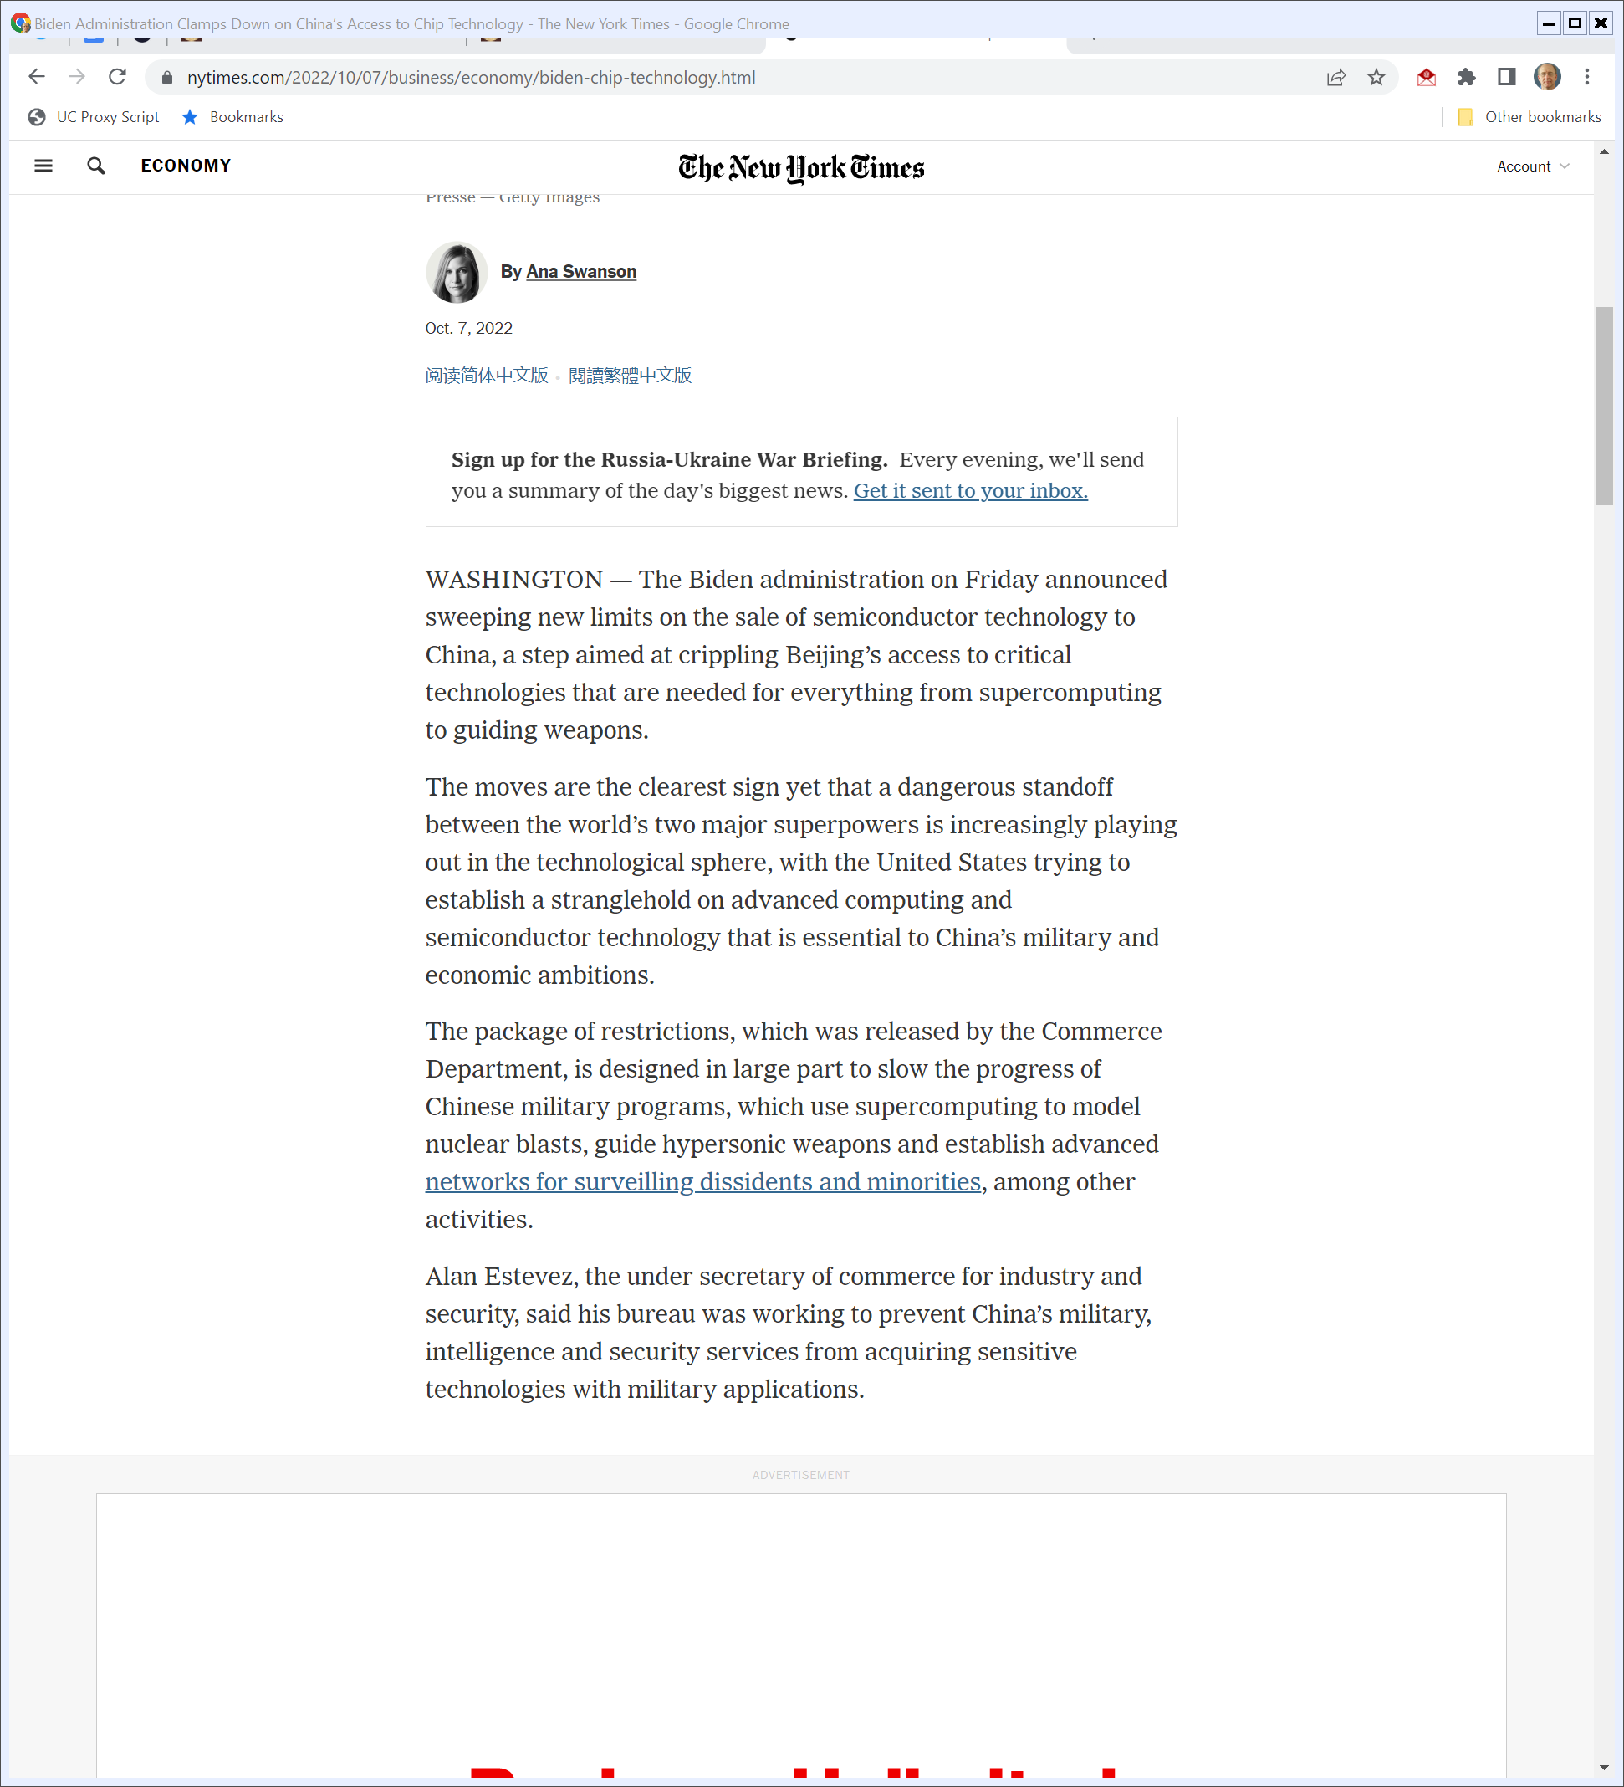
Blocking China
The New York Times (7 Oct 2022)
Notes:
https://www.nytimes.com/2022/10/07/business/economy/biden-chip-technology.html

Slide 62
Export Restrictions
U.S Dept of Commerce (7 Oct 2022)

Slide 63
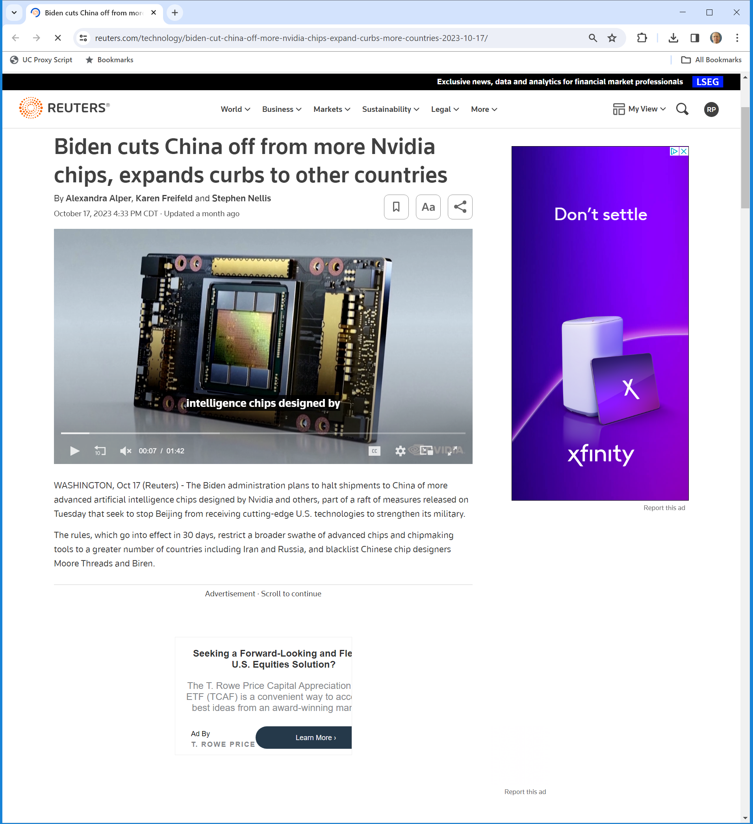
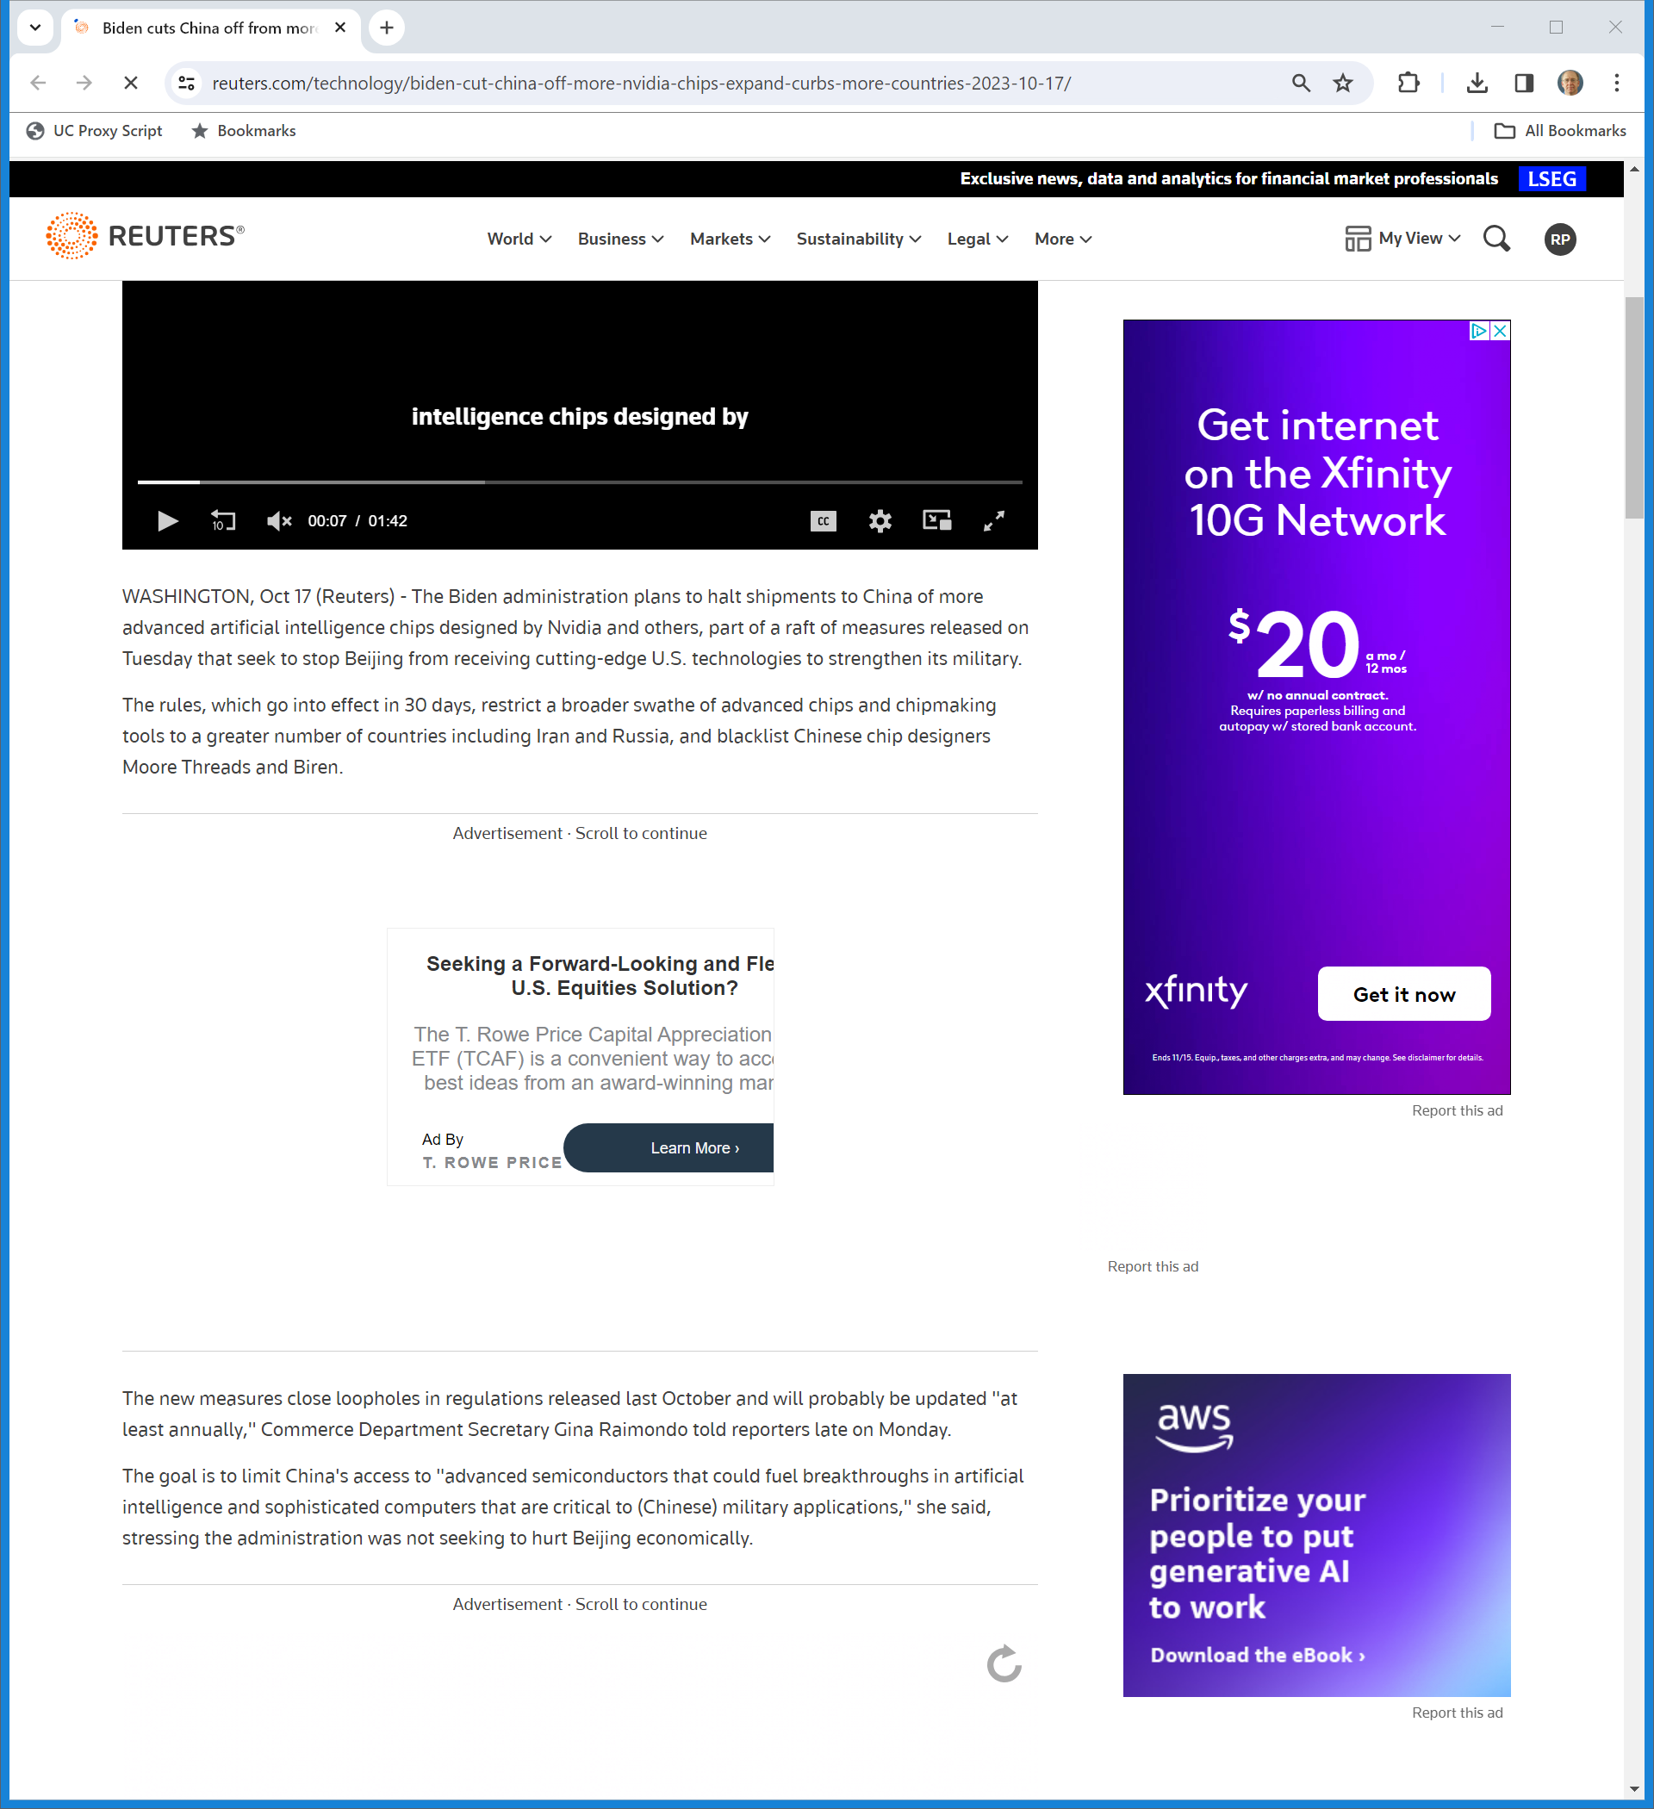
Effect of New Rules
Reuters (17 Oct 2023)
Notes:
https://www.reuters.com/technology/biden-cut-china-off-more-nvidia-chips-expand-curbs-more-countries-2023-10-17/

Slide 64
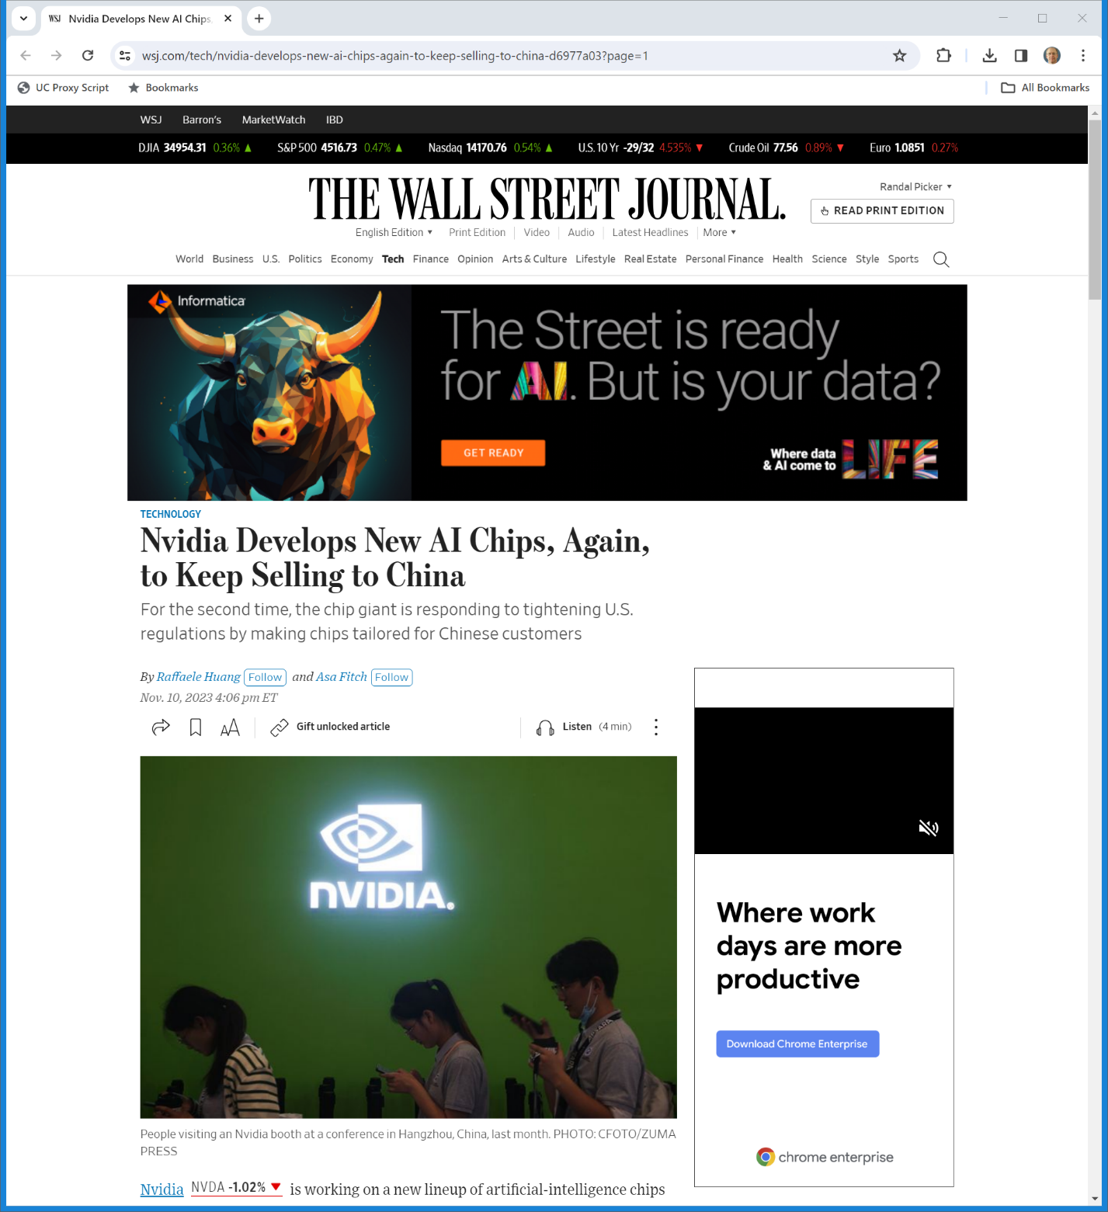
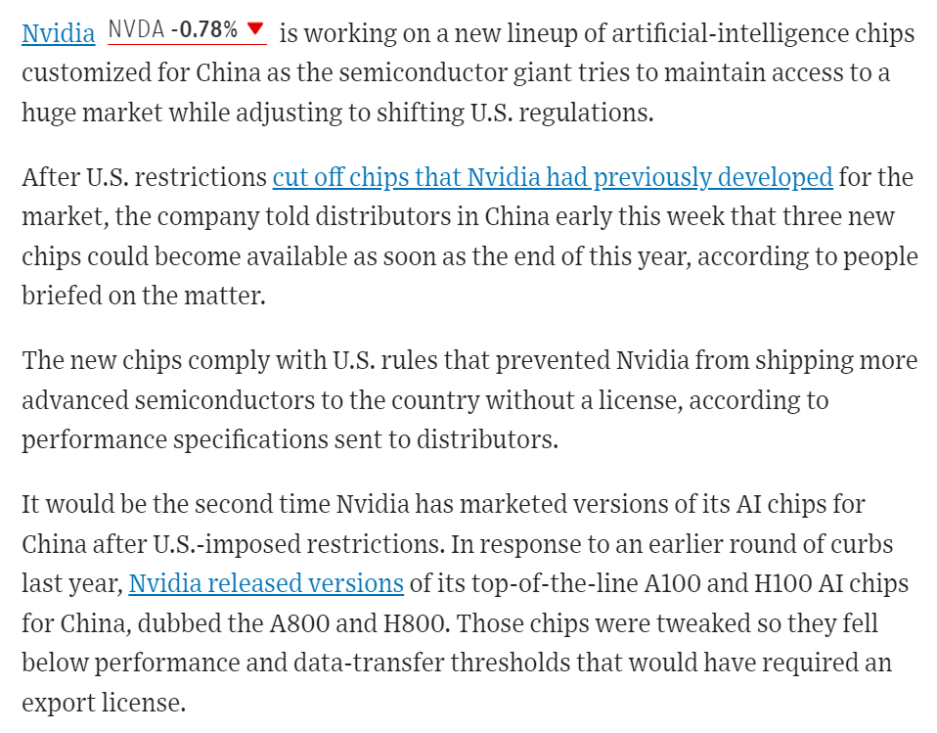
Nvidia Responds
WSJ (10 Nov 2023)

Slide 65
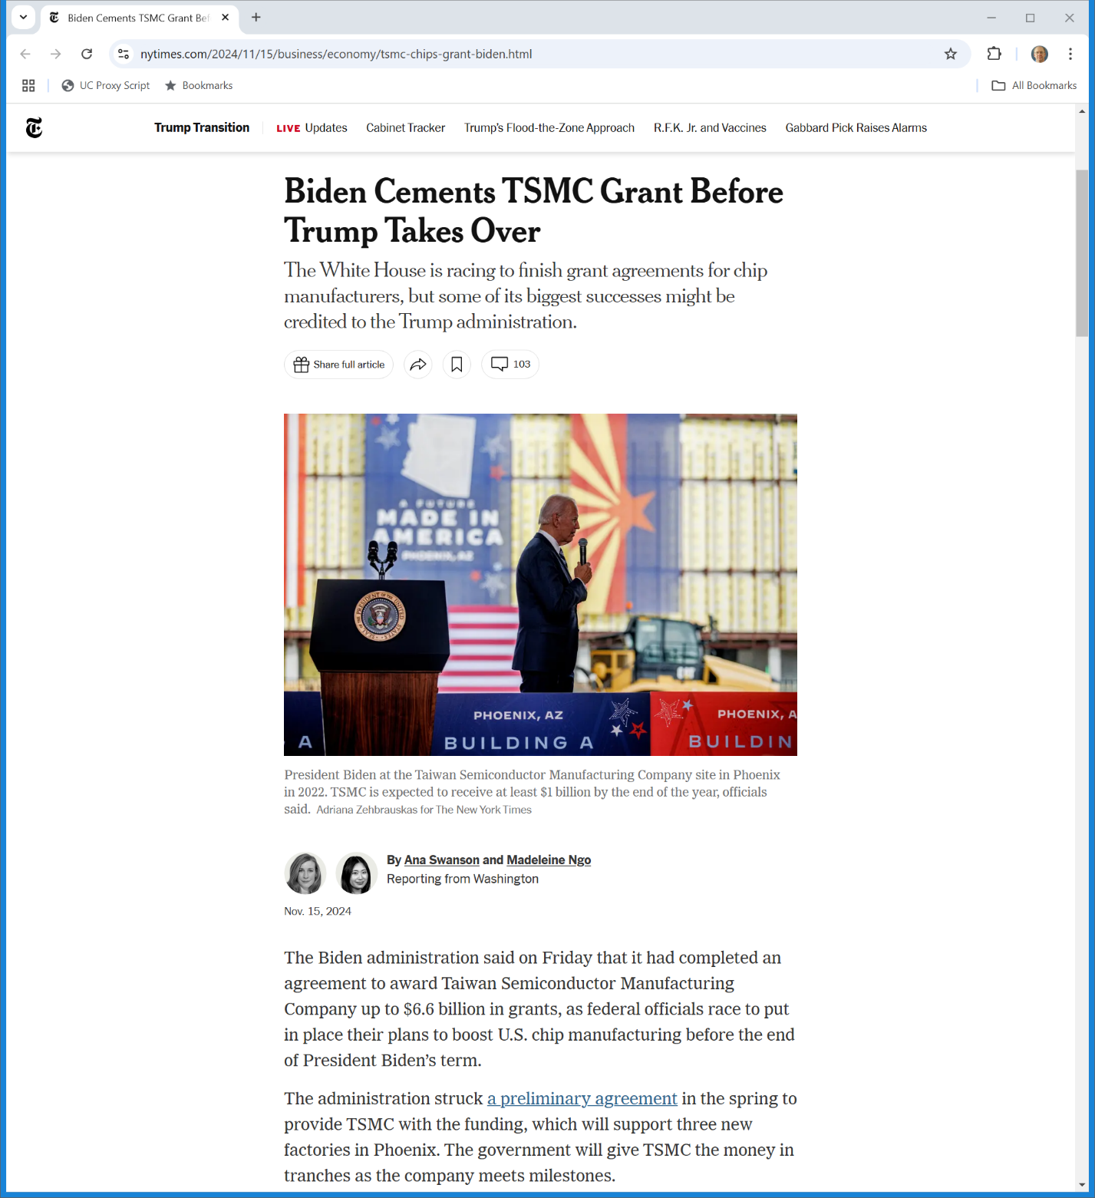
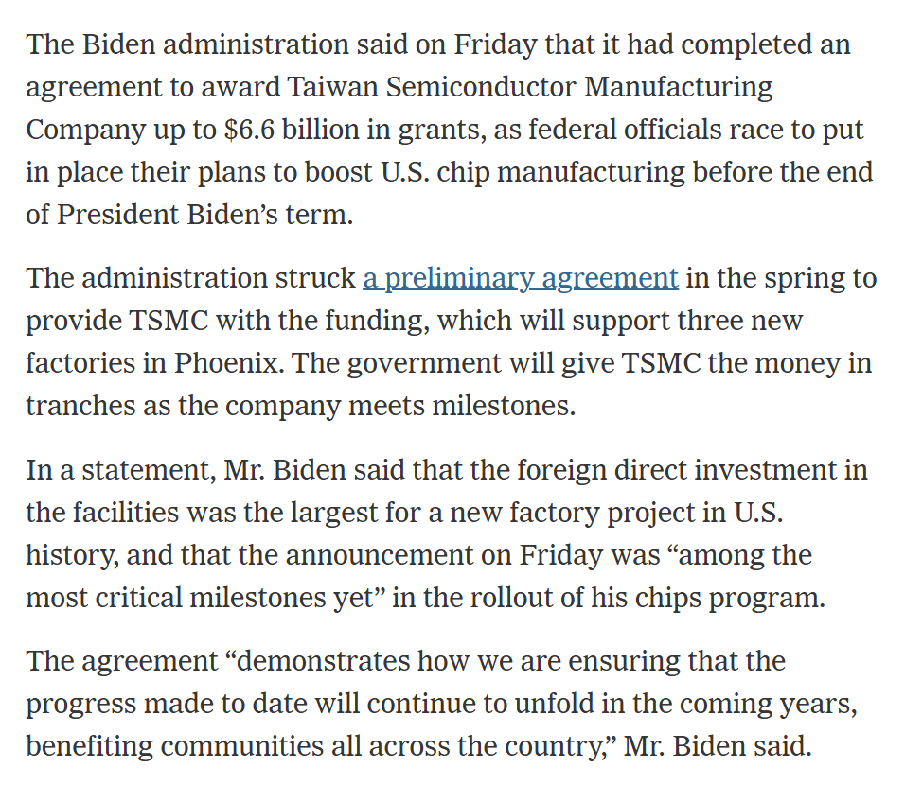
Push to Get Out Chip Grants
NYT (15 Nov 2024)
Notes:
https://www.nytimes.com/2024/11/15/business/economy/tsmc-chips-grant-biden.html

Slide 66
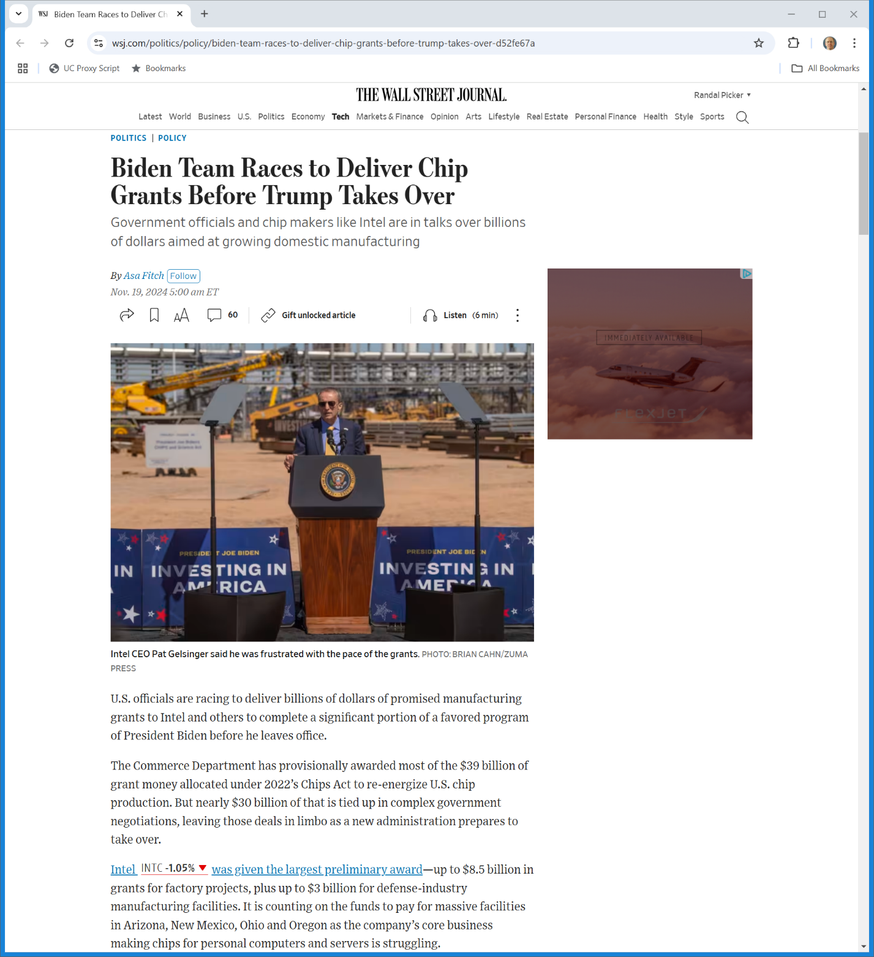
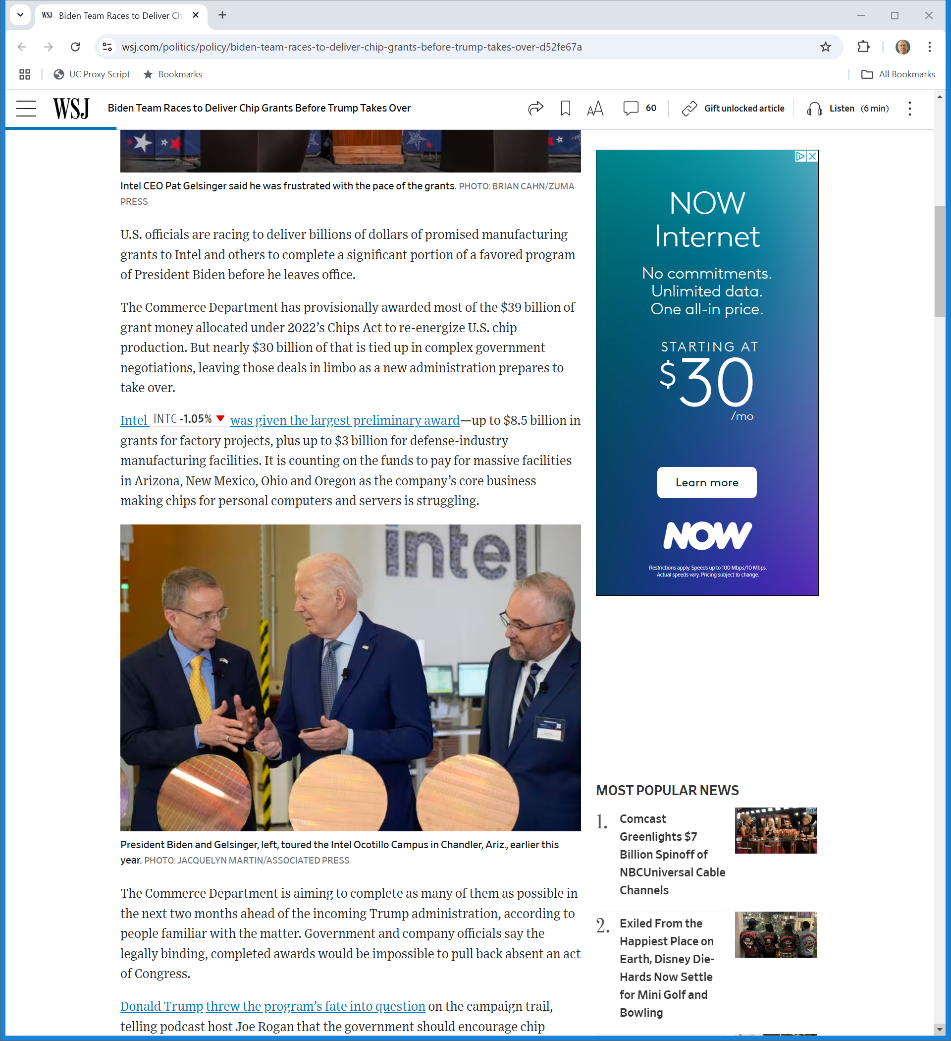
Intel?
WSJ (19 Nov 2024)

Slide 67
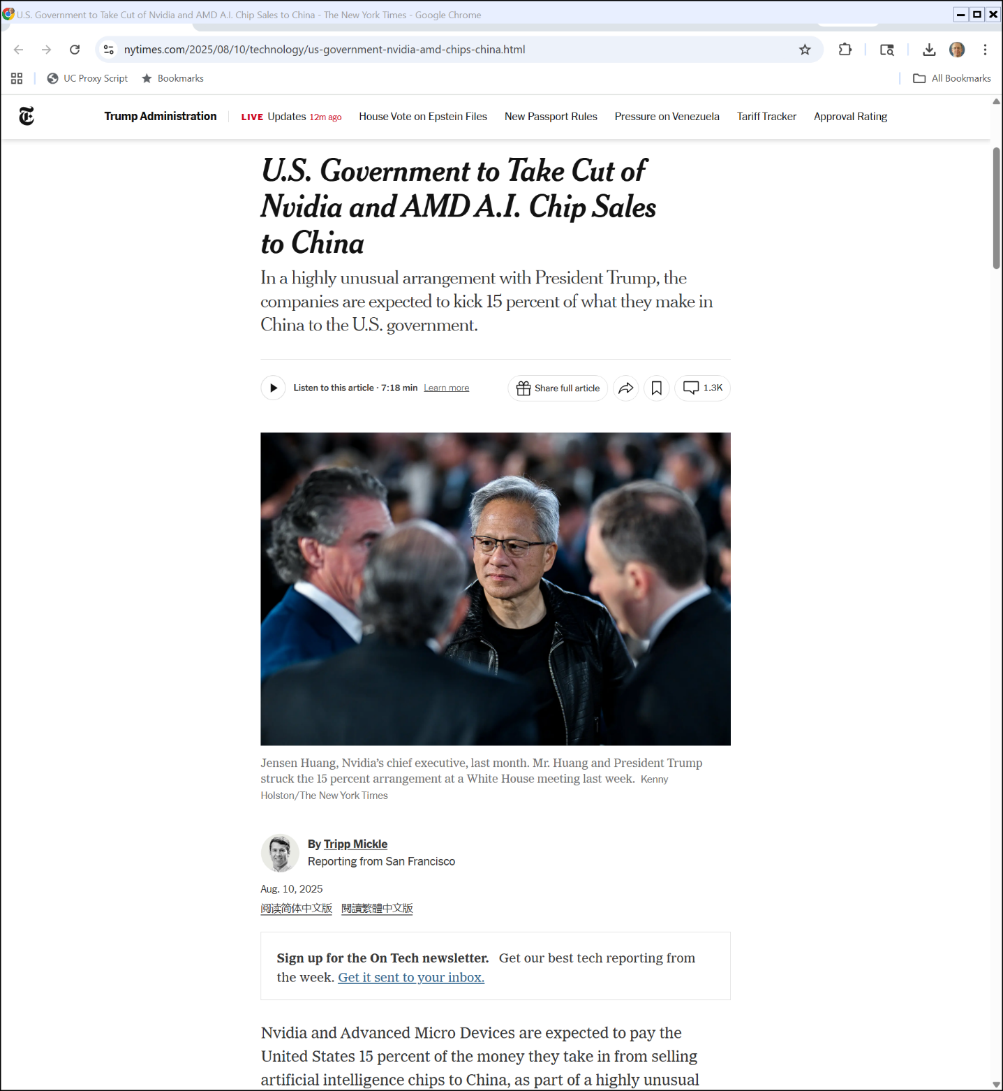
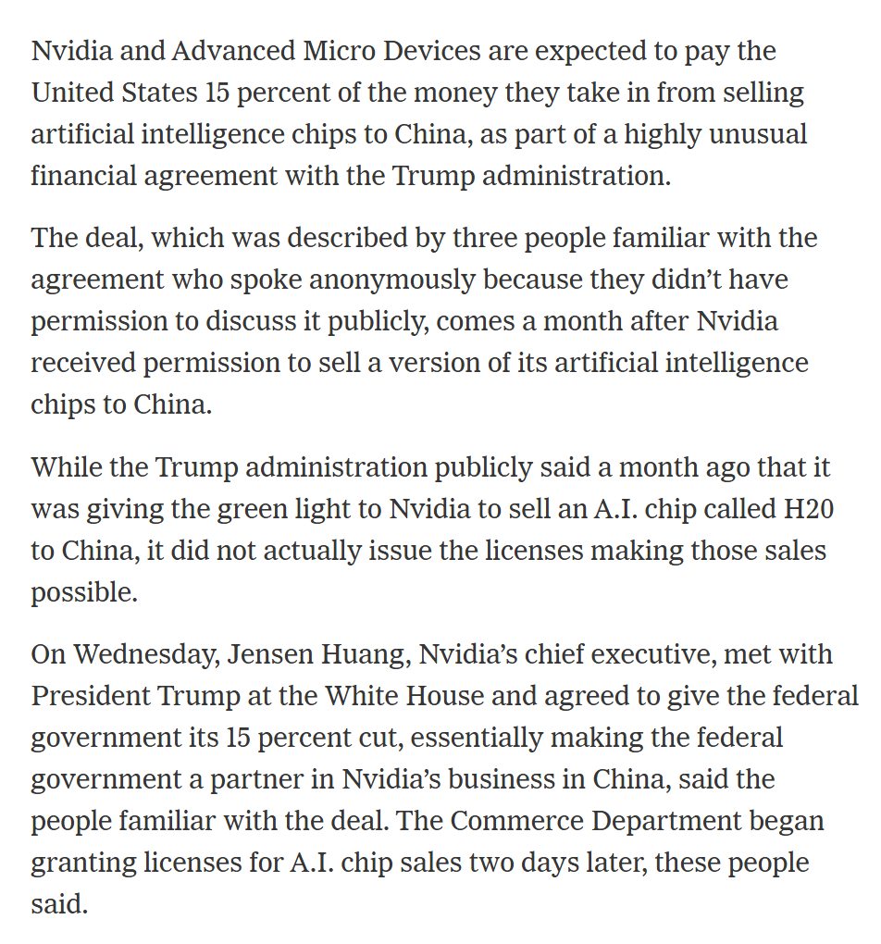
Nvidia/AMD 15% Deal
NYT (10 Aug 2025)

Slide 68
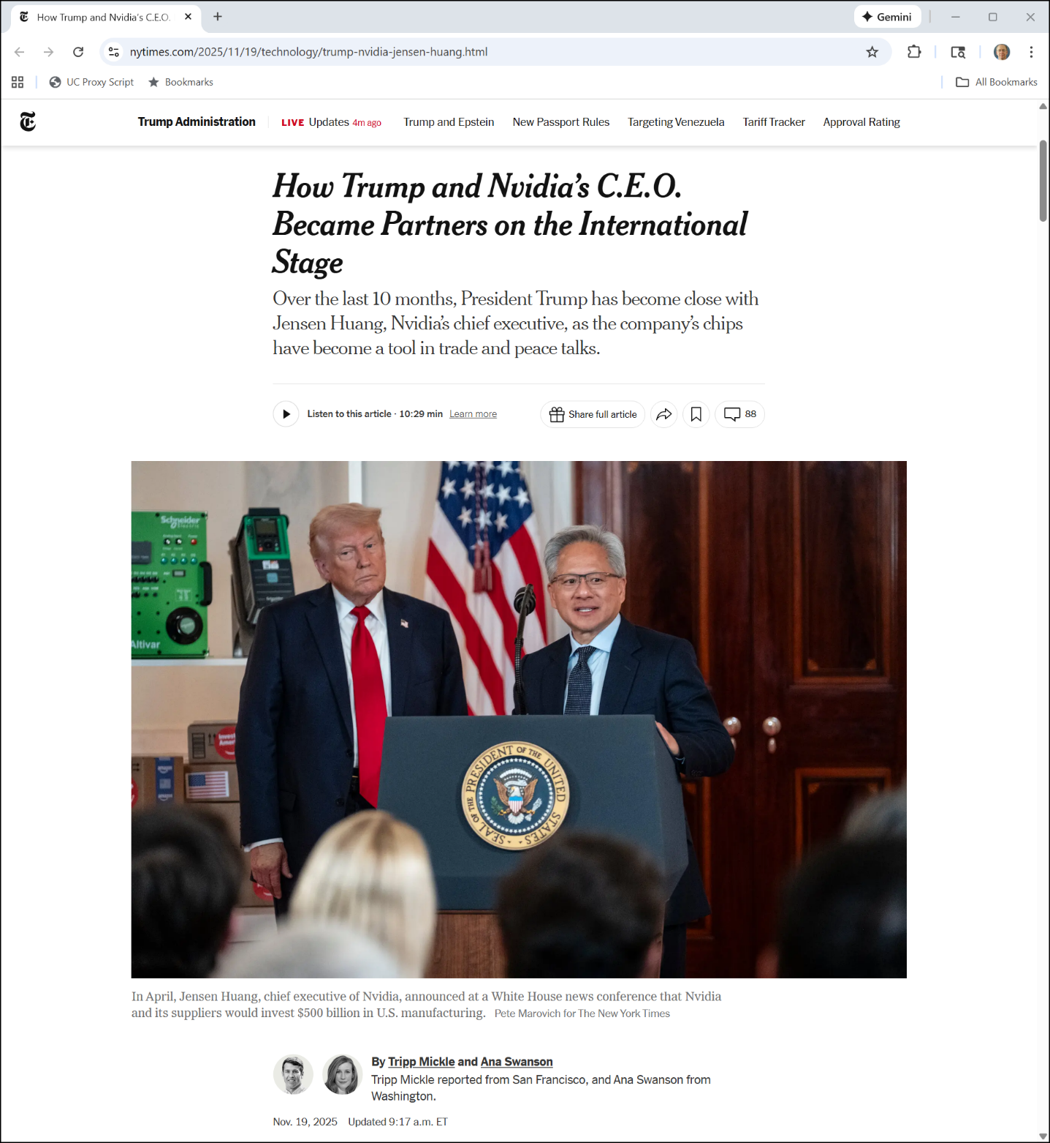
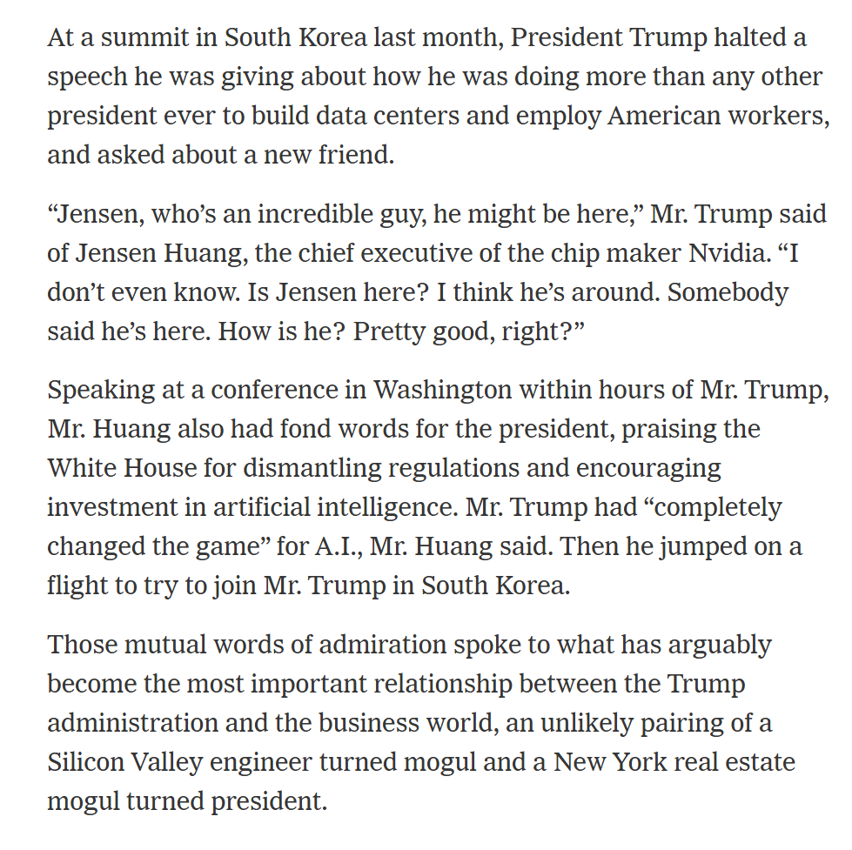
Trump and Huang
NYT (19 Nov 2025)

Slide 69
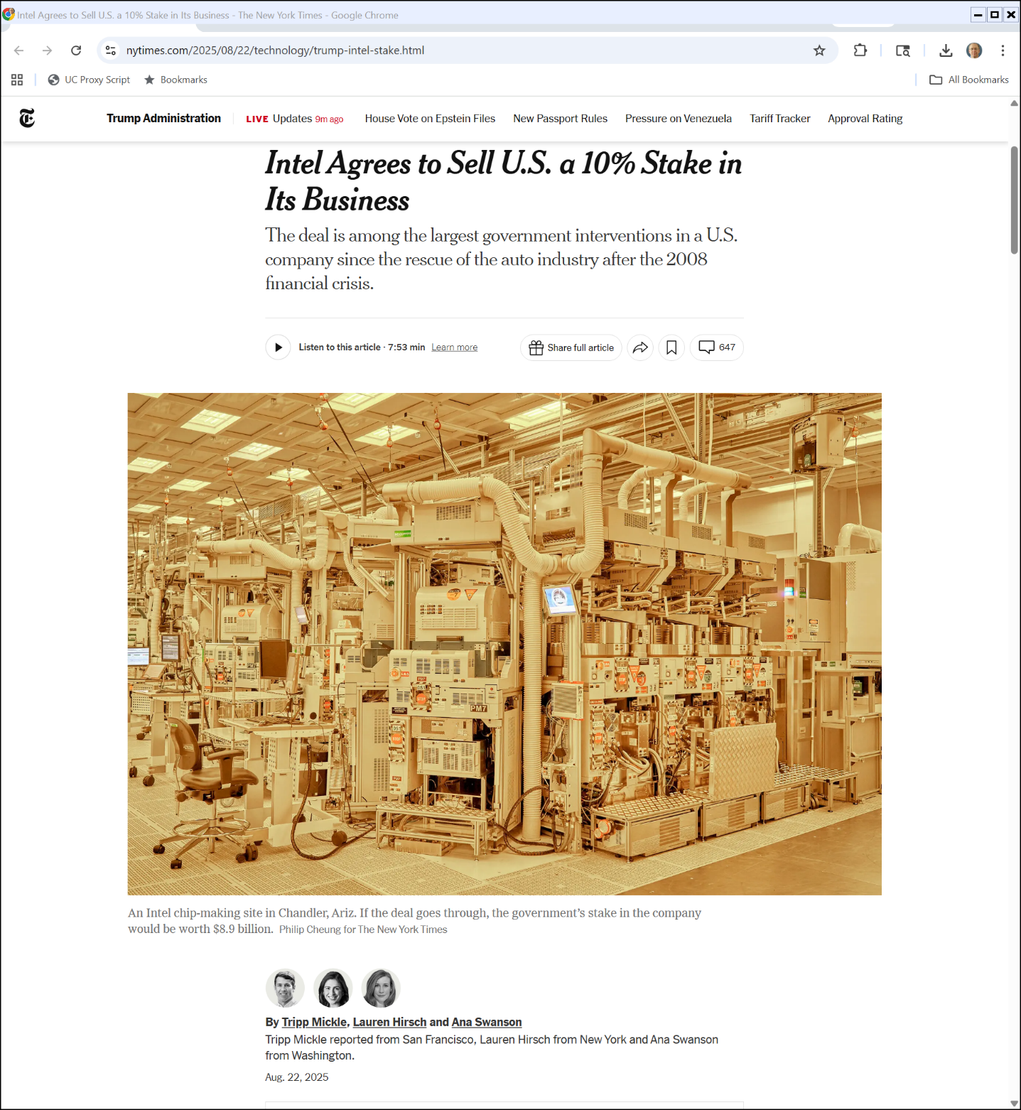
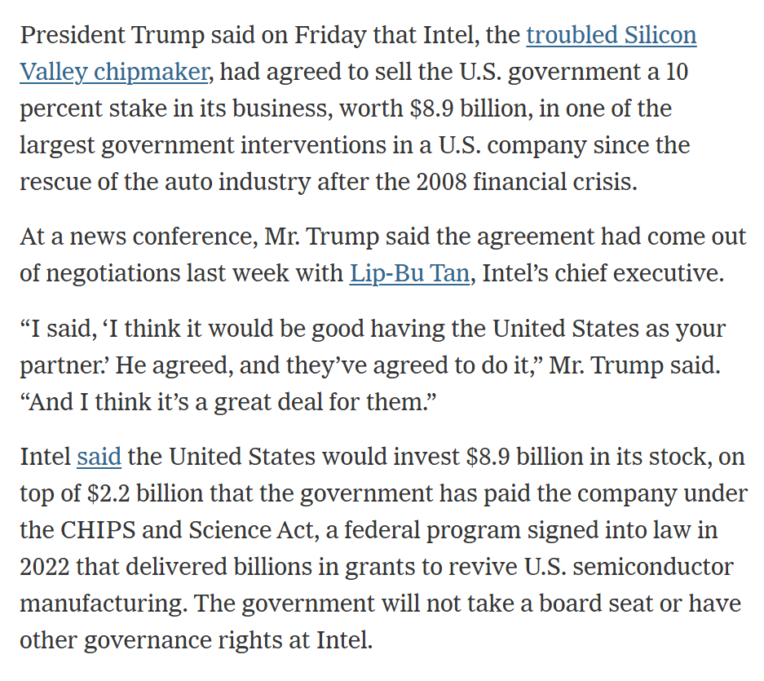
Intel 10% Stake
NYT (22 Aug 2025)
Notes:
https://www.nytimes.com/2025/08/22/technology/trump-intel-stake.html

Slide 70
Spillovers: Which Law?
Spillovers: Which Law Should Matter?

Slide 71
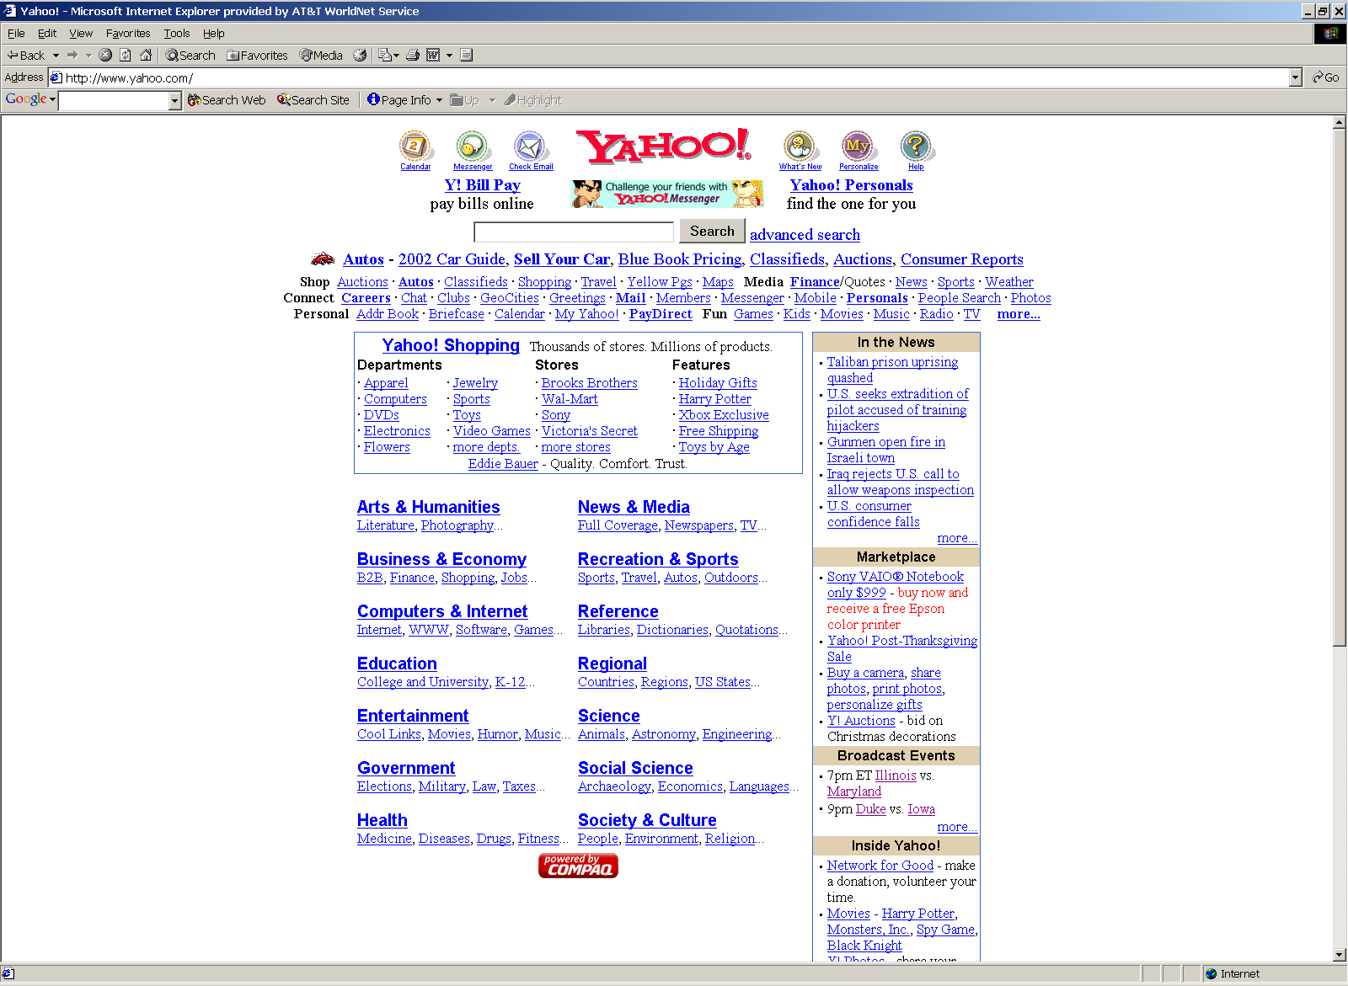
Yahoo US site
Circa 27 Nov 2001?

Slide 72
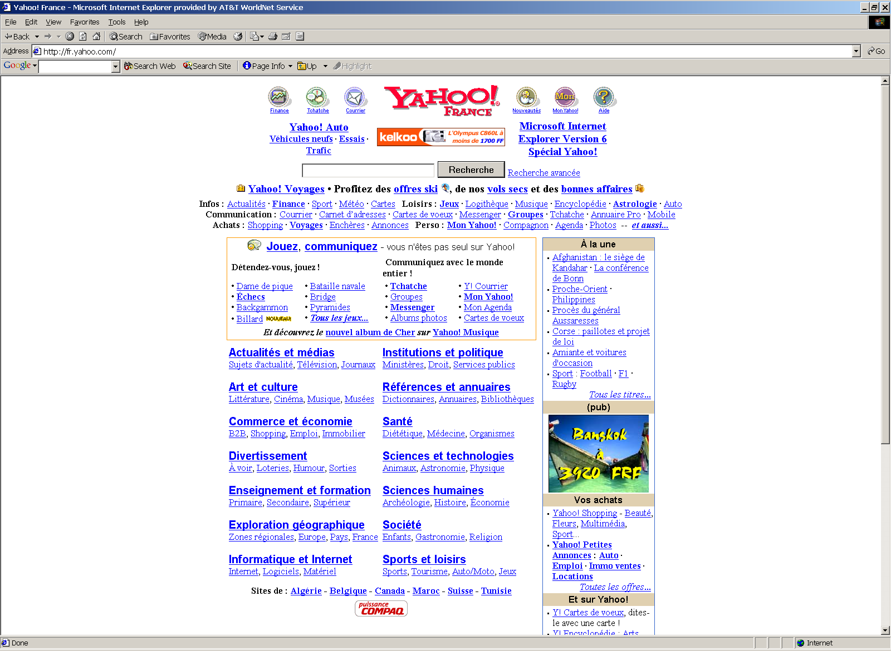
Yahoo France
Date Uncertain

Slide 73
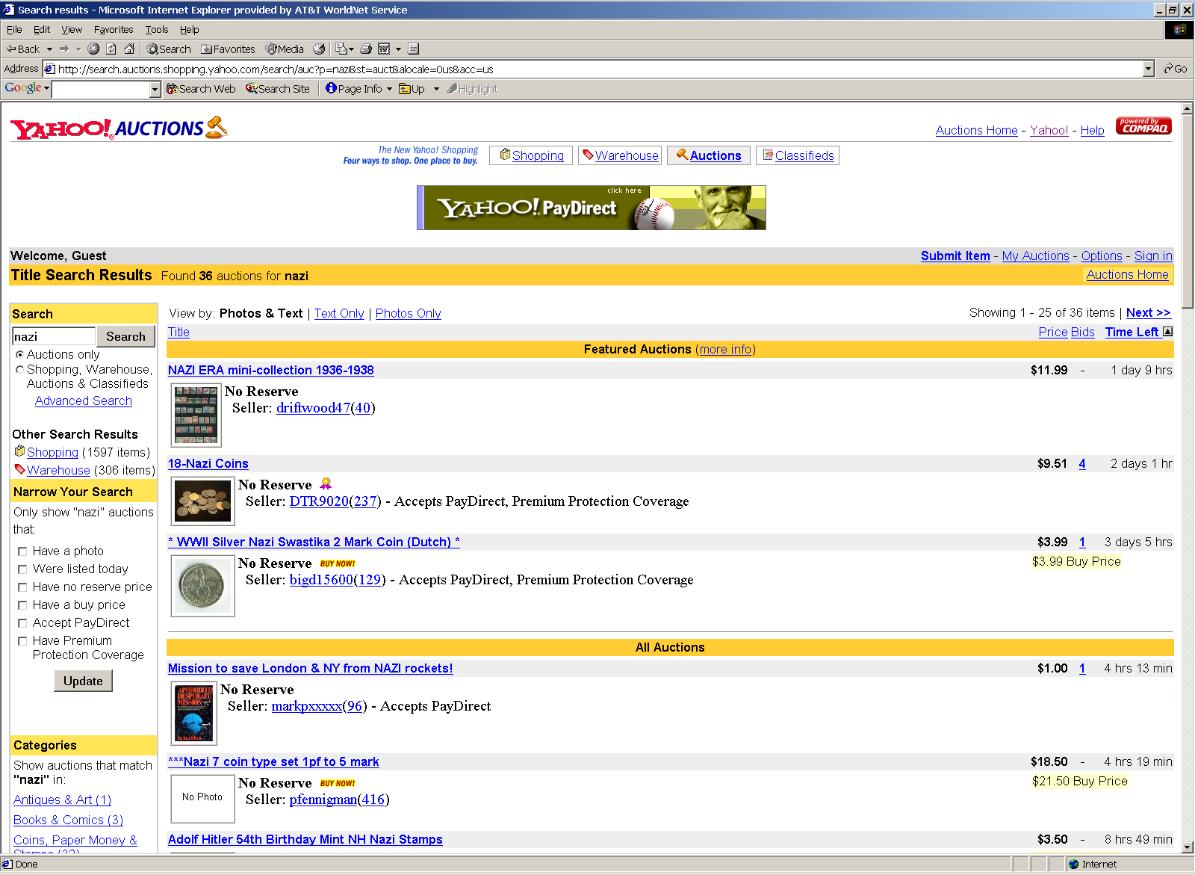
Yahoo Auctions
Date Uncertain

Slide 74
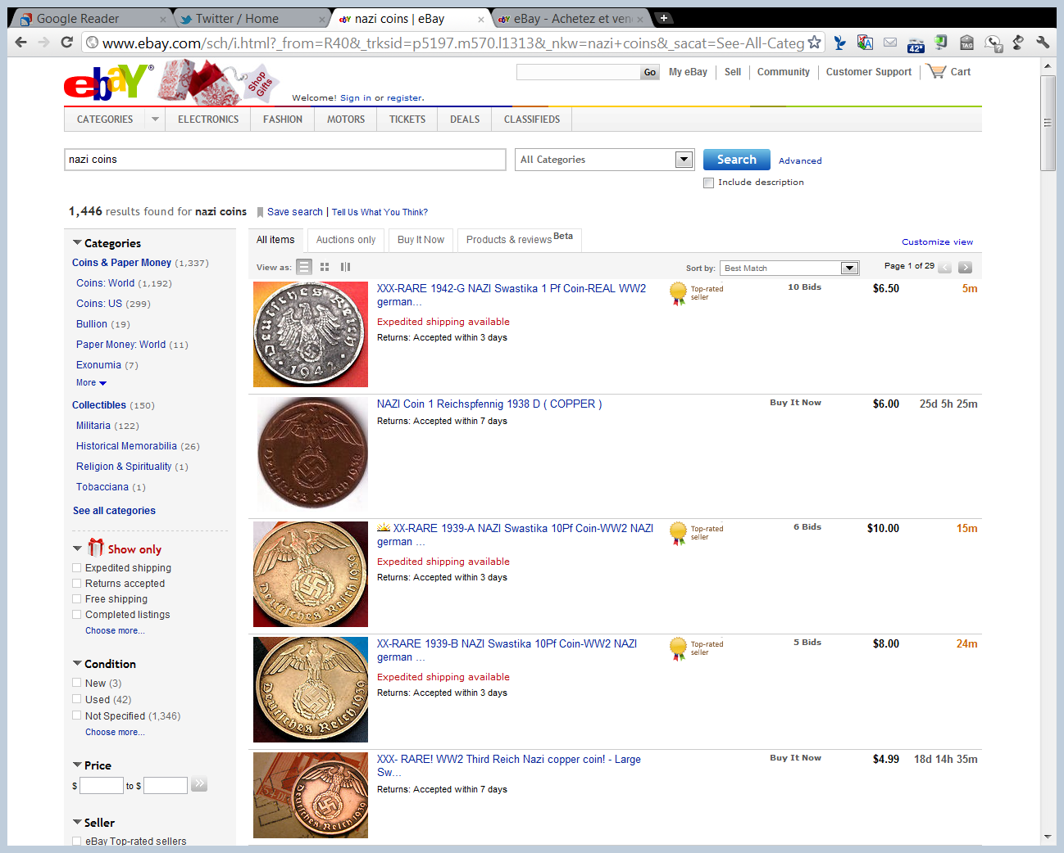
eBay Search
27 Nov 2011

Slide 75
Foreign Money Judgments
UFCMJRA (10 Feb 2006)

Slide 76
Foreign-Country Judgments
UFCMJRA (10 Feb 2006)

Slide 77
Sec. 4(a,b): Shall Recognize; May Not Recognize
UFCMJRA (10 Feb 2006)

Slide 78
Sec. 4(c): Need Not Recognize
UFCMJRA (10 Feb 2006)

Slide 79
Sorting Yahoo
TTYN (1 of 4)
Situation
Yahoo gets sued in France for making Nazi items and certain content available to French citizens in France
The French plaintiffs would like Yahoo to stop
Yahoo has some assets in France, but most of its assets are in the U.S.
How should Yahoo respond to this situation?

Slide 80
Sorting Yahoo
TTYN (2 of 4)
Two Situations
1. Yahoo can offer different websites to different countries: one for the U.S. market and a second for France
2. Yahoo cannot separate markets and must offer the same site to both markets

Slide 81
Sorting Yahoo
TTYN (3 of 4)
Possible Outcomes
Suppose that you defend the lawsuit in France and lose there
The French plaintiffs will likely seek to enforce the French judgment in the U.S.

Slide 82
Sorting Yahoo
TTYN (4 of 4)
Choosing Law
How should we decide which law applies? US law? French law? Both?
What would that mean?
What is at stake here? Are we really concerned about the loss of free speech rights in the US?

Slide 83
Yahoo
433 F.3d 1199 (9th Cir. 2006) (en banc)

Slide 84
Yahoo Loses (But Its Complicated)
Yahoo (9th Cir. 2006)

Slide 85
Dissenting Opinion: Hate Speech Protected under 1A
“Without doubt, the hateful speech the defendants in this case seek to suppress is to be condemned. But censoring speech we find repugnant does not comport with our cherished First Amendment. It is well-settled that a hate speech code which ‘prohibits otherwise permitted speech solely on the basis of the subjects the speech addresses’ is ‘facially unconstitutional.’ R.A.V., 505 U.S. at 381.”
Yahoo (9th Cir. 2006)

Slide 86
Yahoo Stuck Overseas
“Under the majority’s reasoning, a party targeted for enforcement of a foreign judgment restricting its speech in the United States will have no recourse but to appeal to the foreign court, which does not recognize the First Amendment, to try to escape the strictures of the decree—or to demonstrate compliance, either through voluntary action or by submitting to its terms.”
Yahoo (9th Cir. 2006)

Slide 87
Loss to the First Amendment
“Only after enduring the decree’s chilling effects while this process plays out, and then faced with whatever sanction the foreign court may impose for noncompliance, may the doors of the United States District Court be opened. We should not allow a foreign court order to be used as leverage to quash constitutionally protected speech by denying the United States-based target an adjudication of its constitutional rights in federal court.”
Yahoo (9th Cir. 2006)

Slide 88
Yahoo Denied Access to Redress
“By invoking the doctrine of prudential ripeness—notwithstanding having found both personal jurisdiction over the two foreign defendants and a constitutional case or controversy—the majority does just that, denying Yahoo! the only forum in which it can free itself of a facially unconstitutional injunction.”
Yahoo (9th Cir. 2006)

Slide 89
The Internet Spills Over
“Moreover, in doing so the majority creates a new and troubling precedent for U.S.-based Internet service providers who may be confronted with foreign court orders that require them to police the content accessible to Internet users from another country. We therefore respectfully dissent from the majority’s ripeness decision.”
Yahoo (9th Cir. 2006)

Slide 90
24 Sept 2019: EU Court of Justice Google Decision
EU Court of Justice (24 Sept 2019)

Slide 91
Scope of Required Deindexing
EU Court of Justice (24 Sept 2019)

Slide 92
Member States Can Require More
EU Court of Justice (24 Sept 2019)

Slide 93
3 Oct 2019: Next Step: Facebook Removal
EU Court of Justice (3 Oct 2019)

Slide 94
Removal of Defamatory Content on Facebook
EU Court of Justice (3 Oct 2019)

Slide 95
What are FB’s Monitoring Obligations?
EU Court of Justice (3 Oct 2019)

Slide 96
Remove Identical, Equivalent Info and to do so Worldwide
EU Court of Justice (3 Oct 2019)

Slide 97
Spillovers: Overseas Production
Spillovers: Overseas Production and Imports

Slide 98
Unlawful Activities
“(a) Unlawful activities; covered industries; definitions (1) Subject to paragraph (2), the following are unlawful, and when found by the Commission to exist shall be dealt with, in addition to any other provision of law, as provided in this section”
19 USC 1337

Slide 99
Unfairness
“(A) Unfair methods of competition and unfair acts in the importation of articles (other than articles provided for in subparagraphs (B), (C), (D), and (E)) into the United States, or in the sale of such articles by the owner, importer, or consignee, the threat or effect of which is—(i) to destroy or substantially injure an industry in the United States; (ii) to prevent the establishment of such an industry; or (iii) to restrain or monopolize trade and commerce in the United States.”
19 USC 1337

Slide 100
Imports That Violate IP
“(B) The importation into the United States, the sale for importation, or the sale within the United States after importation by the owner, importer, or consignee, of articles that—(i) infringe a valid and enforceable United States patent or a valid and enforceable United States copyright registered under title 17; or (ii) are made, produced, processed, or mined under, or by means of, a process covered by the claims of a valid and enforceable United States patent.”
19 USC 1337

Slide 101
Sorting Tianrui
TTYN (1 of 2)
Situation
Amsted has different processes it uses to produce steel railway wheels. One is superior to the other.
It treats these processes as trade secrets
It is considering licensing the inferior process to a firm in China that in turn would produce wheels for the domestic market in China.

Slide 102
Sorting Tianrui
TTYN (2 of 2)
Questions
What considerations should Amsted have in mind as it considers licensing its trade secret in China?
If there is a trade secret problem, how should it plan on enforcing its rights? In China? In the U.S.? By blocking imports?

Slide 103
Tianrui
661 F.3d 1322 (Fed. Cir. 2011)

Slide 104
Extraterritorial Conduct Within Scope of Act
“We conclude that the Commission has authority to investigate and grant relief based in part on extraterritorial conduct insofar as it is necessary to protect domestic industries from injuries arising out of unfair competition in the domestic marketplace.”
Tianrui (Fed. Cir. 2011)

Slide 105
Trade Secret Theft in China Harms U.S. Industry
“In light of the evidence before the Commission regarding the marketplace for cast steel railway wheels, we affirm the Commission’s determination that the wheel imports threaten to destroy or substantially injure an industry in the United States, in violation of section 337.”
Tianrui (Fed. Cir. 2011)

Slide 106
Spillovers: FCPA
Spillovers: Foreign Corrupt Practices Act

Slide 107
FCPA Legislative History
S. Rep. 95-114 (2 May 1977)

Slide 108
Lots of Overseas Bribes
S. Rep. 95-114 (2 May 1977)

Slide 109
Bribery as a Substitute for Competition
S. Rep. 95-114 (2 May 1977)

Slide 110
A Lack of Confidence
S. Rep. 95-114 (2 May 1977)

Slide 111
Foreign Corrupt Practices Act of 1977
Pub. L. 95-213 (19 Dec 1977)

Slide 112
Foreign Corrupt Practices Act
“(a) Prohibition: It shall be unlawful for any issuer which has a class of securities registered pursuant to section 78l of this title or which is required to file reports under section 78o(d) of this title, or for any officer, director, employee, or agent of such issuer or any stockholder thereof acting on behalf of such issuer,”
15 USC 78dd-1

Slide 113
Corrupt Offers
“to make use of the mails or any means or instrumentality of interstate commerce corruptly in furtherance of an offer, payment, promise to pay, or authorization of the payment of any money, or offer, gift, promise to give, or authorization of the giving of anything of value to—”
15 USC 78dd-1

Slide 114
Illegal Activities
“(1) any foreign official for purposes of—(A) (i) influencing any act or decision of such foreign official in his official capacity, (ii) inducing such foreign official to do or omit to do any act in violation of the lawful duty of such official, or (iii) securing any improper advantage; or”
15 USC 78dd-1

Slide 115
In an Effort to Get Business
“(B) inducing such foreign official to use his influence with a foreign government or instrumentality thereof to affect or influence any act or decision of such government or instrumentality,
in order to assist such issuer in obtaining or retaining business for or with, or directing business to, any person;”
15 USC 78dd-1

Slide 116
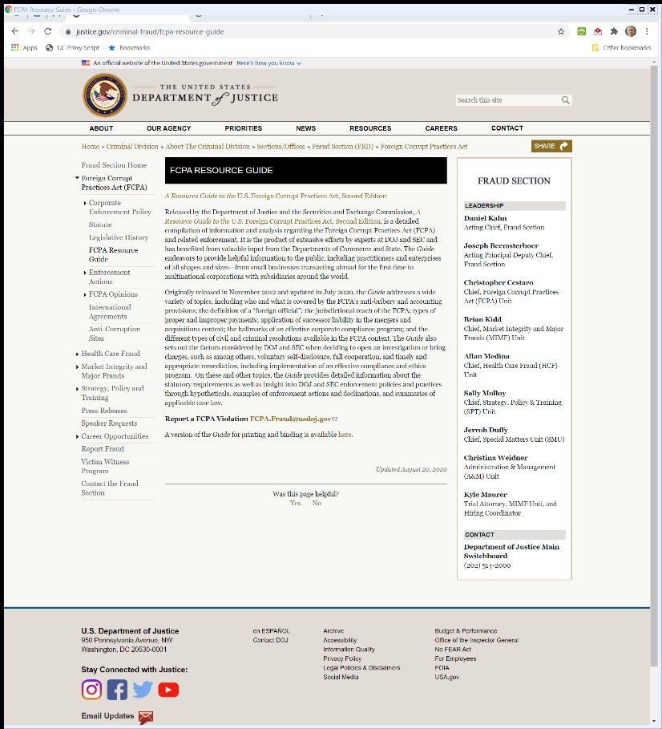
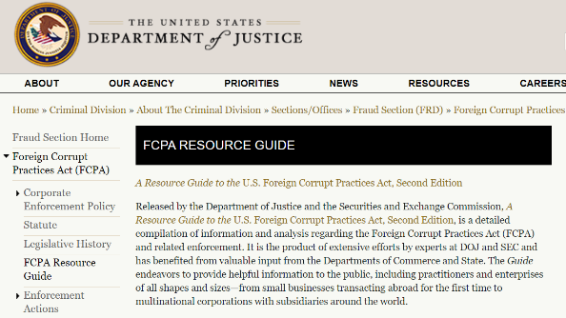
DOJ Guide on FCPA
Justice.gov (20 Aug 2020)
Notes:
https://www.justice.gov/criminal-fraud/fcpa-resource-guide

Slide 117
Joint DOJ/SEC FCPA Guide
FCPA Guide, 2nd Ed. (July 2020)

Slide 118
Point of the Guide
FCPA Guide, 2nd Ed. (July 2020)

Slide 119
What Do Forbidden Bribes Look Like?
FCPA Guide, 2nd Ed. (July 2020)

Slide 120
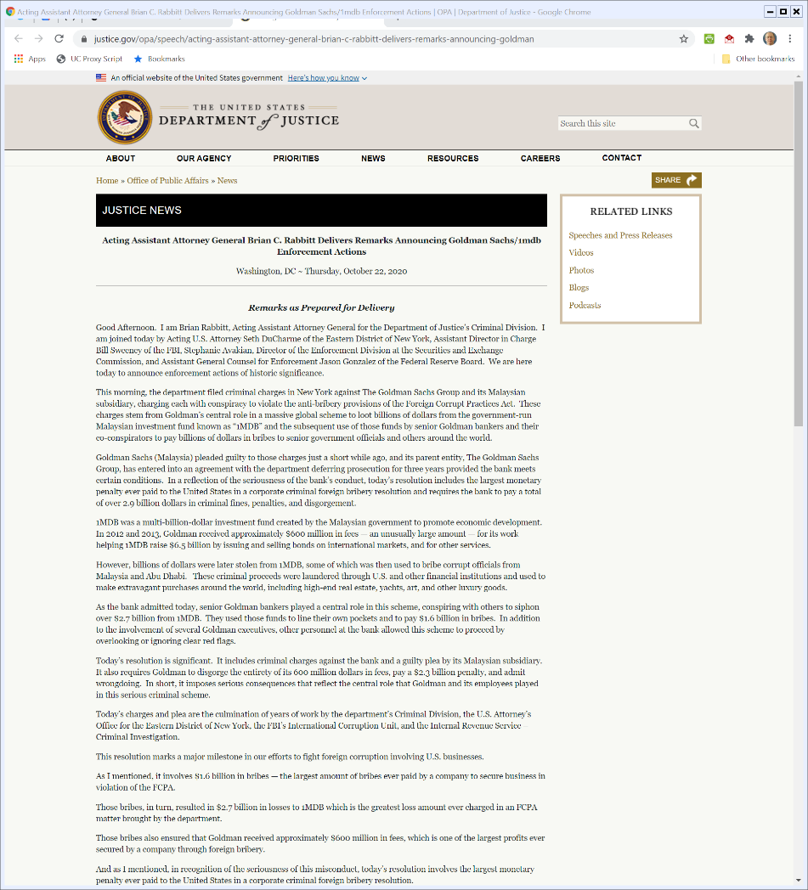
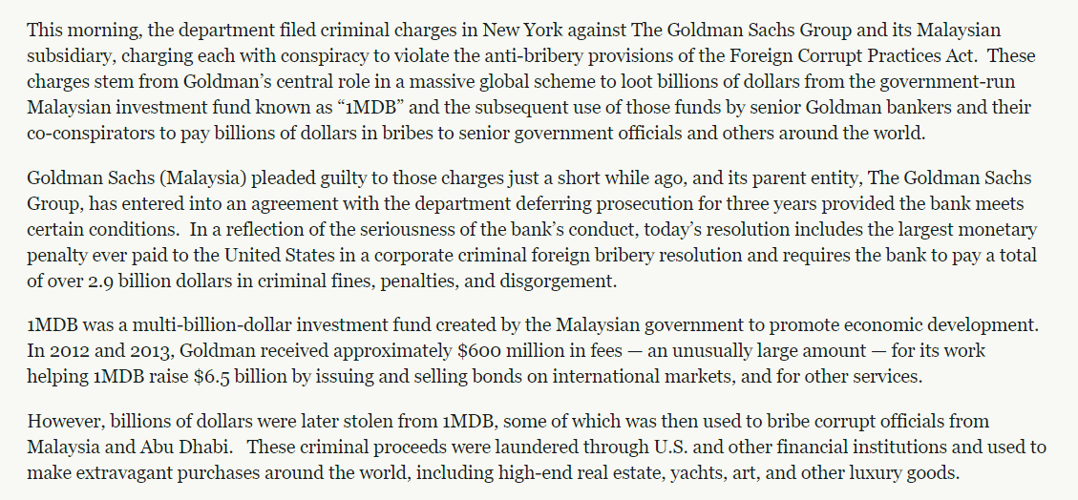
Oct 2020: Goldman Sachs and 1MDB
USDOJ (22 Oct 2020)
Notes:
https://www.justice.gov/opa/speech/acting-assistant-attorney-general-brian-c-rabbitt-delivers-remarks-announcing-goldman

Slide 121
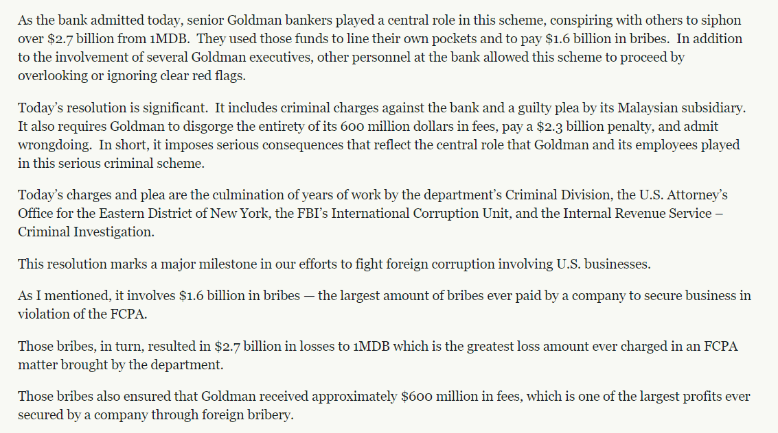
Largest FCPA Bribes Ever
USDOJ (22 Oct 2020)
Notes:
https://www.justice.gov/opa/speech/acting-assistant-attorney-general-brian-c-rabbitt-delivers-remarks-announcing-goldman

Slide 122
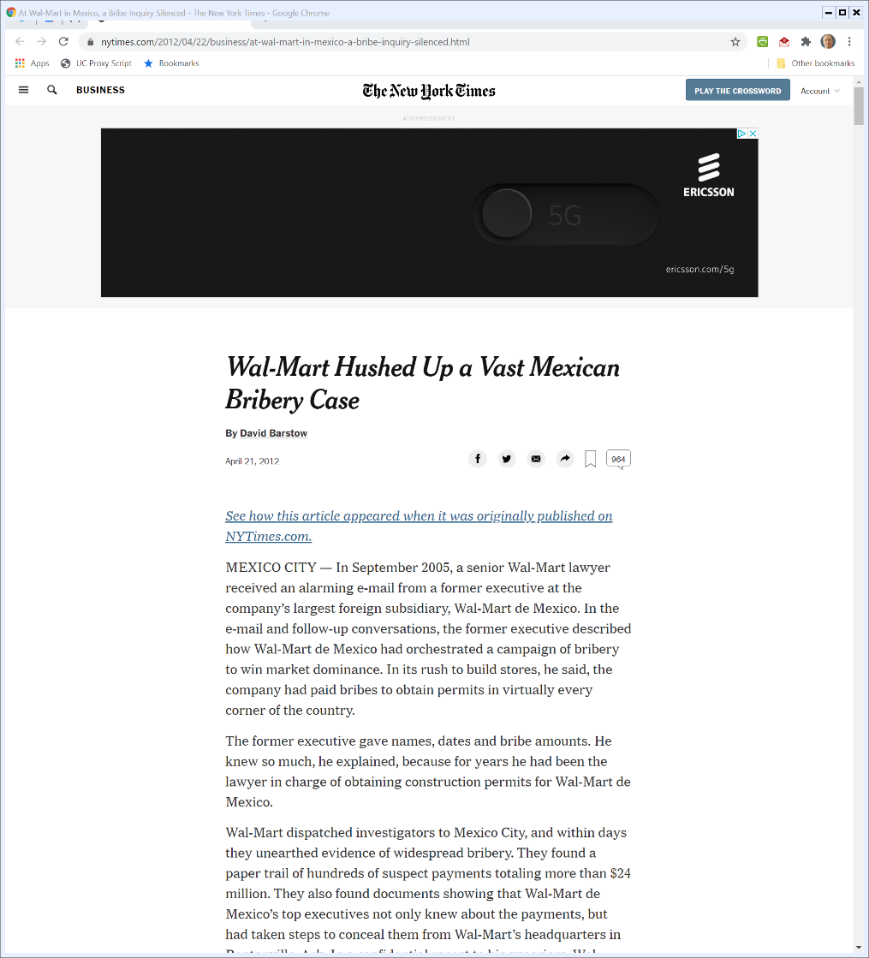
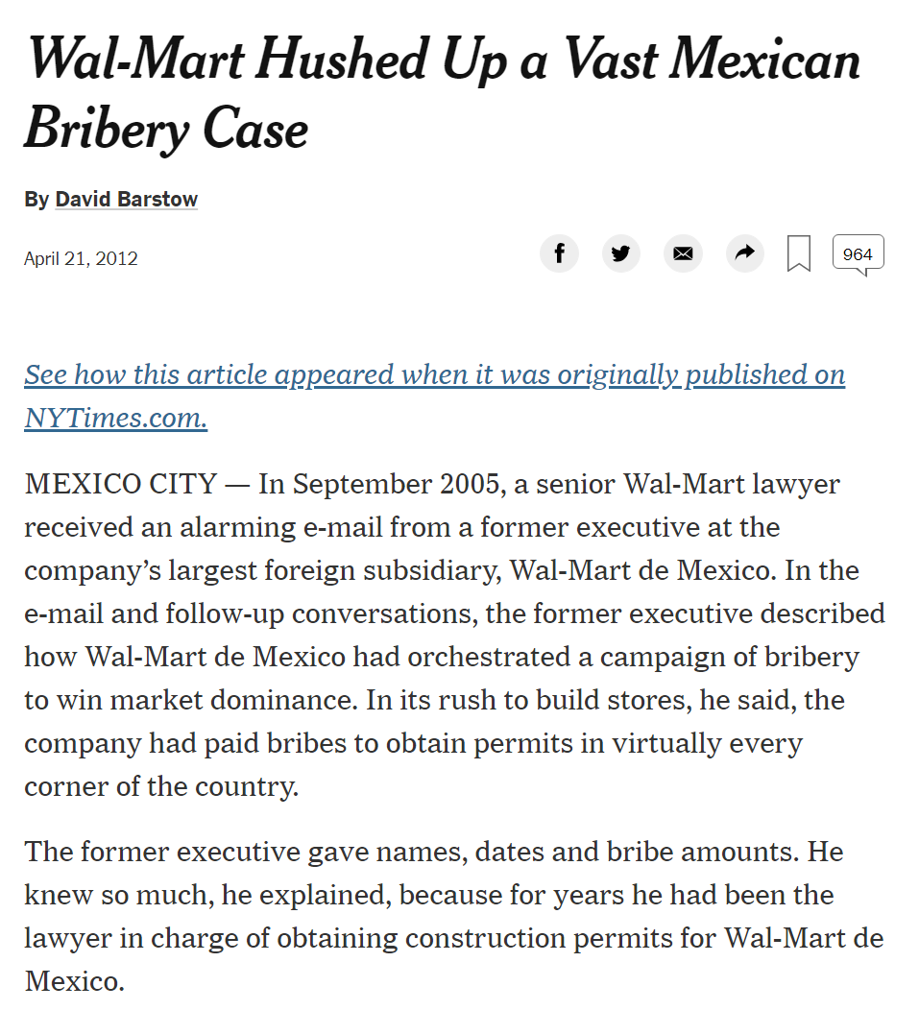
NYT Story on Wal-Mart in Mexico
New York Times (21 Apr 2012)
Notes:
https://www.nytimes.com/2012/04/22/business/at-wal-mart-in-mexico-a-bribe-inquiry-silenced.html

Slide 123
Sorting Walmart
TTYN (1 of 2)
Situation
Walmart wants to build stores in Mexico
Walmart learns that there are a variety of payments that it can make to expedite the process of store approval
How should Walmart assess these possible payments?

Slide 124
Sorting Walmart
TTYN (2 of 2)
Eventually
21 Apr 2012: NYT publishes story:
“Vast Mexico Bribery Case Hushed Up by Wal-Mart After Top-Level Struggle”
How should Walmart respond to the story?

Slide 125
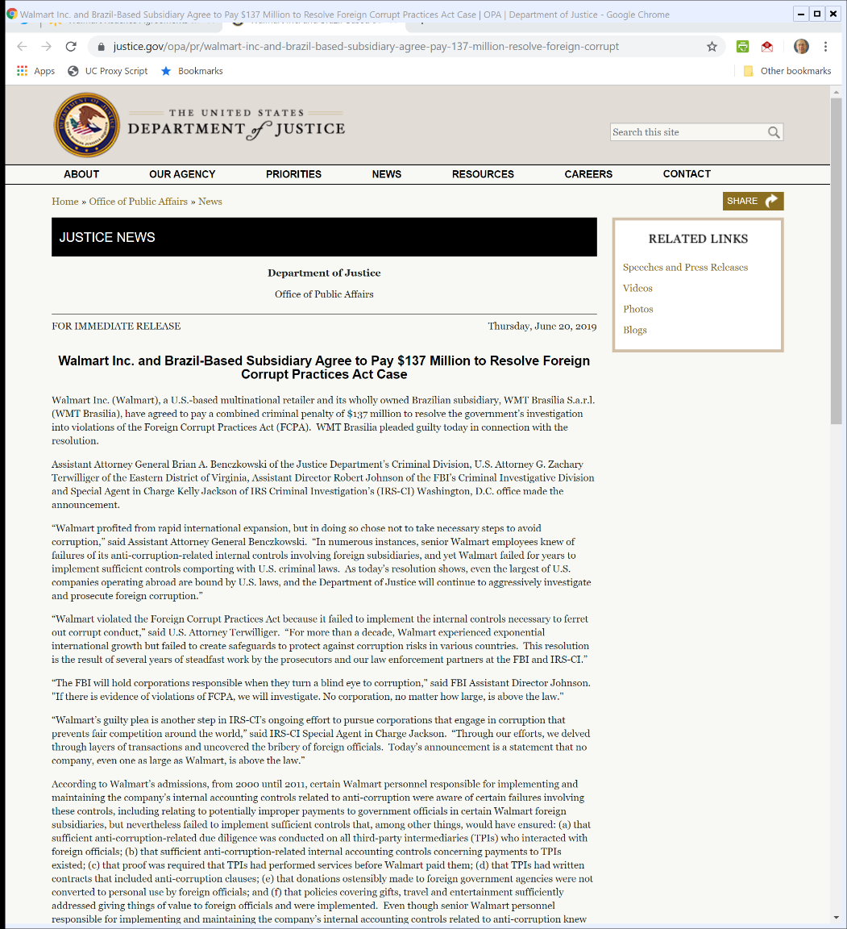

20 June 2019: Walmart Settlement with DOJ
U.S. DOJ (20 June 2019)
Notes:
https://www.justice.gov/opa/pr/walmart-inc-and-brazil-based-subsidiary-agree-pay-137-million-resolve-foreign-corrupt

Slide 126
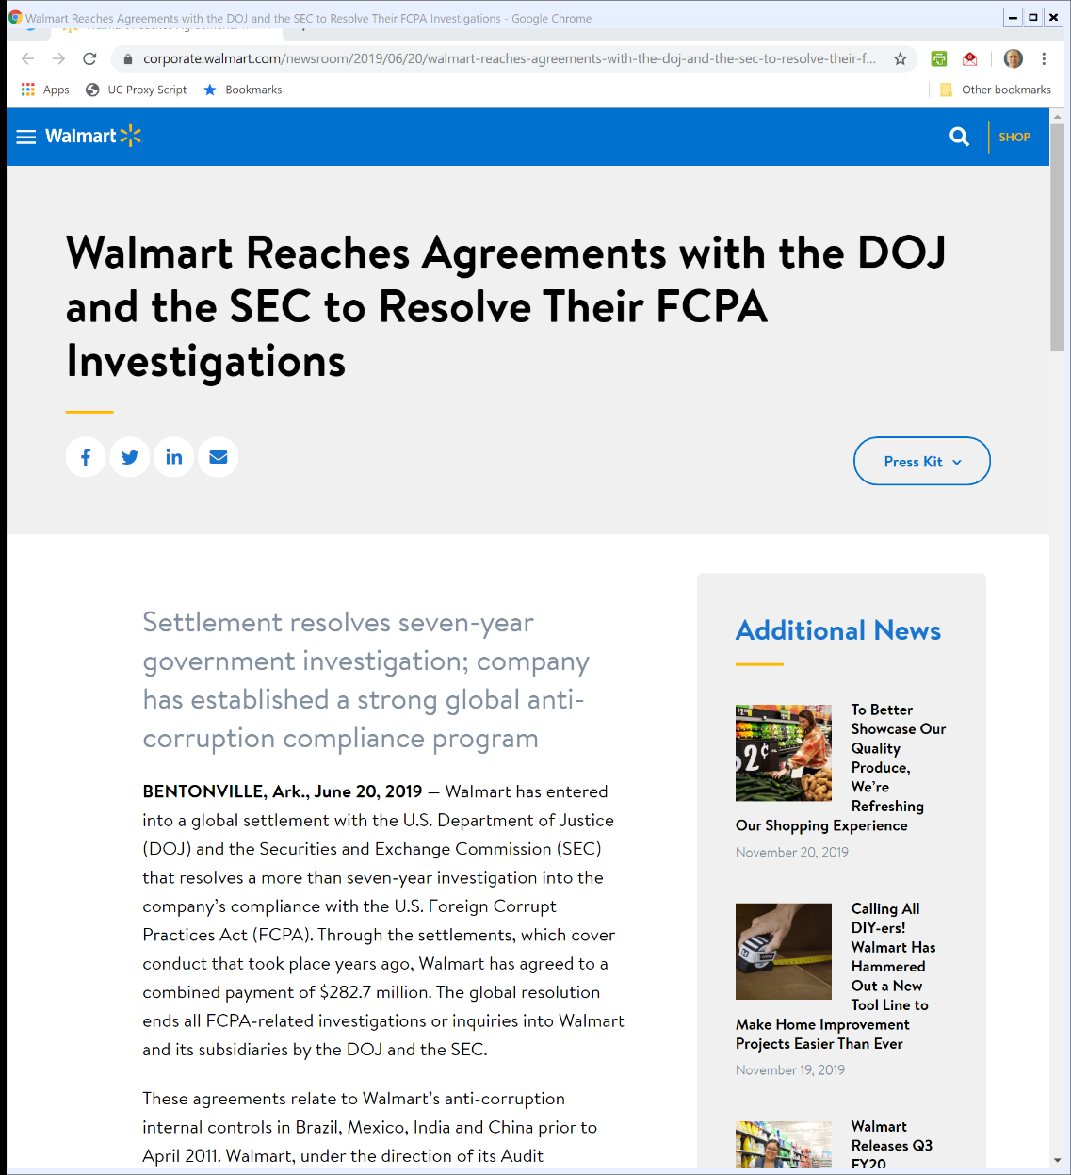
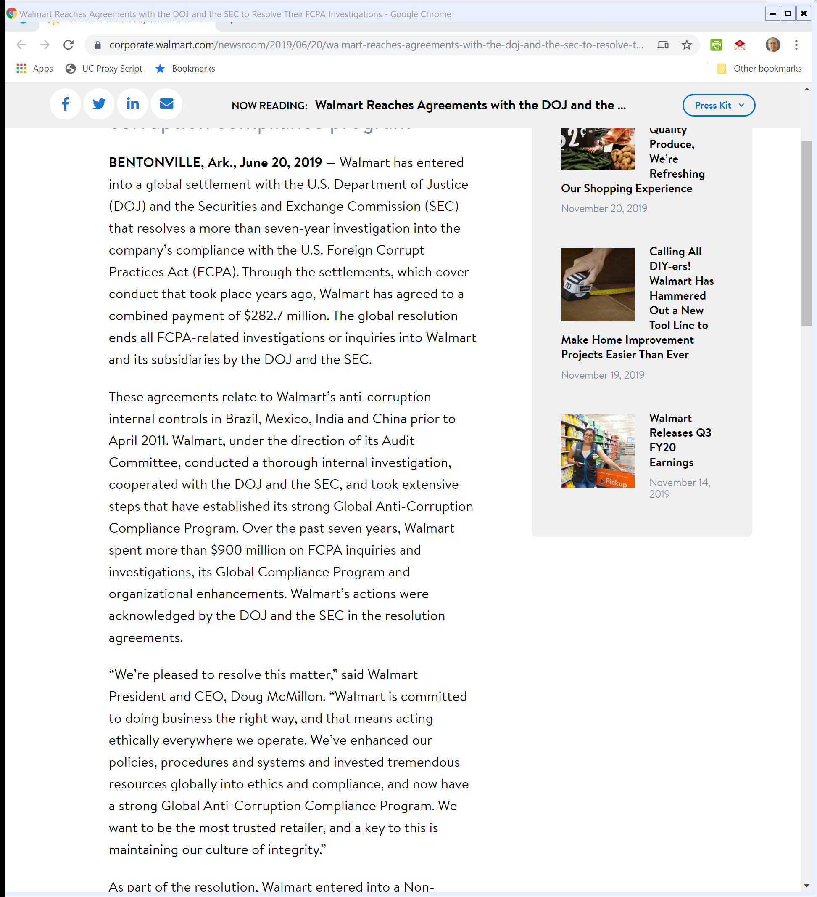
DOJ and SEC Settlements
Walmart (20 June 2019)
Notes:
https://corporate.walmart.com/newsroom/2019/06/20/walmart-reaches-agreements-with-the-doj-and-the-sec-to-resolve-their-fcpa-investigations

Slide 127
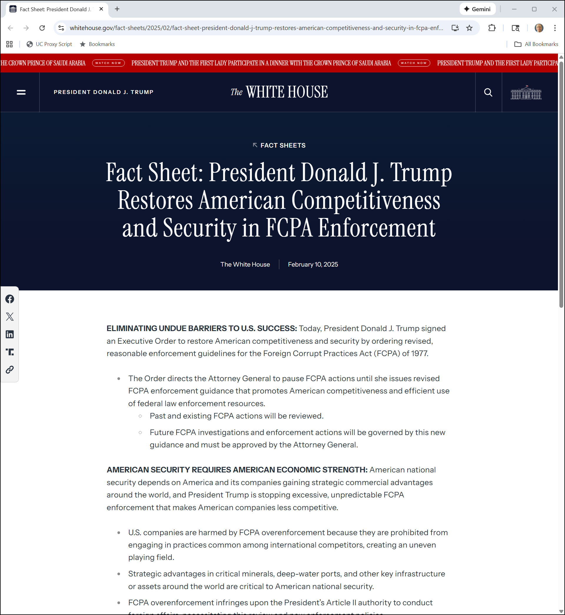
FCPA Enforcement Pause
The White House (10 Feb 2025)

Slide 128
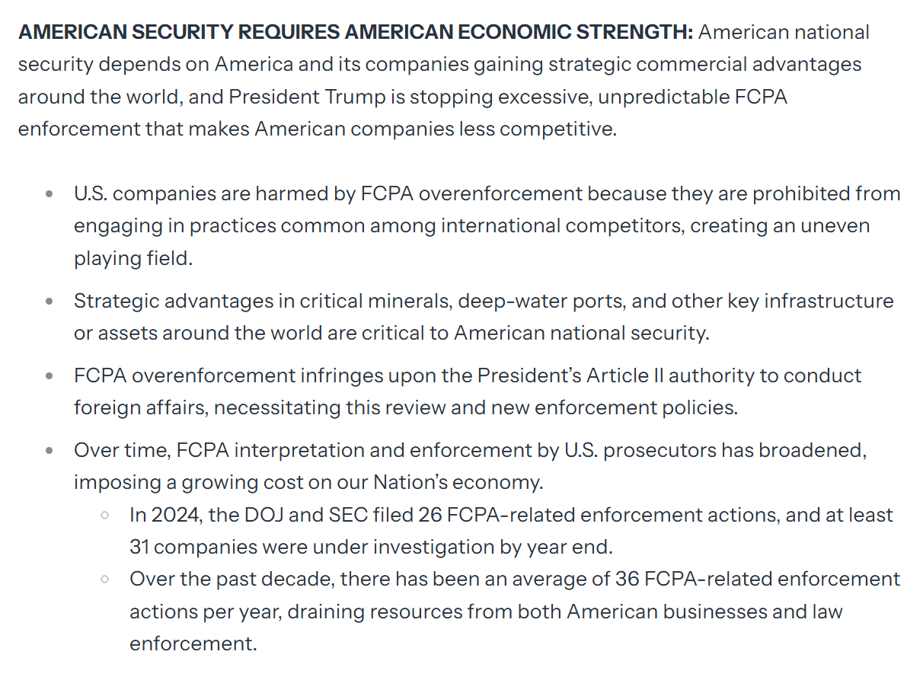
FCPA Enforcement Pause
The White House (10 Feb 2025)

Slide 129
New DOJ Guidance
DOJ FCPA Memo (9 June 2025)

