Slide 1
Class 6: W11/5/2025; S11/8/2025 Booth 42201: The Legal Infrastructure of Business Structuring Transactions, Finance and Bankruptcy
Randal C. Picker
James Parker Hall Distinguished Service Professor of Law
The Law School
The University of Chicago
Copyright © 2002-25 Randal C. Picker. All Rights Reserved.

Slide 2
Capital Structure Theory
Situating Capital Structure

Slide 3
Modigliani-Miller
AER (1958)

Slide 4
Market Value of Firm Independent of Capital Structure
AER (1958)

Slide 5
Said Again
AER (1958)

Slide 6


1990 Econ Nobel
Nobelprize.org
Notes:
https://www.nobelprize.org/prizes/economic-sciences/1990/summary/

Slide 7
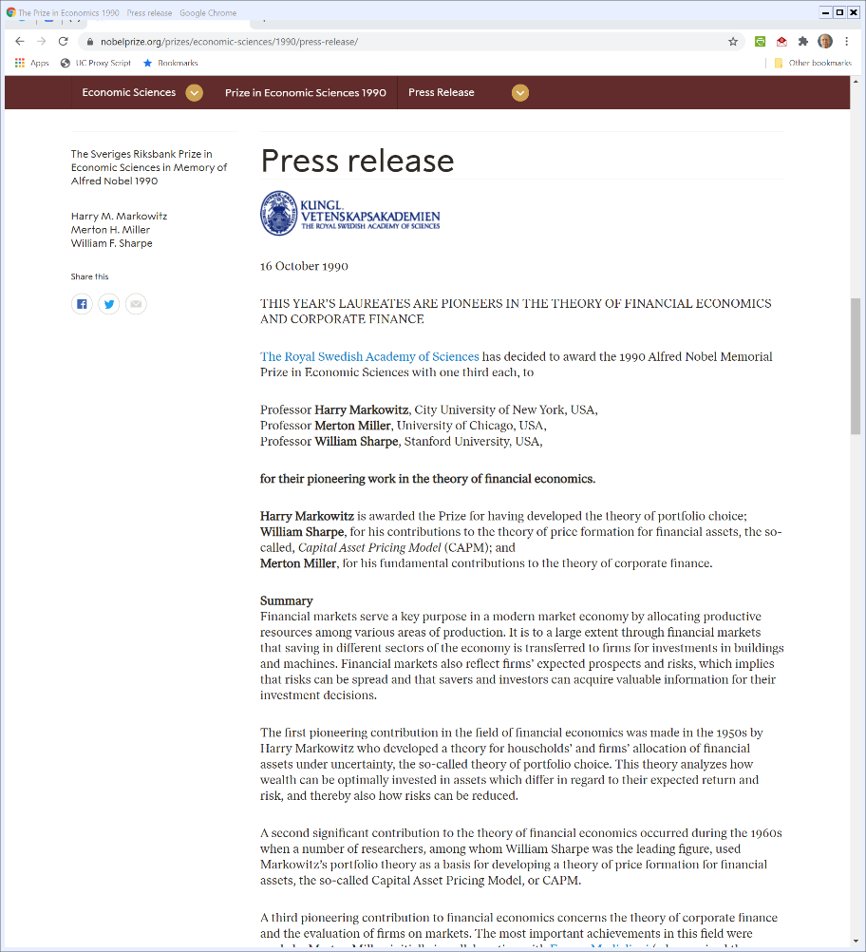
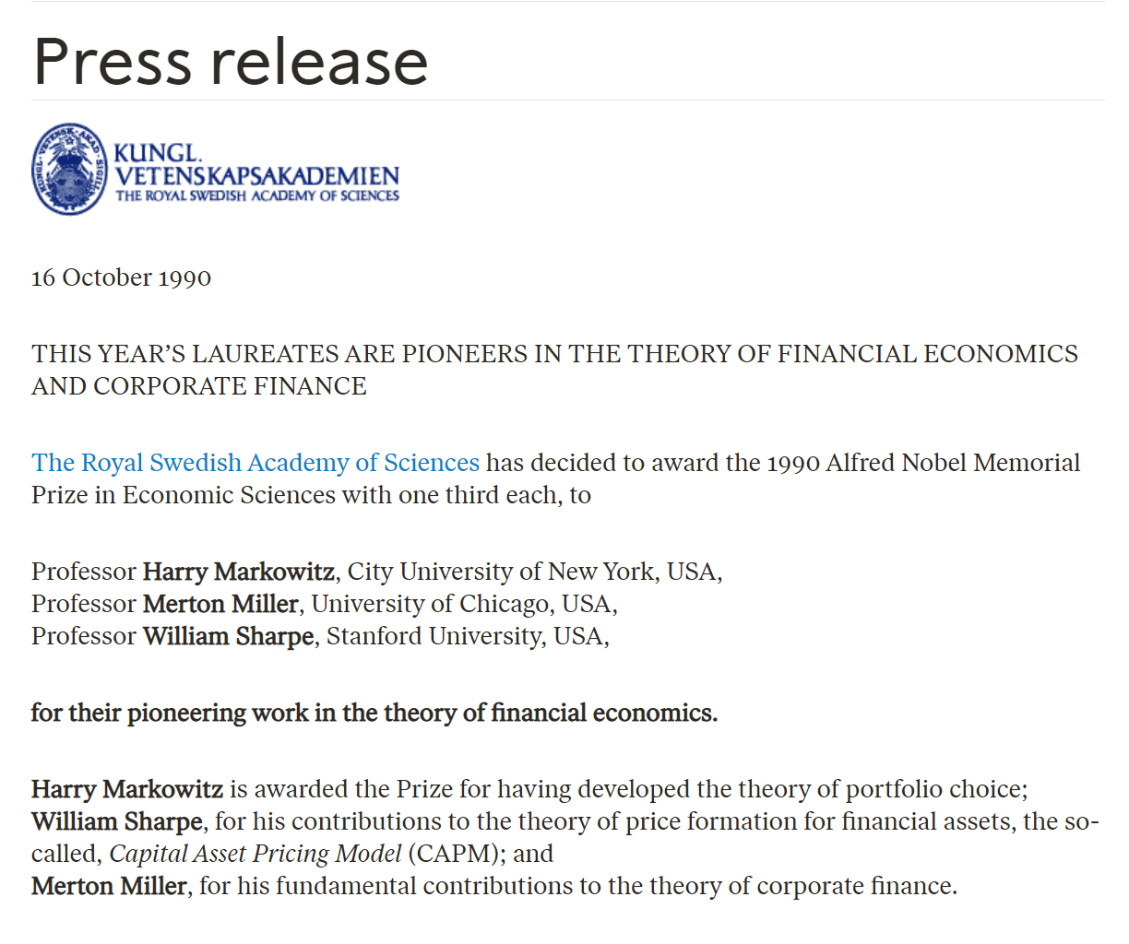
1990 Econ Nobel
Nobelprize.org
Notes:
https://www.nobelprize.org/prizes/economic-sciences/1990/summary/

Slide 8
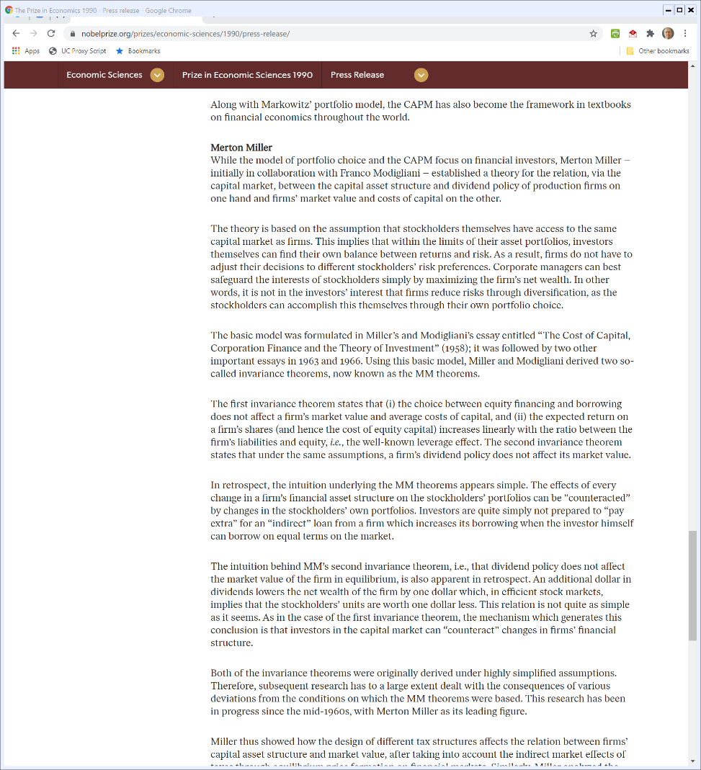
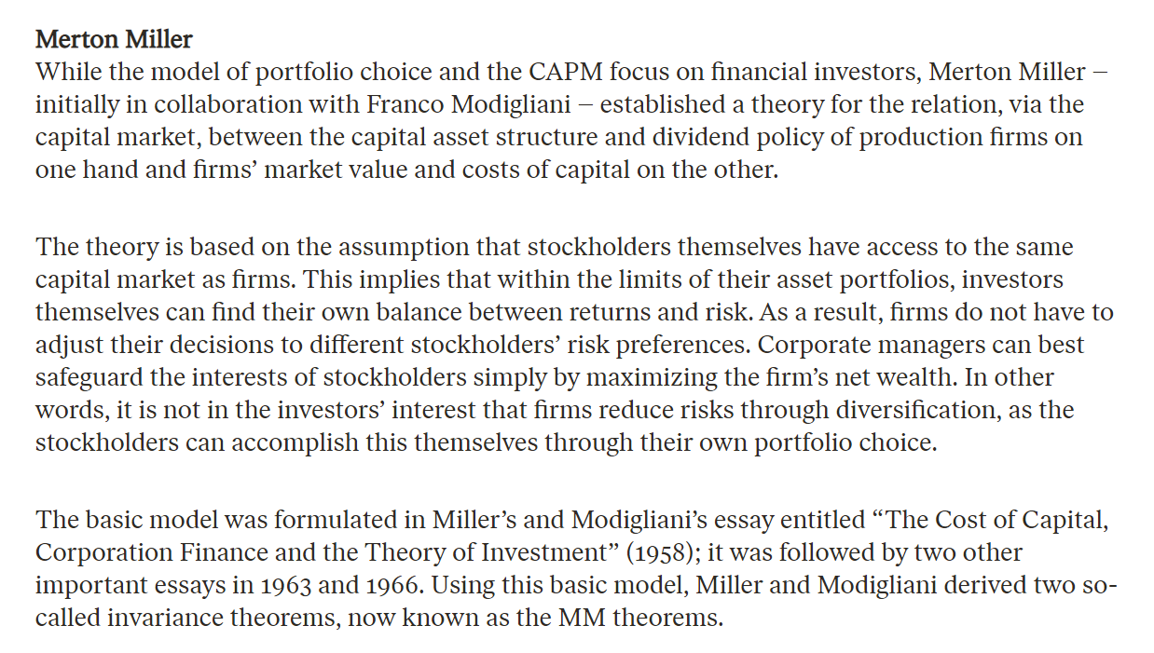
1990 Econ Nobel
Nobelprize.org
Notes:
https://www.nobelprize.org/prizes/economic-sciences/1990/summary/

Slide 9
The Modigliani-Miller Theorem
Yogi Berra and the Pizza
The size of the pie is independent of how many slices it is cut into
Corporate capital structure is irrelevant for the value of the firm

Slide 10
The Irrelevance Theorem
Intuition: Anything You Can Do I Can Do
The key to the theorem is that investors can replicate any debt/equity ratio created by the firm internally by externally creating a portfolio of stock of the pure-equity firm and, say, U.S. government bonds.

Slide 11
The Key Idea
Firm Add Debt? Investors Could Add Debt
If an all-equity firm could create market value by introducing debt into its capital structure—by issuing bonds and using the proceeds to buy back stock, for instance—investors in the firm could have done so by adding bonds to their investment portfolios.

Slide 12
The Key Idea
Match or Offset
Any internal debt move could be matched (or offset) by an external debt move, and so investors should not be willing to pay any premium for internal efforts to create an optimal debt/equity ratio.
Independent Value
The value of the firm is therefore independent of its capital structure.

Slide 13
Hypo: $100 Investment Project
Outcome
Probability
50%
$100
Project Value

Slide 14
Hypo: 2nd Project
Outcome Probability
49%
1%
$100
X
Project Value

Slide 15
Comparing the Projects
Society
Value of curved part of two projects is identical, so a wash
Other parts of the project
Project 1: 50% of time 100 = expected value of 50
Project 2: 49% of time 0 + 1% of time X = .01X
1 vs 2: depends on size of X

Slide 16
Comparing the Projects
Mangers of Firm After $100 Debt Investment to Fund Project Choice
Again, curves are a wash
On Project 1
In the other 50% of the time they get 0 (projects earns $100 and they pay off the debt in full with 0 net)

Slide 17
Comparing the Projects
On Project 2:
49% of time project is complete failure; debt holders get nothing and also true for equity
1% of time debt holders paid in full; equity holders get X – 100
.01*(X – 100) > 0 so equity holders prefer project 2 over project 1 given debt investment

Slide 18
Capital Structure Matters for Project Choice
Society
Project 1 vs. Project 2 depends on the size of X
Equity
Once $100 is in hand and lenders have fixed payment, always prefer project 2
Why Modigliani-Miller is “Wrong”
Capital structure matters: it sets incentives for the use of assets

Slide 19
Debt Priority
Working with Debt Priority

Slide 20
The Key Attributes of Security
Property Rights
The secured creditor has the right to repossess the collateral after default (UCC 9-609)
Also has the right to sell the property (UCC 9-610) or kept it in satisfaction of the debt (UCC 9-620)

Slide 21
The Key Attributes of Security
Priority Rights
The secured creditor has priority over unsecured creditors (UCC 9-201)

Slide 22
Attachment and Perfection of the Security Interest
2: Promises to repay loan
Debtor
1: Lends $
Bank
3: Grants a security interest
in a particular asset
Public
4: Gives notice of
security interest

Slide 23
Article 9 Terminology
Personal Property v. Realty
Note that Article 9 applies only to personal property—for a corporation, inventory, equipment, AR, general intangibles, etc.

Slide 24
Article 9 Terminology
Three Issues
“Attachment” of the Security Interest
Creation of the security interest usually through a written contract
“Perfection” of the Security Interest
Usually by making a public filing with the Secretary of State
The filing is called a “financing statement”
“Priority” of the Security Interest

Slide 25
UCC1 Financing Statement (9-502(a))

Slide 26
The First to File or Perfect Rule: 9-322
SECTION 9‑322. PRIORITIES AMONG CONFLICTING SECURITY INTERESTS IN AND AGRICULTURAL LIENS ON SAME COLLATERAL.
(a) [General priority rules.] Except as otherwise provided in this section, priority among conflicting security interests and agricultural liens in the same collateral is determined according to the following rules:

Slide 27
The First to File or Perfect Rule: 9-322
(1) Conflicting perfected security interests and agricultural liens rank according to priority in time of filing or perfection. Priority dates from the earlier of the time a filing covering the collateral is first made or the security interest or agricultural lien is first perfected, if there is no period thereafter when there is neither filing nor perfection.

Slide 28
Puzzling Through Priority
Puzzling Through Priority

Slide 29
The Reified Priority System
TTYN
Corp
Finco
1/1
SA: EQ
FS: EQ
$10K
2/1
SA: INV
FS: INV
$10K
3/1: $10K Unsecured
Creditco
3/15
INV = $5000
EQ = $15000
Bank
3/15: Who has priority?

Slide 30
Implementing the Reified System
The Key Idea
Priority is not tied only to time in line, but rather to time in line as to particular assets
Having a special property right in one asset, say equipment, creates no special rights in another asset, say, inventory

Slide 31
Implementing the Reified System
Priority Rule
In most situations, the creditor that files the first financing statement for a class of assets will have priority as to those assets. (9-322(a)(1))
This rule matters when creditors have competing security interests in the same assets

Slide 32
Applying this Here
Security Interests
Finco: SI in EQ worth $15K, owed $10K
Bank: SI in INV worth $5K, owed $10K
Finco gets $10K, Bank $5K
What should we do with the other $5K in EQ?

Slide 33
Applying this Here
Unsecured Debts
Finco: $0
Bank: $5K
Creditco: $10K
Assets: $5K in EQ
Fair Division Among Unsecured Creditors
Bankruptcy Code implements pro rata rule in BC 726(b)

Slide 34
The Pro Rata Rule
Three Steps
1: Total the unsecured claims against the assets
2: Total the assets
3: For each creditor, give that creditor the fraction of the assets that that creditor holds of the claims

Slide 35
The Pro Rata Rule
Doing That Here
1: Total Debts: 0 + 5 + 10 = 15
2: Total Assets: 5
3
Bank gets (5/15) x 5 = $1,667
Creditco get (10/15) x 5 = $3,333

Slide 36
Final Distribution
Finco gets $10K
Bank gets $5K + $1,667 = $6,667
Creditco gets $3,333

Slide 37
Subordinated Debt
TTYN
Corp
C2
2/1: $100 USC
Contract between C2 and C3: C2 debt is contractually subordinated to C3 debt
1/1
$100 USC
2/1: $100 USC
C1
C3
3/1: $100 in assets: Who has priority?

Slide 38
Wrong Answer
C1 = C2
Have the same priority
C3 > C2
C3 is senior
This means, C3 > C2 = C1
So give $100K to C3

Slide 39
Right Answer
All three creditors are unsecured; divide pro rata
First round: C1 = C2 = C3 = 33.33K
Second round: C2 is subordinated to C3, so turn over assets
Final answer: C1, 33.33K; C2, 0; C3, 66.67K

Slide 40
Negative Pledges
TTYN
Corp
2/1: $20,000 w/negative pledge
Finco
“Corp promises that it will not grant a security interest in any of its assets”
1/1
$10,000 USC
3/1: SA: All Assets
FS: Same
$30,000
Creditco
Bank
3/1: $40,000 in assets: Who has priority?

Slide 41
Try This
Separate property rights from purely contractual rights
Step 1: Distribute $30,000 to Bank on its security interest

Slide 42
Try This
Step 2: Distribute remaining $10,000 pro rata to Credito and Finco as unsecured creditors ($3,333/$6,667)

Slide 43
Try This
Step 3: Treat the negative pledge as a contractual right of parity between Finco and Bank, so reallocate their funds ($36,667) pro rata ($14,667 to Finco and $22,000 to Bank)

Slide 44
Bankruptcy Basics
Bankruptcy Basics

Slide 45
Bankruptcy Code Overview

Slide 46
Case Commencement
Voluntary Cases
Under Sec. 301, just file petition, no requirement of insolvency
Some limits under Sec. 109
Railroads can’t file Ch. 7, can only file Ch. 11
Domestic insurance companies, banks and S&Ls can’t file at all

Slide 47
Case Commencement
Involuntary Cases under Sec. 303
Takes three unsecured creditors owed at least $[14,425]
Debtor can dispute
Standard to be evaluated
“Is the debtor generally not paying such debtor’s debts as such debts become due?” (303(h)(1))

Slide 48
The DIP and the Trustee
Key Question
Should the prepetition control group remain in control?
If so, debtor in possession under 1101(1), see also 1107 and 1108
If not, trustee under 1104 with duties under 1106
History
Ch X practice: mandatory trustee
Ch XI practice: debtor-in-possession

Slide 49
Consequences of Filing
Three Key Consequences
The Automatic Stay (Sec. 362)
Freezes all actions that creditors can take against the firm
Separation between Pre- and Post-Petition
Most directly through the creation of the bankruptcy estate (Sec. 541)
Extensive Role for Bankruptcy Court

Slide 50
Operating in Chapter 11
Key Questions
Who gets to make decisions?
The apartment project is half completed; the debtor has some cash; should the debtor be able to use the cash to complete the project?
Whose cash is the debtor using?

Slide 51
Operating in Chapter 11
Adequate protection under 361 and 362(d): relief from stay to remove assets from the estate
Use of cash and sales of assets under 363
New money: DIP financing under section 364: again, who bears the risks?

Slide 52
Identifying Prepetition Rights
Who Holds a Claim under Sec. 101(5)?
“(A) right to payment, whether or not such right is reduced to judgment, liquidated, unliquidated, fixed, contingent, matured, unmatured, disputed, undisputed, legal, equitable, secured, or unsecured;”

Slide 53
Plan of Reorganziation
Bankruptcy Plans of Reorganization

Slide 54
Plan Basics
Three Central Steps
Alteration of the Business
Creation of a New Capital Structure
Allocation of the New Rights to Prepetition Creditors

Slide 55
1121: Exclusivity Period
Who may file a plan
(a) The debtor may file a plan with a petition commencing a voluntary case, or at any time in a voluntary case or an involuntary case.
(b) Except as otherwise provided in this section, only the debtor may file a plan until after 120 days after the date of the order for relief under this chapter.

Slide 56
Classification
Why Do We Care About Classes?
Classes of creditors and shareholders vote on the plan
Individuals vote through their classes on the plan, but not directly
Voting Rules (Sec. 1126)
Creditors: at least two-thirds in amount and more than one half in number
Interests: at least two-thirds in amount

Slide 57
Plan Confirmation
Two Key Paths
Consensual Plan (1129(a))
Each class of claims and interests has accepted or is not impaired (1129(a)(8))
Cramdown (1129(b))
Confirmation over the objection of at least one class
At least one impaired class must approve (1129(a)(10))

Slide 58
1129: Best Interest of Creditors
Confirmation of Plan
(a)(7) With respect to each impaired class of claims or interests -
(A) each holder of a claim or interest of such class -
(i) has accepted the plan; or

Slide 59
1129: Best Interest of Creditors
(ii) will receive or retain under the plan on account of such claim or interest property of a value, as of the effective date of the plan, that is not less than the amount that such holder would so receive or retain if the debtor were liquidated under chapter 7 of this title on such date; or

Slide 60
1129: Class Approval
Confirmation of plan (cont.)
(a)(8) With respect to each class of claims or interests -
(A) such class has accepted the plan; or
(B) such class is not impaired under the plan.

Slide 61
1129: Acceptance by Impaired Class of Creditors
Confirmation of plan (cont.)
(a)(cont.)
(10) If a class of claims is impaired under the plan, at least one class of claims that is impaired under the plan has accepted the plan, determined without including any acceptance of the plan by any insider.

Slide 62
Cramdown Under Sec. 1129(b)
As to Impaired Classes that Disapprove
Must not discriminate unfairly
Must be fair and equitable
Fair and equitable includes the requirements of 1129(b)(2), which is absolute priority

Slide 63
1129(b) Cramdown
Key Simplifying Ideas regarding Fair and Equitable
Has the objecting class been paid in full?
If so, move on to next class below it
If not, can’t give money to classes below it
But language matters (see 203 N. LaSalle)

Slide 64
Absolute Priority
Absolute Priority and Cramdown

Slide 65
203 N. LaSalle
Organizing Our Thinking
How should the assets of the firm be used?
What does the pre-petition capital structure look like?
What capital structure going forward will the debtor’s business support?

Slide 66
Use of the Firm’s Assets
Key Asset
15 floors in downtown Chicago office building
This is a single-asset real estate case (SARE)
Likely Use Going Forward
15 floors in downtown Chicago office building
Fight about tenants etc. but small stuff

Slide 67
The Pre-Petition Capital Structure
Bank of America
$93 million nonrecourse loan
Space is worth $54.5 million
Treat BoA as having secured loan for $54.5 million and unsecured loan for $38.5 million
Trade Creditors
Originally: $160K
After purchases: $90K outsiders, $70K insiders
Equity: Limited Partnership

Slide 68
The Proposed Plan
Class 1: BoA Secured Claim
Pay $1,149,500 in cash now, pay balance in 7 to 10 years under secured note
Class 2A: BoA Unsecured Claim
Based on sale or refinancing in 10 years, pay $19 million, or 15% of PV
Class 2B: General Unsecured Creditors
Pay principal but not interest in full

Slide 69
The Proposed Plan
Class 3: Equity
???
Some of the partnership interests would contribute $6.125 million over 5 years in exchange for partnership interests
Tax consequence: preserves tax shelter

Slide 70
Approval of the Plan
TTYN (1 of 2)
Votes
BoA opposes
General Unsecureds favor
Equity favors
Be B of A. How do they understand their situation? What should they have done differently?

Slide 71
Approval of the Plan
TTYN (2 of 2)
Switch: Is this plan confirmable under 1129(a)?

Slide 72
Is the Plan Confirmable in 203 N. LaSalle
Class Approval Under 1129(a)(8)
Classes 1 and 2A oppose
Class 2B approves
Class 3, according to proponent view, would be deemed to oppose
1129(a)(8) not satisfied
Mean cannot confirm under 1129(a)

Slide 73
Confirmable Under 1129(b)?
Need Impaired Class to Say Yes (1129(a)(10))
General unsecured impaired as not getting interest payments
Said yes, so plan can move on to 1129(b) cramdown
How should we assess this?

Slide 74
Answer
Key Question
What role does creditor consent play in this process?
Can unsecured consents for BoA?
Classification Issue
Had unsecured claims of BoA and generals been put together, class would vote against
Could not satisfy 1129(a)(10), so no cramdown possible

Slide 75
Cramdown Under 1129(b)
The Absolute Priority Rule
General idea that higher levels in capital structure are entitled to full payment before junior levels
New Value “Exception”
Cases seem to support some sort of idea that juniors can make new investments to get/retain equity even if seniors not paid in full

Slide 76
Reading 1129(b)
Secured Claims
Present value of payments promised must be in amount of secured claim (here $54.5 million)
Unsecured Claims
Pay in full, or,
Juniors must “not receive or retain under the plan on account of such junior claim or interest any property”

Slide 77
Chrysler
Chrysler

Slide 78
Can You Put Cars under the TARP?
Definition of Financial Institution in TARP
(5) FINANCIAL INSTITUTION.-The term ‘‘financial institution’’ means any institution, including, but not limited to, any bank, savings association, credit union, security broker or dealer, or insurance company, established and regulated under the laws of the United States or any State, territory, or possession of the United States, the District of Columbia, Commonwealth of Puerto Rico, Commonwealth of Northern Mariana Islands, Guam, American Samoa or the United States Virgin Islands, and having significant operations in the United States,

Slide 79
Can You Put Cars under the TARP?
but excluding any central bank of, or institution owned by, a foreign government.

Slide 80
Timeline
Key Dates
April 30, 2009: Chapter 11 case filed
June 1, 2009: Sale Order approved in bankruptcy court
June 2, 2009: Order stayed by 2nd Circuit and direct appeal—skipping district court—to 2nd Circuit allowed
June 5, 2009: 2nd Circuit affirms approval
June 10, 2009: Sale closed

Slide 81
Structure of the Deal
Key Features
Transfer of many assets of Old Chrysler to new entity, New Chrysler
Payment by New Chrysler of $2 billion in cash
Technology, asset and management contribution by Fiat
Assumption by New Chrysler of modified labor agreements and some dealer agreements

Slide 82
Structure of the Deal
New financing by US Gov’t and Export Development Canada
$6 billion in senior secured financing
$5 billion in debtor-in-possession financing
Equity Split
55% to UAW; 8% US Gov’t; 2% Canada Gov’t
20% to Fiat and possibly going up from there

Slide 83
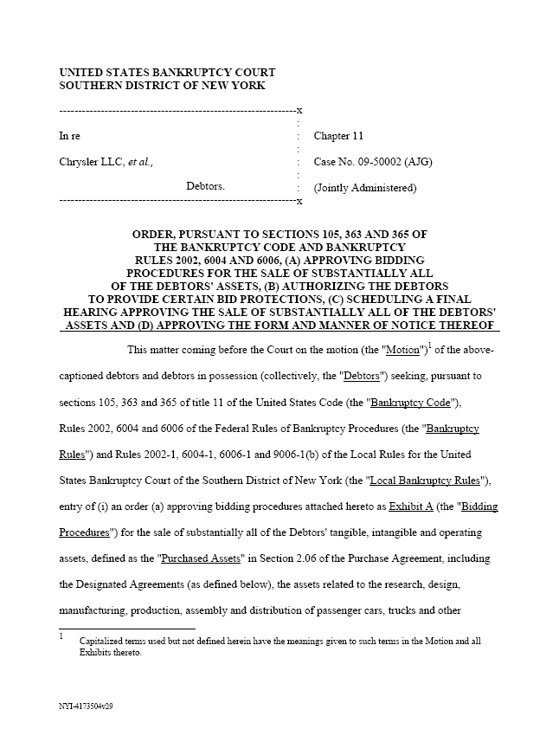
Chrysler Sale Order
Chrysler Sale Order

Slide 84
363
Use, sale, or lease of property
(b)(1) The trustee, after notice and a hearing, may use, sell, or lease, other than in the ordinary course of business, property of the estate … .

Slide 85
363 (cont.)
Use, sale, or lease of property
(f) The trustee may sell property under subsection (b) or (c) of this section free and clear of any interest in such property of an entity other than the estate, only if -
(1) applicable nonbankruptcy law permits sale of such property free and clear of such interest;
(2) such entity consents;

Slide 86
363 (cont.)
(3) such interest is a lien and the price at which such property is to be sold is greater than the aggregate value of all liens on such property;
(4) such interest is in bona fide dispute; or
(5) such entity could be compelled, in a legal or equitable proceeding, to accept a money satisfaction of such interest.

Slide 87
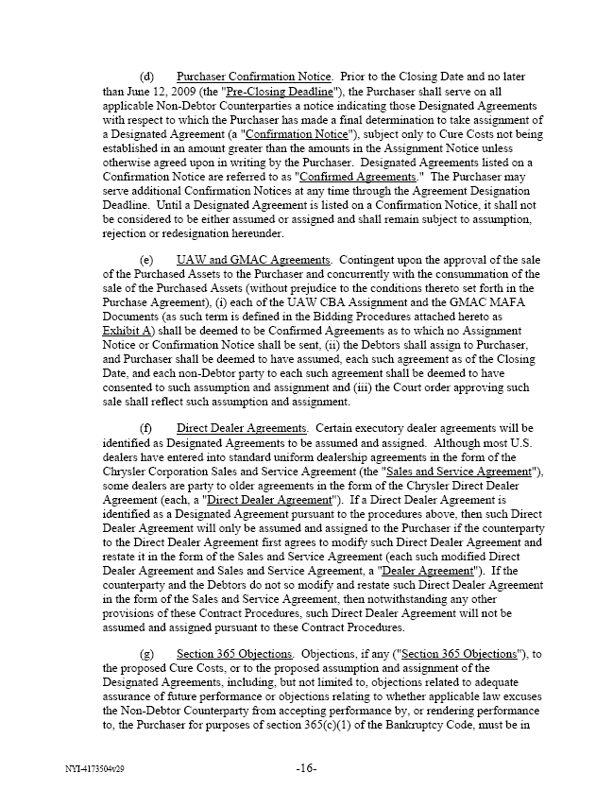
19(e): UAW Contract Assumption
“(e) UAW and GMAC Agreements. Contingent upon the approval of the sale of the Purchased Assets to the Purchaser and concurrently with the consummation of the sale of the Purchased Assets (without prejudice to the conditions thereto set forth in the Purchase Agreement), (i) each of the UAW CBA Assignment and the GMAC MAFA Documents (as such term is defined in the Bidding Procedures attached hereto as Exhibit A) shall be deemed to be Confirmed Agreements as to which no Assignment Notice or Confirmation Notice shall be sent,”
Sale Agreement

Slide 88
Assignment of UAW Agreement
“(ii) the Debtors shall assign to Purchaser, and Purchaser shall be deemed to have assumed, each such agreement as of the Closing Date, and each non-Debtor party to each such agreement shall be deemed to have consented to such assumption and assignment and (iii) the Court order approving such sale shall reflect such assumption and assignment.”
Sale Agreement

Slide 89
Assumption
Meaning
Estate has choice about whether to perform debtor’s prepetition contract
Assumption means estate accepts obligation to perform under contract

Slide 90
Mechanics
To assume a contract (365(b))
Trustee must cure—fix—most prepetition defaults;
Compensate for actual pecuniary losses from the default; and
Provide adequate assurance of future performance

Slide 91
365: Rejection
Executory contracts and unexpired leases (cont.)
(g) Except as provided in subsections (h)(2) and (i)(2) of this section, the rejection of an executory contract or unexpired lease of the debtor constitutes a breach of such contract or lease -

Slide 92
365: Rejection
(1) if such contract or lease has not been assumed under this section or under a plan confirmed under chapter 9, 11, 12, or 13 of this title, immediately before the date of the filing of the petition; or

Slide 93
Understanding the Sale Order: Starting Points
TTYN (1 of 3)
Hypo 1
Debtor
Cash $120
U1: $100
U2: $100
U3: $100
How should we divide the assets?

Slide 94
USO: Sale Instead
TTYN (2 of 3)
Hypo 2
Debtor
Does anything change if we have an asset instead of cash and the asset is sold to a third party first?
Asset $120
U1: $100
U2: $100
U3: $100

Slide 95
USO: Sale w/Assumption
TTYN (3 of 3)
Hypo 3
Debtor
Suppose that we require the buyer to assume U3’s debt: what happens?
Asset $120
U1: $100
U2: $100
U3: $100

Slide 96
USO: Absolute Priority?
TTYN (1 of 2)
Hypo 6
Debtor
Senior wants to claim asset and assume debt of U3: what happens?
Asset $120
Senior: $200
U1: $100
U2: $100
U3: $100

Slide 97
USO: Voluntary Assumption By Buyer
TTYN (2 of 2)
Hypo 7
Debtor
Buyer pays $120 and voluntarily assumes U3 debt: what happens?
Asset $120
U1: $100
U2: $100
U3: $100

Slide 98
The Issues on Appeal
1. “Sub Rosa” Plan
Can you sell the entire company outside of a Chapter 11 plan?
Does this particular sale somehow violate Sec. 1129’s absolute priority rule?
2. Can the assets be sold free and clear of the senior liens?
Yes, with consent and Indiana bound

Slide 99
The Issues on Appeal
3. Does using TARP funds here violate the statute or the Constitution?
Indiana found not to have standing
4. Can the Sale Order ensure that New Chrysler doesn’t face successor liability claims?
This turns on our understanding of “interest in property” under 11 USC 363(f)

Slide 100
The Issues on Appeal
The court looks at existing product liability claims; existing asbestos claims; and future claims
The court offers a broad sense of the power of bankruptcy to limit successor liability claims, especially as to existing claims.
The court leaves open the full extent of the power to do so as to future claims.

Slide 101
J&J
LTL Management

Slide 102
J&J at 125
J&J 2010 Annual

Slide 103
Baby Powder
J&J 2010 Annual

Slide 104
1920 Baby Powder
J&J 2010 Annual

Slide 105
Notes on Legal Proceedings
J&J 2010 Annual

Slide 106
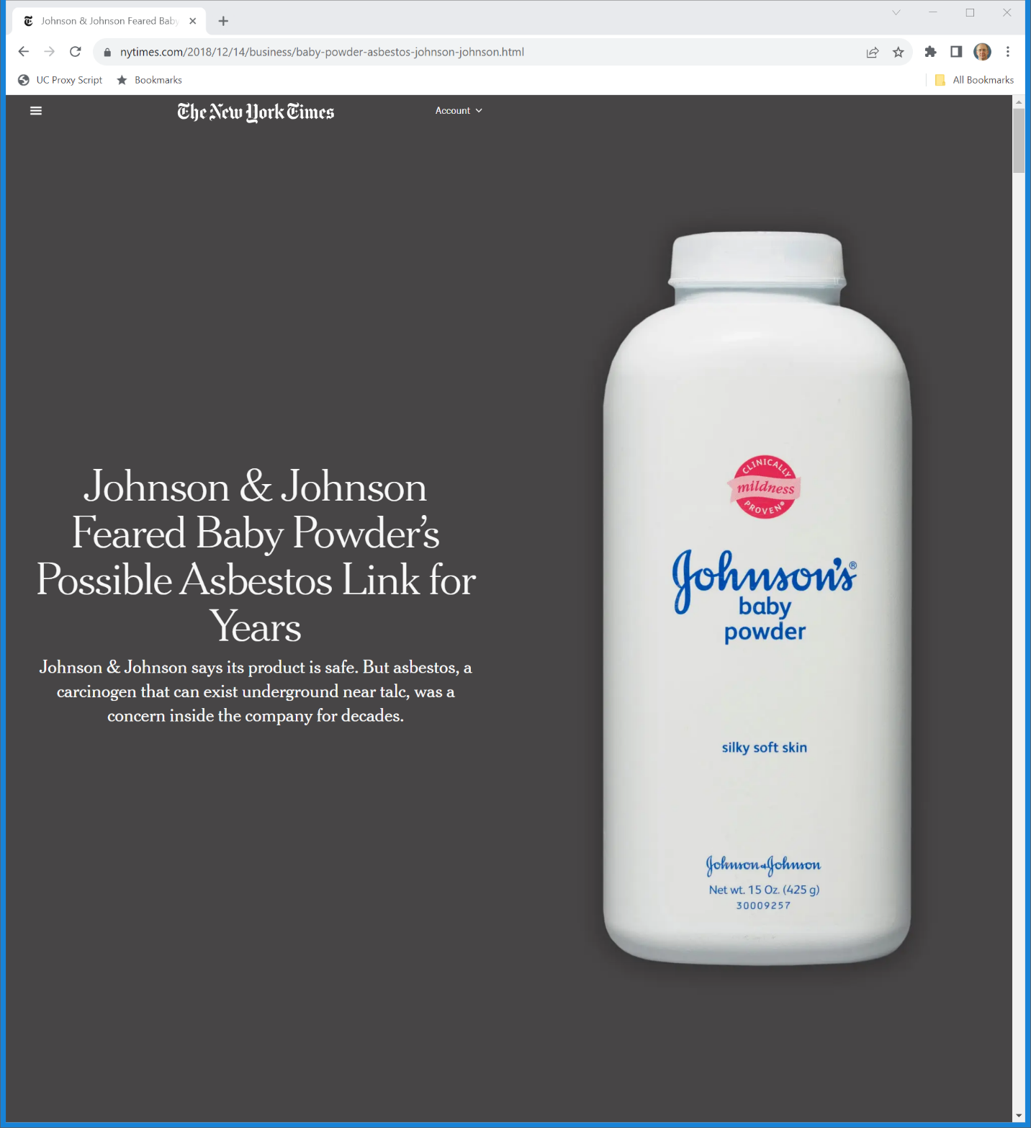
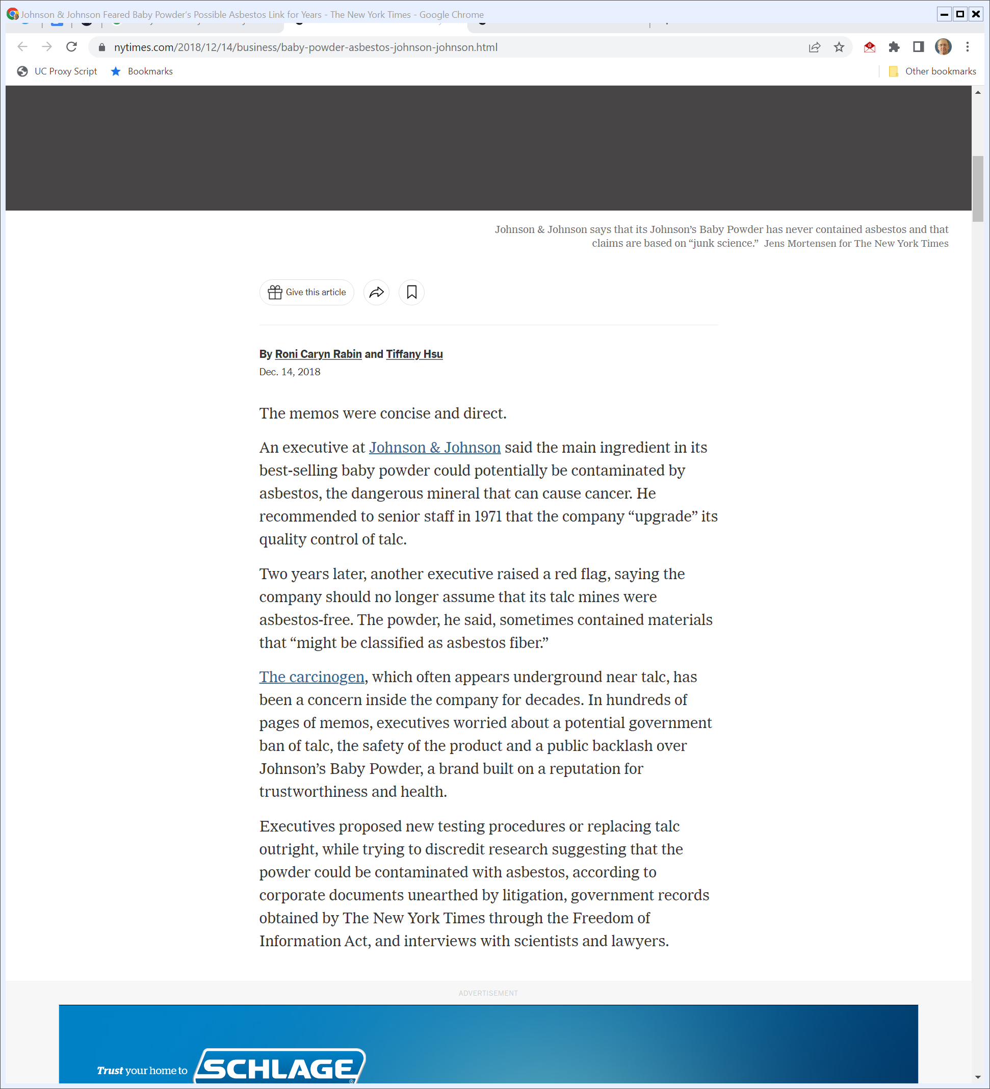
NYT Investigation
New York Times (14 Dec 2018)
Notes:
https://www.nytimes.com/2018/12/14/business/baby-powder-asbestos-johnson-johnson.html

Slide 107
NYT Investigation
New York Times (14 Dec 2018)
Notes:
https://www.nytimes.com/2018/12/14/business/baby-powder-asbestos-johnson-johnson.html

Slide 108
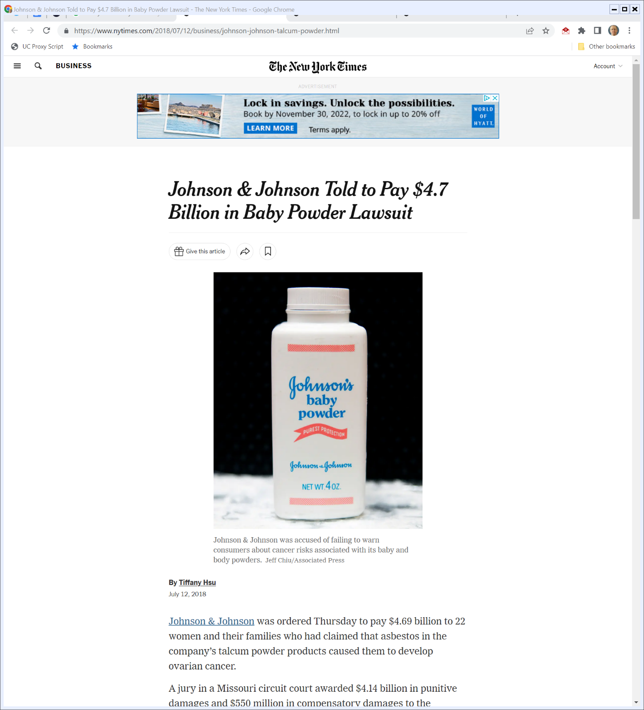
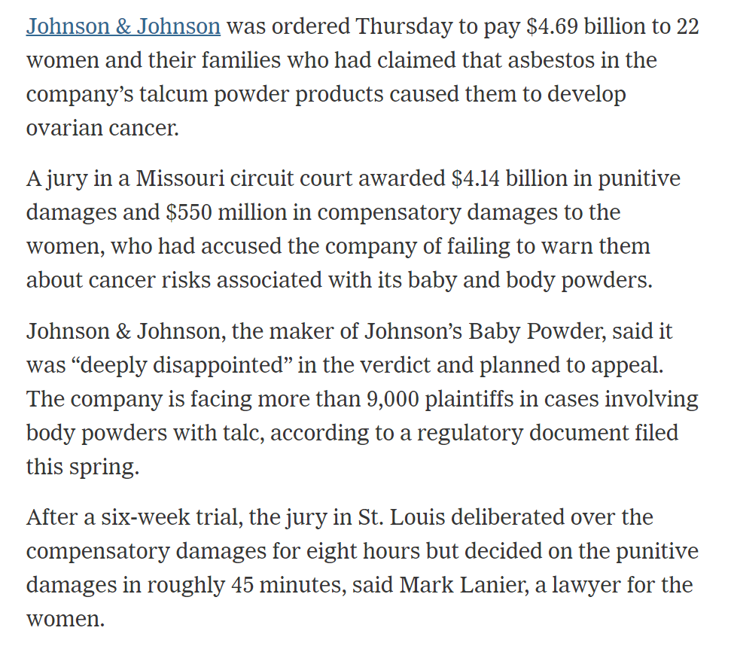
July 2018: $4.7 Billion Jury Verdict
New York Times (12 July 2018)
Notes:
https://www.nytimes.com/2018/07/12/business/johnson-johnson-talcum-powder.html

Slide 109
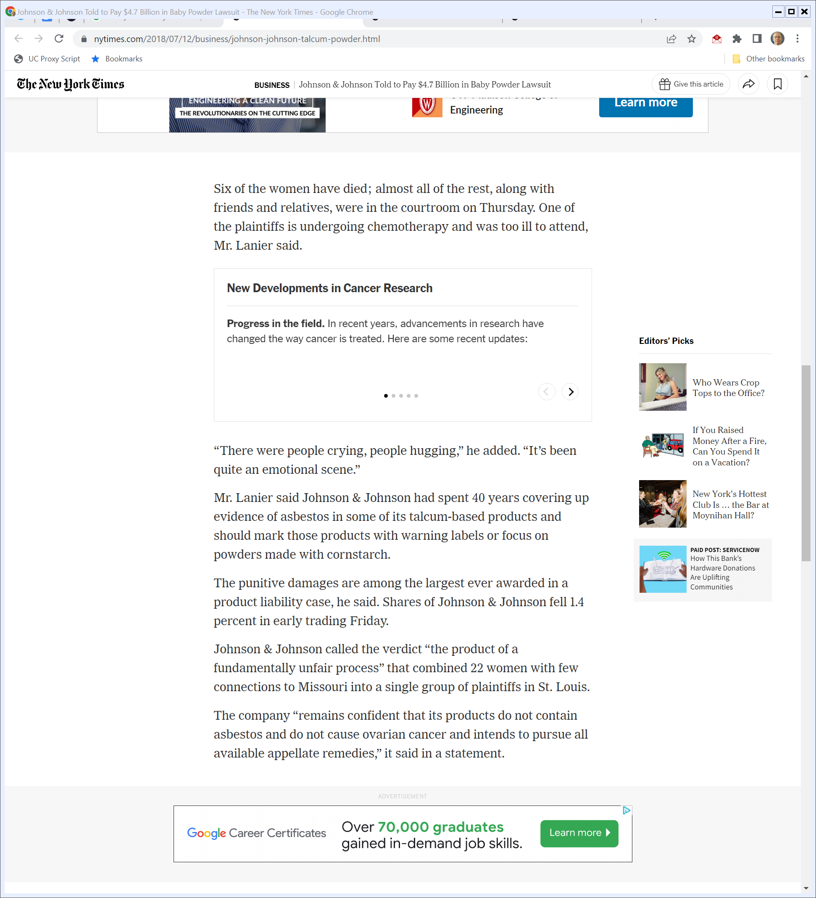
Coverup and Punitive Damages?
New York Times (12 July 2018)
Notes:
https://www.nytimes.com/2018/07/12/business/johnson-johnson-talcum-powder.html

Slide 110
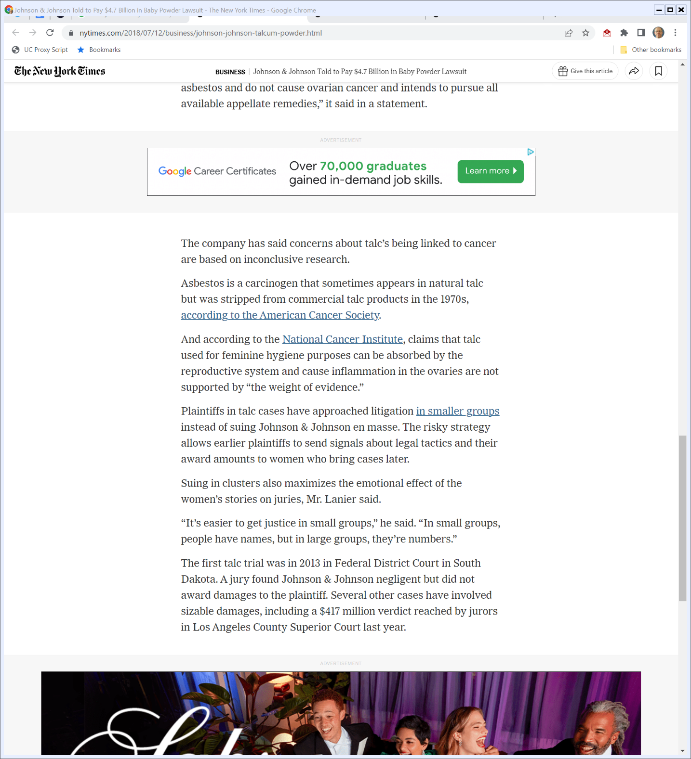

What Does the Research Say?
New York Times (12 July 2018)
Notes:
https://www.nytimes.com/2018/07/12/business/johnson-johnson-talcum-powder.html

Slide 111
The Tort System at Work
New York Times (12 July 2018)
Notes:
https://www.nytimes.com/2018/07/12/business/johnson-johnson-talcum-powder.html

Slide 112
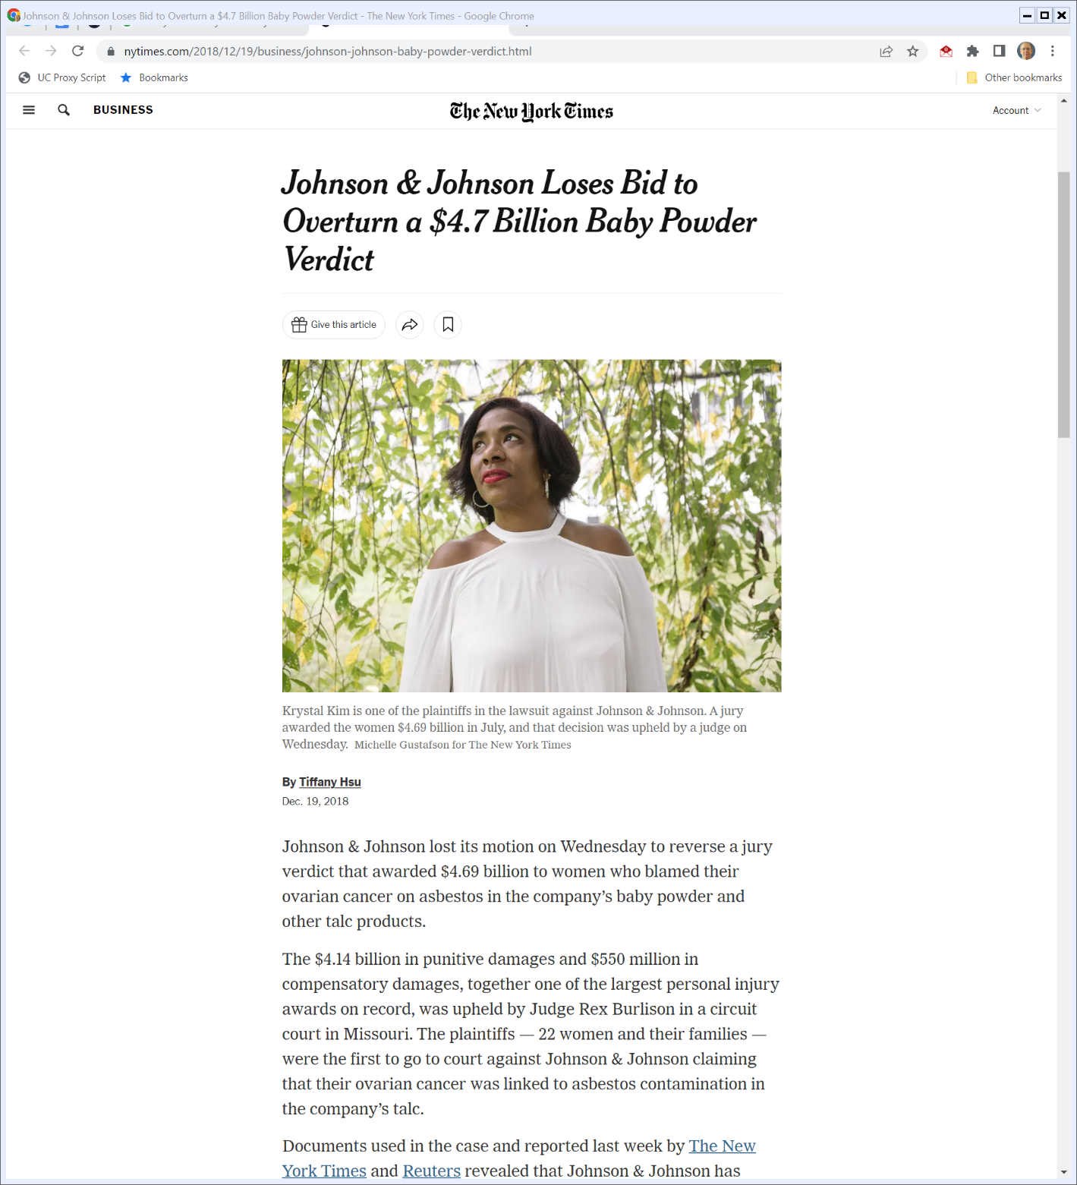

Verdict Upheld on Appeal
New York Times (19 Dec 2018)
Notes:
https://www.nytimes.com/2018/12/19/business/johnson-johnson-baby-powder-verdict.html

Slide 113
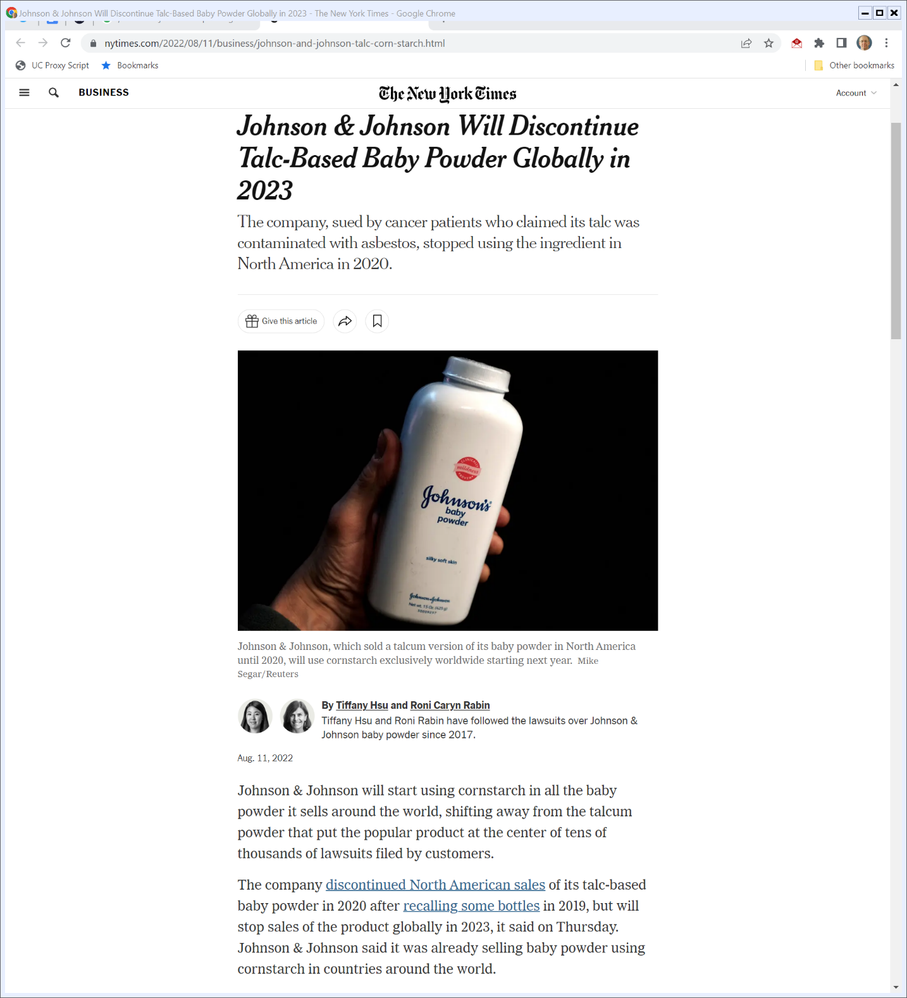
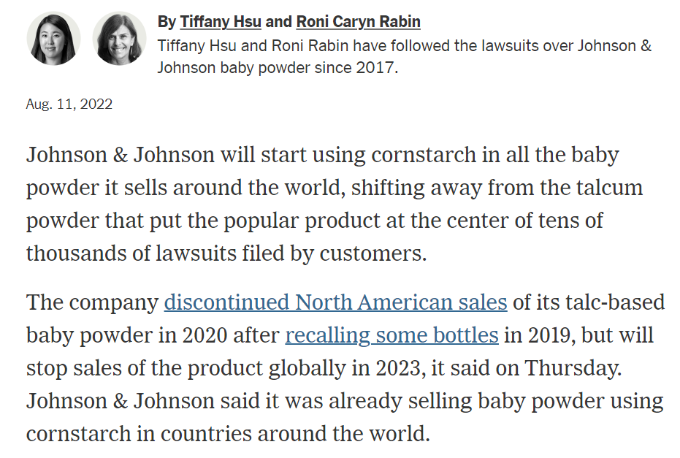
J&J Redesigns Baby Powder
New York Times (11 Aug 2022)
Notes:
https://www.nytimes.com/2022/08/11/business/johnson-and-johnson-talc-corn-starch.html

Slide 114
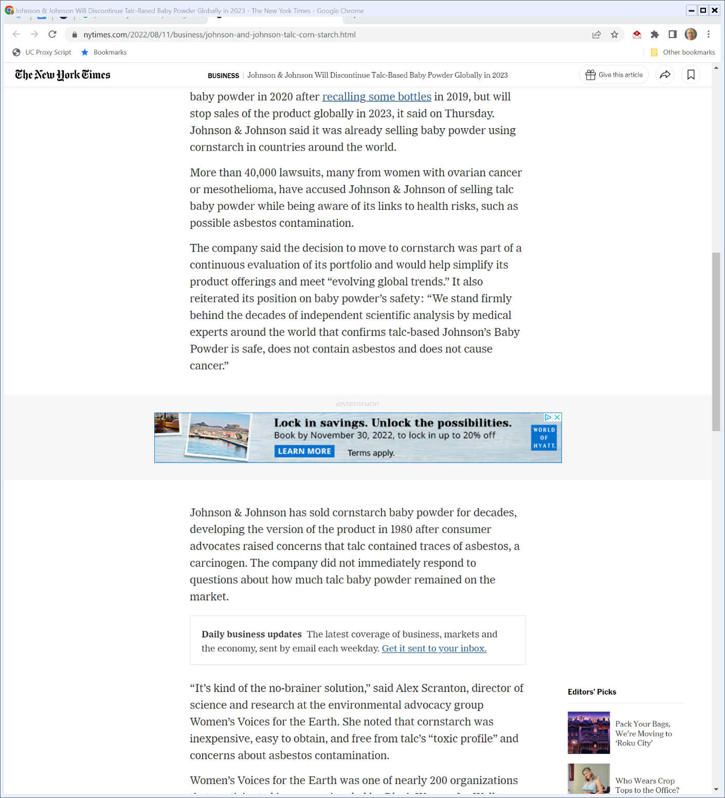
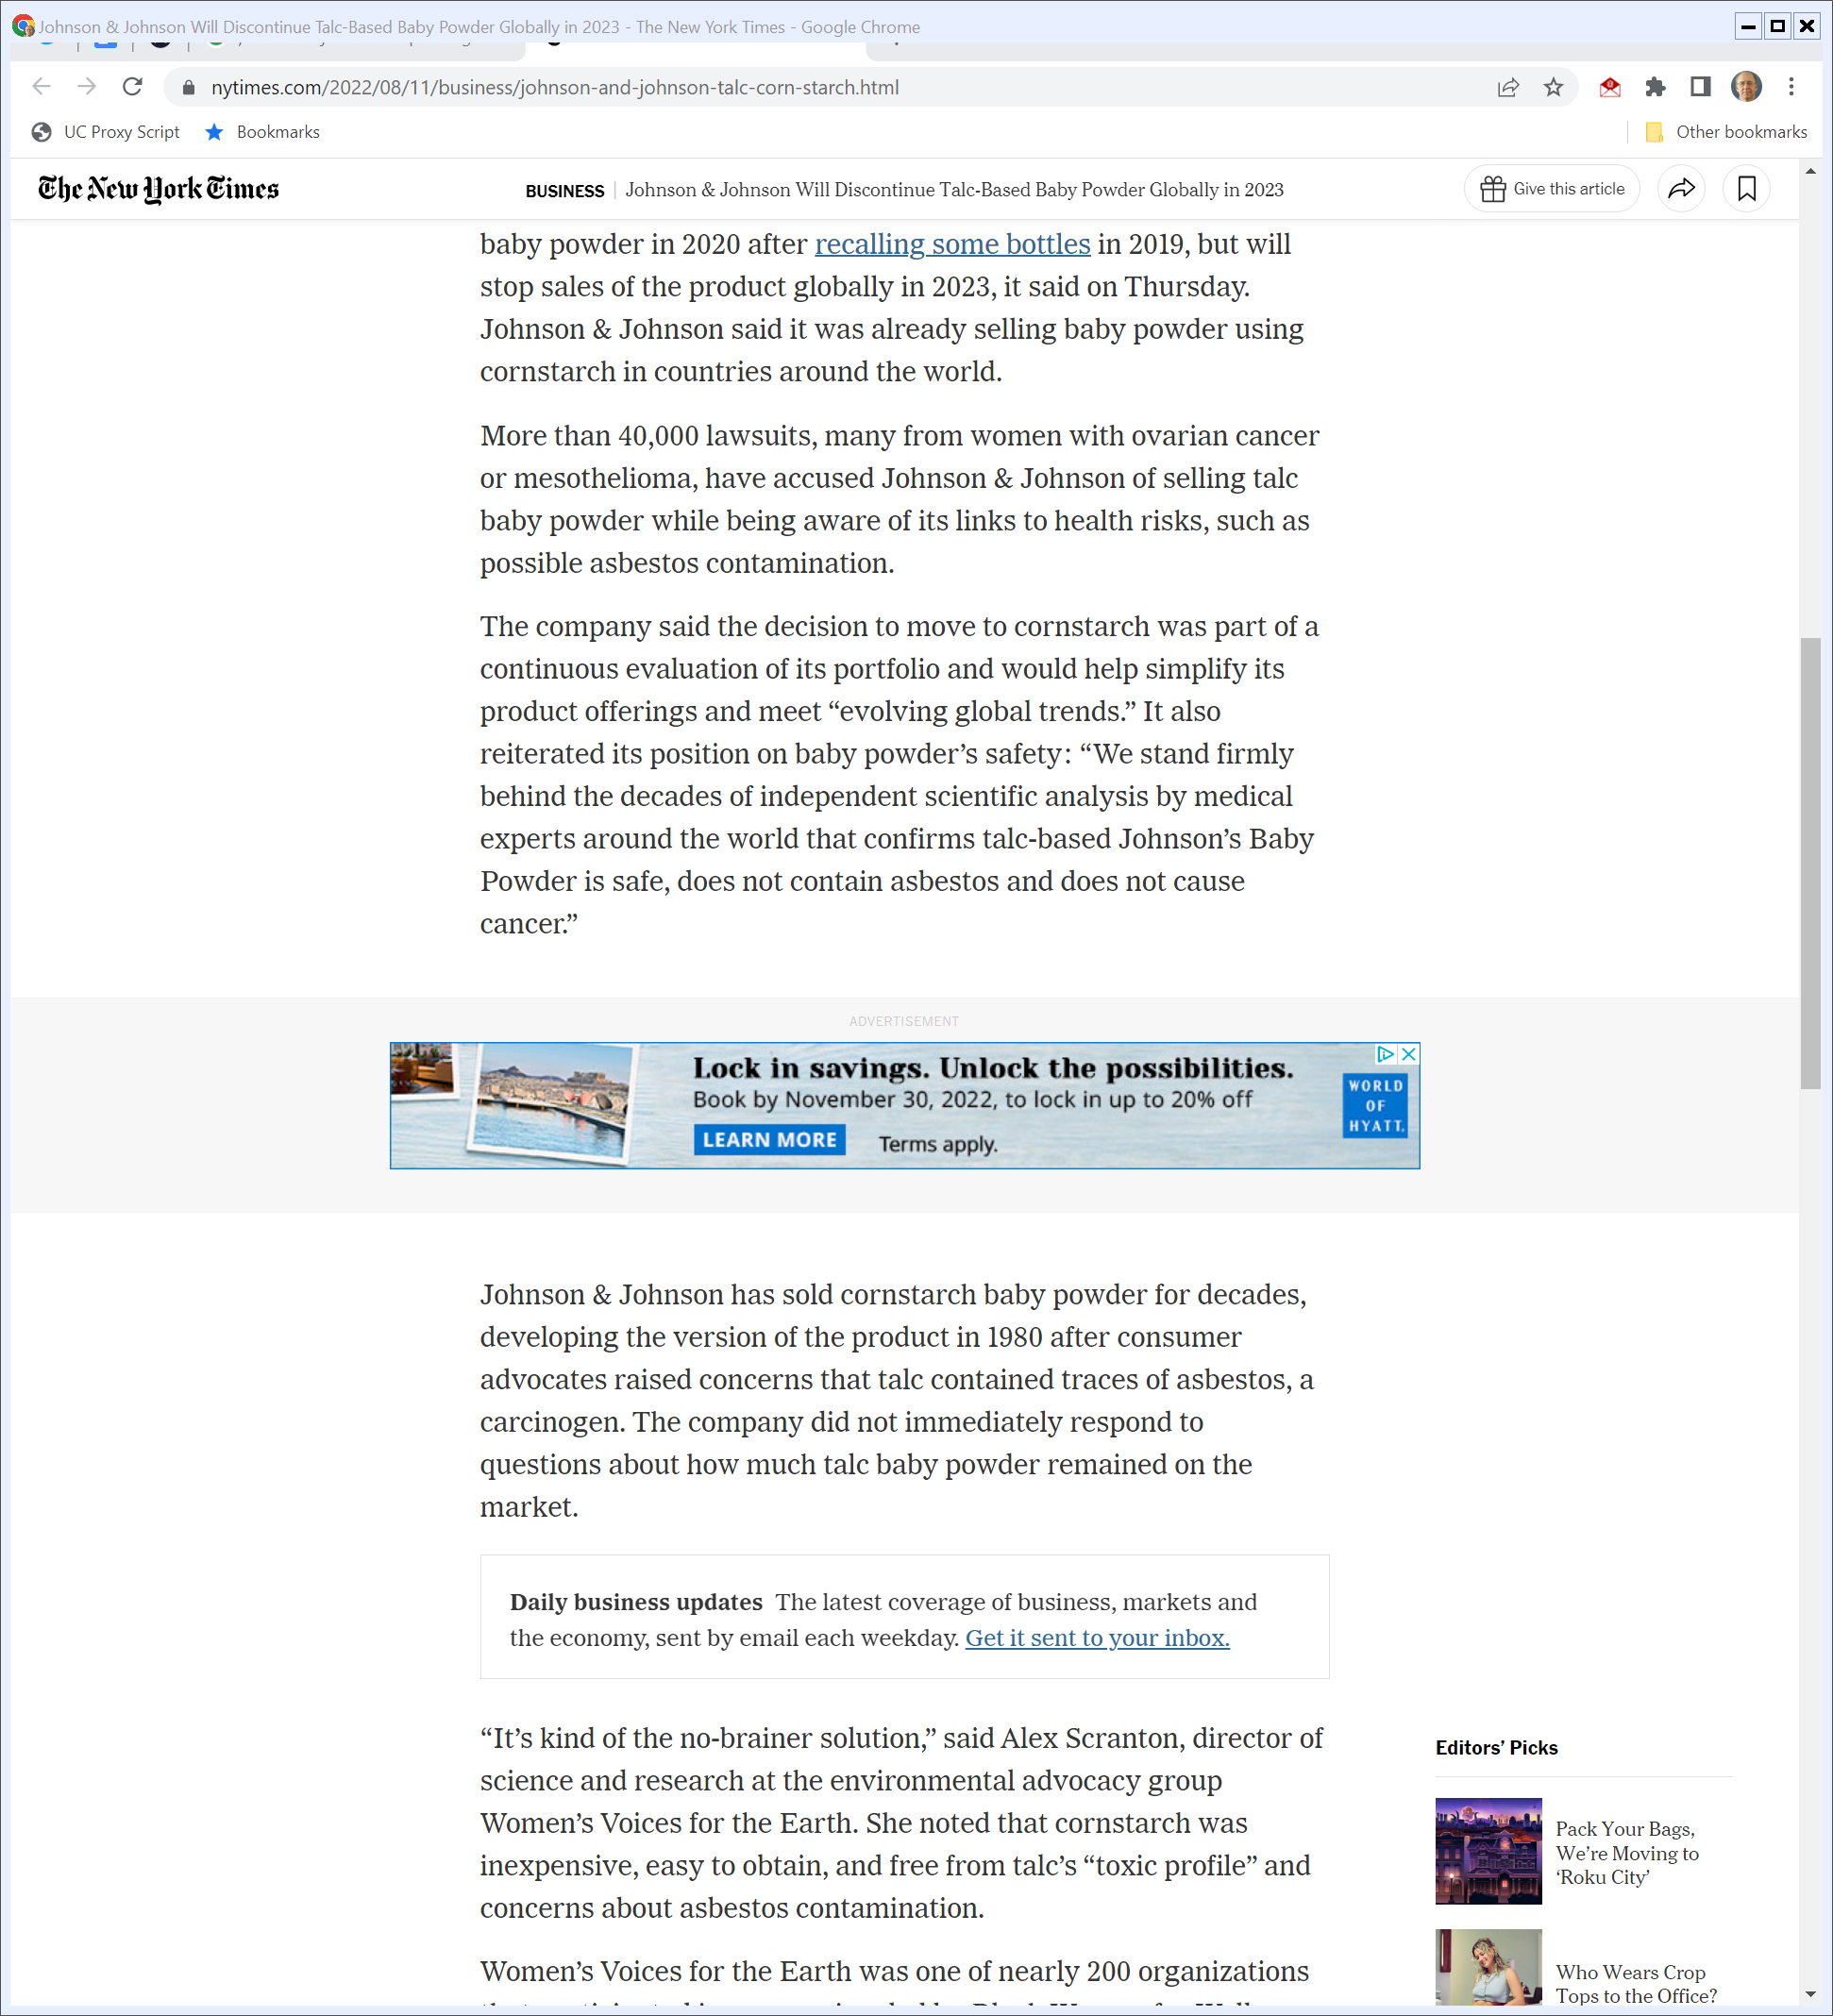
“Evolving Global Trends”
New York Times (11 Aug 2022)
Notes:
https://www.nytimes.com/2022/08/11/business/johnson-and-johnson-talc-corn-starch.html

Slide 115
Moving to Cornstarch
New York Times (11 Aug 2022)
Notes:
https://www.nytimes.com/2022/08/11/business/johnson-and-johnson-talc-corn-starch.html

Slide 116
Parents and Subs I
TTYN (1 of 3)
Parent
Parent
$90K
Sub1 stock
CP1: $25K
CP2: $25K
Is this an appropriate situation for a bankruptcy filing? By which entities?
Sub1
Sub1
CS1: $10K
CS2: $10K
$10K

Slide 117
Parents and Subs II
TTYN (2 of 3)
How should we think about the transfer between Sub1 and Sub2? Is this an appropriate situation for a bankruptcy filing? By which entities?
Parent
Parent
$90K
Sub1 stock
CP1: $25K
CP2: $25K
Sub2 stock
Sub1
Sub2
$10K
CS1: $10K
CS2: $10K
$5K
$5K
Sub1
Sub2
$5K

Slide 118
Parents and Subs III
TTYN (3 of 3)
Parent
Parent
$90K
Sub1 stock
CP1: $25K
CP2: $25K
How should we think about the divisive merger that creates GoodCo and BadCo? Do you need to know something about their balance sheets when they are created? Is this an appropriate situation for a bankruptcy filing? By which entities?
GCo stock
BCo stock
Sub1
Sub1
$10K
CS1: $10K
CS2: $10K
GoodCo
BadCo

Slide 119
14 Oct 2021: J&J Press Release
J&J 8-K (19 Oct 2021)

Slide 120
Not Admitting Liability
J&J 8-K (19 Oct 2021)

Slide 121
LTL Management
64 F.4th 84 (3rd Cir. 2023)

Slide 122
The LTL Bankruptcy Filing
Questions
Why did J&J want to put LTL (and only LTL) in bankruptcy?
Is this about limiting liability? For whom?
Reducing the costs of mass torts?

Slide 123
Basis for Dismissal: “For Cause”
11 U.S.C. 1112

Slide 124
Cause “includes”
11 U.S.C. 1112

Slide 125
Good Faith Required to File (and That Means Financial Distress)
“We start, and stay, with good faith. Good intentions—such as to protect the J&J brand or comprehensively resolve litigation—do not suffice alone. What counts to access the Bankruptcy Code’s safe harbor is to meet its intended purposes. Only a putative debtor in financial distress can do so. LTL was not. Thus we dismiss its petition.”
LTL Management (3rd Cir. 31 Mar 2023)

Slide 126
Good Faith and Financial Distress
“Our precedents show a debtor who does not suffer from financial distress cannot demonstrate its Chapter 11 petition serves a valid bankruptcy purpose supporting good faith.”
LTL Management (3rd Cir. 2023)

Slide 127
Insolvency Isn’t Required
“But what degree of financial distress justifies a debtor’s filing? To say, for example, that a debtor must be in financial distress is not to say it must necessarily be insolvent. We recognize as much, as the Code conspicuously does not contain any particular insolvency requirement. … And we need not set out any specific test to apply rigidly when evaluating financial distress. Nor does the Code direct us to apply one. Instead, the good-faith gateway asks whether the debtor faces the kinds of problems that justify Chapter 11 relief.”
LTL Management (3rd Cir. 31 Mar 2023)

Slide 128
No Financial Distress for LTL
“After these course corrections, we cannot agree LTL was in financial distress when it filed its Chapter 11 petition. The value and quality of its assets, which include a roughly $61.5 billion payment right against J&J and New Consumer, make this holding untenable.”
LTL Management (3rd Cir. 2023)

Slide 129
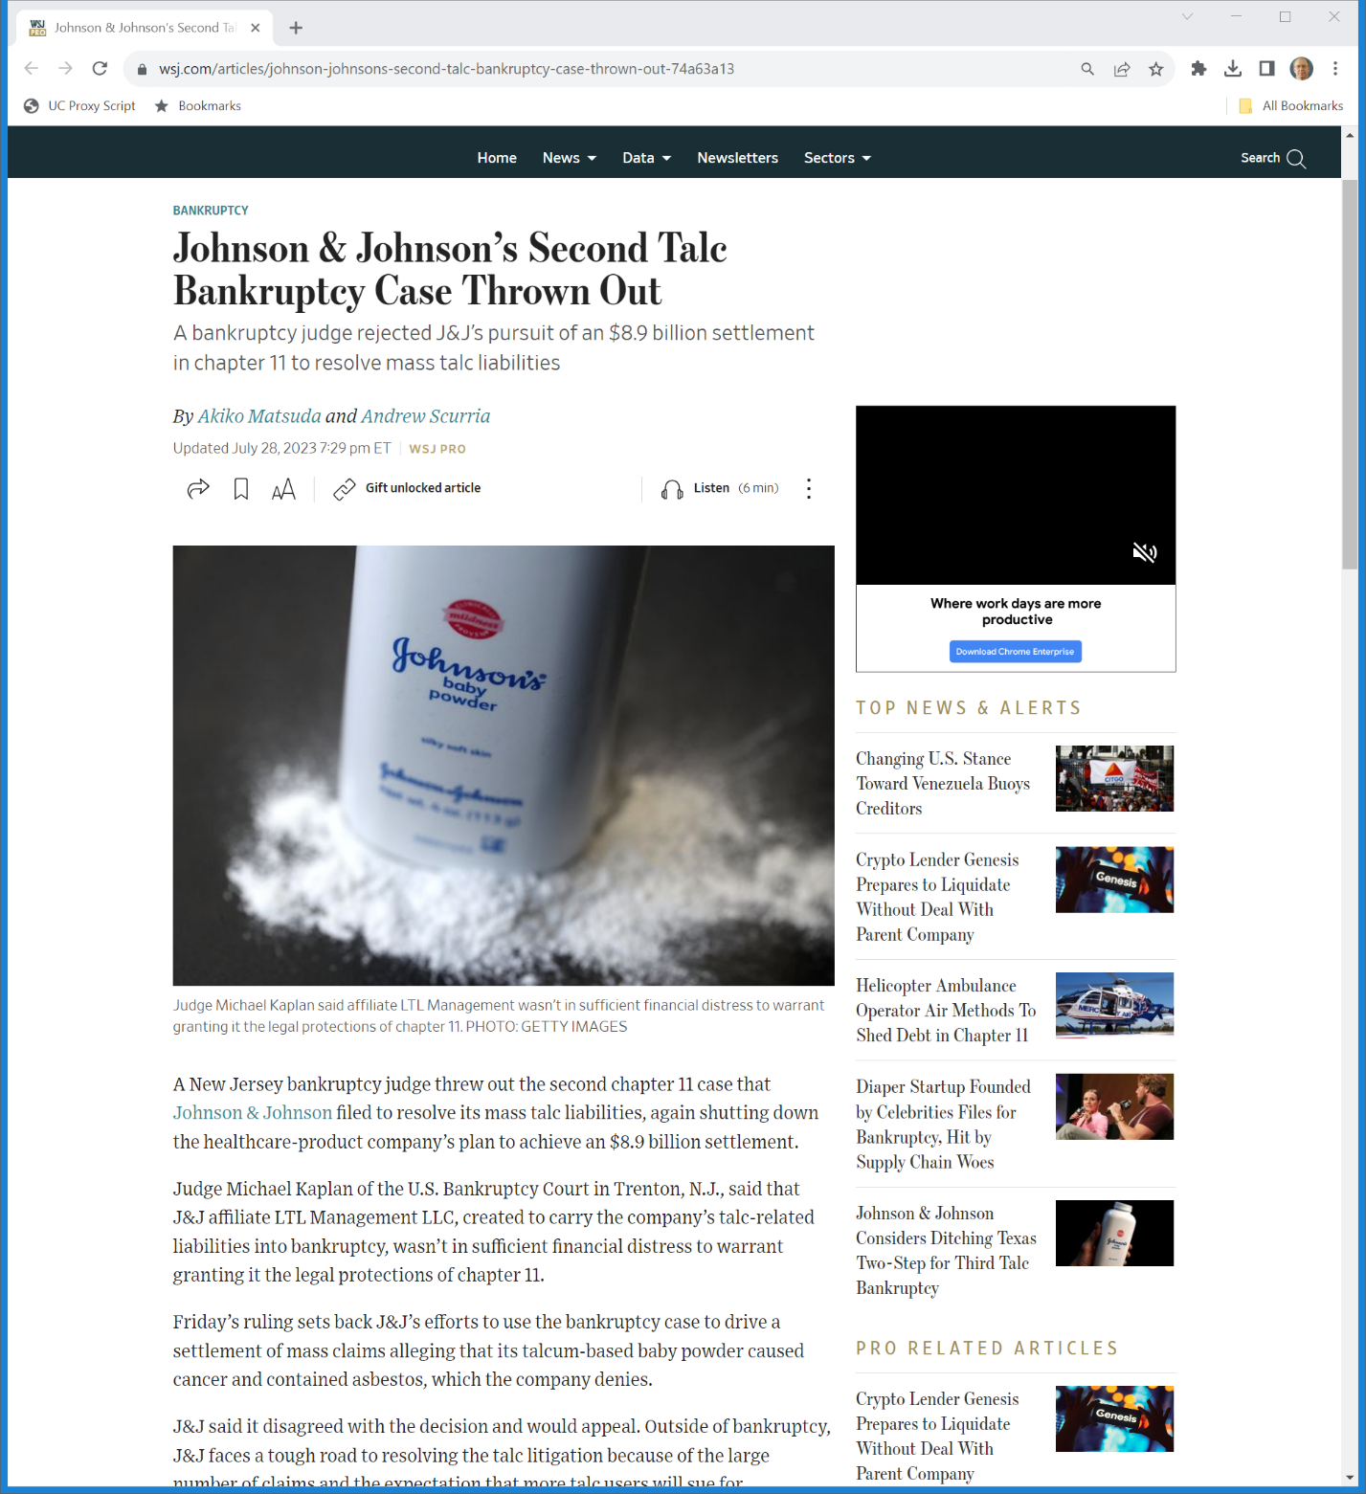
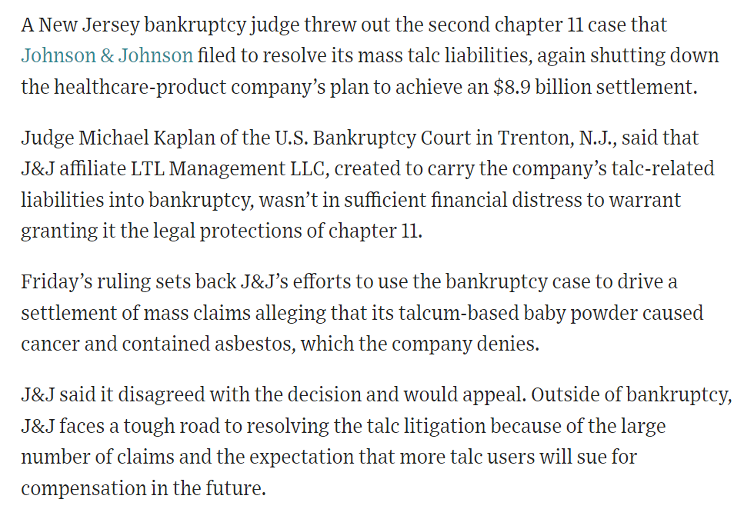
2nd Filing Bounced
WSJ (28 July 2023)
Notes:
https://www.wsj.com/articles/johnson-johnsons-second-talc-bankruptcy-case-thrown-out-74a63a13

Slide 130
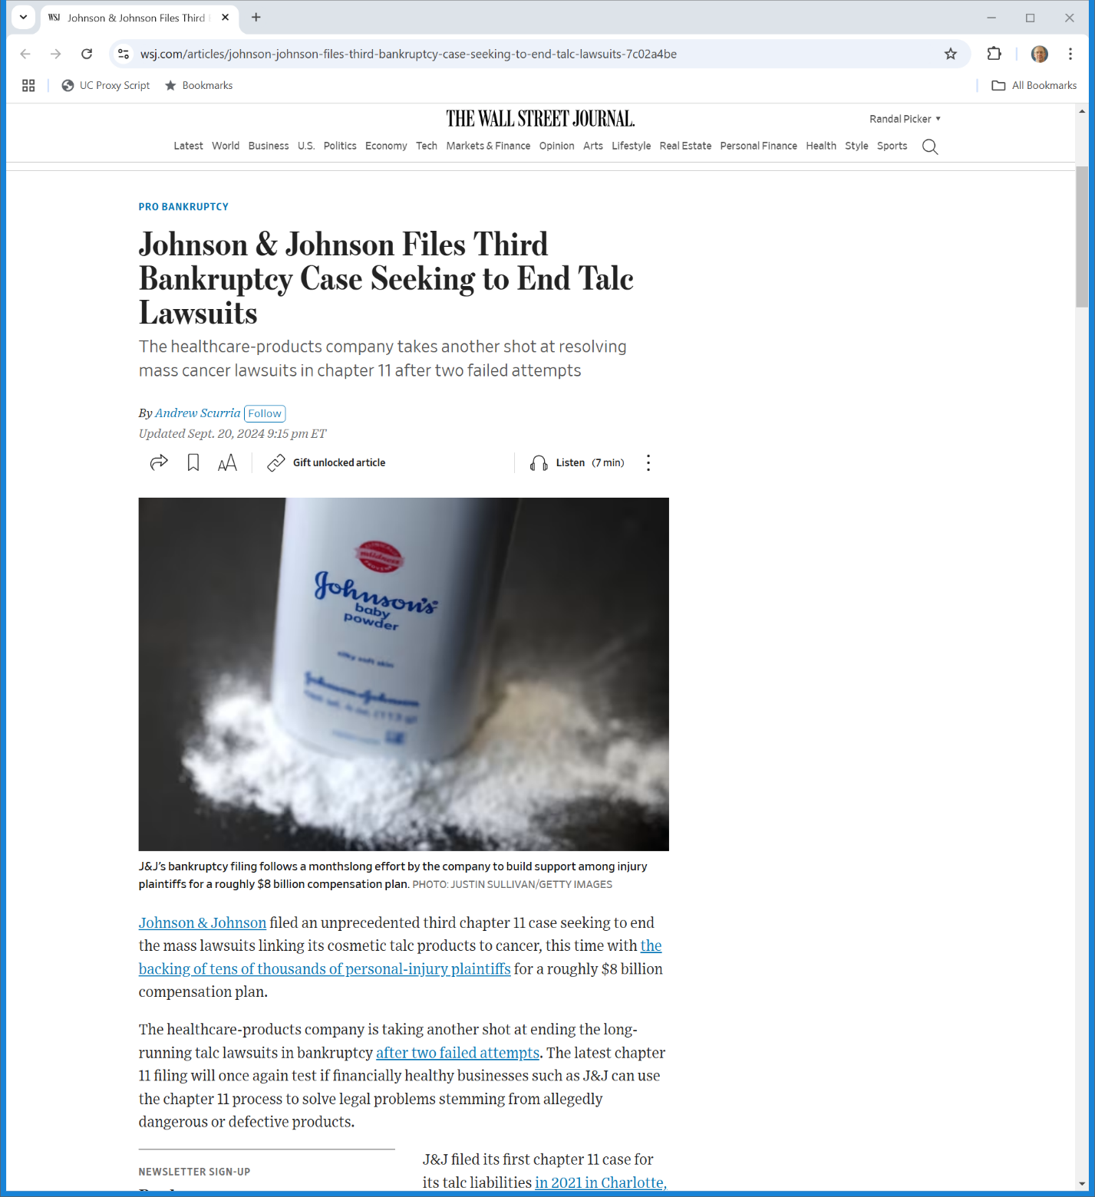
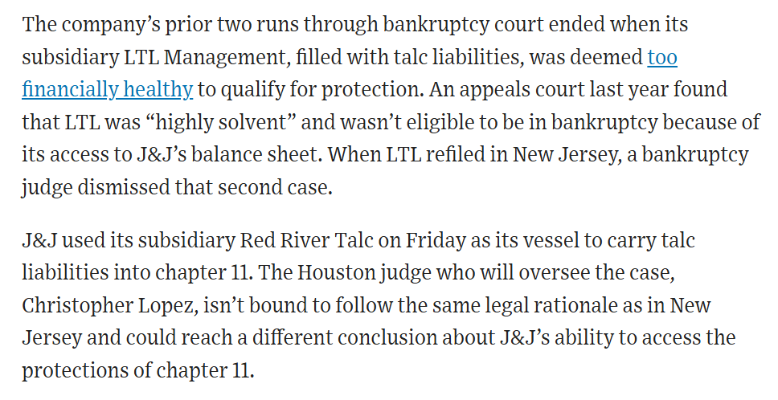
Third Filing
WSJ (20 Sept 2024)
Notes:
https://www.wsj.com/articles/johnson-johnson-files-third-bankruptcy-case-seeking-to-end-talc-lawsuits-7c02a4be

Slide 131
Third-Party Plan Releases
Purdue Pharma (U.S. 2024)

Slide 132
Not Permitted
Purdue Pharma (U.S. 2024)

Slide 133
5-4 Decision
Purdue Pharma (U.S. 2024)

Slide 134
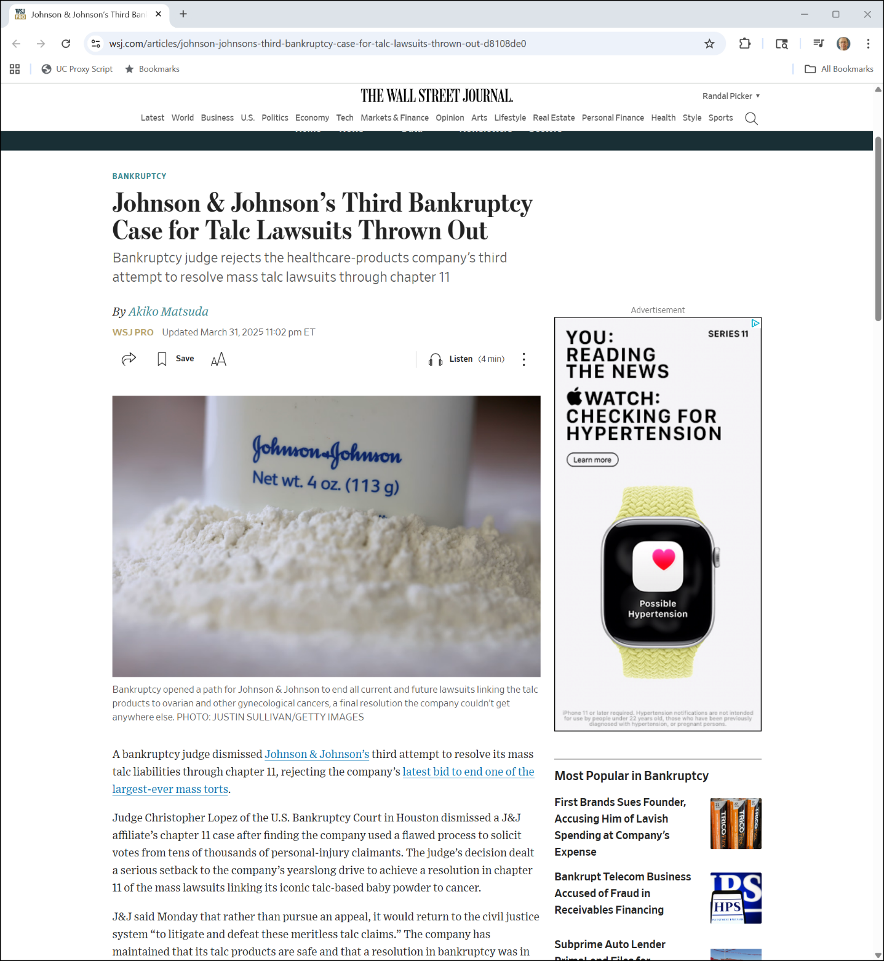
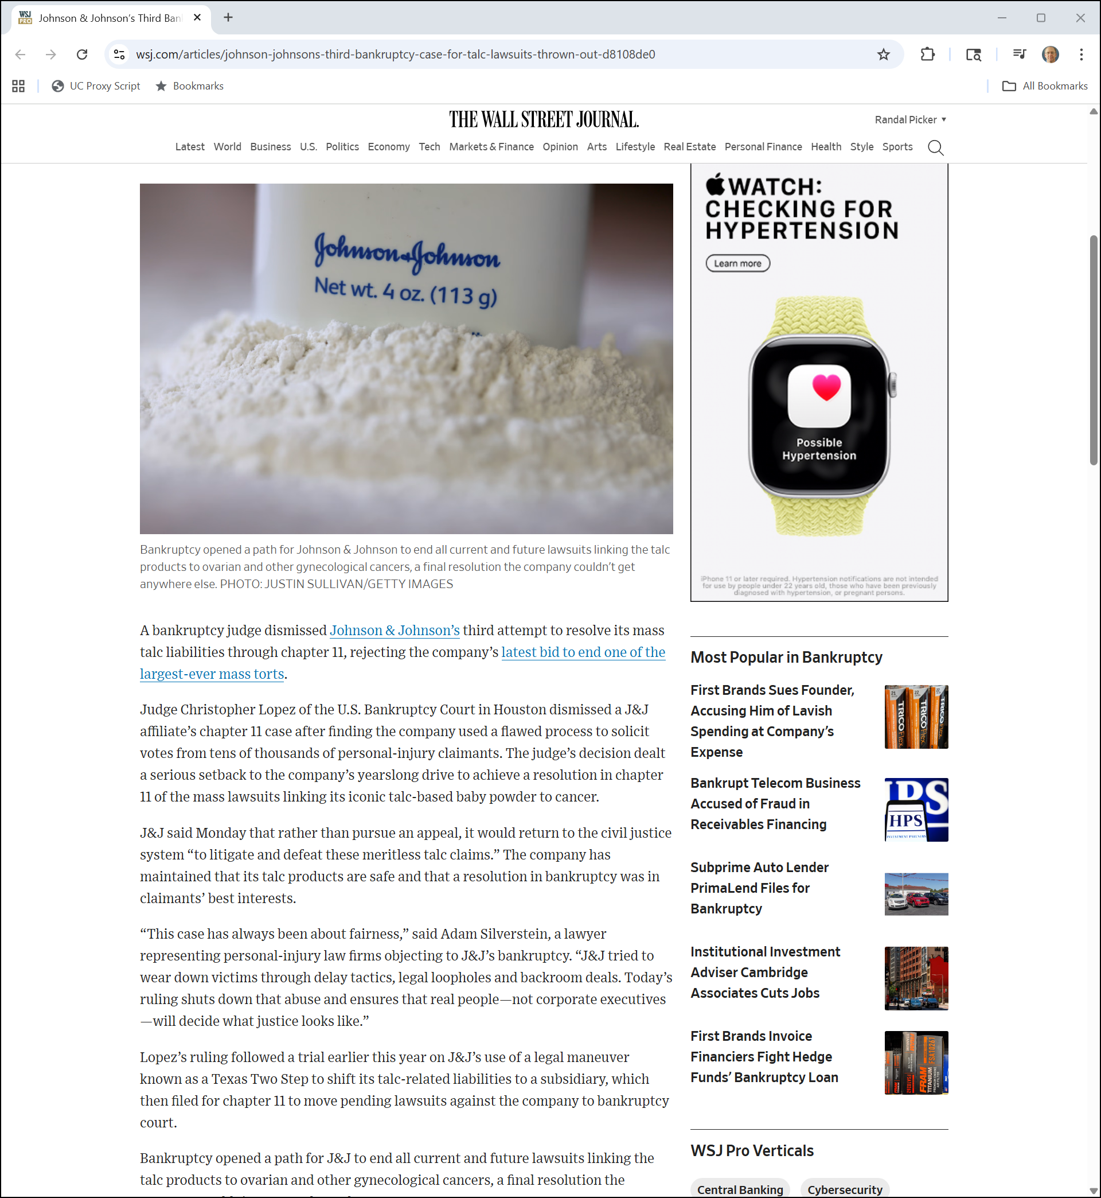
3rd Filing Dismissed
WSJ (31 Mar 2025)
Notes:
https://www.wsj.com/articles/johnson-johnsons-third-bankruptcy-case-for-talc-lawsuits-thrown-out-d8108de0

Slide 135
Looking for Justice
WSJ (31 Mar 2025)
Notes:
https://www.wsj.com/articles/johnson-johnsons-third-bankruptcy-case-for-talc-lawsuits-thrown-out-d8108de0

Slide 136
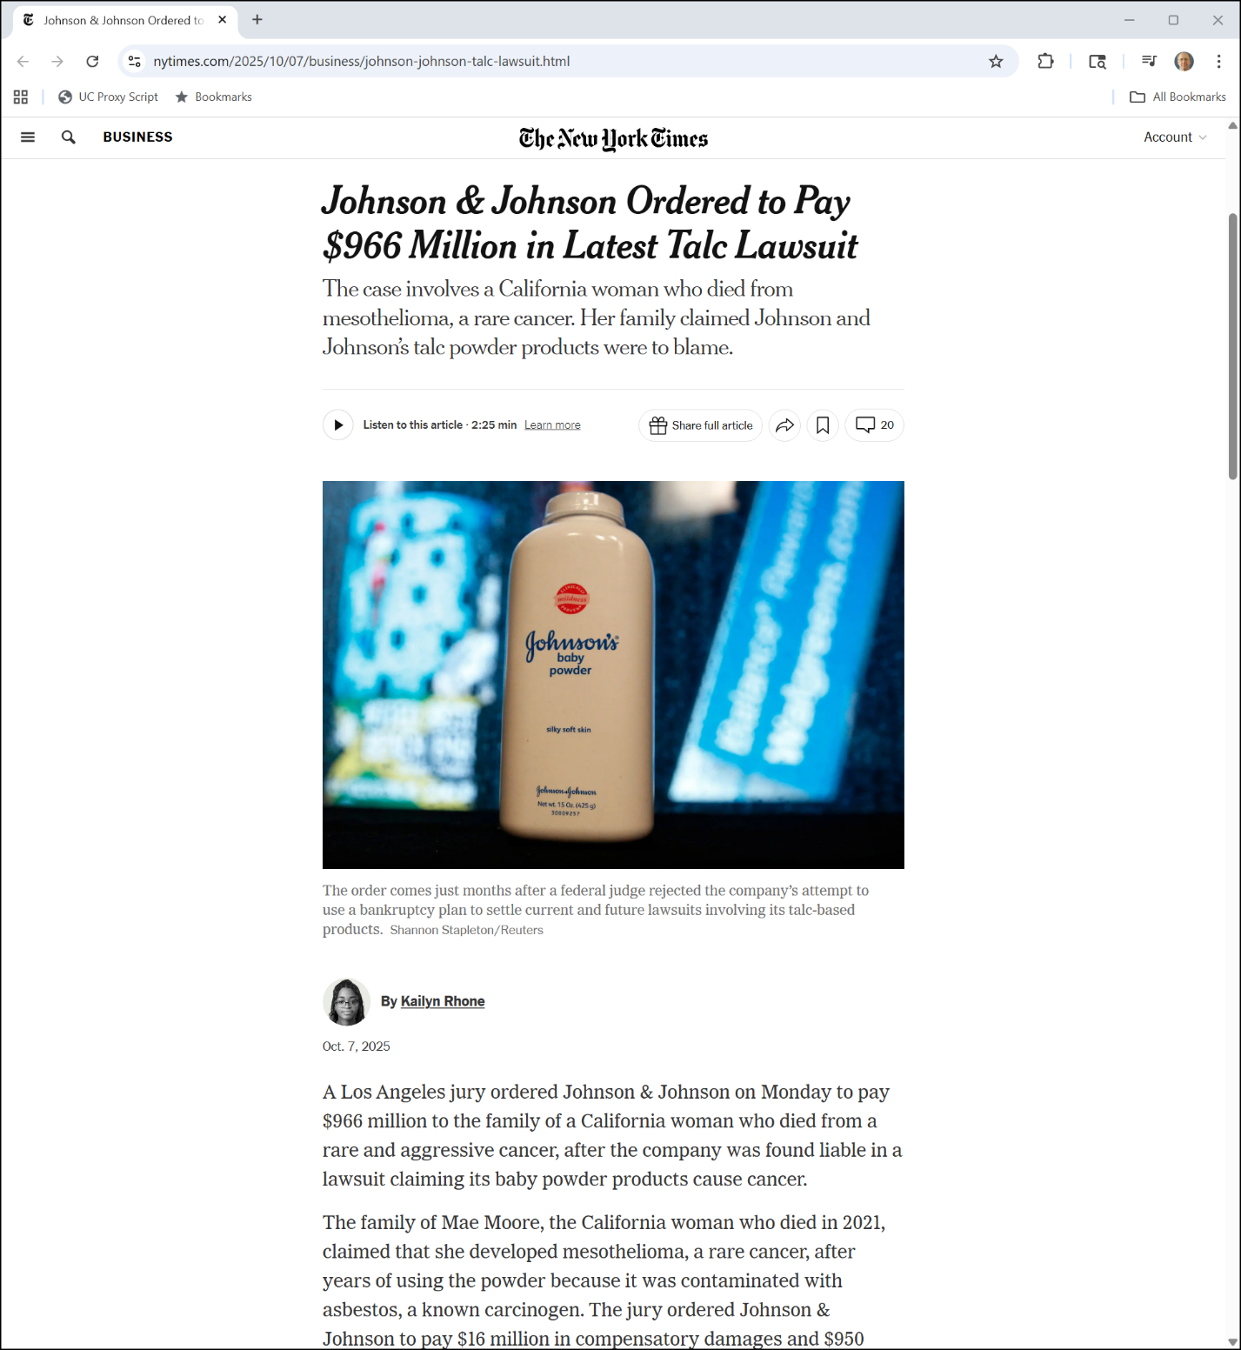
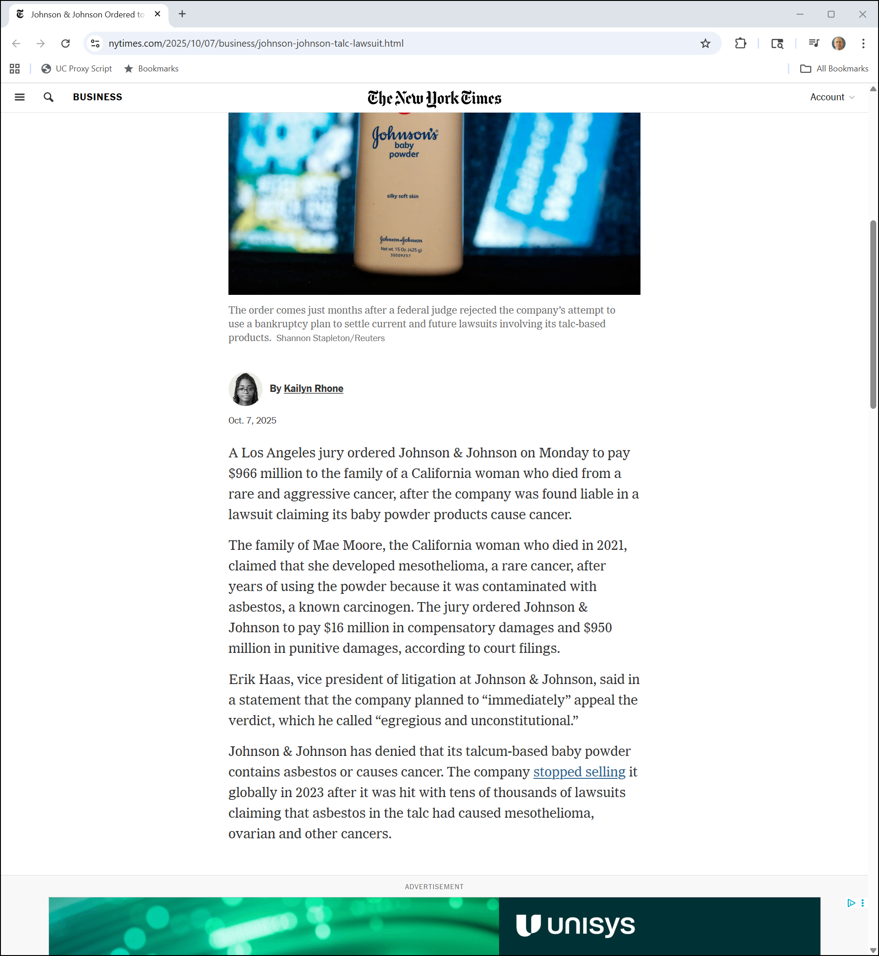
New U.S. Verdict
NYT (7 Oct 2025)

Slide 137
New U.S. Verdict
NYT (7 Oct 2025)

Slide 138
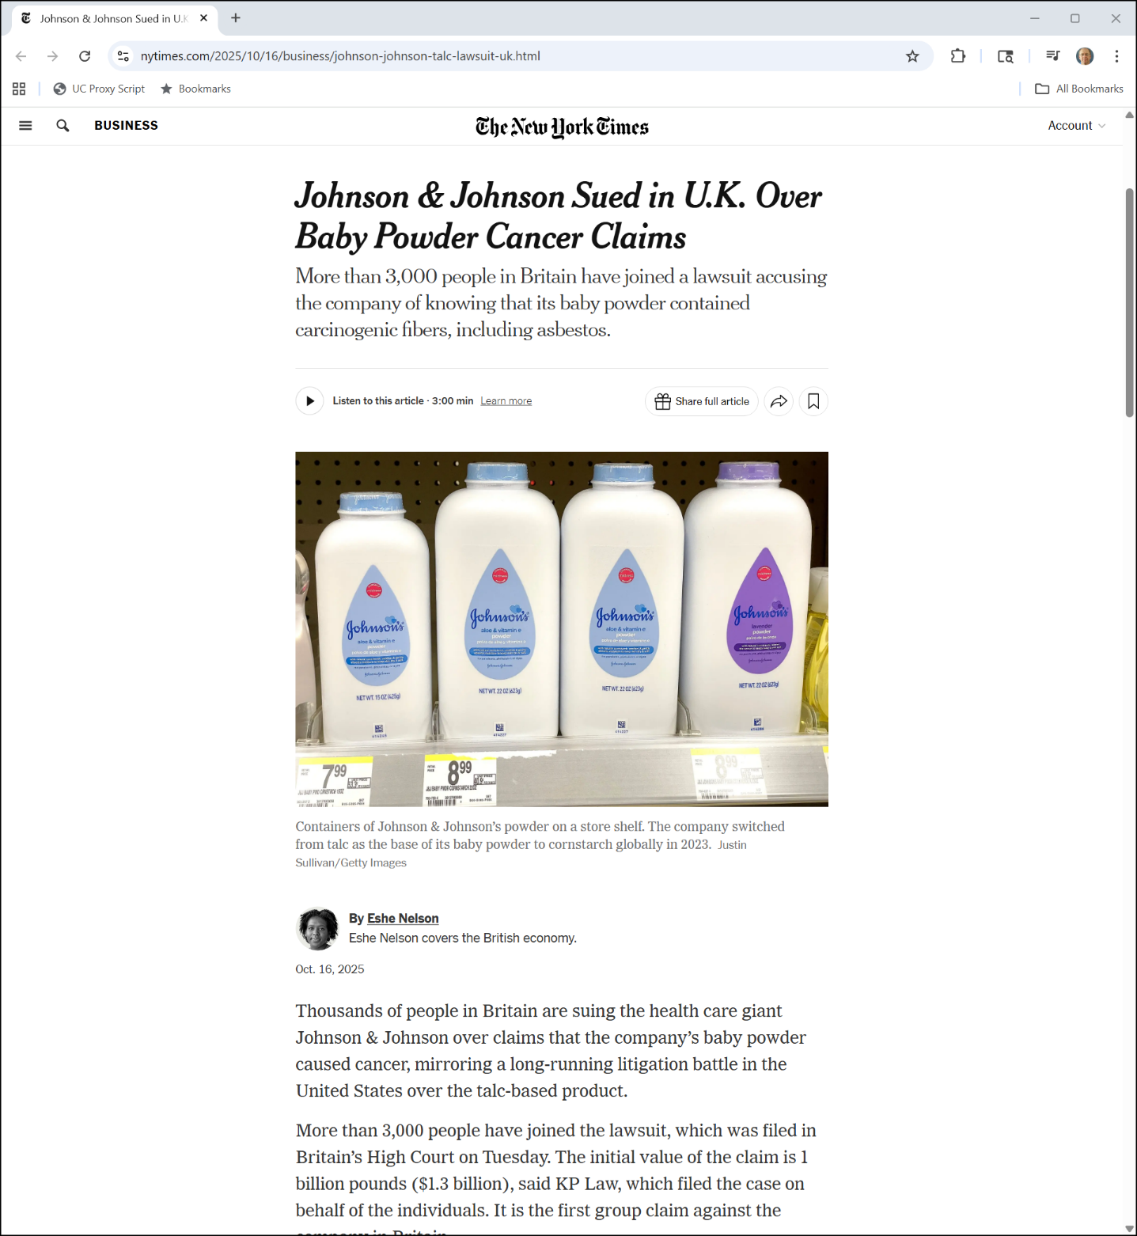
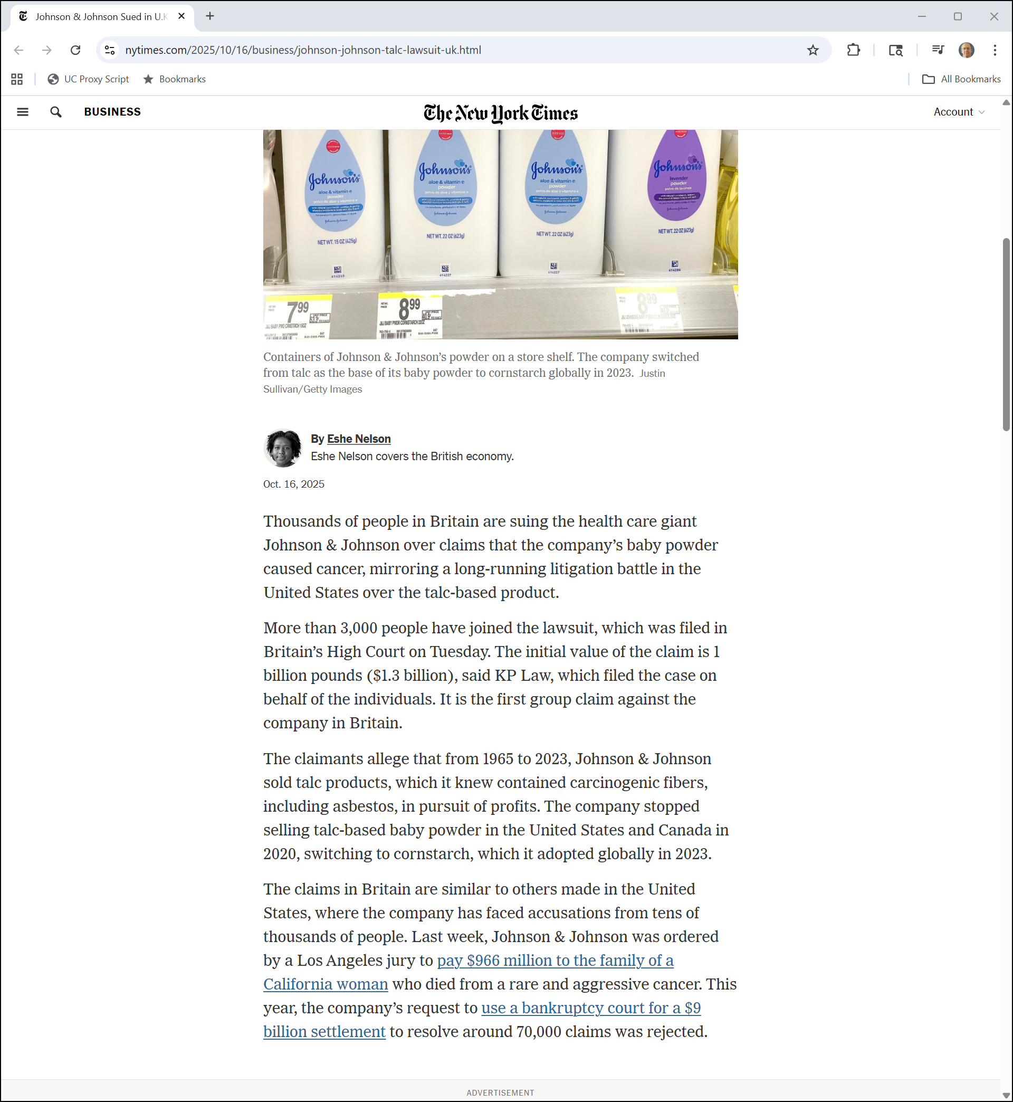
And Now in the UK
NYT (16 Oct 2025)
Notes:
https://www.nytimes.com/2025/10/16/business/johnson-johnson-talc-lawsuit-uk.html

Slide 139
And Now in the UK
NYT (16 Oct 2025)
Notes:
https://www.nytimes.com/2025/10/16/business/johnson-johnson-talc-lawsuit-uk.html

