Slide 1
Class 4: W10/22/2025; S10/25/2025 Booth 42201: The Legal Infrastructure of Business Platforms, Networks and Standards
Randal C. Picker
James Parker Hall Distinguished Service Professor of Law
The Law School
The University of Chicago
Copyright © 2002-25 Randal C. Picker. All Rights Reserved.

Slide 2
Spectrum
Spectrum

Slide 3
Tell Me About Breakfast
TTM

Slide 4
Licensing by Federal Government
“That a person, company, or corporation within the jurisdiction of the United States shall not use or operate any apparatus for radio communication as a means of commercial intercourse among the several States … the effect of which extends beyond the jurisdiction of the State or Territory in which the same are made,”
The Radio Act of 1912

Slide 5
Licensing by Federal Government
“or where interference would be caused thereby with the receipt of messages or signals from beyond the jurisdiction of the said State or Territory, except under and in accordance with a license, revocable for cause, in that behalf granted by the Secretary of Commerce and Labor upon application therefor; … .”
The Radio Act of 1912

Slide 6
Control Radio and Radio Channels
“That this Act is intended to regulate all forms of interstate and foreign radio transmissions and communications within the United States, its Territories and possessions; to maintain the control of the United States over all the channels of interstate and foreign radio transmission;”
Radio Act of 1927

Slide 7
Federally-Defined Licenses
“and to provide for the use of such channels, but not the ownership thereof, by individuals, firms, or corporations, for limited periods of time, under licenses granted by Federal authority, and no such license shall be construed to create any right, beyond the terms, conditions, and periods of the license.”
Radio Act of 1927

Slide 8
Federal Radio Commission
“That a commission is hereby created and established to be known as the Federal Radio Commission, hereinafter referred to as the commission, which shall be composed of five commissioners Appointed by the President … .”
Radio Act of 1927

Slide 9
1934: Creation of FCC
Pub. L. 73-416 (19 June 1934)

Slide 10
Herzel Comment
Leo Herzel, 18 U Chi L Rev 802 (1951)

Slide 11
Or Markets?: Lease to Highest Bidder
Leo Herzel, 18 U Chi L Rev 802 (1951)

Slide 12
What Role Should the FCC Play? (And a Rough Draft of The Problem of Social Cost?)
Coase, 2 J Law & Econ 1 (Oct 1959)

Slide 13
A More Limited FCC Is Possible
Coase, 2 J Law & Econ 1 (Oct 1959)

Slide 14
Prices and Spectrum
Coase, 2 J Law & Econ 1 (Oct 1959)

Slide 15
New Tech Doesn’t Necessarily Require New Regulatory Tools
Coase, 2 J Law & Econ 1 (Oct 1959)

Slide 16
2016 NTIA (magnify)

Slide 17
Radio Neutrality; Fairness
Columbia L Rev (July 1948)

Slide 18
Two Statements: Neutrality; Fairness
Columbia L Rev (July 1948)

Slide 19
TV in 1949
NYT (12 June 1949)

Slide 20
Neutrality Gone, Fairness Required
NYT (12 June 1949)

Slide 21
Red Lion: Fairness Doctrine Upheld
NYT (10 June 1969)

Slide 22
Press Right of Reply Statue
NYT (26 June 1974)

Slide 23
Red Lion and Tornillo?
Geller (1975)

Slide 24
Red Lion and Tornillo?
Geller (1975)

Slide 25
Red Lion and Tornillo?
Geller (1975)

Slide 26
FCC Doubts
NYT (8 Aug 1985)

Slide 27
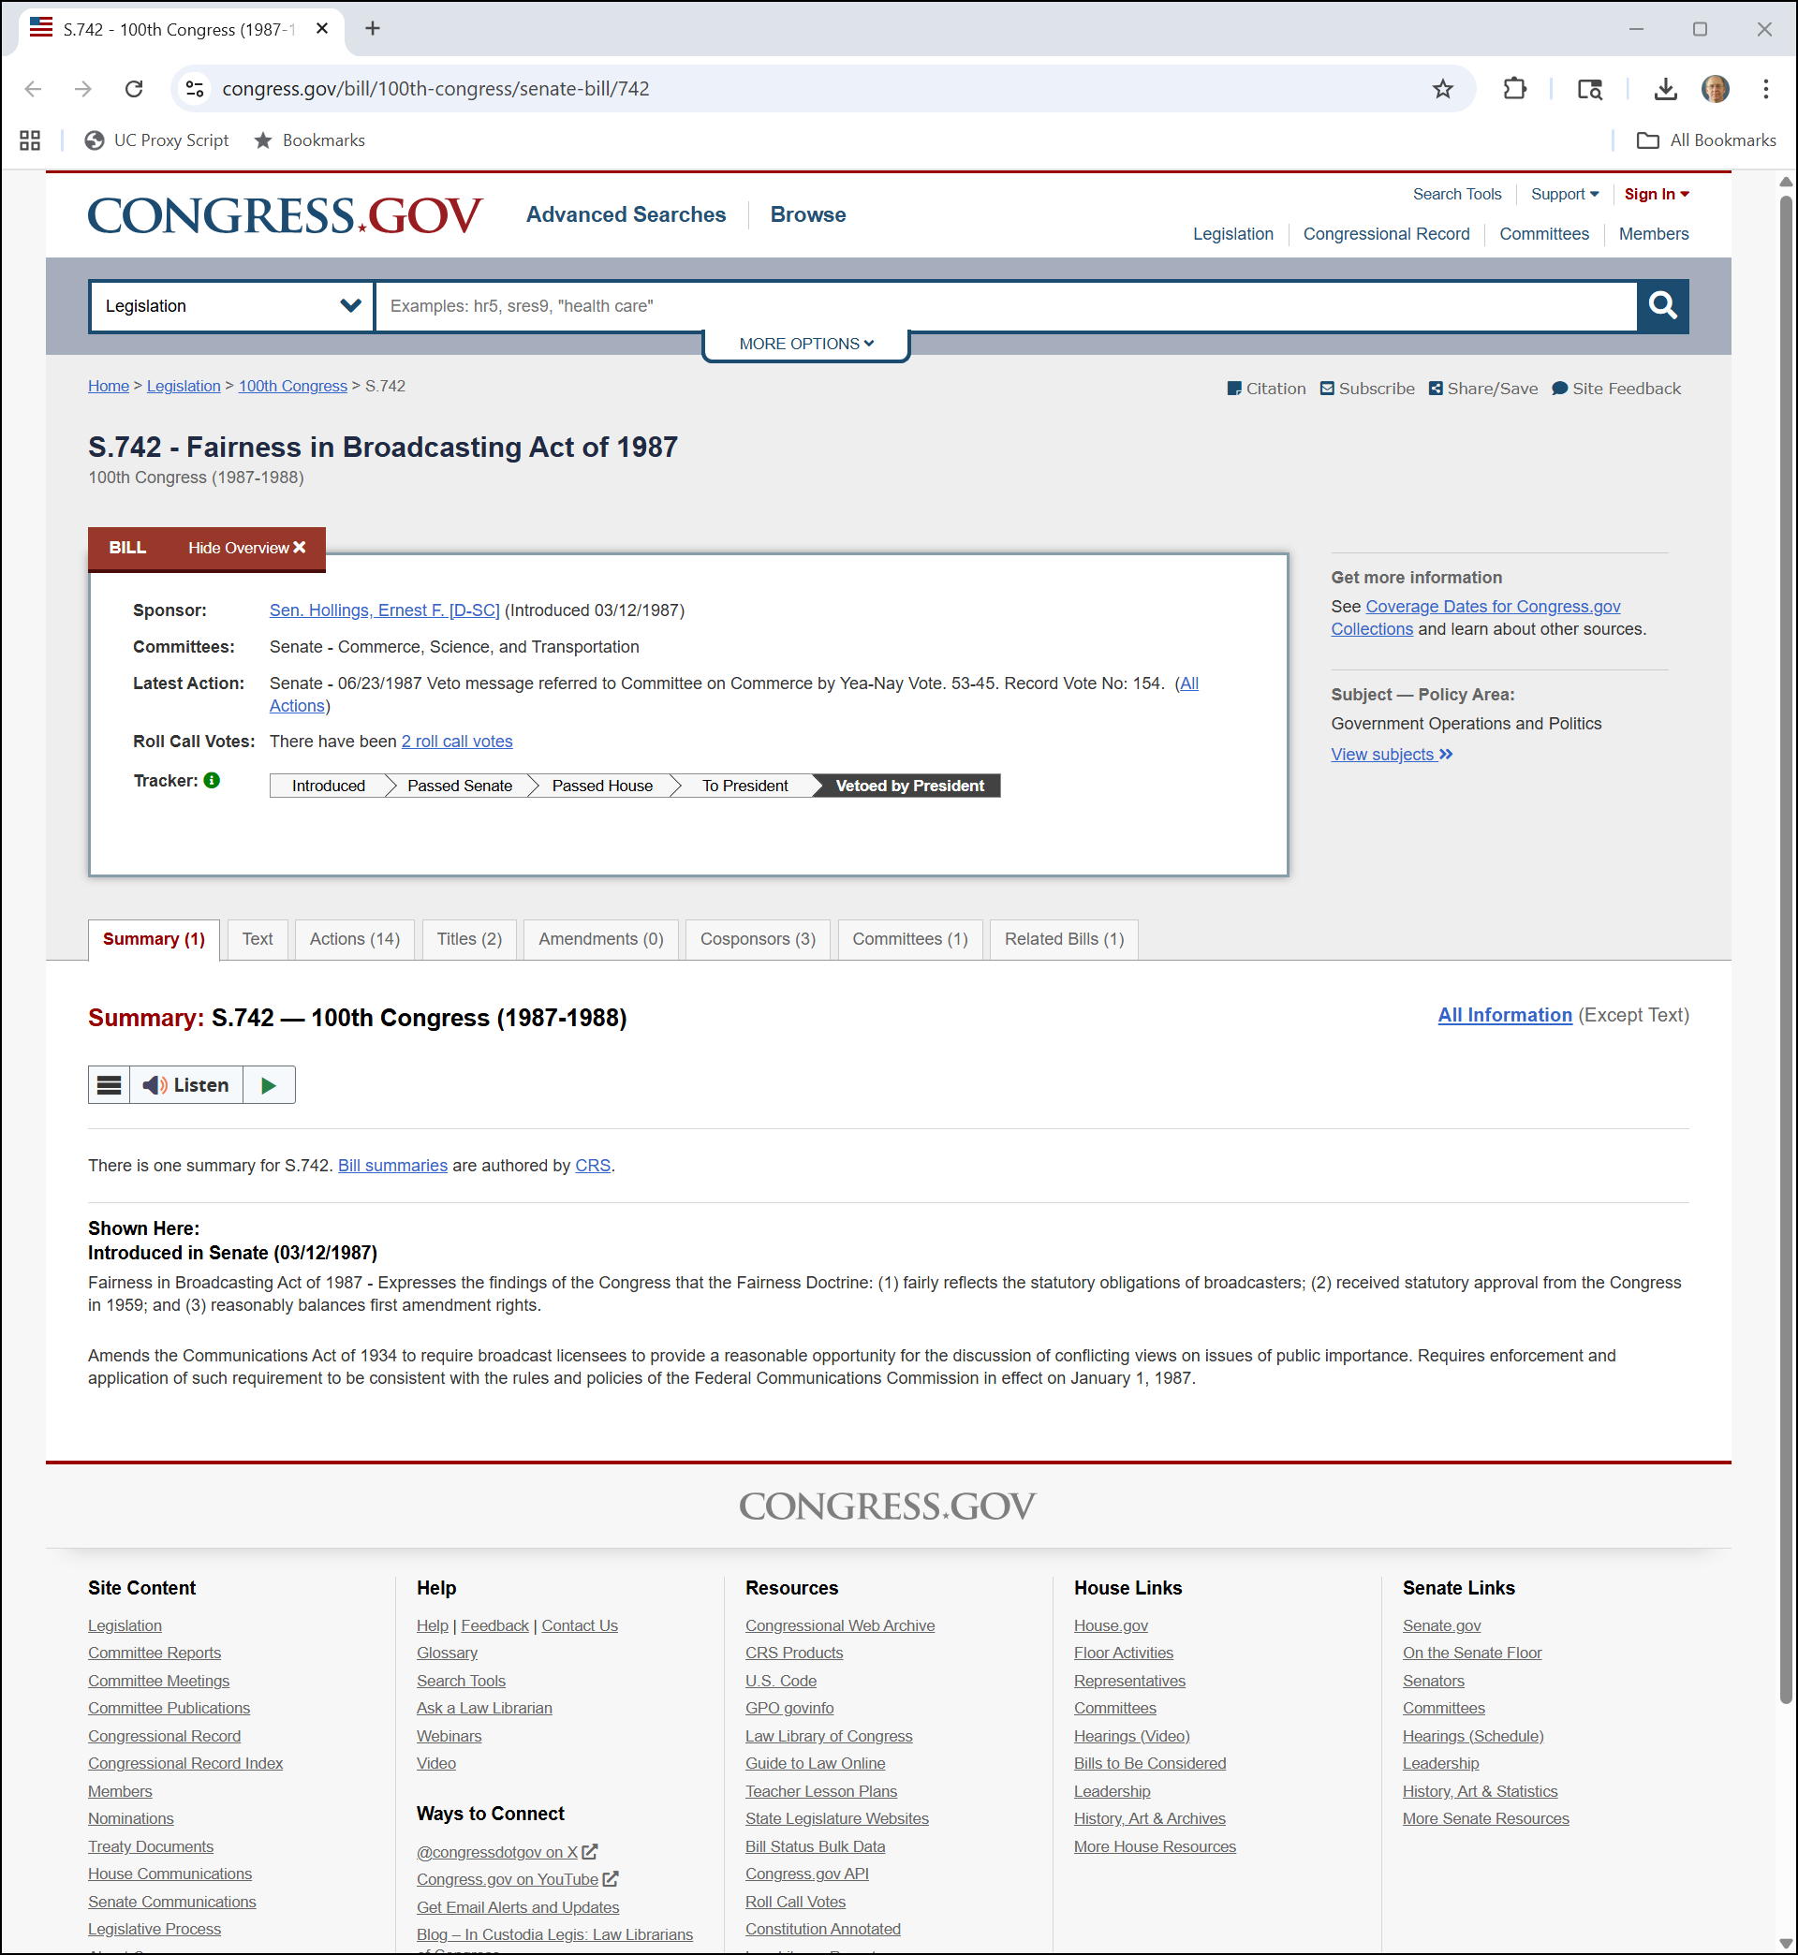
Fairness In Broadcasting Act of 1987
Congress.gov

Slide 28
Fairness In Broadcasting Act of 1987
Congress. gov

Slide 29
Reagan Veto
NYT (21 June 1987)

Slide 30
FCC Kills Fairness Doctrine
NYT (5 Aug 1987)

Slide 31
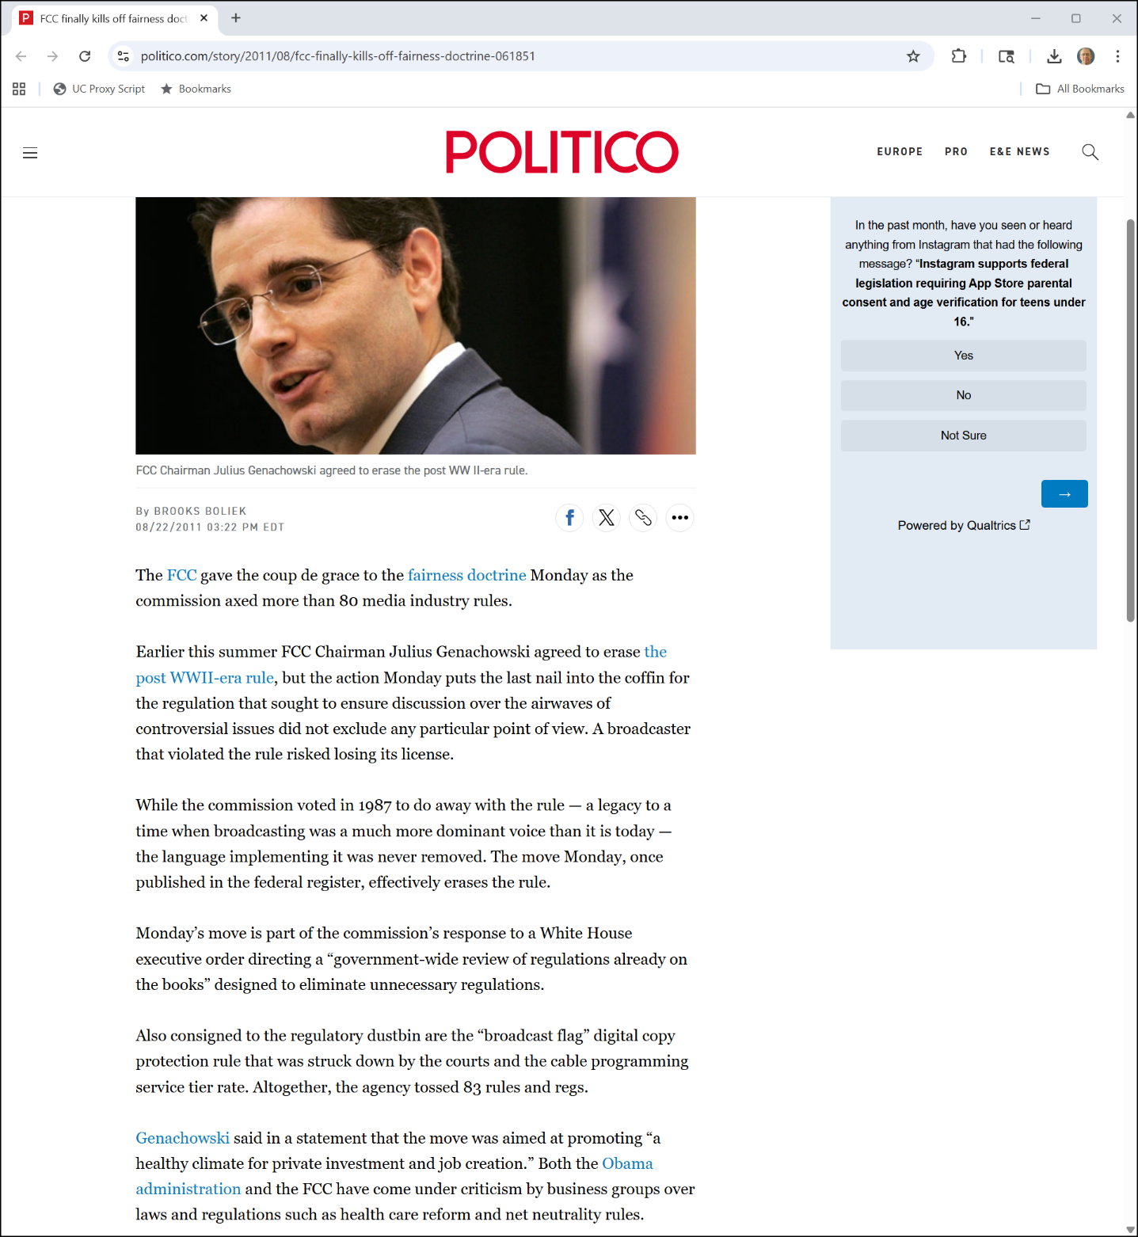

But On the Books Until 2011
Politico (22 Aug 2011)

Slide 32
Social Media and 1st Amendment
Moody (U.S. 2024))

Slide 33
States Can’t Regulate to Create Fairness
Moody (U.S. 2024))

Slide 34
States Can’t Regulate to Create Fairness
Moody (U.S. 2024))

Slide 35
Gov’t Can’t Coerce Third Parties to Suppress Speech
Vullo (U.S. 2024)

Slide 36
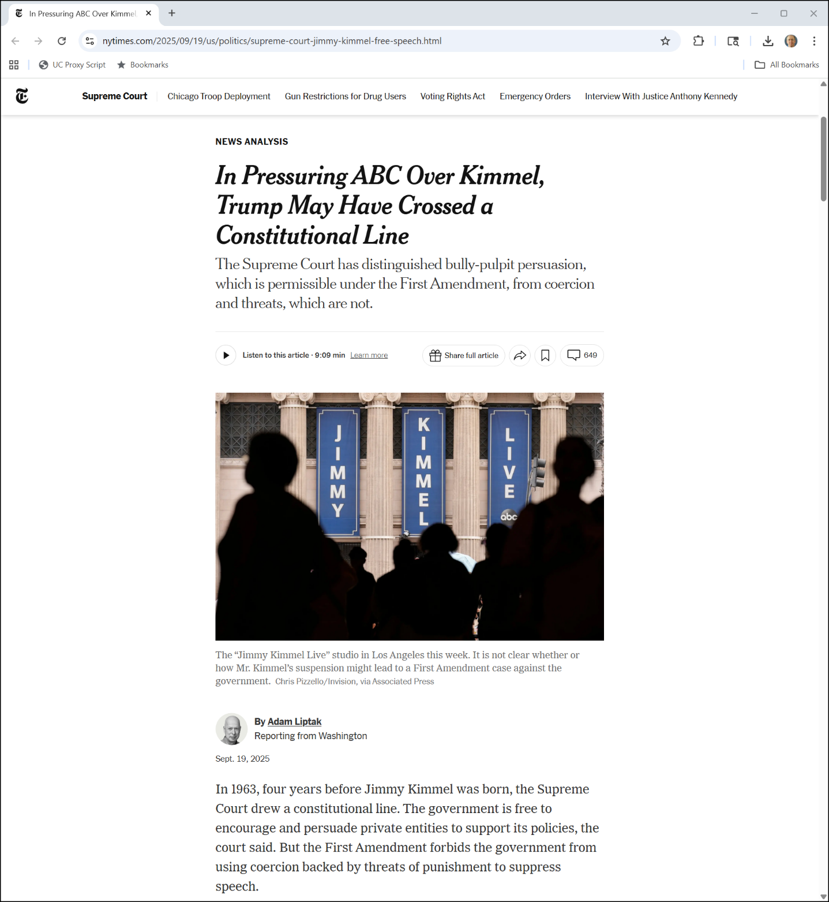
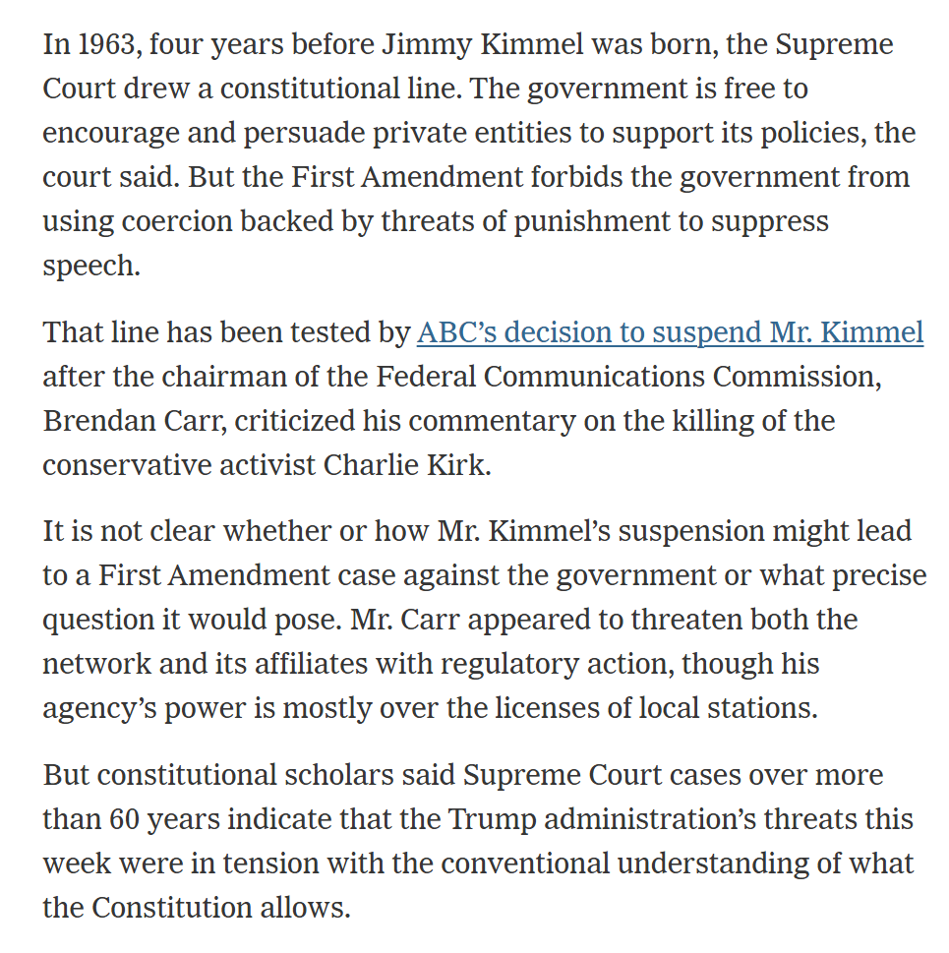
FCC Threats
NYT (19 Sept 2025)

Slide 37
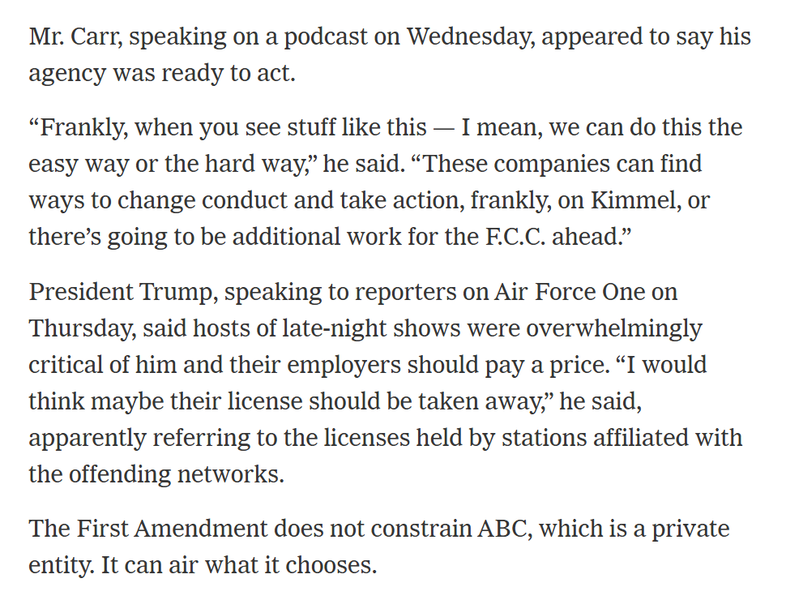
Pull the Licenses
NYT (19 Sept 2025)

Slide 38
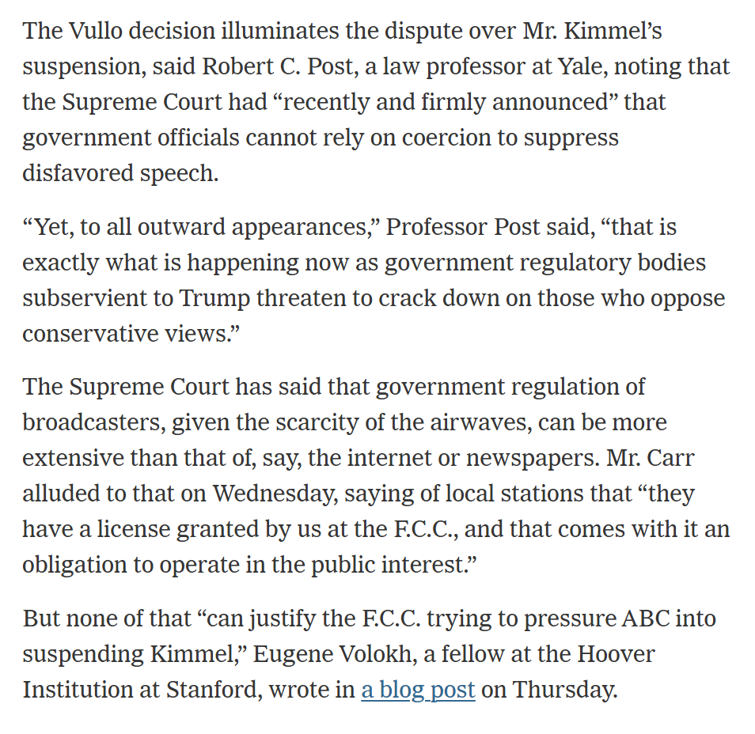
Apply Vullo Here
NYT (19 Sept 2025)

Slide 39
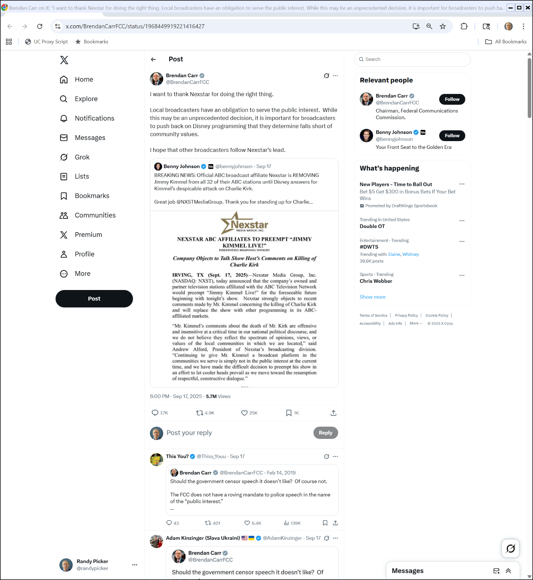

Local Affiliate Preemption
Brendan Carr on Twitter/X (17 Sept 2025)
Notes:
https://x.com/BrendanCarrFCC/status/1968449919221416427

Slide 40
2019 Carr
Brendan Carr on Twitter/X
Notes:
https://x.com/BrendanCarrFCC/status/1968449919221416427

Slide 41
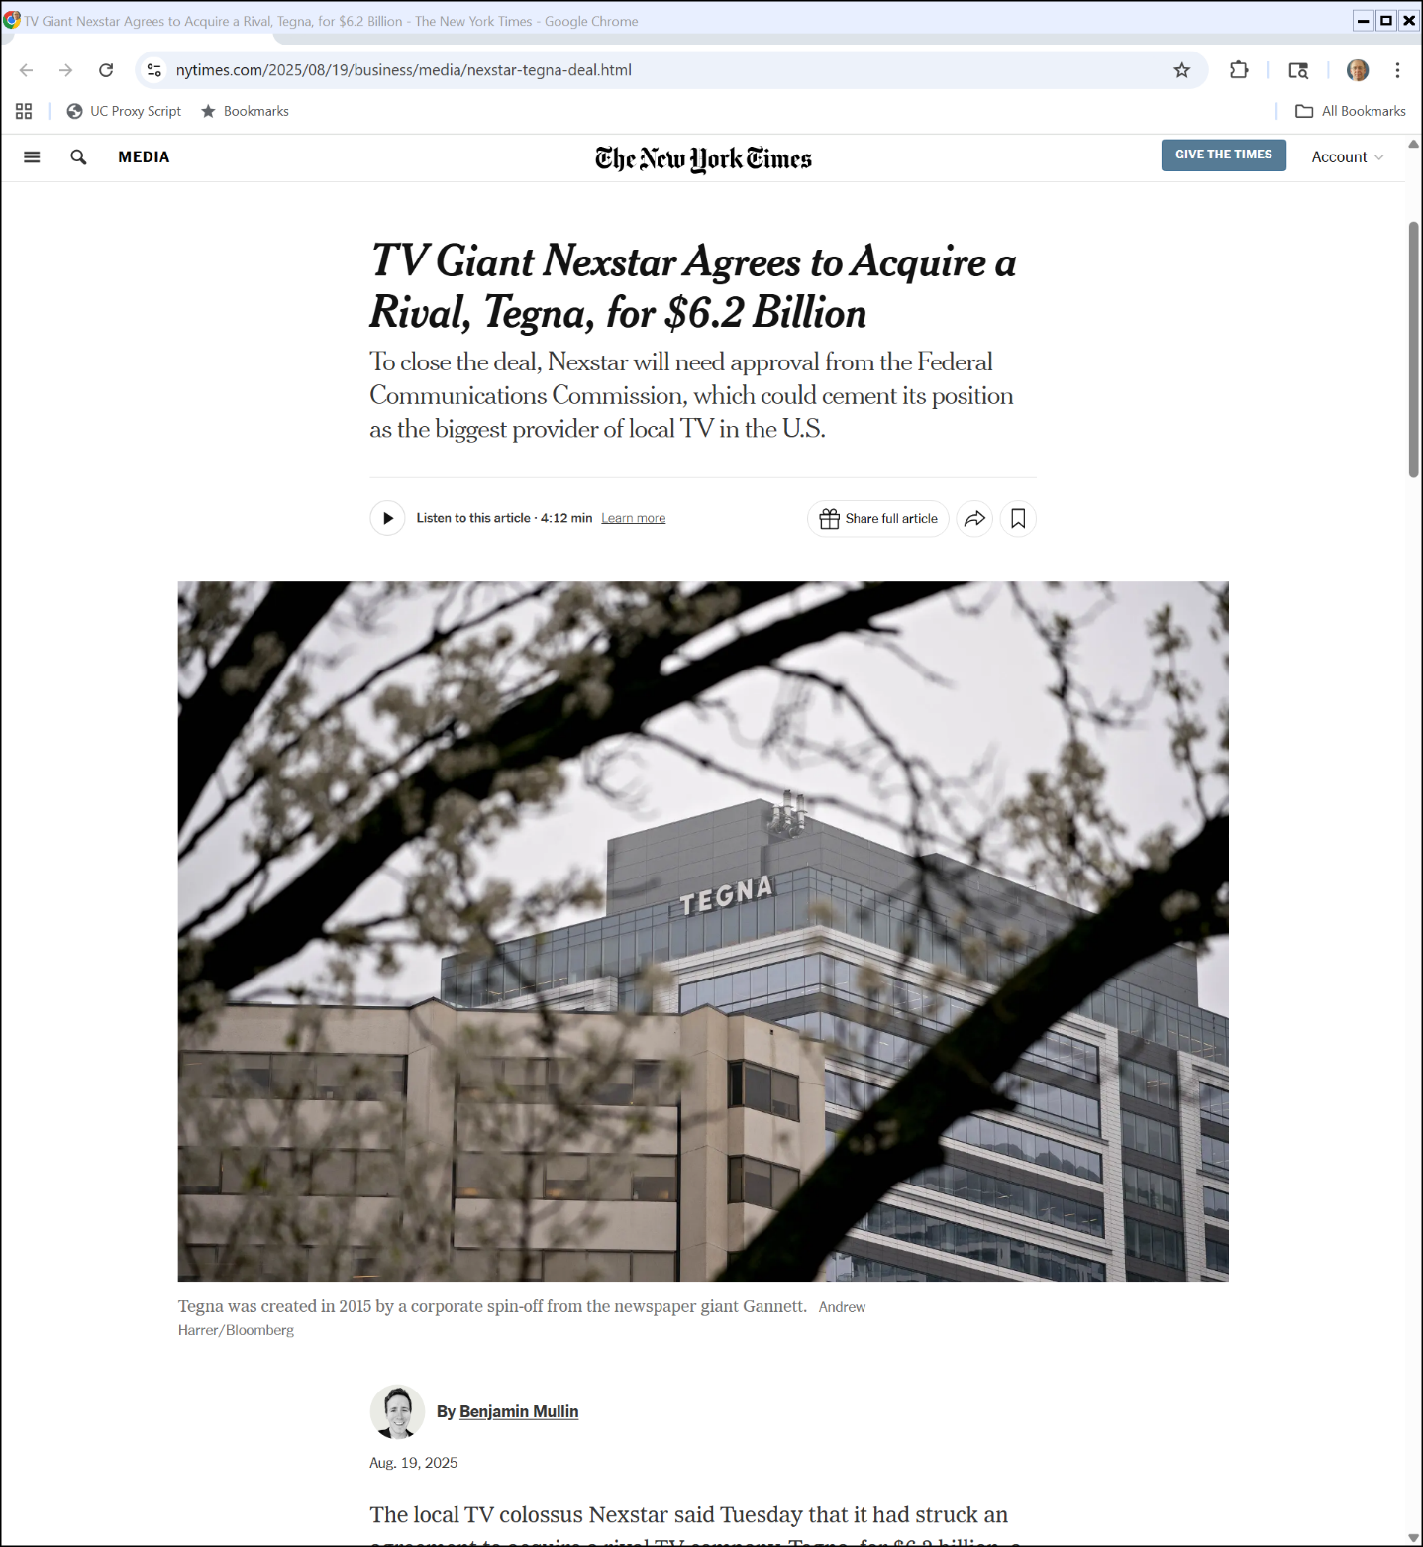
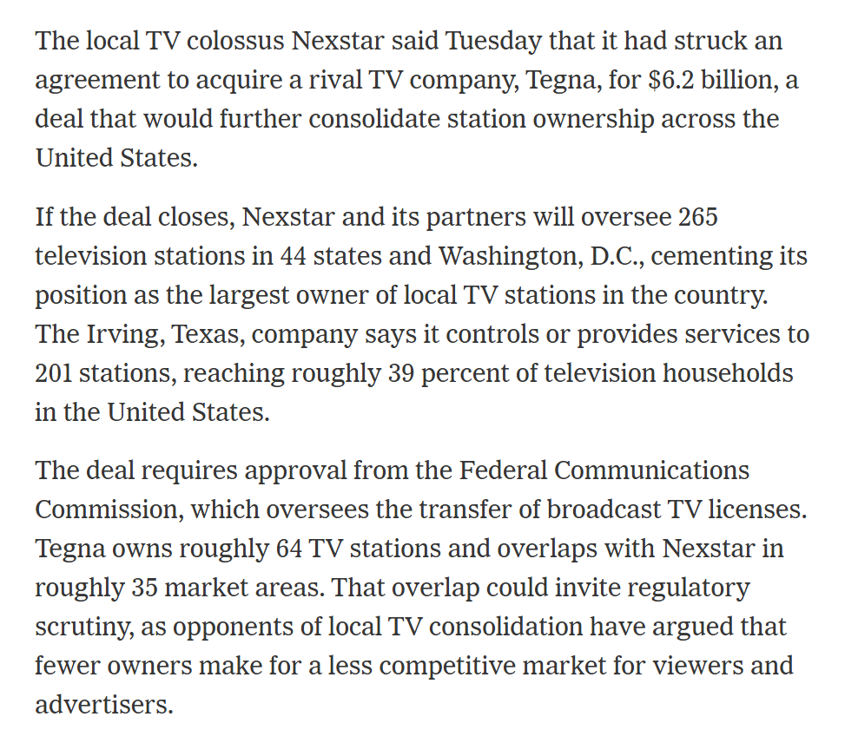
Nexstar Deal
NYT (19 Aug 2025)
Notes:
https://www.nytimes.com/2025/08/19/business/media/nexstar-tegna-deal.html

Slide 42
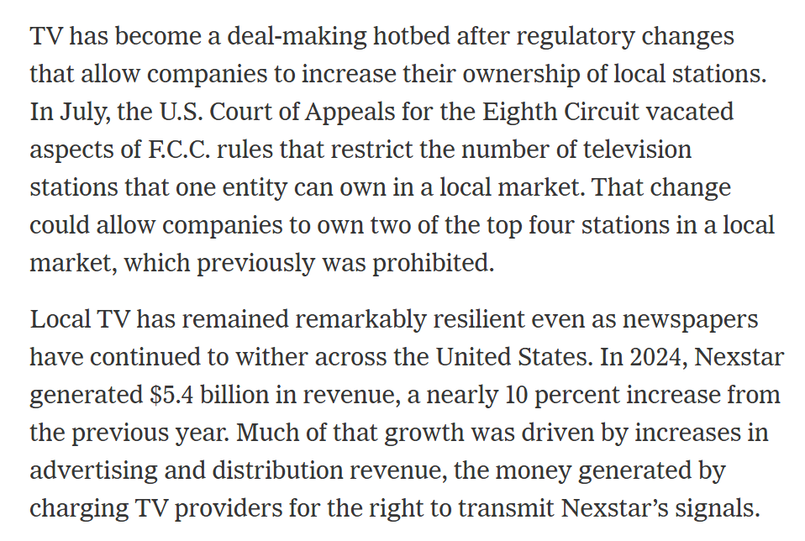
Driven by Regulatory Changes?
NYT (19 Aug 2025)
Notes:
https://www.nytimes.com/2025/08/19/business/media/nexstar-tegna-deal.html

Slide 43
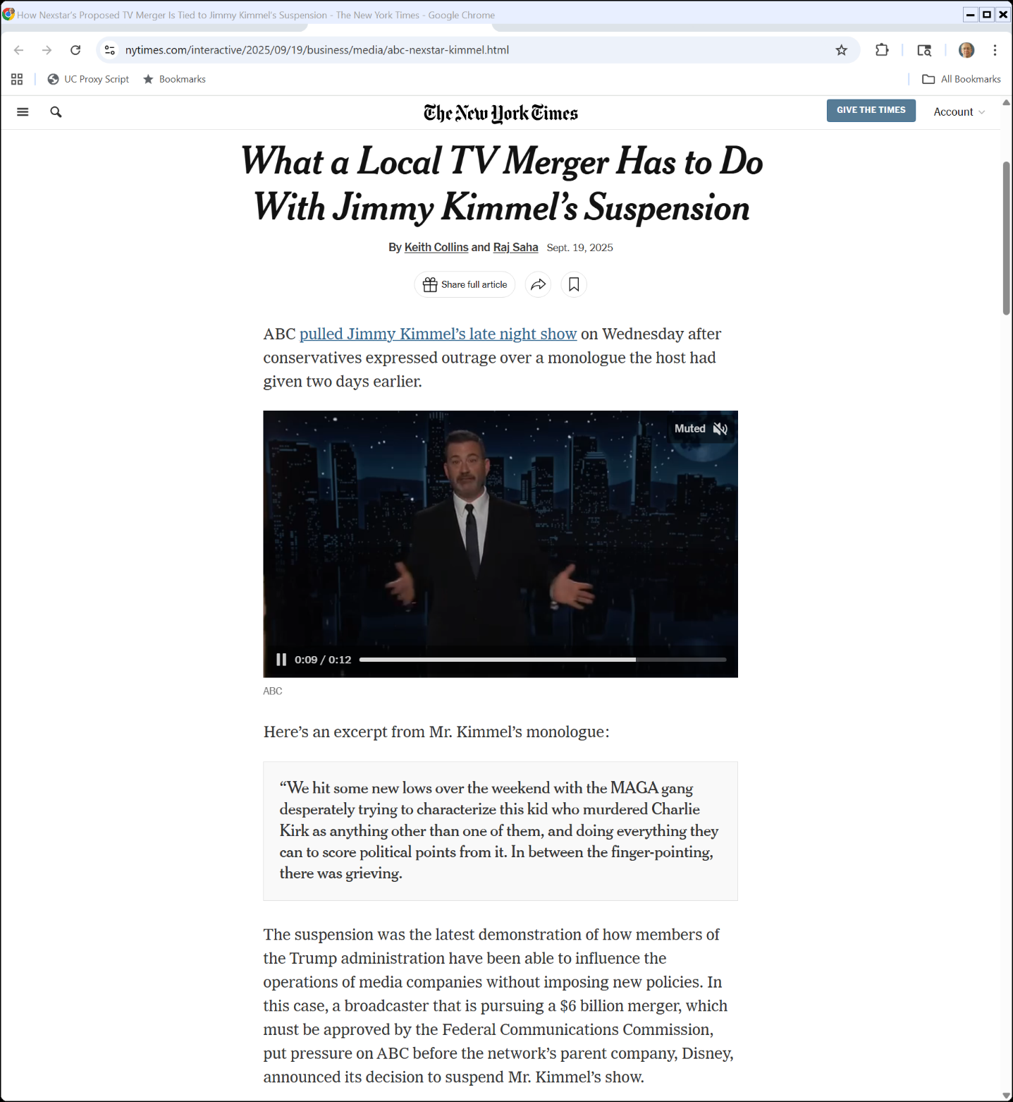
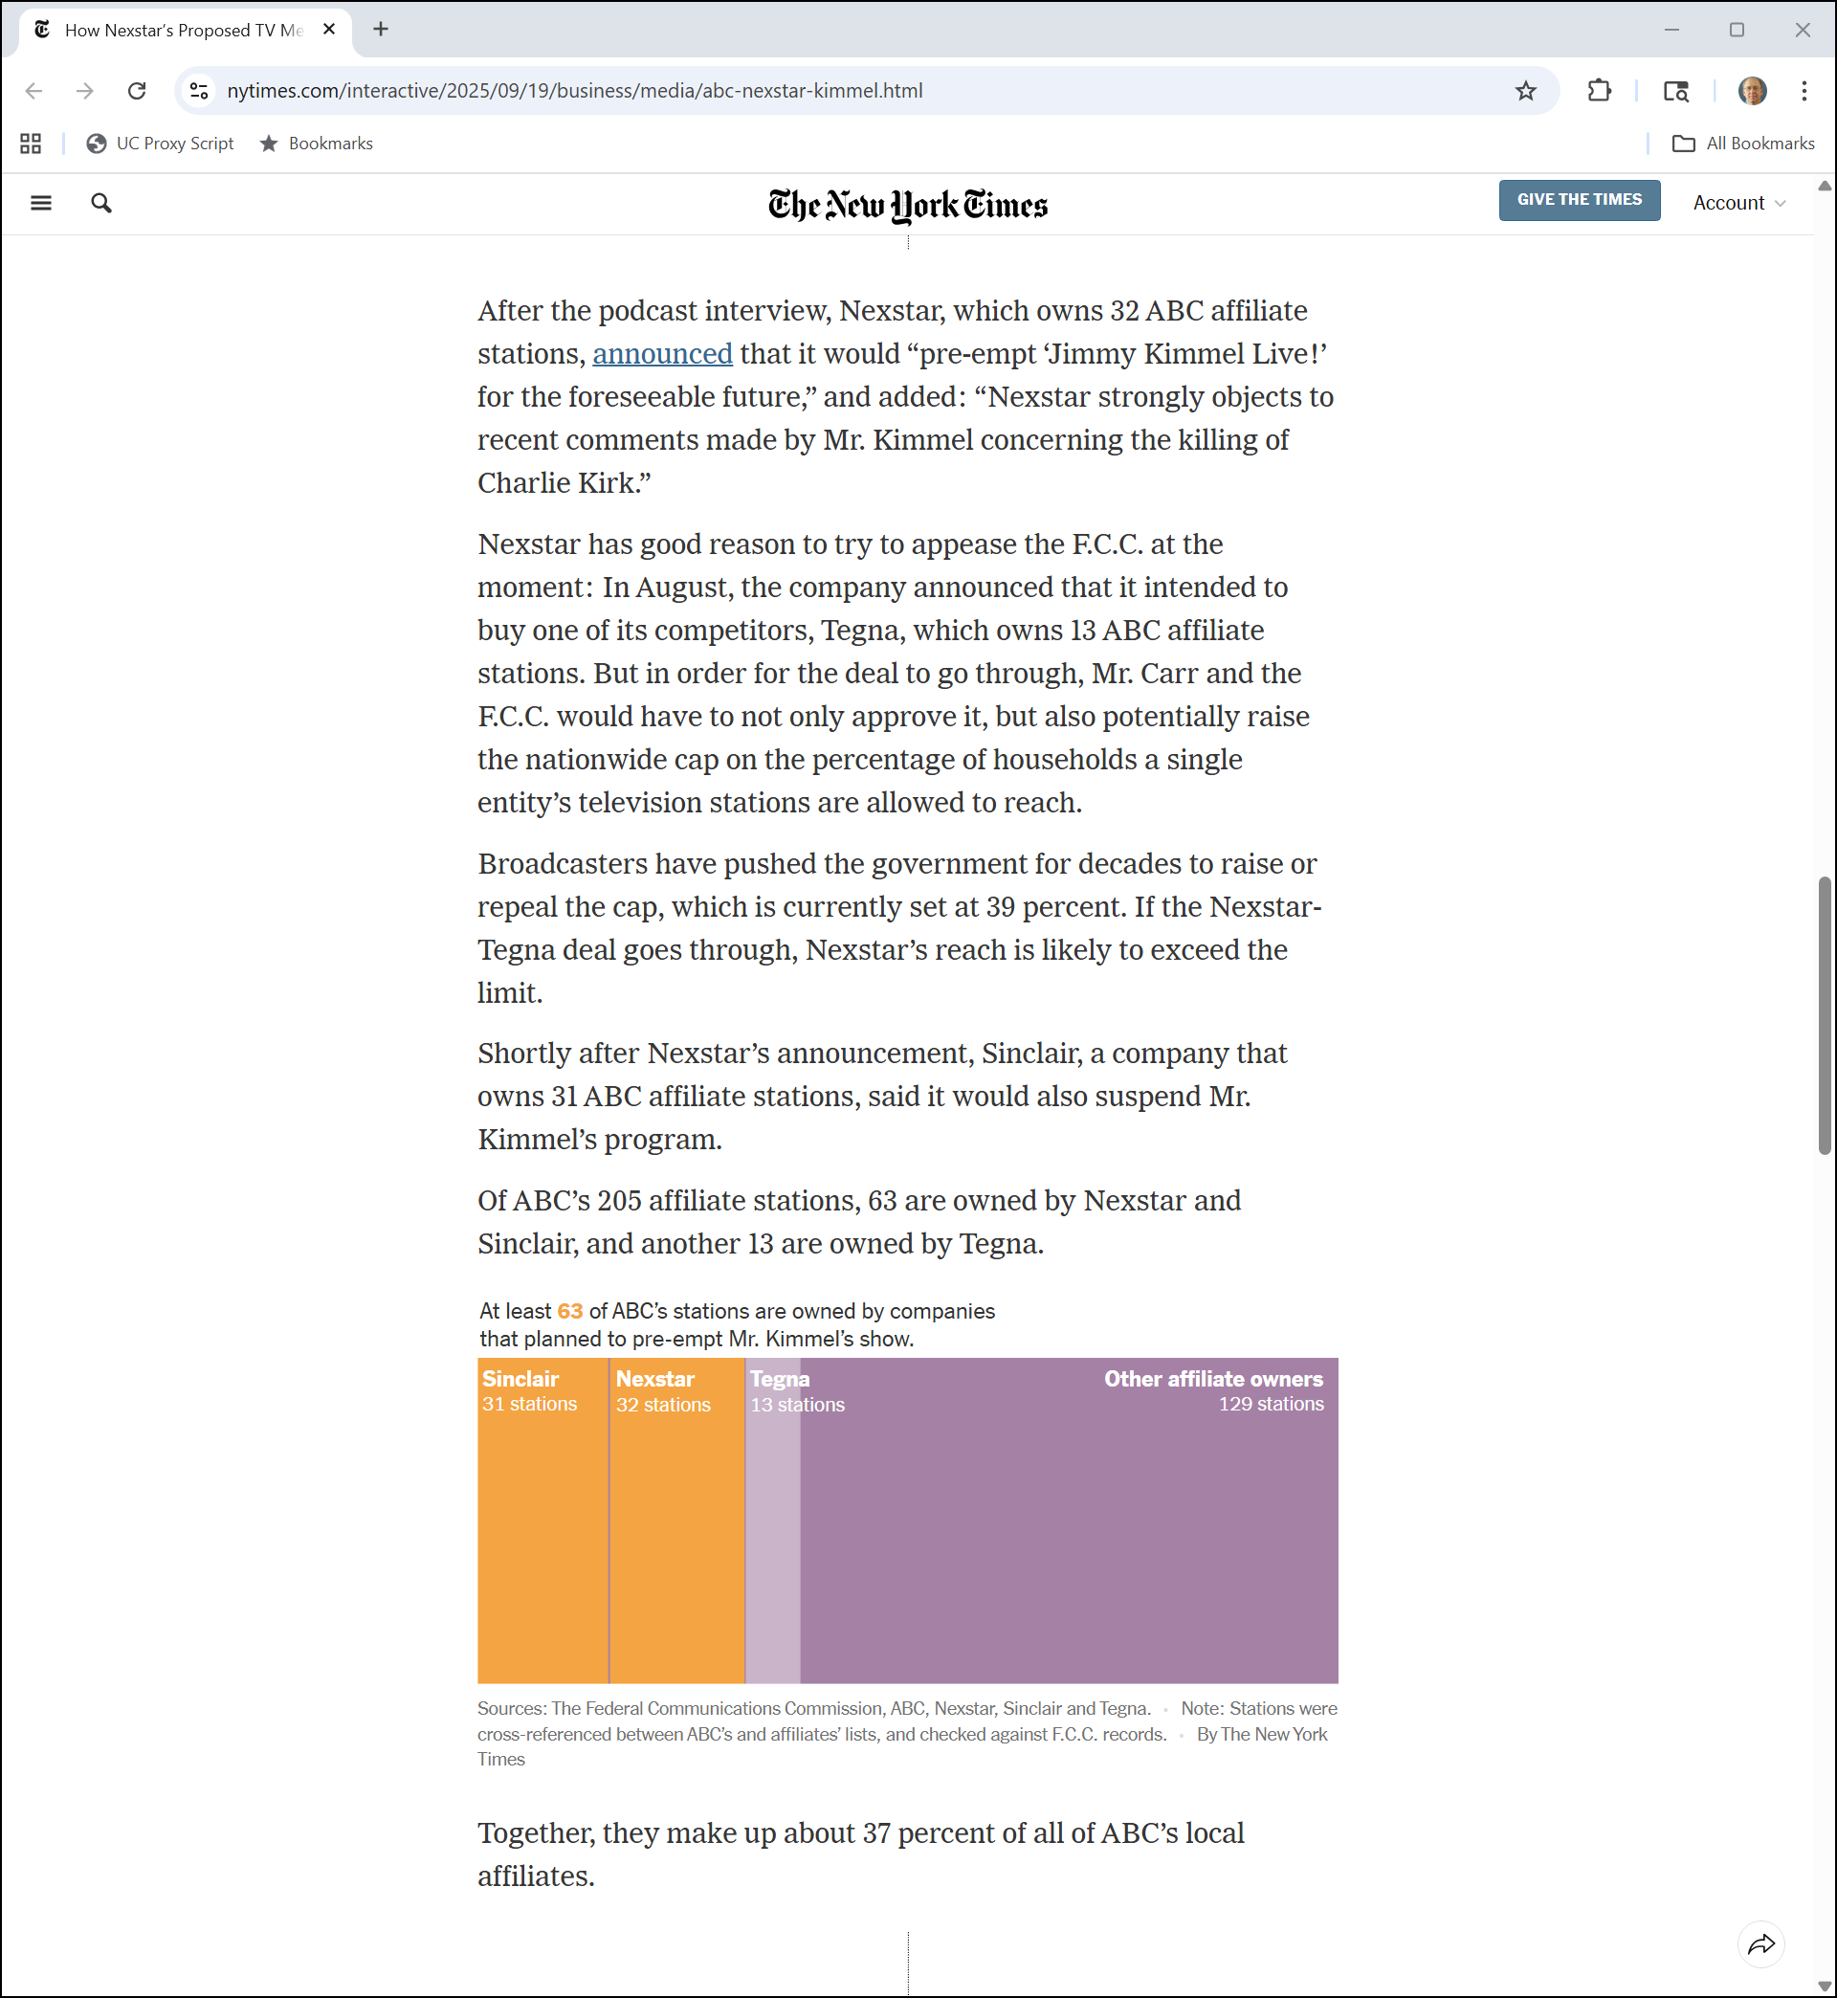
Kimmel and the Nexstar Deal
NYT (19 Sept 2025)
Notes:
https://www.nytimes.com/interactive/2025/09/19/business/media/abc-nexstar-kimmel.html

Slide 44
Kimmel and the Nexstar Deal
NYT (19 Sept 2025)
Notes:
https://www.nytimes.com/interactive/2025/09/19/business/media/abc-nexstar-kimmel.html

Slide 45
The Kimmel Monologue
TTYN (1 of 2)
Situation
Jimmy Kimmel delivers his monologue on Monday
On a podcast Wednesday morning, FCC Chair Carr says the above
Kimmel is planning a responsive monologue for Wednesday evening

Slide 46
The Kimmel Monologue
TTYN (2 of 2)
Situation
Local affiliates are also threatening to preempt Kimmel’s show
You are the CEO of Disney: What do you do?

Slide 47
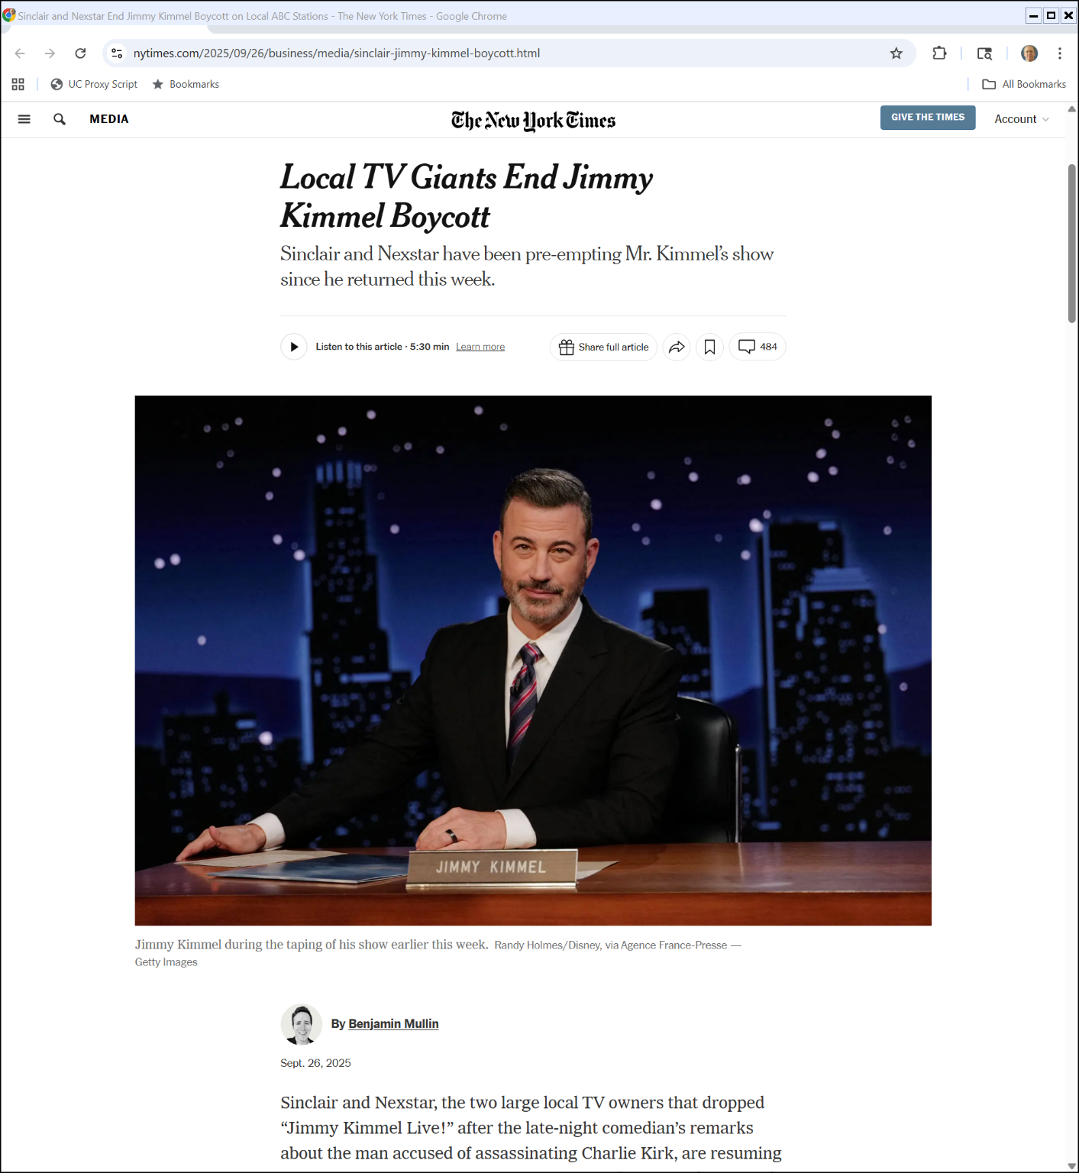
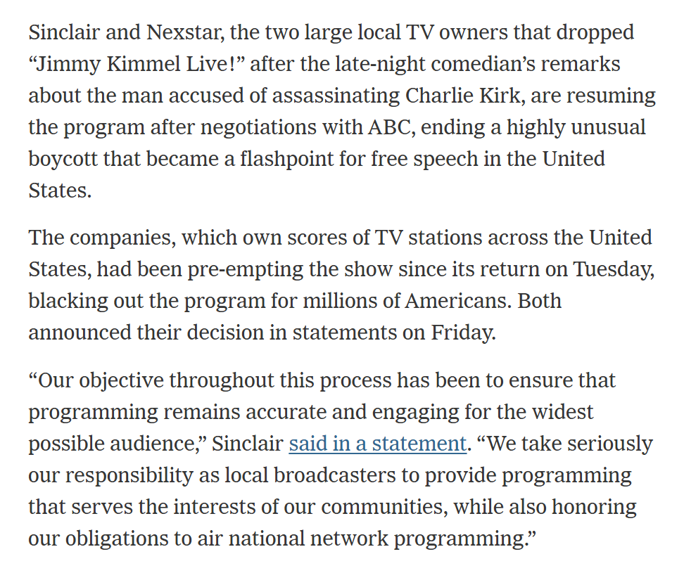
Boycott Over
NYT (3 Sept 1976)

Slide 48
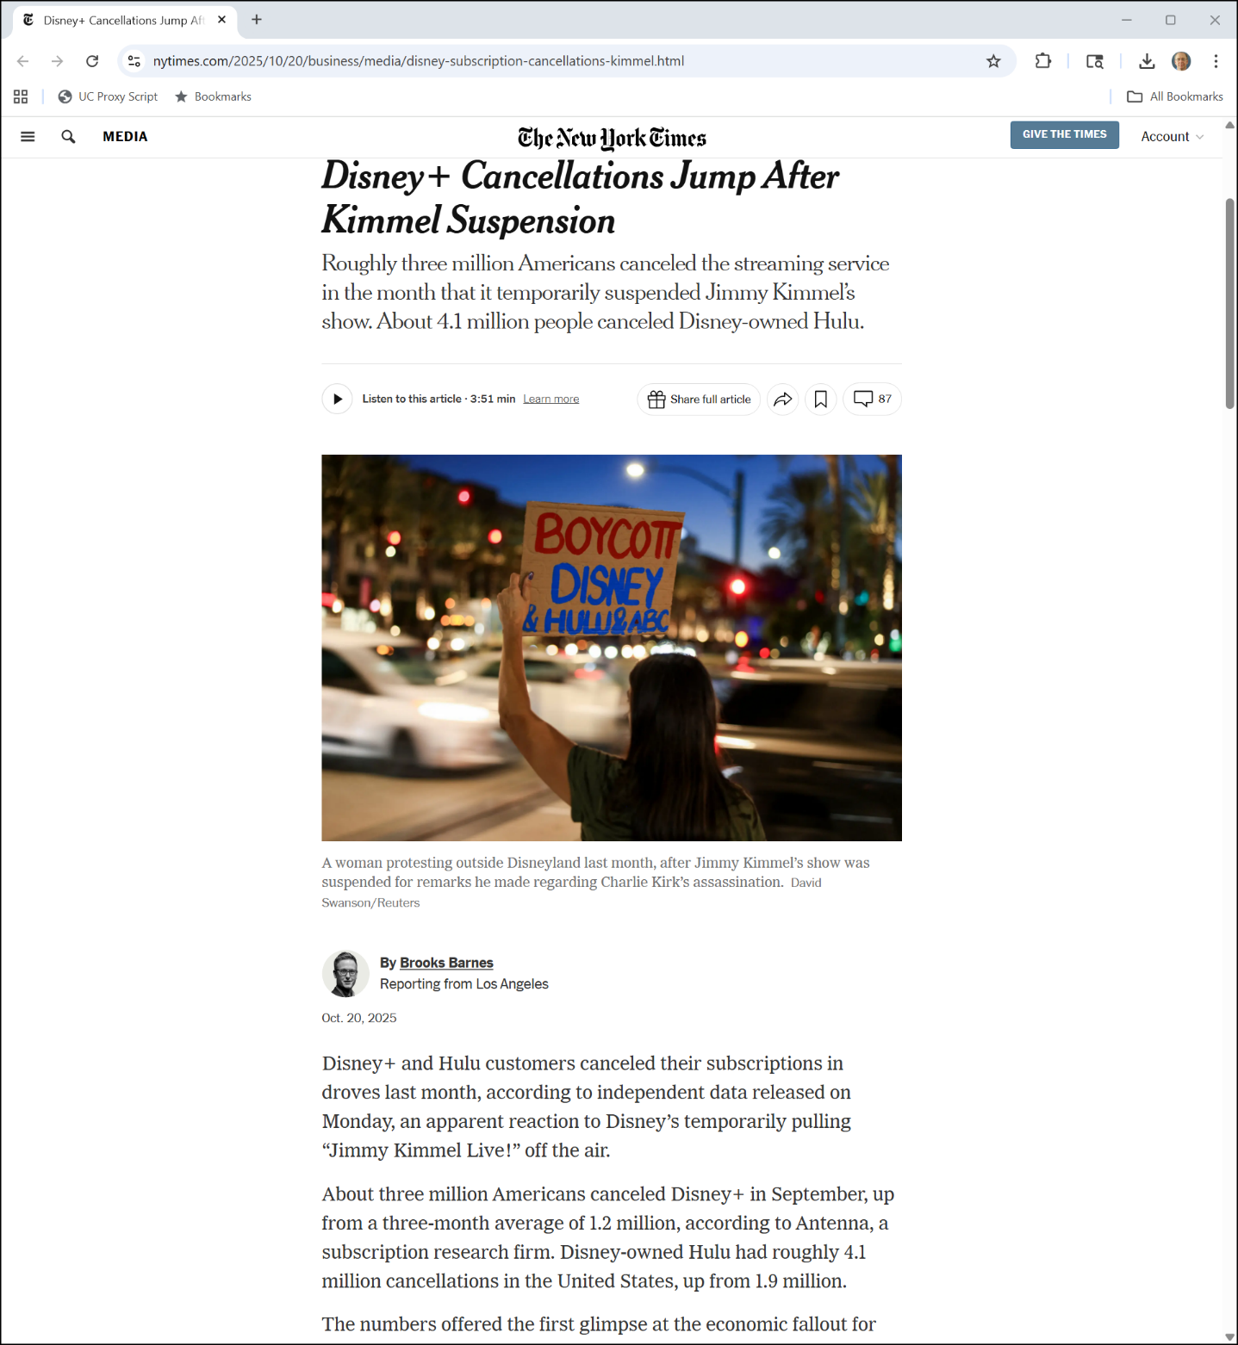
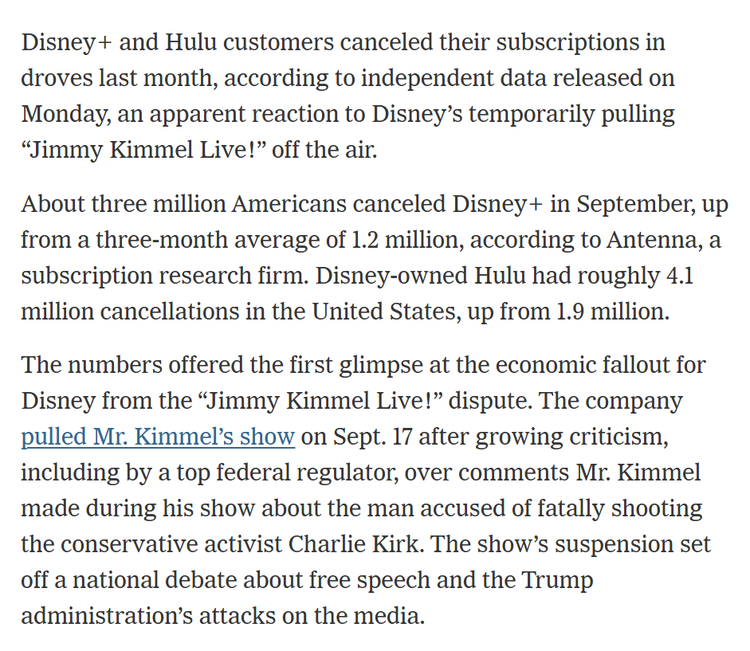
Cancellations
NYT (20 Oct 2025)
Notes:
https://www.nytimes.com/2025/10/20/business/media/disney-subscription-cancellations-kimmel.html

Slide 49
Internet History
A (Very) Short Internet History

Slide 50
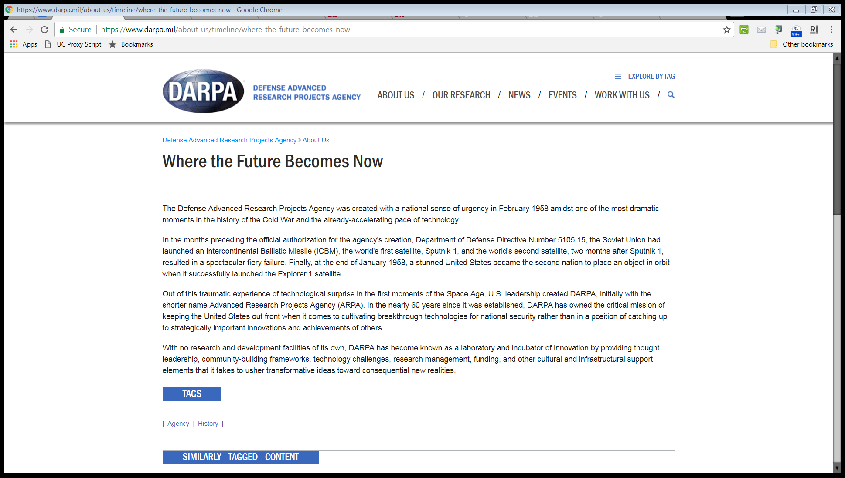
DARPA History
“The Defense Advanced Research Projects Agency was created with a national sense of urgency in February 1958 amidst one of the most dramatic moments in the history of the Cold War and the already-accelerating pace of technology.”

Slide 51
Sputnik and Soviet Missiles
New York Times (13 Oct 1957)

Slide 52
Sputnik and Soviet Missiles
New York Times (13 Oct 1957)

Slide 53
Licklider Intergalactic Computer Memo

Slide 54
How to Control a Network of Computers
Licklider Intergalactic Computer Memo (1963)

Slide 55
Baran, On Distributed Communication Networks
IEEE Publication (March 1964)

Slide 56
Baran, On Distributed Communication Networks
IEEE Publication (March 1964)

Slide 57
Dec 1969: ARPANET Goes Live
Source: BBN Report No. 4799 (April 1981)

Slide 58
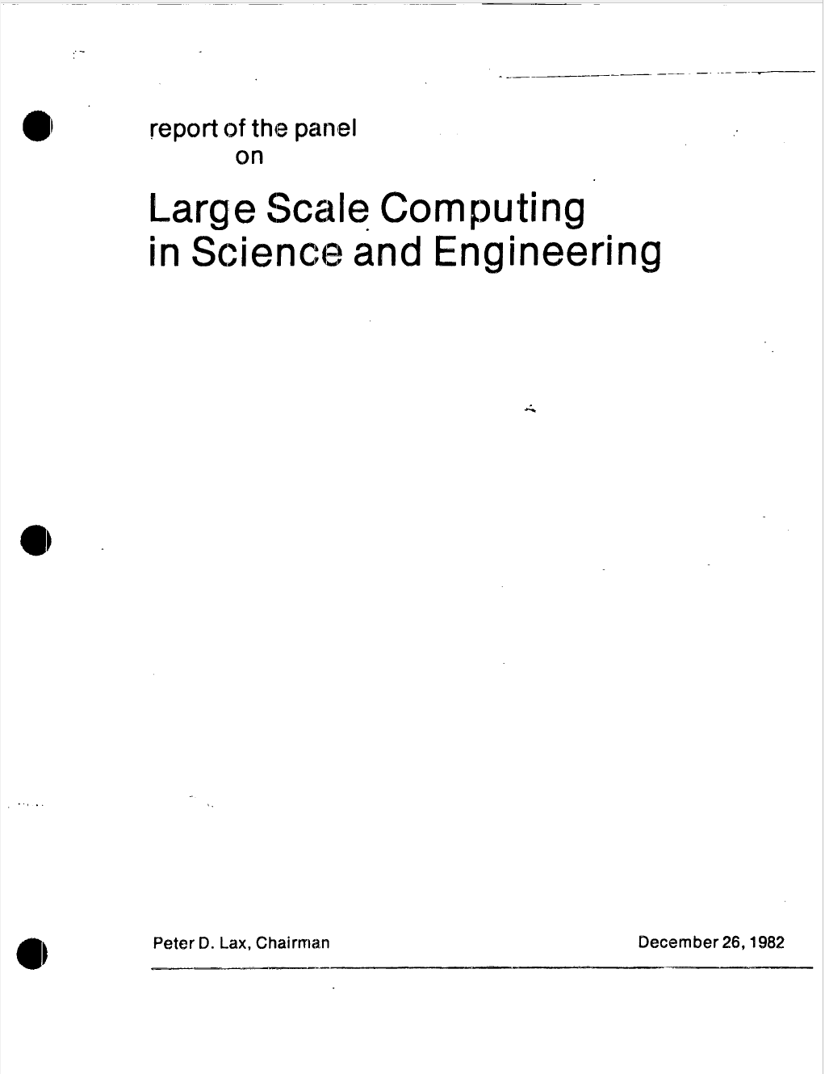
Dec 1982: Lax Report on Supercomputers
Lax Report (26 Dec 1982)

Slide 59
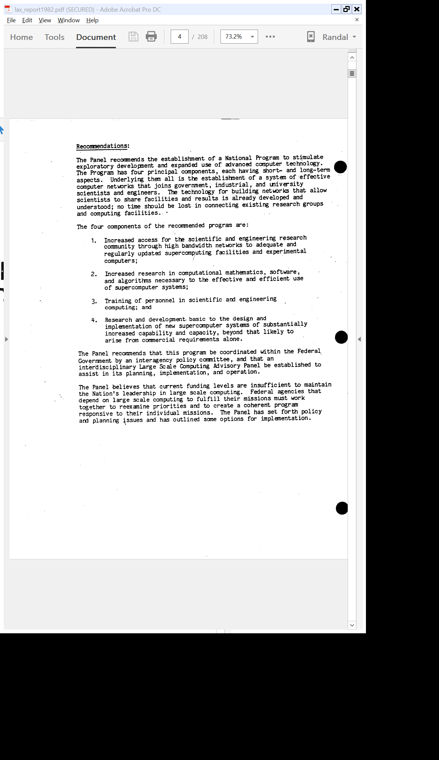
New Supercomputers and a Network to Tie Them Together
Lax Report (26 Dec 1982)

Slide 60
NSFNET: Bridge from ARPANET to Commercial Internet

Slide 61
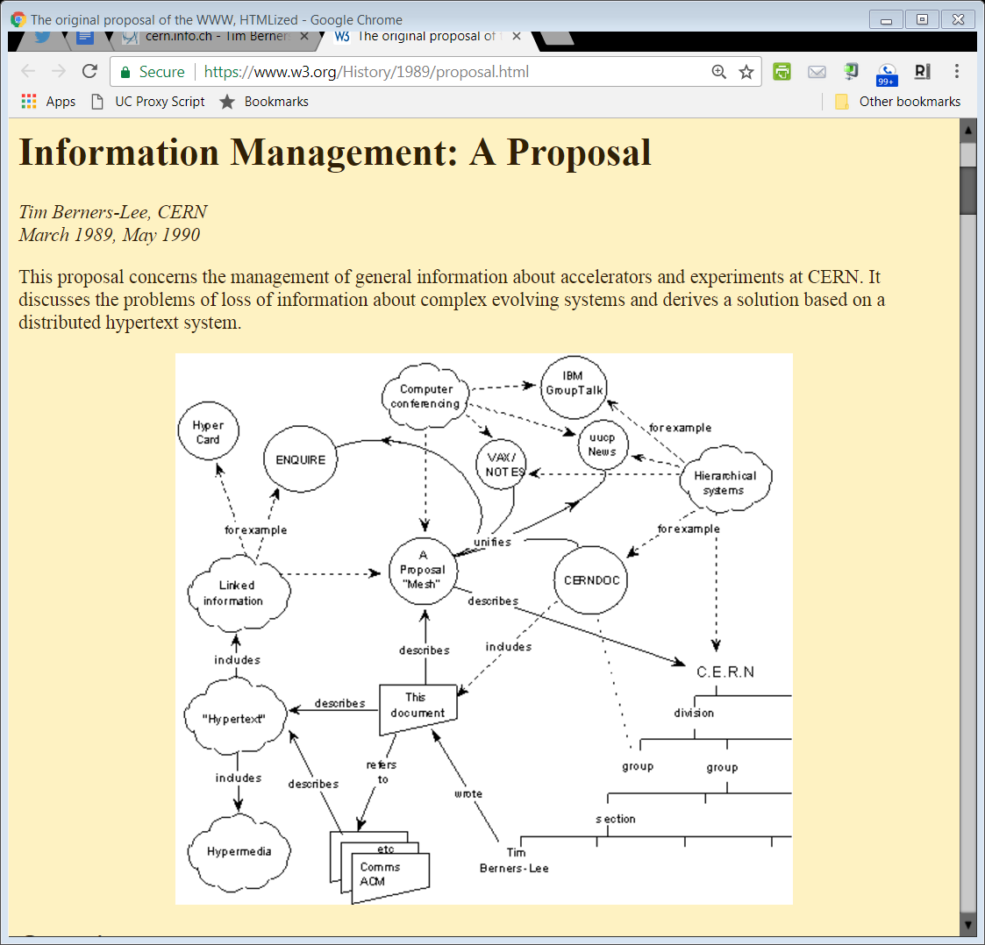
Mar 1989: Berners-Lee Mesh Proposal
www.w3.org
Notes:
https://www.w3.org/History/1989/proposal.html

Slide 62
Berners-Lee Mesh Proposal
www.w3.org
Notes:
https://www.w3.org/History/1989/proposal.html

Slide 63
Mosaic
New York Times (8 Dec 1993)

Slide 64
Mosaic
New York Times (8 Dec 1993)

Slide 65
Net Neutrality
Net Neutrality

Slide 66
Comcast Acceptable Use Policy

Slide 67
Prohibited Uses
XFINITY (Comcast) Acceptable Use Policy for Internet

Slide 68
More Prohibited Uses
XFINITY (Comcast) Acceptable Use Policy for Internet

Slide 69
Comcast Reserves Right to Block Content
XFINITY (Comcast) Acceptable Use Policy for Internet

Slide 70
Manage Network for Benefit of All
XFINITY (Comcast) Acceptable Use Policy for Internet

Slide 71
Lots of Tools Including Throttling
XFINITY (Comcast) Acceptable Use Policy for Internet

Slide 72
Aug 2008: FCC Order re Comcast Practices
FCC Comcast Order (1 Aug 2008)
Notes:
https://docs.fcc.gov/public/attachments/DOC-284286A1.pdf

Slide 73
Comcast Appeal
Comcast v. FCC, 600 F.3d 642 (CADC 2010)

Slide 74
Scope of FCC Authority
Comcast v. FCC, 600 F.3d 642 (CADC 2010)

Slide 75
No Authority Here
Comcast v. FCC, 600 F.3d 642 (CADC 2010)

Slide 76
400 Page Download
FCC Open Internet Order (12 Mar 2015)

Slide 77
Three Problems (and Same Rules for Fixed and Mobile)
“Because the record overwhelmingly supports adopting rules and demonstrates that three specific practices invariably harm the open Internet—Blocking, Throttling, and Paid Prioritization—this Order bans each of them, applying the same rules to both fixed and mobile broadband Internet access service.”
FCC Open Internet Order (12 Mar 2015)

Slide 78
More Net Neutrality Appeals
USTA v FCC (CADC 14 June 2016)

Slide 79
Third Appeal in Seven Years
USTA v FCC (CADC 14 June 2016)

Slide 80
Using Title II: Third Time the Charm (Sort Of)
USTA v FCC (CADC 14 June 2016)

Slide 81
Dec 2017: FCC Reverses Course
FCC Restoring Internet Freedom Order (14 Dec 2017)

Slide 82
Dec 2017: FCC Reverses Course
FCC Restoring Internet Freedom Order (14 Dec 2017)

Slide 83
Pai on Reasons for New Order
Pai Statement (14 Dec 2017)

Slide 84
Oct 2019 Net Neutrality Ruling
Mozilla (CADC 1 Oct 2019)

Slide 85
Net Neutrality Ruling on Internet Freedom Order
Mozilla (CADC 1 Oct 2019)

Slide 86
New Order Mainly Upheld
Mozilla (CADC 1 Oct 2019)

Slide 87
2023: Restoring Net Neutrality
FCC Fact Sheet (26 Sept 2023)

Slide 88
Why Net Neutrality?
Rosenworcel Speech (26 Sept 2023)

Slide 89
Discourse and Protest
Rosenworcel Speech (26 Sept 2023)

Slide 90
Net Neutrality Gone
Ohio Telecom Ass’n (CA6 2 Jan 2025)

Slide 91
Life Under Chevron
Ohio Telecom Ass’n (CA6 2 Jan 2025)

Slide 92
No FCC Authority
Ohio Telecom Ass’n (CA6 2 Jan 2025)

Slide 93
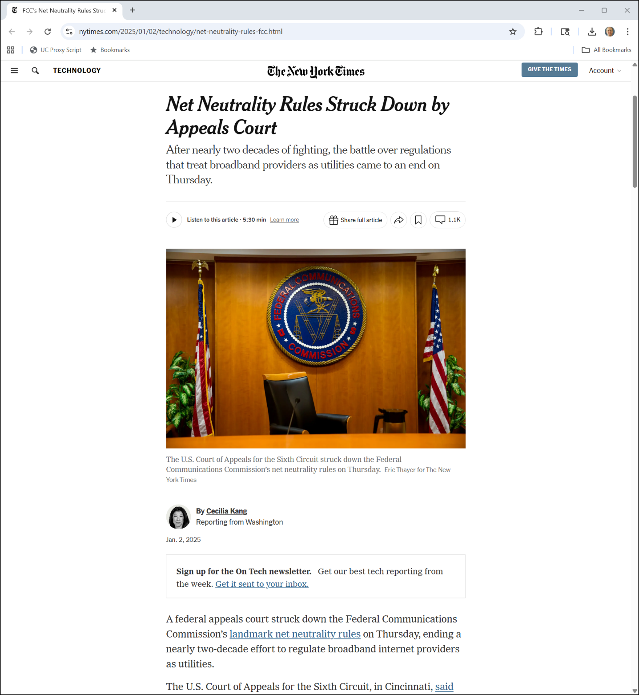
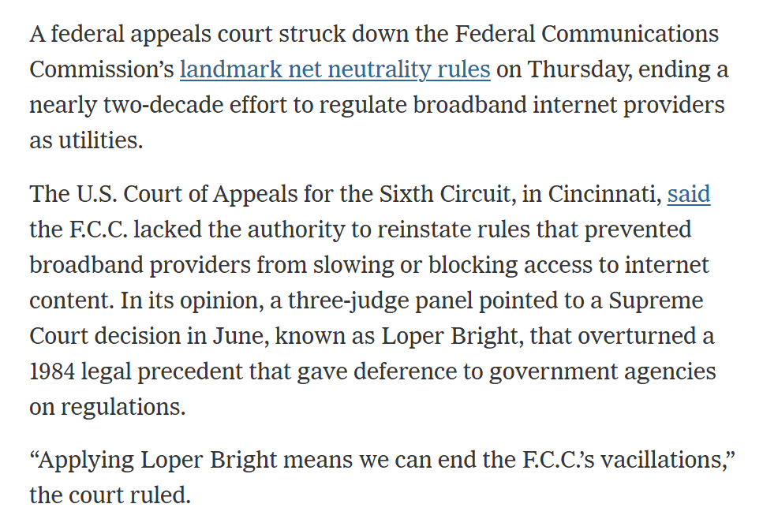
xxx
NYT (2 Jan 2025)
Notes:
https://www.nytimes.com/2025/01/02/technology/net-neutrality-rules-fcc.html

Slide 94
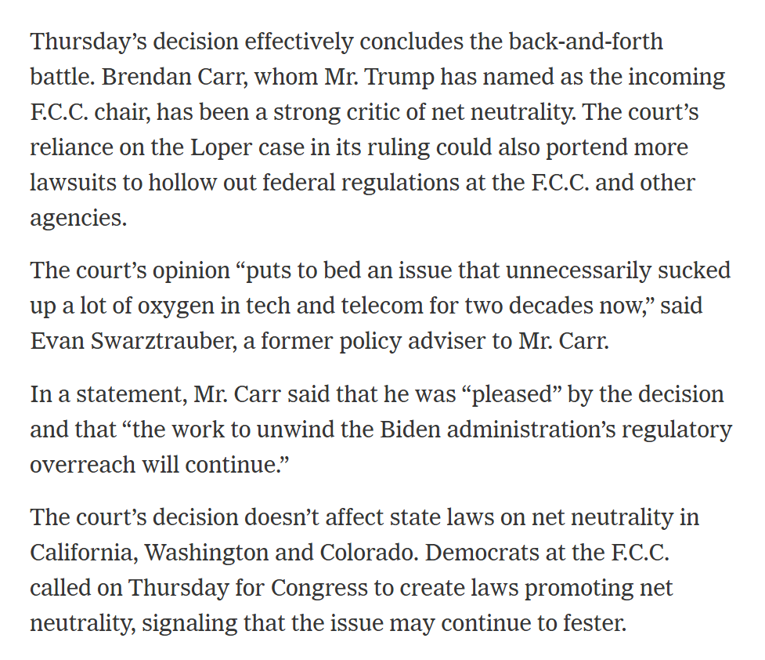
But State Laws Continue
NYT (2 Jan 2025)
Notes:
https://www.nytimes.com/2025/01/02/technology/net-neutrality-rules-fcc.html

Slide 95
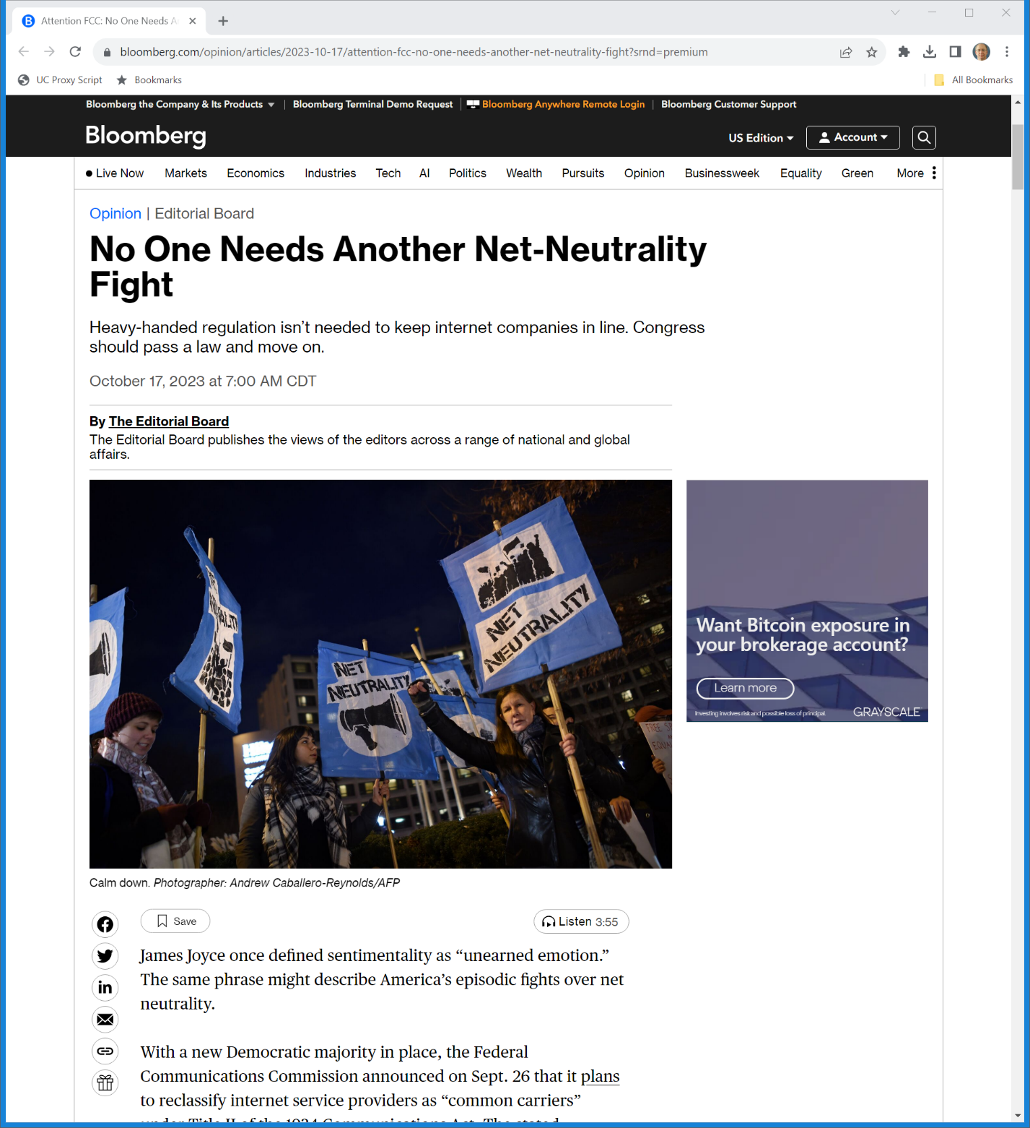
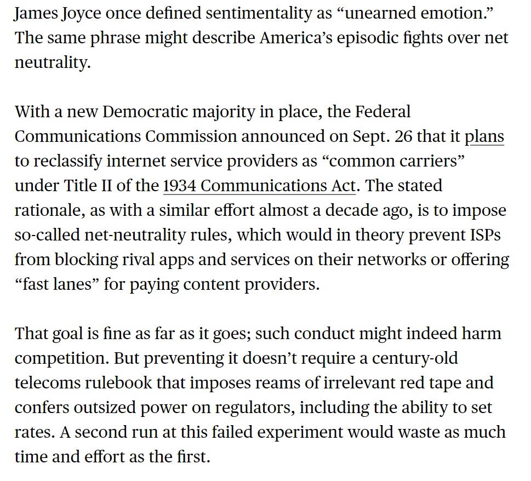
A Few Facts
Bloomberg (17 Oct 2023)

Slide 96
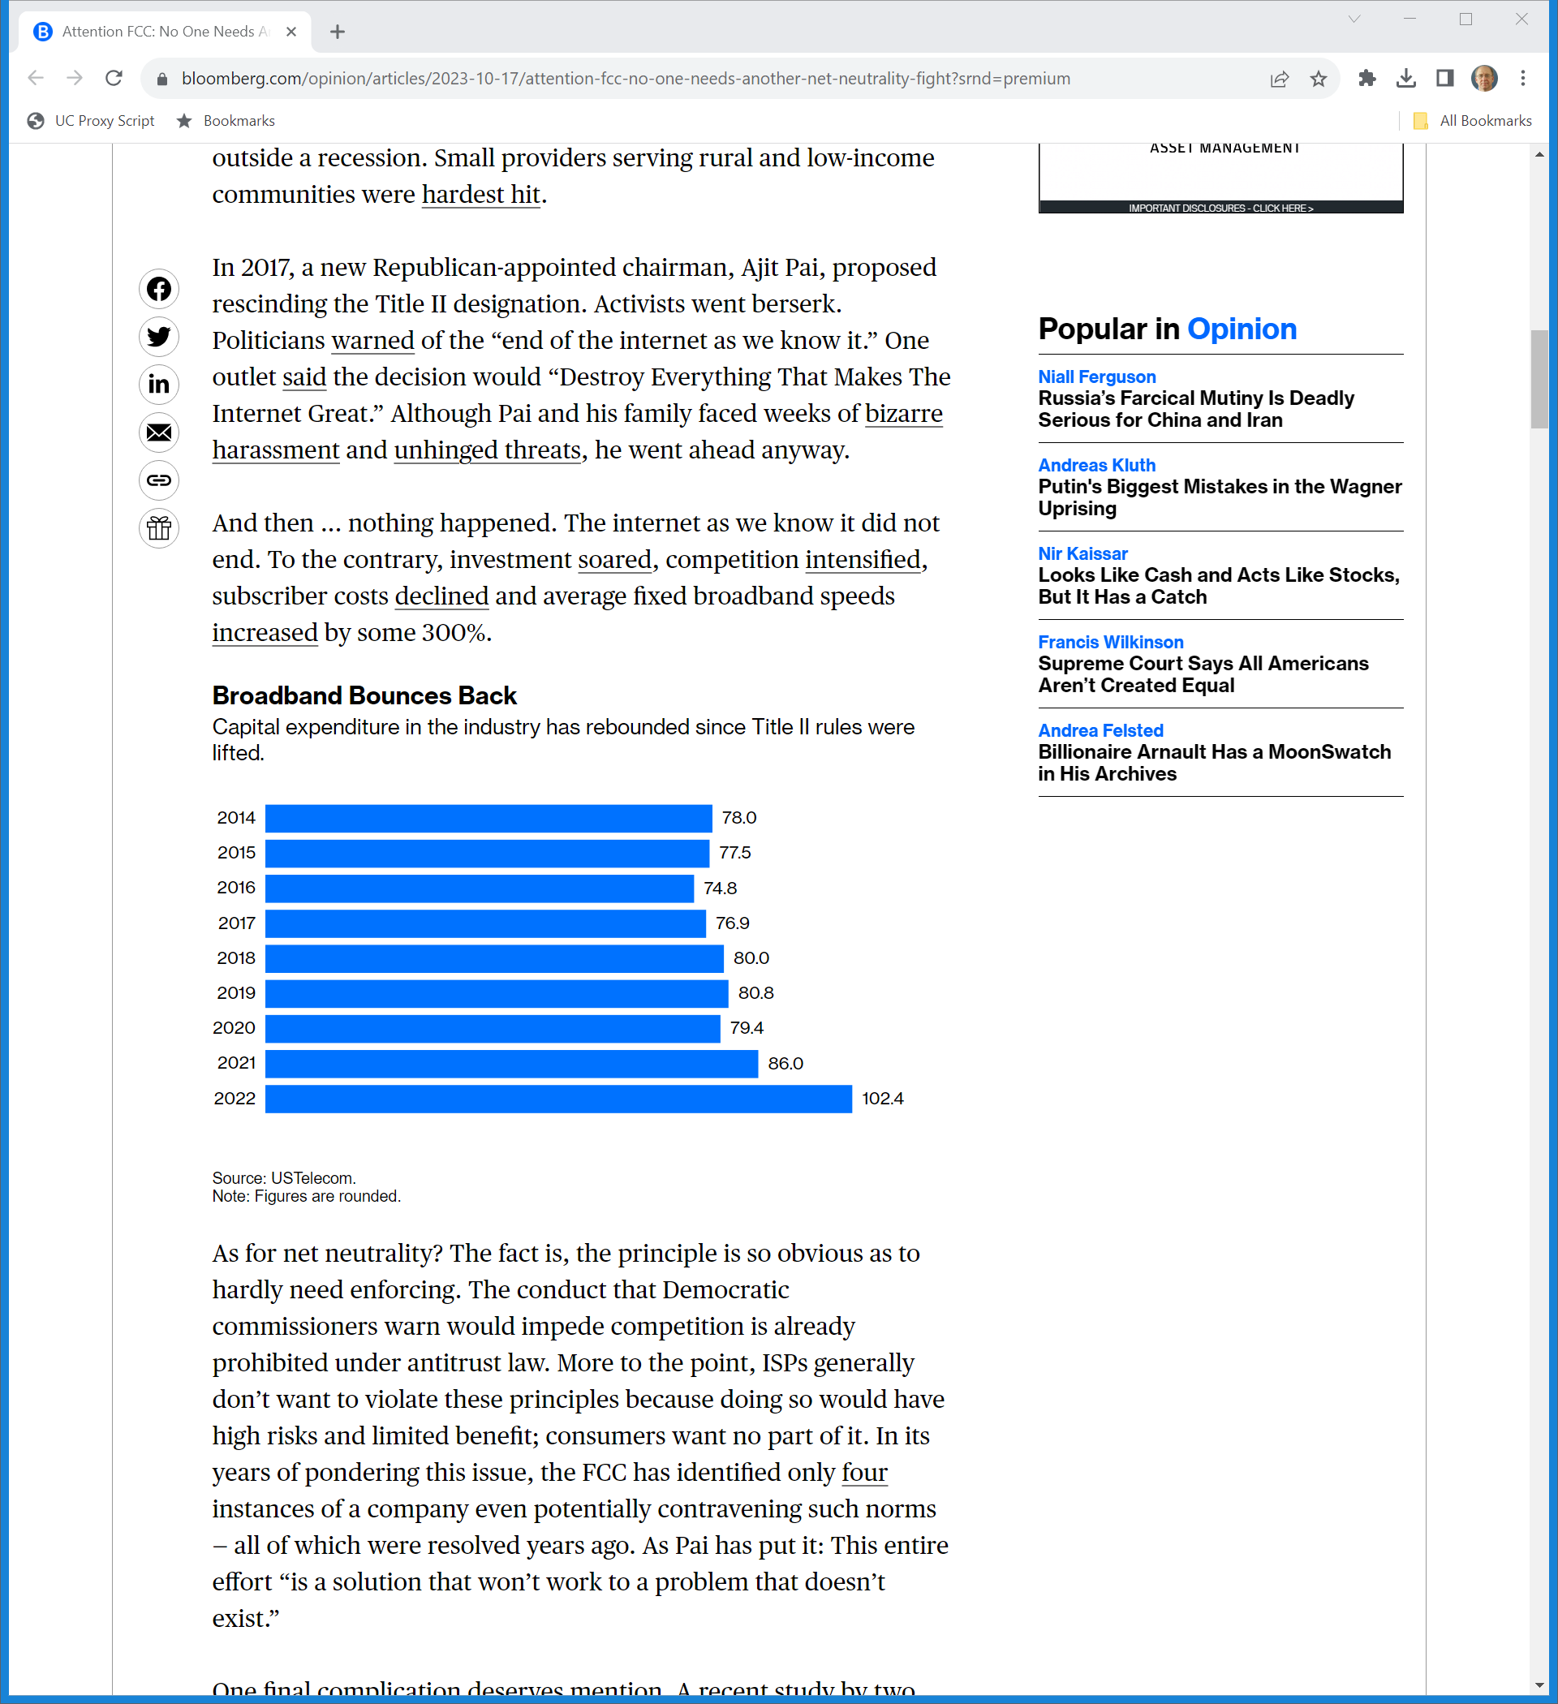
What Has Happened?
Bloomberg (17 Oct 2023)

Slide 97
What Has Happened?
Bloomberg (17 Oct 2023)

Slide 98
DVDs
The Legal Infrastructure of the DVD

Slide 99
1998 DVD Business Review Letters
U.S. DOJ (16 Dec 1998)
Notes:
https://www.justice.gov/sites/default/files/atr/legacy/2006/04/27/2121.pdf

Slide 100
Constructing a New Product and Market
TTYN (1 of 2)
Hypo
It is 1998. A new tech is on the horizon to perhaps supplant the VCR. You have some sense of the competition that took place between two different VCR formats Beta (Sony) and VHS (Matsushita and others).
You understand that there are a bunch of relevant patents

Slide 101
Constructing a New Product and Market
TTYN (2 of 2)
Questions
What are the issues that you confront as you think about this new market?
If you could design the market, what would you do?
What legal tools are relevant to that process?

Slide 102
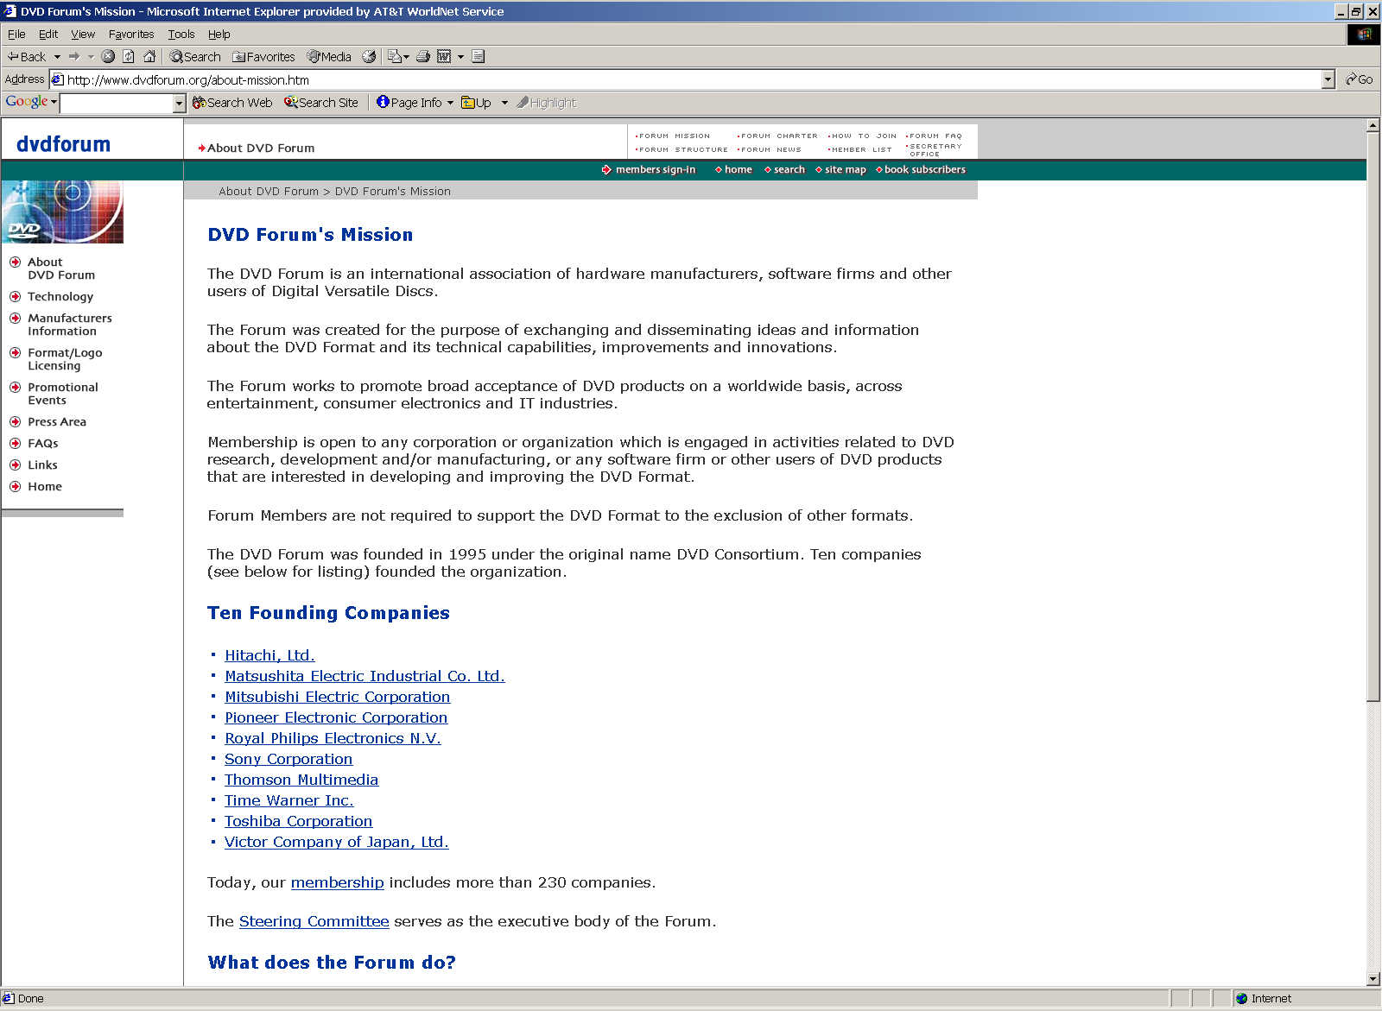
DVD Forum
Notes:
http://www.dvdforum.org/about-mission.htm

Slide 103
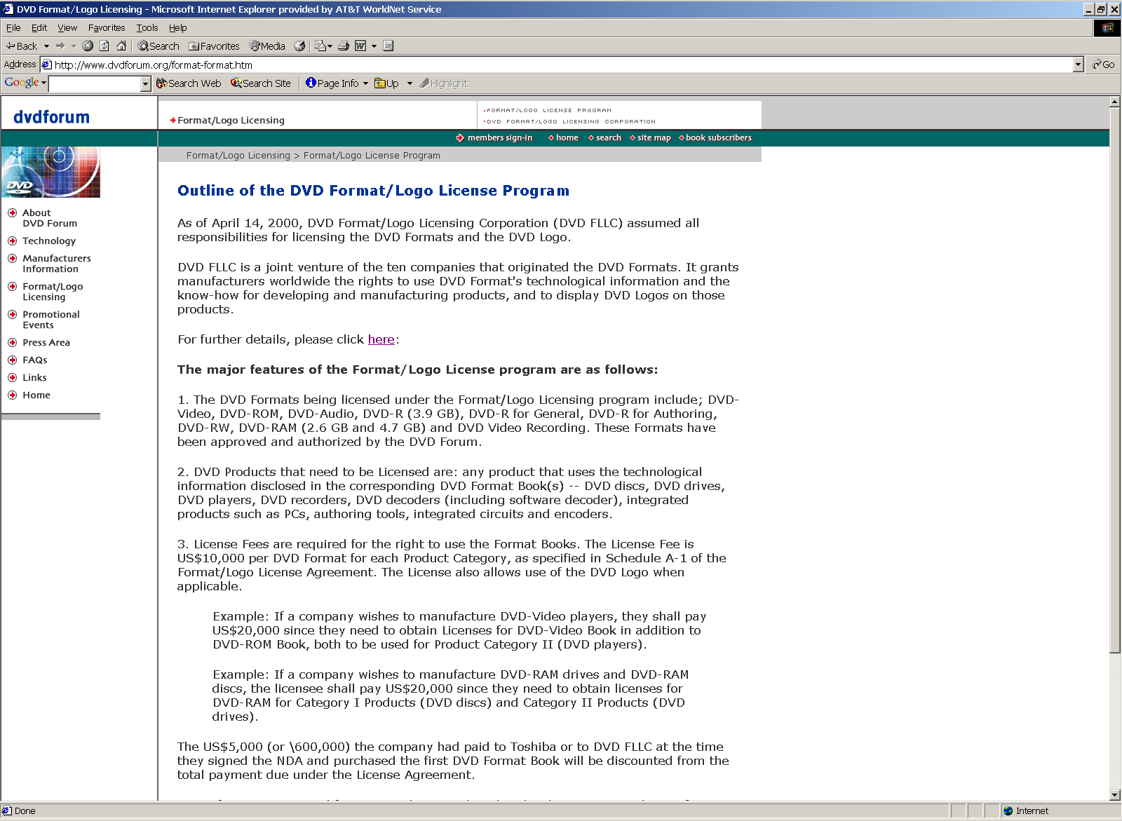
Format and Logo Licensing
DVD Forum

Slide 104
Format and Logo Licensing
DVD Forum

Slide 105
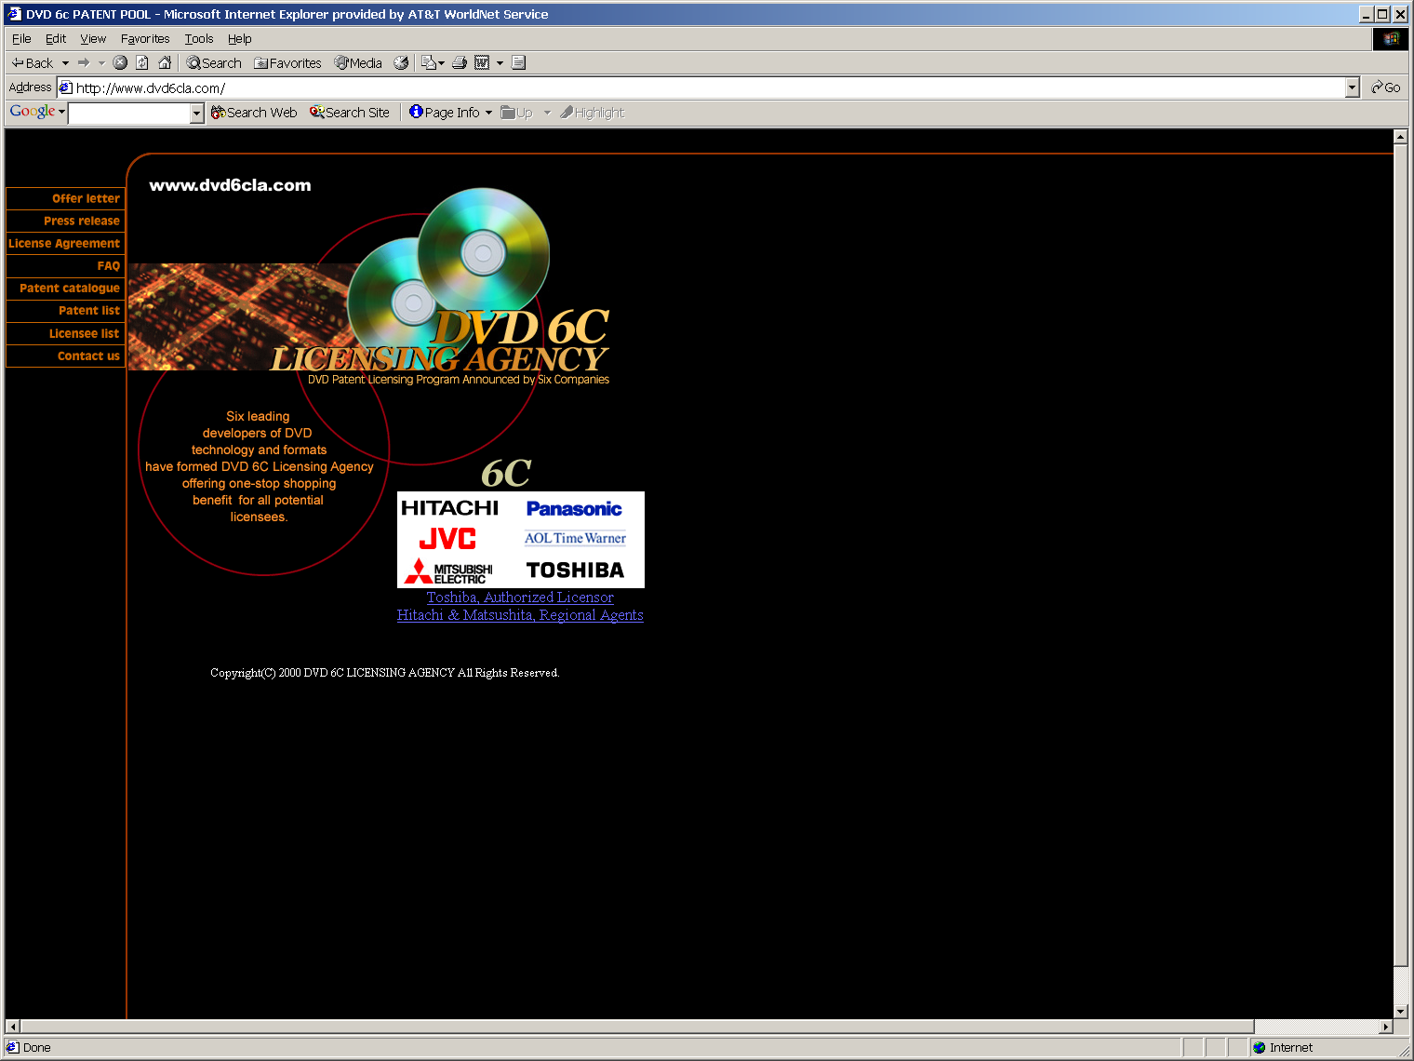
Second DVD Patent Pool

Slide 106
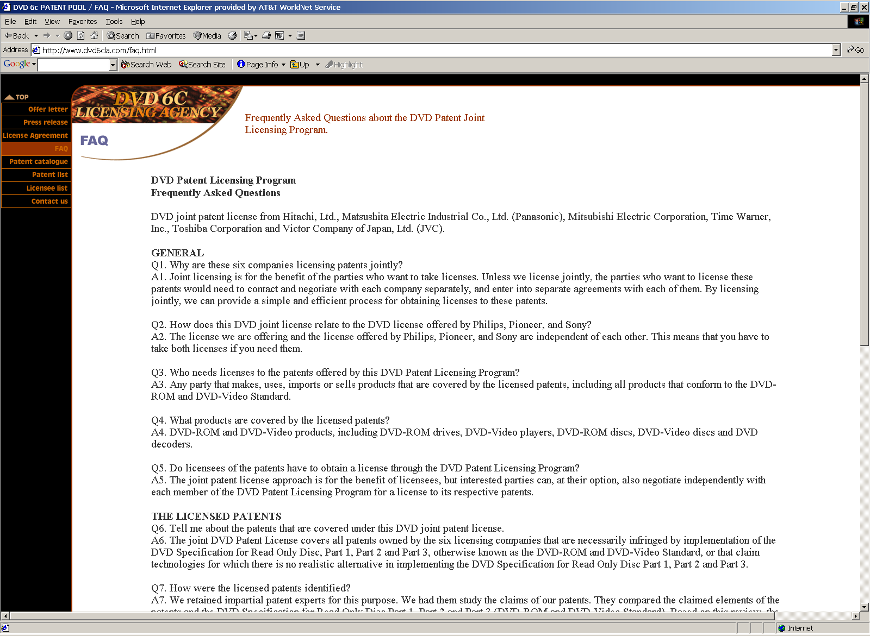
Patent Pool FAQs
DVD 6C Patent Pool

Slide 107
What is the purpose of the DVD patent pool?
Structure Market
Lower Transaction Costs
Establish Payments to Patent Holders

Slide 108
DVD Patent Pool: Key Features
Unification
License of essential patents by Sony and Pioneer to Philips.
Essential Patents
Definition of essential intended to capture those patents required to enable licensee to implement DVD-ROM Standard Specifications.

Slide 109
DVD Patent Pool: Key Features
Right to License Outside Pool
Mitigate potential anti-competitive features of pool by having individual patent holders retain the right to license separately.
Grantback
Include “grantback” provision to bring into the pool patents later found to be essential

Slide 110
DVD Patent Pool: Key Features
This mitigates the holdout problem posed by someone later found to hold an essential patent.

Slide 111
Lower Transaction Costs
Absent the pool, how would a firm license the right to make DVDs?
Many transactions (115 essential patents for player, 95 for disc)
Risk of Holdout problem

Slide 112
Lower Transaction Costs
Patent Pool Advantages
Single Stop Shopping, Sort Of
Unite complementary patents into single package to lower the cost of negotiating individual licenses.
But not patents that might be needed as to which there are substitutes

Slide 113
Lower Transaction Costs
Mitigate the threat of infringement litigation by assembling essential patents.
Compare land assembly problem of real estate developer.

Slide 114
Payments to Patent Holders
How would patent holders realize value absent the pool?
How might a pool change the royalty rates sought by patent holders?

Slide 115
Amazon
Amazon

Slide 116
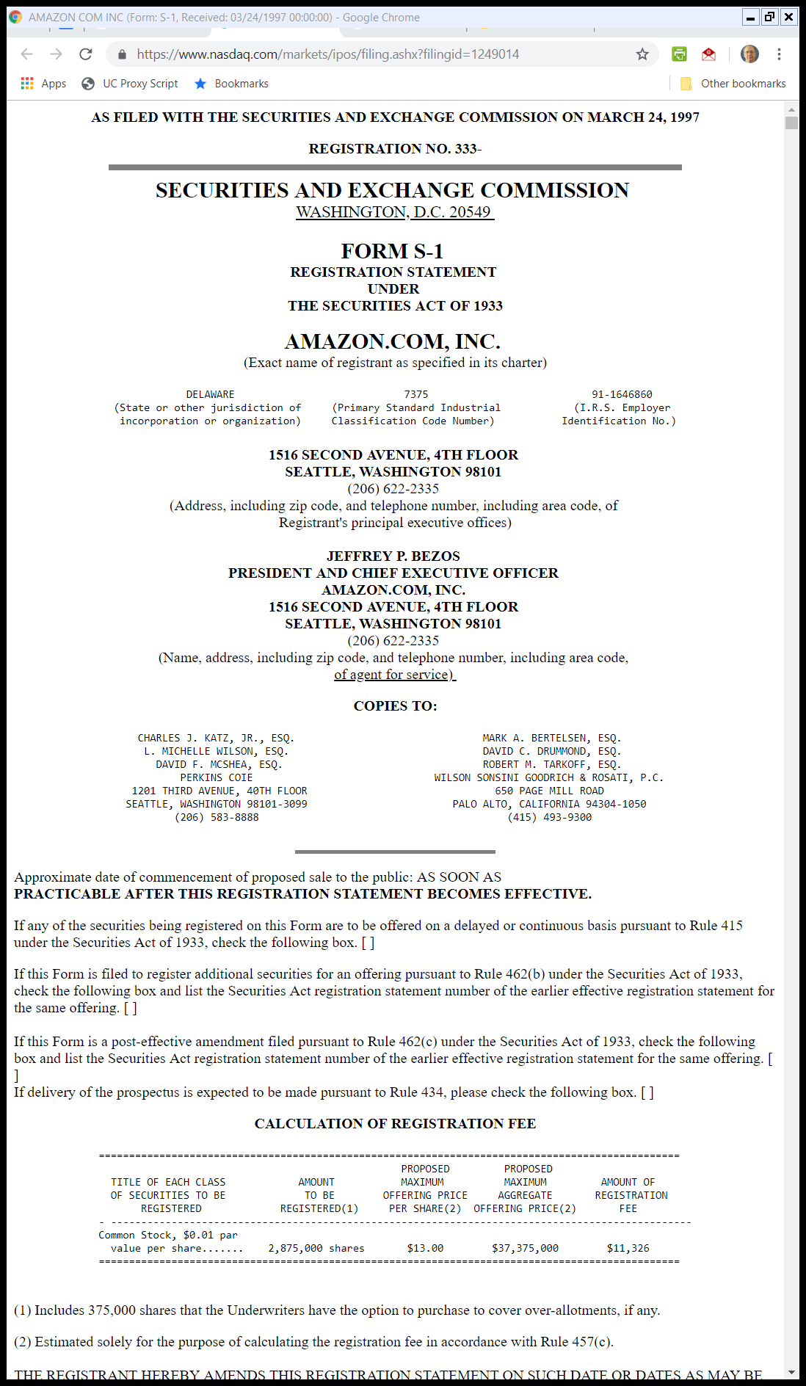
1997: Amazon Goes Public
Form S-1 (24 Mar 1997)
Notes:
https://www.nasdaq.com/markets/ipos/filing.ashx?filingid=1249014

Slide 117
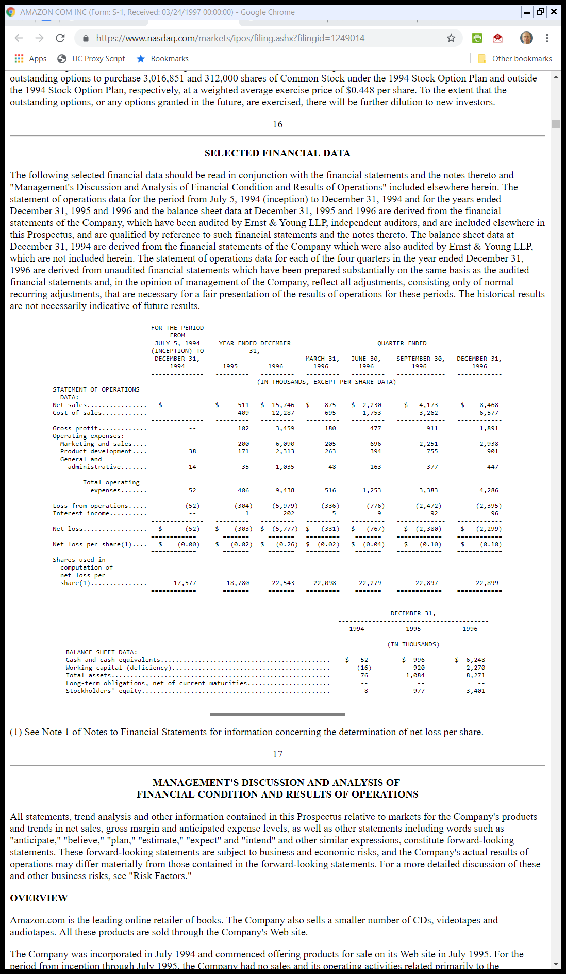
Amazon’s Financials 1994-96
Form S-1 (24 Mar 1997)
Notes:
https://www.nasdaq.com/markets/ipos/filing.ashx?filingid=1249014

Slide 118
Product Line Expansions
1999 Amazon Ann Report

Slide 119
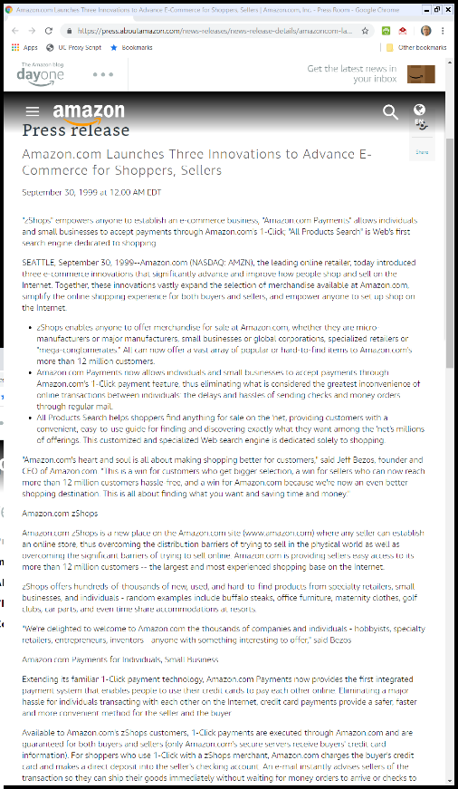
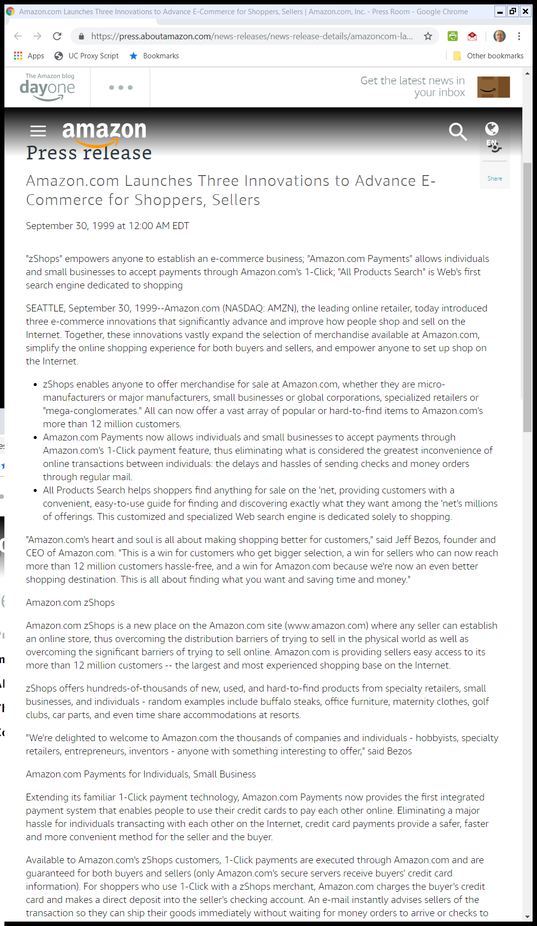
zShops Introduction, Shopping Search Engine
Amazon PR (30 Sept 1999)
Notes:
https://press.aboutamazon.com/news-releases/news-release-details/amazoncom-launches-three-innovations-advance-e-commerce-shoppers/

Slide 120
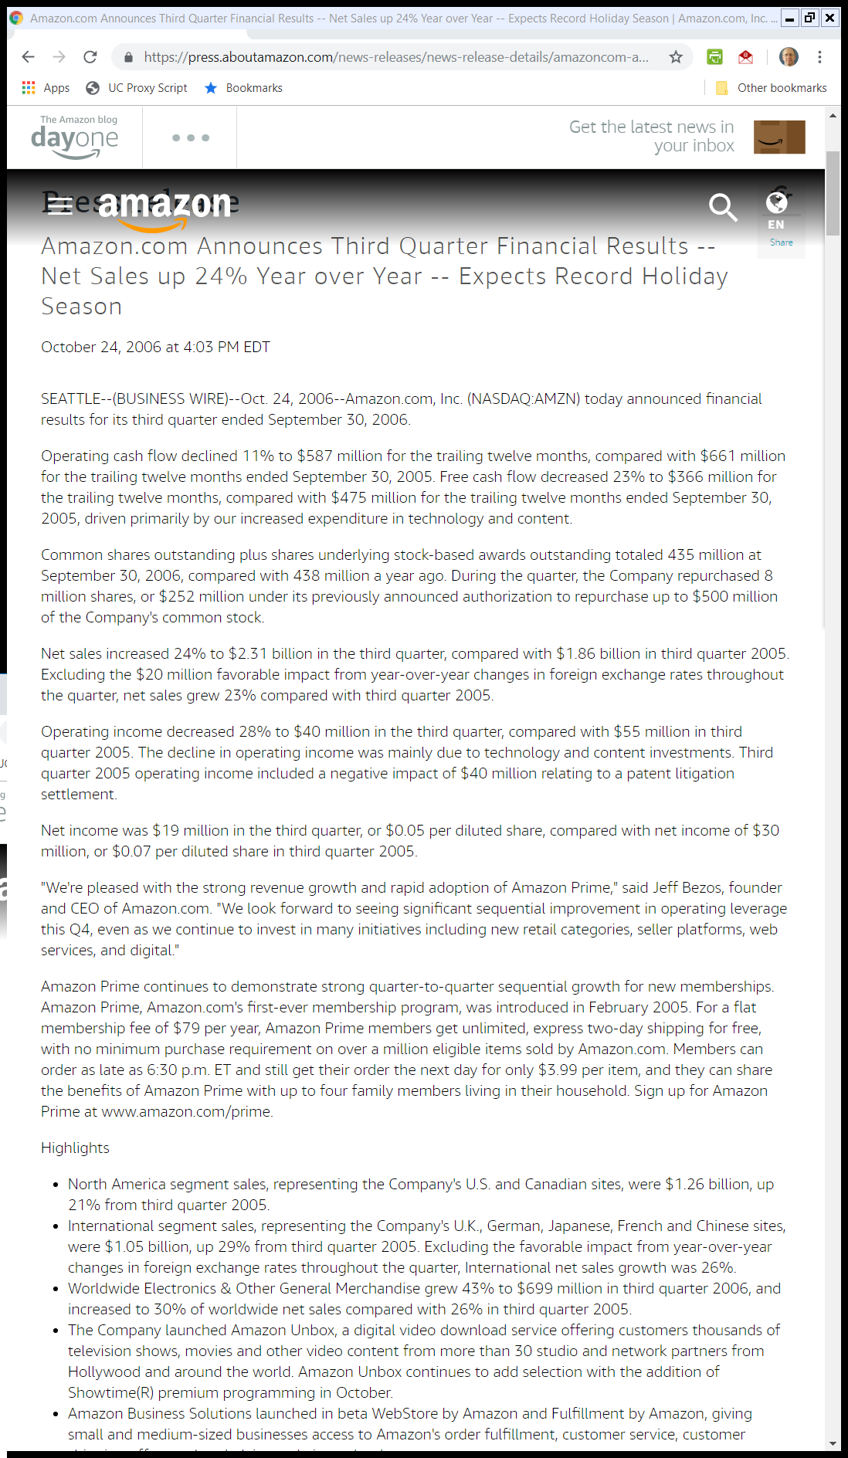
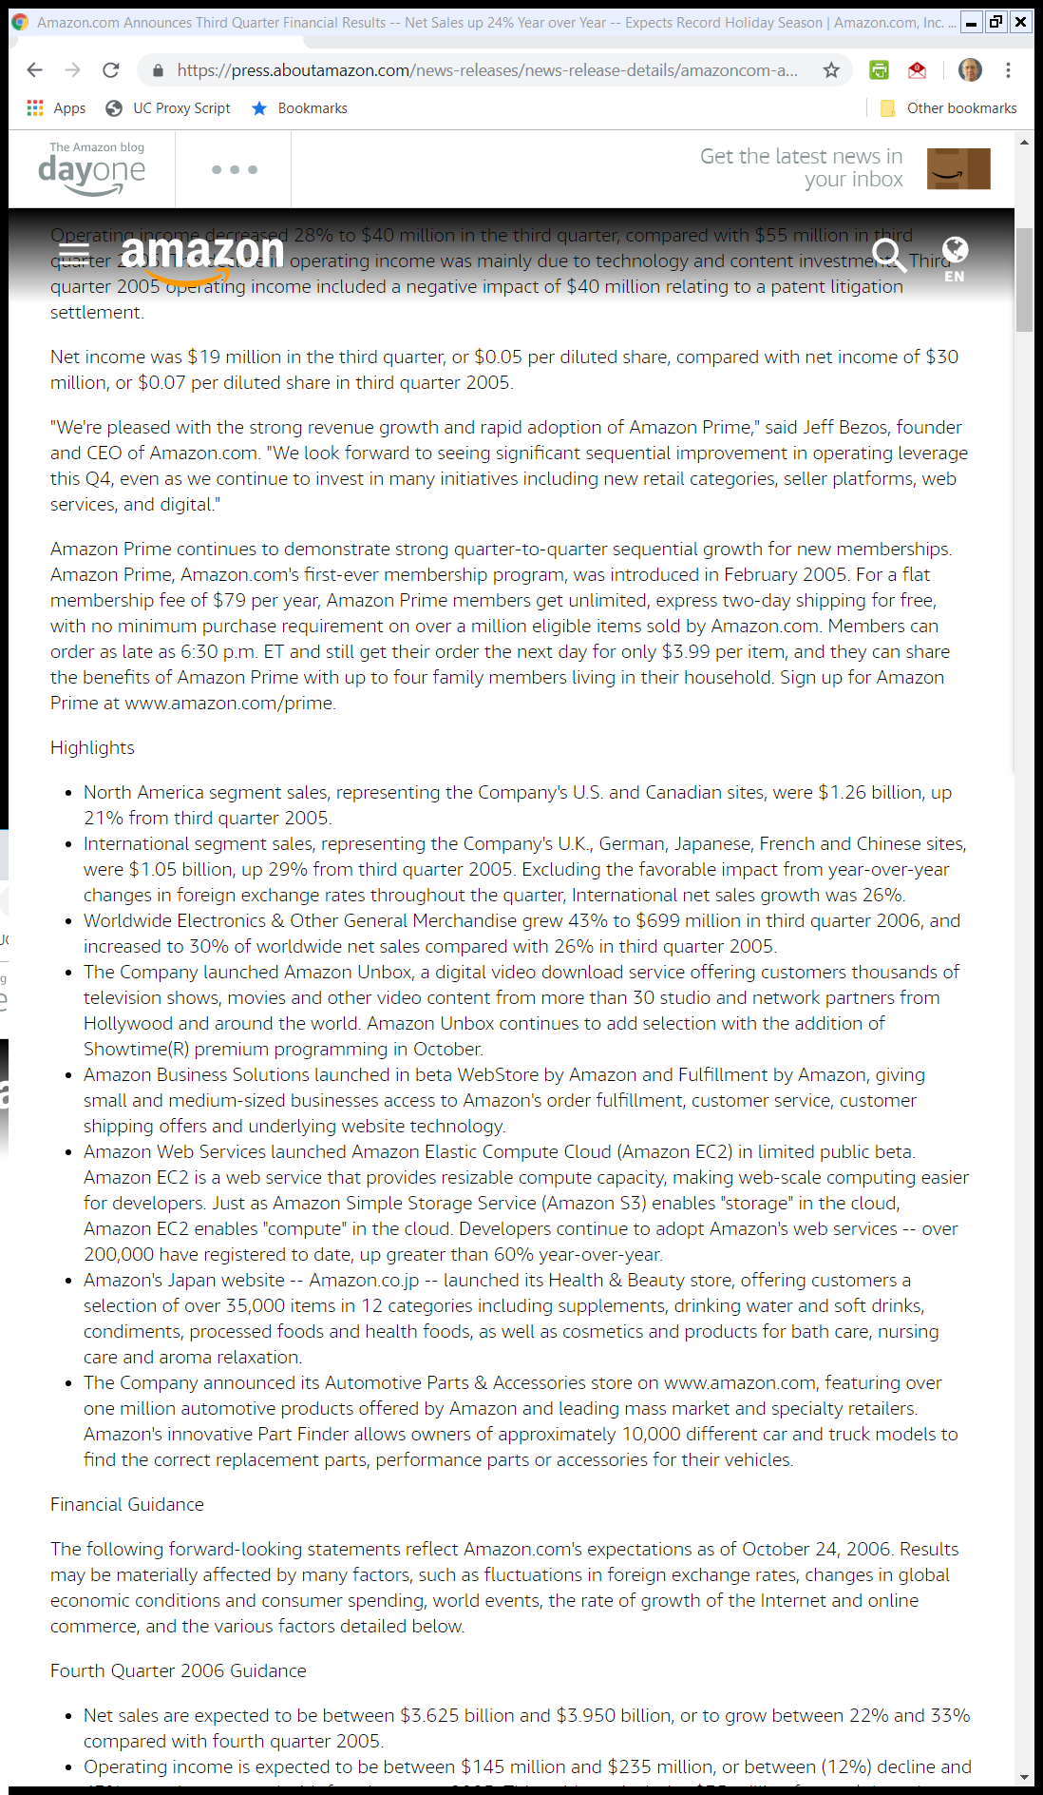
Video, Fulfillment by A, Cloud Computing
Amazon PR (24 Oct 2006)
Notes:
https://press.aboutamazon.com/news-releases/news-release-details/amazoncom-announces-third-quarter-financial-results-net-sales-24

Slide 121
Amazon As a Platform for Third-Party Sales
2018 Amazon Ann Report

Slide 122
2022 Revenues
2022 Amazon Annual Report

Slide 123
2022 Profits (Losses)
2022 Amazon Annual Report

Slide 124
2023 Revenues
2023 Amazon Annual Report

Slide 125
2023 Profits (Losses)
2023 Amazon Annual Report

Slide 126
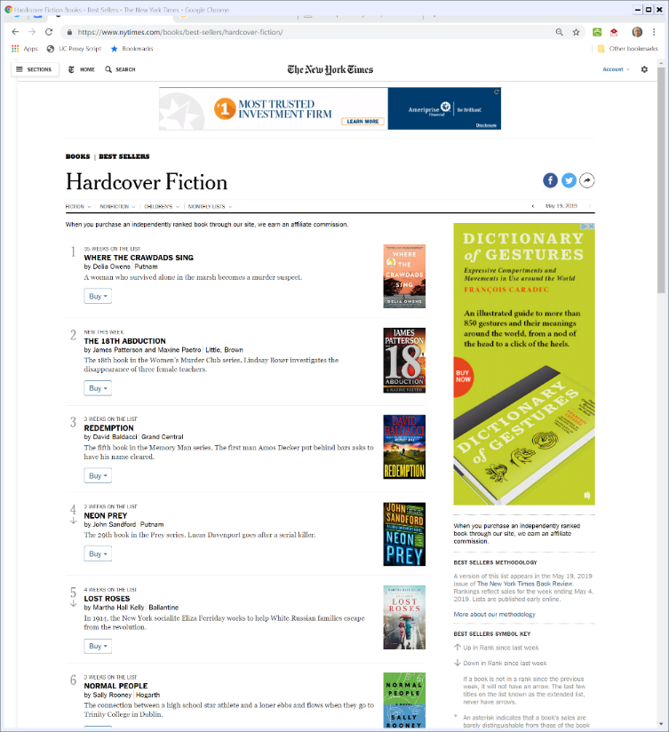

Book Prices
NYT (15 May 2019)

Slide 127
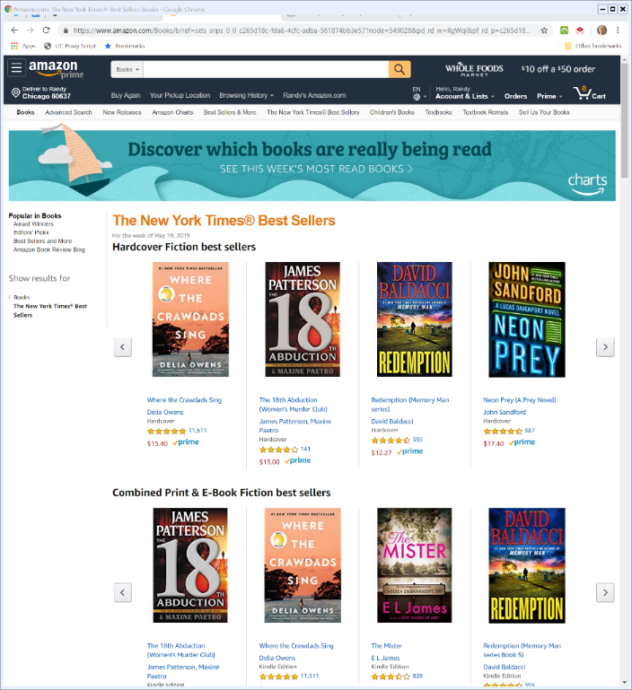
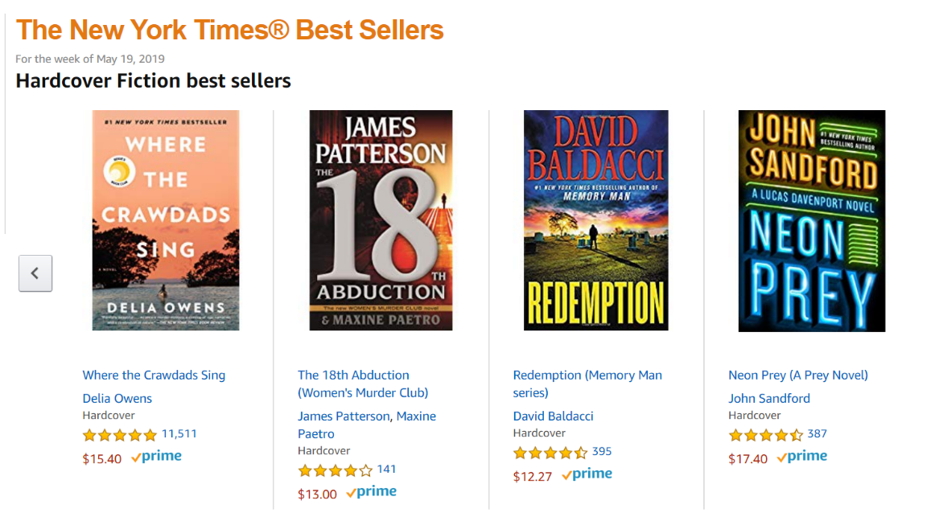
Amazon Prices
Amazon (15 May 2019)

Slide 128
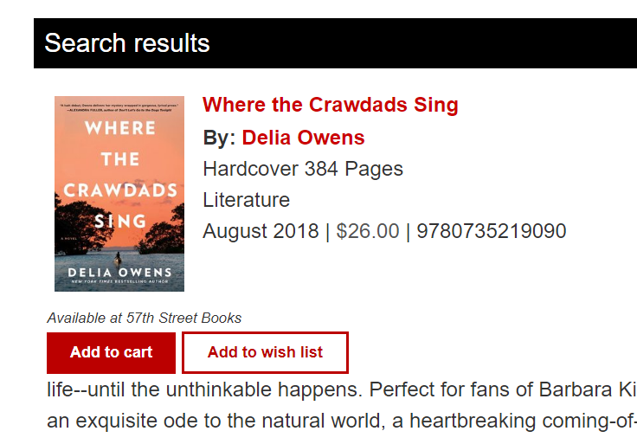
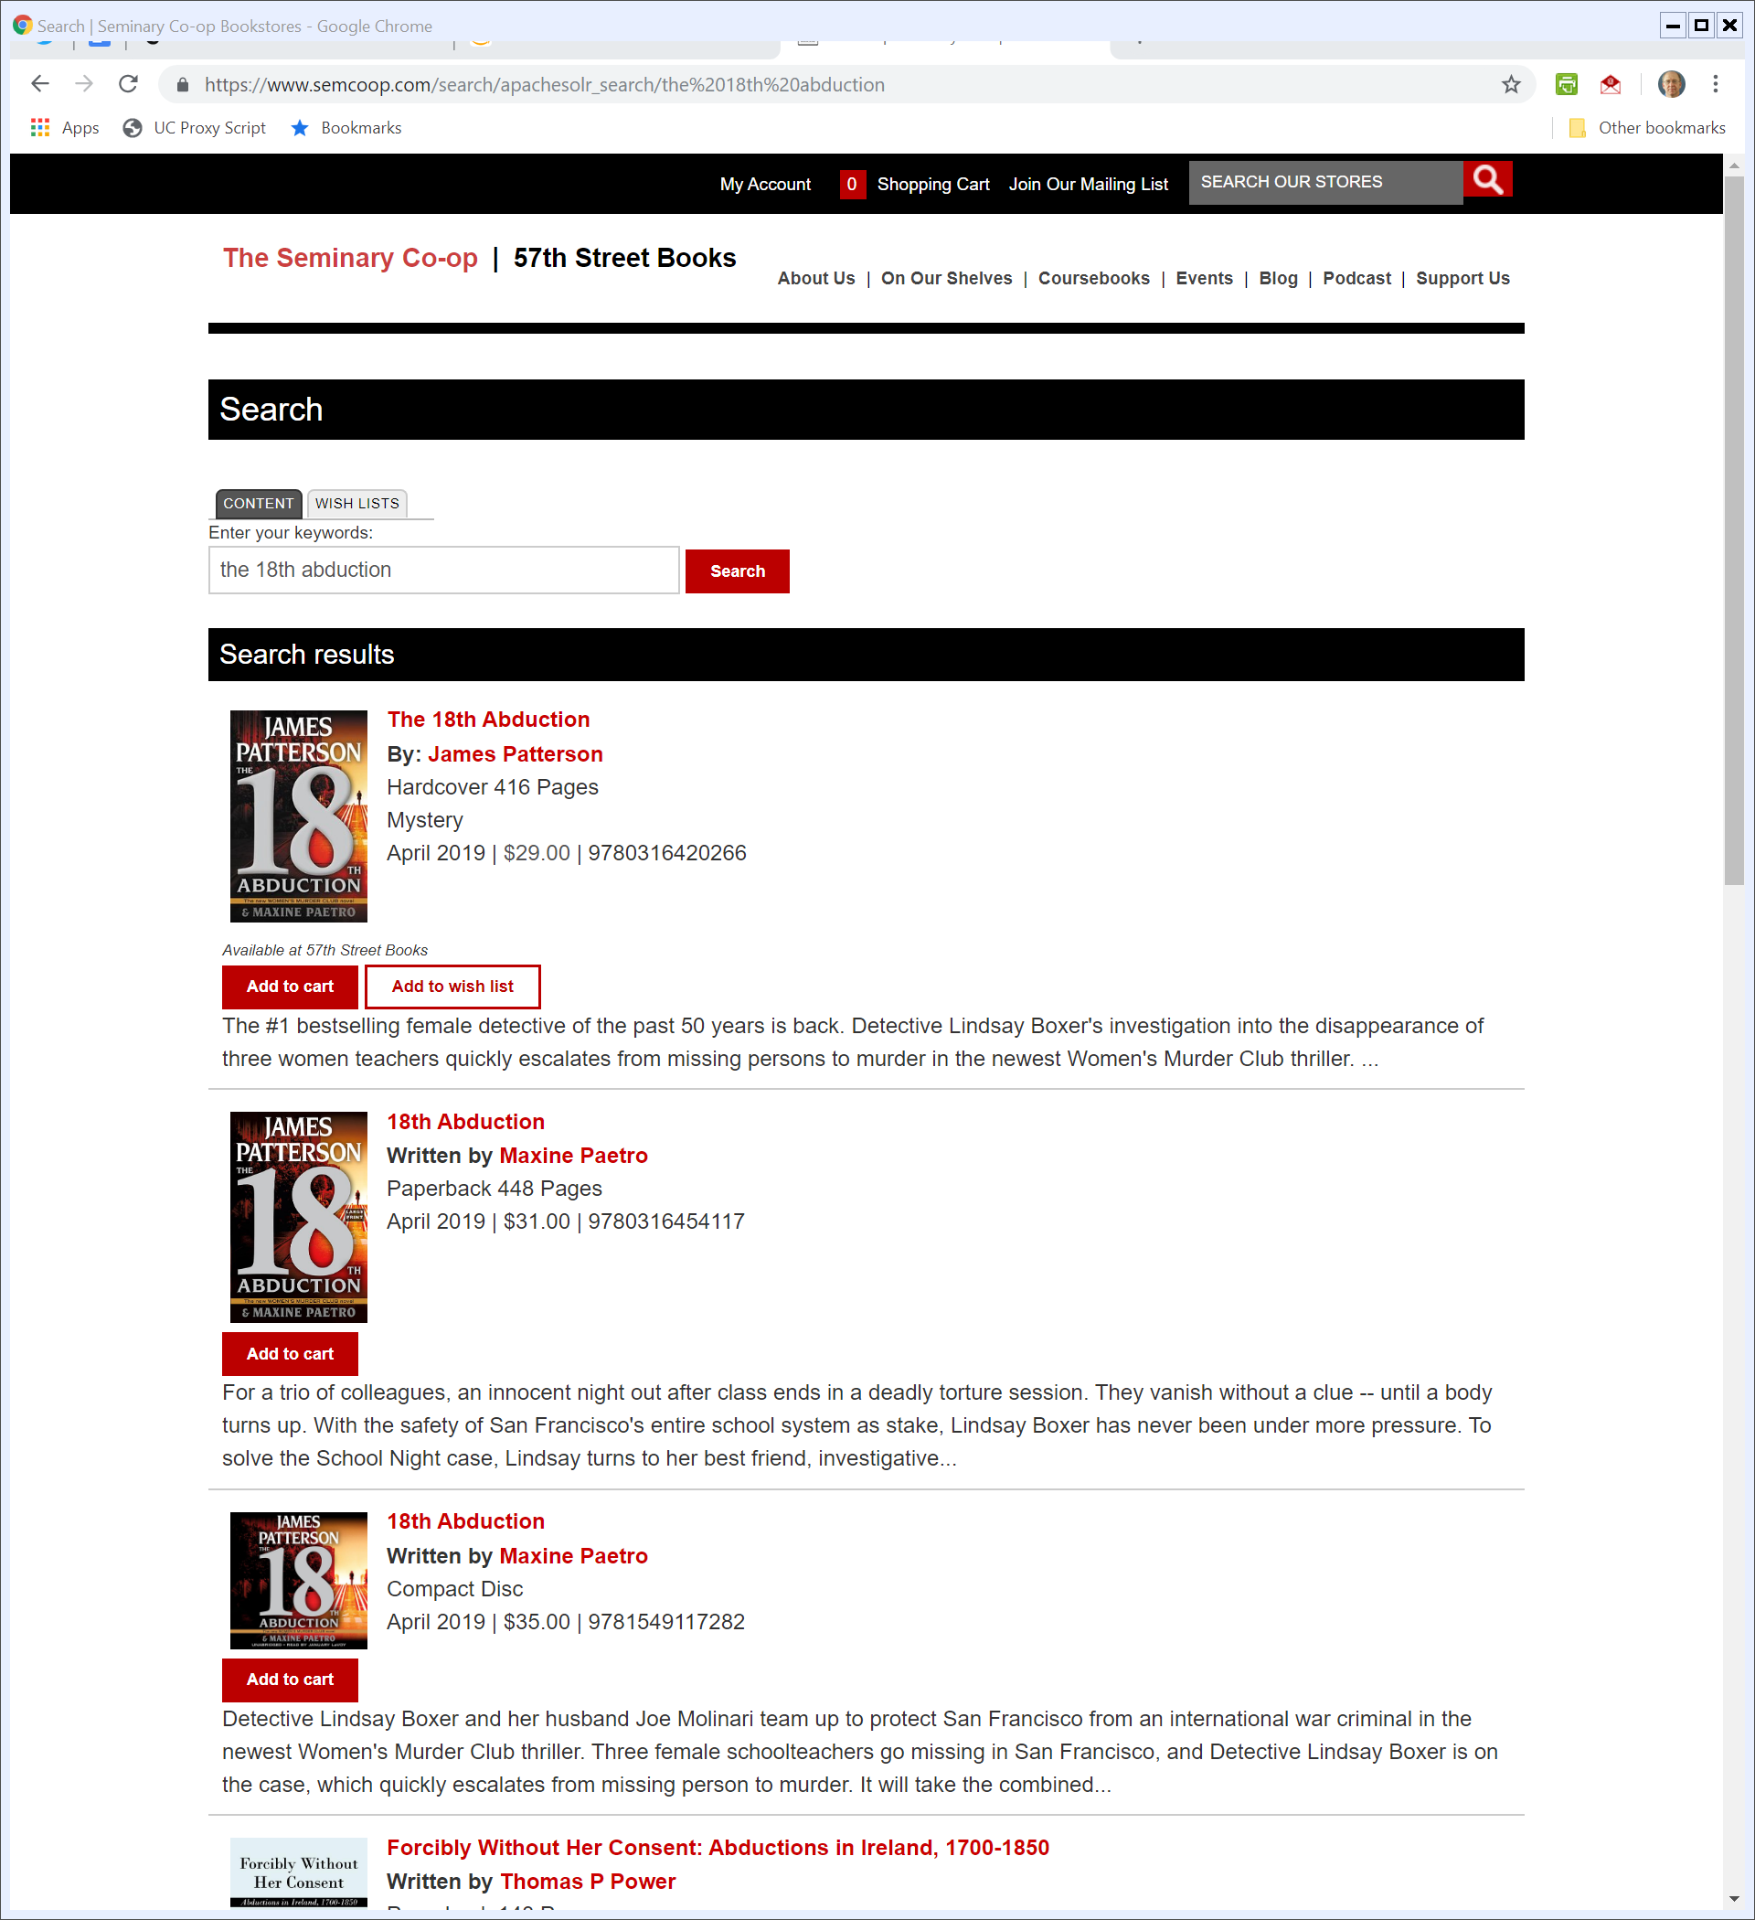
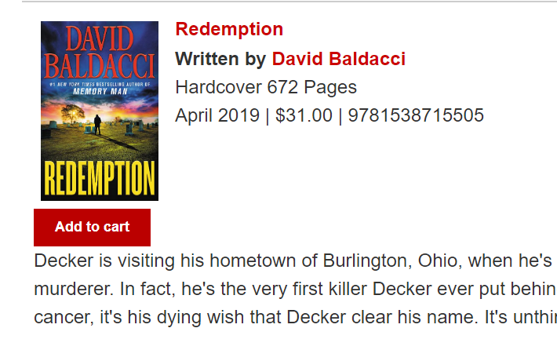
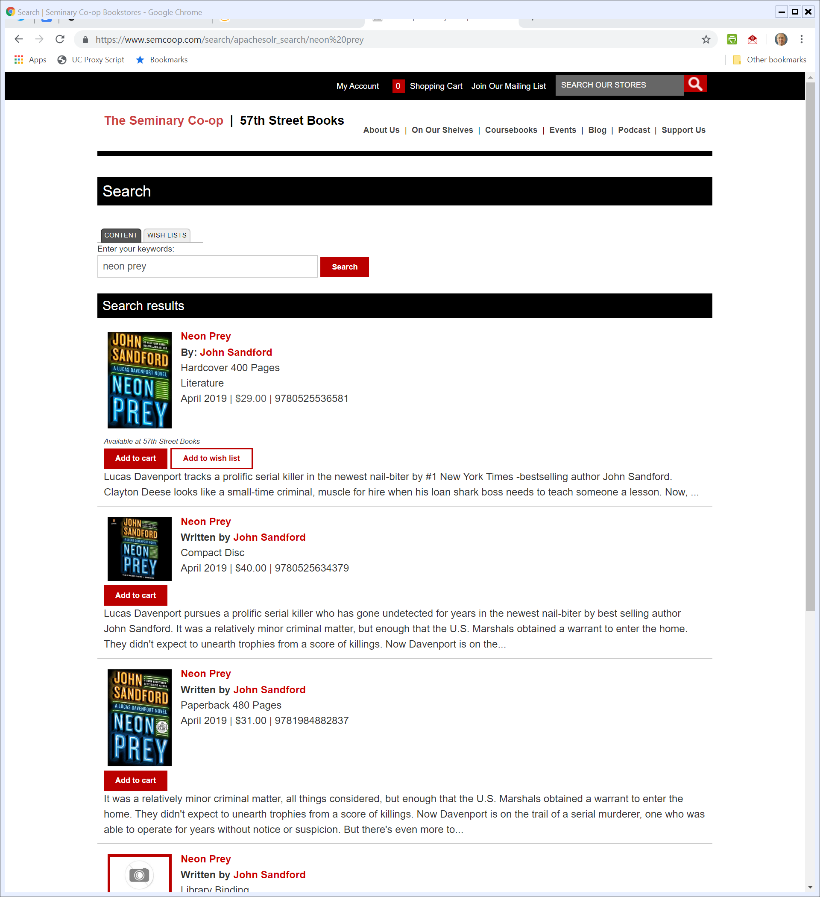
SemCoop Prices
SemCoop (15 May 2019)

Slide 129



Competing Sellers and the Buy Box
Amazon Search (15 May 2019)

Slide 130
EC Opens Amazon Investigation
European Commission (17 July 2019)

Slide 131
EC Amazon Update
European Commission (10 Nov 2020)

Slide 132
Use of Seller Data
European Commission (10 Nov 2020)

Slide 133
Preferential Treatment and the Buy Box
European Commission (10 Nov 2020)

Slide 134
Possible Amazon Laws?
TTYN (1 of 7)
Choices?
1. Inventory. Amazon has to buy inventory from third parties and can sell only that purchased inventory
Meaning cannot vertically integrate into production of goods and create Amazon brands
Can’t establish a platform for sales by third parties

Slide 135
Possible Amazon Laws?
TTYN (2 of 7)
Choices?
2. Platform as Inventory Common Carrier. Online shelf space is unlimited so any ecommerce platform has to carry all items presented by third party merchants
Also can’t prioritize them but has to fill slots at random from all merchants offering the good on the platform

Slide 136
Possible Amazon Laws?
TTYN (3 of 7)
Choices?
3. Only One Business Model. Amazon can run an own-inventory website or a platform for third parties, but not both

Slide 137
Possible Amazon Laws?
TTYN (4 of 7)
Choices?
4. Nondiscrimination. Amazon can sell its own inventory or act as a platform for third-party inventory but it needs to treat each of those by rules not tied to ownership
Best price? Randomization across merchants? Some sort of algorithm?

Slide 138
Possible Amazon Laws?
TTYN (5 of 7)
Choices?
5. Entry Limits
Amazon cannot sell any item in competition with any third-party seller on the platform.
Amazon cannot enter other businesses other than sales (no video, no AWS and so on)
Amazon can’t use data on the platform to decide which businesses to enter

Slide 139
Possible Amazon Laws?
TTYN (6 of 7)
Choices?
6. Amazon Prime
Force Amazon to unbundle and set separate prices for each item in the bundle
Ban Amazon from selling paid-in-advance bulk shipping as doing so distorts competition for the marginal sale at other websites

Slide 140
Possible Amazon Laws?
TTYN (7 of 7)
Choices?
7. Transaction Neutrality
Amazon can’t remember anything
Have to forget and not record your transaction history
Can’t store payment info, so that you have to enter it each time as you would with a new website

Slide 141
Limits on Third-Party Data Use
European Commission (20 Dec 2022)

Slide 142
Buy Box: Equal Treatment; Second Offer
European Commission (20 Dec 2022)

Slide 143
Open Up Prime
European Commission (20 Dec 2022)

Slide 144
Results of the Market Test
European Commission (20 Dec 2022)

Slide 145
Desktop Presentation
European Commission (20 Dec 2022)

Slide 146
Mobile Presentation
European Commission (20 Dec 2022)

Slide 147
Let’s Go Shopping Again
Questions
How do we think these remedies will function?
Would it be cleaner for Amazon to just auction off the Buy Box? Highest bidder (including possibly Amazon gets it)?
Shouldn’t Amazon put in the Buy Box whatever offering makes it the most money? Is that anti-competitive if it does so?

Slide 148
Pending U.S. Antitrust Case
FTC Complaint (26 Sept 2023)

Slide 149
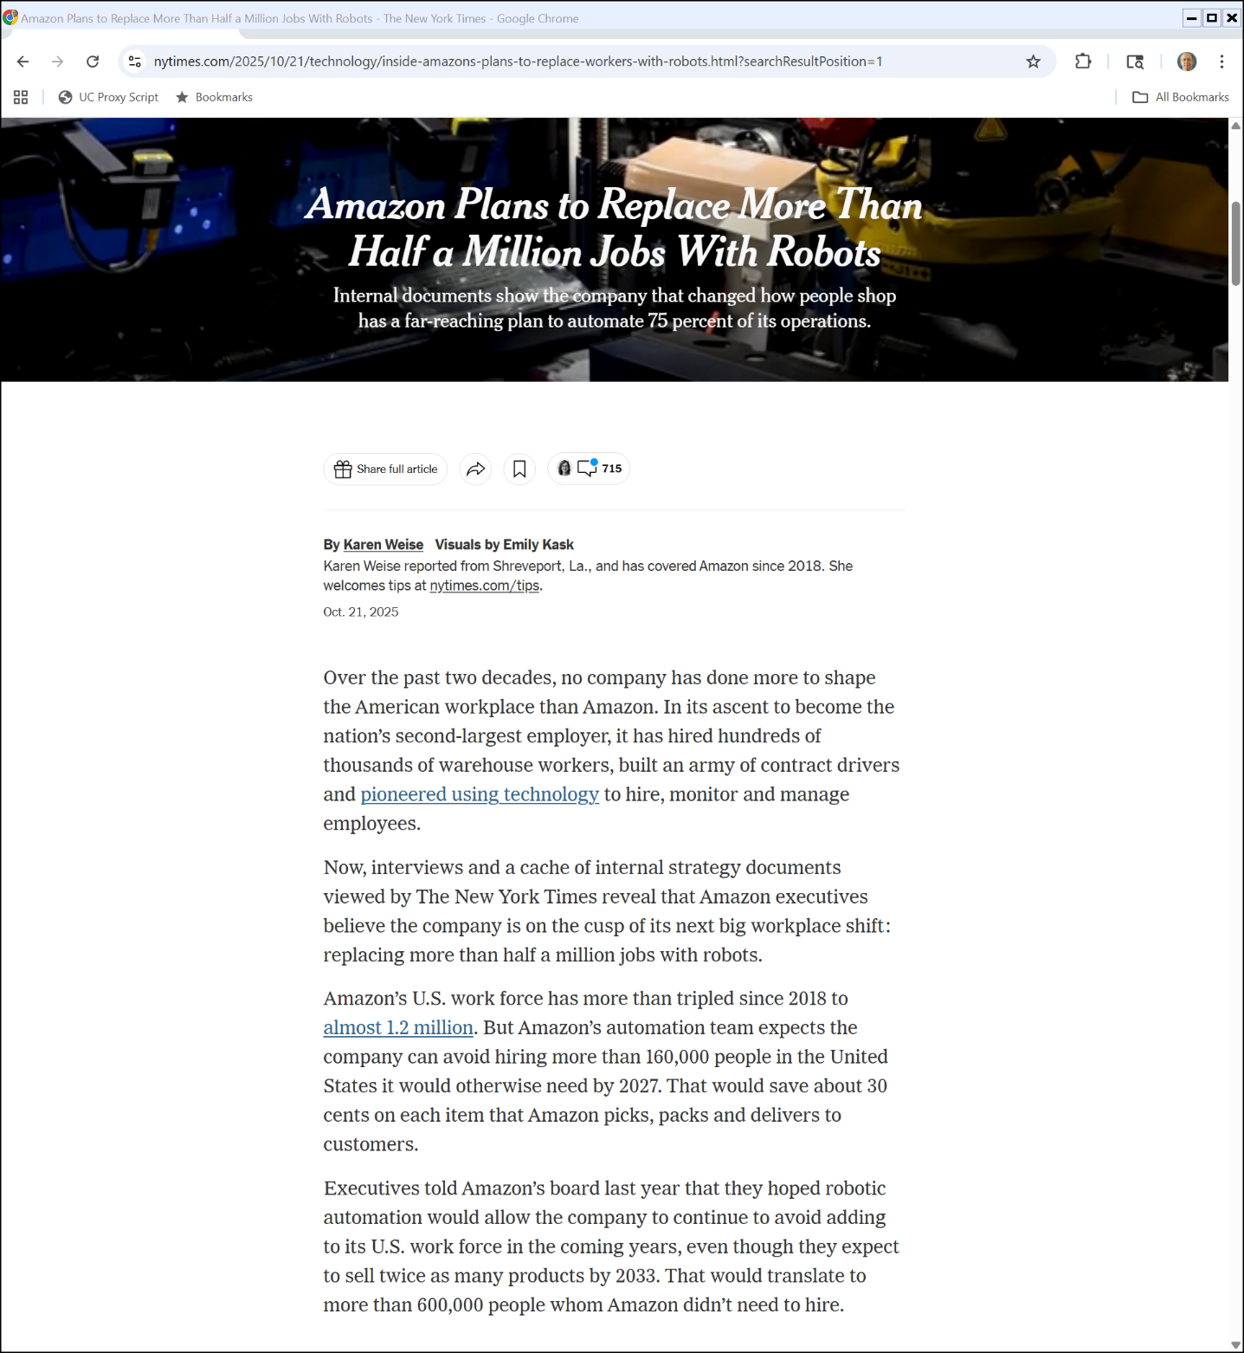

Amazon Robots
New York Times (21 Oct 2025)
Notes:
https://www.nytimes.com/2025/10/21/technology/inside-amazons-plans-to-replace-workers-with-robots.html?searchResultPosition=1

