Slide 1
Class 3: W10/15/2025; S10/18/2024 Booth 42201: The Legal Infrastructure of Business Antitrust and Competition
Randal C. Picker
James Parker Hall Distinguished Service Professor of Law
The Law School
The University of Chicago
Copyright © 2003-25 Randal C. Picker. All Rights Reserved.

Slide 2
Antitrust History
Antitrust in the US: History

Slide 3
Full and Free Competition, Raise Cost to Consumer
S. 3445 (14 Aug 1888)

Slide 4
Sen. Edmunds: An Amendment
S.1 (2 Apr 1890)

Slide 5
Sherman: I Can Live With It
Congressional Record (8 Apr 1890)

Slide 6
Market Position Acquired by Superior Skill Isn’t a Monopoly
Congressional Record (8 Apr 1890)

Slide 7
And Again
Congressional Record (8 Apr 1890)

Slide 8
The Vote (And a New Title for the Bill)
Congressional Record (8 Apr 1890)

Slide 9
The Sherman Act
26 Stat 209 (2 July 1890)

Slide 10
Creation of Federal Trade Commission
38 Stat. 717 (26 Sept 1914)

Slide 11
Unfair Methods of Competition Declared Unlawful
38 Stat. 717 (26 Sept 1914)

Slide 12
The Road to the Clayton Act
H.R. 15657 (14 Apr 1914)

Slide 13
The Clayton Act
38 Stat. 730 (15 Oct 1914)

Slide 14
Should We Take Sec. 1 Literally?
Yes: US v. Trans-Missouri Freight Ass’n (U.S., 1897)
“[T]he plain and ordinary meaning of such language is not limited to that kind of contract alone which is in unreasonable restraint of trade, but all contracts are included in such language, and no exception or limitation can be added without placing in the act that which has been omitted by Congress.”

Slide 15
Should We Take Sec. 1 Literally?
No: Standard Oil Co. of New Jersey v. US (U.S., 1911)
“And as the contracts or acts embraced in the provision were not expressly defined, since the enumeration addressed itself simply to classes of acts, those classes being broad enough to embrace every conceivable contract or combination which could be made concerning trade or commerce or the subjects of such commerce, and thus caused any act done by any of the enumerated methods anywhere in the whole field of human activity to be illegal if in restraint of trade,

Slide 16
Should We Take Sec. 1 Literally?
it inevitably follows that the provision necessarily called for the exercise of judgment which required that some standard should be resorted to for the purpose of determining whether the prohibition contained in the statute had or had not in any given case been violated.”

Slide 17
Should We Take Sec. 1 Literally?
“Thus not specifying, but indubitably contemplating and requiring a standard, it follows that it was intended that the standard of reason which had been applied at the common law and in this country in dealing with subjects of the character embraced by the statute was intended to be the measure used for the purpose of determining whether, in a given case, a particular act had or had not brought about the wrong against which the statute provided.”

Slide 18
Sec. 2: Monopoly v. Monopolization
US v. Aluminum Co. of America (2nd Cir. 1945) (Judge Learned Hand)
“It does not follow because ‘Alcoa’ had such a monopoly, that it ‘monopolized’ the ingot market: it may not have achieved monopoly; monopoly may have been thrust upon it. If it had been a combination of existing smelters which united the whole industry and controlled the production of all aluminum ingot, it would certainly have 'monopolized' the market.”

Slide 19
Sec. 2: Monopoly v. Monopolization
“Nevertheless, it is unquestionably true that from the very outset the courts have at least kept in reserve the possibility that the origin of a monopoly may be critical in determining its legality;”

Slide 20
Sec. 2: Monopoly v. Monopolization
“This notion has usually been expressed by saying that size does not determine guilt; that there must be some ‘exclusion’ of competitors; that the growth must be something else than ‘natural’ or ‘normal’; that there must be a ‘wrongful intent,’ or some other specific intent; or that some ‘unduly’ coercive means must be used. At times there has been emphasis upon the use of the active verb, ‘monopolize,’ as the judge noted in the case at bar.”

Slide 21
Sec. 2: Monopoly v. Monopolization
“A single producer may be the survivor out of a group of active competitors, merely by virtue of his superior skill, foresight and industry. In such cases a strong argument can be made that, although the result may expose the public to the evils of monopoly, the Act does not mean to condemn the resultant of those very forces which it is its prime object to foster: finis opus coronat. The successful competitor, having been urged to compete, must not be turned upon when he wins.”
Notes:
The end crowns the work.

Slide 22
Harms of Monopoly
The Harm of Monopoly Power

Slide 23
Competitive Outcome: Price = MC
Demand Curve: P = 10 – Q
Marginal Cost = MC = 4
P
Zero “Profits”: All inputs earn competitive rates of return
Demand Curve
Consumer Surplus
P_{C}
Marginal Cost
TR & TC
Q_{C}
Q

Slide 24
Why Are Monopolies Bad?
The Simple Answer
Reduced Output
A monopolist will produce less than would be produced under competitive conditions
The output reduction makes society worse off
Here, output will drop from 6 to 3

Slide 25
Deriving Marginal Revenue
TR = P x Q = (10 – Q) x Q = 10Q – QxQ
Differentiate TR with respect to Q:

Slide 26
Monopoly Outcome
Marginal Revenue Curve: P = 10 - 2Q
Max at MR = MC
P
CS
P_{M}
Demand Curve
Profits
DWL
Marginal Cost
TC
Wash
Q_{M}
Q
Marginal Revenue

Slide 27
Mergers
Mergers

Slide 28
Judging Concentration
Concentration Ratios
Just add the market shares for a given number of firms
So speak of four-firm concentration ratio or 8-firm concentration ratio

Slide 29
Judging Concentration
Examples
A: (25,25,25,25): 4-firm ratio is 100%
B: (100,0,0,0): 4-firm ratio is 100%
C: (40,20,10,10,5,5,5,2,2,1): 4 firm ratio is 80%

Slide 30
The Herfindahl-Hirschman Index
Comparing A and B
In the prior example, Industries A and B had the same four-firm ratio, but competition is almost certainly quite different.
Try an alternative measure: square the market shares and add

Slide 31
Calculating HHIs
Examples
A: 25*25 + 25*25 + 25*25 + 25*25 = 2,500
B: 100 * 100 + 0*0 + 0*0 + 0*0 = 10,000
C: 40*40 + 20*20 + 10*10 + 10*10 + 5*5 + 5*5 + 5*5 + 2*2 + 2*2 + 1*1 = 2,284

Slide 32
Mergers and HHIs
A merger of two firms increases the HHI by 2 * S₁ * S₂
When the firms merge, their combined market share will be S₁ + S₂.
(S₁ + S₂) * (S₁ + S₂) = S₁*S₁ + 2*S₁*S₂ + S₂*S₂

Slide 33
Mergers and HHIs
Prior Examples
When the top two firms in Industry C merge, the HHI goes up by 2 * 40 * 20, or 1600, from 2284 to 3884.
When the first firm merges with the fifth firm, the HHI rises by 2 * 40 * 5, or 400, from 2284 to 2684.
This is a 1200 difference.

Slide 34
New Merger Guidelines
FTC/DOJ (18 Dec 2023)

Slide 35
1: Presumed Illegal
“Guideline 1: Mergers Raise a Presumption of Illegality When They Significantly Increase Concentration in a Highly Concentrated Market. Market concentration is often a useful indicator of a merger’s likely effects on competition. The Agencies therefore presume, unless sufficiently disproved or rebutted, that a merger between competitors that significantly increases concentration and creates or further consolidates a highly concentrated market may substantially lessen competition.”
2023 Merger Guidelines

Slide 36
2: Eliminate Substantial Competition
“Guideline 2: Mergers Can Violate the Law When They Eliminate Substantial Competition Between Firms. The Agencies examine whether competition between the merging parties is substantial since their merger will necessarily eliminate any competition between them.”
2023 Merger Guidelines

Slide 37
HHIs: Return to < 2010
“The Agencies generally measure concentration levels using the Herfindahl-Hirschman Index (‘HHI’). The HHI is defined as the sum of the squares of the market shares; it is small when there are many small firms and grows larger as the market becomes more concentrated, reaching 10,000 in a market with a single firm. Markets with an HHI greater than 1,800 are highly concentrated, and a change of more than 100 points is a significant increase.”
2023 Merger Guidelines

Slide 38
The New Grid: Words
“A merger that creates or further consolidates a highly concentrated market that involves an increase in the HHI of more than 100 points is presumed to substantially lessen competition or tend to create a monopoly. The Agencies also may examine the market share of the merged firm: a merger that creates a firm with a share over thirty percent is also presumed to substantially lessen competition or tend to create a monopoly if it also involves an increase in HHI of more than 100 points.”
2023 Merger Guidelines

Slide 39
The New Grid
2023 Merger Guidelines

Slide 40
Apple
Apple eBook Case

Slide 41
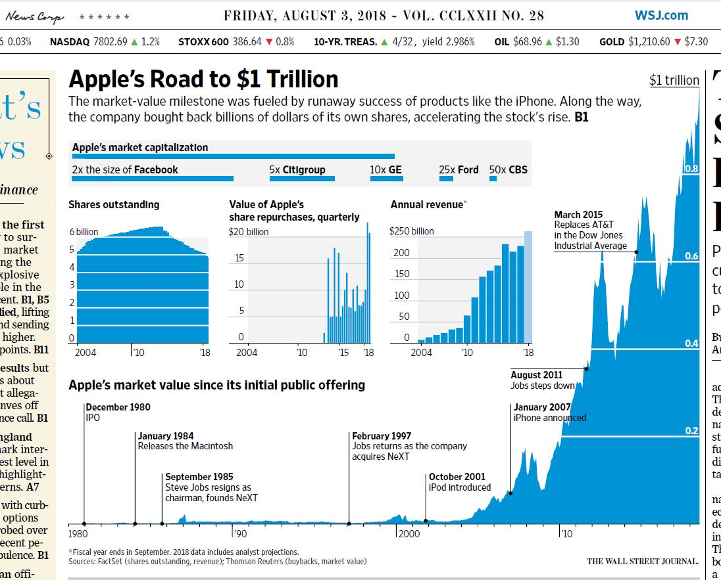
Apple Market Cap Rise (Nominal)
Wall Street Journal (3 Aug 2018)

Slide 42
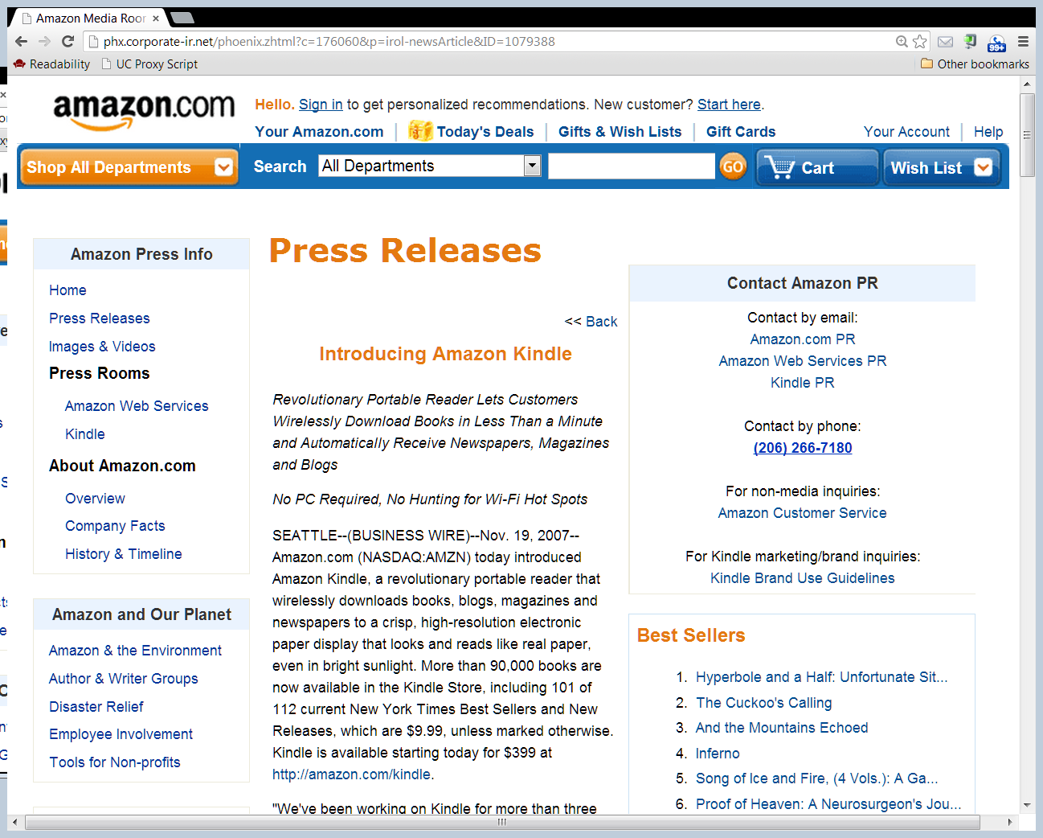
Kindle Launch
Amazron PR (19 Nov 2007)

Slide 43
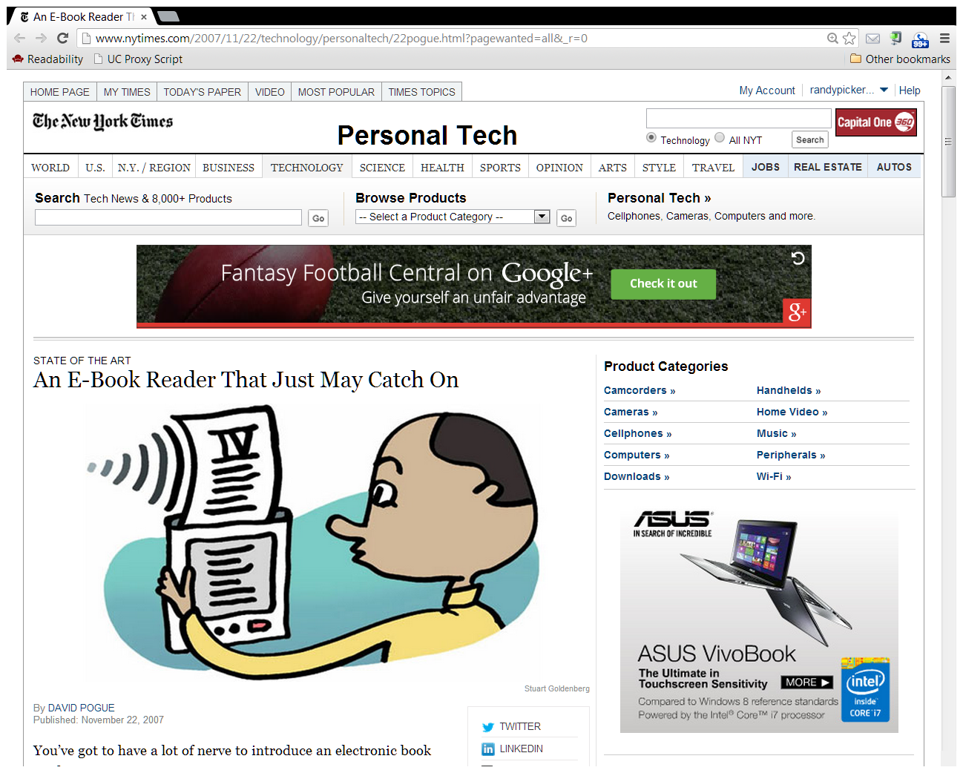
NYT Review
New York Times (22 Nov 2007)

Slide 44
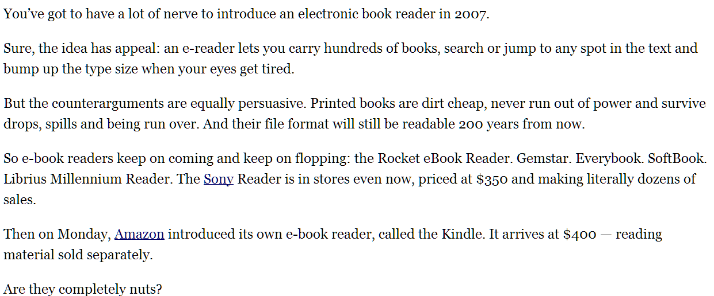
NYT Review
New York Times (22 Nov 2007)

Slide 45
Launching the iBookstore
TTYN (1 of 2)
Situation
It is early December 2009. Apple is planning to launch the iPad in early January 2010. Apple would also like to launch an ebook store at the same time.

Slide 46
Launching the iBookstore
TTYN (2 of 2)
Issues/Questions
What is the right business model here? Traditional retail: buy at wholesale, sell at retail? Agency like the app store?
How should you approach the Big Six book publishers?
What should you do about Amazon? Ask DOJ to sue them?

Slide 47
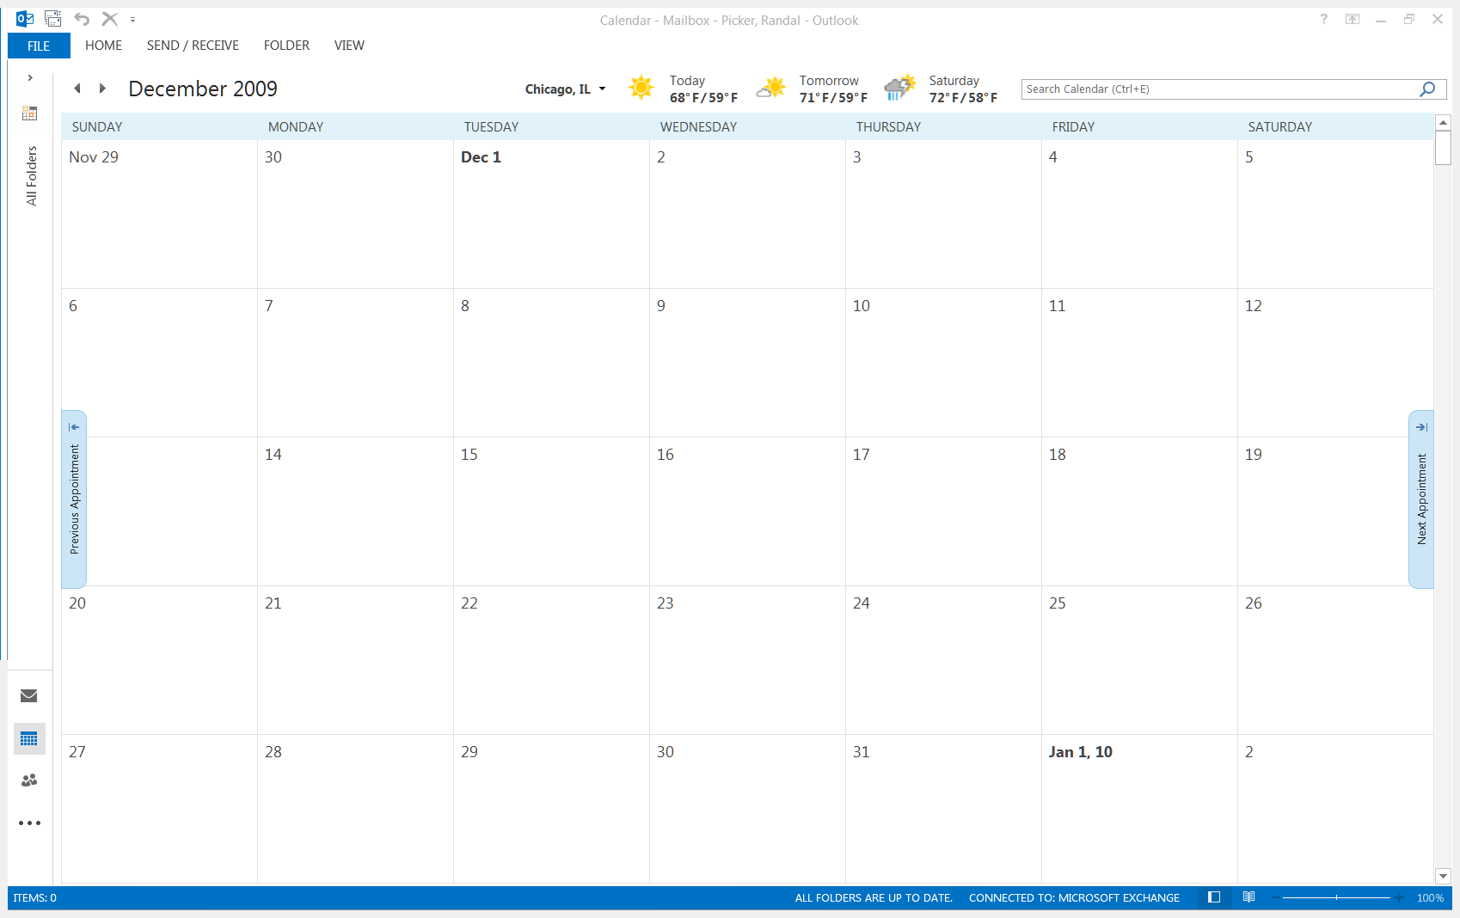
Initial Apple Phone Calls
Apple Phone Calls to Book Publishers
Apple’s Eddie Cue makes phone calls to Big Six publishers to set up in-person meetings in NY
Makes clear to each that he is meeting with each of the Big Six
Tuesday, 8 Dec 2009

Slide 48
Initial Meetings with Publishers
Cue, Moerer and Apple in-house attorney Saul meet with each of the Big Six
Apple discloses iPad and wants bookstore on iPad with Big Six
Apple won’t sell books at a loss but doesn’t want to be at a price disadvantage with Amazon
Apple suggests eBook prices at $11.99 to $14.99
Tues/Wed, 15-16 Dec 2009

Slide 49
Selling Models
Agency Model vs. Wholesale Model
Hachette and HarperCollins propose that Apple use agency model rather than wholesale model
Cue rejects that
Tues/Wed, 15-16 Dec 2009

Slide 50
Second Round of Meetings
Second Round of Apple Meetings with S&S, Macmillan and Random House
Described prior meetings with Big Six
Stated that industry needed to move to agency model
Apple wanted 30% fee
Proposed general eBook pricing at the iBookstore of $12.99
Publishers needed to adopt agency model with other ebook retailers
Mon/Tues, 20-21 Dec 2009

Slide 51
Cue to Jobs re Pricing
Cue Email to Jobs, Mon, 21 Dec 2009, PX-0043

Slide 52
Cue to Reidy
Cue Email to Reidy, Mon, 4 Jan 2010, PX-0021

Slide 53
Cue to Reidy
Cue Email to Reidy, Mon, 4 Jan 2010, PX-0021

Slide 54
Cue to Reidy
Cue Email to Reidy, Mon, 4 Jan 2010, PX-0021

Slide 55
10-11 Jan 2010: The Draft MFN Clause
The Clause:
“If, for any particular New Release in hardcover format, the then-current Customer Price at any time is or becomes higher than a customer price offered by any other reseller (“Other Customer Price”), then Publisher shall designate a new, lower Customer Price to meet such lower Other Customer Price.”

Slide 56
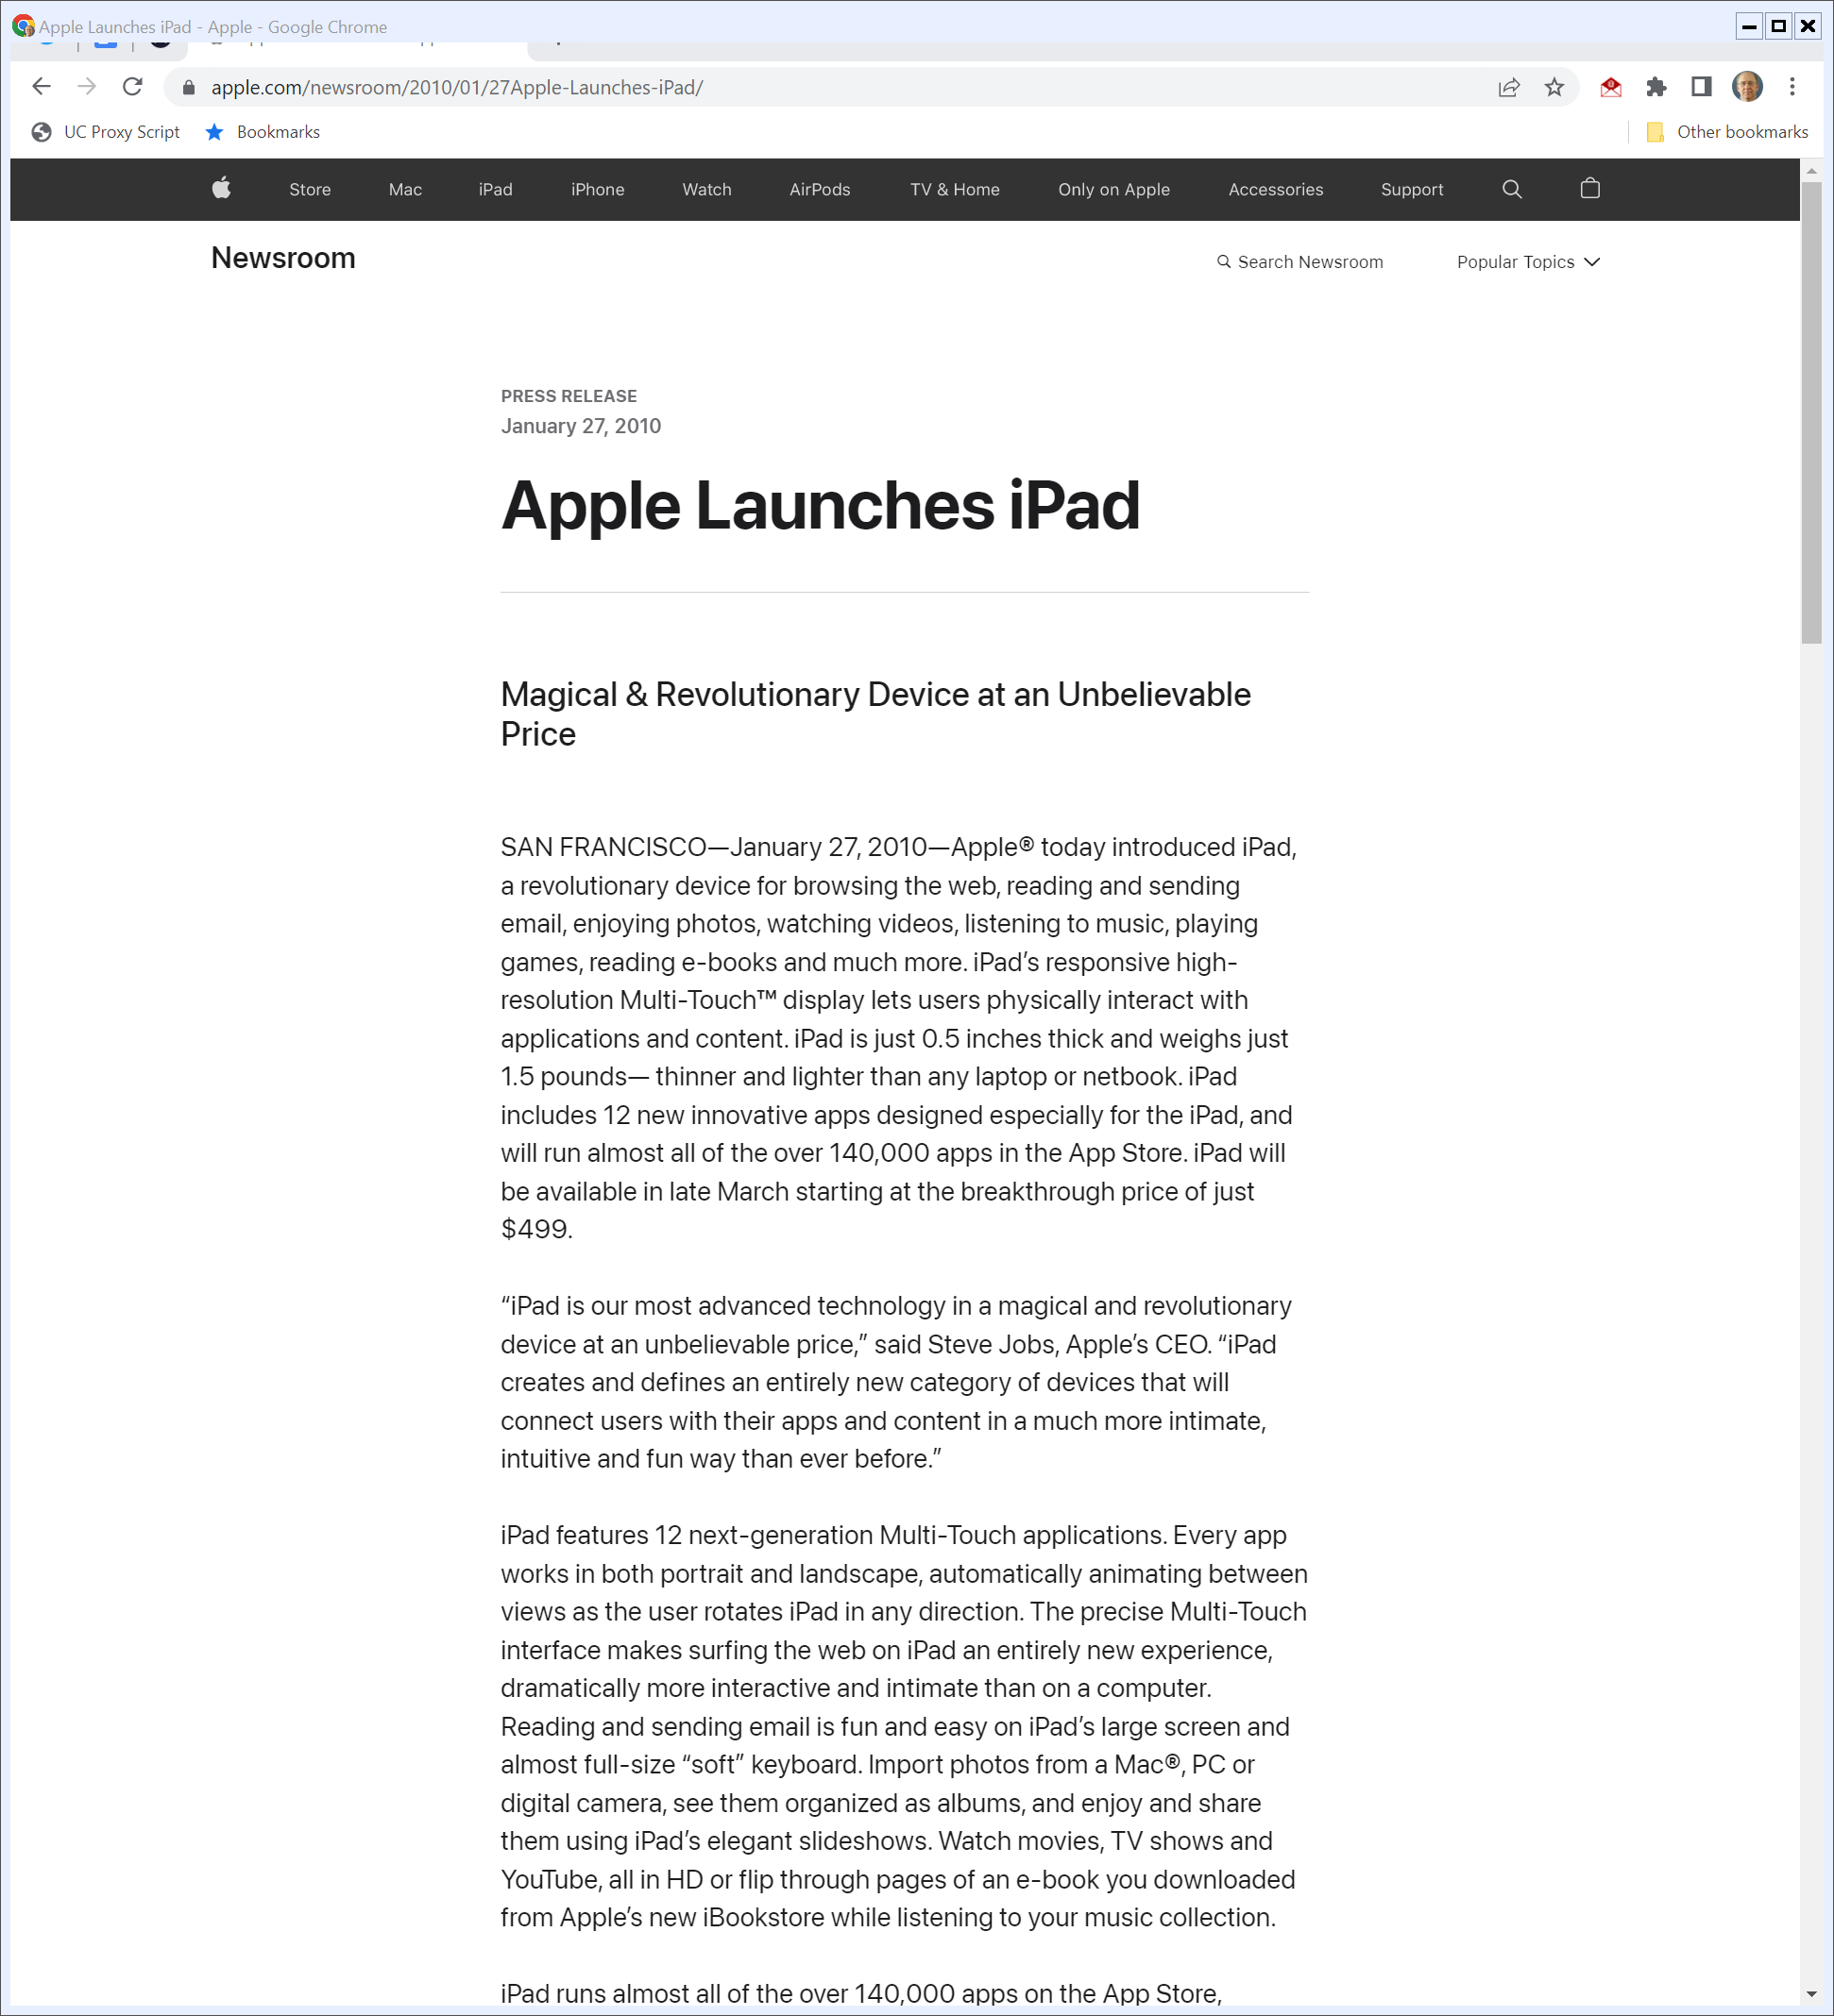
27 Jan 2010: iPad Launch
Apple PR (27 Jan 2010)
Notes:
https://www.apple.com/newsroom/2010/01/27Apple-Launches-iPad/

Slide 57
Post-Launch Evidence
Sargent Email to Cue (31 Jan 2010) PX-0053

Slide 58
eBook Price Increases at Amazon
From the SDNY Opinion, 952 F.Supp.2d 638 (2013)

Slide 59
The iPhone
The iPhone

Slide 60
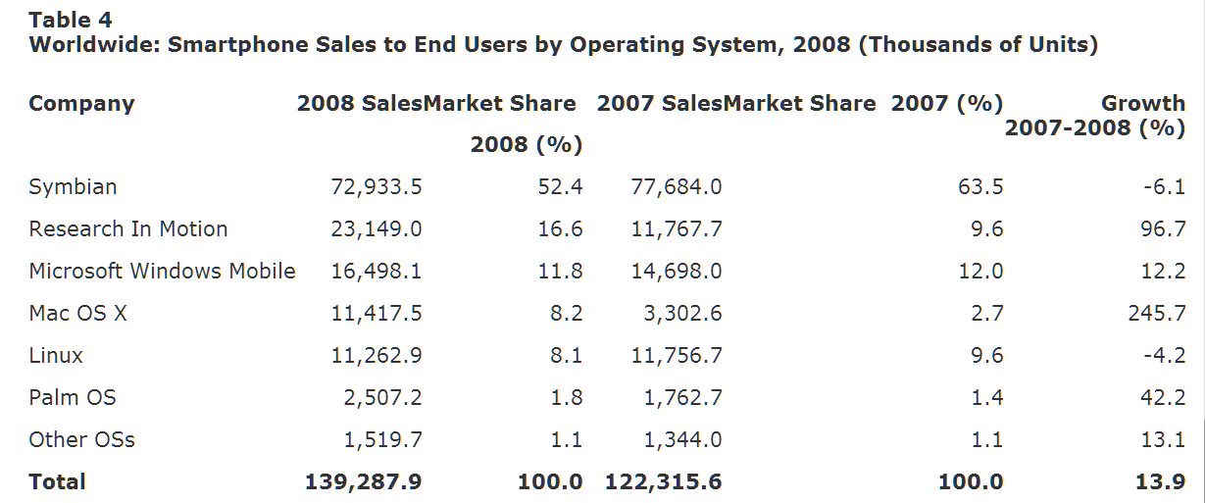
Smartphone OS Market Shares, 2007 & 2008
Gartner (11 Mar 2009)

Slide 61
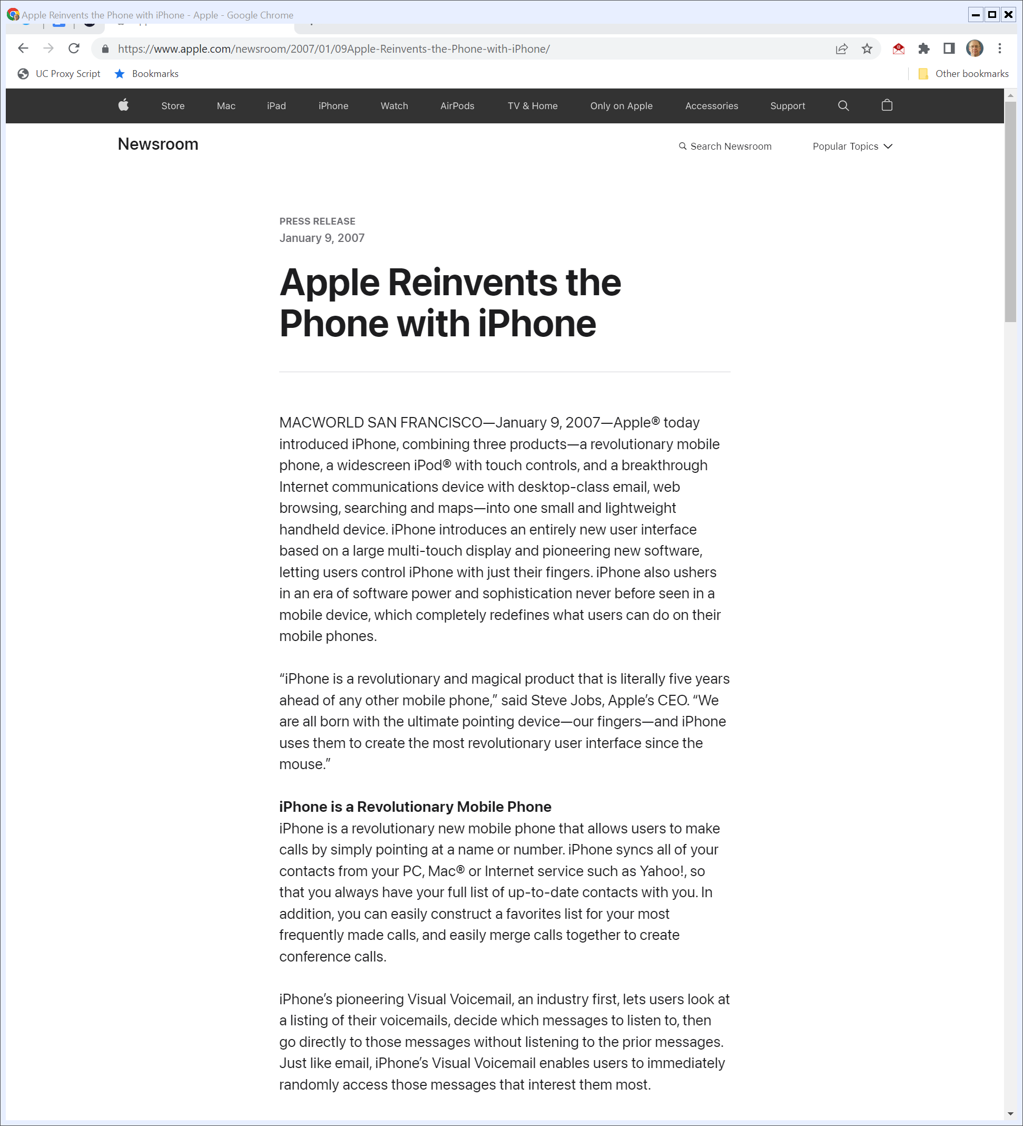
2007 SF Macworld iPhone Launch
“Apple® today introduced iPhone, combining three products—a revolutionary mobile phone, a widescreen iPod® with touch controls, and a breakthrough Internet communications device with desktop-class email, web browsing, searching and maps—into one small and lightweight handheld device.”
Apple (9 Jan 2007)
Notes:
https://www.apple.com/newsroom/2007/01/09Apple-Reinvents-the-Phone-with-iPhone/

Slide 62
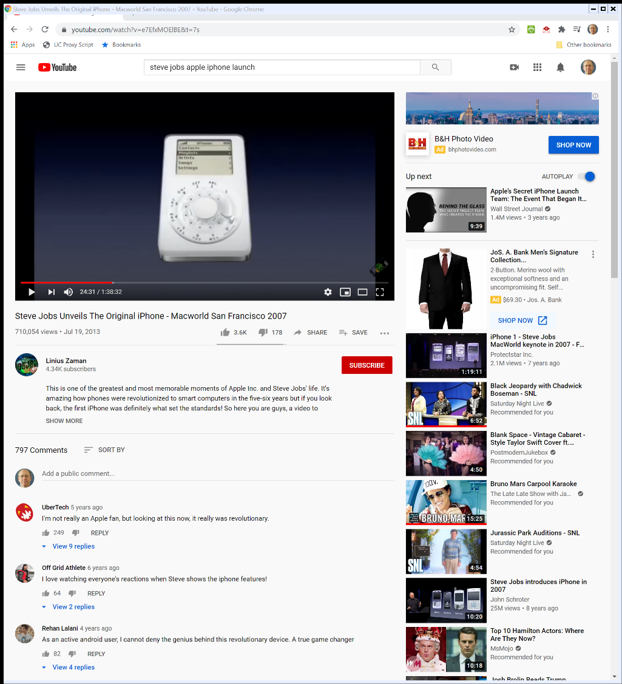

2007 SF Macworld iPhone Launch
Apple (9 Jan 2007)

Slide 63
iPhone Launch
“iPhone introduces an entirely new user interface based on a large multi-touch display and pioneering new software, letting users control iPhone with just their fingers.”
Apple (9 Jan 2007)

Slide 64
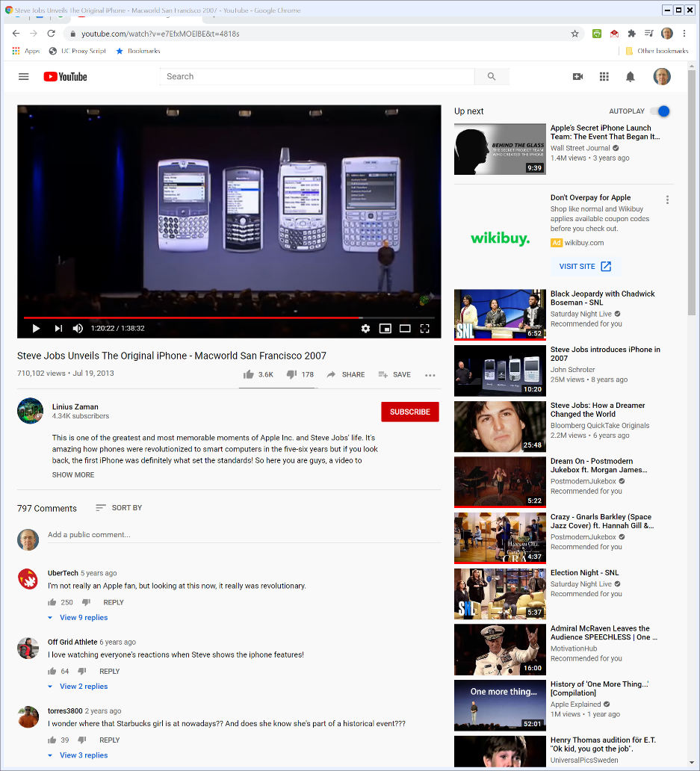

The Future and the Past
2007 SF Macworld
Notes:
https://www.youtube.com/watch?v=e7EfxMOElBE&t=4818s

Slide 65
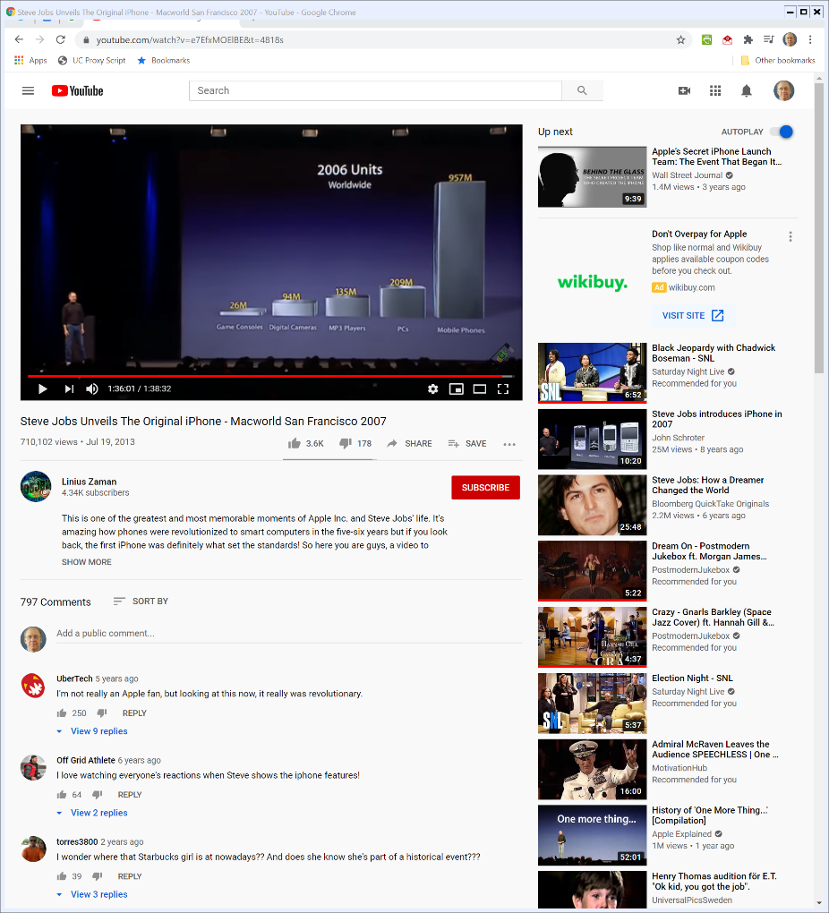

The Size of the Opportunity
2007 SF Macworld
Notes:
https://www.youtube.com/watch?v=e7EfxMOElBE&t=4818s

Slide 66
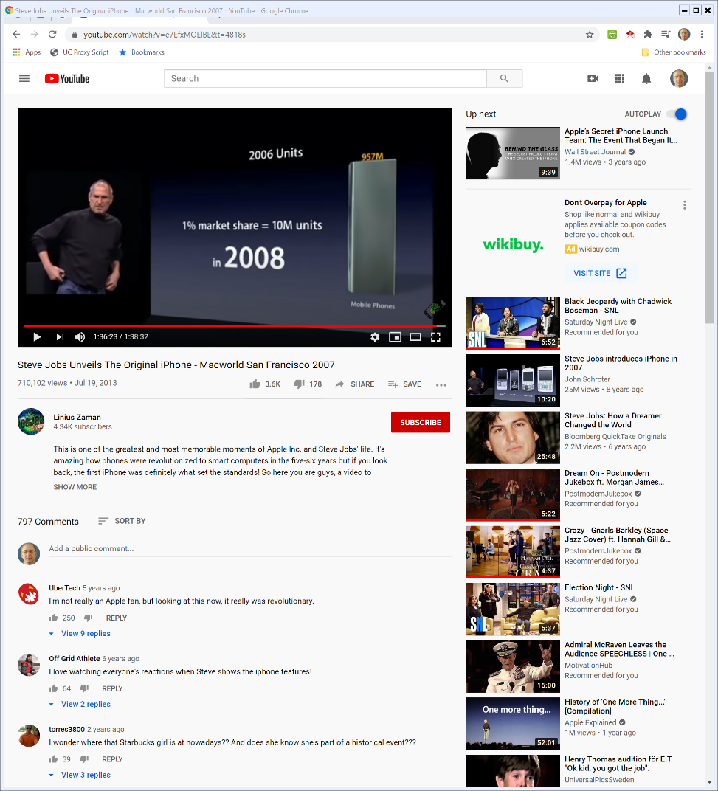

Apple’s Goal in 2008? 1%
2007 SF Macworld
Notes:
https://www.youtube.com/watch?v=e7EfxMOElBE&t=4818s

Slide 67
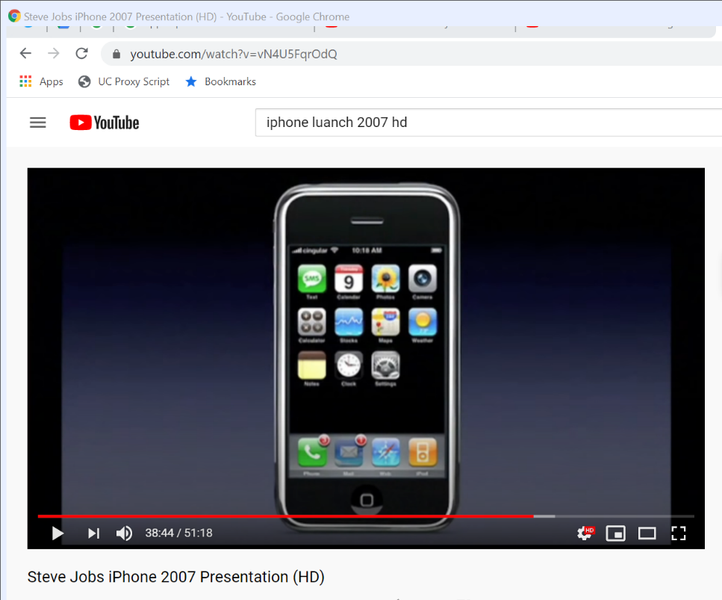
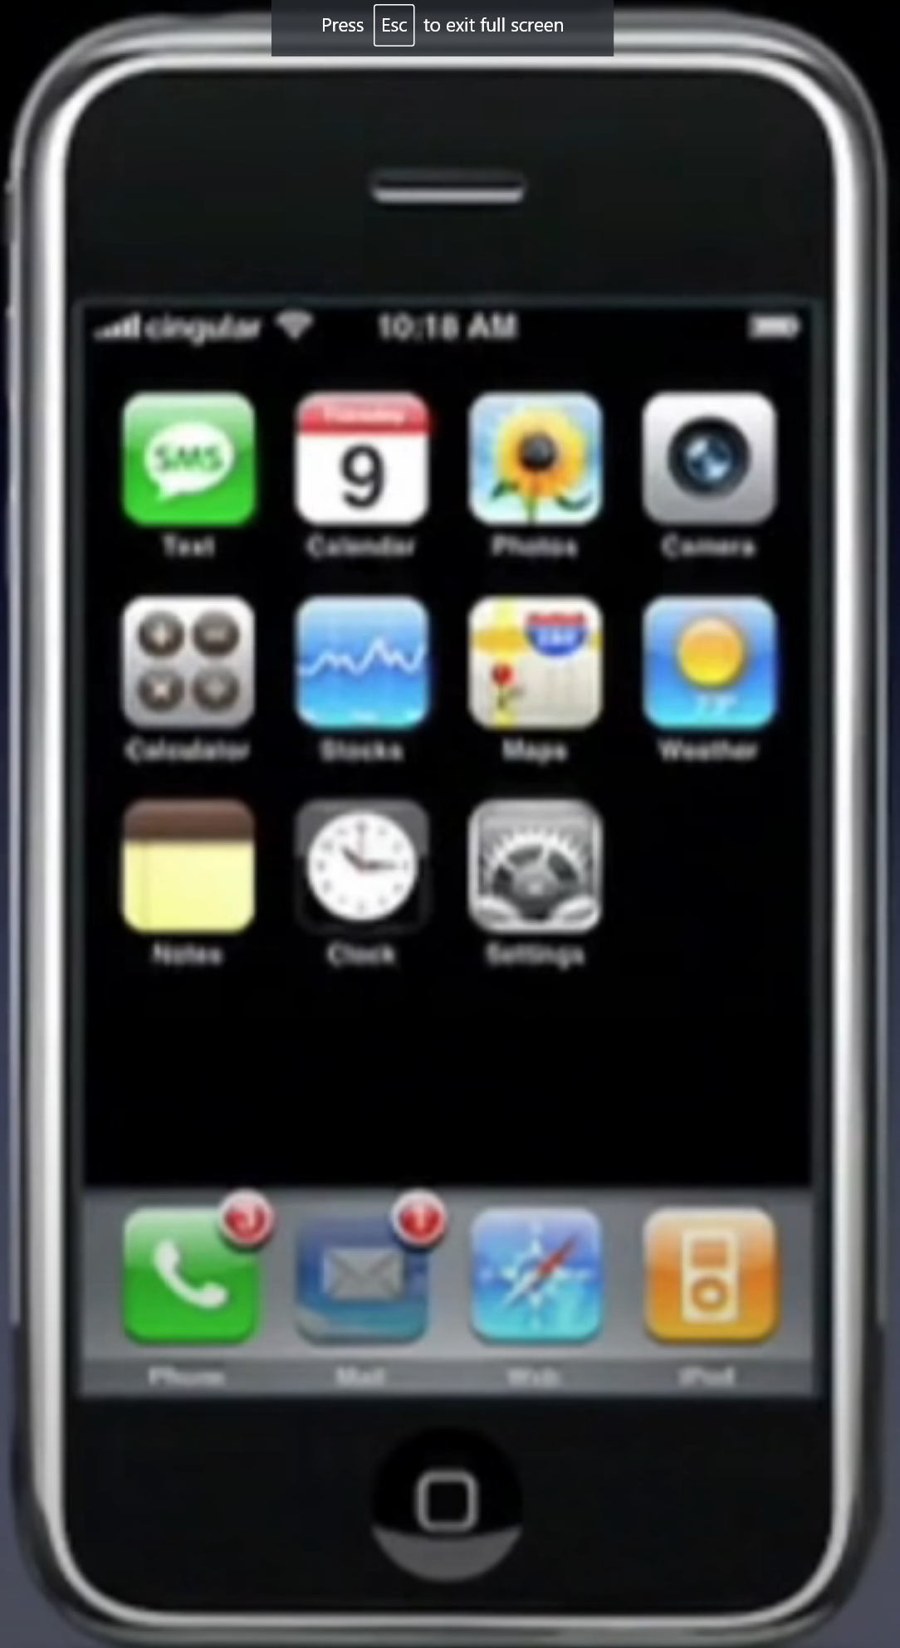
The App Usage and Distribution Model in 2007
1. Apple chooses the apps
2. You use the web (with Google Search and Yahoo Search built-in)
2007 SF Macworld
Notes:
At 38:44 of https://www.youtube.com/watch?v=vN4U5FqrOdQ

Slide 68
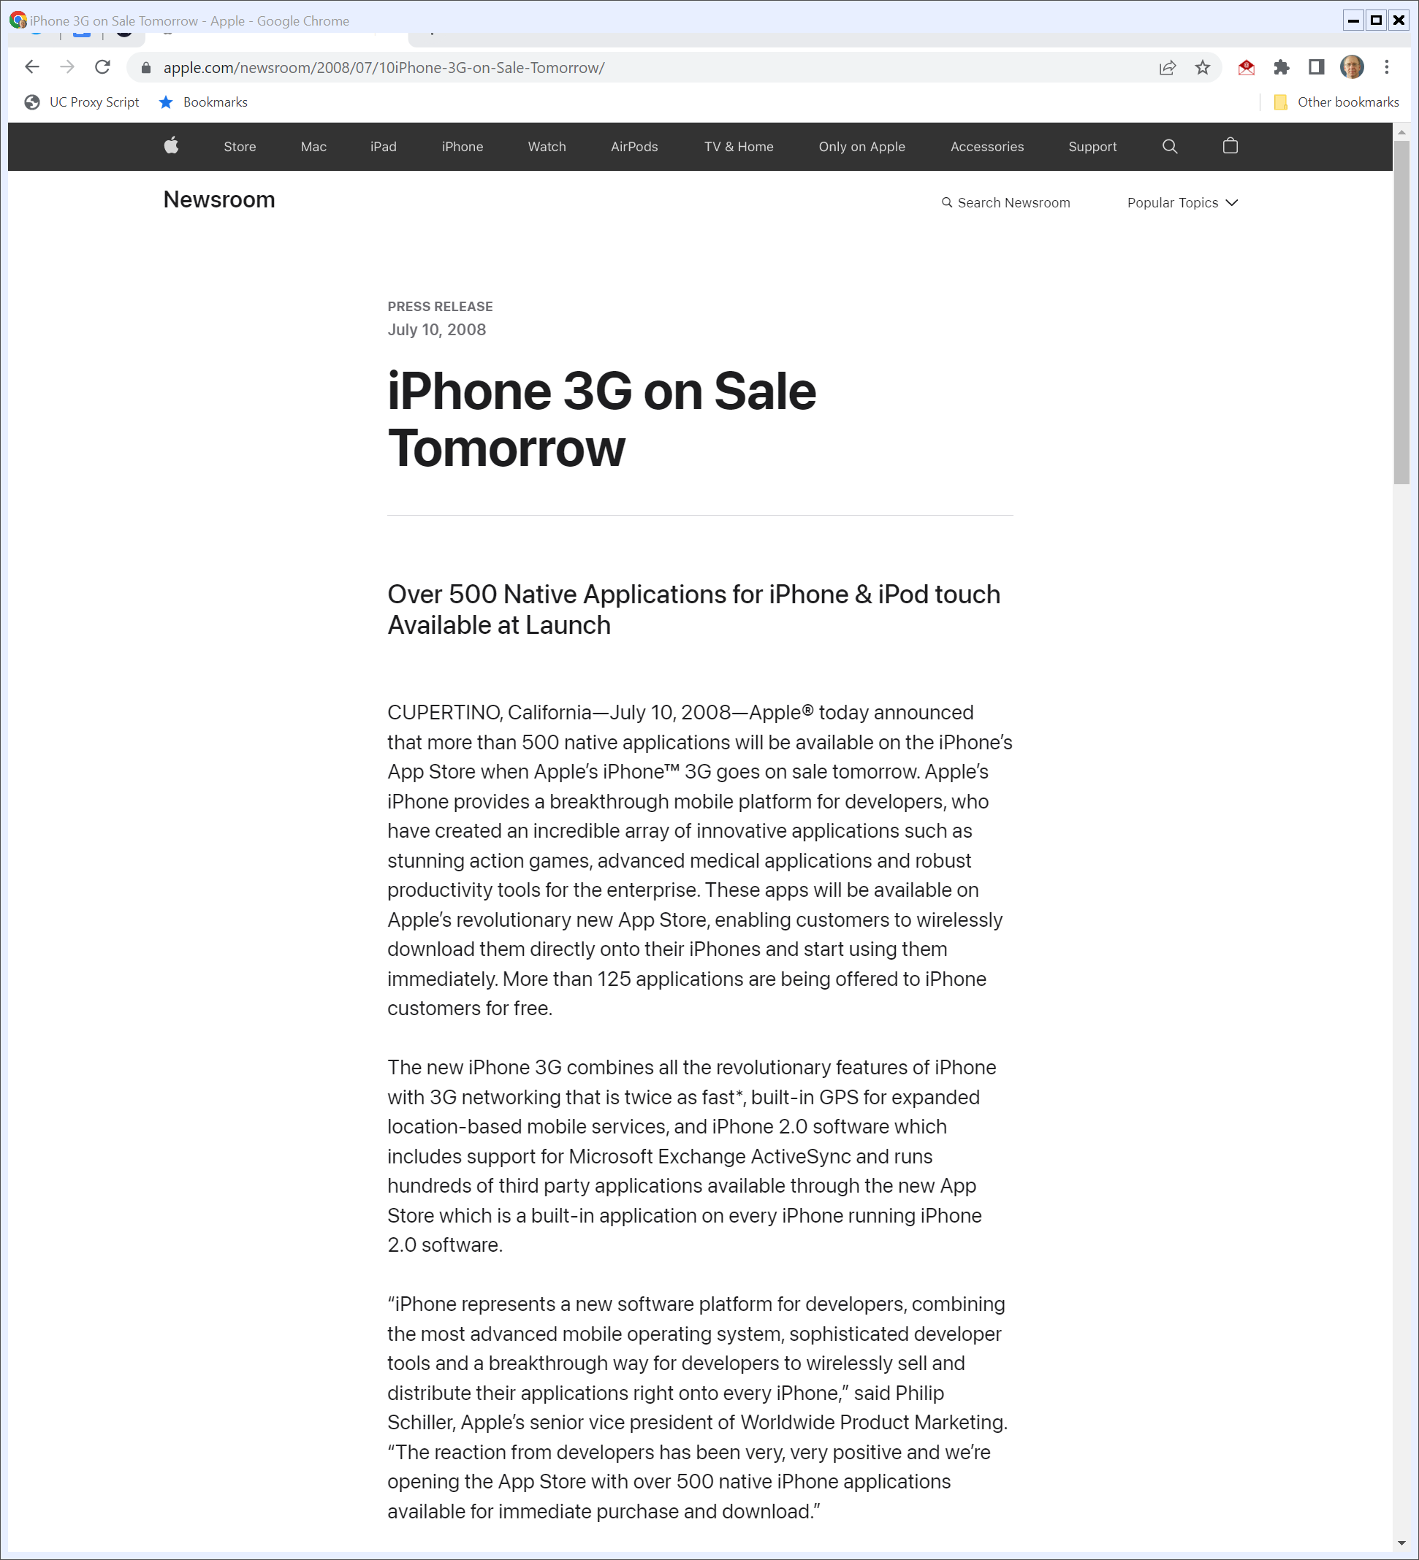
App Store Launch
“Apple® today announced that more than 500 native applications will be available on the iPhone’s App Store when Apple’s iPhone™ 3G goes on sale tomorrow. … .”
Apple (10 July 2008)
Notes:
https://www.apple.com/newsroom/2008/07/10iPhone-3G-on-Sale-Tomorrow/

Slide 69
App Store Launch (Monopolization?)
“These apps will be available on Apple’s revolutionary new App Store, enabling customers to wirelessly download them directly onto their iPhones and start using them immediately.”
Apple (10 July 2008)

Slide 70
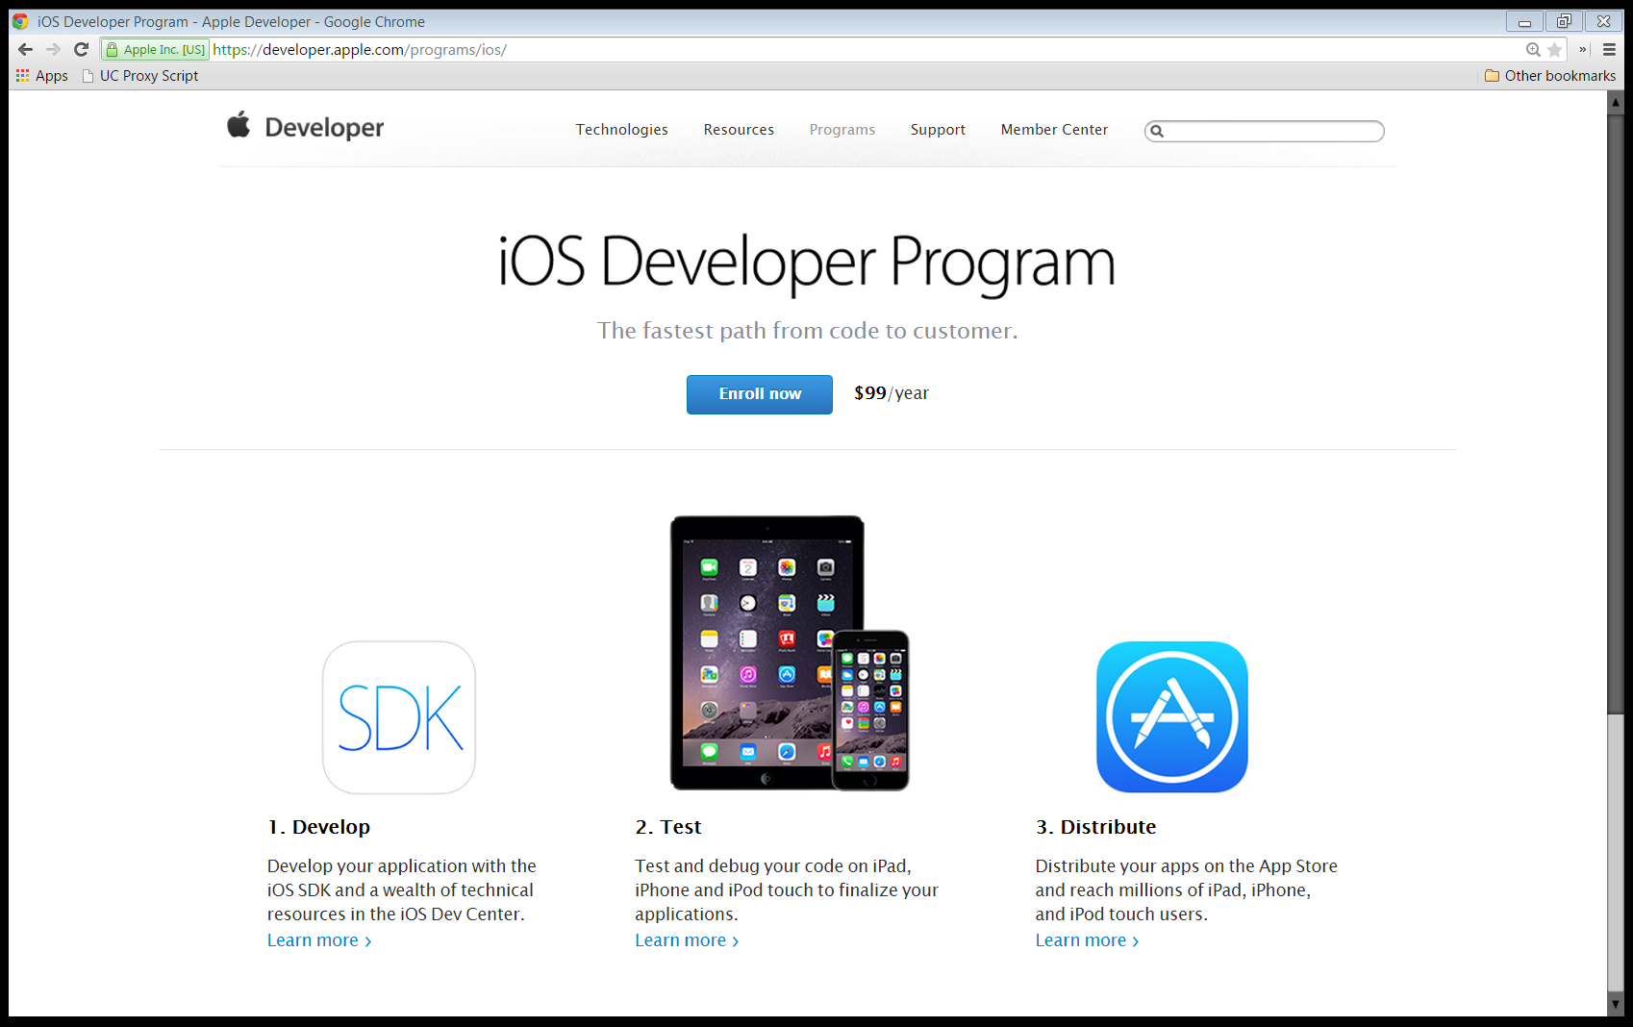
Developer Side of the App Store
Apple iOS Developer Program

Slide 71
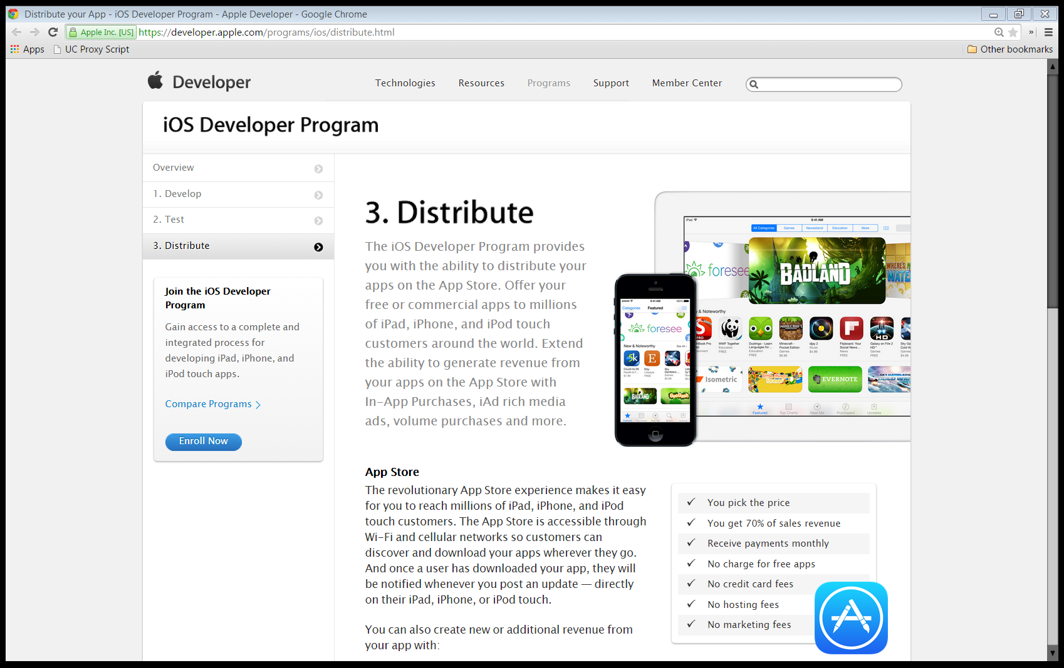
Developer Side of the App Store
Apple iOS Developer Program

Slide 72

Developer Side of the App Store
Apple iOS Developer Program

Slide 73
Epic Games
Epic Games

Slide 74
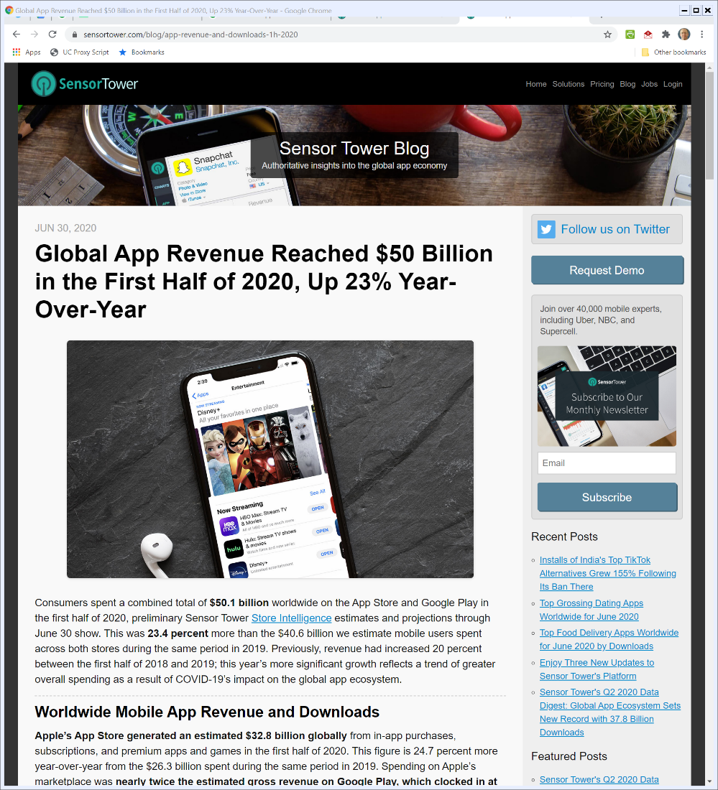

Mobile App Revenue
SensorTower (30 June 2020)
Notes:
https://sensortower.com/blog/app-revenue-and-downloads-1h-2020

Slide 75
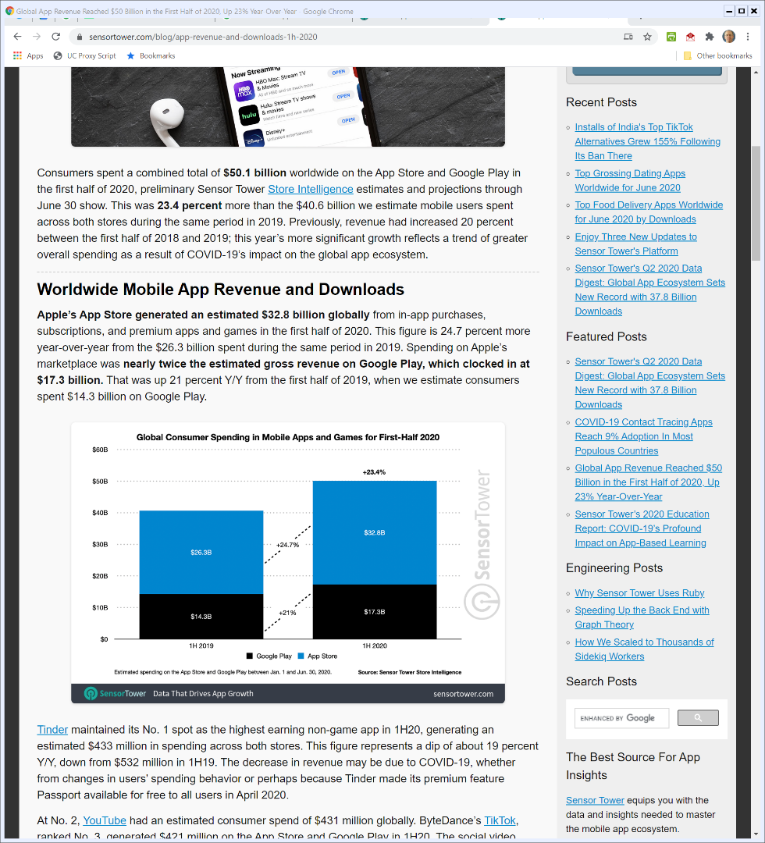

Apple is Roughly Two-Thirds of the Revenue
SensorTower (30 June 2020)
Notes:
https://sensortower.com/blog/app-revenue-and-downloads-1h-2020

Slide 76
30 June 2020: Sweeney Email to Cook et al
Apple TRO Response Ex. D (21 Aug 2020)

Slide 77
30 June 2020: Sweeney Email to Cook et al
Apple TRO Response Ex. D (21 Aug 2020)

Slide 78
30 June 2020: Sweeney Email to Cook et al
Apple TRO Response Ex. D (21 Aug 2020)

Slide 79
10 July 2020: Apple Responds with Six-Page Letter
Apple TRO Response Ex. E: Apple Letter (10 July 2020)

Slide 80
Apple’s Rules Protect the Platform
Apple TRO Response Ex. E: Apple Letter (10 July 2020)

Slide 81
App Store is Not a Public Utility
Apple TRO Response Ex. E: Apple Letter (10 July 2020)

Slide 82
Epic Charges $$$ but Doesn’t Want Apple to Do So
Apple TRO Response Ex. E: Apple Letter (10 July 2020)

Slide 83
Epic Charges $$$ but Doesn’t Want Apple to Do So
Apple TRO Response Ex. E: Apple Letter (10 July 2020)

Slide 84
Epic Launches
Apple TRO Response Ex. G: Sweeney Email (13 Aug 2020)

Slide 85
“Repugnant to the principles of a free society”
Apple TRO Response Ex. G: Sweeney Email (13 Aug 2020)

Slide 86
Epic Launches
Apple TRO Response Ex. G: Sweeney Email (13 Aug 2020)

Slide 87
13 Aug 2020: Epic Turns on Direct Payment Option
Epic Apple Complaint (13 Aug 2020)

Slide 88
Apple Boots Out Fortnite
Epic Apple Complaint (13 Aug 2020)

Slide 89
13 Aug 2020: Epic Sues Apple (and Google)
Epic Apple Complaint (13 Aug 2020)

Slide 90
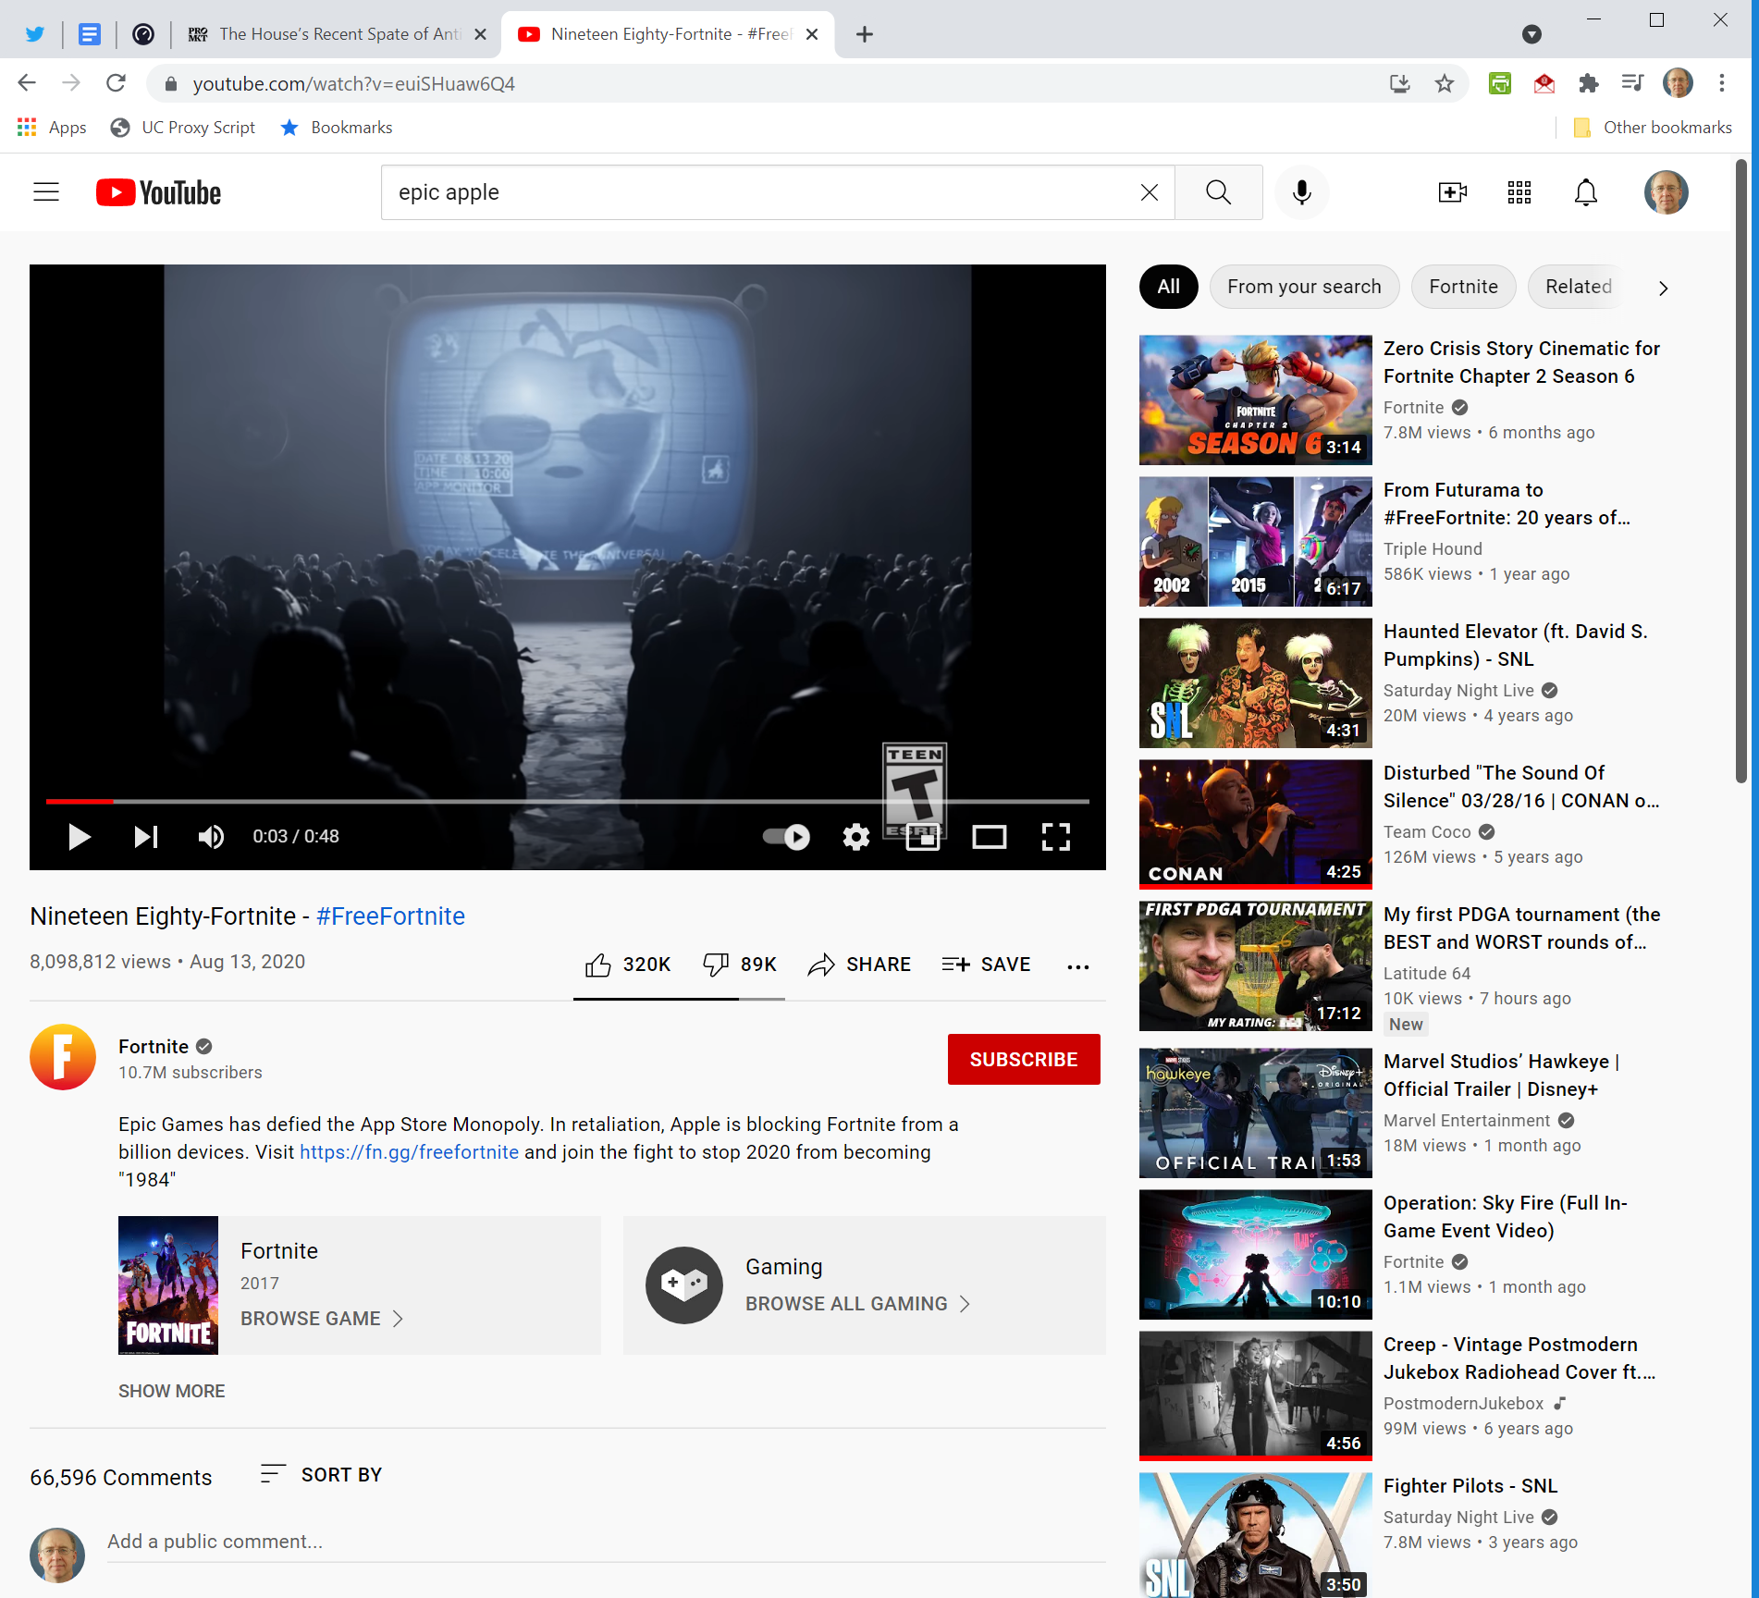
Epic PR Campaign: Link
Epic Games (13 Aug 2020)
Notes:
https://www.youtube.com/watch?v=euiSHuaw6Q4

Slide 91
24 Apr 2023: Ninth Circuit Ruling
Epic v. Apple (9th Cir. 24 Apr 2023)

Slide 92
Mainly Affirmed
Epic v. Apple (9th Cir. 24 Apr 2023)

Slide 93
Mainly Affirmed
Epic v. Apple (9th Cir. 24 Apr 2023)

Slide 94
The Success of the App Store
Epic v. Apple (9th Cir. 24 Apr 2023)

Slide 95
IP Monetization
Epic v. Apple (9th Cir. 24 Apr 2023)

Slide 96
And Epic Doesn’t Want to Pay for It
Epic v. Apple (9th Cir. 24 Apr 2023)

Slide 97
How Does Apple Get Paid for its IP
Epic v. Apple (9th Cir. 24 Apr 2023)

Slide 98
Apple’s Procompetitive Rationales
Epic v. Apple (9th Cir. 24 Apr 2023)

Slide 99
Business Model Competition
Epic v. Apple (9th Cir. 24 Apr 2023)

Slide 100
Non-Price Features as Key Part of Competition
Epic v. Apple (9th Cir. 24 Apr 2023)

Slide 101
Inadequate Proof on IP Payment Alternatives
Epic v. Apple (9th Cir. 24 Apr 2023)

Slide 102
www.ca9.uscourts.gov
Epic v. Google (CA9 31 July 2025)

Slide 103
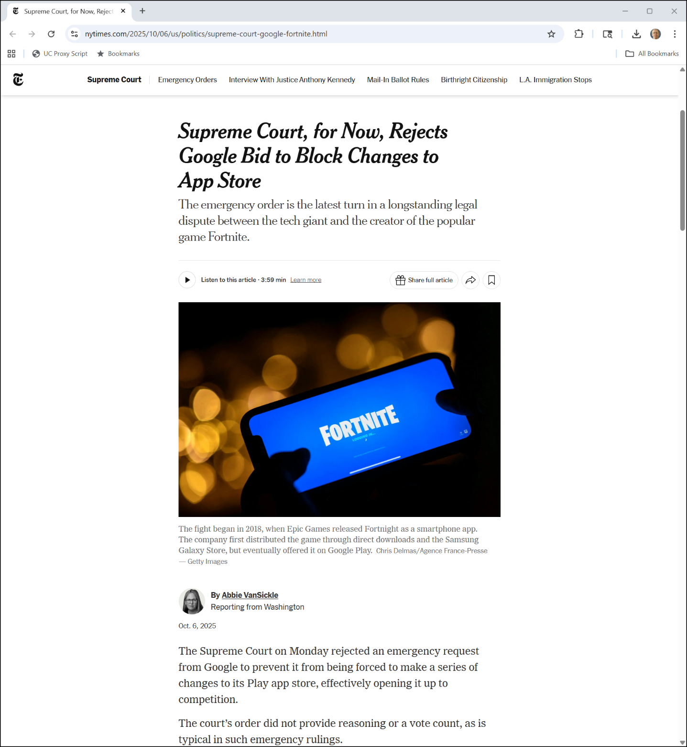
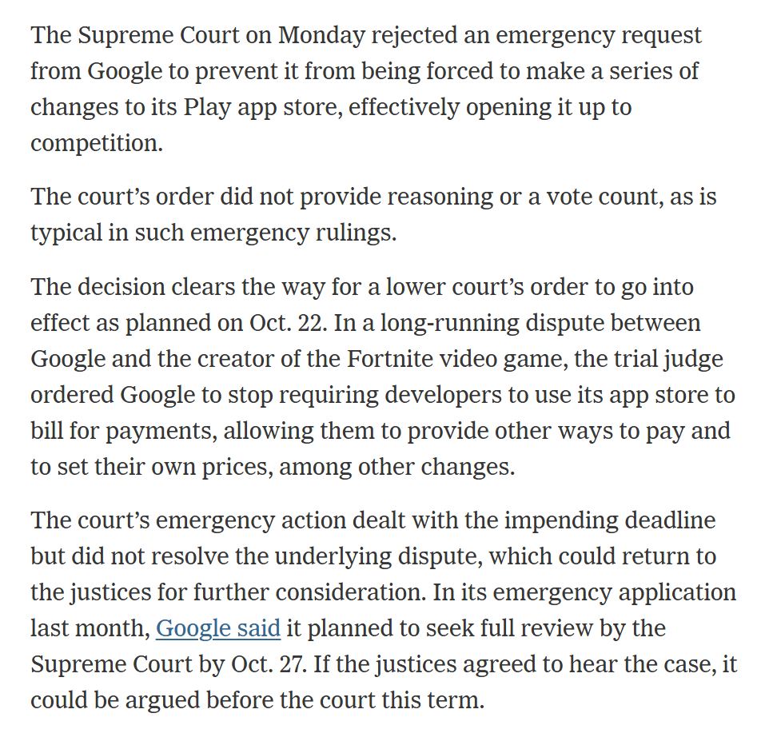
Sup Ct Denies Stay
NYT (6 Oct 2025)
Notes:
https://www.nytimes.com/2025/10/06/us/politics/supreme-court-google-fortnite.html

Slide 104
Google
Google

Slide 105
A Prototype Search Engine
“In this paper, we present Google, a prototype of a large-scale search engine which makes heavy use of the structure present in hypertext.”
Brin & Page (1998)

Slide 106
Advertising and Mixed Motives
“Currently, the predominant business model for commercial search engines is advertising. The goals of the advertising business model do not always correspond to providing quality search to users.”
Brin & Page (1998)

Slide 107
Advertising and Mixed Motives
“For this type of reason …, we expect that advertising funded search engines will be inherently biased towards the advertisers and away from the needs of the consumers.”
Brin & Page (1998)

Slide 108
Conclusion?
“But we believe the issue of advertising causes enough mixed incentives that it is crucial to have a competitive search engine that is transparent and in the academic realm.”
Brin & Page (1998)

Slide 109
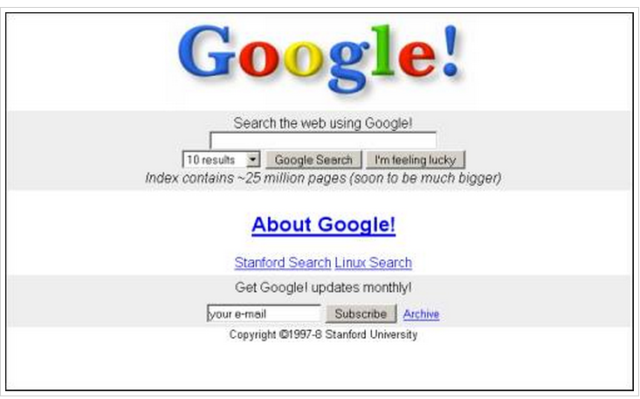
In the Beginning
Data Model: Crawl, index, rank
Goal: Build a great product
Natural Result: Market power (and no apologies for that)
Original Google Homepage (11 Nov 1998)

Slide 110
Market Power in Media Markets
Media markets such as radio and TV
Competition always a click away and (historically) zero cash price to viewers
Exercise market power (raise prices to consumers) through advertising volume and intensity
Original Google Homepage (11 Nov 1998)

Slide 111
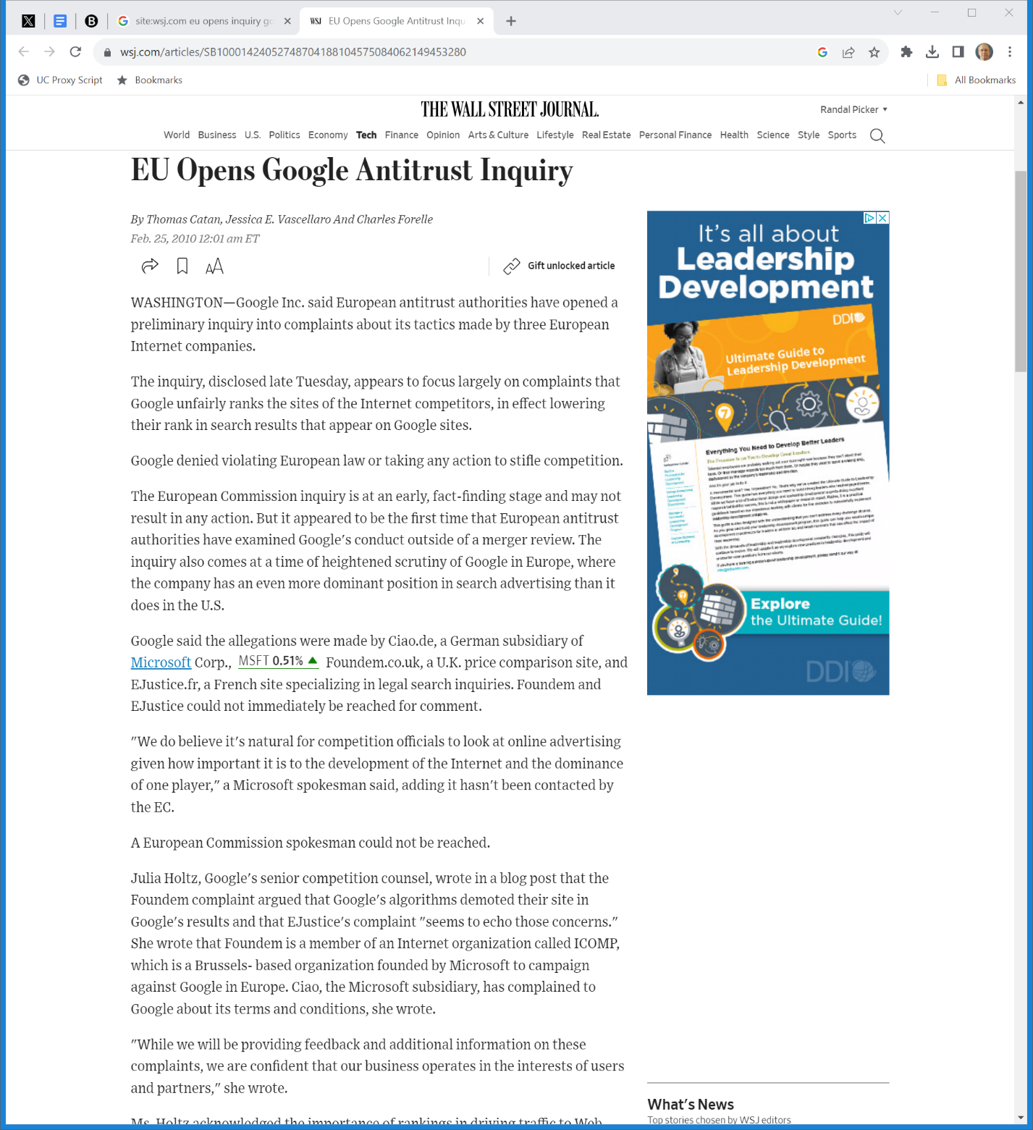

2010: Europe Looks at Google
The Wall Street Journal (25 Feb 2010)
Notes:
https://www.wsj.com/articles/SB10001424052748704188104575084062149453280

Slide 112
FTC Look at Google
WSJ (24 June 2011)

Slide 113
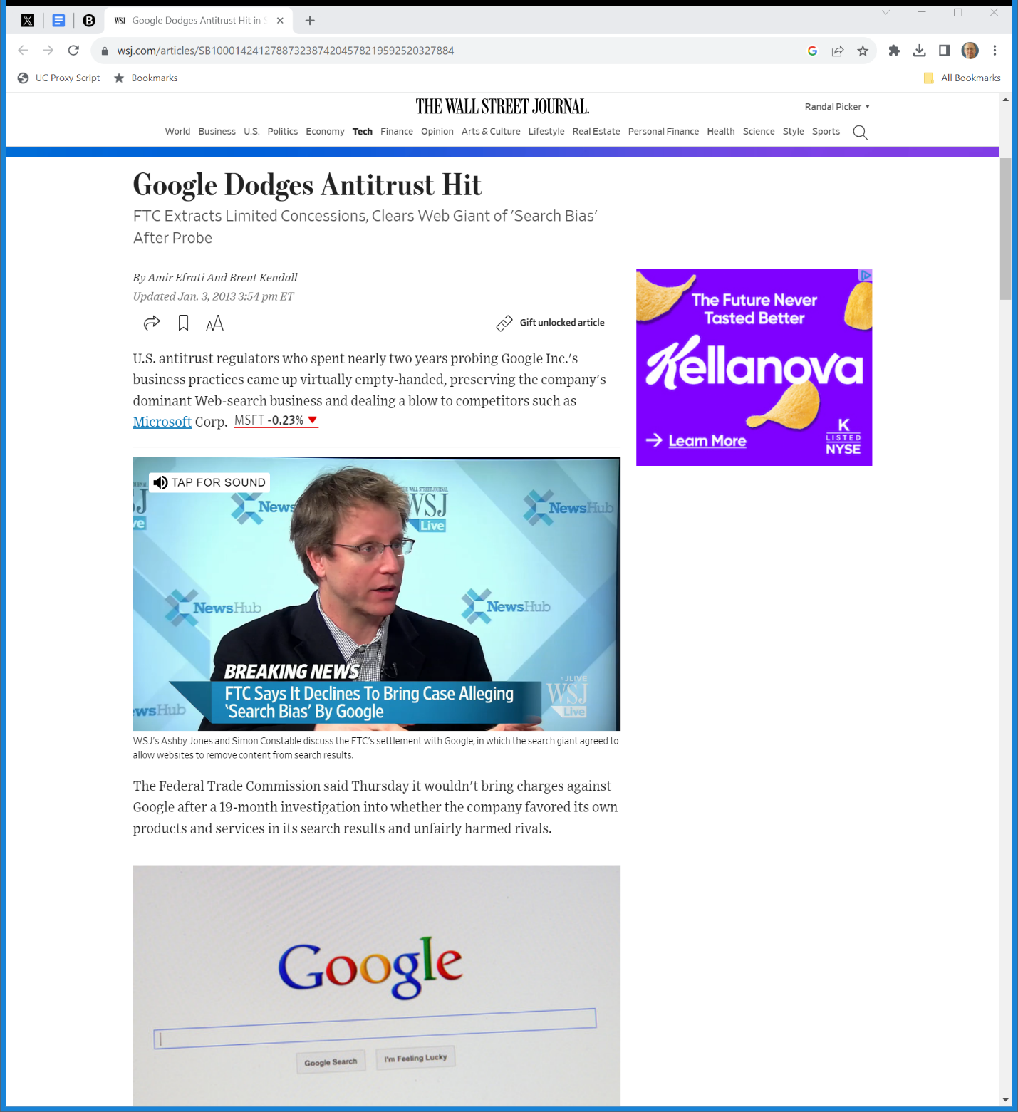

Jan 2013: FTC Ends Google Inquiry
The Wall Street Journal (3 Jan 2013)
Notes:
https://www.wsj.com/articles/SB10001424127887323874204578219592520327884

Slide 114
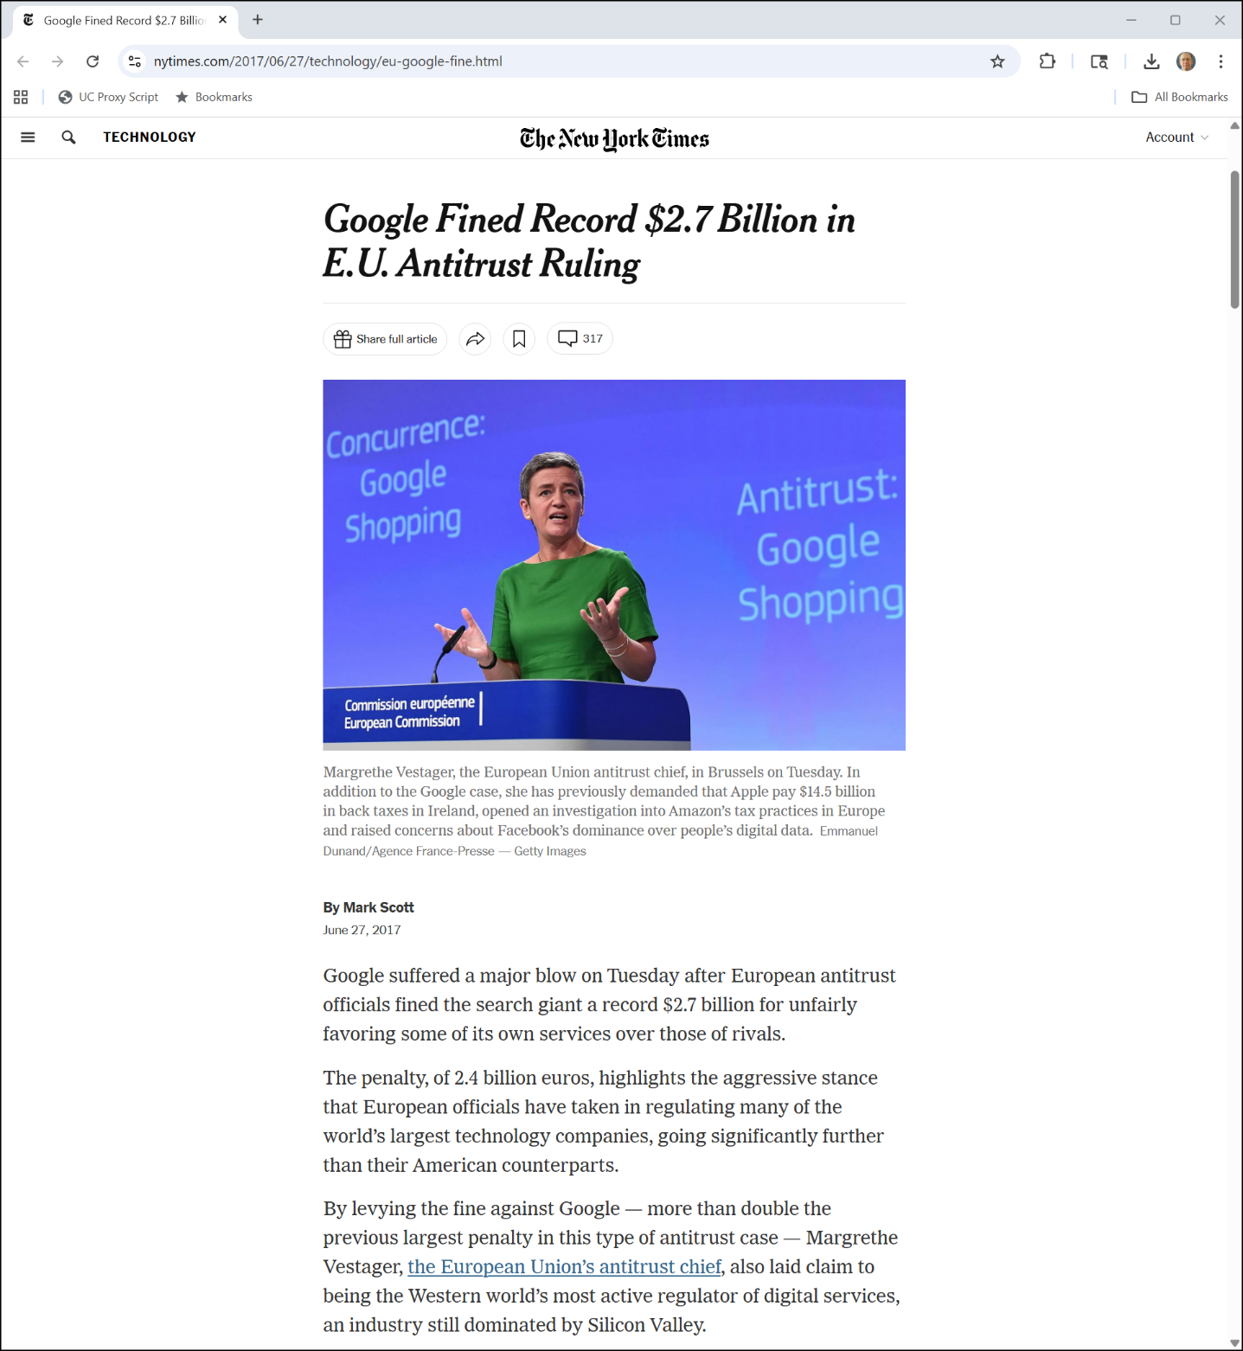
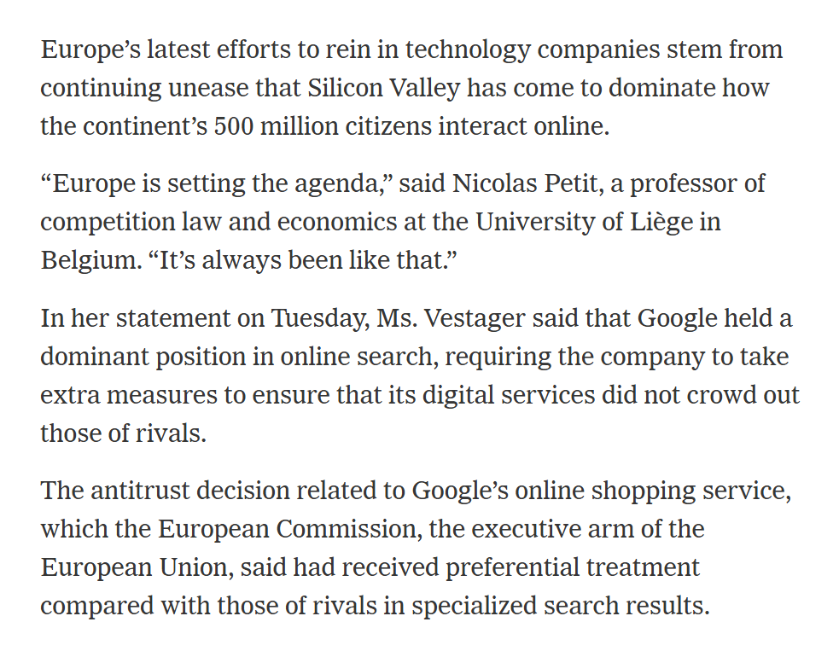
June 2017: EC Google Shopping Result
NYT (27 June 2017)
Notes:
https://www.nytimes.com/2017/06/27/technology/eu-google-fine.html

Slide 115
Oct 2020 Case
U.S. v. Google

Slide 116
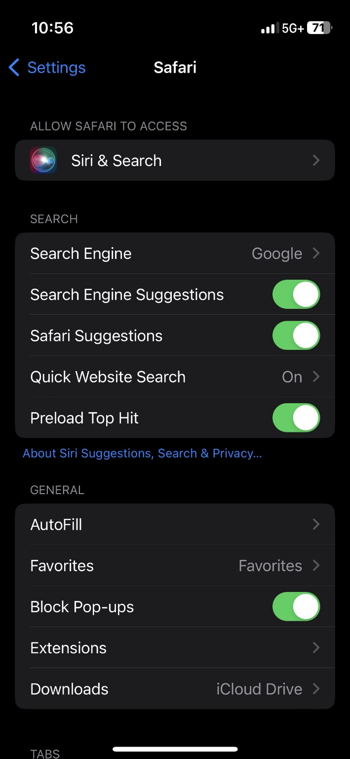

What is the Case About?
Picker iPhone (11 Oct 2023)

Slide 117
Google’s Dominance Since 2009
Whinston Direct Testimony (UPXD 102) (5 Oct 2023)

Slide 118
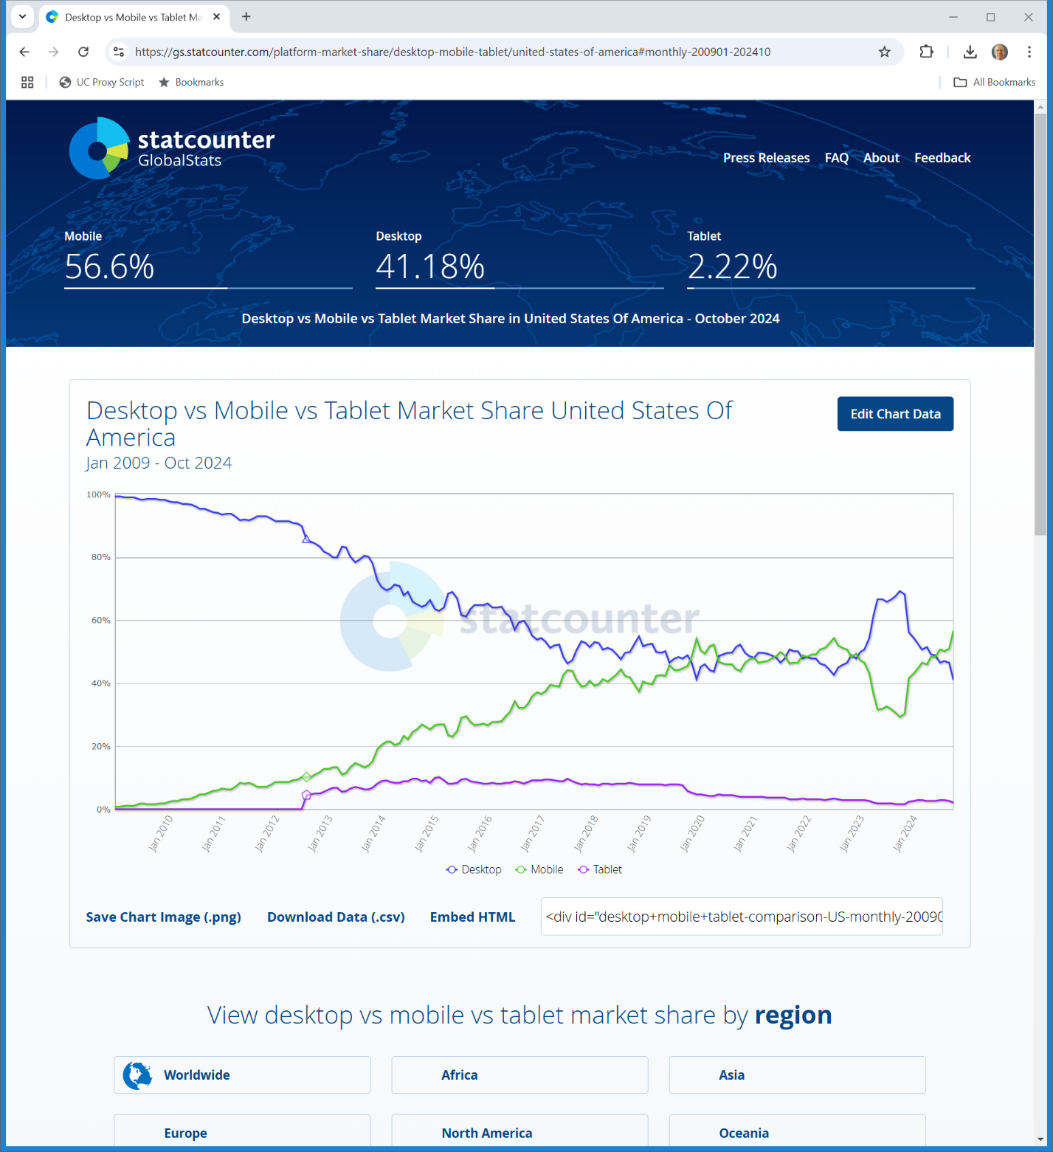
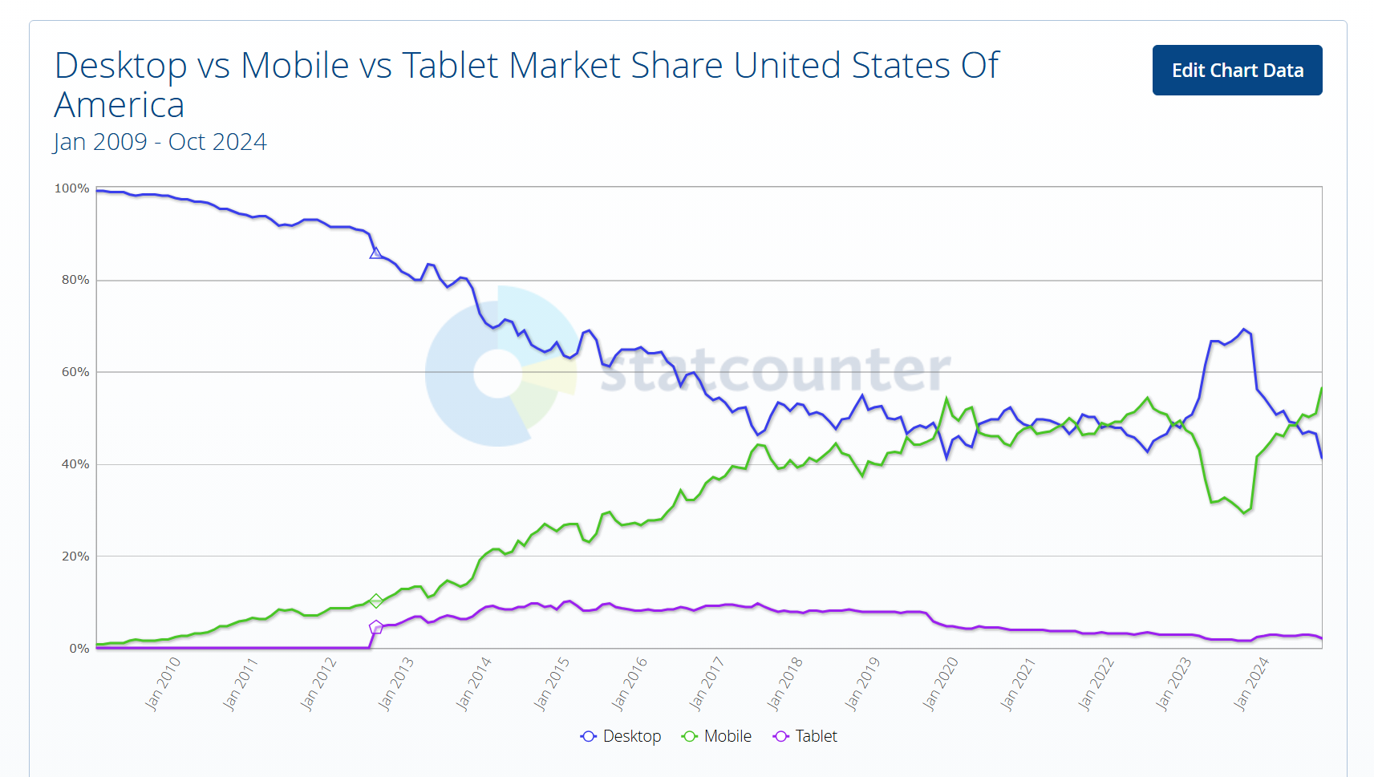
U.S. Device Share
Jan 2009: Desktop: 99.26
statcounter (27 Nov 2024)
Notes:
https://gs.statcounter.com/platform-market-share/desktop-mobile-tablet/united-states-of-america#monthly-200901-202410

Slide 119
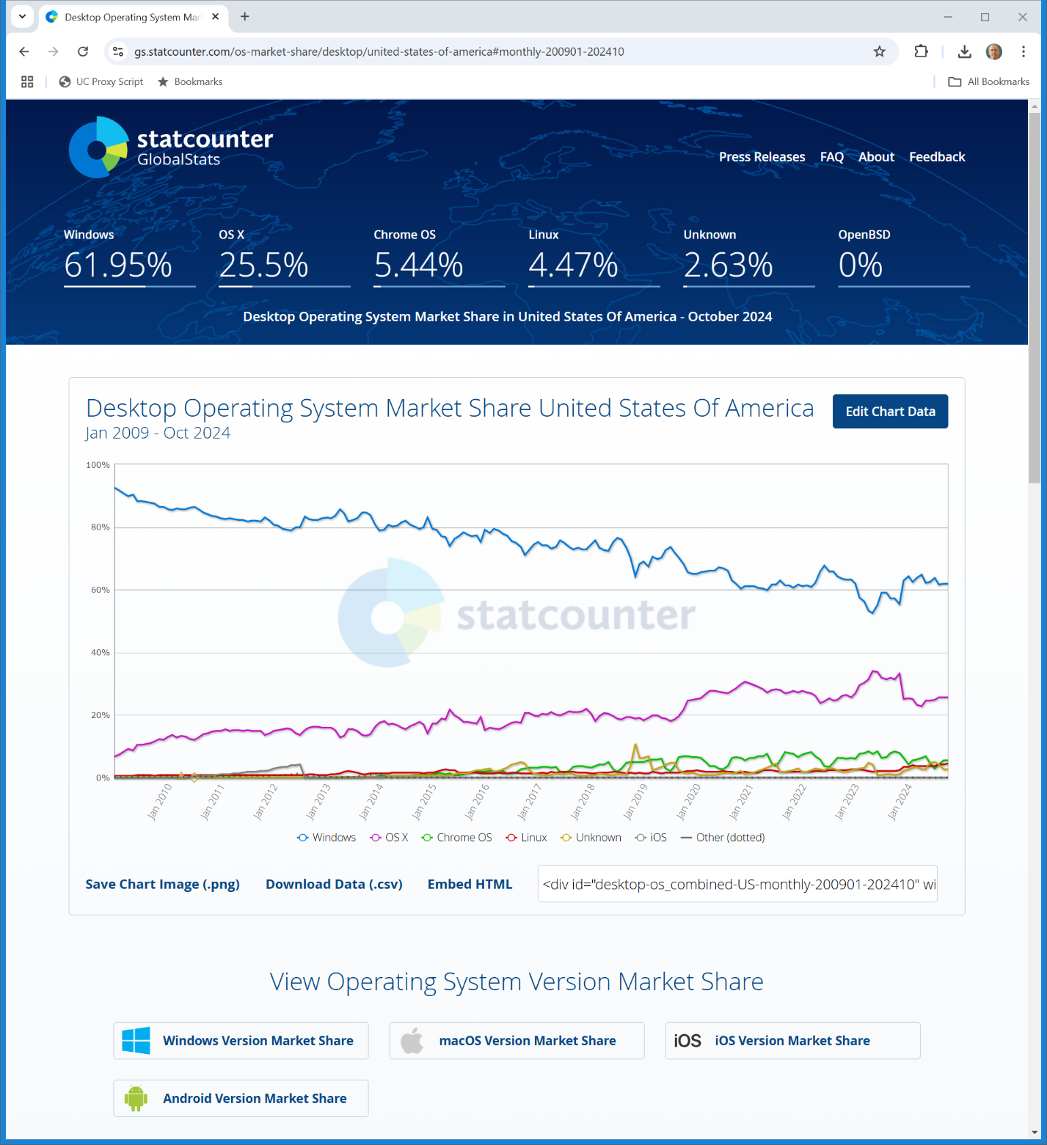

U.S. Desktop OS Market Shares
Jan 2009: W92.37/M6.73
statcounter (27 Nov 2024)
Notes:
https://gs.statcounter.com/os-market-share/desktop/united-states-of-america#monthly-200901-202410

Slide 120
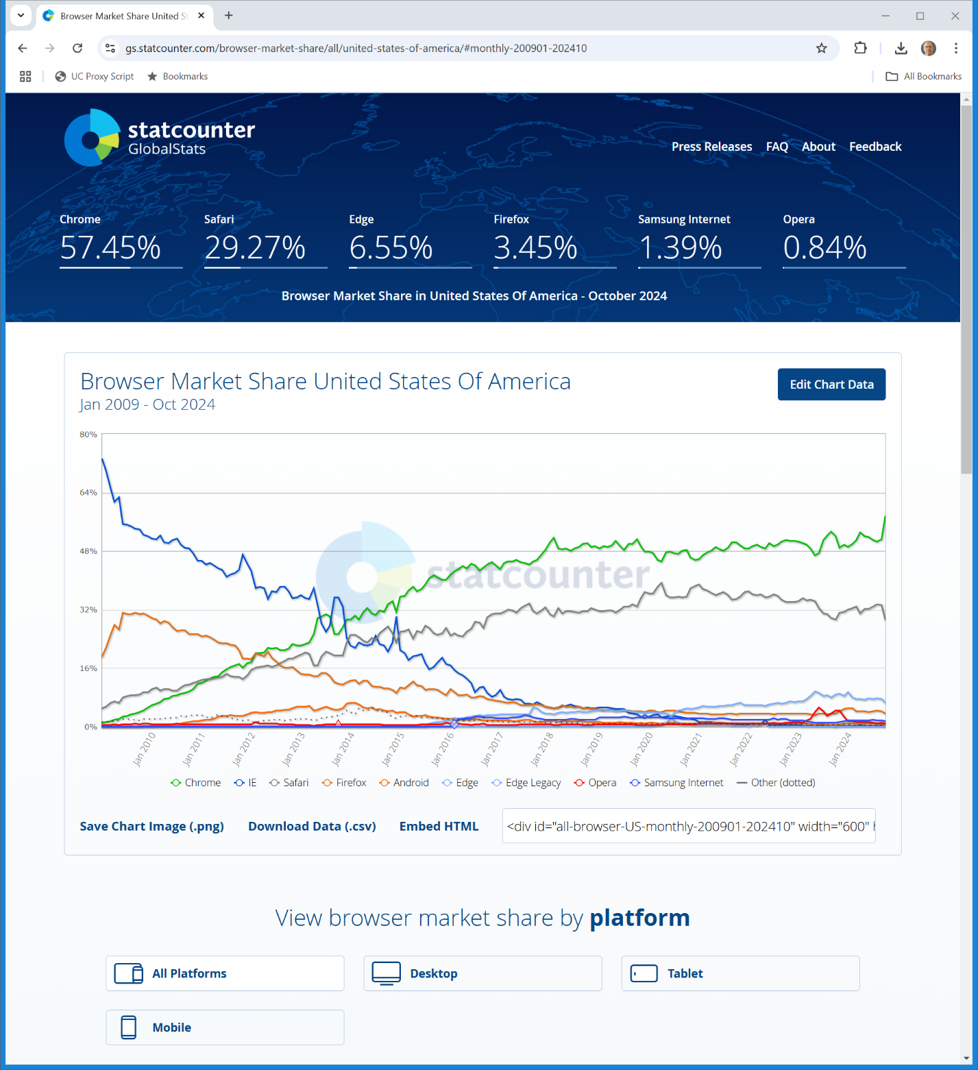
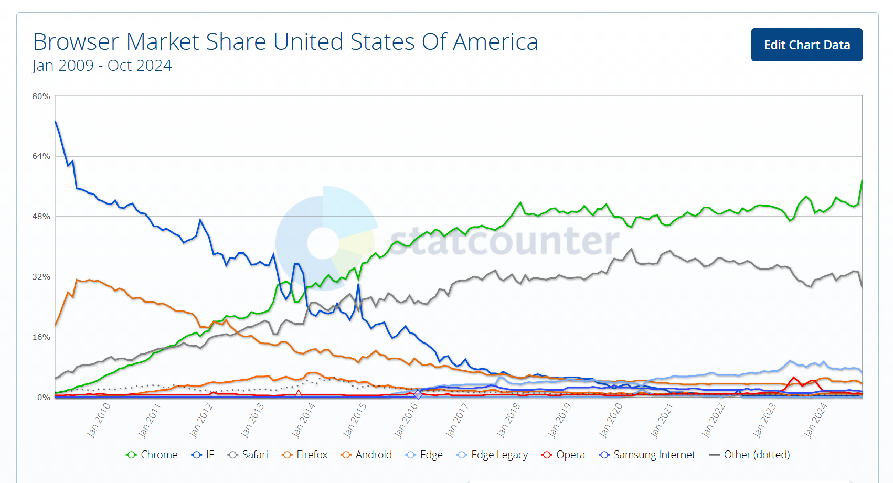
U.S. Browser Market Shares
Jan 2009: IE73.01/F19.25/S5.02
statcounter (27 Nov 2024)
Notes:
https://gs.statcounter.com/browser-market-share/all/united-states-of-america/#monthly-200901-202410

Slide 121
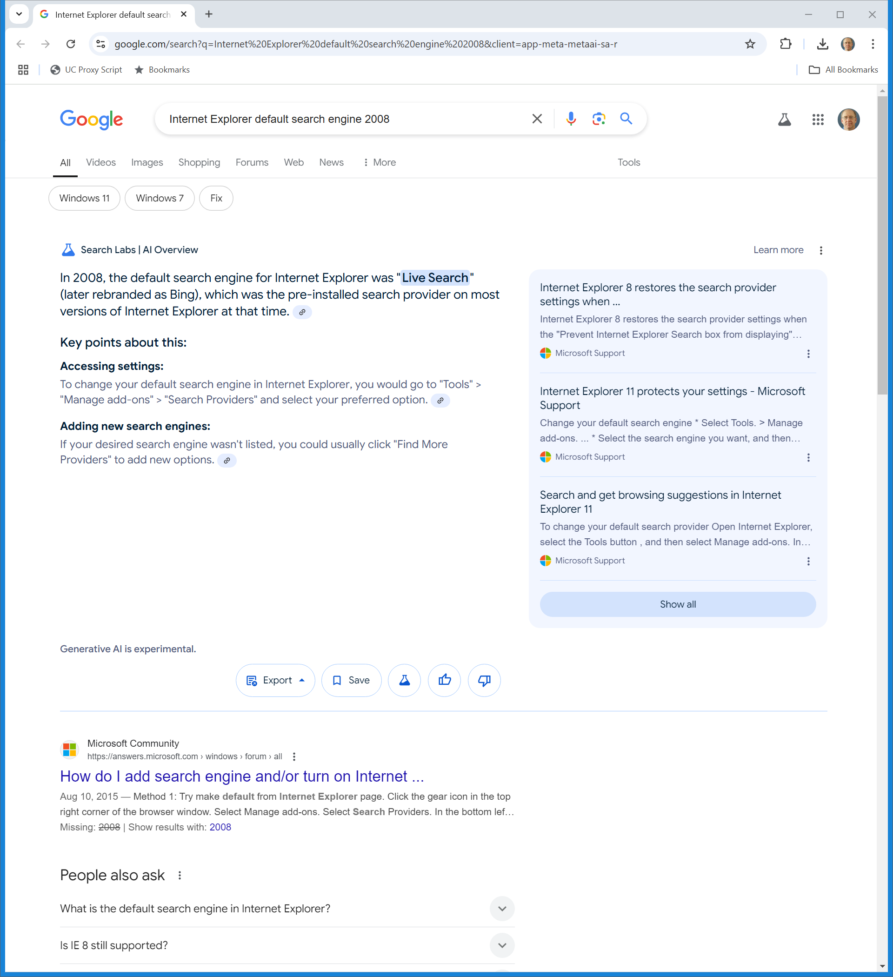
IE Default Search Engine in 2008?
Jan 2009: MS controls 92% of defaults? 73%?
Google (27 Nov 2024)
Notes:
https://www.google.com/search?q=Internet%20Explorer%20default%20search%20engine%202008&client=app-meta-metaai-sa-r

Slide 122
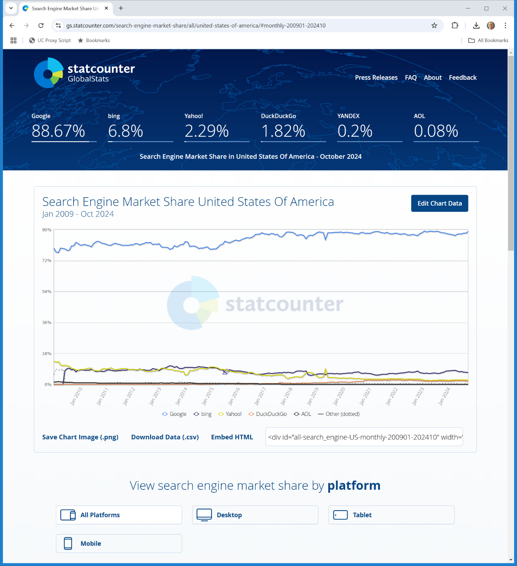
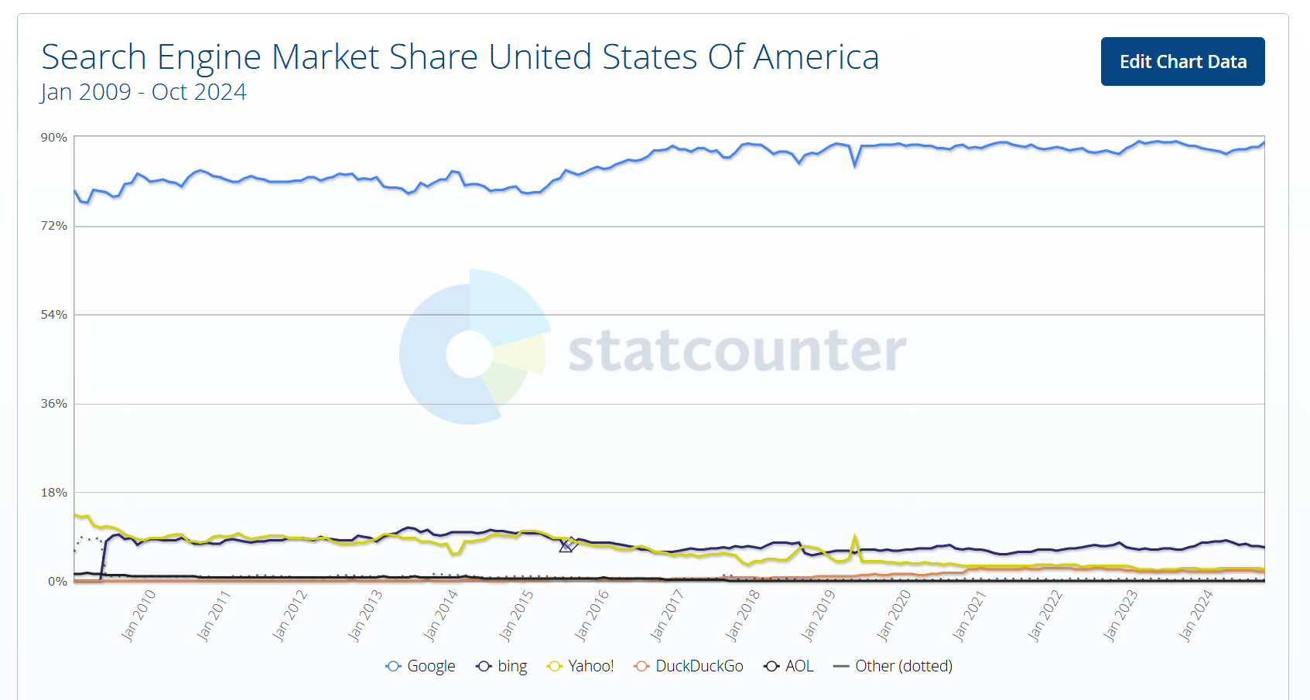
U.S. Search Engine Market Shares
Jun 2009: G78.67/Y10.98/B8.08
statcounter (27 Nov 2024)
Notes:
https://gs.statcounter.com/search-engine-market-share/all/united-states-of-america/#monthly-200901-202410

Slide 123
Looking to the Future
TTYN (1 of 4)
Hypo
From this baseline position, two events will occur
(1) Chrome will displace IE as the leading browser seemingly by building a better product
(2) Microsoft will achieve no meaningful position in smartphone operating systems while Apple and Google will rise to form a duopoly

Slide 124
Looking to the Future
TTYN (2 of 4)
Hypo
Google, via Chrome and Android, and Apple with its control of iOS and Safari, will have the same power over defaults that Microsoft had with Windows and IE when the personal computer was dominant

Slide 125
Looking to the Future
TTYN (3 of 4)
Questions
Does Google need to somehow not set Google as the default search engine in Chrome? What would it do in the alternative?
Google’s business model for Android is to give the software away for free but to charge in-kind by requiring the distribution of Chrome (and more) and by having rules regarding search defaults

Slide 126
Looking to the Future
TTYN (4 of 4)
Questions
Is Google allowed to do that?
What would legitimate competition look like between Bing and Google Search for distribution contracts with Apple, Verizon etc?
Given these two facts, what is your forecast as to Google’s market share in search in 2024 given the starting position in 2009? Lower? Higher?

Slide 127
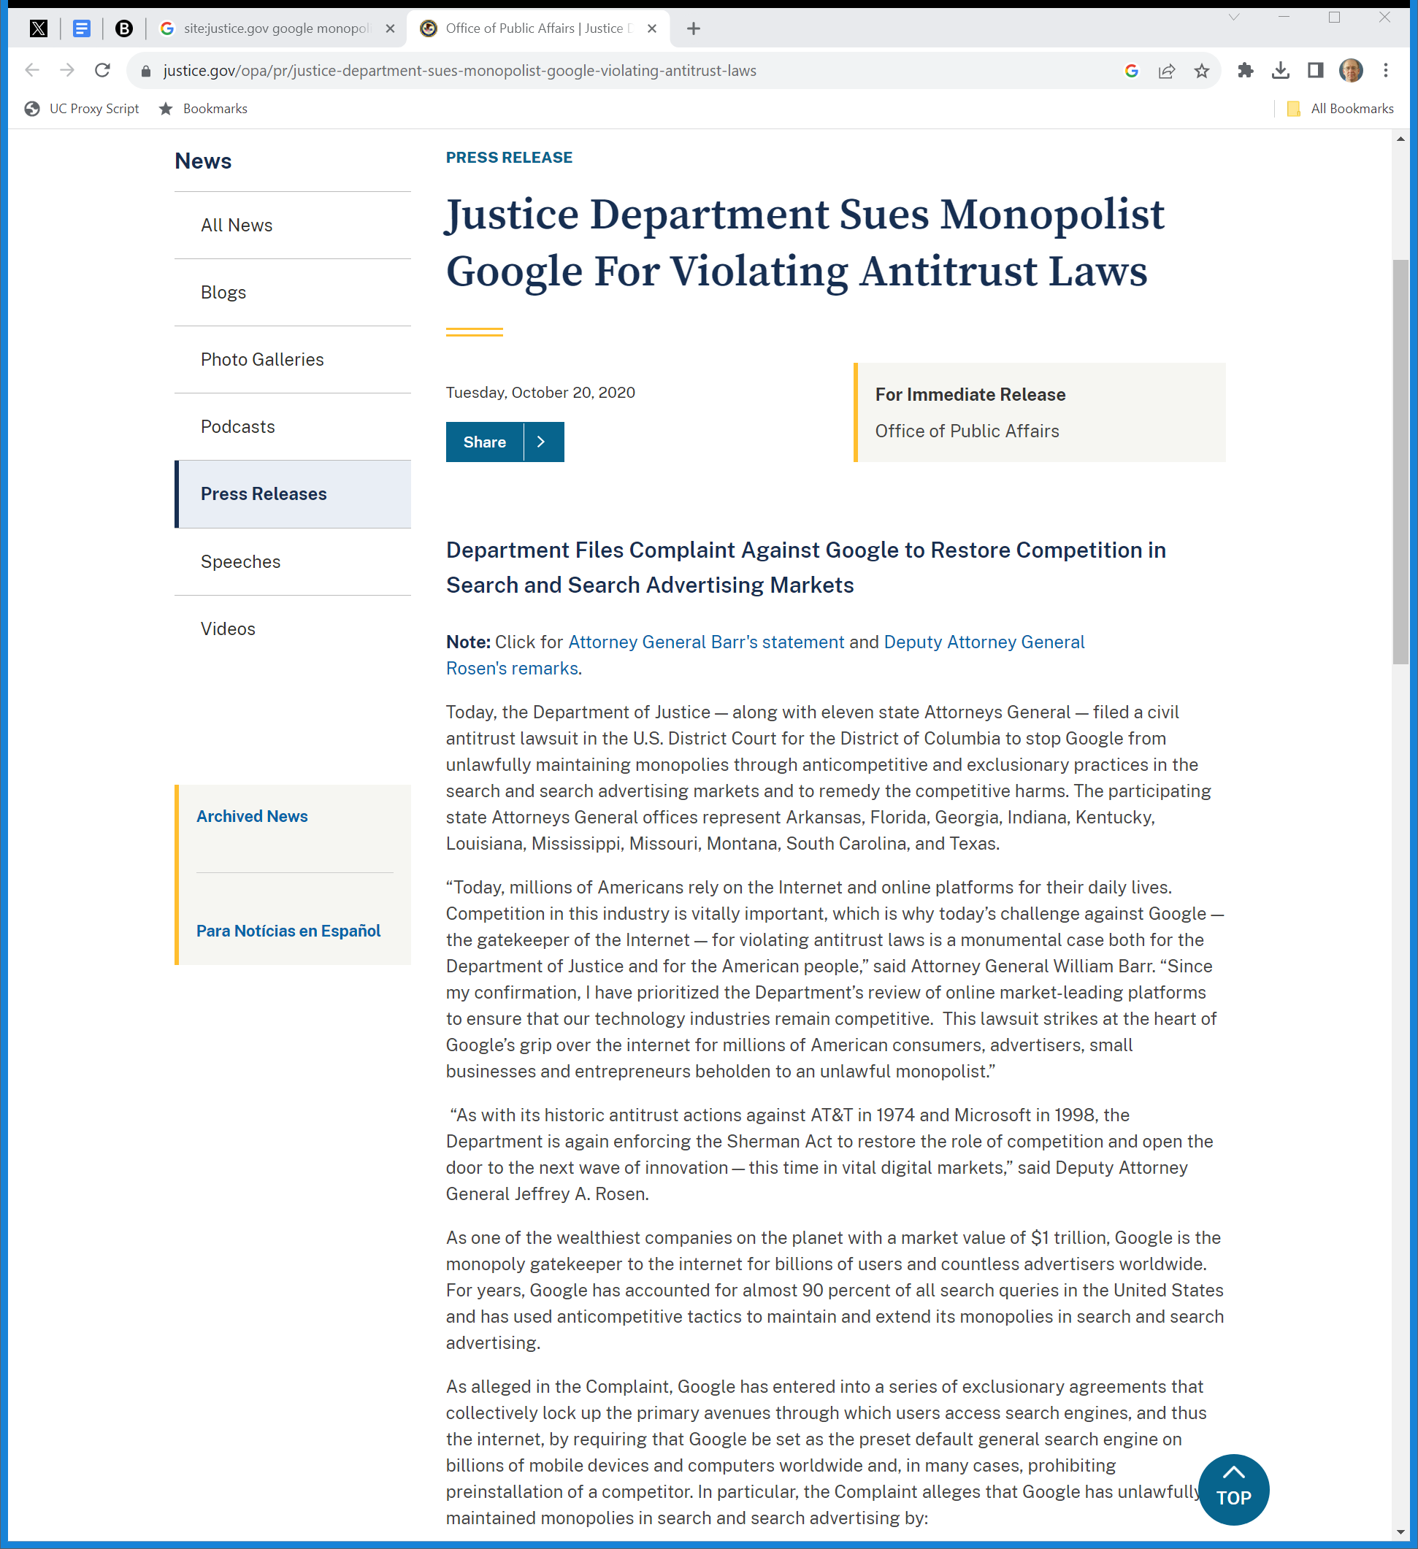
Oct 2020: DOJ Suit v Google
DOJ (20 Oct 2020)
Notes:
https://www.justice.gov/opa/pr/justice-department-sues-monopolist-google-violating-antitrust-laws

Slide 128
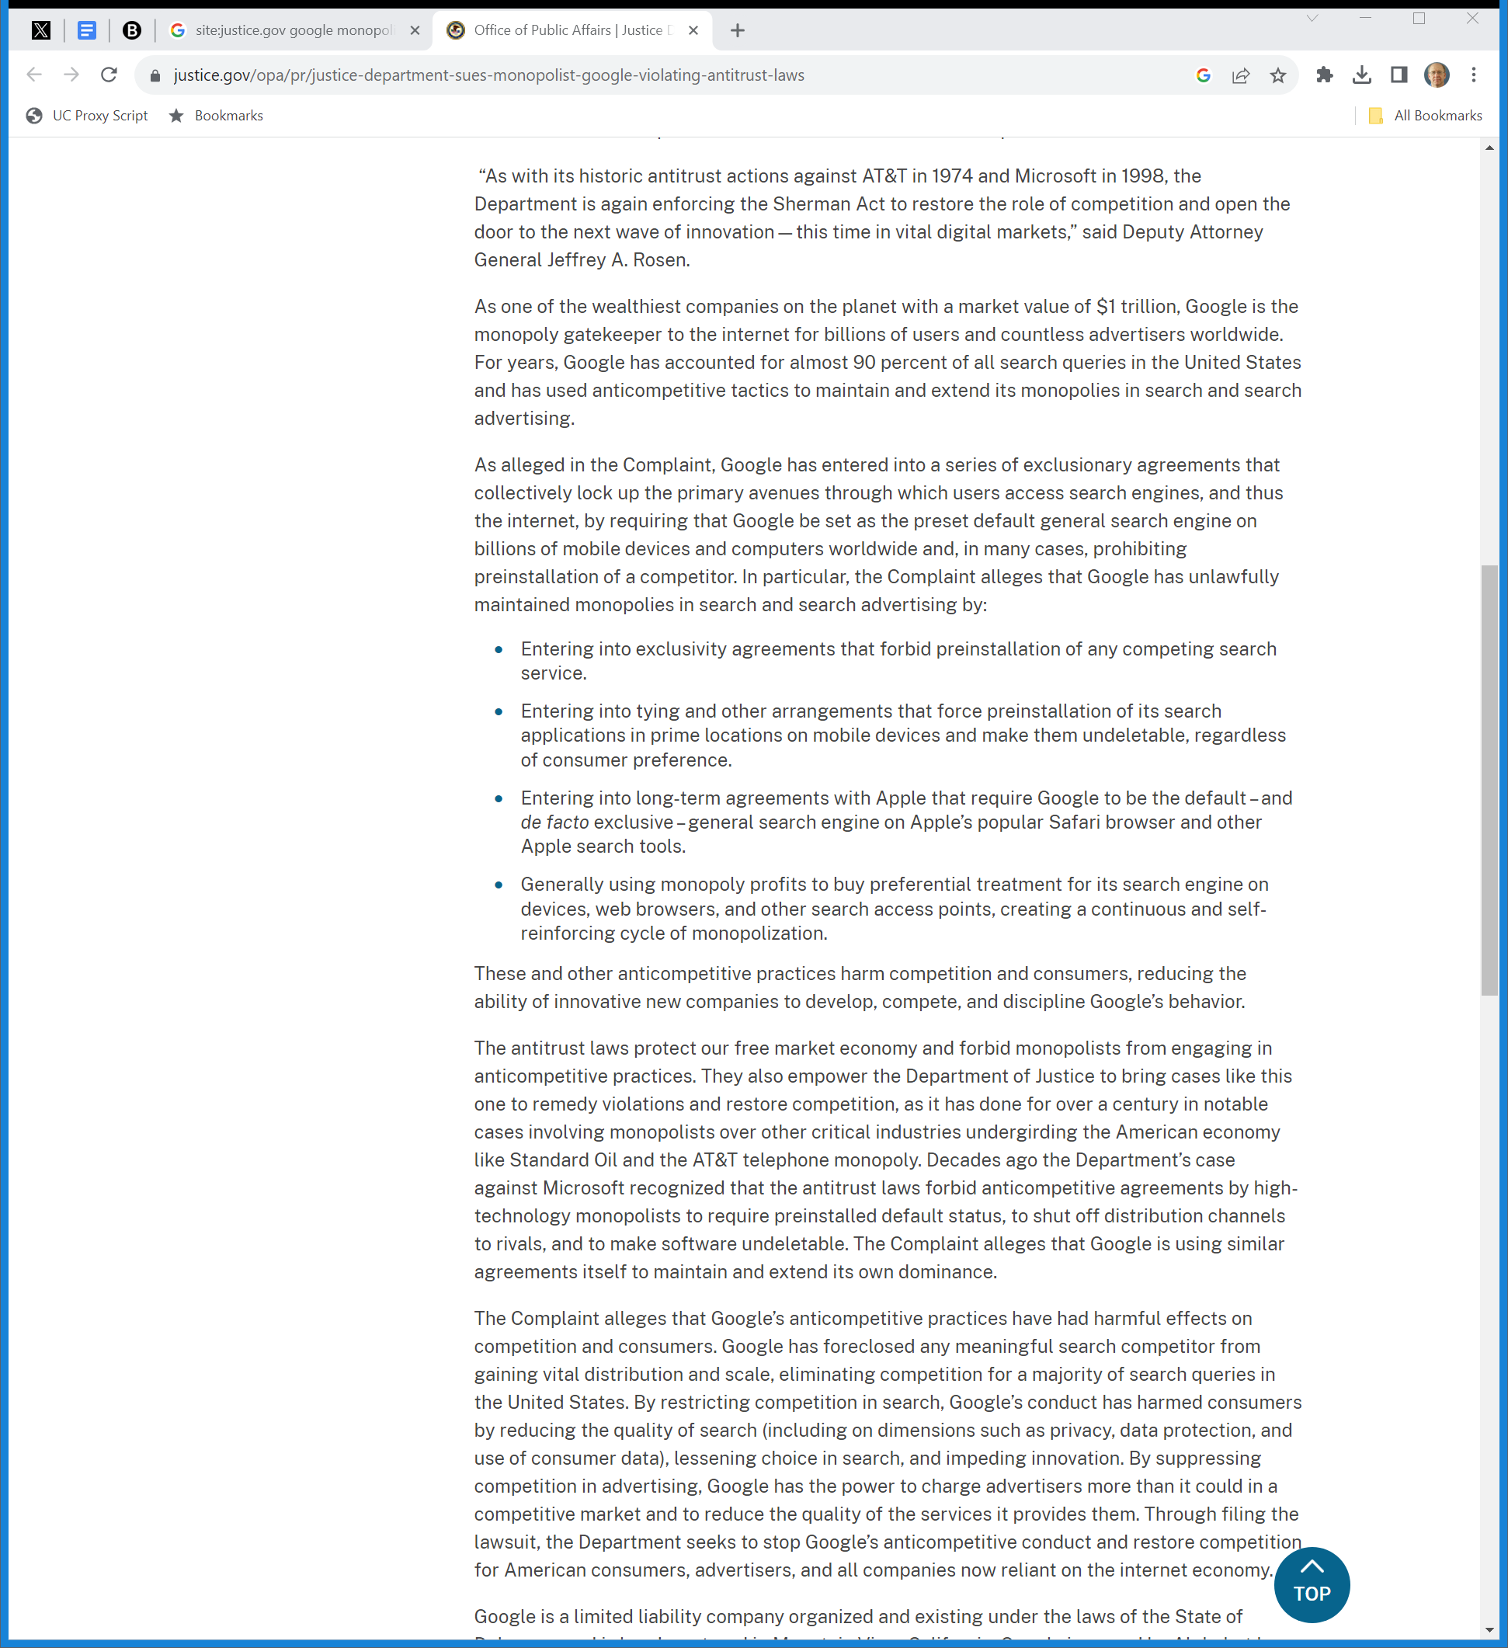
Exclusivity; Preinstallation: Defaults
DOJ (20 Oct 2020)

Slide 129
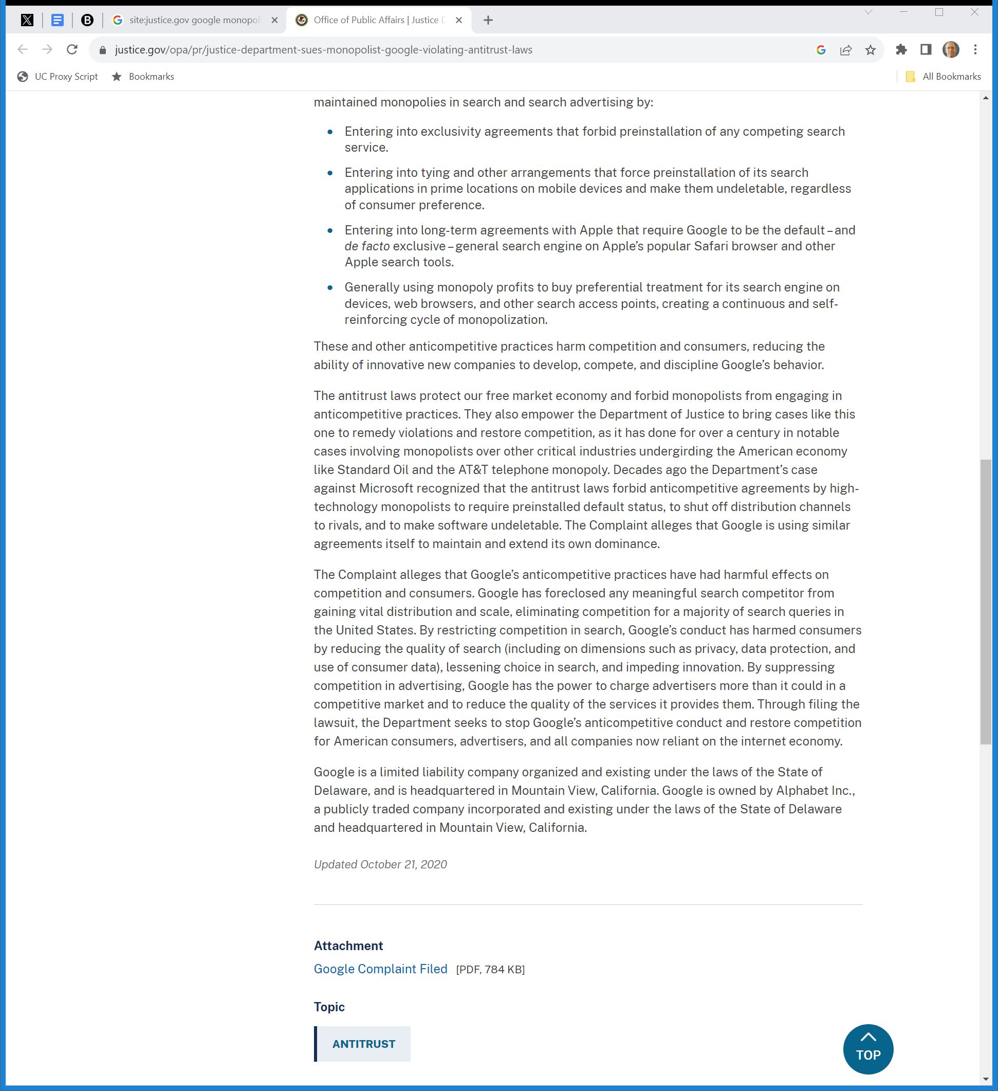
Foreclosed Search Competition
DOJ (20 Oct 2020)

Slide 130
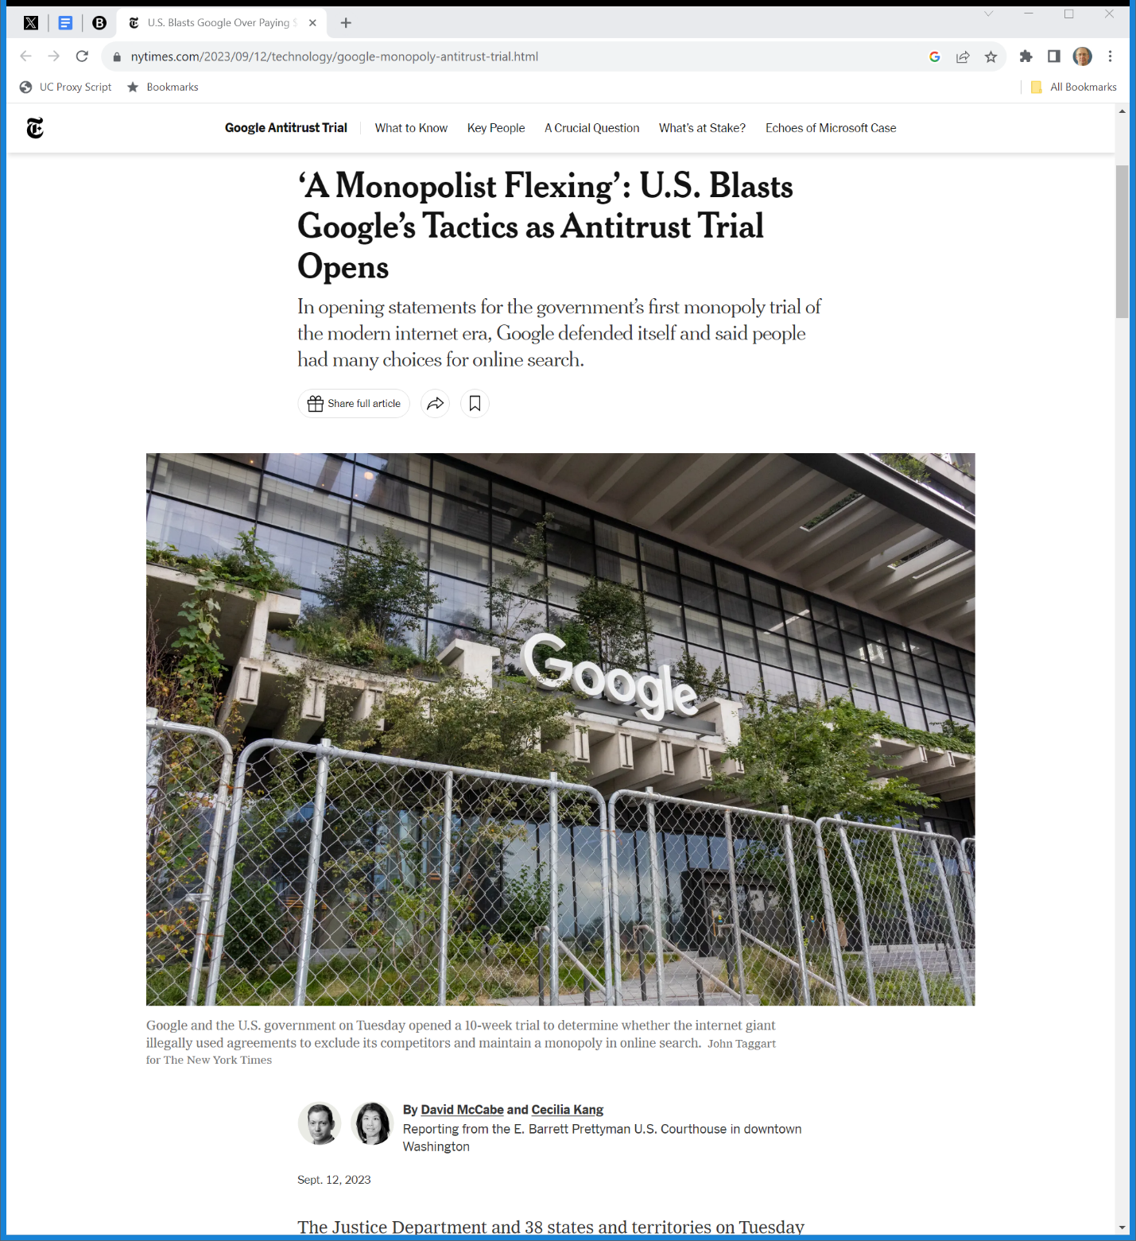
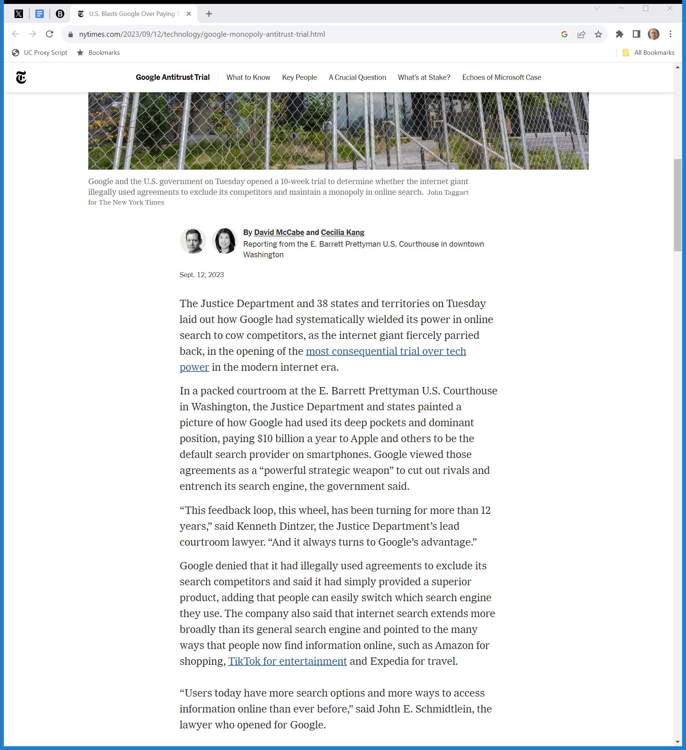
12 Sept 2023: Trial Starts
NYT (12 Sept 2023)
Notes:
https://www.nytimes.com/2023/09/12/technology/google-monopoly-antitrust-trial.html

Slide 131
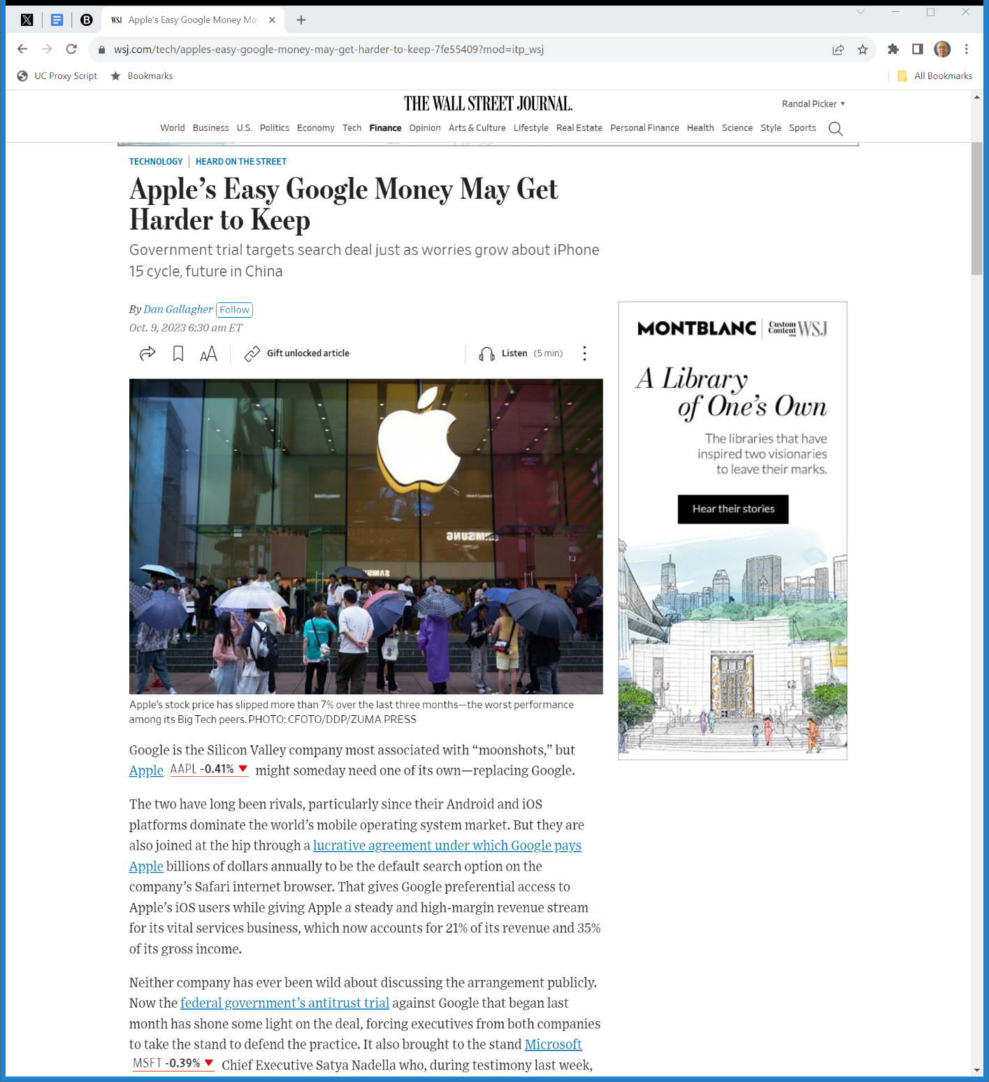
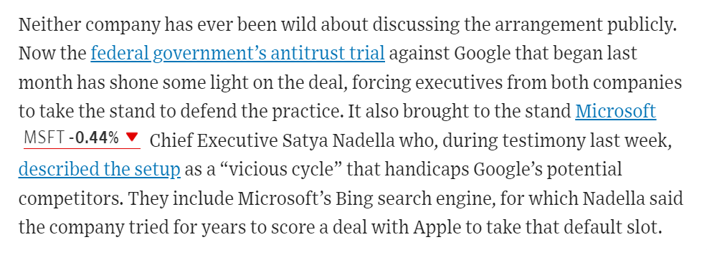
Vicious Cycle?
WSJ (10 Oct 2023)
Notes:
https://www.wsj.com/tech/apples-easy-google-money-may-get-harder-to-keep-7fe55409?mod=itp_wsj

Slide 132
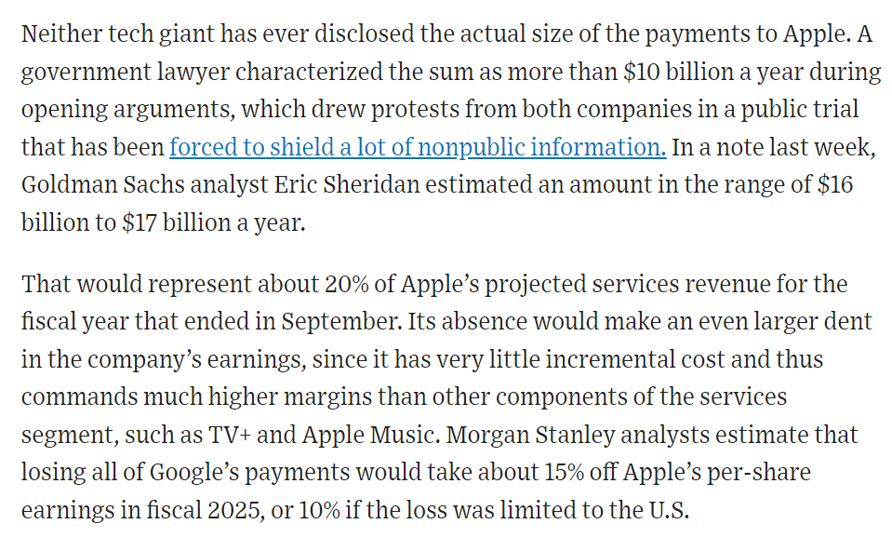
How Much Money?
WSJ (10 Oct 2023)
Notes:
https://www.wsj.com/tech/apples-easy-google-money-may-get-harder-to-keep-7fe55409?mod=itp_wsj

Slide 133
Liability Phase
U.S. v. Google (D.D.C. Aug 5, 2024)

Slide 134
Result?
U.S. v. Google (D.D.C. Aug 5, 2024)

Slide 135
Result?
U.S. v. Google (D.D.C. Aug 5, 2024)

Slide 136
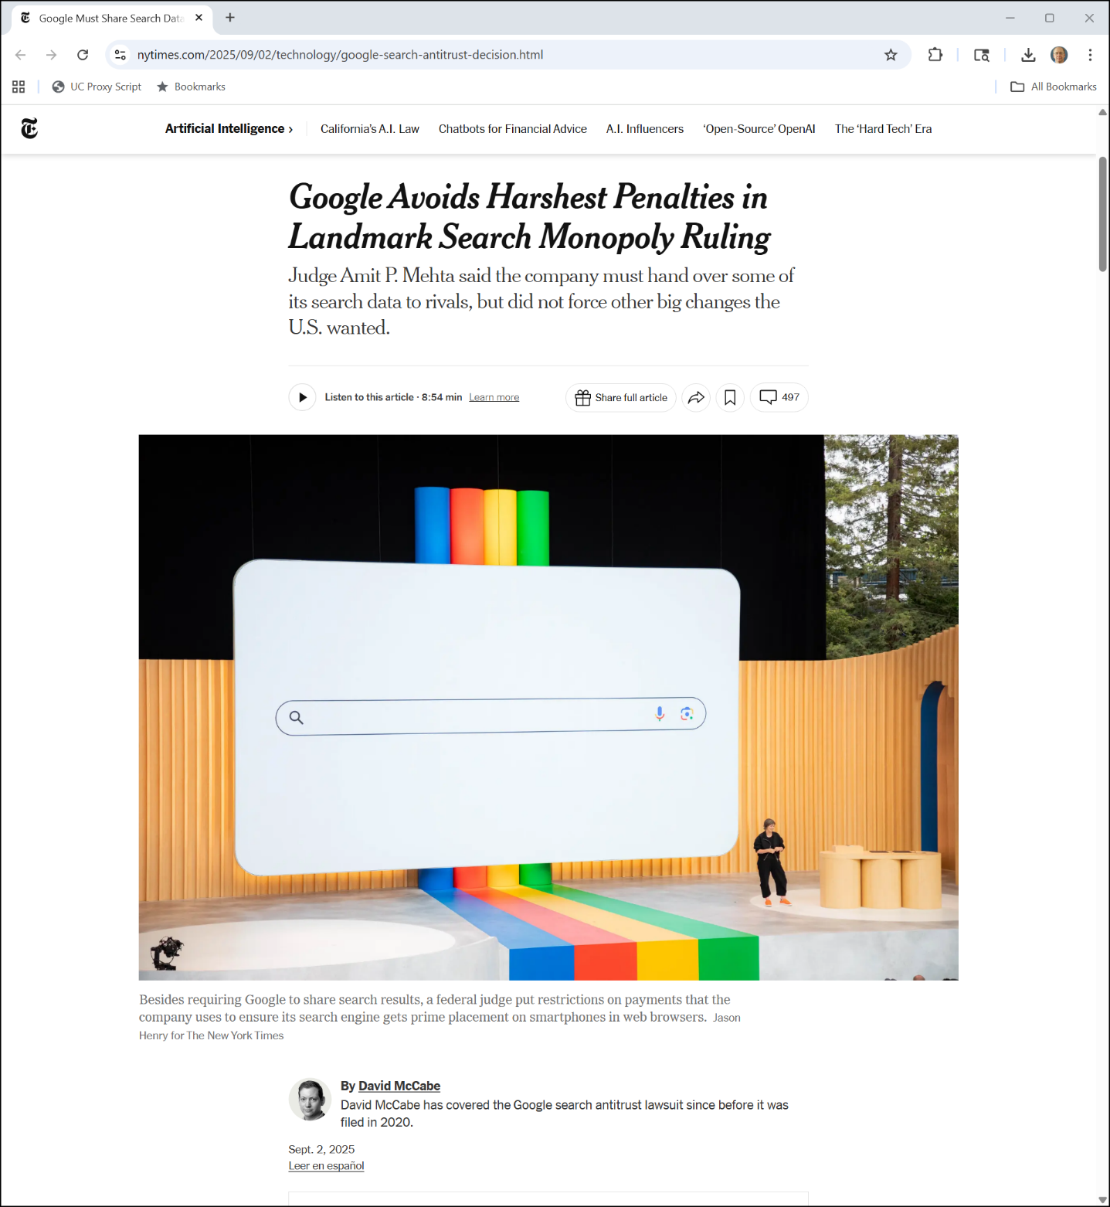
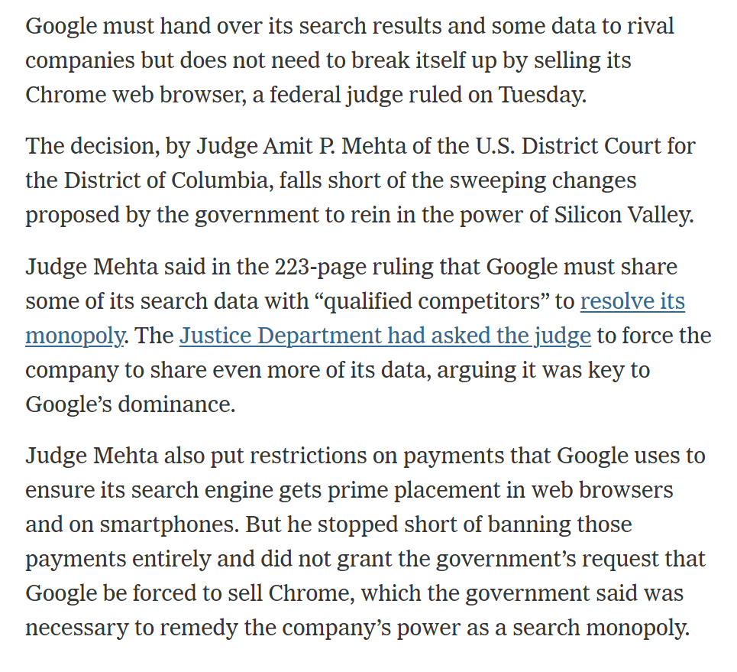
Search Remedies Opinion
NYT (2 Sept 2025)
Notes:
https://www.nytimes.com/2025/09/02/technology/google-search-antitrust-decision.html

Slide 137
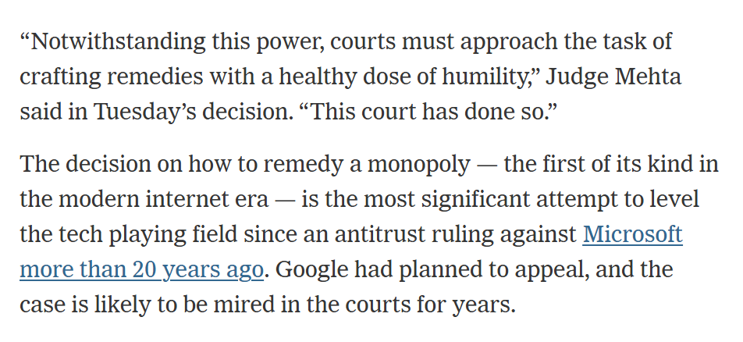
Search Remedies Opinion
NYT (2 Sept 2025)
Notes:
https://www.nytimes.com/2025/09/02/technology/google-search-antitrust-decision.html

Slide 138
Jan 2023 Case
U.S. v. Google

Slide 139
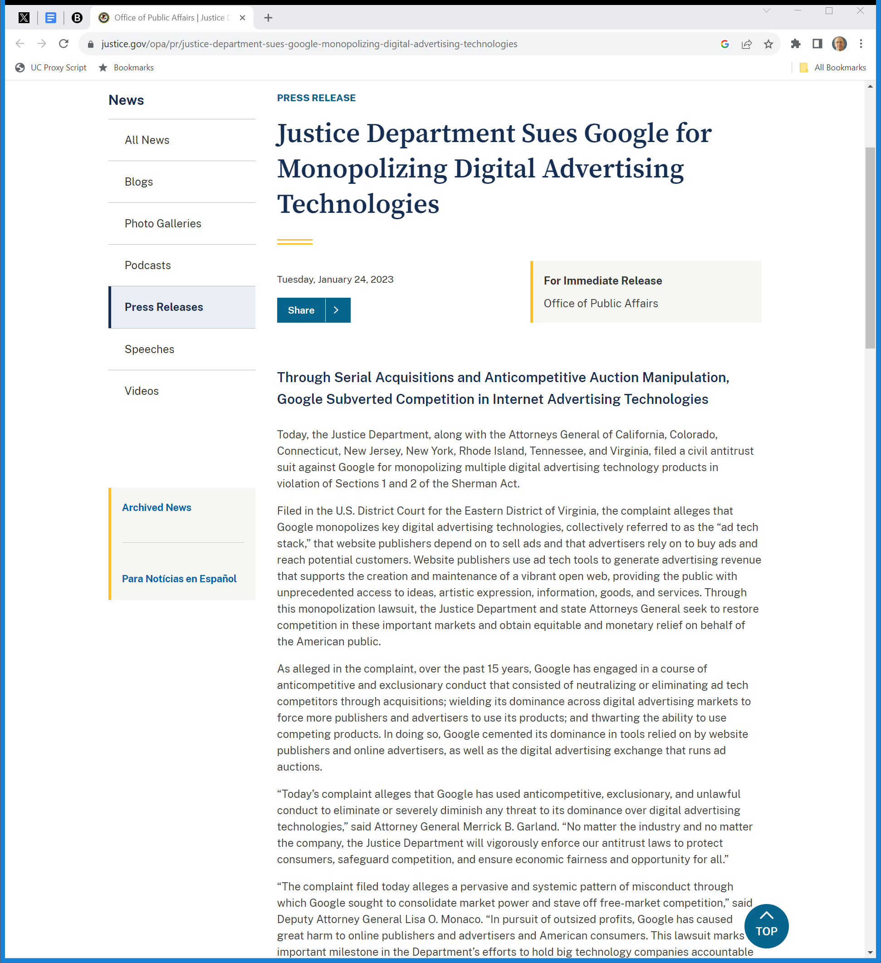
DOJ Ad Tech Case
DOJ (24 Jan 2023)
Notes:
https://www.justice.gov/opa/pr/justice-department-sues-google-monopolizing-digital-advertising-technologies

Slide 140
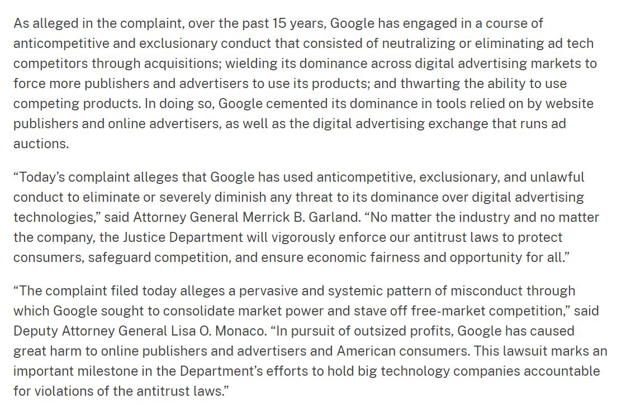
DOJ Ad Tech Case
DOJ (24 Jan 2023)
Notes:
https://www.justice.gov/opa/pr/justice-department-sues-google-monopolizing-digital-advertising-technologies

Slide 141
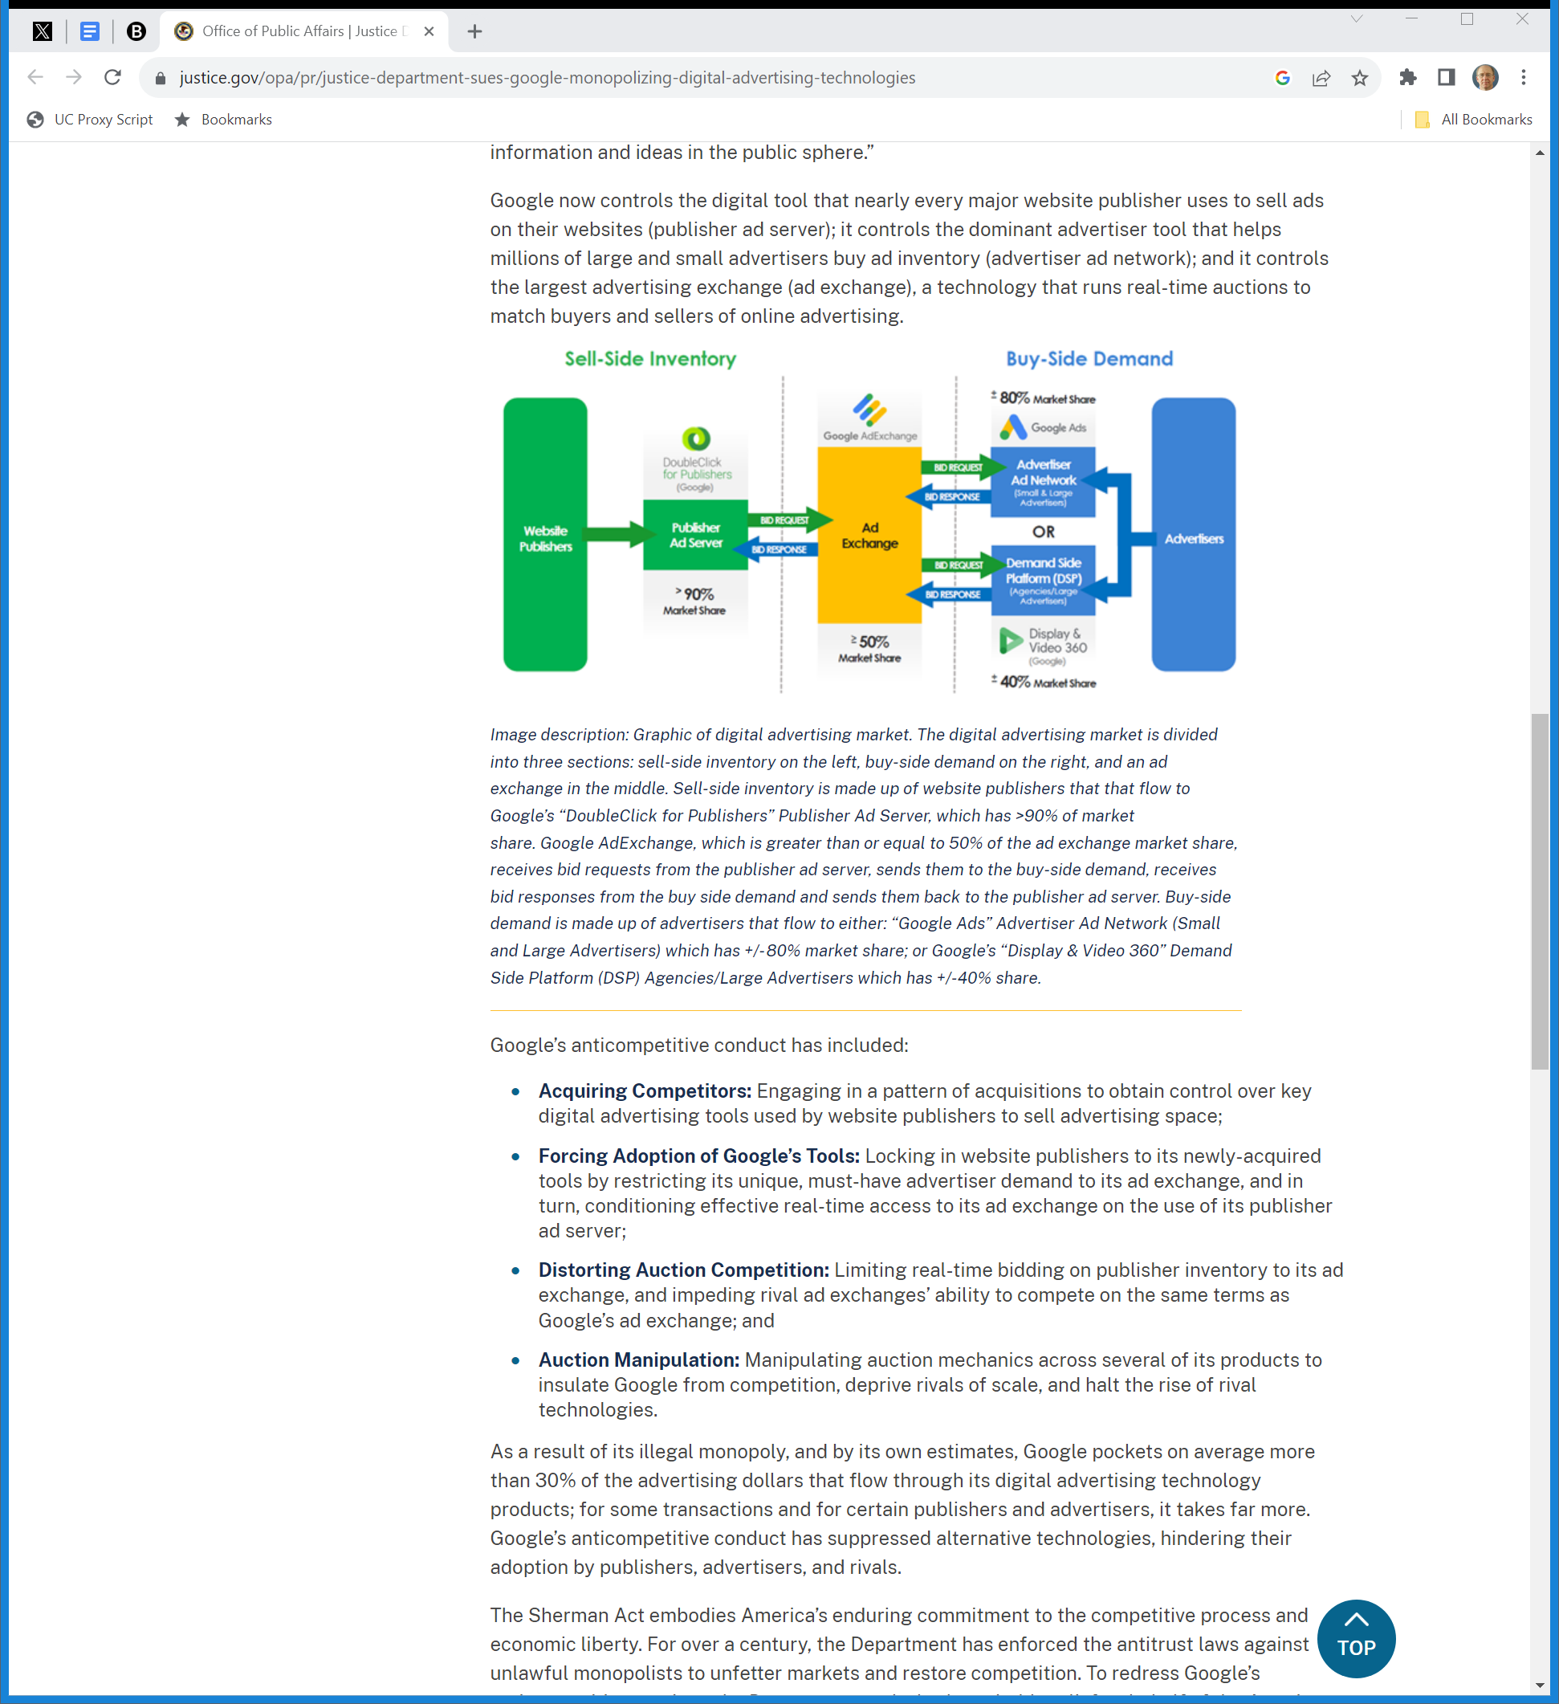
The Ad Tech Stack
DOJ (24 Jan 2023)
Notes:
https://www.justice.gov/opa/pr/justice-department-sues-google-monopolizing-digital-advertising-technologies

Slide 142
Harmful Conduct
DOJ (24 Jan 2023)
Notes:
https://www.justice.gov/opa/pr/justice-department-sues-google-monopolizing-digital-advertising-technologies

Slide 143


April 2025 Liability Finding
NYT (17 Apr 2025)
Notes:
https://www.nytimes.com/2025/04/17/technology/google-ad-tech-antitrust-ruling.html

Slide 144


Remedy Phase
NYT (6 Oct 2025)
Notes:
https://www.nytimes.com/2025/10/06/technology/google-ad-tech-arguments.html

