Slide 1
Class 1: W10/1/2024; S10/4/2024 Booth 42201: The Legal Infrastructure of Business Controlling Information: Property and Contracts
Randal C. Picker
James Parker Hall Distinguished Service Professor of Law
The Law School
The University of Chicago
Copyright © 2001-25 Randal C. Picker. All Rights Reserved.

Slide 2
Class Mechanics
Class Organization

Slide 3
Class Organization
Syllabus
http://picker.uchicago.edu/GSBOnline/GSBSyllOnline.htm
Blogs
Wed: Blog
Sat: Blog

Slide 4
Class Organization
Blog Slot Sign Ups
Wed
Sat

Slide 5
Class Organization
Don’t Have Blog Access?
Login to voices.uchicago.edu with your CNetID
Email me your CNetID (not the password) and which section you are in
I should be able to fix it

Slide 6
Background to the U.S. Constitution
Getting to the U.S. Constitution

Slide 7
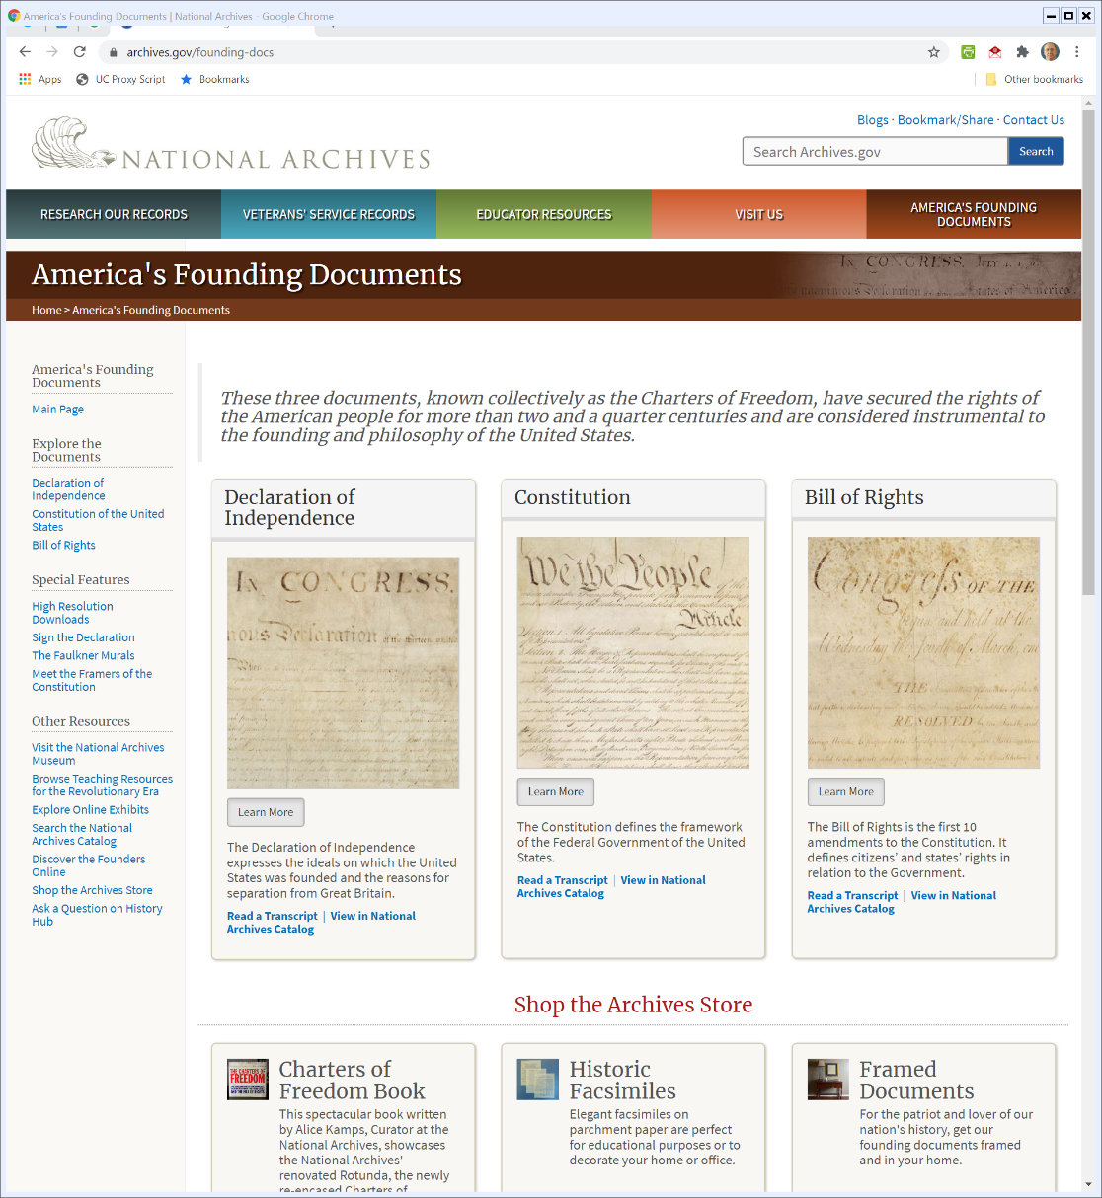

Founding Documents
Archives.gov
Notes:
https://www.archives.gov/founding-docs

Slide 8
4 July 1776: Declaration of Independence
Archives.gov

Slide 9
1823 Stone Engraving
Archives.gov

Slide 10
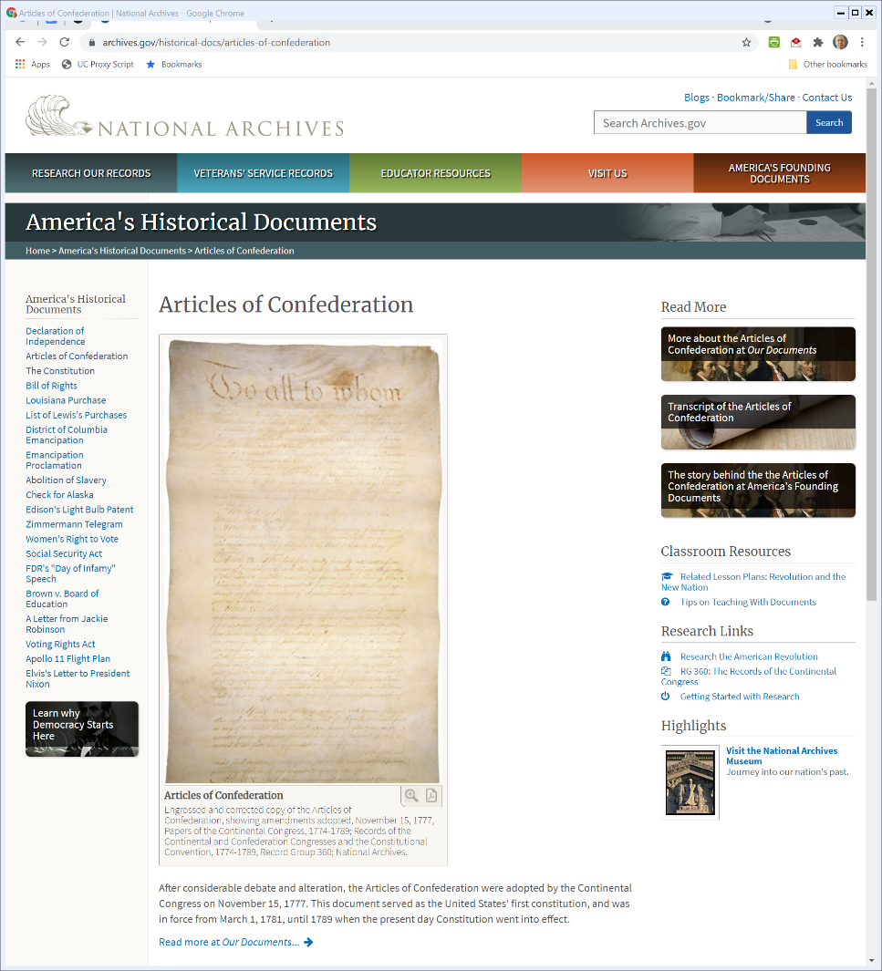

Articles of Confederation: United States 1.0
Archives.gov

Slide 11
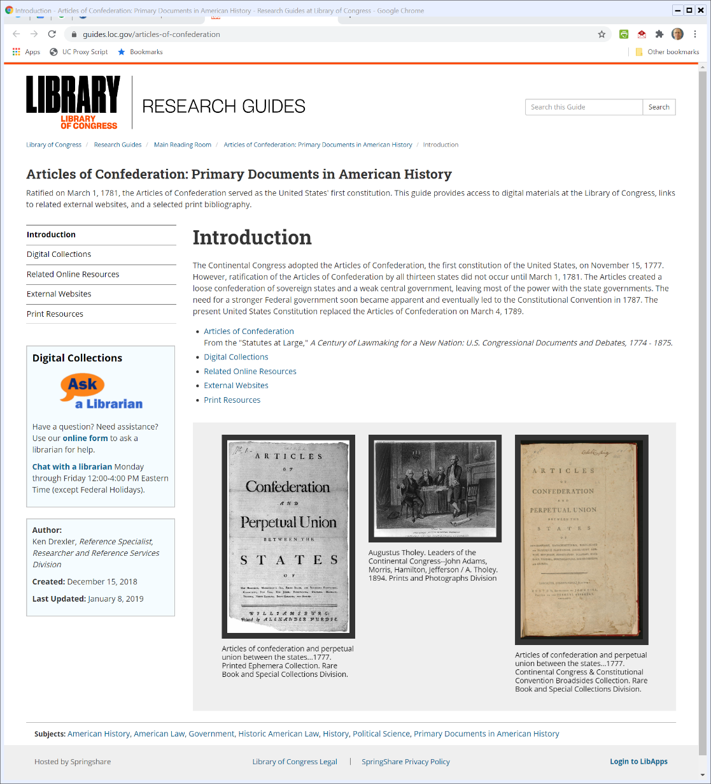
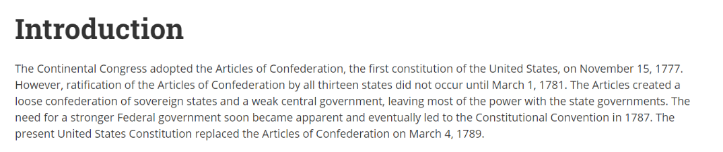
Problems with the Articles of Confederation
Library of Congress

Slide 12
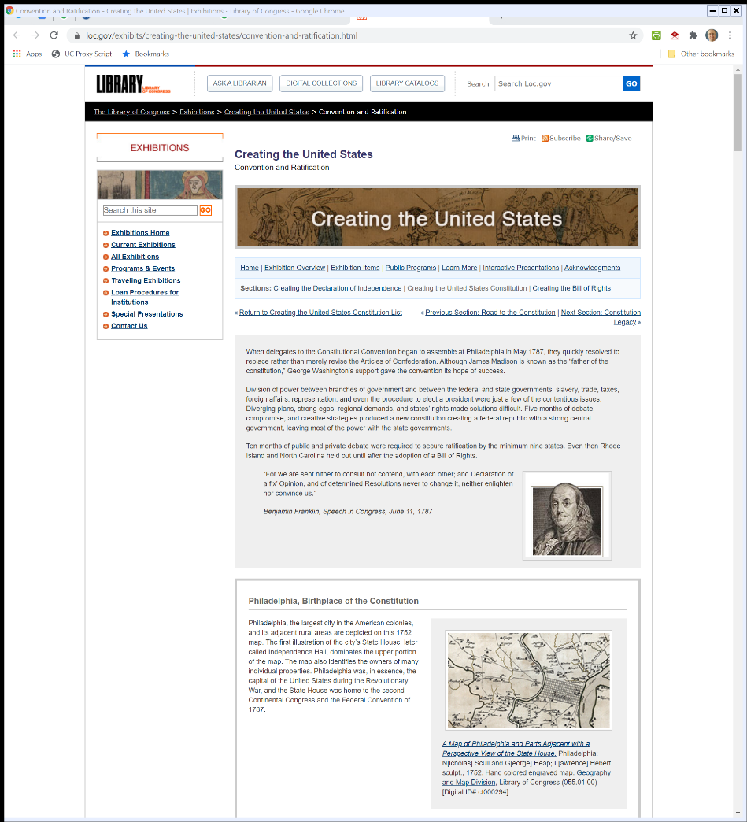
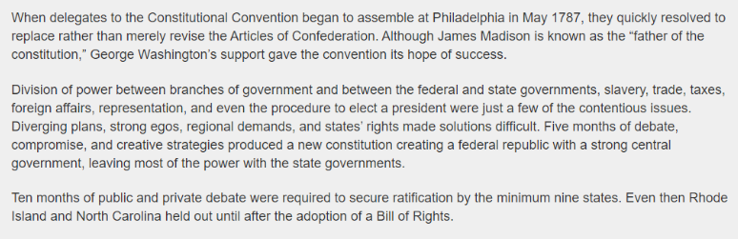
5 May 1787 to 17 Sept 1787: The Constitutional Convention
Library of Congress
Notes:
https://www.loc.gov/exhibits/creating-the-united-states/convention-and-ratification.html

Slide 13
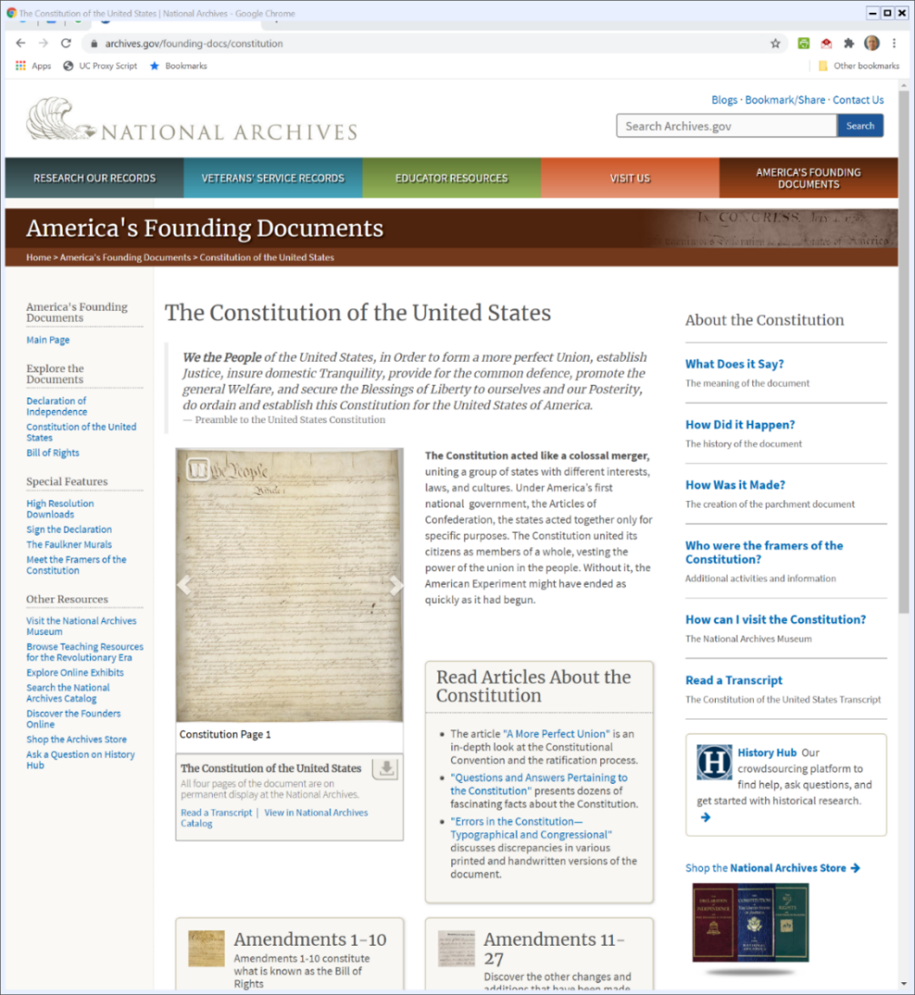

21 June 1788: U.S. Constitution Ratified
Archives.gov
Notes:
https://www.archives.gov/founding-docs/constitution

Slide 14
U.S. Constitution at The National Archive
Archives.gov
Notes:
https://www.archives.gov/founding-docs/constitution

Slide 15
U.S. Constitution at The National Archive
Archives.gov
Notes:
https://www.archives.gov/founding-docs/constitution

Slide 16
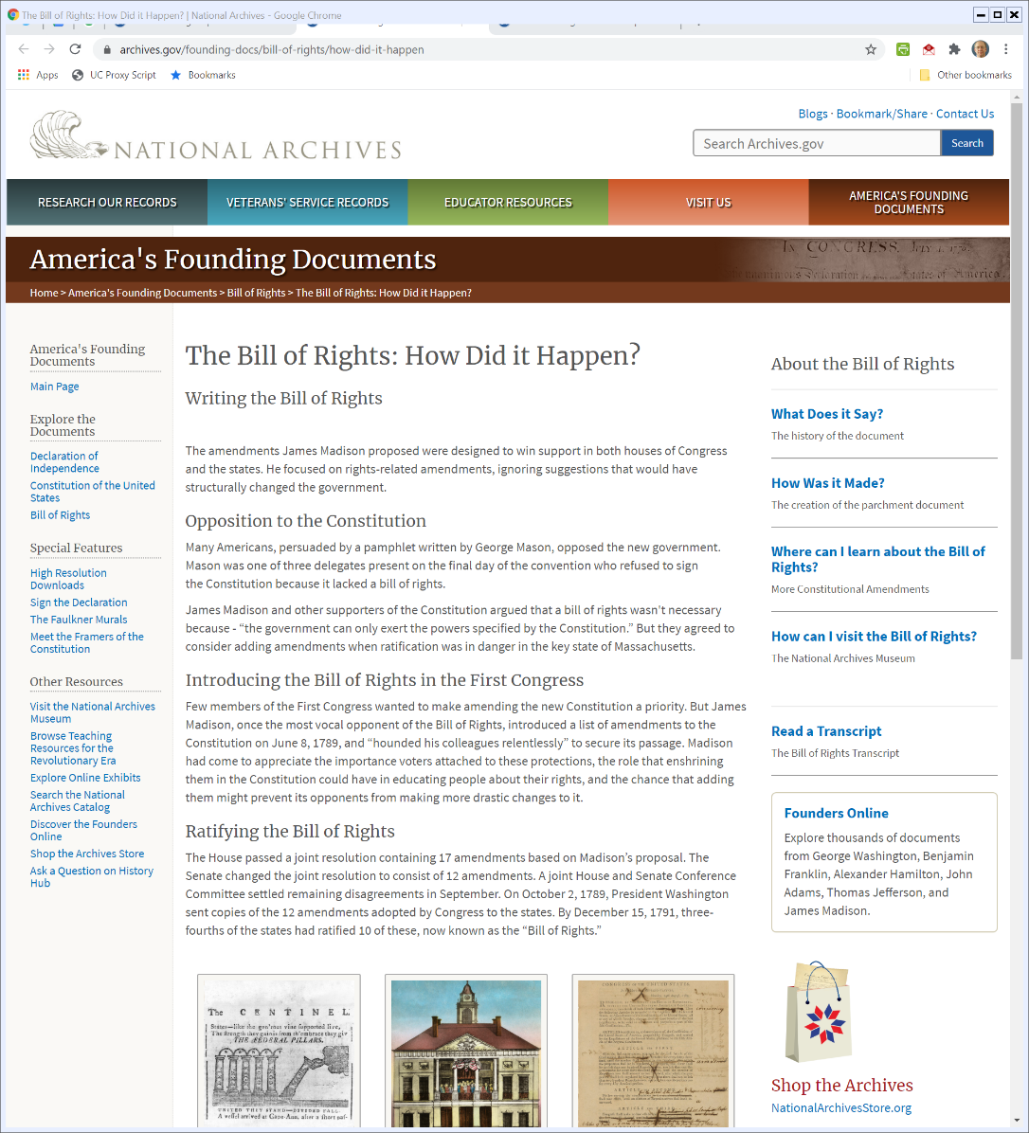

15 Dec 1791: Bill of Rights Ratified
Archives.gov

Slide 17
The Bill of Rights
Archives.gov
Notes:
https://www.archives.gov/founding-docs/constitution

Slide 18
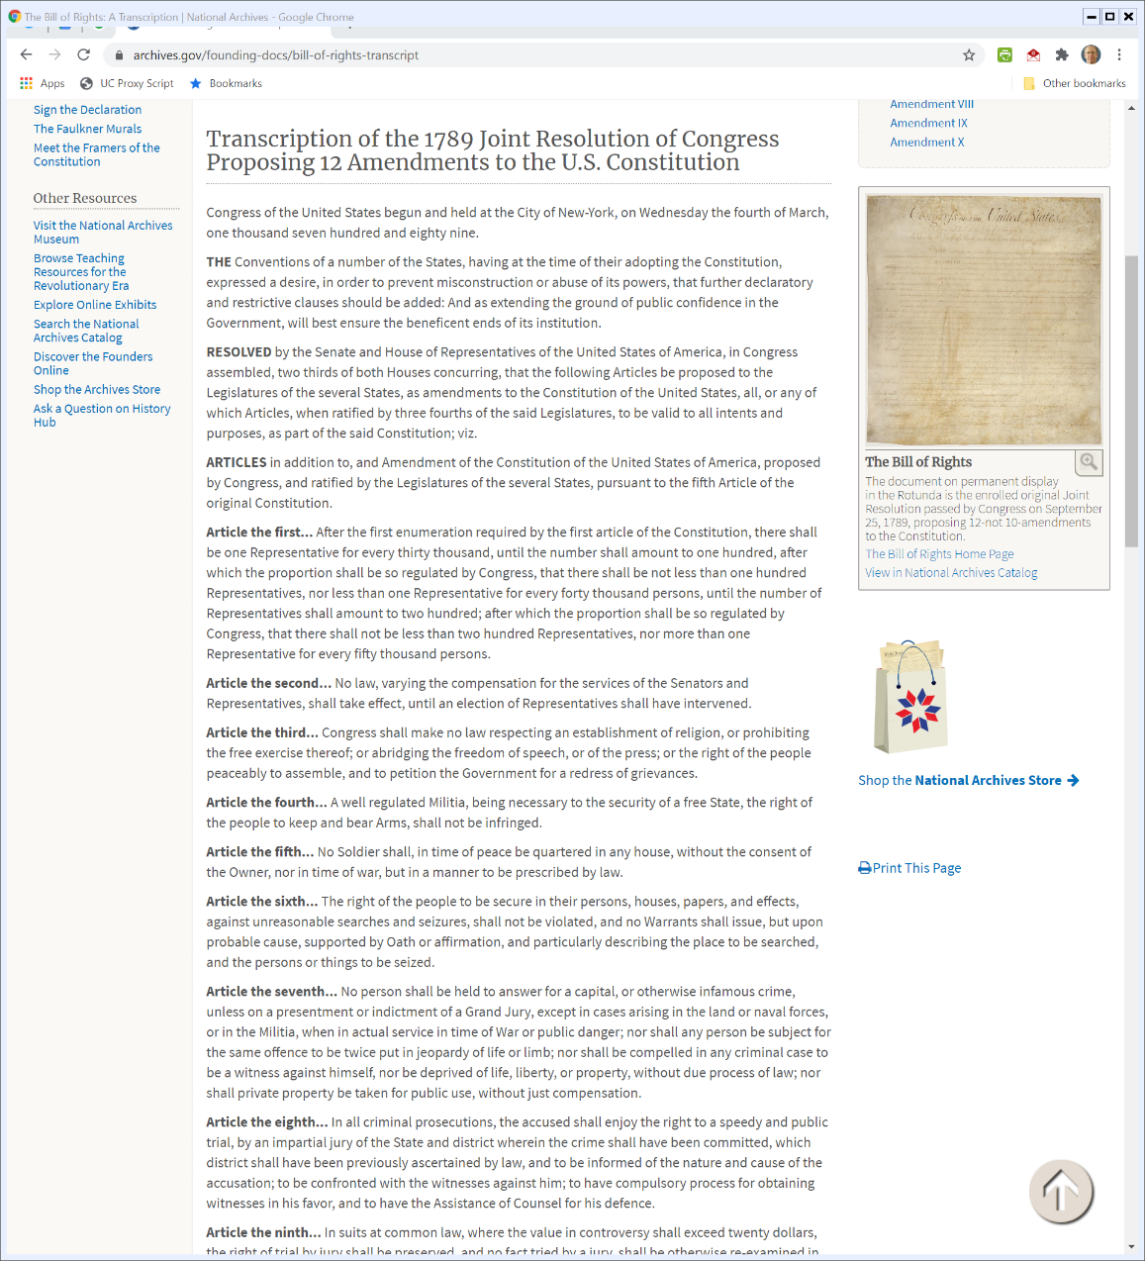

Transcription of Original Bill of Rights
Archives.gov

Slide 19

Transcription of Original Bill of Rights
Archives.gov

Slide 20
Reading the Constitution
What Does the U.S. Constitution Say?

Slide 21
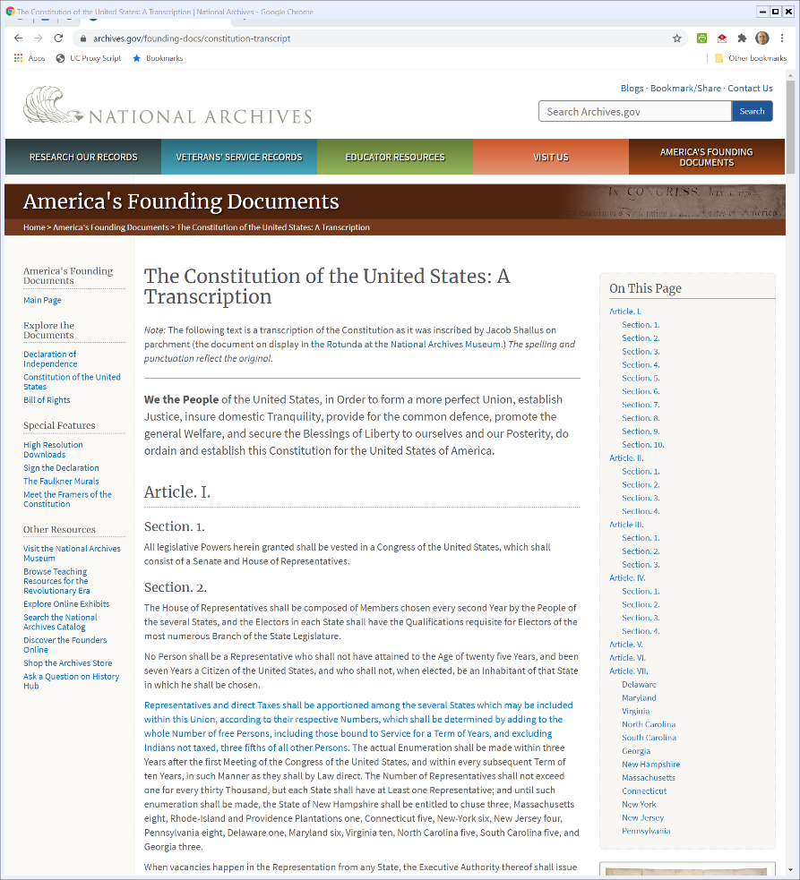
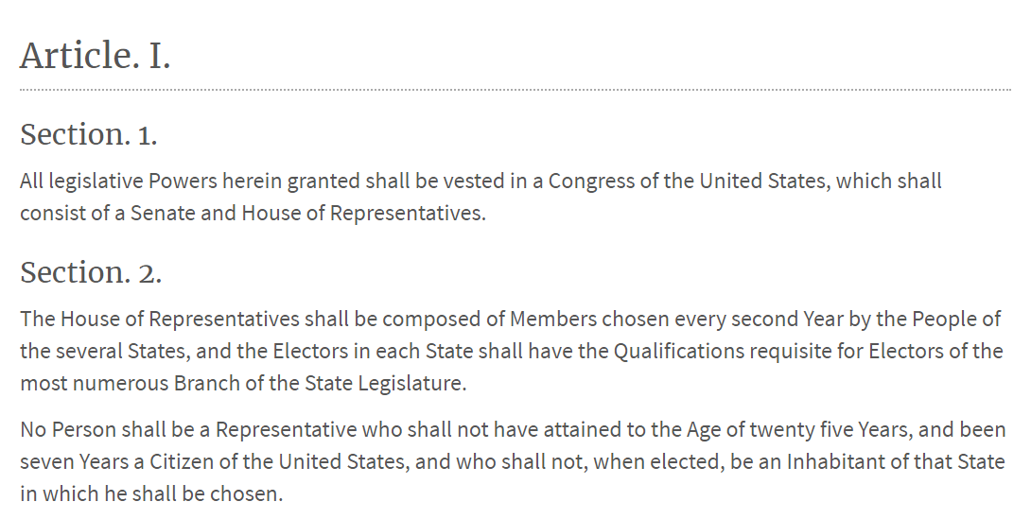
Art I, Sec 1/2: Legislative Powers; House Terms
U.S. Constitution (As Enacted)

Slide 22
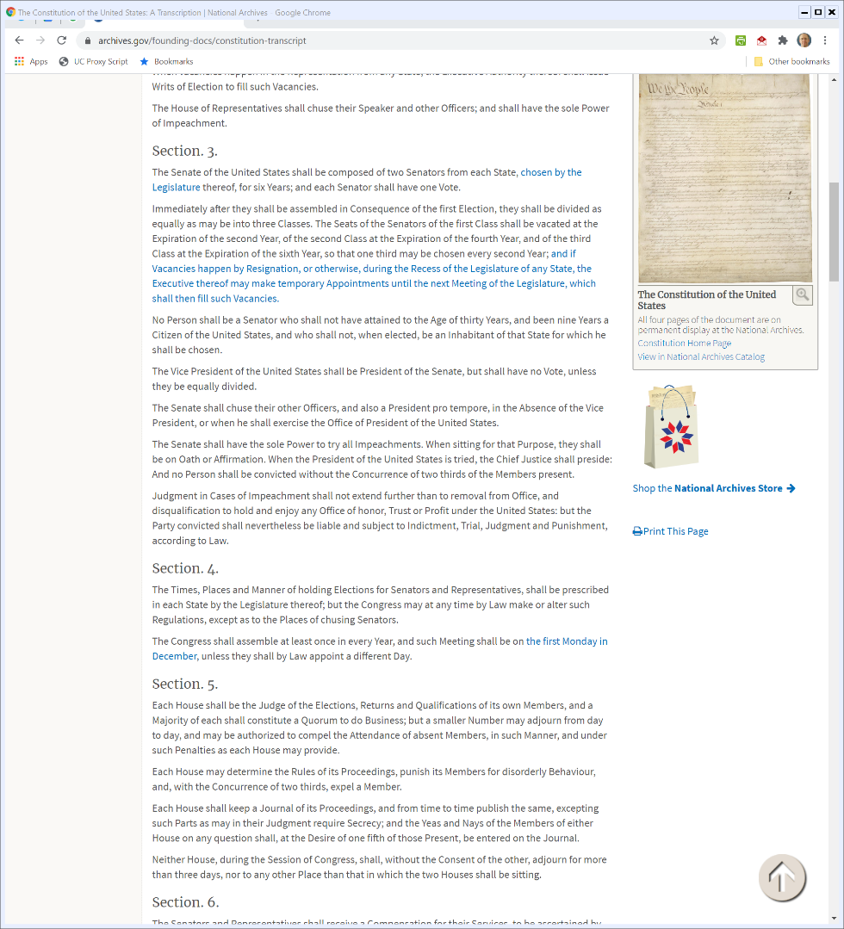

Art I, Sec 3: Congress: Structure of the Senate
U.S. Constitution (As Enacted)

Slide 23
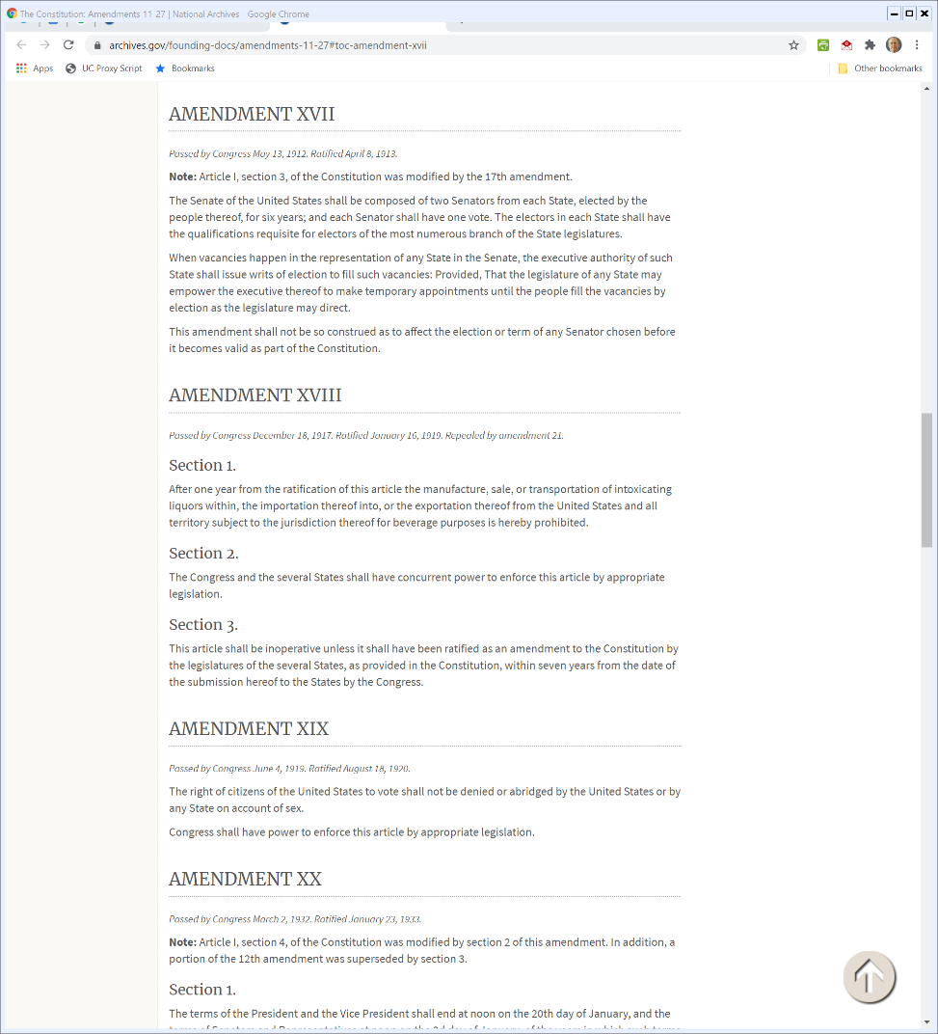
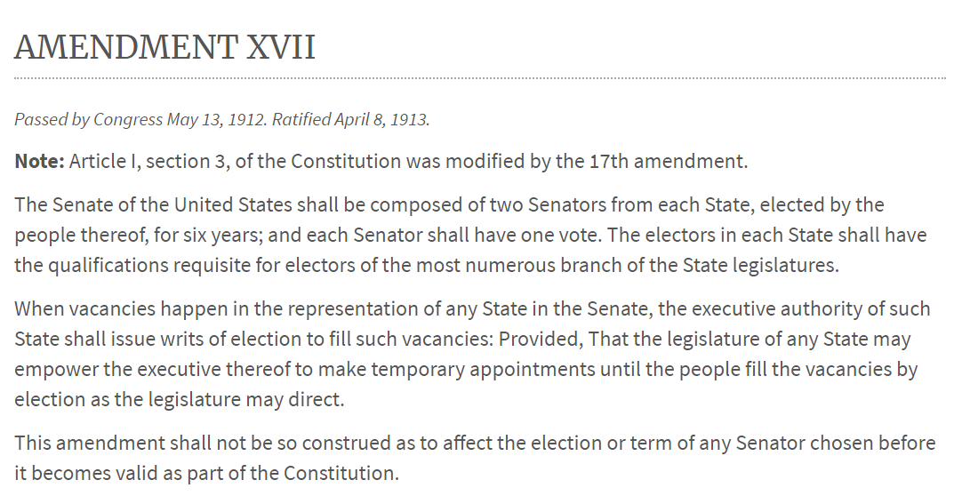
Art I, Sec 3: Congress: 17th Amendment: 8 Apr 1913
U.S. Constitution

Slide 24
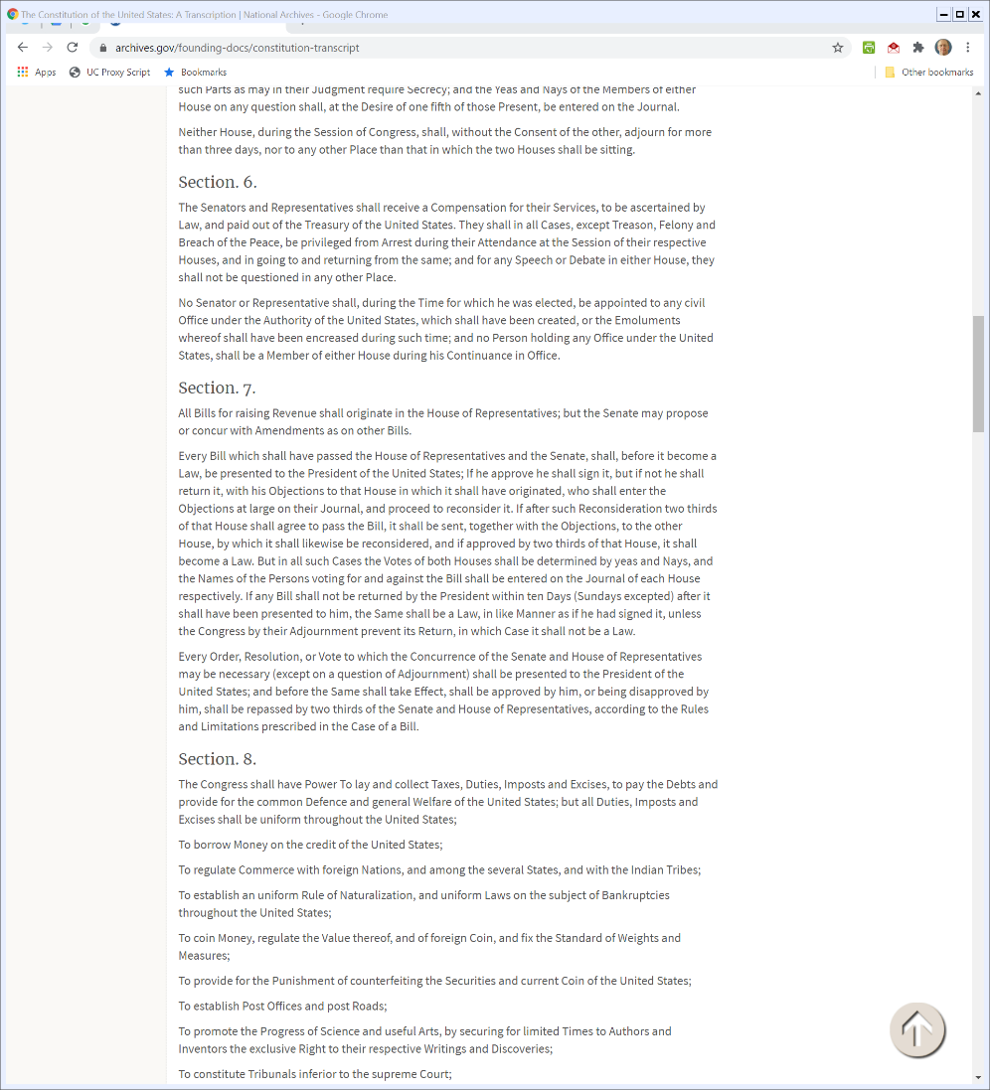
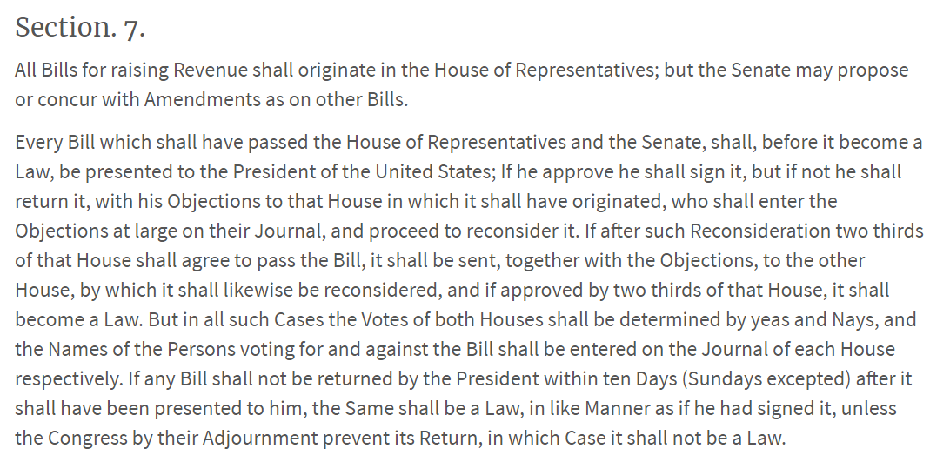
Art I, Sec 7: Congress: How a Bill becomes a Law
U.S. Constitution (As Enacted)

Slide 25
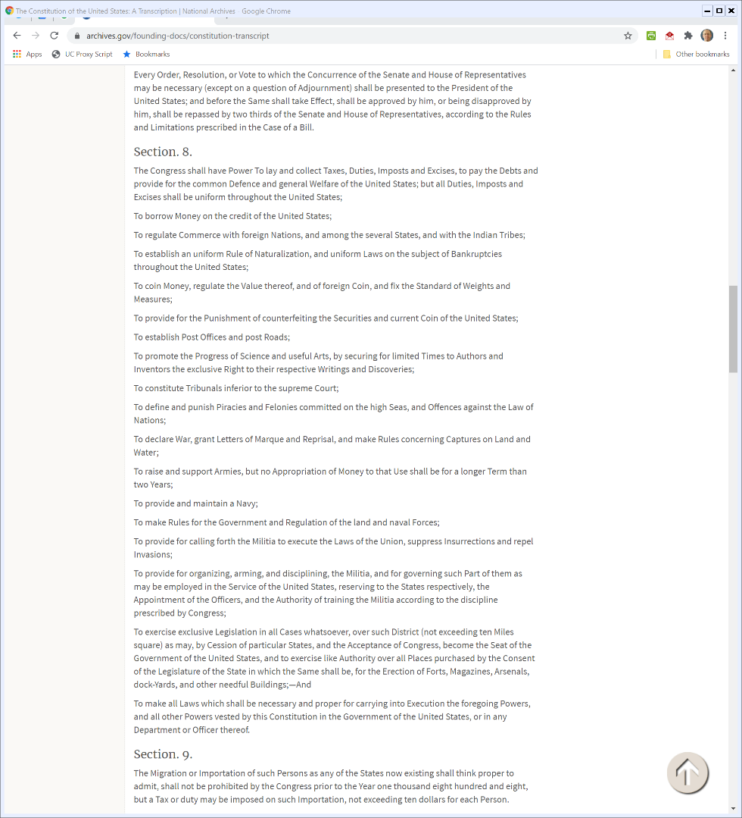
Art I, Sec 8: Powers of Congress
U.S. Constitution (As Enacted)

Slide 26
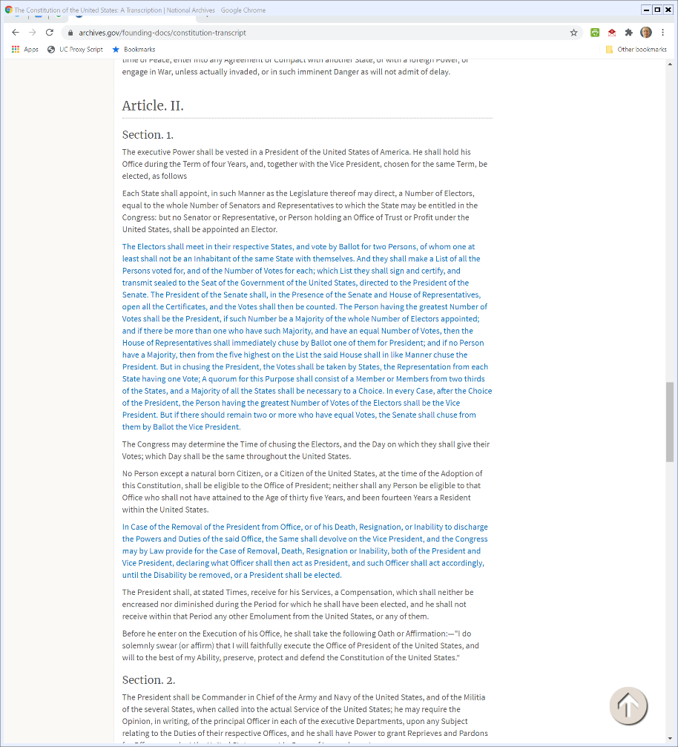
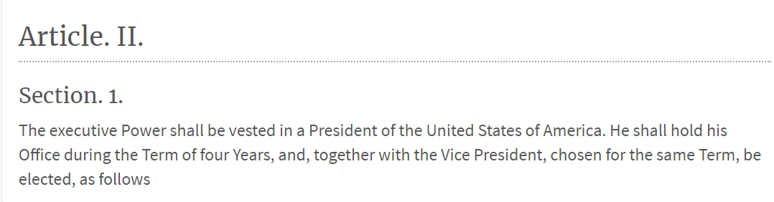
Art II, Sec 1: The Executive Power
U.S. Constitution (As Enacted)

Slide 27
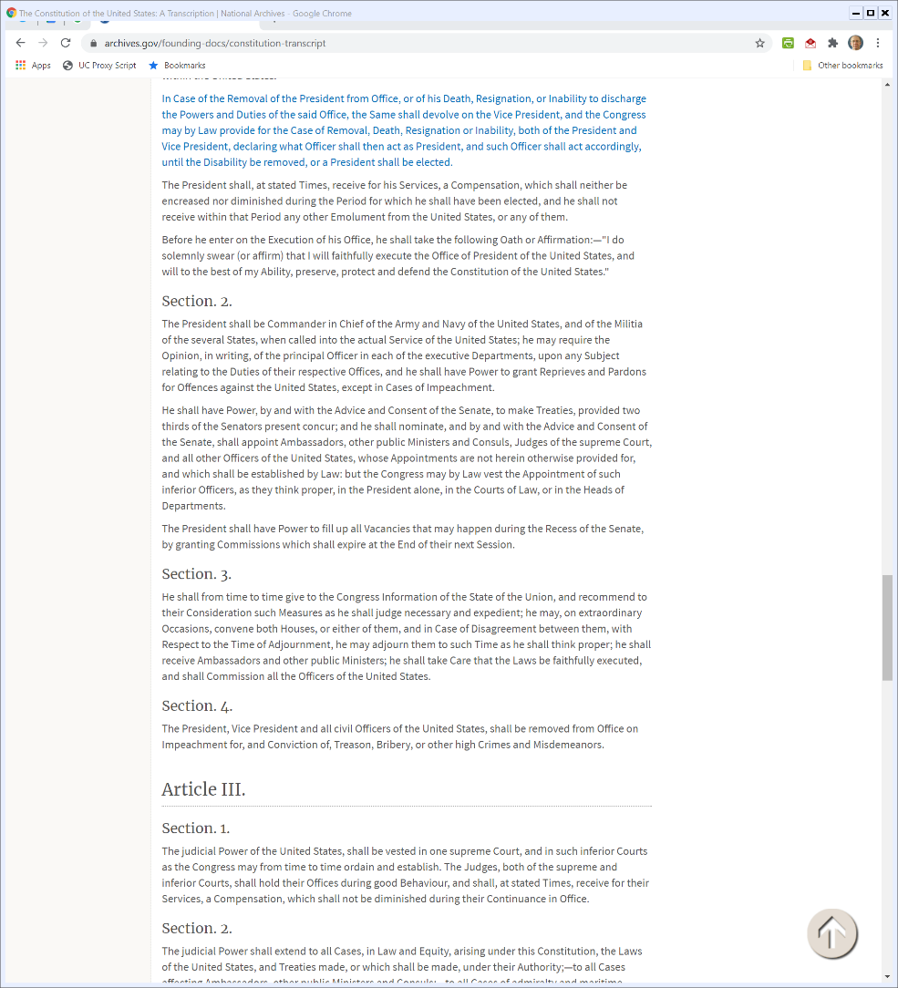

Art II, Sec 2: Powers of The President
U.S. Constitution (As Enacted)

Slide 28
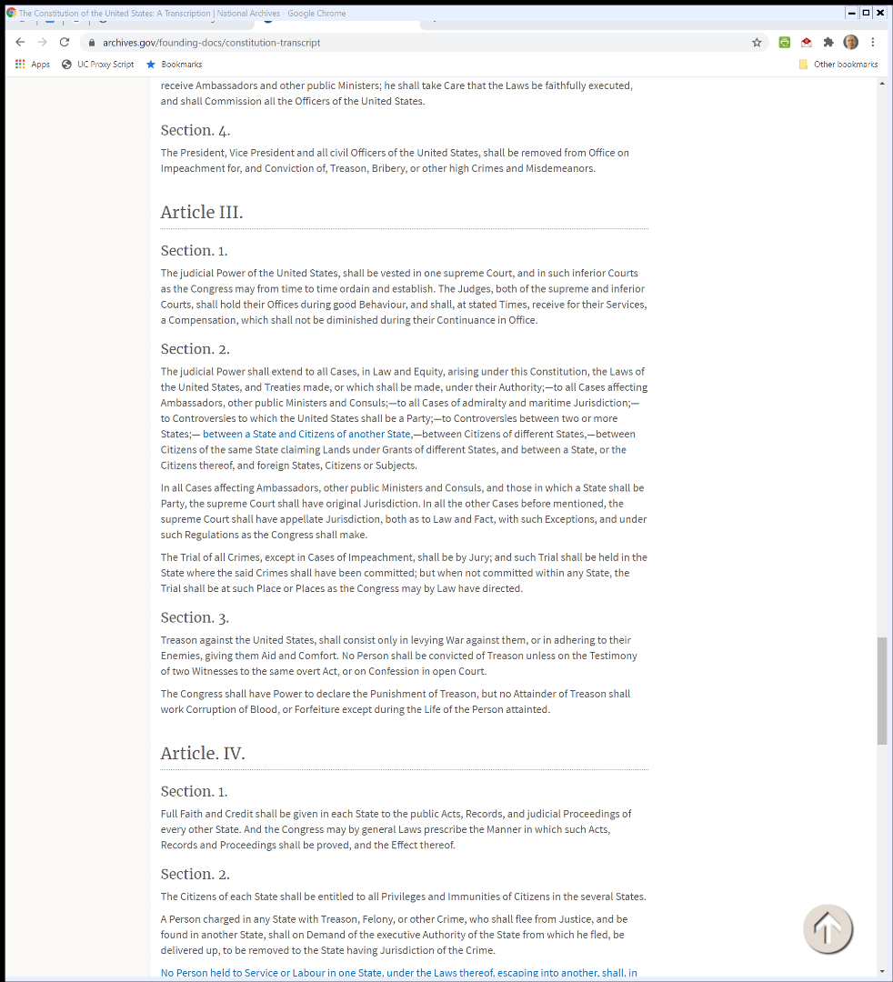
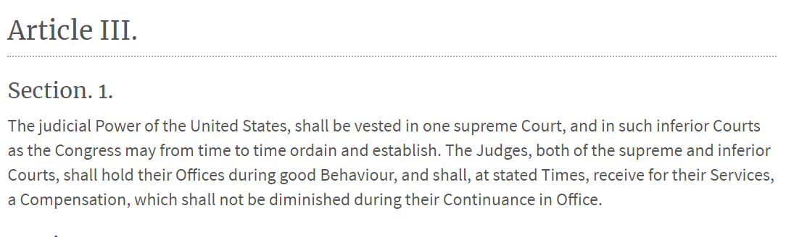
Art III, Sec 1: Courts
U.S. Constitution (As Enacted)

Slide 29
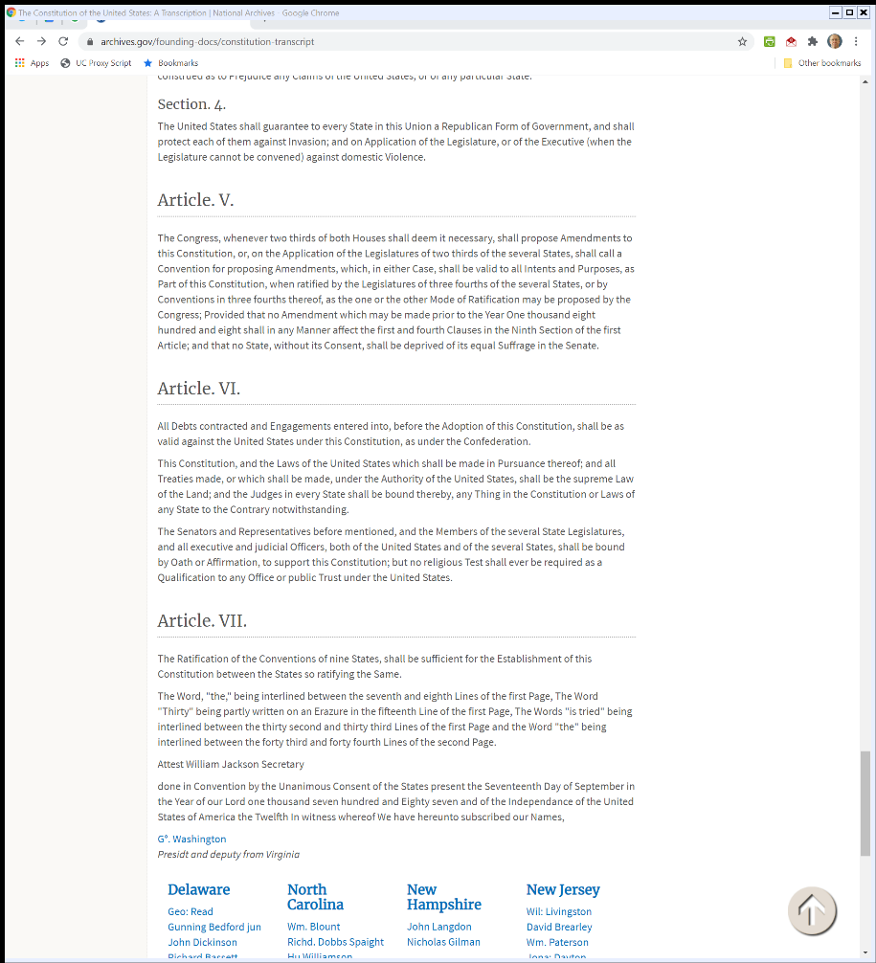

Art V: Amendments
U.S. Constitution (As Enacted)

Slide 30

Art VI: Supremacy Clause
U.S. Constitution (As Enacted)

Slide 31
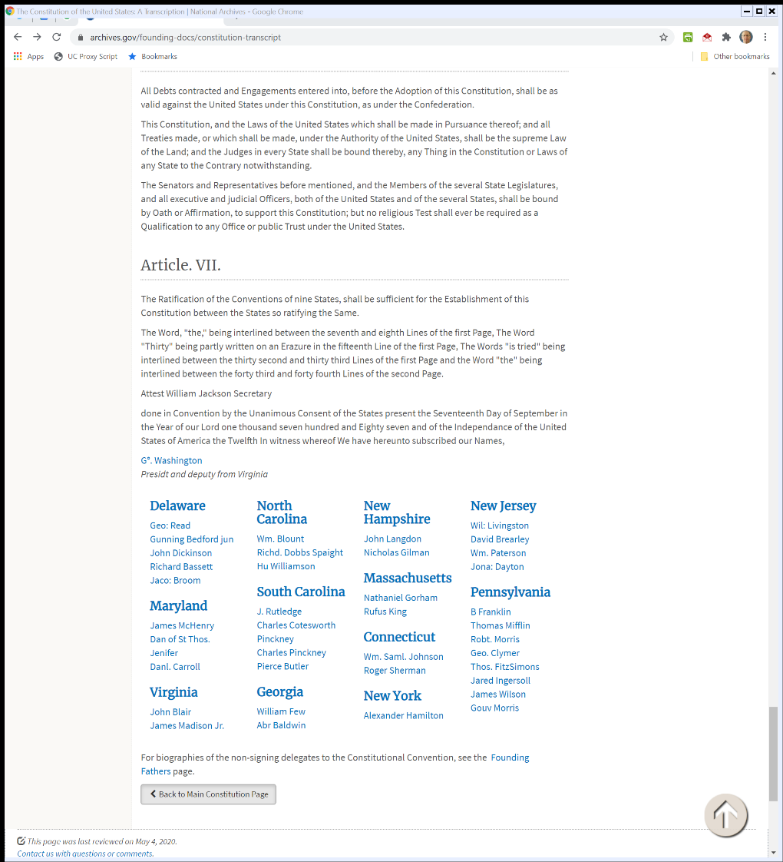
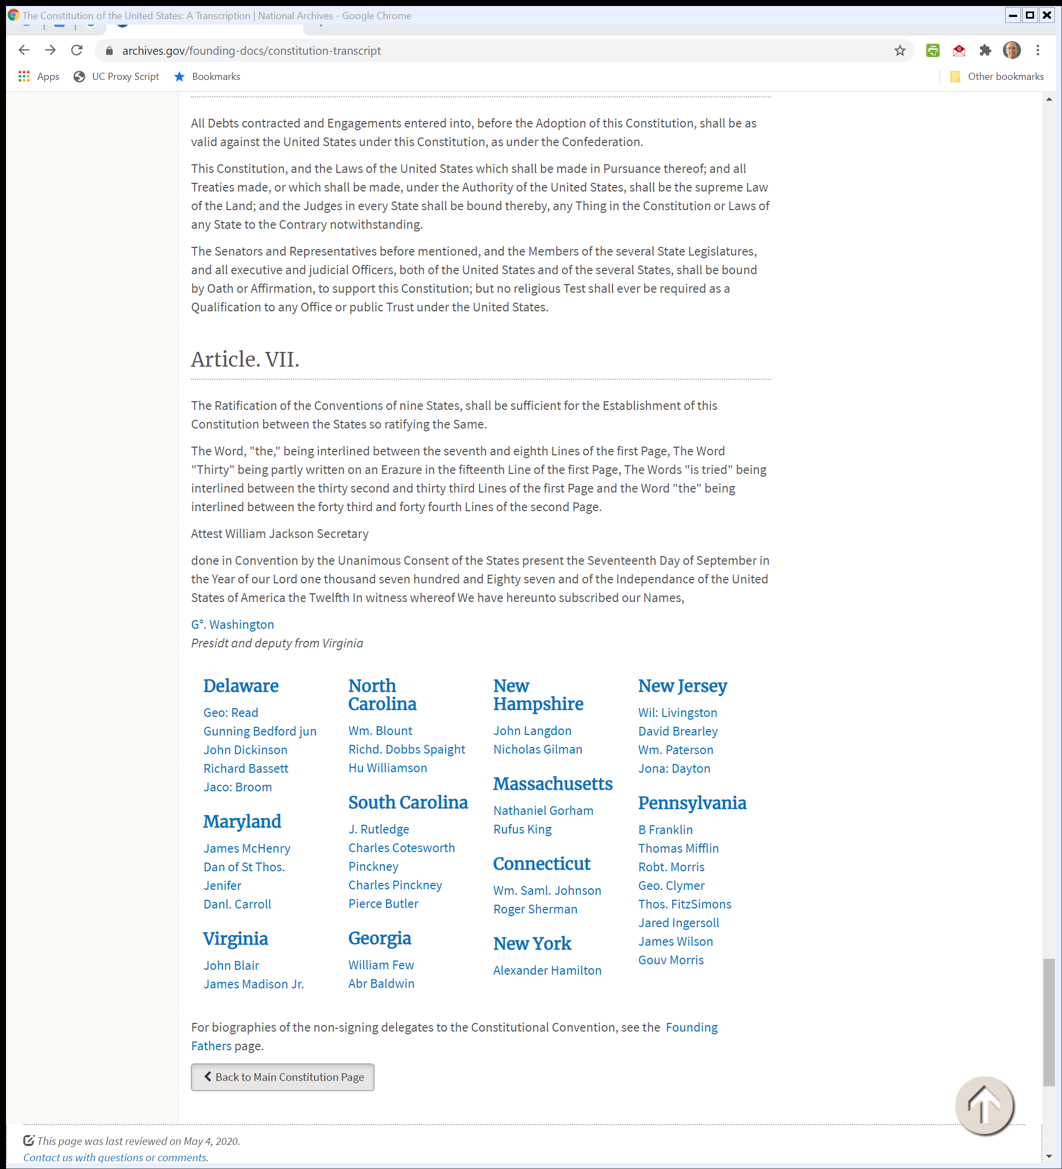
Art VII: Ratification
U.S. Constitution (As Enacted)

Slide 32

Art VII: Signatories
U.S. Constitution (As Enacted)

Slide 33
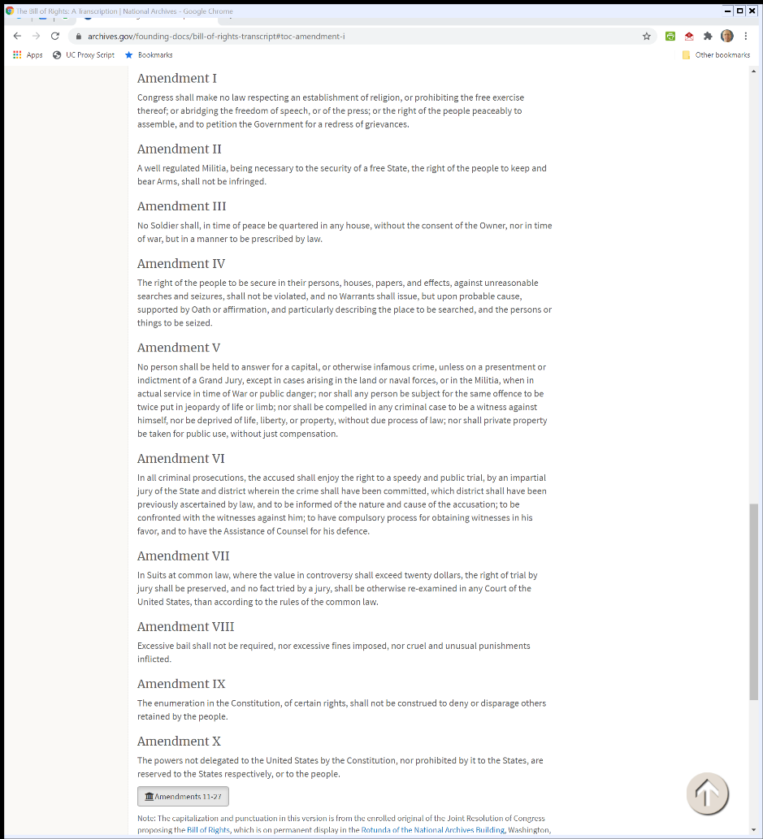
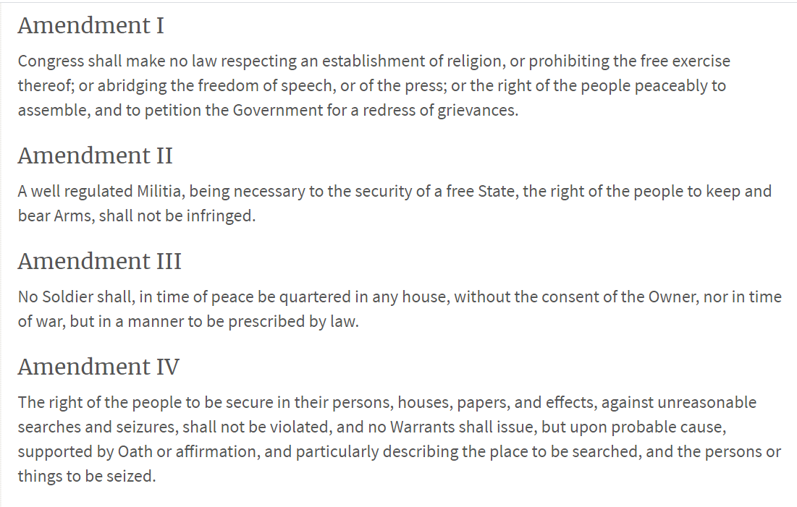
The Bill of Rights
U.S. Constitution (As Enacted)

Slide 34
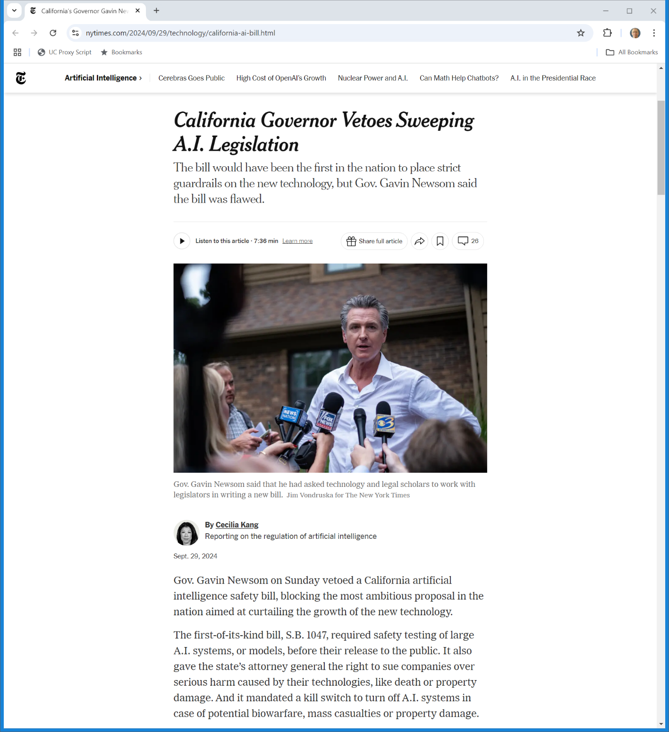
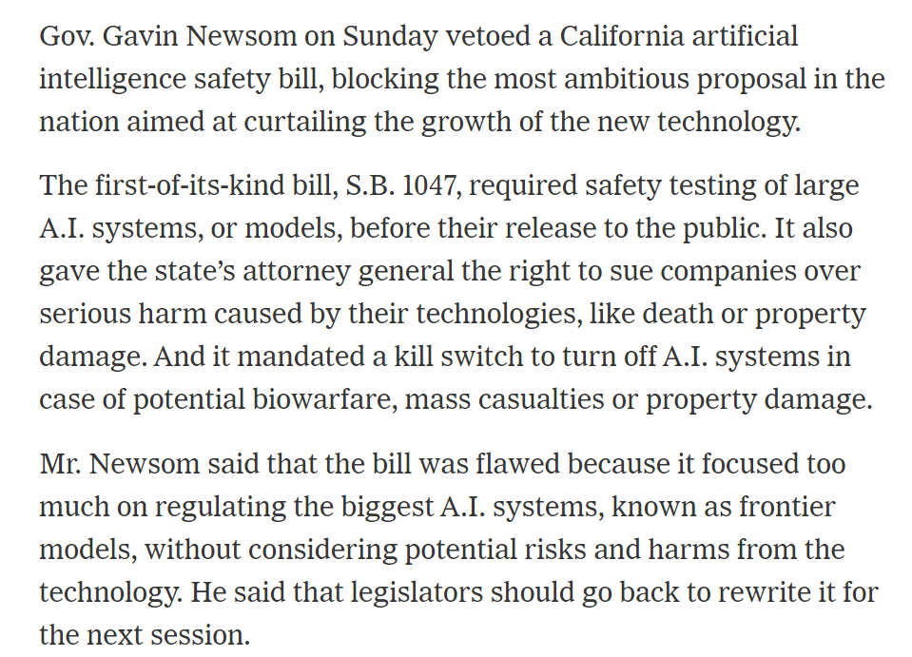
Structure Replicated at State Level
NYT (29 Sept 2024)
Notes:
https://www.nytimes.com/2024/09/29/technology/california-ai-bill.html

Slide 35
Courts
The U.S. Court System

Slide 36
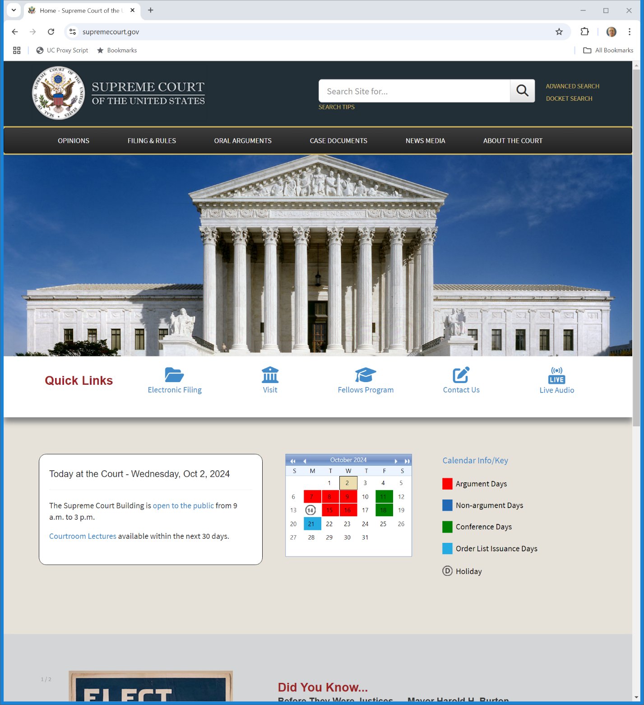
U.S. Supreme Court
supremecourt.gov

Slide 37
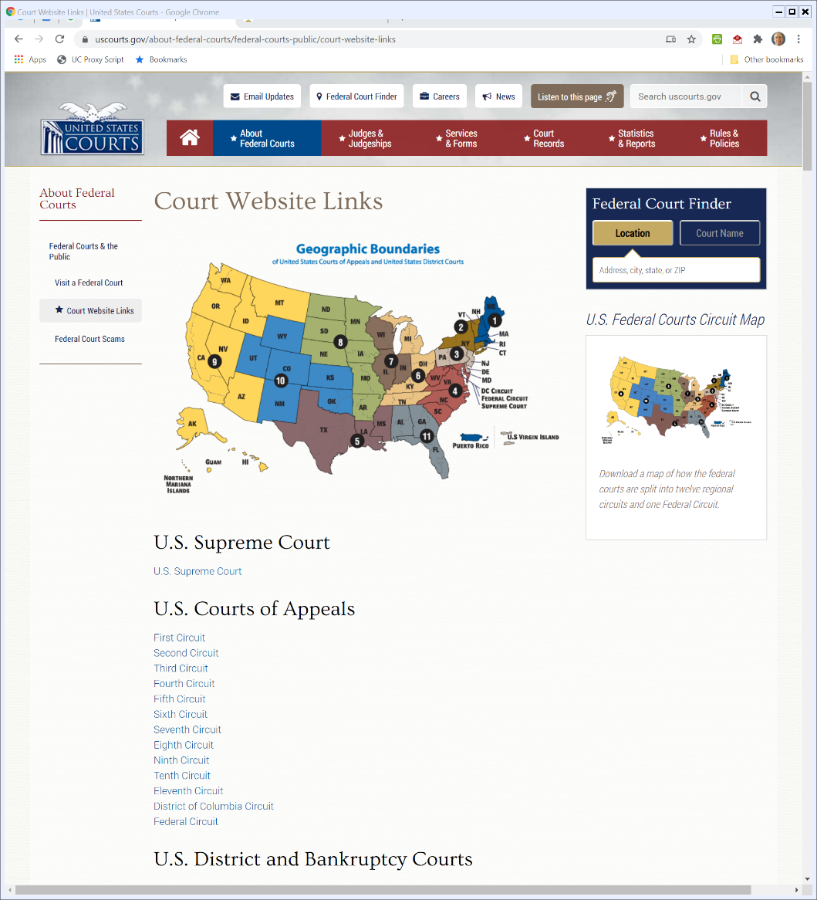

Lower Federal Courts
uscourts.gov
Notes:
https://www.uscourts.gov/about-federal-courts/federal-courts-public/court-website-links

Slide 38
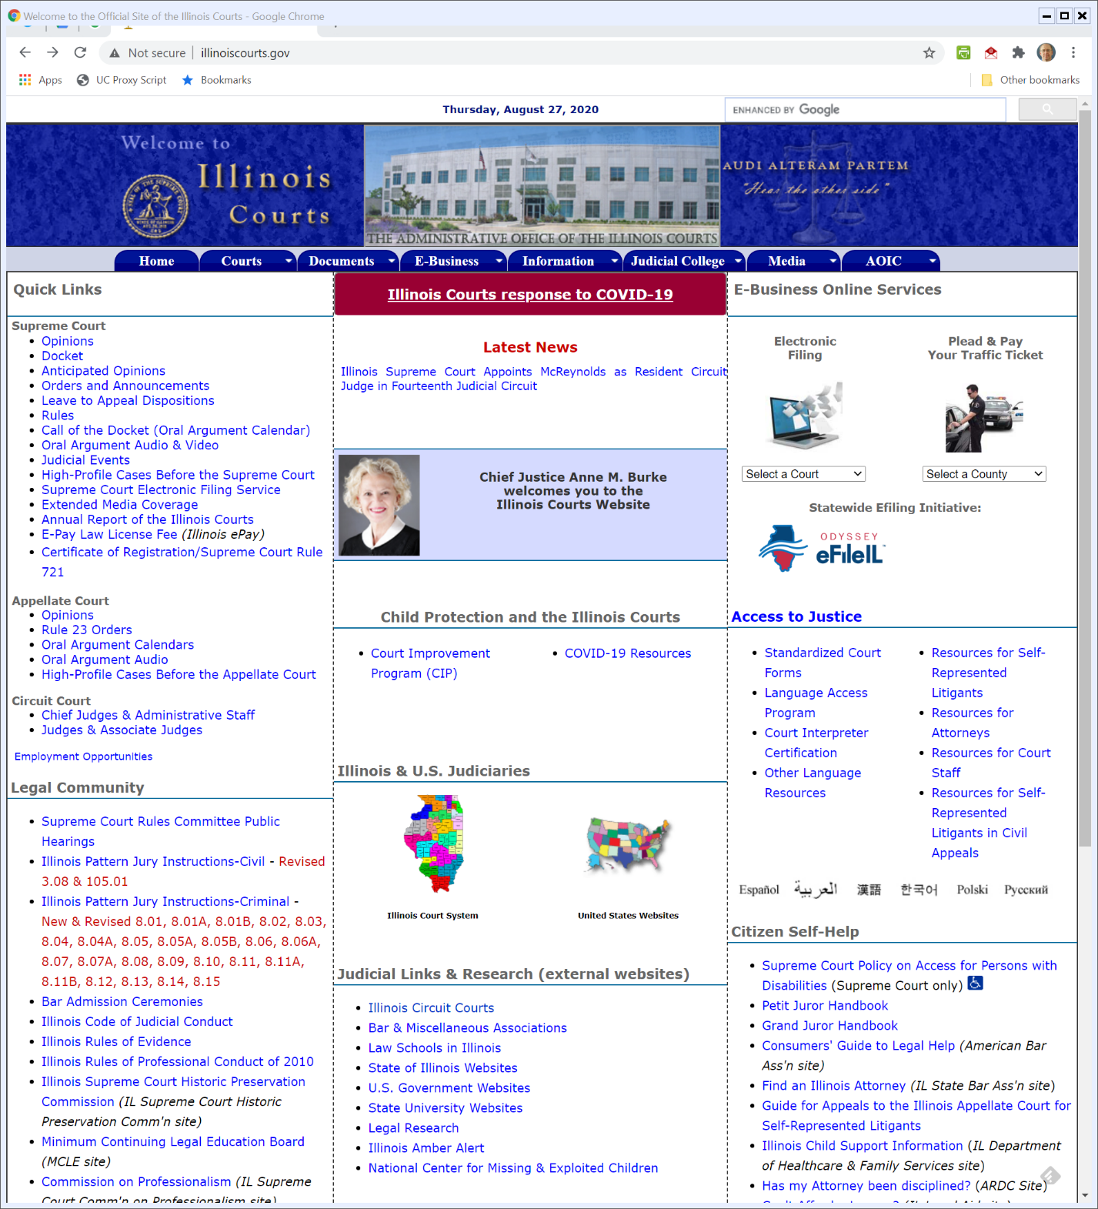
State Courts: Illinois
illinoiscourts.gov

Slide 39
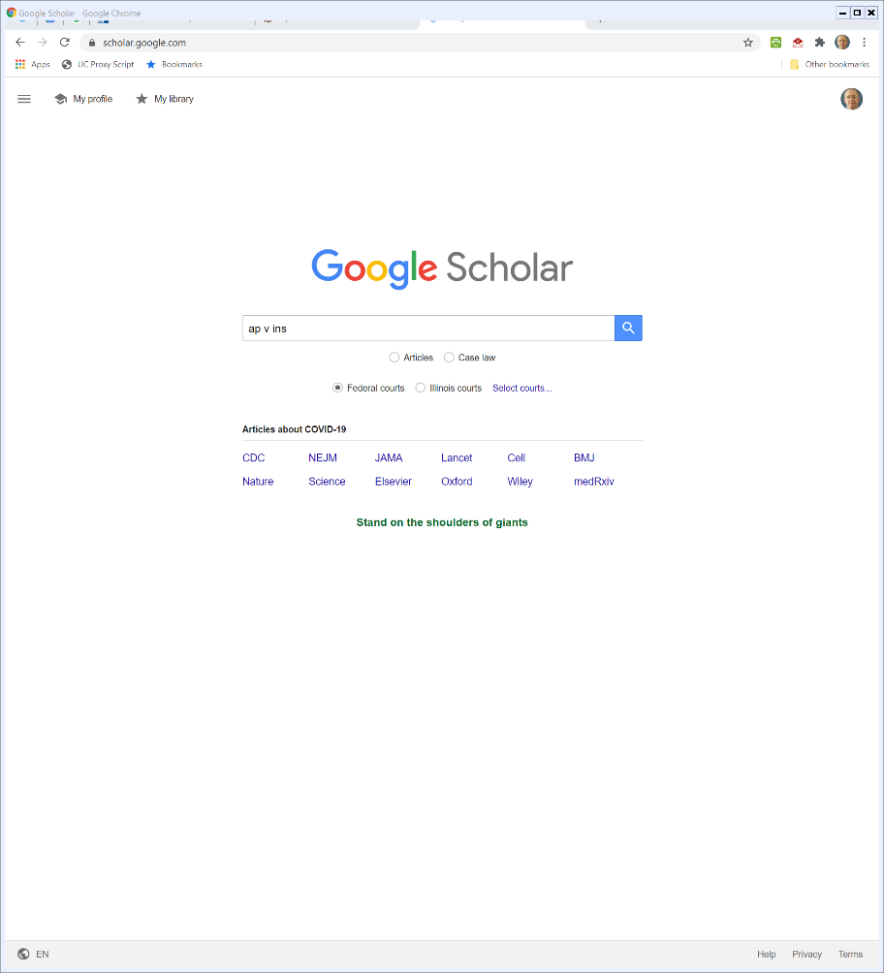
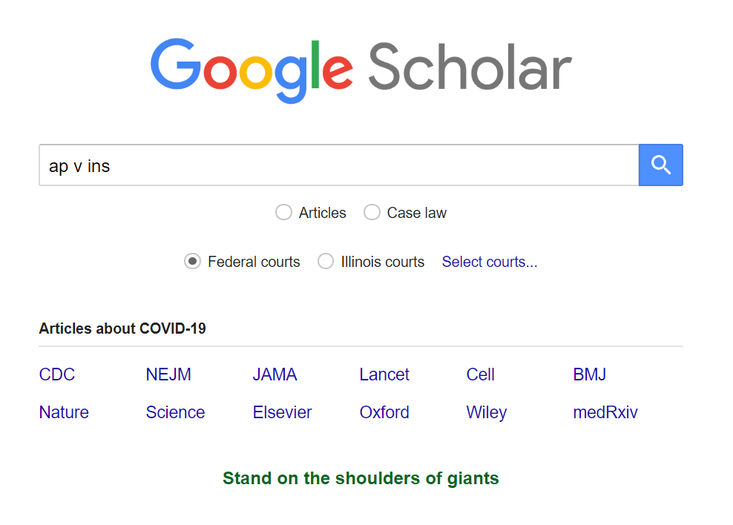
Finding Opinions
scholar.google.com
Notes:
https://www.uscourts.gov/about-federal-courts/federal-courts-public/court-website-links

Slide 40
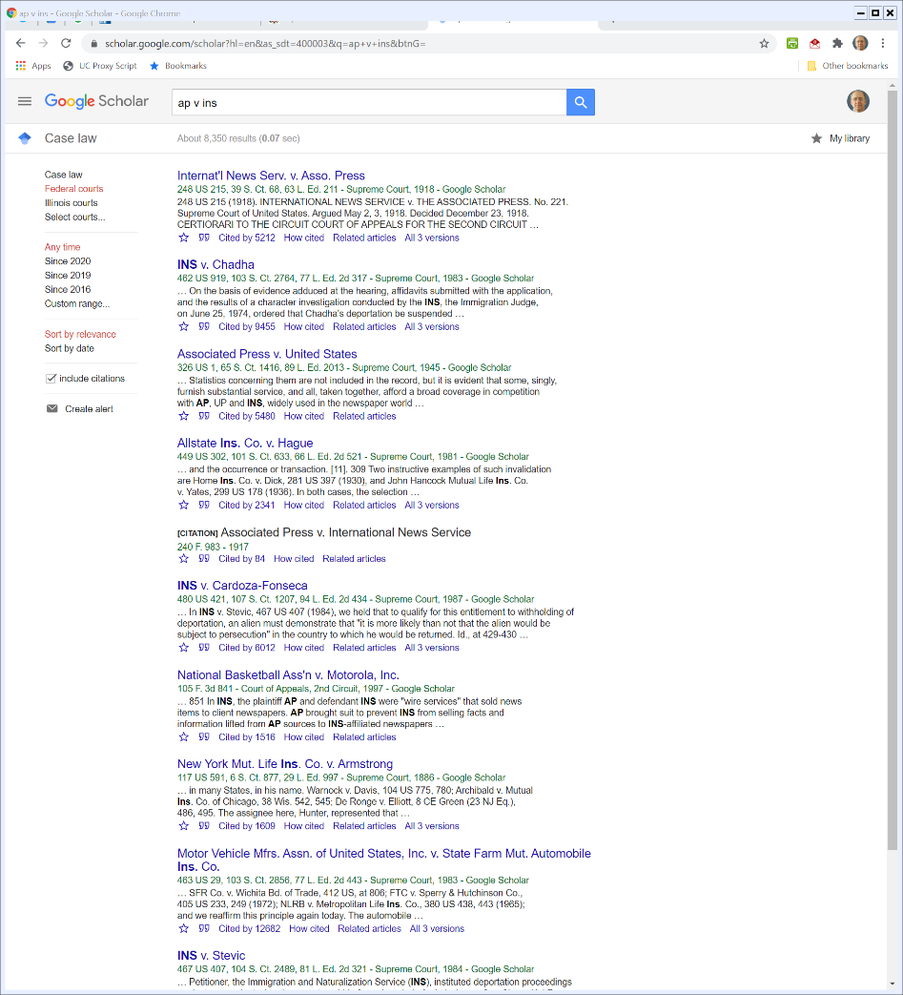

Finding Opinions
scholar.google.com
Notes:
https://www.uscourts.gov/about-federal-courts/federal-courts-public/court-website-links

Slide 41
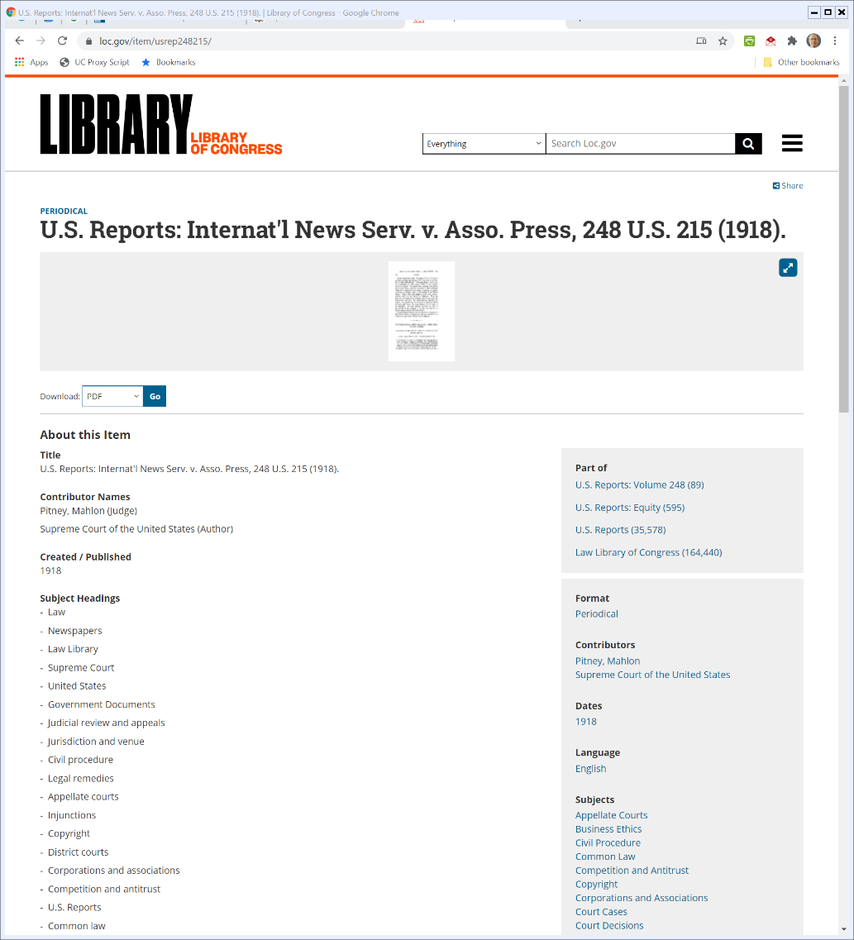

Library of Congress PDFs
https://www.loc.gov/item/usrep248215/
Notes:
https://www.uscourts.gov/about-federal-courts/federal-courts-public/court-website-links

Slide 42
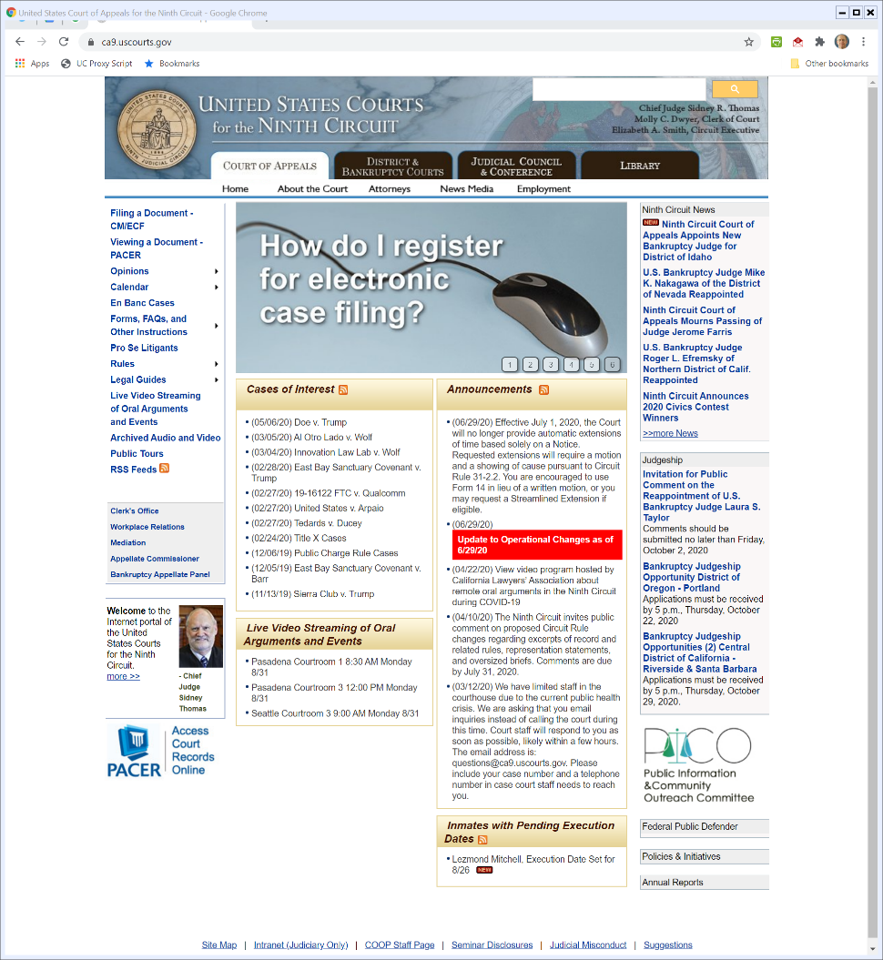

Court Websites
www.ca9.uscourts.gov

Slide 43
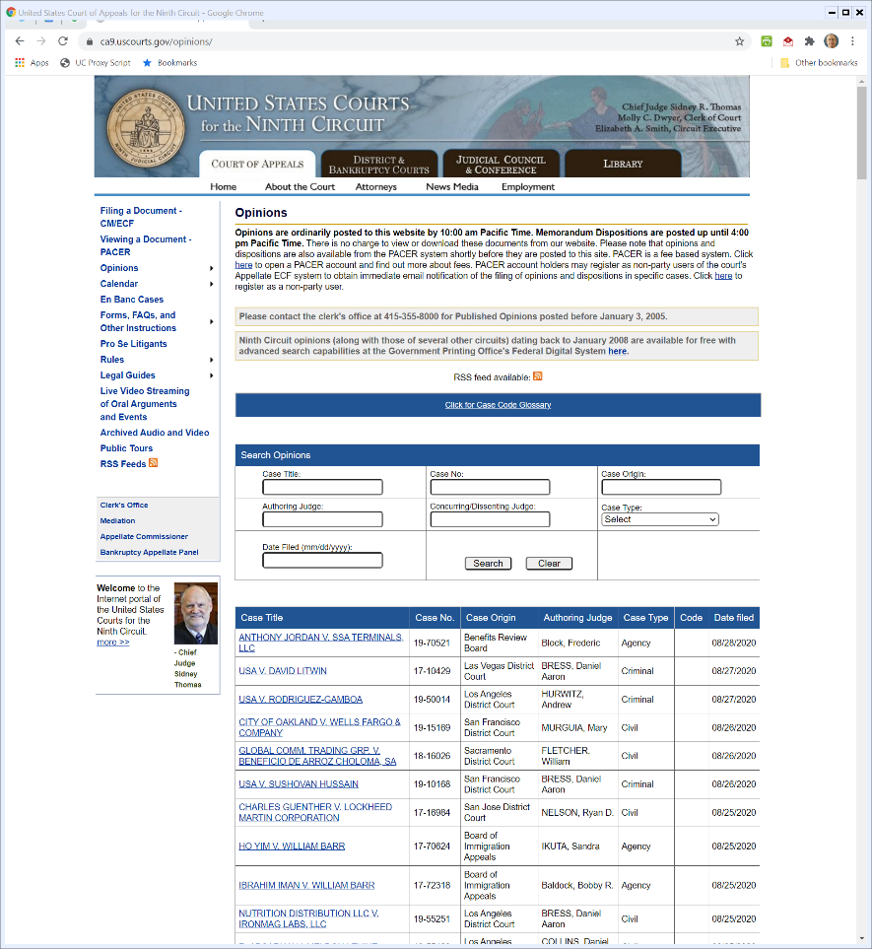

Court Websites
www.ca9.uscourts.gov

Slide 44
FRCP
The Federal Rules of Civil Procedure

Slide 45
Civil Procedure
Key Questions
How do you commence a lawsuit?
What happens next?
What are the possible outcomes?

Slide 46
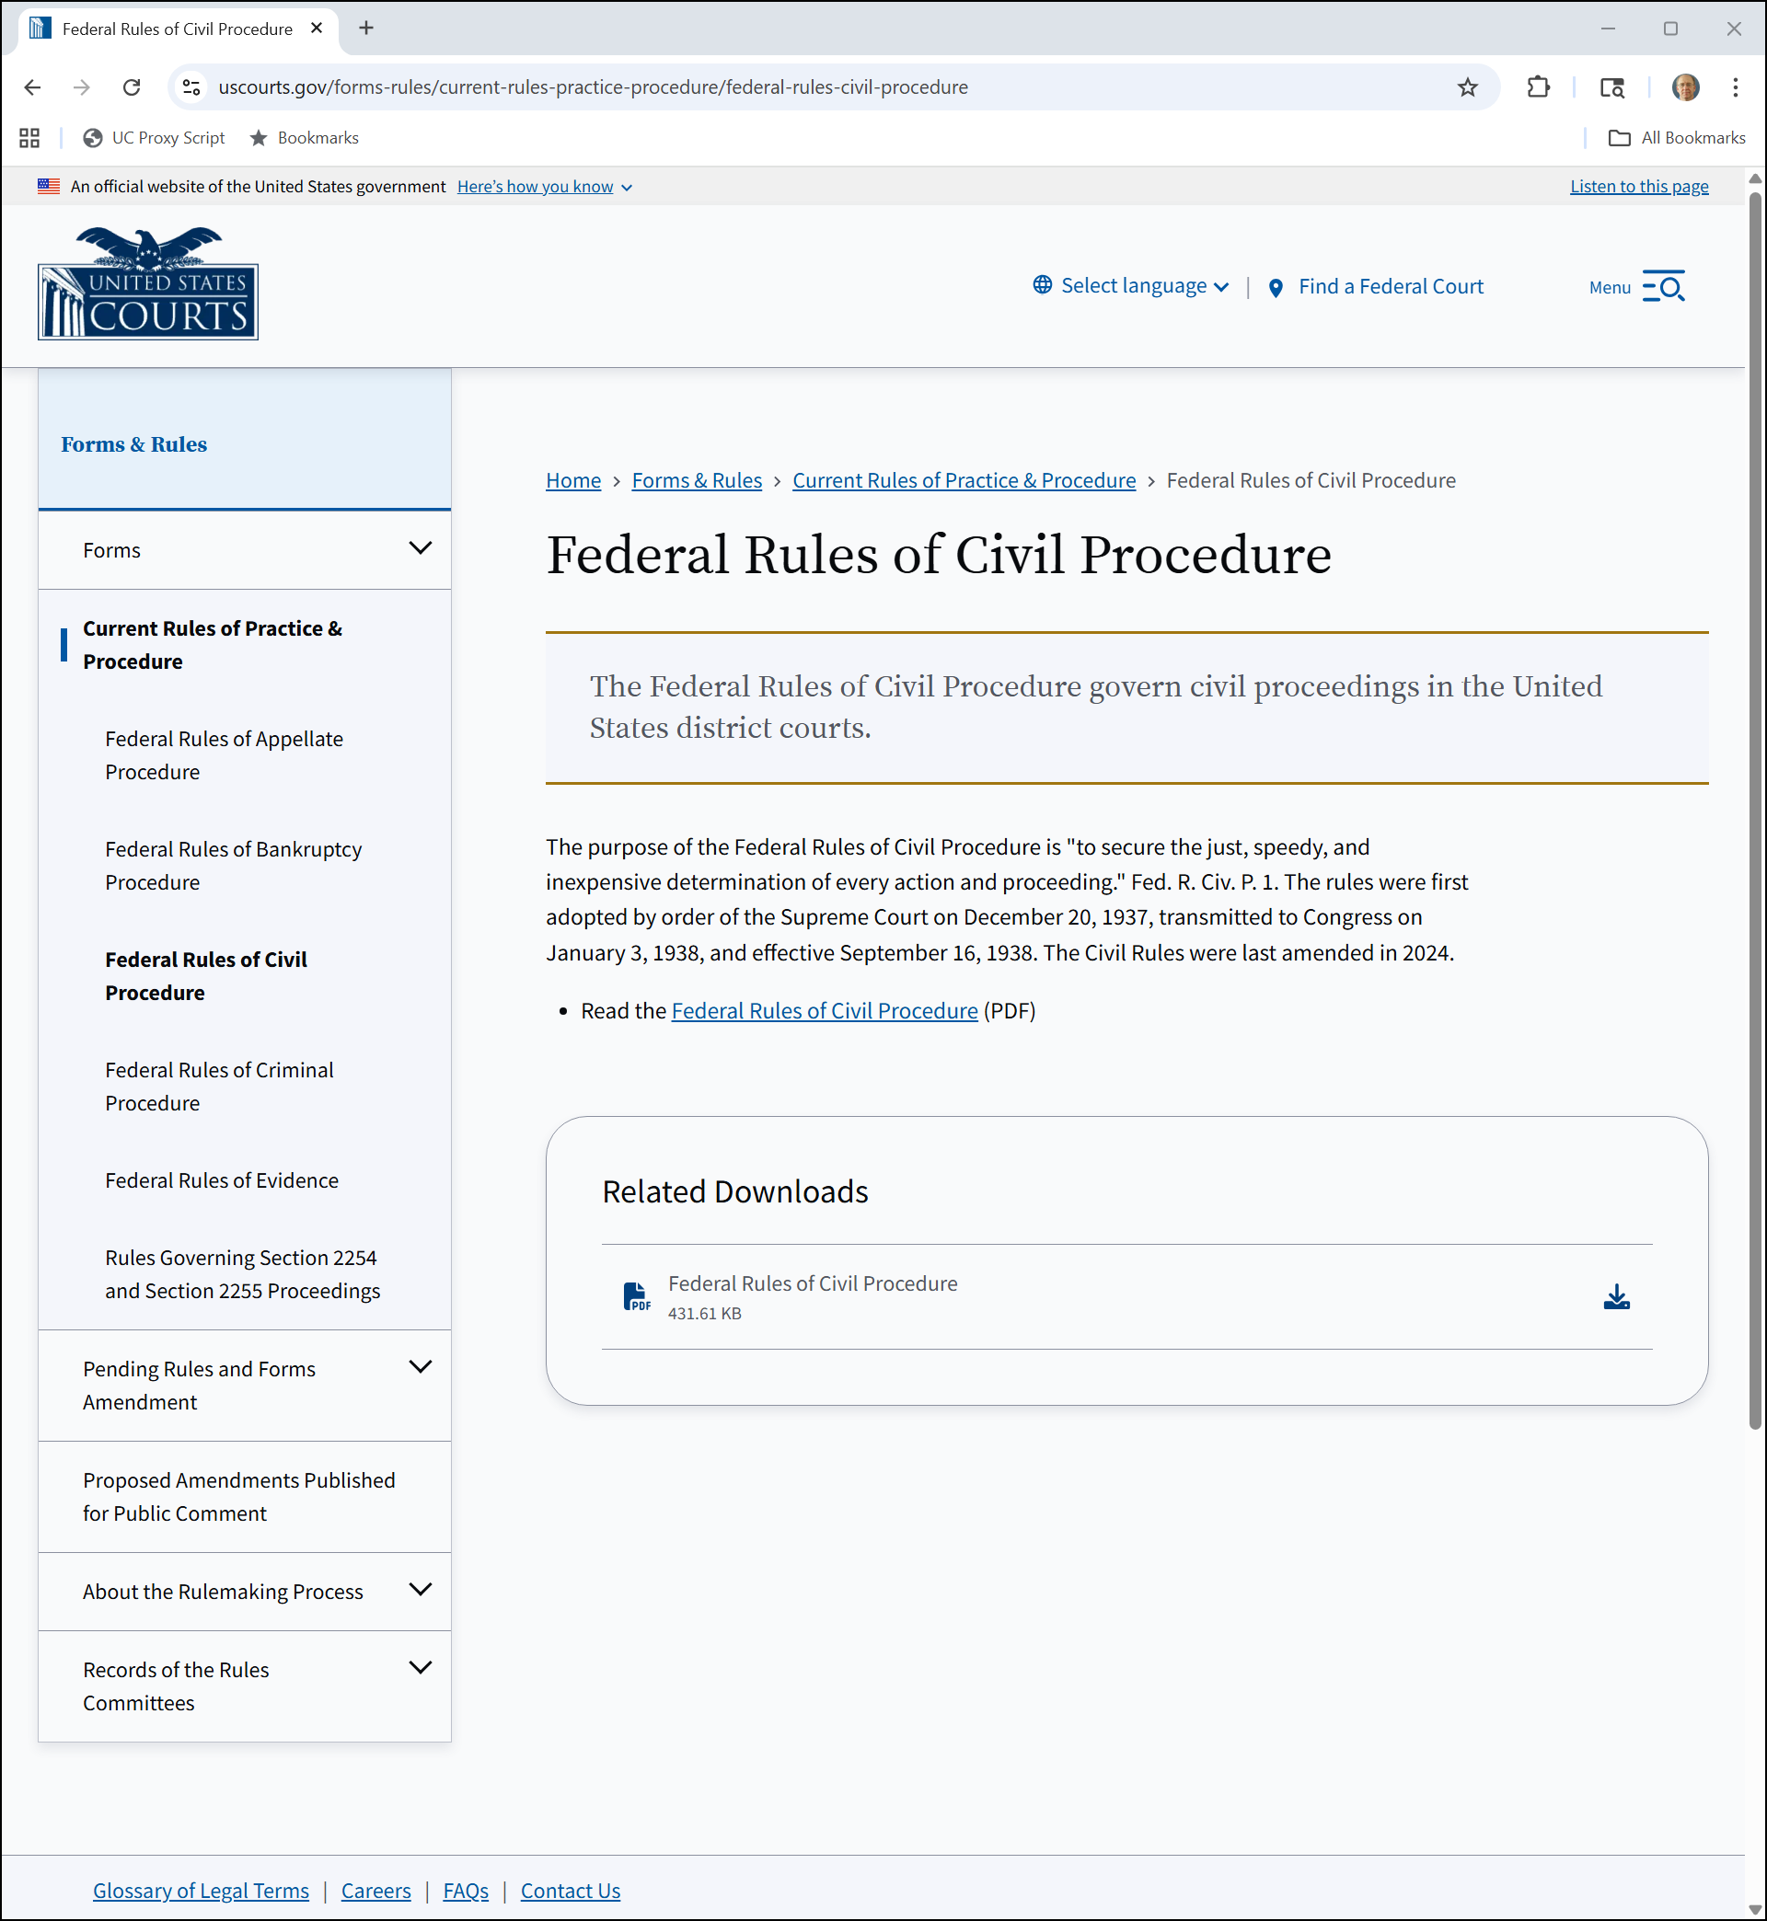
FRCP
uscourts.gov
Notes:
https://www.uscourts.gov/rules-policies/current-rules-practice-procedure/federal-rules-civil-procedure

Slide 47
Federal Rules of Civil Procedure

Slide 48
2024 Amendments?
Federal Rules of Civil Procedure

Slide 49
FRCP: Starting a Case
Federal Rules of Civil Procedure

Slide 50
FRCP: Pleadings and Motions
Federal Rules of Civil Procedure

Slide 51
FRCP: Parties: Who is Involved in the Lawsuit?
Federal Rules of Civil Procedure

Slide 52
FRCP: Disclosures and Discovery: Tools for Getting Information
Federal Rules of Civil Procedure

Slide 53
FRCP: Trials
Federal Rules of Civil Procedure

Slide 54
FRCP: Judgment: What Happens When Someone Wins?
Federal Rules of Civil Procedure

Slide 55
FRCP: Remedies
Federal Rules of Civil Procedure

Slide 56
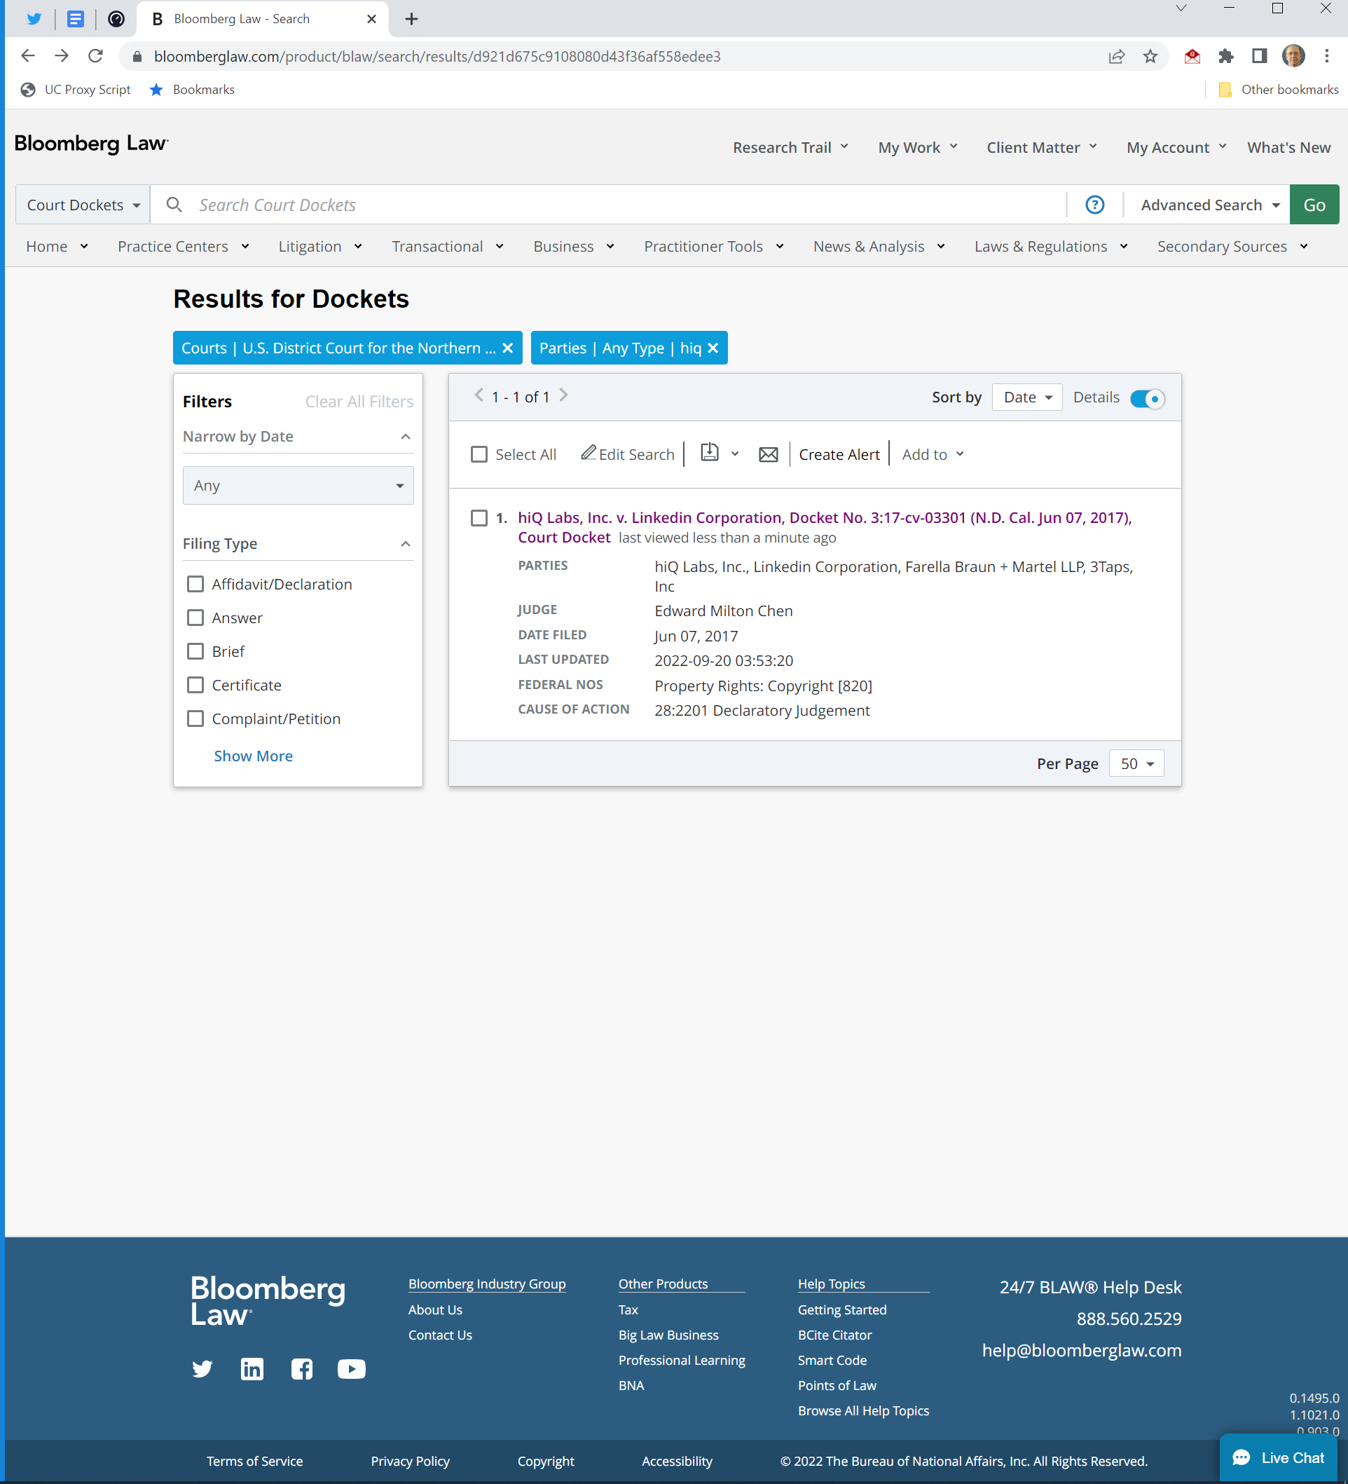
Docket: Running List of Documents Filed in Lawsuit
hiQ v LinkedIn Docket

Slide 57
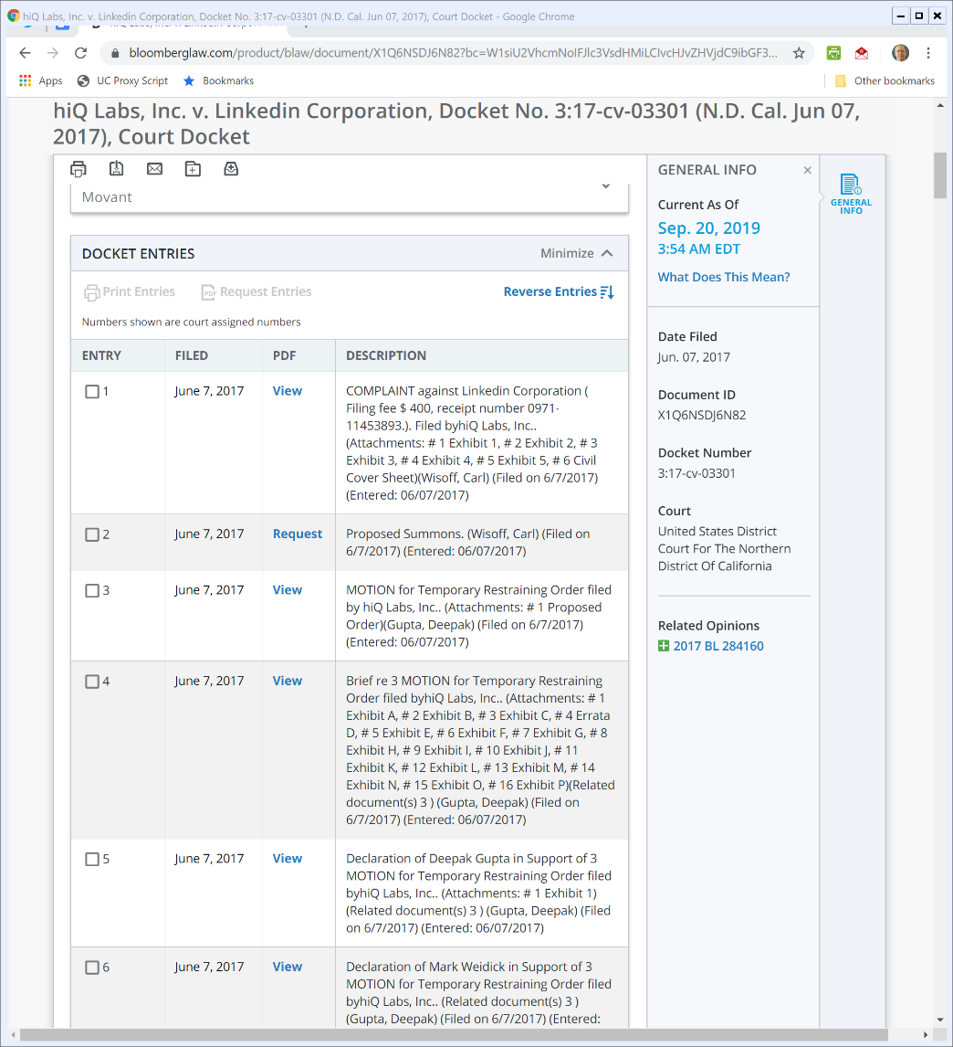
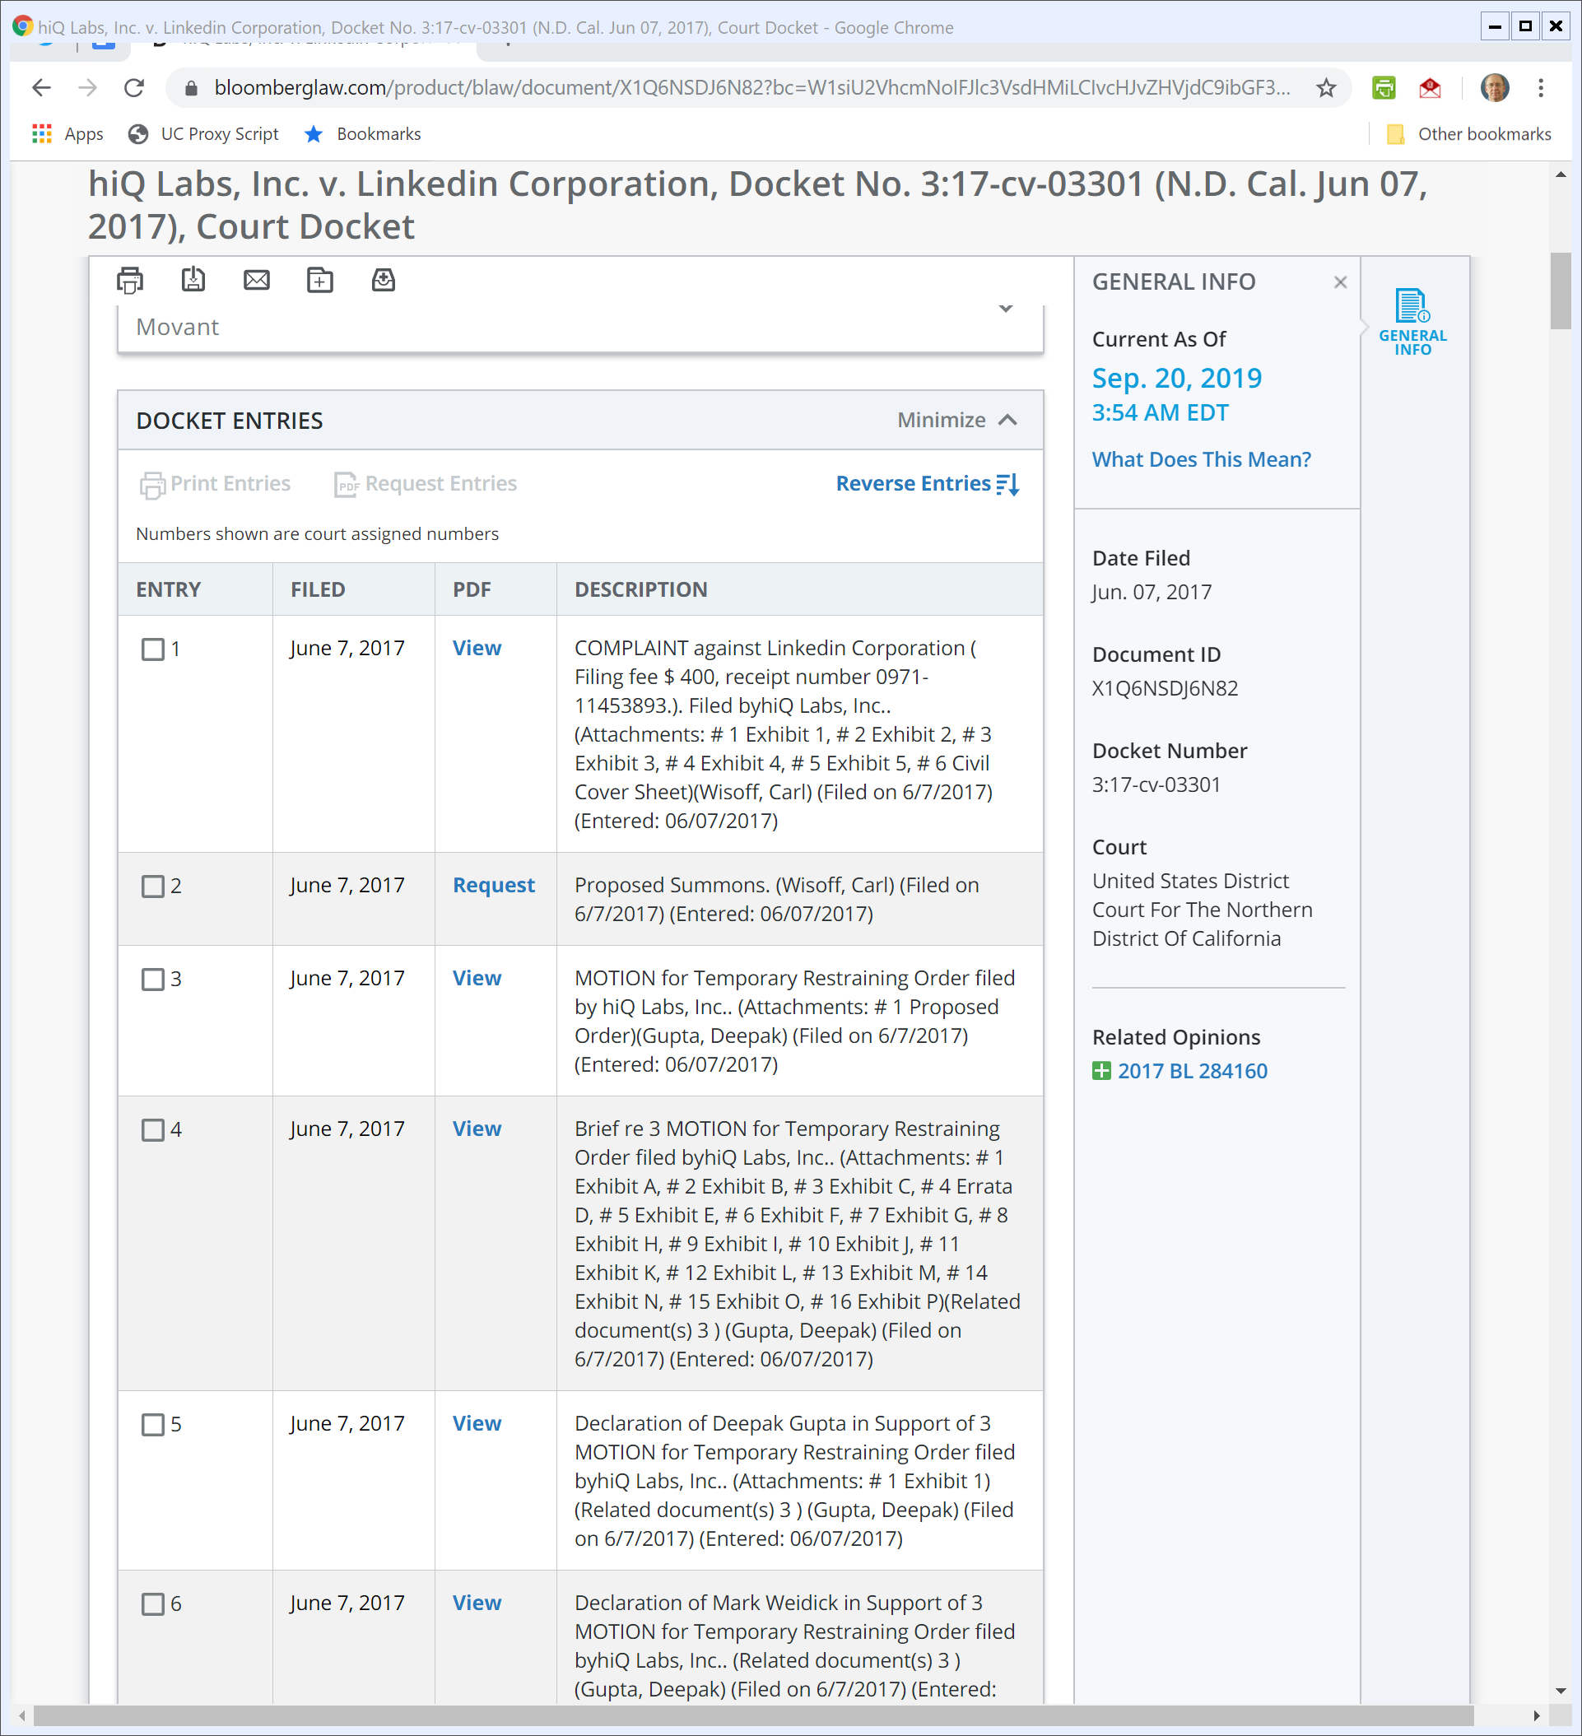
7 June 2017: hiQ Sues LinkedIn
Getting the hiQ Complaint

Slide 58
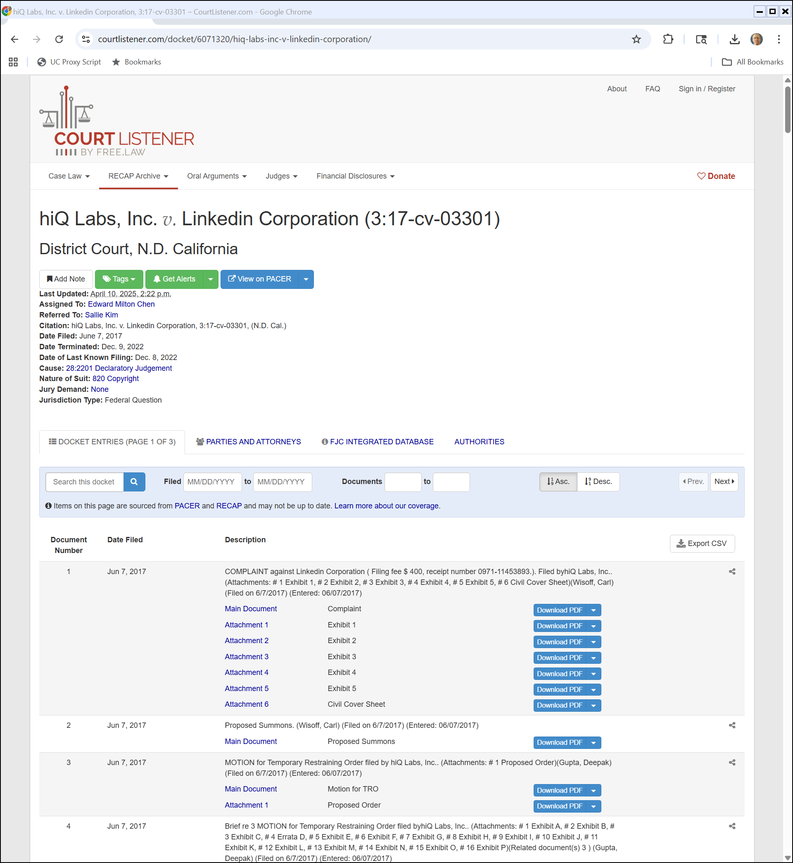
A Public Docket Site
courtlistener.com

Slide 59
AP v INS

Slide 60
NYT on AP vs INS
NYT (24 Dec 1918)
Notes:
WWI ends 11 Nov 1918

Slide 61
NYT Cont.
NYT (24 Dec 1918)

Slide 62
Starting Questions
TTYN (1 of 3)
Why does this litigation arise?
What is going on here?
What is the organization of the news business?
How does AP’s business model differ from INS’s?
What are the public policy issues raised by the case? Are those different than the legal issues?

Slide 63
Three Use Situations
TTYN (2 of 3)
Which of these is allowed?
INS sees AP story and
Copies it word for word and distributes it?
Reads the story, figures out the facts and then rewrites the story in its own words and distributes it?
Reads the story and sends a reporter to investigate; based on that report, writes a story and distributes it?

Slide 64
Three Use Situations
TTYN (3 of 3)
How do these differ?
How do the three different opinions treat these situations?

Slide 65
INS v. AP
248 U.S. 215 (1918)

Slide 66
What Does this Mean?
“The parties are competitors in this field; and, on fundamental principles, applicable here as elsewhere, when the rights or privileges of the one are liable to conflict with those of the other, each party is under a duty so to conduct its own business as not unnecessarily or unfairly to injure that of the other.”
INS v. AP (U.S. 1918)

Slide 67
Understanding Unfair Competition
“Stripped of all disguises, the process amounts to an unauthorized interference with the normal operation of complainant’s legitimate business precisely at the point where the profit is to be reaped, in order to divert a material portion of the profit from those who have earned it to those who have not; with special advantage to defendant in the competition because of the fact that it is not burdened with any part of the expense of gathering the news.”
INS v. AP (U.S. 1918)

Slide 68
Understanding Unfair Competition
“The transaction speaks for itself and a court of equity ought not to hesitate long in characterizing it as unfair competition in business.”
INS v. AP (U.S. 1918)

Slide 69
Justice Holmes Dissenting
The Holmes Dissent
What is Holmes worried about?
Could INS modify its business practices to solve his problems?
What would that mean for AP?

Slide 70
Holmes: Just Attribute It
“But as, in my view, the only ground of complaint that can be recognized without legislation is the implied misstatement, it can be corrected by stating the truth; and a suitable acknowledgment of the source is all that the plaintiff can require.”
INS v. AP (U.S. 1918)

Slide 71
Justice Brandeis Dissenting
The Brandeis Dissent
He disagrees with the Court’s result
Why?

Slide 72
What Are Second Movers Allowed to Do?
“He who follows the pioneer into a new market, or who engages in the manufacture of an article newly introduced by another, seeks profits due largely to the labor and expense of the first adventurer; but the law sanctions, indeed encourages, the pursuit.”
INS v. AP (U.S. 1918)

Slide 73
Ver. 1: Damages But No Injunction
“Or legislators dealing with the subject might conclude, that the right to news values should be protected to the extent of permitting recovery of damages for any unauthorized use, but that protection by injunction should be denied ….”
INS v. AP (U.S. 1918)

Slide 74
Ver. 2: Damages And Injunctions
“Or again, a Legislature might conclude that it was unwise to recognize even so limited a property right in published news as that above indicated; but that a news agency should, on some conditions, be given full protection of its business; and to that end a remedy by injunction as well as one for damages should be granted … .”
INS v. AP (U.S. 1918)

Slide 75
Ver. 3: Public Interest and Mandatory Access
“If a Legislature concluded … that under certain circumstances news-gathering is a business affected with a public interest; it might declare that, in such cases, news should be protected against appropriation, only if the gatherer assumed the obligation of supplying it at reasonable rates and without discrimination, to all papers which applied therefor.”
INS v. AP (U.S. 1918)

Slide 76
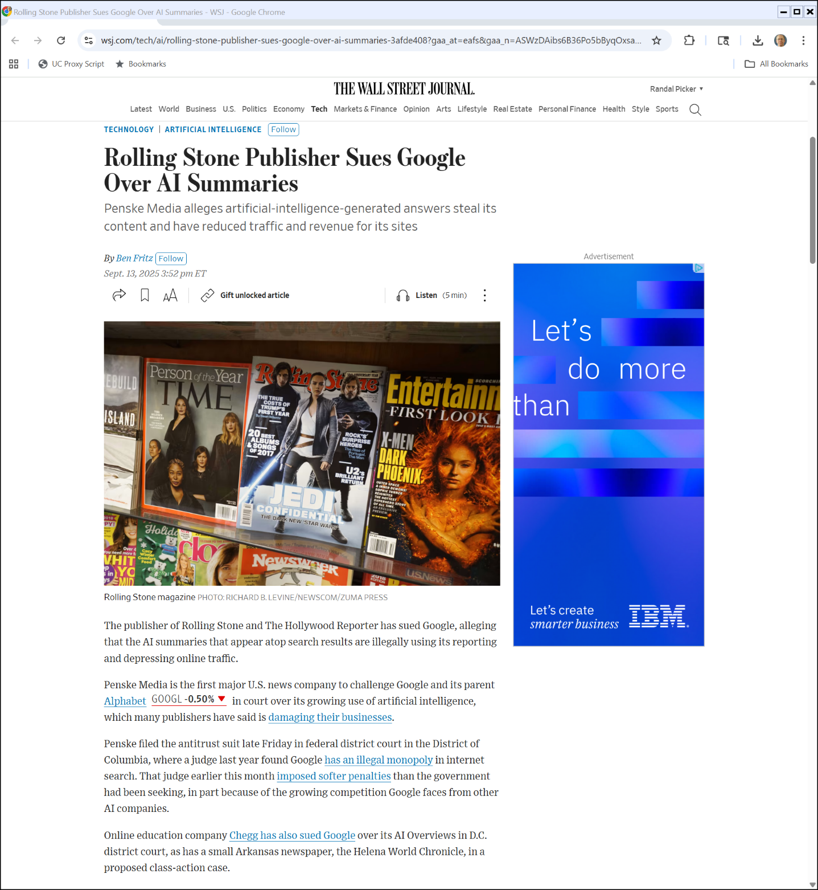
AI Summaries?
WSJ (13 Sept 2025)

Slide 77
What is The Theory of Liability?
Rolling Stone Complaint (12 Sept 2025)

Slide 78
hiQ

Slide 79
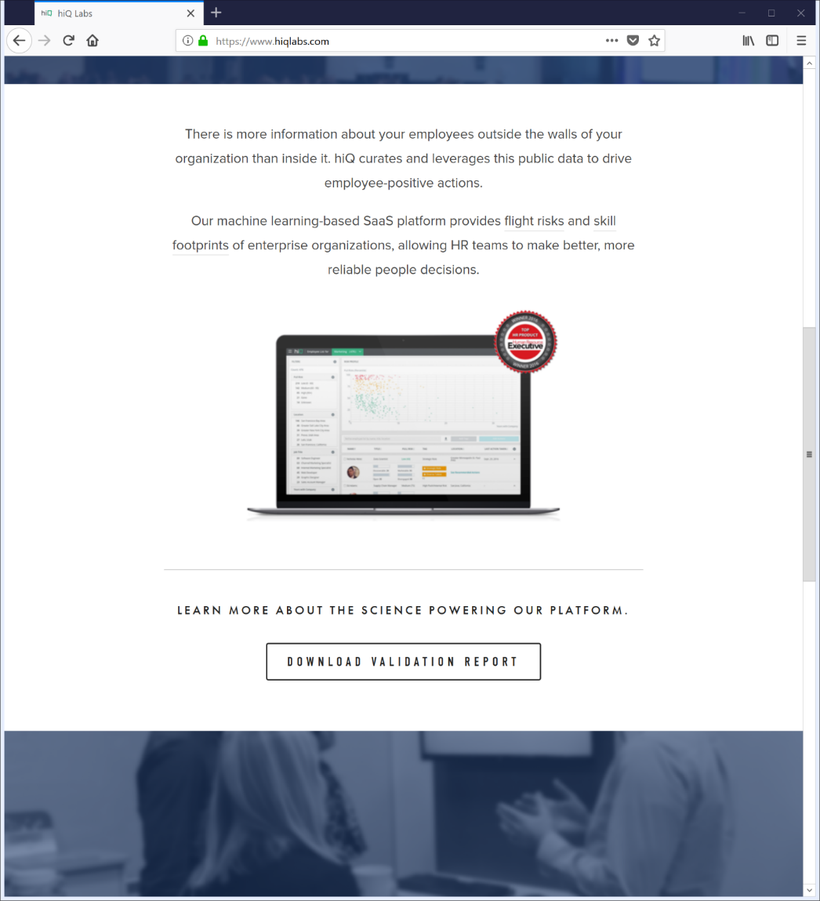
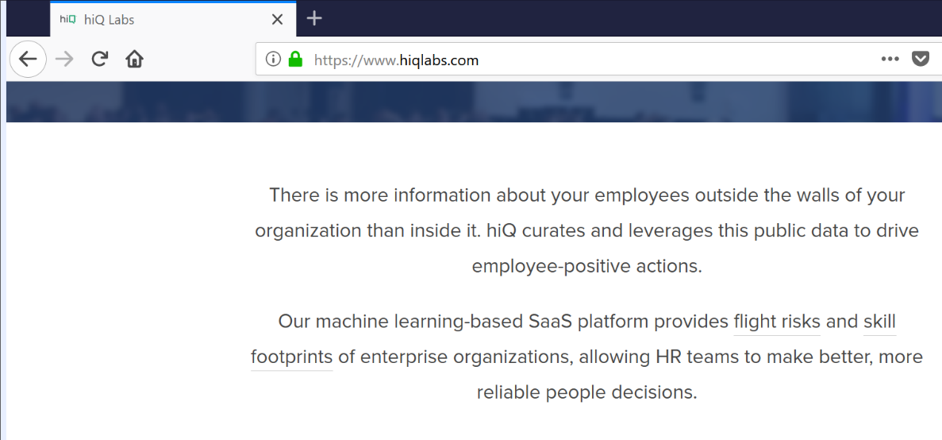
What Does (Did?) hiQ Do?
Finding hiQ (24 Sept 2019)

Slide 80
Stop It!
LinkedIn Cease & Desist Letter (23 May 2017)

Slide 81
hiQ is Scraping and Knows it
LinkedIn Cease & Desist Letter (23 May 2017)

Slide 82
Scraping Violates LI User Agreement
LinkedIn Cease & Desist Letter (23 May 2017)

Slide 83
Detailed Violations
LinkedIn Cease & Desist Letter (23 May 2017)

Slide 84
LinkedIn’s Demands
LinkedIn Cease & Desist Letter (23 May 2017)

Slide 85
Responding to the Letter
TTYN
Setup
You are hiQ and the cease-and-desist letter appears
How do you respond? Is that a business response? A legal response?

Slide 86
Suing LinkedIn
hiQ Complaint (7 June 2017)

Slide 87
Declaratory Judgment Action
hiQ Complaint (7 June 2017)

Slide 88
The Cease-and-Desist Letter
hiQ Complaint (7 June 2017)

Slide 89
Anticompetitive Motives
hiQ Complaint (7 June 2017)

Slide 90
Relief Sought
hiQ Complaint (7 June 2017)

Slide 91
The Preliminary Injunction: Setting the Status Quo During the Lawsuit
FRCP 65

Slide 92
Situating the Dispute
TTYN (1 of 4)
Hypo 1
CEO of hiQ breaks into home of the CEO of LinkedIn to gain access to a document containing wholly public information
hiQ then uses that information in its business
hiQ may have entered into contracts to deliver that information
Legal liability?

Slide 93
Situating the Dispute
TTYN (2 of 4)
Hypo 2
LinkedIn posts no public information but has it stored on its internal computer systems
An employee of hiQ uses fancy computer means to hack into the LinkedIn computers
hiQ then uses that information in its business/contracts
Legal liability?

Slide 94
Situating the Dispute
TTYN (3 of 4)
Hypo 3
LinkedIn posts information from its customers on the Internet
LinkedIn announces that its information is freely downloadable by the public (but not competitors)
hiQ does so and then uses that information in its business/contracts
Legal liability?

Slide 95
Key Questions in hiQ
TTYN (4 of 4)
Questions
Is this case different than AP v. INS? If so, in what ways?
What should LinkedIn do going forward? If LinkedIn could reverse time, what should it have done originally?

Slide 96
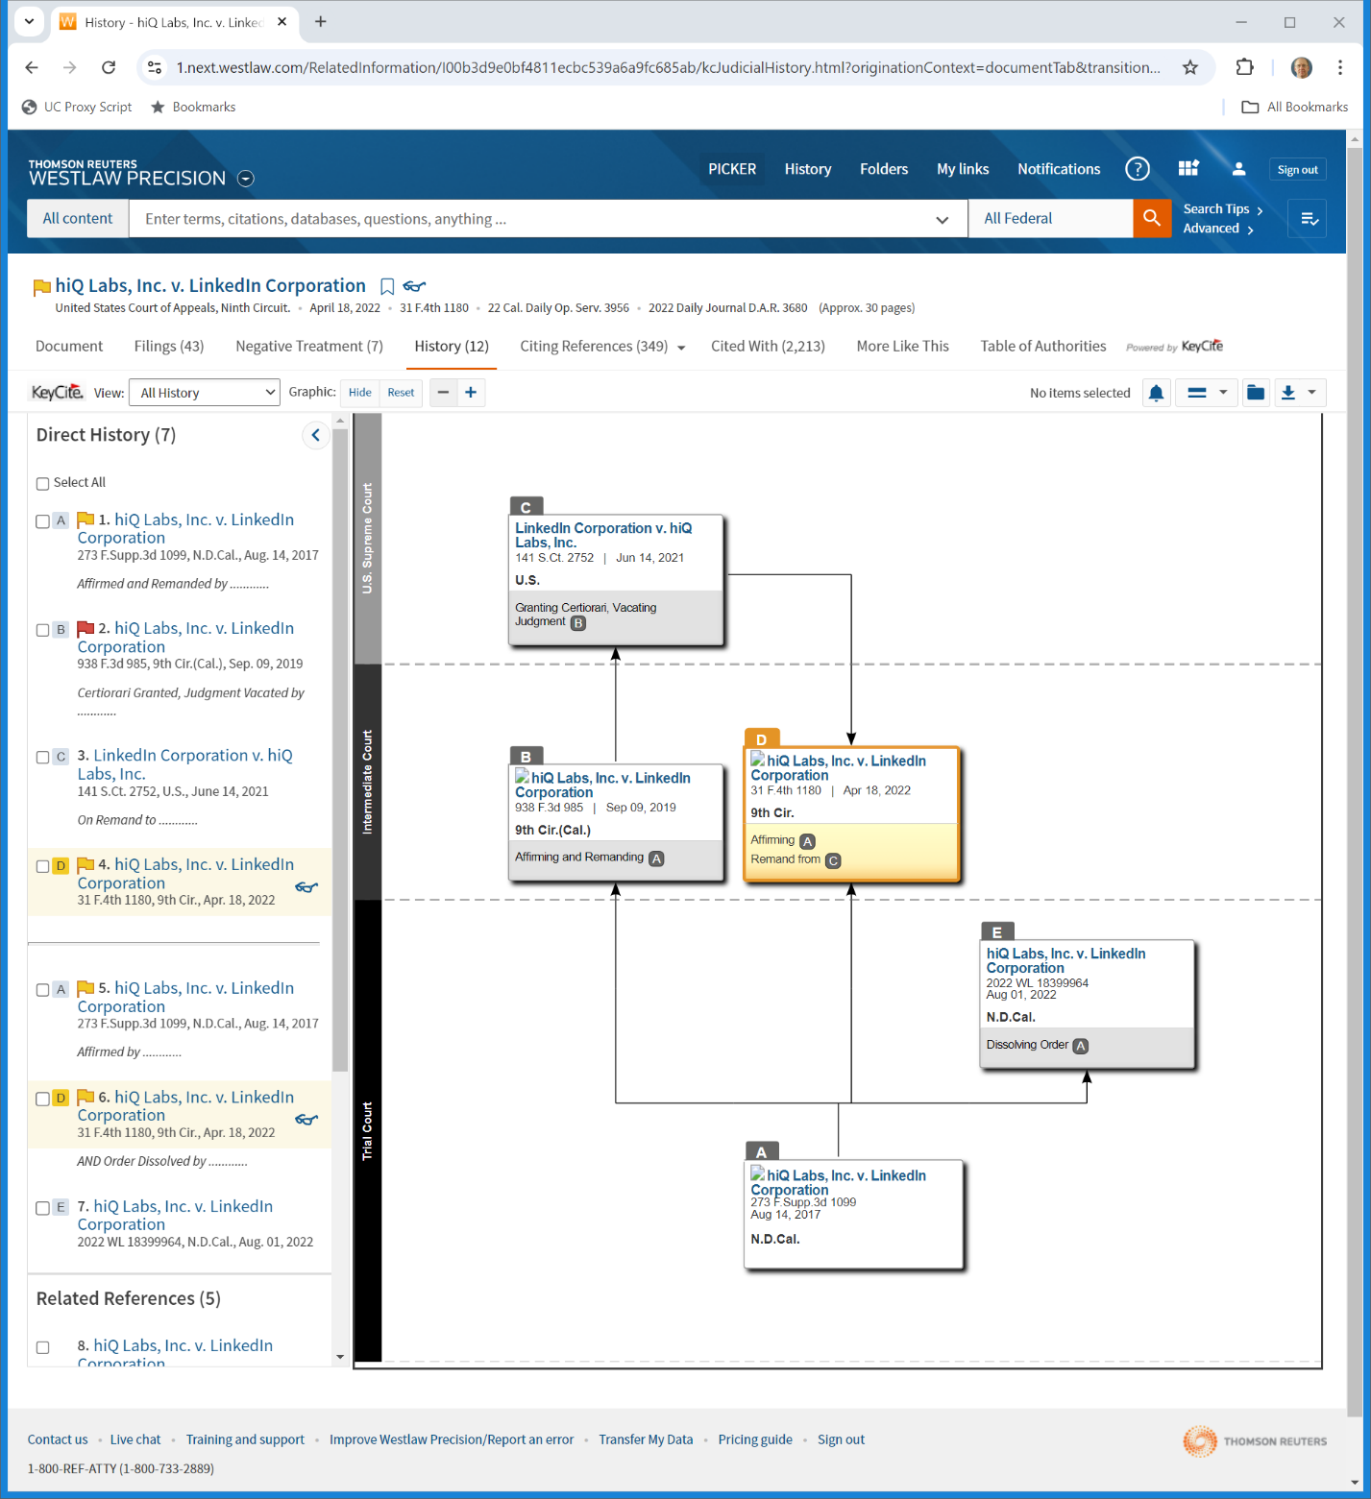
hiQ Case Path
Westlaw Search (25 Sept 2024)

Slide 97
HiQ v LinkedIn (CA9 2022)
31 F.4th 1180 (9th Cir. 2022)

Slide 98
CA9 Lawyers
HiQ (9th Cir. 2022)

Slide 99
Legal Standard for Preliminary Injunction
“‘A plaintiff seeking a preliminary injunction must establish that he is likely to succeed on the merits, that he is likely to suffer irreparable harm in the absence of preliminary relief, that the balance of equities tips in his favor, and that an injunction is in the public interest.” Winter v. Nat. Res. Def. Council, Inc., 555 U.S. 7, 20 (2008). All four elements must be satisfied.”
HiQ (9th Cir. 2022)

Slide 100
Legal Standard for Preliminary Injunction
“… We use a ‘sliding scale’ approach to these factors, according to which “a stronger showing of one element may offset a weaker showing of another.” Alliance for the Wild Rockies v. Cottrell, 632 F.3d 1127, 1131 (9th Cir. 2011). So, when the balance of hardships tips sharply in the plaintiff’s favor, the plaintiff need demonstrate only “serious questions going to the merits.” Id. at 1135.”
HiQ (9th Cir. 2022)

Slide 101
Standard of Review in Appeals Court
“We review the district court’s decision to grant a preliminary injunction for abuse of discretion. The grant of a preliminary injunction constitutes an abuse of discretion if the district court’s evaluation or balancing of the pertinent factors is “illogical, implausible, or without support in the record.” Doe v. Kelly, 878 F.3d 710, 713 (9th Cir. 2017).”
HiQ (9th Cir. 2022)

Slide 102
Tortious Interference with Contract
“HiQ alleges that LinkedIn intentionally interfered with hiQ’s contracts with third parties. ‘The elements which a plaintiff must plead to state the cause of action for intentional interference with contractual relations are (1) a valid contract between plaintiff and a third party; (2) defendant’s knowledge of this contract; (3) defendant’s intentional acts designed to induce a breach or disruption of the contractual relationship; (4) actual breach or disruption of the contractual relationship; and (5) resulting damage.’ Pac. Gas & Elec. Co. v. Bear Stearns & Co., 50 Cal. 3d 1118, 1126 (1990).”
HiQ (9th Cir. 2022)

Slide 103
Balancing Test
“Accordingly, California courts apply a balancing test to determine whether the interests advanced by interference with contract outweigh the societal interest in contractual stability: Whether an intentional interference by a third party is justifiable depends upon a balancing of the importance, social and private, of the objective advanced by the interference against the importance of the interest interfered with, considering all circumstances including the nature of the actor’s conduct and the relationship between the parties. Herron v. State Farm Mut. Ins. Co., 56 Cal. 2d 202, 206 (1961).”
HiQ (9th Cir. 2022)

Slide 104
Controlling Information Monopolists?
“We agree with the district court that giving companies like LinkedIn free rein to decide, on any basis, who can collect and use data—data that the companies do not own, that they otherwise make publicly available to viewers, and that the companies themselves collect and use—risks the possible creation of information monopolies that would disserve the public interest.”
HiQ (9th Cir. 2022)

Slide 105
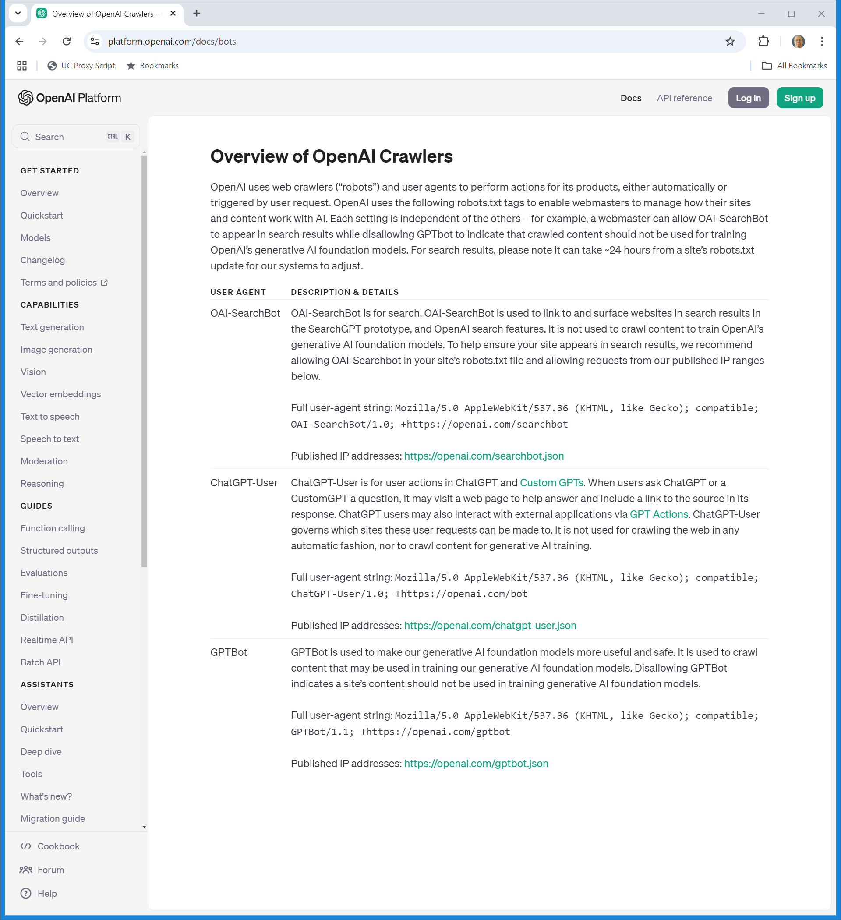
AI Training Data and Scraping
OpenAI (Visited 2 Oct 2024)
Notes:
https://platform.openai.com/docs/bots

Slide 106
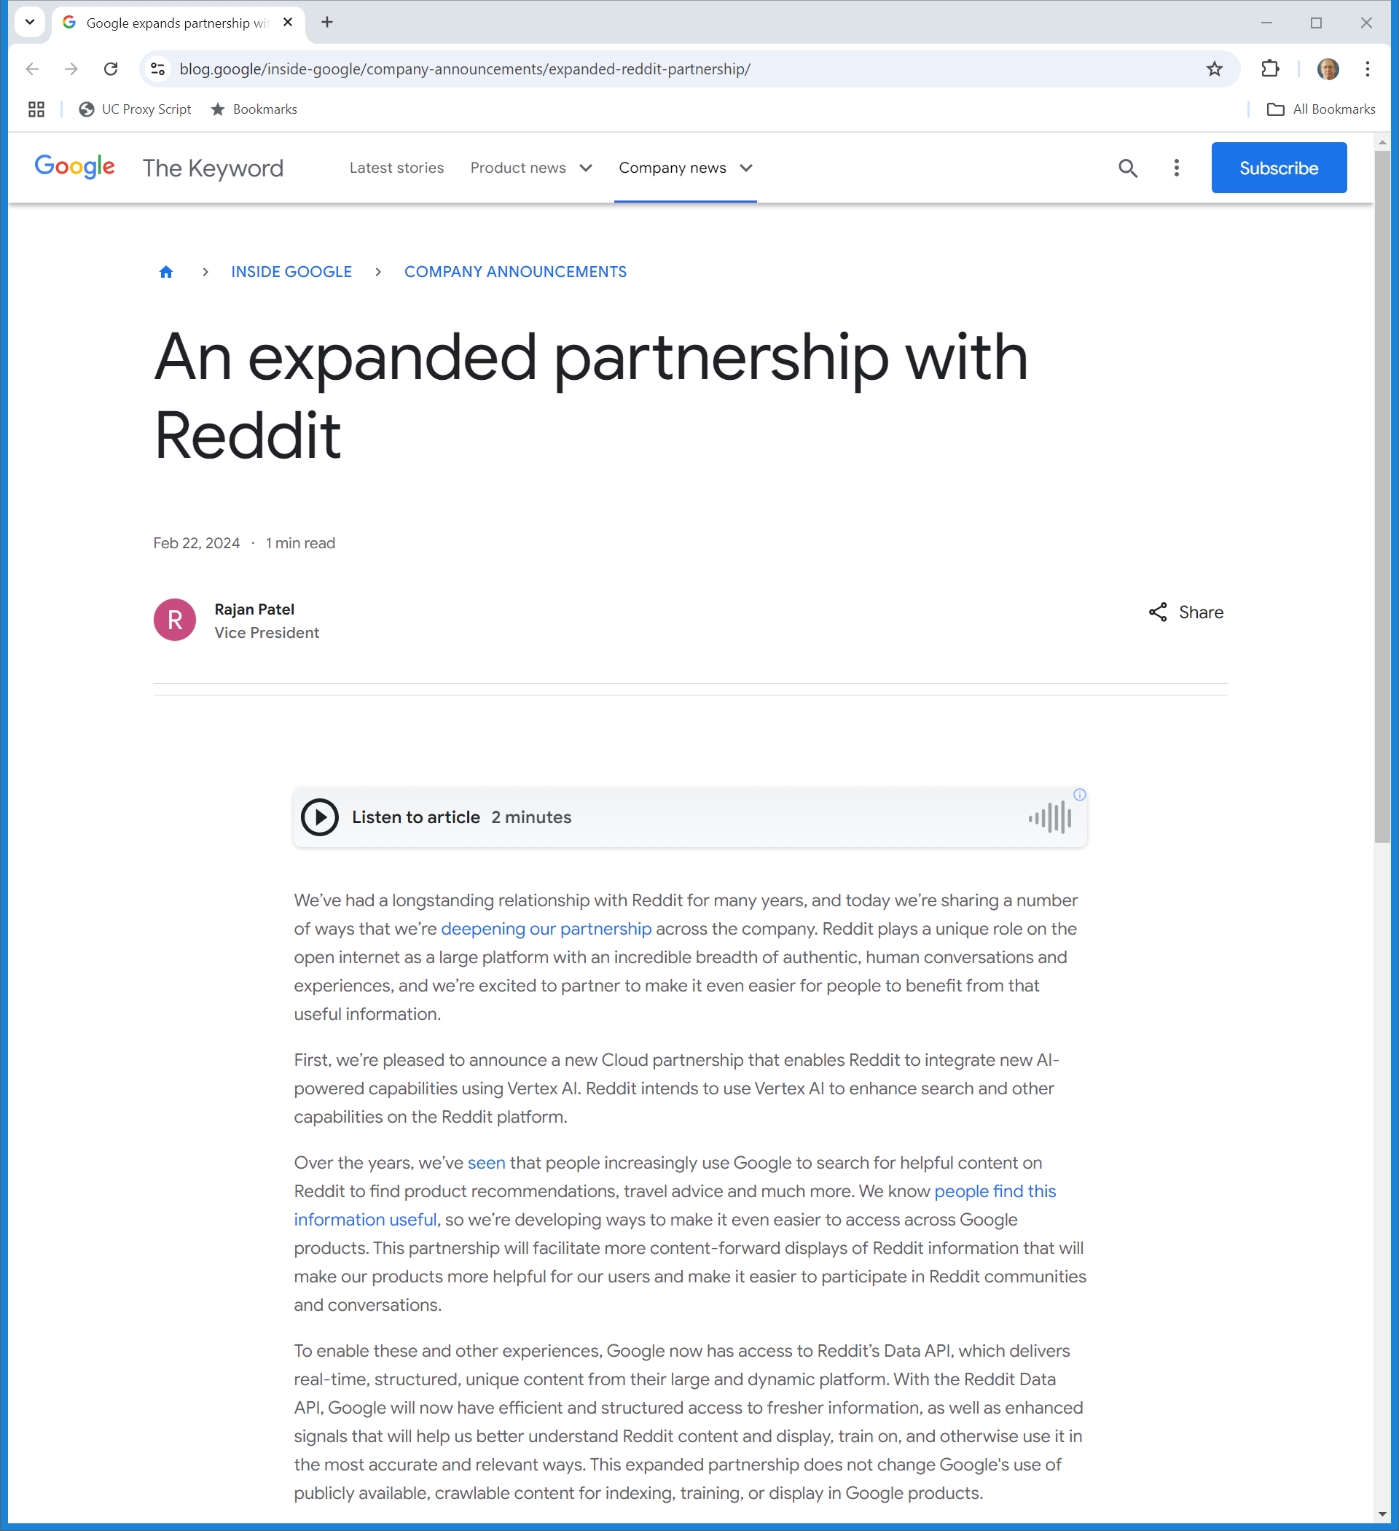
Google Deal With Reddit
Google (22 Feb 2024)
Notes:
https://blog.google/inside-google/company-announcements/expanded-reddit-partnership/

Slide 107
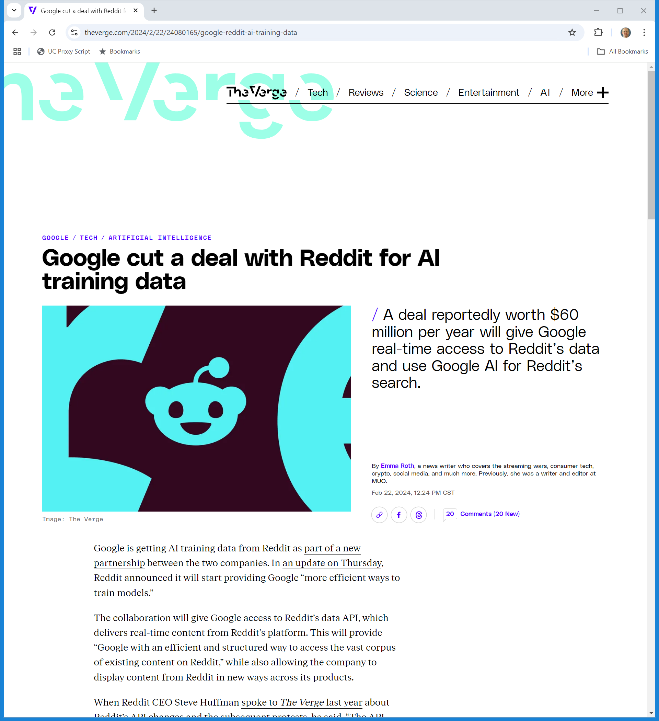
$60 Million Per Year?
The Verge (22 Feb 2024)
Notes:
https://www.theverge.com/2024/2/22/24080165/google-reddit-ai-training-data

Slide 108
Contracts
Contracts

Slide 109
UCC 2-204. Formation in General
(1)
A contract for sale of goods may be made in any manner sufficient to show agreement, including conduct by both parties which recognizes the existence of such a contract.

Slide 110
2-207. Additional Terms in Acceptance or Confirmation.
(1)
A definite and seasonable expression of acceptance or a written confirmation which is sent within a reasonable time operates as an acceptance even though it states terms additional to or different from those offered or agreed upon, unless acceptance is expressly made conditional on assent to the additional or different terms.

Slide 111
2-207. Additional Terms in Acceptance or Confirmation.
(2)
The additional terms are to be construed as proposals for addition to the contract. Between merchants such terms become part of the contract unless:
(a) the offer expressly limits acceptance to the terms of the offer;

Slide 112
Contract Formation
Three Choices
Clickwrap: you can’t get to the site without clicking on a yes
Intrusive: see Ft.com (next slide)
www.barnesandnoble.com
What would you expect that to address? What are the key terms?

Slide 113

Online Clickthrus
The Financial Times

Slide 114
Making Contracts at StubHub
StubHub (9th Cir. 9 Aug 2023)

