Slide 1
Class 26: Thurs 30 Nov 2023
Copyright Fall 2023
AI
Randal C. Picker
James Parker Hall Distinguished Service Professor of Law
The Law School
The University of Chicago

Slide 2
Human Mind Eclipsed
LA Times (21 Oct 1927)

Slide 3
ENIAC: Electronic Numerical Integrator and Computer
Chicago Daily Tribune (15 Feb 1946)

Slide 4
ENIAC: Electronic Numerical Integrator and Computer
Chicago Daily Tribune (15 Feb 1946)

Slide 5
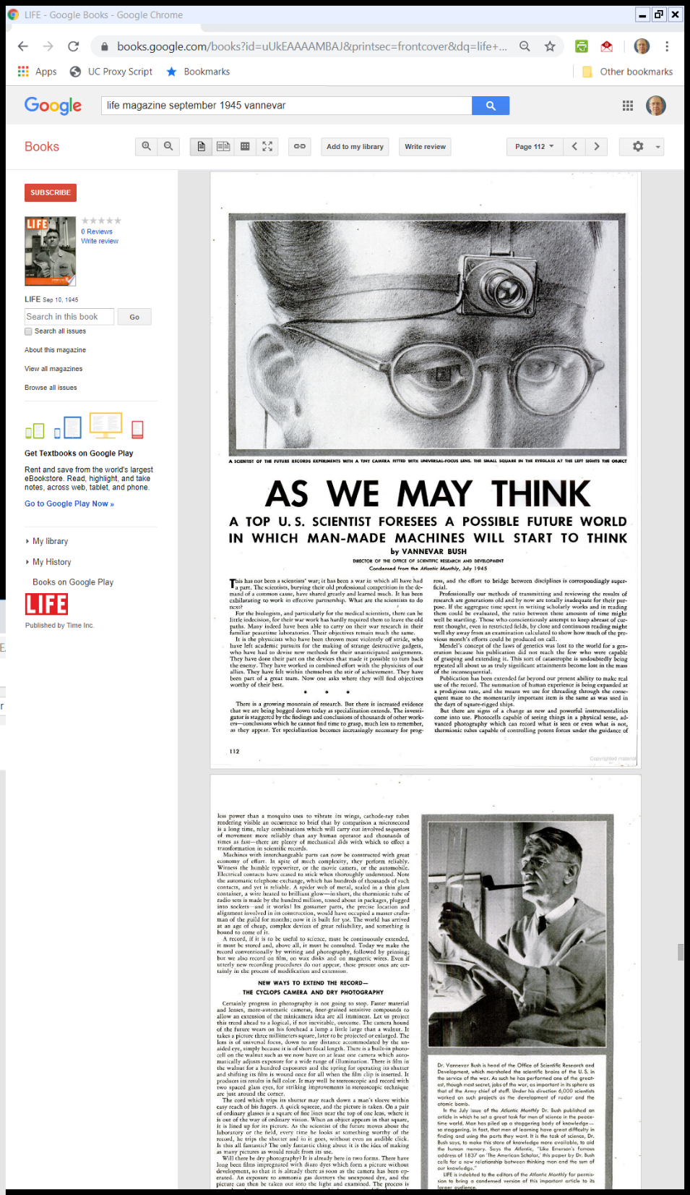
Vannevar Bush Memex
Life Magazine (10 Sept 1945)

Slide 6
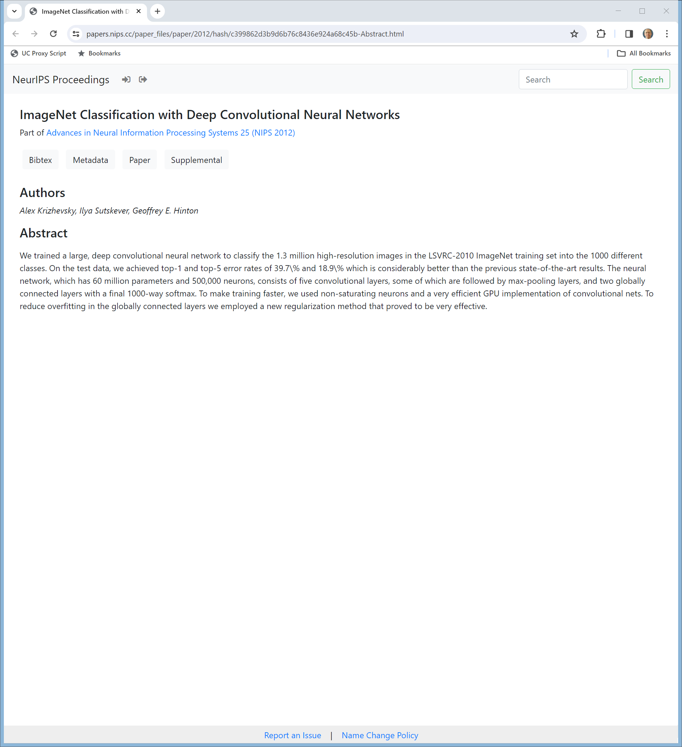
Neural Information Processing Systems Conf, Dec 3-5, 2012
Krizhevsky et al (2012)
Notes:
https://papers.nips.cc/paper_files/paper/2012/hash/c399862d3b9d6b76c8436e924a68c45b-Abstract.html

Slide 7
9 Page Paper
Krizhehsky et al (2012)
Notes:
https://papers.nips.cc/paper_files/paper/2012/file/c399862d3b9d6b76c8436e924a68c45b-Paper.pdf

Slide 8
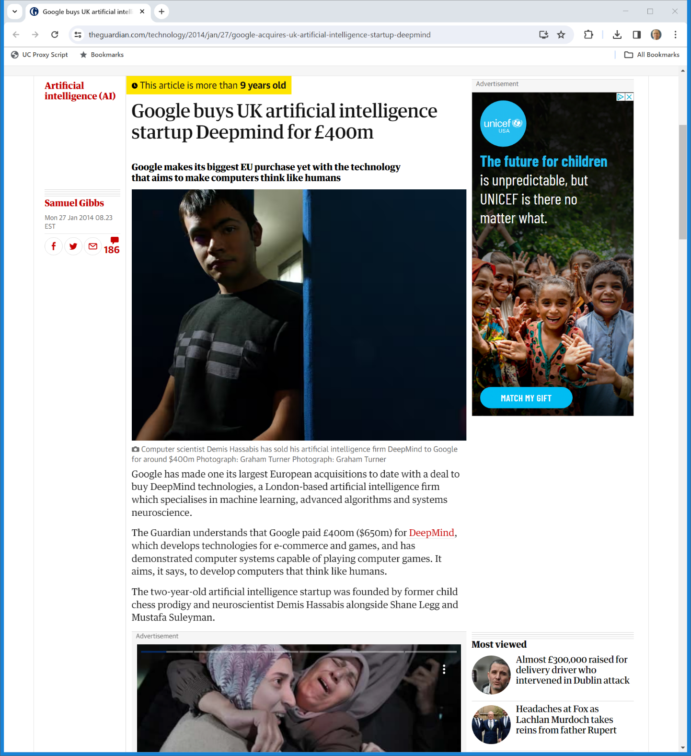

Jan 2014: Google Buys Deepmind
The Guardian (27 Jan 2014)

Slide 9
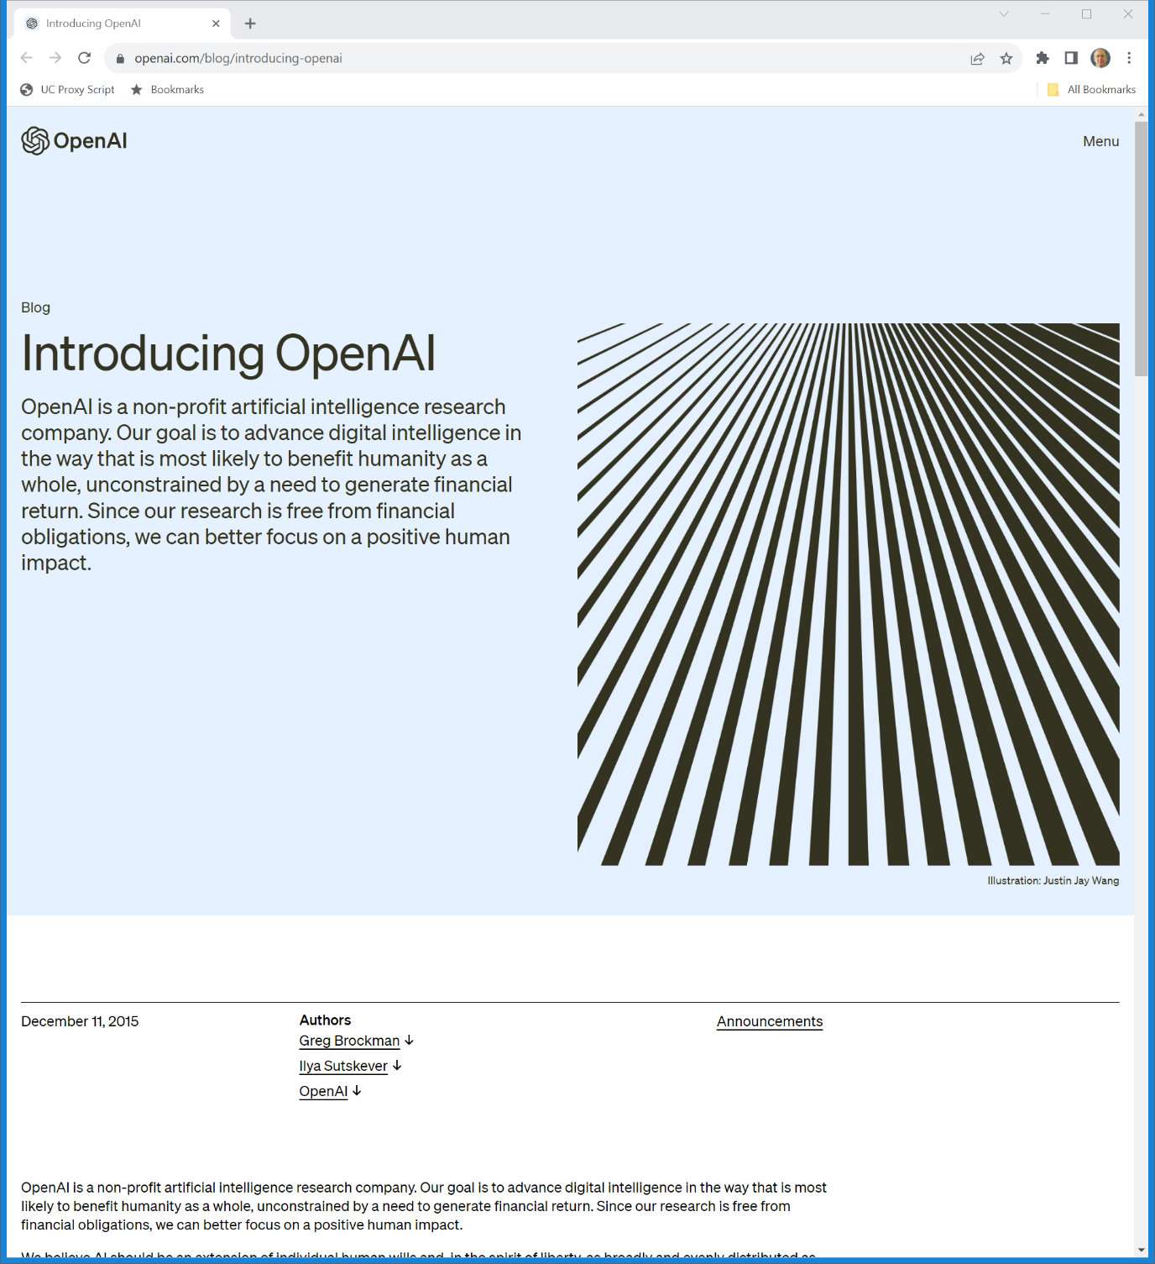
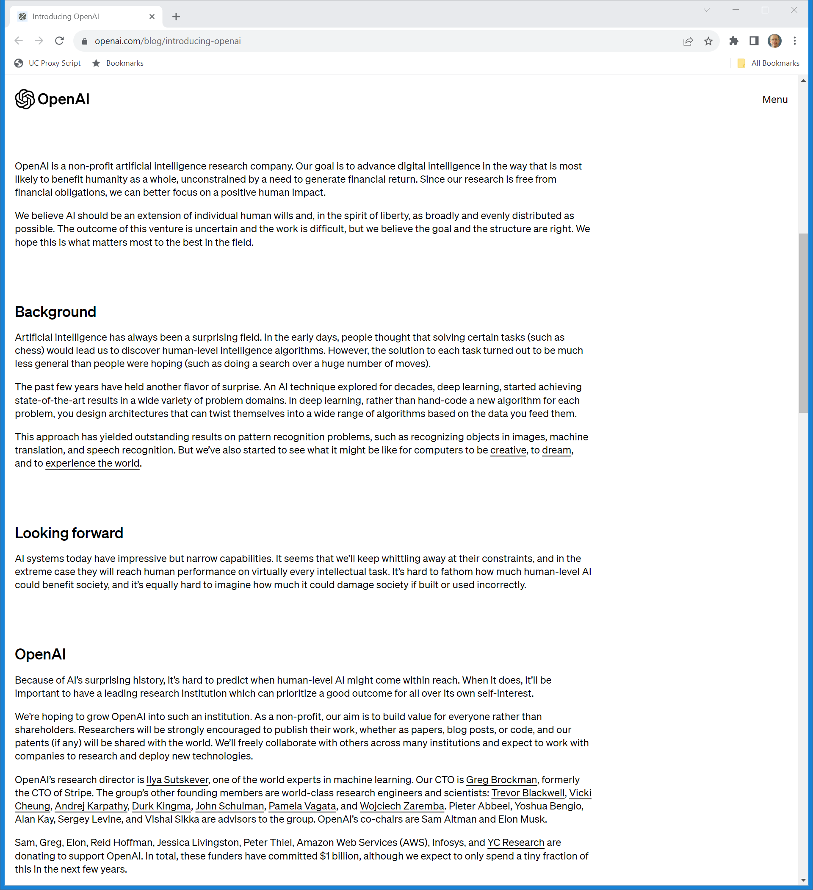
Dec 2015: OpenAI
OpenAI (11 Dec 2015)
Notes:
https://openai.com/blog/introducing-openai

Slide 10
Dec 2015: OpenAI
OpenAI (11 Dec 2015)
Notes:
https://openai.com/blog/introducing-openai

Slide 11
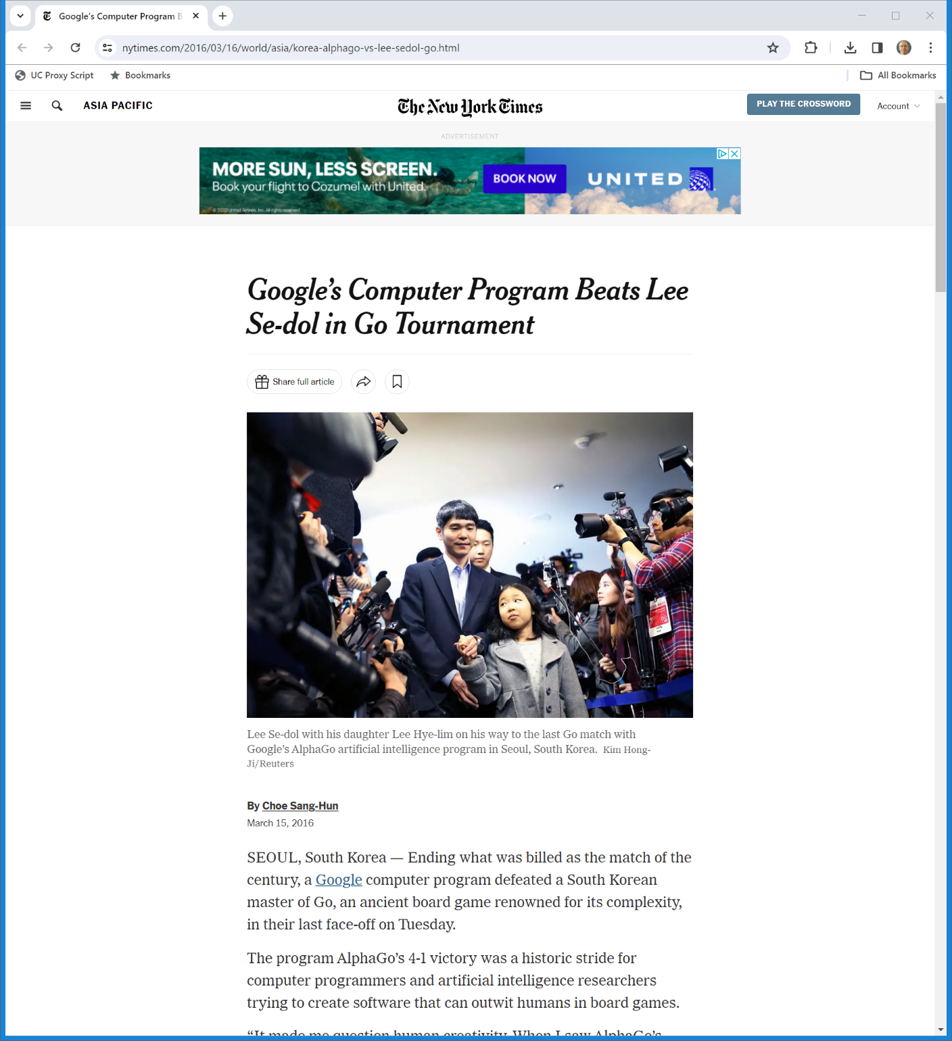
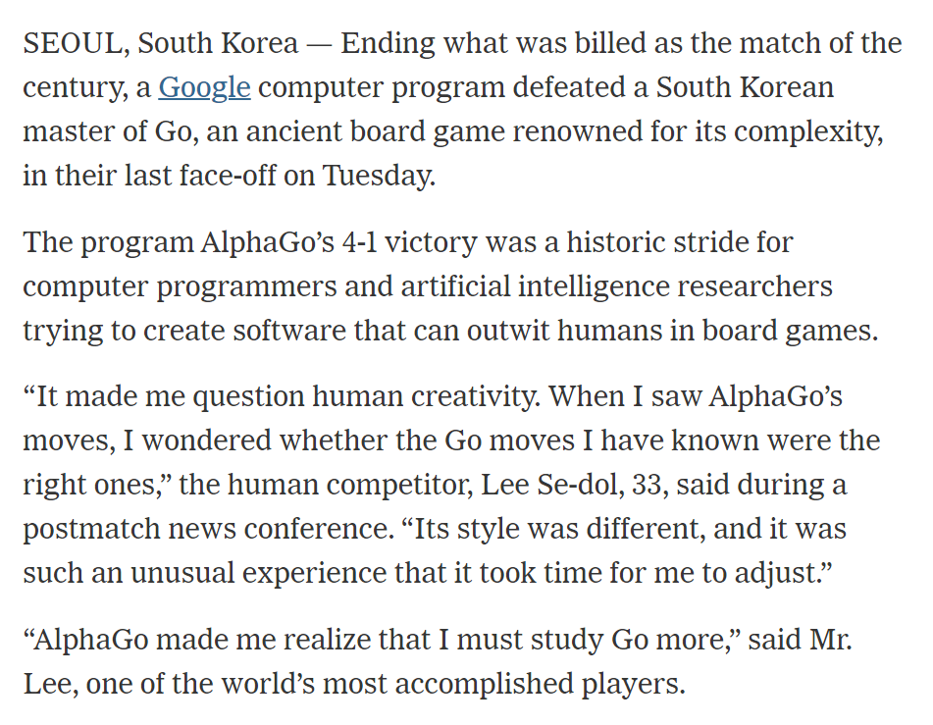
AlphaGo Wins
New York Times (15 Mar 2016)
Notes:
https://www.nytimes.com/2016/03/16/world/asia/korea-alphago-vs-lee-sedol-go.html

Slide 12
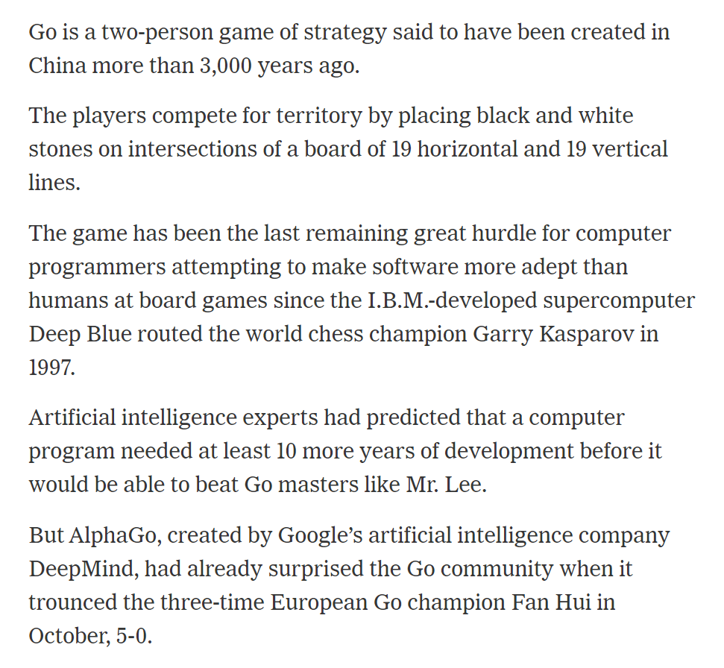
Unexpectedly
New York Times (15 Mar 2016)
Notes:
https://www.nytimes.com/2016/03/16/world/asia/korea-alphago-vs-lee-sedol-go.html

Slide 13
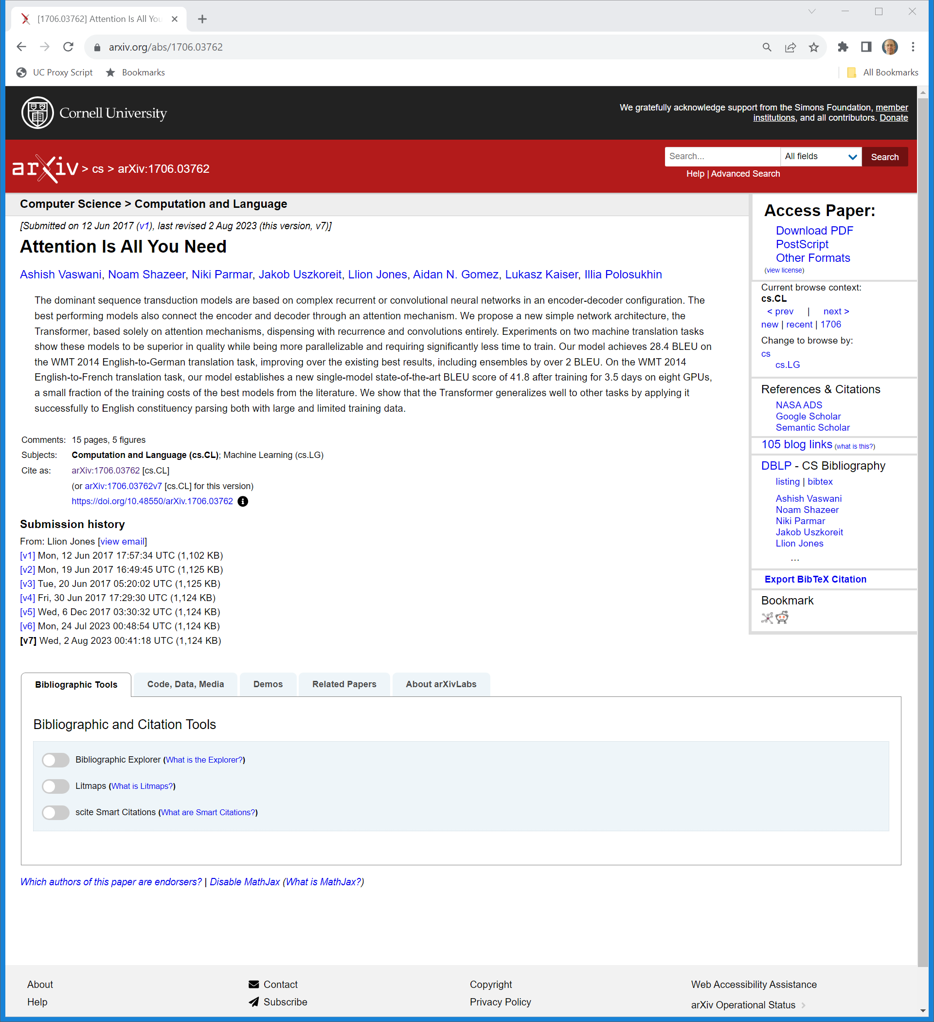
June 2017: Transformer Models
Arxiv.org (Visited 8 Nov 2023)

Slide 14
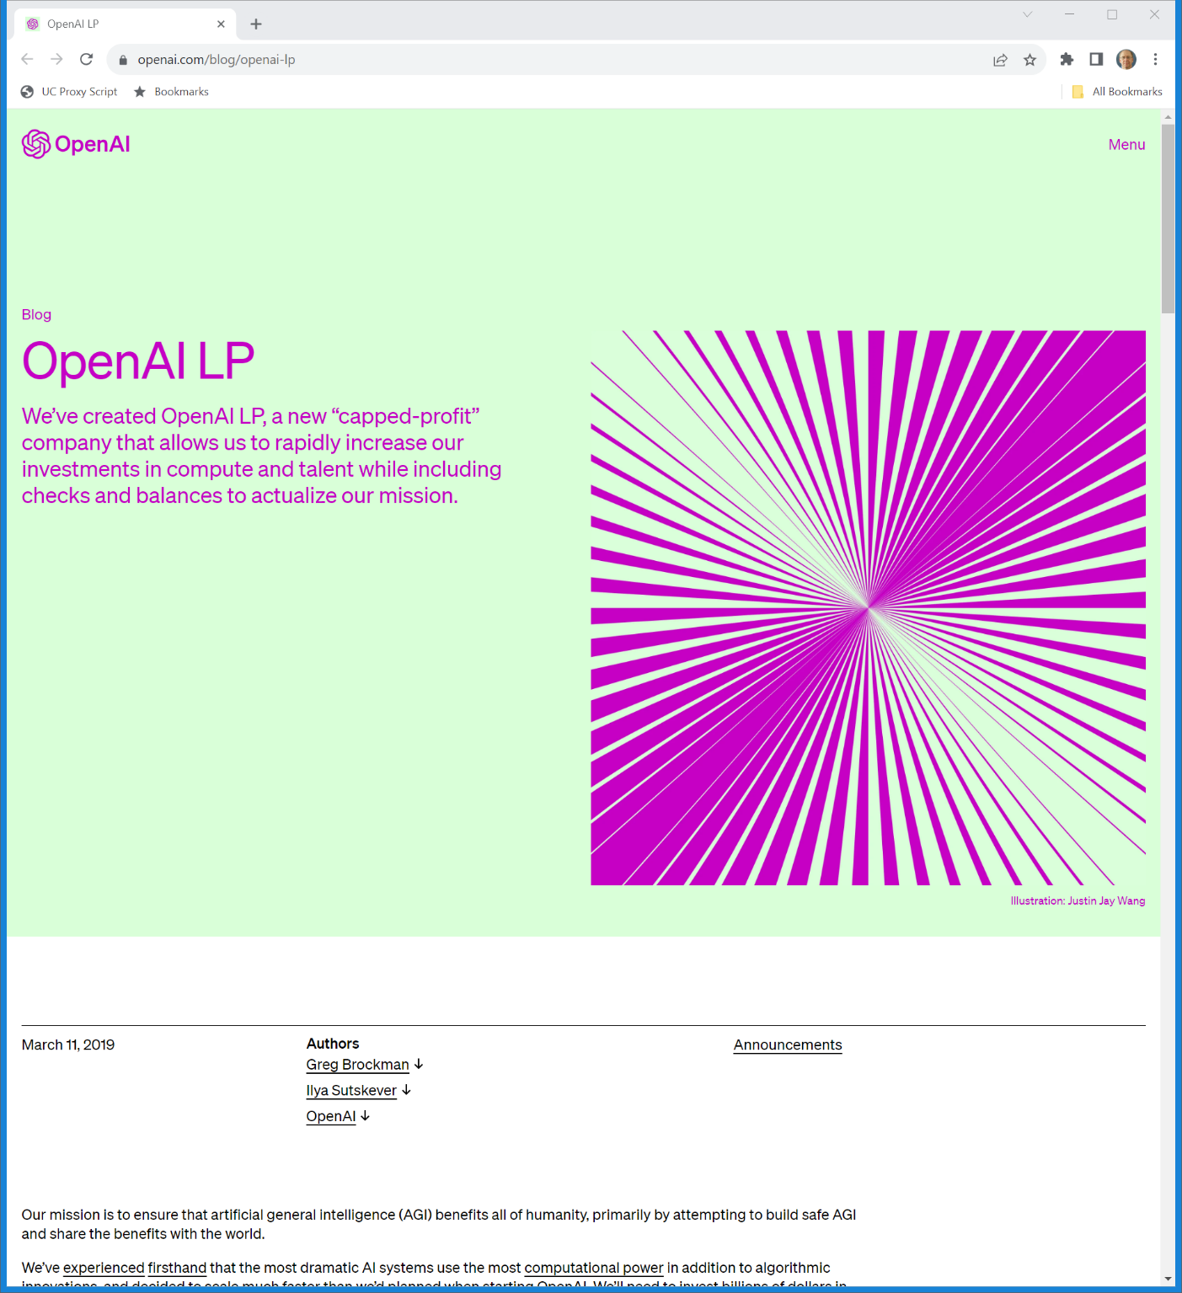
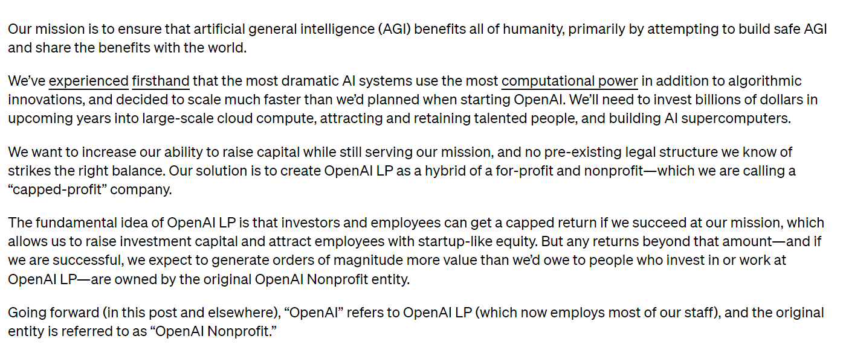
Mar 2019: Capped Profit Model
OpenAI (11 Mar 2019)
Notes:
https://openai.com/blog/openai-lp

Slide 15
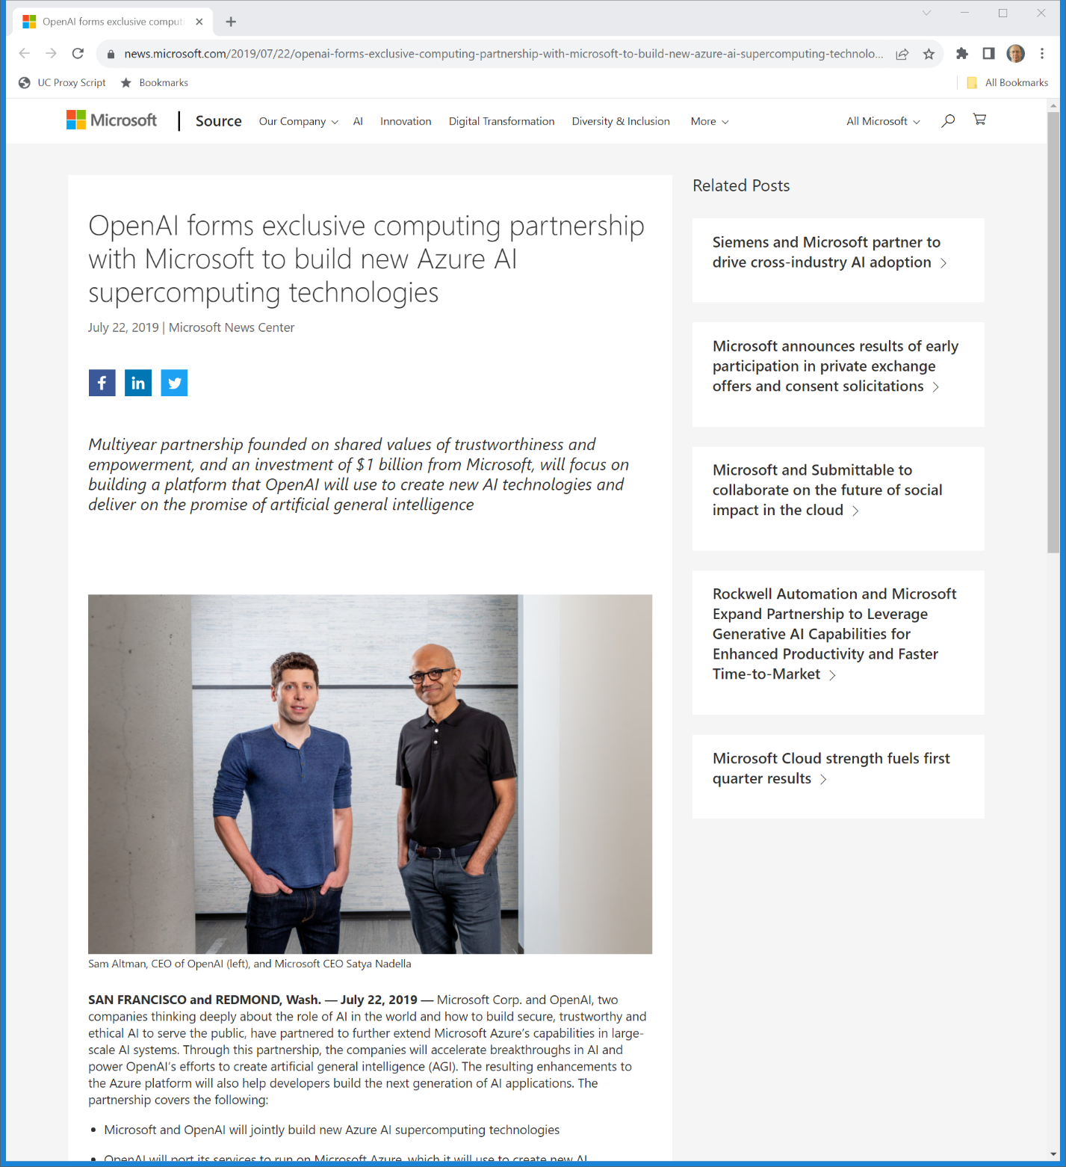
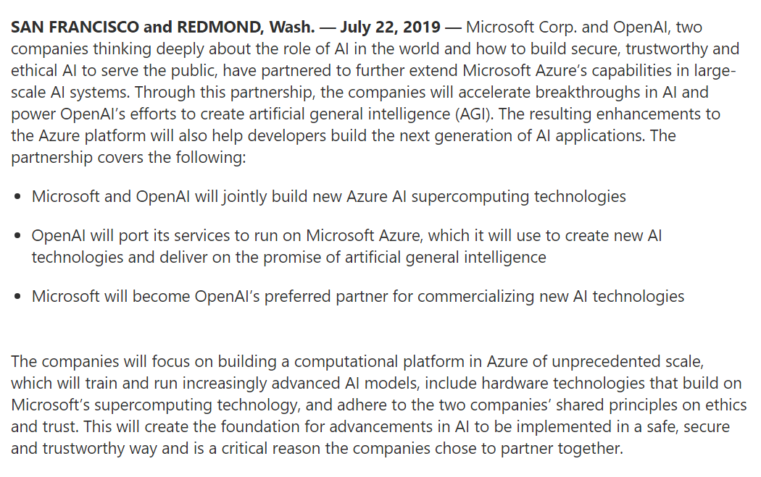
July 2019: Microsoft Investment
Microsoft (22 July 2019)
Notes:
https://news.microsoft.com/2019/07/22/openai-forms-exclusive-computing-partnership-with-microsoft-to-build-new-azure-ai-supercomputing-technologies/

Slide 16
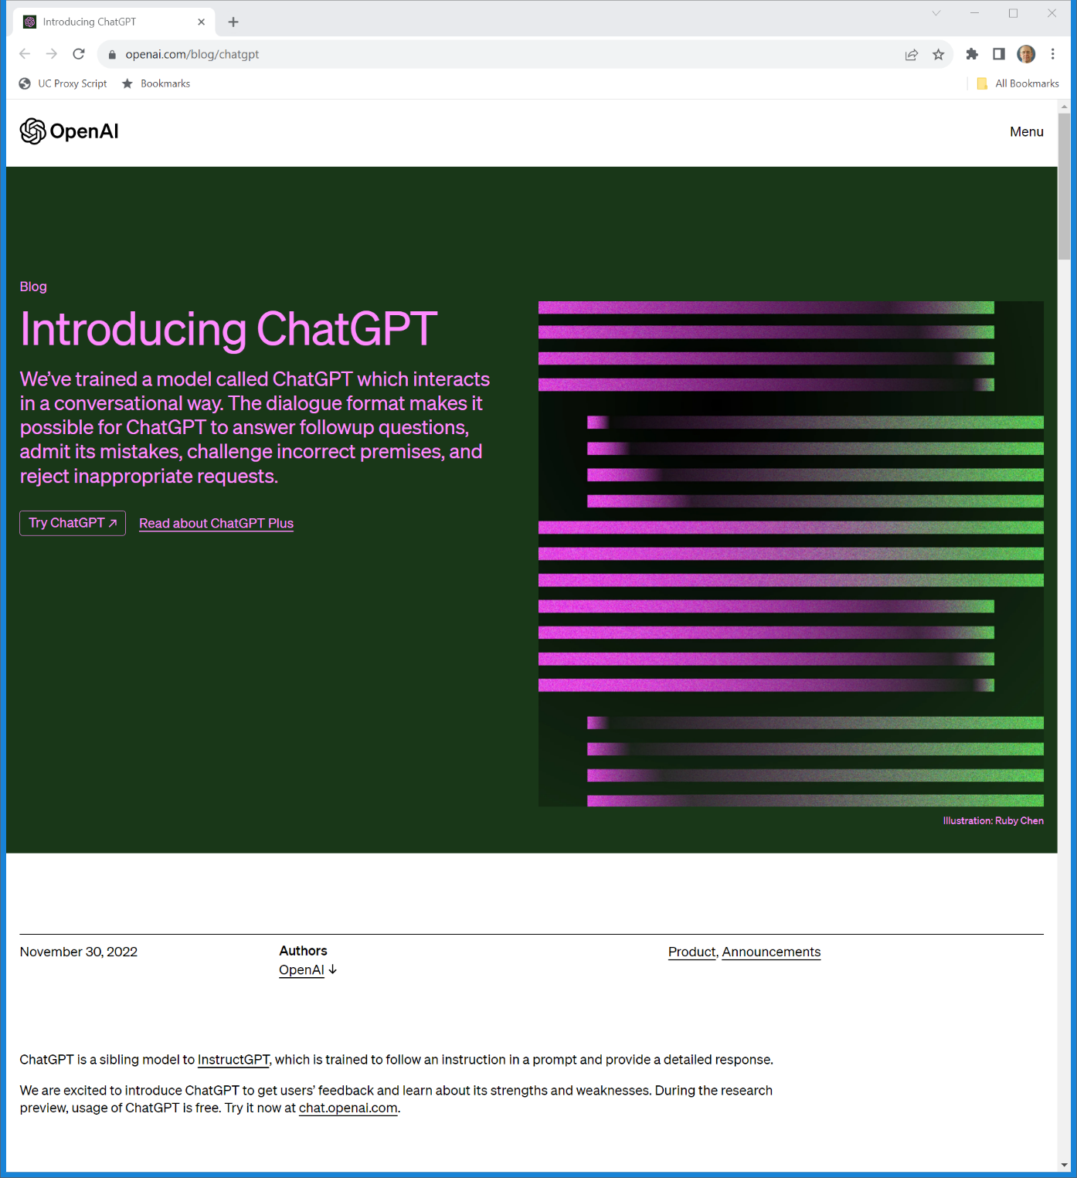
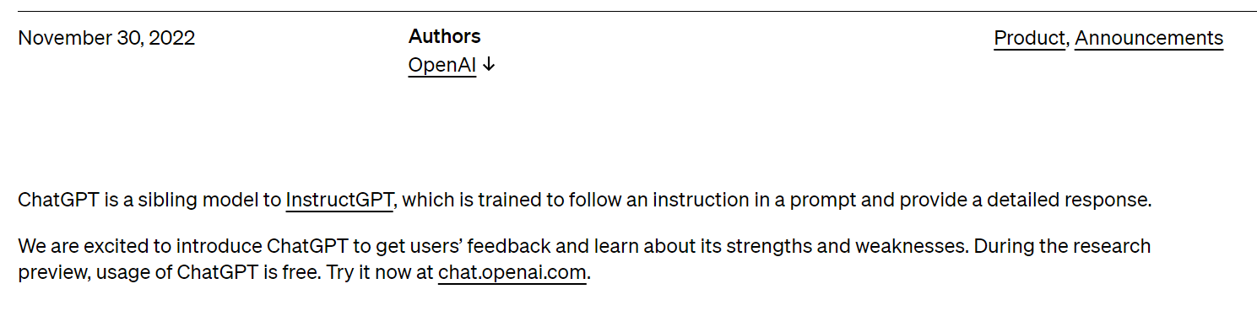
30 Nov 2022: ChatGPT
OpenAI (30 Nov 2022)
Notes:
https://openai.com/blog/chatgpt

Slide 17
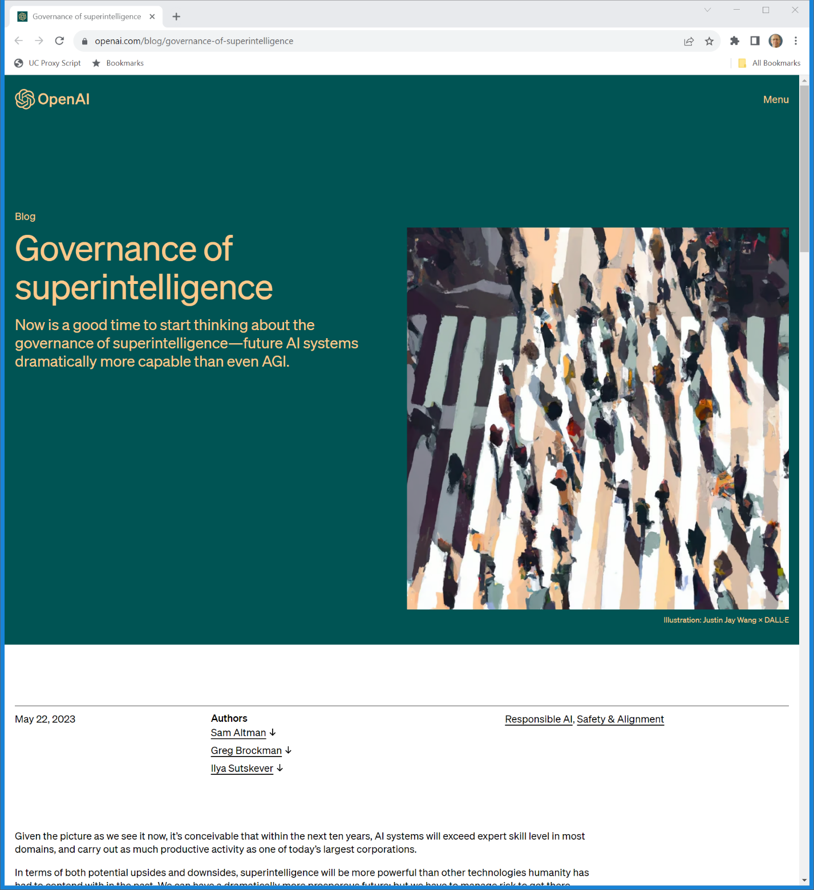
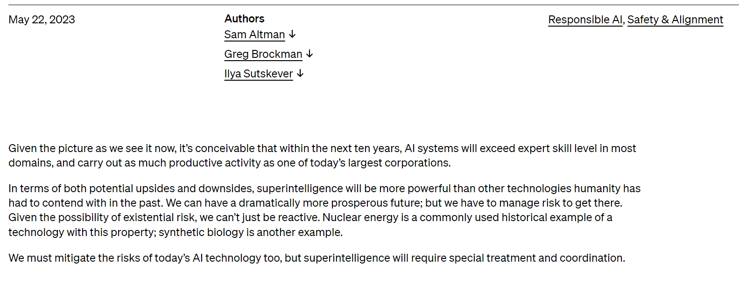
May 2023: Governing Superintelligence
OpenAI (22 May 2023)
Notes:
https://openai.com/blog/governance-of-superintelligence

Slide 18
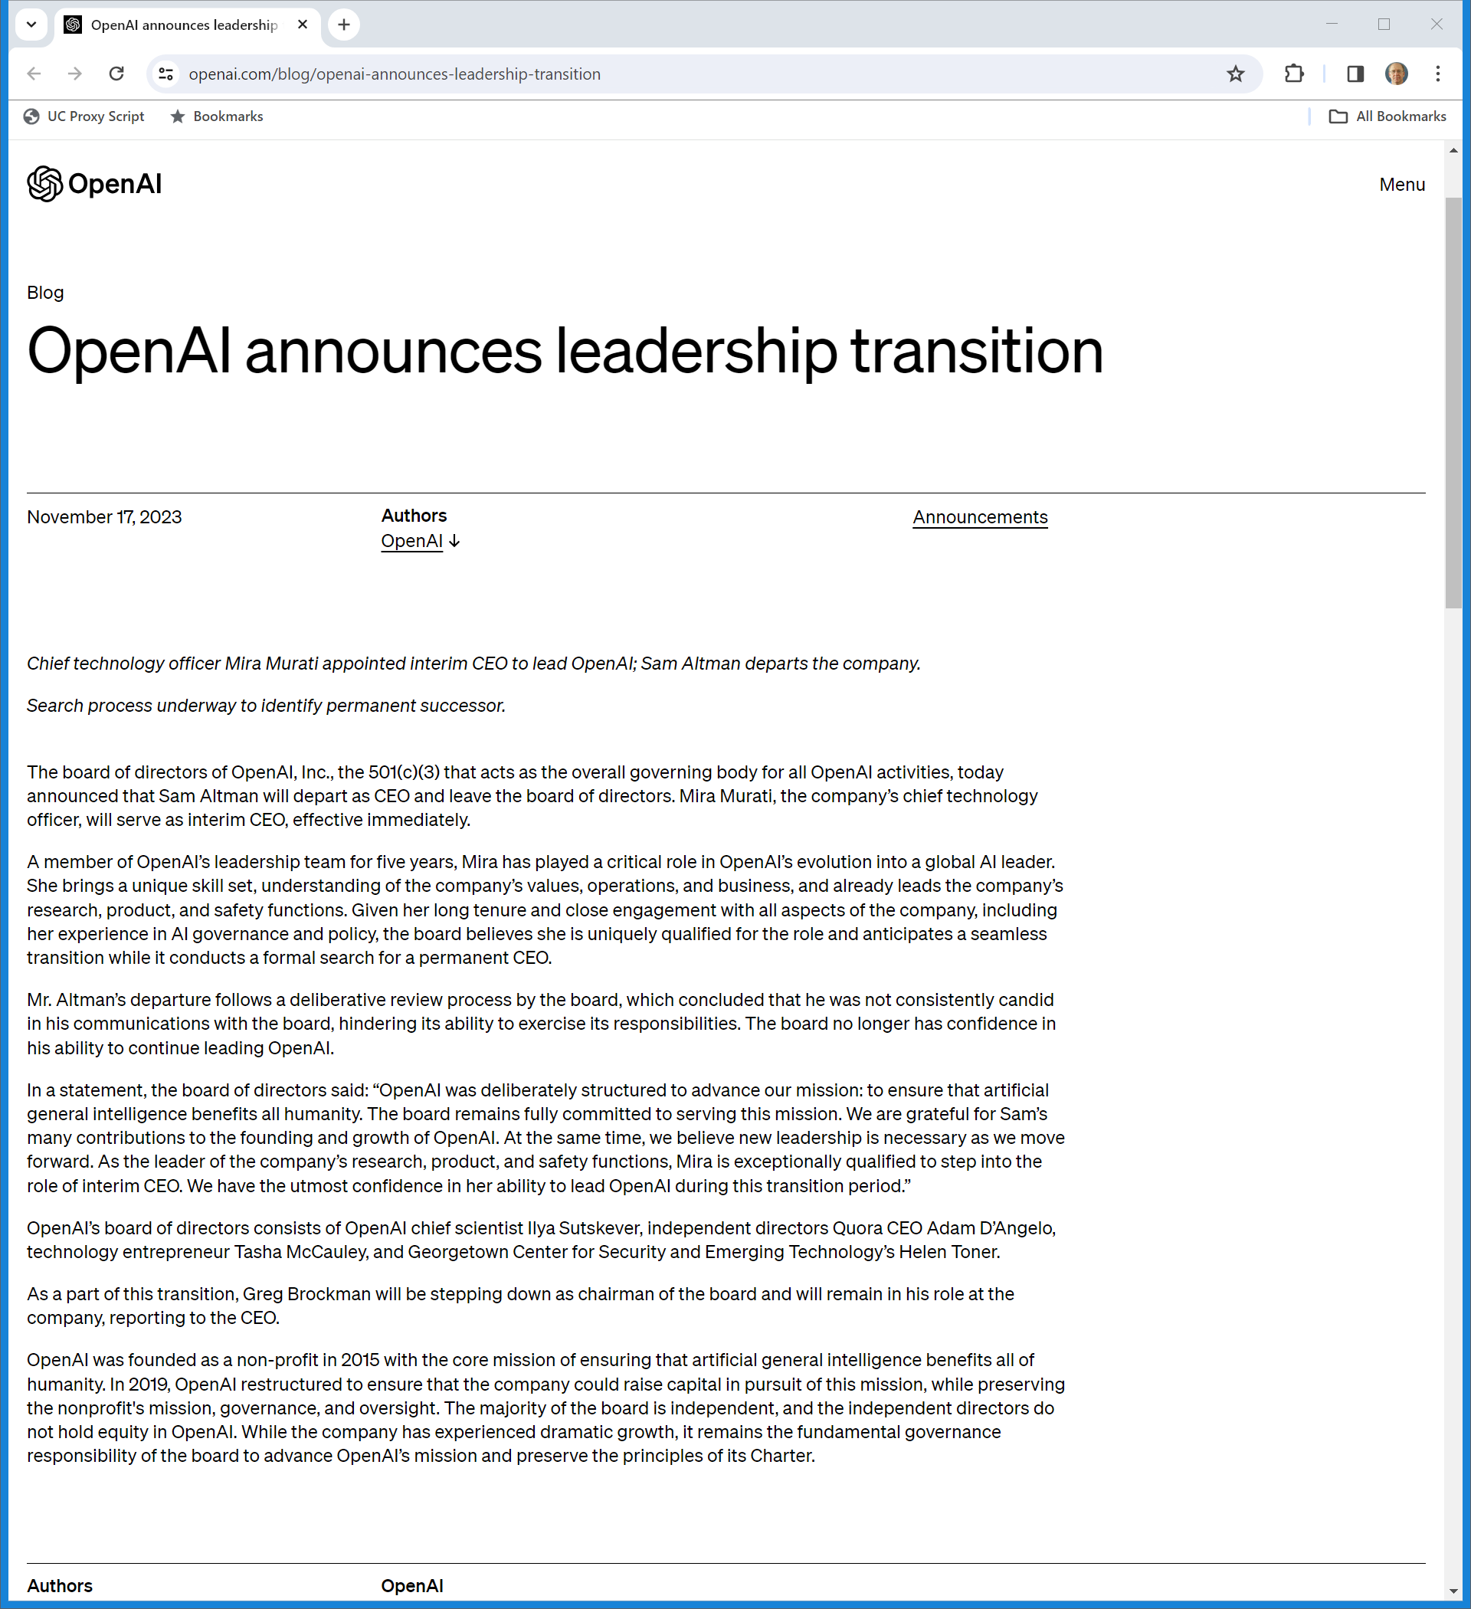
17 Nov 2023: Altman Out
OpenAI (17 Nov 2023)
Notes:
https://openai.com/blog/openai-announces-leadership-transition

Slide 19
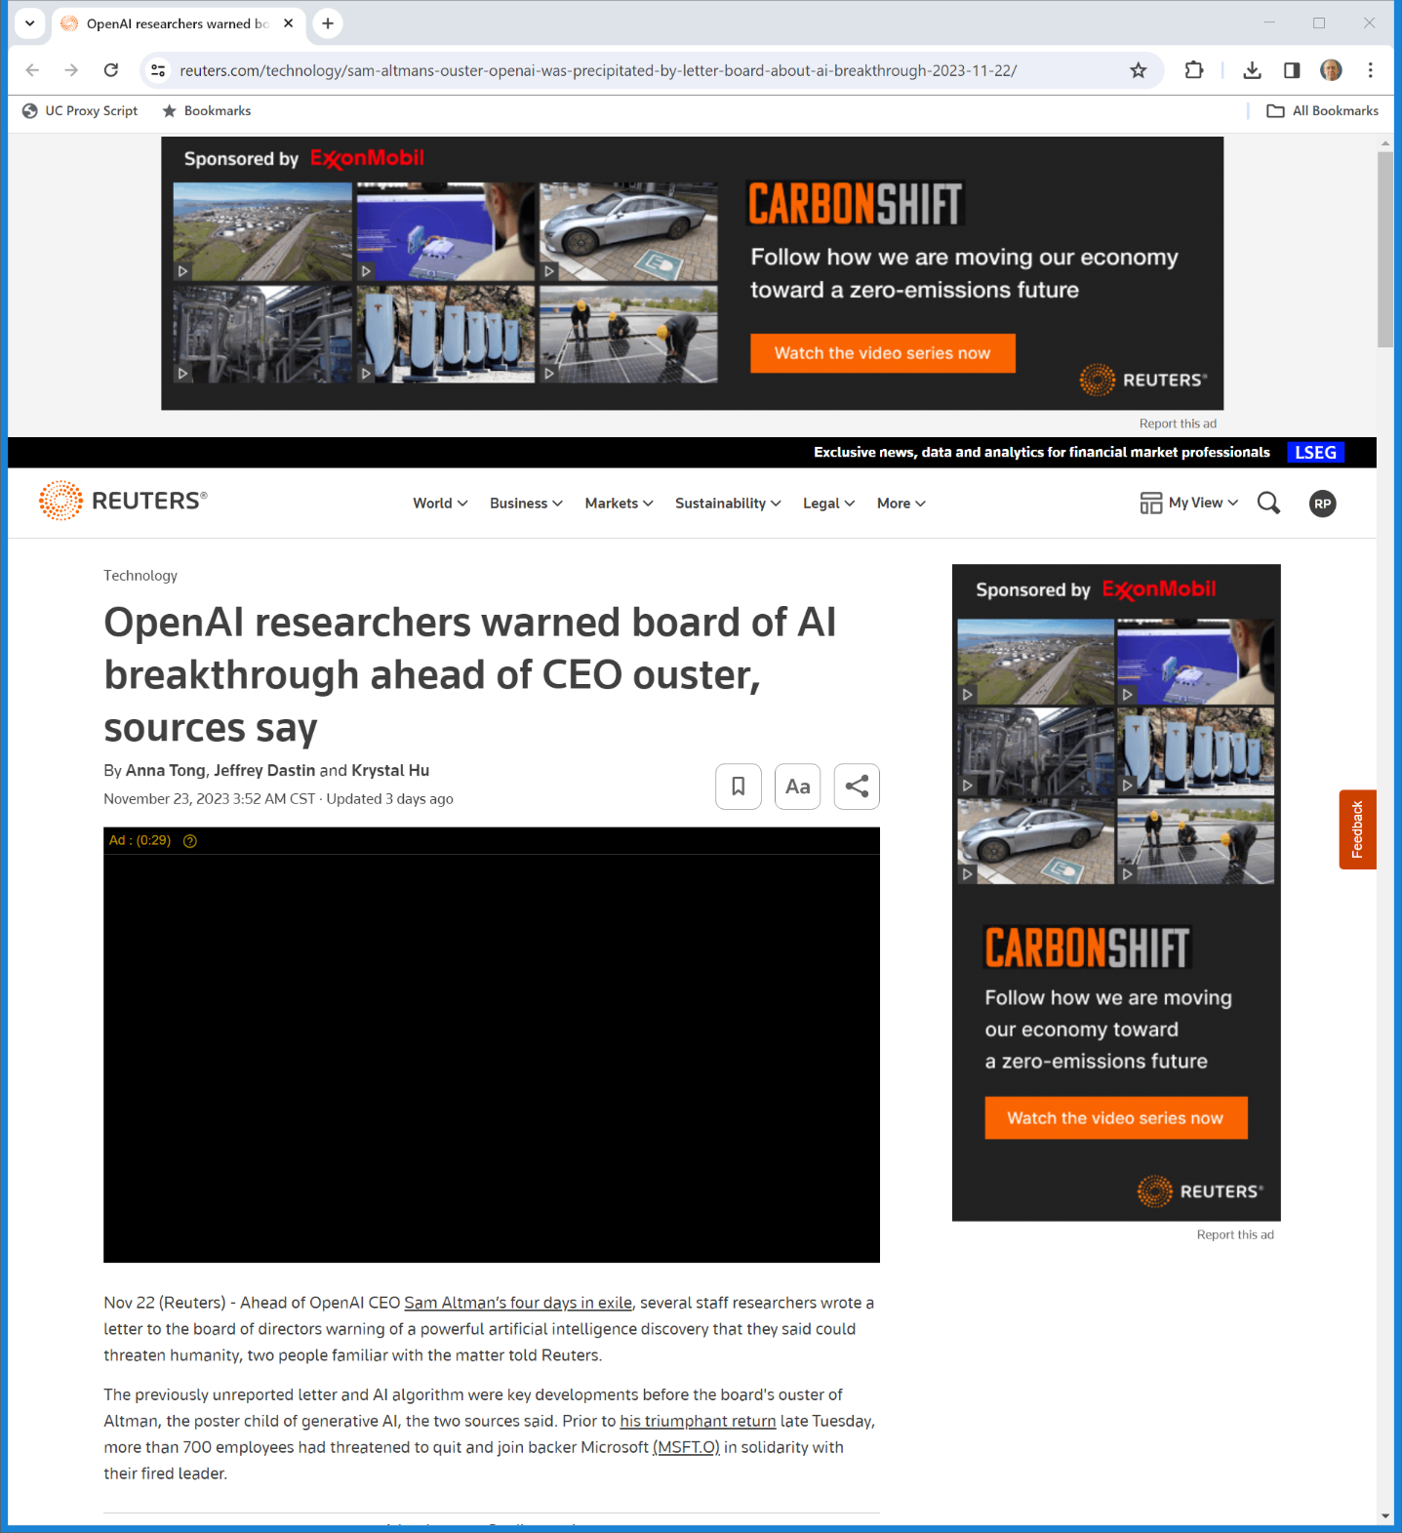
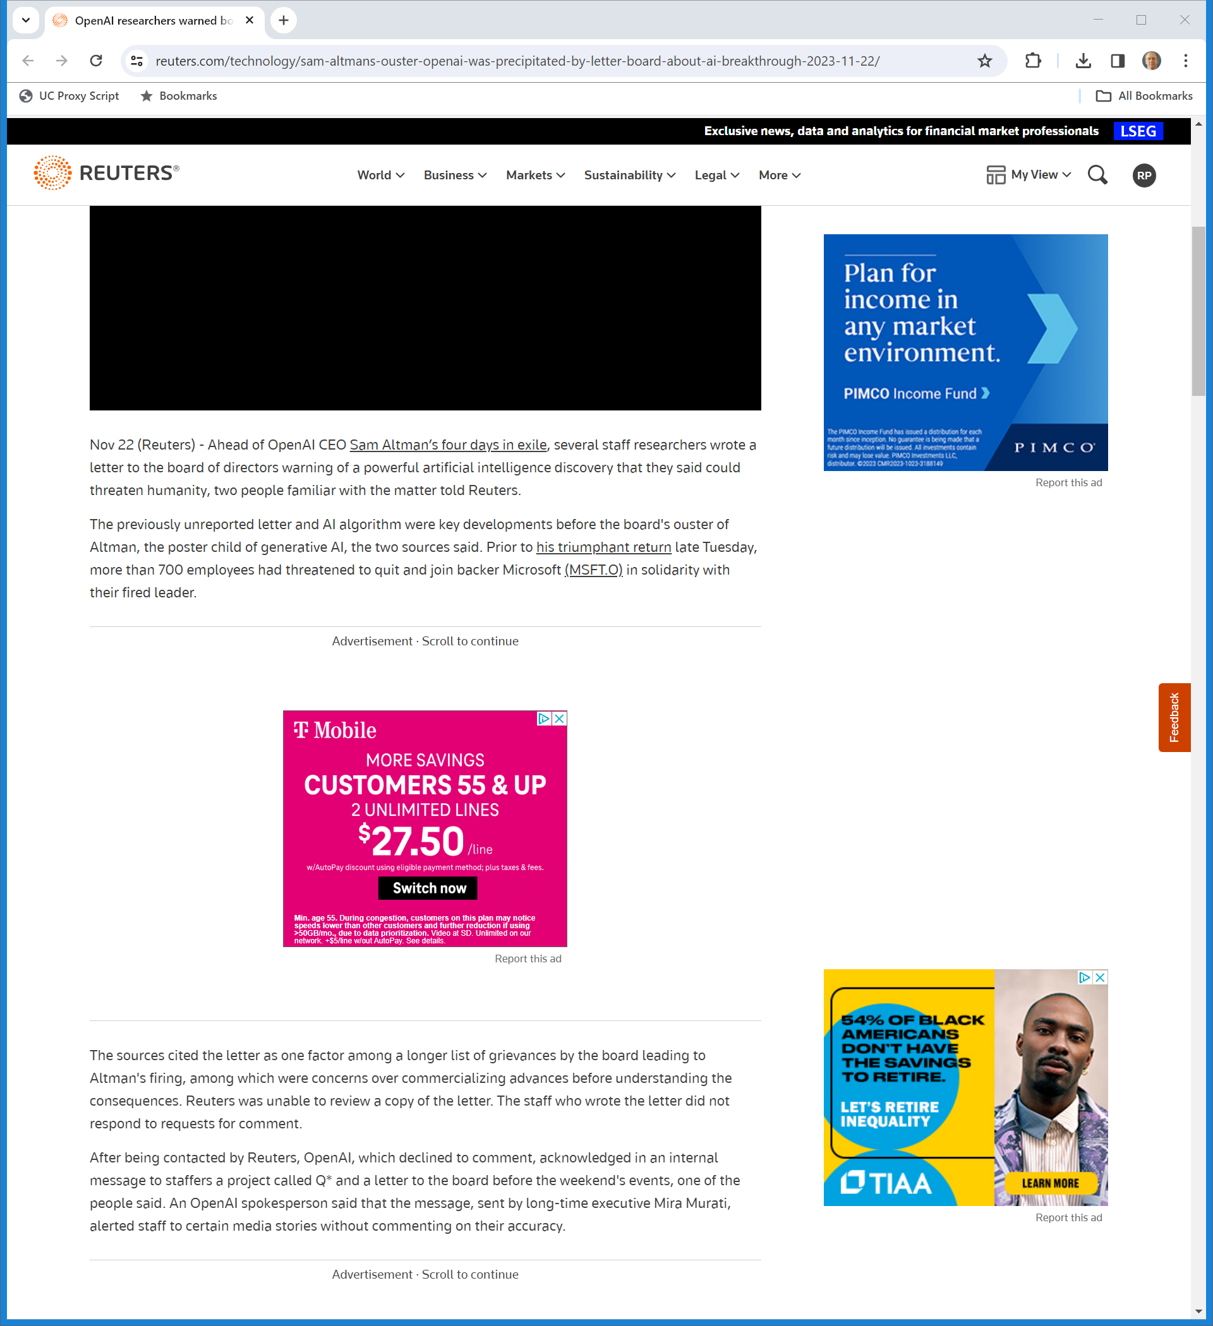
Why Did They Fire Altman?: Q Star?
Reuters (23 Nov 2023)
Notes:
https://www.reuters.com/technology/sam-altmans-ouster-openai-was-precipitated-by-letter-board-about-ai-breakthrough-2023-11-22/

Slide 20
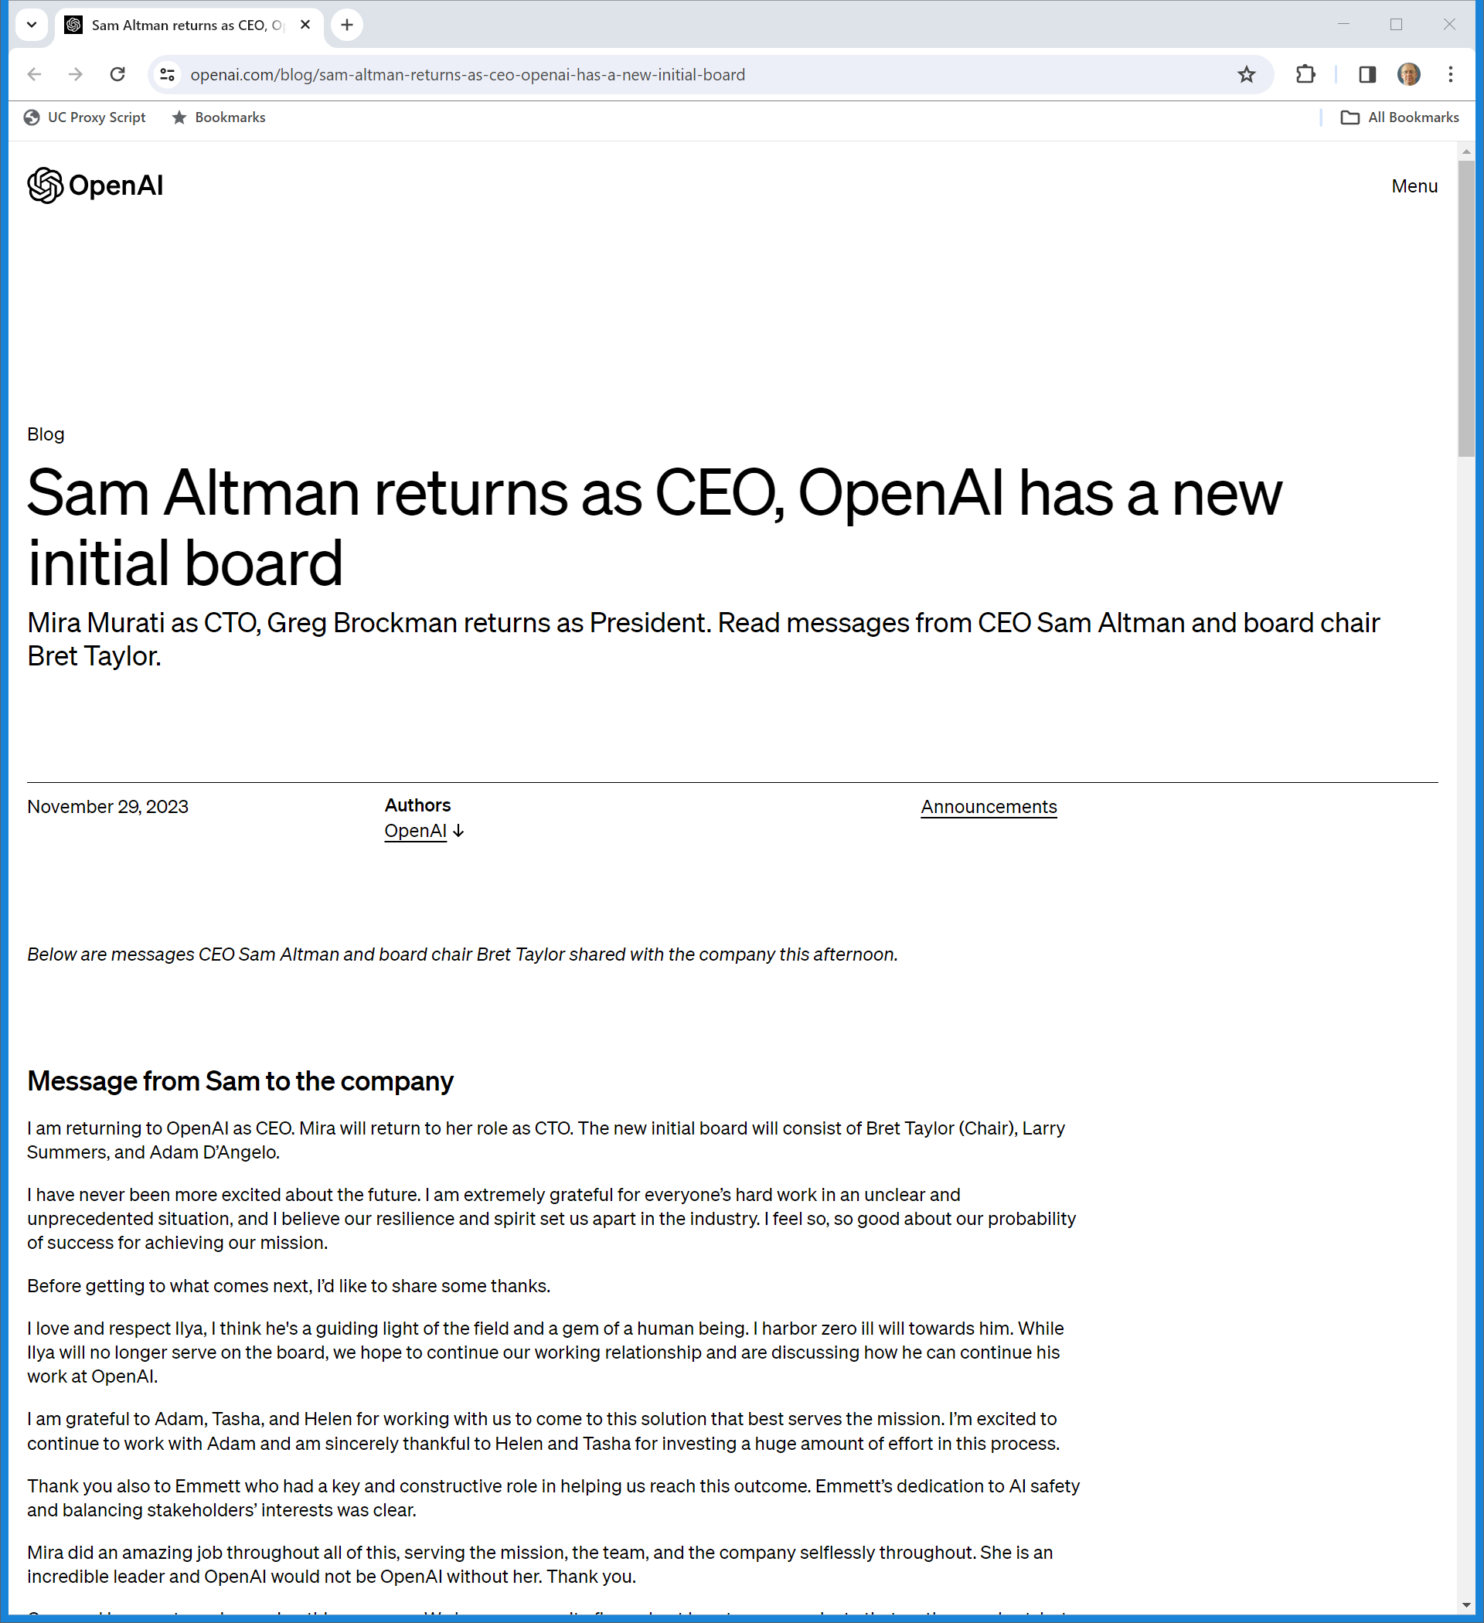
29 Nov 2023: Altman Back
OpenAI (29 Nov 2023)
Notes:
https://openai.com/blog/sam-altman-returns-as-ceo-openai-has-a-new-initial-board

Slide 21
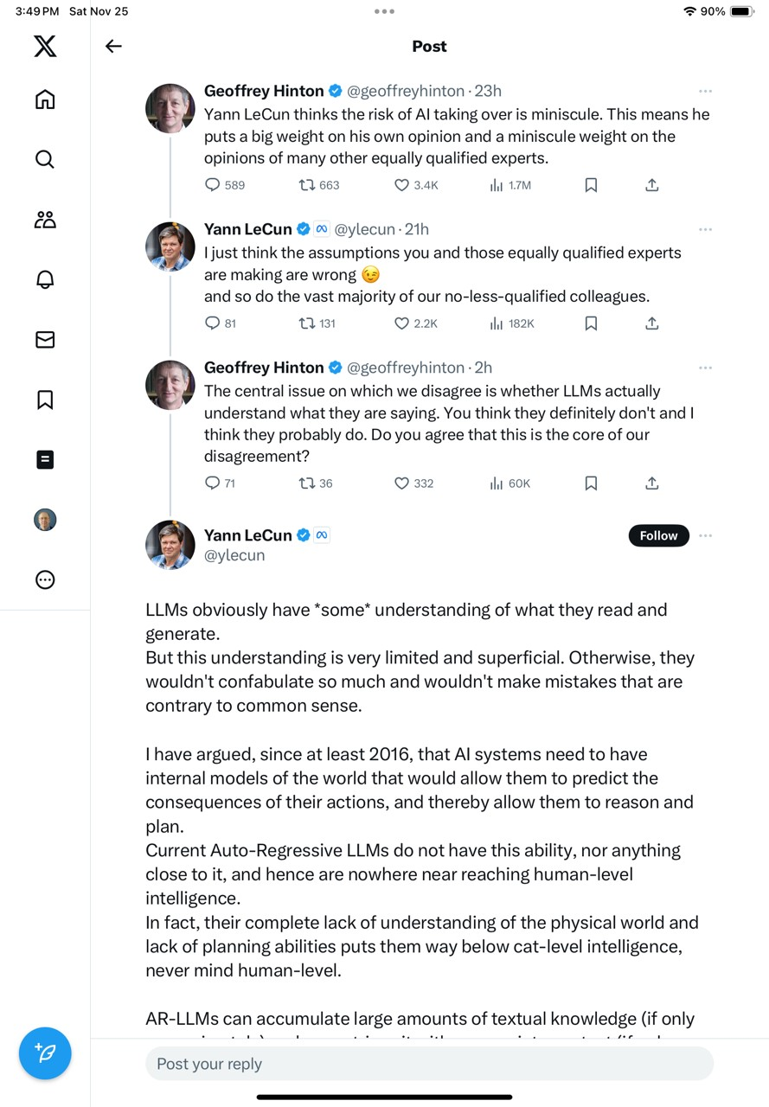
Hinton v. Lecun on AI Risk
Twitter/X (25 Nov 2023)

Slide 22
Hinton v. Lecun on AI Risk
Twitter/X (25 Nov 2023)

Slide 23
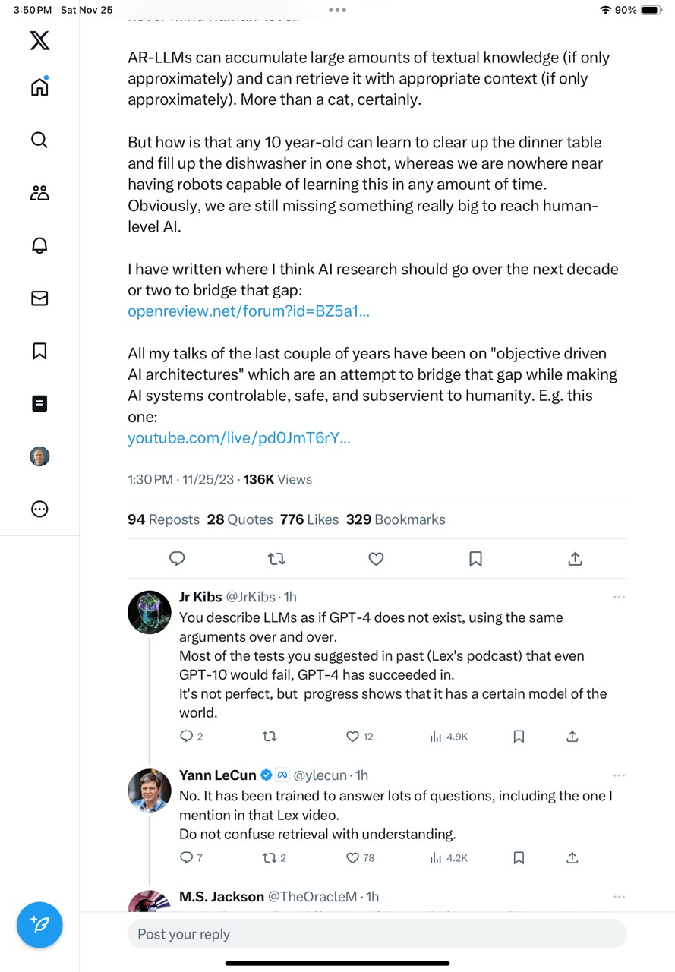
Hinton v. Lecun on AI Risk
Twitter/X (25 Nov 2023)

Slide 24
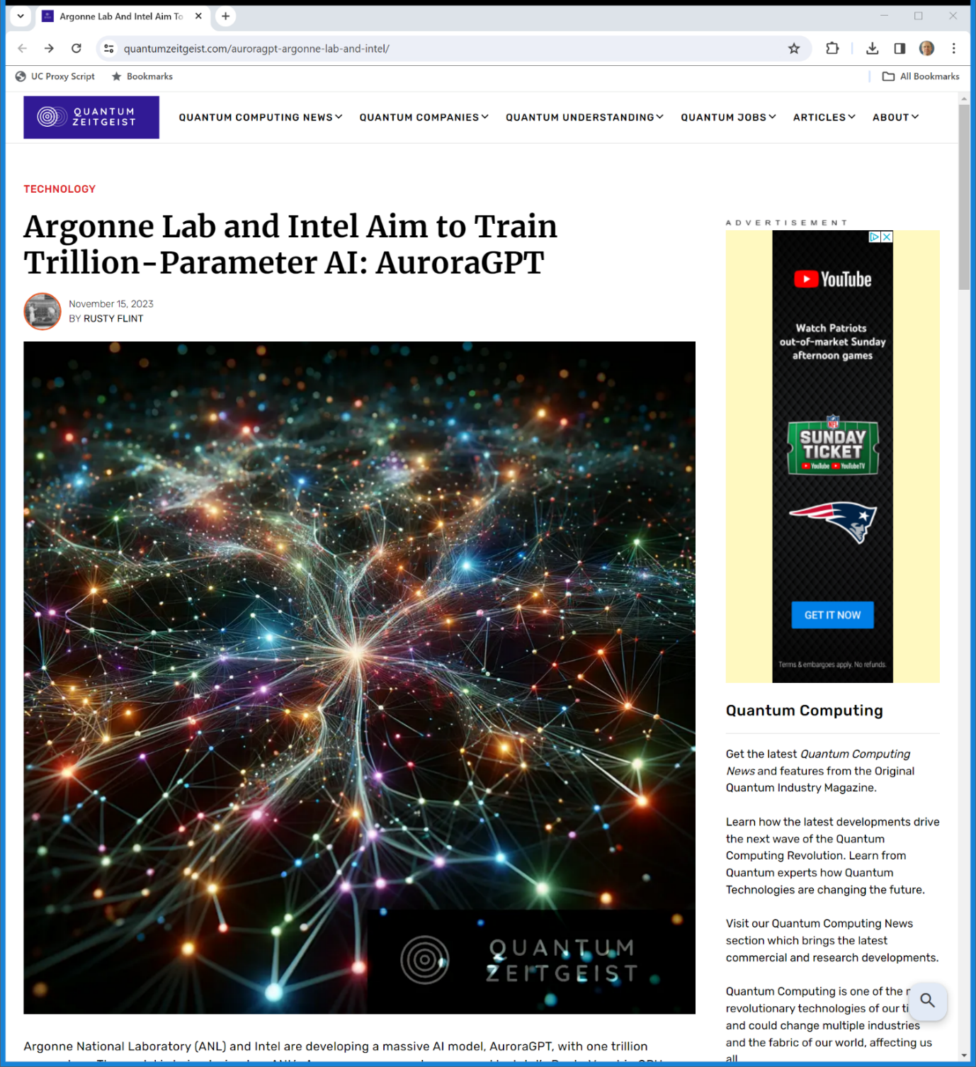
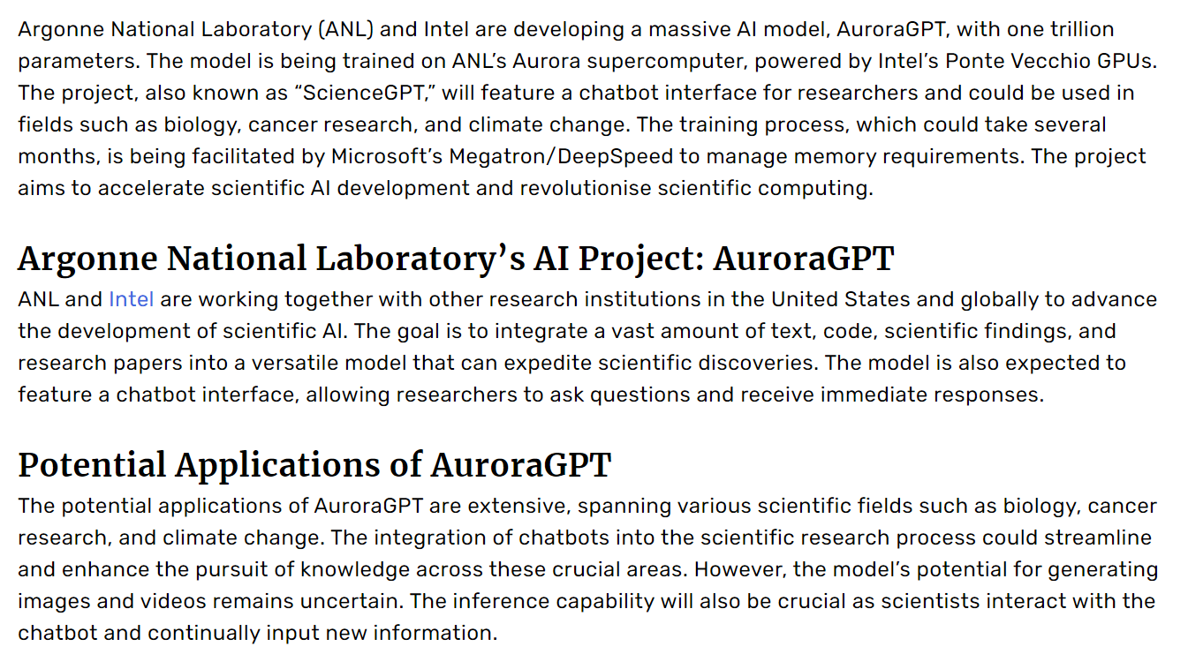
Argonne LLM
Quantum Zeitgeist (15 Nov 2023)
Notes:
https://quantumzeitgeist.com/auroragpt-argonne-lab-and-intel/

Slide 25
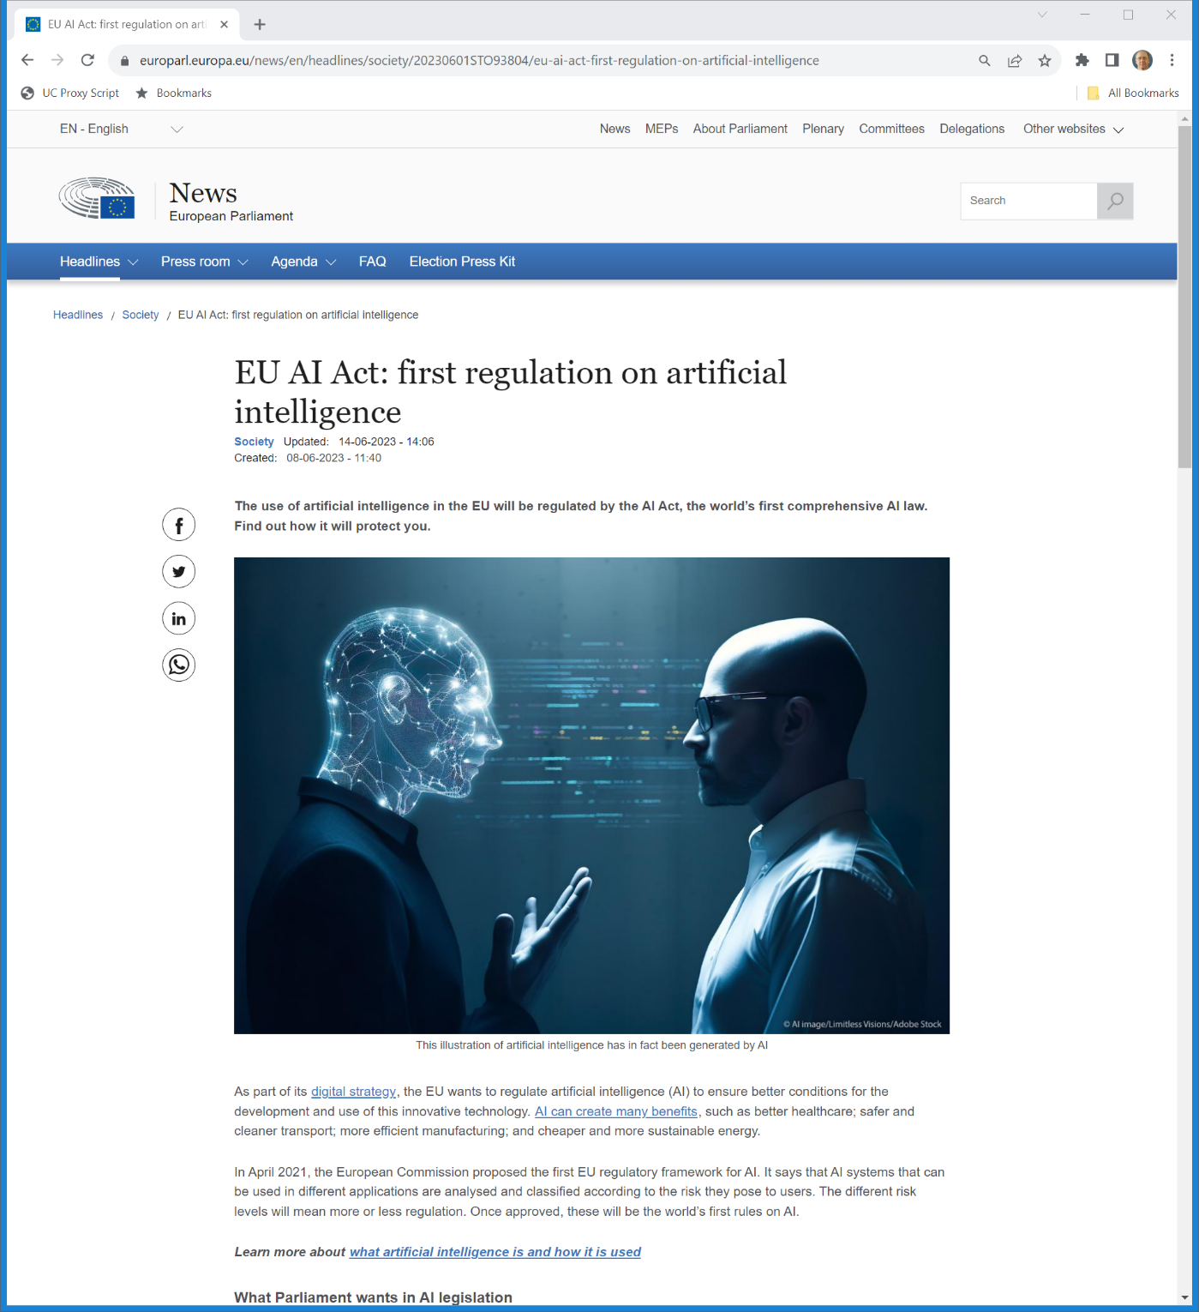
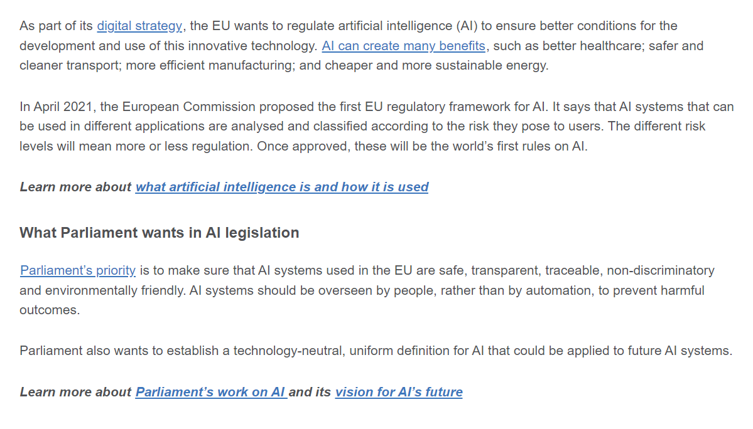
EU AI Act in Process
European Parliament News (8 June 2023)
Notes:
https://www.europarl.europa.eu/news/en/headlines/society/20230601STO93804/eu-ai-act-first-regulation-on-artificial-intelligence

Slide 26
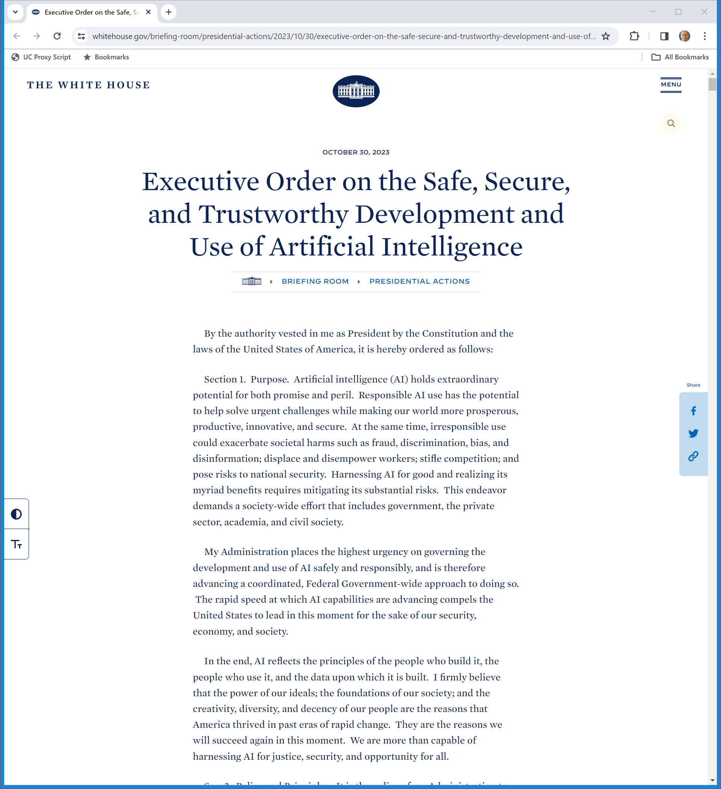
White House AI Exec Order
The White House (30 Oct 2023)
Notes:
https://www.whitehouse.gov/briefing-room/statements-releases/2023/10/30/fact-sheet-president-biden-issues-executive-order-on-safe-secure-and-trustworthy-artificial-intelligence/
https://www.whitehouse.gov/briefing-room/presidential-actions/2023/10/30/executive-order-on-the-safe-secure-and-trustworthy-development-and-use-of-artificial-intelligence/

Slide 27
The News on Google
TTYN (1 of 5)
Hypo 1
  Google hires human beings—gasp—to read news stories, identify facts and write up those stories in real time
  Provides those in response to search queries
Copyright issues? Does G own a copyright in those stories?

Slide 28
The News on Google
TTYN (2 of 5)
Hypo 2
  The Googlebot does its thing and produces search responses to queries for news
  Lists headlines with links to original sources
Copyright issues?

Slide 29
The News on Google
TTYN (3 of 5)
Hypo 3
  Same except now its adds snippets; perhaps the first paragraphs of the story
Copyright issues?

Slide 30
The News on Google
TTYN (4 of 5)
Hypo 4
  Google doesn’t hire human beings—of course not—to read news stories, identify facts and write up those stories in real time
  Instead it creates an algorithm/AI bot to do that
  Results look like the next page
Copyright issues? Does G own a copyright in what it produces?

Slide 31
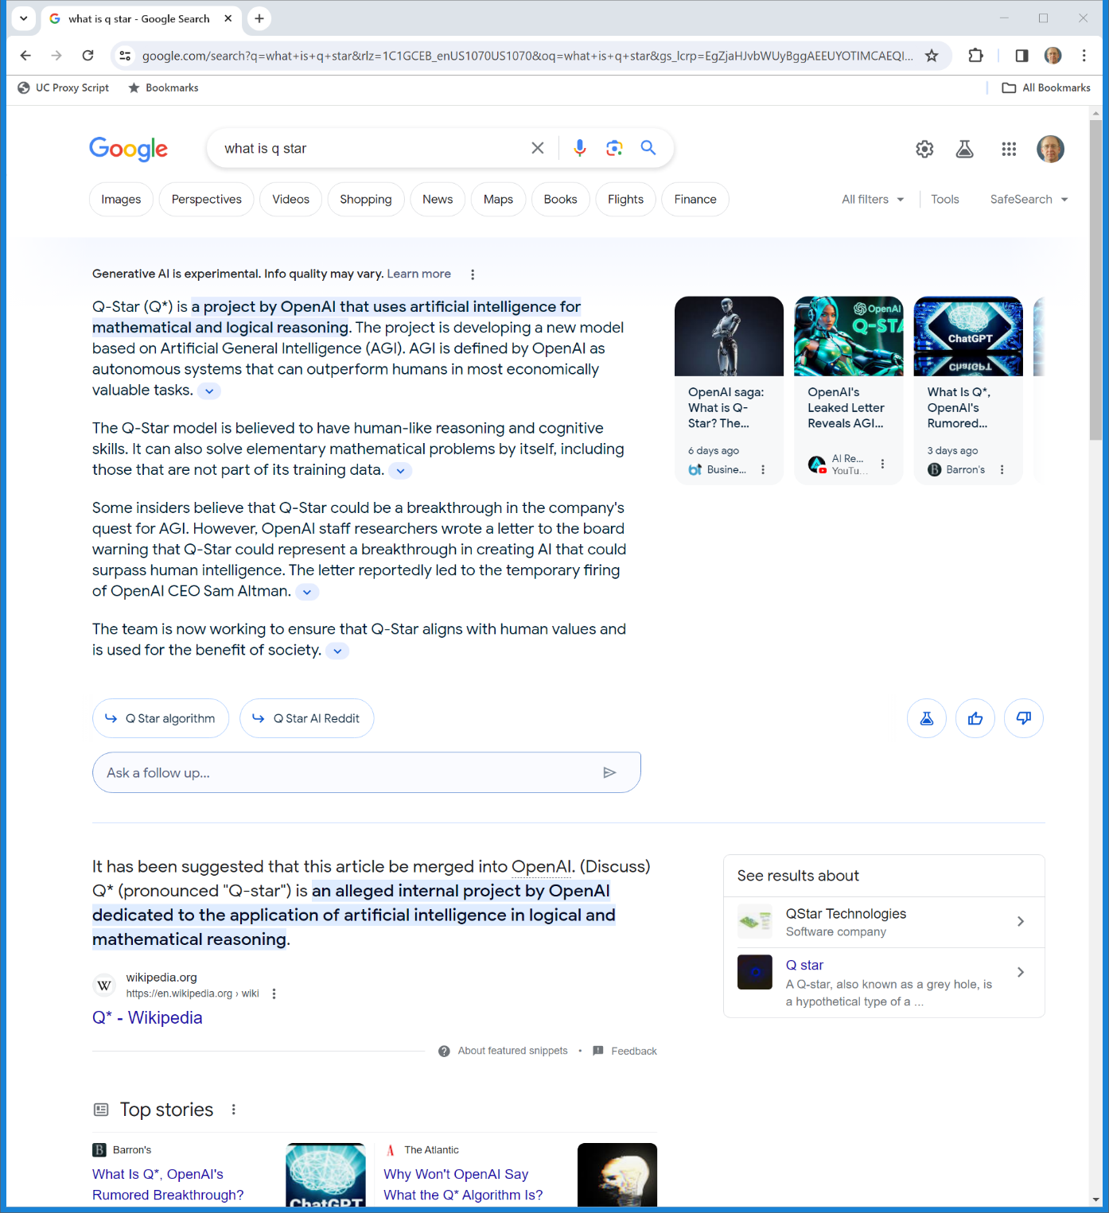
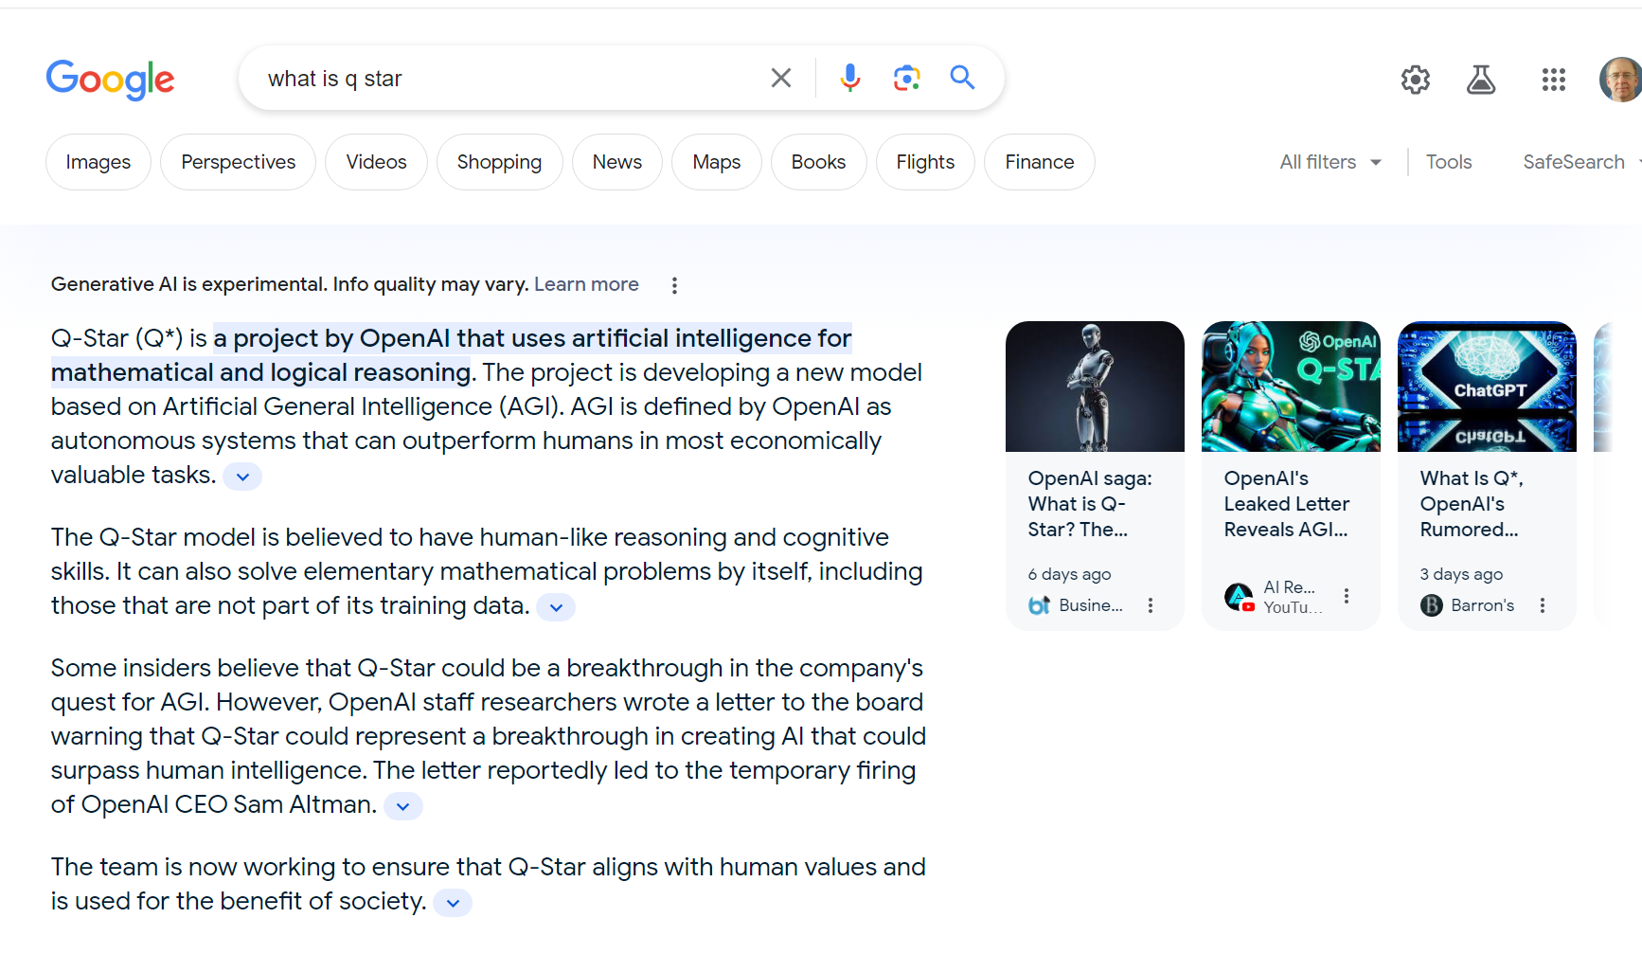
Google Gen AI Response (TTYN (5 of 5))
Google (search of 30 Nov 2023)
Notes:
https://www.google.com/search?q=what+is+q+star&rlz=1C1GCEB_enUS1070US1070&oq=what+is+q+star&gs_lcrp=EgZjaHJvbWUyBggAEEUYOTIMCAEQIxgnGIAEGIoFMgwIAhAAGAoYsQMYgAQyCQgDEAAYChiABDIJCAQQABgKGIAEMgkIBRAAGAoYgAQyCQgGEAAYChiABDIMCAcQABgKGLEDGIAEMgkICBAAGAoYgAQyCQgJEAAYChiABNIBCDcyMzFqMGo3qAIAsAIA&sourceid=chrome&ie=UTF-8

Slide 32
New Google Patent
U.S. 11,769,017 (26 Sept 2023)
Notes:
https://patentimages.storage.googleapis.com/d3/2e/de/63defc51bec99a/US11769017.pdf
https://patents.google.com/patent/US11769017B1/en

Slide 33
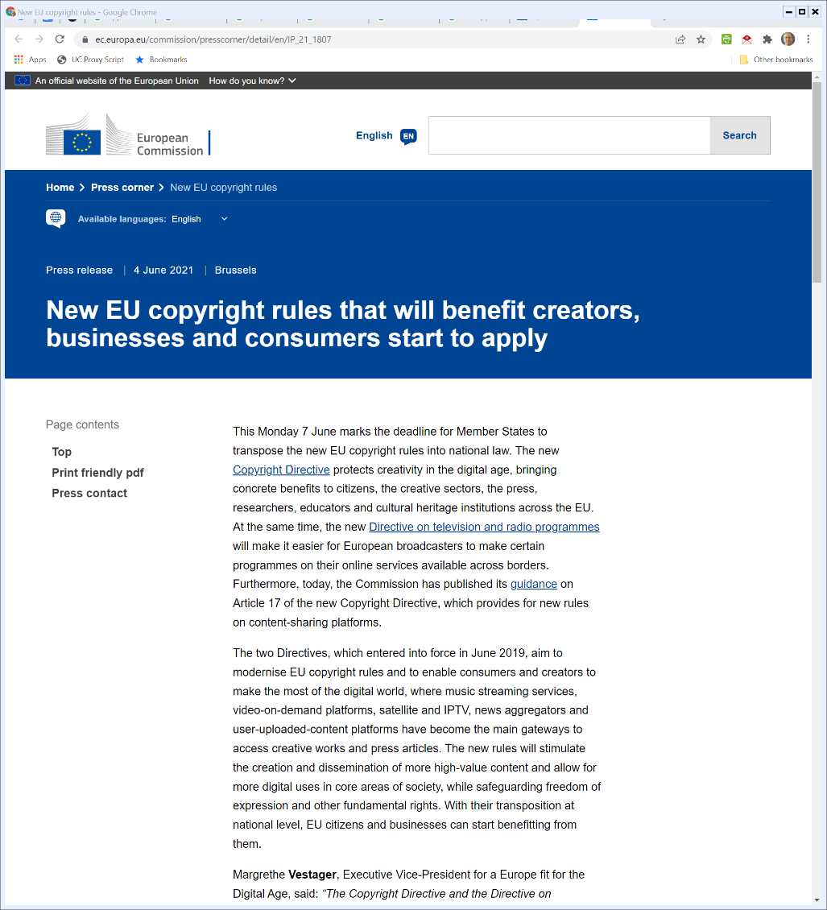
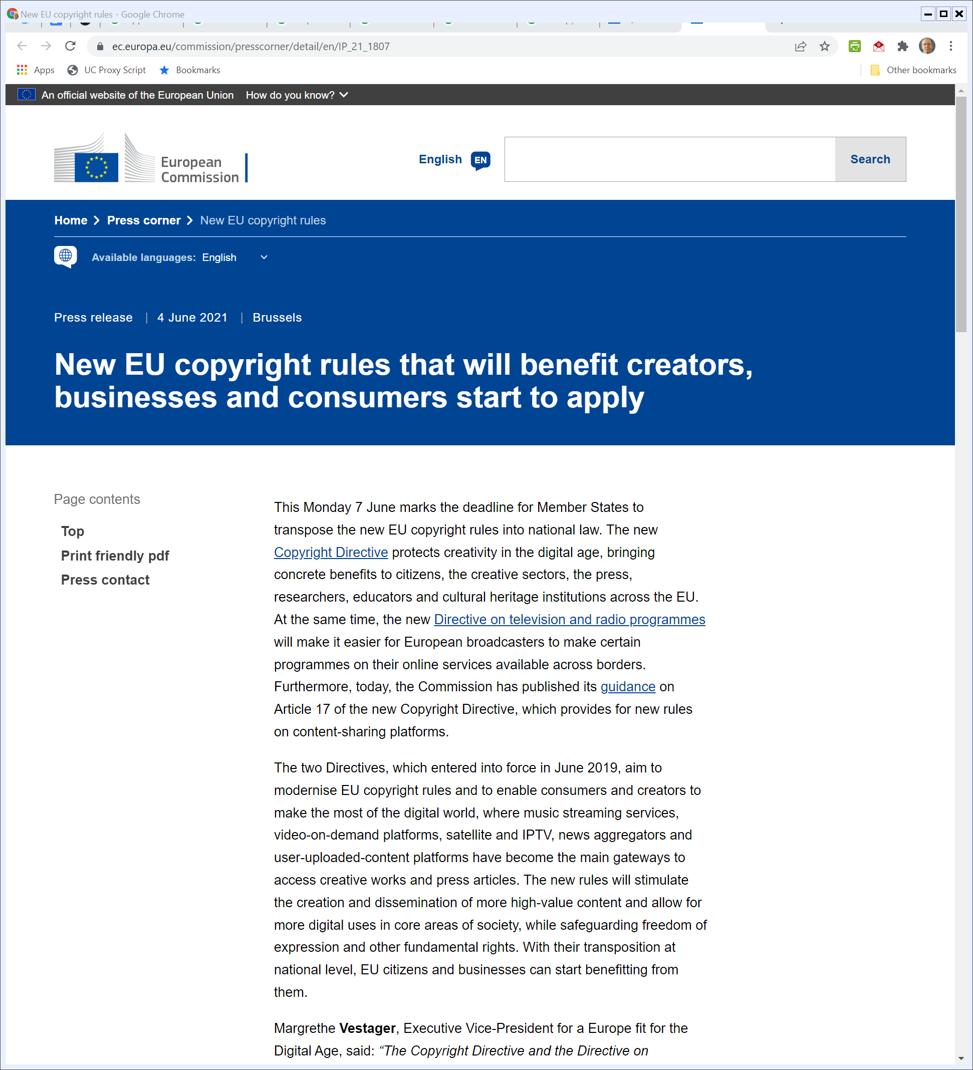
New EU Copyright Directive
EU Press Release (4 June 2021)
Notes:
https://ec.europa.eu/commission/presscorner/detail/en/IP_21_1807

Slide 34
New Right to Protect Press
EU Copyright FAQ (4 June 2021)
Notes:
https://ec.europa.eu/commission/presscorner/detail/en/IP_21_1807

Slide 35
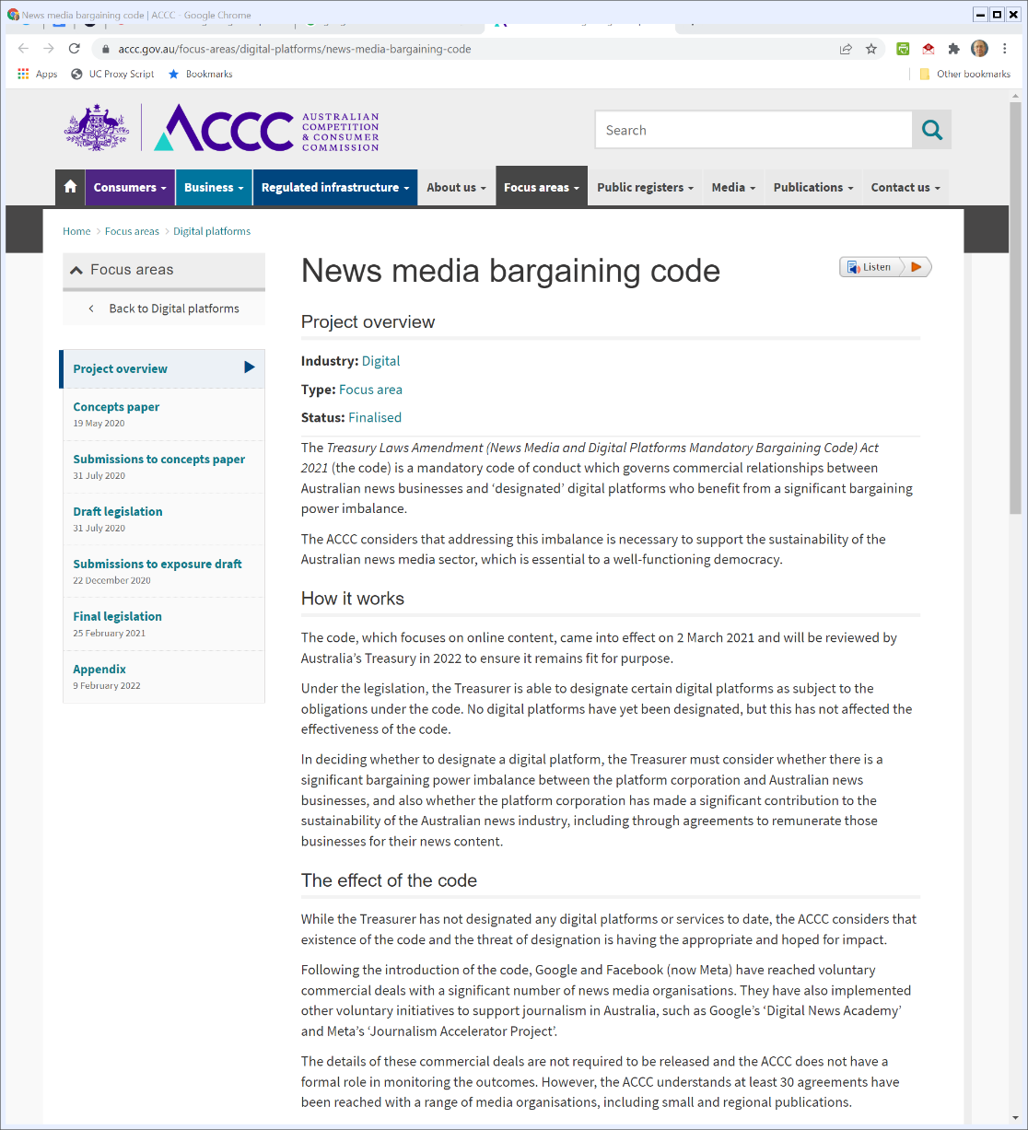

In Australia
ACCC (Visited 21 Feb 2022)
Notes:
https://www.accc.gov.au/focus-areas/digital-platforms/news-media-bargaining-code

Slide 36
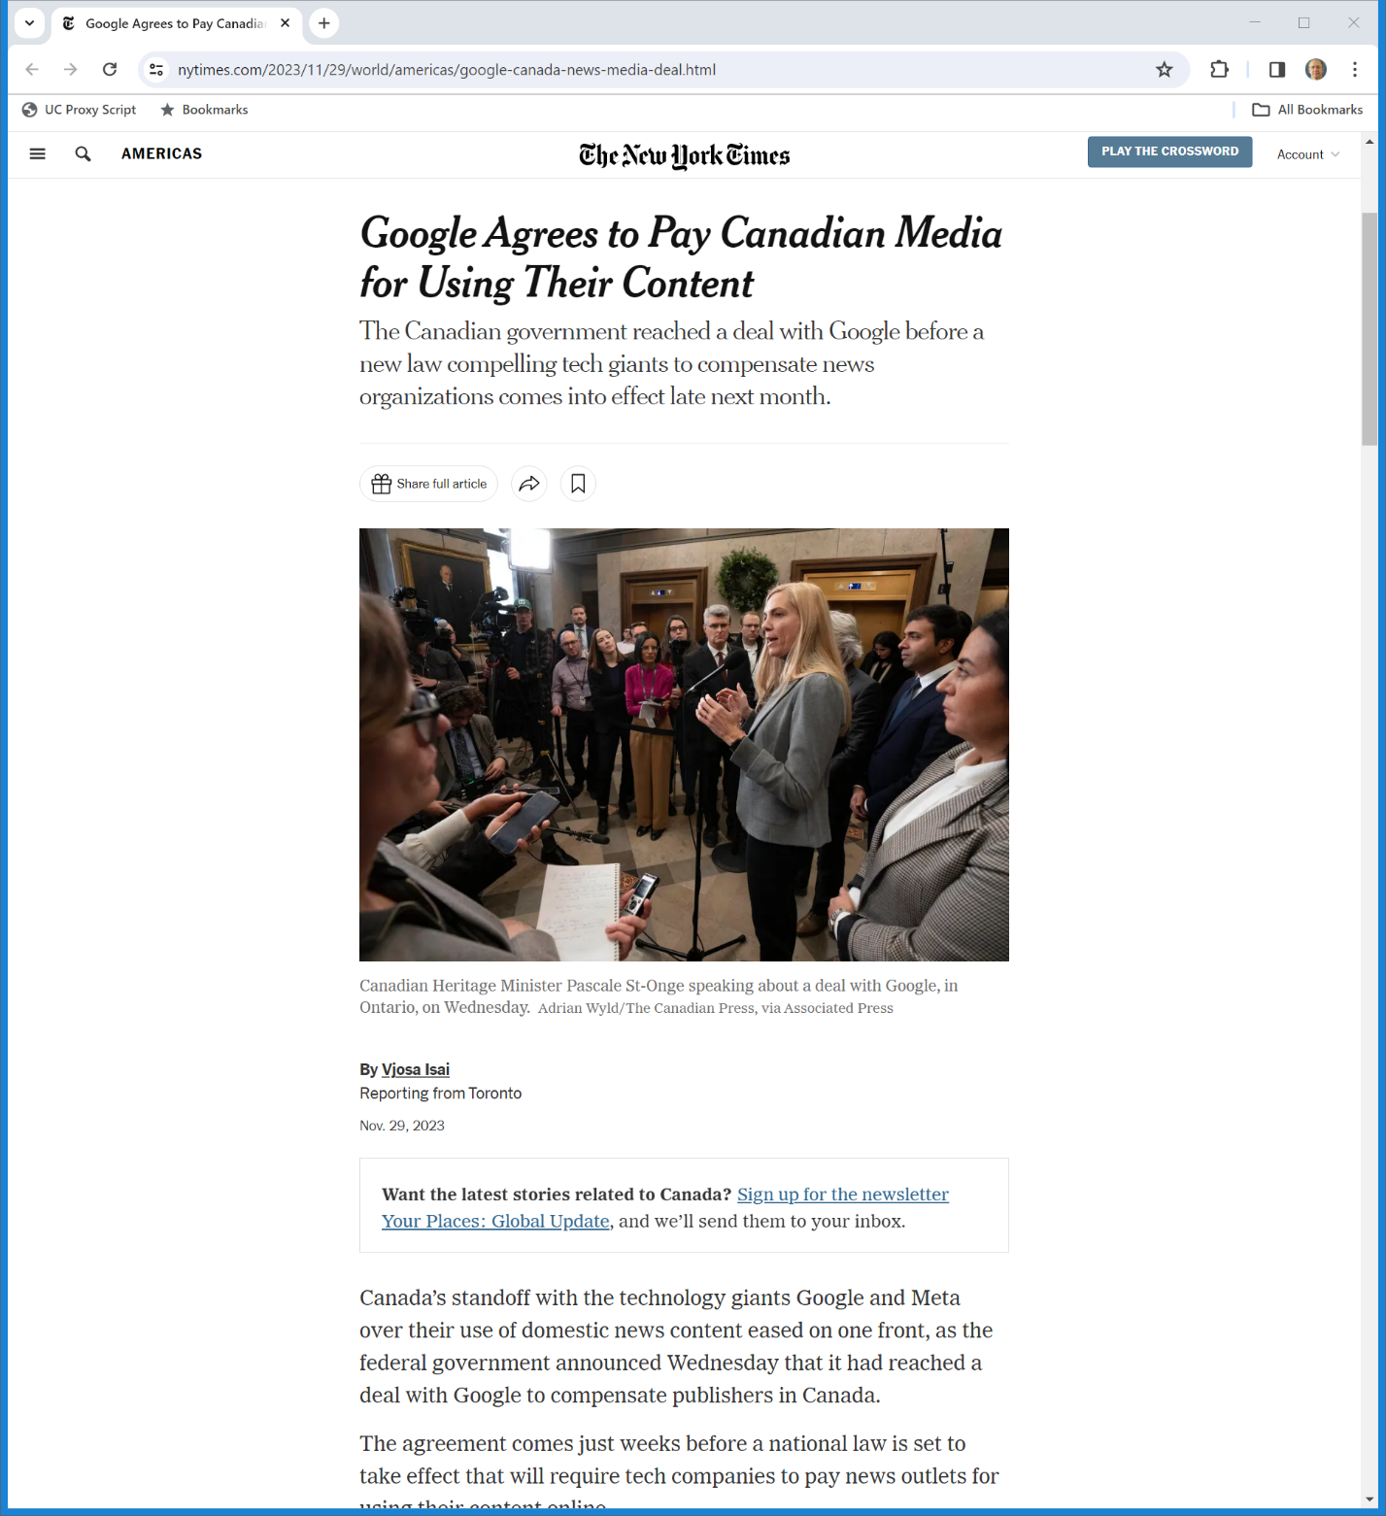
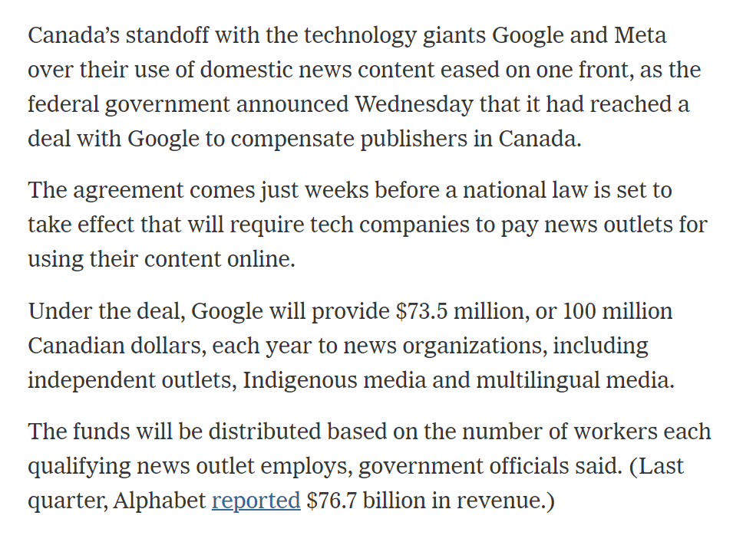
And Yesterday in Canada
New York Times (29 Nov 2023)

Slide 37
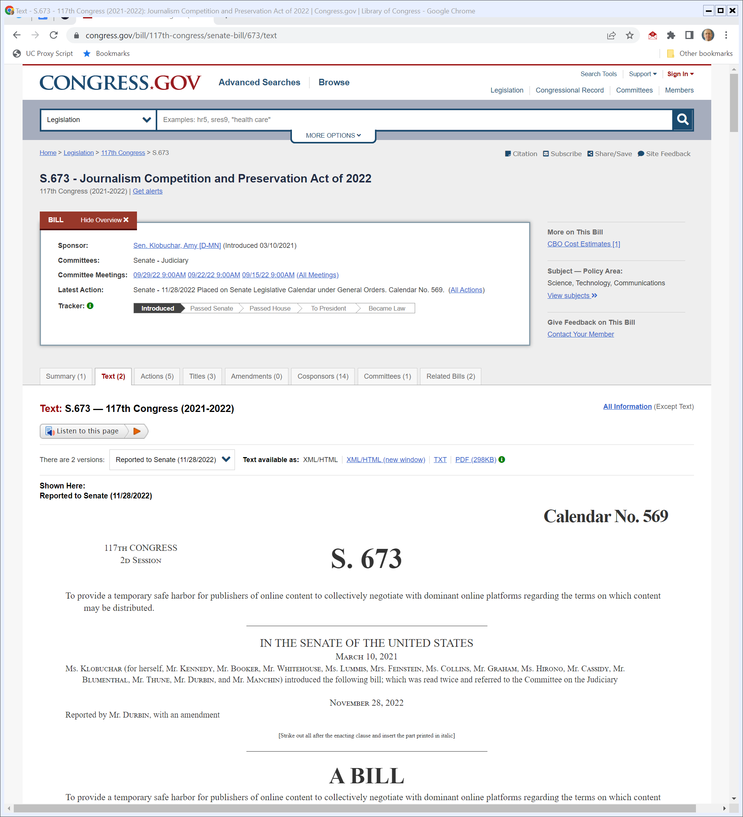
S.673: Journalism Competition and Preservation Act of 2022
Congress.gov (Visited 1 Dec 2022)
Notes:
https://www.congress.gov/bill/117th-congress/senate-bill/673/text

Slide 38
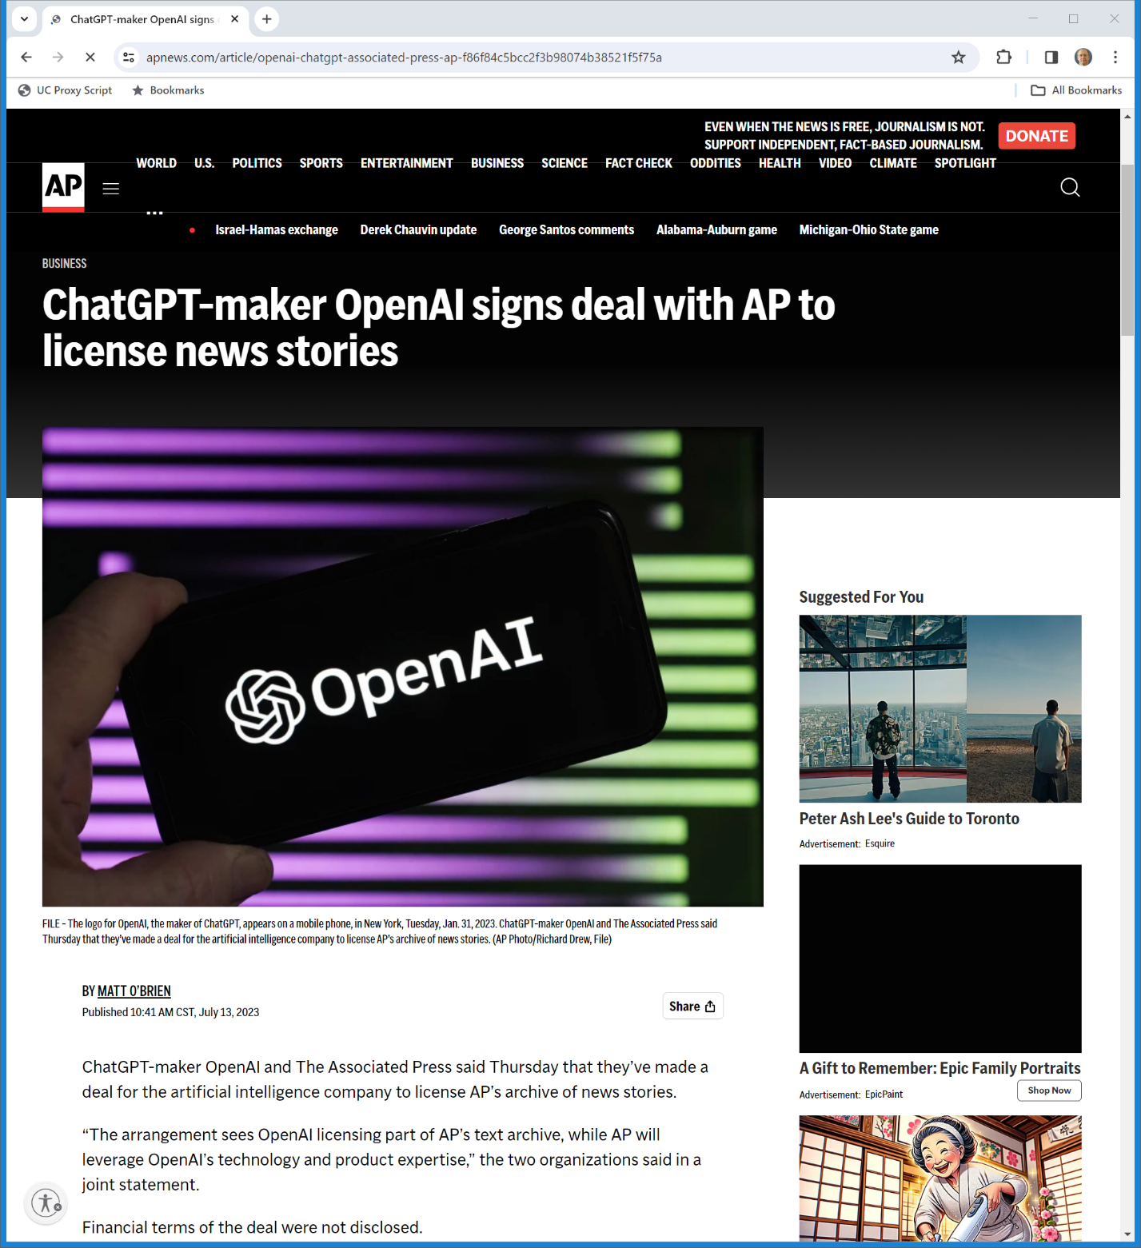
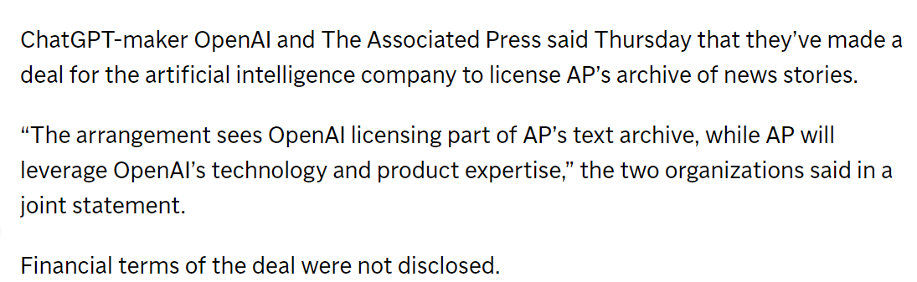
July 2023: OpenAI, AP Deal
AP News (13 July 2023)
Notes:
https://apnews.com/article/openai-chatgpt-associated-press-ap-f86f84c5bcc2f3b98074b38521f5f75a

Slide 39
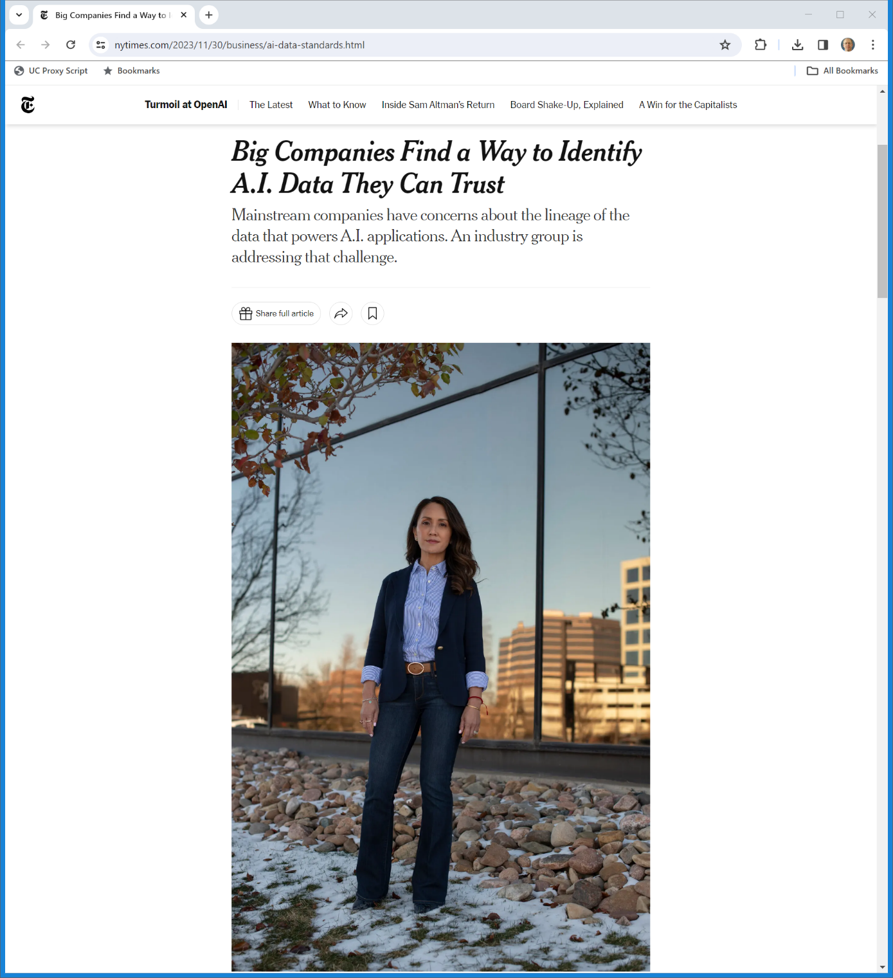
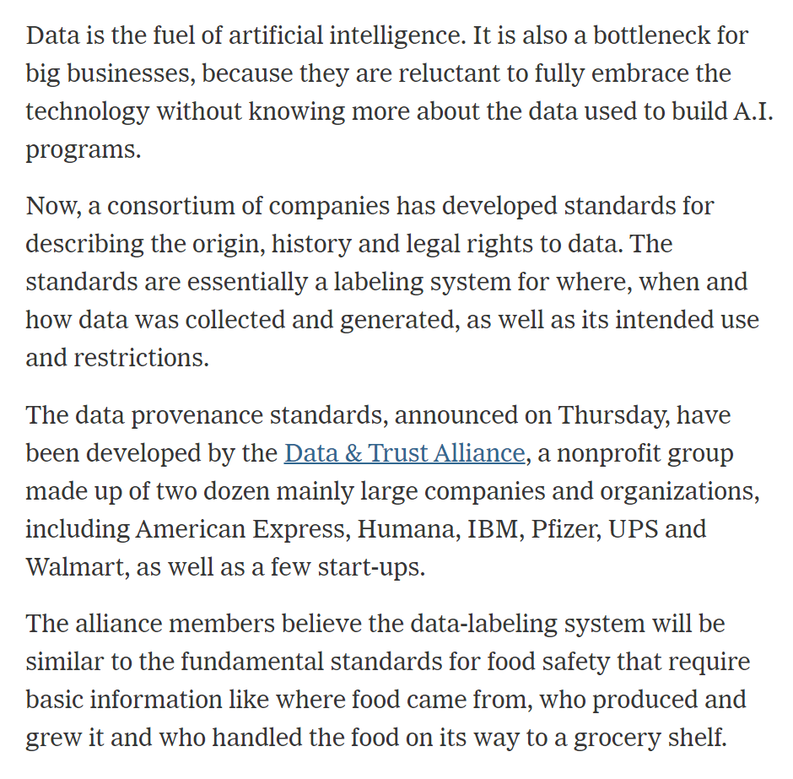
Data Provenance Standards
New York Times (30 Nov 2023)
Notes:
https://www.nytimes.com/2023/11/30/business/ai-data-standards.html

Slide 40
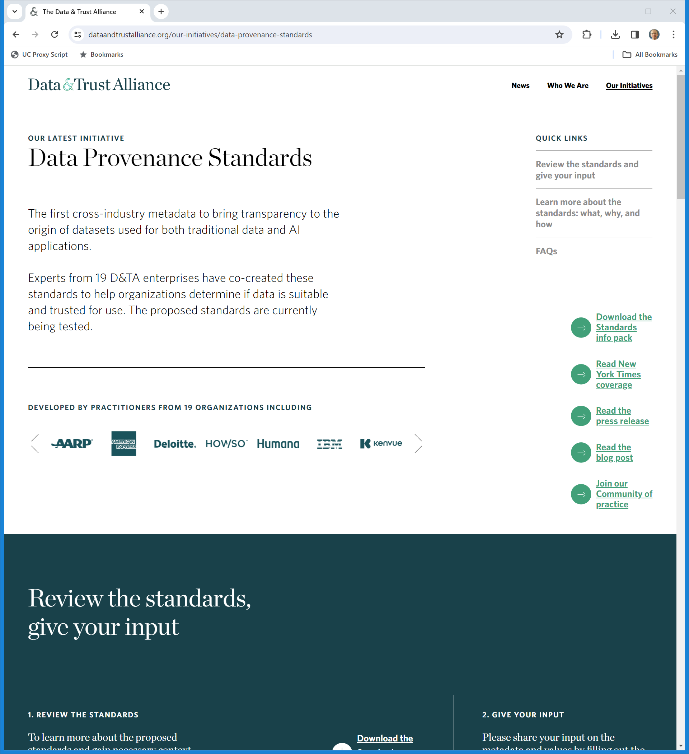
More Info?
Data & Trust Alliance (visited 30 Nov 2023)

Slide 41
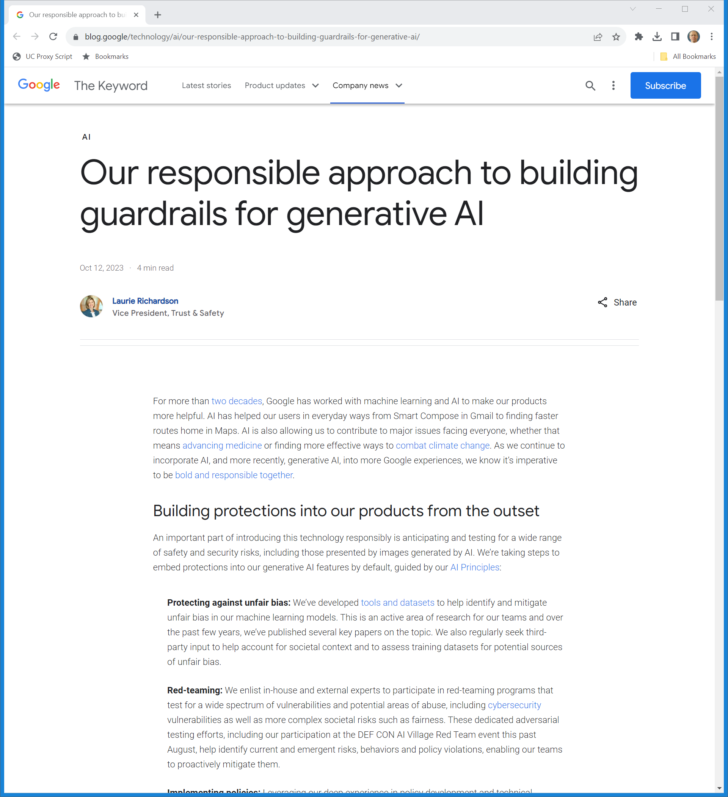
Google Generative AI Guardrails
Google (12 Oct 2023)
Notes:
https://blog.google/technology/ai/our-responsible-approach-to-building-guardrails-for-generative-ai/

Slide 42
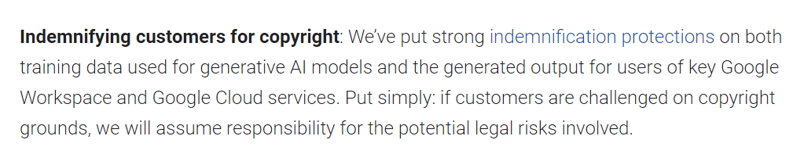
Copyright Indemnification
Google (12 Oct 2023)
Notes:
https://blog.google/technology/ai/our-responsible-approach-to-building-guardrails-for-generative-ai/

Slide 43
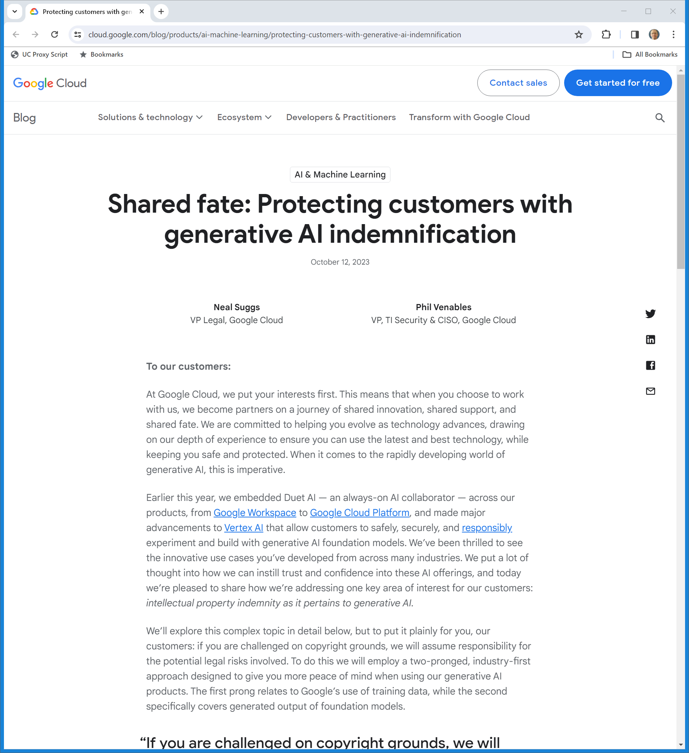
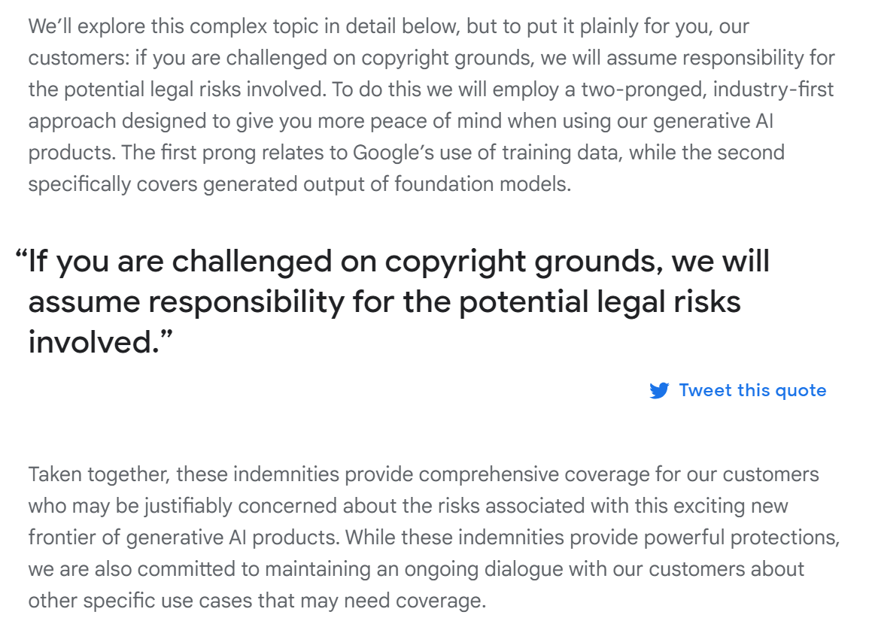
Google Assumes Responsibility
Google (12 Oct 2023)
Notes:
https://cloud.google.com/blog/products/ai-machine-learning/protecting-customers-with-generative-ai-indemnification

Slide 44
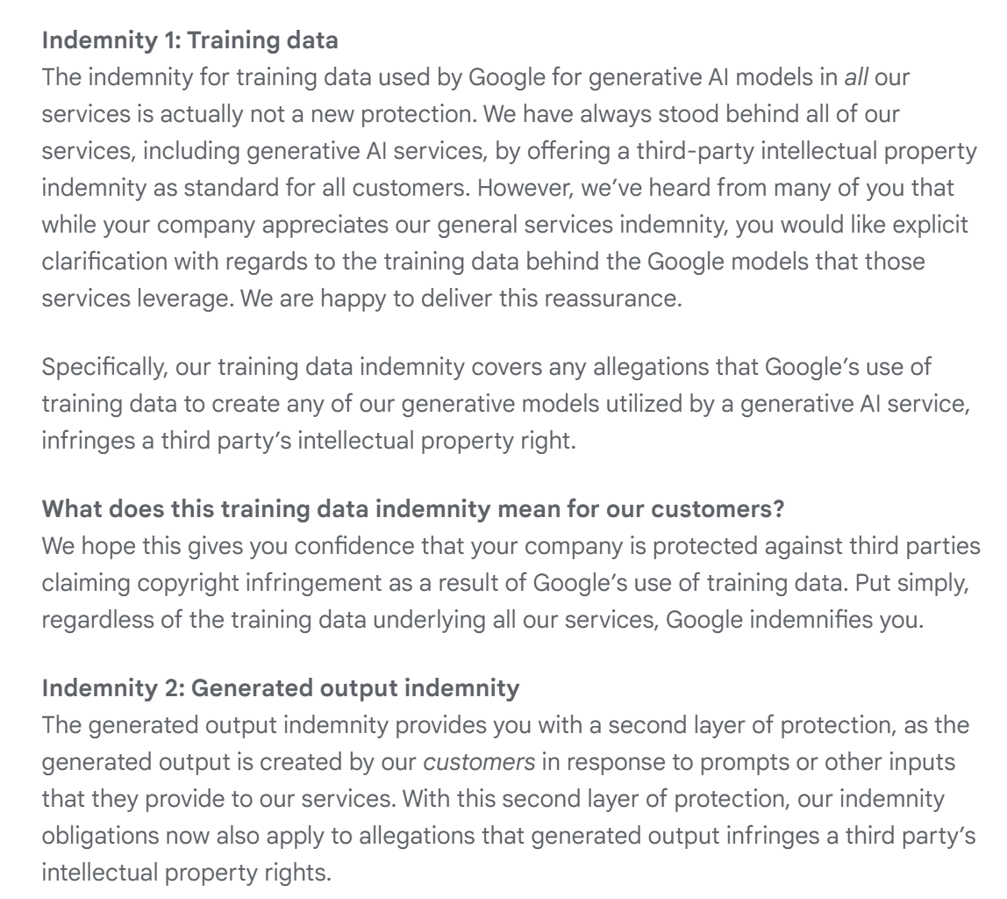
Indemnity re Inputs and Outputs
Google (12 Oct 2023)
Notes:
https://cloud.google.com/blog/products/ai-machine-learning/protecting-customers-with-generative-ai-indemnification

Slide 45
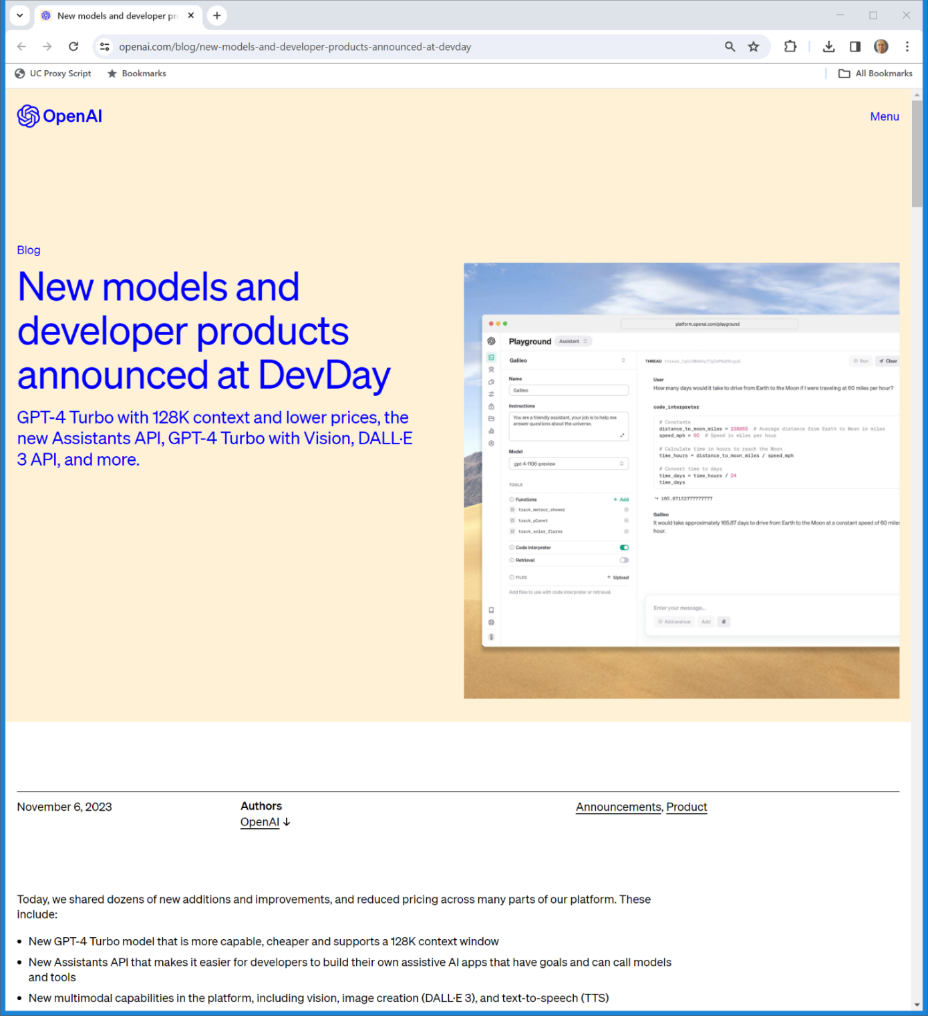
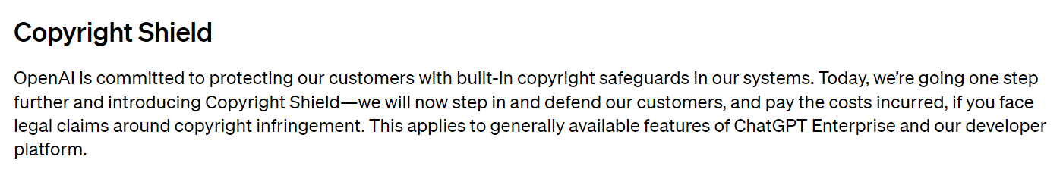
Copyright Shield
OpenAI (6 Nov 2023)
Notes:
https://openai.com/blog/new-models-and-developer-products-announced-at-devday

Slide 46
Kadrey Meta Complaint
Kadrey v. Meta

Slide 47
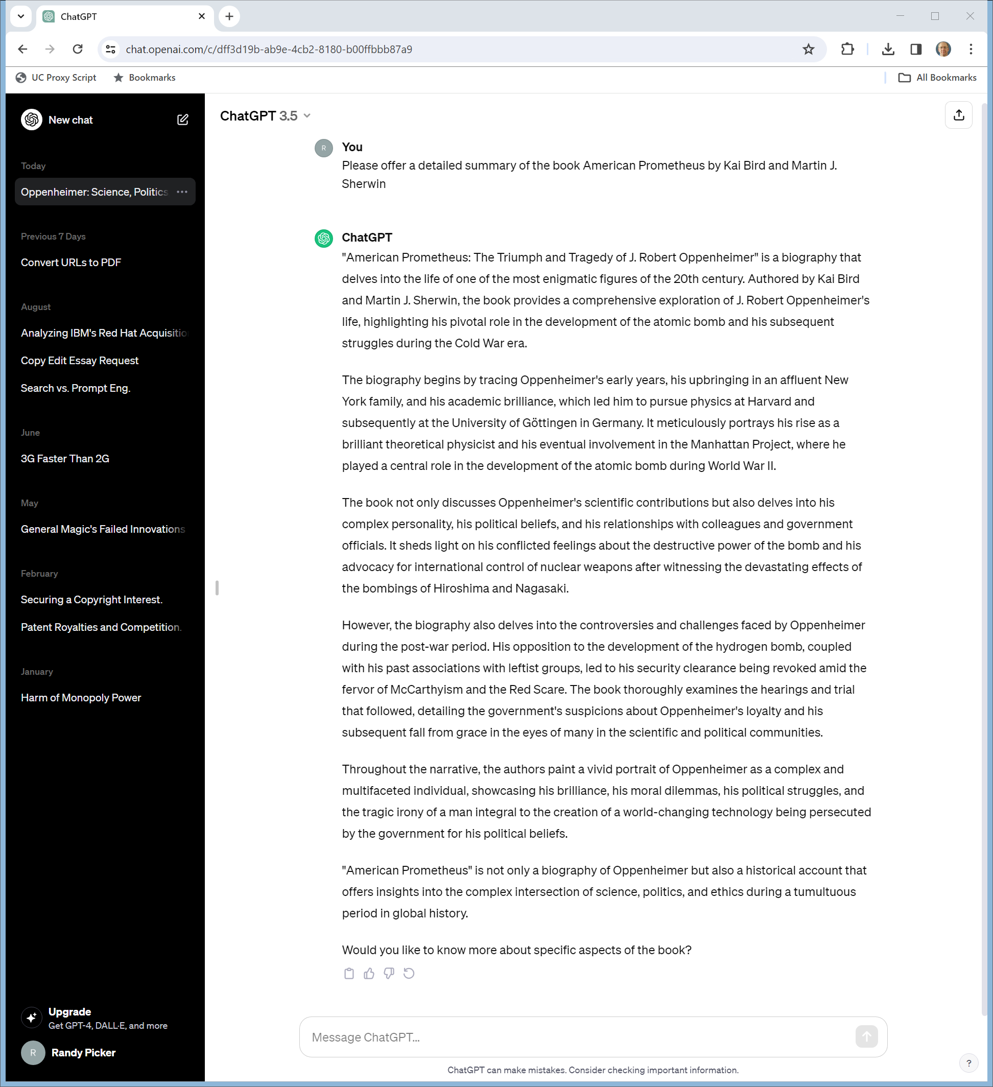
Ask ChatGPT 3.5
ChatGPT (ran 25 Nov 2023)
Notes:
https://chat.openai.com/c/dff3d19b-ab9e-4cb2-8180-b00ffbbb87a9

Slide 48
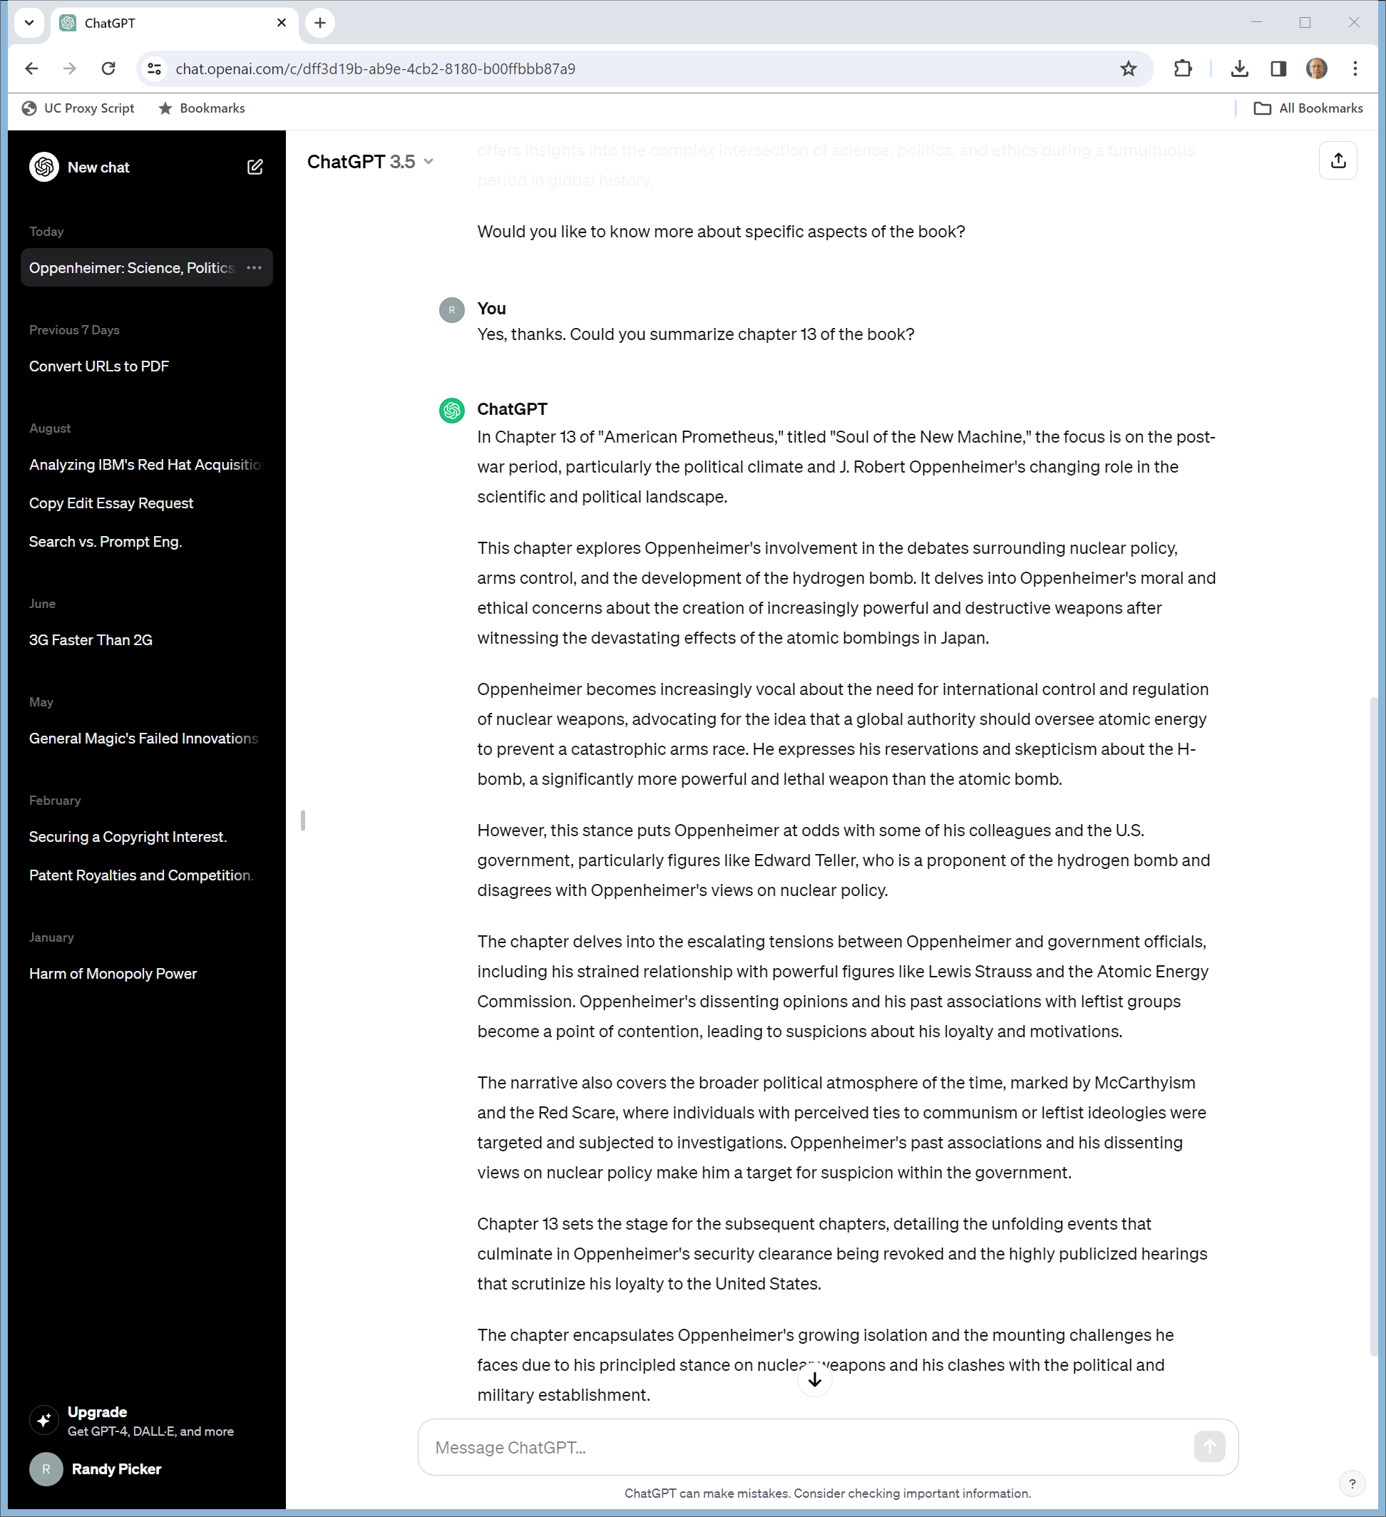
Chapter 13?
ChatGPT 3.5 (ran 25 Nov 2023)

Slide 49

Page 180?
ChatGPT 3.5 (ran on 25 Nov 2023)

Slide 50

And Bard?
Google Bard (ran on 25 Nov 2023)
Notes:
https://bard.google.com/chat/60f8f6fe6084118a

Slide 51


Ch. 13?: Bard Gets the Title Right
Google Bard (ran on 25 Nov 2023)
Notes:
https://bard.google.com/chat/60f8f6fe6084118a

Slide 52
Links to Google Search Proper
Google Bard (ran on 25 Nov 2023)
Notes:
https://bard.google.com/chat/60f8f6fe6084118a

Slide 53


And Page 180?
Google Bard (ran on 25 Nov 2023)

Slide 54
The Copyright Office Study
OpenAI Copyright Filing (30 Oct 2023)

Slide 55
LLM Training Process: Compute + Model + Trillions of Words
OpenAI Copyright Filing (30 Oct 2023)

Slide 56
LLM Training Process: Creating Tokens, Finding Relationships
OpenAI Copyright Filing (30 Oct 2023)

Slide 57
What ChatGPT Says It Does With Copyrighted Works
OpenAI Copyright Filing (30 Oct 2023)

Slide 58

How Much Memorization?
Scalable Extraction (28 Nov 2023)
Notes:
https://arxiv.org/abs/2311.17035

Slide 59
Use Here is Fair
OpenAI Copyright Filing (30 Oct 2023)

Slide 60
Applying Sony
OpenAI Copyright Filing (30 Oct 2023)

Slide 61


“Pervasive, Unauthorized Use”
News/Media Alliance (31 Oct 2023)
Notes:
https://www.newsmediaalliance.org/release-news-media-alliance-study-finds-pervasive-unauthorized-use-of-publisher-content-to-power-generative-ai-technologies/

Slide 62
Extent of Use
News/Media Alliance (31 Oct 2023)
Notes:
https://www.newsmediaalliance.org/release-news-media-alliance-study-finds-pervasive-unauthorized-use-of-publisher-content-to-power-generative-ai-technologies/

Slide 63
Fair Negotiations for Content
News/Media Alliance (31 Oct 2023)
Notes:
https://www.newsmediaalliance.org/release-news-media-alliance-study-finds-pervasive-unauthorized-use-of-publisher-content-to-power-generative-ai-technologies/

Slide 64
Courts Just Getting Started
Kadrey (ND Calif 20 Nov 2023)

Slide 65


Nightshade: Data Poisoning
MIT Tech Review (23 Oct 2023)
Notes:
https://www.technologyreview.com/2023/10/23/1082189/data-poisoning-artists-fight-generative-ai/

Slide 66
Prof. Ben Zhao UChicago Comp Sci
MIT Tech Review (23 Oct 2023)
Notes:
https://www.technologyreview.com/2023/10/23/1082189/data-poisoning-artists-fight-generative-ai/

