Slide 1
Class 23: Wed 14 May 2025 Copyright Spring 2025 AI: Inputs
Randal C. Picker
James Parker Hall Distinguished Service Professor of Law
The Law School
The University of Chicago

Slide 2
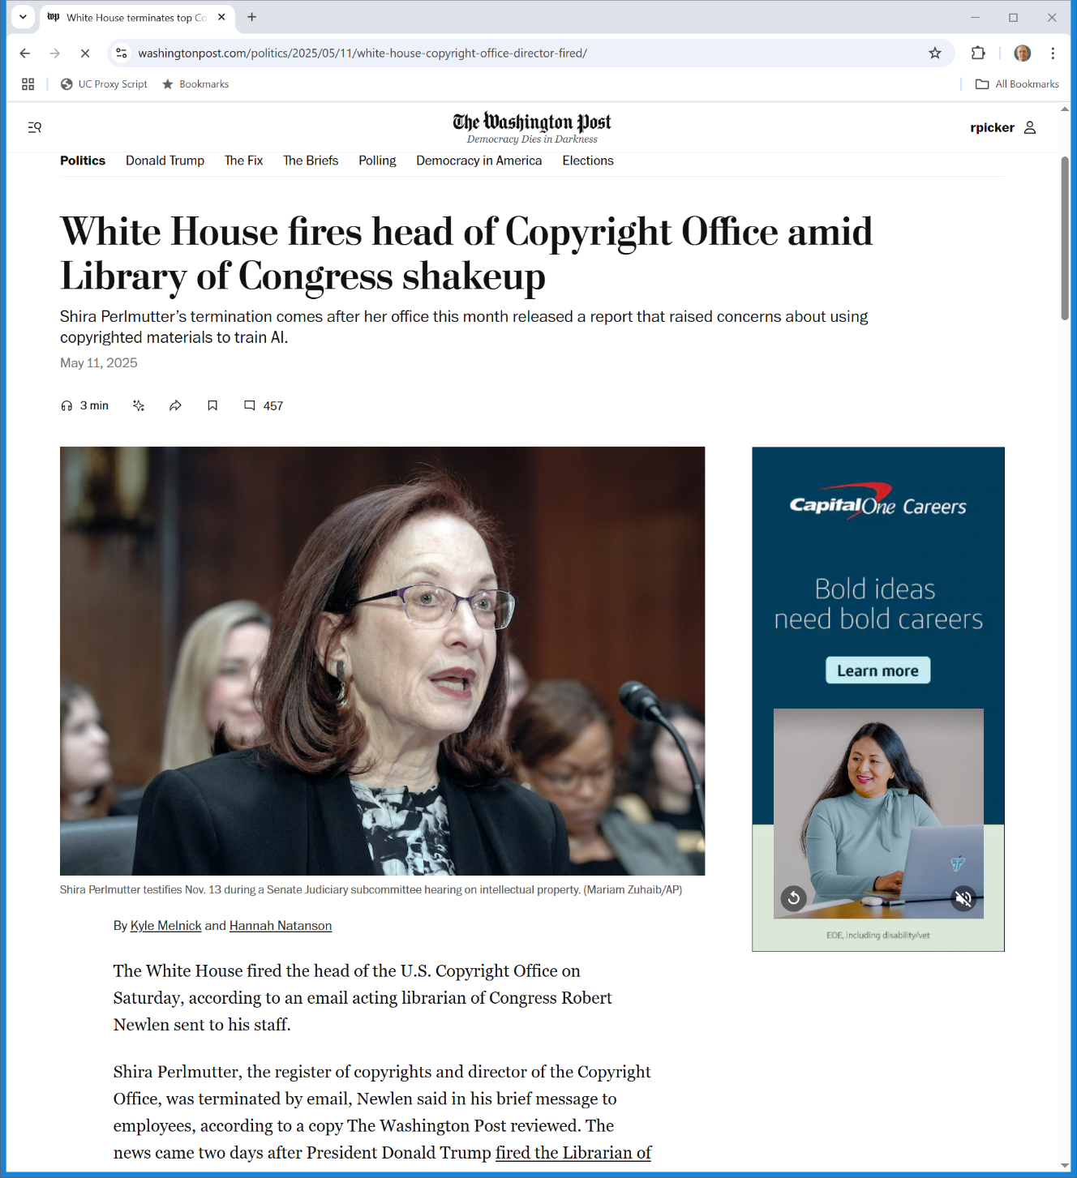
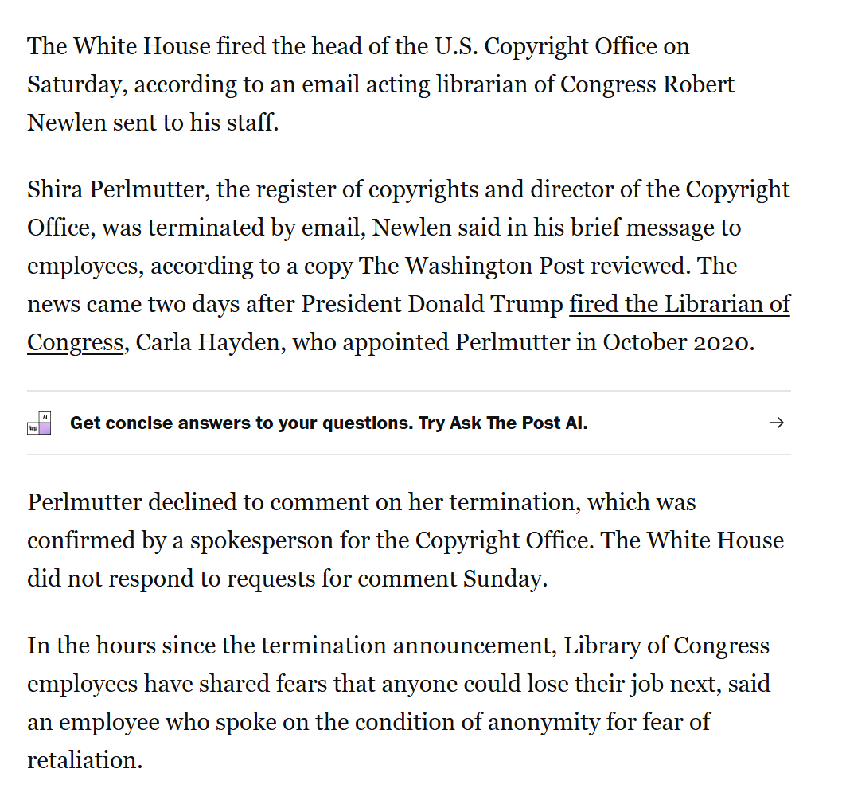
Sat 10 May 2025: Register of Copyrights Fired
Washington Post (11 May 2025)
Notes:
https://www.washingtonpost.com/politics/2025/05/11/white-house-copyright-office-director-fired/

Slide 3
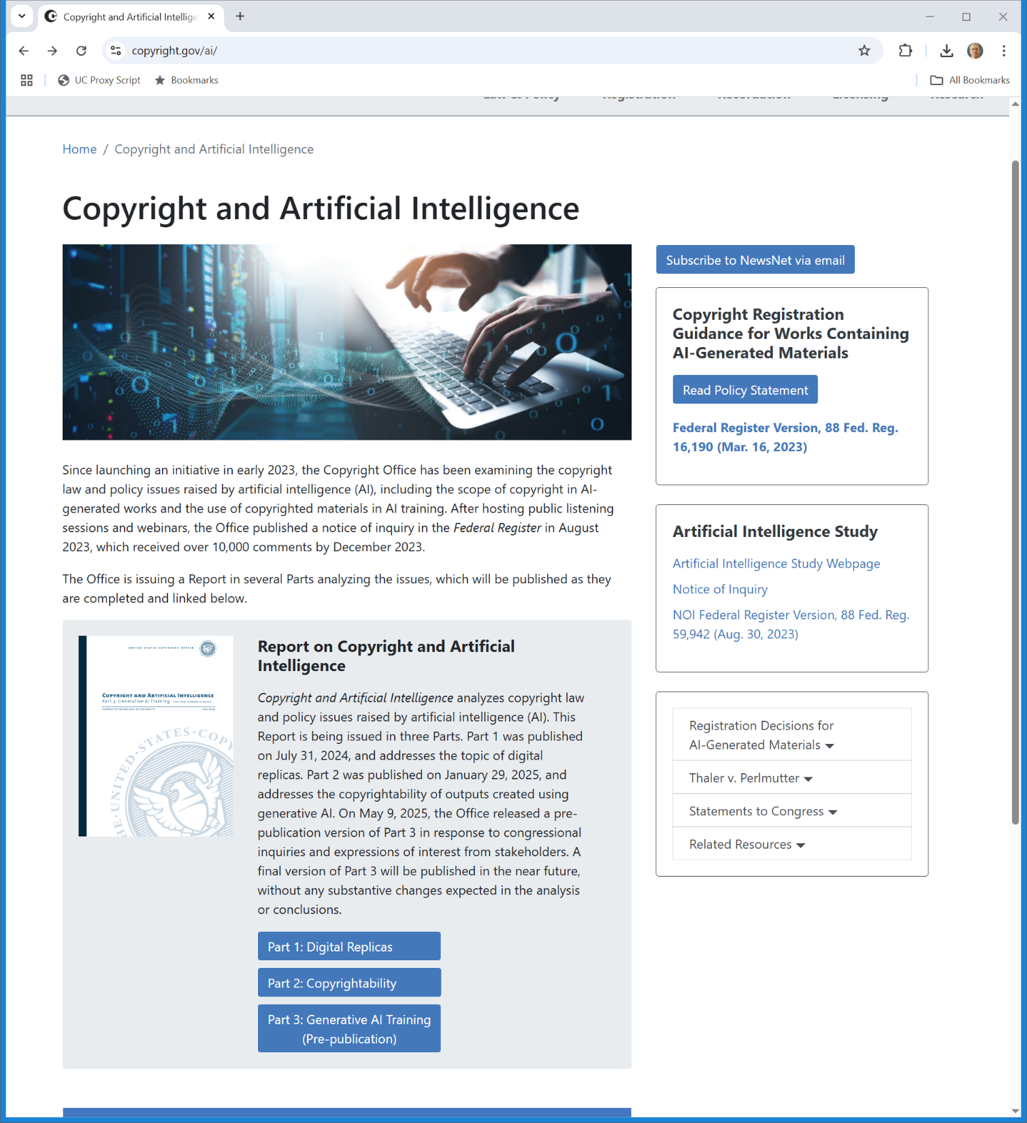
AI Studies
U.S. Copyright Office
Notes:
https://www.copyright.gov/ai/

Slide 4
Generative AI Training
Copyright and AI: Part 3 (May 2025)

Slide 5
“Once Upon A ___”
Copyright and AI: Part 3 (May 2025)

Slide 6
Text to Tokens
Copyright and AI: Part 3 (May 2025)

Slide 7
Predicting the Next Token
Copyright and AI: Part 3 (May 2025)

Slide 8
Surprisingly, It Works
Copyright and AI: Part 3 (May 2025)

Slide 9
Original Complaint
NYT v. Microsoft

Slide 10
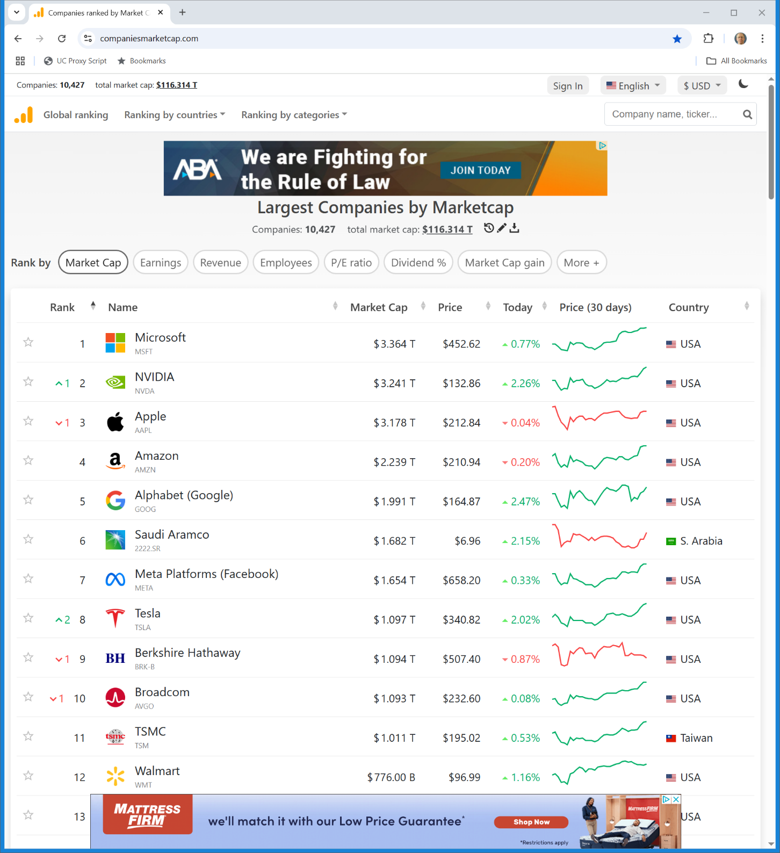
Microsoft Market Cap
Companiesmarketcap.com (14 May 2025)

Slide 11
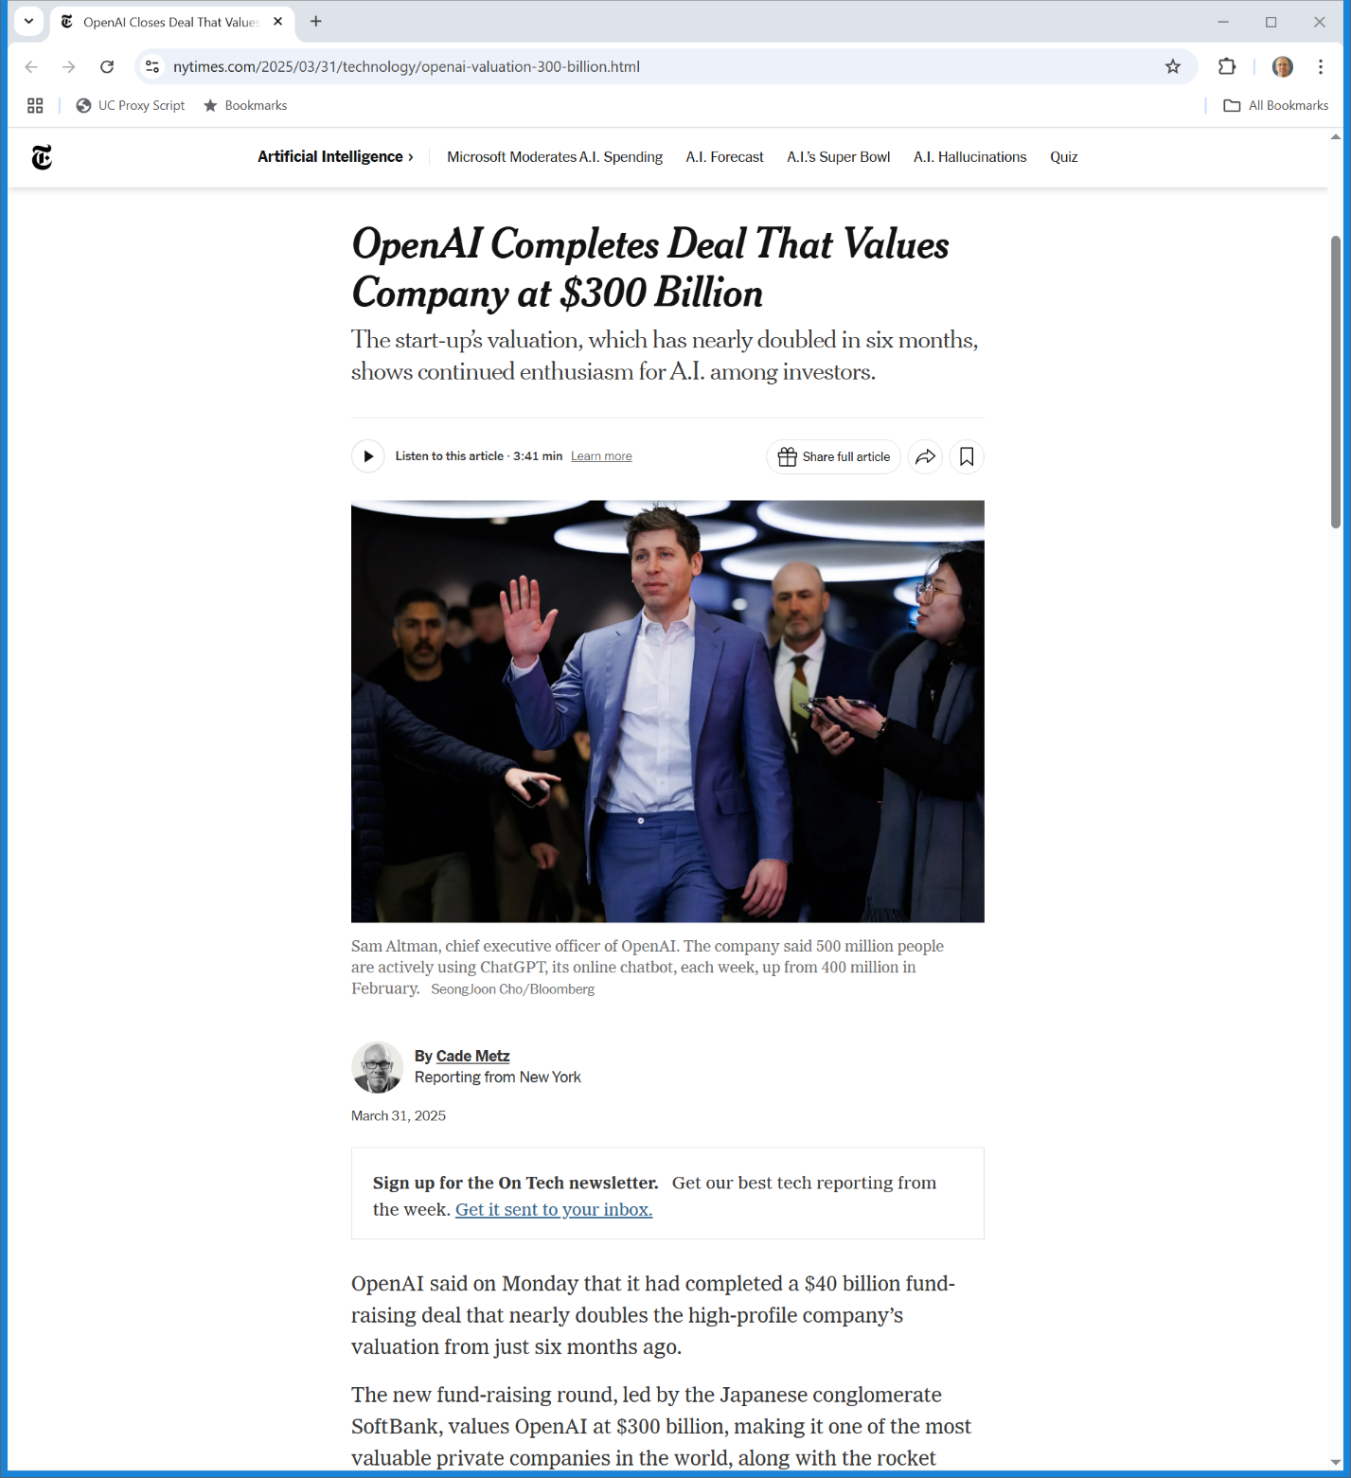
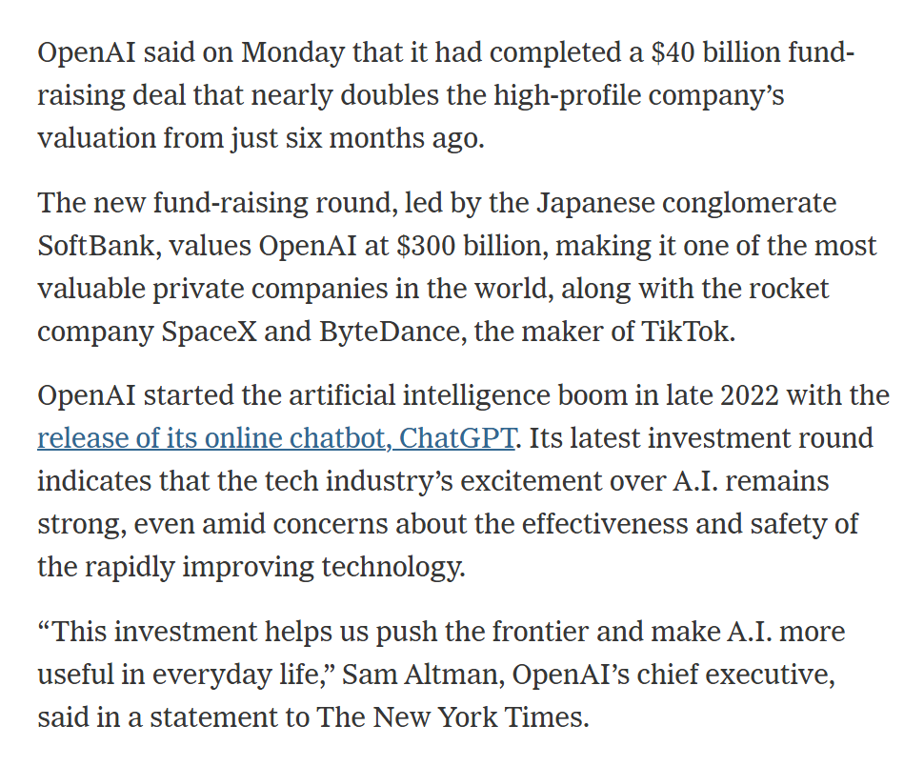
OpenAI: $300B
New York Times (31 Mar 2025)
Notes:
https://www.nytimes.com/2025/03/31/technology/openai-valuation-300-billion.html

Slide 12
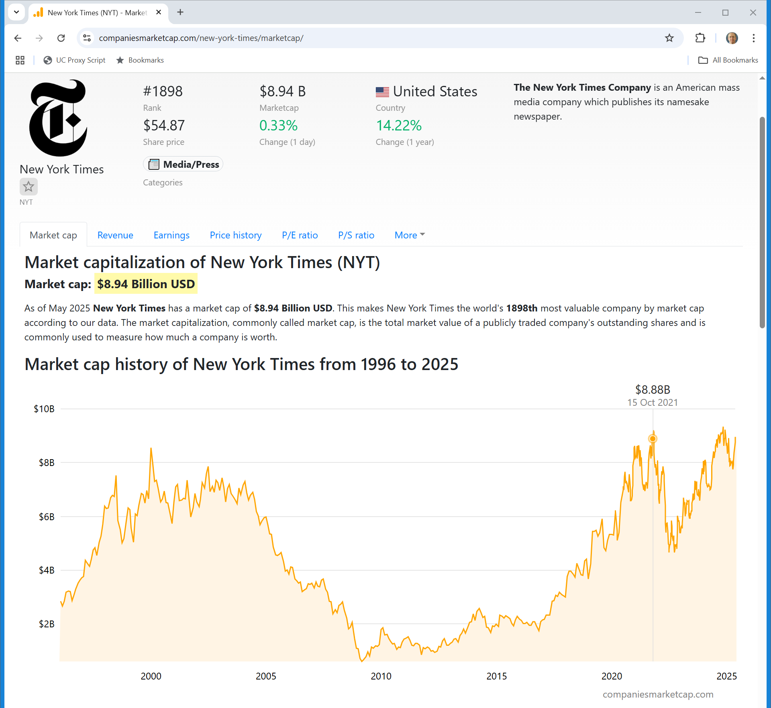
And the NYT?
Companiesmarketcap.com (14 May 2025)
Notes:
https://companiesmarketcap.com/new-york-times/marketcap/

Slide 13
Revised Complaint
NYT Amended Complaint (12 Aug 2024)

Slide 14
GenAI and Free Riding
NYT Amended Complaint (12 Aug 2024)

Slide 15
Memorization and Regurgitation
NYT Amended Complaint (12 Aug 2024)

Slide 16
Beyond Search
NYT Amended Complaint (12 Aug 2024)

Slide 17
They Are Making Money Off of Our Content
NYT Amended Complaint (12 Aug 2024)

Slide 18
We Want to Get Paid a Fair Value
NYT Amended Complaint (12 Aug 2024)

Slide 19
Fair Use? Billions in damages?
NYT Amended Complaint (12 Aug 2024)

Slide 20
Counting Words
TTYN (1 of 3)
Hypo
Google visits the NYT website and scrapes a bunch of articles from the website
That means it copies those articles and stores them in database 1
Google then counts the word usage across the articles and creates a second database with those statistics

Slide 21
Counting Words
TTYN (2 of 3)
Questions
What issues arise from the scaping and storage?
From the counting of word usage?
If Google destroyed database 1 after it formed database 2, would that change the liability that it might face?
How does fair use apply here?

Slide 22
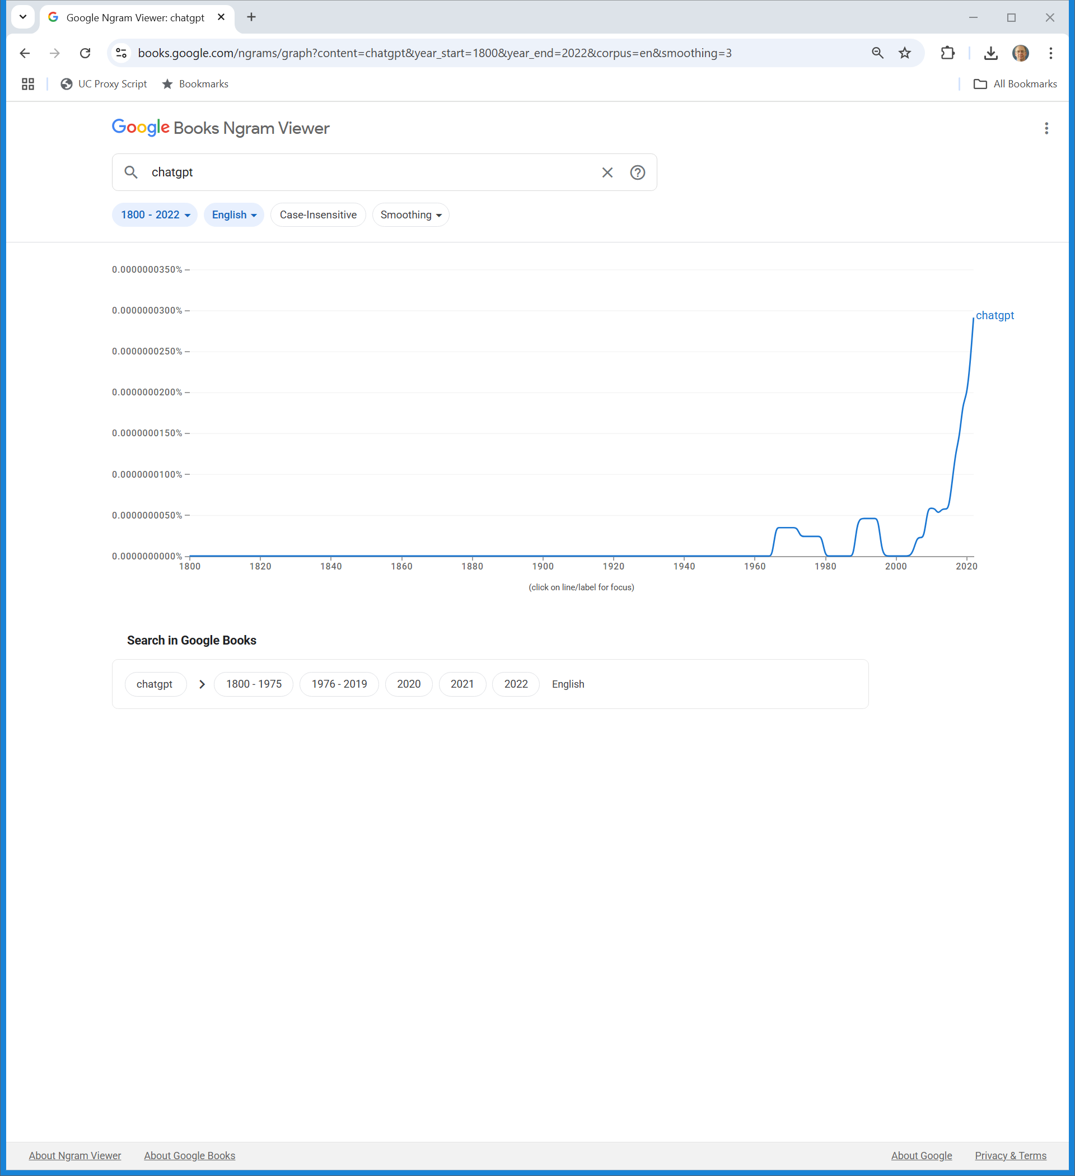
“chatgpt” (TTYN (3 of 3))
Google Ngam (13 May 2025)

Slide 23
Millions of Copies
Authors Guild v. Google, 804 F.3d 302 (2nd Cir. 2015)

Slide 24
Copying Here is Transformative
Authors Guild v. Google, 804 F.3d 302 (2nd Cir. 2015)

Slide 25
Transformative Use
Authors Guild v. Google, 804 F.3d 302 (2nd Cir. 2015)

Slide 26
Early Decision
NYT v. Microsoft (S.D.N.Y. Apr 4, 2025)

Slide 27
Finding Training Data
NYT v. Microsoft (S.D.N.Y. Apr 4, 2025)

Slide 28
Storing and Encoding the Data
NYT v. Microsoft (S.D.N.Y. Apr 4, 2025)

Slide 29
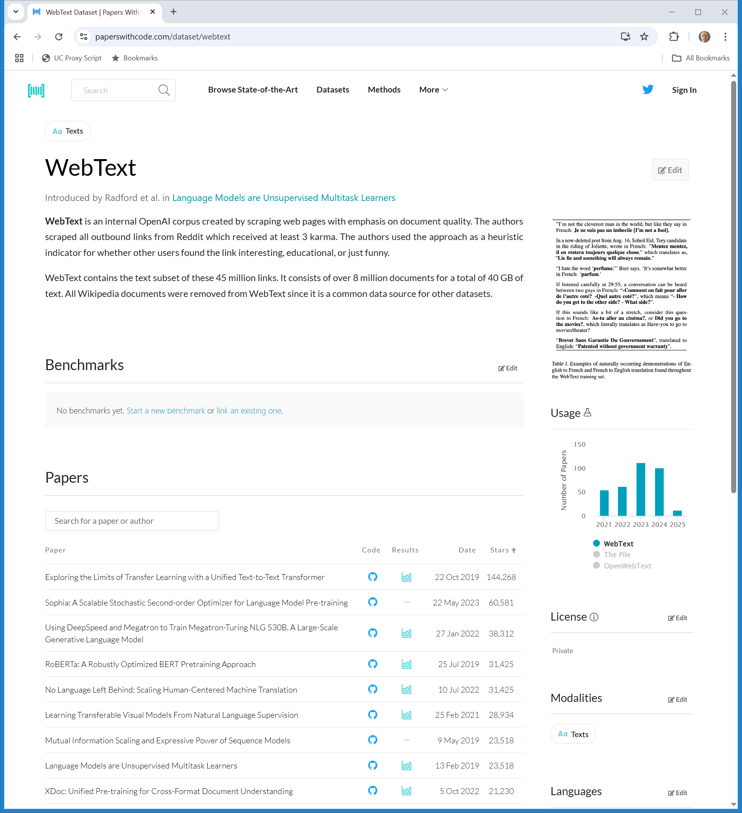
WebText
paperswithcode.com (Visited 14 May 2025)
Notes:
https://paperswithcode.com/dataset/webtext

Slide 30
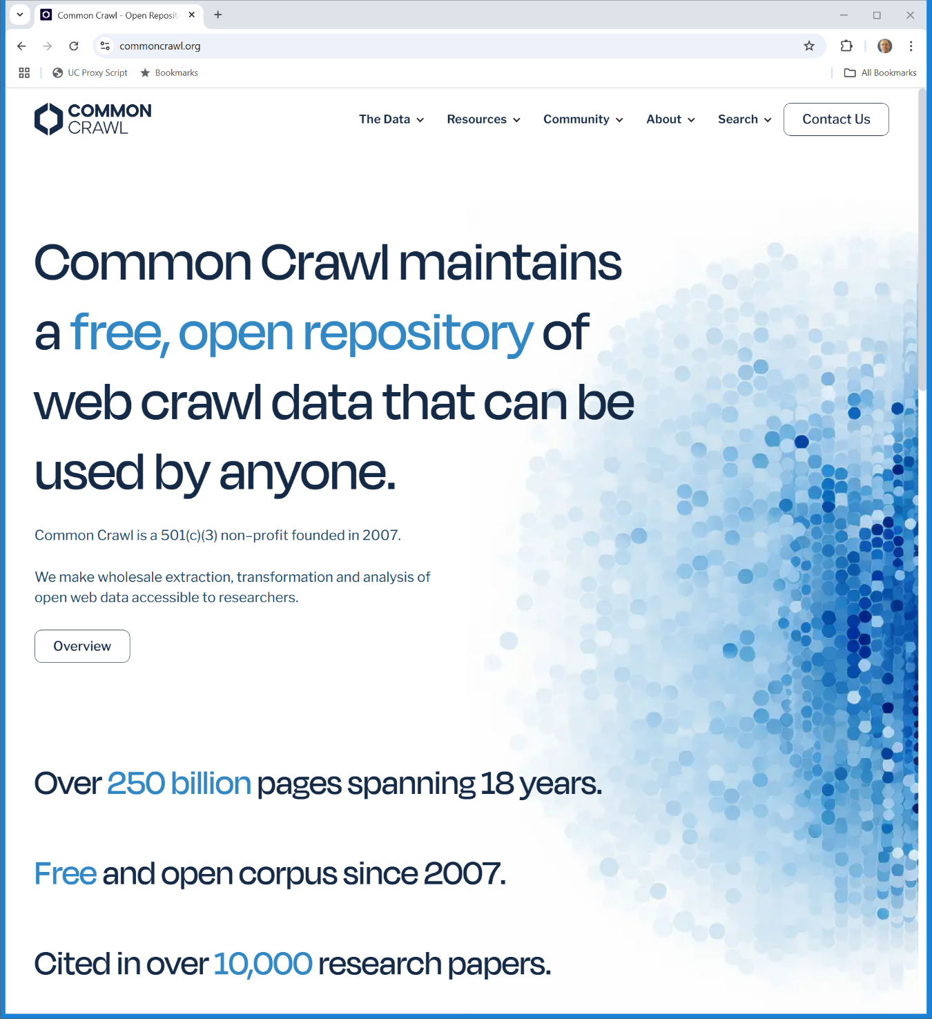
Common Crawl
commoncrawl.org (Visited 14 May 2025)
Notes:
https://commoncrawl.org/

Slide 31
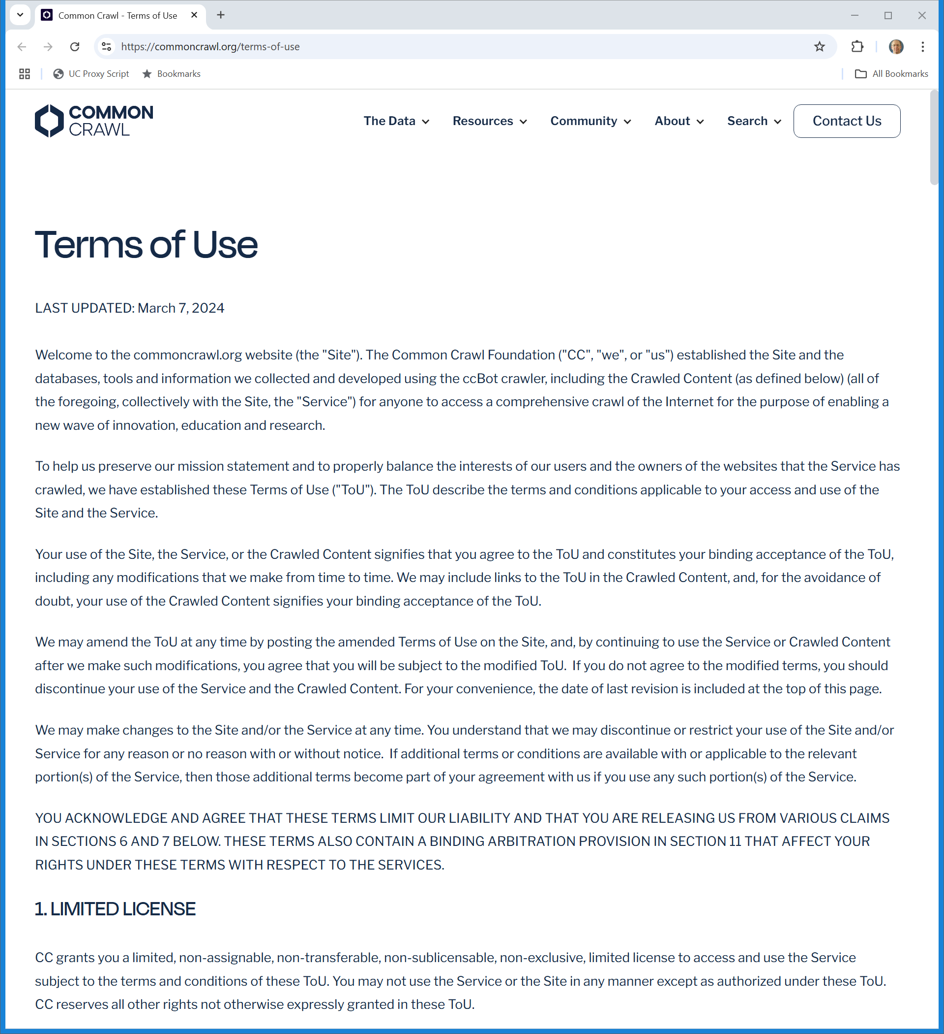
Common Crawl Terms of Use
commoncrawl.org (Visited 14 May 2025)
Notes:
https://commoncrawl.org/terms-of-use

Slide 32
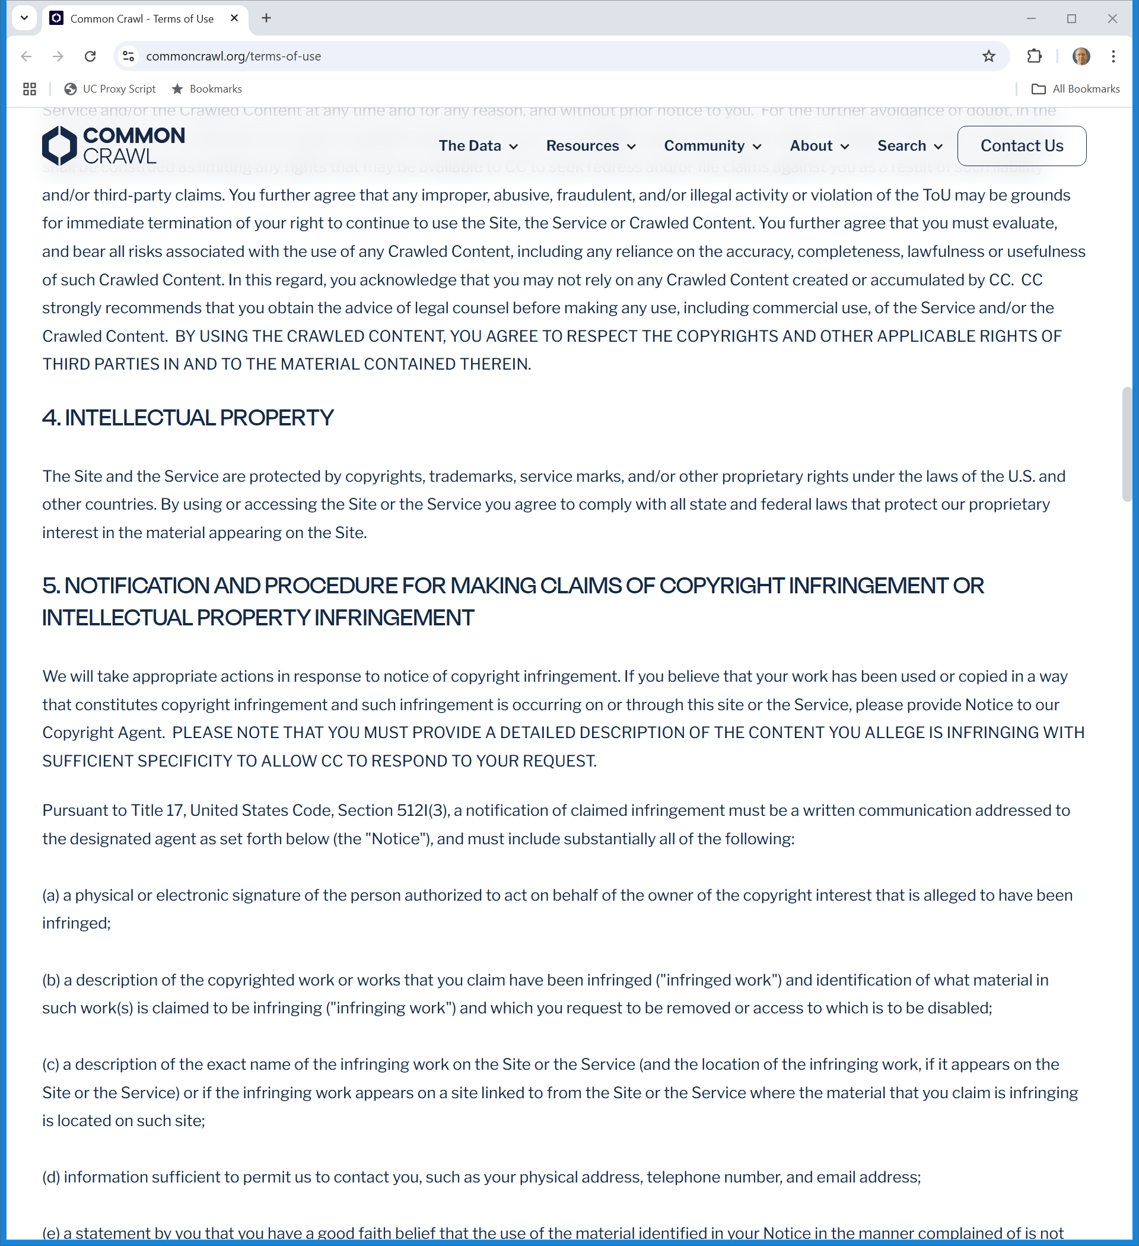
Common Crawl TOU: Copyright
commoncrawl.org (Visited 14 May 2025)
Notes:
https://commoncrawl.org/terms-of-use

Slide 33
Statute of Limitations
NYT v. Microsoft (S.D.N.Y. Apr 4, 2025)

Slide 34
Contributory Copyright Infringement
NYT v. Microsoft (S.D.N.Y. Apr 4, 2025)

Slide 35
Exhibit J: Understanding Outputs (TTYN (1 of 4))
NYT v. Microsoft (S.D.N.Y. Apr 4, 2025)

Slide 36
Exhibit J: Understanding Outputs (TTYN (2 of 4))
NYT v. Microsoft (S.D.N.Y. Apr 4, 2025)

Slide 37
Exhibit J: Understanding Outputs (TTYN (3 of 4))
NYT v. Microsoft (S.D.N.Y. Apr 4, 2025)

Slide 38
Understanding Outputs
TTYN (4 of 4)
Questions
What do we think OpenAI has done here? Have they stored a copy of this article?
Do they distribute/display the article in response to a prompt from a user?
If there is infringement, is that by the user? OpenAI? On what standard?

Slide 39
Material Contribution Theory
NYT v. Microsoft (S.D.N.Y. Apr 4, 2025)

Slide 40
What About Sony?
NYT v. Microsoft (S.D.N.Y. Apr 4, 2025)

Slide 41
Product v. Service
NYT v. Microsoft (S.D.N.Y. Apr 4, 2025)

Slide 42
DMCA CMI and Standing?: Court Says OK
NYT v. Microsoft (S.D.N.Y. Apr 4, 2025)

Slide 43
1202(a): False CMI
“(a) FALSE COPYRIGHT MANAGEMENT INFORMATION.—No person shall knowingly and with the intent to induce, enable, facilitate, or conceal infringement—(1) provide copyright management information that is false, or (2) distribute or import for distribution copyright management information that is false.”
17 U.S.C. 1202

Slide 44
1202(b): Removal of CMI
“(b) REMOVAL OR ALTERATION OF COPYRIGHT MANAGEMENT INFORMATION.—No person shall, without the authority of the copyright owner or the law—
(1) intentionally remove or alter any copyright management information, (2) distribute or import for distribution copyright management information knowing that the copyright management information has been removed or altered without authority of the copyright owner or the law, or (3) distribute, import for distribution, or publicly perform works, copies of works, or phonorecords,
knowing that copyright management information has been removed or altered without authority of the copyright owner or the law, knowing, or, with respect to civil remedies under section 1203, having reasonable grounds to know, that it will induce, enable, facilitate, or conceal an infringement of any right under this title.”
17 U.S.C. 1202

Slide 45
1202(c): CMI Definition
“(c) DEFINITION.—As used in this section, the term ‘copyright management information’ means any of the following information conveyed in connection with copies or phonorecords of a work or performances or displays of a work, including in digital form, except that such term does not include any personally identifying information about a user of a work or of a copy, phonorecord, performance, or display of a work: (1) The title and other information identifying the work, including the information set forth on a notice of copyright. …”
17 U.S.C. 1202

Slide 46
NYT Needs More on Removal
NYT v. Microsoft (S.D.N.Y. Apr 4, 2025)

Slide 47
Others Have Alleged More
NYT v. Microsoft (S.D.N.Y. Apr 4, 2025)

Slide 48
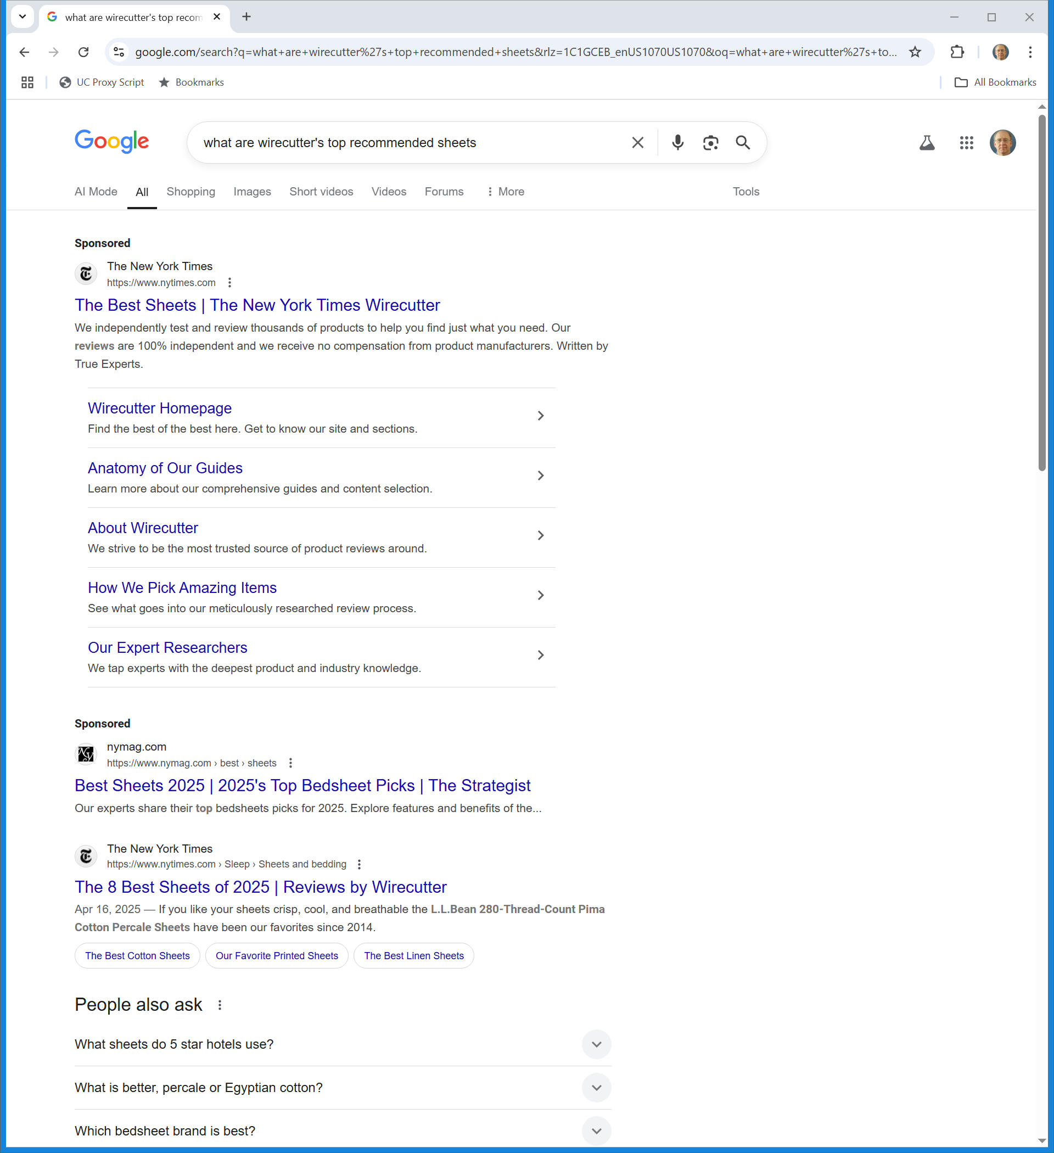
Looking for Bed Sheets
Google (14 May 2025)

Slide 49
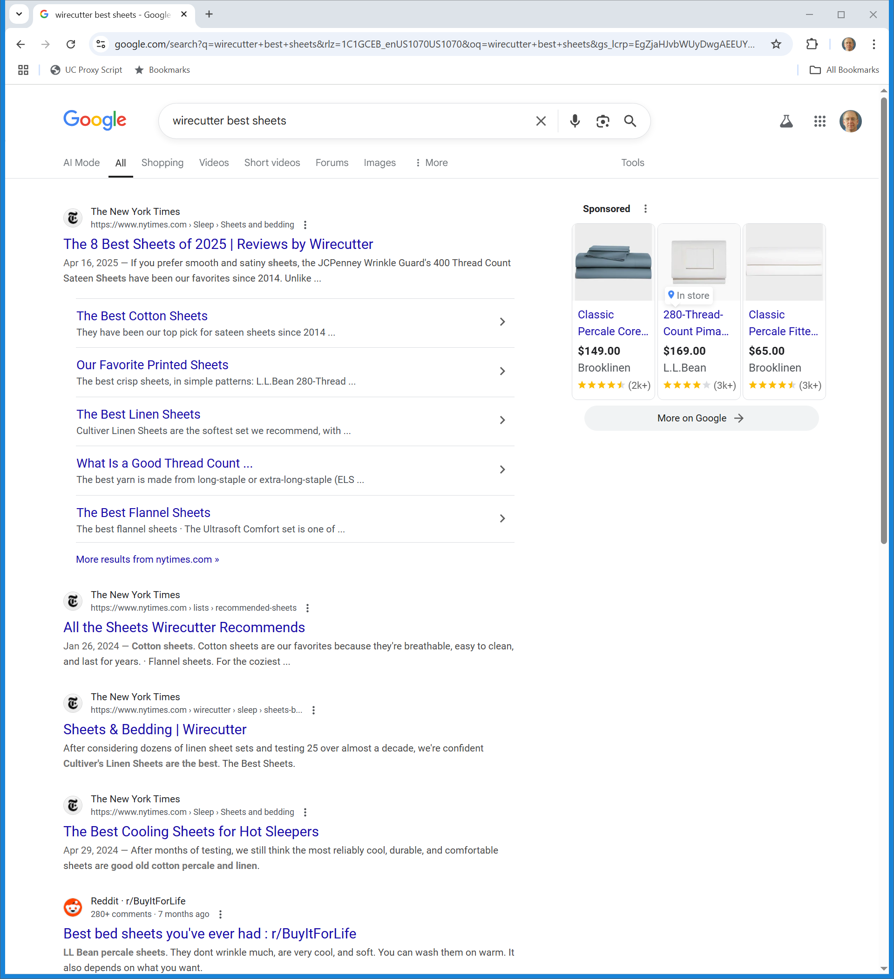
Again
Google (14 May 2025)

Slide 50
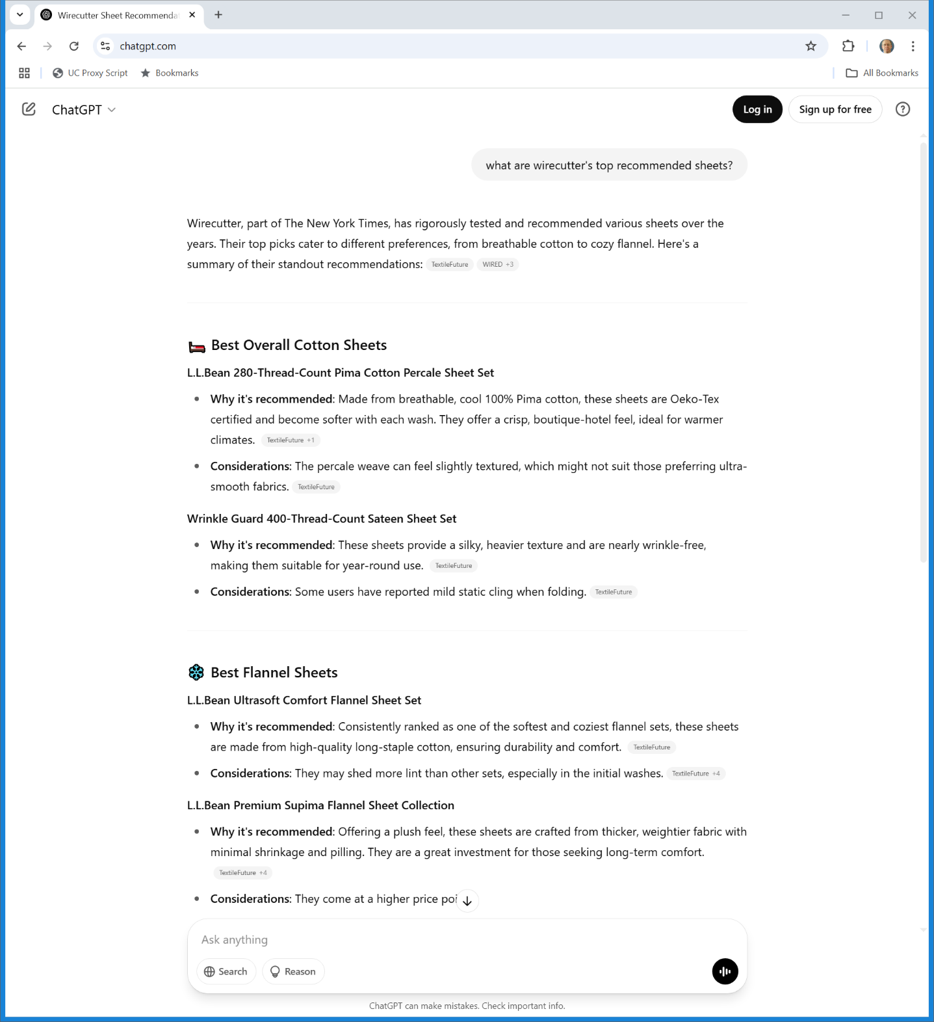
One More Time
ChatGPT (14 May 2025)

Slide 51
NYT Misappropriation Claims Blocked by 301
NYT v. Microsoft (S.D.N.Y. Apr 4, 2025)

Slide 52
The News on Google
TTYN (1 of 5)
Hypo 1
Google hires human beings—gasp—to read news stories, identify facts and write up those stories in real time
Provides those in response to search queries
Copyright issues? Does G own a copyright in those stories?

Slide 53
The News on Google
TTYN (2 of 5)
Hypo 2
The Googlebot does its thing and produces search responses to queries for news
Lists headlines with links to original sources
Copyright issues?

Slide 54
The News on Google
TTYN (3 of 5)
Hypo 3
Same except now its adds snippets; perhaps the first paragraphs of the story
Copyright issues?

Slide 55
The News on Google
TTYN (4 of 5)
Hypo 4
Google doesn’t hire human beings—of course not—to read news stories, identify facts and write up those stories in real time
Instead it creates an algorithm/AI bot to do that
Results look like the next page
Copyright issues? Does G own a copyright in what it produces?

Slide 56
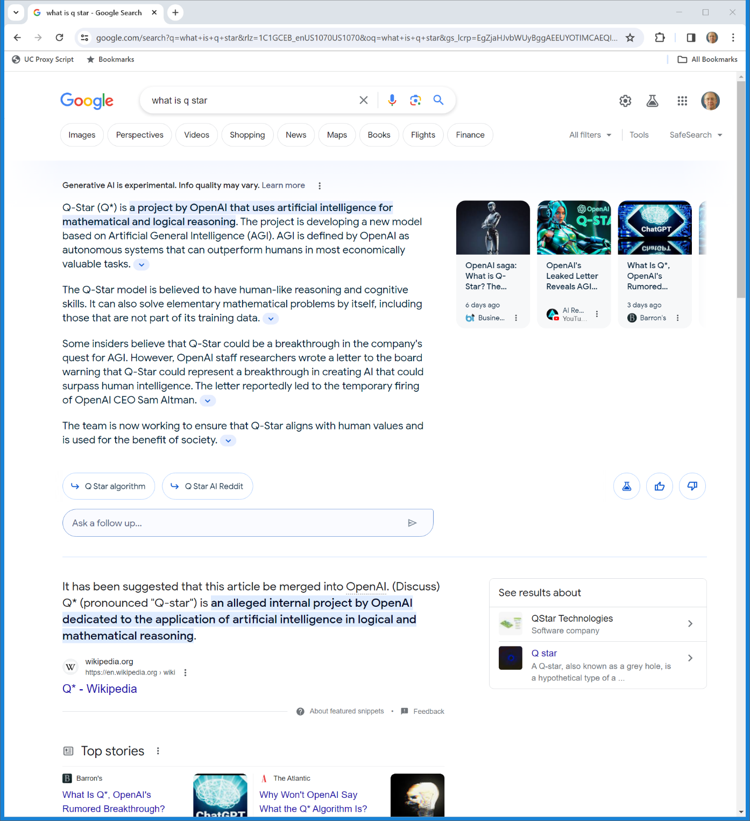
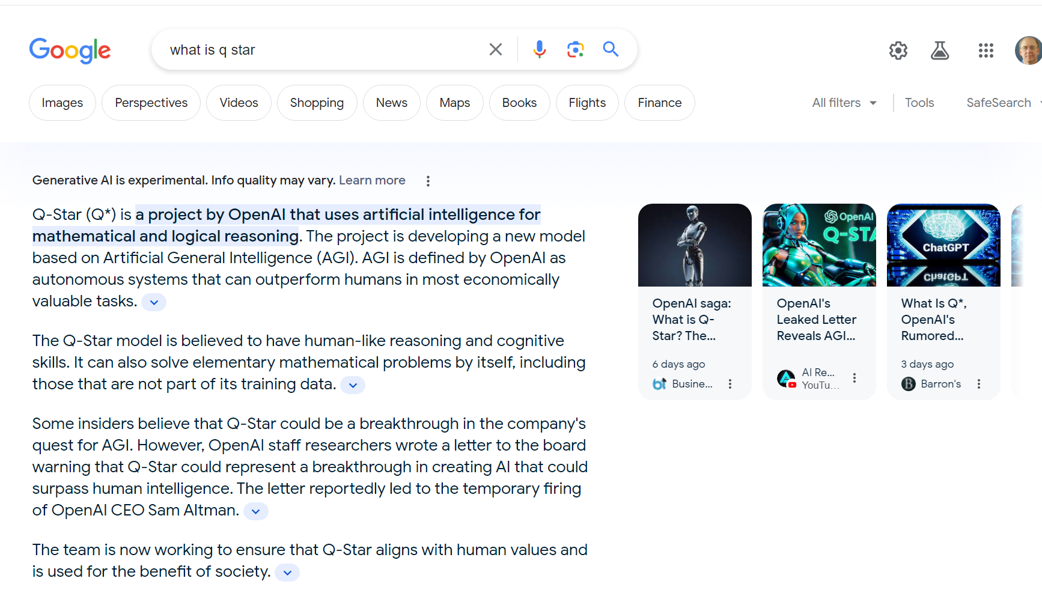
Google Gen AI Response (TTYN (5 of 5))
Google (search of 30 Nov 2023)
Notes:
https://www.google.com/search?q=what+is+q+star&rlz=1C1GCEB_enUS1070US1070&oq=what+is+q+star&gs_lcrp=EgZjaHJvbWUyBggAEEUYOTIMCAEQIxgnGIAEGIoFMgwIAhAAGAoYsQMYgAQyCQgDEAAYChiABDIJCAQQABgKGIAEMgkIBRAAGAoYgAQyCQgGEAAYChiABDIMCAcQABgKGLEDGIAEMgkICBAAGAoYgAQyCQgJEAAYChiABNIBCDcyMzFqMGo3qAIAsAIA&sourceid=chrome&ie=UTF-8

Slide 57
The Abridgements?
NYT v. Microsoft (S.D.N.Y. Apr 4, 2025)

Slide 58
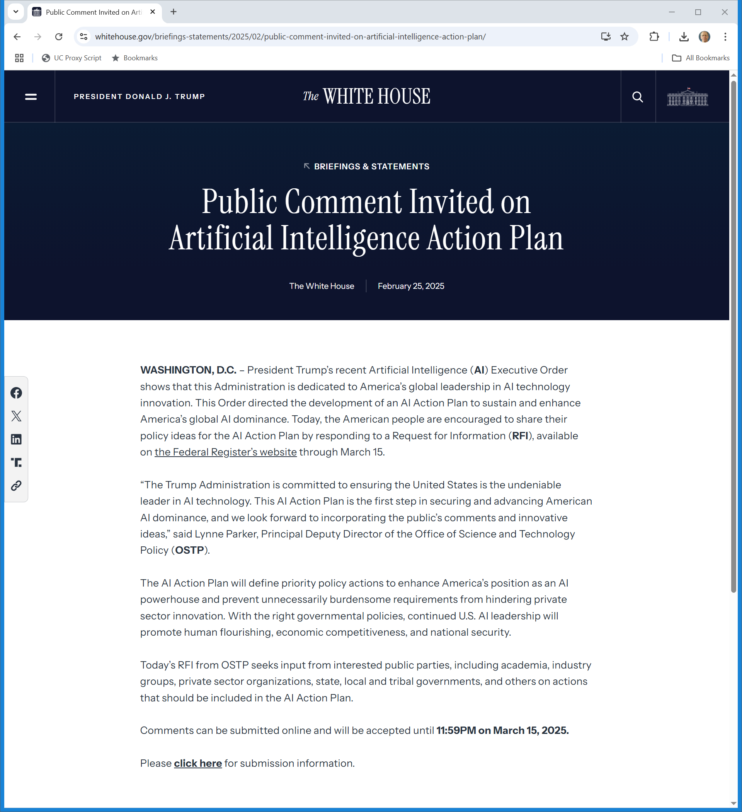
AI Action Plan?
The White House (25 Feb 2025)
Notes:
https://www.whitehouse.gov/briefings-statements/2025/02/public-comment-invited-on-artificial-intelligence-action-plan/

Slide 59
U.S. v. China
OpenAI Submission (13 Mar 2025)

Slide 60
Fair Use as Driver of U.S. AI Success
OpenAI Submission (13 Mar 2025)

Slide 61
EU, UK Limit Uses
OpenAI Submission (13 Mar 2025)

Slide 62
China Won’t Do That
OpenAI Submission (13 Mar 2025)

Slide 63
What the U.S. Gov’t Should Do
OpenAI Submission (13 Mar 2025)

Slide 64
Copyright Drives U.S. Innovation and Success
OpenAI Submission (13 Mar 2025)

Slide 65
“Often Be Transformative”
Copyright and AI: Part 3 (May 2025)

Slide 66
But Not If Outputs Are Substitutes
Copyright and AI: Part 3 (May 2025)

Slide 67
Intermediate Copying, Output Safeguards
Copyright and AI: Part 3 (May 2025)

Slide 68
So Far
Copyright and AI: Part 3 (May 2025)

Slide 69
Fourth Factor?
Copyright and AI: Part 3 (May 2025)

Slide 70
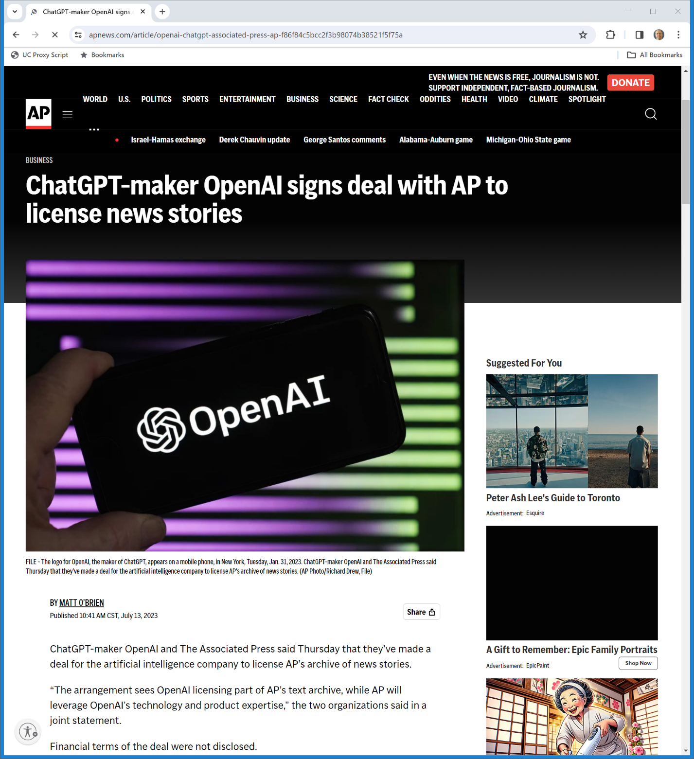
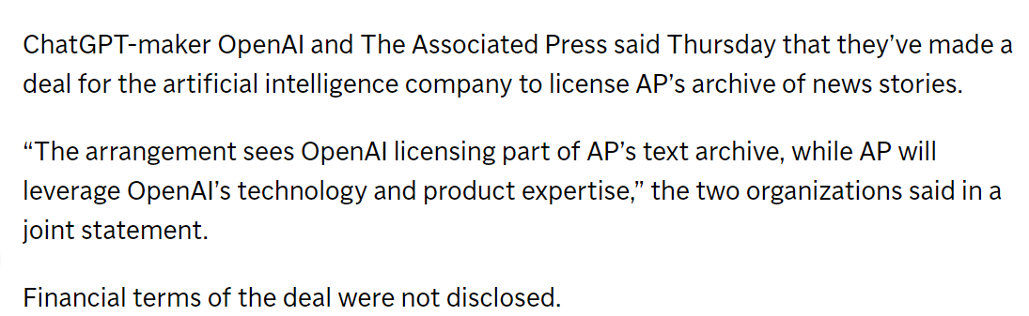
July 2023: OpenAI, AP Deal
AP News (13 July 2023)
Notes:
https://apnews.com/article/openai-chatgpt-associated-press-ap-f86f84c5bcc2f3b98074b38521f5f75a

Slide 71
New Right to Protect Press
EU Copyright FAQ (4 June 2021)
Notes:
https://ec.europa.eu/commission/presscorner/detail/en/IP_21_1807

Slide 72
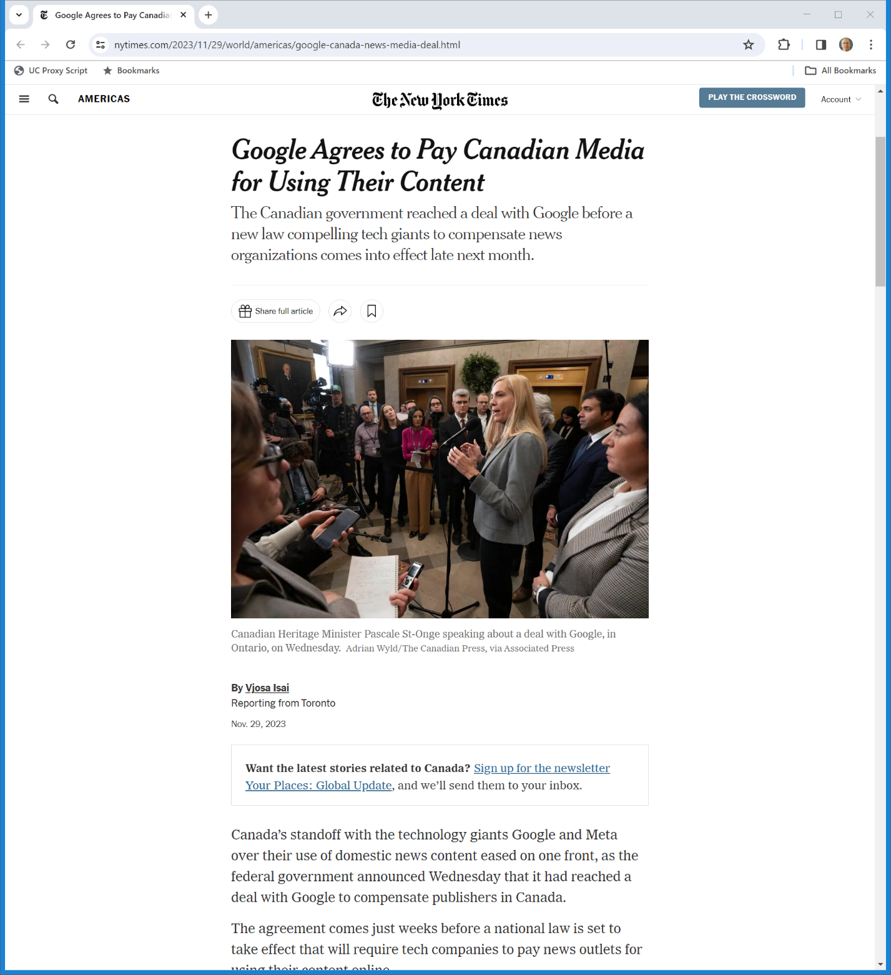
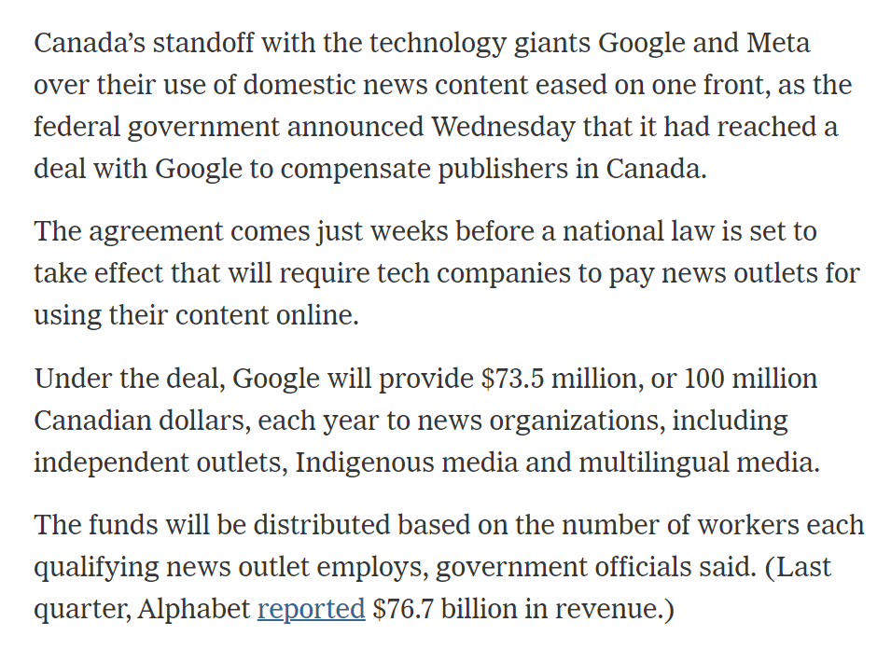
In Canada
New York Times (29 Nov 2023)

Slide 73
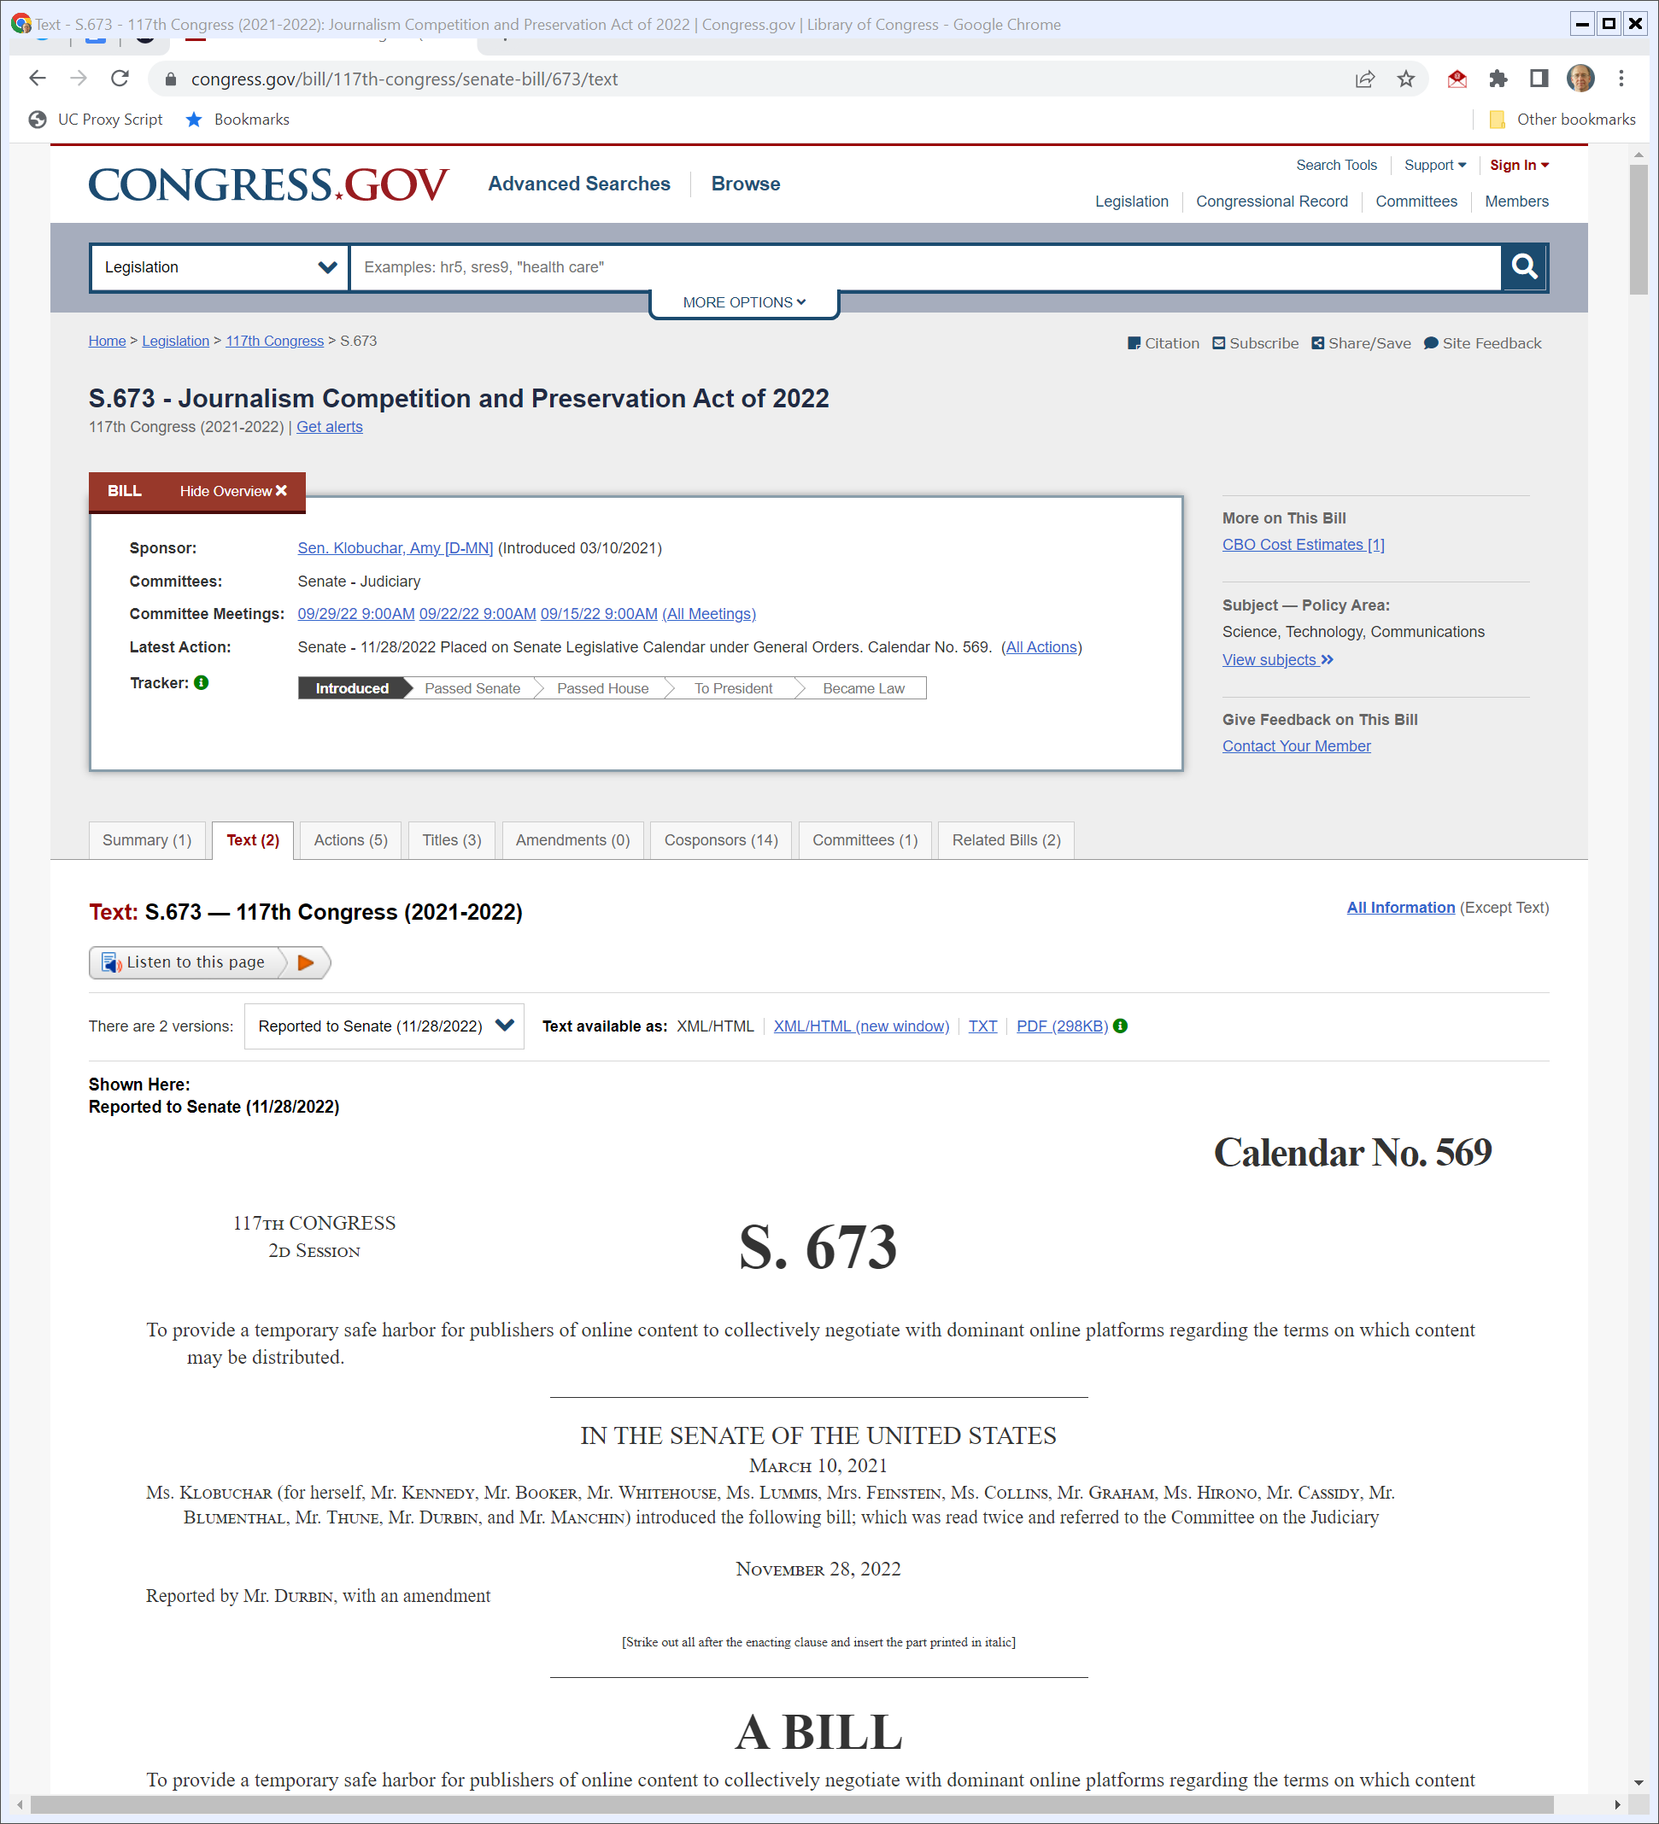
S.673: Journalism Competition and Preservation Act of 2022
Congress.gov (Visited 1 Dec 2022)
Notes:
https://www.congress.gov/bill/117th-congress/senate-bill/673/text

Slide 74
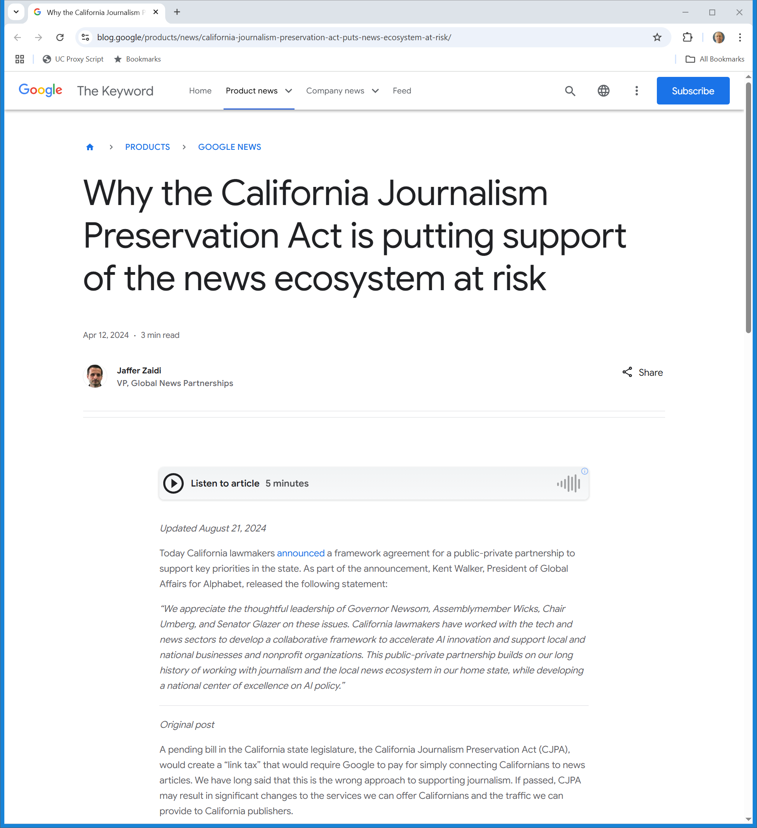
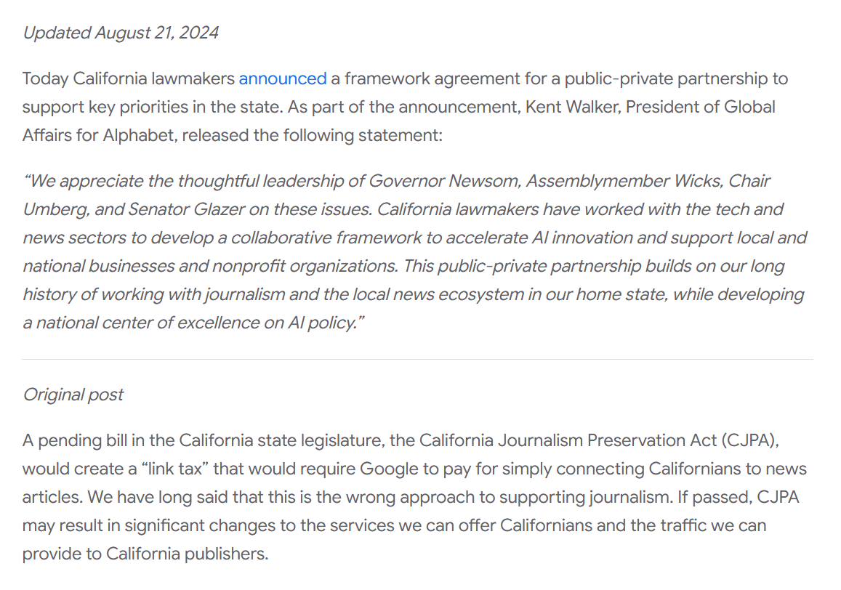
California Efforts
Google (12 Apr 2024)

