Slide 1
Class 22: Mon 12 May 2025 Copyright Spring 2025 AI: Authorship
Randal C. Picker
James Parker Hall Distinguished Service Professor of Law
The Law School
The University of Chicago

Slide 2
Human Mind Eclipsed
LA Times (21 Oct 1927)

Slide 3
ENIAC: Electronic Numerical Integrator and Computer
Chicago Daily Tribune (15 Feb 1946)

Slide 4
ENIAC: Electronic Numerical Integrator and Computer
Chicago Daily Tribune (15 Feb 1946)

Slide 5
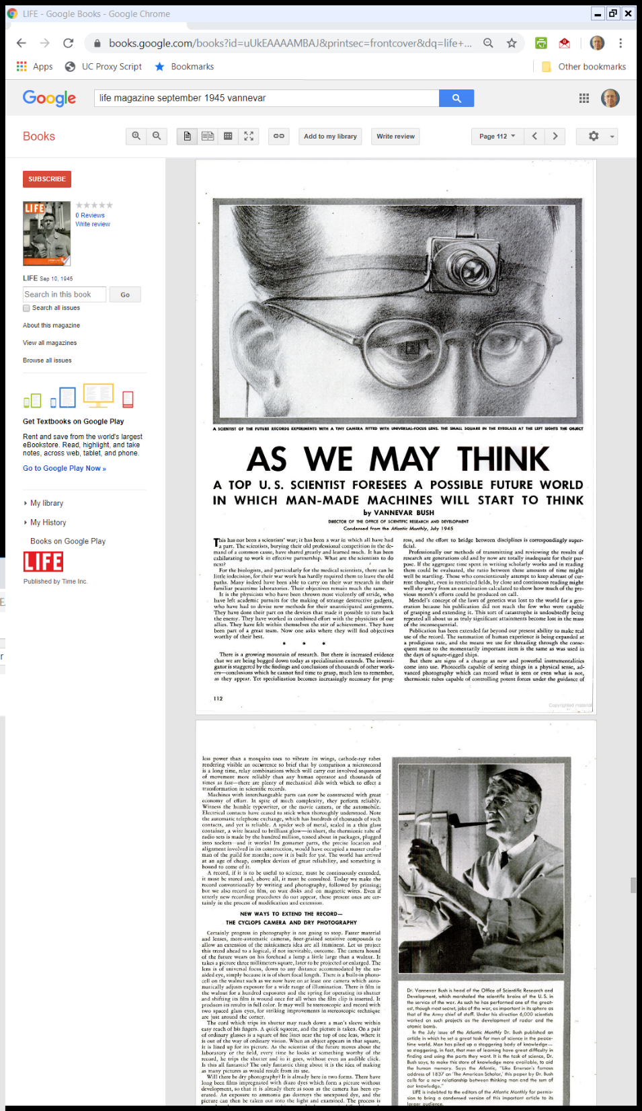
Vannevar Bush Memex
Life Magazine (10 Sept 1945)

Slide 6
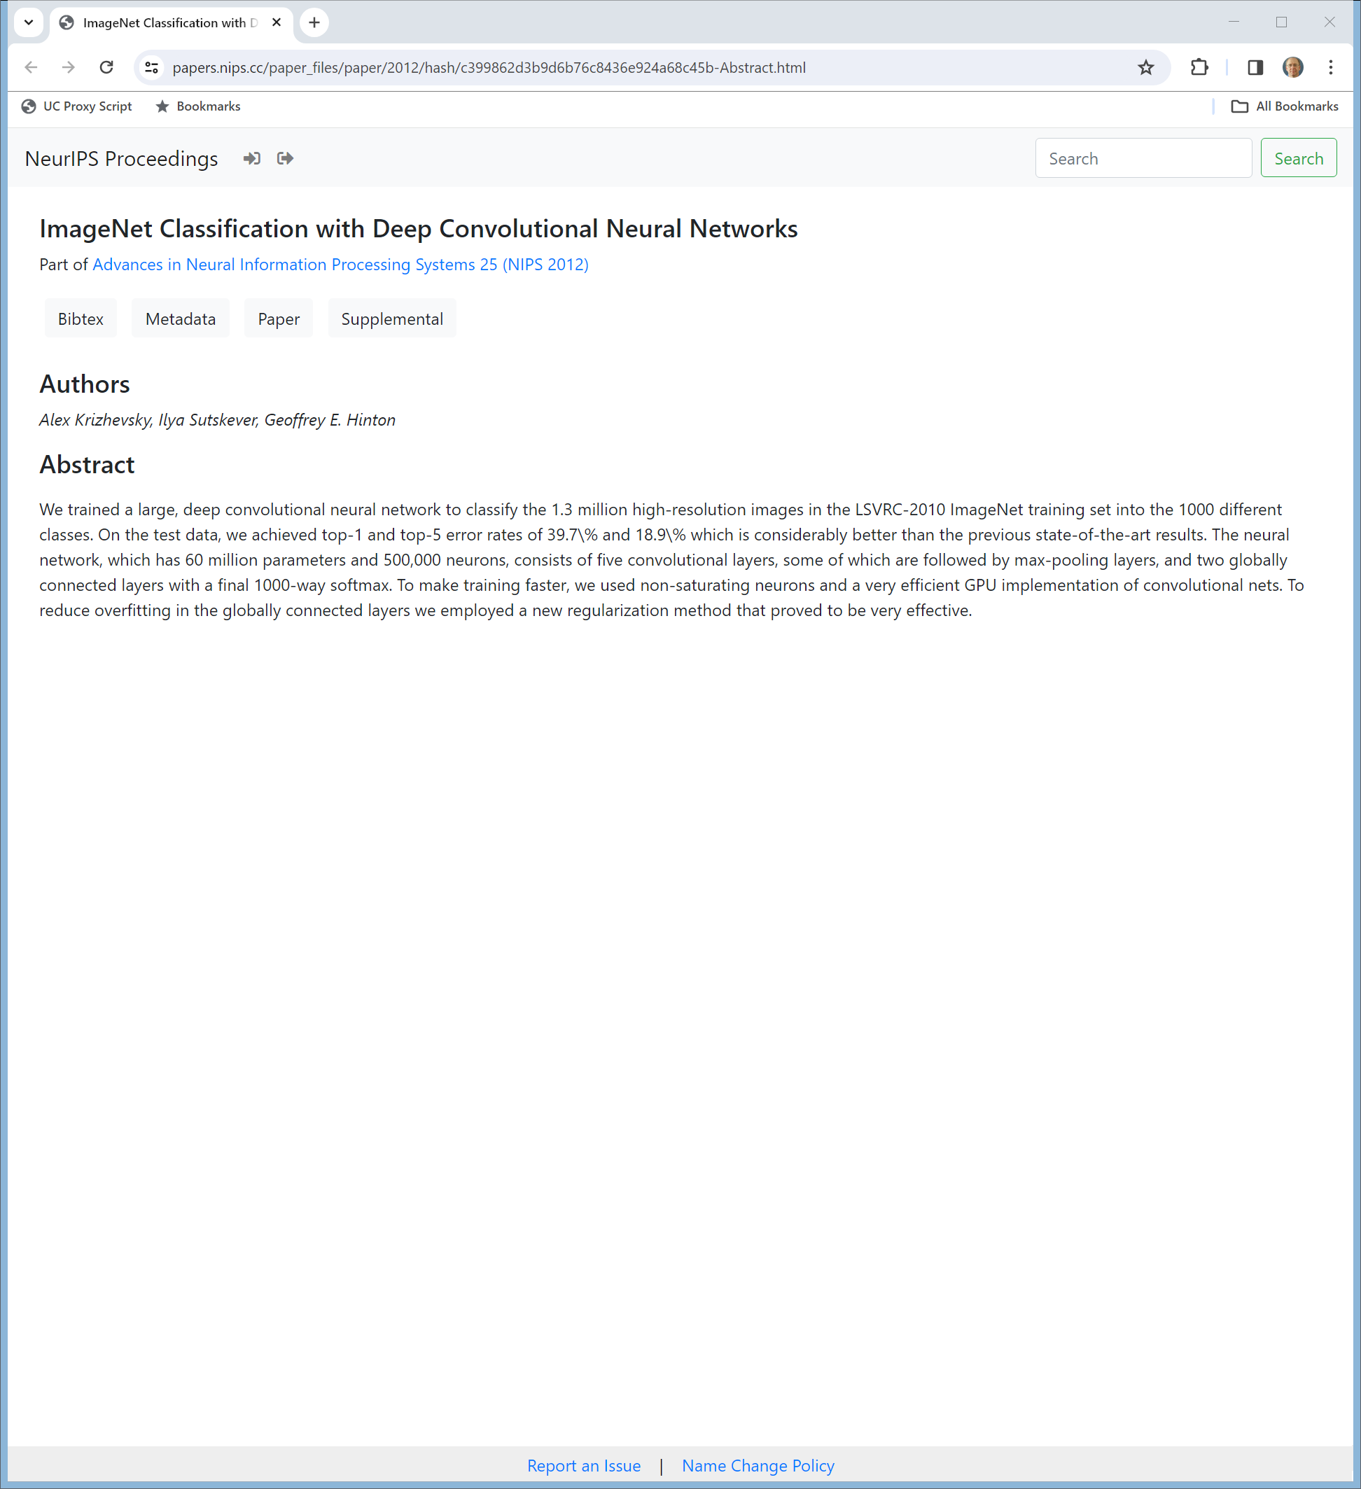
Neural Information Processing Systems Conf, Dec 3-5, 2012
Krizhevsky et al (2012)
Notes:
https://papers.nips.cc/paper_files/paper/2012/hash/c399862d3b9d6b76c8436e924a68c45b-Abstract.html

Slide 7
9 Page Paper
Krizhehsky et al (2012)
Notes:
https://papers.nips.cc/paper_files/paper/2012/file/c399862d3b9d6b76c8436e924a68c45b-Paper.pdf

Slide 8
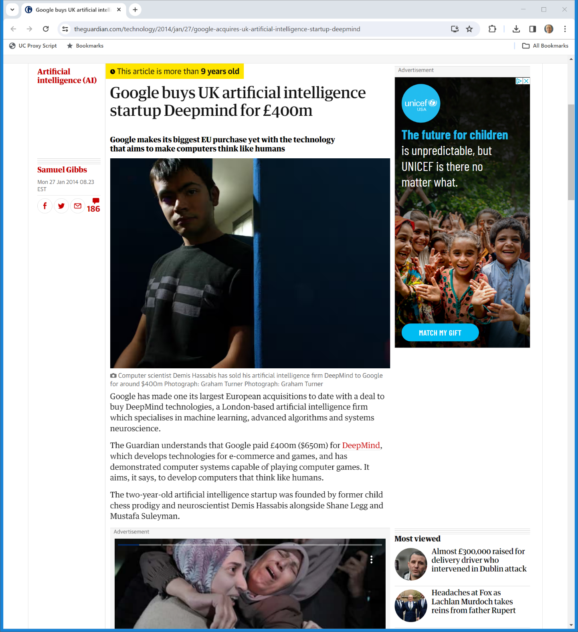

Jan 2014: Google Buys Deepmind
The Guardian (27 Jan 2014)

Slide 9
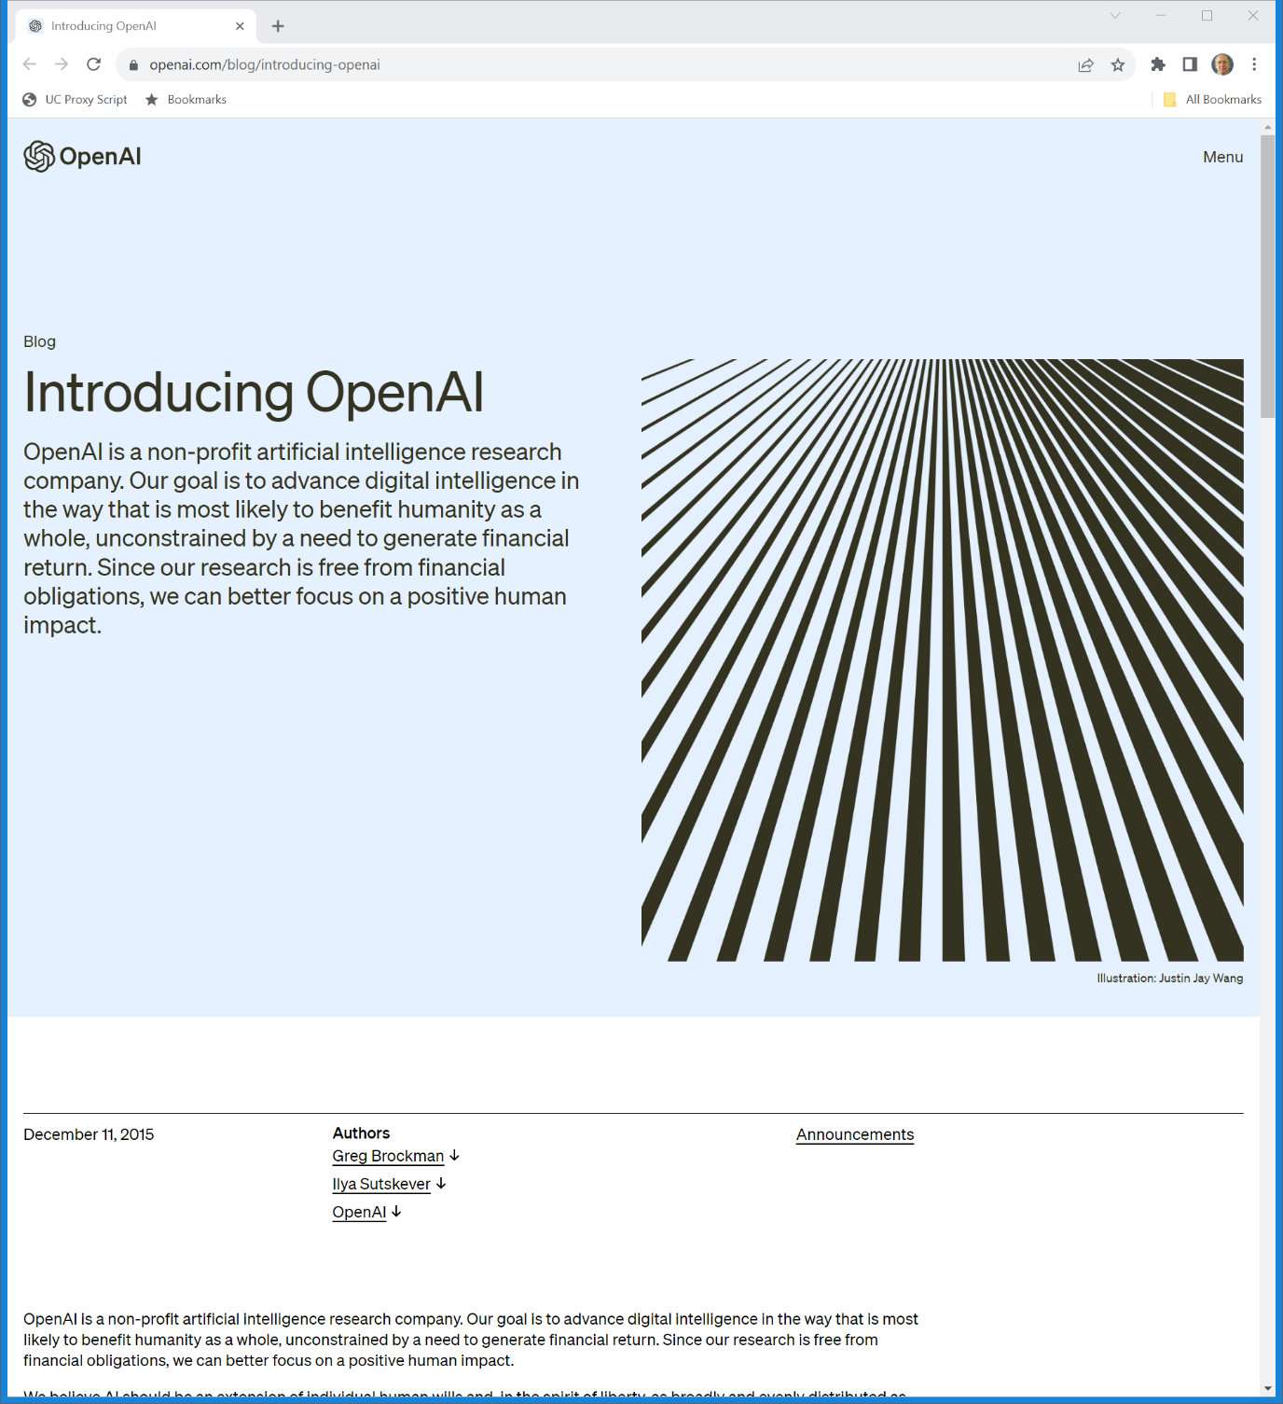
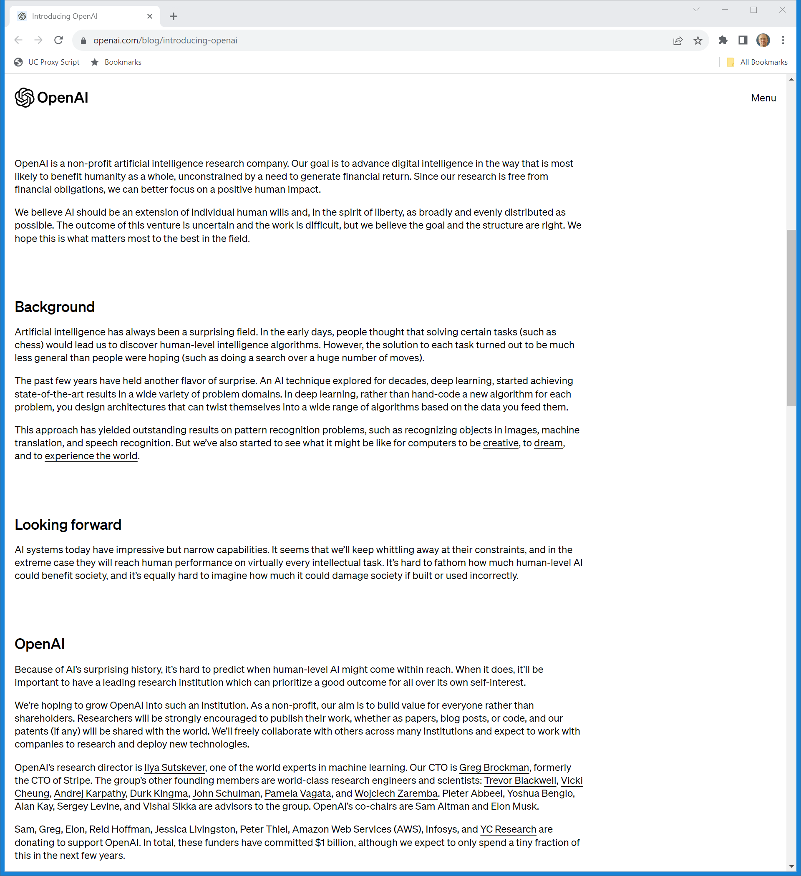
Dec 2015: OpenAI
OpenAI (11 Dec 2015)
Notes:
https://openai.com/blog/introducing-openai

Slide 10
Dec 2015: OpenAI
OpenAI (11 Dec 2015)
Notes:
https://openai.com/blog/introducing-openai

Slide 11
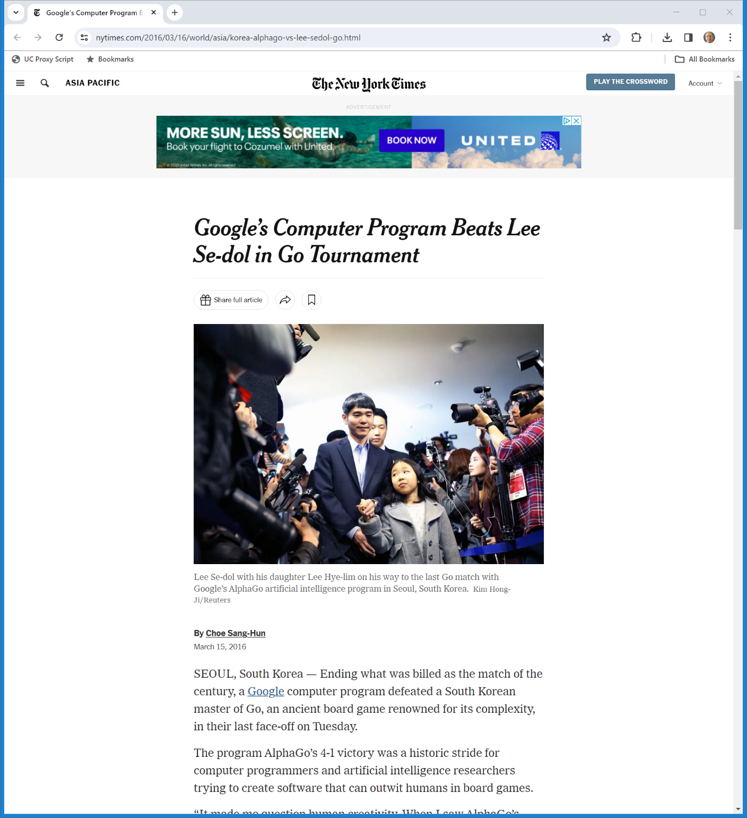
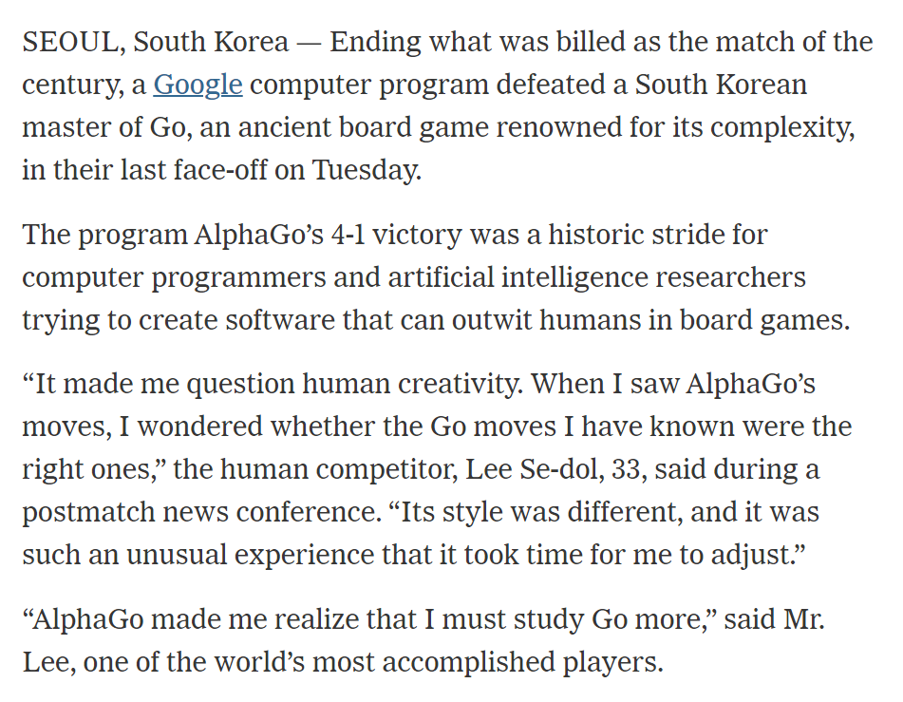
AlphaGo Wins
New York Times (15 Mar 2016)
Notes:
https://www.nytimes.com/2016/03/16/world/asia/korea-alphago-vs-lee-sedol-go.html

Slide 12
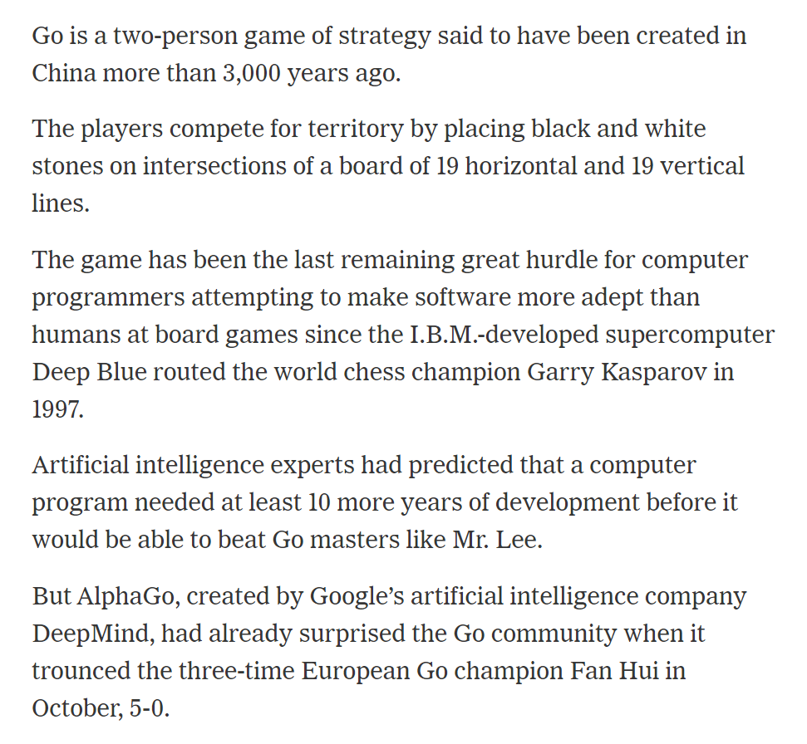
Unexpectedly
New York Times (15 Mar 2016)
Notes:
https://www.nytimes.com/2016/03/16/world/asia/korea-alphago-vs-lee-sedol-go.html

Slide 13
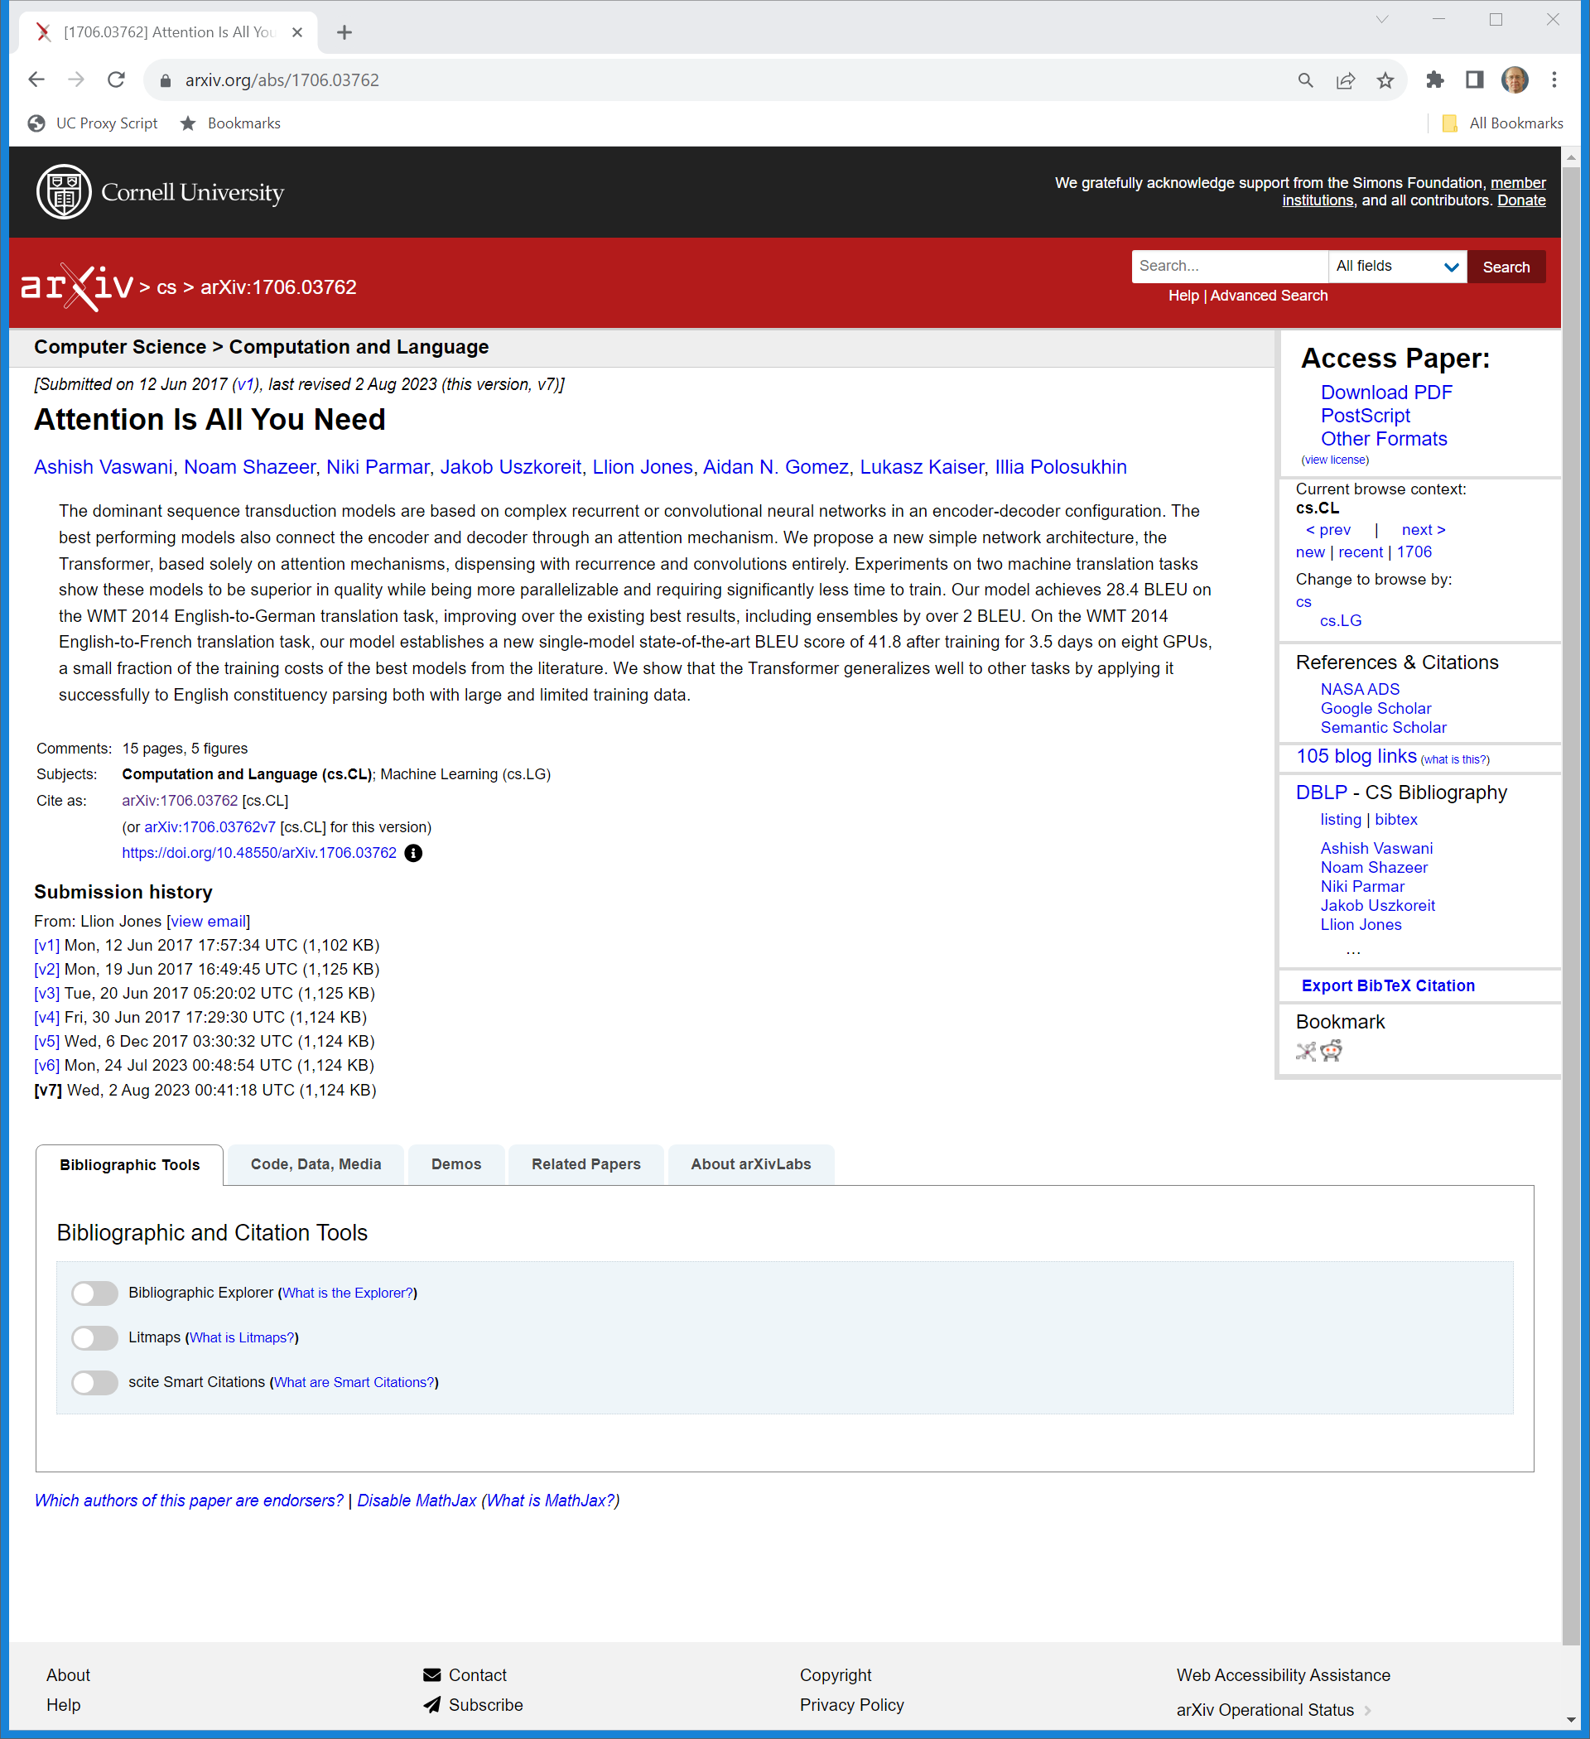
June 2017: Transformer Models
Arxiv.org (Visited 8 Nov 2023)

Slide 14
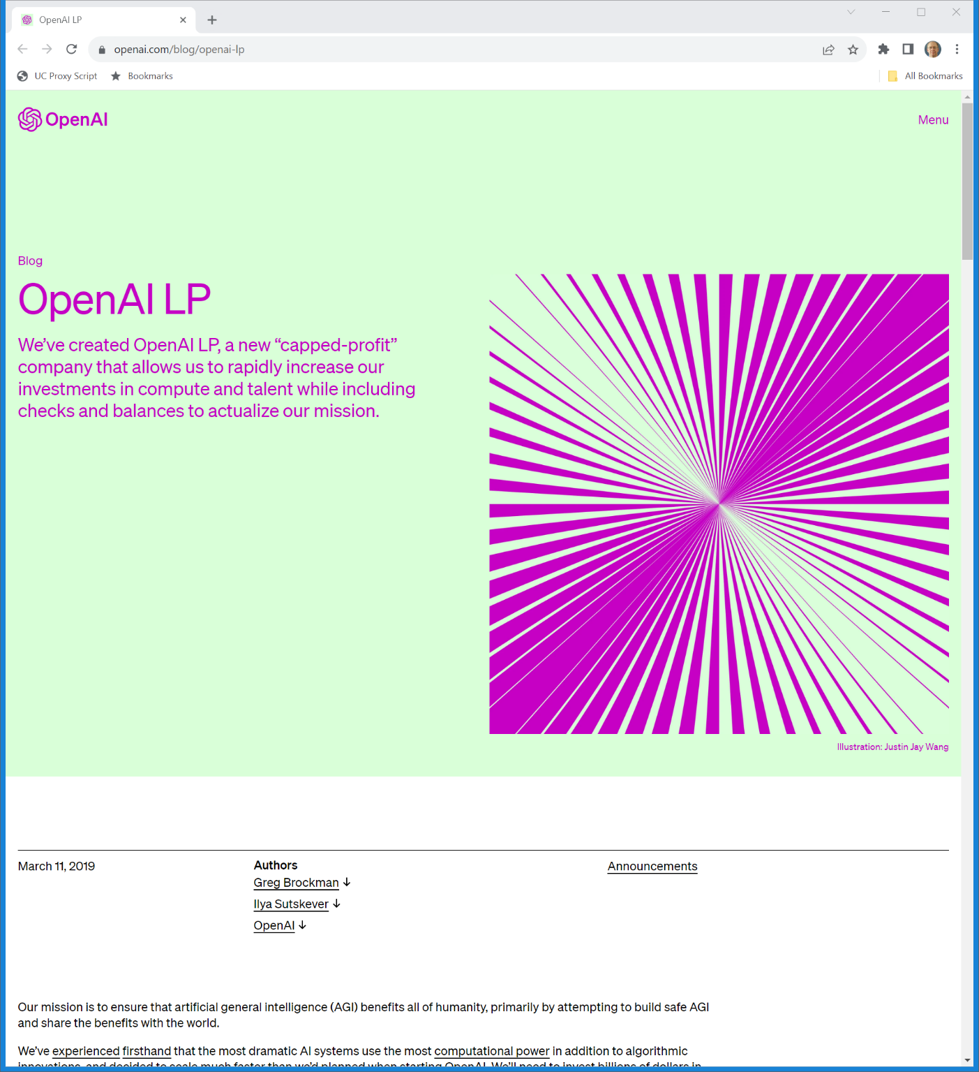
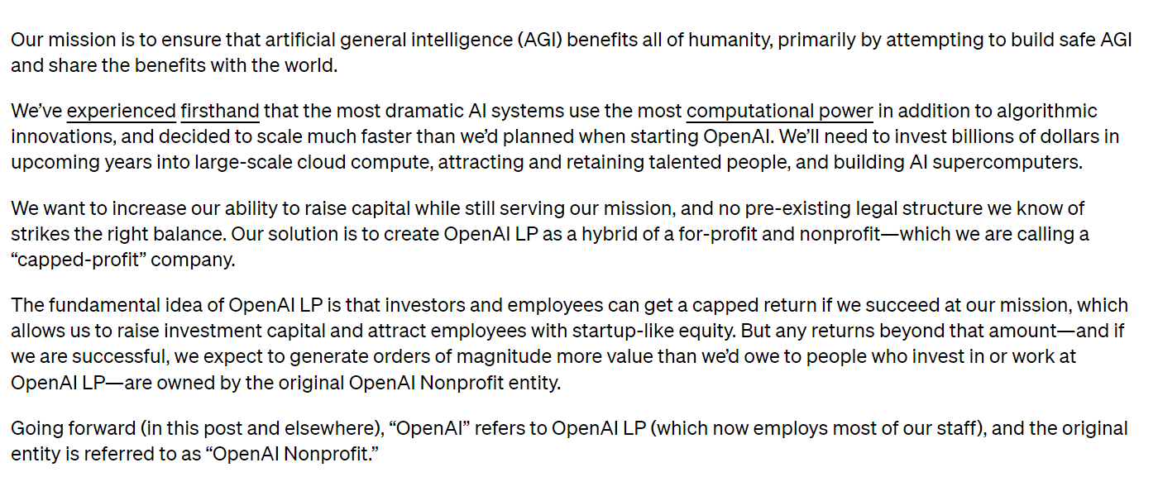
Mar 2019: Capped Profit Model
OpenAI (11 Mar 2019)
Notes:
https://openai.com/blog/openai-lp

Slide 15
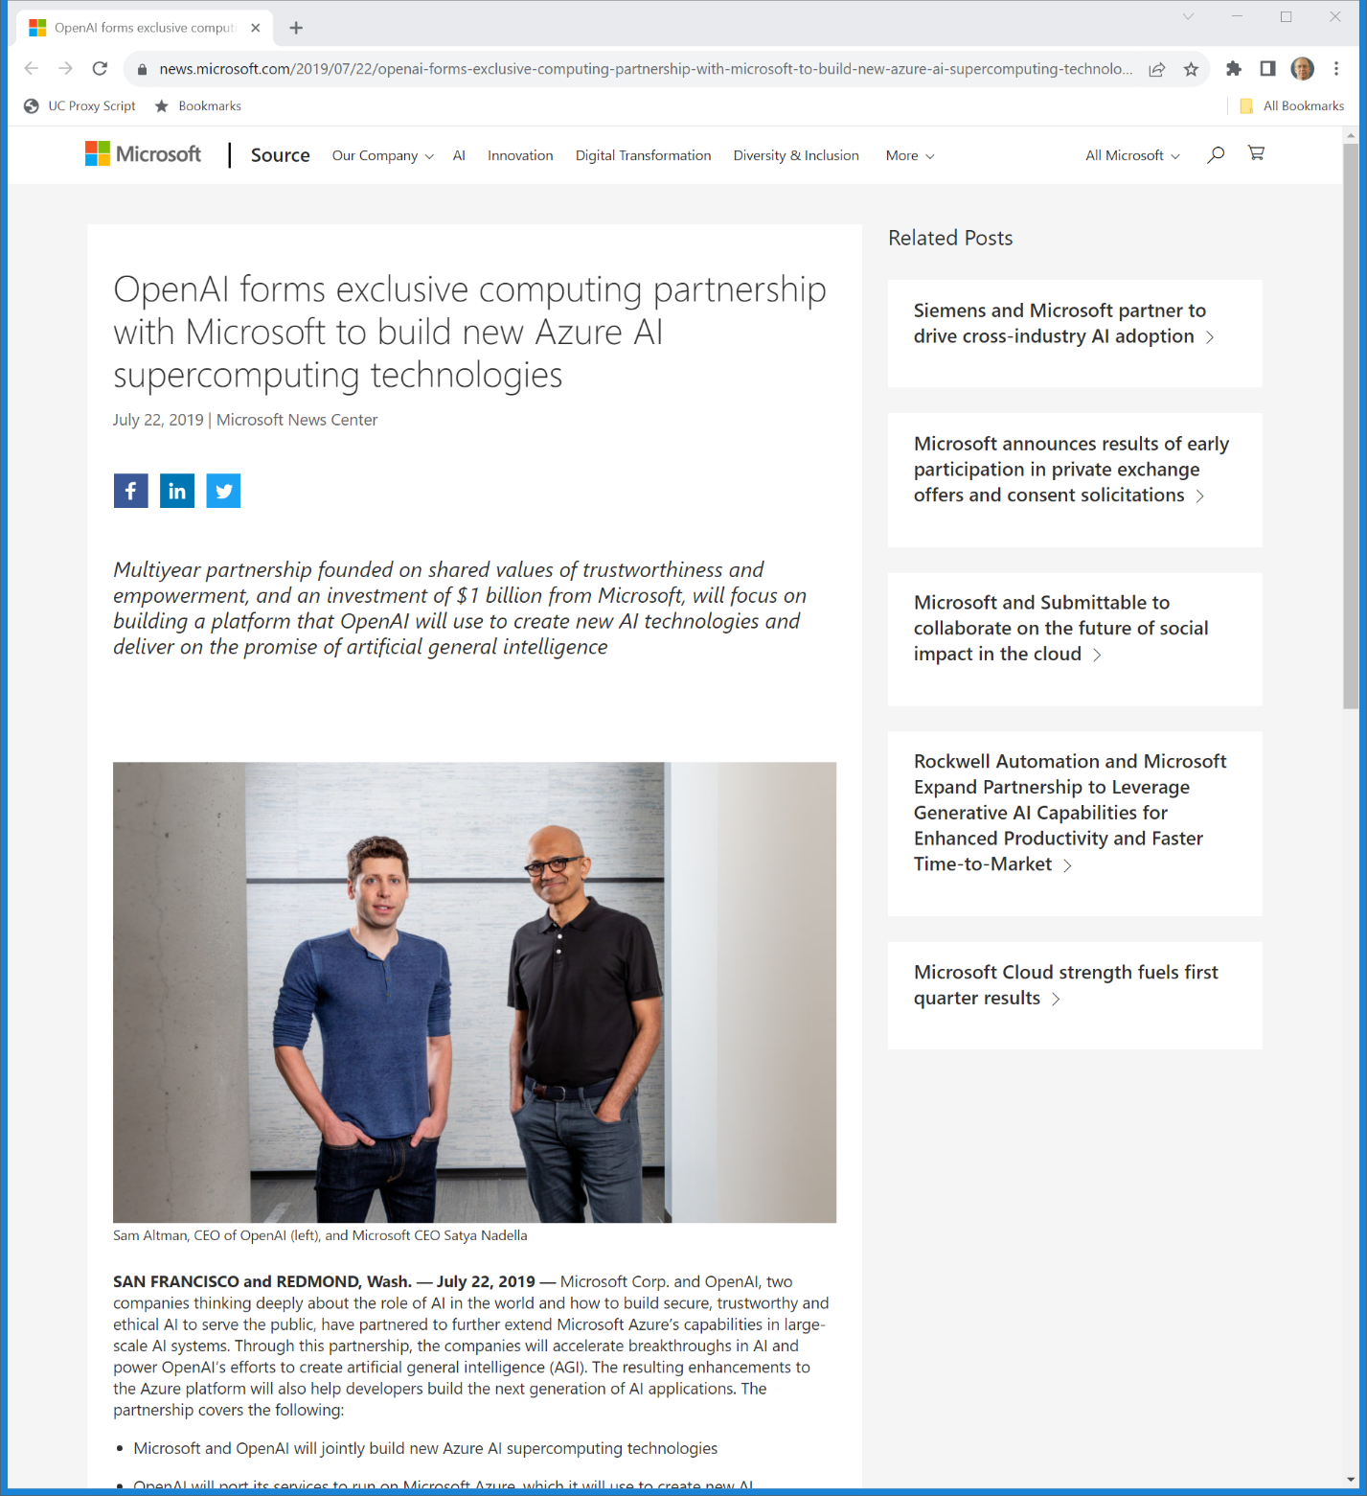
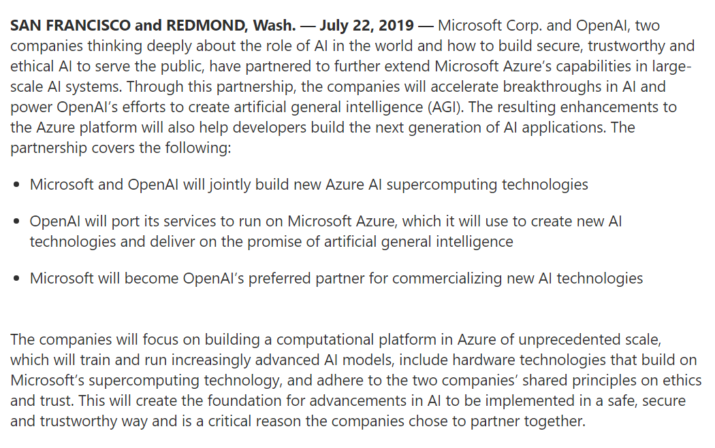
July 2019: Microsoft Investment
Microsoft (22 July 2019)
Notes:
https://news.microsoft.com/2019/07/22/openai-forms-exclusive-computing-partnership-with-microsoft-to-build-new-azure-ai-supercomputing-technologies/

Slide 16
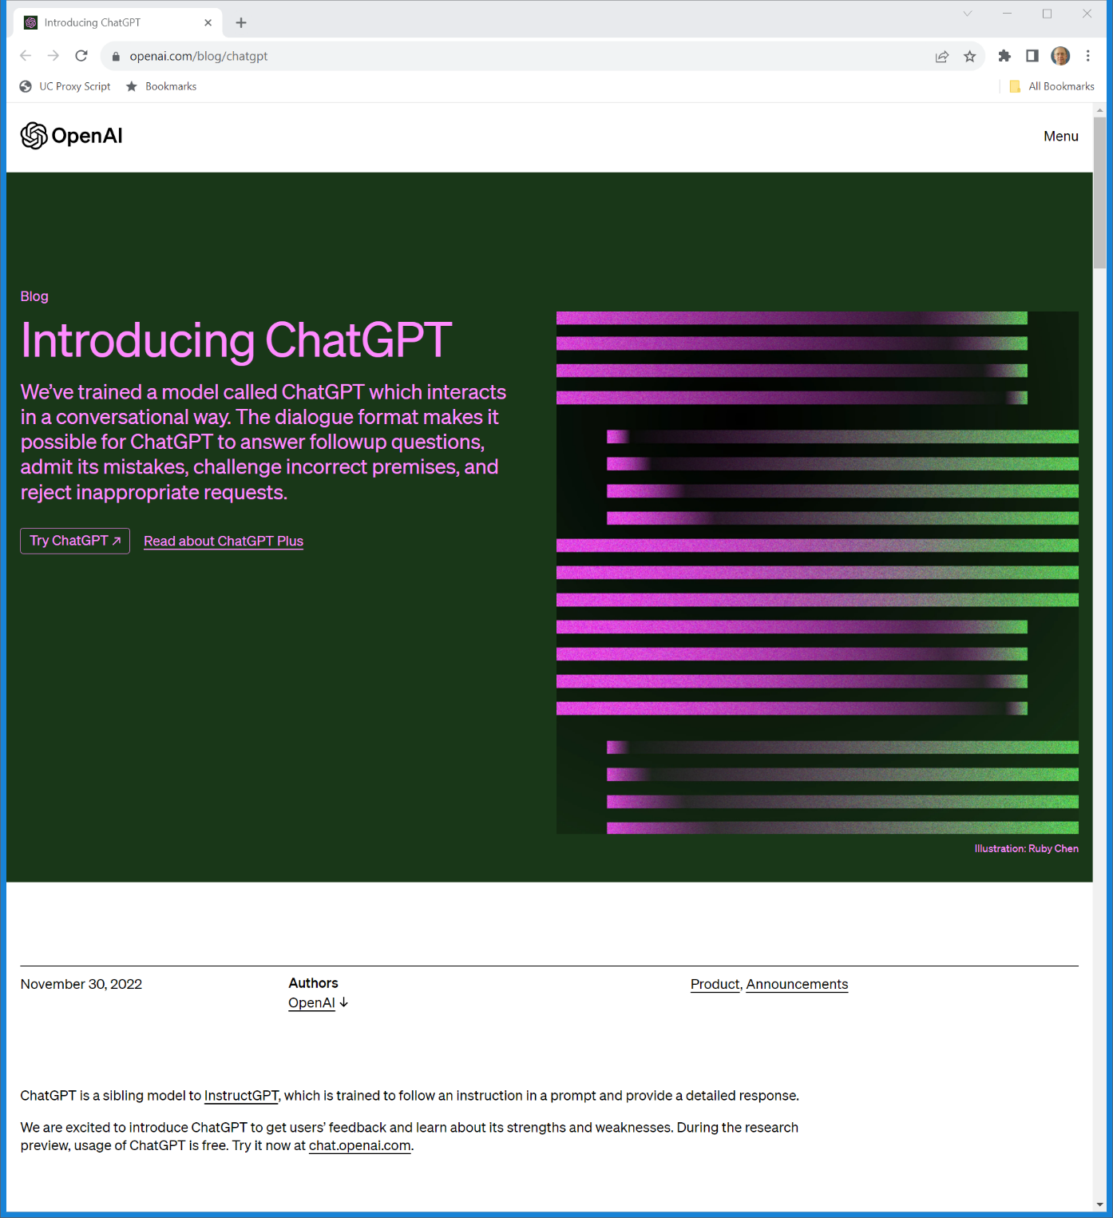
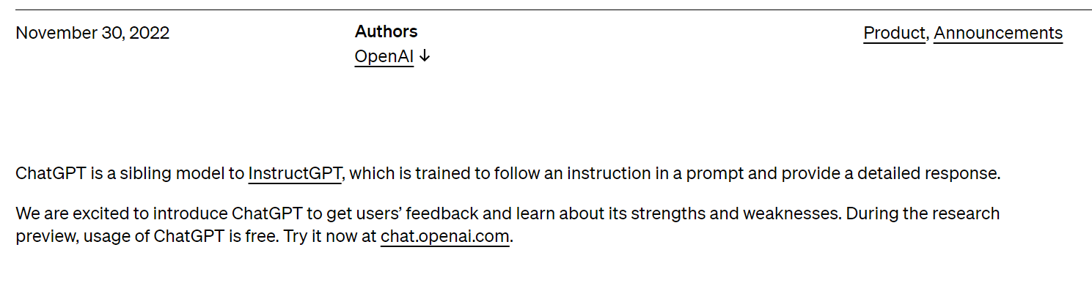
30 Nov 2022: ChatGPT
Generative Pre-Trained Transformer
OpenAI (30 Nov 2022)
Notes:
https://openai.com/blog/chatgpt

Slide 17
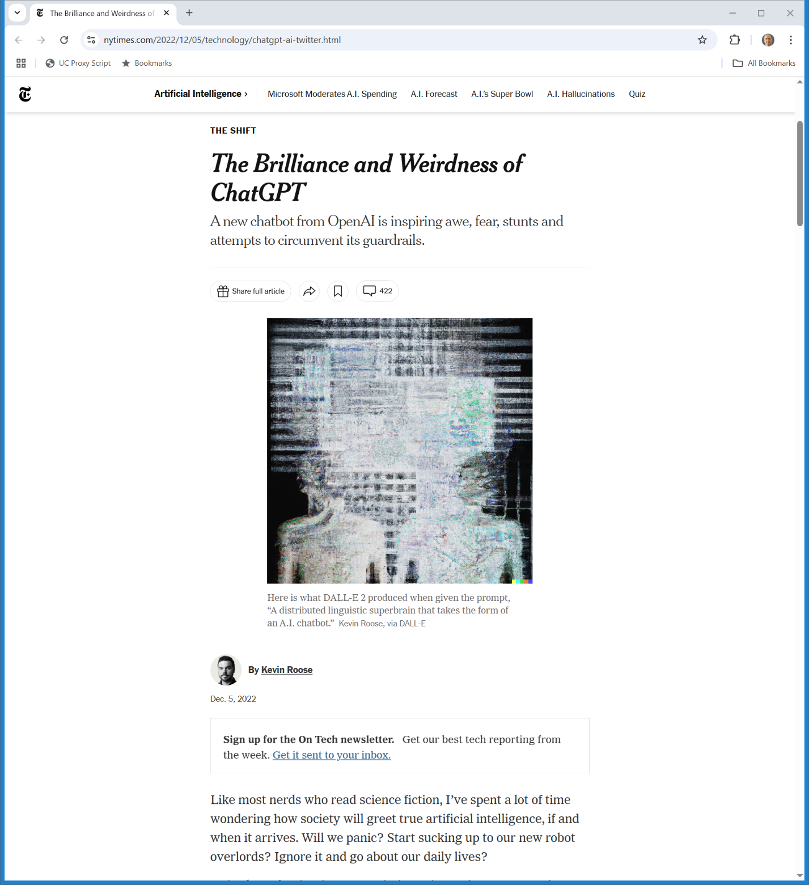
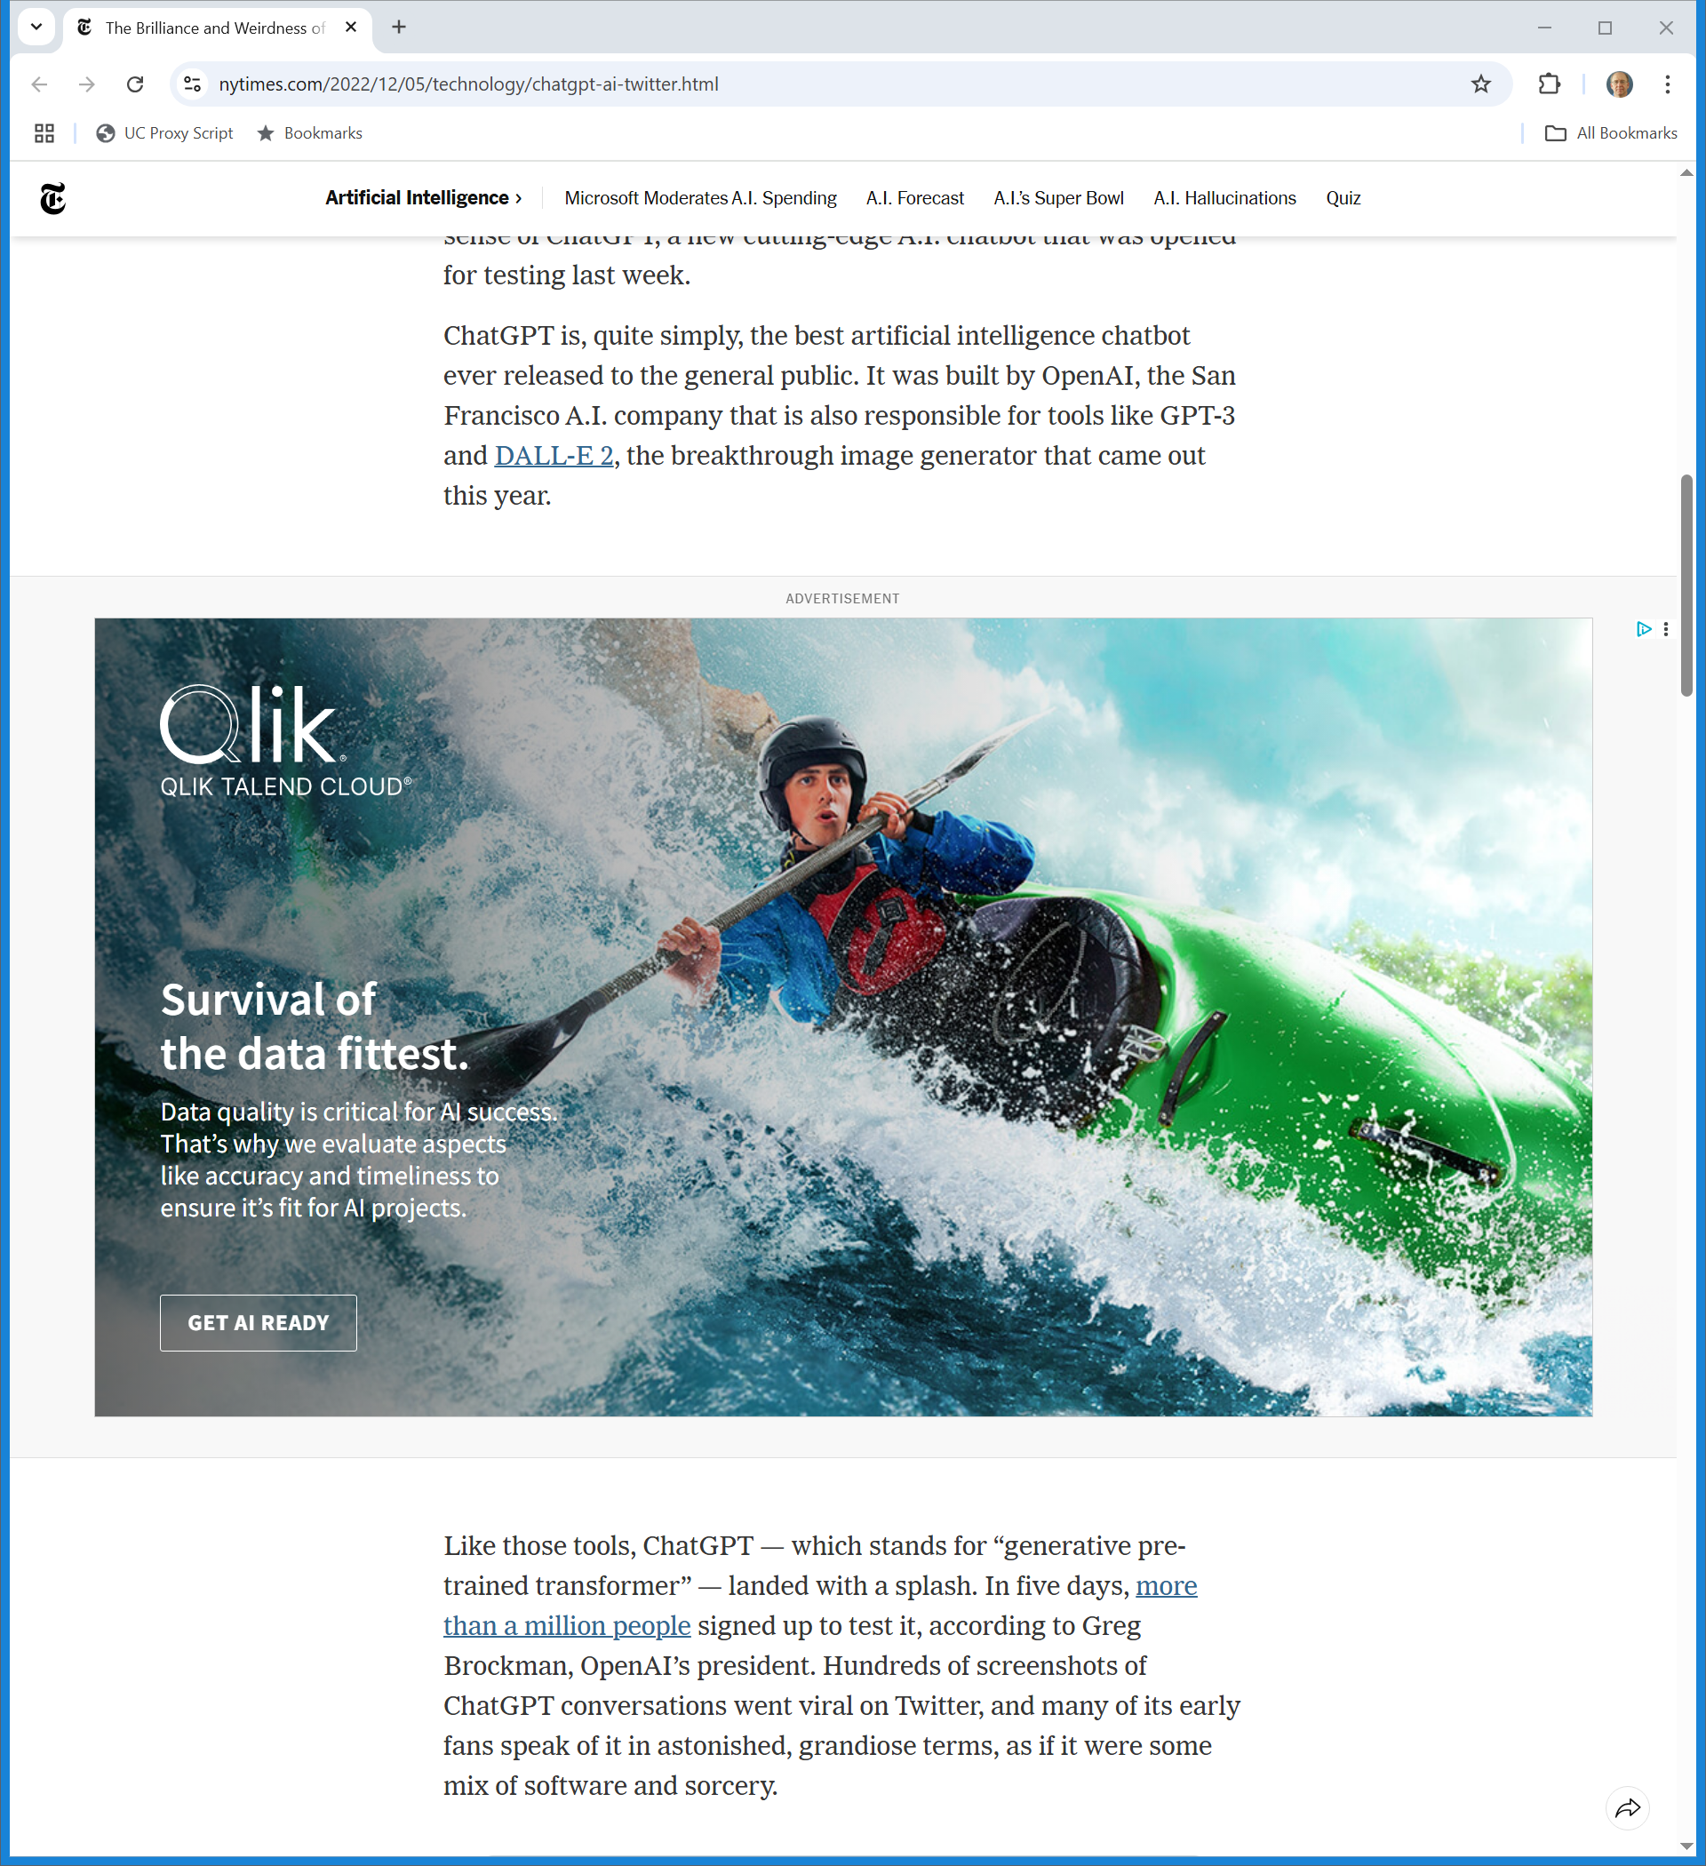
Big Splash
New York Times (5 Dec 2022)
Notes:
https://www.nytimes.com/2022/12/05/technology/chatgpt-ai-twitter.html

Slide 18
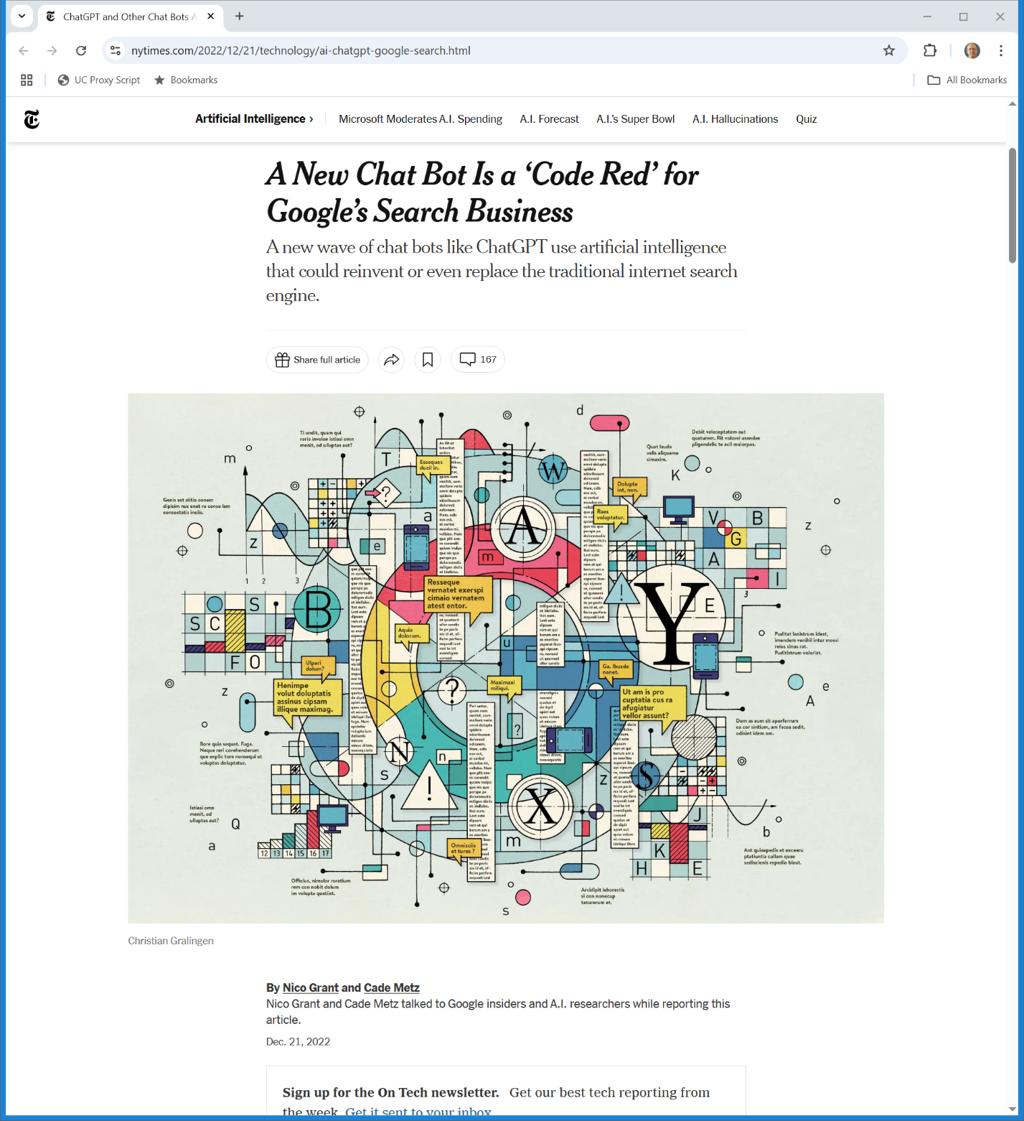
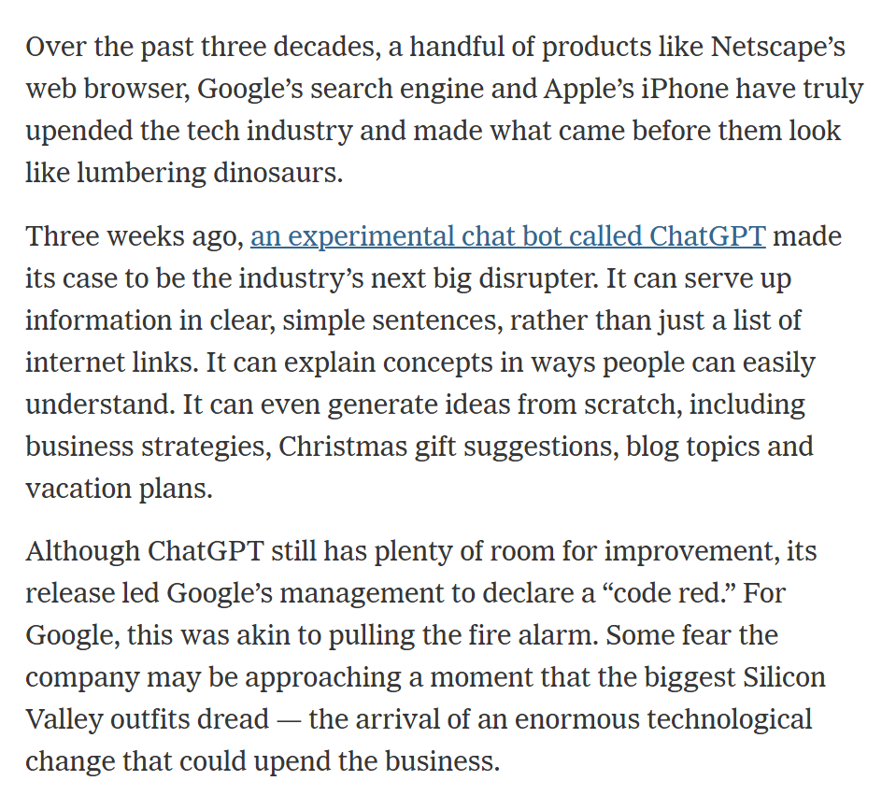
Big Threat?
New York Times (21 Dec 2022)

Slide 19
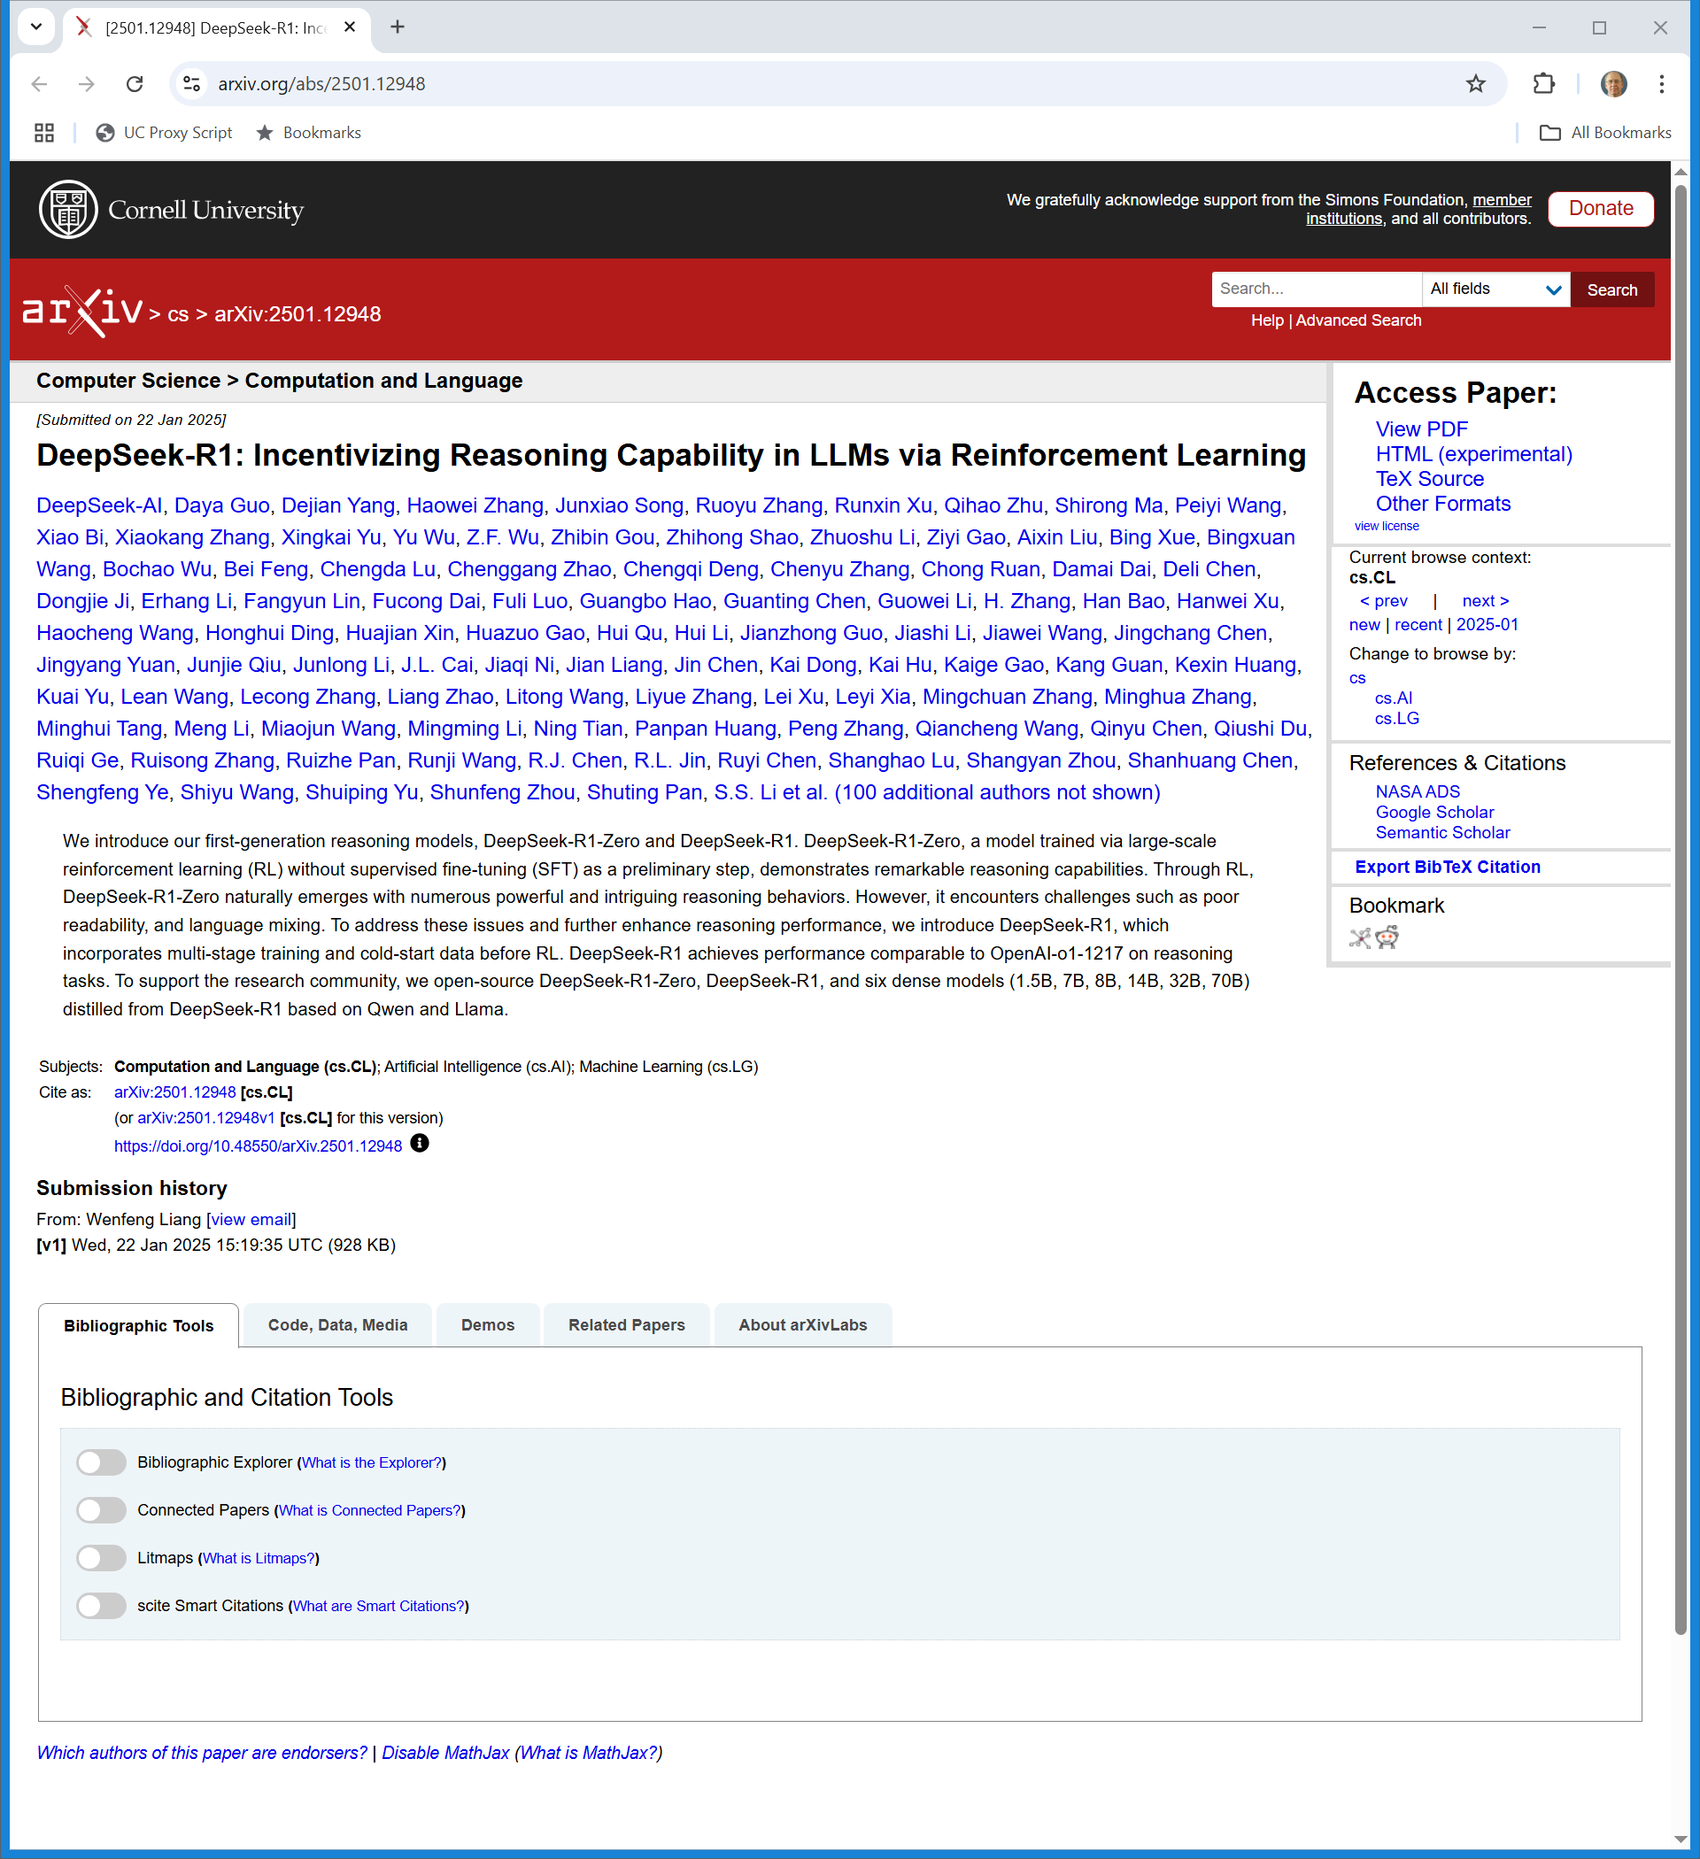
DeepSeek Paper
Arxiv.org (22 Jan 2025)
Notes:
https://arxiv.org/abs/2501.12948

Slide 20
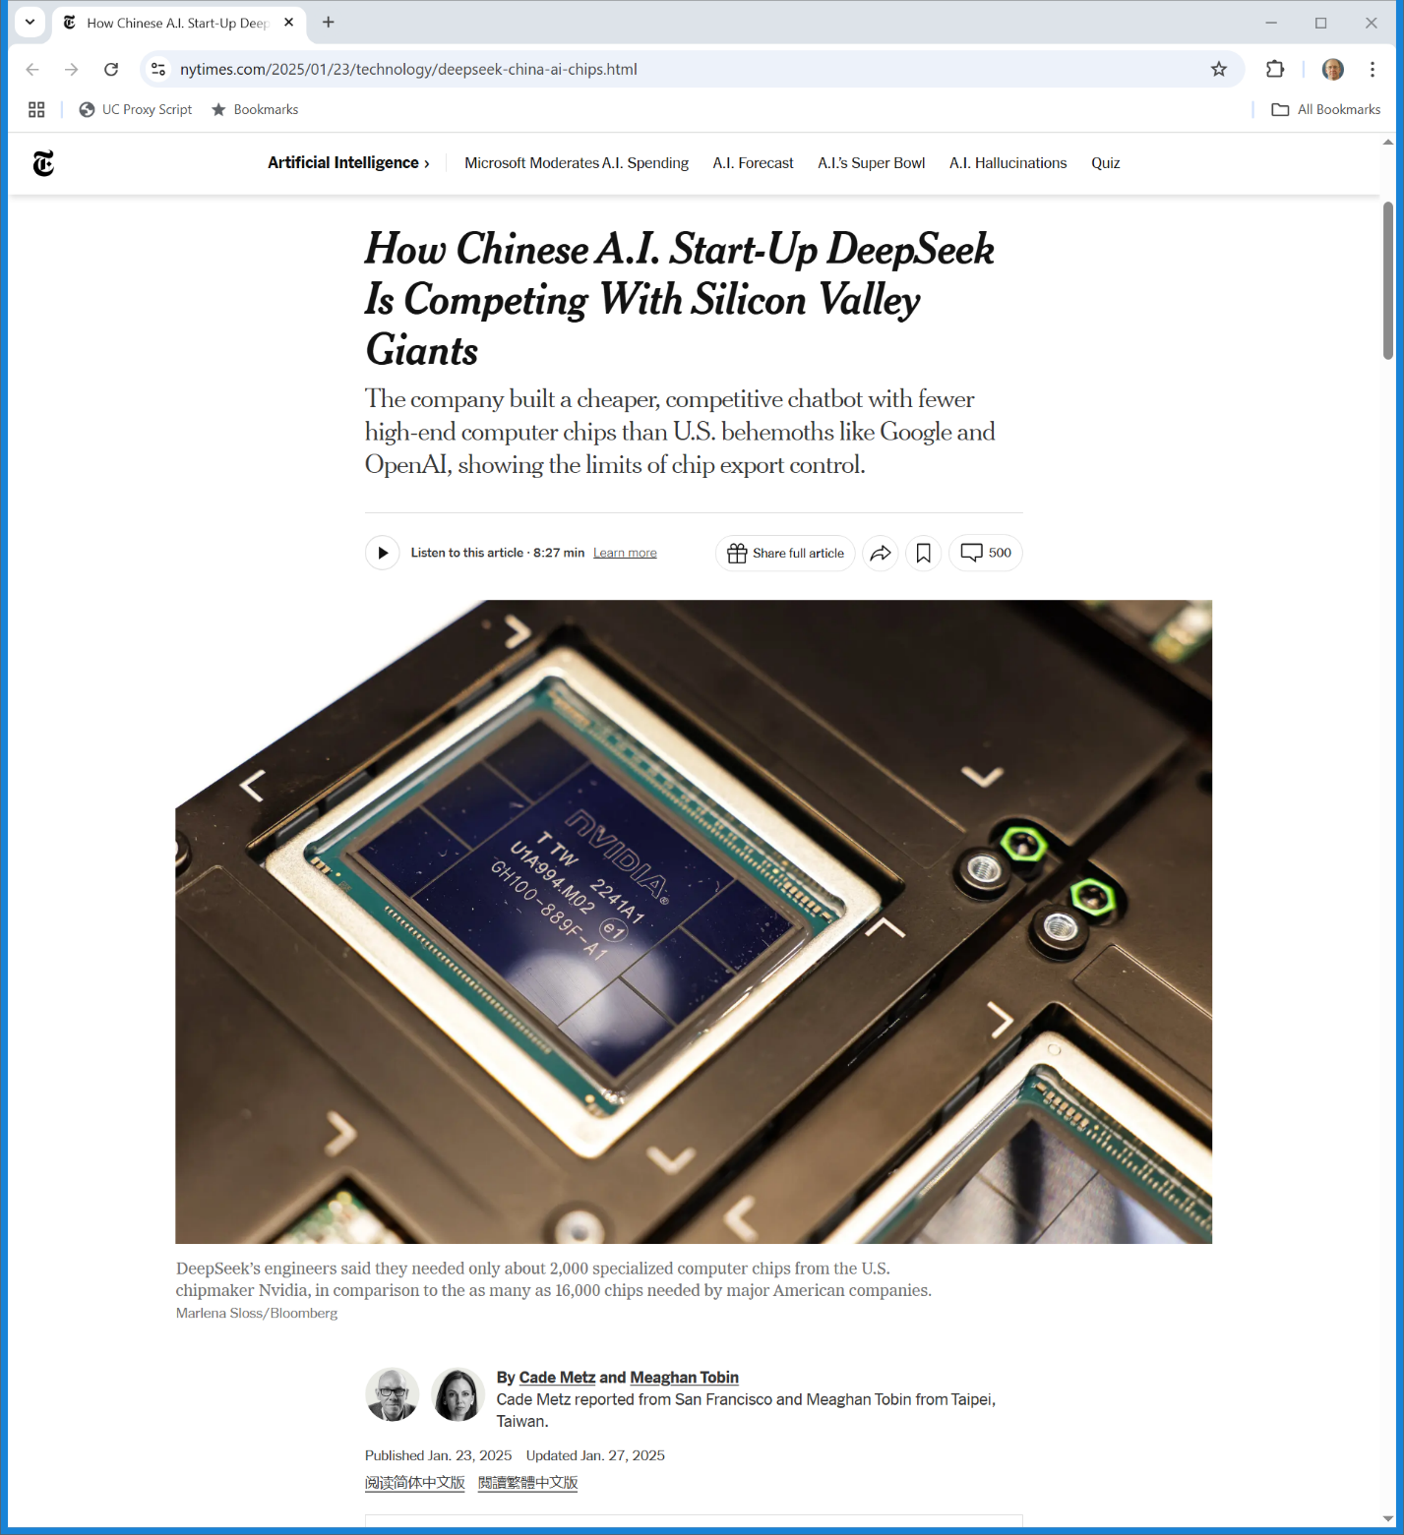
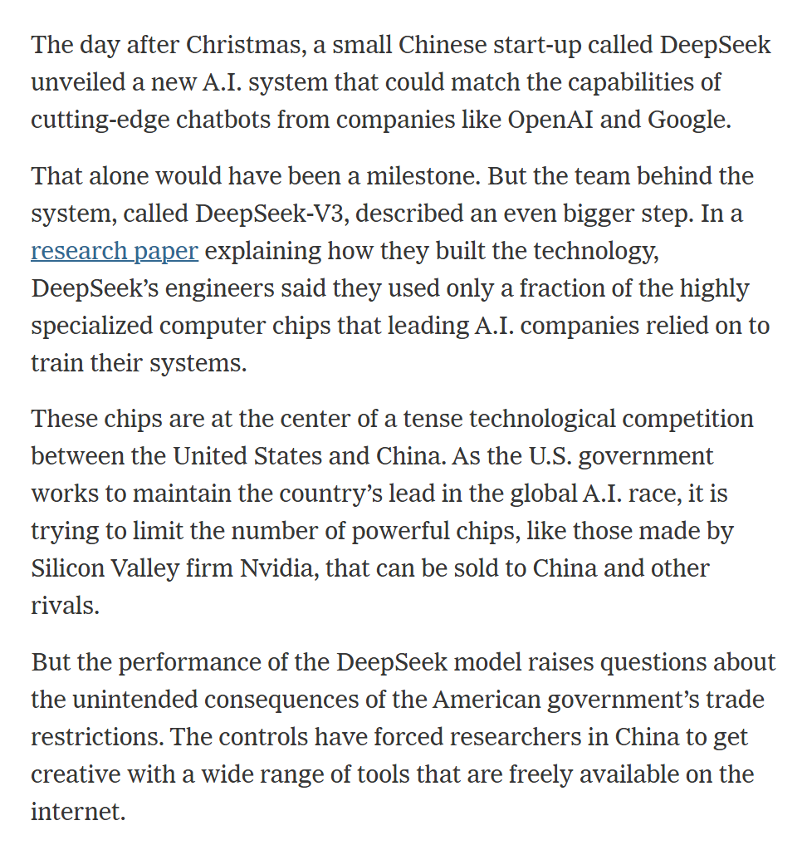
DeepSeek Coverage
New York Times (23 Jan 2025)
Notes:
https://www.nytimes.com/2025/01/23/technology/deepseek-china-ai-chips.html

Slide 21
Making Corporate Art
TTYN (1 of 4)
Hypo 1
Corp X holds a contest for a new painted picture for its corporate headquarters
Ten artists show up and paint pictures
X chooses one from Artist A and buys the physical painting and the copyright in that painting from the artist, who signs an appropriate transfer of the copyright

Slide 22
Making Corporate Art
TTYN (2 of 4)
Questions
Who is the author of the picture? When does the copyright in the picture arise? Who holds it initially?
What is the duration of that copyright?
Who holds the copyright after the transfer? What is the duration of the copyright after the transfer?

Slide 23
Making Corporate Art
TTYN (3 of 4)
Hypo 2
Corp X wants a new painted picture for its corporate headquarters
It hires as an employee Artist A who paints the picture

Slide 24
Making Corporate Art
TTYN (4 of 4)
Questions
Who is the author of the picture? When does the copyright in the picture arise? Who holds it initially?
What is the duration of that copyright?

Slide 25
Answers
Hypo 1
Artist A is the author of the picture
Copyright arises on behalf of A when the picture is completed
Duration is life of the author plus 70 years
Copyright transfers to Corp X and that doesn’t change the duration

Slide 26
Answers
Hypo 2
Corp X is the author of the picture
Copyright arises on behalf of X when the picture is completed
Duration is the min{95 years pub, 120 years creation} rule

Slide 27
Author Gets Copyright
“(a) INITIAL OWNERSHIP.—Copyright in a work protected under this title vests initially in the author or authors of the work. The authors of a joint work are coowners of copyright in the work.”
17 USC 201

Slide 28
Non-Human Authorship
“(b) WORKS MADE FOR HIRE.—In the case of a work made for hire, the employer or other person for whom the work was prepared is considered the author for purposes of this title, and, unless the parties have expressly agreed otherwise in a written instrument signed by them, owns all of the rights comprised in the copyright.”
17 USC 201

Slide 29
Non-Human Authorship Duration
“(c) ANONYMOUS WORKS, PSEUDONYMOUS WORKS, AND WORKS MADE FOR HIRE .—In the case of an anonymous work, a pseudonymous work, or a work made for hire, the copyright endures for a term of 95 years from the year of its first publication, or a term of 120 years from the year of its creation, whichever expires first.”
17 USC 302

Slide 30
Selfies
TTYN (1 of 3)
Hypo
A camera falls into the hands of a human being
The human being takes a selfie with the camera
What is the copyright status of the photo?

Slide 31
Selfies
TTYN (2 of 3)
Hypo
A camera falls into the hands of a monkey in a zoo
The monkey takes a selfie with the camera
What is the copyright status of the photo?

Slide 32
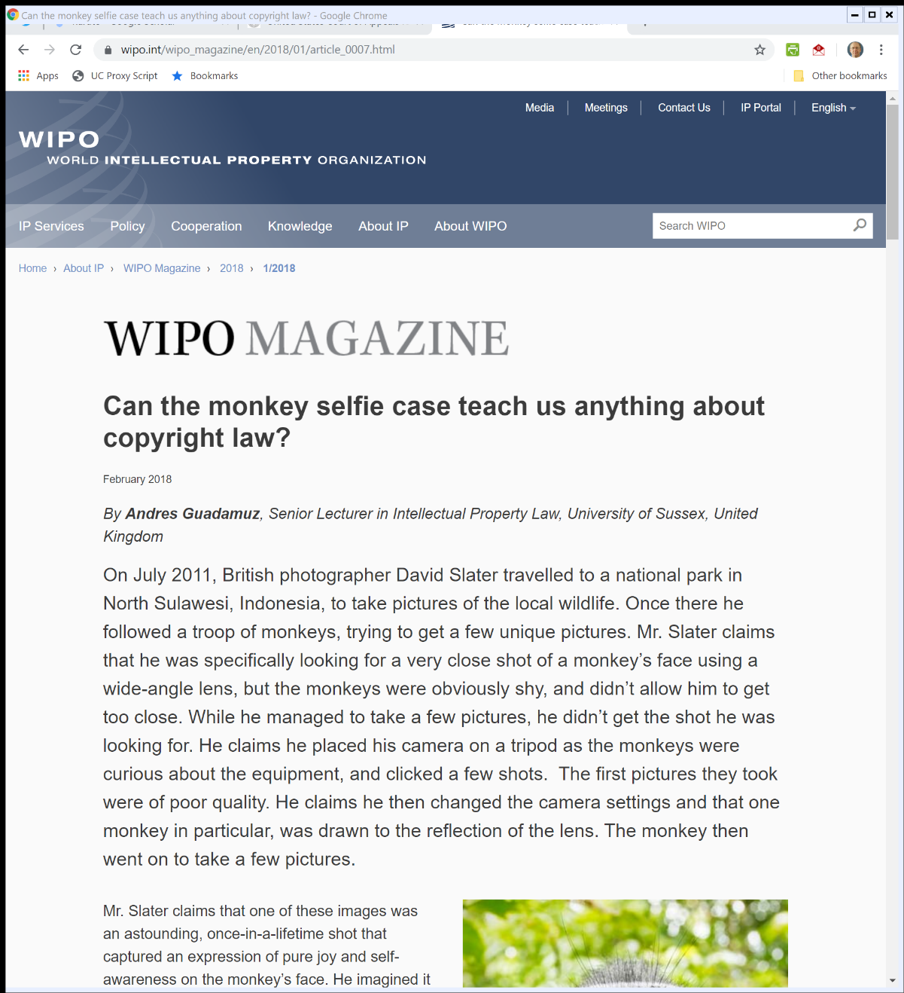
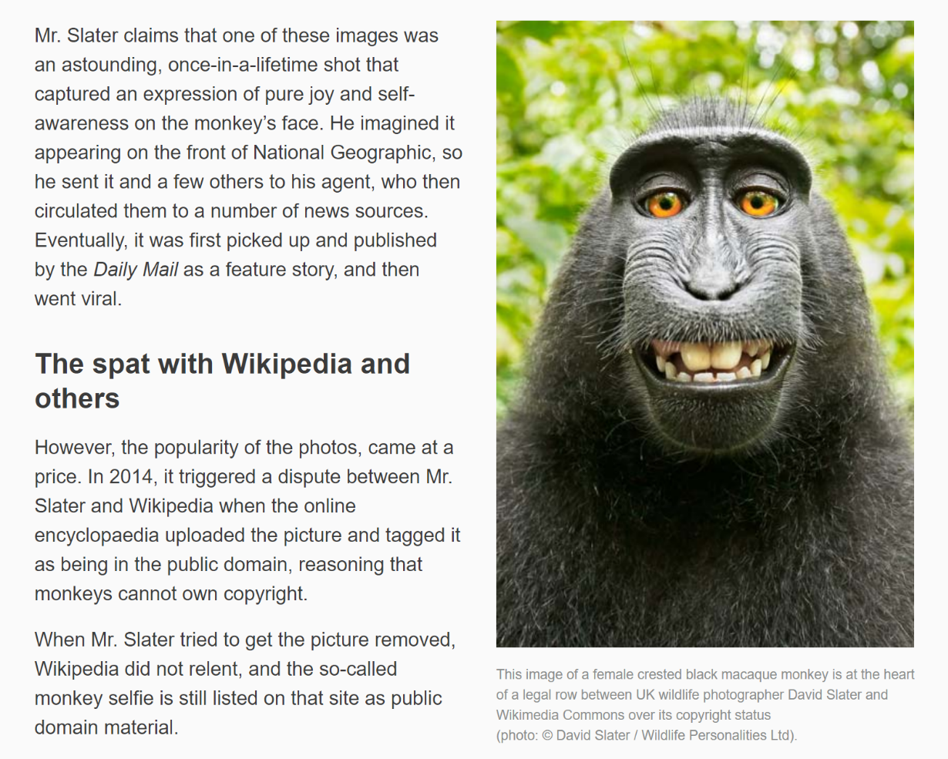
The Monkey Selfie (TTYN (3 of 3))
WIPO Magazine (Feb 2018)

Slide 33
Naruto: The Monkey Selfie Case
Naruto v. Slater, 888 F.3d 418 (9th Cir. 2018)

Slide 34
Naruto Lacks Statutory Standing Under Copyright Act
Naruto (9th Cir. 2018)

Slide 35
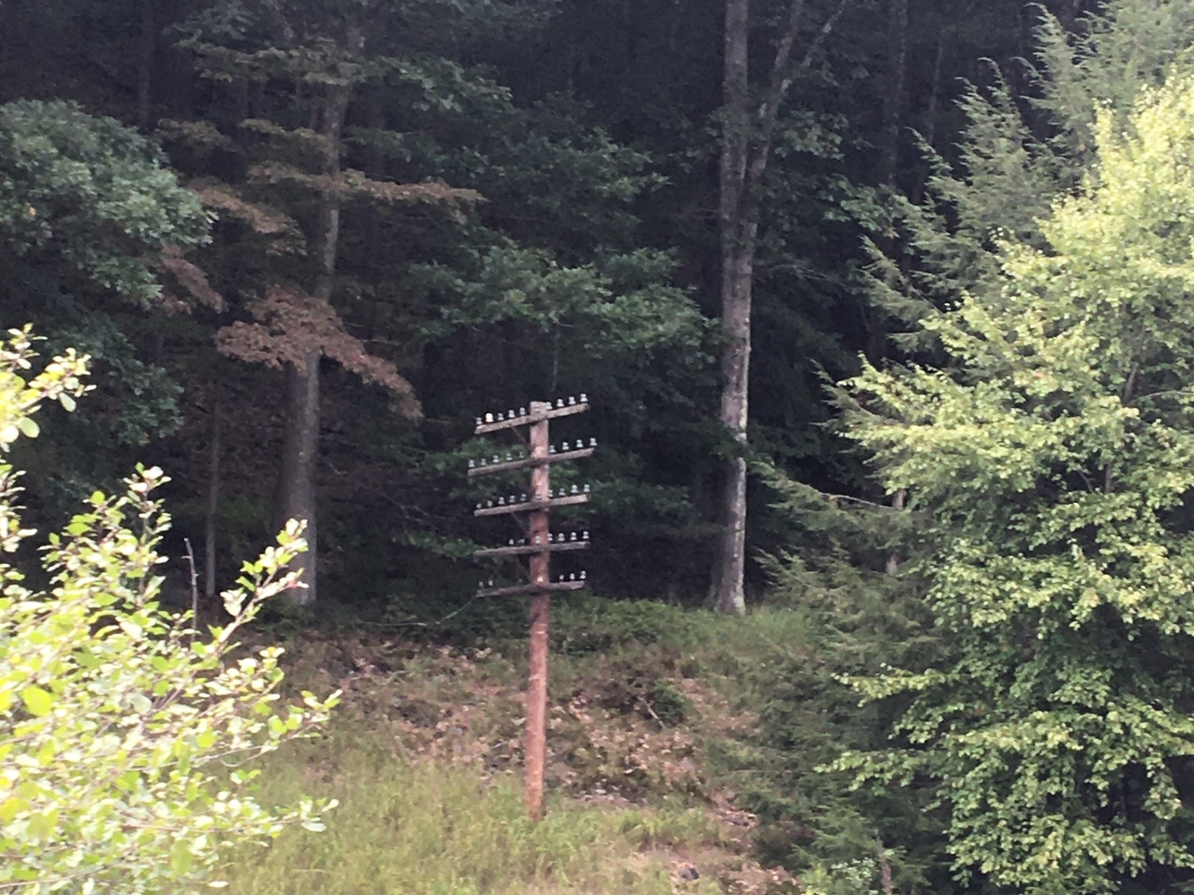
Old Infrastructure: Telegraph Poles (TTYN (1 of 4))
Picker (8 Sept 2022)

Slide 36
“A Recent Entrance to Paradise” (TTYN (2 of 4))
Thaler (D.D.C. 2023)

Slide 37
Registration Application (TTYN (3 of 4))
Thaler Registration

Slide 38
Infrastructure
TTYN (4 of 4)
Questions
I produced the first image using my iPhone
Suppose that I had produced the second image
Does the method of creation matter? Camera app on iPhone? Oil on canvas? A detailed prompt in a generative AI image engine?
How does authorship/copyright depend on that?

Slide 39
Copyright Admin Apparatus
Copyright Review Board (14 Feb 2022)

Slide 40
Human Authorship Requirement Unconstitutional
Copyright Review Board (14 Feb 2022)

Slide 41
No Creative Contribution from Human
Copyright Review Board (14 Feb 2022)

Slide 42
Human Authorship?
Thaler (CADC Mar 18, 2025)

Slide 43
WMFH and Non-Human Authors
“Dr. Thaler points out that the Copyright Act’s work-made-for-hire provision allows those who hire creators to be ‘considered the author’ under the Act. 17 U.S.C. § 201(b). That is why corporations, e.g., Warren v. Fox Fam. Worldwide, Inc., 328 F.3d 1136, 1140 (9th Cir. 2003), and governments, e.g., Georgia v. Public.Resource.Org, Inc., 590 U.S. 255, 270 (2020), can be legally recognized as authors.”
Thaler (CADC Mar 18, 2025)

Slide 44
WMFH: Transfer?
“But the word ‘considered’ in the work-made-for-hire provision does the critical work here. It allows the copyright and authorship protections attaching to a work originally created by a human author to transfer instantaneously, as a matter of law, to the person who hired the creator. See Community for Creative Non-Violence v. Reid, 490 U.S. 730, 737 (1989).”
Thaler (CADC Mar 18, 2025)

Slide 45
Machine as Employee?
“First, Dr. Thaler argues that the Copyright Act’s work-made-for-hire provision allows him to be ‘considered the author’ of the work at issue because the Creativity Machine is his employee. … That argument misunderstands the human authorship requirement.”
Thaler (CADC Mar 18, 2025)

Slide 46
Thaler as User of Machine?
“Second, Dr. Thaler argues that he is the work’s author because he made and used the Creativity Machine. … We cannot reach that argument. The district court held that Dr. Thaler forwent any such argument before the Copyright Office. ”
Thaler (CADC Mar 18, 2025)

Slide 47
Making Art
TTYN (1 of 3)
Hypo
Someone constructs an art machine. It produces work in response to human prompts.
I put in many, many prompts—624 of them — studying what is produced and iterating to produce a final image
Copyright?: OWA fixed in a TME?

Slide 48
Making Art
TTYN (2 of 3)
Allen? Midjourney?, Théâtre D’opéra Spatial (2022?)

Slide 49
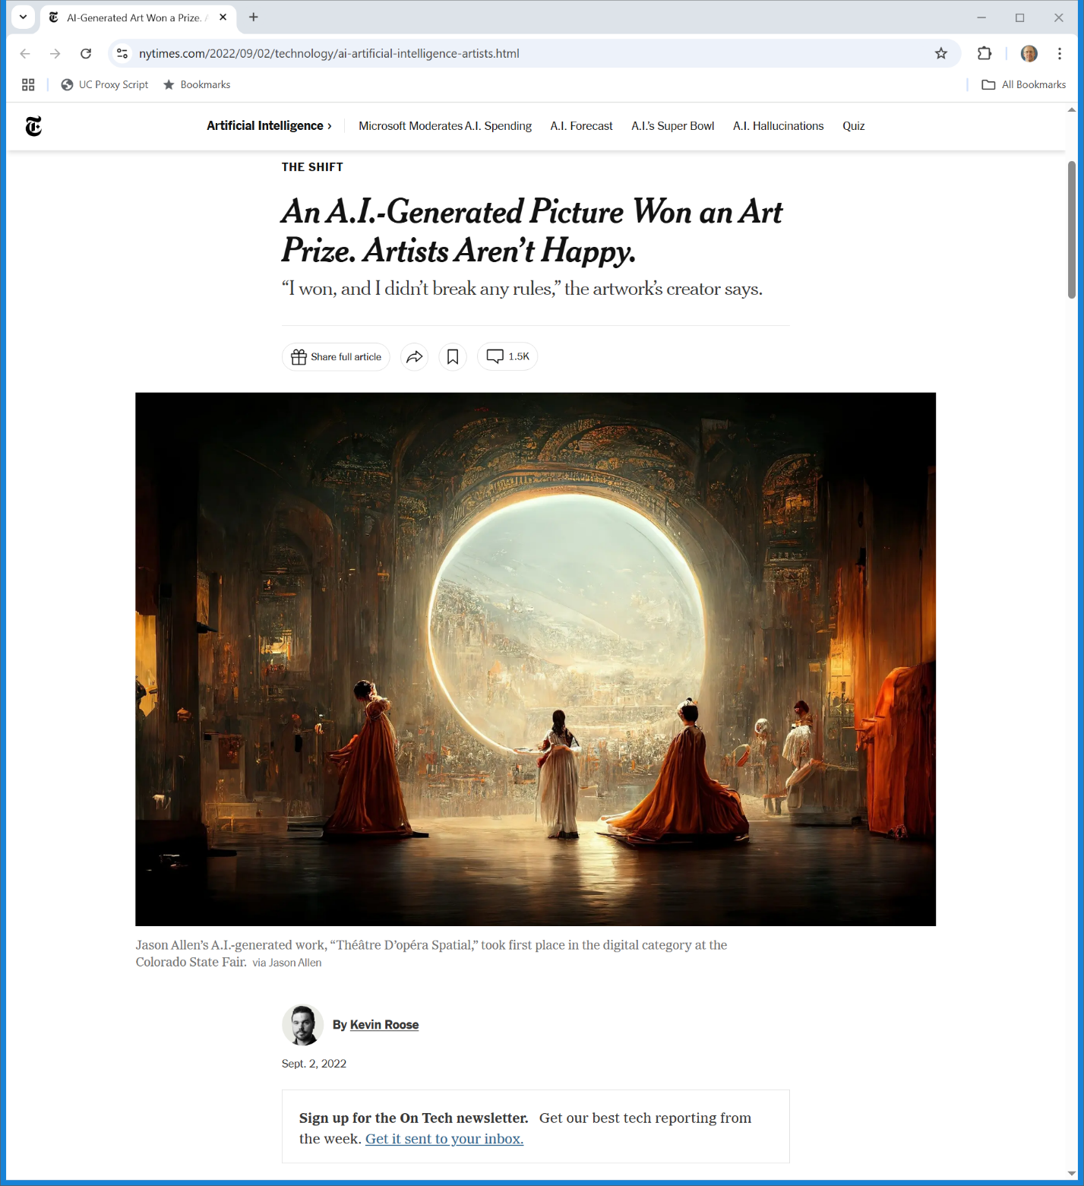
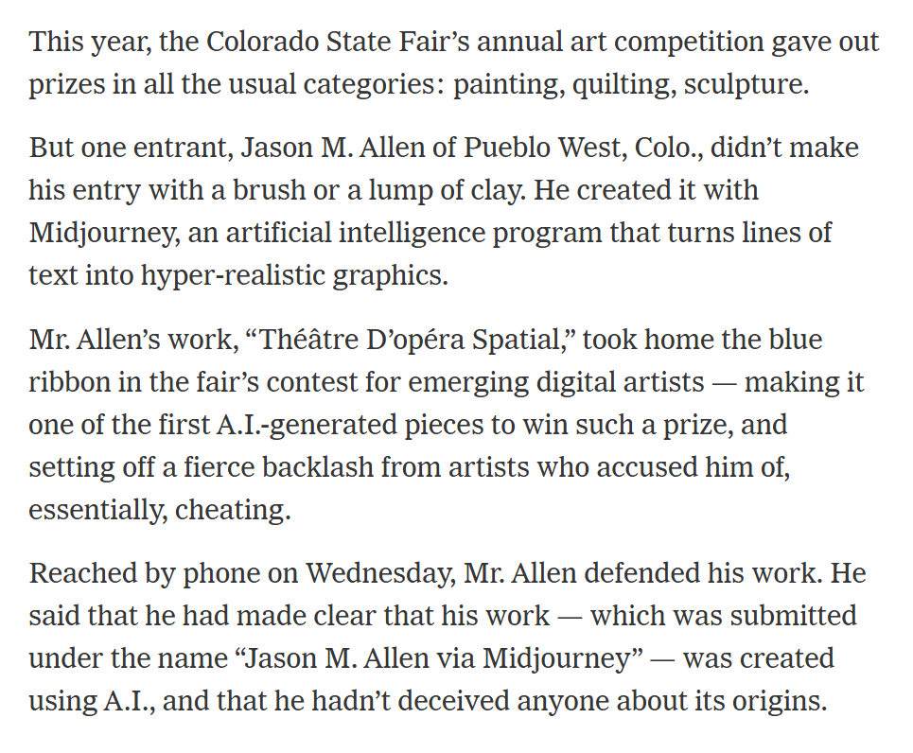
Award-Winning Art (TTYN (3 of 3))
New York Times (2 Sept 2022)

Slide 50
Disclaiming AI?
Copyright Review Board (5 Sept 2023)

Slide 51
Prompt after Prompt
Copyright Review Board (5 Sept 2023)

Slide 52
Merged, Inseparable Contributions
Copyright Review Board (5 Sept 2023)

Slide 53
How Do You Register a Work with AI Inputs?
Copyright Review Board (5 Sept 2023)

Slide 54
624 Prompts Not Enough for Authorship
Copyright Review Board (5 Sept 2023)

Slide 55
No Registration (and No Copyright?)
Copyright Review Board (5 Sept 2023)

Slide 56
Copyright and AI
Copyright Office (Jan 2025)

Slide 57
Prompts Alone Insufficient
“The Office concludes that, given current generally available technology, prompts alone do not provide sufficient human control to make users of an AI system the authors of the output. Prompts essentially function as instructions that convey unprotectible ideas. While highly detailed prompts could contain the user’s desired expressive elements, at present they do not control how the AI system processes them in generating the output.”
U.S. Copyright Office (Jan 2025)

Slide 58
An Example
U.S. Copyright Office (Jan 2025)

Slide 59
Prompt Nonrepeatability and Multiple Prompts
U.S. Copyright Office (Jan 2025)

Slide 60
Jackson Pollock?
U.S. Copyright Office (Jan 2025)

Slide 61
Authorship by Adoption?
U.S. Copyright Office (Jan 2025)

Slide 62
Different Result with More Control
U.S. Copyright Office (Jan 2025)

Slide 63
Expressive Inputs
U.S. Copyright Office (Jan 2025)

Slide 64
Successful Registration
U.S. Copyright Office (Jan 2025)

Slide 65
SCA Works with AI Inputs
U.S. Copyright Office (Jan 2025)

Slide 66
Treat AI Inputs Like Public Domain
U.S. Copyright Office (Jan 2025)

Slide 67
Human Creativity
U.S. Copyright Office (Jan 2025)

Slide 68
AI Element Doesn’t Destroy Copyright
U.S. Copyright Office (Jan 2025)

Slide 69
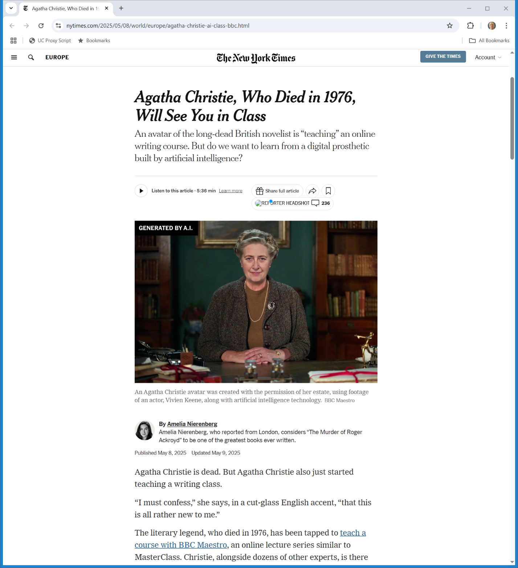
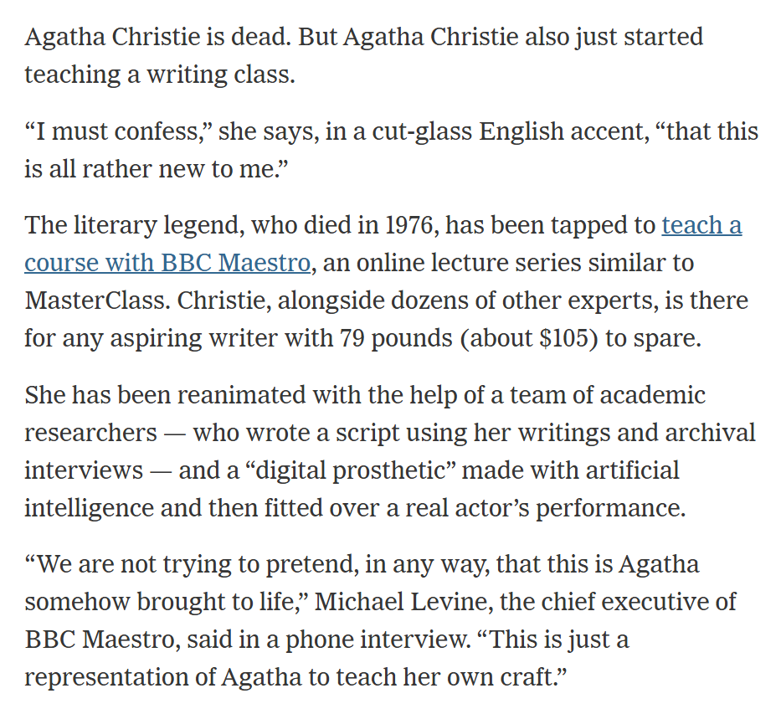
Digital Agatha Christie
New York Times (8 May 2025)
Notes:
https://www.nytimes.com/2025/05/08/world/europe/agatha-christie-ai-class-bbc.html

